Slide 1
Big Data Mining
Tamkang University
Convolutional Neural Networks (CNN)
1071BDM11
TLVXM1A (M2244) (8619) (Fall 2018)
(MBA, DBETKU) (3 Credits, Required) [Full English Course]
(Master’s Program in Digital Business and Economics)
Mon, 9, 10, 11, (16:10-19:00) (B206)
Min-Yuh Day, Ph.D.
Assistant Professor
Department of Information Management
Tamkang University
http://mail.tku.edu.tw/myday
2018-12-03

Slide 2
Course Schedule (1/2)
Tamkang University
Week Date Subject/Topics
1 2018/09/10 Course Orientation for Big Data Mining
2 2018/09/17 ABC: AI, Big Data, Cloud Computing
3 2018/09/24 Mid-Autumn Festival (Day off)
4 2018/10/01 Data Science and Big Data Analytics: Discovering, Analyzing, Visualizing and Presenting Data
5 2018/10/08 Fundamental Big Data: MapReduce Paradigm, Hadoop and Spark Ecosystem
6 2018/10/15 Foundations of Big Data Mining in Python
7 2018/10/22 Supervised Learning: Classification and Prediction
8 2018/10/29 Unsupervised Learning: Cluster Analysis
9 2018/11/05 Unsupervised Learning: Association Analysis

Slide 3
Course Schedule (2/2)
Tamkang University
Week Date Subject/Topics
10 2018/11/12 Midterm Project Report
11 2018/11/19 Machine Learning with Scikit-Learn in Python
12 2018/11/26 Deep Learning for Finance Big Data with TensorFlow
13 2018/12/03 Convolutional Neural Networks (CNN)
14 2018/12/10 Recurrent Neural Networks (RNN)
15 2018/12/17 Reinforcement Learning (RL)
16 2018/12/24 Social Network Analysis (SNA)
17 2018/12/31 Bridge Holiday (Extra Day Off)
18 2019/01/07 Final Project Presentation

Slide 4
Convolutional Neural Networks (CNN)

Slide 5
Outline
Convolutional Neural Networks (CNN)
TensorFlow Image Recognition

Slide 6
AI, ML, DL
Artificial Intelligence (AI)
Machine Learning (ML)
Supervised Learning
Unsupervised Learning
Deep Learning (DL)
CNN
RNN LSTM GRU
GAN
Semi-supervised Learning
Reinforcement Learning
Source: https://leonardoaraujosantos.gitbooks.io/artificial-inteligence/content/deep_learning.html

Slide 7
Convolutional Neural Networks (CNN)
Architecture of LeNet-5 (7 Layers)
(LeCun et al., 1998)
Source: http://yann.lecun.com/exdb/publis/pdf/lecun-01a.pdf
Source: LeCun, Yann, Léon Bottou, Yoshua Bengio, and Patrick Haffner. "Gradient-based learning applied to document recognition." Proceedings of the IEEE 86, no. 11 (1998): 2278-2324.

Slide 8
Convolutional Neural Networks (CNN)
Convolution
Pooling
Fully Connection (FC) (Flattening)

Slide 9
A friendly introduction to Convolutional Neural Networks and Image Recognition
+
-
4
-4
-
+
-4
4
1
-1
1
-1
1
-1
1
-1
1
-
+
-4
4
+
-
4
-4
Convolution Layer
Pooling Layer
Source: Luis Serrano (2017), A friendly introduction to Convolutional Neural Networks and Image Recognition,
https://www.youtube.com/watch?v=2-Ol7ZB0MmU

Slide 10
A friendly introduction to Convolutional Neural Networks and Image Recognition
1
-1
1
1
-1
-1
1
-1
1
-1
1
-1
-1
1
1
-1
1
-1
1
-1
1
-1
1
-1
1
1
-1
-1
1
-1
1
-1
-1
1
-1
-1
1
-1
1
-1
-1
-1
-1
-1
1
-1
-1
-1
1
1
-1
1
-1
-1
-1
1
-1
1
-1
-1
1
-1
-1
1
-1
-1
-1
-1
Source: Luis Serrano (2017), A friendly introduction to Convolutional Neural Networks and Image Recognition,
https://www.youtube.com/watch?v=2-Ol7ZB0MmU

Slide 11
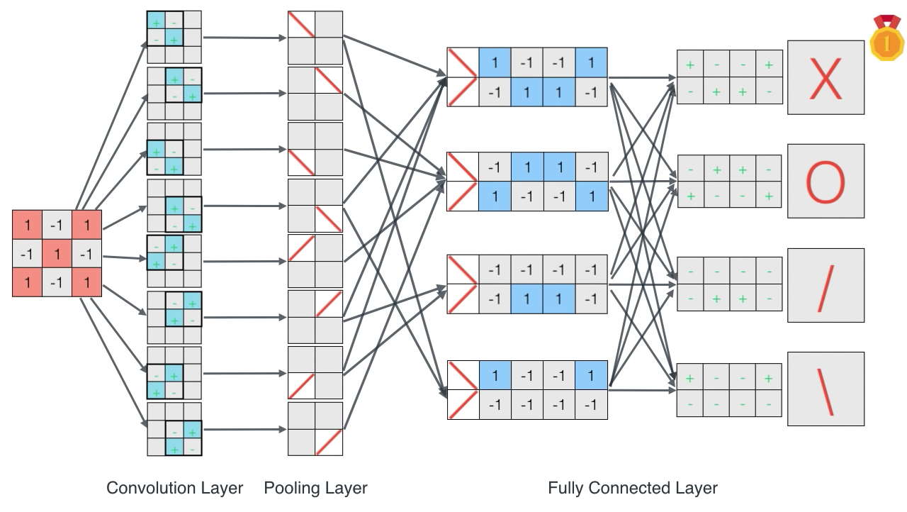
A friendly introduction to Convolutional Neural Networks and Image Recognition
Source: Luis Serrano (2017), A friendly introduction to Convolutional Neural Networks and Image Recognition,
https://www.youtube.com/watch?v=2-Ol7ZB0MmU

Slide 12
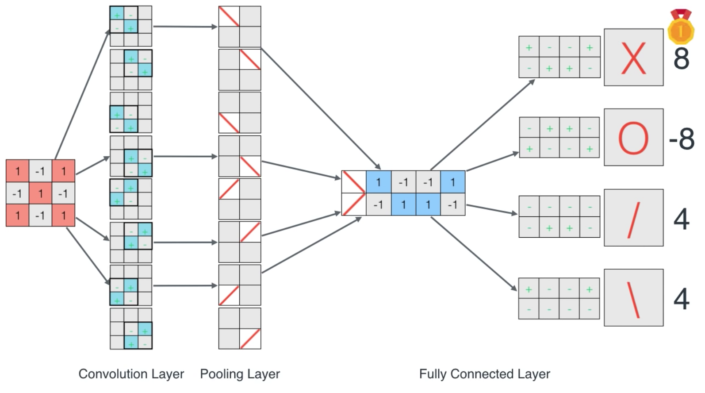
A friendly introduction to Convolutional Neural Networks and Image Recognition
Source: Luis Serrano (2017), A friendly introduction to Convolutional Neural Networks and Image Recognition,
https://www.youtube.com/watch?v=2-Ol7ZB0MmU

Slide 13
CNN Architecture
Source: Arden Dertat (2017), Applied Deep Learning - Part 4: Convolutional Neural Networks, https://towardsdatascience.com/applied-deep-learning-part-4-convolutional-neural-networks-584bc134c1e2

Slide 14
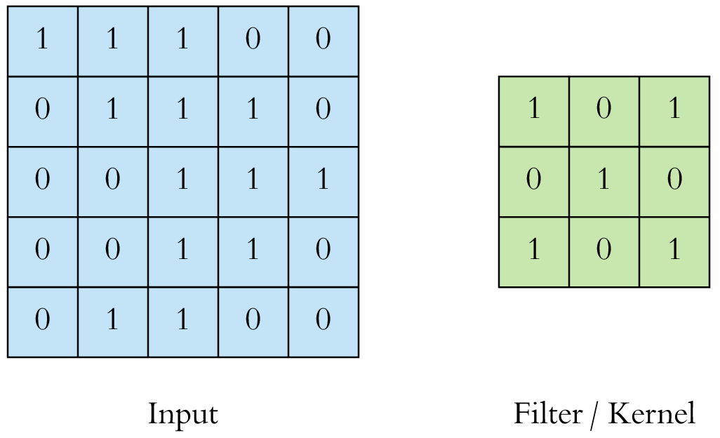
CNN Convolution Layer
Convolution is a mathematical operation to merge two sets of information
3x3 convolution
Source: Arden Dertat (2017), Applied Deep Learning - Part 4: Convolutional Neural Networks, https://towardsdatascience.com/applied-deep-learning-part-4-convolutional-neural-networks-584bc134c1e2

Slide 15
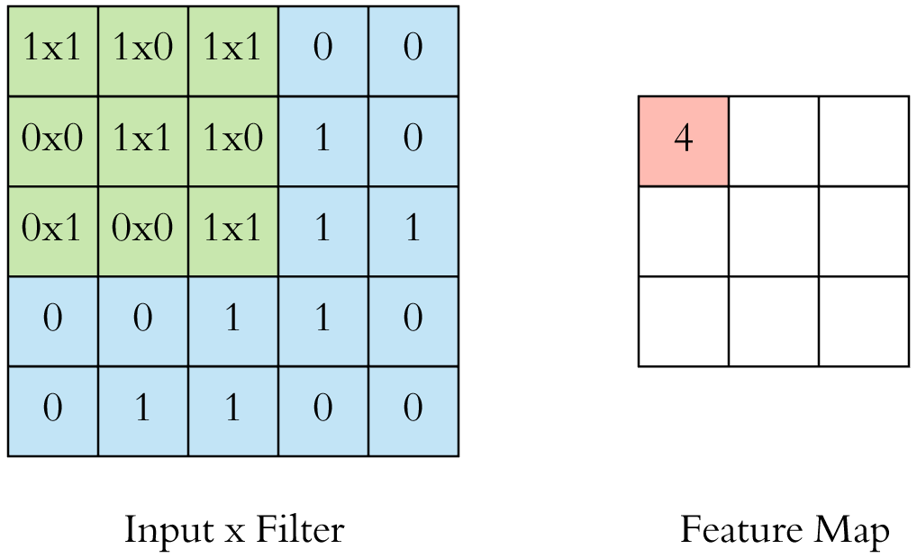
CNN Convolution Layer Input x Filter --> Feature Map
receptive field: 3x3
Source: Arden Dertat (2017), Applied Deep Learning - Part 4: Convolutional Neural Networks, https://towardsdatascience.com/applied-deep-learning-part-4-convolutional-neural-networks-584bc134c1e2

Slide 16
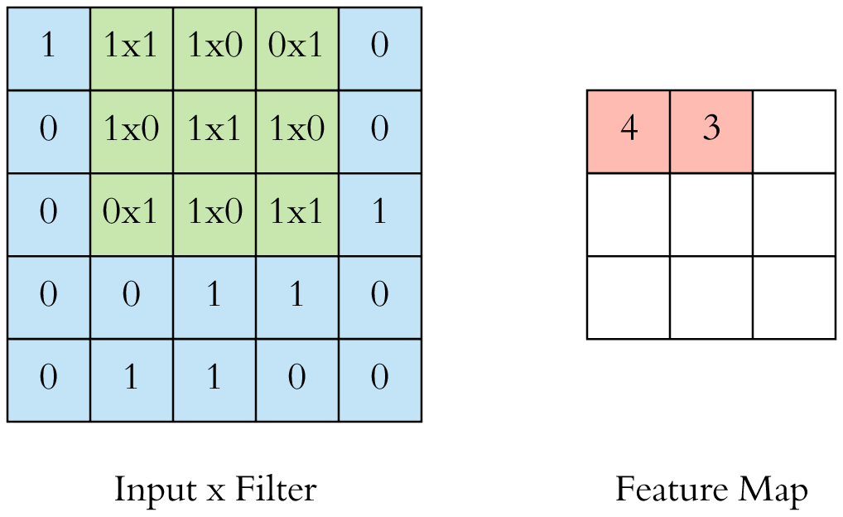
CNN Convolution Layer Input x Filter --> Feature Map
receptive field: 3x3
Source: Arden Dertat (2017), Applied Deep Learning - Part 4: Convolutional Neural Networks, https://towardsdatascience.com/applied-deep-learning-part-4-convolutional-neural-networks-584bc134c1e2

Slide 17
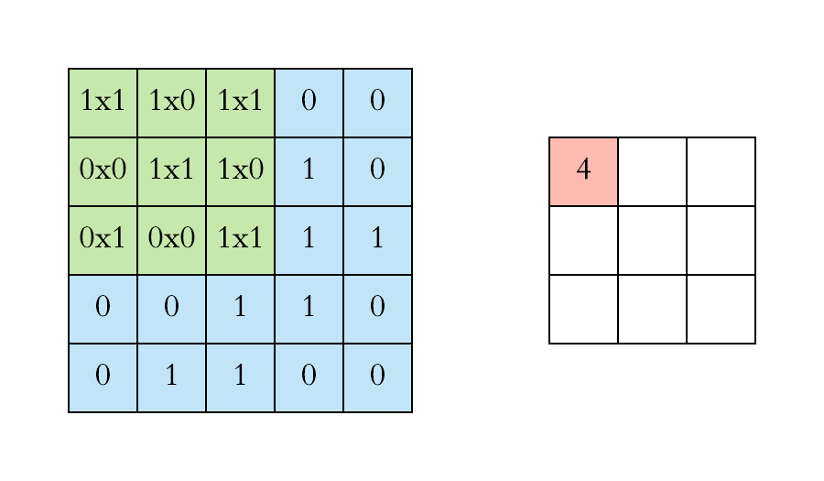
CNN Convolution Layer
Example convolution operation shown in 2D using a 3x3 filter
Source: Arden Dertat (2017), Applied Deep Learning - Part 4: Convolutional Neural Networks, https://towardsdatascience.com/applied-deep-learning-part-4-convolutional-neural-networks-584bc134c1e2

Slide 18
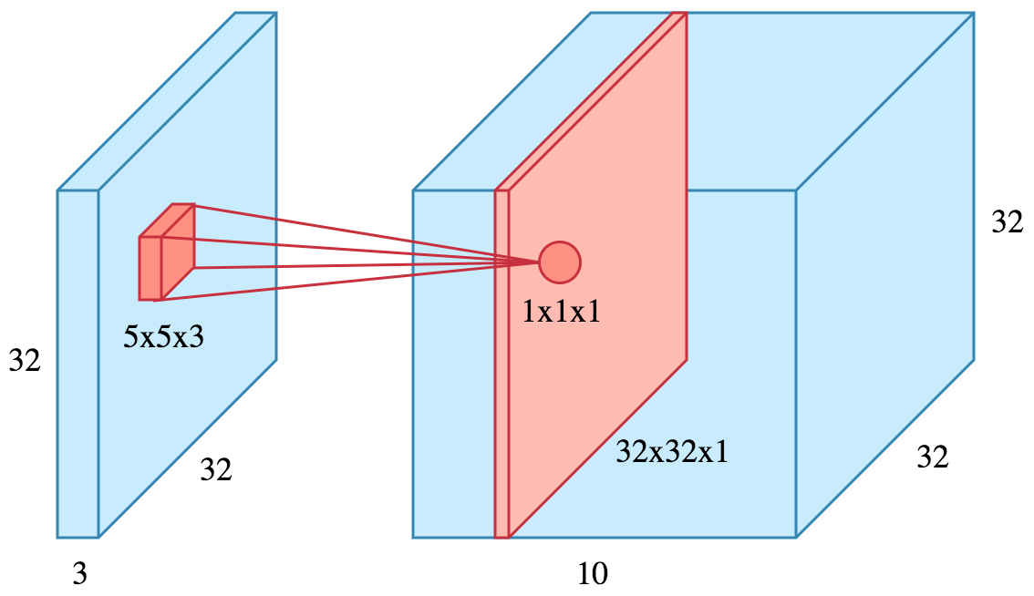
CNN Convolution Layer
10 different filters
10 feature maps of size 32x32x1
final output of the convolution layer: a volume of size 32x32x10
Source: Arden Dertat (2017), Applied Deep Learning - Part 4: Convolutional Neural Networks, https://towardsdatascience.com/applied-deep-learning-part-4-convolutional-neural-networks-584bc134c1e2

Slide 19
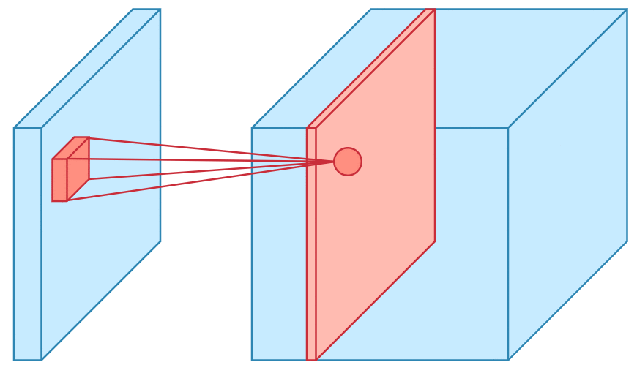
CNN Convolution Layer
Sliding operation at 4 locations
Source: Arden Dertat (2017), Applied Deep Learning - Part 4: Convolutional Neural Networks, https://towardsdatascience.com/applied-deep-learning-part-4-convolutional-neural-networks-584bc134c1e2

Slide 20
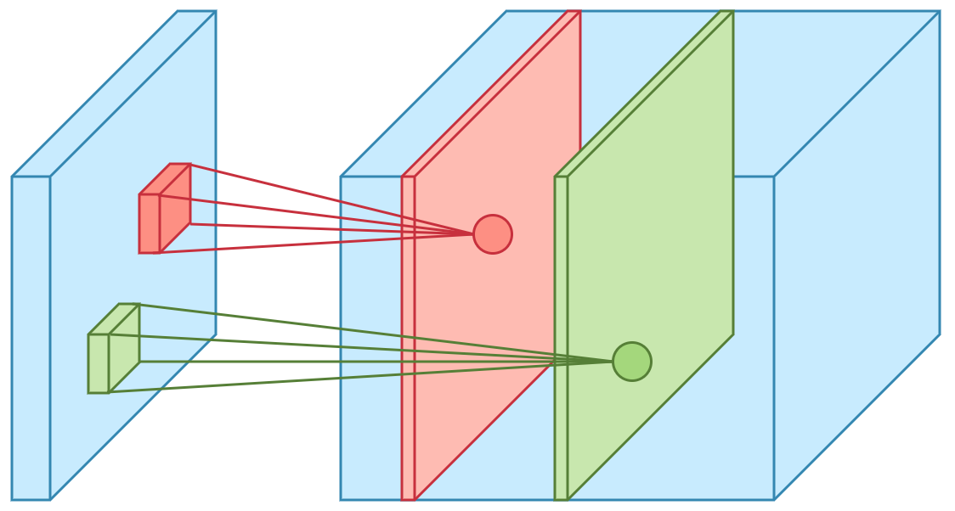
CNN Convolution Layer
two feature maps
Source: Arden Dertat (2017), Applied Deep Learning - Part 4: Convolutional Neural Networks, https://towardsdatascience.com/applied-deep-learning-part-4-convolutional-neural-networks-584bc134c1e2

Slide 21
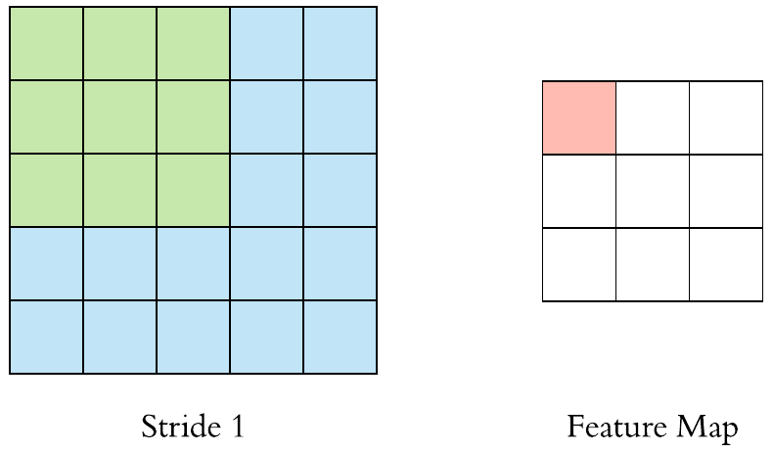
CNN Convolution Layer
Stride specifies how much we move the convolution filter at each step
Source: Arden Dertat (2017), Applied Deep Learning - Part 4: Convolutional Neural Networks, https://towardsdatascience.com/applied-deep-learning-part-4-convolutional-neural-networks-584bc134c1e2

Slide 22
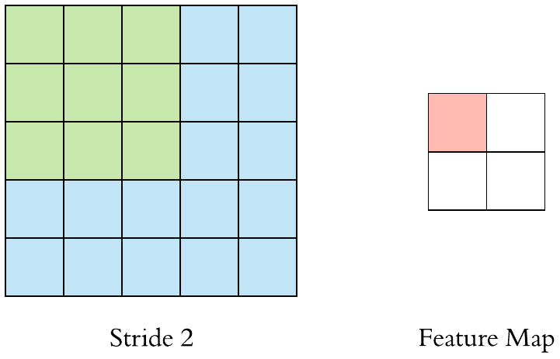
CNN Convolution Layer
Stride specifies how much we move the convolution filter at each step
Source: Arden Dertat (2017), Applied Deep Learning - Part 4: Convolutional Neural Networks, https://towardsdatascience.com/applied-deep-learning-part-4-convolutional-neural-networks-584bc134c1e2

Slide 23
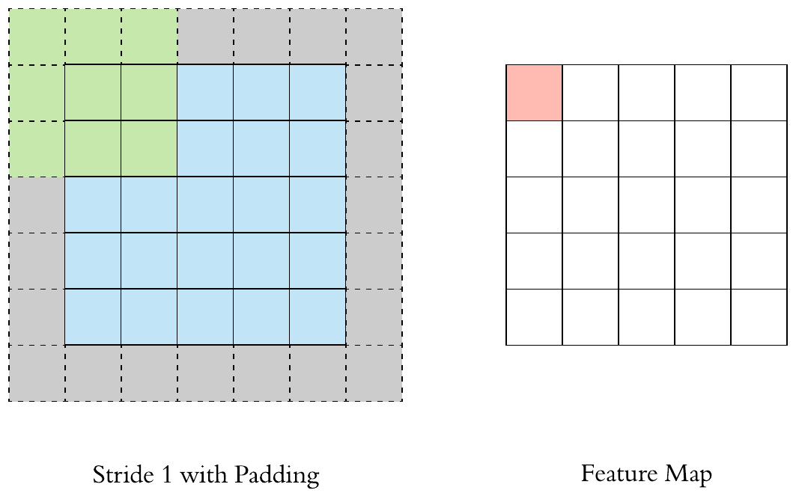
CNN Convolution Layer
Stride 1 with Padding
Source: Arden Dertat (2017), Applied Deep Learning - Part 4: Convolutional Neural Networks, https://towardsdatascience.com/applied-deep-learning-part-4-convolutional-neural-networks-584bc134c1e2

Slide 24
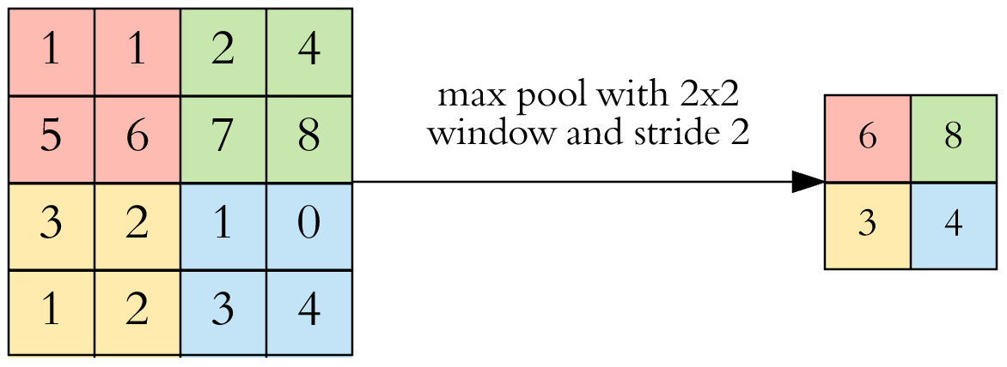
CNN Pooling Layer
Max Pooling
Source: Arden Dertat (2017), Applied Deep Learning - Part 4: Convolutional Neural Networks, https://towardsdatascience.com/applied-deep-learning-part-4-convolutional-neural-networks-584bc134c1e2

Slide 25
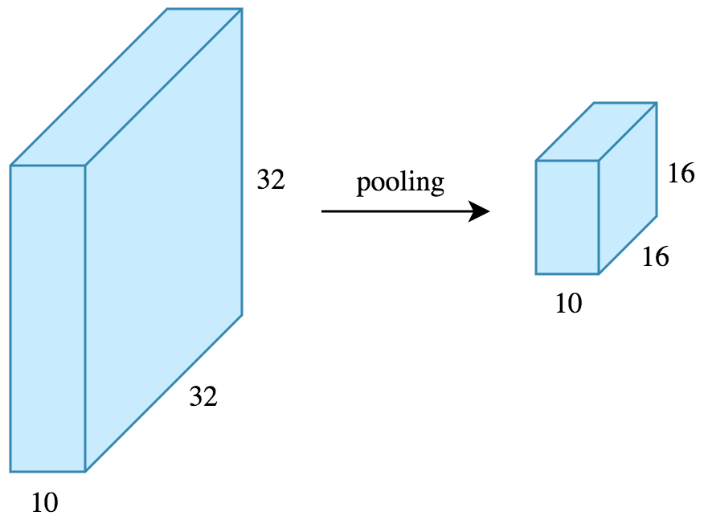
CNN Pooling Layer
Source: Arden Dertat (2017), Applied Deep Learning - Part 4: Convolutional Neural Networks, https://towardsdatascience.com/applied-deep-learning-part-4-convolutional-neural-networks-584bc134c1e2

Slide 26
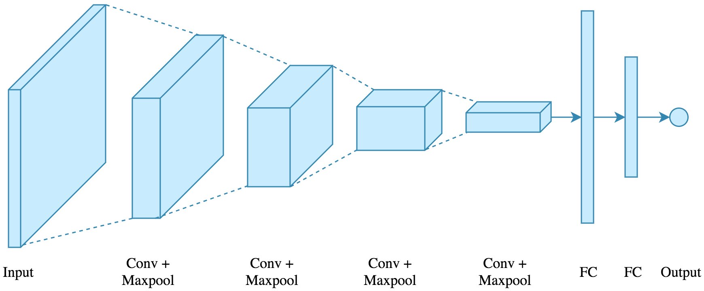
CNN Architecture
4 convolution + pooling layers, followed by 2 fully connected layers
Source: Arden Dertat (2017), Applied Deep Learning - Part 4: Convolutional Neural Networks, https://towardsdatascience.com/applied-deep-learning-part-4-convolutional-neural-networks-584bc134c1e2

Slide 27
CNN Architecture
4 convolution + pooling layers, followed by 2 fully connected layers
https://gist.github.com/ardendertat/0fc5515057c47e7386fe04e9334504e3
model = Sequential()
model.add(Conv2D(32, (3, 3), activation='relu', padding='same', name='conv_1',
input_shape=(150, 150, 3)))
model.add(MaxPooling2D((2, 2), name='maxpool_1'))
model.add(Conv2D(64, (3, 3), activation='relu', padding='same', name='conv_2'))
model.add(MaxPooling2D((2, 2), name='maxpool_2'))
model.add(Conv2D(128, (3, 3), activation='relu', padding='same', name='conv_3'))
model.add(MaxPooling2D((2, 2), name='maxpool_3'))
model.add(Conv2D(128, (3, 3), activation='relu', padding='same', name='conv_4'))
model.add(MaxPooling2D((2, 2), name='maxpool_4'))
model.add(Flatten())
model.add(Dropout(0.5))
model.add(Dense(512, activation='relu', name='dense_1'))
model.add(Dense(128, activation='relu', name='dense_2'))
model.add(Dense(1, activation='sigmoid', name='output'))
Source: Arden Dertat (2017), Applied Deep Learning - Part 4: Convolutional Neural Networks, https://towardsdatascience.com/applied-deep-learning-part-4-convolutional-neural-networks-584bc134c1e2

Slide 28
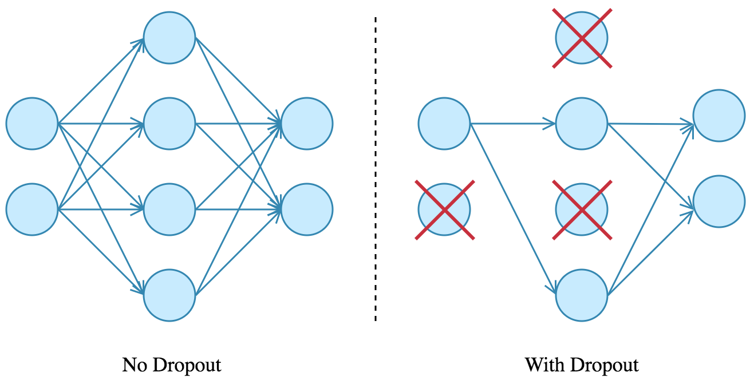
Dropout
Source: Arden Dertat (2017), Applied Deep Learning - Part 4: Convolutional Neural Networks, https://towardsdatascience.com/applied-deep-learning-part-4-convolutional-neural-networks-584bc134c1e2

Slide 29
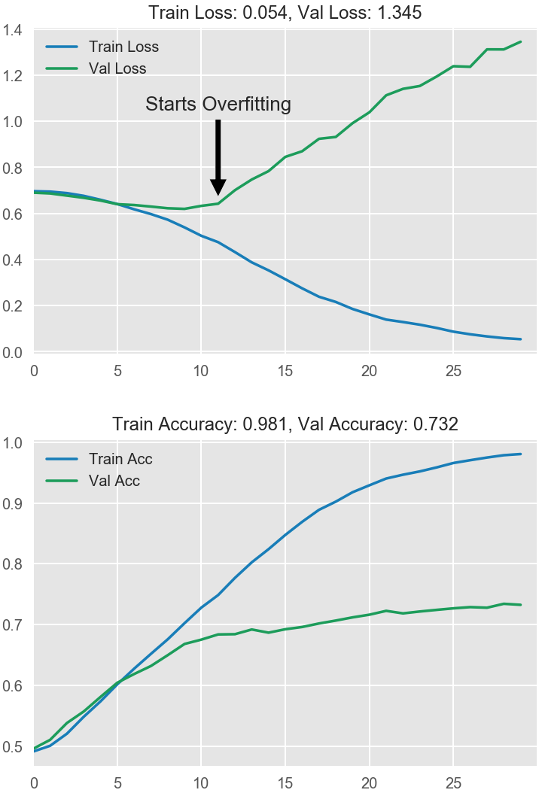
Model Performance
Source: Arden Dertat (2017), Applied Deep Learning - Part 4: Convolutional Neural Networks, https://towardsdatascience.com/applied-deep-learning-part-4-convolutional-neural-networks-584bc134c1e2

Slide 30
Visual Recognition Image Classification

Slide 31
Source: Jeff Dean (2016), Large-Scale Deep Learning For Building Intelligent Computer Systems, WSDM 2016

Slide 32
Convolutional Neural Networks (CNNs / ConvNets)
http://cs231n.github.io/convolutional-networks/

Slide 33
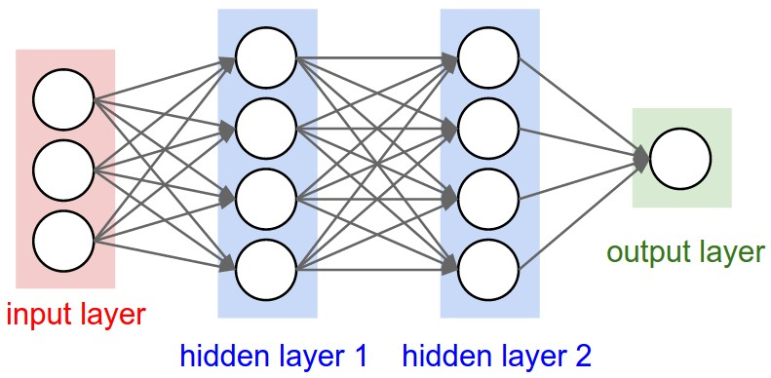
A regular 3-layer Neural Network
http://cs231n.github.io/convolutional-networks/

Slide 34
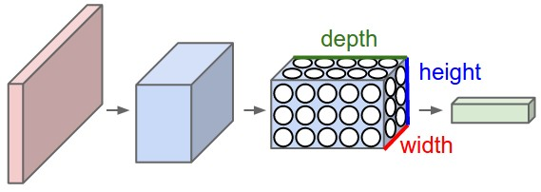
A ConvNet arranges its neurons in three dimensions (width, height, depth)
http://cs231n.github.io/convolutional-networks/

Slide 35
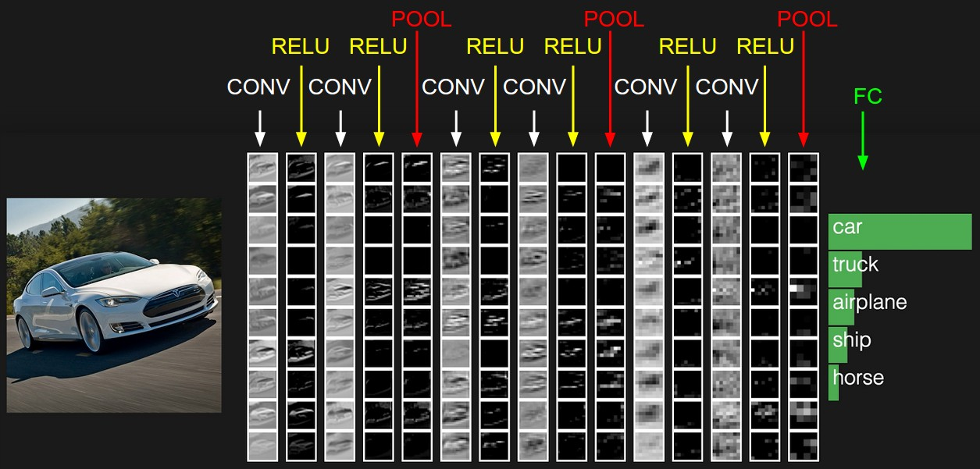
The activations of an example ConvNet architecture.
http://cs231n.github.io/convolutional-networks/

Slide 36
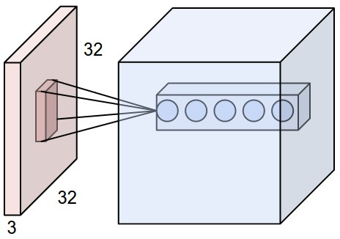
ConvNets
32x32x3 CIFAR-10 image
first Convolutional layer
http://cs231n.github.io/convolutional-networks/

Slide 37
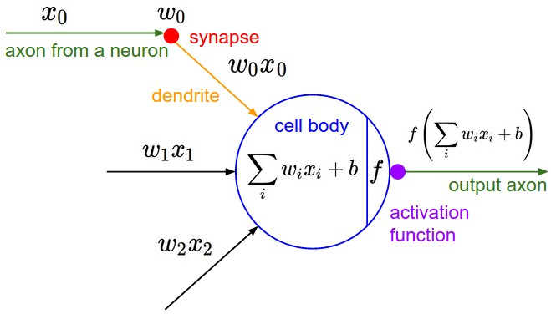
ConvNets
http://cs231n.github.io/convolutional-networks/

Slide 38
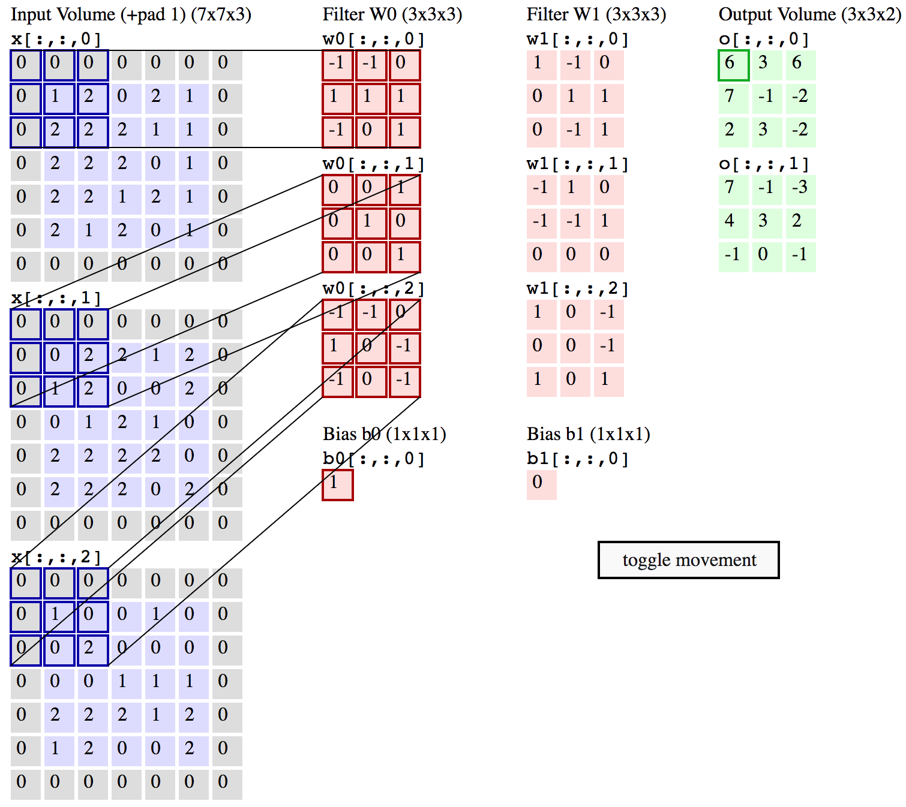
Convolution Demo
http://cs231n.github.io/convolutional-networks/

Slide 39
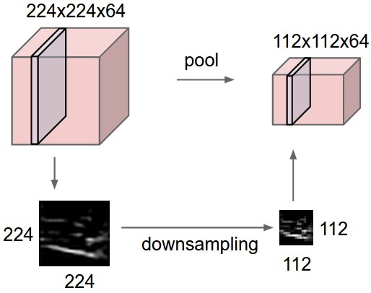
ConvNets
input volume of size [224x224x64] is pooled with filter size 2, stride 2 into output volume of size [112x112x64]
http://cs231n.github.io/convolutional-networks/

Slide 40
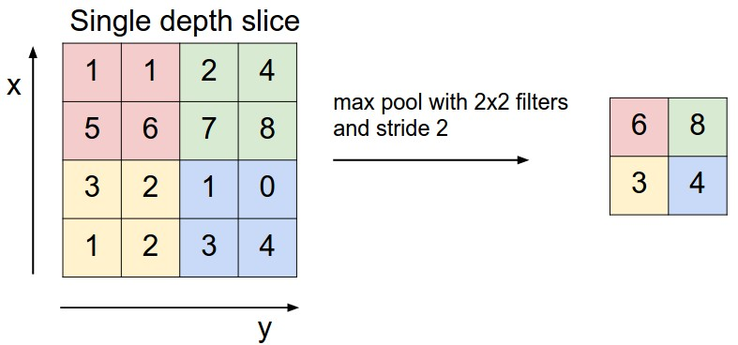
ConvNets max pooling
http://cs231n.github.io/convolutional-networks/

Slide 41
Convolutional Neural Networks (CNN) (LeNet)
Source: http://deeplearning.net/tutorial/lenet.html

Slide 42
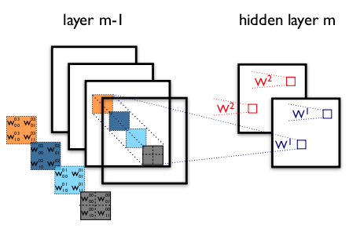
Convolutional Neural Networks (CNN) (LeNet)
example of a convolutional layer
Source: http://deeplearning.net/tutorial/lenet.html

Slide 43
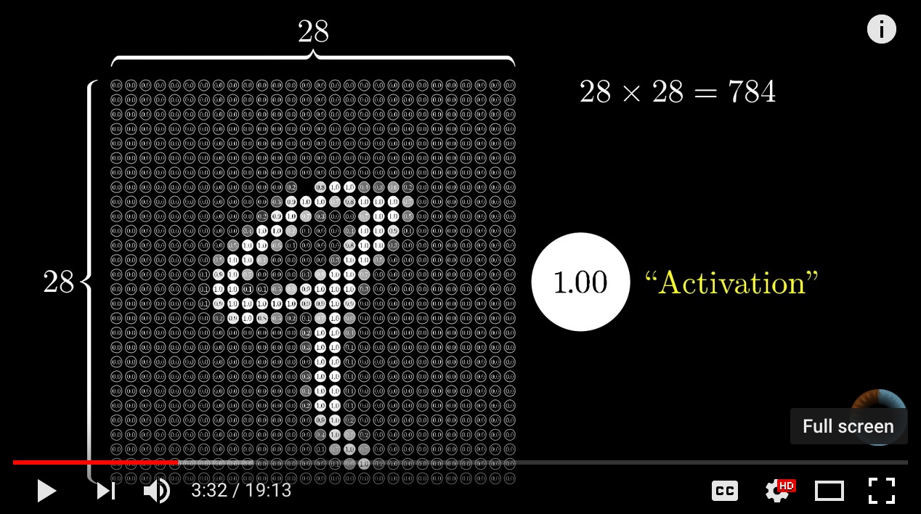
Neural Network and Deep Learning
Source: 3Blue1Brown (2017), But what *is* a Neural Network? | Chapter 1, deep learning, https://www.youtube.com/watch?v=aircAruvnKk

Slide 44
Gradient Descent how neural networks learn
Source: 3Blue1Brown (2017), Gradient descent, how neural networks learn | Chapter 2, deep learning, https://www.youtube.com/watch?v=IHZwWFHWa-w

Slide 45
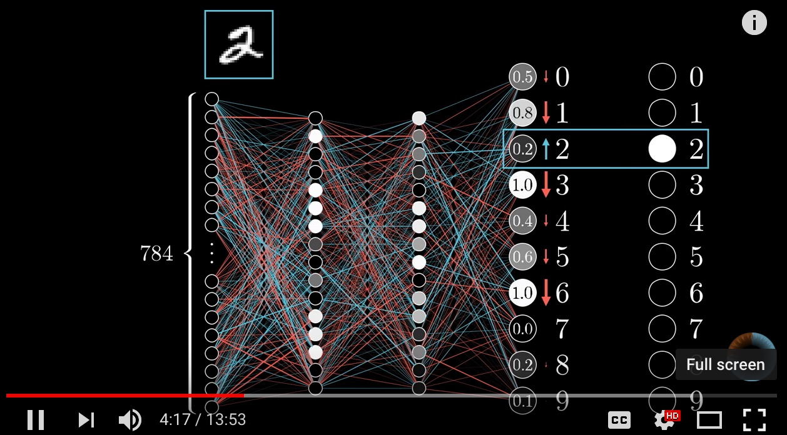
Backpropagation
Source: 3Blue1Brown (2017), What is backpropagation really doing? | Chapter 3, deep learning, https://www.youtube.com/watch?v=Ilg3gGewQ5U

Slide 46
TensorFlow Image Recognition

Slide 47
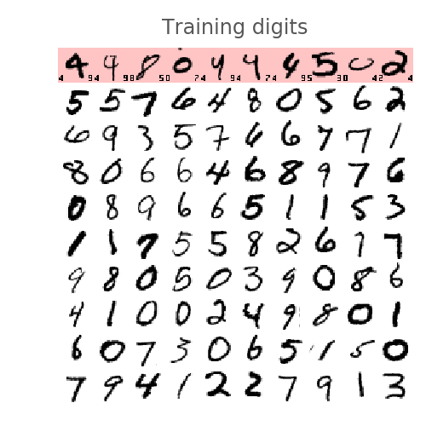
MNIST dataset: 60,000 labeled digits
Source: https://codelabs.developers.google.com/codelabs/cloud-tensorflow-mnist/#0

Slide 48
Get Started with TensorFlow
https://www.tensorflow.org/tutorials/

Slide 49
Get Started with TensorFlow
MNIST
import tensorflow as tf
mnist = tf.keras.datasets.mnist
(x_train, y_train),(x_test, y_test) = mnist.load_data()
x_train, x_test = x_train / 255.0, x_test / 255.0
model = tf.keras.models.Sequential([
tf.keras.layers.Flatten(),
tf.keras.layers.Dense(512, activation=tf.nn.relu),
tf.keras.layers.Dropout(0.2),
tf.keras.layers.Dense(10, activation=tf.nn.softmax)
])
model.compile(optimizer='adam',
loss='sparse_categorical_crossentropy',
metrics=['accuracy'])
model.fit(x_train, y_train, epochs=5)
model.evaluate(x_test, y_test)
https://www.tensorflow.org/tutorials/

Slide 50
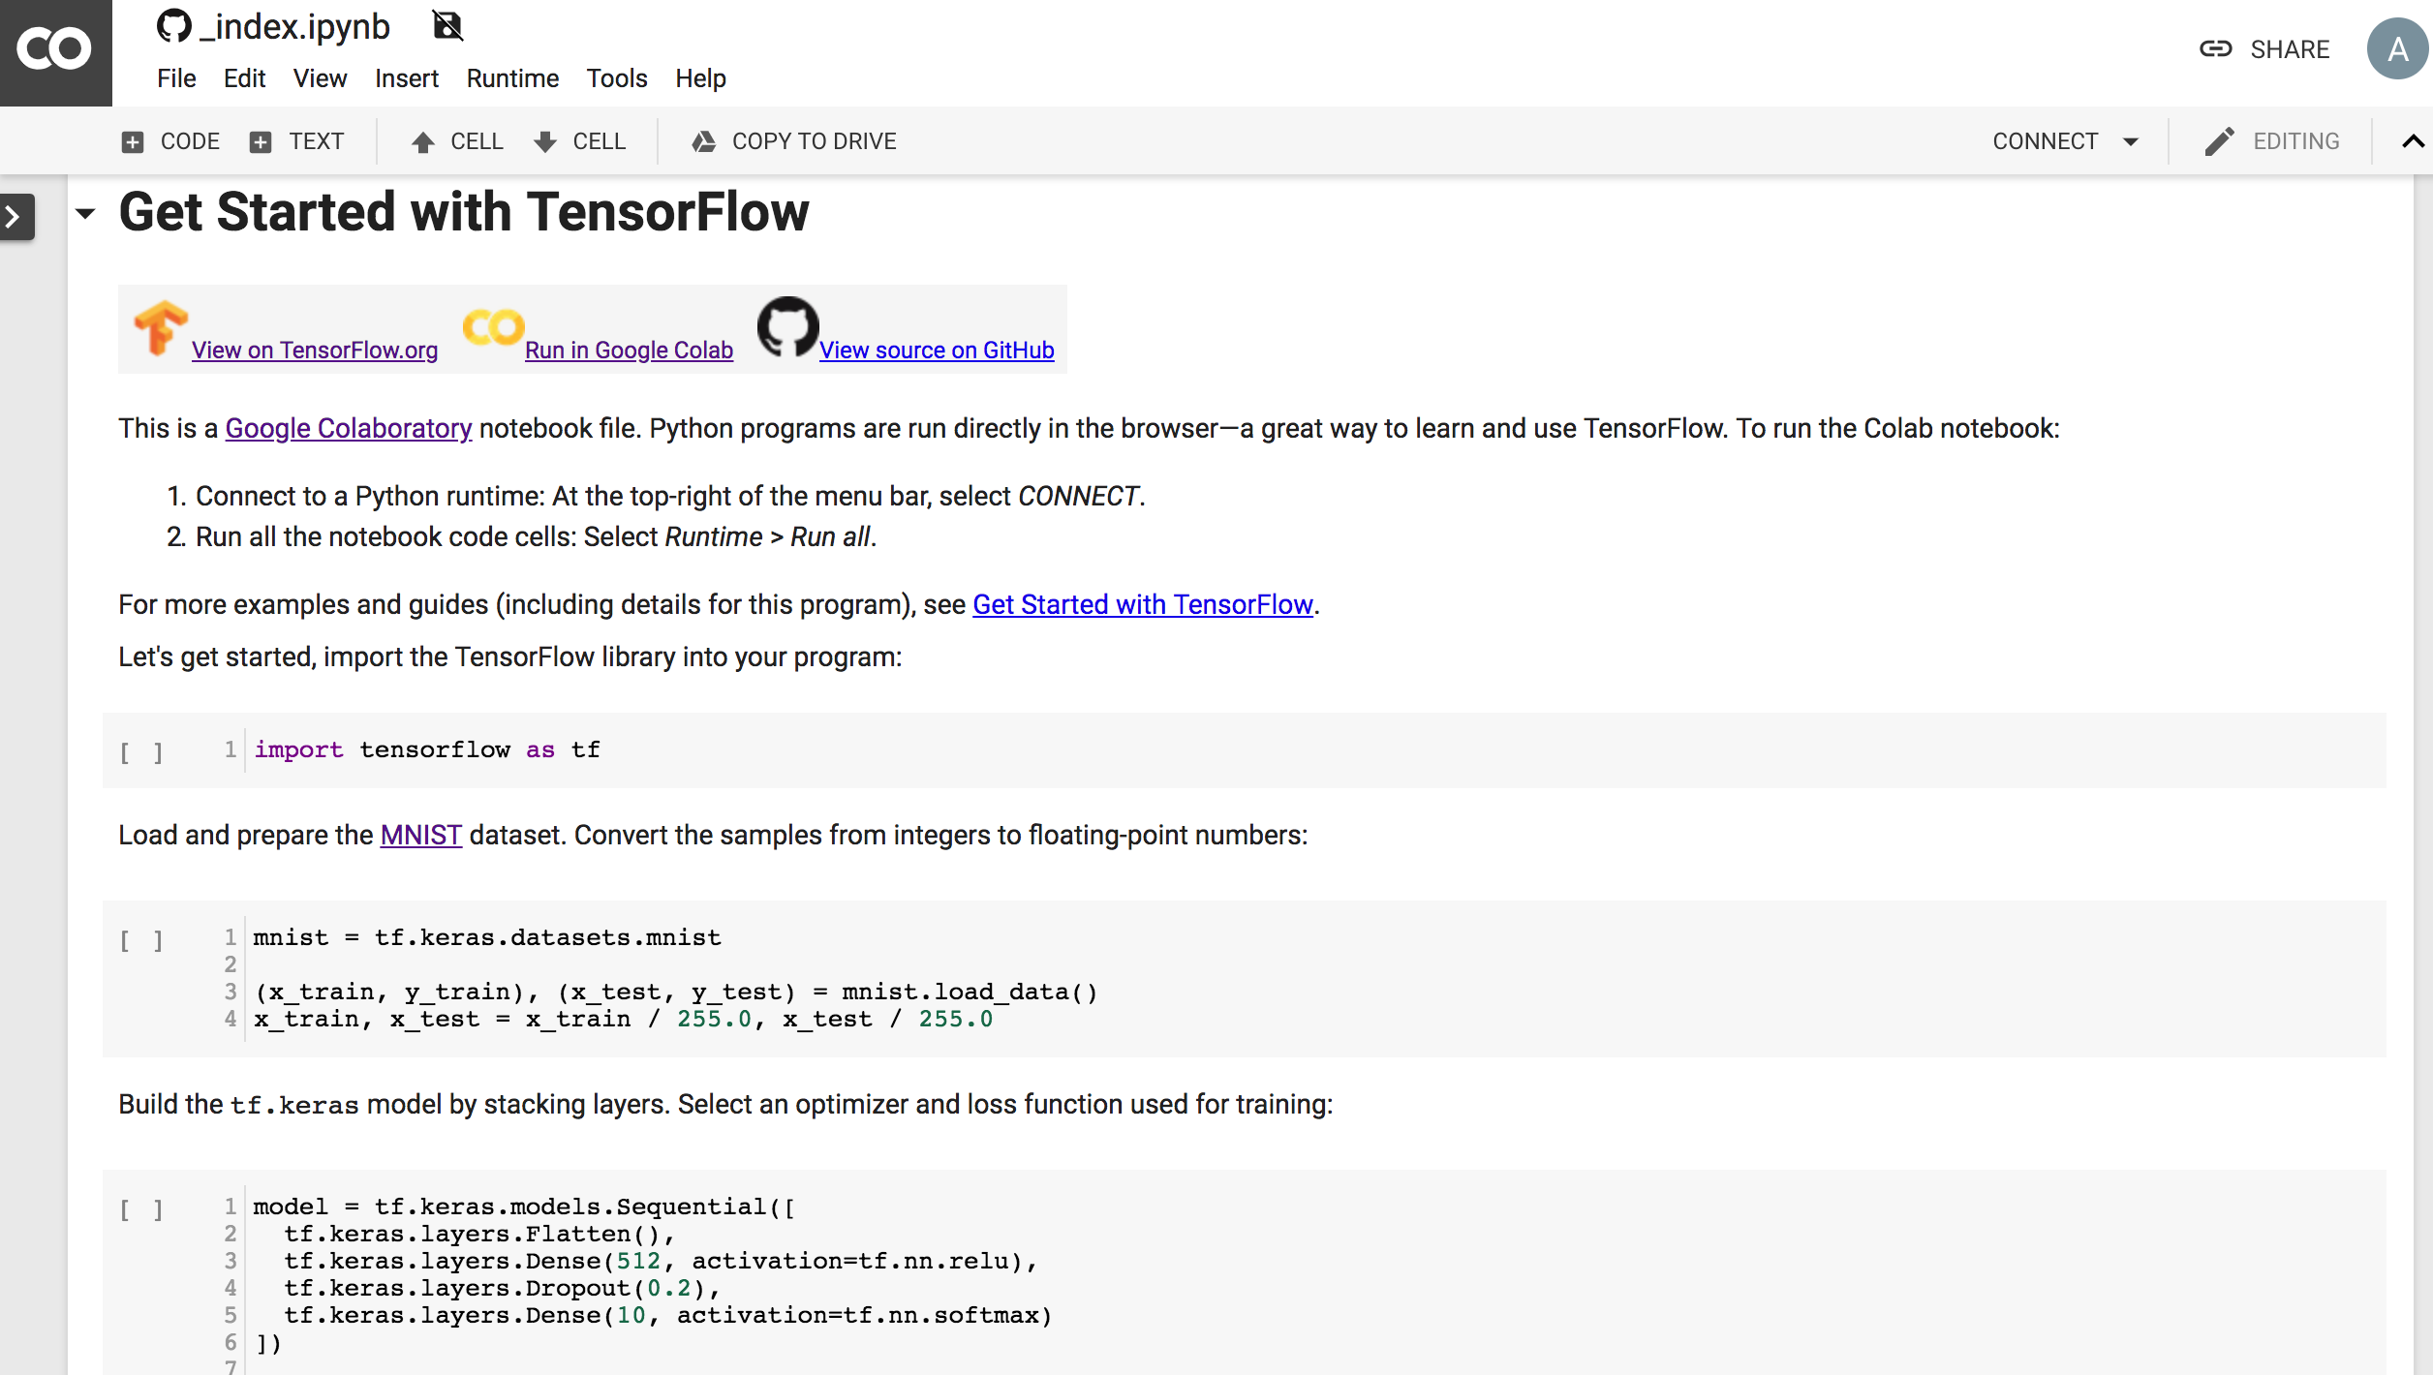
Get Started with TensorFlow
MNIST
https://colab.research.google.com/github/tensorflow/docs/blob/master/site/en/tutorials/_index.ipynb

Slide 51
TensorFlow and Deep Learning
Source: https://codelabs.developers.google.com/codelabs/cloud-tensorflow-mnist/#0

Slide 52
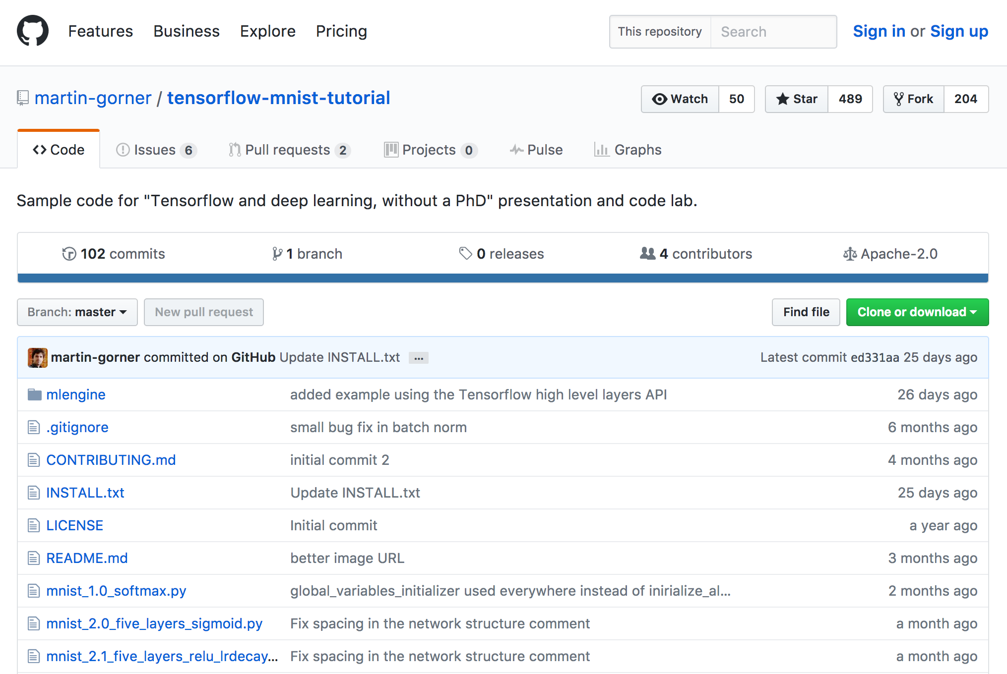
TensorFlow MNIST Tutorial
https://github.com/martin-gorner/tensorflow-mnist-tutorial/

Slide 53
TensorFlow and Deep Learning
What is a neural network and how to train it
How to build a basic 1-layer neural network using TensorFlow
How to add more layers
Training tips and tricks: overfitting, dropout, learning rate decay ...
How to troubleshoot deep neural networks
How to build convolutional networks
Source: https://codelabs.developers.google.com/codelabs/cloud-tensorflow-mnist/#0

Slide 54
TensorFlow MNIST Tutorial
git clone https://github.com/martin-gorner/tensorflow-mnist-tutorial.git
cd tensorflow-mnist-tutorial
python3 mnist_1.0_softmax.py
python mnist_1.0_softmax.py
pythonw mnist_1.0_softmax.py
Source: https://github.com/martin-gorner/tensorflow-mnist-tutorial/blob/master/INSTALL.txt

Slide 55
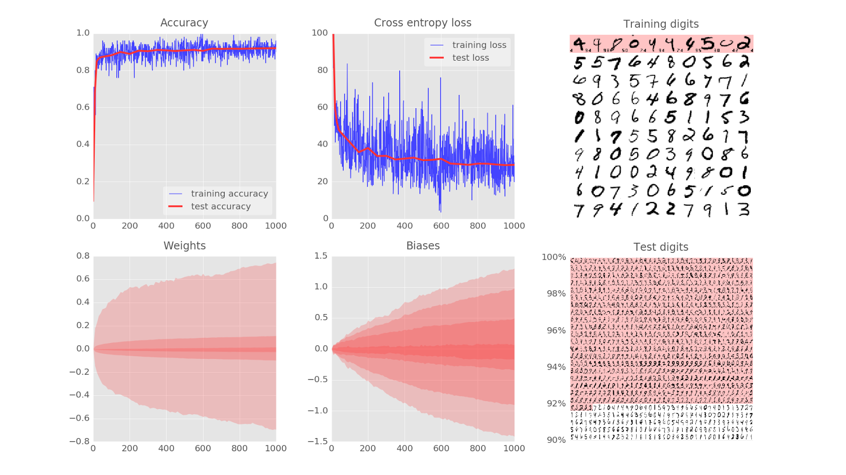
cd tensorflow-mnist-tutorial
python3 mnist_1.0_softmax.py
Source: https://codelabs.developers.google.com/codelabs/cloud-tensorflow-mnist/#1

Slide 56
Train a Neural Network
Training digits
updates to weights and biases =>
better recognition (loop)
Source: https://codelabs.developers.google.com/codelabs/cloud-tensorflow-mnist/#2

Slide 57
Training digits
Source: https://codelabs.developers.google.com/codelabs/cloud-tensorflow-mnist/#2

Slide 58
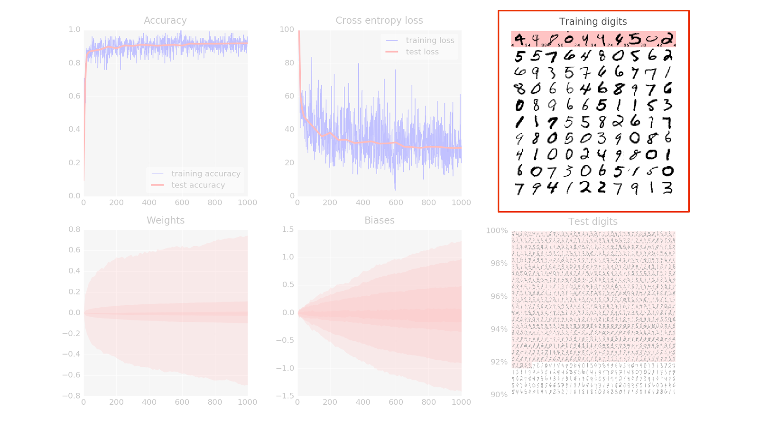
Training digits
Source: https://codelabs.developers.google.com/codelabs/cloud-tensorflow-mnist/#2

Slide 59
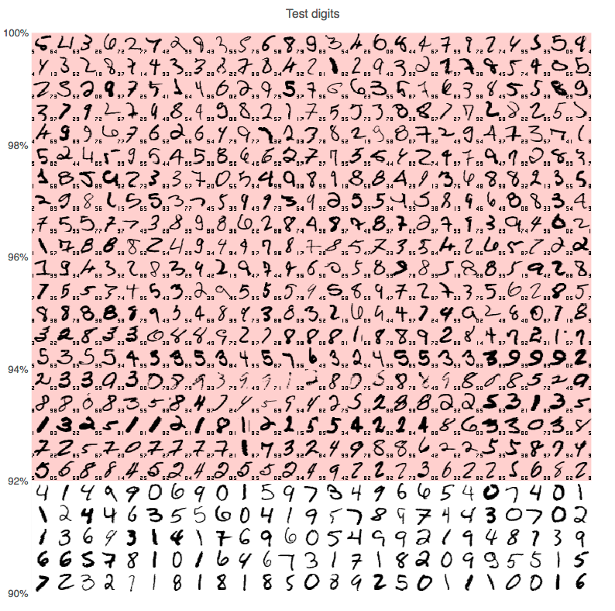
Source: https://codelabs.developers.google.com/codelabs/cloud-tensorflow-mnist/#2

Slide 60
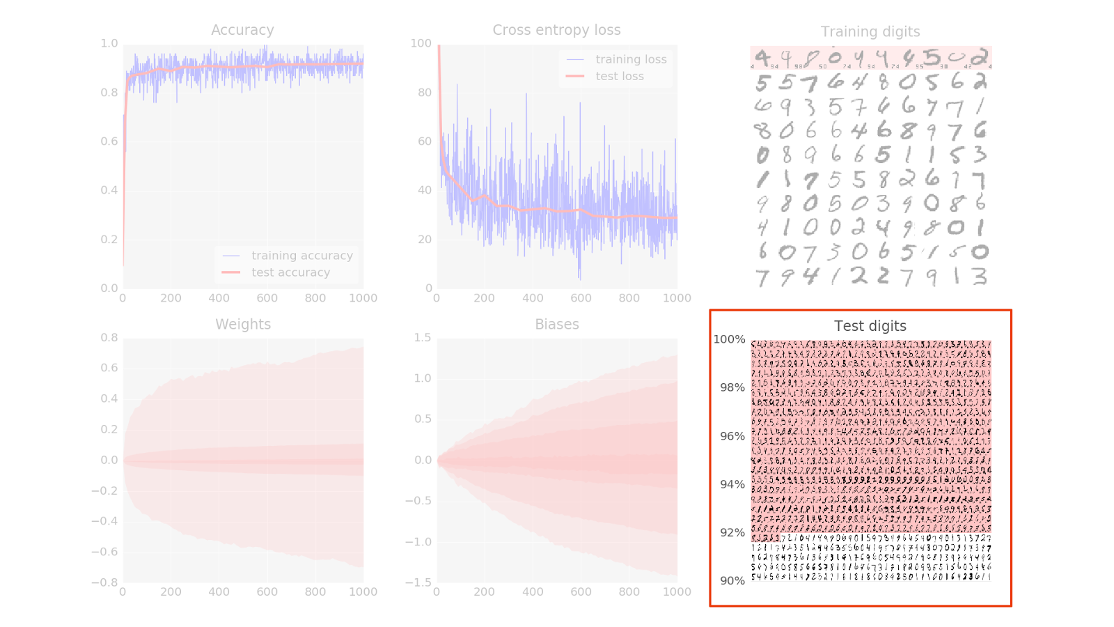
Test digits
Source: https://codelabs.developers.google.com/codelabs/cloud-tensorflow-mnist/#2

Slide 61
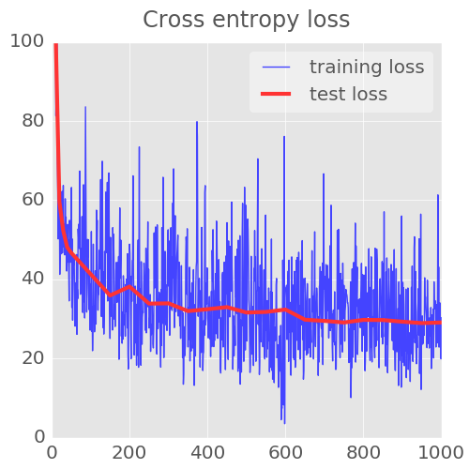
Cross entropy loss
Source: https://codelabs.developers.google.com/codelabs/cloud-tensorflow-mnist/#2

Slide 62
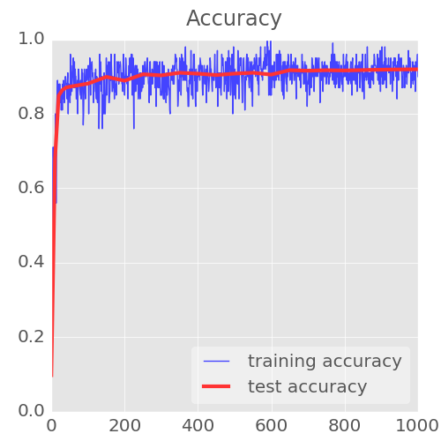
Accuracy
Source: https://codelabs.developers.google.com/codelabs/cloud-tensorflow-mnist/#2

Slide 63
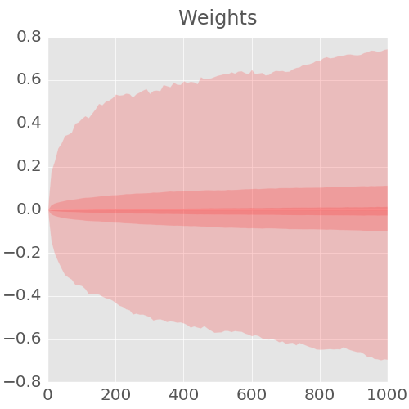
Weights
Source: https://codelabs.developers.google.com/codelabs/cloud-tensorflow-mnist/#2

Slide 64
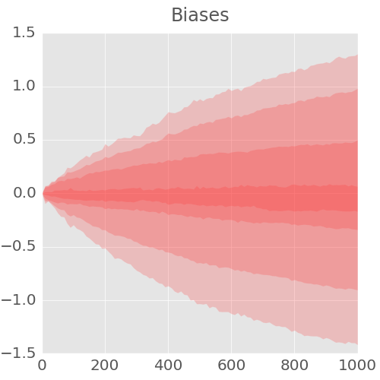
Biases
Source: https://codelabs.developers.google.com/codelabs/cloud-tensorflow-mnist/#2

Slide 65
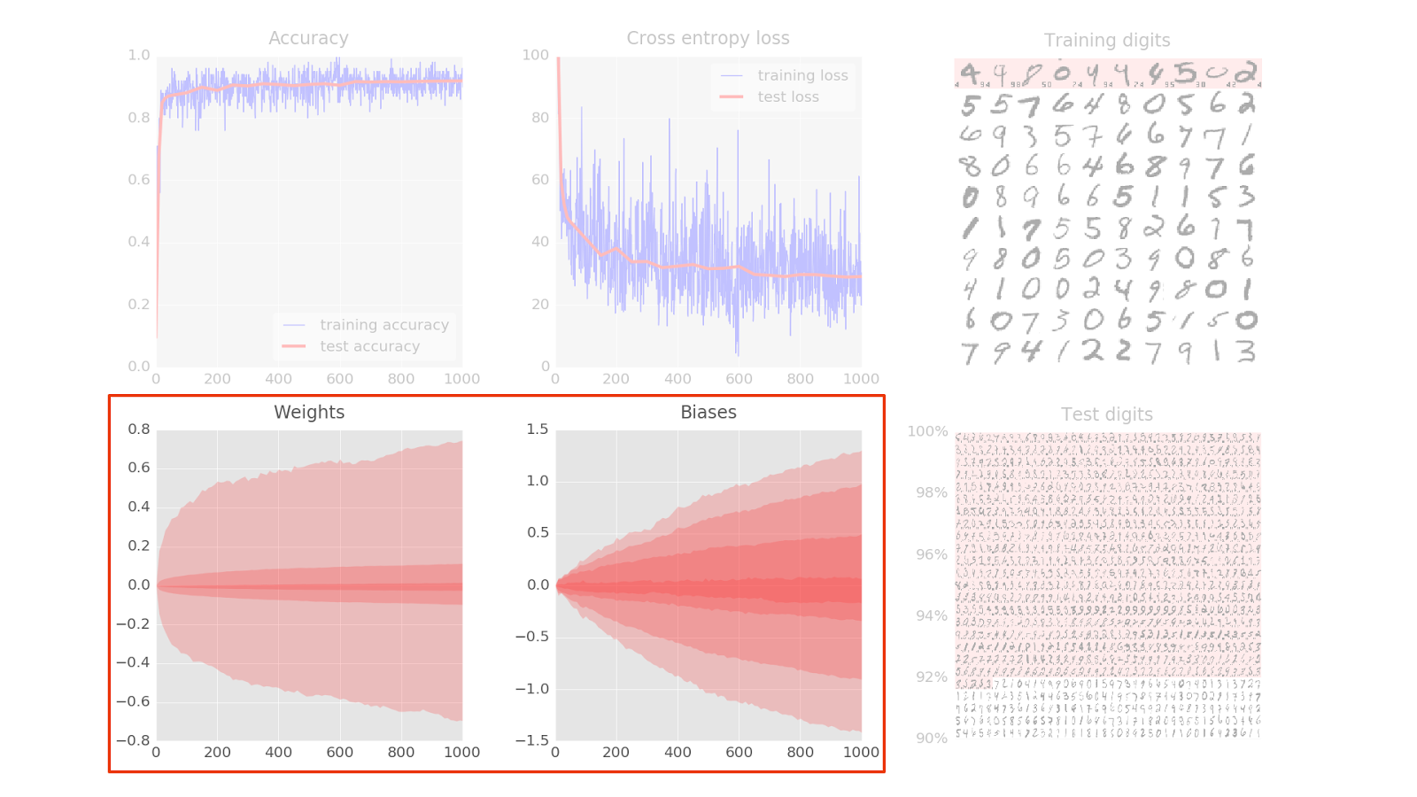
Weights and Biases
Source: https://codelabs.developers.google.com/codelabs/cloud-tensorflow-mnist/#2

Slide 66
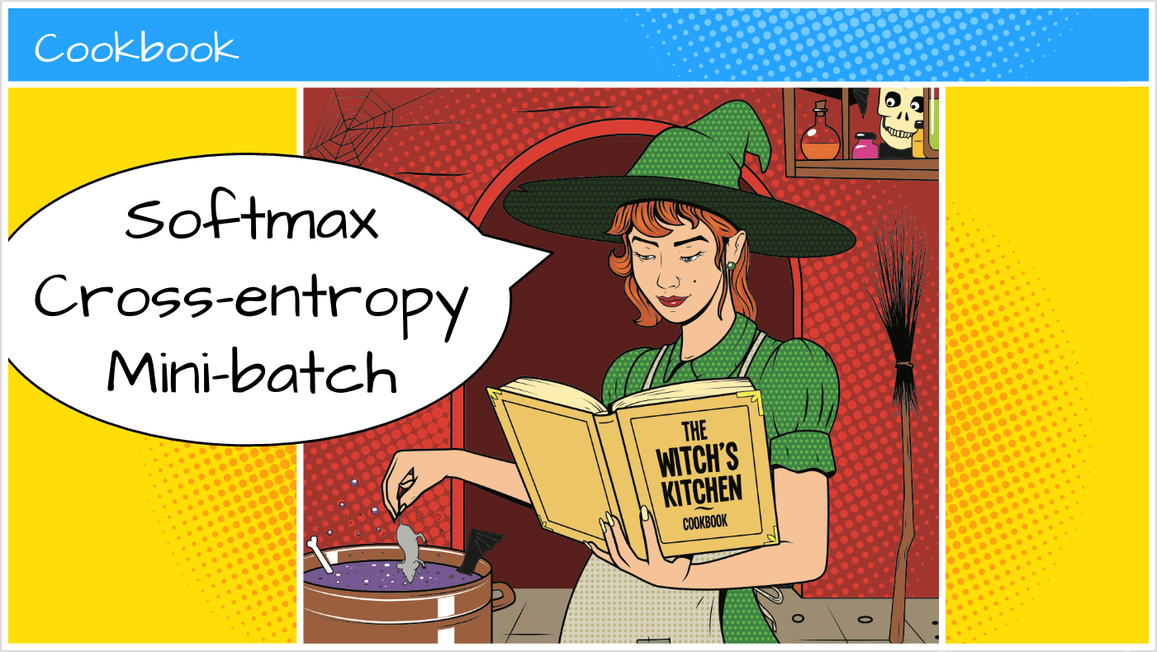
Source: https://codelabs.developers.google.com/codelabs/cloud-tensorflow-mnist/

Slide 67
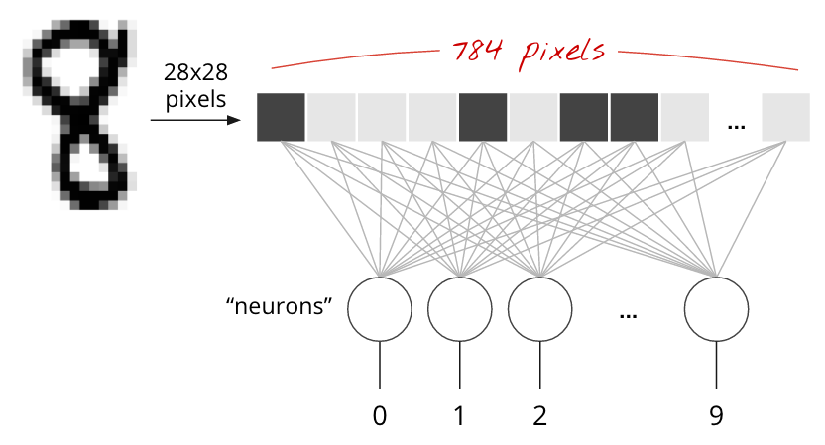
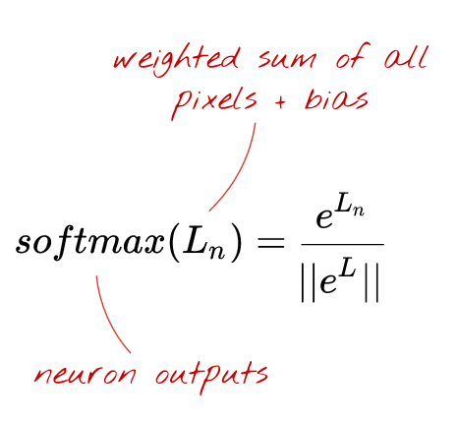
Very Simple Model: Softmax Classification
Source: https://codelabs.developers.google.com/codelabs/cloud-tensorflow-mnist/

Slide 68
Very Simple Model: Softmax Classification
Source: https://codelabs.developers.google.com/codelabs/cloud-tensorflow-mnist/

Slide 69
Very Simple Model: Softmax Classification
Source: https://codelabs.developers.google.com/codelabs/cloud-tensorflow-mnist/

Slide 70
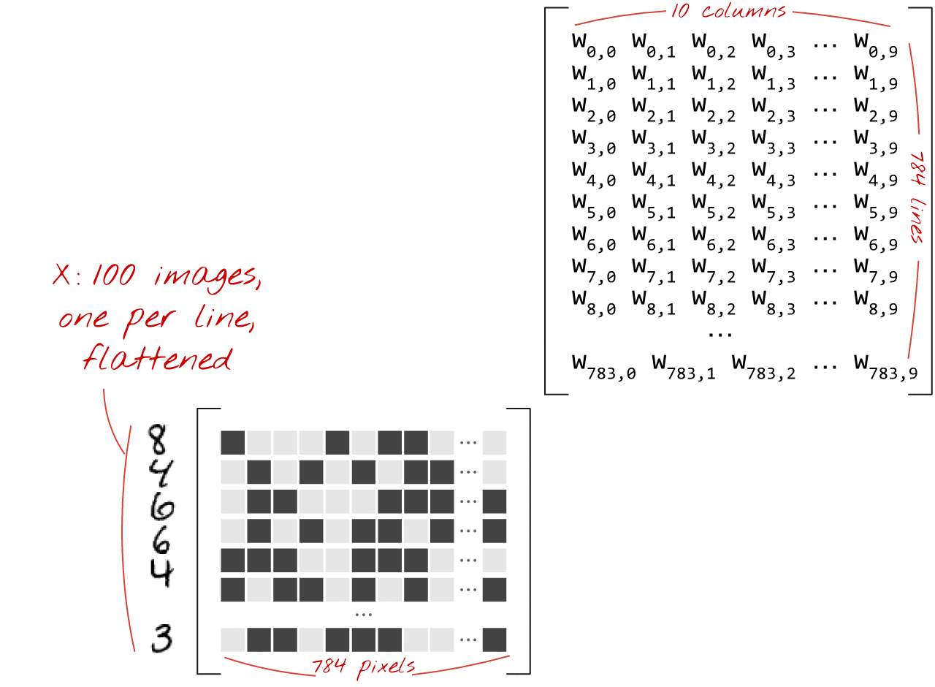
In Matrix notation, 100 images at a time
Source: https://codelabs.developers.google.com/codelabs/cloud-tensorflow-mnist/

Slide 71
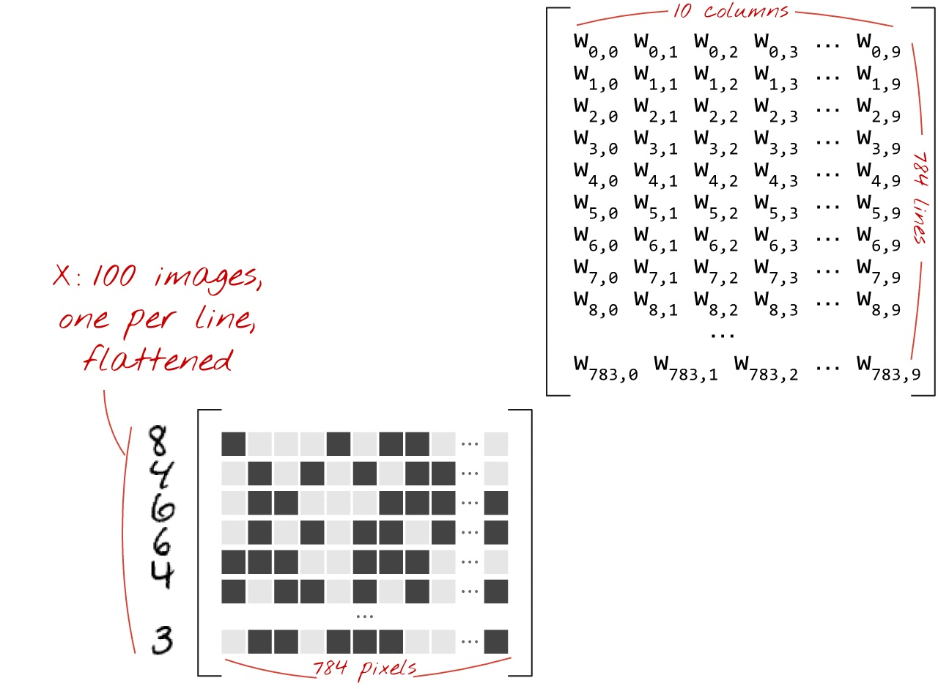
Source: https://codelabs.developers.google.com/codelabs/cloud-tensorflow-mnist/

Slide 72
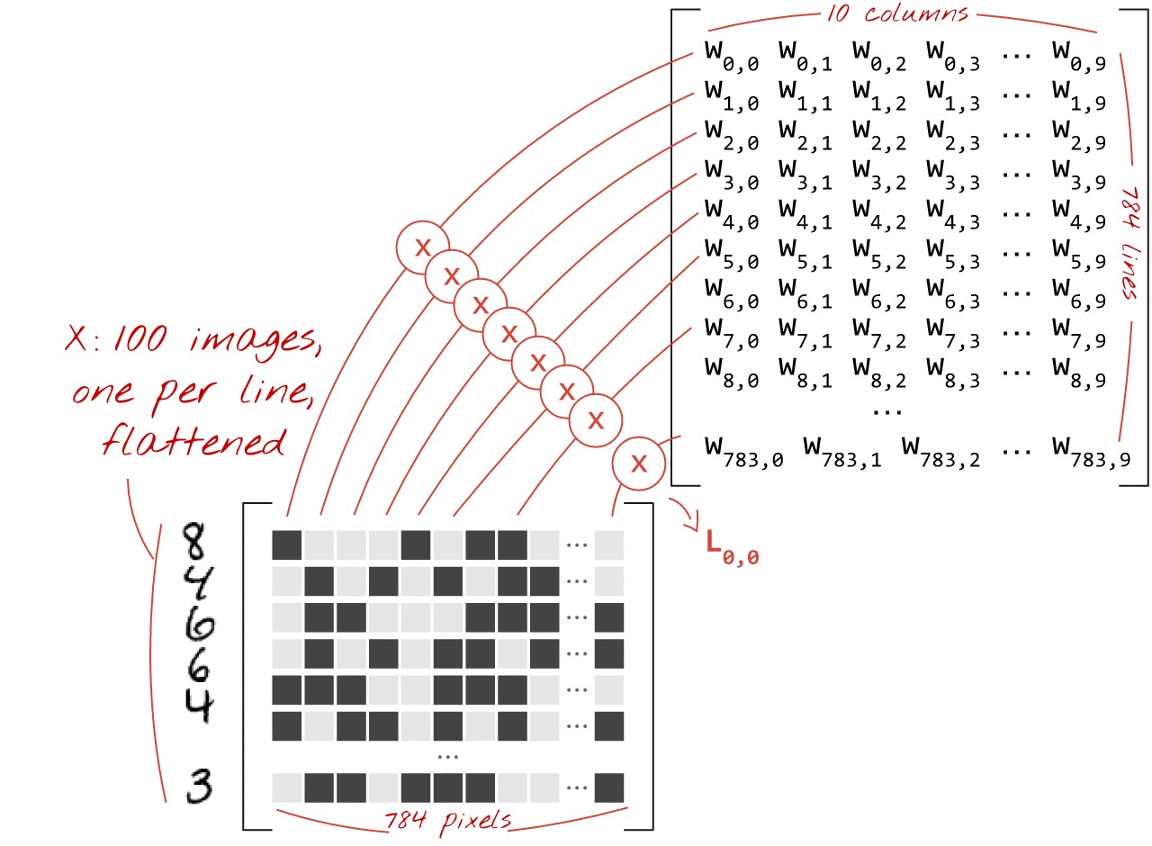
Source: https://codelabs.developers.google.com/codelabs/cloud-tensorflow-mnist/

Slide 73
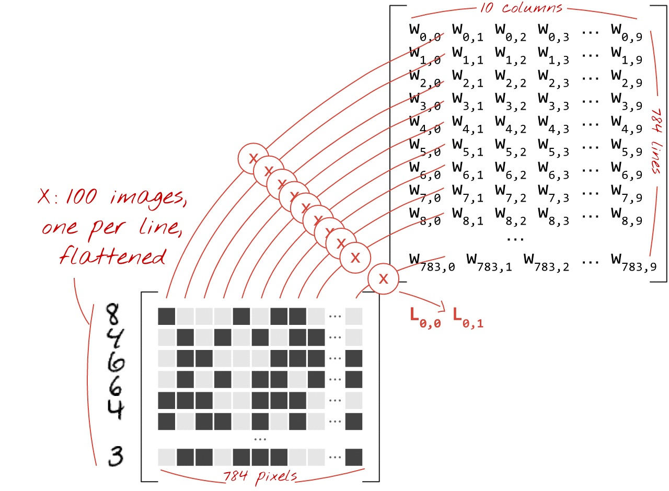
Source: https://codelabs.developers.google.com/codelabs/cloud-tensorflow-mnist/

Slide 74
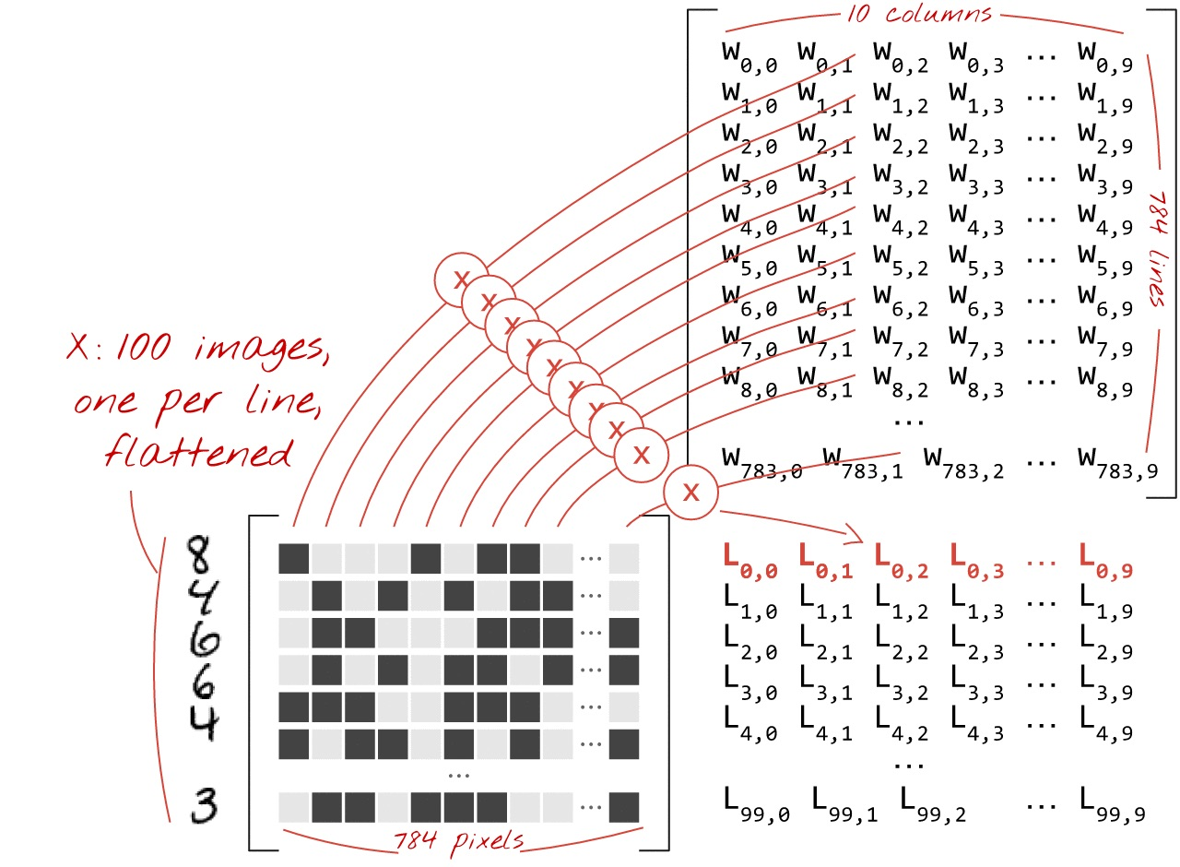
Source: https://codelabs.developers.google.com/codelabs/cloud-tensorflow-mnist/

Slide 75
What are "weights" and "biases" ? How is the "cross-entropy" computed ? How exactly does the training algorithm work ?
Source: https://codelabs.developers.google.com/codelabs/cloud-tensorflow-mnist/

Slide 76
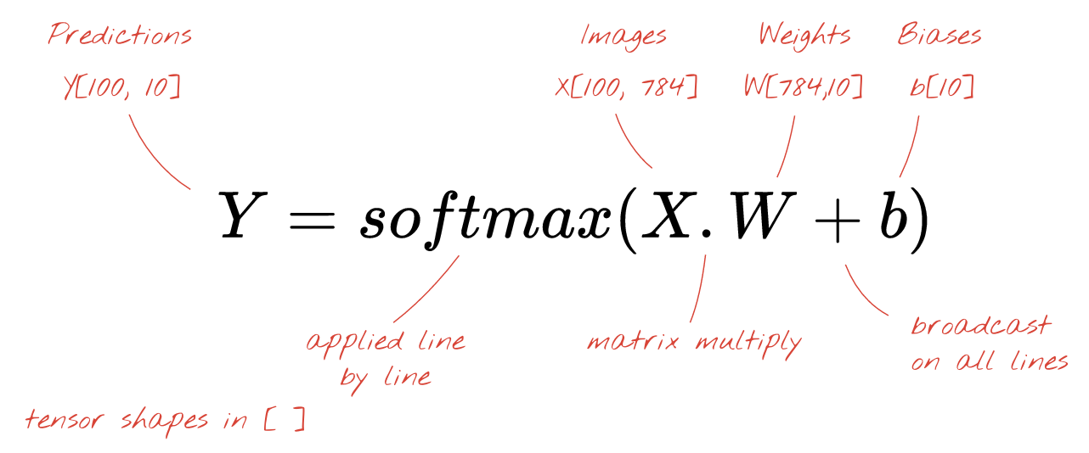
Y = f(X)
Y = tf.nn.softmax(tf.matmul(X, W) + b)
Source: https://codelabs.developers.google.com/codelabs/cloud-tensorflow-mnist/

Slide 77
Y = tf.nn.softmax(tf.matmul(X, W) + b)
TensorFlow (Python) Softmax
Predictions:
Y[100, 10]
tensor shapes: X[100, 784] W[784, 10] b[10]
matrix multiply
broadcast on all lines
Source: https://codelabs.developers.google.com/codelabs/cloud-tensorflow-mnist/

Slide 78
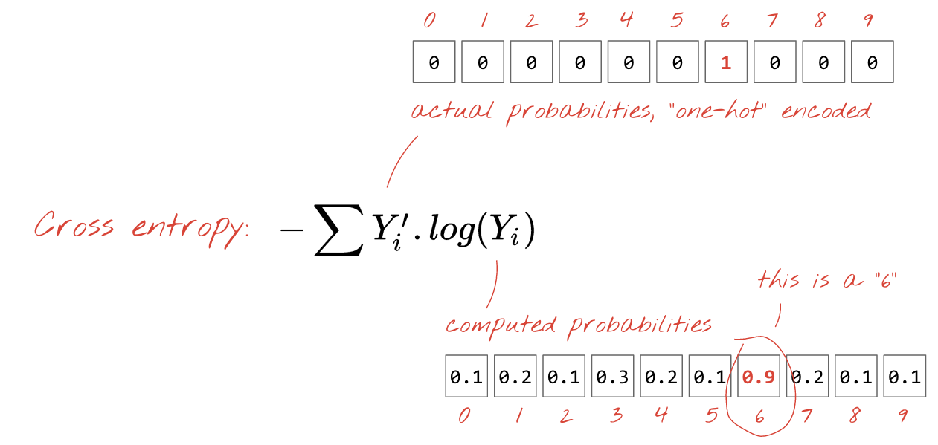
Cross Entropy
Source: https://codelabs.developers.google.com/codelabs/cloud-tensorflow-mnist/

Slide 79
Minimizing Cross Entropy (Minimizing Loss)
Source: https://codelabs.developers.google.com/codelabs/cloud-tensorflow-mnist/

Slide 80
Training digits and labels => loss function => gradient (partial derivatives) => steepest descent => update weights and biases => repeat with next mini-batch of training images and labels
Training Loop
Source: https://codelabs.developers.google.com/codelabs/cloud-tensorflow-mnist/

Slide 81
"mini-batches": 100 images and labels
Source: https://codelabs.developers.google.com/codelabs/cloud-tensorflow-mnist/

Slide 82
import tensorflow as tf
Source: https://codelabs.developers.google.com/codelabs/cloud-tensorflow-mnist/#5

Slide 83
mnist_1.0_softmax.py
import tensorflow as tf
X = tf.placeholder(tf.float32, [None, 28, 28, 1])
W = tf.Variable(tf.zeros([784, 10]))
b = tf.Variable(tf.zeros([10]))
init = tf.initialize_all_variables()
Source: https://codelabs.developers.google.com/codelabs/cloud-tensorflow-mnist/#5

Slide 84
mnist_1.0_softmax.py
# model
Y = tf.nn.softmax(tf.matmul(tf.reshape(X, [-1, 784]), W) + b)
# placeholder for correct labels
Y_ = tf.placeholder(tf.float32, [None, 10])
# loss function
cross_entropy = -tf.reduce_sum(Y_ * tf.log(Y))
# % of correct answers found in batch
is_correct = tf.equal(tf.argmax(Y,1), tf.argmax(Y_,1)) accuracy = tf.reduce_mean(tf.cast(is_correct, tf.float32))
Source: https://codelabs.developers.google.com/codelabs/cloud-tensorflow-mnist/#5

Slide 85
mnist_1.0_softmax.py
sess = tf.Session()
sess.run(init)
for i in range(1000):
# load batch of images and correct answers
batch_X, batch_Y = mnist.train.next_batch(100)
train_data={X: batch_X, Y_: batch_Y}
# train
sess.run(train_step, feed_dict=train_data)
Source: https://codelabs.developers.google.com/codelabs/cloud-tensorflow-mnist/#5

Slide 86
mnist_1.0_softmax.py
# success ?
a,c = sess.run([accuracy, cross_entropy], feed_dict=train_data)
# success on test data ?
test_data={X: mnist.test.images, Y_: mnist.test.labels}
a,c = sess.run([accuracy, cross_entropy], feed=test_data)
Source: https://codelabs.developers.google.com/codelabs/cloud-tensorflow-mnist/#5

Slide 87
mnist_1.0_softmax.py
Source: https://codelabs.developers.google.com/codelabs/cloud-tensorflow-mnist/#5

Slide 88
Deep Learning
Source: https://codelabs.developers.google.com/codelabs/cloud-tensorflow-mnist/

Slide 89
5 fully-connected layers
Source: https://codelabs.developers.google.com/codelabs/cloud-tensorflow-mnist/

Slide 90
Sigmoid
Source: https://codelabs.developers.google.com/codelabs/cloud-tensorflow-mnist/

Slide 91
5 fully-connected layers
Source: https://codelabs.developers.google.com/codelabs/cloud-tensorflow-mnist/

Slide 92
TensorFlow MNIST Tutorial
Source: https://codelabs.developers.google.com/codelabs/cloud-tensorflow-mnist/

Slide 93
ReLU
Source: https://codelabs.developers.google.com/codelabs/cloud-tensorflow-mnist/

Slide 94
TensorFlow MNIST Tutorial
Source: https://codelabs.developers.google.com/codelabs/cloud-tensorflow-mnist/

Slide 95
ReLU
Source: https://codelabs.developers.google.com/codelabs/cloud-tensorflow-mnist/

Slide 96
TensorFlow MNIST Tutorial
Source: https://codelabs.developers.google.com/codelabs/cloud-tensorflow-mnist/

Slide 97
Learning Rate
Source: https://codelabs.developers.google.com/codelabs/cloud-tensorflow-mnist/

Slide 98
TensorFlow MNIST Tutorial
Source: https://codelabs.developers.google.com/codelabs/cloud-tensorflow-mnist/

Slide 99
TensorFlow MNIST Tutorial
Source: https://codelabs.developers.google.com/codelabs/cloud-tensorflow-mnist/

Slide 100
Dropout
Source: https://codelabs.developers.google.com/codelabs/cloud-tensorflow-mnist/

Slide 101
Overfitting
Source: https://codelabs.developers.google.com/codelabs/cloud-tensorflow-mnist/

Slide 102
Dropout
Source: https://codelabs.developers.google.com/codelabs/cloud-tensorflow-mnist/

Slide 103
TensorFlow MNIST Tutorial
Source: https://codelabs.developers.google.com/codelabs/cloud-tensorflow-mnist/

Slide 104
TensorFlow MNIST Tutorial
Source: https://codelabs.developers.google.com/codelabs/cloud-tensorflow-mnist/

Slide 105
Overfitting
Source: https://codelabs.developers.google.com/codelabs/cloud-tensorflow-mnist/

Slide 106
Convolutional Layer
Source: https://codelabs.developers.google.com/codelabs/cloud-tensorflow-mnist/

Slide 107
Convolutional Layer
Source: https://codelabs.developers.google.com/codelabs/cloud-tensorflow-mnist/

Slide 108
Convolutional Max-Pool
Source: https://codelabs.developers.google.com/codelabs/cloud-tensorflow-mnist/

Slide 109
All Convolutional
Source: https://codelabs.developers.google.com/codelabs/cloud-tensorflow-mnist/

Slide 110
Bigger Convolutional Neural Network
Source: https://codelabs.developers.google.com/codelabs/cloud-tensorflow-mnist/

Slide 111
Bigger Convolutional Neural Network
Source: https://codelabs.developers.google.com/codelabs/cloud-tensorflow-mnist/

Slide 112
Bigger Convolutional Neural Network + Dropout
Source: https://codelabs.developers.google.com/codelabs/cloud-tensorflow-mnist/

Slide 113
TensorFlow MNIST Tutorial
Source: https://codelabs.developers.google.com/codelabs/cloud-tensorflow-mnist/

Slide 114
TensorFlow MNIST Tutorial
Source: https://codelabs.developers.google.com/codelabs/cloud-tensorflow-mnist/

Slide 115
TensorFlow MNIST Tutorial
Source: https://github.com/martin-gorner/tensorflow-mnist-tutorial/

Slide 116
TensorFlow MNIST Tutorial
python3 mnist_1.0_softmax.py
python mnist_1.0_softmax.py
pythonw mnist_1.0_softmax.py
python3 mnist_2.0_five_layers_sigmoid.py
python3 mnist_2.2_five_layers_relu_lrdecay_dropout.py
python3 mnist_3.0_convolutional.py
python3 mnist_3.1_convolutional_bigger_dropout.py
python3 mnist_4.0_batchnorm_five_layers_sigmoid.py
python3 mnist_4.1_batchnorm_five_layers_relu.py
python3 mnist_4.2_batchnorm_convolutional.py
Source: https://github.com/martin-gorner/tensorflow-mnist-tutorial/
Source: https://codelabs.developers.google.com/codelabs/cloud-tensorflow-mnist/

Slide 117
AI + VDI POS TensorFlow Models
M1: Basic Classification (Image Classification) (65 Seconds)
https://colab.research.google.com/github/tensorflow/docs/blob/master/site/en/tutorials/keras/basic_classification.ipynb
M2: Basic Text Classification (Text Classification) (46 Seconds)
https://colab.research.google.com/github/tensorflow/docs/blob/master/site/en/tutorials/keras/basic_text_classification.ipynb
M3: Basic Regression (Predict House Prices) (43 Seconds)
https://colab.research.google.com/github/tensorflow/docs/blob/master/site/en/tutorials/keras/basic_regression.ipynb
M4: Pix2Pix Eager (Option) (7-8 Hours)
https://colab.research.google.com/github/tensorflow/tensorflow/blob/master/tensorflow/contrib/eager/python/examples/pix2pix/pix2pix_eager.ipynb
M5. NMT with Attention (Option) (20-30 minutes)
https://colab.research.google.com/github/tensorflow/tensorflow/blob/master/tensorflow/contrib/eager/python/examples/nmt_with_attention/nmt_with_attention.ipynb

Slide 118
Basic Classification Fashion MNIST Image Classification
https://colab.research.google.com/drive/19PJOJi1vn1kjcutlzNHjRSLbeVl4kd5z
Source: https://colab.research.google.com/github/tensorflow/docs/blob/master/site/en/tutorials/keras/basic_classification.ipynb

Slide 119
Text Classification IMDB Movie Reviews
https://colab.research.google.com/drive/1x16h1GhHsLIrLYtPCvCHaoO1W-i_gror
Source: https://colab.research.google.com/github/tensorflow/docs/blob/master/site/en/tutorials/keras/basic_text_classification.ipynb

Slide 120
Basic Regression Predict House Prices
https://colab.research.google.com/drive/1v4c8ZHTnRtgd2_25K_AURjR6SCVBRdlj
Source: https://colab.research.google.com/github/tensorflow/docs/blob/master/site/en/tutorials/keras/basic_regression.ipynb

Slide 121
AI+VDI POC ISAC+TKU Test
AI+VDI POC Folder (3+1 ipynb) (v3.0.20181120)
https://drive.google.com/open?id=1qHOemktbEmUz-ot8eFxIKbGwJvXlrjtc
run3models.ipynb
https://colab.research.google.com/drive/1HQ1GrIqQUUPCct7_AVgoMwMrh0UqMm0f

Slide 122
Summary
Convolutional Neural Networks (CNN)
TensorFlow Image Recognition

Slide 123
References
Arden Dertat (2017), Applied Deep Learning - Part 4: Convolutional Neural Networks, https://towardsdatascience.com/applied-deep-learning-part-4-convolutional-neural-networks-584bc134c1e2
Luis Serrano (2017), A friendly introduction to Convolutional Neural Networks and Image Recognition, https://www.youtube.com/watch?v=2-Ol7ZB0MmU
Martin Gorner (2017), TensorFlow and Deep Learning without a PhD, Part 1 (Google Cloud Next '17), https://www.youtube.com/watch?v=u4alGiomYP4
Martin Gorner (2017), TensorFlow and Deep Learning without a PhD, Part 2 (Google Cloud Next '17), https://www.youtube.com/watch?v=fTUwdXUFfI8
Martin Gorner (2017), TensorFlow and Deep Learning without a PhD, https://goo.gl/pHeXe7, https://codelabs.developers.google.com/codelabs/cloud-tensorflow-mnist
Deep Learning Basics: Neural Networks Demystified, https://www.youtube.com/playlist?list=PLiaHhY2iBX9hdHaRr6b7XevZtgZRa1PoU
Deep Learning SIMPLIFIED, https://www.youtube.com/playlist?list=PLjJh1vlSEYgvGod9wWiydumYl8hOXixNu
3Blue1Brown (2017), But what *is* a Neural Network? | Chapter 1, deep learning, https://www.youtube.com/watch?v=aircAruvnKk
3Blue1Brown (2017), Gradient descent, how neural networks learn | Chapter 2, deep learning, https://www.youtube.com/watch?v=IHZwWFHWa-w
3Blue1Brown (2017), What is backpropagation really doing? | Chapter 3, deep learning, https://www.youtube.com/watch?v=Ilg3gGewQ5U
TensorFlow: https://www.tensorflow.org/
Keras: http://keras.io/
Udacity, Deep Learning, https://www.youtube.com/playlist?list=PLAwxTw4SYaPn_OWPFT9ulXLuQrImzHfOV
http://p.migdal.pl/2017/04/30/teaching-deep-learning.html
https://github.com/leriomaggio/deep-learning-keras-tensorflow

