Slide 1


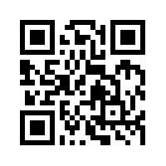
Big Data Mining
Tamkang
University
Unsupervised Learning:
Association Analysis
1071BDM08
TLVXM1A (M2244) (8619) (Fall 2018)
(MBA, DBETKU) (3 Credits, Required) [Full English Course]
(Master’s Program in Digital Business and Economics)
Mon, 9, 10, 11, (16:10-19:00) (B206)
Min-Yuh Day, Ph.D.
Assistant Professor
Department of Information Management
Tamkang University
http://mail.tku.edu.tw/myday
2018-11-05

Slide 2
Course Schedule (1/2)
Tamkang
University
Week Date Subject/Topics
1 2018/09/10 Course Orientation for Big Data Mining
2 2018/09/17 ABC: AI, Big Data, Cloud Computing
3 2018/09/24 Mid-Autumn Festival (Day off)
4 2018/10/01 Data Science and Big Data Analytics: Discovering,
Analyzing, Visualizing and Presenting Data
5 2018/10/08 Fundamental Big Data: MapReduce Paradigm,
Hadoop and Spark Ecosystem
6 2018/10/15 Foundations of Big Data Mining in Python
7 2018/10/22 Supervised Learning: Classification and Prediction
8 2018/10/29 Unsupervised Learning: Cluster Analysis
9 2018/11/05 Unsupervised Learning: Association Analysis

Slide 3
Course Schedule (2/2)
Tamkang
University
Week Date Subject/Topics
10 2018/11/12 Midterm Project Report
11 2018/11/19 Machine Learning with Scikit-Learn in Python
12 2018/11/26 Deep Learning for Finance Big Data with
TensorFlow
13 2018/12/03 Convolutional Neural Networks (CNN)
14 2018/12/10 Recurrent Neural Networks (RNN)
15 2018/12/17 Reinforcement Learning (RL)
16 2018/12/24 Social Network Analysis (SNA)
17 2018/12/31 Bridge Holiday (Extra Day Off)
18 2019/01/07 Final Project Presentation

Slide 4
Unsupervised Learning:
Association Analysis

Slide 5
Outline
Association Analysis
Apriori algorithm
  Frequent Itemsets
  Association Rules

Slide 6
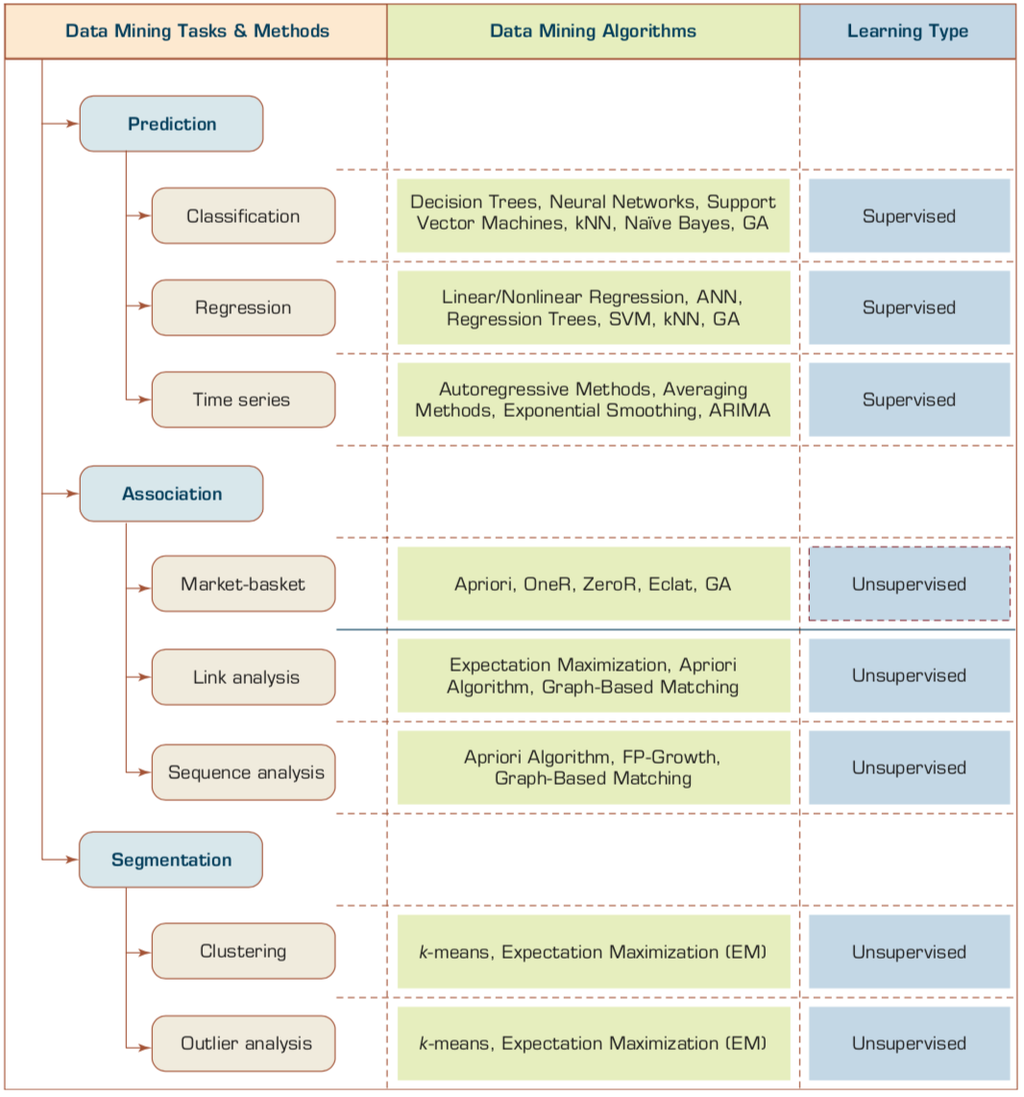
Data Mining Tasks and Machine Learning
Unsupervised Learning:
Association Analysis
Source: Ramesh Sharda, Dursun Delen, and Efraim Turban (2017), Business Intelligence, Analytics, and Data Science: A Managerial Perspective, 4th Edition, Pearson

Slide 7
Transaction Database
Transaction ID | Items bought
T01 | A, B, D
T02 | A, C, D
T03 | B, C, D, E
T04 | A, B, D
T05 | A, B, C, E
T06 | A, C
T07 | B, C, D
T08 | B, D
T09 | A, C, E
T10 | B, D

Slide 8
Association Analysis

Slide 9
Association Analysis:
Mining Frequent Patterns,
Association and Correlations
Association Analysis
Mining Frequent Patterns
Association and Correlations
Apriori Algorithm
Source: Han & Kamber (2006)

Slide 10
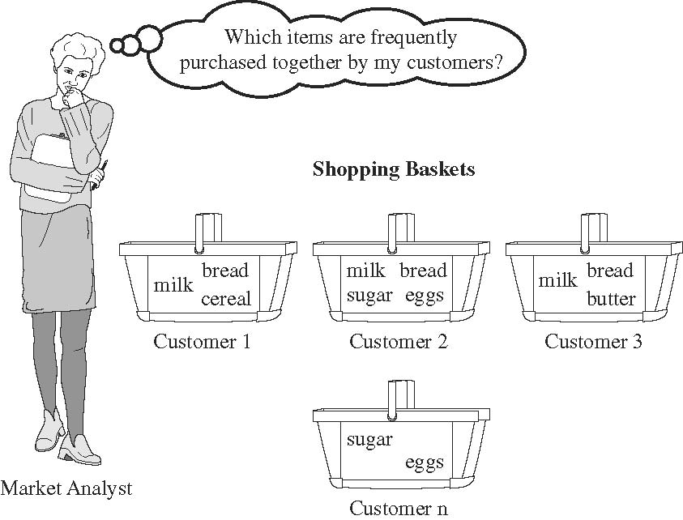
Market Basket Analysis
Source: Han & Kamber (2006)

Slide 11
Association Rule Mining
Apriori Algorithm
Source: Turban et al. (2011), Decision Support and Business Intelligence Systems

Slide 12
Association Rule Mining
A very popular DM method in business
Finds interesting relationships (affinities) between variables (items or events)
Part of machine learning family
Employs unsupervised learning
There is no output variable
Also known as market basket analysis
Often used as an example to describe DM to ordinary people, such as the famous “relationship between diapers and beers!”
Source: Turban et al. (2011), Decision Support and Business Intelligence Systems

Slide 13
Association Rule Mining
Input: the simple point-of-sale transaction data
Output: Most frequent affinities among items
Example: according to the transaction data…
“Customer who bought a laptop computer and a virus protection software, also bought extended service plan 70 percent of the time."
How do you use such a pattern/knowledge?
  Put the items next to each other for ease of finding
  Promote the items as a package (do not put one on sale if the other(s) are on sale)
  Place items far apart from each other so that the customer has to walk the aisles to search for it, and by doing so potentially seeing and buying other items
Source: Turban et al. (2011), Decision Support and Business Intelligence Systems

Slide 14
Association Rule Mining
A representative applications of association rule mining include
  In business: cross-marketing, cross-selling, store design, catalog design, e-commerce site design, optimization of online advertising, product pricing, and sales/promotion configuration
  In medicine: relationships between symptoms and illnesses; diagnosis and patient characteristics and treatments (to be used in medical DSS); and genes and their functions (to be used in genomics projects)…
Source: Turban et al. (2011), Decision Support and Business Intelligence Systems

Slide 15
Association Rule Mining
Are all association rules interesting and useful?
  A Generic Rule: X ⇒ Y [S%, C%]
  X, Y: products and/or services
  X: Left-hand-side (LHS)
  Y: Right-hand-side (RHS)
  S: Support: how often X and Y go together
  C: Confidence: how often Y go together with the X
  Example: {Laptop Computer, Antivirus Software} ⇒ {Extended Service Plan} [30%, 70%]
Source: Turban et al. (2011), Decision Support and Business Intelligence Systems

Slide 16
Association Rule Mining
Algorithms are available for generating association rules
  Apriori
  Eclat
  FP-Growth
  + Derivatives and hybrids of the three
The algorithms help identify the frequent item sets, which are, then converted to association rules
Source: Turban et al. (2011), Decision Support and Business Intelligence Systems

Slide 17
Association Rule Mining
Apriori Algorithm
  Finds subsets that are common to at least a minimum number of the itemsets
  uses a bottom-up approach
    frequent subsets are extended one item at a time (the size of frequent subsets increases from one-item subsets to two-item subsets, then three-item subsets, and so on), and
    groups of candidates at each level are tested against the data for minimum
Source: Turban et al. (2011), Decision Support and Business Intelligence Systems

Slide 18
Basic Concepts: Frequent Patterns and Association Rules
Transaction-id | Items bought
10 | A, B, D
20 | A, C, D
30 | A, D, E
40 | B, E, F
50 | B, C, D, E, F
Itemset X = {x₁, …, x_{k}}
Find all the rules X → Y with minimum support and confidence
  support, s, probability that a transaction contains X ∪ Y
  confidence, c, conditional probability that a transaction having X also contains Y
Customer
buys both
Customer
buys diaper
Let sup_{min} = 50%, conf_{min} = 50%
Freq. Pat.: {A:3, B:3, D:4, E:3, AD:3}
Association rules:
  A → D (60%, 100%)
  D → A (60%, 75%)
Customer
buys beer
A → D (support = 3/5 = 60%, confidence = 3/3 =100%)
D → A (support = 3/5 = 60%, confidence = 3/4 = 75%)
Source: Han & Kamber (2006)

Slide 19
Market basket analysis
Example
  Which groups or sets of items are customers likely to purchase on a given trip to the store?
Association Rule
  Computer → antivirus_software
  [support = 2%; confidence = 60%]
    A support of 2% means that 2% of all the transactions under analysis show that computer and antivirus software are purchased together.
    A confidence of 60% means that 60% of the customers who purchased a computer also bought the software.
Source: Han & Kamber (2006)

Slide 20
Association rules
Association rules are considered interesting if they satisfy both
  a minimum support threshold and
  a minimum confidence threshold.
Source: Han & Kamber (2006)

Slide 21
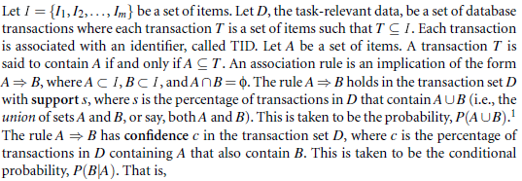
Frequent Itemsets,
Closed Itemsets, and
Association Rules
Support (A→ B) = P(A ∪ B)
Confidence (A→ B) = P(B|A)
Source: Han & Kamber (2006)

Slide 22
Support (A→ B) = P(A ∪ B)
Confidence (A→ B) = P(B|A)
The notation P(A ∪ B) indicates the probability that a transaction contains the union of set A and set B
  (i.e., it contains every item in A and in B).
This should not be confused with P(A or B), which indicates the probability that a transaction contains either A or B.
Source: Han & Kamber (2006)

Slide 23
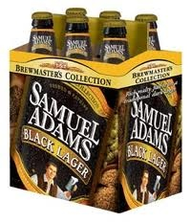


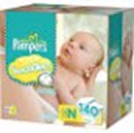
Does diaper purchase predict beer purchase?
Contingency tables
Beer
Yes No
Beer
Yes No
6 | 94
40 | 60
100
100
23 | 77
23 | 77
No diapers
diapers
DEPENDENT (yes)
INDEPENDENT (no predictability)
Source: Dickey (2012) http://www4.stat.ncsu.edu/~dickey/SAScode/Encore_2012.ppt

Slide 24
Support (A→ B) = P(A ∪ B)
Confidence (A→ B) = P(B|A)
Conf (A → B) = Supp (A ∪ B)/ Supp (A)
Lift (A → B) = Supp (A ∪ B) / (Supp (A) x Supp (B))
Lift (Correlation)
Lift (A→B) = Confidence (A→B) / Support(B)
Source: Dickey (2012) http://www4.stat.ncsu.edu/~dickey/SAScode/Encore_2012.ppt

Slide 25
Lift
Lift = Confidence / Expected Confidence if Independent
Checking Saving | No (1500) | Yes (8500) | (10000)
No | 500 | 3500 | 4000
Yes | 1000 | 5000 | 6000
SVG=>CHKG Expect 8500/10000 = 85% if independent
Observed Confidence is 5000/6000 = 83%
Lift = 83/85 < 1.
Savings account holders actually LESS likely than others to have checking account !!!
Source: Dickey (2012) http://www4.stat.ncsu.edu/~dickey/SAScode/Encore_2012.ppt

Slide 26
Support & Confidence
A
B
C
A
C
D
B
C
D
A
D
E
B
C
E
Rule
A ⇒ D
C ⇒ A
A ⇒ C
B & C ⇒ D
Support
2/5
2/5
2/5
1/5
Confidence
2/3
2/4
2/3
1/3
Source: SAS Enterprise Miner Course Notes, 2014, SAS

Slide 27
Support & Confidence & Lift
Checking Account
No
Yes
4,000
500
3500
No
Saving
Account
6,000
1000
5000
Yes
10,000
Support(SVG ⇒ CK) = 50%=5,000/10,000
Confidence(SVG ⇒ CK) = 83%=5,000/6,000
Expected Confidence(SVG ⇒ CK) = 85%=8,500/10,000
Lift (SVG → CK) = Confidence/Expected Confidence = 0.83/0.85 < 1
Source: SAS Enterprise Miner Course Notes, 2014, SAS

Slide 28
Support (A→B)
Confidence (A→B)
Expected Confidence (A→B)
Lift (A→B)

Slide 29
Support (A→ B) = P(A ∪ B)
Count(A&B)/Count(Total)
Confidence (A→ B) = P(B|A)
Conf (A → B) = Supp (A ∪ B)/ Supp (A)
Count(A&B)/Count(A)
Expected Confidence (A→B) = Support(B) Count(B)
Lift (A → B) = Confidence (A→B) / Expected Confidence (A→B)
Lift (A → B) = Supp (A ∪ B) / (Supp (A) x Supp (B))
Lift (Correlation)
Lift (A→B) = Confidence (A→B) / Support(B)

Slide 30
Lift (A→B)
Lift (A→B)
= Confidence (A→B) / Expected Confidence (A→B)
= Confidence (A→B) / Support(B)
= (Supp (A&B) / Supp (A)) / Supp(B)
= Supp (A&B) / Supp (A) x Supp (B)

Slide 31
Minimum Support and
Minimum Confidence
Rules that satisfy both a minimum support threshold (min_sup) and a minimum confidence threshold (min_conf) are called strong.
By convention, we write support and confidence values so as to occur between 0% and 100%, rather than 0 to 1.0.
Source: Han & Kamber (2006)

Slide 32
K-itemset
itemset
  A set of items is referred to as an itemset.
K-itemset
  An itemset that contains k items is a k-itemset.
Example:
  The set {computer, antivirus software} is a 2-itemset.
Source: Han & Kamber (2006)

Slide 33
Absolute Support and
Relative Support
Absolute Support
  The occurrence frequency of an itemset is the number of transactions that contain the itemset
    frequency, support count, or count of the itemset
  Ex: 3
Relative support
  Ex: 60%
Source: Han & Kamber (2006)

Slide 34
Frequent Itemset
If the relative support of an itemset I satisfies a prespecified minimum support threshold, then I is a frequent itemset.
  i.e., the absolute support of I satisfies the corresponding minimum support count threshold
The set of frequent k-itemsets is commonly denoted by L_{K}
Source: Han & Kamber (2006)

Slide 35

Confidence
the confidence of rule A→ B can be easily derived from the support counts of A and A ∪ B.
once the support counts of A, B, and A ∪ B are found, it is straightforward to derive the corresponding association rules A→B and B→A and check whether they are strong.
Thus the problem of mining association rules can be reduced to that of mining frequent itemsets.
Source: Han & Kamber (2006)

Slide 36
Association rule mining:
Two-step process
1. Find all frequent itemsets
  By definition, each of these itemsets will occur at least as frequently as a predetermined minimum support count, min_sup.
2. Generate strong association rules from the frequent itemsets
  By definition, these rules must satisfy minimum support and minimum confidence.
Source: Han & Kamber (2006)

Slide 37
Efficient and Scalable
Frequent Itemset Mining Methods
The Apriori Algorithm
  Finding Frequent Itemsets Using Candidate Generation
Source: Han & Kamber (2006)

Slide 38
Apriori Algorithm
Apriori is a seminal algorithm proposed by R. Agrawal and R. Srikant in 1994 for mining frequent itemsets for Boolean association rules.
The name of the algorithm is based on the fact that the algorithm uses prior knowledge of frequent itemset properties, as we shall see following.
Source: Han & Kamber (2006)

Slide 39
Apriori Algorithm
Apriori employs an iterative approach known as a level-wise search, where k-itemsets are used to explore (k+1)-itemsets.
First, the set of frequent 1-itemsets is found by scanning the database to accumulate the count for each item, and collecting those items that satisfy minimum support. The resulting set is denoted L₁.
Next, L₁ is used to find L₂, the set of frequent 2-itemsets, which is used to find L₃, and so on, until no more frequent k-itemsets can be found.
The finding of each L_{k} requires one full scan of the database.
Source: Han & Kamber (2006)

Slide 40
Apriori Algorithm
To improve the efficiency of the level-wise generation of frequent itemsets, an important property called the Apriori property.
Apriori property
  All nonempty subsets of a frequent itemset must also be frequent.
Source: Han & Kamber (2006)

Slide 41
Apriori algorithm
(1) Frequent Itemsets
(2) Association Rules

Slide 42
Transaction Database
Transaction ID | Items bought
T01 | A, B, D
T02 | A, C, D
T03 | B, C, D, E
T04 | A, B, D
T05 | A, B, C, E
T06 | A, C
T07 | B, C, D
T08 | B, D
T09 | A, C, E
T10 | B, D

Slide 43
Table 1 shows a database with 10 transactions.
Let minimum support = 20% and minimum confidence = 80%.
Please use Apriori algorithm for generating association rules from frequent itemsets.
Table 1: Transaction Database
Transaction ID | Items bought
T01 | A, B, D
T02 | A, C, D
T03 | B, C, D, E
T04 | A, B, D
T05 | A, B, C, E
T06 | A, C
T07 | B, C, D
T08 | B, D
T09 | A, C, E
T10 | B, D

Slide 44
Transaction ID | Items bought
T01 | A, B, D
T02 | A, C, D
T03 | B, C, D, E
T04 | A, B, D
T05 | A, B, C, E
T06 | A, C
T07 | B, C, D
T08 | B, D
T09 | A, C, E
T10 | B, D
Apriori Algorithm
C₁ → L₁
Step 1-1
C₁
L₁
Itemset | Support Count
A | 6
B | 7
C | 6
D | 7
E | 3
minimum
support = 20%
= 2 / 10
Min. Support
Count = 2
Itemset | Support Count
A | 6
B | 7
C | 6
D | 7
E | 3

Slide 45
Transaction ID | Items bought
T01 | A, B, D
T02 | A, C, D
T03 | B, C, D, E
T04 | A, B, D
T05 | A, B, C, E
T06 | A, C
T07 | B, C, D
T08 | B, D
T09 | A, C, E
T10 | B, D
Apriori Algorithm
C₂ → L₂
Step 1-2
C₂
L₂
Itemset | Support Count
A, B | 3
A, C | 4
A, D | 3
A, E | 2
B, C | 3
B, D | 6
B, E | 2
C, D | 3
C, E | 3
D, E | 1
Itemset | Support Count
A, B | 3
A, C | 4
A, D | 3
A, E | 2
B, C | 3
B, D | 6
B, E | 2
C, D | 3
C, E | 3
L₁
minimum
support = 20%
= 2 / 10
Min. Support
Count = 2
Itemset | Support Count
A | 6
B | 7
C | 6
D | 7
E | 3

Slide 46
Transaction ID | Items bought
T01 | A, B, D
T02 | A, C, D
T03 | B, C, D, E
T04 | A, B, D
T05 | A, B, C, E
T06 | A, C
T07 | B, C, D
T08 | B, D
T09 | A, C, E
T10 | B, D
Apriori Algorithm
C₃ → L₃
Step 1-3
C₃
L₃
Itemset | Support Count
A, B, C | 1
A, B, D | 2
A, B, E | 1
A, C, D | 1
A, C, E | 2
B, C, D | 2
B, C, E | 2
minimum
support = 20%
= 2 / 10
Min. Support
Count = 2
Itemset | Support Count
A, B, D | 2
A, C, E | 2
B, C, D | 2
B, C, E | 2
L₂
Itemset | Support Count
A, B | 3
A, C | 4
A, D | 3
A, E | 2
B, C | 3
B, D | 6
B, E | 2
C, D | 3
C, E | 3

Slide 47
Transaction ID | Items bought
T01 | A, B, D
T02 | A, C, D
T03 | B, C, D, E
T04 | A, B, D
T05 | A, B, C, E
T06 | A, C
T07 | B, C, D
T08 | B, D
T09 | A, C, E
T10 | B, D
Generating Association Rules
Step 2-1
minimum confidence = 80%
L₂
Association Rules
Generated from L₂
L₁
Itemset | Support Count
A, B | 3
A, C | 4
A, D | 3
A, E | 2
B, C | 3
B, D | 6
B, E | 2
C, D | 3
C, E | 3
A→B: 3/6 | B→A: 3/7
A→C: 4/6 | C→A: 4/6
A→D: 3/6 | D→A: 3/7
A→E: 2/6 | E→A: 2/3
B→C: 3/7 | C→B: 3/6
B→D: 6/7=85.7% * | D→B: 6/7=85.7% *
B→E: 2/7 | E→B: 2/3
C→D: 3/6 | D→C: 2/7
C→E: 3/6 | E→C: 3/3=100% *
Itemset | Support Count
A | 6
B | 7
C | 6
D | 7
E | 3

Slide 48
Transaction ID | Items bought
T01 | A, B, D
T02 | A, C, D
T03 | B, C, D, E
T04 | A, B, D
T05 | A, B, C, E
T06 | A, C
T07 | B, C, D
T08 | B, D
T09 | A, C, E
T10 | B, D
Generating Association Rules
Step 2-2
minimum confidence = 80%
Association Rules
Generated from L₃
A→BD: 2/6 | B→CD: 2/7
B→AD: 2/7 | C→BD: 2/6
D→AB: 2/7 | D→BC: 2/7
AB→D: 2/3 | BC→D: 2/3
AD→B: 2/3 | BD→C: 2/6
BD→A: 2/6 | CD→B: 2/3
A→CE: 2/6 | B→CE: 2/7
C→AE: 2/6 | C→BE: 2/6
E→AC: 2/3 | E→BC: 2/3
AC→E: 2/4 | BC→E: 2/3
AE→C: 2/2=100%* | BE→C: 2/2=100%*
CE→A: 2/3 | CE→B: 2/3
L₁
L₂
L₃
Itemset | Support Count
A | 6
B | 7
C | 6
D | 7
E | 3
Itemset | Support Count
A, B | 3
A, C | 4
A, D | 3
A, E | 2
B, C | 3
B, D | 6
B, E | 2
C, D | 3
C, E | 3
Itemset | Support Count
A, B, D | 2
A, C, E | 2
B, C, D | 2
B, C, E | 2

Slide 49
Transaction ID | Items bought
T01 | A, B, D
T02 | A, C, D
T03 | B, C, D, E
T04 | A, B, D
T05 | A, B, C, E
T06 | A, C
T07 | B, C, D
T08 | B, D
T09 | A, C, E
T10 | B, D
Frequent Itemsets and Association Rules
L₁
L₂
L₃
Itemset | Support Count
A | 6
B | 7
C | 6
D | 7
E | 3
Itemset | Support Count
A, B | 3
A, C | 4
A, D | 3
A, E | 2
B, C | 3
B, D | 6
B, E | 2
C, D | 3
C, E | 3
Itemset | Support Count
A, B, D | 2
A, C, E | 2
B, C, D | 2
B, C, E | 2
minimum support = 20%
minimum confidence = 80%
Association Rules:
B→D (60%, 85.7%) (Sup.: 6/10, Conf.: 6/7)
D→B (60%, 85.7%) (Sup.: 6/10, Conf.: 6/7)
E→C (30%, 100%) (Sup.: 3/10, Conf.: 3/3)
AE→C (20%, 100%) (Sup.: 2/10, Conf.: 2/2)
BE→C (20%, 100%) (Sup.: 2/10, Conf.: 2/2)

Slide 50
Table 1 shows a database with 10 transactions.
Let minimum support = 20% and minimum confidence = 80%.
Please use Apriori algorithm for generating association rules from frequent itemsets.
Transaction ID | Items bought
T01 | A, B, D
T02 | A, C, D
T03 | B, C, D, E
T04 | A, B, D
T05 | A, B, C, E
T06 | A, C
T07 | B, C, D
T08 | B, D
T09 | A, C, E
T10 | B, D
Association Rules:
B→D (60%, 85.7%) (Sup.: 6/10, Conf.: 6/7)
D→B (60%, 85.7%) (Sup.: 6/10, Conf.: 6/7)
E→C (30%, 100%) (Sup.: 3/10, Conf.: 3/3)
AE→C (20%, 100%) (Sup.: 2/10, Conf.: 2/2)
BE→C (20%, 100%) (Sup.: 2/10, Conf.: 2/2)

Slide 51
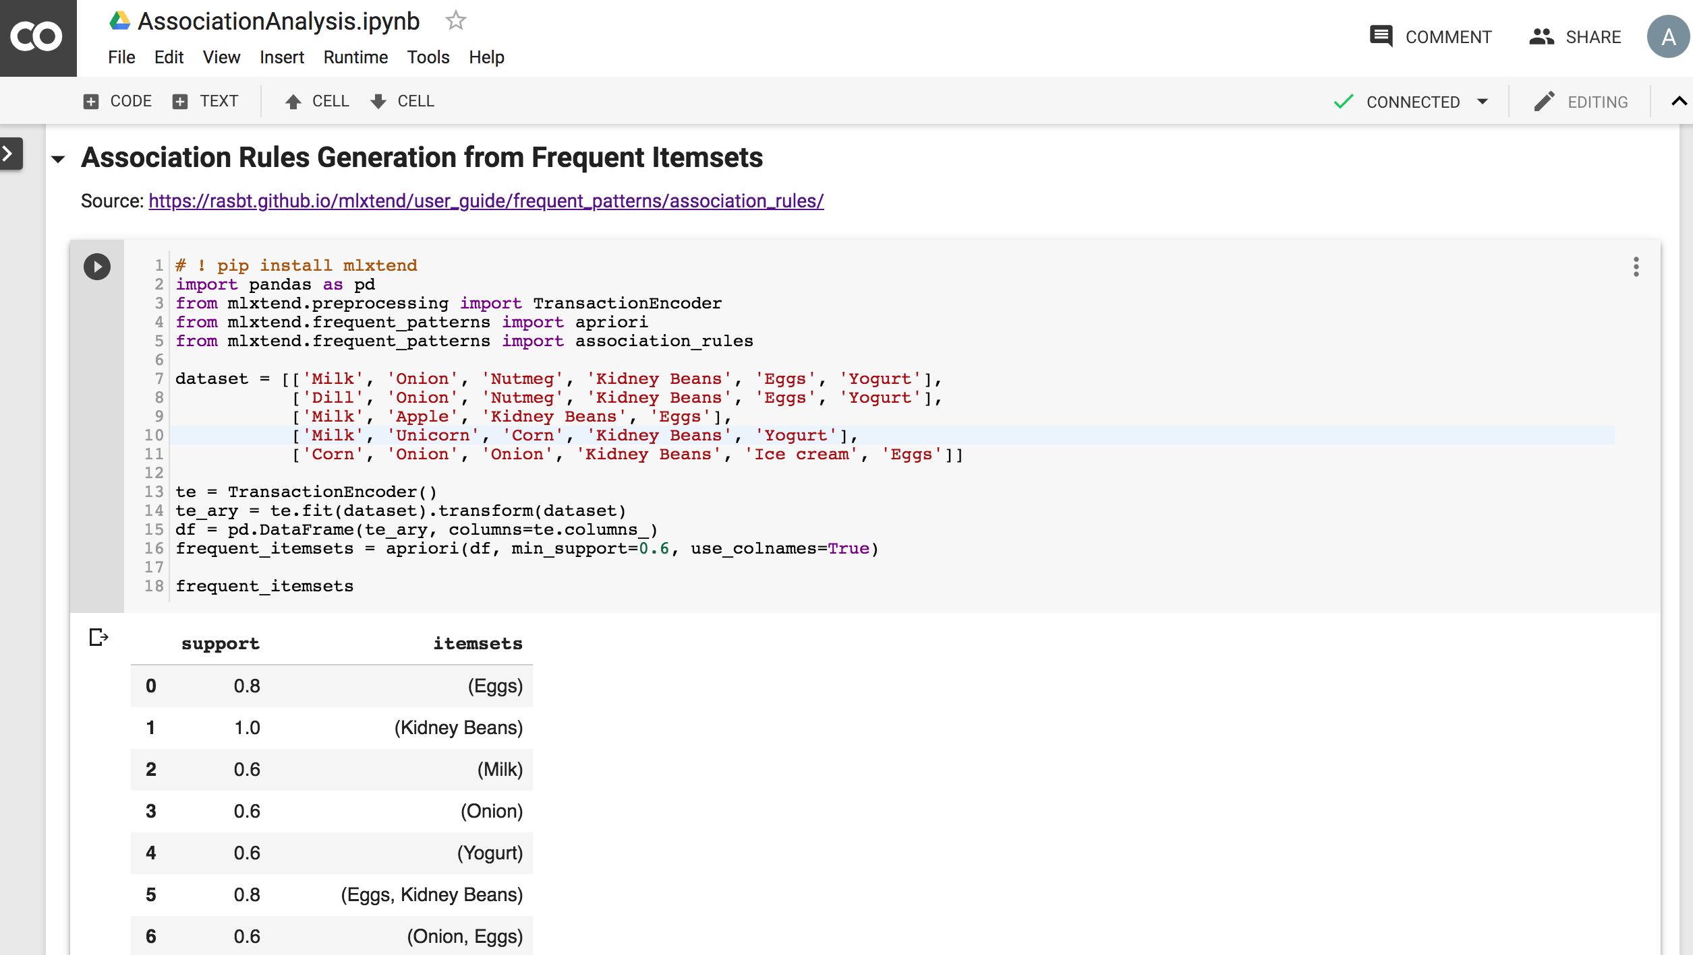
Association Analysis in Google Colab
https://colab.research.google.com/drive/1dkZITXbEM9hZykd5qyWZ2rljri1Pdtud
https://colab.research.google.com/drive/1dkZITXbEM9hZykd5qyWZ2rljri1Pdtud
Notes:
Association Rules Generation from Frequent Itemsets
Source: https://rasbt.github.io/mlxtend/user_guide/frequent_patterns/association_rules/
# -*- coding: utf-8 -*-
"""AssociationAnalysis.ipynb
Automatically generated by Colaboratory.
Original file is located at
https://colab.research.google.com/drive/1dkZITXbEM9hZykd5qyWZ2rljri1Pdtud
# Association Analysis
"""
! pip install mlxtend
! pip install xlrd
"""## Association Rules Generation from Frequent Itemsets
Source: https://rasbt.github.io/mlxtend/user_guide/frequent_patterns/association_rules/
"""
# ! pip install mlxtend
import pandas as pd
from mlxtend.preprocessing import TransactionEncoder
from mlxtend.frequent_patterns import apriori
from mlxtend.frequent_patterns import association_rules
dataset = [['Milk', 'Onion', 'Nutmeg', 'Kidney Beans', 'Eggs', 'Yogurt'],
['Dill', 'Onion', 'Nutmeg', 'Kidney Beans', 'Eggs', 'Yogurt'],
['Milk', 'Apple', 'Kidney Beans', 'Eggs'],
['Milk', 'Unicorn', 'Corn', 'Kidney Beans', 'Yogurt'],
['Corn', 'Onion', 'Onion', 'Kidney Beans', 'Ice cream', 'Eggs']]
te = TransactionEncoder()
te_ary = te.fit(dataset).transform(dataset)
df = pd.DataFrame(te_ary, columns=te.columns_)
frequent_itemsets = apriori(df, min_support=0.6, use_colnames=True)
frequent_itemsets
association_rules(frequent_itemsets, metric="confidence", min_threshold=0.7)
rules = association_rules(frequent_itemsets, metric="lift", min_threshold=1.2)
rules
rules["antecedent_len"] = rules["antecedents"].apply(lambda x: len(x))
rules
rules[ (rules['antecedent_len'] >= 2) &
(rules['confidence'] > 0.75) &
(rules['lift'] > 1.2) ]
rules[rules['antecedents'] == {'Eggs', 'Kidney Beans'}]
"""## Market Basket Analysis in Python
Source: Chris Moffitt (2017), Introduction to Market Basket Analysis in Python, http://pbpython.com/market-basket-analysis.html
"""
# ! pip install mlxtend
# ! pip install xlrd
# Source: Chris Moffitt (2017), Introduction to Market Basket Analysis in Python, http://pbpython.com/market-basket-analysis.html
import numpy as np
import matplotlib.pyplot as plt
import pandas as pd
from mlxtend.frequent_patterns import apriori
from mlxtend.frequent_patterns import association_rules
df = pd.read_excel('http://archive.ics.uci.edu/ml/machine-learning-databases/00352/Online%20Retail.xlsx')
df.head()
df.head(10)
df.describe()
df
df.to_csv("Online_Retail.csv")
! ls -l
df['Description'] = df['Description'].str.strip()
df.dropna(axis=0, subset=['InvoiceNo'], inplace=True)
df['InvoiceNo'] = df['InvoiceNo'].astype('str')
df = df[~df['InvoiceNo'].str.contains('C')]
df
basket = (df[df['Country'] =="France"]
.groupby(['InvoiceNo', 'Description'])['Quantity']
.sum().unstack().reset_index().fillna(0)
.set_index('InvoiceNo'))
basket
def encode_units(x):
if x <= 0:
return 0
if x >= 1:
return 1
basket_sets = basket.applymap(encode_units)
basket_sets.drop('POSTAGE', inplace=True, axis=1)
frequent_itemsets = apriori(basket_sets, min_support=0.07, use_colnames=True)
frequent_itemsets
rules = association_rules(frequent_itemsets, metric="lift", min_threshold=1)
rules.head()
rules[ (rules['lift'] >= 6) &
(rules['confidence'] >= 0.8) ]
basket['ALARM CLOCK BAKELIKE GREEN'].sum()
basket['ALARM CLOCK BAKELIKE RED'].sum()
basket2 = (df[df['Country'] =="Germany"]
.groupby(['InvoiceNo', 'Description'])['Quantity']
.sum().unstack().reset_index().fillna(0)
.set_index('InvoiceNo'))
basket_sets2 = basket2.applymap(encode_units)
basket_sets2.drop('POSTAGE', inplace=True, axis=1)
frequent_itemsets2 = apriori(basket_sets2, min_support=0.05, use_colnames=True)
rules2 = association_rules(frequent_itemsets2, metric="lift", min_threshold=1)
rules2[ (rules2['lift'] >= 4) &
(rules2['confidence'] >= 0.5)]

Slide 52
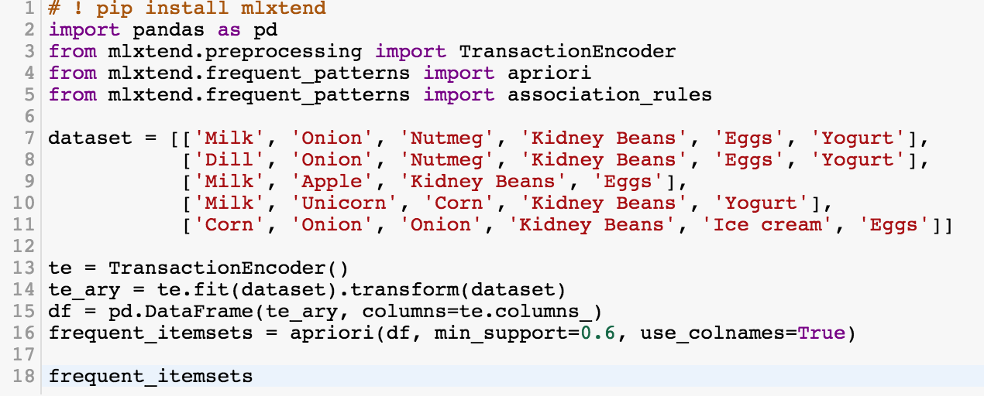
# ! pip install mlxtend
from mlxtend.frequent_patterns import apriori
from mlxtend.frequent_patterns import association_rules
frequent_itemsets = apriori(df, min_support=0.6, use_colnames=True)
https://colab.research.google.com/drive/1dkZITXbEM9hZykd5qyWZ2rljri1Pdtud

Slide 53
# ! pip install mlxtend
import pandas as pd
from mlxtend.preprocessing import TransactionEncoder
from mlxtend.frequent_patterns import apriori
from mlxtend.frequent_patterns import association_rules
dataset = [['Milk', 'Onion', 'Nutmeg', 'Kidney Beans', 'Eggs', 'Yogurt'],
['Dill', 'Onion', 'Nutmeg', 'Kidney Beans', 'Eggs', 'Yogurt'],
['Milk', 'Apple', 'Kidney Beans', 'Eggs'],
['Milk', 'Unicorn', 'Corn', 'Kidney Beans', 'Yogurt'],
['Corn', 'Onion', 'Onion', 'Kidney Beans', 'Ice cream', 'Eggs']]
te = TransactionEncoder()
te_ary = te.fit(dataset).transform(dataset)
df = pd.DataFrame(te_ary, columns=te.columns_)
frequent_itemsets = apriori(df, min_support=0.6, use_colnames=True)
frequent_itemsets
https://colab.research.google.com/drive/1dkZITXbEM9hZykd5qyWZ2rljri1Pdtud

Slide 54
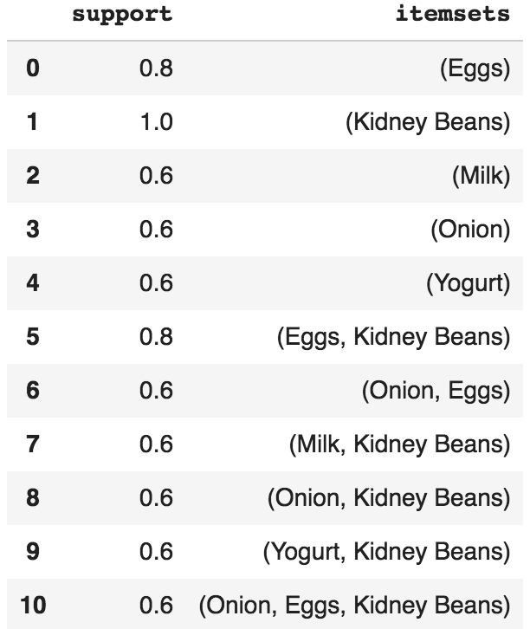
frequent_itemsets = apriori(df, min_support=0.6, use_colnames=True)
https://colab.research.google.com/drive/1dkZITXbEM9hZykd5qyWZ2rljri1Pdtud

Slide 55
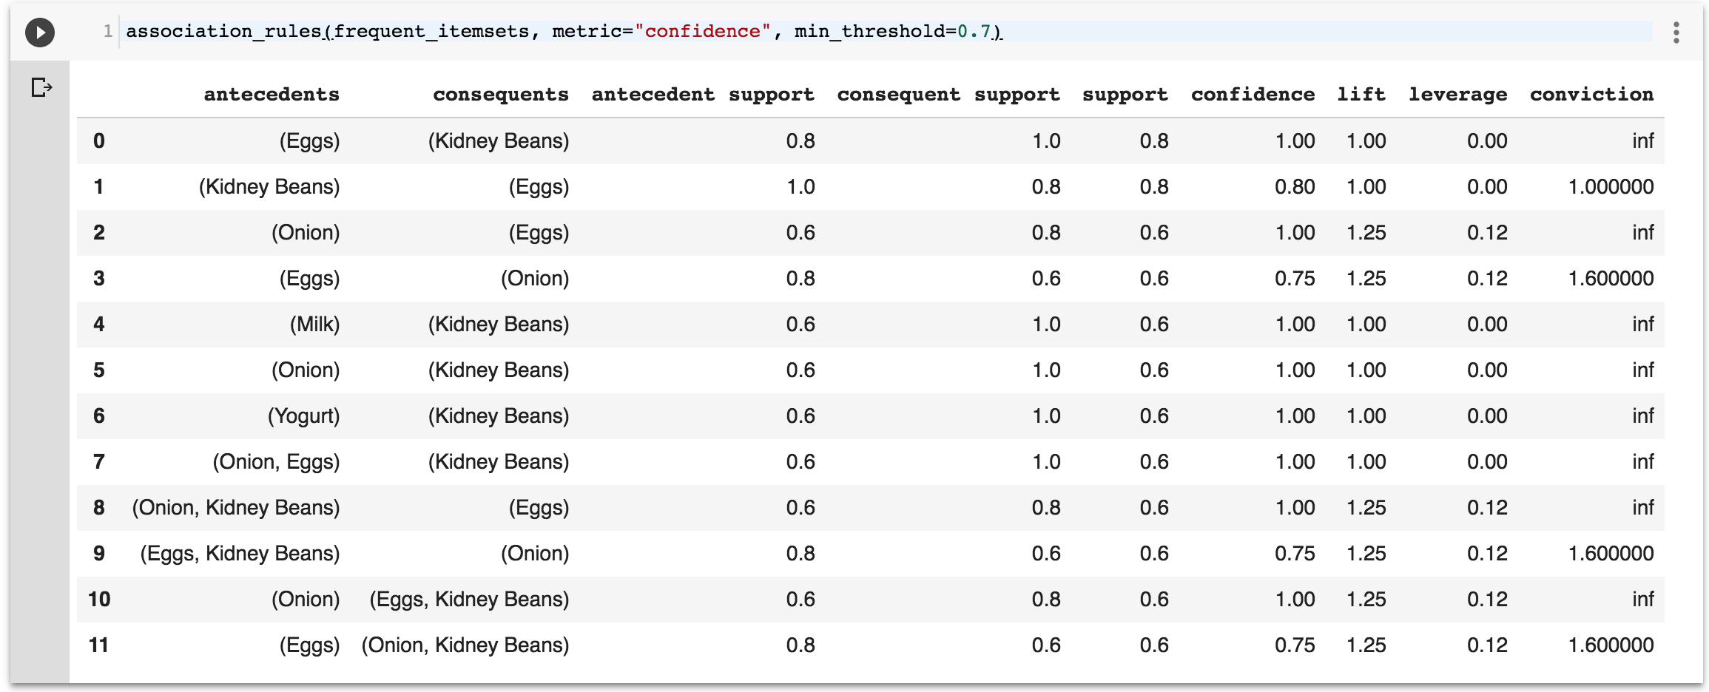
association_rules(frequent_itemsets, metric="confidence", min_threshold=0.7)
https://colab.research.google.com/drive/1dkZITXbEM9hZykd5qyWZ2rljri1Pdtud

Slide 56
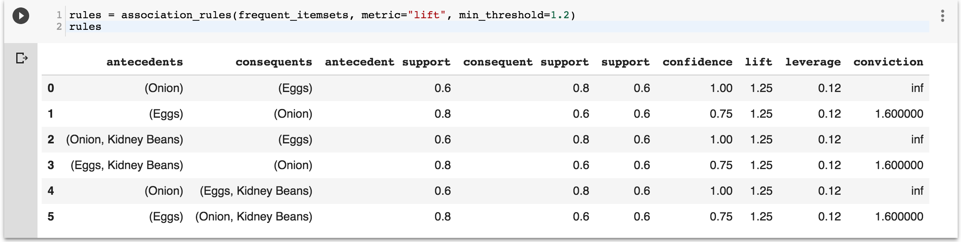
rules = association_rules(frequent_itemsets, metric="lift", min_threshold=1.2)
rules
https://colab.research.google.com/drive/1dkZITXbEM9hZykd5qyWZ2rljri1Pdtud

Slide 57
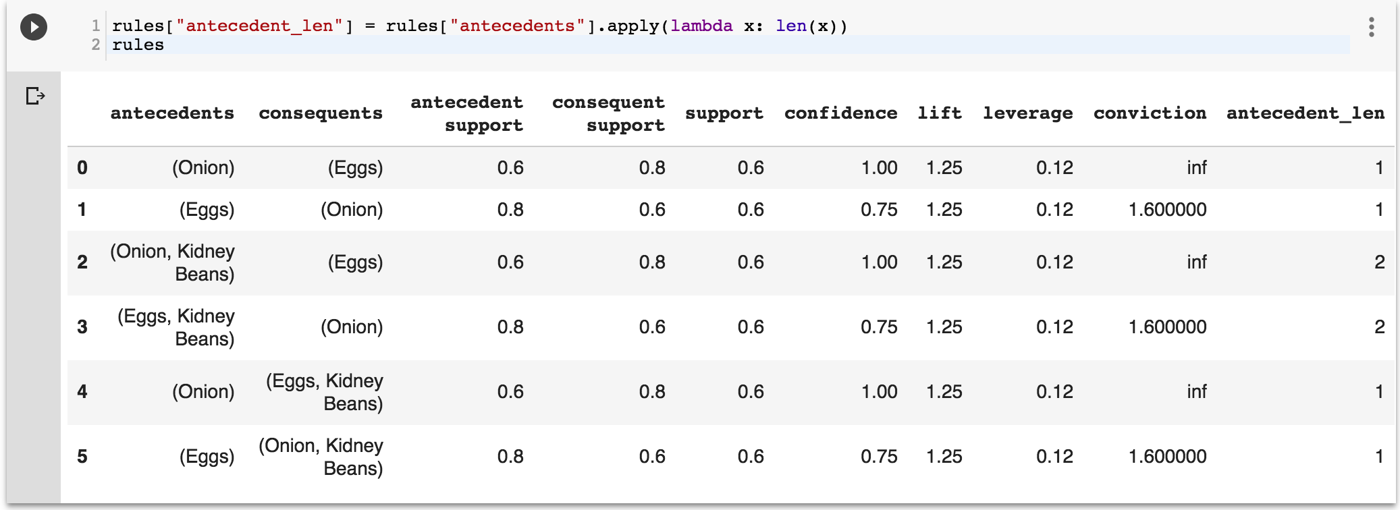
rules["antecedent_len"] = rules["antecedents"].apply(lambda x: len(x))
rules
https://colab.research.google.com/drive/1dkZITXbEM9hZykd5qyWZ2rljri1Pdtud

Slide 58
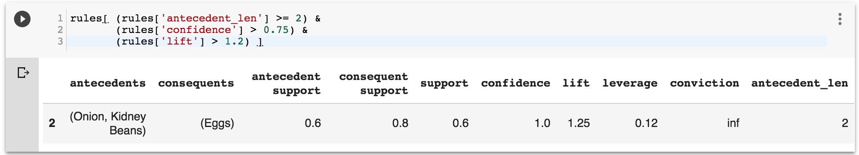
rules[ (rules['antecedent_len'] >= 2) &
(rules['confidence'] > 0.75) &
(rules['lift'] > 1.2) ]
https://colab.research.google.com/drive/1dkZITXbEM9hZykd5qyWZ2rljri1Pdtud

Slide 59
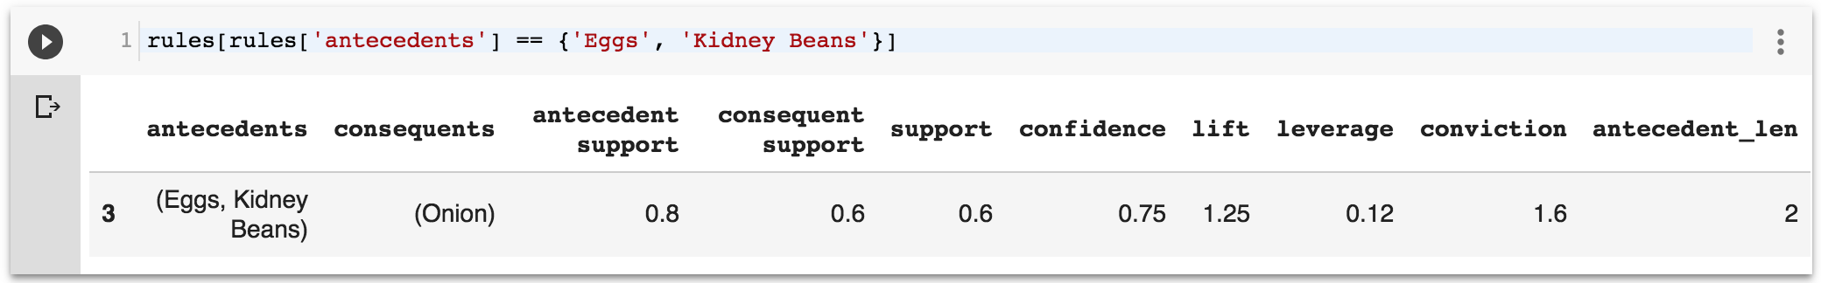
rules[rules['antecedents'] == {'Eggs', 'Kidney Beans’}]
https://colab.research.google.com/drive/1dkZITXbEM9hZykd5qyWZ2rljri1Pdtud

Slide 60
Summary
Association Analysis
Apriori algorithm
  Frequent Itemsets
  Association Rules

Slide 61
References
Jiawei Han and Micheline Kamber (2006), Data Mining: Concepts and Techniques, Second Edition, Elsevier, 2006.
Jiawei Han, Micheline Kamber and Jian Pei (2011), Data Mining: Concepts and Techniques, Third Edition, Morgan Kaufmann 2011.
Efraim Turban, Ramesh Sharda, Dursun Delen (2011), Decision Support and Business Intelligence Systems, Ninth Edition, Pearson.
Ramesh Sharda, Dursun Delen, and Efraim Turban (2017), Business Intelligence, Analytics, and Data Science: A Managerial Perspective, 4th Edition, Pearson.
Jake VanderPlas (2016), Python Data Science Handbook: Essential Tools for Working with Data, O'Reilly Media.
Wes McKinney (2017), Python for Data Analysis: Data Wrangling with Pandas, NumPy, and IPython, 2nd Edition, O'Reilly Media. https://github.com/wesm/pydata-book

