Slide 1



Big Data Mining
Tamkang
University
Data Science and Big Data Analytics: Discovering, Analyzing, Visualizing and
Presenting Data
1071BDM03
TLVXM1A (M2244) (8619) (Fall 2018)
(MBA, DBETKU) (3 Credits, Required) [Full English Course]
(Master’s Program in Digital Business and Economics)
Mon, 9, 10, 11, (16:10-19:00) (B206)
Min-Yuh Day, Ph.D.
Assistant Professor
Department of Information Management
Tamkang University
http://mail.tku.edu.tw/myday
2018-10-01

Slide 2
Course Schedule (1/2)
Tamkang
University
Week Date Subject/Topics
1 2018/09/10 Course Orientation for Big Data Mining
2 2018/09/17 ABC: AI, Big Data, Cloud Computing
3 2018/09/24 Mid-Autumn Festival (Day off)
4 2018/10/01 Data Science and Big Data Analytics: Discovering,
Analyzing, Visualizing and Presenting Data
5 2018/10/08 Fundamental Big Data: MapReduce Paradigm,
Hadoop and Spark Ecosystem
6 2018/10/15 Foundations of Big Data Mining in Python
7 2018/10/22 Supervised Learning: Classification and Prediction
8 2018/10/29 Unsupervised Learning: Cluster Analysis
9 2018/11/05 Unsupervised Learning: Association Analysis

Slide 3
Course Schedule (2/2)
Tamkang
University
Week Date Subject/Topics
10 2018/11/12 Midterm Project Report
11 2018/11/19 Machine Learning with Scikit-Learn in Python
12 2018/11/26 Deep Learning for Finance Big Data with
TensorFlow
13 2018/12/03 Convolutional Neural Networks (CNN)
14 2018/12/10 Recurrent Neural Networks (RNN)
15 2018/12/17 Reinforcement Learning (RL)
16 2018/12/24 Social Network Analysis (SNA)
17 2018/12/31 Bridge Holiday (Extra Day Off)
18 2019/01/07 Final Project Presentation

Slide 4
Data Science and
Big Data Analytics:
Discovering,
Analyzing,
Visualizing and
Presenting Data

Slide 5
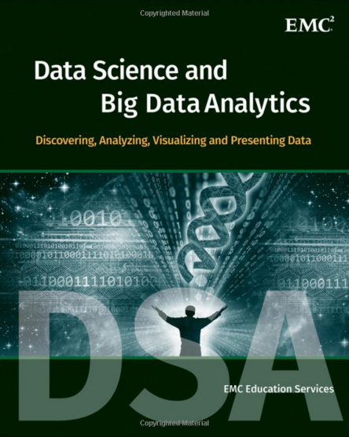
EMC Education Services,
Data Science and Big Data Analytics:
Discovering, Analyzing, Visualizing and Presenting Data,
Wiley, 2015
Source: http://www.amazon.com/Data-Science-Big-Analytics-Discovering/dp/111887613X

Slide 6
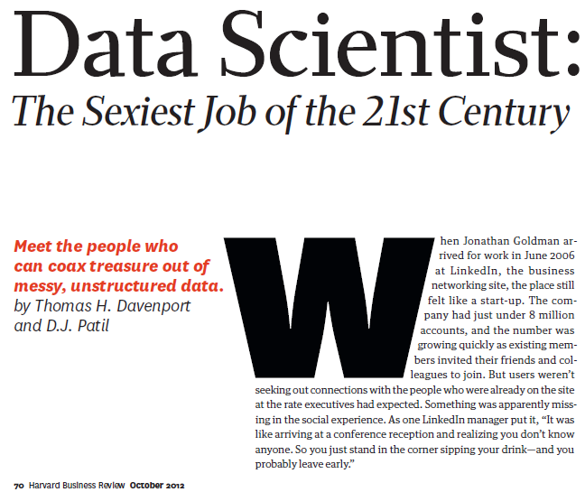
Source: Davenport, T. H., & Patil, D. J. (2012). Data Scientist. Harvard business review

Slide 7
Data Science

Slide 8
Data Analyst
Data analyst is just another term for professionals who were doing BI in the form of data compilation, cleaning, reporting, and perhaps some visualization.
Their skill sets included Excel, some SQL knowledge, and reporting.
You would recognize those capabilities as descriptive or reporting analytics.
Source: Ramesh Sharda, Dursun Delen, and Efraim Turban (2017), Business Intelligence, Analytics, and Data Science: A Managerial Perspective, 4th Edition, Pearson

Slide 9
Data Scientist
Data scientist is responsible for predictive analysis, statistical analysis, and more advanced analytical tools and algorithms.
They may have a deeper knowledge of algorithms and may recognize them under various labels—data mining, knowledge discovery, or machine learning.
Some of these professionals may also need deeper programming knowledge to be able to write code for data cleaning/analysis in current Web-oriented languages such as Java or Python and statistical languages such as R.
Many analytics professionals also need to build significant expertise in statistical modeling, experimentation, and analysis.
Source: Ramesh Sharda, Dursun Delen, and Efraim Turban (2017), Business Intelligence, Analytics, and Data Science: A Managerial Perspective, 4th Edition, Pearson

Slide 10
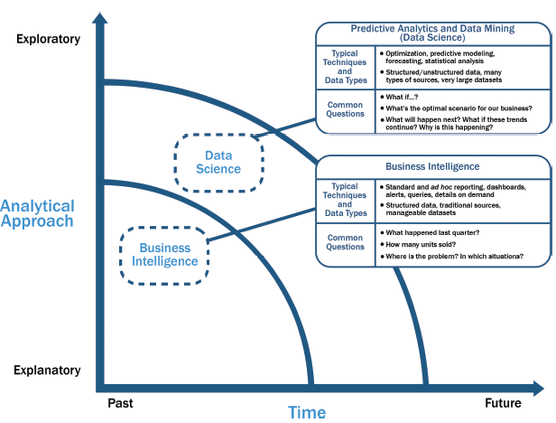
Data Science and
Business Intelligence
Source: EMC Education Services, Data Science and Big Data Analytics: Discovering, Analyzing, Visualizing and Presenting Data, Wiley, 2015

Slide 11
Data Science and
Business Intelligence
Predictive Analytics
and Data Mining
(Data Science)
Source: EMC Education Services, Data Science and Big Data Analytics: Discovering, Analyzing, Visualizing and Presenting Data, Wiley, 2015

Slide 12
Data Science and
Business Intelligence
Predictive Analytics
and Data Mining
(Data Science)
Structured/unstructured data, many types of sources,
very large datasets
Optimization, predictive modeling, forecasting statistical analysis
What if…?
What’s the optimal scenario for our business?
What will happen next?
What if these trends countinue?
Why is this happening?
Source: EMC Education Services, Data Science and Big Data Analytics: Discovering, Analyzing, Visualizing and Presenting Data, Wiley, 2015

Slide 13
Profile of a Data Scientist
Quantitative
  mathematics or statistics
Technical
  software engineering,
  machine learning,
  and programming skills
Skeptical mind-set and critical thinking
Curious and creative
Communicative and collaborative
Source: EMC Education Services, Data Science and Big Data Analytics: Discovering, Analyzing, Visualizing and Presenting Data, Wiley, 2015

Slide 14
Data Scientist Profile
Quantitative
Technical
Curious
and
Creative
Data Scientist
Skeptical
Communicative
and
Collaborative
Source: EMC Education Services, Data Science and Big Data Analytics: Discovering, Analyzing, Visualizing and Presenting Data, Wiley, 2015

Slide 15
Big Data Analytics Lifecycle

Slide 16
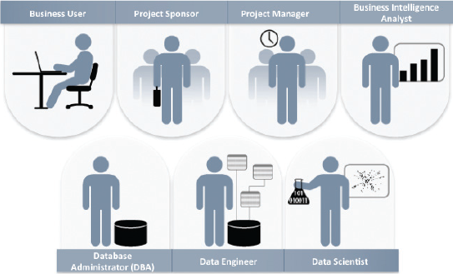
Key Roles for a
Successful Analytics Project
Source: EMC Education Services, Data Science and Big Data Analytics: Discovering, Analyzing, Visualizing and Presenting Data, Wiley, 2015

Slide 17
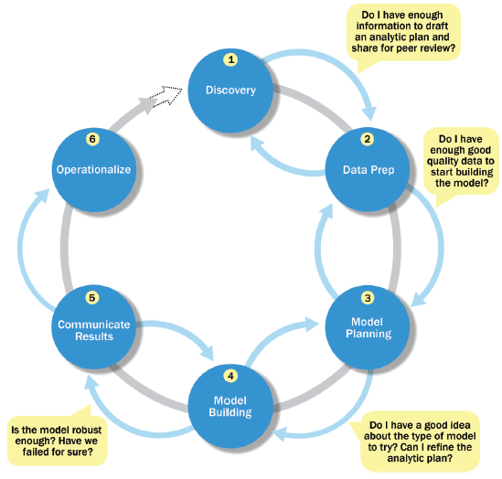
Overview of Data Analytics Lifecycle
Source: EMC Education Services, Data Science and Big Data Analytics: Discovering, Analyzing, Visualizing and Presenting Data, Wiley, 2015

Slide 18
Overview of Data Analytics Lifecycle
1. Discovery
2. Data preparation
3. Model planning
4. Model building
5. Communicate results
6. Operationalize
Source: EMC Education Services, Data Science and Big Data Analytics: Discovering, Analyzing, Visualizing and Presenting Data, Wiley, 2015

Slide 19
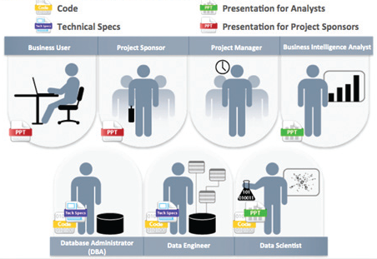
Key Outputs from a
Successful Analytics Project
Source: EMC Education Services, Data Science and Big Data Analytics: Discovering, Analyzing, Visualizing and Presenting Data, Wiley, 2015

Slide 20
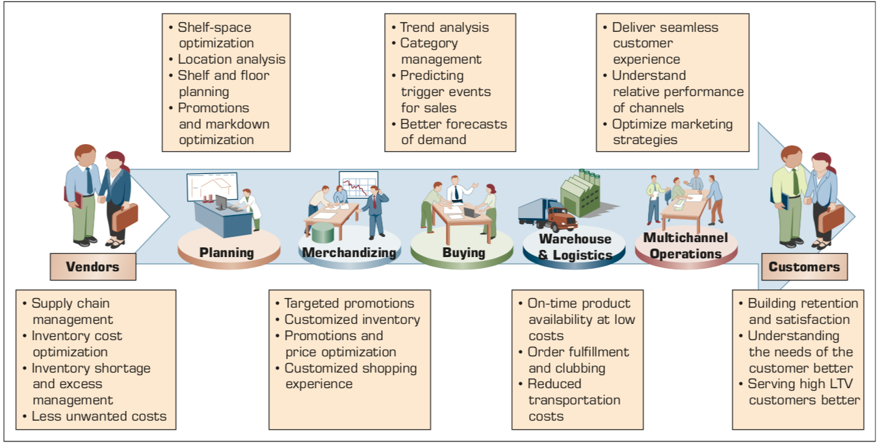
Example of Analytics Applications in a Retail Value Chain
Retail Value Chain
Critical needs at every touch point of the Retail Value Chain
Source: Ramesh Sharda, Dursun Delen, and Efraim Turban (2017), Business Intelligence, Analytics, and Data Science: A Managerial Perspective, 4th Edition, Pearson

Slide 21
Analytics Ecosystem
Source: Ramesh Sharda, Dursun Delen, and Efraim Turban (2017), Business Intelligence, Analytics, and Data Science: A Managerial Perspective, 4th Edition, Pearson

Slide 22
Job Titles of Analytics
Source: Ramesh Sharda, Dursun Delen, and Efraim Turban (2017), Business Intelligence, Analytics, and Data Science: A Managerial Perspective, 4th Edition, Pearson

Slide 23
Three Types of Analytics
Source: Ramesh Sharda, Dursun Delen, and Efraim Turban (2017), Business Intelligence, Analytics, and Data Science: A Managerial Perspective, 4th Edition, Pearson

Slide 24
A Data to Knowledge Continuum
Source: Ramesh Sharda, Dursun Delen, and Efraim Turban (2017), Business Intelligence, Analytics, and Data Science: A Managerial Perspective, 4th Edition, Pearson

Slide 25
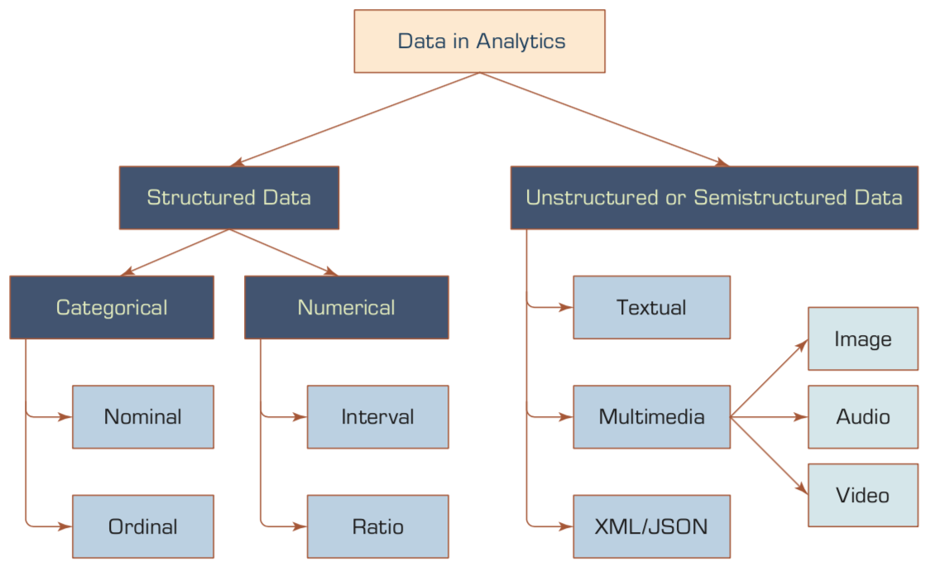
A Simple Taxonomy of Data
Source: Ramesh Sharda, Dursun Delen, and Efraim Turban (2017), Business Intelligence, Analytics, and Data Science: A Managerial Perspective, 4th Edition, Pearson

Slide 26
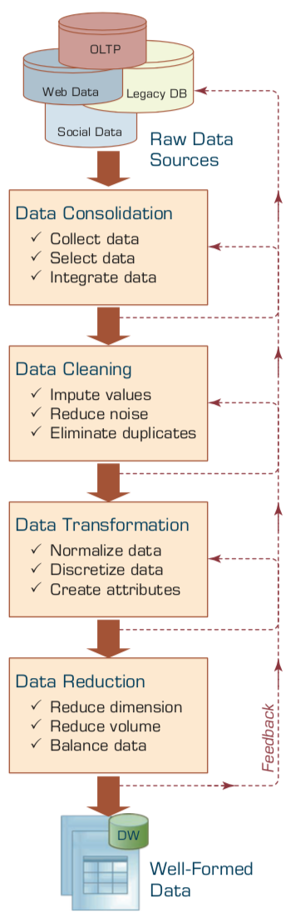
Data Preprocessing Steps
Source: Ramesh Sharda, Dursun Delen, and Efraim Turban (2017), Business Intelligence, Analytics, and Data Science: A Managerial Perspective, 4th Edition, Pearson

Slide 27
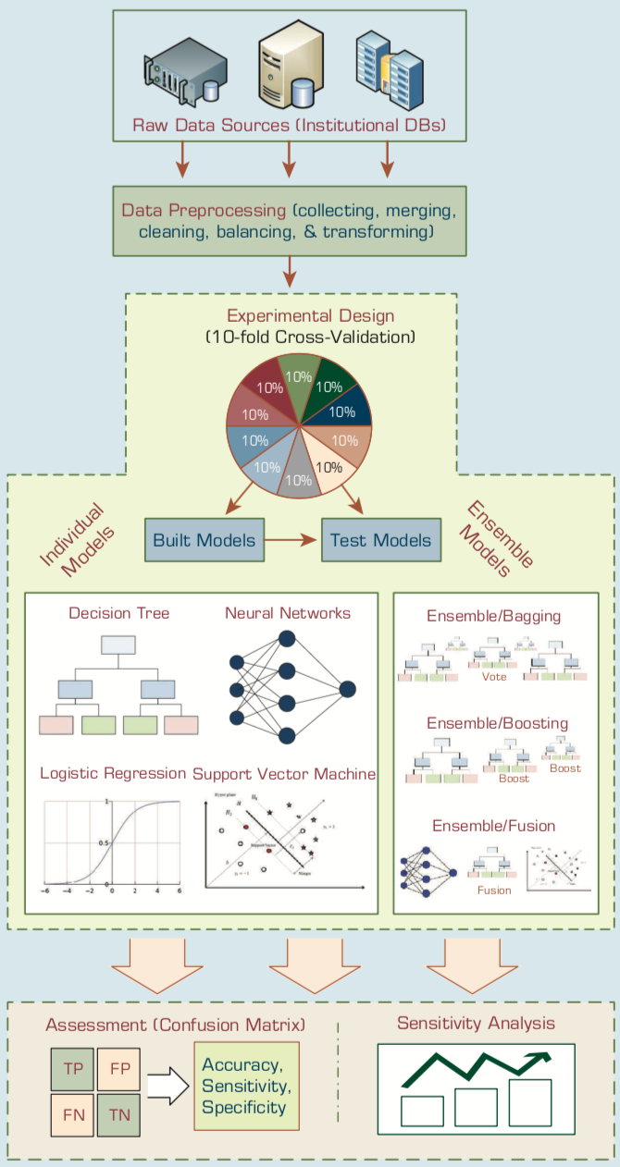
An Analytics Approach to Predicting Student Attrition
Source: Ramesh Sharda, Dursun Delen, and Efraim Turban (2017), Business Intelligence, Analytics, and Data Science: A Managerial Perspective, 4th Edition, Pearson

Slide 28
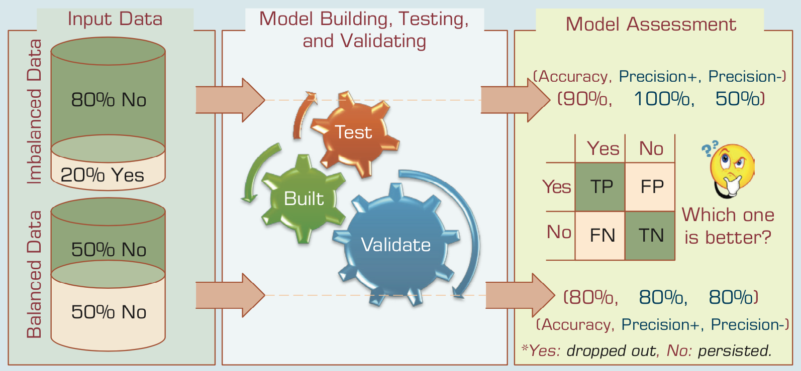
A Graphical Depiction of the
Class Imbalance Problem
Source: Ramesh Sharda, Dursun Delen, and Efraim Turban (2017), Business Intelligence, Analytics, and Data Science: A Managerial Perspective, 4th Edition, Pearson

Slide 29
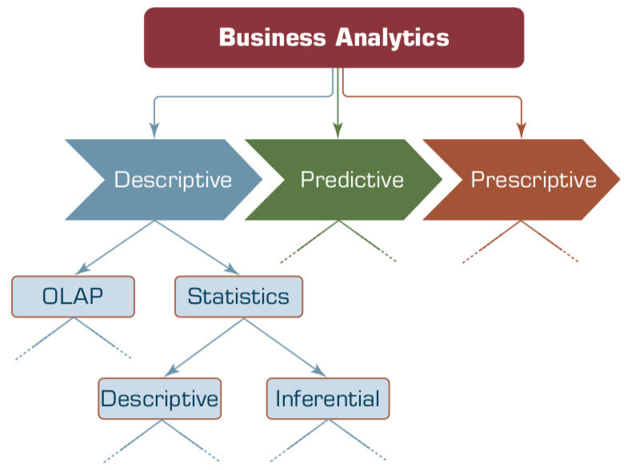
Relationship between Statistics and Descriptive Analytics
Source: Ramesh Sharda, Dursun Delen, and Efraim Turban (2017), Business Intelligence, Analytics, and Data Science: A Managerial Perspective, 4th Edition, Pearson

Slide 30
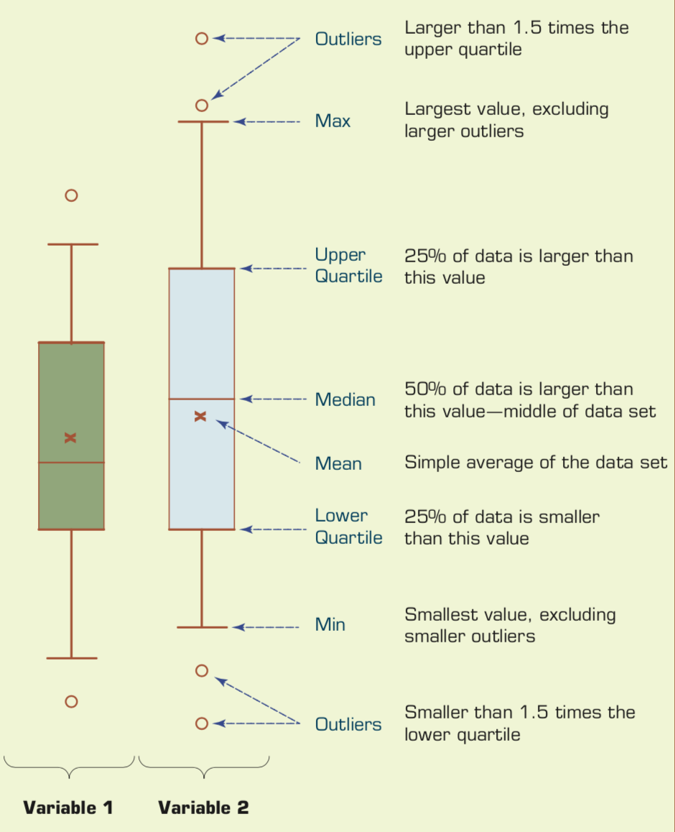
Understanding the Specifics about
Box-and-Whiskers Plots
Source: Ramesh Sharda, Dursun Delen, and Efraim Turban (2017), Business Intelligence, Analytics, and Data Science: A Managerial Perspective, 4th Edition, Pearson

Slide 31
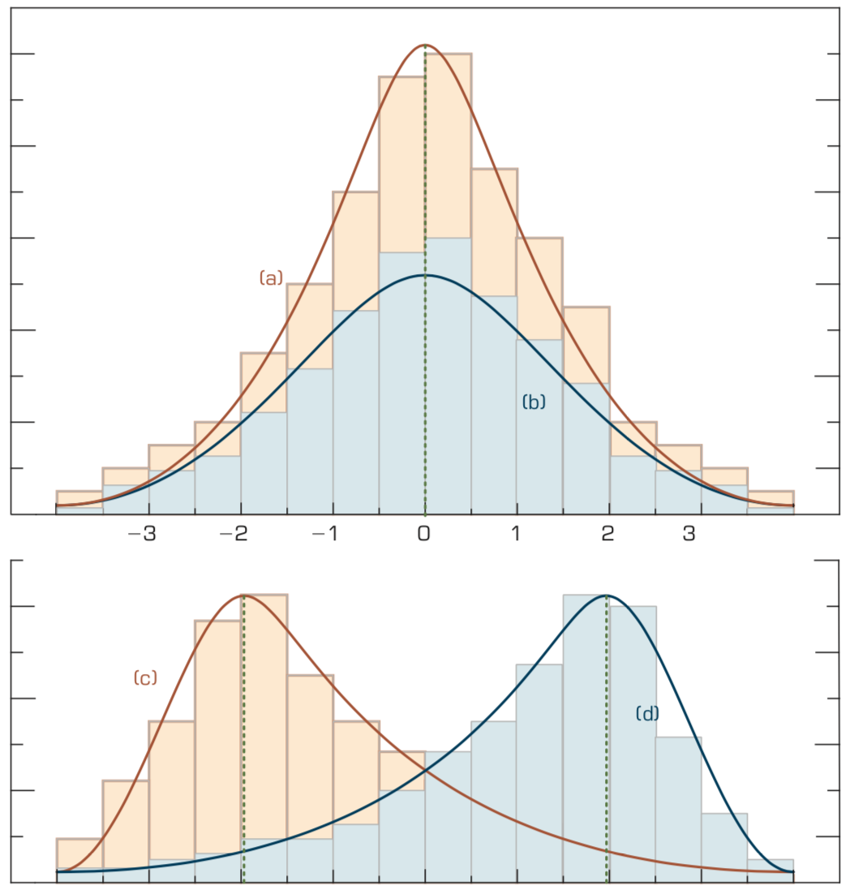
Relationship between
Dispersion and Shape Properties.
Source: Ramesh Sharda, Dursun Delen, and Efraim Turban (2017), Business Intelligence, Analytics, and Data Science: A Managerial Perspective, 4th Edition, Pearson

Slide 32
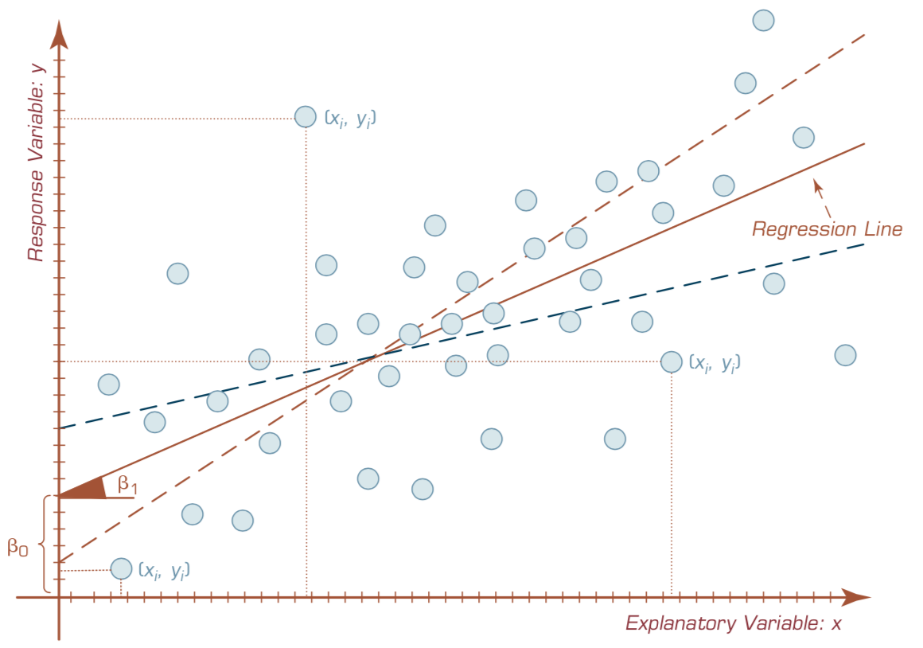
A Scatter Plot and a Linear Regression Line
Source: Ramesh Sharda, Dursun Delen, and Efraim Turban (2017), Business Intelligence, Analytics, and Data Science: A Managerial Perspective, 4th Edition, Pearson

Slide 33
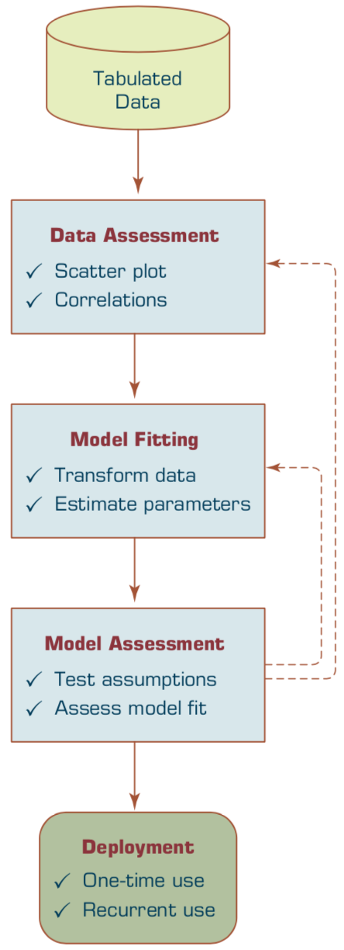
A Process Flow for Developing Regression Models.
Source: Ramesh Sharda, Dursun Delen, and Efraim Turban (2017), Business Intelligence, Analytics, and Data Science: A Managerial Perspective, 4th Edition, Pearson

Slide 34

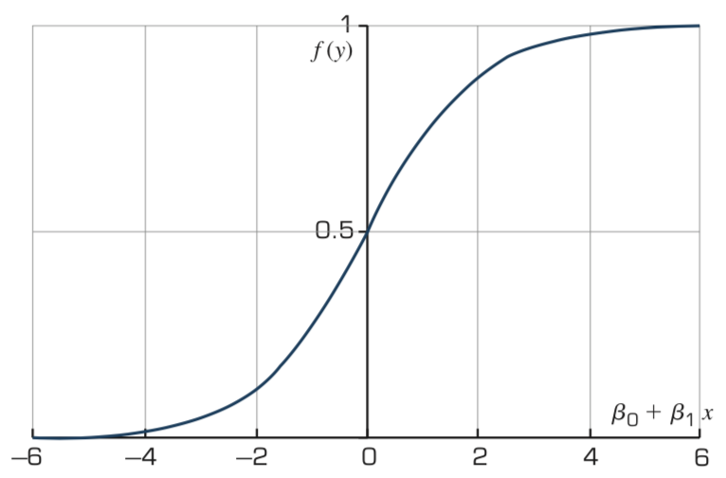
The Logistic Function
Source: Ramesh Sharda, Dursun Delen, and Efraim Turban (2017), Business Intelligence, Analytics, and Data Science: A Managerial Perspective, 4th Edition, Pearson

Slide 35
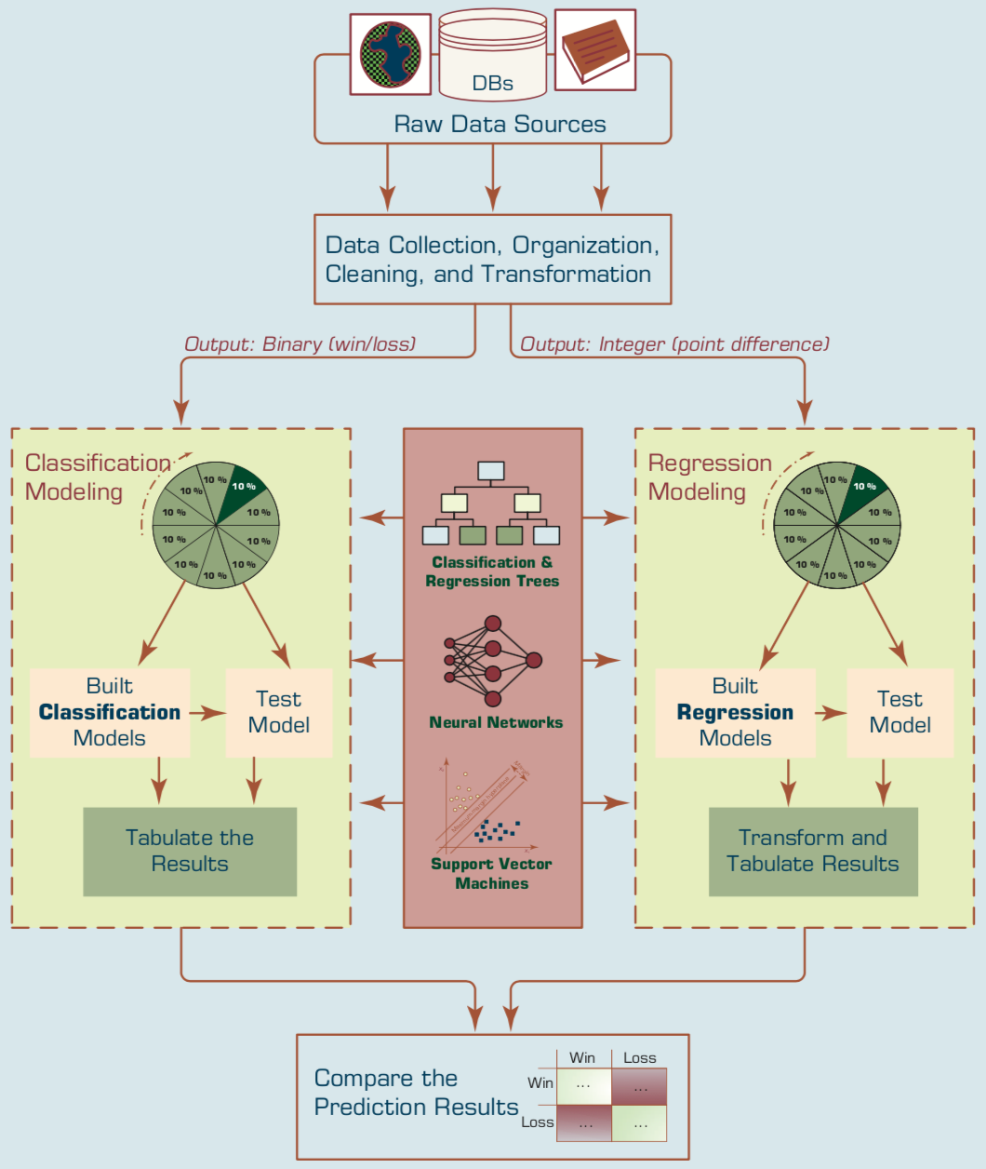
Predicting NCAA Bowl Game Outcomes
Source: Ramesh Sharda, Dursun Delen, and Efraim Turban (2017), Business Intelligence, Analytics, and Data Science: A Managerial Perspective, 4th Edition, Pearson

Slide 36
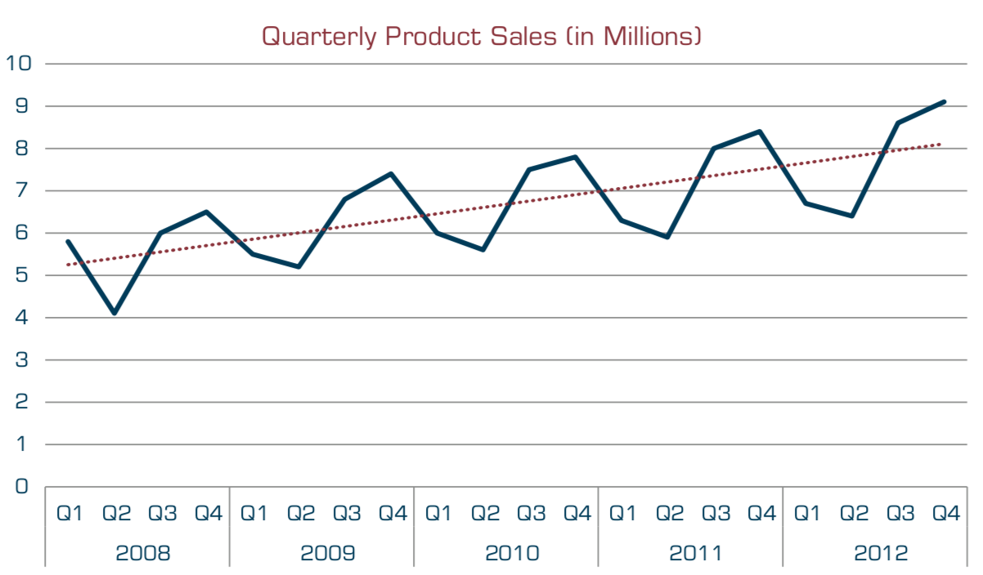
A Sample Time Series of Data on Quarterly Sales Volumes
Source: Ramesh Sharda, Dursun Delen, and Efraim Turban (2017), Business Intelligence, Analytics, and Data Science: A Managerial Perspective, 4th Edition, Pearson

Slide 37
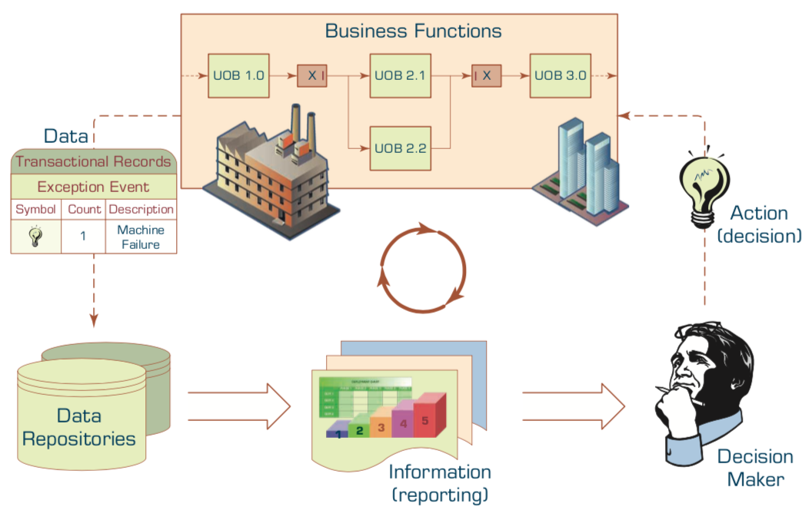
The Role of Information Reporting in Managerial Decision Making
Source: Ramesh Sharda, Dursun Delen, and Efraim Turban (2017), Business Intelligence, Analytics, and Data Science: A Managerial Perspective, 4th Edition, Pearson

Slide 38
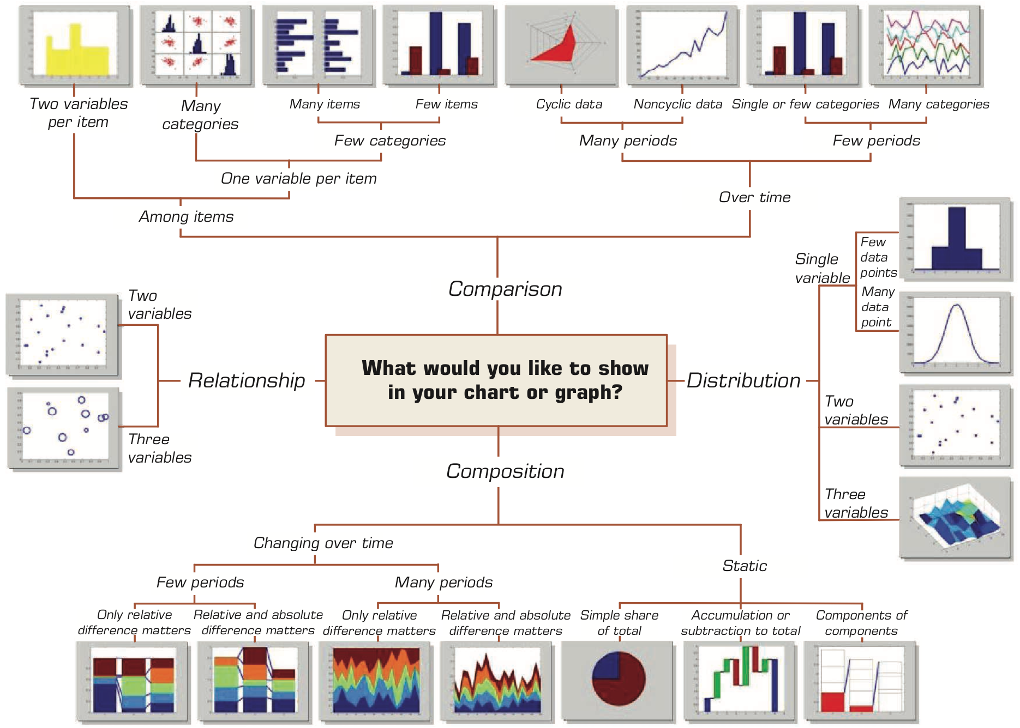
A Taxonomy of Charts and Graphs
Source: Ramesh Sharda, Dursun Delen, and Efraim Turban (2017), Business Intelligence, Analytics, and Data Science: A Managerial Perspective, 4th Edition, Pearson

Slide 39
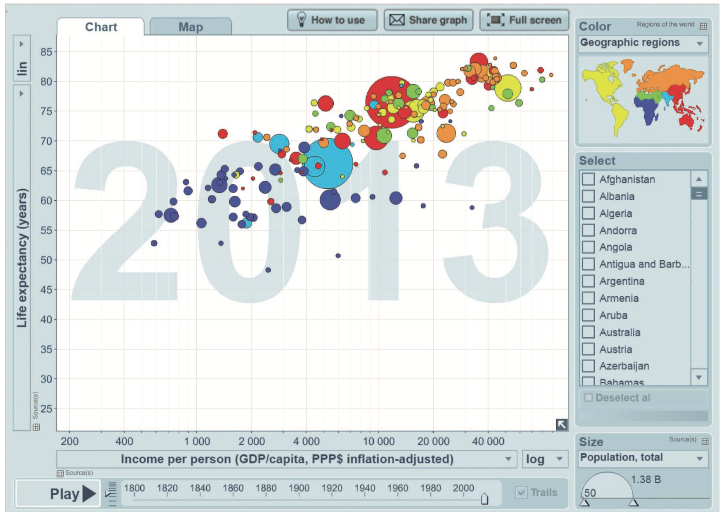
A Gapminder Chart That Shows the Wealth and Health of Nations
Source: Ramesh Sharda, Dursun Delen, and Efraim Turban (2017), Business Intelligence, Analytics, and Data Science: A Managerial Perspective, 4th Edition, Pearson

Slide 40
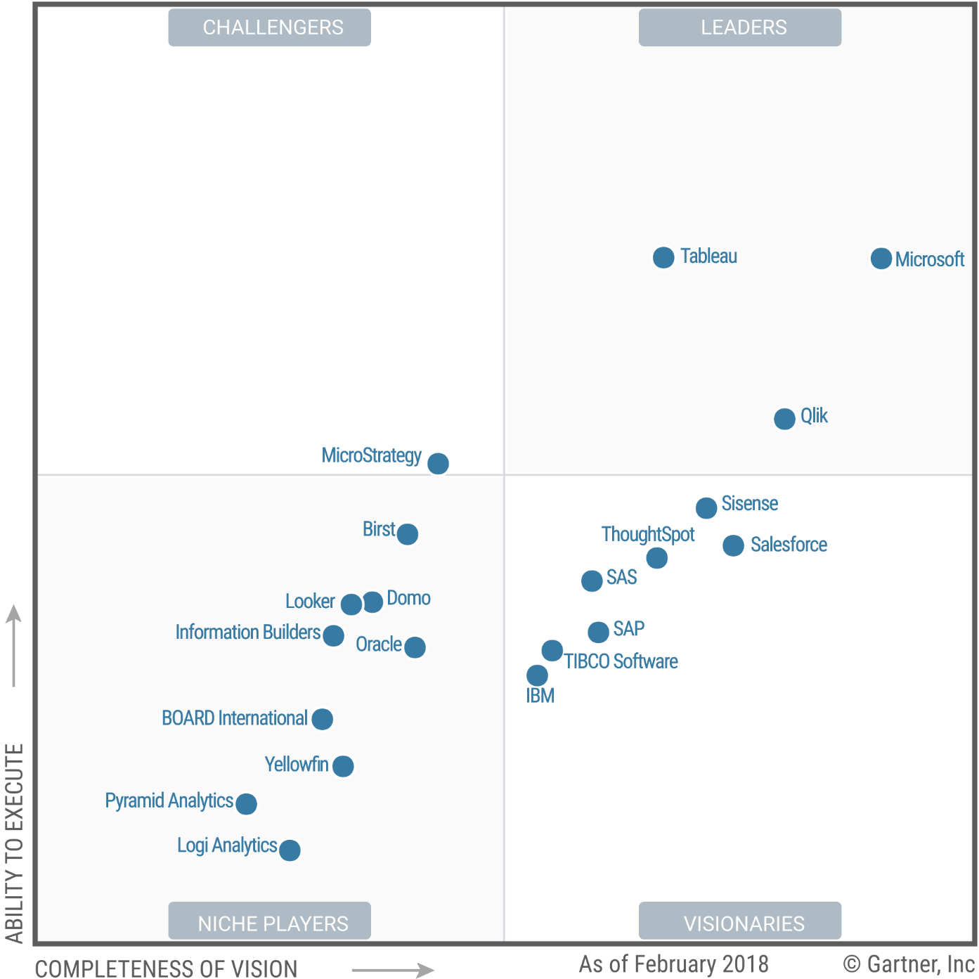
Magic Quadrant for Business Intelligence and Analytics Platforms
Source: https://www.tableau.com/reports/gartner

Slide 41
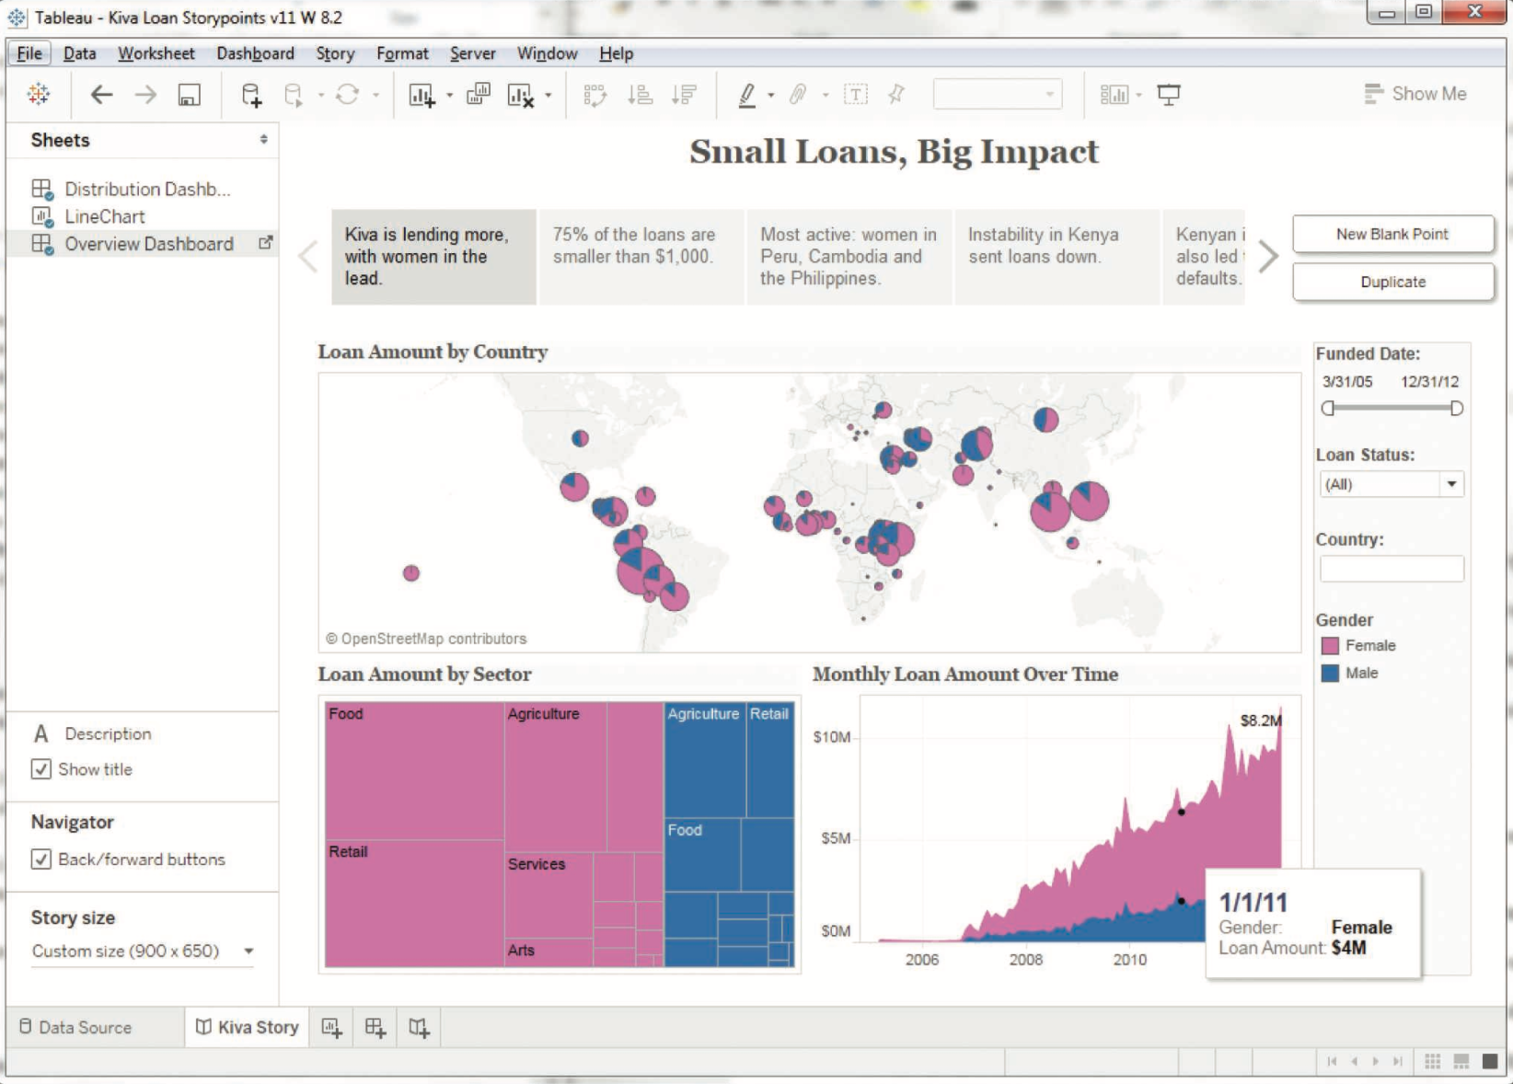
A Storyline Visualization in Tableau Software
Source: Ramesh Sharda, Dursun Delen, and Efraim Turban (2017), Business Intelligence, Analytics, and Data Science: A Managerial Perspective, 4th Edition, Pearson

Slide 42
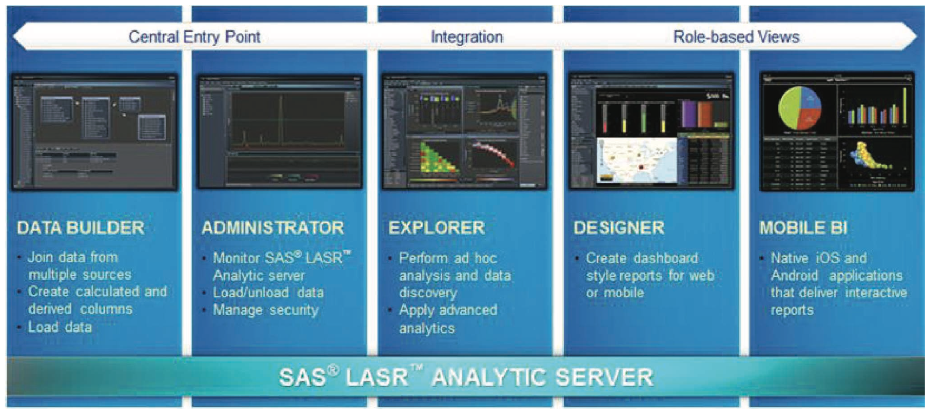
An Overview of SAS
Visual Analytics Architecture
Source: Ramesh Sharda, Dursun Delen, and Efraim Turban (2017), Business Intelligence, Analytics, and Data Science: A Managerial Perspective, 4th Edition, Pearson

Slide 43
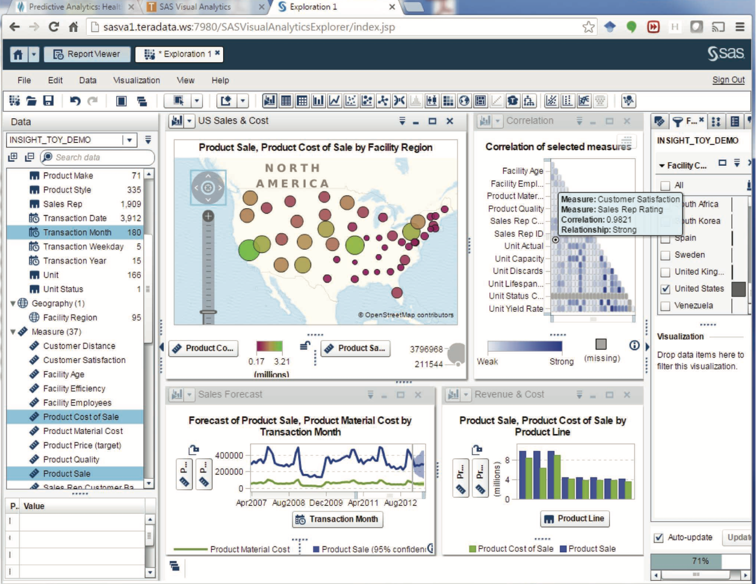
A Screenshot from SAS Visual Analytics
Source: Ramesh Sharda, Dursun Delen, and Efraim Turban (2017), Business Intelligence, Analytics, and Data Science: A Managerial Perspective, 4th Edition, Pearson

Slide 44
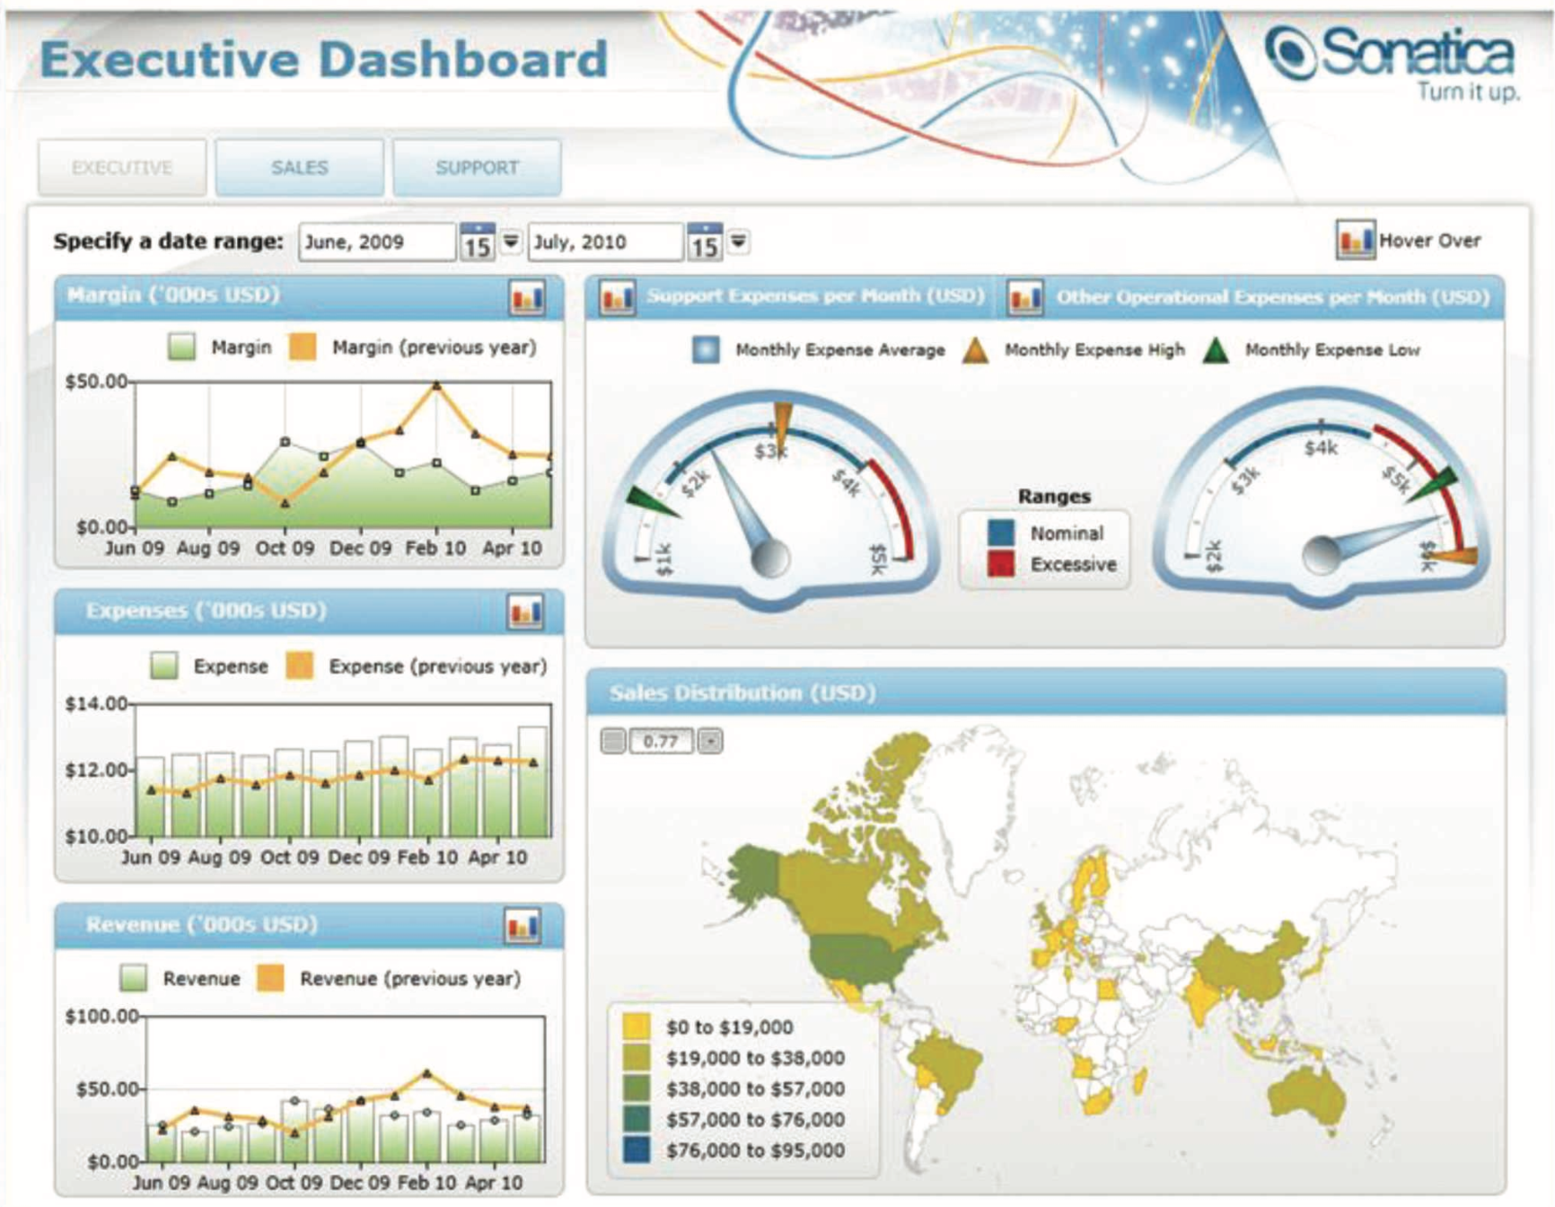
A Sample Executive Dashboard
Source: Ramesh Sharda, Dursun Delen, and Efraim Turban (2017), Business Intelligence, Analytics, and Data Science: A Managerial Perspective, 4th Edition, Pearson

Slide 45
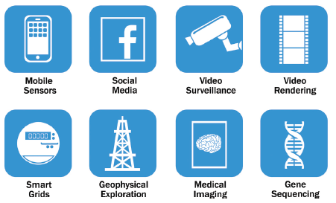
Big Data
Source: EMC Education Services, Data Science and Big Data Analytics: Discovering, Analyzing, Visualizing and Presenting Data, Wiley, 2015

Slide 46
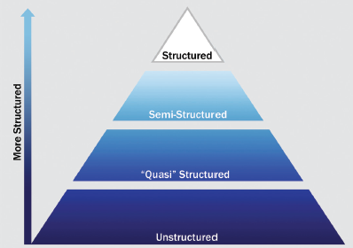
Big Data Growth is increasingly unstructured
Source: EMC Education Services, Data Science and Big Data Analytics: Discovering, Analyzing, Visualizing and Presenting Data, Wiley, 2015

Slide 47
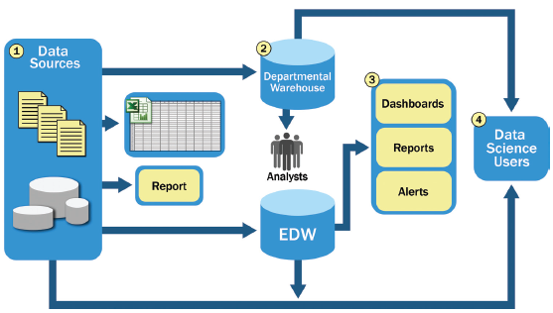
Typical Analytic Architecture
Source: EMC Education Services, Data Science and Big Data Analytics: Discovering, Analyzing, Visualizing and Presenting Data, Wiley, 2015

Slide 48
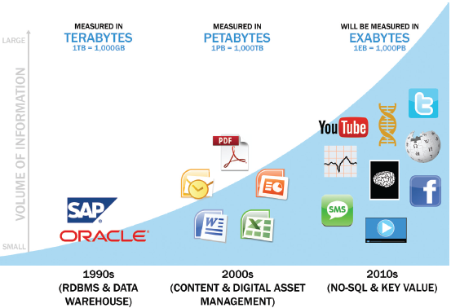
Data Evolution and the
Rise of Big Data Sources
Source: EMC Education Services, Data Science and Big Data Analytics: Discovering, Analyzing, Visualizing and Presenting Data, Wiley, 2015

Slide 49
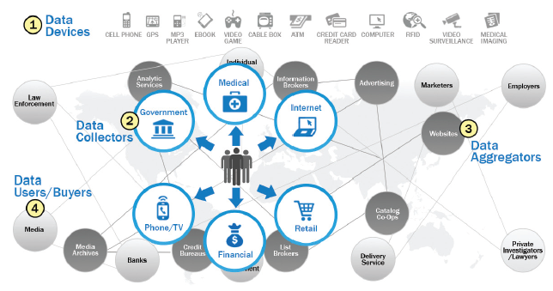
Emerging Big Data Ecosystem
Source: EMC Education Services, Data Science and Big Data Analytics: Discovering, Analyzing, Visualizing and Presenting Data, Wiley, 2015

Slide 50
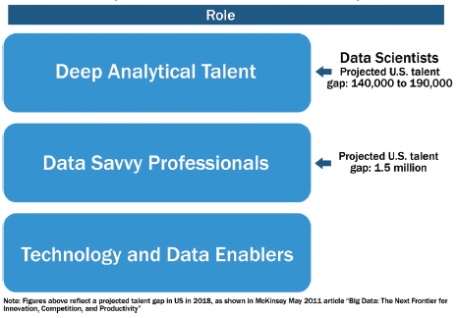
Key Roles for the New
Big Data Ecosystem
Source: EMC Education Services, Data Science and Big Data Analytics: Discovering, Analyzing, Visualizing and Presenting Data, Wiley, 2015

Slide 51
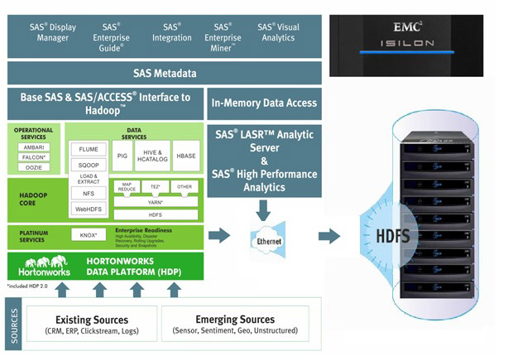
Big Data Solution
EG
EM
VA
Source: http://www.newera-technologies.com/big-data-solution.html

Slide 52
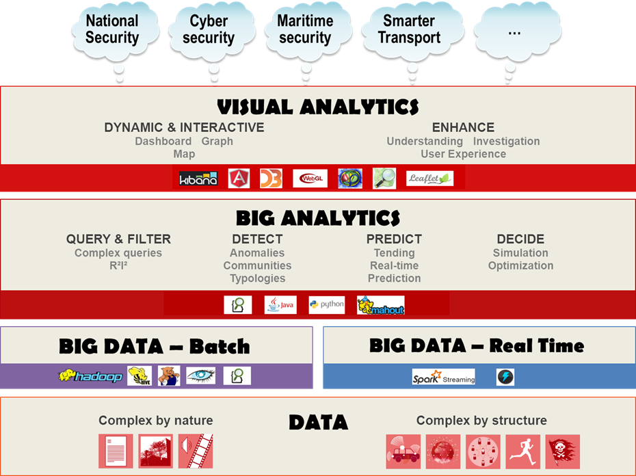
Source: https://www.thalesgroup.com/en/worldwide/big-data/big-data-big-analytics-visual-analytics-what-does-it-all-mean

Slide 53
Architectures of
Big Data Analytics

Slide 54

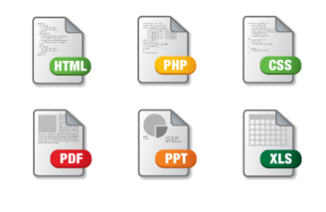




Traditional Analytics
BI and Analytics
Data Mart
Operational Data Sources
Data Mart
EDW
Analytic Mart
Analytic Mart
Unstructured, Semi-structured and Streaming data (i.e. sensor data) handled often outside the Warehouse flow
Source: Deepak Ramanathan (2014), SAS Modernization architectures - Big Data Analytics

Slide 55

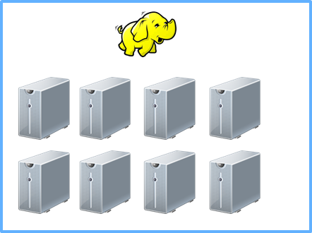
Hadoop as a “new data” Store
BI and Analytics
Data Mart
Operational Data Sources
Data Mart
EDW
Analytic Mart
Analytic Mart
Source: Deepak Ramanathan (2014), SAS Modernization architectures - Big Data Analytics

Slide 56
Hadoop as an additional input to the EDW
BI and Analytics
Data Mart
Operational Data Sources
Data Mart
EDW
Analytic Mart
Analytic Mart
Analytic Mart
Data Mart
Source: Deepak Ramanathan (2014), SAS Modernization architectures - Big Data Analytics

Slide 57


Hadoop Data Platform As a
“staging Layer” as part of a “data Lake”
– Downstream stores could be Hadoop, data appliances or an RDBMS
BI and Analytics
Operational Data Sources
EDW
Data Mart
Data Mart
Analytic Mart
Analytic Mart
Source: Deepak Ramanathan (2014), SAS Modernization architectures - Big Data Analytics

Slide 58
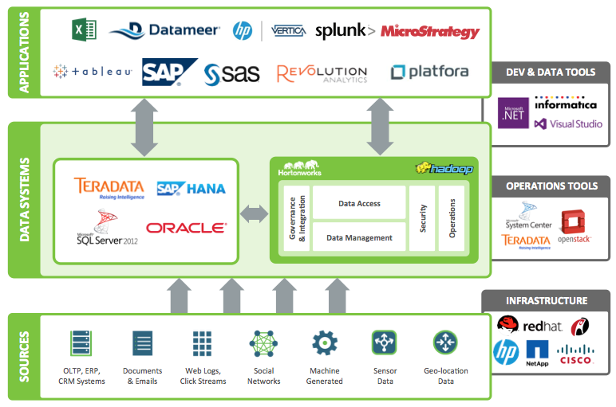
SAS Big data Strategy
– SAS areas
Source: Deepak Ramanathan (2014), SAS Modernization architectures - Big Data Analytics

Slide 59

SAS Big data Strategy
– SAS areas
Source: Deepak Ramanathan (2014), SAS Modernization architectures - Big Data Analytics

Slide 60






SAS® Within the
HADOOP ECOSYSTEM
EG
EM
VA
User
Interface
SAS® Enterprise
Guide®
SAS® Data Integration
SAS® Enterprise Miner™
SAS® Visual Analytics
SAS® In-Memory Statistics for Haodop
SAS Metadata
SAS® User
Metadata
Next-Gen
SAS® User
Data
Access
Base SAS & SAS/ACCESS®
to Hadoop™
In-Memory
Data Access
Impala
Pig
Hive
SAS Embedded
Process
Accelerators
SAS® LASR™
Analytic
Server
SAS® High-
Performance
Analytic Procedures
Data
Processing
Map Reduce
MPI Based
File
System
HDFS
Source: Deepak Ramanathan (2014), SAS Modernization architectures - Big Data Analytics

Slide 61











SAS enables the entire lifecycle around HADOOP
SAS enableS the entire lifecycle around HADOOP
Done using either the Data Preparation, Data Exploration or Build Model Tools
SAS Visual Analytics
Decision Manager
IDENTIFY /
FORMULATE
PROBLEM
EVALUATE /
MONITOR
RESULTS
DATA
PREPARATION
SAS Visual Analytics
SAS Visual Statistics
SAS In-Memory Statistics for Hadoop
SAS Scoring Accelerator for Hadoop
SAS Code Accelerator for Hadoop
DEPLOY
MODEL
DATA
EXPLORATION
Done using either the Data Preparation, Data Exploration or Build Model Tools
VALIDATE
MODEL
TRANSFORM
& SELECT
Decision Manager
BUILD
MODEL
SAS High Performance Analytics Offerings supported by relevant clients like SAS Enterprise Miner, SAS/STAT etc.
Source: Deepak Ramanathan (2014), SAS Modernization architectures - Big Data Analytics

Slide 62
SAS® VISUAL ANALYTICS
A Single solution for
Data Discovery,
Visualization, analytics and reporting
Source: Deepak Ramanathan (2014), SAS Modernization architectures - Big Data Analytics

Slide 63
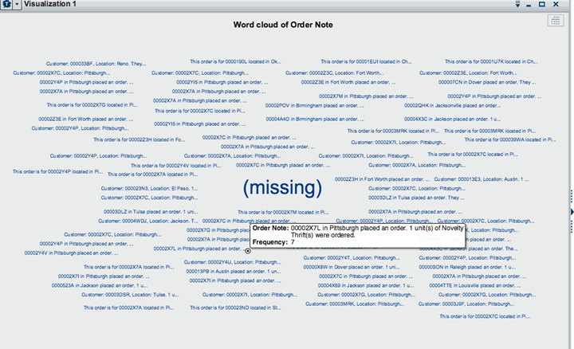

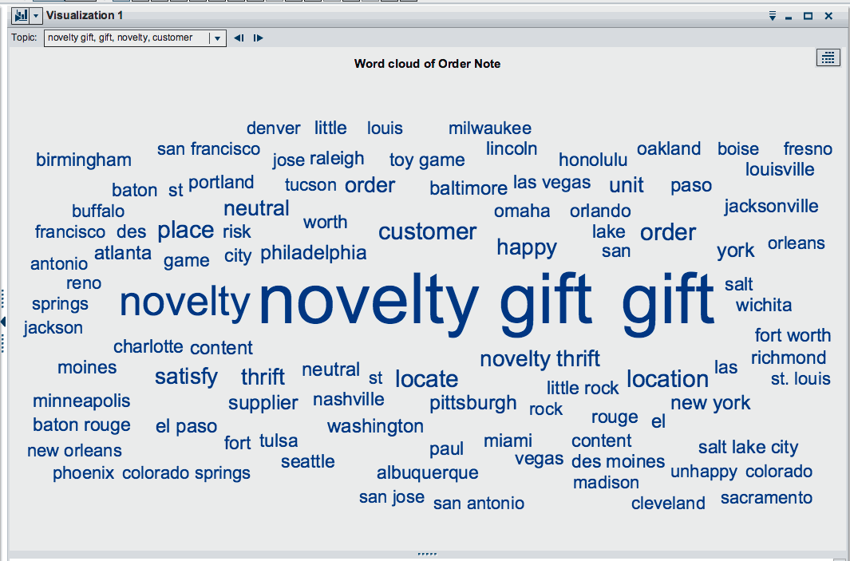
SAS® VISUAL ANALYTICS
Example: text analysis gives you insight to customer experience and opinion
Visualization Powered by SAS Analytics
Analytics applied to text provides real MEANING
Source: Deepak Ramanathan (2014), SAS Modernization architectures - Big Data Analytics
Notes:
Example:
Applying text analysis to twitter streams, or to customer comments in call logs, can give quick insight into the “hot topics” discussed.
It’s more than a simple world=cloud that shows which topics are being discussed, but the analytics applied behind the scenes determine which words are used most frequently –so you can determine which topics are the most “important” and warrant further understanding/exploration.

Slide 64
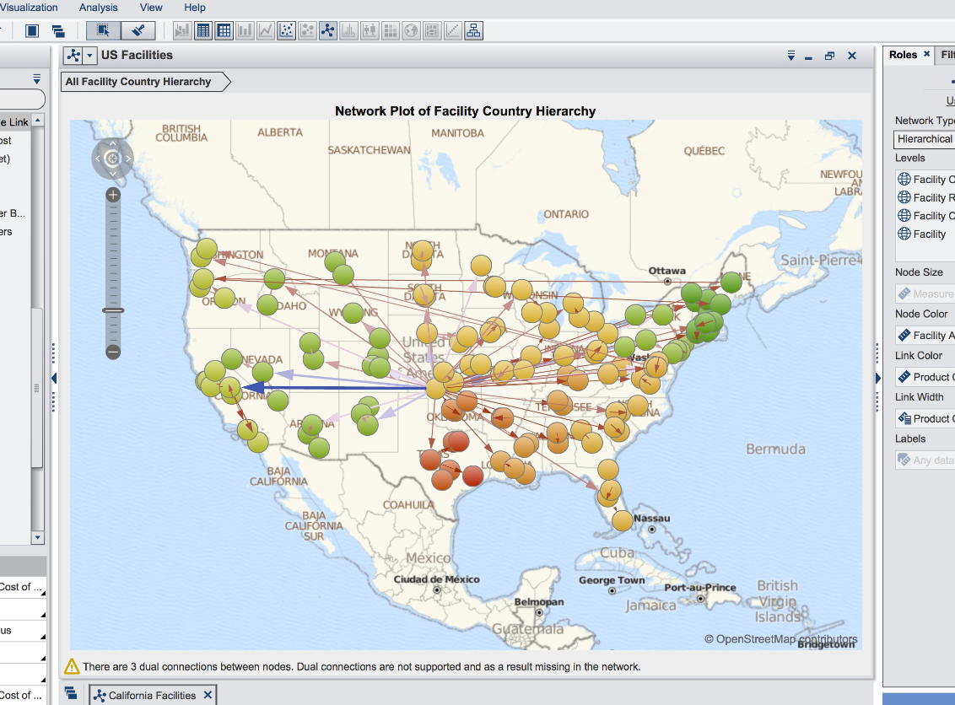
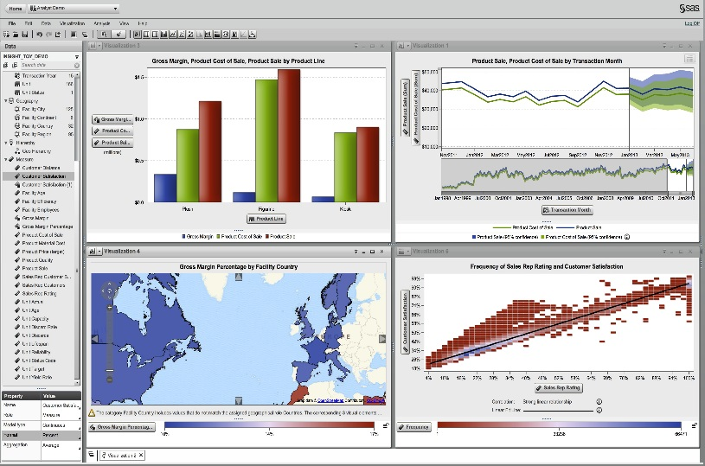
Visualization
Source: Deepak Ramanathan (2014), SAS Modernization architectures - Big Data Analytics

Slide 65

Devangana Khokhar (2015),
Gephi Cookbook, Packt Publishing
Source: http://www.amazon.com/Gephi-Cookbook-Devangana-Khokhar/dp/1783987405
Notes:
Devangana Khokhar (2015), Gephi Cookbook, Packt Publishing

Slide 66
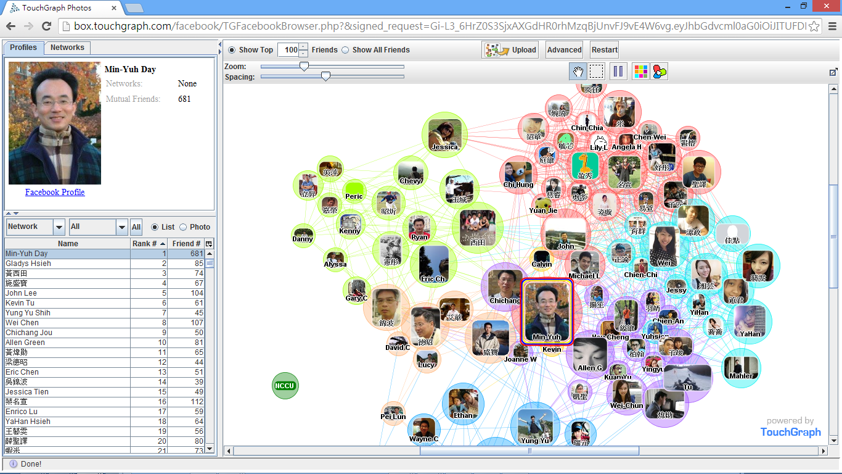
Social Network Analysis (SNA)
Facebook TouchGraph

Slide 67
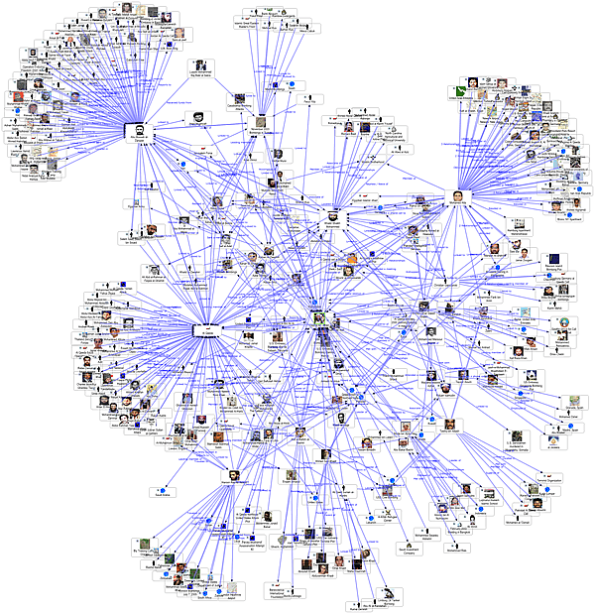
Social Network Analysis
Source: http://www.fmsasg.com/SocialNetworkAnalysis/

Slide 68
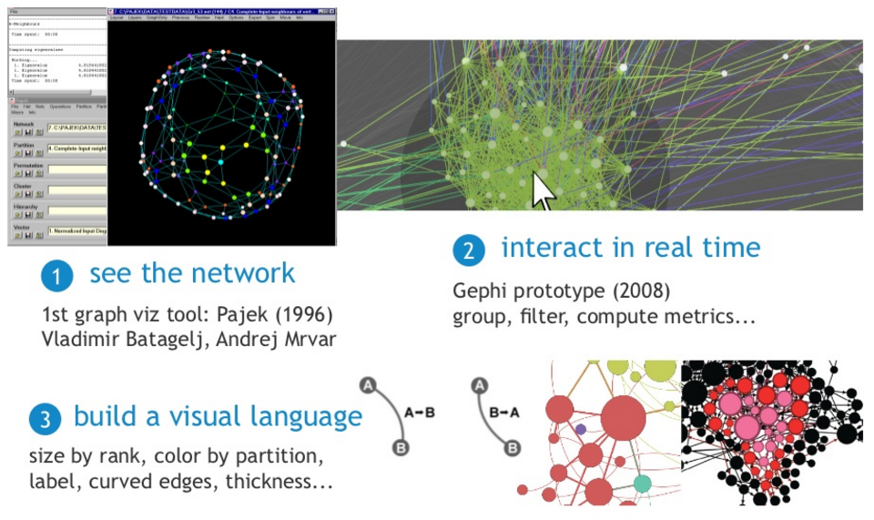
Exploratory Network Analysis
Source: http://sebastien.pro/gephi-icwsm-tutorial.pdf

Slide 69
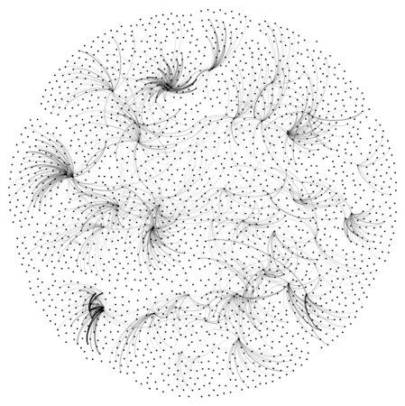
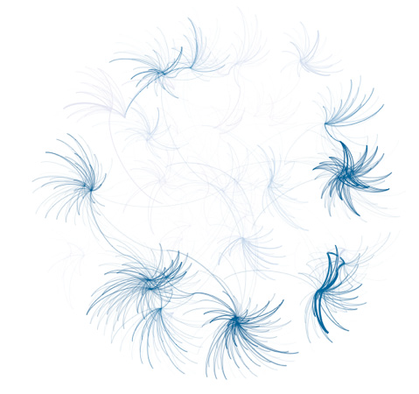
Looking for a “Simple Small Truth”?
What Data Visualization Should Do?
1. Make complex things simple
2. Extract small information from large data
3. Present truth, do not deceive
Source: http://sebastien.pro/gephi-icwsm-tutorial.pdf

Slide 70
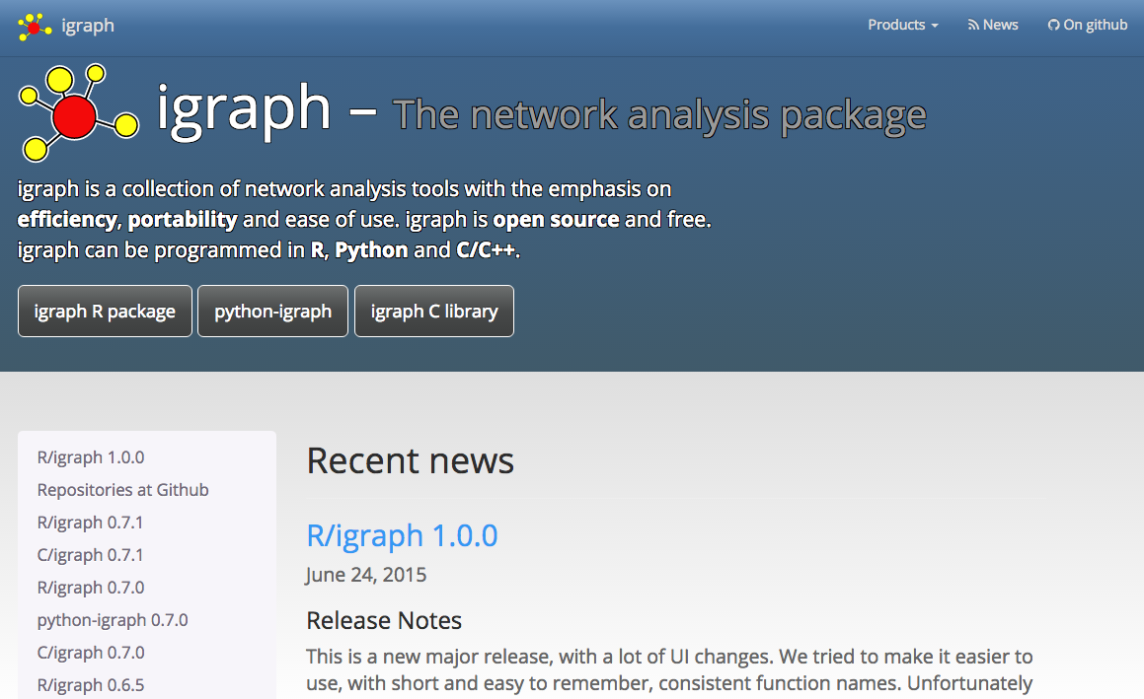
igraph
http://igraph.org/redirect.html

Slide 71
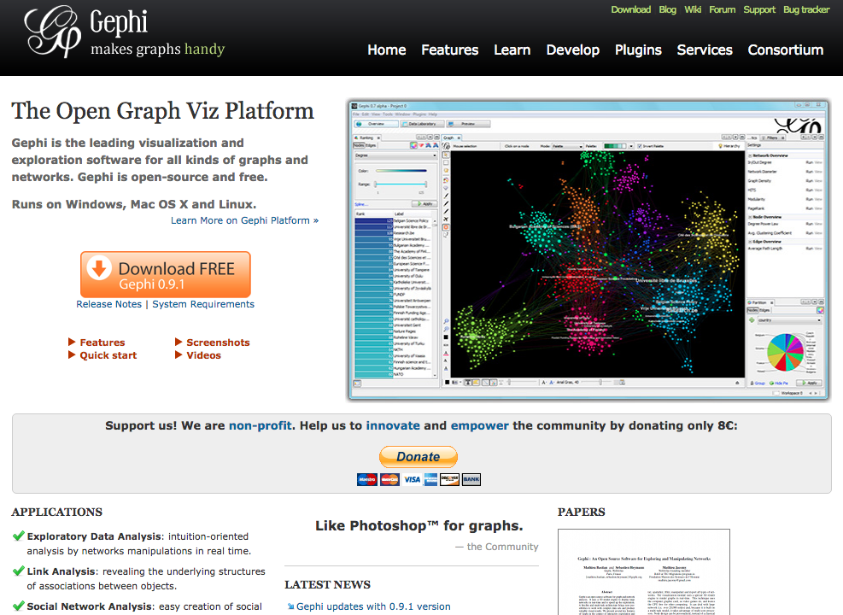
Gephi
https://gephi.org/

Slide 72
Discovering,
Analyzing,
Visualizing and
Presenting Data with Python in Google Colab

Slide 73
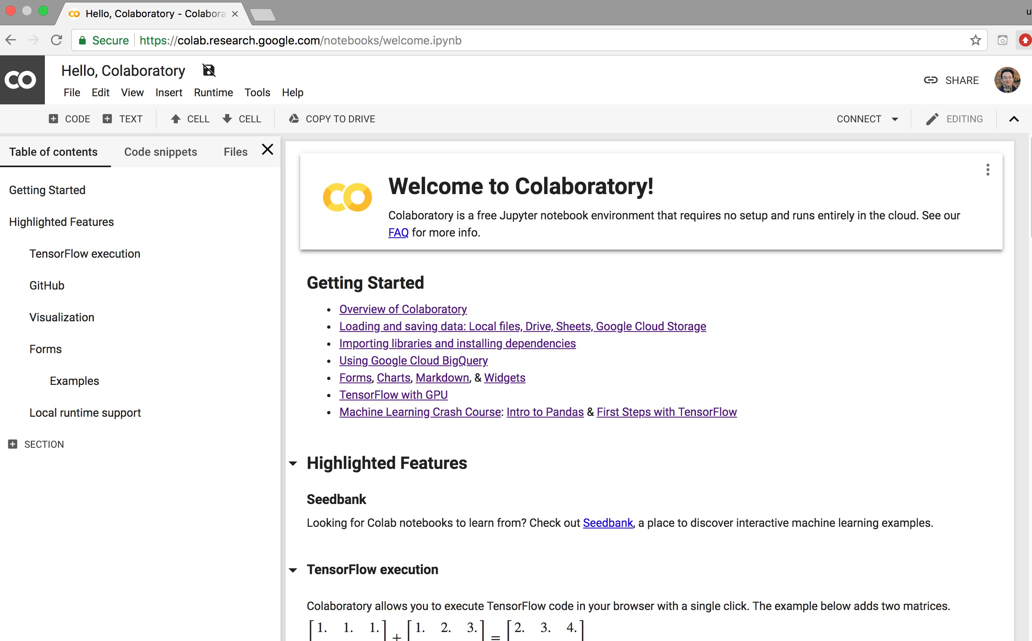
Google Colab
https://colab.research.google.com/notebooks/welcome.ipynb

Slide 74

The Quant Finance PyData Stack
Source: http://nbviewer.jupyter.org/format/slides/github/quantopian/pyfolio/blob/master/pyfolio/examples/overview_slides.ipynb#/5

Slide 75
Python matplotlib
Source: https://matplotlib.org/

Slide 76
Python Pandas
http://pandas.pydata.org/

Slide 77
Iris flower data set
setosa
versicolor
virginica
Source: https://en.wikipedia.org/wiki/Iris_flower_data_set
Source: http://suruchifialoke.com/2016-10-13-machine-learning-tutorial-iris-classification/

Slide 78
Iris Classfication
Source: http://suruchifialoke.com/2016-10-13-machine-learning-tutorial-iris-classification/

Slide 79
iris.data
https://archive.ics.uci.edu/ml/machine-learning-databases/iris/iris.data
5.1,3.5,1.4,0.2,Iris-setosa 4.9,3.0,1.4,0.2,Iris-setosa 4.7,3.2,1.3,0.2,Iris-setosa 4.6,3.1,1.5,0.2,Iris-setosa 5.0,3.6,1.4,0.2,Iris-setosa 5.4,3.9,1.7,0.4,Iris-setosa 4.6,3.4,1.4,0.3,Iris-setosa 5.0,3.4,1.5,0.2,Iris-setosa 4.4,2.9,1.4,0.2,Iris-setosa 4.9,3.1,1.5,0.1,Iris-setosa 5.4,3.7,1.5,0.2,Iris-setosa 4.8,3.4,1.6,0.2,Iris-setosa 4.8,3.0,1.4,0.1,Iris-setosa 4.3,3.0,1.1,0.1,Iris-setosa 5.8,4.0,1.2,0.2,Iris-setosa 5.7,4.4,1.5,0.4,Iris-setosa 5.4,3.9,1.3,0.4,Iris-setosa 5.1,3.5,1.4,0.3,Iris-setosa 5.7,3.8,1.7,0.3,Iris-setosa 5.1,3.8,1.5,0.3,Iris-setosa 5.4,3.4,1.7,0.2,Iris-setosa 5.1,3.7,1.5,0.4,Iris-setosa 4.6,3.6,1.0,0.2,Iris-setosa 5.1,3.3,1.7,0.5,Iris-setosa 4.8,3.4,1.9,0.2,Iris-setosa 5.0,3.0,1.6,0.2,Iris-setosa 5.0,3.4,1.6,0.4,Iris-setosa 5.2,3.5,1.5,0.2,Iris-setosa 5.2,3.4,1.4,0.2,Iris-setosa 4.7,3.2,1.6,0.2,Iris-setosa 4.8,3.1,1.6,0.2,Iris-setosa 5.4,3.4,1.5,0.4,Iris-setosa 5.2,4.1,1.5,0.1,Iris-setosa 5.5,4.2,1.4,0.2,Iris-setosa 4.9,3.1,1.5,0.1,Iris-setosa 5.0,3.2,1.2,0.2,Iris-setosa 5.5,3.5,1.3,0.2,Iris-setosa 4.9,3.1,1.5,0.1,Iris-setosa 4.4,3.0,1.3,0.2,Iris-setosa 5.1,3.4,1.5,0.2,Iris-setosa 5.0,3.5,1.3,0.3,Iris-setosa 4.5,2.3,1.3,0.3,Iris-setosa 4.4,3.2,1.3,0.2,Iris-setosa 5.0,3.5,1.6,0.6,Iris-setosa 5.1,3.8,1.9,0.4,Iris-setosa 4.8,3.0,1.4,0.3,Iris-setosa 5.1,3.8,1.6,0.2,Iris-setosa 4.6,3.2,1.4,0.2,Iris-setosa 5.3,3.7,1.5,0.2,Iris-setosa 5.0,3.3,1.4,0.2,Iris-setosa 7.0,3.2,4.7,1.4,Iris-versicolor 6.4,3.2,4.5,1.5,Iris-versicolor 6.9,3.1,4.9,1.5,Iris-versicolor 5.5,2.3,4.0,1.3,Iris-versicolor 6.5,2.8,4.6,1.5,Iris-versicolor 5.7,2.8,4.5,1.3,Iris-versicolor 6.3,3.3,4.7,1.6,Iris-versicolor 4.9,2.4,3.3,1.0,Iris-versicolor 6.6,2.9,4.6,1.3,Iris-versicolor 5.2,2.7,3.9,1.4,Iris-versicolor 5.0,2.0,3.5,1.0,Iris-versicolor 5.9,3.0,4.2,1.5,Iris-versicolor 6.0,2.2,4.0,1.0,Iris-versicolor 6.1,2.9,4.7,1.4,Iris-versicolor 5.6,2.9,3.6,1.3,Iris-versicolor 6.7,3.1,4.4,1.4,Iris-versicolor 5.6,3.0,4.5,1.5,Iris-versicolor 5.8,2.7,4.1,1.0,Iris-versicolor 6.2,2.2,4.5,1.5,Iris-versicolor 5.6,2.5,3.9,1.1,Iris-versicolor 5.9,3.2,4.8,1.8,Iris-versicolor 6.1,2.8,4.0,1.3,Iris-versicolor 6.3,2.5,4.9,1.5,Iris-versicolor 6.1,2.8,4.7,1.2,Iris-versicolor 6.4,2.9,4.3,1.3,Iris-versicolor 6.6,3.0,4.4,1.4,Iris-versicolor 6.8,2.8,4.8,1.4,Iris-versicolor 6.7,3.0,5.0,1.7,Iris-versicolor 6.0,2.9,4.5,1.5,Iris-versicolor 5.7,2.6,3.5,1.0,Iris-versicolor 5.5,2.4,3.8,1.1,Iris-versicolor 5.5,2.4,3.7,1.0,Iris-versicolor 5.8,2.7,3.9,1.2,Iris-versicolor 6.0,2.7,5.1,1.6,Iris-versicolor 5.4,3.0,4.5,1.5,Iris-versicolor 6.0,3.4,4.5,1.6,Iris-versicolor 6.7,3.1,4.7,1.5,Iris-versicolor 6.3,2.3,4.4,1.3,Iris-versicolor 5.6,3.0,4.1,1.3,Iris-versicolor 5.5,2.5,4.0,1.3,Iris-versicolor 5.5,2.6,4.4,1.2,Iris-versicolor 6.1,3.0,4.6,1.4,Iris-versicolor 5.8,2.6,4.0,1.2,Iris-versicolor 5.0,2.3,3.3,1.0,Iris-versicolor 5.6,2.7,4.2,1.3,Iris-versicolor 5.7,3.0,4.2,1.2,Iris-versicolor 5.7,2.9,4.2,1.3,Iris-versicolor 6.2,2.9,4.3,1.3,Iris-versicolor 5.1,2.5,3.0,1.1,Iris-versicolor 5.7,2.8,4.1,1.3,Iris-versicolor 6.3,3.3,6.0,2.5,Iris-virginica 5.8,2.7,5.1,1.9,Iris-virginica 7.1,3.0,5.9,2.1,Iris-virginica 6.3,2.9,5.6,1.8,Iris-virginica 6.5,3.0,5.8,2.2,Iris-virginica 7.6,3.0,6.6,2.1,Iris-virginica 4.9,2.5,4.5,1.7,Iris-virginica 7.3,2.9,6.3,1.8,Iris-virginica 6.7,2.5,5.8,1.8,Iris-virginica 7.2,3.6,6.1,2.5,Iris-virginica 6.5,3.2,5.1,2.0,Iris-virginica 6.4,2.7,5.3,1.9,Iris-virginica 6.8,3.0,5.5,2.1,Iris-virginica 5.7,2.5,5.0,2.0,Iris-virginica 5.8,2.8,5.1,2.4,Iris-virginica 6.4,3.2,5.3,2.3,Iris-virginica 6.5,3.0,5.5,1.8,Iris-virginica 7.7,3.8,6.7,2.2,Iris-virginica 7.7,2.6,6.9,2.3,Iris-virginica 6.0,2.2,5.0,1.5,Iris-virginica 6.9,3.2,5.7,2.3,Iris-virginica 5.6,2.8,4.9,2.0,Iris-virginica 7.7,2.8,6.7,2.0,Iris-virginica 6.3,2.7,4.9,1.8,Iris-virginica 6.7,3.3,5.7,2.1,Iris-virginica 7.2,3.2,6.0,1.8,Iris-virginica 6.2,2.8,4.8,1.8,Iris-virginica 6.1,3.0,4.9,1.8,Iris-virginica 6.4,2.8,5.6,2.1,Iris-virginica 7.2,3.0,5.8,1.6,Iris-virginica 7.4,2.8,6.1,1.9,Iris-virginica 7.9,3.8,6.4,2.0,Iris-virginica 6.4,2.8,5.6,2.2,Iris-virginica 6.3,2.8,5.1,1.5,Iris-virginica 6.1,2.6,5.6,1.4,Iris-virginica 7.7,3.0,6.1,2.3,Iris-virginica 6.3,3.4,5.6,2.4,Iris-virginica 6.4,3.1,5.5,1.8,Iris-virginica 6.0,3.0,4.8,1.8,Iris-virginica 6.9,3.1,5.4,2.1,Iris-virginica 6.7,3.1,5.6,2.4,Iris-virginica 6.9,3.1,5.1,2.3,Iris-virginica 5.8,2.7,5.1,1.9,Iris-virginica 6.8,3.2,5.9,2.3,Iris-virginica 6.7,3.3,5.7,2.5,Iris-virginica 6.7,3.0,5.2,2.3,Iris-virginica 6.3,2.5,5.0,1.9,Iris-virginica 6.5,3.0,5.2,2.0,Iris-virginica 6.2,3.4,5.4,2.3,Iris-virginica 5.9,3.0,5.1,1.8,Iris-virginica
setosa
virginica
versicolor

Slide 80
Iris Data Visualization
Source: https://seaborn.pydata.org/generated/seaborn.pairplot.html

Slide 81

Connect Google Colab in Google Drive

Slide 82

Google Colab

Slide 83

Google Colab

Slide 84

Connect Colaboratory to Google Drive

Slide 85

Google Colab

Slide 86

Google Colab

Slide 87

Google Colab

Slide 88

Run Jupyter Notebook
Python3 GPU
Google Colab

Slide 89

Google Colab Python Hello World print('Hello World')

Slide 90

Data Visualization in Google Colab
Source: https://seaborn.pydata.org/generated/seaborn.pairplot.html

Slide 91
import seaborn as sns
sns.set(style="ticks", color_codes=True)
iris = sns.load_dataset("iris")
g = sns.pairplot(iris, hue="species")
Source: https://seaborn.pydata.org/generated/seaborn.pairplot.html

Slide 92
https://colab.research.google.com/drive/1KRqtEUd2Hg4dM2au9bfVQKrxWnWN3O9-
import numpy as np
import pandas as pd
%matplotlib inline
import matplotlib.pyplot as plt
import seaborn as sns
from pandas.plotting import scatter_matrix
# Load dataset
url = "https://archive.ics.uci.edu/ml/machine-learning-databases/iris/iris.data"
names = ['sepal-length', 'sepal-width', 'petal-length', 'petal-width', 'class']
df = pd.read_csv(url, names=names)
print(df.head(10))
print(df.tail(10))
print(df.describe())
print(df.info())
print(df.shape)
print(df.groupby('class').size())
plt.rcParams["figure.figsize"] = (10,8)
df.plot(kind='box', subplots=True, layout=(2,2), sharex=False, sharey=False)
plt.show()
df.hist()
plt.show()
scatter_matrix(df)
plt.show()
sns.pairplot(df, hue="class", size=2)
Source: https://machinelearningmastery.com/machine-learning-in-python-step-by-step/
Notes:
# coding: utf-8
# Source: https://machinelearningmastery.com/machine-learning-in-python-step-by-step/
# https://colab.research.google.com/drive/1KRqtEUd2Hg4dM2au9bfVQKrxWnWN3O9-
import numpy as np
import pandas as pd
%matplotlib inline
import matplotlib.pyplot as plt
import seaborn as sns
from pandas.plotting import scatter_matrix
# Load dataset
url = "https://archive.ics.uci.edu/ml/machine-learning-databases/iris/iris.data"
names = ['sepal-length', 'sepal-width', 'petal-length', 'petal-width', 'class']
df = pd.read_csv(url, names=names)
print(df.head(10))
print(df.tail(10))
print(df.describe())
print(df.info())
print(df.shape)
print(df.groupby('class').size())
plt.rcParams["figure.figsize"] = (10,8)
df.plot(kind='box', subplots=True, layout=(2,2), sharex=False, sharey=False)
plt.show()
df.hist()
plt.show()
scatter_matrix(df)
plt.show()
sns.pairplot(df, hue="class", size=2)

Slide 93

import numpy as np
import pandas as pd
%matplotlib inline
import matplotlib.pyplot as plt
import seaborn as sns
from pandas.plotting import scatter_matrix

Slide 94

url = "https://archive.ics.uci.edu/ml/machine-learning-databases/iris/iris.data"
names = ['sepal-length', 'sepal-width', 'petal-length', 'petal-width', 'class']
df = pd.read_csv(url, names=names)
print(df.head(10))

Slide 95

df.tail(10)

Slide 96

df.describe()

Slide 97

print(df.info())
print(df.shape)

Slide 98

df.groupby('class').size()

Slide 99

plt.rcParams["figure.figsize"] = (10,8)
df.plot(kind='box', subplots=True, layout=(2,2), sharex=False, sharey=False)
plt.show()

Slide 100

df.hist()
plt.show()

Slide 101

scatter_matrix(df)
plt.show()

Slide 102

sns.pairplot(df, hue="class", size=2)

Slide 103
References
Ramesh Sharda, Dursun Delen, and Efraim Turban (2017), Business Intelligence, Analytics, and Data Science: A Managerial Perspective, 4th Edition, Pearson.
EMC Education Services (2015),
Data Science and Big Data Analytics: Discovering, Analyzing, Visualizing and Presenting Data, Wiley
SAS Modernization architectures - Big Data Analytics, http://www.slideshare.net/deepakramanathan/sas-modernization-architectures-big-data-analytics

