Slide 1




人工智慧投資分析
Artificial Intelligence for Investment Analysis
Tamkang
University
Python Pandas量化投資分析
(Quantitative Investing with
Pandas in Python)
1071AIIA07
EMBA, IMTKU (M2399) (8540)
Thu 12,13,14 (19:20-22:10) (D503)
Min-Yuh Day
戴敏育
Assistant Professor
專任助理教授
Dept. of Information Management, Tamkang University
淡江大學 資訊管理學系
http://mail. tku.edu.tw/myday/
2018-11-01

Slide 2
課程大綱 (Syllabus)
週次 (Week) 日期 (Date) 內容 (Subject/Topics)
1 2018/09/13 人工智慧投資分析課程介紹
(Course Orientation on Artificial Intelligence for
Investment Analysis)
2 2018/09/20 AI 金融科技: 金融服務創新應用
(AI in FinTech: Financial Services Innovation and Application)
3 2018/09/27 機器人理財顧問與AI交談機器人
(Robo-Advisors and AI Chatbots)
4 2018/10/04 投資心理學與行為財務學
(Investing Psychology and Behavioral Finance)
5 2018/10/11 財務金融事件研究法 (Event Studies in Finance)
6 2018/10/18 人工智慧投資分析個案研究 I
(Case Study on Artificial Intelligence for Investment Analysis I)

Slide 3
課程大綱 (Syllabus)
週次 (Week) 日期 (Date) 內容 (Subject/Topics)
7 2018/10/25 Python AI投資分析基礎
(Foundations of AI Investment Analysis in Python)
8 2018/11/01 Python Pandas量化投資分析
(Quantitative Investing with Pandas in Python)
9 2018/11/08 Python Scikit-Learn 機器學習
(Machine Learning with Scikit-Learn In Python)
10 2018/11/15 期中報告 (Midterm Project Report)
11 2018/11/22 TensorFlow 深度學習財務時間序列預測 I
(Deep Learning for Financial Time Series Forecasting
with TensorFlow I)
12 2018/11/29 TensorFlow 深度學習財務時間序列預測 II
(Deep Learning for Financial Time Series Forecasting
with TensorFlow II)

Slide 4
課程大綱 (Syllabus)
週次 (Week) 日期 (Date) 內容 (Subject/Topics)
13 2018/12/06 人工智慧投資分析個案研究 II
(Case Study on Artificial Intelligence for Investment Analysis II)
14 2018/12/13 TensorFlow 深度學習財務時間序列預測 III
(Deep Learning for Financial Time Series Forecasting
with TensorFlow III)
15 2018/12/20 投資組合最佳化與程式交易
(Portfolio Optimization and Algorithmic Trading)
16 2018/12/27 自然語言處理 (Natural Language Processing)
17 2019/01/03 期末報告 I (Final Project Presentation I)
18 2019/01/10 期末報告 II (Final Project Presentation II)

Slide 5
Quantitative Investing with
Pandas in Python

Slide 6
Outline
Quantitative Investing with Pandas in Python
  Numpy
  Pandas

Slide 7
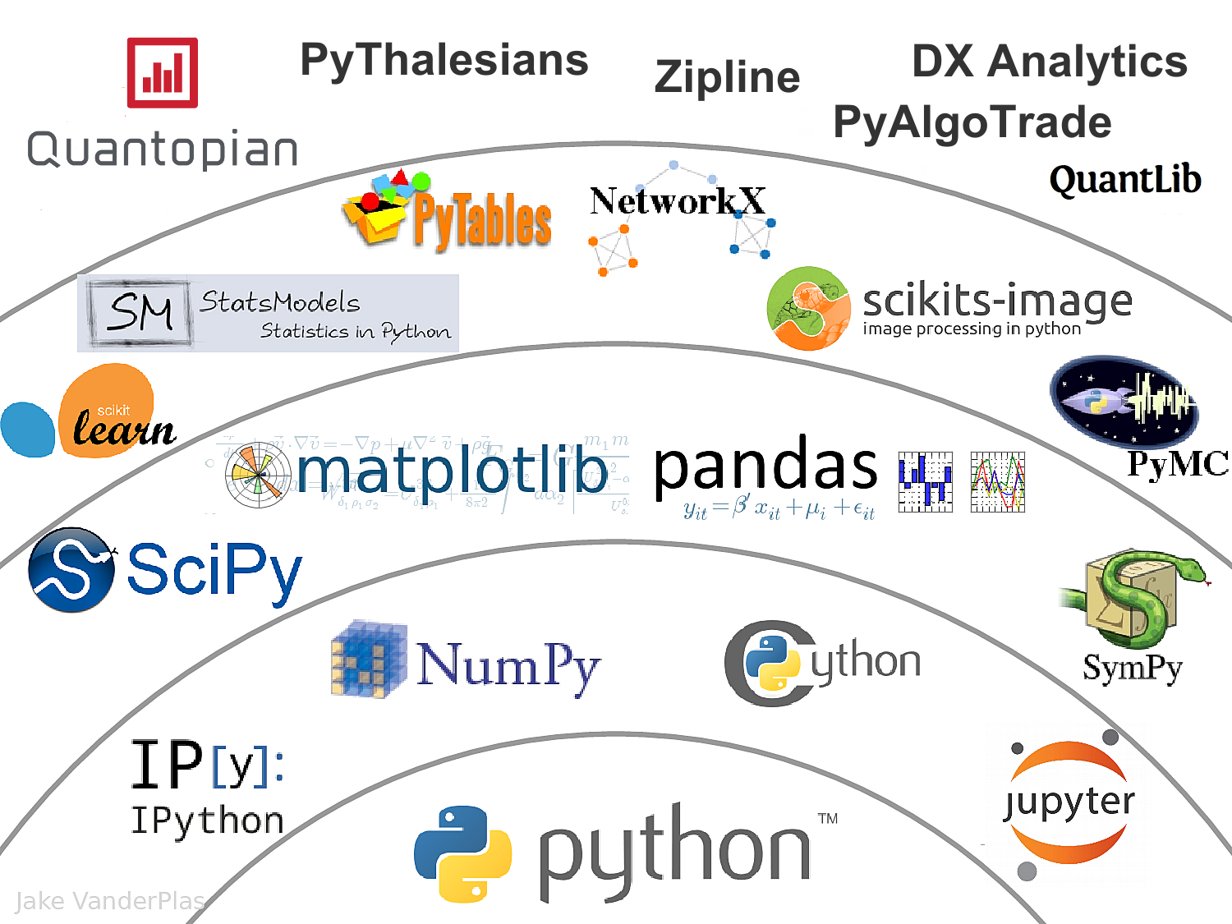
The Quant Finance PyData Stack
Source: http://nbviewer.jupyter.org/format/slides/github/quantopian/pyfolio/blob/master/pyfolio/examples/overview_slides.ipynb#/5

Slide 8
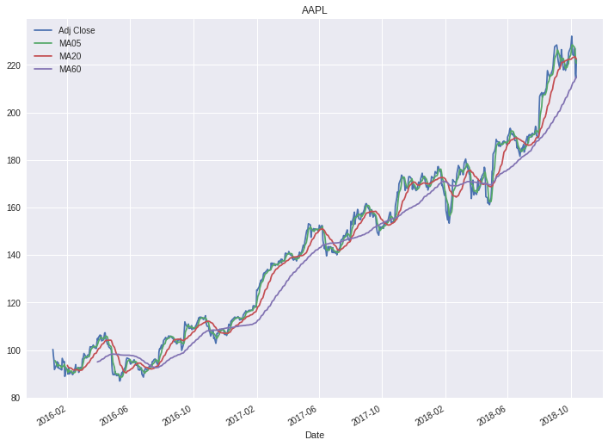

Slide 9
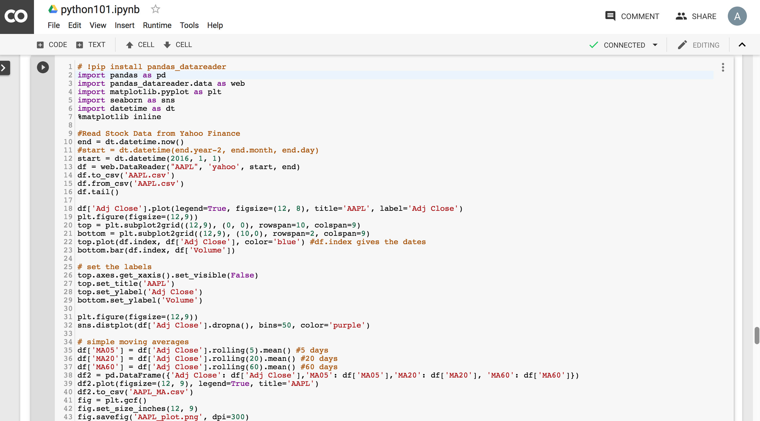
Python in Google Colab
https://colab.research.google.com/drive/1FEG6DnGvwfUbeo4zJ1zTunjMqf2RkCrT

Slide 10
Big Data Analytics with
Numpy in Python

Slide 11
Numpy
NumPy
Base
N-dimensional array package

Slide 12
NumPy is the fundamental package for scientific computing with Python.
Source: http://www.numpy.org/

Slide 13
NumPy
NumPy
NumPy provides a
multidimensional array object
to store homogenous or heterogeneous data;
it also provides
optimized functions/methods to operate on this array object.
Source: Yves Hilpisch (2014), Python for Finance: Analyze Big Financial Data, O'Reilly

Slide 14
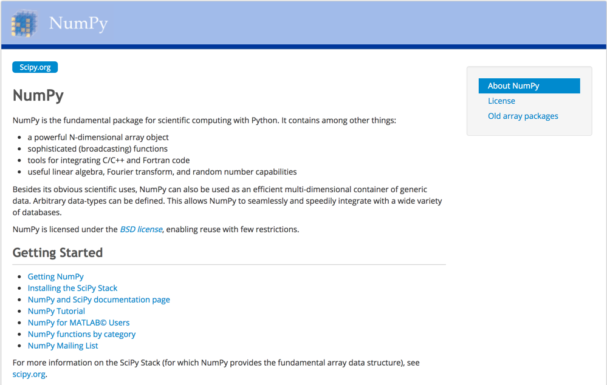
NumPy
http://www.numpy.org/

Slide 15
NumPy ndarray
NumPy
One-dimensional Array
(1-D Array)
0 | 1 |  |  | n-1
1 | 2 | 3 | 4 | 5
Two-dimensional Array
(2-D Array)
 | 0 | 1 |  |  | n-1
0 | 1 | 2 | 3 | 4 | 5
1 | 6 | 7 | 8 | 9 | 10
 | 11 | 12 | 13 | 14 | 15
m-1 | 16 | 17 | 18 | 19 | 20

Slide 16
v = list(range(1, 6)) v
2 * v import numpy as np v = np.arange(1, 6) v
2 * v
NumPy
NumPy
Source: Yves Hilpisch (2014), Python for Finance: Analyze Big Financial Data, O'Reilly
Notes:
# pip3 install numpy
# pip install numpy
# sudo pip3 install numpy
import numpy as np

Slide 17
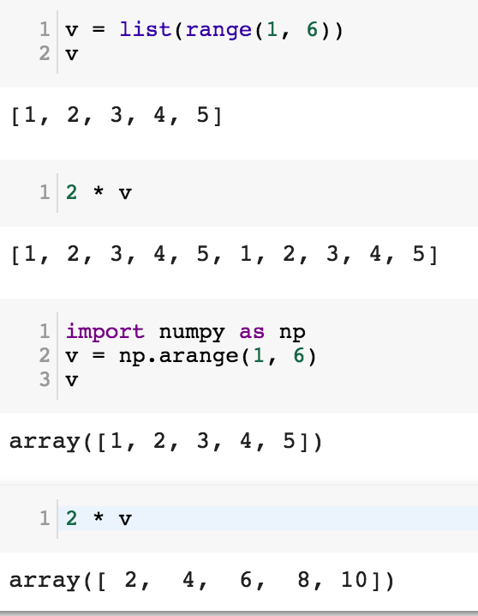
NumPy
Base
N-dimensional array package

Slide 18
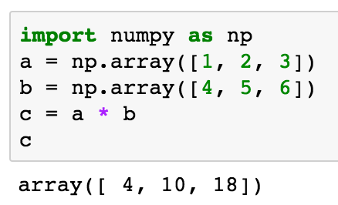
import numpy as np a = np.array([1, 2, 3]) b = np.array([4, 5, 6]) c = a * b c
NumPy Create Array
NumPy
Source: Yves Hilpisch (2014), Python for Finance: Analyze Big Financial Data, O'Reilly

Slide 19
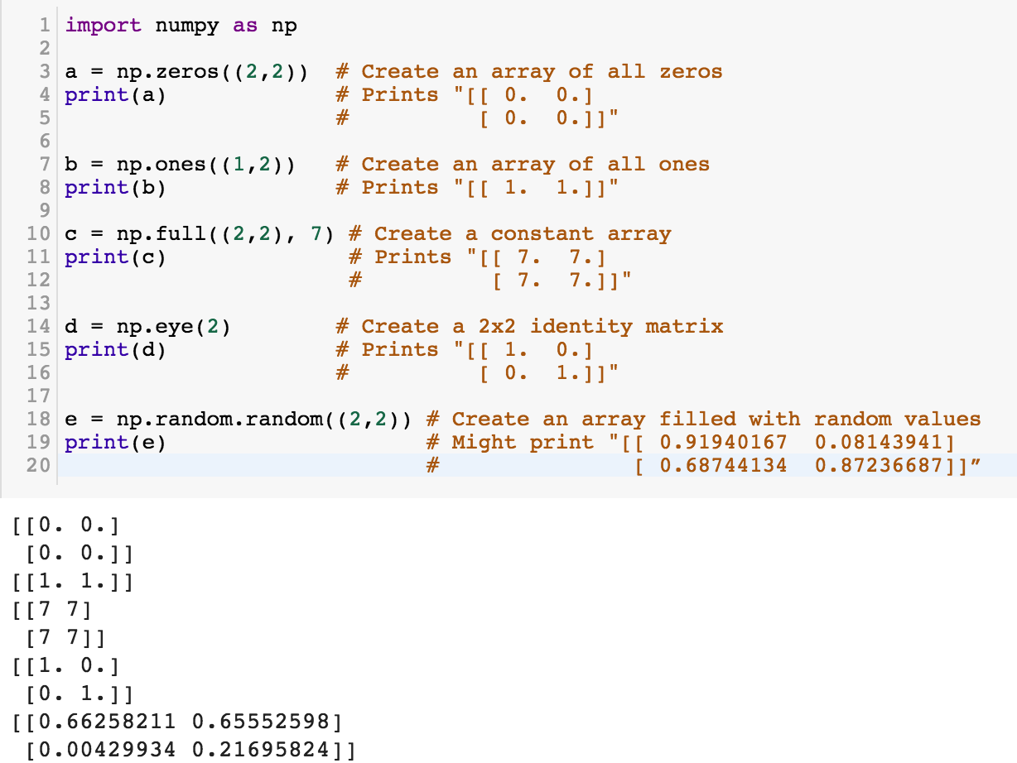
NumPy
NumPy
Source: http://cs231n.github.io/python-numpy-tutorial/
Notes:
import numpy as np
a = np.zeros((2,2)) # Create an array of all zeros
print(a) # Prints "[[ 0. 0.]
# [ 0. 0.]]"
b = np.ones((1,2)) # Create an array of all ones
print(b) # Prints "[[ 1. 1.]]"
c = np.full((2,2), 7) # Create a constant array
print(c) # Prints "[[ 7. 7.]
# [ 7. 7.]]"
d = np.eye(2) # Create a 2x2 identity matrix
print(d) # Prints "[[ 1. 0.]
# [ 0. 1.]]"
e = np.random.random((2,2)) # Create an array filled with random values
print(e) # Might print "[[ 0.91940167 0.08143941]
# [ 0.68744134 0.87236687]]”
Source: http://cs231n.github.io/python-numpy-tutorial/

Slide 20
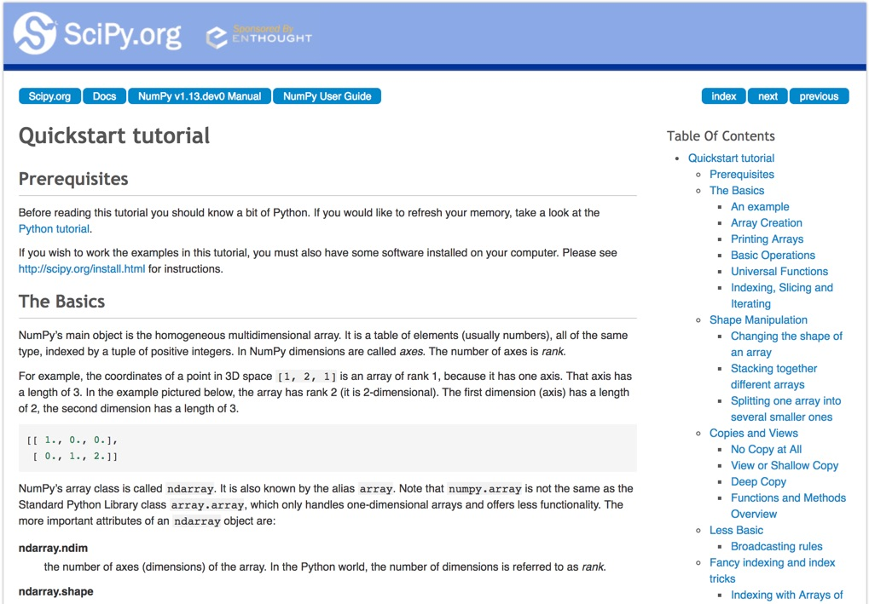
Numpy Quickstart Tutorial
https://docs.scipy.org/doc/numpy-dev/user/quickstart.html

Slide 21
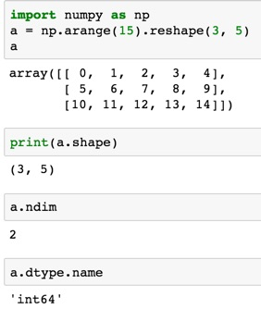
import numpy as np
a = np.arange(15).reshape(3, 5)
a.shape
a.ndim
a.dtype.name
Source: https://docs.scipy.org/doc/numpy-dev/user/quickstart.html
Notes:
Numpy Tutorial
Source: https://docs.scipy.org/doc/numpy-dev/user/quickstart.html
In [1]:
import numpy as np
a = np.arange(15).reshape(3, 5)
a
Out[1]:
array([[ 0, 1, 2, 3, 4],
[ 5, 6, 7, 8, 9],
[10, 11, 12, 13, 14]])
In [2]:
print(a.shape)
(3, 5)
In [3]:
a.ndim
Out[3]:
2
In [4]:
a.dtype.name
Out[4]:
'int64'
In [5]:
a.itemsize
Out[5]:
8
In [6]:
a.size
Out[6]:
15
In [7]:
type(a)
Out[7]:
numpy.ndarray
In [8]:
b = np.array([1, 2, 3])
In [9]:
b
Out[9]:
array([1, 2, 3])
In [10]:
type(b)
Out[10]:
numpy.ndarray

Slide 22
Matrix
Source: https://simple.wikipedia.org/wiki/Matrix_(mathematics)

Slide 23
NumPy ndarray:
Multidimensional Array Object

Slide 24
NumPy ndarray
One-dimensional Array
(1-D Array)
0 | 1 |  |  | n-1
1 | 2 | 3 | 4 | 5
Two-dimensional Array
(2-D Array)
 | 0 | 1 |  |  | n-1
0 | 1 | 2 | 3 | 4 | 5
1 | 6 | 7 | 8 | 9 | 10
 | 11 | 12 | 13 | 14 | 15
m-1 | 16 | 17 | 18 | 19 | 20

Slide 25

import numpy as np a = np.array([1,2,3,4,5])
One-dimensional Array
(1-D Array)
0 | 1 |  |  | n-1
1 | 2 | 3 | 4 | 5

Slide 26
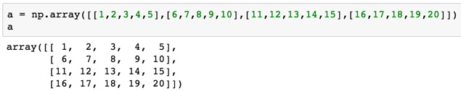
a = np.array([[1,2,3,4,5],[6,7,8,9,10],[11,12,13,14,15],[16,17,18,19,20]])
Two-dimensional Array
(2-D Array)
 | 0 | 1 |  |  | n-1
0 | 1 | 2 | 3 | 4 | 5
1 | 6 | 7 | 8 | 9 | 10
 | 11 | 12 | 13 | 14 | 15
m-1 | 16 | 17 | 18 | 19 | 20

Slide 27
import numpy as np
a = np.array([[0, 1, 2, 3], [10, 11, 12, 13],
[20, 21, 22, 23]])
a
0 | 1 | 2 | 3
10 | 11 | 12 | 13
20 | 21 | 22 | 23
Notes:
import numpy as np
a = np.array([[0, 1, 2, 3], [10, 11, 12, 13],
[20, 21, 22, 23]])
a

Slide 28
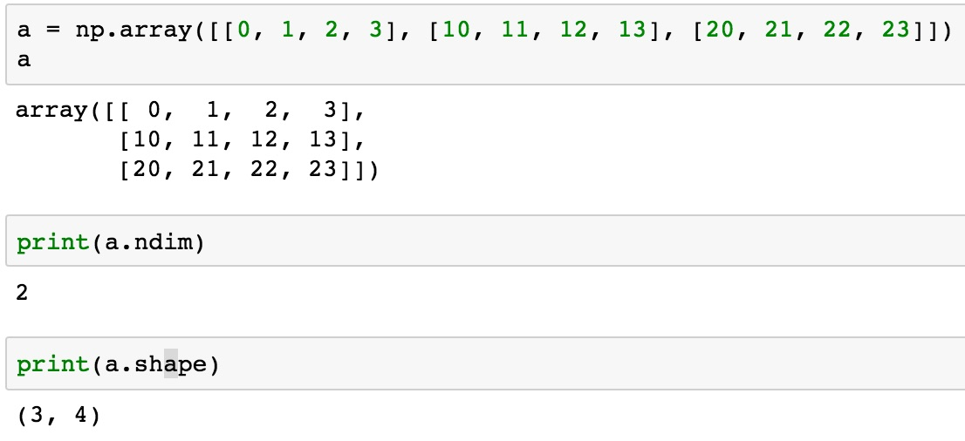
a = np.array([[0, 1, 2, 3], [10, 11, 12, 13], [20, 21, 22, 23]])
0 | 1 | 2 | 3
10 | 11 | 12 | 13
20 | 21 | 22 | 23

Slide 29
NumPy Basics:
Arrays and Vectorized Computation
Source: https://www.safaribooksonline.com/library/view/python-for-data/9781449323592/ch04.html

Slide 30
NumPy Array
Source: https://www.safaribooksonline.com/library/view/python-for-data/9781449323592/ch04.html

Slide 31
Numpy Array
Source: https://www.safaribooksonline.com/library/view/python-for-data/9781449323592/ch04.html

Slide 32
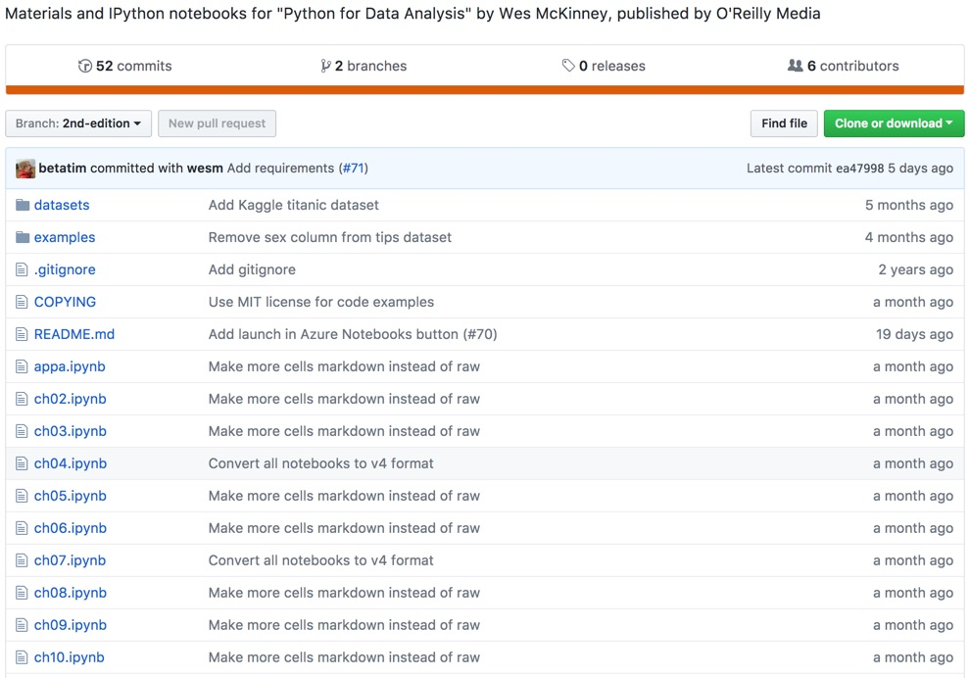
Wes McKinney (2017), "Python for Data Analysis: Data Wrangling with Pandas, NumPy, and IPython", 2nd Edition, O'Reilly Media.
https://github.com/wesm/pydata-book

Slide 33
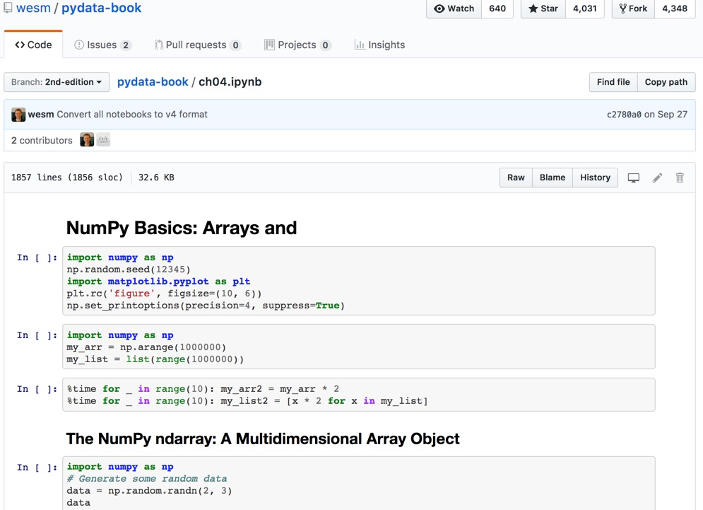
Wes McKinney (2017), "Python for Data Analysis: Data Wrangling with Pandas, NumPy, and IPython", 2nd Edition, O'Reilly Media.
Source: https://github.com/wesm/pydata-book/blob/2nd-edition/ch04.ipynb

Slide 34
Python Pandas

Slide 35
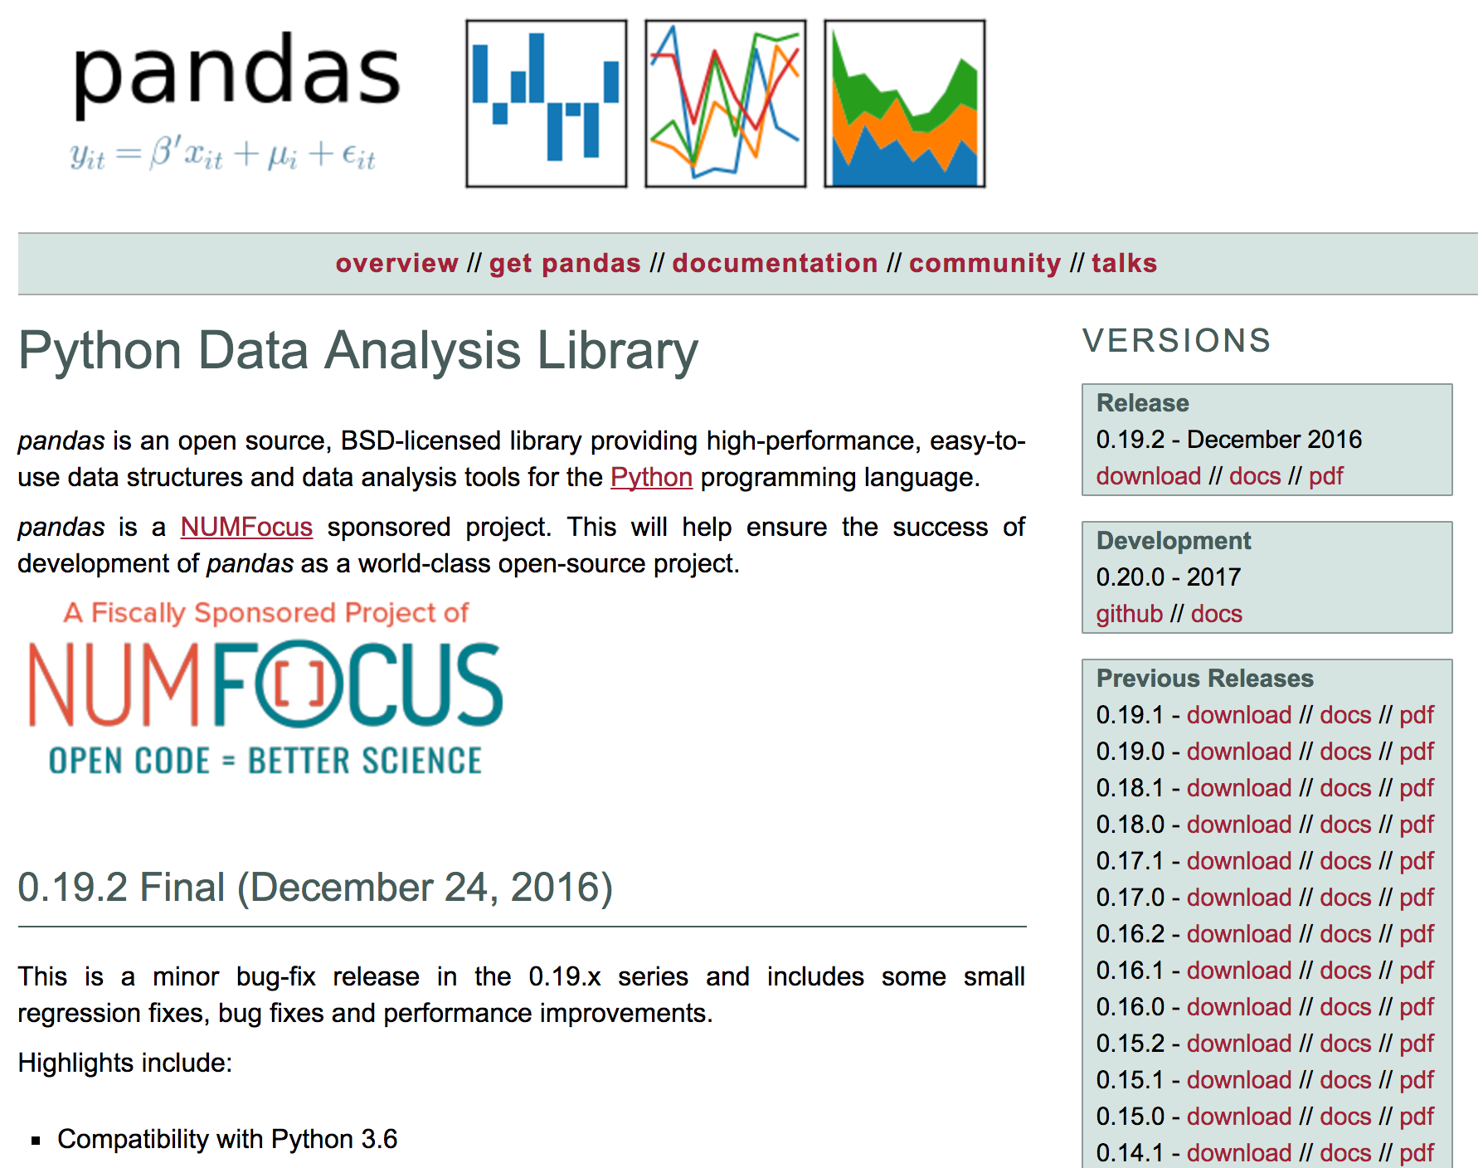
pandas
http://pandas.pydata.org/

Slide 36
pandas
Python Data Analysis Library providing high-performance, easy-to-use data structures and data analysis tools for the Python programming language.
Source: http://pandas.pydata.org/

Slide 37
pandas Ecosystem
Statistics and Machine Learning
  Statsmodels
  sklearn-pandas
Visualization
  Bokeh
  yhat/ggplot
  Seaborn
  Vincent
  IPython Vega
  Plotly
  Pandas-Qt
IDE
  IPython
  quantopian/qgrid
  Spyder
API
  pandas-datareader
  quandl/Python
  pydatastream
  pandaSDMX
  fredapi
Domain Specific
  Geopandas
  xarray
Out-of-core
  Dask
  Blaze
  Odo
Source: http://pandas.pydata.org/pandas-docs/stable/index.html

Slide 38
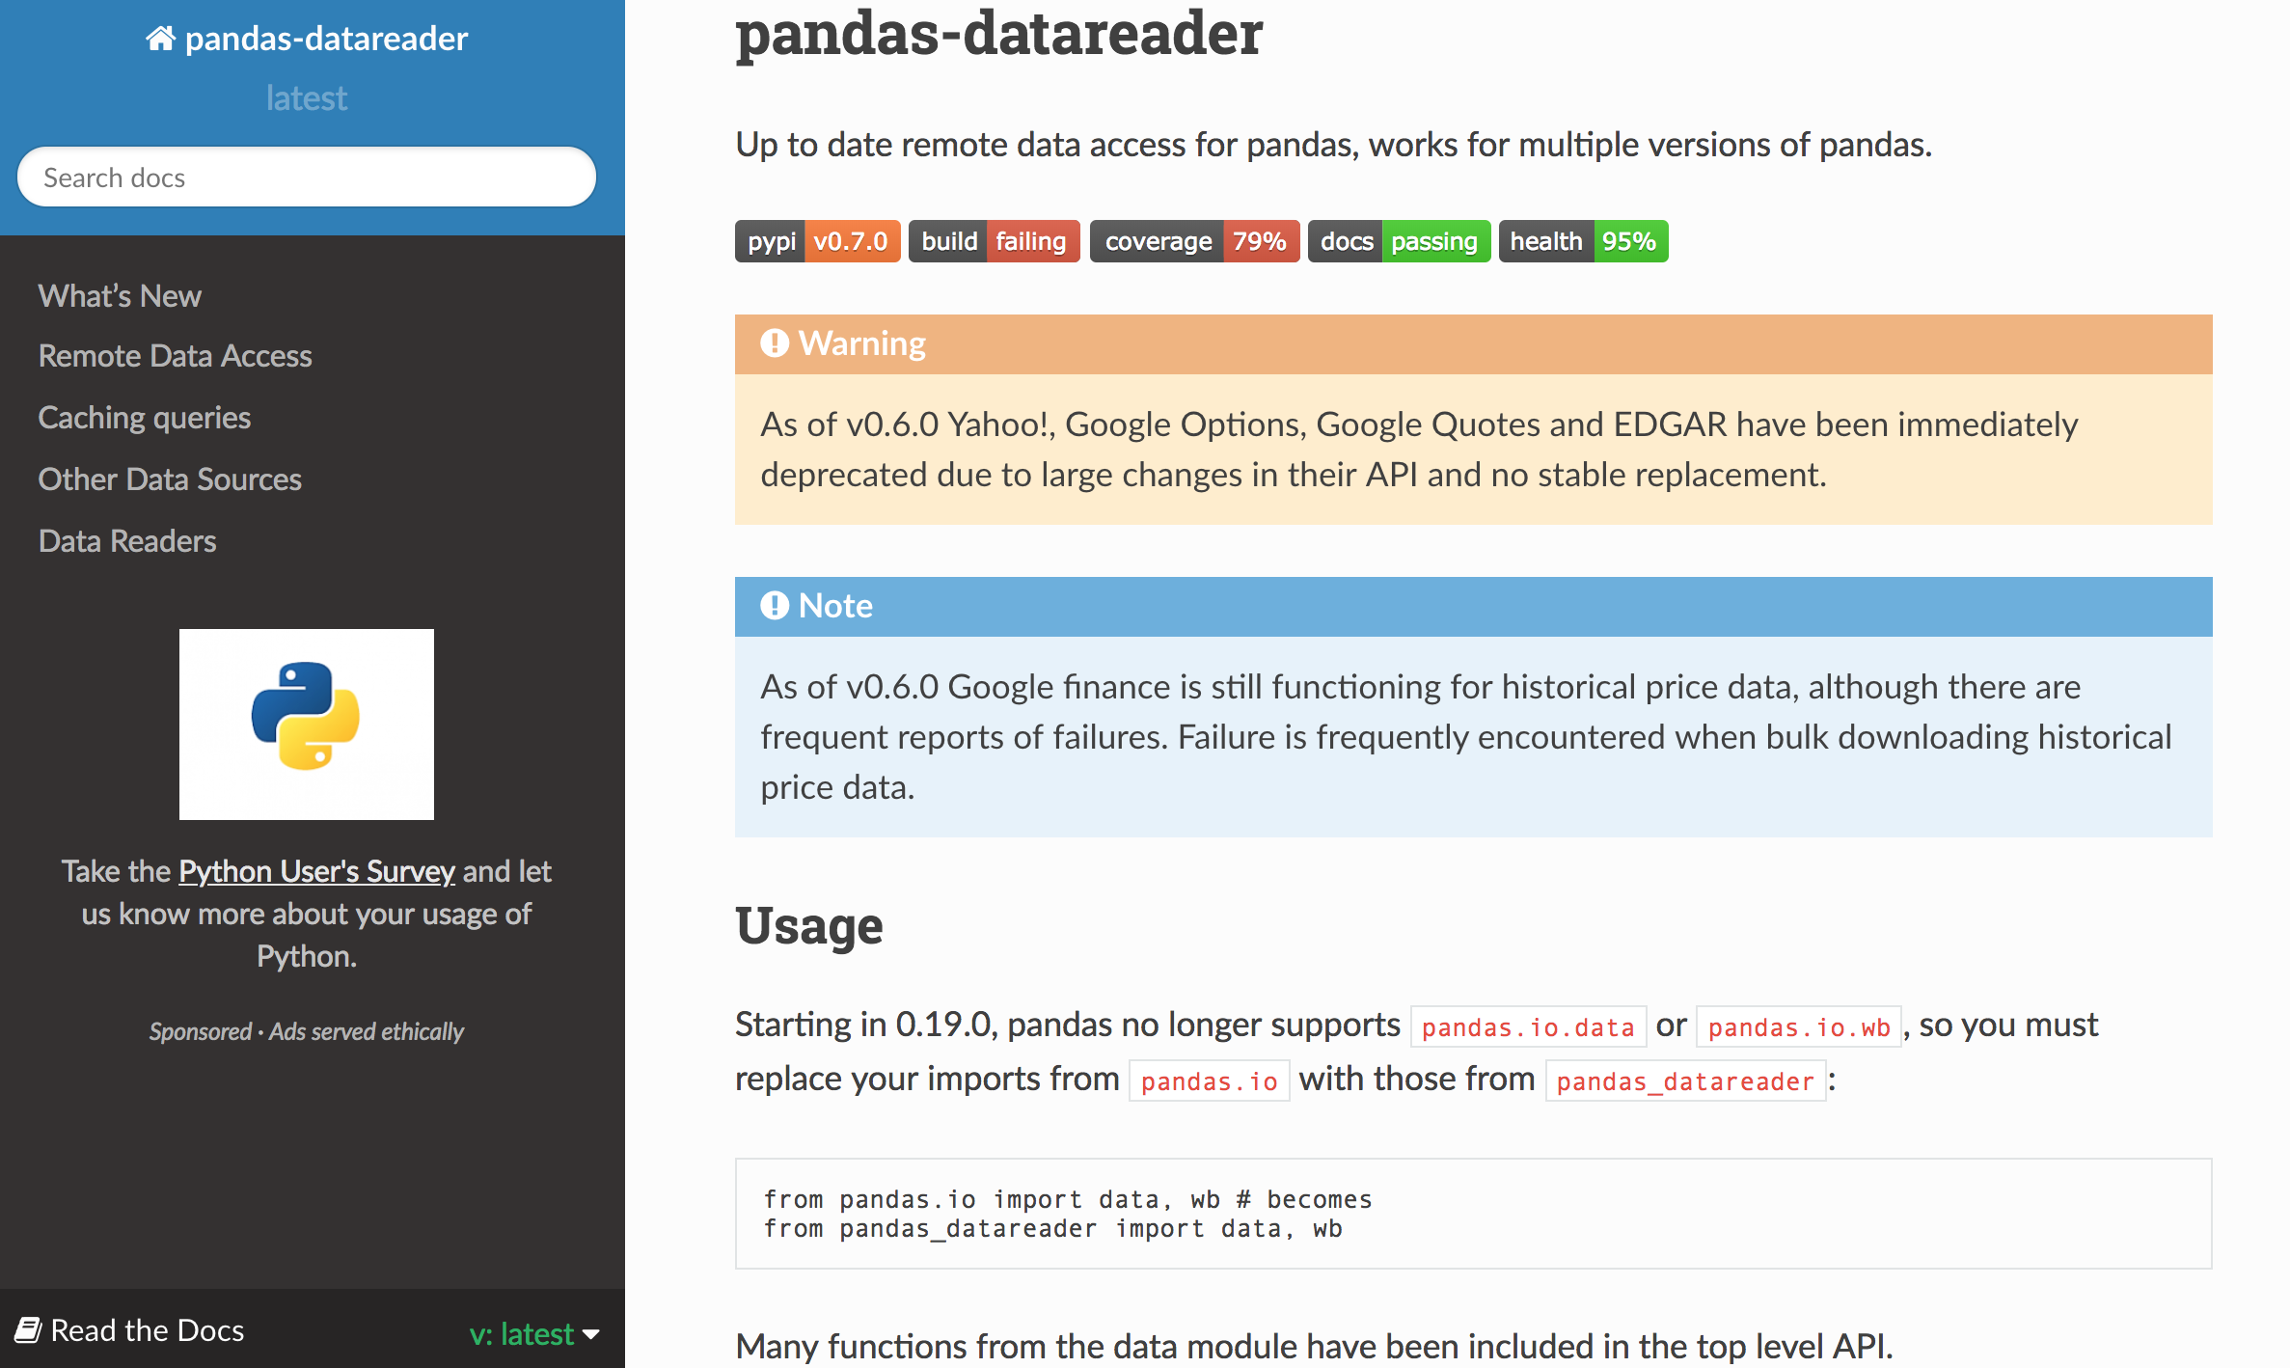
pandas-datareader
https://pandas-datareader.readthedocs.io/en/latest/

Slide 39
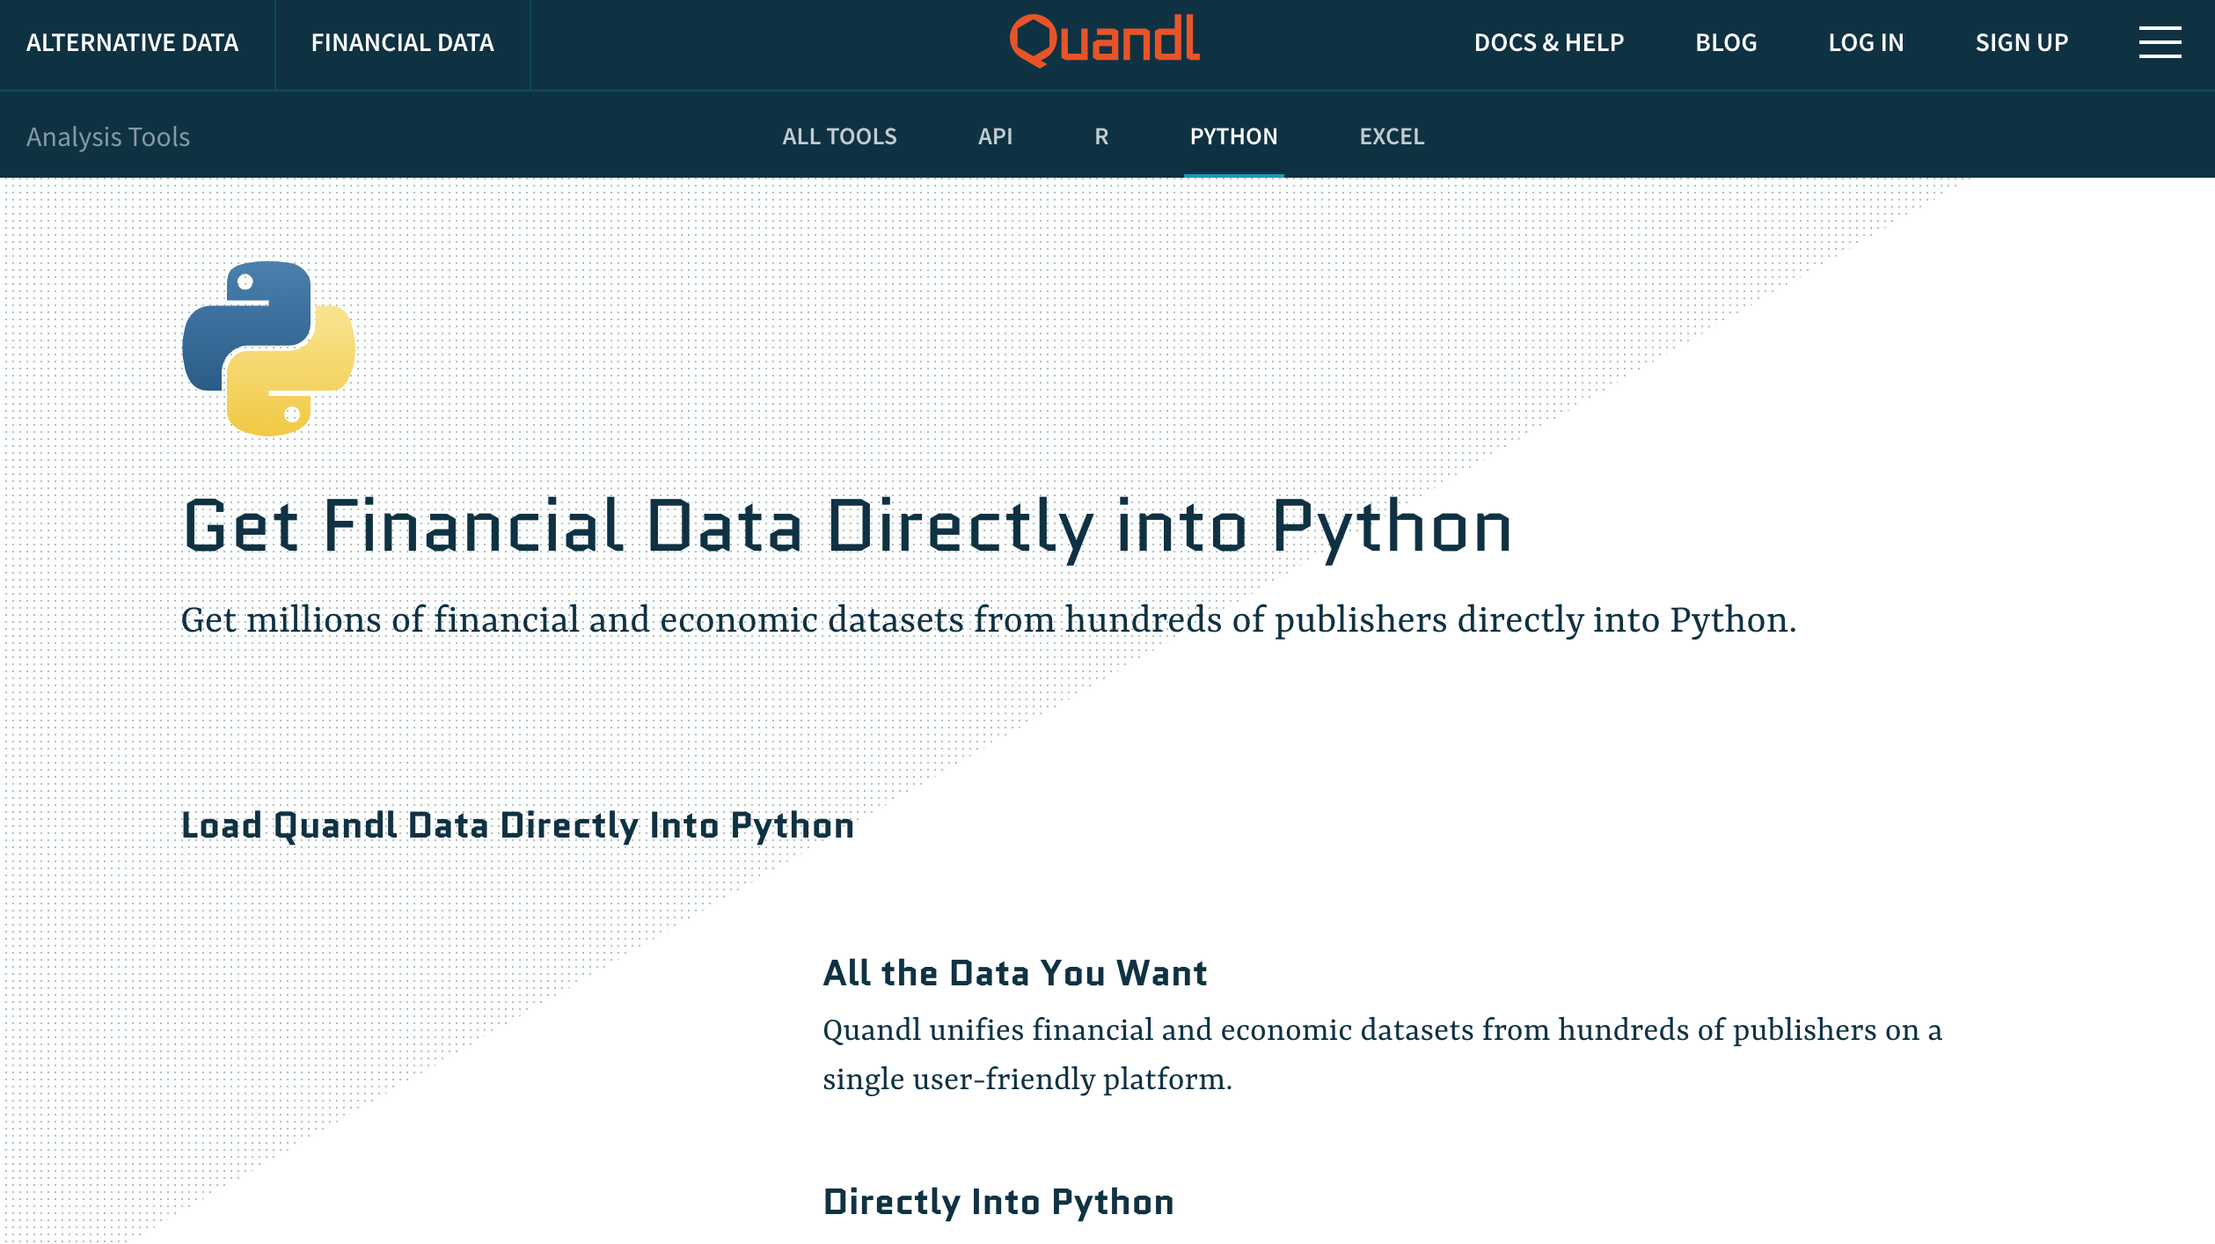
Quandl
https://www.quandl.com/tools/python

Slide 40
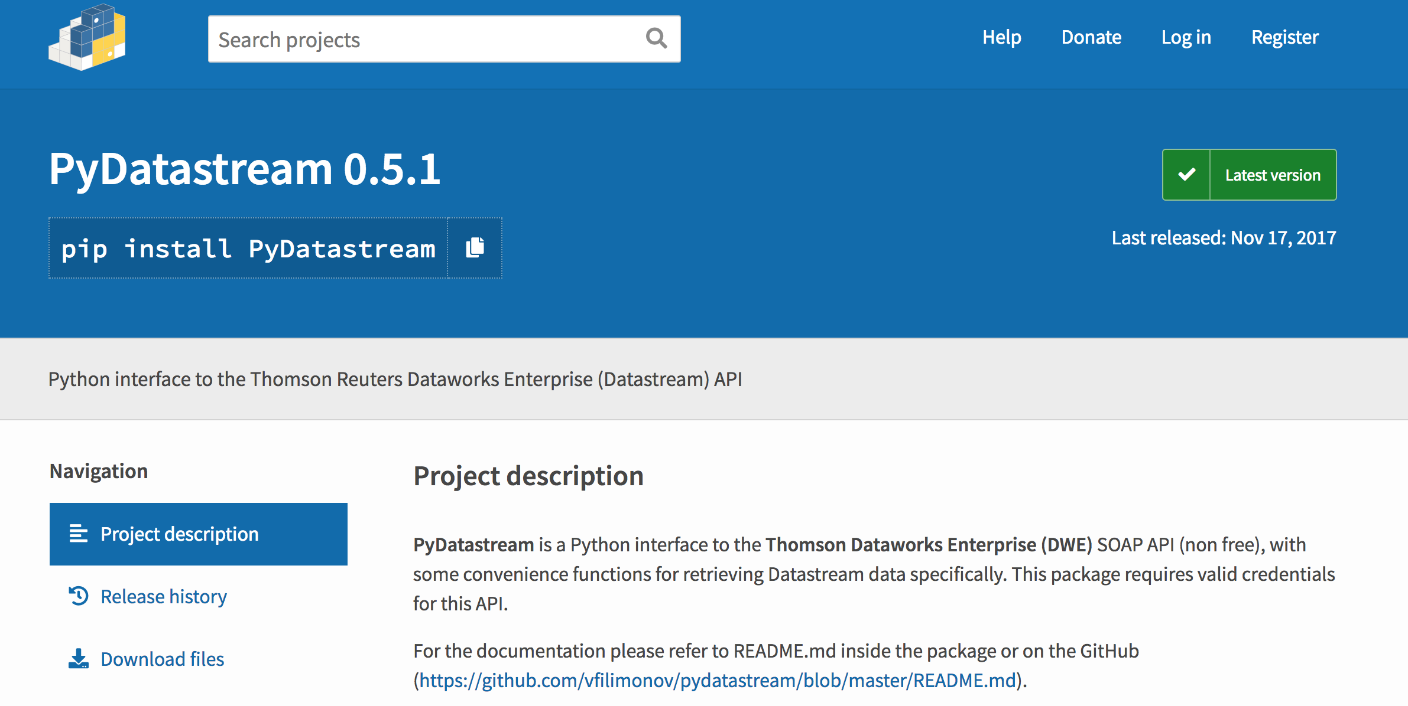
PyDatastream
https://pypi.org/project/PyDatastream/

Slide 41
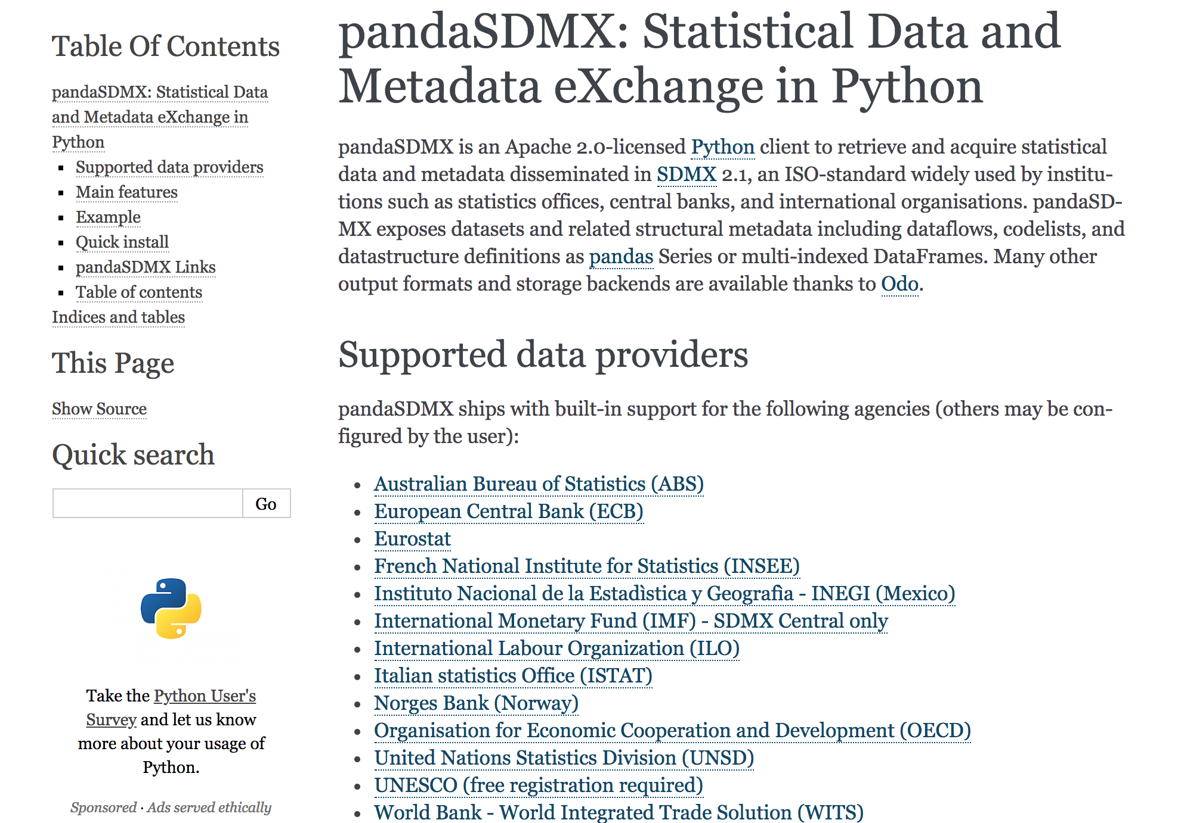
pandasSDMX
https://pandasdmx.readthedocs.io/en/latest/

Slide 42
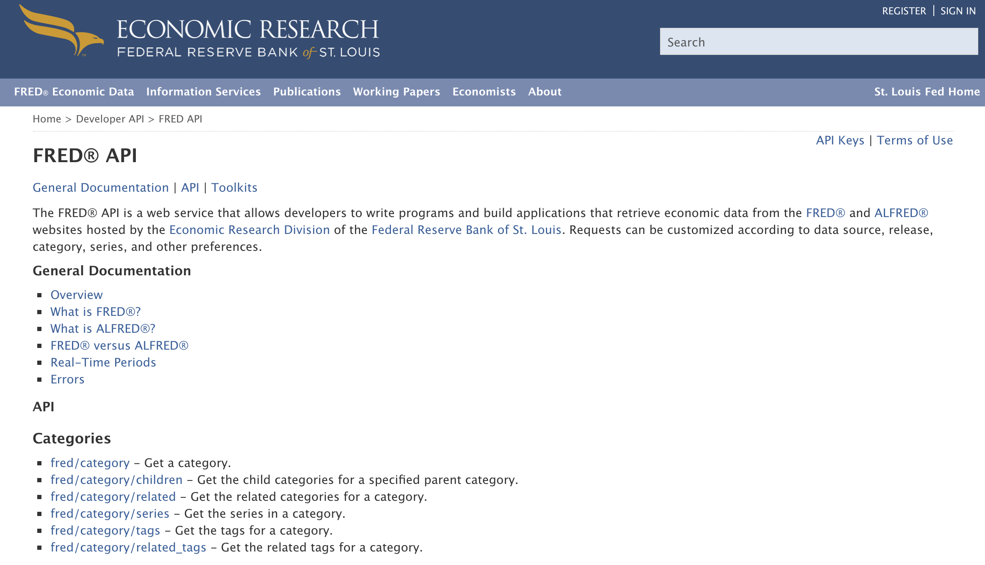
Fred API
https://research.stlouisfed.org/docs/api/fred/

Slide 43
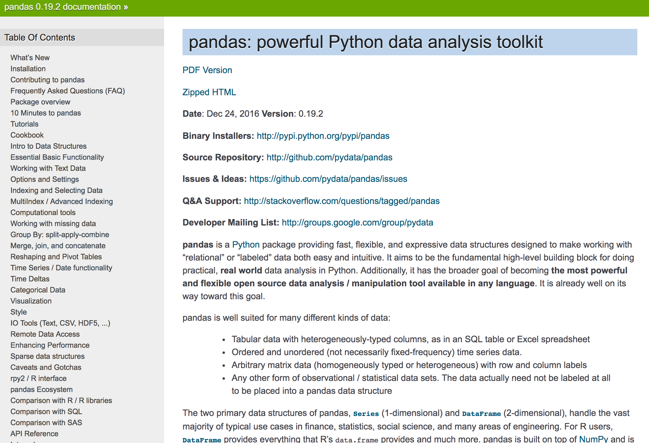
pandas: powerful Python data analysis toolkit
http://pandas.pydata.org/pandas-docs/stable/

Slide 44
pandas: powerful Python data analysis toolkit
Tabular data with
heterogeneously-typed columns,
as in an SQL table or Excel spreadsheet
Ordered and unordered (not necessarily fixed-frequency) time series data.
Arbitrary matrix data (homogeneously typed or heterogeneous) with row and column labels
Any other form of observational / statistical data sets. The data actually need not be labeled at all to be placed into a pandas data structure
Source: http://pandas.pydata.org/pandas-docs/stable/

Slide 45
Series
DataFrame
Primary data structures of pandas
  Series (1-dimensional)
  DataFrame (2-dimensional)
Handle the vast majority of typical use cases in finance, statistics, social science, and many areas of engineering.
Source: http://pandas.pydata.org/pandas-docs/stable/

Slide 46
pandas DataFrame
DataFrame provides everything that R’s data.frame provides and much more.
pandas is built on top of NumPy and is intended to integrate well within a scientific computing environment with many other 3rd party libraries.

Slide 47
pandas
Comparison with SAS
pandas | SAS
DataFrame | data set
column | variable
row | observation
groupby | BY-group
NaN | .
Source: http://pandas.pydata.org/pandas-docs/stable/comparison_with_sas.html

Slide 48
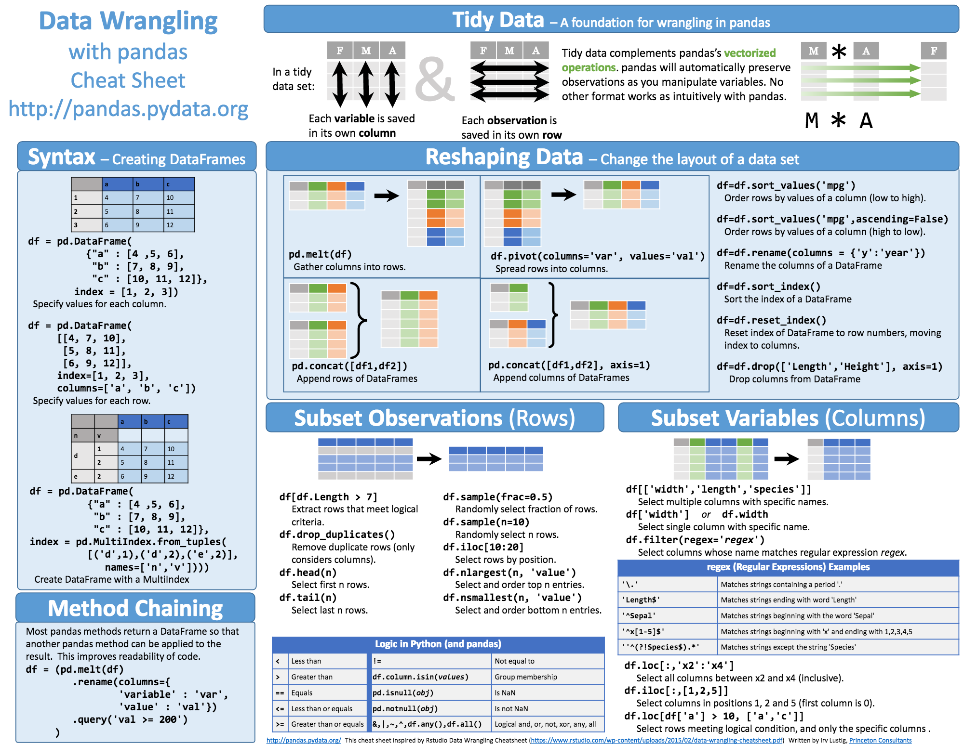
Python Pandas Cheat Sheet
Source: https://github.com/pandas-dev/pandas/blob/master/doc/cheatsheet/Pandas_Cheat_Sheet.pdf

Slide 49
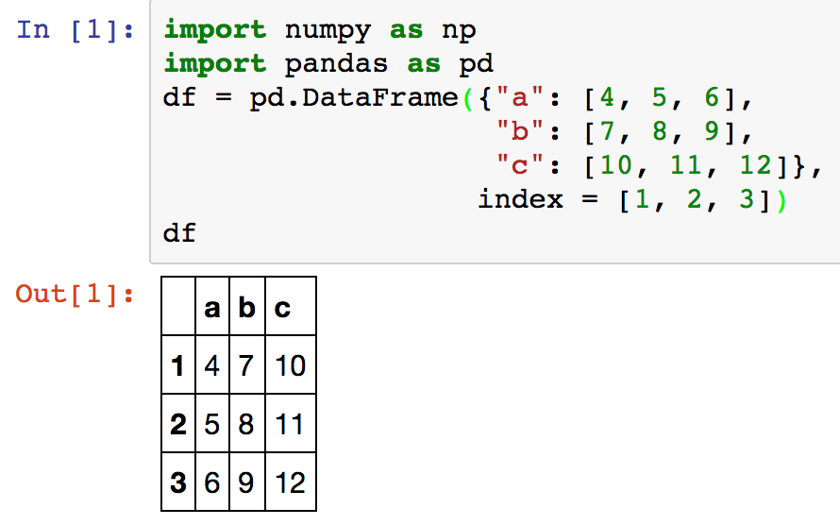
Creating pd.DataFrame
 | a | b | c
1 | 4 | 7 | 10
2 | 5 | 8 | 11
3 | 6 | 9 | 12
import pandas as pd
df = pd.DataFrame({"a": [4, 5, 6],
"b": [7, 8, 9],
"c": [10, 11, 12]},
index = [1, 2, 3])
Source: https://github.com/pandas-dev/pandas/blob/master/doc/cheatsheet/Pandas_Cheat_Sheet.pdf
Notes:
import numpy as np
import pandas as pd
df = pd.DataFrame({"a": [4, 5, 6],
"b": [7, 8, 9],
"c": [10, 11, 12]},
index = [1, 2, 3])
df

Slide 50
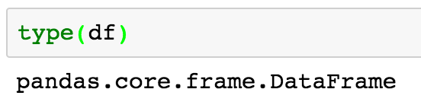
Pandas DataFrame
type(df)

Slide 51
import numpy as np
import pandas as pd
import matplotlib.pyplot as plt
print('pandas imported')
s = pd.Series([1,3,5,np.nan,6,8])
s
dates = pd.date_range('20181001', periods=6)
dates
Source: http://pandas.pydata.org/pandas-docs/stable/10min.html

Slide 52
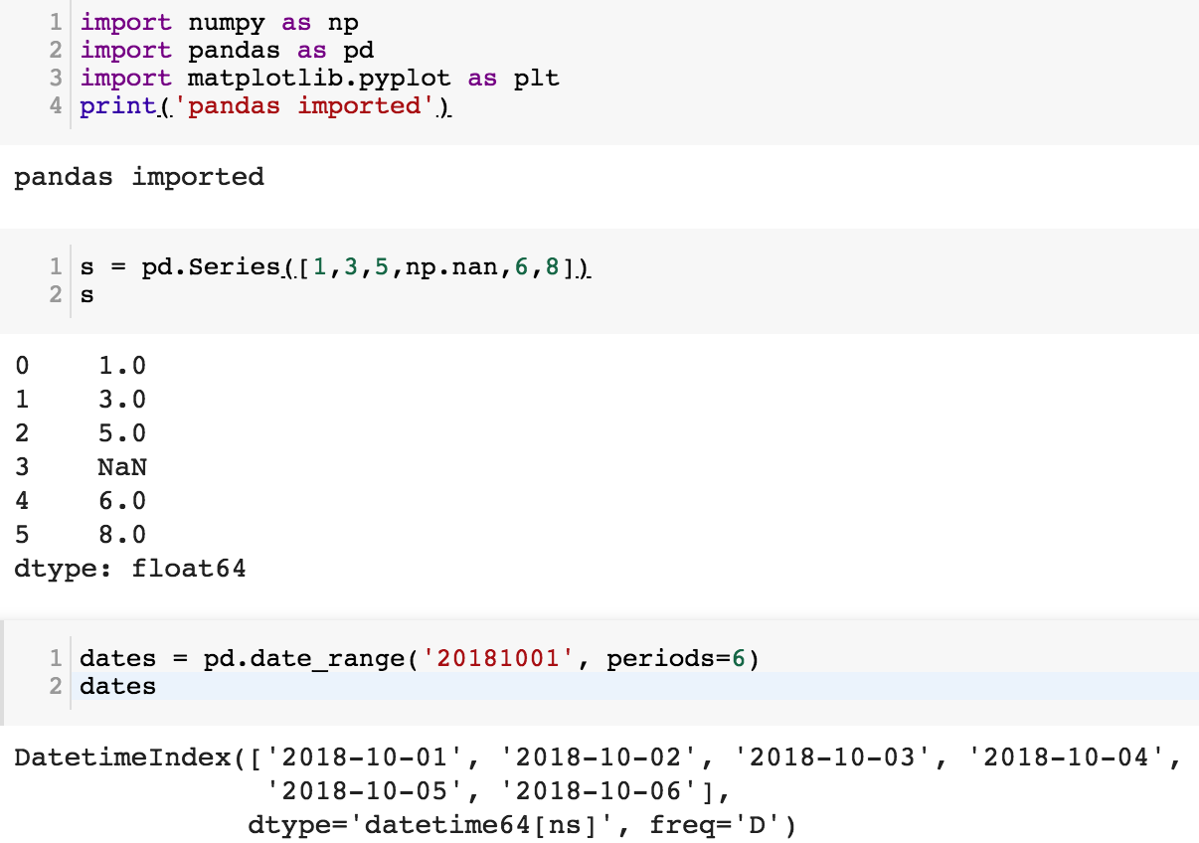

Slide 53
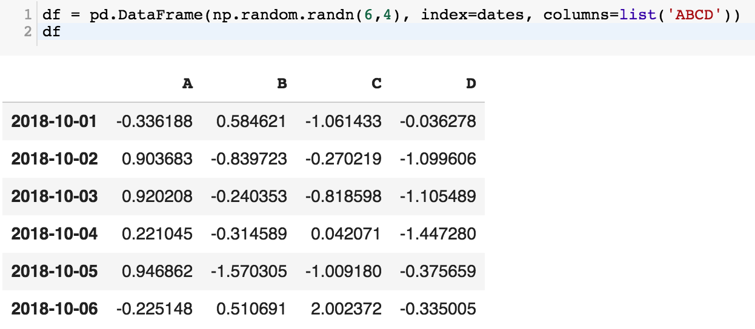
df = pd.DataFrame(np.random.randn(6,4), index=dates, columns=list('ABCD'))
df

Slide 54
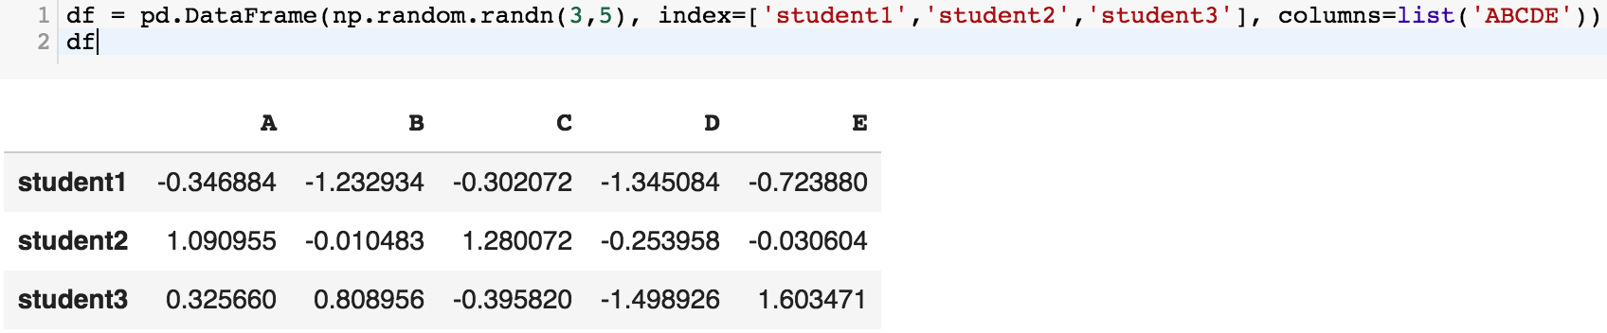
df = pd.DataFrame(np.random.randn(3,5), index=['student1','student2','student3'], columns=list('ABCDE'))
df

Slide 55
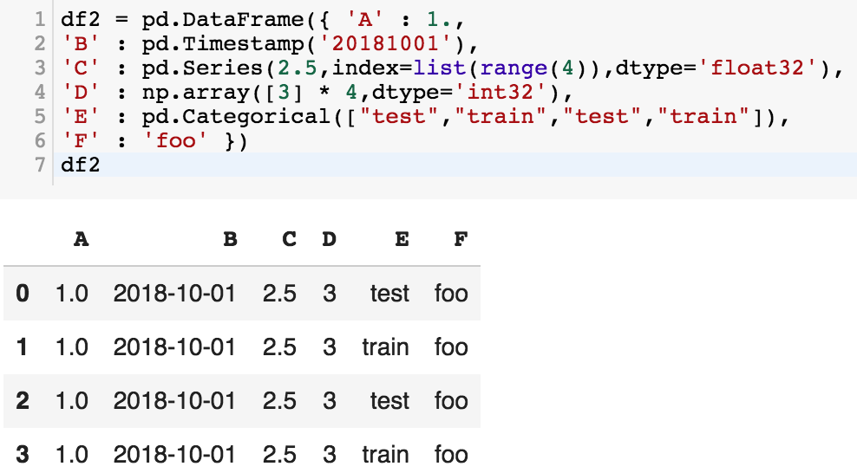
df2 = pd.DataFrame({ 'A' : 1.,
'B' : pd.Timestamp('20181001'),
'C' : pd.Series(2.5,index=list(range(4)),dtype='float32'),
'D' : np.array([3] * 4,dtype='int32'),
'E' : pd.Categorical(["test","train","test","train"]),
'F' : 'foo' })
df2

Slide 56
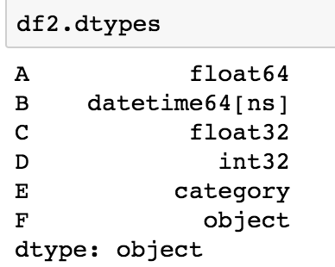
df2.dtypes

Slide 57
Python Pandas for Finance
Source: https://mapattack.wordpress.com/2017/02/12/using-python-for-stocks-1/

Slide 58
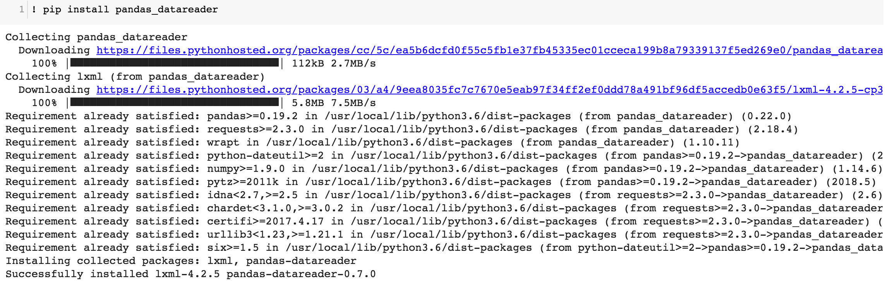
! pip install pandas_datareader

Slide 59
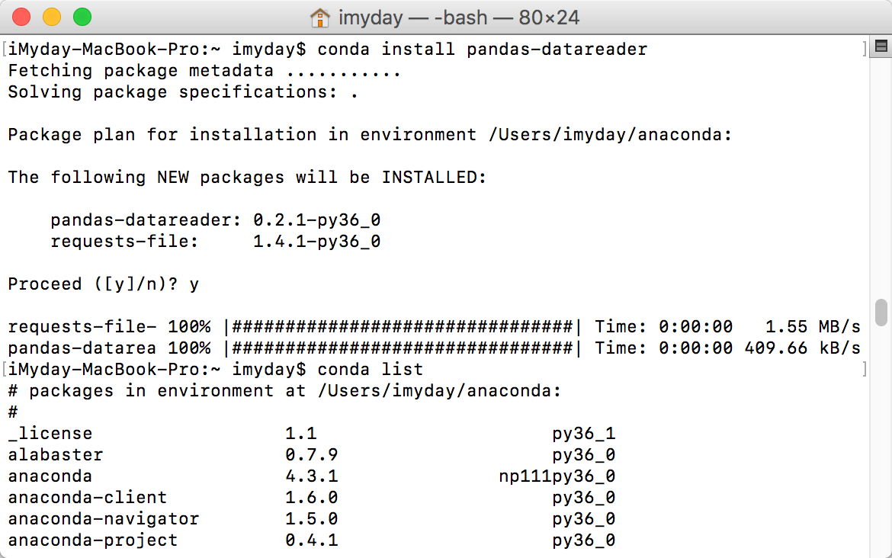
conda install pandas-datareader

Slide 61
Finance Data from Yahoo Finance
# !pip install pandas_datareader
import pandas_datareader.data as web
import datetime as dt
#Read Stock Data from Yahoo Finance
end = dt.datetime(2017, 12, 31)
start = dt.datetime(2016, 1, 1)
df = web.DataReader("AAPL", 'yahoo', start, end)
df.to_csv('AAPL.csv')
df.from_csv('AAPL.csv')
df.tail()

Slide 62
# !pip install pandas_datareader
import pandas as pd
import pandas_datareader.data as web
import matplotlib.pyplot as plt
import seaborn as sns
import datetime as dt
%matplotlib inline
#Read Stock Data from Yahoo Finance
end = dt.datetime.now()
#start = dt.datetime(end.year-2, end.month, end.day)
start = dt.datetime(2016, 1, 1)
df = web.DataReader("AAPL", 'yahoo', start, end)
df.to_csv('AAPL.csv')
df.from_csv('AAPL.csv')
df.tail()

Slide 63
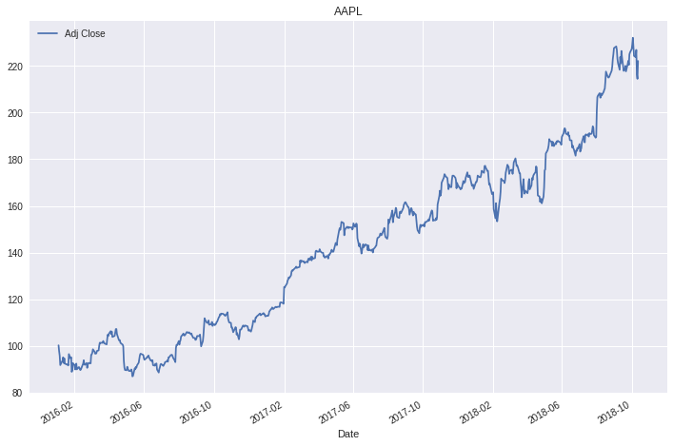
df['Adj Close'].plot(legend=True, figsize=(12, 8), title='AAPL’, label='Adj Close')

Slide 64
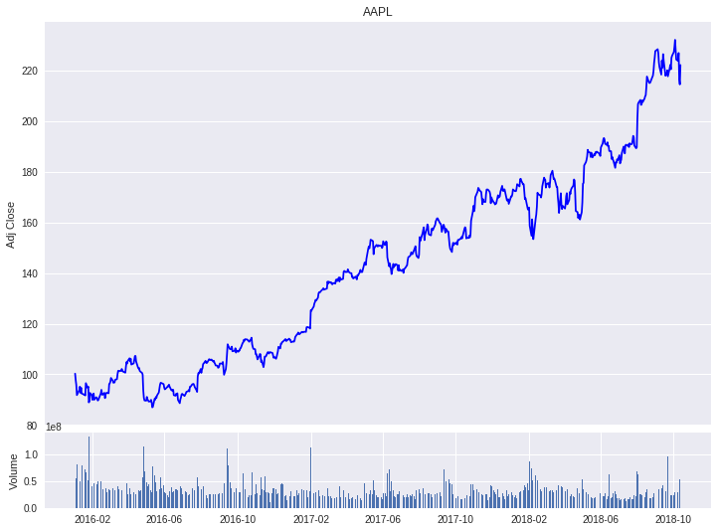
plt.figure(figsize=(12,9))
top = plt.subplot2grid((12,9), (0, 0), rowspan=10, colspan=9)
bottom = plt.subplot2grid((12,9), (10,0), rowspan=2, colspan=9)
top.plot(df.index, df['Adj Close'], color='blue') #df.index gives the dates
bottom.bar(df.index, df['Volume'])

Slide 66
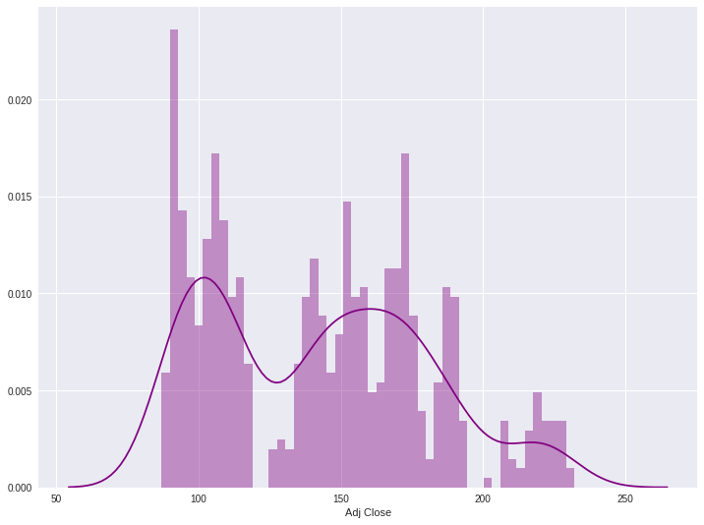
# set the labels
top.axes.get_xaxis().set_visible(False)
top.set_title('AAPL')
top.set_ylabel('Adj Close')
bottom.set_ylabel('Volume')
plt.figure(figsize=(12,9))
sns.distplot(df['Adj Close'].dropna(), bins=50, color='purple')

Slide 68
# simple moving averages
df['MA05'] = df['Adj Close'].rolling(5).mean() #5 days
df['MA20'] = df['Adj Close'].rolling(20).mean() #20 days
df['MA60'] = df['Adj Close'].rolling(60).mean() #60 days
df2 = pd.DataFrame({'Adj Close': df['Adj Close'],'MA05': df['MA05'],'MA20': df['MA20'], 'MA60': df['MA60']})
df2.plot(figsize=(12, 9), legend=True, title='AAPL')
df2.to_csv('AAPL_MA.csv')
fig = plt.gcf()
fig.set_size_inches(12, 9)
fig.savefig('AAPL_plot.png', dpi=300)
plt.show()

Slide 70
# !pip install pandas_datareader
import pandas as pd
import pandas_datareader.data as web
import matplotlib.pyplot as plt
import seaborn as sns
import datetime as dt
%matplotlib inline
#Read Stock Data from Yahoo Finance
end = dt.datetime.now()
#start = dt.datetime(end.year-2, end.month, end.day)
start = dt.datetime(2016, 1, 1)
df = web.DataReader("AAPL", 'yahoo', start, end)
df.to_csv('AAPL.csv')
df.from_csv('AAPL.csv')
df.tail()
df['Adj Close'].plot(legend=True, figsize=(12, 8), title='AAPL', label='Adj Close')
plt.figure(figsize=(12,9))
top = plt.subplot2grid((12,9), (0, 0), rowspan=10, colspan=9)
bottom = plt.subplot2grid((12,9), (10,0), rowspan=2, colspan=9)
top.plot(df.index, df['Adj Close'], color='blue') #df.index gives the dates
bottom.bar(df.index, df['Volume'])
# set the labels
top.axes.get_xaxis().set_visible(False)
top.set_title('AAPL')
top.set_ylabel('Adj Close')
bottom.set_ylabel('Volume')
plt.figure(figsize=(12,9))
sns.distplot(df['Adj Close'].dropna(), bins=50, color='purple')
# simple moving averages
df['MA05'] = df['Adj Close'].rolling(5).mean() #5 days
df['MA20'] = df['Adj Close'].rolling(20).mean() #20 days
df['MA60'] = df['Adj Close'].rolling(60).mean() #60 days
df2 = pd.DataFrame({'Adj Close': df['Adj Close'],'MA05': df['MA05'],'MA20': df['MA20'], 'MA60': df['MA60']})
df2.plot(figsize=(12, 9), legend=True, title='AAPL')
df2.to_csv('AAPL_MA.csv')
fig = plt.gcf()
fig.set_size_inches(12, 9)
fig.savefig('AAPL_plot.png', dpi=300)
plt.show()

Slide 71
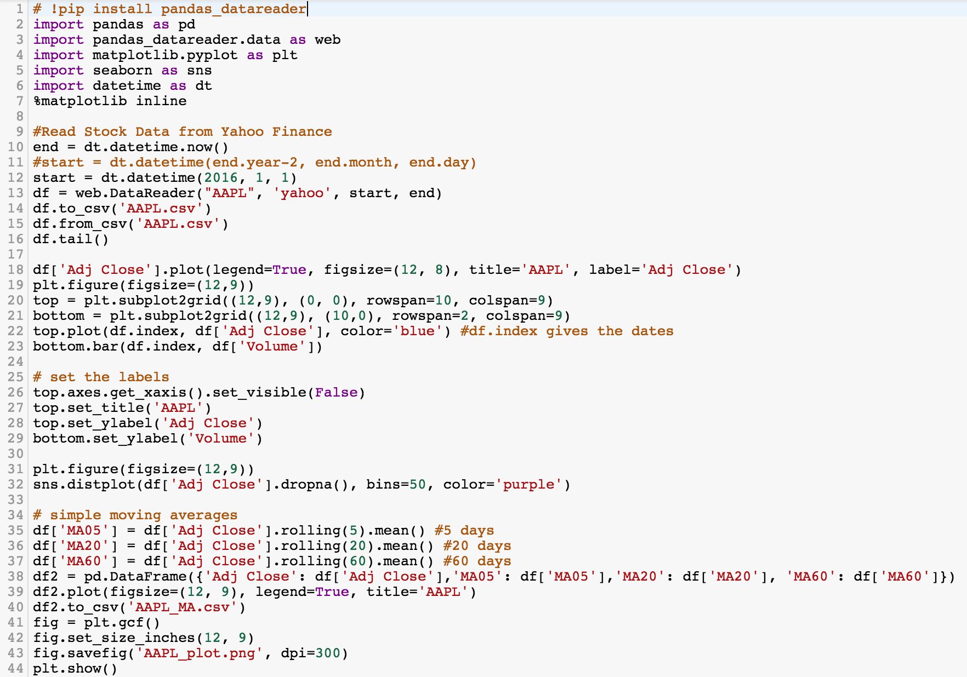

Slide 72
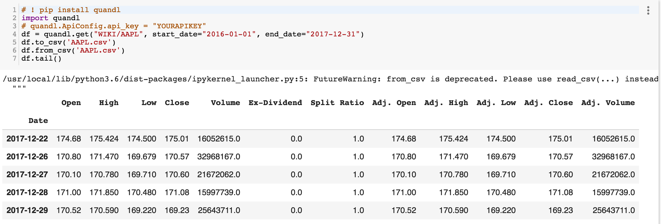
Finance Data from Quandl
# ! pip install quandl
import quandl
# quandl.ApiConfig.api_key = "YOURAPIKEY"
df = quandl.get("WIKI/AAPL", start_date="2016-01-01", end_date="2017-12-31")
df.to_csv('AAPL.csv')
df.from_csv('AAPL.csv')
df.tail()
Source: https://www.quandl.com/tools/python
Notes:
# ! pip install quandl
import quandl
# quandl.ApiConfig.api_key = "YOURAPIKEY"
df = quandl.get("WIKI/AAPL", start_date="2016-01-01", end_date="2017-12-31")
df.to_csv('AAPL.csv')
df.from_csv('AAPL.csv')
df.tail()

Slide 73
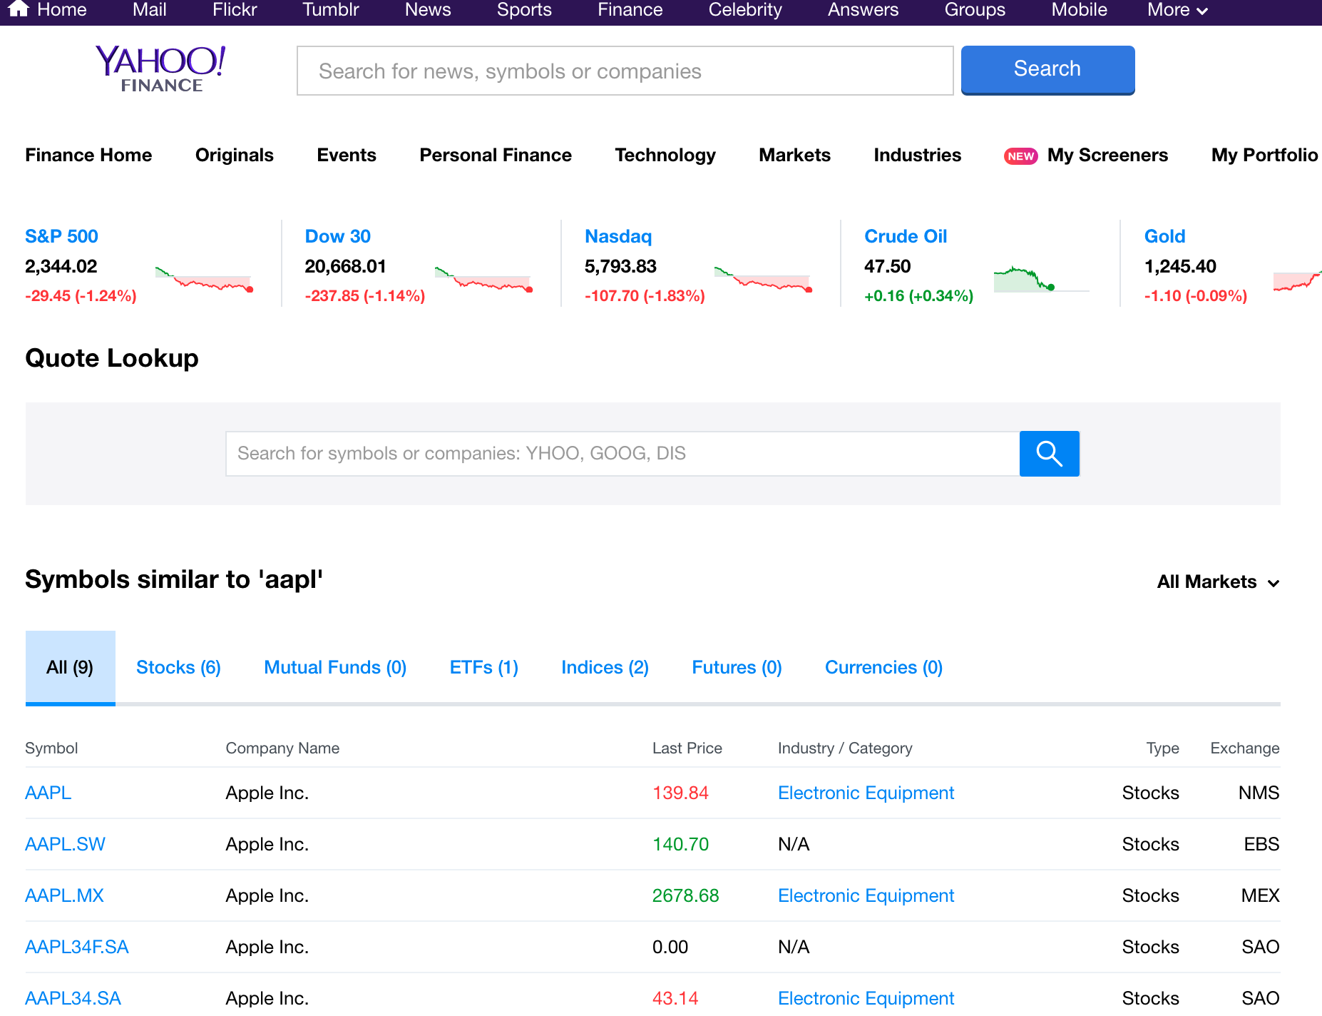
Yahoo Finance Symbols: AAPL Apple Inc. (AAPL)
http://finance.yahoo.com/q?s=AAPL

Slide 74
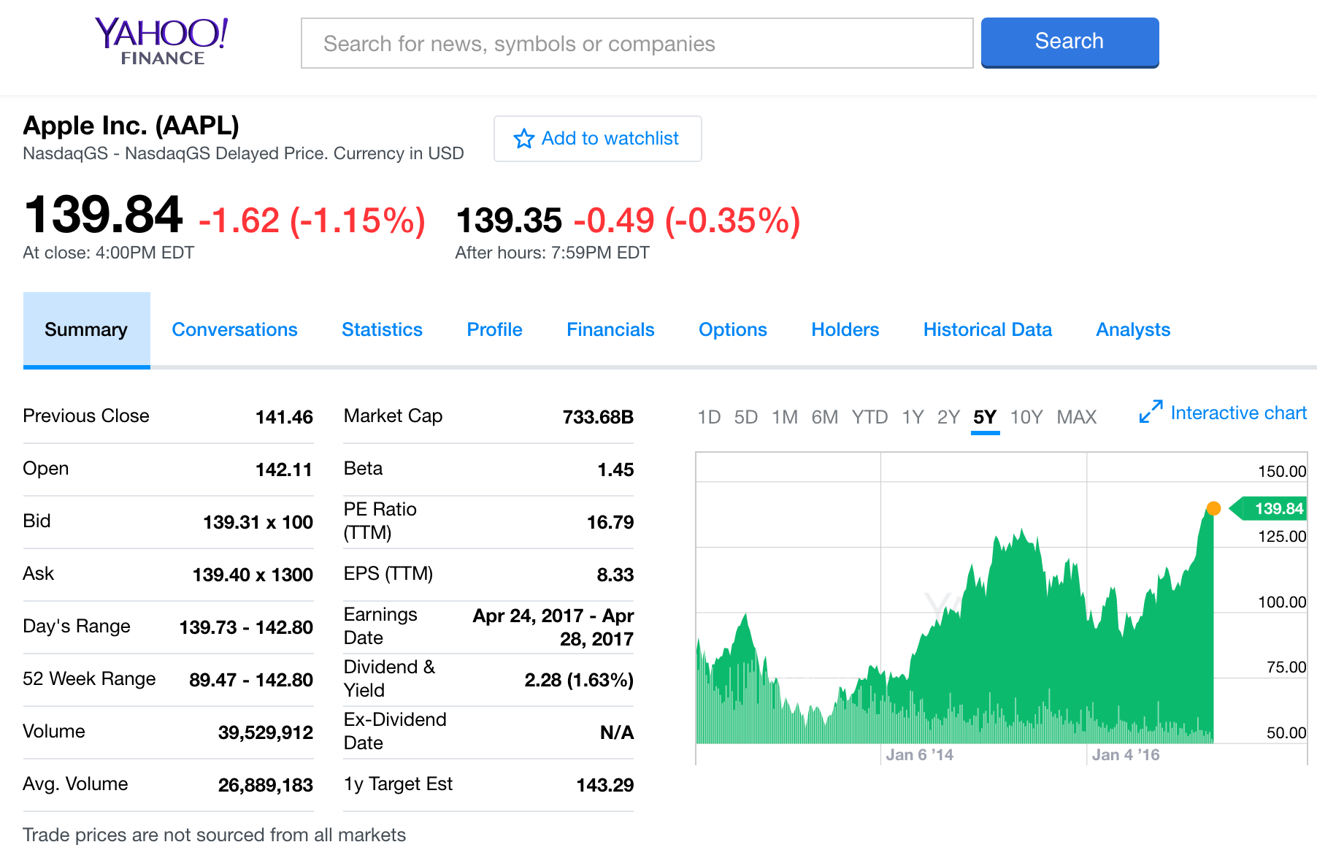
Apple Inc. (AAPL) -NasdaqGS
http://finance.yahoo.com/quote/AAPL?p=AAPL

Slide 75
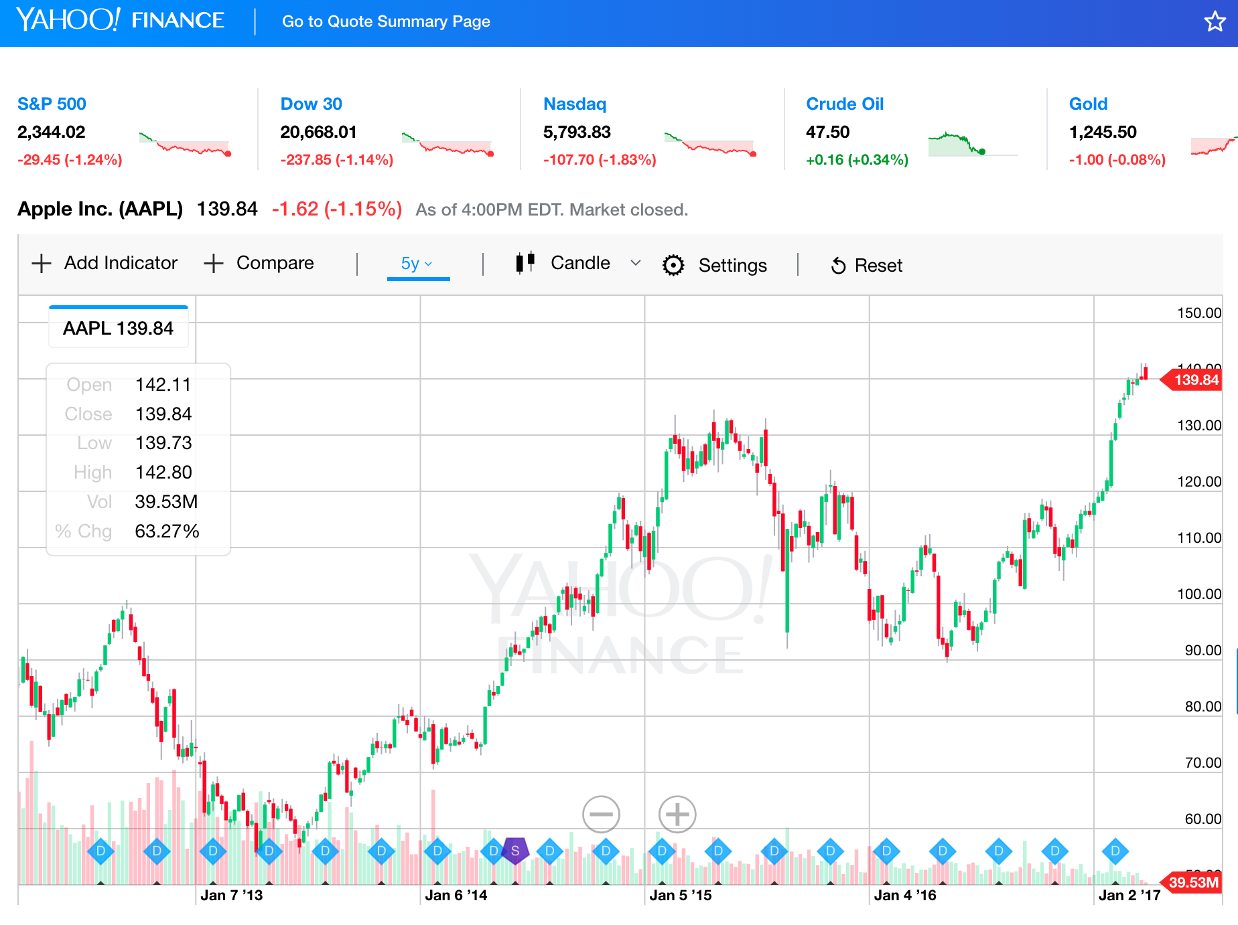
Yahoo Finance Charts: Apple Inc. (AAPL)
http://finance.yahoo.com/chart/AAPL

Slide 76
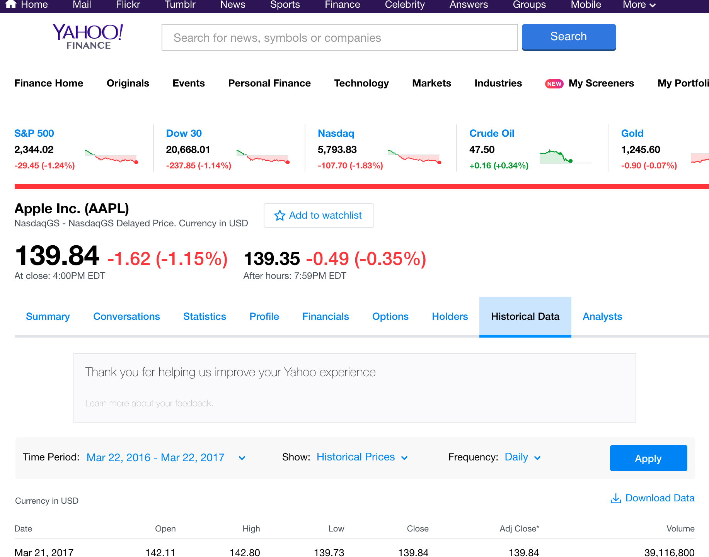
Apple Inc. (AAPL) Historical Data
http://finance.yahoo.com/q/hp?s=AAPL+Historical+Prices

Slide 77
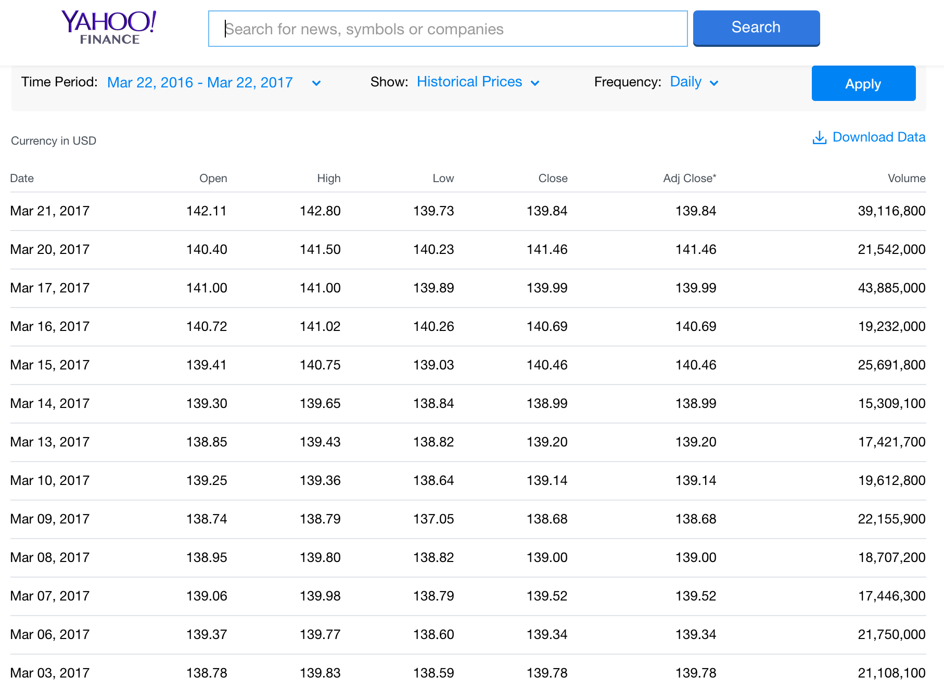
Yahoo Finance Historical Prices
Apple Inc. (AAPL)
http://finance.yahoo.com/quote/AAPL/history

Slide 78
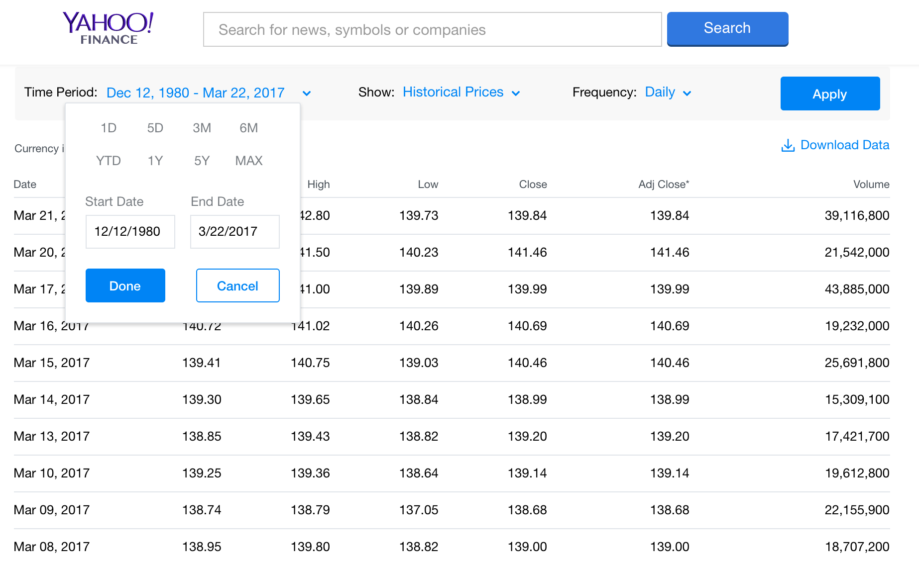
Yahoo Finance Historical Prices
Apple Inc. (AAPL)
http://finance.yahoo.com/quote/AAPL/history?period1=345398400&period2=1490112000&interval=1d&filter=history&frequency=1d

Slide 79
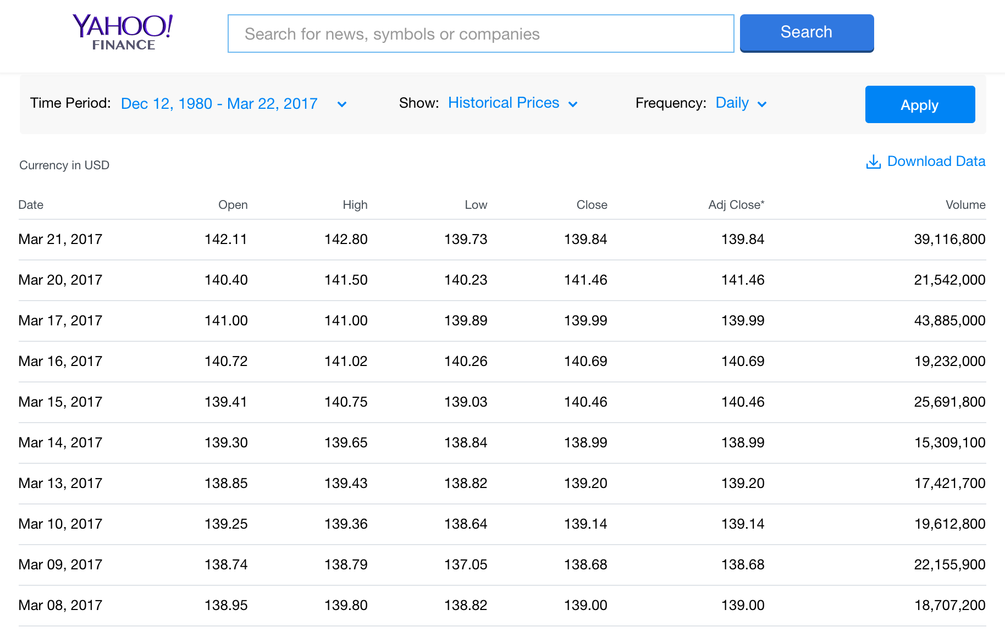
Yahoo Finance Historical Prices
Apple Inc. (AAPL)
http://finance.yahoo.com/quote/AAPL/history?period1=345398400&period2=1490112000&interval=1d&filter=history&frequency=1d

Slide 80
Yahoo Finance Historical Prices
http://ichart.finance.yahoo.com/table.csv?s=AAPL
table.csv
Date,Open,High,Low,Close,Volume,Adj Close
2017-03-21,142.110001,142.800003,139.729996,139.839996,39116800,139.839996
2017-03-20,140.399994,141.50,140.229996,141.460007,20213100,141.460007
2017-03-17,141.00,141.00,139.889999,139.990005,43597400,139.990005
2017-03-16,140.720001,141.020004,140.259995,140.690002,19132500,140.690002
2017-03-15,139.410004,140.75,139.029999,140.460007,25566800,140.460007
2017-03-14,139.300003,139.649994,138.839996,138.990005,15189700,138.990005
2017-03-13,138.850006,139.429993,138.820007,139.199997,17042400,139.199997
2017-03-10,139.25,139.360001,138.639999,139.139999,19488000,139.139999
2017-03-09,138.740005,138.789993,137.050003,138.679993,22065200,138.679993
2017-03-08,138.949997,139.800003,138.820007,139.00,18681800,139.00
2017-03-07,139.059998,139.979996,138.789993,139.520004,17267500,139.520004
2017-03-06,139.369995,139.770004,138.600006,139.339996,21155300,139.339996
2017-03-03,138.779999,139.830002,138.589996,139.779999,21108100,139.779999
2017-03-02,140.00,140.279999,138.759995,138.960007,26153300,138.960007
2017-03-01,137.889999,140.149994,137.600006,139.789993,36272400,139.789993
2017-02-28,137.080002,137.440002,136.699997,136.990005,23403500,136.990005
2017-02-27,137.139999,137.440002,136.279999,136.929993,20196400,136.929993
2017-02-24,135.910004,136.660004,135.279999,136.660004,21690900,136.660004
2017-02-23,137.380005,137.479996,136.300003,136.529999,20704100,136.529999
2017-02-22,136.429993,137.119995,136.110001,137.110001,20745300,137.110001

Slide 81
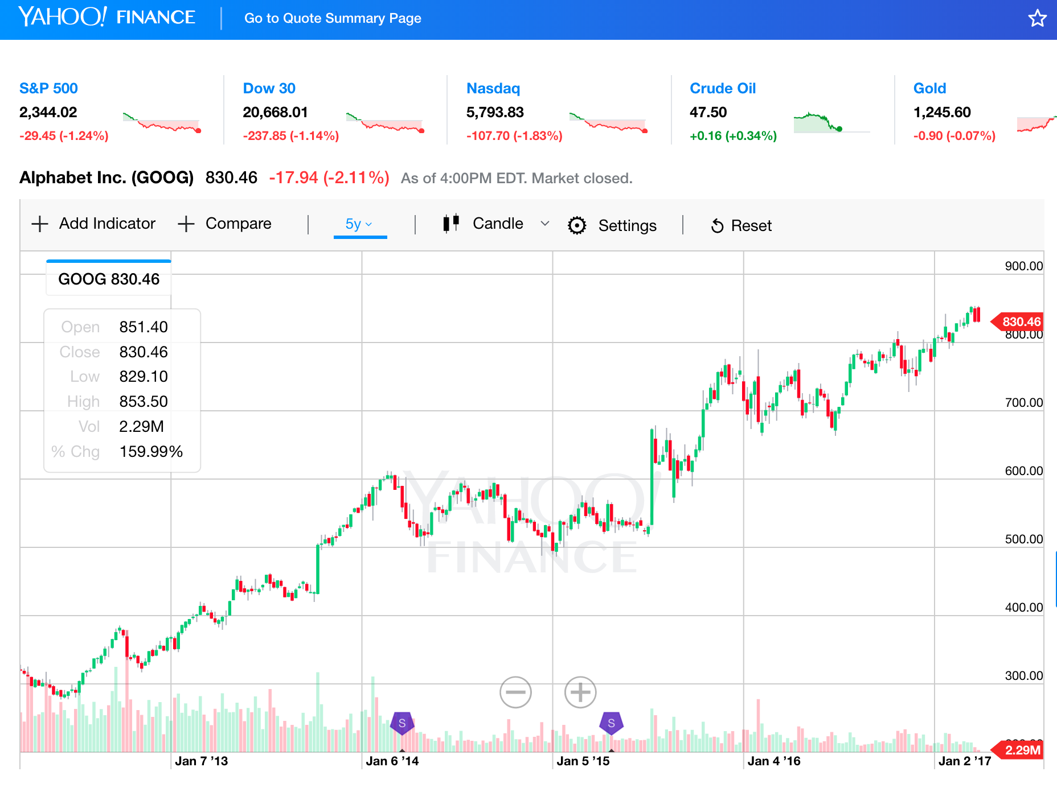
Yahoo Finance Charts
Alphabet Inc. (GOOG)
Alphabet Inc. (GOOG)
http://finance.yahoo.com/echarts?s=GOOG+Interactive#{"showArea":false,"showLine":false,"showCandle":true,"lineType":"candle","range":"5y","allowChartStacking":true}

Slide 82
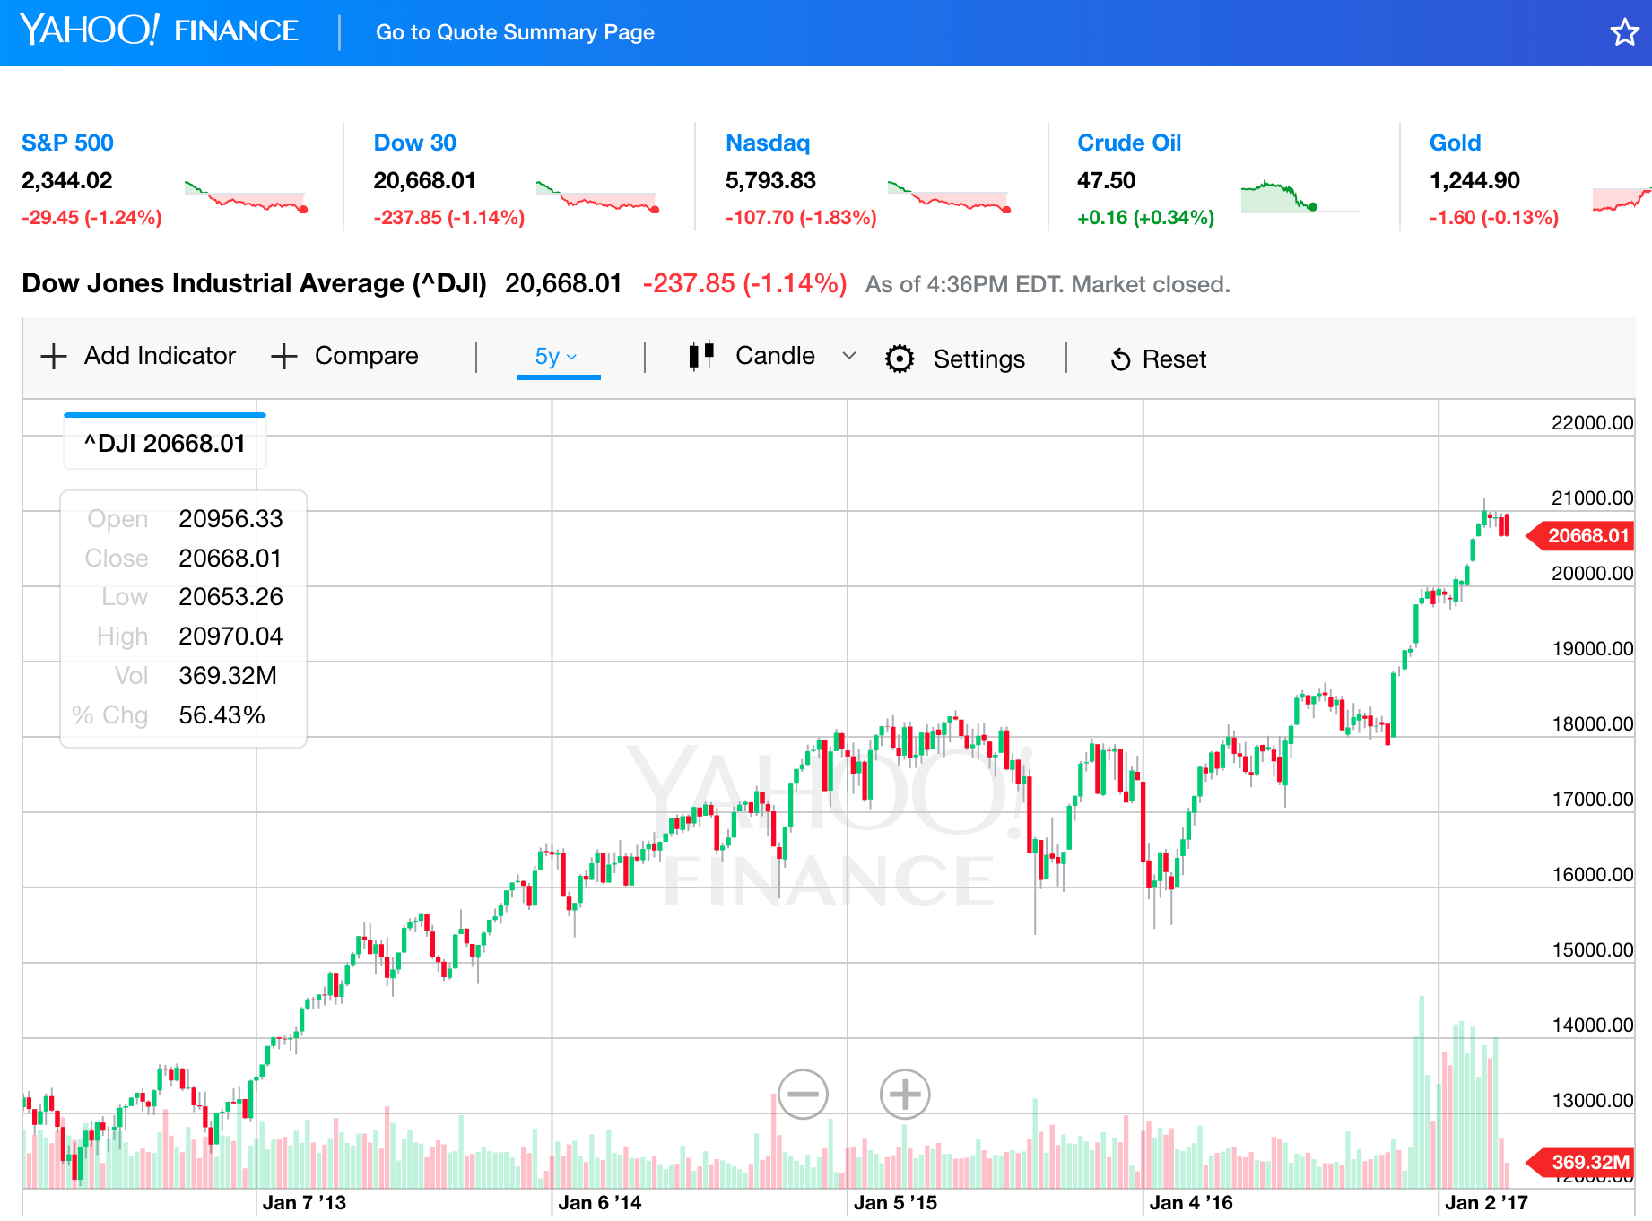
Dow Jones Industrial Average
(^DJI)
http://finance.yahoo.com/chart/^DJI

Slide 83
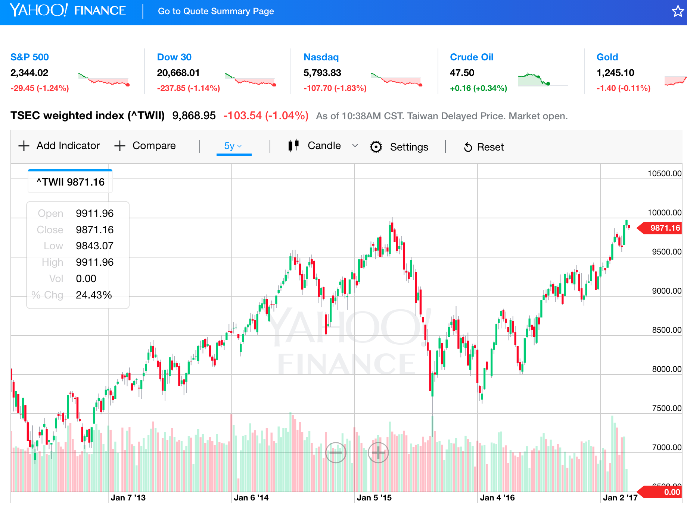
TSEC weighted index (^TWII) - Taiwan
http://finance.yahoo.com/chart/^TWII

Slide 84
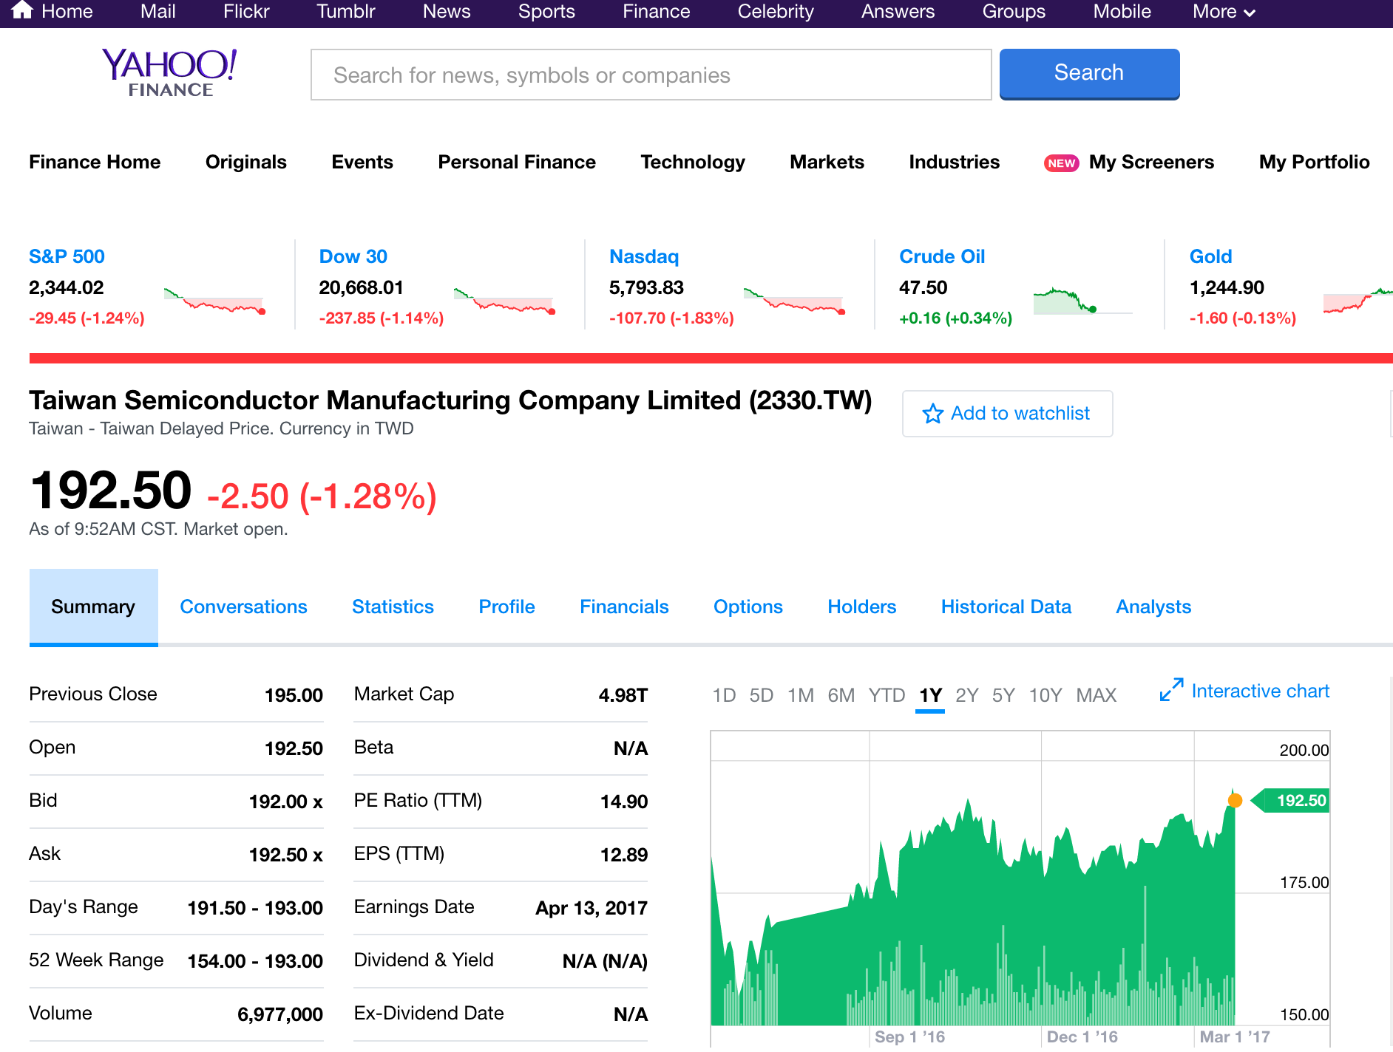
Taiwan Semiconductor Manufacturing Company Limited (2330.TW)
http://finance.yahoo.com/q?s=2330.TW

Slide 85
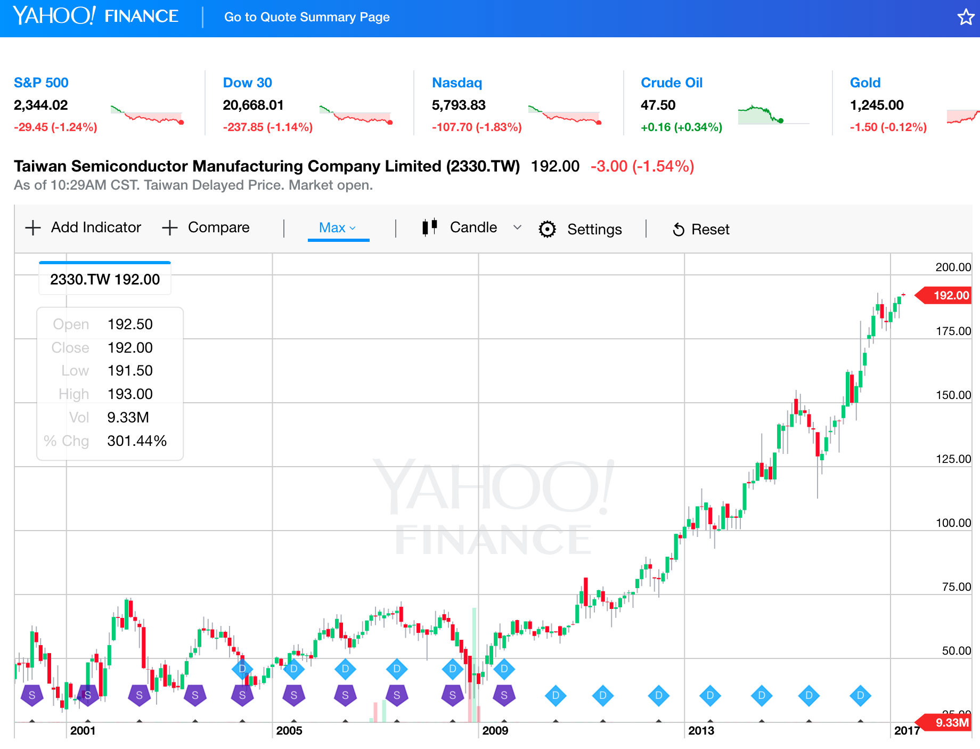
Yahoo Finance Charts
TSMC (2330.TW)
http://finance.yahoo.com/chart/2330.TW

Slide 86
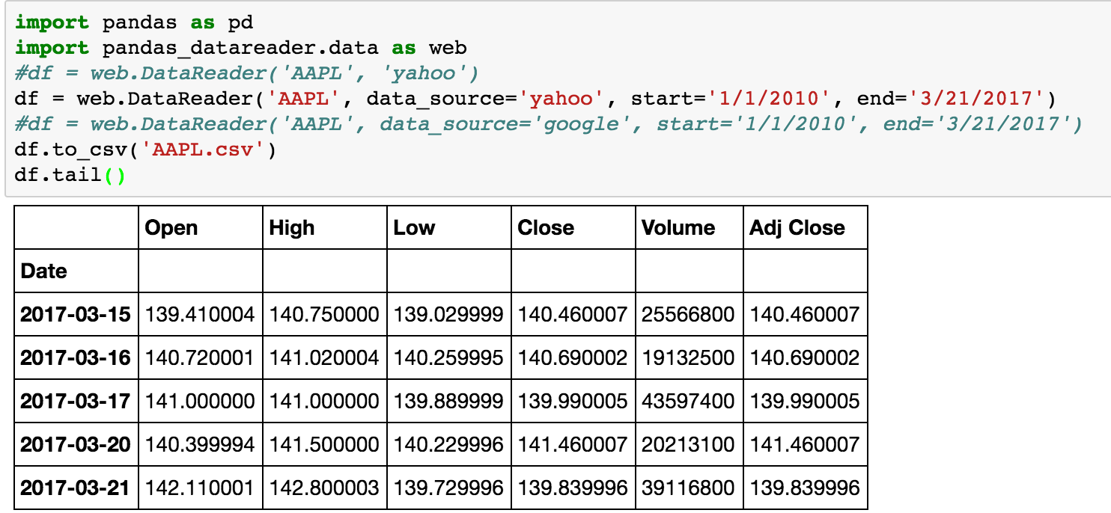
import pandas as pd
import pandas_datareader.data as web
df = web.DataReader('AAPL', data_source='yahoo', start='1/1/2010', end='3/21/2017')
df.to_csv('AAPL.csv')
df.tail()

Slide 87
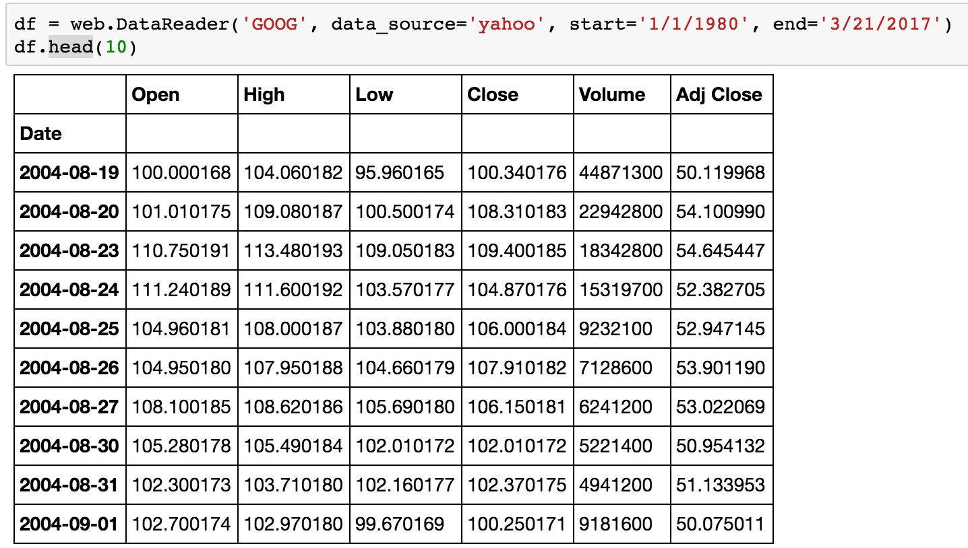
df = web.DataReader('GOOG', data_source='yahoo', start='1/1/1980', end='3/21/2017')
df.head(10)

Slide 88
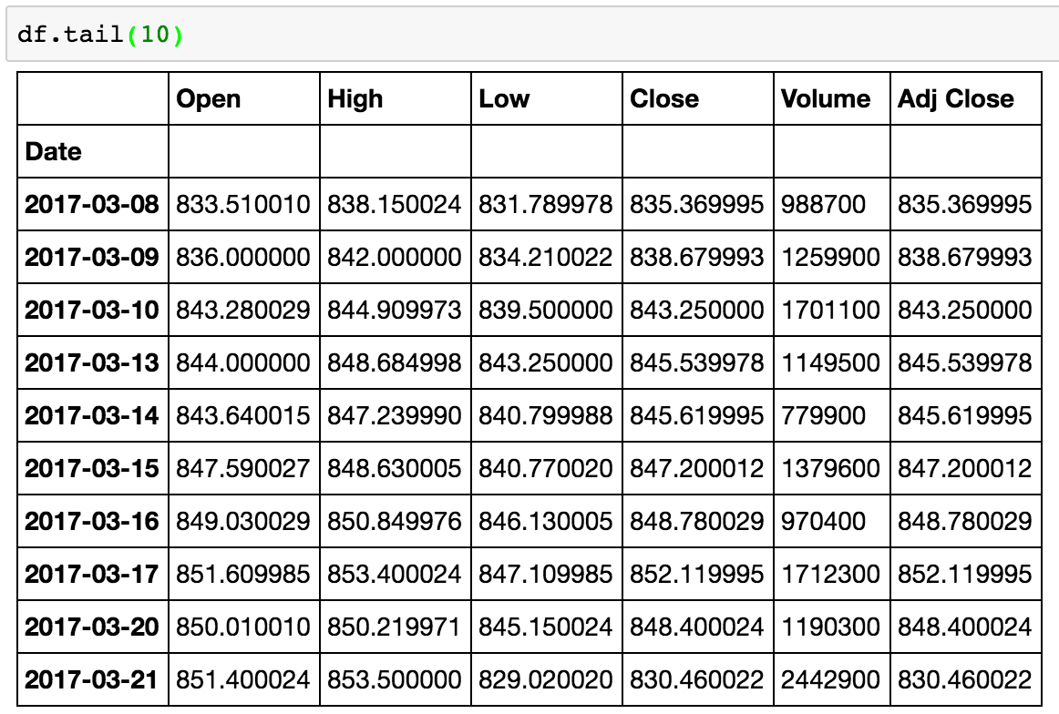
df.tail(10)

Slide 89

df.count()

Slide 90

df.ix['2015-12-31']

Slide 91

df.to_csv('2330.TW.Yahoo.Finance.Data.csv')

Slide 92

import fix_yahoo_finance as yf
data = yf.download("^TWII", start="2017-07-01", end="2017-11-15")
data.to_csv('TWII_201707_201711.csv')
data.tail()
Notes:
# pip install fix_yahoo_finance
import fix_yahoo_finance as yf
data = yf.download("^TWII", start="2017-07-01", end="2017-11-15")
data.to_csv('TWII_201707_201711.csv')
data.tail()
data.head()
# https://pypi.python.org/pypi/fix-yahoo-finance
# pip install fix_yahoo_finance --upgrade --no-cache-dir

Slide 93
df.loc[start:end]
df = df.loc['2017-10-01':'2017-11-15']

Slide 94
import matplotlib.pyplot as plt
%matplotlib inline
import fix_yahoo_finance as yf
df = yf.download("^TWII", start="2000-01-01", end="2017-11-15")
df.to_csv('YF_TWII_2000_2017.csv')
print(df.head())
fig = plt.figure(figsize=(16,9))
df["Adj Close"].plot()
fig.show()
Notes:
import matplotlib.pyplot as plt
%matplotlib inline
import fix_yahoo_finance as yf
df = yf.download("^TWII", start="2000-01-01", end="2017-11-15")
df.to_csv('YF_TWII_2000_2017.csv')
print(df.head())
fig = plt.figure(figsize=(16,9))
df["Adj Close"].plot()
fig.show()

Slide 95
import matplotlib.pyplot as plt from matplotlib.finance import candlestick_ohlc
candlestick_ohlc
Source: https://matplotlib.org/examples/pylab_examples/finance_demo.html

Slide 96
import matplotlib.pyplot as plt
from matplotlib.finance import candlestick_ohlc
Source: https://ntguardian.wordpress.com/2016/09/19/introduction-stock-market-data-python-1/
Notes:
# Source: https://ntguardian.wordpress.com/2016/09/19/introduction-stock-market-data-python-1/
import matplotlib.pyplot as plt
from matplotlib.dates import DateFormatter, WeekdayLocator, DayLocator, MONDAY
from matplotlib.finance import candlestick_ohlc
def pandas_candlestick_ohlc(dat, stick = "day", otherseries = None):
mondays = WeekdayLocator(MONDAY) # major ticks on the mondays
alldays = DayLocator() # minor ticks on the days
dayFormatter = DateFormatter('%d') # e.g., 12
# Create a new DataFrame which includes OHLC data for each period specified by stick input
transdat = dat.loc[:,["Open", "High", "Low", "Close"]]
if (type(stick) == str):
if stick == "day":
plotdat = transdat
stick = 1 # Used for plotting
elif stick in ["week", "month", "year"]:
if stick == "week":
transdat["week"] = pd.to_datetime(transdat.index).map(lambda x: x.isocalendar()[1]) # Identify weeks
elif stick == "month":
transdat["month"] = pd.to_datetime(transdat.index).map(lambda x: x.month) # Identify months
transdat["year"] = pd.to_datetime(transdat.index).map(lambda x: x.isocalendar()[0]) # Identify years
grouped = transdat.groupby(list(set(["year",stick]))) # Group by year and other appropriate variable
plotdat = pd.DataFrame({"Open": [], "High": [], "Low": [], "Close": []}) # Create empty data frame containing what will be plotted
for name, group in grouped:
plotdat = plotdat.append(pd.DataFrame({"Open": group.iloc[0,0],
"High": max(group.High),
"Low": min(group.Low),
"Close": group.iloc[-1,3]},
index = [group.index[0]]))
if stick == "week": stick = 5
elif stick == "month": stick = 30
elif stick == "year": stick = 365
elif (type(stick) == int and stick >= 1):
transdat["stick"] = [np.floor(i / stick) for i in range(len(transdat.index))]
grouped = transdat.groupby("stick")
plotdat = pd.DataFrame({"Open": [], "High": [], "Low": [], "Close": []}) # Create empty data frame containing what will be plotted
for name, group in grouped:
plotdat = plotdat.append(pd.DataFrame({"Open": group.iloc[0,0],
"High": max(group.High),
"Low": min(group.Low),
"Close": group.iloc[-1,3]},
index = [group.index[0]]))
else:
raise ValueError('Valid inputs to argument "stick" include the strings "day", "week", "month", "year", or a positive integer')
# Set plot parameters, including the axis object ax used for plotting
fig, ax = plt.subplots()
fig.subplots_adjust(bottom=0.2)
if plotdat.index[-1] - plotdat.index[0] < pd.Timedelta('730 days'):
weekFormatter = DateFormatter('%Y-%m-%d')
ax.xaxis.set_major_locator(mondays)
ax.xaxis.set_minor_locator(alldays)
else:
weekFormatter = DateFormatter('%b %d, %Y')
ax.xaxis.set_major_formatter(weekFormatter)
ax.grid(True)
# Create the candelstick chart
candlestick_ohlc(ax, list(zip(list(date2num(plotdat.index.tolist())), plotdat["Open"].tolist(), plotdat["High"].tolist(),
plotdat["Low"].tolist(), plotdat["Close"].tolist())),
colorup = "red", colordown = "green", width = stick * .4)
# Plot other series (such as moving averages) as lines
if otherseries != None:
if type(otherseries) != list:
otherseries = [otherseries]
dat.loc[:,otherseries].plot(ax = ax, lw = 1.3, grid = True)
ax.xaxis_date()
ax.autoscale_view()
plt.setp(plt.gca().get_xticklabels(), rotation=45, horizontalalignment='right')
plt.show()
pandas_candlestick_ohlc(data)

Slide 97
daily_to_weekly
#Convert Daily Data to Weekly Data
def daily_to_weekly(df):
#dfWeekly = daily_to_weekly(df)
#df.sort_index(axis=0, level=None, ascending=True, inplace=True)
Open = df.Open.resample('W-Fri').first() #W #W-MON #W-Fri
High = df.High.resample('W-Fri').max()
Low = df.Low.resample('W-Fri').min()
Close = df.Close.resample('W-Fri').last()
Volume = df.Volume.resample('W-Fri').sum()
Adj_Close = df["Adj Close"].resample('W-Fri').last()
dfWeekly = pd.concat([Open, High, Low, Close, Volume, Adj_Close], axis=1)
dfWeekly = dfWeekly[pd.notnull(dfWeekly['Adj Close'])]
return dfWeekly

Slide 98
daily_to_monthly
#Convert Daily Data to Monthly Data
def daily_to_monthly(df):
#dfMonthly = daily_to_monthly(df)
Open = df.Open.resample('M').first()
High = df.High.resample('M').max()
Low = df.Low.resample('M').min()
Close = df.Close.resample('M').last()
Volume = df.Volume.resample('M').sum()
Adj_Close = df["Adj Close"].resample('M').last()
dfMonthly = pd.concat([Open, High, Low, Close, Volume, Adj_Close], axis=1)
dfMonthly = dfMonthly[pd.notnull(dfMonthly['Adj Close'])]
return dfMonthly

Slide 99

TA-Lib:
Technical Analysis Library
http://ta-lib.org/

Slide 100
Stochastic Oscillator (KD)
#Stochastic oscillator %D
def KDJ(df, n, m1, m2):
#KDJ(df, 9, 3, 3)
KDJ_n = n
KDJ_m1 = m1
KDJ_m2 = m2
df['Low_n'] = pd.rolling_min(df['Low'], KDJ_n)
df['Low_n'].fillna(value=pd.expanding_min(df['Low']), inplace=True)
df['High_n'] = pd.rolling_max(df['High'], KDJ_n)
df['High_n'].fillna(value=pd.expanding_max(df['High']), inplace=True)
df['RSV'] = (df['Close'] - df['Low_n']) / (df['High_n'] - df['Low_n']) * 100
df['KDJ_K'] = pd.ewma(df['RSV'], KDJ_m1)
df['KDJ_D'] = pd.ewma(df['KDJ_K'], KDJ_m2)
df['KDJ_J'] = 3 * df['KDJ_K'] - 2 * df['KDJ_D']
return df
Source: https://www.quantopian.com/posts/technical-analysis-indicators-without-talib-code

Slide 101
Bollinger Bands
#Bollinger Bands
def BBANDS20(df, n):
MA = pd.Series(pd.rolling_mean(df['Close'], n))
MSD = pd.Series(pd.rolling_std(df['Close'], n))
b1 = 4 * MSD / MA
B1 = pd.Series(b1, name = 'BollingerB_' + str(n))
df = df.join(B1)
b2 = (df['Close'] - MA + 2 * MSD) / (4 * MSD)
B2 = pd.Series(b2, name = 'Bollinger%b_' + str(n))
df = df.join(B2)
return df
Source: https://www.quantopian.com/posts/technical-analysis-indicators-without-talib-code

Slide 102
Bollinger Bands
#BB Bollinger Bands BB_20
def BB_20(df):
df['BB_MA20'] = pd.stats.moments.rolling_mean(df["Adj Close"], 20)
df['BB_SD20'] = pd.stats.moments.rolling_std(df['Adj Close'],20)
df['BB_UpperBand'] = df['BB_MA20'] + (df['BB_SD20']*2) # Default 2*SD
df['BB_LowerBand'] = df['BB_MA20'] - (df['BB_SD20']*2)
df['BB_PB'] = (df['Adj Close'] - df['BB_LowerBand']) / (df['BB_UpperBand'] - df['BB_LowerBand'])
df['BB_BW'] = (df['BB_UpperBand'] - df['BB_LowerBand']) / df['BB_MA20']
df['BB_UpperBand_1SD'] = df['BB_MA20'] + (df['BB_SD20'])
df['BB_LowerBand_1SD'] = df['BB_MA20'] - (df['BB_SD20'])
#BB_PB: Bollinger Band Percent b (PB)
#BB_BW: Bollinger Band Band Width (BW)
return df
Source: https://www.quantopian.com/posts/technical-analysis-indicators-without-talib-code

Slide 103
The Quant Finance PyData Stack
Source: http://nbviewer.jupyter.org/format/slides/github/quantopian/pyfolio/blob/master/pyfolio/examples/overview_slides.ipynb#/5

Slide 104

Quantopian
https://www.quantopian.com/

Slide 105
Summary
Quantitative Investing with Pandas in Python
  Numpy
  Pandas

Slide 106
References
Wes McKinney (2017), "Python for Data Analysis: Data Wrangling with Pandas, NumPy, and IPython", 2nd Edition, O'Reilly Media.
https://github.com/wesm/pydata-book
Avinash Jain (2017), Introduction To Python Programming, Udemy, https://www.udemy.com/pythonforbeginnersintro/
Alfred Essa (2015), Awesome Data Science: 1.0 Jupyter Notebook Tour, https://www.youtube.com/watch?v=e9cSF3eVQv0
Ties de Kok (2017), Learn Python for Research, https://github.com/TiesdeKok/LearnPythonforResearch
Ivan Idris (2015), Numpy Beginner's Guide, Third Edition, Packt Publishing
Numpy Tutorial, https://docs.scipy.org/doc/numpy-dev/user/quickstart.html
Wes McKinney (2012), Python for Data Analysis: Data Wrangling with Pandas, NumPy, and IPython, O'Reilly Media
Yves Hilpisch (2014), Python for Finance: Analyze Big Financial Data, O'Reilly
Michael Heydt (2015) , Mastering Pandas for Finance, Packt Publishing
Michael Heydt (2015), Learning Pandas - Python Data Discovery and Analysis Made Easy, Packt Publishing
James Ma Weiming (2015), Mastering Python for Finance, Packt Publishing
Fabio Nelli (2015), Python Data Analytics: Data Analysis and Science using PANDAs, matplotlib and the Python Programming Language, Apress
Wes McKinney (2013), 10-minute tour of pandas, https://vimeo.com/59324550
Jason Wirth (2015), A Visual Guide To Pandas, https://www.youtube.com/watch?v=9d5-Ti6onew
Edward Schofield (2013), Modern scientific computing and big data analytics in Python, PyCon Australia, https://www.youtube.com/watch?v=hqOsfS3dP9w
Python Programming, https://pythonprogramming.net/
Python, https://www.python.org/
Python Programming Language, http://pythonprogramminglanguage.com/
Numpy, http://www.numpy.org/
Pandas, http://pandas.pydata.org/
Skikit-learn, http://scikit-learn.org/
Data School (2015), Machine learning in Python with scikit-learn, https://www.youtube.com/playlist?list=PL5-da3qGB5ICeMbQuqbbCOQWcS6OYBr5A
Jason Brownlee (2016), Your First Machine Learning Project in Python Step-By-Step, https://machinelearningmastery.com/machine-learning-in-python-step-by-step/

