Slide 1
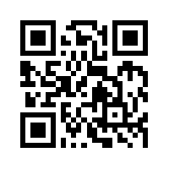
行銷管理 Marketing Management
Tamkang University
Tamkang University
Introduction to Marketing Management
1062MM3A01
TLMXB3A (M0142) Tue 2 (9:10-10:00) B702; Thu 7,8 (14:10-16:00) B608
Min-Yuh Day
戴敏育
Assistant Professor
專任助理教授
Dept. of Information Management, Tamkang University
淡江大學 資訊管理學系
http://mail. tku.edu.tw/myday/
2018-02-27; 2018-03-01

Slide 2
淡江大學106學年度第2學期 課程教學計畫表 Spring 2018 (2018.02.26 - 2018.06.30)
課程名稱：行銷管理 (Marketing Management)
授課教師：戴敏育 (Min-Yuh Day)
開課系級：資管3A (TLMXB3A)(M0142)
開課資料：必修 單學期 3 學分 (3 Credits, Required)
上課時間地點：週二 2 (09:10-10:00) B702 週四 7, 8 (14:10-16:00) B608

Slide 3
課程簡介
本課程介紹行銷管理基礎理論與實務。
課程內容包括：
瞭解行銷管理
掌握行銷洞察力
連結顧客
建立強勢品牌
創造價值
傳遞價值
溝通價值
永續成功的行銷

Slide 4
Course Introduction
This course introduces the fundamental theories and practices of marketing management.
Topics include:
Understanding Marketing Management
Capturing Marketing Insights
Connecting with Customers
Building Strong Brands
Creating Value and Shaping the Market Offerings
Delivering Value
Communicating Value
Conducting Marketing Responsibly for Long-term Success

Slide 5
課程目標
學生將能夠暸解及應用 行銷管理 基礎理論與實務。

Slide 6
Objective
Student will be able to understand and apply the fundamental concepts and practices of marketing management.

Slide 7
課程大綱 (Syllabus)
週次 (Week) 日期 (Date) 內容 (Subject/Topics)
1 2018/02/27, 03/01 Introduction to Marketing Management
2 2018/03/06, 03/08 Defining Marketing for the New Realities, Developing Marketing Strategies and Plans (Nike) (Ch1, pp.52-54)
3 2018/03/13, 03/15 Collecting Information and Forecasting Demand, Conducting Marketing Research (Microsoft) (Ch3, pp.116-117)
4 2018/03/20, 03/22 Creating Long-term Loyalty Relationships, Analyzing Consumer Markets (Disney) (Ch6, pp.206-207)
5 2018/03/27, 03/29 Analyzing Business Markets, Tapping into Global Markets (Accenture) (Ch7, pp.235-236)

Slide 8
課程大綱 (Syllabus)
週次 (Week) 日期 (Date) 內容 (Subject/Topics)
6 2018/04/03, 04/05 Off-campus study (教學行政觀摩日)
7 2018/04/10, 04/12 Identifying Market Segments and Targets, Crafting the Brand Positioning (HSBC) (Ch9, pp.292-293)
8 2018/04/17, 04/19 Creating Brand Equity, Addressing Competition and Driving Growth (McDonald's) (Ch11, pp.353-354)
9 2018/04/24, 04/26 Midterm Report (期中報告)
10 2018/05/01, 05/03 Midterm Exam Week (期中考試週)

Slide 9
課程大綱 (Syllabus)
週次 (Week) 日期 (Date) 內容 (Subject/Topics)
11 2018/05/08, 05/10 Setting Product Strategy, Designing and Managing Services (Toyota) (Ch13, pp.418-419)
12 2018/05/15, 05/17 Introducing New Market Offerings, Developing Pricing Strategies and Programs (Salesforce.com) (Ch15, pp.481)
13 2018/05/22, 05/24 Delivering Value: Designing and Managing Integrated Marketing Channels (Zara) (Ch18, pp.574)
14 2018/05/29, 05/31 Communicating Value: Designing and Managing Integrated Marketing Communications (Evian) (Ch20, pp. 632-633)

Slide 10
課程大綱 (Syllabus)
週次 (Week) 日期 (Date) 內容 (Subject/Topics)
15 2018/06/05, 06/07 Managing a Holistic Marketing Organization for the Long Run (Starbucks) (Ch23, pp.706-707)
16 2018/06/12, 06/14 Final Report I (期末報告 I)
17 2018/06/19, 06/21 Final Report II (期末報告 II)
18 2018/06/26, 06/28 Final Exam Week (期末考試週)

Slide 11
教學目標之教學方法與評量方法
教學方法
講述、討論、賞析、問題解決
評量方法
紙筆測驗、報告、上課表現

Slide 12
學期成績計算方式
期中評量： 30.0 %
期末評量： 30.0 %
平時評量 ：40.0 % (課堂參與及報告討論表現)

Slide 13
教材課本與參考書籍
教材課本 (Textbook)
Philip Kotler and Kevin Lane Keller (2016), Marketing Management, 15th edition, Pearson.
參考書籍 (References)
徐世同、楊景傅譯 (2017), 行銷管理 (Kotler/Marketing Management 15e), 華泰文化

Slide 14
修課應注意事項
1. 請同學於行銷管理個案討論前 應詳細研讀個案，並思考個案研究問題。
2. 請同學於上課前預習行銷管理相關理論， 以作為個案分析及擬定管理對策的依據。
3. 請同學於上課前 先繳交行銷管理個案研究問題書面報告。
4.上課時間地點： 週二 Tue 2 (09:10-10:00) B702 週四 Thu 7, 8 (14:10-16:00) B608

Slide 15
Marketing Management
1
Understanding Marketing Management
2
Capturing Marketing Insights
3
Connecting with Customers
4
Building Strong Brands
5
Creating Value
6
Delivering Value
7
Communicating Value
8
Conducting Marketing Responsibly for Long-term Success

Slide 16
Marketing

Slide 17
Marketing
“Meeting needs profitably”

Slide 18
Marketing
“Marketing is an organizational function and a set of processes for creating, communicating, and delivering value to customers and for managing customer relationships in ways that benefit the organization and its stakeholders.”

Slide 19
Marketing Management

Slide 20
Marketing Management
“Marketing management is the art and science of choosing target markets and getting, keeping, and growing customers through creating, delivering, and communicating superior customer value.”

Slide 21
Marketing Management Tasks
Developing market strategies and plans
Capturing marketing insights
Connecting with customers
Building strong brands
Creating value
Delivering value
Communicating value
Creating successful long-term growth

Slide 22
The Essence of Strategic Marketing (STP)
Segmentation
Targeting
Positioning

Slide 23
Customer Value

Slide 24
Value
the sum of the tangible and intangible benefits and costs

Slide 25
Value
Total customer benefit
Customer perceived value
Total customer cost

Slide 26
Customer Perceived Value
Product benefit
Total customer benefit
Customer perceived value
Services benefit
Personnel benefit
Image benefit
Monetary cost
Total customer cost
Time cost
Energy cost
Psychological cost

Slide 27
Customer Value Triad
Quality, Service, and Price (qsp)
Quality
Service
Price

Slide 28
Value and Satisfaction
Marketing
identification, creation, communication, delivery, and monitoring of customer value.
Satisfaction
a person’s judgment of a product’s perceived performance in relationship to expectations

Slide 29
Building Customer Value, Satisfaction, and Loyalty

Slide 30
Satisfaction
“a person’s feelings of pleasure or disappointment that result from comparing a product’s perceived performance (or outcome) to expectations”

Slide 31
Loyalty
“a deeply held commitment to rebuy or repatronize a preferred product or service in the future despite situational influences and marketing efforts having the potential to cause switching behavior.”

Slide 32
Customer Perceived Value, Customer Satisfaction, and Loyalty
Customer Perceived Performance
Customer
Perceived Value
Customer
Satisfaction
Customer
Loyalty
Customer
Expectations

Slide 33
CEO CIO CFO
CEO
Strategy and Sales
(Leading)
CIO
Enterprise Technology Integration
CFO-COO
Finance and Operations
(Lagging)
Source: http://www.r3now.com/what-is-the-proper-relationship-for-the-cio-ceo-and-cfo/

Slide 34
CEO CIO CMO
CEO
Strategy and Sales
(Leading)
CIO
Enterprise Technology Integration
CMO
Marketing
Communication
Adapted from: http://www.r3now.com/what-is-the-proper-relationship-for-the-cio-ceo-and-cfo/

Slide 35
CEO CIO CMO
CEO
Vision
Strategy
CIO
CMO
Mission
Tactics
Goals
Objectives
Operations
Tasks
Adapted from: http://www.argowiki.com/index.php?title=The_Relationship_Between_the_CEO_and_CIO

Slide 36
Nothing is so practical as a good theory

Slide 37
Case Study

Slide 38
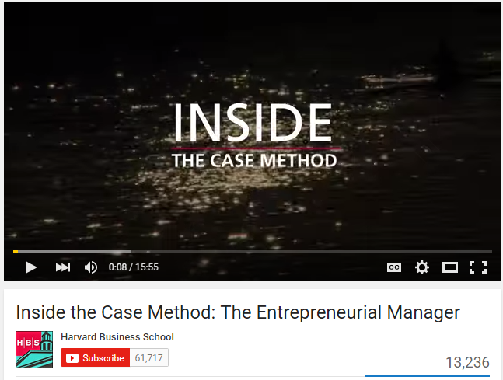
Case Study
Harvard Business School
The Case Method at HBS
Inside the Case Method: The Entrepreneurial Manager
http://www.youtube.com/watch?v=YWybEVsVwe4 (15:56)

Slide 39
Marketing Case Study 1: Nike (Ch1, pp.52-54)
What are the pros, cons, and risks associated with Nike’s core marketing strategy?
If you were Adidas, how would you compete with Nike?

Slide 40
Business Model

Slide 41
Business Model
8
7
2
4
1
Key Partners
Key Activities
Value Proposition
Customer Relationships
Customer Segments
6
3
Key Resources
Channels
9
5
Cost Structure
Revenue Streams
Source: Alexander Osterwalder & Yves Pigneur, Business Model Generation: A Handbook for Visionaries, Game Changers, and Challengers, Wiley, 2010.

Slide 42
Definition of Business Model
A business model describes the rationale of how an organization creates, delivers, and captures value.
Source: Alexander Osterwalder & Yves Pigneur, Business Model Generation: A Handbook for Visionaries, Game Changers, and Challengers, Wiley, 2010.

Slide 43
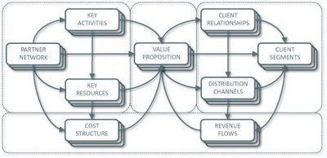
Business Model Canvas
Key Activities
Customer Relationships
Key Partners
Value Preposition
Customer Segments
Key Resources
Channels
Cost Structure
Revenue Streams
Source: http://nonlinearthinking.typepad.com/nonlinear_thinking/2008/07/the-business-model-canvas.html
https://www.youtube.com/watch?v=QoAOzMTLP5s

Slide 44
Business Model Canvas
Infrastructure Management
Product
Customer Interface
Key Activities
Customer Relationships
Key Partners
Value Preposition
Customer Segments
Key Resources
Channels
Financial Aspects
Cost Structure
Revenue Streams
Source: http://nonlinearthinking.typepad.com/nonlinear_thinking/2008/07/the-business-model-canvas.html
https://www.youtube.com/watch?v=QoAOzMTLP5s

Slide 45
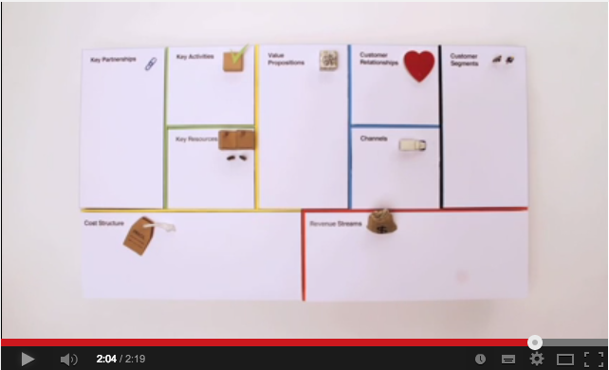
Business Model Canvas Explained
Source: http://www.youtube.com/watch?v=QoAOzMTLP5s

Slide 46
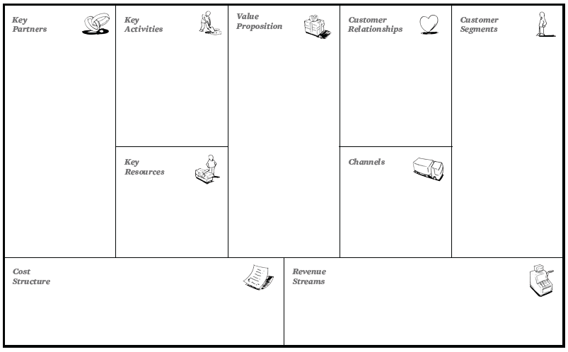
The 9 Building Blocks of Business Model
8
7
2
4
1
6
3
9
5
Source: Alexander Osterwalder & Yves Pigneur, Business Model Generation: A Handbook for Visionaries, Game Changers, and Challengers, Wiley, 2010.

Slide 47
The 9 Building Blocks of Business Model
8
7
2
4
1
How?
What?
Who?
6
3
Why?
9
5
Source: Alexander Osterwalder & Yves Pigneur, Business Model Generation: A Handbook for Visionaries, Game Changers, and Challengers, Wiley, 2010.

Slide 48
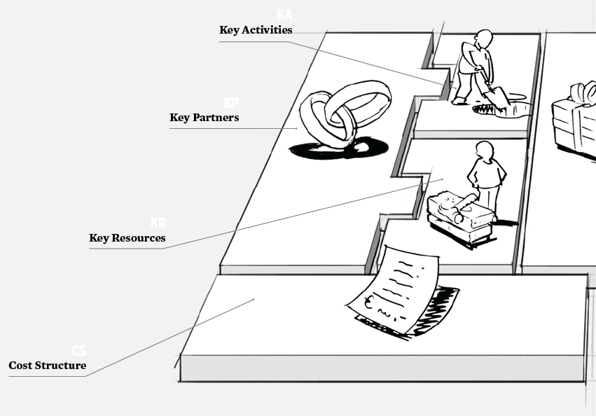
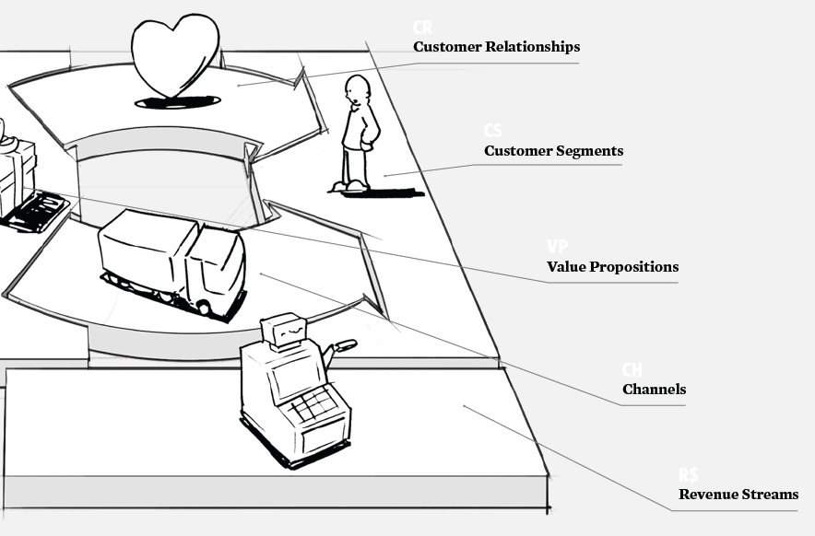
The 9 Building Blocks of Business Model
Source: Alexander Osterwalder & Yves Pigneur, Business Model Generation: A Handbook for Visionaries, Game Changers, and Challengers, Wiley, 2010.

Slide 49
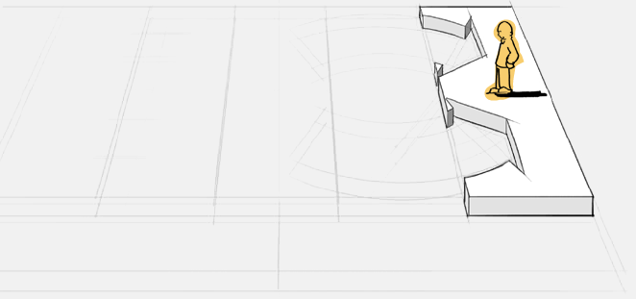
1. Customer Segments
Defines the different groups of people or organizations an enterprise aims to reach and serve
Source: Alexander Osterwalder & Yves Pigneur, Business Model Generation: A Handbook for Visionaries, Game Changers, and Challengers, Wiley, 2010.

Slide 50
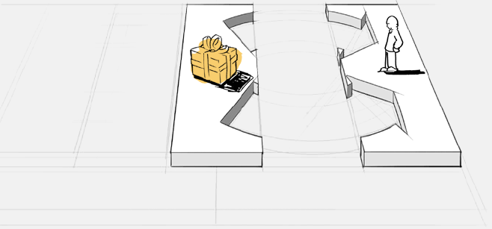
2. Value Propositions
Describes the bundle of products and services that create value for a specific Customer Segment
Source: Alexander Osterwalder & Yves Pigneur, Business Model Generation: A Handbook for Visionaries, Game Changers, and Challengers, Wiley, 2010.

Slide 51
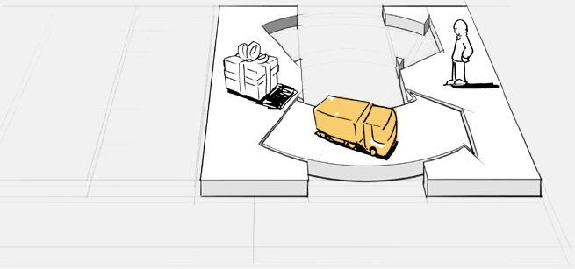
3. Channels
Describes how a company communicates with and reaches its Customer Segments to deliver a Value Proposition
Source: Alexander Osterwalder & Yves Pigneur, Business Model Generation: A Handbook for Visionaries, Game Changers, and Challengers, Wiley, 2010.

Slide 52
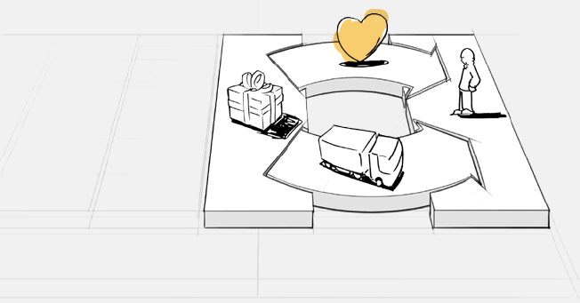
4. Customer Relationships
Describes the types of relationships a company establishes with specific Customer Segments
Source: Alexander Osterwalder & Yves Pigneur, Business Model Generation: A Handbook for Visionaries, Game Changers, and Challengers, Wiley, 2010.

Slide 53
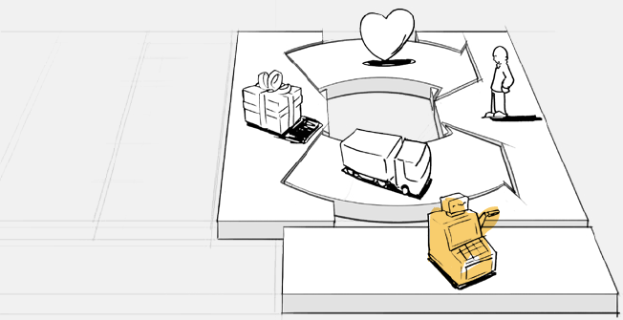
5. Revenue Streams
Represents the cash a company generates from each Customer Segment (costs must be subtracted from revenues to create earnings)
Source: Alexander Osterwalder & Yves Pigneur, Business Model Generation: A Handbook for Visionaries, Game Changers, and Challengers, Wiley, 2010.

Slide 54
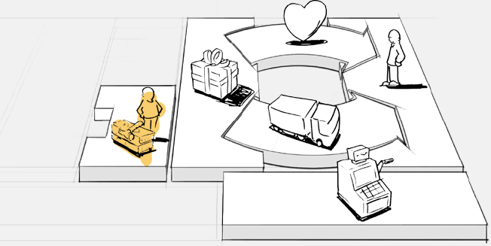
6. Key Resources
Describes the most important assets required to make a business model work
Source: Alexander Osterwalder & Yves Pigneur, Business Model Generation: A Handbook for Visionaries, Game Changers, and Challengers, Wiley, 2010.

Slide 55
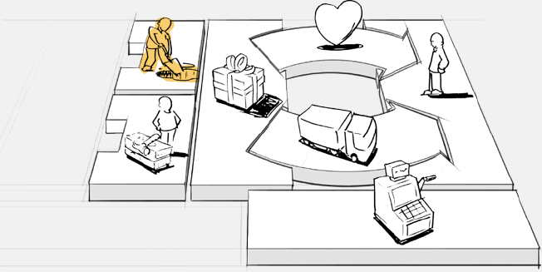
7. Key Activities
Describes the most important things a company must do to make its business model work
Source: Alexander Osterwalder & Yves Pigneur, Business Model Generation: A Handbook for Visionaries, Game Changers, and Challengers, Wiley, 2010.

Slide 56
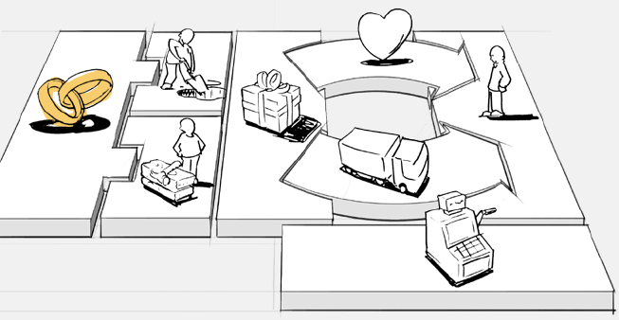
8. Key Partnerships
Describes the network of suppliers and partners that make the business model work
Source: Alexander Osterwalder & Yves Pigneur, Business Model Generation: A Handbook for Visionaries, Game Changers, and Challengers, Wiley, 2010.

Slide 57
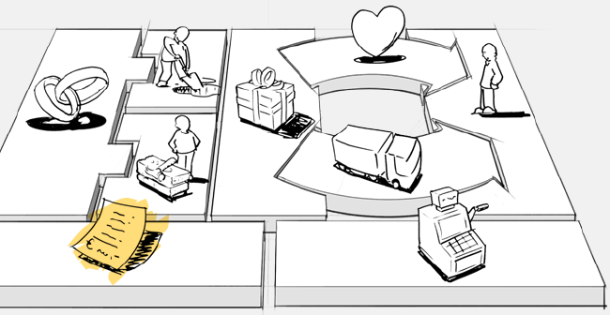
9. Cost Structure
Describes all costs incurred to operate a business model
Source: Alexander Osterwalder & Yves Pigneur, Business Model Generation: A Handbook for Visionaries, Game Changers, and Challengers, Wiley, 2010.

Slide 58
The 9 Building Blocks of Business Model
1. Customer Segments
An organization serves one or several Customer Segments.
2. Value Propositions
It seeks to solve customer problems and satisfy customer needs with value propositions.
3. Channels
Value propositions are delivered to customers through communication, distribution, and sales Channels.
4. Customer Relationships
Customer relationships are established and maintained with each Customer Segment.
Source: Alexander Osterwalder & Yves Pigneur, Business Model Generation: A Handbook for Visionaries, Game Changers, and Challengers, Wiley, 2010.

Slide 59
The 9 Building Blocks of Business Model
5. Revenue Streams
Revenue streams result from value propositions successfully offered to customers.
6. Key Resources
Key resources are the assets required to offer and deliver the previously described elements…
7. Key Activities
…by performing a number of Key Activities.
8. Key Partnerships
Some activities are outsourced and some resources are acquired outside the enterprise.
9. Cost Structure
The business model elements result in the cost structure.
Source: Alexander Osterwalder & Yves Pigneur, Business Model Generation: A Handbook for Visionaries, Game Changers, and Challengers, Wiley, 2010.

Slide 60
Marketing Strategy

Slide 61
Marketing Plan

Slide 62
Strategy vs. Tactics

Slide 63
Strategy vs. Tactics
Policy
Strategic
Procedure
Tactical
Execution
Operational
Source: http://joyante.wordpress.com/2011/02/21/business-strategy-versus-tactics/

Slide 64
Strategy vs. Tactics
Strategy
Tactics
Planning
Doing
Large Scale
Smaller Scale
Why
How
Difficult to Copy
Easy to Copy
Long Time Frame
Short Time Frame

Slide 65
Strategy
Plans
Tactics

Slide 66
Strategy > Plans > Tactics
Strategy involves a blueprint for gaining a competitive advantage.
Plans are the second-level goals in the hierarchy.
A complex strategy may contain many plans.
Tactics are the step-by-step methods you use to accomplish a plan.

Slide 67
Marketing Planning Process
Analyzing marketing opportunities
Selecting target markets
Designing marketing strategies
Developing marketing programs
Managing the marketing effort

Slide 68
The Strategic Planning, Implementation, and Control Processes
Planning
Implementing
Controlling
Corporate Planning
Organizing
Measuring Results
Division Planning
Diagnosing Results
Implementing
Business Planning
Taking corrective action
Product Planning

Slide 69
Marketing Plan
The strategic marketing plan lays out the target markets and the firm’s value proposition, based on an analysis of the best market opportunities.

Slide 70
Marketing Plan
The tactical marketing plan specifies the marketing tactics, including product features, promotion, merchandising, pricing, sales channels, and service.

Slide 71
Business Unit Strategic-Planning Process
External environment (Opportunity & Threat analysis)
Business Mission
Goal formulation
Strategy formulation
Program formulation
Implementation
Feedback and Control
SWOT analysis
Internal environment (Strengths & weakness analysis)

Slide 72
Business Unit Strategic-Planning Process
External environment (Opportunity & Threat analysis)
Business Mission
Goal formulation
Strategy formulation
Program formulation
Implementation
Feedback and Control
SWOT analysis
Internal environment (Strengths & weakness analysis)
1
Business Mission

Slide 73
Business Unit Strategic-Planning Process
External environment (Opportunity & Threat analysis)
Business Mission
Goal formulation
Strategy formulation
Program formulation
Implementation
Feedback and Control
SWOT analysis
Internal environment (Strengths & weakness analysis)
2
External environment (Opportunity & Threat analysis)
SWOT analysis
Internal environment (Strengths & weakness analysis)

Slide 74
Business Unit Strategic-Planning Process
External environment (Opportunity & Threat analysis)
Business Mission
Goal formulation
Strategy formulation
Program formulation
Implementation
Feedback and Control
SWOT analysis
Internal environment (Strengths & weakness analysis)
3
Goal formulation

Slide 75
Business Unit Strategic-Planning Process
External environment (Opportunity & Threat analysis)
Business Mission
Goal formulation
Strategy formulation
Program formulation
Implementation
Feedback and Control
SWOT analysis
Internal environment (Strengths & weakness analysis)
4
Strategy formulation

Slide 76
Business Unit Strategic-Planning Process
External environment (Opportunity & Threat analysis)
Business Mission
Goal formulation
Strategy formulation
Program formulation
Implementation
Feedback and Control
SWOT analysis
Internal environment (Strengths & weakness analysis)
5
Program formulation

Slide 77
Business Unit Strategic-Planning Process
External environment (Opportunity & Threat analysis)
Business Mission
Goal formulation
Strategy formulation
Program formulation
Implementation
Feedback and Control
SWOT analysis
Internal environment (Strengths & weakness analysis)
6
Implementation

Slide 78
Business Unit Strategic-Planning Process
External environment (Opportunity & Threat analysis)
Business Mission
Goal formulation
Strategy formulation
Program formulation
Implementation
Feedback and Control
SWOT analysis
Internal environment (Strengths & weakness analysis)
7
Feedback and Control

Slide 79
Marketing Plan Contents
Executive summary (1.0)
Table of contents
Situation analysis (2.0) (Ch1)
Marketing strategy (3.0) (Ch2)
Marketing tactics (4.0) (Ch3)
Financial projections (5.0) (Ch4)
Implementation controls (6.0) (Ch5)

Slide 80
Sample Marketing Plan
1.0
Executive Summary
1.0 Executive Summary
2.0 Situation Analysis
3.0 Marketing Strategy
4.0 Marketing Tactics
5.0 Financials
6.0 Controls
2.0
Situation Analysis
3.0
Marketing Strategy
4.0
Marketing Tactics
5.0
Financials
6.0
Controls

Slide 81
2.0 Situation Analysis
Sample Marketing Plan
1.0
Executive Summary
2.1 Market Summary
2.2 SWOT Analysis
2.3 Competition
2.4 Product Offering
2.5 Keys to Success
2.6 Critical Issues
2.0
Situation Analysis
3.0
Marketing Strategy
4.0
Marketing Tactics
5.0
Financials
6.0
Controls

Slide 82
2.1 Market Summary
Sample Marketing Plan
1.0
Executive Summary
2.1.1 Market Demographics
Geographics
Demographics
Behavior Factors
2.1.2 Market Needs
2.1.3 Market Trends
2.1.4 Market Growth
2.0
Situation Analysis
3.0
Marketing Strategy
4.0
Marketing Tactics
5.0
Financials
6.0
Controls

Slide 83
3.0 Marketing Strategy
Sample Marketing Plan
1.0
Executive Summary
3.1 Mission
3.2 Marketing Objectives
3.3 Financial Objectives
3.4 Target Markets
3.5 Positioning
2.0
Situation Analysis
3.0
Marketing Strategy
4.0
Marketing Tactics
5.0
Financials
6.0
Controls

Slide 84
4.0 Marketing Tactics
Sample Marketing Plan
1.0
Executive Summary
4.1 Product
4.2 Pricing
4.3 Distribution (Place)
4.4 Communications (Promotion)
4.5 Marketing Research
2.0
Situation Analysis
3.0
Marketing Strategy
4.0
Marketing Tactics
5.0
Financials
6.0
Controls

Slide 85
5.0 Financials
Sample Marketing Plan
1.0
Executive Summary
5.1 Break-Even Analysis
5.2 Sales Forecast
5.3 Expense Forecast
2.0
Situation Analysis
3.0
Marketing Strategy
4.0
Marketing Tactics
5.0
Financials
6.0
Controls

Slide 86
6.0 Controls
Sample Marketing Plan
1.0
Executive Summary
6.1 Implementation
6.2 Marketing Organization
6.3 Contingency Planning
2.0
Situation Analysis
3.0
Marketing Strategy
4.0
Marketing Tactics
5.0
Financials
6.0
Controls

Slide 87
Evaluating a Marketing Plan
Is the plan simple/succinct?
Is the plan complete?
Is the plan specific?
Is the plan realistic?

Slide 88
TSC 崇越行銷大賞 http://marketing.topco-global.com/TopcoMKT

Slide 89
Summary
This course introduces the fundamental theories and practices of marketing management.
Topics include:
Understanding Marketing Management
Capturing Marketing Insights
Connecting with Customers
Building Strong Brands
Creating Value and Shaping the Market Offerings
Delivering Value
Communicating Value
Conducting Marketing Responsibly for Long-term Success

Slide 90
Marketing Case Study 1: Nike (Ch1, pp.52-54)
What are the pros, cons, and risks associated with Nike’s core marketing strategy?
If you were Adidas, how would you compete with Nike?

Slide 91
修課應注意事項
1. 請同學於行銷管理個案討論前 應詳細研讀個案，並思考個案研究問題。
2. 請同學於上課前預習行銷管理相關理論， 以作為個案分析及擬定管理對策的依據。
3. 請同學於上課前 先繳交行銷管理個案研究問題書面報告。
4.上課時間地點： 週二 Tue 2 (09:10-10:00) B702 週四 Thu 7, 8 (14:10-16:00) B608

Slide 92
Contact Information
戴敏育 博士 (Min-Yuh Day, Ph.D.)
專任助理教授
淡江大學 資訊管理學系
電話：02-26215656 #2846
傳真：02-26209737
研究室：B929
地址： 25137 新北市淡水區英專路151號
Email： myday@mail.tku.edu.tw
網址：http://mail.tku.edu.tw/myday/

