Slide 1
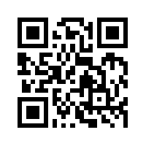
Social Media Apps Programming
Tamkang University
Twitter API
1061SMAP14
TLMXM1A (8648) (M2143) (Fall 2017)
(MIS MBA) (2 Credits, Elective) [Full English Course]
Fri 8,9 (15:10-17:00) B206
Min-Yuh Day, Ph.D.
Assistant Professor
Department of Information Management
Tamkang University
http://mail.tku.edu.tw/myday
2018-01-05

Slide 2
Course Schedule (1/2)
Tamkang University
Week Date Subject/Topics
1 2017/09/22 Course Orientation and Introduction to Social Media and Mobile Apps Programming
2 2017/09/29 Introduction to Android / iOS Apps Programming
3 2017/10/06 Developing Android Native Apps with Java (Android Studio)
4 2017/10/13 Developing iPhone / iPad Native Apps with Swift (XCode)
5 2017/10/20 Mobile Apps using HTML5/CSS3/JavaScript
6 2017/10/27 jQuery Mobile
7 2017/11/03 Create Hybrid Apps with Phonegap
8 2017/11/10 jQuery Mobile/Phonegap
9 2017/11/17 jQuery Mobile/Phonegap

Slide 3
Course Schedule (2/2)
Tamkang University
Week Date Subject/Topics
10 2017/11/24 Midterm Project Report
11 2017/12/01 Case Study on Social Media Apps Programming and Marketing in Google Play and App Store
12 2017/12/08 Google Cloud Platform
13 2017/12/15 Google App Engine
14 2017/12/22 Google Map API
15 2017/12/29 Facebook API (Facebook JavaScript SDK) (Integrate Facebook with iOS/Android Apps)
16 2018/01/05 Twitter API
17 2018/01/12 Final Project Presentation
18 2018/01/19 Final Exam Week (Final Project Presentation)

Slide 4
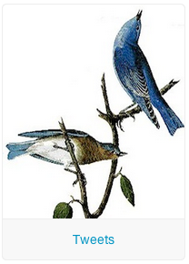
Outline
Twitter Developers
Twitter Platform Objects
Twitter for Websites
Twitter Search API
Twitter REST API
Twitter Streaming API

Slide 5
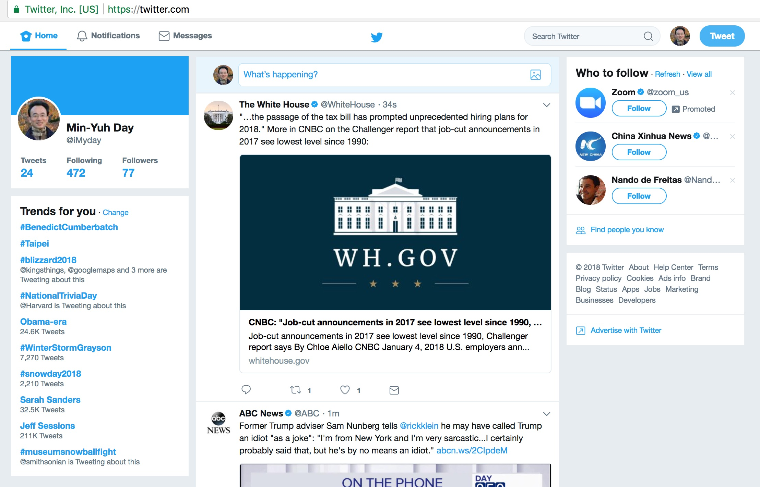
Twitter
https://twitter.com/

Slide 6
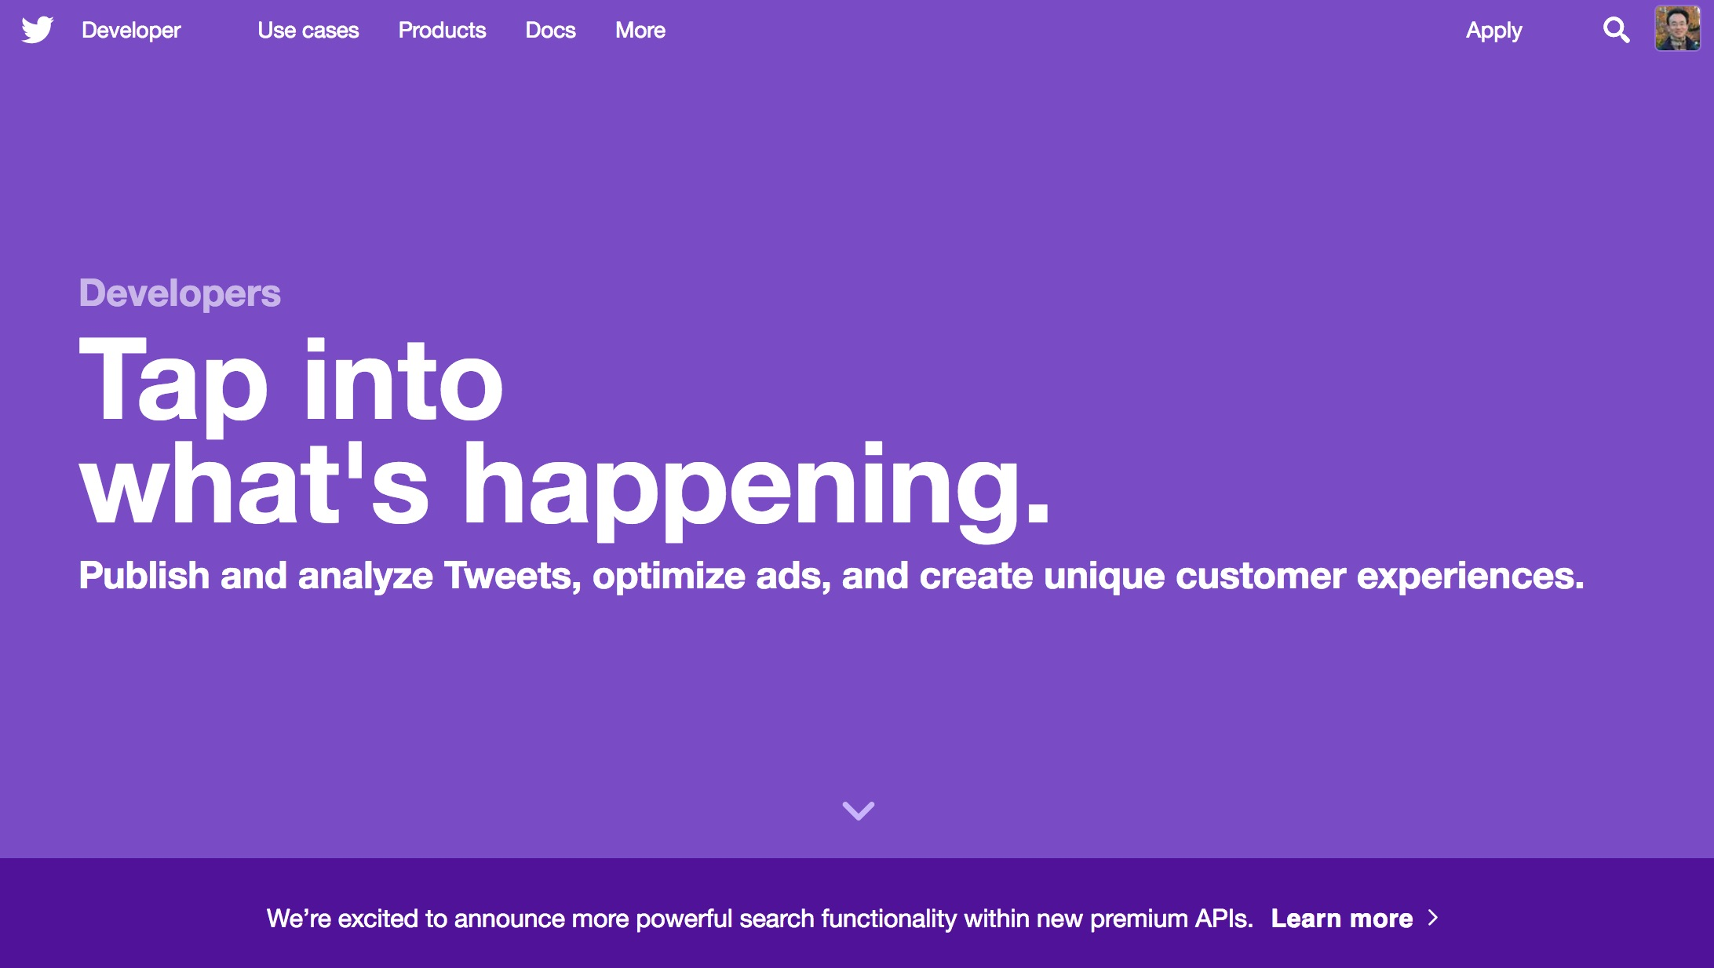
Twitter Developer
https://developer.twitter.com/

Slide 7
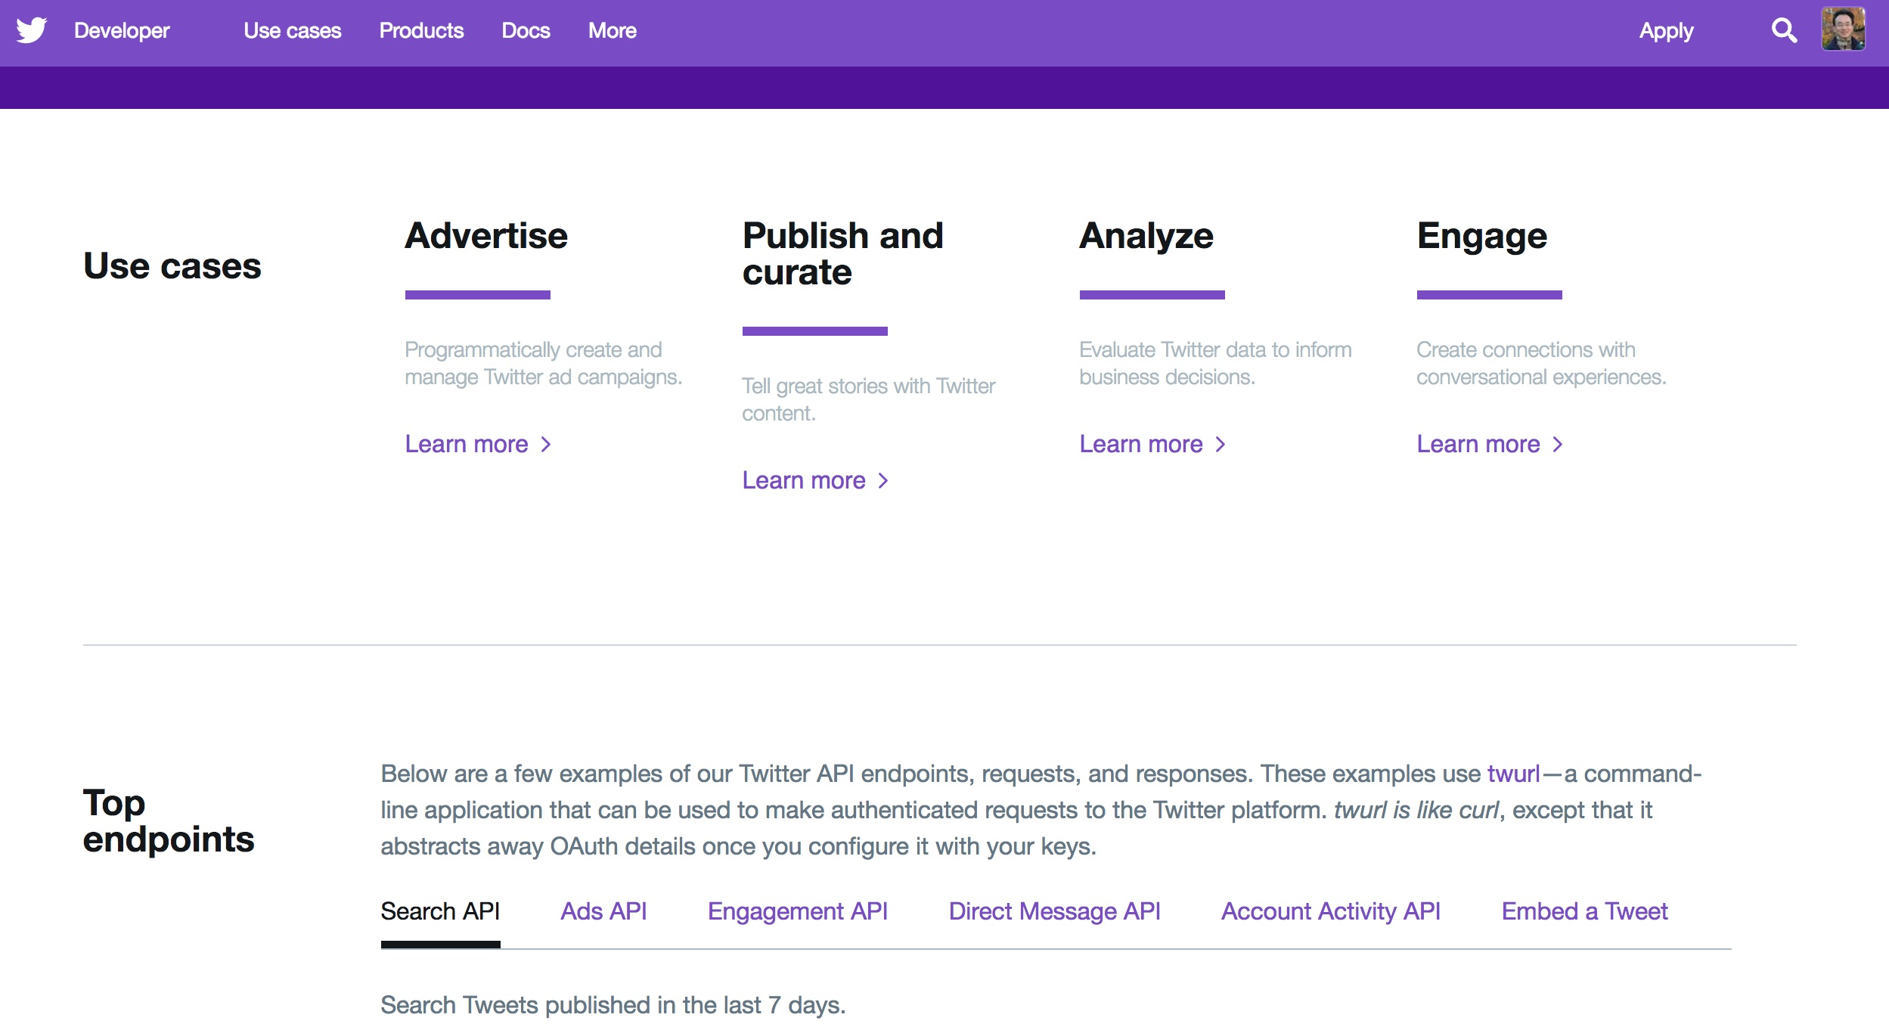
Twitter Developer
https://developer.twitter.com/

Slide 8
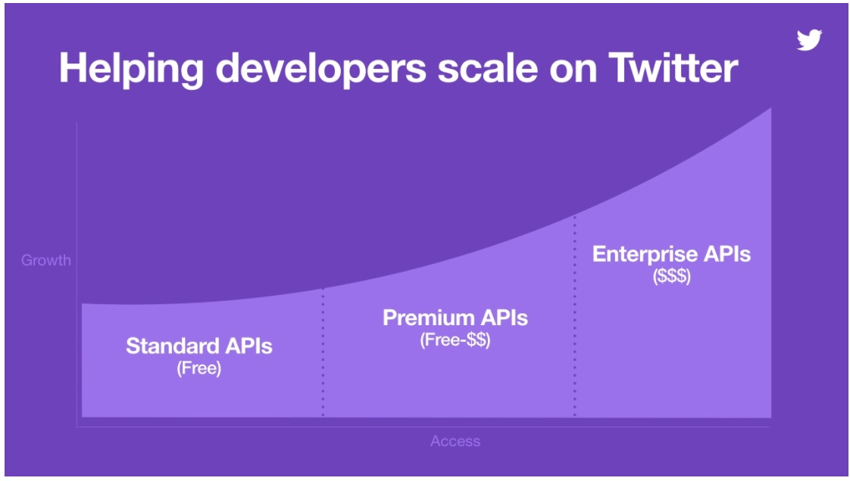
Twitter APIs Standard, Premium, Enterprise
Source: https://blog.twitter.com/developer/en_us/topics/tools/2017/introducing-twitter-premium-apis.html

Slide 9
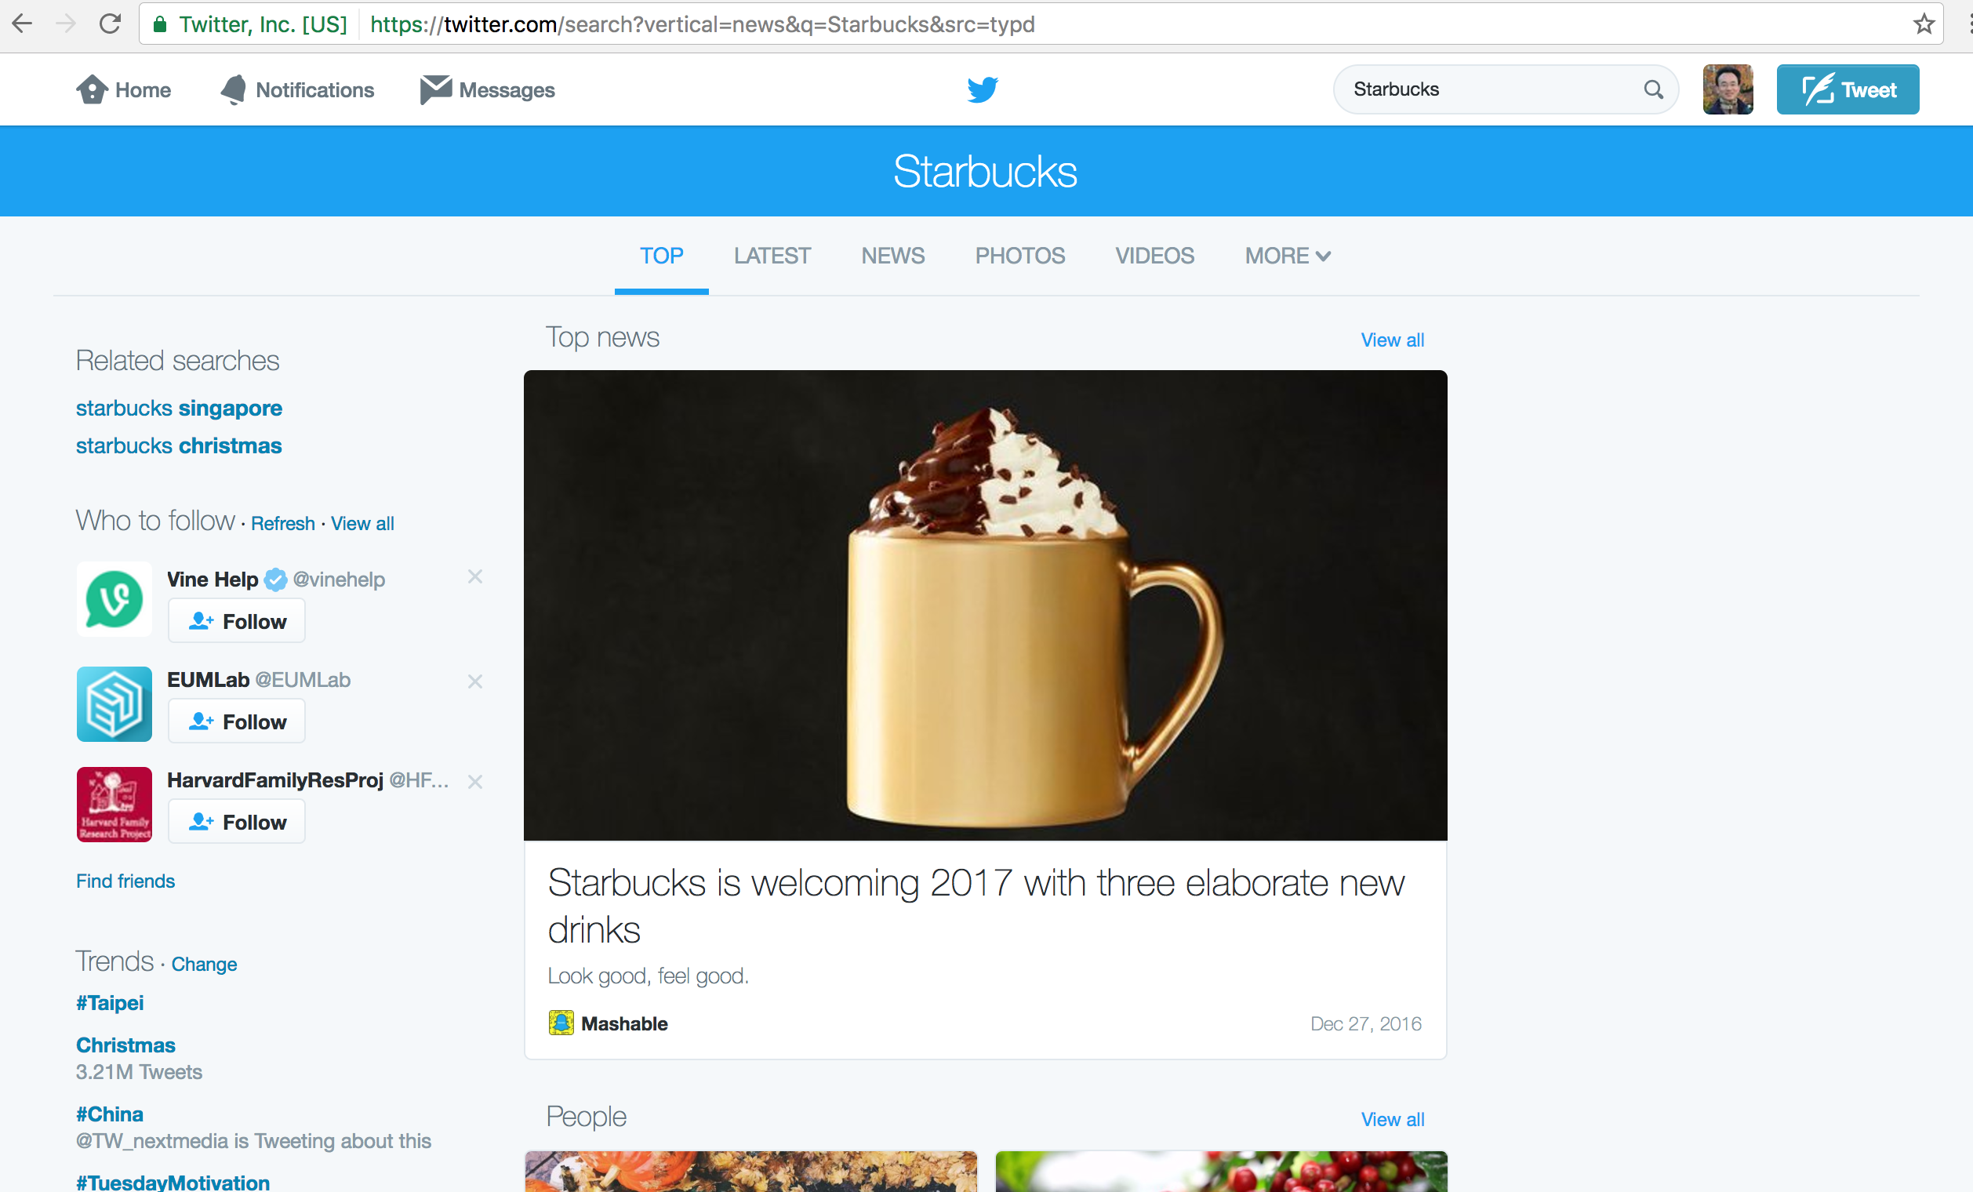
Twitter
https://twitter.com/search?src=typd&q=Starbucks

Slide 10
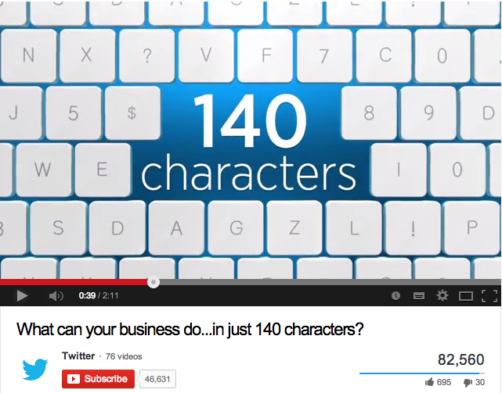
What can your business do...in just 140 characters?
http://www.youtube.com/watch?v=BGirUZq1WtQ

Slide 11
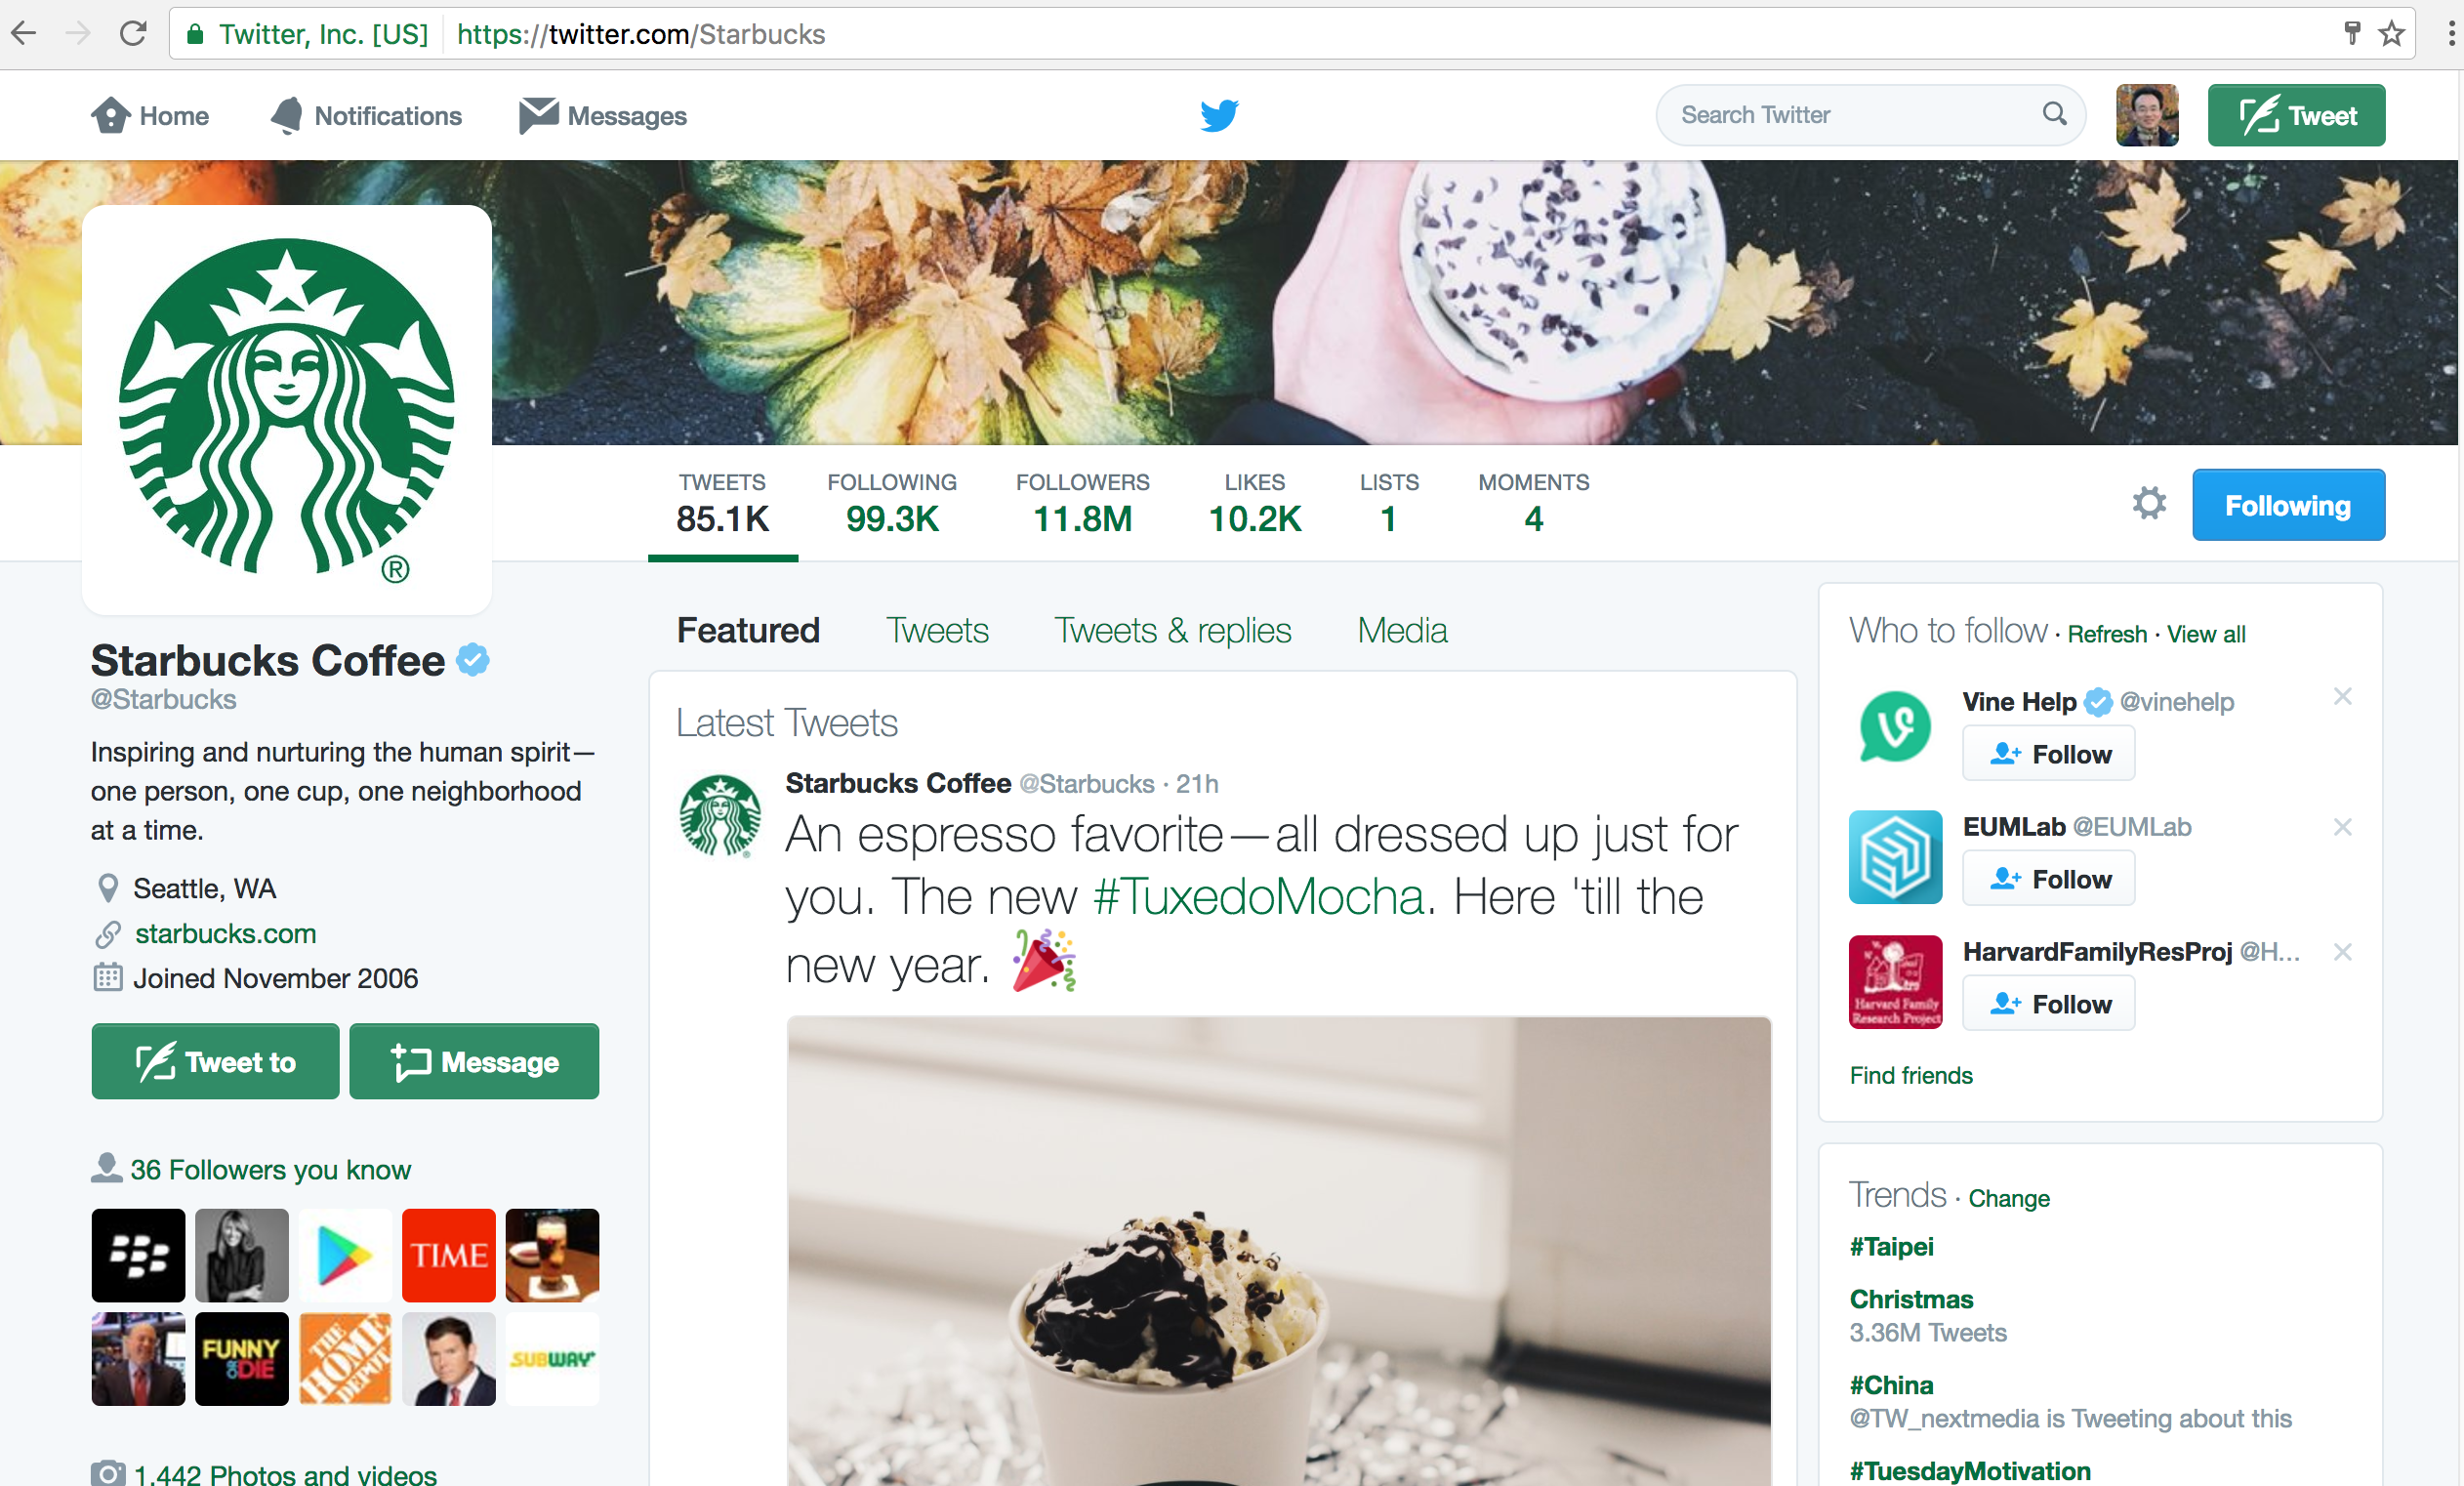
Twitter
https://twitter.com/Starbucks

Slide 12
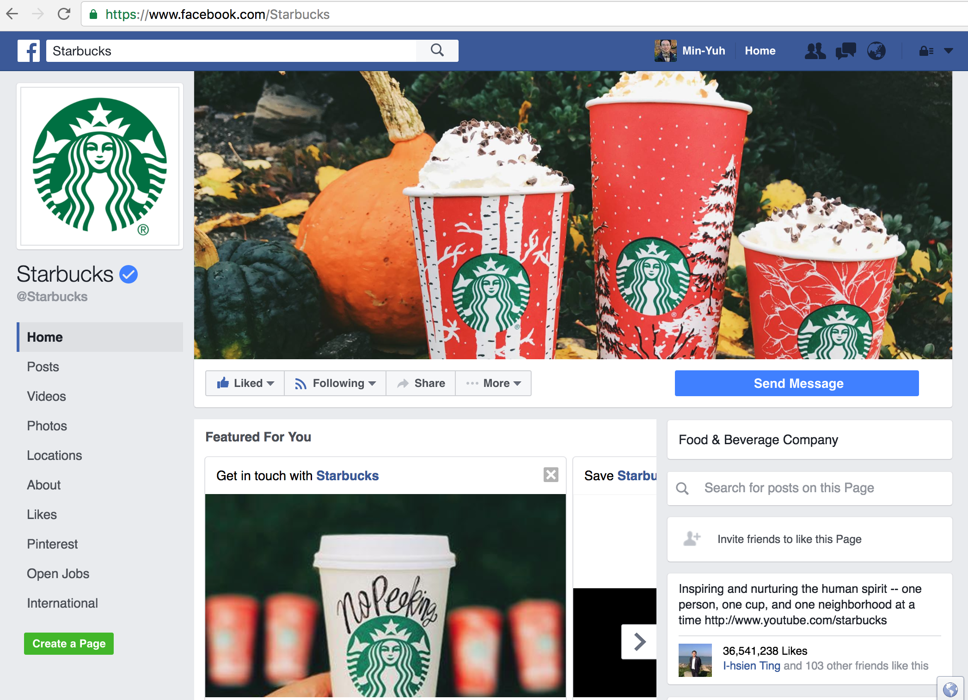
Facebook
https://www.facebook.com/Starbucks

Slide 13
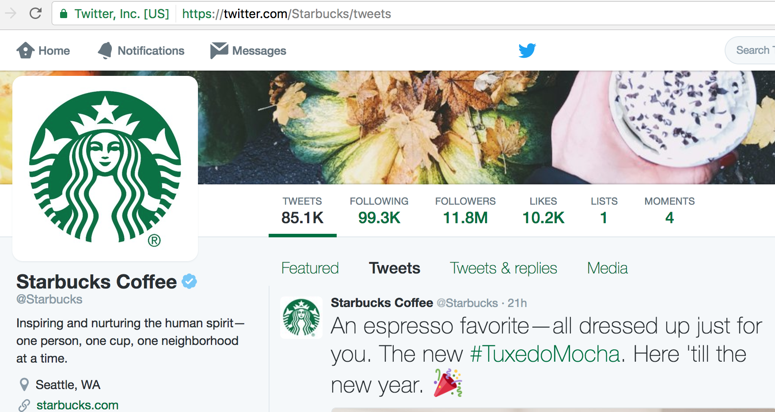
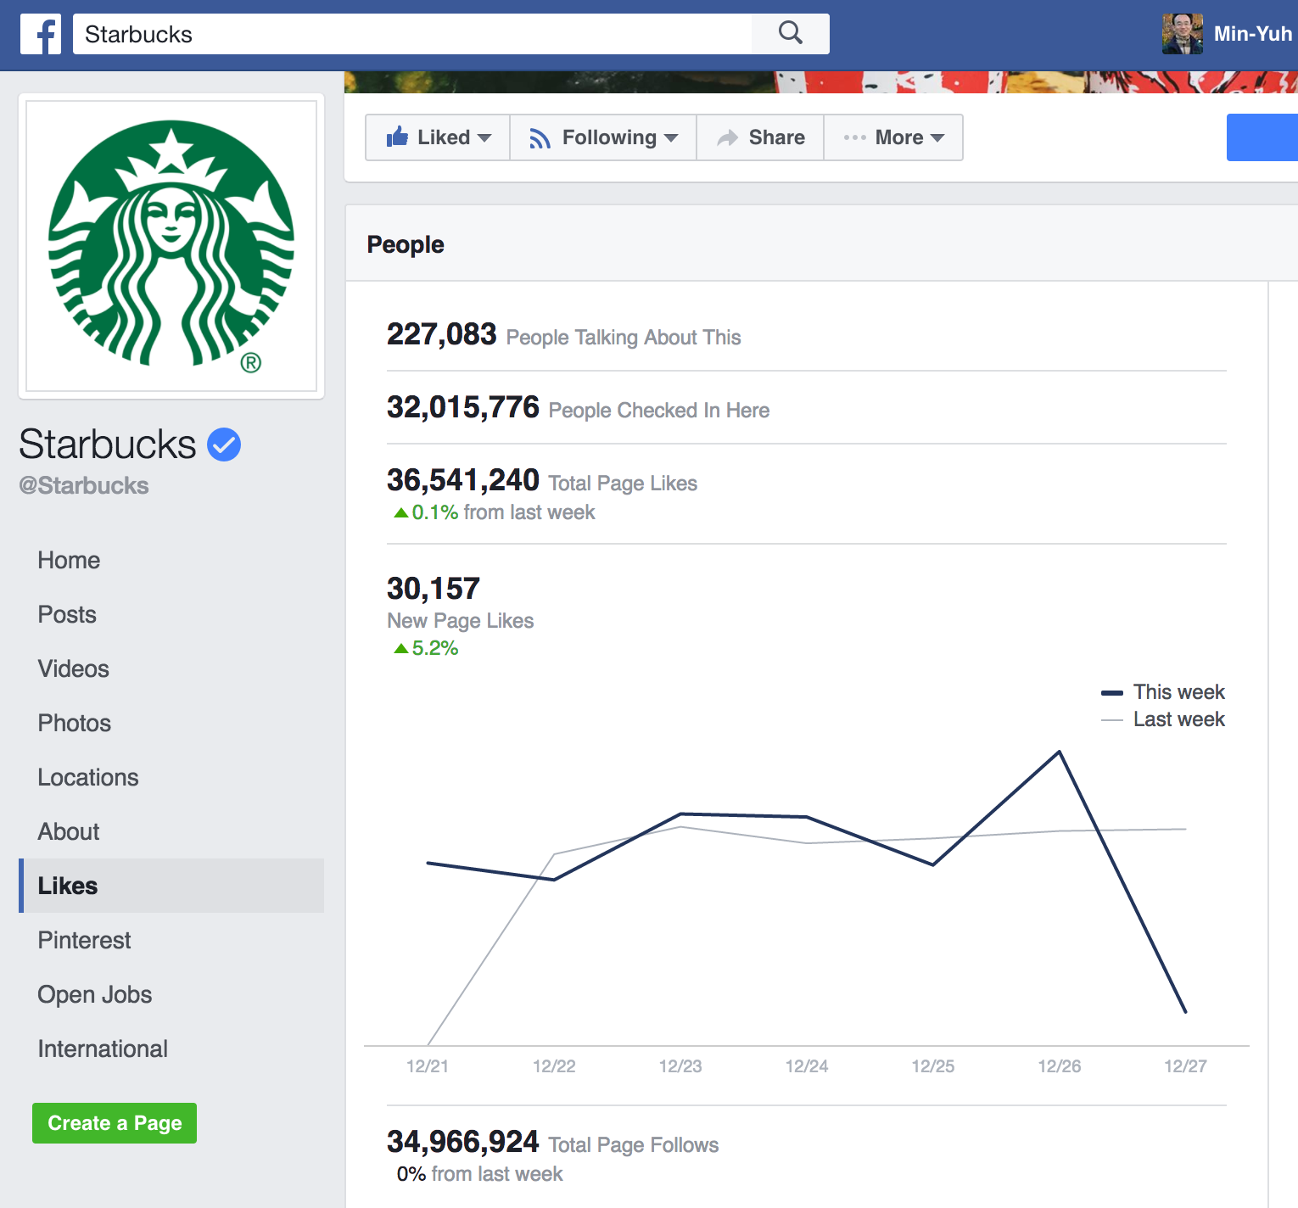
Twitter vs. Facebook
https://twitter.com/Starbucks/
https://www.facebook.com/pg/Starbucks/likes/?ref=page_internal

Slide 14
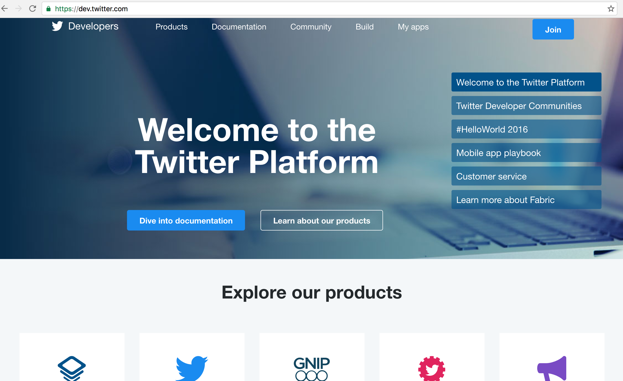
Twitter Developers
https://dev.twitter.com/

Slide 15
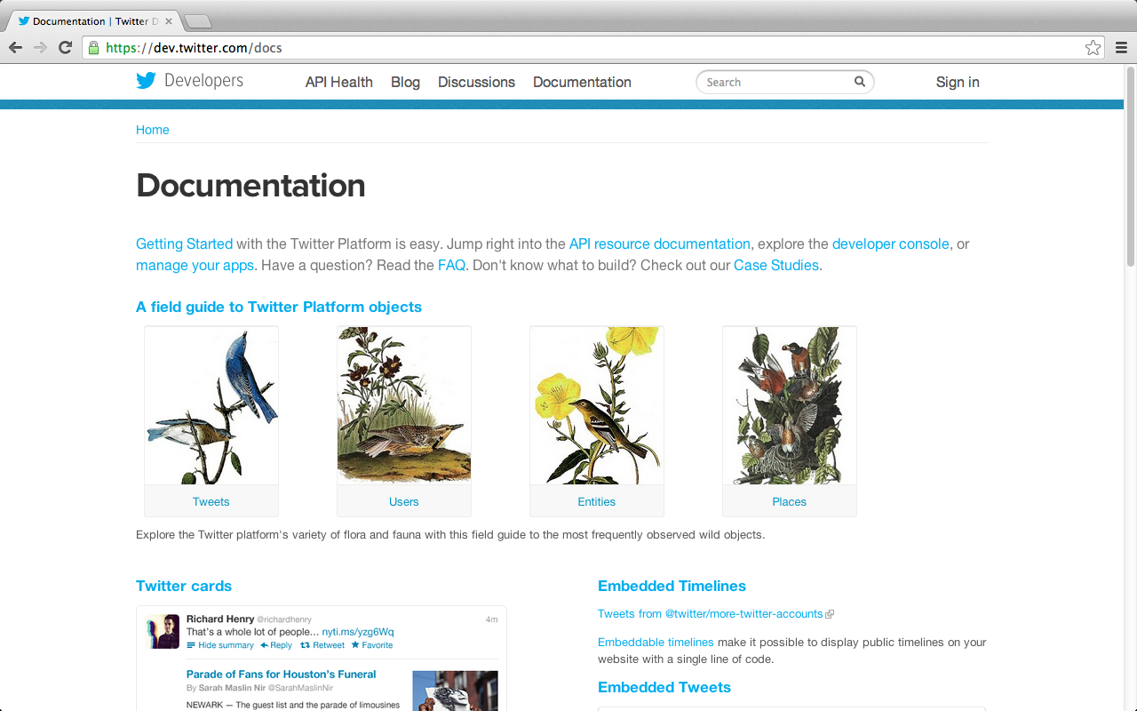
Twitter Developers Documentation
Documentation
https://dev.twitter.com/docs

Slide 16
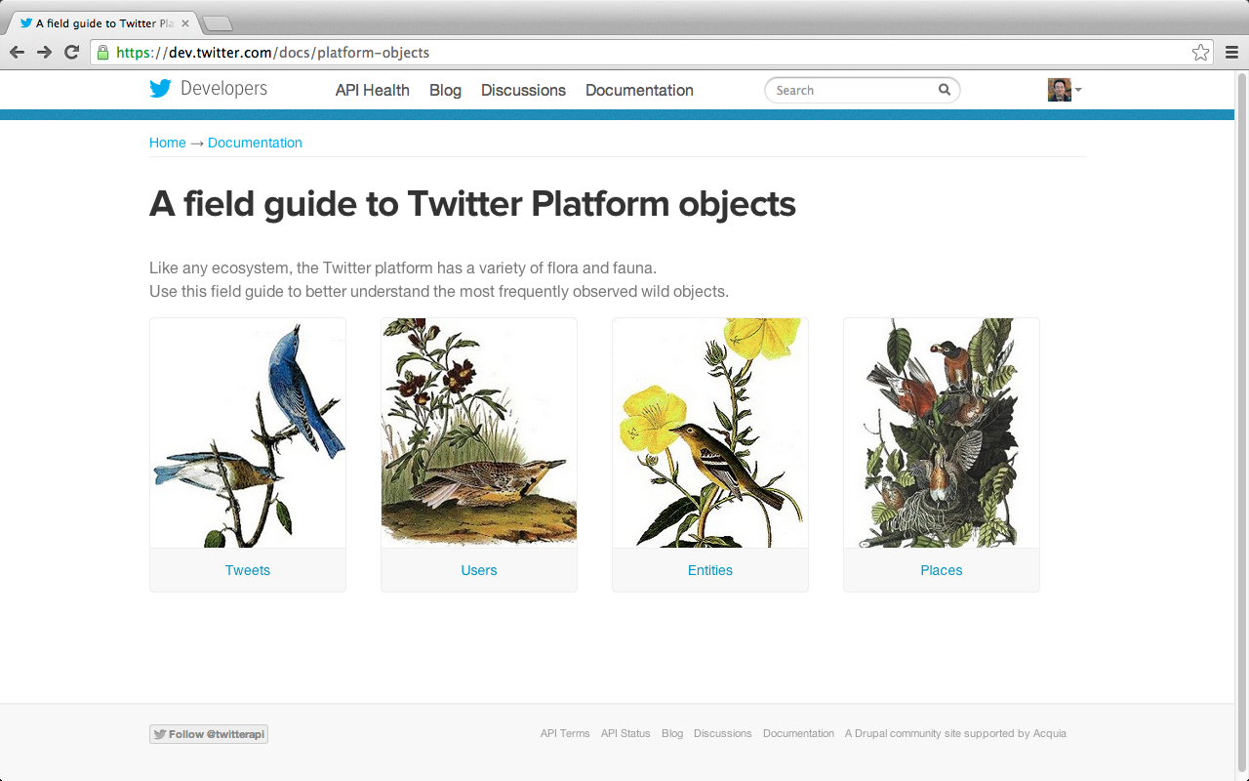
A field guide to Twitter Platform objects
https://dev.twitter.com/docs/platform-objects
Notes:
Source: https://dev.twitter.com/docs/platform-objects
A field guide to Twitter Platform objects
Like any ecosystem, the Twitter platform has a variety of flora and fauna.
Use this field guide to better understand the most frequently observed wild objects.

Slide 17
Tweets
Tweets are the basic atomic building block of all things Twitter.
Source: https://dev.twitter.com/docs/platform-objects

Slide 18
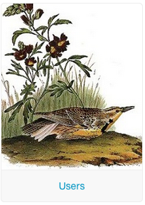
Users
Users can be anyone or anything.
Source: https://dev.twitter.com/docs/platform-objects

Slide 19
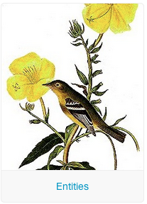
Entities
Entities provide metadata and additional contextual information about content posted on Twitter.
Source: https://dev.twitter.com/docs/platform-objects

Slide 20
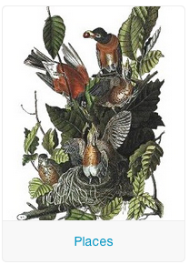
Places
Places are specific, named locations with corresponding geo coordinates.
Source: https://dev.twitter.com/docs/platform-objects

Slide 21
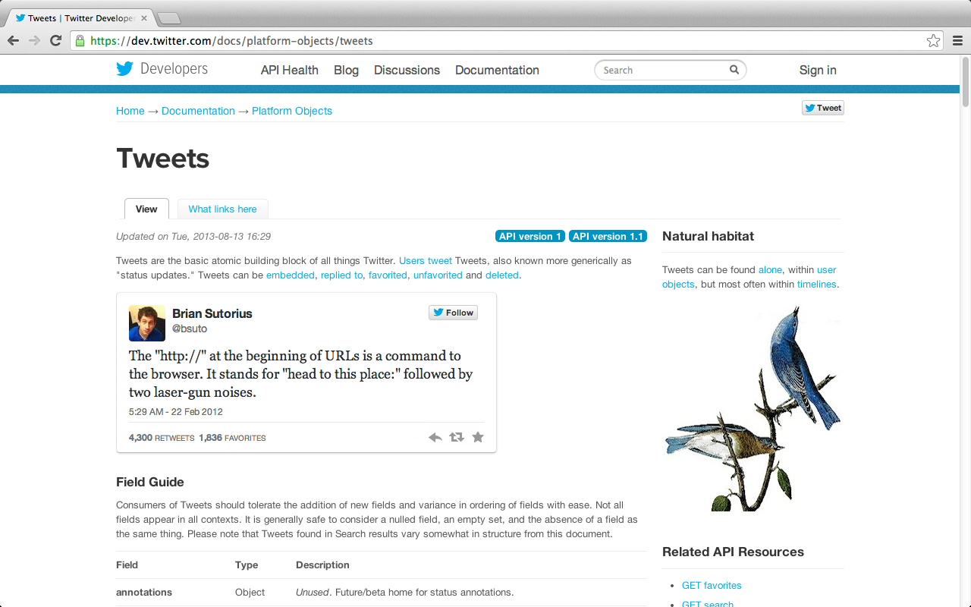
Tweets
https://dev.twitter.com/docs/platform-objects/tweets

Slide 22
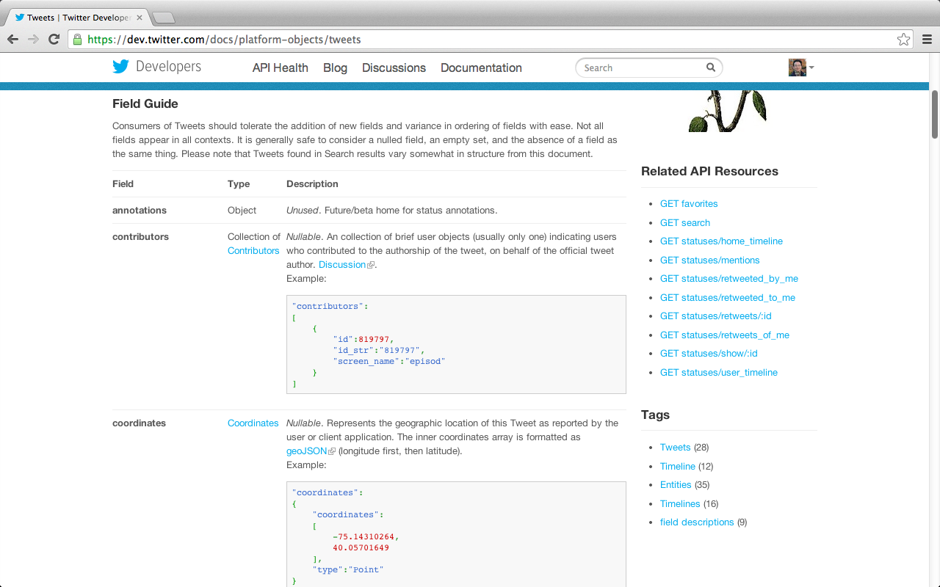
Tweets
https://dev.twitter.com/docs/platform-objects/tweets

Slide 23
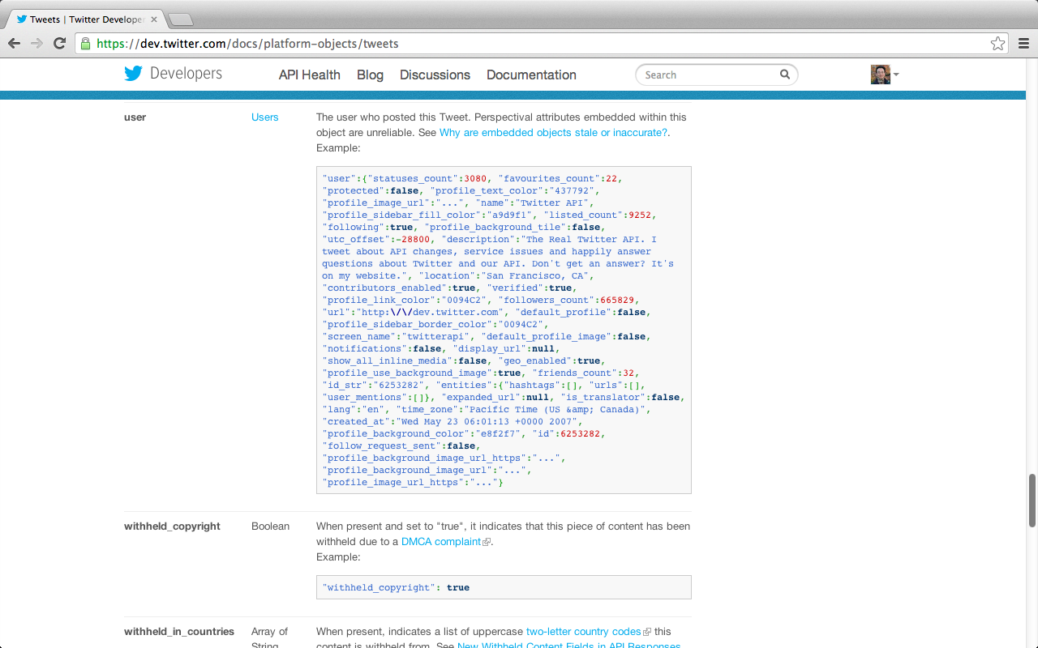
Tweets
https://dev.twitter.com/docs/platform-objects/tweets

Slide 24
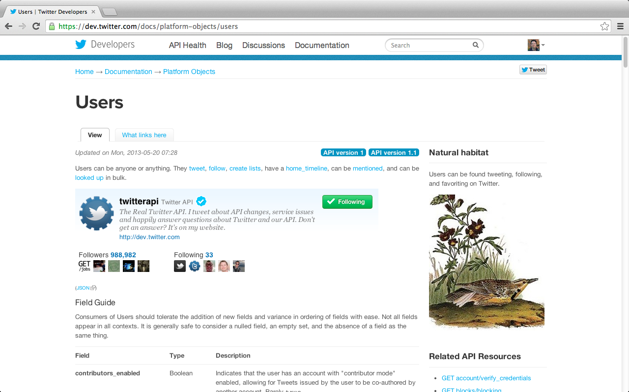
Users
https://dev.twitter.com/docs/platform-objects/users

Slide 25
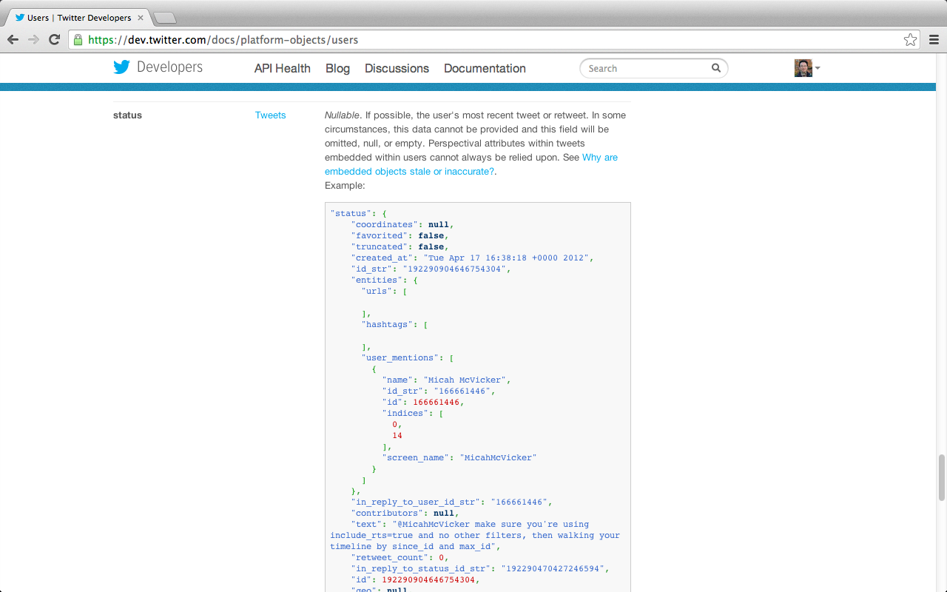
Users
https://dev.twitter.com/docs/platform-objects/users

Slide 26
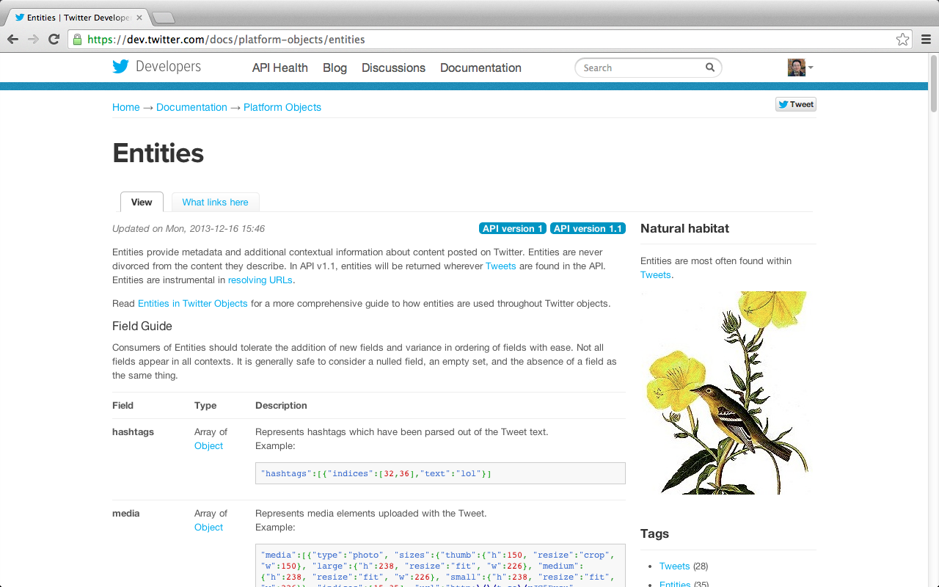
Entities
https://dev.twitter.com/docs/platform-objects/entities

Slide 27
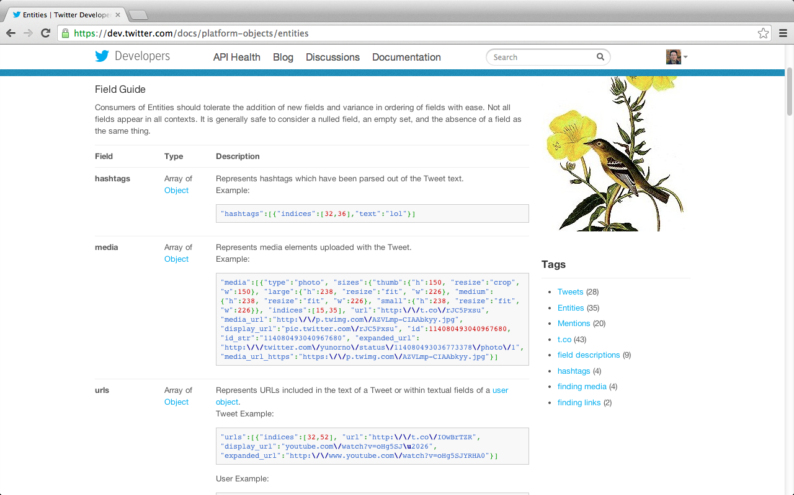
Entities
https://dev.twitter.com/docs/platform-objects/entities

Slide 28
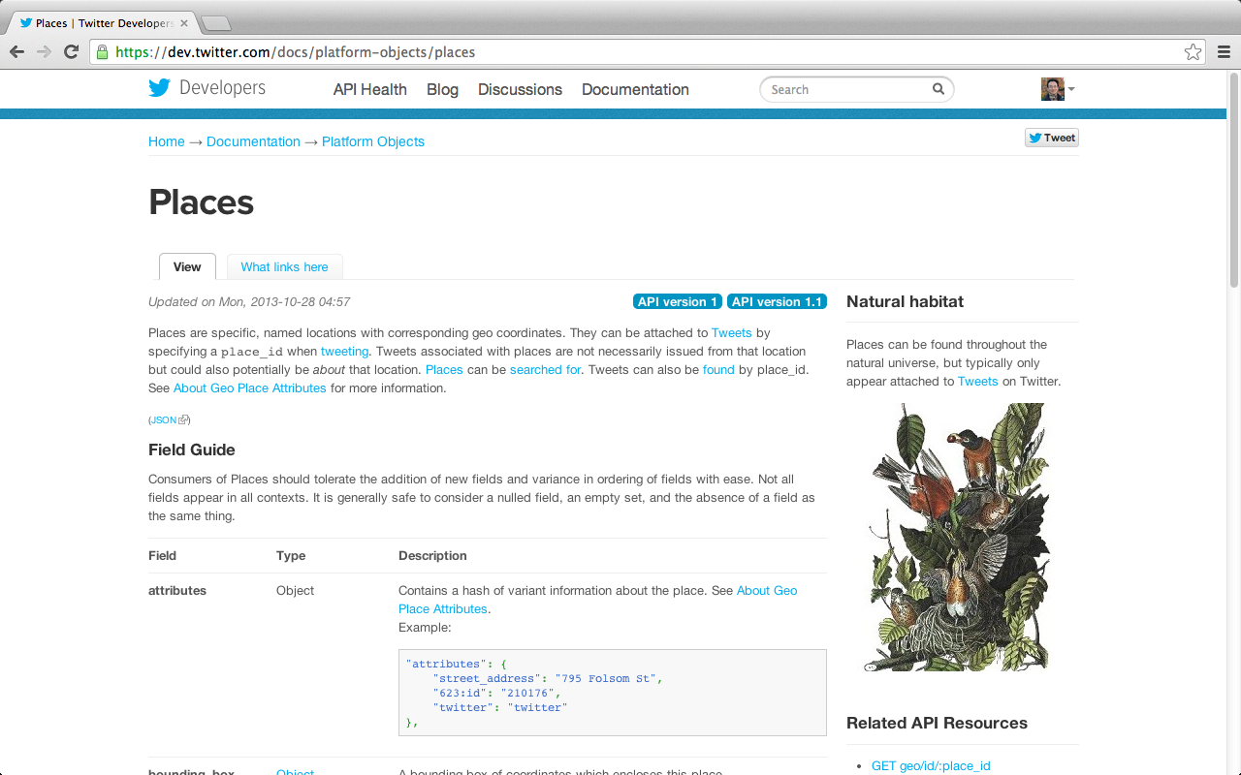
Places
https://dev.twitter.com/docs/platform-objects/places

Slide 29
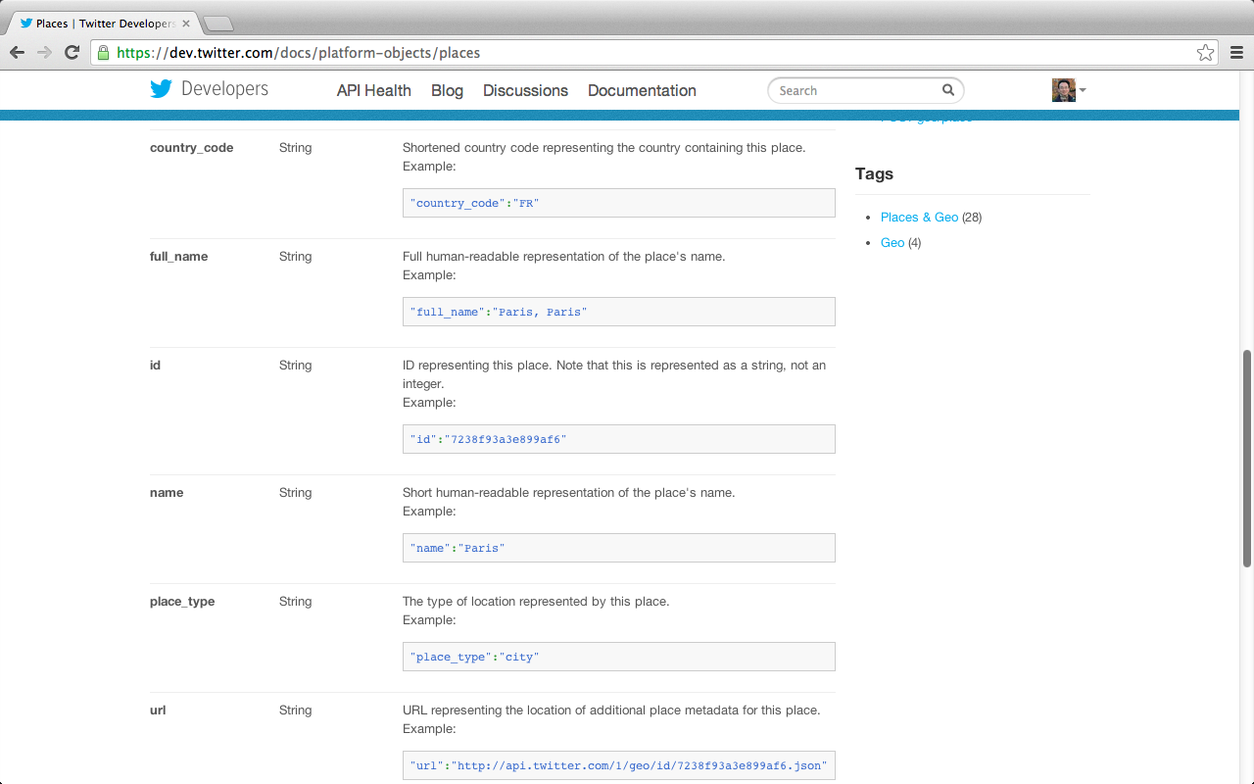
Places
https://dev.twitter.com/docs/platform-objects/places

Slide 30
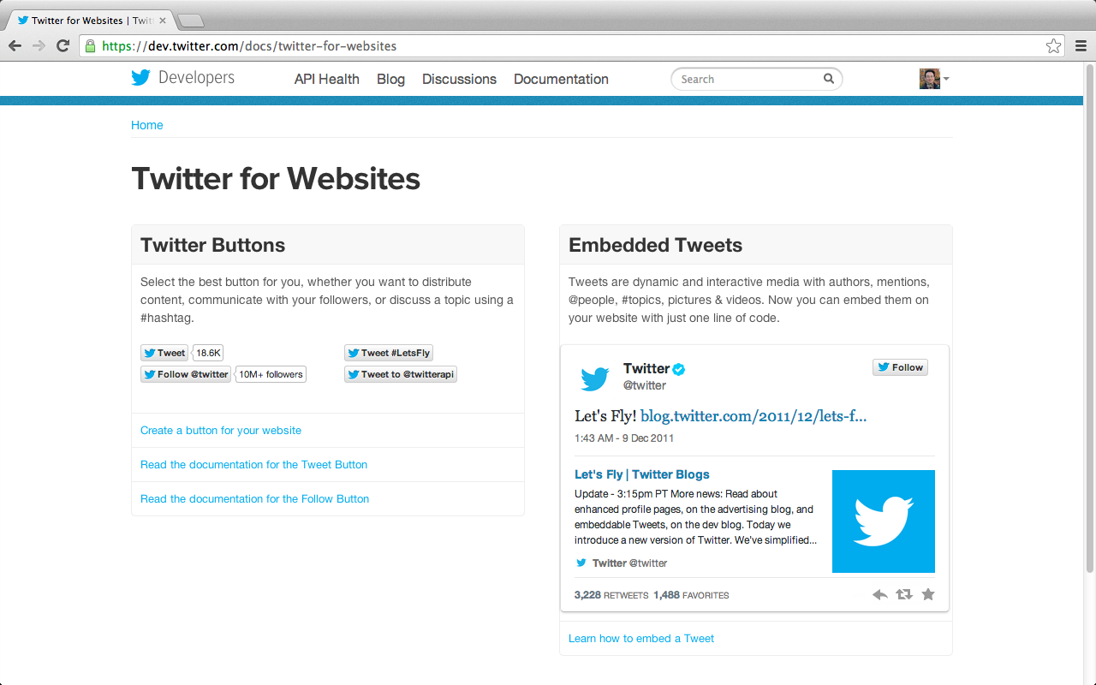
Twitter for Websites
https://dev.twitter.com/docs/twitter-for-websites

Slide 31
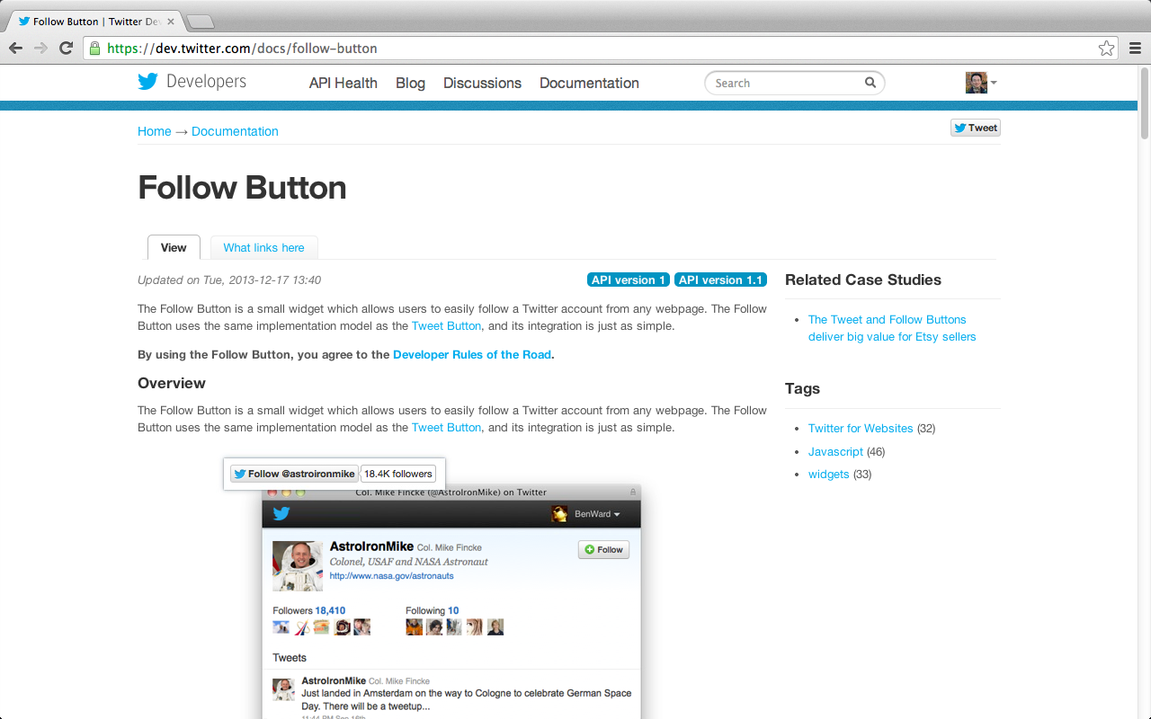
Follow Button
https://dev.twitter.com/docs/follow-button

Slide 32
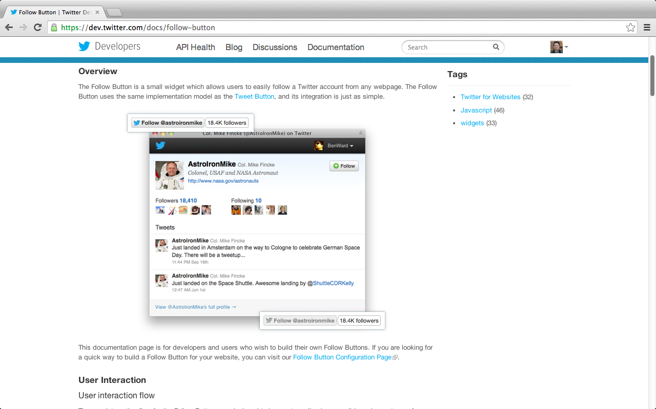
Follow Button
https://dev.twitter.com/docs/follow-button

Slide 33
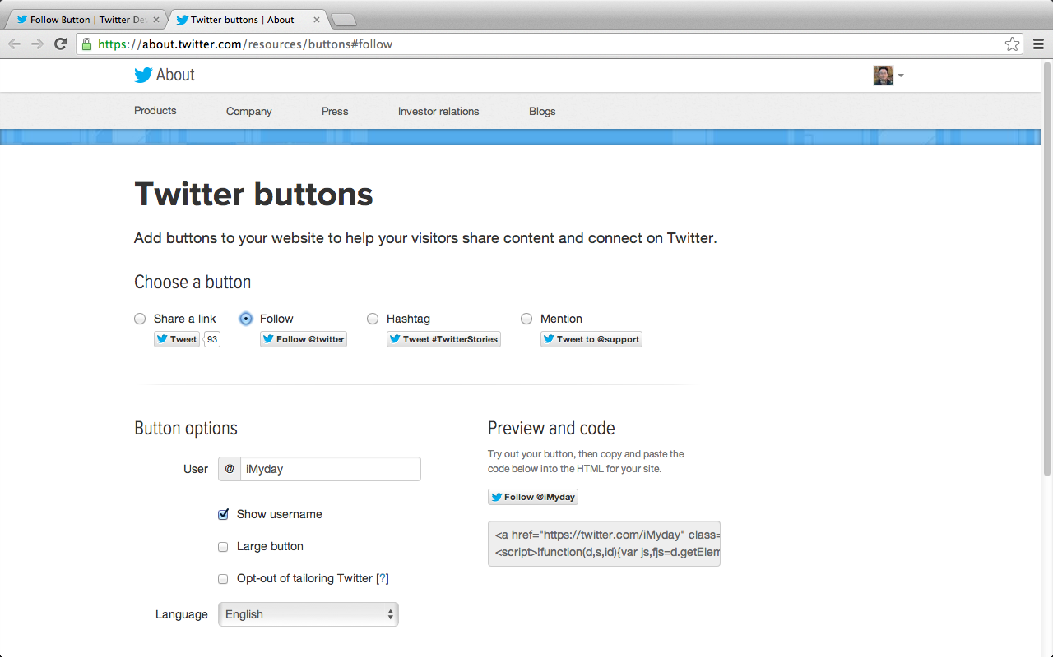
Twitter buttons
https://about.twitter.com/resources/buttons#follow

Slide 34
Follow @iMyday
<a href="https://twitter.com/iMyday" class="twitter-follow-button" data-show-count="false">Follow @iMyday</a>
<script>!function(d,s,id){var js,fjs=d.getElementsByTagName(s)[0],p=/^http:/.test(d.location)?'http':'https';if(!d.getElementById(id)){js=d.createElement(s);js.id=id;js.src=p+'://platform.twitter.com/widgets.js';fjs.parentNode.insertBefore(js,fjs);}}(document, 'script', 'twitter-wjs');</script>

Slide 35
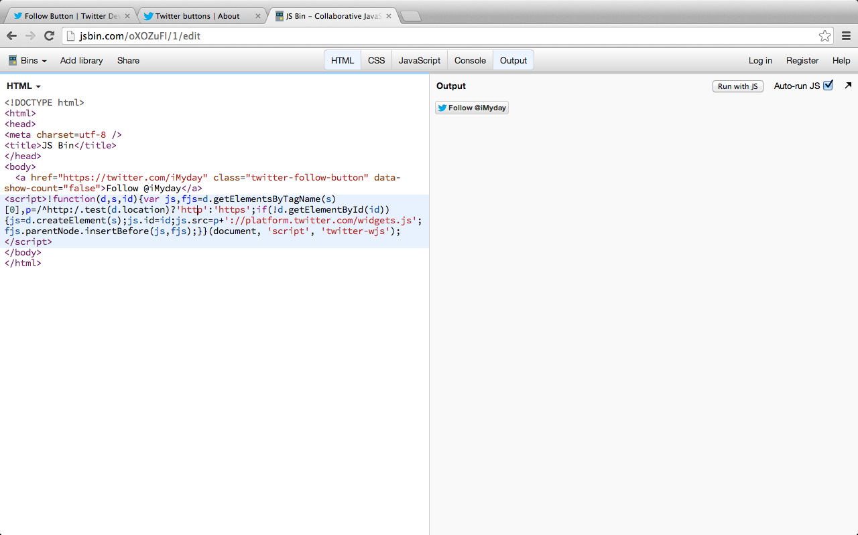
Test Twitter Button on jsbin.com

Slide 36
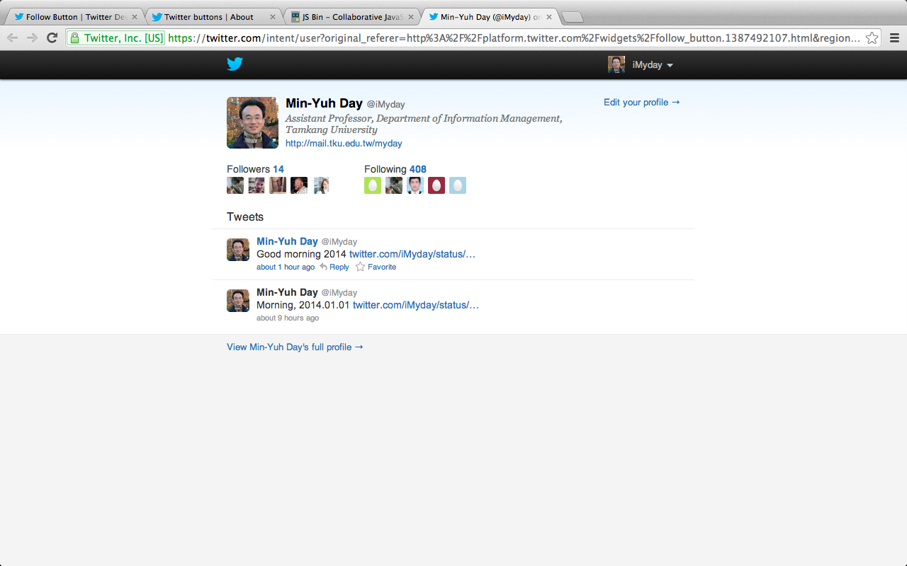
Follow @iMyday

Slide 37
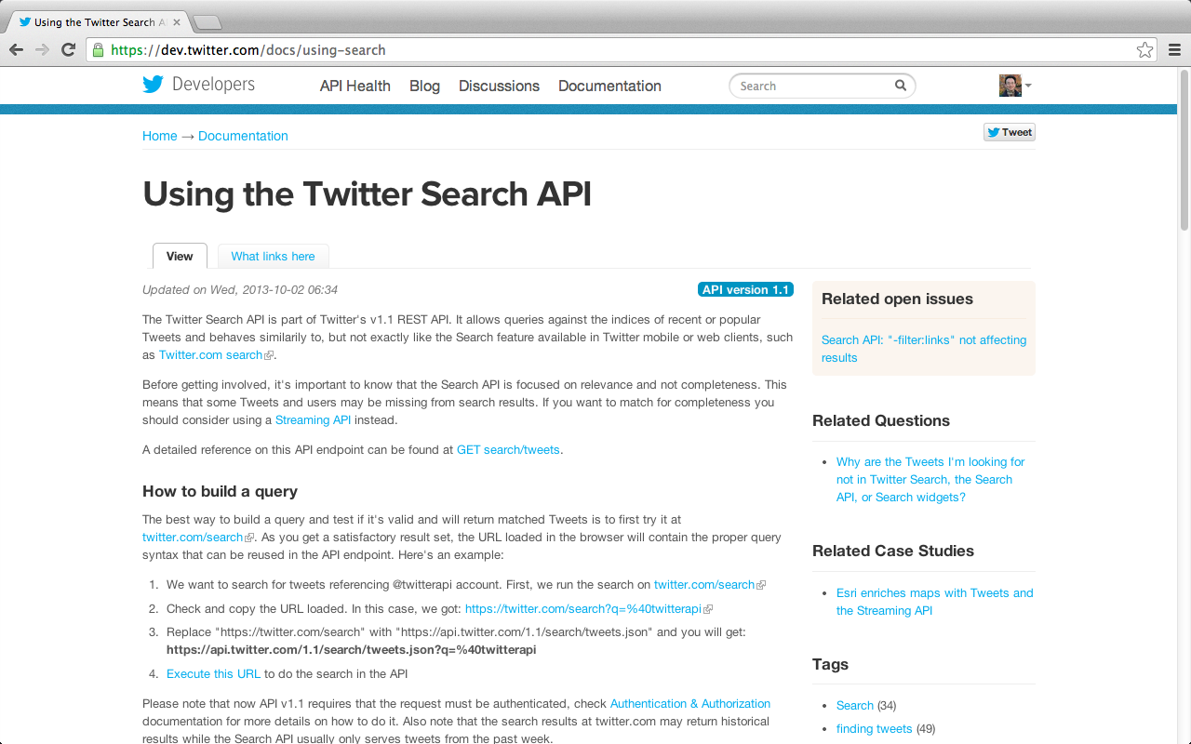
Twitter Search API
https://dev.twitter.com/docs/using-search

Slide 38
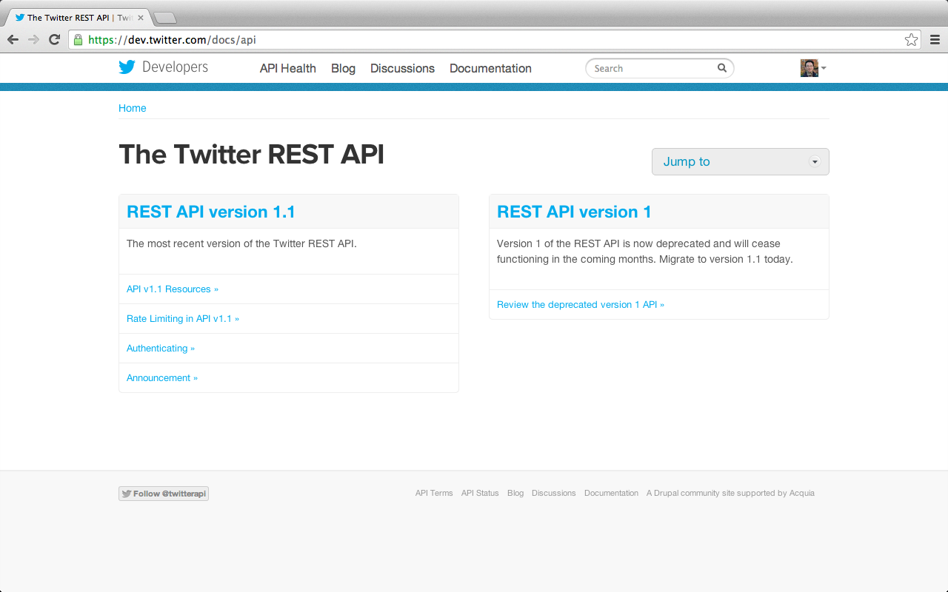
Twitter REST API
https://dev.twitter.com/docs/api

Slide 39
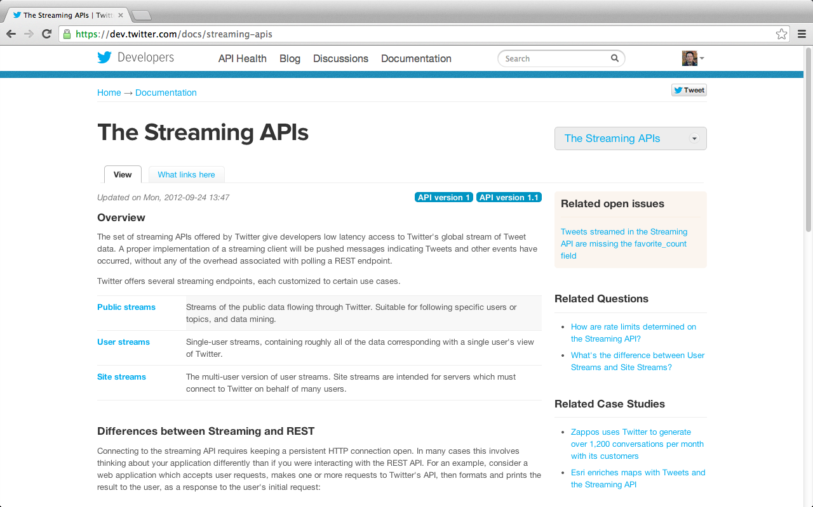
Streaming API
https://dev.twitter.com/docs/streaming-apis

Slide 40
Twitter REST API
The REST API provides simple interfaces for most Twitter functionality.
https://dev.twitter.com/docs

Slide 41
Twitter Streaming API
The Streaming API is a family of powerful real-time APIs for Tweets and other social events.
https://dev.twitter.com/docs

Slide 42
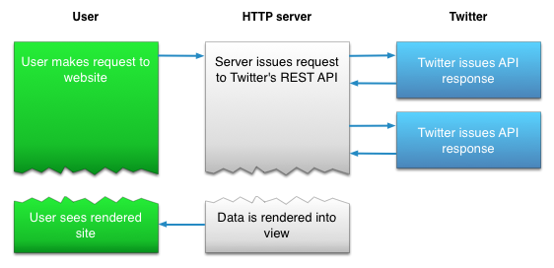
Differences between Streaming and REST API
Twitter REST API
https://dev.twitter.com/docs/streaming-apis
Notes:
Differences between Streaming and REST
Source: https://dev.twitter.com/docs/streaming-apis
Connecting to the streaming API requires keeping a persistent HTTP connection open. In many cases this involves thinking about your application differently than if you were interacting with the REST API. For an example, consider a web application which accepts user requests, makes one or more requests to Twitter's API, then formats and prints the result to the user, as a response to the user's initial request:
Diagram of a HTTP server issuing Twitter API requests in response to user requests
An app which connects to the Streaming APIs will not be able to establish a connection in response to a user request, as shown in the above example. Instead, the code for maintaining the Streaming connection is typically run in a process separate from the process which handles HTTP requests:
Diagram of two server processes, where one process receives streamed Tweets, while the other handles HTTP requests
The streaming process gets the input Tweets and performs any parsing, filtering, and/or aggregation needed before storing the result to a data store. The HTTP handling process queries the data store for results in response to user requests. While this model is more complex than the first example, the benefits from having a realtime stream of Tweet data make the integration worthwhile for many types of apps.

Slide 43
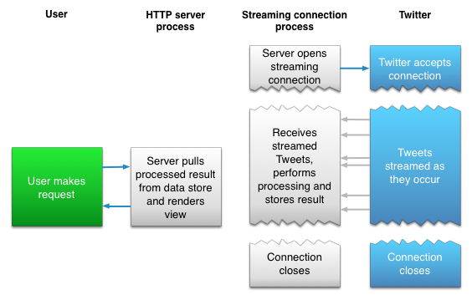
Differences between Streaming and REST API
Twitter Streaming API
https://dev.twitter.com/docs/streaming-apis

Slide 44
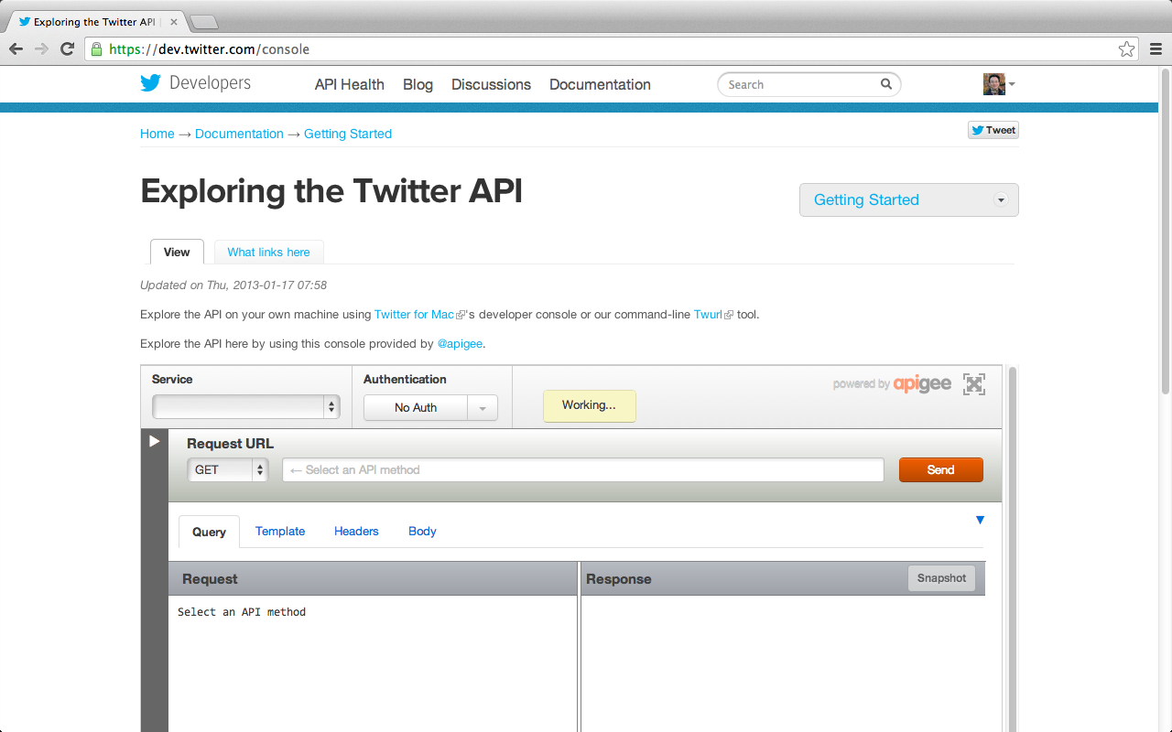
Exploring the Twitter API
https://dev.twitter.com/console

Slide 45
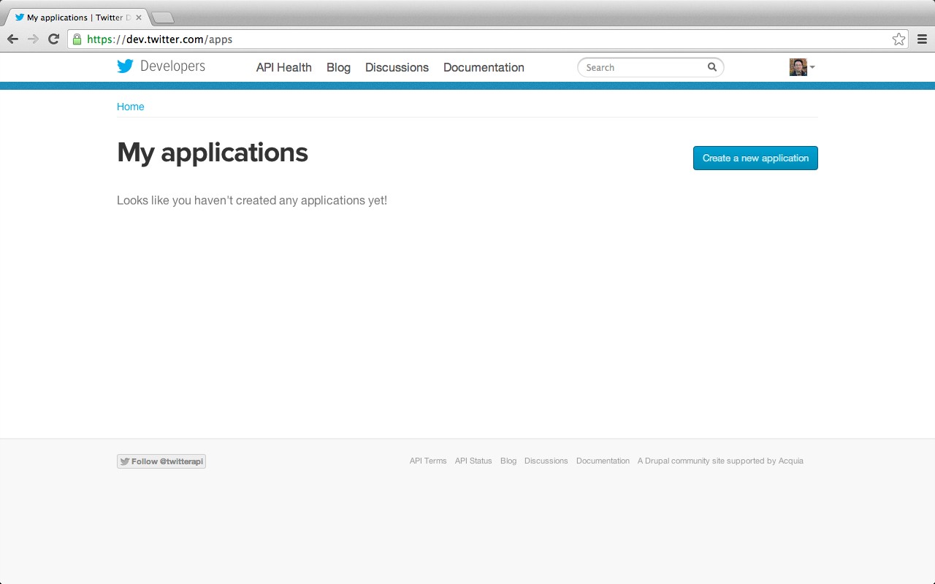
Create a new app
Apps
https://dev.twitter.com/apps

Slide 46
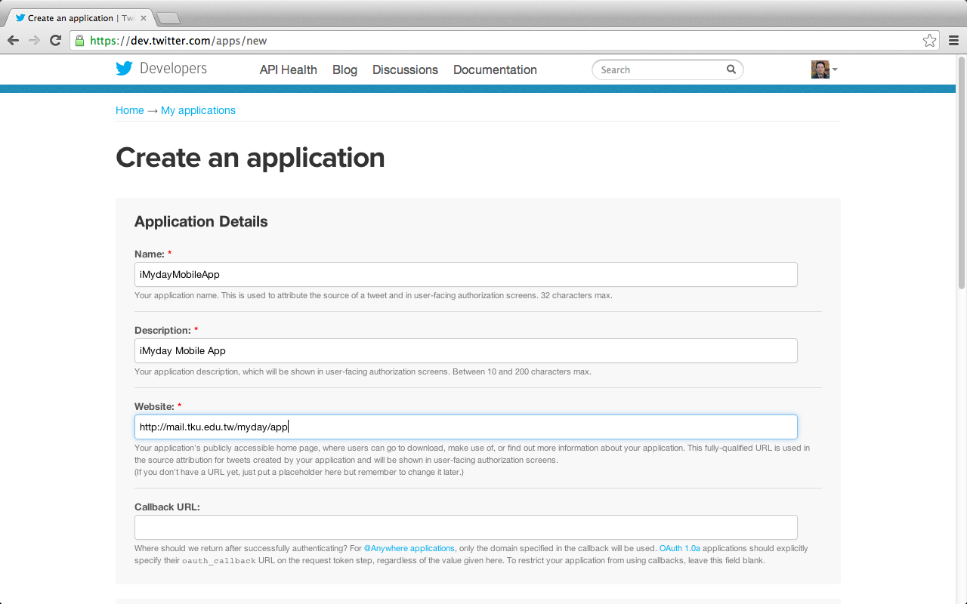
Create a new app
https://dev.twitter.com/apps/new

Slide 47
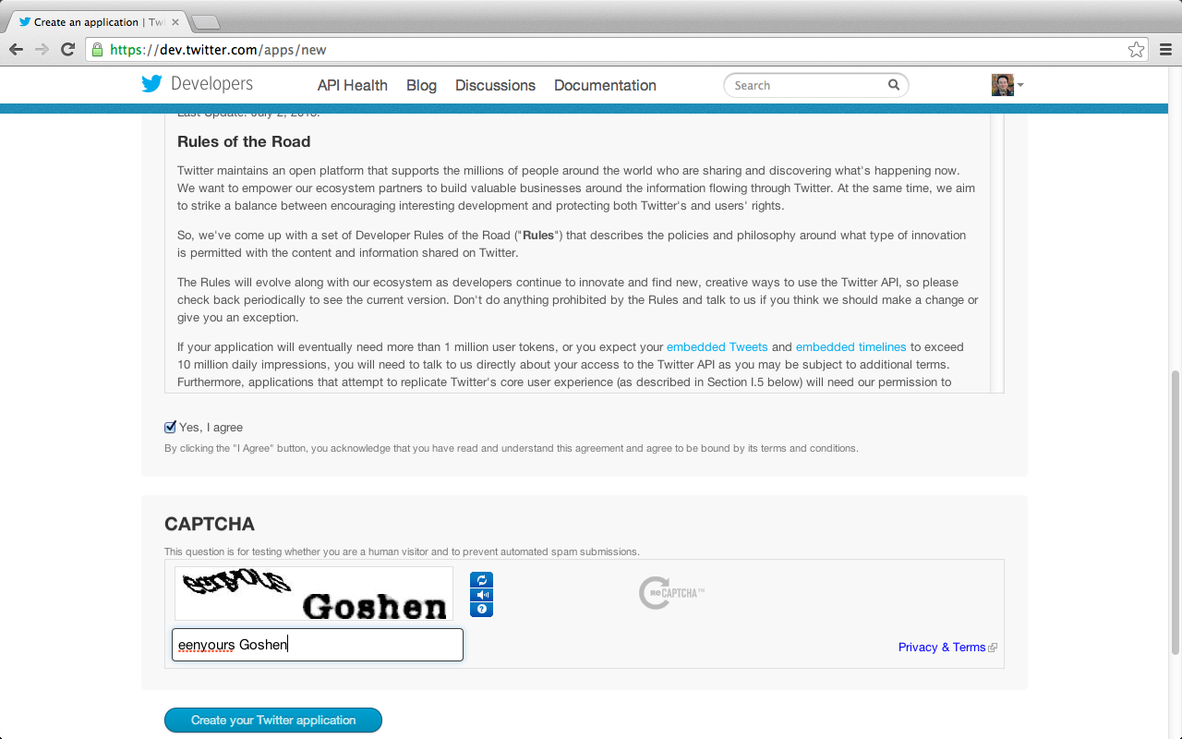
Create a new app
https://dev.twitter.com/apps/new

Slide 48
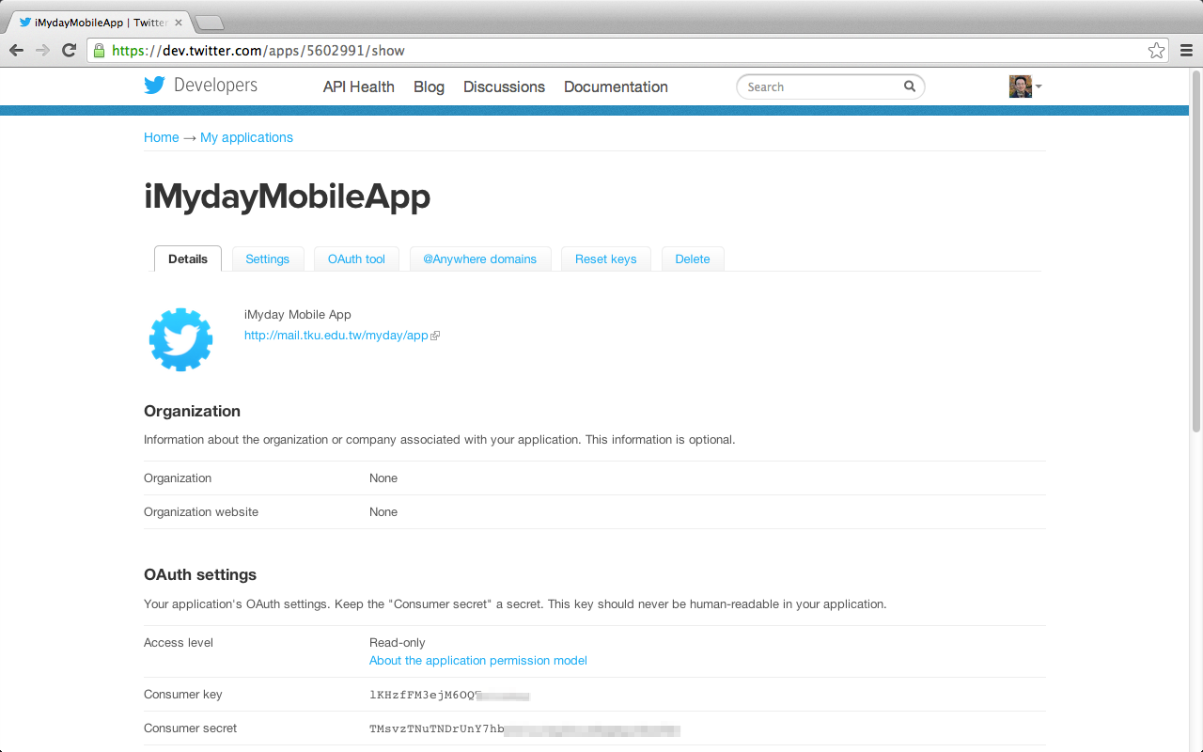
Create a new app

Slide 49
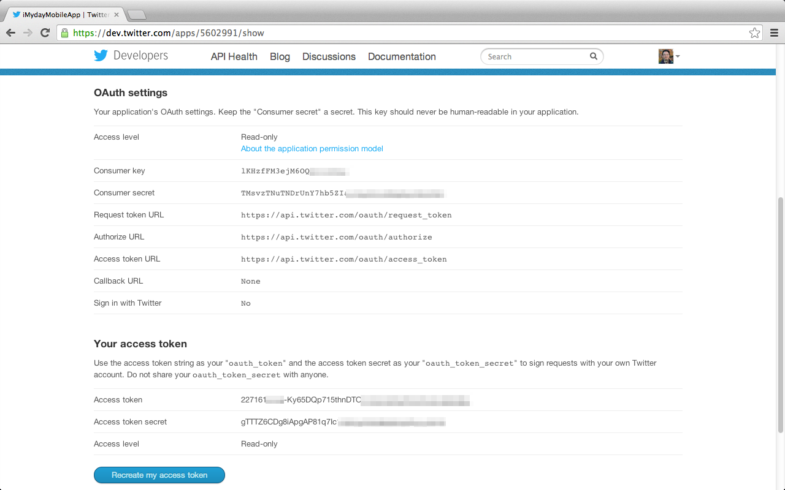
Create a new app

Slide 50
Create a new app
Consumer key lKHzfFM3ejM6O********
Consumer secret TMsvzTNuTNDrUnY7hb5ZIarXqZDnsKW***********
Request token URL https://api.twitter.com/oauth/request_token
Authorize URL https://api.twitter.com/oauth/authorize
Access token URL https://api.twitter.com/oauth/access_token

Slide 51
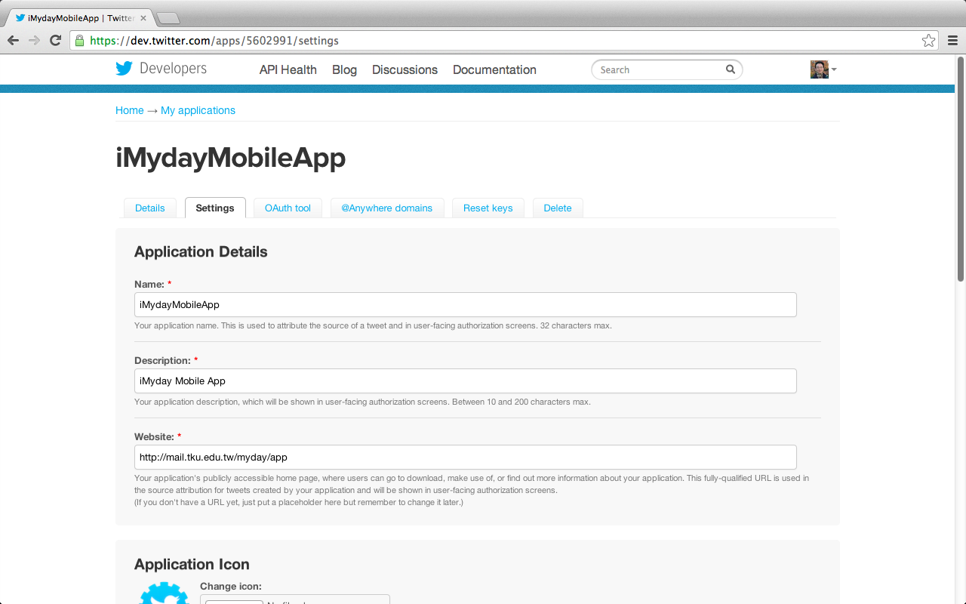
Update Twitter’s App Settings

Slide 52
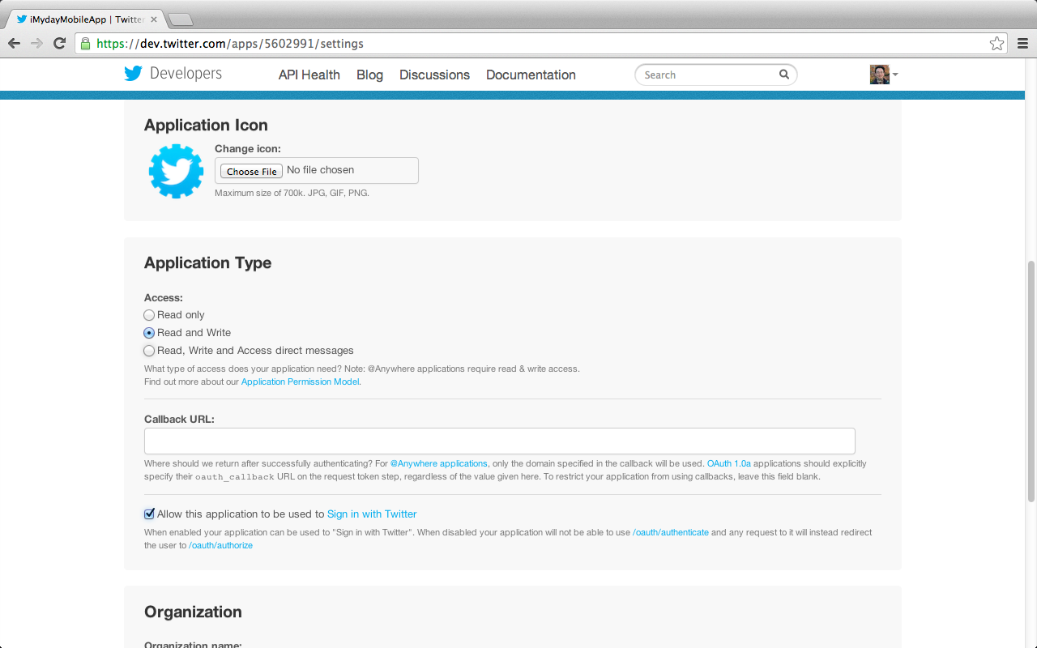
Update Twitter’s App Settings

Slide 53
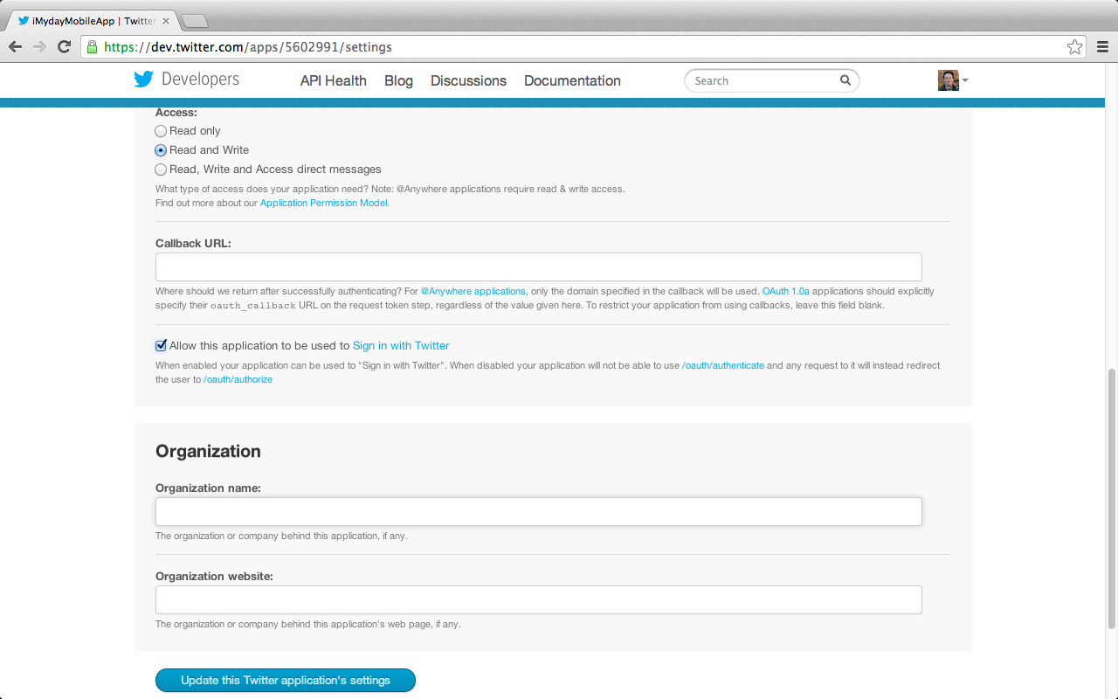
Update Twitter’s App Settings

Slide 54
OAuth Settings Updated

Slide 55
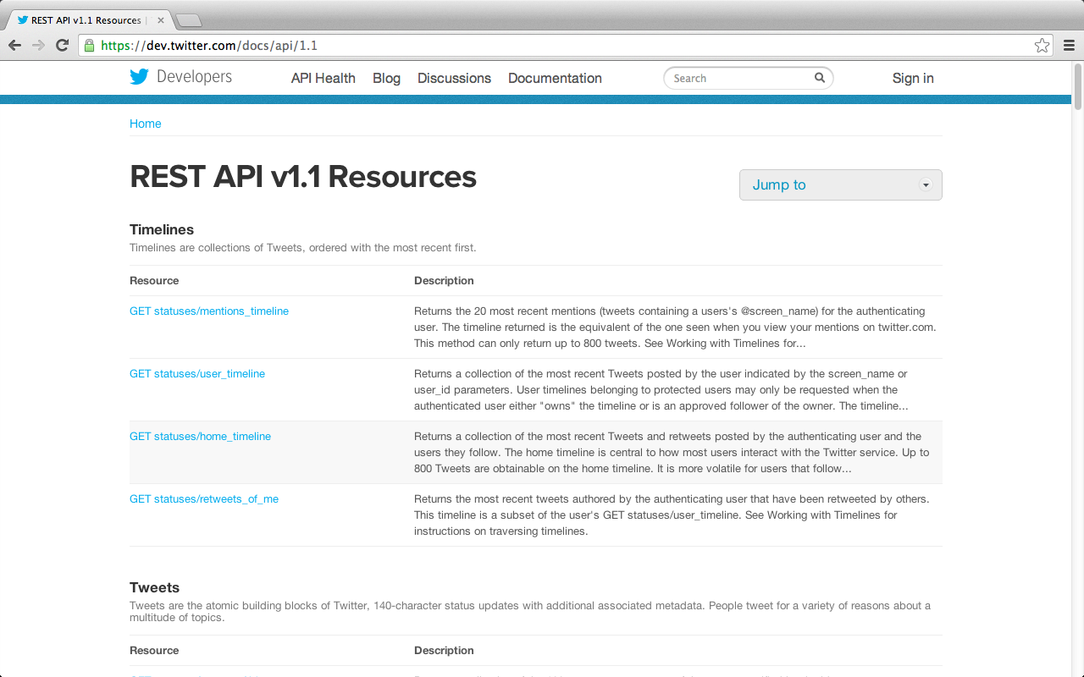
Twitter REST API v1.1 Resources
https://dev.twitter.com/docs/api/1.1

Slide 56
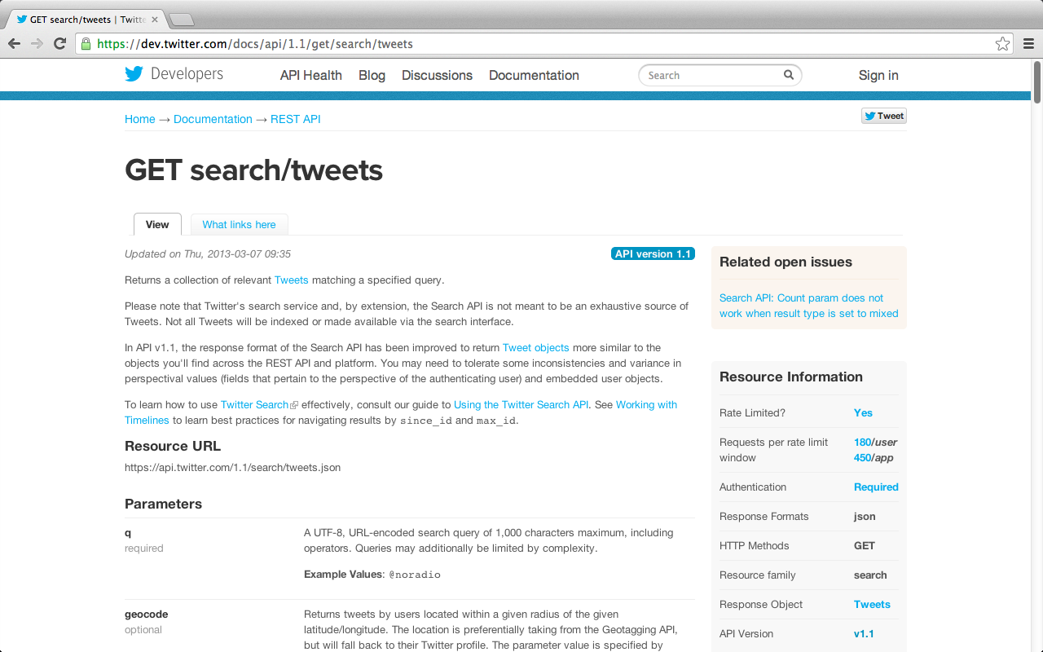
GET search/tweets
https://dev.twitter.com/docs/api/1.1/get/search/tweets

Slide 57
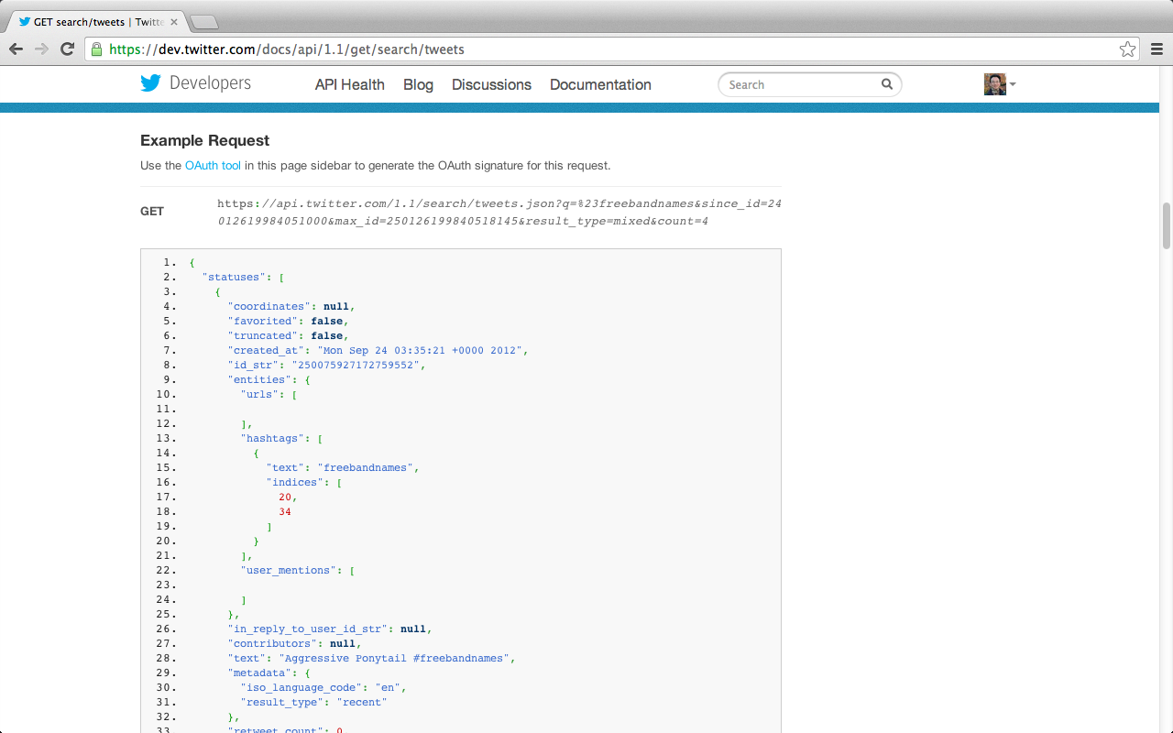
GET search/tweets
https://dev.twitter.com/docs/api/1.1/get/search/tweets

Slide 58
GET search/tweets
https://api.twitter.com/1.1/search/tweets.json?q=%23freebandnames&since_id=24012619984051000&max_id=250126199840518145&result_type=mixed&count=4
https://dev.twitter.com/docs/api/1.1/get/search/tweets

Slide 59
OAuth Tool
https://dev.twitter.com/docs/api/1.1/get/search/tweets#oauth-tool

Slide 60
OAuth Tool
Generate OAuth signature
https://dev.twitter.com/docs/api/1.1/get/search/tweets#oauth-tool

Slide 61
OAuth Tool

Slide 62
OAuth Tool
See OAuth signature for this request

Slide 63
OAuth Signing Results

Slide 64
Web Intents
https://dev.twitter.com/docs/intents

Slide 65
Web Intents
https://dev.twitter.com/docs/intents

Slide 66
JavaScript Interfaces for Twitter for Websites
https://dev.twitter.com/docs/intents/events

Slide 67
JavaScript Interfaces for Twitter for Websites
https://dev.twitter.com/docs/intents/events

Slide 68
Twitter API Getting Started
https://dev.twitter.com/start

Slide 69
Twitter REST API certificate updates
https://dev.twitter.com/blog/rest-api-ssl-certificate-updates

Slide 70
Connecting to Twitter API using SSL
https://dev.twitter.com/docs/security/using-ssl

Slide 71
Connecting to Twitter API using SSL
https://dev.twitter.com/docs/security/using-ssl

Slide 72
Connecting to Twitter API using SSL
https://dev.twitter.com/docs/security/using-ssl

Slide 73
Connecting to Twitter API using SSL
https://dev.twitter.com/docs/security/using-ssl

Slide 74
Connecting to Twitter API using SSL
https://dev.twitter.com/docs/security/using-ssl

Slide 75
Summary
Twitter Developers
Twitter Platform Objects
Twitter for Websites
Twitter Search API
Twitter REST API
Twitter Streaming API

Slide 76
References
Twitter Developer, https://developer.twitter.com/

