Slide 1


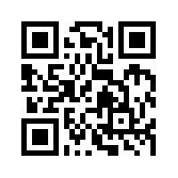
Social Media Apps Programming
Tamkang
University
Google App Engine
1061SMAP11
TLMXM1A (8648) (M2143) (Fall 2017)
(MIS MBA) (2 Credits, Elective) [Full English Course]
Fri 8,9 (15:10-17:00) B206
Min-Yuh Day, Ph.D.
Assistant Professor
Department of Information Management
Tamkang University
http://mail.tku.edu.tw/myday
2017-12-15

Slide 2
Course Schedule (1/2)
Tamkang
University
Week Date Subject/Topics
1 2017/09/22 Course Orientation and Introduction to
Social Media and Mobile Apps Programming
2 2017/09/29 Introduction to Android / iOS Apps Programming
3 2017/10/06 Developing Android Native Apps with Java
(Android Studio)
4 2017/10/13 Developing iPhone / iPad Native Apps with Swift
(XCode)
5 2017/10/20 Mobile Apps using HTML5/CSS3/JavaScript
6 2017/10/27 jQuery Mobile
7 2017/11/03 Create Hybrid Apps with Phonegap
8 2017/11/10 jQuery Mobile/Phonegap
9 2017/11/17 jQuery Mobile/Phonegap

Slide 3
Course Schedule (2/2)
Tamkang
University
Week Date Subject/Topics
10 2017/11/24 Midterm Project Report
11 2017/12/01 Case Study on Social Media Apps Programming
and Marketing in Google Play and App Store
12 2017/12/08 Google Cloud Platform
13 2017/12/15 Google App Engine
14 2017/12/22 Google Map API
15 2017/12/29 Facebook API (Facebook JavaScript SDK)
(Integrate Facebook with iOS/Android Apps)
16 2018/01/05 Twitter API
17 2018/01/12 Final Project Presentation
18 2018/01/19 Final Exam Week (Final Project Presentation)

Slide 4



Outline
Google App Engine
  Google Cloud Platform
  Google Cloud Datastore
  Google Firebase

Slide 5
App Backend

Slide 6
App Frontend
iOS
Android
Web
iOS
Android
Web

Slide 7
Mobile Apps Backend on Google Cloud
App Backend

Slide 8
App Backend
iOS
Android
Web
Frontend

Slide 9
Google Cloud Platform
Hosting + Compute
Storage
Big Data
Services
Source: https://cloud.google.com/products/

Slide 10








Google Cloud Platform
Compute
Storage
Big Data
Services
App Engine
Cloud Datastore
Cloud Endpoints
Compute Engine
Cloud SQL
Big Query
Translate API
Container Engine
Cloud Storage
Prediction API
Source: https://cloud.google.com/products/

Slide 11
Mobile App Backend Services
iOS
Android
Cloud Endpoints
App Engine
Cloud Datastore
Web
Services
Compute
Storage
Source: https://cloud.google.com/solutions/mobile/mobile-app-backend-services

Slide 12
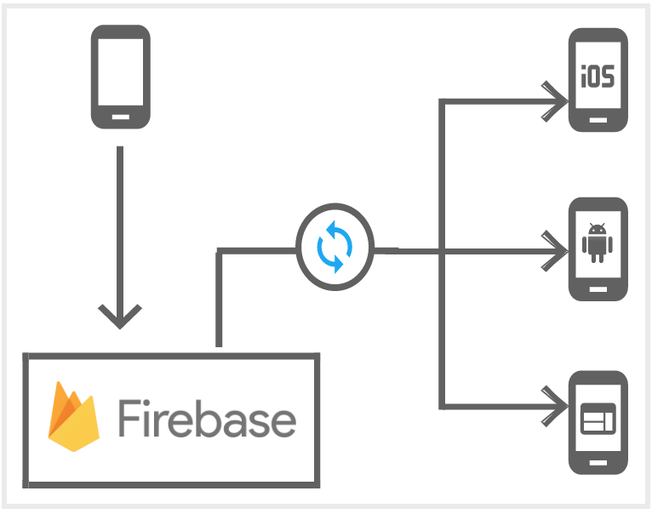
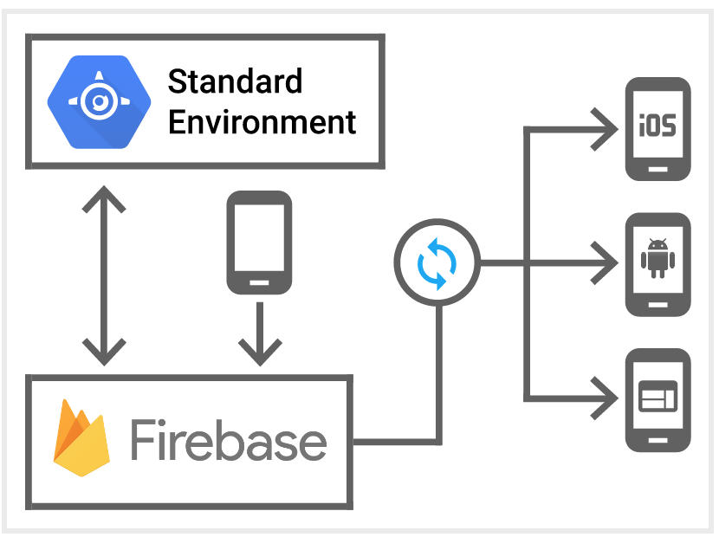
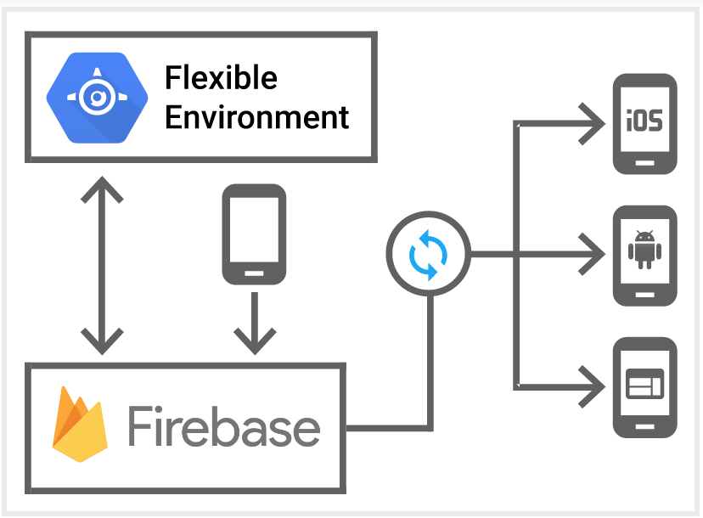
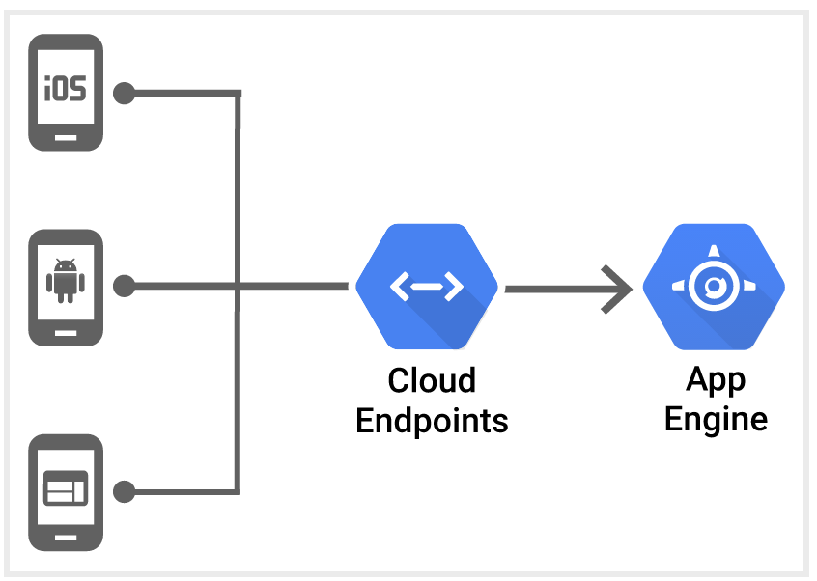
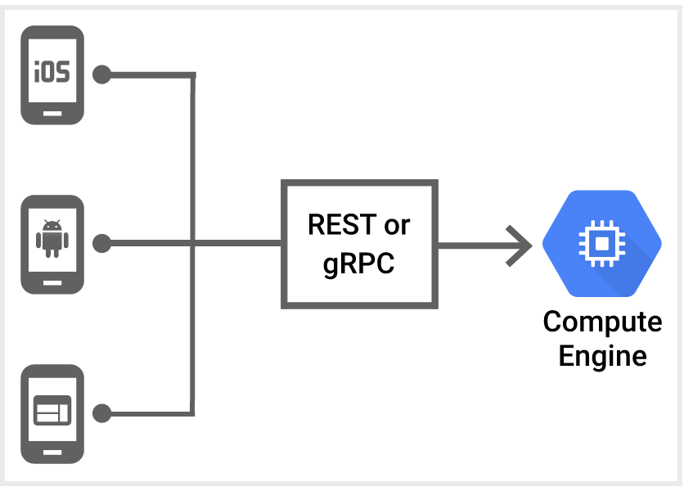
Mobile App Backend Services
Source: https://cloud.google.com/solutions/mobile/mobile-app-backend-services

Slide 13
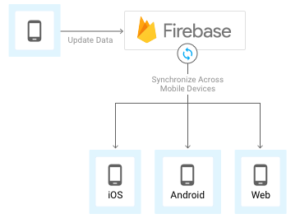
Firebase
Source: https://cloud.google.com/solutions/mobile/mobile-app-backend-services

Slide 14
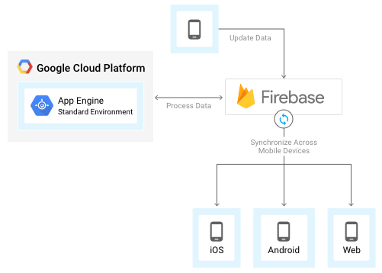
Firebase and
Google App Engine standard environment
Source: https://cloud.google.com/solutions/mobile/mobile-app-backend-services

Slide 15
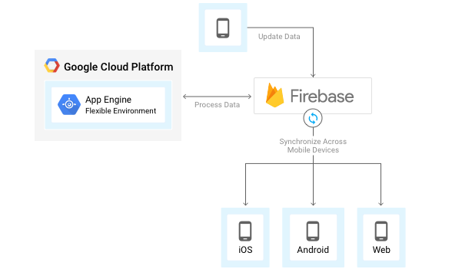
Firebase and
App Engine flexible environment
Source: https://cloud.google.com/solutions/mobile/mobile-app-backend-services

Slide 16
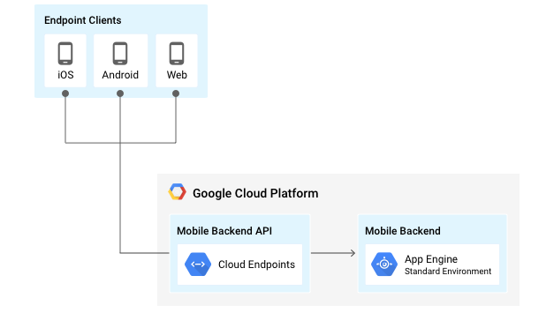
App Engine and
Cloud Endpoints
Source: https://cloud.google.com/solutions/mobile/mobile-app-backend-services

Slide 17
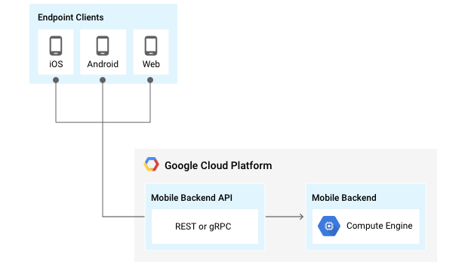
Compute Engine and REST or gRPC
Source: https://cloud.google.com/solutions/mobile/mobile-app-backend-services

Slide 18
Storing data and
Exchanging data

Slide 19
JSON
JSON
  JavaScript Object Notation.
JSON is a syntax
for storing and exchanging data.
JSON is an
easier-to-use alternative to XML.
Source: http://www.w3schools.com/js/js_json_intro.asp

Slide 20
JSON
{"employees":[
{"firstName":"John", "lastName":"Doe"},
{"firstName":"Anna", "lastName":"Smith"},
{"firstName":"Peter", "lastName":"Jones"}
]}
Source: http://www.w3schools.com/js/js_json_intro.asp

Slide 21
XML
<employees>
<employee>
<firstName>John</firstName> <lastName>Doe</lastName>
</employee>
<employee>
<firstName>Anna</firstName> <lastName>Smith</lastName>
</employee>
<employee>
<firstName>Peter</firstName> <lastName>Jones</lastName>
</employee>
</employees>
Source: http://www.w3schools.com/js/js_json_intro.asp

Slide 22
JSON vs. XML
{"employees":[
{"firstName":"John", "lastName":"Doe"},
{"firstName":"Anna", "lastName":"Smith"},
{"firstName":"Peter", "lastName":"Jones"}
]}
<employees>
<employee>
<firstName>John</firstName> <lastName>Doe</lastName>
</employee>
<employee>
<firstName>Anna</firstName> <lastName>Smith</lastName>
</employee>
<employee>
<firstName>Peter</firstName> <lastName>Jones</lastName>
</employee>
</employees>
Source: http://www.w3schools.com/js/js_json_intro.asp

Slide 23
API
Application
Programming
Interface

Slide 24
API
Your App

Slide 25
API
Request
http://graph.facebook.com/4
Your App

Slide 26
API
Response
Request
{
"id": "4",
"first_name": "Mark",
"gender": "male",
"last_name": "Zuckerberg",
"link": "https://www.facebook.com/zuck",
"locale": "en_US",
"name": "Mark Zuckerberg",
"username": "zuck"
}
http://graph.facebook.com/4
Your App

Slide 27
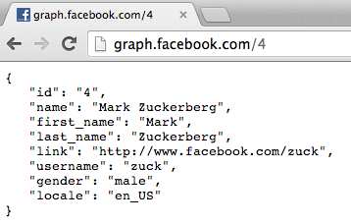
http://graph.facebook.com/4

Slide 28
Facebook API (JSON) http://graph.facebook.com/4
{
"id": "4",
"first_name": "Mark",
"gender": "male",
"last_name": "Zuckerberg",
"link": "https://www.facebook.com/zuck",
"locale": "en_US",
"name": "Mark Zuckerberg",
"username": "zuck"
}

Slide 29
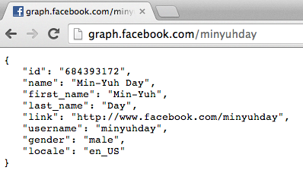
http://graph.facebook.com/minyuhday

Slide 30
JavaScript vs. JSON
JSON
  JavaScript Object Notation
    Format for sharing data
    Derived from JavaScript
    Language independent
    An alternative to XML
Source: https://www.youtube.com/watch?v=40aKlrL-2V8

Slide 31
JSON
Advantages
  Easy to read
  Easy to write
  Easy to Parse
    Var info = JSON.parse(data);
    info.name
    info.position
    info.courses[i]
  Learner than XML
  Growing support in APIs (i.e., Facebook, Twitter)
  Natural format for JavaScript
  Implementation in many languages
Source: https://www.youtube.com/watch?v=40aKlrL-2V8

Slide 32
JSON
{
“name” : “Min-Yuh Day”
“position” : “Assistant Professor”
“courses” : [
“Social Media Apps Programming”
“Social Media Marketing”
“Data Mining”
]
}
var info = JSON.parse(data);
info.name
info.position
info.courses[i]
Source: https://www.youtube.com/watch?v=40aKlrL-2V8

Slide 33
App Engine and
Cloud Endpoints
Source: https://cloud.google.com/solutions/mobile/mobile-app-backend-services

Slide 34

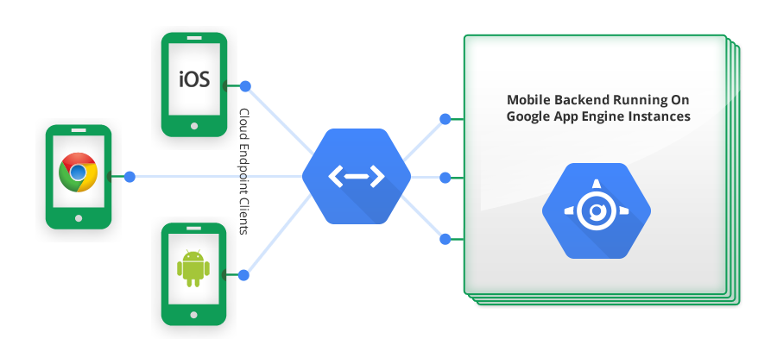
Mobile Apps Backend on Google App Engine
Cloud Endpoints
App Engine
Google Cloud Endpoints Architecture
Source: https://cloud.google.com/appengine/docs/java/endpoints/

Slide 35
Google App Engine,
Google Cloud Datastore
Datasotre is a database (persistent storage) for App Engine
Google App Engine
Traditional
Web applications
Web application framework
(AP)
Google App Engine
(Java, Python, Go)
Perl/CGI
PHP
Ruby on Rails
ASP/JSP
Persistent storage
(Database)
Datastore
RDBMS
MySQL
PostgreSQL
SQL Server
Oracle
Source: Datastore Introduction, http://www.youtube.com/watch?v=fQazhzcC-rg

Slide 36
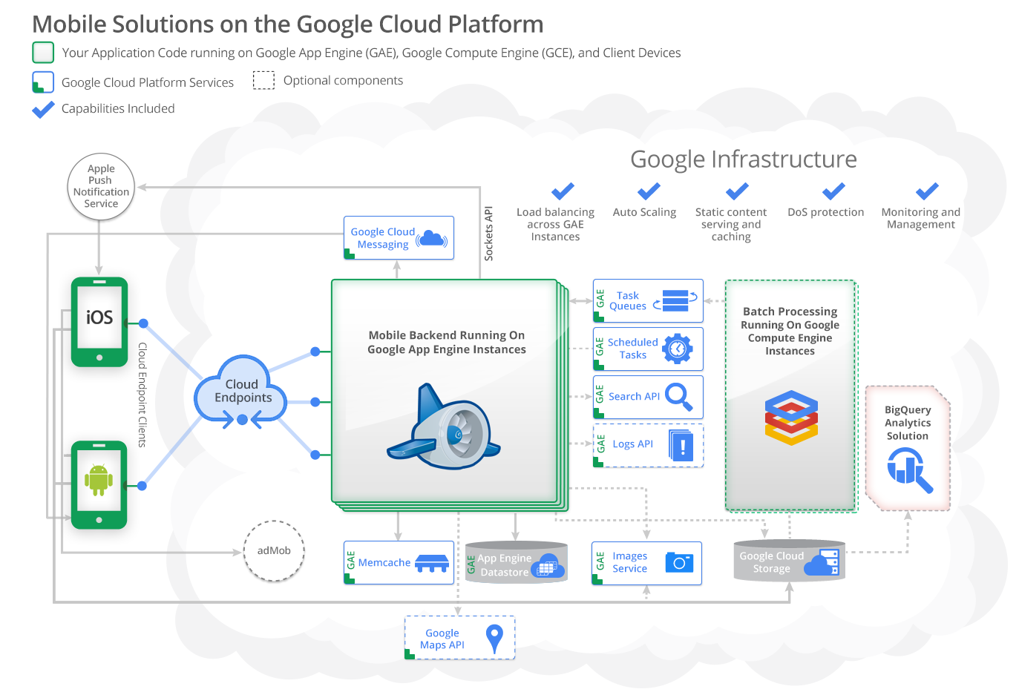
Source: https://cloud.google.com/developers/articles/mobile-application-solutions/

Slide 37
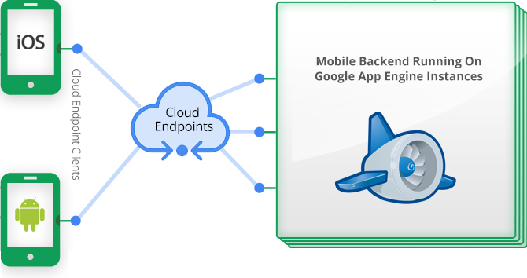

Mobile App Solutions Architecture
Source: https://cloud.google.com/developers/articles/mobile-application-solutions/

Slide 38
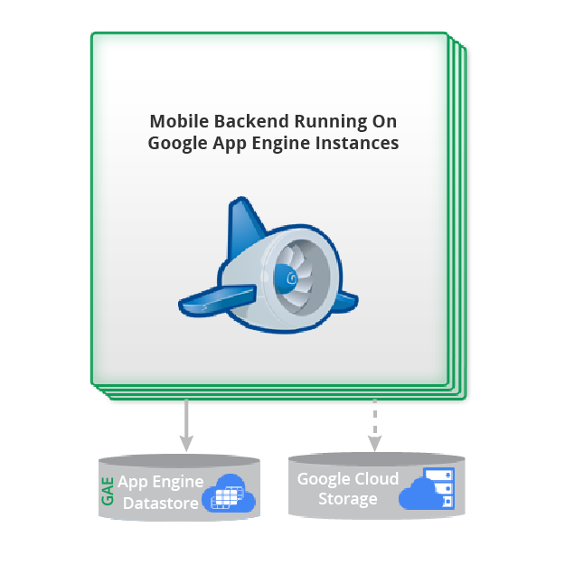
Storing data
Source: https://cloud.google.com/developers/articles/mobile-application-solutions/

Slide 39
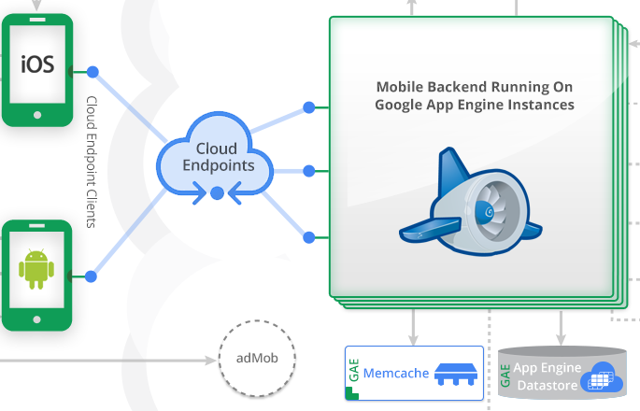
Optimizing data access with Memcache
Source: https://cloud.google.com/developers/articles/mobile-application-solutions/

Slide 40
Google App Engine
Platform as a Service (PaaS)
build and run applications on Google’s infrastructure
Source: https://cloud.google.com/appengine/docs

Slide 41
Google App Engine
Platform as a Service (PaaS)
Google Compute Engine
Infrastructure as a Service (IaaS)
Source: https://cloud.google.com/appengine/docs

Slide 42
Mobile App Backend Services
Source: https://cloud.google.com/solutions/mobile/mobile-app-backend-services

Slide 43
Mobile App Backend Services
Source: https://cloud.google.com/solutions/mobile/mobile-app-backend-services

Slide 44
Google App Engine
1 GB of data storage and traffic for free
can be increased
by enabling paid applications
Source: https://cloud.google.com/appengine/docs/whatisgoogleappengine

Slide 45
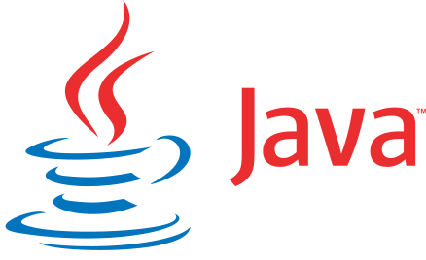



Google App Engine
Google App Engine supports apps written in a variety of programming languages: Python, Java, PHP, Go
Python
Java
PHP
Go
Source: https://cloud.google.com/appengine/docs/whatisgoogleappengine

Slide 46
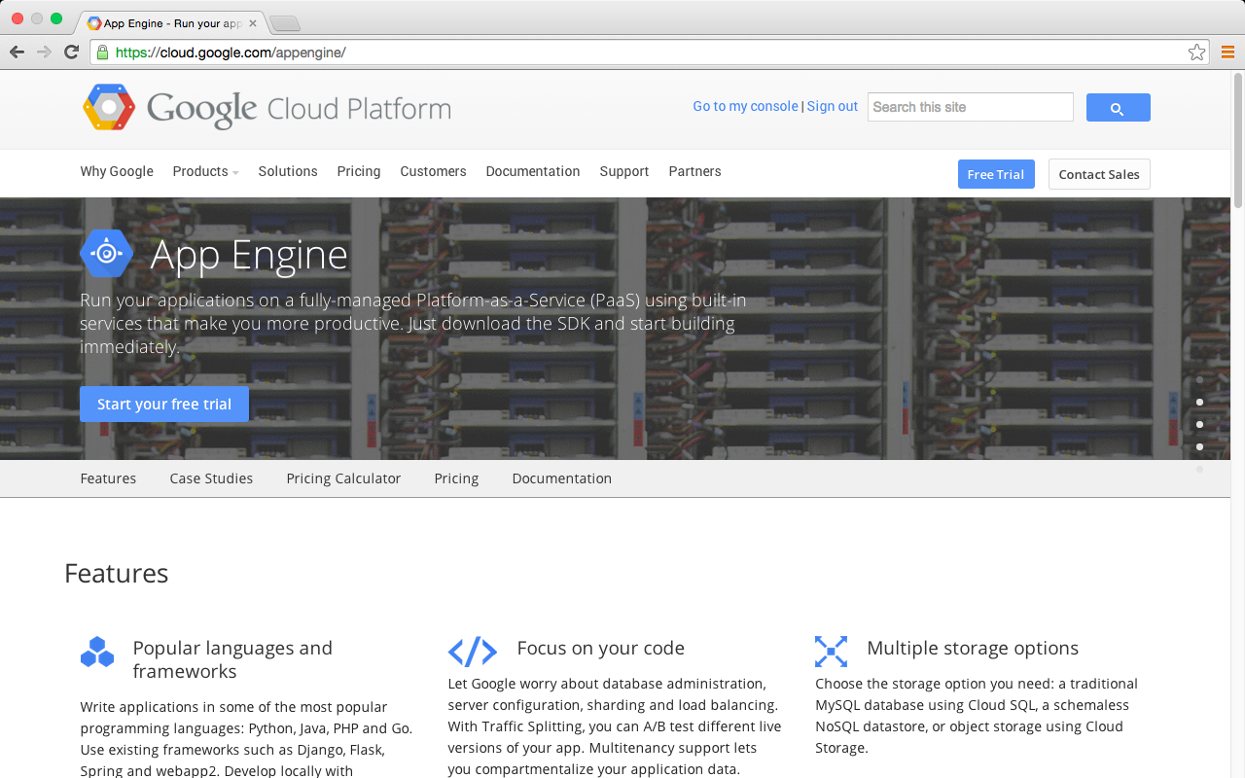
Google App Engine
https://cloud.google.com/appengine/

Slide 47
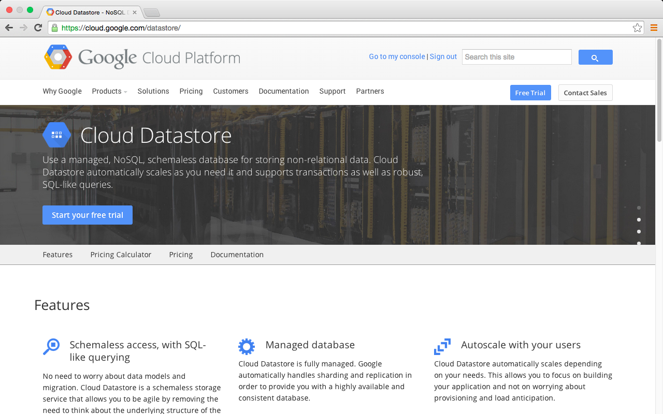
Google Cloud Datastore
https://cloud.google.com/datastore/

Slide 48
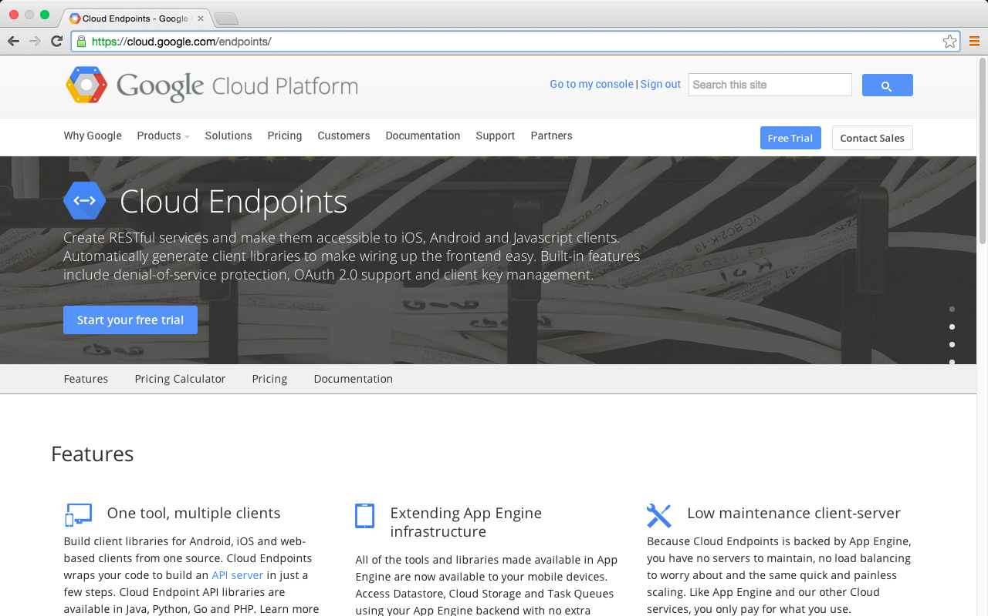
Google Cloud Endpoints
Source: https://cloud.google.com/endpoints/

Slide 49
Mobile Apps Backend on Google App Engine
Cloud Endpoints
App Engine
Google Cloud Endpoints Architecture
Source: https://cloud.google.com/appengine/docs/java/endpoints/

Slide 50
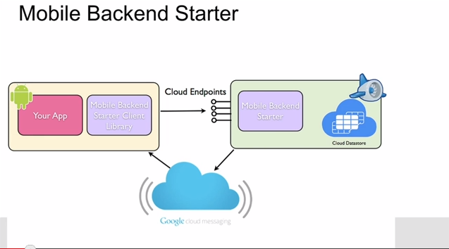
Mobile App, Goolge App Engine, Cloud Datasotre
http://www.youtube.com/watch?v=v5u_Owtbfew

Slide 51
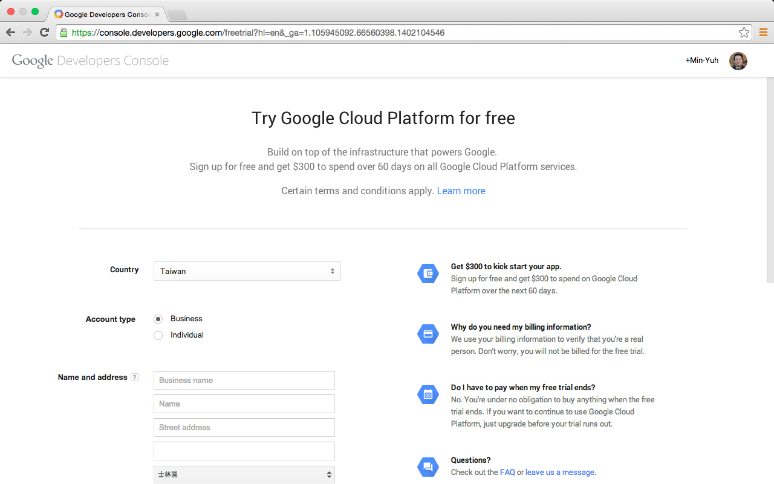
Try Google Cloud Platform for free

Slide 52
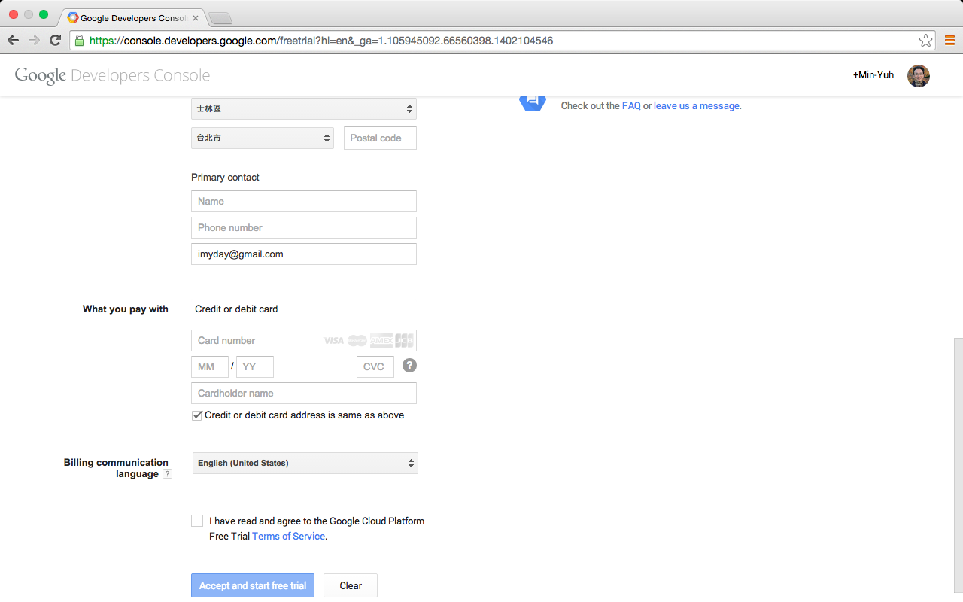
Try Google Cloud Platform for free

Slide 53
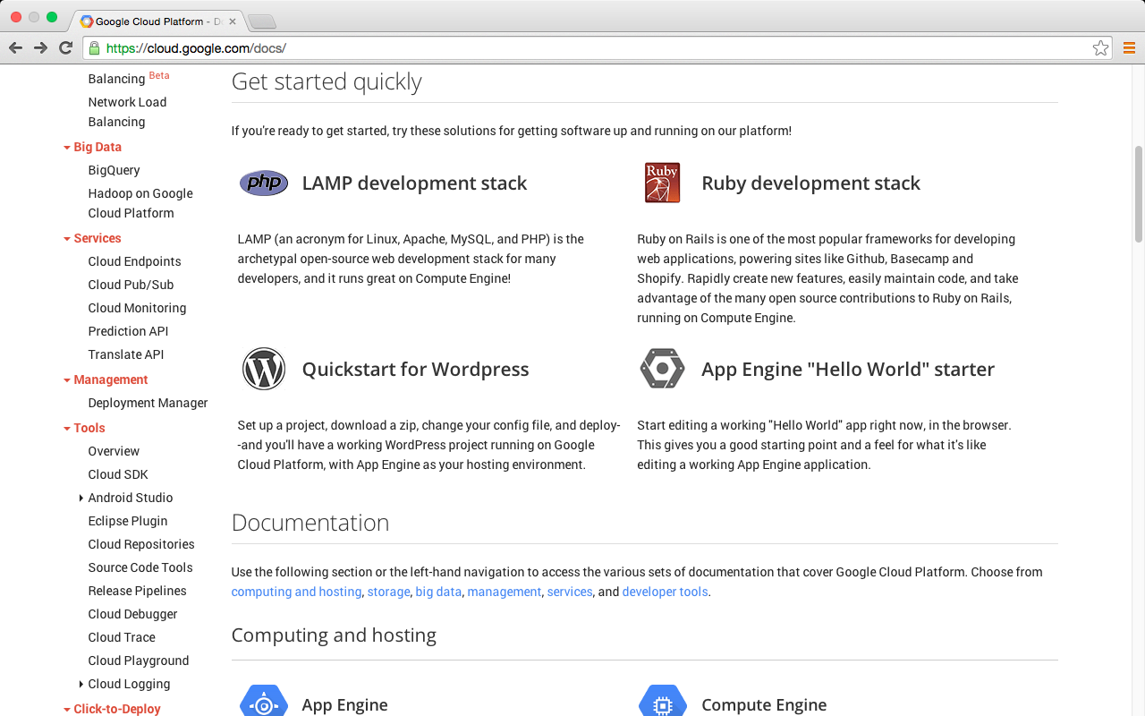
Google Cloud Platform
https://cloud.google.com/docs/

Slide 54
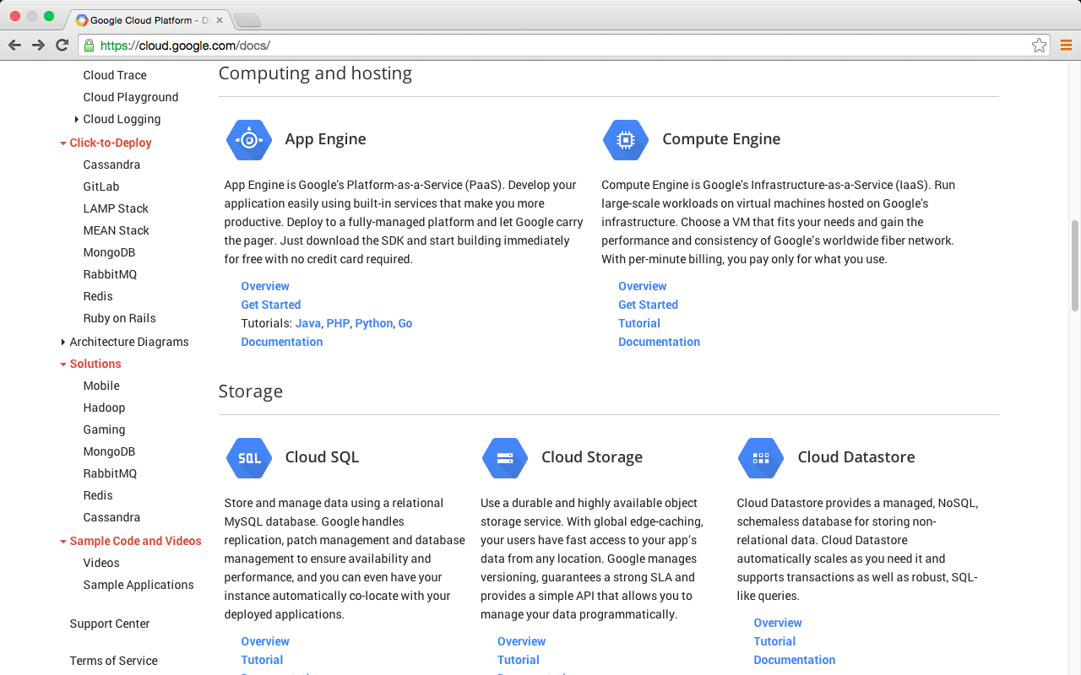
Google Cloud Platform
https://cloud.google.com/docs/

Slide 55
Mobile App Backend Services
iOS
Android
Cloud Endpoints
App Engine
Cloud Datastore
Web
Services
Compute
Storage
Source: https://cloud.google.com/solutions/mobile/mobile-app-backend-services

Slide 56
App Engine "Hello World" starter
Google App Engine
https://console.developers.google.com/start/appengine
Deploy your first app in five minutes
Start editing a working "Hello World" app right now, in the browser.
This gives you a good starting point and a feel for what it's like editing a working App Engine application.

Slide 57
Try Google App Engine Now
NAME YOUR PROJECT
SELECT YOUR LANGUAGE
EXPLORE THE STARTER CODE
INSTALL GOOGLE CLOUD SDK
RUN YOUR APP LOCALLY
CREATE YOUR PROJECT AND DEPLOY

Slide 58
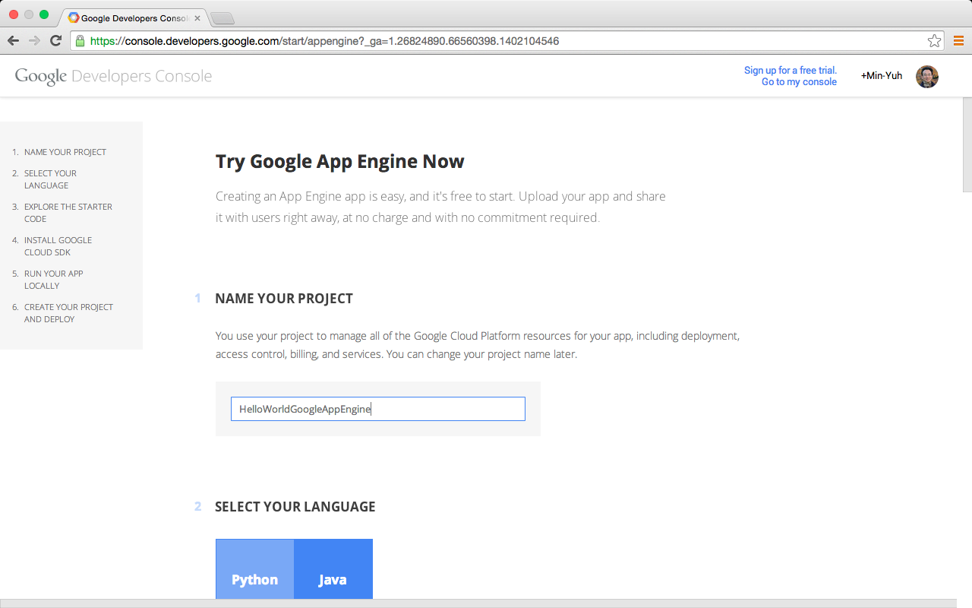
Google App Engine

Slide 59
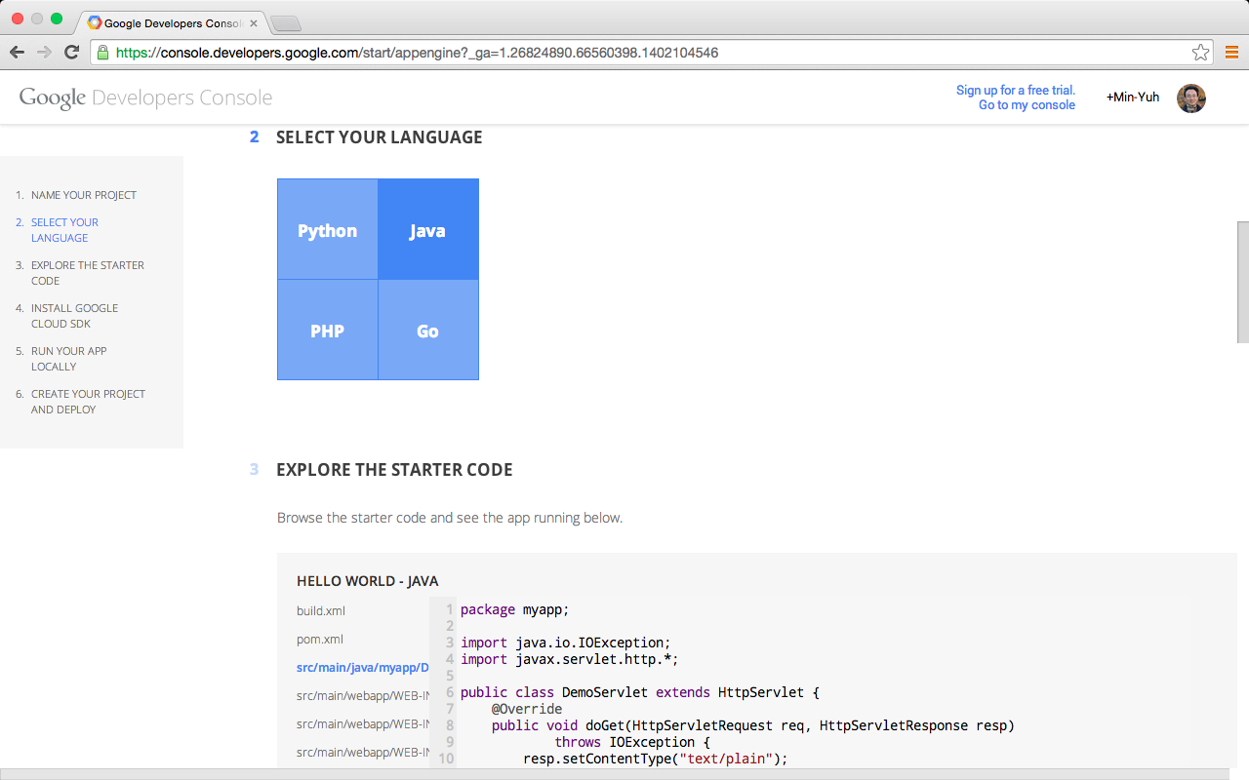
Google App Engine

Slide 60
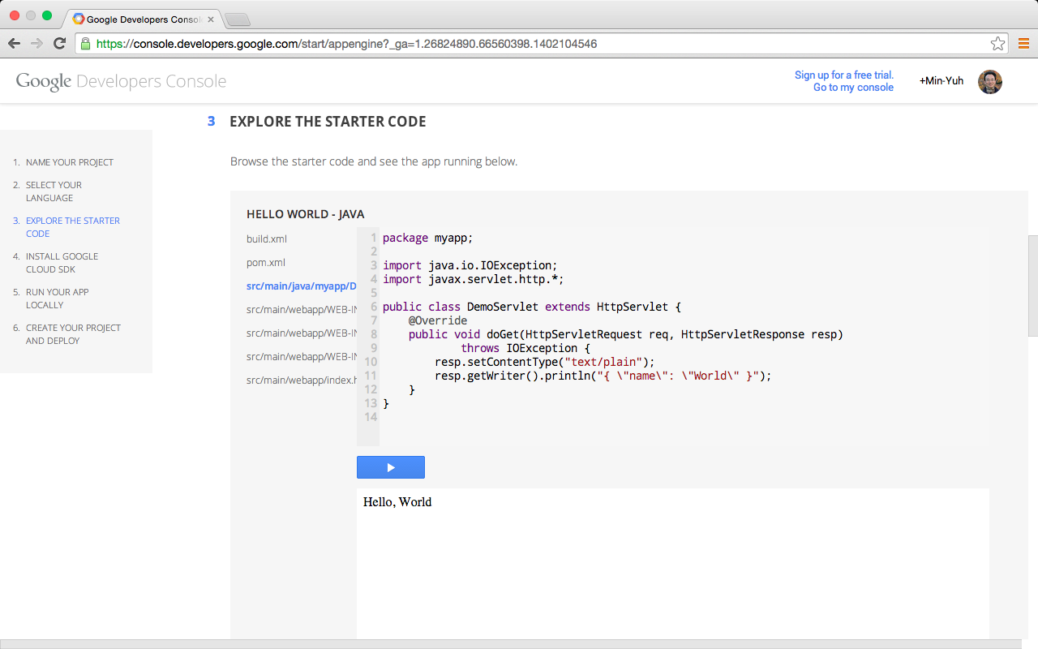
Google App Engine

Slide 61
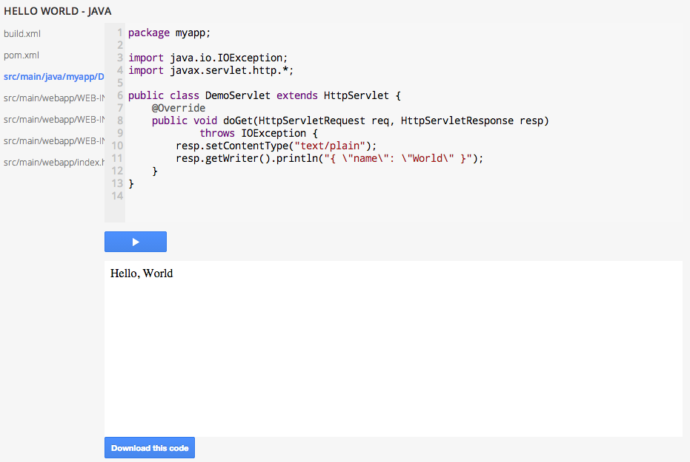
Google App Engine

Slide 62
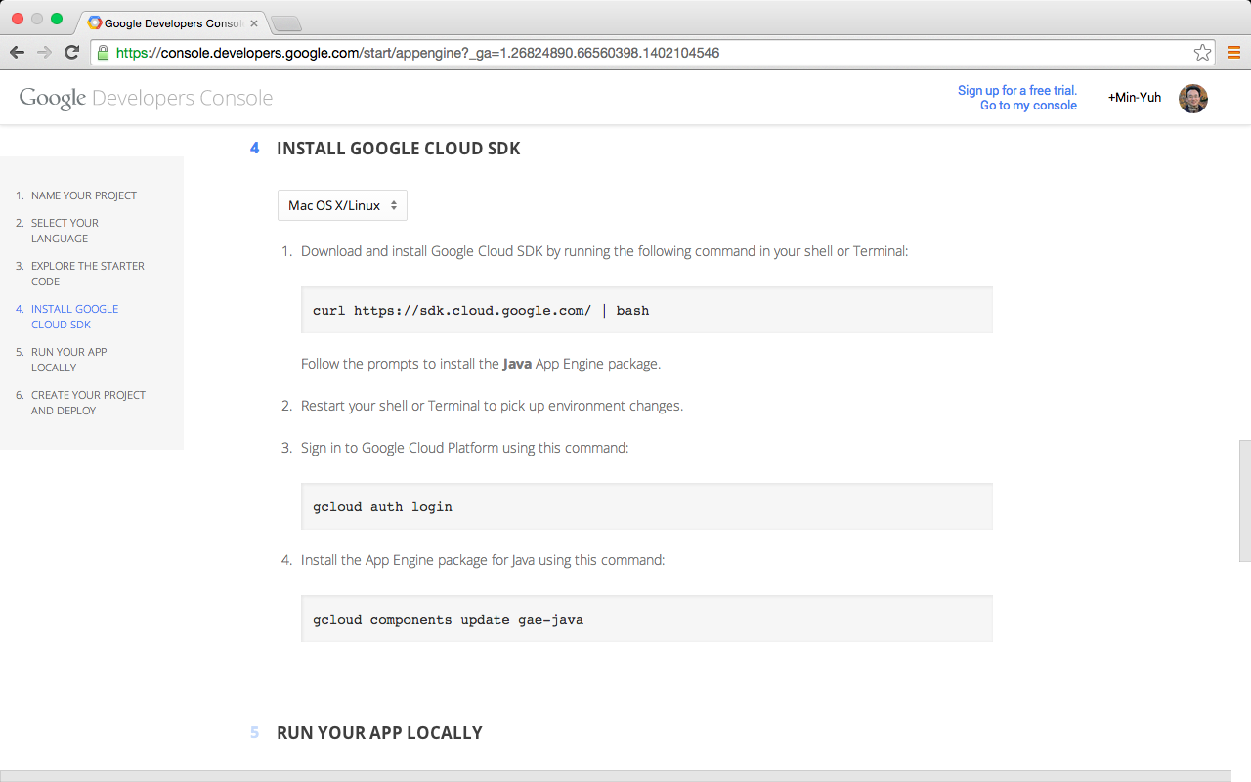
Google App Engine

Slide 63
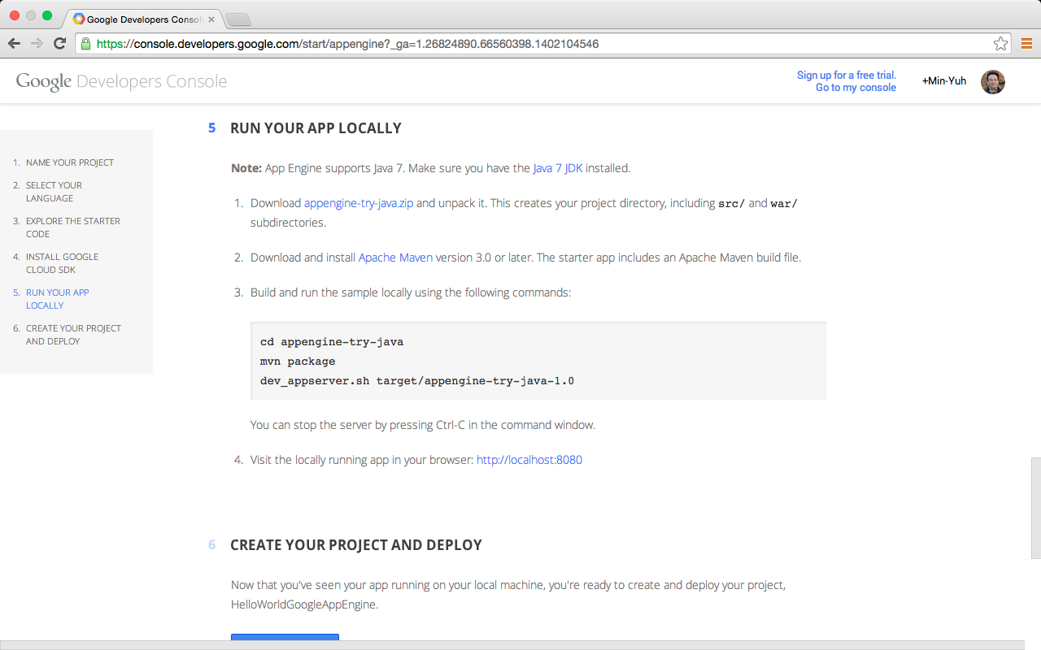
Google App Engine

Slide 64
Google App Engine

Slide 65
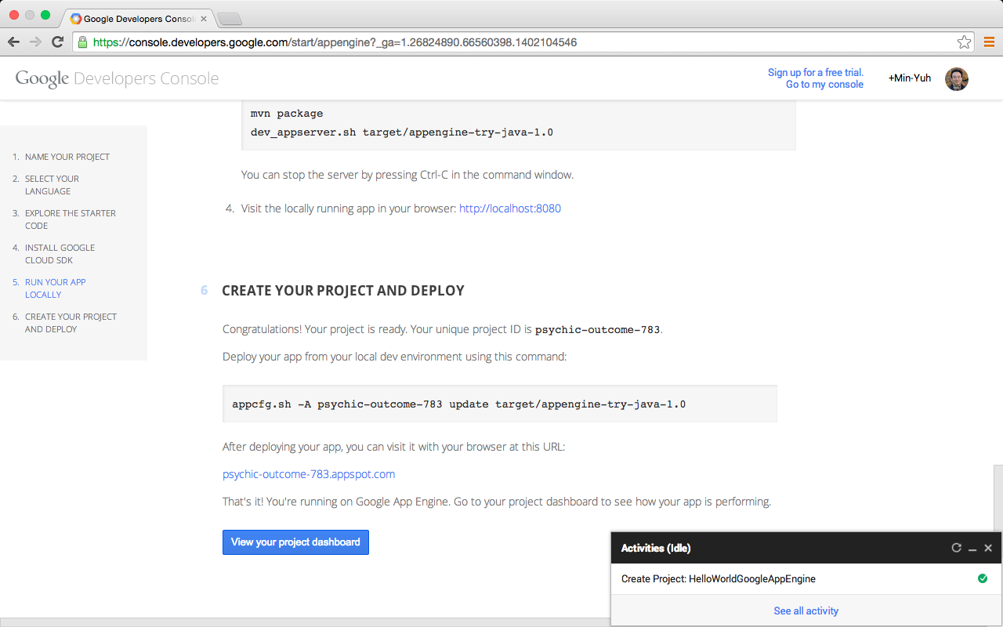
Google App Engine

Slide 66
Google App Engine
Build an App Engine Application using Python
Creating a Guestbook
1. Download the App Engine SDK
2. Explaining the webapp2 Framework
3. Using the Users Service
4. Handling Forms with webapp2
5. Using the Datastore
6. Using Templates
7. Using Static Files
8. Uploading Your Application
Source: https://cloud.google.com/appengine/docs/python/gettingstartedpython27/introduction

Slide 67
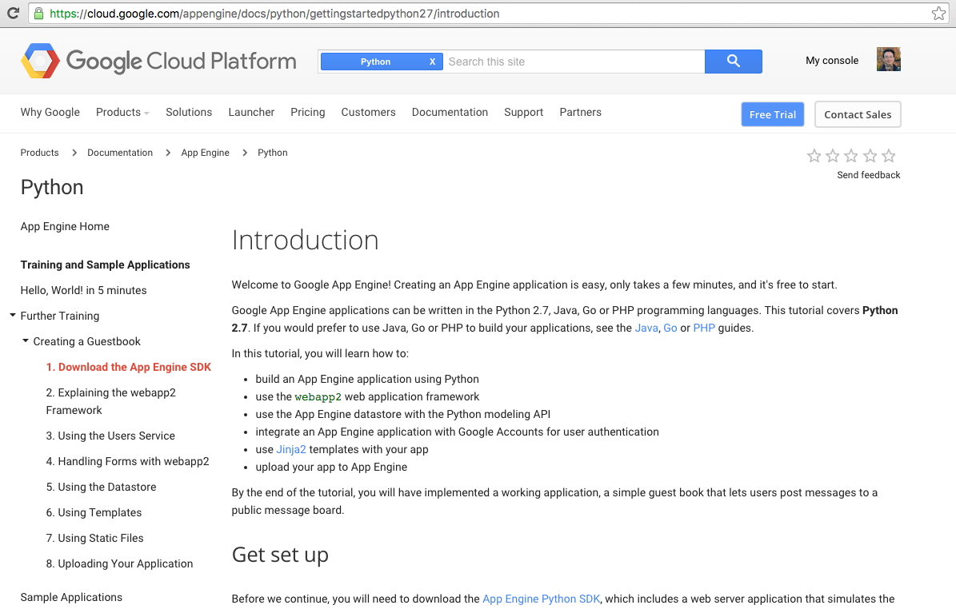
Google App Engine
Source: https://cloud.google.com/appengine/docs/python/gettingstartedpython27/introduction

Slide 68
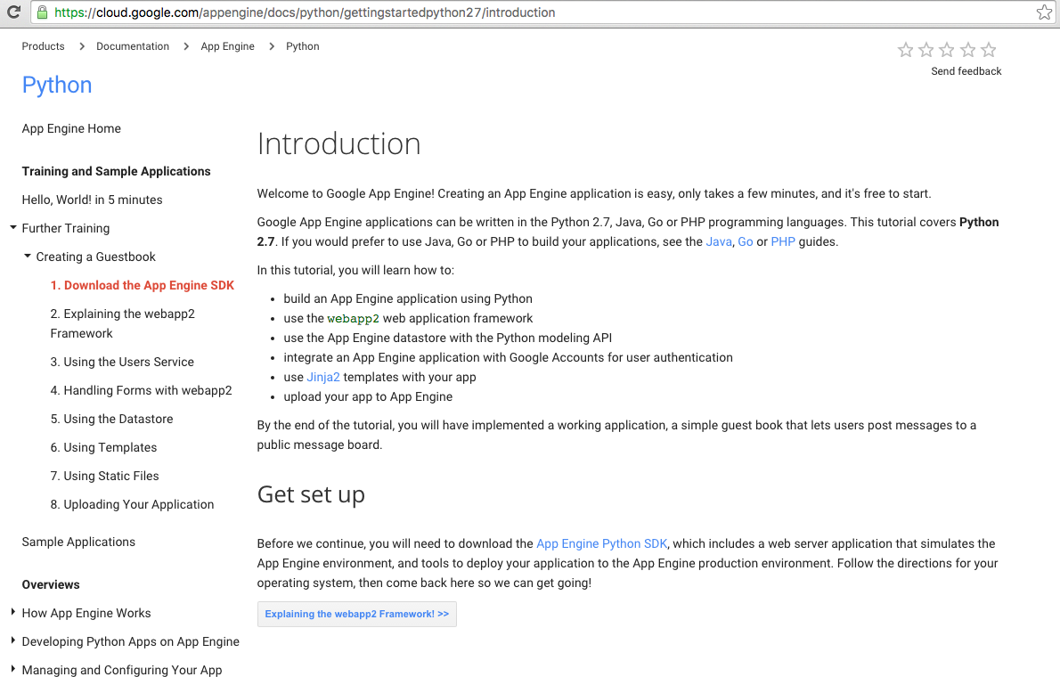
Google App Engine
Source: https://cloud.google.com/appengine/docs/python/gettingstartedpython27/introduction

Slide 69
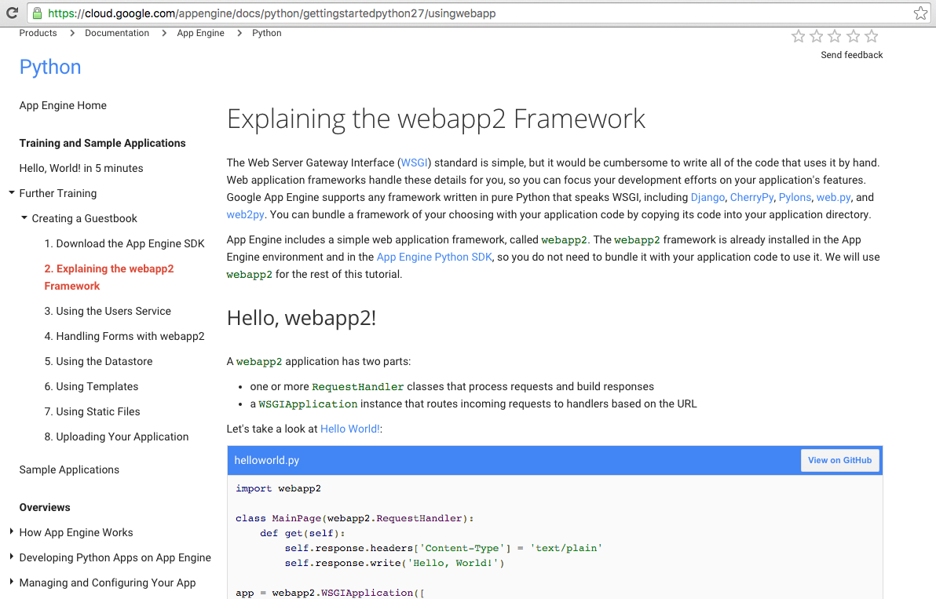
Google App Engine
Source: https://cloud.google.com/appengine/docs/python/gettingstartedpython27/introduction

Slide 70
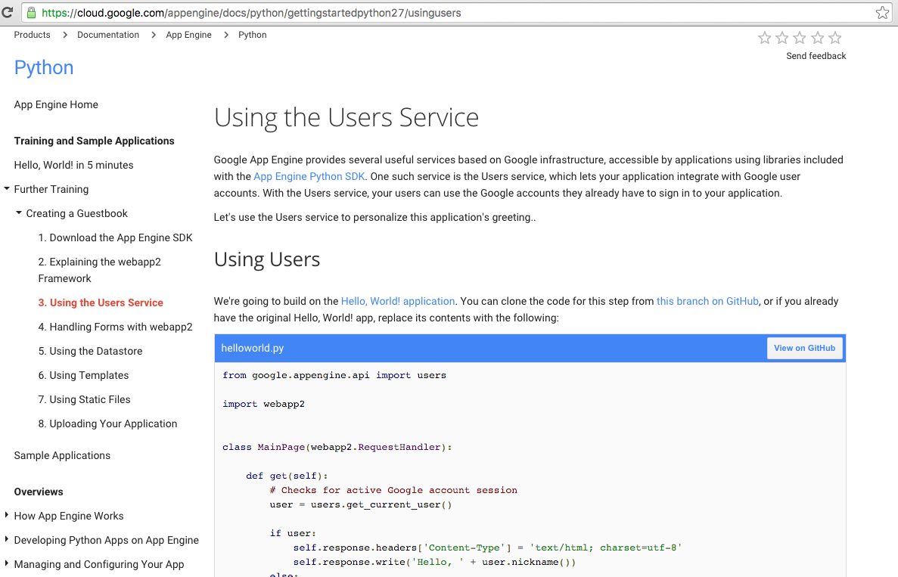
Google App Engine
Source: https://cloud.google.com/appengine/docs/python/gettingstartedpython27/introduction

Slide 71
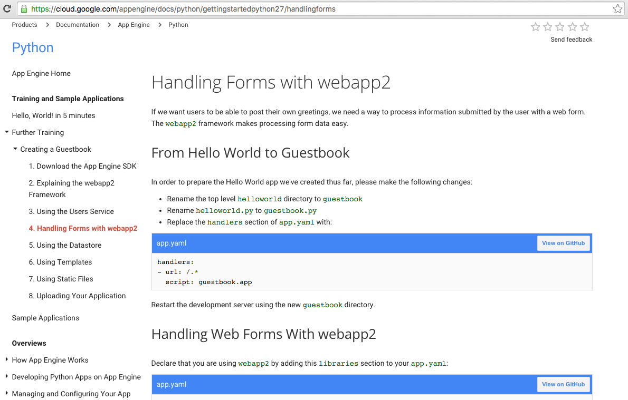
Google App Engine
Source: https://cloud.google.com/appengine/docs/python/gettingstartedpython27/introduction

Slide 72
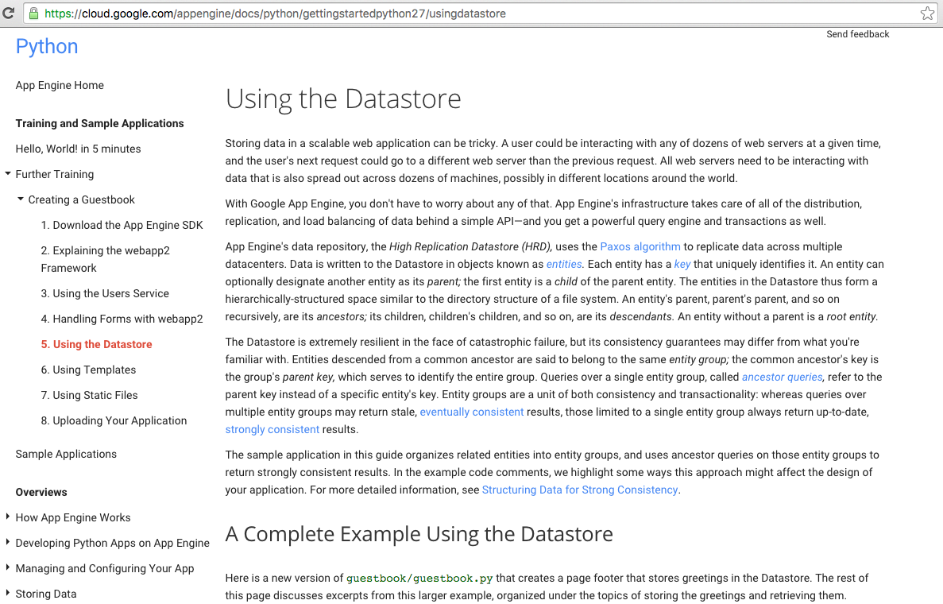
Google App Engine
Source: https://cloud.google.com/appengine/docs/python/gettingstartedpython27/introduction

Slide 73
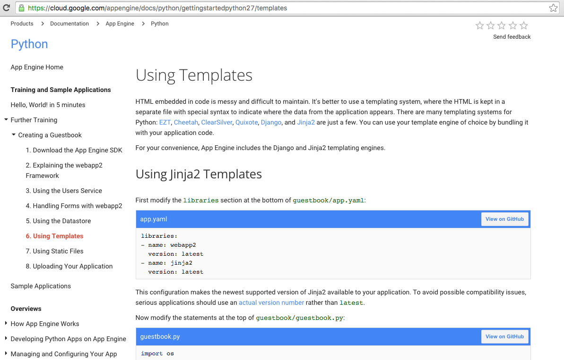
Google App Engine
Source: https://cloud.google.com/appengine/docs/python/gettingstartedpython27/introduction

Slide 74
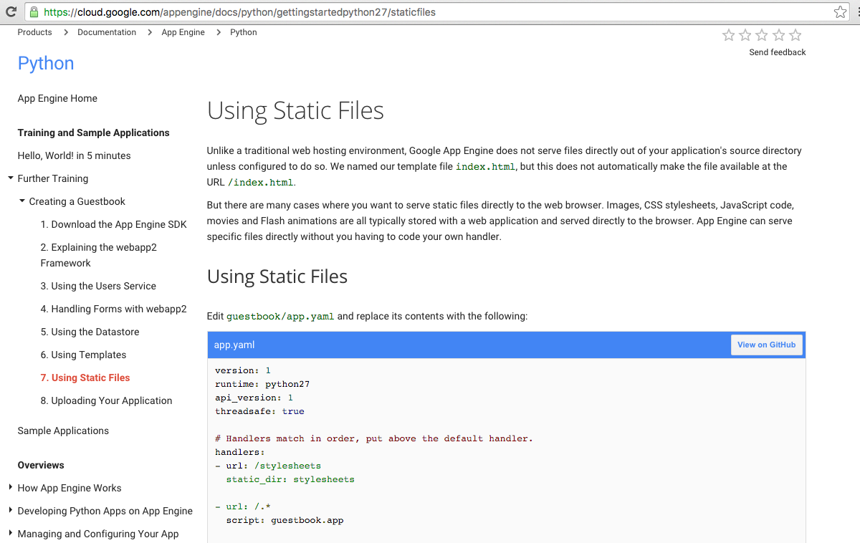
Google App Engine
Source: https://cloud.google.com/appengine/docs/python/gettingstartedpython27/introduction

Slide 75
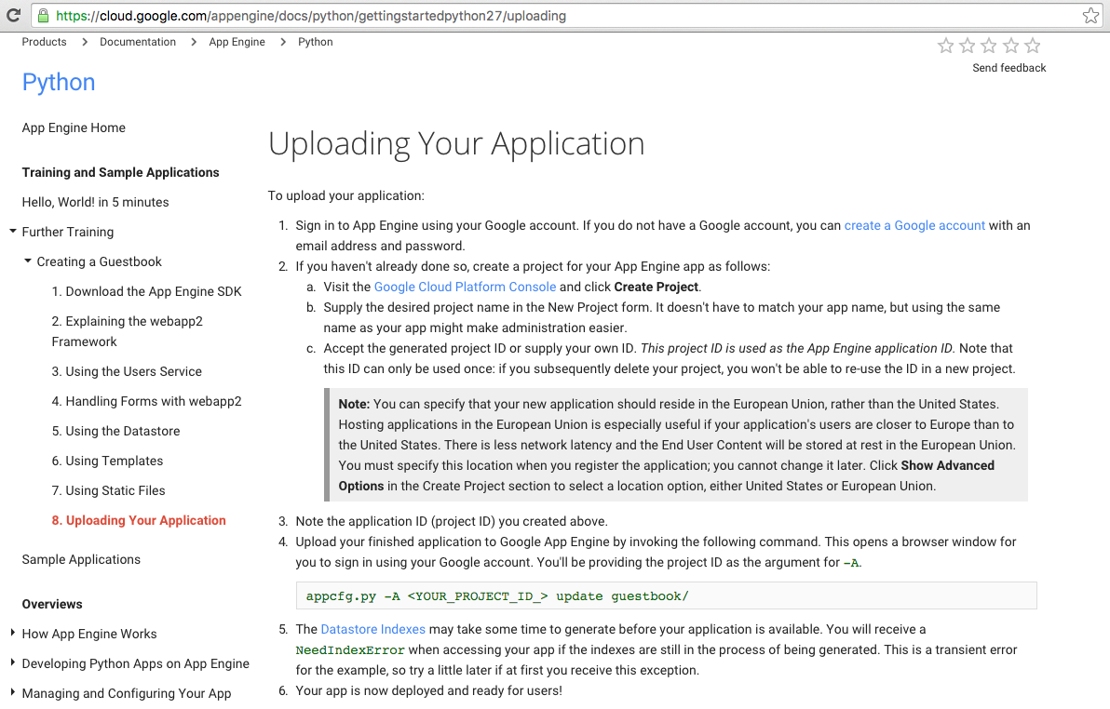
Google App Engine
Source: https://cloud.google.com/appengine/docs/python/gettingstartedpython27/introduction

Slide 76
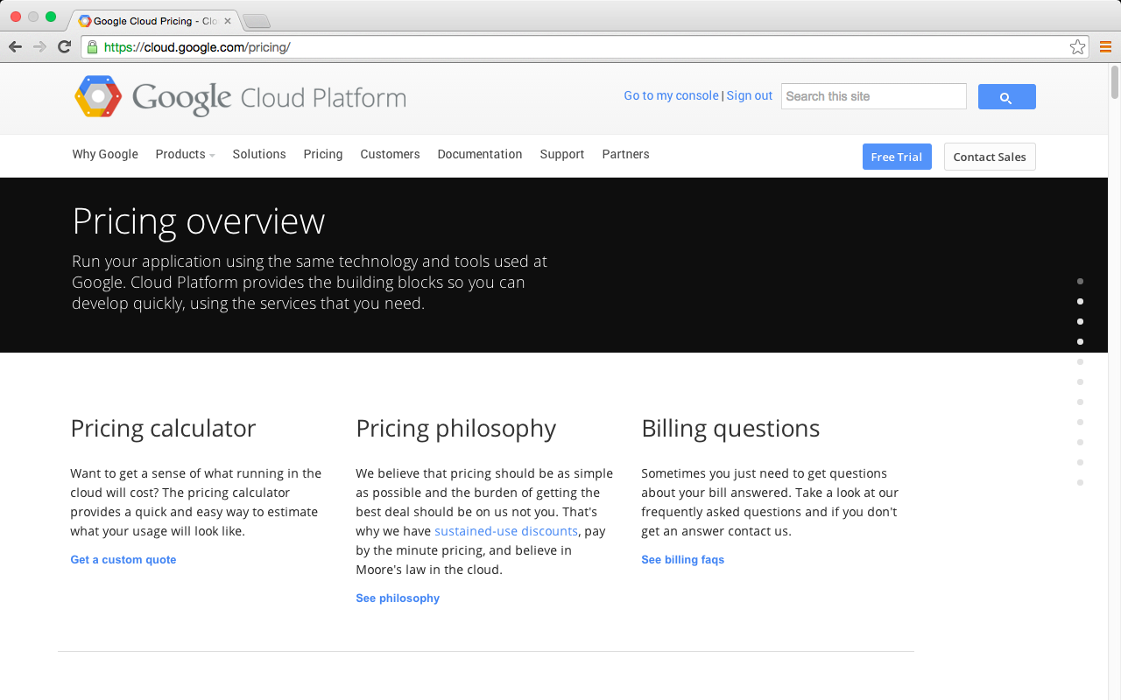
Google Cloud Platform

Slide 77
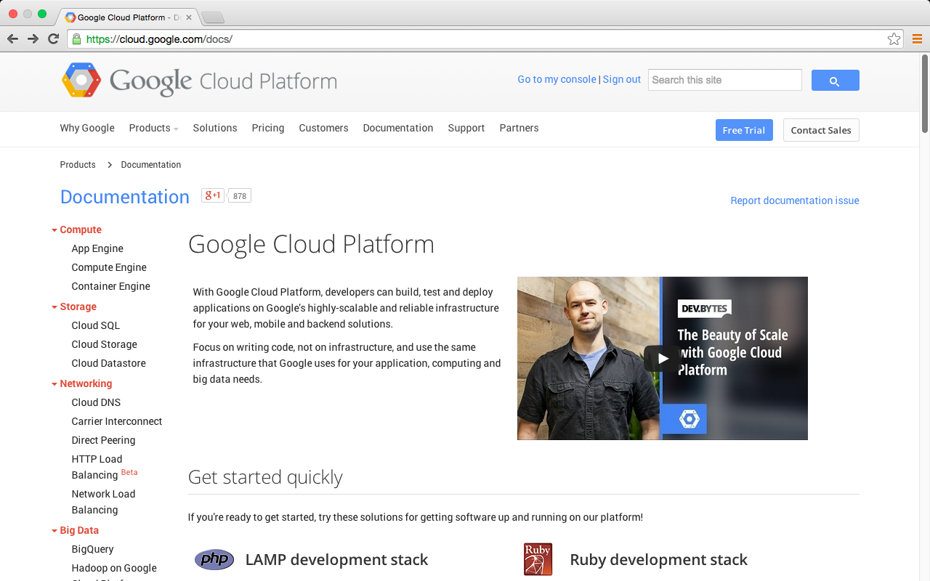
Google Cloud Platform
https://cloud.google.com/docs/

Slide 78
Try Google Cloud Platform for free

Slide 79
Try Google Cloud Platform for free

Slide 80
Google Cloud Platform
https://cloud.google.com/docs/

Slide 81
App Engine "Hello World" starter
Google App Engine
https://console.developers.google.com/start/appengine
Deploy your first app in five minutes
Start editing a working "Hello World" app right now, in the browser.
This gives you a good starting point and a feel for what it's like editing a working App Engine application.

Slide 82
Try Google App Engine Now
NAME YOUR PROJECT
SELECT YOUR LANGUAGE
EXPLORE THE STARTER CODE
INSTALL GOOGLE CLOUD SDK
RUN YOUR APP LOCALLY
CREATE YOUR PROJECT AND DEPLOY

Slide 83
Google App Engine

Slide 84
Google App Engine

Slide 85
Google App Engine

Slide 86
Google App Engine

Slide 87
Google App Engine

Slide 88
Google App Engine

Slide 89
Google App Engine

Slide 90
Google App Engine

Slide 91
Google
Cloud
Datastore

Slide 92
Mobile App Backend Services
iOS
Android
Cloud Endpoints
App Engine
Cloud Datastore
Web
Services
Compute
Storage
Source: https://cloud.google.com/solutions/mobile/mobile-app-backend-services

Slide 93
Datastore Internals
Based on Bigtable
  high scalability
  High availability
    synchronous writes on multiple datacenters
Datastore
query
Megastore
transactions
Bigtable
Scalable and reliable storage
Source: Datastore Introduction, http://www.youtube.com/watch?v=fQazhzcC-rg

Slide 94
What is Bigtable?
Scalable, distributed, highly-available and structured storage
  Bigtable is not database by itself (it doesn’t support query)
Google usage
  In production since April 2005
  Web Search, YouTube, Earth, Analytics
Bigtable
Scalable and reliable storage
Source: Datastore Introduction, http://www.youtube.com/watch?v=fQazhzcC-rg

Slide 95
Bigtable Data Model
A row has a Key and Columns
Sorted by Key
  In lexical order
  Enables range query by application
“contents:”
“anchor:cnnsi.com”
“anchor:my.look.ca”
“<html>…”
t₃
“com.cnn.www”
“<html>…”
t₅
“<html>…”
t₆
“CNN”
t₉
“CNN.com”
t₈
Source: Datastore Introduction, http://www.youtube.com/watch?v=fQazhzcC-rg

Slide 96
Google Datastore Basic Operation
Different terms for corresponding concepts
 | Google Datastore | Relational Database Management System (RDBMS)
Category of object | Kind | Table
One entry/object | Entity | Row
Unique identifier of data entry | Key | Primary Key (PK)
Individual data | Property | Field
Source: Datastore Introduction, http://www.youtube.com/watch?v=fQazhzcC-rg

Slide 97
Kind, Entity and Key
Kinds
Key
BlogEntry
User
Key: 1234
name: joe@ex.com
message: xxxxx
data: 1/1/2012 12:32
Key: joe@ex.com
email: joe@ex.com
followees:
[usr2@ex.com, usr3@ex.com]
followers:
[]
Key: usr2@ex.com
email: usr2@ex.com
followees:
[]
followers:
[joe@ex.com]
Entities
Source: Datastore Introduction, http://www.youtube.com/watch?v=fQazhzcC-rg

Slide 98
Properties and Data Types
Each entity has one or more named properties
Variety of datatypes (int, float, boolean, Sring, Date,…)
Can be multi-valued
BlogEntry
User
Key: 1234
name: joe@ex.com
message: xxxxx
data: 1/1/2012 12:32
Key: joe@ex.com
email: joe@ex.com
followees:
[usr2@ex.com, usr3@ex.com]
followers:
[]
Key: usr2@ex.com
email: usr2@ex.com
followees:
[]
followers:
[joe@ex.com]
Properties
Source: Datastore Introduction, http://www.youtube.com/watch?v=fQazhzcC-rg

Slide 99
Creating an Entity with Java Low-level API
DatastoreService datastore = DatastoreServiceFactory.getDatastoreService();
Entity employee = new Entity(“Employee”);
employee.setProperty(“name”, “Antonio Saliery”);
employee.setProperty(“hireDate”, new Date());
employee.setProperty(“attendedHrTraining”, true);
datastore.put(emploee);
Source: Datastore Introduction, http://www.youtube.com/watch?v=fQazhzcC-rg

Slide 100
Mobile App Backend Services
Source: https://cloud.google.com/solutions/mobile/mobile-app-backend-services

Slide 101
Source: https://firebase.google.com/

Slide 102
Firebase:
Backend as a Service (BaaS)
Source: https://firebase.google.com/

Slide 103
Mobile App Backend Services
Source: https://cloud.google.com/solutions/mobile/mobile-app-backend-services

Slide 104
Mobile App Backend Services
Source: https://cloud.google.com/solutions/mobile/mobile-app-backend-services

Slide 105
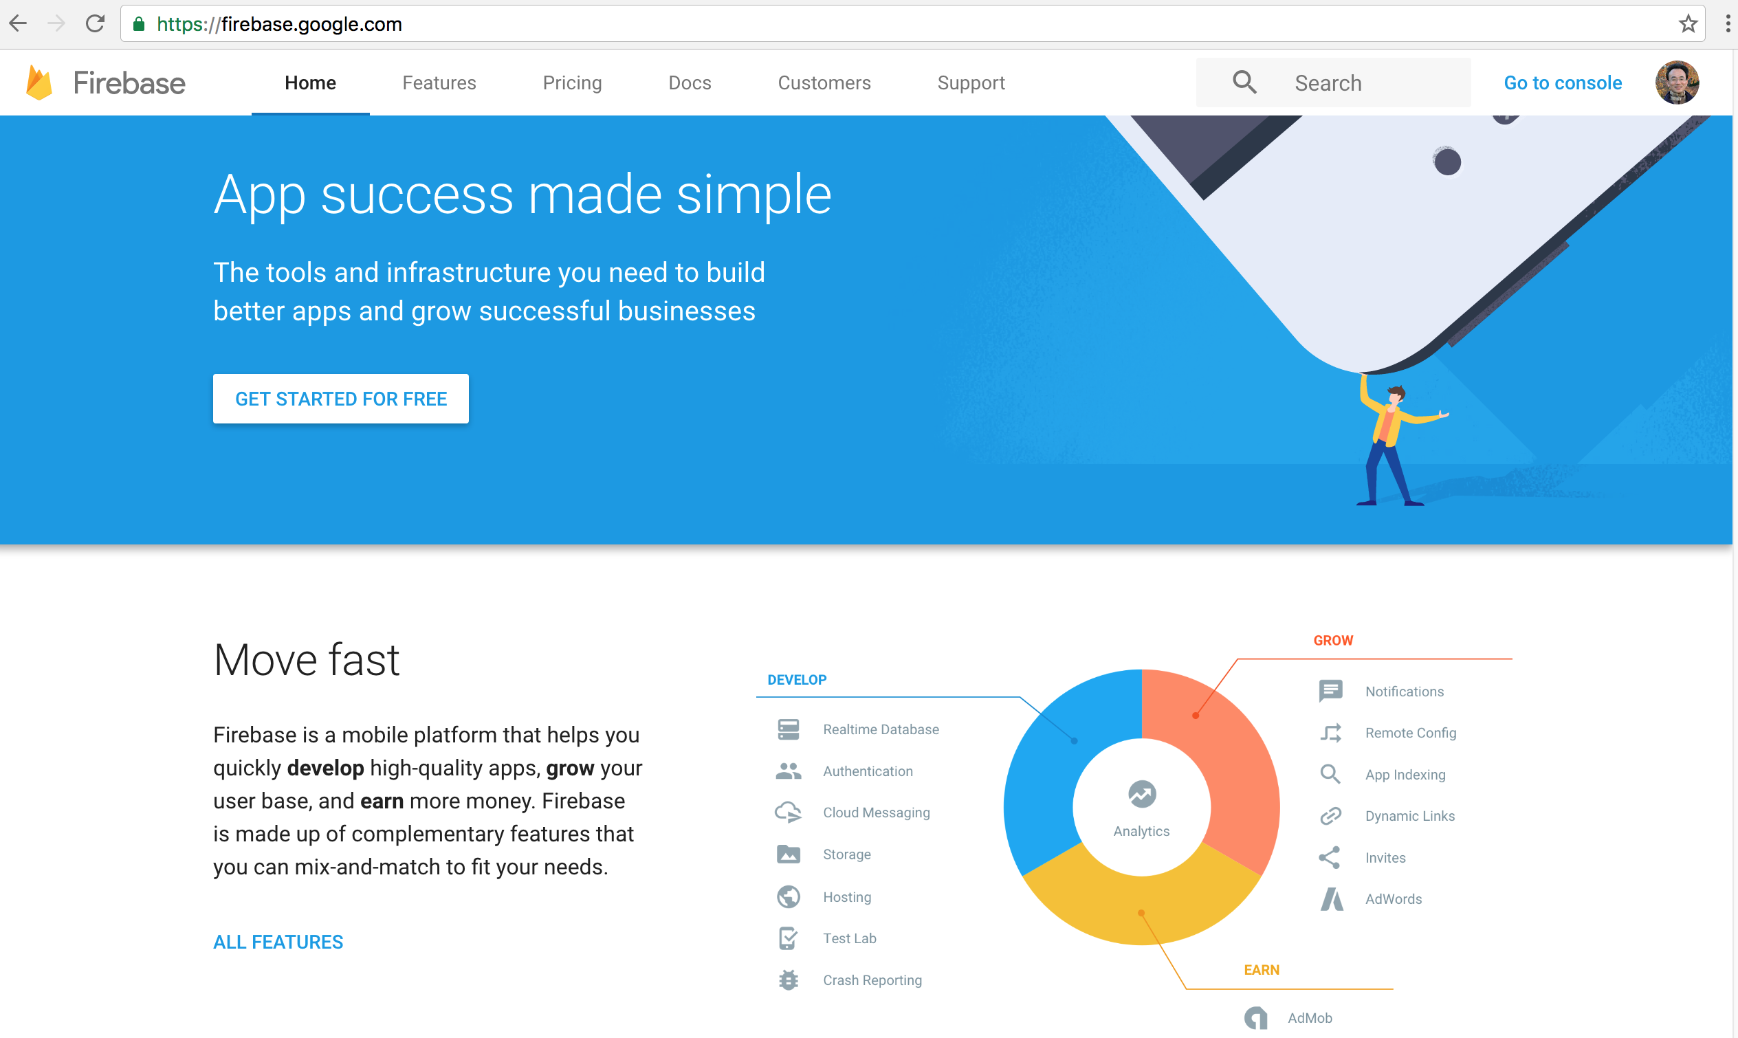
Firebase
Source: https://firebase.google.com/

Slide 106
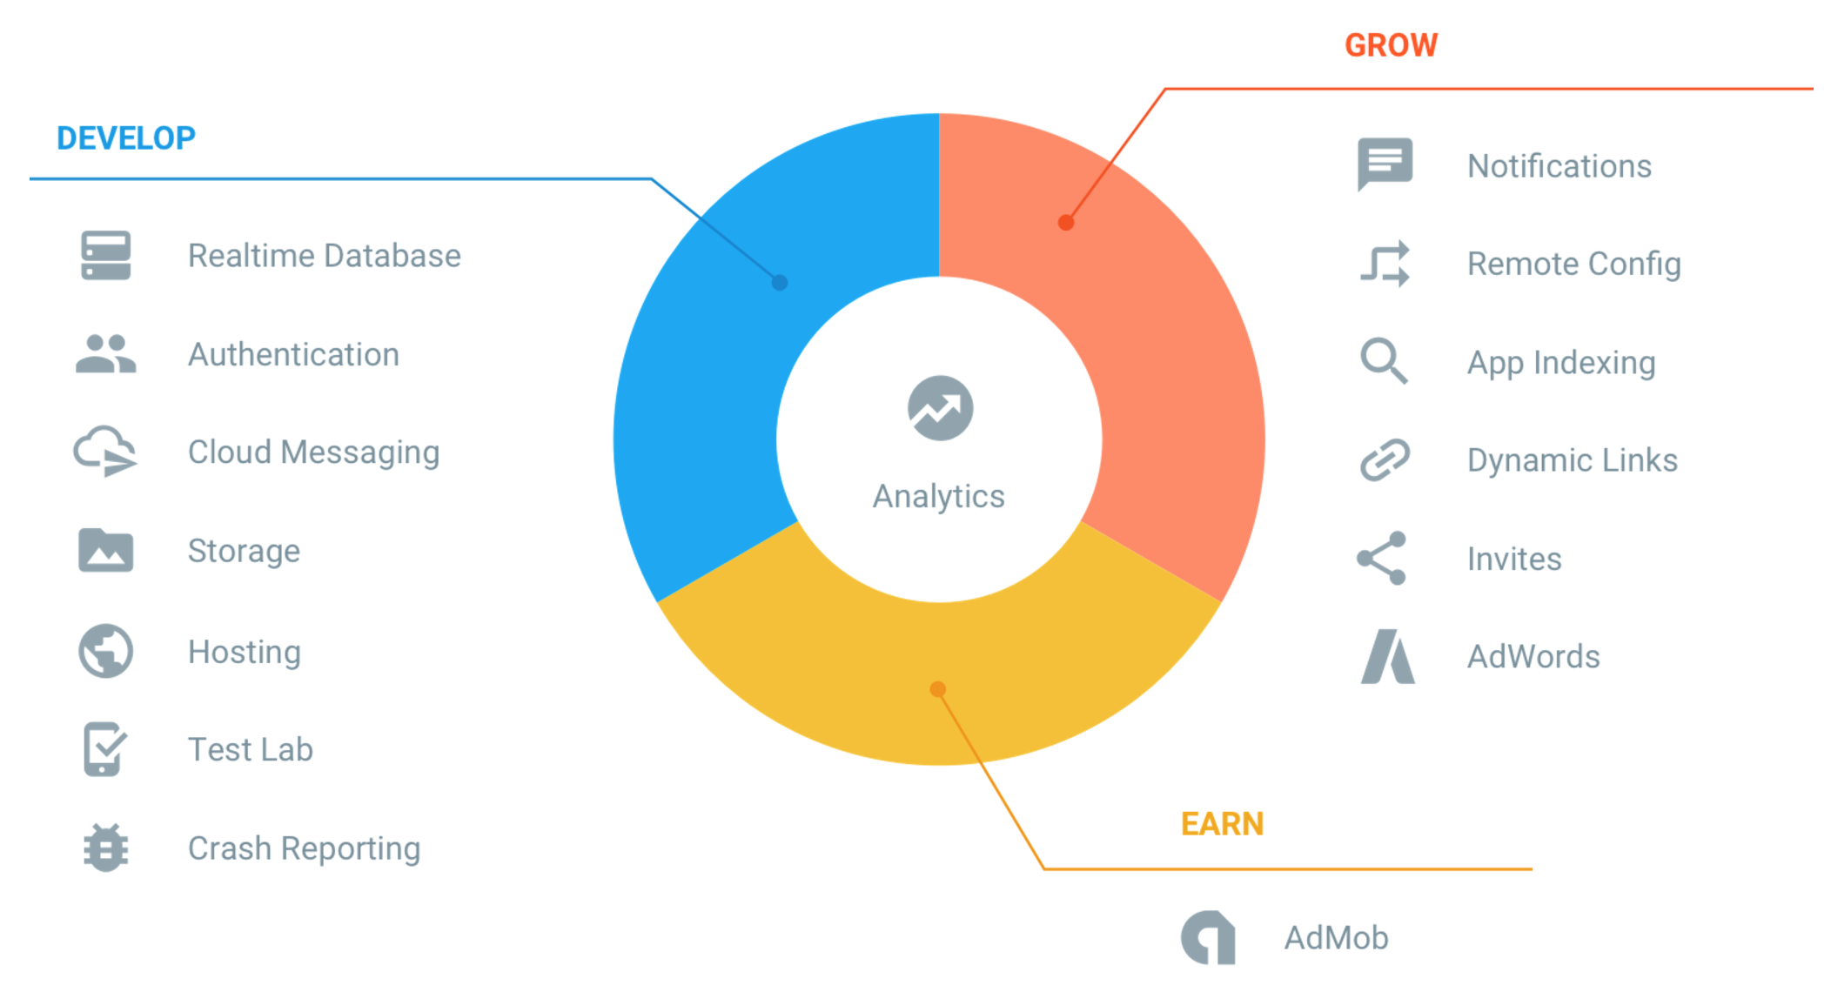
Firebase
Source: https://firebase.google.com/

Slide 107
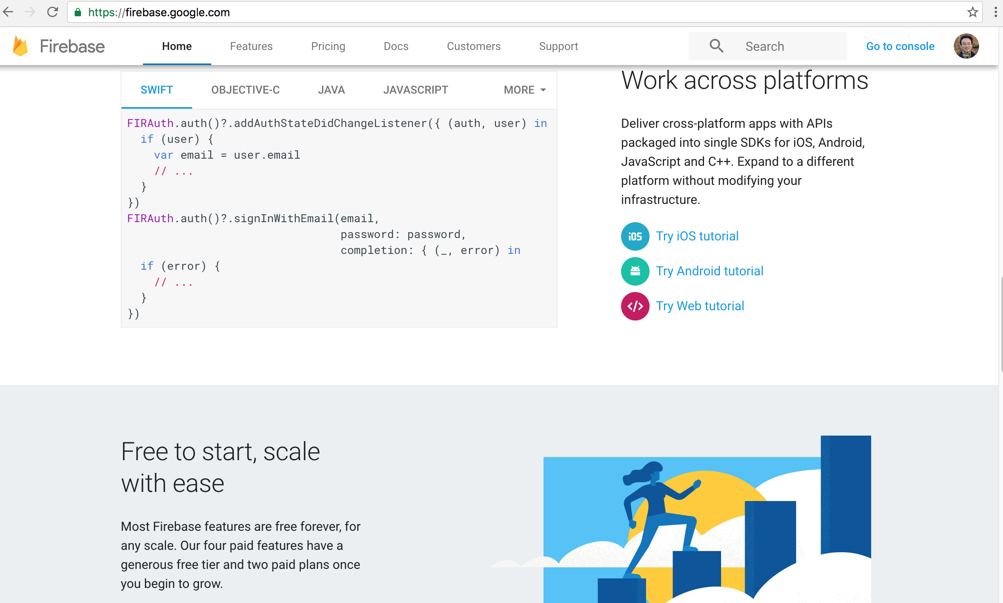
Firebase
Source: https://firebase.google.com/

Slide 108
Firebase
Source: https://firebase.google.com/

Slide 109
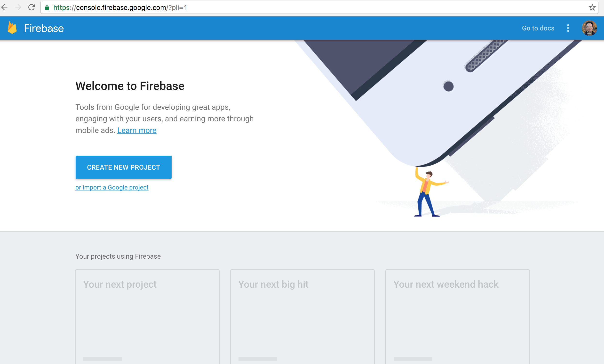
Firebase Project
https://console.firebase.google.com/?pli=1

Slide 110
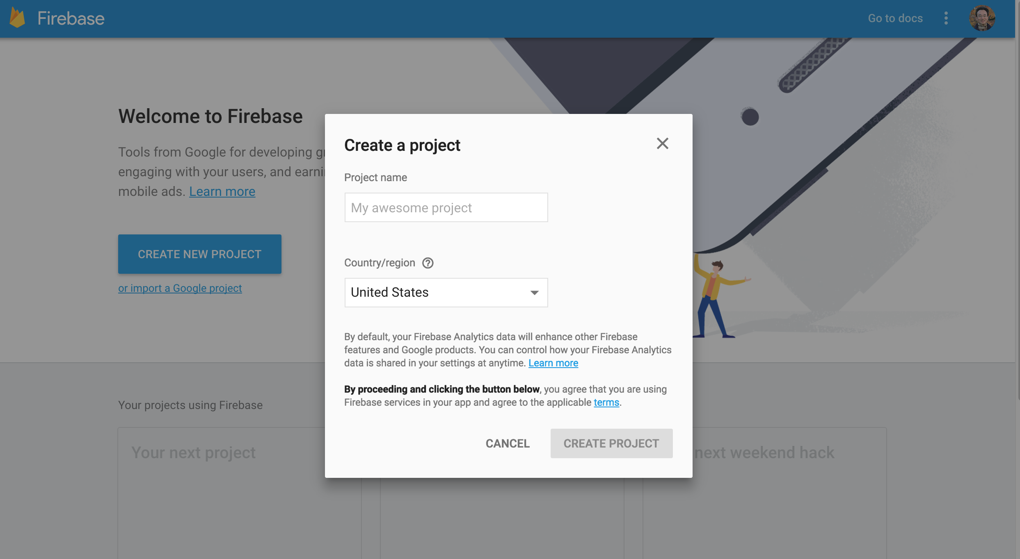
Firebase Project

Slide 111

Firebase Project

Slide 112

Firebase Project

Slide 113

Add Firebase to Your Web App

Slide 114

Add Firebase to Your Web App

Slide 115
Add Firebase to Your Web App
<script src="https://www.gstatic.com/firebasejs/3.6.4/firebase.js"></script>
<script>
// Initialize Firebase
var config = {
apiKey: "AIzaSyDu4JodvREiNjYJP2_YBVgZLpNu1HUEB_g",
authDomain: "helloworldfirebase-d6ef2.firebaseapp.com",
databaseURL: "https://helloworldfirebase-d6ef2.firebaseio.com",
storageBucket: "helloworldfirebase-d6ef2.appspot.com",
messagingSenderId: "778984601289"
};
firebase.initializeApp(config);
</script>

Slide 116

Add Firebase to Your Web App
firebase-app - The core firebase client (required).
firebase-auth - Firebase Authentication (optional).
firebase-database - The Firebase Realtime Database (optional).
Source: https://firebase.google.com/docs/web/setup

Slide 117

Add Firebase to Your Web App
Source: https://firebase.google.com/docs/web/setup

Slide 118

Add Firebase to Your Web App
Source: https://firebase.google.com/docs/web/setup

Slide 119

Add Firebase to Your Web App
Source: https://firebase.google.com/docs/web/setup

Slide 120

Firebase Database Web Start
Source: https://firebase.google.com/docs/database/web/start

Slide 121

Firebase Database Structure Data
Source: https://firebase.google.com/docs/database/web/structure-data

Slide 122

Firebase Database Structure Data
Source: https://firebase.google.com/docs/database/web/structure-data

Slide 123


Firebase Database Write Data
Source: https://firebase.google.com/docs/database/web/read-and-write

Slide 124

Firebase Database Read Data
Source: https://firebase.google.com/docs/database/web/read-and-write

Slide 125

Firebase Database

Slide 126

Firebase Database Rules

Slide 127

Firebase Database

Slide 128

Firebase Database

Slide 129

Firebase Database

Slide 130
Summary
Google App Engine
  Google Cloud Platform
  Google Cloud Datastore
  Google Firebase

Slide 131
References
Google Cloud Platform,
https://cloud.google.com/
Google App Engine,
https://cloud.google.com/appengine/
Google Cloud Datastore,
https://cloud.google.com/datastore/
Google Cloud Endpoints,
https://cloud.google.com/endpoints/
Google Firebase
https://firebase.google.com/

