Slide 1
Social Media Apps Programming
Tamkang University
Mobile Apps using HTML5/CSS3/JavaScript
1061SMAP05
TLMXM1A (8648) (M2143) (Fall 2017)
(MIS MBA) (2 Credits, Elective) [Full English Course]
Fri 8,9 (15:10-17:00) B206
Min-Yuh Day, Ph.D.
Assistant Professor
Department of Information Management
Tamkang University
http://mail.tku.edu.tw/myday
2017-10-20

Slide 2
Course Schedule (1/2)
Tamkang University
Week Date Subject/Topics
1 2017/09/22 Course Orientation and Introduction to Social Media and Mobile Apps Programming
2 2017/09/29 Introduction to Android / iOS Apps Programming
3 2017/10/06 Developing Android Native Apps with Java (Android Studio)
4 2017/10/13 Developing iPhone / iPad Native Apps with Swift (XCode)
5 2017/10/20 Mobile Apps using HTML5/CSS3/JavaScript
6 2017/10/27 jQuery Mobile
7 2017/11/03 Create Hybrid Apps with Phonegap
8 2017/11/10 jQuery Mobile/Phonegap
9 2017/11/17 jQuery Mobile/Phonegap

Slide 3
Course Schedule (2/2)
Tamkang University
Week Date Subject/Topics
10 2017/11/24 Midterm Project Report
11 2017/12/01 Case Study on Social Media Apps Programming and Marketing in Google Play and App Store
12 2017/12/08 Google Cloud Platform
13 2017/12/15 Google App Engine
14 2017/12/22 Google Map API
15 2017/12/29 Facebook API (Facebook JavaScript SDK) (Integrate Facebook with iOS/Android Apps)
16 2018/01/05 Twitter API
17 2018/01/12 Final Project Presentation
18 2018/01/19 Final Exam Week (Final Project Presentation)

Slide 4
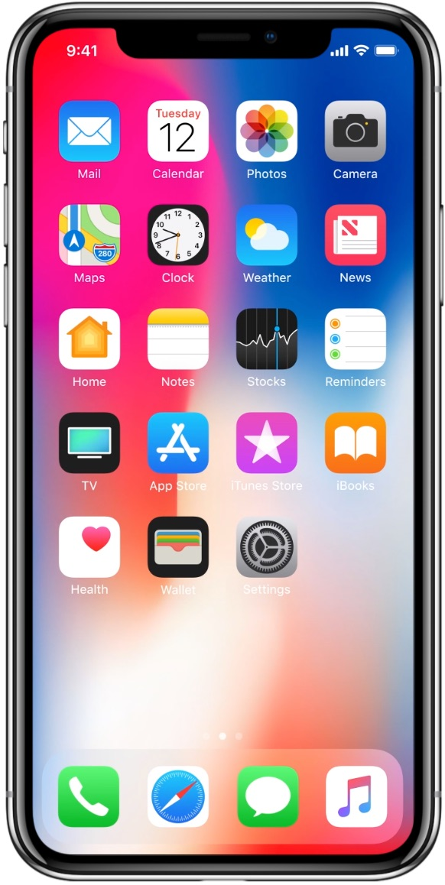
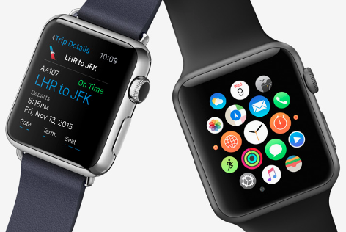
Android /iOS Apps Programming
Native Apps
Hybrid Apps
Mobile Web Apps

Slide 5
App Development Comparison
Device Access
Speed
Development Cost
App Store
Approval Process
Native Apps
Full
Very Fast
Expensive
Available
Mandatory
Hybrid Apps
Full
Native Speed as Necessary
Reasonable
Available
Low Overhead
Web Apps
Partial
Fast
Reasonable
Not Available
None
Source: http://www.scribd.com/doc/50805466/Native-Web-or-Hybrid-Mobile-App-Development

Slide 6
Outline
Mobile Apps
HTML5
Hyper Text Markup Language (version 5)(2014)
Content and Structure
CSS3
Cascading Style Sheets (version 3)
Presentation, Layout and User Interface
JavaScript
Behavior and Business Logic

Slide 7
Building Android Apps with HTML, CSS, and JavaScript: Making Native Apps with Standards-Based Web Tools, Jonathan Stark & Brian Jepson, O’reilly, 2012
Source: http://www.amazon.com/Building-Android-Apps-HTML-JavaScript/dp/1449316417

Slide 8
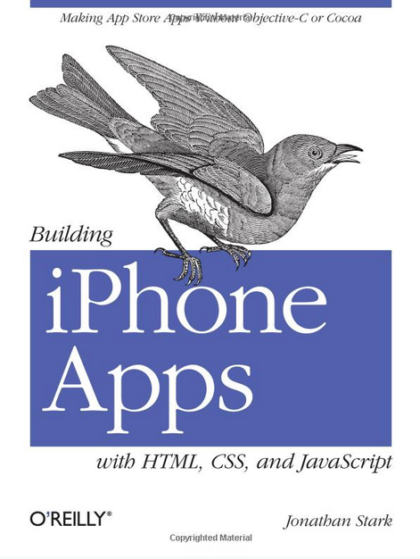
Building iPhone Apps with HTML, CSS, and JavaScript: Making App Store Apps Without Objective-C or Cocoa, Jonathan Stark, O’reilly, 2010
Source: http://www.amazon.com/Building-iPhone-Apps-HTML-JavaScript/dp/0596805780

Slide 9
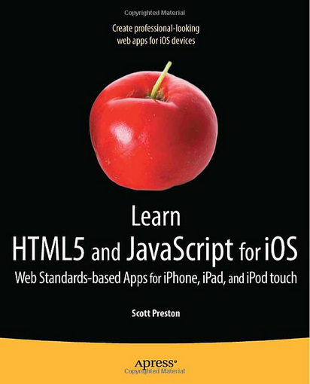
Learn HTML5 and JavaScript for iOS: Web Standards-based Apps for iPhone, iPad, and iPod touch, Scott Preston, Apress, 2012
Source: http://www.amazon.com/Learn-HTML5-JavaScript-iOS-Standards-based/dp/1430240385

Slide 10
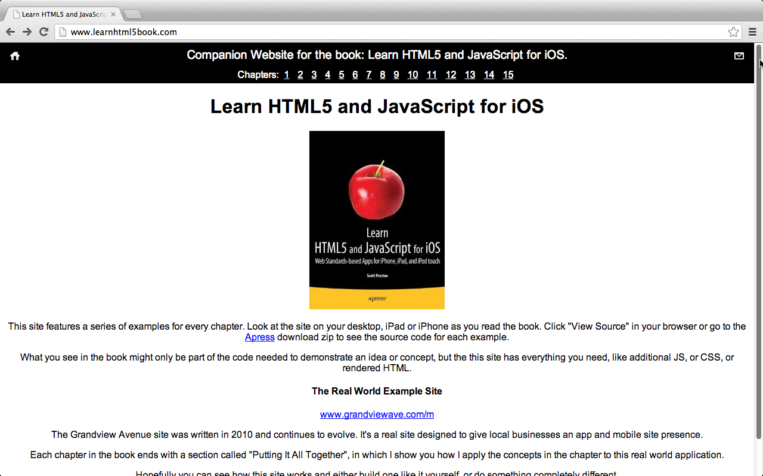
Learn HTML5 and JavaScript for iOS
http://www.learnhtml5book.com/

Slide 11
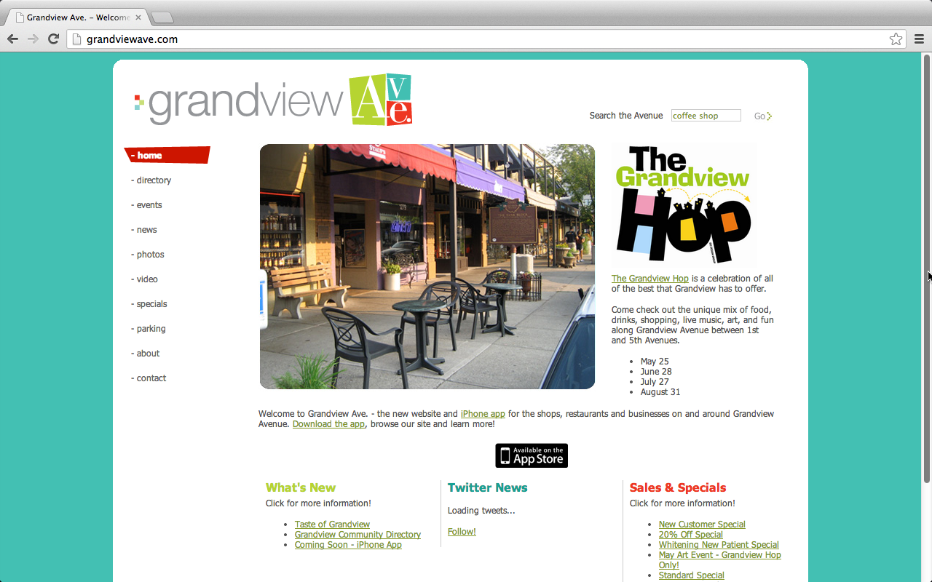
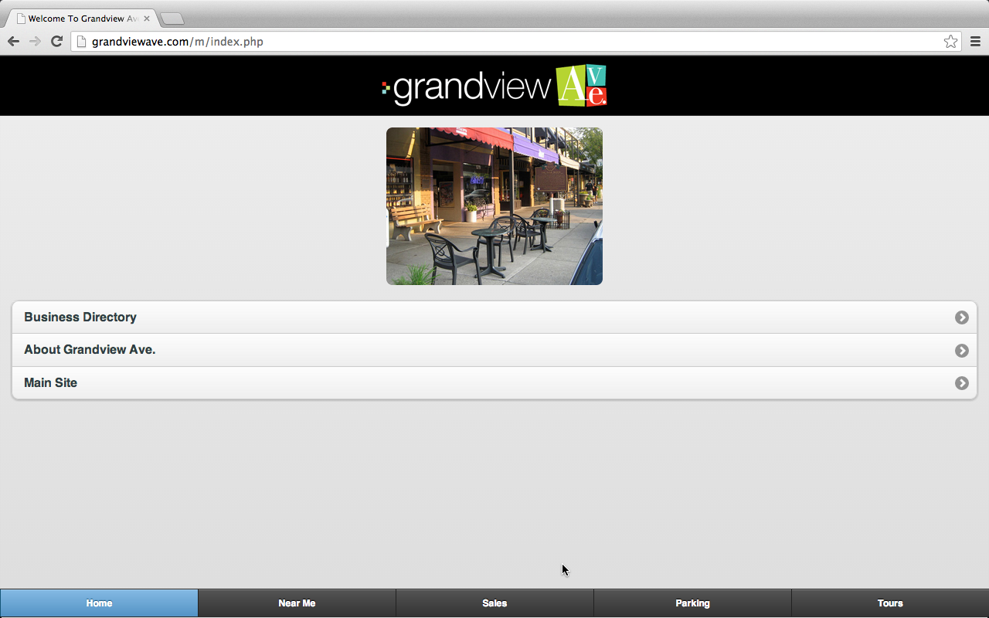
Mobile Apps
Mobile Website
Classic Website
Mobile Apps
Web Apps
Responsive Web Design (RWD)
Source: Scott Preston, Learn HTML5 and JavaScript for iOS: Web Standards-based Apps for iPhone, iPad, and iPod touch, Apress, 2012

Slide 12
Mobile Website Classic Website
http://grandviewave.com/

Slide 13
Mobile Apps (Web Apps)
http://grandviewave.com/

Slide 14
Responsive Web Design (RWD)
http://grandviewave.com/m/

Slide 15
Mobile Web App
HTML
Phone Data
Templates
CSS
JavaScript
External Data
Mobile frameworks and Libraries
Source: Scott Preston, Learn HTML5 and JavaScript for iOS: Web Standards-based Apps for iPhone, iPad, and iPod touch, Apress, 2012

Slide 16
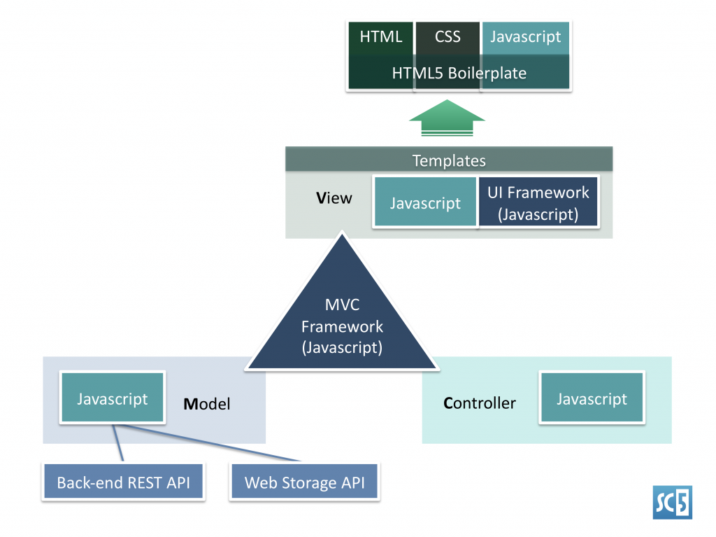
MVC Framework of Mobile Apps (HTML5, CSS3, JavaScript)
Source: http://sc5.io/blog/2012/02/anatomy-of-a-html5-app/

Slide 17
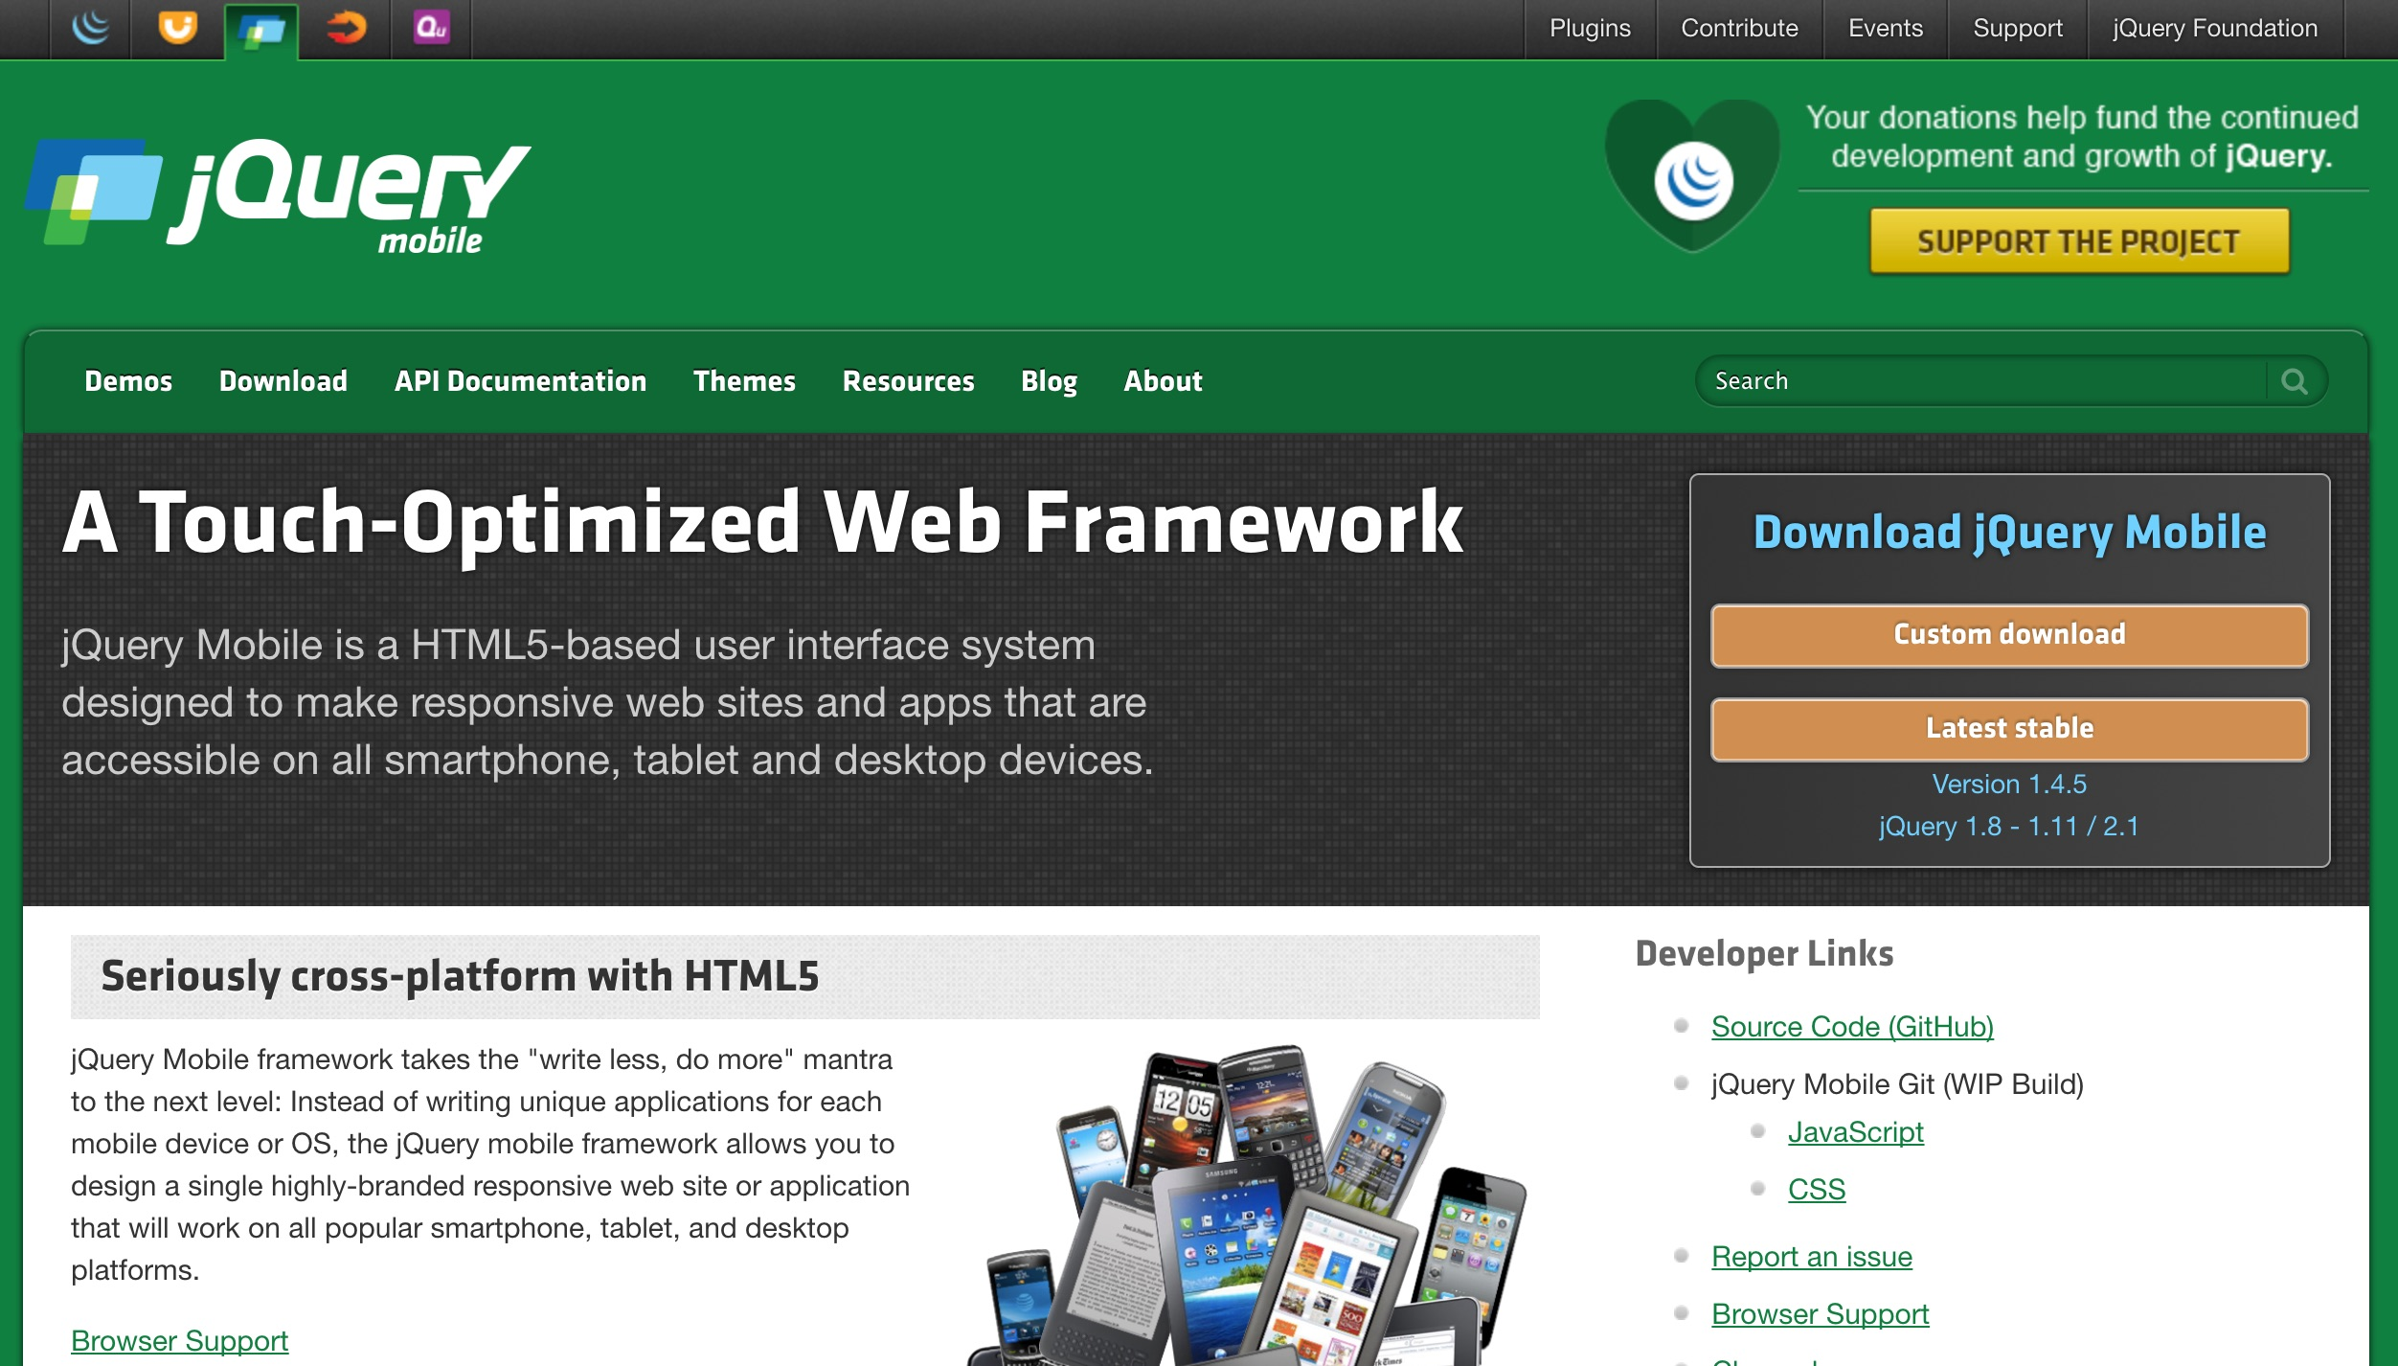
jQuery Mobile
https://jquerymobile.com/

Slide 18
Bootstrap
http://getbootstrap.com/

Slide 19
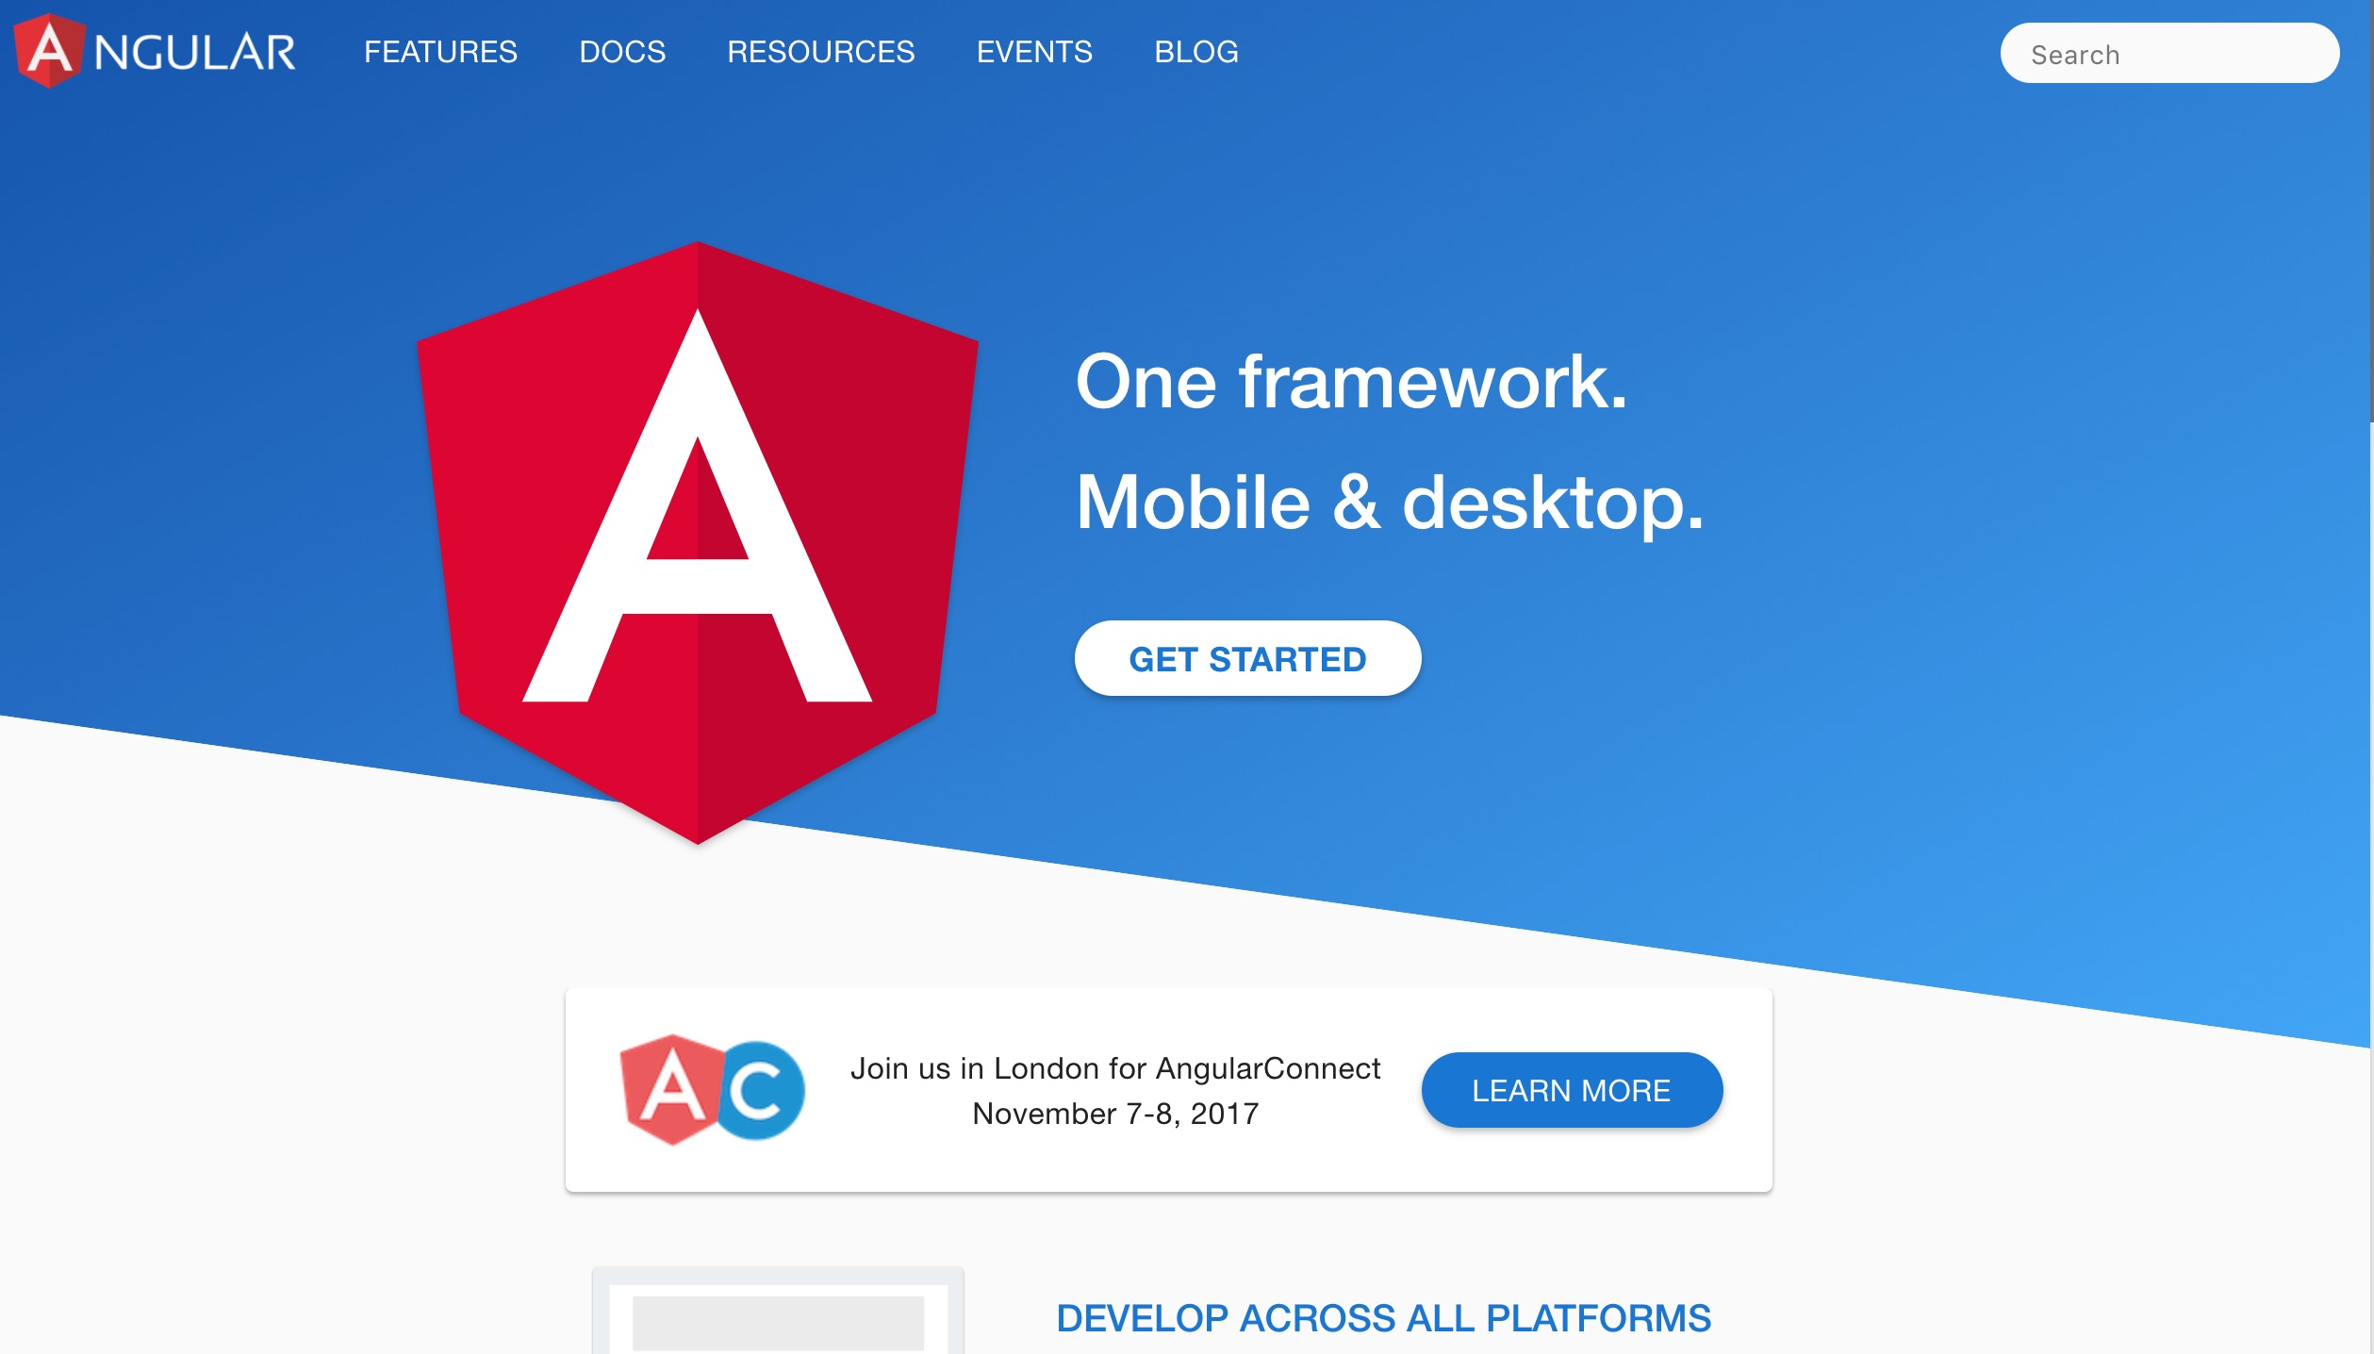
Angular
https://angular.io/

Slide 20
React js
https://reactjs.org/

Slide 21
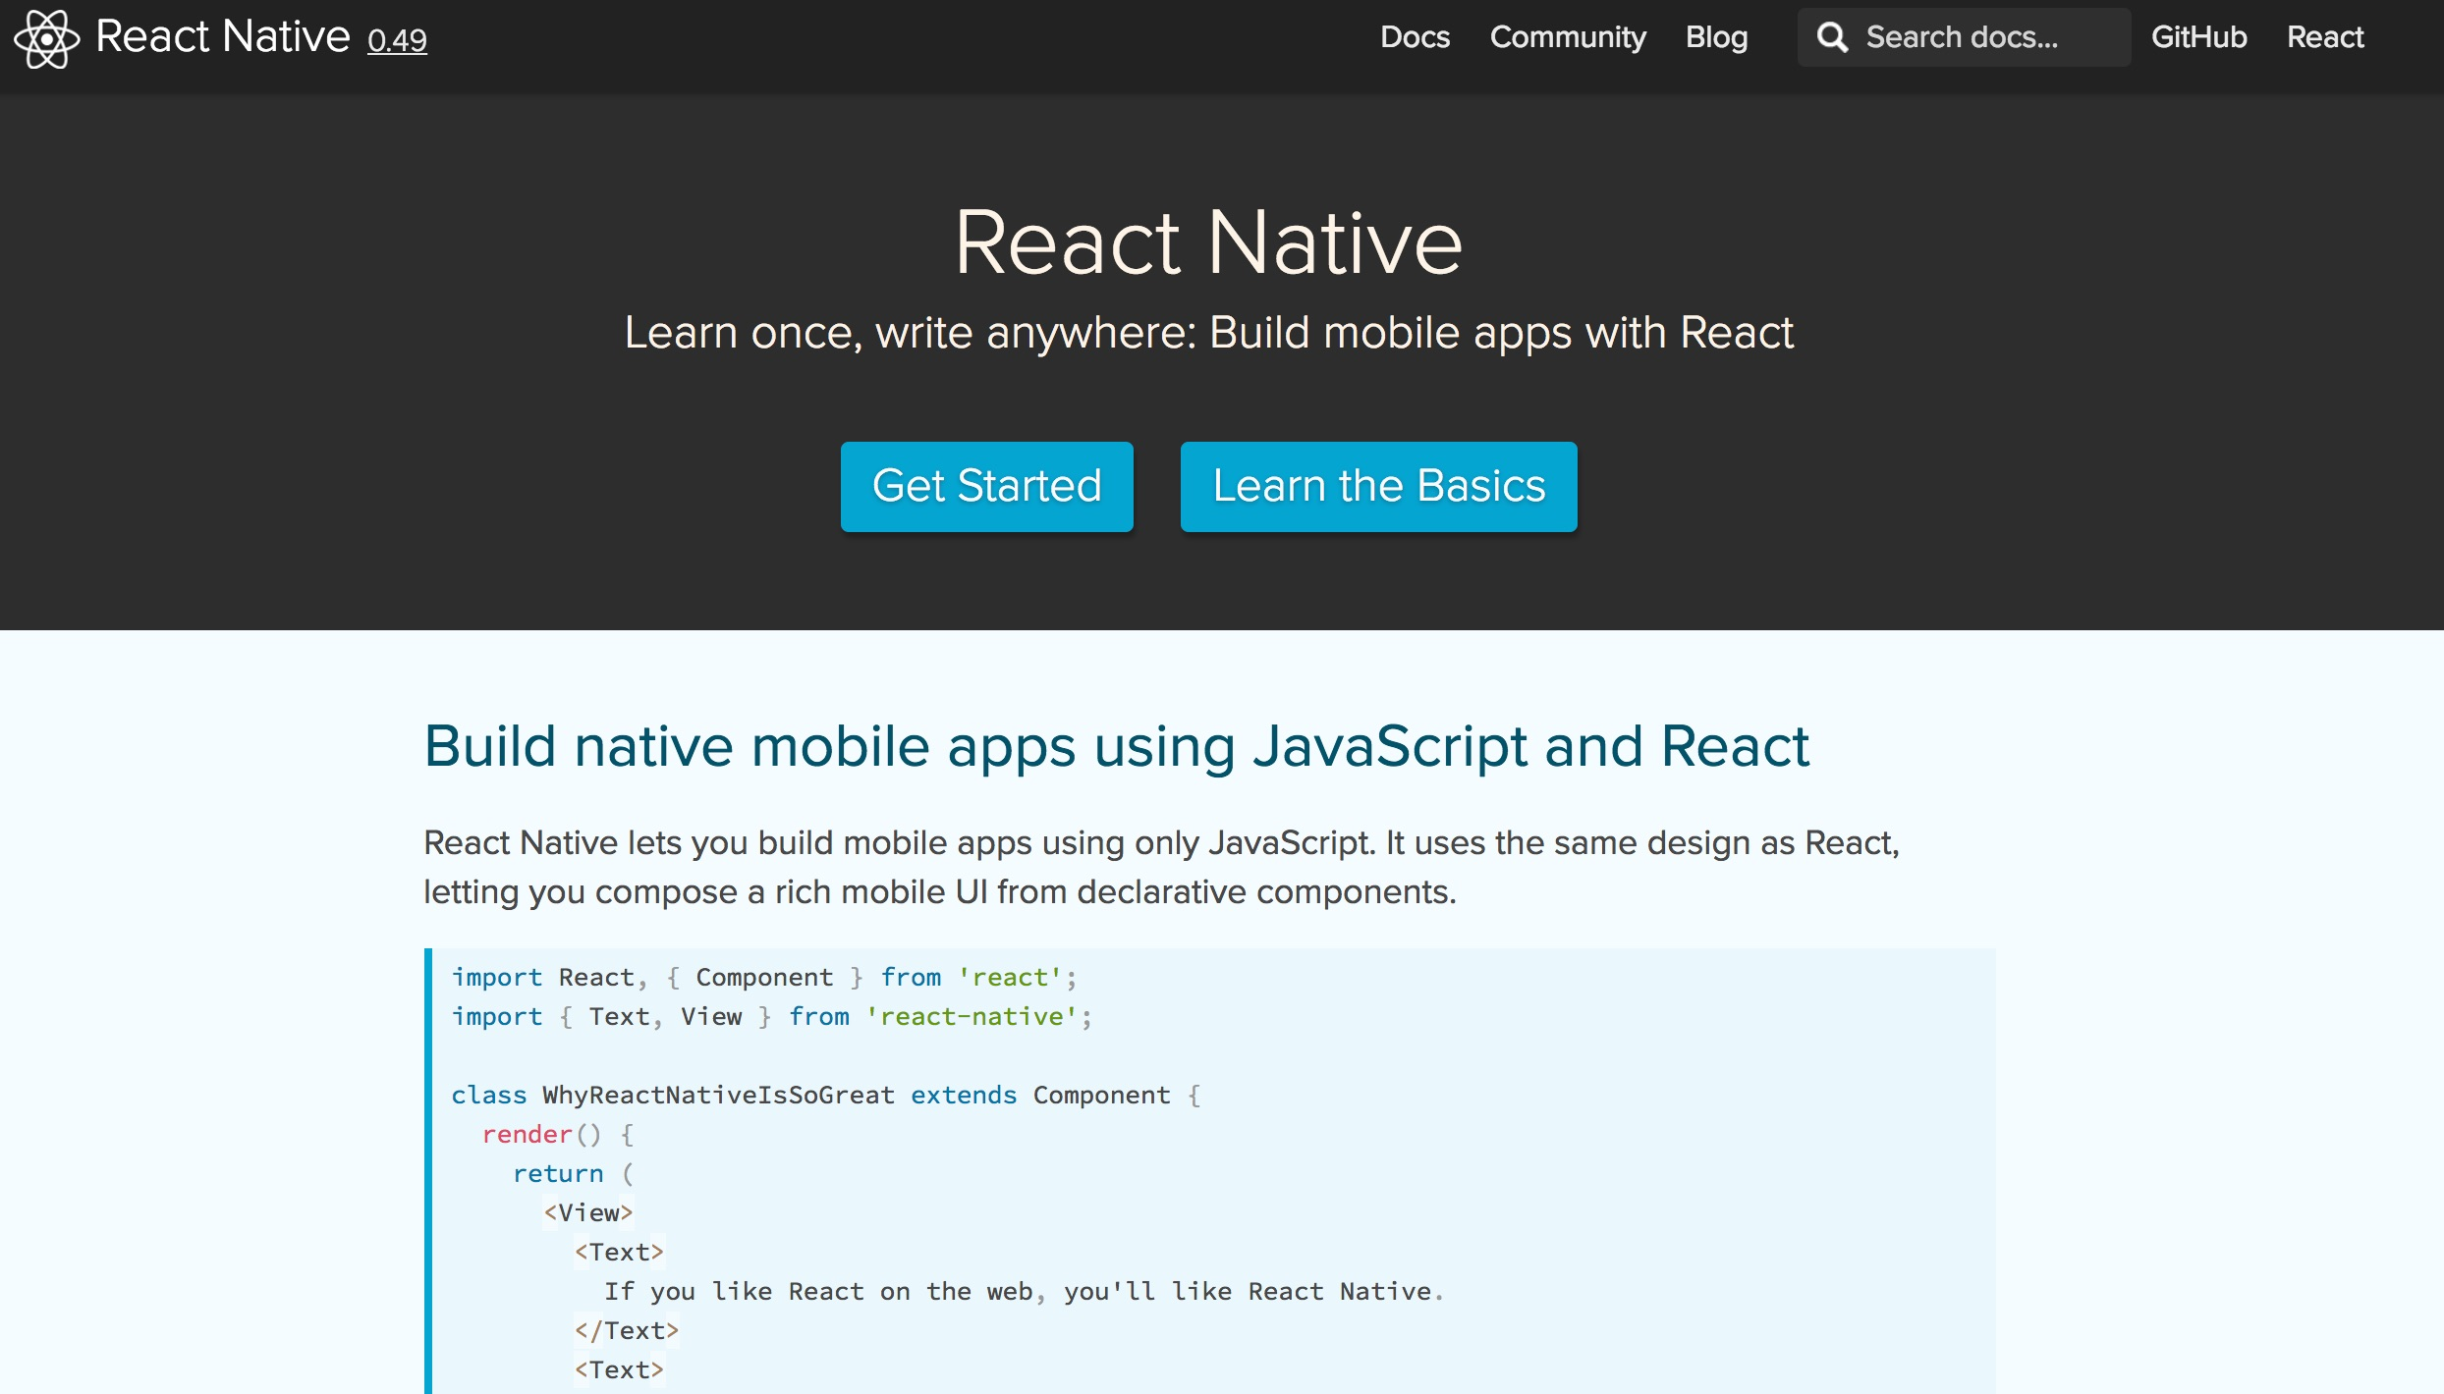
React Native
https://facebook.github.io/react-native/

Slide 22
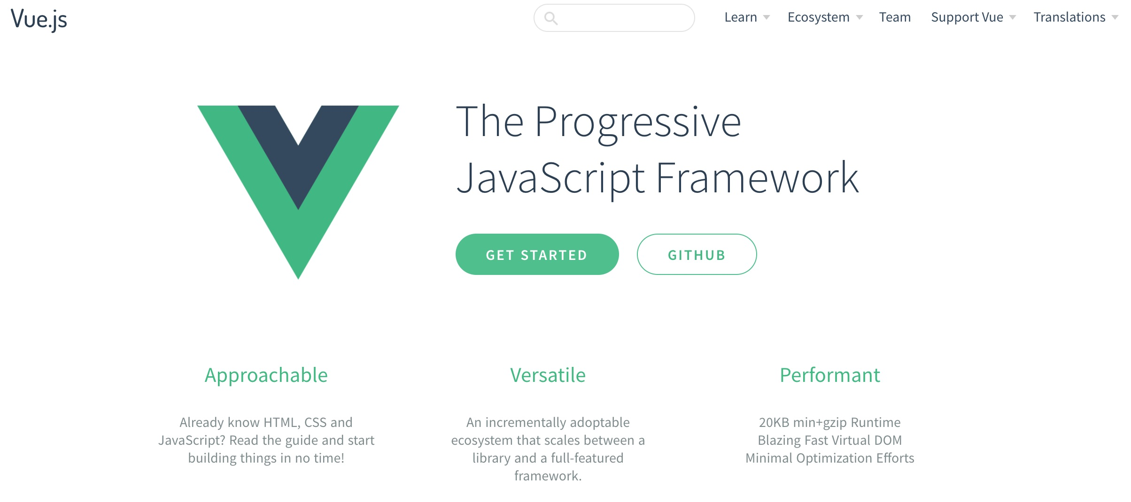
Vue.js
https://vuejs.org/

Slide 23
PhoneGap: Mobile Apps Powered by Open Web Tech
https://phonegap.com/

Slide 24
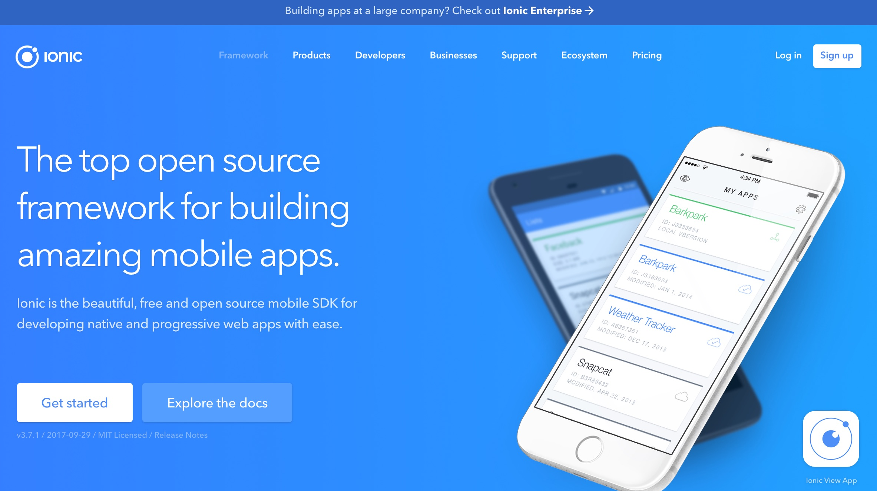
Ionic: Framework for Developing Native and Progressive Web Apps
https://ionicframework.com/

Slide 25
Mobile Web App Organizing files in directories
Classic Website
/ - for all HTML files
/css - for all CSS
/js - for all JavaScript
/images - for all images
Mobile Web App
/m -for all HTML files
/m/css - for all CSS
/m/js - for all JavaScript
/m/images - for all images.
Source: Scott Preston, Learn HTML5 and JavaScript for iOS: Web Standards-based Apps for iPhone, iPad, and iPod touch, Apress, 2012

Slide 26
HTML5

Slide 27
HTML5 index.html
<!DOCTYPE html>
<html>
<head>
<meta charset=“UTF-8”>
<title>My Title</title>
</head>
<body>
Hello World
</body>
</html>

Slide 28
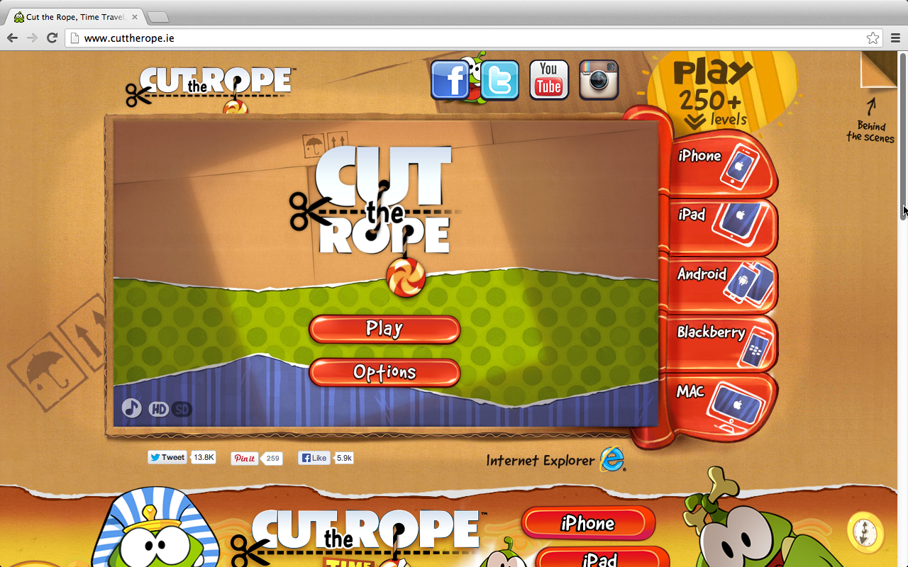
HTML5 Game http://www.cuttherope.ie/
http://www.cuttherope.ie/

Slide 29
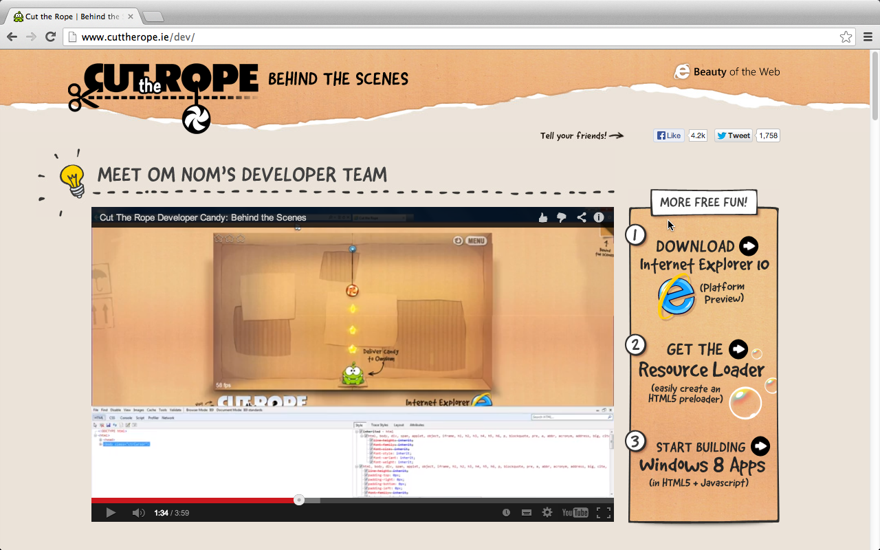
Objective-C to JavaScript
http://www.cuttherope.ie/dev/

Slide 30
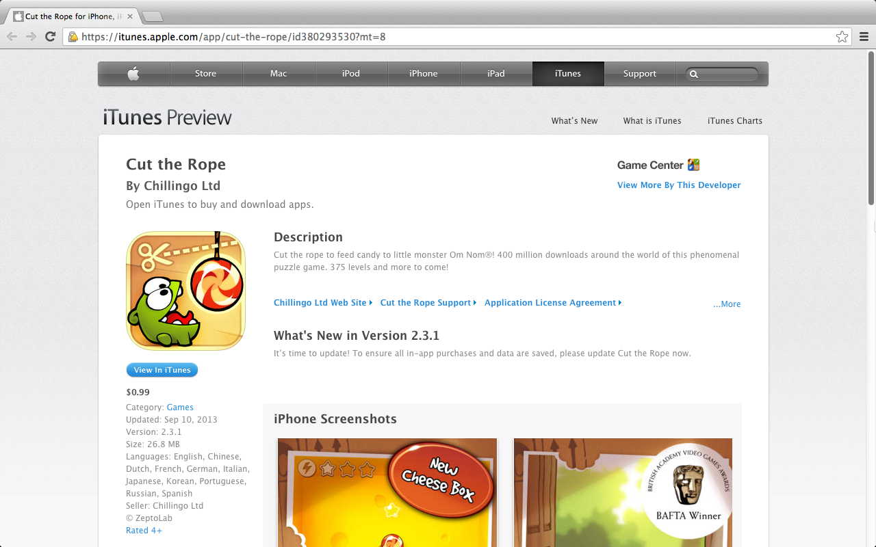
Cut the Rope App
Source: https://itunes.apple.com/app/cut-the-rope/id380293530?mt=8

Slide 31
HTML Versions
Version | Year
HTML | 1991
HTML+ | 1993
HTML 2.0 | 1995
HTML 3.2 | 1997
HTML 4.01 | 1999
XHTML 1.0 | 2000
HTML5 | 2014
Source: http://www.w3schools.com/html/html_intro.asp

Slide 32
The <!DOCTYPE> Declaration
HTML5
<!DOCTYPE html>
HTML 4.01
<!DOCTYPE HTML PUBLIC "-//W3C//DTD HTML 4.01 Transitional//EN"
"http://www.w3.org/TR/html4/loose.dtd">
XHTML 1.0
<!DOCTYPE html PUBLIC "-//W3C//DTD XHTML 1.0 Transitional//EN"
"http://www.w3.org/TR/xhtml1/DTD/xhtml1-transitional.dtd">
Source: http://www.w3schools.com/html/html_intro.asp

Slide 33
What is HTML?
HTML is a language for describing web pages.
HTML stands for Hyper Text Markup Language
HTML is a markup language
A markup language is a set of markup tags
The tags describe document content
HTML documents contain HTML tags and plain text
HTML documents are also called web pages
<!DOCTYPE html>
<html>
<head>
<meta charset=“UTF-8”>
<title>My Title</title>
</head>
<body>
Hello World
</body>
</html>
Source: http://www.w3schools.com/html/html_intro.asp

Slide 34
HTML Tag, Element, Attribute
HTML Element
<title>My Title</title>
<p>This is a paragraph.</p>
<tagname>content</tagname>

Slide 35
HTML Tag, Element, Attribute
HTML Element
<title>My Title</title>
Tag
Tag
Start Tag
End Tag
Opening Tag
Closing Tag

Slide 36
HTML Tag, Element, Attribute
Element
<meta charset=“UTF-8”>
Tag
Attibute

Slide 37
What is HTML5
HTML5 is The New HTML Standard
What HTML5 is Not
The new HTML5 structural elements and attributes
The new HTML5 form input types and attributes

Slide 38
What HTML5 is Not
It’s Not XHTML
<div id=container>This is a div<br></div>
<div id="container">This is another div<br/></div>
It’s Not HTML4+1
HTML5 is Not Just Markup
Not just tags
It’s also a set of JavaScript APIs
Provide a richer user experience
Source: Scott Preston, Learn HTML5 and JavaScript for iOS: Web Standards-based Apps for iPhone, iPad, and iPod touch, Apress, 2012

Slide 39
HTML5 is The New HTML Standard
Source: http://www.w3.org/html/logo/

Slide 40
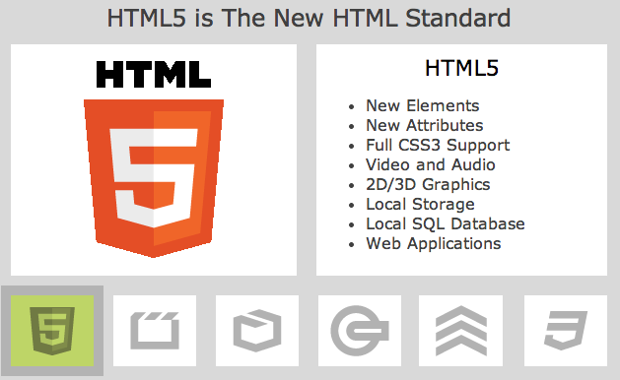
HTML5 is The New HTML Standard
Source: http://www.w3schools.com/html/html5_intro.asp

Slide 41
HTML5 is The New HTML Standard
New Elements
New Attributes
Full CSS3 Support
Video and Audio
2D/3D Graphics
Local Storage
Local SQL Database
Web Applications
Source: http://www.w3schools.com/html/html5_intro.asp

Slide 42
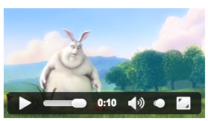
HTML5 Multimedia
With HTML5, playing video and audio is easier than ever.
HTML5 <video>
HTML5 <audio>
<!DOCTYPE HTML>
<html>
<body>
<video width="320" height="240" controls>
<source src="movie.mp4" type="video/mp4">
<source src="movie.ogg" type="video/ogg">
Your browser does not support the video tag.
</video>
</body>
</html>
Source: http://www.w3schools.com/html/html5_intro.asp

Slide 43
HTML5 Graphics
With HTML5, drawing graphics is easier than ever:
Using the <canvas> element
Using inline SVG
Using CSS3 2D/3D
Source: http://www.w3schools.com/html/html5_intro.asp

Slide 44
HTML5 Applications
With HTML5, web application development is easier than ever.
Local data storage
Local file access
Local SQL database
Application cache
Javascript workers
XHTMLHttpRequest 2
Source: http://www.w3schools.com/html/html5_intro.asp

Slide 45
Semantic Elements HTML5 Forms
Semantic Elements
New elements for headers, footers, menus, sections, and articles.
HTML5 Forms
New form elements,
new attributes,
new input types,
automatic validation.
Source: http://www.w3schools.com/html/html5_intro.asp

Slide 46
HTML5 uses CSS3
New Selectors
New Properties
Animations
2D/3D Transformations
Rounded Corners
Shadow Effects
Downloadable Fonts
Source: http://www.w3schools.com/html/html5_intro.asp

Slide 47
HTML5 index.html
<!DOCTYPE html>
<html>
<head>
<meta charset=“UTF-8”>
<title>My Title</title>
</head>
<body>
Hello World
</body>
</html>

Slide 48
CSS3

Slide 49
Cascading Style Sheets (CSS)
a simple mechanism for adding style (e.g., fonts, colors, spacing) to Web documents.
Source: http://www.w3.org/Style/CSS/

Slide 50
CSS3
CSS3 is the latest standard for CSS.
CSS3 is completely backwards-compatible with earlier versions of CSS.
Source: http://www.w3schools.com/css/css3_intro.asp

Slide 51
CSS
http://www.w3schools.com/css/css_syntax.asp

Slide 52
css
<link rel=“stylesheet” type=“text/css” href=“mystyle1.css”>

Slide 53
CSS
<style>
body {background-color:yellow;}
h1 {color:green}
p {color:red;}
div {color:blue; font-size:18px;}
</style>

Slide 54
JavaScript

Slide 55
JavaScript
JavaScript is a Scripting Language
A scripting language is a lightweight programming language.
JavaScript is programming code that can be inserted into HTML pages.
JavaScript code can be executed by all modern web browsers.
JavaScript is easy to learn.
Source: http://www.w3schools.com/js/js_intro.asp

Slide 56
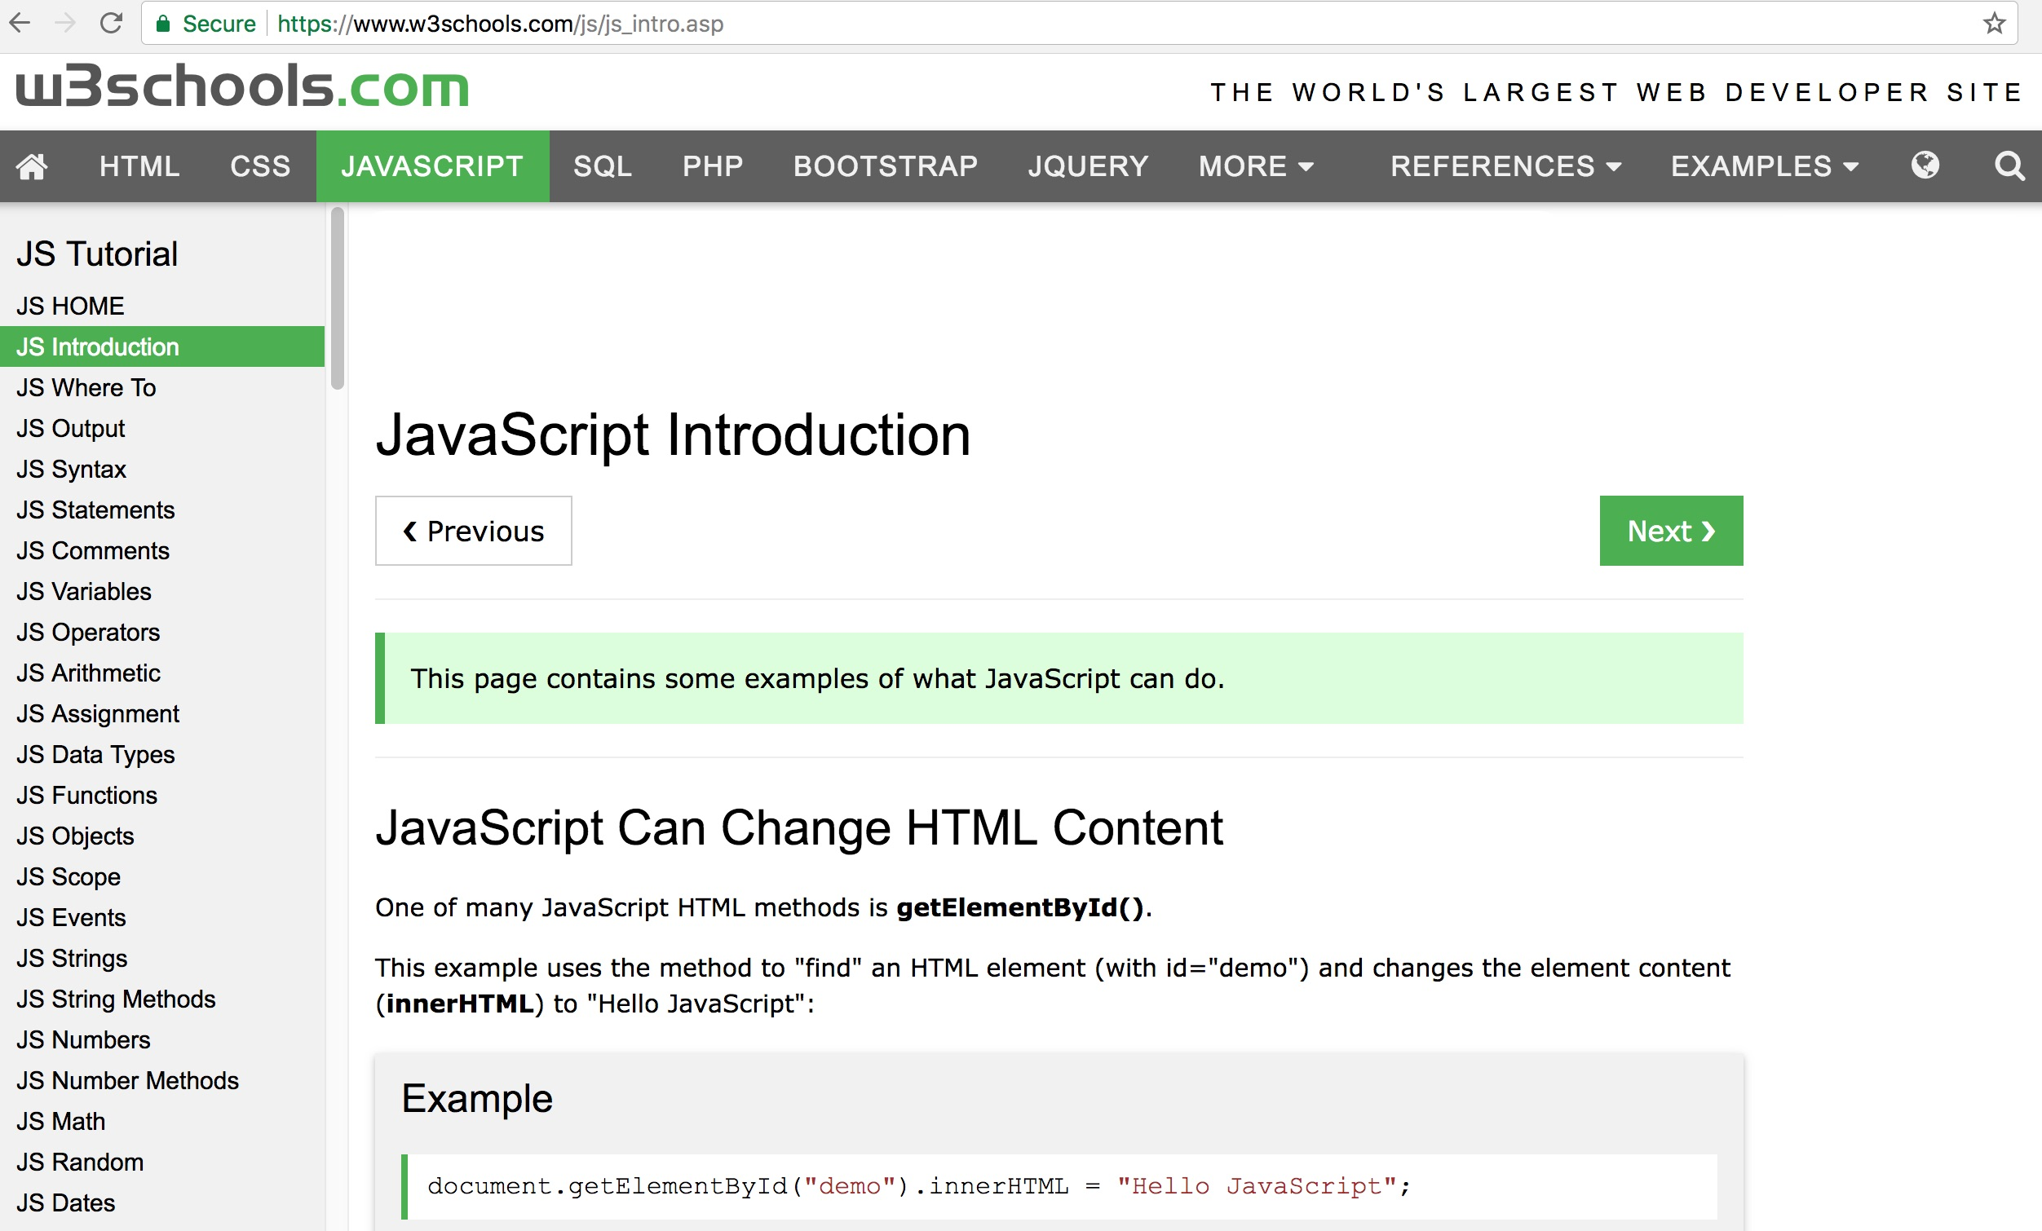
w3schools.com JavaScript Tutorial
https://www.w3schools.com/js/js_intro.asp

Slide 57
JavaScript: Writing Into HTML Output
document.write("<h1>This is a heading</h1>");
document.write("<p>This is a paragraph</p>");

Slide 58
JavaScript: Reacting to Events
<button type="button" onclick="alert('Welcome!')"> Click Me!</button>

Slide 59
JavaScript: Changing HTML Content
x=document.getElementById("demo"); x.innerHTML="Hello JavaScript”;

Slide 60
Hello JavaScript
<!DOCTYPE html>
<html>
<body>
<h2>Hello JavaScript Demo</h2>
<p id="demo">HTML content</p>
<button type="button" onclick="document.getElementById('demo').innerHTML = 'Hello JavaScript'">Click Me</button>
</body>
</html>
Source: http://www.w3schools.com/js/js_intro.asp

Slide 61
Hello if else
<!DOCTYPE html>
<html>
<body>
<p>JavaScript if else</p>
<button onclick="myFunction()">Try it</button>
<p id="demo"></p>
<script>
function myFunction() {
var greeting;
var time = new Date().getHours();
if (time < 10) {
greeting = "Good morning";
} else if (time < 20) {
greeting = "Good day";
} else {
greeting = "Good evening";
}
document.getElementById("demo").innerHTML = greeting;
}
</script>
</body>
</html>
Source: https://www.w3schools.com/js/tryit.asp?filename=tryjs_elseif

Slide 62
HTML5 Editors

Slide 63
Maqetta: Online HTML5 WYSIWYG Editor
http://maqetta.org/

Slide 64
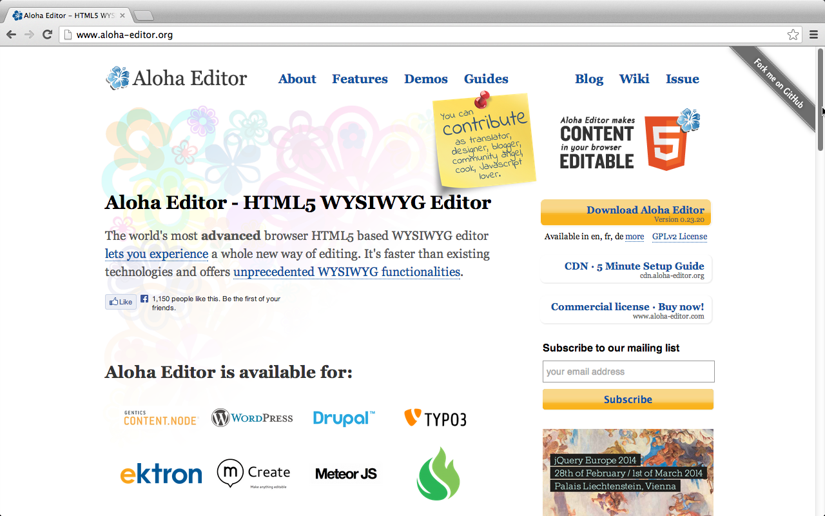
Aloha Editor: HTML5 WYSIWYG editor
http://www.aloha-editor.org/

Slide 65
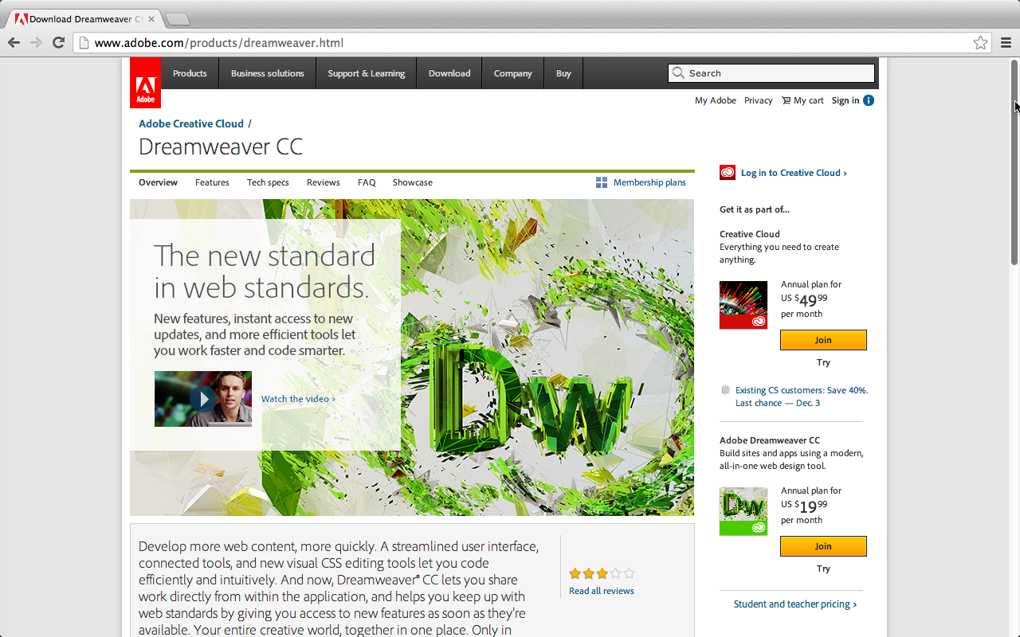
Adobe Dreamweaver
http://www.adobe.com/products/dreamweaver.html

Slide 66
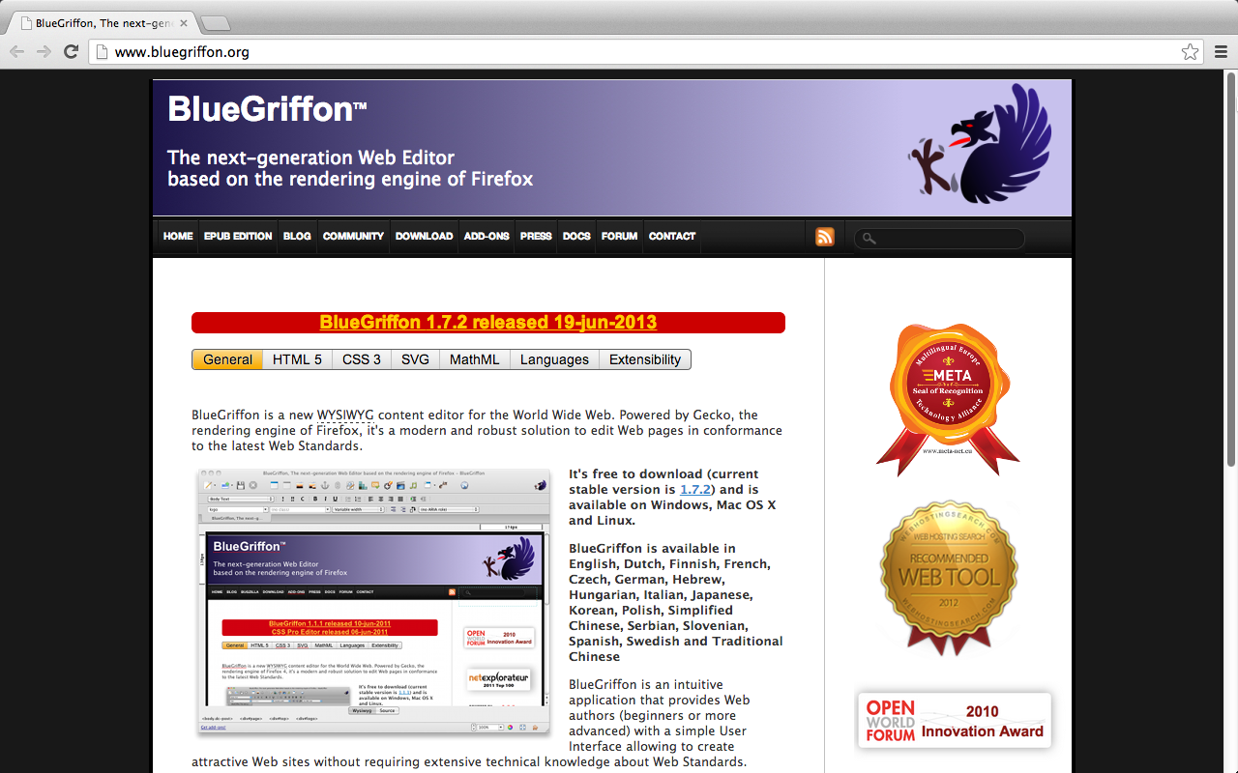
BlueGriffon: WYSIWYG content editor
http://www.bluegriffon.org/

Slide 67
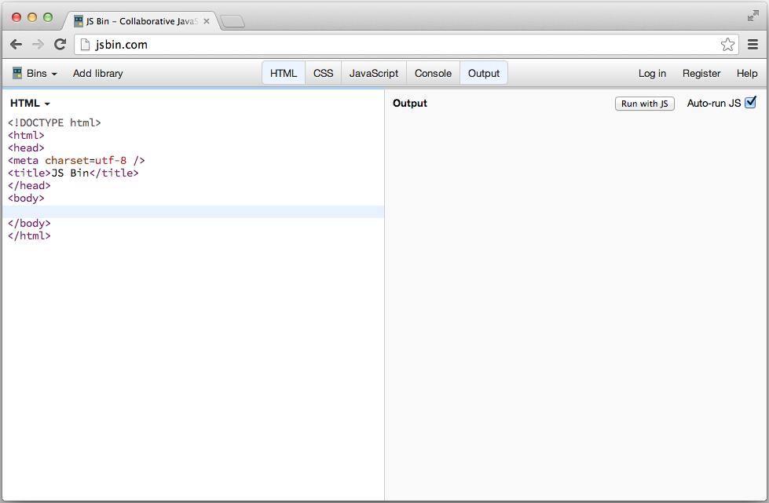
Online Editor: http://jsbin.com
http://jsbin.com/

Slide 68
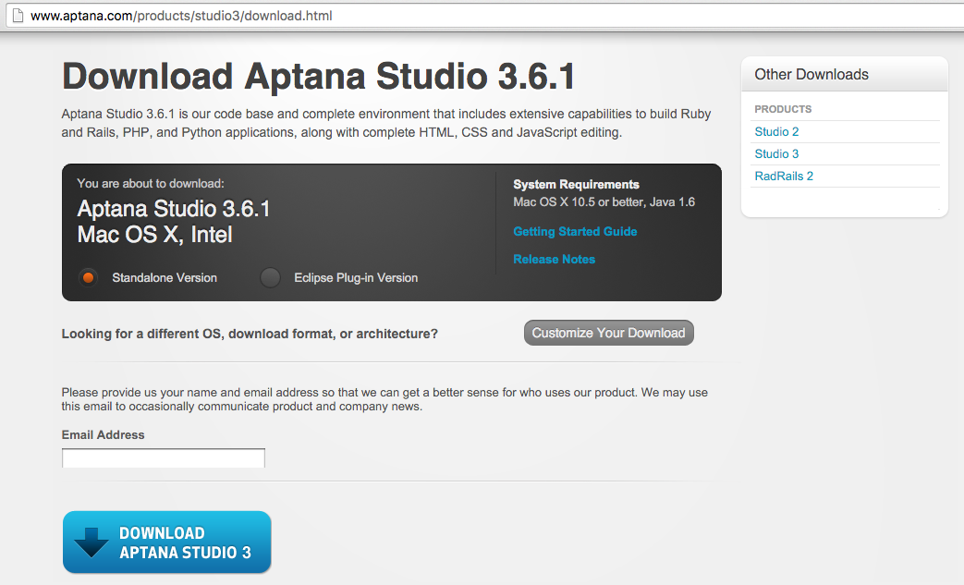
Aptana Studio 3
http://www.aptana.com/products/studio3/download.html

Slide 69
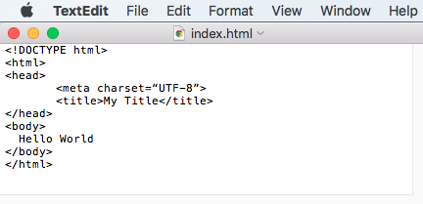
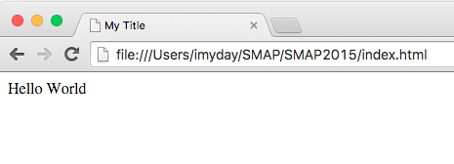
TextEdit in Mac OSX

Slide 70
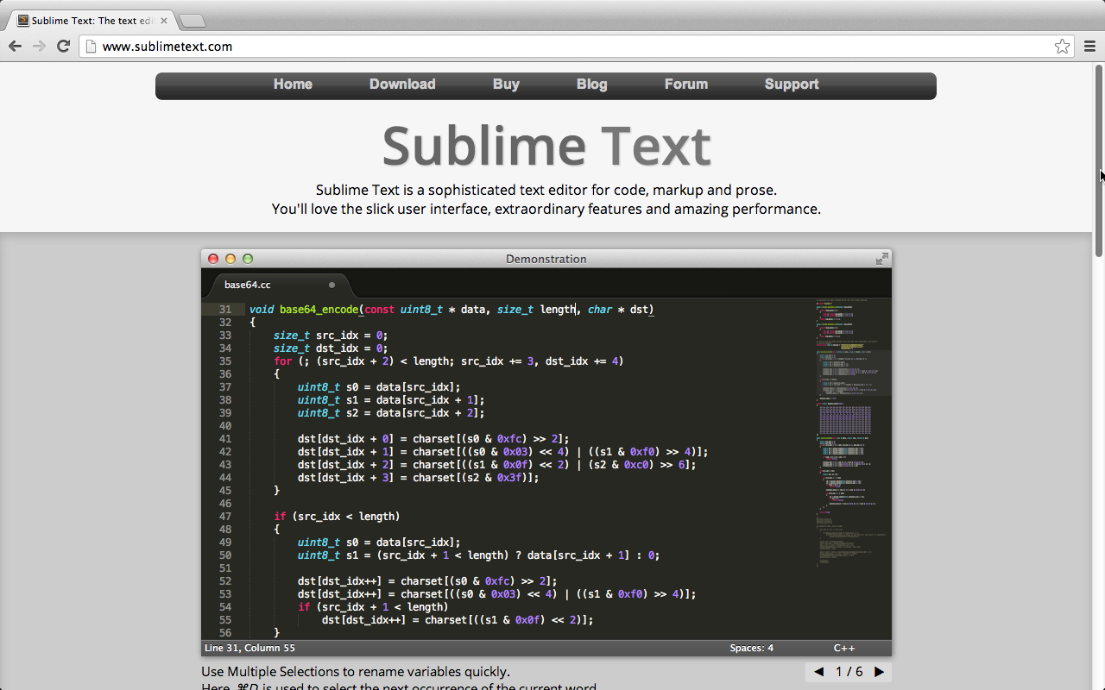
Sublime Text
http://www.sublimetext.com/

Slide 71
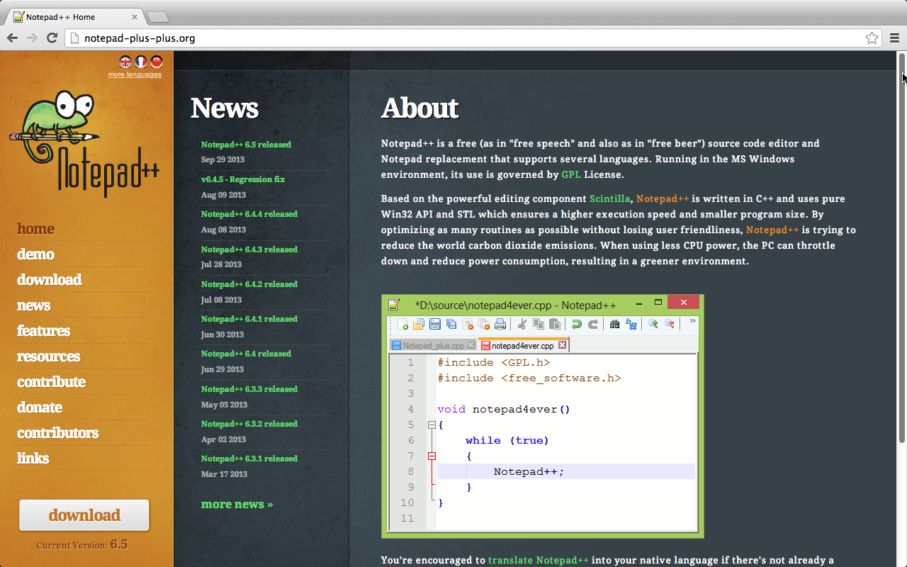
Notepad++
http://notepad-plus-plus.org/

Slide 72
codiqa: drag-and-drop builder for mobile apps
https://codiqa.com/

Slide 73
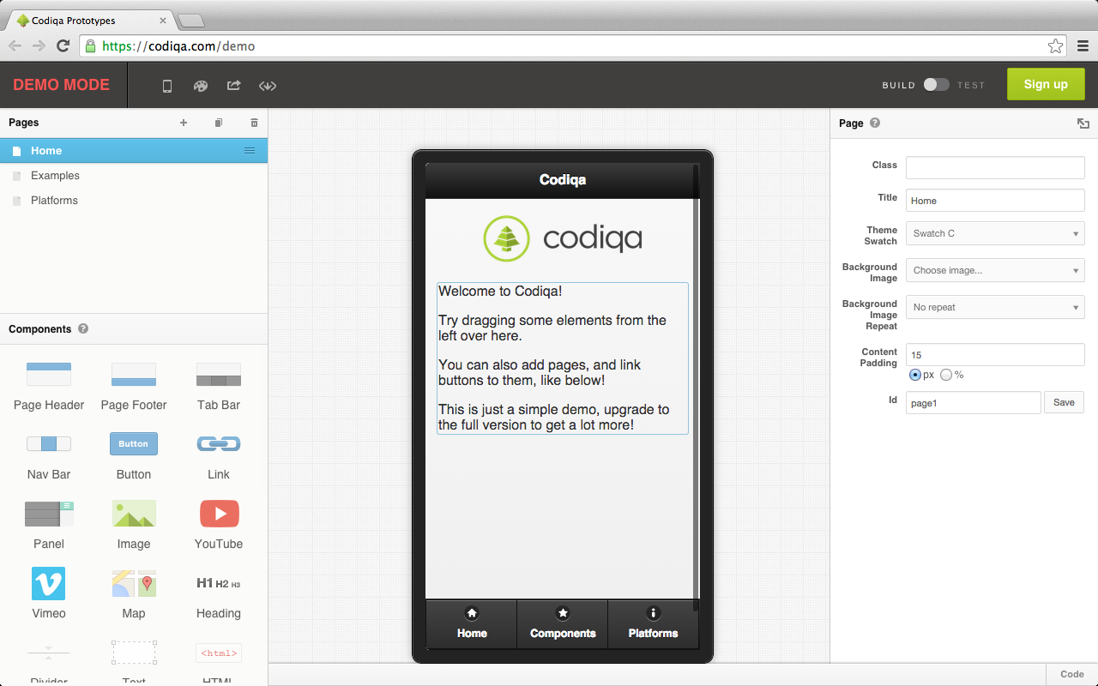
codiqa demo
https://codiqa.com/demo

Slide 74
HTML5 Mobile Apps Simulators

Slide 75
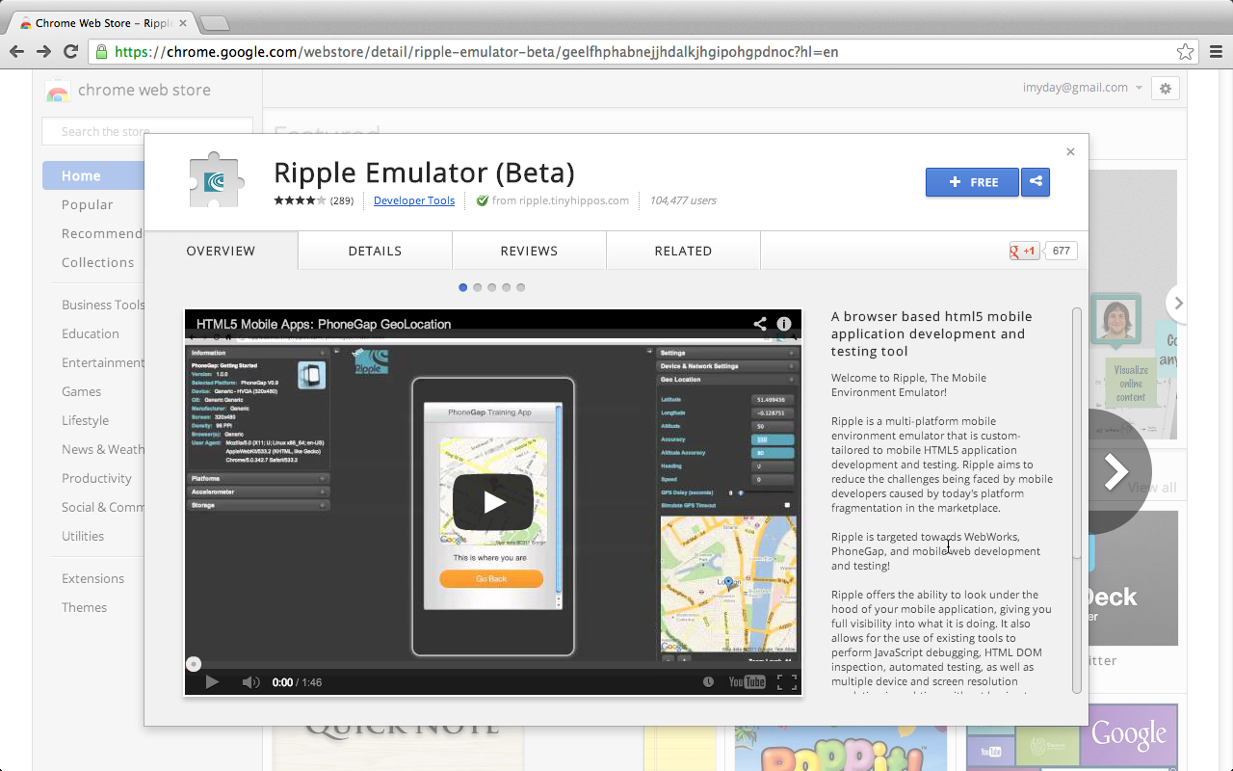
Ripple Emulator
https://chrome.google.com/webstore/detail/ripple-emulator-beta/geelfhphabnejjhdalkjhgipohgpdnoc?hl=en

Slide 76
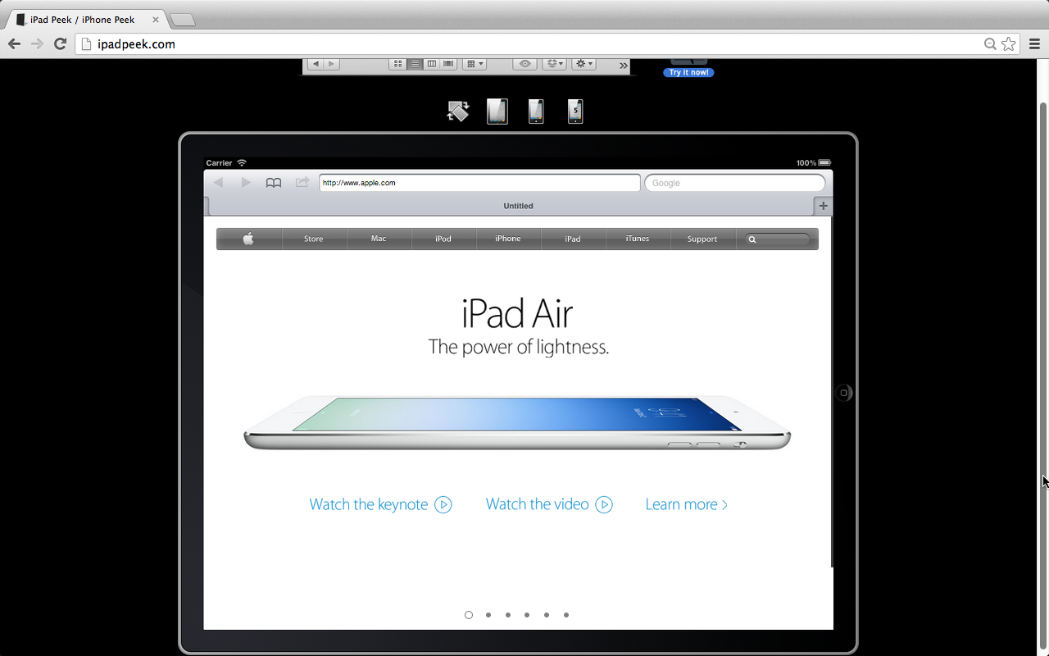
Online browser simulator: ipadpeek.com
http://ipadpeek.com/

Slide 77
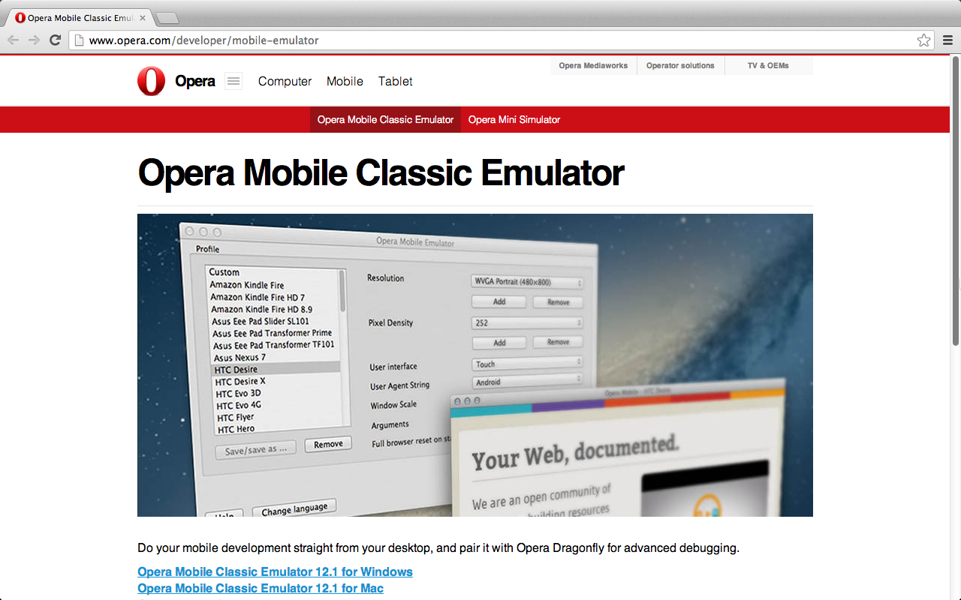
Opera Mobile Emulator
http://www.opera.com/developer/mobile-emulator

Slide 78
iPhone5Simulator
http://iphone5simulator.com/

Slide 79
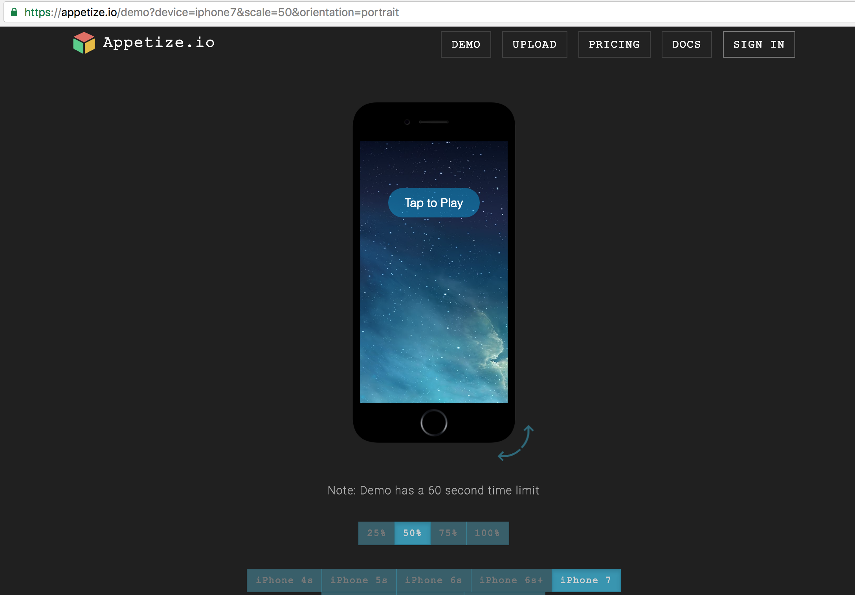
Appetize.io
https://appetize.io/demo

Slide 80
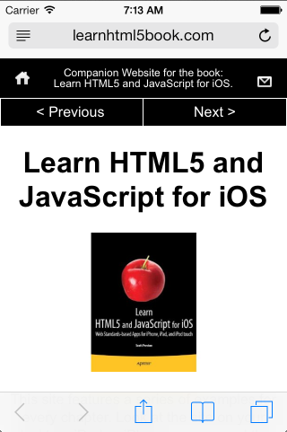
Xcode iPhone Simulator

Slide 81
http://grandviewave.com

Slide 82
http://grandviewave.com

Slide 83
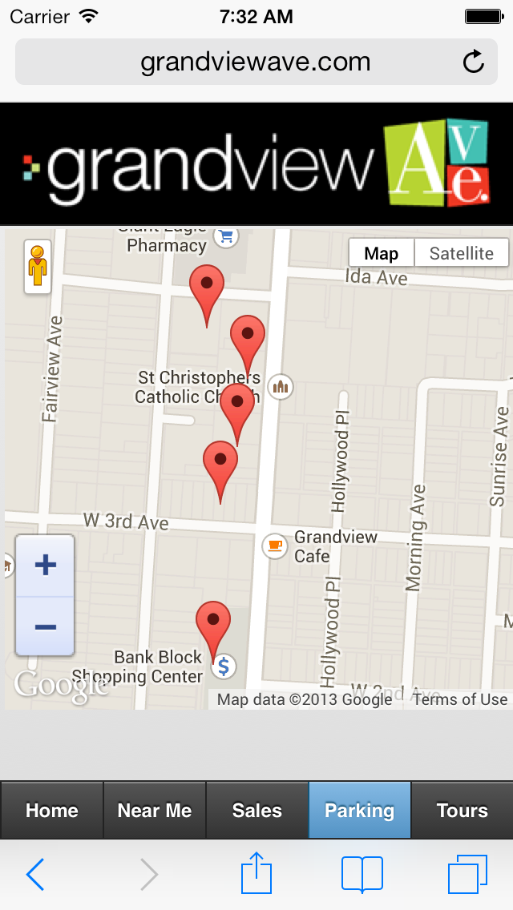
http://grandviewave.com

Slide 84
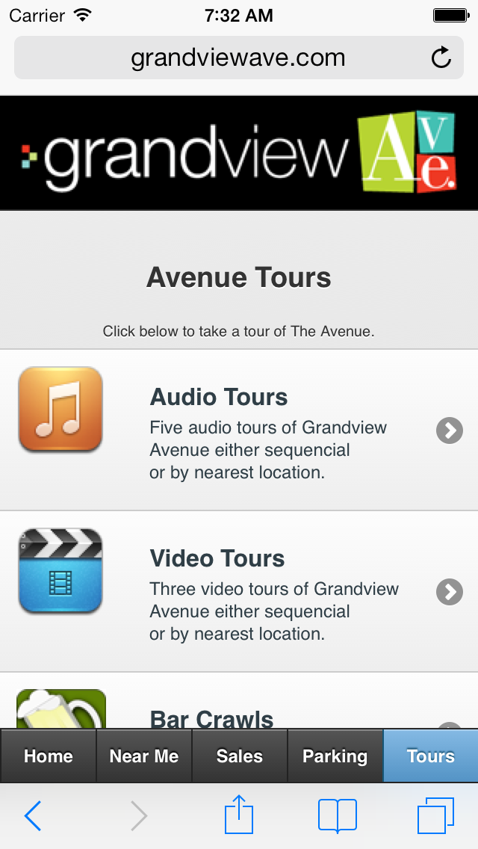
http://grandviewave.com

Slide 85
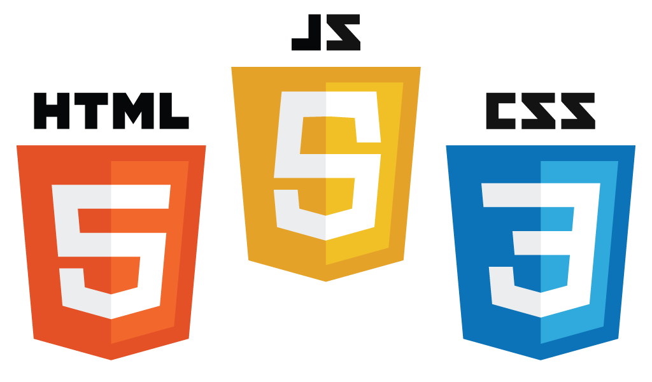
Demo Building Mobile Apps with HTML5, CSS3, and JavaScript
http://jsbin.com

Slide 86
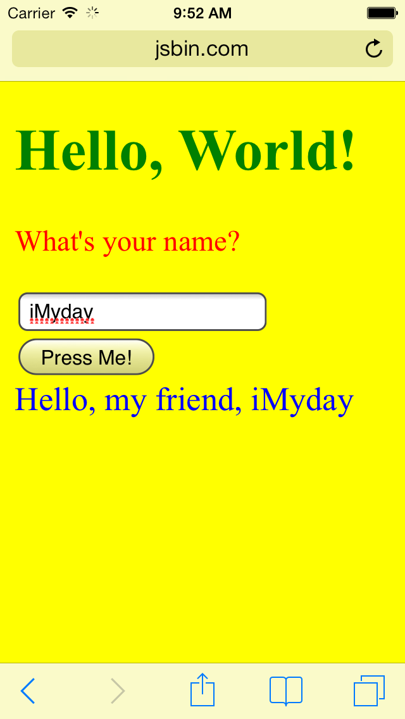
HTML5 CSS3 JavaScript Hello World
index.html
<!DOCTYPE html>
<html>
<head>
<meta charset=utf-8 />
<meta name="viewport" content="width=device-width, initial-scale=1" />
<title>Hello World HTML5 by Myday</title>
<style>
body {background-color:yellow;}
h1 {color:green}
p {color:red;}
div {color:blue; font-size:18px;}
</style>
<script language="javascript">
function sayHello()
{
var strNameInput = document.getElementById('txtNameInput').value;
var strOutput = "Hello, my friend, " + strNameInput;
document.getElementById('divOutput').innerHTML = strOutput;
}
</script>
</head>
<body>
<h1>Hello, World!</h1>
<p>What's your name?</p>
<input id="txtNameInput" type="text"><br>
<button type="button" id="btnClick1" onClick="sayHello()">Press Me!</button><br>
<div id="divOutput">Hi</div>
</body>
</html>
http://jsbin.com/oWOsUcI/1

Slide 87
Online Editor: http://jsbin.com
http://jsbin.com/

Slide 88
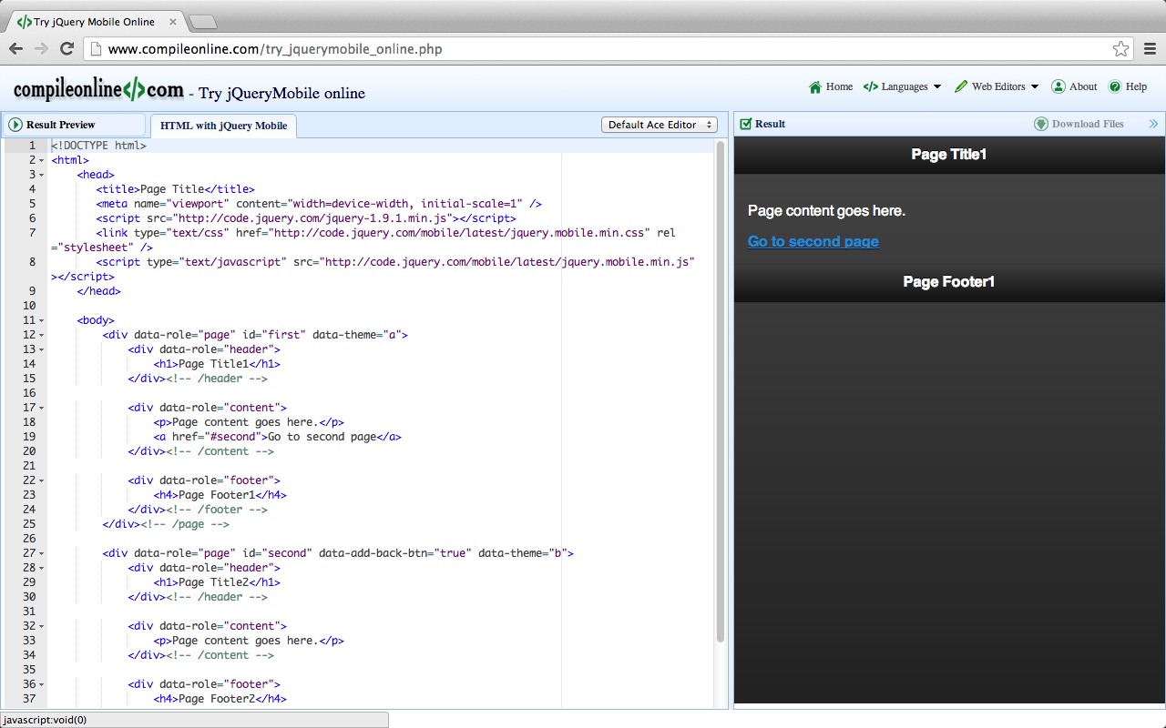
CompileOnline: Try jQueryMobile Online
http://www.compileonline.com/try_jquerymobile_online.php

Slide 89
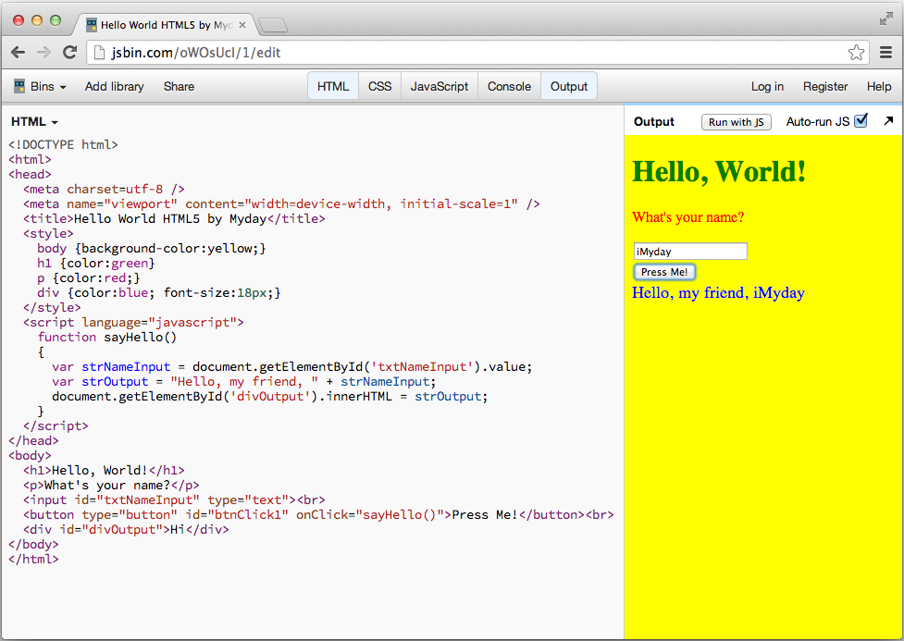
http://jsbin.com/oWOsUcI/1/edit

Slide 90
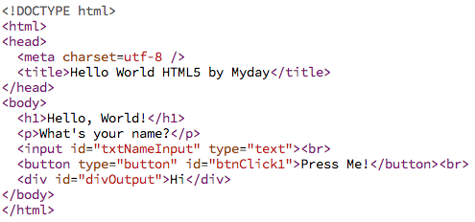
HTML5

Slide 91
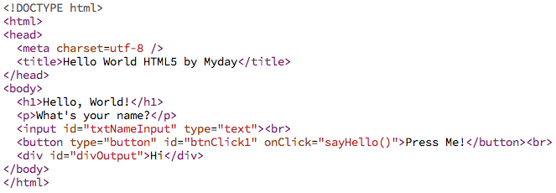
HTML5 Event

Slide 92
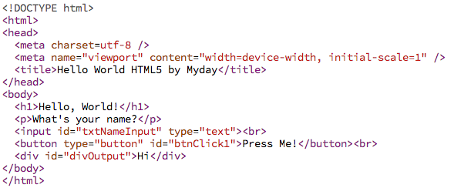
HTML5 viewport

Slide 93
HTML5

Slide 94
CSS3

Slide 95
JavaScript

Slide 96
Mobile App with HTML5, CSS3, and JavaScript

Slide 97
http://jsbin.com/oWOsUcI/1/edit

Slide 98
HTML5 CSS3 JavaScript Hello World
index.html
<!DOCTYPE html>
<html>
<head>
<meta charset=utf-8 />
<meta name="viewport" content="width=device-width, initial-scale=1" />
<title>Hello World HTML5 by Myday</title>
<style>
body {background-color:yellow;}
h1 {color:green}
p {color:red;}
div {color:blue; font-size:18px;}
</style>
<script language="javascript">
function sayHello()
{
var strNameInput = document.getElementById('txtNameInput').value;
var strOutput = "Hello, my friend, " + strNameInput;
document.getElementById('divOutput').innerHTML = strOutput;
}
</script>
</head>
<body>
<h1>Hello, World!</h1>
<p>What's your name?</p>
<input id="txtNameInput" type="text"><br>
<button type="button" id="btnClick1" onClick="sayHello()">Press Me!</button><br>
<div id="divOutput">Hi</div>
</body>
</html>
http://jsbin.com/oWOsUcI/1

Slide 99
HTML5 CSS3 JavaScript Hello World
index.html
<!DOCTYPE html>
<html>
<head>
<meta charset=utf-8 />
<meta name="viewport" content="width=device-width, initial-scale=1" />
<title>Hello World HTML5 by Myday</title>
<style>
body {background-color:yellow;}
h1 {color:green}
p {color:red;}
div {color:blue; font-size:18px;}
</style>
<script language="javascript">
function sayHello()
{
var strNameInput = document.getElementById('txtNameInput').value;
var strOutput = "Hello, my friend, " + strNameInput;
document.getElementById('divOutput').innerHTML = strOutput;
}
</script>
</head>
<body>
<h1>Hello, World!</h1>
<p>What's your name?</p>
<input id="txtNameInput" type="text"><br>
<button type="button" id="btnClick1" onClick="sayHello()">Press Me!</button><br>
<div id="divOutput">Hi</div>
</body>
</html>
<body>
<h1>Hello, World!</h1>
<p>What's your name?</p>
<input id="txtNameInput" type="text"><br>
<button type="button" id="btnClick1" onClick="sayHello()">Press Me!</button><br>
<div id="divOutput">Hi</div>
</body>
http://jsbin.com/oWOsUcI/1

Slide 100
HTML5 CSS3 JavaScript Hello World
index.html
<!DOCTYPE html>
<html>
<head>
<meta charset=utf-8 />
<meta name="viewport" content="width=device-width, initial-scale=1" />
<title>Hello World HTML5 by Myday</title>
<style>
body {background-color:yellow;}
h1 {color:green}
p {color:red;}
div {color:blue; font-size:18px;}
</style>
<script language="javascript">
function sayHello()
{
var strNameInput = document.getElementById('txtNameInput').value;
var strOutput = "Hello, my friend, " + strNameInput;
document.getElementById('divOutput').innerHTML = strOutput;
}
</script>
</head>
<body>
<h1>Hello, World!</h1>
<p>What's your name?</p>
<input id="txtNameInput" type="text"><br>
<button type="button" id="btnClick1" onClick="sayHello()">Press Me!</button><br>
<div id="divOutput">Hi</div>
</body>
</html>
<style>
body {background-color:yellow;}
h1 {color:green}
p {color:red;}
div {color:blue; font-size:18px;}
</style>
http://jsbin.com/oWOsUcI/1

Slide 101
HTML5 CSS3 JavaScript Hello World
<script language="javascript">
function sayHello()
{
var strNameInput = document.getElementById('txtNameInput').value;
var strOutput = "Hello, my friend, " + strNameInput;
document.getElementById('divOutput').innerHTML = strOutput;
}
</script>
index.html
<!DOCTYPE html>
<html>
<head>
<meta charset=utf-8 />
<meta name="viewport" content="width=device-width, initial-scale=1" />
<title>Hello World HTML5 by Myday</title>
<style>
body {background-color:yellow;}
h1 {color:green}
p {color:red;}
div {color:blue; font-size:18px;}
</style>
<script language="javascript">
function sayHello()
{
var strNameInput = document.getElementById('txtNameInput').value;
var strOutput = "Hello, my friend, " + strNameInput;
document.getElementById('divOutput').innerHTML = strOutput;
}
</script>
</head>
<body>
<h1>Hello, World!</h1>
<p>What's your name?</p>
<input id="txtNameInput" type="text"><br>
<button type="button" id="btnClick1" onClick="sayHello()">Press Me!</button><br>
<div id="divOutput">Hi</div>
</body>
</html>
http://jsbin.com/oWOsUcI/1

Slide 102
Summary
Mobile Apps
HTML5
Hyper Text Markup Language (version 5)(2014)
Content and Structure
CSS3
Cascading Style Sheets (version 3)
Presentation, Layout and User Interface
JavaScript
Behavior and Business Logic

Slide 103
References
Learn HTML5 and JavaScript for iOS: Web Standards-based Apps for iPhone, iPad, and iPod touch, Scott Preston, Apress, 2012
Building Android Apps with HTML, CSS, and JavaScript: Making Native Apps with Standards-Based Web Tools, Jonathan Stark & Brian Jepson, O’reilly, 2012
Building iPhone Apps with HTML, CSS, and JavaScript: Making App Store Apps Without Objective-C or Cocoa, Jonathan Stark, O’reilly, 2010
What is HTML5?
https://www.youtube.com/watch?v=4oX9DXH4fiA
What is CSS3?
https://www.youtube.com/watch?v=oHmm9dMAW0s
What is JavaScript?
https://www.youtube.com/watch?v=955L9-NoBoE
HTML5 Tutorial For Beginners
https://www.youtube.com/watch?v=9gTw2EDkaDQ
CSS Tutorial for Beginners
https://www.youtube.com/watch?v=Wz2klMXDqF4
JavaScript & jQuery Tutorial for Beginners
https://www.youtube.com/watch?v=VRnQOcVclS8

