Slide 1
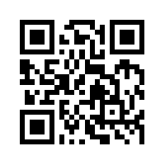
Social Media Apps Programming
Tamkang University
Course Orientation and Introduction to Social Media and Mobile Apps Programming
1061SMAP01
TLMXM1A (8648) (M2143) (Fall 2017)
(MIS MBA) (2 Credits, Elective) [Full English Course]
Fri 8,9 (15:10-17:00) B206
Min-Yuh Day, Ph.D.
Assistant Professor
Department of Information Management
Tamkang University
http://mail.tku.edu.tw/myday
2017-09-22

Slide 2
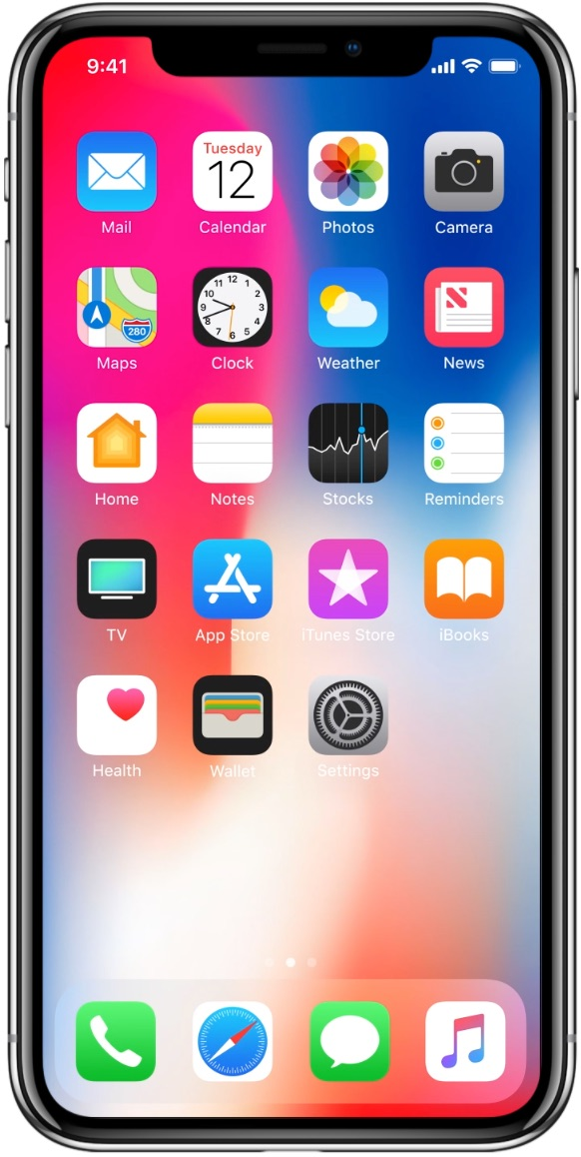
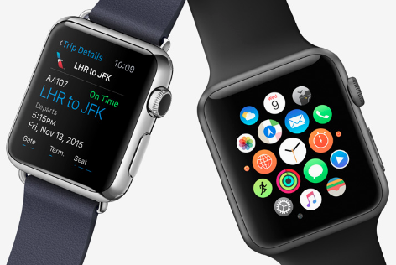
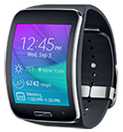
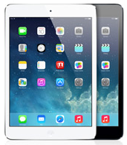
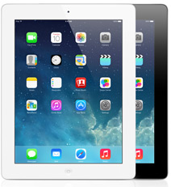
Android /iOS Apps Programming
Native Apps
Hybrid Apps
Mobile Web Apps

Slide 3
Native Mobile App Hybrid Mobile App Responsive Web App Progressive Web App (PWA)
Source: http://srishta.com/blog_hybrid.html

Slide 4
Progressive Web App (PWA) Responsive Web Apps Responsive Design HTML5/CSS3/JavaScript
Source: http://www.ihealthspot.com/ResponsiveWebsiteDesign.aspx

Slide 5
Enterprise Apps in 2015
Hybrid Apps
Gartner recommend hybrid apps over native apps development for businesses
Source: http://blog.commontime.com/hybrid-apps-the-right-response-to-byod-in-business/

Slide 6
Enterprise Apps (Hybrid HTML5) in 2016
Source: http://justcreative.com/2016/03/17/html5-vs-native-apps-whats-best-for-2016/
Notes:
Enterprises Will Deploy More Than 50% of Hybrid HTML5 in 2016

Slide 7
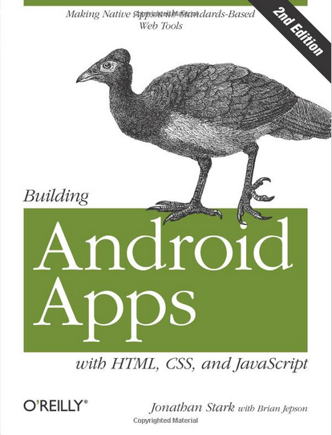
Building Android Apps with HTML, CSS, and JavaScript: Making Native Apps with Standards-Based Web Tools, Jonathan Stark & Brian Jepson, O’reilly, 2012
Source: http://www.amazon.com/Building-Android-Apps-HTML-JavaScript/dp/1449316417

Slide 8
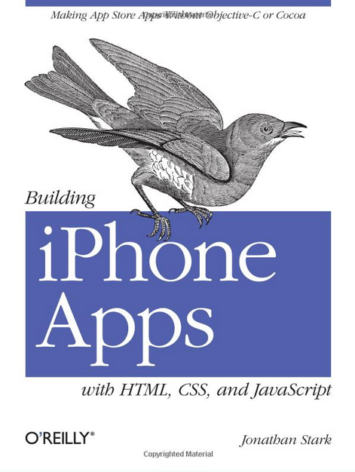
Building iPhone Apps with HTML, CSS, and JavaScript: Making App Store Apps Without Objective-C or Cocoa, Jonathan Stark, O’reilly, 2010
Source: http://www.amazon.com/Building-iPhone-Apps-HTML-JavaScript/dp/0596805780

Slide 9
App Development Comparison
Device Access
Speed
Development Cost
App Store
Approval Process
Native Apps
Full
Very Fast
Expensive
Available
Mandatory
Hybrid Apps
Full
Native Speed as Necessary
Reasonable
Available
Low Overhead
Web Apps
Partial
Fast
Reasonable
Not Available
None
Source: http://www.scribd.com/doc/50805466/Native-Web-or-Hybrid-Mobile-App-Development

Slide 10
Course Syllabus Tamkang University Academic Year 106, 1st Semester (Fall, 2017)
Tamkang University
Course Title: Social Media Apps Programming
Instructor: Min-Yuh Day
Course Class: TLMXM1A (MIS MBA)
Master’s Program, Department of Information Management, 1A
Details
Selective
One Semester
2 Credits
Time & Place: Fri 8, 9 (15:10-17:00) B206

Slide 11
Department Teaching Objectives
Tamkang University
Devoting to the integration and research of information technology and business management knowledge
Cultivating for society, middle and higher level managers with both information capabilities and modern management skills

Slide 12
Department Core Competences
Tamkang University
Use of modern management knowledge
Logical thinking
Critical analysis
Integration of information technology and business management
Research and innovation
Theory and applications data analysis
Information and communication security management
Verbal and writing communication skills

Slide 13
Course Introduction
Tamkang University
This course introduces the fundamental concepts and practices of social media and mobile apps programming.
Topics include
Introduction to Android / iOS apps programming,
Developing Android native apps with Java (Android Studio),
Developing iPhone / iPad apps native apps with Swift (XCode),
Mobile apps using HTML5/CSS3/JavaScript,
jQuery Mobile,
Create hybrid apps with Phonegap,
Google Cloud Platform,
Google app engine, Google map API,
Facebook API,
Twitter API,
Case study on social media apps programming and marketing in Google Play and App Store.

Slide 14
Teaching Objectives
Tamkang University
Students will be able to understand and apply the fundamental concepts and practices of social media and mobile apps programming

Slide 15
Teaching Methods
Tamkang University
Lecture
Discussion
Simulation
Practicum
Problem Solving

Slide 16
Assessment
Tamkang University
Practicum
Report
Participation

Slide 17
Course Schedule (1/2)
Tamkang University
Week Date Subject/Topics
1 2017/09/22 Course Orientation and Introduction to Social Media and Mobile Apps Programming
2 2017/09/29 Introduction to Android / iOS Apps Programming
3 2017/10/06 Developing Android Native Apps with Java (Android Studio)
4 2017/10/13 Developing iPhone / iPad Native Apps with Swift (XCode)
5 2017/10/20 Mobile Apps using HTML5/CSS3/JavaScript
6 2017/10/27 jQuery Mobile
7 2017/11/03 Create Hybrid Apps with Phonegap
8 2017/11/10 jQuery Mobile/Phonegap
9 2017/11/17 jQuery Mobile/Phonegap

Slide 18
Course Schedule (2/2)
Tamkang University
Week Date Subject/Topics
10 2017/11/24 Midterm Project Report
11 2017/12/01 Case Study on Social Media Apps Programming and Marketing in Google Play and App Store
12 2017/12/08 Google Cloud Platform
13 2017/12/15 Google App Engine
14 2017/12/22 Google Map API
15 2017/12/29 Facebook API (Facebook JavaScript SDK) (Integrate Facebook with iOS/Android Apps)
16 2018/01/05 Twitter API
17 2018/01/12 Final Project Presentation
18 2018/01/19 Final Exam Week (Final Project Presentation)

Slide 19
Grading Policy
Tamkang University
Mark of Usual: 50%
Final Apps Project: 50%
Midterm Project Report
Final Project Report

Slide 20
Textbooks and References
Tamkang University
Textbook: Slides
http://mail.tku.edu.tw/myday/teaching.htm#1061SMAP
Jonathan Stark, Building iPhone Apps with HTML, CSS, and JavaScript: Making App Store Apps Without Objective-C or Cocoa, O’reilly, 2010.
Rohit Ghatol and Yogesh Patel, Beginning PhoneGap: Mobile Web Framework for JavaScript and HTML5, Apress, 2012.
Jon Reid, jQuery Mobile, O’reilly, 2012.

Slide 21
References
jQuery Mobil: http://jquerymobile.com/
PhoneGap: http://phonegap.com/
MIT App Inventor: http://appinventor.mit.edu/
Apple Developer: https://developer.apple.com/
Android Developer: http://developer.android.com/
Facebook Developers: https://developers.facebook.com/
Twitter Developers: https://dev.twitter.com/
Google App Engine: https://developers.google.com/appengine/
Gephi: Social Network Analysis and Visualization: https://gephi.org/
Netvizz: Facebook Netvizz app: https://apps.facebook.com/netvizz/

Slide 22
Building iPhone Apps with HTML, CSS, and JavaScript: Making App Store Apps Without Objective-C or Cocoa, Jonathan Stark, O’reilly, 2010
Source: http://www.amazon.com/Building-iPhone-Apps-HTML-JavaScript/dp/0596805780

Slide 23
Building Android Apps with HTML, CSS, and JavaScript: Making Native Apps with Standards-Based Web Tools, Jonathan Stark & Brian Jepson, O’reilly, 2012
Source: http://www.amazon.com/Building-Android-Apps-HTML-JavaScript/dp/1449316417

Slide 24
Rohit Ghatol and Yogesh Patel, Beginning PhoneGap: Mobile Web Framework for JavaScript and HTML5, Apress, 2012
Source: http://www.amazon.com/Beginning-PhoneGap-Mobile-Framework-JavaScript/dp/1430239034

Slide 25
Jon Reid, jQuery Mobile, O’reilly, 2012
Source: http://www.amazon.com/jQuery-Mobile-Running-Maximiliano-Firtman/dp/1449397654

Slide 26
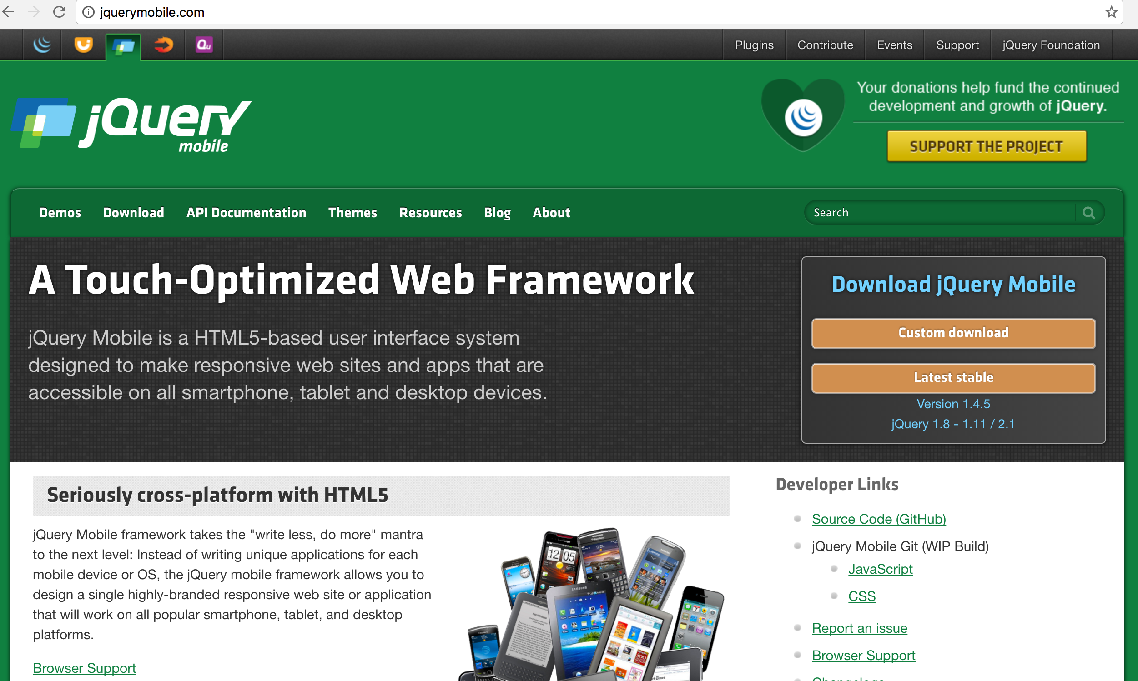
jQuery Mobile http://jquerymobile.com/

Slide 27
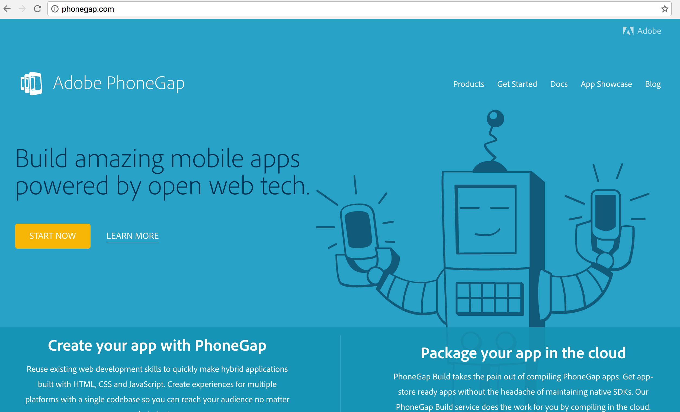
PhoneGap http://phonegap.com/

Slide 28
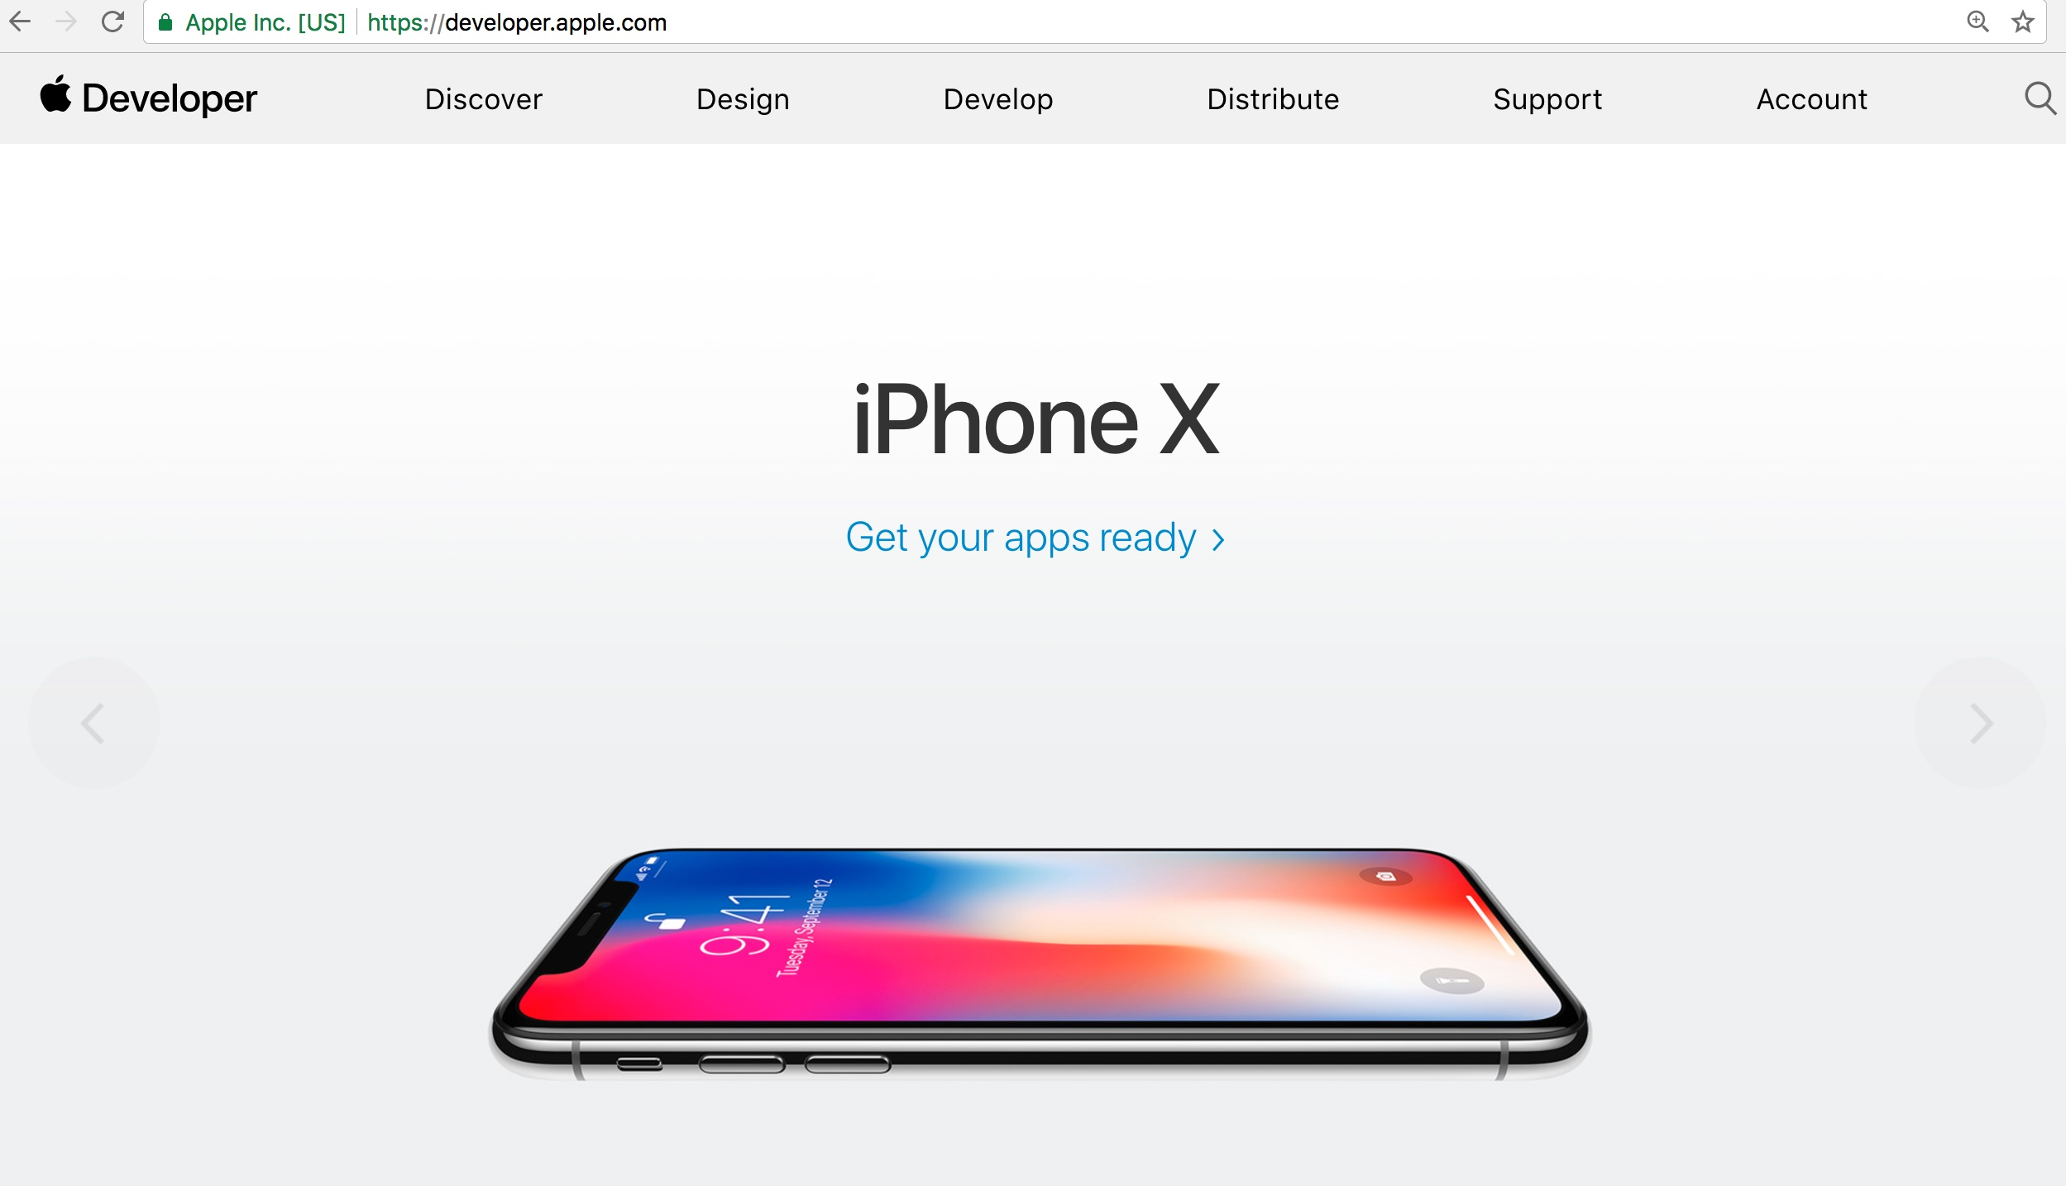
Apple Developer https://developer.apple.com/

Slide 29
Apple Swift for iOS
Source: https://developer.apple.com/swift/

Slide 30
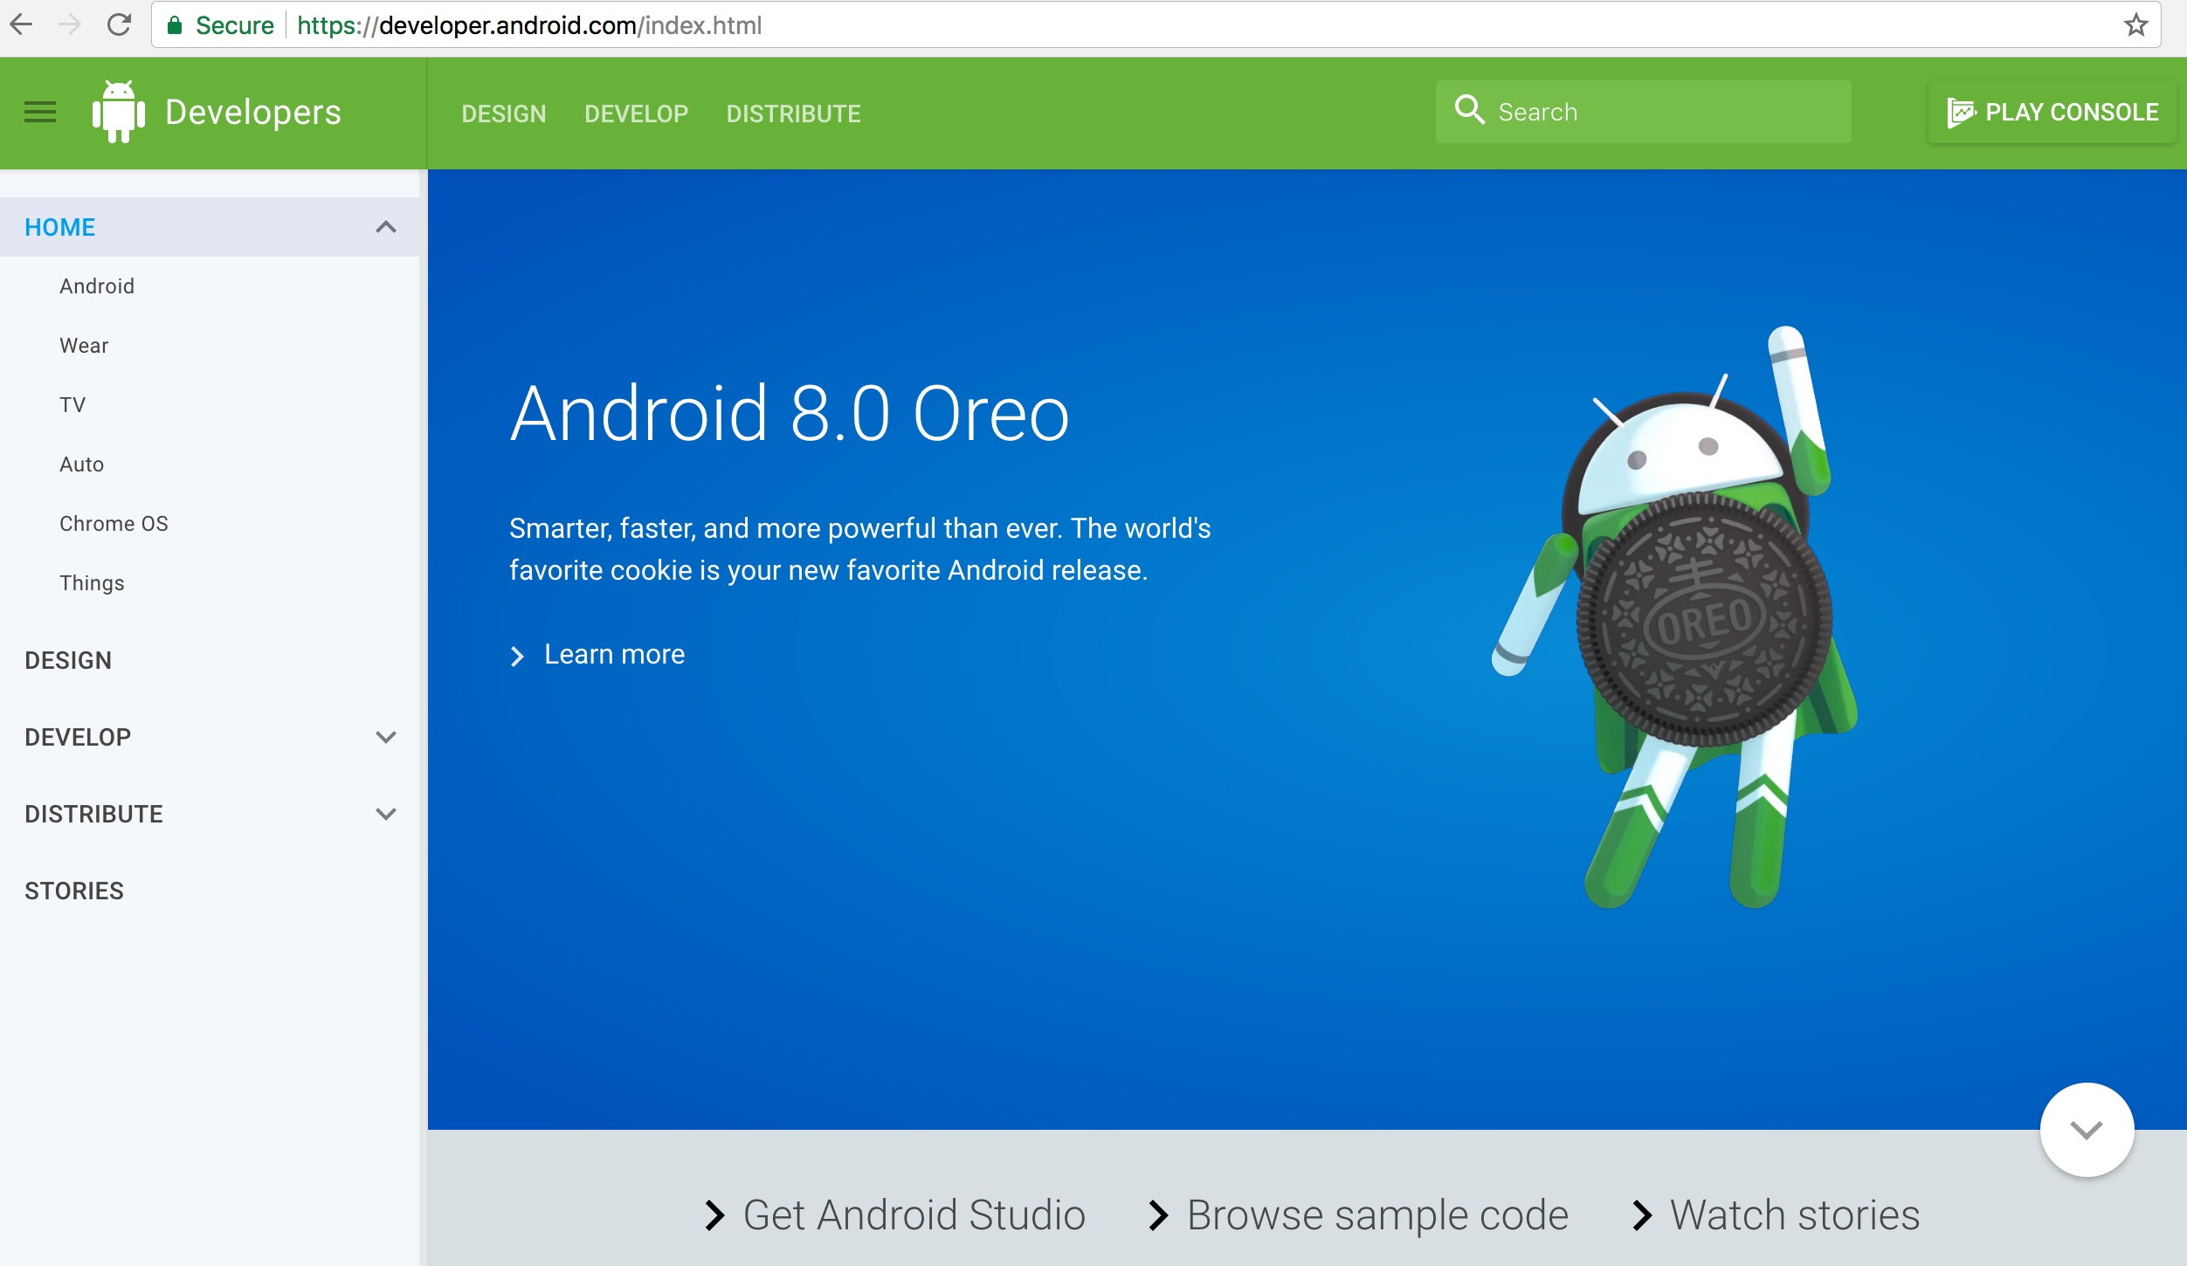
Android Developer http://developer.android.com/

Slide 31
Facebook Developers
https://developers.facebook.com/

Slide 32
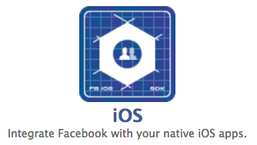
Integrate Facebook with your native iOS apps
https://developers.facebook.com/

Slide 33
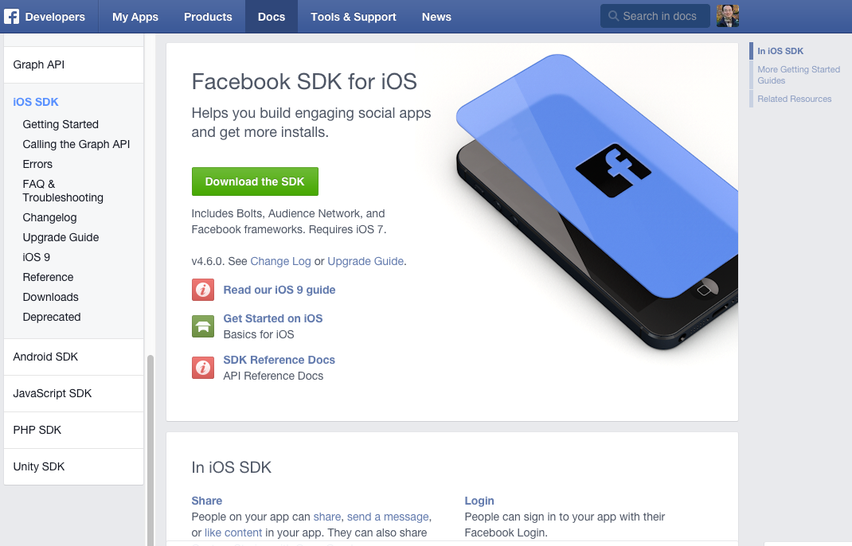
Facebook SDK for iOS
https://developers.facebook.com/docs/ios/

Slide 34
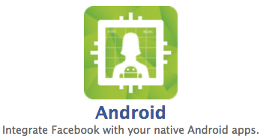
Integrate Facebook with your native Android apps.
https://developers.facebook.com/

Slide 35
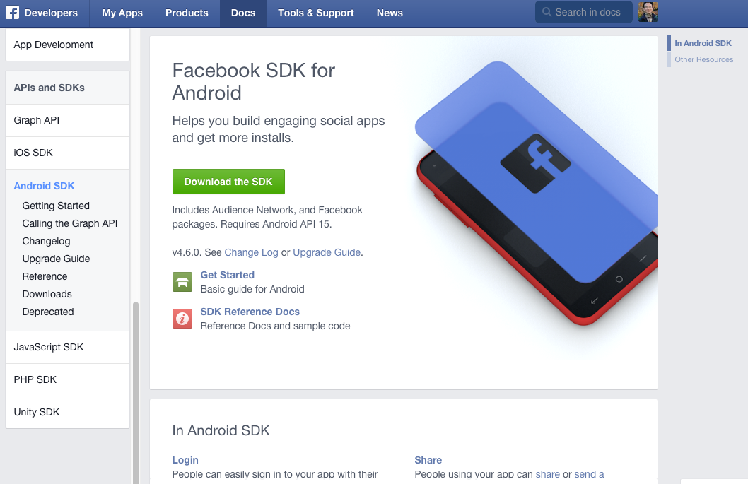
Facebook SDK for Android
Source: https://developers.facebook.com/docs/android

Slide 36
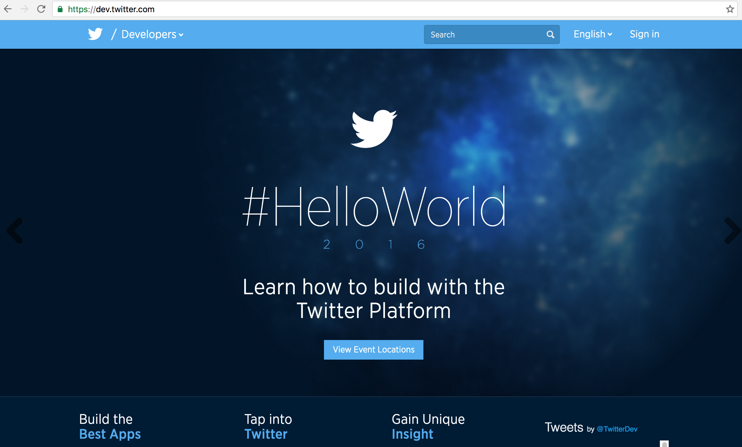
Twitter Developers https://dev.twitter.com/

Slide 37
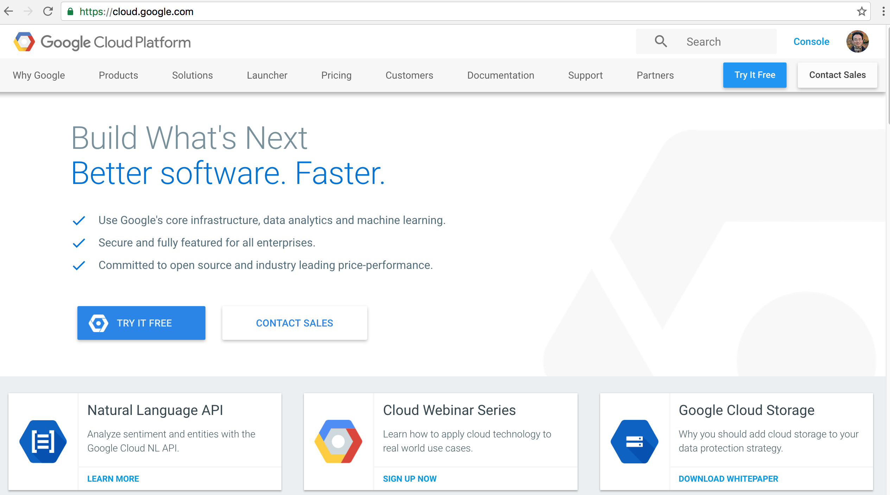
Google Cloud Platform
https://cloud.google.com/

Slide 38
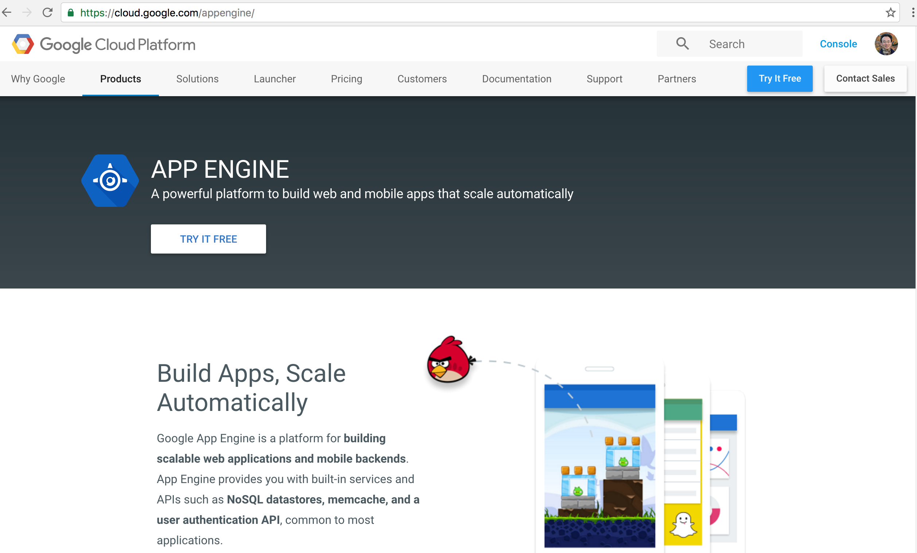
Google App Engine
https://cloud.google.com/appengine/

Slide 39
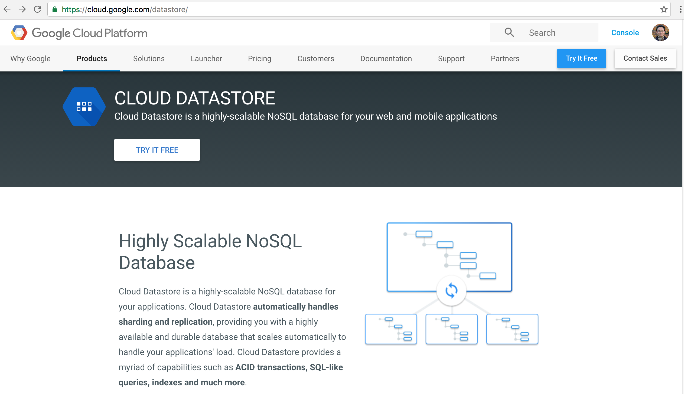
Google Cloud Datastore
https://cloud.google.com/datastore/

Slide 40
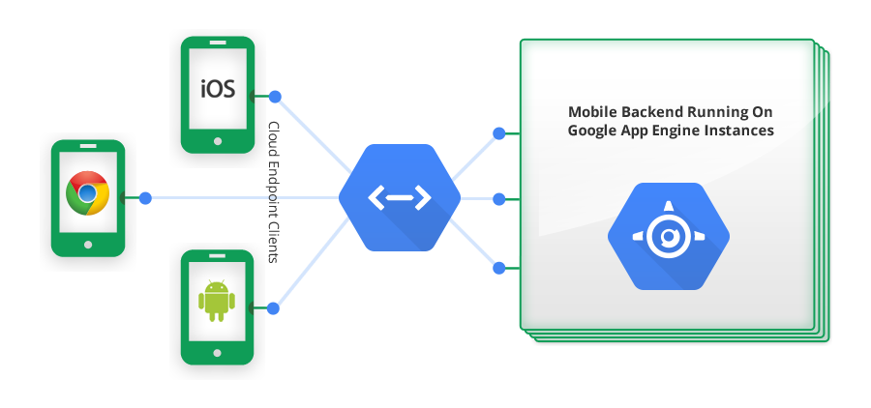
Google Cloud Endpoints
https://developers.google.com/appengine/docs/java/endpoints/

Slide 41
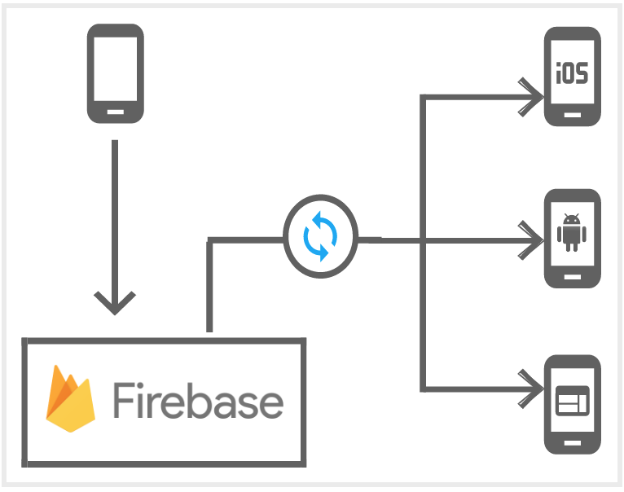
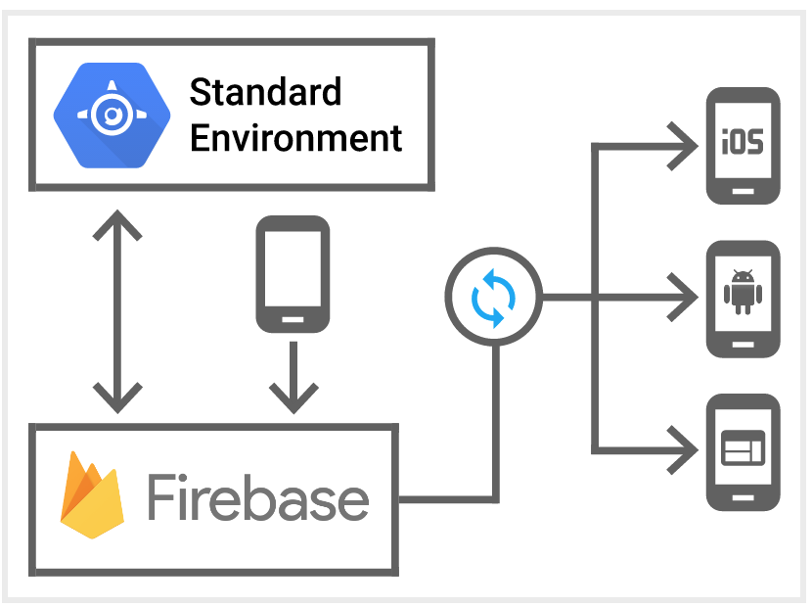
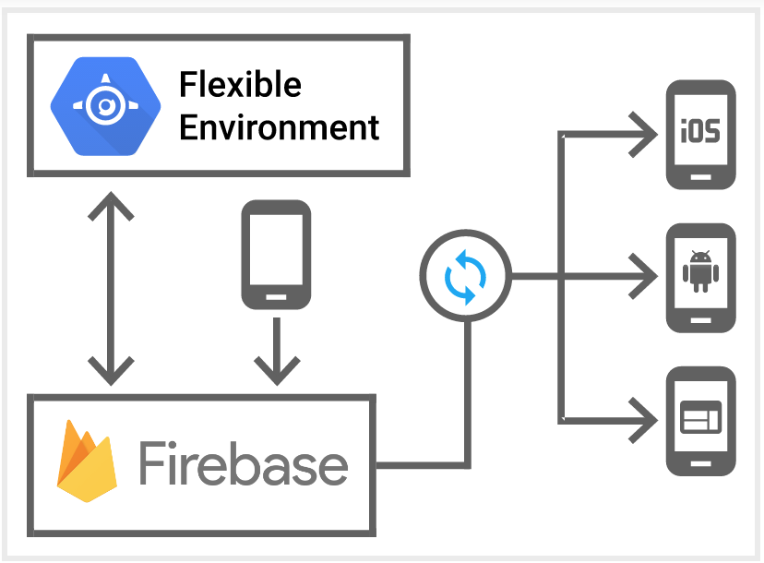
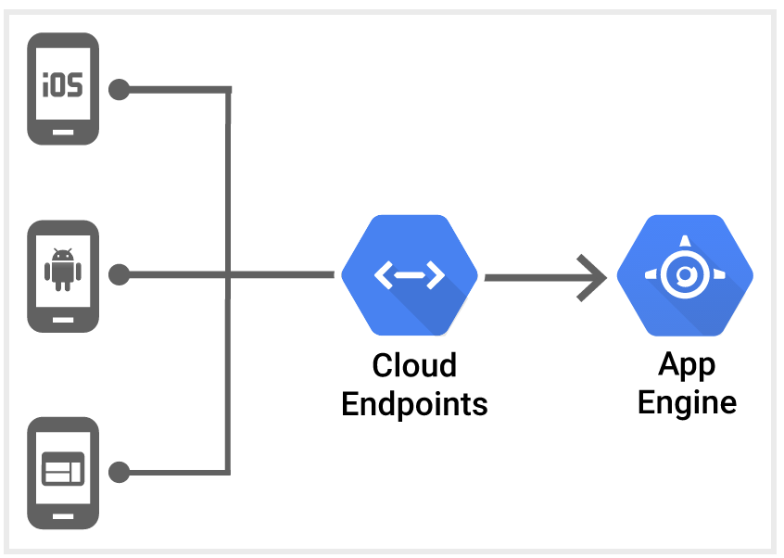
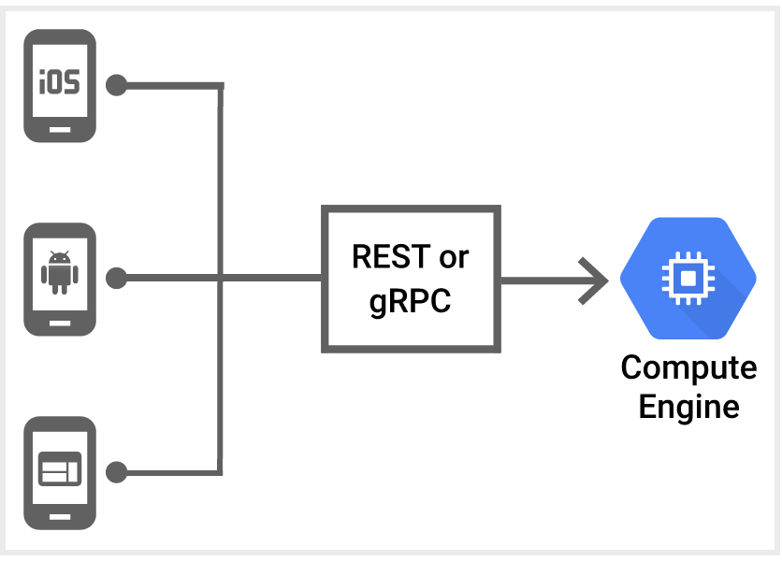
Mobile App Backend Services
Source: https://cloud.google.com/solutions/mobile/mobile-app-backend-services

Slide 42
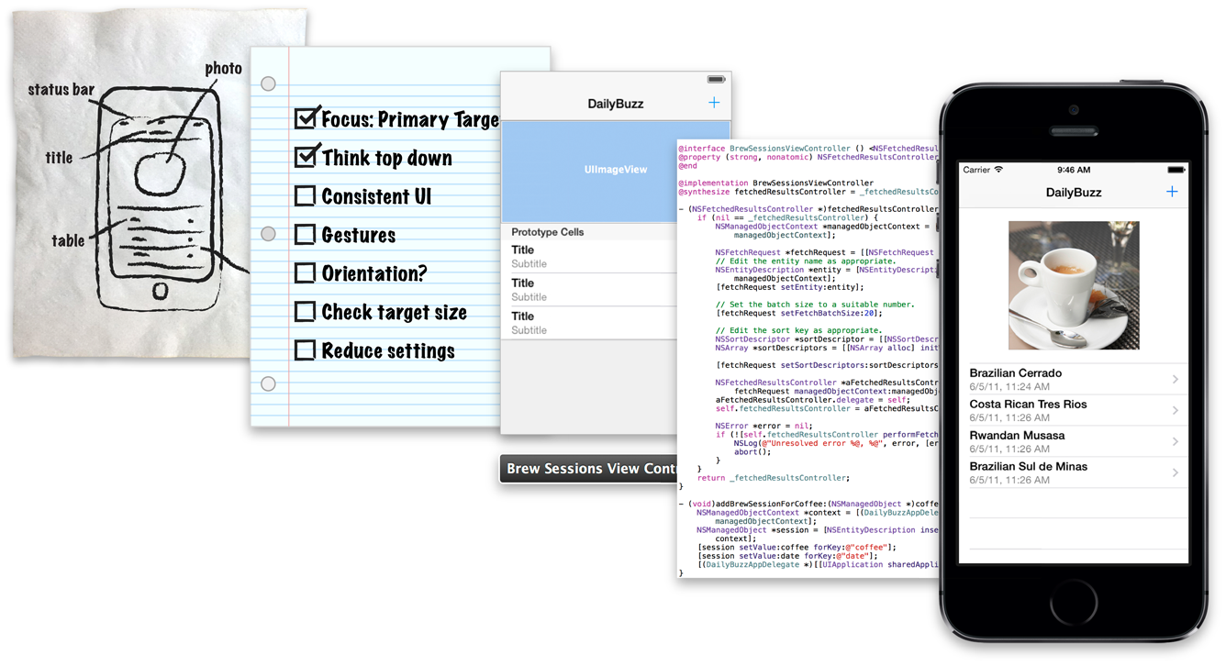
iOS App Development Process
Source: https://developer.apple.com/library/ios/referencelibrary/GettingStarted/RoadMapiOS/AppDevelopmentProcess.html

Slide 43
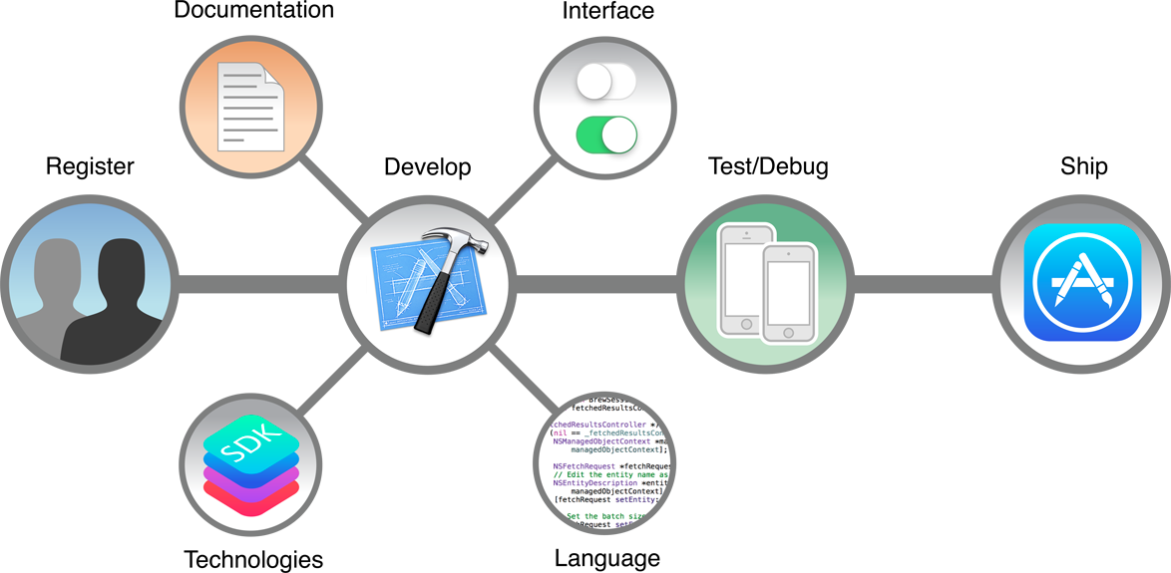
Apps Development Life Cycle
Source: https://developer.apple.com/library/ios/referencelibrary/GettingStarted/RoadMapiOS/WhereToGoFromHere.html

Slide 44
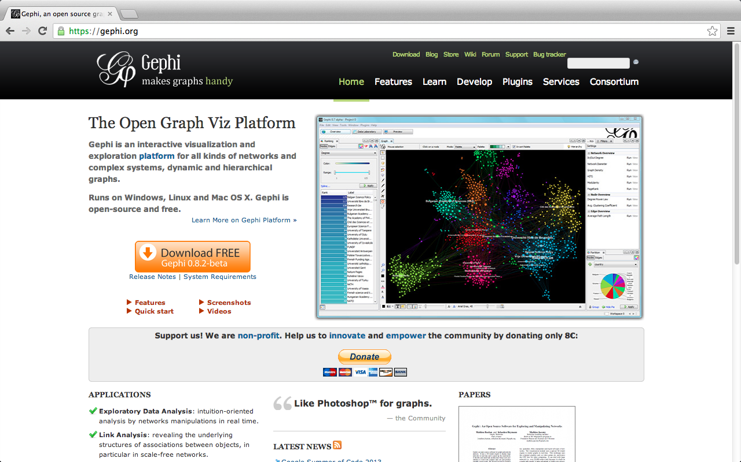
Gephi: Social Network Analysis and Visualization: https://gephi.org/

Slide 45
Summary
This course introduces the fundamental concepts and practices of social media and mobile apps programming.
Topics include
Introduction to Android / iOS apps programming,
Developing Android native apps with Java (Android Studio),
Developing iPhone / iPad apps native apps with Swift (XCode),
Mobile apps using HTML5/CSS3/JavaScript,
jQuery Mobile,
Create hybrid apps with Phonegap,
Google Cloud Platform,
Google app engine, Google map API,
Facebook API,
Twitter API,
Case study on social media apps programming and marketing in Google Play and App Store.

Slide 46
Contact
Tamkang University
Social Media Apps Programming
Min-Yuh Day, Ph.D.
Assistant Professor
Department of Information Management, Tamkang University
Tel: 886-2-26215656 ext. 2846
Fax: 886-2-26209737
Office: B929
Address: No.151, Yingzhuan Rd., Danshui Dist., New Taipei City 25137, Taiwan (R.O.C.)
Email: myday@mail.tku.edu.tw
Web: http://mail.tku.edu.tw/myday/

