Slide 1
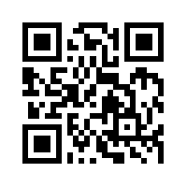
資訊管理專題 Hot Issues of Information Management
Tamkang University
Tamkang University
Telecommunications, the Internet, and Wireless Technology: Google, Apple, and Microsoft (Chap. 7)
1061IM4C08
TLMXB4C (M0842) Thu 7,8 (14:10-16:00) B702
Min-Yuh Day
戴敏育
Assistant Professor
專任助理教授
Dept. of Information Management, Tamkang University
淡江大學 資訊管理學系
http://mail. tku.edu.tw/myday/
2017-11-30; 2017-12-07

Slide 2
課程大綱 (Syllabus)
週次 (Week) 日期 (Date) 內容 (Subject/Topics)
1 2017/09/21 Introduction to Case Study for Hot Issues of Information Management
2 2017/09/28 Information Systems in Global Business: UPS (Chap. 1) (pp.53-54)
3 2017/10/05 Global E-Business and Collaboration: P&G (Chap. 2) (pp.84-85)
4 2017/10/12 Information Systems, Organization, and Strategy: Starbucks (Chap. 3) (pp.129-130)
5 2017/10/19 Ethical and Social Issues in Information Systems: Facebook (Chap. 4) (pp.188-190)
6 2017/10/26 IT Infrastructure and Emerging Technologies: Amazon and Cloud Computing (Chap. 5) (pp. 234-236)

Slide 3
課程大綱 (Syllabus)
週次 (Week) 日期 (Date) 內容 (Subject/Topics)
7 2017/11/02 IT Infrastructure and Emerging Technologies: Amazon and Cloud Computing (Chap. 5) (pp. 234-236)
8 2017/11/09 Foundations of Business Intelligence: IBM and Big Data (Chap. 6) (pp.261-262)
9 2017/11/16 Midterm Report (期中報告)
10 2017/11/23 Midterm Exam Week (期中考試週)
11 2017/11/30 Telecommunications, the Internet, and Wireless Technology: Google, Apple, and Microsoft (Chap. 7) (pp.318-320)
12 2017/12/07 Telecommunications, the Internet, and Wireless Technology: Google, Apple, and Microsoft (Chap. 7) (pp.318-320)

Slide 4
課程大綱 (Syllabus)
週次 日期 內容（Subject/Topics）
13 2017/12/14 Enterprise Applications: Summit and SAP (Chap. 9) (pp.396-398)
14 2017/12/21 E-commerce: Zagat (Chap. 10) (pp.443-445)
15 2017/12/28 Enhancing Decision Making: Zynga (Chap. 12) (pp.512-514)
16 2018/01/04 Final Report I (期末報告 I)
17 2018/01/11 Final Report II (期末報告 II)
18 2018/01/18 Final Exam Week (期末考試週)

Slide 5
Management Information Systems: Managing the Digital Firm
1
Organization, Management, and the Networked Enterprise
2
Information Technology Infrastructure
3
Key System Applications for the Digital Age
4
Building and Managing Systems

Slide 6
Chap. 7 Telecommunications, the Internet, and Wireless Technology: Google, Apple, and Microsoft

Slide 7
Case Study: Google, Apple, and Microsoft (Chap. 7) (pp. 318-320) Apple, Google, and Microsoft Battle for Your Internet Experience
1. Define and compare the business models and areas of strength of Apple, Google, and Microsoft.
2. Why is mobile computing so important to these three firms? Evaluate the mobile platform offerings of each firm.
3. What is the significance of applications and app stores, and closed vs. open app standards to the success or failure of mobile computing?
4. Which company and business model do you believe will prevail in this epic struggle? Explain your answer.
5. What difference would it make to a business or to an individual consumer if Apple, Google, or Microsoft dominated the Internet experience? Explain your answer.

Slide 8
Overview of Fundamental MIS Concepts
Business Challenges
Management
Organization
Information System
Business Solutions
Technology

Slide 9
Business Model
8
7
2
4
1
Key Partners
Key Activities
Value Proposition
Customer Relationships
Customer Segments
6
3
Key Resources
Channels
9
5
Cost Structure
Revenue Streams
Source: Alexander Osterwalder & Yves Pigneur, Business Model Generation: A Handbook for Visionaries, Game Changers, and Challengers, Wiley, 2010.

Slide 10
Business Model
8
7
2
4
1
Key Partners
Key Activities
Value Proposition
Customer Relationships
Customer Segments
What?
6
3
Key Resources
Channels
Who?
How?
Why?
9
5
Cost Structure
Revenue Streams
Source: Alexander Osterwalder & Yves Pigneur, Business Model Generation: A Handbook for Visionaries, Game Changers, and Challengers, Wiley, 2010.

Slide 11
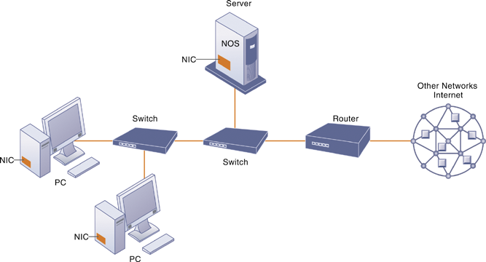
Components of a Simple Computer Network

Slide 12
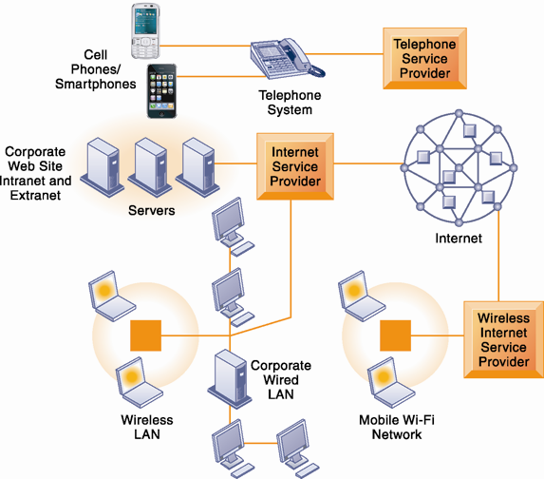
Corporate Network Infrastructure

Slide 13
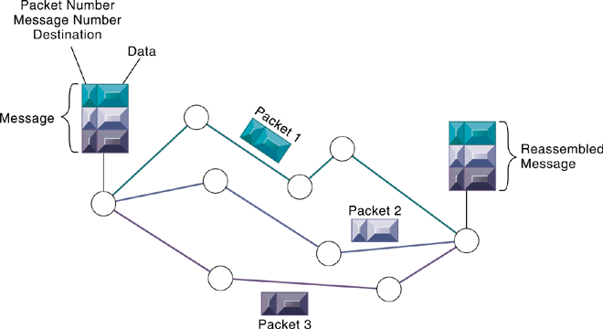
Packet-Switched Networks and Packet Communications

Slide 14
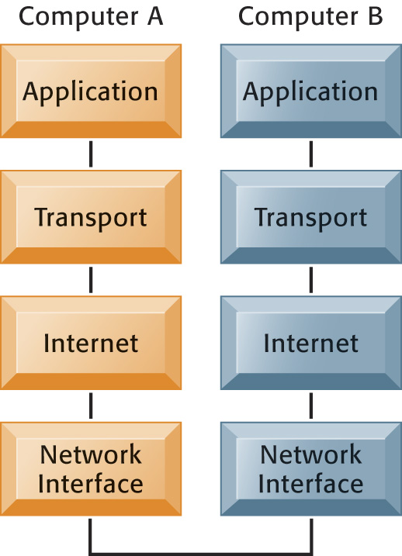
The Transmission Control Protocol/Internet Protocol (TCP/IP) Reference Model

Slide 15
Functions of the Modem

Slide 16
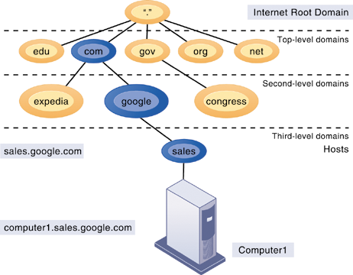
The Domain Name System
Source: Kenneth C. Laudon & Jane P. Laudon (2014), Management Information Systems: Managing the Digital Firm, Thirteenth Edition, Pearson.

Slide 17
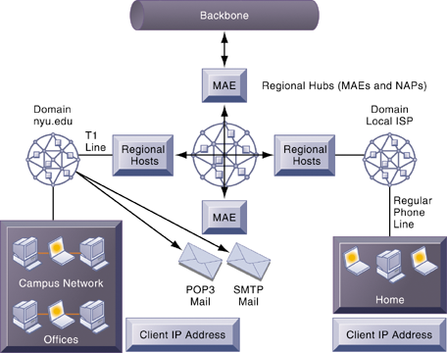
Internet Network Architecture

Slide 18
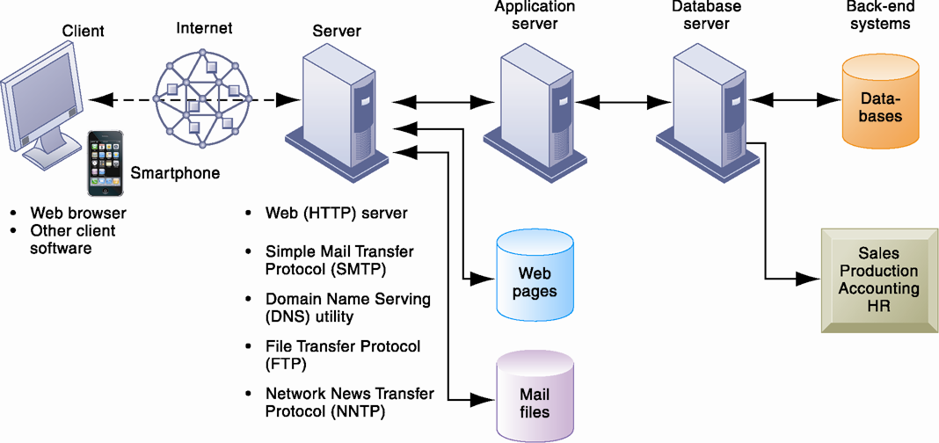
Client/Server Computing on the Internet

Slide 19
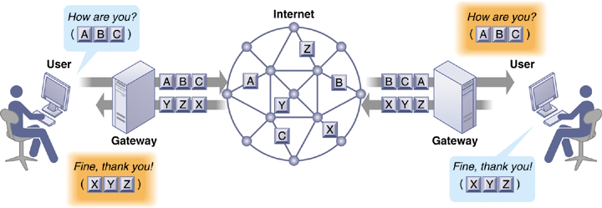
How Voice over IP Works

Slide 20
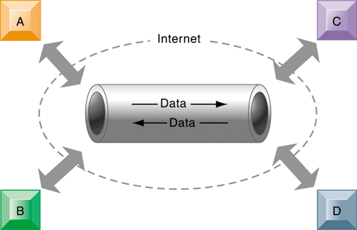
A Virtual Private Network Using the Internet

Slide 21
The Global Internet
Search engines
Started as simpler programs using keyword indexes
Google improved indexing and created page ranking system
Mobile search: 20% of all searches in 2012
Search engine marketing
Major source of Internet advertising revenue
Search engine optimization (SEO)
Adjusting Web site and traffic to improve rankings in search engine results

Slide 22
The Global Internet
Social search
Google +1, Facebook Like
Semantic search
Anticipating what users are looking for rather than simply returning millions of links
Intelligent agent shopping bots
Use intelligent agent software for searching Internet for shopping information

Slide 23
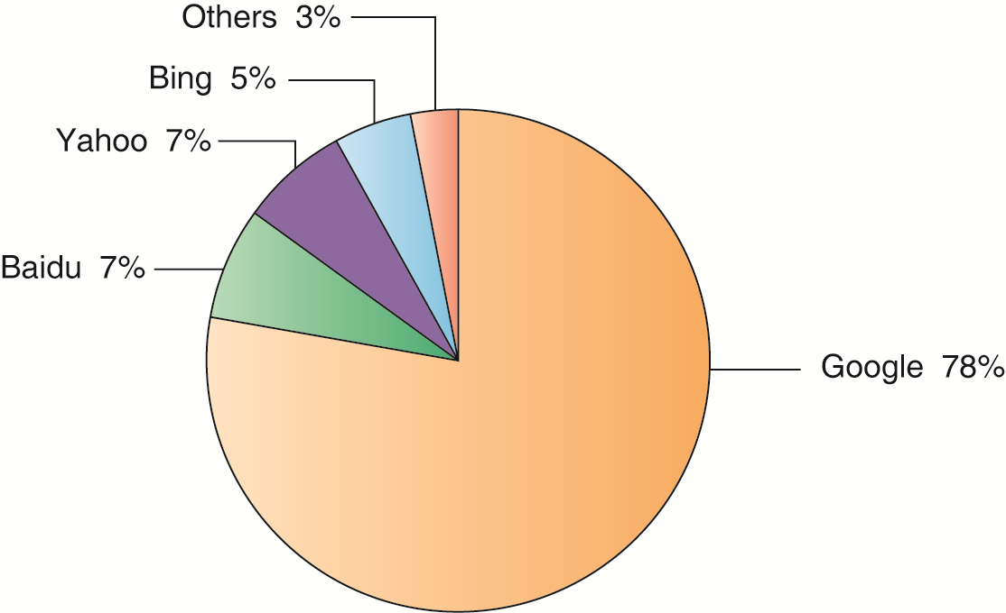
Top U.S. Web Search Engines

Slide 24
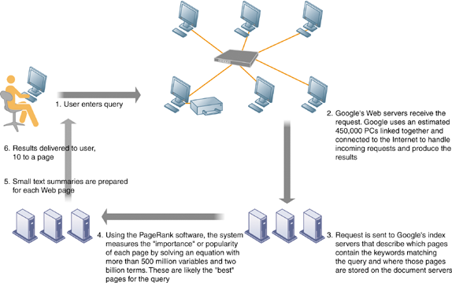
How Google Works

Slide 25
Web 2.0
Second-generation services
Enabling collaboration, sharing information, and creating new services online
Features
Interactivity
Real-time user control
Social participation (sharing)
User-generated content

Slide 26
Web 2.0 services and tools
Blogs: chronological, informal Web sites created by individuals
RSS (Really Simple Syndication): syndicates Web content so aggregator software can pull content for use in another setting or viewing later
Blogosphere
Microblogging
Wikis: collaborative Web sites where visitors can add, delete, or modify content on the site
Social networking sites: enable users to build communities of friends and share information

Slide 27
Web 3.0: The “Semantic Web”
A collaborative effort led by W3C to add layer of meaning to the existing Web
Goal is to reduce human effort in searching for and processing information
Making Web more “intelligent” and intuitive
Increased communication and synchronization with computing devices, communities
“Web of things”
Increased cloud computing, mobile computing

Slide 28
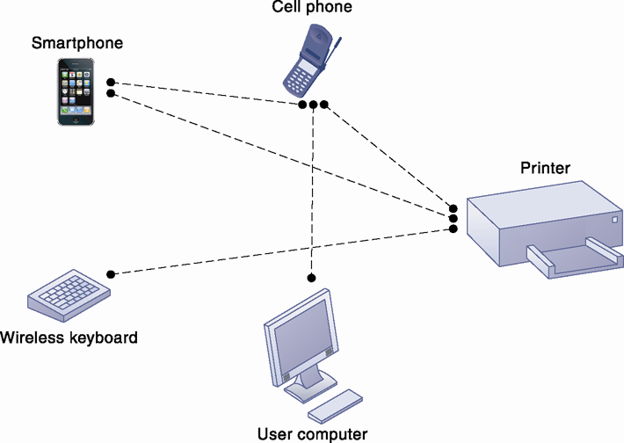
A Bluetooth Network (PAN)

Slide 29
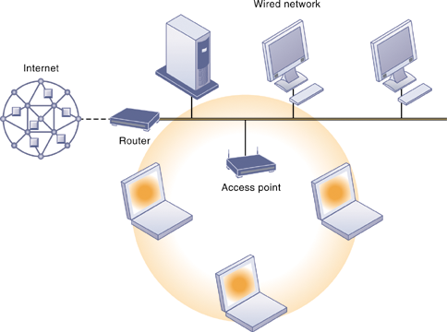
An 802.11 Wireless LAN

Slide 30
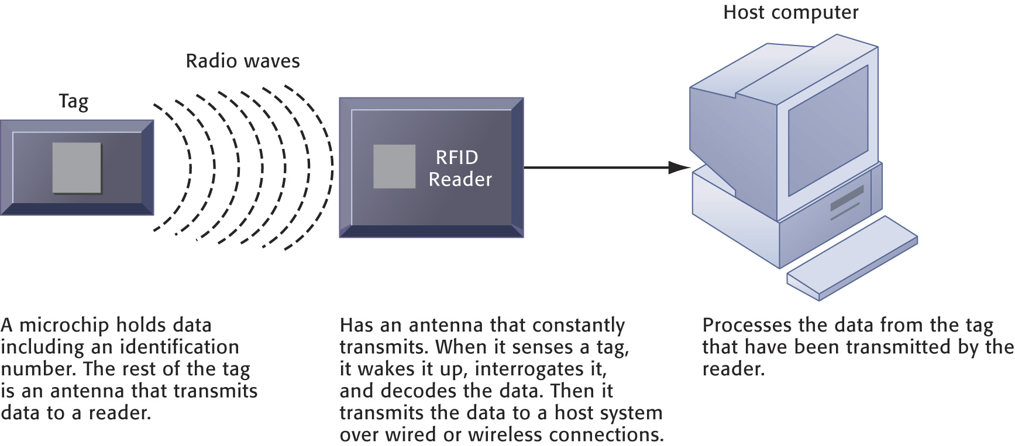
How RFID Works

Slide 31
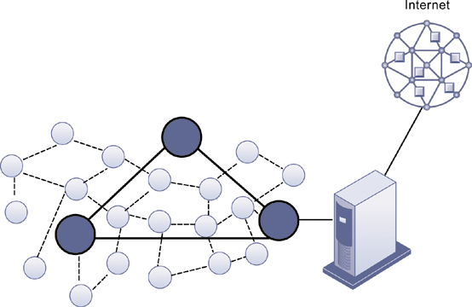
A Wireless Sensor Network

Slide 32
Case Study: Summit and SAP (Chap. 9) (pp. 396-398) Summit Electric Lights Up with a New ERP System
1. Which business processes are the most important at Summit Electric Supply? Why?
2. What problems did Summit have with its old systems? What was the business impact of those problems?
3. How did Summit’s ERP system improve operational efficiency and decision making? Give several examples.
4. Describe two ways in which Summit’s customers benefit from the new ERP system.
5. Diagram Summit’s old and new process for handling chargebacks.

Slide 33
資訊管理專題 (Hot Issues of Information Management)
1. 請同學於資訊管理專題個案討論前 應詳細研讀個案，並思考個案研究問題。
2. 請同學於上課前複習相關資訊管理相關理論，以作為個案分析及擬定管理對策的依據。
3. 請同學於上課前 先繳交資訊管理專題個案研究問題書面報告。
4.上課時間地點： 週四 7,8 (14:10-16:00) B702

Slide 34
References
Kenneth C. Laudon & Jane P. Laudon (2014), Management Information Systems: Managing the Digital Firm, Thirteenth Edition, Pearson.
Kenneth C. Laudon & Jane P. Laudon原著， 游張松 主編，陳文生 翻譯 (2014)， 資訊管理系統，第13版，滄海

