Slide 1
資訊管理專題 Hot Issues of Information Management
Tamkang University
Tamkang University
Foundations of Business Intelligence: IBM and Big Data (Chap. 6)
1061IM4C07
TLMXB4C (M0842) Thu 7,8 (14:10-16:00) B702
Min-Yuh Day
戴敏育
Assistant Professor
專任助理教授
Dept. of Information Management, Tamkang University
淡江大學 資訊管理學系
http://mail. tku.edu.tw/myday/
2017-11-09

Slide 2
課程大綱 (Syllabus)
週次 (Week) 日期 (Date) 內容 (Subject/Topics)
1 2017/09/21 Introduction to Case Study for Hot Issues of Information Management
2 2017/09/28 Information Systems in Global Business: UPS (Chap. 1) (pp.53-54)
3 2017/10/05 Global E-Business and Collaboration: P&G (Chap. 2) (pp.84-85)
4 2017/10/12 Information Systems, Organization, and Strategy: Starbucks (Chap. 3) (pp.129-130)
5 2017/10/19 Ethical and Social Issues in Information Systems: Facebook (Chap. 4) (pp.188-190)
6 2017/10/26 IT Infrastructure and Emerging Technologies: Amazon and Cloud Computing (Chap. 5) (pp. 234-236)

Slide 3
課程大綱 (Syllabus)
週次 (Week) 日期 (Date) 內容 (Subject/Topics)
7 2017/11/02 IT Infrastructure and Emerging Technologies: Amazon and Cloud Computing (Chap. 5) (pp. 234-236)
8 2017/11/09 Foundations of Business Intelligence: IBM and Big Data (Chap. 6) (pp.261-262)
9 2017/11/16 Midterm Report (期中報告)
10 2017/11/23 Midterm Exam Week (期中考試週)
11 2017/11/30 Telecommunications, the Internet, and Wireless Technology: Google, Apple, and Microsoft (Chap. 7) (pp.318-320)
12 2017/12/07 Enterprise Applications: Summit and SAP (Chap. 9) (pp.396-398)

Slide 4
課程大綱 (Syllabus)
週次 日期 內容（Subject/Topics）
13 2017/12/14 E-commerce: Zagat (Chap. 10) (pp.443-445)
14 2017/12/21 Enhancing Decision Making: Zynga (Chap. 12) (pp.512-514)
15 2017/12/28 Building Information Systems: USAA (Chap. 13) (pp.547-548)
16 2018/01/04 Final Report I (期末報告 I)
17 2018/01/11 Final Report II (期末報告 II)
18 2018/01/18 Final Exam Week (期末考試週)

Slide 5
Management Information Systems: Managing the Digital Firm
1
Organization, Management, and the Networked Enterprise
2
Information Technology Infrastructure
3
Key System Applications for the Digital Age
4
Building and Managing Systems

Slide 6
Chap. 6 Foundations of Business Intelligence: IBM and Big Data

Slide 7
Case Study: IBM and Big Data (Chap. 6) (pp. 261-262) Interactive Session: Technology: Big Data, Big Rewards
1. Describe the kinds of “big data” collected by the organizations described in this case.
2. List and describe the business intelligence technologies described in this case.
3. Why did the companies described in this case need to maintain and analyze big data? What business benefits did they obtain?
4. Identify three decisions that were improved by using “big data.”
5. What kinds of organizations are most likely to need “big data” management and analytical tools? Why?

Slide 8
Overview of Fundamental MIS Concepts
Business Challenges
Management
Organization
Information System
Business Solutions
Technology

Slide 9
Business Model
8
7
2
4
1
Key Partners
Key Activities
Value Proposition
Customer Relationships
Customer Segments
6
3
Key Resources
Channels
9
5
Cost Structure
Revenue Streams
Source: Alexander Osterwalder & Yves Pigneur, Business Model Generation: A Handbook for Visionaries, Game Changers, and Challengers, Wiley, 2010.

Slide 10
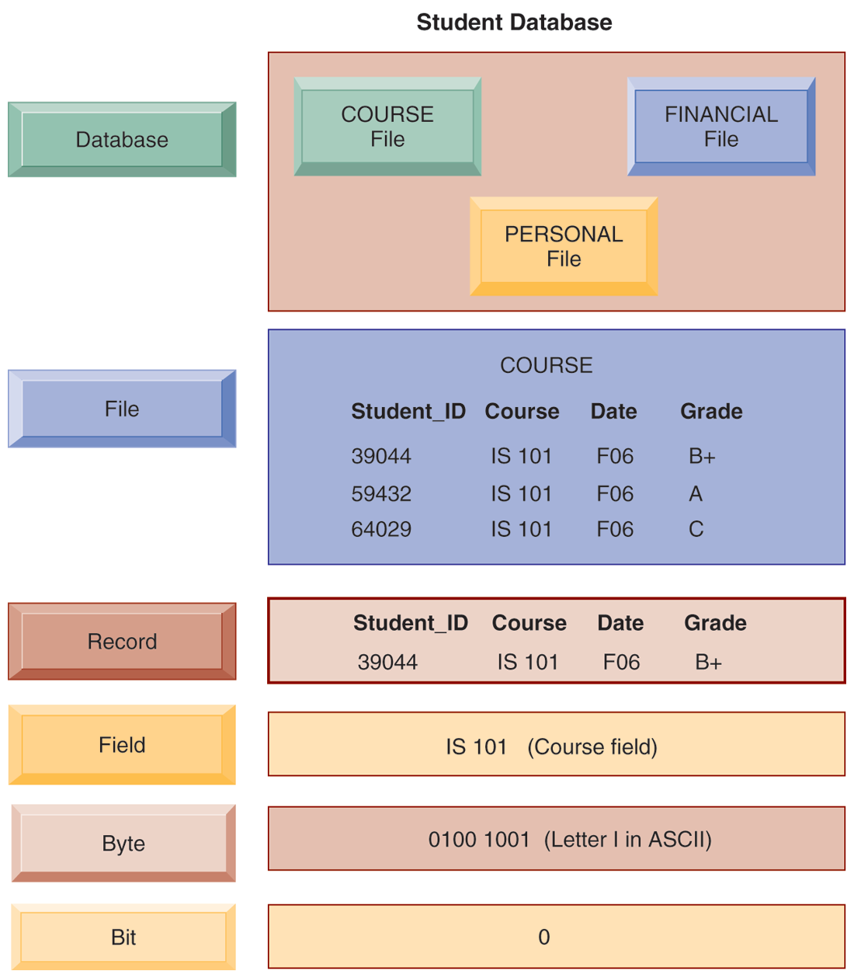
THE DATA HIERARCHY

Slide 11
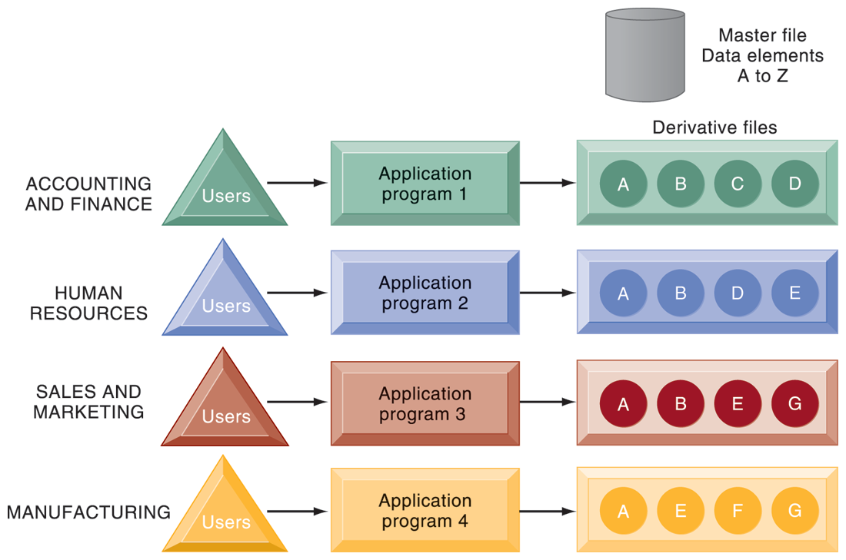
TRADITIONAL FILE PROCESSING

Slide 12
The Database Approach to Data Management
Database
Serves many applications by centralizing data and controlling redundant data

Slide 13
The Database Approach to Data Management
Database management system (DBMS)
Interfaces between applications and physical data files
Separates logical and physical views of data
Solves problems of traditional file environment
Controls redundancy
Eliminates inconsistency
Uncouples programs and data
Enables organization to central manage data and data security

Slide 14
HUMAN RESOURCES DATABASE WITH MULTIPLE VIEWS

Slide 15
Relational DBMS
Represent data as two-dimensional tables
Each table contains data on entity and attributes

Slide 16
Table: grid of columns and rows
Rows (tuples): Records for different entities
Fields (columns): Represents attribute for entity
Key field: Field used to uniquely identify each record
Primary key: Field in table used for key fields
Foreign key: Primary key used in second table as look-up field to identify records from original table

Slide 17
RELATIONAL DATABASE TABLES

Slide 18
Operations of a Relational DBMS
Three basic operations used to develop useful sets of data
SELECT: Creates subset of data of all records that meet stated criteria
JOIN: Combines relational tables to provide user with more information than available in individual tables
PROJECT: Creates subset of columns in table, creating tables with only the information specified

Slide 19
THE THREE BASIC OPERATIONS OF A RELATIONAL DBMS
The select, join, and project operations enable data from two different tables to be combined and only selected attributes to be displayed.

Slide 20
Non-relational databases: “NoSQL”
More flexible data model
Data sets stored across distributed machines
Easier to scale
Handle large volumes of unstructured and structured data (Web, social media, graphics)

Slide 21
Databases in the cloud
Typically, less functionality than on-premises DBs
Amazon Relational Database Service, Microsoft SQL Azure
Private clouds

Slide 22
Designing Databases
Conceptual (logical) design:
abstract model from business perspective
Physical design:
How database is arranged on direct-access storage devices

Slide 23
Design process identifies and Normalization
Design process identifies:
Relationships among data elements, redundant database elements
Most efficient way to group data elements to meet business requirements, needs of application programs
Normalization
Streamlining complex groupings of data to minimize redundant data elements and awkward many-to-many relationships

Slide 24
AN UNNORMALIZED RELATION FOR ORDER

Slide 25
NORMALIZED TABLES CREATED FROM ORDER

Slide 26
AN ENTITY-RELATIONSHIP DIAGRAM

Slide 27
Using Databases to Improve Business Performance and Decision Making
Big data
Massive sets of unstructured/semi-structured data from Web traffic, social media, sensors, and so on
Petabytes, exabytes of data
Volumes too great for typical DBMS
Can reveal more patterns and anomalies

Slide 28
Using Databases to Improve Business Performance and Decision Making
Business intelligence infrastructure
Today includes an array of tools for separate systems, and big data
Contemporary tools:
Data warehouses
Data marts
Hadoop
In-memory computing
Analytical platforms

Slide 29
Business Intelligence Infrastructure

Slide 30
Data Warehouse vs. Data Marts
Data warehouse:
Stores current and historical data from many core operational transaction systems
Consolidates and standardizes information for use across enterprise, but data cannot be altered
Provides analysis and reporting tools
Data marts:
Subset of data warehouse
Summarized or focused portion of data for use by specific population of users
Typically focuses on single subject or line of business

Slide 31
Hadoop
Enables distributed parallel processing of big data across inexpensive computers
Key services
Hadoop Distributed File System (HDFS): data storage
MapReduce: breaks data into clusters for work
Hbase: NoSQL database
Used by Facebook, Yahoo, NextBio

Slide 32
In-memory computing
Used in big data analysis
Use computers main memory (RAM) for data storage to avoid delays in retrieving data from disk storage
Can reduce hours/days of processing to seconds
Requires optimized hardware

Slide 33
Analytic platforms
High-speed platforms using both relational and non-relational tools optimized for large datasets
Examples:
IBM Netezza
Oracle Exadata

Slide 34
Analytical tools: Relationships, patterns, trends
Business Intelligence Analytics and Applications
Tools for consolidating, analyzing, and providing access to vast amounts of data to help users make better business decisions
Multidimensional data analysis (OLAP)
Data mining
Text mining
Web mining

Slide 35
Online analytical processing (OLAP)
Supports multidimensional data analysis
Viewing data using multiple dimensions
Each aspect of information (product, pricing, cost, region, time period) is different dimension
Example: How many washers sold in East in June compared with other regions?
OLAP enables rapid, online answers to ad hoc queries

Slide 36
MULTIDIMENSIONAL DATA MODEL

Slide 37
Data mining
Finds hidden patterns, relationships in datasets
Example: customer buying patterns
Infers rules to predict future behavior
Data mining provides insights into data that cannot be discovered through OLAP, by inferring rules from patterns in data.

Slide 38
Types of Information Obtained from Data Mining
Associations: Occurrences linked to single event
Sequences: Events linked over time
Classification: Recognizes patterns that describe group to which item belongs
Clustering: Similar to classification when no groups have been defined; finds groupings within data
Forecasting: Uses series of existing values to forecast what other values will be

Slide 39
Text mining
Extracts key elements from large unstructured data sets
Stored e-mails
Call center transcripts
Legal cases
Patent descriptions
Service reports, and so on
Sentiment analysis software
Mines e-mails, blogs, social media to detect opinions

Slide 40
Web mining
Discovery and analysis of useful patterns and information from Web
Understand customer behavior
Evaluate effectiveness of Web site, and so on
3 Tasks of Web Mining
Web content mining
Mines content of Web pages
Web structure mining
Analyzes links to and from Web page
Web usage mining
Mines user interaction data recorded by Web server

Slide 41
Databases and the Web
Many companies use Web to make some internal databases available to customers or partners
Typical configuration includes:
Web server
Application server/middleware/CGI scripts
Database server (hosting DBMS)
Advantages of using Web for database access:
Ease of use of browser software
Web interface requires few or no changes to database
Inexpensive to add Web interface to system

Slide 42
LINKING INTERNAL DATABASES TO THE WEB

Slide 43
Managing Data Resources
Establishing an information policy
Firm’s rules, procedures, roles for sharing, managing, standardizing data
Data administration
Establishes policies and procedures to manage data
Data governance
Deals with policies and processes for managing availability, usability, integrity, and security of data, especially regarding government regulations
Database administration
Creating and maintaining database

Slide 44
Managing Data Resources
Ensuring data quality
More than 25% of critical data in Fortune 1000 company databases are inaccurate or incomplete
Redundant data
Inconsistent data
Faulty input
Before new database in place, need to:
Identify and correct faulty data
Establish better routines for editing data once database in operation

Slide 45
Managing Data Resources
Data quality audit
Structured survey of the accuracy and level of completeness of the data in an information system
Survey samples from data files, or
Survey end users for perceptions of quality
Data cleansing
Software to detect and correct data that are incorrect, incomplete, improperly formatted, or redundant
Enforces consistency among different sets of data from separate information systems

Slide 46
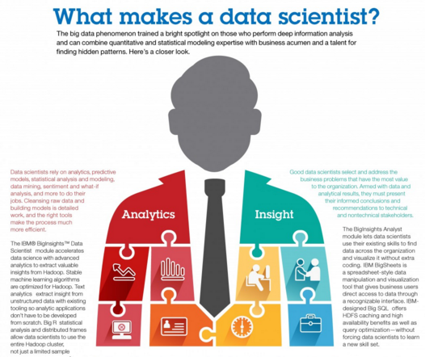
Data Scientist
Source: http://www.ibmbigdatahub.com/infographic/what-makes-data-scientist

Slide 47
Architecture of Big Data Analytics
Big Data Analytics Applications
Big Data Sources
Big Data Transformation
Big Data Platforms & Tools
* Internal
* External
* Multiple formats
* Multiple locations
* Multiple applications
Middleware
Hadoop
MapReduce
Pig
Hive
Jaql
Zookeeper
Hbase
Cassandra
Oozie
Avro
Mahout
Others
Queries
Raw Data
Transformed Data
Big Data Analytics
Extract Transform Load
Reports
Data Warehouse
OLAP
Traditional Format CSV, Tables
Data Mining
Source: Stephan Kudyba (2014), Big Data, Mining, and Analytics: Components of Strategic Decision Making, Auerbach Publications

Slide 48
Architecture of Big Data Analytics
Big Data Analytics Applications
Big Data Sources
Big Data Transformation
Big Data Platforms & Tools
* Internal
* External
* Multiple formats
* Multiple locations
* Multiple applications
Data Mining
Big Data Analytics Applications
Middleware
Hadoop
MapReduce
Pig
Hive
Jaql
Zookeeper
Hbase
Cassandra
Oozie
Avro
Mahout
Others
Queries
Raw Data
Transformed Data
Big Data Analytics
Extract Transform Load
Reports
Data Warehouse
OLAP
Traditional Format CSV, Tables
Data Mining
Source: Stephan Kudyba (2014), Big Data, Mining, and Analytics: Components of Strategic Decision Making, Auerbach Publications

Slide 49
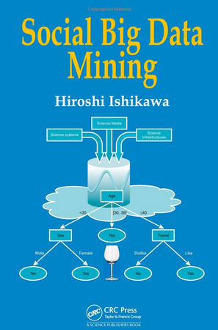
Social Big Data Mining (Hiroshi Ishikawa, 2015)
Source: http://www.amazon.com/Social-Data-Mining-Hiroshi-Ishikawa/dp/149871093X

Slide 50
Architecture for Social Big Data Mining (Hiroshi Ishikawa, 2015)
Enabling Technologies
Analysts
Integrated analysis
Integrated analysis model
Model Construction
Explanation by Model
Conceptual Layer
Natural Language Processing
Information Extraction
Anomaly Detection
Discovery of relationships among heterogeneous data
Large-scale visualization
Construction and confirmation of individual hypothesis
Description and execution of application-specific task
Data Mining
Multivariate analysis
Application specific task
Logical Layer
Parallel distrusted processing
Software
Social Data
Hardware
Physical Layer
Source: Hiroshi Ishikawa (2015), Social Big Data Mining, CRC Press

Slide 51
Case Study: Google, Apple, and Microsoft (Chap. 7) (pp. 318-320) Apple, Google, and Microsoft Battle for Your Internet Experience
1. Define and compare the business models and areas of strength of Apple, Google, and Microsoft.
2. Why is mobile computing so important to these three firms? Evaluate the mobile platform offerings of each firm.
3. What is the significance of applications and app stores, and closed vs. open app standards to the success or failure of mobile computing?
4. Which company and business model do you believe will prevail in this epic struggle? Explain your answer.
5. What difference would it make to a business or to an individual consumer if Apple, Google, or Microsoft dominated the Internet experience? Explain your answer.

Slide 52
2017/11/16 Midterm Report (期中報告)
請各組組長整理期中報告資料檔案， 於2017/11/16 (週四) 下午14:00 前， 完成Email 寄出以下兩個壓縮檔的下載連結， 給所有組員和老師 (正本to: 老師，副本cc: 所有組員) 。
1. 整組各次簡報的 ppt (含整組期中報告目錄 ppt) 壓縮檔
(例如：MI4C_資訊管理專題_第1組_期中各次簡報.zip)。
2. 整組各組員的 [(1) 個人期中報告.ppt (2) 個人期中書面報告.pdf] 之壓縮檔
(例如：MI4C_資訊管理專題_第1組_組員個人期中報告.zip)。

Slide 53
資訊管理專題 (Hot Issues of Information Management)
1. 請同學於資訊管理專題個案討論前 應詳細研讀個案，並思考個案研究問題。
2. 請同學於上課前複習相關資訊管理相關理論，以作為個案分析及擬定管理對策的依據。
3. 請同學於上課前 先繳交資訊管理專題個案研究問題書面報告。
4.上課時間地點： 週四 7,8 (14:10-16:00) B702

Slide 54
References
Kenneth C. Laudon & Jane P. Laudon (2014), Management Information Systems: Managing the Digital Firm, Thirteenth Edition, Pearson.
Kenneth C. Laudon & Jane P. Laudon原著， 游張松 主編，陳文生 翻譯 (2014)， 資訊管理系統，第13版，滄海

