Slide 1
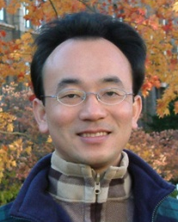
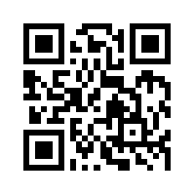
資訊管理專題 Hot Issues of Information Management
Tamkang University
Tamkang University
IT Infrastructure and Emerging Technologies: Amazon and Cloud Computing (Chap. 5)
1061IM4C06
TLMXB4C (M0842) Thu 7,8 (14:10-16:00) B702
Min-Yuh Day
戴敏育
Assistant Professor
專任助理教授
Dept. of Information Management, Tamkang University
淡江大學 資訊管理學系
http://mail. tku.edu.tw/myday/
2017-10-26; 2017-11-02

Slide 2
課程大綱 (Syllabus)
週次 (Week) 日期 (Date) 內容 (Subject/Topics)
1 2017/09/21 Introduction to Case Study for Hot Issues of Information Management
2 2017/09/28 Information Systems in Global Business: UPS (Chap. 1) (pp.53-54)
3 2017/10/05 Global E-Business and Collaboration: P&G (Chap. 2) (pp.84-85)
4 2017/10/12 Information Systems, Organization, and Strategy: Starbucks (Chap. 3) (pp.129-130)
5 2017/10/19 Ethical and Social Issues in Information Systems: Facebook (Chap. 4) (pp.188-190)
6 2017/10/26 IT Infrastructure and Emerging Technologies: Amazon and Cloud Computing (Chap. 5) (pp. 234-236)

Slide 3
課程大綱 (Syllabus)
週次 (Week) 日期 (Date) 內容 (Subject/Topics)
7 2017/11/02 IT Infrastructure and Emerging Technologies: Amazon and Cloud Computing (Chap. 5) (pp. 234-236)
8 2017/11/09 Foundations of Business Intelligence: IBM and Big Data (Chap. 6) (pp.261-262)
9 2017/11/16 Midterm Report (期中報告)
10 2017/11/23 Midterm Exam Week (期中考試週)
11 2017/11/30 Telecommunications, the Internet, and Wireless Technology: Google, Apple, and Microsoft (Chap. 7) (pp.318-320)
12 2017/12/07 Enterprise Applications: Summit and SAP (Chap. 9) (pp.396-398)

Slide 4
課程大綱 (Syllabus)
週次 日期 內容（Subject/Topics）
13 2017/12/14 E-commerce: Zagat (Chap. 10) (pp.443-445)
14 2017/12/21 Enhancing Decision Making: Zynga (Chap. 12) (pp.512-514)
15 2017/12/28 Building Information Systems: USAA (Chap. 13) (pp.547-548)
16 2018/01/04 Final Report I (期末報告 I)
17 2018/01/11 Final Report II (期末報告 II)
18 2018/01/18 Final Exam Week (期末考試週)

Slide 5
Management Information Systems: Managing the Digital Firm
1
Organization, Management, and the Networked Enterprise
2
Information Technology Infrastructure
3
Key System Applications for the Digital Age
4
Building and Managing Systems

Slide 6
Chap. 5 IT Infrastructure and Emerging Technologies: Amazon and Cloud Computing

Slide 7
Case Study: Amazon and Cloud Computing (Chap. 5) (pp. 234-236) Should Businesses Move to the Cloud?
1. What business benefits do cloud computing services provide? What problems do they solve?
2. What are the disadvantages of cloud computing?
3. How do the concepts of capacity planning, scalability, and TCO apply to this case? Apply these concepts both to Amazon and to subscribers of its services.
4. What kinds of businesses are most likely to benefit from using cloud computing? Why?

Slide 8
Overview of Fundamental MIS Concepts
Business Challenges
Management
Organization
Information System
Business Solutions
Technology

Slide 9
Business Model
8
7
2
4
1
Key Partners
Key Activities
Value Proposition
Customer Relationships
Customer Segments
6
3
Key Resources
Channels
9
5
Cost Structure
Revenue Streams
Source: Alexander Osterwalder & Yves Pigneur, Business Model Generation: A Handbook for Visionaries, Game Changers, and Challengers, Wiley, 2010.

Slide 10
IT Infrastructure
Set of physical devices and software required to operate enterprise
Set of firmwide services including:
Computing platforms providing computing services
Telecommunications services
Data management services
Application software services
Physical facilities management services
IT management, standards, education, research and development services
“Service platform” perspective more accurate view of value of investments

Slide 11
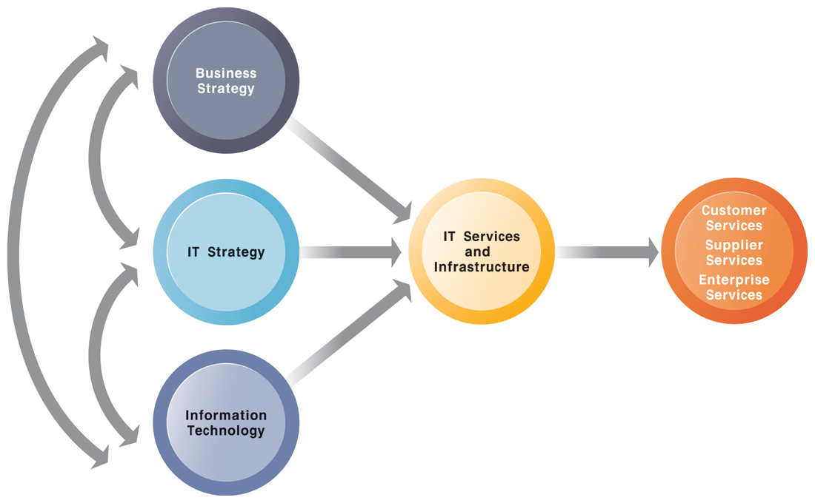
CONNECTION BETWEEN THE FIRM, IT INFRASTRUCTURE, AND BUSINESS CAPABILITIES

Slide 12
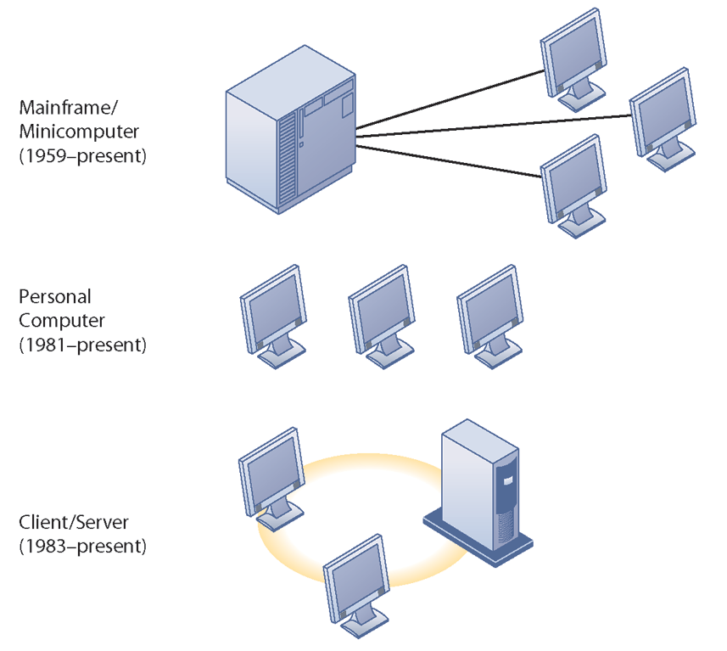
STAGES IN IT INFRASTRUCTURE EVOLUTION

Slide 13
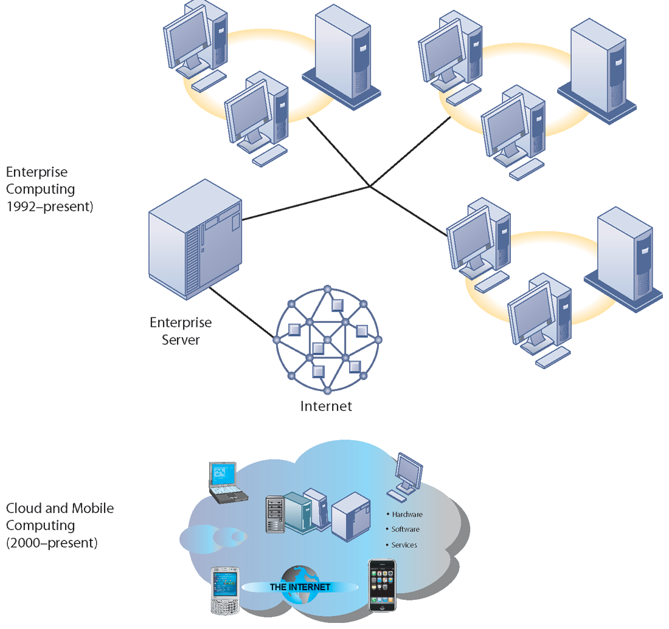
STAGES IN IT INFRASTRUCTURE EVOLUTION

Slide 14
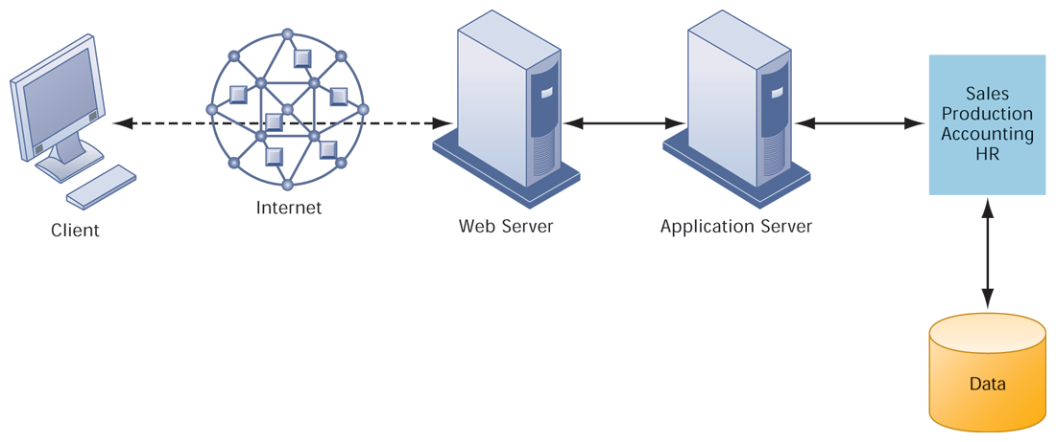
A MULTITIERED CLIENT/SERVER NETWORK (N-TIER)

Slide 15
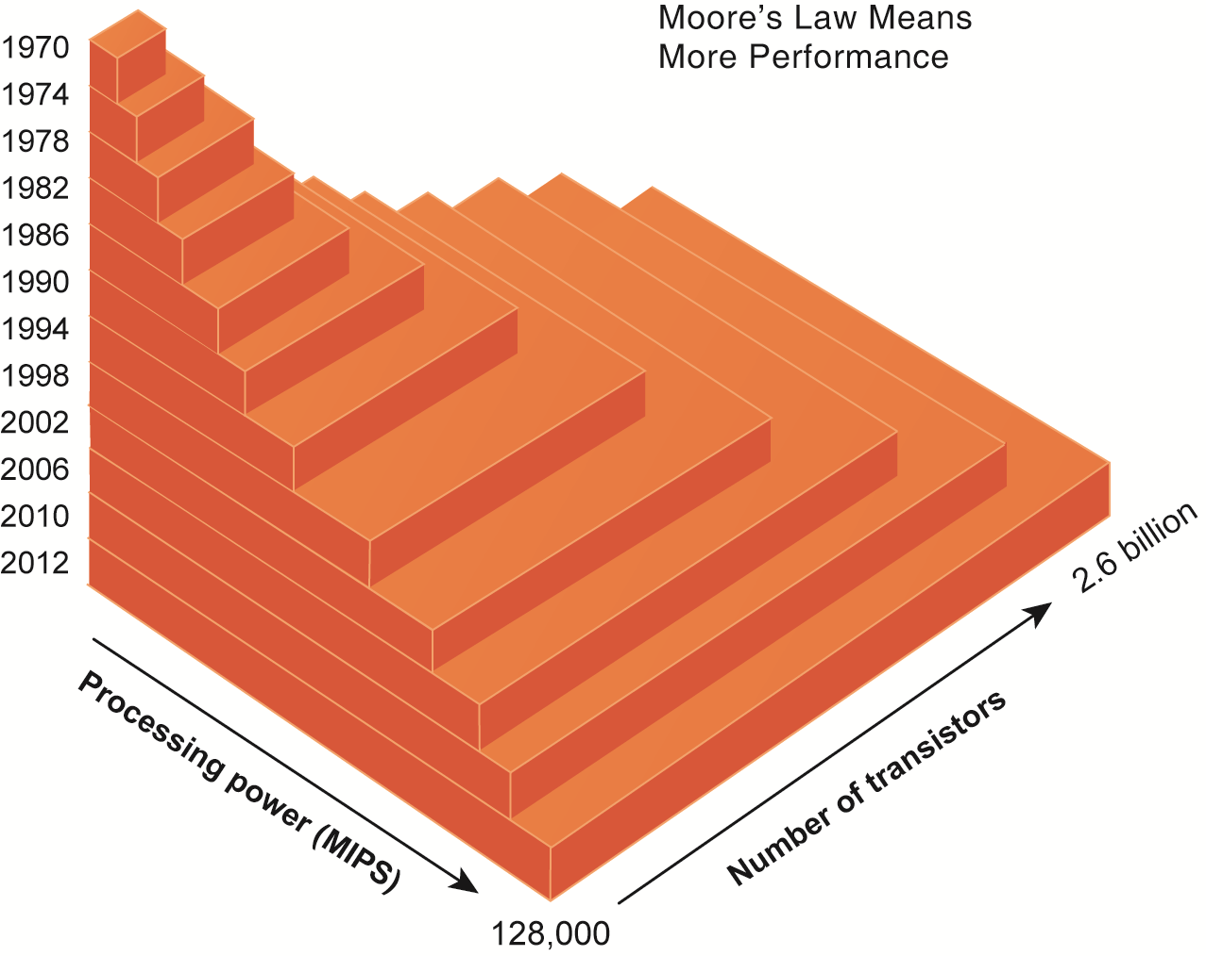
MOORE’S LAW AND MICROPROCESSOR PERFORMANCE

Slide 16
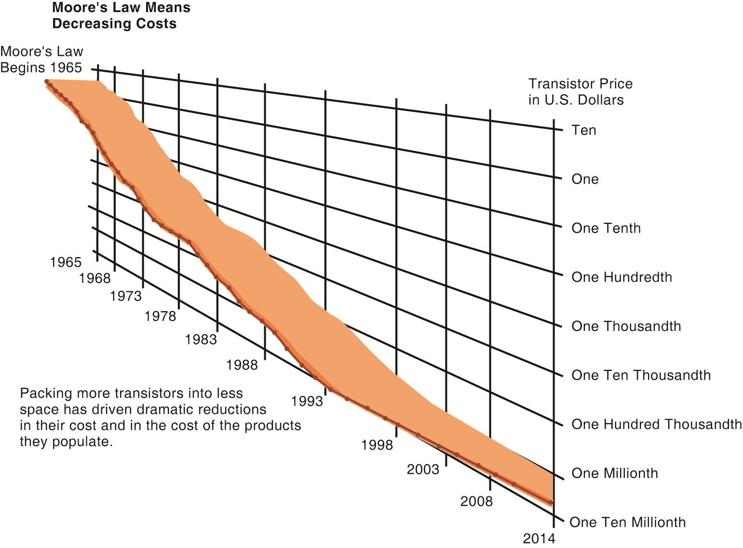
FALLING COST OF CHIPS

Slide 17
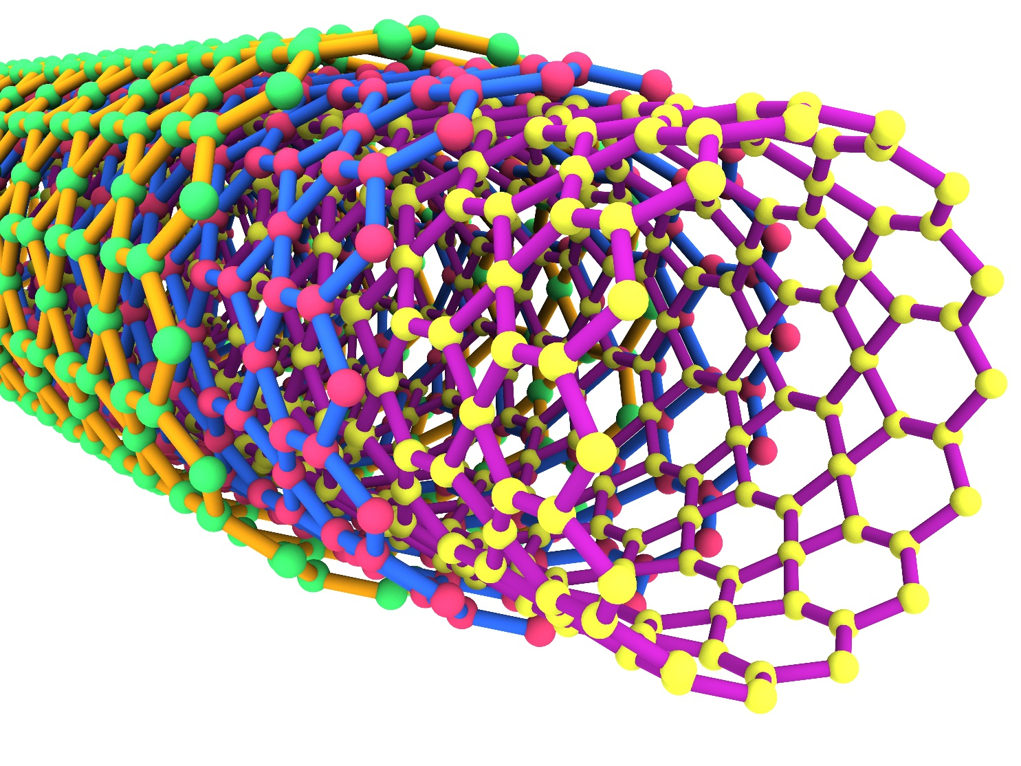
EXAMPLES OF NANOTUBES

Slide 18
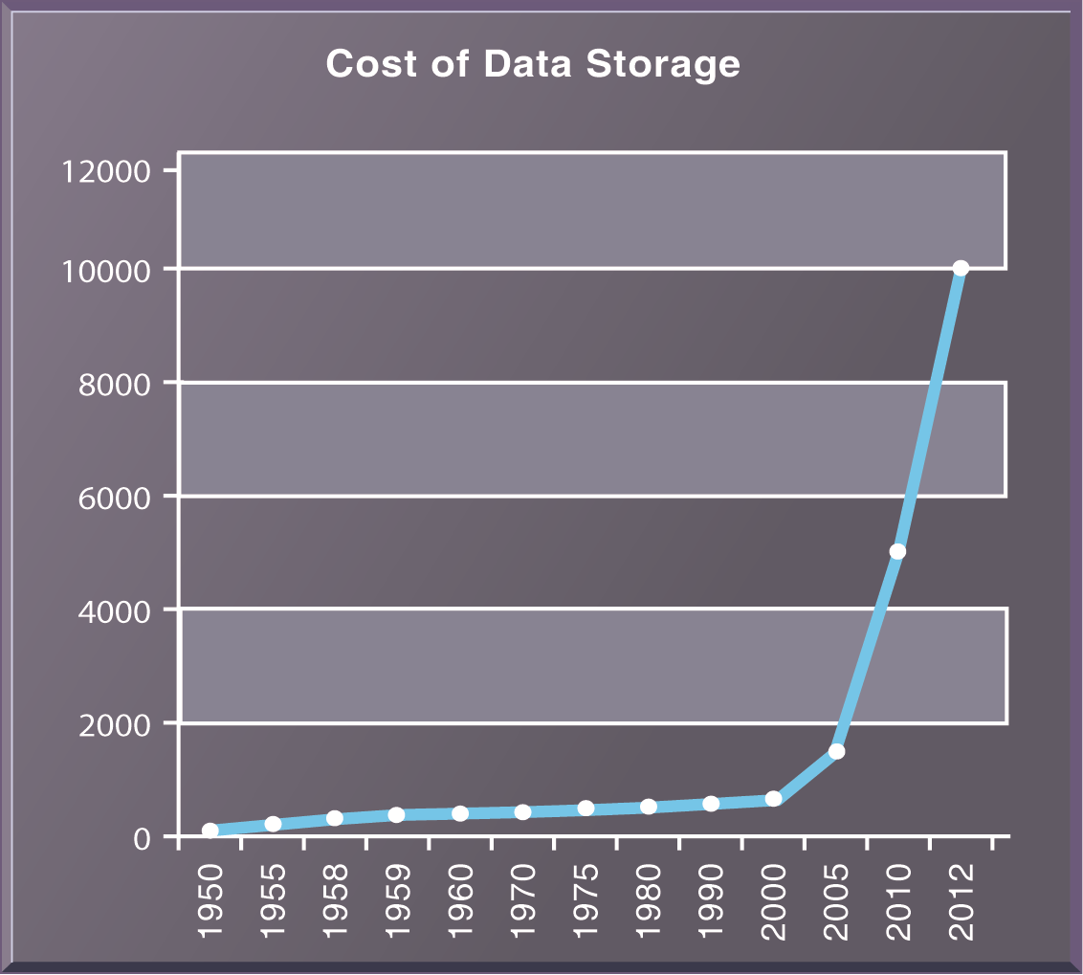
THE COST OF STORING DATA DECLINES EXPONENTIALLY 1950–2012

Slide 19
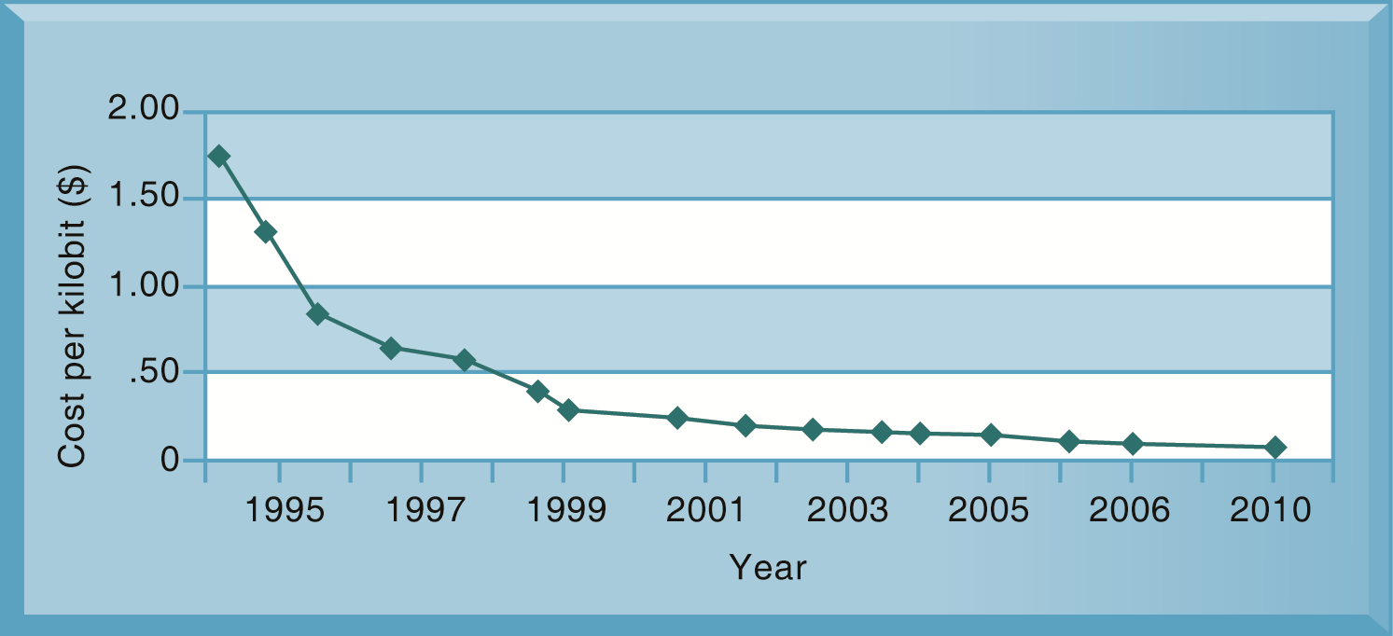
EXPONENTIAL DECLINES IN INTERNET COMMUNICATIONS COSTS

Slide 20
IT Infrastructure has seven main components
Computer hardware platforms
Operating system platforms
Enterprise software applications
Data management and storage
Networking/telecommunications platforms
Internet platforms
Consulting system integration services

Slide 21
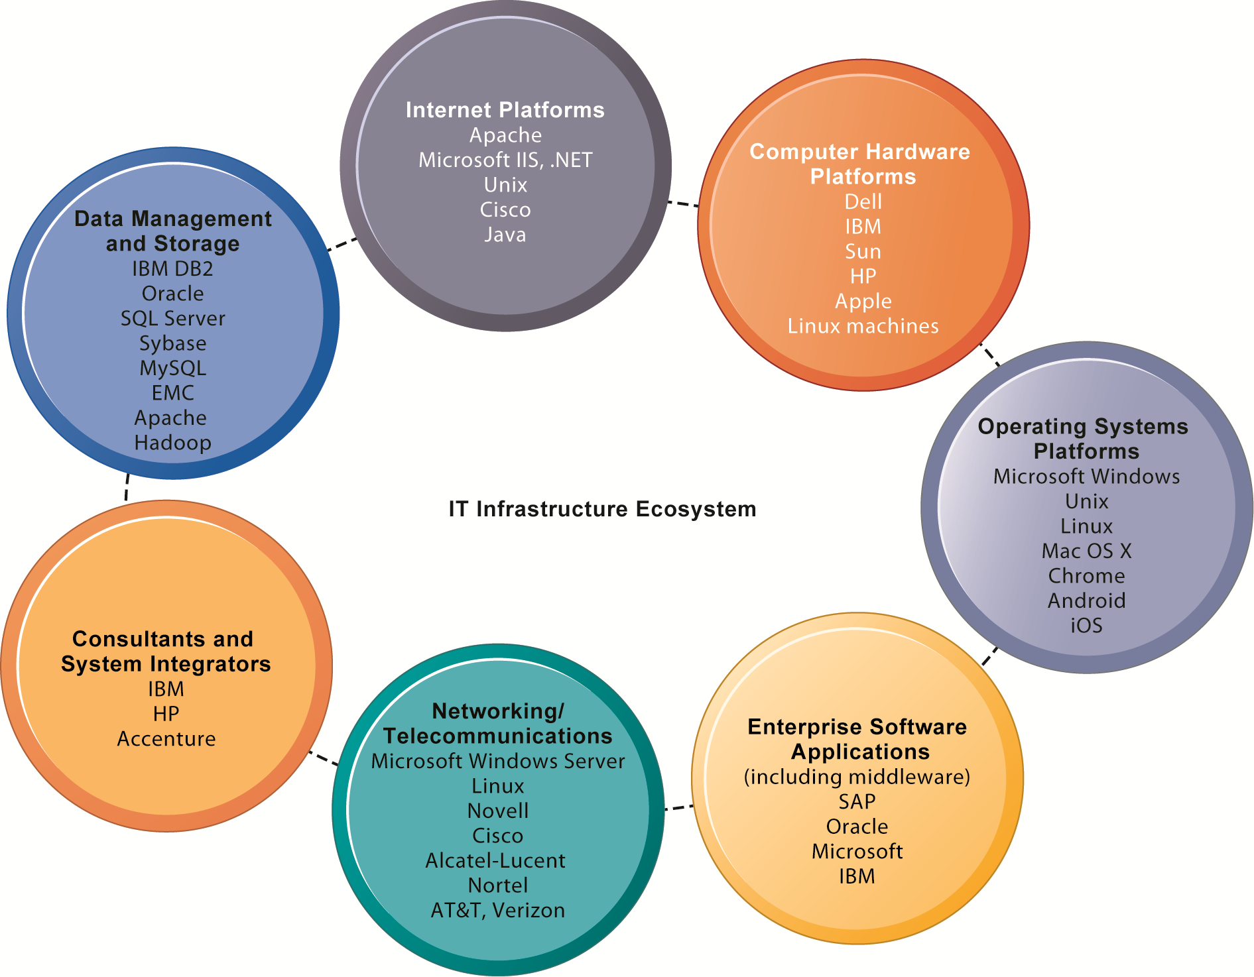
THE IT INFRASTRUCTURE ECOSYSTEM

Slide 22
Contemporary Hardware Platform Trends
The Mobile Digital Platform
Consumerization of IT and BYOD
Grid computing
Virtualization
Cloud Computing
Green Computing
High-Performance and Power-Saving Processors
Autonomic Computing

Slide 23
Cloud computing
On-demand (utility) computing services obtained over network
Infrastructure as a service (IaaS)
Platform as a service (PaaS)
Software as a service (SaaS)
Cloud can be public or private
Allows companies to minimize IT investments
Drawbacks: Concerns of security, reliability
Hybrid cloud computing model

Slide 24
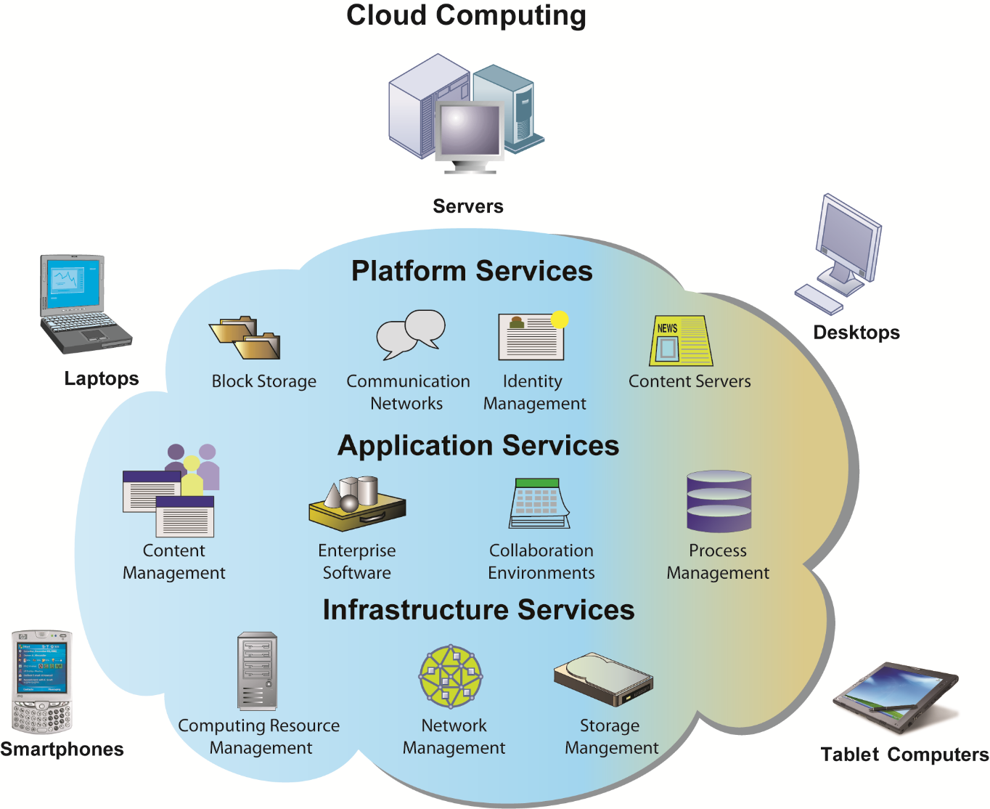
CLOUD COMPUTING PLATFORM

Slide 25
Contemporary Software Platform Trends
Open Source Software
Linux
Software for the Web
Java
HTML and HTML5
Web Services
Service-Oriented Architecture (SOA)
Software Outsourcing
Cloud Services

Slide 26
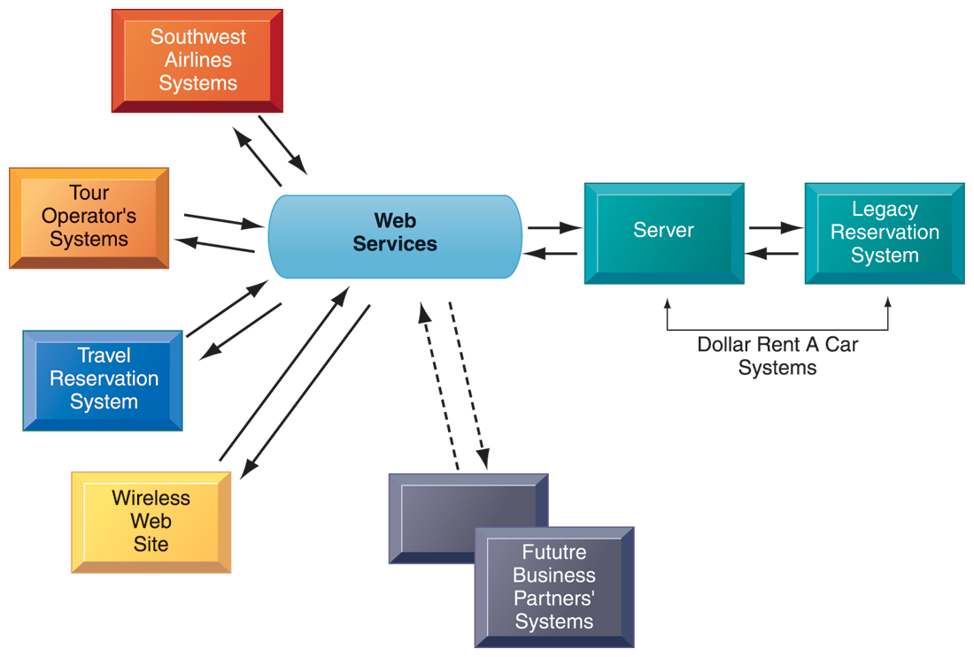
HOW DOLLAR RENT A CAR USES WEB SERVICES

Slide 27
CHANGING SOURCES OF FIRM SOFTWARE

Slide 28
Software outsourcing and cloud services
Three external sources for software:
1. Software packages and enterprise software
2. Software outsourcing
Contracting outside firms to develop software
3. Cloud-based software services
Software as a service (SaaS)
Accessed with Web browser over Internet
Service Level Agreements (SLAs): formal agreement with service providers

Slide 29
Software outsourcing and cloud services
Mashups
Combinations of two or more online applications, such as combining mapping software (Google Maps) with local content
Apps
Small pieces of software that run on the Internet, on your computer, or on your cell phone
iPhone, Android
Generally delivered over the Internet

Slide 30
Management Issues
Dealing with platform and infrastructure change
As firms shrink or grow, IT needs to be flexible and scalable
Scalability:
Ability to expand to serve larger numbers of users
For mobile computing and cloud computing
New policies and procedures for managing these new platforms
Contractual agreements with firms running clouds and distributing software required

Slide 31
Management Issues
Management and governance
Who controls IT infrastructure?
How should IT department be organized?
Centralized
Central IT department makes decisions
Decentralized
Business unit IT departments make own decisions
How are costs allocated between divisions, departments?

Slide 32
Management Issues
Making wise infrastructure investments
Amount to spend on IT is complex question
Rent vs. buy, outsourcing
Total cost of ownership (TCO) model
Analyzes direct and indirect costs
Hardware, software account for only about 20% of TCO
Other costs: Installation, training, support, maintenance, infrastructure, downtime, space and energy
TCO can be reduced through use of cloud services, greater centralization and standardization of hardware and software resources

Slide 33
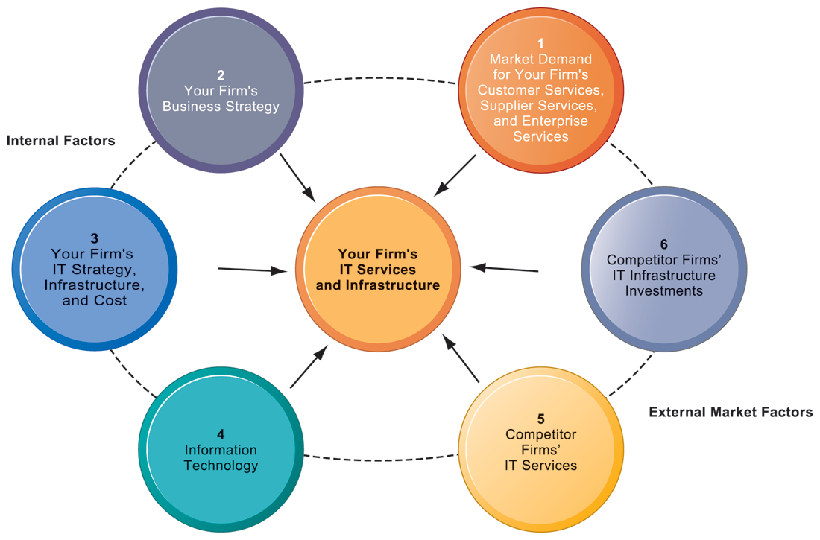
COMPETITIVE FORCES MODEL FOR IT INFRASTRUCTURE

Slide 34
Competitive forces model for IT infrastructure investment
Market demand for firm’s services
Firm’s business strategy
Firm’s IT strategy, infrastructure, and cost
Information technology assessment
Competitor firm services
Competitor firm IT infrastructure investments

Slide 35
Case Study: IBM and Big Data (Chap. 6) (pp. 261-262) Interactive Session: Technology: Big Data, Big Rewards
1. Describe the kinds of “big data” collected by the organizations described in this case.
2. List and describe the business intelligence technologies described in this case.
3. Why did the companies described in this case need to maintain and analyze big data? What business benefits did they obtain?
4. Identify three decisions that were improved by using “big data.”
5. What kinds of organizations are most likely to need “big data” management and analytical tools? Why?

Slide 36
資訊管理專題 (Hot Issues of Information Management)
1. 請同學於資訊管理專題個案討論前 應詳細研讀個案，並思考個案研究問題。
2. 請同學於上課前複習相關資訊管理相關理論，以作為個案分析及擬定管理對策的依據。
3. 請同學於上課前 先繳交資訊管理專題個案研究問題書面報告。
4.上課時間地點： 週四 7,8 (14:10-16:00) B702

Slide 37
References
Kenneth C. Laudon & Jane P. Laudon (2014), Management Information Systems: Managing the Digital Firm, Thirteenth Edition, Pearson.
Kenneth C. Laudon & Jane P. Laudon原著， 游張松 主編，陳文生 翻譯 (2014)， 資訊管理系統，第13版，滄海

