Slide 1
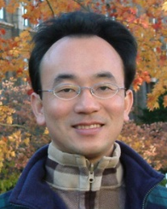
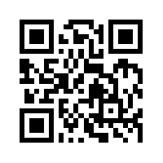
資訊管理專題 Hot Issues of Information Management
Tamkang University
Tamkang University
Ethical and Social Issues in Information Systems: Facebook (Chap. 4)
1061IM4C05
TLMXB4C (M0842) Thu 7,8 (14:10-16:00) B702
Min-Yuh Day
戴敏育
Assistant Professor
專任助理教授
Dept. of Information Management, Tamkang University
淡江大學 資訊管理學系
http://mail. tku.edu.tw/myday/
2017-10-19

Slide 2
課程大綱 (Syllabus)
週次 (Week) 日期 (Date) 內容 (Subject/Topics)
1 2017/09/21 Introduction to Case Study for Hot Issues of Information Management
2 2017/09/28 Information Systems in Global Business: UPS (Chap. 1) (pp.53-54)
3 2017/10/05 Global E-Business and Collaboration: P&G (Chap. 2) (pp.84-85)
4 2017/10/12 Information Systems, Organization, and Strategy: Starbucks (Chap. 3) (pp.129-130)
5 2017/10/19 Ethical and Social Issues in Information Systems: Facebook (Chap. 4) (pp.188-190)
6 2017/10/26 IT Infrastructure and Emerging Technologies: Amazon and Cloud Computing (Chap. 5) (pp. 234-236)

Slide 3
課程大綱 (Syllabus)
週次 (Week) 日期 (Date) 內容 (Subject/Topics)
7 2017/11/02 Foundations of Business Intelligence: IBM and Big Data (Chap. 6) (pp.261-262)
8 2017/11/09 Telecommunications, the Internet, and Wireless Technology: Google, Apple, and Microsoft (Chap. 7) (pp.318-320)
9 2017/11/16 Midterm Report (期中報告)
10 2017/11/23 Midterm Exam Week (期中考試週)
11 2017/11/30 Enterprise Applications: Summit and SAP (Chap. 9) (pp.396-398)
12 2017/12/07 E-commerce: Zagat (Chap. 10) (pp.443-445)

Slide 4
課程大綱 (Syllabus)
週次 日期 內容（Subject/Topics）
13 2017/12/14 Enhancing Decision Making: Zynga (Chap. 12) (pp.512-514)
14 2017/12/21 Building Information Systems: USAA (Chap. 13) (pp.547-548)
15 2017/12/28 Managing Projects: NYCAPS and CityTime (Chap. 14) (pp.586-588)
16 2018/01/04 Final Report I (期末報告 I)
17 2018/01/11 Final Report II (期末報告 II)
18 2018/01/18 Final Exam Week (期末考試週)

Slide 5
Management Information Systems: Managing the Digital Firm
1
Organization, Management, and the Networked Enterprise
2
Information Technology Infrastructure
3
Key System Applications for the Digital Age
4
Building and Managing Systems

Slide 6
Chap. 4 Ethical and Social Issues in Information Systems: Facebook

Slide 7
Case Study: Facebook (Chap. 4) (pp.188-190) Facebook: It’s about the Money
1. Perform an ethical analysis of Facebook. What is the ethical dilemma presented by this case?
2. What is the relationship of privacy to Facebook’s business model?
3. Describe the weaknesses of Facebook’s privacy policies and features. What management, organization, and technology factors have contributed to those weaknesses?
4. Will Facebook be able to have a successful business model without invading privacy? Explain your answer. Are there any measures Facebook could take to make this possible?

Slide 8
Overview of Fundamental MIS Concepts
Business Challenges
Management
Organization
Information System
Business Solutions
Technology

Slide 9
Business Model
8
7
2
4
1
Key Partners
Key Activities
Value Proposition
Customer Relationships
Customer Segments
6
3
Key Resources
Channels
9
5
Cost Structure
Revenue Streams
Source: Alexander Osterwalder & Yves Pigneur, Business Model Generation: A Handbook for Visionaries, Game Changers, and Challengers, Wiley, 2010.

Slide 10
Information Systems and Ethics
Information systems raise new ethical questions because they create opportunities for:
Intense social change, threatening existing distributions of power, money, rights, and obligations
New kinds of crime

Slide 11
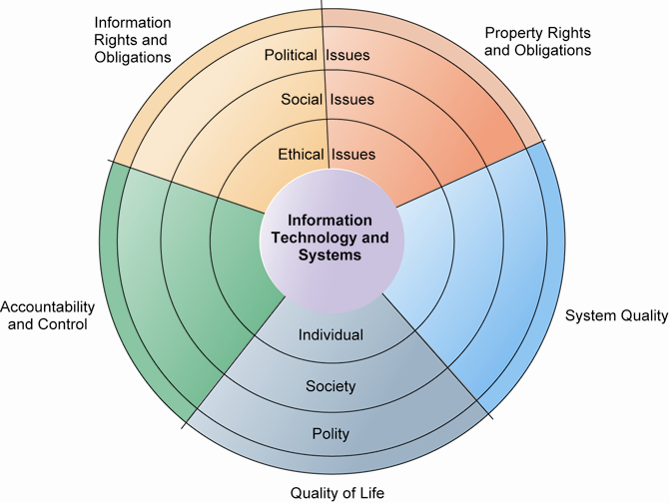
THE RELATIONSHIP AMONG ETHICAL, SOCIAL, POLITICAL ISSUES IN AN INFORMATION SOCIETY

Slide 12
A model for thinking about ethical, social, and political Issues
Society as a calm pond
IT as rock dropped in pond, creating ripples of new situations not covered by old rules
Social and political institutions cannot respond overnight to these ripples—it may take years to develop etiquette, expectations, laws
Requires understanding of ethics to make choices in legally gray areas

Slide 13
Five moral dimensions of the information age
Information rights and obligations
Property rights and obligations
Accountability and control
System quality
Quality of life

Slide 14
Key technology trends that raise ethical issues
1. Doubling of computer power
More organizations depend on computer systems for critical operations.
2. Rapidly declining data storage costs
Organizations can easily maintain detailed databases on individuals.
3. Networking advances and the Internet
Copying data from one location to another and accessing personal data from remote locations are much easier.

Slide 15
Key technology trends that raise ethical issues
4. Advances in data analysis techniques
Profiling
Combining data from multiple sources to create dossiers of detailed information on individuals
Nonobvious relationship awareness (NORA)
Combining data from multiple sources to find obscure hidden connections that might help identify criminals or terrorists
5. Mobile device growth
Tracking of individual cell phones

Slide 16
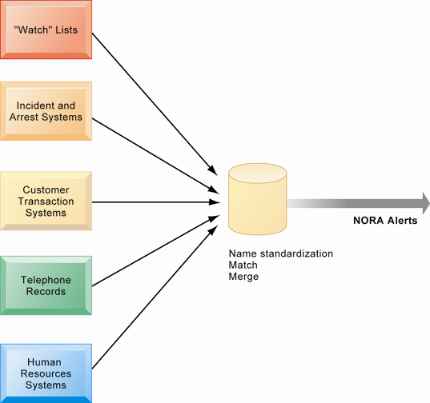
NONOBVIOUS RELATIONSHIP AWARENESS (NORA)

Slide 17
Basic concepts for ethical analysis
Responsibility:
Accepting the potential costs, duties, and obligations for decisions
Accountability:
Mechanisms for identifying responsible parties
Liability:
Permits individuals (and firms) to recover damages done to them
Due process:
Laws are well-known and understood, with an ability to appeal to higher authorities

Slide 18
Five-step ethical analysis
Identify and clearly describe the facts.
Define the conflict or dilemma and identify the higher-order values involved.
Identify the stakeholders.
Identify the options that you can reasonably take.
Identify the potential consequences of your options.

Slide 19
Information rights: privacy and freedom in the Internet age
Privacy:
Claim of individuals to be left alone, free from surveillance or interference from other individuals, organizations, or state; claim to be able to control information about yourself
In the United States, privacy protected by:
First Amendment (freedom of speech)
Fourth Amendment (unreasonable search and seizure)
Additional federal statues (e.g., Privacy Act of 1974)

Slide 20
Fair Information Practices (FIP)
Set of principles governing the collection and use of information
Basis of most U.S. and European privacy laws
Based on mutuality of interest between record holder and individual
Restated and extended by FTC in 1998 to provide guidelines for protecting online privacy
Used to drive changes in privacy legislation
COPPA
Gramm-Leach-Bliley Act
HIPAA
Do-Not-Track Online Act of 2011

Slide 21
Federal Trade Commission (FTC) Fair Information Practices (FIP) principles
1. Notice/awareness (core principle)
Web sites must disclose practices before collecting data.
2. Choice/consent (core principle)
Consumers must be able to choose how information is used for secondary purposes.
3. Access/participation
Consumers must be able to review and contest accuracy of personal data.

Slide 22
Federal Trade Commission (FTC) Fair Information Practices (FIP) principles
4. Security
Data collectors must take steps to ensure accuracy, security of personal data.
5. Enforcement
Must be mechanism to enforce FIP principles.

Slide 23
Internet challenges to privacy
Cookies
Identify browser and track visits to site
Super cookies (Flash cookies)
Web beacons (Web bugs)
Tiny graphics embedded in e-mails and Web pages
Monitor who is reading e-mail message or visiting site
Spyware
Surreptitiously installed on user’s computer
May transmit user’s keystrokes or display unwanted ads
Google services and behavioral targeting

Slide 24
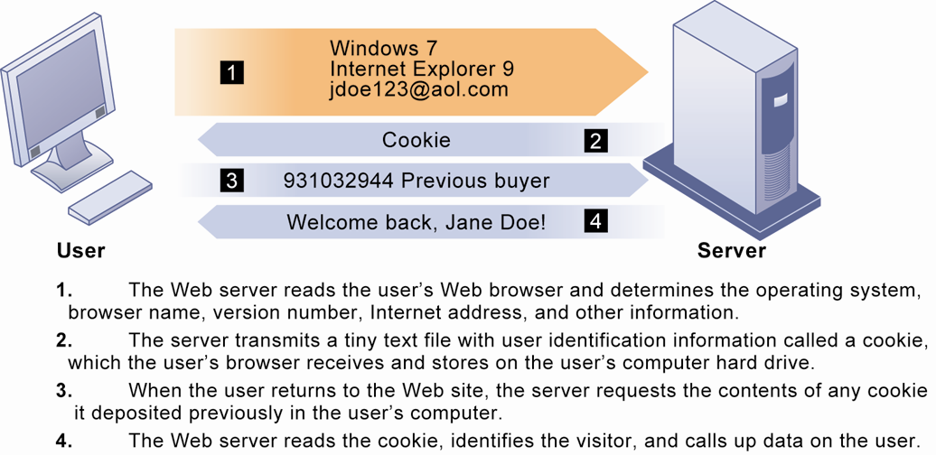
HOW COOKIES IDENTIFY WEB VISITORS

Slide 25
Internet challenges to privacy
The United States allows businesses to gather transaction information and use this for other marketing purposes.
Opt-out vs. opt-in model
Online industry promotes self-regulation over privacy legislation.
However, extent of responsibility taken varies:
Complex/ambiguous privacy statements
Opt-out models selected over opt-in
Online “seals” of privacy principles

Slide 26
Technical solutions for privacy
E-mail encryption
Anonymity tools
Anti-spyware tools
Browser features
“Private” browsing
“Do not track” options
Overall, few technical solutions

Slide 27
Property rights: Intellectual property
Intellectual property: intangible property of any kind created by individuals or corporations
Three main ways that intellectual property is protected:
Trade secret: intellectual work or product belonging to business, not in the public domain
Copyright: statutory grant protecting intellectual property from being copied for the life of the author, plus 70 years
Patents: grants creator of invention an exclusive monopoly on ideas behind invention for 20 years

Slide 28
Challenges to intellectual property rights
Digital media different from physical media (e.g., books)
Ease of replication
Ease of transmission (networks, Internet)
Difficulty in classifying software
Compactness
Difficulties in establishing uniqueness
Digital Millennium Copyright Act (DMCA)
Makes it illegal to circumvent technology-based protections of copyrighted materials

Slide 29
Accountability, liability, control
Computer-related liability problems
If software fails, who is responsible?
If seen as part of machine that injures or harms, software producer and operator may be liable.
If seen as similar to book, difficult to hold author/publisher responsible.
What should liability be if software seen as service? Would this be similar to telephone systems not being liable for transmitted messages?

Slide 30
System quality: Data quality and system errors
What is an acceptable, technologically feasible level of system quality?
Flawless software is economically unfeasible.
Three principal sources of poor system performance:
Software bugs, errors
Hardware or facility failures
Poor input data quality (most common source of business system failure)

Slide 31
Quality of life: Equity, access, boundaries
Negative social consequences of systems
Balancing power: although computing power decentralizing, key decision making remains centralized
Rapidity of change: businesses may not have enough time to respond to global competition
Maintaining boundaries: computing, Internet use lengthens work-day, infringes on family, personal time
Dependence and vulnerability: public and private organizations ever more dependent on computer systems

Slide 32
Quality of life: Equity, access, boundaries
Computer crime and abuse
Computer crime: commission of illegal acts through use of computer or against a computer system—computer may be object or instrument of crime
Computer abuse: unethical acts, not illegal
Spam: high costs for businesses in dealing with spam
Employment:
Reengineering work resulting in lost jobs
Equity and access—the digital divide:
Certain ethnic and income groups in the United States less likely to have computers or Internet access

Slide 33
Quality of life: Equity, access, boundaries
Health risks
Repetitive stress injury (RSI)
Largest source is computer keyboards
Carpal tunnel syndrome (CTS)
Computer vision syndrome (CVS)
Eyestrain and headaches related to screen use
Technostress
Aggravation, impatience, fatigue

Slide 34
Case Study: Amazon and Cloud Computing (Chap. 5) (pp. 234-236) Should Businesses Move to the Cloud?
1. What business benefits do cloud computing services provide? What problems do they solve?
2. What are the disadvantages of cloud computing?
3. How do the concepts of capacity planning, scalability, and TCO apply to this case? Apply these concepts both to Amazon and to subscribers of its services.
4. What kinds of businesses are most likely to benefit from using cloud computing? Why?

Slide 35
資訊管理專題 (Hot Issues of Information Management)
1. 請同學於資訊管理專題個案討論前 應詳細研讀個案，並思考個案研究問題。
2. 請同學於上課前複習相關資訊管理相關理論，以作為個案分析及擬定管理對策的依據。
3. 請同學於上課前 先繳交資訊管理專題個案研究問題書面報告。
4.上課時間地點： 週四 7,8 (14:10-16:00) B702

Slide 36
References
Kenneth C. Laudon & Jane P. Laudon (2014), Management Information Systems: Managing the Digital Firm, Thirteenth Edition, Pearson.
Kenneth C. Laudon & Jane P. Laudon原著， 游張松 主編，陳文生 翻譯 (2014)， 資訊管理系統，第13版，滄海

