Slide 1
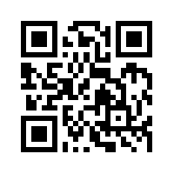
資訊管理專題 Hot Issues of Information Management
Tamkang University
Tamkang University
Global E-Business and Collaboration: P&G (Chap. 2)
1061IM4C03
TLMXB4C (M0842) Thu 7,8 (14:10-16:00) B702
Min-Yuh Day
戴敏育
Assistant Professor
專任助理教授
Dept. of Information Management, Tamkang University
淡江大學 資訊管理學系
http://mail. tku.edu.tw/myday/
2017-10-05

Slide 2
課程大綱 (Syllabus)
週次 (Week) 日期 (Date) 內容 (Subject/Topics)
1 2017/09/21 Introduction to Case Study for Hot Issues of Information Management
2 2017/09/28 Information Systems in Global Business: UPS (Chap. 1) (pp.53-54)
3 2017/10/05 Global E-Business and Collaboration: P&G (Chap. 2) (pp.84-85)
4 2017/10/12 Information Systems, Organization, and Strategy: Starbucks (Chap. 3) (pp.129-130)
5 2017/10/19 Ethical and Social Issues in Information Systems: Facebook (Chap. 4) (pp.188-190)
6 2017/10/26 IT Infrastructure and Emerging Technologies: Amazon and Cloud Computing (Chap. 5) (pp. 234-236)

Slide 3
課程大綱 (Syllabus)
週次 (Week) 日期 (Date) 內容 (Subject/Topics)
7 2017/11/02 Foundations of Business Intelligence: IBM and Big Data (Chap. 6) (pp.261-262)
8 2017/11/09 Telecommunications, the Internet, and Wireless Technology: Google, Apple, and Microsoft (Chap. 7) (pp.318-320)
9 2017/11/16 Midterm Report (期中報告)
10 2017/11/23 Midterm Exam Week (期中考試週)
11 2017/11/30 Enterprise Applications: Summit and SAP (Chap. 9) (pp.396-398)
12 2017/12/07 E-commerce: Zagat (Chap. 10) (pp.443-445)

Slide 4
課程大綱 (Syllabus)
週次 日期 內容（Subject/Topics）
13 2017/12/14 Enhancing Decision Making: Zynga (Chap. 12) (pp.512-514)
14 2017/12/21 Building Information Systems: USAA (Chap. 13) (pp.547-548)
15 2017/12/28 Managing Projects: NYCAPS and CityTime (Chap. 14) (pp.586-588)
16 2018/01/04 Final Report I (期末報告 I)
17 2018/01/11 Final Report II (期末報告 II)
18 2018/01/18 Final Exam Week (期末考試週)

Slide 5
Management Information Systems: Managing the Digital Firm
1
Organization, Management, and the Networked Enterprise
2
Information Technology Infrastructure
3
Key System Applications for the Digital Age
4
Building and Managing Systems

Slide 6
Chap. 2 Global E-Business and Collaboration: P&G

Slide 7
Case Study: P&G (Chap. 2) (pp.84-85) Piloting Procter & Gamble from Decision Cockpits
1. What management, organization, and technology issues had to be addressed when implementing Business Sufficiency, Business Sphere, and Decision Cockpits?
2. How did these decision-making tools change the way the company ran its business? How effective are they? Why?
3. How are these systems related to P&G’s business strategy?

Slide 8
Overview of Fundamental MIS Concepts
Business Challenges
Management
Organization
Information System
Business Solutions
Technology

Slide 9
Business Model
8
7
2
4
1
Key Partners
Key Activities
Value Proposition
Customer Relationships
Customer Segments
6
3
Key Resources
Channels
9
5
Cost Structure
Revenue Streams
Source: Alexander Osterwalder & Yves Pigneur, Business Model Generation: A Handbook for Visionaries, Game Changers, and Challengers, Wiley, 2010.

Slide 10
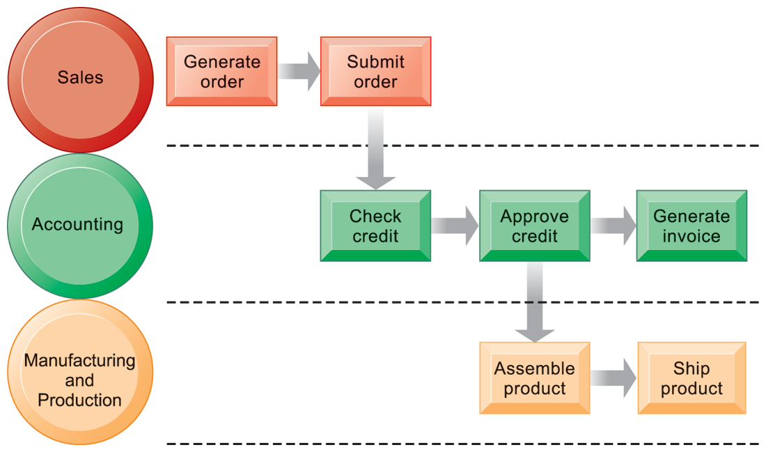
The Order Fulfillment Process

Slide 11
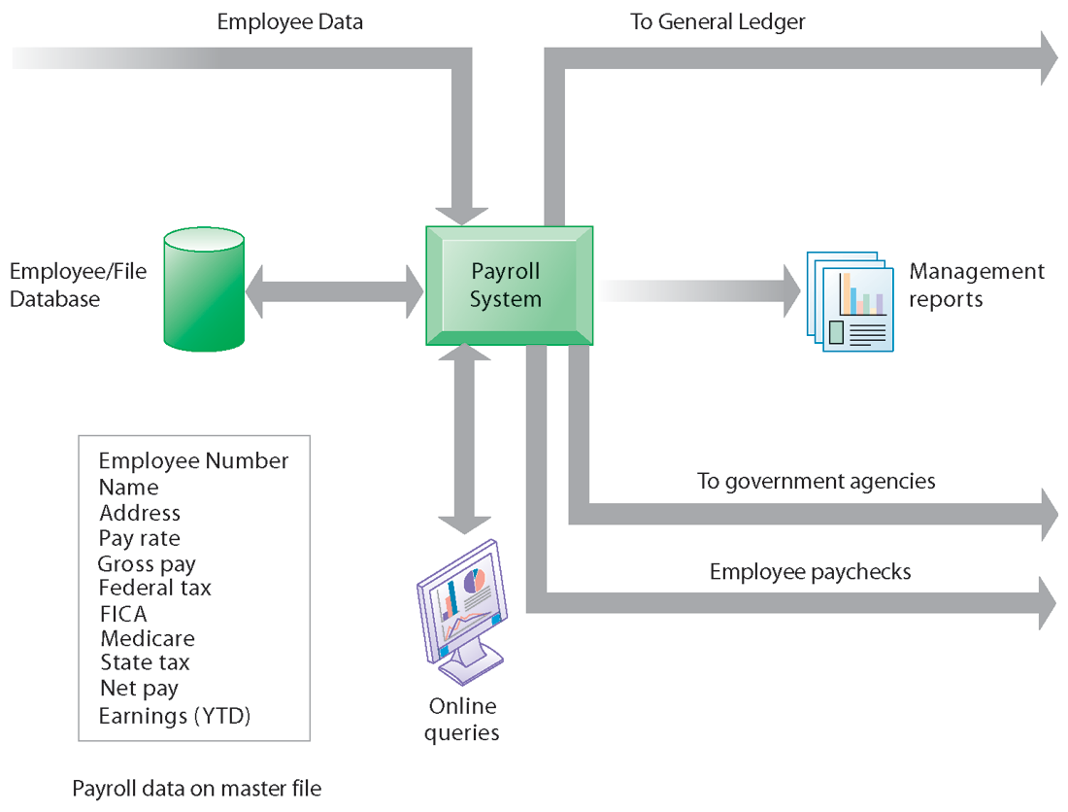
A Payroll TPS

Slide 12
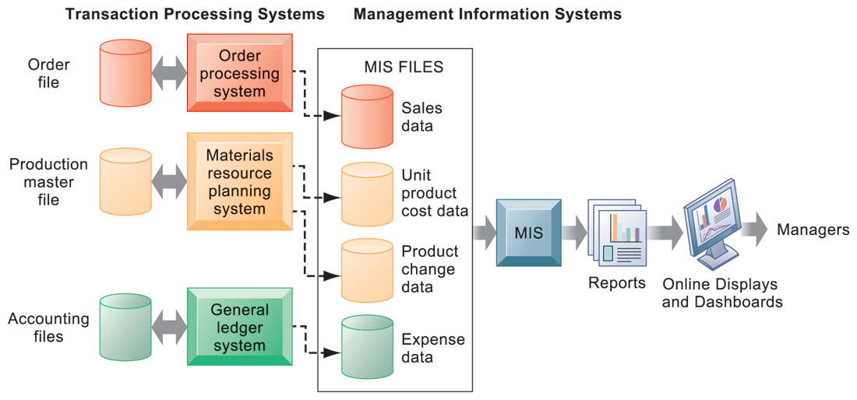
How Management Information Systems Obtain Their Data from the Organization’s TPS

Slide 13
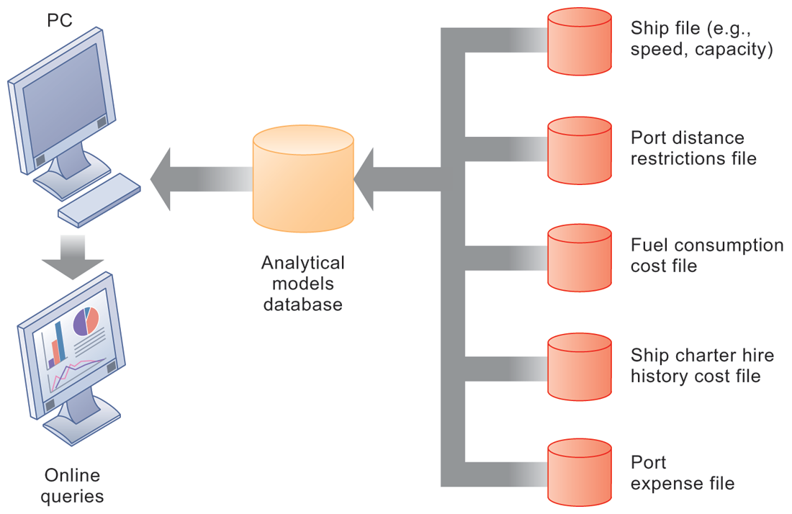
Voyage-Estimating Decision Support System

Slide 14
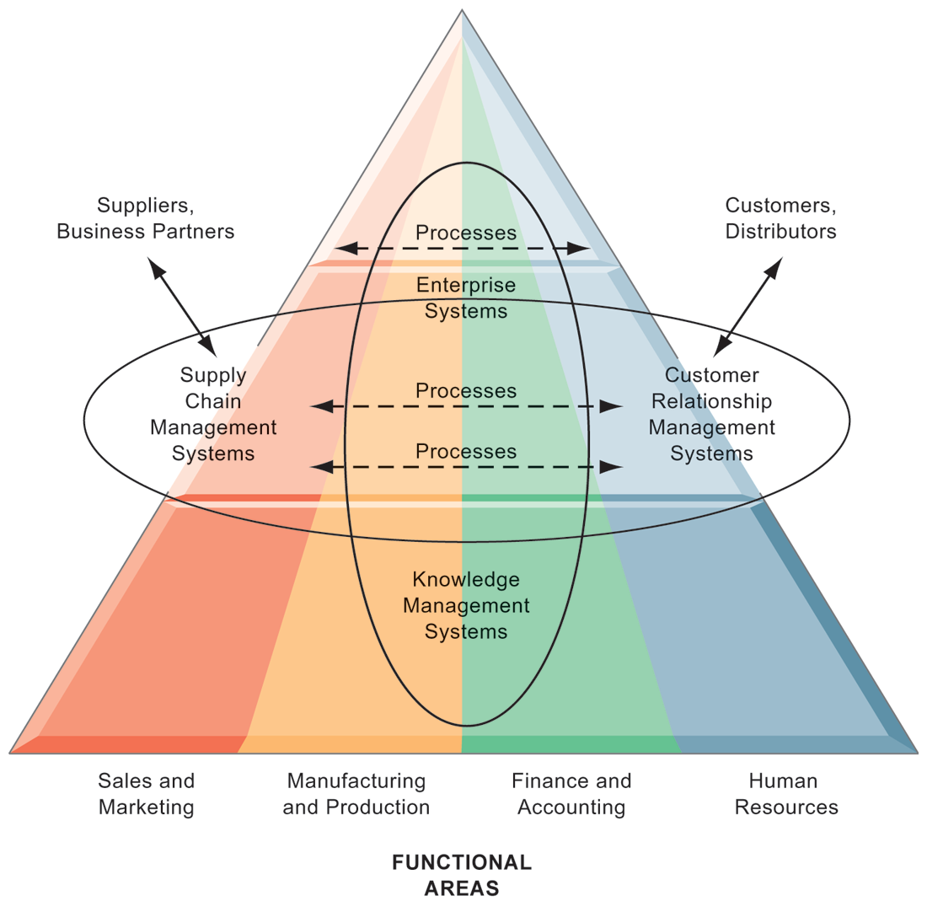
Enterprise Application Architecture

Slide 15
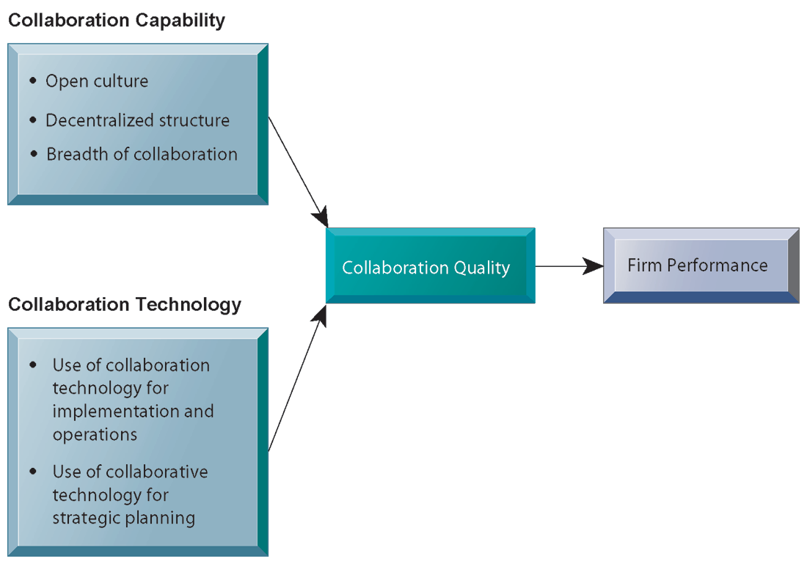
Requirements for Collaboration

Slide 16
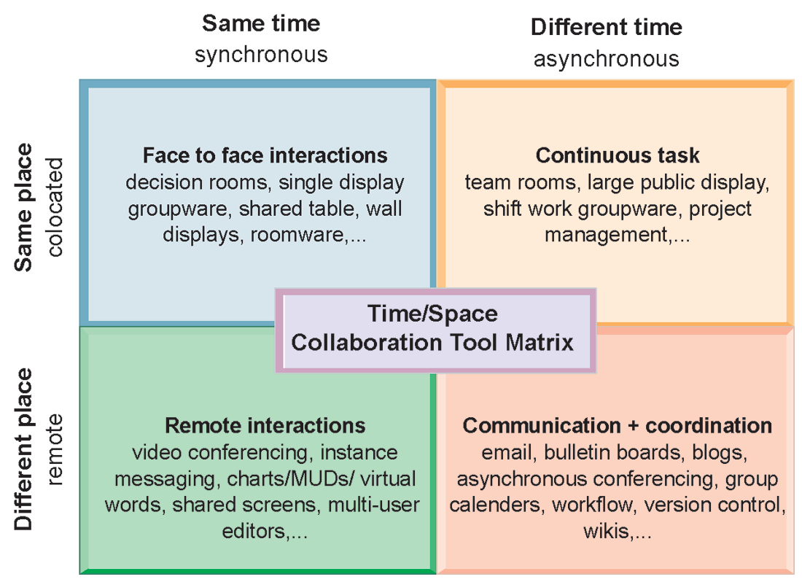
The Time/Space Collaboration Tool Matrix

Slide 17
The Information Systems Function in Business
Information systems department:
Formal organizational unit responsible for information technology services
Often headed by chief information officer (CIO)
Other senior positions include chief security officer (CSO), chief knowledge officer (CKO), chief privacy officer (CPO)
Programmers
Systems analysts
Information systems managers

Slide 18
The Information Systems Function in Business
End users
Representatives of other departments for whom applications are developed
Increasing role in system design, development
IT Governance:
Strategies and policies for using IT in the organization
Decision rights
Accountability
Organization of information systems function
Centralized, decentralized, and so on

Slide 19
Definition of Business Model
A business model describes the rationale of how an organization creates, delivers, and captures value.
Source: Alexander Osterwalder & Yves Pigneur, Business Model Generation: A Handbook for Visionaries, Game Changers, and Challengers, Wiley, 2010.

Slide 20
Definition of Business Strategy
A business strategy is a long term plan of action designed to achieve a particular goal or set of goals or objectives.

Slide 21
Business
“the activity of providing goods and services involving financial, commercial and industrial aspects.” (WordNet 2.0)

Slide 22
Model
“a simplified description and representation of a complex entity or process.” (WordNet 2.0)

Slide 23
Business Model
A business model is a conceptual tool containing a set of objects, concepts and their relationships with the objective to express the business logic of a specific firm.
Therefore we must consider which concepts and relationships allow a simplified description and representation of what value is provided to customers, how this is done and with which financial consequences.
23

Slide 24
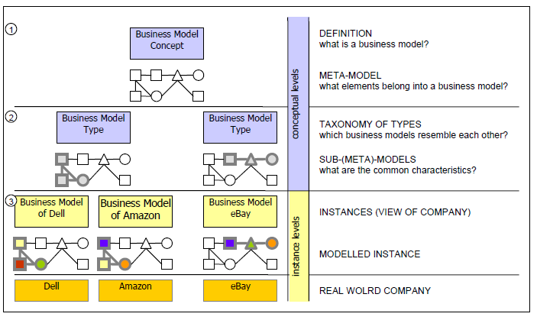
Business Model Concept Hierarchy
24

Slide 25
Business Model vs. Business Process Model
Business Model
a view of the firm's logic for creating and commercializing value
Business process model
how a business case is implemented in processes

Slide 26
Business Model vs. Strategy
Business Models
a system that shows how the pieces of a business fit together.
an abstraction of a firm's strategy
Strategy
includes competition

Slide 27
Implementing Business Models
27

Slide 28
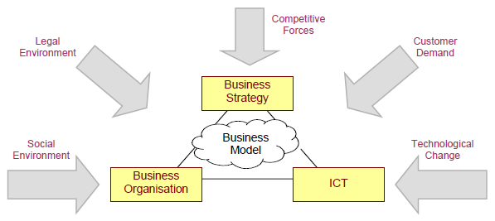
The Business Model's Place in the Firm
28

Slide 29
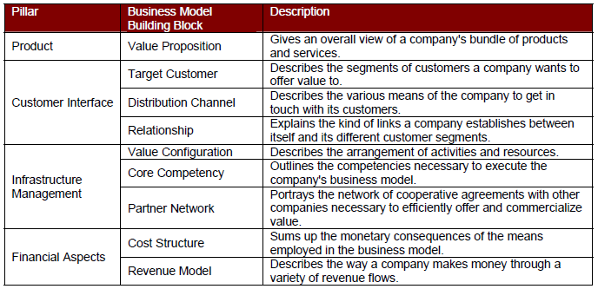
Nine Business Model Building Blocks
29

Slide 30
Planning, Changing and Implementing Business Models
30

Slide 31
Business Strategy and Information Systems Alignment
31

Slide 32
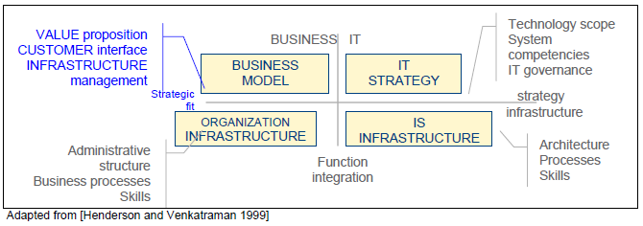
Business and IT/IS Alignment
32

Slide 33
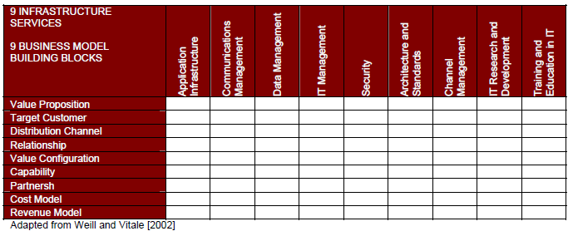
Infrastructure Alignment
33

Slide 34
Case Study: Starbucks (Chap. 3) (pp.129-130) Technology Helps Starbucks Find New Ways to Compete
1. Analyze Starbucks using the competitive forces and value chain models.
2. What is Starbucks’ business strategy? Assess the role played by technology in this business strategy.
3. How much has technology helped Starbucks compete? Explain your answer.

Slide 35
資訊管理專題 (Hot Issues of Information Management)
1. 請同學於資訊管理專題個案討論前 應詳細研讀個案，並思考個案研究問題。
2. 請同學於上課前複習相關資訊管理相關理論，以作為個案分析及擬定管理對策的依據。
3. 請同學於上課前 先繳交資訊管理專題個案研究問題書面報告。
4.上課時間地點： 週四 7,8 (14:10-16:00) B702

Slide 36
References
Kenneth C. Laudon & Jane P. Laudon (2014), Management Information Systems: Managing the Digital Firm, Thirteenth Edition, Pearson.
Kenneth C. Laudon & Jane P. Laudon原著， 游張松 主編，陳文生 翻譯 (2014)， 資訊管理系統，第13版，滄海

