Slide 1
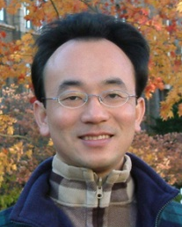
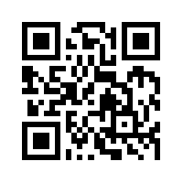
資訊管理專題 Hot Issues of Information Management
Tamkang University
Tamkang University
Introduction to Case Study for Hot Issues of Information Management
1061IM4C01
TLMXB4C (M0842) Thu 7,8 (14:10-16:00) B702
Min-Yuh Day
戴敏育
Assistant Professor
專任助理教授
Dept. of Information Management, Tamkang University
淡江大學 資訊管理學系
http://mail. tku.edu.tw/myday/
2017-09-21

Slide 2
淡江大學106學年度第1學期 課程教學計畫表 Fall 2017 (2017.09.20 - 2018.01.17)
課程名稱：資訊管理專題 (Hot Issues of Information Management)
授課教師：戴敏育 (Min-Yuh Day)
開課系級：資管4C (TLMXB4C)(M0842)
開課資料：必修 單學期 2 學分 (2 Credits, Required)
上課時間地點：週四 7,8 (14:10-16:00) B702

Slide 3
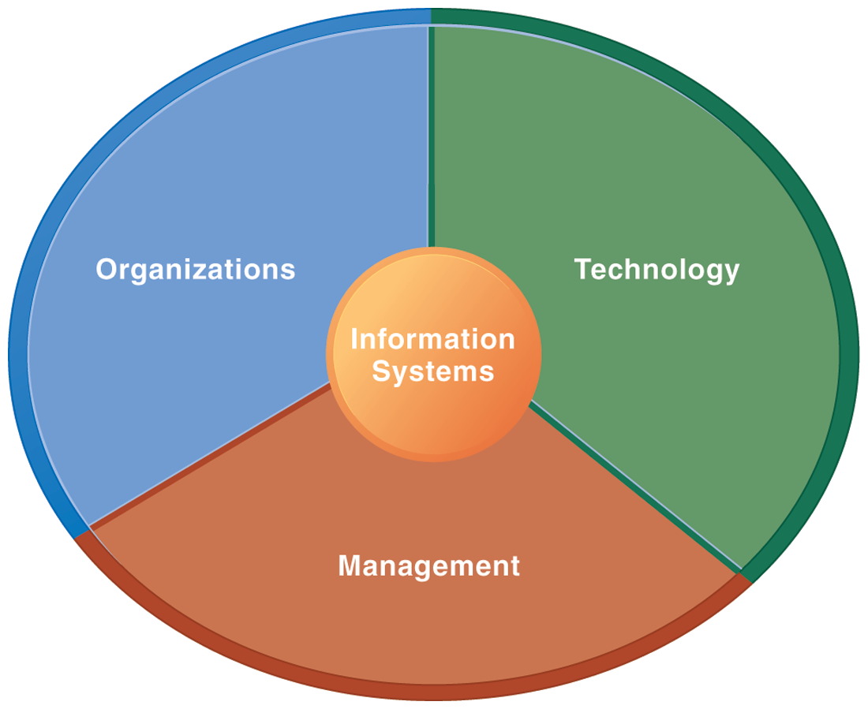
Information Management (MIS) Information Systems

Slide 4
Overview of Fundamental MIS Concepts
Business Challenges
Management
Organization
Information System
Business Solutions
Technology

Slide 5
Management Information Systems: Managing the Digital Firm
1
Organization, Management, and the Networked Enterprise
2
Information Technology Infrastructure
3
Key System Applications for the Digital Age
4
Building and Managing Systems

Slide 6
課程簡介
本課程透過資訊管理專題個案研究讓學生理解 資訊系統與企業績效的直接連結。
資訊管理專題課程讓學生可以更好的了解 特定公司如何使用資訊系統 來達成主要的企業目標：
卓越的經營
新產品、服務和商業模式
客戶和供應商的緊密關係
改善決策制定
競爭優勢
永續經營

Slide 7
Course Introduction
This course helps students to understand and analysis the direct connection between information systems and business performance though case study of information management hot topics.
It helps students a better understanding of how specific companies use information systems to achieve the main business objectives:
operational excellence
new products, services, and business models
customer and supplier intimacy
improved decision making
competitive advantage
survival

Slide 8
課程目標
學生將能夠暸解及應用 資訊管理專題個案研究的方法

Slide 9
Objective
Student will be able to understand and apply the methods of case study for information management hot topics.

Slide 10
課程大綱 (Syllabus)
週次 (Week) 日期 (Date) 內容 (Subject/Topics)
1 2017/09/21 Introduction to Case Study for Hot Issues of Information Management
2 2017/09/28 Information Systems in Global Business: UPS (Chap. 1) (pp.53-54)
3 2017/10/05 Global E-Business and Collaboration: P&G (Chap. 2) (pp.84-85)
4 2017/10/12 Information Systems, Organization, and Strategy: Starbucks (Chap. 3) (pp.129-130)
5 2017/10/19 Ethical and Social Issues in Information Systems: Facebook (Chap. 4) (pp.188-190)
6 2017/10/26 IT Infrastructure and Emerging Technologies: Amazon and Cloud Computing (Chap. 5) (pp. 234-236)

Slide 11
課程大綱 (Syllabus)
週次 (Week) 日期 (Date) 內容 (Subject/Topics)
7 2017/11/02 Foundations of Business Intelligence: IBM and Big Data (Chap. 6) (pp.261-262)
8 2017/11/09 Telecommunications, the Internet, and Wireless Technology: Google, Apple, and Microsoft (Chap. 7) (pp.318-320)
9 2017/11/16 Midterm Report (期中報告)
10 2017/11/23 Midterm Exam Week (期中考試週)
11 2017/11/30 Enterprise Applications: Summit and SAP (Chap. 9) (pp.396-398)
12 2017/12/07 E-commerce: Zagat (Chap. 10) (pp.443-445)

Slide 12
課程大綱 (Syllabus)
週次 日期 內容（Subject/Topics）
13 2017/12/14 Enhancing Decision Making: Zynga (Chap. 12) (pp.512-514)
14 2017/12/21 Building Information Systems: USAA (Chap. 13) (pp.547-548)
15 2017/12/28 Managing Projects: NYCAPS and CityTime (Chap. 14) (pp.586-588)
16 2018/01/04 Final Report I (期末報告 I)
17 2018/01/11 Final Report II (期末報告 II)
18 2018/01/18 Final Exam Week (期末考試週)

Slide 13
教材課本與參考書籍
教材課本 (Textbook)
Kenneth C. Laudon & Jane P. Laudon (2014), Management Information Systems: Managing the Digital Firm, Thirteenth Edition, Pearson.
參考書籍 (References)
Kenneth C. Laudon & Jane P. Laudon原著， 游張松 主編，陳文生 翻譯 (2014)， 資訊管理系統，第13版，滄海

Slide 14
修課應注意事項
1. 請同學於資訊管理專題個案討論前 應詳細研讀個案，並思考個案研究問題。
2. 請同學於上課前複習相關資訊管理相關理論，以作為個案分析及擬定管理對策的依據。
3. 請同學於上課前 先繳交資訊管理專題個案研究問題書面報告。
4.上課時間地點： 週四 7,8 (14:10-16:00) B702

Slide 15
學期成績計算方式
期中評量： 30.0 %
期末評量： 30.0 %
平時評量 ：40.0 % (課堂參與及報告討論表現)

Slide 16
Case Study

Slide 17
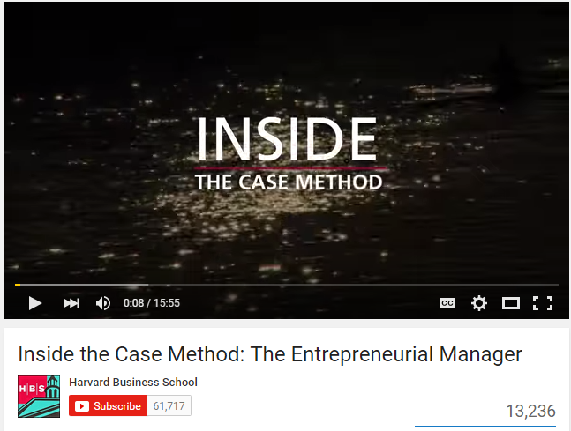
Case Study
Harvard Business School
The Case Method at HBS
Inside the Case Method: The Entrepreneurial Manager
http://www.youtube.com/watch?v=YWybEVsVwe4 (15:56)

Slide 18
Information Management (MIS) Information Systems

Slide 19
Overview of Fundamental MIS Concepts
Business Challenges
Management
Organization
Information System
Business Solutions
Technology

Slide 20
Management Information Systems: Managing the Digital Firm
1
Organization, Management, and the Networked Enterprise
2
Information Technology Infrastructure
3
Key System Applications for the Digital Age
4
Building and Managing Systems

Slide 21
Business Model

Slide 22
Business Model
8
7
2
4
1
Key Partners
Key Activities
Value Proposition
Customer Relationships
Customer Segments
6
3
Key Resources
Channels
9
5
Cost Structure
Revenue Streams
Source: Alexander Osterwalder & Yves Pigneur, Business Model Generation: A Handbook for Visionaries, Game Changers, and Challengers, Wiley, 2010.

Slide 23
Definition of Business Model
A business model describes the rationale of how an organization creates, delivers, and captures value.
Source: Alexander Osterwalder & Yves Pigneur, Business Model Generation: A Handbook for Visionaries, Game Changers, and Challengers, Wiley, 2010.

Slide 24
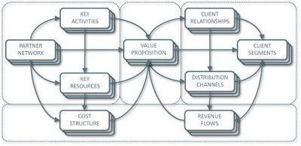
Business Model Canvas
Key Activities
Customer Relationships
Key Partners
Value Preposition
Customer Segments
Key Resources
Channels
Cost Structure
Revenue Streams
Source: http://nonlinearthinking.typepad.com/nonlinear_thinking/2008/07/the-business-model-canvas.html
https://www.youtube.com/watch?v=QoAOzMTLP5s

Slide 25
Business Model Canvas
Infrastructure Management
Product
Customer Interface
Key Activities
Customer Relationships
Key Partners
Value Preposition
Customer Segments
Key Resources
Channels
Financial Aspects
Cost Structure
Revenue Streams
Source: http://nonlinearthinking.typepad.com/nonlinear_thinking/2008/07/the-business-model-canvas.html
https://www.youtube.com/watch?v=QoAOzMTLP5s

Slide 26
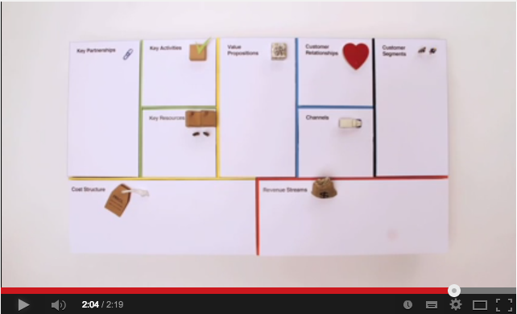
Business Model Canvas Explained
Source: http://www.youtube.com/watch?v=QoAOzMTLP5s

Slide 27
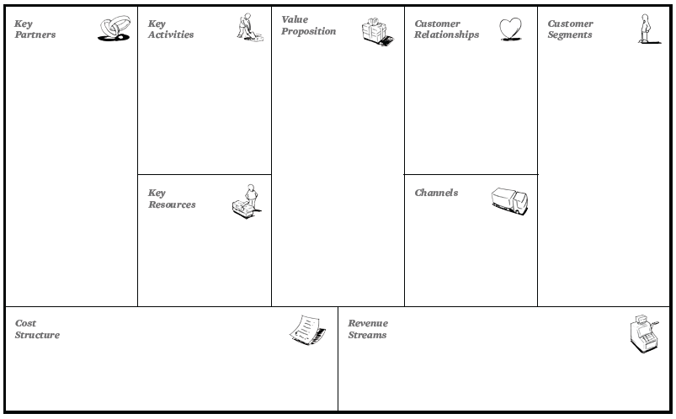
The 9 Building Blocks of Business Model
8
7
2
4
1
6
3
9
5
Source: Alexander Osterwalder & Yves Pigneur, Business Model Generation: A Handbook for Visionaries, Game Changers, and Challengers, Wiley, 2010.

Slide 28
Case Study: UPS (Chap. 1) (pp.53-54) UPS Competes Globally with Information Technology

Slide 29
Ponsse: Efficiency in Wood Harvesting with Information System
Source: http://www.ponsse.com/

Slide 30
Overview of Fundamental MIS Concepts using an integrated framework for describing and analyzing information systems
Business Challenges
Develop new production processes
Develop new management techniques
Increase use of data by managers
New sources of competition
Declining customer base
Increasing costs
Management
Build new business production processes
Train new channels of information flow
Train employee in use of the systems
Organization
Information System
Business Solutions
Optimize utilization of forests
Increase production efficiency
Coordinate production process
Technology
Display and report GPS location data
Reports on production
Provide online coordination
Develop GPS systems for field use
Create email links with operators
Develop data base to receive information

Slide 31
Information Systems in Global Business
How are information systems transforming business and what is their relationship to globalization?
Why are information systems so essential for running and managing a business today?
What exactly is an information system? How does it work? What are its management, organization, and technology components?
What are complementary assets? Why are complementary assets essential for ensuring that information systems provide genuine value for an organization?
What academic disciplines are used to study information systems? How does each contribute to an understanding of information systems? What is a sociotechnical systems perspective?

Slide 32
How information systems are transforming business
Emerging mobile digital platform
Growing business use of “big data”
Growth in cloud computing

Slide 33
Globalization opportunities
Internet has drastically reduced costs of operating on global scale
Increases in foreign trade, outsourcing
Presents both challenges and opportunities

Slide 34
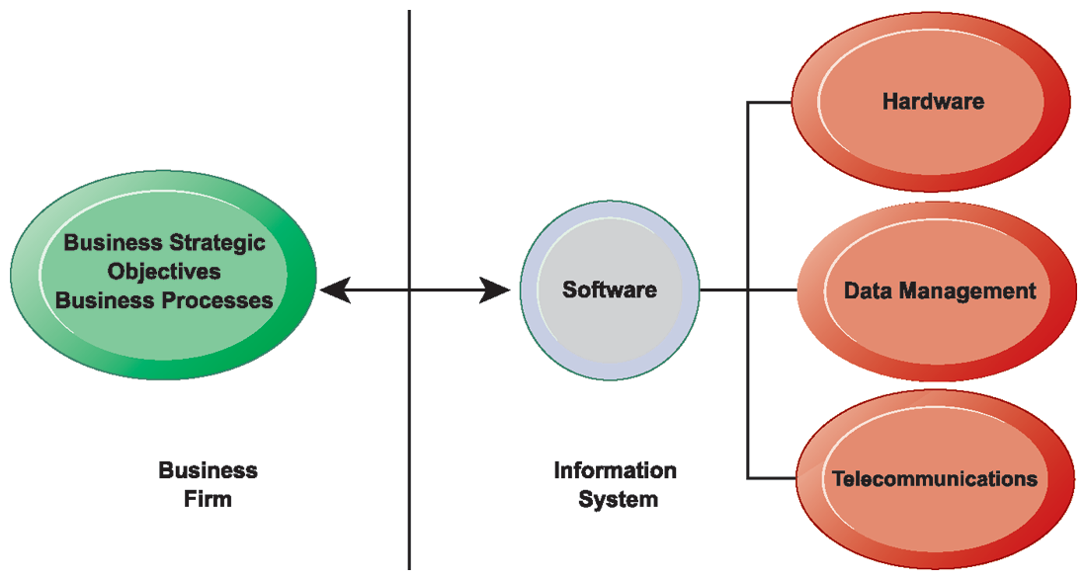
The Interdependence Between Organizations and Information Technology

Slide 35
Strategic Business Objectives of Information Systems
Operational Excellence
New Products, Services and Business Models
Customer and Supplier Intimacy
Improved Decision Making
Competitive Advantage
Survival

Slide 36
1. Operational Excellence
Improvement of efficiency to attain higher profitability
Information systems, technology an important tool in achieving greater efficiency and productivity
Walmart’s Retail Link system links suppliers to stores for superior replenishment system

Slide 37
2. New Products, Services, and Business Models
Business model: describes how company produces, delivers, and sells product or service to create wealth
Information systems and technology a major enabling tool for new products, services, business models
Examples: Apple’s iPad, Google’s Android OS, and Netflix

Slide 38
3. Customer and Supplier Intimacy
Serving customers well leads to customers returning, which raises revenues and profits.
Example: High-end hotels that use computers to track customer preferences and used to monitor and customize environment
Intimacy with suppliers allows them to provide vital inputs, which lowers costs.
Example: JCPenney’s information system which links sales records to contract manufacturer

Slide 39
4. Improved Decision Making
Without accurate information:
Managers must use forecasts, best guesses, luck
Results in:
Overproduction, underproduction
Misallocation of resources
Poor response times
Poor outcomes raise costs, lose customers
Example:
Verizon’s Web-based digital dashboard to provide managers with real-time data on customer complaints, network performance, line outages

Slide 40
5. Competitive advantage
Delivering better performance
Charging less for superior products
Responding to customers and suppliers in real time
Examples: Apple, Walmart, UPS

Slide 41
6. Survival
Information technologies as necessity of business
Industry-level changes
Example: Citibank’s introduction of ATMs
Governmental regulations requiring record-keeping
Examples: Toxic Substances Control Act, Sarbanes-Oxley Act

Slide 42
Information Systems Are More Than Computers

Slide 43
Dimensions of Information Systems
Organizations
People, structure, business processes, politics, and culture.
Management
Make sense out of the many situations faced by organizations, make decisions, and formulate action plans to solve organizational problems.
Information Technology
Computer hardware, software, data management technology, networking and telecommunications technology

Slide 44
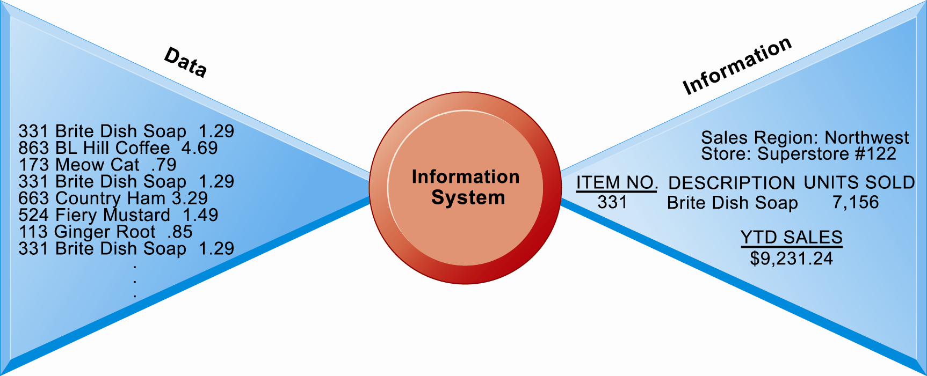
Perspectives on Information Systems: Data and Information

Slide 45
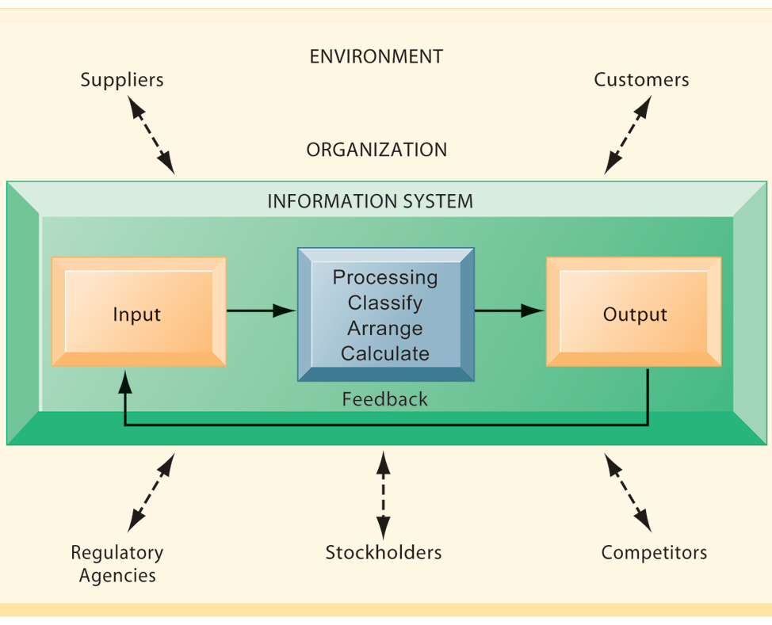
Functions of an Information System

Slide 46
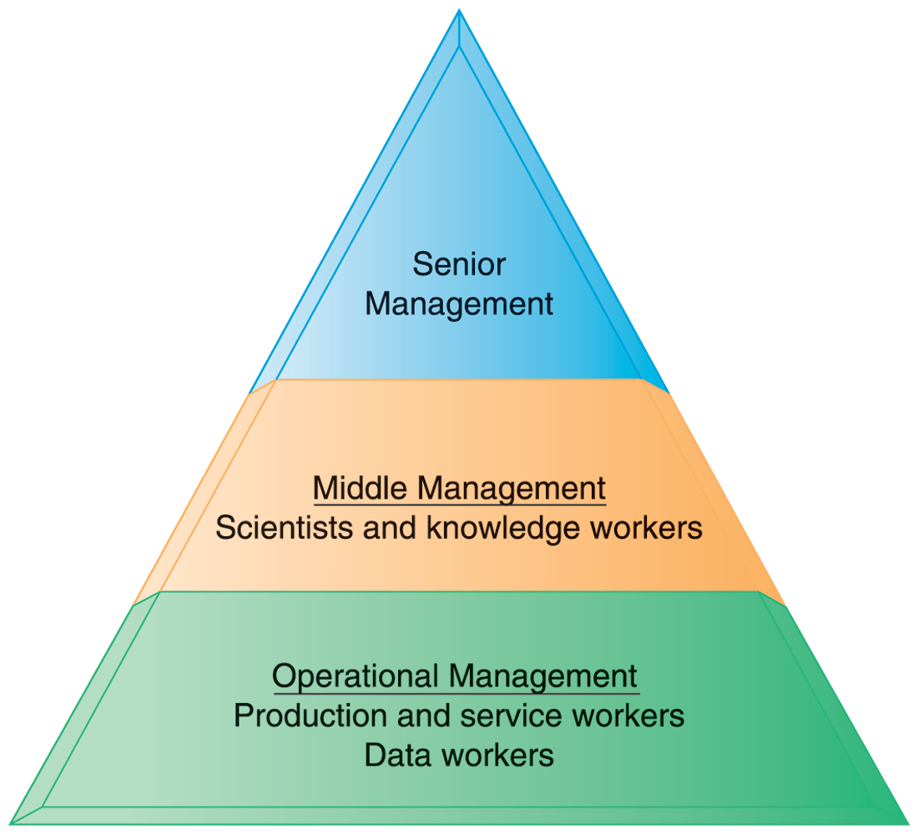
Levels in a Firm

Slide 47
MAJOR BUSINESS FUNCTIONS
FUNCTION | PURPOSE
Sales and marketing | Selling the organization’s products and services
Manufacturing and production | Producing and delivering products and services
Finance and accounting | Managing the organization’s financial assets and maintaining the organization’s financial records
Human resources | Attracting, developing, and maintaining the organization’s labor force; maintaining employee records

Slide 48
IT ISN’T JUST TECHNOLOGY: A BUSINESS PERSPECTIVE ON INFORMATION SYSTEMS

Slide 49
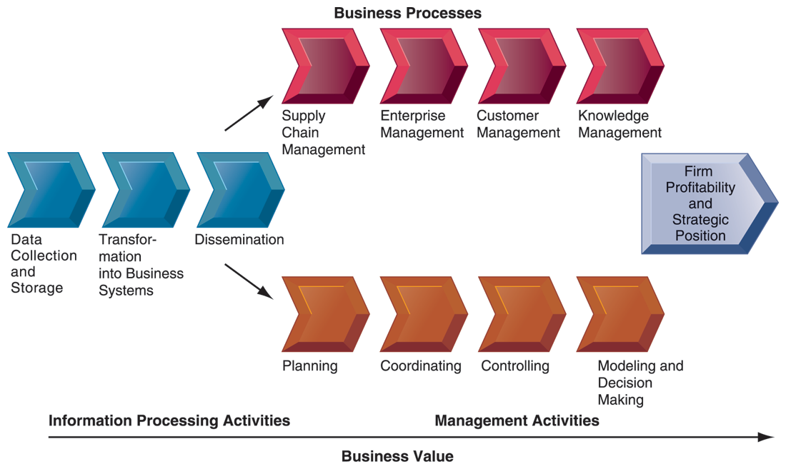
The Business Information Value Chain

Slide 50
The Business Information Value Chain
From a business perspective, information systems are part of a series of value-adding activities for acquiring, transforming, and distributing information that managers can use to improve decision making, enhance organizational performance, and, ultimately, increase firm profitability.

Slide 51
COMPLEMENTARY SOCIAL, MANAGERIAL, AND ORGANIZATIONAL ASSETS REQUIRED TO OPTIMIZE RETURNS FROM INFORMATION TECHNOLOGY INVESTMENTS

Slide 52
Organizational assets
Supportive organizational culture that values efficiency and effectiveness
Appropriate business model
Efficient business processes
Decentralized authority
Distributed decision-making rights
Strong IS development team

Slide 53
Managerial assets
Strong senior management support for technology investment and change
Incentives for management innovation
Teamwork and collaborative work environments
Training programs to enhance management decision skills
Management culture that values flexibility and knowledge-based decision making.

Slide 54
Social assets
The Internet and telecommunications infrastructure
IT-enriched educational programs raising labor force computer literacy
Standards (both government and private sector)
Laws and regulations creating fair, stable market environments
Technology and service firms in adjacent markets to assist implementation

Slide 55
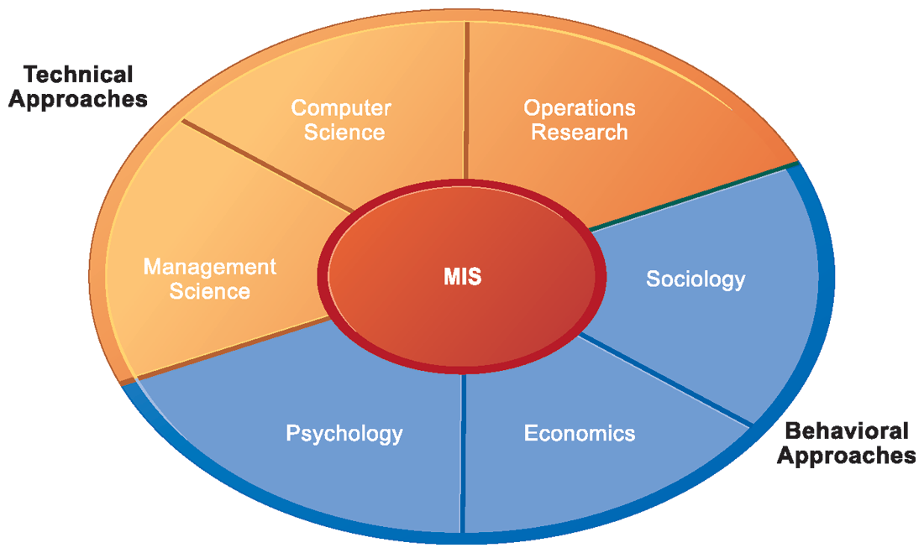
Contemporary Approaches to Information Systems

Slide 56
Contemporary Approaches to Information Systems
Technical Approach
Behavioral Approach
Sociotechnical Systems

Slide 57
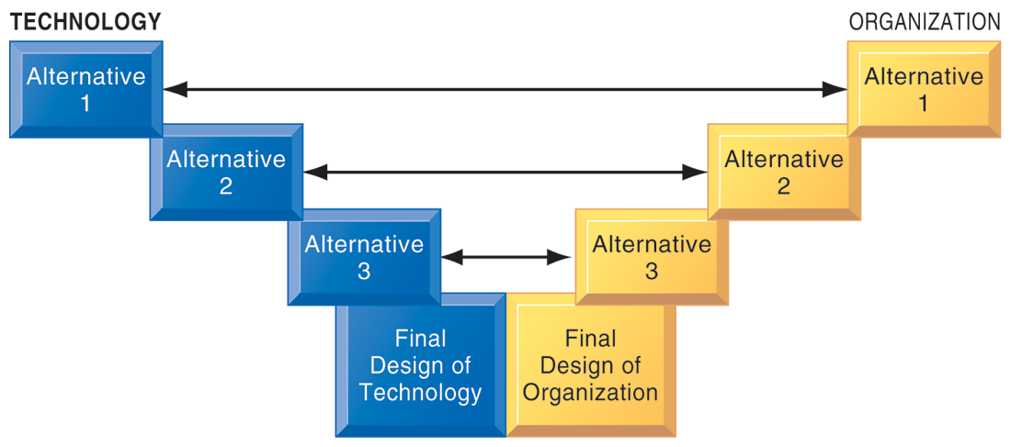
A Sociotechnical Perspective on Information Systems

Slide 58
Case Study: UPS (Chap. 1) (pp.53-54) UPS Competes Globally with Information Technology
1. What are the inputs, processing, and outputs of UPS’s package tracking system?
2. What technologies are used by UPS? How are these technologies related to UPS’s business strategy?
3. What strategic business objectives do UPS’s information systems address?
4. What would happen if UPS’s information systems were not available?

Slide 59
資訊管理專題 (Hot Issues of Information Management)
1. 請同學於資訊管理專題個案討論前 應詳細研讀個案，並思考個案研究問題。
2. 請同學於上課前複習相關資訊管理相關理論，以作為個案分析及擬定管理對策的依據。
3. 請同學於上課前 先繳交資訊管理專題個案研究問題書面報告。
4.上課時間地點： 週四 7,8 (14:10-16:00) B702

Slide 60
Summary
This course helps students to understand and analysis the direct connection between information systems and business performance though case study of information management hot topics.
It helps students a better understanding of how specific companies use information systems to achieve the main business objectives:
operational excellence
new products, services, and business models
customer and supplier intimacy
improved decision making
competitive advantage
survival

Slide 61
Contact Information
戴敏育 博士 (Min-Yuh Day, Ph.D.)
專任助理教授
淡江大學 資訊管理學系
電話：02-26215656 #2846
傳真：02-26209737
研究室：B929
地址： 25137 新北市淡水區英專路151號
Email： myday@mail.tku.edu.tw
網址：http://mail.tku.edu.tw/myday/

