Slide 1
資訊管理專題 Hot Issues of Information Management
Tamkang University
Tamkang University
E-commerce: Digital Markets, Digital Goods: Zagat (Chap. 10)
1061IM4B10
TLMXB4B (M0842) Wed 8,9 (15:10-17:00) B702
Min-Yuh Day
戴敏育
Assistant Professor
專任助理教授
Dept. of Information Management, Tamkang University
淡江大學 資訊管理學系
http://mail. tku.edu.tw/myday/
2017-12-27

Slide 2
課程大綱 (Syllabus)
週次 (Week) 日期 (Date) 內容 (Subject/Topics)
1 2017/09/20 Introduction to Case Study for Hot Issues of Information Management
2 2017/09/27 Information Systems in Global Business: UPS (Chap. 1) (pp.53-54)
3 2017/10/04 Mid-Autumn Festival (Day off) (中秋節) (放假一天)
4 2017/10/11 Global E-Business and Collaboration: P&G (Chap. 2) (pp.84-85)
5 2017/10/18 Information Systems, Organization, and Strategy: Starbucks (Chap. 3) (pp.129-130)
6 2017/10/25 Ethical and Social Issues in Information Systems: Facebook (Chap. 4) (pp.188-190)

Slide 3
課程大綱 (Syllabus)
週次 (Week) 日期 (Date) 內容 (Subject/Topics)
7 2017/11/01 IT Infrastructure and Emerging Technologies: Amazon and Cloud Computing (Chap. 5) (pp. 234-236)
8 2017/11/08 IT Infrastructure and Emerging Technologies: Amazon and Cloud Computing (Chap. 5) (pp. 234-236)
9 2017/11/15 Midterm Report (期中報告)
10 2017/11/22 Midterm Exam Week (期中考試週)
11 2017/11/29 Foundations of Business Intelligence: IBM and Big Data (Chap. 6) (pp.261-262)
12 2017/12/06 Foundations of Business Intelligence: IBM and Big Data (Chap. 6) (pp.261-262)

Slide 4
課程大綱 (Syllabus)
週次 日期 內容（Subject/Topics）
13 2017/12/13 Telecommunications, the Internet, and Wireless Technology: Google, Apple, and Microsoft (Chap. 7) (pp.318-320)
14 2017/12/20 Enterprise Applications: Summit and SAP (Chap. 9) (pp.396-398)
15 2017/12/27 E-commerce: Zagat (Chap. 10) (pp.443-445)
16 2018/01/03 Final Report I (期末報告 I)
17 2018/01/10 Final Report II (期末報告 II)
18 2018/01/17 Final Exam Week (期末考試週)

Slide 5
Management Information Systems: Managing the Digital Firm
1
Organization, Management, and the Networked Enterprise
2
Information Technology Infrastructure
3
Key System Applications for the Digital Age
4
Building and Managing Systems

Slide 6
Chap. 10 E-commerce: Digital Markets, Digital Goods: Zagat

Slide 7
Case Study: E-commerce: Zagat (Chap. 10) (pp.443-445) To Pay or Not to Pay: Zagat’s Dilemma
1. Evaluate Zagat using the competitive forces and value chain models.
2. Compare Zagat’s and Yelp’s e-commerce business models. How have those models affected each company's Web strategy?
3. Why was Zagat’s content well suited for the Web and for the mobile digital platform?
4. Do you think Zagat’s decision to use a pay wall for its Web site was a mistake? Why or why not?
5. Will Zagat’s acquisition by Google make it more competitive? Explain your answer.

Slide 8
Overview of Fundamental MIS Concepts
Business Challenges
Management
Organization
Information System
Business Solutions
Technology

Slide 9
Business Model
8
7
2
4
1
Key Partners
Key Activities
Value Proposition
Customer Relationships
Customer Segments
6
3
Key Resources
Channels
9
5
Cost Structure
Revenue Streams
Source: Alexander Osterwalder & Yves Pigneur, Business Model Generation: A Handbook for Visionaries, Game Changers, and Challengers, Wiley, 2010.

Slide 10
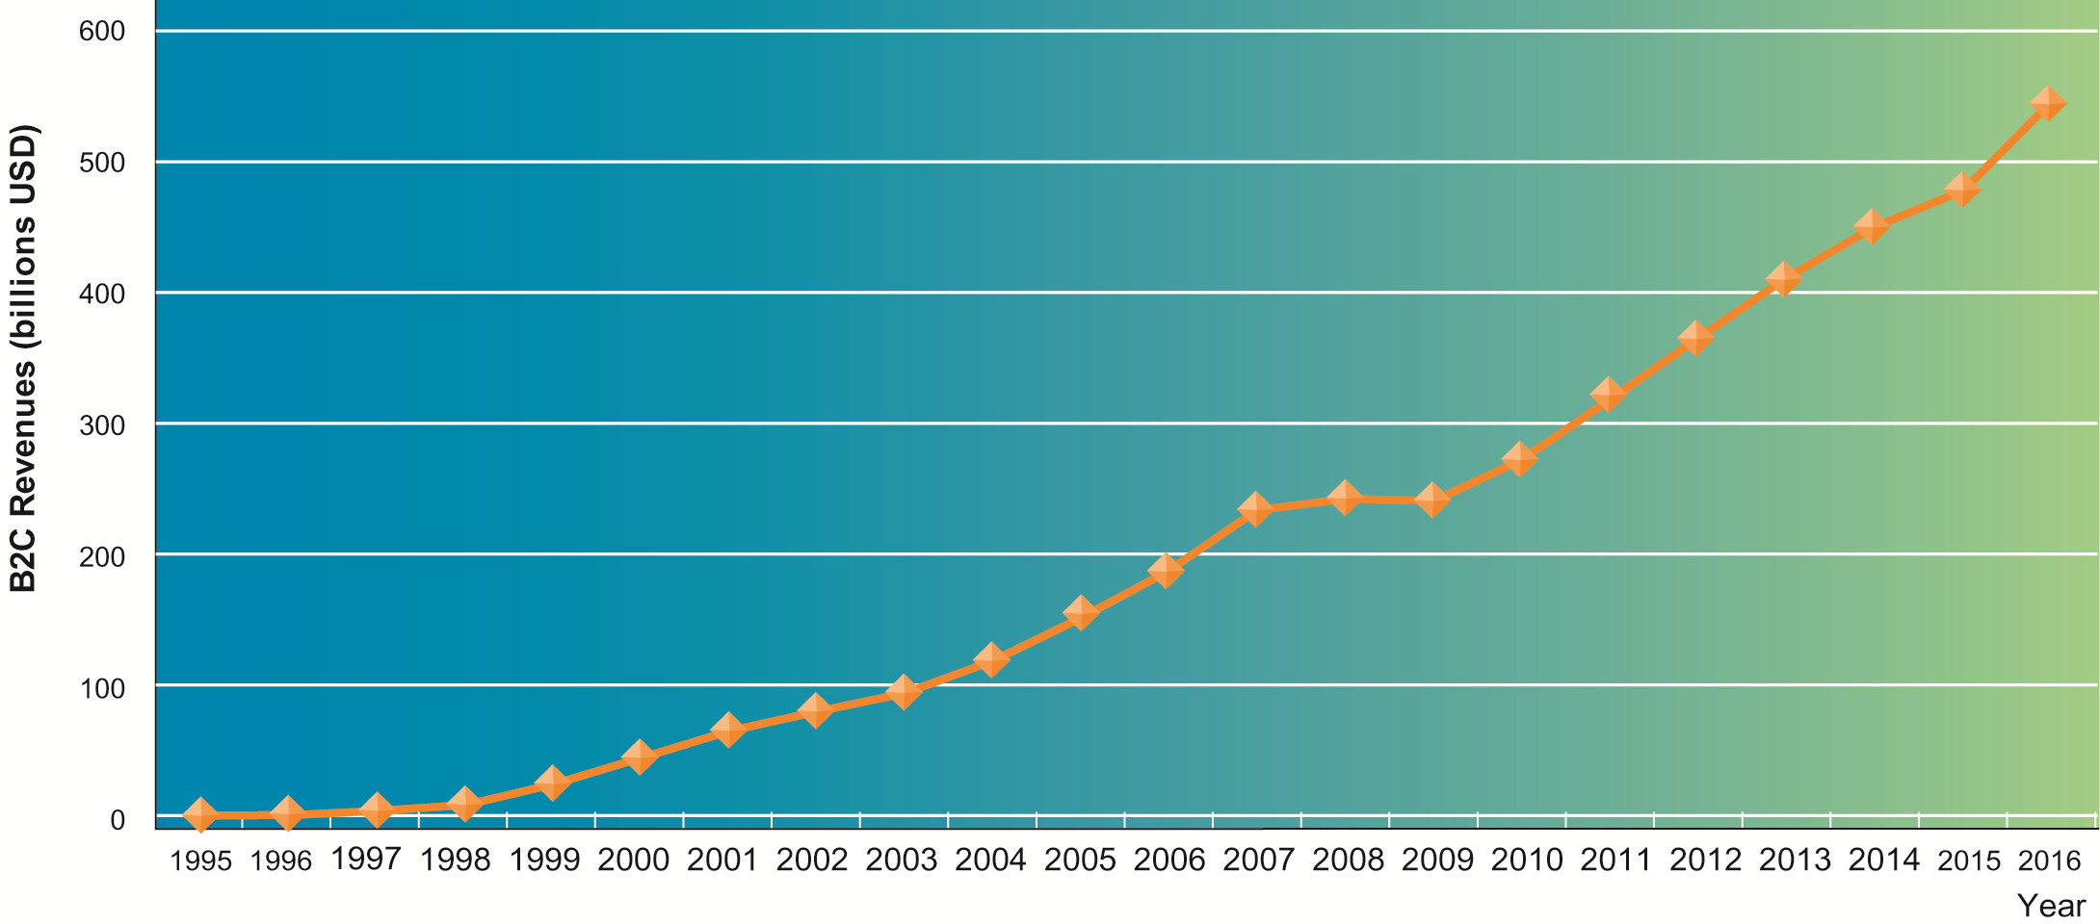
The Growth of E-Commerce

Slide 11
8 Unique Features of E-commerce
Ubiquity
Global reach
Universal standards
Richness
Interactivity
Information density
Personalization/Customization
Social technology

Slide 12
Ubiquity
Internet/Web technology available everywhere: work, home, and so on, anytime.
Effect:
Marketplace removed from temporal, geographic locations to become “marketspace”
Enhanced customer convenience and reduced shopping costs
Reduces transaction costs
Costs of participating in market

Slide 13
Global reach
The technology reaches across national boundaries, around Earth
Effect:
Commerce enabled across cultural and national boundaries seamlessly and without modification.
Marketspace includes, potentially, billions of consumers and millions of businesses worldwide.

Slide 14
Universal standards
One set of technology standards: Internet standards
Effect:
Disparate computer systems easily communicate with one another
Lower market entry costs—costs merchants must pay to bring goods to market
Lower consumers’ search costs—effort required to find suitable products

Slide 15
Richness
Supports video, audio, and text messages
Effect:
Possible to deliver rich messages with text, audio, and video simultaneously to large numbers of people.
Video, audio, and text marketing messages can be integrated into single marketing message and consumer experience.

Slide 16
Interactivity
The technology works through interaction with the user.
Effect:
Consumers engaged in dialog that dynamically adjusts experience to the individual.
Consumer becomes co-participant in process of delivering goods to market.

Slide 17
Information density
Large increases in information density—the total amount and quality of information available to all market participants
Effect:
Greater price transparency
Greater cost transparency
Enables merchants to engage in price discrimination

Slide 18
Personalization/Customization
Technology permits modification of messages, goods
Effect:
Personalized messages can be sent to individuals as well as groups.
Products and services can be customized to individual preferences.

Slide 19
Social technology
The technology promotes user content generation and social networking
Effect:
New Internet social and business models enable user content creation and distribution, support social networks
Many-to-many model

Slide 20
Effect of the Internet on the marketplace
Reduces information asymmetry
Offers greater flexibility and efficiency because of:
Reduced search costs and transaction costs
Lower menu costs
Greater price discrimination
Dynamic pricing
May reduce or increase switching costs
May delay gratification: effects dependent on product
Increased market segmentation
Stronger network effects
More disintermediation

Slide 21
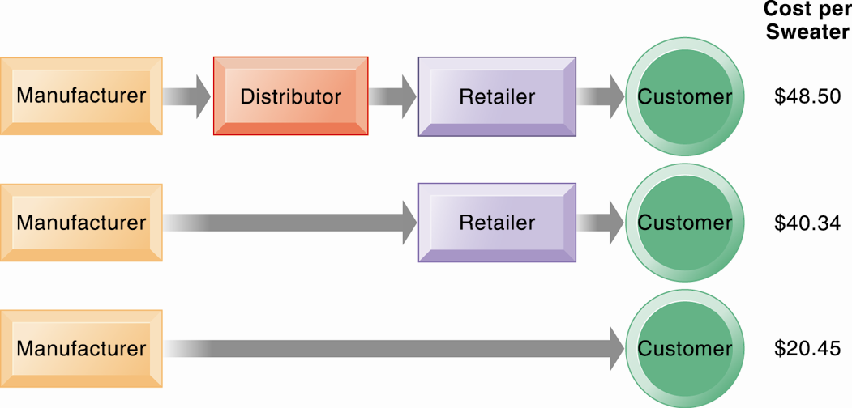
The Benefits of Disintermediation to the Consumer

Slide 22
Digital goods
Goods that can be delivered over a digital network
For example: music tracks, video, software, newspapers, books
Cost of producing first unit is almost entire cost of product
Costs of delivery over the Internet very low
Marketing costs remain the same; pricing highly variable
Industries with digital goods are undergoing revolutionary changes (publishers, record labels, etc.)

Slide 23
Types of E-Commerce
Three major types of e-commerce
Business-to-Consumer (B2C)
Example: BarnesandNoble.com
Business-to-Business (B2B)
Example: ChemConnect
Consumer-to-Consumer (C2C)
Example: eBay
E-commerce can be categorized by platform
Mobile Commerce (m-commerce)

Slide 24
E-commerce Business Models
E-tailer
Transaction broker
Market creator
Content provider
Community provider
Portal
Service provider

Slide 25
E-commerce Revenue Models
Advertising
Sales
Subscription
Free/Freemium
Transaction Fee
Affiliate

Slide 26
Understanding Business Model
Business Model
Revenue Model
Business Strategy
Business Strategy and Information System Alignment

Slide 27
Business Model

Slide 28
Value

Slide 29
Business Model
8
7
2
4
1
Key Partners
Key Activities
Value Proposition
Customer Relationships
Customer Segments
6
3
Key Resources
Channels
9
5
Cost Structure
Revenue Streams
Source: Alexander Osterwalder & Yves Pigneur, Business Model Generation: A Handbook for Visionaries, Game Changers, and Challengers, Wiley, 2010.

Slide 30
Business Model
8
7
2
4
1
Key Partners
Key Activities
Value Proposition
Customer Relationships
Customer Segments
What?
6
3
Key Resources
Channels
Who?
How?
Why?
9
5
Cost Structure
Revenue Streams
Source: Alexander Osterwalder & Yves Pigneur, Business Model Generation: A Handbook for Visionaries, Game Changers, and Challengers, Wiley, 2010.

Slide 31
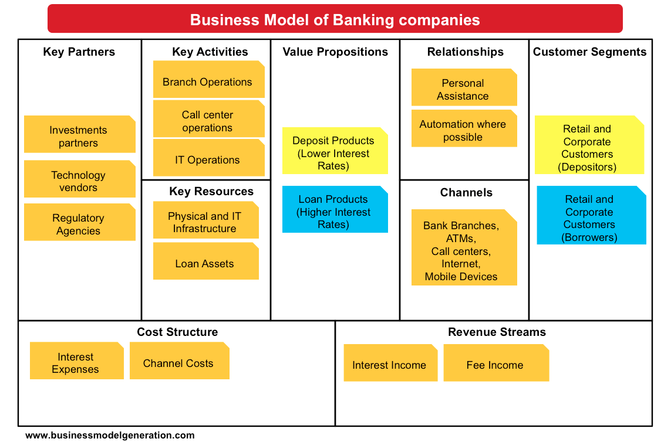
Source: http://bmimatters.com/tag/business-model-canvas-examples/

Slide 32
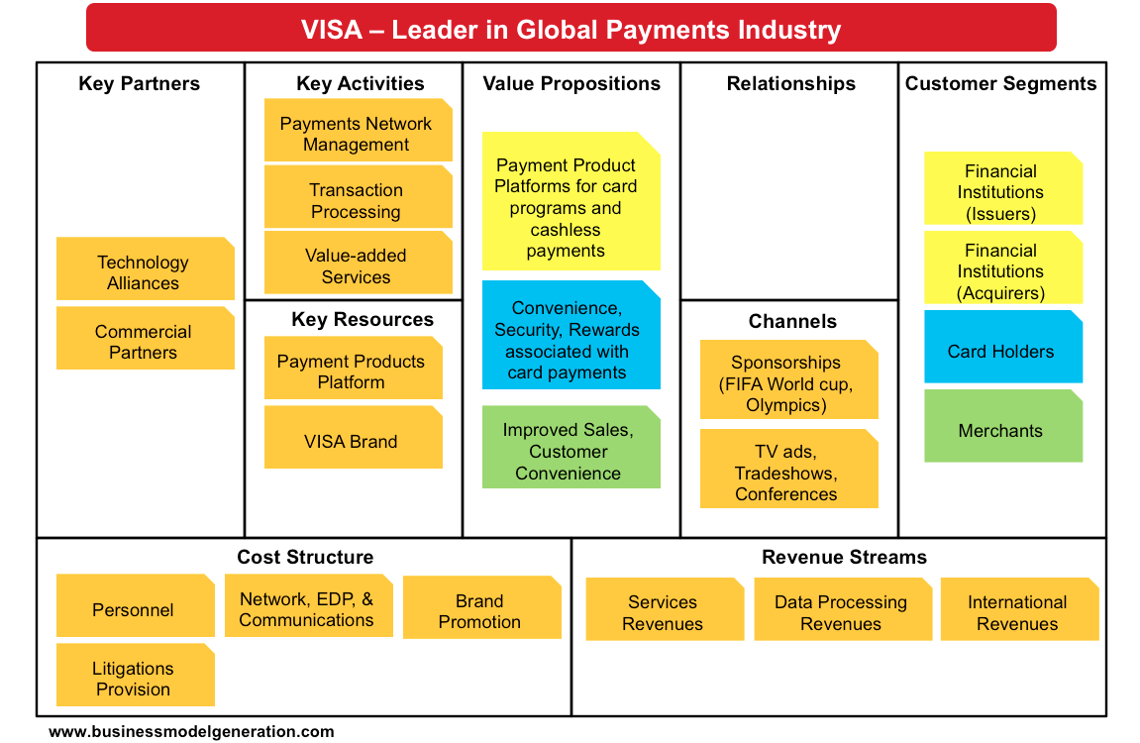
Source: http://bmimatters.com/tag/business-model-canvas-examples/

Slide 33
Apply Pay Business Model
Source: https://www.slideshare.net/Strategyzer/apple-pay-bmc/16-Apple_Pay_Seamless_Secure_Mobile

Slide 34
Value Proposition

Slide 35
Source: http://www.peterjthomson.com/value-proposition-canvas-example-evernote/

Slide 36
Business Models Innovation

Slide 37
Why Business Model Innovation
Target Market
Revenue Mechanism
Value Proposition
Value Network
(Ecosystem)
Value Chain
Competitive Strategy
Source: Chesbrough, Henry. "Business model innovation: it's not just about technology anymore." Strategy & leadership 35, no. 6 (2007): 12-17.

Slide 38
Business Model Innovation
Adding new activities
Linking activities in novel ways
Changing one or more parties that perform any of the activities
Source: Amit, Raphael, and Christoph Zott. "Creating value through business model innovation." MIT Sloan Management Review 53, no. 3 (2012): 41.
Notes:
Business Model Innovation
adding new activities
linking activities in novel ways
changing one or more parties that perform any of the activities.
Source: Amit, Raphael, and Christoph Zott. "Creating value through business model innovation." MIT Sloan Management Review 53, no. 3 (2012): 41.

Slide 39
Business Model Innovation
2
What novel activities could help satisfy those needs
5
How will value be created for each stakeholder?
1
What customer needs will the new business model address?
3
How could the activities be linked in novel ways?
6
What revenues models can be adopted to complement the business model?
What should perform the activities? What novel governance arrangements can be found?
4
Source: Amit, Raphael, and Christoph Zott. "Creating value through business model innovation." MIT Sloan Management Review 53, no. 3 (2012): 41.

Slide 40
Digital goods
Goods that can be delivered over a digital network
For example: music tracks, video, software, newspapers, books
Cost of producing first unit is almost entire cost of product
Costs of delivery over the Internet very low
Marketing costs remain the same; pricing highly variable
Industries with digital goods are undergoing revolutionary changes (publishers, record labels, etc.)

Slide 41
Types of E-Commerce
Three major types of e-commerce
Business-to-Consumer (B2C)
Example: BarnesandNoble.com
Business-to-Business (B2B)
Example: ChemConnect
Consumer-to-Consumer (C2C)
Example: eBay
E-commerce can be categorized by platform
Mobile Commerce (m-commerce)

Slide 42
E-commerce Business Models
E-tailer
Transaction broker
Market creator
Content provider
Community provider
Portal
Service provider

Slide 43
Business Models of the Future
Source: https://www.raconteur.net/business/online-marketplaces-uberisation-and-business-models-of-tomorrow

Slide 44
Understanding Business Model
Business Model
Revenue Model
Business Strategy
Business Strategy and Information System Alignment

Slide 45
Definition of Business Model
A business model describes the rationale of how an organization creates, delivers, and captures value.
Source: Alexander Osterwalder & Yves Pigneur, Business Model Generation: A Handbook for Visionaries, Game Changers, and Challengers, Wiley, 2010.

Slide 46
Definition of Business Strategy
A business strategy is a long term plan of action designed to achieve a particular goal or set of goals or objectives.

Slide 47
Business
“the activity of providing goods and services involving financial, commercial and industrial aspects.” (WordNet 2.0)

Slide 48
Model
“a simplified description and representation of a complex entity or process.” (WordNet 2.0)

Slide 49
Business Model
A business model is a conceptual tool containing a set of objects, concepts and their relationships with the objective to express the business logic of a specific firm.
Therefore we must consider which concepts and relationships allow a simplified description and representation of what value is provided to customers, how this is done and with which financial consequences.
49

Slide 50
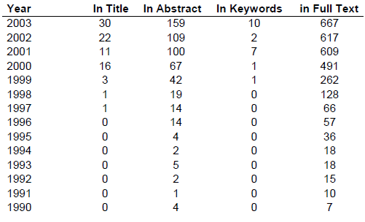
Occurrences of the Term "Business Model" in Scholarly Reviewed Journals
50

Slide 51
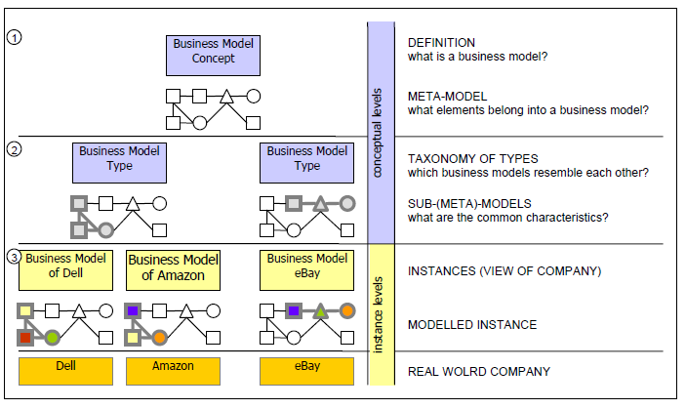
Business Model Concept Hierarchy
51

Slide 52
Evolution of the Business Model Concept
52

Slide 53
Business Model vs. Business Process Model
Business Model
a view of the firm's logic for creating and commercializing value
Business process model
how a business case is implemented in processes

Slide 54
Business Model vs. Strategy
Business Models
a system that shows how the pieces of a business fit together.
an abstraction of a firm's strategy
Strategy
includes competition

Slide 55
Implementing Business Models
55

Slide 56
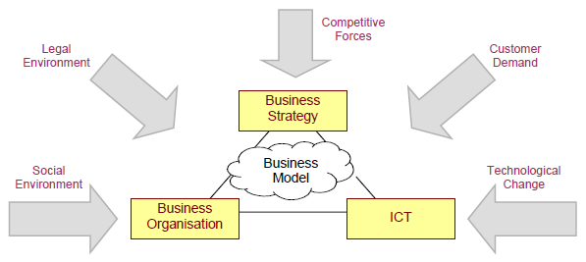
The Business Model's Place in the Firm
56

Slide 57
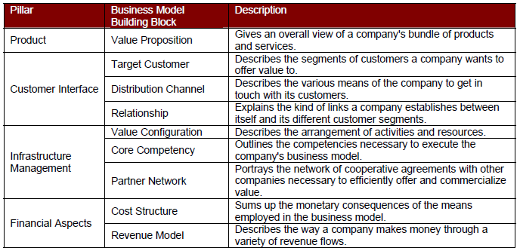
Nine Business Model Building Blocks
57

Slide 58
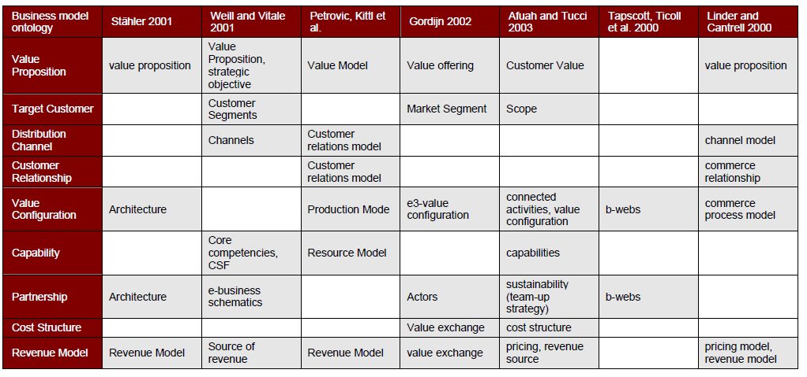
Domains Addressed in Business Models
58

Slide 59
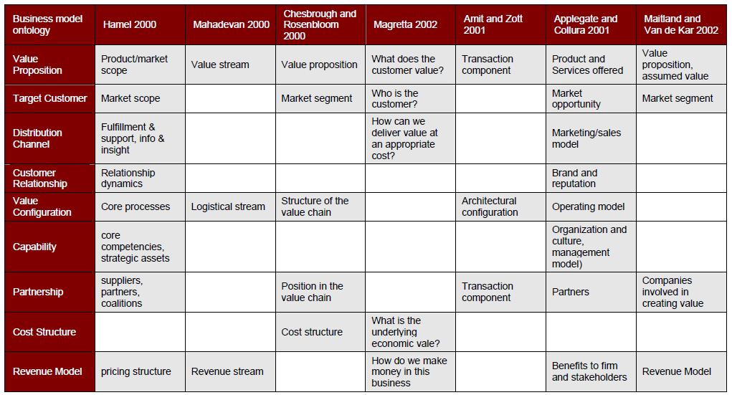
Domains Addressed in Business Models (cont.)
59

Slide 60
Planning, Changing and Implementing Business Models
60

Slide 61
Business Strategy and Information Systems Alignment
61

Slide 62
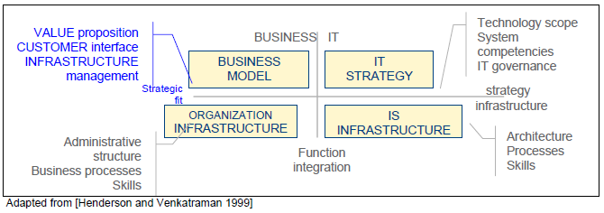
Business and IT/IS Alignment
62

Slide 63
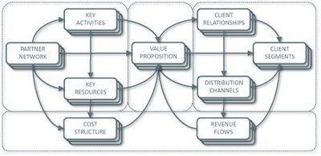
Business Model Canvas
Key Activities
Customer Relationships
Key Partners
Value Preposition
Customer Segments
Key Resources
Channels
Cost Structure
Revenue Streams
Source: http://nonlinearthinking.typepad.com/nonlinear_thinking/2008/07/the-business-model-canvas.html
https://www.youtube.com/watch?v=QoAOzMTLP5s

Slide 64
Business Model Canvas
Infrastructure Management
Product
Customer Interface
Key Activities
Customer Relationships
Key Partners
Value Preposition
Customer Segments
Key Resources
Channels
Financial Aspects
Cost Structure
Revenue Streams
Source: http://nonlinearthinking.typepad.com/nonlinear_thinking/2008/07/the-business-model-canvas.html
https://www.youtube.com/watch?v=QoAOzMTLP5s

Slide 65
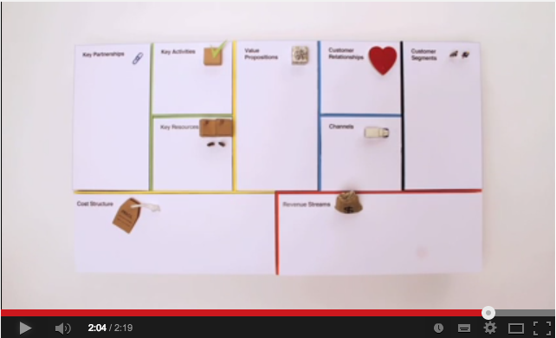
Business Model Canvas Explained
Source: http://www.youtube.com/watch?v=QoAOzMTLP5s

Slide 66
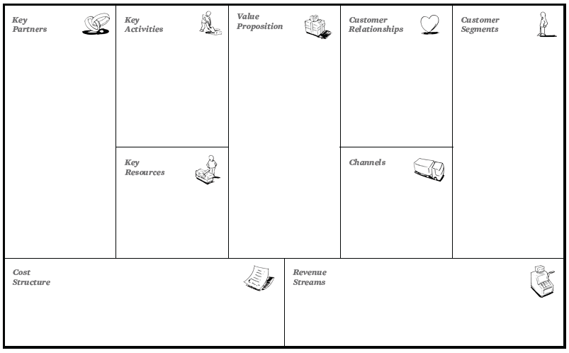
The 9 Building Blocks of Business Model
8
7
2
4
1
6
3
9
5
Source: Alexander Osterwalder & Yves Pigneur, Business Model Generation: A Handbook for Visionaries, Game Changers, and Challengers, Wiley, 2010.

Slide 67
The 9 Building Blocks of Business Model
8
7
2
4
1
How?
What?
Who?
6
3
Why?
9
5
Source: Alexander Osterwalder & Yves Pigneur, Business Model Generation: A Handbook for Visionaries, Game Changers, and Challengers, Wiley, 2010.

Slide 68
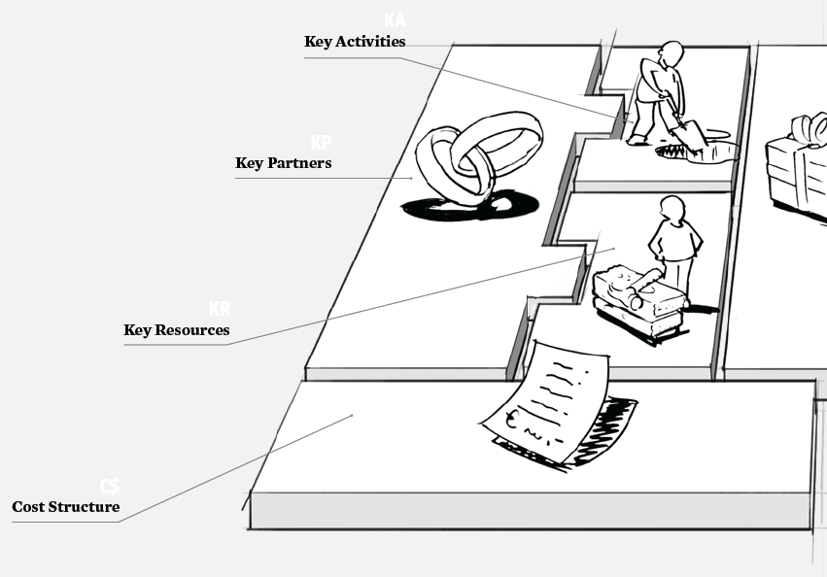
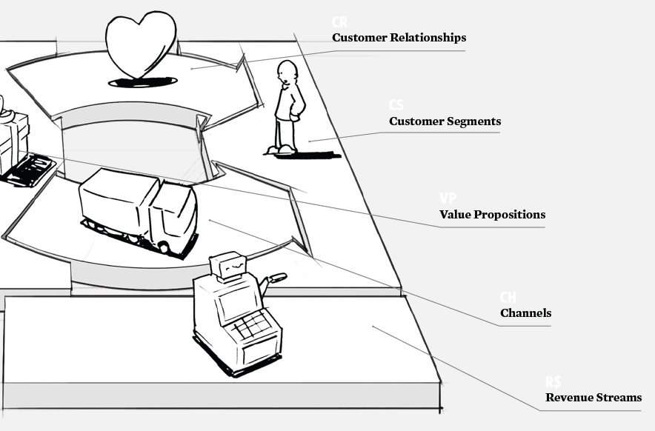
The 9 Building Blocks of Business Model
Source: Alexander Osterwalder & Yves Pigneur, Business Model Generation: A Handbook for Visionaries, Game Changers, and Challengers, Wiley, 2010.

Slide 69
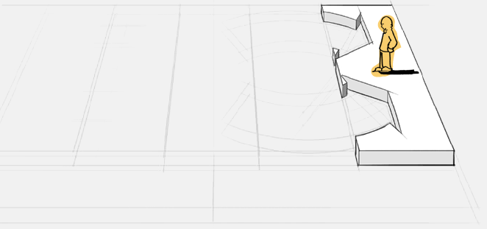
1. Customer Segments
Defines the different groups of people or organizations an enterprise aims to reach and serve
Source: Alexander Osterwalder & Yves Pigneur, Business Model Generation: A Handbook for Visionaries, Game Changers, and Challengers, Wiley, 2010.

Slide 70
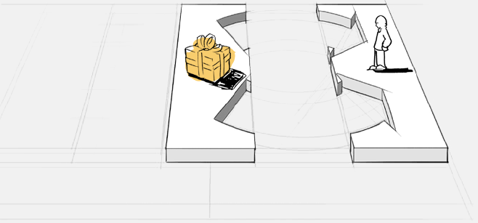
2. Value Propositions
Describes the bundle of products and services that create value for a specific Customer Segment
Source: Alexander Osterwalder & Yves Pigneur, Business Model Generation: A Handbook for Visionaries, Game Changers, and Challengers, Wiley, 2010.

Slide 71
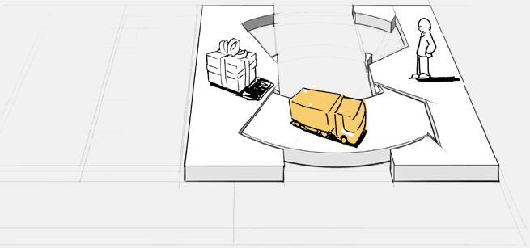
3. Channels
Describes how a company communicates with and reaches its Customer Segments to deliver a Value Proposition
Source: Alexander Osterwalder & Yves Pigneur, Business Model Generation: A Handbook for Visionaries, Game Changers, and Challengers, Wiley, 2010.

Slide 72
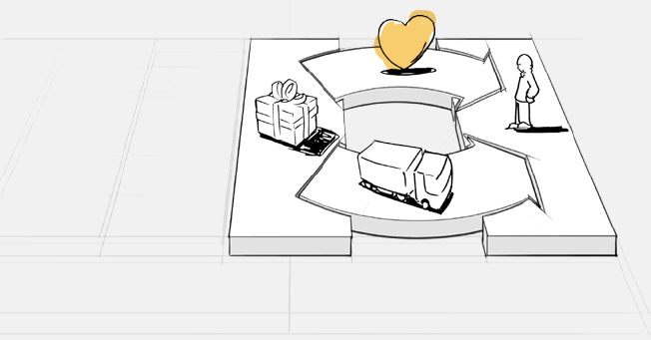
4. Customer Relationships
Describes the types of relationships a company establishes with specific Customer Segments
Source: Alexander Osterwalder & Yves Pigneur, Business Model Generation: A Handbook for Visionaries, Game Changers, and Challengers, Wiley, 2010.

Slide 73
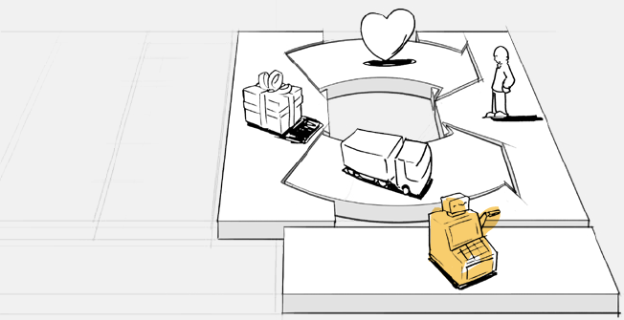
5. Revenue Streams
Represents the cash a company generates from each Customer Segment (costs must be subtracted from revenues to create earnings)
Source: Alexander Osterwalder & Yves Pigneur, Business Model Generation: A Handbook for Visionaries, Game Changers, and Challengers, Wiley, 2010.

Slide 74
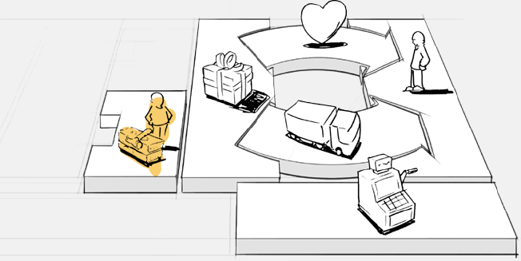
6. Key Resources
Describes the most important assets required to make a business model work
Source: Alexander Osterwalder & Yves Pigneur, Business Model Generation: A Handbook for Visionaries, Game Changers, and Challengers, Wiley, 2010.

Slide 75
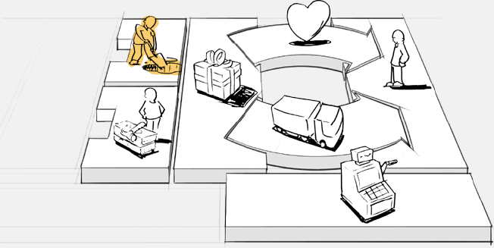
7. Key Activities
Describes the most important things a company must do to make its business model work
Source: Alexander Osterwalder & Yves Pigneur, Business Model Generation: A Handbook for Visionaries, Game Changers, and Challengers, Wiley, 2010.

Slide 76
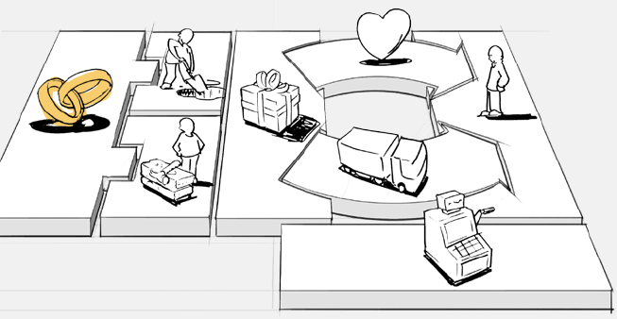
8. Key Partnerships
Describes the network of suppliers and partners that make the business model work
Source: Alexander Osterwalder & Yves Pigneur, Business Model Generation: A Handbook for Visionaries, Game Changers, and Challengers, Wiley, 2010.

Slide 77
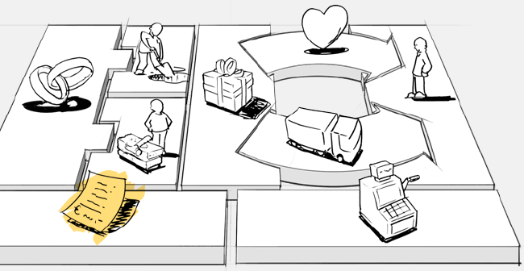
9. Cost Structure
Describes all costs incurred to operate a business model
Source: Alexander Osterwalder & Yves Pigneur, Business Model Generation: A Handbook for Visionaries, Game Changers, and Challengers, Wiley, 2010.

Slide 78
The 9 Building Blocks of Business Model
1. Customer Segments
An organization serves one or several Customer Segments.
2. Value Propositions
It seeks to solve customer problems and satisfy customer needs with value propositions.
3. Channels
Value propositions are delivered to customers through communication, distribution, and sales Channels.
4. Customer Relationships
Customer relationships are established and maintained with each Customer Segment.
Source: Alexander Osterwalder & Yves Pigneur, Business Model Generation: A Handbook for Visionaries, Game Changers, and Challengers, Wiley, 2010.

Slide 79
The 9 Building Blocks of Business Model
5. Revenue Streams
Revenue streams result from value propositions successfully offered to customers.
6. Key Resources
Key resources are the assets required to offer and deliver the previously described elements…
7. Key Activities
…by performing a number of Key Activities.
8. Key Partnerships
Some activities are outsourced and some resources are acquired outside the enterprise.
9. Cost Structure
The business model elements result in the cost structure.
Source: Alexander Osterwalder & Yves Pigneur, Business Model Generation: A Handbook for Visionaries, Game Changers, and Challengers, Wiley, 2010.

Slide 80
Business Model
8
7
2
4
1
Key Partners
Key Activities
Value Proposition
Customer Relationships
Customer Segments
6
3
Key Resources
Channels
9
5
Cost Structure
Revenue Streams
Source: Alexander Osterwalder & Yves Pigneur, Business Model Generation: A Handbook for Visionaries, Game Changers, and Challengers, Wiley, 2010.

Slide 81
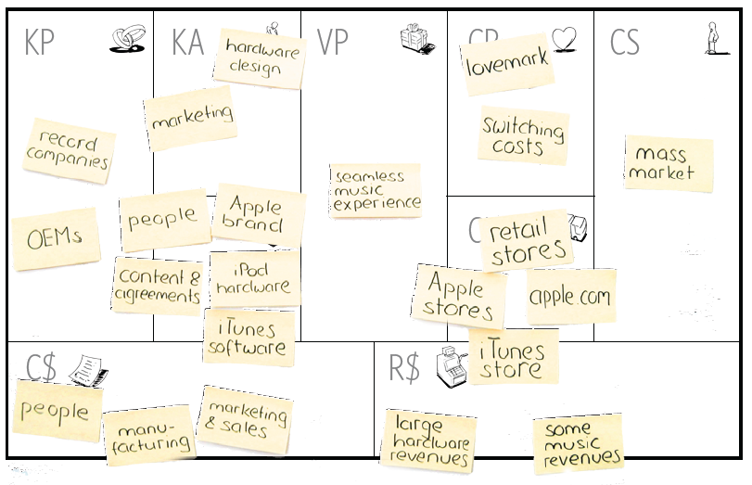
Business Model Generation
Source: Alexander Osterwalder & Yves Pigneur, Business Model Generation: A Handbook for Visionaries, Game Changers, and Challengers, Wiley, 2010.

Slide 82
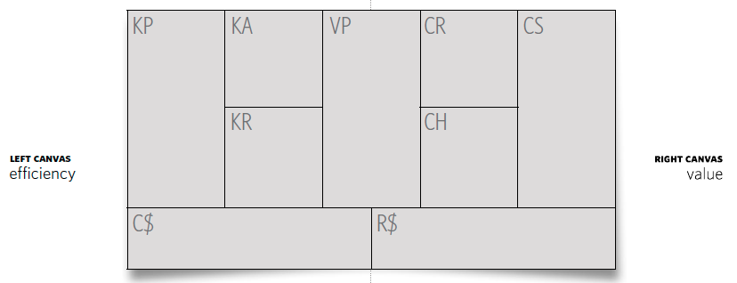
Business Model Generation
Source: Alexander Osterwalder & Yves Pigneur, Business Model Generation: A Handbook for Visionaries, Game Changers, and Challengers, Wiley, 2010.

Slide 83
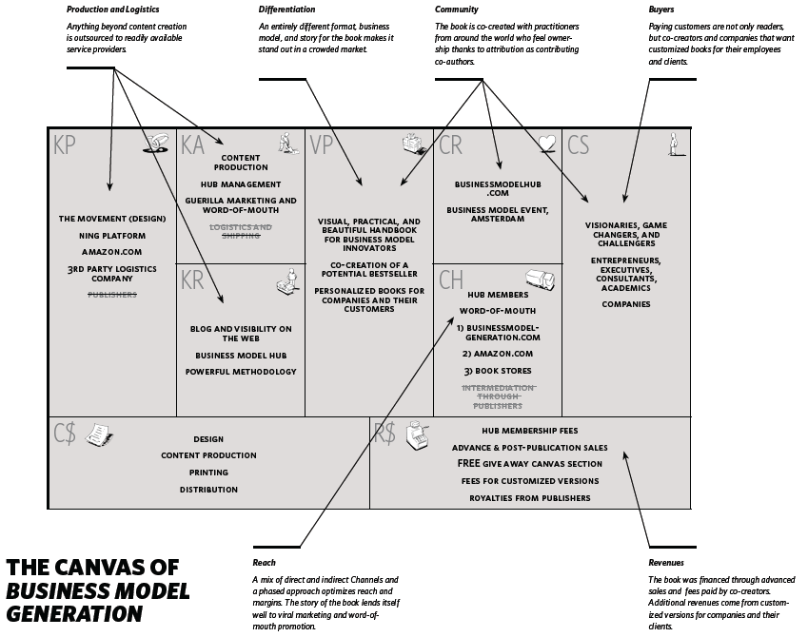
Source: Alexander Osterwalder & Yves Pigneur, Business Model Generation: A Handbook for Visionaries, Game Changers, and Challengers, Wiley, 2010.

Slide 84
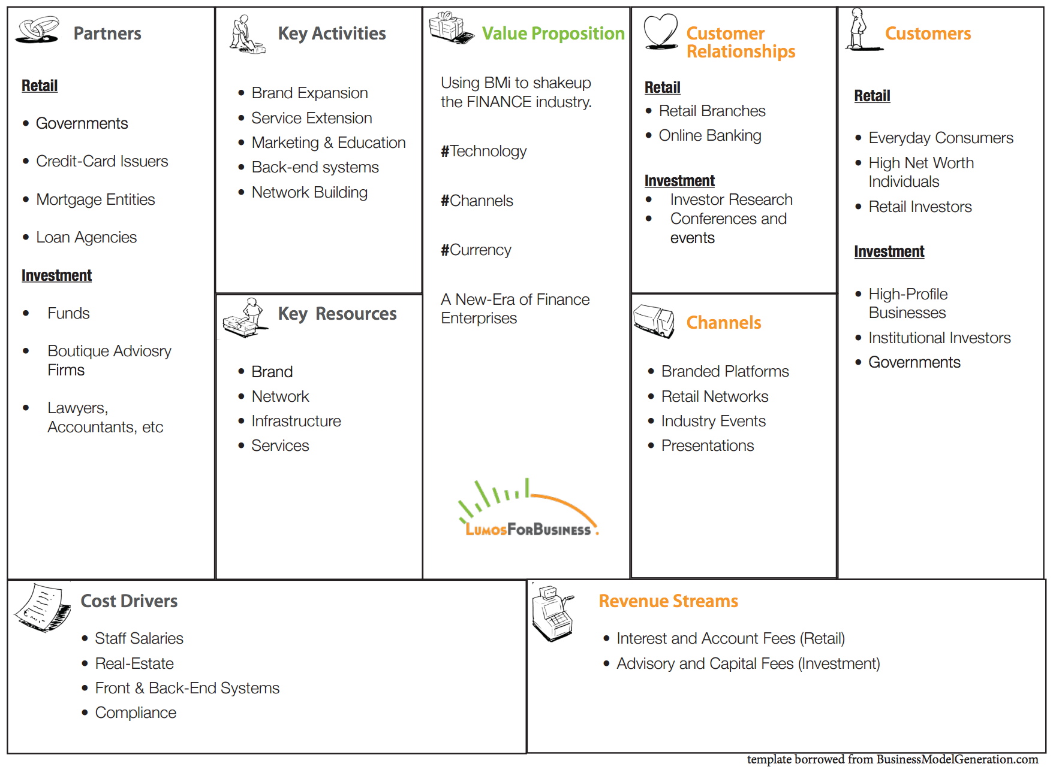
Finance Business Model
Source: http://www.lumosforbusiness.com/blog/858/19-12-2013/BMi+Business+Model+Innovation++FINANCE

Slide 85
Foreign Exchange Business Model

Slide 86
Source: https://www.slideshare.net/heimohanninen/sample-canvas-seb

Slide 87
Source: https://www.slideshare.net/Alex.Osterwalder/private-banking-business-models

Slide 88
Source: http://bmimatters.com/tag/business-model-canvas-examples/

Slide 89
Source: http://bmimatters.com/tag/business-model-canvas-examples/

Slide 90
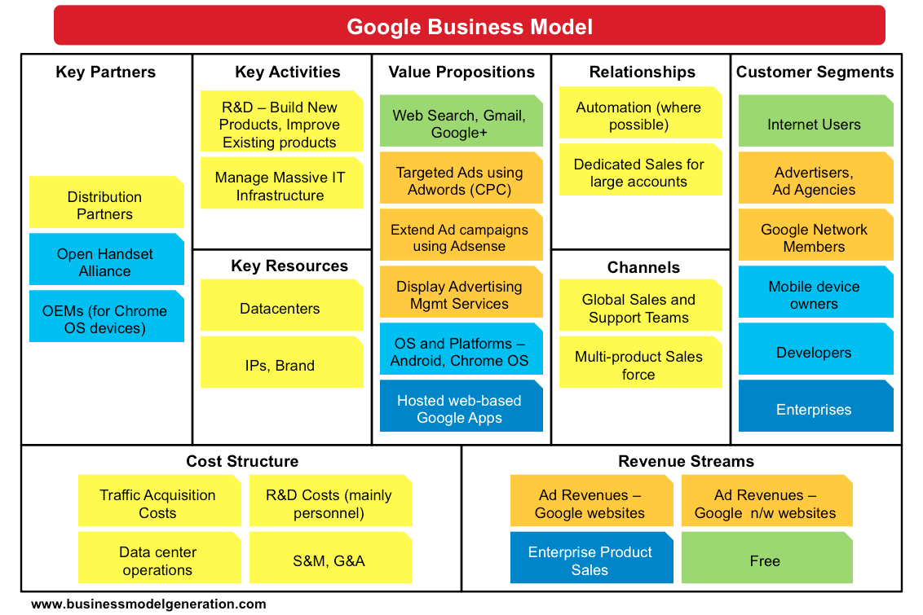
Source: http://bmimatters.com/tag/business-model-canvas-examples/

Slide 91
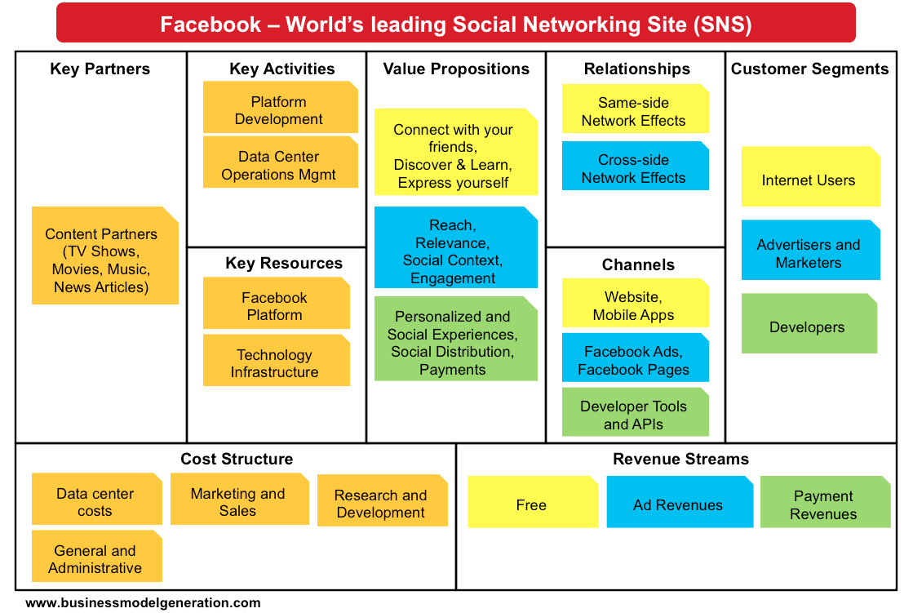
Source: http://bmimatters.com/tag/business-model-canvas-examples/

Slide 92
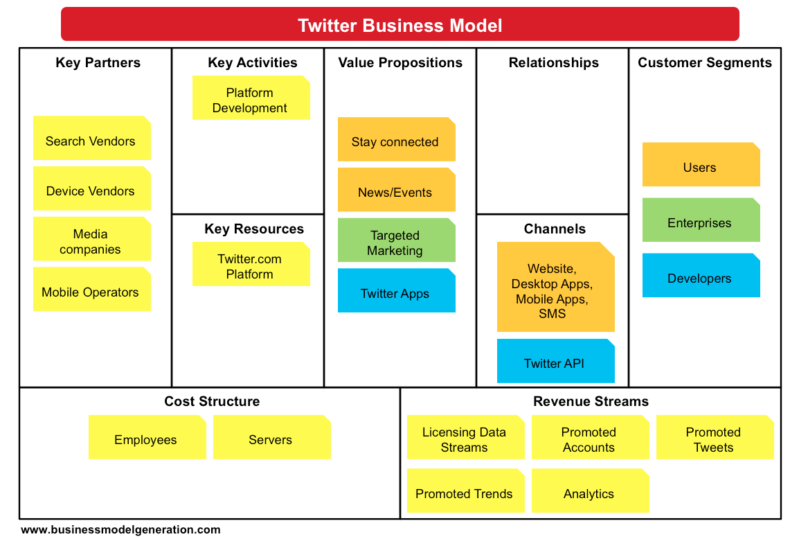
Source: http://bmimatters.com/tag/business-model-canvas-examples/

Slide 93
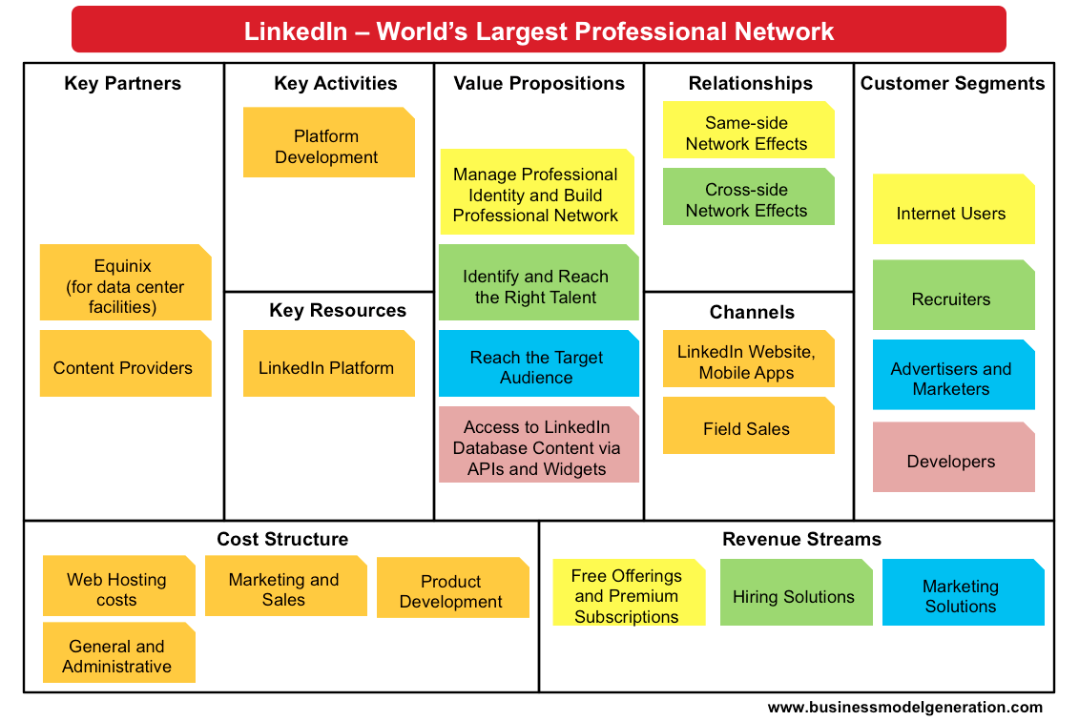
Source: http://bmimatters.com/tag/business-model-canvas-examples/

Slide 94
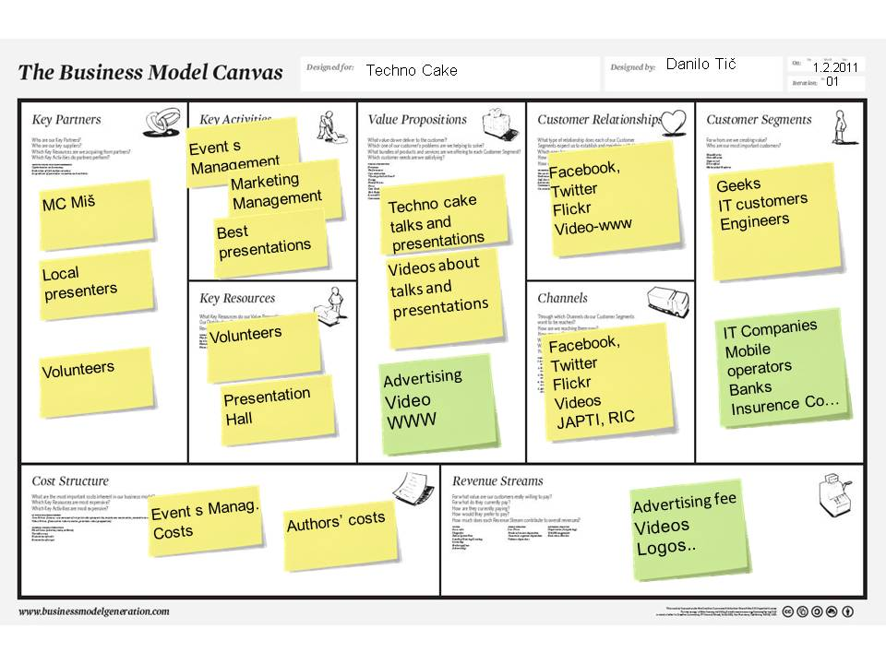
Source: http://businessmodelcombo.wordpress.com/2011/02/04/what-would-a-sustainable-techno-cake-business-model-look-like/
94

Slide 95
How Airbnb Works? Insights into Business Model & Revenue Model
Source: http://nextjuggernaut.com/blog/airbnb-business-model-canvas-how-airbnb-works-revenue-insights/

Slide 96
Airbnb Business Model Canvas
Source: http://nextjuggernaut.com/blog/airbnb-business-model-canvas-how-airbnb-works-revenue-insights/

Slide 97
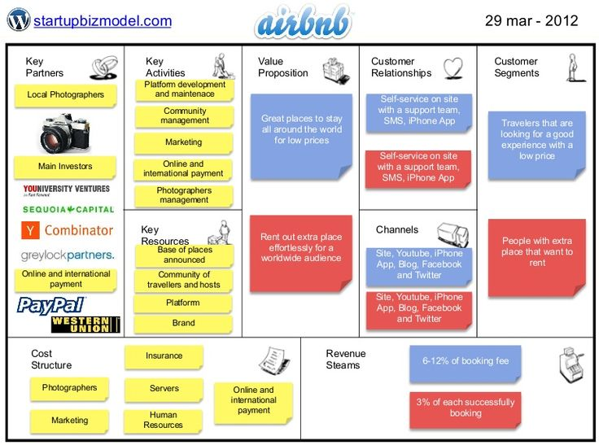
Source: http://www.slideshare.net/ThiagoPaiva/airbnb-12210879

Slide 98
How Uber Works? Insights into Business Model & Revenue Model
Source: http://nextjuggernaut.com/blog/how-uber-works-business-model-revenue-uber-insights/

Slide 99
Uber Business Model Canvas
Source: http://nextjuggernaut.com/blog/how-uber-works-business-model-revenue-uber-insights/

Slide 100
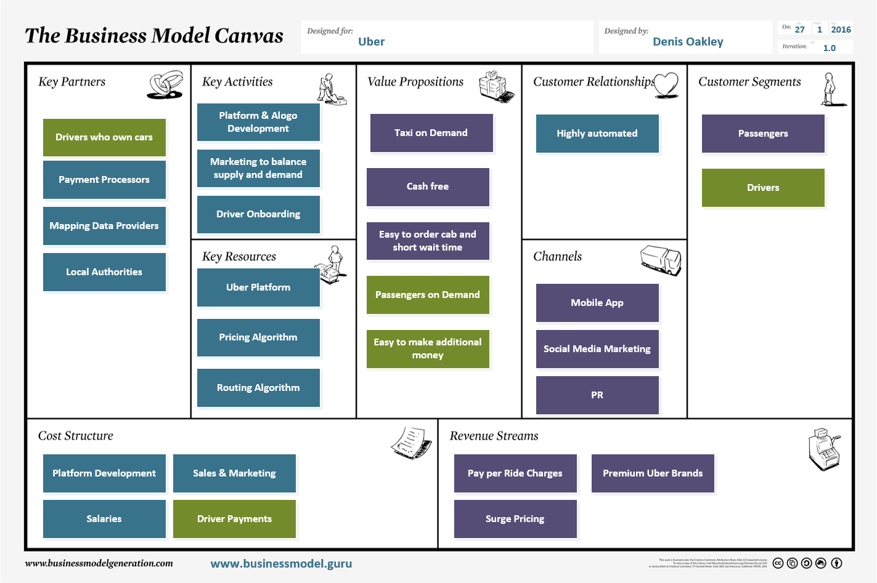
Uber Business Model Canvas
Source: http://businessmodel.guru/the-uber-business-model-canvas/

Slide 101
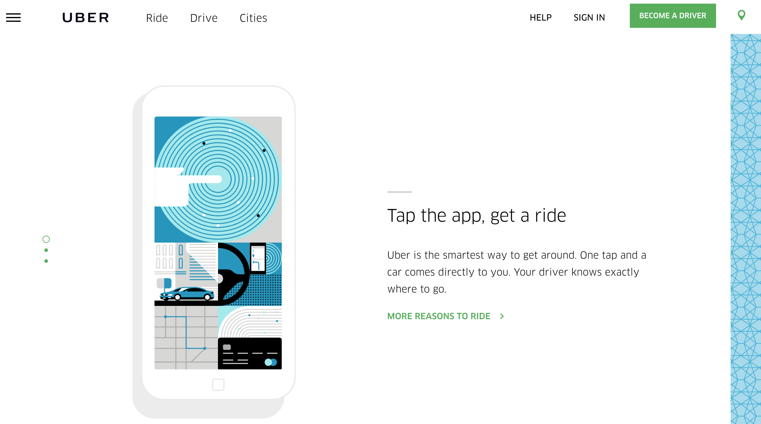
Uber
https://www.uber.com/

Slide 102
Come up with Killer Startup Ideas
Source: http://ownstartup.com/wp-content/uploads/2015/12/Add-subheading-2-585x390.jpg

Slide 103
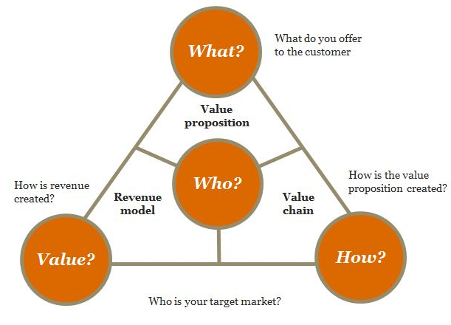
Structure of a Business Model
2
3
4
1
Source: https://digital.pwc.co.nz/ideas/uber-digital-and-disruption-whats-happening-and-why-does-it-work/
Notes:
Who is your target customer?
What do you offer to the customer?
How is the value proposition created?
How is revenue created?

Slide 104
New Business Model
direction
Strategy
People
Structure
skills/mind-set
New Business Model
power
Rewards
Process
motivation
information
Source: https://www.slideshare.net/Alex.Osterwalder/private-banking-business-models

Slide 105
Source: http://angelab.me/review-of-business-model-generation/

Slide 106
Customer Value
Source: Philip Kotler & Kevin Lane Keller, Marketing Management, 14th ed., Pearson, 2012

Slide 107
Marketing
“Meeting needs profitably”
Source: Philip Kotler & Kevin Lane Keller, Marketing Management, 14th ed., Pearson, 2012

Slide 108
Value
the sum of the tangible and intangible benefits and costs
Source: Philip Kotler & Kevin Lane Keller, Marketing Management, 14th ed., Pearson, 2012

Slide 109
Value
Total customer benefit
Customer perceived value
Total customer cost
Source: Philip Kotler & Kevin Lane Keller, Marketing Management, 14th ed., Pearson, 2012

Slide 110
Customer Value Triad
Quality, Service, and Price (qsp)
Quality
Service
Price
Source: Philip Kotler & Kevin Lane Keller, Marketing Management, 14th ed., Pearson, 2012

Slide 111
Value and Satisfaction
Marketing
identification, creation, communication, delivery, and monitoring of customer value.
Satisfaction
a person’s judgment of a product’s perceived performance in relationship to expectations
Source: Philip Kotler & Kevin Lane Keller, Marketing Management, 14th ed., Pearson, 2012

Slide 112
Building Customer Value, Satisfaction, and Loyalty
Source: Philip Kotler & Kevin Lane Keller, Marketing Management, 14th ed., Pearson, 2012

Slide 113
Customer Perceived Value
Product benefit
Total customer benefit
Customer perceived value
Services benefit
Personnel benefit
Image benefit
Monetary cost
Total customer cost
Time cost
Energy cost
Psychological cost
Source: Philip Kotler & Kevin Lane Keller, Marketing Management, 14th ed., Pearson, 2012

Slide 114
Satisfaction
“a person’s feelings of pleasure or disappointment that result from comparing a product’s perceived performance (or outcome) to expectations”
Source: Philip Kotler & Kevin Lane Keller, Marketing Management, 14th ed., Pearson, 2012

Slide 115
Loyalty
“a deeply held commitment to rebuy or repatronize a preferred product or service in the future despite situational influences and marketing efforts having the potential to cause switching behavior.”
Source: Philip Kotler & Kevin Lane Keller, Marketing Management, 14th ed., Pearson, 2012

Slide 116
Customer Perceived Value, Customer Satisfaction, and Loyalty
Customer Perceived Performance
Customer
Perceived Value
Customer
Satisfaction
Customer
Loyalty
Customer
Expectations
Source: Philip Kotler & Kevin Lane Keller, Marketing Management, 14th ed., Pearson, 2012

Slide 117
CEO CIO CFO
CEO
Strategy and Sales
(Leading)
CIO
Enterprise Technology Integration
CFO-COO
Finance and Operations
(Lagging)
Source: http://www.r3now.com/what-is-the-proper-relationship-for-the-cio-ceo-and-cfo/

Slide 118
CEO CIO CMO
CEO
Strategy and Sales
(Leading)
CIO
Enterprise Technology Integration
CMO
Marketing
Communication
Adapted from: http://www.r3now.com/what-is-the-proper-relationship-for-the-cio-ceo-and-cfo/

Slide 119
CEO CIO CMO
CEO
Vision
Strategy
CIO
CMO
Mission
Tactics
Goals
Objectives
Operations
Tasks
Adapted from: http://www.argowiki.com/index.php?title=The_Relationship_Between_the_CEO_and_CIO

Slide 120
Nothing is so practical as a good theory

Slide 121
Social Networking and the Wisdom of Crowds
Most popular Web 2.0 service: social networking
Social shopping sites: Swap shopping ideas with friends
Wisdom of crowds
Crowdsourcing
Large numbers of people can make better decisions about topics and products than a single person.
Prediction markets
Peer-to-peer betting markets on specific outcomes (elections, sales figures, designs for new products)

Slide 122
E-commerce Marketing
Internet provides new ways to identify and communicate with customers.
Long tail marketing:
Ability to reach a large audience inexpensively
Behavioral targeting:
Tracking online behavior of individuals on thousands of Web sites
Internet advertising formats
Search engine marketing, display ads, rich media, e-mail, and so on

Slide 123
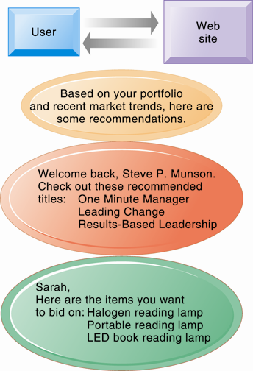
Web Site Personalization

Slide 124
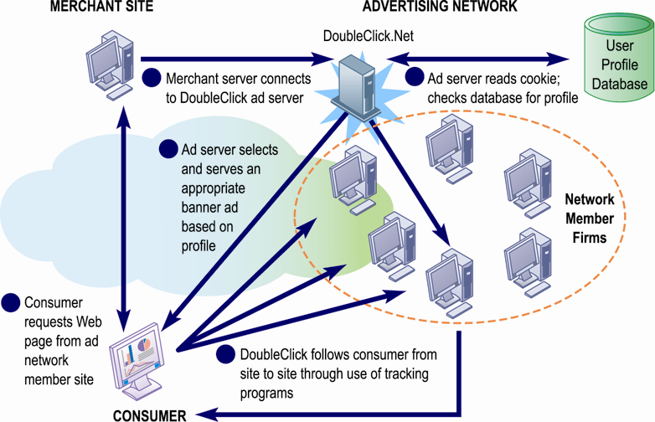
How an Advertising Network Works

Slide 125
Social E-commerce
Social e-commerce:
Based on digital social graph
Mapping of all significant online relationships
Four features of social e-commerce driving its growth
Social sign-on
Collaborative shopping
Network notification
Social search (recommendations)

Slide 126
Social Media Marketing
Social media:
Fastest growing media for branding and marketing
Social network marketing:
Seeks to leverage individuals influence over others in social graph
Target is a social network of people sharing interests and advice
Facebook’s “Like button”
Social networks have huge audiences
Facebook: 150 million U.S. visitors monthly

Slide 127
B2B E-commerce
U.S. B2B trade in 2012 is $16 trillion
U.S. B2B e-commerce in 2012 is $4.1 trillion
Procurement requires significant overhead costs, which Internet and networking helps automate
Variety of Internet-enabled technologies used in B2B
Electronic data interchange (EDI)
Private industrial networks (private exchanges)
Net marketplaces
Exchanges

Slide 128
Electronic Data Interchange (EDI)

Slide 129
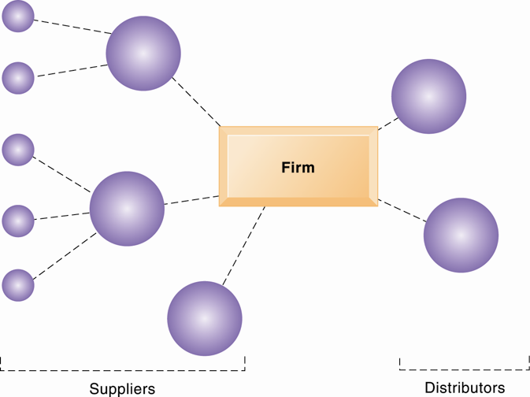
A Private Industrial Network

Slide 130
Net Marketplaces (e-hubs)
Single market for many buyers and sellers
Industry-owned or owned by independent intermediary
Generate revenue from transaction fees, other services
Use prices established through negotiation, auction, RFQs, or fixed prices
May focus on direct or indirect goods
May be vertical or horizontal marketplaces

Slide 131
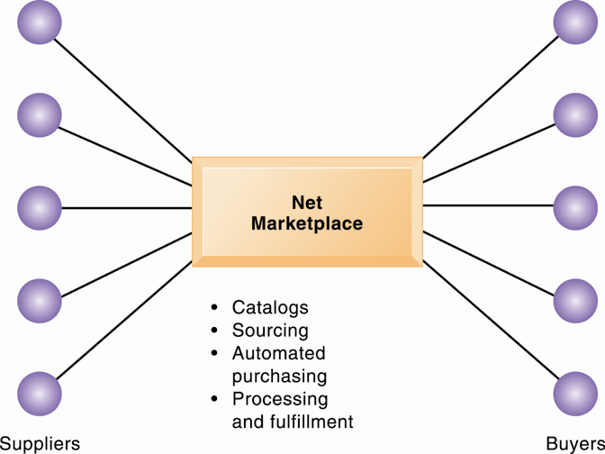
A Net Marketplace

Slide 132
Exchanges
Independently owned third-party Net marketplaces
Connect thousands of suppliers and buyers for spot purchasing
Typically provide vertical markets for direct goods for single industry (food, electronics)
Proliferated during early years of e-commerce; many have failed
Competitive bidding drove prices down and did not offer long-term relationships with buyers or services to make lowering prices worthwhile.

Slide 133
The Mobile Digital Platform and Mobile E-commerce

Slide 134
M-commerce
In 2012 is 10% of all e-commerce
Fastest growing form of e-commerce
Some areas growing at 50%
Four billion mobile phone users worldwide
Main areas of growth
Retail sales at top Mobile 400 (Amazon, eBay, etc.)
Sales of digital content (music, TV, etc.)
Local search for restaurants, museums, stores

Slide 135
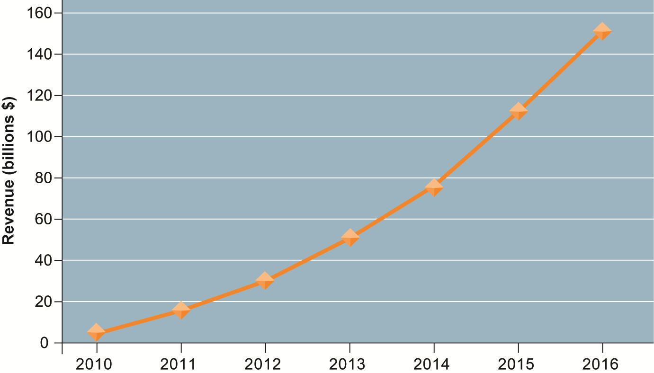
Consolidated Mobile Commerce Revenues

Slide 136
Location-based services
Used by 74% of smartphone owners
Based on GPS map services
Types
Geosocial services
Where friends are
Geoadvertising
What shops are nearby
Geoinformation services
Price of house you are passing

Slide 137
Other Mobile Commerce Services
Banks, credit card companies provide account management apps
Mobile display advertising
iAd, AdMob, Facebook
Games and entertainment
Downloadable and streamable services
Games
Video, short films, movies, TV shows
Music and ring tones

Slide 138
Building an E-commerce Web Site
Pieces of the site-building puzzle
Assembling a team with the skills required to make decisions about:
Technology
Site design
Social and information policies
Hardware, software, and telecommunications infrastructure
Customer’s demands should drive the site’s technology and design.

Slide 139
Building an E-commerce Web Site
Business objectives
The capabilities the site should have
Business decisions should drive technology
Example: execute a transaction payment
System functionality
Technology needed to achieve objective
Example: a shopping cart or other payment system
Information requirement
Specific data and processes needed
Example: secure credit card clearing, multiple payment options

Slide 140
Building an E-commerce Web Site
Alternatives in building the Web site:
Completely in-house
Mixed responsibility
Completely outsourced
Co-location
Web site budgets
Several thousand to millions per year
50% of budget is system maintenance and content creation

Slide 141
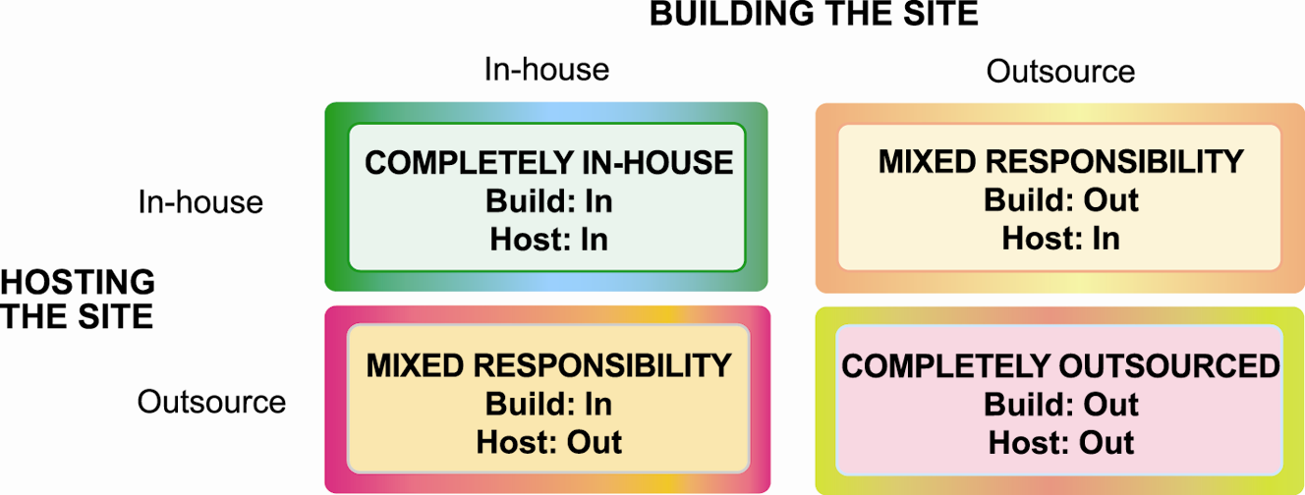
Choices in Building and Hosting Web Sites

Slide 142
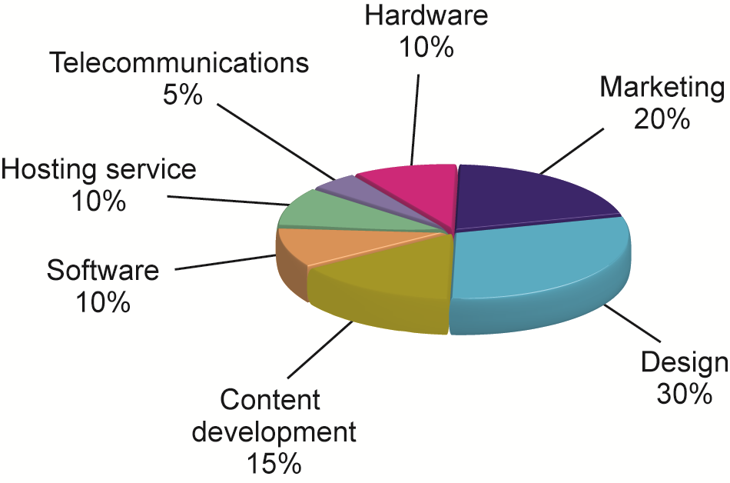
Components of a Web Site Budget

Slide 143
2018/01/03 Final Report (期末報告)
請各組組長整理期末報告資料檔案， 於 2018/01/03 (週三) 下午15:00 前， 完成Email 寄出以下兩個壓縮檔的下載連結 (Google Drive URL)， 給所有組員和老師 (正本to: 老師，副本cc: 所有組員) 。
1. 整組各次簡報的 ppt (含整組期末報告目錄 ppt) 壓縮檔
(例如：MI4B_資訊管理專題_第1組_期末各次簡報.zip)。
2. 整組各組員的 [(1) 個人期末報告.ppt (2) 個人期末書面報告.pdf] 之壓縮檔
(例如：MI4B_資訊管理專題_第1組_組員個人期末報告.zip)。

Slide 144
資訊管理專題 (Hot Issues of Information Management)
1. 請同學於資訊管理專題個案討論前 應詳細研讀個案，並思考個案研究問題。
2. 請同學於上課前複習相關資訊管理相關理論，以作為個案分析及擬定管理對策的依據。
3. 請同學於上課前 先繳交資訊管理專題個案研究問題書面報告。
4.上課時間地點： 週三 8,9 (15:10-17:00) B702

Slide 145
References
Kenneth C. Laudon & Jane P. Laudon (2014), Management Information Systems: Managing the Digital Firm, Thirteenth Edition, Pearson.
Kenneth C. Laudon & Jane P. Laudon原著， 游張松 主編，陳文生 翻譯 (2014)， 資訊管理系統，第13版，滄海

