Slide 1
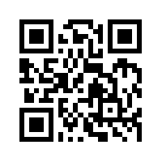
財務金融大數據分析 Big Data Analytics in Finance
Tamkang University
財務金融大數據分析課程介紹 (Course Orientation for Big Data Analytics in Finance)
1061BDAF01
MIS EMBA (M2322) (8605) Thu 12,13,14 (19:20-22:10) (D503)
Min-Yuh Day
戴敏育
Assistant Professor
專任助理教授
Dept. of Information Management, Tamkang University
淡江大學 資訊管理學系
http://mail. tku.edu.tw/myday/
2017-09-21

Slide 2
財務金融 大數據分析 Big Data Analytics in Finance

Slide 3
淡江大學106學年度第1學期 課程教學計畫表 Fall 2017 (2017.09 - 2018.01)
課程名稱：財務金融大數據分析 (Big Data Analytics in Finance)
授課教師：戴敏育 (Min-Yuh Day)
開課系級：資管所碩專班 (TLMXJ1A)
開課資料：選修 單學期 3 學分 (3 Credits, Elective)
上課時間：週五 12,13,14 (Thu 19:20-22:10)
上課教室： D503 (淡江大學台北校園)

Slide 4
課程簡介
本課程介紹財務金融大數據分析基本概念與研究議題
課程內容包括
金融科技商業模式
人工智慧投資分析與機器人理財顧問
金融科技對話式商務與智慧型交談機器人
事件研究法
Python 財務大數據分析基礎
Python Numpy 大數據分析
Python Pandas 財務大數據分析
文字探勘分析技術與自然語言處理
Python Keras 深度學習
TensorFlow 深度學習
財務金融大數據深度學習
社會網絡分析
財務金融大數據分析個案研究

Slide 5
Course Introduction
This course introduces the fundamental concepts and research issues of Big Data Analytics in Finance.
Topics include
Business Models of Fintech
Artificial Intelligence for Investment Analysis and Robo-Advisors
Conversational Commerce and Intelligent Chatbots for Fintech
Event Study
Foundations of Finance Big Data Analytics in Python
Big Data Analytics with Numpy in Python
Finance Big Data Analytics with Pandas in Python
Text Mining Techniques and Natural Language Processing
Deep Learning with Keras in Python
Deep Learning with TensorFlow
Deep Learning for Finance Big Data
Social Network Analysis
Case Study on Big Data Analytics in Finance

Slide 6
課程目標 (Objective)
瞭解及應用財務金融大數據分析 基本概念與研究議題。 (Understand and apply the fundamental concepts and research issues of Big Data Analytics in Finance.)
進行財務金融大數據分析相關之 資訊管理研究。 (Conduct information systems research in the context of Big Data Analytics in Finance.)

Slide 7
課程大綱 (Syllabus)
週次 (Week) 日期 (Date) 內容 (Subject/Topics)
1 2017/09/21 財務金融大數據分析課程介紹 (Course Orientation for Big Data Analytics in Finance)
2 2017/09/28 金融科技商業模式 (Business Models of Fintech)
3 2017/10/05 人工智慧投資分析與機器人理財顧問 (Artificial Intelligence for Investment Analysis and Robo-Advisors)
4 2017/10/12 金融科技對話式商務與智慧型交談機器人 (Conversational Commerce and Intelligent Chatbots for Fintech)
5 2017/10/19 事件研究法 (Event Study)
6 2017/10/26 財務金融大數據分析個案研究 I (Case Study on Big Data Analytics in Finance I)

Slide 8
課程大綱 (Syllabus)
週次 (Week) 日期 (Date) 內容 (Subject/Topics)
7 2017/11/02 Python 財務大數據分析基礎 (Foundations of Finance Big Data Analytics in Python)
8 2017/11/09 Python Numpy大數據分析 (Big Data Analytics with Numpy in Python)
9 2017/11/16 Python Pandas 財務大數據分析 (Finance Big Data Analytics with Pandas in Python)
10 2017/11/23 期中報告 (Midterm Project Report)
11 2017/11/30 文字探勘分析技術與自然語言處理 (Text Mining Techniques and Natural Language Processing)
12 2017/12/07 Python Keras深度學習 (Deep Learning with Keras in Python)

Slide 9
課程大綱 (Syllabus)
週次 (Week) 日期 (Date) 內容 (Subject/Topics)
13 2017/12/14 財務金融大數據分析個案研究 II (Case Study on Big Data Analytics in Finance II)
14 2017/12/21 TensorFlow深度學習 (Deep Learning with TensorFlow)
15 2017/12/28 財務金融大數據深度學習 (Deep Learning for Finance Big Data)
16 2018/01/04 社會網絡分析 (Social Network Analysis)
17 2018/01/11 期末報告 I (Final Project Presentation I)
18 2018/01/18 期末報告 II (Final Project Presentation II)

Slide 10
教學方法與評量方法
教學方法
講述、討論、 賞析、模擬、 問題解決、實作
評量方法
實作、報告、上課表現

Slide 11
教材課本
教材課本
講義 (Slides)
財務金融大數據分析相關個案與論文 (Cases and Papers related to Big Data Analytics in Finance)

Slide 12
參考書籍 (References)
Doron Kliger and Gregory Gurevich (2014), Event Studies for Financial Research: A Comprehensive Guide, Palgrave Macmillan
Fabio Nelli (2015), Python Data Analytics: Data Analysis and Science using PANDAs, matplotlib and the Python Programming Language, Apress
Michael Heydt (2015) , Mastering Pandas for Finance, Packt Publishing
Yves Hilpisch, Python for Finance: Analyze Big Financial Data, OReilly Media
James Ma Weiming (2015), Mastering Python for Finance, Packt Publishing
Yuxing Yan (2017), Python for Finance, Second Edition, Packt Publishing
Paolo Sironi (2016), FinTech Innovation: From Robo-Advisors to Goal Based Investing and Gamification, Wiley
Susanne Chishti and Janos Barberis (2016), The FINTECH Book: The Financial Technology Handbook for Investors, Entrepreneurs and Visionaries, Wiley

Slide 13
作業與學期成績計算方式
作業篇數
3篇
學期成績計算方式
期中評量：30 ％
期末評量：30 ％
其他（課堂參與及報告討論表現）： 40 ％

Slide 14
AI and Big Data Analytics in Finance
財務金融大數據分析
Big Data Analytics in Finance
投資大數據分析
Big Data Analytics in Investment
人工智慧與財務應用
Artificial Intelligence and Financial Application
人工智慧與投資分析
Artificial Intelligence and Investment Analysis

Slide 15
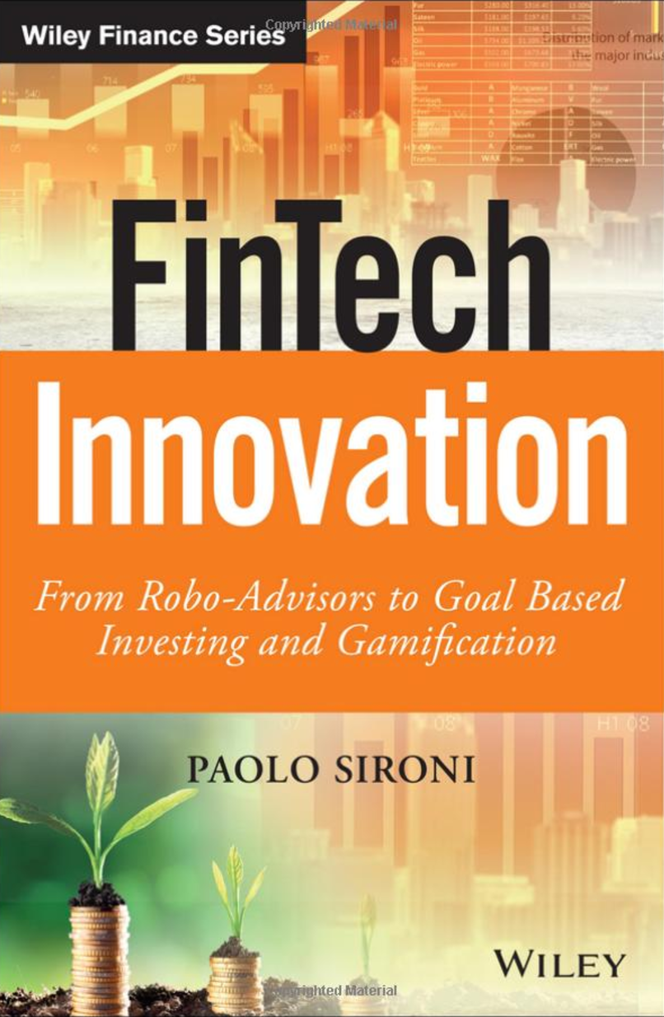
FinTech Innovation: From Robo-Advisors to Goal Based Investing and Gamification, Paolo Sironi, Wiley, 2016
Source: https://www.amazon.com/FinTech-Innovation-Robo-Advisors-Investing-Gamification/dp/1119226988

Slide 16
Doron Kliger and Gregory Gurevich (2014), Event Studies for Financial Research: A Comprehensive Guide, Palgrave Macmillan
Source: https://www.amazon.com/Event-Studies-Financial-Research-Comprehensive/dp/1137435380/

Slide 17
事件研究法： 財務與會計實證研究必備 沈中華、李建然 (2000)
Source: 沈中華、李建然 (2000)，事件研究法：財務與會計實證研究必備，華泰文化

Slide 18
Yuxing Yan (2017), Python for Finance, Second Edition, Packt Publishing
Source: https://www.amazon.com/Python-Finance-Second-Yuxing-Yan/dp/1787125696/

Slide 19
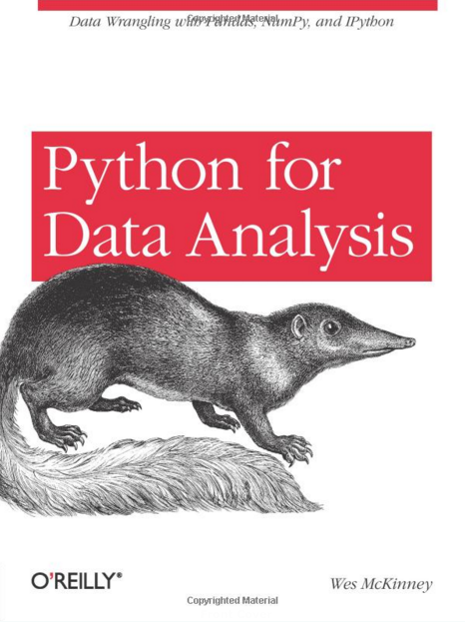
Wes McKinney (2012), Python for Data Analysis: Data Wrangling with Pandas, NumPy, and IPython, O'Reilly Media
Source: http://www.amazon.com/Python-Data-Analysis-Wrangling-IPython/dp/1449319793/

Slide 20
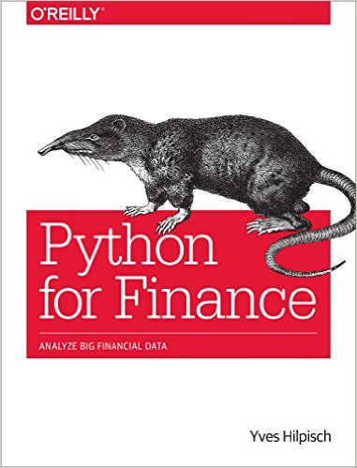
Yves Hilpisch, Python for Finance: Analyze Big Financial Data, O'Reilly, 2014
Source: http://www.amazon.com/Python-Finance-Analyze-Financial-Data/dp/1491945281

Slide 21
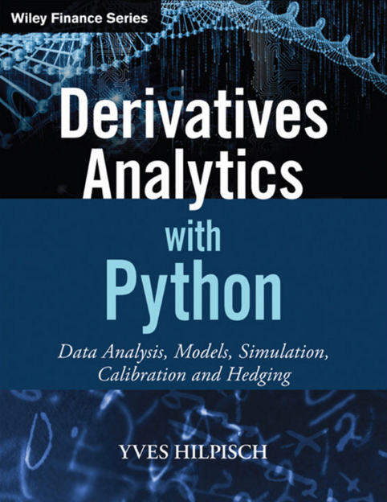
Yves Hilpisch (2015), Derivatives Analytics with Python: Data Analysis, Models, Simulation, Calibration and Hedging, Wiley
Source: http://www.amazon.com/Derivatives-Analytics-Python-Simulation-Calibration/dp/1119037999/

Slide 22
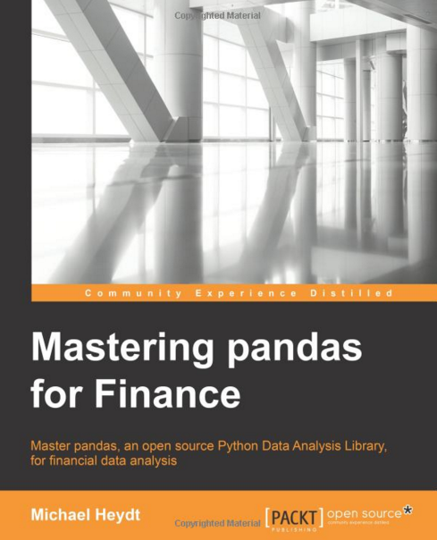
Michael Heydt , Mastering Pandas for Finance, Packt Publishing, 2015
Source: http://www.amazon.com/Mastering-Pandas-Finance-Michael-Heydt/dp/1783985100

Slide 23
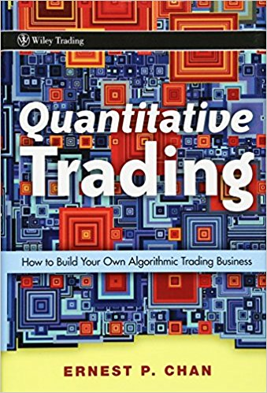
Source: Ernie Chan (2008), “Quantitative Trading: How to Build Your Own Algorithmic Trading Business”, Wiley

Slide 24
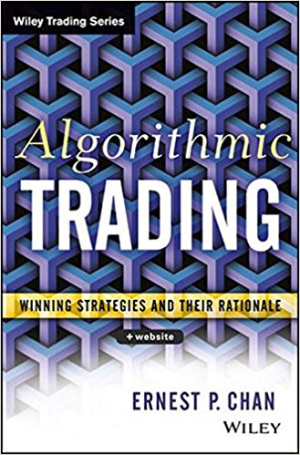
Source: Ernie Chan (2013), “Algorithmic Trading: Winning Strategies and Their Rationale”, Wiley

Slide 25
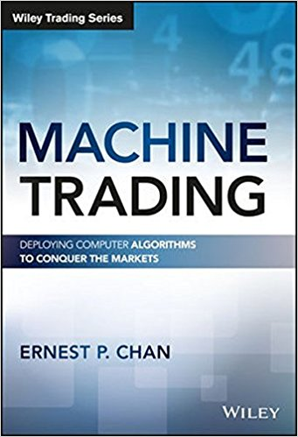
Source: Ernest P. Chan (2017), “Machine Trading: Deploying Computer Algorithms to Conquer the Markets”, Wiley

Slide 26
FinTech

Slide 27
Financial Technology

Slide 28
FinTech

Slide 29
Financial Technology FinTech
“providing financial services by making use of software and modern technology”
Source: https://www.fintechweekly.com/fintech-definition

Slide 30
Financial Services

Slide 31
Financial Services
Source: http://www.crackitt.com/7-reasons-why-your-fintech-startup-needs-visual-marketing/

Slide 32
Financial Revolution with Fintech
Source: http://www.hedgethink.com/fintech/european-fintech-top-100/

Slide 33
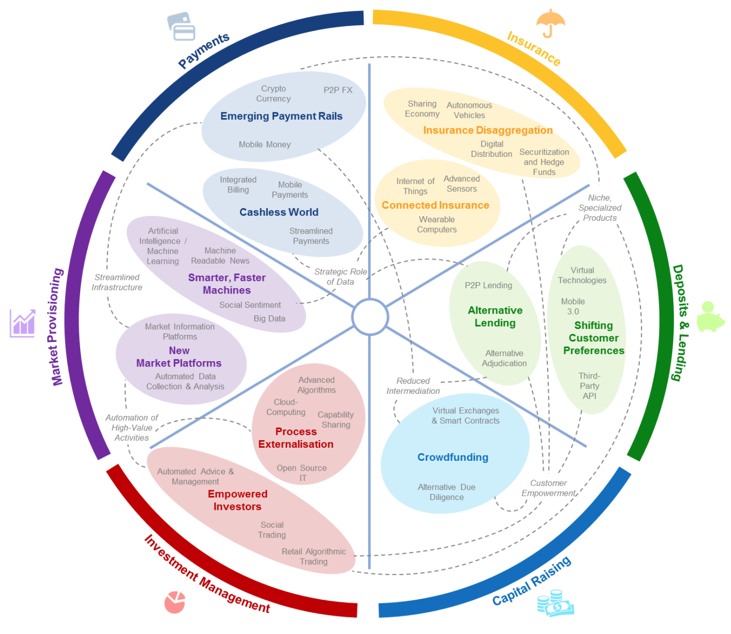
FinTech: Financial Services Innovation
Source: http://www3.weforum.org/docs/WEF_The_future__of_financial_services.pdf

Slide 34
FinTech: Financial Services Innovation 1. Payments 2. Insurance 3. Deposits & Lending 4. Capital Raising 5. Investment Management 6. Market Provisioning
Source: http://www3.weforum.org/docs/WEF_The_future__of_financial_services.pdf

Slide 35
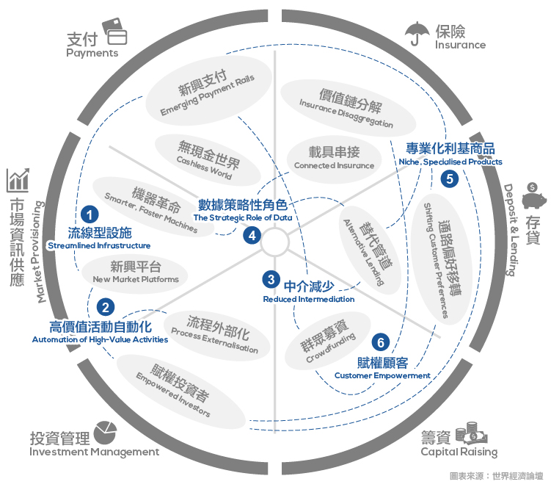
Source: https://www.stockfeel.com.tw/2015年世界經濟論壇－未來的金融服務/

Slide 36
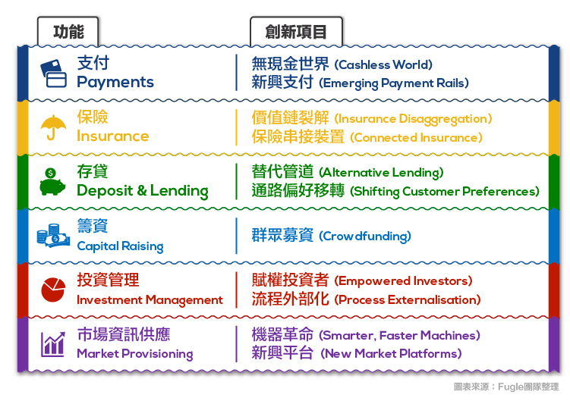
FinTech: Financial Services Innovation
Source: https://www.stockfeel.com.tw/2015年世界經濟論壇－未來的金融服務/

Slide 37
FinTech: Payment
1
Source: http://www3.weforum.org/docs/WEF_The_future__of_financial_services.pdf

Slide 38
FinTech: Payment Cashless World Emerging Payment Rails
1
Source: https://www.stockfeel.com.tw/2015年世界經濟論壇－未來的金融服務/

Slide 39
FinTech: Insurance
2
Source: http://www3.weforum.org/docs/WEF_The_future__of_financial_services.pdf

Slide 40
FinTech: Insurance Insurance Disaggregation Connected Insurance
2
Source: https://www.stockfeel.com.tw/2015年世界經濟論壇－未來的金融服務/

Slide 41
FinTech: Deposits & Lending
3
Source: http://www3.weforum.org/docs/WEF_The_future__of_financial_services.pdf

Slide 42
FinTech: Deposits & Lending Alternative Lending Shifting Customer Preferences
3
Source: https://www.stockfeel.com.tw/2015年世界經濟論壇－未來的金融服務/

Slide 43
FinTech: Capital Raising
4
Source: http://www3.weforum.org/docs/WEF_The_future__of_financial_services.pdf

Slide 44
FinTech: Capital Raising Crowdfunding
4
Source: https://www.stockfeel.com.tw/2015年世界經濟論壇－未來的金融服務/

Slide 45
FinTech: Investment Management
5
Source: http://www3.weforum.org/docs/WEF_The_future__of_financial_services.pdf

Slide 46
FinTech: Investment Management Empowered Investors Process Externalization
5
Source: https://www.stockfeel.com.tw/2015年世界經濟論壇－未來的金融服務/

Slide 47
FinTech: Market Provisioning
6
Source: http://www3.weforum.org/docs/WEF_The_future__of_financial_services.pdf

Slide 48
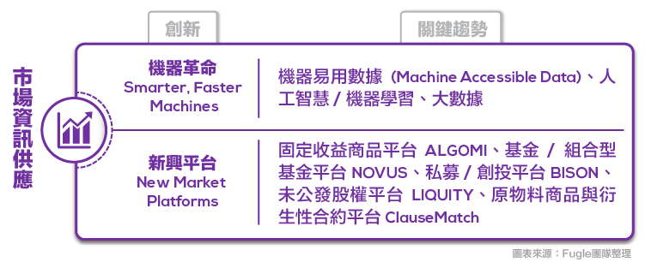
FinTech: Market Provisioning Smarter, Faster Machines New Market Platforms
6
Source: https://www.stockfeel.com.tw/2015年世界經濟論壇－未來的金融服務/

Slide 49
Fintech Business Models Innovation

Slide 50
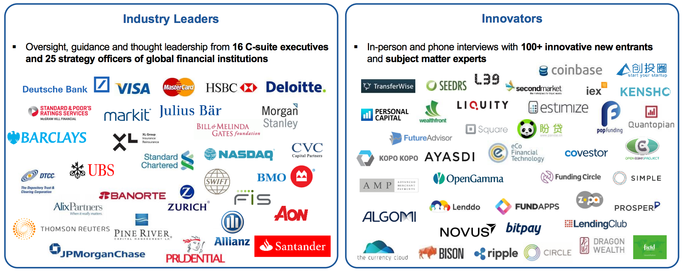
The Future of Financial Services
Source: World Economic Forum (2015), The Future of Financial Services, http://www3.weforum.org/docs/WEF_The_future__of_financial_services.pdf

Slide 51
Business Model

Slide 52
Value

Slide 53
Business Model
8
7
2
4
1
Key Partners
Key Activities
Value Proposition
Customer Relationships
Customer Segments
6
3
Key Resources
Channels
9
5
Cost Structure
Revenue Streams
Source: Alexander Osterwalder & Yves Pigneur, Business Model Generation: A Handbook for Visionaries, Game Changers, and Challengers, Wiley, 2010.

Slide 54
Business Model
8
7
2
4
1
Key Partners
Key Activities
Value Proposition
Customer Relationships
Customer Segments
What?
6
3
Key Resources
Channels
Who?
How?
Why?
9
5
Cost Structure
Revenue Streams
Source: Alexander Osterwalder & Yves Pigneur, Business Model Generation: A Handbook for Visionaries, Game Changers, and Challengers, Wiley, 2010.

Slide 55
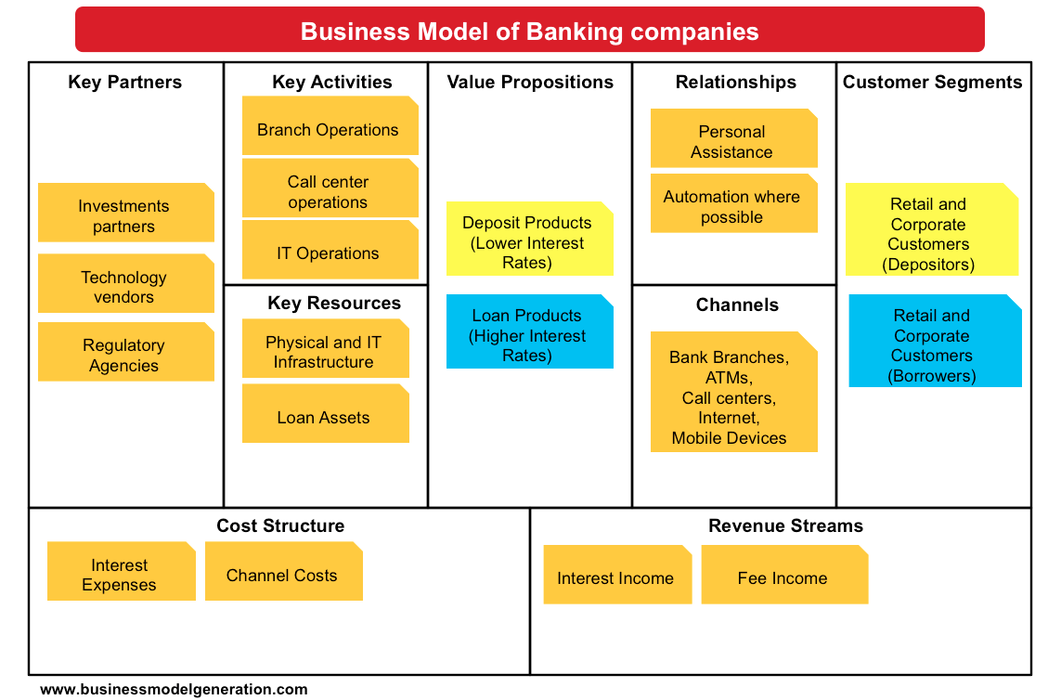
Source: http://bmimatters.com/tag/business-model-canvas-examples/

Slide 56
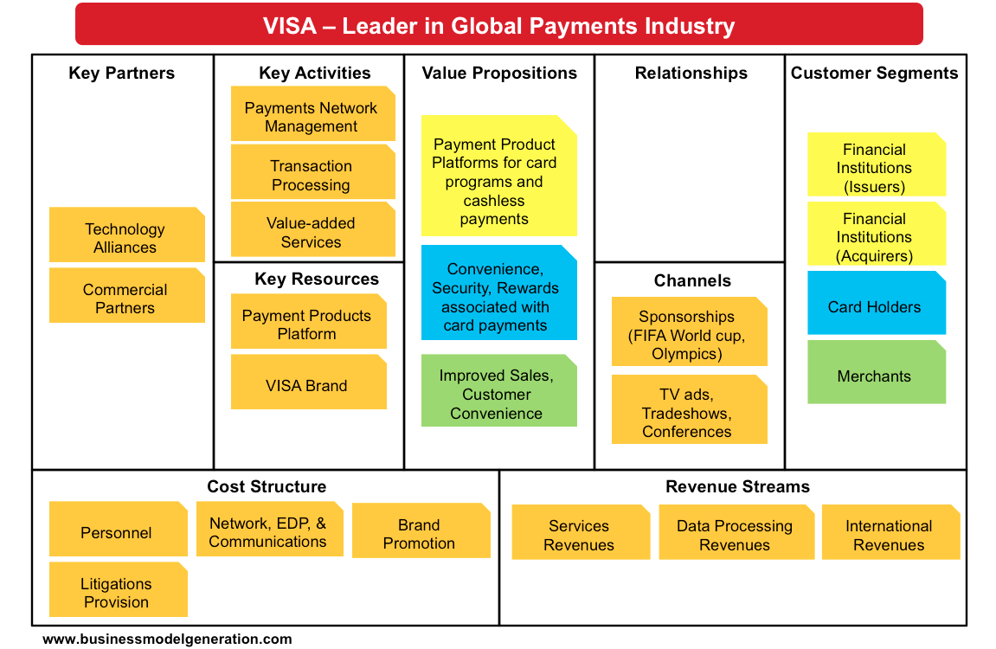
Source: http://bmimatters.com/tag/business-model-canvas-examples/

Slide 57
Business Models Innovation

Slide 58
Why Business Model Innovation
Target Market
Revenue Mechanism
Value Proposition
Value Network
(Ecosystem)
Value Chain
Competitive Strategy
Source: Chesbrough, Henry. "Business model innovation: it's not just about technology anymore." Strategy & leadership 35, no. 6 (2007): 12-17.

Slide 59
Business Model Innovation
Adding new activities
Linking activities in novel ways
Changing one or more parties that perform any of the activities
Source: Amit, Raphael, and Christoph Zott. "Creating value through business model innovation." MIT Sloan Management Review 53, no. 3 (2012): 41.
Notes:
Business Model Innovation
adding new activities
linking activities in novel ways
changing one or more parties that perform any of the activities.
Source: Amit, Raphael, and Christoph Zott. "Creating value through business model innovation." MIT Sloan Management Review 53, no. 3 (2012): 41.

Slide 60
Business Model Innovation
2
What novel activities could help satisfy those needs
5
How will value be created for each stakeholder?
1
What customer needs will the new business model address?
3
How could the activities be linked in novel ways?
6
What revenues models can be adopted to complement the business model?
What should perform the activities? What novel governance arrangements can be found?
4
Source: Amit, Raphael, and Christoph Zott. "Creating value through business model innovation." MIT Sloan Management Review 53, no. 3 (2012): 41.

Slide 61
From E-Commerce to Conversational Commerce: Chatbots and Virtual Assistants
Source: http://www.guided-selling.org/from-e-commerce-to-conversational-commerce/

Slide 62
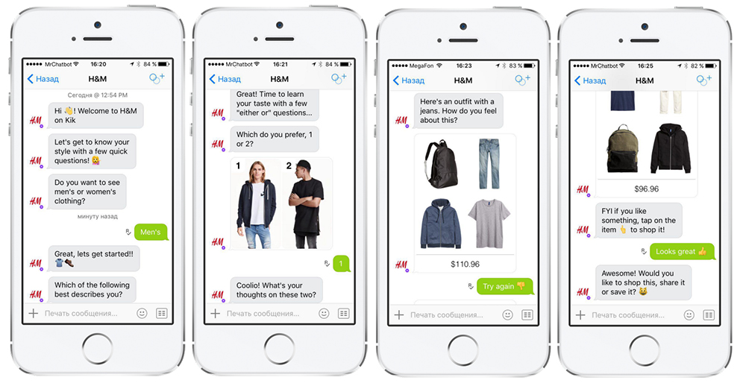
H&M’s chatbot on Kik
Source: http://www.guided-selling.org/from-e-commerce-to-conversational-commerce/

Slide 63
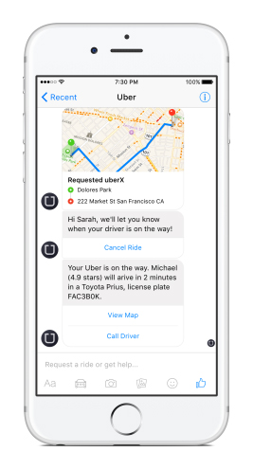
Uber’s chatbot on Facebook’s messenger
Uber’s chatbot on Facebook’s messenger - one main benefit: it loads much faster than the Uber app
Source: http://www.guided-selling.org/from-e-commerce-to-conversational-commerce/

Slide 64
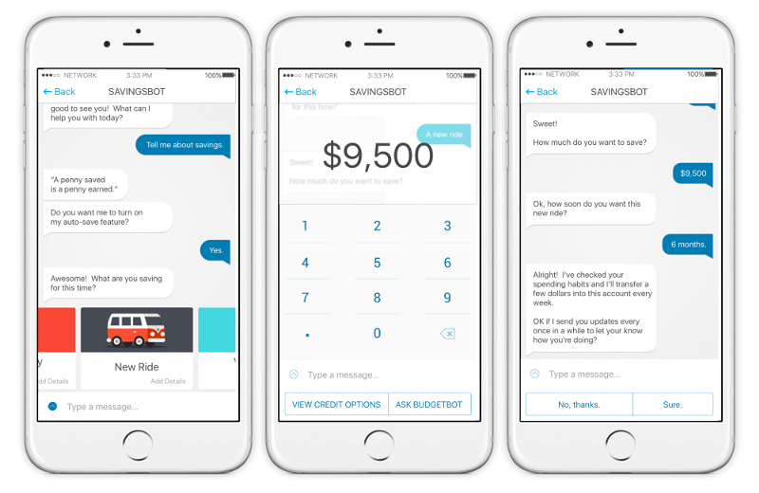
Savings Bot
Source: https://chatbotsmagazine.com/artificial-intelligence-ai-and-fintech-part-1-7cae1e67dc13

Slide 65
Source: https://www.oreilly.com/ideas/infographic-the-bot-platform-ecosystem

Slide 66
Source: https://www.oreilly.com/ideas/infographic-the-bot-platform-ecosystem

Slide 67
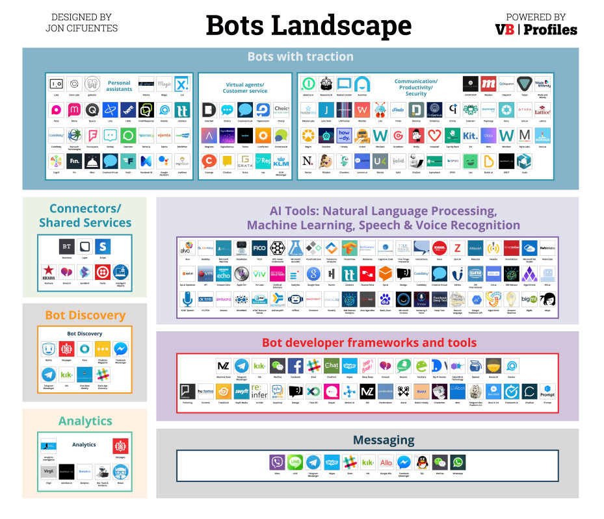
Source: https://venturebeat.com/2016/08/11/introducing-the-bots-landscape-170-companies-4-billion-in-funding-thousands-of-bots/

Slide 68
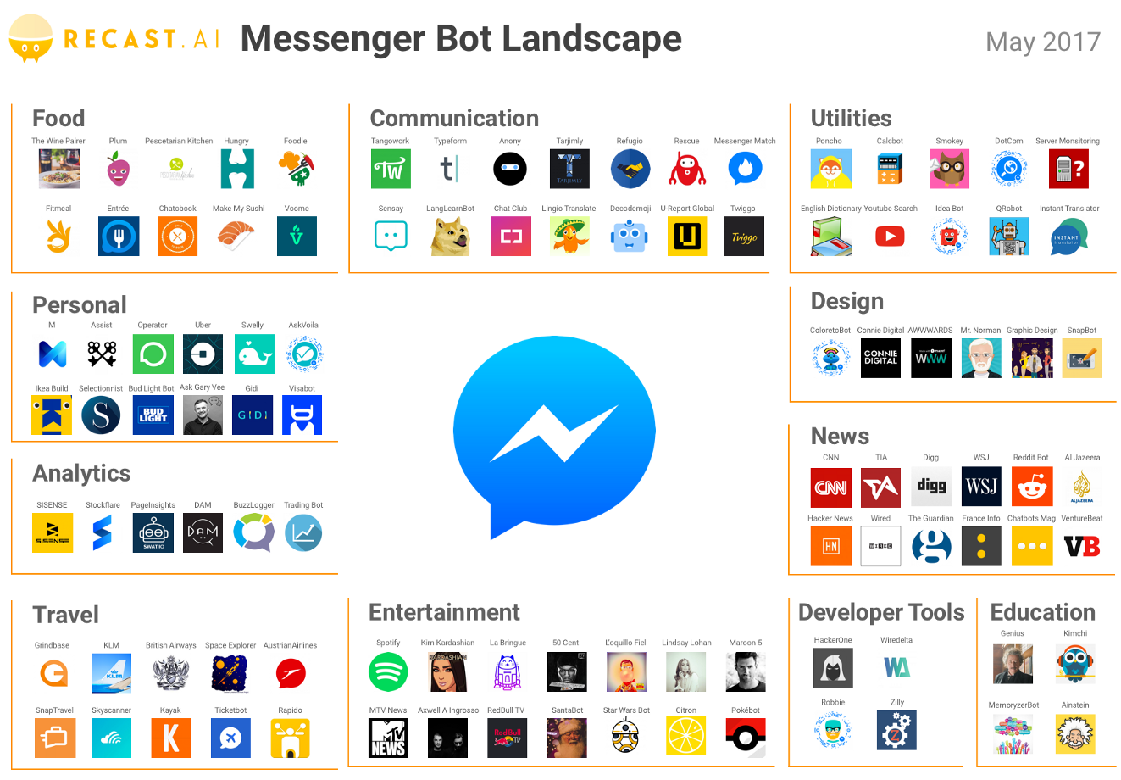
Source: https://medium.com/@RecastAI/2017-messenger-bot-landscape-a-public-spreadsheet-gathering-1000-messenger-bots-f017fdb1448a /

Slide 69
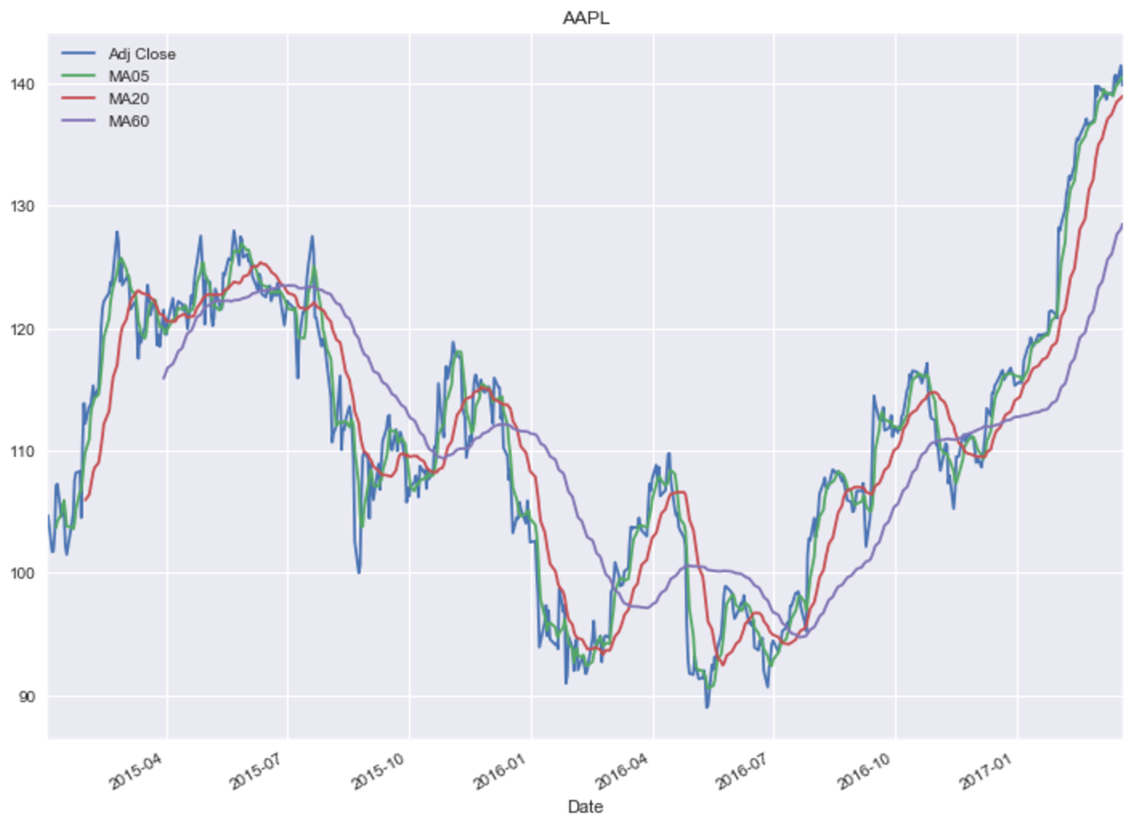
Python Pandas for Finance
Source: https://mapattack.wordpress.com/2017/02/12/using-python-for-stocks-1/

Slide 70
Artificial Intelligence and Deep Learning for Fintech

Slide 71
From Algorithmic Trading to Personal Finance Bots: 41 Startups Bringing AI to Fintech
Source: https://www.cbinsights.com/blog/artificial-intelligence-fintech-market-map-company-list/

Slide 72
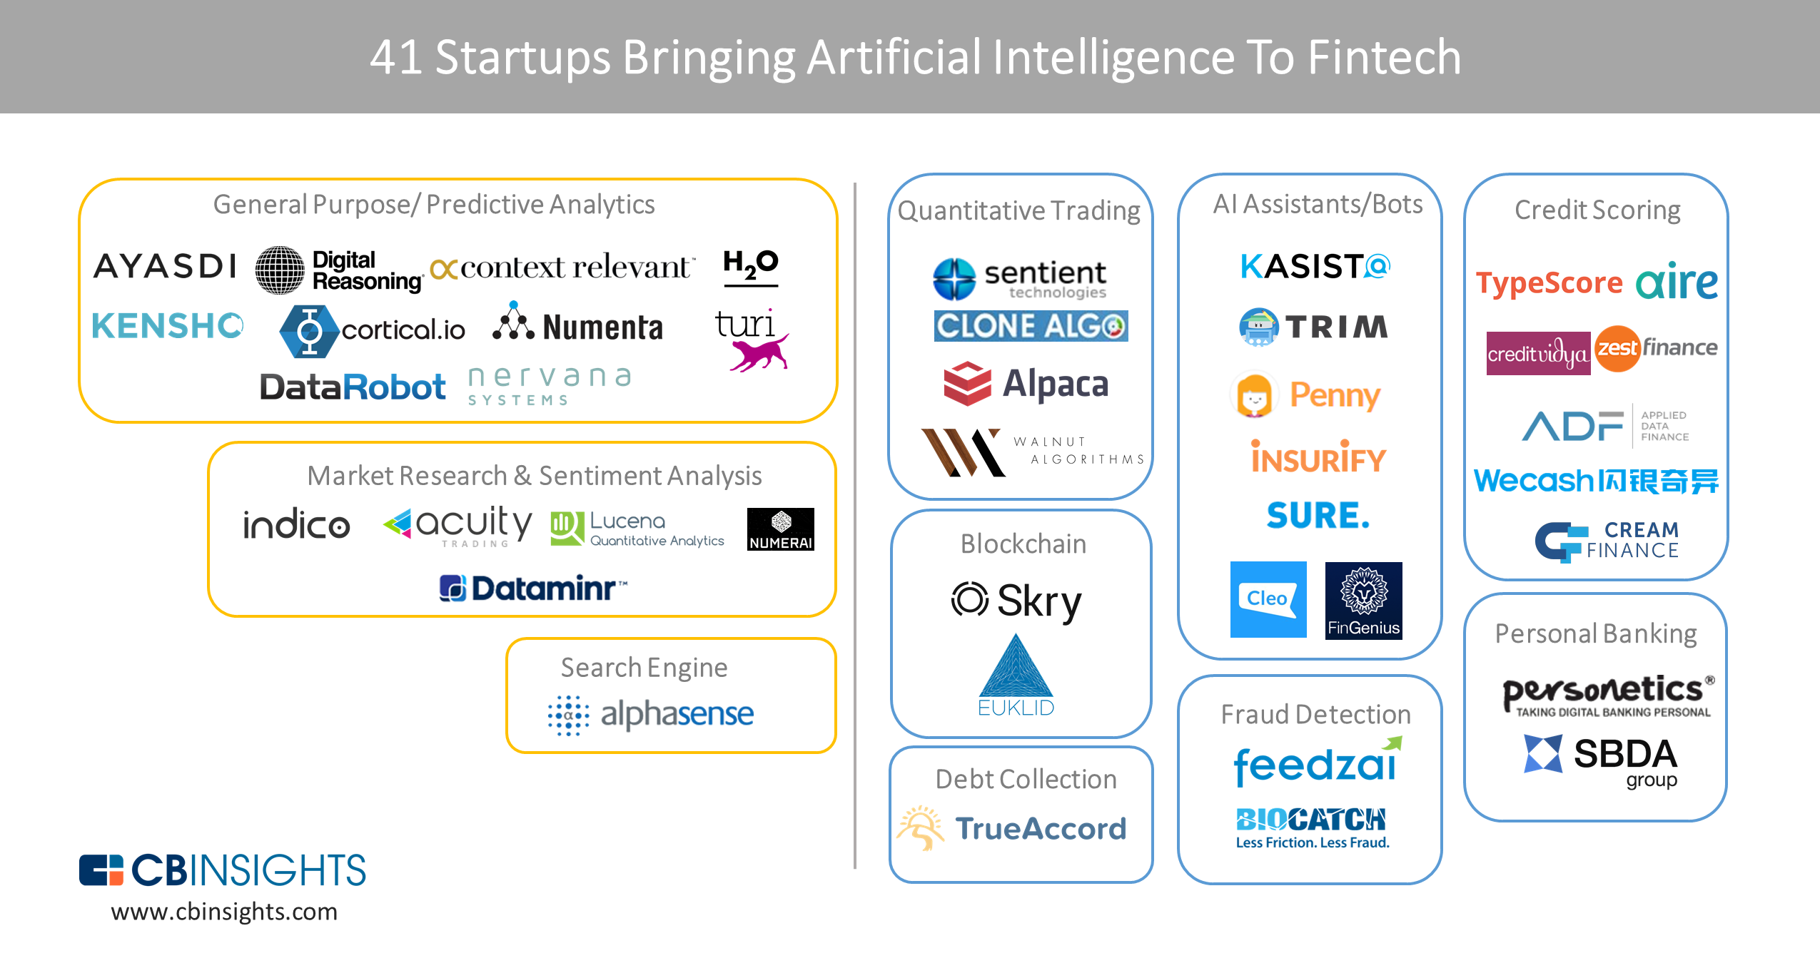
From Algorithmic Trading To Personal Finance Bots: 41 Startups Bringing AI To Fintech
AI in Fintech
Source: https://www.cbinsights.com/blog/artificial-intelligence-fintech-market-map-company-list/

Slide 73
Artificial Intelligence (AI) in Fintech
Source: https://www.cbinsights.com/blog/artificial-intelligence-fintech-market-map-company-list/

Slide 74
Artificial Intelligence (AI) in Fintech
Source: https://www.cbinsights.com/blog/artificial-intelligence-fintech-market-map-company-list/

Slide 75
Artificial Intelligence Machine Learning & Deep Learning
Source: https://blogs.nvidia.com/blog/2016/07/29/whats-difference-artificial-intelligence-machine-learning-deep-learning-ai/

Slide 76
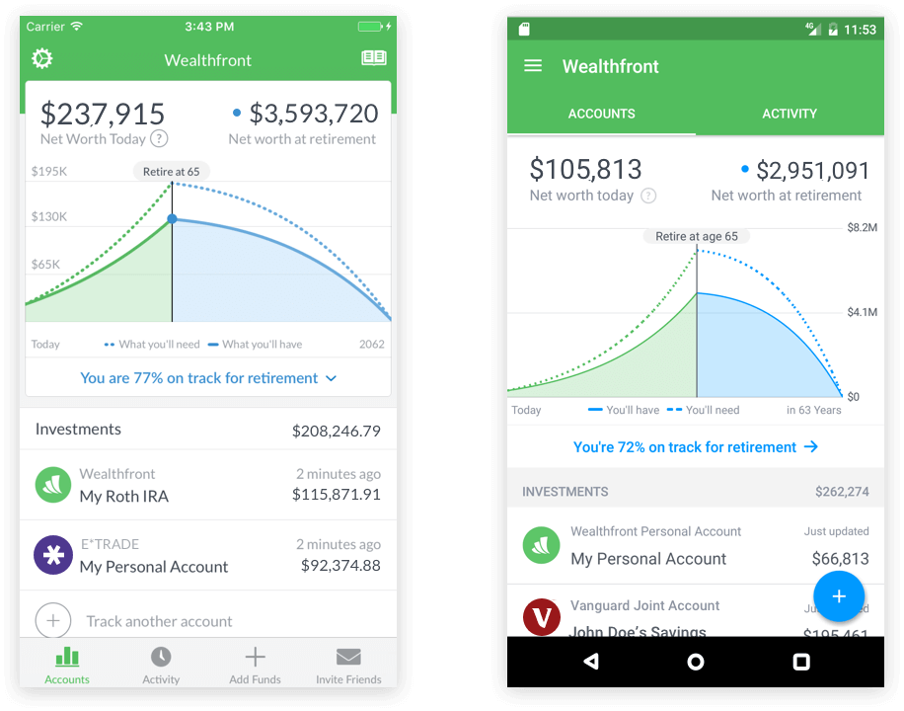
Wealthfront Robo Advisor
Source: https://www.wealthfront.com/

Slide 77
財務金融大數據分析 Big Data Analytics in Finance

Slide 78
投資大數據分析 Big Data Analytics in Investment

Slide 79
人工智慧與財務應用 Artificial Intelligence and Financial Application

Slide 80
人工智慧與投資分析 Artificial Intelligence and Investment Analysis

Slide 81
Summary
This course introduces the fundamental concepts and research issues of Big Data Analytics in Finance.
Topics include
Business Models of Fintech
Artificial Intelligence for Investment Analysis and Robo-Advisors
Conversational Commerce and Intelligent Chatbots for Fintech
Event Study
Foundations of Finance Big Data Analytics in Python
Big Data Analytics with Numpy in Python
Finance Big Data Analytics with Pandas in Python
Text Mining Techniques and Natural Language Processing
Deep Learning with Keras in Python
Deep Learning with TensorFlow
Deep Learning for Finance Big Data
Social Network Analysis
Case Study on Big Data Analytics in Finance

Slide 82
Contact Information
戴敏育 博士 (Min-Yuh Day, Ph.D.)
專任助理教授
淡江大學 資訊管理學系
電話：02-26215656 #2846
傳真：02-26209737
研究室：B929
地址： 25137 新北市淡水區英專路151號
Email： myday@mail.tku.edu.tw
網址：http://mail.tku.edu.tw/myday/

