Slide 1
Social Computing and Big Data Analytics 社群運算與大數據分析
Tamkang University
Tamkang University
Measurements and Tools of Social Network Analysis (社會網絡分析量測與工具)
1052SCBDA13
MIS MBA (M2226) (8606)
Wed, 8,9, (15:10-17:00) (L206)
Min-Yuh Day
戴敏育
Assistant Professor
專任助理教授
Dept. of Information Management, Tamkang University
淡江大學 資訊管理學系
http://mail. tku.edu.tw/myday/
2017-05-24

Slide 2
課程大綱 (Syllabus)
週次 (Week) 日期 (Date) 內容 (Subject/Topics)
1 2017/02/15 Course Orientation for Social Computing and Big Data Analytics (社群運算與大數據分析課程介紹)
2 2017/02/22 Data Science and Big Data Analytics: Discovering, Analyzing, Visualizing and Presenting Data (資料科學與大數據分析： 探索、分析、視覺化與呈現資料)
3 2017/03/01 Fundamental Big Data: MapReduce Paradigm, Hadoop and Spark Ecosystem (大數據基礎：MapReduce典範、 Hadoop與Spark生態系統)

Slide 3
課程大綱 (Syllabus)
週次 (Week) 日期 (Date) 內容 (Subject/Topics)
4 2017/03/08 Big Data Processing Platforms with SMACK: Spark, Mesos, Akka, Cassandra and Kafka (大數據處理平台SMACK： Spark, Mesos, Akka, Cassandra, Kafka)
5 2017/03/15 Big Data Analytics with Numpy in Python (Python Numpy 大數據分析)
6 2017/03/22 Finance Big Data Analytics with Pandas in Python (Python Pandas 財務大數據分析)
7 2017/03/29 Text Mining Techniques and Natural Language Processing (文字探勘分析技術與自然語言處理)
8 2017/04/05 Off-campus study (教學行政觀摩日)

Slide 4
課程大綱 (Syllabus)
週次 (Week) 日期 (Date) 內容 (Subject/Topics)
9 2017/04/12 Social Media Marketing Analytics (社群媒體行銷分析)
10 2017/04/19 期中報告 (Midterm Project Report)
11 2017/04/26 Deep Learning with Theano and Keras in Python (Python Theano 和 Keras 深度學習)
12 2017/05/03 Deep Learning with Google TensorFlow (Google TensorFlow 深度學習)
13 2017/05/10 Sentiment Analysis on Social Media with Deep Learning (深度學習社群媒體情感分析)

Slide 5
課程大綱 (Syllabus)
週次 (Week) 日期 (Date) 內容 (Subject/Topics)
14 2017/05/17 Social Network Analysis (社會網絡分析)
15 2017/05/24 Measurements and Tools of Social Network Analysis (社會網絡分析量測與工具)
16 2017/05/31 Invited Talk: From Blog to Job Bank (社群平台分析) [Invited Speaker: Dr. Rick Cheng-Yu Lu, CDO, 104]
17 2017/06/07 Final Project Presentation I (期末報告 I)
18 2017/06/14 Final Project Presentation II (期末報告 II)

Slide 6
Measurements and Tools of Social Network Analysis

Slide 7
Jennifer Golbeck (2013), Analyzing the Social Web, Morgan Kaufmann
Source: http://www.amazon.com/Analyzing-Social-Web-Jennifer-Golbeck/dp/0124055311

Slide 8
Devangana Khokhar (2015), Gephi Cookbook, Packt Publishing
Source: http://www.amazon.com/Gephi-Cookbook-Devangana-Khokhar/dp/1783987405
Notes:
Devangana Khokhar (2015), Gephi Cookbook, Packt Publishing

Slide 9
Graph Theory

Slide 10
Graph
C
A
D
B
E

Slide 11
Graph g = (V, E)

Slide 12
Vertex (Node)

Slide 13
Vertices (Nodes)

Slide 14
Edge

Slide 15
Edges

Slide 16
Arc

Slide 17
Arcs

Slide 18
Undirected Graph
C
A
D
B
E
Source: https://www.youtube.com/watch?v=89mxOdwPfxA

Slide 19
Directed Graph
C
A
D
B
E
Source: https://www.youtube.com/watch?v=89mxOdwPfxA

Slide 20
Measurements of Social Network Analysis

Slide 21
Exploratory Network Analysis
Source: http://sebastien.pro/gephi-icwsm-tutorial.pdf

Slide 22
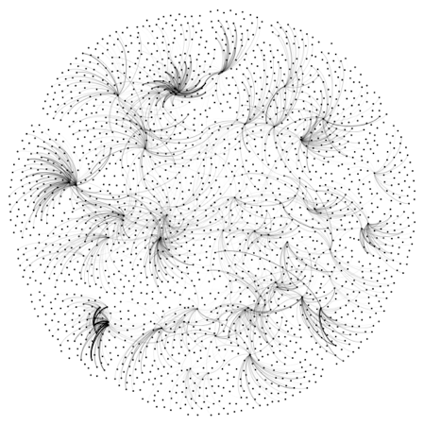
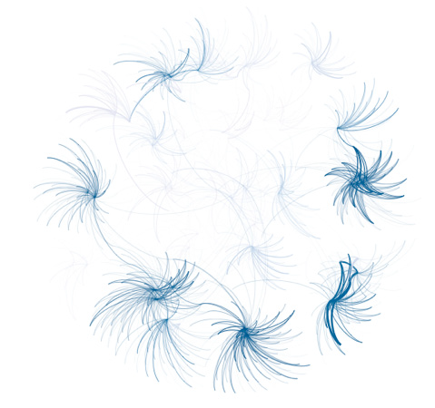
Looking for a “Simple Small Truth”? What Data Visualization Should Do?
1. Make complex things simple
2. Extract small information from large data
3. Present truth, do not deceive
Source: http://sebastien.pro/gephi-icwsm-tutorial.pdf

Slide 23
Measurements

Slide 24
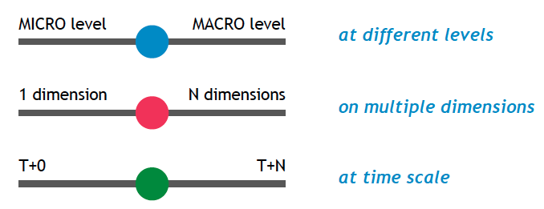
Looking for Orderness in Data
Make varying 3 cursors simultaneously to extract meaningful patterns
Source: http://sebastien.pro/gephi-icwsm-tutorial.pdf

Slide 25
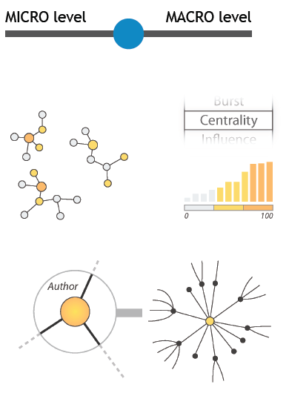
“Zoom” cursor on Quantitative Data
Global
- connectivity
- density
- centralization
Local
- communities
- bridges between communities
- local centers vs periphery
Individual
- centrality
- distances
- neighborhood
- location
- local authority vs hub
Source: http://sebastien.pro/gephi-icwsm-tutorial.pdf

Slide 26
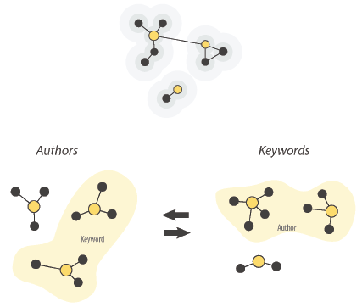
“Crossing” cursor on Quantitative Data
Social
- who with whom
- communities
- brokerage
- influence and power
- homophily
Semantic
- topics
- thematic clusters
Geographic
- spatial phenomena
Source: http://sebastien.pro/gephi-icwsm-tutorial.pdf

Slide 27
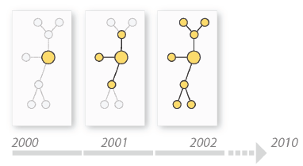
“Timeline” cursor on Temporal Data
Evolution of social ties
Evolution of communities
Evolution of topics
Source: http://sebastien.pro/gephi-icwsm-tutorial.pdf

Slide 28
SNA Guideline
Source: http://sebastien.pro/gephi-icwsm-tutorial.pdf

Slide 29
Degree
C
A
D
B
E
Source: https://www.youtube.com/watch?v=89mxOdwPfxA

Slide 30
Degree
C
A: 2
B: 4
C: 2
D:1
E: 1
A
D
B
E
Source: https://www.youtube.com/watch?v=89mxOdwPfxA

Slide 31
Density
C
A
D
B
E
Source: https://www.youtube.com/watch?v=89mxOdwPfxA

Slide 32
Density
Edges (Links): 5
Total Possible Edges: 10
Density: 5/10 = 0.5
C
A
D
B
E
Source: https://www.youtube.com/watch?v=89mxOdwPfxA

Slide 33
Density
A
E
I
C
G
H
B
J
D
F
Nodes (n): 10
Edges (Links): 13
Total Possible Edges: (n * (n-1)) / 2 = (10 * 9) / 2 = 45
Density: 13/45 = 0.29

Slide 34
Diameter
radius (r)
diameter (d)

Slide 35
Diameter
A
E
I
C
G
H
B
J
D
F

Slide 36
Diameter Geodesic Path (Shortest Path)
A
E
I
C
G
H
B
J
D
F
A→ I : Diameter = 4

Slide 37
Which Node is Most Important?
A
E
I
C
G
H
B
J
D
F

Slide 38
Centrality
Important or prominent actors are those that are linked or involved with other actors extensively.
A person with extensive contacts (links) or communications with many other people in the organization is considered more important than a person with relatively fewer contacts.
The links can also be called ties. A central actor is one involved in many ties.
Source: Bing Liu (2011) , “Web Data Mining: Exploring Hyperlinks, Contents, and Usage Data”

Slide 39
Social Network Analysis (SNA)
Degree Centrality
Betweenness Centrality
Closeness Centrality

Slide 40
Degree Centrality

Slide 41
Social Network Analysis: Degree Centrality
A
E
I
C
G
H
B
J
D
F

Slide 42
Social Network Analysis: Degree Centrality
Node | Score | Standardized Score
A | 2 | 2/10 = 0.2
B | 2 | 2/10 = 0.2
C | 5 | 5/10 = 0.5
D | 3 | 3/10 = 0.3
E | 3 | 3/10 = 0.3
F | 2 | 2/10 = 0.2
G | 4 | 4/10 = 0.4
H | 3 | 3/10 = 0.3
I | 1 | 1/10 = 0.1
J | 1 | 1/10 = 0.1
A
E
I
C
G
H
B
J
D
F

Slide 43
Betweenness Centrality

Slide 44
Betweenness centrality:
Connectivity
Number of shortest paths going through the actor

Slide 45
Betweenness Centrality
Where g_{jk} = the number of shortest paths connecting jk
g_{jk}(i) = the number that actor i is on.
Normalized Betweenness Centrality
Number of pairs of vertices excluding the vertex itself
Source: https://www.youtube.com/watch?v=RXohUeNCJiU

Slide 46
Betweenness Centrality
C
A:
B→C: 0/1 = 0
B→D: 0/1 = 0
B→E: 0/1 = 0
C→D: 0/1 = 0
C→E: 0/1 = 0
D→E: 0/1 = 0
Total: 0
A
D
B
E
A: Betweenness Centrality = 0

Slide 47
Betweenness Centrality
C
B:
A→C: 0/1 = 0
A→D: 1/1 = 1
A→E: 1/1 = 1
C→D: 1/1 = 1
C→E: 1/1 = 1
D→E: 1/1 = 1
Total: 5
A
D
B
E
B: Betweenness Centrality = 5

Slide 48
Betweenness Centrality
C
C:
A→B: 0/1 = 0
A→D: 0/1 = 0
A→E: 0/1 = 0
B→D: 0/1 = 0
B→E: 0/1 = 0
D→E: 0/1 = 0
Total: 0
A
D
B
E
C: Betweenness Centrality = 0

Slide 49
Betweenness Centrality
C
A: 0
B: 5
C: 0
D: 0
E: 0
A
D
B
E

Slide 50
Which Node is Most Important?
F
G
H
B
E
A
C
I
D
J
F
H
B
E
A
C
D
J

Slide 51
Which Node is Most Important?
F
G
H
B
E
A
C
I
D
J
F
G
H
E
A
I
D
J

Slide 52
Betweenness Centrality
B
E
A
C
D

Slide 53
Betweenness Centrality
C
A:
B→C: 0/1 = 0
B→D: 0/1 = 0
B→E: 0/1 = 0
C→D: 0/1 = 0
C→E: 0/1 = 0
D→E: 0/1 = 0
Total: 0
A
D
B
E
A: Betweenness Centrality = 0

Slide 54
Closeness Centrality

Slide 55
Social Network Analysis: Closeness Centrality
C→A: 1
C→B: 1
C→D: 1
C→E: 1
C→F: 2
C→G: 1
C→H: 2
C→I: 3
C→J: 3
Total=15
A
E
I
C
G
H
B
J
D
F
C: Closeness Centrality = 15/9 = 1.67

Slide 56
Social Network Analysis: Closeness Centrality
G→A: 2
G→B: 2
G→C: 1
G→D: 2
G→E: 1
G→F: 1
G→H: 1
G→I: 2
G→J: 2
Total=14
A
E
I
C
G
H
B
J
D
F
G: Closeness Centrality = 14/9 = 1.56

Slide 57
Social Network Analysis: Closeness Centrality
H→A: 3
H→B: 3
H→C: 2
H→D: 2
H→E: 2
H→F: 2
H→G: 1
H→I: 1
H→J: 1
Total=17
A
E
I
C
G
H
B
J
D
F
H: Closeness Centrality = 17/9 = 1.89

Slide 58
Social Network Analysis: Closeness Centrality
A
E
I
C
G
H
B
J
D
F
G: Closeness Centrality = 14/9 = 1.56
1
C: Closeness Centrality = 15/9 = 1.67
2
H: Closeness Centrality = 17/9 = 1.89
3

Slide 59
Social Network Analysis (SNA) importance of neighbors
Eigenvector centrality

Slide 60
Eigenvector centrality:
Importance of a node depends on the importance of its neighbors

Slide 61
Social Network Analysis: Closeness Centrality
Sum of the reciprocal distances
where d(p_{j}, p_{k}) is the geodesic distance (shortest paths) linking p_{j}, p_{k}

Slide 62
Social Network Analysis: Betweenness Centrality
where g_{ij} is the geodesic distance (shortest paths) linking p_{i} and p_{j} and g_{ij} (p_{k} ) is the geodesic distance linking p_{i} and p_{j} that contains p_{k}.
Source: Abbasi, A., Hossain, L., & Leydesdorff, L. (2012). Betweenness centrality as a driver of preferential attachment in the evolution of research collaboration networks. Journal of Informetrics, 6(3), 403-412.

Slide 63
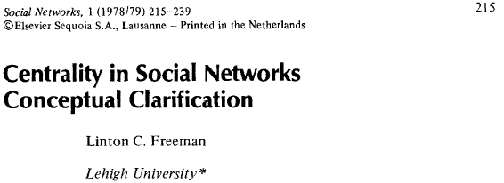
Social Network Analysis: Degree Centrality
where a(p_{i}, p_{k}) = 1 if and only if p_{i} and p_{k} are connected by a line
0 otherwise

Slide 64
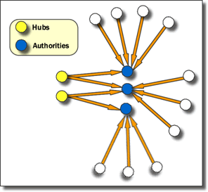
Social Network Analysis: Hub and Authority
Hubs are entities that point to a relatively large number of authorities. They are essentially the mutually reinforcing analogues to authorities. Authorities point to high hubs. Hubs point to high authorities. You cannot have one without the other.
Source: http://www.fmsasg.com/SocialNetworkAnalysis/

Slide 65
Tools of Social Network Analysis

Slide 66
Social Network Analysis (SNA) Tools
NetworkX
igraph
Gephi
UCINet
Pajek

Slide 67
Tools of Social Network Analysis
Focused Desktop Tools
Gephi
Ucinet
Pajek
NodeXL
Cytoscape
Source: https://www.researchgate.net/post/Which_open_source_software_is_best_for_network_data_analysis

Slide 68
Tools of Social Network Analysis
Developer Tools
NetworkX
iGraph
SNAP
sigma.js
Source: https://www.researchgate.net/post/Which_open_source_software_is_best_for_network_data_analysis

Slide 69
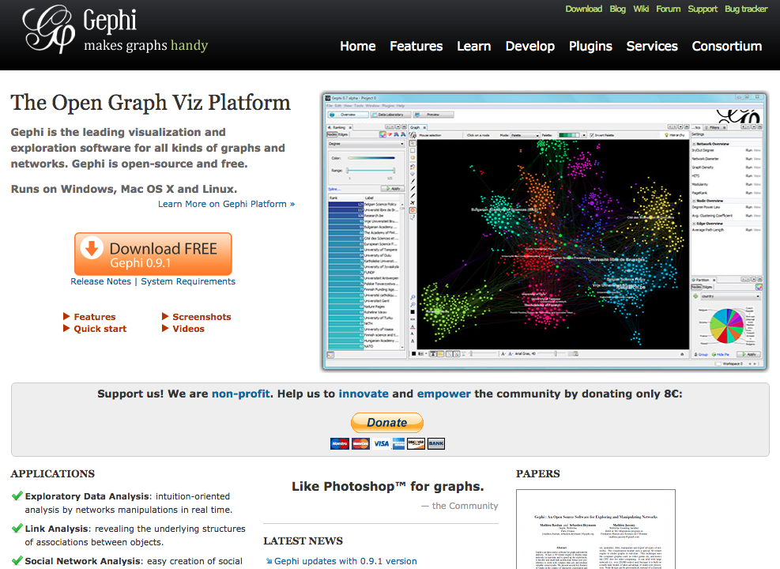
Gephi
https://gephi.org/

Slide 70
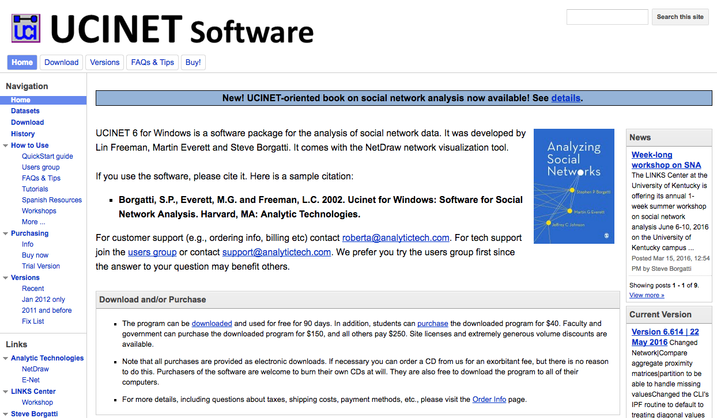
UCINET
https://sites.google.com/site/ucinetsoftware/home

Slide 71
Pajek
http://vlado.fmf.uni-lj.si/pub/networks/pajek/

Slide 72
Pajek
http://mrvar.fdv.uni-lj.si/pajek/

Slide 73
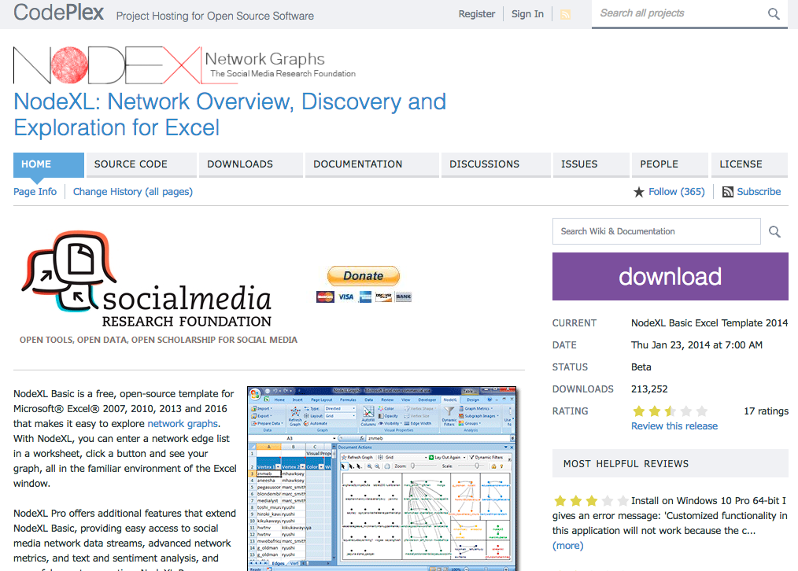
NodeXL
https://nodexl.codeplex.com/

Slide 74
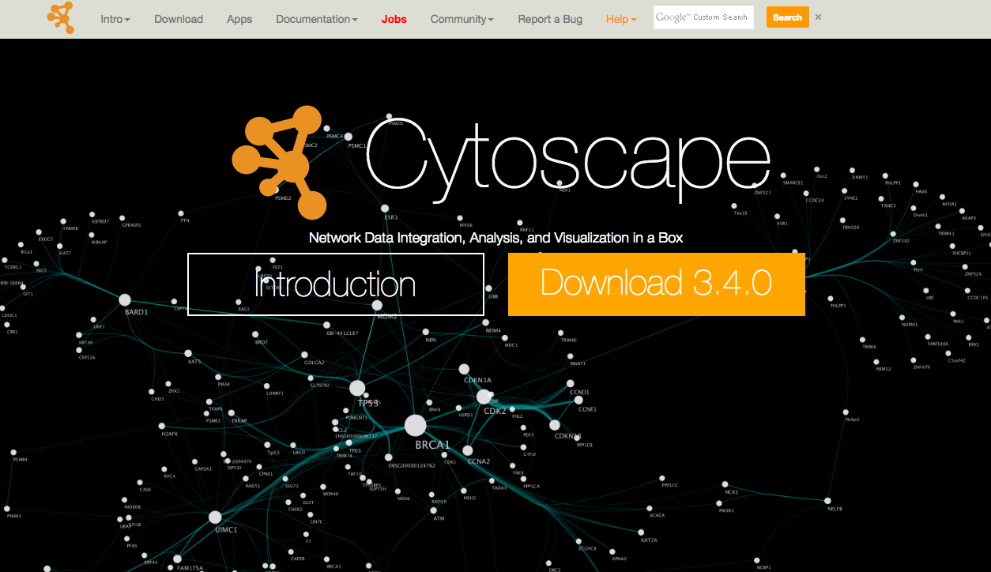
Cytoscape
http://www.cytoscape.org/

Slide 75
NetworkX
https://networkx.github.io/

Slide 76
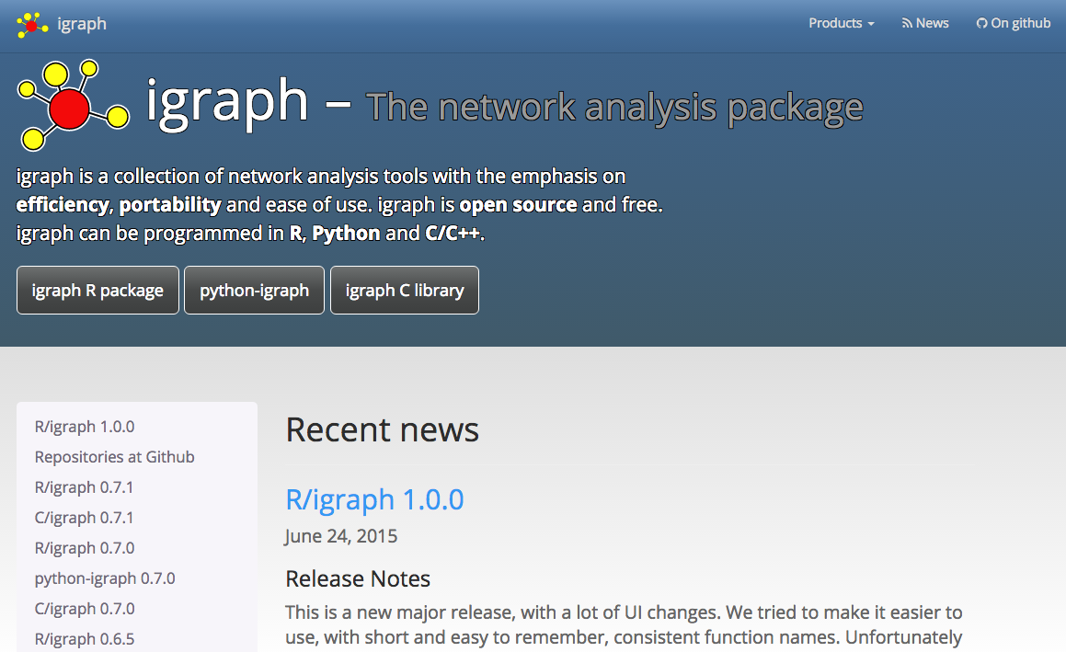
igraph
http://igraph.org/redirect.html

Slide 77
SNAP
http://snap.stanford.edu/

Slide 78
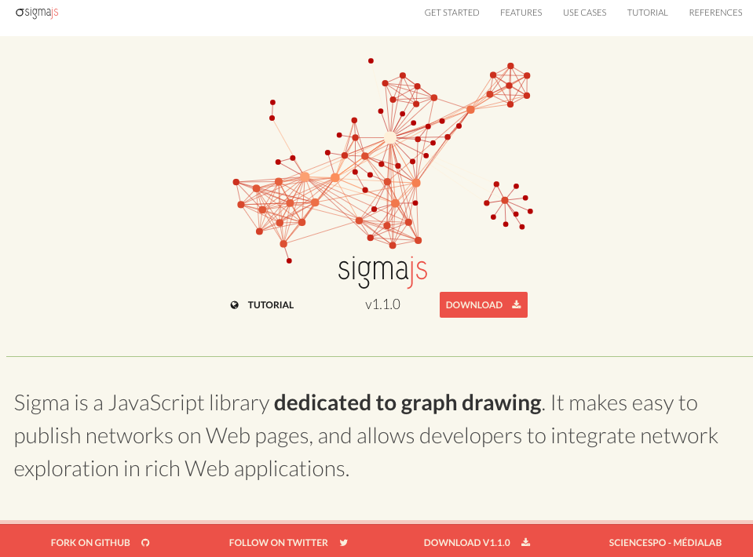
sigma.js
http://sigmajs.org/

Slide 79
Gephi: Social Network Analysis and Visualization

Slide 80
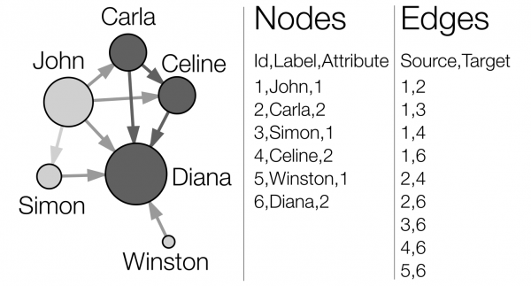
Network Analysis and Visualization with Gephi
Source: http://www.martingrandjean.ch/gephi-introduction/

Slide 81
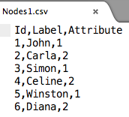
Nodes and Edges CSV Text Data for Gephi
Nodes1.csv
Edges1.csv
Id,Label,Attribute
1,John,1
2,Carla,2
3,Simon,1
4,Celine,2
5,Winston,1
6,Diana,2
Source,Target
1,2
1,3
1,4
1,6
2,4
2,6
3,6
4,6
5,6
Source: http://www.martingrandjean.ch/gephi-introduction/

Slide 82
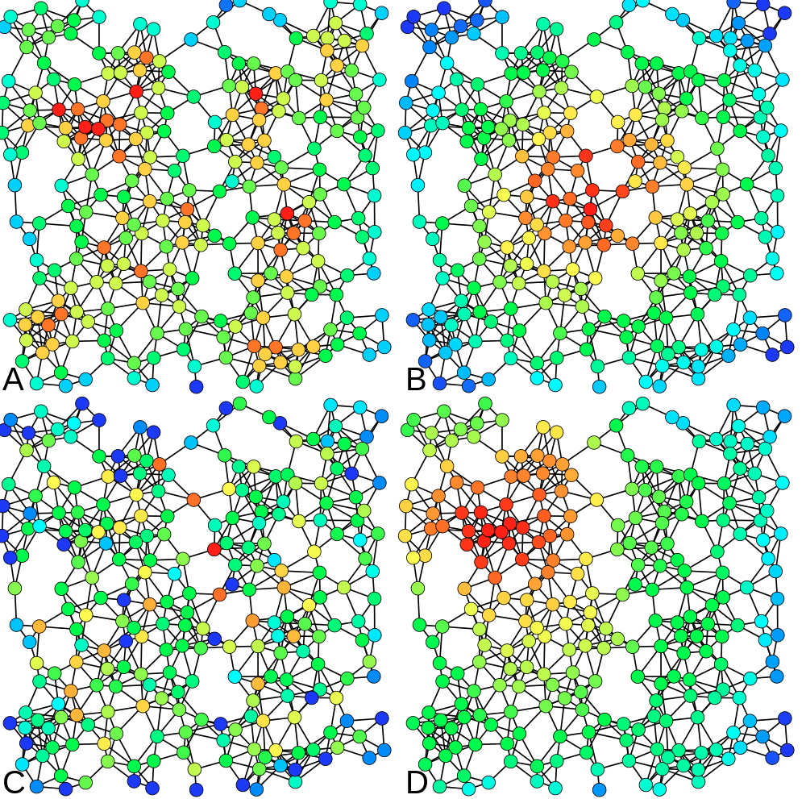
A = Degree centrality
number of connexions
B = Closeness centrality
closeness to the entire network
C = Betweenness centrality
bridges nodes
D = Eigenvector centrality
connection to well-connected nodes
Source: http://www.martingrandjean.ch/gephi-introduction/

Slide 83
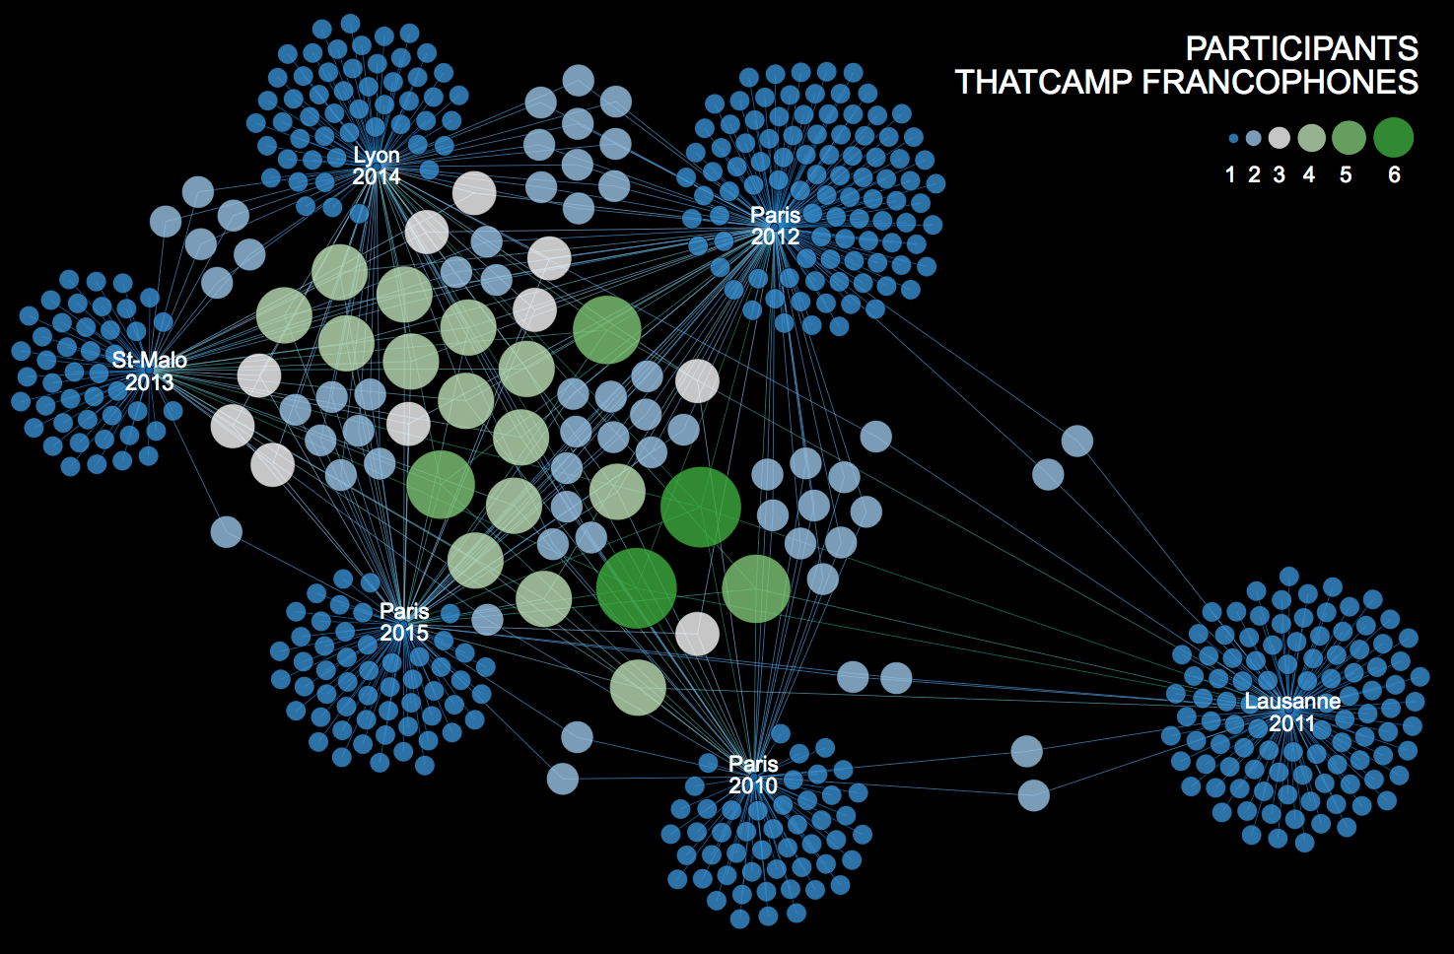
Conference Participants
Source: http://www.martingrandjean.ch/analyse-de-reseau-thatcamp-et-communaute-des-humanites-numeriques-francophones/

Slide 84
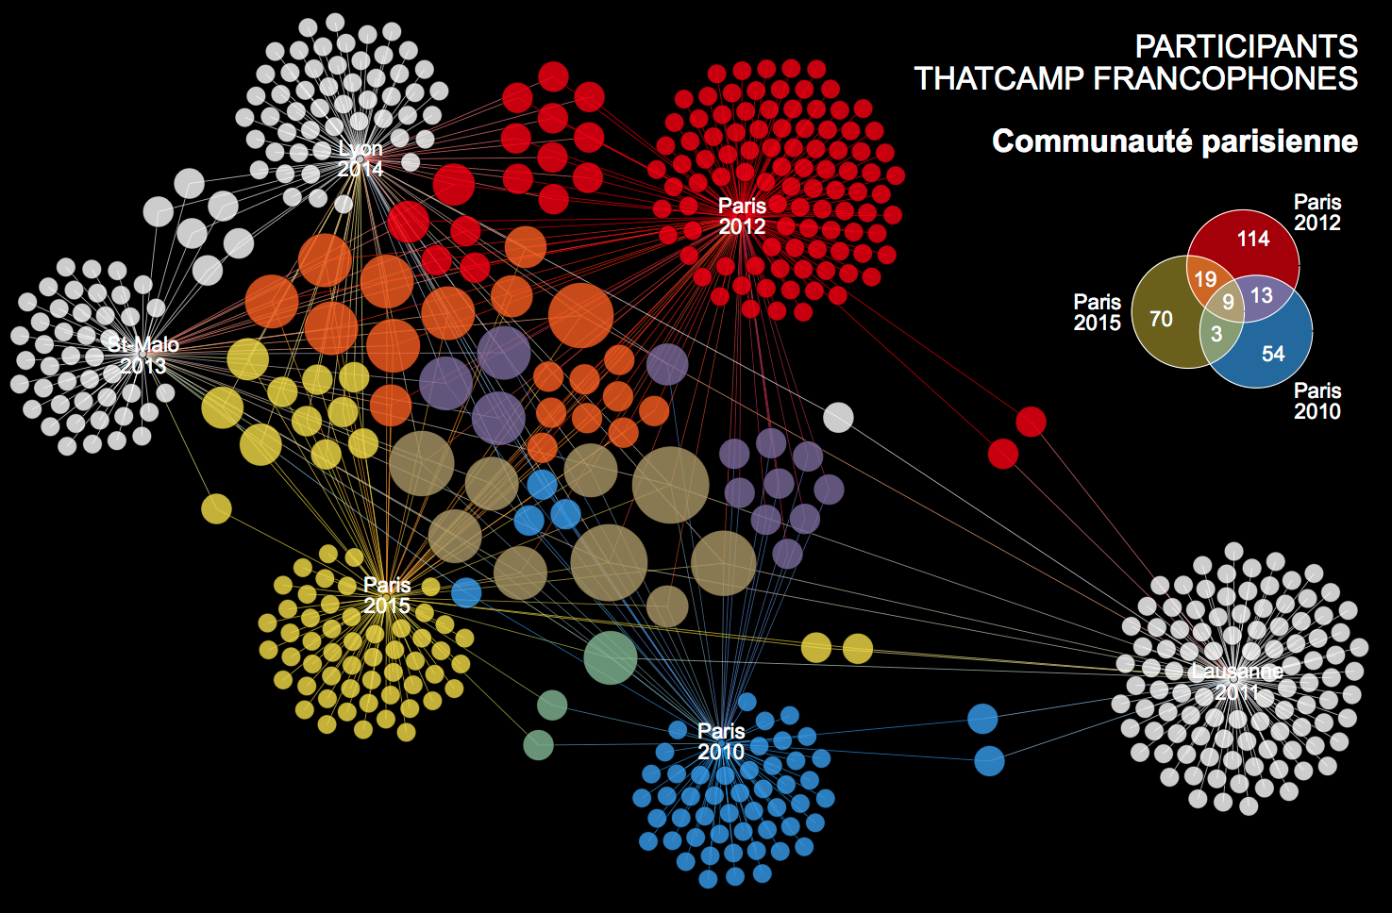
Conference Participants
Source: http://www.martingrandjean.ch/analyse-de-reseau-thatcamp-et-communaute-des-humanites-numeriques-francophones/

Slide 85
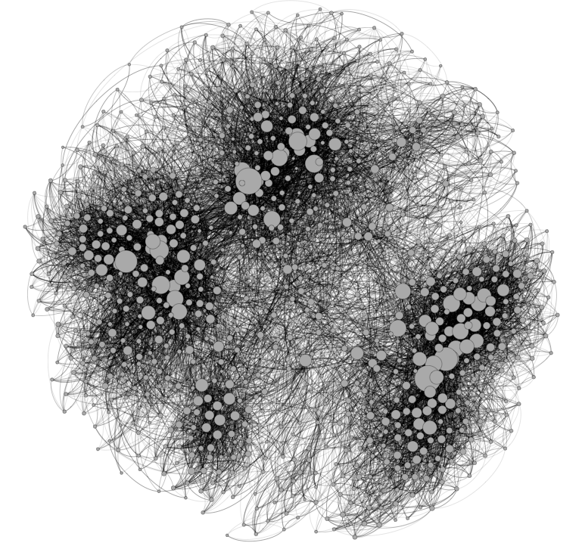
Fruchterman Reingold
Source: http://www.martingrandjean.ch/gephi-introduction/

Slide 86
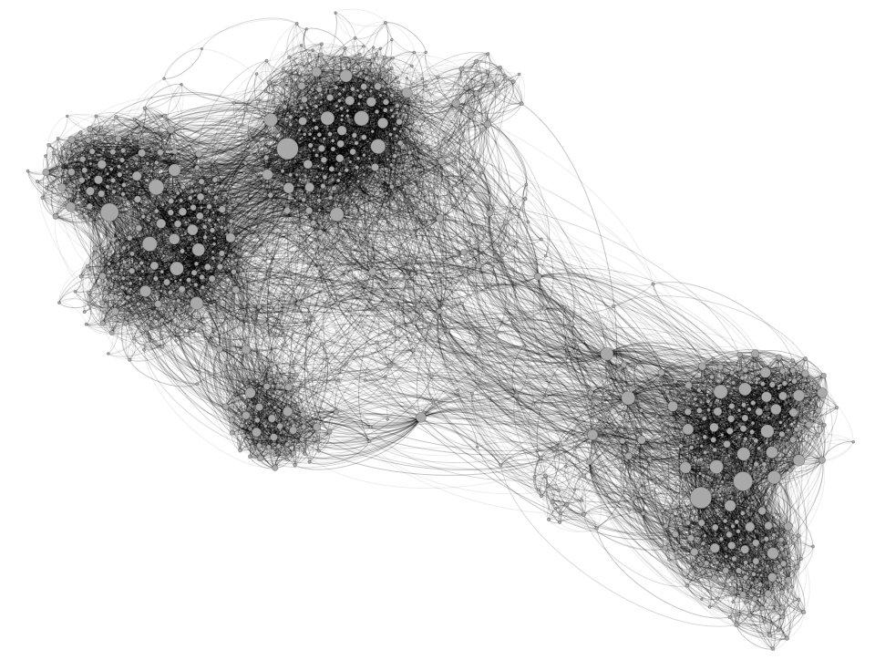
Force Atlas 2
Source: http://www.martingrandjean.ch/gephi-introduction/

Slide 87
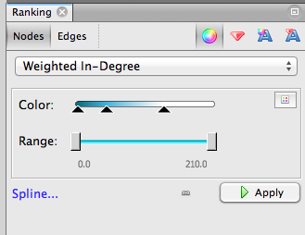
Nodes’ color Weighted In-Degree
Source: http://www.martingrandjean.ch/gephi-introduction/

Slide 88
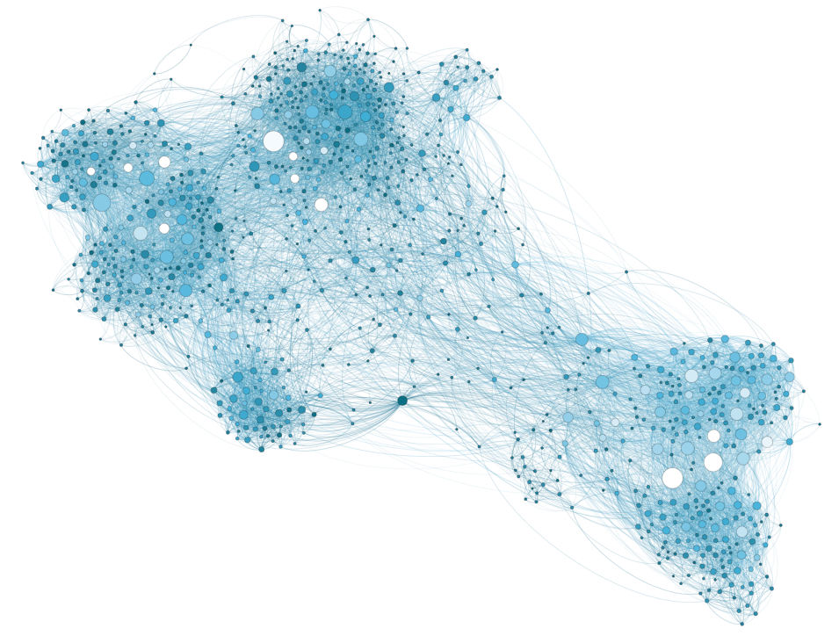
Weighted In-Degree
Source: http://www.martingrandjean.ch/gephi-introduction/

Slide 89
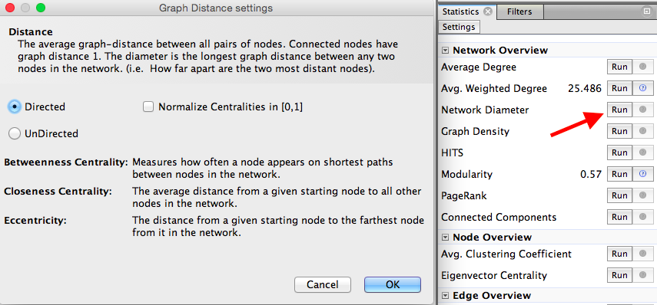
Network Diameter Betweenness Centrality Closeness Centrality
Source: http://www.martingrandjean.ch/gephi-introduction/

Slide 90
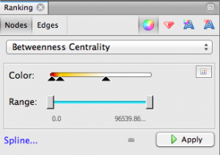
Nodes’ color Betweenness Centrality
Source: http://www.martingrandjean.ch/gephi-introduction/

Slide 91
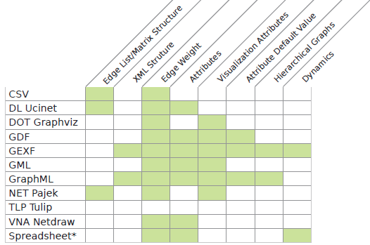
Gephi Supported Graph Formats
Source: https://gephi.org/users/supported-graph-formats/

Slide 92
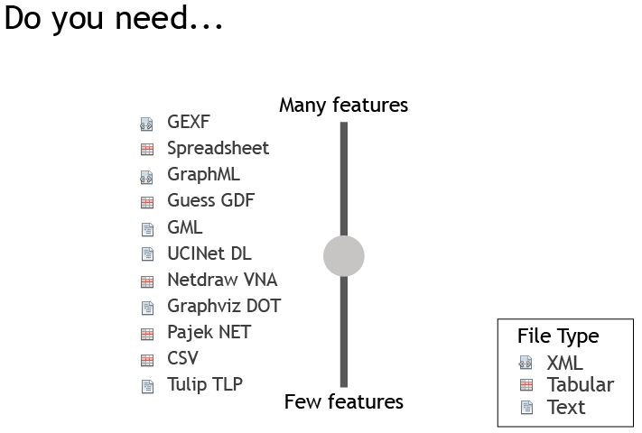
Gephi Supported Graph Formats
Source: https://gephi.org/users/supported-graph-formats/

Slide 93
Gephi
https://gephi.org/

Slide 94
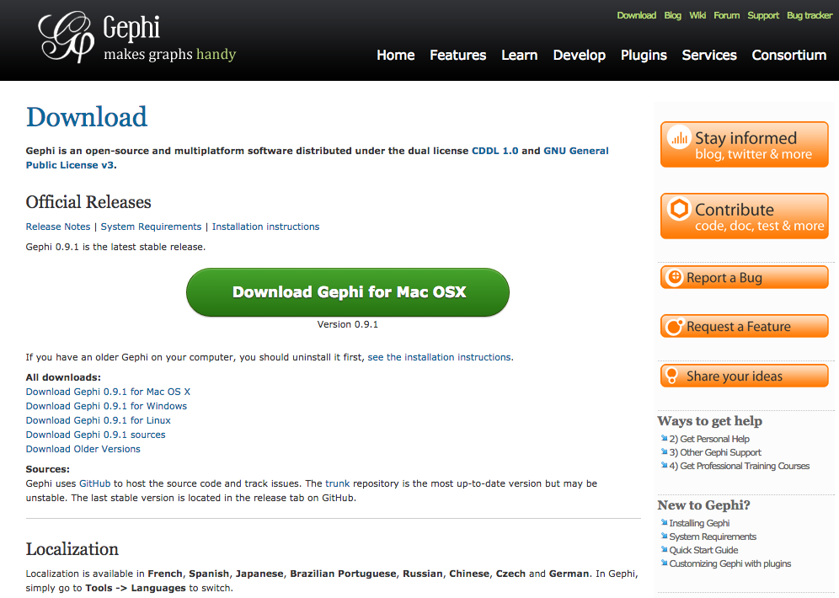
Download Gephi
https://gephi.org/users/download/

Slide 95
Download Gephi

Slide 96
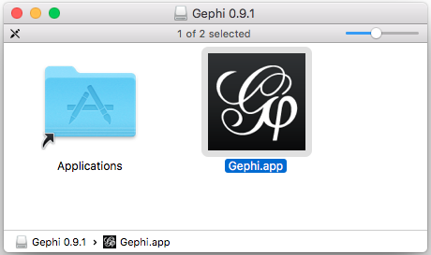
Gephi 0.9.1

Slide 97
Gephi

Slide 98
Gephi: New Project Import Nodes1.csv and Edges1.csv to Gephi

Slide 99
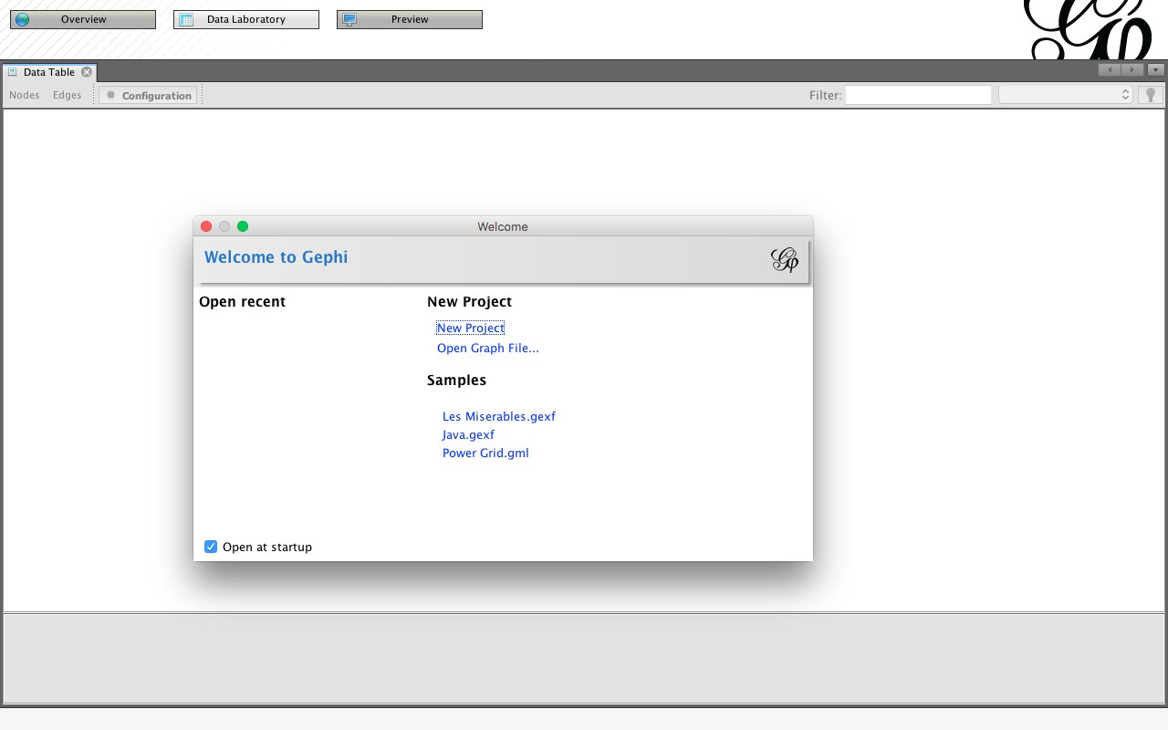
Gephi New Project

Slide 100
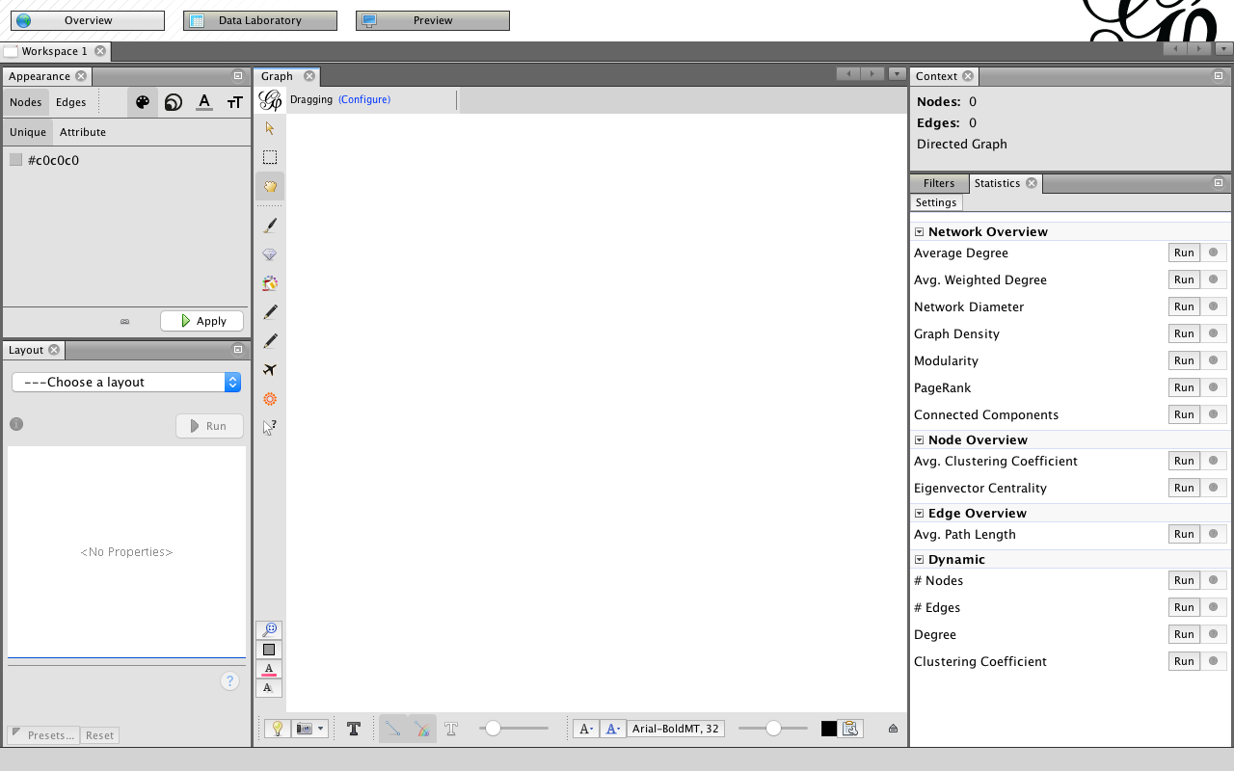
Gephi Overview
4. Context
1. Appearance
Nodes
Edges
3. Graph
2. Layout
5. Statistics
Filters

Slide 101
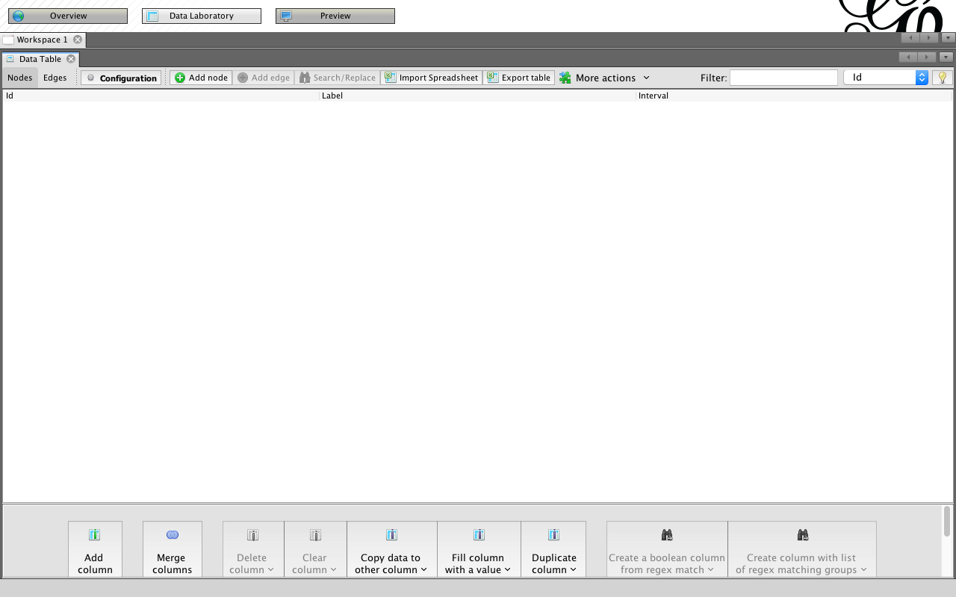
Gephi Data Laboratory: Import Spreadsheet

Slide 102
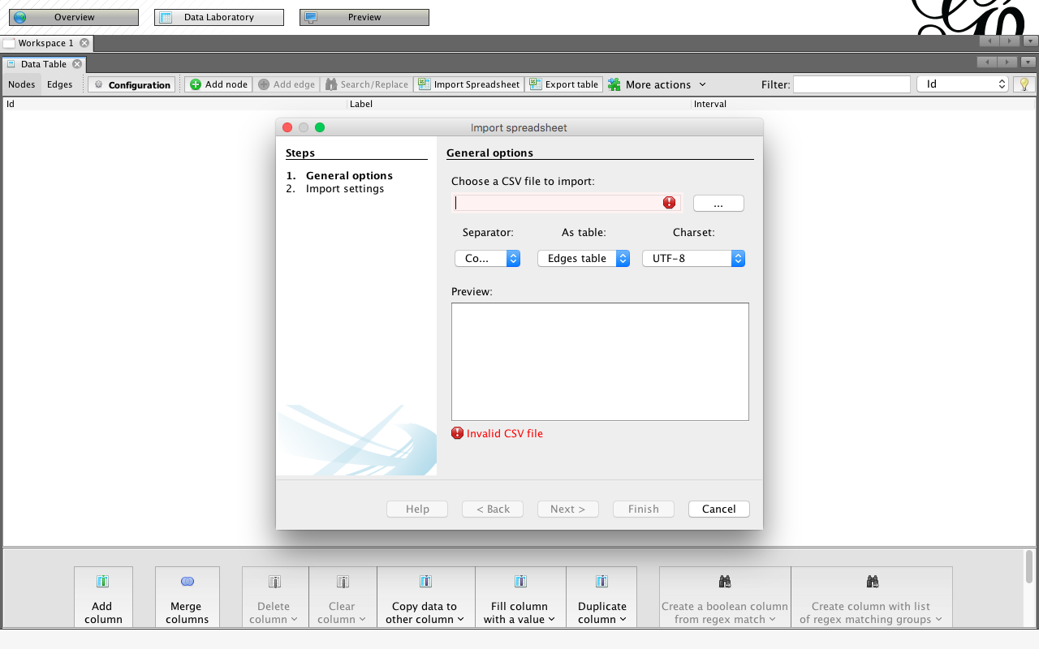
Gephi Data Laboratory: Import Spreadsheet

Slide 103
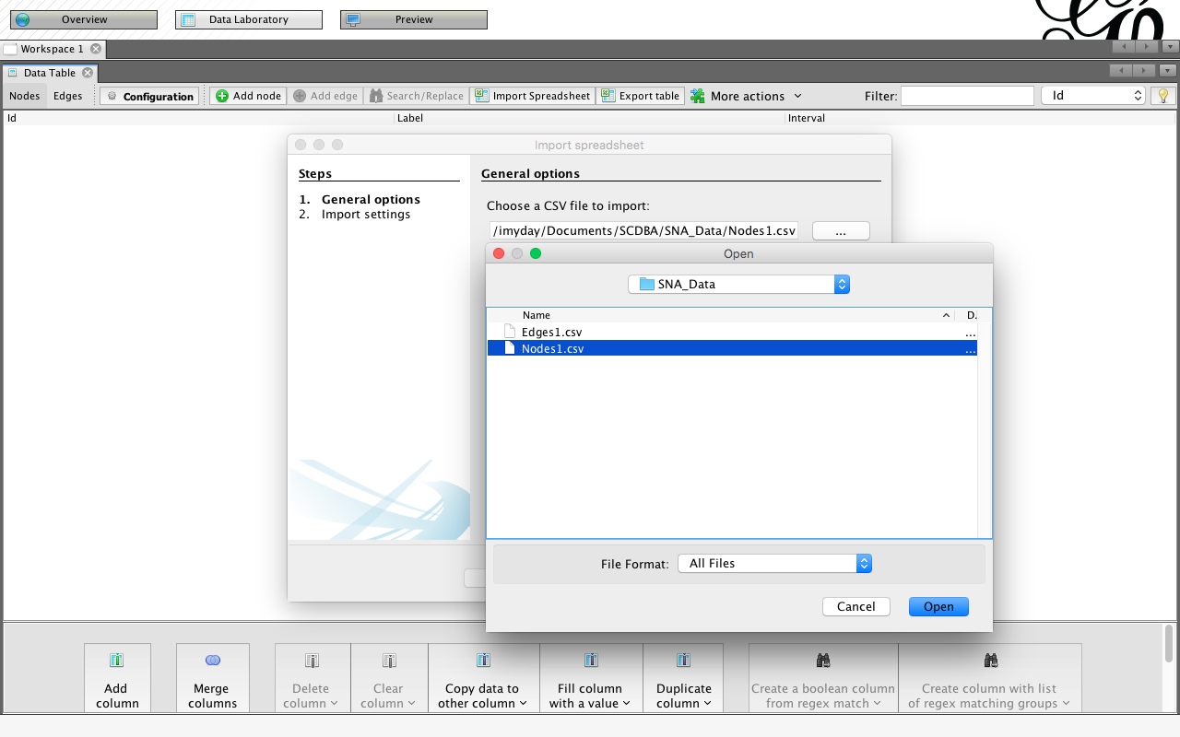
Import Nodes1.csv to Gephi
Nodes1.csv
Id,Label,Attribute
1,John,1
2,Carla,2
3,Simon,1
4,Celine,2
5,Winston,1
6,Diana,2

Slide 104
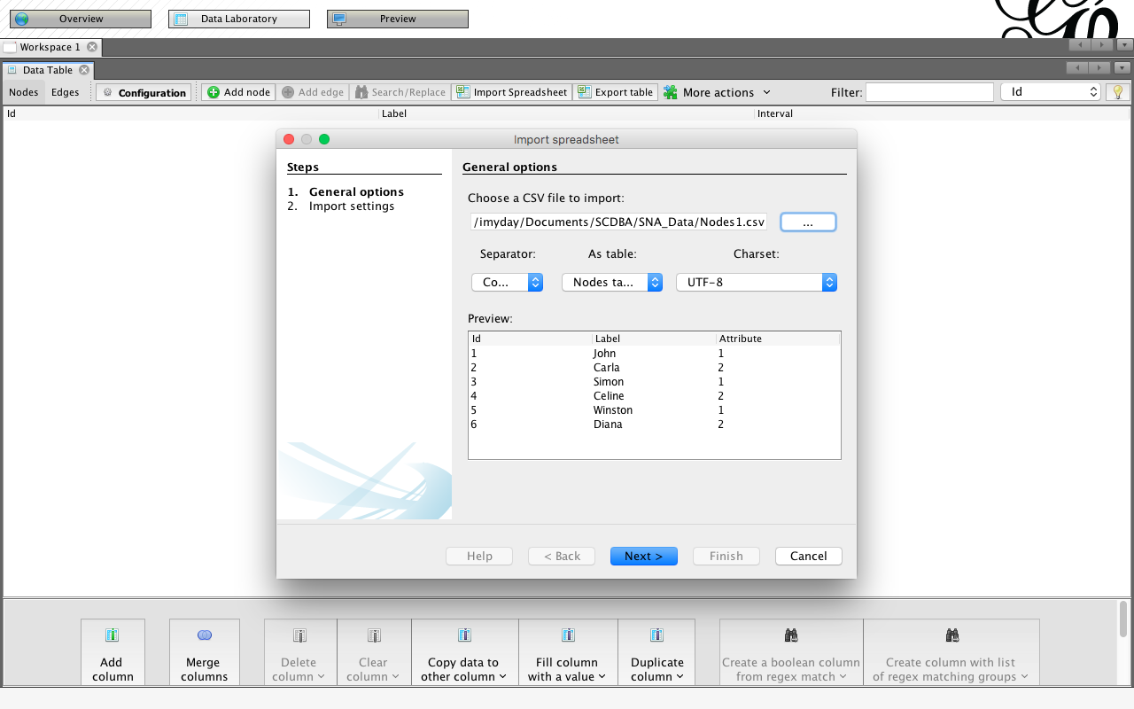
Import Nodes1.csv to Gephi

Slide 105
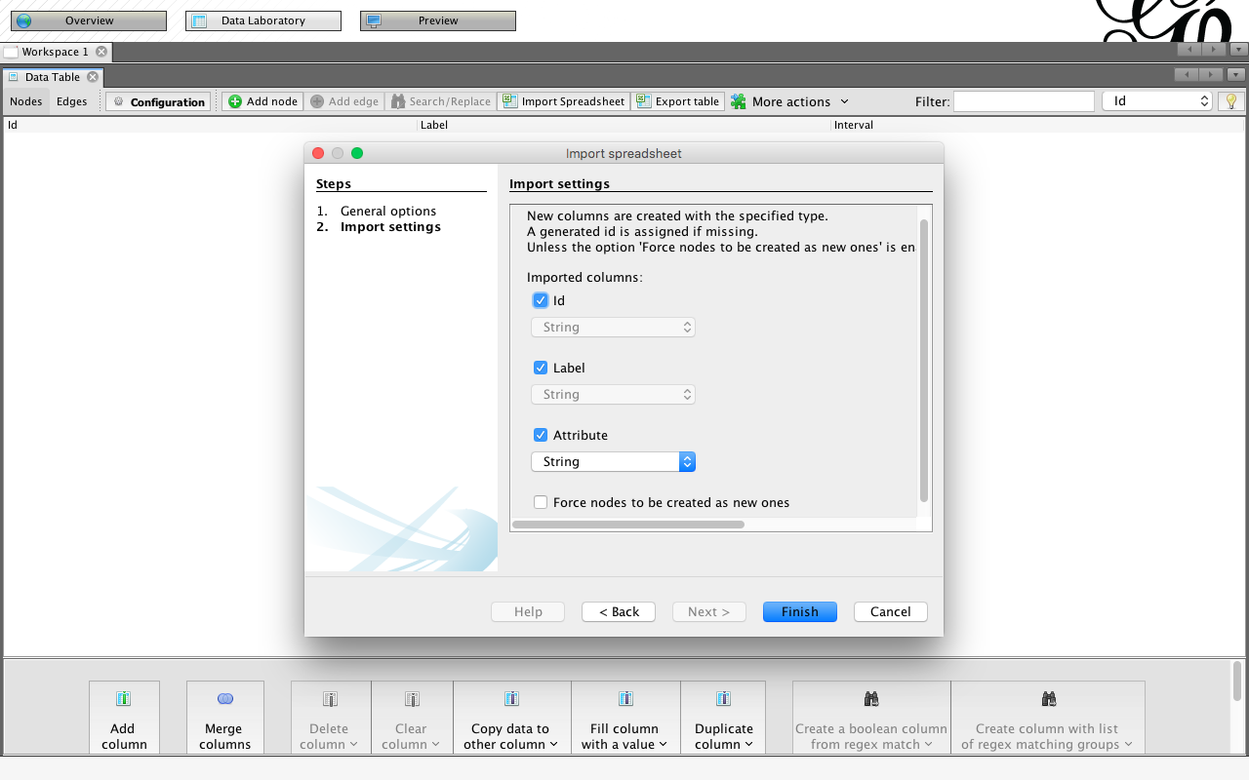
Import Nodes1.csv to Gephi

Slide 106
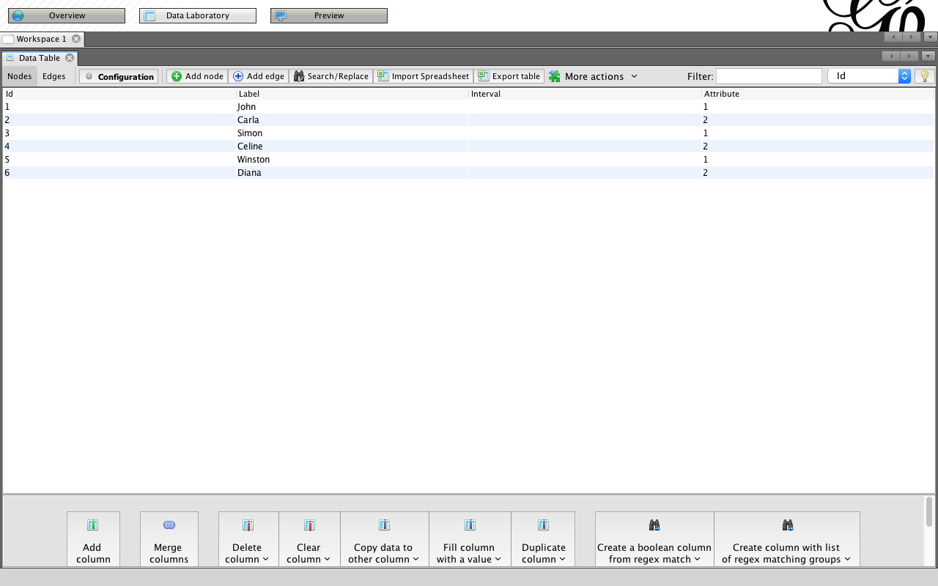
Import Nodes1.csv to Gephi
Nodes1.csv
Id,Label,Attribute
1,John,1
2,Carla,2
3,Simon,1
4,Celine,2
5,Winston,1
6,Diana,2

Slide 107
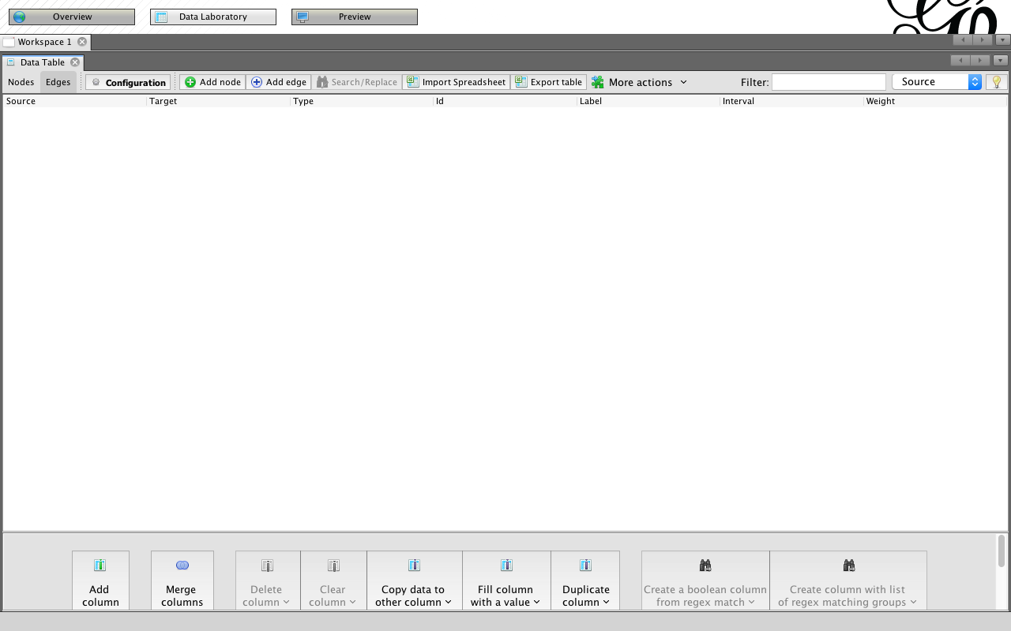
Import Edges1.csv to Gephi

Slide 108
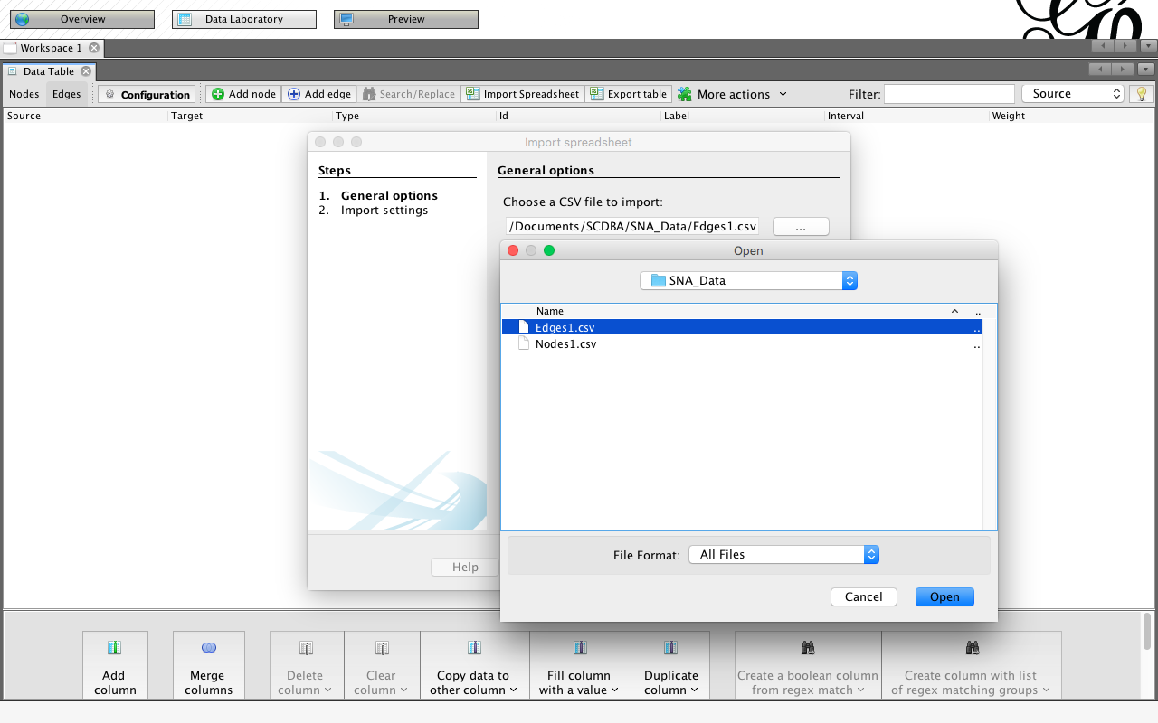
Import Edges1.csv to Gephi
Edges1.csv
Source,Target
1,2
1,3
1,4
1,6
2,4
2,6
3,6
4,6
5,6

Slide 109
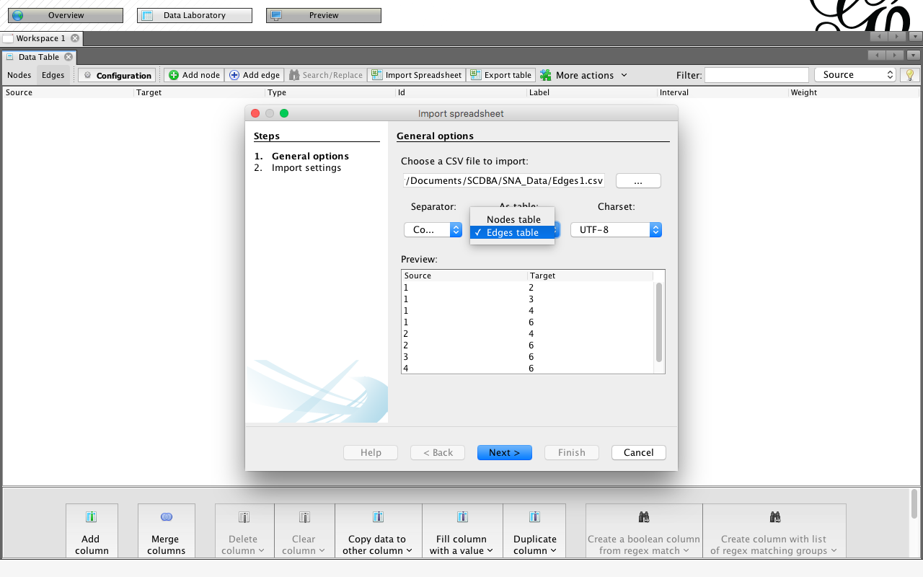
Import Edges1.csv to Gephi
Edges table

Slide 110
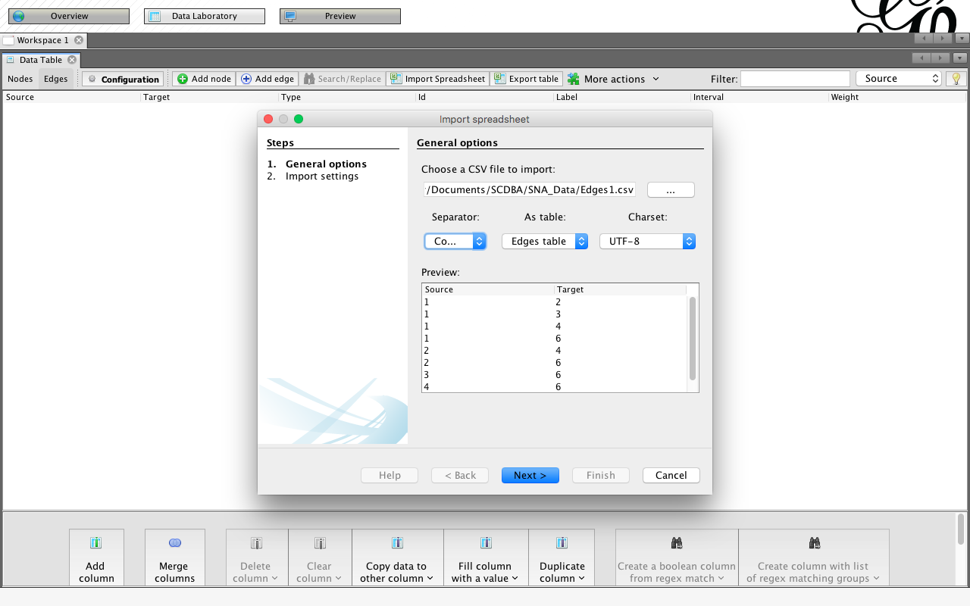
Import Edges1.csv to Gephi
Edges table

Slide 111
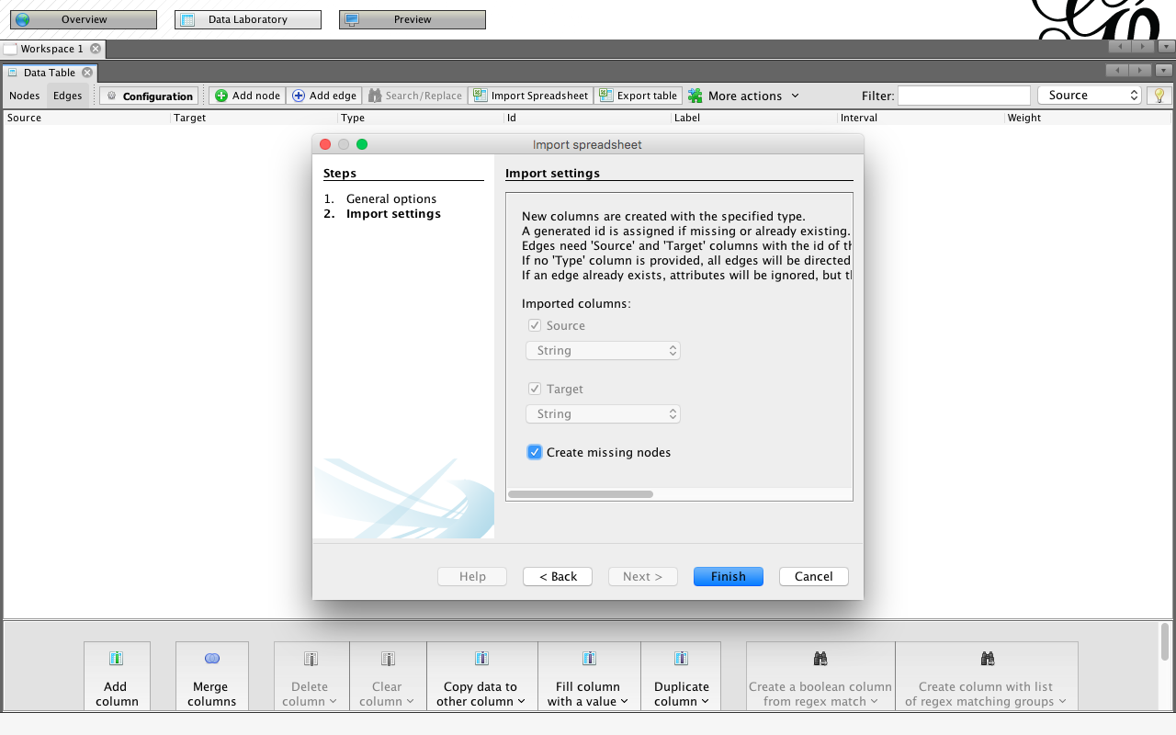
Import Edges1.csv to Gephi

Slide 112
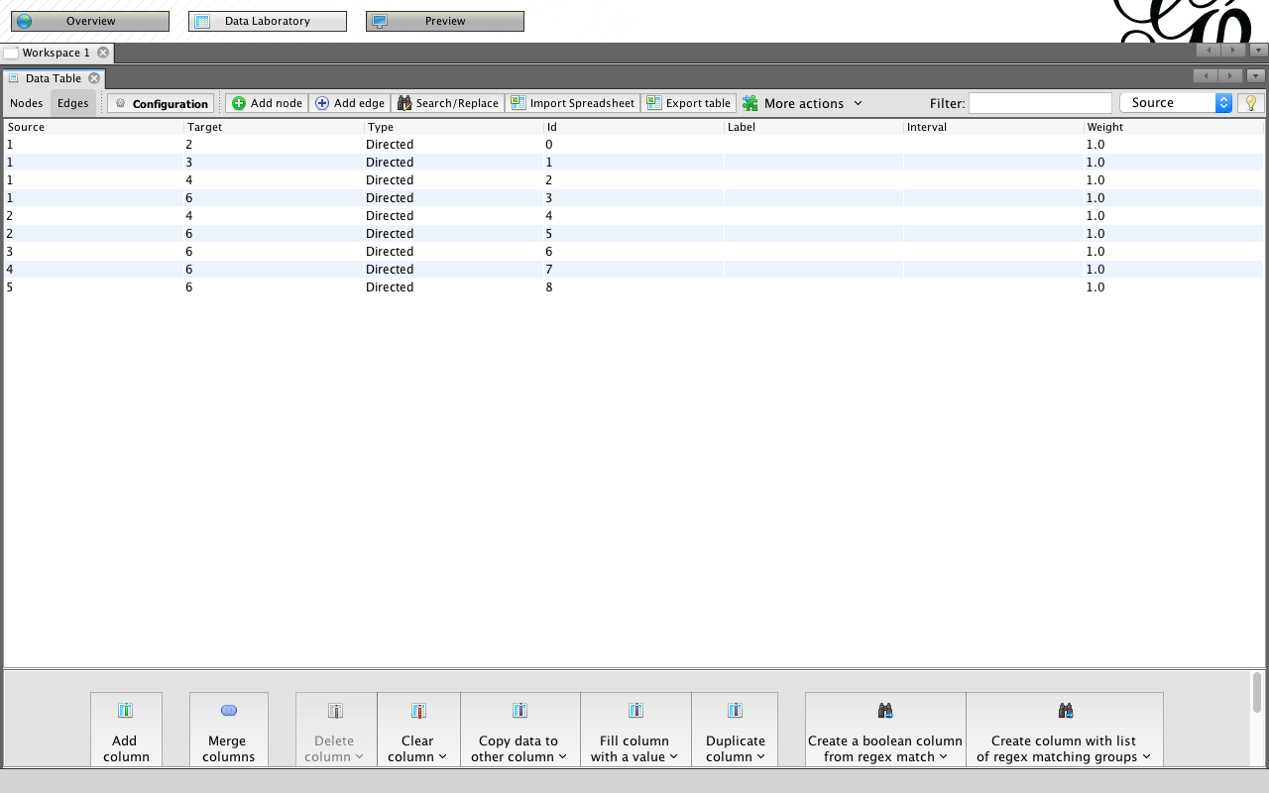
Import Edges1.csv to Gephi

Slide 113
Gephi Overview

Slide 114
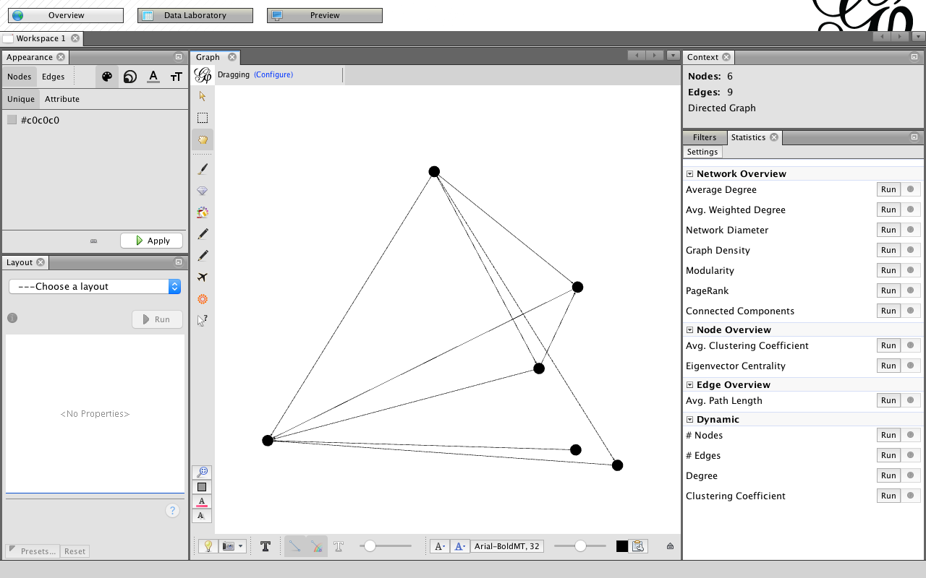
Gephi Overview: Graph

Slide 115
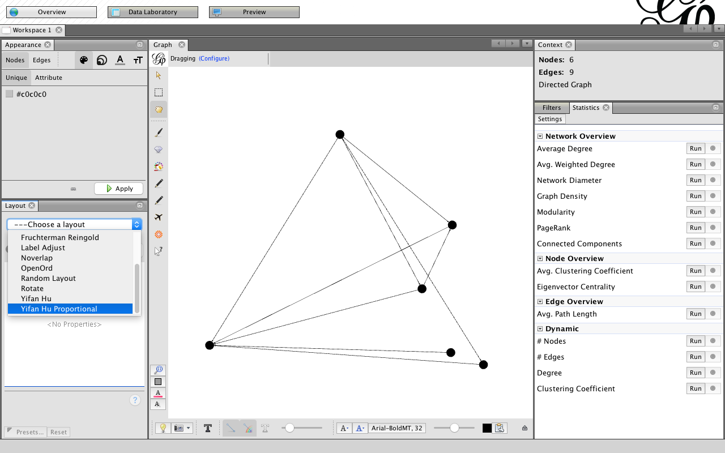
Gephi Overview: Layout

Slide 116
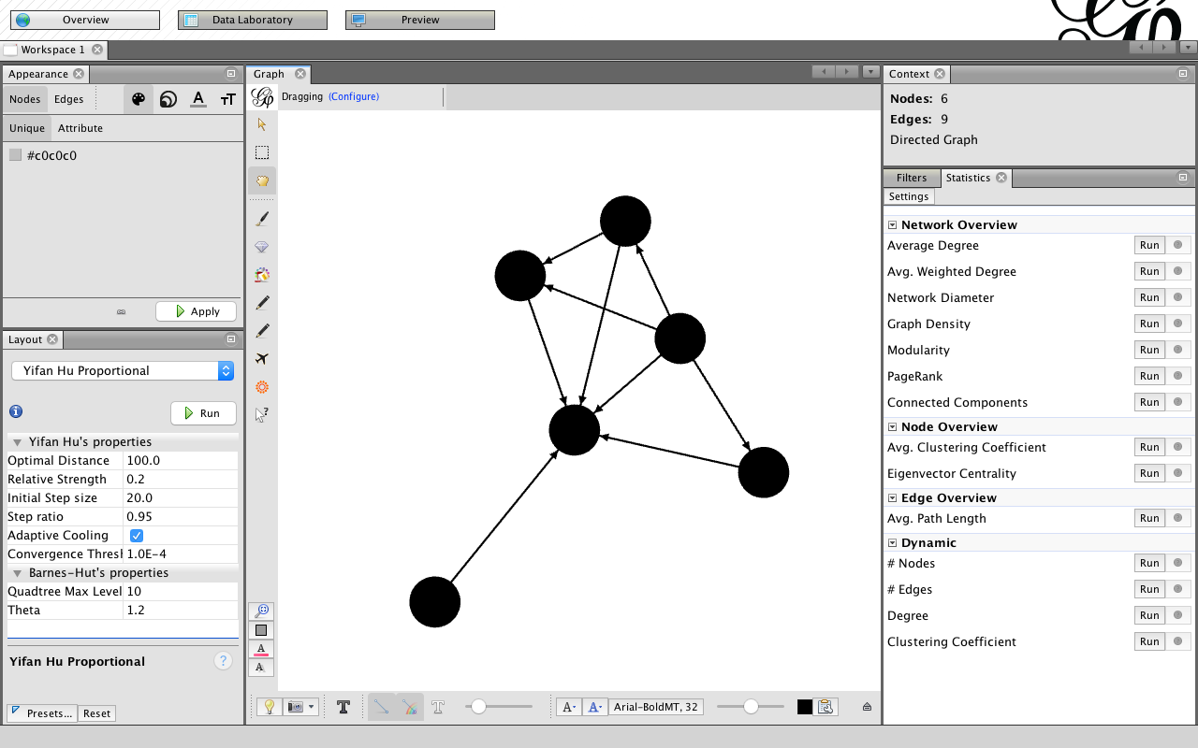
Gephi Overview: Layout Yifan Hu Proportional

Slide 117
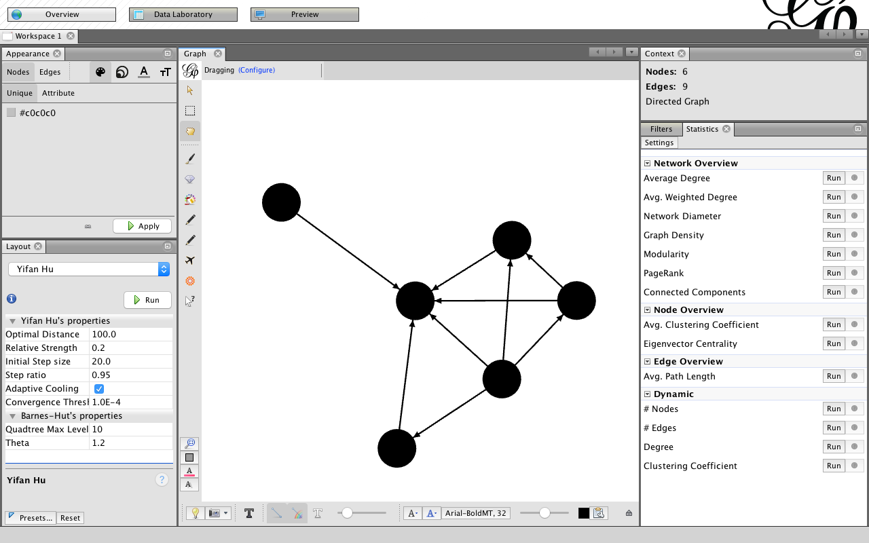
Gephi Overview: Layout Yifan Hu

Slide 118
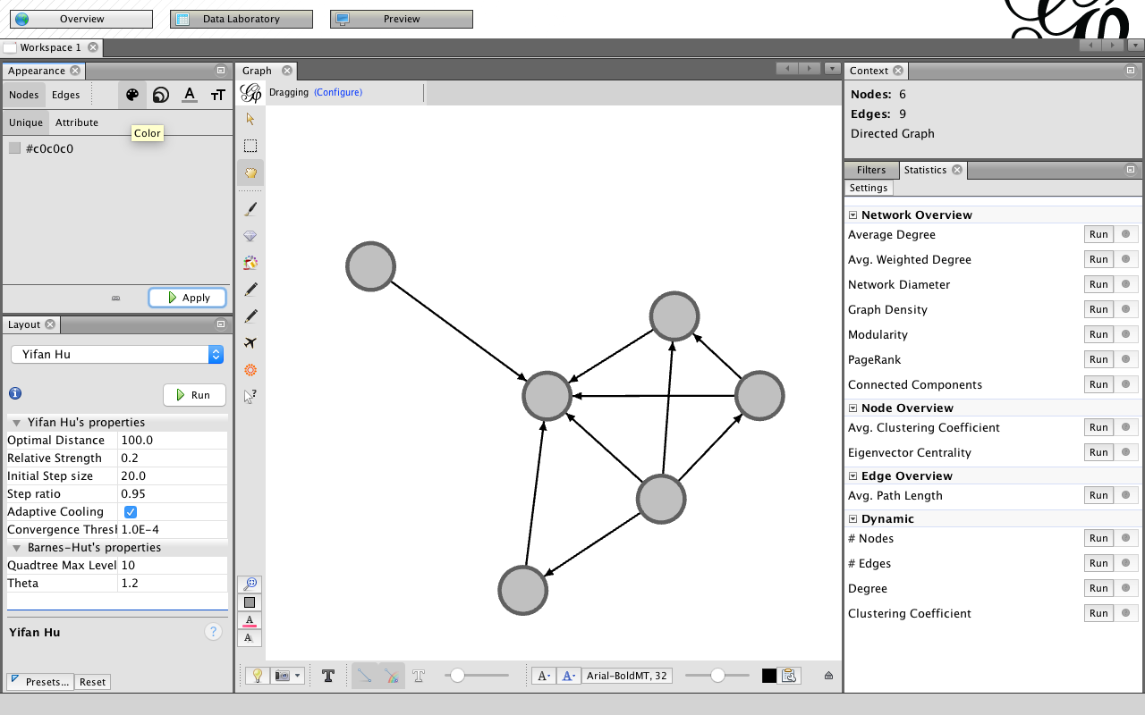
Appearance: Nodes Color

Slide 119
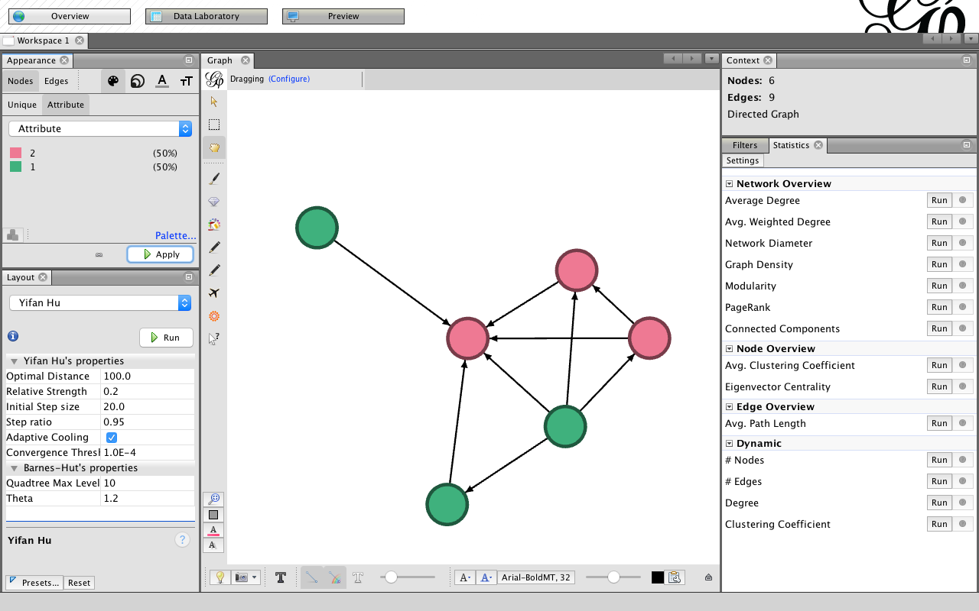
Nodes Color / Attribute / Apply

Slide 120
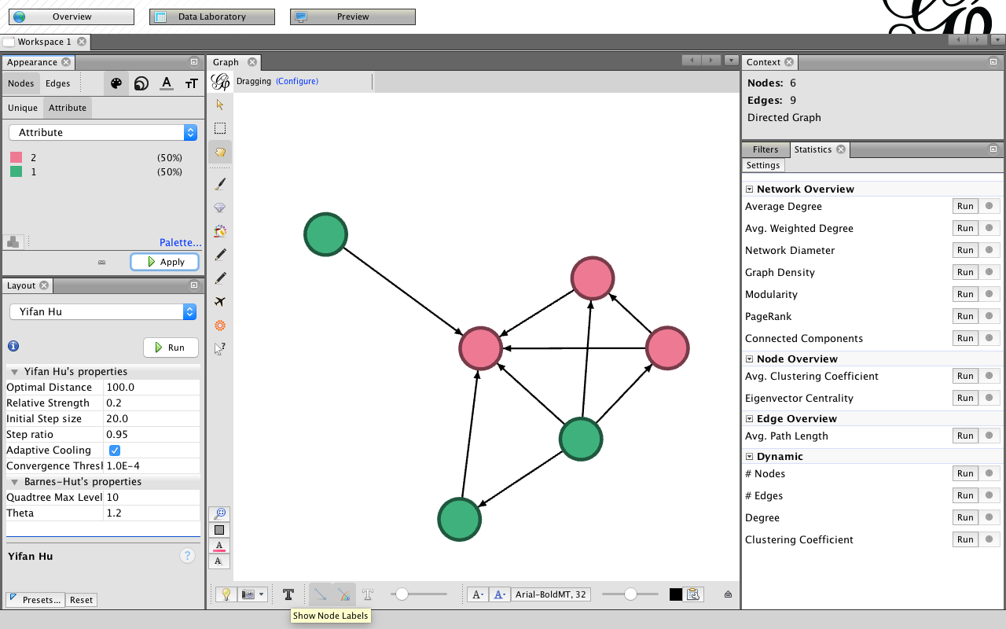
Show Node Labels

Slide 121
Show Node Labels

Slide 122
Show Labels

Slide 123
Global Edges Labels

Slide 124
Labels

Slide 125
Labels Node Size

Slide 126
Labels Node Font Size

Slide 127
Labels Node Size

Slide 128
Labels Scaled

Slide 129
Labels Color

Slide 130
Labels Color

Slide 131
Gephi Statistics: Average Degree

Slide 132
Gephi Statistics: Average Degree

Slide 133
Gephi Statistics: Avg. Weighted Degree

Slide 134
Gephi Statistics: Network Diameter

Slide 135
Gephi Statistics: Network Diameter

Slide 136
Gephi Statistics: Graph Density

Slide 137
Gephi Statistics: Modularity

Slide 138
Gephi Statistics: Modularity

Slide 139
Gephi Statistics: Connected Components

Slide 140
Gephi Statistics: Connected Components

Slide 141
Appearance Nodes Size

Slide 142
Appearance Nodes Size
Attribute / In-Degree

Slide 143
Appearance Nodes Size
Attribute / In-Degree / Min size / Max size / Apply

Slide 144
Appearance Edges
Attribute / Weight / Color

Slide 145
Appearance Edges
Attribute / Weight / Color / Apply

Slide 146
Gephi Data Laboratory

Slide 147
Gephi Preview

Slide 148
Gephi Preview: Show Labels

Slide 149
Gephi Preview: Default Straight

Slide 150
Gephi Preview: Default Straight

Slide 151
Gephi Preview: Export SVG/PDF/PNG

Slide 152
Open Gephi Samples

Slide 153
Gephi Samples

Slide 154
Gephi Samples Les Miserables.gexf

Slide 155
Gephi Import Report

Slide 156
Gephi Overview

Slide 157
Gephi Layout

Slide 158
Gephi Layout: Force Atlas

Slide 159
Gephi Layout: Contraction

Slide 160
Gephi Layout: Expansion

Slide 161
Gephi Layout: ForceAtlas 2

Slide 162
Gephi Layout: Fruchterman Reingold

Slide 163
Gephi Layout: OpenOrd

Slide 164
Gephi Layout: Yifan Hu

Slide 165
Gephi Layout: Yifan Hu Proportional

Slide 166
Gephi Data Laboratory: Nodes

Slide 167
Gephi Data Laboratory: Edges

Slide 168
Gephi Data Laboratory: Export table to CSV file

Slide 169
Gephi Preview

Slide 170
Gephi Preview: Export SVG/PDF/PNG

Slide 171
Gephi Overview: Text Labels

Slide 172
Gephi Overview: Text Labels

Slide 173
Comparison of Social Network Analysis (SNA) Tools

Slide 174
General Comparison of SNA Tools
Naheed Akhtar (2014)
Source: Naheed Akhtar (2014), "Social network analysis tools." In 2014 Fourth International Conference on Communication Systems and Network Technologies (CSNT)

Slide 175
Network Types Supported by SNA Tools
Naheed Akhtar (2014)
Source: Naheed Akhtar (2014), "Social network analysis tools." In 2014 Fourth International Conference on Communication Systems and Network Technologies (CSNT)

Slide 176
Graph Layout Supported by SNA Tools
Naheed Akhtar (2014)
Source: Naheed Akhtar (2014), "Social network analysis tools." In 2014 Fourth International Conference on Communication Systems and Network Technologies (CSNT)

Slide 177
Execution Time for SNA Features
Naheed Akhtar (2014)
Source: Naheed Akhtar (2014), "Social network analysis tools." In 2014 Fourth International Conference on Communication Systems and Network Technologies (CSNT)

Slide 178
Comparative analysis of Social Networking Analysis tools
Source: Agrawal, H., Thakur, A., Slathia, R., & Sumangali, K. (2015). A Comparative Analysis of Social Networking Analysis Tools. J Inform Tech Softw Eng, 5(157), 2.

Slide 179
Comparative analysis of Social Networking Analysis tools
Source: Agrawal, H., Thakur, A., Slathia, R., & Sumangali, K. (2015). A Comparative Analysis of Social Networking Analysis Tools. J Inform Tech Softw Eng, 5(157), 2.

Slide 180
Comparative analysis of Social Networking Analysis tools
Source: Agrawal, H., Thakur, A., Slathia, R., & Sumangali, K. (2015). A Comparative Analysis of Social Networking Analysis Tools. J Inform Tech Softw Eng, 5(157), 2.

Slide 181
A Survey of Tools for Community Detection and Mining in Social Networks
(Maivizhi et al., 2016)
Tools | Pajek | Gephi | igraph
Version | 4.1 | 0.9.1 | 1.0.1
Website | vlado.fmf.uni­lj.si/pub/networks/pajek/ | gephi.org | igraph.org
Type | Software | Software | Library
Platform | Windows | Windows, Mac OS X, Linux | R, Python, C/C++
License | Free and Commercial | Open source and free | Open source and free
Number of nodes | 1 Billion | 0.6 Million | >1 Million
Computing Time | Medium | Fast | Fast
Source: Maivizhi, R., S. Sendhilkumar, and G. S. Mahalakshmi. "A Survey of Tools for Community Detection and Mining in Social Networks." In Proceedings of the International Conference on Informatics and Analytics, p. 71. ACM, 2016.

Slide 182
A Survey of Tools for Community Detection and Mining in Social Networks
(Maivizhi et al., 2016)
Network Type | Pajek | Gephi | igraph
1-mode network | Yes | Yes | Yes
2-mode network | Yes | Yes | Yes
Multi-relational network | Yes | No | No
Temporal (dynamic) network | Yes | No | No
Source: Maivizhi, R., S. Sendhilkumar, and G. S. Mahalakshmi. "A Survey of Tools for Community Detection and Mining in Social Networks." In Proceedings of the International Conference on Informatics and Analytics, p. 71. ACM, 2016.

Slide 183
A Survey of Tools for Community Detection and Mining in Social Networks
(Maivizhi et al., 2016)
File Format | Pajek | Gephi | igraph
.net | Yes | Yes | No
.gml | No | Yes | Yes
.graphml | No | Yes | Yes
.txt | No | No | Yes
.csv | No | Yes | Yes
.pajek | Yes | Import only | Yes
.dl | No | Yes | Import only
.graphdb | No | No | Yes
.dot | No | Yes | Export only
Source: Maivizhi, R., S. Sendhilkumar, and G. S. Mahalakshmi. "A Survey of Tools for Community Detection and Mining in Social Networks." In Proceedings of the International Conference on Informatics and Analytics, p. 71. ACM, 2016.

Slide 184
A Survey of Tools for Community Detection and Mining in Social Networks
(Maivizhi et al., 2016)
Visualization Layout | Pajek | Gephi | igraph
Kamada-kawai | Yes | No | Yes
Fruchterman-Reingold | Yes | Yes | Yes
Other spring layout | Yes | No | Yes
Circular layout | Yes | No | Yes
Random layout | Yes | Yes | Yes
Force atlas layout | Yes | Yes | Yes
Spectral layout | No | No | No
Tree layout | No | No | Yes
Source: Maivizhi, R., S. Sendhilkumar, and G. S. Mahalakshmi. "A Survey of Tools for Community Detection and Mining in Social Networks." In Proceedings of the International Conference on Informatics and Analytics, p. 71. ACM, 2016.

Slide 185
Visualization using igraph and Gephi
Visualization of American College Football using igraph with kamada-kawai layout.
Visualization of American College Football using Gephi with force-directed layout.
Source: Maivizhi, R., S. Sendhilkumar, and G. S. Mahalakshmi. "A Survey of Tools for Community Detection and Mining in Social Networks." In Proceedings of the International Conference on Informatics and Analytics, p. 71. ACM, 2016.

Slide 186
A Survey of Tools for Community Detection and Mining in Social Networks
(Maivizhi et al., 2016)
Network Metrics | Pajek | Gephi | igraph
Degree Centrality | Yes | Yes | Yes
Betweenness Centrality | Yes | Yes | Yes
Closeness Centrality | Yes | Yes | Yes
Network Diameter | Yes | Yes | Yes
Dyad Census | No | No | Yes
Triad Census | Yes | No | Yes
HITS | No | No | Yes
Page Rank | No | Yes | Yes
Source: Maivizhi, R., S. Sendhilkumar, and G. S. Mahalakshmi. "A Survey of Tools for Community Detection and Mining in Social Networks." In Proceedings of the International Conference on Informatics and Analytics, p. 71. ACM, 2016.

Slide 187
A Survey of Tools for Community Detection and Mining in Social Networks
(Maivizhi et al., 2016)
Community Algorithms | Pajek | Gephi | igraph
Louvain Method | Yes | Yes | Yes
Edge Betweenness | No | No | Yes
Greedy Method | No | No | Yes
Modularity Method | No | No | No
Clique Percolation Method | No | No | No
Label Propagation | No | No | Yes
Eigen Vector | No | No | Yes
Random Walk | No | No | Yes
Statistical Method | No | No | Yes
Source: Maivizhi, R., S. Sendhilkumar, and G. S. Mahalakshmi. "A Survey of Tools for Community Detection and Mining in Social Networks." In Proceedings of the International Conference on Informatics and Analytics, p. 71. ACM, 2016.

Slide 188
Community Detection using Gephi and igraph
Community detection using Gephi with Louvain method.
Community detection using igraph with Fast Greedy Algorithm.
Source: Maivizhi, R., S. Sendhilkumar, and G. S. Mahalakshmi. "A Survey of Tools for Community Detection and Mining in Social Networks." In Proceedings of the International Conference on Informatics and Analytics, p. 71. ACM, 2016.

Slide 189
References
Jennifer Golbeck (2013), Analyzing the Social Web, Morgan Kaufmann http://analyzingthesocialweb.com/course-materials.shtml
Devangana Khokhar (2015), Gephi Cookbook, Packt Publishing
Sentinel Visualizer, http://www.fmsasg.com/SocialNetworkAnalysis/
Min-Yuh Day, Sheng-Pao Shih, Weide Chang (2011), "Social Network Analysis of Research Collaboration in Information Reuse and Integration," The First International Workshop on Issues and Challenges in Social Computing (WICSOC 2011), August 2, 2011, in Proceedings of the IEEE International Conference on Information Reuse and Integration (IEEE IRI 2011), Las Vegas, Nevada, USA, August 3-5, 2011, pp. 551-556.
Bastian M., Heymann S., Jacomy M. (2009), “Gephi: an open source software for exploring and manipulating networks”, International AAAI Conference on Weblogs and Social Media.
Agrawal, H., Thakur, A., Slathia, R., & Sumangali, K. (2015). A Comparative Analysis of Social Networking Analysis Tools. J Inform Tech Softw Eng, 5(157), 2.
Naheed Akhtar (2014), "Social network analysis tools." In 2014 Fourth International Conference on Communication Systems and Network Technologies (CSNT)
Maivizhi, R., S. Sendhilkumar, G. S. Mahalakshmi (2016), "A Survey of Tools for Community Detection and Mining in Social Networks." In Proceedings of the International Conference on Informatics and Analytics, p. 71. ACM, 2016.

