Slide 1
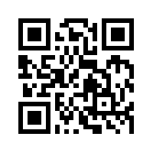
Social Computing and Big Data Analytics 社群運算與大數據分析
Tamkang University
Tamkang University
Social Media Marketing Analytics (社群媒體行銷分析)
1052SCBDA08
MIS MBA (M2226) (8606)
Wed, 8,9, (15:10-17:00) (L206)
Min-Yuh Day
戴敏育
Assistant Professor
專任助理教授
Dept. of Information Management, Tamkang University
淡江大學 資訊管理學系
http://mail. tku.edu.tw/myday/
2017-04-12

Slide 2
課程大綱 (Syllabus)
週次 (Week) 日期 (Date) 內容 (Subject/Topics)
1 2017/02/15 Course Orientation for Social Computing and Big Data Analytics (社群運算與大數據分析課程介紹)
2 2017/02/22 Data Science and Big Data Analytics: Discovering, Analyzing, Visualizing and Presenting Data (資料科學與大數據分析： 探索、分析、視覺化與呈現資料)
3 2017/03/01 Fundamental Big Data: MapReduce Paradigm, Hadoop and Spark Ecosystem (大數據基礎：MapReduce典範、 Hadoop與Spark生態系統)

Slide 3
課程大綱 (Syllabus)
週次 (Week) 日期 (Date) 內容 (Subject/Topics)
4 2017/03/08 Big Data Processing Platforms with SMACK: Spark, Mesos, Akka, Cassandra and Kafka (大數據處理平台SMACK： Spark, Mesos, Akka, Cassandra, Kafka)
5 2017/03/15 Big Data Analytics with Numpy in Python (Python Numpy 大數據分析)
6 2017/03/22 Finance Big Data Analytics with Pandas in Python (Python Pandas 財務大數據分析)
7 2017/03/29 Text Mining Techniques and Natural Language Processing (文字探勘分析技術與自然語言處理)
8 2017/04/05 Off-campus study (教學行政觀摩日)

Slide 4
課程大綱 (Syllabus)
週次 (Week) 日期 (Date) 內容 (Subject/Topics)
9 2017/04/12 Social Media Marketing Analytics (社群媒體行銷分析)
10 2017/04/19 期中報告 (Midterm Project Report)
11 2017/04/26 Deep Learning with Theano and Keras in Python (Python Theano 和 Keras 深度學習)
12 2017/05/03 Deep Learning with Google TensorFlow (Google TensorFlow 深度學習)
13 2017/05/10 Sentiment Analysis on Social Media with Deep Learning (深度學習社群媒體情感分析)

Slide 5
課程大綱 (Syllabus)
週次 (Week) 日期 (Date) 內容 (Subject/Topics)
14 2017/05/17 Social Network Analysis (社會網絡分析)
15 2017/05/24 Measurements of Social Network (社會網絡量測)
16 2017/05/31 Tools of Social Network Analysis (社會網絡分析工具)
17 2017/06/07 Final Project Presentation I (期末報告 I)
18 2017/06/14 Final Project Presentation II (期末報告 II)

Slide 6
Social Media Marketing Analytics

Slide 7
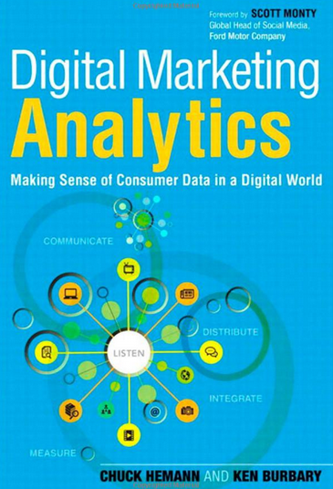
Digital Marketing Analytics: Making Sense of Consumer Data in a Digital World, Chuck Hemann and Ken Burbary, Que. 2013
Source: http://www.amazon.com/Digital-Marketing-Analytics-Consumer-Biz-Tech/dp/0789750309

Slide 8
Consumer Psychology and Behavior on Social Media

Slide 9
Marketing
“Meeting needs profitably”
Source: Philip Kotler & Kevin Lane Keller, Marketing Management, 14th ed., Pearson, 2012

Slide 10
How consumers think, feel, and act
Source: Philip Kotler & Kevin Lane Keller, Marketing Management, 14th ed., Pearson, 2012

Slide 11
Analyzing Consumer Markets
The aim of marketing is to meet and satisfy target customers’ needs and wants better than competitors.
Marketers must have a thorough understanding of how consumers think, feel, and act and offer clear value to each and every target consumer.
Source: Philip Kotler & Kevin Lane Keller, Marketing Management, 14th ed., Pearson, 2012

Slide 12
Value
the sum of the tangible and intangible benefits and costs
Source: Philip Kotler & Kevin Lane Keller, Marketing Management, 14th ed., Pearson, 2012

Slide 13
Value
Total customer benefit
Customer perceived value
Total customer cost
Source: Philip Kotler & Kevin Lane Keller, Marketing Management, 14th ed., Pearson, 2012

Slide 14
Customer Perceived Value
Product benefit
Total customer benefit
Customer perceived value
Services benefit
Personnel benefit
Image benefit
Monetary cost
Total customer cost
Time cost
Energy cost
Psychological cost
Source: Philip Kotler & Kevin Lane Keller, Marketing Management, 14th ed., Pearson, 2012

Slide 15
Model of Consumer Behavior
Psychology
Marketing Stimuli
Other Stimuli
Buying
Decision Process
Purchase
Decision
Motivation
Perception
Learning
Memory
Products & Services
Price
Distribution
Communications
Economic
Technological
Political
Cultural
Problem Recognition
Information Search
Evaluation of Alternatives
Purchase decision
Post-purchase behavior
Product choice
Brand choice
Dealer choice
Purchase amount
Purchase timing
Payment method
Consumer Characteristics
Cultural
Social
Personal
Source: Philip Kotler & Kevin Lane Keller, Marketing Management, 14th ed., Pearson, 2012

Slide 16
Building Customer Value, Satisfaction, and Loyalty
Source: Philip Kotler & Kevin Lane Keller, Marketing Management, 14th ed., Pearson, 2012

Slide 17
Customer Perceived Value, Customer Satisfaction, and Loyalty
Customer Perceived Performance
Customer
Perceived Value
Customer
Satisfaction
Customer
Loyalty
Customer
Expectations
Source: Philip Kotler & Kevin Lane Keller, Marketing Management, 14th ed., Pearson, 2012

Slide 18
Social Media Marketing Analytics
Social Media Listening
Search Analytics
Content Analytics
Engagement Analytics
Source: Chuck Hemann and Ken Burbary, Digital Marketing Analytics: Making Sense of Consumer Data in a Digital World, Que. 2013
Notes:
Social Media Listening
Search Analytics
Content Analytics
Engagement Analytics

Slide 19
The Convergence of Paid, Owned & Earned Media
Promoted Brand Content
Paid Media
Traditional Ads
Owned Media
Corporate Ads
Converged Media
Sponsored Customer
Brands that ask for shared
Press Coverage
Earned Media
Organic
Source: “The Converged Media Imperative: How Brands Will Combine Paid, Owned and Earned Media”, Altimeter Group, July 19, 2012)
http://www.altimetergroup.com/2012/07/the-converged-media-imperative/

Slide 20
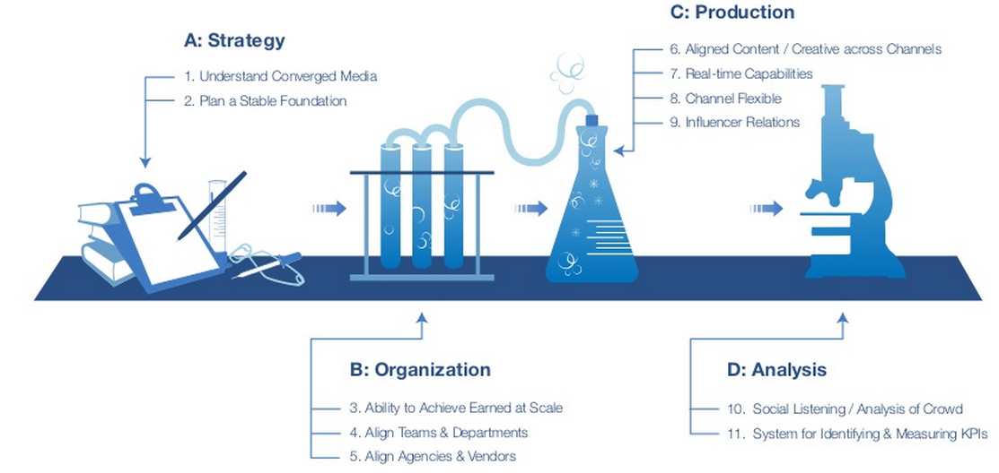
Converged Media Top 11 Success Criteria
Social Listening / Analysis of Crowd
Source: “The Converged Media Imperative: How Brands Will Combine Paid, Owned and Earned Media”, Altimeter Group, July 19, 2012)
http://www.altimetergroup.com/2012/07/the-converged-media-imperative/

Slide 21
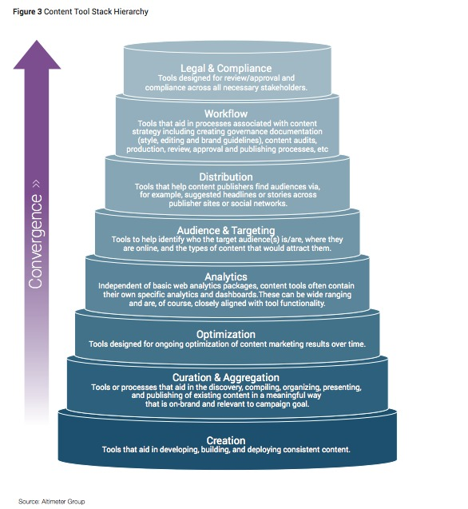
Content Tool Stack Hierarchy
Source: Rebecca Lieb, "Content marketing in 2015 -- research, not predictions", December 16, 2014
http://www.imediaconnection.com/content/37909.asp

Slide 22
Competitive Intelligence
Gather competitive intelligence data
Source: Chuck Hemann and Ken Burbary, Digital Marketing Analytics: Making Sense of Consumer Data in a Digital World, Que. 2013

Slide 23
Google Alexa Compete
Which audience segments are competitors reaching that you are not?
What keywords are successful for your competitors?
What sources are driving traffic to your competitors’ websites?
Source: Chuck Hemann and Ken Burbary, Digital Marketing Analytics: Making Sense of Consumer Data in a Digital World, Que. 2013

Slide 24
Competitive Intelligence
Facebook competitive analysis
Facebook content analysis
YouTube competitive analysis
YouTube channel analysis
Twitter profile analysis
Source: Chuck Hemann and Ken Burbary, Digital Marketing Analytics: Making Sense of Consumer Data in a Digital World, Que. 2013

Slide 25
Web Analytics (Clickstream)
Content Analytics
Mobile Analytics
Source: Chuck Hemann and Ken Burbary, Digital Marketing Analytics: Making Sense of Consumer Data in a Digital World, Que. 2013

Slide 26
Mobile Analytics
Where is my mobile traffic coming from?
What content are mobile users most interested in?
How is my mobile app being used? What’s working? What isn’t?
Which mobile platforms work best with my site?
How does mobile user’s engagement with my site compare to traditional web users’ engagement?
Source: Chuck Hemann and Ken Burbary, Digital Marketing Analytics: Making Sense of Consumer Data in a Digital World, Que. 2013

Slide 27
Identifying a Social Media Listening Tool
Data Capture
Spam Prevention
Integration with Other Data Sources
Cost
Mobile Capability
API Access
Consistent User Interface
Workflow Functionality
Historical Data
Source: Chuck Hemann and Ken Burbary, Digital Marketing Analytics: Making Sense of Consumer Data in a Digital World, Que. 2013

Slide 28
Search Analytics
Free Tools for Collecting Insights Through
Search Data
Google Trends
YouTube Trends
The Google AdWords Keyword Tool
Yahoo! Clues
Paid Tools for Collecting Insights Through Search Data
The BrightEdge SEO Platform
Source: Chuck Hemann and Ken Burbary, Digital Marketing Analytics: Making Sense of Consumer Data in a Digital World, Que. 2013

Slide 29
Owned Social Metrics
Facebook page
Twitter account
YouTube channel
Source: Chuck Hemann and Ken Burbary, Digital Marketing Analytics: Making Sense of Consumer Data in a Digital World, Que. 2013

Slide 30
Own Social Media Metrics: Facebook
Total likes
Reach
Organic
Paid reach
Viral reach
Engaged users
People taking about this (PTAT)
Likes, comments, and shares by post
Source: Chuck Hemann and Ken Burbary, Digital Marketing Analytics: Making Sense of Consumer Data in a Digital World, Que. 2013

Slide 31
Own Social Media Metrics: Twitter
Followers
Retweets
Replies
Clicks and click-through rate (CTR)
Impressions
Source: Chuck Hemann and Ken Burbary, Digital Marketing Analytics: Making Sense of Consumer Data in a Digital World, Que. 2013

Slide 32
Own Social Media Metrics: YouTube
Views
Subscribers
Likes/dislikes
Comments
Favorites
Sharing
Source: Chuck Hemann and Ken Burbary, Digital Marketing Analytics: Making Sense of Consumer Data in a Digital World, Que. 2013

Slide 33
Own Social Media Metrics: SlideShare
Followers
Views
Comments
Shares
Source: Chuck Hemann and Ken Burbary, Digital Marketing Analytics: Making Sense of Consumer Data in a Digital World, Que. 2013

Slide 34
Own Social Media Metrics: Pinterest
Followers
Number of boards
Number of pins
Likes
Repins
Comments
Source: Chuck Hemann and Ken Burbary, Digital Marketing Analytics: Making Sense of Consumer Data in a Digital World, Que. 2013

Slide 35
Own Social Media Metrics: Google+
Number of people who have an account circled
+1s
Comments
Source: Chuck Hemann and Ken Burbary, Digital Marketing Analytics: Making Sense of Consumer Data in a Digital World, Que. 2013

Slide 36
Earned Social Media Metrics
Earned conversations
In-network conversations
Source: Chuck Hemann and Ken Burbary, Digital Marketing Analytics: Making Sense of Consumer Data in a Digital World, Que. 2013

Slide 37
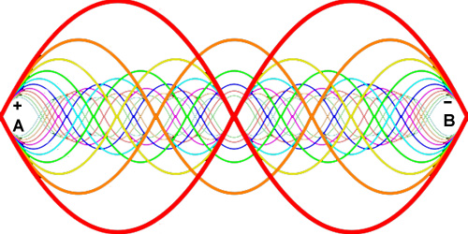
Earned Social Media Metrics: Earned conversations
Share of voice
Share of conversation
Sentiment
Message resonance
Overall conversation volume
Source: http://www.elvtd.com/elevation/p/beings-of-resonance
Source: Chuck Hemann and Ken Burbary, Digital Marketing Analytics: Making Sense of Consumer Data in a Digital World, Que. 2013

Slide 38
Demystifying Web Data
Visits
Unique page views
Bounce rate
Pages per visit
Traffic sources
Conversion
Source: Chuck Hemann and Ken Burbary, Digital Marketing Analytics: Making Sense of Consumer Data in a Digital World, Que. 2013

Slide 39
Searching for the Right Metrics
Paid Searches
Organic Searches
Source: Chuck Hemann and Ken Burbary, Digital Marketing Analytics: Making Sense of Consumer Data in a Digital World, Que. 2013
Notes:
Searching for the Right Metrics
Paid Searches
Organic Searches

Slide 40
Paid Searches
Impressions
Clicks
Click-through rate (CTR)
Cost per click (CPC)
Impression share
Sales or revenue per click
Average position
Source: Chuck Hemann and Ken Burbary, Digital Marketing Analytics: Making Sense of Consumer Data in a Digital World, Que. 2013

Slide 41
Organic Searches
Known and unknown keywords
Known and unknown branded keywords
Total visits
Total conversions from known keywords
Average search position
Source: Chuck Hemann and Ken Burbary, Digital Marketing Analytics: Making Sense of Consumer Data in a Digital World, Que. 2013

Slide 42
Aligning Digital and Traditional Analytics
Primary Research
Brand reputation
Message resonance
Executive reputation
Advertising performance
Traditional Media Monitoring
Traditional CRM Data
Source: Chuck Hemann and Ken Burbary, Digital Marketing Analytics: Making Sense of Consumer Data in a Digital World, Que. 2013

Slide 43
Social Media Listening Evolution
Location of conversations
Sentiment
Key message penetration
Key influencers
Source: Chuck Hemann and Ken Burbary, Digital Marketing Analytics: Making Sense of Consumer Data in a Digital World, Que. 2013
Notes:
Social Media Listening Evolution
Location of conversations
Sentiment
Key message penetration
Key influencers

Slide 44
Social Analytics Lifecycle (5 Stages)
1. Discover
2. Analyze
3. Segment
4. Strategy
5. Execution
Source: Chuck Hemann and Ken Burbary, Digital Marketing Analytics: Making Sense of Consumer Data in a Digital World, Que. 2013
Notes:
Social Analytics Lifecycle (5 Stages)
Discover
Analyze
Segment
Strategize
Execute

Slide 45
Social Analytics Lifecycle (5 Stages)
1. Discover
1. Discover
2. Analyze
Social Web
(blogs, social networks, forums/message boards,
Video/phone sharing)
3. Segment
4. Strategy
5. Execution
Source: Chuck Hemann and Ken Burbary, Digital Marketing Analytics: Making Sense of Consumer Data in a Digital World, Que. 2013
Notes:
Social Analytics Lifecycle (5 Stages)
Discover
Analyze
Segment
Strategize
Execute

Slide 46
Social Analytics Lifecycle (5 Stages)
1. Discover
Social Web
(blogs, social networks, forums/message boards,
Video/phone sharing)
2. Analyze
Distill relevant signal from social noise
3. Segment
4. Strategy
5. Execution
Source: Chuck Hemann and Ken Burbary, Digital Marketing Analytics: Making Sense of Consumer Data in a Digital World, Que. 2013
Notes:
Social Analytics Lifecycle (5 Stages)
Discover
Analyze
Segment
Strategize
Execute

Slide 47
Social Analytics Lifecycle (5 Stages)
1. Discover
Social Web
(blogs, social networks, forums/message boards,
Video/phone sharing)
2. Analyze
Distill relevant signal from social noise
Data Segmentation (Filter, Group, Tag, Assign)
3. Segment
Strategic Planning
Corps Communication
Customer Care
4. Strategy
Product Development
Marketing & Advertising
Sales
5. Execution
Strategic
Tactical
Source: Chuck Hemann and Ken Burbary, Digital Marketing Analytics: Making Sense of Consumer Data in a Digital World, Que. 2013
Notes:
Social Analytics Lifecycle (5 Stages)
Discover
Analyze
Segment
Strategize
Execute

Slide 48
Social Analytics Lifecycle (5 Stages)
1. Discover
Social Web
(blogs, social networks, forums/message boards,
Video/phone sharing)
2. Analyze
Distill relevant signal from social noise
3. Segment
Data Segmentation (Filter, Group, Tag, Assign)
4. Strategy
Insights drive focused business strategies
5. Execution
Source: Chuck Hemann and Ken Burbary, Digital Marketing Analytics: Making Sense of Consumer Data in a Digital World, Que. 2013
Notes:
Social Analytics Lifecycle (5 Stages)
Discover
Analyze
Segment
Strategize
Execute

Slide 49
Social Analytics Lifecycle (5 Stages)
1. Discover
Social Web
(blogs, social networks, forums/message boards,
Video/phone sharing)
2. Analyze
Distill relevant signal from social noise
3. Segment
Data Segmentation (Filter, Group, Tag, Assign)
4. Strategy
Insights drive focused business strategies
Innovation
Future Direction
Reputation Management
Campaigns
Customer Satisfaction Improvements
5. Execution
CRM
Source: Chuck Hemann and Ken Burbary, Digital Marketing Analytics: Making Sense of Consumer Data in a Digital World, Que. 2013
Notes:
Social Analytics Lifecycle (5 Stages)
Discover
Analyze
Segment
Strategize
Execute

Slide 50
Social Analytics Lifecycle (5 Stages)
1. Discover
Social Web
(blogs, social networks, forums/message boards,
Video/phone sharing)
2. Analyze
Distill relevant signal from social noise
3. Segment
Data Segmentation (Filter, Group, Tag, Assign)
4. Strategy
Insights drive focused business strategies
Innovation
Future Direction
Reputation Management
Campaigns
Customer Satisfaction Improvements
5. Execution
CRM
Source: Chuck Hemann and Ken Burbary, Digital Marketing Analytics: Making Sense of Consumer Data in a Digital World, Que. 2013
Notes:
Social Analytics Lifecycle (5 Stages)
Discover
Analyze
Segment
Strategize
Execute

Slide 51
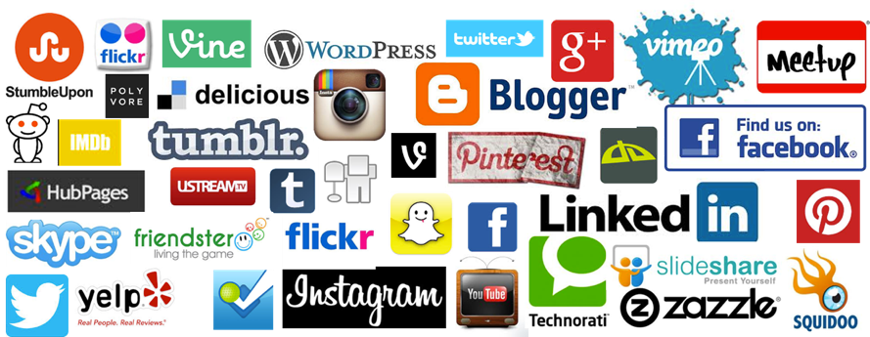
Social Media
Source: http://hungrywolfmarketing.com/2013/09/09/what-are-your-social-marketing-goals/

Slide 52
Emotions
Love
Anger
Joy
Sadness
Surprise
Fear
Source: Bing Liu (2011) , “Web Data Mining: Exploring Hyperlinks, Contents, and Usage Data,” Springer, 2nd Edition,

Slide 53
Example of Opinion: review segment on iPhone
“I bought an iPhone a few days ago.
It was such a nice phone.
The touch screen was really cool.
The voice quality was clear too.
However, my mother was mad with me as I did not tell her before I bought it.
She also thought the phone was too expensive, and wanted me to return it to the shop. … ”
Source: Bing Liu (2011) , “Web Data Mining: Exploring Hyperlinks, Contents, and Usage Data,” Springer, 2nd Edition,

Slide 54
Example of Opinion: review segment on iPhone
“(1) I bought an iPhone a few days ago.
(2) It was such a nice phone.
(3) The touch screen was really cool.
(4) The voice quality was clear too.
(5) However, my mother was mad with me as I did not tell her before I bought it.
(6) She also thought the phone was too expensive, and wanted me to return it to the shop. … ”
+Positive Opinion
-Negative Opinion
Source: Bing Liu (2011) , “Web Data Mining: Exploring Hyperlinks, Contents, and Usage Data,” Springer, 2nd Edition,

Slide 55
How consumers think, feel, and act
Source: Philip Kotler & Kevin Lane Keller, Marketing Management, 14th ed., Pearson, 2012

Slide 56
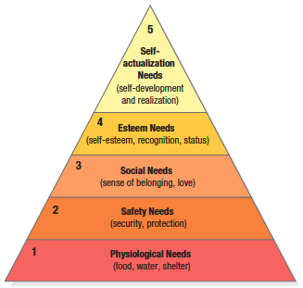
Maslow’s Hierarchy of Needs
Source: Philip Kotler & Kevin Lane Keller, Marketing Management, 14th ed., Pearson, 2012

Slide 57
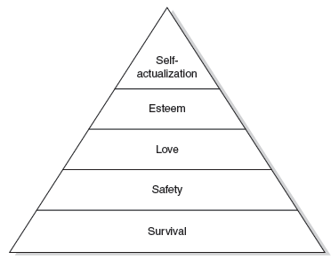
Maslow’s hierarchy of human needs (Maslow, 1943)

Slide 58
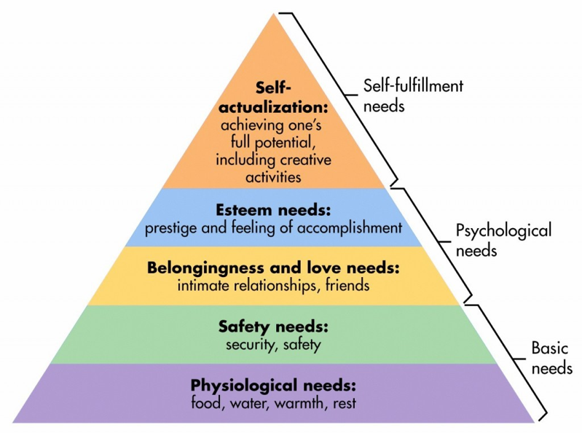
Maslow’s Hierarchy of Needs
Source: http://sixstoriesup.com/social-psyche-what-makes-us-go-social/

Slide 59
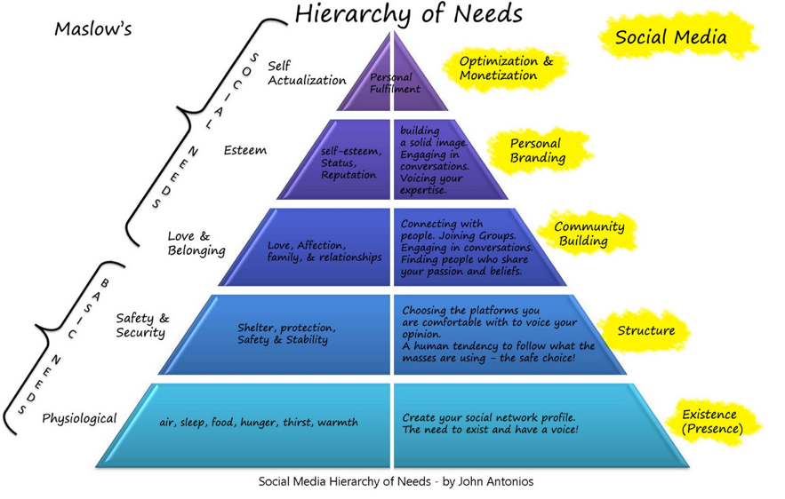
Social Media Hierarchy of Needs
Source: http://2.bp.blogspot.com/_Rta1VZltiMk/TPavcanFtfI/AAAAAAAAACo/OBGnRL5arSU/s1600/social-media-heirarchy-of-needs1.jpg

Slide 60
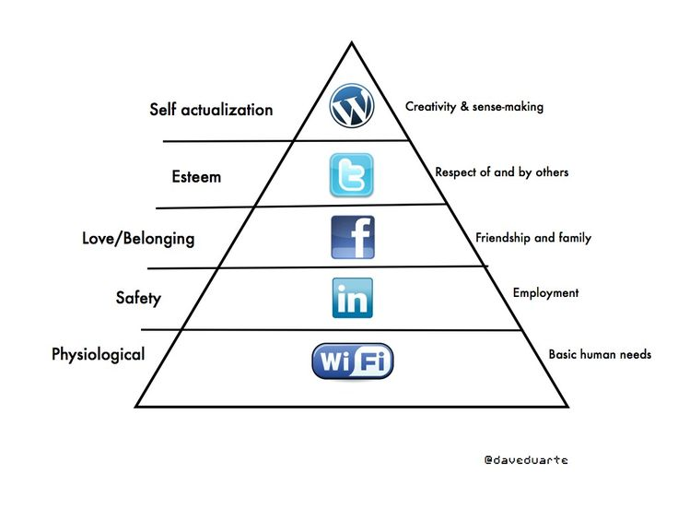
Social Media Hierarchy of Needs
Source: http://www.pinterest.com/pin/18647785930903585/

Slide 61
The Social Feedback Cycle Consumer Behavior on Social Media
Marketer-Generated
User-Generated
Form Opinion
Awareness
Consideration
Purchase
Use
Talk
Source: Evans et al. (2010), Social Media Marketing: The Next Generation of Business Engagement

Slide 62
The New Customer Influence Path
Awareness
Consideration
Purchase
Source: Evans et al. (2010), Social Media Marketing: The Next Generation of Business Engagement

Slide 63
Architectures of Sentiment Analytics

Slide 64
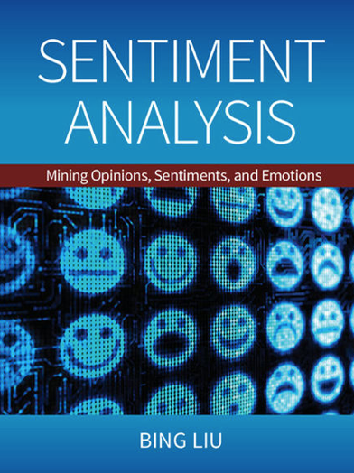
Bing Liu (2015), Sentiment Analysis: Mining Opinions, Sentiments, and Emotions, Cambridge University Press
http://www.amazon.com/Sentiment-Analysis-Opinions-Sentiments-Emotions/dp/1107017890

Slide 65
Sentiment Analysis and Opinion Mining
Computational study of opinions, sentiments, subjectivity, evaluations, attitudes, appraisal, affects, views, emotions, ets., expressed in text.
Reviews, blogs, discussions, news, comments, feedback, or any other documents
Source: Bing Liu (2011) , “Web Data Mining: Exploring Hyperlinks, Contents, and Usage Data,” Springer, 2nd Edition,

Slide 66
Research Area of Opinion Mining
Many names and tasks with difference objective and models
Sentiment analysis
Opinion mining
Sentiment mining
Subjectivity analysis
Affect analysis
Emotion detection
Opinion spam detection
Source: Bing Liu (2011) , “Web Data Mining: Exploring Hyperlinks, Contents, and Usage Data,” Springer, 2nd Edition,

Slide 67
Sentiment Analysis
Sentiment
A thought, view, or attitude, especially one based mainly on emotion instead of reason
Sentiment Analysis
opinion mining
use of natural language processing (NLP) and computational techniques to automate the extraction or classification of sentiment from typically unstructured text

Slide 68
Applications of Sentiment Analysis
Consumer information
Product reviews
Marketing
Consumer attitudes
Trends
Politics
Politicians want to know voters’ views
Voters want to know policitians’ stances and who else supports them
Social
Find like-minded individuals or communities

Slide 69
Sentiment detection
How to interpret features for sentiment detection?
Bag of words (IR)
Annotated lexicons (WordNet, SentiWordNet)
Syntactic patterns
Which features to use?
Words (unigrams)
Phrases/n-grams
Sentences

Slide 70
Problem statement of Opinion Mining
Two aspects of abstraction
Opinion definition
What is an opinion?
What is the structured definition of opinion?
Opinion summarization
Opinion are subjective
An opinion from a single person (unless a VIP) is often not sufficient for action
We need opinions from many people, and thus opinion summarization.
Source: Bing Liu (2011) , “Web Data Mining: Exploring Hyperlinks, Contents, and Usage Data,” Springer, 2nd Edition,

Slide 71
What is an opinion?
Id: Abc123 on 5-1-2008 “I bought an iPhone a few days ago. It is such a nice phone. The touch screen is really cool. The voice quality is clear too. It is much better than my old Blackberry, which was a terrible phone and so difficult to type with its tiny keys. However, my mother was mad with me as I did not tell her before I bought the phone. She also thought the phone was too expensive, …”
One can look at this review/blog at the
Document level
Is this review + or -?
Sentence level
Is each sentence + or -?
Entity and feature/aspect level
Source: Bing Liu (2011) , “Web Data Mining: Exploring Hyperlinks, Contents, and Usage Data,” Springer, 2nd Edition,

Slide 72
Entity and aspect/feature level
Id: Abc123 on 5-1-2008 “I bought an iPhone a few days ago. It is such a nice phone. The touch screen is really cool. The voice quality is clear too. It is much better than my old Blackberry, which was a terrible phone and so difficult to type with its tiny keys. However, my mother was mad with me as I did not tell her before I bought the phone. She also thought the phone was too expensive, …”
What do we see?
Opinion targets: entities and their features/aspects
Sentiments: positive and negative
Opinion holders: persons who hold the opinions
Time: when opinion are expressed
Source: Bing Liu (2011) , “Web Data Mining: Exploring Hyperlinks, Contents, and Usage Data,” Springer, 2nd Edition,

Slide 73
Two main types of opinions
Regular opinions: Sentiment/Opinion expressions on some target entities
Direct opinions: sentiment expressions on one object:
“The touch screen is really cool.”
“The picture quality of this camera is great”
Indirect opinions: comparisons, relations expressing similarities or differences (objective or subjective) of more than one object
“phone X is cheaper than phone Y.” (objective)
“phone X is better than phone Y.” (subjective)
Comparative opinions: comparisons of more than one entity.
“iPhone is better than Blackberry.”
Source: Bing Liu (2011) , “Web Data Mining: Exploring Hyperlinks, Contents, and Usage Data,” Springer, 2nd Edition,

Slide 74
Subjective and Objective
Objective
An objective sentence expresses some factual information about the world.
“I returned the phone yesterday.”
Objective sentences can implicitly indicate opinions
“The earphone broke in two days.”
Subjective
A subjective sentence expresses some personal feelings or beliefs.
“The voice on my phone was not so clear”
Not every subjective sentence contains an opinion
“I wanted a phone with good voice quality”
➔ Subjective analysis
Source: Bing Liu (2011) , “Web Data Mining: Exploring Hyperlinks, Contents, and Usage Data,” Springer, 2nd Edition,

Slide 75
Sentiment Analysis vs. Subjectivity Analysis
Sentiment Analysis
Subjectivity Analysis
Positive
Subjective
Negative
Neutral
Objective

Slide 76
A (regular) opinion
Opinion (a restricted definition)
An opinion (regular opinion) is simply a positive or negative sentiment, view, attitude, emotion, or appraisal about an entity or an aspect of the entity from an opinion holder.
Sentiment orientation of an opinion
Positive, negative, or neutral (no opinion)
Also called:
Opinion orientation
Semantic orientation
Sentiment polarity
Source: Bing Liu (2011) , “Web Data Mining: Exploring Hyperlinks, Contents, and Usage Data,” Springer, 2nd Edition,

Slide 77
Entity and aspect
Definition of Entity:
An entity e is a product, person, event, organization, or topic.
e is represented as
A hierarchy of components, sub-components.
Each node represents a components and is associated with a set of attributes of the components
An opinion can be expressed on any node or attribute of the node
Aspects(features)
represent both components and attribute
Source: Bing Liu (2011) , “Web Data Mining: Exploring Hyperlinks, Contents, and Usage Data,” Springer, 2nd Edition,

Slide 78
Opinion Definition
An opinion is a quintuple (e_{j}, a_{jk}, so_{ijkl}, h_{i}, t_{l}) where
e_{j} is a target entity.
a_{jk} is an aspect/feature of the entity e_{j} .
so_{ijkl} is the sentiment value of the opinion from the opinion holder on feature of entity at time. so_{ijkl} is +ve, -ve, or neu, or more granular ratings
h_{i} is an opinion holder.
t_{l} is the time when the opinion is expressed.
(e_{j}, a_{jk}) is also called opinion target
Source: Bing Liu (2011) , “Web Data Mining: Exploring Hyperlinks, Contents, and Usage Data,” Springer, 2nd Edition,

Slide 79
Terminologies
Entity: object
Aspect: feature, attribute, facet
Opinion holder: opinion source
Topic: entity, aspect
Product features, political issues
Source: Bing Liu (2011) , “Web Data Mining: Exploring Hyperlinks, Contents, and Usage Data,” Springer, 2nd Edition,

Slide 80
Subjectivity and Emotion
Sentence subjectivity
An objective sentence presents some factual information, while a subjective sentence expresses some personal feelings, views, emotions, or beliefs.
Emotion
Emotions are people’s subjective feelings and thoughts.
Source: Bing Liu (2011) , “Web Data Mining: Exploring Hyperlinks, Contents, and Usage Data,” Springer, 2nd Edition,

Slide 81
Classification Based on Supervised Learning
Sentiment classification
Supervised learning Problem
Three classes
Positive
Negative
Neutral
Source: Bing Liu (2011) , “Web Data Mining: Exploring Hyperlinks, Contents, and Usage Data,” Springer, 2nd Edition,

Slide 82
Opinion words in Sentiment classification
topic-based classification
topic-related words are important
e.g., politics, sciences, sports
Sentiment classification
topic-related words are unimportant
opinion words (also called sentiment words)
that indicate positive or negative opinions are important, e.g., great, excellent, amazing, horrible, bad, worst
Source: Bing Liu (2011) , “Web Data Mining: Exploring Hyperlinks, Contents, and Usage Data,” Springer, 2nd Edition,

Slide 83
Features in Opinion Mining
Terms and their frequency
TF-IDF
Part of speech (POS)
Adjectives
Opinion words and phrases
beautiful, wonderful, good, and amazing are positive opinion words
bad, poor, and terrible are negative opinion words.
opinion phrases and idioms, e.g., cost someone an arm and a leg
Rules of opinions
Negations
Syntactic dependency
Source: Bing Liu (2011) , “Web Data Mining: Exploring Hyperlinks, Contents, and Usage Data,” Springer, 2nd Edition,

Slide 84
Sentiment Analysis Architecture
Positive tweets
Negative tweets
Word features
Training set
Features
extractor
Classifier
Features
extractor
Tweet
Positive
Negative
Vishal Kharde and Sheetal Sonawane (2016), "Sentiment Analysis of Twitter Data: A Survey of Techniques," International Journal of Computer Applications, Vol 139, No. 11, 2016. pp.5-15

Slide 85
Sentiment Classification Based on Emoticons
Tweeter
Tweeter Streaming API 1.1
Tweet preprocessing
Based on Positive Emotions
Based on Negative Emotions
Generate Training Dataset for Tweet
Positive tweets
Negative tweets
Test Dataset
Training Dataset
Classifier
Feature Extraction
Positive
Negative
Vishal Kharde and Sheetal Sonawane (2016), "Sentiment Analysis of Twitter Data: A Survey of Techniques," International Journal of Computer Applications, Vol 139, No. 11, 2016. pp.5-15

Slide 86
Lexicon-Based Model
Tokenized Document Collection
Preassembled Word Lists
Sentiment Scoring and Classification:
Polarity
Merged Lexicon
Generic Word Lists
Sentiment Polarity
Vishal Kharde and Sheetal Sonawane (2016), "Sentiment Analysis of Twitter Data: A Survey of Techniques," International Journal of Computer Applications, Vol 139, No. 11, 2016. pp.5-15

Slide 87
Sentiment Analysis Tasks
Object/Feature extraction
Opinionated Document
Subjectivity Classification
Sentiment Classification
Opinion holder extraction
Vishal Kharde and Sheetal Sonawane (2016), "Sentiment Analysis of Twitter Data: A Survey of Techniques," International Journal of Computer Applications, Vol 139, No. 11, 2016. pp.5-15

Slide 88
Levels of Sentiment Analysis
Sentiment Analysis
Word level
Sentiment Analysis
Sentence level
Sentiment Analysis
Document level
Sentiment Analysis
Feature level
Sentiment Analysis
Vishal Kharde and Sheetal Sonawane (2016), "Sentiment Analysis of Twitter Data: A Survey of Techniques," International Journal of Computer Applications, Vol 139, No. 11, 2016. pp.5-15

Slide 89
Sentiment Analysis
Subjectivity Classification
Polarity Determination
Approaches
Machine Learning based
Sentiment Classification
Vagueness resolution in opinionated text
Lexicon based
Sentiment Analysis
Review Usefulness Measurement
Multi- & Cross- Lingual SC
Hybrid approaches
Opinion Spam Detection
Cross-domain SC
Lexicon Creation
Ontology based
Tasks
Non-Ontology based
Aspect Extraction
Application
Source: Kumar Ravi and Vadlamani Ravi (2015), "A survey on opinion mining and sentiment analysis: tasks, approaches and applications." Knowledge-Based Systems, 89, pp.14-46.

Slide 90
Sentiment Classification Techniques
Decision Tree Classifiers
Support Vector Machine (SVM)
Supervised Learning
Neural Network (NN)
Machine Learning Approach
Linear Classifiers
Deep Learning (DL)
Rule-based Classifiers
Naïve Bayes (NB)
Sentiment Analysis
Unsupervised Learning
Probabilistic Classifiers
Bayesian Network (BN)
Dictionary-based Approach
Maximum Entropy (ME)
Lexicon-based Approach
Statistical
Corpus-based Approach
Semantic
Source: Jesus Serrano-Guerrero, Jose A. Olivas, Francisco P. Romero, and Enrique Herrera-Viedma (2015), "Sentiment analysis: A review and comparative analysis of web services," Information Sciences, 311, pp. 18-38.

Slide 91
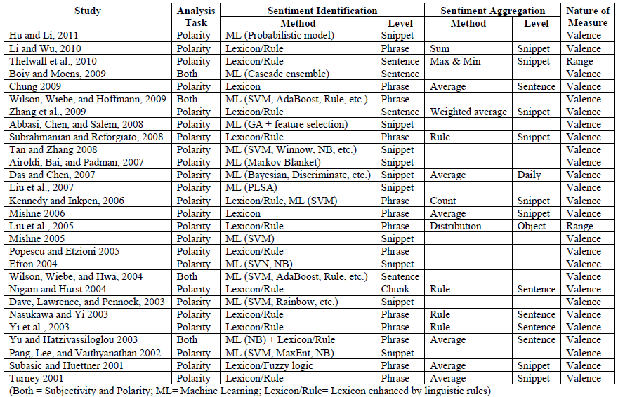
A Brief Summary of Sentiment Analysis Methods
Source: Zhang, Z., Li, X., and Chen, Y. (2012), "Deciphering word-of-mouth in social media: Text-based metrics of consumer reviews," ACM Trans. Manage. Inf. Syst. (3:1) 2012, pp 1-23.,

Slide 92
Word-of-Mouth (WOM)
“This book is the best written documentary thus far, yet sadly, there is no soft cover edition.”
“This book is the best written documentary thus far, yet sadly, there is no soft cover edition.”
Source: Zhang, Z., Li, X., and Chen, Y. (2012), "Deciphering word-of-mouth in social media: Text-based metrics of consumer reviews," ACM Trans. Manage. Inf. Syst. (3:1) 2012, pp 1-23.,

Slide 93
Word | POS
This | DT
book | NN
is | VBZ
the | DT
best | JJS
written | VBN
documentary | NN
thus | RB
far | RB
, | ,
yet | RB
sadly | RB
, | ,
there | EX
is | VBZ
no | DT
soft | JJ
cover | NN
edition | NN
. | .
This
book
is
the
best
written
documentary
thus
far
,
yet
sadly
,
there
is
no
soft
cover
edition
.
Source: Zhang, Z., Li, X., and Chen, Y. (2012), "Deciphering word-of-mouth in social media: Text-based metrics of consumer reviews," ACM Trans. Manage. Inf. Syst. (3:1) 2012, pp 1-23.,

Slide 94
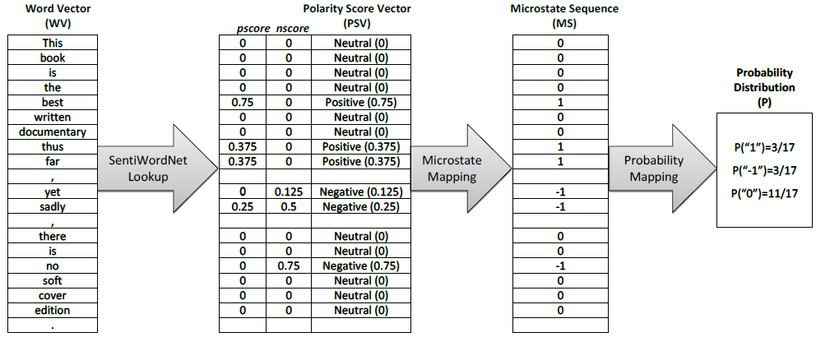
Conversion of text representation
Source: Zhang, Z., Li, X., and Chen, Y. (2012), "Deciphering word-of-mouth in social media: Text-based metrics of consumer reviews," ACM Trans. Manage. Inf. Syst. (3:1) 2012, pp 1-23.,

Slide 95
Example of SentiWordNet
POS ID PosScore NegScore SynsetTerms Gloss
a 00217728 0.75 0 beautiful#1 delighting the senses or exciting intellectual or emotional admiration; "a beautiful child"; "beautiful country"; "a beautiful painting"; "a beautiful theory"; "a beautiful party“
a 00227507 0.75 0 best#1 (superlative of `good') having the most positive qualities; "the best film of the year"; "the best solution"; "the best time for planting"; "wore his best suit“
r 00042614 0 0.625 unhappily#2 sadly#1 in an unfortunate way; "sadly he died before he could see his grandchild“
r 00093270 0 0.875 woefully#1 sadly#3 lamentably#1 deplorably#1 in an unfortunate or deplorable manner; "he was sadly neglected"; "it was woefully inadequate“
r 00404501 0 0.25 sadly#2 with sadness; in a sad manner; "`She died last night,' he said sadly"

Slide 96
SenticNet
The car is very old but it is rather not expensive.
The car is very old but it is rather not expensive.
The car is very old but it is rather not expensive.
Source: Cambria, Erik, Soujanya Poria, Rajiv Bajpai, and Björn Schuller. "SenticNet 4: A semantic resource for sentiment analysis based on conceptual primitives." In the 26th International Conference on Computational Linguistics (COLING), Osaka. 2016.

Slide 97
Polarity Detection with SenticNet
The car is very old but it is rather not expensive.
The car is very old but it is rather not expensive.
Source: Cambria, Erik, Soujanya Poria, Rajiv Bajpai, and Björn Schuller. "SenticNet 4: A semantic resource for sentiment analysis based on conceptual primitives." In the 26th International Conference on Computational Linguistics (COLING), Osaka. 2016.

Slide 98
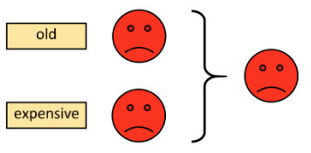
Polarity Detection with SenticNet
Source: Cambria, Erik, Soujanya Poria, Rajiv Bajpai, and Björn Schuller. "SenticNet 4: A semantic resource for sentiment analysis based on conceptual primitives." In the 26th International Conference on Computational Linguistics (COLING), Osaka. 2016.

Slide 99
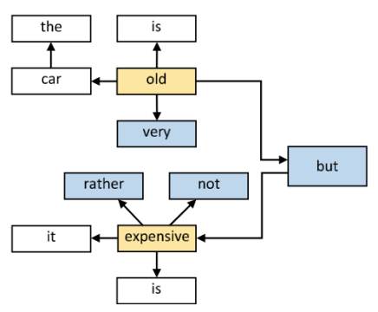
Polarity Detection with SenticNet
Source: Cambria, Erik, Soujanya Poria, Rajiv Bajpai, and Björn Schuller. "SenticNet 4: A semantic resource for sentiment analysis based on conceptual primitives." In the 26th International Conference on Computational Linguistics (COLING), Osaka. 2016.

Slide 100
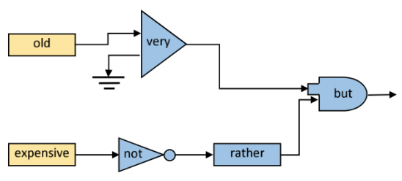
Polarity Detection with SenticNet
Source: Cambria, Erik, Soujanya Poria, Rajiv Bajpai, and Björn Schuller. "SenticNet 4: A semantic resource for sentiment analysis based on conceptual primitives." In the 26th International Conference on Computational Linguistics (COLING), Osaka. 2016.

Slide 101
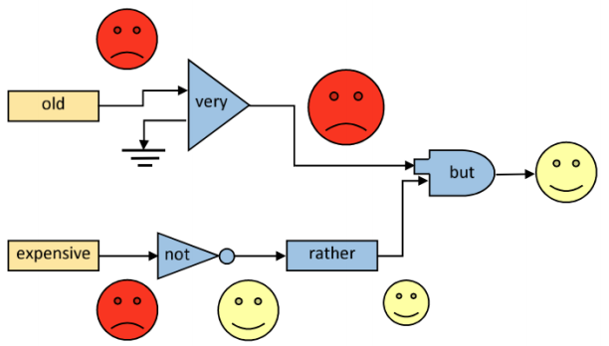
Polarity Detection with SenticNet
Source: Cambria, Erik, Soujanya Poria, Rajiv Bajpai, and Björn Schuller. "SenticNet 4: A semantic resource for sentiment analysis based on conceptual primitives." In the 26th International Conference on Computational Linguistics (COLING), Osaka. 2016.

Slide 102
Evaluation of Text Mining and Sentiment Analysis
Evaluation of Information Retrieval
Evaluation of Classification Model (Prediction)
Accuracy
Precision
Recall
F-score

Slide 103
Deep Learning for Sentiment Analytics

Slide 104
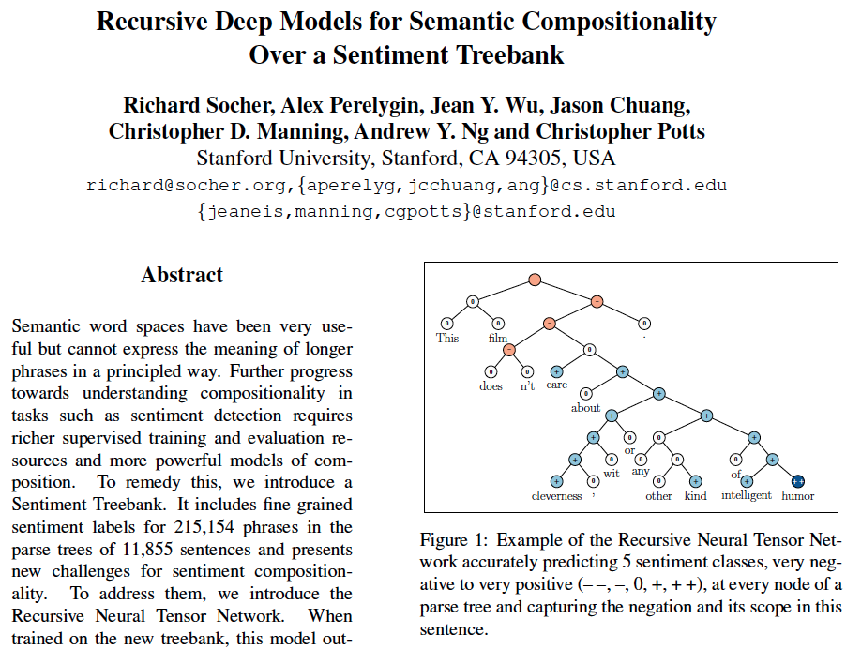
Recursive Deep Models for Semantic Compositionality Over a Sentiment Treebank
Source: Richard Socher et al. (2013) "Recursive Deep Models for Semantic Compositionality Over a Sentiment Treebank", EMNLP 2013

Slide 105
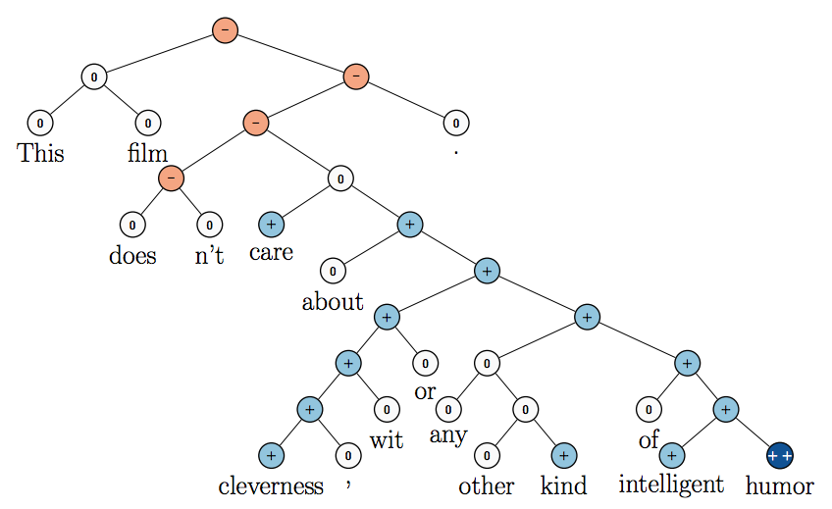
Recursive Neural Tensor Network (RNTN)
Source: Richard Socher et al. (2013) "Recursive Deep Models for Semantic Compositionality Over a Sentiment Treebank", EMNLP 2013

Slide 106
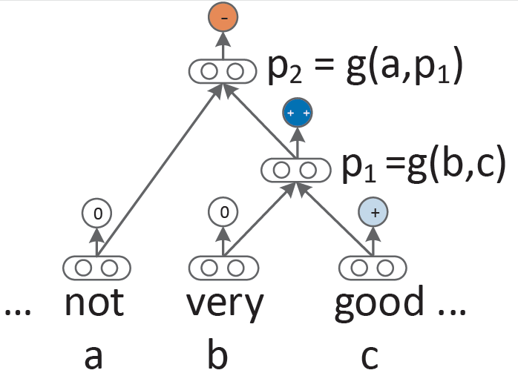
Recursive Neural Network (RNN) models for sentiment
Source: Richard Socher et al. (2013) "Recursive Deep Models for Semantic Compositionality Over a Sentiment Treebank", EMNLP 2013

Slide 107
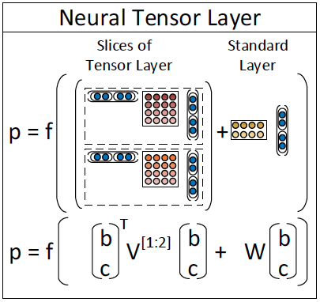
Recursive Neural Tensor Network (RNTN)
Source: Richard Socher et al. (2013) "Recursive Deep Models for Semantic Compositionality Over a Sentiment Treebank", EMNLP 2013

Slide 108
Roger Dodger is one of the most compelling variations on this theme. Roger Dodger is one of the least compelling variations on this theme.
Source: Richard Socher et al. (2013) "Recursive Deep Models for Semantic Compositionality Over a Sentiment Treebank", EMNLP 2013

Slide 109
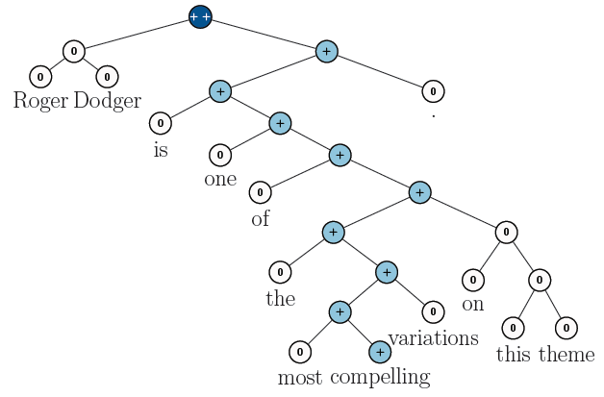
RNTN for Sentiment Analysis
Roger Dodger is one of the most compelling variations on this theme.
Source: Richard Socher et al. (2013) "Recursive Deep Models for Semantic Compositionality Over a Sentiment Treebank", EMNLP 2013

Slide 110
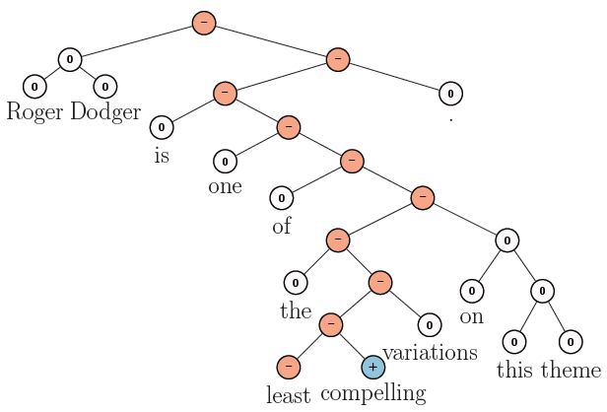
RNTN for Sentiment Analysis
Roger Dodger is one of the least compelling variations on this theme.
Source: Richard Socher et al. (2013) "Recursive Deep Models for Semantic Compositionality Over a Sentiment Treebank", EMNLP 2013

Slide 111
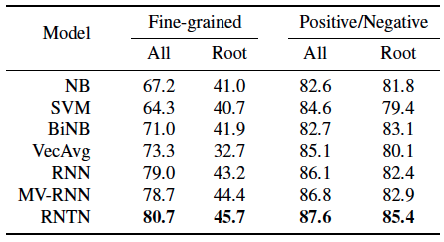
Accuracy for fine grained (5-class) and binary predictions at the sentence level (root) and for all nodes
Source: Richard Socher et al. (2013) "Recursive Deep Models for Semantic Compositionality Over a Sentiment Treebank", EMNLP 2013

Slide 112
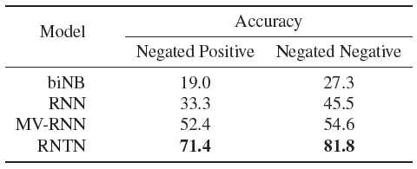
Accuracy of negation detection
Source: Richard Socher et al. (2013) "Recursive Deep Models for Semantic Compositionality Over a Sentiment Treebank", EMNLP 2013

Slide 113
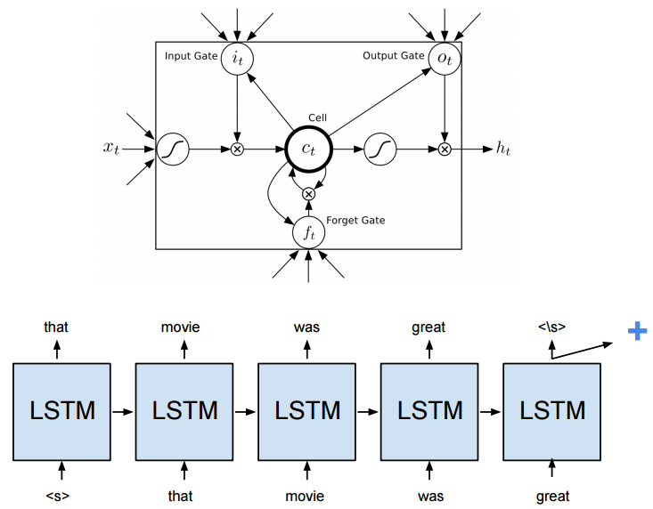
Long Short-Term Memory (LSTM)
Source: https://cs224d.stanford.edu/reports/HongJames.pdf

Slide 114
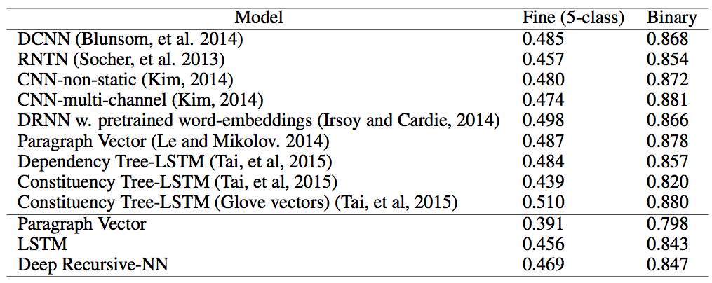
Deep Learning for Sentiment Analysis CNN RNTN LSTM
Source: https://cs224d.stanford.edu/reports/HongJames.pdf

Slide 115
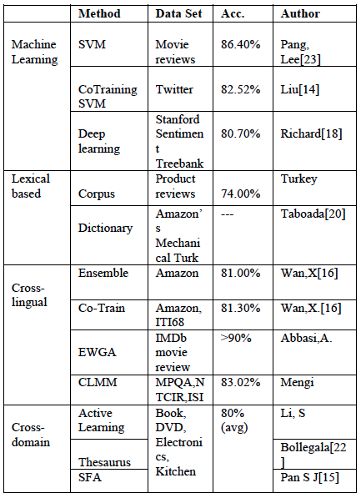
Performance Comparison of Sentiment Analysis Methods
Vishal Kharde and Sheetal Sonawane (2016), "Sentiment Analysis of Twitter Data: A Survey of Techniques," International Journal of Computer Applications, Vol 139, No. 11, 2016. pp.5-15

Slide 116
Resources of Opinion Mining

Slide 117
Datasets of Opinion Mining
Blog06
25GB TREC test collection
http://ir.dcs.gla.ac.uk/test collections/access to data.html
Cornell movie-review datasets
http://www.cs.cornell.edu/people/pabo/movie-review-data/
Customer review datasets
http://www.cs.uic.edu/∼liub/FBS/CustomerReviewData.zip
Multiple-aspect restaurant reviews
http://people.csail.mit.edu/bsnyder/naacl07
NTCIR multilingual corpus
NTCIR Multilingual Opinion-Analysis Task (MOAT)
Source: Bo Pang and Lillian Lee (2008), "Opinion mining and sentiment analysis,” Foundations and Trends in Information Retrieval

Slide 118
Lexical Resources of Opinion Mining
SentiWordnet
http://sentiwordnet.isti.cnr.it/
General Inquirer
http://www.wjh.harvard.edu/∼inquirer/
OpinionFinder’s Subjectivity Lexicon
http://www.cs.pitt.edu/mpqa/
NTU Sentiment Dictionary (NTUSD)
http://nlg18.csie.ntu.edu.tw:8080/opinion/
Hownet Sentiment
http://www.keenage.com/html/c_bulletin_2007.htm

Slide 119
Sentiment Analysis Dictionary
NTUSD: SD\NTUSD.rar
HOWNET: SD\HOWNET.rar
SentiWordNet: SD\SentiWordNet3.rar
TYCCL Antonym Negation: SD\TYCCL\TYCCL.rar
DLUTSD : SD\DLUTSD.zip
IMTKU iCosmeSD: SD\iCosmeSD2014.rar
IMTKU iMFinanceSD: SD\iMFinanceSD.zip
IMTKU Antonym: SD\IMTKUAntonym.txt

Slide 120
Example of SentiWordNet
POS ID PosScore NegScore SynsetTerms Gloss
a 00217728 0.75 0 beautiful#1 delighting the senses or exciting intellectual or emotional admiration; "a beautiful child"; "beautiful country"; "a beautiful painting"; "a beautiful theory"; "a beautiful party“
a 00227507 0.75 0 best#1 (superlative of `good') having the most positive qualities; "the best film of the year"; "the best solution"; "the best time for planting"; "wore his best suit“
r 00042614 0 0.625 unhappily#2 sadly#1 in an unfortunate way; "sadly he died before he could see his grandchild“
r 00093270 0 0.875 woefully#1 sadly#3 lamentably#1 deplorably#1 in an unfortunate or deplorable manner; "he was sadly neglected"; "it was woefully inadequate“
r 00404501 0 0.25 sadly#2 with sadness; in a sad manner; "`She died last night,' he said sadly"

Slide 121
《知網》情感分析用詞語集（beta版）
“中英文情感分析用詞語集”
包含詞語約 17887
“中文情感分析用詞語集”
包含詞語約 9193
“英文情感分析用詞語集”
包含詞語 8945
Source: http://www.keenage.com/html/c_bulletin_2007.htm

Slide 122
中文情感分析用詞語集
中文正面情感詞語 | 836
中文負面情感詞語 | 1254
中文正面評價詞語 | 3730
中文負面評價詞語 | 3116
中文程度級別詞語 | 219
中文主張詞語 | 38
Total | 9193
Source: http://www.keenage.com/html/c_bulletin_2007.htm

Slide 123
中文情感分析用詞語集
“正面情感”詞語
如： 愛，讚賞，快樂，感同身受，好奇， 喝彩，魂牽夢縈，嘉許 ...
“負面情感”詞語
如： 哀傷，半信半疑，鄙視，不滿意，不是滋味兒，後悔，大失所望 ...
Source: http://www.keenage.com/html/c_bulletin_2007.htm

Slide 124
中文情感分析用詞語集
“正面評價”詞語
如： 不可或缺，部優，才高八斗，沉魚落雁， 催人奮進，動聽，對勁兒 ...
“負面評價”詞語
如： 醜，苦，超標，華而不實，荒涼，混濁， 畸輕畸重，價高，空洞無物 ...
Source: http://www.keenage.com/html/c_bulletin_2007.htm

Slide 125
中文情感分析用詞語集
“程度級別”詞語
1. “極其|extreme / 最|most”
非常，極，極度，無以倫比，最為
2. “很|very”
多麼，分外，格外，著實
…
“主張”詞語
1. {perception|感知}
感覺，覺得，預感
2. {regard|認為}
認為，以為，主張
Source: http://www.keenage.com/html/c_bulletin_2007.htm

Slide 126
Fake Review Opinion Spam Detection

Slide 127
Opinion Spam Detection
Opinion Spam Detection: Detecting Fake Reviews and Reviewers
Spam Review
Fake Review
Bogus Review
Deceptive review
Opinion Spammer
Review Spammer
Fake Reviewer
Shill (Stooge or Plant)
Source: http://www.cs.uic.edu/~liub/FBS/fake-reviews.html

Slide 128
Opinion Spamming
Opinion Spamming
"illegal" activities
e.g., writing fake reviews, also called shilling
try to mislead readers or automated opinion mining and sentiment analysis systems by giving undeserving positive opinions to some target entities in order to promote the entities and/or by giving false negative opinions to some other entities in order to damage their reputations.
Source: http://www.cs.uic.edu/~liub/FBS/fake-reviews.html

Slide 129
Forms of Opinion spam
fake reviews (also called bogus reviews)
fake comments
fake blogs
fake social network postings
deceptions
deceptive messages
Source: http://www.cs.uic.edu/~liub/FBS/fake-reviews.html

Slide 130
Fake Review Detection
Methods
supervised learning
pattern discovery
graph-based methods
relational modeling
Signals
Review content
Reviewer abnormal behaviors
Product related features
Relationships
Source: http://www.cs.uic.edu/~liub/FBS/fake-reviews.html

Slide 131
Professional Fake Review Writing Services (some Reputation Management companies)
Post positive reviews
Sponsored reviews
Pay per post
Need someone to write positive reviews about our company (budget: $250-$750 USD)
Fake review writer
Product review writer for hire
Hire a content writer
Fake Amazon book reviews (hiring book reviewers)
People are just having fun (not serious)
Source: http://www.cs.uic.edu/~liub/FBS/fake-reviews.html

Slide 132
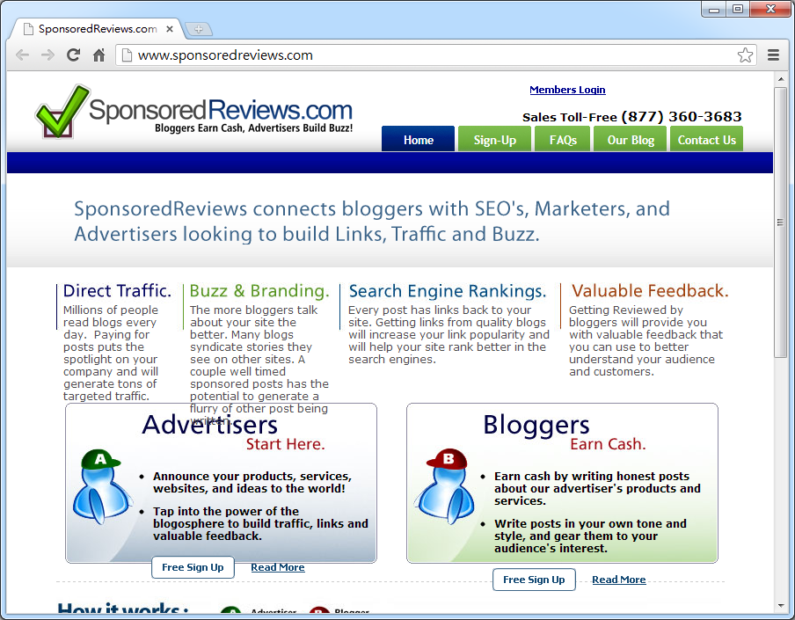
Source:http://www.sponsoredreviews.com/

Slide 133
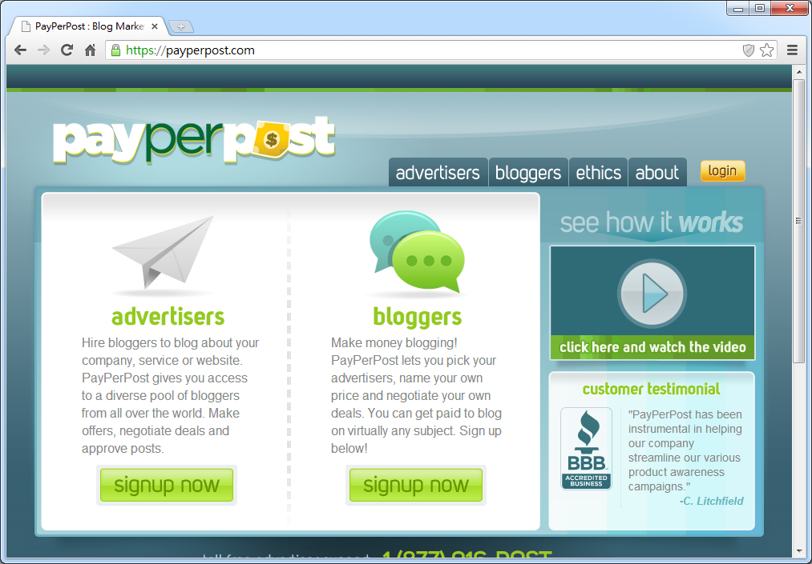
Source: https://payperpost.com/

Slide 134
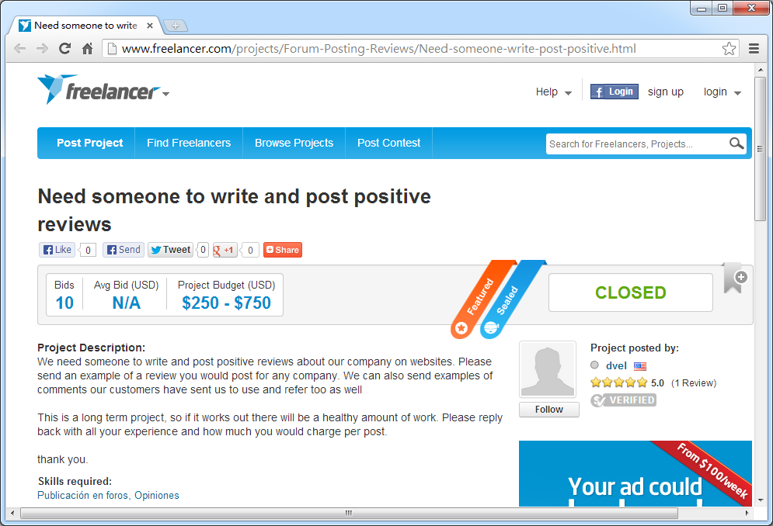
Source:http://www.freelancer.com/projects/Forum-Posting-Reviews/Need-someone-write-post-positive.html

Slide 135
Deceptive Review Spam Detection Techniques
Supervised learning techniques
labeled data
Unsupervised learning techniques
unlabeled data
Semi-supervised learning techniques
minimum labeled data
Source: Rout, Jitendra Kumar, Smriti Singh, Sanjay Kumar Jena, and Sambit Bakshi. "Deceptive review detection using labeled and unlabeled data." Multimedia Tools and Applications (2017): 1-25.

Slide 136
Comparison of deceptive review spam detection techniques based on labeled data
Authors | Key concept | Features | Learner | Result
Jindal and Liu (2008) | Text duplication | Review, reviewer and product centric | Logistic regression | 78 %(accuracy)
Lai et al. (2010) | Text similarity | Review text | SVM | 81 %(precision)
Algur et al. (2010) | Product feature similarity | Product features | Cosine similarity | 43.6 %(precision)
Ott et al. (2011) | Content similarity | LIWC + Bigram | SVM | 89.6(accuracy)
Ott et al. (2013) | Content review(Taking negative reviews only) | n-gram | SVM | 86 %(accuracy)
Mukherjee et al. (2013) | Content similarity | Behavioral+ Bigrams | SVM | 86.1 %(accuracy)
Shojaee et al. (2013) | Stylometric | Lexical and syntactical | SVM | 84 %(F-score)
Long et al. (2014) | Ontology | Ontological features | Conditional filtering | 75 %(precision)
Rout et al. (2017) | Content similarity | Sentiment Score, | SVM | 88.71 %(accuracy)
Rout et al. (2017) | and sentiment | Lingustic features | Naive Bayes | 91.9 %(accuracy)
Rout et al. (2017) | polarity | and unigram | Decision Tree | 92.11 %(accuracy)
Source: Rout, Jitendra Kumar, Smriti Singh, Sanjay Kumar Jena, and Sambit Bakshi. "Deceptive review detection using labeled and unlabeled data." Multimedia Tools and Applications (2017): 1-25.

Slide 137
Comparison of deceptive review spam detection techniques based on unlabeled data
Author | Key concept | Dataset | Features | Approach
Wu et al. (2010) | Distortion used to separate out true positives from false positives. | Irish tripAdvisor Data | Proportion of positive singletons (PPS) and concentration of positive singletons(CPS) | Clustering
Raymond et al. (2011) | Semantic content overlapping among reviews | Amazon review dataset | cosine similarity measure | Clustering
Mukherjee et al. (2013) | Difference in behavioral distributions of spammers and non-spammers | Amazon review dataset | Author features, Review features | Unsupervised clustering in bayesian setting
Akoglu et al. (2013) | Network effect among reviewer and products | Software marketplace (SWM) dataset | Honesty and goodness of products, Review scores | Graph clustering (Cross-Association Clustering)
Rout et al. (2017) | Difference in behavioral patterns of reviews | Amazon cell phone reviews dataset | Review data, Reviewer data and product information | Clustering
Source: Rout, Jitendra Kumar, Smriti Singh, Sanjay Kumar Jena, and Sambit Bakshi. "Deceptive review detection using labeled and unlabeled data." Multimedia Tools and Applications (2017): 1-25.

Slide 138
Comparison of deceptive review spam detection techniques based on minimum labeled data
Author | Key concept | Dataset | Approach | Features | Result
Li et al. (2011) | Review spammer consistently writes spam | Product reviews obtained from Epinions | Co-training algorithm | Review related features (Content, sentiment, product, data features) and reviewer related features (Profile and Behavioral Features) | 0.631 (F-Score)
Fusilier et al. (2013) | Learning from positive example and set of unlabeled data | Ott’s hotel review dataset | PU-learning | n-gram | 0.84 (F-score)
Ren et al. (2014) | Based on some truthful reviews and a lot of unlabeled reviews to build an accurate classifier | Ott’s hotel review dataset | Mixing population and individual property PU learning(MPIPUL) | Similarity weights | 83.91 % (Accuracy)
Source: Rout, Jitendra Kumar, Smriti Singh, Sanjay Kumar Jena, and Sambit Bakshi. "Deceptive review detection using labeled and unlabeled data." Multimedia Tools and Applications (2017): 1-25.

Slide 139
References
Chuck Hemann and Ken Burbary (2013), Digital Marketing Analytics: Making Sense of Consumer Data in a Digital World, Que.
Bing Liu (2015), Sentiment Analysis: Mining Opinions, Sentiments, and Emotions, Cambridge University Press
Bing Liu (2011) , “Web Data Mining: Exploring Hyperlinks, Contents, and Usage Data,” 2nd Edition, Springer. http://www.cs.uic.edu/~liub/WebMiningBook.html
Bing Liu (2013), Opinion Spam Detection: Detecting Fake Reviews and Reviewers, http://www.cs.uic.edu/~liub/FBS/fake-reviews.html
Bo Pang and Lillian Lee (2008), "Opinion mining and sentiment analysis,” Foundations and Trends in Information Retrieval 2(1-2), pp. 1–135, 2008.
Wiltrud Kessler (2012), Introduction to Sentiment Analysis, http://www.ims.uni-stuttgart.de/~kesslewd/lehre/sentimentanalysis12s/introduction_sentimentanalysis.pdf
Z. Zhang, X. Li, and Y. Chen (2012), "Deciphering word-of-mouth in social media: Text-based metrics of consumer reviews," ACM Trans. Manage. Inf. Syst. (3:1) 2012, pp 1-23.
Efraim Turban, Ramesh Sharda, Dursun Delen (2011), Decision Support and Business Intelligence Systems, Ninth Edition, 2011, Pearson.
Guandong Xu, Yanchun Zhang, Lin Li (2011), Web Mining and Social Networking: Techniques and Applications, 2011, Springer

Slide 140
References
Cambria, Erik, Soujanya Poria, Rajiv Bajpai, and Björn Schuller. "SenticNet 4: A semantic resource for sentiment analysis based on conceptual primitives." In the 26th International Conference on Computational Linguistics (COLING), Osaka. 2016.
Richard Socher, Alex Perelygin, Jean Y. Wu, Jason Chuang, Christopher D. Manning, Andrew Y. Ng, and Christopher Potts (2013), "Recursive Deep Models for Semantic Compositionality Over a Sentiment Treebank," In Proceedings of the conference on empirical methods in natural language processing (EMNLP), vol. 1631, p. 1642 http://nlp.stanford.edu/~socherr/EMNLP2013_RNTN.pdf
Kumar Ravi and Vadlamani Ravi (2015), "A survey on opinion mining and sentiment analysis: tasks, approaches and applications." Knowledge-Based Systems, 89, pp.14-46.
Vishal Kharde and Sheetal Sonawane (2016), "Sentiment Analysis of Twitter Data: A Survey of Techniques," International Journal of Computer Applications, vol 139, no. 11, 2016. pp.5-15.
Jesus Serrano-Guerrero, Jose A. Olivas, Francisco P. Romero, and Enrique Herrera-Viedma (2015), "Sentiment analysis: A review and comparative analysis of web services," Information Sciences, 311, pp. 18-38.
Steven Struhl (2015), Practical Text Analytics: Interpreting Text and Unstructured Data for Business Intelligence (Marketing Science), Kogan Page
Jitendra Kumar Rout, Smriti Singh, Sanjay Kumar Jena, and Sambit Bakshi (2017), "Deceptive review detection using labeled and unlabeled data." Multimedia Tools and Applications (2017): 1-25.

