Slide 1
Social Computing and Big Data Analytics 社群運算與大數據分析
Tamkang University
Tamkang University
Finance Big Data Analytics with Pandas in Python
(Python Pandas 財務大數據分析)
1052SCBDA06
MIS MBA (M2226) (8606)
Wed, 8,9, (15:10-17:00) (L206)
Min-Yuh Day
戴敏育
Assistant Professor
專任助理教授
Dept. of Information Management, Tamkang University
淡江大學 資訊管理學系
http://mail. tku.edu.tw/myday/
2017-03-22

Slide 2
課程大綱 (Syllabus)
週次 (Week) 日期 (Date) 內容 (Subject/Topics)
1 2017/02/15 Course Orientation for Social Computing and Big Data Analytics (社群運算與大數據分析課程介紹)
2 2017/02/22 Data Science and Big Data Analytics: Discovering, Analyzing, Visualizing and Presenting Data (資料科學與大數據分析： 探索、分析、視覺化與呈現資料)
3 2017/03/01 Fundamental Big Data: MapReduce Paradigm, Hadoop and Spark Ecosystem (大數據基礎：MapReduce典範、 Hadoop與Spark生態系統)

Slide 3
課程大綱 (Syllabus)
週次 (Week) 日期 (Date) 內容 (Subject/Topics)
4 2017/03/08 Big Data Processing Platforms with SMACK: Spark, Mesos, Akka, Cassandra and Kafka (大數據處理平台SMACK： Spark, Mesos, Akka, Cassandra, Kafka)
5 2017/03/15 Big Data Analytics with Numpy in Python (Python Numpy 大數據分析)
6 2017/03/22 Finance Big Data Analytics with Pandas in Python (Python Pandas 財務大數據分析)
7 2017/03/29 Text Mining Techniques and Natural Language Processing (文字探勘分析技術與自然語言處理)
8 2017/04/05 Off-campus study (教學行政觀摩日)

Slide 4
課程大綱 (Syllabus)
週次 (Week) 日期 (Date) 內容 (Subject/Topics)
9 2017/04/12 Social Media Marketing Analytics (社群媒體行銷分析)
10 2017/04/19 期中報告 (Midterm Project Report)
11 2017/04/26 Deep Learning with Theano and Keras in Python (Python Theano 和 Keras 深度學習)
12 2017/05/03 Deep Learning with Google TensorFlow (Google TensorFlow 深度學習)
13 2017/05/10 Sentiment Analysis on Social Media with Deep Learning (深度學習社群媒體情感分析)

Slide 5
課程大綱 (Syllabus)
週次 (Week) 日期 (Date) 內容 (Subject/Topics)
14 2017/05/17 Social Network Analysis (社會網絡分析)
15 2017/05/24 Measurements of Social Network (社會網絡量測)
16 2017/05/31 Tools of Social Network Analysis (社會網絡分析工具)
17 2017/06/07 Final Project Presentation I (期末報告 I)
18 2017/06/14 Final Project Presentation II (期末報告 II)

Slide 6
Source: https://www.python.org/community/logos/
http://pandas.pydata.org/

Slide 7
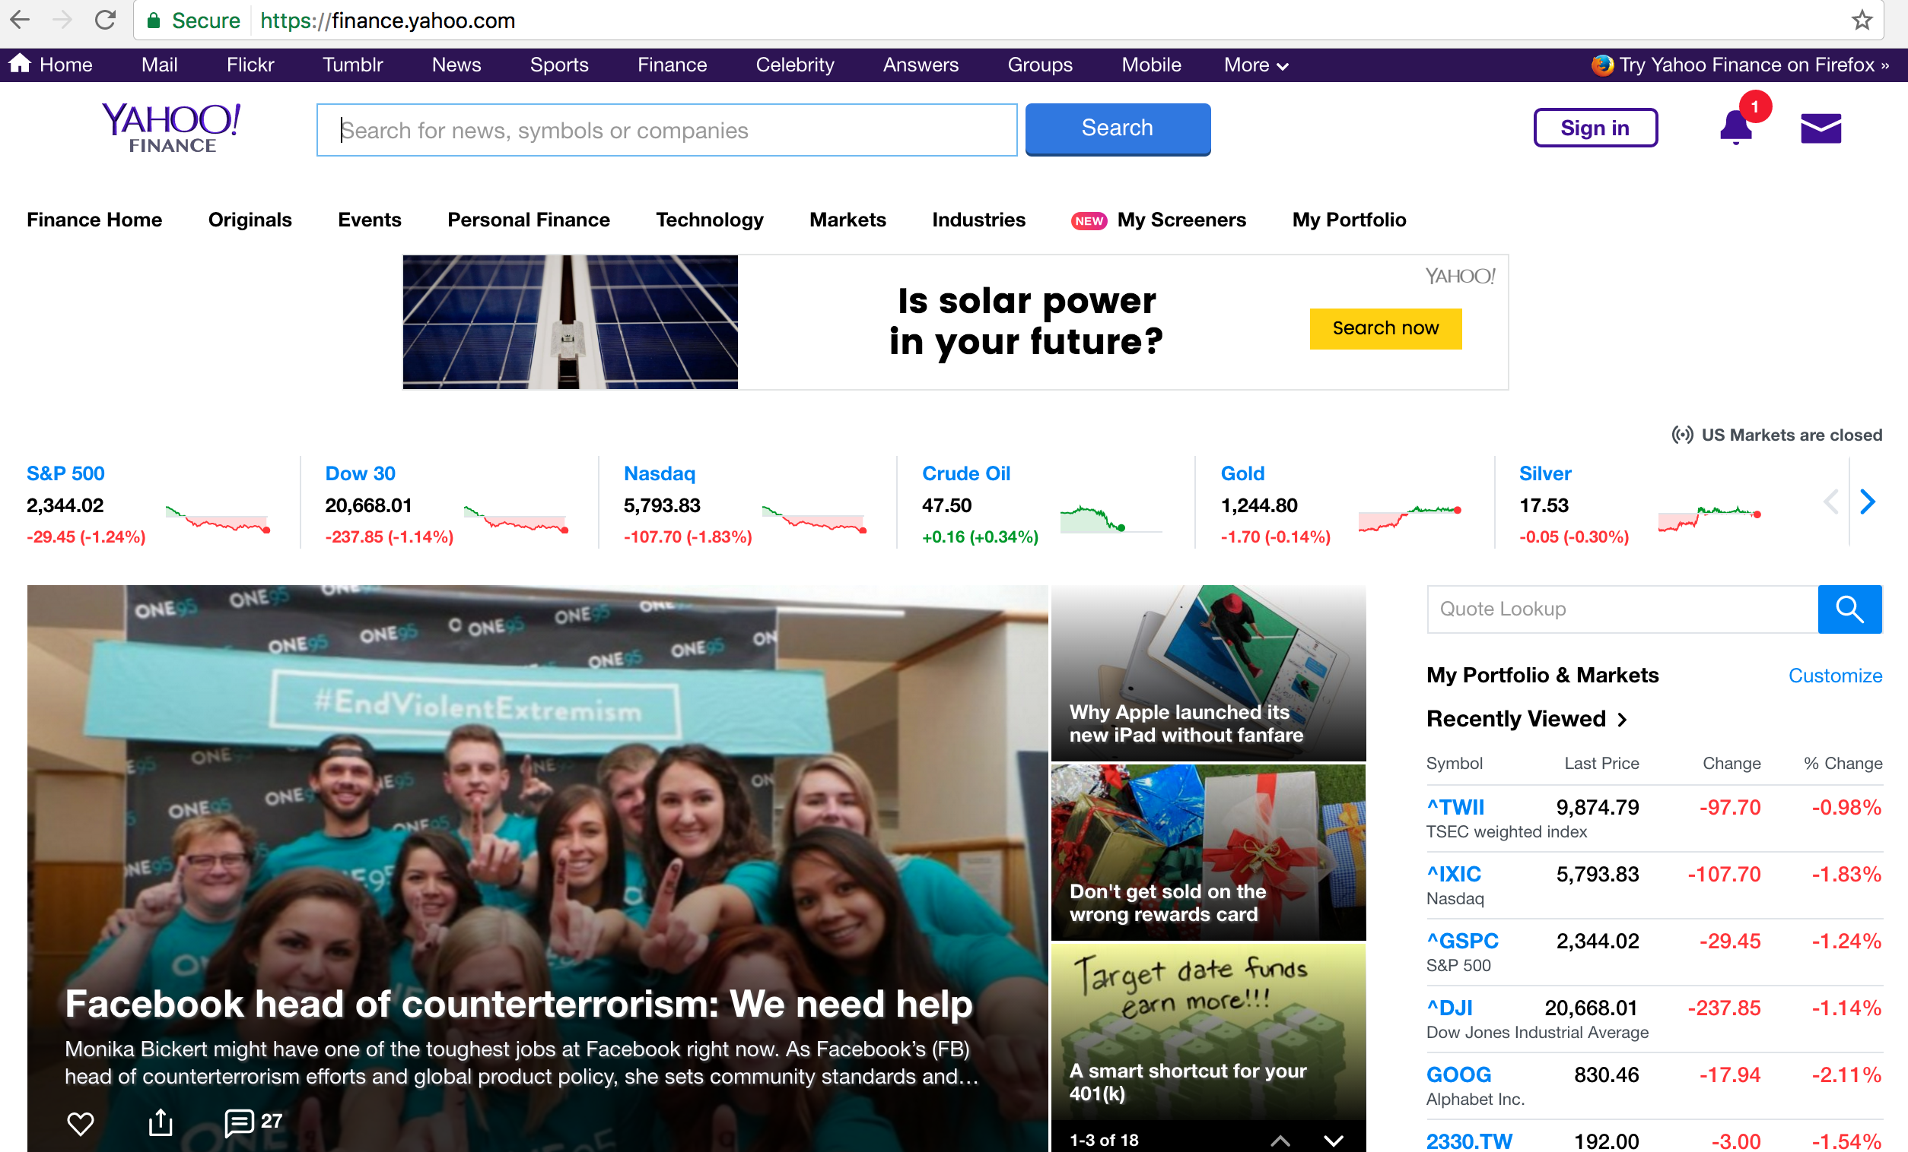
Yahoo Finance
http://finance.yahoo.com/

Slide 8
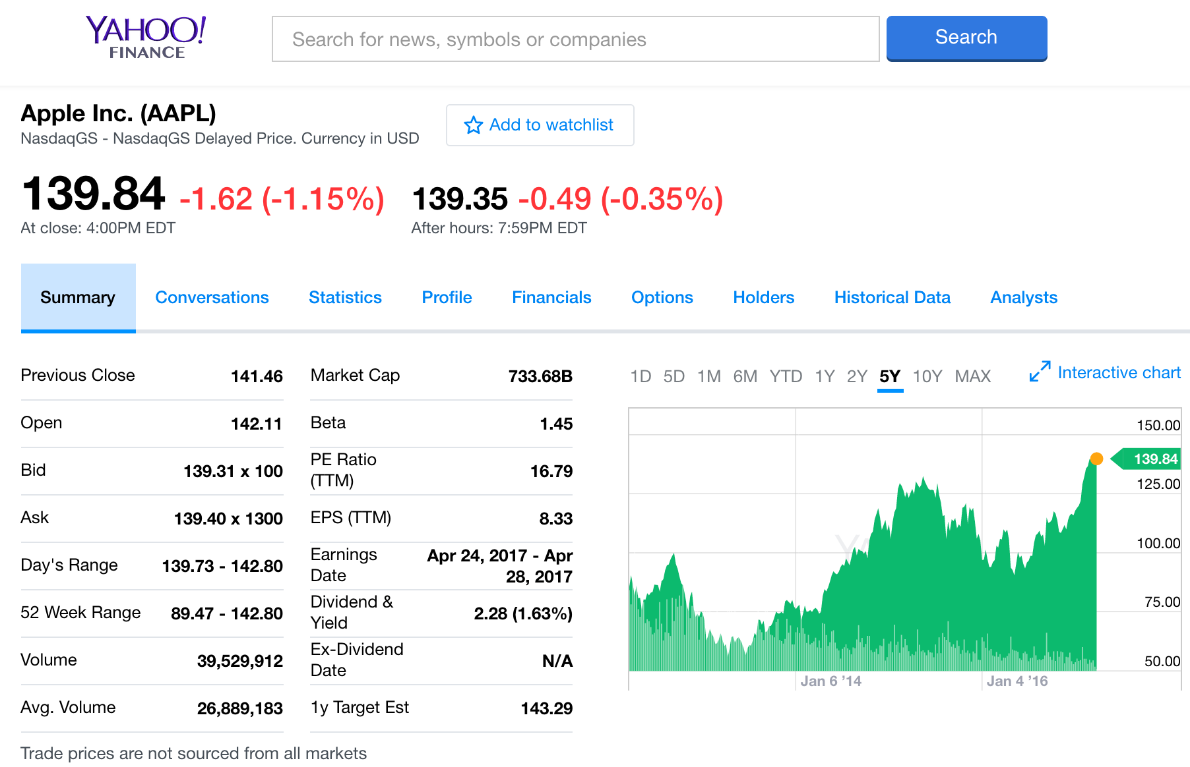
Apple Inc. (AAPL) -NasdaqGS
http://finance.yahoo.com/quote/AAPL?p=AAPL

Slide 9
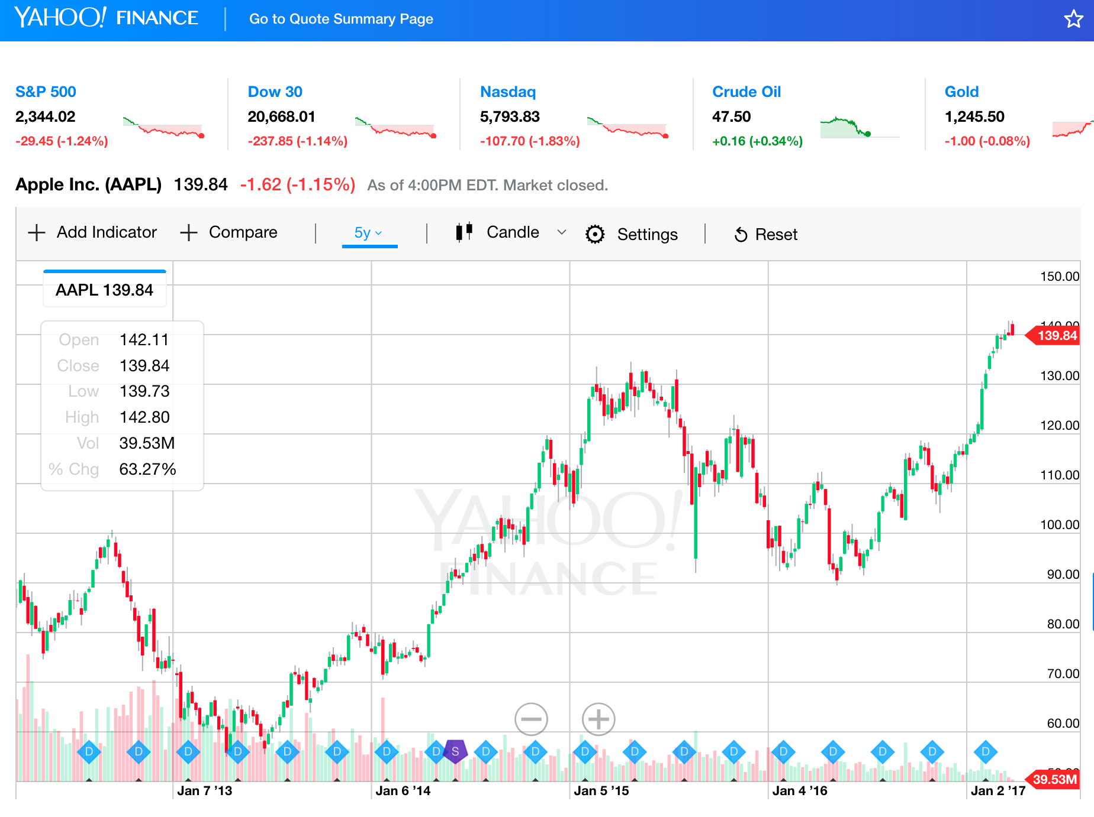
Yahoo Finance Charts: Apple Inc. (AAPL)
http://finance.yahoo.com/chart/AAPL

Slide 10
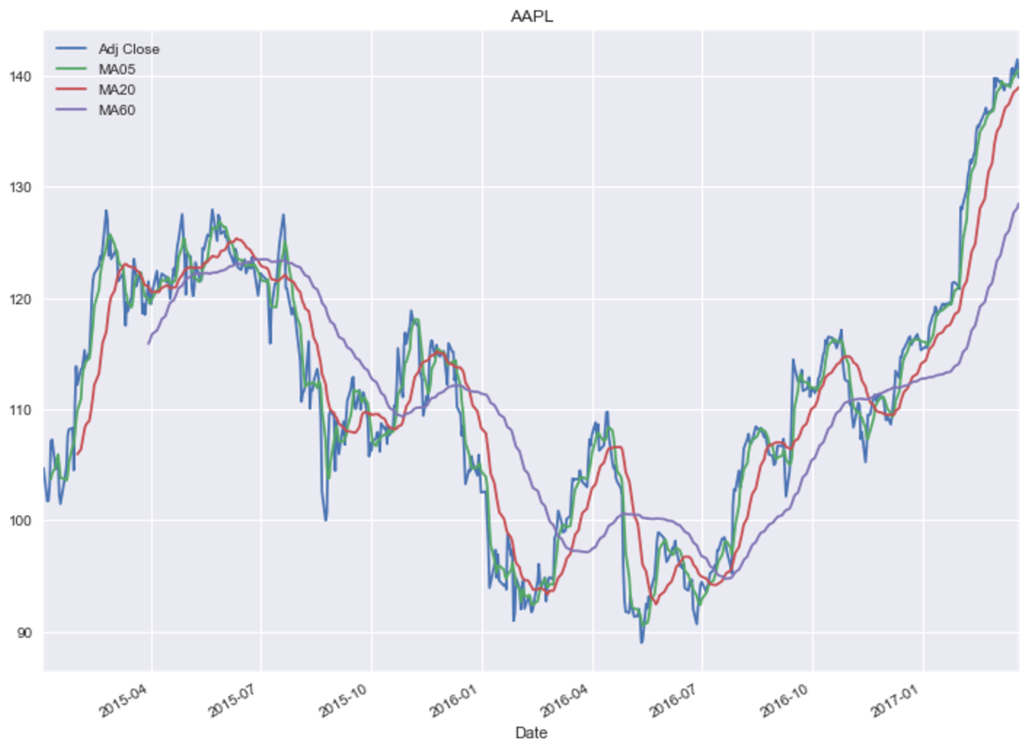
Python Pandas for Finance
Source: https://mapattack.wordpress.com/2017/02/12/using-python-for-stocks-1/

Slide 11
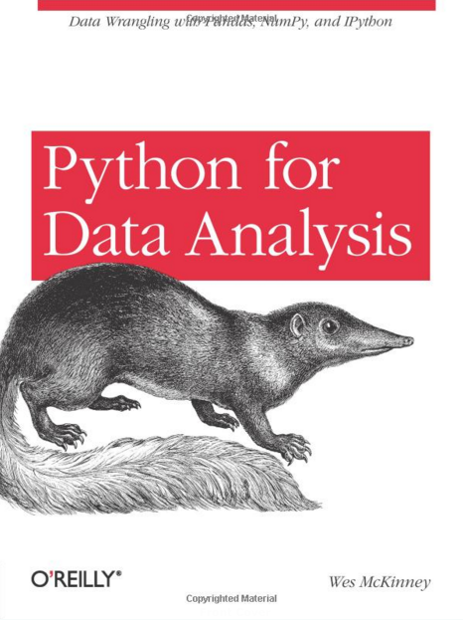
Wes McKinney (2012), Python for Data Analysis: Data Wrangling with Pandas, NumPy, and IPython, O'Reilly Media
Source: http://www.amazon.com/Python-Data-Analysis-Wrangling-IPython/dp/1449319793/

Slide 12
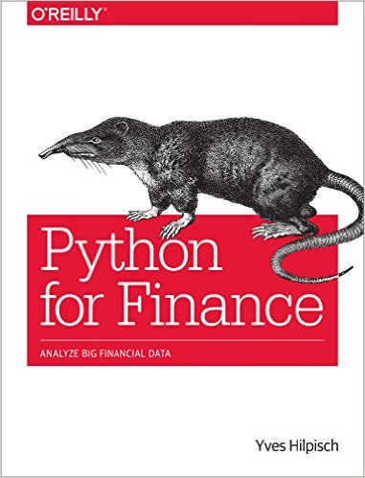
Yves Hilpisch, Python for Finance: Analyze Big Financial Data, O'Reilly, 2014
Source: http://www.amazon.com/Python-Finance-Analyze-Financial-Data/dp/1491945281

Slide 13
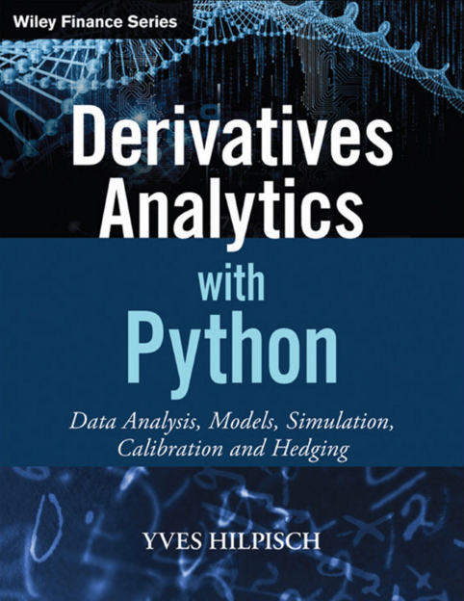
Yves Hilpisch (2015), Derivatives Analytics with Python: Data Analysis, Models, Simulation, Calibration and Hedging, Wiley
Source: http://www.amazon.com/Derivatives-Analytics-Python-Simulation-Calibration/dp/1119037999/

Slide 14
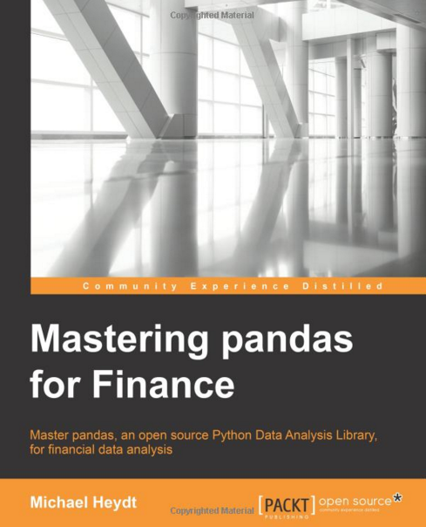
Michael Heydt , Mastering Pandas for Finance, Packt Publishing, 2015
Source: http://www.amazon.com/Mastering-Pandas-Finance-Michael-Heydt/dp/1783985100

Slide 15
Anaconda
https://www.continuum.io/

Slide 16
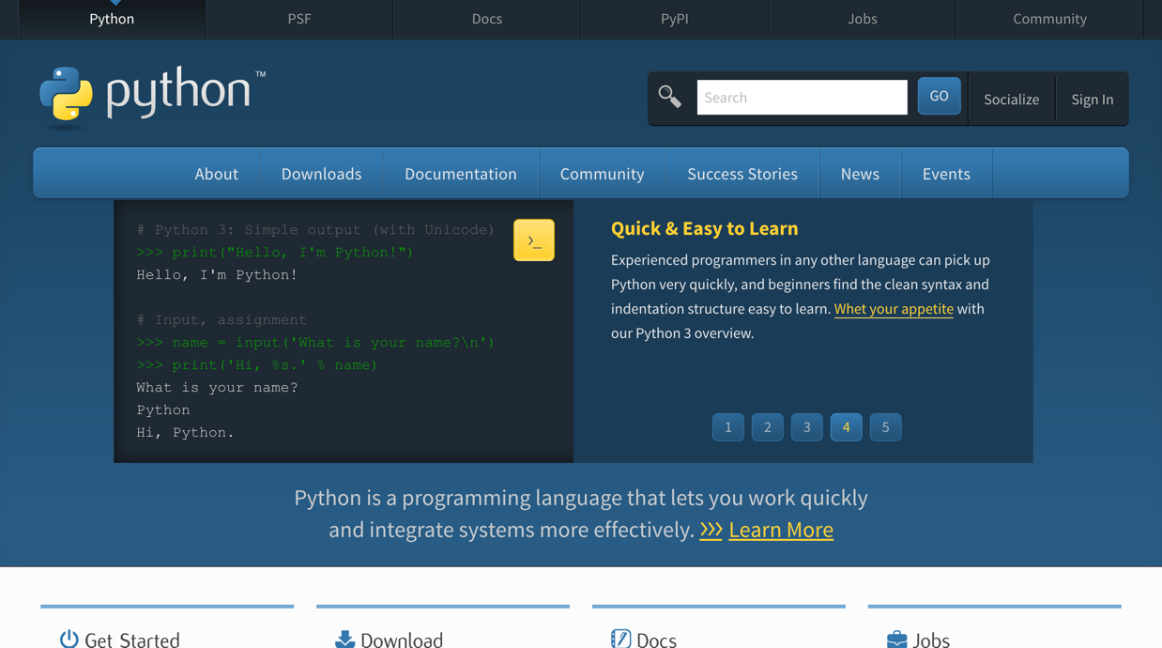
Python
https://www.python.org/

Slide 17
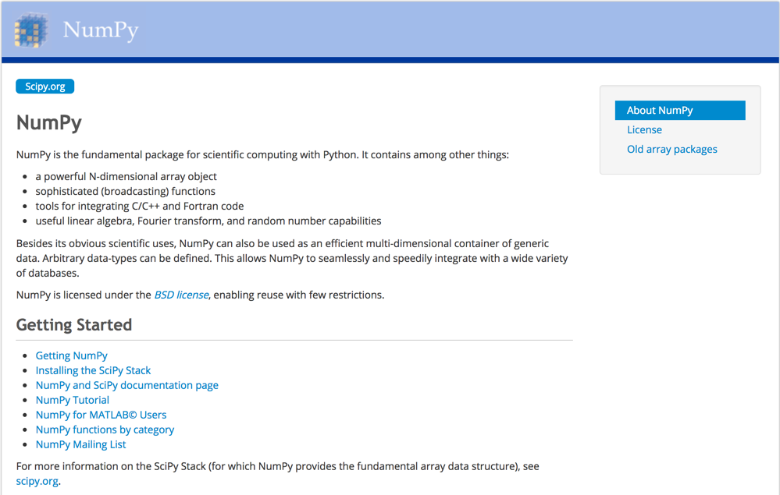
NumPy
http://www.numpy.org/

Slide 18
pandas
http://pandas.pydata.org/

Slide 19
pandas Python Data Analysis Library providing high-performance, easy-to-use data structures and data analysis tools for the Python programming language.
Source: http://pandas.pydata.org/

Slide 20
pandas Ecosystem
Statistics and Machine Learning
Statsmodels
sklearn-pandas
Visualization
Bokeh
yhat/ggplot
Seaborn
Vincent
IPython Vega
Plotly
Pandas-Qt
IDE
IPython
quantopian/qgrid
Spyder
API
pandas-datareader
quandl/Python
pydatastream
pandaSDMX
fredapi
Domain Specific
Geopandas
xarray
Out-of-core
Dask
Blaze
Odo
Source: http://pandas.pydata.org/pandas-docs/stable/index.html

Slide 21
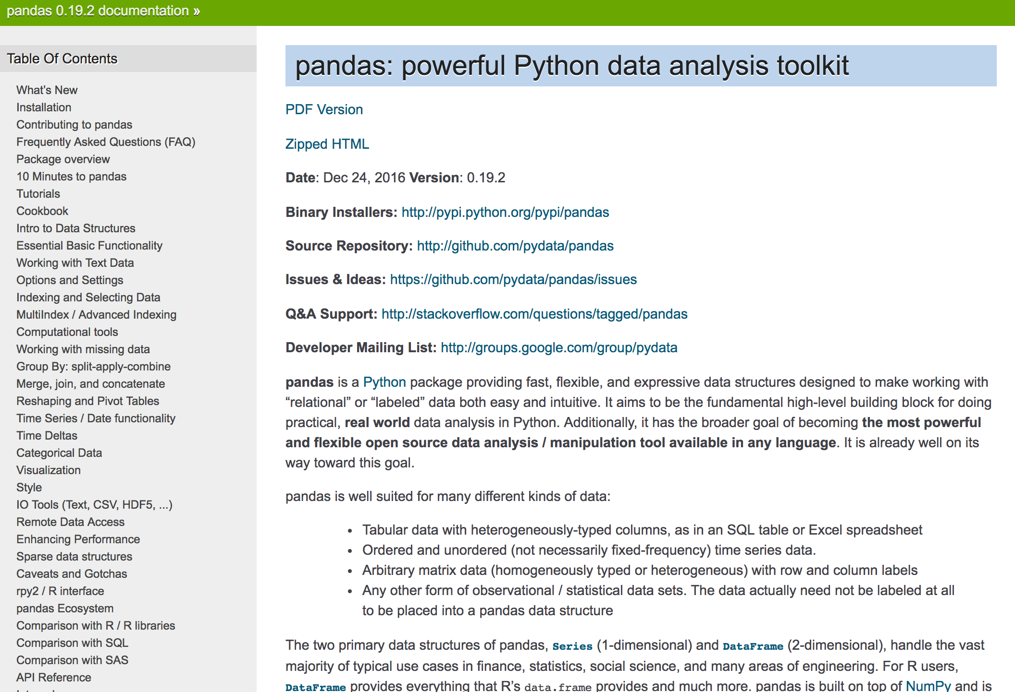
pandas: powerful Python data analysis toolkit
http://pandas.pydata.org/pandas-docs/stable/

Slide 22
pandas: powerful Python data analysis toolkit
Tabular data with heterogeneously-typed columns, as in an SQL table or Excel spreadsheet
Ordered and unordered (not necessarily fixed-frequency) time series data.
Arbitrary matrix data (homogeneously typed or heterogeneous) with row and column labels
Any other form of observational / statistical data sets. The data actually need not be labeled at all to be placed into a pandas data structure
Source: http://pandas.pydata.org/pandas-docs/stable/

Slide 23
Series DataFrame
Primary data structures of pandas
Series (1-dimensional)
DataFrame (2-dimensional)
Handle the vast majority of typical use cases in finance, statistics, social science, and many areas of engineering.
Source: http://pandas.pydata.org/pandas-docs/stable/

Slide 24
pandas DataFrame
DataFrame provides everything that R’s data.frame provides and much more.
pandas is built on top of NumPy and is intended to integrate well within a scientific computing environment with many other 3rd party libraries.

Slide 25
pandas Comparison with SAS
pandas | SAS
DataFrame | data set
column | variable
row | observation
groupby | BY-group
NaN | .
Source: http://pandas.pydata.org/pandas-docs/stable/comparison_with_sas.html

Slide 26
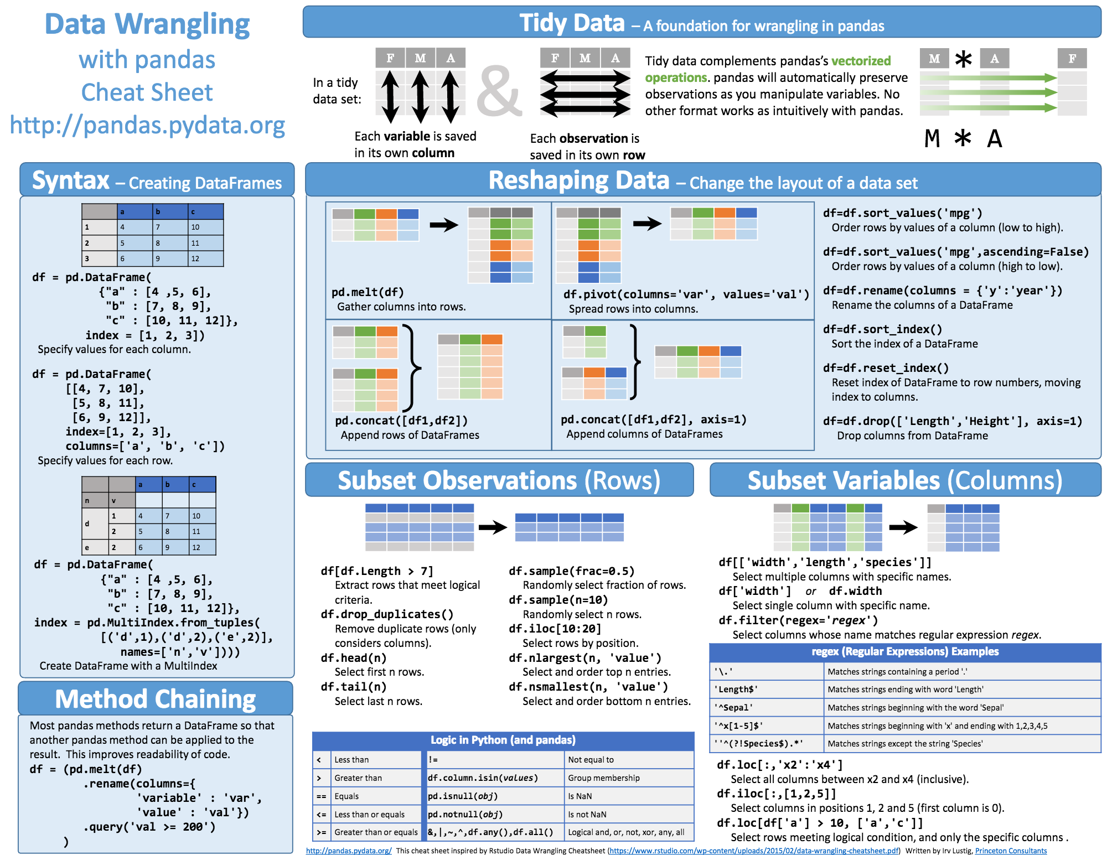
Python Pandas Cheat Sheet
Source: https://github.com/pandas-dev/pandas/blob/master/doc/cheatsheet/Pandas_Cheat_Sheet.pdf

Slide 27
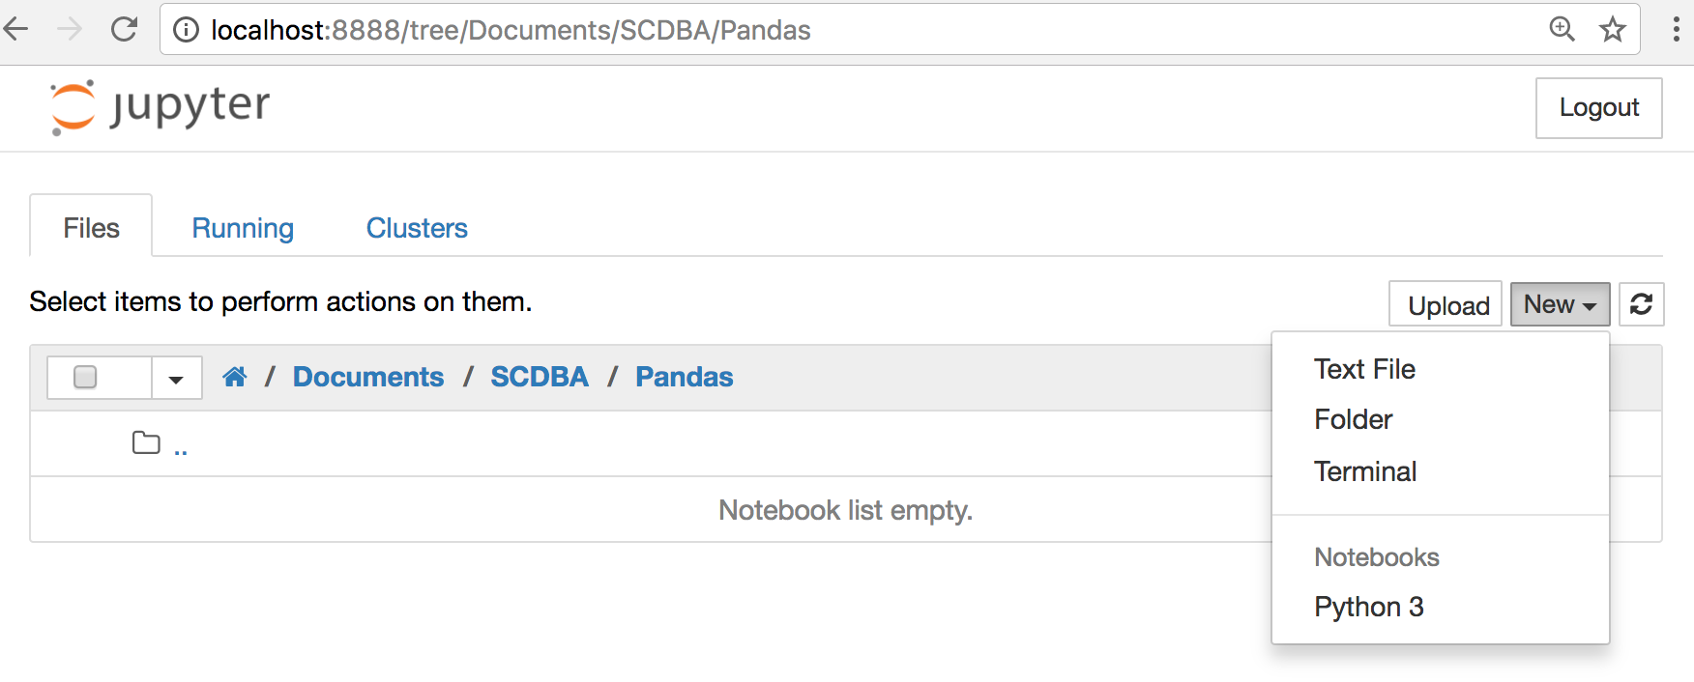
Jupyter Notebook New Python 3

Slide 28
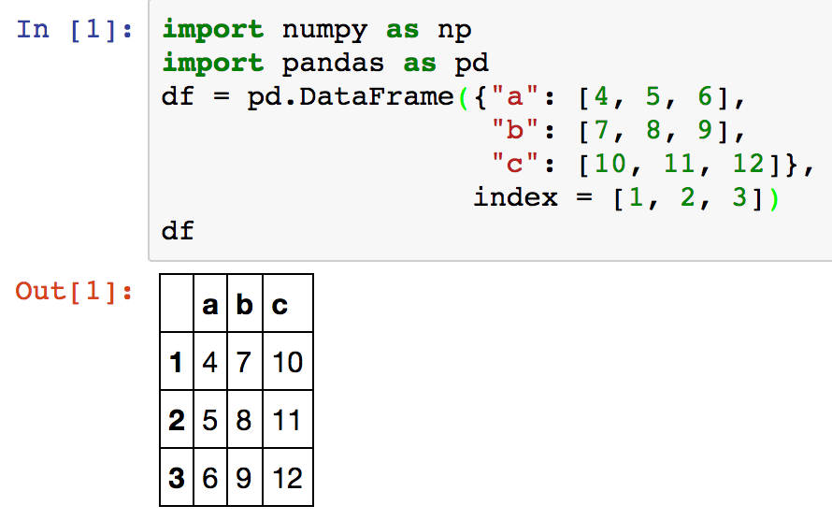
Creating pd.DataFrame
 | a | b | c
1 | 4 | 7 | 10
2 | 5 | 8 | 11
3 | 6 | 9 | 12
df = pd.DataFrame({"a": [4, 5, 6], "b": [7, 8, 9], "c": [10, 11, 12]}, index = [1, 2, 3])
Source: https://github.com/pandas-dev/pandas/blob/master/doc/cheatsheet/Pandas_Cheat_Sheet.pdf

Slide 29
Pandas DataFrame
type(df)

Slide 30
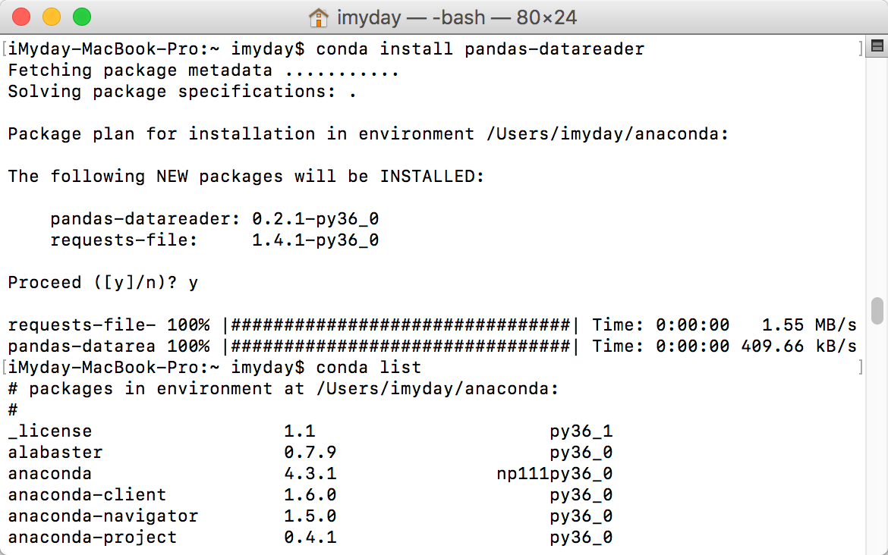
conda install pandas-datareader

Slide 31
Jupyter Notebook New Python 3

Slide 32
import numpy as np
import pandas as pd
import matplotlib.pyplot as plt
print('Hello Pandas')
s = pd.Series([1,3,5,np.nan,6,8])
s
dates = pd.date_range('20170301', periods=6)
dates
Source: http://pandas.pydata.org/pandas-docs/stable/10min.html

Slide 33
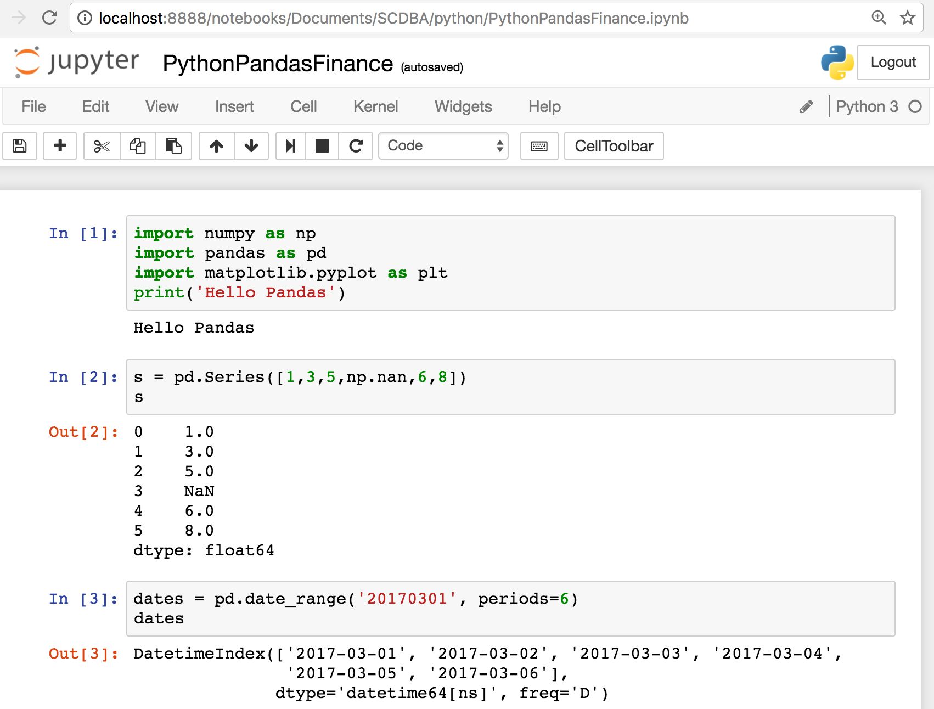

Slide 34
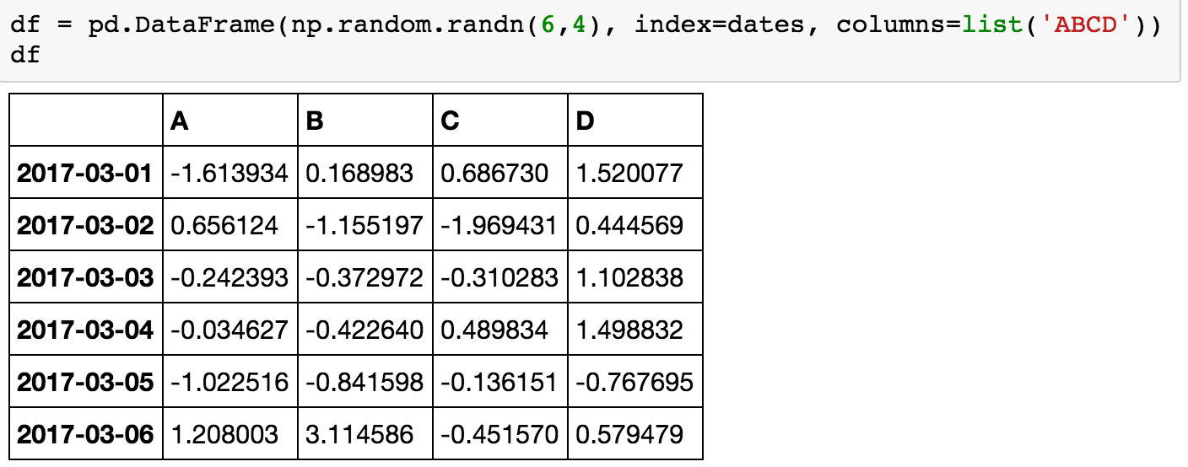
df = pd.DataFrame(np.random.randn(6,4), index=dates, columns=list('ABCD'))
df

Slide 35
df = pd.DataFrame(np.random.randn(4,6), index=['student1','student2','student3','student4'], columns=list('ABCDEF'))
df

Slide 36
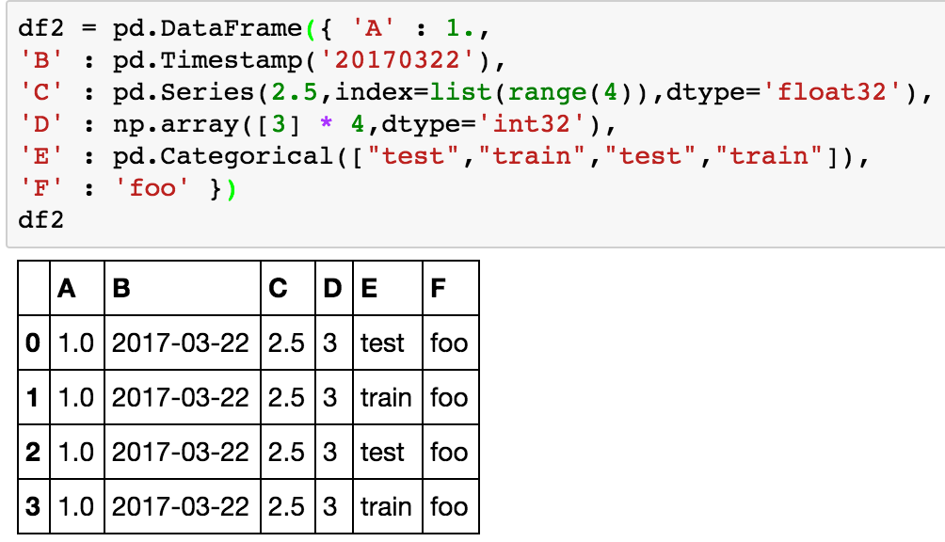
df2 = pd.DataFrame({ 'A' : 1.,
'B' : pd.Timestamp('20170322'),
'C' : pd.Series(2.5,index=list(range(4)),dtype='float32'),
'D' : np.array([3] * 4,dtype='int32'),
'E' : pd.Categorical(["test","train","test","train"]),
'F' : 'foo' })
df2

Slide 37
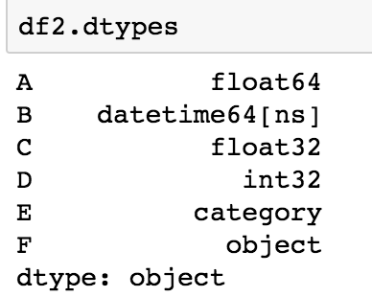
df2.dtypes

Slide 38
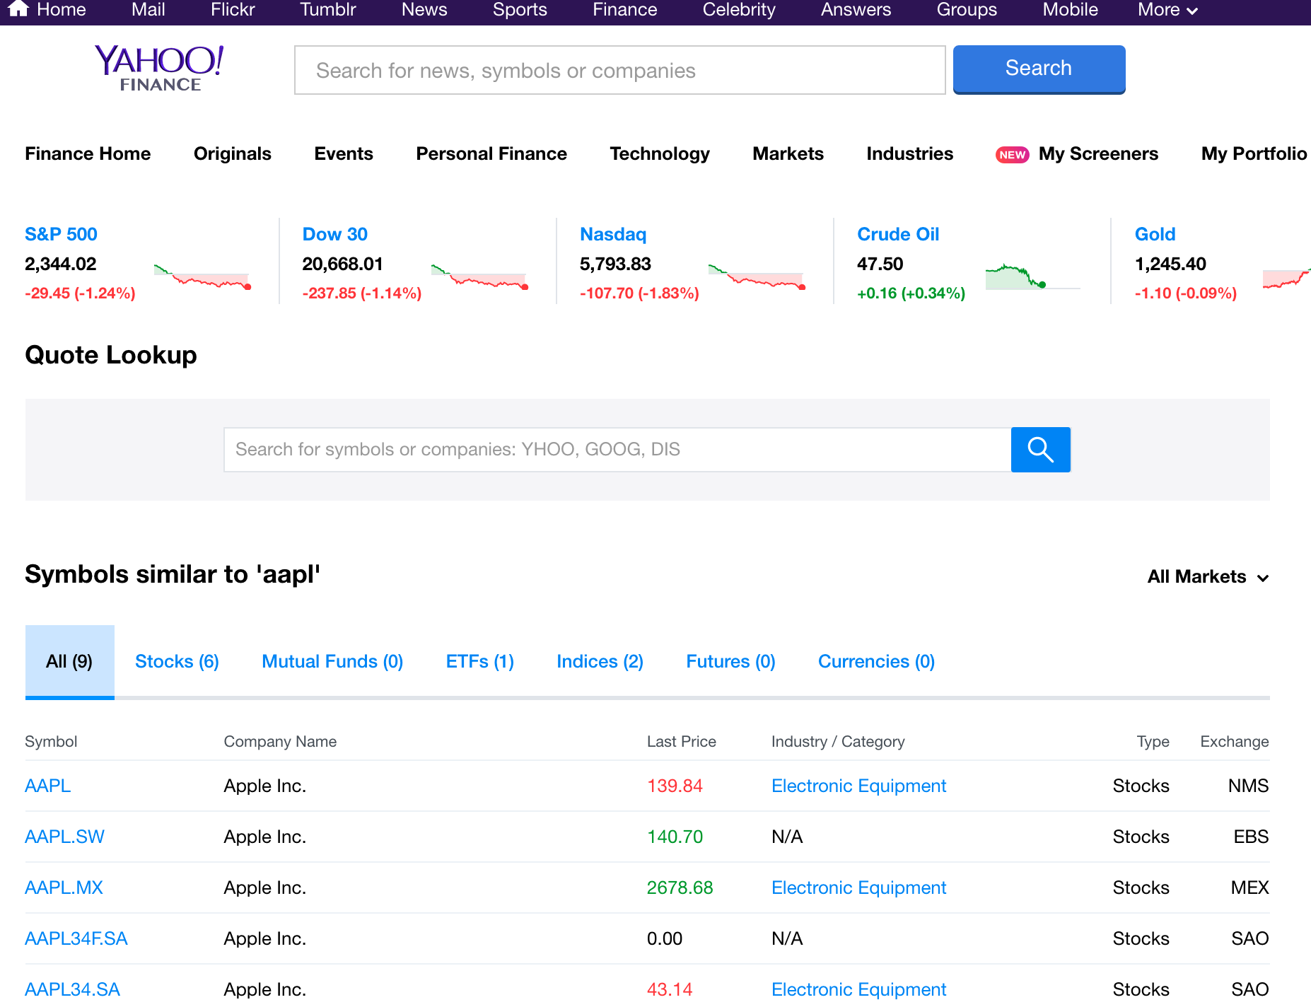
Yahoo Finance Symbols: AAPL Apple Inc. (AAPL)
http://finance.yahoo.com/q?s=AAPL

Slide 39
Apple Inc. (AAPL) -NasdaqGS
http://finance.yahoo.com/quote/AAPL?p=AAPL

Slide 40
Yahoo Finance Charts: Apple Inc. (AAPL)
http://finance.yahoo.com/chart/AAPL

Slide 41
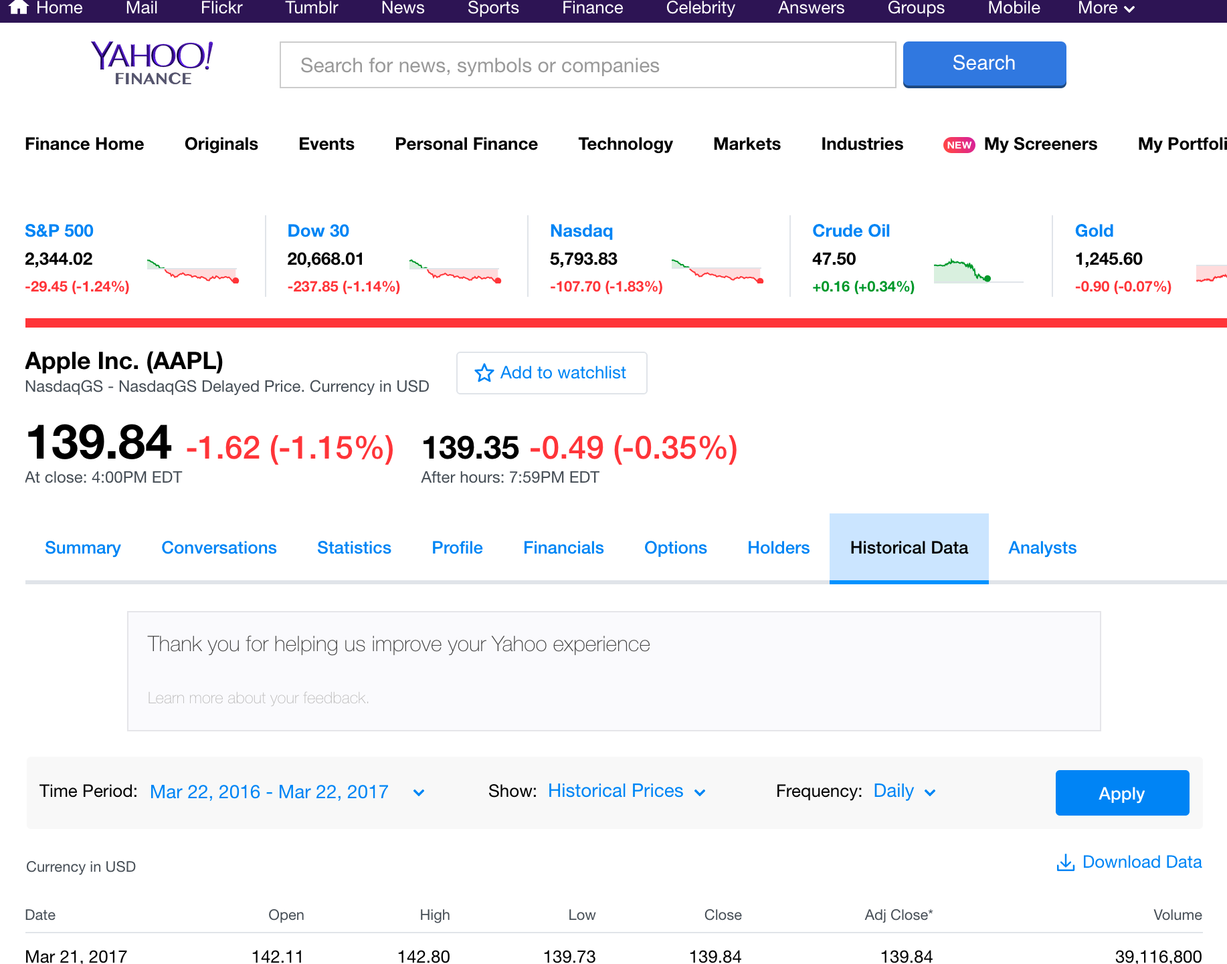
Apple Inc. (AAPL) Historical Data
http://finance.yahoo.com/q/hp?s=AAPL+Historical+Prices

Slide 42
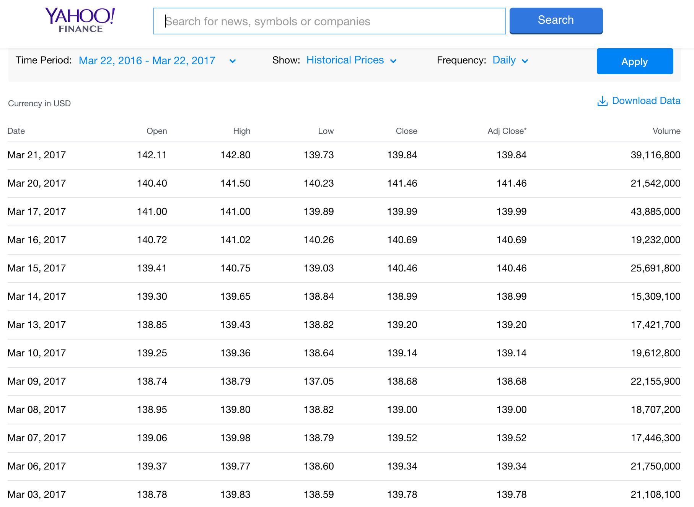
Yahoo Finance Historical Prices Apple Inc. (AAPL)
http://finance.yahoo.com/quote/AAPL/history

Slide 43
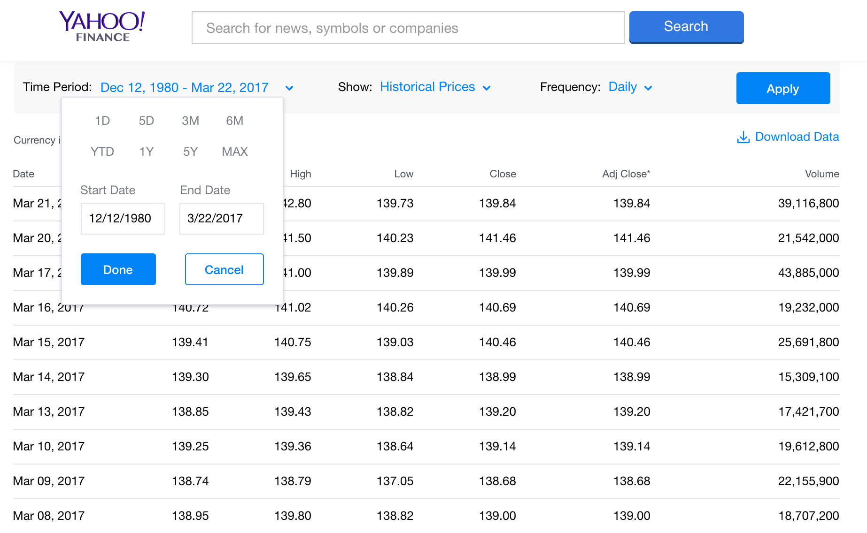
Yahoo Finance Historical Prices Apple Inc. (AAPL)
http://finance.yahoo.com/quote/AAPL/history?period1=345398400&period2=1490112000&interval=1d&filter=history&frequency=1d

Slide 44
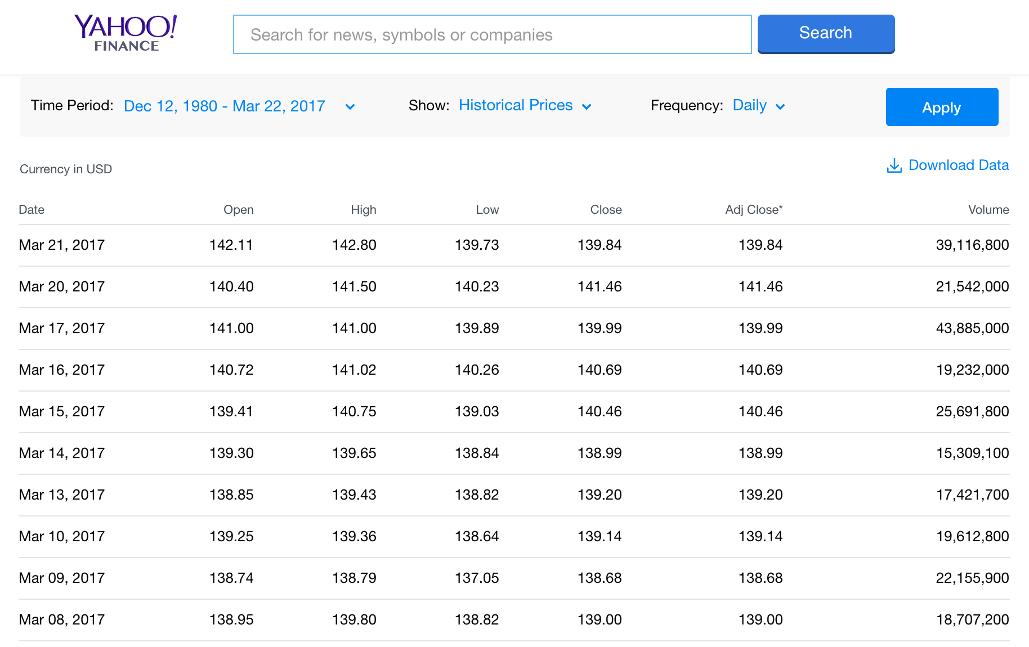
Yahoo Finance Historical Prices Apple Inc. (AAPL)
http://finance.yahoo.com/quote/AAPL/history?period1=345398400&period2=1490112000&interval=1d&filter=history&frequency=1d

Slide 45
Yahoo Finance Historical Prices
http://ichart.finance.yahoo.com/table.csv?s=AAPL
table.csv
Date,Open,High,Low,Close,Volume,Adj Close
2017-03-21,142.110001,142.800003,139.729996,139.839996,39116800,139.839996
2017-03-20,140.399994,141.50,140.229996,141.460007,20213100,141.460007
2017-03-17,141.00,141.00,139.889999,139.990005,43597400,139.990005
2017-03-16,140.720001,141.020004,140.259995,140.690002,19132500,140.690002
2017-03-15,139.410004,140.75,139.029999,140.460007,25566800,140.460007
2017-03-14,139.300003,139.649994,138.839996,138.990005,15189700,138.990005
2017-03-13,138.850006,139.429993,138.820007,139.199997,17042400,139.199997
2017-03-10,139.25,139.360001,138.639999,139.139999,19488000,139.139999
2017-03-09,138.740005,138.789993,137.050003,138.679993,22065200,138.679993
2017-03-08,138.949997,139.800003,138.820007,139.00,18681800,139.00
2017-03-07,139.059998,139.979996,138.789993,139.520004,17267500,139.520004
2017-03-06,139.369995,139.770004,138.600006,139.339996,21155300,139.339996
2017-03-03,138.779999,139.830002,138.589996,139.779999,21108100,139.779999
2017-03-02,140.00,140.279999,138.759995,138.960007,26153300,138.960007
2017-03-01,137.889999,140.149994,137.600006,139.789993,36272400,139.789993
2017-02-28,137.080002,137.440002,136.699997,136.990005,23403500,136.990005
2017-02-27,137.139999,137.440002,136.279999,136.929993,20196400,136.929993
2017-02-24,135.910004,136.660004,135.279999,136.660004,21690900,136.660004
2017-02-23,137.380005,137.479996,136.300003,136.529999,20704100,136.529999
2017-02-22,136.429993,137.119995,136.110001,137.110001,20745300,137.110001

Slide 46
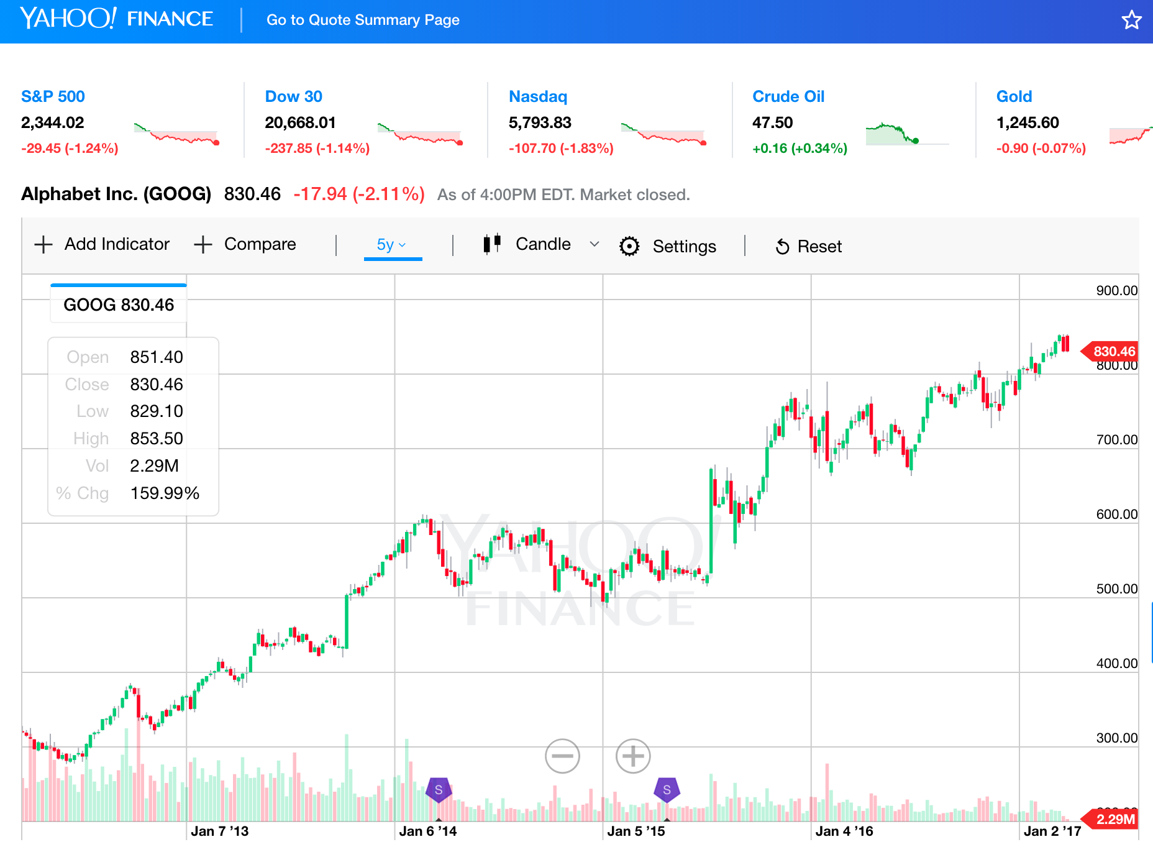
Yahoo Finance Charts Alphabet Inc. (GOOG)
Alphabet Inc. (GOOG)
http://finance.yahoo.com/echarts?s=GOOG+Interactive#{"showArea":false,"showLine":false,"showCandle":true,"lineType":"candle","range":"5y","allowChartStacking":true}

Slide 47
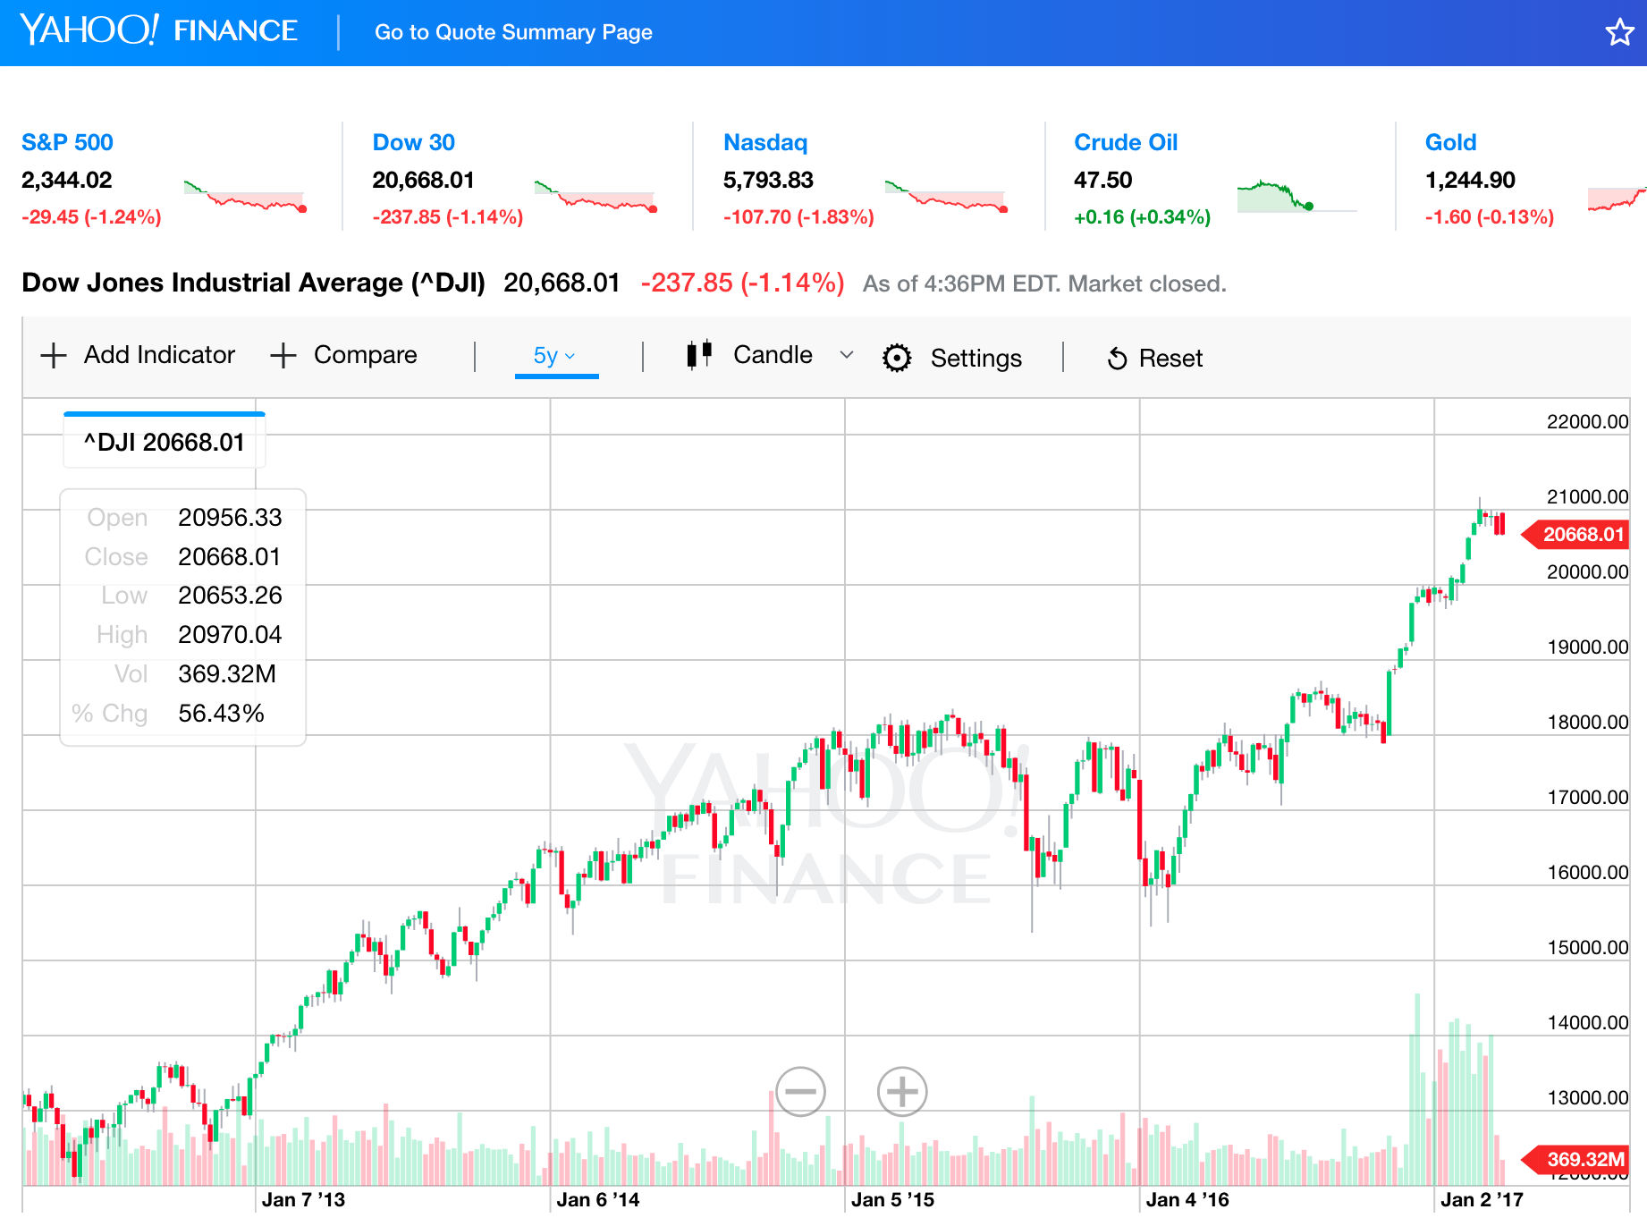
Dow Jones Industrial Average (^DJI)
http://finance.yahoo.com/chart/^DJI

Slide 48
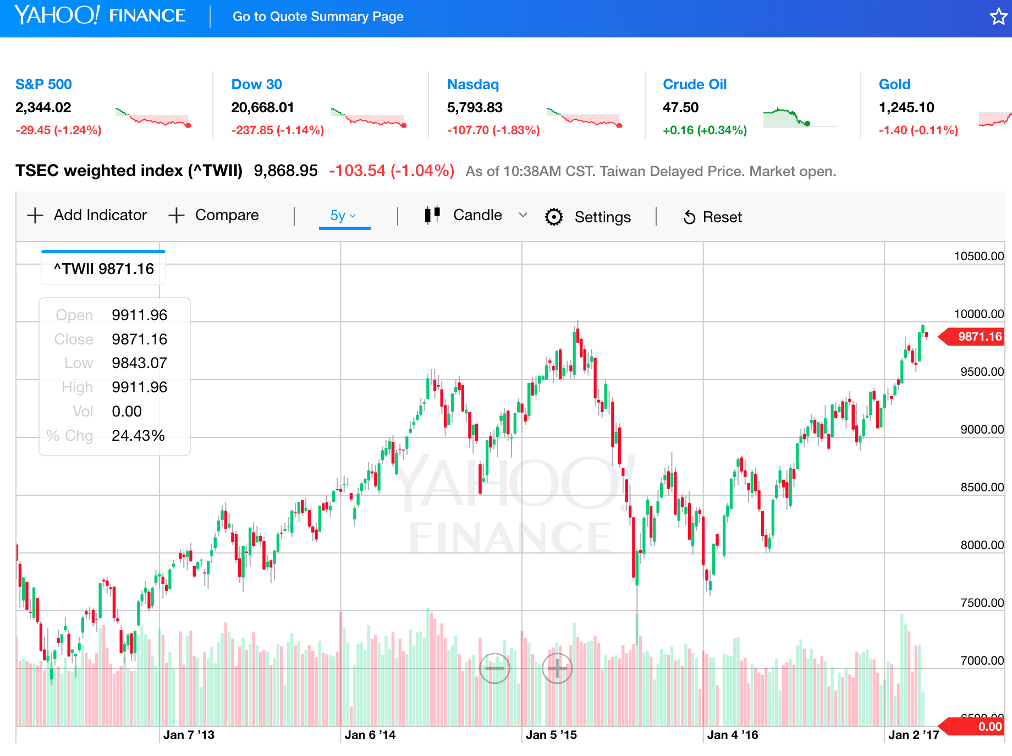
TSEC weighted index (^TWII) - Taiwan
http://finance.yahoo.com/chart/^DJI

Slide 49
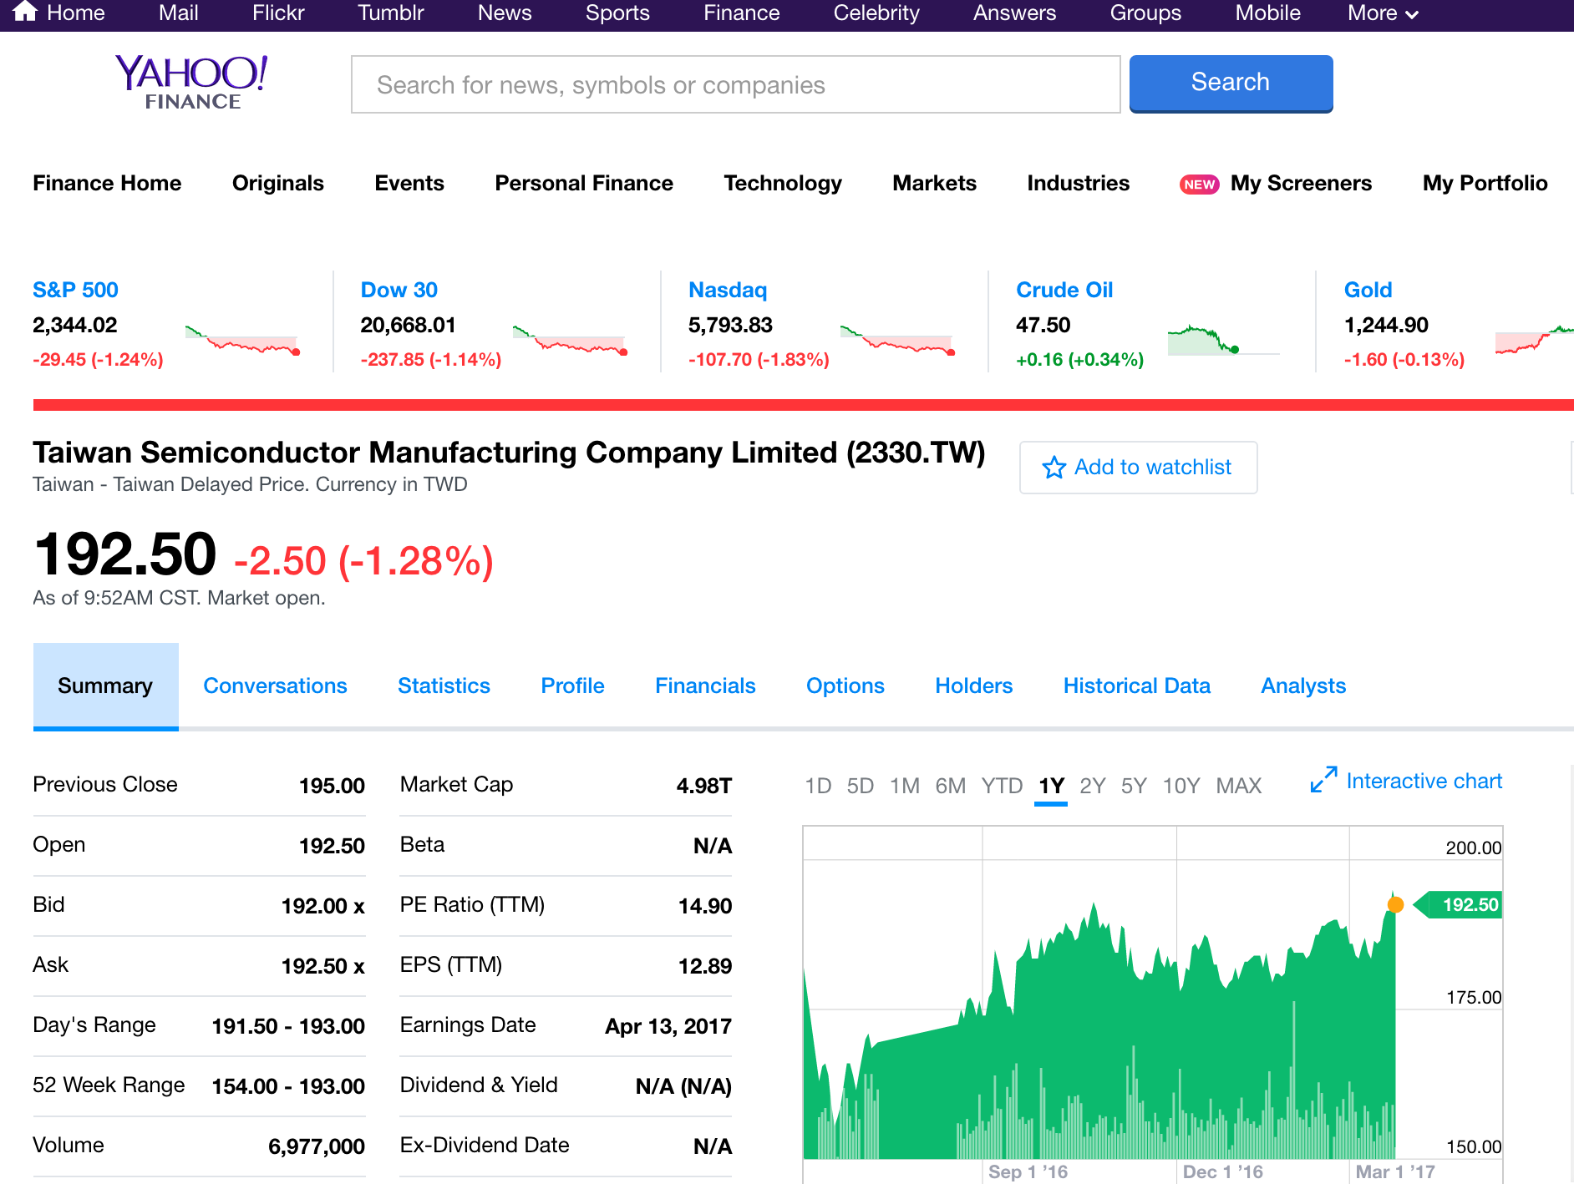
Taiwan Semiconductor Manufacturing Company Limited (2330.TW)
http://finance.yahoo.com/q?s=2330.TW

Slide 50
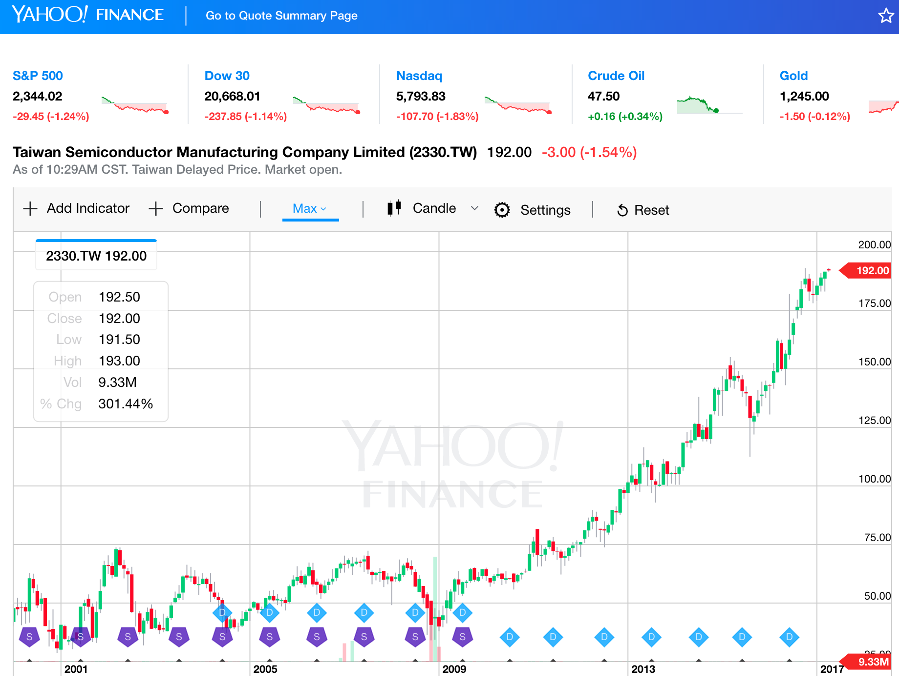
Yahoo Finance Charts TSMC (2330.TW)
http://finance.yahoo.com/chart/2330.TW

Slide 51
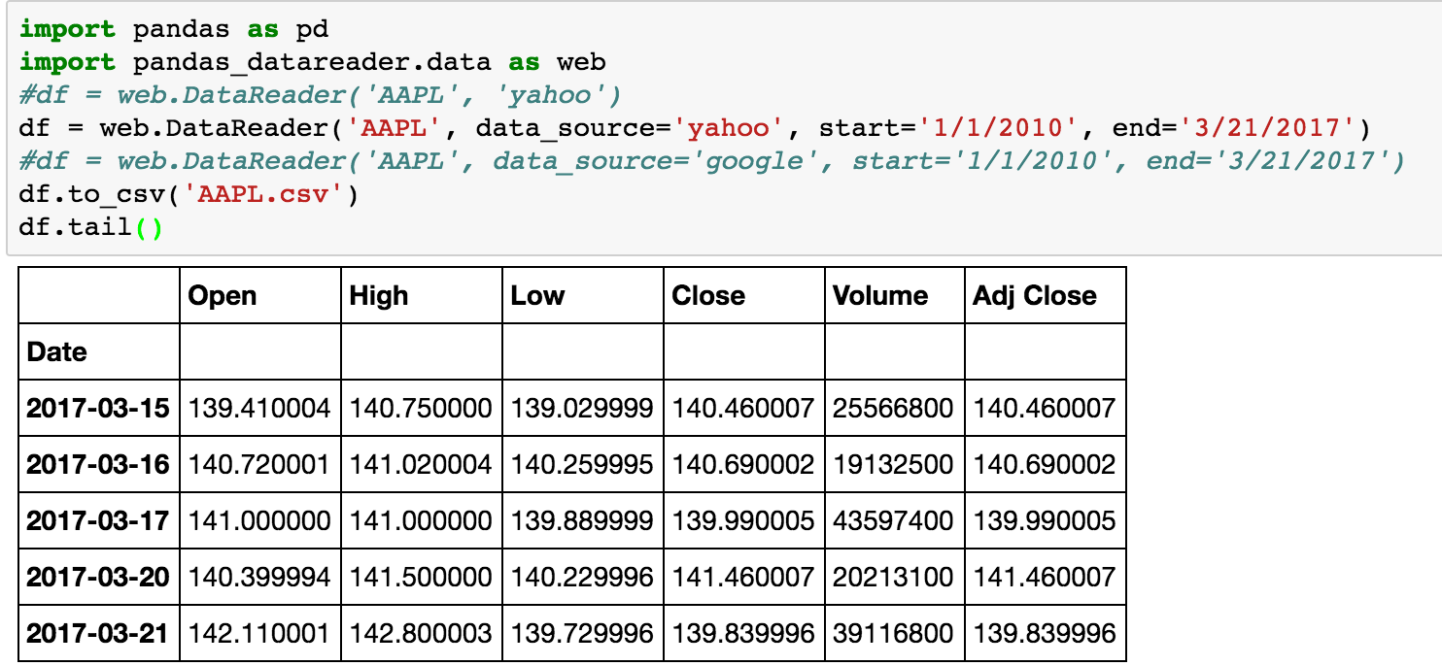
import pandas as pd
import pandas_datareader.data as web
df = web.DataReader('AAPL', data_source='yahoo', start='1/1/2010', end='3/21/2017')
df.to_csv('AAPL.csv')
df.tail()

Slide 52
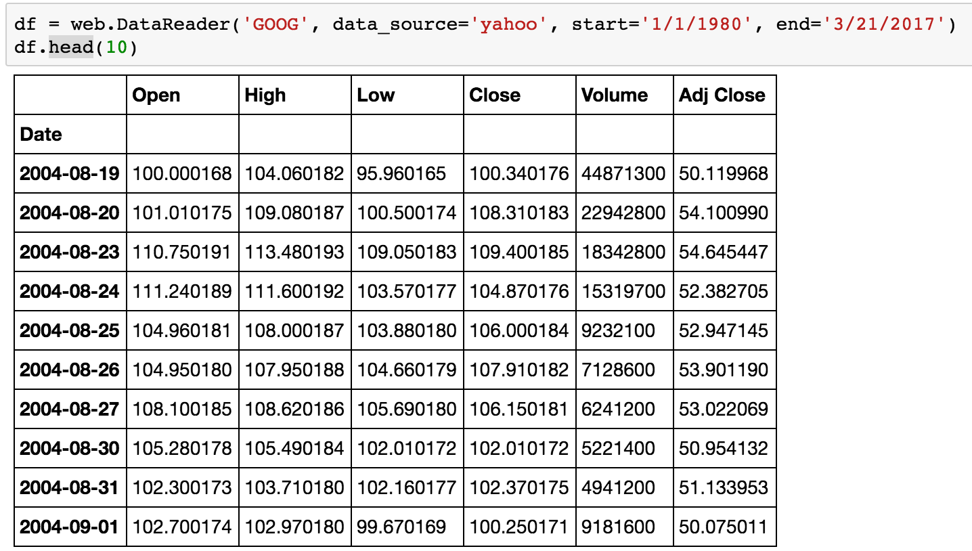
df = web.DataReader('GOOG', data_source='yahoo', start='1/1/1980', end='3/21/2017')
df.head(10)

Slide 53
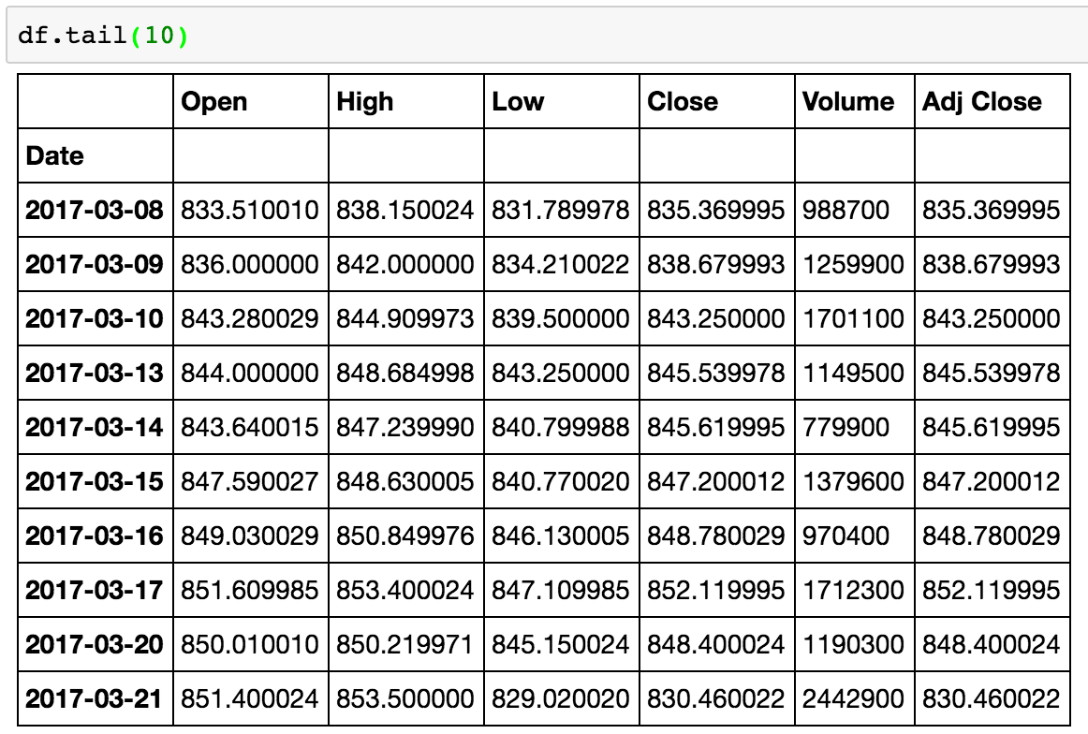
df.tail(10)

Slide 54
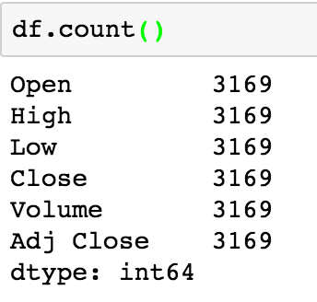
df.count()

Slide 55
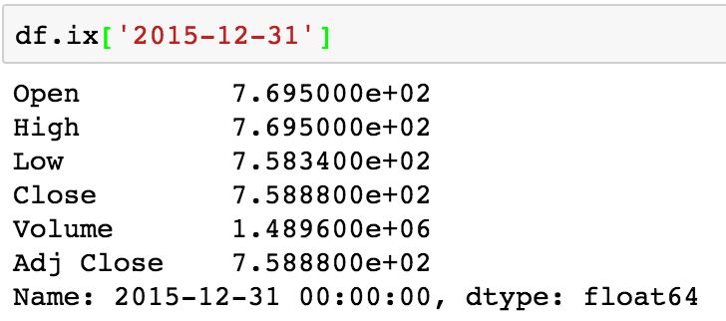
df.ix['2015-12-31']

Slide 56
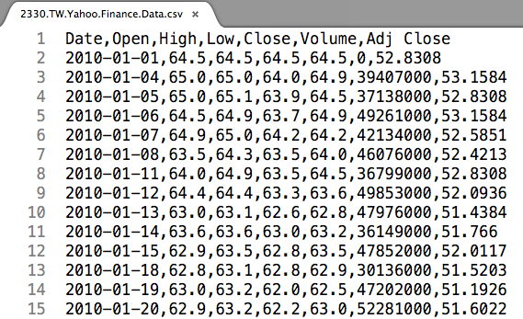
df.to_csv('2330.TW.Yahoo.Finance.Data.csv')

Slide 57
Python Pandas for Finance
Source: https://mapattack.wordpress.com/2017/02/12/using-python-for-stocks-1/

Slide 58
Python Pandas for Finance
import pandas as pd
import pandas_datareader.data as web
import matplotlib.pyplot as plt
import seaborn as sns
import datetime as dt
%matplotlib inline
Source: https://mapattack.wordpress.com/2017/02/12/using-python-for-stocks-1/

Slide 59
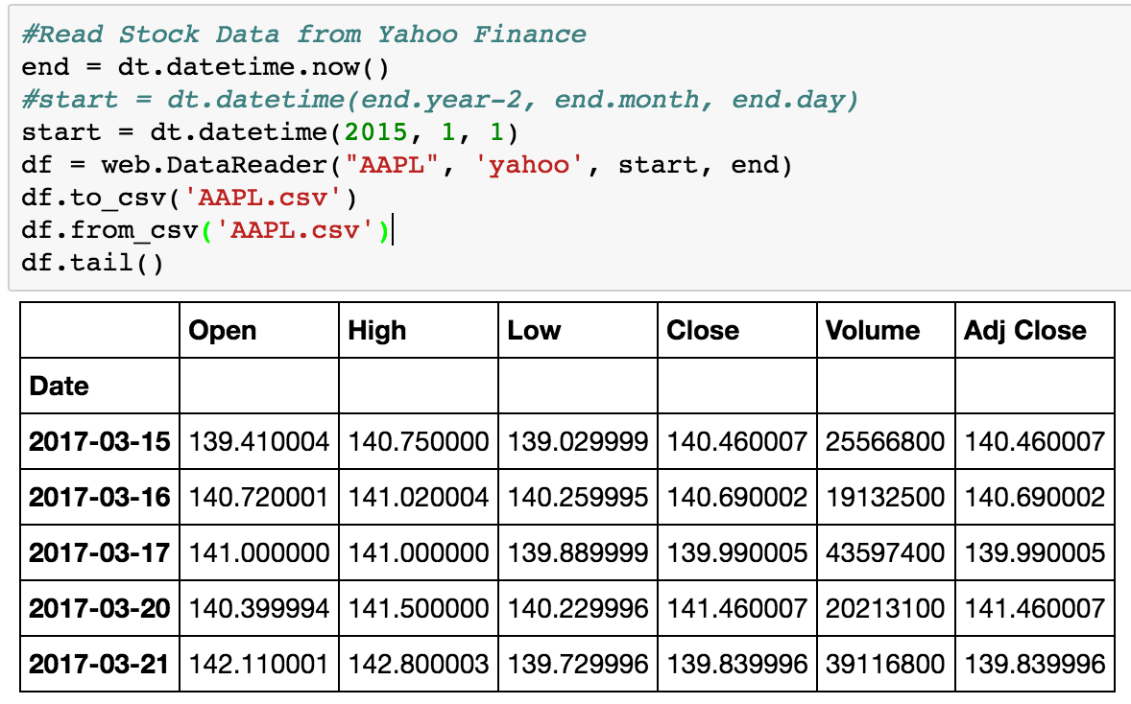
Python Pandas for Finance
#Read Stock Data from Yahoo Finance
end = dt.datetime.now()
#start = dt.datetime(end.year-2, end.month, end.day)
start = dt.datetime(2015, 1, 1)
df = web.DataReader("AAPL", 'yahoo', start, end)
df.to_csv('AAPL.csv')
df.from_csv('AAPL.csv')
df.tail()
Source: https://mapattack.wordpress.com/2017/02/12/using-python-for-stocks-1/

Slide 60
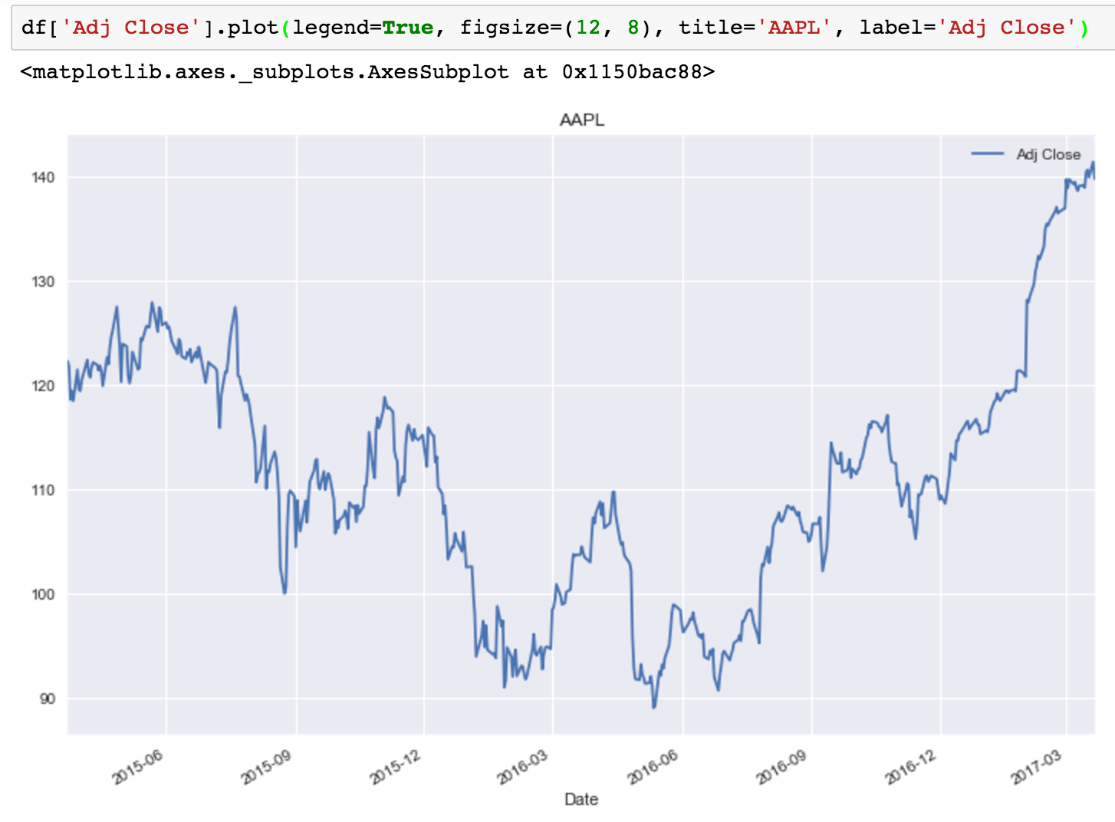
Python Pandas for Finance
df['Adj Close'].plot(legend=True, figsize=(12, 8), title='AAPL', label='Adj Close')
Source: https://mapattack.wordpress.com/2017/02/12/using-python-for-stocks-1/

Slide 61
Python Pandas for Finance
plt.figure(figsize=(12,9))
top = plt.subplot2grid((12,9), (0, 0), rowspan=10, colspan=9)
bottom = plt.subplot2grid((12,9), (10,0), rowspan=2, colspan=9)
top.plot(df.index, df['Adj Close'], color='blue') #df.index gives the dates
bottom.bar(df.index, df['Volume'])
# set the labels
top.axes.get_xaxis().set_visible(False)
top.set_title('AAPL')
top.set_ylabel('Adj Close')
bottom.set_ylabel('Volume')
Source: https://mapattack.wordpress.com/2017/02/12/using-python-for-stocks-1/

Slide 62
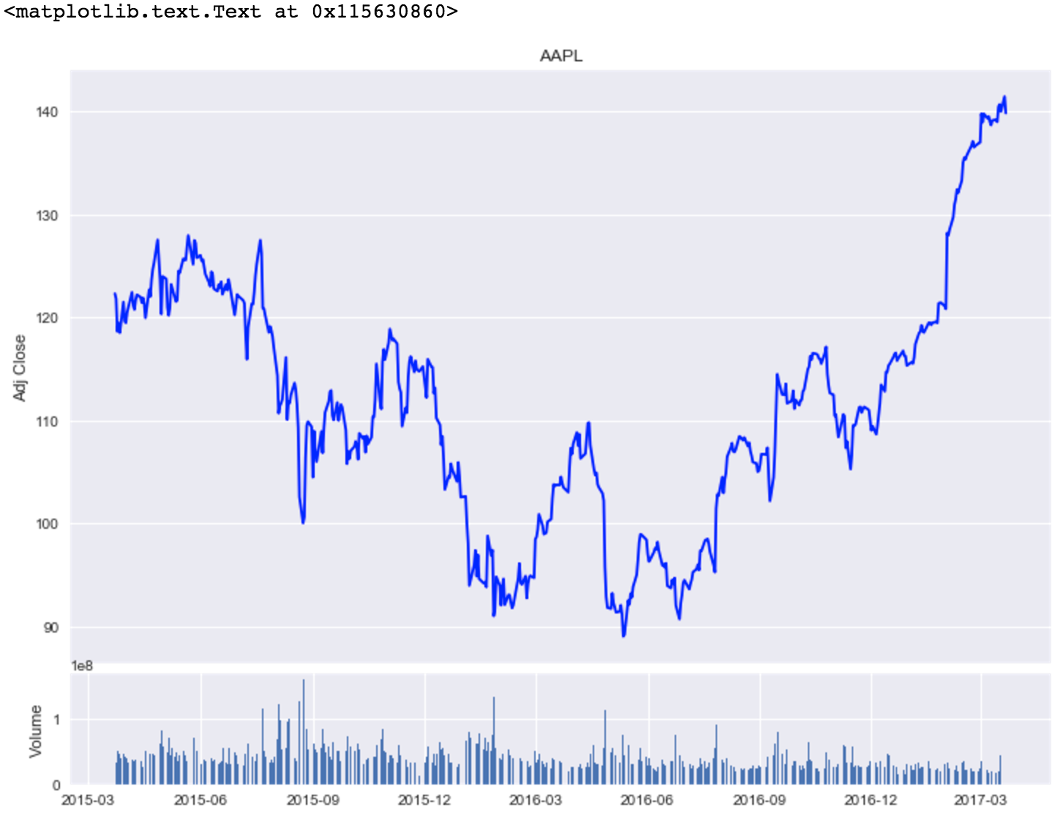
Python Pandas for Finance
Source: https://mapattack.wordpress.com/2017/02/12/using-python-for-stocks-1/

Slide 63
Python Pandas for Finance
Source: https://mapattack.wordpress.com/2017/02/12/using-python-for-stocks-1/

Slide 64
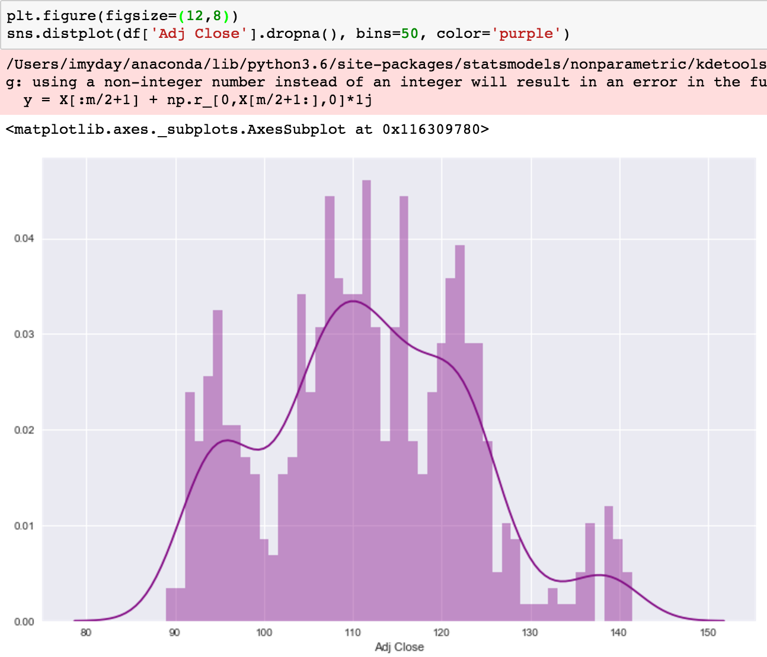
Python Pandas for Finance
plt.figure(figsize=(12,9))
sns.distplot(df['Adj Close'].dropna(), bins=50, color='purple')
Source: https://mapattack.wordpress.com/2017/02/12/using-python-for-stocks-1/

Slide 65
Python Pandas for Finance
# simple moving averages
df['MA05'] = df['Adj Close'].rolling(5).mean()
df['MA20'] = df['Adj Close'].rolling(20).mean() #20 days
df['MA60'] = df['Adj Close'].rolling(60).mean() #60 days
df2 = pd.DataFrame({'Adj Close': df['Adj Close'],'MA05': df['MA05'],'MA20': df['MA20'], 'MA60': df['MA60']})
df2.plot(figsize=(12, 9), legend=True, title='AAPL')
df2.to_csv('AAPL_MA.csv')
fig = plt.gcf()
fig.set_size_inches(12, 9)
fig.savefig(’AAPL_plot.png', dpi=300)
plt.show()
Source: https://mapattack.wordpress.com/2017/02/12/using-python-for-stocks-1/

Slide 66
Python Pandas for Finance
Source: https://mapattack.wordpress.com/2017/02/12/using-python-for-stocks-1/

Slide 67
Python Pandas for Finance
Source: https://mapattack.wordpress.com/2017/02/12/using-python-for-stocks-1/

Slide 68
import pandas as pd
import pandas_datareader.data as web
import matplotlib.pyplot as plt
import seaborn as sns
import datetime as dt
%matplotlib inline
#Read Stock Data from Yahoo Finance
end = dt.datetime.now()
#start = dt.datetime(end.year-2, end.month, end.day)
start = dt.datetime(2015, 1, 1)
df = web.DataReader("AAPL", 'yahoo', start, end)
df.to_csv('AAPL.csv')
df.from_csv('AAPL.csv')
df.tail()
df['Adj Close'].plot(legend=True, figsize=(12, 8), title='AAPL', label='Adj Close') plt.figure(figsize=(12,9))
top = plt.subplot2grid((12,9), (0, 0), rowspan=10, colspan=9)
bottom = plt.subplot2grid((12,9), (10,0), rowspan=2, colspan=9)
top.plot(df.index, df['Adj Close'], color='blue') #df.index gives the dates
bottom.bar(df.index, df['Volume'])
# set the labels
top.axes.get_xaxis().set_visible(False)
top.set_title('AAPL')
top.set_ylabel('Adj Close')
bottom.set_ylabel('Volume')
plt.figure(figsize=(12,9))
sns.distplot(df['Adj Close'].dropna(), bins=50, color='purple')
# simple moving averages
df['MA05'] = df['Adj Close'].rolling(5).mean() #5 days
df['MA20'] = df['Adj Close'].rolling(20).mean() #20 days
df['MA60'] = df['Adj Close'].rolling(60).mean() #60 days
df2 = pd.DataFrame({'Adj Close': df['Adj Close'],'MA05': df['MA05'],'MA20': df['MA20'], 'MA60': df['MA60']})
df2.plot(figsize=(12, 9), legend=True, title='AAPL')
df2.to_csv('AAPL_MA.csv')
fig = plt.gcf()
fig.set_size_inches(12, 9)
fig.savefig(’AAPL_plot.png', dpi=300)
plt.show()
Source: https://mapattack.wordpress.com/2017/02/12/using-python-for-stocks-1/

Slide 69
Examples: Python Pandas for Finance

Slide 70
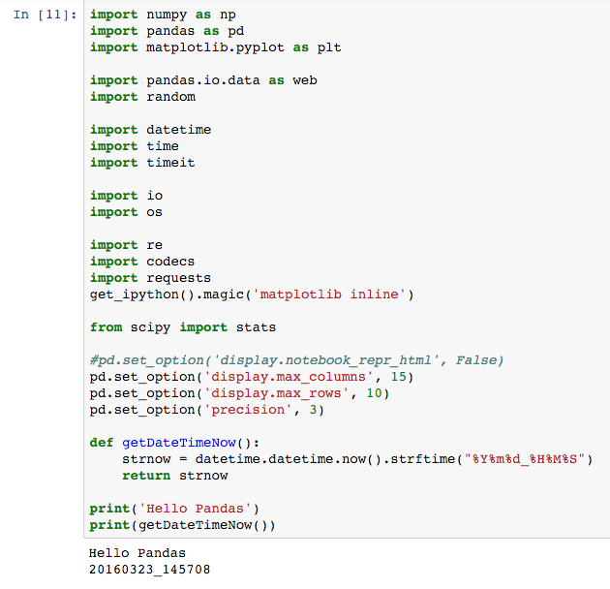

Slide 71
sSymbol = "AAPL"
#sSymbol = "GOOG"
#sSymbol = "IBM"
#sSymbol = "MSFT"
#sSymbol = "^TWII"
#sSymbol = "000001.SS"
#sSymbol = "2330.TW"
#sSymbol = "2317.TW"
# sURL = "http://ichart.finance.yahoo.com/table.csv?s=AAPL"
# sBaseURL = "http://ichart.finance.yahoo.com/table.csv?s="
sURL = "http://ichart.finance.yahoo.com/table.csv?s=" + sSymbol
#req = requests.get("http://ichart.finance.yahoo.com/table.csv?s=2330.TW")
#req = requests.get("http://ichart.finance.yahoo.com/table.csv?s=AAPL")
req = requests.get(sURL)
sText = req.text
#print(sText)
#df = web.DataReader(sSymbol, 'yahoo', starttime, endtime)
#df = web.DataReader("2330.TW", 'yahoo')
sPath = "data/"
sPathFilename = sPath + sSymbol + ".csv"
print(sPathFilename)
f = open(sPathFilename, 'w')
f.write(sText)
f.close()
sIOdata = io.StringIO(sText)
df = pd.DataFrame.from_csv(sIOdata)
df.head(5)

Slide 72
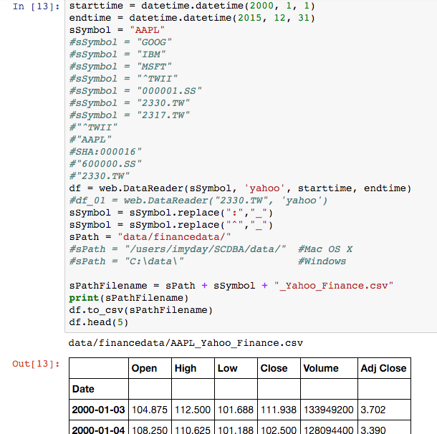

Slide 73
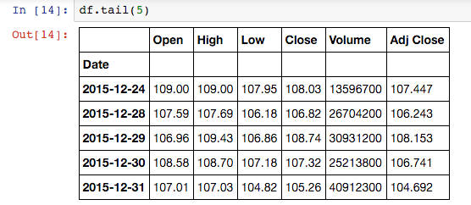
df.tail(5)

Slide 74
sSymbol = "AAPL”
# sURL = "http://ichart.finance.yahoo.com/table.csv?s=AAPL"
sURL = "http://ichart.finance.yahoo.com/table.csv?s=" + sSymbol
#req = requests.get("http://ichart.finance.yahoo.com/table.csv?s=AAPL")
req = requests.get(sURL)
sText = req.text
#print(sText)
sPath = "data/"
sPathFilename = sPath + sSymbol + ".csv"
print(sPathFilename)
f = open(sPathFilename, 'w')
f.write(sText)
f.close()
sIOdata = io.StringIO(sText)
df = pd.DataFrame.from_csv(sIOdata)
df.head(5)

Slide 75
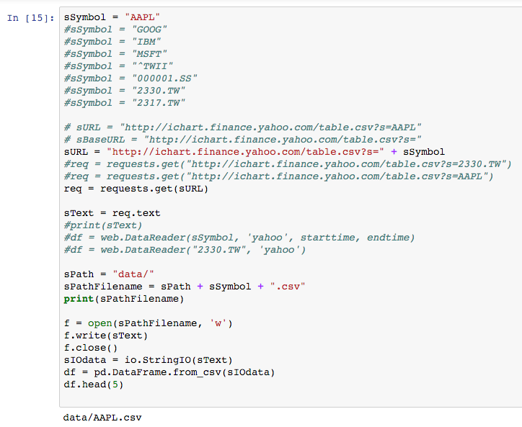

Slide 76
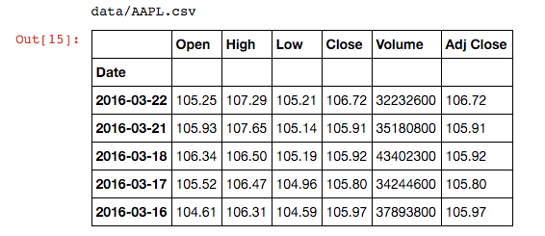

Slide 77
def getYahooFinanceData(sSymbol, starttime, endtime, sDir):
#GetMarketFinanceData_From_YahooFinance
#"^TWII"
#"000001.SS"
#"AAPL"
#SHA:000016"
#"600000.SS"
#"2330.TW"
#sSymbol = "^TWII"
starttime = datetime.datetime(2000, 1, 1)
endtime = datetime.datetime(2015, 12, 31)
sPath = sDir
#sPath = "data/financedata/"
df_YahooFinance = web.DataReader(sSymbol, 'yahoo', starttime, endtime)
#df_01 = web.DataReader("2330.TW", 'yahoo')
sSymbol = sSymbol.replace(":","_")
sSymbol = sSymbol.replace("^","_")
sPathFilename = sPath + sSymbol + "_Yahoo_Finance.csv"
df_YahooFinance.to_csv(sPathFilename)
#df_YahooFinance.head(5)
return sPathFilename
#End def getYahooFinanceData(sSymbol, starttime, endtime, sDir):

Slide 78
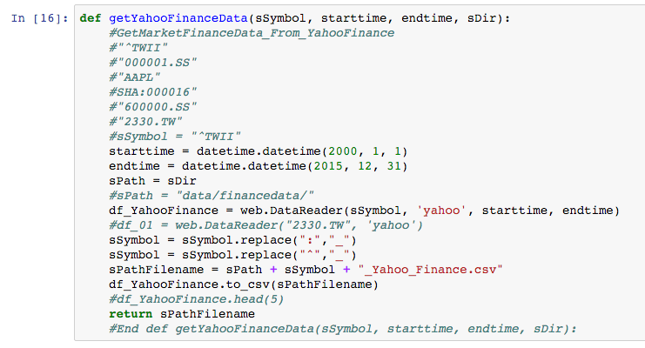

Slide 79
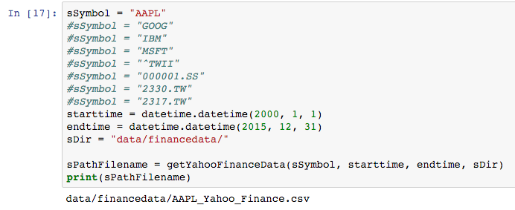
sSymbol = "AAPL”
starttime = datetime.datetime(2000, 1, 1)
endtime = datetime.datetime(2015, 12, 31)
sDir = "data/financedata/"
sPathFilename = getYahooFinanceData(sSymbol, starttime, endtime, sDir)
print(sPathFilename)

Slide 80
import pandas as pd
import pandas_datareader.data as web
import matplotlib.pyplot as plt
import seaborn as sns
import datetime as dt
%matplotlib inline
#Read Stock Data from Yahoo Finance
end = dt.datetime.now()
#start = dt.datetime(end.year-2, end.month, end.day)
start = dt.datetime(2015, 1, 1)
df = web.DataReader("AAPL", 'yahoo', start, end)
df.to_csv('AAPL.csv')
df.from_csv('AAPL.csv')
df.tail()
df['Adj Close'].plot(legend=True, figsize=(12, 8), title='AAPL', label='Adj Close') plt.figure(figsize=(12,9))
top = plt.subplot2grid((12,9), (0, 0), rowspan=10, colspan=9)
bottom = plt.subplot2grid((12,9), (10,0), rowspan=2, colspan=9)
top.plot(df.index, df['Adj Close'], color='blue') #df.index gives the dates
bottom.bar(df.index, df['Volume'])
# set the labels
top.axes.get_xaxis().set_visible(False)
top.set_title('AAPL')
top.set_ylabel('Adj Close')
bottom.set_ylabel('Volume')
plt.figure(figsize=(12,9))
sns.distplot(df['Adj Close'].dropna(), bins=50, color='purple')
# simple moving averages
df['MA05'] = df['Adj Close'].rolling(5).mean() #5 days
df['MA20'] = df['Adj Close'].rolling(20).mean() #20 days
df['MA60'] = df['Adj Close'].rolling(60).mean() #60 days
df2 = pd.DataFrame({'Adj Close': df['Adj Close'],'MA05': df['MA05'],'MA20': df['MA20'], 'MA60': df['MA60']})
df2.plot(figsize=(12, 9), legend=True, title='AAPL')
df2.to_csv('AAPL_MA.csv')
fig = plt.gcf()
fig.set_size_inches(12, 9)
fig.savefig(’AAPL_plot.png', dpi=300)
plt.show()
Source: https://mapattack.wordpress.com/2017/02/12/using-python-for-stocks-1/

Slide 81
Python Pandas for Finance
Source: https://mapattack.wordpress.com/2017/02/12/using-python-for-stocks-1/

Slide 82
References
Wes McKinney (2012), Python for Data Analysis: Data Wrangling with Pandas, NumPy, and IPython, O'Reilly Media
Yves Hilpisch (2014), Python for Finance: Analyze Big Financial Data, O'Reilly
Yves Hilpisch (2015), Derivatives Analytics with Python: Data Analysis, Models, Simulation, Calibration and Hedging, Wiley
Michael Heydt (2015) , Mastering Pandas for Finance, Packt Publishing
Michael Heydt (2015), Learning Pandas - Python Data Discovery and Analysis Made Easy, Packt Publishing
James Ma Weiming (2015), Mastering Python for Finance, Packt Publishing
Fabio Nelli (2015), Python Data Analytics: Data Analysis and Science using PANDAs, matplotlib and the Python Programming Language, Apress
Wes McKinney (2013), 10-minute tour of pandas, https://vimeo.com/59324550
Jason Wirth (2015), A Visual Guide To Pandas, https://www.youtube.com/watch?v=9d5-Ti6onew
Edward Schofield (2013), Modern scientific computing and big data analytics in Python, PyCon Australia, https://www.youtube.com/watch?v=hqOsfS3dP9w
Python Programming, https://pythonprogramming.net/

