Slide 1
Social Computing and Big Data Analytics 社群運算與大數據分析
Tamkang University
Tamkang University
Big Data Processing Platforms with SMACK: Spark, Mesos, Akka, Cassandra and Kafka (大數據處理平台SMACK)
1052SCBDA04
MIS MBA (M2226) (8606)
Wed, 8,9, (15:10-17:00) (L206)
Min-Yuh Day
戴敏育
Assistant Professor
專任助理教授
Dept. of Information Management, Tamkang University
淡江大學 資訊管理學系
http://mail. tku.edu.tw/myday/
2017-03-08

Slide 2
課程大綱 (Syllabus)
週次 (Week) 日期 (Date) 內容 (Subject/Topics)
1 2017/02/15 Course Orientation for Social Computing and Big Data Analytics (社群運算與大數據分析課程介紹)
2 2017/02/22 Data Science and Big Data Analytics: Discovering, Analyzing, Visualizing and Presenting Data (資料科學與大數據分析： 探索、分析、視覺化與呈現資料)
3 2017/03/01 Fundamental Big Data: MapReduce Paradigm, Hadoop and Spark Ecosystem (大數據基礎：MapReduce典範、 Hadoop與Spark生態系統)

Slide 3
課程大綱 (Syllabus)
週次 (Week) 日期 (Date) 內容 (Subject/Topics)
4 2017/03/08 Big Data Processing Platforms with SMACK: Spark, Mesos, Akka, Cassandra and Kafka (大數據處理平台SMACK： Spark, Mesos, Akka, Cassandra, Kafka)
5 2017/03/15 Big Data Analytics with Numpy in Python (Python Numpy 大數據分析)
6 2017/03/22 Finance Big Data Analytics with Pandas in Python (Python Pandas 財務大數據分析)
7 2017/03/29 Text Mining Techniques and Natural Language Processing (文字探勘分析技術與自然語言處理)
8 2017/04/05 Off-campus study (教學行政觀摩日)

Slide 4
課程大綱 (Syllabus)
週次 (Week) 日期 (Date) 內容 (Subject/Topics)
9 2017/04/12 Social Media Marketing Analytics (社群媒體行銷分析)
10 2017/04/19 期中報告 (Midterm Project Report)
11 2017/04/26 Deep Learning with Theano and Keras in Python (Python Theano 和 Keras 深度學習)
12 2017/05/03 Deep Learning with Google TensorFlow (Google TensorFlow 深度學習)
13 2017/05/10 Sentiment Analysis on Social Media with Deep Learning (深度學習社群媒體情感分析)

Slide 5
課程大綱 (Syllabus)
週次 (Week) 日期 (Date) 內容 (Subject/Topics)
14 2017/05/17 Social Network Analysis (社會網絡分析)
15 2017/05/24 Measurements of Social Network (社會網絡量測)
16 2017/05/31 Tools of Social Network Analysis (社會網絡分析工具)
17 2017/06/07 Final Project Presentation I (期末報告 I)
18 2017/06/14 Final Project Presentation II (期末報告 II)

Slide 6
2017/03/08 Big Data Processing Platforms with SMACK: Spark, Mesos, Akka, Cassandra and Kafka (大數據處理平台SMACK： Spark, Mesos, Akka, Cassandra, Kafka)

Slide 7
SMACK Architectures Building data processing platforms with Spark, Mesos, Akka, Cassandra and Kafka
Source: Anton Kirillov (2015), Data processing platforms architectures with Spark, Mesos, Akka, Cassandra and Kafka, Big Data AW Meetup

Slide 8
SMACK Stack
Spark
fast and general engine for distributed, large-scale data processing
Mesos
cluster resource management system that provides efficient resource isolation and sharing across distributed applications
Akka
a toolkit and runtime for building highly concurrent, distributed, and resilient message-driven applications on the JVM
Cassandra
distributed, highly available database designed to handle large amounts of data across multiple datacenters
Kafka
a high-throughput, low-latency distributed messaging system designed for handling real-time data feeds
Source: Anton Kirillov (2015), Data processing platforms architectures with Spark, Mesos, Akka, Cassandra and Kafka, Big Data AW Meetup

Slide 9
Why SMACK? Big, Fast and Event Data Processing
Source: http://www.natalinobusa.com/2015/11/why-is-smack-stack-all-rage-lately.html

Slide 10
S
M
A
C
K
kafka
Source: https://blogs.technet.microsoft.com/msuspartner/2016/11/15/open-source-fast-big-data/

Slide 11
Spark Ecosystem

Slide 12
Apache Spark is a fast and general engine for large-scale data processing.
Lightning-fast cluster computing
Source: http://spark.apache.org/

Slide 13
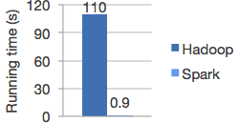
Logistic regression in Hadoop and Spark
Run programs up to 100x faster than Hadoop MapReduce in memory, or 10x faster on disk.
Source: http://spark.apache.org/

Slide 14
Ease of Use
Write applications quickly in Java, Scala, Python, R.
Source: http://spark.apache.org/

Slide 15
Word count in Spark's Python API
text_file = spark.textFile("hdfs://...")
text_file.flatMap(lambda line: line.split())
.map(lambda word: (word, 1))
.reduceByKey(lambda a, b: a+b)
Source: http://spark.apache.org/

Slide 16
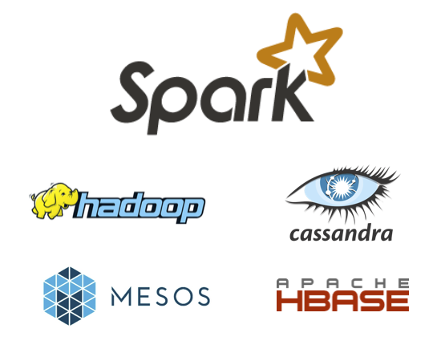
Spark and Hadoop
Source: http://spark.apache.org/

Slide 17
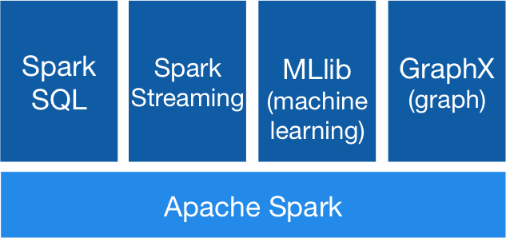
Spark Ecosystem
Source: http://spark.apache.org/

Slide 18
Spark Ecosystem
Spark
Spark
Streaming
Mllib (machine learning)
Spark
SQL
GraphX
(graph)
Kafka
Flume
H2O
Hive
Titan
HBase
Cassandra
HDFS
Source: Mike Frampton (2015), Mastering Apache Spark, Packt Publishing

Slide 19
Hadoop vs. Spark
HDFS read
HDFS write
HDFS read
HDFS write
Iter. 1
Iter. 2
Input
Iter. 1
Iter. 2
Input
Source: Shiva Achari (2015), Hadoop Essentials - Tackling the Challenges of Big Data with Hadoop, Packt Publishing

Slide 20
SMACK Stack
Spark
fast and general engine for distributed, large-scale data processing
Mesos
cluster resource management system that provides efficient resource isolation and sharing across distributed applications
Akka
a toolkit and runtime for building highly concurrent, distributed, and resilient message-driven applications on the JVM
Cassandra
distributed, highly available database designed to handle large amounts of data across multiple datacenters
Kafka
a high-throughput, low-latency distributed messaging system designed for handling real-time data feeds
Source: Anton Kirillov (2015), Data processing platforms architectures with Spark, Mesos, Akka, Cassandra and Kafka, Big Data AW Meetup

Slide 21
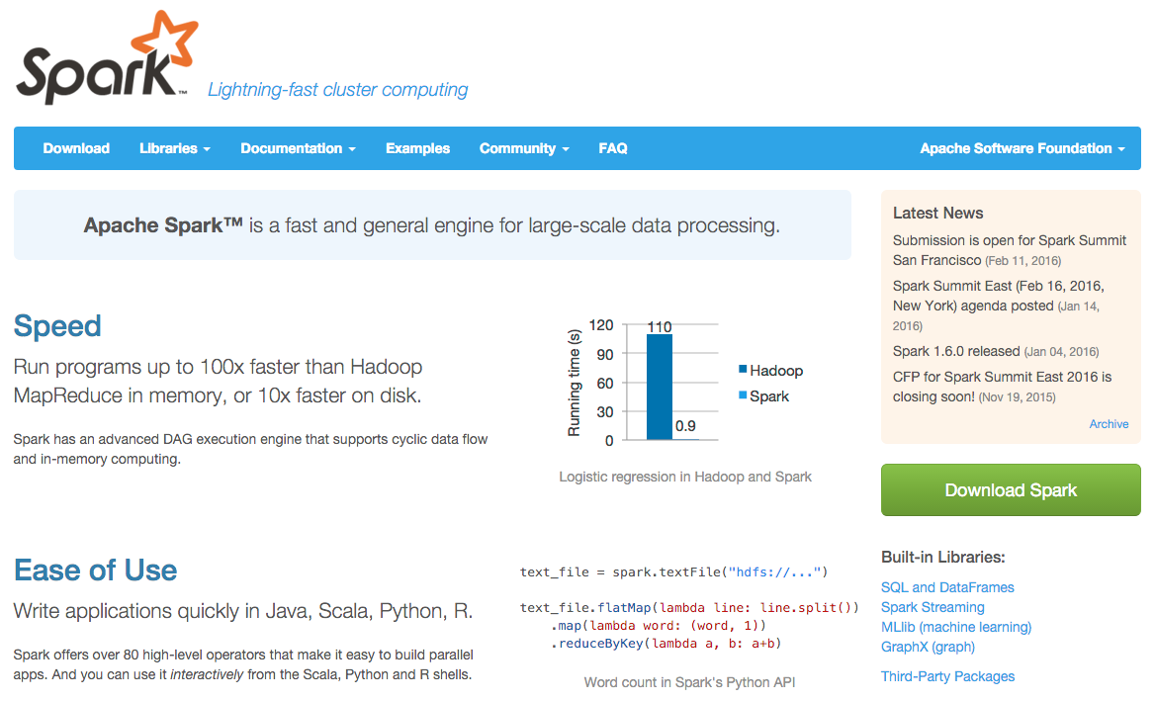
Spark
http://spark.apache.org/

Slide 22
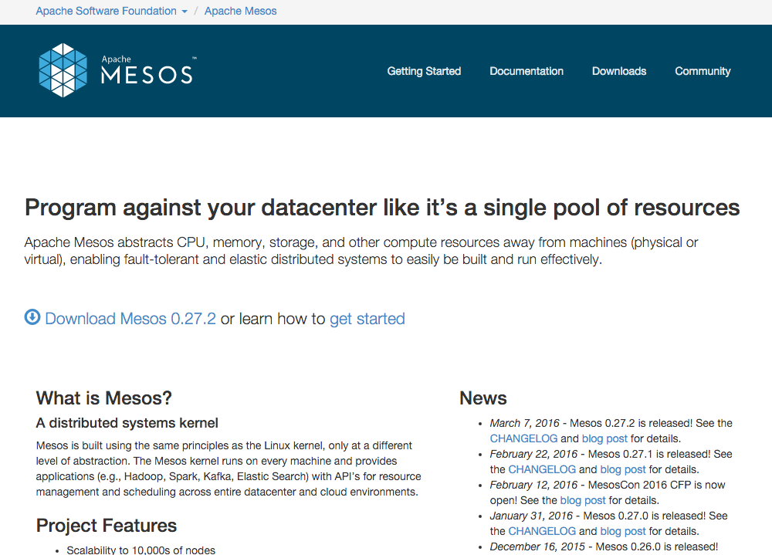
Mesos
http://mesos.apache.org/

Slide 23
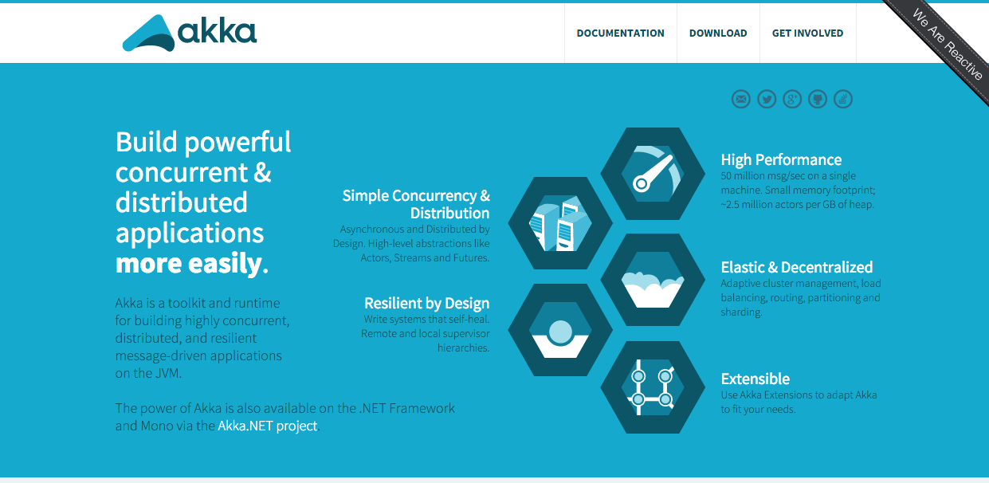
Akka
http://akka.io/

Slide 24
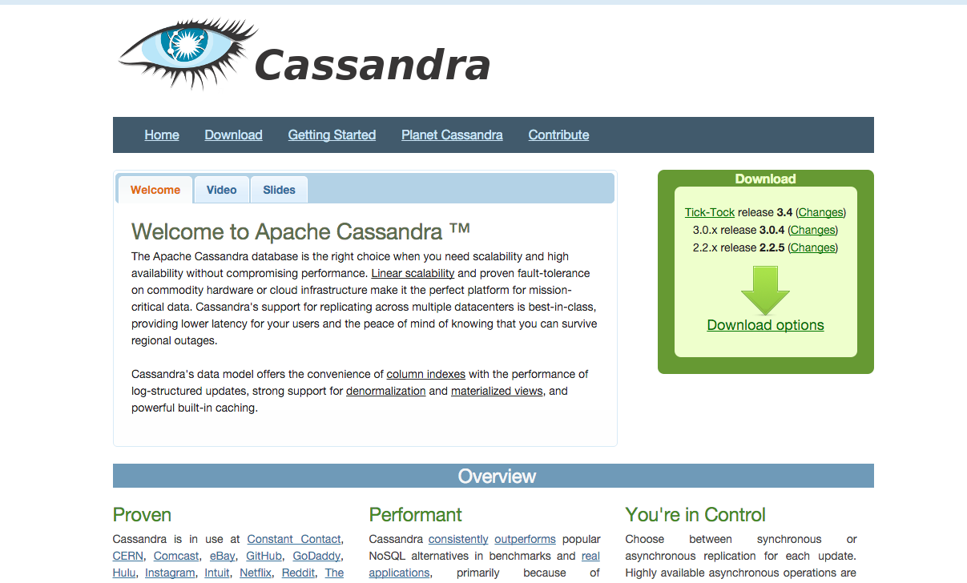
Cassandra
http://cassandra.apache.org/

Slide 25
Kafka

Slide 26
SMACK Stack Building data processing platforms with Spark, Mesos, Akka, Cassandra and Kafka
Source: http://www.natalinobusa.com/2015/11/why-is-smack-stack-all-rage-lately.html

Slide 27
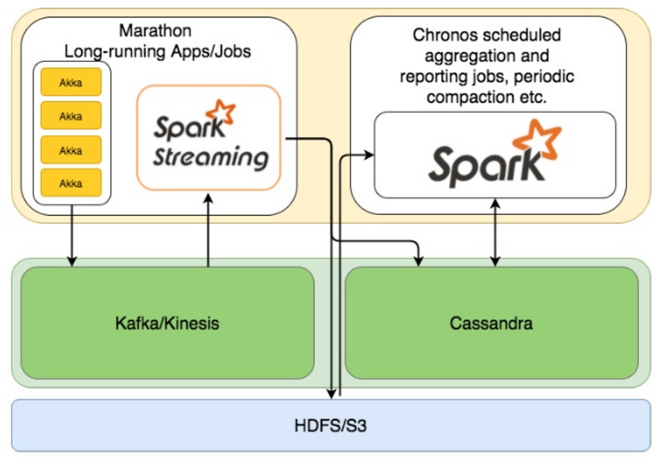
SMACK
Source: Anton Kirillov (2015), Data processing platforms architectures with Spark, Mesos, Akka, Cassandra and Kafka,

Slide 28
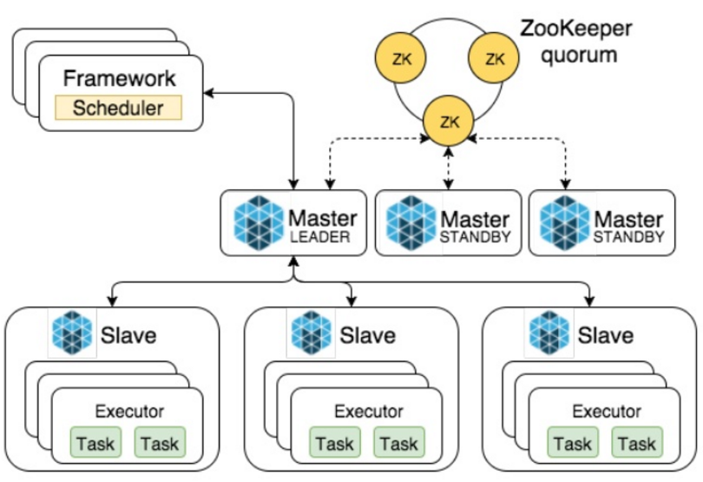
Mesos Architecture Overview
Source: Anton Kirillov (2015), Data processing platforms architectures with Spark, Mesos, Akka, Cassandra and Kafka,

Slide 29
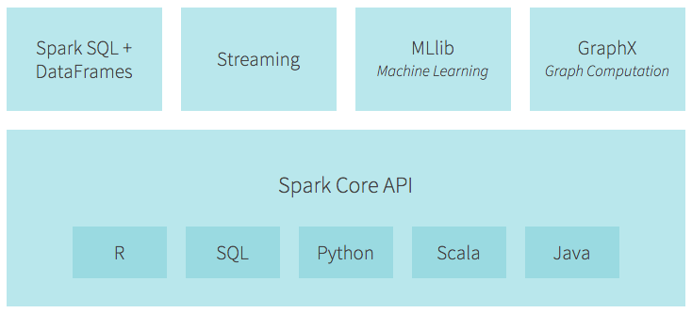
Spark Ecosystem
Source: https://databricks.com/spark/about

Slide 30
databricks
https://databricks.com/spark/about

Slide 31
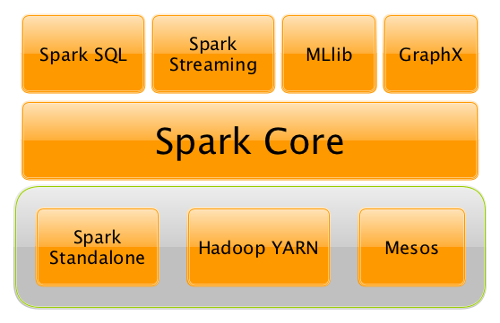
The Spark Platform
Source: https://jaceklaskowski.gitbooks.io/mastering-apache-spark/content/spark-overview.html

Slide 32
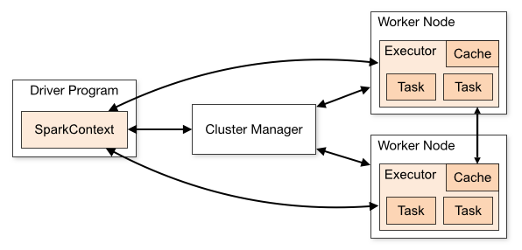
Spark Cluster Overview
Source: http://spark.apache.org/docs/latest/cluster-overview.html

Slide 33
3 Types of Spark Cluster Manager
Standalone
a simple cluster manager included with Spark that makes it easy to set up a cluster.
Apache Mesos
a general cluster manager that can also run Hadoop MapReduce and service applications.
Hadoop YARN
the resource manager in Hadoop 2.
Spark’s EC2 launch scripts make it easy to launch a standalone cluster on Amazon EC2.
Source: http://spark.apache.org/docs/latest/cluster-overview.html

Slide 34
Running Spark on cluster Cluster Managers (Schedulers)
Spark’s own Standalone cluster manager
Hadoop YARN
Apache Mesos
Source: https://jaceklaskowski.gitbooks.io/mastering-apache-spark/content/spark-cluster.html

Slide 35
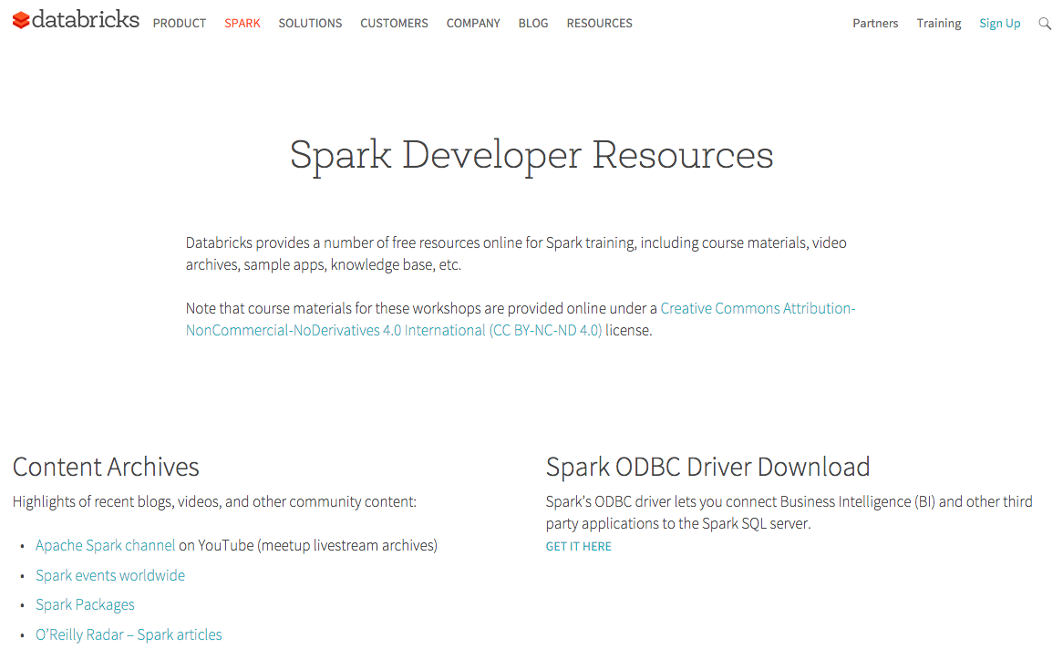
Spark Developer Resources
https://databricks.com/spark/developer-resources

Slide 36
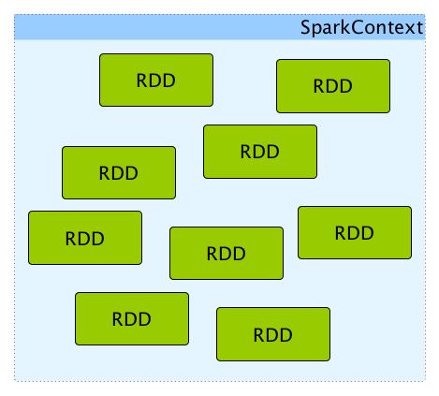
SparkContext and RDDs
Source: https://jaceklaskowski.gitbooks.io/mastering-apache-spark/content/spark-sparkcontext.html

Slide 37
Resilient Distributed Dataset (RDD)

Slide 38
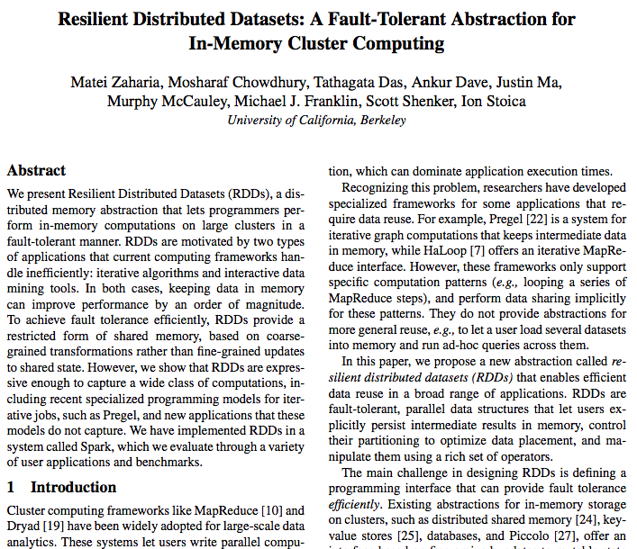
Source: https://www.cs.berkeley.edu/~matei/papers/2012/nsdi_spark.pdf

Slide 39
RDD
Resilient
fault-tolerant and so able to recompute missing or damaged partitions on node failures with the help of RDD lineage graph.
Distributed across clusters.
Dataset
a collection of partitioned data.
Source: https://jaceklaskowski.gitbooks.io/mastering-apache-spark/content/spark-rdd.html

Slide 40
Resilient Distributed Datasets (RDD) are the primary abstraction in Spark – a fault-tolerant collection of elements that can be operated on in parallel
Source: Databricks (2016), Intro to Apache Spark

Slide 41
Resilient Distributed Dataset (RDD) Spark’s “Interface” to data

Slide 42
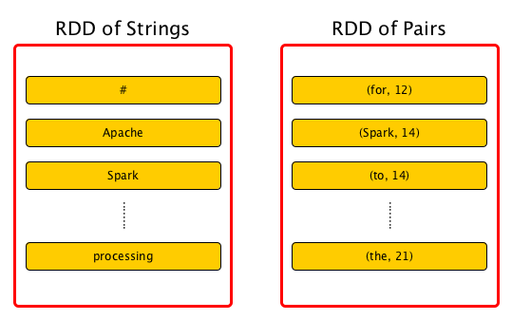
Spark RDD
Source: https://jaceklaskowski.gitbooks.io/mastering-apache-spark/content/spark-rdd.html

Slide 43
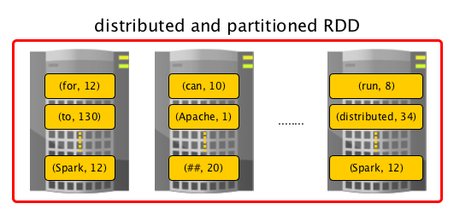
Spark RDD
Source: https://jaceklaskowski.gitbooks.io/mastering-apache-spark/content/spark-rdd.html

Slide 44
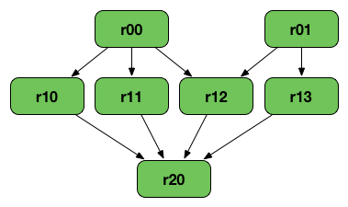
RDD Lineage Graph (RDD operator graph)
Source: https://jaceklaskowski.gitbooks.io/mastering-apache-spark/content/spark-rdd.html

Slide 45
Resilient Distributed Dataset (RDD) Operations
Transformations
Actions
Intro to Apache Spark (Brain-Friendly Tutorial)
Source: Liondatasystems (2015), Intro to Apache Spark (Brain-Friendly Tutorial)
Notes:
Lion Data Systems (2015), Intro to Apache Spark (Brain-Friendly Tutorial), https://www.youtube.com/watch?v=rvDpBTV89AM

Slide 46
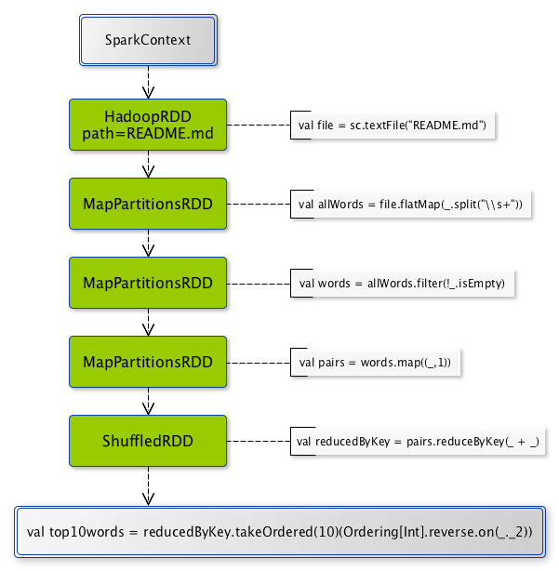
Spark RDD Operations
Source: https://jaceklaskowski.gitbooks.io/mastering-apache-spark/content/spark-rdd-operations.html

Slide 47
Get Started using Apache Spark on a Personal Computer (Windows/Mac OS X)
Step 1. Install Java JDK
Step 2. Download Spark
Step 3. Run Spark Shell
Step 4. Create RDD
Source: Databricks (2016), Intro to Apache Spark

Slide 48
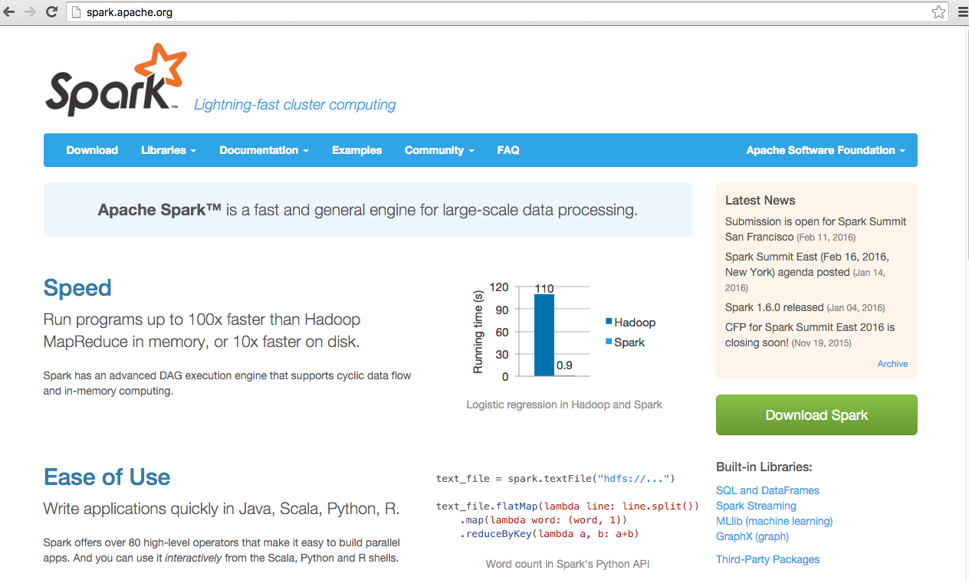
Apache Spark
http://spark.apache.org/

Slide 49
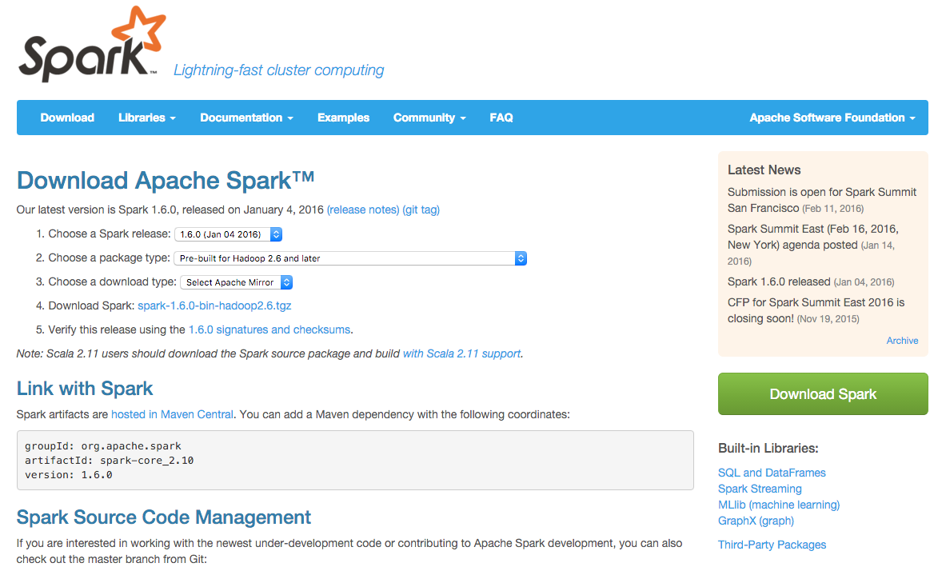
Spark Download
http://spark.apache.org/downloads.html

Slide 50
Scala 2.11
./dev/change-scala-version.sh 2.11
mvn -Pyarn -Phadoop-2.4 -Dscala-2.11 -DskipTests clean package
Source: http://spark.apache.org/docs/latest/building-spark.html#building-for-scala-211

Slide 51
Get Started using Apache Spark on a Personal Computer (Windows/Mac OS X)
Step 1. Install Java JDK
Spark's interactive shell
./bin/spark-shell
val data = 1 to 10000
Step 2. Download Spark
Step 3. Run Spark Shell
Step 4. Create RDD
Source: Databricks (2016), Intro to Apache Spark

Slide 52
Get Started using Apache Spark on a Personal Computer (Windows/Mac OS X)
Step 1. Install Java JDK
Step 2. Download Spark
val distData = sc.parallelize(data)
distData.filter(_ < 10).collect()
Step 3. Run Spark Shell
Step 4. Create RDD
Source: Databricks (2016), Intro to Apache Spark

Slide 53
Word Count Hello World in Big Data

Slide 54
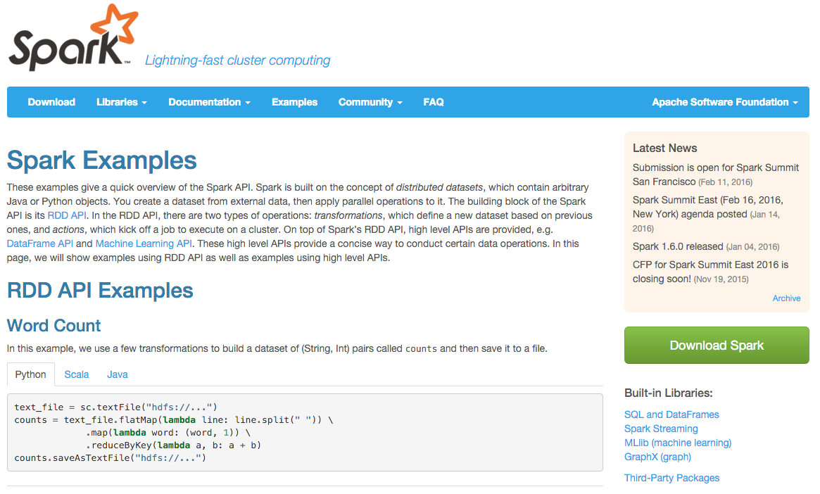
Spark Examples
Source: http://spark.apache.org/examples.html

Slide 55
Spark Word Count Python
text_file = sc.textFile("hdfs://...")
counts = text_file.flatMap(lambda line: line.split(" ")) \
.map(lambda word: (word, 1)) \
.reduceByKey(lambda a, b: a + b)
counts.saveAsTextFile("hdfs://...")
Source: http://spark.apache.org/examples.html

Slide 56
Spark Word Count Scala
val textFile = sc.textFile("hdfs://...")
val counts = textFile.flatMap(line => line.split(" "))
.map(word => (word, 1))
.reduceByKey(_ + _)
counts.saveAsTextFile("hdfs://...")
Source: http://spark.apache.org/examples.html

Slide 57
Spark Word Count Java
JavaRDD<String> textFile = sc.textFile("hdfs://...");
JavaRDD<String> words = textFile.flatMap(new FlatMapFunction<String, String>() {
public Iterable<String> call(String s) { return Arrays.asList(s.split(" ")); }
});
JavaPairRDD<String, Integer> pairs = words.mapToPair(new PairFunction<String, String, Integer>() {
public Tuple2<String, Integer> call(String s) { return new Tuple2<String, Integer>(s, 1); }
});
JavaPairRDD<String, Integer> counts = pairs.reduceByKey(new Function2<Integer, Integer, Integer>() {
public Integer call(Integer a, Integer b) { return a + b; }
});
counts.saveAsTextFile("hdfs://...");
Source: http://spark.apache.org/examples.html

Slide 58
Spark Word Count
Python
Scala
Java
Source: http://spark.apache.org/examples.html

Slide 59
Spark Word Count Python
text_file = sc.textFile(”input_readme.txt")
counts = text_file.flatMap(lambda line: line.split(" ")) .map(lambda word: (word, 1)) .reduceByKey(lambda a, b: a + b)
counts.saveAsTextFile(”output_wordcount.txt")
Source: http://spark.apache.org/examples.html

Slide 60
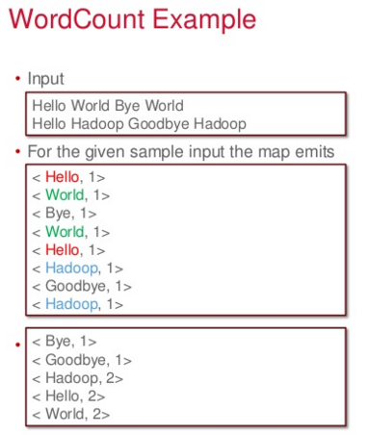
Source: http://www.slideshare.net/tcloudcomputing-tw/hadoop-product-family-2013q3-t-cloud-computing-26218439

Slide 61
Scala
http://www.scala-lang.org/

Slide 62
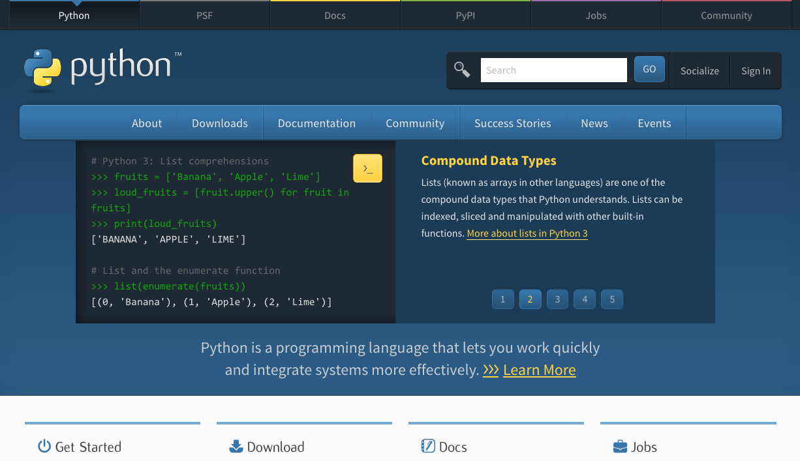
Python
https://www.python.org/

Slide 63
PySpark: Spark Python API

Slide 64
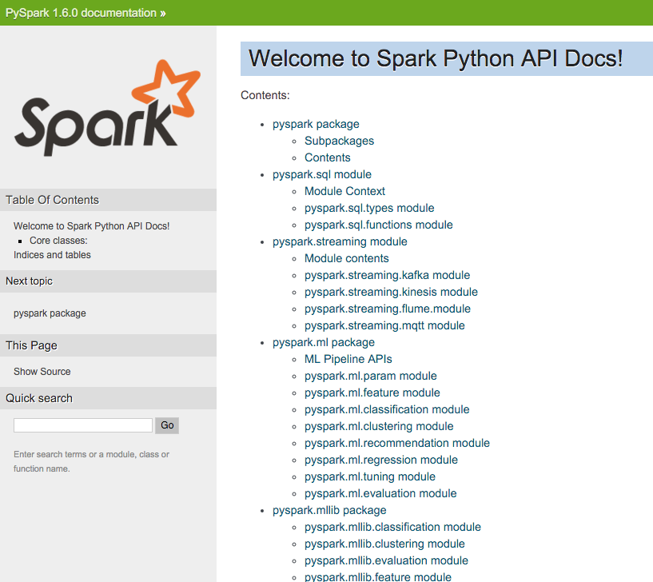
http://spark.apache.org/docs/latest/api/python/

Slide 65
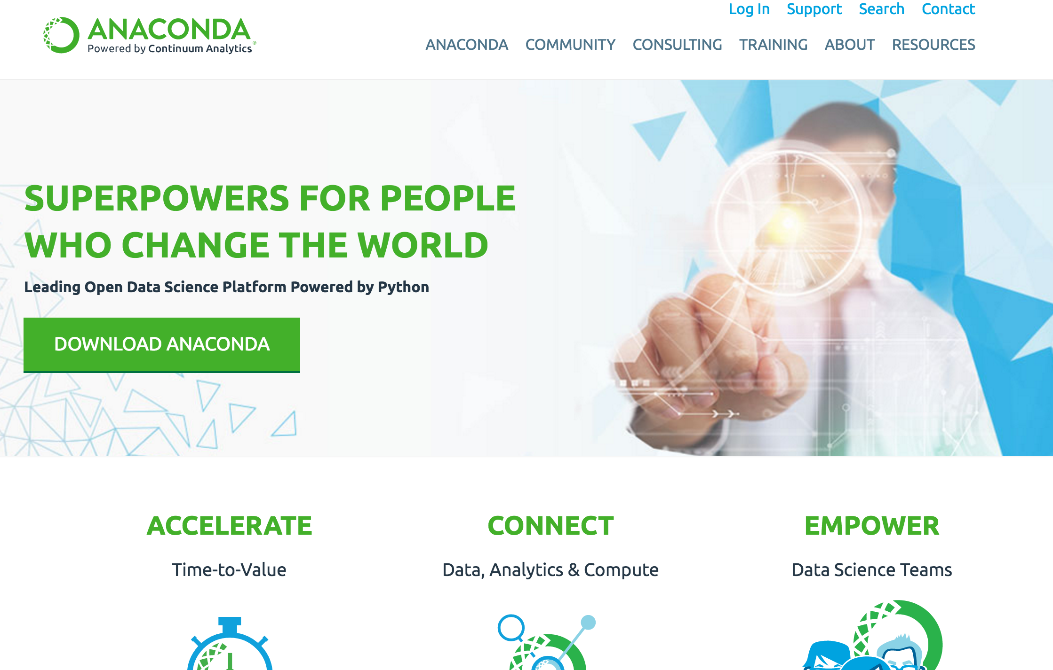
Anaconda
https://www.continuum.io/

Slide 66
Anaconda OPEN DATA SCIENCE PLATFORM Accelerate. Connect. Empower.
https://www.continuum.io/

Slide 67
Anaconda OPEN DATA SCIENCE PLATFORM Accelerate. Connect. Empower.
https://www.continuum.io/

Slide 68
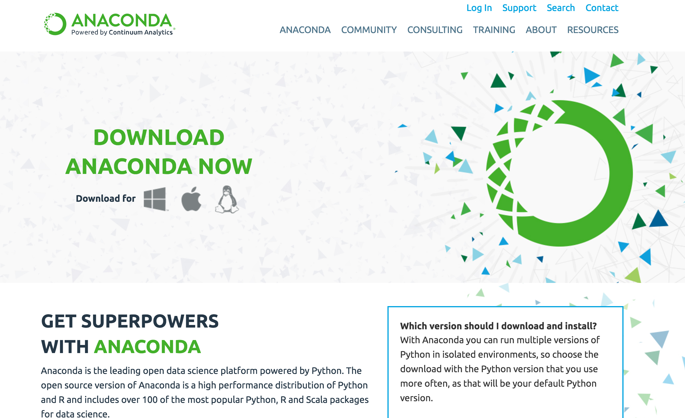
Download Anaconda
https://www.continuum.io/downloads

Slide 69
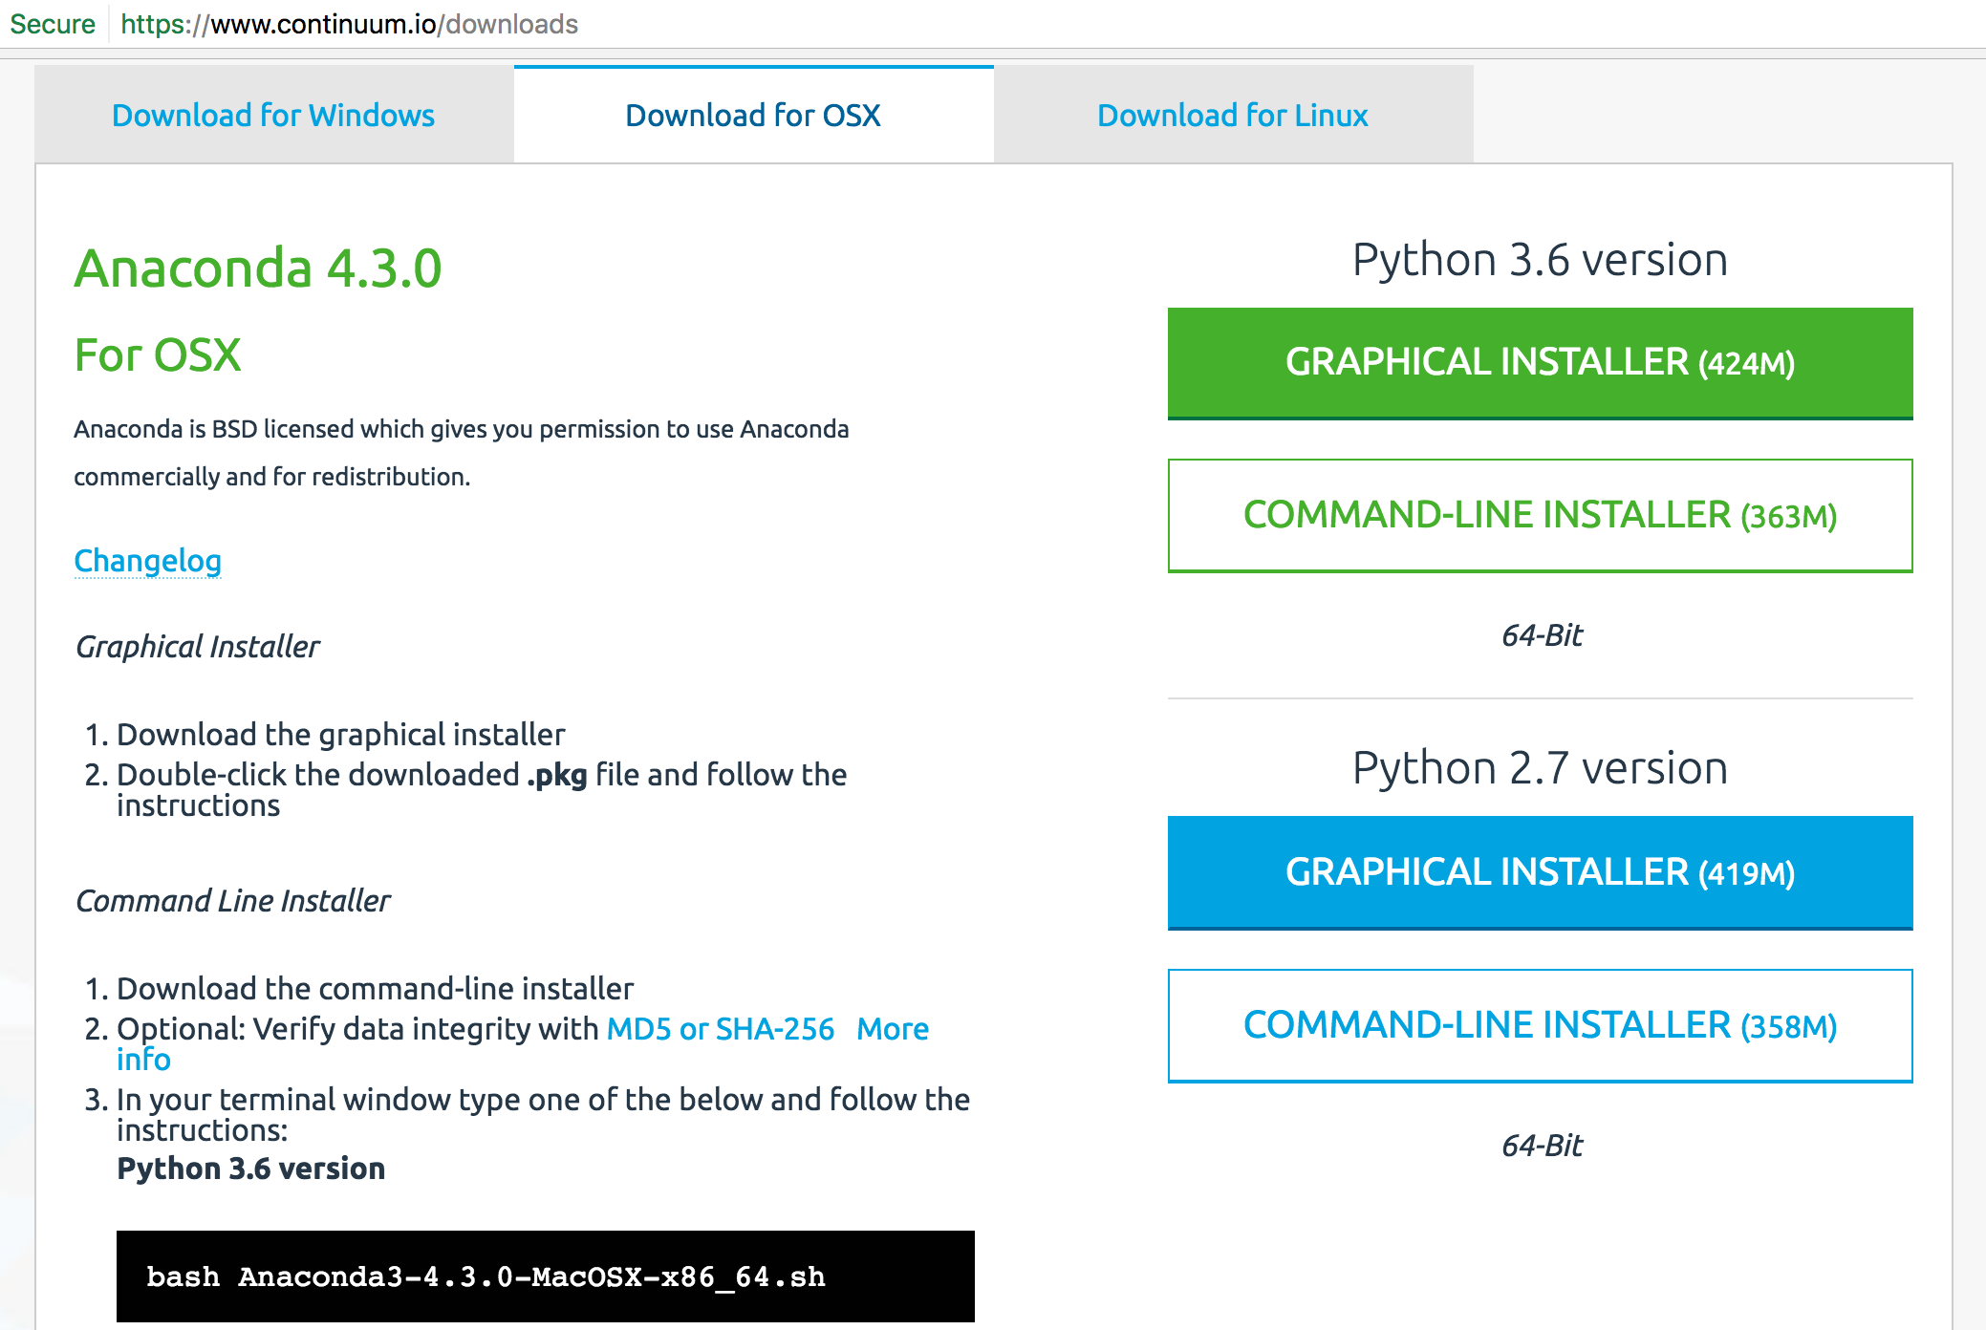
Download Anaconda Python 3.6
https://www.continuum.io/downloads

Slide 70
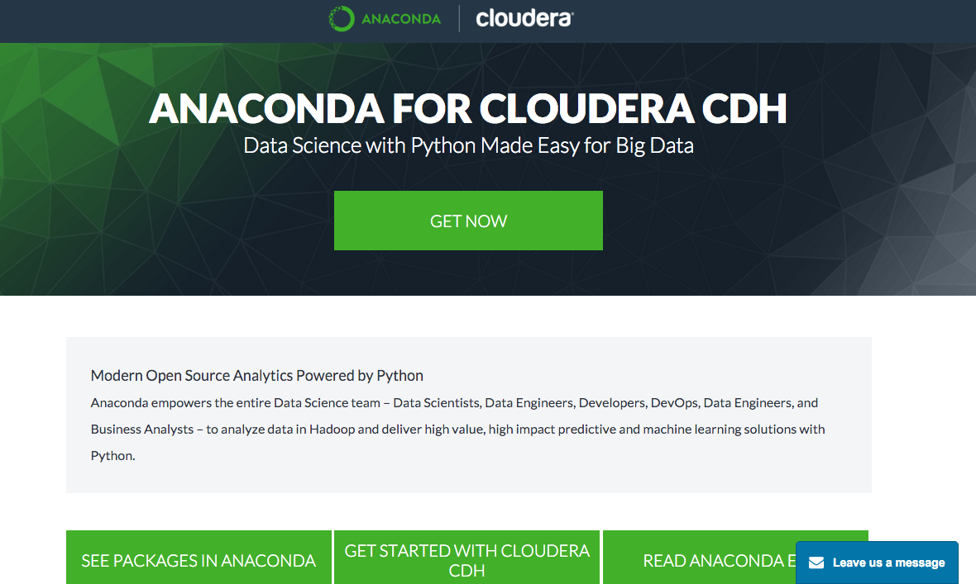
Anadonda for Cloudera CDH
http://know.continuum.io/anaconda-for-cloudera.html

Slide 71
Anadonda for Cloudera CDH
Source: http://know.continuum.io/anaconda-for-cloudera.html

Slide 72
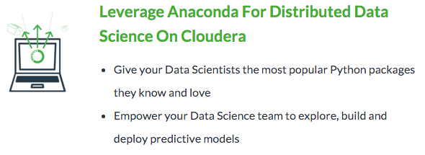
Anadonda for Cloudera CDH
Source: http://know.continuum.io/anaconda-for-cloudera.html

Slide 73
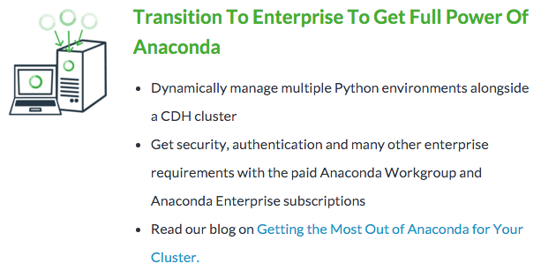
Anadonda for Cloudera CDH
Source: http://know.continuum.io/anaconda-for-cloudera.html

Slide 74
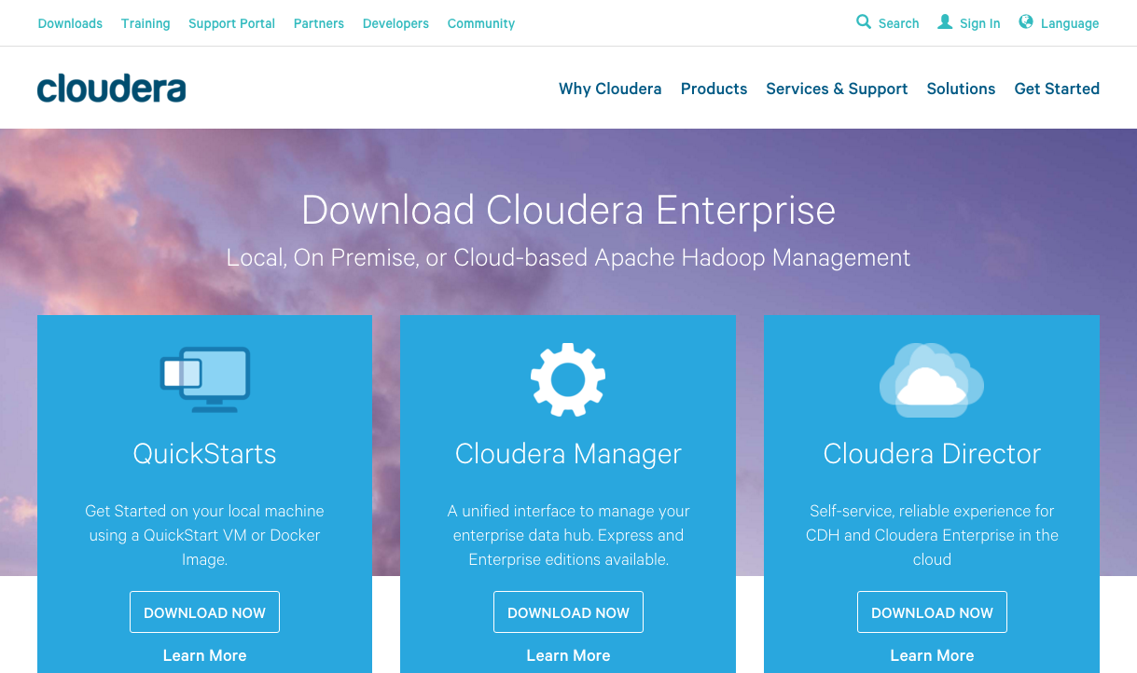
Cloudera
http://www.cloudera.com/downloads.html

Slide 75
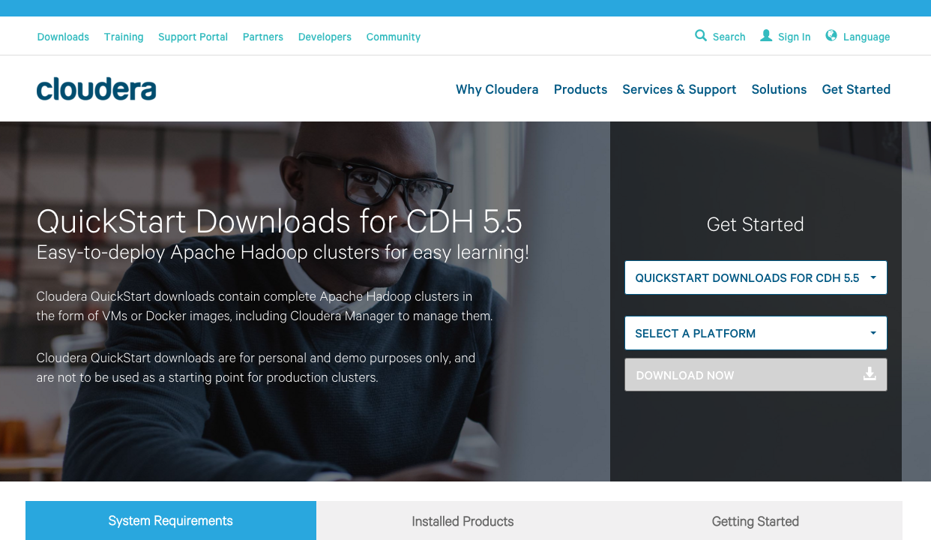
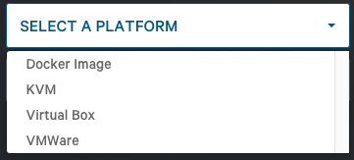
Cloudera CDH 5.5
http://www.cloudera.com/downloads/quickstart_vms/5-5.html

Slide 76
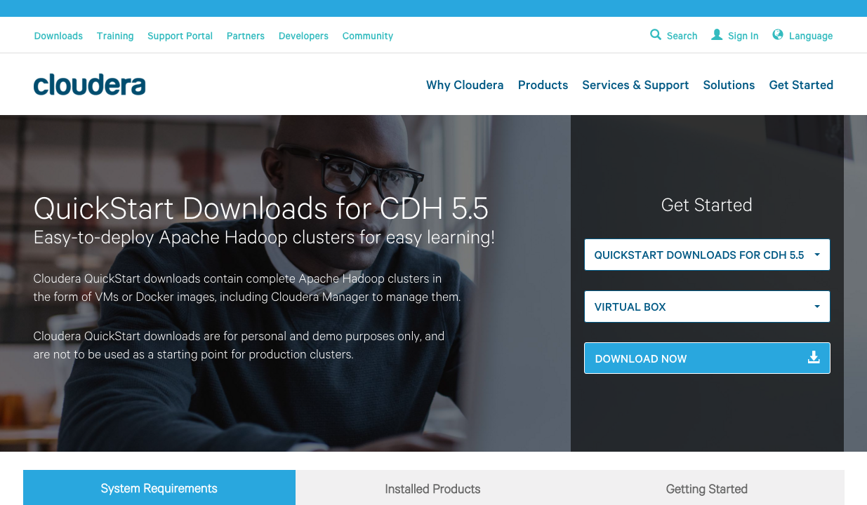
Cloudera CDH 5.5
http://www.cloudera.com/downloads/quickstart_vms/5-5.html

Slide 77
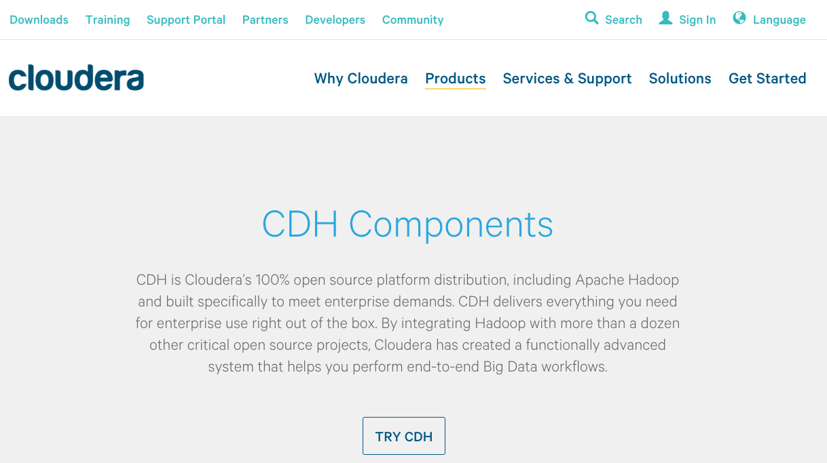
Cloudera CDH
http://www.cloudera.com/products/apache-hadoop/key-cdh-components.html

Slide 78
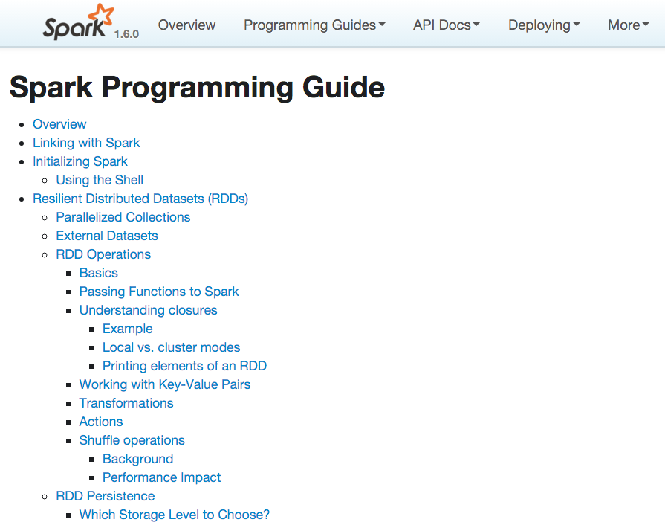
http://spark.apache.org/docs/latest/programming-guide.html

Slide 79
References
Mike Frampton (2015), Mastering Apache Spark, Packt Publishing
Anton Kirillov (2015), Data processing platforms architectures with Spark, Mesos, Akka, Cassandra and Kafka, Big Data AW Meetup, http://www.slideshare.net/akirillov/data-processing-platforms-architectures-with-spark-mesos-akka-cassandra-and-kafka
Spark Apache (2016), PySpark: Spark Python API, http://spark.apache.org/docs/latest/api/python/
Spark Apache (2016), Spark Programming Guide, http://spark.apache.org/docs/latest/programming-guide.html
Spark Submit (2014), Spark Summit 2014 Training, https://spark-summit.org/2014/training
Databricks (2016), Spark Developer Resources, https://databricks.com/spark/developer-resources
Liondatasystems (2015), Intro to Apache Spark (Brain-Friendly Tutorial), https://www.youtube.com/watch?v=rvDpBTV89AM
Databricks (2016), Intro to Apache Spark, http://training.databricks.com/workshop/itas_workshop.pdf

