Slide 1
Social Computing and Big Data Analytics 社群運算與大數據分析
Tamkang University
Tamkang University
巨量資料基礎： MapReduce典範、Hadoop與Spark生態系統
(Fundamental Big Data: MapReduce Paradigm, Hadoop and Spark Ecosystem)
1052SCBDA03
MIS MBA (M2226) (8606)
Wed, 8,9, (15:10-17:00) (B505)
Min-Yuh Day
戴敏育
Assistant Professor
專任助理教授
Dept. of Information Management, Tamkang University
淡江大學 資訊管理學系
http://mail. tku.edu.tw/myday/
2017-03-01

Slide 2
課程大綱 (Syllabus)
週次 (Week) 日期 (Date) 內容 (Subject/Topics)
1 2017/02/15 Course Orientation for Social Computing and Big Data Analytics (社群運算與大數據分析課程介紹)
2 2017/02/22 Data Science and Big Data Analytics: Discovering, Analyzing, Visualizing and Presenting Data (資料科學與大數據分析： 探索、分析、視覺化與呈現資料)
3 2017/03/01 Fundamental Big Data: MapReduce Paradigm, Hadoop and Spark Ecosystem (大數據基礎：MapReduce典範、 Hadoop與Spark生態系統)

Slide 3
課程大綱 (Syllabus)
週次 (Week) 日期 (Date) 內容 (Subject/Topics)
4 2017/03/08 Big Data Processing Platforms with SMACK: Spark, Mesos, Akka, Cassandra and Kafka (大數據處理平台SMACK： Spark, Mesos, Akka, Cassandra, Kafka)
5 2017/03/15 Big Data Analytics with Numpy in Python (Python Numpy 大數據分析)
6 2017/03/22 Finance Big Data Analytics with Pandas in Python (Python Pandas 財務大數據分析)
7 2017/03/29 Text Mining Techniques and Natural Language Processing (文字探勘分析技術與自然語言處理)
8 2017/04/05 Off-campus study (教學行政觀摩日)

Slide 4
課程大綱 (Syllabus)
週次 (Week) 日期 (Date) 內容 (Subject/Topics)
9 2017/04/12 Social Media Marketing Analytics (社群媒體行銷分析)
10 2017/04/19 期中報告 (Midterm Project Report)
11 2017/04/26 Deep Learning with Theano and Keras in Python (Python Theano 和 Keras 深度學習)
12 2017/05/03 Deep Learning with Google TensorFlow (Google TensorFlow 深度學習)
13 2017/05/10 Sentiment Analysis on Social Media with Deep Learning (深度學習社群媒體情感分析)

Slide 5
課程大綱 (Syllabus)
週次 (Week) 日期 (Date) 內容 (Subject/Topics)
14 2017/05/17 Social Network Analysis (社會網絡分析)
15 2017/05/24 Measurements of Social Network (社會網絡量測)
16 2017/05/31 Tools of Social Network Analysis (社會網絡分析工具)
17 2017/06/07 Final Project Presentation I (期末報告 I)
18 2017/06/14 Final Project Presentation II (期末報告 II)

Slide 6
2017/03/01 巨量資料基礎： MapReduce典範、 Hadoop與Spark生態系統 (Fundamental Big Data: MapReduce Paradigm, Hadoop and Spark Ecosystem)

Slide 7
Architecture of Big Data Analytics
Big Data Analytics Applications
Big Data Sources
Big Data Transformation
Big Data Platforms & Tools
* Internal
* External
* Multiple formats
* Multiple locations
* Multiple applications
Middleware
Hadoop
MapReduce
Pig
Hive
Jaql
Zookeeper
Hbase
Cassandra
Oozie
Avro
Mahout
Others
Queries
Raw Data
Transformed Data
Big Data Analytics
Extract Transform Load
Reports
Data Warehouse
OLAP
Traditional Format CSV, Tables
Data Mining
Source: Stephan Kudyba (2014), Big Data, Mining, and Analytics: Components of Strategic Decision Making, Auerbach Publications

Slide 8
Business Intelligence (BI) Infrastructure

Slide 9
SAS® Within the HADOOP ECOSYSTEM
EG
EM
VA
User Interface
SAS® Enterprise
Guide®
SAS® Data Integration
SAS® Enterprise Miner™
SAS® Visual Analytics
SAS® In-Memory Statistics for Haodop
SAS Metadata
SAS® User
Metadata
Next-Gen
SAS® User
Data Access
Base SAS & SAS/ACCESS® to Hadoop™
In-Memory
Data Access
Impala
Pig
Hive
SAS Embedded
Process
Accelerators
SAS® LASR™ Analytic
Server
SAS® High-
Performance
Analytic Procedures
Data Processing
Map Reduce
MPI Based
File System
HDFS
Source: Deepak Ramanathan (2014), SAS Modernization architectures - Big Data Analytics

Slide 10
Fundamental Big Data: MapReduce Paradigm, Hadoop and Spark Ecosystem

Slide 11
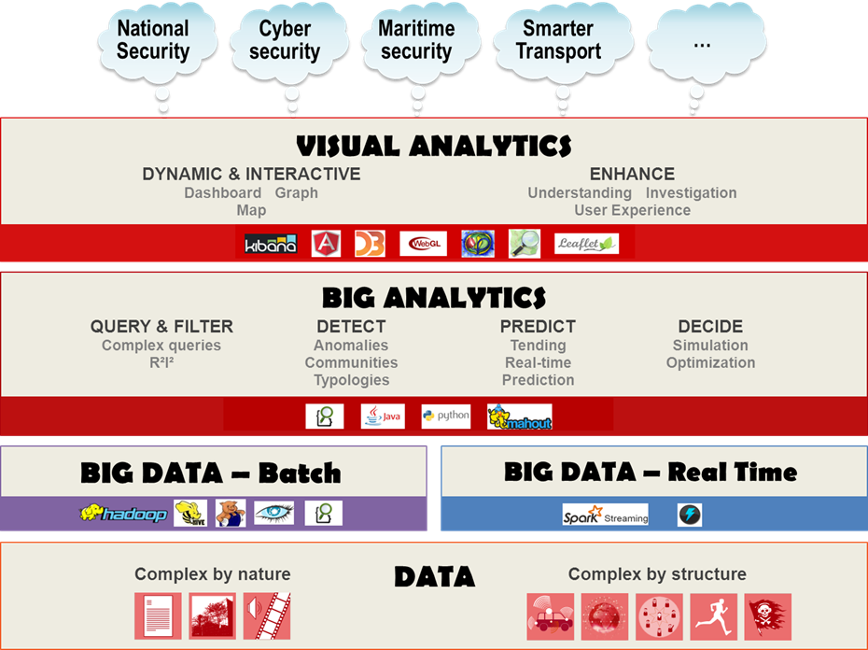
Source: https://www.thalesgroup.com/en/worldwide/big-data/big-data-big-analytics-visual-analytics-what-does-it-all-mean

Slide 12
MapReduce Paradigm

Slide 13
MapReduce Paradigm
Big Data
Map
Map0
Map1
Map2
Map3
Reduce
Reduce0
Reduce1
Reduce2
Reduce3
MapReduce Data
Output Data

Slide 14
MapReduce Word Count
Input
Dog Love Cat
Bird Love Bird
Dog Bird Cat
Source: https://www.edureka.co/blog/mapreduce-tutorial/

Slide 15
MapReduce Word Count
Input
Output
Dog Love Cat
Bird Love Bird
Dog Bird Cat
Bird, 3
Cat, 2
Dog, 2
Love, 2
Source: https://www.edureka.co/blog/mapreduce-tutorial/

Slide 16
MapReduce Word Count
Input
Split
Map
Shuffle
Reduce
Output
Bird, (1, 1, 1)
Bird, 3
Dog, 1
Love, 1
Cat, 1
Dog Love Cat
Cat, (1, 1)
Cat, 2
Bird, 3
Cat, 2
Dog, 2
Love, 2
Dog Love Cat
Bird Love Bird
Dog Bird Cat
Bird, 1
Love, 1
Bird, 1
Bird Love Bird
Dog, (1, 1)
Dog, 2
Dog Bird Cat
Dog, 1
Bird, 1
Cat, 1
Love, (1, 1)
Love, 2
Source: https://www.edureka.co/blog/mapreduce-tutorial/

Slide 17
Hadoop Ecosystem

Slide 18
The Apache™ Hadoop® project develops open-source software for reliable, scalable, distributed computing.
Source: http://hadoop.apache.org/

Slide 19
MapReduce
Processing
HDFS
Storage
Source: http://hadoop.apache.org/

Slide 20
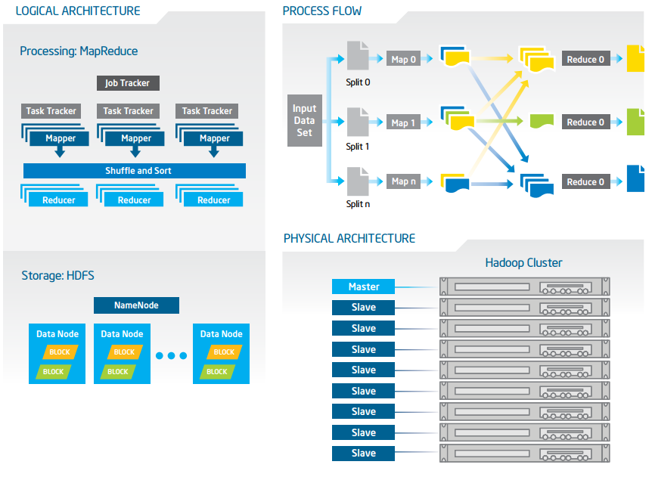
Big Data with Hadoop Architecture
Source: https://software.intel.com/sites/default/files/article/402274/etl-big-data-with-hadoop.pdf

Slide 21
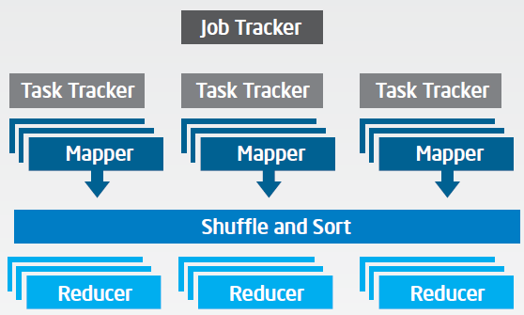
Big Data with Hadoop Architecture Logical Architecture Processing: MapReduce
Source: https://software.intel.com/sites/default/files/article/402274/etl-big-data-with-hadoop.pdf

Slide 22
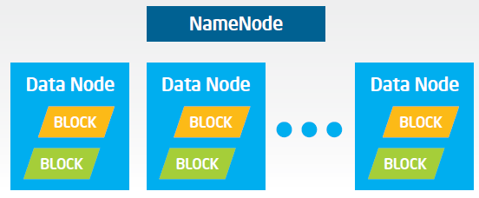
Big Data with Hadoop Architecture Logical Architecture Storage: HDFS
Source: https://software.intel.com/sites/default/files/article/402274/etl-big-data-with-hadoop.pdf

Slide 23
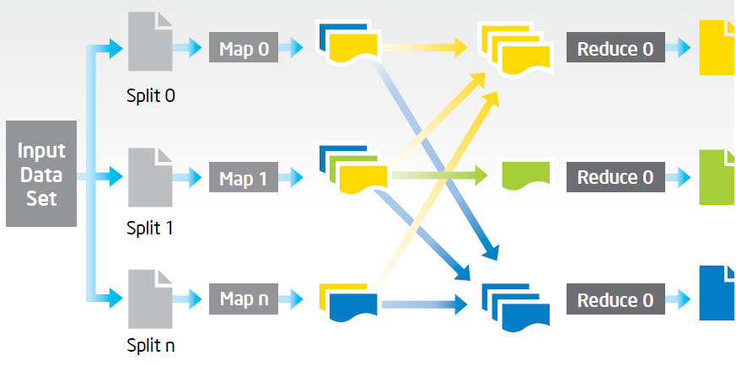
Big Data with Hadoop Architecture Process Flow
Source: https://software.intel.com/sites/default/files/article/402274/etl-big-data-with-hadoop.pdf

Slide 24
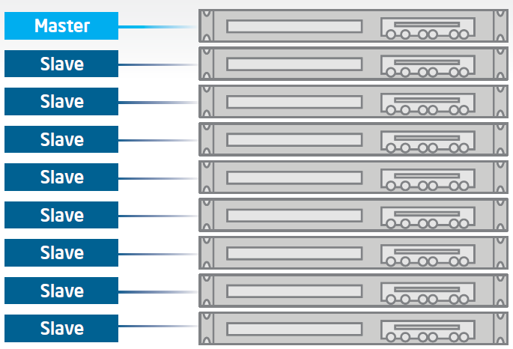
Big Data with Hadoop Architecture Hadoop Cluster
Source: https://software.intel.com/sites/default/files/article/402274/etl-big-data-with-hadoop.pdf

Slide 25
Hadoop Ecosystem
Source: https://savvycomsoftware.com/what-you-need-to-know-about-hadoop-and-its-ecosystem/

Slide 26
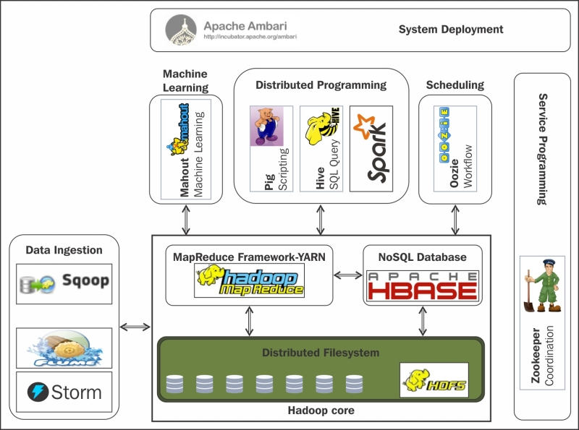
Hadoop Ecosystem
Source: Shiva Achari (2015), Hadoop Essentials - Tackling the Challenges of Big Data with Hadoop, Packt Publishing

Slide 27
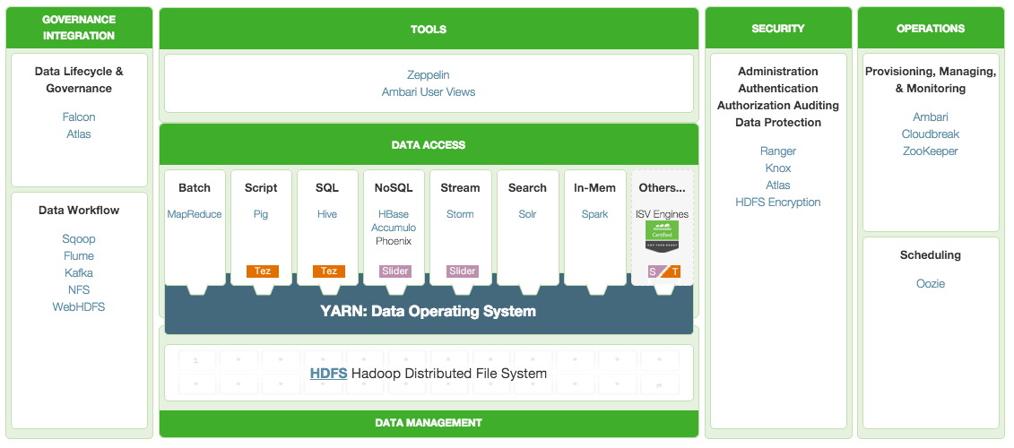
HDP (Hortonworks Data Platform) A Complete Enterprise Hadoop Data Platform
Source: http://hortonworks.com/hdp/

Slide 28
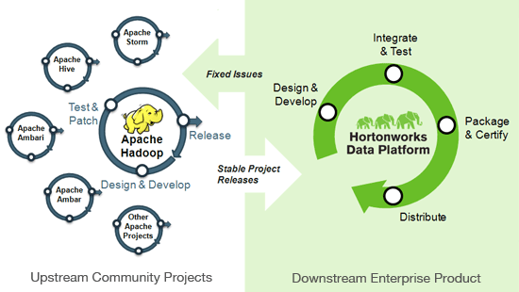
Apache Hadoop Hortonworks Data Platform
Source: http://hortonworks.com/hdp/

Slide 29
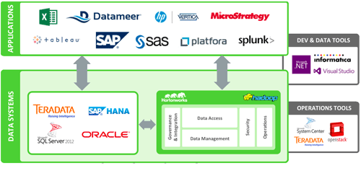
Hadoop and Data Analytics Tools
Source: http://hortonworks.com/hdp/

Slide 30
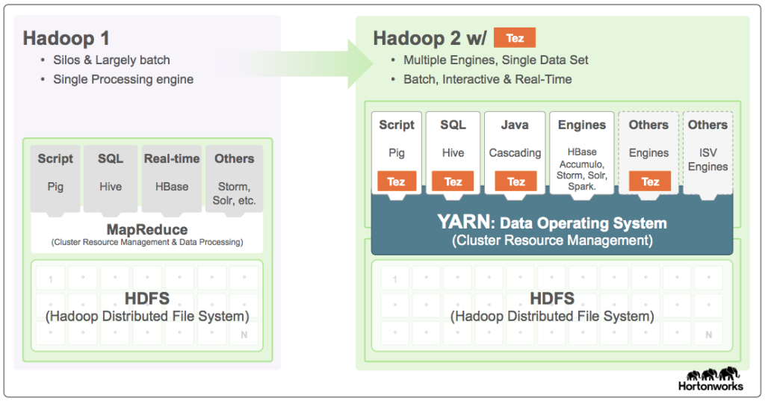
Hadoop 1 → Hadoop 2
Source: http://hortonworks.com/hadoop/tez/

Slide 31
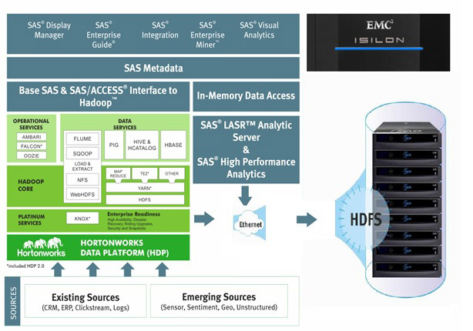
Big Data Solution
EG
EM
VA
Source: http://www.newera-technologies.com/big-data-solution.html

Slide 32
Traditional ETL Architecture
Source: https://software.intel.com/sites/default/files/article/402274/etl-big-data-with-hadoop.pdf

Slide 33
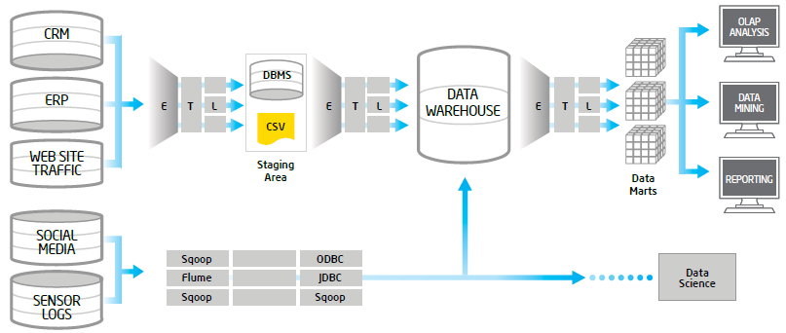
Offload ETL with Hadoop (Big Data Architecture)
Source: https://software.intel.com/sites/default/files/article/402274/etl-big-data-with-hadoop.pdf

Slide 34
Spark Ecosystem

Slide 35
Apache Spark is a fast and general engine for large-scale data processing.
Lightning-fast cluster computing
Source: http://spark.apache.org/

Slide 36
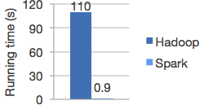
Logistic regression in Hadoop and Spark
Run programs up to 100x faster than Hadoop MapReduce in memory, or 10x faster on disk.
Source: http://spark.apache.org/

Slide 37
Ease of Use
Write applications quickly in Java, Scala, Python, R.
Source: http://spark.apache.org/

Slide 38
Word count in Spark's Python API
text_file = spark.textFile("hdfs://...")
text_file.flatMap(lambda line: line.split())
.map(lambda word: (word, 1))
.reduceByKey(lambda a, b: a+b)
Source: http://spark.apache.org/

Slide 39
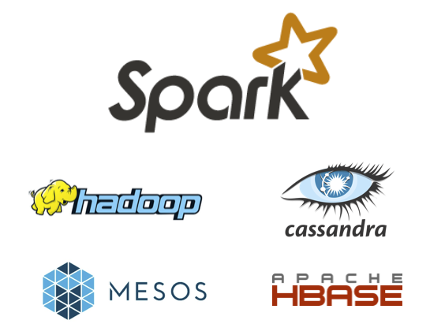
Spark and Hadoop
Source: http://spark.apache.org/

Slide 40
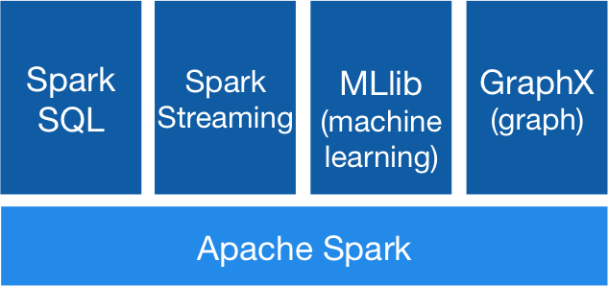
Spark Ecosystem
Source: http://spark.apache.org/

Slide 41
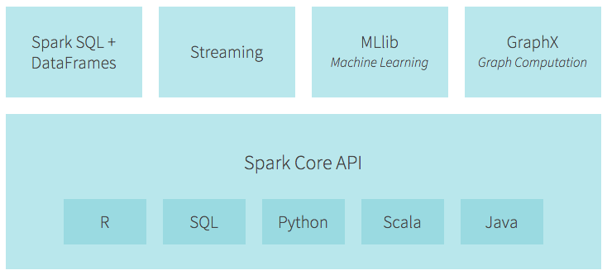
Spark Ecosystem
Source: https://databricks.com/spark/about

Slide 42
Spark Ecosystem
Spark
Spark
Streaming
MLlib (machine learning)
Spark
SQL
GraphX
(graph)
Kafka
Flume
H2O
Hive
Titan
HBase
Cassandra
HDFS
Source: Mike Frampton (2015), Mastering Apache Spark, Packt Publishing

Slide 43
SMACK Stack
Spark
fast and general engine for distributed, large-scale data processing
Mesos
cluster resource management system that provides efficient resource isolation and sharing across distributed applications
Akka
a toolkit and runtime for building highly concurrent, distributed, and resilient message-driven applications on the JVM
Cassandra
distributed, highly available database designed to handle large amounts of data across multiple datacenters
Kafka
a high-throughput, low-latency distributed messaging system designed for handling real-time data feeds
Source: Anton Kirillov (2015), Data processing platforms architectures with Spark, Mesos, Akka, Cassandra and Kafka, Big Data AW Meetup

Slide 44
Hadoop vs. Spark
HDFS read
HDFS write
HDFS read
HDFS write
Iter. 1
Iter. 2
Input
Iter. 1
Iter. 2
Input
Source: Shiva Achari (2015), Hadoop Essentials - Tackling the Challenges of Big Data with Hadoop, Packt Publishing

Slide 45
Hadoop Distribution
Apache Hadoop
http://hadoop.apache.org/
Amazon Elastic Map Reduce (EMR)
https://aws.amazon.com/emr/
Cloudera CDH
https://www.cloudera.com/downloads.html
Hortonworks Sandbox
https://hortonworks.com/products/sandbox/

Slide 46
Steps to Install Hadoop on a Personal Computer (Windows/OS X)
Source: https://www.youtube.com/watch?v=rO-V1mxhzcM&list=PLyZEf-TOnZen8E5m5TIpIsdok2fyKDNRa&index=5

Slide 47
Hodoop: Linux Based Software
LINUX
LINUX
LINUX
LINUX
Source: https://www.youtube.com/watch?v=rO-V1mxhzcM&list=PLyZEf-TOnZen8E5m5TIpIsdok2fyKDNRa&index=5

Slide 48
Appliance
Personal Computer (Windows / OS X)
Virtual Machine (VirtualBox / VMWare)
Linux
Hadoop
Source: https://www.youtube.com/watch?v=rO-V1mxhzcM&list=PLyZEf-TOnZen8E5m5TIpIsdok2fyKDNRa&index=5

Slide 49
Connection to Hadoop
Access from host
Personal Computer (Windows / OS X)
Browser
Virtual Machine (VirtualBox / VMWare)
Linux
Hadoop
Source: https://www.youtube.com/watch?v=rO-V1mxhzcM&list=PLyZEf-TOnZen8E5m5TIpIsdok2fyKDNRa&index=5

Slide 50
Steps to Install Hadoop on a Personal Computer (Windows/OS X)
Step 1. Download and Install VirtualBox
Step 2. Download Appliance
Step 3. Import Appliance
Step 4. Configure Virtual Machine (VM)
Step 5. Start Virtual Machine (VM)
Step 6. Test Connection From Host
Source: https://www.youtube.com/watch?v=rO-V1mxhzcM&list=PLyZEf-TOnZen8E5m5TIpIsdok2fyKDNRa&index=5

Slide 51
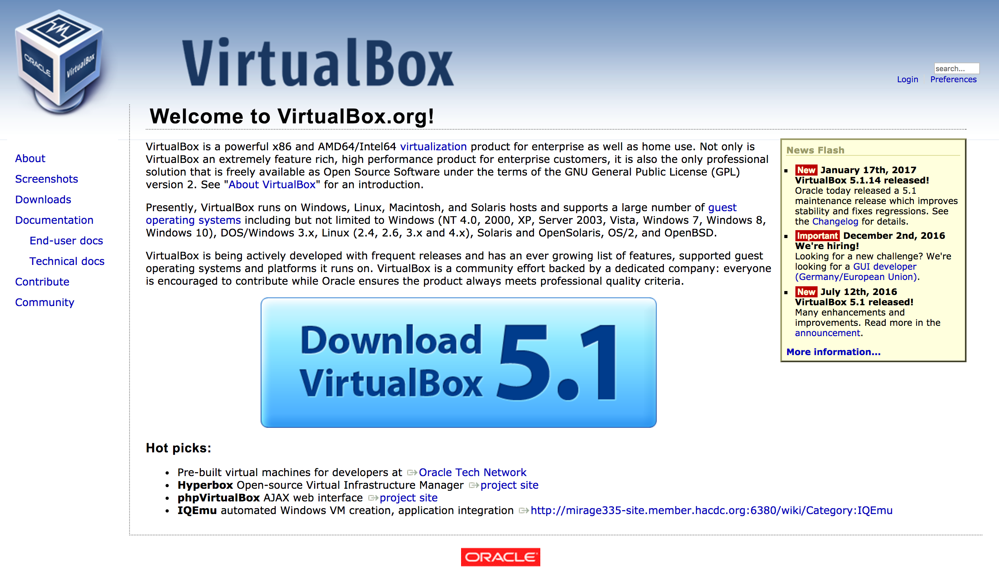
Virtual Box
https://www.virtualbox.org/

Slide 52
Steps to Install Hadoop on a Personal Computer (Windows/OS X)
Step 1. Download and Install VirtualBox
Step 2. Download Appliance
Hortonworks Sandbox
Step 3. Import Appliance
Step 4. Configure Virtual Machine (VM)
Step 5. Start Virtual Machine (VM)
Step 6. Test Connection From Host
Source: https://www.youtube.com/watch?v=rO-V1mxhzcM&list=PLyZEf-TOnZen8E5m5TIpIsdok2fyKDNRa&index=5

Slide 53
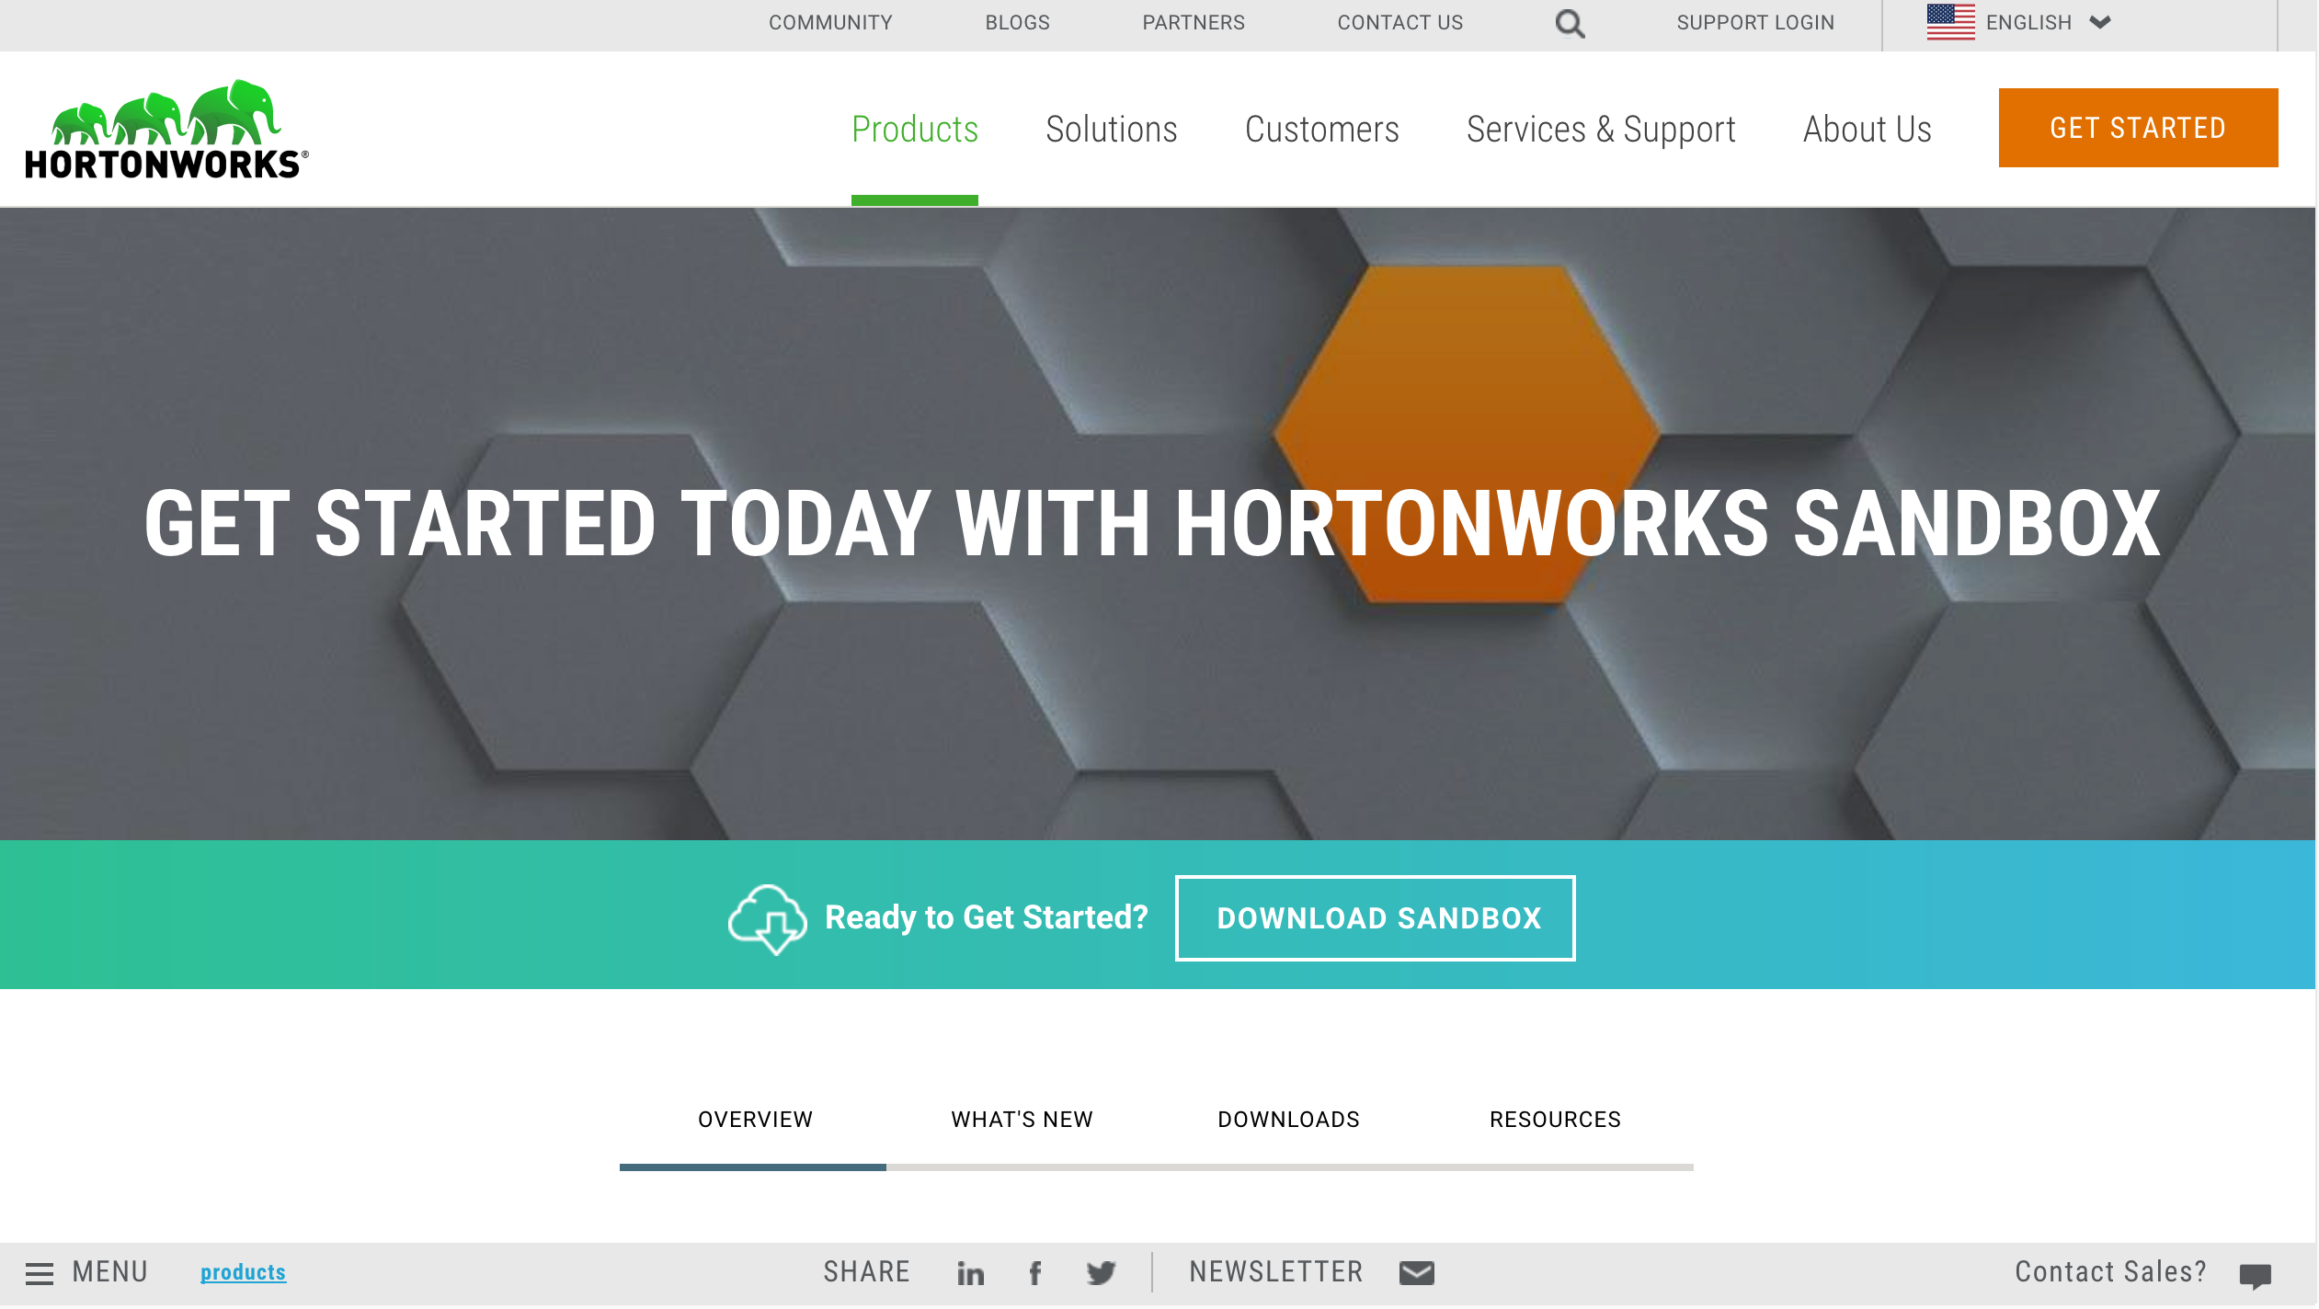
Hortonworks Sandbox The easiest way to get started with Enterprise Hadoop
http://hortonworks.com/products/hortonworks-sandbox/#install

Slide 54
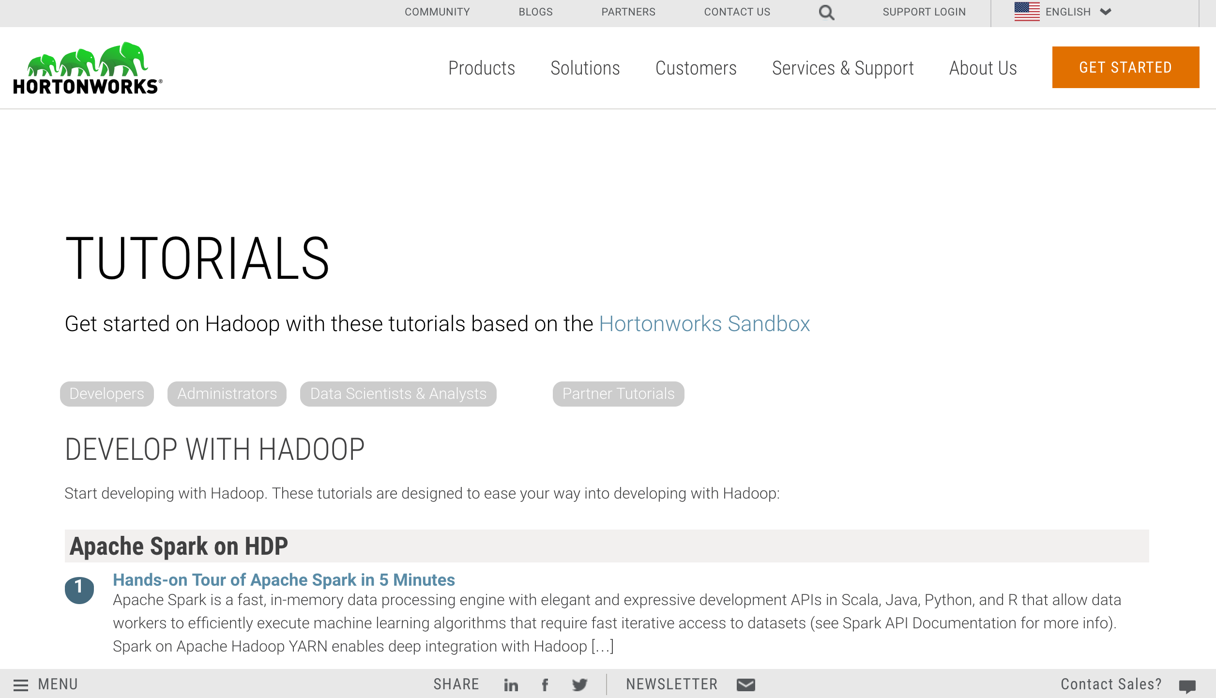
Get started on Hadoop with these tutorials based on the Hortonworks Sandbox
http://hortonworks.com/tutorials/

Slide 55
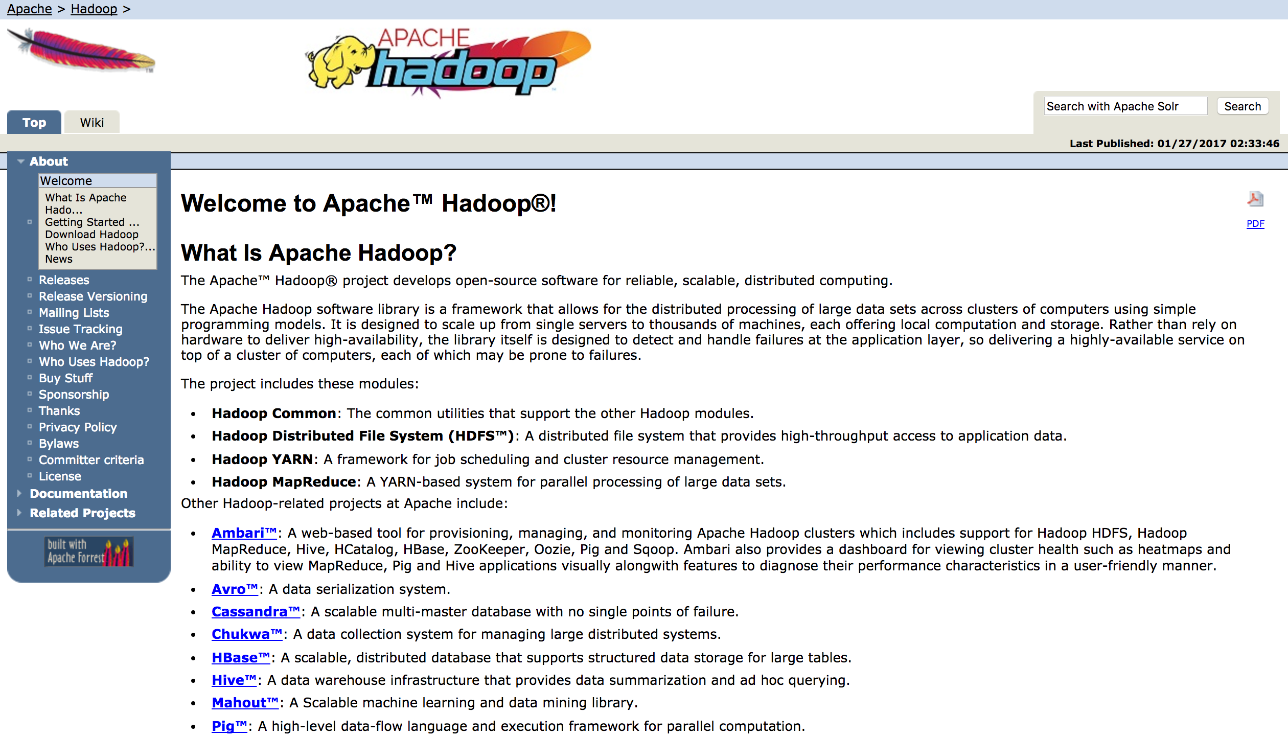
Apache Hadoop
http://hadoop.apache.org/

Slide 56
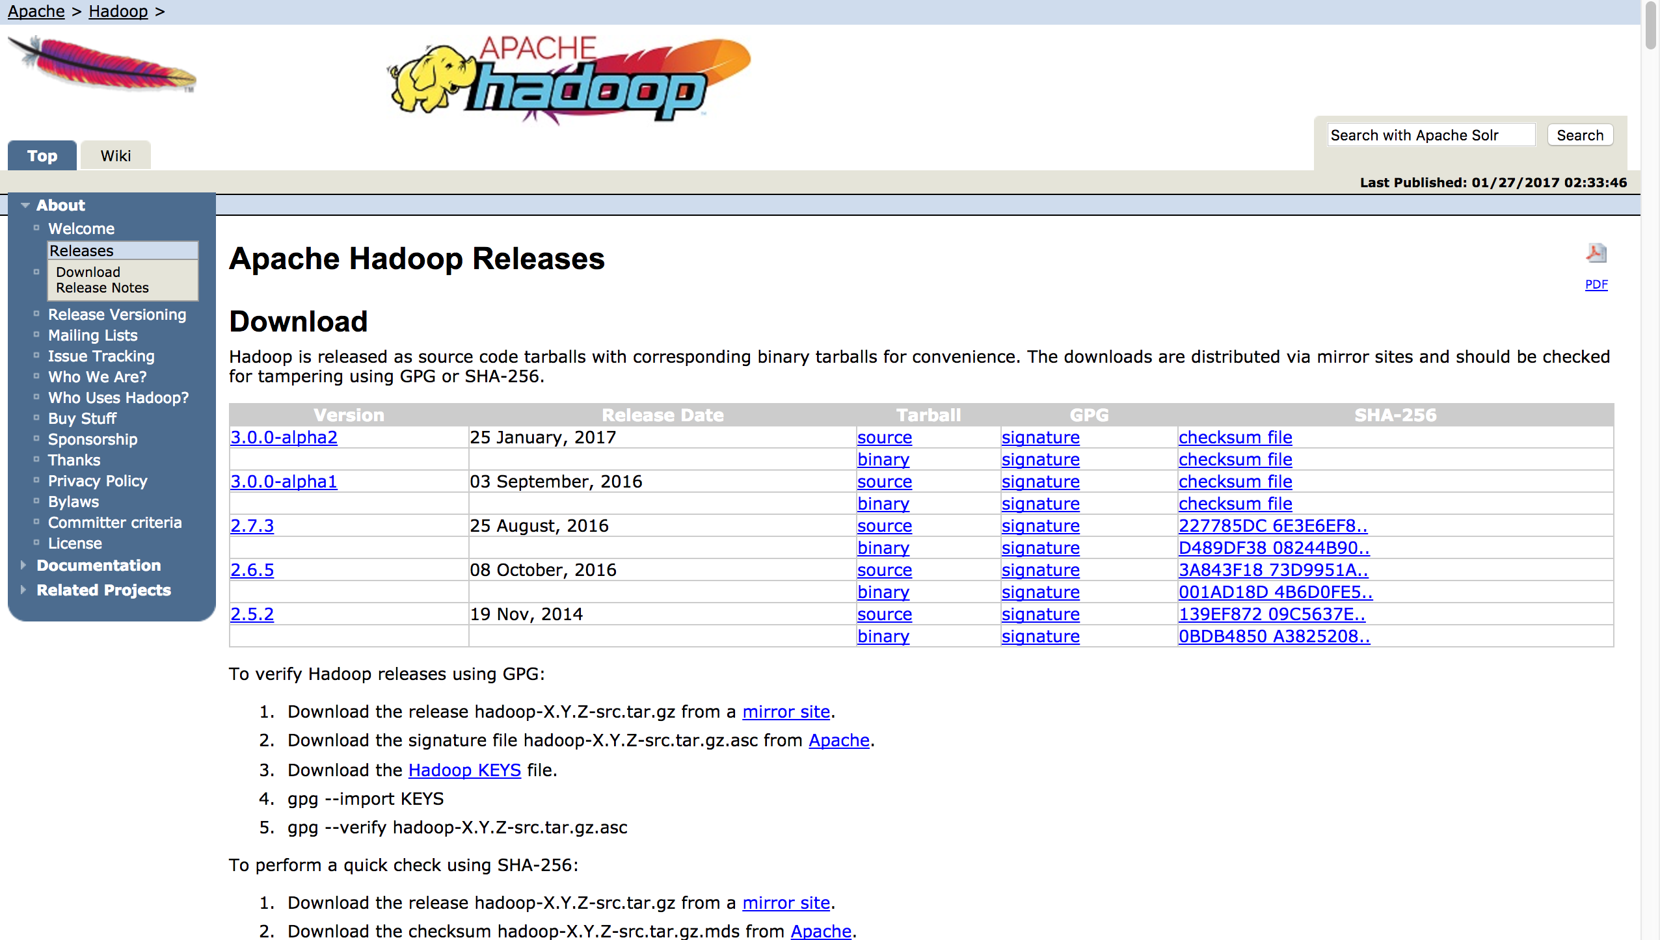
Apache Hadoop
http://hadoop.apache.org/releases.html#Download

Slide 57
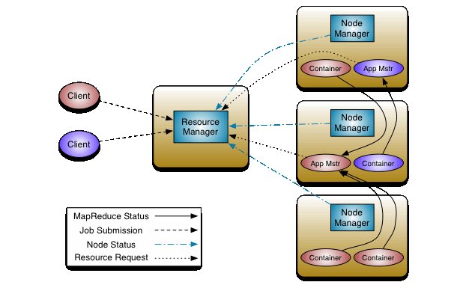
Apache Hadoop YARN
Source: http://hadoop.apache.org/docs/current/hadoop-yarn/hadoop-yarn-site/YARN.html

Slide 58
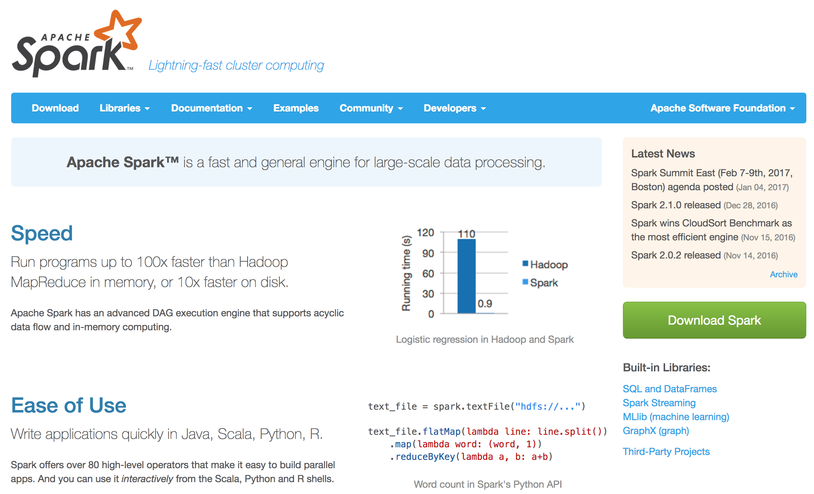
Apache Spark
http://spark.apache.org/

Slide 59
Source: http://mattturck.com/2016/02/01/big-data-landscape/

Slide 60
References
EMC Education Services (2015), Data Science and Big Data Analytics: Discovering, Analyzing, Visualizing and Presenting Data, Wiley
Shiva Achari (2015), Hadoop Essentials - Tackling the Challenges of Big Data with Hadoop, Packt Publishing
Mike Frampton (2015), Mastering Apache Spark, Packt Publishing
Deepak Ramanathan (2014), SAS Modernization architectures - Big Data Analytics, http://www.slideshare.net/deepakramanathan/sas-modernization-architectures-big-data-analytics

