Slide 1
金融科技 FinTech: Financial Technology
Tamkang University
金融科技智慧問答系統 (Intelligent Question Answering System for Fintech)
1052FinTech11
MIS EMBA (M2263) (8595) Fri, 12,13,14 (19:20-22:10) (D409)
Min-Yuh Day
戴敏育
Assistant Professor
專任助理教授
Dept. of Information Management, Tamkang University
淡江大學 資訊管理學系
http://mail. tku.edu.tw/myday/
2017-06-02

Slide 2
課程大綱 (Syllabus)
週次 (Week) 日期 (Date) 內容 (Subject/Topics)
1 2017/02/17 Fintech 金融科技課程介紹 (Course Orientation for Fintech: Financial Technology)
2 2017/02/24 Fintech 金融科技的演進：貨幣與金融服務 (Evolution of Fintech: Money and Financial Services)
3 2017/03/03 Fintech 金融科技：金融服務科技創新 (Fintech: Technology Innovation in Financial Services)
4 2017/03/10 Fintech 金融科技與金融服務價值鏈 (Fintech and Financial Services Value Chain)
5 2017/03/17 Fintech 金融科技商業模式創新 (Fintech Business Models Innovation)
6 2017/03/24 Fintech 金融科技個案研究 I (Case Study on Fintech I)

Slide 3
課程大綱 (Syllabus)
週次 (Week) 日期 (Date) 內容 (Subject/Topics)
7 2017/03/31 金融服務消費者心理與行為 (Consumer Psychology and Behavior on Financial Services)
8 2017/04/07 教學行政觀摩日 (Off-campus study)
9 2017/04/14 區塊鏈技術 (Blockchain Technology) [Invited Speaker: Dr. Raymund Lin, IBM (林俊叡 博士，IBM)]
10 2017/04/21 期中報告 (Midterm Project Report)
11 2017/04/28 Python Pandas財務大數據分析 (Finance Big Data Analytics with Pandas in Python)
12 2017/05/05 人工智慧與深度學習金融科技 (Artificial Intelligence and Deep Learning for Fintech)

Slide 4
課程大綱 (Syllabus)
週次 (Week) 日期 (Date) 內容 (Subject/Topics)
13 2017/05/12 Fintech 金融科技個案研究 II (Case Study on Fintech II)
14 2017/05/19 金融科技財富管理：機器人理財顧問 (Robo-Advisors for Wealth Management in Fintech)
15 2017/05/26 投資組合最佳化與程式交易 (Portfolio Optimization and Algorithmic Trading)
16 2017/06/02 金融科技智慧問答系統 (Intelligent Question Answering System for Fintech)
17 2017/06/09 期末報告 I (Final Project Presentation I)
18 2017/06/16 期末報告 II (Final Project Presentation II)

Slide 5
Intelligent Question Answering System for Fintech

Slide 6
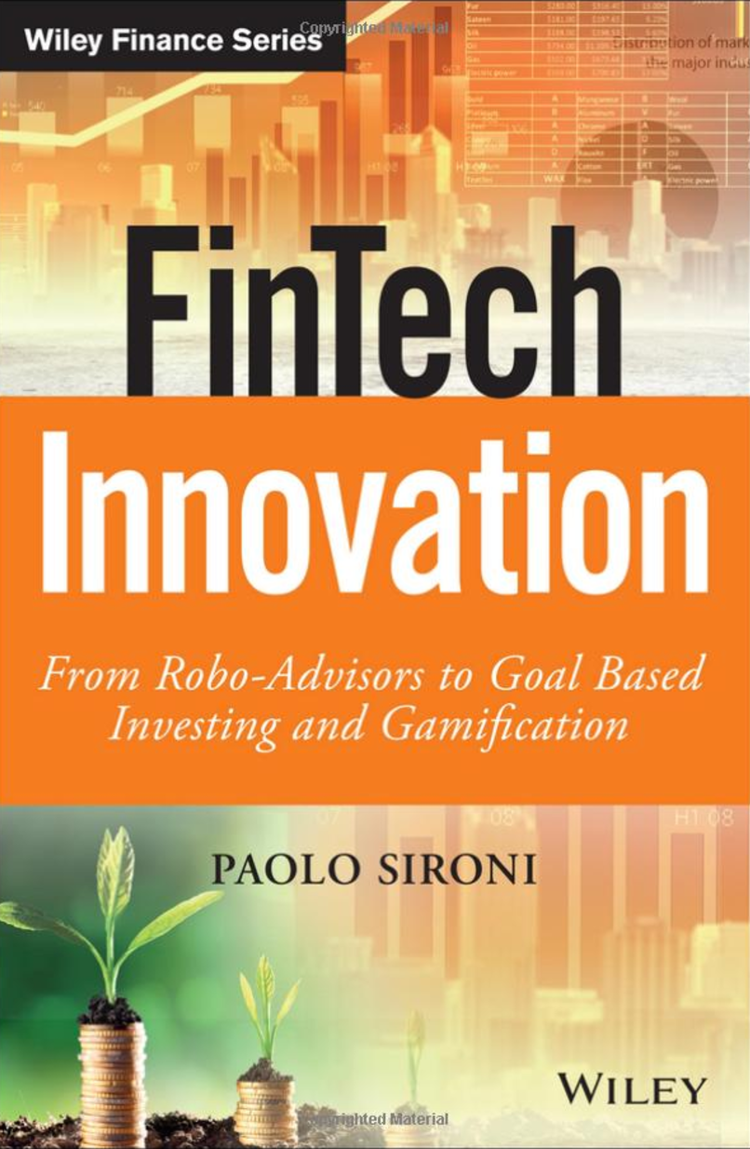
FinTech Innovation: From Robo-Advisors to Goal Based Investing and Gamification, Paolo Sironi, Wiley, 2016
Source: https://www.amazon.com/FinTech-Innovation-Robo-Advisors-Investing-Gamification/dp/1119226988

Slide 7
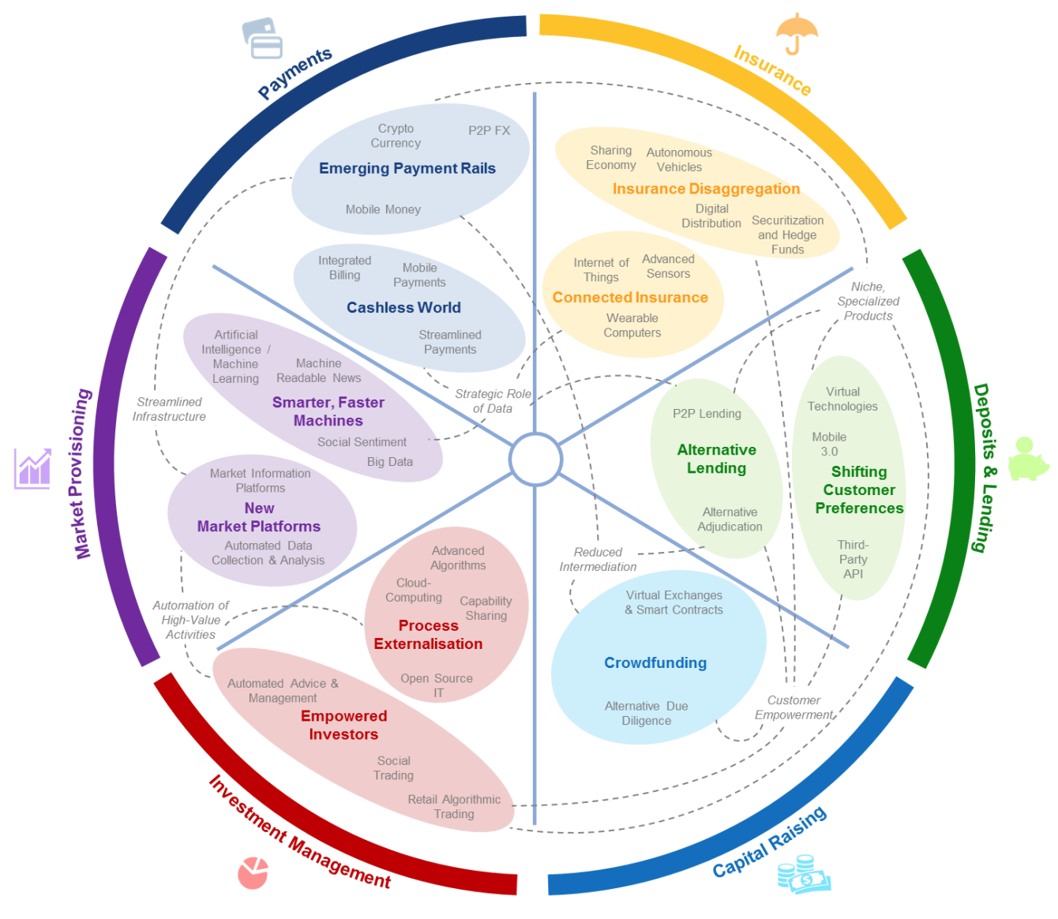
FinTech: Financial Services Innovation
Source: http://www3.weforum.org/docs/WEF_The_future__of_financial_services.pdf

Slide 8
FinTech: Financial Services Innovation 1. Payments 2. Insurance 3. Deposits & Lending 4. Capital Raising 5. Investment Management 6. Market Provisioning
Source: http://www3.weforum.org/docs/WEF_The_future__of_financial_services.pdf

Slide 9
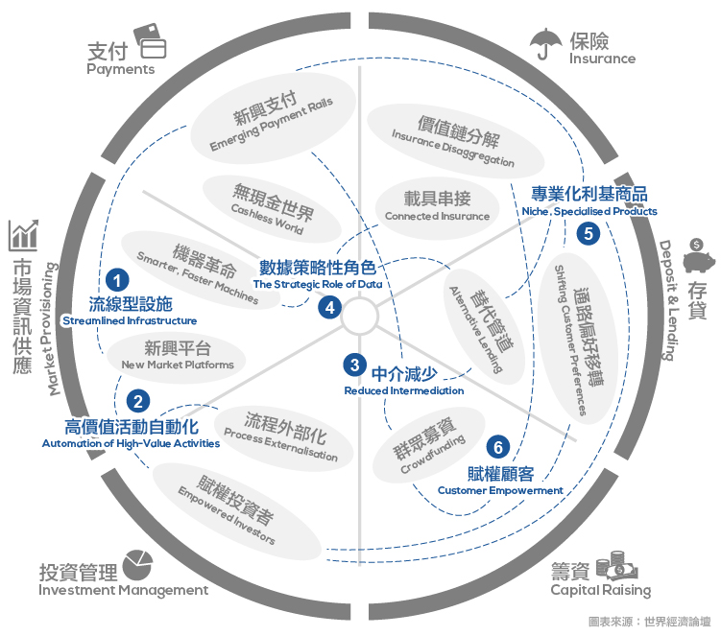
Source: https://www.stockfeel.com.tw/2015年世界經濟論壇－未來的金融服務/

Slide 10
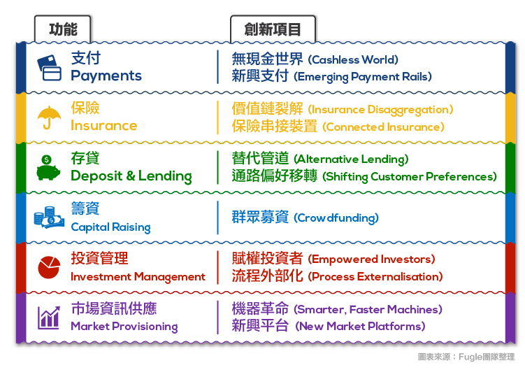
FinTech: Financial Services Innovation
Source: https://www.stockfeel.com.tw/2015年世界經濟論壇－未來的金融服務/

Slide 11
FinTech: Investment Management
5
Source: http://www3.weforum.org/docs/WEF_The_future__of_financial_services.pdf

Slide 12
FinTech: Investment Management Empowered Investors Process Externalization
5
Source: https://www.stockfeel.com.tw/2015年世界經濟論壇－未來的金融服務/

Slide 13
FinTech: Market Provisioning
6
Source: http://www3.weforum.org/docs/WEF_The_future__of_financial_services.pdf

Slide 14
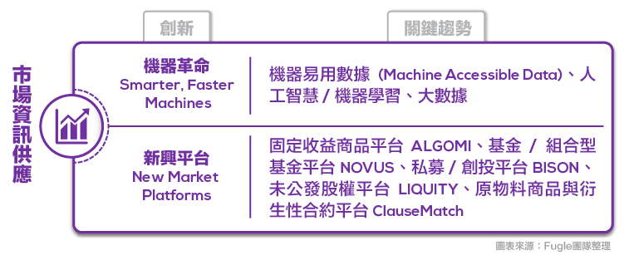
FinTech: Market Provisioning Smarter, Faster Machines New Market Platforms
6
Source: https://www.stockfeel.com.tw/2015年世界經濟論壇－未來的金融服務/

Slide 15
AI and Big Data Analytics in Finance
財務金融大數據分析
Big Data Analytics in Finance
投資大數據分析
Big Data Analytics in Investment
人工智慧與財務應用
Artificial Intelligence and Financial Application
人工智慧與投資分析
Artificial Intelligence and Investment Analysis

Slide 16
Question Answering

Slide 17
Dialogue System

Slide 18
Chatbot

Slide 19
From E-Commerce to Conversational Commerce: Chatbots and Virtual Assistants
Source: http://www.guided-selling.org/from-e-commerce-to-conversational-commerce/

Slide 20
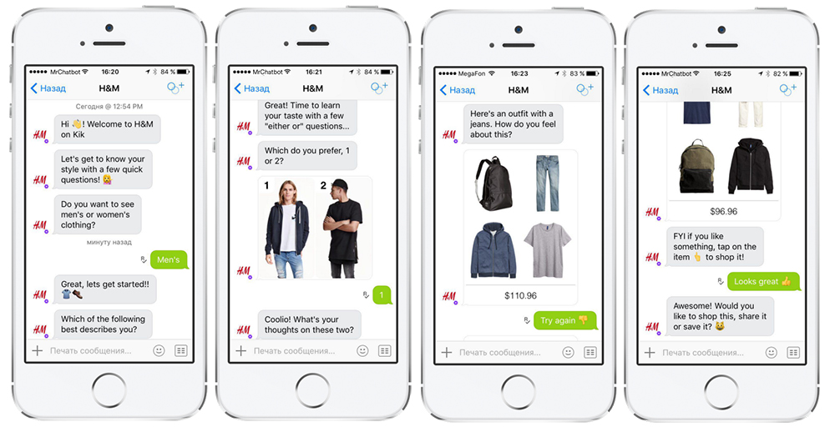
H&M’s chatbot on Kik
Source: http://www.guided-selling.org/from-e-commerce-to-conversational-commerce/

Slide 21
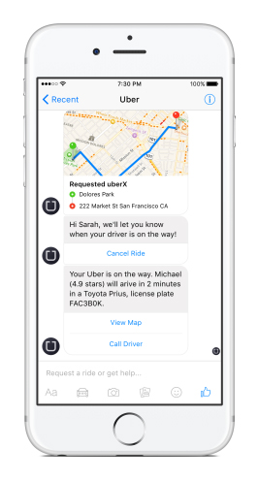
Uber’s chatbot on Facebook’s messenger
Uber’s chatbot on Facebook’s messenger - one main benefit: it loads much faster than the Uber app
Source: http://www.guided-selling.org/from-e-commerce-to-conversational-commerce/

Slide 22
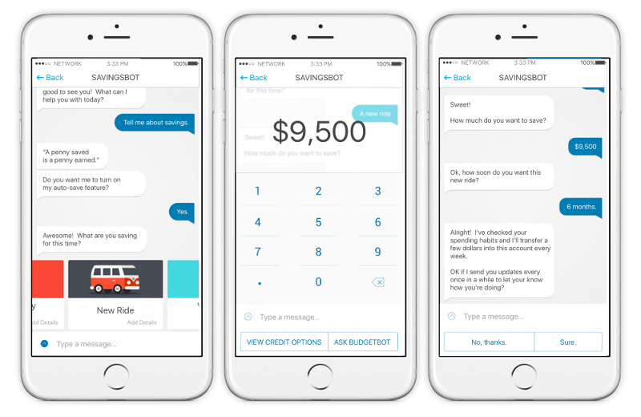
Savings Bot
Source: https://chatbotsmagazine.com/artificial-intelligence-ai-and-fintech-part-1-7cae1e67dc13

Slide 23
Source: https://www.oreilly.com/ideas/infographic-the-bot-platform-ecosystem

Slide 24
Source: https://www.oreilly.com/ideas/infographic-the-bot-platform-ecosystem

Slide 25
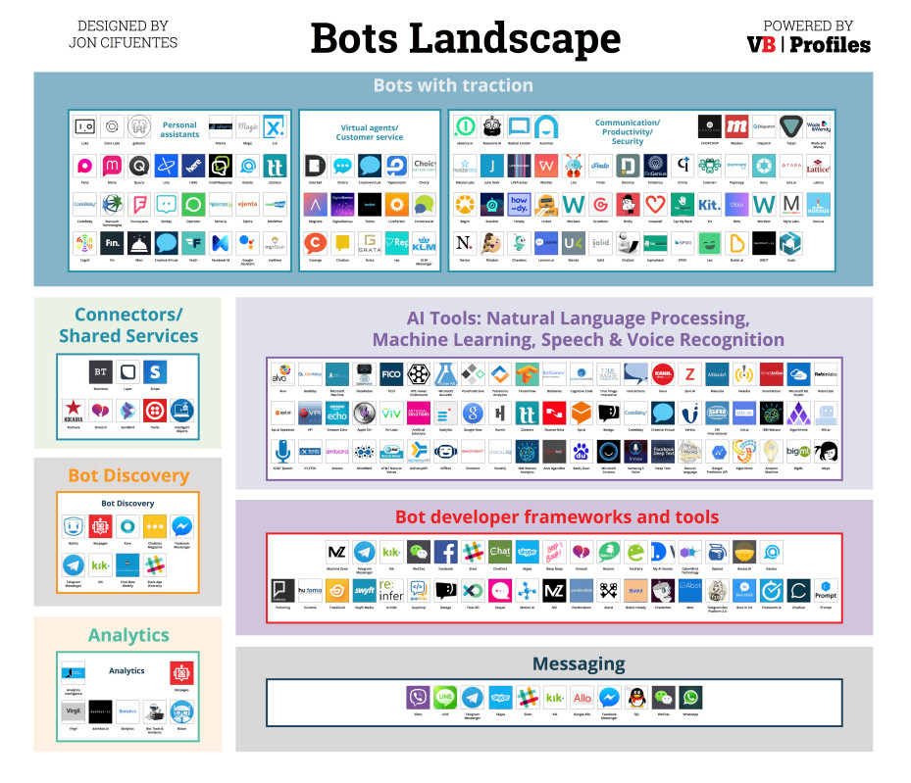
Source: https://venturebeat.com/2016/08/11/introducing-the-bots-landscape-170-companies-4-billion-in-funding-thousands-of-bots/

Slide 26
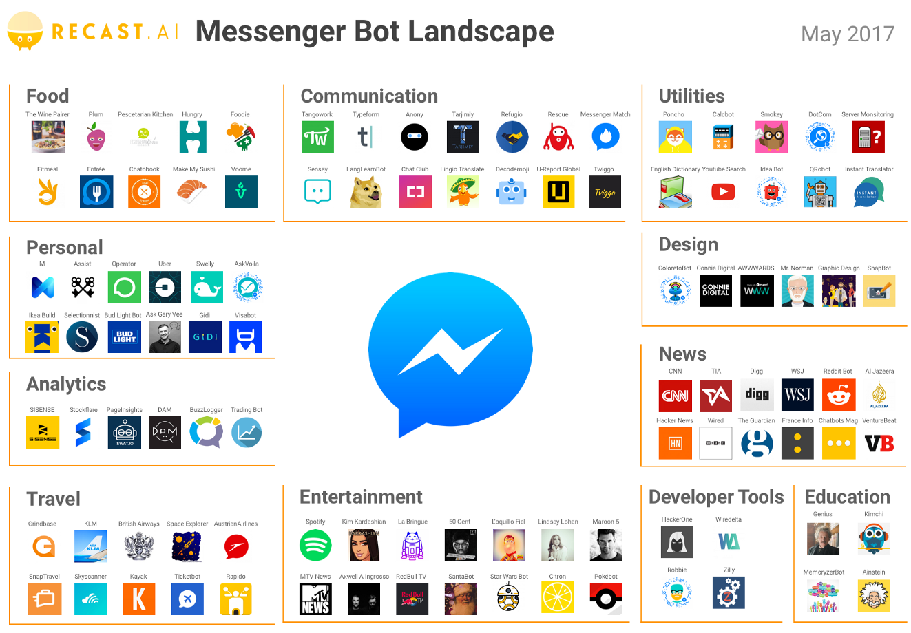
Source: https://medium.com/@RecastAI/2017-messenger-bot-landscape-a-public-spreadsheet-gathering-1000-messenger-bots-f017fdb1448a /

Slide 27
System Architecture of Intelligent Dialogue and Question Answering System
User Question Input
RNN
LSTM
GRU
Deep Learning
TensorFlow
Dialogue Intention Detection
Question Analysis
Python
NLTK
AIML KB
AIML
Dialogue Engine
Dialogue KB
Document Retrieval
IR
Answer Extraction
Cloud
Resource
Real Time
Dialogue
API
Answer Generation
Answer Validation
Deep Learning
System Response Generator
Answer

Slide 28
IMTKU System Architecture for NTCIR-12 QALab2
Question (XML)
JA&EN Translator
Complex Essay
Question Analysis
Simple Essay
Stanford CoreNLP
True-or-False
Factoid
Document Retrieval
Lucene
Slot-Filling
Unique
Wikipedia
Answer Extraction
Answer Generation
Answer Validation
Machine Learning
Answer (XML)

Slide 29
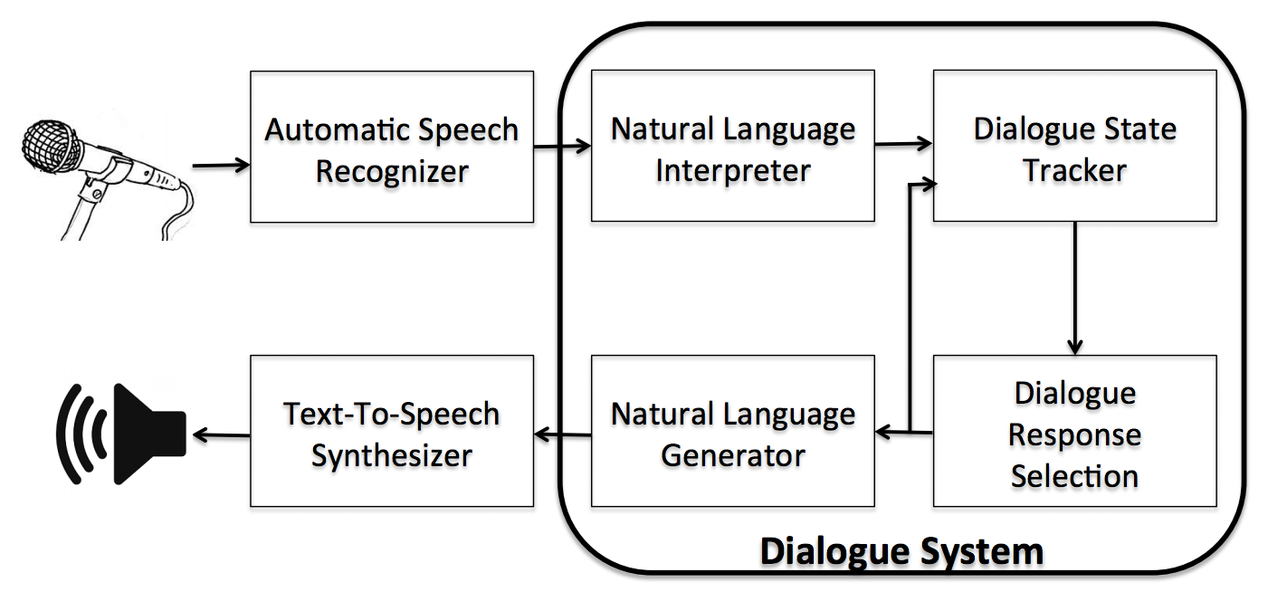
Dialogue System
Source: Serban, I. V., Lowe, R., Charlin, L., & Pineau, J. (2015). A survey of available corpora for building data-driven dialogue systems. arXiv preprint arXiv:1512.05742.

Slide 30
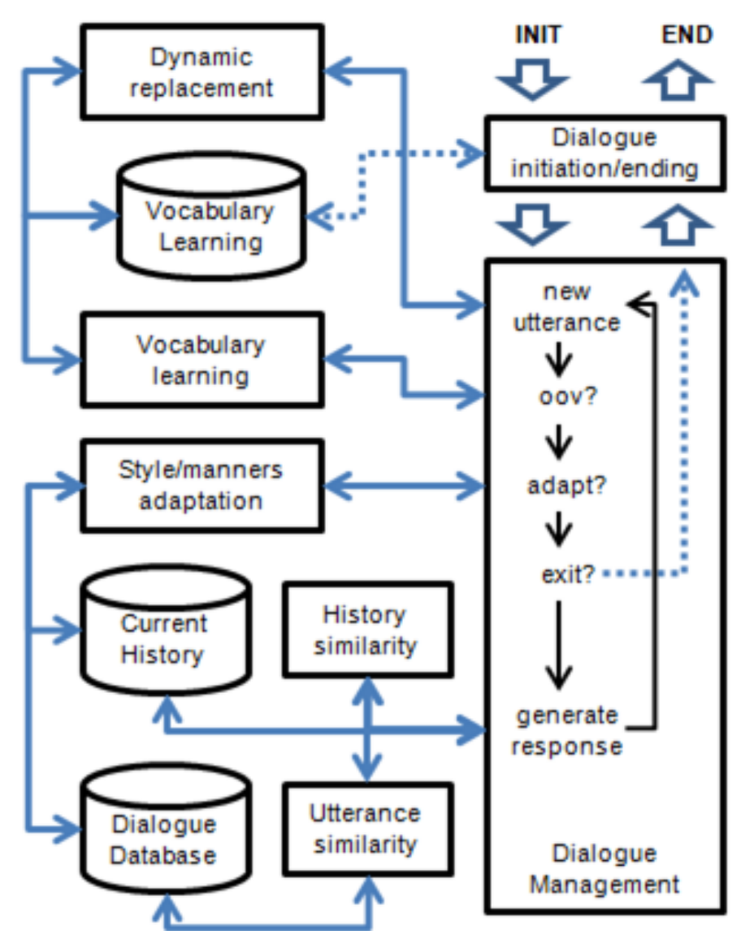
Chat-oriented Dialogue System
Source: Banchs, R. E., & Li, H. (2012, July). IRIS: a chat-oriented dialogue system based on the vector space model. In Proceedings of the ACL 2012 System Demonstrations (pp. 37-42). Association for Computational Linguistics.

Slide 31
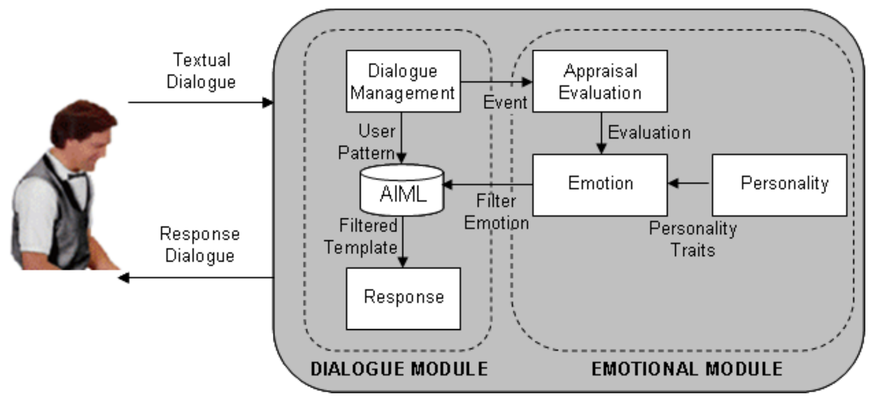
AIML Dialogue System
Source: Morales-Rodríguez, María Lucila, Rogelio Florencia Juárez, Hector J. Fraire Huacuja, and José A. Martínez Flores. "Emotional conversational agents in clinical psychology and psychiatry." In Mexican International Conference on Artificial Intelligence, pp. 458-466. Springer Berlin Heidelberg, 2010.

Slide 32
Deep Learning for Dialogues Intent Classification Intent LSTM LSTM (Long-Short Term Memory) GRU (Gated Recurrent Unit)
Source: Hakkani-Tür, Dilek, Gokhan Tur, Asli Celikyilmaz, Yun-Nung Chen, Jianfeng Gao, Li Deng, and Ye-Yi Wang. "Multi-domain joint semantic frame parsing using bi-directional RNN-LSTM." In Proceedings of The 17th Annual Meeting of the International Speech Communication Association. 2016.

Slide 33
Dialogue Utterance
An example utterance with annotations of semantic slots in IOB format (S), domain (D), and intent (I), B-dir and I-dir denote the director name.
Source: Hakkani-Tür, Dilek, Gokhan Tur, Asli Celikyilmaz, Yun-Nung Chen, Jianfeng Gao, Li Deng, and Ye-Yi Wang. "Multi-domain joint semantic frame parsing using bi-directional RNN-LSTM." In Proceedings of The 17th Annual Meeting of the International Speech Communication Association. 2016.

Slide 34
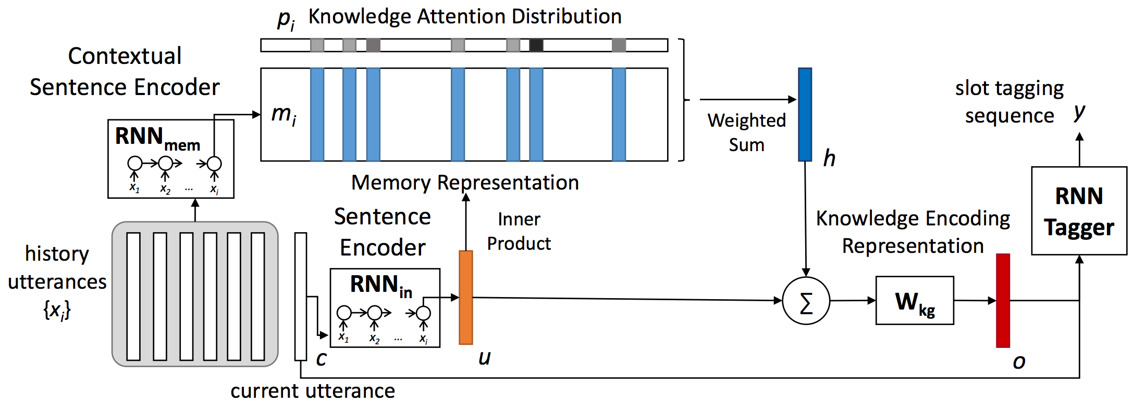
End-to-end Memory Network Model for Multi-turn SLU
Source: Chen, Yun-Nung, Dilek Hakkani-Tür, Gokhan Tur, Jianfeng Gao, and Li Deng. "End-to-end memory networks with knowledge carryover for multi-turn spoken language understanding." In Proceedings of Interspeech. 2016.

Slide 35
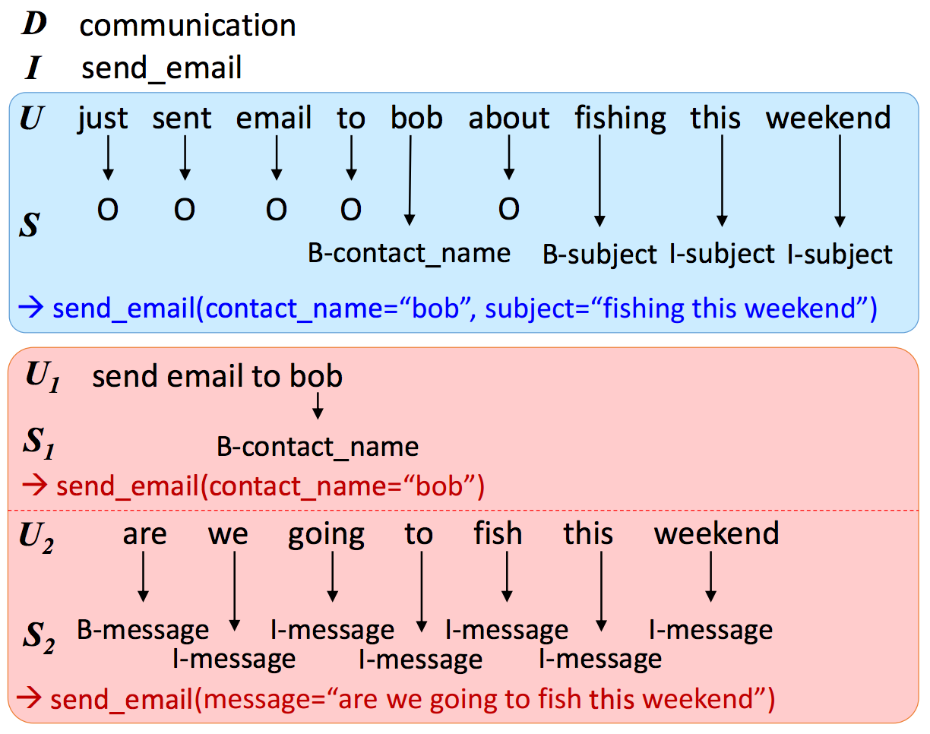
Source: Chen, Yun-Nung, Dilek Hakkani-Tür, Gokhan Tur, Jianfeng Gao, and Li Deng. "End-to-end memory networks with knowledge carryover for multi-turn spoken language understanding." In Proceedings of Interspeech. 2016.

Slide 36
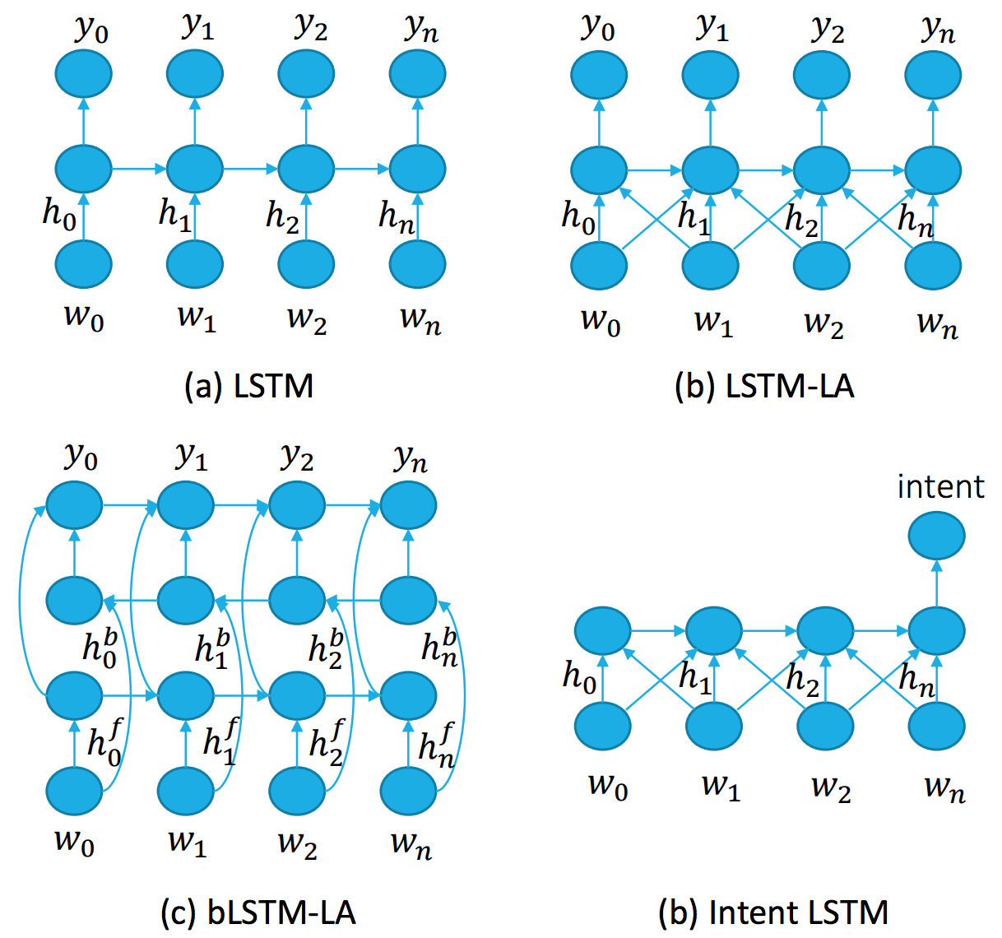
Deep Learning for SLU (Spoken Language Understanding)
Source: Hakkani-Tür, Dilek, Gokhan Tur, Asli Celikyilmaz, Yun-Nung Chen, Jianfeng Gao, Li Deng, and Ye-Yi Wang. "Multi-domain joint semantic frame parsing using bi-directional RNN-LSTM." In Proceedings of The 17th Annual Meeting of the International Speech Communication Association. 2016.

Slide 37
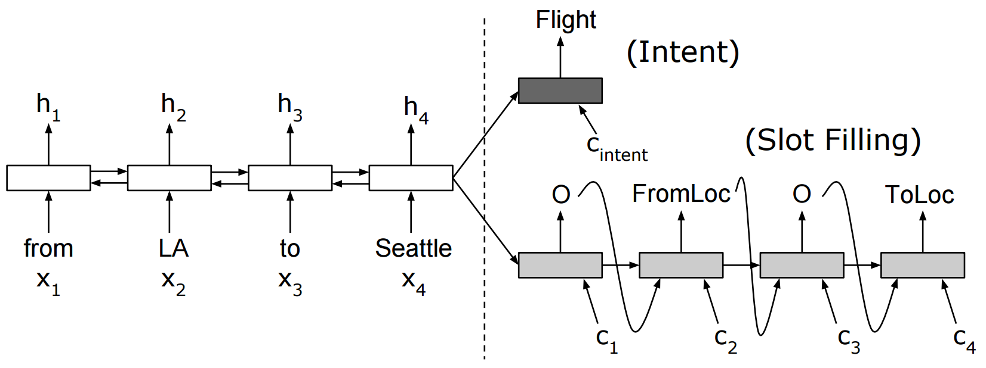
Encoder-decoder model for joint intent detection and slot filling
(a) with no aligned inputs.
Source: Liu, Bing, and Ian Lane. "Attention-Based Recurrent Neural Network Models for Joint Intent Detection and Slot Filling." arXiv preprint arXiv:1609.01454 (2016).

Slide 38
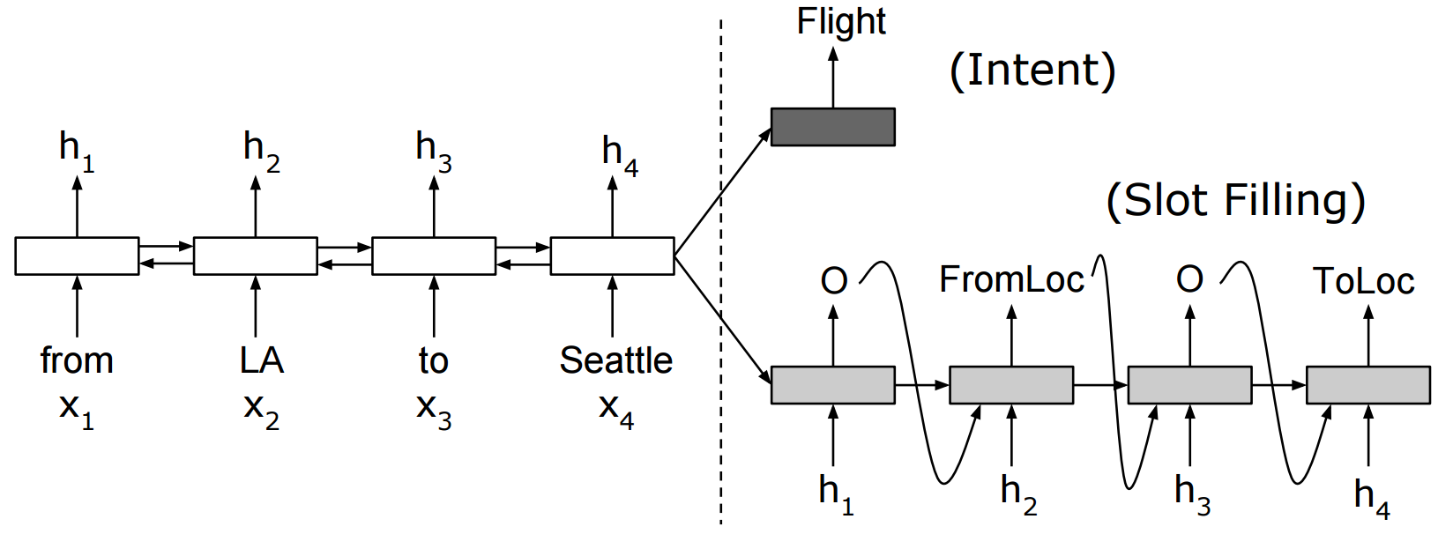
Encoder-decoder model for joint intent detection and slot filling
(b) with aligned inputs.
Source: Liu, Bing, and Ian Lane. "Attention-Based Recurrent Neural Network Models for Joint Intent Detection and Slot Filling." arXiv preprint arXiv:1609.01454 (2016).

Slide 39
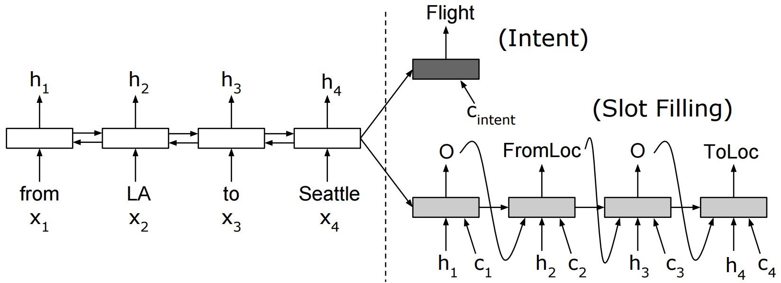
Encoder-decoder model for joint intent detection and slot filling
(c) with aligned inputs and attention
Source: Liu, Bing, and Ian Lane. "Attention-Based Recurrent Neural Network Models for Joint Intent Detection and Slot Filling." arXiv preprint arXiv:1609.01454 (2016).

Slide 40
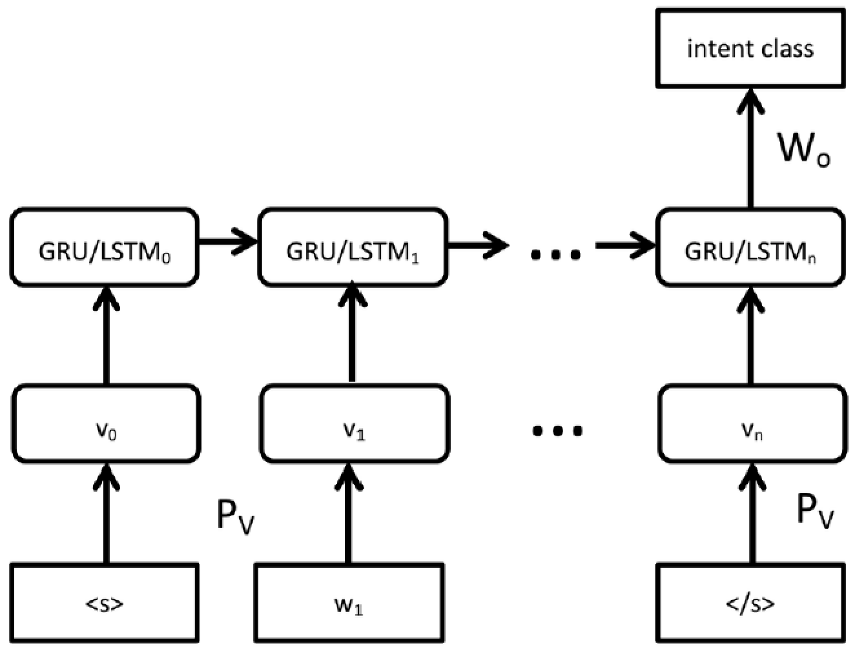
LSTM/GRU Utterance Classifer
Source: Ravuri, Suman, and Andreas Stolcke. "A comparative study of recurrent neural network models for lexical domain classification." In Acoustics, Speech and Signal Processing (ICASSP), 2016 IEEE International Conference on, pp. 6075-6079. IEEE, 2016.

Slide 41
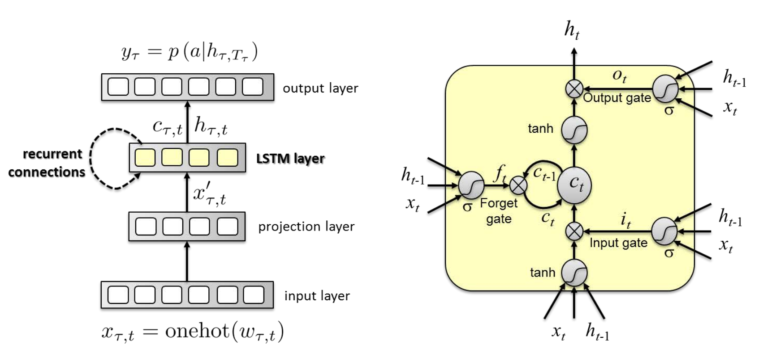
RNN and LSTM cell
Source: Hori, Chiori, Takaaki Hori, Shinji Watanabe, and John R. Hershey. "Context-Sensitive and Role-Dependent Spoken Language Understanding using Bidirectional and Attention LSTMs." Interspeech 2016 (2016): 3236-3240.

Slide 42
Basic Chat Bot Components
Jeongkyu Shin (2016), Building AI Chat bot with Python 3 and TensorFlow, PyCon APAC 2016

Slide 43
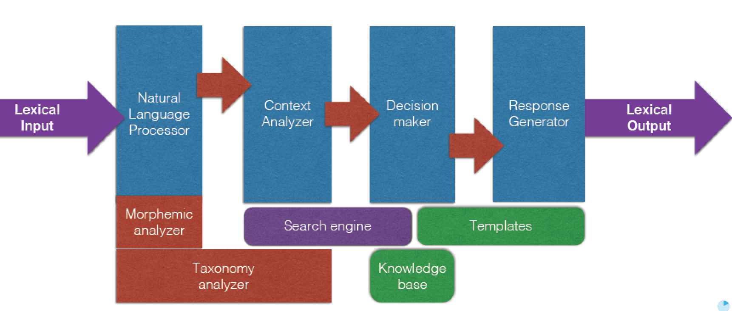
Traditional Chat Bots
Jeongkyu Shin (2016), Building AI Chat bot with Python 3 and TensorFlow, PyCon APAC 2016

Slide 44
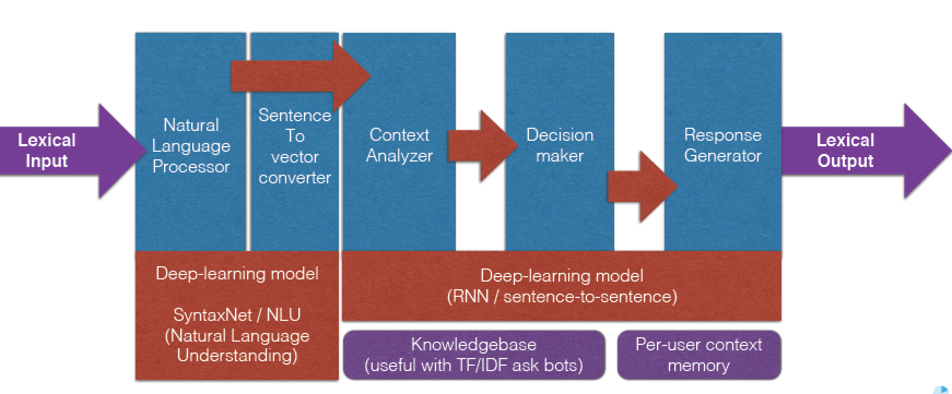
Chatbots with Machine Learning
Jeongkyu Shin (2016), Building AI Chat bot with Python 3 and TensorFlow, PyCon APAC 2016

Slide 45
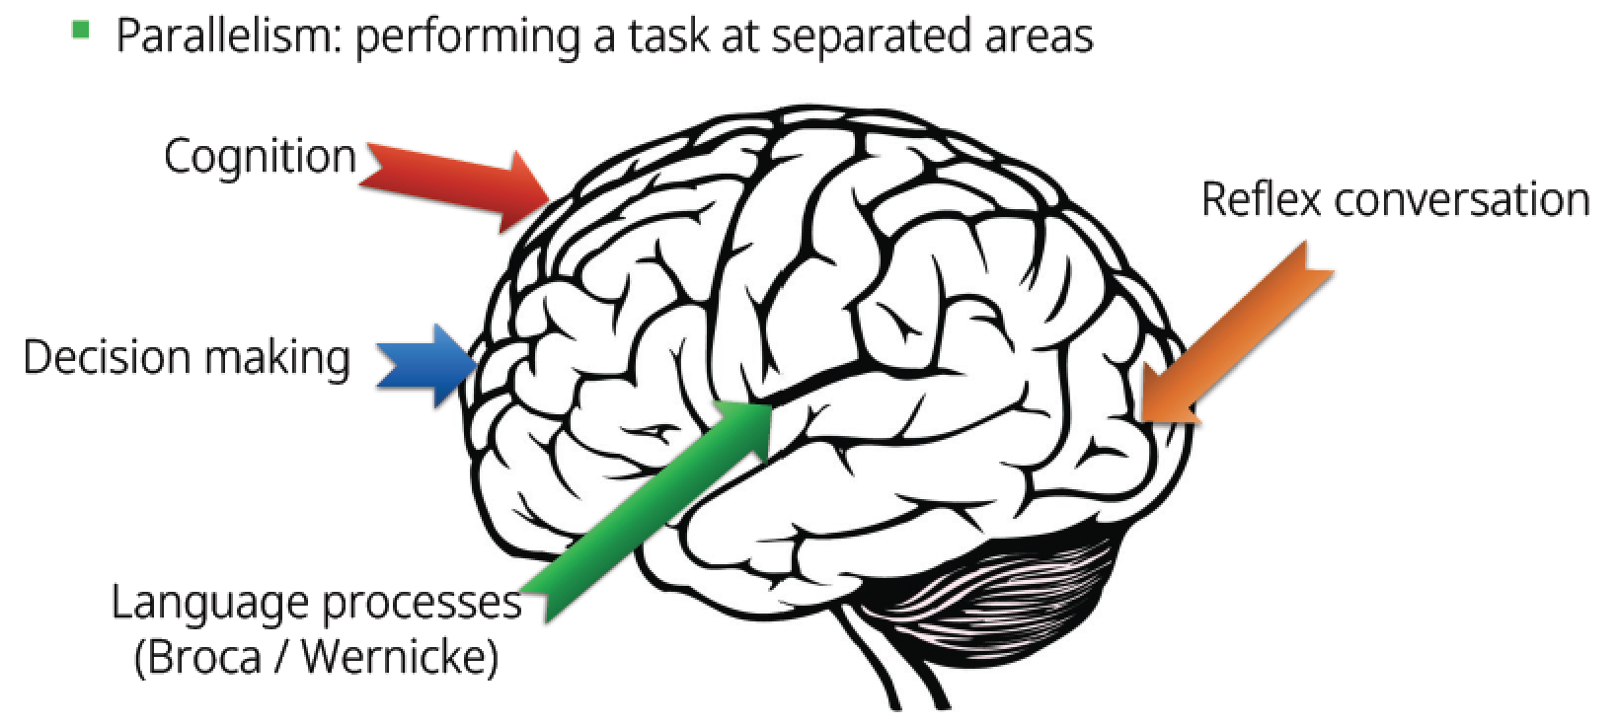
How Brain Works
Jeongkyu Shin (2016), Building AI Chat bot with Python 3 and TensorFlow, PyCon APAC 2016

Slide 46
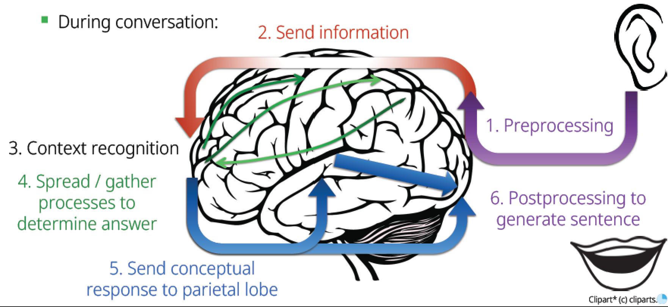
Information Pathway During Conversation
Jeongkyu Shin (2016), Building AI Chat bot with Python 3 and TensorFlow, PyCon APAC 2016

Slide 47
Idea from Structure
Jeongkyu Shin (2016), Building AI Chat bot with Python 3 and TensorFlow, PyCon APAC 2016

Slide 48
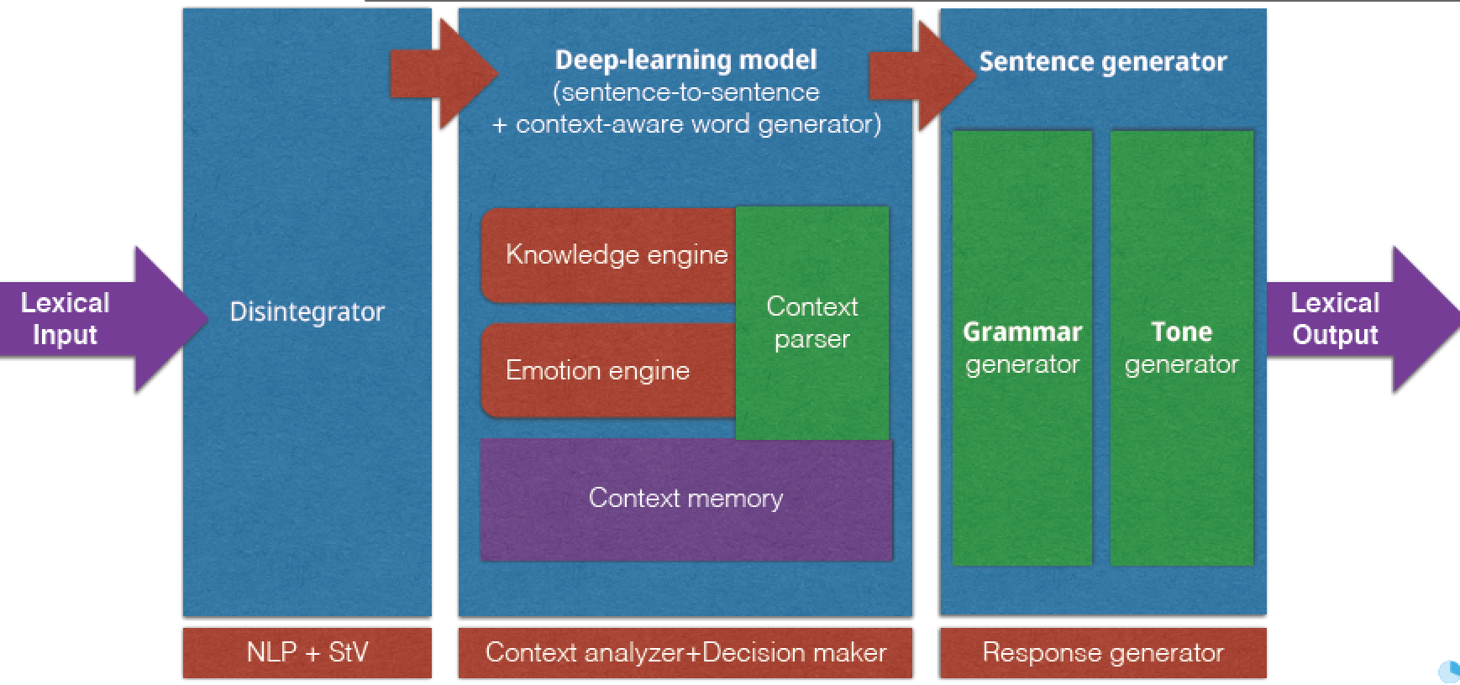
AI Deep Learning Chatbot Architecture
Jeongkyu Shin (2016), Building AI Chat bot with Python 3 and TensorFlow, PyCon APAC 2016

Slide 49
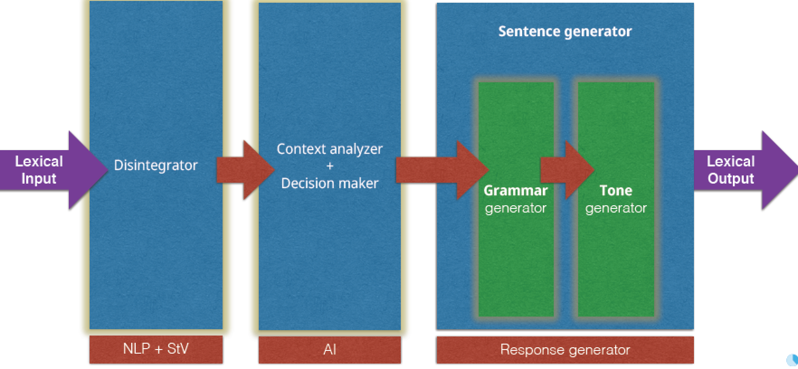
Model Chain Order
Jeongkyu Shin (2016), Building AI Chat bot with Python 3 and TensorFlow, PyCon APAC 2016

Slide 50
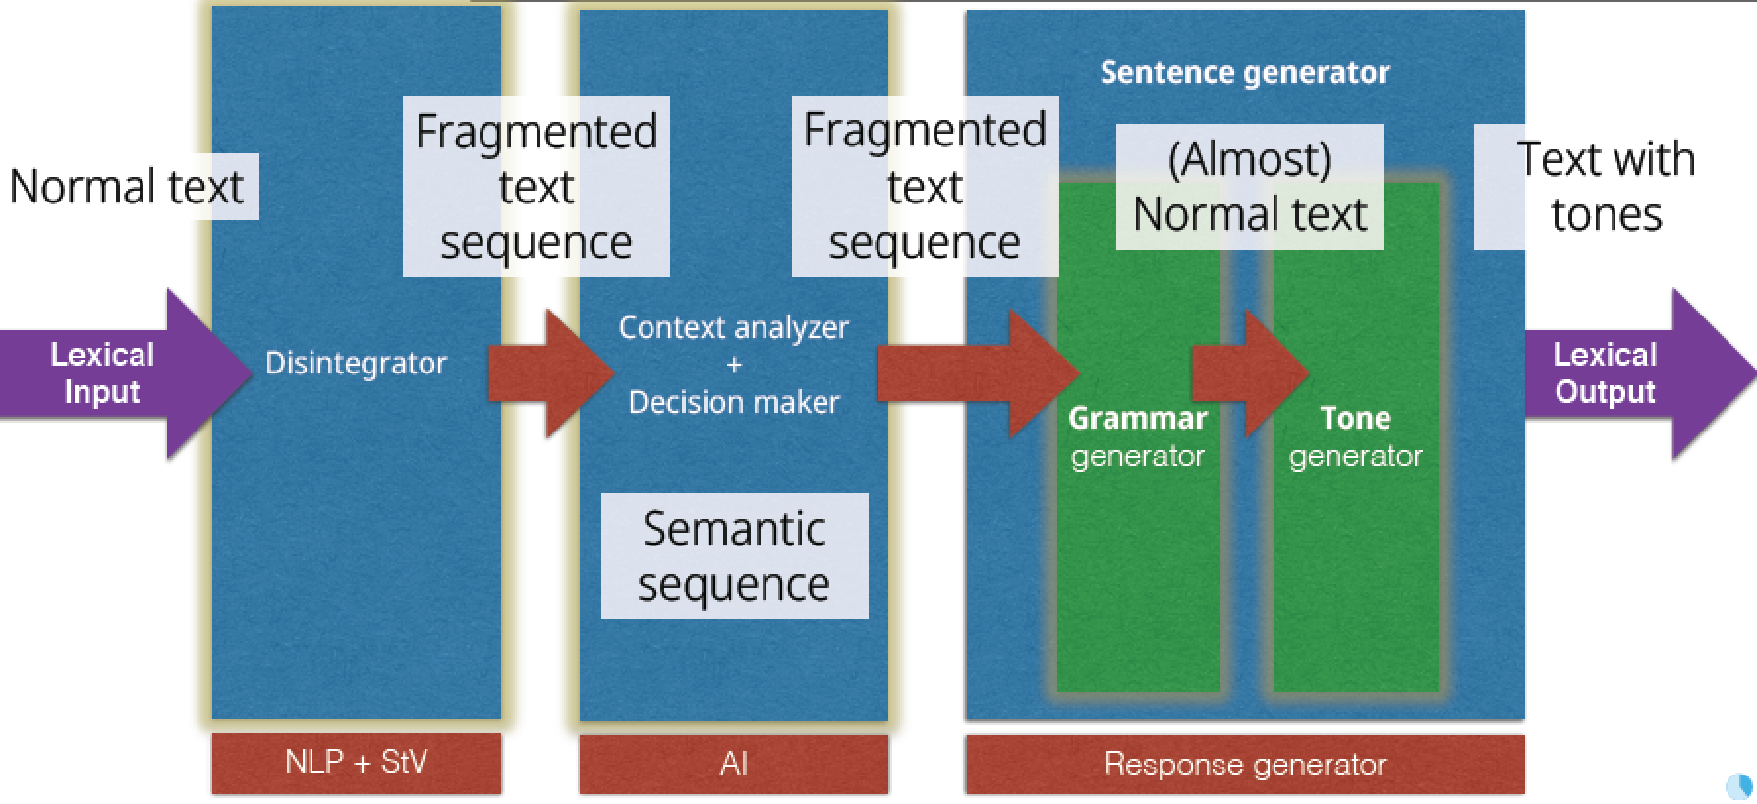
Model Chain Order
Jeongkyu Shin (2016), Building AI Chat bot with Python 3 and TensorFlow, PyCon APAC 2016

Slide 51
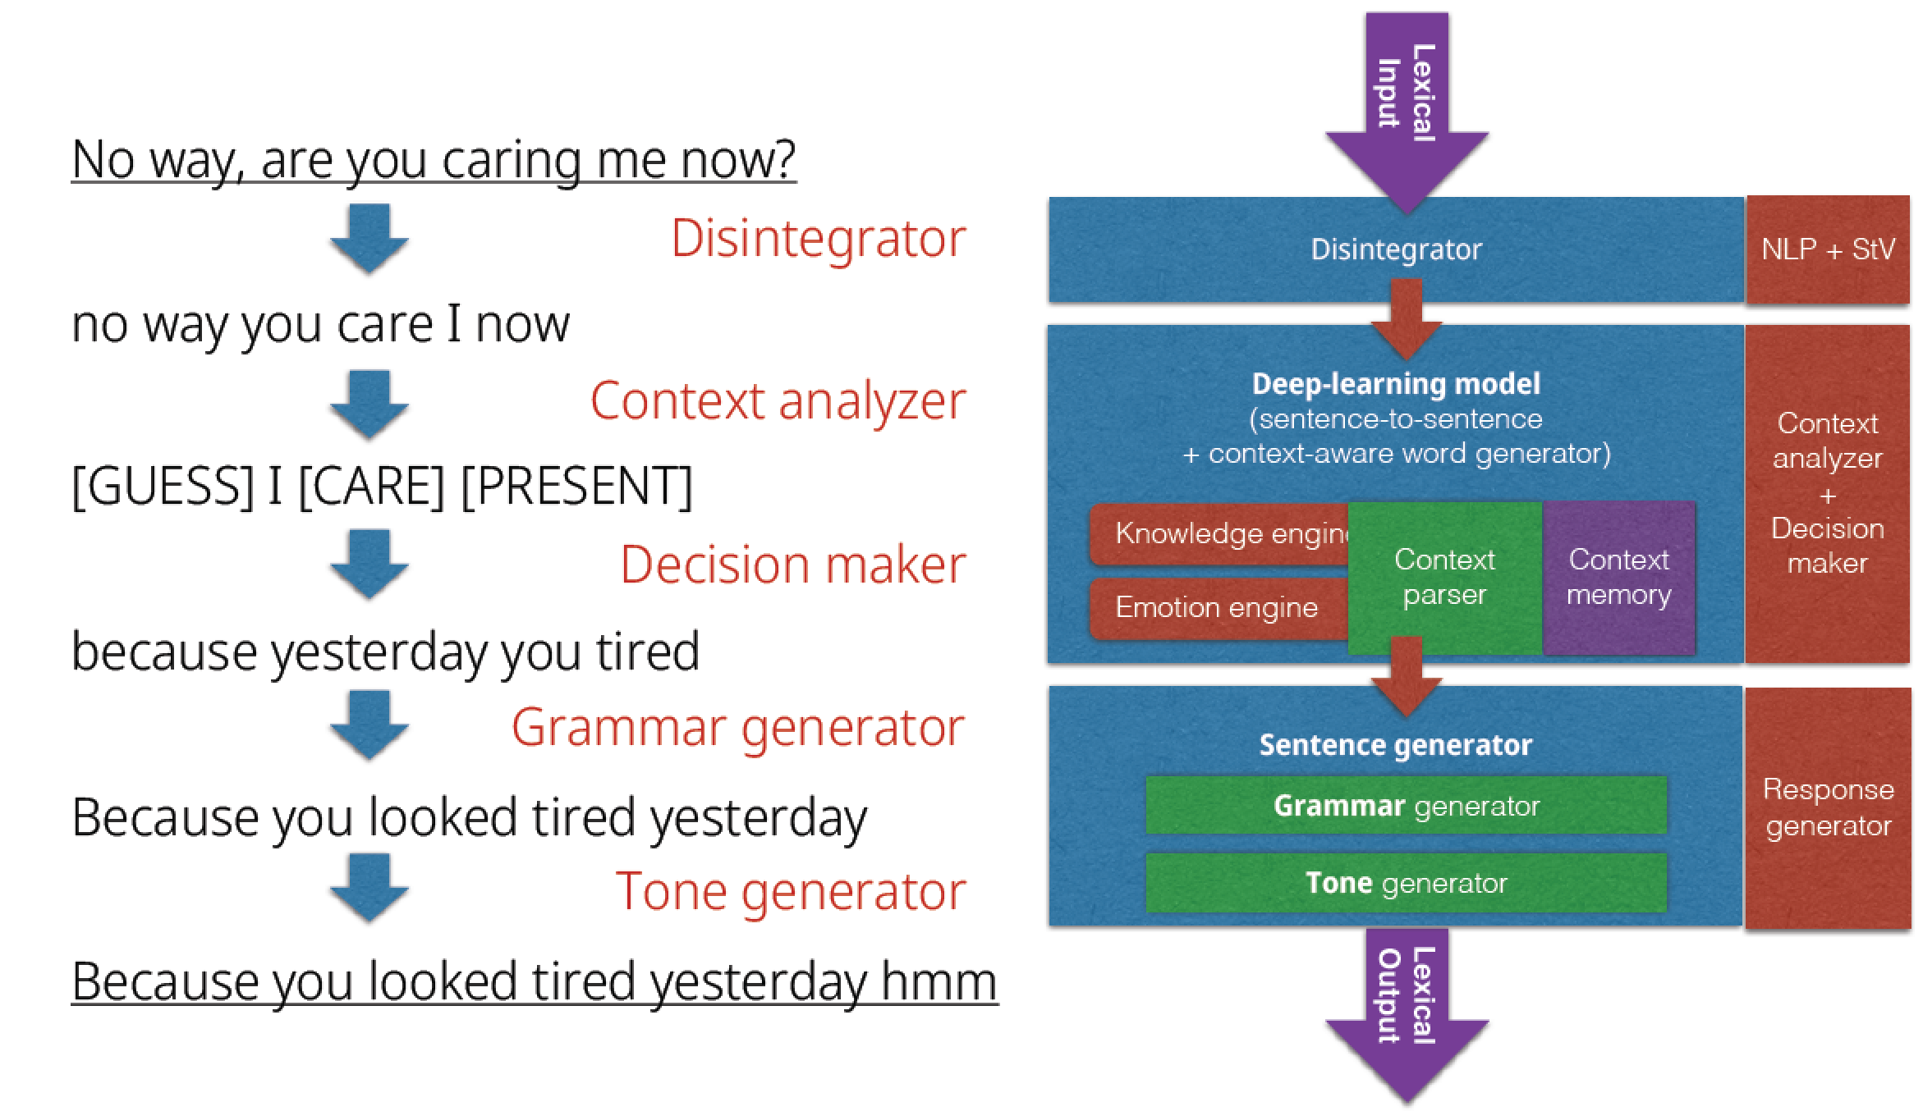
AI Deep Learning for Chatbot
Jeongkyu Shin (2016), Building AI Chat bot with Python 3 and TensorFlow, PyCon APAC 2016

Slide 52
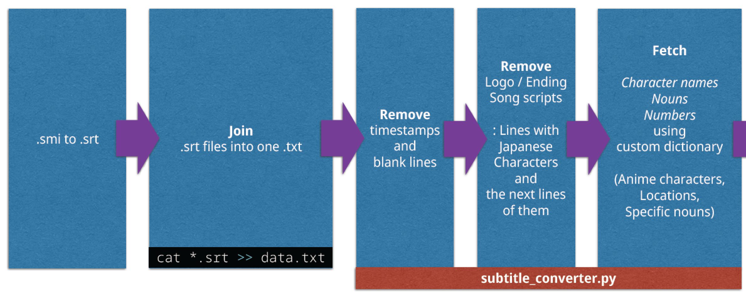
Data Converter for Chatbot Subtitle Files from Movie
Jeongkyu Shin (2016), Building AI Chat bot with Python 3 and TensorFlow, PyCon APAC 2016

Slide 53
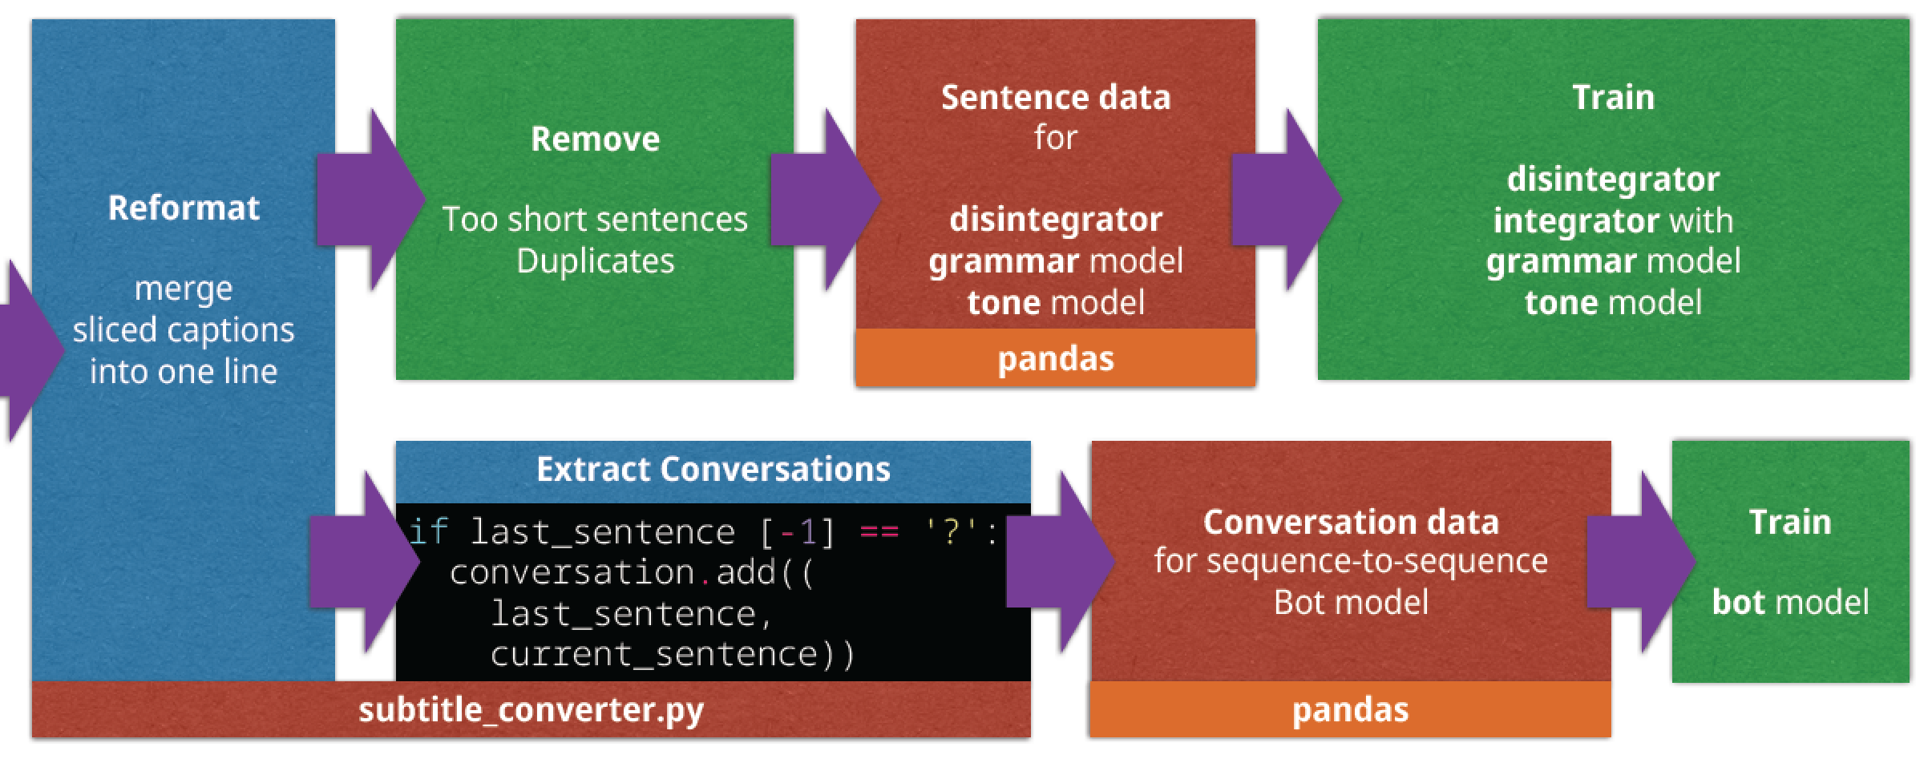
Data Converter for Chatbot Subtitle Files from Movie
Jeongkyu Shin (2016), Building AI Chat bot with Python 3 and TensorFlow, PyCon APAC 2016

Slide 54
Conversation Bot Model
Embedding RNN Sequence-to-sequence model
Testing
4-layer to 8-layer swallow learning (without input/output layer)
Use tensorflow.contrib.learn (formally sklearn package)
Simpler and easier than traditional handcrafted RNN
Seq2seq, LSTMCell, GRUCell
Jeongkyu Shin (2016), Building AI Chat bot with Python 3 and TensorFlow, PyCon APAC 2016

Slide 55
Question Answering

Slide 56
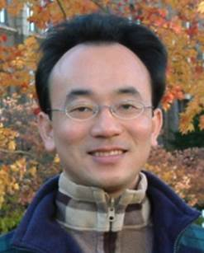
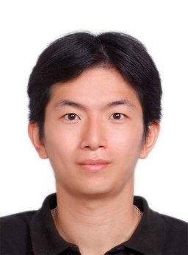
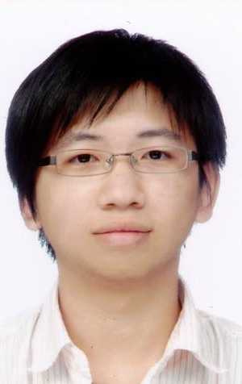
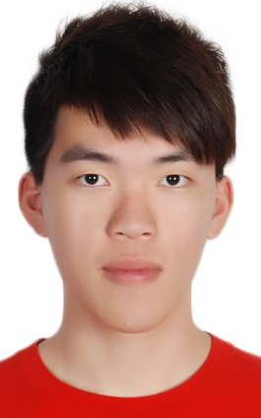
IMTKU Question Answering System for World History Exams at NTCIR-12 QA Lab2
Tamkang University
Department of Information Management
Tamkang University, Taiwan
Sagacity Technology
Min-Yuh Day
Cheng-Chia Tsai
Wei-Chun Chung
Hsiu-Yuan Chang
Tzu-Jui Sun
Yuan-Jie Tsai
Jin-Kun Lin
Cheng-Hung Lee
Yu-Ming Guo
Yue-Da Lin
Wei-Ming Chen
Yun-Da Tsai
Cheng-Jhih Han
Yi-Jing Lin
Yi-Heng Chiang
Ching-Yuan Chien
myday@mail.tku.edu.tw
NTCIR-12 Conference, June 7-10, 2016, Tokyo, Japan

Slide 57
IMTKU Question Answering System for
World History Exams at NTCIR-12 QA Lab2

Slide 58
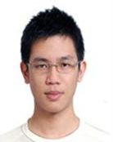
Tamkang University
2011
Tamkang University
IMTKU Textual Entailment System for Recognizing Inference in Text at NTCIR-9 RITE
Department of Information Management Tamkang University, Taiwan
Min-Yuh Day
Chun Tu
myday@mail.tku.edu.tw
NTCIR-9 Workshop, December 6-9, 2011, Tokyo, Japan

Slide 59
IMTKU Textual Entailment System for Recognizing Inference in Text at NTCIR-10 RITE-2
Tamkang University
2013
Tamkang University
Department of Information Management Tamkang University, Taiwan
Min-Yuh Day
Chun Tu
Hou-Cheng Vong
Shih-Wei Wu
Shih-Jhen Huang
myday@mail.tku.edu.tw
NTCIR-10 Conference, June 18-21, 2013, Tokyo, Japan

Slide 60
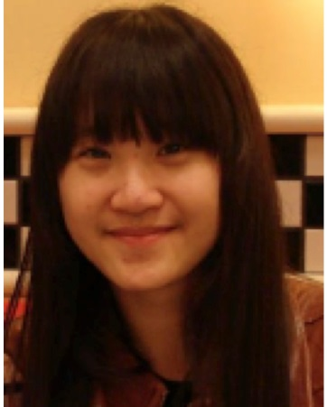
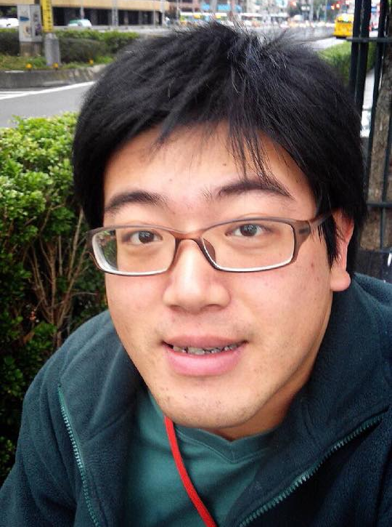
IMTKU Textual Entailment System for Recognizing Inference in Text at NTCIR-11 RITE-VAL 2014
Tamkang University
Min-Yuh Day
Ya-Jung Wang
Che-Wei Hsu
En-Chun Tu
Huai-Wen Hsu
Yu-An Lin
Shang-Yu Wu
Yu-Hsuan Tai
Cheng-Chia Tsai
NTCIR-11 Conference, December 8-12, 2014, Tokyo, Japan

Slide 61
IMTKU Question Answering System for World History Exams at NTCIR-12 QA Lab2
2016
Tamkang University
Department of Information Management
Tamkang University, Taiwan
Sagacity Technology
Min-Yuh Day
Cheng-Chia Tsai
Wei-Chun Chung
Hsiu-Yuan Chang
Tzu-Jui Sun
Yuan-Jie Tsai
Jin-Kun Lin
Cheng-Hung Lee
Yu-Ming Guo
Yue-Da Lin
Wei-Ming Chen
Yun-Da Tsai
Cheng-Jhih Han
Yi-Jing Lin
Yi-Heng Chiang
Ching-Yuan Chien
myday@mail.tku.edu.tw
NTCIR-12 Conference, June 7-10, 2016, Tokyo, Japan

Slide 62
Motivation Question Answering System
Who was the U.S. president in 2012?
Barack Obama

Slide 63
Highlights
IMTKU (Information Management at TamKang University) Question Answering System for World History Exams at NTCIR-12 QA Lab2
Phase-1
6 End-to-End QA runs results for English subtask for National Center Test for University Admissions and Secondary exams subtask.
Phase-3
7 End-to-End QA run results for English and Japanese subtask for Nation Center Exams and Secondary exams subtask.

Slide 64
IMTKU System Architecture for NTCIR-12 QALab2
Question (XML)
JA&EN Translator
Complex Essay
Question Analysis
Simple Essay
Stanford CoreNLP
True-or-False
Factoid
Document Retrieval
Lucene
Slot-Filling
Unique
Wikipedia
Answer Extraction
Answer Generation
Answer Validation
Machine Learning
Answer (XML)

Slide 65
IMTKU System Description

Slide 66
Question Analysis
1
Question (XML)
JA & EN Translator
JA&EN Translator
Stanford CoreNLP
Complex Essay
NER & POS Tagger
Simple Essay
True-or-False
Question Type Identification
Factoid
Slot-Filling
Unique
Keyword Extraction
Question Analysis Result (XML)

Slide 67
JA & EN Translator
JA&EN Translator
Japanese: 欧陽脩や蘇軾は，唐代を代表する文筆家である。
English (provided by organizer): Ouyang Xiu and Su Shi are writers representative of the Tang period.
English (JA & EN Translator by Google Translate): Ouyang Xiu and Su Shi is a writer representative of the Tang Dynasty.

Slide 68
NER & POS tagger
Stanford CoreNLP
Raw Data:
Wang Anshi, who lived during the Song period, carried out reforms called the New Policies (xin fa).
POS tagger and NER:
Wang/PERSON/NNP Anshi/PERSON/NNP ,/O/, who/O/WP lived/O/VBD during/O/IN the/O/DT Song/O/NN period/O/NN ,/O/, carried/O/VBD out/O/RP reforms/O/NNS called/O/VBD the/O/DT New/O/JJ Policies/O/NNS -LRB-/O/-LRB- xin/O/FW fa/O/FW -RRB-/O/-RRB- ./O/.

Slide 69
Question Analysis Result
<KEY_TERM_SET LANGUAGE="EN">
<KEY_TERM RANK="1" SCORE="1">time</KEY_TERM>
<KEY_TERM RANK="2" SCORE="0.95">Tsuda</KEY_TERM>
<KEY_TERM RANK="3" SCORE="0.9">Umeko</KEY_TERM>
<KEY_TERM RANK="4" SCORE="0.85">journey</KEY_TERM>
<KEY_TERM RANK="5" SCORE="0.8">USA</KEY_TERM>
<KEY_TERM RANK="6" SCORE="0.75">China</KEY_TERM>
<KEY_TERM RANK="7" SCORE="0.7">language</KEY_TERM>
<KEY_TERM RANK="8" SCORE="0.65">schools</KEY_TERM>
<KEY_TERM RANK="9" SCORE="0.6">students</KEY_TERM>
<KEY_TERM RANK="10" SCORE="0.55">modernization</KEY_TERM>
<KEY_TERM RANK="11" SCORE="0.5">policy</KEY_TERM>
<KEY_TERM RANK="12" SCORE="0.45">foreign</KEY_TERM>
<KEY_TERM RANK="13" SCORE="0.4">government-funded</KEY_TERM>
<KEY_TERM RANK="14" SCORE="0.35">Tsuda</KEY_TERM>
<KEY_TERM RANK="15" SCORE="0.3">Umeko</KEY_TERM>
</KEY_TERM_SET>

Slide 70
Document Retrieval
2
Question Analysis Result (XML)
Keyword
Index Matching
N
Wikipedia
Y
Wikipedia Preprocessing
Wikipedia Search
Lucene
Lucene Search
Wikipedia Knowledge Base
IR run Result (XML)

Slide 71
Document Retrieval Result
<DOCUMENT_SET>
<DOCUMENT RANK="1" SCORE="0.4393864" SOURCE_ID="https://en.wikipedia.org/wiki/Buddha-nature" SOURCE_ID_TYPE="WEB">Zen in the USA</DOCUMENT>
<DOCUMENT RANK="2" SCORE="0.3515091" SOURCE_ID="https://en.wikipedia.org/wiki/Robert_Smithson" SOURCE_ID_TYPE="WEB">Spiral Jetty, Utah, USA</DOCUMENT>
<DOCUMENT RANK="3" SCORE="0.2636318" SOURCE_ID="https://en.wikipedia.org/wiki/Buddhism_in_China" SOURCE_ID_TYPE="WEB">Sheng Yen also founded dharma centers in the USA</DOCUMENT>
<DOCUMENT RANK="4" SCORE="0.2515581" SOURCE_ID="https://en.wikipedia.org/wiki/Chinese_language" SOURCE_ID_TYPE="WEB">Numbers of first-language speakers</DOCUMENT>
<DOCUMENT RANK="5" SCORE="0.2500338" SOURCE_ID="https://en.wikipedia.org/wiki/Gloucester,_Massachusetts" SOURCE_ID_TYPE="WEB">The following schools are located within the Gloucester Public Schools District:</DOCUMENT>
</DOCUMENT_SET>

Slide 72
Answer Extraction
3
Question Analysis Result (XML)
Document Retrieval Result (XML)
Sentence Scoring
True-or-False
Factoid
Slot-Filling
Answer Scoring
Unique
Answer Extraction Result (XML)

Slide 73
Answer Extraction Result
<question anscol="A1" target="time">
<keyList>
<mainKey>Imperial</mainKey>
<mainKey>Tang</mainKey>
<mainKey>Song</mainKey>
<mainKey>onwards</mainKey>
<mainKey>culture</mainKey>
<viceKey>song</viceKey>
<viceKey>tang</viceKey>
</keyList>
<sentenceList>
<sentence>During this time, the Song court retreated south of the Yangtze River and established their capital at Lin'an Although the Song Dynasty had lost control of the traditional birthplace of Chinese civilization along the Yellow River, the Song economy was not in ruins, as the Southern Song Empire contained 60 percent of China's population and a majority of the most productive agricultural land</sentence>
<sentence>Southern Tang was conquered in 976 by the Northern Song Dynasty</sentence>
</sentenceList>
<answerList>
<A><answer>Ouyang Xiu and Su Shi are writers representative of the Tang period.</answer></A>
<B><answer>Yan Zhenqing is a calligrapher representative of the Song period.</answer></B>
<C><answer>Wang Anshi, who lived during the Song period, carried out reforms called the New Policies (xin fa).</answer></C>
<D><answer>Qin Hui came into conflict with the party in favor of war, concerning the relationship with the Yuan.</answer></D>
</answerList>
</question>
NTCIR-12 Conference, June 7-10, 2016, Tokyo, Japan

Slide 74
Answer Generation
4
Question Analysis Result (XML)
Document Retrieval Result (XML)
Answer Extraction Result (XML)
Combination and Matching Strategy
Complex Essay
Simple Essay
Answer (XML)

Slide 75
Answer Generation Result
<answer match_type="exact" order="-1" choices="" format_string="" length_limit="-1">
<expression_set>
<expression>
Jessica Motaung
</expression>
</expression_set>
</answer>

Slide 76
Answer Validation
5
Answer Extraction Result (XML)
Cosine Similarity
Machine Learning (SVM)
Answer (XML)

Slide 77
Answer Validation Result
<combine>
<sentence>China is the largest trading nation in the world and plays a vital role in international trade, and has increasingly engaged in trade organizations and treaties in recent years</sentence>
<answer>Song is to manage maritime trade, established a Maritime Affairs.</answer>
<option>1</option>
<dict>0.177122977108019</dict>
</combine>
<combine>
<sentence>China is the largest trading nation in the world and plays a vital role in international trade, and has increasingly engaged in trade organizations and treaties in recent years</sentence>
<answer>In the Middle Ages of the Champagne region, large-scale regular city is opened.</answer>
<option>2</option>
<dict>0.180775381515547</dict>
</combine>
<combine>

Slide 78
Dialogue System

Slide 79
Dialogue System
Source: Serban, I. V., Lowe, R., Charlin, L., & Pineau, J. (2015). A survey of available corpora for building data-driven dialogue systems. arXiv preprint arXiv:1512.05742.

Slide 80
Chat-oriented Dialogue System
Source: Banchs, R. E., & Li, H. (2012, July). IRIS: a chat-oriented dialogue system based on the vector space model. In Proceedings of the ACL 2012 System Demonstrations (pp. 37-42). Association for Computational Linguistics.

Slide 81
AIML Dialogue System
Source: Morales-Rodríguez, María Lucila, Rogelio Florencia Juárez, Hector J. Fraire Huacuja, and José A. Martínez Flores. "Emotional conversational agents in clinical psychology and psychiatry." In Mexican International Conference on Artificial Intelligence, pp. 458-466. Springer Berlin Heidelberg, 2010.

Slide 82
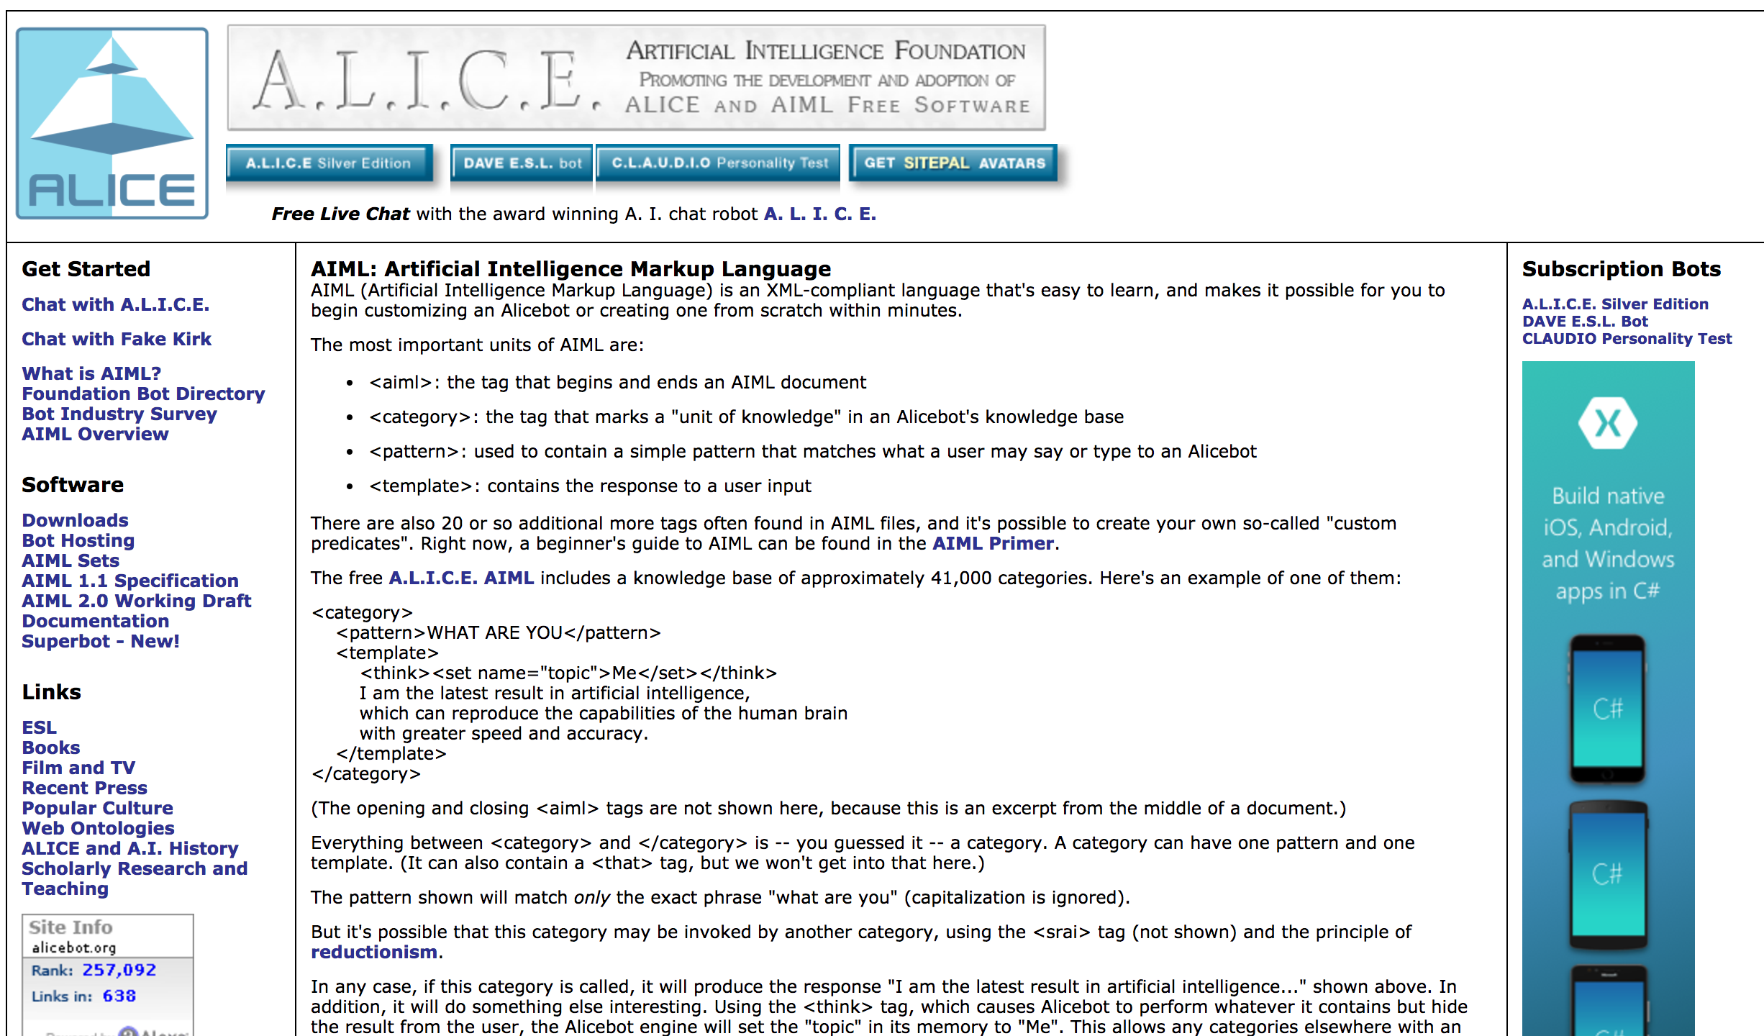
ALICE and AIML
Source: http://www.alicebot.org/aiml.html

Slide 83
AIML (Artificial Intelligence Markup Language)
<category>
<pattern>HELLO</pattern>
<template>Hi, I am a robot</template>
</category>
Source: http://www.alicebot.org/aiml.html

Slide 84
AIML (Artificial Intelligence Markup Language)
<aiml>
the tag that begins and ends an AIML document
<category>
the tag that marks a "unit of knowledge" in an Alicebot's knowledge base
<pattern>
used to contain a simple pattern that matches what a user may say or type to an Alicebot
<template>
contains the response to a user input
Source: http://www.alicebot.org/aiml.html

Slide 85
AIML (Artificial Intelligence Markup Language)
<category> <pattern>WHAT ARE YOU</pattern> <template> <think><set name="topic">Me</set></think> I am the latest result in artificial intelligence, which can reproduce the capabilities of the human brain with greater speed and accuracy. </template> </category>
Source: http://www.alicebot.org/aiml.html

Slide 86
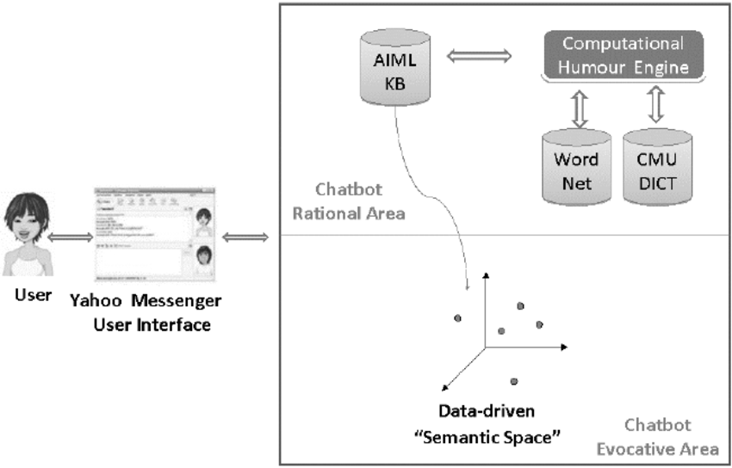
Humorist Chat-bot
Source: Pilato, G., Augello, A., Vassallo, G., & Gaglio, S. (2008). EHeBby: An evocative humorist chat-bot. Mobile Information Systems, 4(3), 165-181.

Slide 87
Ask Me Anything: Dynamic Memory Networks for Natural Language Processing
Source: Kumar, Ankit, Ozan Irsoy, Jonathan Su, James Bradbury, Robert English, Brian Pierce, Peter Ondruska, Ishaan Gulrajani, and Richard Socher. "Ask me anything: Dynamic memory networks for natural language processing." arXiv preprint arXiv:1506.07285 (2015).

Slide 88
Dynamic Memory Networks (DMN)
I: Jane went to the hallway.
I: Mary walked to the bathroom.
I: Sandra went to the garden.
I: Daniel went back to the garden.
I: Sandra took the milk there.
Q: Where is the milk?
Source: Kumar, Ankit, Ozan Irsoy, Jonathan Su, James Bradbury, Robert English, Brian Pierce, Peter Ondruska, Ishaan Gulrajani, and Richard Socher. "Ask me anything: Dynamic memory networks for natural language processing." arXiv preprint arXiv:1506.07285 (2015).

Slide 89
Dynamic Memory Networks (DMN)
I: Jane went to the hallway.
I: Mary walked to the bathroom.
I: Sandra went to the garden.
I: Daniel went back to the garden.
I: Sandra took the milk there.
Q: Where is the milk?
A: garden
Source: Kumar, Ankit, Ozan Irsoy, Jonathan Su, James Bradbury, Robert English, Brian Pierce, Peter Ondruska, Ishaan Gulrajani, and Richard Socher. "Ask me anything: Dynamic memory networks for natural language processing." arXiv preprint arXiv:1506.07285 (2015).

Slide 90
Dynamic Memory Networks (DMN)
I: Jane went to the hallway.
I: Mary walked to the bathroom.
I: Sandra went to the garden.
I: Daniel went back to the garden.
I: Sandra took the milk there.
Q: Where is the milk?
A: garden
I: It started boring, but then it got interesting.
Q: What’s the sentiment?
A: positive
Q: POS tags?
A: PRP VBD JJ , CC RB PRP VBD JJ .
Source: Kumar, Ankit, Ozan Irsoy, Jonathan Su, James Bradbury, Robert English, Brian Pierce, Peter Ondruska, Ishaan Gulrajani, and Richard Socher. "Ask me anything: Dynamic memory networks for natural language processing." arXiv preprint arXiv:1506.07285 (2015).

Slide 91
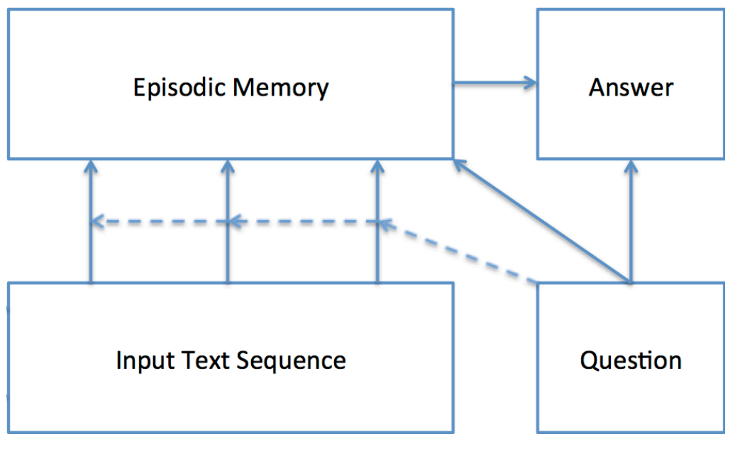
Dynamic Memory Networks (DMN)
Source: Kumar, Ankit, Ozan Irsoy, Jonathan Su, James Bradbury, Robert English, Brian Pierce, Peter Ondruska, Ishaan Gulrajani, and Richard Socher. "Ask me anything: Dynamic memory networks for natural language processing." arXiv preprint arXiv:1506.07285 (2015).

Slide 92
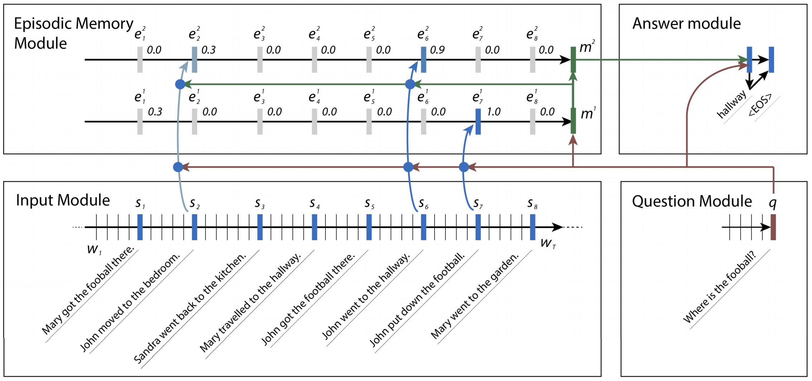
Dynamic Memory Networks (DMN)
Source: Kumar, Ankit, Ozan Irsoy, Jonathan Su, James Bradbury, Robert English, Brian Pierce, Peter Ondruska, Ishaan Gulrajani, and Richard Socher. "Ask me anything: Dynamic memory networks for natural language processing." arXiv preprint arXiv:1506.07285 (2015).

Slide 93
Dynamic Memory Networks (DMN)
Question: Where was Mary before the Bedroom?
Source: Kumar, Ankit, Ozan Irsoy, Jonathan Su, James Bradbury, Robert English, Brian Pierce, Peter Ondruska, Ishaan Gulrajani, and Richard Socher. "Ask me anything: Dynamic memory networks for natural language processing." arXiv preprint arXiv:1506.07285 (2015).

Slide 94
Dynamic Memory Networks (DMN)
Question: Where was Mary before the Bedroom?
Answer: Cinema.
Source: Kumar, Ankit, Ozan Irsoy, Jonathan Su, James Bradbury, Robert English, Brian Pierce, Peter Ondruska, Ishaan Gulrajani, and Richard Socher. "Ask me anything: Dynamic memory networks for natural language processing." arXiv preprint arXiv:1506.07285 (2015).

Slide 95
Dynamic Memory Networks for Visual and Textual Question Answering

Slide 96
Question Answering with Dynamic Memory Network (DMN+)
Source: Xiong, Caiming, Stephen Merity, and Richard Socher. "Dynamic memory networks for visual and textual question answering." arXiv preprint arXiv:1603.01417 (2016).

Slide 97
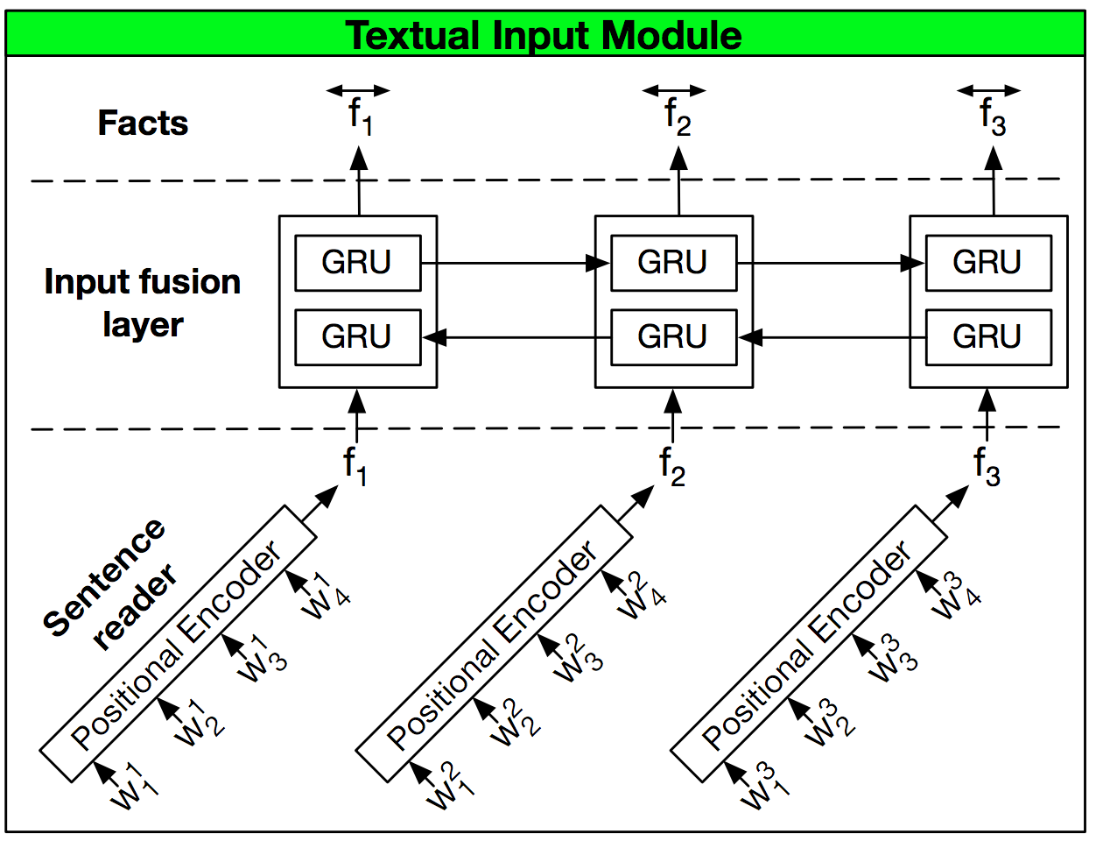
Dynamic Memory Network (DMN+)
Source: Xiong, Caiming, Stephen Merity, and Richard Socher. "Dynamic memory networks for visual and textual question answering." arXiv preprint arXiv:1603.01417 (2016).

Slide 98
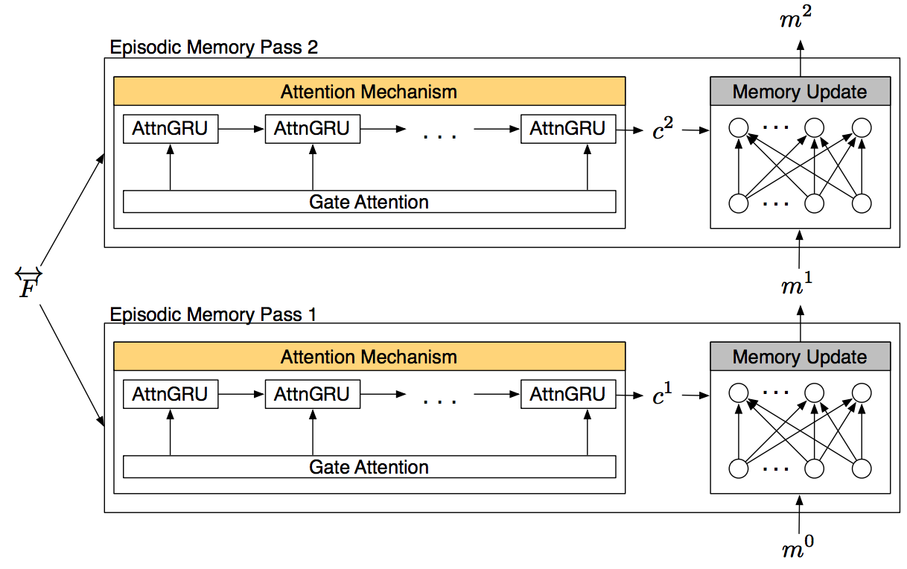
Dynamic Memory Network (DMN+)
Episodic Memory Module of the DMN+
Source: Xiong, Caiming, Stephen Merity, and Richard Socher. "Dynamic memory networks for visual and textual question answering." arXiv preprint arXiv:1603.01417 (2016).

Slide 99
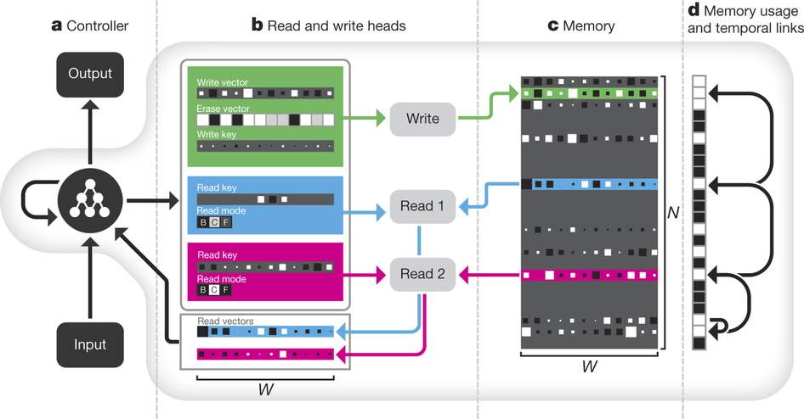
Differentiable Neural Computer (DNC)
Source: Graves, A., Wayne, G., Reynolds, M., Harley, T., Danihelka, I., Grabska-Barwińska, A., ... & Badia, A. P. (2016). Hybrid computing using a neural network with dynamic external memory. Nature, 538(7626), 471-476

Slide 100
Facebook AI Research : bAbI Project
The (20) QA bAbI tasks
The (6) dialog bAbI tasks
The Children’s Book Test
The Movie Dialog dataset
The WikiMovies dataset
The Dialog-based Language Learning dataset
The SimpleQuestions dataset
Source: https://research.fb.com/projects/babi/

Slide 101
Facebook bAbI QA Datasets
1 Mary moved to the bathroom.
2 John went to the hallway.
3 Where is Mary? bathroom 1
4 Daniel went back to the hallway.
5 Sandra moved to the garden.
6 Where is Daniel? hallway 4
7 John moved to the office.
8 Sandra journeyed to the bathroom.
9 Where is Daniel? hallway 4
10 Mary moved to the hallway.
11 Daniel travelled to the office.
12 Where is Daniel? office 11
13 John went back to the garden.
14 John moved to the bedroom.
15 Where is Sandra? bathroom 8
1 Sandra travelled to the office.
2 Sandra went to the bathroom.
3 Where is Sandra? bathroom 2
Source: https://research.fb.com/projects/babi/

Slide 102
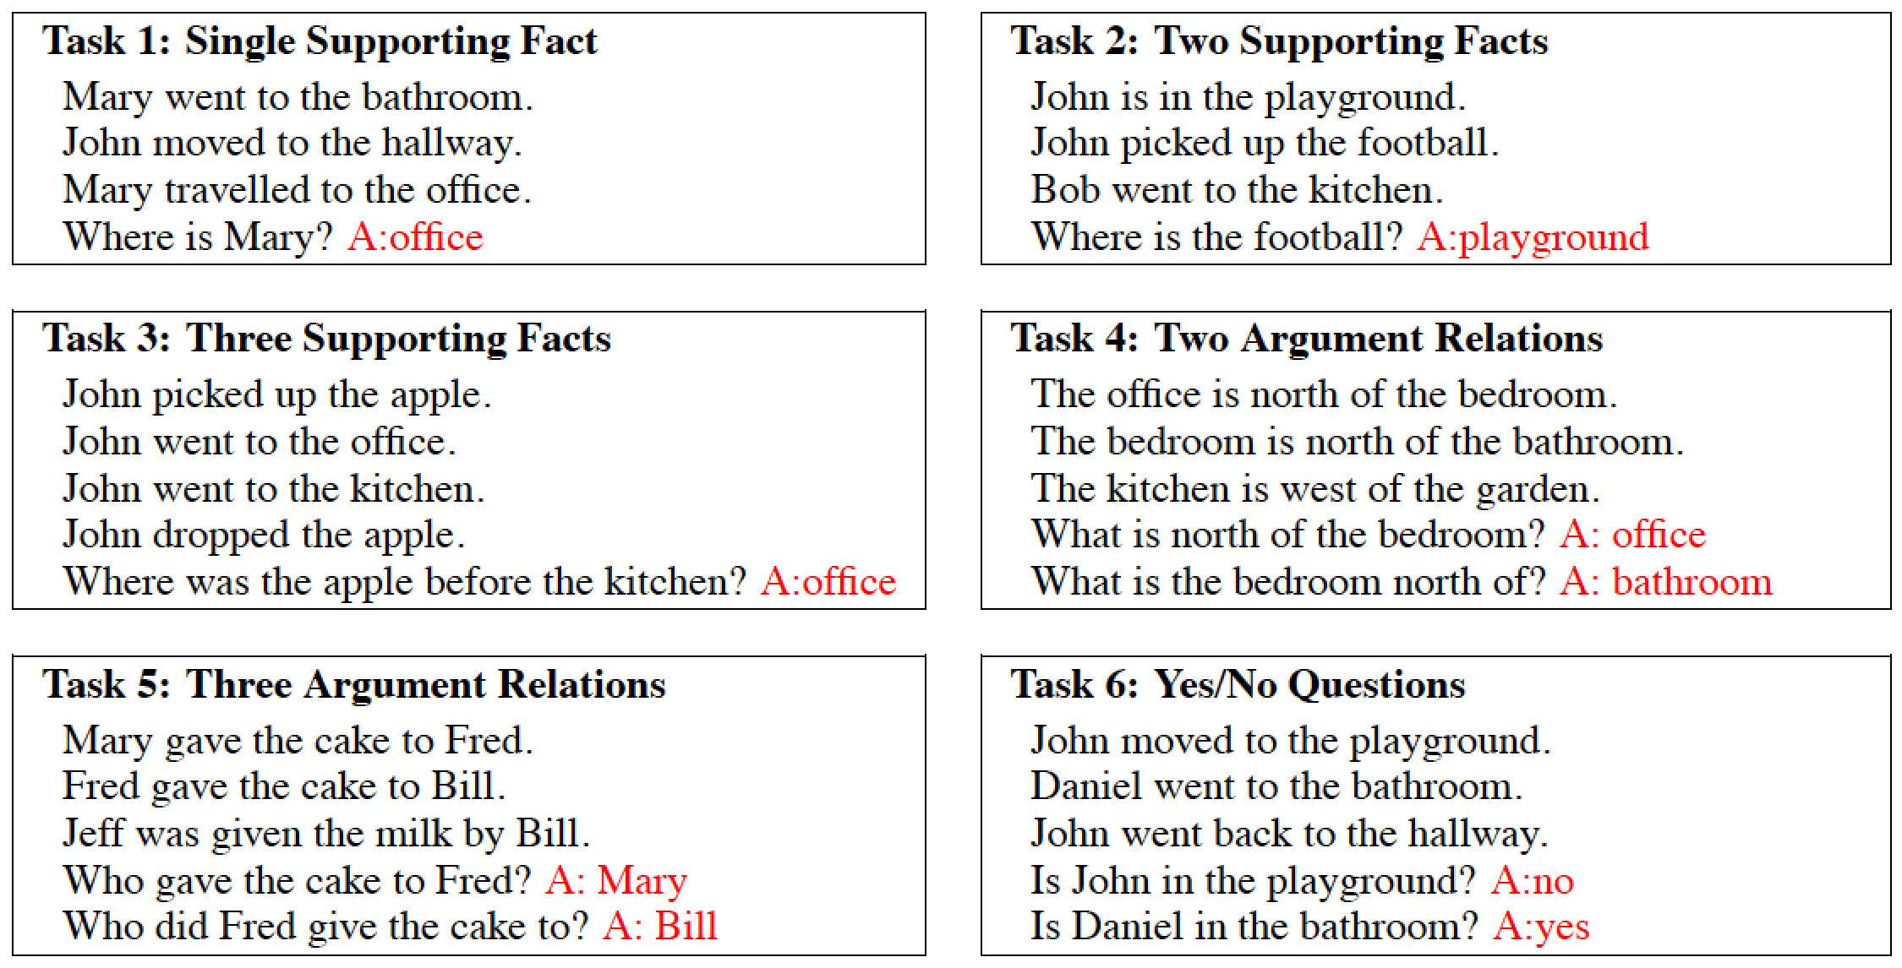
Facebook bAbI QA Datasets
Source: Weston, Jason, Antoine Bordes, Sumit Chopra, Alexander M. Rush, Bart van Merriënboer, Armand Joulin, and Tomas Mikolov. "Towards AI-complete question answering: A set of prerequisite toy tasks." arXiv preprint arXiv:1502.05698 (2015).

Slide 103
Facebook bAbI QA Datasets
Source: Weston, Jason, Antoine Bordes, Sumit Chopra, Alexander M. Rush, Bart van Merriënboer, Armand Joulin, and Tomas Mikolov. "Towards AI-complete question answering: A set of prerequisite toy tasks." arXiv preprint arXiv:1502.05698 (2015).

Slide 104
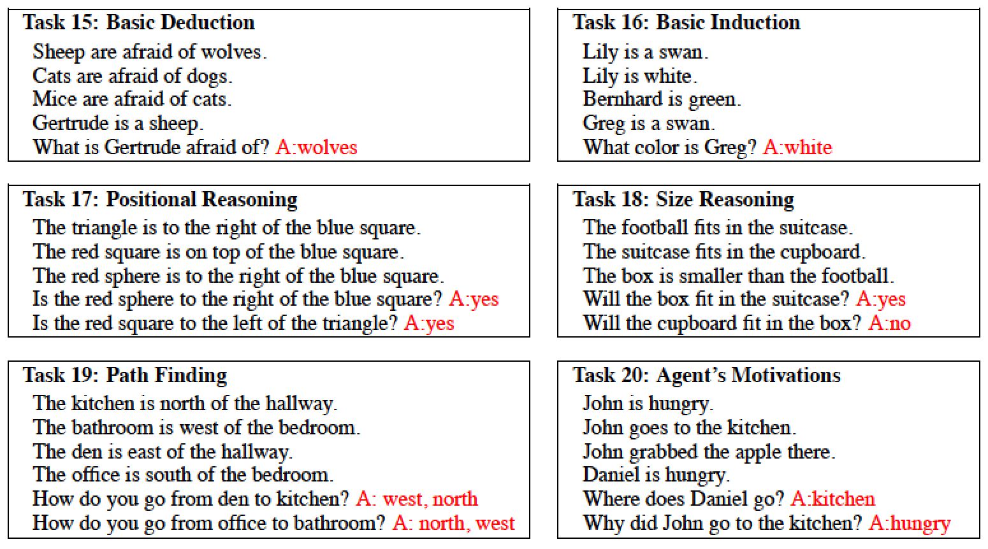
Facebook bAbI QA Datasets
Source: Weston, Jason, Antoine Bordes, Sumit Chopra, Alexander M. Rush, Bart van Merriënboer, Armand Joulin, and Tomas Mikolov. "Towards AI-complete question answering: A set of prerequisite toy tasks." arXiv preprint arXiv:1502.05698 (2015).

Slide 105
Learning End-to-End Goal-Oriented Dialog

Slide 106
Facebook bAbI Dialogue Datasets
1 hi hello what can i help you with today
2 can you make a restaurant reservation with italian cuisine for six people in a cheap price range i'm on it
3 <SILENCE> where should it be
4 rome please ok let me look into some options for you
5 <SILENCE> api_call italian rome six cheap
Source: https://research.fb.com/projects/babi/

Slide 107
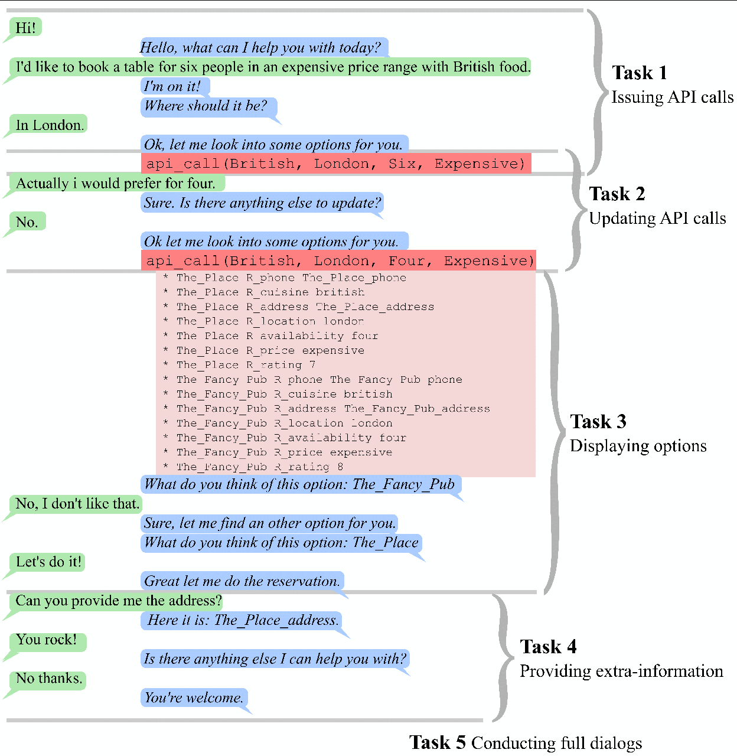
Source: Bordes, Antoine, and Jason Weston. "Learning End-to-End Goal-Oriented Dialog." arXiv preprint arXiv:1605.07683 (2016).

Slide 108
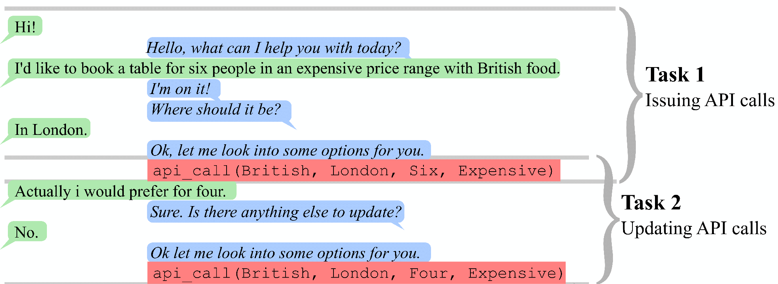
The Dialog bAbI Tasks
Source: Bordes, Antoine, and Jason Weston. "Learning End-to-End Goal-Oriented Dialog." arXiv preprint arXiv:1605.07683 (2016).

Slide 109
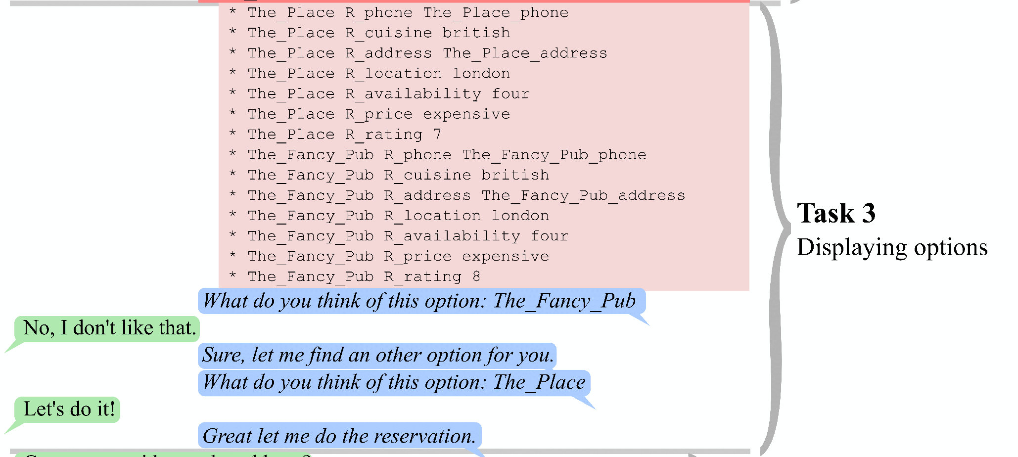
The Dialog bAbI Tasks
Source: Bordes, Antoine, and Jason Weston. "Learning End-to-End Goal-Oriented Dialog." arXiv preprint arXiv:1605.07683 (2016).

Slide 110
The Dialog bAbI Tasks
Source: Bordes, Antoine, and Jason Weston. "Learning End-to-End Goal-Oriented Dialog." arXiv preprint arXiv:1605.07683 (2016).

Slide 111
References
Paolo Sironi (2016), “FinTech Innovation: From Robo-Advisors to Goal Based Investing and Gamification”, Wiley.
Min-Yuh Day, Cheng-Chia Tsai, Wei-Chun Chuang, Jin-Kun Lin, Hsiu-Yuan Chang, Tzu-Jui Sun, Yuan-Jie Tsai, Yi-Heng Chiang, Cheng-Zhi Han, Wei-Ming Chen, Yun-Da Tsai, Yi-Jing Lin, Yue-Da Lin, Yu-Ming Guo, Ching-Yuan Chien, and Cheng-Hung Lee (2016), "IMTKU Question Answering System for World History Exams at NTCIR-12 QA Lab2", The 12th NTCIR Conference on Evaluation of Information Access Technologies (NTCIR-12), Tokyo, Japan, June 7-10, 2016, pp.425-431
Yun-Nung Chen, Dilek Hakkani-Tür, Gokhan Tur, Jianfeng Gao, and Li Deng (2016), "End-to-end memory networks with knowledge carryover for multi-turn spoken language understanding." In Proceedings of Interspeech.
Hakkani-Tür, Dilek, Gokhan Tur, Asli Celikyilmaz, Yun-Nung Chen, Jianfeng Gao, Li Deng, and Ye-Yi Wang. "Multi-domain joint semantic frame parsing using bi-directional RNN-LSTM." In Proceedings of The 17th Annual Meeting of the International Speech Communication Association. 2016.
Jeongkyu Shin (2016), Building AI Chat bot with Python 3 and TensorFlow, PyCon APAC 2016.
Ankit Kumar, Ozan Irsoy, Jonathan Su, James Bradbury, Robert English, Brian Pierce, Peter Ondruska, Ishaan Gulrajani, and Richard Socher (2015). "Ask me anything: Dynamic memory networks for natural language processing." arXiv preprint arXiv:1506.07285.
Antoine Bordes and Jason Weston (2016), "Learning End-to-End Goal-Oriented Dialog." arXiv preprint arXiv:1605.07683.
Jason Weston, Antoine Bordes, Sumit Chopra, Alexander M. Rush, Bart van Merriënboer, Armand Joulin, and Tomas Mikolov (2015), "Towards AI-complete question answering: A set of prerequisite toy tasks." arXiv preprint arXiv:1502.05698.

