Slide 1
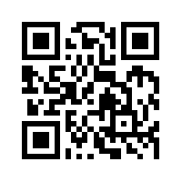
金融科技 FinTech: Financial Technology
Tamkang University
Fintech 金融科技： 金融服務科技創新 (Fintech: Technology Innovation in Financial Services)
1052FinTech03
MIS EMBA (M2263) (8595) Fri, 12,13,14 (19:20-22:10) (D409)
Min-Yuh Day
戴敏育
Assistant Professor
專任助理教授
Dept. of Information Management, Tamkang University
淡江大學 資訊管理學系
http://mail. tku.edu.tw/myday/
2017-03-03

Slide 2
課程大綱 (Syllabus)
週次 (Week) 日期 (Date) 內容 (Subject/Topics)
1 2017/02/17 Fintech 金融科技課程介紹 (Course Orientation for Fintech: Financial Technology)
2 2017/02/24 Fintech 金融科技的演進：貨幣與金融服務 (Evolution of Fintech: Money and Financial Services)
3 2017/03/03 Fintech 金融科技：金融服務科技創新 (Fintech: Technology Innovation in Financial Services)
4 2017/03/10 Fintech 金融科技與金融服務價值鏈 (Fintech and Financial Services Value Chain)
5 2017/03/17 Fintech 金融科技商業模式創新 (Fintech Business Models Innovation)
6 2017/03/24 Fintech 金融科技個案研究 I (Case Study on Fintech I)

Slide 3
課程大綱 (Syllabus)
週次 (Week) 日期 (Date) 內容 (Subject/Topics)
7 2017/03/31 金融服務消費者心理與行為 (Consumer Psychology and Behavior on Financial Services)
8 2017/04/07 教學行政觀摩日 (Off-campus study)
9 2017/04/14 區塊鏈技術 (Blockchain Technology) [Invited Speaker: Dr. Raymund Lin, IBM (林俊叡 博士，IBM)]
10 2017/04/21 期中報告 (Midterm Project Report)
11 2017/04/28 Python Pandas財務大數據分析 (Finance Big Data Analytics with Pandas in Python)
12 2017/05/05 人工智慧與深度學習金融科技 (Artificial Intelligence and Deep Learning for Fintech)

Slide 4
課程大綱 (Syllabus)
週次 (Week) 日期 (Date) 內容 (Subject/Topics)
13 2017/05/12 Fintech 金融科技個案研究 II (Case Study on Fintech II)
14 2017/05/19 金融科技財富管理：機器人理財顧問 (Robo-Advisors for Wealth Management in Fintech)
15 2017/05/26 投資組合最佳化與程式交易 (Portfolio Optimization and Algorithmic Trading)
16 2017/06/02 金融科技智慧問答系統 (Intelligent Question Answering System for Fintech)
17 2017/06/09 期末報告 I (Final Project Presentation I)
18 2017/06/16 期末報告 II (Final Project Presentation II)

Slide 5
Fintech: Technology Innovation in Financial Services

Slide 6
Paolo Sironi (2016) FinTech Innovation: From Robo-Advisors to Goal Based Investing and Gamification, Wiley
Source: https://www.amazon.com/FinTech-Innovation-Robo-Advisors-Investing-Gamification/dp/1119226988

Slide 7
John M. Jordan (2012),
Information, Technology, and Innovation: Resources for Growth in a Connected World, Wiley
Source: https://www.amazon.com/Information-Technology-Innovation-Resources-Connected/dp/1118155785

Slide 8
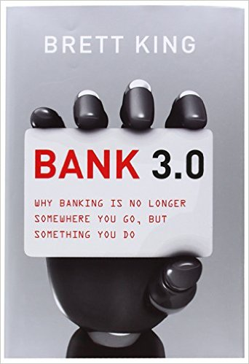
Brett King (2012), Bank 3.0 Why banking is no longer somewhere you go, but something you do, Marshall Cavendish International Asia Pte Ltd
Source: https://www.amazon.com/Bank-3-0-Banking-Somewhere-Something/dp/1118589637

Slide 9
Brett King (2014), Breaking Banks: The Innovators, Rogues, and Strategists Rebooting Banking Wiley
Source: https://www.amazon.com/Breaking-Banks-Innovators-Strategists-Rebooting/dp/1118900146

Slide 10
Chris Skinner (2014), Digital Bank: Strategies to Launch or Become a Digital Bank, Marshall Cavendish International Asia Pte Ltd
Source: https://www.amazon.com/Digital-Bank-Strategies-Launch-Become/dp/9814516465

Slide 11
Everett M. Rogers (2003), Diffusion of Innovations, 5th Edition, Free Press
(Rogers, 1962; 1971; 1983; 1995; 2003)
Source: https://www.amazon.com/Diffusion-Innovations-5th-Everett-Rogers/dp/0743222091

Slide 12
Joseph A. Schumpeter, The Theory of Economic Development: An Inquiry into Profits, Capital, Credit, Interest, and the Business Cycle, Transaction Publishers, 1982
(Schumpeter, 1912)
Source: https://www.amazon.com/Theory-Economic-Development-Interest-Business/dp/0878556982

Slide 13
Financial Technology FinTech
“providing financial services by making use of software and modern technology”
Source: https://www.fintechweekly.com/fintech-definition

Slide 14
Financial Services

Slide 15
Technology Innovation

Slide 16
Innovation
Source: https://www.merriam-webster.com/dictionary/innovation

Slide 17
Innovation: a new idea, method, or device
Source: https://www.merriam-webster.com/dictionary/innovation

Slide 18
Innovation: something new
Source: https://www.merriam-webster.com/dictionary/innovation

Slide 19
Novelty : something new or unusual the novelty of a self-driving car
Source: https://www.merriam-webster.com/dictionary/novelty

Slide 20
Creativity is not a new Idea. Creativity is an old belief you leave behind
Notes:
Creativity is not a new idea. Creativity is an old belief you leave behind.

Slide 21
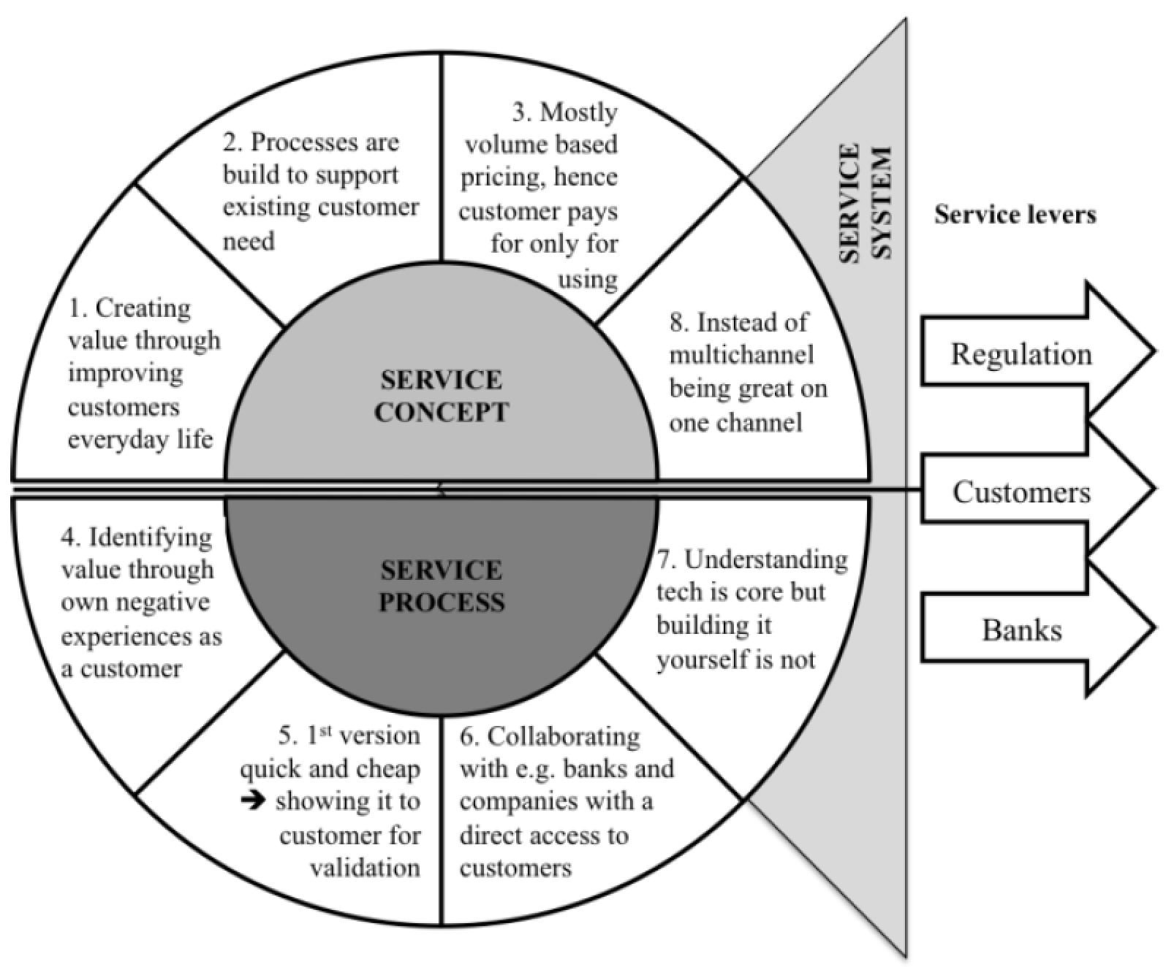
FinTechs as Service Innovators: Analysing Components of Innovation
Source: Riikkinen, Mikko, Kaisa Still, Saila Saraniemi, and Katri Kallio. "FinTechs as service innovators: analysing components of innovation." In ISPIM Innovation Symposium, The International Society for Professional Innovation Management (ISPIM), 2016.

Slide 22
Innovation “a process of searching and recombining existing knowledge elements”
Source: Savino, Tommaso, Antonio Messeni Petruzzelli, and Vito Albino. "Search and recombination process to innovate: A review of the empirical evidence and a research agenda." International Journal of Management Reviews (2017).

Slide 23
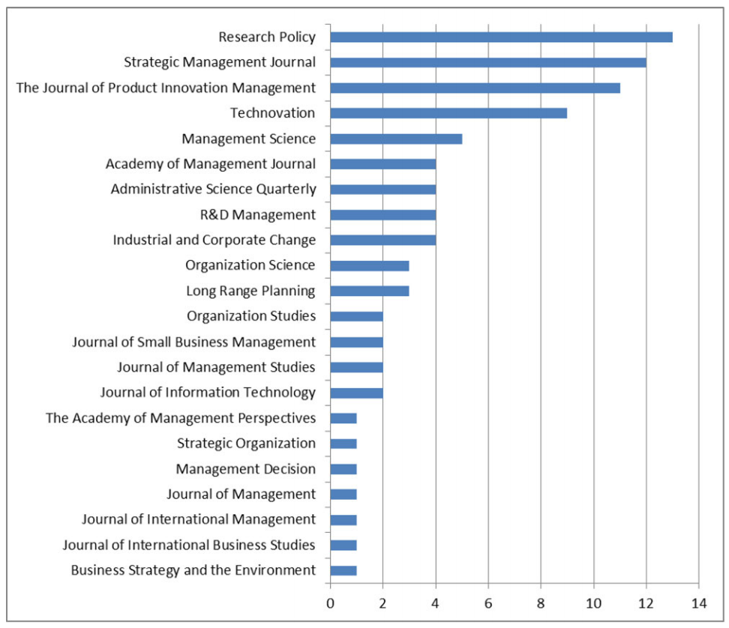
Search and recombination process to innovate: A review of the empirical evidence and a research agenda
Source: Savino, Tommaso, Antonio Messeni Petruzzelli, and Vito Albino. "Search and recombination process to innovate: A review of the empirical evidence and a research agenda." International Journal of Management Reviews (2017).

Slide 24
Innovation Research in Economics, Sociology and Technology Management
Source: Gopalakrishnan, Shanti, and Fariborz Damanpour. "A review of innovation research in economics, sociology and technology management." Omega 25, no. 1 (1997): 15-28.

Slide 25
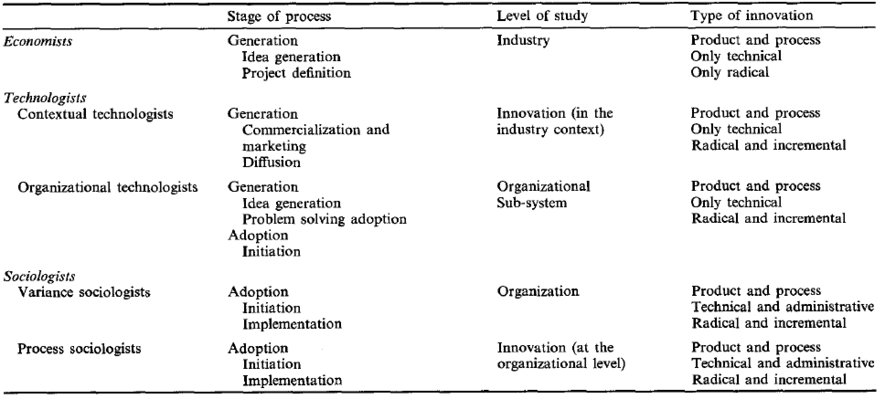
Innovation Research in Economics, Sociology and Technology Management
Source: Gopalakrishnan, Shanti, and Fariborz Damanpour. "A review of innovation research in economics, sociology and technology management." Omega 25, no. 1 (1997): 15-28.

Slide 26
Business, Innovation, and Knowledge Ecosystems
Source: Valkokari, Katri. "Business, innovation, and knowledge ecosystems: how they differ and how to survive and thrive within them." Technology Innovation Management Review 5, no. 8 (2015).

Slide 27
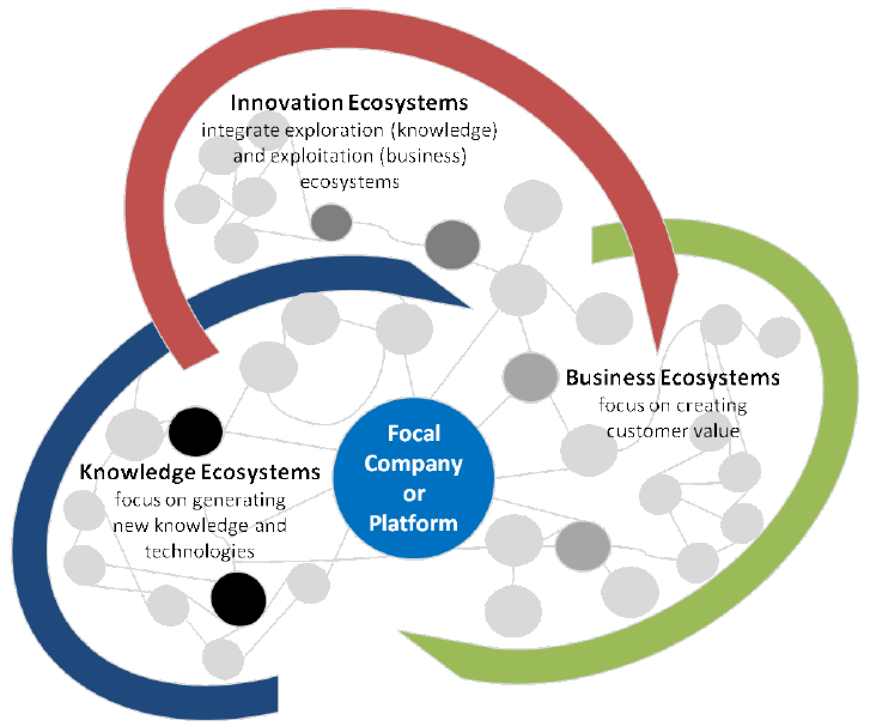
Business, Innovation, and Knowledge Ecosystems
Source: Valkokari, Katri. "Business, innovation, and knowledge ecosystems: how they differ and how to survive and thrive within them." Technology Innovation Management Review 5, no. 8 (2015).

Slide 28
Innovation Ecosystems Characteristics
 | Business Ecosystems | Innovation Ecosystems | Knowledge Ecosystems
Baseline of Ecosystem | Resource exploitation for customer value | Co-creation of innovation | Knowledge exploration
Relationships and Connectivity | Global business relationships both competitive and co-operative | Geographically clustered actors, different levels of collaboration and openness | Decentralized and disturbed knowledge nodes, synergies through knowledge exchange
Actors and Roles | Suppliers, customers, and focal companies as a core, other actors more loosely involved | Innovation policymakers, local intermediators, innovation brokers, and funding organizations | Research institutes, innovators, and technology entrepreneurs serve as knowledge nodes
Logic of Action | A main actor that operates as a platform sharing resources, assets, and benefits or aggregates other actors together in the networked business operations | Geographically proximate actors interacting around hubs facilitated by intermediating actors | A large number of actors that are grouped around knowledge exchange or a central non-proprietary resource for the benefit of all actors
Source: Valkokari, Katri. "Business, innovation, and knowledge ecosystems: how they differ and how to survive and thrive within them." Technology Innovation Management Review 5, no. 8 (2015).

Slide 29
Diffusion of Innovation Theory (DOI)
Source: Everett M. Rogers (2003), “Diffusion of Innovations”, Free Press, 5th Edition

Slide 30
Innovation (Diffusion of Innovation)
1. Relative advantage
2. Compatibility
3. Complexity
4. Trialability
5. Observability
Source: Everett M. Rogers (2003), “Diffusion of Innovations”, Free Press, 5th Edition

Slide 31
Diffusion of Innovation
Source: https://en.wikipedia.org/wiki/Diffusion_of_innovations

Slide 32
Innovation Adoption Process
Initiation
Adoption Decision
Implementation
Source: Pichlak, Magdalena. "The innovation adoption process: A multidimensional approach." Journal of Management and Organization 22, no. 4 (2016): 476.

Slide 33
Innovation Adoption Process
Initiation
Adoption Decision
Implementation
Environmental Characteristics
Organizational Characteristics
Top Managers Characteristics
Innovation Characteristics
User Acceptance Attributes
TAM= Technology Acceptance Model
RBV= Resource-Based View
DOI = Diffusion of Innovation Theory
Source: Pichlak, Magdalena. "The innovation adoption process: A multidimensional approach." Journal of Management and Organization 22, no. 4 (2016): 476.

Slide 34
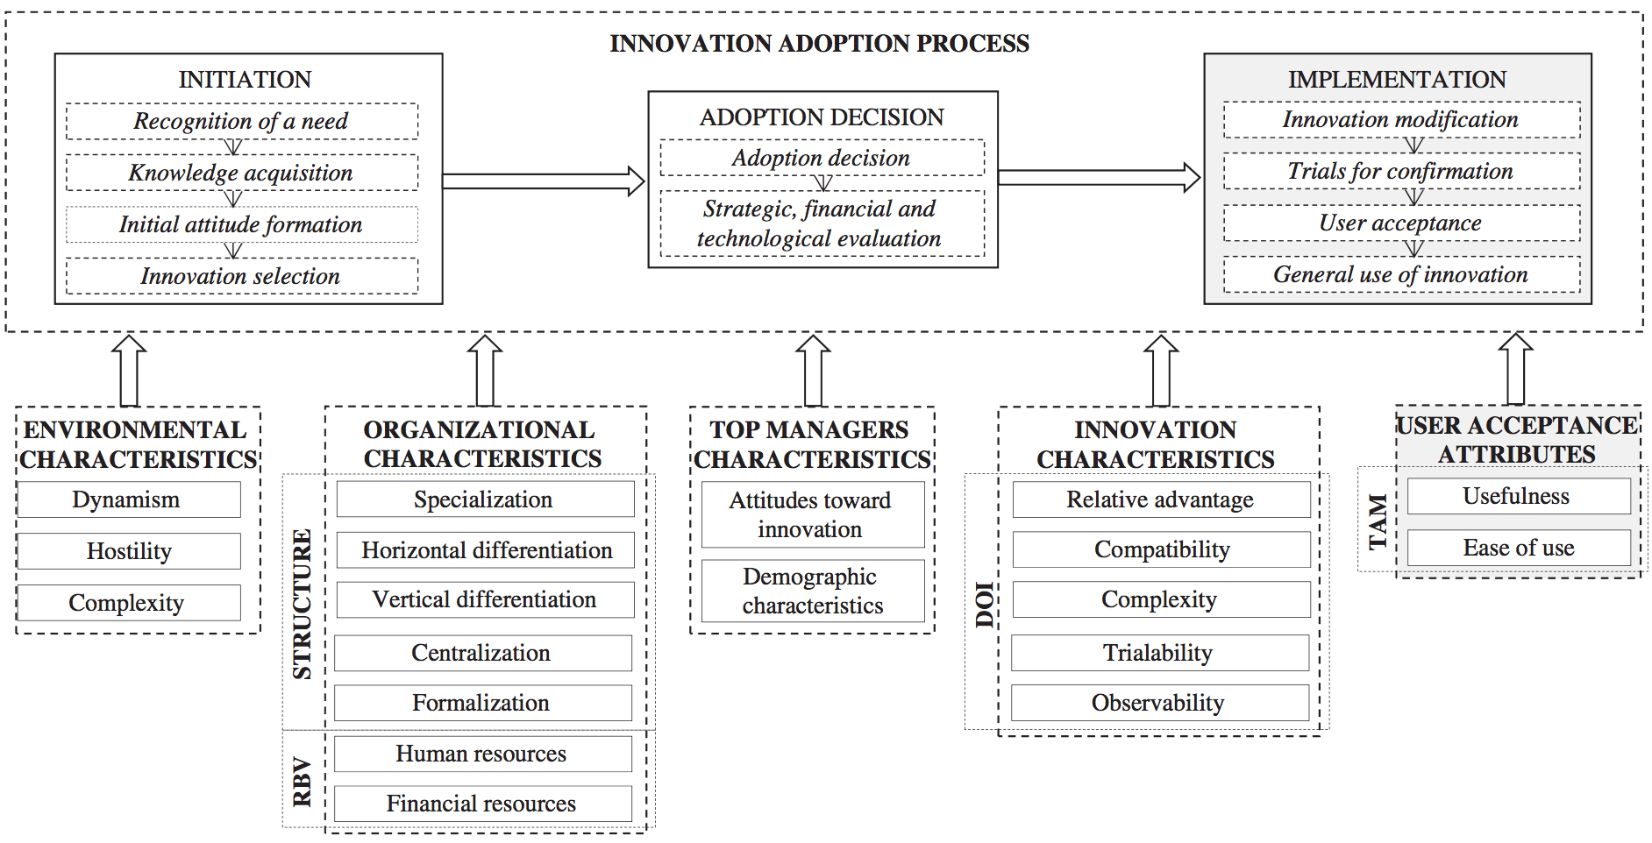
Innovation Adoption Process
TAM= Technology Acceptance Model
RBV= Resource-Based View
DOI = Diffusion of Innovation Theory
Source: Pichlak, Magdalena. "The innovation adoption process: A multidimensional approach." Journal of Management and Organization 22, no. 4 (2016): 476.

Slide 35
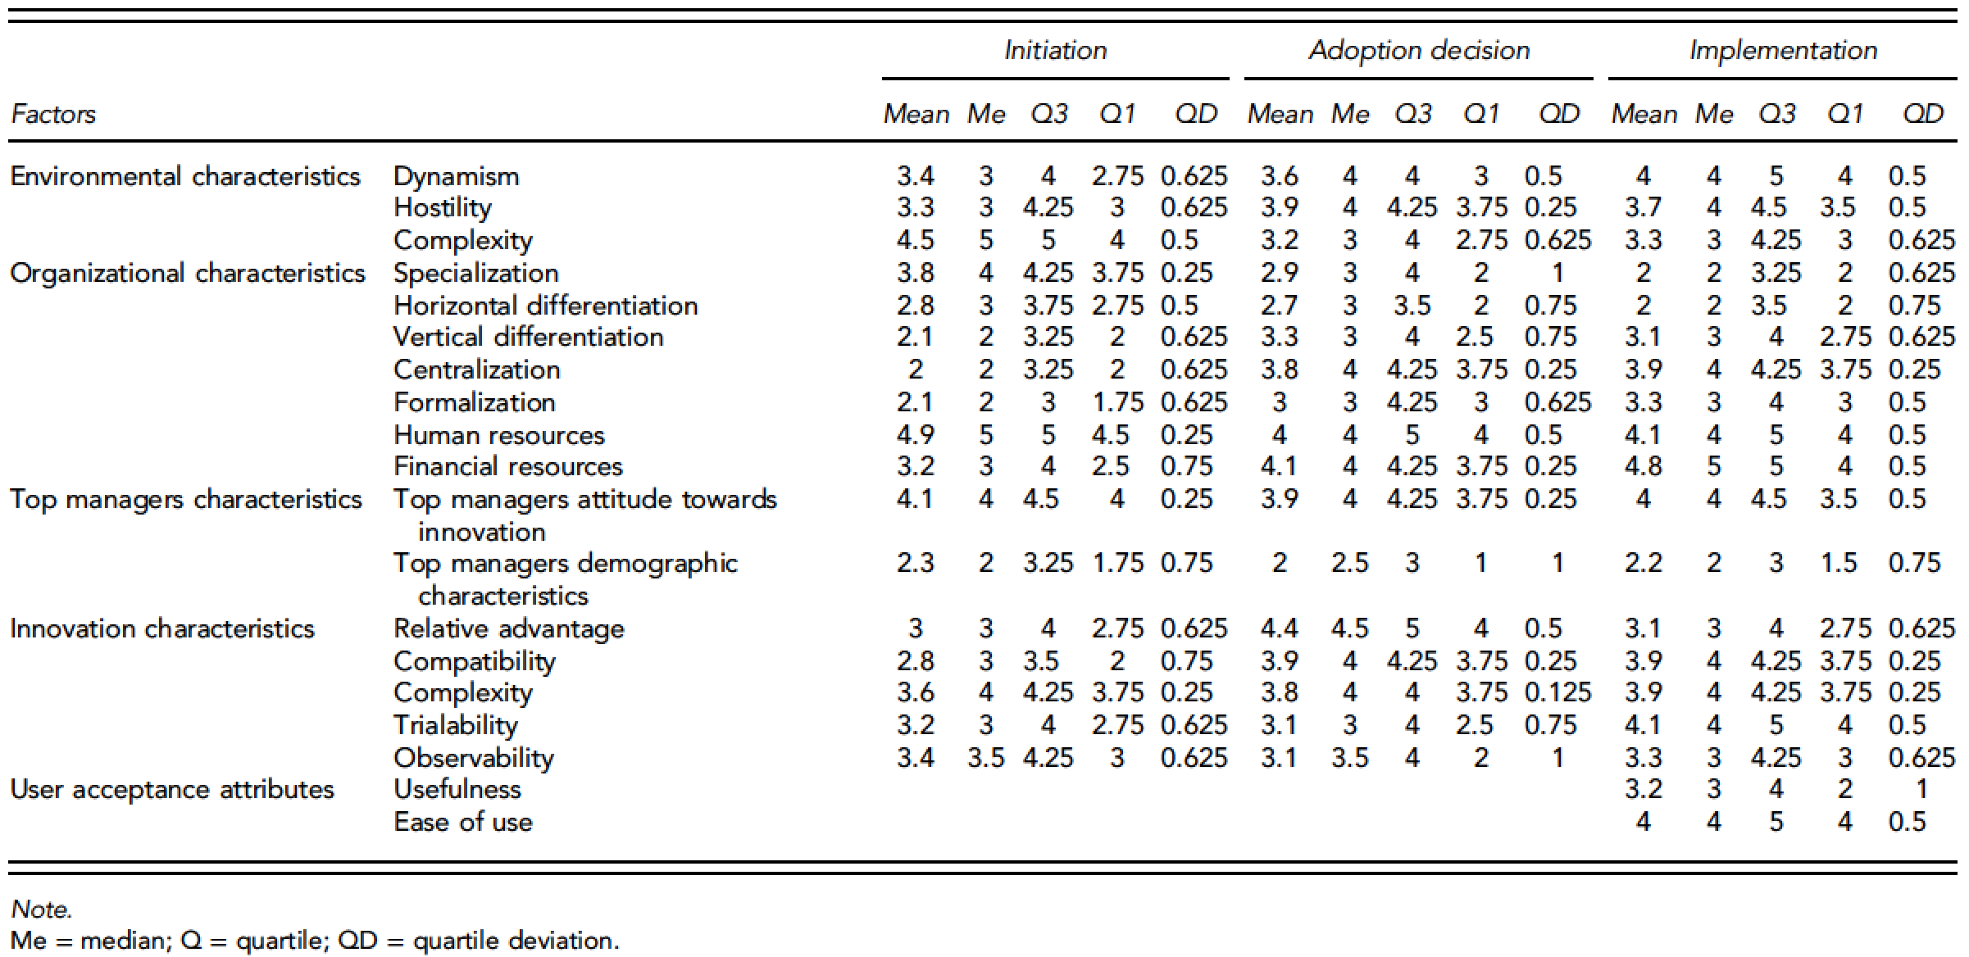
Innovation Adoption Process
Source: Pichlak, Magdalena. "The innovation adoption process: A multidimensional approach." Journal of Management and Organization 22, no. 4 (2016): 476.

Slide 36
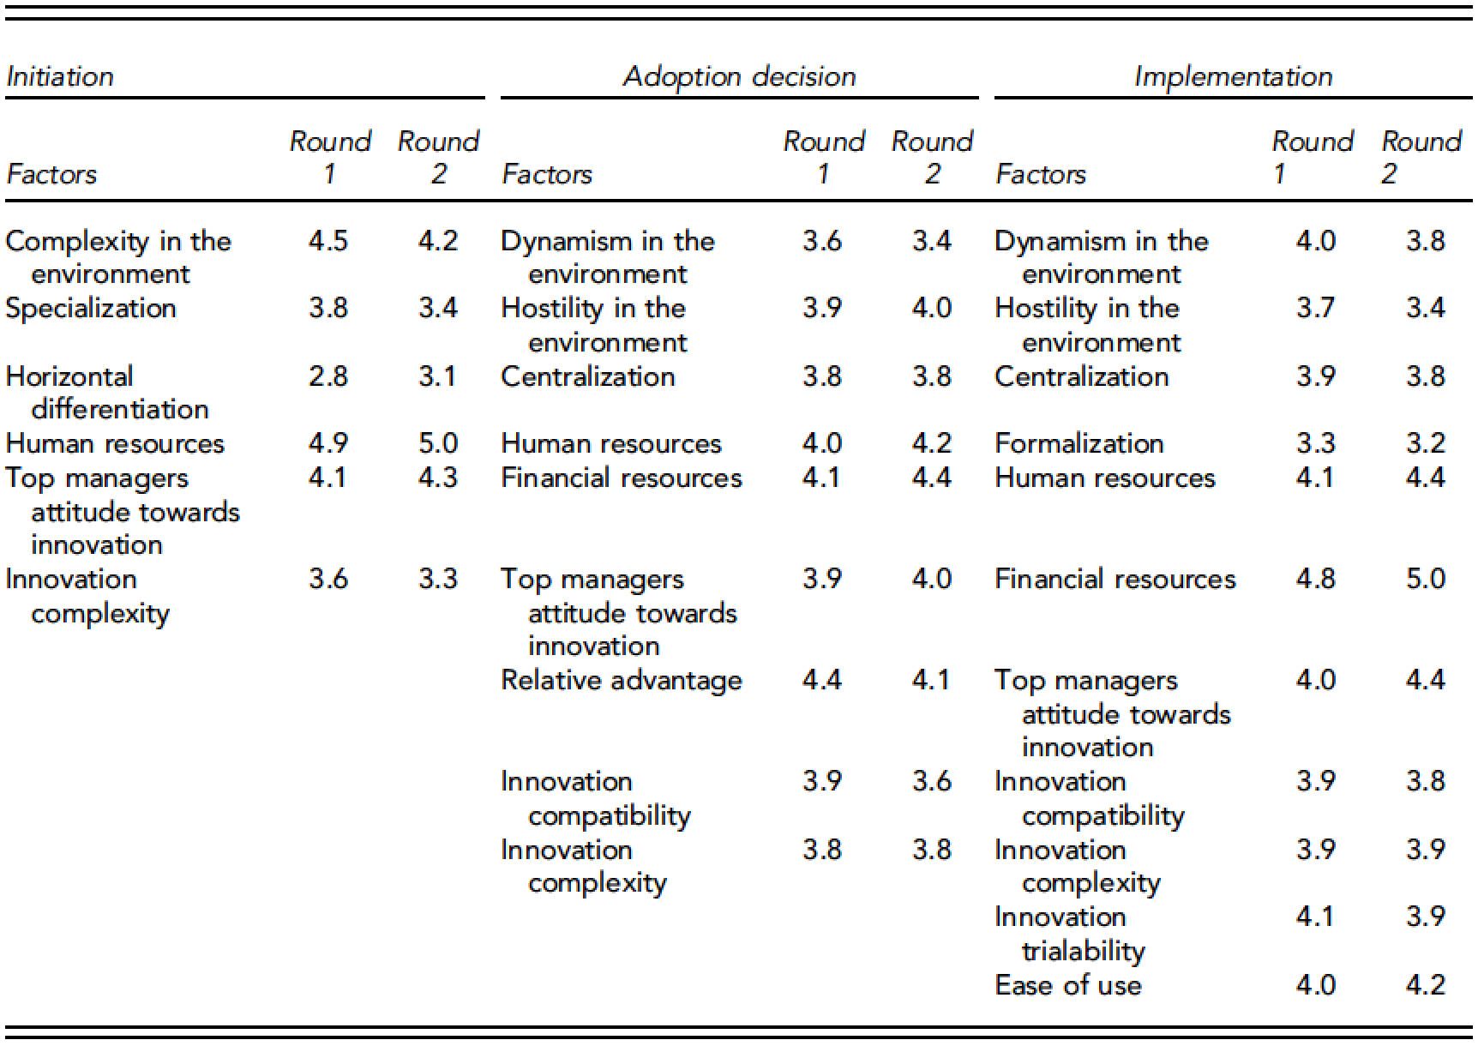
Innovation Adoption Process
Source: Pichlak, Magdalena. "The innovation adoption process: A multidimensional approach." Journal of Management and Organization 22, no. 4 (2016): 476.

Slide 37
FinTech Innovation FinTech high-level classification
Lending
Payments
Robo Advisors
Analytics
Others
Profile
Advice
Re-Balance
Indexing
Source: Paolo Sironi (2016), “FinTech Innovation: From Robo-Advisors to Goal Based Investing and Gamification”, Wiley.

Slide 38
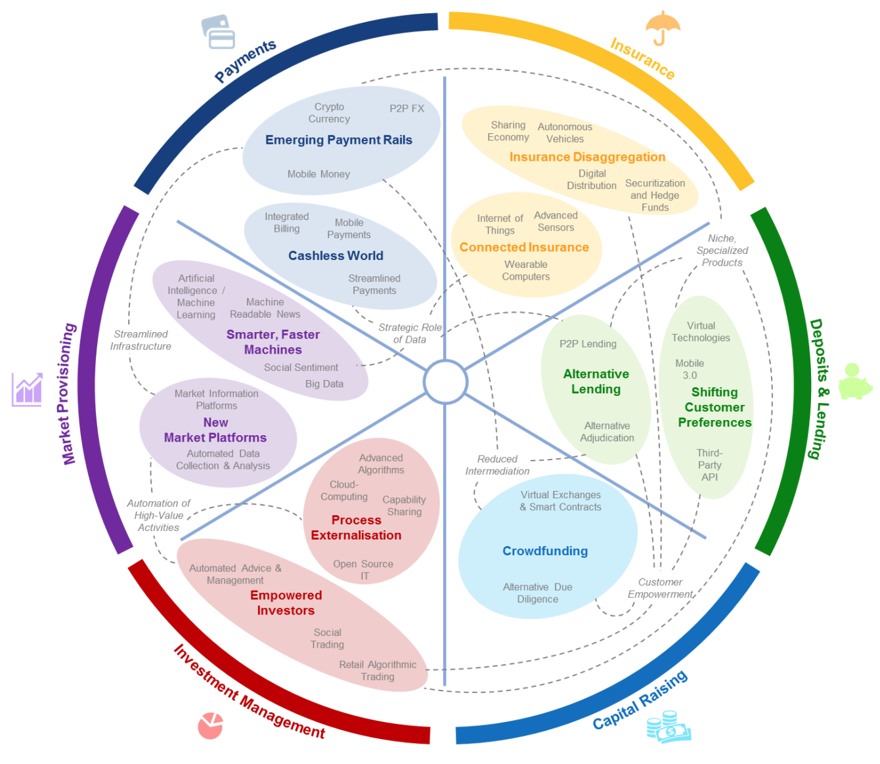
FinTech: Financial Services Innovation
Source: http://www3.weforum.org/docs/WEF_The_future__of_financial_services.pdf

Slide 39
FinTech: Financial Services Innovation 1. Payments 2. Insurance 3. Deposits & Lending 4. Capital Raising 5. Investment Management 6. Market Provisioning
Source: http://www3.weforum.org/docs/WEF_The_future__of_financial_services.pdf

Slide 40
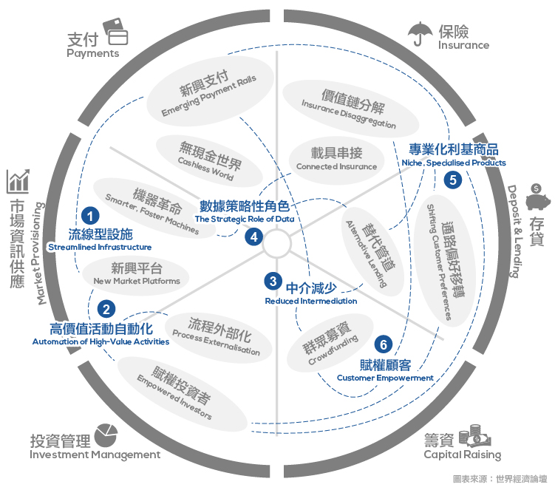
Source: https://www.stockfeel.com.tw/2015年世界經濟論壇－未來的金融服務/

Slide 41
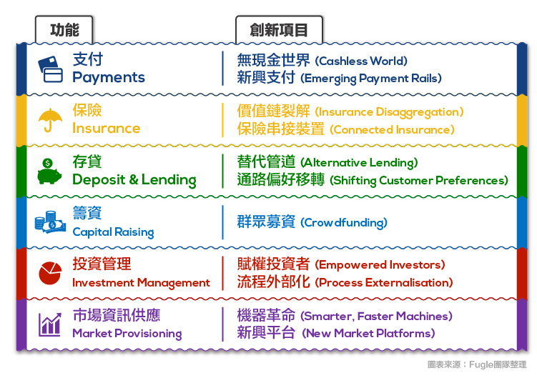
FinTech: Financial Services Innovation
Source: https://www.stockfeel.com.tw/2015年世界經濟論壇－未來的金融服務/

Slide 42
FinTech: Payment
1
Source: http://www3.weforum.org/docs/WEF_The_future__of_financial_services.pdf

Slide 43
FinTech: Payment Cashless World Emerging Payment Rails
1
Source: https://www.stockfeel.com.tw/2015年世界經濟論壇－未來的金融服務/

Slide 44
FinTech: Insurance
2
Source: http://www3.weforum.org/docs/WEF_The_future__of_financial_services.pdf

Slide 45
FinTech: Insurance Insurance Disaggregation Connected Insurance
2
Source: https://www.stockfeel.com.tw/2015年世界經濟論壇－未來的金融服務/

Slide 46
FinTech: Deposits & Lending
3
Source: http://www3.weforum.org/docs/WEF_The_future__of_financial_services.pdf

Slide 47
FinTech: Deposits & Lending Alternative Lending Shifting Customer Preferences
3
Source: https://www.stockfeel.com.tw/2015年世界經濟論壇－未來的金融服務/

Slide 48
FinTech: Capital Raising
4
Source: http://www3.weforum.org/docs/WEF_The_future__of_financial_services.pdf

Slide 49
FinTech: Capital Raising Crowdfunding
4
Source: https://www.stockfeel.com.tw/2015年世界經濟論壇－未來的金融服務/

Slide 50
FinTech: Investment Management
5
Source: http://www3.weforum.org/docs/WEF_The_future__of_financial_services.pdf

Slide 51
FinTech: Investment Management Empowered Investors Process Externalization
5
Source: https://www.stockfeel.com.tw/2015年世界經濟論壇－未來的金融服務/

Slide 52
FinTech: Market Provisioning
6
Source: http://www3.weforum.org/docs/WEF_The_future__of_financial_services.pdf

Slide 53
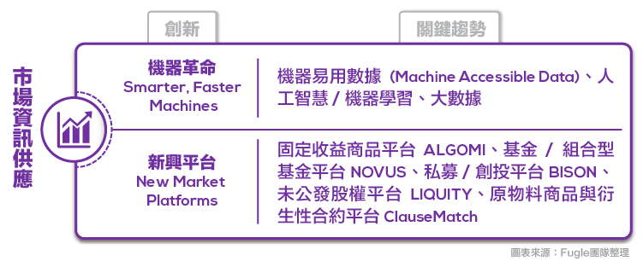
FinTech: Market Provisioning Smarter, Faster Machines New Market Platforms
6
Source: https://www.stockfeel.com.tw/2015年世界經濟論壇－未來的金融服務/

Slide 54
Brett King (2014), Breaking Banks: The Innovators, Rogues, and Strategists Rebooting Banking Wiley
Source: https://www.amazon.com/Breaking-Banks-Innovators-Strategists-Rebooting/dp/1118900146

Slide 55
“In the next 10 years, we'll see more disruption and changes to the banking and financial industry than we've seen in the preceding 100 years.” (Brett King, 2014)
Source: Brett King (2014), Breaking Banks: The Innovators, Rogues, and Strategists Rebooting Banking, Wiley

Slide 56
Fintech: Financial Technology
Disrupting Banking: The Fintech Startups That Are Unbundling Wells Fargo, Citi and Bank of America
Source: https://www.cbinsights.com/blog/industry-market-map-landscape/

Slide 57
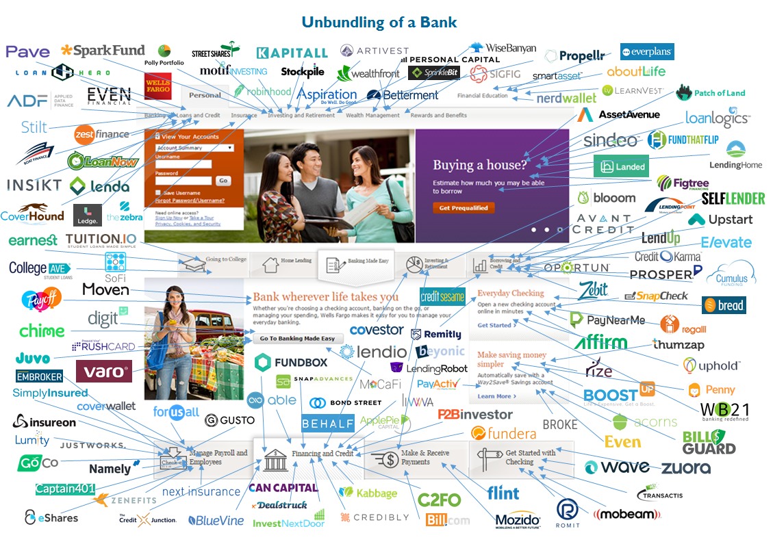
Fintech: Unbunding the Bank
Source: https://www.cbinsights.com/blog/disrupting-banking-fintech-startups-2016/

Slide 58
Fintech: Unbunding the Bank
Wealth Management: Wealthfront
Source: https://www.cbinsights.com/blog/disrupting-banking-fintech-startups-2016/

Slide 59
Fintech: Financial Technology
Disrupting European Banking: The FinTech Startups That Are Unbundling HSBC, Santander, and BNP
Source: https://www.cbinsights.com/blog/industry-market-map-landscape/

Slide 60
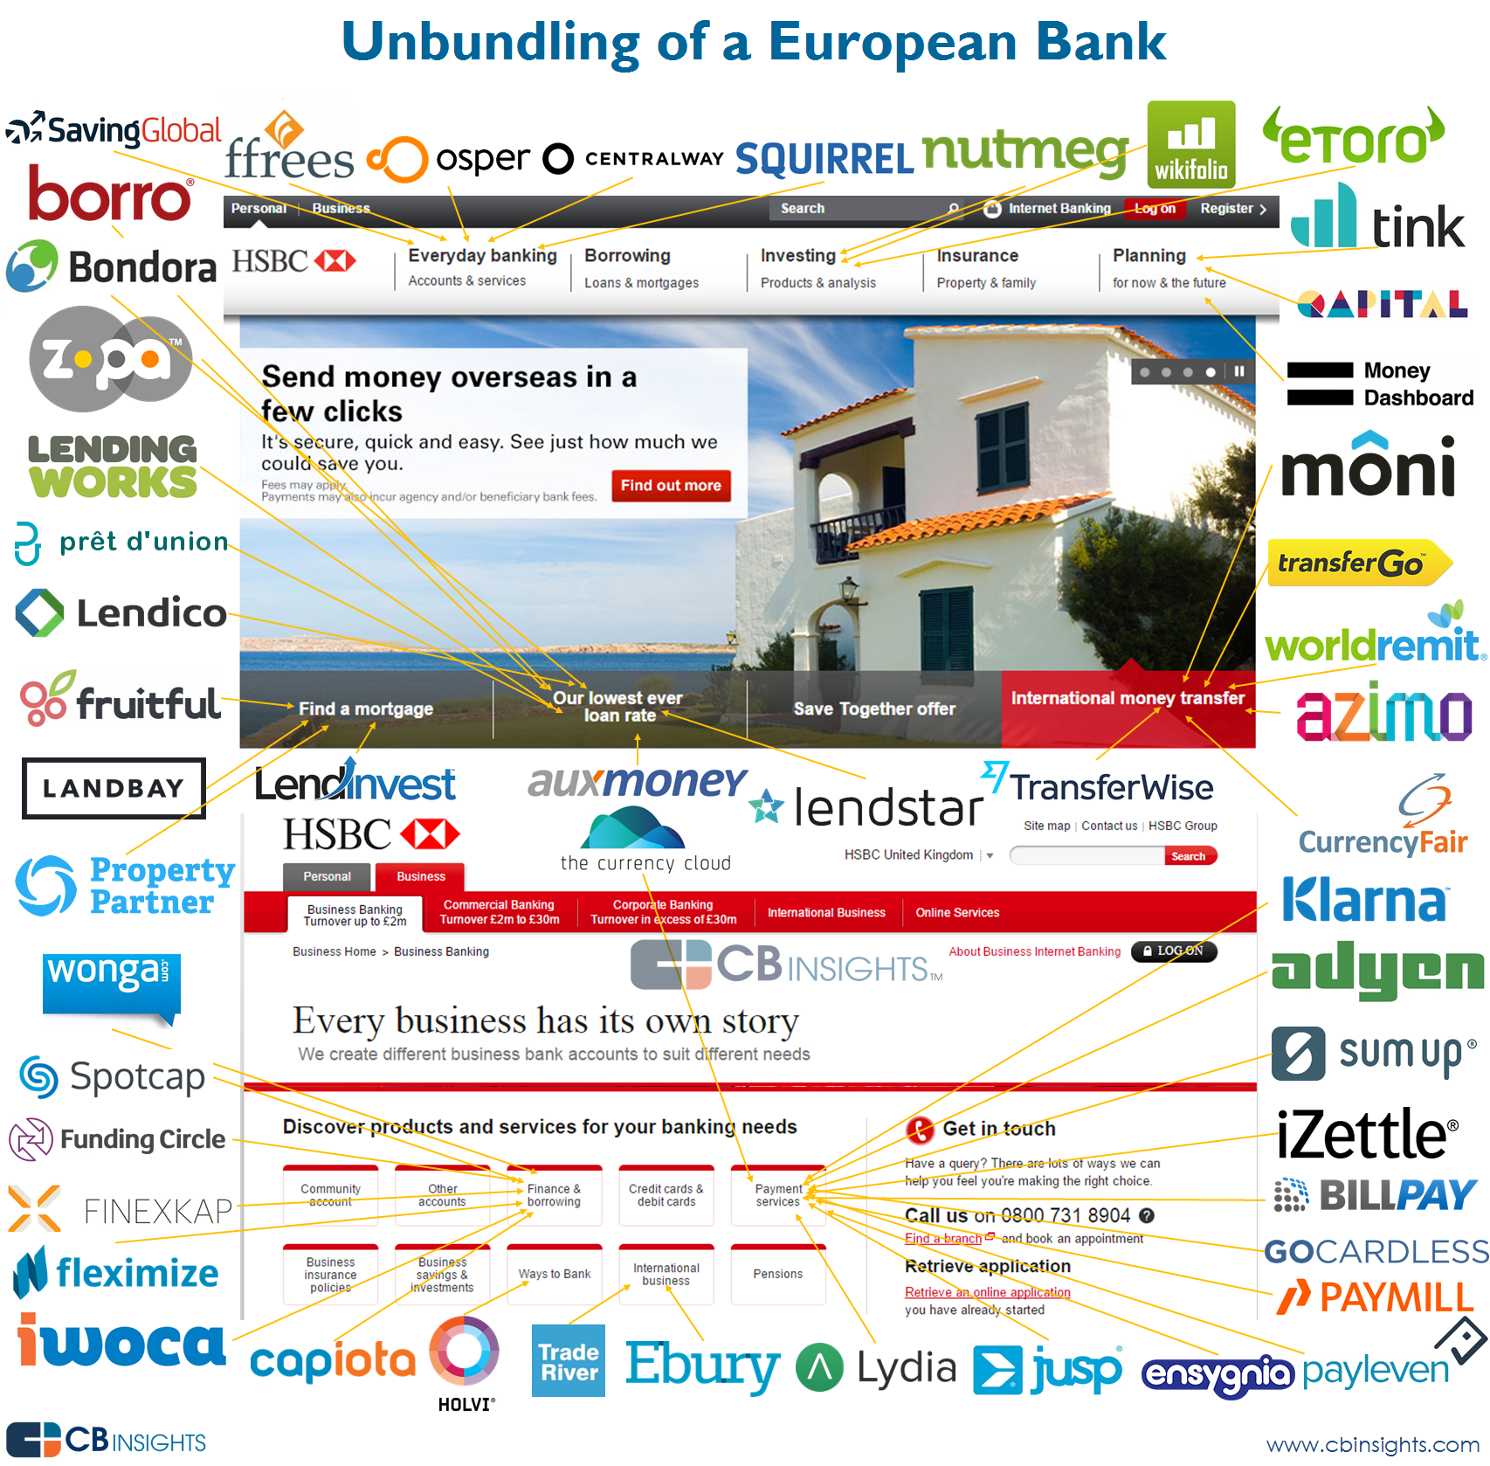
Source: https://www.cbinsights.com/blog/disrupting-european-banking-fintech-startups/

Slide 61
Source: https://www.cbinsights.com/blog/disrupting-european-banking-fintech-startups/

Slide 62
Financial Technology (Fintech) Categories
Banking Infrastructure
Business Lending
Consumer and Commercial Banking
Consumer Lending
Consumer Payments
Crowdfunding
Equity Financing
Financial Research and Data
Financial Transaction Security
Institutional Investing
International Money Transfer
Payments Backend and Infrastructure
Personal Finance
Point of Sale Payments
Retail Investing
Small and Medium Business Tools
Source: http://www.venturescanner.com/financial-technology

Slide 63
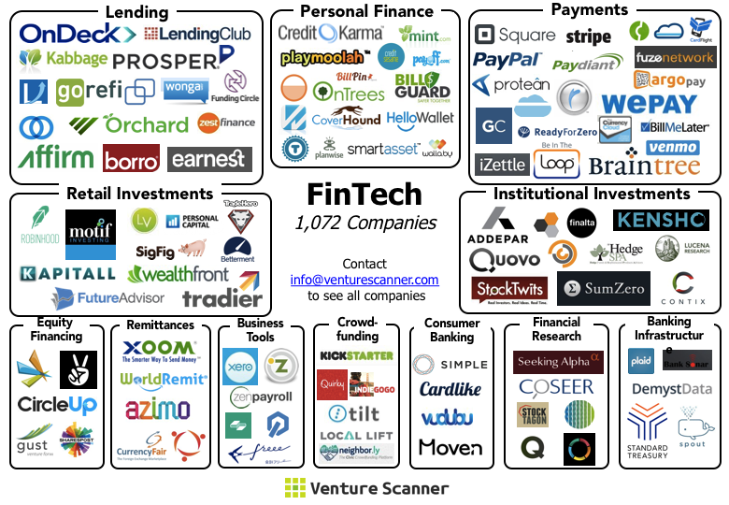
FinTech Ecosystem (April 2015)
Source: https://venturescannerinsights.wordpress.com/2015/04/07/fintech-ecosystem-update-april-2015/

Slide 64
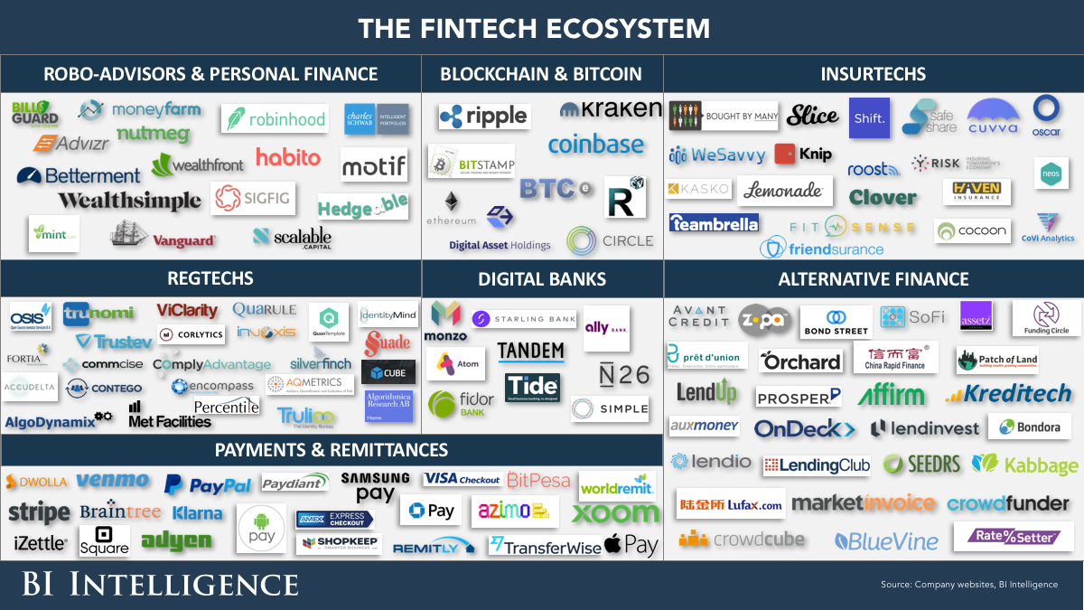
Financial Technology (FinTech)
Source: http://www.businessinsider.com/the-fintech-ecosystem-explained-measuring-the-effects-of-technology-on-the-entire-financial-services-industry-2015-12

Slide 65
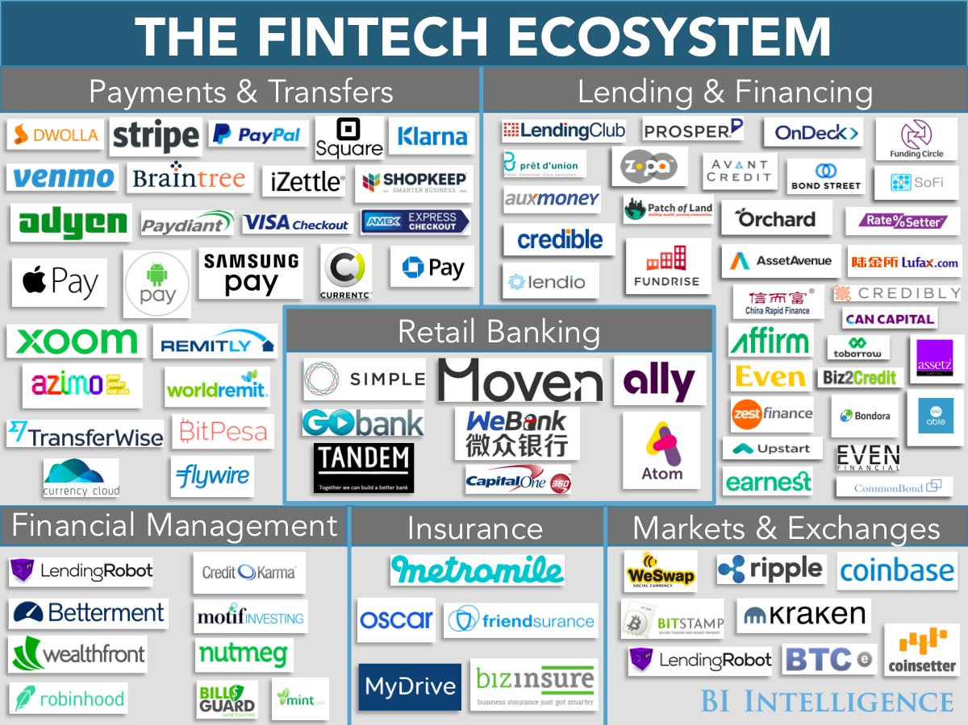
Financial Technology (FinTech)
Source: http://www.businessinsider.com/fintech-ecosystem-financial-technology-research-plus-business-opportunities-2016-2

Slide 66
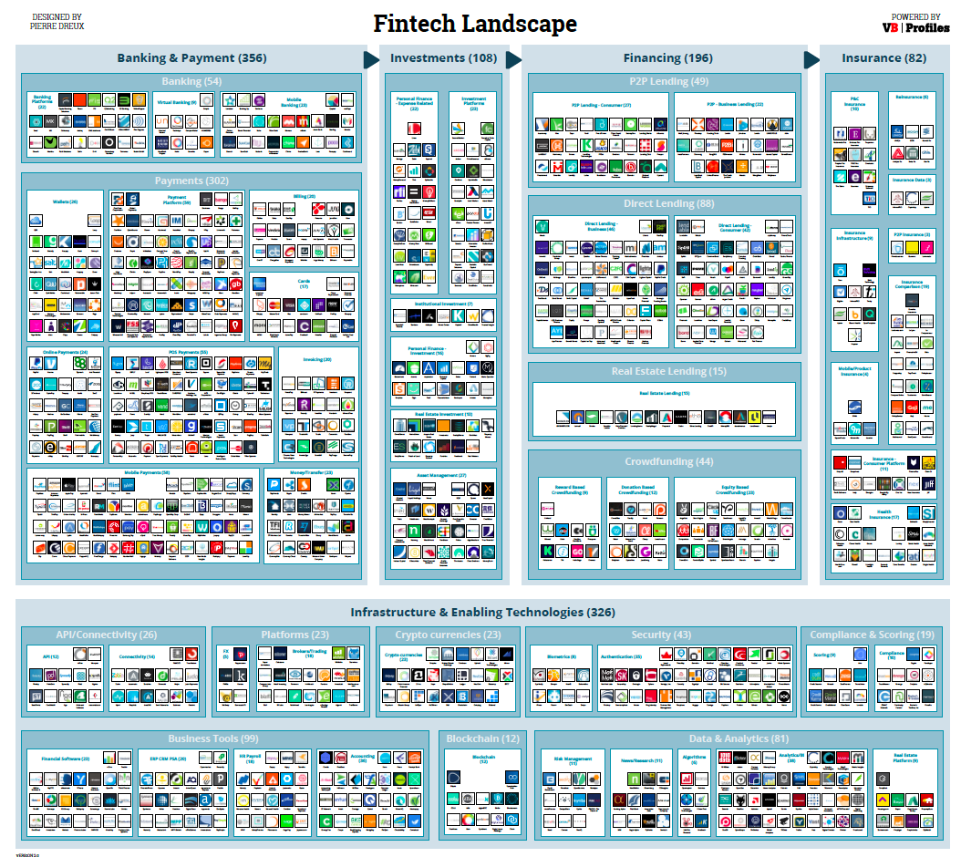
Source: http://www.forbes.com/sites/jeanbaptiste/2016/09/28/the-global-fintech-landscape-reaches-over-1000-companies-105b-in-funding-867b-in-value-report

Slide 67
FinTech Landscape Enabling Technologies Data & Analytics
Source: https://www.vbprofiles.com/l/fintech

Slide 68
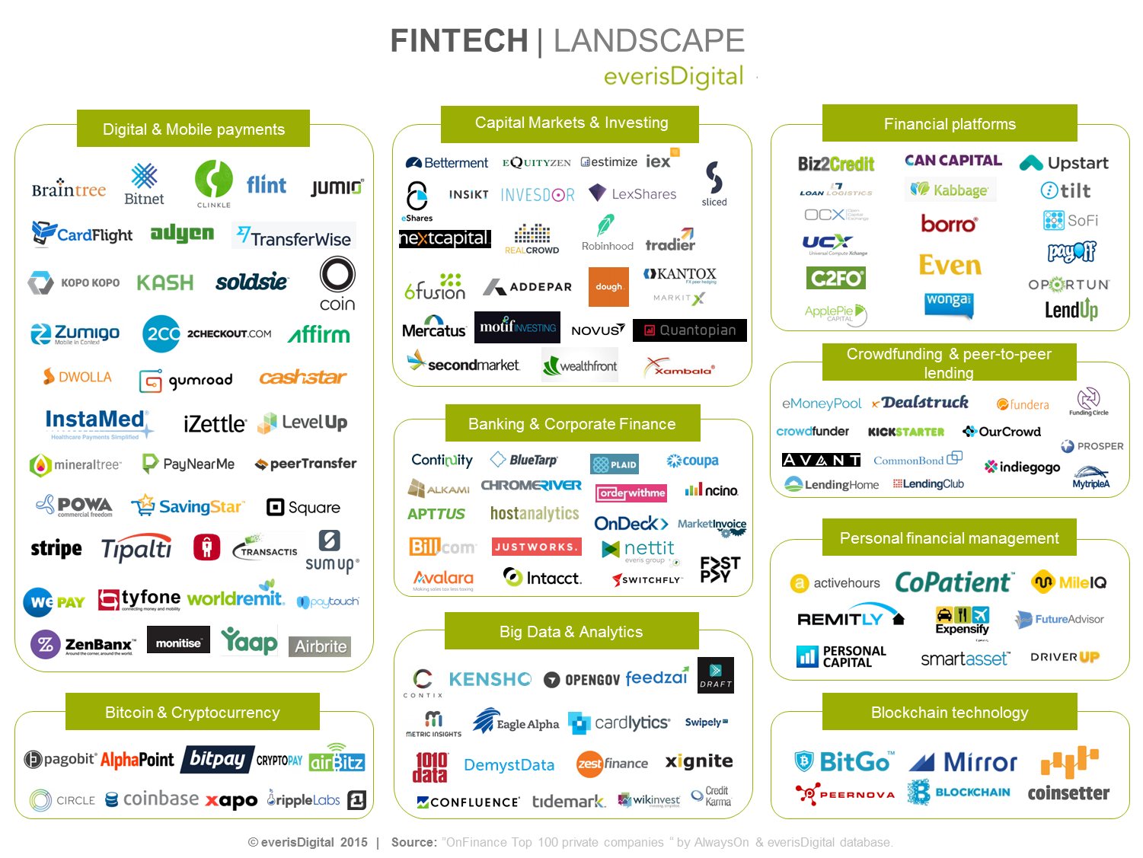
Source: https://everisnext.com/2015/06/02/top-9-verticals-within-the-fintech-landscape-for-large-corporations/

Slide 69
FinTech Startups Worldwide

Slide 70
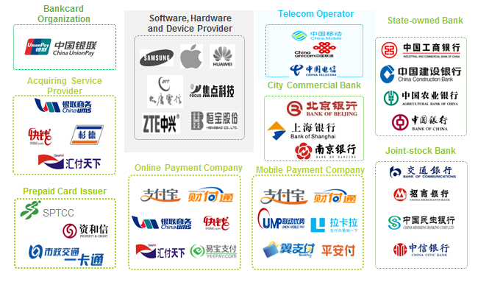
Fintech Startups WorldWide
Source: https://startups.watch/fintech-ecosystems-worldwide/

Slide 71
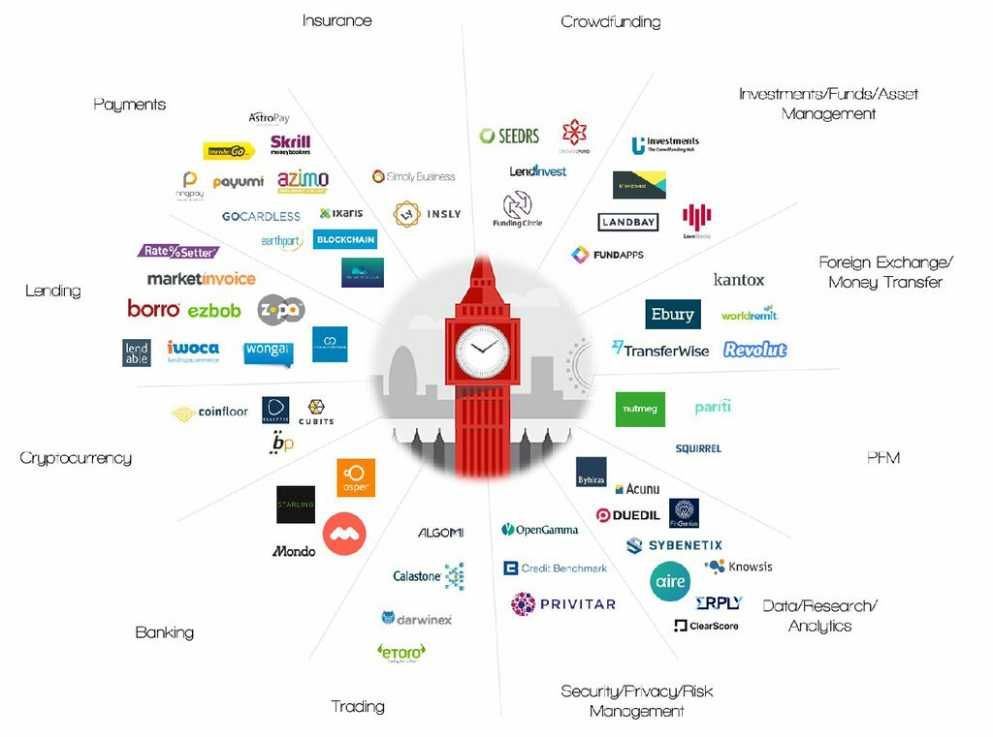
Fintech Startups WorldWide
Source: https://startups.watch/fintech-ecosystems-worldwide/

Slide 72
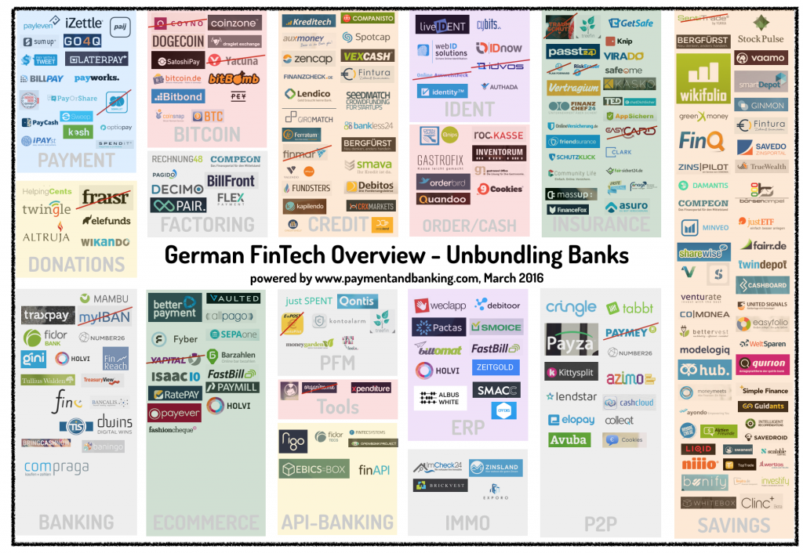
Fintech Startups WorldWide
Source: https://startups.watch/fintech-ecosystems-worldwide/

Slide 73
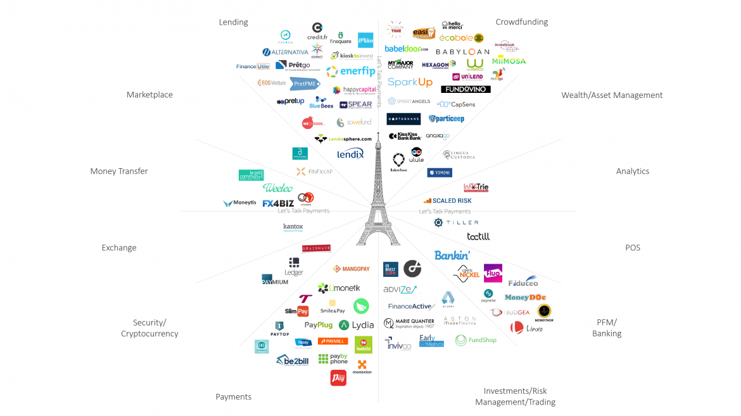
Fintech Startups WorldWide
Source: https://startups.watch/fintech-ecosystems-worldwide/

Slide 74
Fintech Startups WorldWide
Source: https://startups.watch/fintech-ecosystems-worldwide/

Slide 75
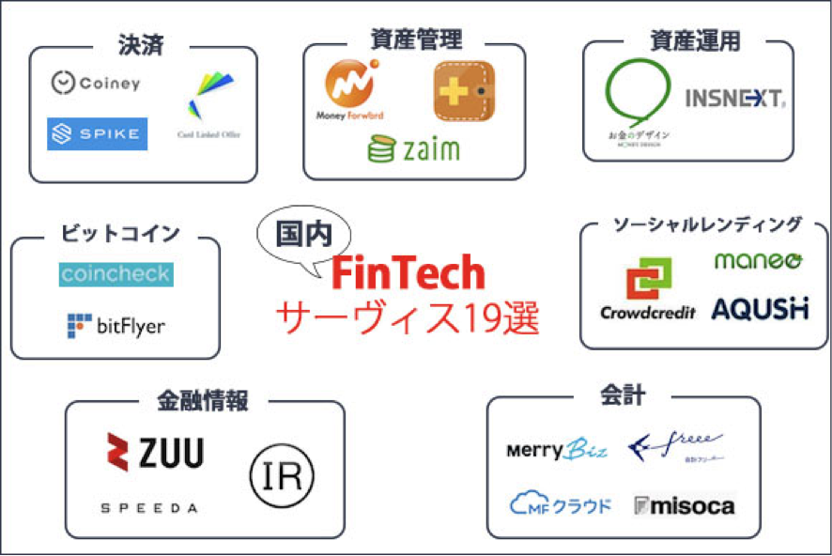
Fintech Startups WorldWide
Source: https://startups.watch/fintech-ecosystems-worldwide/

Slide 76
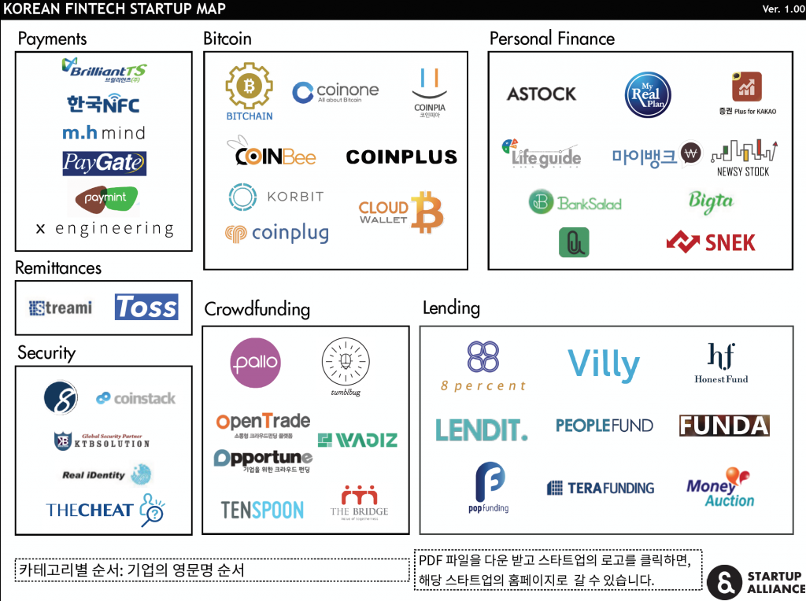
Fintech Startups WorldWide
Source: https://startups.watch/fintech-ecosystems-worldwide/

Slide 77
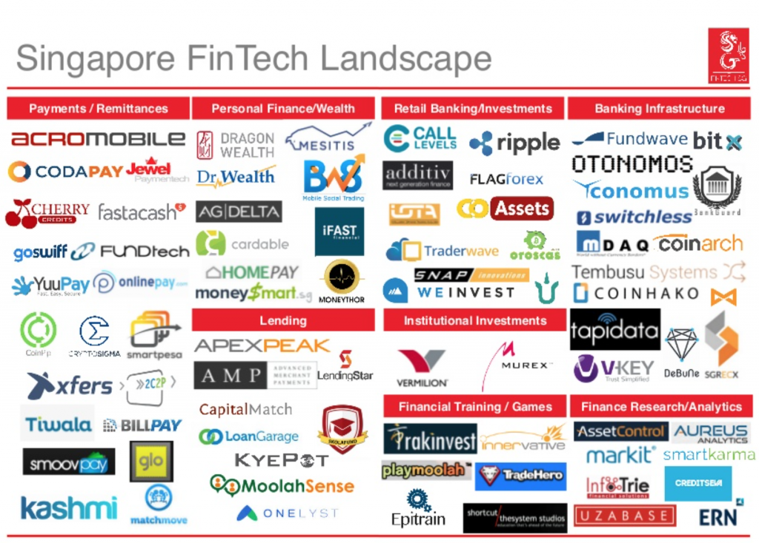
Fintech Startups WorldWide
Source: https://startups.watch/fintech-ecosystems-worldwide/

Slide 78
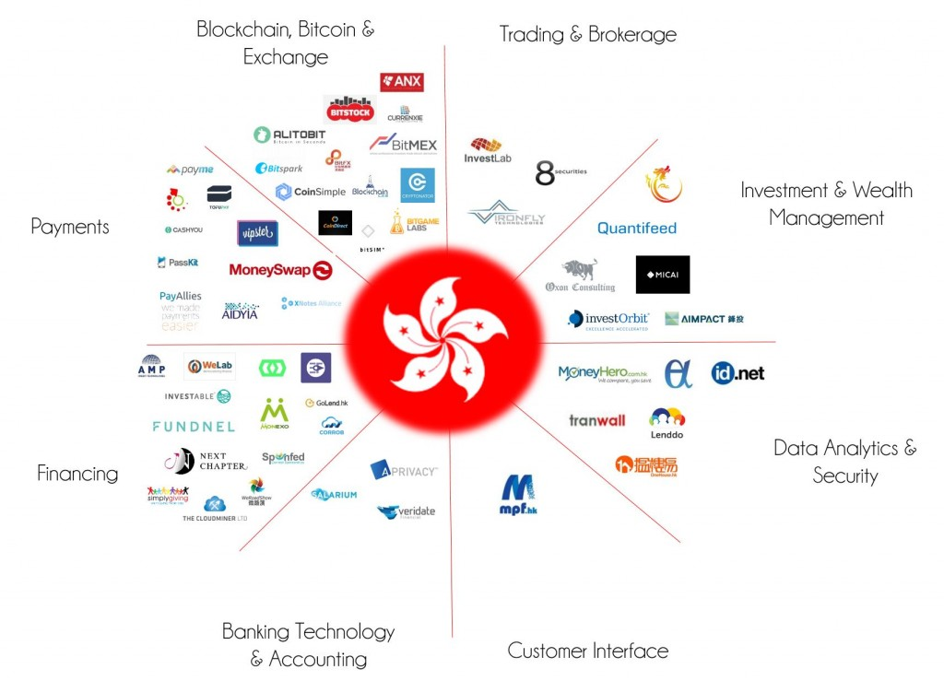
Fintech Startups WorldWide
Source: https://startups.watch/fintech-ecosystems-worldwide/

Slide 79
References
Paolo Sironi (2016), “FinTech Innovation: From Robo-Advisors to Goal Based Investing and Gamification”, Wiley.
Brett King (2014), “Breaking Banks: The Innovators, Rogues, and Strategists Rebooting Banking”, Wiley.
Brett King (2012), “Bank 3.0: Why banking is no longer somewhere you go, but something you do”, John Wiley & Sons
Susanne Chishti and Janos Barberis (2016), “The FINTECH Book: The Financial Technology Handbook for Investors, Entrepreneurs and Visionaries”, Wiley.
Gopalakrishnan, Shanti, and Fariborz Damanpour. "A review of innovation research in economics, sociology and technology management." Omega 25, no. 1 (1997): 15-28.
Pichlak, Magdalena. "The innovation adoption process: A multidimensional approach." Journal of Management and Organization 22, no. 4 (2016): 476.
Everett M. Rogers (2003), “Diffusion of Innovations”, Free Press, 5th Edition

