Slide 1
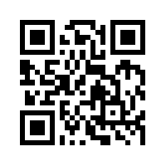
金融科技 FinTech: Financial Technology
Tamkang University
Fintech 金融科技的演進： 貨幣與金融服務 (Evolution of Fintech: Money and Financial Services)
1052FinTech02
MIS EMBA (M2263) (8595) Fri, 12,13,14 (19:20-22:10) (D409)
Min-Yuh Day
戴敏育
Assistant Professor
專任助理教授
Dept. of Information Management, Tamkang University
淡江大學 資訊管理學系
http://mail. tku.edu.tw/myday/
2017-02-24

Slide 2
課程大綱 (Syllabus)
週次 (Week) 日期 (Date) 內容 (Subject/Topics)
1 2017/02/17 Fintech 金融科技課程介紹 (Course Orientation for Fintech: Financial Technology)
2 2017/02/24 Fintech 金融科技的演進：貨幣與金融服務 (Evolution of Fintech: Money and Financial Services)
3 2017/03/03 Fintech 金融科技：金融服務科技創新 (Fintech: Technology Innovation in Financial Services)
4 2017/03/10 Fintech 金融科技與金融服務價值鏈 (Fintech and Financial Services Value Chain)
5 2017/03/17 Fintech 金融科技商業模式創新 (Fintech Business Models Innovation)
6 2017/03/24 Fintech 金融科技個案研究 I (Case Study on Fintech I)

Slide 3
課程大綱 (Syllabus)
週次 (Week) 日期 (Date) 內容 (Subject/Topics)
7 2017/03/31 金融服務消費者心理與行為 (Consumer Psychology and Behavior on Financial Services)
8 2017/04/07 教學行政觀摩日 (Off-campus study)
9 2017/04/14 區塊鏈技術 (Blockchain Technology)
10 2017/04/21 期中報告 (Midterm Project Report)
11 2017/04/28 Python Pandas財務大數據分析 (Finance Big Data Analytics with Pandas in Python)
12 2017/05/05 人工智慧與深度學習金融科技 (Artificial Intelligence and Deep Learning for Fintech)

Slide 4
課程大綱 (Syllabus)
週次 (Week) 日期 (Date) 內容 (Subject/Topics)
13 2017/05/12 Fintech 金融科技個案研究 II (Case Study on Fintech II)
14 2017/05/19 金融科技財富管理：機器人理財顧問 (Robo-Advisors for Wealth Management in Fintech)
15 2017/05/26 投資組合最佳化與程式交易 (Portfolio Optimization and Algorithmic Trading)
16 2017/06/02 金融科技智慧問答系統 (Intelligent Question Answering System for Fintech)
17 2017/06/09 期末報告 I (Final Project Presentation I)
18 2017/06/16 期末報告 II (Final Project Presentation II)

Slide 5
Evolution of Fintech: Money and Financial Services

Slide 6
Frederic S. Mishkin (2015), The Economics of Money, Banking and Financial Markets, 11th Edition, Pearson
Source: https://www.amazon.com/Economics-Banking-Financial-Markets-Pearson/dp/0133836797

Slide 7
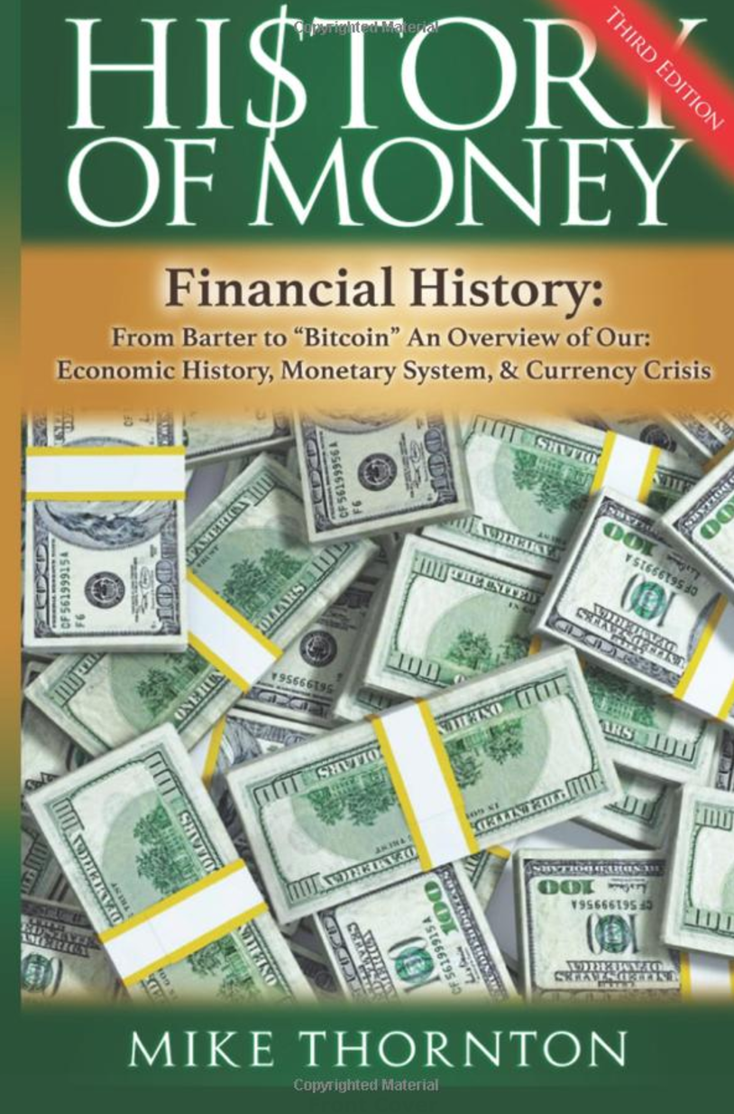
Mike Thornton (2016), History of Money: Financial History: From Barter to Bitcoin - An Overview of Our Economic History, Monetary System & Currency Crisis, CreateSpace Independent Publishing Platform
Source: https://www.amazon.com/History-Money-Financial-Overview-Economic/dp/154107582X

Slide 8
Money and Financial History
Why is a printed piece of paper worth anything?
How can a coin be worth more or even less than the number stamped on it?
Why is digital money real money?
How can money be worth more or less than it was yesterday?
Source: Mike Thornton (2016), History of Money: Financial History: From Barter to Bitcoin - An Overview of Our Economic History, Monetary System & Currency Crisis, CreateSpace Independent Publishing Platform

Slide 9
Money

Slide 10
Exchange

Slide 11
Barter

Slide 12
Barter
Source: https://www.jacksonvillebarter.com/

Slide 13
Barter

Slide 14
Money
Source: http://www.wpclipart.com/money/bills/bills_2/stack_of_bills_2.png.html

Slide 15
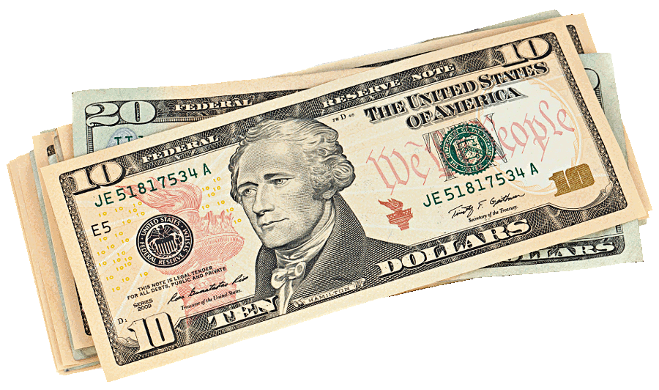
Bills
Source: http://www.wpclipart.com/money/bills/bills_2/stack_of_bills_2.png.html

Slide 16
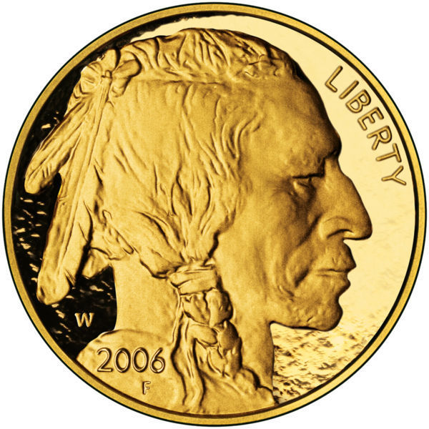
Gold Bullion Coin
Source: http://www.wpclipart.com/money/coins/American_buffalo_gold_bullion_coin_front.jpg.html

Slide 17
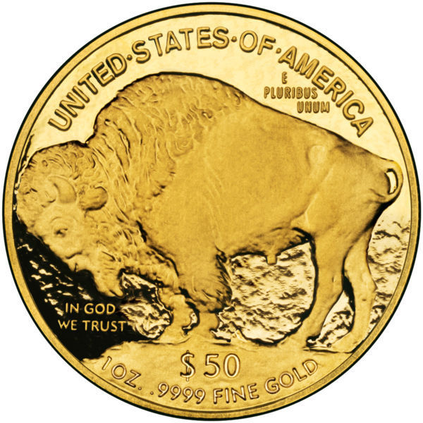
Gold Bullion Coin
Source: http://www.wpclipart.com/money/coins/American_buffalo_gold_bullion_coin_back.jpg.html

Slide 18
Coin US Penny
Source: http://www.wpclipart.com/money/coins/coin_US_penny_2.png.html

Slide 19
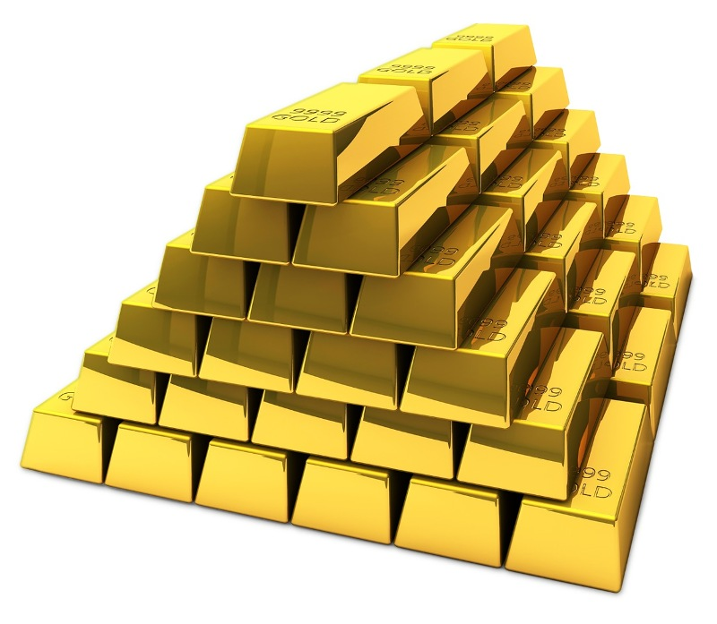
Gold Bricks
Source: http://www.wpclipart.com/money/gold/gold_bricks_stacked.jpg.html

Slide 20
Financial Services

Slide 21
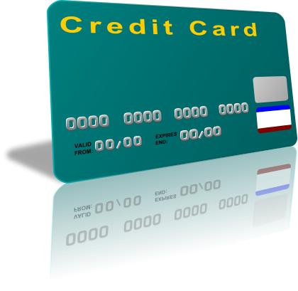
Financial Services
Source: http://www.wpclipart.com/money/credit_card/credit_card.png.html

Slide 22
Financial Services
Source: http://www.wpclipart.com/working/icons/Accountant_bank_officer.png.html

Slide 23
Treasure
Source: http://www.wpclipart.com/money/treasure/treasure_chest_3.png.html

Slide 24
Safe
Source: http://www.wpclipart.com/money/safe/steel_safe.png.html

Slide 25
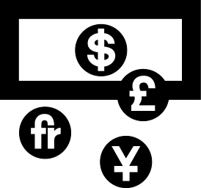
Currency Exchange
Source: http://www.wpclipart.com/signs_symbol/BW/travel_symbols/currency_exchange.png.html

Slide 26
Market

Slide 27
Financial Services
Source: http://www.crackitt.com/7-reasons-why-your-fintech-startup-needs-visual-marketing/

Slide 28
Financial Revolution with Fintech
Source: http://www.hedgethink.com/fintech/european-fintech-top-100/

Slide 29
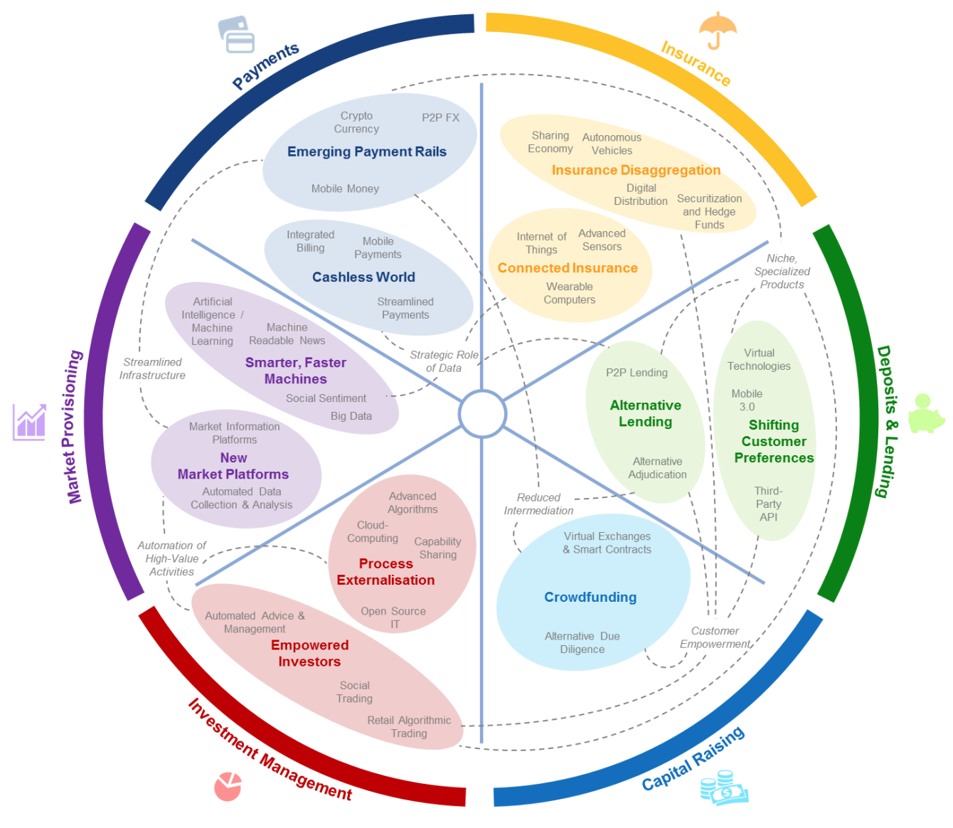
FinTech: Financial Services Innovation
Source: http://www3.weforum.org/docs/WEF_The_future__of_financial_services.pdf

Slide 30
The Economics of Money, Banking and Financial Markets
Source: Frederic S. Mishkin (2015), The Economics of Money, Banking and Financial Markets, 11th Edition, Pearson

Slide 31
Frederic S. Mishkin (2015), The Economics of Money, Banking and Financial Markets, 11th Edition, Pearson
Source: https://www.amazon.com/Economics-Banking-Financial-Markets-Pearson/dp/0133836797

Slide 32
Economics of Money, Banking and Financial Markets
Money, Banking, and Financial System
Financial Markets
Financial Institutions
Central Banking and the Conduct of Monetary Policy
International Finance and Monetary Policy
Monetary Theory
Financial Services Industry
Source: Frederic S. Mishkin (2015), The Economics of Money, Banking and Financial Markets, 11th Edition, Pearson

Slide 33
INTRODUCTION
1. Why Study Money, Banking, and Financial Markets?
2. An Overview of the Financial System
3. What Is Money?
Source: Frederic S. Mishkin (2015), The Economics of Money, Banking and Financial Markets, 11th Edition, Pearson

Slide 34
FINANCIAL MARKETS
4. Understanding Interest Rates
5. The Behavior of Interest Rates
6. The Risk and Term Structure of Interest Rates
7. The Stock Market, the Theory of Rational Expectations, and the Efficient Market Hypothesis
Source: Frederic S. Mishkin (2015), The Economics of Money, Banking and Financial Markets, 11th Edition, Pearson

Slide 35
FINANCIAL INSTITUTIONS
8. An Economic Analysis of Financial Structure
9. Banking and the Management of Financial Institutions
10. Economic Analysis of Financial Regulation
11. Banking Industry: Structure and Competition
12. Financial Crises
Source: Frederic S. Mishkin (2015), The Economics of Money, Banking and Financial Markets, 11th Edition, Pearson

Slide 36
CENTRAL BANKING AND THE CONDUCT OF MONETARY POLICY
13. Central Banks and the Federal Reserve System
14. The Money Supply Process
15. The Tools of Monetary Policy
16. The Conduct of Monetary Policy: Strategy and Tactics
Source: Frederic S. Mishkin (2015), The Economics of Money, Banking and Financial Markets, 11th Edition, Pearson

Slide 37
MONETARY THEORY
19. Quantity Theory, Inflation, and the Demand for Money
20. The IS Curve
21. The Monetary Policy and Aggregate Demand Curves
22. Aggregate Demand and Supply Analysis
23. Monetary Policy Theory
24. The Role of Expectations in Monetary Policy
25. Transmission Mechanisms of Monetary Policy
Source: Frederic S. Mishkin (2015), The Economics of Money, Banking and Financial Markets, 11th Edition, Pearson

Slide 38
Financial Services Industry
26. Financial Crises in Emerging Market Economies
27. The ISLM Model
28. Nonbank Finance
29. Financial Derivatives
30. Conflicts of Interest in the Financial Services Industry
Source: Frederic S. Mishkin (2015), The Economics of Money, Banking and Financial Markets, 11th Edition, Pearson

Slide 39
Why Study Money, Banking, and Financial Markets?
Source: Frederic S. Mishkin (2015), The Economics of Money, Banking and Financial Markets, 11th Edition, Pearson

Slide 40
Why Study Money, Banking, and Financial Markets?
To examine how financial markets such as bond, stock and foreign exchange markets work
To examine how financial institutions such as banks and insurance companies work
To examine the role of money in the economy
Source: Frederic S. Mishkin (2015), The Economics of Money, Banking and Financial Markets, 11th Edition, Pearson

Slide 41
Financial Markets
Markets in which funds are transferred from people who have an excess of available funds to people who have a shortage of funds
Bond market
Stock market
Foreign exchange market
Source: Frederic S. Mishkin (2015), The Economics of Money, Banking and Financial Markets, 11th Edition, Pearson

Slide 42
Financial Institutions
Financial Intermediaries: institutions that borrow funds from people who have saved and make loans to other people:
Banks: accept deposits and make loans
Other Financial Institutions: insurance companies, finance companies, pension funds, mutual funds and investment banks
Financial Innovation: the advent of the information age and e-finance
Source: Frederic S. Mishkin (2015), The Economics of Money, Banking and Financial Markets, 11th Edition, Pearson

Slide 43
Money and Business Cycles
Money plays an important role in generating business cycles
Recessions (unemployment) and expansions affect all of us
Monetary Theory ties changes in the money supply to changes in aggregate economic activity and the price level
Source: Frederic S. Mishkin (2015), The Economics of Money, Banking and Financial Markets, 11th Edition, Pearson

Slide 44
Overview of the Financial System
Indirect Finance
Financial Intermediaries
Funds
Funds
Funds
Lender-Savers
1. Households
2. Business firms
3. Government
4. Foreigners
Financial Markets
Borrower-Senders
1. Business firms
2. Government
3. Households
4. Foreigners
Funds
Funds
Direct Finance
Source: Frederic S. Mishkin (2015), The Economics of Money, Banking and Financial Markets, 11th Edition, Pearson

Slide 45
What is Money?
Source: Frederic S. Mishkin (2015), The Economics of Money, Banking and Financial Markets, 11th Edition, Pearson

Slide 46
Money
Source: http://www.wpclipart.com/money/bills/bills_2/stack_of_bills_2.png.html

Slide 47
Bills
Source: http://www.wpclipart.com/money/bills/bills_2/stack_of_bills_2.png.html

Slide 48
Meaning of Money
Money (=money supply) any vehicle used as a means of exchange to pay for goods, services or debts.
In today’s society, any asset that can quickly be transferred into cash is considered money.
The more liquid an asset is, the closer it is to money.
In economics, money does not mean wealth nor does it mean income.
Source: Frederic S. Mishkin (2015), The Economics of Money, Banking and Financial Markets, 11th Edition, Pearson

Slide 49
Functions of Money
Medium of Exchange
Unit of Account
Store of Value
Source: Frederic S. Mishkin (2015), The Economics of Money, Banking and Financial Markets, 11th Edition, Pearson

Slide 50
Medium of Exchange
By eliminating barter, this function of money increases efficiency in a society.
As human societies started to engage in exchange money had to be invented.
Any technological change that reduces transaction costs increases the wealth of the society.
Any technological change that allows people to specialize also increases wealth.
Source: Frederic S. Mishkin (2015), The Economics of Money, Banking and Financial Markets, 11th Edition, Pearson

Slide 51
Unit of Account
We use money to measure the value of goods and services.
Suppose we had 4 goods and no money. How do we measure the price of each good?
A in terms of B
B in terms of C N!/2(N-2)!
C in terms of D
A in terms of C
A in terms of D
B in terms of D
Money allows to quote prices in terms of currency only.
Source: Frederic S. Mishkin (2015), The Economics of Money, Banking and Financial Markets, 11th Edition, Pearson

Slide 52
Store of Value
All assets are stored value.
Money, although without any return, is still desirable to hold because it allows purchases immediately.
Other assets take time (transaction costs) to use as a payment for purchases.
The more liquid an asset is, the less transaction cost it carries.
Inflation erodes the value of money.
Source: Frederic S. Mishkin (2015), The Economics of Money, Banking and Financial Markets, 11th Edition, Pearson

Slide 53
Store of Value
All assets are stored value.
Money, although without any return, is still desirable to hold because it allows purchases immediately.
Other assets take time (transaction costs) to use as a payment for purchases.
The more liquid an asset is, the less transaction cost it carries.
Inflation erodes the value of money.
Source: Frederic S. Mishkin (2015), The Economics of Money, Banking and Financial Markets, 11th Edition, Pearson

Slide 54
Evolution of the Payments System
Commodity Money:
valuable, easily standardized and divisible commodities (e.g. precious metals, cigarettes).
Fiat Money:
paper money decreed by governments as legal tender.
Source: Frederic S. Mishkin (2015), The Economics of Money, Banking and Financial Markets, 11th Edition, Pearson

Slide 55
Electronic Money
Debit Cards
Instant transfer from your checking account to merchant’s checking account.
Stored Value Card
Gift cards.
Electronic Cash
Account set up on a person’s PC from her bank whereby she can buy products over the Internet.
Electronic Checks
Checks written on PC and sent through the Internet.
Source: Frederic S. Mishkin (2015), The Economics of Money, Banking and Financial Markets, 11th Edition, Pearson

Slide 56
Benefits of Paper Checks
Cheaper than telecommunications network.
Provide receipts.
Allow float.
May be more secure; avoid hacker problems.
Do not leave a wealth of information trail.
Source: Frederic S. Mishkin (2015), The Economics of Money, Banking and Financial Markets, 11th Edition, Pearson

Slide 57
Measuring Money
M1:
Currency, demand deposits, travelers checks.
M2:
M1, saving deposits, small time deposits, retail MMMF.
M3:
M2, large time deposits, repos, Eurodollar deposits, institutional MMMF.
MZM:
M2, institutional MMMF minus small time deposits.
Growth rates of these aggregates do not always go hand in hand, making monetary policy difficult since signals are conflicting.
Source: Frederic S. Mishkin (2015), The Economics of Money, Banking and Financial Markets, 11th Edition, Pearson

Slide 58
The IS Curve
Source: Frederic S. Mishkin (2015), The Economics of Money, Banking and Financial Markets, 11th Edition, Pearson

Slide 59
The IS (Investment/Saving) Curve
Source: Frederic S. Mishkin (2015), The Economics of Money, Banking and Financial Markets, 11th Edition, Pearson

Slide 60
The IS (Investment/Saving) Curve
Goods Markets
Interest rate, i
i
IS
Y
Output (Income), Y
Source: Frederic S. Mishkin (2015), The Economics of Money, Banking and Financial Markets, 11th Edition, Pearson

Slide 61
Demand
Demand
Price (p)
P*
D
Q*
Quantity (q)
Source: Frederic S. Mishkin (2015), The Economics of Money, Banking and Financial Markets, 11th Edition, Pearson

Slide 62
The ISLM Model
Source: Frederic S. Mishkin (2015), The Economics of Money, Banking and Financial Markets, 11th Edition, Pearson

Slide 63
Goods and Financial Markets: The ISLM Model (Investment Saving – Liquidity Preference Money Supply) model
Source: Frederic S. Mishkin (2015), The Economics of Money, Banking and Financial Markets, 11th Edition, Pearson

Slide 64
The ISLM Model (Investment Saving – Liquidity Preference Money Supply) model
LM
Goods Markets
Financial Markets
Interest rate, i
i
IS
Y
Output (Income), Y
Source: Frederic S. Mishkin (2015), The Economics of Money, Banking and Financial Markets, 11th Edition, Pearson

Slide 65
Supply and Demand
S
Demand
Supply
Price (p)
P*
Equilibrium
D
Q *
Quantity (q)
Source: Frederic S. Mishkin (2015), The Economics of Money, Banking and Financial Markets, 11th Edition, Pearson

Slide 66
FinTech: Financial Services Innovation
Source: http://www3.weforum.org/docs/WEF_The_future__of_financial_services.pdf

Slide 67
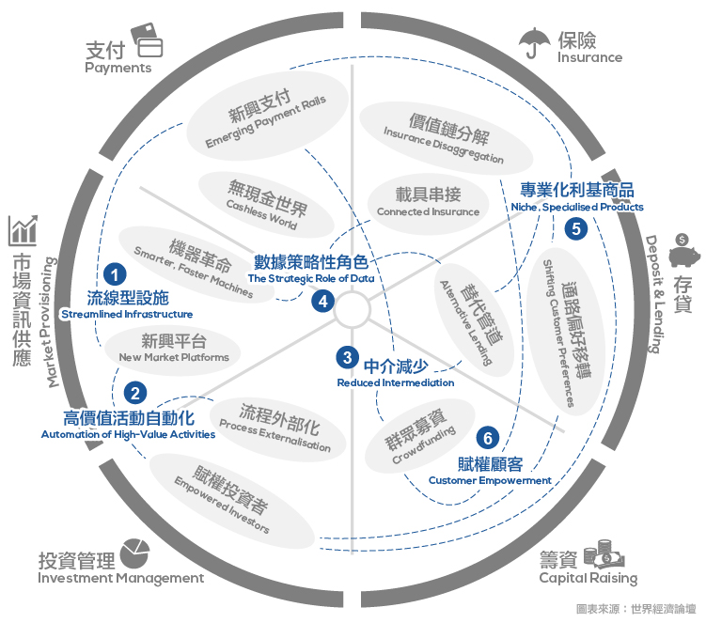
Source: https://www.stockfeel.com.tw/2015年世界經濟論壇－未來的金融服務/

Slide 68
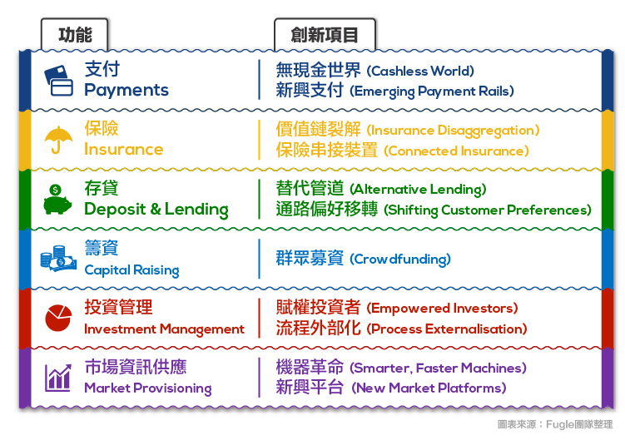
FinTech
Source: https://www.stockfeel.com.tw/2015年世界經濟論壇－未來的金融服務/

Slide 69
FinTech: Financial Services Innovation
Source: http://www3.weforum.org/docs/WEF_The_future__of_financial_services.pdf

Slide 70
FinTech: Cashless World Emerging Payment Rails
Source: https://www.stockfeel.com.tw/2015年世界經濟論壇－未來的金融服務/

Slide 71
FinTech: Financial Services Innovation
Source: http://www3.weforum.org/docs/WEF_The_future__of_financial_services.pdf

Slide 72
FinTech: Alternative Lending Shifting Customer Preferences
Source: https://www.stockfeel.com.tw/2015年世界經濟論壇－未來的金融服務/

Slide 73
FinTech: Financial Services Innovation
Source: http://www3.weforum.org/docs/WEF_The_future__of_financial_services.pdf

Slide 74
FinTech: Crowdfunding
Source: https://www.stockfeel.com.tw/2015年世界經濟論壇－未來的金融服務/

Slide 75
Fintech: Financial Technology
Disrupting Banking: The Fintech Startups That Are Unbundling Wells Fargo, Citi and Bank of America
Source: https://www.cbinsights.com/blog/industry-market-map-landscape/

Slide 76
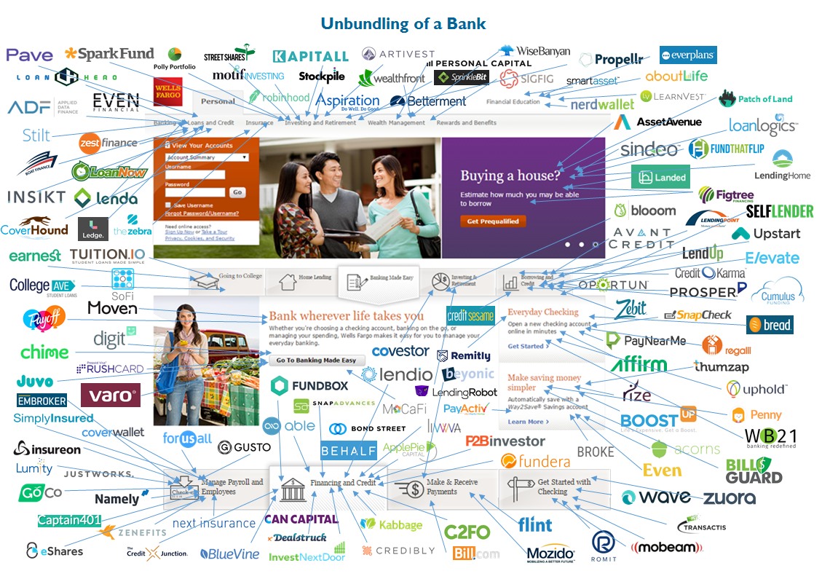
Fintech: Unbunding the Bank
Source: https://www.cbinsights.com/blog/disrupting-banking-fintech-startups-2016/

Slide 77
Fintech: Unbunding the Bank
Wealth Management: Wealthfront
Source: https://www.cbinsights.com/blog/disrupting-banking-fintech-startups-2016/

Slide 78
Fintech: Financial Technology
Disrupting European Banking: The FinTech Startups That Are Unbundling HSBC, Santander, and BNP
Source: https://www.cbinsights.com/blog/industry-market-map-landscape/

Slide 79
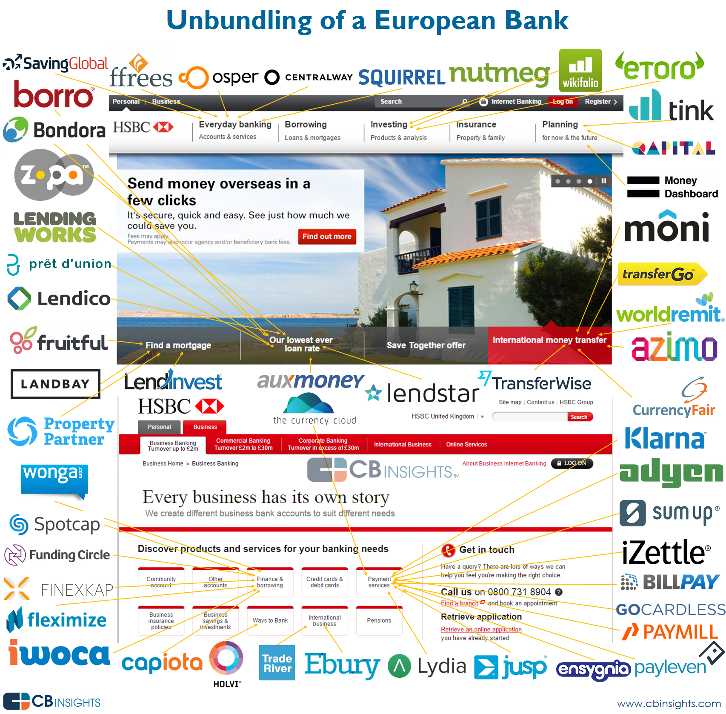
Source: https://www.cbinsights.com/blog/disrupting-european-banking-fintech-startups/

Slide 80
Source: https://www.cbinsights.com/blog/disrupting-european-banking-fintech-startups/

Slide 81
References
Frederic S. Mishkin (2015), “The Economics of Money, Banking and Financial Markets”, 11th Edition, Pearson
Susanne Chishti and Janos Barberis (2016), “The FINTECH Book: The Financial Technology Handbook for Investors, Entrepreneurs and Visionaries”, Wiley.
Paolo Sironi (2016), “FinTech Innovation: From Robo-Advisors to Goal Based Investing and Gamification”, Wiley.

