Slide 1
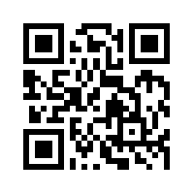
金融科技 FinTech: Financial Technology
Tamkang University
FinTech 金融科技課程介紹 (Course Orientation for Fintech: Financial Technology)
1052FinTech01
MIS EMBA (M2263) (8595) Fri, 12,13,14 (19:20-22:10) (D409)
Min-Yuh Day
戴敏育
Assistant Professor
專任助理教授
Dept. of Information Management, Tamkang University
淡江大學 資訊管理學系
http://mail. tku.edu.tw/myday/
2017-02-17

Slide 2
金融科技 FinTech Financial Technology

Slide 3
淡江大學105學年度第2學期 課程教學計畫表 Spring 2017 (2017.02 - 2017.06)
課程名稱：金融科技 (FinTech: Financial Technology)
授課教師：戴敏育 (Min-Yuh Day)
開課系級：資管所碩專班 (TLMXJ1A)
開課資料：選修 單學期 3 學分 (3 Credits, Elective)
上課時間：週五 12,13,14 (Fri 19:20-22:10)
上課教室： D409 (淡江大學台北校園)

Slide 4
課程簡介
本課程介紹Fintech金融科技基本概念與研究議題。
課程內容包括
Fintech 金融科技的演進：貨幣與金融服務
Fintech 金融科技：金融服務科技創新
Fintech 金融科技與金融服務價值鏈
Fintech 金融科技商業模式創新
金融服務消費者心理與行為
區塊鏈技術
Python Pandas 財務大數據分析
人工智慧與深度學習金融科技
金融科技財富管理：機器人理財顧問
投資組合最佳化與程式交易
金融科技智慧問答系統
Fintech 金融科技個案研究

Slide 5
Course Introduction
This course introduces the fundamental concepts and research issues of Financial Technology (Fintech).
Topics include
Evolution of Fintech: Money and Financial Services
Fintech: Technology Innovation in Financial Services
Fintech and Financial Services Value Chain
Fintech Business Models Innovation
Consumer Psychology and Behavior on Financial Services
Blockchain Technology
Finance Big Data Analytics with Pandas in Python
Artificial Intelligence and Deep Learning for Fintech
Robo-Advisors for Wealth Management in Fintech
Portfolio Optimization and Algorithmic Trading
Intelligent Question Answering System for Fintech
Case Study on Fintech

Slide 6
課程目標 (Objective)
瞭解及應用金融科技 Fintech 基本概念與研究議題。 (Understand and apply the fundamental concepts and research issues of Financial Technology (Fintech).)
進行金融科技 Fintech相關之資訊管理研究。 (Conduct information systems research in the context of Financial Technology (Fintech).)

Slide 7
課程大綱 (Syllabus)
週次 (Week) 日期 (Date) 內容 (Subject/Topics)
1 2017/02/17 Fintech 金融科技課程介紹 (Course Orientation for Fintech: Financial Technology)
2 2017/02/24 Fintech 金融科技的演進：貨幣與金融服務 (Evolution of Fintech: Money and Financial Services)
3 2017/03/03 Fintech 金融科技：金融服務科技創新 (Fintech: Technology Innovation in Financial Services)
4 2017/03/10 Fintech 金融科技與金融服務價值鏈 (Fintech and Financial Services Value Chain)
5 2017/03/17 Fintech 金融科技商業模式創新 (Fintech Business Models Innovation)
6 2017/03/24 Fintech 金融科技個案研究 I (Case Study on Fintech I)

Slide 8
課程大綱 (Syllabus)
週次 (Week) 日期 (Date) 內容 (Subject/Topics)
7 2017/03/31 金融服務消費者心理與行為 (Consumer Psychology and Behavior on Financial Services)
8 2017/04/07 教學行政觀摩日 (Off-campus study)
9 2017/04/14 區塊鏈技術 (Blockchain Technology)
10 2017/04/21 期中報告 (Midterm Project Report)
11 2017/04/28 Python Pandas財務大數據分析 (Finance Big Data Analytics with Pandas in Python)
12 2017/05/05 人工智慧與深度學習金融科技 (Artificial Intelligence and Deep Learning for Fintech)

Slide 9
課程大綱 (Syllabus)
週次 (Week) 日期 (Date) 內容 (Subject/Topics)
13 2017/05/12 Fintech 金融科技個案研究 II (Case Study on Fintech II)
14 2017/05/19 金融科技財富管理：機器人理財顧問 (Robo-Advisors for Wealth Management in Fintech)
15 2017/05/26 投資組合最佳化與程式交易 (Portfolio Optimization and Algorithmic Trading)
16 2017/06/02 金融科技智慧問答系統 (Intelligent Question Answering System for Fintech)
17 2017/06/09 期末報告 I (Final Project Presentation I)
18 2017/06/16 期末報告 II (Final Project Presentation II)

Slide 10
教學方法與評量方法
教學方法
講述、討論、 賞析、模擬、 問題解決、實作
評量方法
實作、報告、上課表現

Slide 11
教材課本
教材課本
講義 (Slides)
Fintech 金融科技相關個案與論文 (Cases and Papers related to Fintech Financial Technology)

Slide 12
參考書籍
Susanne Chishti and Janos Barberis, The FINTECH Book: The Financial Technology Handbook for Investors, Entrepreneurs and Visionaries, Wiley, 2016.
Paolo Sironi, FinTech Innovation: From Robo-Advisors to Goal Based Investing and Gamification, Wiley, 2016.
Michael Heydt , Mastering Pandas for Finance, Packt Publishing, 2015
Yves Hilpisch, Python for Finance: Analyze Big Financial Data, OReilly Media, 2014
James Ma Weiming, Mastering Python for Finance, Packt Publishing, 2015
Fabio Nelli, Python Data Analytics: Data Analysis and Science using PANDAs, matplotlib and the Python Programming Language, Apress, 2015

Slide 13
作業與學期成績計算方式
作業篇數
3篇
學期成績計算方式
期中評量：30 ％
期末評量：30 ％
其他（課堂參與及報告討論表現）： 40 ％

Slide 14
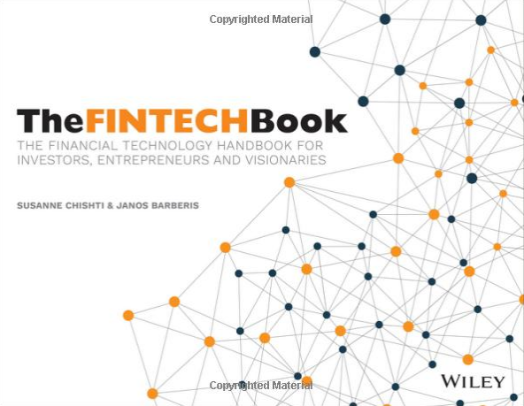
The FINTECH Book: The Financial Technology Handbook for Investors, Entrepreneurs and Visionaries, Susanne Chishti and Janos Barberis, Wiley, 2016.
Source: https://www.amazon.com/FINTECH-Book-Technology-Entrepreneurs-Visionaries/dp/111921887X

Slide 15
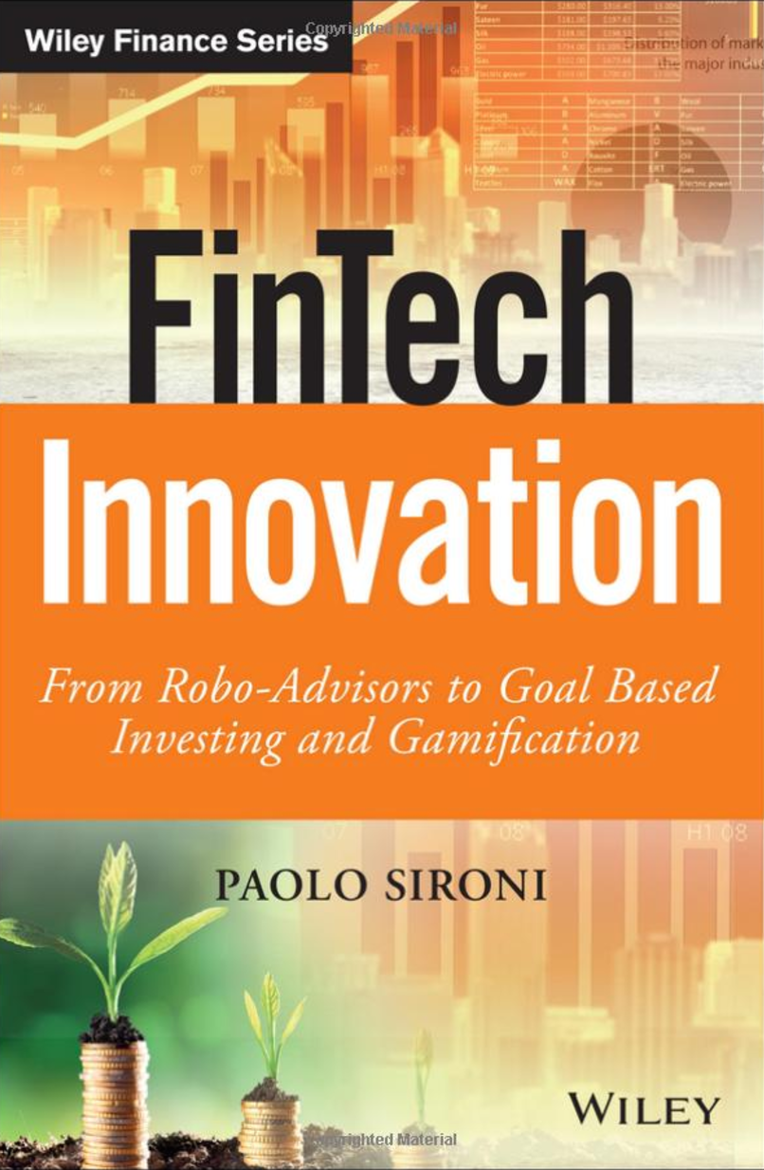
FinTech Innovation: From Robo-Advisors to Goal Based Investing and Gamification, Paolo Sironi, Wiley, 2016
Source: https://www.amazon.com/FinTech-Innovation-Robo-Advisors-Investing-Gamification/dp/1119226988

Slide 16
FinTech

Slide 17
Financial Technology

Slide 18
FinTech

Slide 19
Financial Technology FinTech
“providing financial services by making use of software and modern technology”
Source: https://www.fintechweekly.com/fintech-definition

Slide 20
Financial Services

Slide 21
Money

Slide 22
Market

Slide 23
Financial Services
Source: http://www.crackitt.com/7-reasons-why-your-fintech-startup-needs-visual-marketing/

Slide 24
Financial Revolution with Fintech
Source: http://www.hedgethink.com/fintech/european-fintech-top-100/

Slide 25
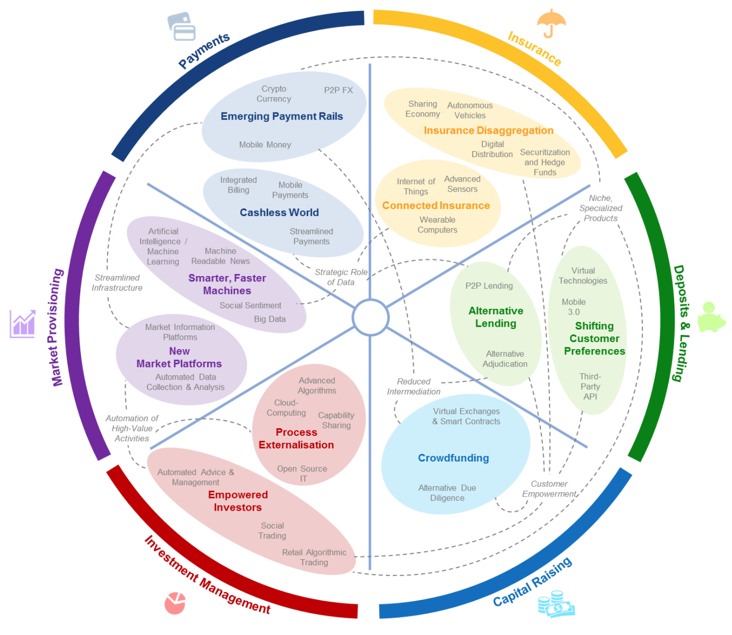
FinTech: Financial Services Innovation
Source: http://www3.weforum.org/docs/WEF_The_future__of_financial_services.pdf

Slide 26
FinTech: Investment Management Market Provisioning

Slide 27
FinTech: Market Provisioning
Source: http://www3.weforum.org/docs/WEF_The_future__of_financial_services.pdf

Slide 28
FinTech: Investment Management
Source: http://www3.weforum.org/docs/WEF_The_future__of_financial_services.pdf

Slide 29
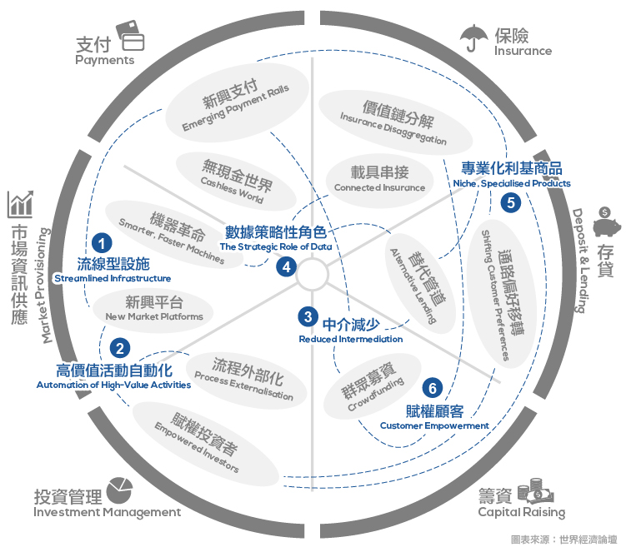
Source: https://www.stockfeel.com.tw/2015年世界經濟論壇－未來的金融服務/

Slide 30
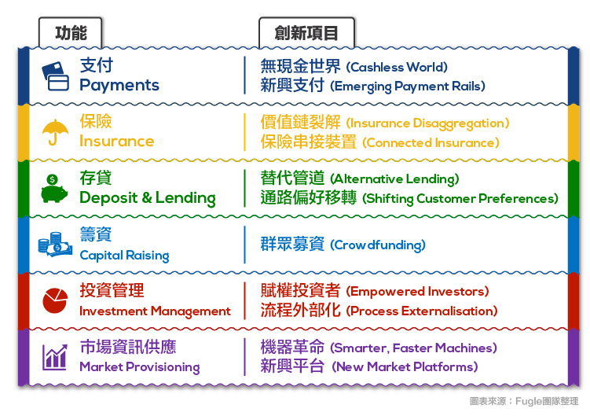
FinTech
Source: https://www.stockfeel.com.tw/2015年世界經濟論壇－未來的金融服務/

Slide 31
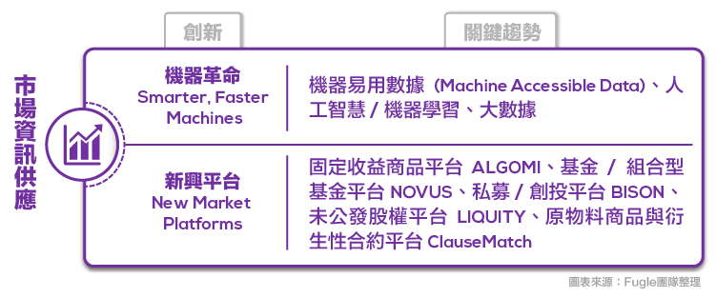
FinTech: Market Provisioning Smarter, Faster Machines
Source: https://www.stockfeel.com.tw/2015年世界經濟論壇－未來的金融服務/

Slide 32
FinTech: Investment Management
Source: https://www.stockfeel.com.tw/2015年世界經濟論壇－未來的金融服務/

Slide 33
FinTech for Financial Services
Retail Banking
Lending and Financing
Payments and Transfers
Wealth and Asset Management
Markets and Exchanges
Insurance
Blockchain Transactions
Source: https://fintechweekly.com/fintech-companies

Slide 34
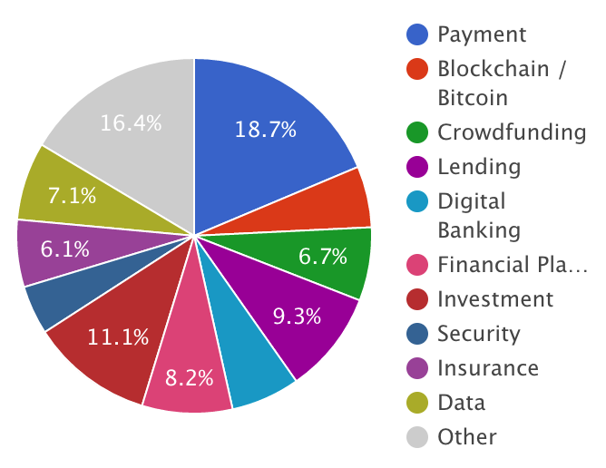
Fintech Companies
Source: https://fintechweekly.com/fintech-companies

Slide 35
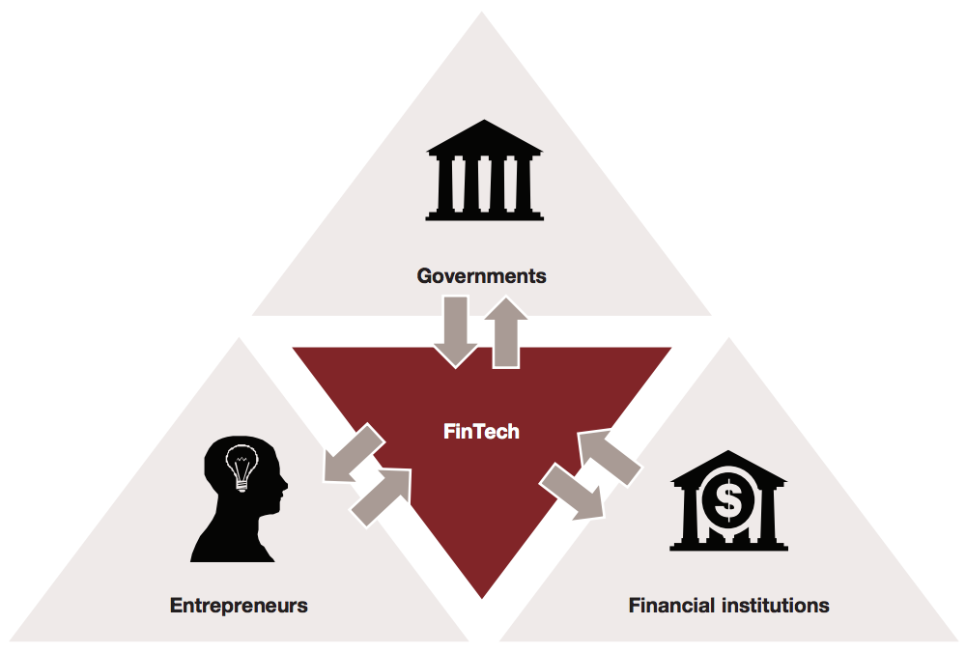
Major Participants in the FinTech Ecosystem
Source: http://www.strategyand.pwc.com/media/file/Developing-a-FinTech-ecosystem-in-the-GCC.pdf

Slide 36
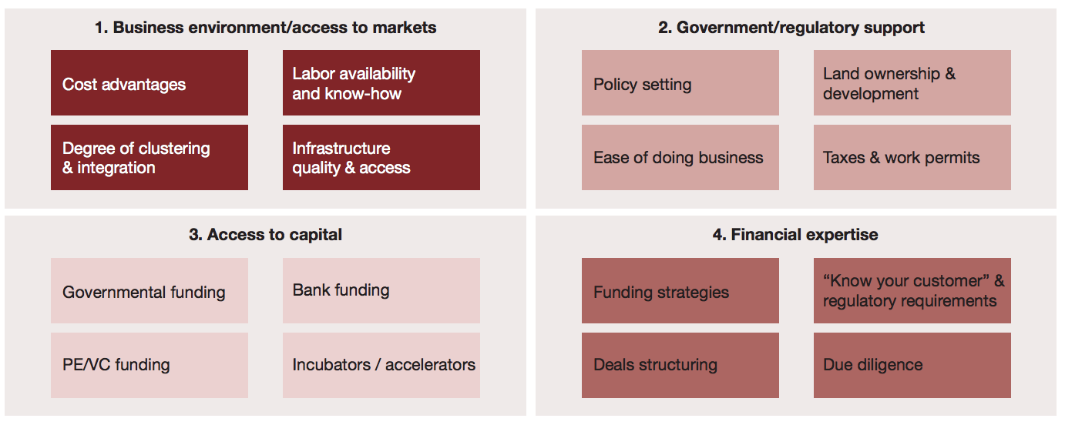
FinTech Ecosystem Development Framework
Source: http://www.strategyand.pwc.com/media/file/Developing-a-FinTech-ecosystem-in-the-GCC.pdf

Slide 37
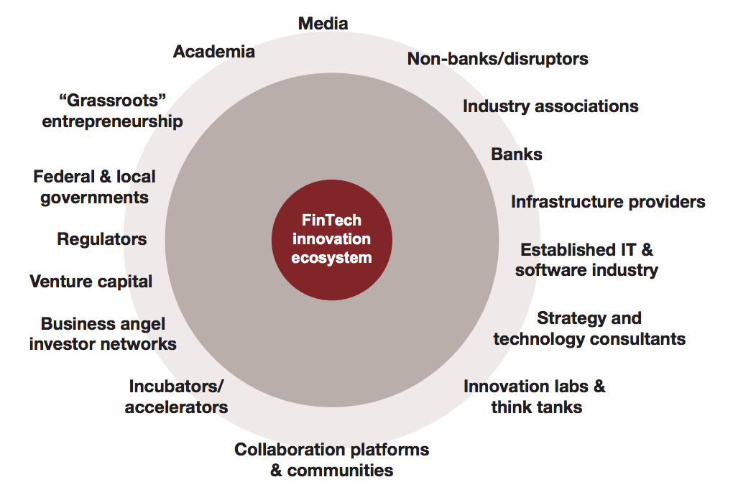
The FinTech Innovation Ecosystem
Source: http://www.strategyand.pwc.com/media/file/Developing-a-FinTech-ecosystem-in-the-GCC.pdf

Slide 38
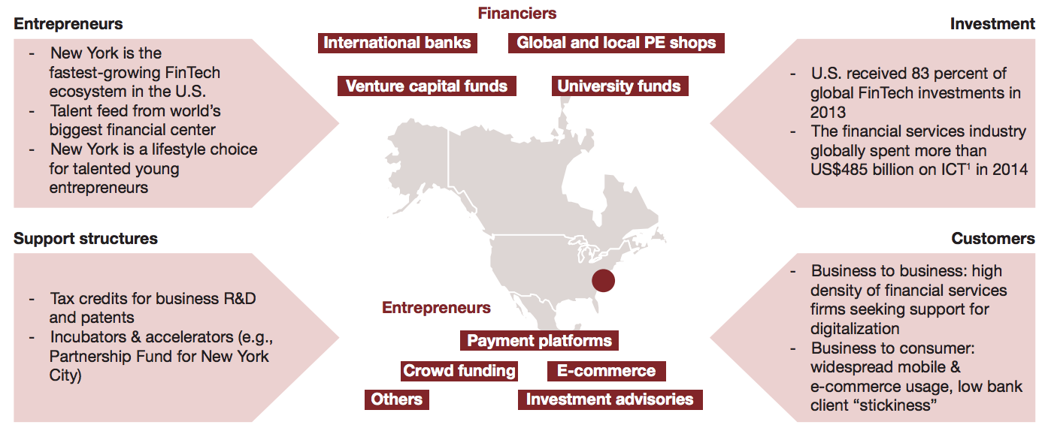
The U.S. FinTech landscape
Source: http://www.strategyand.pwc.com/media/file/Developing-a-FinTech-ecosystem-in-the-GCC.pdf

Slide 39
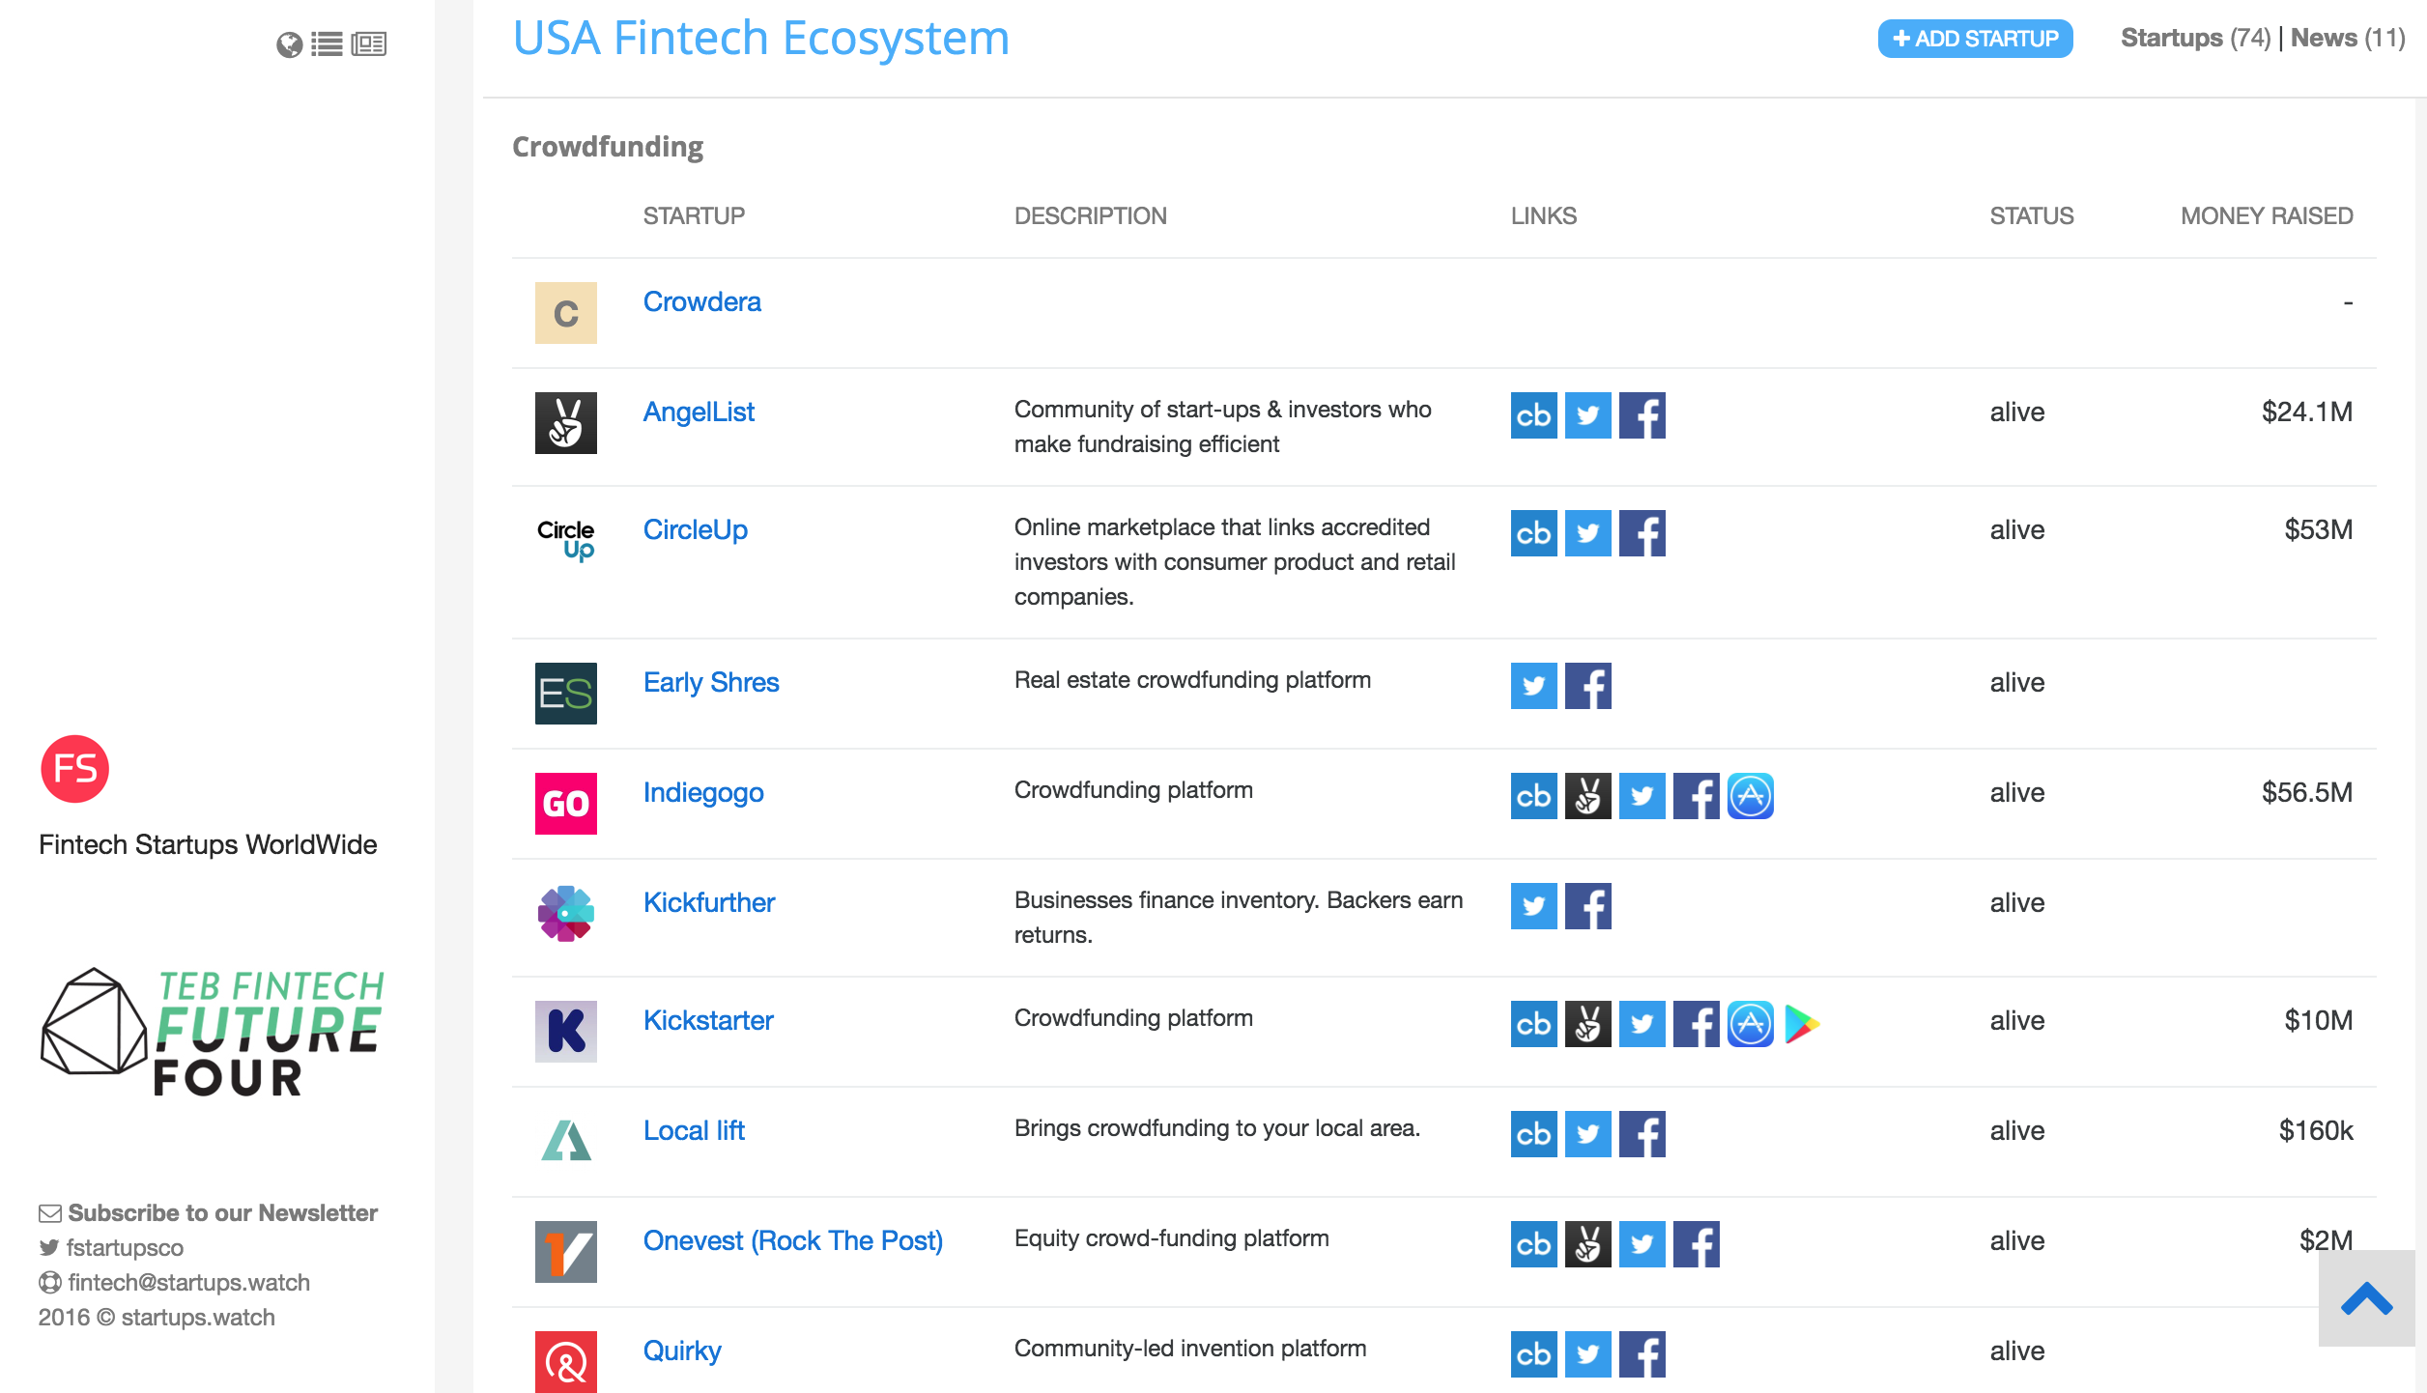
Fintech Startups
Source: https://fintechstartups.co

Slide 40
Financial Technology (Fintech) Categories
Banking Infrastructure
Business Lending
Consumer and Commercial Banking
Consumer Lending
Consumer Payments
Crowdfunding
Equity Financing
Financial Research and Data
Financial Transaction Security
Institutional Investing
International Money Transfer
Payments Backend and Infrastructure
Personal Finance
Point of Sale Payments
Retail Investing
Small and Medium Business Tools
Source: http://www.venturescanner.com/financial-technology

Slide 41
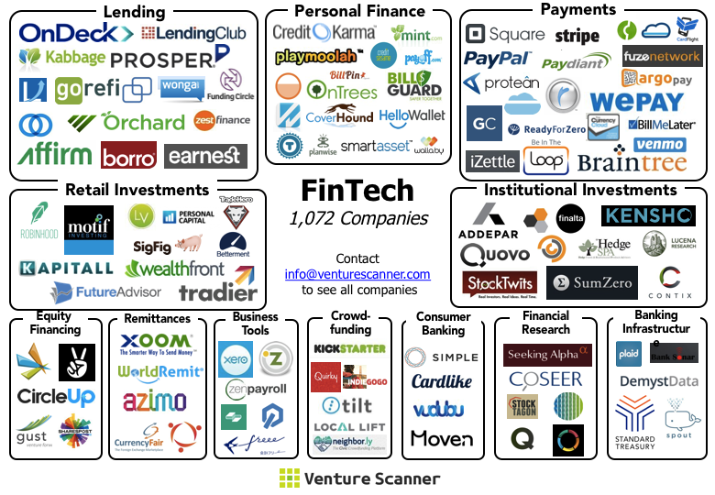
FinTech Ecosystem (April 2015)
Source: https://venturescannerinsights.wordpress.com/2015/04/07/fintech-ecosystem-update-april-2015/

Slide 42
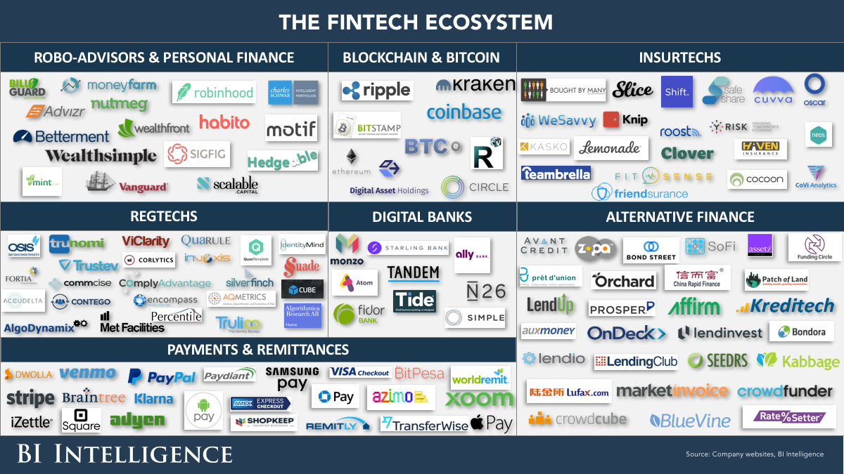
Financial Technology (FinTech)
Source: http://www.businessinsider.com/the-fintech-ecosystem-explained-measuring-the-effects-of-technology-on-the-entire-financial-services-industry-2015-12

Slide 43
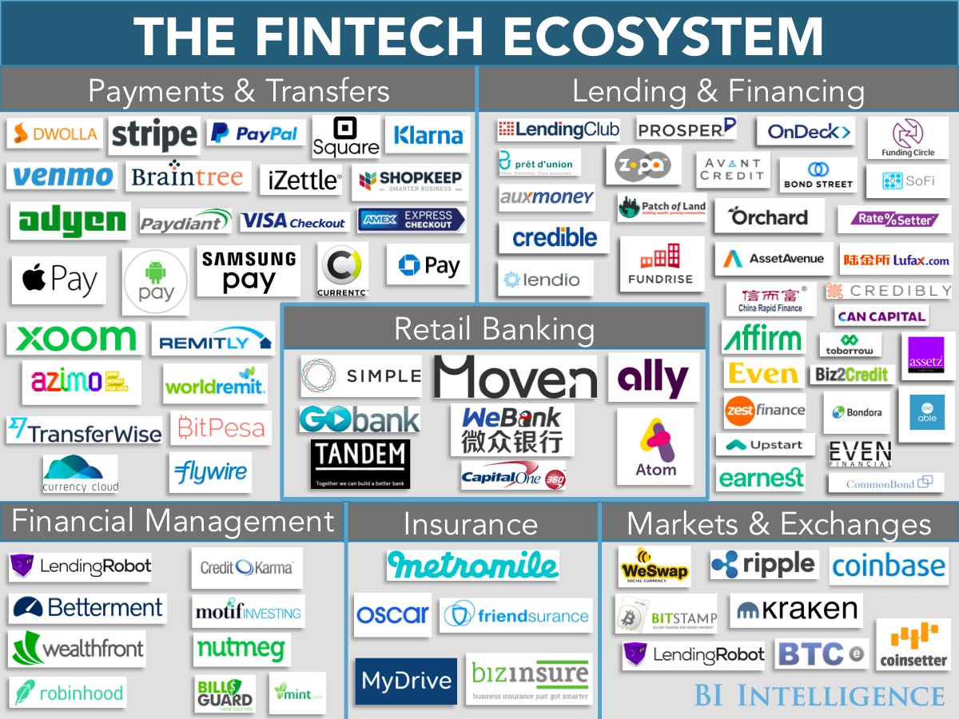
Financial Technology (FinTech)
Source: http://www.businessinsider.com/fintech-ecosystem-financial-technology-research-plus-business-opportunities-2016-2

Slide 44
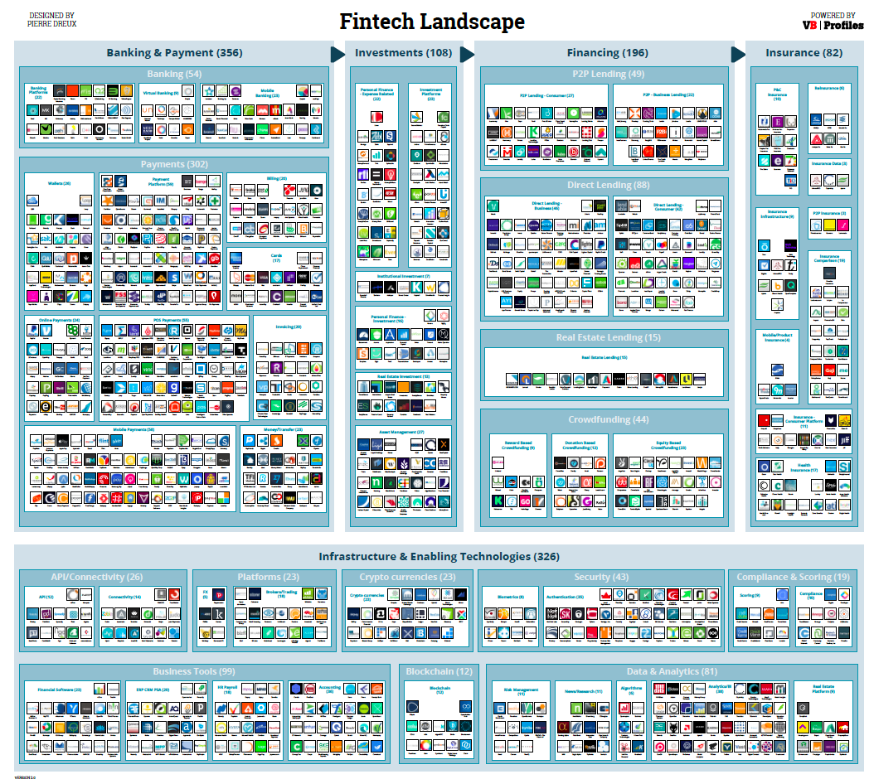
Source: http://www.forbes.com/sites/jeanbaptiste/2016/09/28/the-global-fintech-landscape-reaches-over-1000-companies-105b-in-funding-867b-in-value-report

Slide 45
FinTech Landscape Enabling Technologies Data & Analytics
Source: https://www.vbprofiles.com/l/fintech

Slide 46
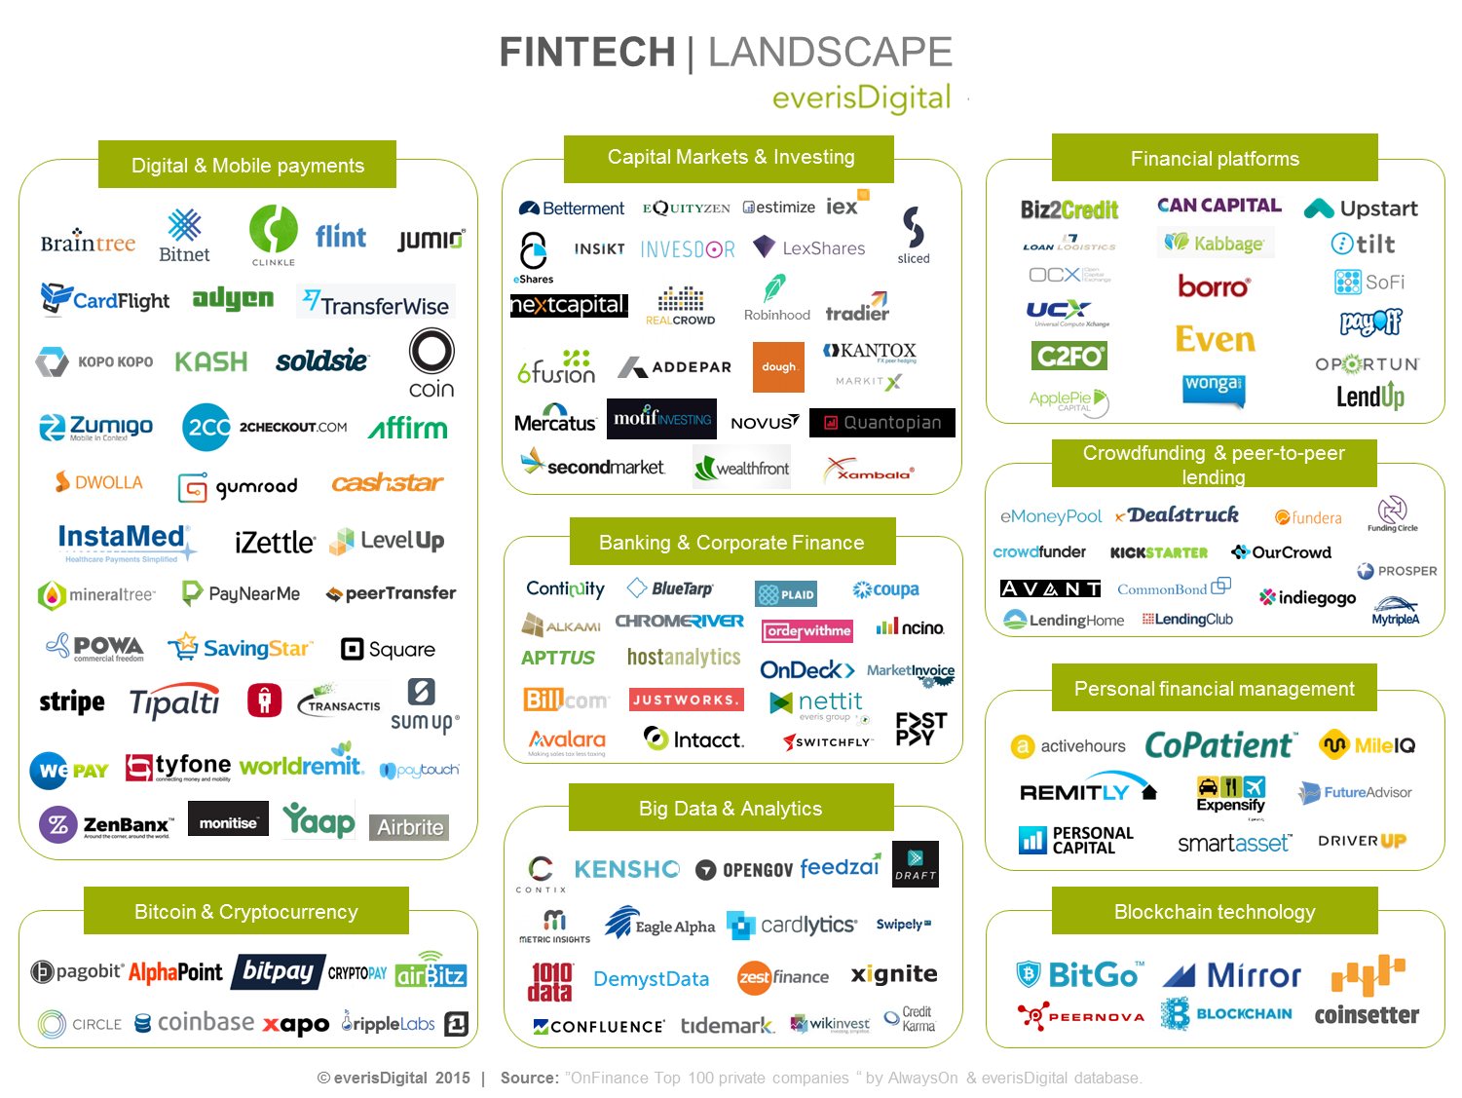
Source: https://everisnext.com/2015/06/02/top-9-verticals-within-the-fintech-landscape-for-large-corporations/

Slide 47
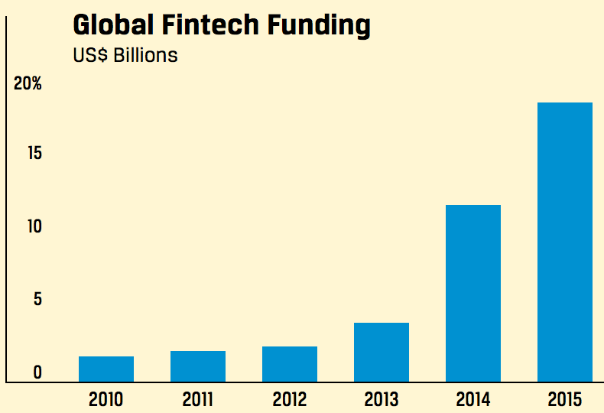
Global Fintech Funding
Source: Rubino, J. (2016). My Favorite Robot. CFA Institute Magazine, 27(3), 43-46.

Slide 48
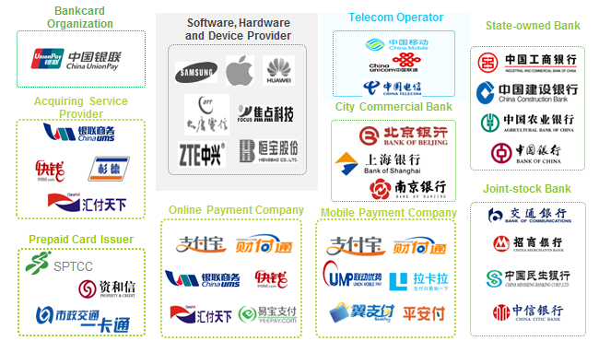
Fintech Startups WorldWide
Source: https://startups.watch/fintech-ecosystems-worldwide/

Slide 49
Fintech: Financial Technology
Disrupting Banking: The Fintech Startups That Are Unbundling Wells Fargo, Citi and Bank of America
Source: https://www.cbinsights.com/blog/industry-market-map-landscape/

Slide 50
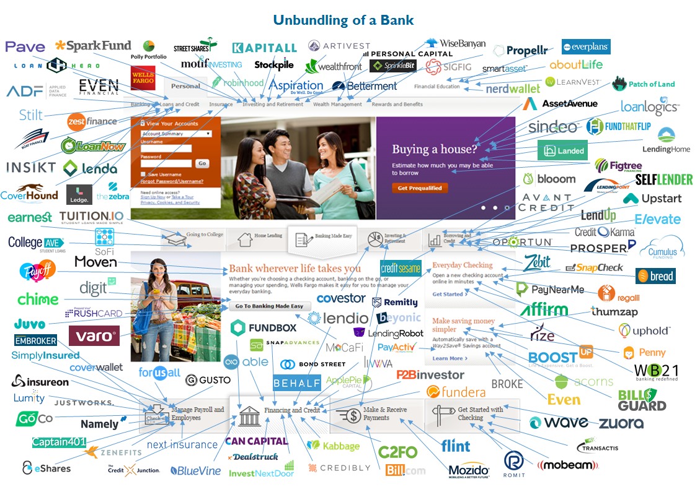
Fintech: Unbunding the Bank
Source: https://www.cbinsights.com/blog/disrupting-banking-fintech-startups-2016/

Slide 51
Fintech: Unbunding the Bank
Wealth Management: Wealthfront
Source: https://www.cbinsights.com/blog/disrupting-banking-fintech-startups-2016/

Slide 52
Fintech: Financial Technology
Disrupting European Banking: The FinTech Startups That Are Unbundling HSBC, Santander, and BNP
Source: https://www.cbinsights.com/blog/industry-market-map-landscape/

Slide 53
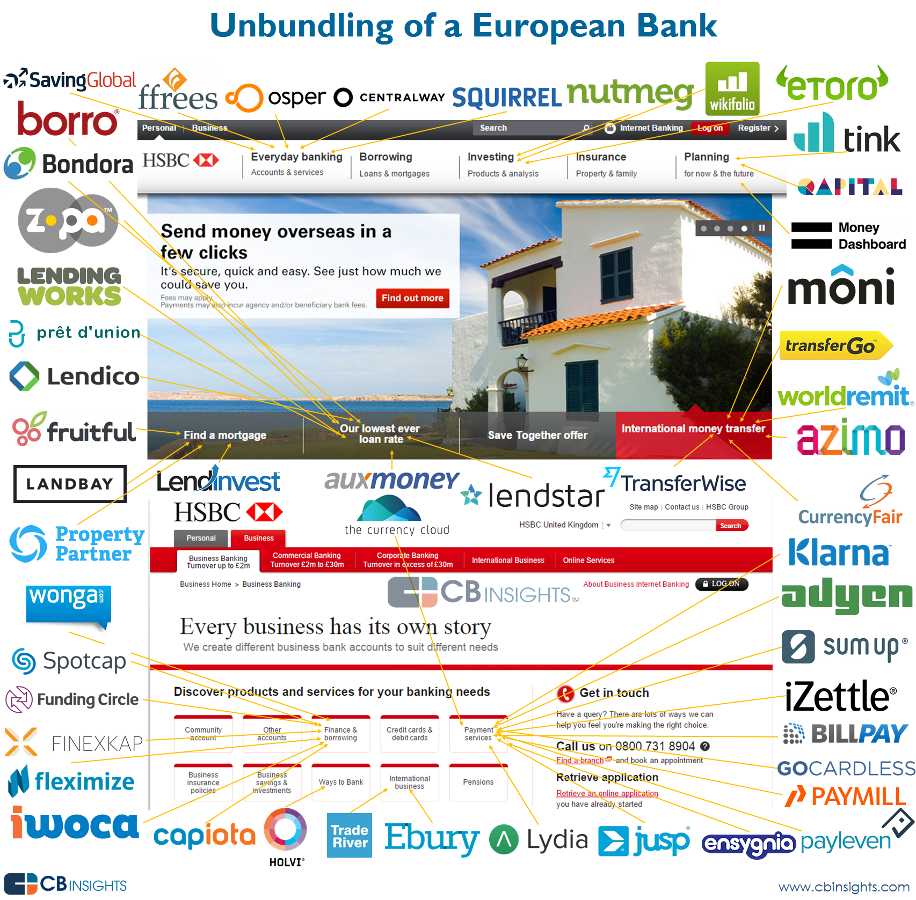
Source: https://www.cbinsights.com/blog/disrupting-european-banking-fintech-startups/

Slide 54
Source: https://www.cbinsights.com/blog/disrupting-european-banking-fintech-startups/

Slide 55
The New Alpha: 30+ Startups Providing Alternative Data For Sophisticated Investors
New sources of data mined by startups like Foursquare, Premise, and Orbital Insight are letting investors understand trends before they happen.
Source: https://www.cbinsights.com/blog/alternative-data-startups-market-map-company-list/

Slide 56
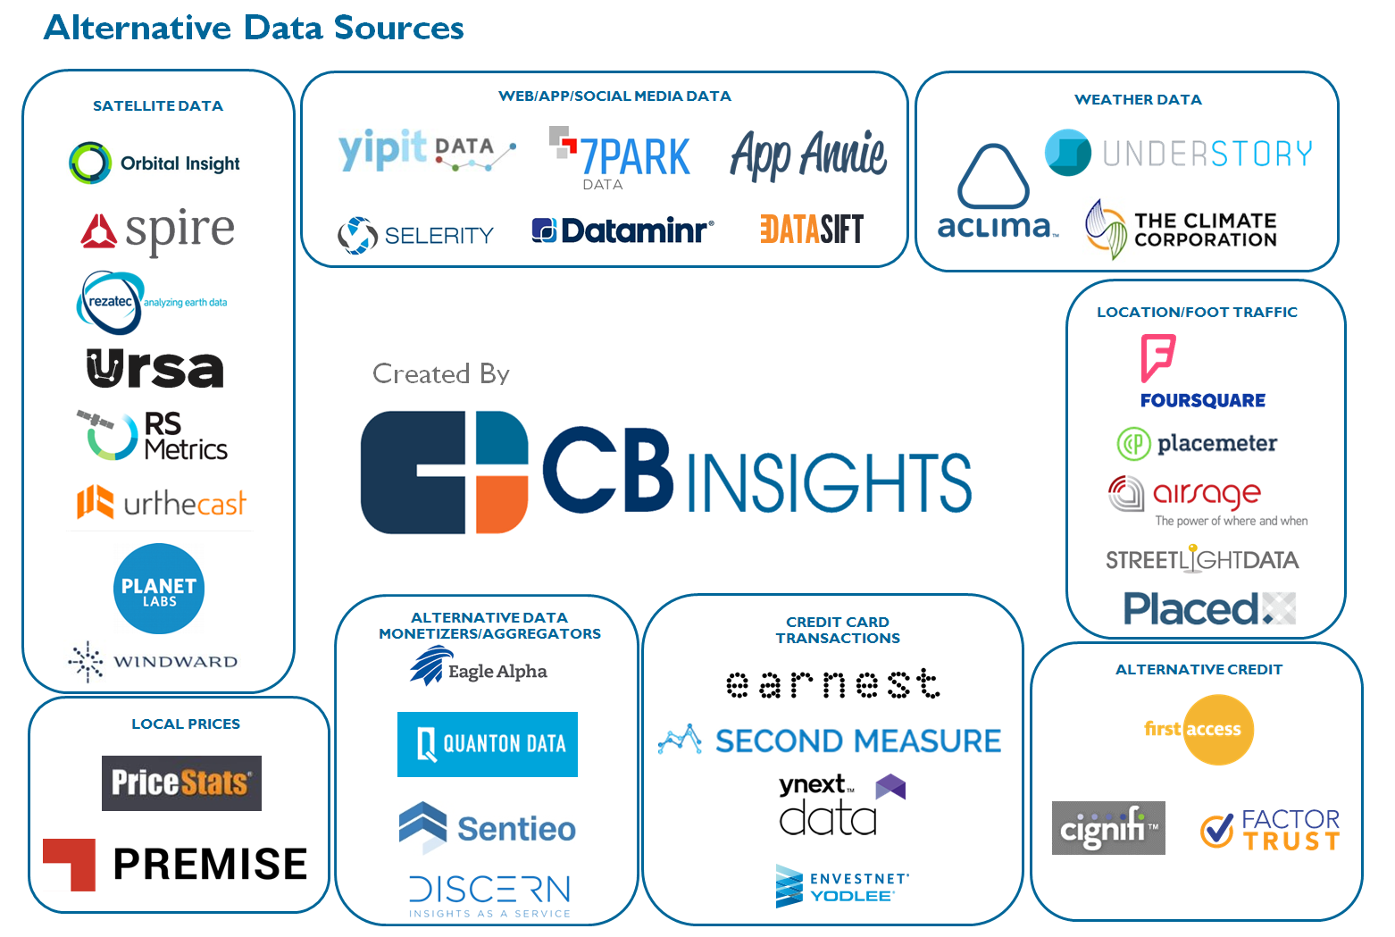
The New Alpha: 30+ Startups Providing Alternative Data For Sophisticated Investors
Source: https://www.cbinsights.com/blog/alternative-data-startups-market-map-company-list/

Slide 57
From Algorithmic Trading To Personal Finance Bots: 41 Startups Bringing AI To Fintech
Source: https://www.cbinsights.com/blog/artificial-intelligence-fintech-market-map-company-list/

Slide 58
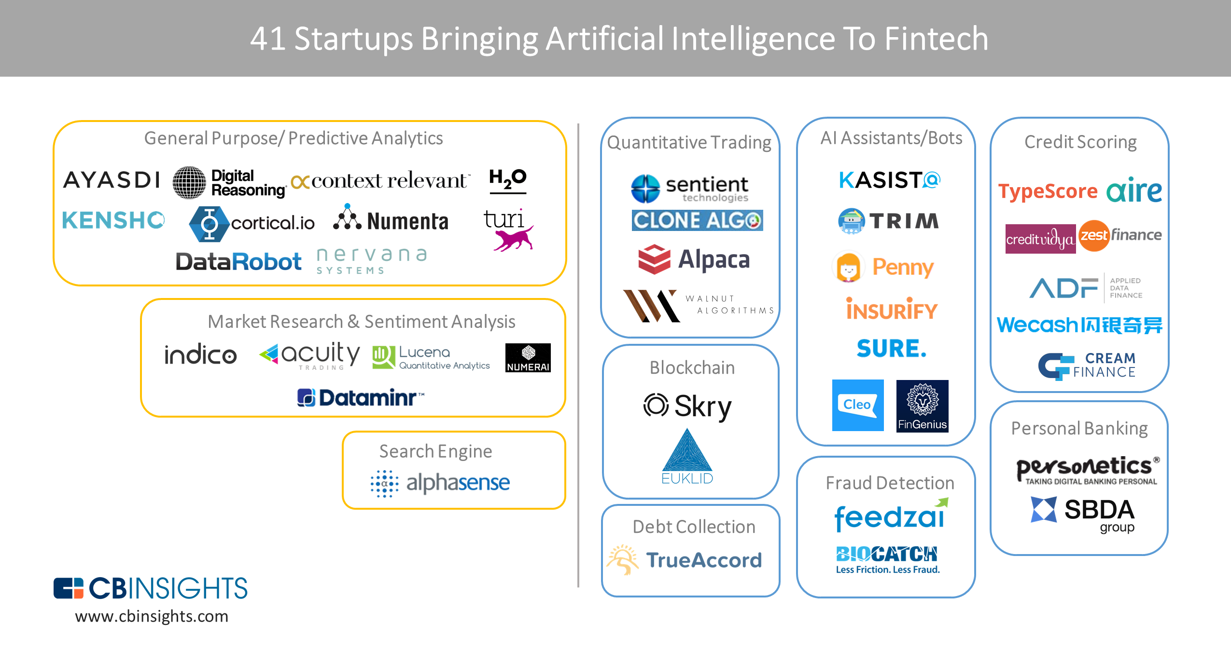
From Algorithmic Trading To Personal Finance Bots: 41 Startups Bringing AI To Fintech
AI in Fintech
Source: https://www.cbinsights.com/blog/artificial-intelligence-fintech-market-map-company-list/

Slide 59
Artificial Intelligence (AI) in Fintech
Source: https://www.cbinsights.com/blog/artificial-intelligence-fintech-market-map-company-list/

Slide 60
Artificial Intelligence (AI) in Fintech
Source: https://www.cbinsights.com/blog/artificial-intelligence-fintech-market-map-company-list/

Slide 61
Fintech: Wealth Management
Company | Select Investors
Wealthfront | DAG Ventures, Index Ventures, Greylock Partners, The Social+Capital Partnership
Betterment | Bessemer Venture Partners, Athemis Group, Menlo Ventures
SigFig | Doll Capital Management, Union Square Ventures, Bain Capital Ventures
Aspiration | Renren, GSV Capital, Capricorn Investment Group, IGSB
Blooom | Commerce Ventures, DST Systems, Hyde Park VP, QED Investors, UMB Financial
Rebalance IRA | N/A
Hedgeable | SixThirty
WiseBanyan | VegasTech Fund
Personal Capital | Institutional Venture Partners, Venrock, Crosslink Capital
Source: https://www.cbinsights.com/blog/fin-tech-startups-millennials/

Slide 62
Fintech: Personal Investing
Company | Select Investors
eToro | BRM Group, Ping An Ventures, Spark Capital
Openfolio | FinTech Collective
DriveWealth | Route 66 Ventures
Tip’d Off | Raj Parekh, Bill Crane, Shaun Coleman
Kapitall | Bendigo Partners, Linden Venture Fund
Stash | N/A
Stox | SingulariTeam
Robinhood | Google Ventures, Index Ventures, Andreessen Horowitz, Ribbit Capital, NEA
Motif Investing | Norwest Venture Partners, Foundation Capital, Ignition Capital, Goldman Sachs
Loyal3 | DNS Capital
Source: https://www.cbinsights.com/blog/fin-tech-startups-millennials/

Slide 63
FinTech Trends
Source: http://mashable.com/2016/01/27/financial-tech-brandspeak’

Slide 64
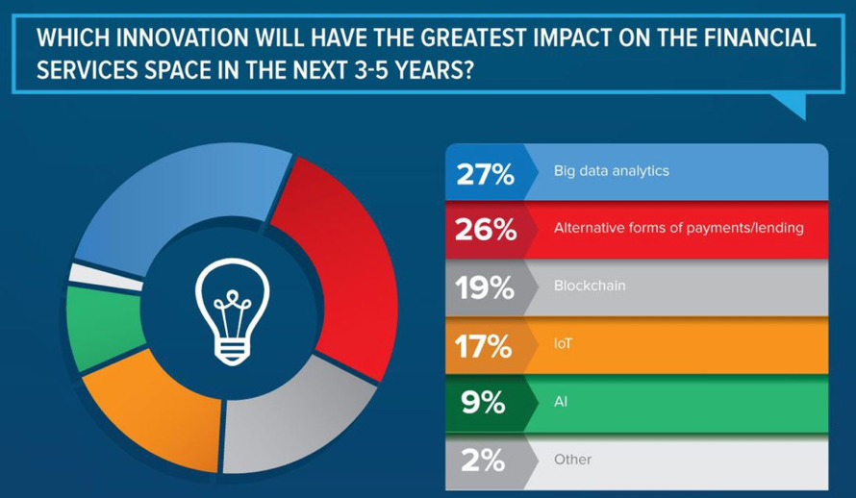
FinTech Big Data Analytics
Source: http://mashable.com/2016/01/27/financial-tech-brandspeak’

Slide 65
Fintech Robo Advisors

Slide 66
Big Data Driven Disruption: Robo-Advisor
Source: http://www.vamsitalkstech.com/?p=2329

Slide 67
FinTech high-level classification
Lending
Payments
Robo Advisors
Analytics
Others
Profile
Advice
Re-Balance
Indexing
Source: Paolo Sironi (2016), “FinTech Innovation: From Robo-Advisors to Goal Based Investing and Gamification”, Wiley.

Slide 68
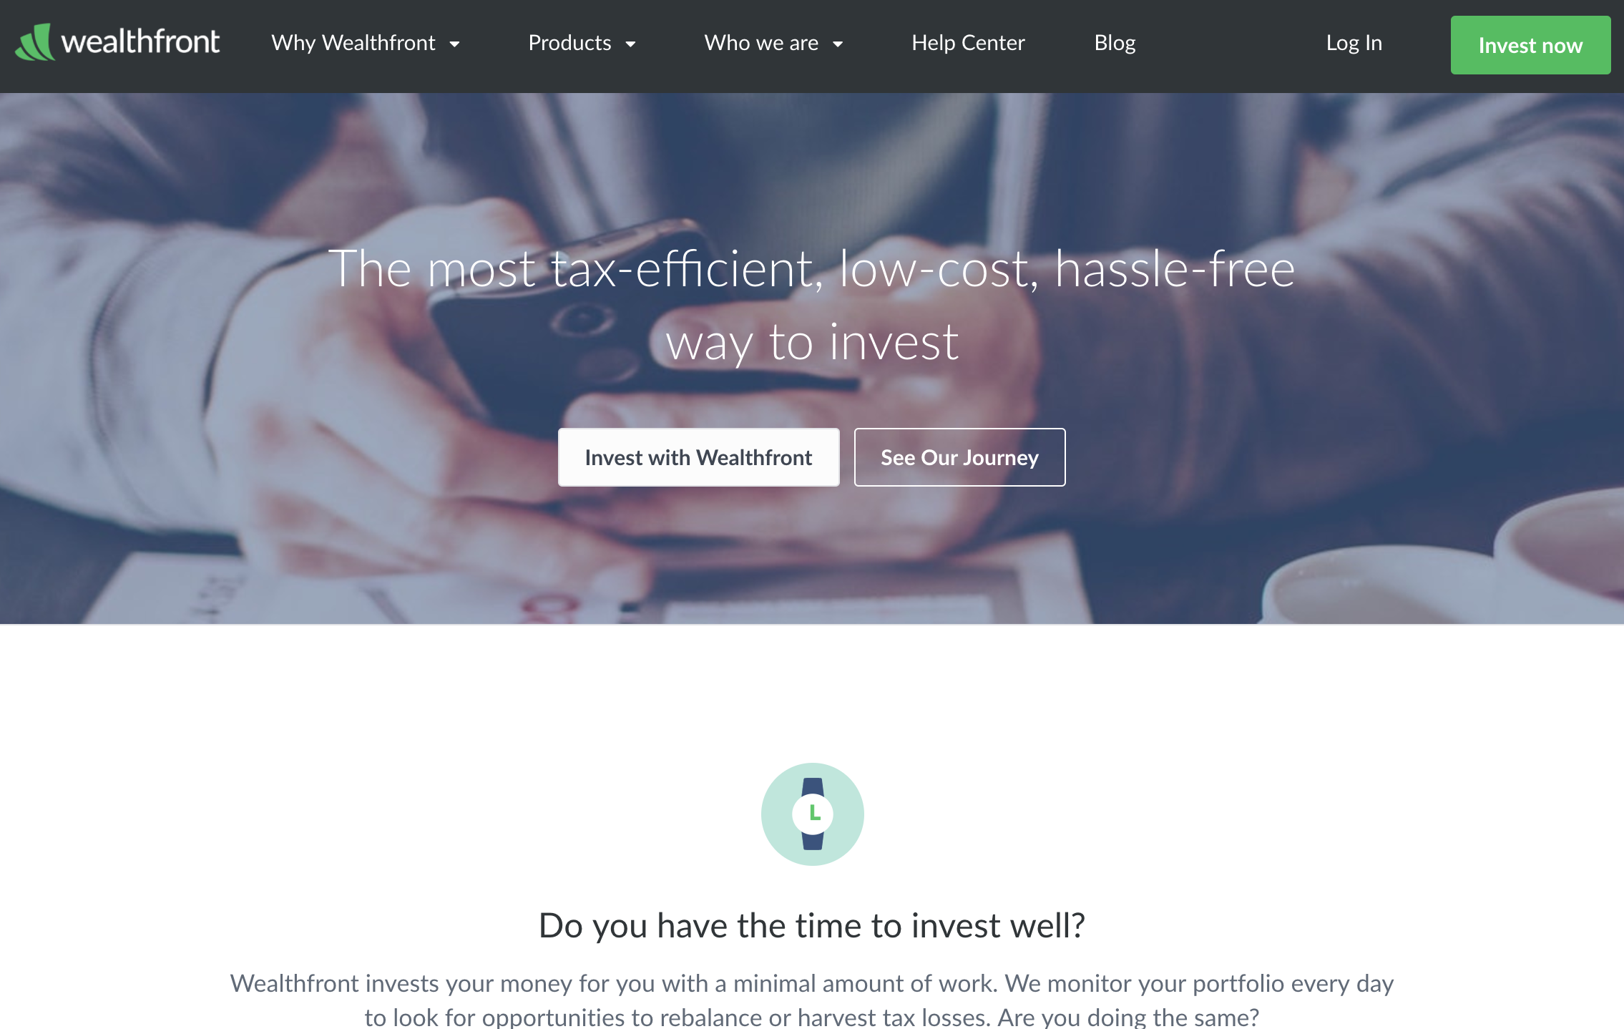
Wealthfront: Fintech Robo Advisor
https://www.wealthfront.com/

Slide 69
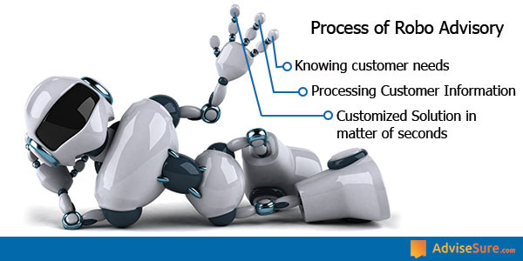
Process of Robo Advisors
Source: https://advisesure.com/blog/what-is-meaning-of-term-robo-advisor-and--their-benefits

Slide 70
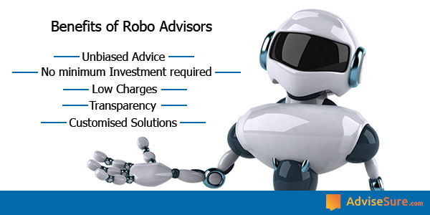
Benefits of Robo Advisors
Source: https://advisesure.com/blog/what-is-meaning-of-term-robo-advisor-and--their-benefits

Slide 71
Robo-Advisor Business Models
Full service online Robo-advisor
100% automated without any human element
Hybrid Robo-advisor model
being pioneered by firms like Vanguard & Charles Schwab
Pure online advisor
primarily human in nature
Source: http://www.vamsitalkstech.com/?p=2329

Slide 72
Usecases of Robo-Advisors
Determine individual Client profiles & preferences
Identify appropriate financial products
Establish correct Investment Mix for the client’s profile
Using a algorithmic approach, choose the appropriate securities for each client account
Continuously monitor the portfolio & transactions within it to tune performance
Provide value added services
Ensure the best user experience by handling a whole range of financial services
Source: http://www.vamsitalkstech.com/?p=2418

Slide 73
Business Requirements for a Robo-Advisor (RA)
Collect Individual Client Data
Client Segmentation
Algorithm Based Investment Allocation
Portfolio Rebalancing
Tax Loss Harvesting
A Single View of a Client’s Financial History
Source: http://www.vamsitalkstech.com/?p=2354

Slide 74
Algorithms for a Robo-Advisor (RA)
Leverage data science & statistical modeling to automatically allocate client wealth across different asset classes (such as domestic/foreign stocks, bonds & real estate related securities) to automatically rebalance portfolio positions based on changing market conditions or client preferences.
These investment decisions are also made based on detailed behavioral understanding of a client’s financial journey metrics – Age, Risk Appetite & other related information.
Source: http://www.vamsitalkstech.com/?p=2354

Slide 75
Algorithms for a Robo-Advisor (RA)
RA platforms also provide 24×7 tracking of market movements to use that to track rebalancing decisions from not just a portfolio standpoint but also from a taxation standpoint.
Source: http://www.vamsitalkstech.com/?p=2354

Slide 76
Algorithms for a Robo-Advisor (RA)
A mixture of different algorithms can be used such as Modern Portfolio Theory (MPT), Capital Asset Pricing Model (CAPM), the Black Litterman Model, the Fama-French etc.
These are used to allocate assets as well as to adjust positions based on market movements and conditions.
Source: http://www.vamsitalkstech.com/?p=2354

Slide 77
SAS第六屆大數據資料科學家競賽 FinTech預測未來挑戰賽
http://saschampion.com.tw/

Slide 78
SAS第六屆大數據資料科學家競賽 FinTech預測未來挑戰賽
http://saschampion.com.tw/detail.php

Slide 79
AI and Big Data Analytics in Finance
財務金融大數據分析
Big Data Analytics in Finance
投資大數據分析
Big Data Analytics in Investment
人工智慧與財務應用
Artificial Intelligence and Financial Application
人工智慧與投資分析
Artificial Intelligence and Investment Analysis

Slide 80
財務金融大數據分析 Big Data Analytics in Finance

Slide 81
投資大數據分析 Big Data Analytics in Investment

Slide 82
人工智慧與財務應用 Artificial Intelligence and Financial Application

Slide 83
人工智慧與投資分析 Artificial Intelligence and Investment Analysis

Slide 84
Summary
This course introduces the fundamental concepts and research issues of Financial Technology (Fintech).
Topics include
Evolution of Fintech: Money and Financial Services
Fintech: Technology Innovation in Financial Services
Fintech and Financial Services Value Chain
Fintech Business Models Innovation
Consumer Psychology and Behavior on Financial Services
Blockchain Technology
Finance Big Data Analytics with Pandas in Python
Artificial Intelligence and Deep Learning for Fintech
Robo-Advisors for Wealth Management in Fintech
Portfolio Optimization and Algorithmic Trading
Intelligent Question Answering System for Fintech
Case Study on Fintech

Slide 85
Contact Information
戴敏育 博士 (Min-Yuh Day, Ph.D.)
專任助理教授
淡江大學 資訊管理學系
電話：02-26215656 #2846
傳真：02-26209737
研究室：B929
地址： 25137 新北市淡水區英專路151號
Email： myday@mail.tku.edu.tw
網址：http://mail.tku.edu.tw/myday/

