Slide 1
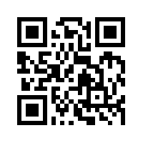
Social Media Apps Programming
Tamkang University
jQuery Mobile
1051SMAP06
TLMXM1A (8648) (M2143) (Fall 2016)
(MIS MBA) (2 Credits, Elective) [Full English Course]
Wed 8,9 (15:10-17:00) B310
Min-Yuh Day, Ph.D.
Assistant Professor
Department of Information Management
Tamkang University
http://mail.tku.edu.tw/myday
2016-10-19

Slide 2
Course Schedule (1/3)
Week Date Subject/Topics
1 2016/09/14 Course Orientation and Introduction to Social Media and Mobile Apps Programming
2 2016/09/21 Introduction to Android / iOS Apps Programming
3 2016/09/28 Developing Android Native Apps with Java (Eclipse) (MIT App Inventor)
4 2016/10/05 Developing iPhone / iPad Native Apps with Swift (XCode)
5 2016/10/12 Mobile Apps using HTML5/CSS3/JavaScript
6 2016/10/19 jQuery Mobile

Slide 3
Course Schedule (2/3)
Week Date Subject/Topics
7 2016/10/26 Create Hybrid Apps with Phonegap
8 2016/11/02 jQuery Mobile/Phonegap
9 2016/11/09 jQuery Mobile/Phonegap
10 2016/11/16 Midterm Exam Week (Midterm Project Report)
11 2016/11/23 Case Study on Social Media Apps Programming and Marketing in Google Play and App Store
12 2016/11/30 Invited Speaker: Prof. Yoshinobu Kano, Associate Professor, Faculty of Informatics, Shizuoka University

Slide 4
Course Schedule (3/3)
Week Date Subject/Topics
13 2016/12/07 Google Cloud Platform
14 2016/12/14 Google App Engine and Google Map API
15 2016/12/21 Facebook API (Facebook JavaScript SDK) (Integrate Facebook with iOS/Android Apps)
16 2016/12/28 Twitter API
17 2017/01/04 Final Project Presentation
18 2017/01/11 Final Exam Week (Final Project Presentation)

Slide 5
Outline
jQuery Mobile
JavaScript Library
jQuery
jQuery UI
Demo
Building Mobile Apps with JQuery Mobile

Slide 6
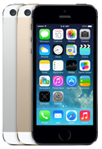
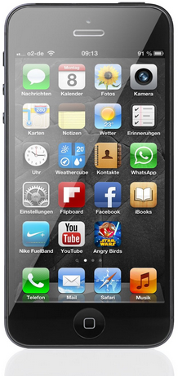
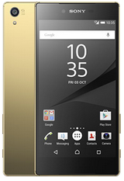
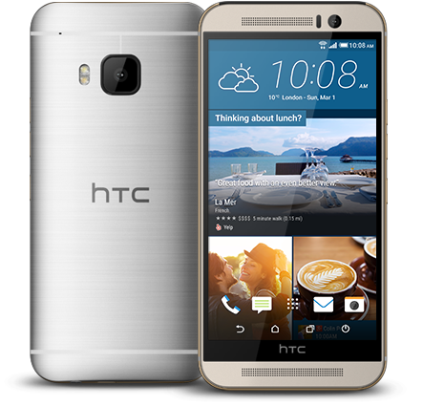
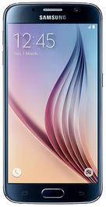
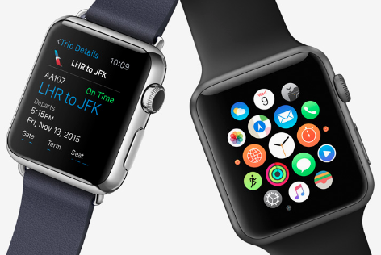
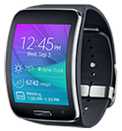
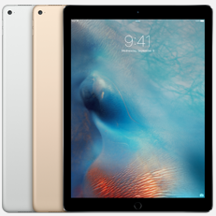
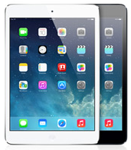
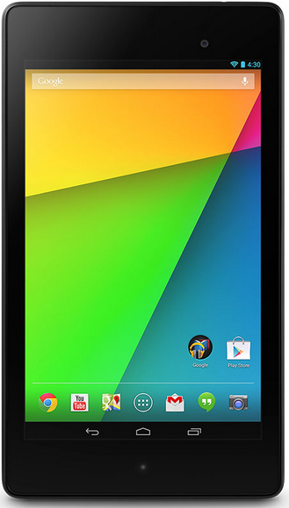
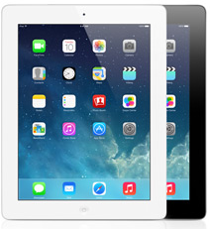
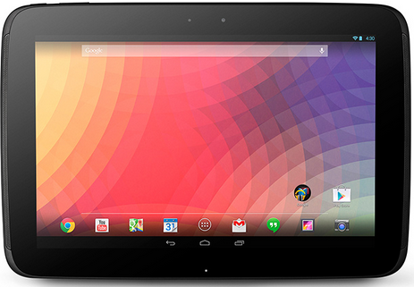
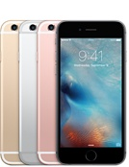
Android /iOS Apps Programming
Native Apps
Hybrid Apps
Mobile Web Apps

Slide 7
App Development Comparison
Device Access
Speed
Development Cost
App Store
Approval Process
Native Apps
Full
Very Fast
Expensive
Available
Mandatory
Hybrid Apps
Full
Native Speed as Necessary
Reasonable
Available
Low Overhead
Web Apps
Partial
Fast
Reasonable
Not Available
None
Source: http://www.scribd.com/doc/50805466/Native-Web-or-Hybrid-Mobile-App-Development

Slide 8
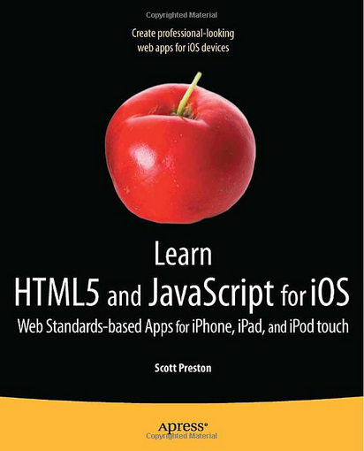
Learn HTML5 and JavaScript for iOS: Web Standards-based Apps for iPhone, iPad, and iPod touch, Scott Preston, Apress, 2012
Source: http://www.amazon.com/Learn-HTML5-JavaScript-iOS-Standards-based/dp/1430240385

Slide 9
Mobile Web App
HTML
Phone Data
Templates
CSS
JavaScript
External Data
Mobile frameworks and Libraries
Source: Scott Preston, Learn HTML5 and JavaScript for iOS: Web Standards-based Apps for iPhone, iPad, and iPod touch, Apress, 2012

Slide 10
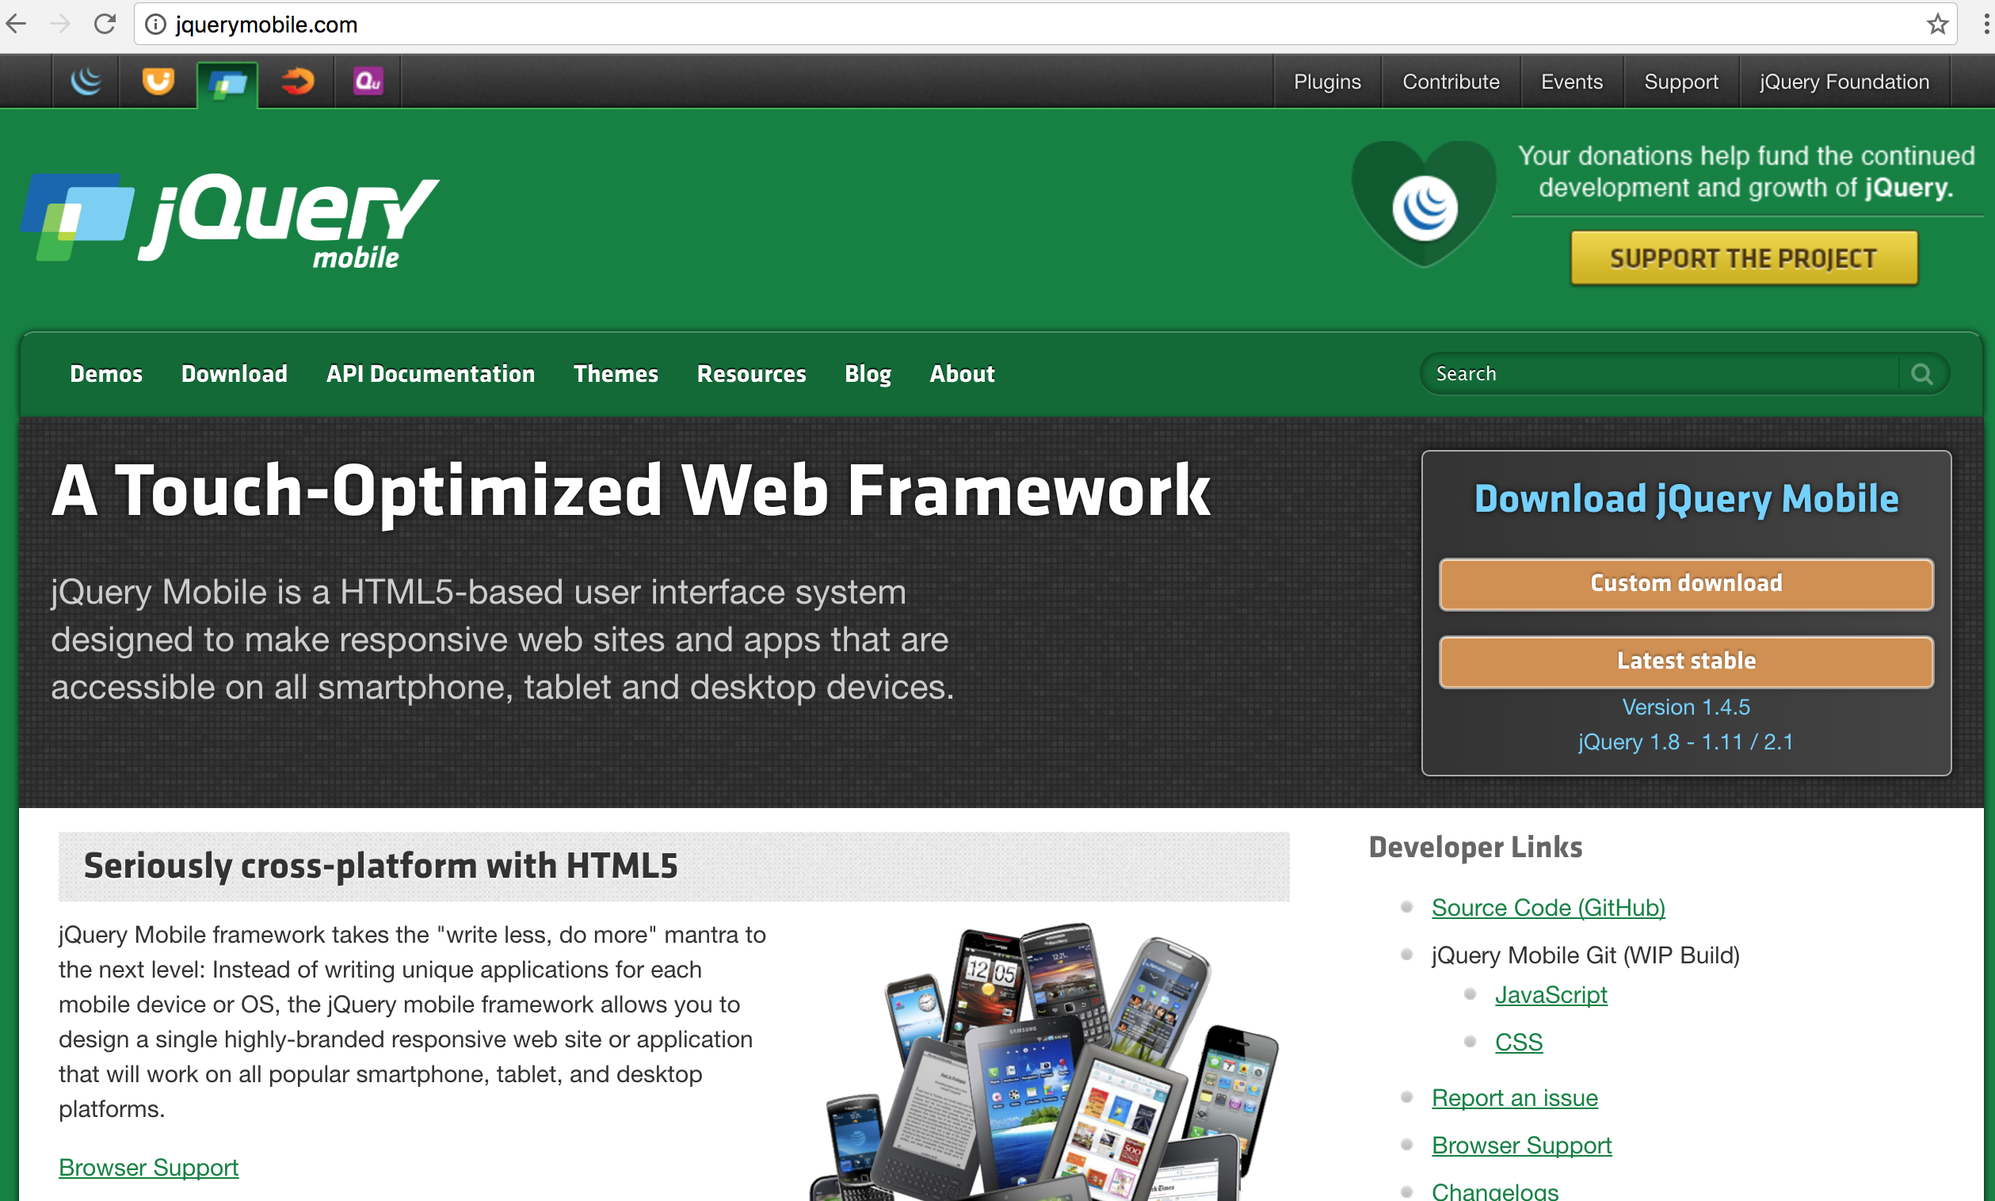
jQuery Mobile
http://jquerymobile.com/

Slide 11
Responsive Web Design (RWD) Responsive Front-end Framework Google Material Design
Mobile frameworks and Libraries

Slide 12
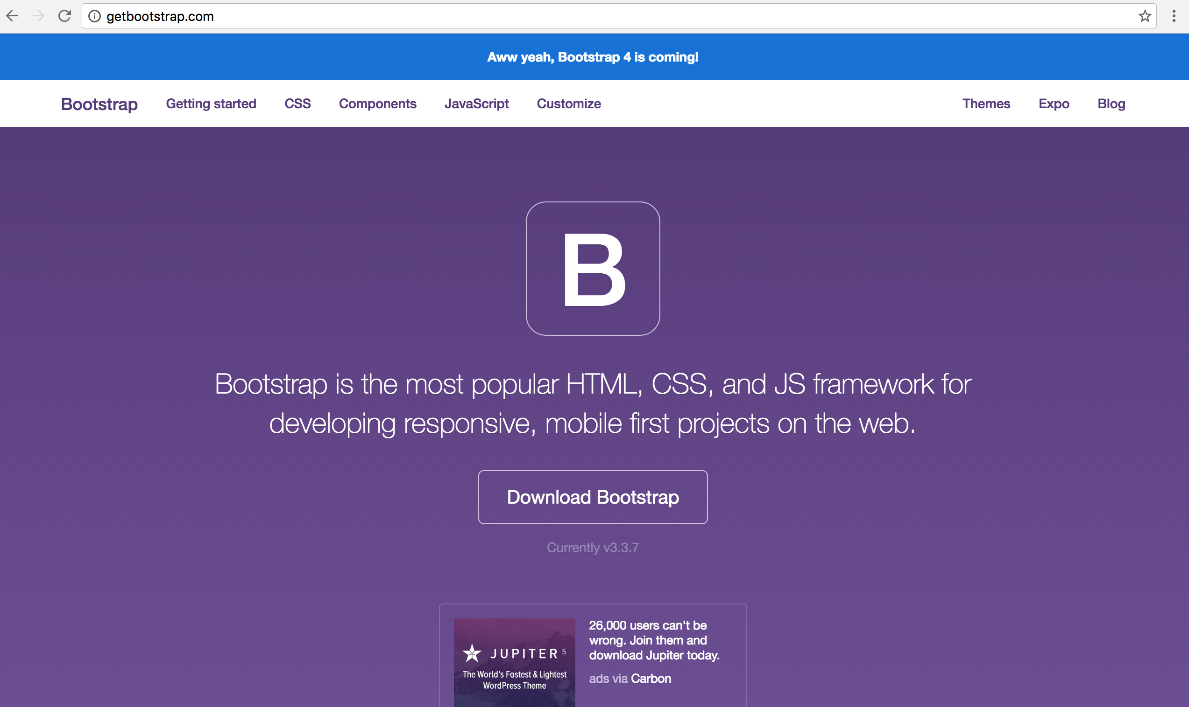
Bootstrap
http://getbootstrap.com/

Slide 13
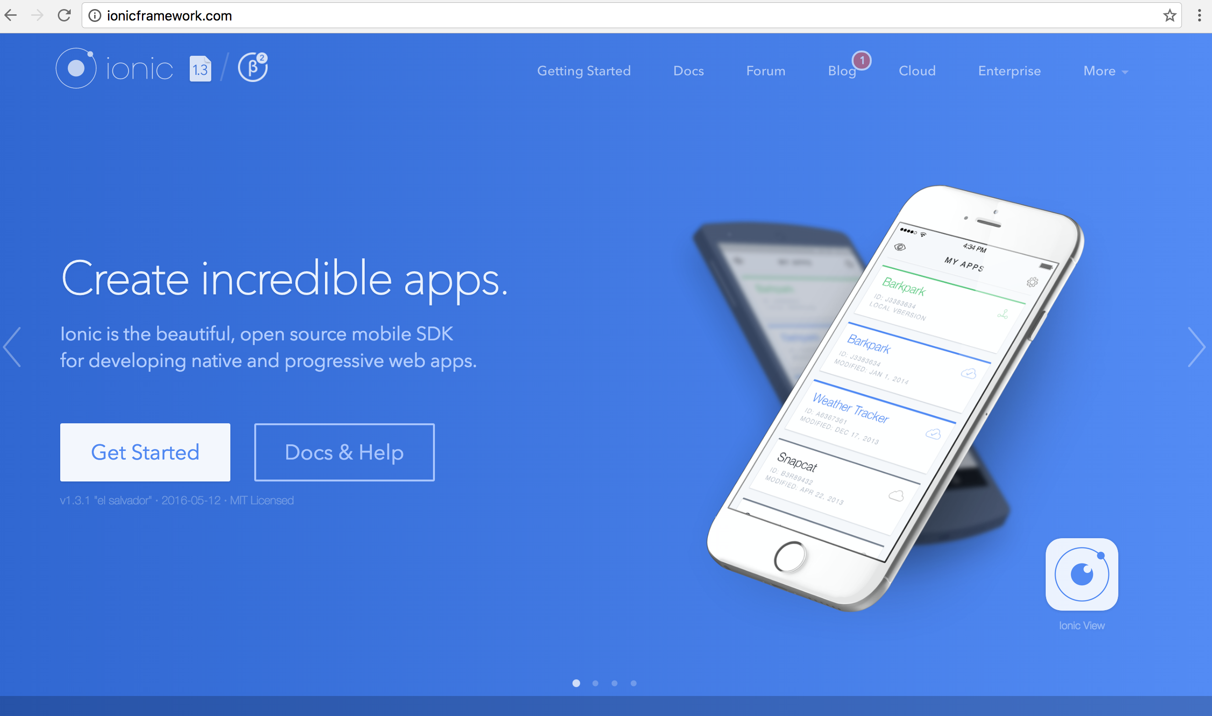
ionic
http://ionicframework.com/

Slide 14
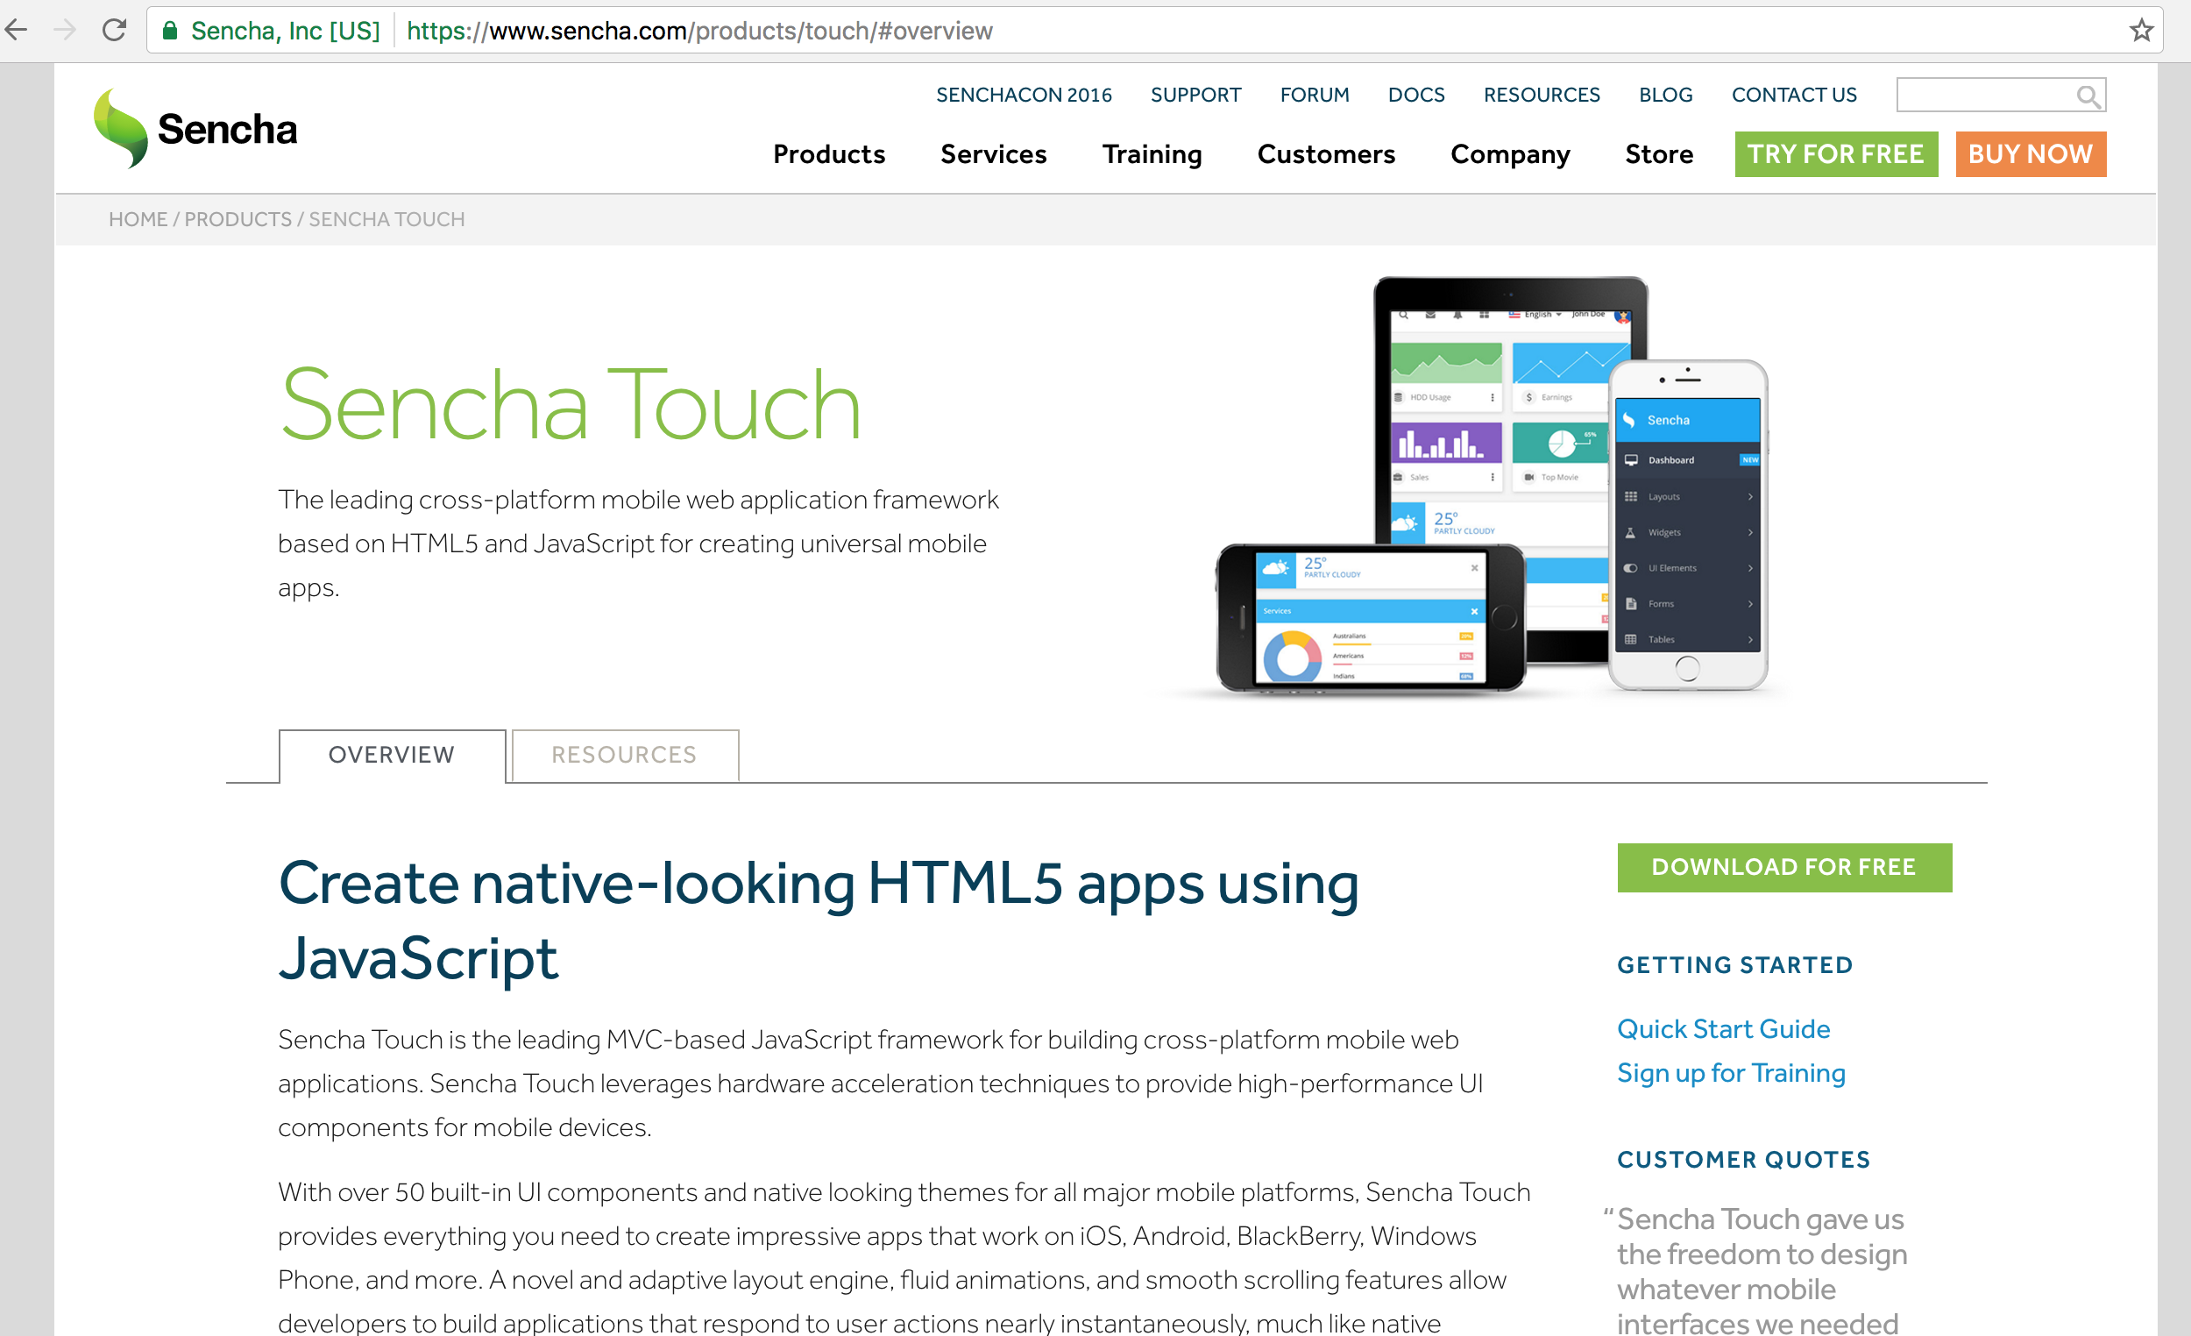
Sencha Touch
https://www.sencha.com/products/touch

Slide 15
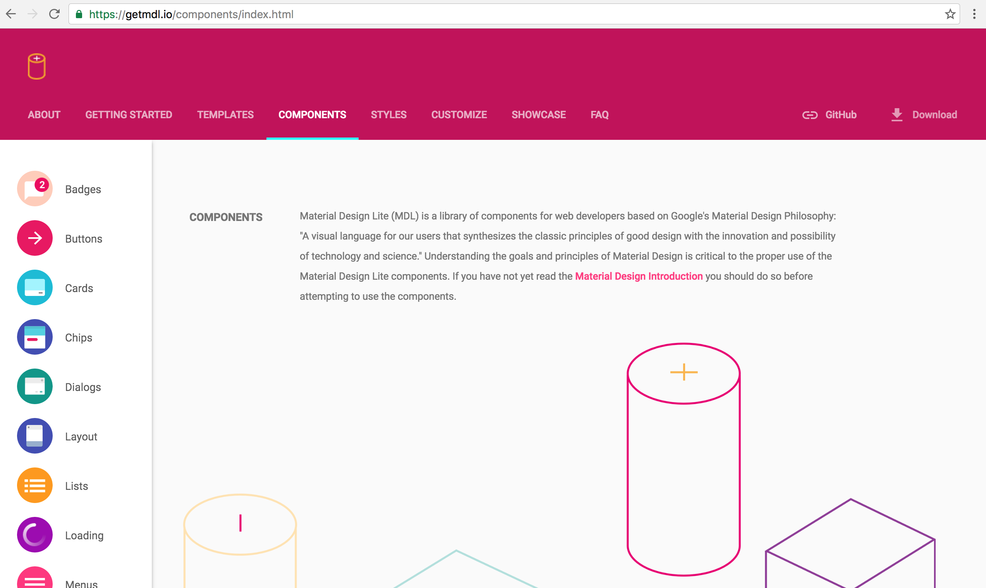
Material Design Lite (MDL)
https://getmdl.io/

Slide 16
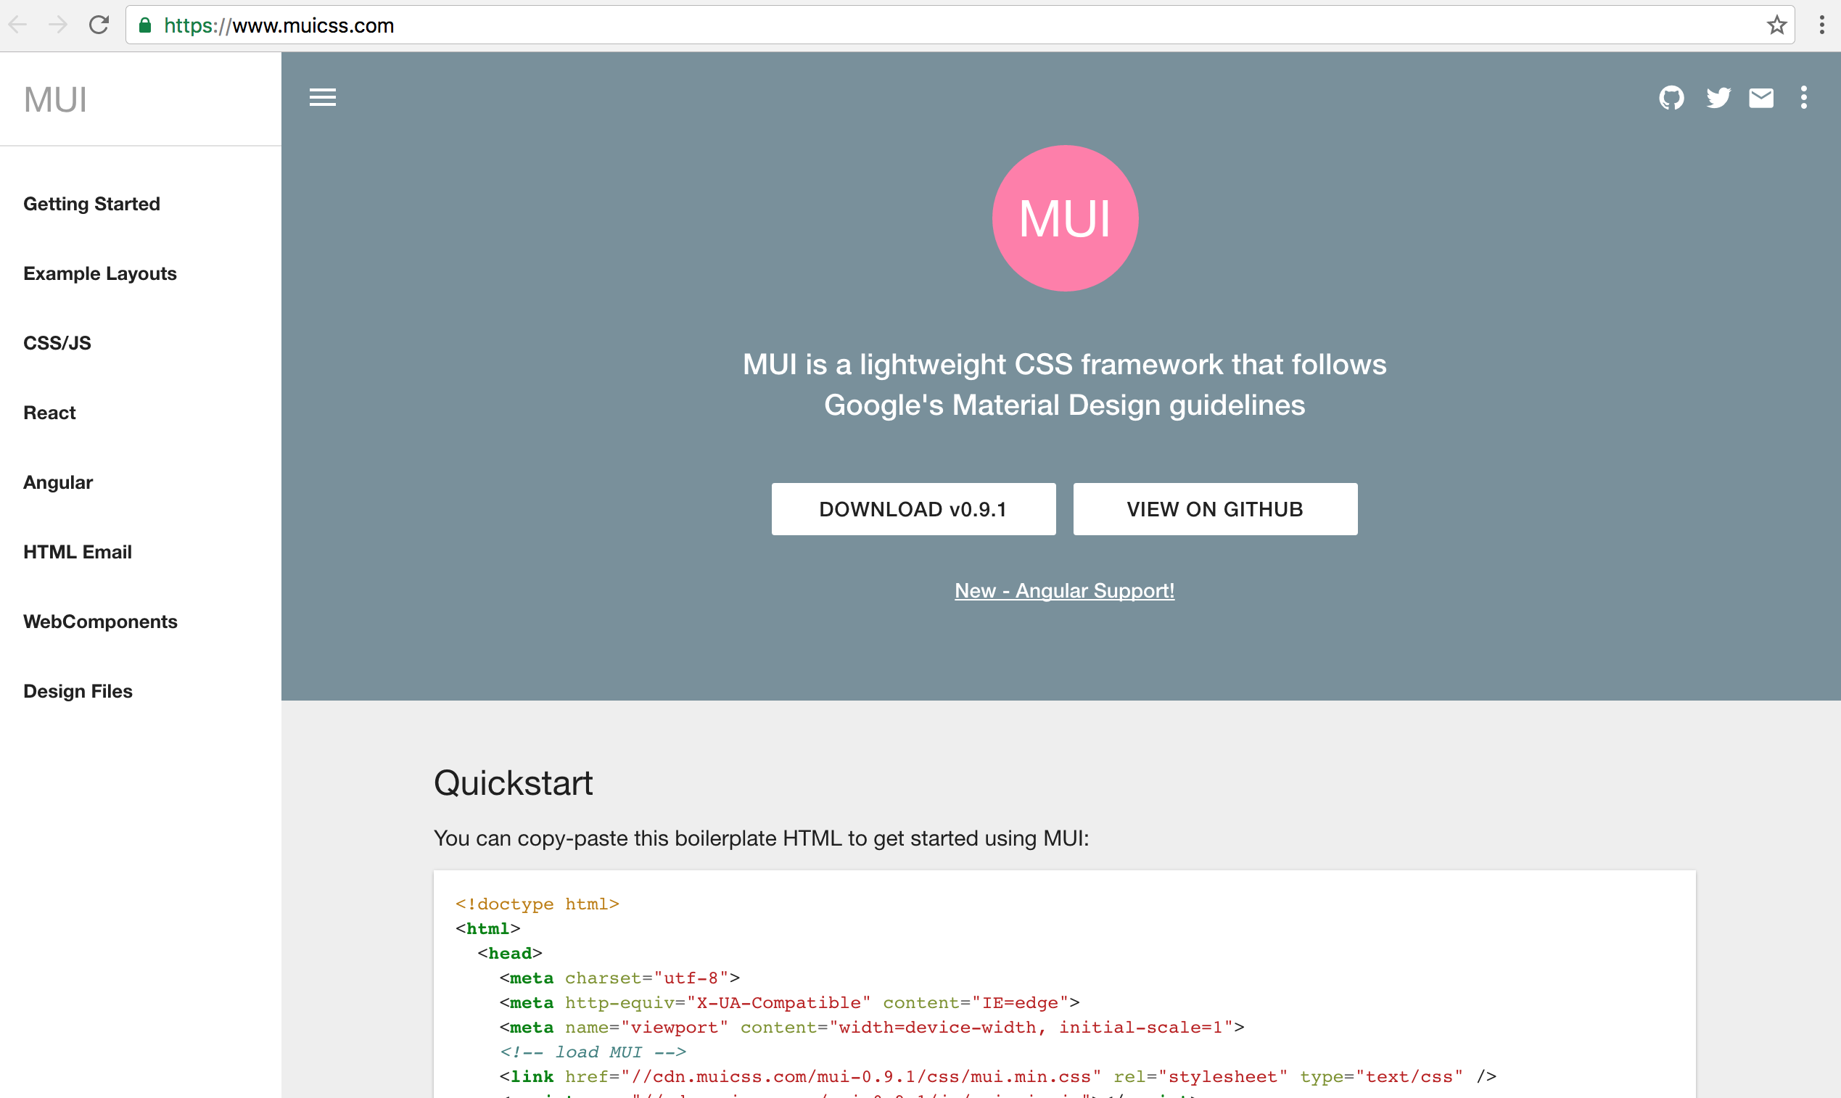
MUI
https://www.muicss.com/

Slide 17
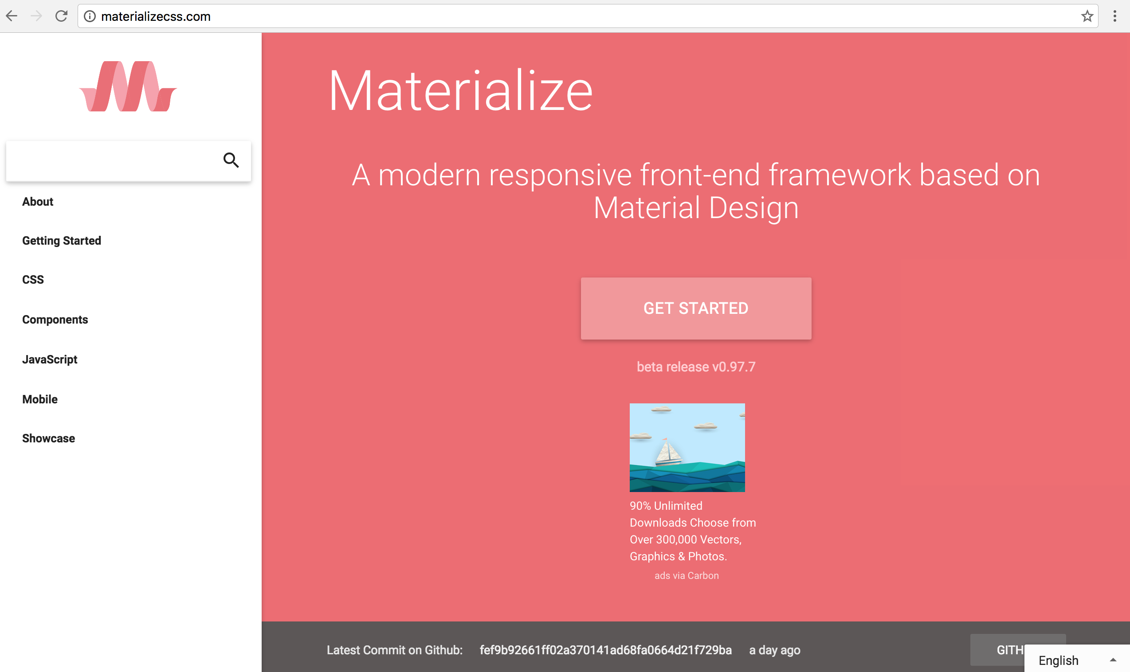
Materialize
http://materializecss.com/

Slide 18
jQuery Mobile
http://jquerymobile.com/

Slide 19
jQuery Mobile
Touch-Optimized Web Framework for Smartphones & Tablets
A unified, HTML5-based user interface system for all popular mobile device platforms
built on the rock-solid jQuery and jQuery UI foundation.
Its lightweight code is built with progressive enhancement, and has a flexible, easily themeable design.
Source: http://jquerymobile.com/

Slide 20
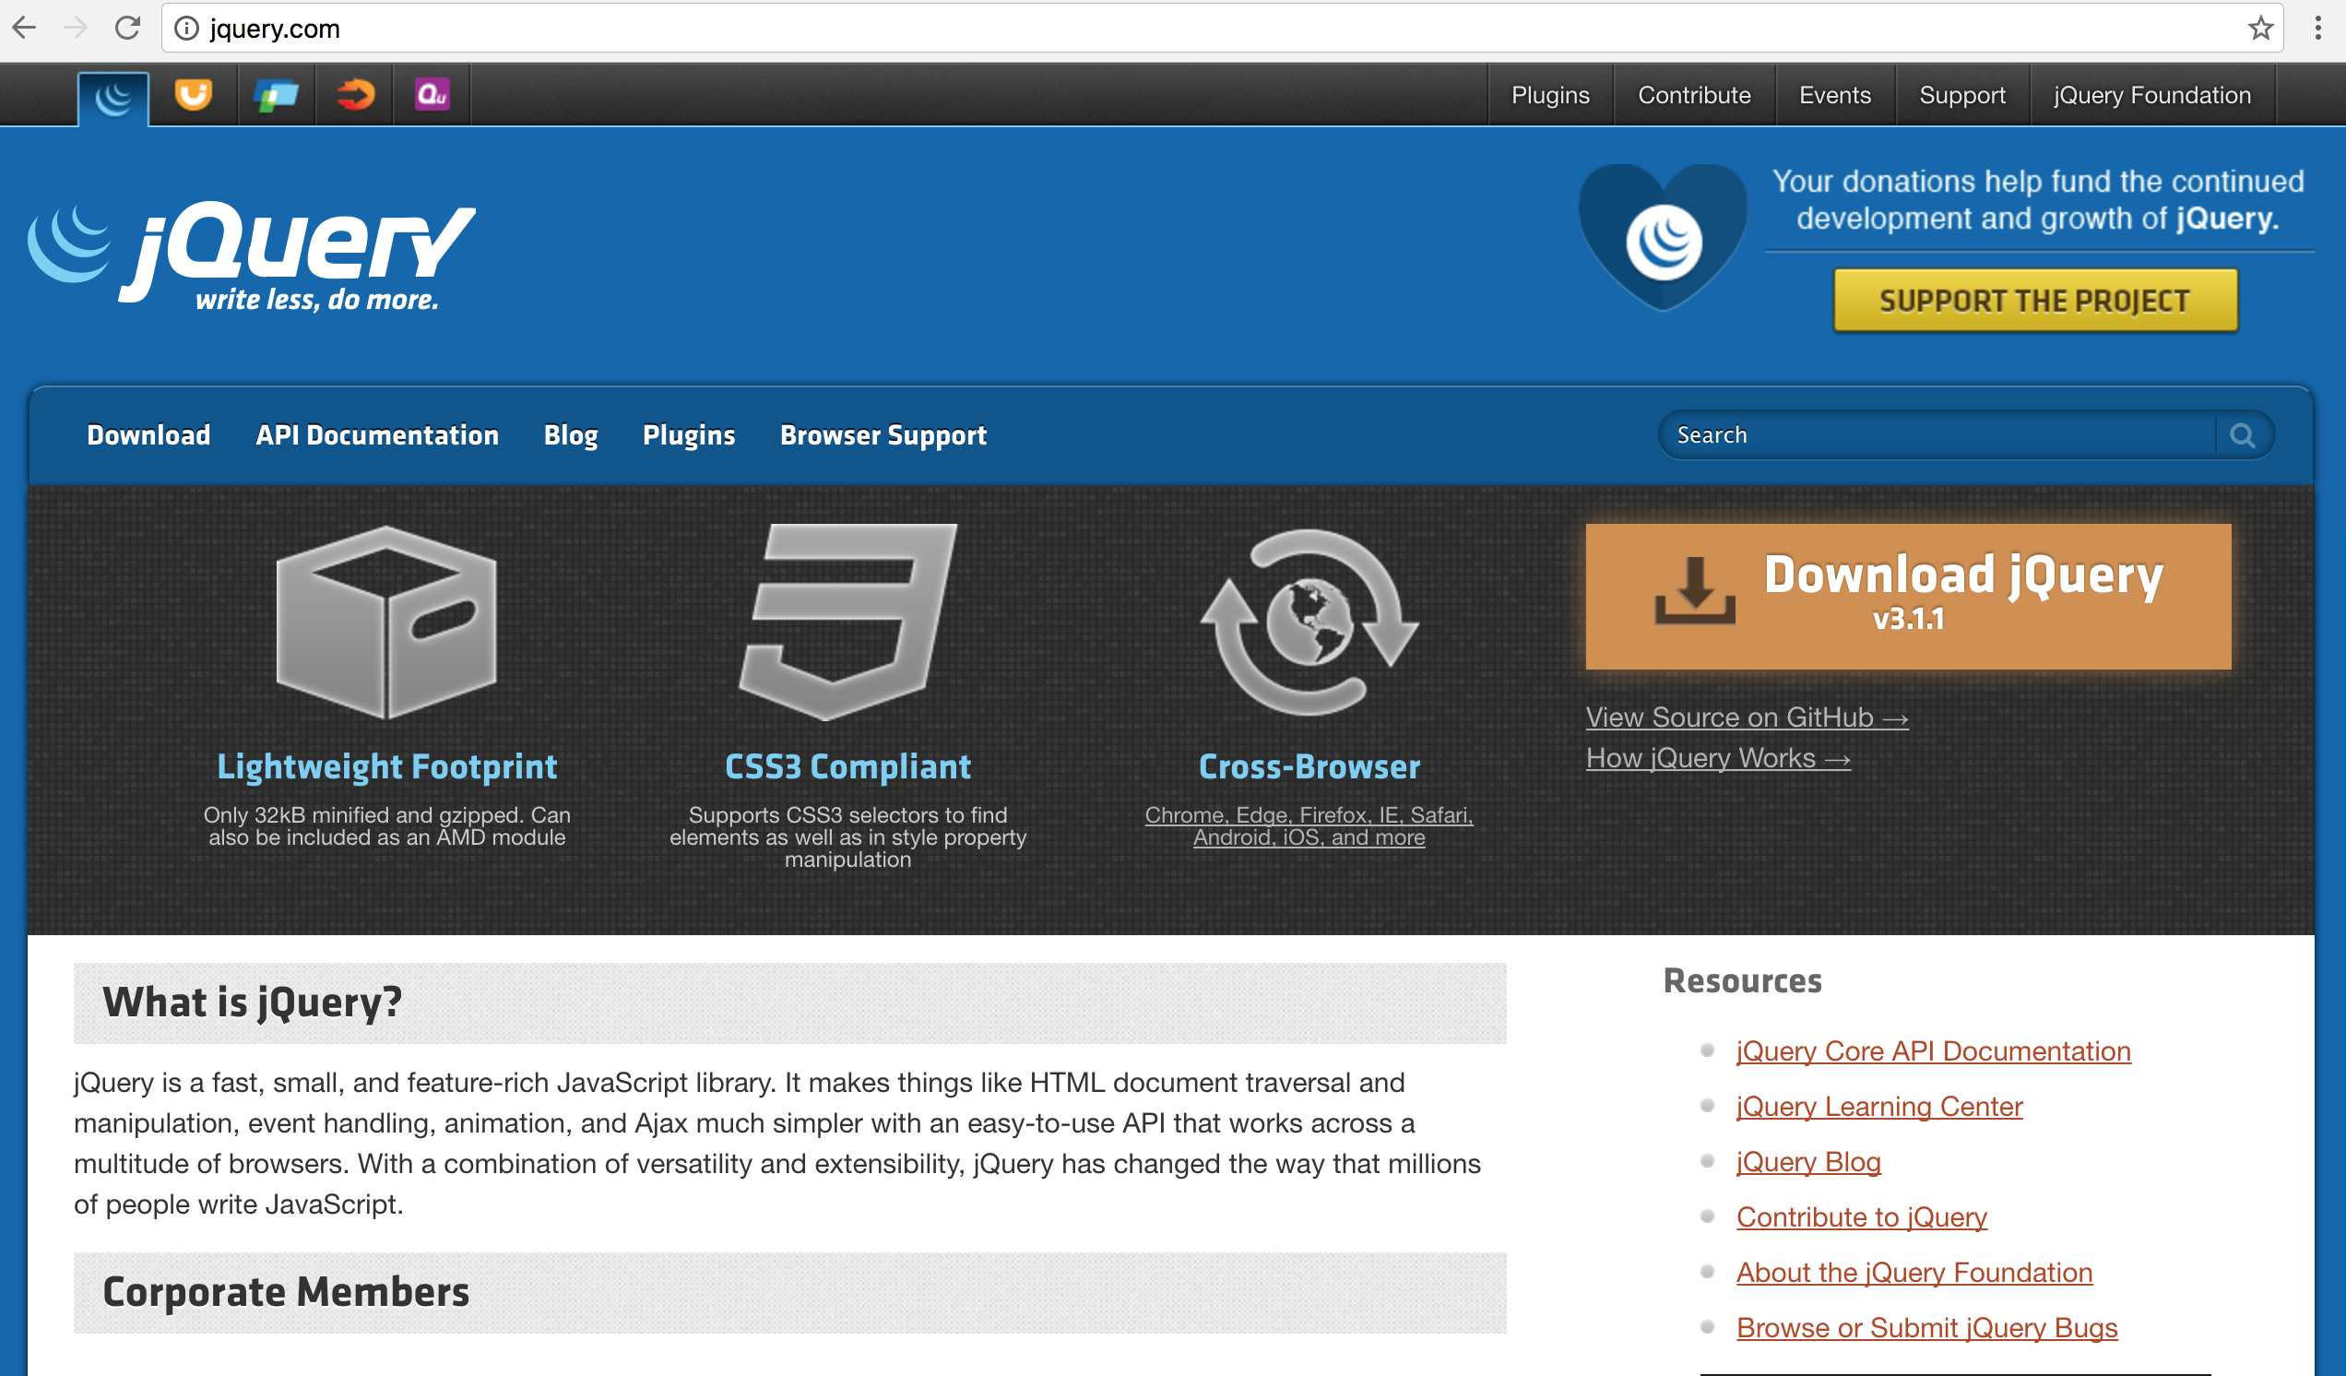
jQuery
http://jquery.com/

Slide 21
jQuery
jQuery is a fast, small, and feature-rich JavaScript library.
jQuery is the most popular JavaScript library
versatility and extensibility
It makes things like HTML document traversal and manipulation, event handling, animation, and Ajax much simpler with an easy-to-use API that works across a multitude of browsers.
Source: http://jquery.com/

Slide 22
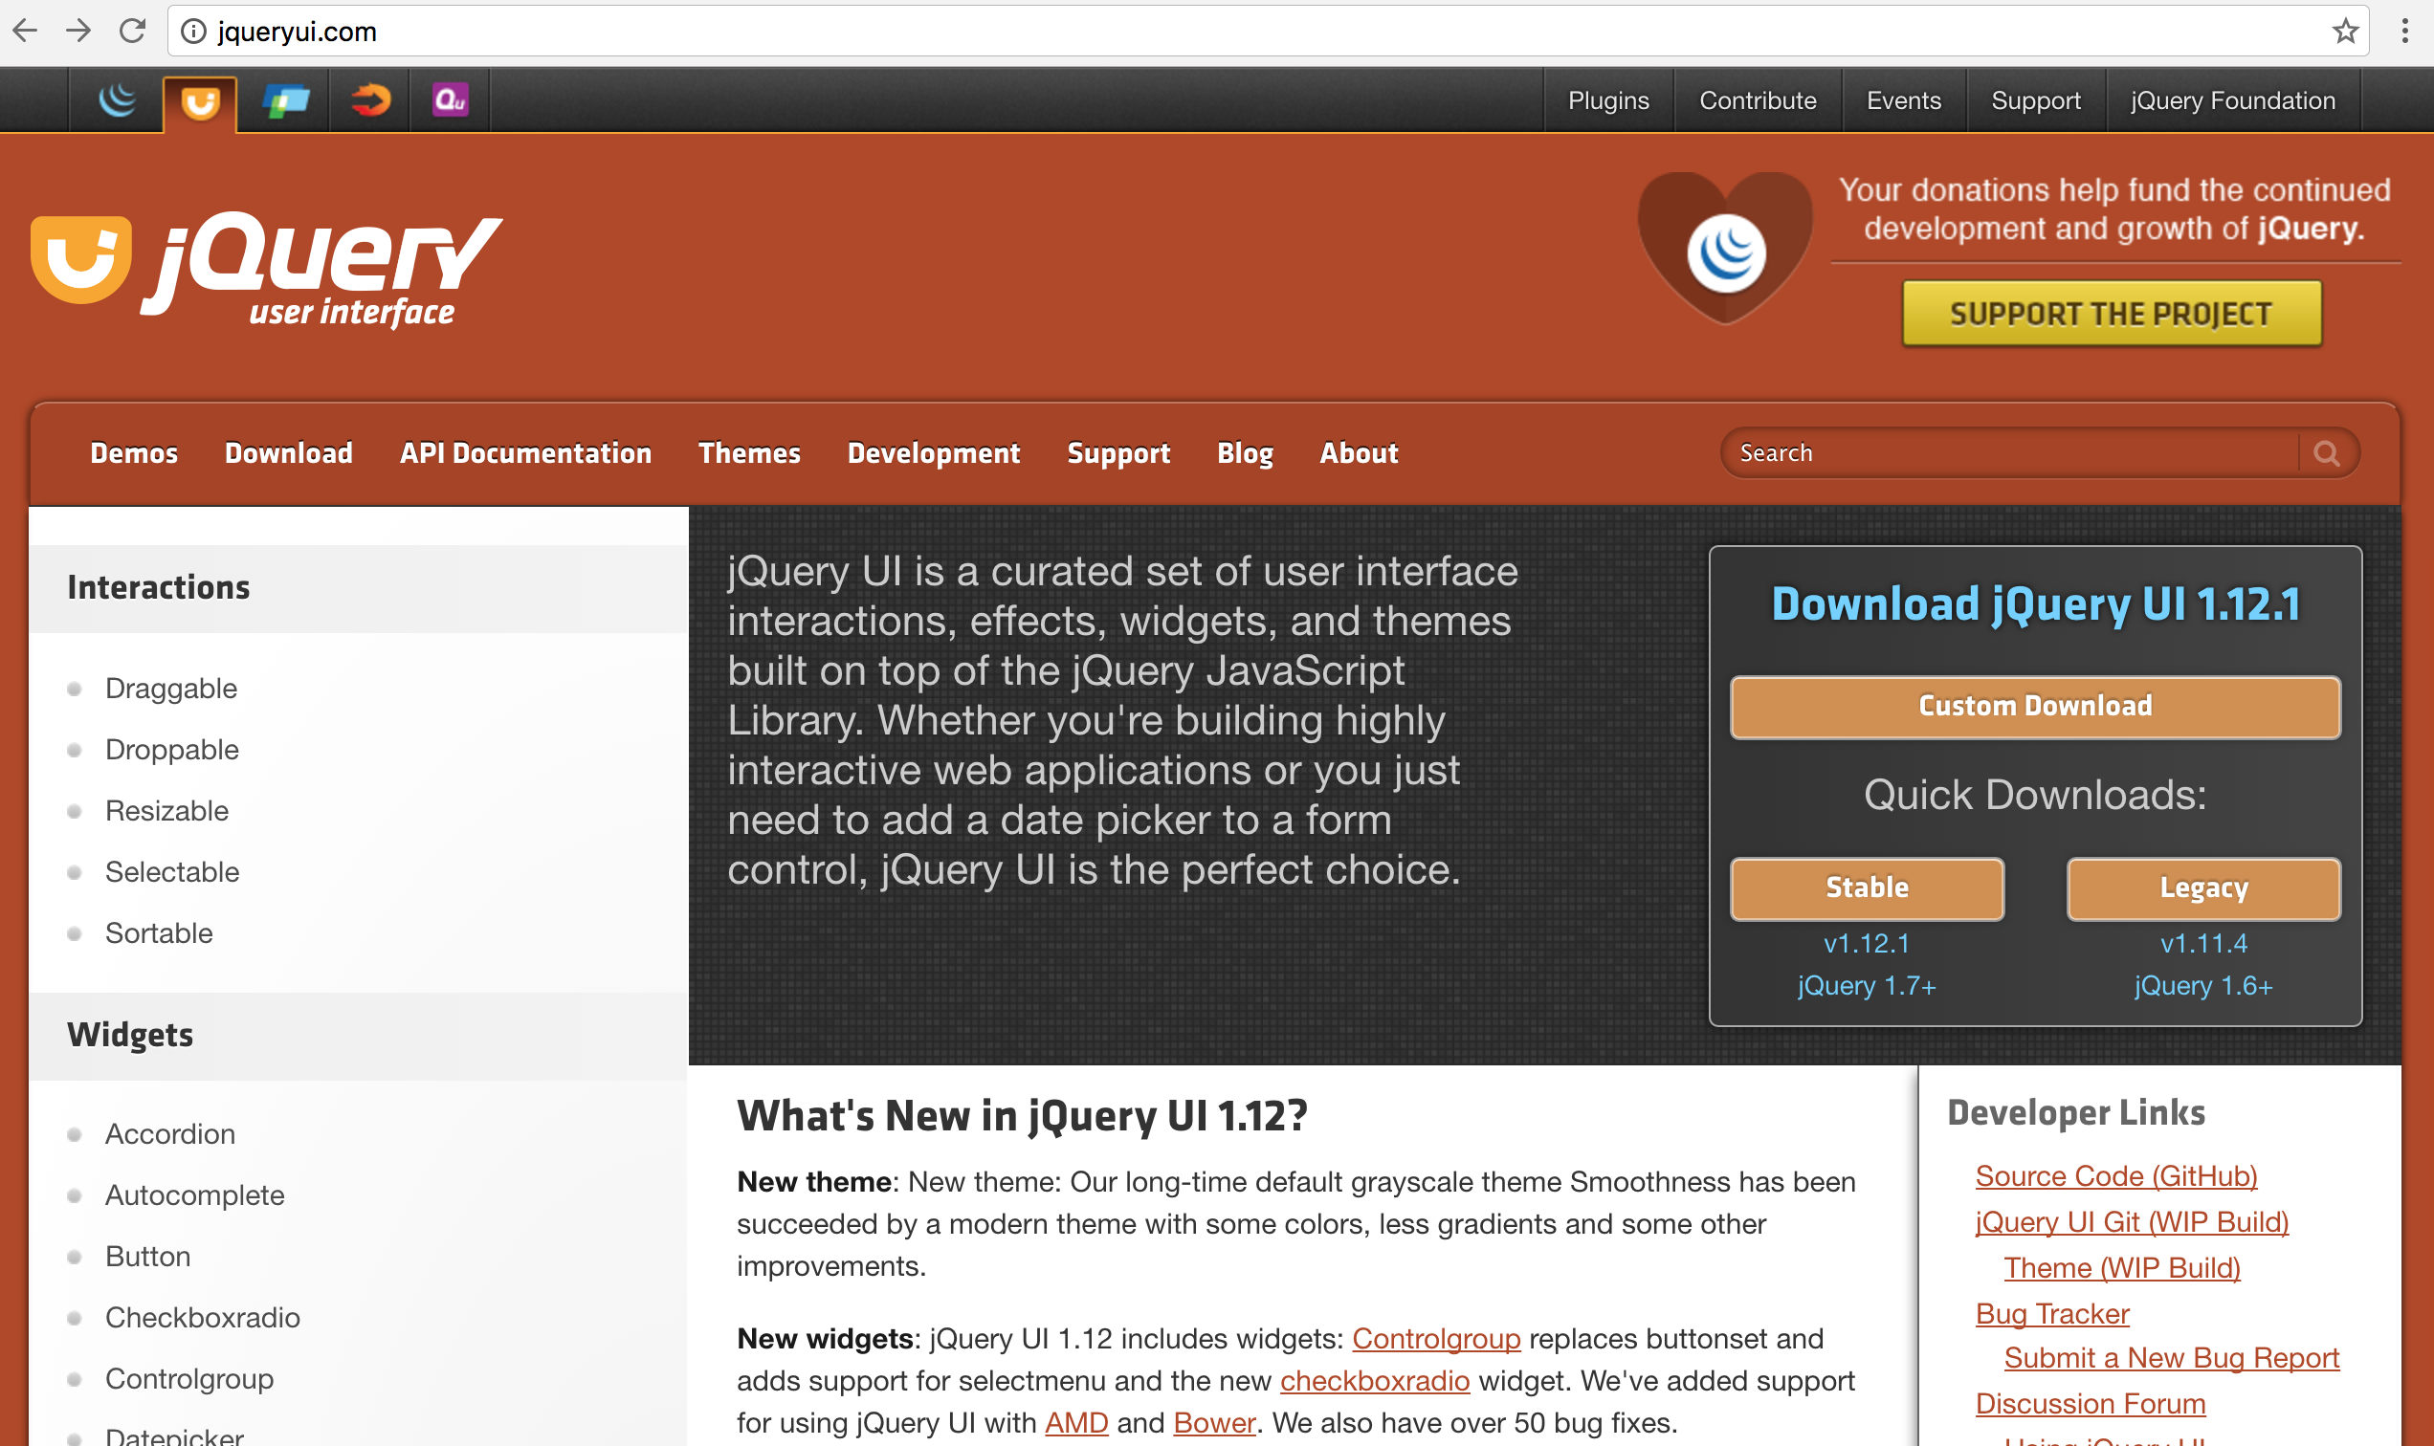
jQuery UI
http://jqueryui.com/

Slide 23
jQuery Mobile
Seriously cross-platform with HTML5
write less, do more
Source: http://jquerymobile.com/

Slide 24
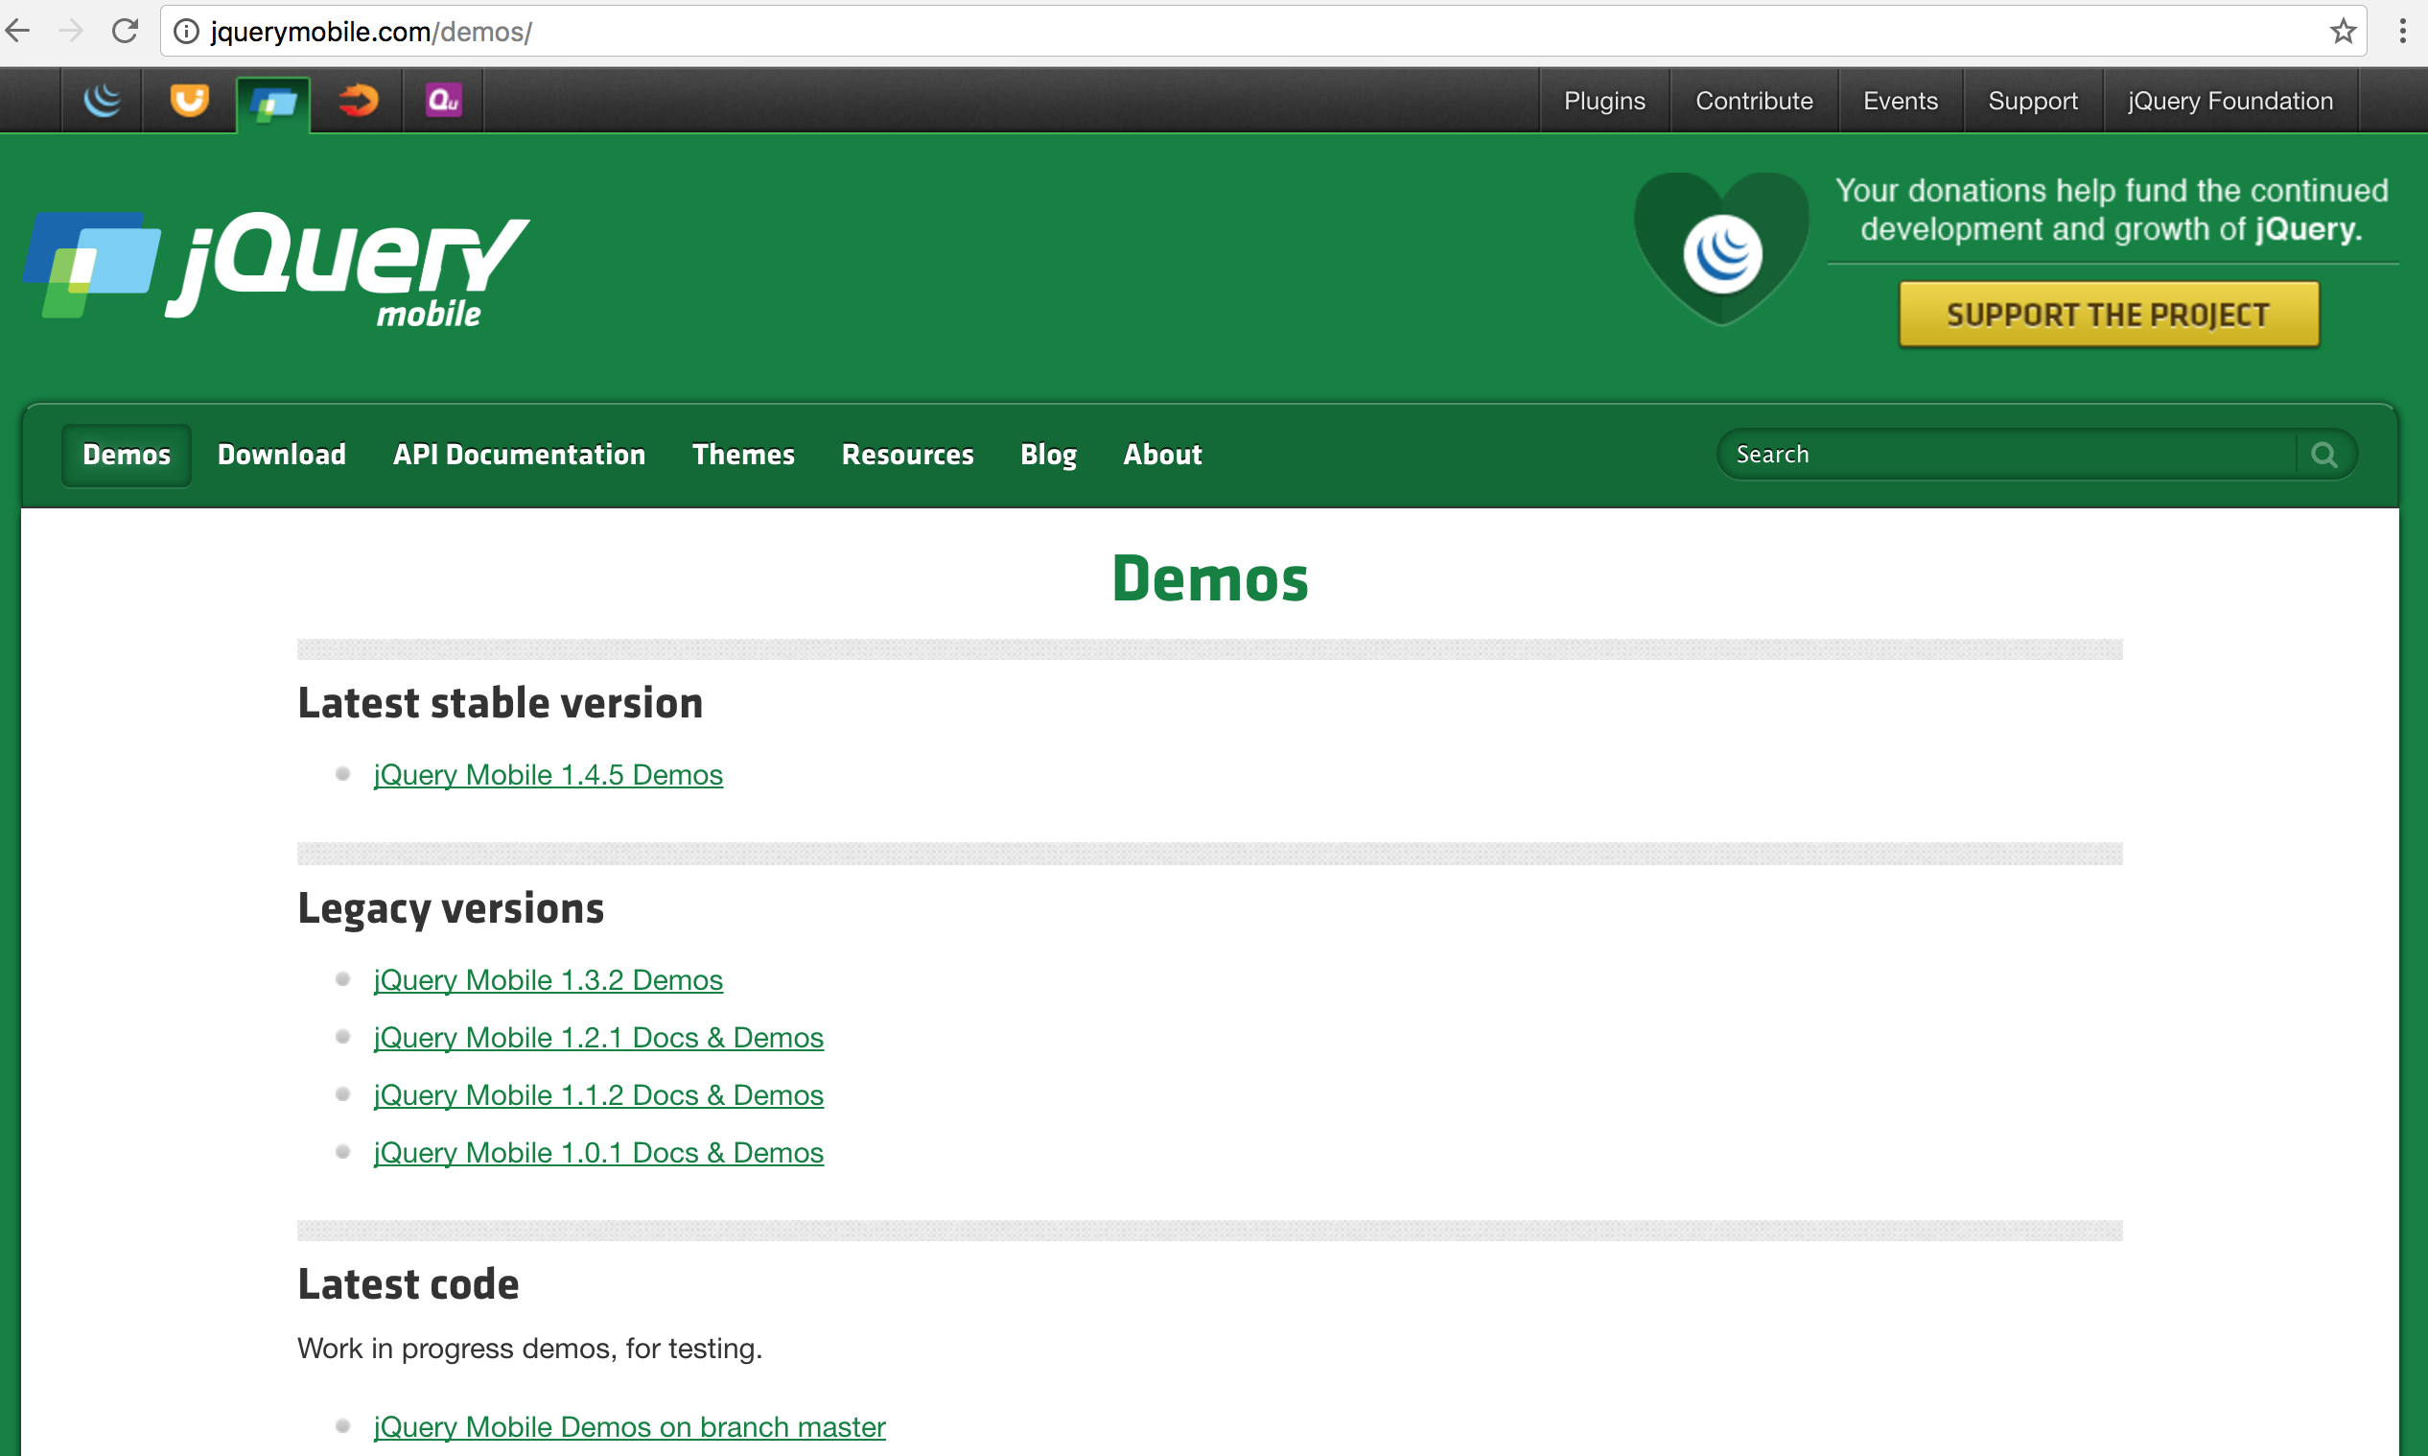
jQuery Mobile Demos
Source: http://jquerymobile.com/demos/

Slide 25
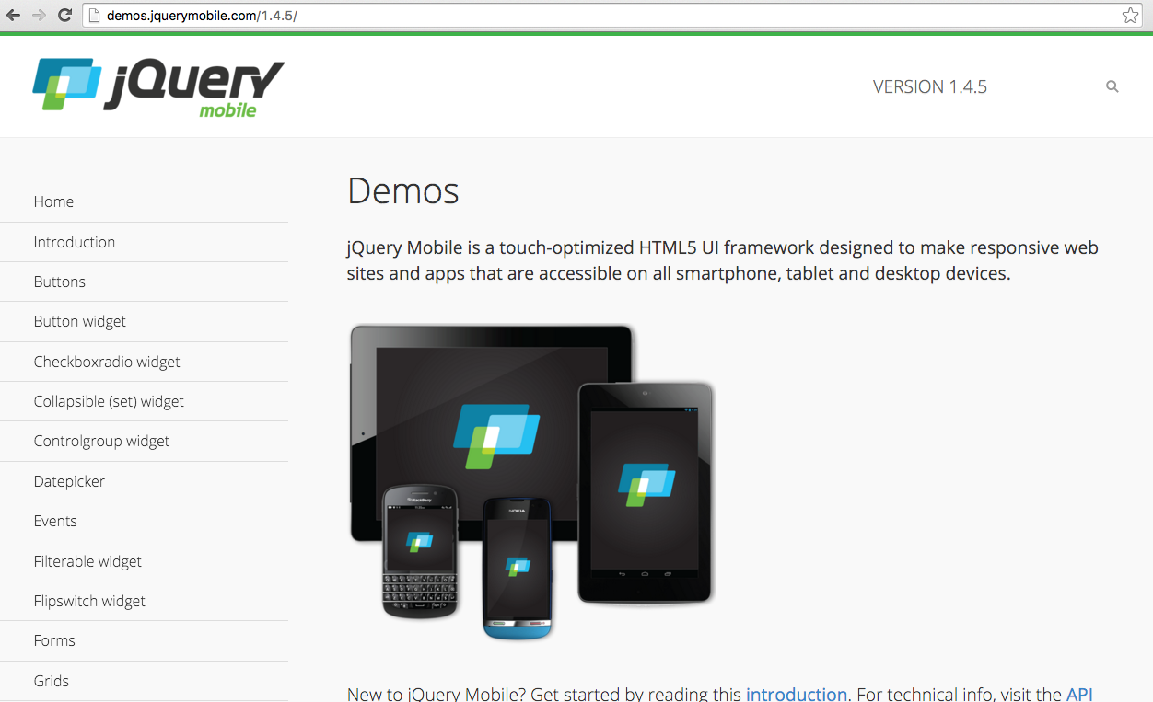
jQuery Mobile Demos
Source: http://demos.jquerymobile.com/1.4.5/

Slide 26
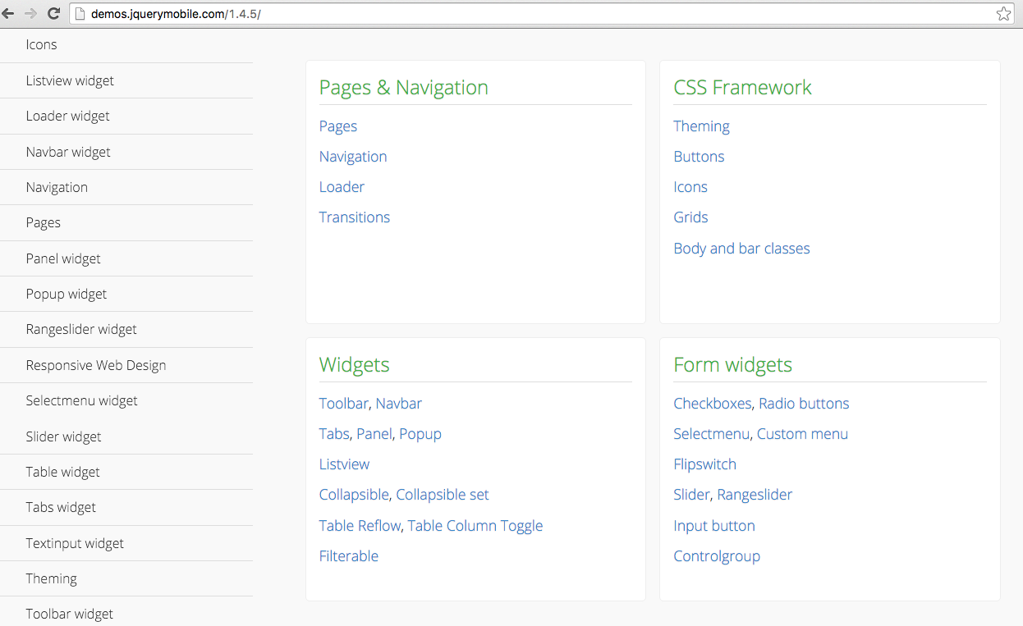
jQuery Mobile Demos
Source: http://demos.jquerymobile.com/1.4.4/

Slide 27
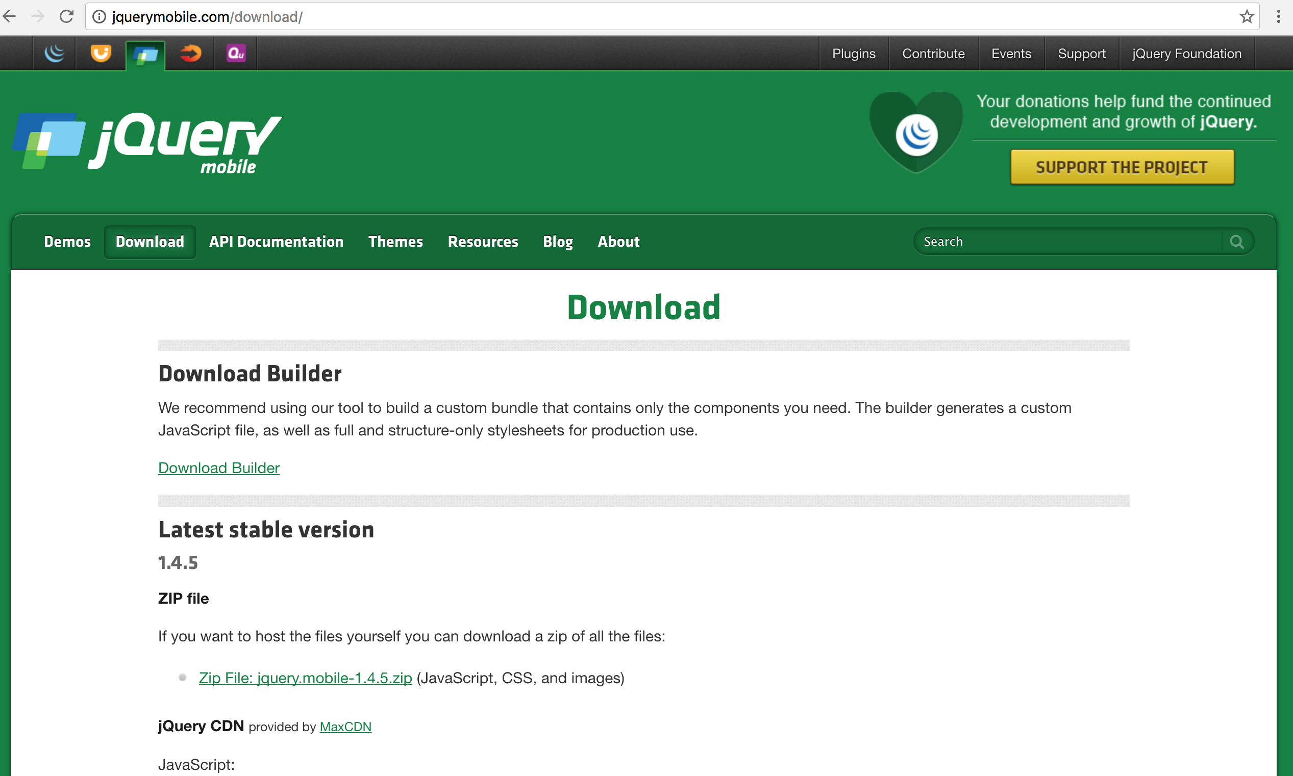
jQuery Mobile Download
Source: http://jquerymobile.com/download/

Slide 28
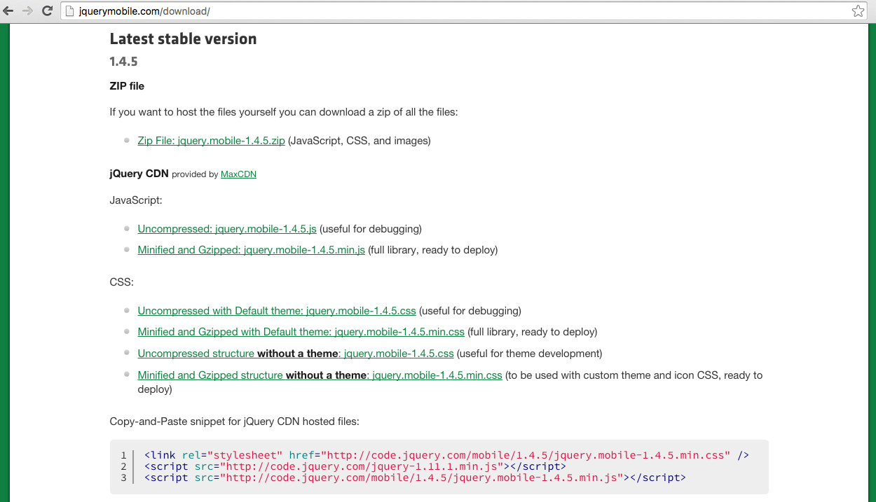
jQuery Mobile
Source: http://jquerymobile.com/download/

Slide 29
viewport
<!DOCTYPE html>
<html>
<head>
<title>Mobile App Title</title>
<meta charset=utf-8 />
<meta name="viewport" content="width=device-width, initial-scale=1">
<link rel="stylesheet" href="http://code.jquery.com/mobile/1.4.5/jquery.mobile-1.4.5.min.css">
<script src="http://code.jquery.com/jquery-1.11.1.min.js"></script>
<script src="http://code.jquery.com/mobile/1.4.5/jquery.mobile-1.4.5.min.js"></script>
</head>
<body>
</body>
</html>

Slide 30
viewport
<meta name="viewport" content="width=device-width, initial-scale=1">

Slide 31
jquery-1.11.1.min.js jquery.mobile-1.4.5.min.css jquery.mobile-1.4.5.min.js
<!DOCTYPE html>
<html>
<head>
<title>Mobile App Title</title>
<meta charset=utf-8 />
<meta name="viewport" content="width=device-width, initial-scale=1">
<link rel="stylesheet" href="http://code.jquery.com/mobile/1.4.5/jquery.mobile-1.4.5.min.css">
<script src="http://code.jquery.com/jquery-1.11.1.min.js"></script>
<script src="http://code.jquery.com/mobile/1.4.5/jquery.mobile-1.4.5.min.js"></script>
</head>
<body>
</body>
</html>

Slide 32
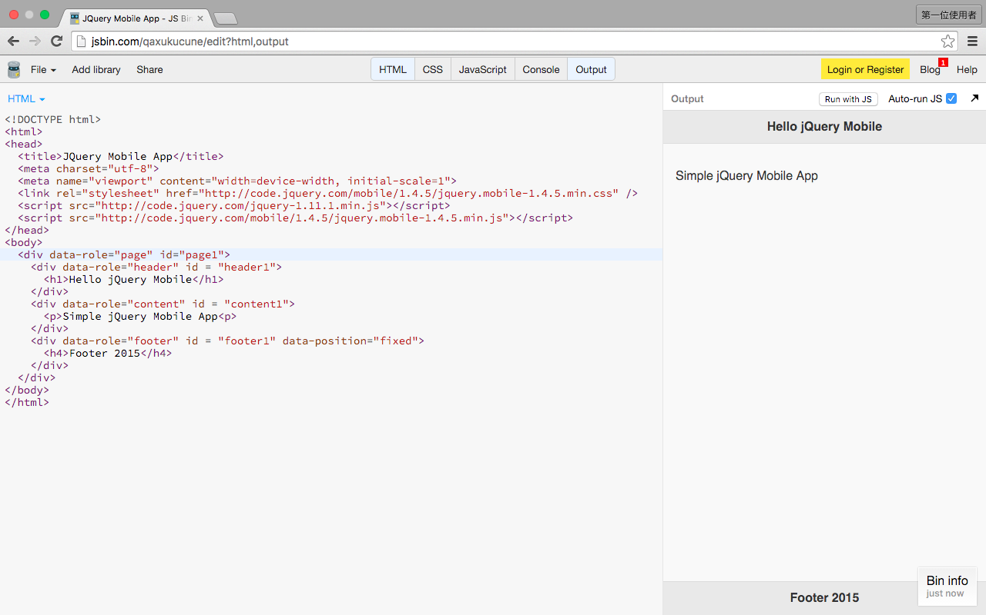
jQuery Mobile Page
http://jsbin.com/qaxukucune/edit?html,output

Slide 33
jQuery Mobile Page
<!DOCTYPE html>
<html>
<head>
<title>JQuery Mobile App</title>
<meta charset="utf-8">
<meta name="viewport" content="width=device-width, initial-scale=1">
<link rel="stylesheet" href="http://code.jquery.com/mobile/1.4.5/jquery.mobile-1.4.5.min.css" />
<script src="http://code.jquery.com/jquery-1.11.1.min.js"></script>
<script src="http://code.jquery.com/mobile/1.4.5/jquery.mobile-1.4.5.min.js"></script>
</head>
<body>
<div data-role="page" id="page1">
<div data-role="header" id = "header1">
<h1>Hello jQuery Mobile</h1>
</div>
<div data-role="content" id = "content1">
<p>Simple jQuery Mobile App<p>
</div>
<div data-role="footer" id = "footer1" data-position="fixed">
<h4>Footer 2015</h4>
</div>
</div>
</body>
</html>
http://jsbin.com/qaxukucune/edit?html,output

Slide 34
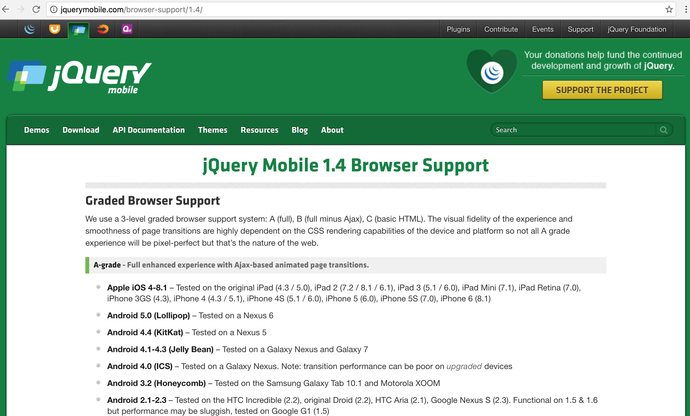
jQuery Mobile: Mobile Graded Browser Support
Source: http://jquerymobile.com/gbs/1.4/

Slide 35
jQuery Mobile: Mobile Graded Browser Support
jQuery Mobile has broad support for the vast majority of all modern desktop, smartphone, tablet, and e-reader platforms.
A-grade – Full enhanced experience with Ajax-based animated page transitions.
Apple iOS 4-8.1
Tested on the original iPad (4.3 / 5.0), iPad 2 (7.2 / 8.1 / 6.1), iPad 3 (5.1 / 6.0), iPad Mini (7.1), iPad Retina (7.0), iPhone 3GS (4.3), iPhone 4 (4.3 / 5.1), iPhone 4S (5.1 / 6.0), iPhone 5 (6.0), iPhone 5S (7.0), iPhone 6 (8.1)
Android 5.0 (Lollipop)
Tested on a Nexus 6
Android 4.4 (KitKat)
Tested on a Nexus 5
Android 4.1-4.3 (Jelly Bean)
Tested on a Galaxy Nexus and Galaxy 7
Source: http://jquerymobile.com/gbs/

Slide 36
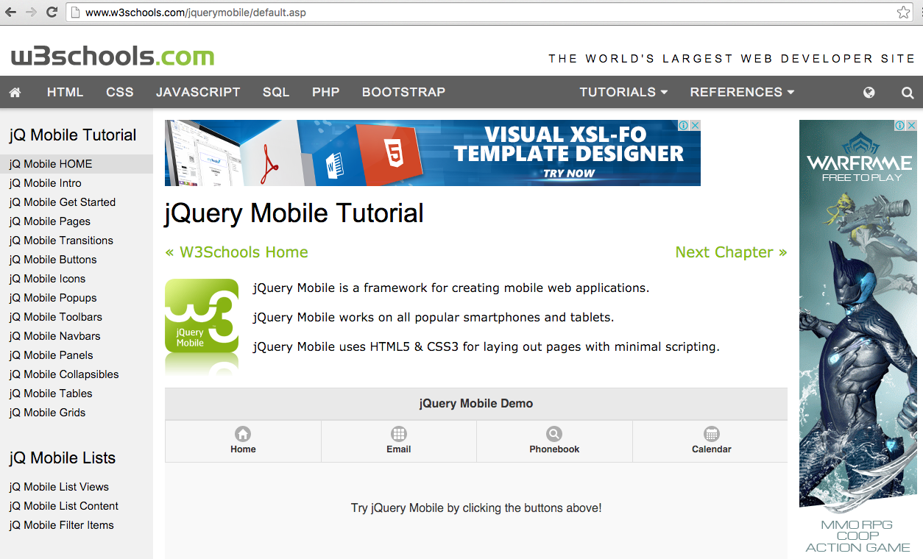
W3schools.com jQuery Mobile
Source: http://www.w3schools.com/jquerymobile/default.asp

Slide 37
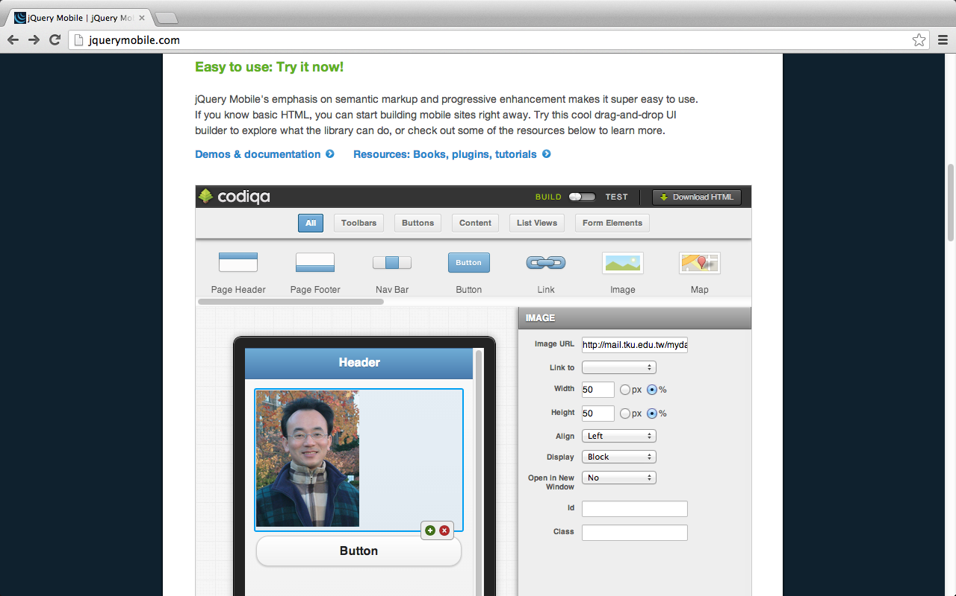
codiqa: drag-and-drop builder for mobile apps
Source: http://jquerymobile.com/

Slide 38
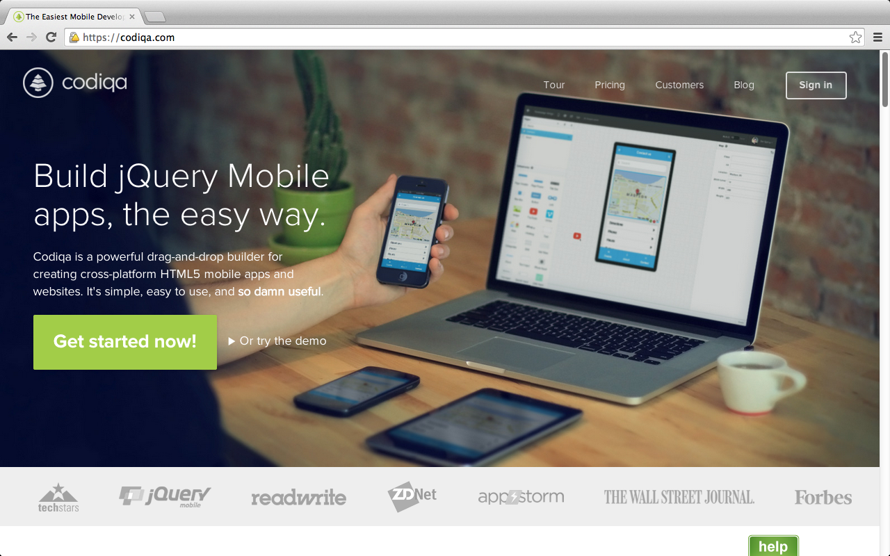
codiqa: drag-and-drop builder for mobile apps
https://codiqa.com/

Slide 39
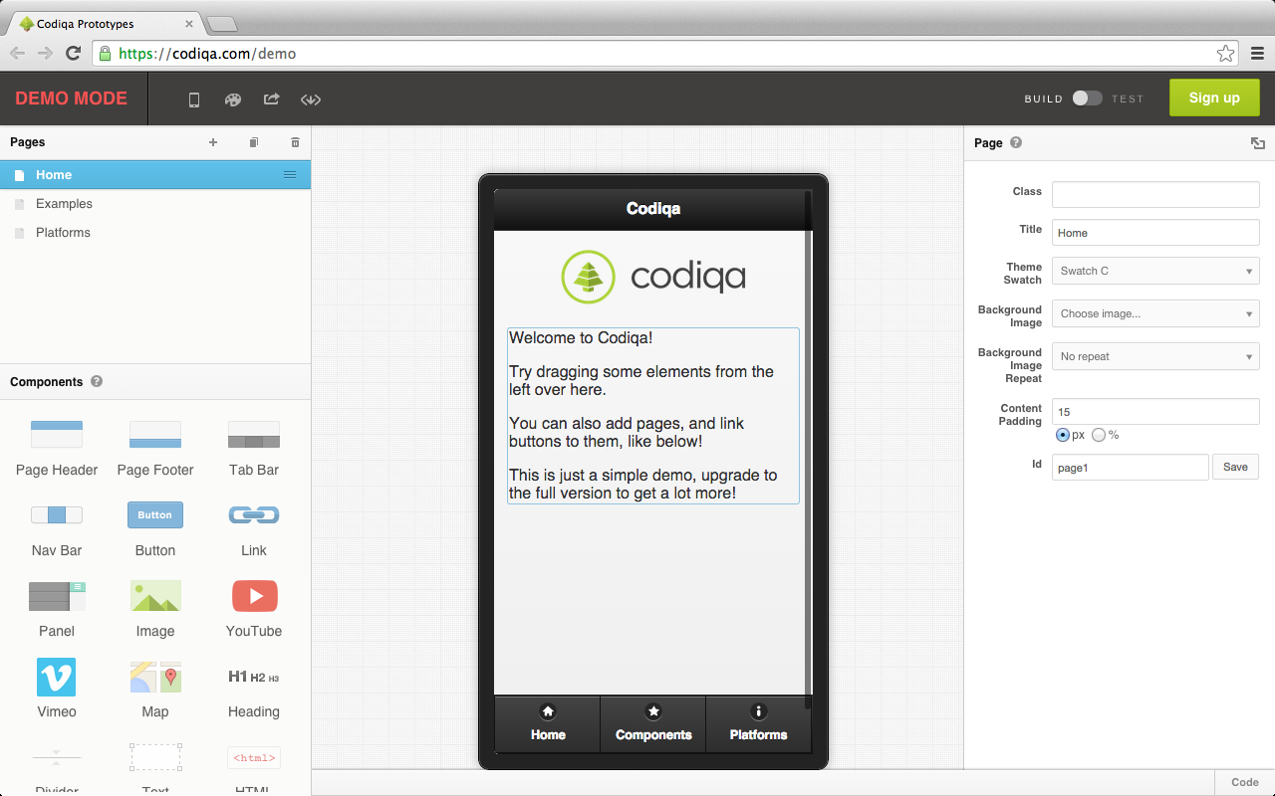
codiqa demo
https://codiqa.com/demo

Slide 40
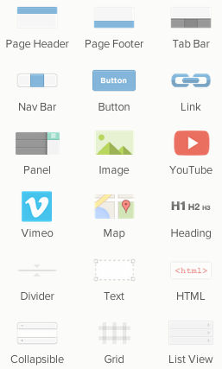
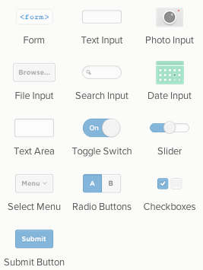
Codiqa Components
https://codiqa.com/demo

Slide 41
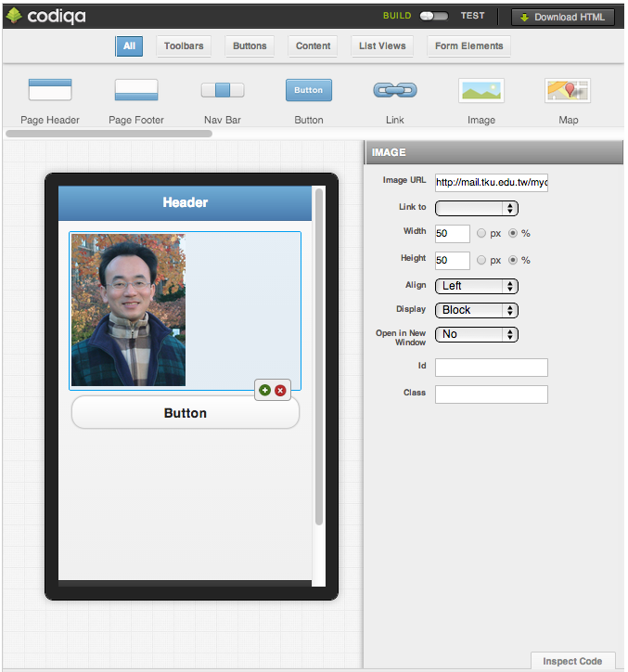
Source: http://jquerymobile.com/

Slide 42
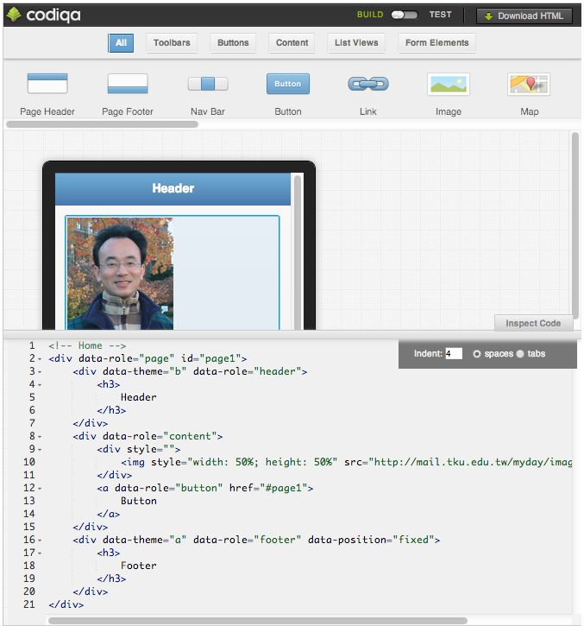
Source: http://jquerymobile.com/

Slide 43
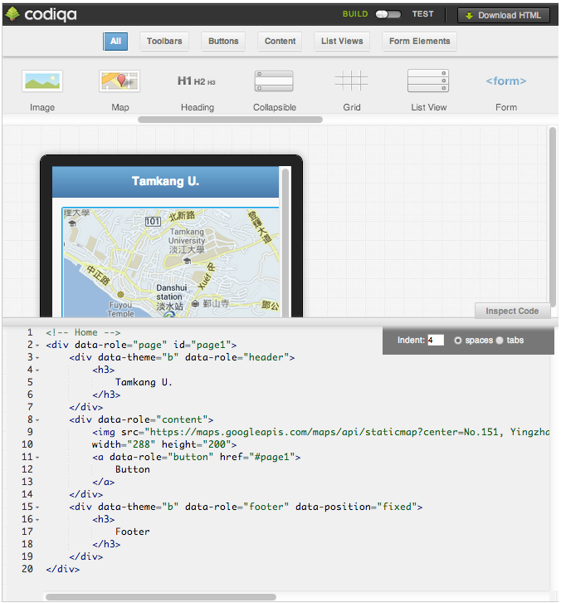
Source: http://jquerymobile.com/

Slide 44
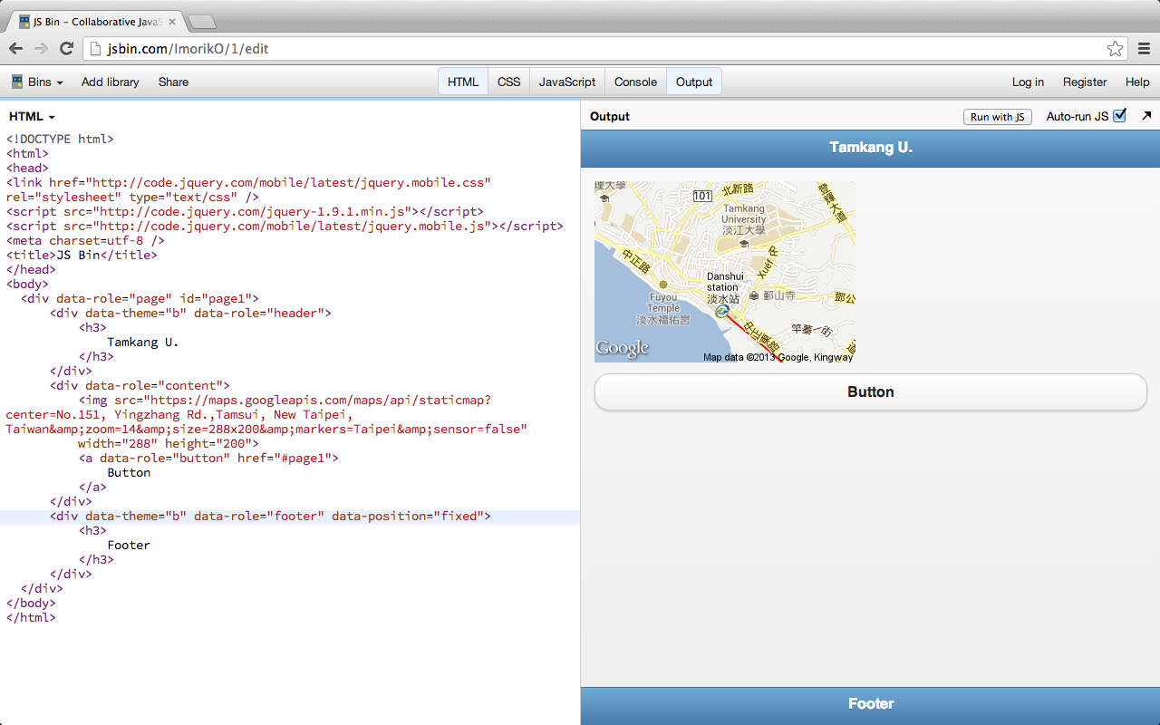
http://jsbin.com/ImorikO/1/edit

Slide 45
<!DOCTYPE html>
<html>
<head>
<link href="http://code.jquery.com/mobile/latest/jquery.mobile.css" rel="stylesheet" type="text/css" />
<script src="http://code.jquery.com/jquery-1.9.1.min.js"></script>
<script src="http://code.jquery.com/mobile/latest/jquery.mobile.js"></script>
<meta charset=utf-8 />
<title>JS Bin</title>
</head>
<body>
<div data-role="page" id="page1">
<div data-theme="b" data-role="header">
<h3>
Tamkang U.
</h3>
</div>
<div data-role="content">
<img src="https://maps.googleapis.com/maps/api/staticmap?center=No.151, Yingzhang Rd.,Tamsui, New Taipei, Taiwan&amp;zoom=14&amp;size=288x200&amp;markers=Taipei&amp;sensor=false"
width="288" height="200">
<a data-role="button" href="#page1">
Button
</a>
</div>
<div data-theme="b" data-role="footer" data-position="fixed">
<h3>
Footer
</h3>
</div>
</div>
</body>
</html>

Slide 46
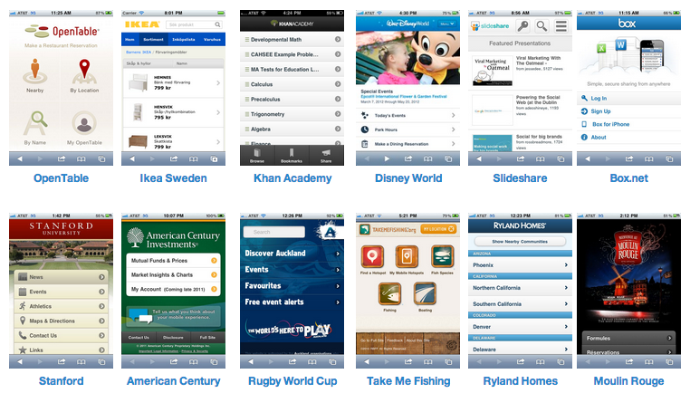
Get inspired: Built with jQuery Mobile
Source: http://jquerymobile.com/
Notes:
Get inspired: Built with jQuery Mobile
There are hundreds of popular web sites and apps built with jQuery Mobile. Here's a small sampling of sites collected on jQM Gallery - be sure to check that site often to see what's new and notable.

Slide 47
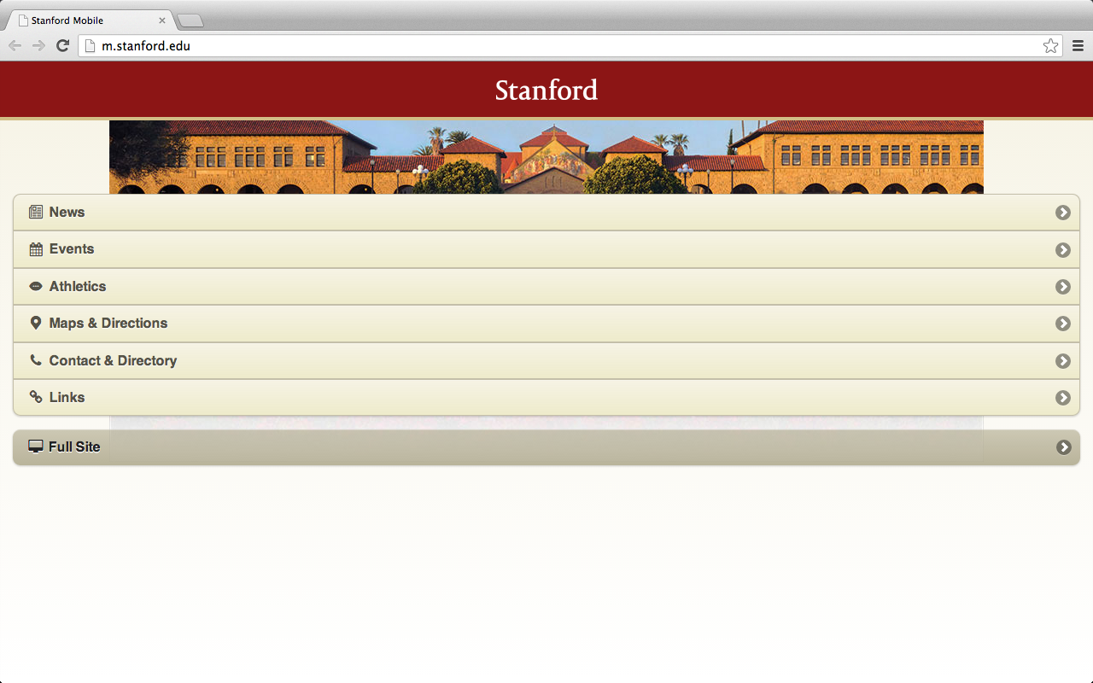
http://m.stanford.edu/

Slide 48
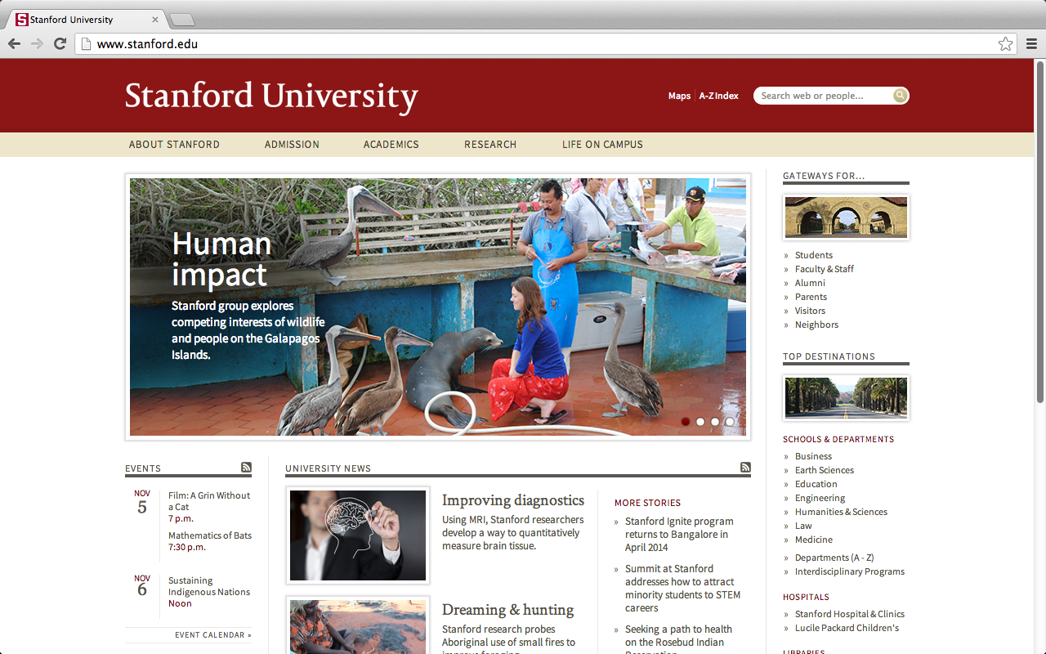
http://www.stanford.edu/

Slide 49
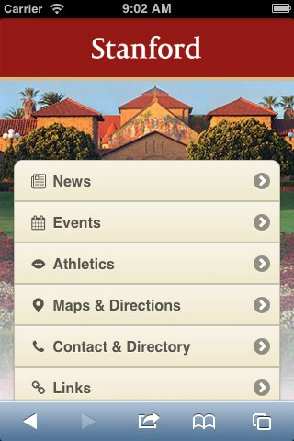
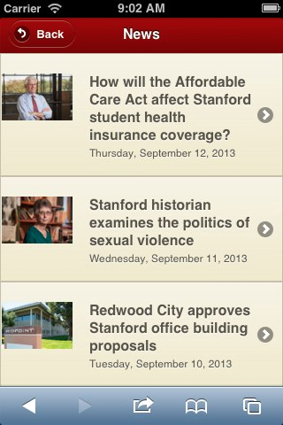
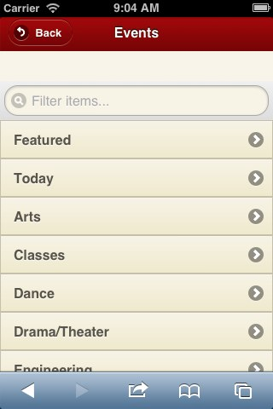
Mobile website for Stanford University http://m.stanford.edu
http://www.jqmgallery.com/2011/06/10/stanford/

Slide 50
data-role="page”
<div data-role="page" id="first" data-theme="b">
<div data-role="header">
<div data-role="content">
<div data-role="page" id="first" data-theme="b">
<div data-role="header">
<h1>Page Header</h1>
</div><!-- /header -->
<div data-role="content">
<p>Page content goes here.</p>
<a href="#second">Go to second page</a>
</div><!-- /content -->
<div data-role="footer" data-position="fixed">
<h4>Page Footer</h4>
</div><!-- /footer -->
</div><!-- /page -->
<div data-role="footer" data-position="fixed">

Slide 51
data-role=“button”
<a href="#" data-role="button" data-icon="star">Star button</a>
Source: http://view.jquerymobile.com/1.3.2/dist/demos/intro/

Slide 52
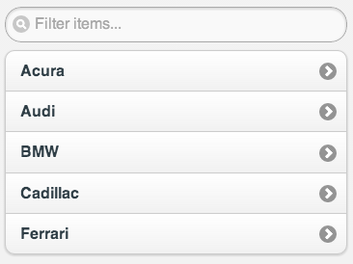
data-role=“listview”
<ul data-role="listview" data-inset="true” data-filter="true">
<li><a href="#">Acura</a></li>
<li><a href="#">Audi</a></li>
<li><a href="#">BMW</a></li>
<li><a href="#">Cadillac</a></li>
<li><a href="#">Ferrari</a></li>
</ul>

Slide 53
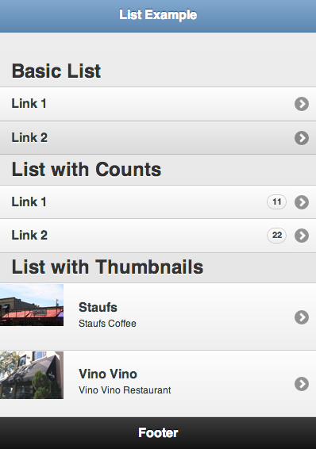
ListView Example
http://www.learnhtml5book.com/chapter5/jquerymobile/lists.html

Slide 54
ListView Example
<div data-role="page" >
<header data-role="header" data-theme="b">
<h1>List Example</h1>
</header>
<section data-role="content">
<h1>Basic List</h1>
<ul data-role="listview">
<li><a href="">Link 1</a></li>
<li><a href="">Link 2</a></li>
</ul>
<h1>List with Counts</h1>
<ul data-role="listview">
<li><a href="">Link 1</a><span class="ui-li-count ui-btn-up-c ui-btn-corner-all">11</span></li>
<li><a href="">Link 2</a><span class="ui-li-count ui-btn-up-c ui-btn-corner-all">22</span></li>
</ul>
<h1>List with Thumbnails</h1>
<ul data-role="listview">
<li><a href="index.html" class="ui-link-inherit">
<img src="staufs_thumb.jpg" class="ui-li-thumb">
<h3 class="ui-li-heading">Staufs</h3>
<p class="ui-li-desc">Staufs Coffee</p>
</a>
</li>
<li><a href="index.html" class="ui-link-inherit">
<img src="vino-vino_thumb.jpg" class="ui-li-thumb">
<h3 class="ui-li-heading">Vino Vino</h3>
<p class="ui-li-desc">Vino Vino Restaurant</p>
</a>
</li>
</ul>
</section>
http://www.learnhtml5book.com/chapter5/jquerymobile/lists.html

Slide 55
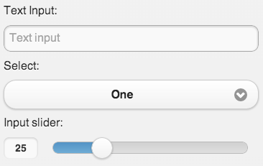
Form Element
<form>
<label for="textinput-s">Text Input:</label>
<input type="text" name="textinput-s" id="textinput-s" placeholder="Text input" value="" data-clear-btn="true">
<label for="select-native-s">Select:</label>
<select name="select-native-s" id="select-native-s">
<option value="small">One</option>
<option value="medium">Two</option>
<option value="large">Three</option>
</select>
<label for="slider-s">Input slider:</label>
<input type="range" name="slider-s" id="slider-s" value="25" min="0" max="100" data-highlight="true">
</form>

Slide 56
data-theme=“a”
<a href="#" data-role="button" data-icon="star" data-theme="a">data-theme="a"</a>
<a href="#" data-role="button" data-icon="star" data-theme="b">data-theme="b"</a>
<a href="#" data-role="button" data-icon="star” data-theme=”c">data-theme="c"</a>
<a href="#" data-role="button" data-icon="star" data-theme="d">data-theme="d"</a>
<a href="#" data-role="button" data-icon="star" data-theme="e">data-theme="e"</a>
Source: http://view.jquerymobile.com/1.3.2/dist/demos/intro/

Slide 57
data-icon=“star”
<a href="#" data-role="button" data-icon="star" data-theme="c">data-icon="star"</a>
Custom Icons
.ui-icon-myapp-email {
background-image: url("app-icon-email.png");
}
white icon
18x18 pixels
PNG-8 with alpha transparency
Source: http://view.jquerymobile.com/1.3.2/dist/demos/widgets/icons/

Slide 58
jQuery Mobile Icon Pack
Source: http://jqmiconpack.andymatthews.net/

Slide 59
ThemeRoller for jQuery Mobile
http://jquerymobile.com/themeroller/

Slide 60
ThemeRoller for jQuery Mobile
http://jquerymobile.com/themeroller/

Slide 61
http://grandviewave.com

Slide 62
Demo Building Mobile Apps with jQuery Mobile
http://jsbin.com

Slide 63
Mobile Myday
http://jsbin.com/IwOMezo

Slide 64
Online Editor: http://jsbin.com
http://jsbin.com/

Slide 65
CompileOnline: Try jQueryMobile Online
http://www.compileonline.com/try_jquerymobile_online.php

Slide 66
http://jsbin.com/IwOMezo

Slide 67
jQuery jQuery.Mobile js css
<!DOCTYPE html>
<html>
<head>
<title>Min-Yuh Day Mobile App</title>
<meta charset=utf-8 />
<meta name="viewport" content="width=device-width, initial-scale=1" />
<script src="http://code.jquery.com/jquery-1.9.1.min.js"></script>
<link type="text/css" href="http://code.jquery.com/mobile/latest/jquery.mobile.min.css" rel="stylesheet" />
<script type="text/javascript" src="http://code.jquery.com/mobile/latest/jquery.mobile.min.js"></script>
</head>
http://jsbin.com/IwOMezo

Slide 68
Page 1 MyHome
<body>
<div data-role="page" id="first" data-theme="b">
<div data-role="header" data-theme="b">
<h1>Min-Yuh Day</h1>
<a href="index.html" data-icon="home">Home</a>
</div><!-- /header -->
<div data-role="content">
<div style="text-align:center">
<img style="width: 50%; height: 50%" src="http://mail.tku.edu.tw/myday/images/Myday_Photo.jpg">
</div>
<ul data-role="listview" data-inset="true" data-filter="true">
<li><a href="#Vita">Vita</a></li>
<li><a href="#Education">Education</a></li>
<li><a href="#Research">Research</a></li>
<li><a href="#Publications">Publications</a></li>
<li><a href="#Teaching">Teaching</a></li>
<li><a href="#ProfessionalActivities">Professional Activities</a></li>
</ul>
<a href="http://mail.tku.edu.tw/myday" data-role="button" data-icon="star">Classic Web</a>
</div><!-- /content -->
<div data-role="footer" data-position="fixed" data-theme="b">
<h4>Mobile Myday @ 2013</h4>
</div><!-- /footer -->
</div><!-- /page 1-->
http://jsbin.com/IwOMezo

Slide 69
Page 2 Vita
<div data-role="page" id="Vita" data-add-back-btn="true" data-theme="b">
<div data-role="header" data-theme="b">
<h1>Vita</h1>
</div><!-- /header -->
<div data-role="content">
<div style="text-align:center">
<img style="width: 50%; height: 50%" src="http://mail.tku.edu.tw/myday/images/Myday_Photo.jpg">
</div>
<p>Dr. Min-Yuh Day is an Assistant Professor in the Department of Information Management at Tamkang University, Taiwan. ….</p>
</div><!-- /content -->
<div data-role="footer" data-position="fixed" data-theme="b">
<h4>Mobile Myday @ 2013</h4>
</div><!-- /footer -->
</div><!-- /page 2 Vita-->
http://jsbin.com/IwOMezo

Slide 70
Page 3 Education
<div data-role="page" id="Education" data-theme="b">
<div data-role="header" data-position="inline" data-theme="b">
<a data-icon="back" data-rel="back" back-btn="true">Back</a>
<h1>Education</h1>
<a href="#" data-icon="home">Home</a>
</div><!-- /header -->
<div data-role="content">
<ul data-role="listview" data-inset="true" data-filter="true">
<li>
<a href="#" class="ui-link-inherit">
<h3 class="ui-li-heading">Ph.D.</h3>
<p class="ui-li-desc">Department of Information Management, National Taiwan University, 2001-2010</p>
</a>
</li>
<li>
<a href="#" class="ui-link-inherit">
<h3 class="ui-li-heading">M.B.A.</h3>
<p class="ui-li-desc">Department of Information Management, Tamkang University, 1993-1995</p>
</a>
</li>
<li>
<a href="#" class="ui-link-inherit">
<h3 class="ui-li-heading">B.B.A.</h3>
<p class="ui-li-desc">Department of Information Management, Tamkang University, 1989-1993</p>
</a>
</li>
</ul>
</div><!-- /content -->
<div data-role="footer" data-position="fixed" data-theme="b">
<h4>Mobile Myday @ 2013</h4>
</div><!-- /footer -->
</div><!-- /page 3 Education-->
</body>
</html>
http://jsbin.com/IwOMezo

Slide 71
Mobile Myday
http://jsbin.com/IwOMezo

Slide 72
Mobile Myday
http://mail.tku.edu.tw/myday/m

Slide 73
Page 4 Research
<div data-role="page" id="Research" data-theme="b">
<div data-role="header" data-position="inline" data-theme="b">
<a data-icon="back" data-rel="back" back-btn="true">Back</a>
<h1>Myday Research</h1>
<a href="#MyHome" data-icon="home">Home</a>
</div><!-- /header -->
<div data-role="content">
<ul data-role="listview" data-inset="true" data-filter="true" data-filter-placeholder="Search topics..." data-theme="c">
<li data-role="list-divider" data-theme="c">Research Interests</li>
<li data-icon="info"><a href="#"><p>Social Media Service</p></a></li>
<li data-icon="info"><a href="#"><p>Mobile Apps Marketing</p></a></li>
<li data-icon="info"><a href="#"><p>Data Mining and Text Mining</p></a></li>
<li data-icon="info"><a href="#"><p>Business Intelligence</p></a></li>
<li data-icon="info"><a href="#"><p>Big Data Analytics</p></a></li>
<li data-icon="info"><a href="#"><p>Information Systems Evaluation</p></a></li>
<li data-icon="info"><a href="#"><p>Question Answering Systems</p></a></li>
<li data-icon="info"><a href="#"><p>Knowledge Management</p></a></li>
<li data-icon="info"><a href="#"><p>Electronic Commerce</p></a></li>
<li data-icon="info"><a href="#"><p>Learning Technology</p></a></li>
<li data-icon="info"><a href="#"><p>Intelligent Information Systems</p></a></li>
<li data-icon="info"><a href="#"><p>Biomedical Informatics</p></a></li>
</ul>
</div><!-- /content -->
<div data-role="footer" data-position="fixed" data-theme="b">
<div data-role="navbar">
<ul>
<li><a href="#MyHome" class="ui-btn-active ui-state-persist" data-transition="fade" data-icon="home">Home</a></li>
<li><a href="#Research" class="ui-btn-active ui-state-persist" data-transition="fade" data-icon="star">Research</a></li>
<li><a href="#Teaching" class="ui-btn-active ui-state-persist" data-transition="fade" data-icon="check">Teaching</a></li>
<li><a href="#About" class="ui-btn-active ui-state-persist" data-transition="fade" data-icon="grid">About</a></li>
</ul>
</div>
</div><!-- /footer -->
</div><!-- /page 4 Research-->
http://mail.tku.edu.tw/myday/m

Slide 74
Page 5 Teaching
<div data-role="page" id="Teaching" data-theme="b">
<div data-role="header" data-position="inline" data-theme="b">
<a data-icon="back" data-rel="back" back-btn="true">Back</a>
<h1>Myday Teaching</h1>
<a href="#MyHome" data-icon="home">Home</a>
</div><!-- /header -->
<div data-role="content">
<div style="text-align:center">
<img style="width: 25%; height: 25%" src="http://mail.tku.edu.tw/myday/images/Myday_Photo.jpg">
</div>
<ul data-role="listview" data-inset="true" data-filter="true" data-filter-placeholder="Search courses..." data-theme="c">
<li data-role="list-divider" data-theme="c">Fall 2013 (2013.09-2014.01)<span class="ui-li-count">3</span></li>
<li><a href="http://mail.tku.edu.tw/myday/teaching.htm#1021SMAP" rel="external"><p>Social Media Apps Programming <br>(Fall 2013)</p></a></li>
<li><a href="http://mail.tku.edu.tw/myday/teaching.htm#1021CSIM4B" rel="external"><p>Case Study for Information Management <br>(Fall 2013)</p></a></li>
<li><a href="http://mail.tku.edu.tw/myday/teaching.htm#1021IS" rel="external"><p>Digital Information Services <br>(Fall 2013)</p></a></li>
<li data-role="list-divider" data-theme="c">Spring 2013 (2013.02-2013.06)<span class="ui-li-count">4</span></li>
<li><a href="http://mail.tku.edu.tw/myday/teaching.htm#1012BIT" rel="external"><p>Business Intelligence Trends <br>(Spring 2013)</p></a></li>
<li><a href="http://mail.tku.edu.tw/myday/teaching.htm#1012SMMM" rel="external"><p>Social Media Marketing Management <br>(Spring 2013)</p></a></li>
<li><a href="http://mail.tku.edu.tw/myday/teaching.htm#1012DM" rel="external"><p>Data Mining <br>(Spring 2013)</p></a></li>
<li><a href="http://mail.tku.edu.tw/myday/teaching.htm#1012ISM" rel="external"><p>The Issue of Information Security Management <br>(Spring 2013)</p></a></li>
</ul>
</div><!-- /content -->
<div data-role="footer" data-position="fixed" data-theme="b">
<div data-role="navbar">
<ul>
<li><a href="#MyHome" class="ui-btn-active ui-state-persist" data-transition="fade" data-icon="home">Home</a></li>
<li><a href="#Research" class="ui-btn-active ui-state-persist" data-transition="fade" data-icon="star">Research</a></li>
<li><a href="#Teaching" class="ui-btn-active ui-state-persist" data-transition="fade" data-icon="check">Teaching</a></li>
<li><a href="#About" class="ui-btn-active ui-state-persist" data-transition="fade" data-icon="grid">About</a></li>
</ul>
</div>
</div><!-- /footer -->
</div><!-- /page 5 Teaching-->
http://mail.tku.edu.tw/myday/m

Slide 75
Summary
jQuery Mobile
JavaScript Library
jQuery
jQuery UI
Demo
Building Mobile Apps with JQuery Mobile

Slide 76
References
Learn HTML5 and JavaScript for iOS: Web Standards-based Apps for iPhone, iPad, and iPod touch, Scott Preston, Apress, 2012
jQuery Mobile
http://jquerymobile.com/
W3schools jQuery Mobile
http://www.w3schools.com/jquerymobile/default.asp

