Slide 1
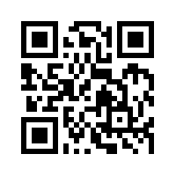
Social Media Apps Programming
Tamkang University
Introduction to Android / iOS Apps Programming
1051SMAP02
TLMXM1A (8648) (M2143) (Fall 2016)
(MIS MBA) (2 Credits, Elective) [Full English Course]
Wed 8,9 (15:10-17:00) B310
Min-Yuh Day, Ph.D.
Assistant Professor
Department of Information Management
Tamkang University
http://mail.tku.edu.tw/myday
2016-09-21

Slide 2
Course Schedule (1/3)
Week Date Subject/Topics
1 2016/09/14 Course Orientation and Introduction to Social Media and Mobile Apps Programming
2 2016/09/21 Introduction to Android / iOS Apps Programming
3 2016/09/28 Developing Android Native Apps with Java (Eclipse) (MIT App Inventor)
4 2016/10/05 Developing iPhone / iPad Native Apps with Swift (XCode)
5 2016/10/12 Mobile Apps using HTML5/CSS3/JavaScript
6 2016/10/19 jQuery Mobile

Slide 3
Course Schedule (2/3)
Week Date Subject/Topics
7 2016/10/26 Create Hybrid Apps with Phonegap
8 2016/11/02 jQuery Mobile/Phonegap
9 2016/11/09 jQuery Mobile/Phonegap
10 2016/11/16 Midterm Exam Week (Midterm Project Report)
11 2016/11/23 Case Study on Social Media Apps Programming and Marketing in Google Play and App Store
12 2016/11/30 Invited Speaker: Prof. Yoshinobu Kano, Associate Professor, Faculty of Informatics, Shizuoka University

Slide 4
Course Schedule (3/3)
Week Date Subject/Topics
13 2016/12/07 Google Cloud Platform
14 2016/12/14 Google App Engine and Google Map API
15 2016/12/21 Facebook API (Facebook JavaScript SDK) (Integrate Facebook with iOS/Android Apps)
16 2016/12/28 Twitter API
17 2017/01/04 Final Project Presentation
18 2017/01/11 Final Exam Week (Final Project Presentation)

Slide 5
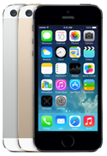
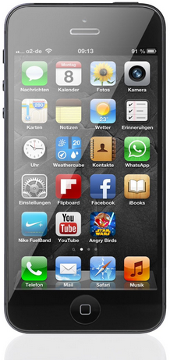
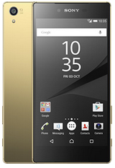
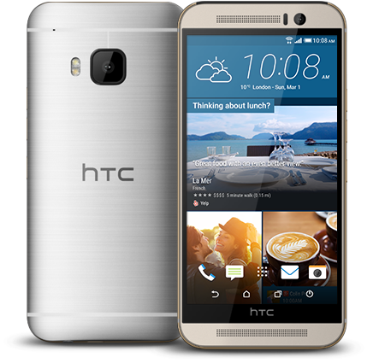
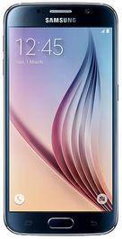
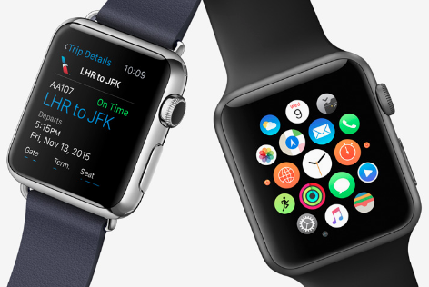
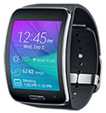
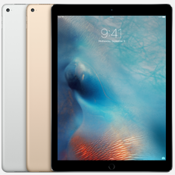
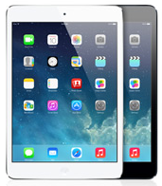
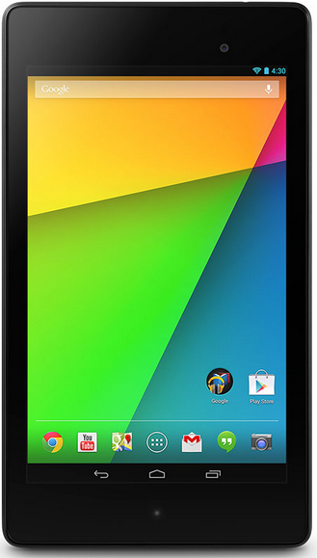
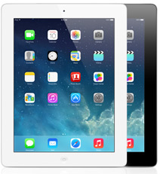
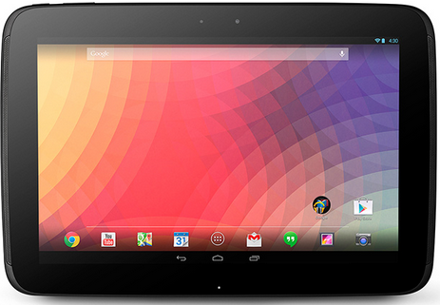
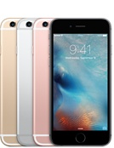
Android /iOS Apps Programming
Native Apps
Hybrid Apps
Mobile Web Apps

Slide 6
Android / iOS Apps Programming
Native Apps
Mobile Apps (Web Apps)
Hybrid Apps

Slide 7
App Development Comparison
Device Access
Speed
Development Cost
App Store
Approval Process
Native Apps
Full
Very Fast
Expensive
Available
Mandatory
Hybrid Apps
Full
Native Speed as Necessary
Reasonable
Available
Low Overhead
Web Apps
Partial
Fast
Reasonable
Not Available
None
Source: http://www.scribd.com/doc/50805466/Native-Web-or-Hybrid-Mobile-App-Development

Slide 8
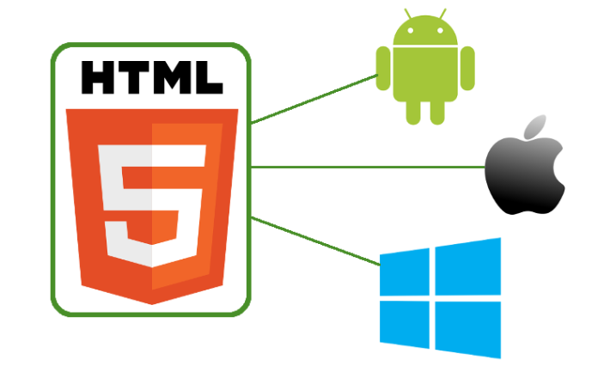
Hybrid Apps Mobile Apps, Native Apps
Source: http://www.androidauthority.com/html-5-vs-native-android-app-607214/

Slide 9
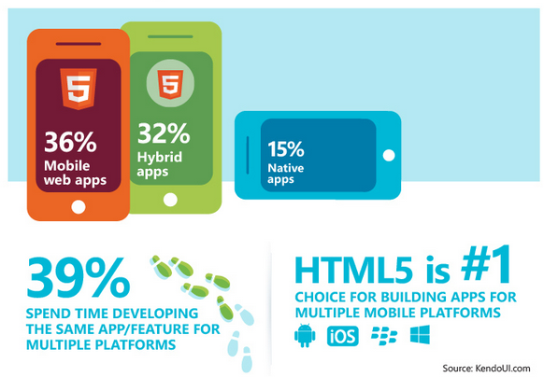
HTML5 vs. Hybrid vs. Native Apps
Source: http://techcrunch.com/2013/02/26/survey-most-developers-now-prefer-html5-for-cross-platform-development/
Notes:
According to a new survey commissioned by Telerik’s Kendo UI, the majority of developers now prefer to work with HTML5 instead of native apps for their cross-platform development. Half of the 5,000 developers surveyed in the company’s 2013 Global Developer Survey also said that they developed apps using HTML5 in 2012 and 90% of them plan to do so in 2013. Only 15% of developers said they would prefer to use a native-only approach.
http://techcrunch.com/2013/02/26/survey-most-developers-now-prefer-html5-for-cross-platform-development/

Slide 10
Native Mobile app Hybrid Mobile App Responsive Web
Source: http://srishta.com/blog_hybrid.html

Slide 11
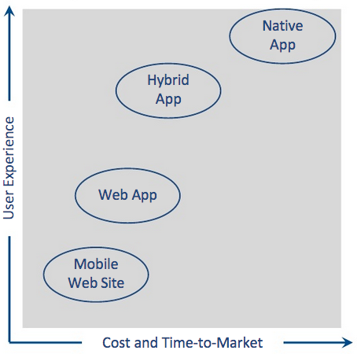
Native Apps vs. Hybrid Apps
Source: http://www.scribd.com/doc/50805466/Native-Web-or-Hybrid-Mobile-App-Development

Slide 12
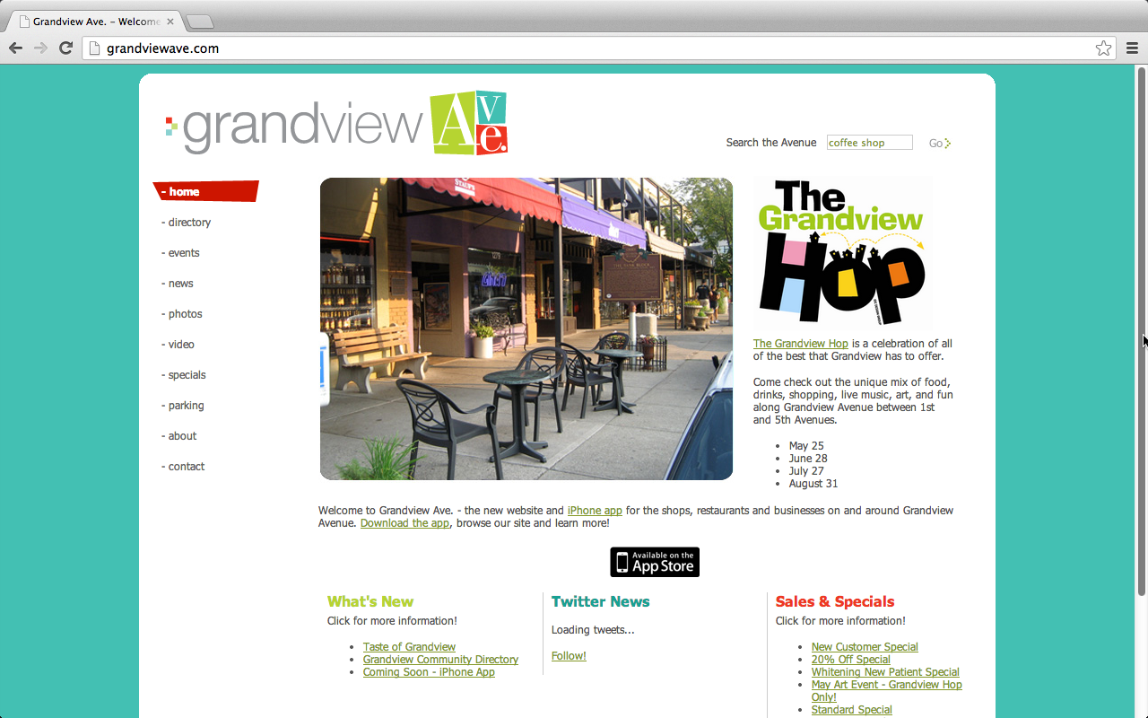
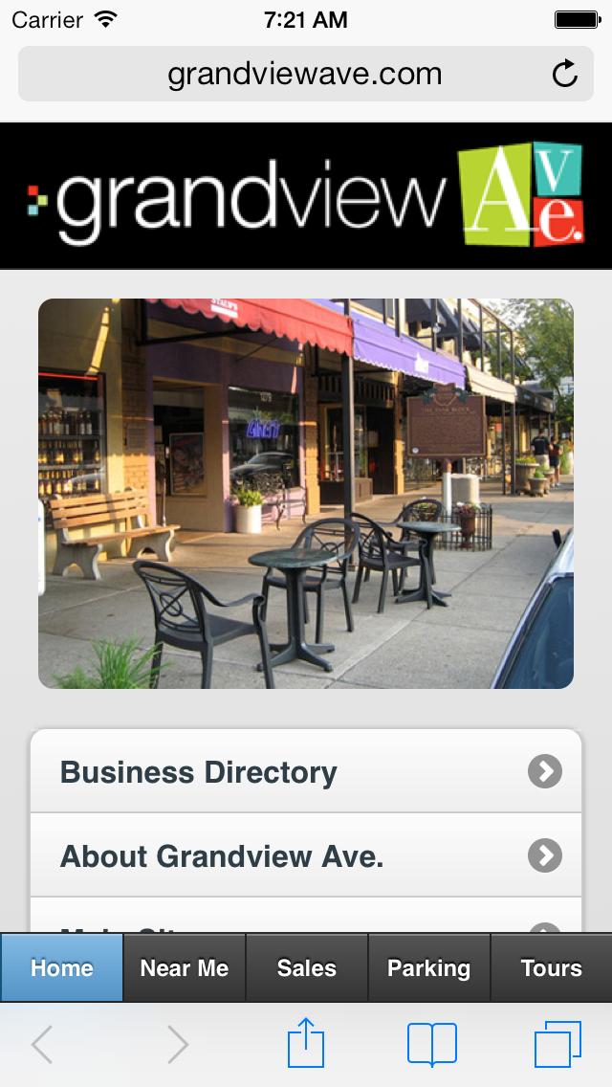
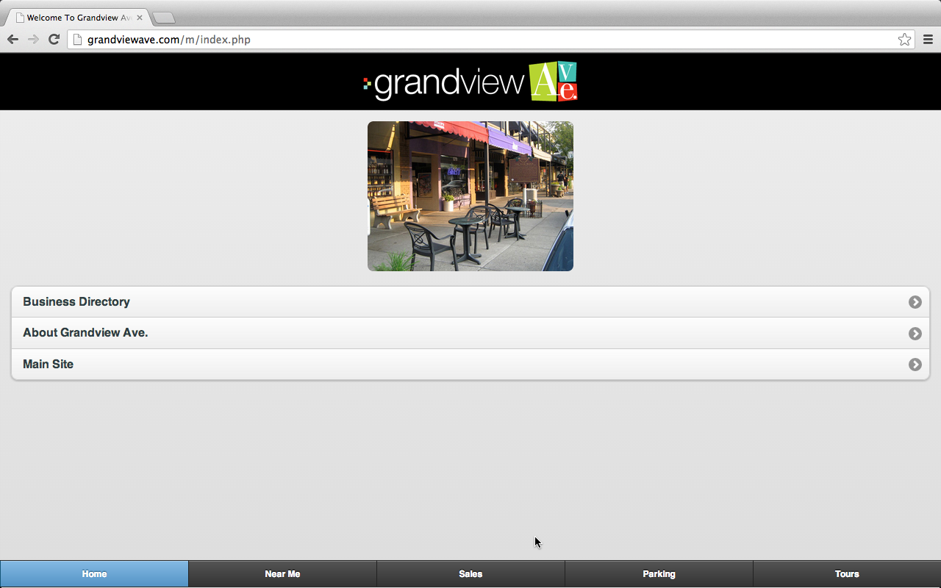
Mobile Apps
Mobile Website
Classic Website
Mobile Apps
Web Apps
Responsive Web Design (RWD)
Source: Scott Preston, Learn HTML5 and JavaScript for iOS: Web Standards-based Apps for iPhone, iPad, and iPod touch, Apress, 2012

Slide 13
Mobile Website Classic Website
http://grandviewave.com/

Slide 14
Mobile Apps (Web Apps)
http://grandviewave.com/

Slide 15
Responsive Web Design (RWD)
http://grandviewave.com/m/

Slide 16
Mobile Web App
HTML
Phone Data
Templates
CSS
JavaScript
External Data
Mobile frameworks and Libraries
Source: Scott Preston, Learn HTML5 and JavaScript for iOS: Web Standards-based Apps for iPhone, iPad, and iPod touch, Apress, 2012

Slide 17
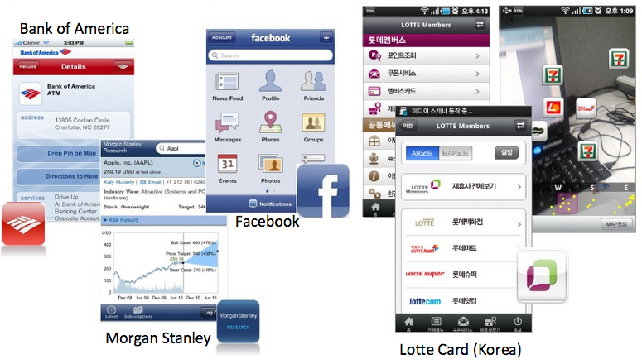
Hybrid App Examples
Source: http://www.scribd.com/doc/50805466/Native-Web-or-Hybrid-Mobile-App-Development

Slide 18
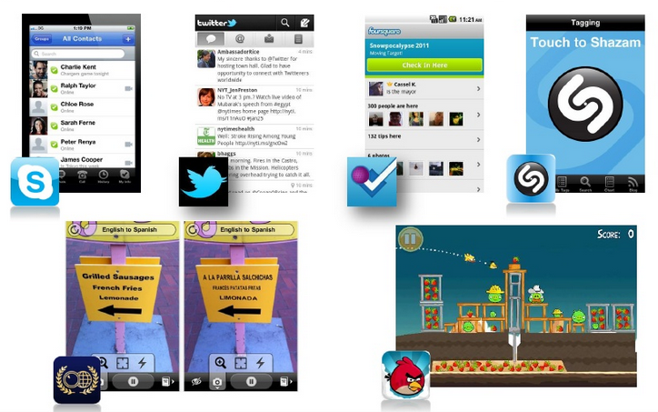
Examples of Purely-Native Mobile Apps
Source: http://www.scribd.com/doc/50805466/Native-Web-or-Hybrid-Mobile-App-Development

Slide 19
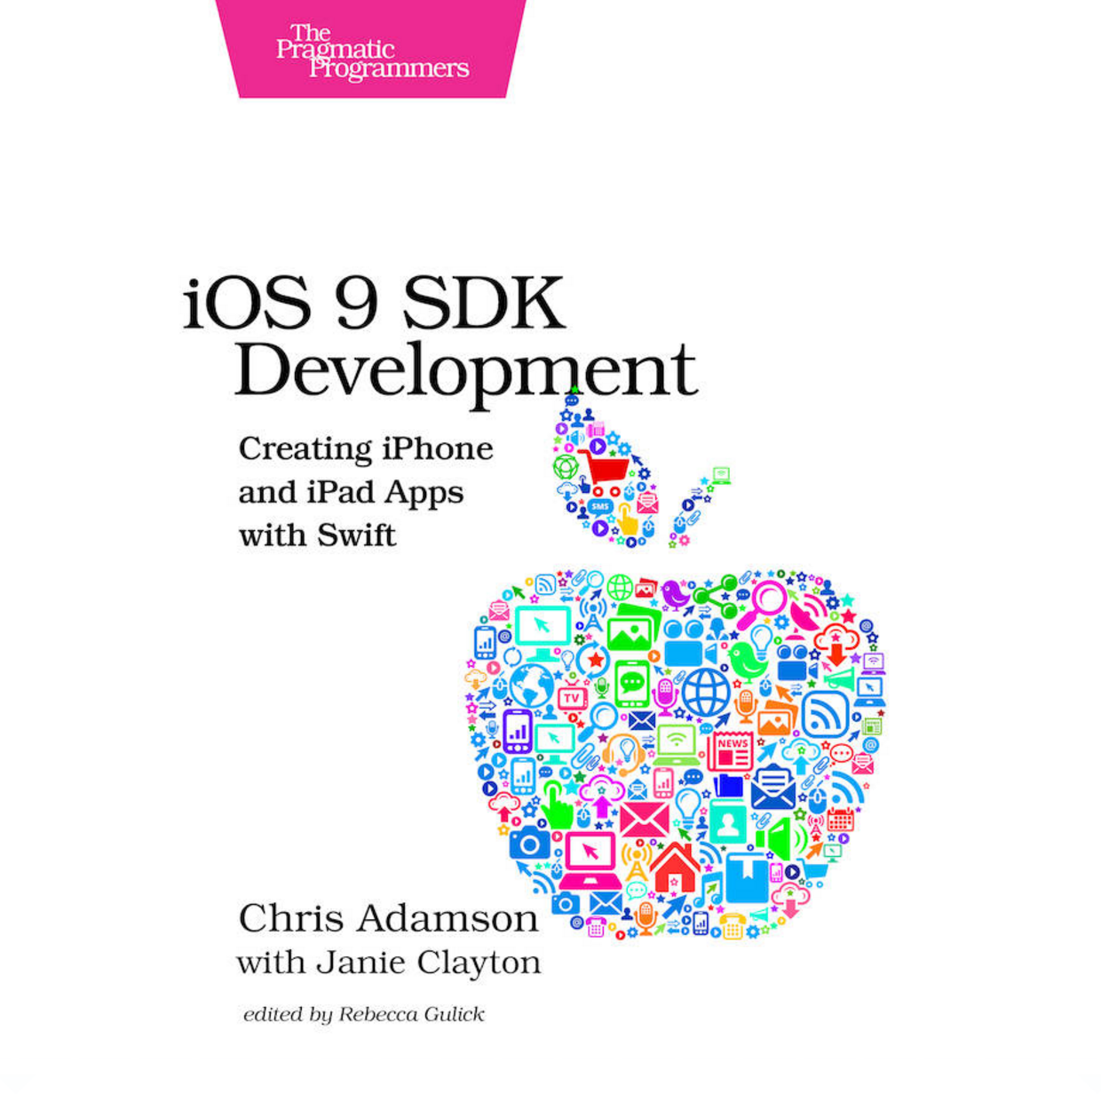
Chris Adamson and Janie Clayton, iOS 9 SDK Development: Creating iPhone and iPad Apps with Swift, Pragmatic Bookshelf, 2016
Source: https://www.amazon.com/iOS-SDK-Development-Creating-iPhone/dp/1680501321

Slide 20
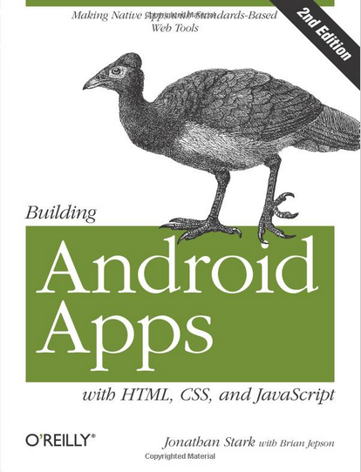
Building Android Apps with HTML, CSS, and JavaScript: Making Native Apps with Standards-Based Web Tools, J onathan Stark & Brian Jepson, O’reilly, 2012
Source: http://www.amazon.com/Building-Android-Apps-HTML-JavaScript/dp/1449316417

Slide 21
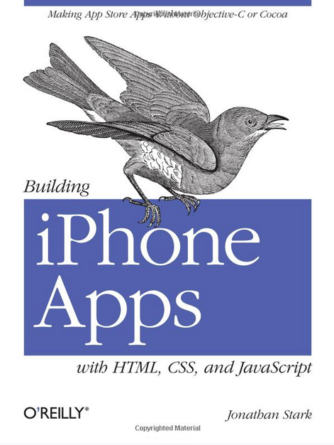
Building iPhone Apps with HTML, CSS, and JavaScript: Making App Store Apps Without Objective-C or Cocoa, Jonathan Stark, O’reilly, 2010
Source: http://www.amazon.com/Building-iPhone-Apps-HTML-JavaScript/dp/0596805780

Slide 22
Jon Reid, jQuery Mobile, O’reilly, 2012
Source: http://www.amazon.com/jQuery-Mobile-Running-Maximiliano-Firtman/dp/1449397654

Slide 23
Rohit Ghatol and Yogesh Patel, Beginning PhoneGap: Mobile Web Framework for JavaScript and HTML5, Apress, 2012
Source: http://www.amazon.com/Beginning-PhoneGap-Mobile-Framework-JavaScript/dp/1430239034

Slide 24
Responsive Design HTML5/CSS3/JavaScript
Source: http://www.ihealthspot.com/ResponsiveWebsiteDesign.aspx

Slide 25
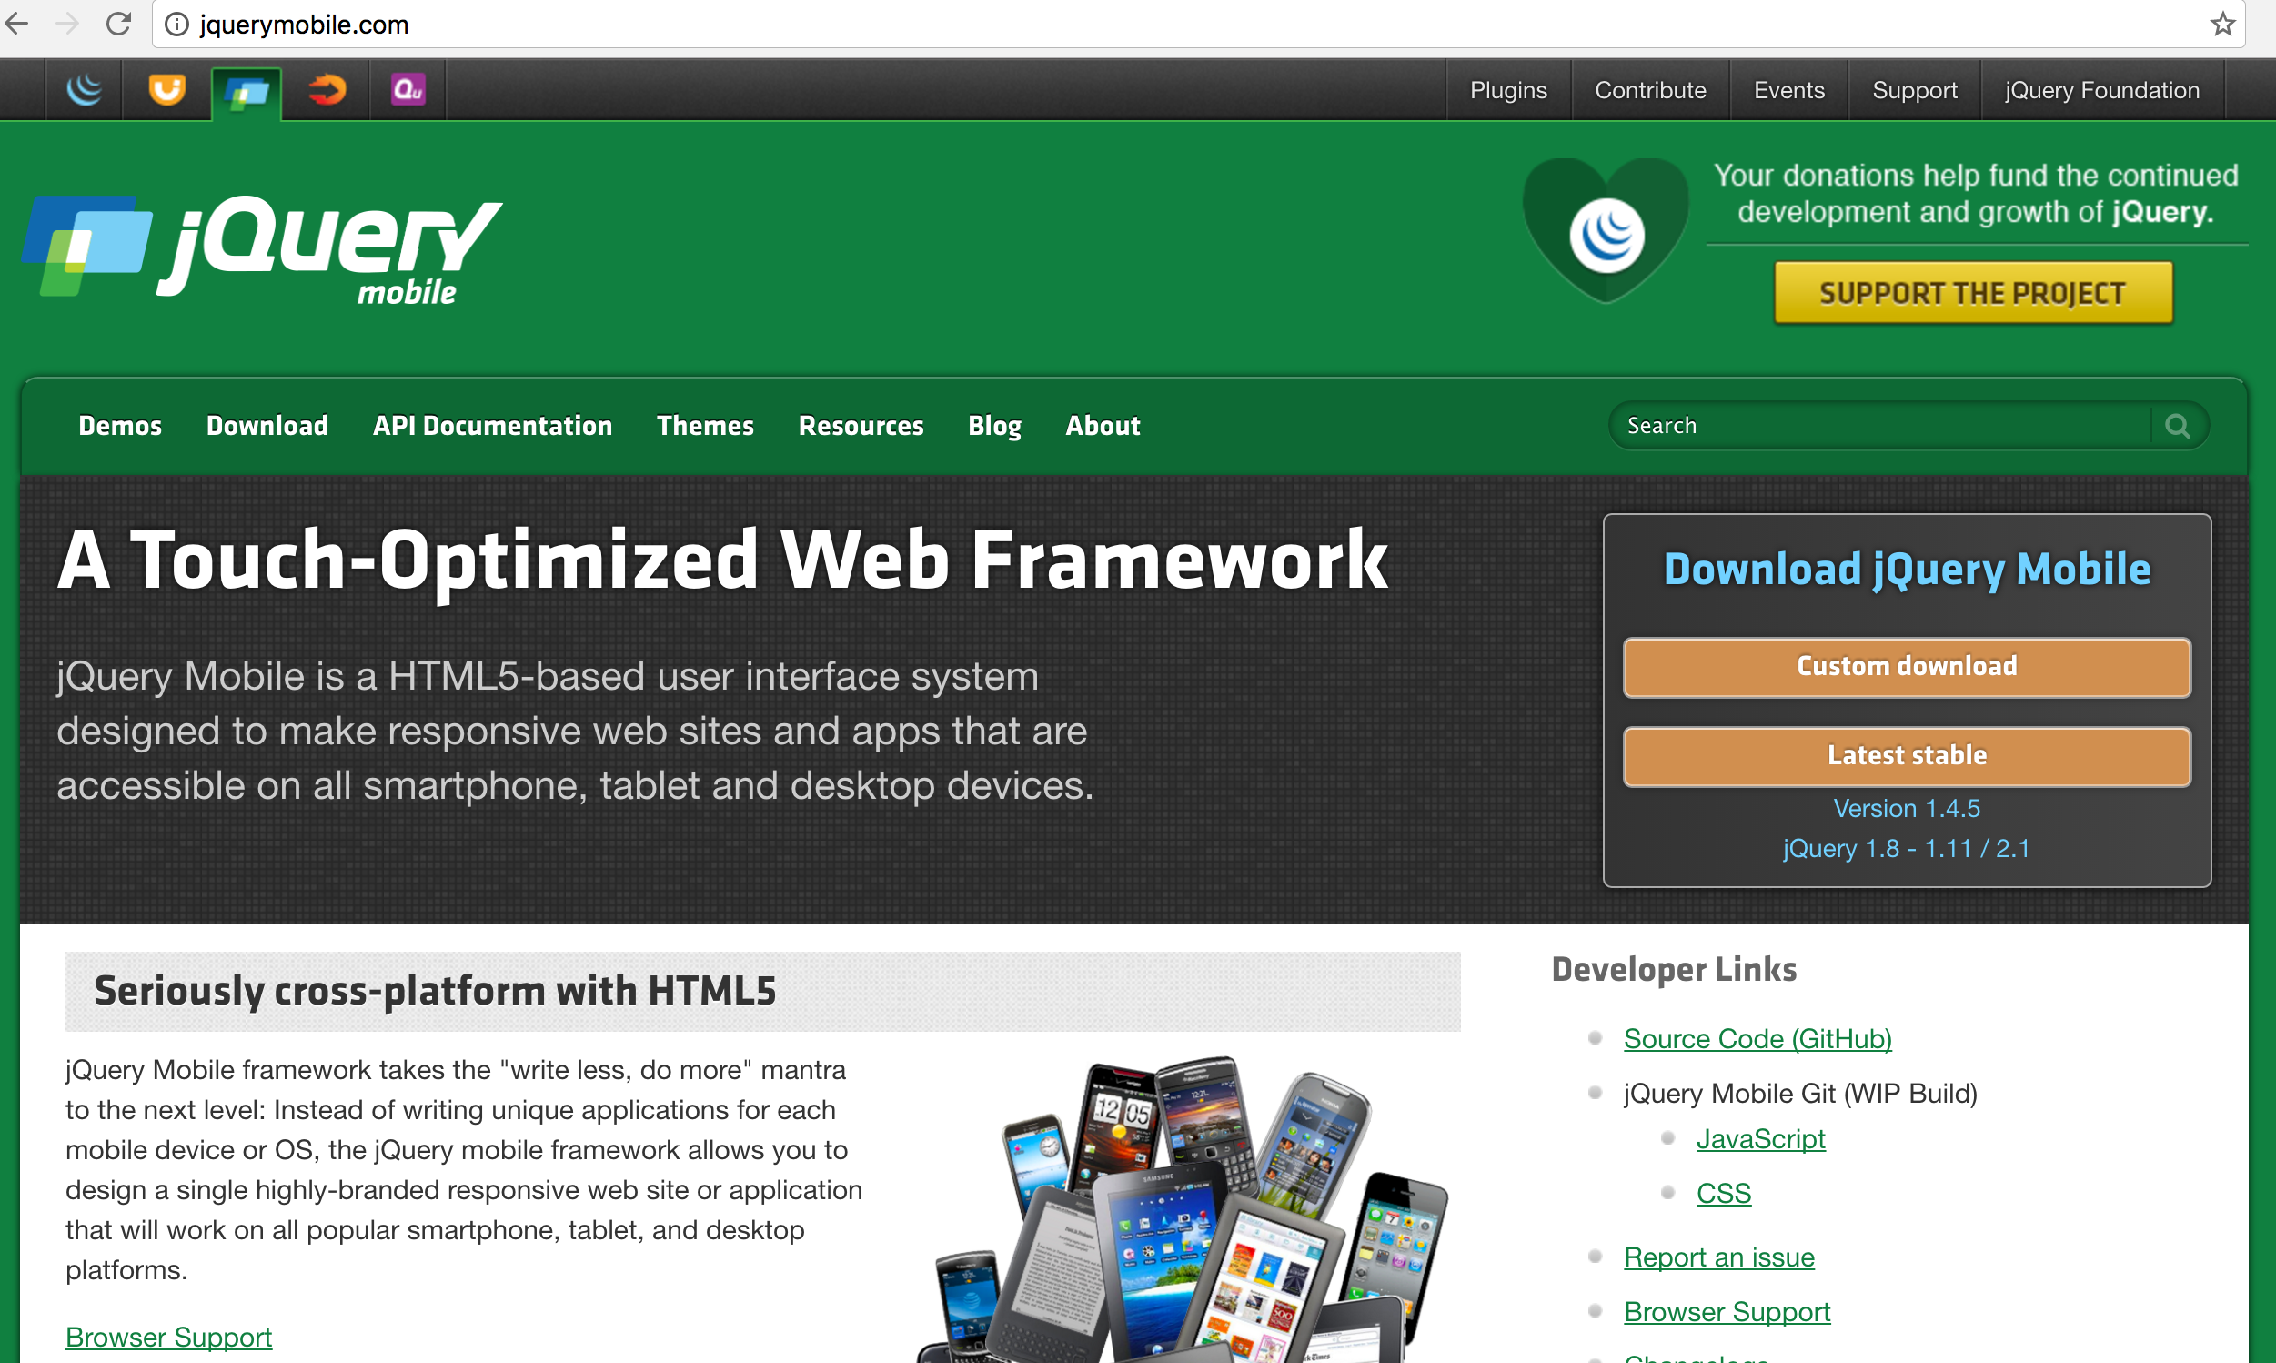
jQuery Mobile http://jquerymobile.com/

Slide 26
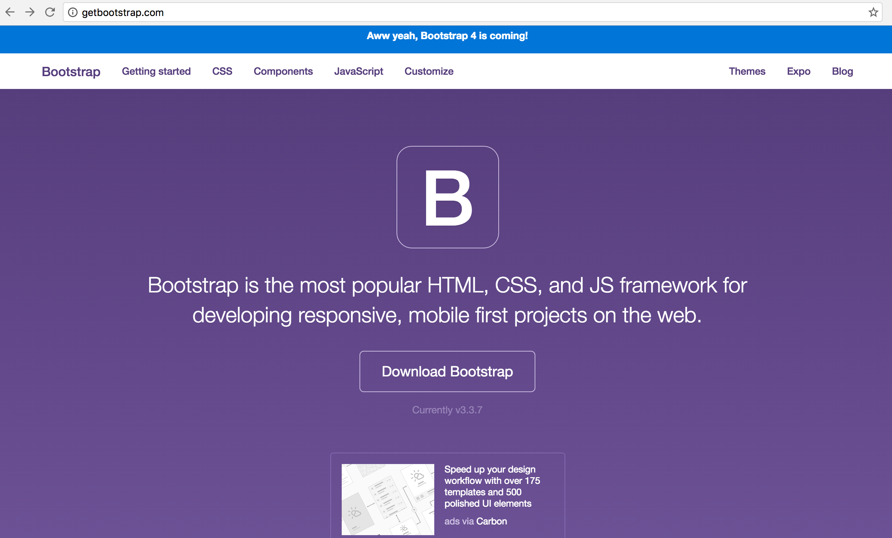
Bootstrap http://getbootstrap.com/

Slide 27
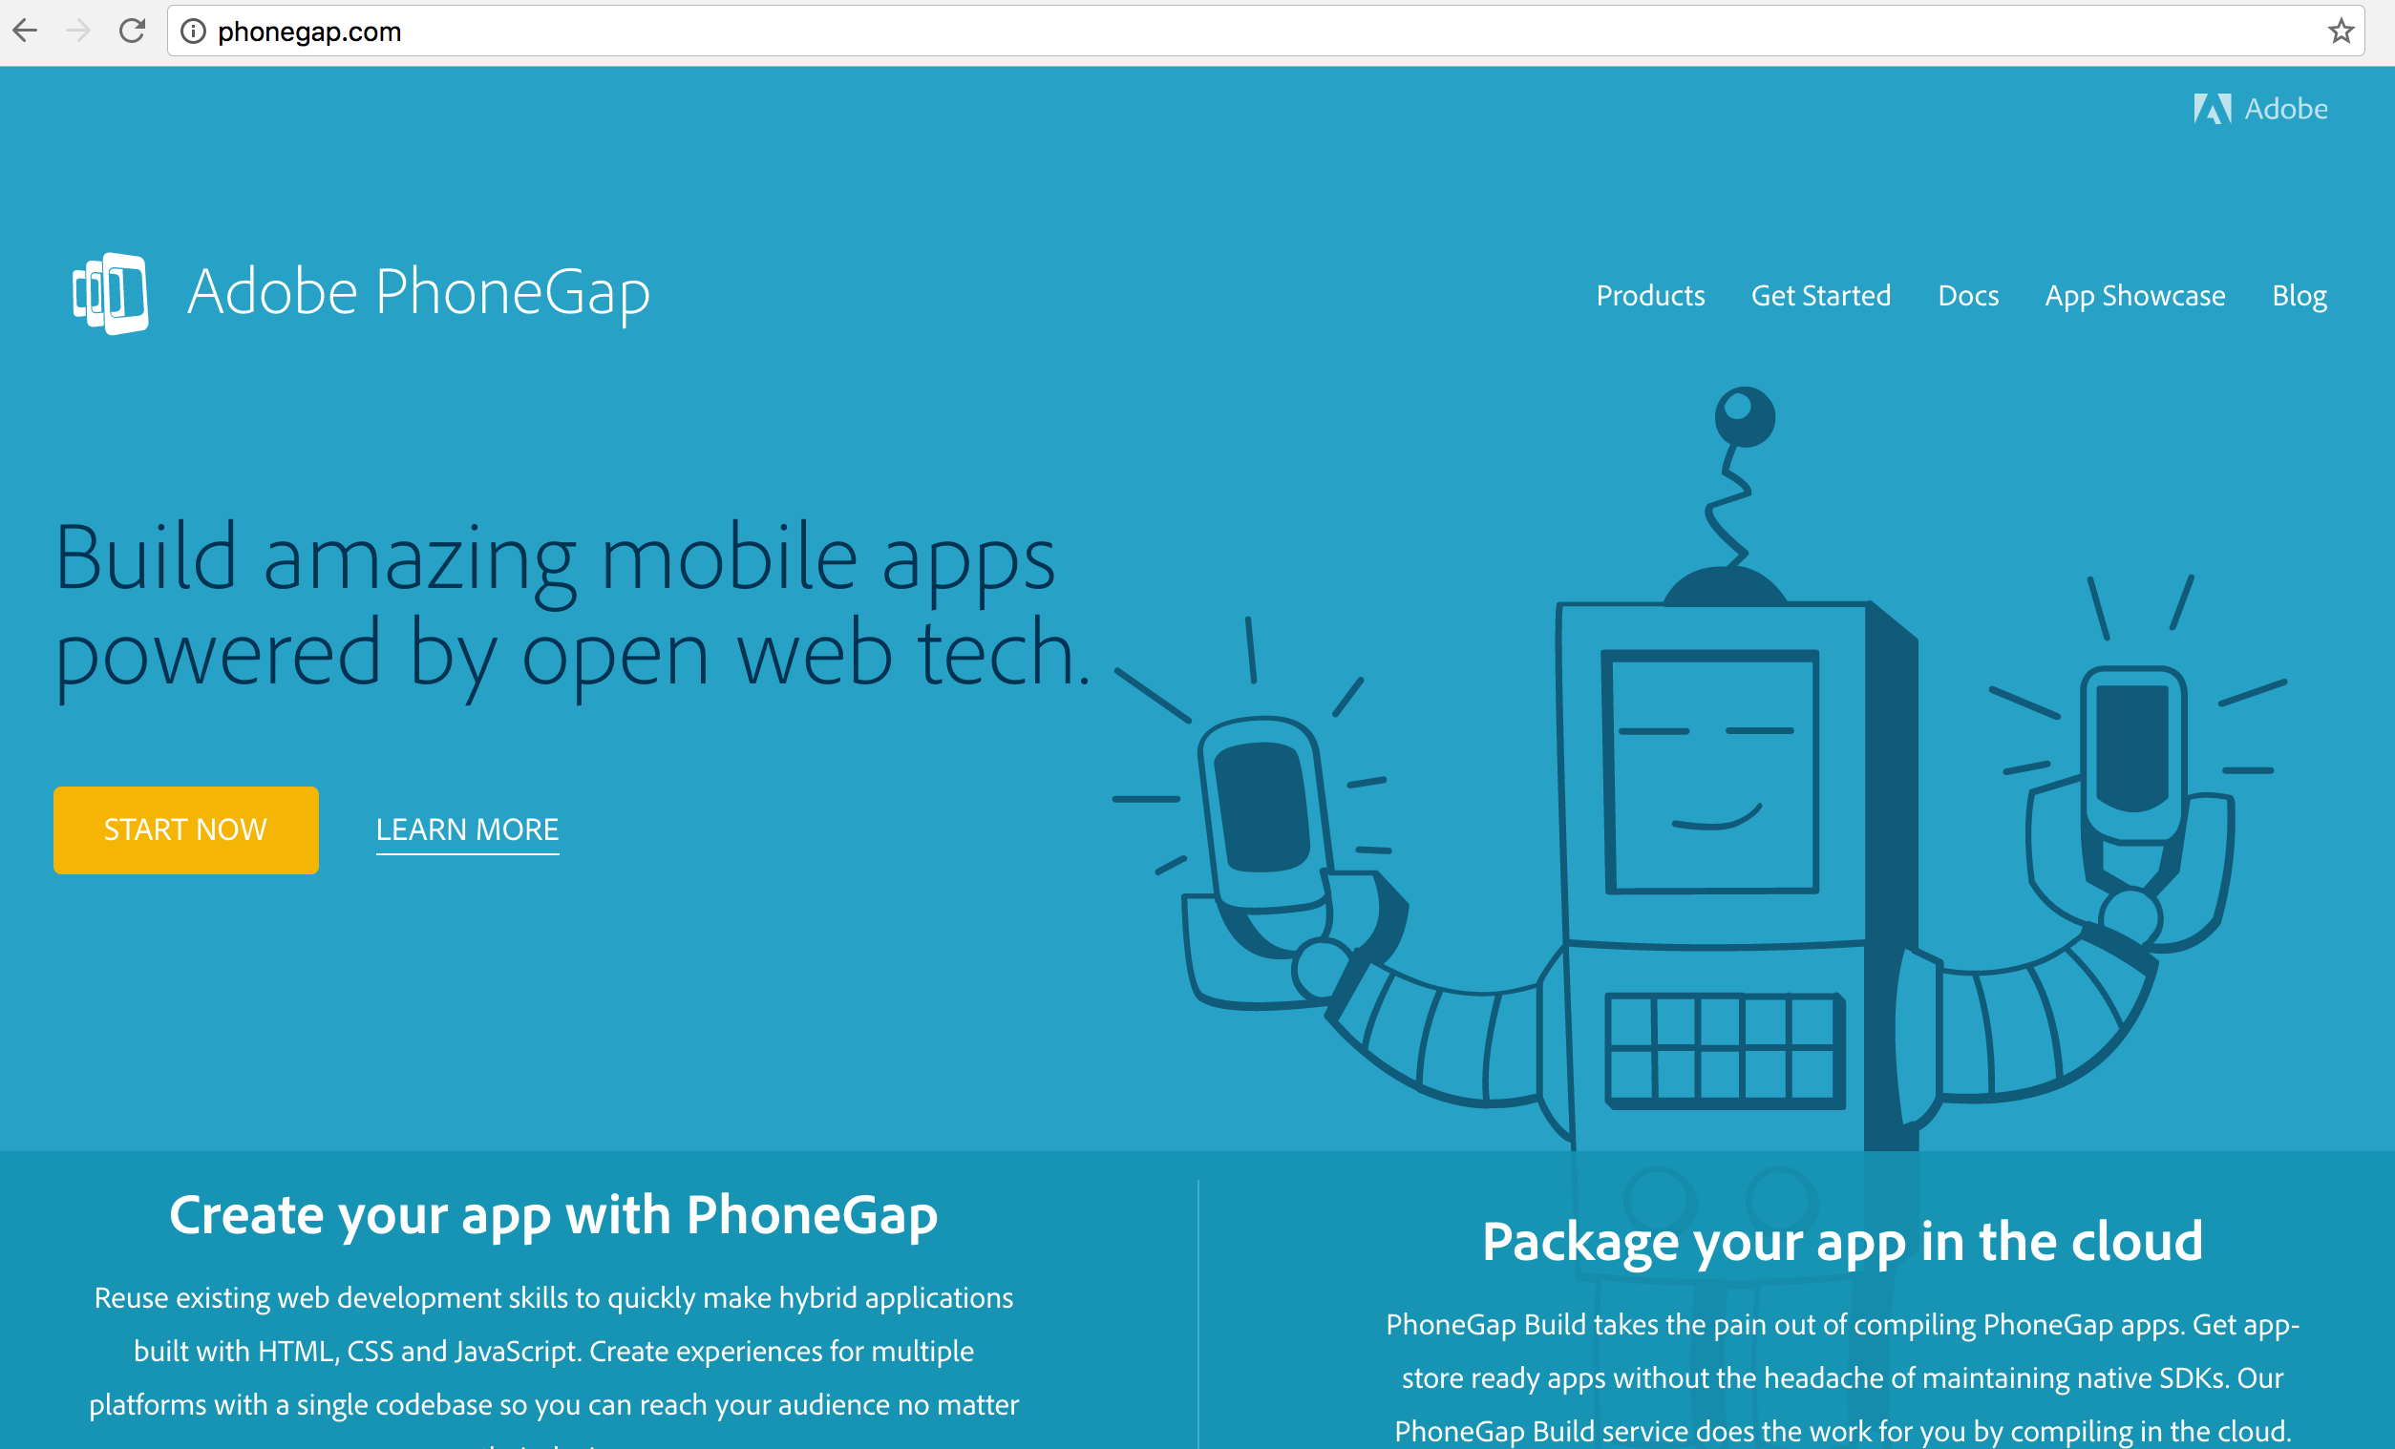
PhoneGap http://phonegap.com/

Slide 28
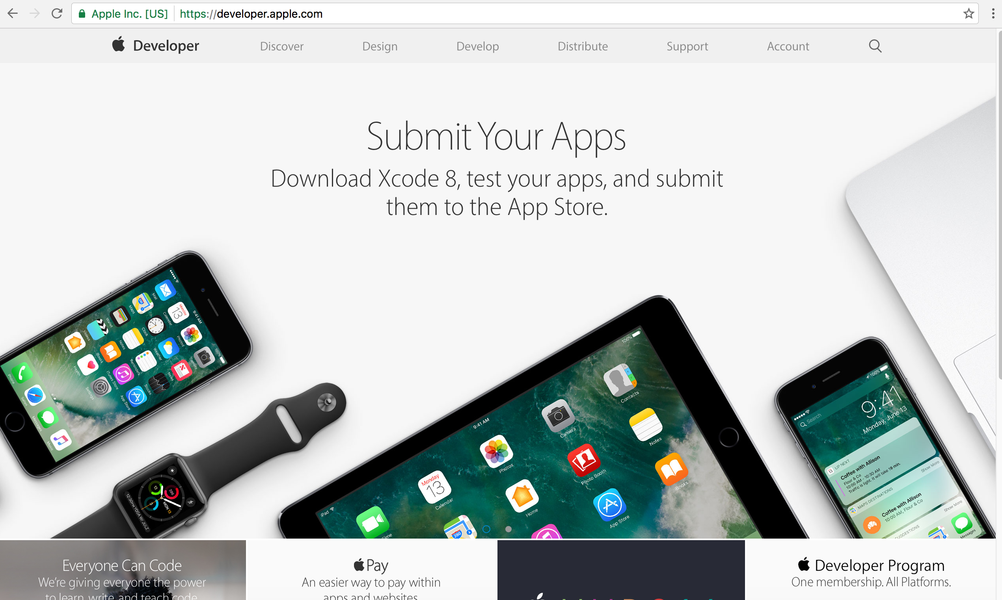
Apple Developer https://developer.apple.com/

Slide 29
Apple Swift for iOS
Source: https://developer.apple.com/swift/

Slide 30
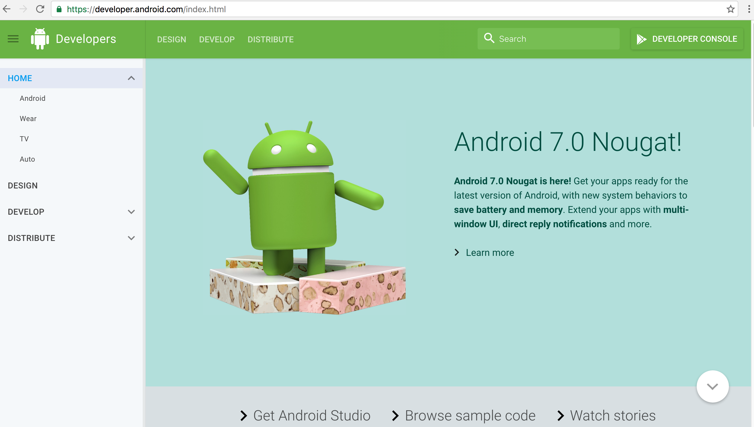
Android Developer http://developer.android.com/

Slide 31
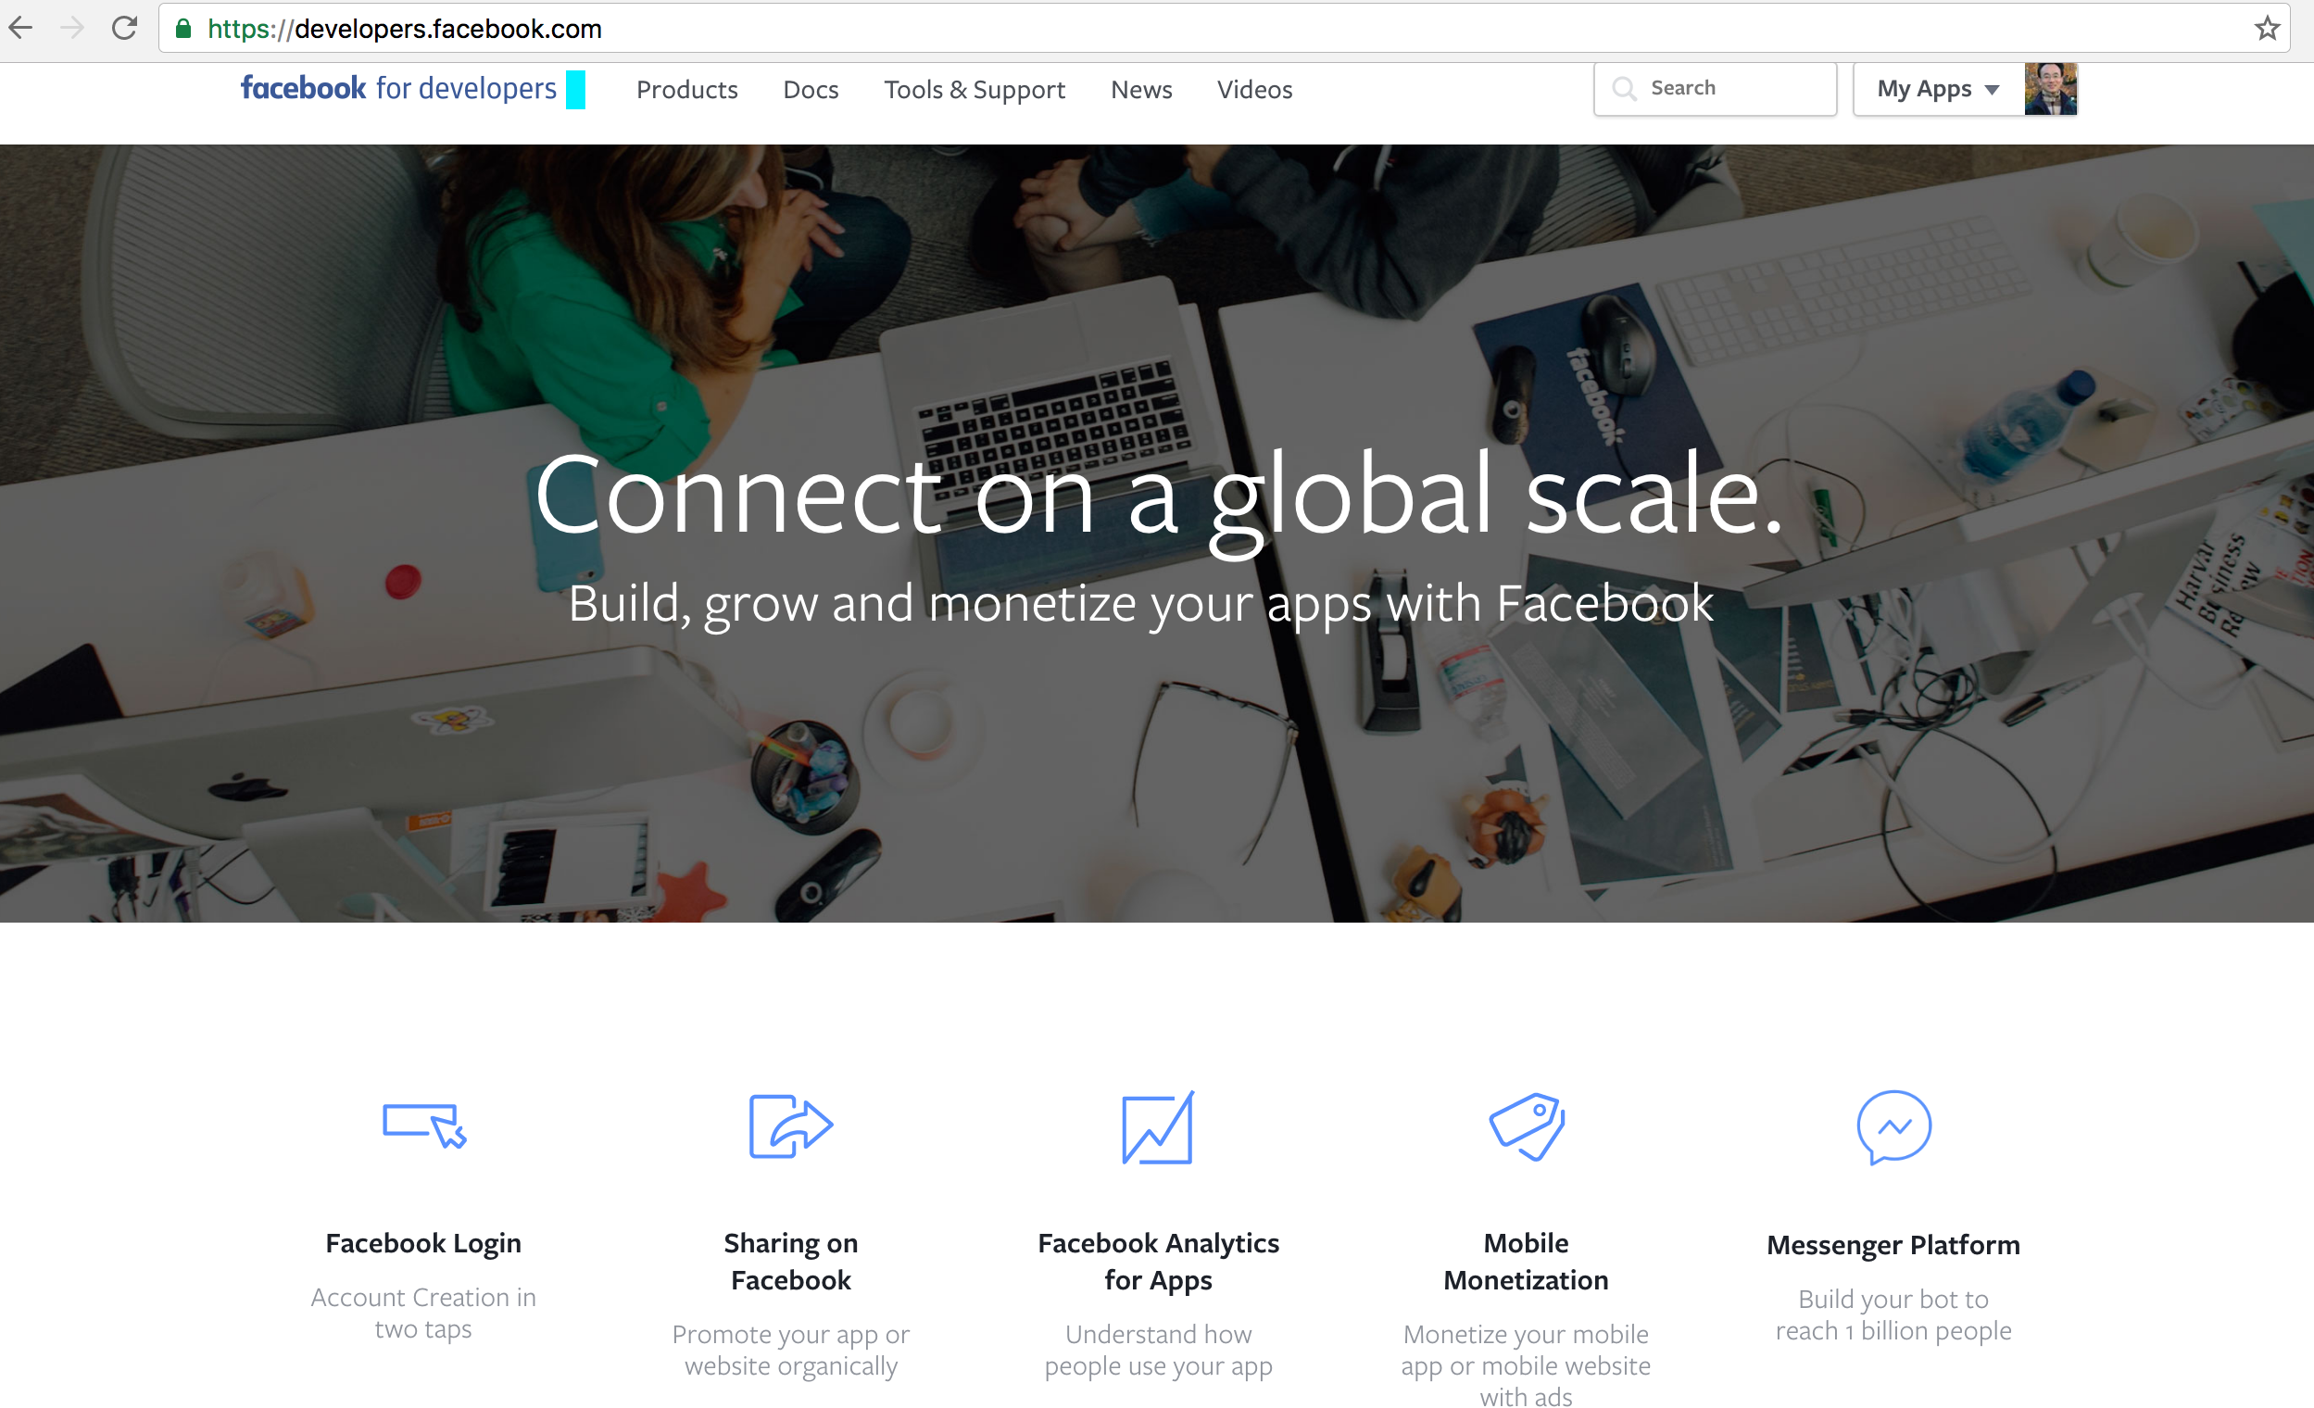
Facebook Developers
https://developers.facebook.com/

Slide 32
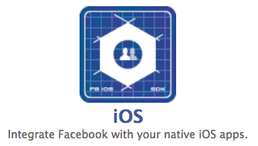
Integrate Facebook with your native iOS apps
https://developers.facebook.com/

Slide 33
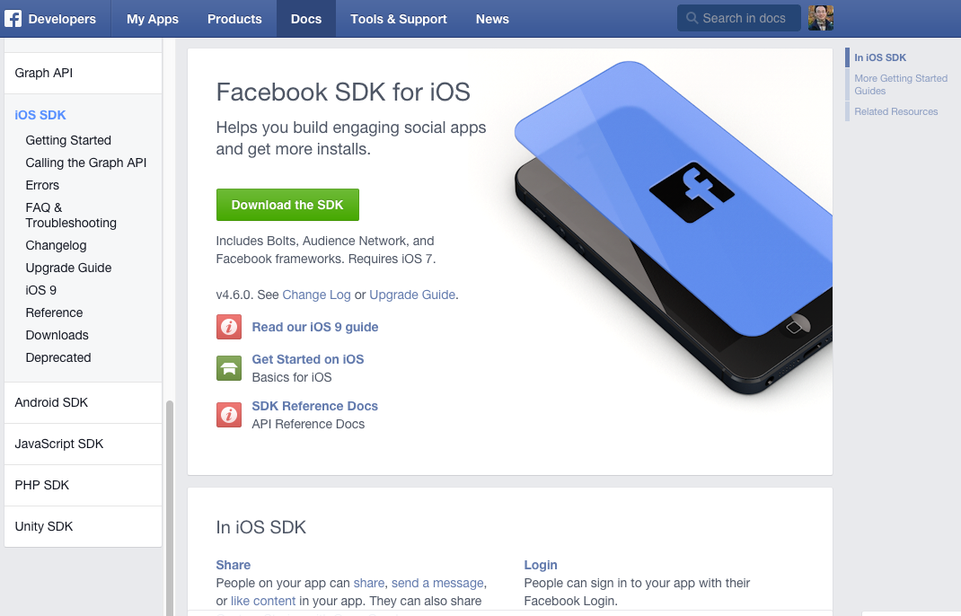
Facebook SDK for iOS
https://developers.facebook.com/docs/ios/

Slide 34
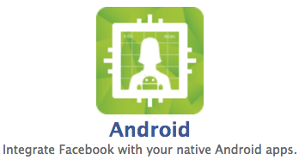
Integrate Facebook with your native Android apps.
https://developers.facebook.com/

Slide 35
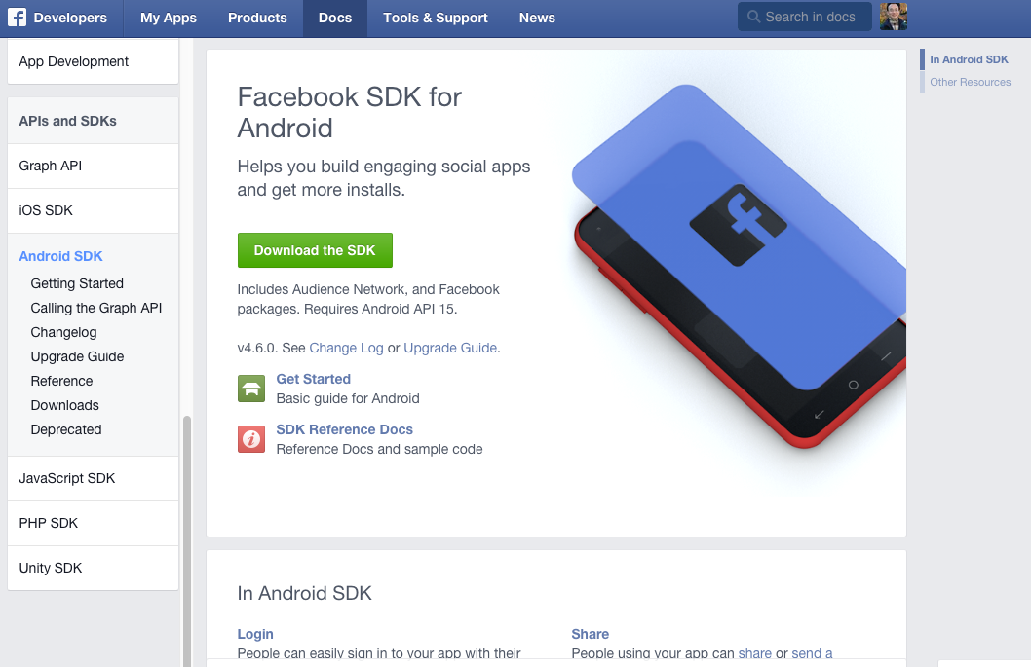
Facebook SDK for Android
Source: https://developers.facebook.com/docs/android

Slide 36
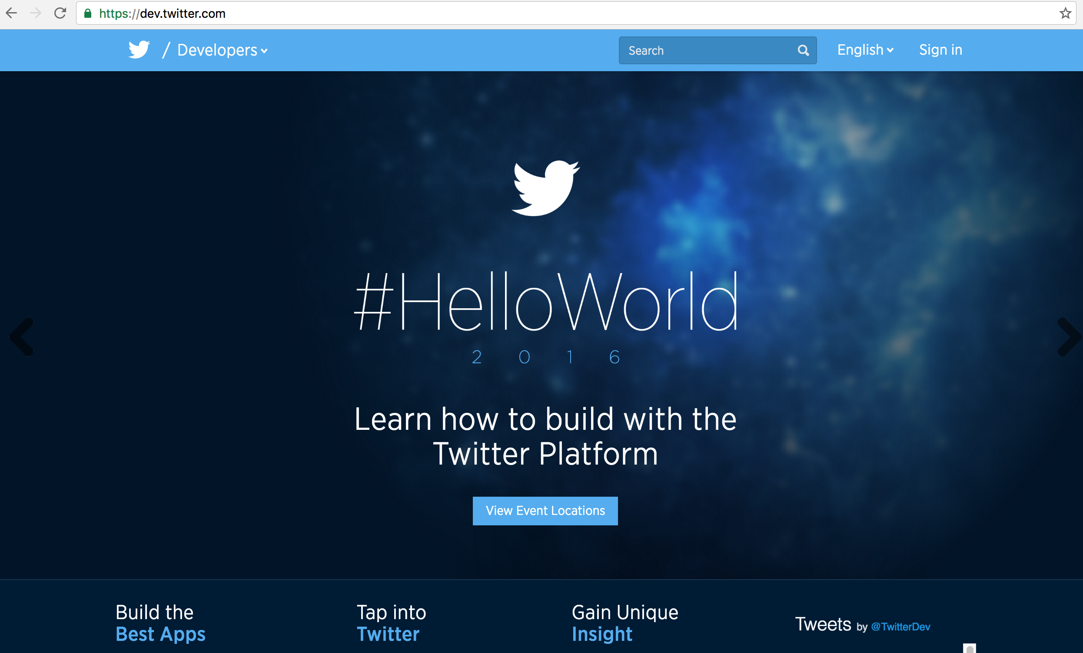
Twitter Developers https://dev.twitter.com/

Slide 37
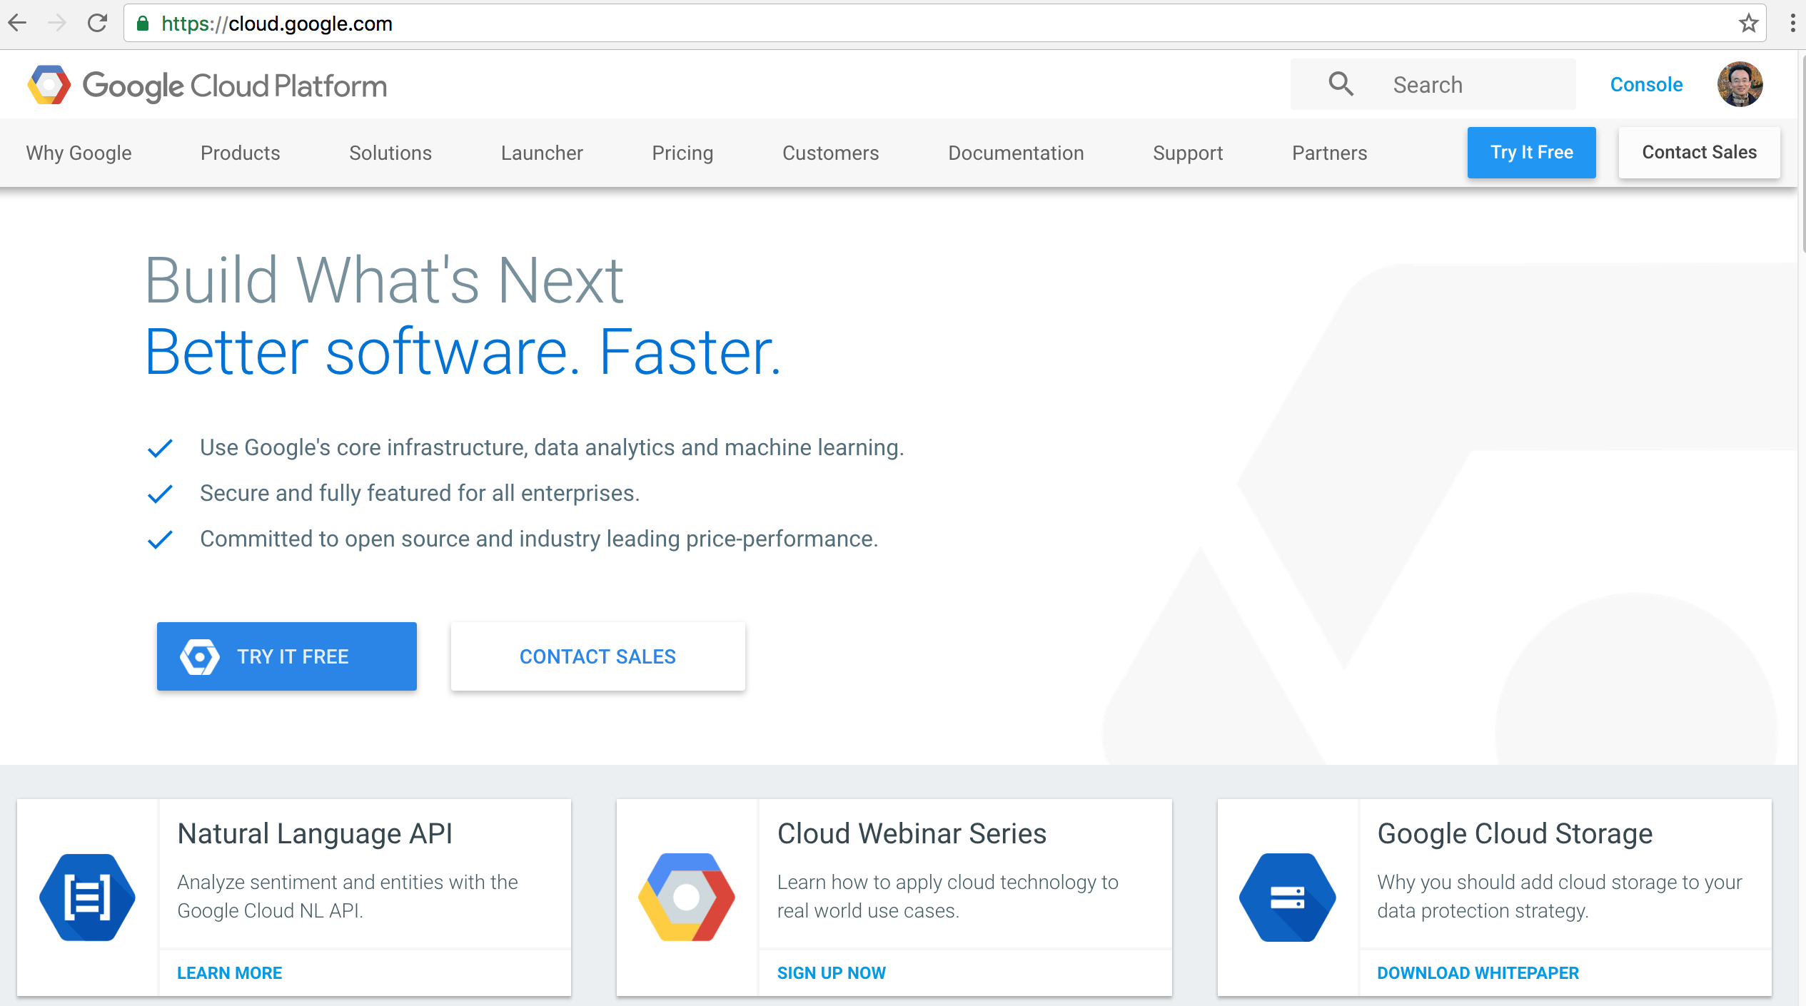
Google Cloud Platform
https://cloud.google.com/

Slide 38
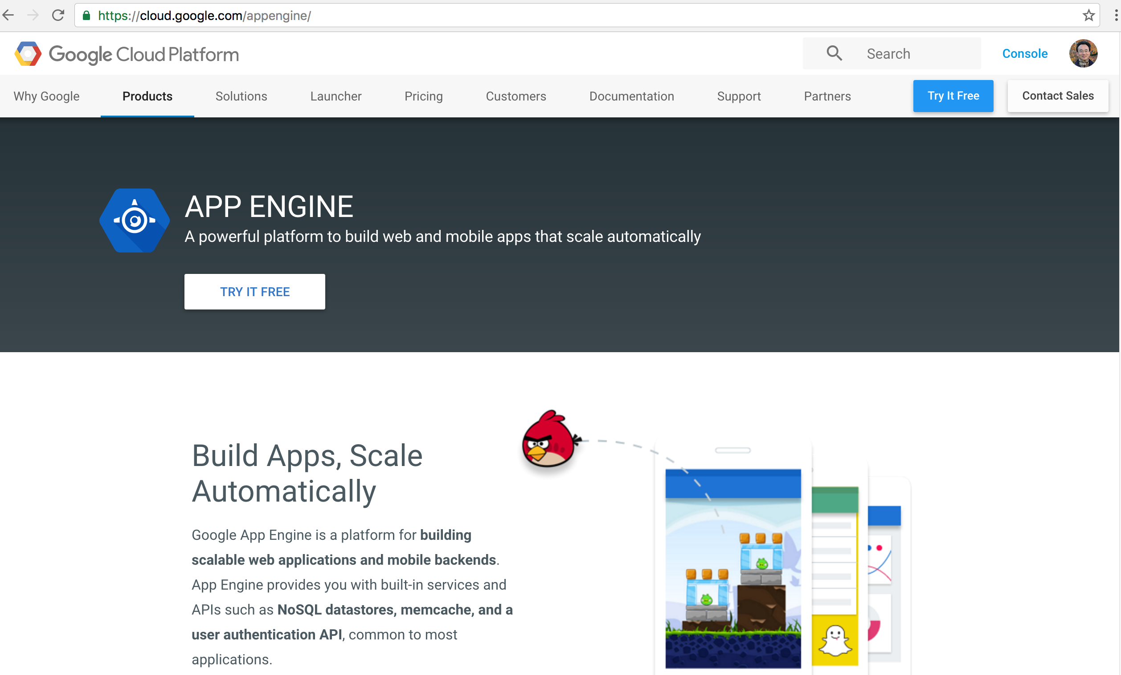
Google App Engine
https://cloud.google.com/appengine/

Slide 39
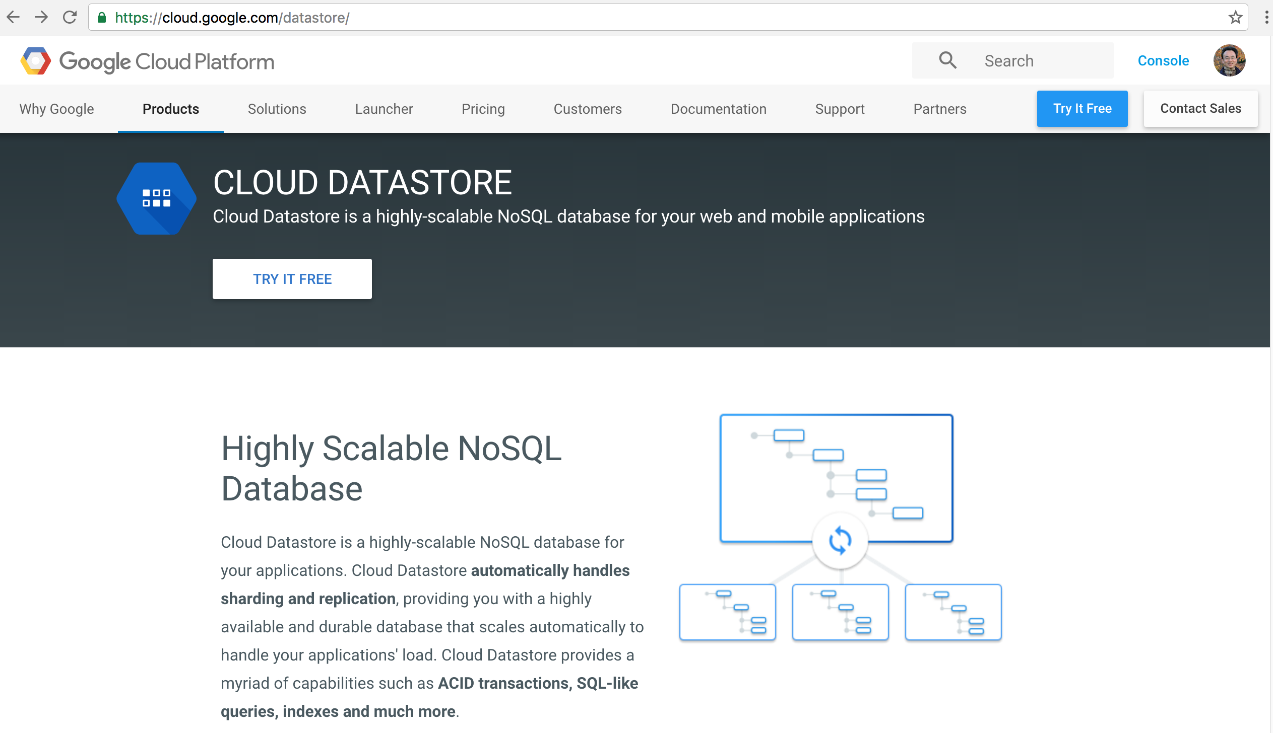
Google Cloud Datastore
https://cloud.google.com/datastore/

Slide 40
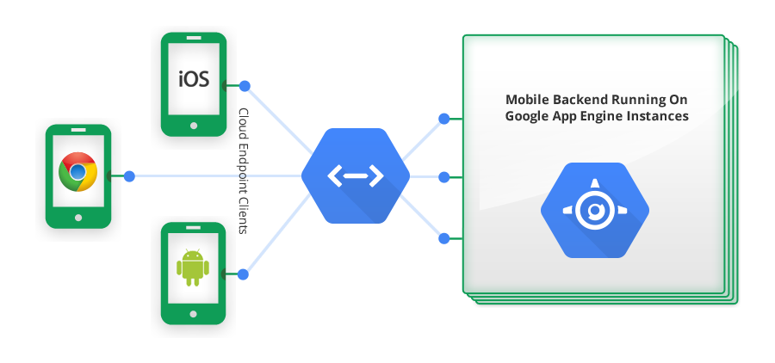
Google Cloud Endpoints
https://developers.google.com/appengine/docs/java/endpoints/

Slide 41
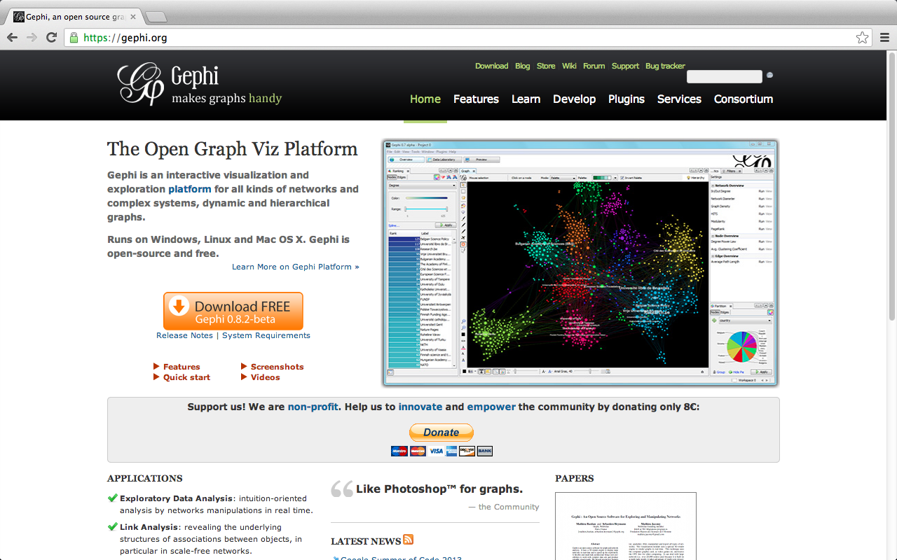
Gephi: Social Network Analysis and Visualization: https://gephi.org/

Slide 42
Characteristics of a Purely-Native Mobile App
A binary “executable image”, that is explicitly downloaded and stored on the file system of the mobile device
Distributed through the popular app store or marketplace of the device, or via an enterprise distribution mechanism
Executed directly by the operating system
Launched from the home screen
Does not require another “container app” to run it
Makes explicit use of operating-system APIs
Source: http://www.scribd.com/doc/50805466/Native-Web-or-Hybrid-Mobile-App-Development

Slide 43
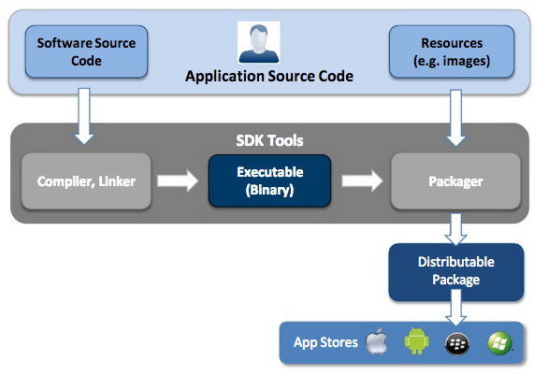
Native App Development
Source: http://www.scribd.com/doc/50805466/Native-Web-or-Hybrid-Mobile-App-Development

Slide 44
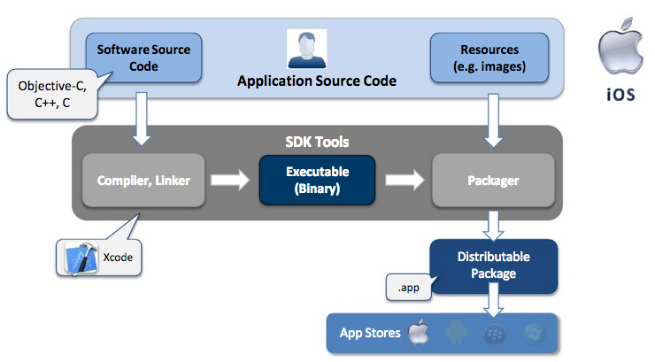
iOS - Native App Development
Swift
.ipa
Source: http://www.scribd.com/doc/50805466/Native-Web-or-Hybrid-Mobile-App-Development

Slide 45
Swift Language
Swift is a new object-oriented programming language for iOS and OS X development.
Swift is modern, powerful, expressive, and easy to use.
Source: https://developer.apple.com/swift/
Notes:
Swift Language
Swift is a new object-oriented programming language for iOS and OS X development. Swift is modern, powerful, expressive, and easy to use.
https://developer.apple.com/swift/

Slide 46
Swift Language
Unified A complete replacement for both the C and Objective-C languages.
Swift provides full object-oriented features, and includes low-level language primitives such as types, flow control, and operators.
Fast
Complete platform
Safe by design
Modern
Interactive
Source: https://developer.apple.com/swift/
Notes:
Swift Language
Swift is a new object-oriented programming language for iOS and OS X development. Swift is modern, powerful, expressive, and easy to use.
Fast. Compiles and optimizes with the advanced code analysis in LLVM to create high-performance apps.
Complete platform. Access all of the Cocoa and Cocoa Touch frameworks with Swift.
Safe by design. Eliminate huge categories of bugs, crashes, and security holes. Swift pairs increased type safety with type inference, restricts direct access to pointers, and automatically manages memory using ARC, making it easy for you to use Swift and create secure, stable software. Other language safety related features include mandatory variables initialization, automatic bounds checking to prevent overflows, conditionals break by default, and elimination of pointers to direct memory by default.
Modern. Write, debug, and maintain less code, with an easy to write and read syntax, and no headers to maintain. Swift includes optionals, generics, closures, tuples, and other modern language features. Inspired by and improving upon Objective-C, Swift code feels natural to read and write.
Interactive. Use Swift interactively to experiment with your ideas and see instant results.
Unified. A complete replacement for both the C and Objective-C languages. Swift provides full object-oriented features, and includes low-level language primitives such as types, flow control, and operators.
https://developer.apple.com/swift/
https://developer.apple.com/library/prerelease/mac/documentation/Swift/Conceptual/Swift_Programming_Language/index.html

Slide 47
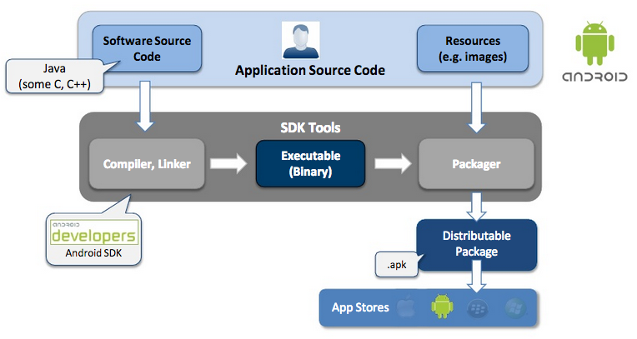
Android - Native App Development
Source: http://www.scribd.com/doc/50805466/Native-Web-or-Hybrid-Mobile-App-Development

Slide 48
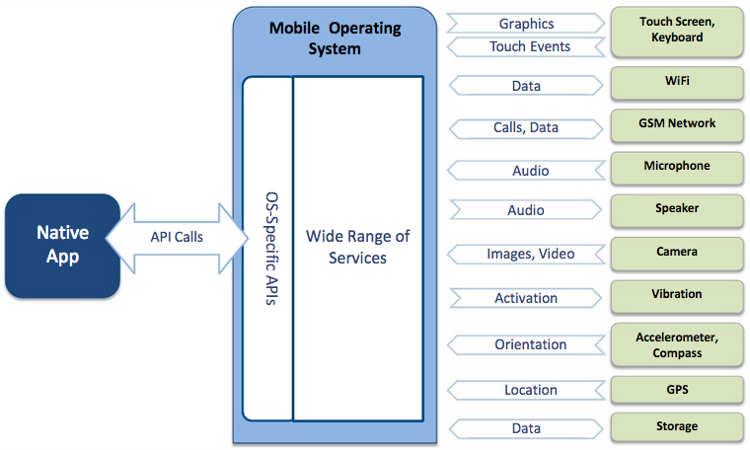
Native App – Interaction with Mobile Device
Source: http://www.scribd.com/doc/50805466/Native-Web-or-Hybrid-Mobile-App-Development

Slide 49
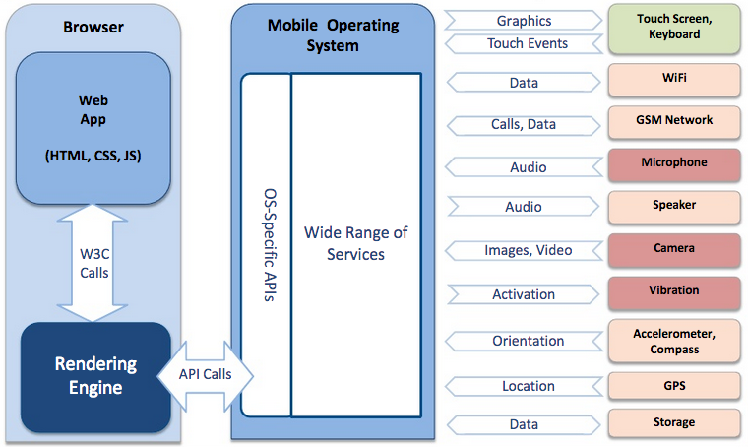
Web App – Interaction with Mobile Device
Source: http://www.scribd.com/doc/50805466/Native-Web-or-Hybrid-Mobile-App-Development

Slide 50
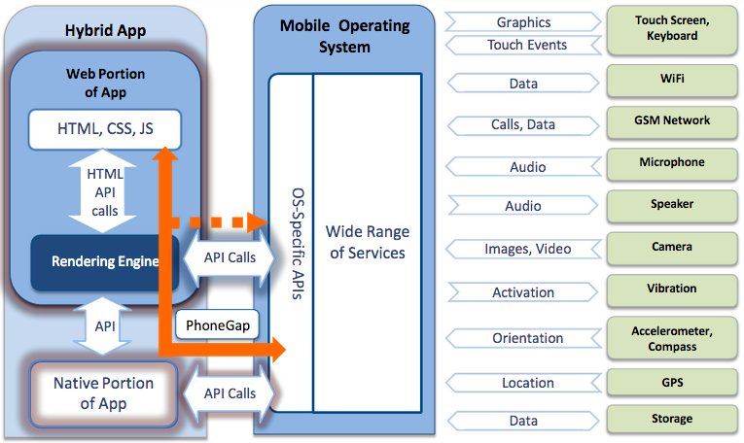
Hybrid App – Interaction with Mobile Device
Source: http://www.scribd.com/doc/50805466/Native-Web-or-Hybrid-Mobile-App-Development

Slide 51
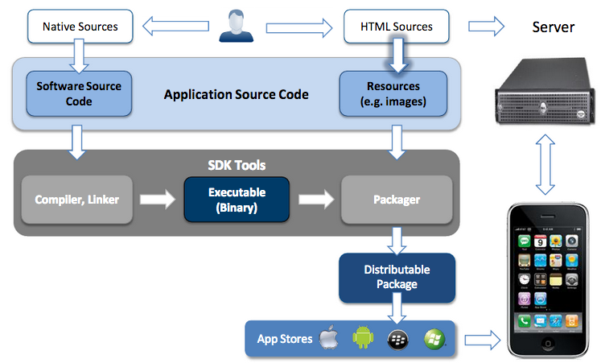
Hybrid App Development
Source: http://www.scribd.com/doc/50805466/Native-Web-or-Hybrid-Mobile-App-Development

Slide 52
Hybrid App Examples
Source: http://www.scribd.com/doc/50805466/Native-Web-or-Hybrid-Mobile-App-Development

Slide 53
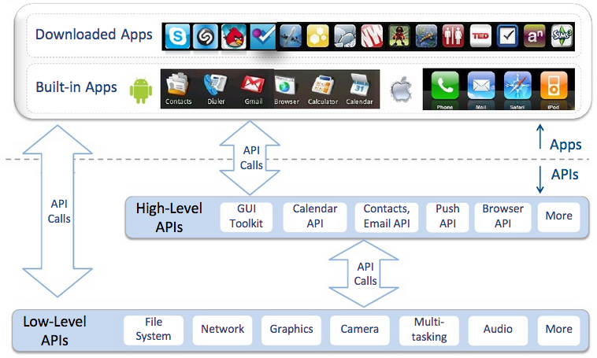
Native App – High-level APIs and Built-in Apps
Source: http://www.scribd.com/doc/50805466/Native-Web-or-Hybrid-Mobile-App-Development

Slide 54
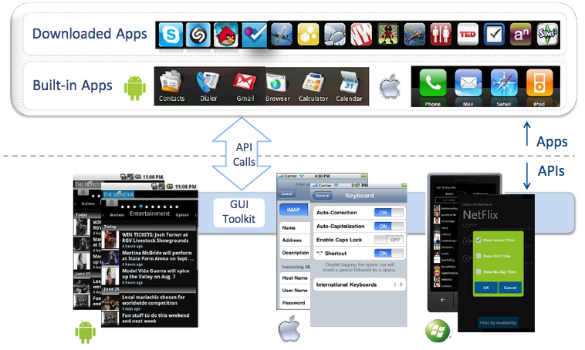
GUI Toolkit Provides App With “Native” Look
Source: http://www.scribd.com/doc/50805466/Native-Web-or-Hybrid-Mobile-App-Development

Slide 55
Mobile Web Apps and Mobile Browsing
Source: http://www.scribd.com/doc/50805466/Native-Web-or-Hybrid-Mobile-App-Development

Slide 56
Mobile Browsing and Mobile Web Apps
Source: http://www.scribd.com/doc/50805466/Native-Web-or-Hybrid-Mobile-App-Development

Slide 57
Mobile Browsing vs. Mobile Web Apps
Source: http://www.scribd.com/doc/50805466/Native-Web-or-Hybrid-Mobile-App-Development

Slide 58
Characteristics of Mobile Web Apps
Entirely written using web technologies
HTML, CSS and JavaScript
Code is executed by the browser, not by the OS
Various launch mechanisms
Typing URL, clicking hyperlink, scanning QR Code or clicking home-screen shortcut
Installation is optional
Combine cross-platform HTML5 and device-specific features optimize apps
Touch-optimized look & feel
No address bar
Suggestion to pin to home screen
Offline availability
Source: http://www.scribd.com/doc/50805466/Native-Web-or-Hybrid-Mobile-App-Development

Slide 59
HTML5 and related technologies
Main HTML5/CSS3 features on mobile
Bitmapped and vector graphics, including animations
Offline support and data URLs
Geolocation
Video and Audio
Continuous communications with the server
More…
Source: http://www.scribd.com/doc/50805466/Native-Web-or-Hybrid-Mobile-App-Development

Slide 60
Characteristics of Hybrid Apps
A Hybrid App is a native app with embedded HTML
It has all the benefits of native apps: full access to APIs, app-store presence, etc.
Selected portions of the app are written using web technologies
The web portions of the app can either be downloaded from the web or packaged within the app
Source: http://www.scribd.com/doc/50805466/Native-Web-or-Hybrid-Mobile-App-Development

Slide 61
Native Apps vs. Hybrid HTML5 Apps
Source: Porting your Apple iOS and Android Apps to HTML5, https://www.youtube.com/watch?v=-k43St4LCe0

Slide 62
HTML5, JavaScript, CSS3

Slide 63
jQuery Mobile http://jquerymobile.com/

Slide 64
Bootstrap http://getbootstrap.com/

Slide 65
PhoneGap http://phonegap.com/

Slide 66
PhoneGap: http://phonegap.com/

Slide 67
Adobe PhoneGap Build: Package mobile apps in the cloud https://build.phonegap.com/

Slide 68
Demo CompileOnline: Try jQueryMobile Online
http://www.compileonline.com/try_jquerymobile_online.php

Slide 69
CompileOnline: Try jQueryMobile Online
http://www.compileonline.com/try_jquerymobile_online.php

Slide 70
http://www.compileonline.com/try_jquerymobile_online.php

Slide 71
http://www.compileonline.com/try_jquerymobile_online.php

Slide 72
http://www.compileonline.com/try_jquerymobile_online.php

Slide 73
<!DOCTYPE html>
<html>
<head>
<title>Page Title</title>
<meta name="viewport" content="width=device-width, initial-scale=1" />
<script src="http://code.jquery.com/jquery-1.9.1.min.js"></script>
<link type="text/css" href="http://code.jquery.com/mobile/latest/jquery.mobile.min.css" rel="stylesheet" />
<script type="text/javascript" src="http://code.jquery.com/mobile/latest/jquery.mobile.min.js"></script>
</head>
<body>
<div data-role="page" id="first" data-theme="a">
<div data-role="header">
<h1>Page Title1</h1>
</div><!-- /header -->
<div data-role="content">
<p>Page content goes here. Hello World Myday</p>
<a href="#second">Go to second page</a>
</div><!-- /content -->
<div data-role="footer">
<h4>Page Footer1</h4>
</div><!-- /footer -->
</div><!-- /page -->
<div data-role="page" id="second" data-add-back-btn="true" data-theme="b">
<div data-role="header">
<h1>Page Title2</h1>
</div><!-- /header -->
<div data-role="content">
<p>Page content goes here.</p>
</div><!-- /content -->
<div data-role="footer">
<h4>Page Footer2</h4>
</div><!-- /footer -->
</div><!-- /page -->
</body>
</html>

Slide 74
<!DOCTYPE html>
<html>
<head>
<title>Page Title</title>
<meta name="viewport" content="width=device-width, initial-scale=1" />
<script src="http://code.jquery.com/jquery-1.9.1.min.js"></script>
<link type="text/css" href="http://code.jquery.com/mobile/latest/jquery.mobile.min.css" rel="stylesheet" />
<script type="text/javascript" src="http://code.jquery.com/mobile/latest/jquery.mobile.min.js"></script>
</head>

Slide 75
<body>
<div data-role="page" id="first" data-theme="a">
<div data-role="header">
<h1>Page Title1</h1>
</div><!-- /header -->
<div data-role="content">
<p>Page content goes here. Hello World Myday</p>
<a href="#second">Go to second page</a>
</div><!-- /content -->
<div data-role="footer">
<h4>Page Footer1</h4>
</div><!-- /footer -->
</div><!-- /page -->

Slide 76
<div data-role="page" id="second" data-add-back-btn="true" data-theme="b">
<div data-role="header">
<h1>Page Title2</h1>
</div><!-- /header -->
<div data-role="content">
<p>Page content goes here.</p>
</div><!-- /content -->
<div data-role="footer">
<h4>Page Footer2</h4>
</div><!-- /footer -->
</div><!-- /page -->
</body>
</html>

Slide 77
http://www.compileonline.com/try_jquerymobile_online.php

Slide 78
http://www.compileonline.com/try_jquerymobile_online.php

Slide 79
http://www.compileonline.com/try_jquerymobile_online.php

Slide 80
http://www.compileonline.com/try_jquerymobile_online.php

Slide 81
Online Editor: http://jsbin.com
http://jsbin.com/

Slide 82
appery.io
http://appery.io/

Slide 83
appery.io
http://appery.io/

Slide 84
Summary
Native Apps
Mobile Apps (Web Apps)
Hybrid Apps

Slide 85
References
Building Android Apps with HTML, CSS, and JavaScript: Making Native Apps with Standards-Based Web Tools, Jonathan Stark & Brian Jepson, O’reilly, 2012
Building iPhone Apps with HTML, CSS, and JavaScript: Making App Store Apps Without Objective-C or Cocoa, Jonathan Stark, O’reilly, 2010
Chris Adamson and Janie Clayton, iOS 9 SDK Development: Creating iPhone and iPad Apps with Swift, Pragmatic Bookshelf, 2016
Native, Web or Hybrid Mobile Apps?, https://www.youtube.com/watch?v=Ns-JS4amlTc
Swift, https://developer.apple.com/swift/
Porting your Apple iOS and Android Apps to HTML5, https://www.youtube.com/watch?v=-k43St4LCe0
jQuery Mobil: http://jquerymobile.com/
PhoneGap: http://phonegap.com/
Adobe PhoneGap Build: Package mobile apps in the cloud, https://build.phonegap.com/
Try jQueryMobile Online: http://www.compileonline.com/try_jquerymobile_online.php
Online Editor jsbin: http://jsbin.com/
appery.io: http://appery.io/

