Slide 1
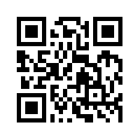
資訊管理專題 Hot Issues of Information Management
Tamkang University
Tamkang University
Achieving Operational Excellence and Customer Intimacy – Enterprise Application: Summit and SAP (Chap. 9)
1051IM4C09
TLMXB4C (M0842) Thu 7,8 (14:10-16:00) B709
Min-Yuh Day
戴敏育
Assistant Professor
專任助理教授
Dept. of Information Management, Tamkang University
淡江大學 資訊管理學系
http://mail. tku.edu.tw/myday/
2016-12-08

Slide 2
課程大綱 (Syllabus)
週次 (Week) 日期 (Date) 內容 (Subject/Topics)
1 2016/09/15 中秋節 (放假一天) (Mid-Autumn Festival)(Day off)
2 2016/09/22 Introduction to Case Study for Information Management Hot Topics
3 2016/09/29 Information Systems in Global Business: UPS (Chap. 1) (pp.53-54)
4 2016/10/06 Information Systems in Global Business: UPS (Chap. 1) (pp.53-54)
5 2016/10/13 Global E-Business and Collaboration: P&G (Chap. 2) (pp.84-85)
6 2016/10/20 Information Systems, Organization, and Strategy: Starbucks (Chap. 3) (pp.129-130)

Slide 3
課程大綱 (Syllabus)
週次 (Week) 日期 (Date) 內容 (Subject/Topics)
7 2016/10/27 Ethical and Social Issues in Information Systems: Facebook (Chap. 4) (pp.188-190)
8 2016/11/03 IT Infrastructure and Emerging Technologies: Amazon and Cloud Computing (Chap. 5) (pp. 234-236)
9 2016/11/10 Foundations of Business Intelligence: IBM and Big Data (Chap. 6) (pp.261-262)
10 2016/11/17 期中考試週
11 2016/11/24 Midterm Report (期中報告)
12 2016/12/01 Telecommunications, the Internet, and Wireless Technology: Google, Apple, and Microsoft (Chap. 7) (pp.318-320)

Slide 4
課程大綱 (Syllabus)
週次 日期 內容（Subject/Topics）
13 2016/12/08 Enterprise Applications: Summit and SAP (Chap. 9) (pp.396-398)
14 2016/12/15 E-commerce: Zagat (Chap. 10) (pp.443-445)
15 2016/12/22 Enhancing Decision Making: Zynga (Chap. 12) (pp.512-514)
16 2016/12/29 Final Report I (期末報告 I)
17 2017/01/05 Final Report II (期末報告 II)
18 2017/01/12 期末考試週

Slide 5
Management Information Systems: Managing the Digital Firm
1
Organization, Management, and the Networked Enterprise
2
Information Technology Infrastructure
3
Key System Applications for the Digital Age
4
Building and Managing Systems

Slide 6
Chap. 9 Achieving Operational Excellence and Customer Intimacy – Enterprise Application: Summit and SAP

Slide 7
Case Study: Summit and SAP (Chap. 9) (pp. 396-398) Summit Electric Lights Up with a New ERP System
1. Which business processes are the most important at Summit Electric Supply? Why?
2. What problems did Summit have with its old systems? What was the business impact of those problems?
3. How did Summit’s ERP system improve operational efficiency and decision making? Give several examples.
4. Describe two ways in which Summit’s customers benefit from the new ERP system.
5. Diagram Summit’s old and new process for handling chargebacks.

Slide 8
Overview of Fundamental MIS Concepts
Business Challenges
Management
Organization
Information System
Business Solutions
Technology

Slide 9
Business Model
8
6
2
4
1
Key Partners
Key Activities
Value Proposition
Customer Relationships
Customer Segments
7
3
Key Resources
Channels
9
5
Cost Structure
Revenue Streams
Source: Alexander Osterwalder & Yves Pigneur, Business Model Generation: A Handbook for Visionaries, Game Changers, and Challengers, Wiley, 2010.

Slide 10
Definition of Business Model
A business model describes the rationale of how an organization creates, delivers, and captures value.
Source: Alexander Osterwalder & Yves Pigneur, Business Model Generation: A Handbook for Visionaries, Game Changers, and Challengers, Wiley, 2010.

Slide 11
Definition of Business Strategy
A business strategy is a long term plan of action designed to achieve a particular goal or set of goals or objectives.

Slide 12
Objectives

Slide 13
Business Objectives

Slide 14
Strategic Business Objectives of Information Systems

Slide 15
Strategic Business Objectives of Information Systems
Operational Excellence
New Products, Services and Business Models
Customer and Supplier Intimacy
Improved Decision Making
Competitive Advantage
Survival

Slide 16
Chap. 9 Achieving Operational Excellence and Customer Intimacy – Enterprise Application

Slide 17
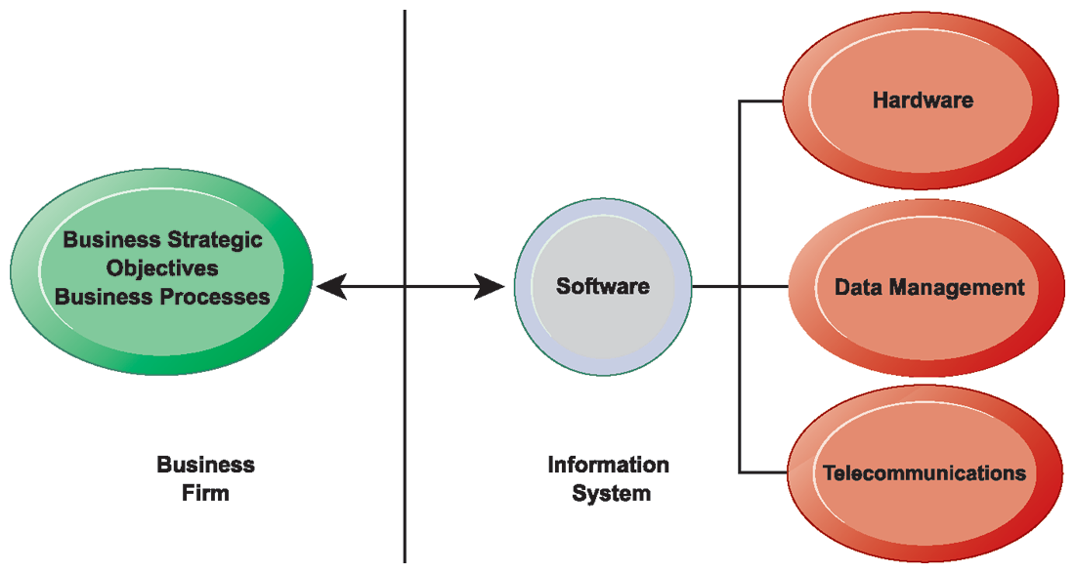
The Interdependence Between Organizations and Information Technology

Slide 18
Business Processes
Business processes:
the set of logically related tasks and behaviors that organizations develop over time to produce specific business results and the unique manner in which these activities are organized and coordinated.
Business processes:
the manner in which work is organized, coordinated, and focused to produce a valuable product or service.
Business processes are the collection of activities required to produce a product or service.

Slide 19
Enterprise Systems
Enterprise resource planning (ERP) systems
Suite of integrated software modules and a common central database
Collects data from many divisions of firm for use in nearly all of firm’s internal business activities
Information entered in one process is immediately available for other processes

Slide 20
Enterprise Software
Built around thousands of predefined business processes that reflect best practices
Finance and accounting: General ledger, accounts payable, etc.
Human resources: Personnel administration, payroll, etc.
Manufacturing and production: Purchasing, shipping, etc.
Sales and marketing: Order processing, billing, sales planning, etc.
To implement, firms:
Select functions of system they wish to use
Map business processes to software processes
Use software’s configuration tables for customizing

Slide 21
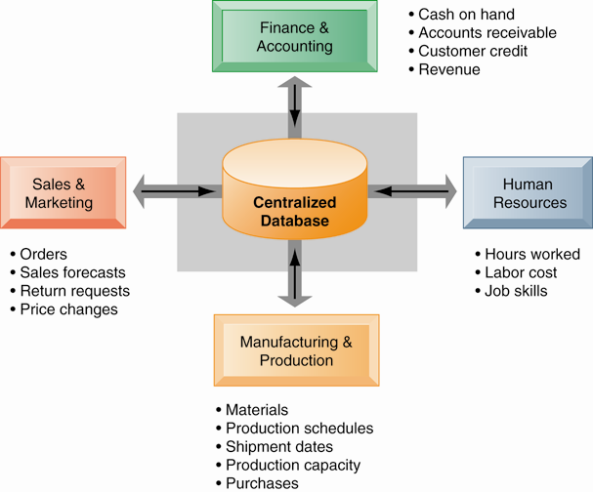
How Enterprise Systems Work

Slide 22
Business Value of Enterprise Systems
Increase operational efficiency
Provide firm-wide information to support decision making
Enable rapid responses to customer requests for information or products
Include analytical tools to evaluate overall organizational performance

Slide 23
Supply Chain Management Systems
Supply Chain
Network of organizations and processes for:
Procuring materials, transforming them into products, and distributing the products
Upstream supply chain:
Firm’s suppliers, suppliers’ suppliers, processes for managing relationships with them
Downstream supply chain:
Organizations and processes responsible for delivering products to customers
Internal supply chain

Slide 24
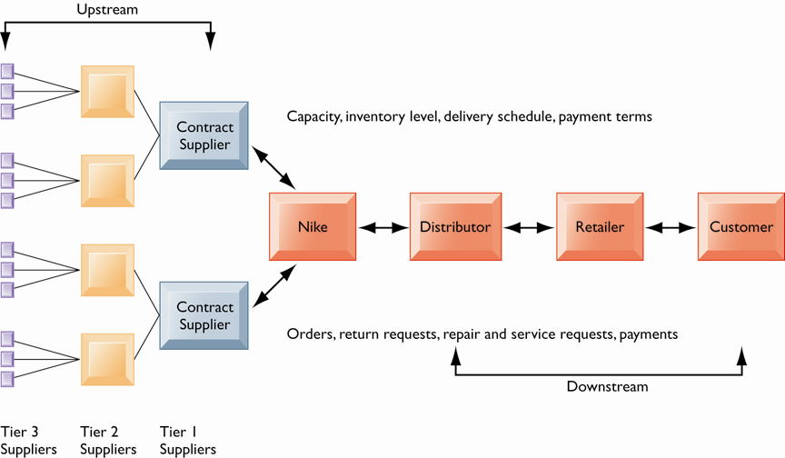
Supply Chain Management Systems: Nike’s Supply Chain

Slide 25
Supply Chain Management Systems
Supply Chain Management (SCM)
Inefficiencies cut into a company’s operating costs
Can waste up to 25% of operating expenses
Just-in-time strategy:
Components arrive as they are needed
Finished goods shipped after leaving assembly line
Safety stock: Buffer for lack of flexibility in supply chain
Bullwhip effect
Information about product demand gets distorted as it passes from one entity to next across supply chain

Slide 26
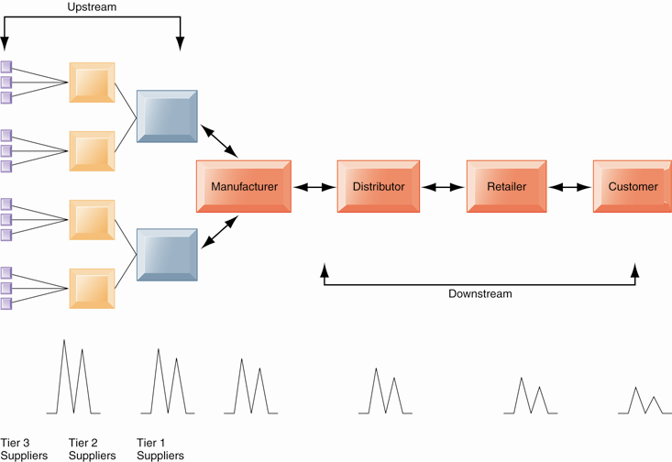
Supply Chain Management Systems: The Bullwhip Effect

Slide 27
Supply Chain Management Software
Supply chain planning systems
Model existing supply chain
Enable demand planning
Optimize sourcing, manufacturing plans
Establish inventory levels
Identify transportation modes
Supply chain execution systems
Manage flow of products through distribution centers and warehouses

Slide 28
Global Supply Chain Issues
Greater geographical distances
Greater time differences
Participants from different countries
Different performance standards
Different legal requirements

Slide 29
Internet Helps Manage Global Complexities
Warehouse management
Transportation management
Logistics
Outsourcing

Slide 30
Supply Chain Management
Push-based model (build-to-stock)
Earlier SCM systems
Schedules based on best guesses of demand
Pull-based model (demand-driven)
Web-based
Customer orders trigger events in supply chain
Internet enables move from sequential supply chains to concurrent supply chains
Complex networks of suppliers can adjust immediately

Slide 31
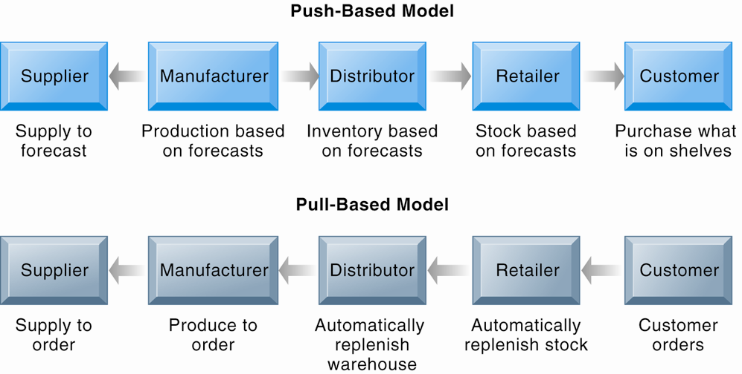
Push- Versus Pull-Based Supply Chain Models

Slide 32
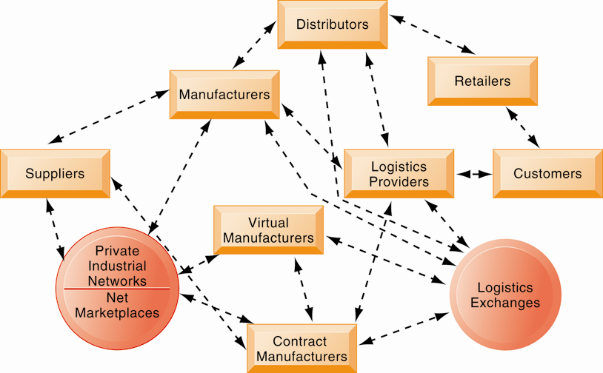
The Future Internet-Driven Supply Chain

Slide 33
Business Value of SCM Systems
Match supply to demand; reduce inventory levels
Improve delivery service
Speed product time to market
Use assets more effectively
Reduced supply chain costs lead to increased profitability
Total supply chain costs can be 75% of operating budget
Increase sales

Slide 34
Customer Relationship Management Systems
Customer relationship management (CRM)
Knowing the customer
In large businesses, too many customers and too many ways customers interact with firm
CRM systems:
Capture and integrate customer data from all over the organization
Consolidate and analyze customer data
Distribute customer information to various systems and customer touch points across enterprise
Provide single enterprise view of customers

Slide 35
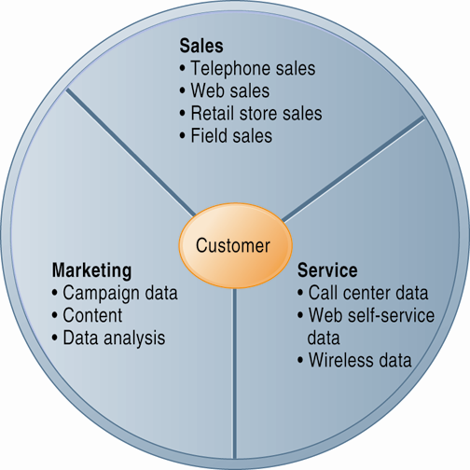
Customer Relationship Management (CRM)

Slide 36
CRM Software
Packages range from niche tools to large-scale enterprise applications.
More comprehensive have modules for:
Partner relationship management (PRM)
Integrating lead generation, pricing, promotions, order configurations, and availability
Tools to assess partners’ performances
Employee relationship management (ERM)
Setting objectives, employee performance management, performance-based compensation, employee training

Slide 37
CRM packages typically include tools for
Sales force automation (SFA)
Sales prospect and contact information, sales quote generation capabilities
Customer service
Assigning and managing customer service requests, Web-based self-service capabilities
Marketing
Capturing prospect and customer data, scheduling and tracking direct-marketing mailings or e-mail, cross-selling

Slide 38
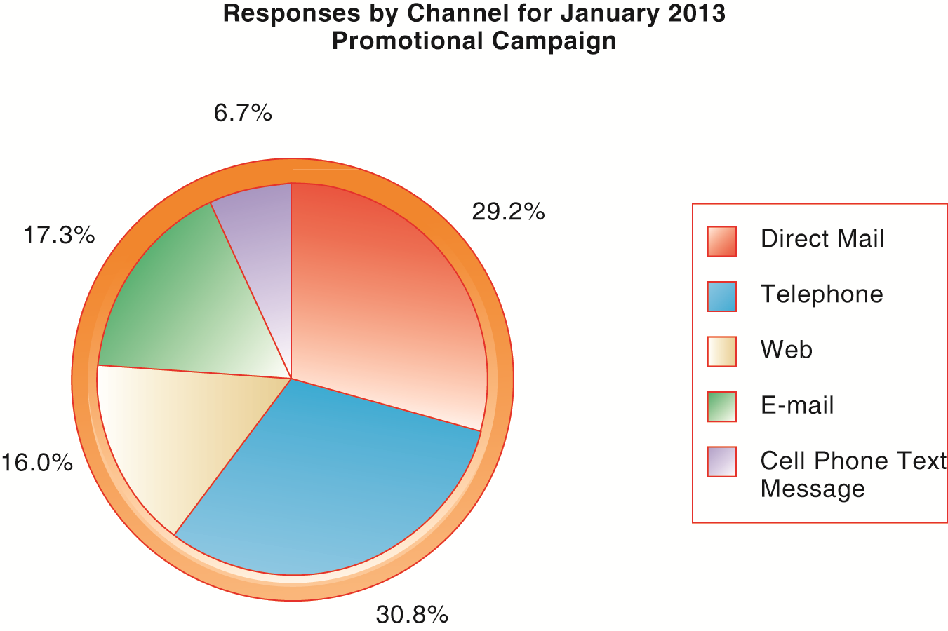
How CRM Systems Support Marketing

Slide 39
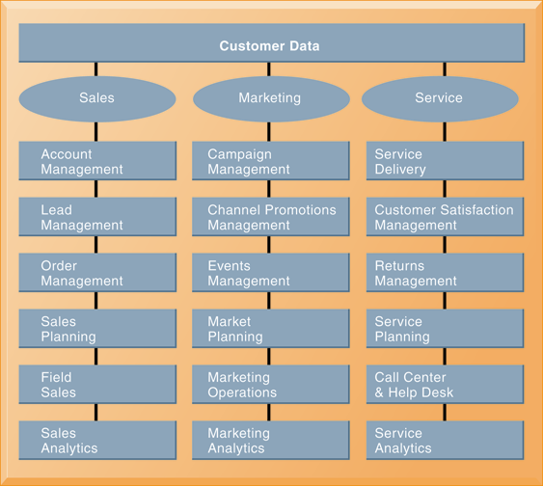
CRM Software Capabilities

Slide 40
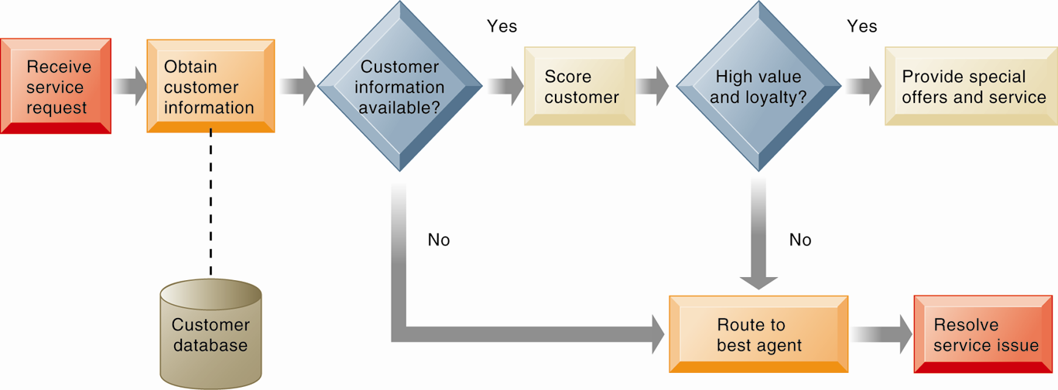
Customer Loyalty Management Process Map

Slide 41
Customer Relationship Management Systems
Operational CRM:
Customer-facing applications such as sales force automation, call center and customer service support, and marketing automation
Analytical CRM:
Based on data warehouses populated by operational CRM systems and customer touch points
Analyzes customer data (OLAP, data mining, etc.)
Customer lifetime value (CLTV)

Slide 42
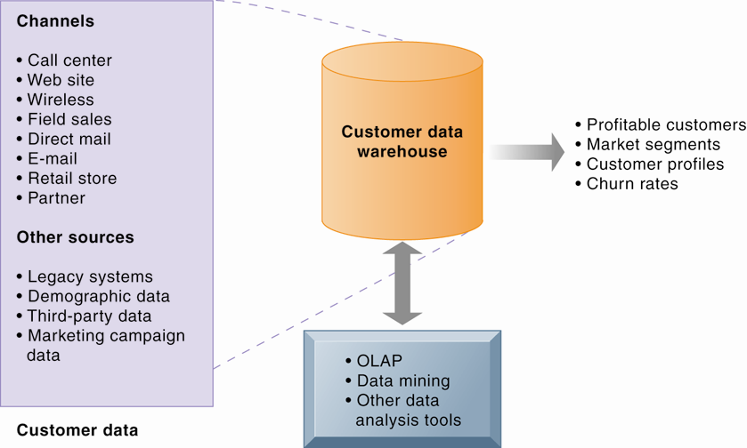
Analytical CRM Data Warehouse

Slide 43
Business Value of CRM Systems
Increased customer satisfaction
Reduced direct-marketing costs
More effective marketing
Lower costs for customer acquisition/retention
Increased sales revenue

Slide 44
Churn Rate
Number of customers who stop using or purchasing products or services from a company
Indicator of growth or decline of firm’s customer base

Slide 45
Enterprise Applications: New Opportunities and Challenges
Enterprise application challenges
Highly expensive to purchase and implement enterprise applications
Average “large” system—$12 million +
Average “small/midsize” system—$3.5 million
Technology changes
Business process changes
Organizational learning, changes
Switching costs, dependence on software vendors
Data standardization, management, cleansing

Slide 46
Next-Generation Enterprise Applications
Enterprise solutions/suites:
Make applications more flexible, Web-enabled, integrated with other systems
SOA standards
Open-source applications
On-demand solutions
Cloud-based versions
Functionality for mobile platform

Slide 47
Next-Generation Enterprise Applications
Social CRM
Incorporating social networking technologies
Company social networks
Customer interaction via Facebook
For example: Buzzient platform integrates social media with enterprise applications
Business intelligence
Inclusion of BI with enterprise applications
Flexible reporting, ad hoc analysis, “what-if” scenarios, digital dashboards, data visualization

Slide 48
Case Study: E-commerce: Zagat (Chap. 10) (pp.443-445) To Pay or Not to Pay: Zagat’s Dilemma
1. Evaluate Zagat using the competitive forces and value chain models.
2. Compare Zagat’s and Yelp’s e-commerce business models. How have those models affected each company's Web strategy?
3. Why was Zagat’s content well suited for the Web and for the mobile digital platform?
4. Do you think Zagat’s decision to use a pay wall for its Web site was a mistake? Why or why not?
5. Will Zagat’s acquisition by Google make it more competitive? Explain your answer.

Slide 49
資訊管理專題 (Hot Issues of Information Management)
1. 請同學於資訊管理專題個案討論前 應詳細研讀個案，並思考個案研究問題。
2. 請同學於上課前複習相關資訊管理相關理論，以作為個案分析及擬定管理對策的依據。
3. 請同學於上課前 先繳交資訊管理專題個案研究問題書面報告。
4.上課時間地點： 週四 7,8 (14:10-16:00) B709

Slide 50
References
Kenneth C. Laudon & Jane P. Laudon (2014), Management Information Systems: Managing the Digital Firm, Thirteenth Edition, Pearson.
Kenneth C. Laudon & Jane P. Laudon原著， 游張松 主編，陳文生 翻譯 (2014)， 資訊管理系統，第13版，滄海

