Slide 1
資訊管理專題 Hot Issues of Information Management
Tamkang University
Tamkang University
Telecommunications, the Internet, and Wireless Technology: Google, Apple, and Microsoft (Chap. 7)
1051IM4C08
TLMXB4C (M0842) Thu 7,8 (14:10-16:00) B709
Min-Yuh Day
戴敏育
Assistant Professor
專任助理教授
Dept. of Information Management, Tamkang University
淡江大學 資訊管理學系
http://mail. tku.edu.tw/myday/
2016-11-24

Slide 2
課程大綱 (Syllabus)
週次 (Week) 日期 (Date) 內容 (Subject/Topics)
1 2016/09/15 中秋節 (放假一天) (Mid-Autumn Festival)(Day off)
2 2016/09/22 Introduction to Case Study for Information Management Hot Topics
3 2016/09/29 Information Systems in Global Business: UPS (Chap. 1) (pp.53-54)
4 2016/10/06 Global E-Business and Collaboration: P&G (Chap. 2) (pp.84-85)
5 2016/10/13 Information Systems, Organization, and Strategy: Starbucks (Chap. 3) (pp.129-130)
6 2016/10/20 Ethical and Social Issues in Information Systems: Facebook (Chap. 4) (pp.188-190)

Slide 3
課程大綱 (Syllabus)
週次 (Week) 日期 (Date) 內容 (Subject/Topics)
7 2016/10/27 IT Infrastructure and Emerging Technologies: Amazon and Cloud Computing (Chap. 5) (pp. 234-236)
8 2016/11/03 Foundations of Business Intelligence: IBM and Big Data (Chap. 6) (pp.261-262)
9 2016/11/10 Midterm Report (期中報告)
10 2016/11/17 期中考試週
11 2016/11/24 Telecommunications, the Internet, and Wireless Technology: Google, Apple, and Microsoft (Chap. 7) (pp.318-320)
12 2016/12/01 Enterprise Applications: Summit and SAP (Chap. 9) (pp.396-398)

Slide 4
課程大綱 (Syllabus)
週次 日期 內容（Subject/Topics）
13 2016/12/08 E-commerce: Zagat (Chap. 10) (pp.443-445)
14 2016/12/15 Enhancing Decision Making: Zynga (Chap. 12) (pp.512-514)
15 2016/12/22 Managing Projects: NYCAPS and CityTime (Chap. 14) (pp.586-588)
16 2016/12/29 Final Report I (期末報告 I)
17 2017/01/05 Final Report II (期末報告 II)
18 2017/01/12 期末考試週

Slide 5
Management Information Systems: Managing the Digital Firm
1
Organization, Management, and the Networked Enterprise
2
Information Technology Infrastructure
3
Key System Applications for the Digital Age
4
Building and Managing Systems

Slide 6
Chap. 7 Telecommunications, the Internet, and Wireless Technology: Google, Apple, and Microsoft

Slide 7
Case Study: Google, Apple, and Microsoft (Chap. 7) (pp. 318-320) Apple, Google, and Microsoft Battle for Your Internet Experience
1. Define and compare the business models and areas of strength of Apple, Google, and Microsoft.
2. Why is mobile computing so important to these three firms? Evaluate the mobile platform offerings of each firm.
3. What is the significance of applications and app stores, and closed vs. open app standards to the success or failure of mobile computing?
4. Which company and business model do you believe will prevail in this epic struggle? Explain your answer.
5. What difference would it make to a business or to an individual consumer if Apple, Google, or Microsoft dominated the Internet experience? Explain your answer.

Slide 8
Overview of Fundamental MIS Concepts
Business Challenges
Management
Organization
Information System
Business Solutions
Technology

Slide 9
Business Model
8
6
2
4
1
Key Partners
Key Activities
Value Proposition
Customer Relationships
Customer Segments
7
3
Key Resources
Channels
9
5
Cost Structure
Revenue Streams
Source: Alexander Osterwalder & Yves Pigneur, Business Model Generation: A Handbook for Visionaries, Game Changers, and Challengers, Wiley, 2010.

Slide 10
Understanding Business Model
Business Model
Revenue Model
Business Strategy
Business Strategy and Information System Alignment

Slide 11
Business Model

Slide 12
Value

Slide 13
Definition of Business Model
A business model describes the rationale of how an organization creates, delivers, and captures value.
Source: Alexander Osterwalder & Yves Pigneur, Business Model Generation: A Handbook for Visionaries, Game Changers, and Challengers, Wiley, 2010.

Slide 14
E-commerce Business Models
Portal
E-tailer
Content Provider
Transaction Broker
Market Creator
Service Provider
Community Provider

Slide 15
E-commerce Revenue Models
Advertising
Sales
Subscription
Free/Freemium
Transaction Fee
Affiliate

Slide 16
Types of E-commerce
Business-to-consumer (B2C)
Business-to-business (B2B)
Consumer-to-consumer (C2C)
Mobile commerce (m-commerce)

Slide 17
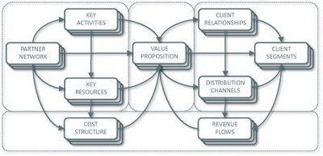
Business Model Canvas
Key Activities
Customer Relationships
Key Partners
Value Preposition
Customer Segments
Key Resources
Channels
Cost Structure
Revenue Streams
Source: http://nonlinearthinking.typepad.com/nonlinear_thinking/2008/07/the-business-model-canvas.html
https://www.youtube.com/watch?v=QoAOzMTLP5s

Slide 18
Business Model Canvas
Infrastructure Management
Product
Customer Interface
Key Activities
Customer Relationships
Key Partners
Value Preposition
Customer Segments
Key Resources
Channels
Cost Structure
Revenue Streams
Financial Aspects
Source: http://nonlinearthinking.typepad.com/nonlinear_thinking/2008/07/the-business-model-canvas.html
https://www.youtube.com/watch?v=QoAOzMTLP5s

Slide 19
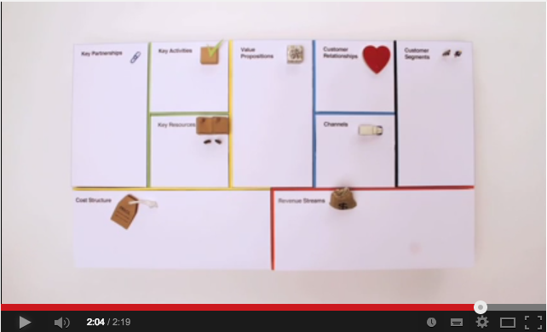
Business Model Canvas Explained
Source: http://www.youtube.com/watch?v=QoAOzMTLP5s

Slide 20
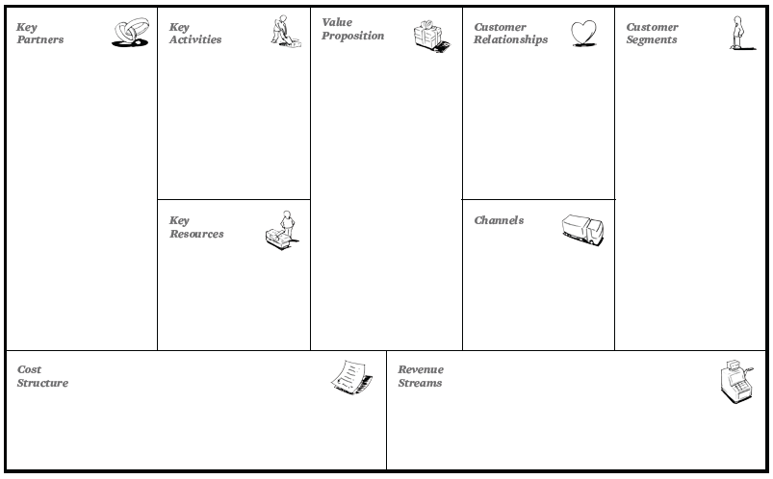
The 9 Building Blocks of Business Model
8
6
2
4
1
7
3
9
5
Source: Alexander Osterwalder & Yves Pigneur, Business Model Generation: A Handbook for Visionaries, Game Changers, and Challengers, Wiley, 2010.

Slide 21
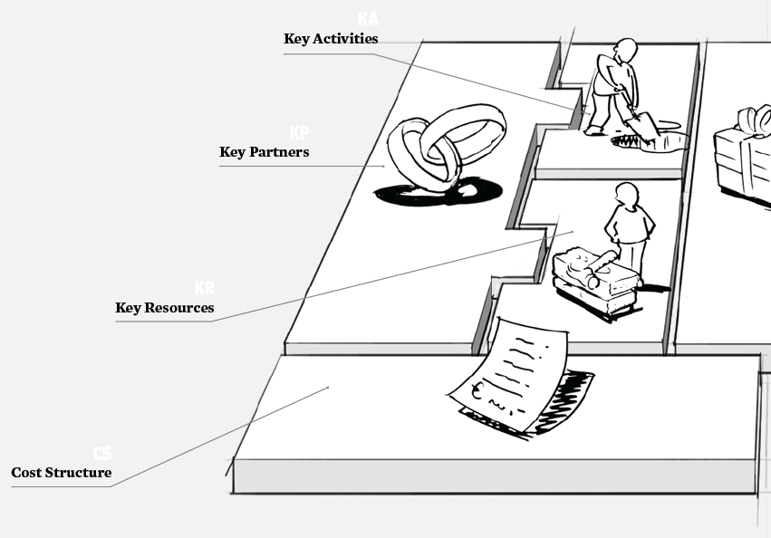
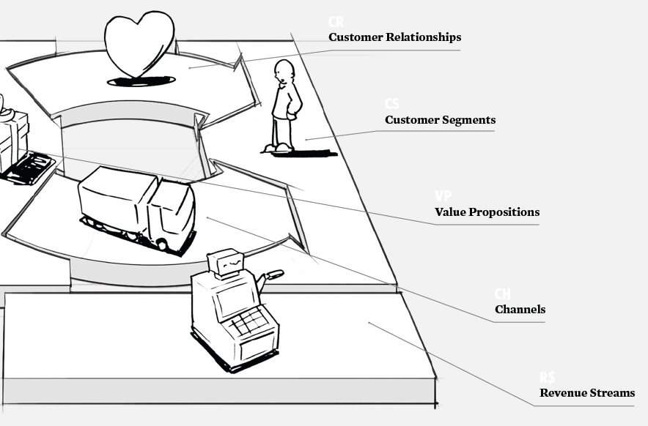
The 9 Building Blocks of Business Model
Source: Alexander Osterwalder & Yves Pigneur, Business Model Generation: A Handbook for Visionaries, Game Changers, and Challengers, Wiley, 2010.

Slide 22
The 9 Building Blocks of Business Model
1. Customer Segments
An organization serves one or several Customer Segments.
2. Value Propositions
It seeks to solve customer problems and satisfy customer needs with value propositions.
3. Channels
Value propositions are delivered to customers through communication, distribution, and sales Channels.
4. Customer Relationships
Customer relationships are established and maintained with each Customer Segment.
Source: Alexander Osterwalder & Yves Pigneur, Business Model Generation: A Handbook for Visionaries, Game Changers, and Challengers, Wiley, 2010.

Slide 23
The 9 Building Blocks of Business Model
5. Revenue Streams
Revenue streams result from value propositions successfully offered to customers.
6. Key Resources
Key resources are the assets required to offer and deliver the previously described elements…
7. Key Activities
…by performing a number of Key Activities.
8. Key Partnerships
Some activities are outsourced and some resources are acquired outside the enterprise.
9. Cost Structure
The business model elements result in the cost structure.
Source: Alexander Osterwalder & Yves Pigneur, Business Model Generation: A Handbook for Visionaries, Game Changers, and Challengers, Wiley, 2010.

Slide 24
Business Model
8
6
2
4
1
Key Partners
Key Activities
Value Proposition
Customer Relationships
Customer Segments
7
3
Key Resources
Channels
9
5
Cost Structure
Revenue Streams
Source: Alexander Osterwalder & Yves Pigneur, Business Model Generation: A Handbook for Visionaries, Game Changers, and Challengers, Wiley, 2010.

Slide 25
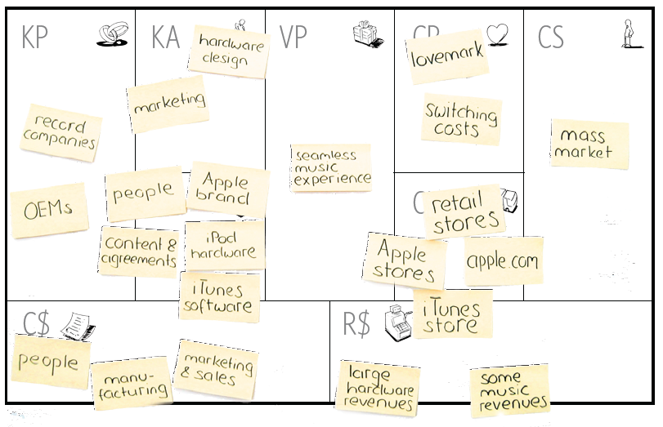
Business Model Generation
Source: Alexander Osterwalder & Yves Pigneur, Business Model Generation: A Handbook for Visionaries, Game Changers, and Challengers, Wiley, 2010.

Slide 26
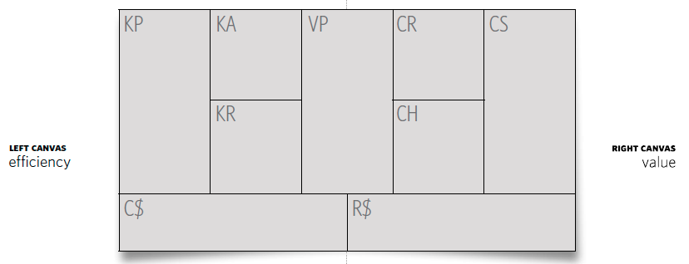
Business Model Generation
Source: Alexander Osterwalder & Yves Pigneur, Business Model Generation: A Handbook for Visionaries, Game Changers, and Challengers, Wiley, 2010.

Slide 27
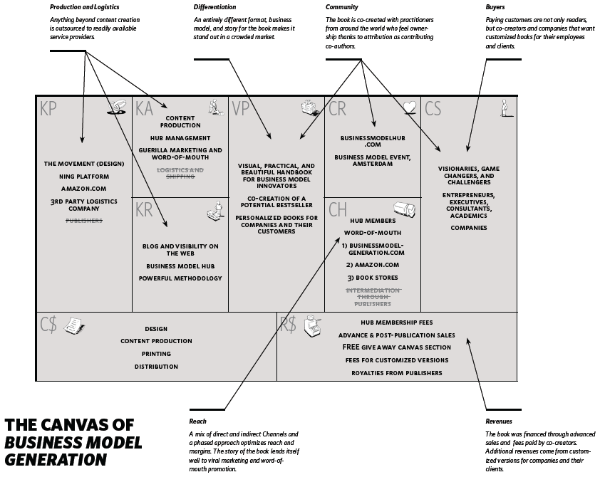
Source: Alexander Osterwalder & Yves Pigneur, Business Model Generation: A Handbook for Visionaries, Game Changers, and Challengers, Wiley, 2010.

Slide 28
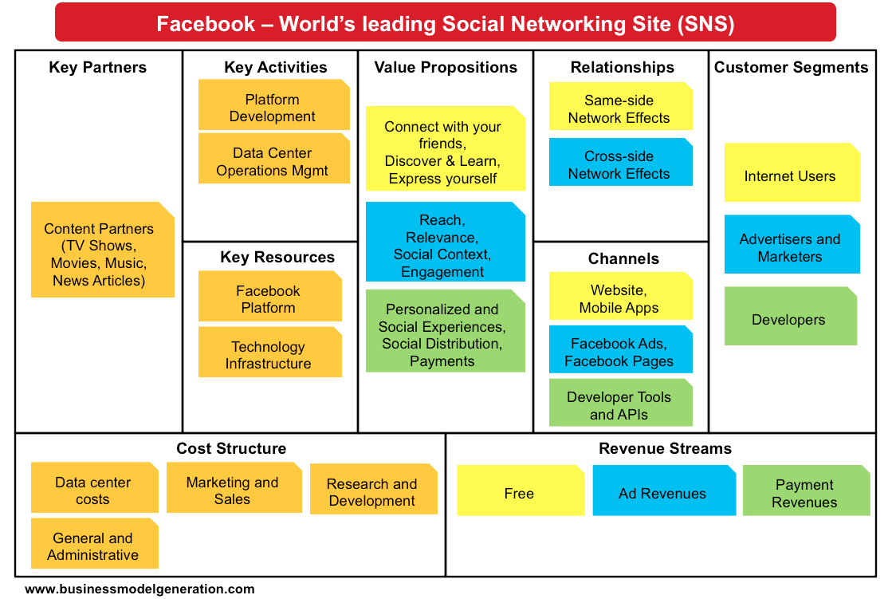
Source: http://bmimatters.com/tag/business-model-canvas-examples/

Slide 29
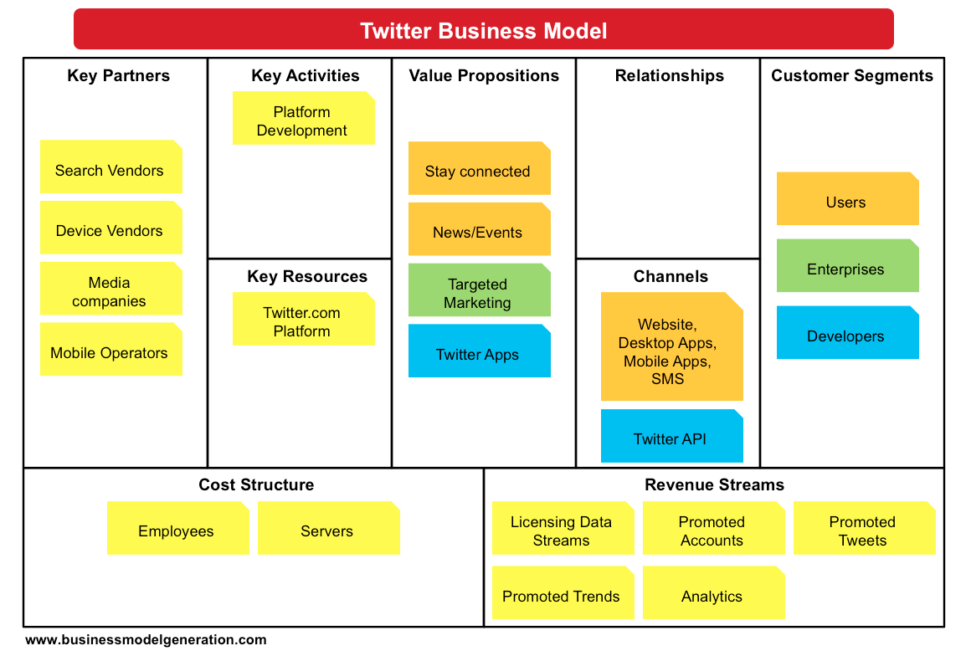
Source: http://bmimatters.com/tag/business-model-canvas-examples/

Slide 30
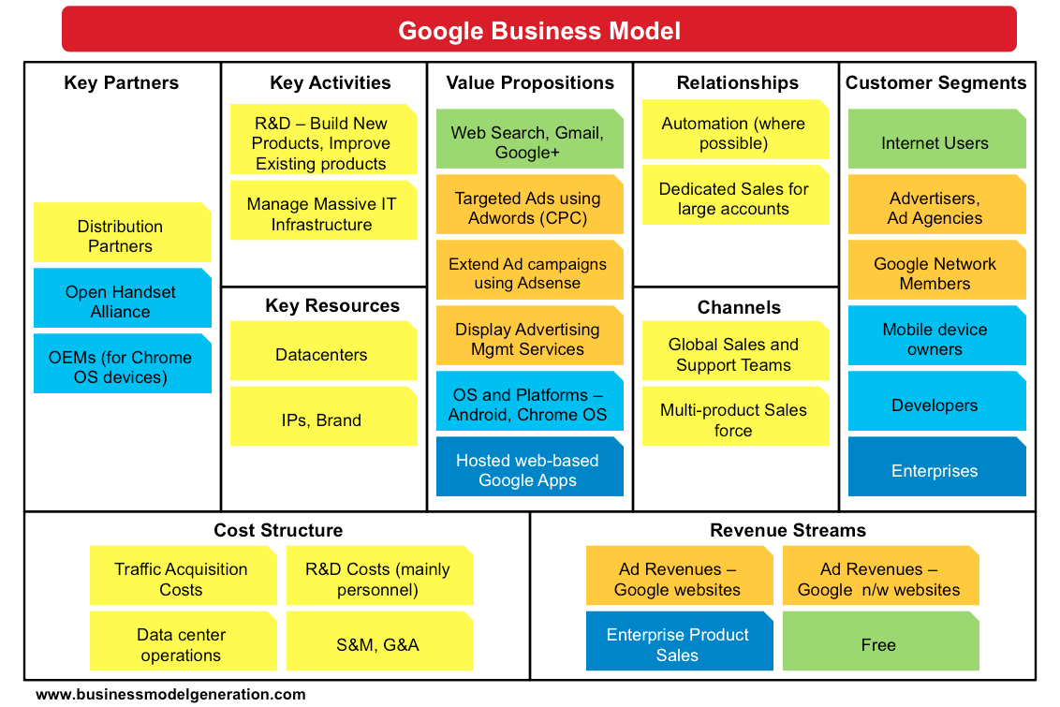
Source: http://bmimatters.com/tag/business-model-canvas-examples/

Slide 31
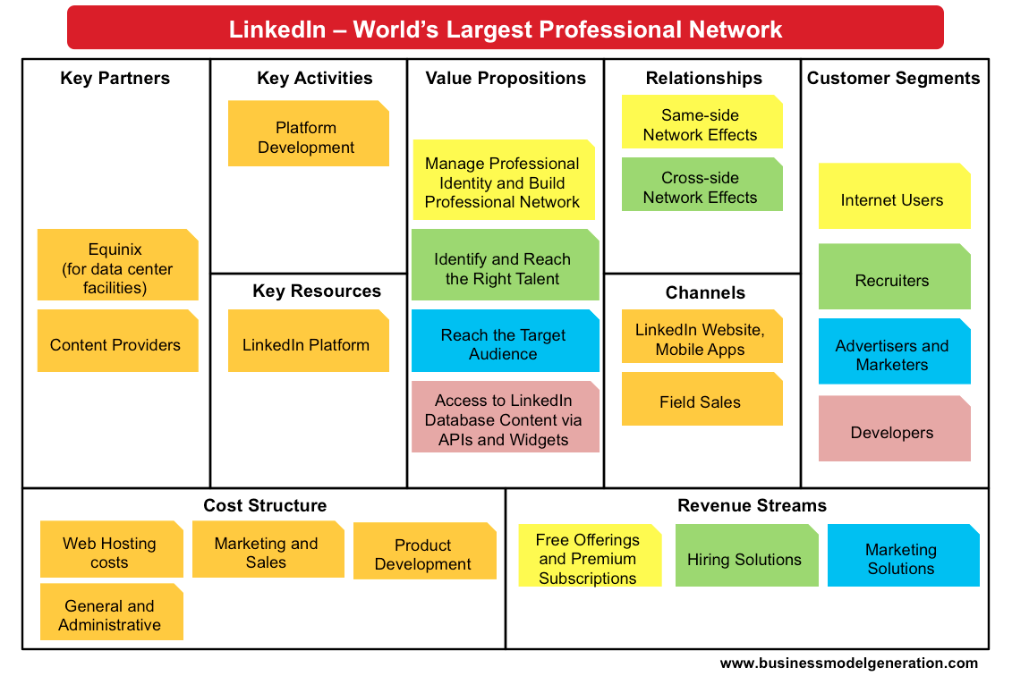
Source: http://bmimatters.com/tag/business-model-canvas-examples/

Slide 32
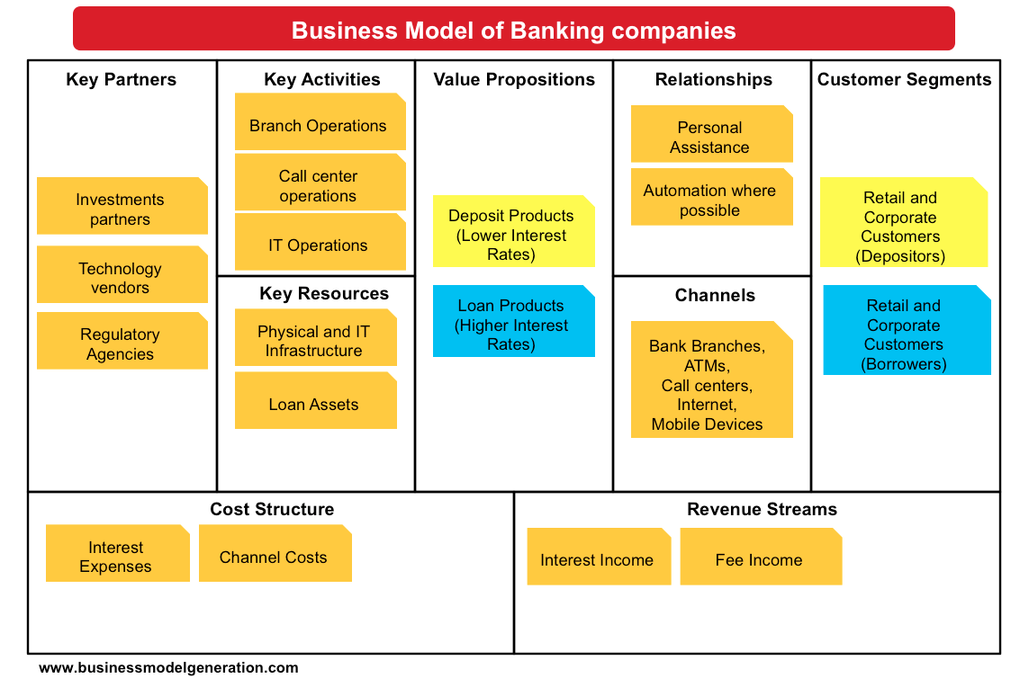
Source: http://bmimatters.com/tag/business-model-canvas-examples/

Slide 33
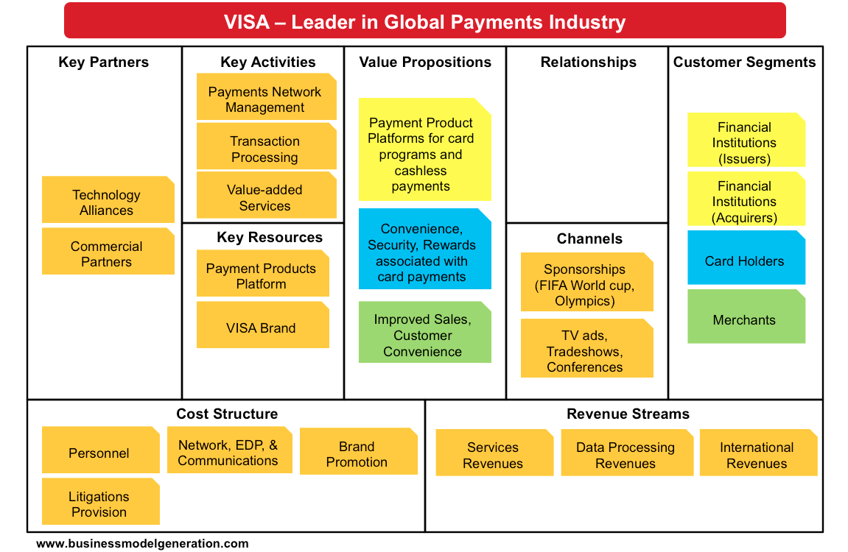
Source: http://bmimatters.com/tag/business-model-canvas-examples/

Slide 34
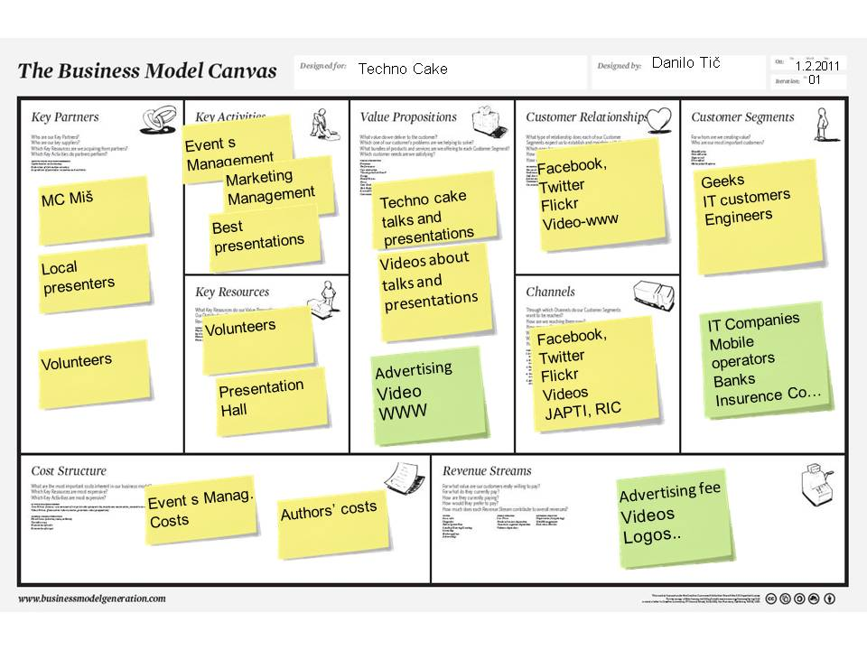
Source: http://businessmodelcombo.wordpress.com/2011/02/04/what-would-a-sustainable-techno-cake-business-model-look-like/
34

Slide 35
Customer Value
Source: Philip Kotler & Kevin Lane Keller, Marketing Management, 14th ed., Pearson, 2012

Slide 36
Marketing
“Meeting needs profitably”
Source: Philip Kotler & Kevin Lane Keller, Marketing Management, 14th ed., Pearson, 2012

Slide 37
Value
the sum of the tangible and intangible benefits and costs
Source: Philip Kotler & Kevin Lane Keller, Marketing Management, 14th ed., Pearson, 2012

Slide 38
Value
Total customer benefit
Customer perceived value
Total customer cost
Source: Philip Kotler & Kevin Lane Keller, Marketing Management, 14th ed., Pearson, 2012

Slide 39
Customer Value Triad
Quality, Service, and Price (qsp)
Quality
Service
Price
Source: Philip Kotler & Kevin Lane Keller, Marketing Management, 14th ed., Pearson, 2012

Slide 40
Value and Satisfaction
Marketing
identification, creation, communication, delivery, and monitoring of customer value.
Satisfaction
a person’s judgment of a product’s perceived performance in relationship to expectations
Source: Philip Kotler & Kevin Lane Keller, Marketing Management, 14th ed., Pearson, 2012

Slide 41
Building Customer Value, Satisfaction, and Loyalty
Source: Philip Kotler & Kevin Lane Keller, Marketing Management, 14th ed., Pearson, 2012

Slide 42
Customer Perceived Value
Product benefit
Total customer benefit
Customer perceived value
Services benefit
Personnel benefit
Image benefit
Monetary cost
Total customer cost
Time cost
Energy cost
Psychological cost
Source: Philip Kotler & Kevin Lane Keller, Marketing Management, 14th ed., Pearson, 2012

Slide 43
Satisfaction
“a person’s feelings of pleasure or disappointment that result from comparing a product’s perceived performance (or outcome) to expectations”
Source: Philip Kotler & Kevin Lane Keller, Marketing Management, 14th ed., Pearson, 2012

Slide 44
Loyalty
“a deeply held commitment to rebuy or repatronize a preferred product or service in the future despite situational influences and marketing efforts having the potential to cause switching behavior.”
Source: Philip Kotler & Kevin Lane Keller, Marketing Management, 14th ed., Pearson, 2012

Slide 45
Customer Perceived Value, Customer Satisfaction, and Loyalty
Customer Perceived Performance
Customer
Perceived Value
Customer
Satisfaction
Customer
Loyalty
Customer
Expectations
Source: Philip Kotler & Kevin Lane Keller, Marketing Management, 14th ed., Pearson, 2012

Slide 46
CEO CIO CFO
CEO
Strategy and Sales
(Leading)
CIO
Enterprise Technology Integration
CFO-COO
Finance and Operations
(Lagging)
Source: http://www.r3now.com/what-is-the-proper-relationship-for-the-cio-ceo-and-cfo/

Slide 47
CEO CIO CMO
CEO
Strategy and Sales
(Leading)
CIO
Enterprise Technology Integration
CMO
Marketing
Communication
Adapted from: http://www.r3now.com/what-is-the-proper-relationship-for-the-cio-ceo-and-cfo/

Slide 48
CEO CIO CMO
CEO
Vision
Strategy
CIO
CMO
Mission
Tactics
Goals
Objectives
Operations
Tasks
Adapted from: http://www.argowiki.com/index.php?title=The_Relationship_Between_the_CEO_and_CIO

Slide 49
Nothing is so practical as a good theory

Slide 50
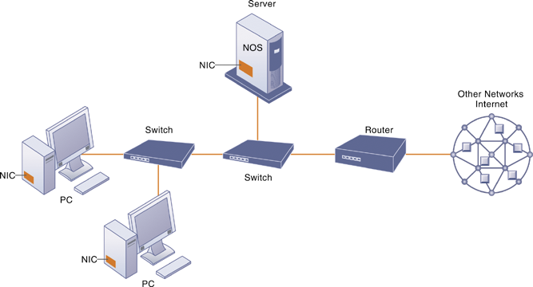
Components of a Simple Computer Network

Slide 51
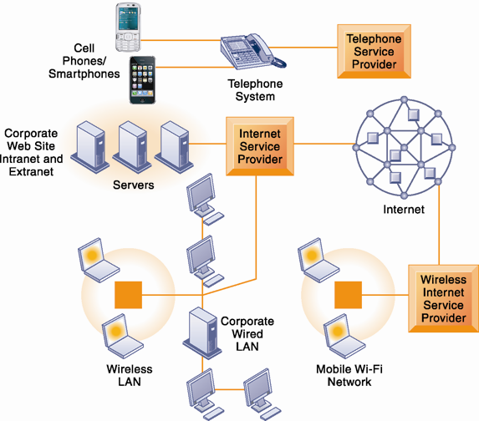
Corporate Network Infrastructure

Slide 52
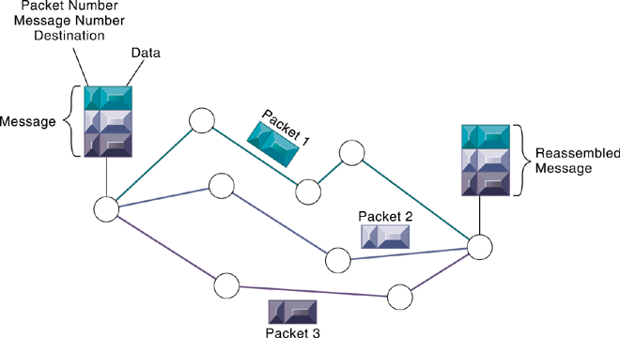
Packet-Switched Networks and Packet Communications

Slide 53
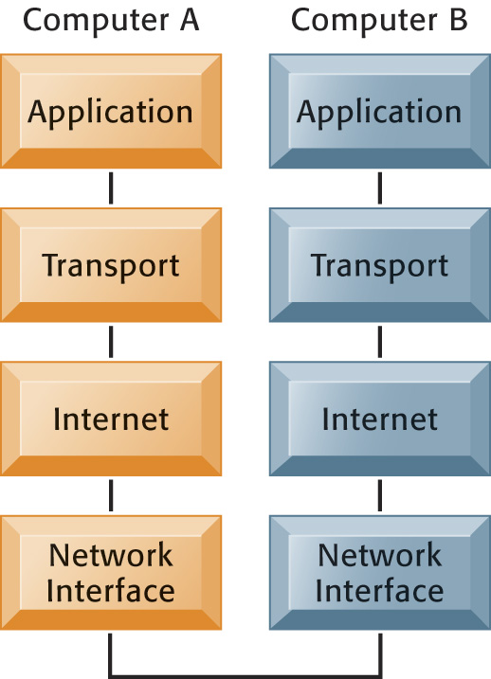
The Transmission Control Protocol/Internet Protocol (TCP/IP) Reference Model

Slide 54
Functions of the Modem

Slide 55
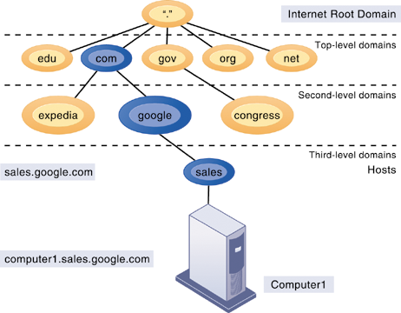
The Domain Name System
Source: Kenneth C. Laudon & Jane P. Laudon (2014), Management Information Systems: Managing the Digital Firm, Thirteenth Edition, Pearson.

Slide 56
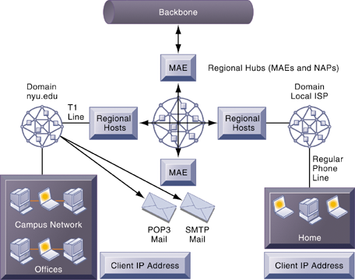
Internet Network Architecture

Slide 57
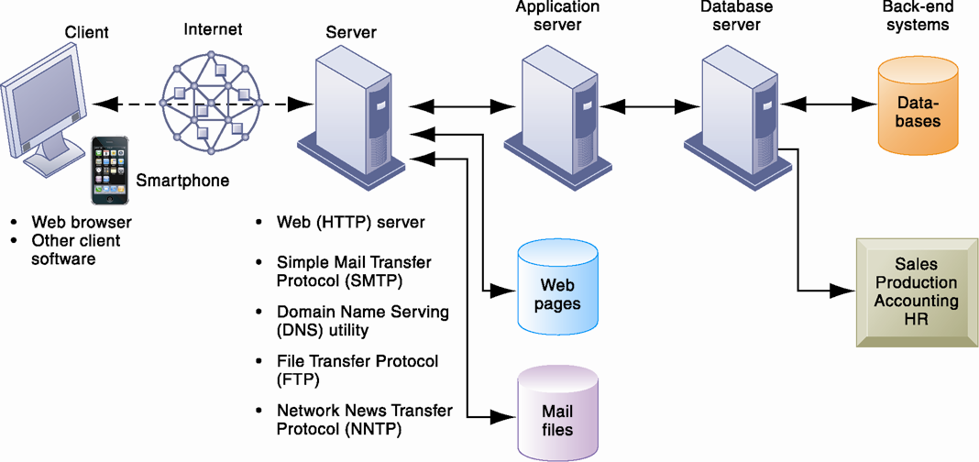
Client/Server Computing on the Internet

Slide 58
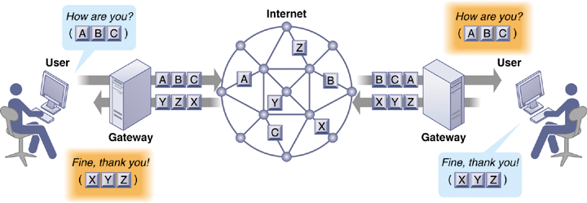
How Voice over IP Works

Slide 59
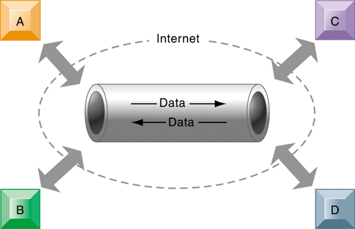
A Virtual Private Network Using the Internet

Slide 60
The Global Internet
Search engines
Started as simpler programs using keyword indexes
Google improved indexing and created page ranking system
Mobile search: 20% of all searches in 2012
Search engine marketing
Major source of Internet advertising revenue
Search engine optimization (SEO)
Adjusting Web site and traffic to improve rankings in search engine results

Slide 61
The Global Internet
Social search
Google +1, Facebook Like
Semantic search
Anticipating what users are looking for rather than simply returning millions of links
Intelligent agent shopping bots
Use intelligent agent software for searching Internet for shopping information

Slide 62
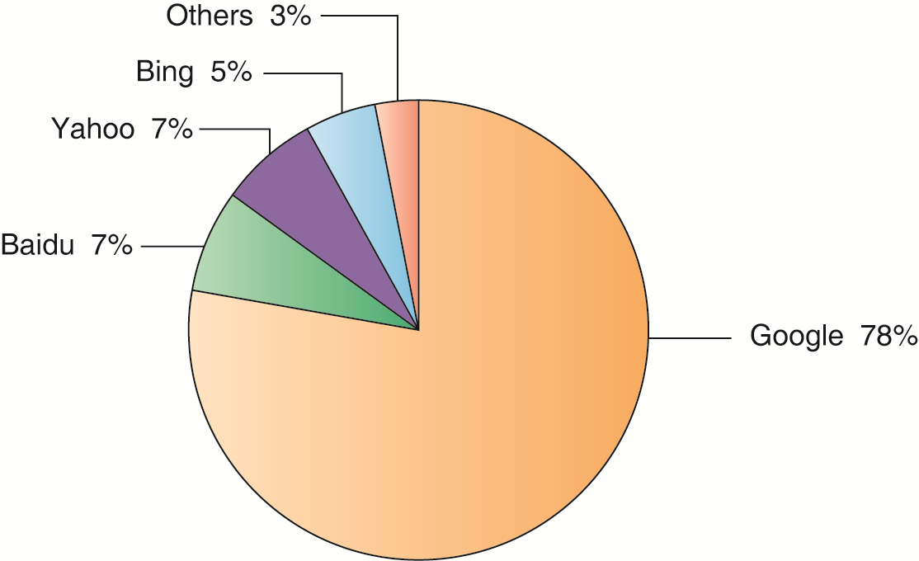
Top U.S. Web Search Engines

Slide 63
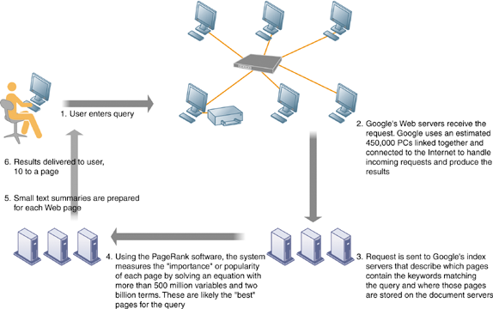
How Google Works

Slide 64
Web 2.0
Second-generation services
Enabling collaboration, sharing information, and creating new services online
Features
Interactivity
Real-time user control
Social participation (sharing)
User-generated content

Slide 65
Web 2.0 services and tools
Blogs: chronological, informal Web sites created by individuals
RSS (Really Simple Syndication): syndicates Web content so aggregator software can pull content for use in another setting or viewing later
Blogosphere
Microblogging
Wikis: collaborative Web sites where visitors can add, delete, or modify content on the site
Social networking sites: enable users to build communities of friends and share information

Slide 66
Web 3.0: The “Semantic Web”
A collaborative effort led by W3C to add layer of meaning to the existing Web
Goal is to reduce human effort in searching for and processing information
Making Web more “intelligent” and intuitive
Increased communication and synchronization with computing devices, communities
“Web of things”
Increased cloud computing, mobile computing

Slide 67
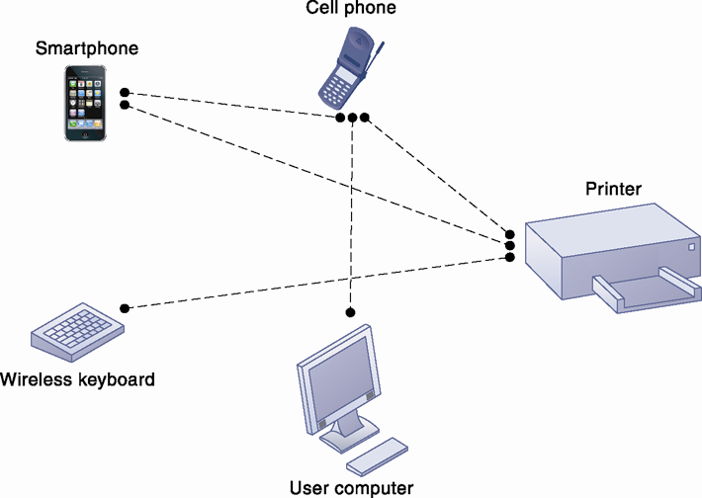
A Bluetooth Network (PAN)

Slide 68
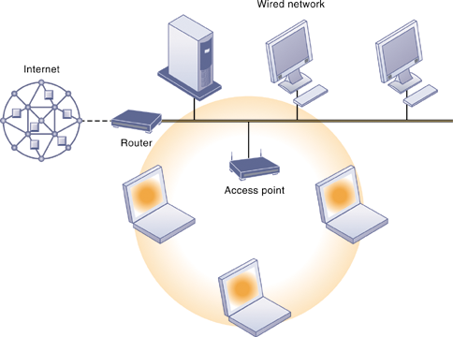
An 802.11 Wireless LAN

Slide 69
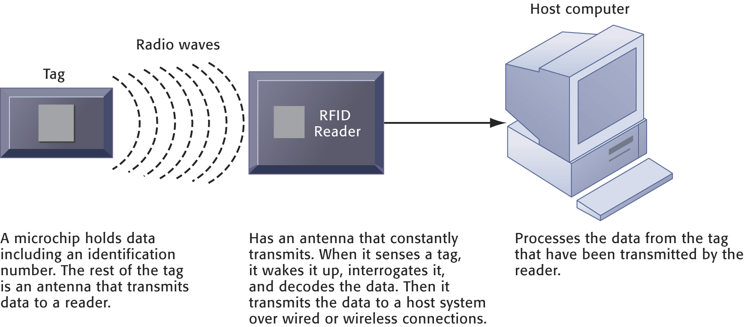
How RFID Works

Slide 70
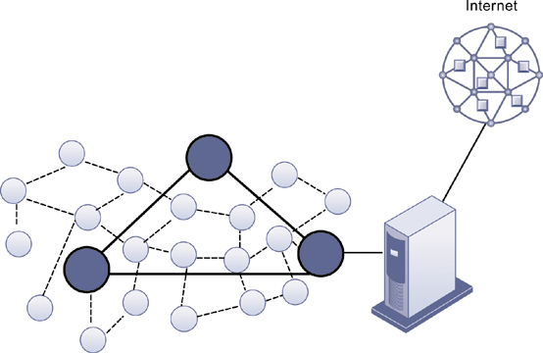
A Wireless Sensor Network

Slide 71
Case Study: Summit and SAP (Chap. 9) (pp. 396-398) Summit Electric Lights Up with a New ERP System
1. Which business processes are the most important at Summit Electric Supply? Why?
2. What problems did Summit have with its old systems? What was the business impact of those problems?
3. How did Summit’s ERP system improve operational efficiency and decision making? Give several examples.
4. Describe two ways in which Summit’s customers benefit from the new ERP system.
5. Diagram Summit’s old and new process for handling chargebacks.

Slide 72
資訊管理專題 (Hot Issues of Information Management)
1. 請同學於資訊管理專題個案討論前 應詳細研讀個案，並思考個案研究問題。
2. 請同學於上課前複習相關資訊管理相關理論，以作為個案分析及擬定管理對策的依據。
3. 請同學於上課前 先繳交資訊管理專題個案研究問題書面報告。
4.上課時間地點： 週四 7,8 (14:10-16:00) B709

Slide 73
References
Kenneth C. Laudon & Jane P. Laudon (2014), Management Information Systems: Managing the Digital Firm, Thirteenth Edition, Pearson.
Kenneth C. Laudon & Jane P. Laudon原著， 游張松 主編，陳文生 翻譯 (2014)， 資訊管理系統，第13版，滄海

