Slide 1
資訊管理專題 Hot Issues of Information Management
Tamkang University
Tamkang University
Information Systems in Global Business: UPS (Chap. 1)
1051IM4C02
TLMXB4C (M0842) Thu 7,8 (14:10-16:00) B613
Min-Yuh Day
戴敏育
Assistant Professor
專任助理教授
Dept. of Information Management, Tamkang University
淡江大學 資訊管理學系
http://mail. tku.edu.tw/myday/
2016-09-29

Slide 2
課程大綱 (Syllabus)
週次 (Week) 日期 (Date) 內容 (Subject/Topics)
1 2016/09/15 中秋節 (放假一天) (Mid-Autumn Festival)(Day off)
2 2016/09/22 Introduction to Case Study for Information Management Hot Topics
3 2016/09/29 Information Systems in Global Business: UPS (Chap. 1) (pp.53-54)
4 2016/10/06 Global E-Business and Collaboration: P&G (Chap. 2) (pp.84-85)
5 2016/10/13 Information Systems, Organization, and Strategy: Starbucks (Chap. 3) (pp.129-130)
6 2016/10/20 Ethical and Social Issues in Information Systems: Facebook (Chap. 4) (pp.188-190)

Slide 3
課程大綱 (Syllabus)
週次 (Week) 日期 (Date) 內容 (Subject/Topics)
7 2016/10/27 IT Infrastructure and Emerging Technologies: Amazon and Cloud Computing (Chap. 5) (pp. 234-236)
8 2016/11/03 Foundations of Business Intelligence: IBM and Big Data (Chap. 6) (pp.261-262)
9 2016/11/10 Midterm Report (期中報告)
10 2016/11/17 期中考試週
11 2016/11/24 Telecommunications, the Internet, and Wireless Technology: Google, Apple, and Microsoft (Chap. 7) (pp.318-320)
12 2016/12/01 Enterprise Applications: Summit and SAP (Chap. 9) (pp.396-398)

Slide 4
課程大綱 (Syllabus)
週次 日期 內容（Subject/Topics）
13 2016/12/08 E-commerce: Zagat (Chap. 10) (pp.443-445)
14 2016/12/15 Enhancing Decision Making: Zynga (Chap. 12) (pp.512-514)
15 2016/12/22 Managing Projects: NYCAPS and CityTime (Chap. 14) (pp.586-588)
16 2016/12/29 Final Report I (期末報告 I)
17 2017/01/05 Final Report II (期末報告 II)
18 2017/01/12 期末考試週

Slide 5
Management Information Systems: Managing the Digital Firm
1
Organization, Management, and the Networked Enterprise
2
Information Technology Infrastructure
3
Key System Applications for the Digital Age
4
Building and Managing Systems

Slide 6
Chap. 1 Information Systems in Global Business: UPS

Slide 7
Case Study: UPS (Chap. 1) (pp.53-54) UPS Competes Globally with Information Technology
1. What are the inputs, processing, and outputs of UPS’s package tracking system?
2. What technologies are used by UPS? How are these technologies related to UPS’s business strategy?
3. What strategic business objectives do UPS’s information systems address?
4. What would happen if UPS’s information systems were not available?

Slide 8
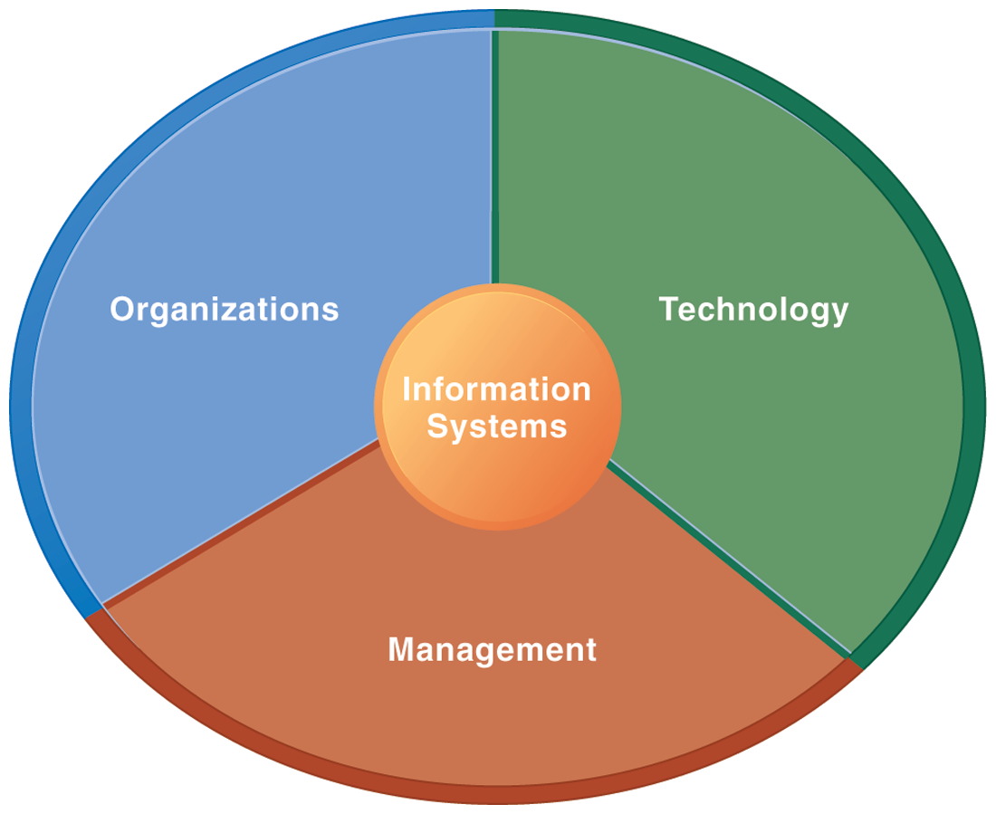
Information Management (MIS) Information Systems

Slide 9
Overview of Fundamental MIS Concepts
Business Challenges
Management
Organization
Information System
Business Solutions
Technology

Slide 10
Business Model
8
6
2
4
1
Key Partners
Key Activities
Value Proposition
Customer Relationships
Customer Segments
7
3
Key Resources
Channels
9
5
Cost Structure
Revenue Streams
Source: Alexander Osterwalder & Yves Pigneur, Business Model Generation: A Handbook for Visionaries, Game Changers, and Challengers, Wiley, 2010.

Slide 11
Ponsse: Efficiency in Wood Harvesting with Information System
Source: http://www.ponsse.com/

Slide 12
Overview of Fundamental MIS Concepts using an integrated framework for describing and analyzing information systems
Business Challenges
Develop new production processes
Develop new management techniques
Increase use of data by managers
New sources of competition
Declining customer base
Increasing costs
Management
Build new business production processes
Train new channels of information flow
Train employee in use of the systems
Organization
Information System
Business Solutions
Optimize utilization of forests
Increase production efficiency
Coordinate production process
Technology
Display and report GPS location data
Reports on production
Provide online coordination
Develop GPS systems for field use
Create email links with operators
Develop data base to receive information

Slide 13
Information Systems in Global Business
How are information systems transforming business and what is their relationship to globalization?
Why are information systems so essential for running and managing a business today?
What exactly is an information system? How does it work? What are its management, organization, and technology components?
What are complementary assets? Why are complementary assets essential for ensuring that information systems provide genuine value for an organization?
What academic disciplines are used to study information systems? How does each contribute to an understanding of information systems? What is a sociotechnical systems perspective?

Slide 14
How information systems are transforming business
Emerging mobile digital platform
Growing business use of “big data”
Growth in cloud computing

Slide 15
Globalization opportunities
Internet has drastically reduced costs of operating on global scale
Increases in foreign trade, outsourcing
Presents both challenges and opportunities

Slide 16
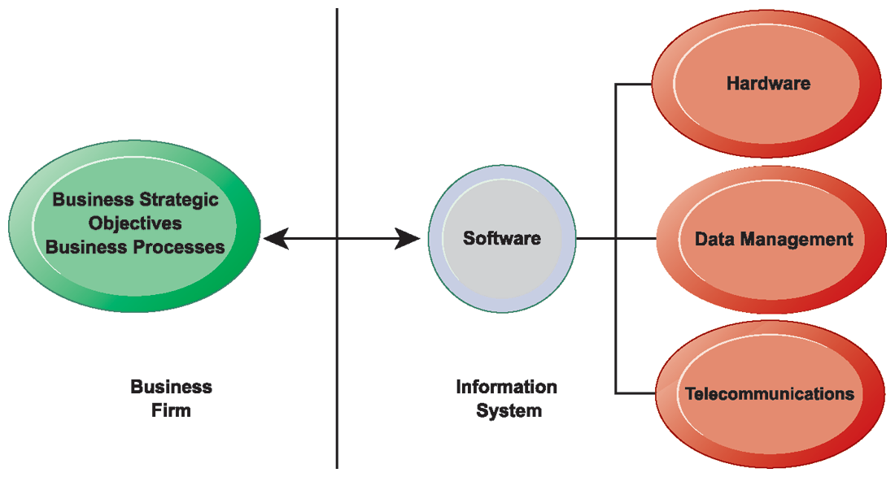
The Interdependence Between Organizations and Information Technology

Slide 17
Strategic Business Objectives of Information Systems
Operational Excellence
New Products, Services and Business Models
Customer and Supplier Intimacy
Improved Decision Making
Competitive Advantage
Survival

Slide 18
1. Operational Excellence
Improvement of efficiency to attain higher profitability
Information systems, technology an important tool in achieving greater efficiency and productivity
Walmart’s Retail Link system links suppliers to stores for superior replenishment system

Slide 19
2. New Products, Services, and Business Models
Business model: describes how company produces, delivers, and sells product or service to create wealth
Information systems and technology a major enabling tool for new products, services, business models
Examples: Apple’s iPad, Google’s Android OS, and Netflix

Slide 20
3. Customer and Supplier Intimacy
Serving customers well leads to customers returning, which raises revenues and profits.
Example: High-end hotels that use computers to track customer preferences and used to monitor and customize environment
Intimacy with suppliers allows them to provide vital inputs, which lowers costs.
Example: JCPenney’s information system which links sales records to contract manufacturer

Slide 21
4. Improved Decision Making
Without accurate information:
Managers must use forecasts, best guesses, luck
Results in:
Overproduction, underproduction
Misallocation of resources
Poor response times
Poor outcomes raise costs, lose customers
Example:
Verizon’s Web-based digital dashboard to provide managers with real-time data on customer complaints, network performance, line outages

Slide 22
5. Competitive advantage
Delivering better performance
Charging less for superior products
Responding to customers and suppliers in real time
Examples: Apple, Walmart, UPS

Slide 23
6. Survival
Information technologies as necessity of business
Industry-level changes
Example: Citibank’s introduction of ATMs
Governmental regulations requiring record-keeping
Examples: Toxic Substances Control Act, Sarbanes-Oxley Act

Slide 24
Information Systems Are More Than Computers

Slide 25
Dimensions of Information Systems
Organizations
People, structure, business processes, politics, and culture.
Management
Make sense out of the many situations faced by organizations, make decisions, and formulate action plans to solve organizational problems.
Information Technology
Computer hardware, software, data management technology, networking and telecommunications technology

Slide 26
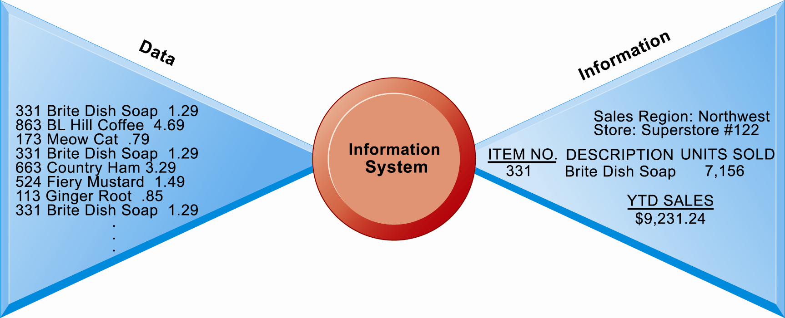
Perspectives on Information Systems: Data and Information

Slide 27
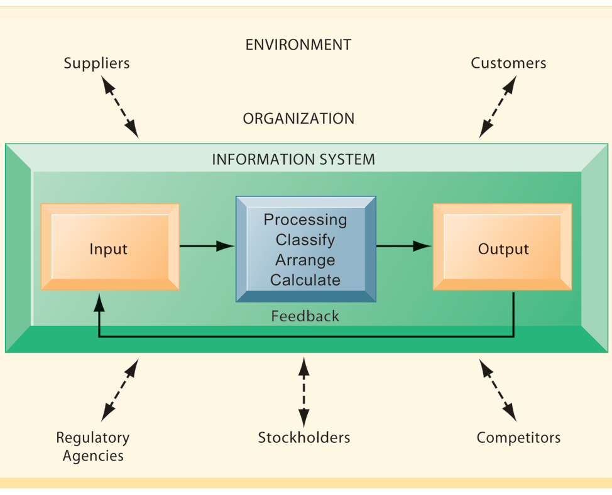
Functions of an Information System

Slide 28
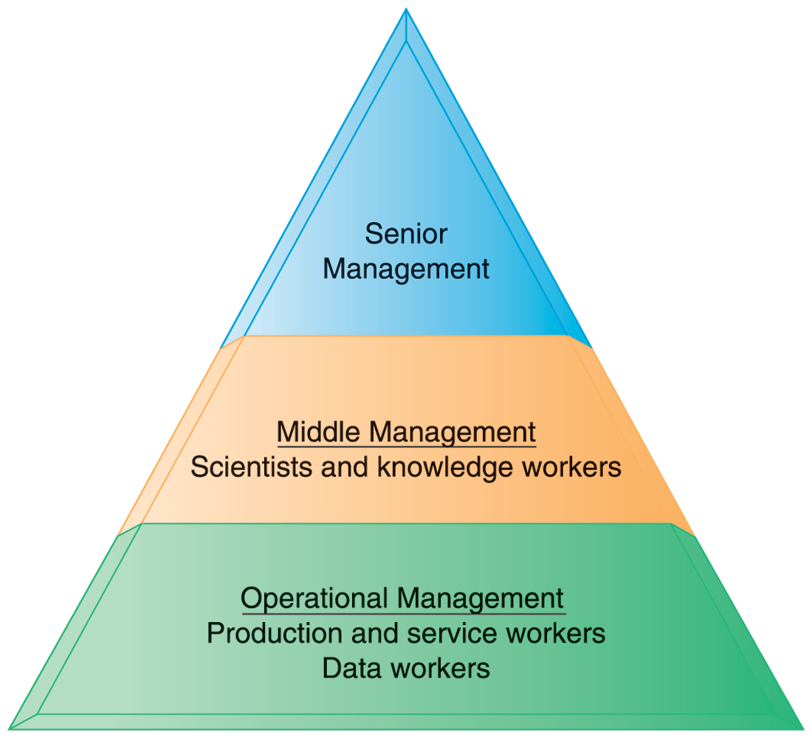
Levels in a Firm

Slide 29
MAJOR BUSINESS FUNCTIONS
FUNCTION | PURPOSE
Sales and marketing | Selling the organization’s products and services
Manufacturing and production | Producing and delivering products and services
Finance and accounting | Managing the organization’s financial assets and maintaining the organization’s financial records
Human resources | Attracting, developing, and maintaining the organization’s labor force; maintaining employee records

Slide 30
IT ISN’T JUST TECHNOLOGY: A BUSINESS PERSPECTIVE ON INFORMATION SYSTEMS

Slide 31
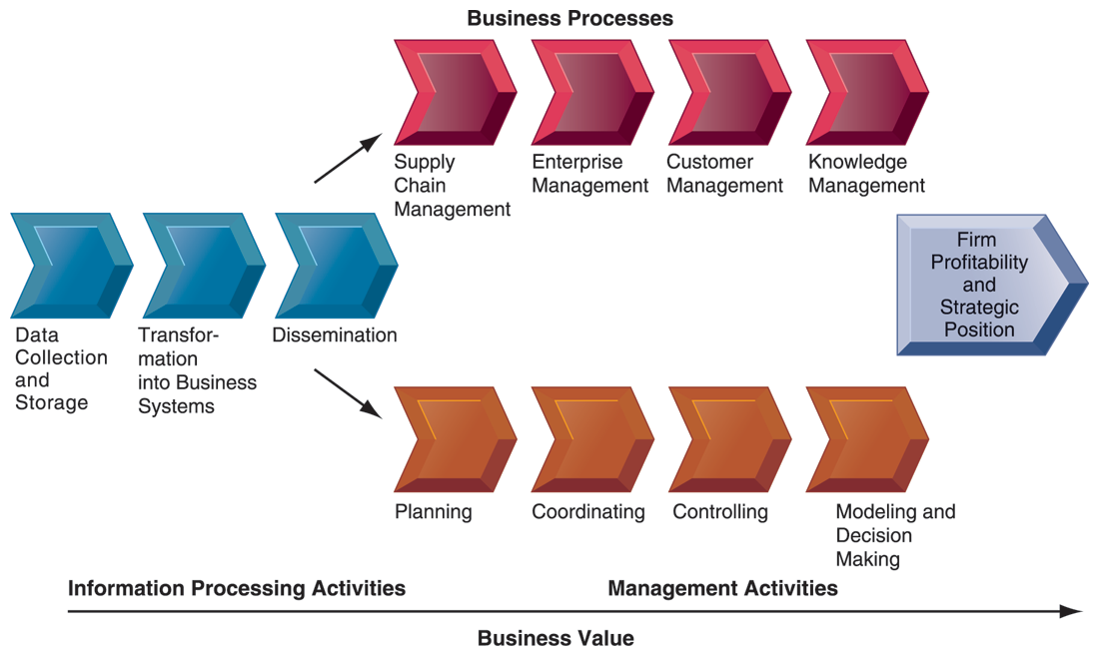
The Business Information Value Chain

Slide 32
The Business Information Value Chain
From a business perspective, information systems are part of a series of value-adding activities for acquiring, transforming, and distributing information that managers can use to improve decision making, enhance organizational performance, and, ultimately, increase firm profitability.

Slide 33
COMPLEMENTARY SOCIAL, MANAGERIAL, AND ORGANIZATIONAL ASSETS REQUIRED TO OPTIMIZE RETURNS FROM INFORMATION TECHNOLOGY INVESTMENTS

Slide 34
Organizational assets
Supportive organizational culture that values efficiency and effectiveness
Appropriate business model
Efficient business processes
Decentralized authority
Distributed decision-making rights
Strong IS development team

Slide 35
Managerial assets
Strong senior management support for technology investment and change
Incentives for management innovation
Teamwork and collaborative work environments
Training programs to enhance management decision skills
Management culture that values flexibility and knowledge-based decision making.

Slide 36
Social assets
The Internet and telecommunications infrastructure
IT-enriched educational programs raising labor force computer literacy
Standards (both government and private sector)
Laws and regulations creating fair, stable market environments
Technology and service firms in adjacent markets to assist implementation

Slide 37
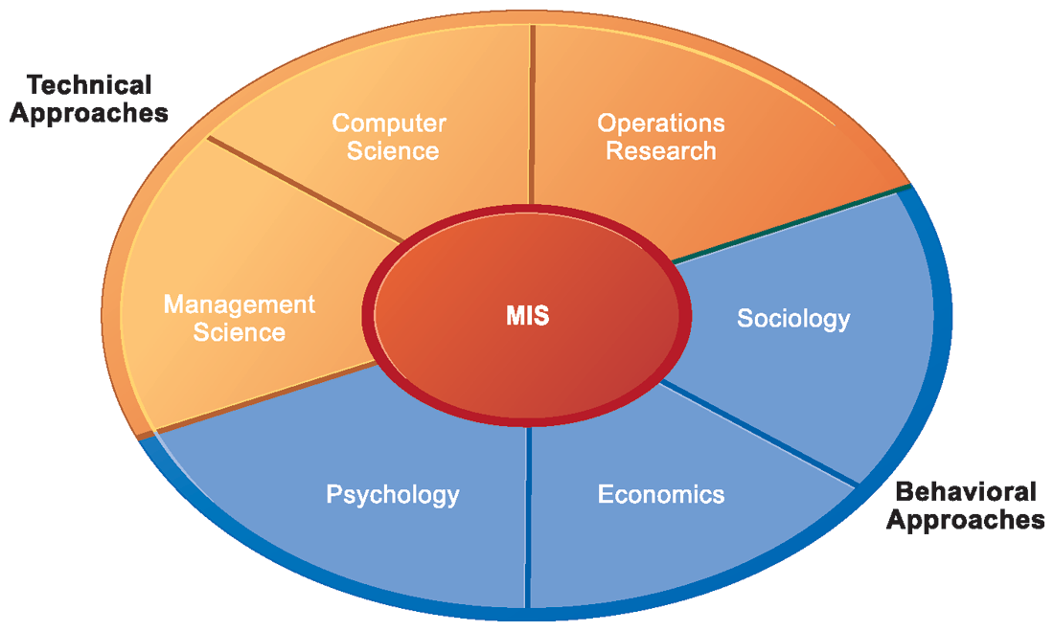
Contemporary Approaches to Information Systems

Slide 38
Contemporary Approaches to Information Systems
Technical Approach
Behavioral Approach
Sociotechnical Systems

Slide 39
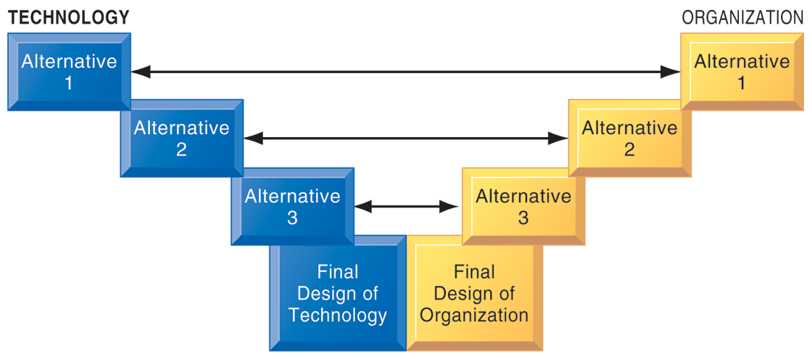
A Sociotechnical Perspective on Information Systems

Slide 40
Business Model

Slide 41
Business Model
8
6
2
4
1
Key Partners
Key Activities
Value Proposition
Customer Relationships
Customer Segments
7
3
Key Resources
Channels
9
5
Cost Structure
Revenue Streams
Source: Alexander Osterwalder & Yves Pigneur, Business Model Generation: A Handbook for Visionaries, Game Changers, and Challengers, Wiley, 2010.

Slide 42
Definition of Business Model
A business model describes the rationale of how an organization creates, delivers, and captures value.
Source: Alexander Osterwalder & Yves Pigneur, Business Model Generation: A Handbook for Visionaries, Game Changers, and Challengers, Wiley, 2010.

Slide 43
Definition of Business Strategy
A business strategy is a long term plan of action designed to achieve a particular goal or set of goals or objectives.

Slide 44
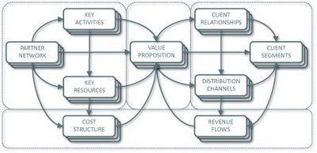
Business Model Canvas
Key Activities
Customer Relationships
Key Partners
Value Preposition
Customer Segments
Key Resources
Channels
Cost Structure
Revenue Streams
Source: http://nonlinearthinking.typepad.com/nonlinear_thinking/2008/07/the-business-model-canvas.html
https://www.youtube.com/watch?v=QoAOzMTLP5s

Slide 45
Business Model Canvas
Infrastructure Management
Product
Customer Interface
Key Activities
Customer Relationships
Key Partners
Value Preposition
Customer Segments
Key Resources
Channels
Financial Aspects
Cost Structure
Revenue Streams
Source: http://nonlinearthinking.typepad.com/nonlinear_thinking/2008/07/the-business-model-canvas.html
https://www.youtube.com/watch?v=QoAOzMTLP5s

Slide 46
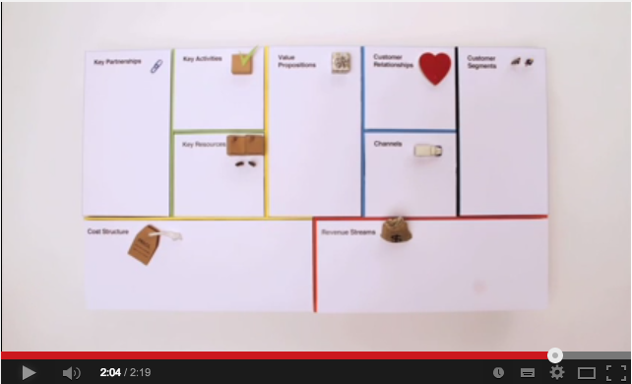
Business Model Canvas Explained
Source: http://www.youtube.com/watch?v=QoAOzMTLP5s

Slide 47
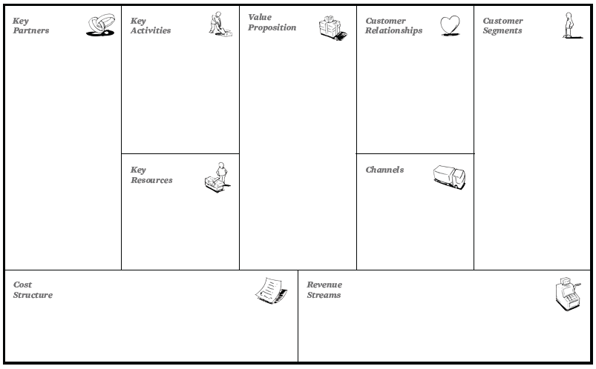
The 9 Building Blocks of Business Model
8
6
2
4
1
7
3
9
5
Source: Alexander Osterwalder & Yves Pigneur, Business Model Generation: A Handbook for Visionaries, Game Changers, and Challengers, Wiley, 2010.

Slide 48
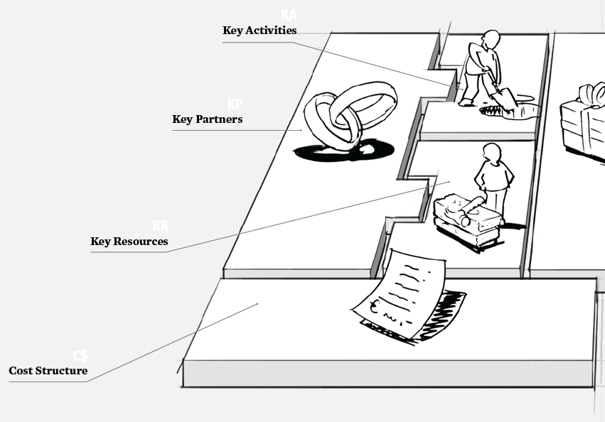
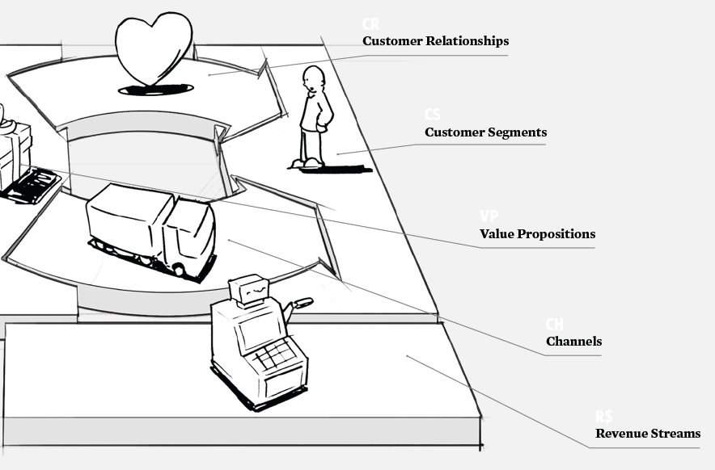
The 9 Building Blocks of Business Model
Source: Alexander Osterwalder & Yves Pigneur, Business Model Generation: A Handbook for Visionaries, Game Changers, and Challengers, Wiley, 2010.

Slide 49
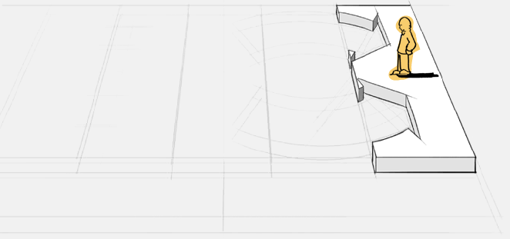
1. Customer Segments
Defines the different groups of people or organizations an enterprise aims to reach and serve
Source: Alexander Osterwalder & Yves Pigneur, Business Model Generation: A Handbook for Visionaries, Game Changers, and Challengers, Wiley, 2010.

Slide 50
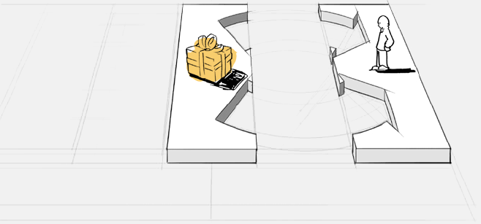
2. Value Propositions
Describes the bundle of products and services that create value for a specific Customer Segment
Source: Alexander Osterwalder & Yves Pigneur, Business Model Generation: A Handbook for Visionaries, Game Changers, and Challengers, Wiley, 2010.

Slide 51
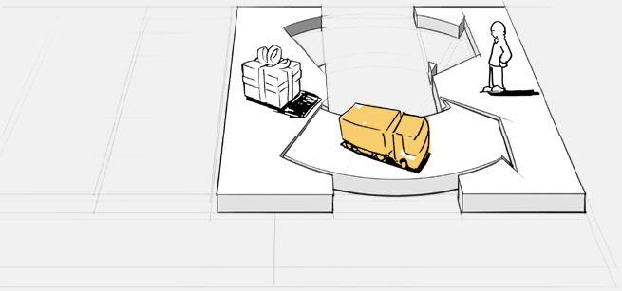
3. Channels
Describes how a company communicates with and reaches its Customer Segments to deliver a Value Proposition
Source: Alexander Osterwalder & Yves Pigneur, Business Model Generation: A Handbook for Visionaries, Game Changers, and Challengers, Wiley, 2010.

Slide 52
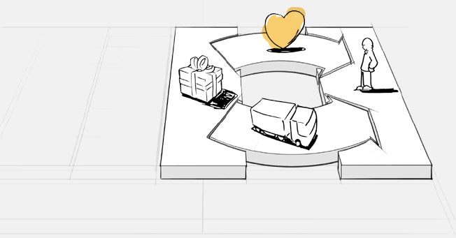
4. Customer Relationships
Describes the types of relationships a company establishes with specific Customer Segments
Source: Alexander Osterwalder & Yves Pigneur, Business Model Generation: A Handbook for Visionaries, Game Changers, and Challengers, Wiley, 2010.

Slide 53
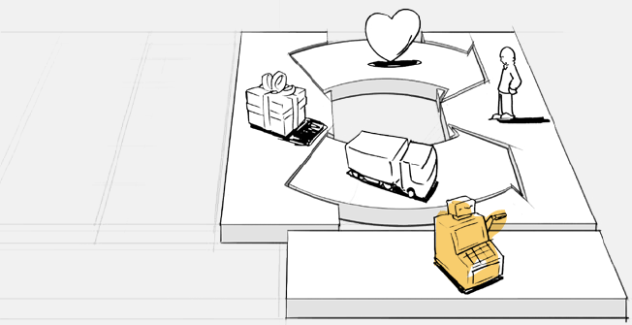
5. Revenue Streams
Represents the cash a company generates from each Customer Segment (costs must be subtracted from revenues to create earnings)
Source: Alexander Osterwalder & Yves Pigneur, Business Model Generation: A Handbook for Visionaries, Game Changers, and Challengers, Wiley, 2010.

Slide 54
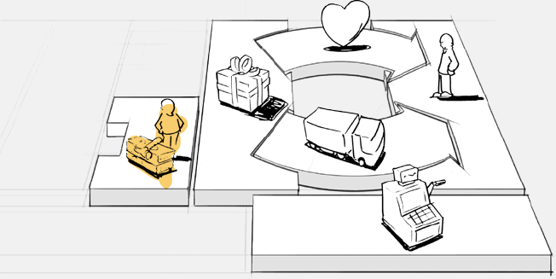
6. Key Resources
Describes the most important assets required to make a business model work
Source: Alexander Osterwalder & Yves Pigneur, Business Model Generation: A Handbook for Visionaries, Game Changers, and Challengers, Wiley, 2010.

Slide 55
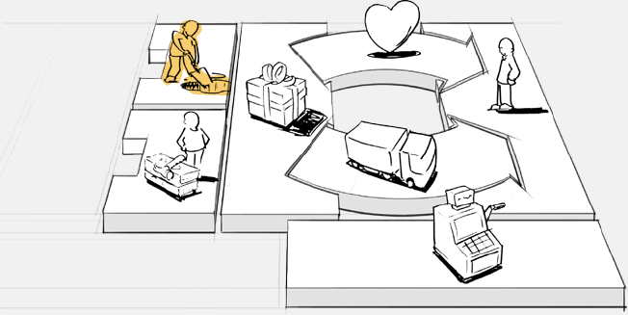
7. Key Activities
Describes the most important things a company must do to make its business model work
Source: Alexander Osterwalder & Yves Pigneur, Business Model Generation: A Handbook for Visionaries, Game Changers, and Challengers, Wiley, 2010.

Slide 56
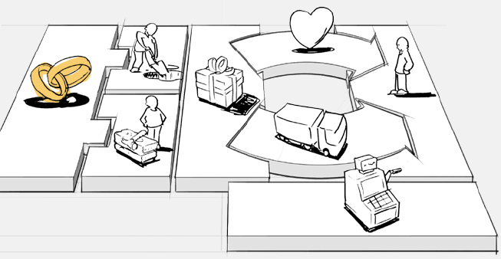
8. Key Partnerships
Describes the network of suppliers and partners that make the business model work
Source: Alexander Osterwalder & Yves Pigneur, Business Model Generation: A Handbook for Visionaries, Game Changers, and Challengers, Wiley, 2010.

Slide 57
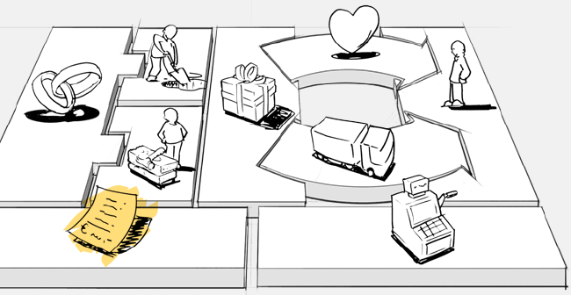
9. Cost Structure
Describes all costs incurred to operate a business model
Source: Alexander Osterwalder & Yves Pigneur, Business Model Generation: A Handbook for Visionaries, Game Changers, and Challengers, Wiley, 2010.

Slide 58
The 9 Building Blocks of Business Model
1. Customer Segments
An organization serves one or several Customer Segments.
2. Value Propositions
It seeks to solve customer problems and satisfy customer needs with value propositions.
3. Channels
Value propositions are delivered to customers through communication, distribution, and sales Channels.
4. Customer Relationships
Customer relationships are established and maintained with each Customer Segment.
Source: Alexander Osterwalder & Yves Pigneur, Business Model Generation: A Handbook for Visionaries, Game Changers, and Challengers, Wiley, 2010.

Slide 59
The 9 Building Blocks of Business Model
5. Revenue Streams
Revenue streams result from value propositions successfully offered to customers.
6. Key Resources
Key resources are the assets required to offer and deliver the previously described elements…
7. Key Activities
…by performing a number of Key Activities.
8. Key Partnerships
Some activities are outsourced and some resources are acquired outside the enterprise.
9. Cost Structure
The business model elements result in the cost structure.
Source: Alexander Osterwalder & Yves Pigneur, Business Model Generation: A Handbook for Visionaries, Game Changers, and Challengers, Wiley, 2010.

Slide 60
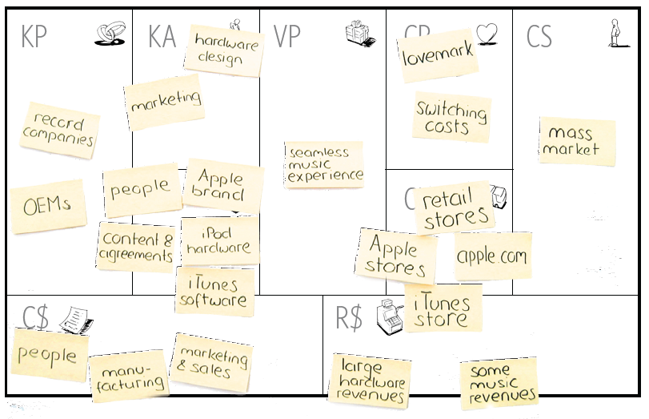
Business Model Generation
Source: Alexander Osterwalder & Yves Pigneur, Business Model Generation: A Handbook for Visionaries, Game Changers, and Challengers, Wiley, 2010.

Slide 61
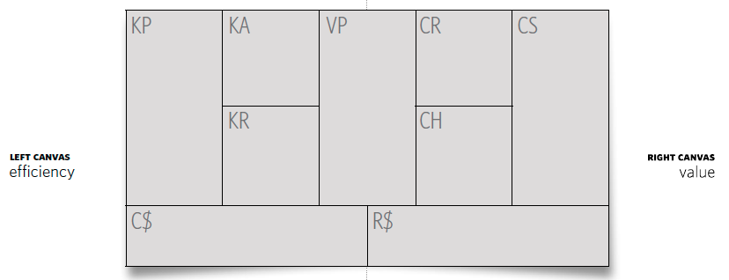
Business Model Generation
Source: Alexander Osterwalder & Yves Pigneur, Business Model Generation: A Handbook for Visionaries, Game Changers, and Challengers, Wiley, 2010.

Slide 62
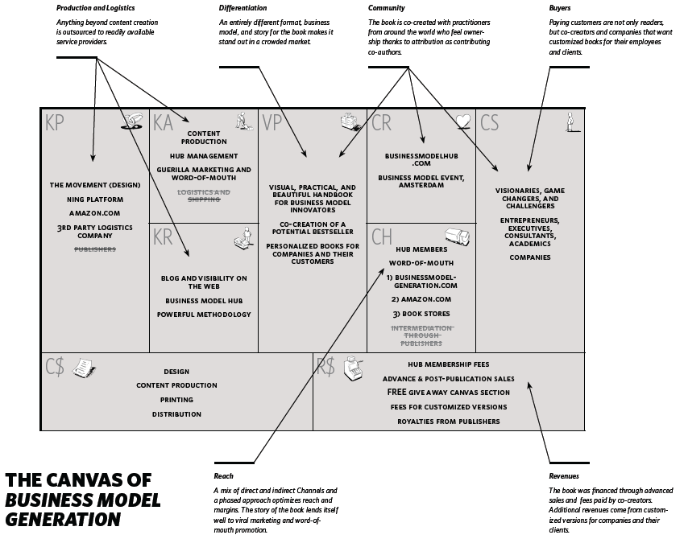
Source: Alexander Osterwalder & Yves Pigneur, Business Model Generation: A Handbook for Visionaries, Game Changers, and Challengers, Wiley, 2010.

Slide 63
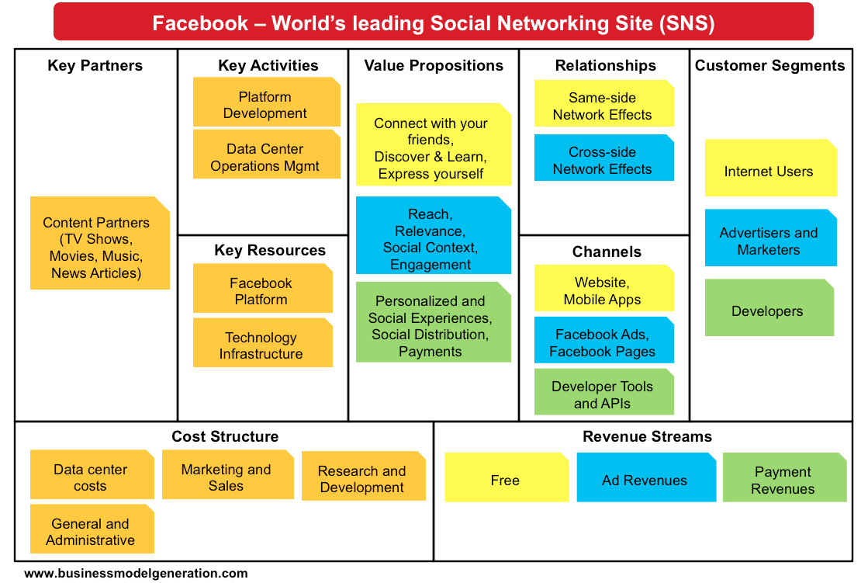
Source: http://bmimatters.com/tag/business-model-canvas-examples/

Slide 64
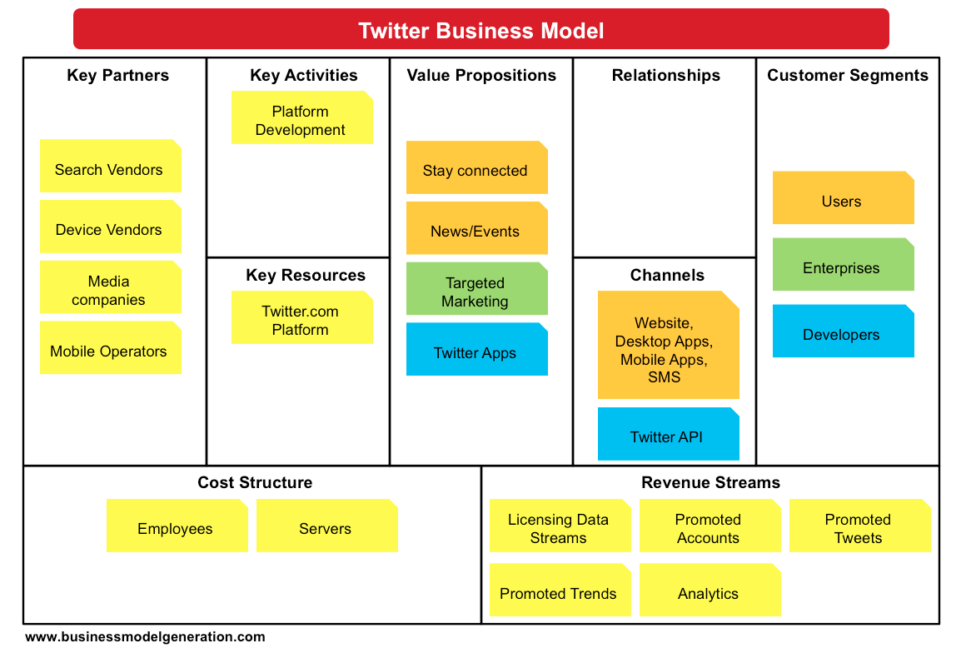
Source: http://bmimatters.com/tag/business-model-canvas-examples/

Slide 65
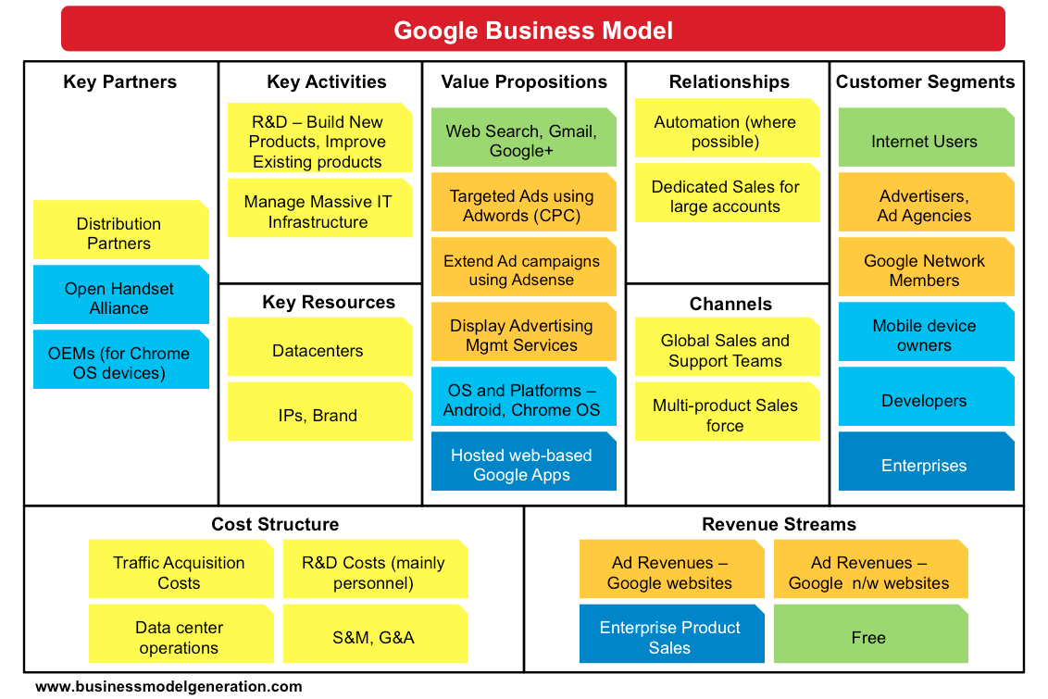
Source: http://bmimatters.com/tag/business-model-canvas-examples/

Slide 66
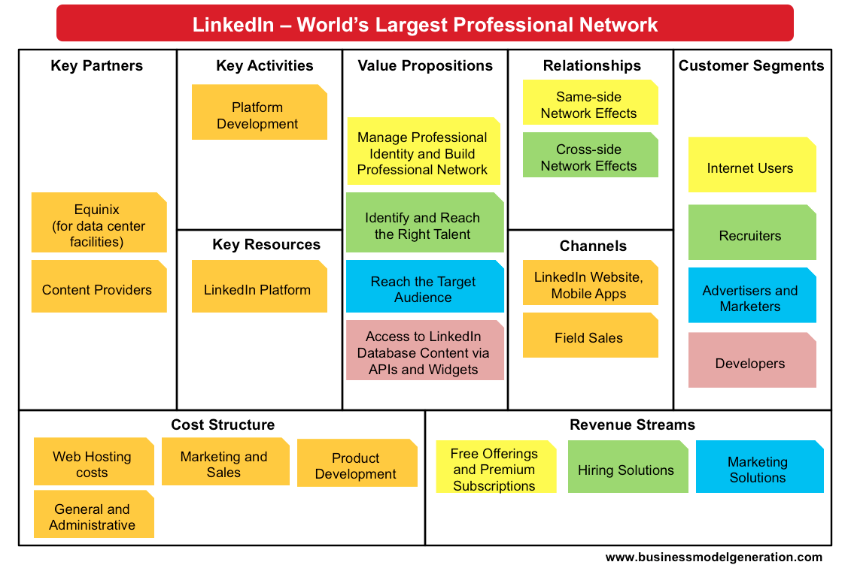
Source: http://bmimatters.com/tag/business-model-canvas-examples/

Slide 67
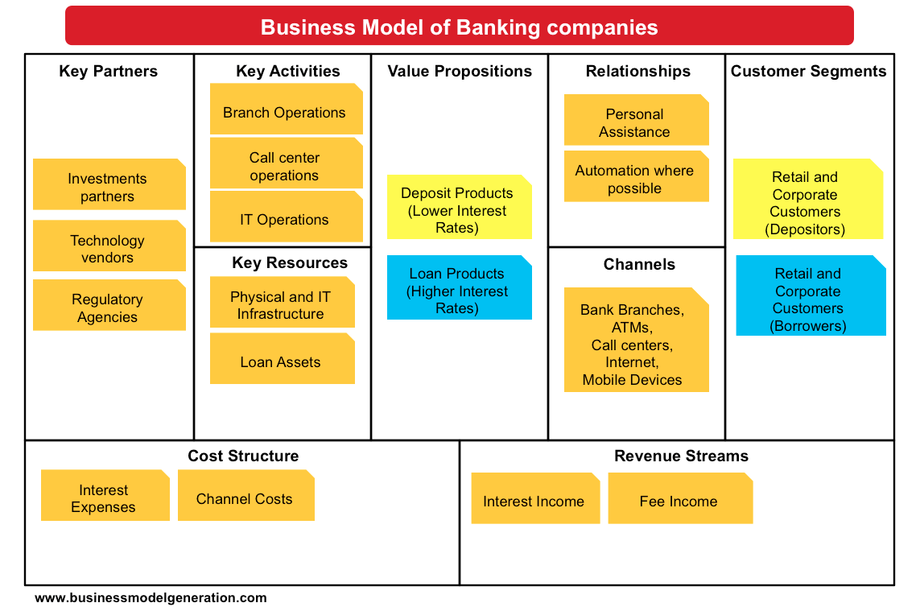
Source: http://bmimatters.com/tag/business-model-canvas-examples/

Slide 68
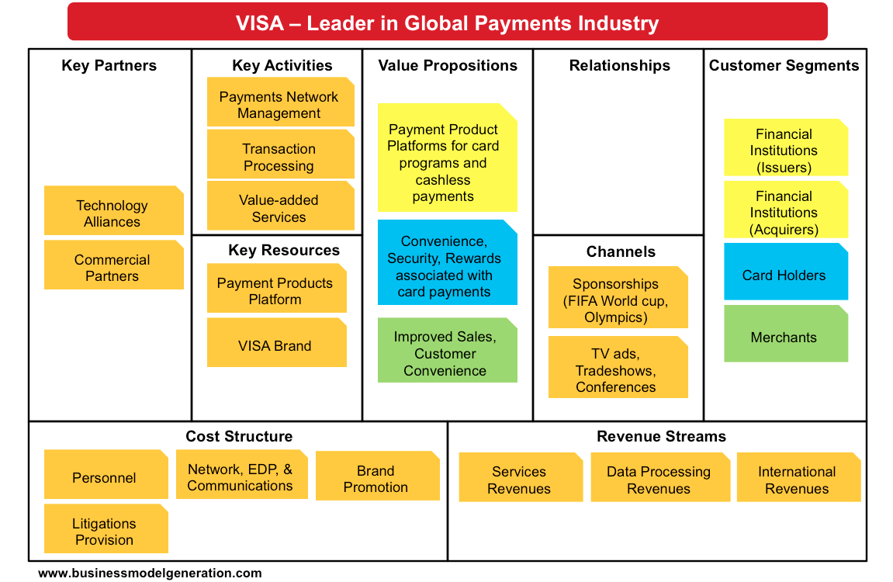
Source: http://bmimatters.com/tag/business-model-canvas-examples/

Slide 69
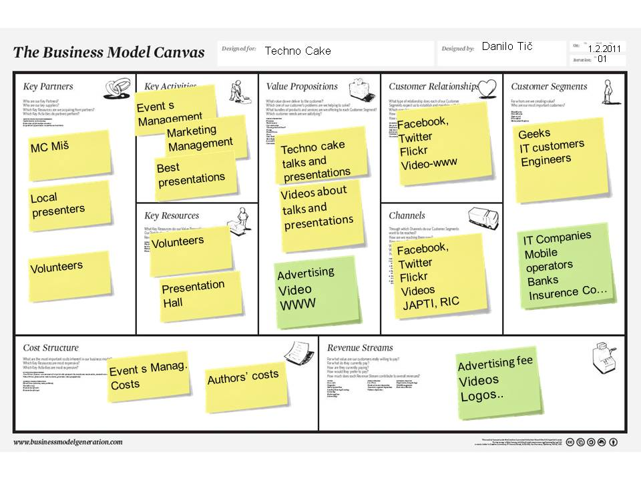
Source: http://businessmodelcombo.wordpress.com/2011/02/04/what-would-a-sustainable-techno-cake-business-model-look-like/
69

Slide 70
How Airbnb Works? Insights into Business Model & Revenue Model
Source: http://nextjuggernaut.com/blog/airbnb-business-model-canvas-how-airbnb-works-revenue-insights/

Slide 71
Airbnb Business Model Canvas
Source: http://nextjuggernaut.com/blog/airbnb-business-model-canvas-how-airbnb-works-revenue-insights/

Slide 72
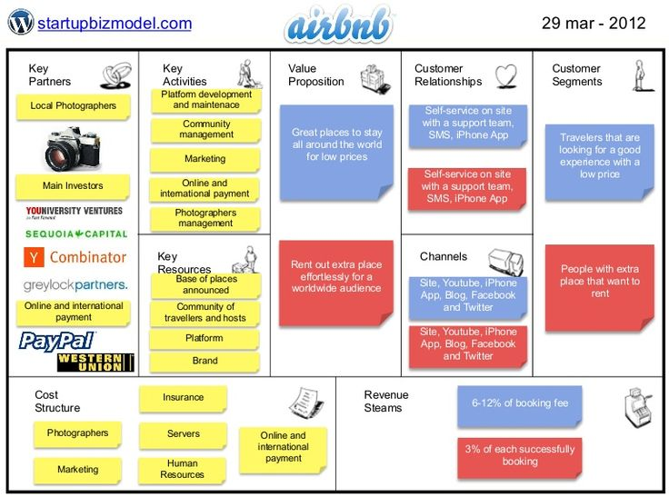
Source: http://www.slideshare.net/ThiagoPaiva/airbnb-12210879

Slide 73
Case Study: P&G (Chap. 2) (pp.84-85) Piloting Procter & Gamble from Decision Cockpits
1. What management, organization, and technology issues had to be addressed when implementing Business Sufficiency, Business Sphere, and Decision Cockpits?
2. How did these decision-making tools change the way the company ran its business? How effective are they? Why?
3. How are these systems related to P&G’s business strategy?

Slide 74
資訊管理專題 (Hot Issues of Information Management)
1. 請同學於資訊管理專題個案討論前 應詳細研讀個案，並思考個案研究問題。
2. 請同學於上課前複習相關資訊管理相關理論，以作為個案分析及擬定管理對策的依據。
3. 請同學於上課前 先繳交資訊管理專題個案研究問題書面報告。
4.上課時間地點： 週四 7,8 (14:10-16:00) B613

Slide 75
References
Kenneth C. Laudon & Jane P. Laudon (2014), Management Information Systems: Managing the Digital Firm, Thirteenth Edition, Pearson.
Kenneth C. Laudon & Jane P. Laudon原著， 游張松 主編，陳文生 翻譯 (2014)， 資訊管理系統，第13版，滄海

