Slide 1
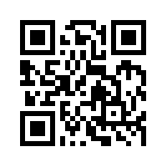
大數據行銷研究 Big Data Marketing Research
Tamkang University
金融科技行銷研究 (FinTech Marketing Research)
1051BDMR12
MIS EMBA (M2262) (8638)
Thu, 12,13,14 (19:20-22:10) (D409)
Min-Yuh Day
戴敏育
Assistant Professor
專任助理教授
Dept. of Information Management, Tamkang University
淡江大學 資訊管理學系
http://mail. tku.edu.tw/myday/
2016-12-30

Slide 2
課程大綱 (Syllabus)
週次 (Week) 日期 (Date) 內容 (Subject/Topics)
1 2016/09/16 中秋節 (調整放假一天) (Mid-Autumn Festival Holiday)(Day off)
2 2016/09/23 大數據行銷研究課程介紹 (Course Orientation for Big Data Marketing Research)
3 2016/09/30 資料科學與大數據行銷 (Data Science and Big Data Marketing)
4 2016/10/07 大數據行銷分析與研究 (Big Data Marketing Analytics and Research)
5 2016/10/14 測量構念 (Measuring the Construct)
6 2016/10/21 測量與量表 (Measurement and Scaling)

Slide 3
課程大綱 (Syllabus)
週次 (Week) 日期 (Date) 內容 (Subject/Topics)
7 2016/10/28 大數據行銷個案分析 I (Case Study on Big Data Marketing I)
8 2016/11/04 探索性因素分析 (Exploratory Factor Analysis)
9 2016/11/11 確認性因素分析 (Confirmatory Factor Analysis)
10 2016/11/18 期中報告 (Midterm Presentation)
11 2016/11/25 社群運算與大數據分析 (Social Computing and Big Data Analytics)
12 2016/12/02 社會網路分析 (Social Network Analysis)

Slide 4
課程大綱 (Syllabus)
週次 (Week) 日期 (Date) 內容 (Subject/Topics)
13 2016/12/09 大數據行銷個案分析 II (Case Study on Big Data Marketing II)
14 2016/12/16 社會網絡分析量測與實務 (Measurements and Practices of Social Network Analysis)
15 2016/12/23 大數據情感分析 (Big Data Sentiment Analysis)
16 2016/12/30 金融科技行銷研究 (FinTech Marketing Research)
17 2017/01/06 期末報告 I (Term Project Presentation I)
18 2017/01/13 期末報告 II (Term Project Presentation II)

Slide 5
Outline
FinTech
Robo-Advisors
Financial Sentiment Analysis

Slide 6
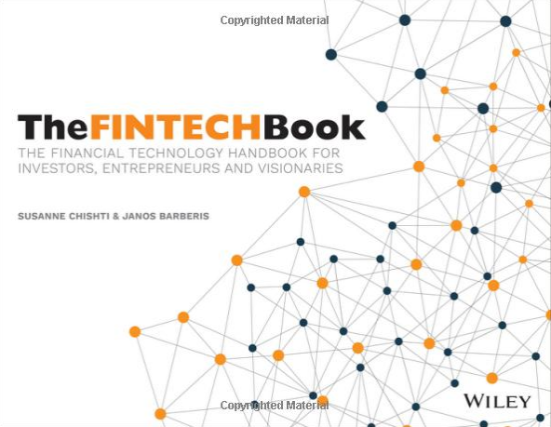
The FINTECH Book: The Financial Technology Handbook for Investors, Entrepreneurs and Visionaries, Susanne Chishti and Janos Barberis, Wiley, 2016.
Source: https://www.amazon.com/FINTECH-Book-Technology-Entrepreneurs-Visionaries/dp/111921887X

Slide 7
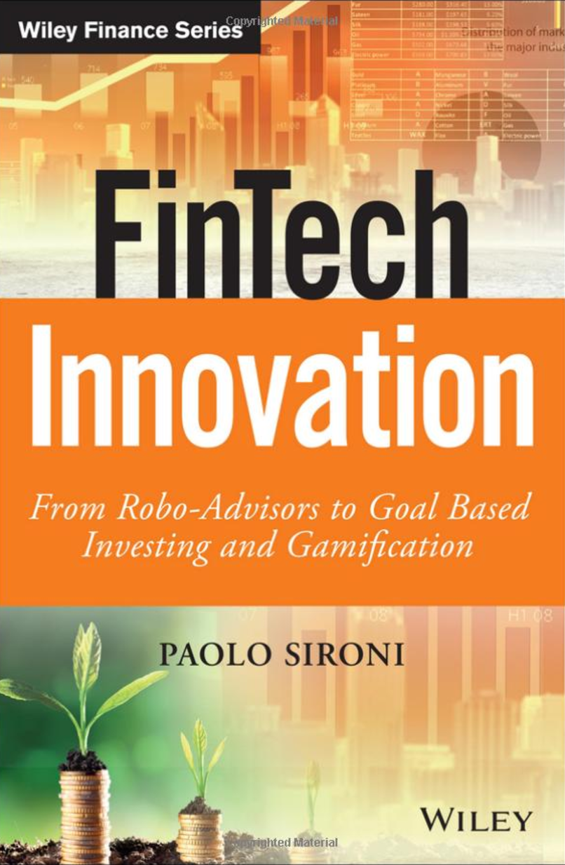
FinTech Innovation: From Robo-Advisors to Goal Based Investing and Gamification, Paolo Sironi, Wiley, 2016
Source: https://www.amazon.com/FinTech-Innovation-Robo-Advisors-Investing-Gamification/dp/1119226988

Slide 8
FinTech

Slide 9
Financial Technology

Slide 10
FinTech

Slide 11
Financial Technology FinTech
“providing financial services by making use of software and modern technology”
Source: https://www.fintechweekly.com/fintech-definition

Slide 12
Financial Services

Slide 13
Money

Slide 14
Market

Slide 15
Financial Services
Source: http://www.crackitt.com/7-reasons-why-your-fintech-startup-needs-visual-marketing/

Slide 16
Financial Revolution with Fintech
Source: http://www.hedgethink.com/fintech/european-fintech-top-100/

Slide 17
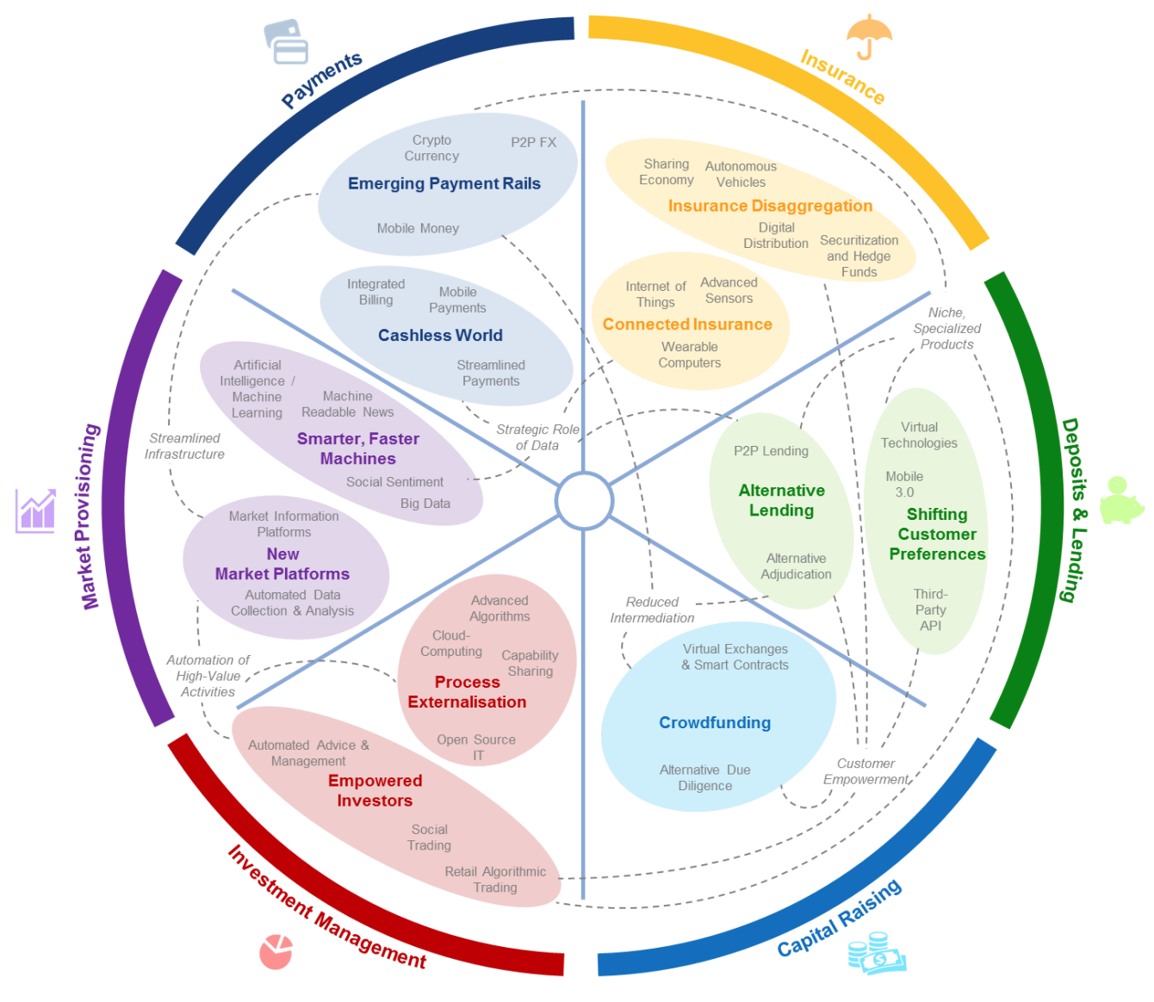
FinTech: Financial Services Innovation
Source: http://www3.weforum.org/docs/WEF_The_future__of_financial_services.pdf

Slide 18
FinTech: Investment Management Market Provisioning

Slide 19
FinTech: Market Provisioning
Source: http://www3.weforum.org/docs/WEF_The_future__of_financial_services.pdf

Slide 20
FinTech: Investment Management
Source: http://www3.weforum.org/docs/WEF_The_future__of_financial_services.pdf

Slide 21
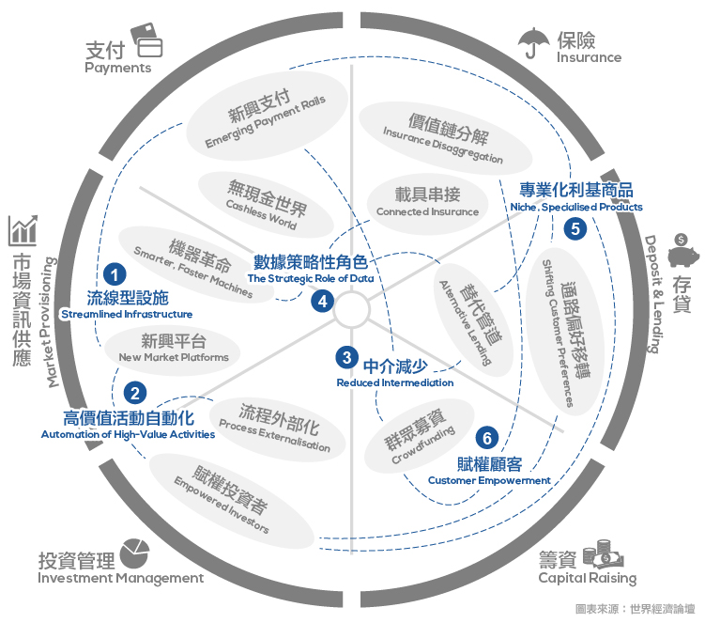
Source: https://www.stockfeel.com.tw/2015年世界經濟論壇－未來的金融服務/

Slide 22
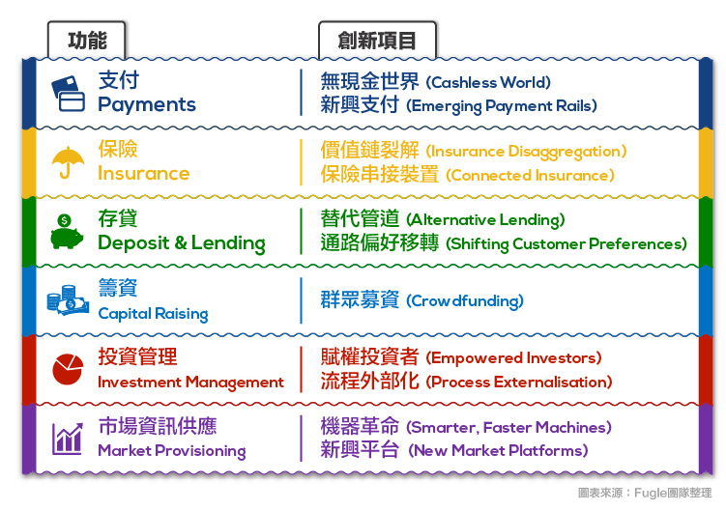
FinTech
Source: https://www.stockfeel.com.tw/2015年世界經濟論壇－未來的金融服務/

Slide 23
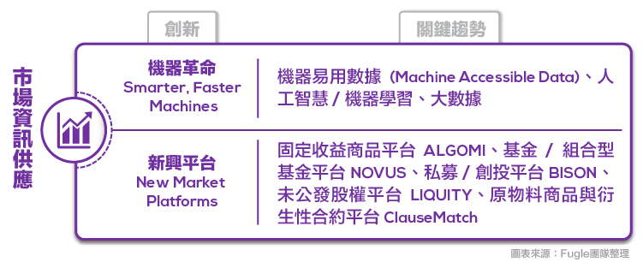
FinTech: Market Provisioning Smarter, Faster Machines
Source: https://www.stockfeel.com.tw/2015年世界經濟論壇－未來的金融服務/

Slide 24
FinTech: Investment Management
Source: https://www.stockfeel.com.tw/2015年世界經濟論壇－未來的金融服務/

Slide 25
FinTech for Financial Services
Retail Banking
Lending and Financing
Payments and Transfers
Wealth and Asset Management
Markets and Exchanges
Insurance
Blockchain Transactions
Source: https://fintechweekly.com/fintech-companies

Slide 26
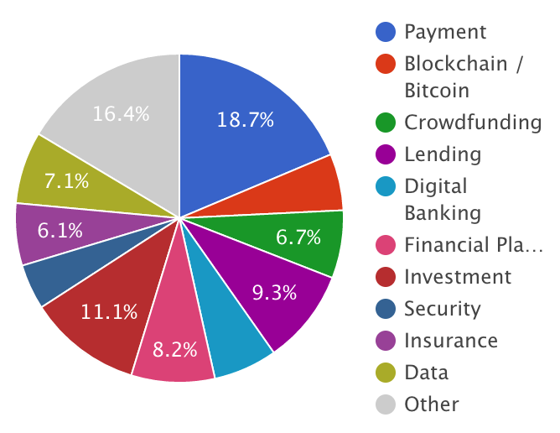
Fintech Companies
Source: https://fintechweekly.com/fintech-companies

Slide 27
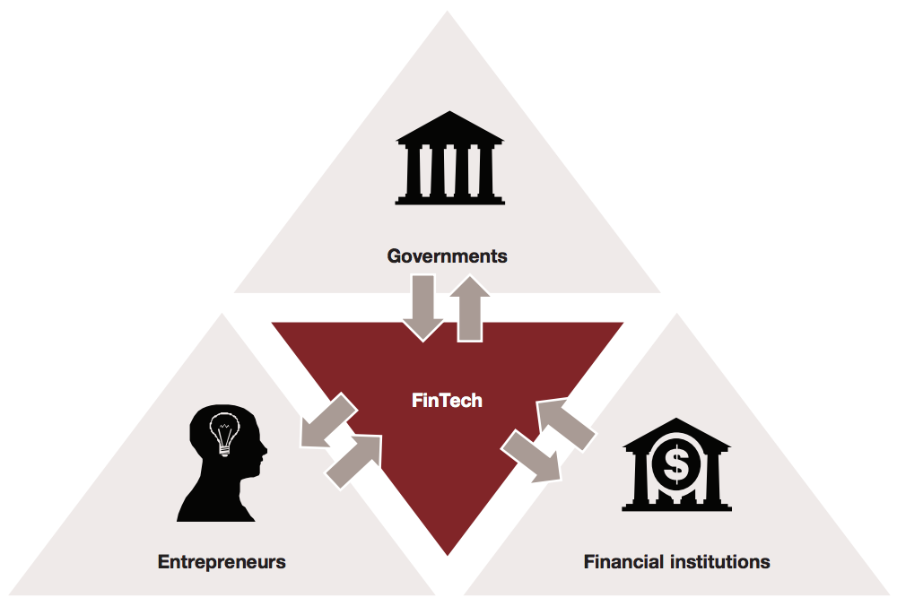
Major Participants in the FinTech Ecosystem
Source: http://www.strategyand.pwc.com/media/file/Developing-a-FinTech-ecosystem-in-the-GCC.pdf

Slide 28
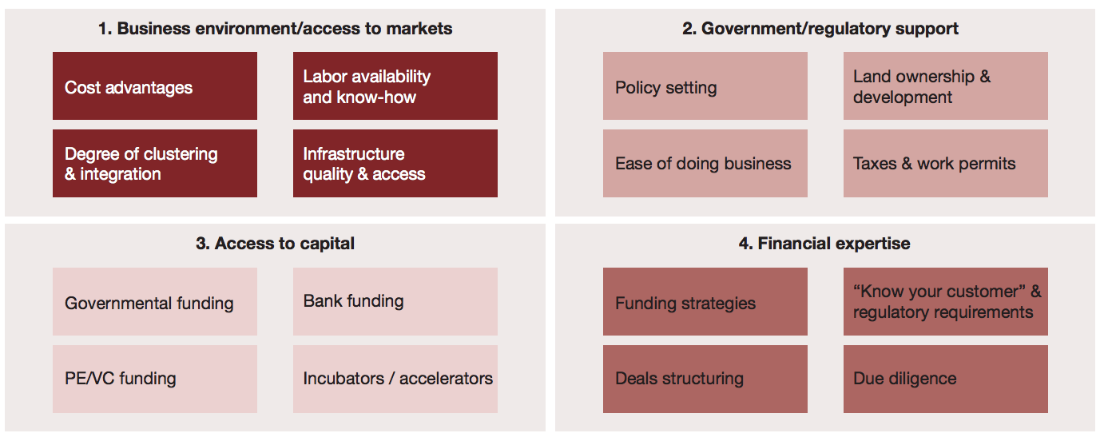
FinTech Ecosystem Development Framework
Source: http://www.strategyand.pwc.com/media/file/Developing-a-FinTech-ecosystem-in-the-GCC.pdf

Slide 29
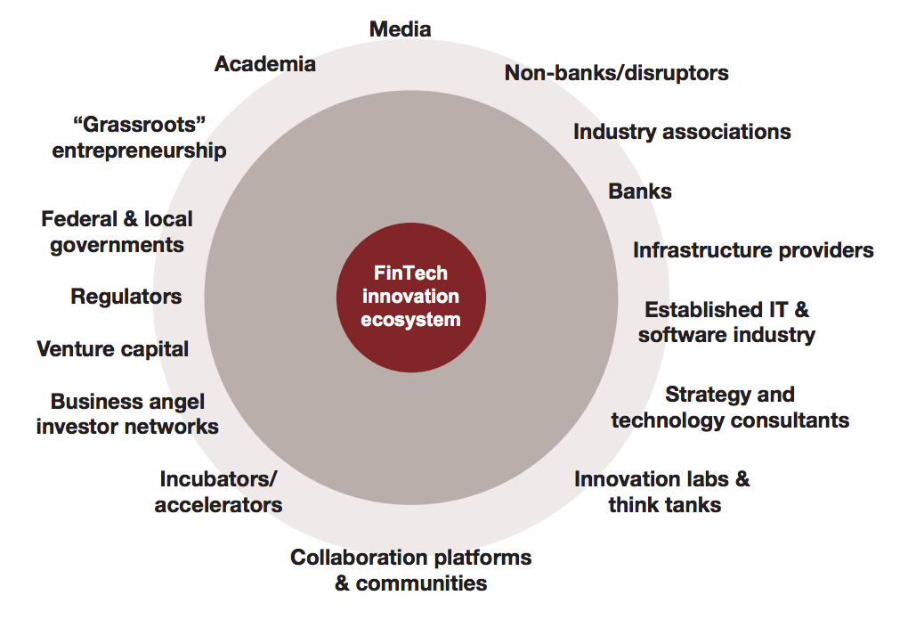
The FinTech Innovation Ecosystem
Source: http://www.strategyand.pwc.com/media/file/Developing-a-FinTech-ecosystem-in-the-GCC.pdf

Slide 30
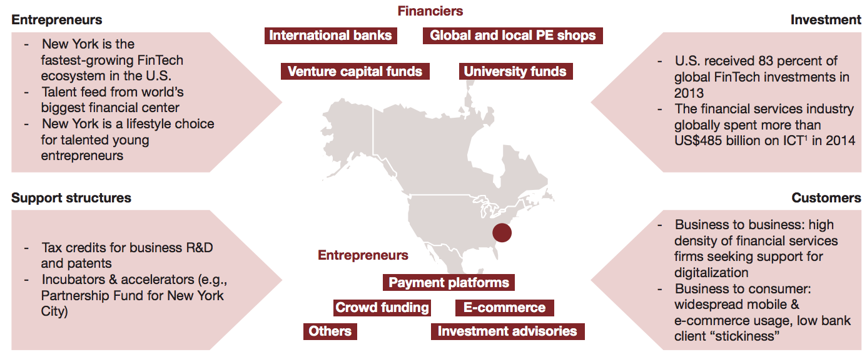
The U.S. FinTech landscape
Source: http://www.strategyand.pwc.com/media/file/Developing-a-FinTech-ecosystem-in-the-GCC.pdf

Slide 31
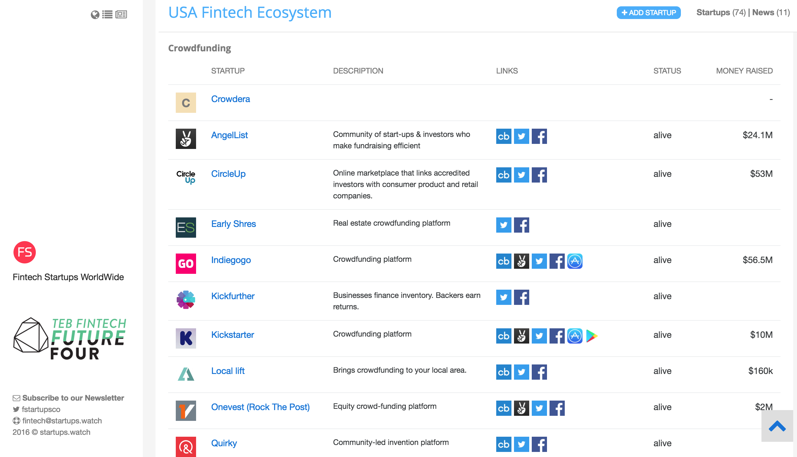
Fintech Startups
Source: https://fintechstartups.co

Slide 32
Financial Technology (Fintech) Categories
Banking Infrastructure
Business Lending
Consumer and Commercial Banking
Consumer Lending
Consumer Payments
Crowdfunding
Equity Financing
Financial Research and Data
Financial Transaction Security
Institutional Investing
International Money Transfer
Payments Backend and Infrastructure
Personal Finance
Point of Sale Payments
Retail Investing
Small and Medium Business Tools
Source: http://www.venturescanner.com/financial-technology

Slide 33
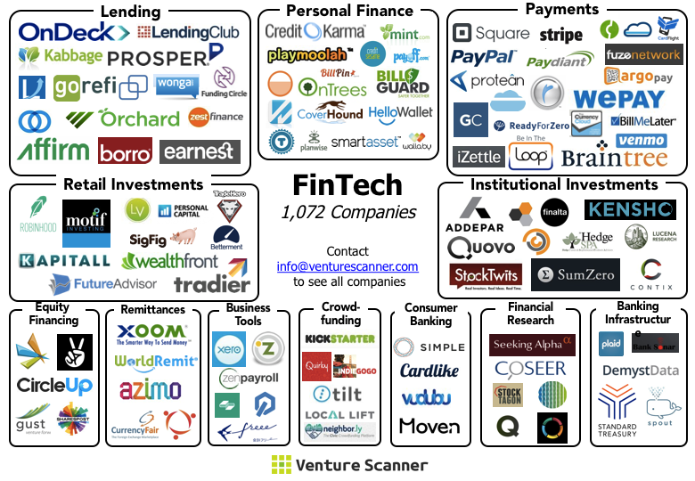
FinTech Ecosystem (April 2015)
Source: https://venturescannerinsights.wordpress.com/2015/04/07/fintech-ecosystem-update-april-2015/

Slide 34
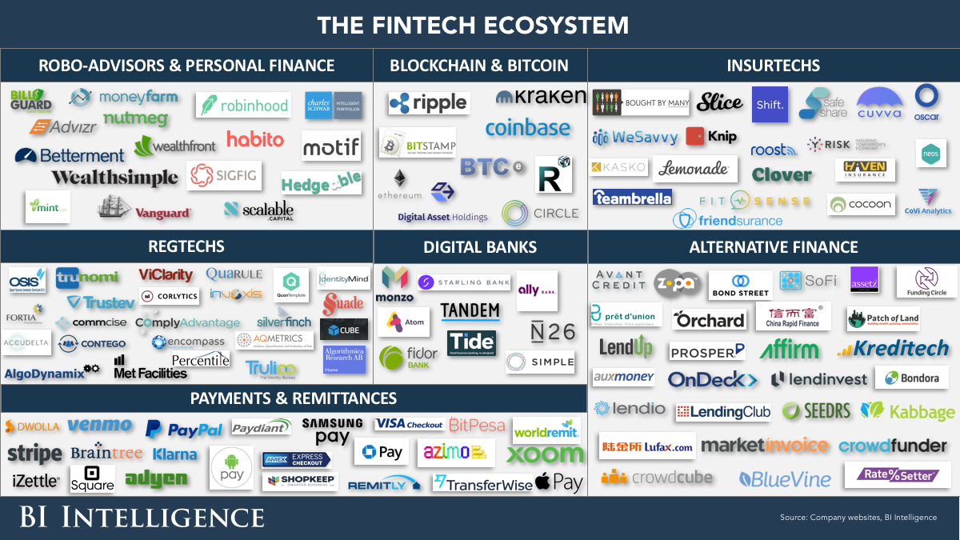
Financial Technology (FinTech)
Source: http://www.businessinsider.com/the-fintech-ecosystem-explained-measuring-the-effects-of-technology-on-the-entire-financial-services-industry-2015-12

Slide 35
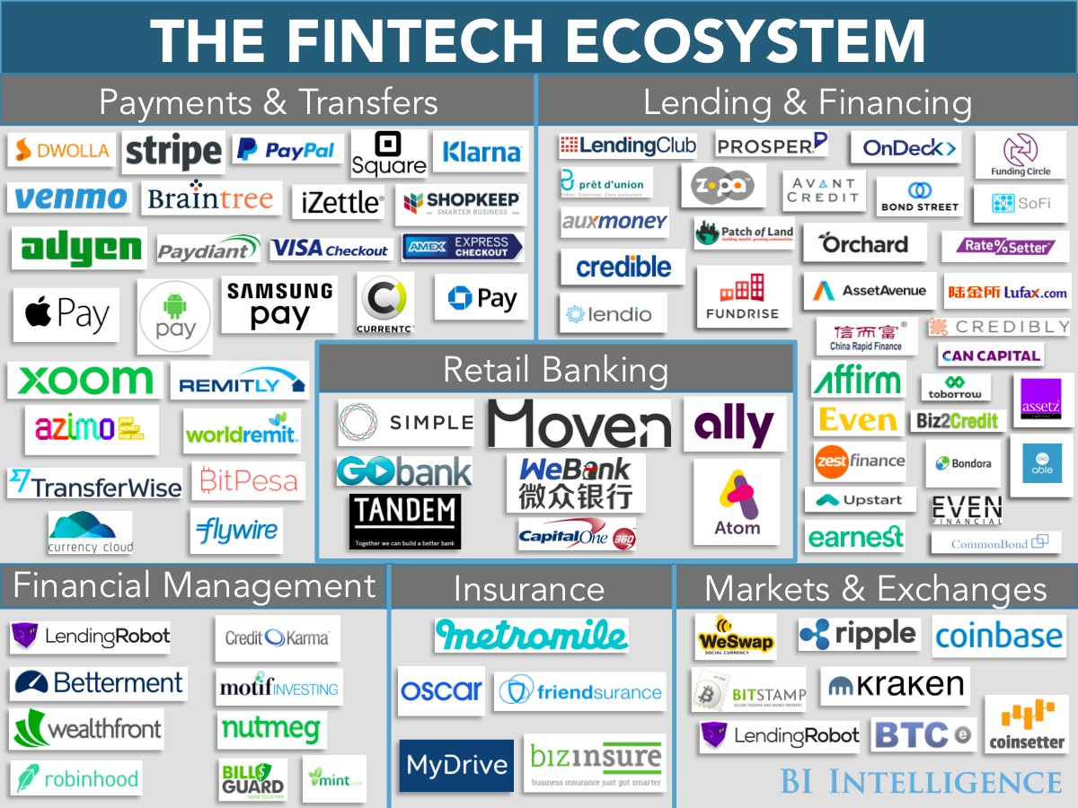
Financial Technology (FinTech)
Source: http://www.businessinsider.com/fintech-ecosystem-financial-technology-research-plus-business-opportunities-2016-2

Slide 36
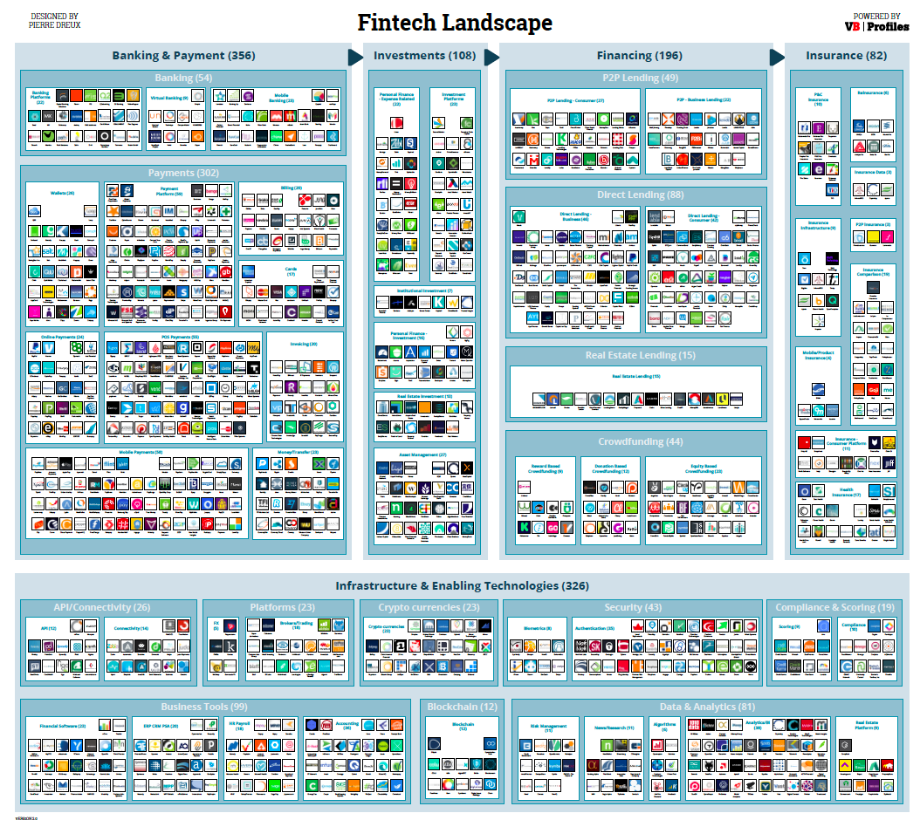
Source: http://www.forbes.com/sites/jeanbaptiste/2016/09/28/the-global-fintech-landscape-reaches-over-1000-companies-105b-in-funding-867b-in-value-report

Slide 37
FinTech Landscape Enabling Technologies Data & Analytics
Source: https://www.vbprofiles.com/l/fintech

Slide 38
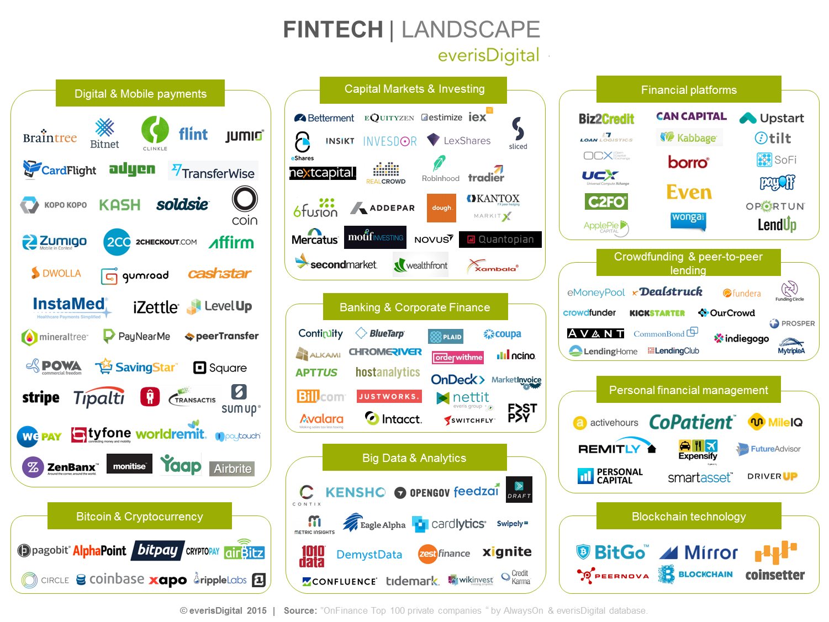
Source: https://everisnext.com/2015/06/02/top-9-verticals-within-the-fintech-landscape-for-large-corporations/

Slide 39
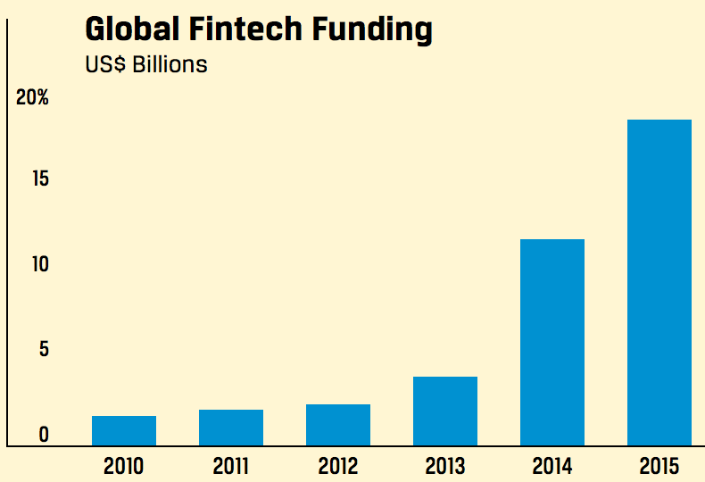
Global Fintech Funding
Source: Rubino, J. (2016). My Favorite Robot. CFA Institute Magazine, 27(3), 43-46.

Slide 40
FinTech Startups Worldwide

Slide 41
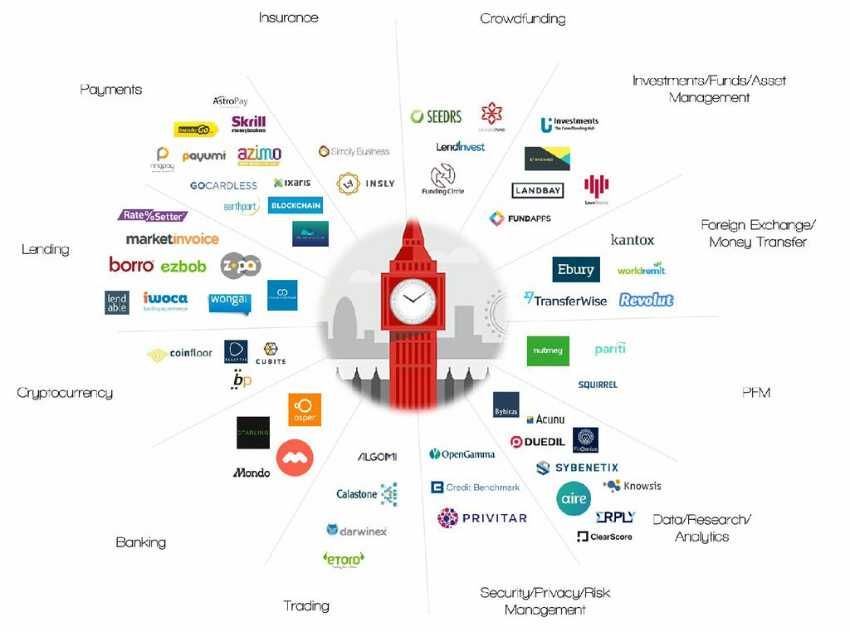
Fintech Startups WorldWide
Source: https://startups.watch/fintech-ecosystems-worldwide/

Slide 42
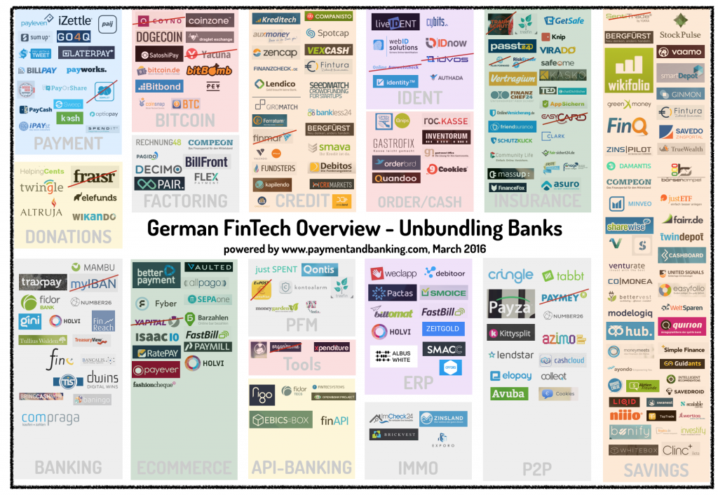
Fintech Startups WorldWide
Source: https://startups.watch/fintech-ecosystems-worldwide/

Slide 43
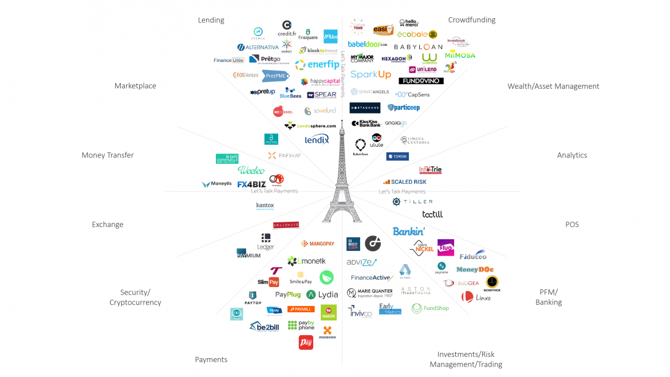
Fintech Startups WorldWide
Source: https://startups.watch/fintech-ecosystems-worldwide/

Slide 44
Fintech Startups WorldWide
Source: https://startups.watch/fintech-ecosystems-worldwide/

Slide 45
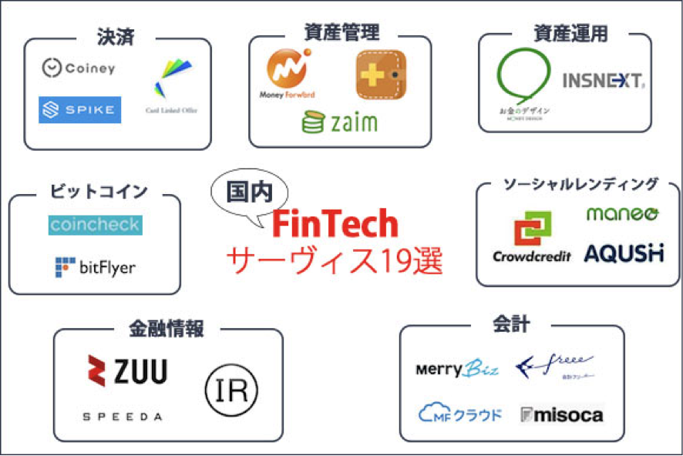
Fintech Startups WorldWide
Source: https://startups.watch/fintech-ecosystems-worldwide/

Slide 46
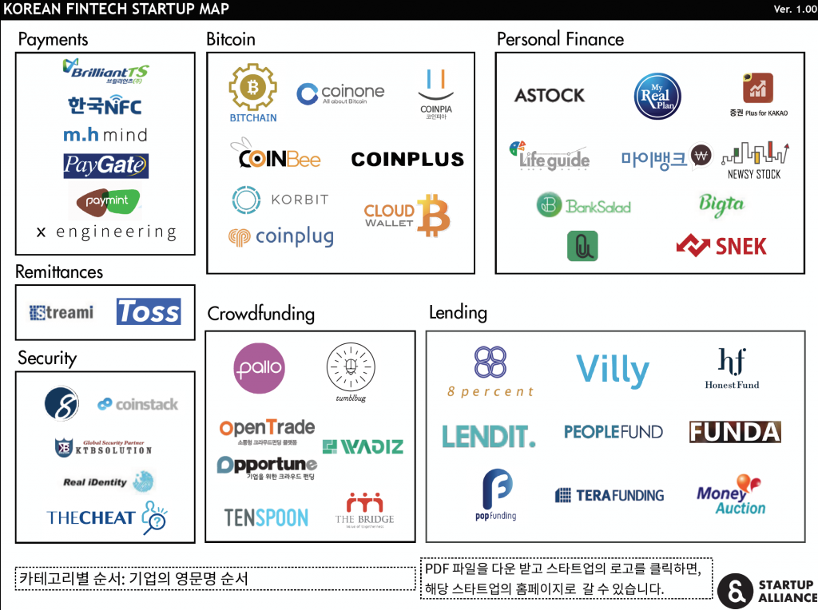
Fintech Startups WorldWide
Source: https://startups.watch/fintech-ecosystems-worldwide/

Slide 47
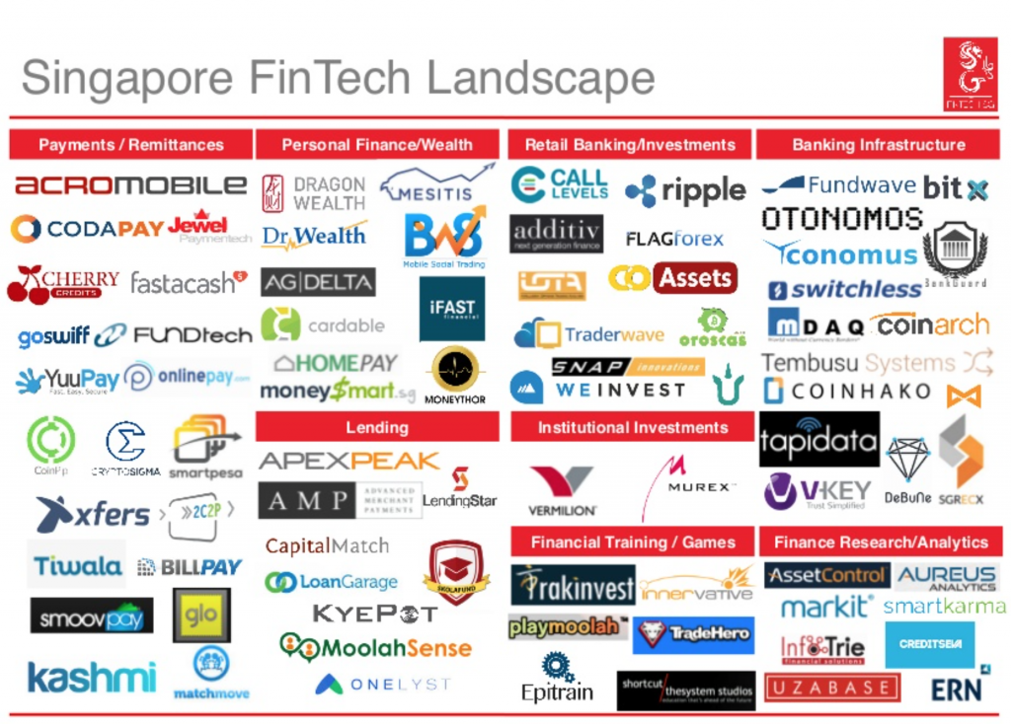
Fintech Startups WorldWide
Source: https://startups.watch/fintech-ecosystems-worldwide/

Slide 48
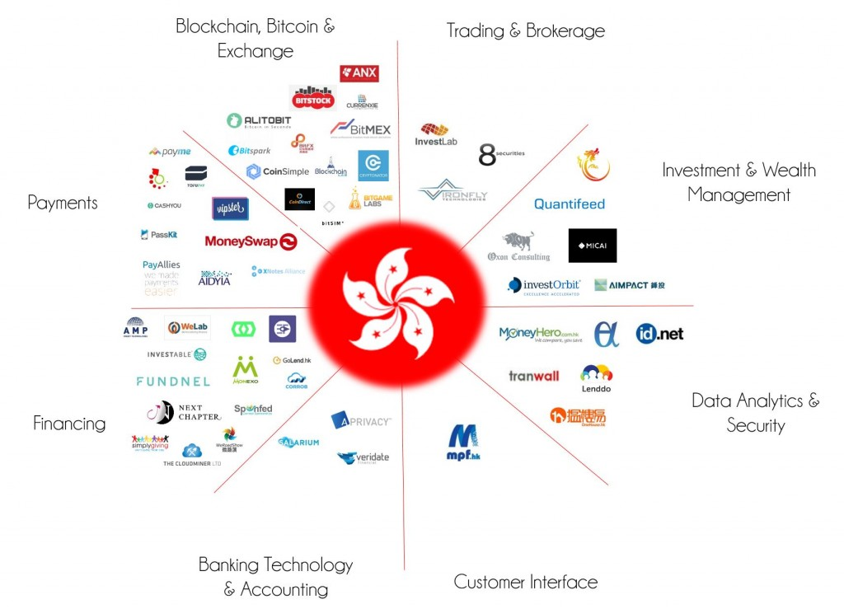
Fintech Startups WorldWide
Source: https://startups.watch/fintech-ecosystems-worldwide/

Slide 49
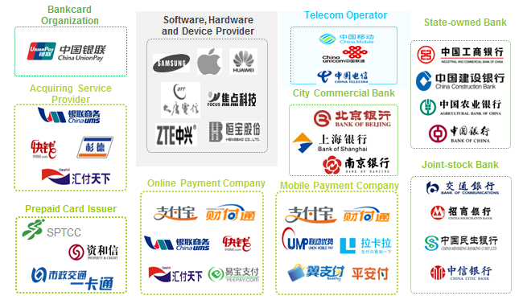
Fintech Startups WorldWide
Source: https://startups.watch/fintech-ecosystems-worldwide/

Slide 50
Fintech: Financial Technology
Disrupting Banking: The Fintech Startups That Are Unbundling Wells Fargo, Citi and Bank of America
Source: https://www.cbinsights.com/blog/industry-market-map-landscape/

Slide 51
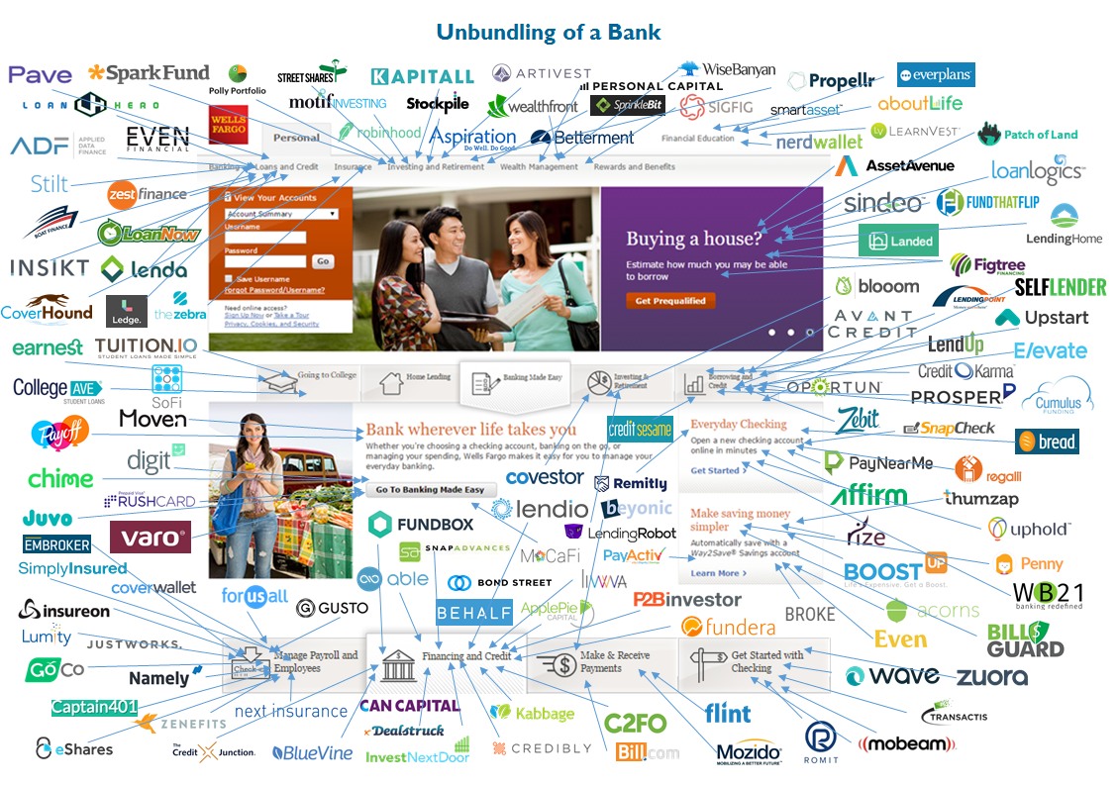
Fintech: Unbunding the Bank
Source: https://www.cbinsights.com/blog/disrupting-banking-fintech-startups-2016/

Slide 52
Fintech: Unbunding the Bank
Wealth Management: Wealthfront
Source: https://www.cbinsights.com/blog/disrupting-banking-fintech-startups-2016/

Slide 53
Fintech: Financial Technology
Disrupting European Banking: The FinTech Startups That Are Unbundling HSBC, Santander, and BNP
Source: https://www.cbinsights.com/blog/industry-market-map-landscape/

Slide 54
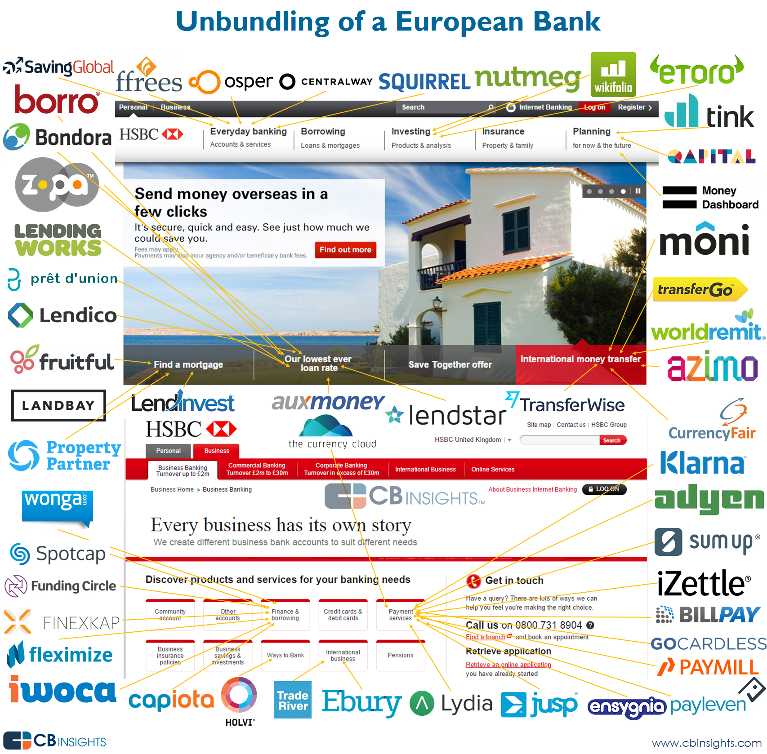
Source: https://www.cbinsights.com/blog/disrupting-european-banking-fintech-startups/

Slide 55
Source: https://www.cbinsights.com/blog/disrupting-european-banking-fintech-startups/

Slide 56
The New Alpha: 30+ Startups Providing Alternative Data For Sophisticated Investors
New sources of data mined by startups like Foursquare, Premise, and Orbital Insight are letting investors understand trends before they happen.
Source: https://www.cbinsights.com/blog/alternative-data-startups-market-map-company-list/

Slide 57
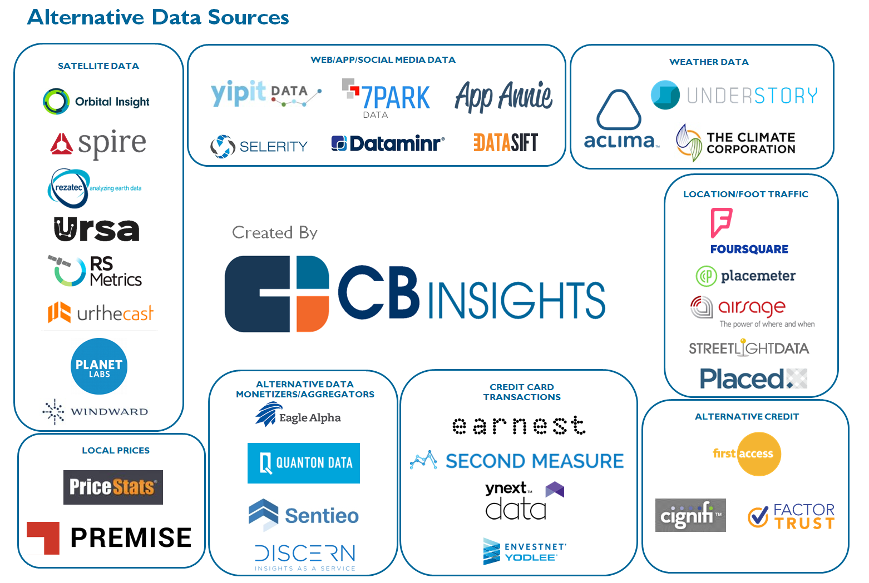
The New Alpha: 30+ Startups Providing Alternative Data For Sophisticated Investors
Source: https://www.cbinsights.com/blog/alternative-data-startups-market-map-company-list/

Slide 58
From Algorithmic Trading To Personal Finance Bots: 41 Startups Bringing AI To Fintech
Source: https://www.cbinsights.com/blog/artificial-intelligence-fintech-market-map-company-list/

Slide 59
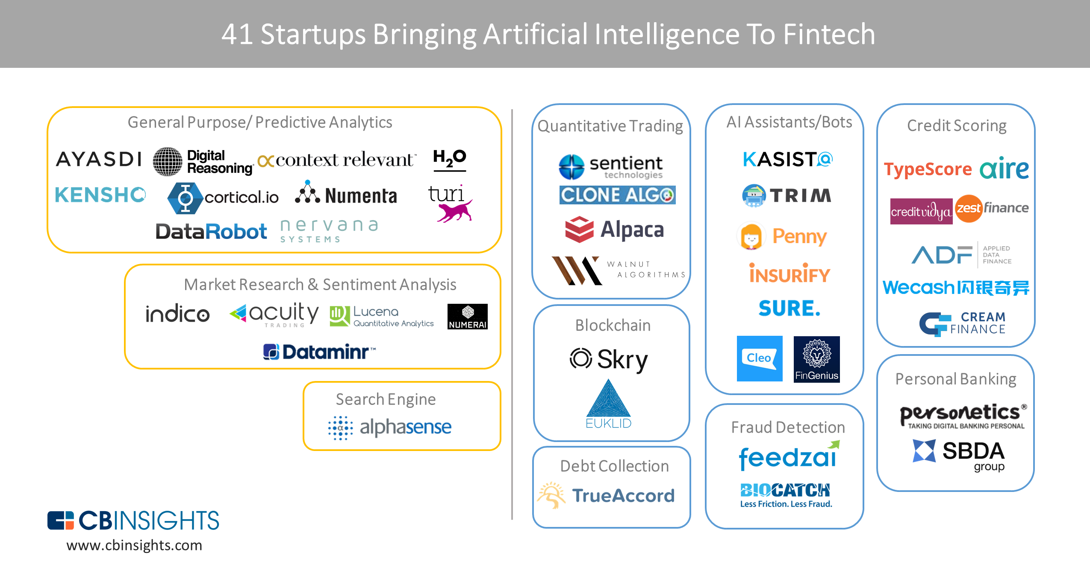
From Algorithmic Trading To Personal Finance Bots: 41 Startups Bringing AI To Fintech
AI in Fintech
Source: https://www.cbinsights.com/blog/artificial-intelligence-fintech-market-map-company-list/

Slide 60
Artificial Intelligence (AI) in Fintech
Source: https://www.cbinsights.com/blog/artificial-intelligence-fintech-market-map-company-list/

Slide 61
Artificial Intelligence (AI) in Fintech
Source: https://www.cbinsights.com/blog/artificial-intelligence-fintech-market-map-company-list/

Slide 62
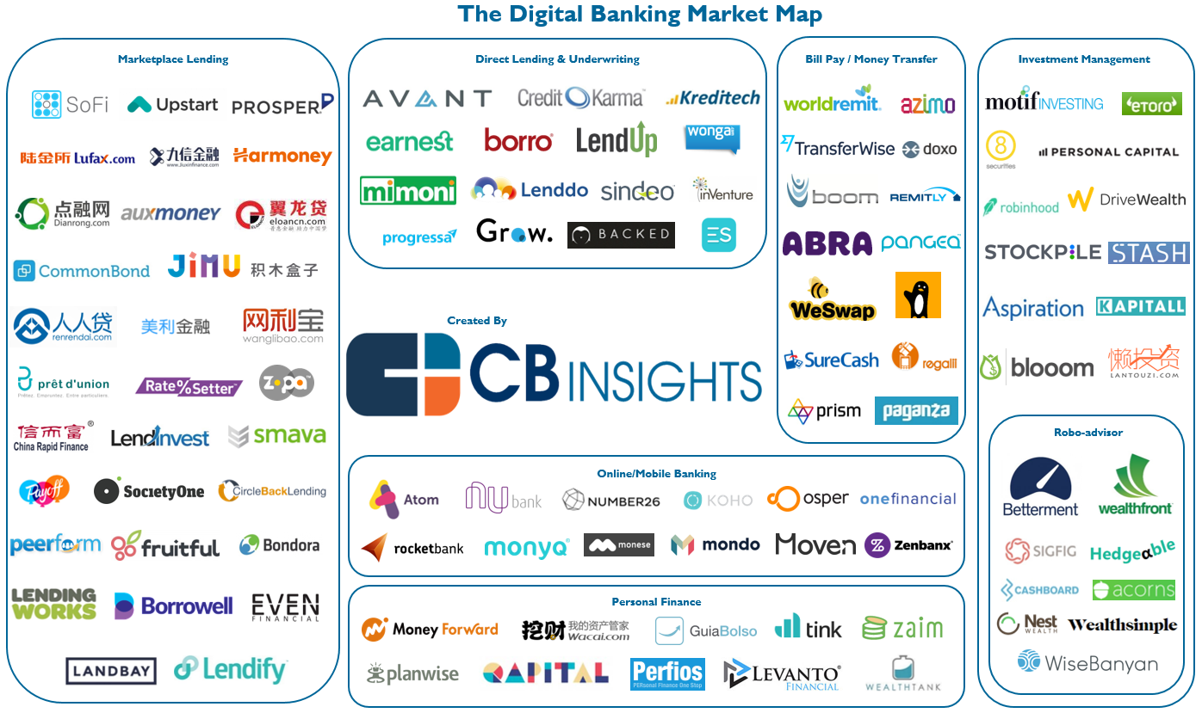
Lending, Investments, And Personal Finance: 102 Startups Attacking The Retail Banking Value Chain
Source: https://www.cbinsights.com/blog/industry-market-map-landscape/

Slide 63
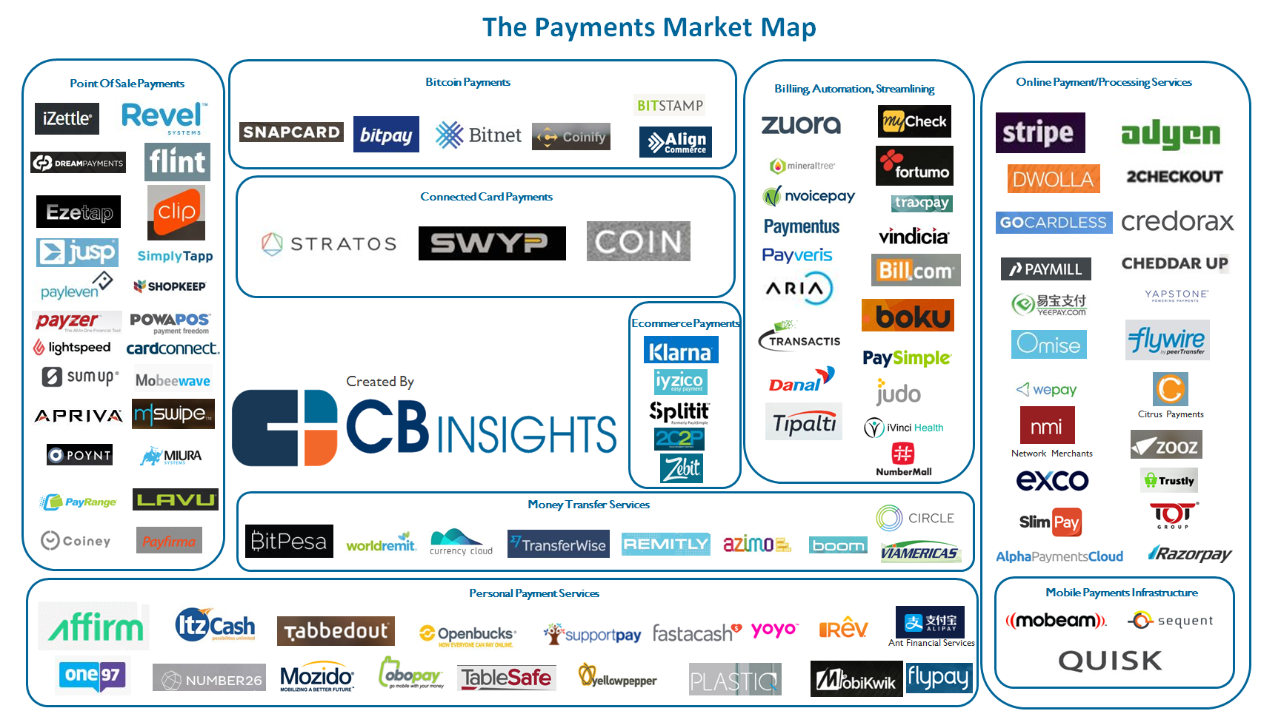
From Point-Of-Sale To Money Transfers: 109 Startups Disrupting The Payments Industry
Source: https://www.cbinsights.com/blog/industry-market-map-landscape/

Slide 64
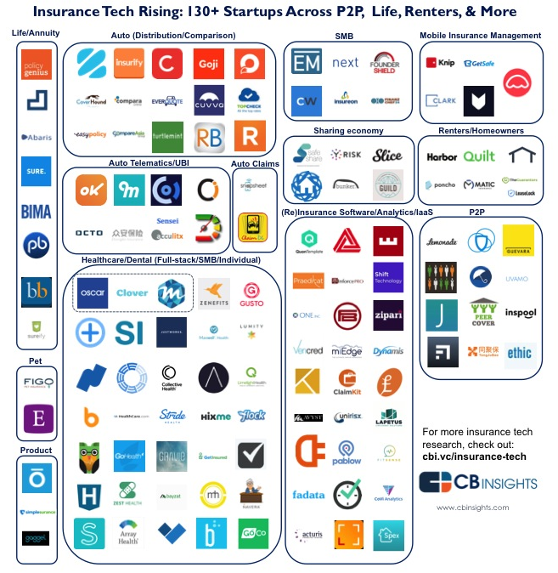
Insurance Tech Rising: 135+ Insurance Startups Across P2P, Life, Commercial & More
Source: https://www.cbinsights.com/blog/industry-market-map-landscape/

Slide 65
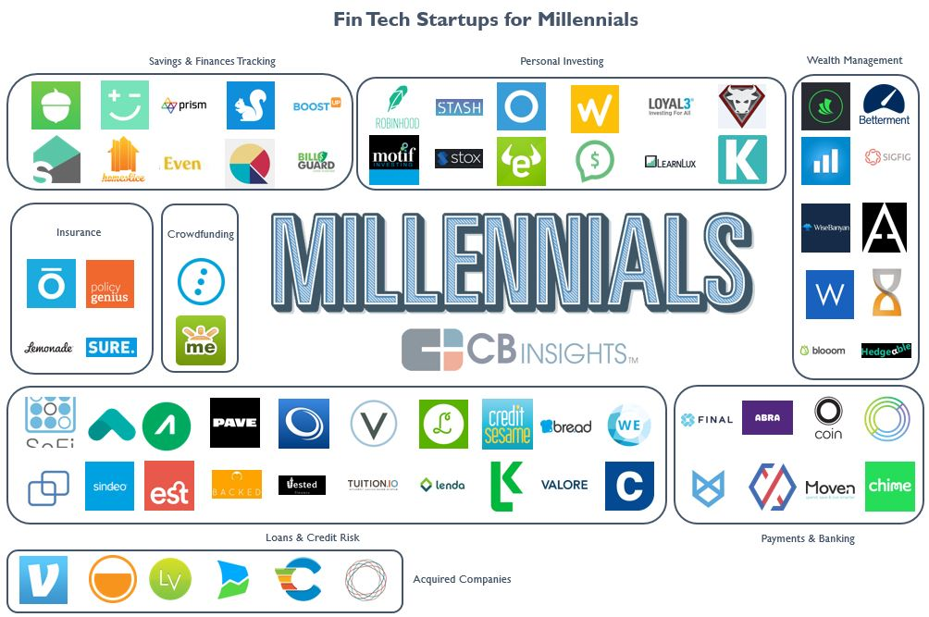
Millennial Personal Finance: 63 Fintech Startups Targeting Millennials
Source: https://www.cbinsights.com/blog/fin-tech-startups-millennials/

Slide 66
Marketing to Millenials
Source: http://www.digitalinformationworld.com/2016/07/infographic-how-millennials-view-your-site-and-why-it-matters.html?utm_source=feedburner&utm_medium=email&utm_campaign=Feed:+blogspot/qtdAg+(Digital+Information+World)

Slide 67
Marketing to Millenials
Source: http://www.digitalinformationworld.com/2016/07/infographic-how-millennials-view-your-site-and-why-it-matters.html?utm_source=feedburner&utm_medium=email&utm_campaign=Feed:+blogspot/qtdAg+(Digital+Information+World)

Slide 68
Marketing to Millenials
Source: http://www.digitalinformationworld.com/2016/07/infographic-how-millennials-view-your-site-and-why-it-matters.html?utm_source=feedburner&utm_medium=email&utm_campaign=Feed:+blogspot/qtdAg+(Digital+Information+World)

Slide 69
Fintech for Millennials
Fintech Category | #Company
Crowdfunding | 2
Insurance (Non-Health) | 4
Loans & Credit Risk | 20
Mobile Banking & Payments | 8
Personal Investing | 10
Savings & Finances Tracking | 10
Wealth Management | 9
Total | 63
Source: https://www.cbinsights.com/blog/fin-tech-startups-millennials/

Slide 70
Fintech: Wealth Management
Company | Select Investors
Wealthfront | DAG Ventures, Index Ventures, Greylock Partners, The Social+Capital Partnership
Betterment | Bessemer Venture Partners, Athemis Group, Menlo Ventures
SigFig | Doll Capital Management, Union Square Ventures, Bain Capital Ventures
Aspiration | Renren, GSV Capital, Capricorn Investment Group, IGSB
Blooom | Commerce Ventures, DST Systems, Hyde Park VP, QED Investors, UMB Financial
Rebalance IRA | N/A
Hedgeable | SixThirty
WiseBanyan | VegasTech Fund
Personal Capital | Institutional Venture Partners, Venrock, Crosslink Capital
Source: https://www.cbinsights.com/blog/fin-tech-startups-millennials/

Slide 71
Fintech: Personal Investing
Company | Select Investors
eToro | BRM Group, Ping An Ventures, Spark Capital
Openfolio | FinTech Collective
DriveWealth | Route 66 Ventures
Tip’d Off | Raj Parekh, Bill Crane, Shaun Coleman
Kapitall | Bendigo Partners, Linden Venture Fund
Stash | N/A
Stox | SingulariTeam
Robinhood | Google Ventures, Index Ventures, Andreessen Horowitz, Ribbit Capital, NEA
Motif Investing | Norwest Venture Partners, Foundation Capital, Ignition Capital, Goldman Sachs
Loyal3 | DNS Capital
Source: https://www.cbinsights.com/blog/fin-tech-startups-millennials/

Slide 72
FinTech Marketing
Source: http://www.crackitt.com/7-reasons-why-your-fintech-startup-needs-visual-marketing/

Slide 73
FinTech Trends
Source: http://mashable.com/2016/01/27/financial-tech-brandspeak’

Slide 74
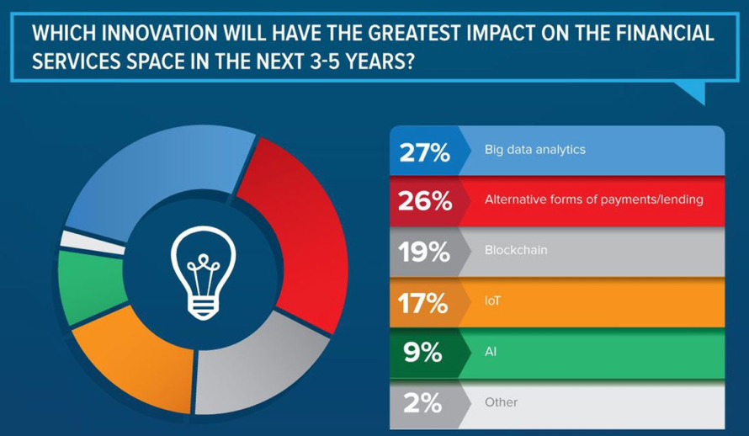
FinTech Big Data Analytics
Source: http://mashable.com/2016/01/27/financial-tech-brandspeak’

Slide 75
Blockchain Technology
The blockchain is a decentralized ledger of all transactions across a peer-to-peer network.
Source: https://www.pwc.com/us/en/financial-services/fintech/bitcoin-blockchain-cryptocurrency.html

Slide 76
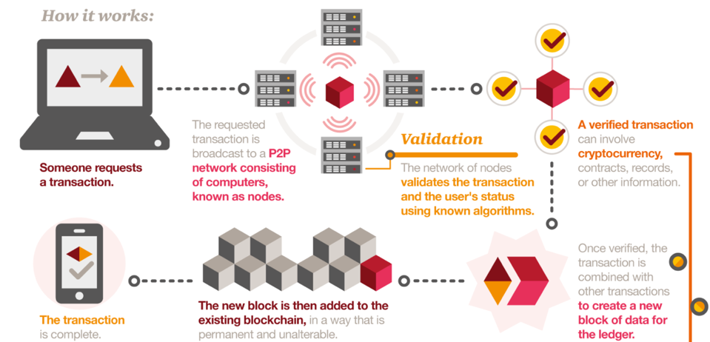
Blockchain Technology
Source: https://www.pwc.com/us/en/financial-services/fintech/bitcoin-blockchain-cryptocurrency.html

Slide 77
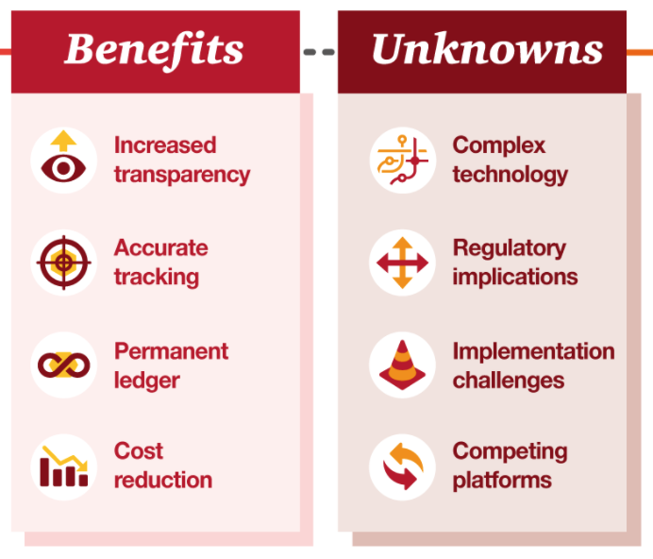
Blockchain Technology
Source: https://www.pwc.com/us/en/financial-services/fintech/bitcoin-blockchain-cryptocurrency.html

Slide 78
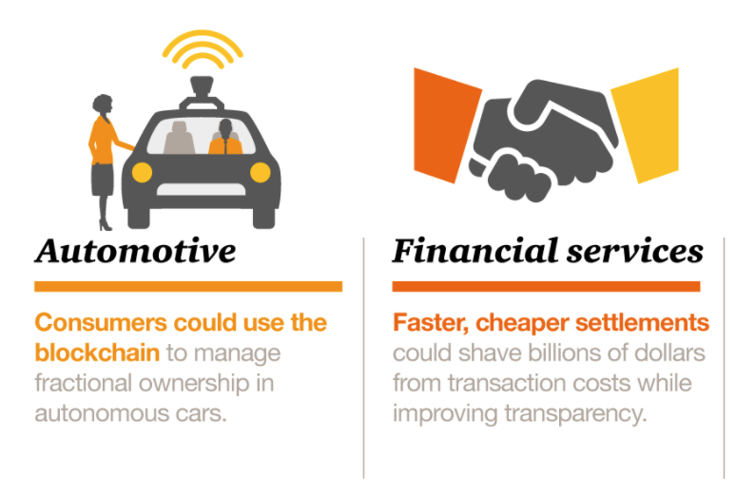
Blockchain Technology Potential Applications
Source: https://www.pwc.com/us/en/financial-services/fintech/bitcoin-blockchain-cryptocurrency.html

Slide 79
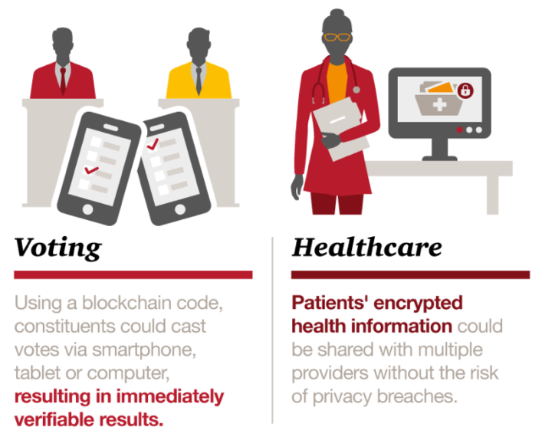
Blockchain Technology Potential Applications
Source: https://www.pwc.com/us/en/financial-services/fintech/bitcoin-blockchain-cryptocurrency.html

Slide 80
Fintech Robo Advisors

Slide 81
Big Data Driven Disruption: Robo-Advisor
Source: http://www.vamsitalkstech.com/?p=2329

Slide 82
FinTech high-level classification
Lending
Payments
Robo Advisors
Analytics
Others
Profile
Advice
Re-Balance
Indexing
Source: Paolo Sironi (2016), “FinTech Innovation: From Robo-Advisors to Goal Based Investing and Gamification”, Wiley.

Slide 83
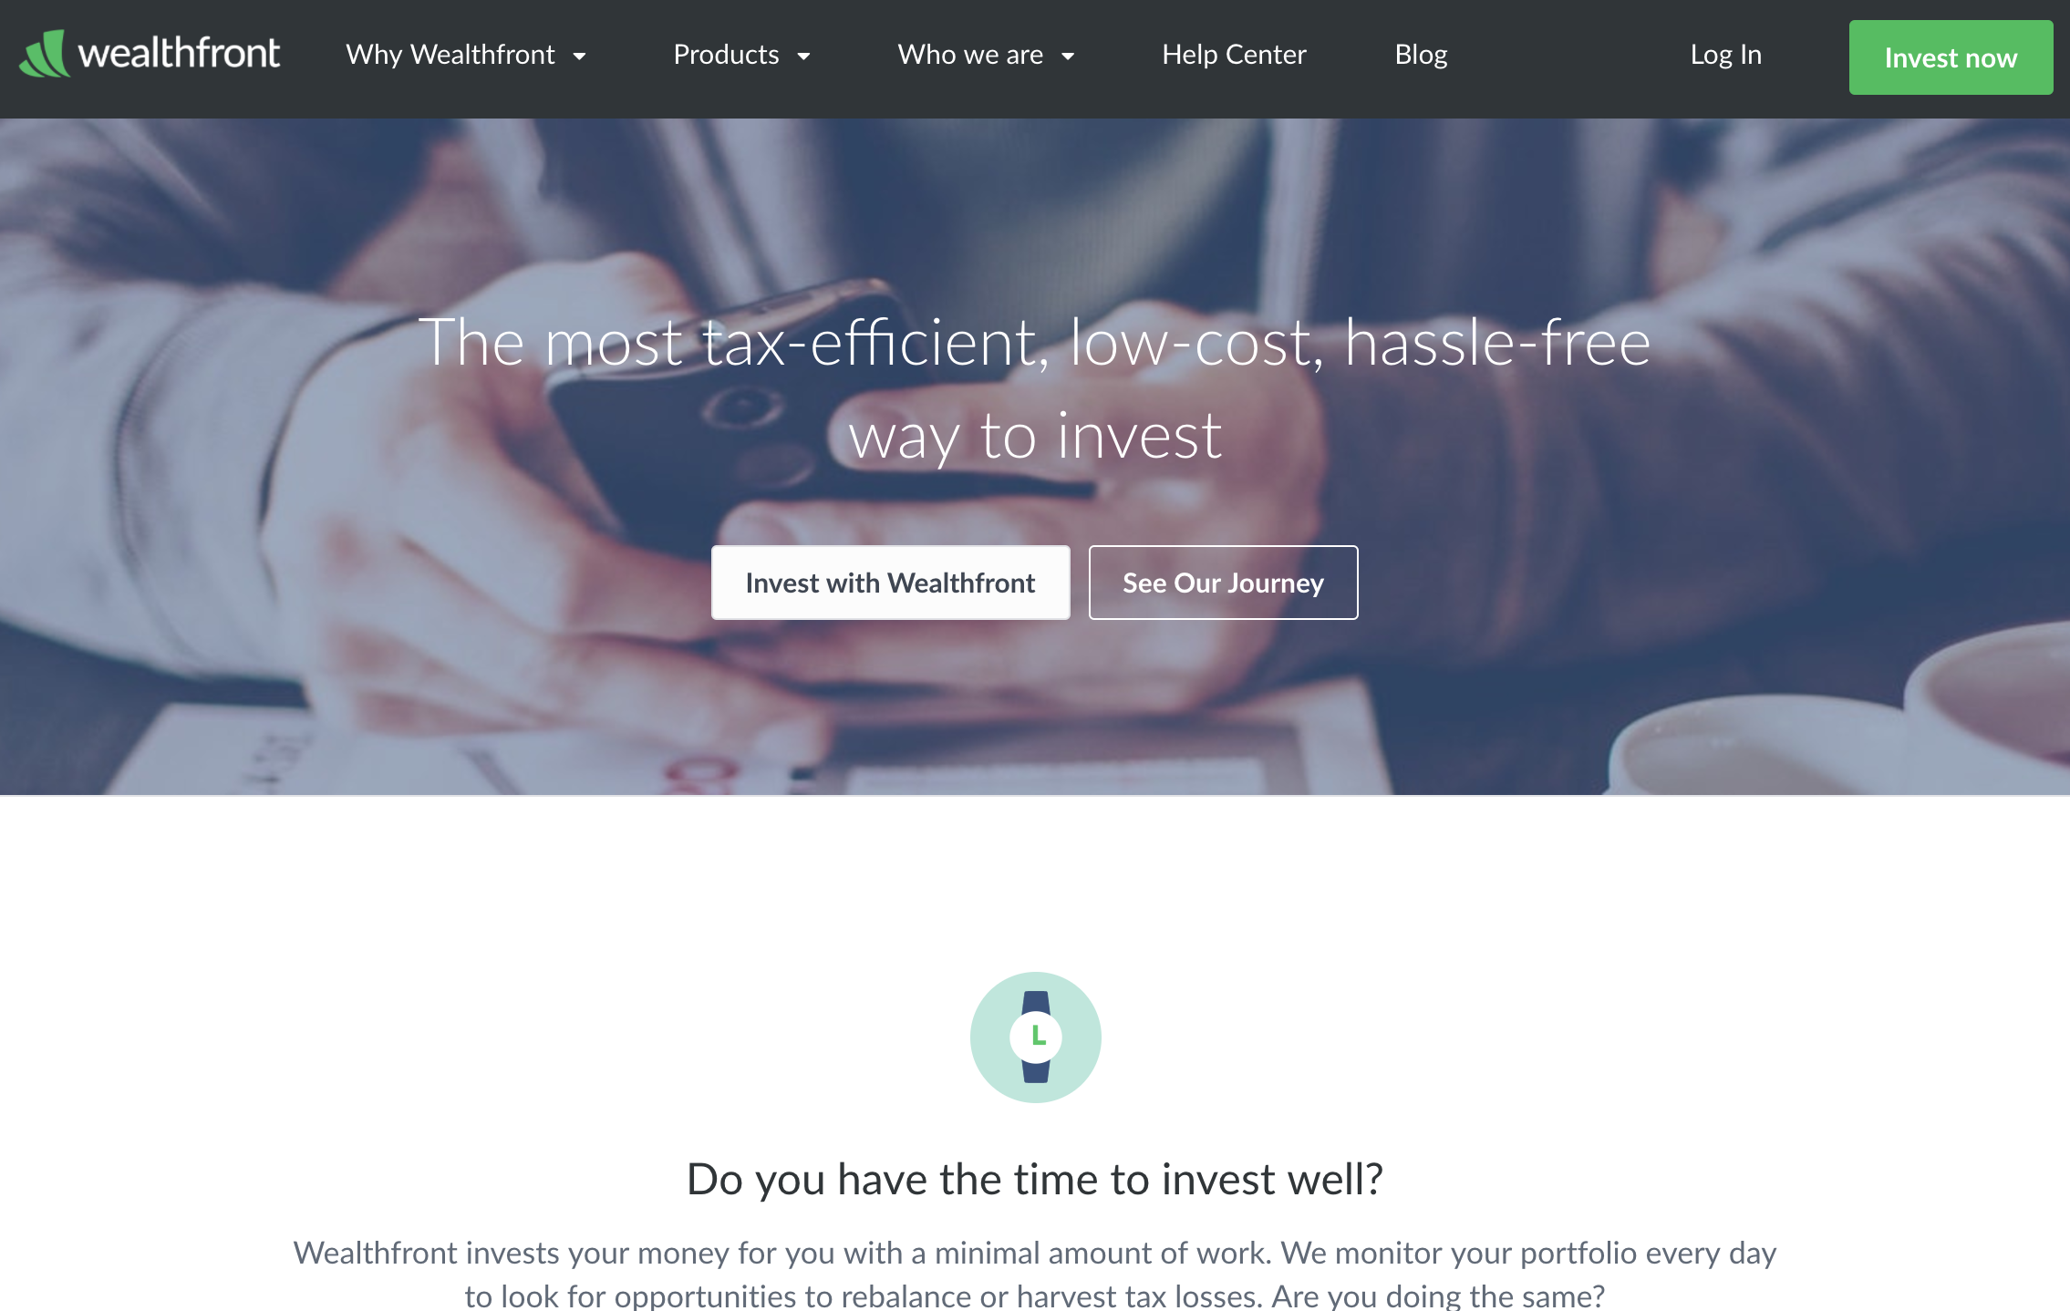
Wealthfront: Fintech Robo Advisor
https://www.wealthfront.com/

Slide 84
A classic workflow for financial recommendations
Source: Musto, C., Semeraro, G., Lops, P., de Gemmis, M., & Lekkas, G. (2015). Personalized finance advisory through case-based recommender systems and diversification strategies. Decision Support Systems, 77, 100-111.

Slide 85
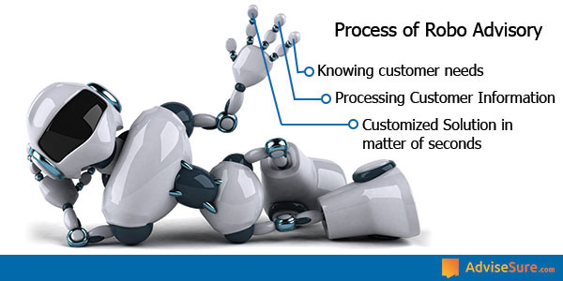
Process of Robo Advisors
Source: https://advisesure.com/blog/what-is-meaning-of-term-robo-advisor-and--their-benefits

Slide 86
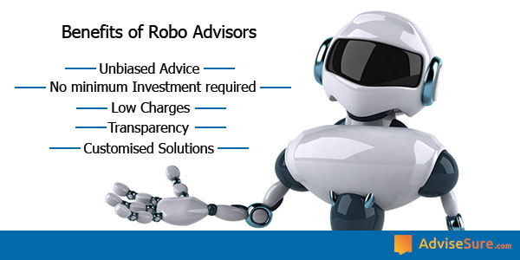
Benefits of Robo Advisors
Source: https://advisesure.com/blog/what-is-meaning-of-term-robo-advisor-and--their-benefits

Slide 87
Robo-Advisor Business Models
Full service online Robo-advisor
100% automated without any human element
Hybrid Robo-advisor model
being pioneered by firms like Vanguard & Charles Schwab
Pure online advisor
primarily human in nature
Source: http://www.vamsitalkstech.com/?p=2329

Slide 88
Robo-Advisor Business Models
Full service online Robo-advisor
100% automated without any human element
Hybrid Robo-advisor model
being pioneered by firms like Vanguard & Charles Schwab
Pure online advisor
primarily human in nature
Source: http://www.vamsitalkstech.com/?p=2329

Slide 89
Usecases of Robo-Advisors
Determine individual Client profiles & preferences
Identify appropriate financial products
Establish correct Investment Mix for the client’s profile
Using a algorithmic approach, choose the appropriate securities for each client account
Continuously monitor the portfolio & transactions within it to tune performance
Provide value added services
Ensure the best user experience by handling a whole range of financial services
Source: http://www.vamsitalkstech.com/?p=2418

Slide 90
Business Requirements for a Robo-Advisor (RA)
Collect Individual Client Data
Client Segmentation
Algorithm Based Investment Allocation
Portfolio Rebalancing
Tax Loss Harvesting
A Single View of a Client’s Financial History
Source: http://www.vamsitalkstech.com/?p=2354

Slide 91
Algorithms for a Robo-Advisor (RA)
Leverage data science & statistical modeling to automatically allocate client wealth across different asset classes (such as domestic/foreign stocks, bonds & real estate related securities) to automatically rebalance portfolio positions based on changing market conditions or client preferences.
These investment decisions are also made based on detailed behavioral understanding of a client’s financial journey metrics – Age, Risk Appetite & other related information.
Source: http://www.vamsitalkstech.com/?p=2354

Slide 92
Algorithms for a Robo-Advisor (RA)
RA platforms also provide 24×7 tracking of market movements to use that to track rebalancing decisions from not just a portfolio standpoint but also from a taxation standpoint.
Source: http://www.vamsitalkstech.com/?p=2354

Slide 93
Algorithms for a Robo-Advisor (RA)
A mixture of different algorithms can be used such as Modern Portfolio Theory (MPT), Capital Asset Pricing Model (CAPM), the Black Litterman Model, the Fama-French etc.
These are used to allocate assets as well as to adjust positions based on market movements and conditions.
Source: http://www.vamsitalkstech.com/?p=2354

Slide 94
Robo-Advisor (RA) Sample Portfolios
Sample Portfolios – for an aggressive investor
1. Equity – 85%
A) US Domestic Stock (50%)
– Large Cap – 30%, Medium Cap – 10% , Small Cap – 10%, Dividend Stocks – 0%
B) Foreign Stock – (35%) – Emerging Markets – 18%, Developed Markets – 17%
2. Fixed Income – 5%
A) Developed Market Bonds – 2%
B) US Bonds – 1%
C) International Bonds – 1%
D) Emerging Markets Bonds – 1%
3. Other – 5%
A) Real Estate – 3%
B) Currencies – 0%
C) Gold and Precious Metals – 0%
D) Commodities – 2%
4. Cash – 5%
Source: http://www.vamsitalkstech.com/?p=2354

Slide 95
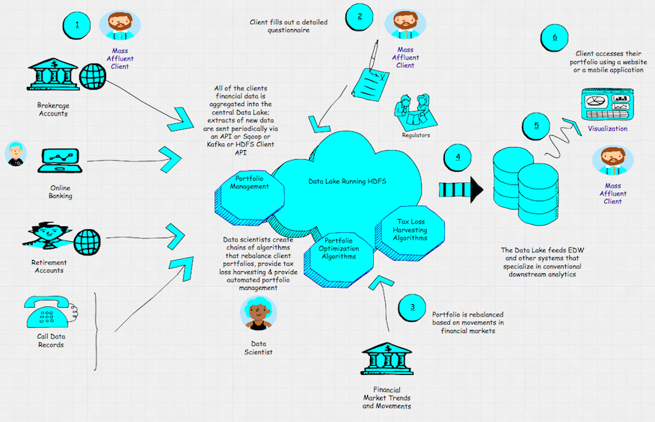
Architecture of a Robo-Advisor (RA)
Source: http://hortonworks.com/blog/architecture-of-a-roboadvisor/

Slide 96
Financial Sentiment Analysis

Slide 97
Big Data Approach to Combining Internal and External Data
Source: Susanne Chishti and Janos Barberis, The FINTECH Book: The Financial Technology Handbook for Investors, Entrepreneurs and Visionaries, Wiley, 2016

Slide 98
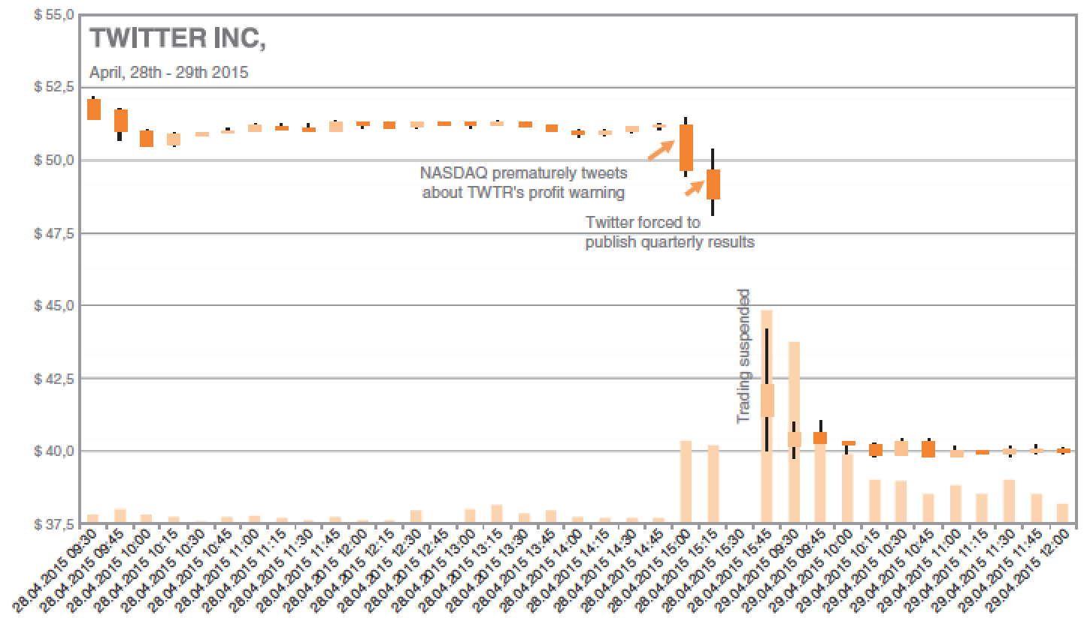
Ultra‐Fast Text Analytics in Trading Strategies
Twitter stock prices affected by news, Source: econob
Source: Susanne Chishti and Janos Barberis, The FINTECH Book: The Financial Technology Handbook for Investors, Entrepreneurs and Visionaries, Wiley, 2016

Slide 99
Deep Learning for Financial Sentiment Analysis on Finance News Providers
Tamkang University
Min-Yuh Day
Chia-Chou Lee
Department of Information Management
Tamkang University, Taiwan
myday@mail.tku.edu.tw
The 7th International Workshop on Mining and Analyzing Social Networks for Decision Support (MSNDS 2016)
MSNDS 2016, IEEE/ACM ASONAM 2016, San Francisco, CA, USA, August 18-21, 2016
Notes:
Min-Yuh Day and Chia-Chou Lee, "Deep Learning for Financial Sentiment Analysis on Finance News Providers", The 7th International Workshop on Mining and Analyzing Social Networks for Decision Support (MSNDS 2016), San Francisco, California, USA, Aug 18-21, 2016, in Proceedings of the 2016 IEEE/ACM International Conference on Advances in Social Networks Analysis and Mining (ASONAM 2016), San Francisco, California, USA, Aug 18-21, 2016.

Slide 100
Outline
Introduction
System Architecture
Experimental Results and Discussion
Conclusion

Slide 101
Introduction

Slide 102
Financial Sentiment Analysis

Slide 103
Motivation
Investors have always been interested in stock price forecasting.
The rapid development of electronic media, the big data of financial news are released on different media every day.

Slide 104
Research Gap
Few research involved the discussion on whether using different media could affect forecasting results.
Financial sentiment analysis is an important research area of financial technology (FinTech).

Slide 105
Highlights
This research focuses on investigating the influence of using different financial resources to investment and how to improve the accuracy of forecasting through deep learning.
The experimental result shows various financial resources have significantly different effects to investors and their investments, while the accuracy of news categorization could be improved through deep learning.

Slide 106
The relationship between Events, News and Markets (price) through Information.
Event
News
Market (Price)
Information

Slide 107
Financial Sentiment Analysis
Machine Learning Approach
Financial
Sentiment Analysis
Lexicon-based Approach

Slide 108
System Architecture

Slide 109
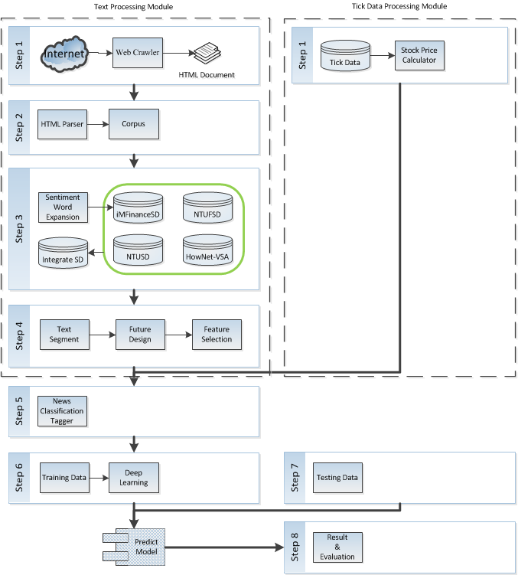
System Architecture

Slide 110
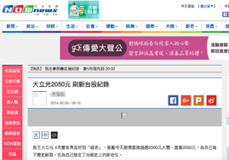
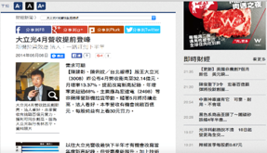
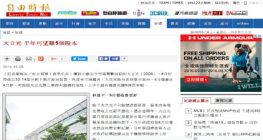
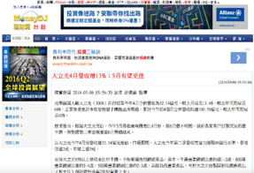
Finance News Data
AppleDaily
NowNews
LTN
MoneyDJ

Slide 111
Feature used for financial sentiment analysis
ID | Future Name | Description
F01 | NewsCharacters | Total word number of news text
F02 | NewsTokens | Number of news words
F03 | NTUSD_Positive | NTUSD positive word
F04 | NTUSD_Negative | NTUSD negative word
F05 | NTUSD_PNDiff | NTUSD difference of positive and negative word
F06 | HowNet_Positive | HowNet positive sentiment word
F07 | HowNet_Negative | HowNet negative sentiment word
F08 | HowNet_PNDiff | HowNet difference of positive and negative word
F09 | FinanceSD_Positive | NTUFSD+iMFinanceSD positive word
F10 | FinanceSD_Negative | NTUFSD+iMFinanceSD negative word
F11 | FinanceSD_PNDiff | NTUFSD+iMFinanceSD difference of positive and negative word

Slide 112
Example of feature used for Financial Sentiment Analysis
D00001, 516, 185, 3, 8, -5, 0, 1, -1, 14, 8, 6, 3008, 2013-01-04
D00002, 534, 185, 4, 2, 2, 0, 0, 0, 13, 2, 11, 3008, 2013-01-07
D00003, 846, 296, 6, 9, -3, 0, 1, -1, 25, 15, 10, 3008, 2013-01-09
D00004, 1495, 489, 55, 19, 36, 3, 0, 3, 23, 16, 7, 3008, 2013-01-10
D00005, 872, 282, 3, 5, -2, 0, 0, 0, 12, 17, -5, 3008, 2013-01-14
D00006, 573, 183, 2, 5, -3, 0, 0, 0, 8, 9, -1, 3008, 2013-01-21

Slide 113
Deep Learning and Neural Network

Slide 114
Deep Learning and Neural Networks
Input Layer
(X)
Hidden Layer
(H)
Output Layer
(Y)
X1
Y
X2

Slide 115
Deep Learning and Neural Networks
Input Layer
(X)
Hidden Layer
(H)
Output Layer
(Y)

Slide 116
Deep Learning and Neural Networks
Input Layer
(X)
Hidden Layers
(H)
Output Layer
(Y)
Deep Neural Networks
Deep Learning

Slide 117
Deep Neural Networks

Slide 118
Construction flow chart of deep learning prediction model
Rising
Falling

Slide 119
Comparison of editorial team and contents of news providers
News providers | Platform | Content | Editorial team
NowsNews | Electronic media | Comprehensive | Owned
AppleDaily | Electronic media/newspaper | Comprehensive | Owned
LTN | Electronic media/newspaper | Comprehensive | Owned
MoneyDJ | Electronic media | Finance | Owned

Slide 120
Developing Finance Sentiment Dictionary
NTUSD
HowNet-VSA
NTUFSD
iMFinanceSD

Slide 121
Sample iMFinanceSD opinion words
Positive |  | Negative
No | Word | No | Word
1 | 衝破 (break through) | 1 | 震盪 (shock)
2 | 穩住 (stabilize) | 2 | 低於 (less then)
3 | 挹注 (inject) | 3 | 放緩 (slowdown)
4 | 歷史新高 (Historical high) | 4 | 走緩 (slowly)
5 | 不遑多讓 (be no slouch) | 5 | 大幅砍殺 (Stabbed sharply)

Slide 122
Experimental Results and Discussion

Slide 123
Total news of each news provider for Financial Sentiment Analysis (Text Data)
Provider | NowNews | AppleDaily | LTN | MoneyDJ
Total | 5,499 | 456 | 1,147 | 1,370

Slide 124
ROI of 5 days trading with Deep Learning predicting stock price trend

Slide 125
ROI of 20 days trading with Deep Learning predicting stock price trend

Slide 126
ROI of 60 days trading with Deep Learning predicting stock price trend

Slide 127
ROI of 5 days with Lexicon-based Trading

Slide 128
ROI of 20 days with Lexicon-based Trading

Slide 129
ROI of 60 days with Lexicon-based Trading

Slide 130
ROI Heatmap of Lexicon-base Trading

Slide 131
ROI Heatmap of Trading with Deep Learning Approach

Slide 132
Comparison of ROI Heatmap from Various Finance News Media
NowNews
AppleDaily
LTN
MoneyDJ

Slide 133
Conclusions

Slide 134
Findings
We proposed analytical methods with deep learning in financial news sources on the stock price trend forecasts.
The results showed that the source of financial news media for the exclusive domain of Finance and Economics, revealed its investment information representing a reference value.

Slide 135
Contributions
The different news media release financial news different from its reference value level messages containing investment, as investors choose finance message referenced sources.
The prediction accuracy will be improved via a prediction model of the deep learning.

Slide 136
Managerial Implications
Different news media with their own characteristics and specializations.
The values of the financial information may be different due to the following reasons:
Company’s business principles.
Edition team’s specializations and their knowledge of industry.
Journalist’s habits and preferences in wording.
Sensitivity of financial market trends of the Media.

Slide 137
Deep Learning for Financial Sentiment Analysis on Finance News Providers
Q&A
Tamkang University
Min-Yuh Day
Chia-Chou Lee
Department of Information Management
Tamkang University, Taiwan
myday@mail.tku.edu.tw
The 7th International Workshop on Mining and Analyzing Social Networks for Decision Support (MSNDS 2016)
MSNDS 2016, IEEE/ACM ASONAM 2016, San Francisco, CA, USA, August 18-21, 2016

Slide 138
Summary
FinTech
Robo-Advisors
Financial Sentiment Analysis

Slide 139
References
Susanne Chishti and Janos Barberis (2016), “The FINTECH Book: The Financial Technology Handbook for Investors, Entrepreneurs and Visionaries”, Wiley.
Paolo Sironi (2016), “FinTech Innovation: From Robo-Advisors to Goal Based Investing and Gamification”, Wiley.
Musto, C., Semeraro, G., Lops, P., de Gemmis, M., & Lekkas, G. (2015). Personalized finance advisory through case-based recommender systems and diversification strategies. Decision Support Systems, 77, 100-111.
Rubino, J. (2016). My Favorite Robot. CFA Institute Magazine, 27(3), 43-46.
Min-Yuh Day and Chia-Chou Lee (2016), "Deep Learning for Financial Sentiment Analysis on Finance News Providers", The 7th International Workshop on Mining and Analyzing Social Networks for Decision Support (MSNDS 2016), San Francisco, California, USA, Aug 18-21, 2016, in Proceedings of the 2016 IEEE/ACM International Conference on Advances in Social Networks Analysis and Mining (ASONAM 2016), San Francisco, California, USA, Aug 18-21, 2016.

