Slide 1



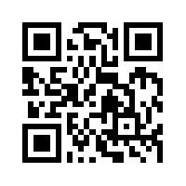
大數據行銷研究
Big Data Marketing Research
Tamkang
University
大數據情感分析
(Big Data Sentiment Analysis)
1051BDMR11
MIS EMBA (M2262) (8638)
Thu, 12,13,14 (19:20-22:10) (D409)
Min-Yuh Day
戴敏育
Assistant Professor
專任助理教授
Dept. of Information Management, Tamkang University
淡江大學 資訊管理學系
http://mail. tku.edu.tw/myday/
2016-12-23

Slide 2
課程大綱 (Syllabus)
週次 (Week) 日期 (Date) 內容 (Subject/Topics)
1 2016/09/16 中秋節 (調整放假一天)
(Mid-Autumn Festival Holiday)(Day off)
2 2016/09/23 大數據行銷研究課程介紹
(Course Orientation for Big Data Marketing Research)
3 2016/09/30 資料科學與大數據行銷
(Data Science and Big Data Marketing)
4 2016/10/07 大數據行銷分析與研究
(Big Data Marketing Analytics and Research)
5 2016/10/14 測量構念 (Measuring the Construct)
6 2016/10/21 測量與量表 (Measurement and Scaling)

Slide 3
課程大綱 (Syllabus)
週次 (Week) 日期 (Date) 內容 (Subject/Topics)
7 2016/10/28 大數據行銷個案分析 I
(Case Study on Big Data Marketing I)
8 2016/11/04 探索性因素分析 (Exploratory Factor Analysis)
9 2016/11/11 確認性因素分析 (Confirmatory Factor Analysis)
10 2016/11/18 期中報告 (Midterm Presentation)
11 2016/11/25 社群運算與大數據分析
(Social Computing and Big Data Analytics)
12 2016/12/02 社會網路分析 (Social Network Analysis)

Slide 4
課程大綱 (Syllabus)
週次 (Week) 日期 (Date) 內容 (Subject/Topics)
13 2016/12/09 大數據行銷個案分析 II
(Case Study on Big Data Marketing II)
14 2016/12/16 社會網絡分析量測與實務
(Measurements and Practices of Social Network Analysis)
15 2016/12/23 大數據情感分析
(Big Data Sentiment Analysis)
16 2016/12/30 金融科技行銷研究
(FinTech Marketing Research)
17 2017/01/06 期末報告 I (Term Project Presentation I)
18 2017/01/13 期末報告 II (Term Project Presentation II)

Slide 5
Outline
Sentiment Analysis
Architectures of Sentiment Analytics
Opinion Spam Detection
Text Mining Techniques and
Natural Language Processing

Slide 6


Sentiment Analysis

Slide 7
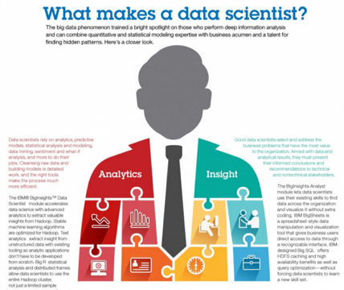
Data Scientist
資料科學家
Source: http://www.ibmbigdatahub.com/infographic/what-makes-data-scientist

Slide 8
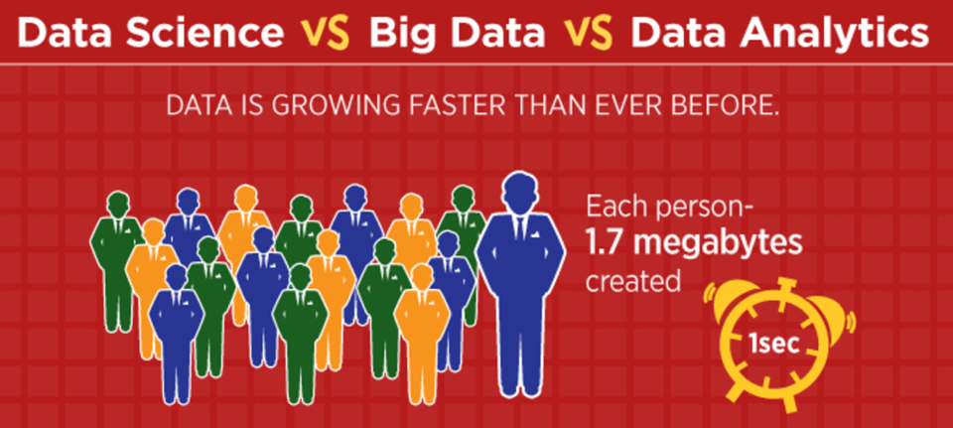
Data Science vs.
Big Data vs. Data Analytics
Source: https://www.simplilearn.com/data-science-vs-big-data-vs-data-analytics-article

Slide 9
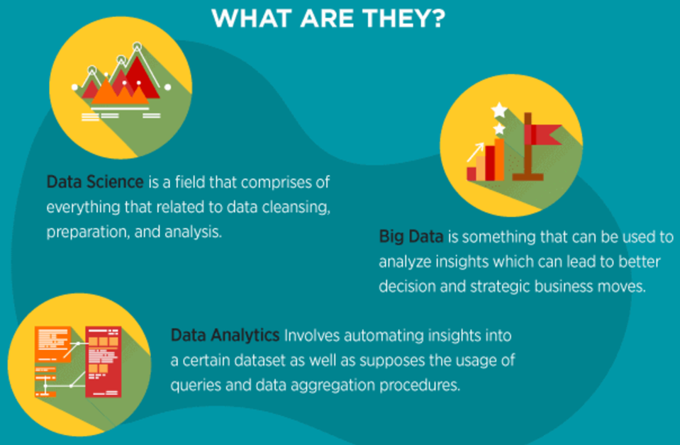
Data Science vs. Big Data vs. Data Analytics
Source: https://www.simplilearn.com/data-science-vs-big-data-vs-data-analytics-article

Slide 10
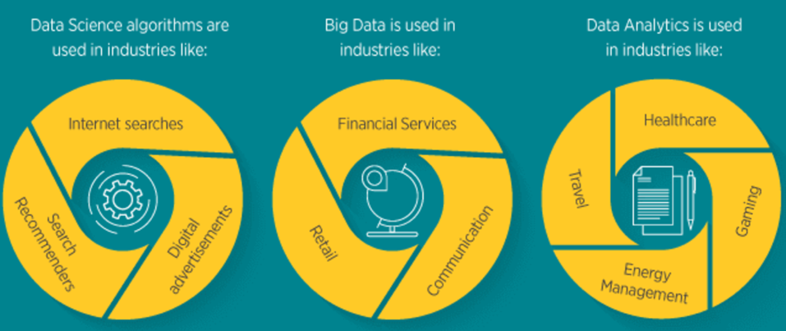
What are they used?
Source: https://www.simplilearn.com/data-science-vs-big-data-vs-data-analytics-article

Slide 11
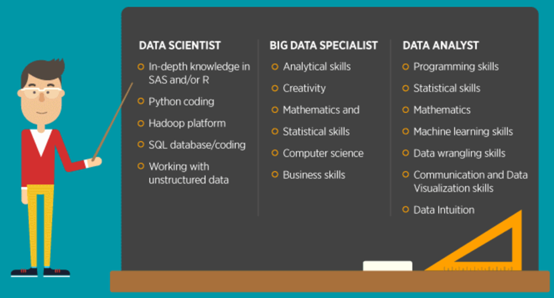
Data Science
What are the Skills Required?
Source: https://www.simplilearn.com/data-science-vs-big-data-vs-data-analytics-article

Slide 12
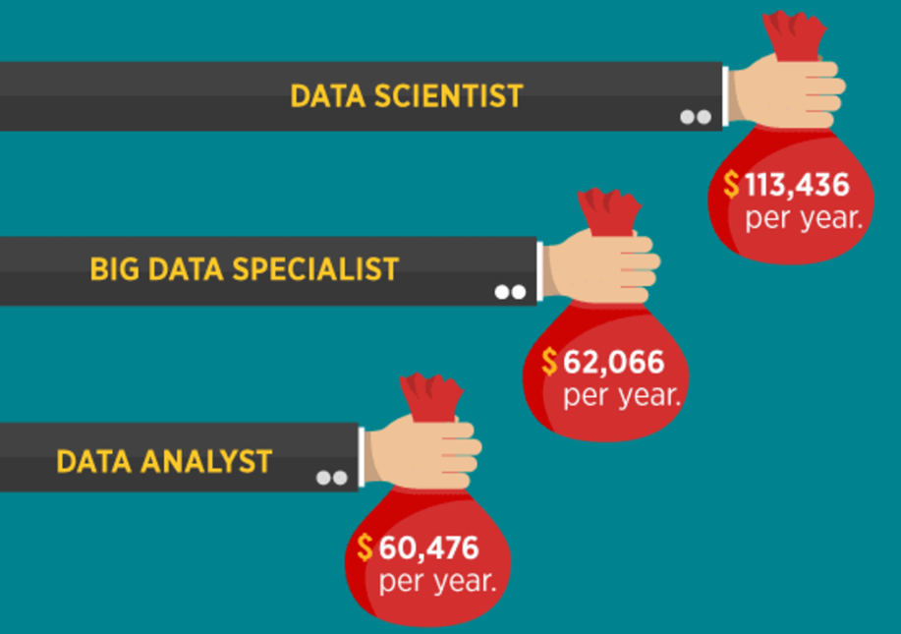
Source: https://www.simplilearn.com/data-science-vs-big-data-vs-data-analytics-article

Slide 13
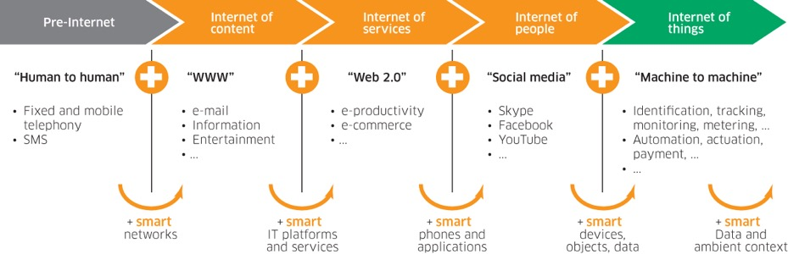
Internet Evolution
Internet of People (IoP): Social Media
Internet of Things (IoT): Machine to Machine
Source: Marc Jadoul (2015), The IoT: The next step in internet evolution, March 11, 2015 http://www2.alcatel-lucent.com/techzine/iot-internet-of-things-next-step-evolution/

Slide 14




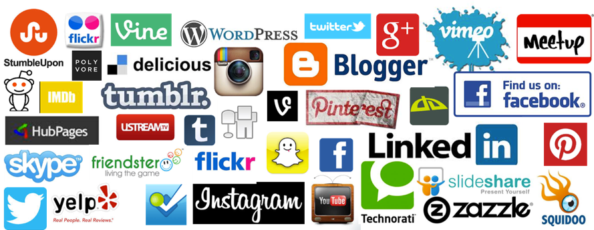
Social Media
Source: http://hungrywolfmarketing.com/2013/09/09/what-are-your-social-marketing-goals/

Slide 15
Emotions
Love
Anger
Joy
Sadness
Surprise
Fear
Source: Bing Liu (2011) , “Web Data Mining: Exploring Hyperlinks, Contents, and Usage Data,” Springer, 2nd Edition,

Slide 16
Example of Opinion: review segment on iPhone
“I bought an iPhone a few days ago.
It was such a nice phone.
The touch screen was really cool.
The voice quality was clear too.
However, my mother was mad with me as I did not tell her before I bought it.
She also thought the phone was too expensive, and wanted me to return it to the shop. … ”
Source: Bing Liu (2011) , “Web Data Mining: Exploring Hyperlinks, Contents, and Usage Data,” Springer, 2nd Edition,

Slide 17
Example of Opinion:
review segment on iPhone
“(1) I bought an iPhone a few days ago.
(2) It was such a nice phone.
(3) The touch screen was really cool.
(4) The voice quality was clear too.
(5) However, my mother was mad with me as I did not tell her before I bought it.
(6) She also thought the phone was too expensive, and wanted me to return it to the shop. … ”
+Positive Opinion
-Negative Opinion
Source: Bing Liu (2011) , “Web Data Mining: Exploring Hyperlinks, Contents, and Usage Data,” Springer, 2nd Edition,

Slide 18
How consumers think, feel, and act
Source: Philip Kotler & Kevin Lane Keller, Marketing Management, 14th ed., Pearson, 2012

Slide 19
Emotions
Love
Anger
Joy
Sadness
Surprise
Fear
Source: Bing Liu (2011) , “Web Data Mining: Exploring Hyperlinks, Contents, and Usage Data,” Springer, 2nd Edition,

Slide 20
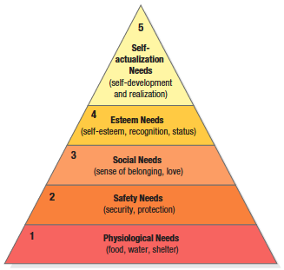

Maslow’s Hierarchy of Needs
Source: Philip Kotler & Kevin Lane Keller, Marketing Management, 14th ed., Pearson, 2012

Slide 21
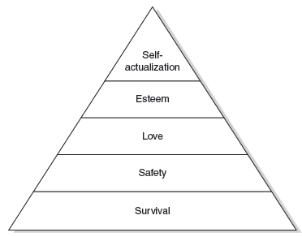
Maslow’s hierarchy of human needs
(Maslow, 1943)

Slide 22
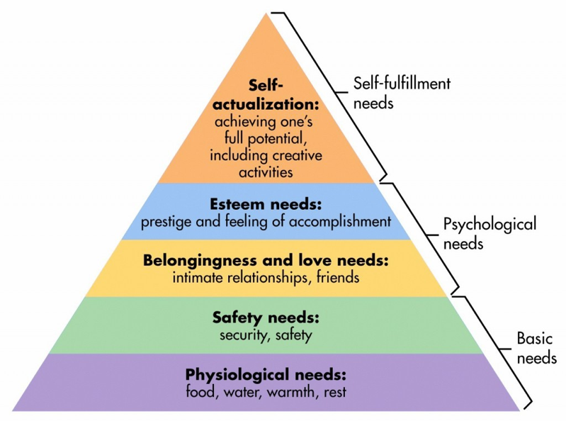
Maslow’s Hierarchy of Needs
Source: http://sixstoriesup.com/social-psyche-what-makes-us-go-social/

Slide 23
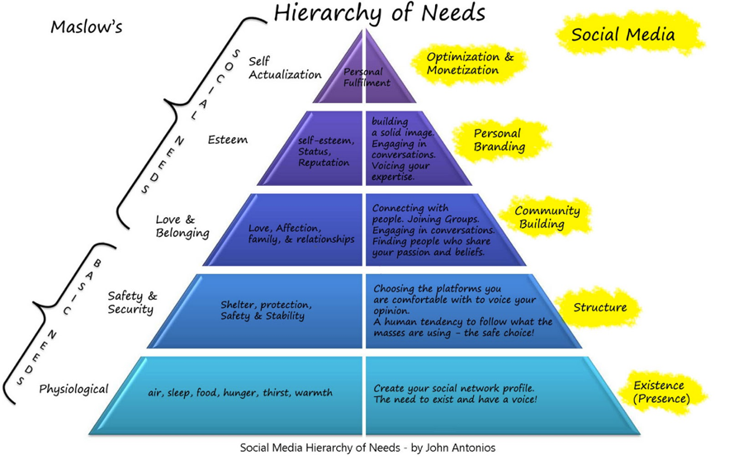
Social Media Hierarchy of Needs
Source: http://2.bp.blogspot.com/_Rta1VZltiMk/TPavcanFtfI/AAAAAAAAACo/OBGnRL5arSU/s1600/social-media-heirarchy-of-needs1.jpg

Slide 24
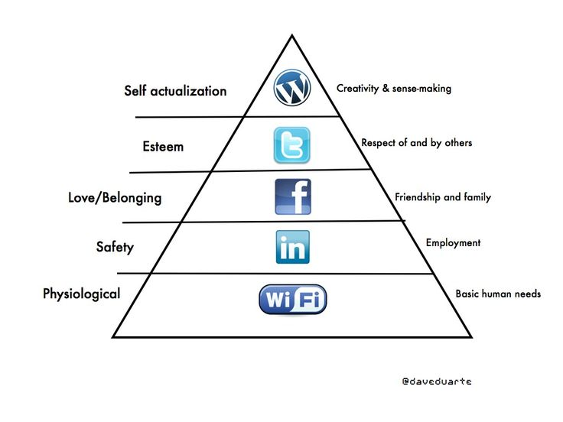


Social Media Hierarchy of Needs
Source: http://www.pinterest.com/pin/18647785930903585/

Slide 25
The Social Feedback Cycle
Consumer Behavior on Social Media
Marketer-Generated
User-Generated
Form
Opinion
Awareness
Consideration
Purchase
Use
Talk
Source: Evans et al. (2010), Social Media Marketing: The Next Generation of Business Engagement

Slide 26






The New Customer Influence Path
Awareness
Consideration
Purchase
Source: Evans et al. (2010), Social Media Marketing: The Next Generation of Business Engagement

Slide 27
Architectures of
Sentiment Analytics

Slide 28
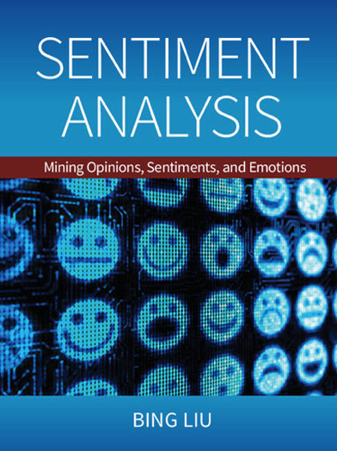
Bing Liu (2015),
Sentiment Analysis:
Mining Opinions, Sentiments, and Emotions,
Cambridge University Press
http://www.amazon.com/Sentiment-Analysis-Opinions-Sentiments-Emotions/dp/1107017890

Slide 29
Sentiment Analysis and
Opinion Mining
Computational study of
opinions,
sentiments,
subjectivity,
evaluations,
attitudes,
appraisal,
affects,
views,
emotions,
ets., expressed in text.
  Reviews, blogs, discussions, news, comments, feedback, or any other documents
Source: Bing Liu (2011) , “Web Data Mining: Exploring Hyperlinks, Contents, and Usage Data,” Springer, 2nd Edition,

Slide 30
Research Area of Opinion Mining
Many names and tasks with difference objective and models
  Sentiment analysis
  Opinion mining
  Sentiment mining
  Subjectivity analysis
  Affect analysis
  Emotion detection
  Opinion spam detection
Source: Bing Liu (2011) , “Web Data Mining: Exploring Hyperlinks, Contents, and Usage Data,” Springer, 2nd Edition,

Slide 31
Sentiment Analysis
Sentiment
  A thought, view, or attitude, especially one based mainly on emotion instead of reason
Sentiment Analysis
  opinion mining
  use of natural language processing (NLP) and computational techniques to automate the extraction or classification of sentiment from typically unstructured text

Slide 32
Applications of Sentiment Analysis
Consumer information
  Product reviews
Marketing
  Consumer attitudes
  Trends
Politics
  Politicians want to know voters’ views
  Voters want to know policitians’ stances and who else supports them
Social
  Find like-minded individuals or communities

Slide 33
Sentiment detection
How to interpret features for sentiment detection?
  Bag of words (IR)
  Annotated lexicons (WordNet, SentiWordNet)
  Syntactic patterns
Which features to use?
  Words (unigrams)
  Phrases/n-grams
  Sentences

Slide 34
Problem statement of
Opinion Mining
Two aspects of abstraction
  Opinion definition
    What is an opinion?
    What is the structured definition of opinion?
  Opinion summarization
    Opinion are subjective
      An opinion from a single person (unless a VIP)
      is often not sufficient for action
    We need opinions from many people,
    and thus opinion summarization.
Source: Bing Liu (2011) , “Web Data Mining: Exploring Hyperlinks, Contents, and Usage Data,” Springer, 2nd Edition,

Slide 35
What is an opinion?
Id: Abc123 on 5-1-2008 “I bought an iPhone a few days ago. It is such a nice phone. The touch screen is really cool. The voice quality is clear too. It is much better than my old Blackberry, which was a terrible phone and so difficult to type with its tiny keys. However, my mother was mad with me as I did not tell her before I bought the phone. She also thought the phone was too expensive, …”
One can look at this review/blog at the
  Document level
    Is this review + or -?
  Sentence level
    Is each sentence + or -?
  Entity and feature/aspect level
Source: Bing Liu (2011) , “Web Data Mining: Exploring Hyperlinks, Contents, and Usage Data,” Springer, 2nd Edition,

Slide 36
Entity and aspect/feature level
Id: Abc123 on 5-1-2008 “I bought an iPhone a few days ago. It is such a nice phone. The touch screen is really cool. The voice quality is clear too. It is much better than my old Blackberry, which was a terrible phone and so difficult to type with its tiny keys. However, my mother was mad with me as I did not tell her before I bought the phone. She also thought the phone was too expensive, …”
What do we see?
  Opinion targets: entities and their features/aspects
  Sentiments: positive and negative
  Opinion holders: persons who hold the opinions
  Time: when opinion are expressed
Source: Bing Liu (2011) , “Web Data Mining: Exploring Hyperlinks, Contents, and Usage Data,” Springer, 2nd Edition,

Slide 37
Two main types of opinions
Regular opinions: Sentiment/Opinion expressions on some target entities
  Direct opinions: sentiment expressions on one object:
    “The touch screen is really cool.”
    “The picture quality of this camera is great”
  Indirect opinions: comparisons, relations expressing similarities or differences (objective or subjective) of more than one object
    “phone X is cheaper than phone Y.” (objective)
    “phone X is better than phone Y.” (subjective)
Comparative opinions: comparisons of more than one entity.
  “iPhone is better than Blackberry.”
Source: Bing Liu (2011) , “Web Data Mining: Exploring Hyperlinks, Contents, and Usage Data,” Springer, 2nd Edition,

Slide 38
Subjective and Objective
Objective
  An objective sentence expresses some factual information about the world.
  “I returned the phone yesterday.”
  Objective sentences can implicitly indicate opinions
    “The earphone broke in two days.”
Subjective
  A subjective sentence expresses some personal feelings or beliefs.
  “The voice on my phone was not so clear”
  Not every subjective sentence contains an opinion
    “I wanted a phone with good voice quality”
➔ Subjective analysis
Source: Bing Liu (2011) , “Web Data Mining: Exploring Hyperlinks, Contents, and Usage Data,” Springer, 2nd Edition,

Slide 39
Sentiment Analysis vs.
Subjectivity Analysis
Sentiment Analysis
Subjectivity Analysis
Positive
Subjective
Negative
Neutral
Objective

Slide 40
A (regular) opinion
Opinion (a restricted definition)
  An opinion (regular opinion) is simply a positive or negative sentiment, view, attitude, emotion, or appraisal about an entity or an aspect of the entity from an opinion holder.
Sentiment orientation of an opinion
  Positive, negative, or neutral (no opinion)
  Also called:
    Opinion orientation
    Semantic orientation
    Sentiment polarity
Source: Bing Liu (2011) , “Web Data Mining: Exploring Hyperlinks, Contents, and Usage Data,” Springer, 2nd Edition,

Slide 41
Entity and aspect
Definition of Entity:
  An entity e is a product, person, event, organization, or topic.
  e is represented as
    A hierarchy of components, sub-components.
    Each node represents a components and is associated with a set of attributes of the components
An opinion can be expressed on any node or attribute of the node
Aspects(features)
  represent both components and attribute
Source: Bing Liu (2011) , “Web Data Mining: Exploring Hyperlinks, Contents, and Usage Data,” Springer, 2nd Edition,

Slide 42
Opinion Definition
An opinion is a quintuple
(e_{j}, a_{jk}, so_{ijkl}, h_{i}, t_{l})
where
  e_{j} is a target entity.
  a_{jk} is an aspect/feature of the entity e_{j} .
  so_{ijkl} is the sentiment value of the opinion from the opinion holder on feature of entity at time.
  so_{ijkl} is +ve, -ve, or neu, or more granular ratings
  h_{i} is an opinion holder.
  t_{l} is the time when the opinion is expressed.
(e_{j}, a_{jk}) is also called opinion target
Source: Bing Liu (2011) , “Web Data Mining: Exploring Hyperlinks, Contents, and Usage Data,” Springer, 2nd Edition,

Slide 43
Terminologies
Entity: object
Aspect: feature, attribute, facet
Opinion holder: opinion source
Topic: entity, aspect
Product features, political issues
Source: Bing Liu (2011) , “Web Data Mining: Exploring Hyperlinks, Contents, and Usage Data,” Springer, 2nd Edition,

Slide 44
Subjectivity and Emotion
Sentence subjectivity
  An objective sentence presents some factual information, while a subjective sentence expresses some personal feelings, views, emotions, or beliefs.
Emotion
  Emotions are people’s subjective feelings and thoughts.
Source: Bing Liu (2011) , “Web Data Mining: Exploring Hyperlinks, Contents, and Usage Data,” Springer, 2nd Edition,

Slide 45
Classification Based on
Supervised Learning
Sentiment classification
  Supervised learning Problem
  Three classes
    Positive
    Negative
    Neutral
Source: Bing Liu (2011) , “Web Data Mining: Exploring Hyperlinks, Contents, and Usage Data,” Springer, 2nd Edition,

Slide 46
Opinion words in
Sentiment classification
topic-based classification
  topic-related words are important
    e.g., politics, sciences, sports
Sentiment classification
  topic-related words are unimportant
  opinion words (also called sentiment words)
    that indicate positive or negative opinions are important,
    e.g., great, excellent, amazing, horrible, bad, worst
Source: Bing Liu (2011) , “Web Data Mining: Exploring Hyperlinks, Contents, and Usage Data,” Springer, 2nd Edition,

Slide 47
Features in Opinion Mining
Terms and their frequency
  TF-IDF
Part of speech (POS)
  Adjectives
Opinion words and phrases
  beautiful, wonderful, good, and amazing are positive opinion words
  bad, poor, and terrible are negative opinion words.
  opinion phrases and idioms,
  e.g., cost someone an arm and a leg
Rules of opinions
Negations
Syntactic dependency
Source: Bing Liu (2011) , “Web Data Mining: Exploring Hyperlinks, Contents, and Usage Data,” Springer, 2nd Edition,

Slide 48
Sentiment Analysis
Subjectivity
Classification
Polarity Determination
Approaches
Machine Learning based
Sentiment Classification
Vagueness resolution in opinionated text
Lexicon based
Sentiment Analysis
Review Usefulness Measurement
Multi- & Cross- Lingual SC
Hybrid
approaches
Opinion Spam Detection
Cross-domain SC
Lexicon Creation
Ontology based
Tasks
Non-Ontology based
Aspect Extraction
Application
Source: Kumar Ravi and Vadlamani Ravi (2015), "A survey on opinion mining and sentiment analysis: tasks, approaches and applications." Knowledge-Based Systems, 89, pp.14-46.

Slide 49
Sentiment Classification Techniques
Decision Tree Classifiers
Support Vector Machine (SVM)
Supervised Learning
Neural Network (NN)
Machine Learning Approach
Linear Classifiers
Deep Learning (DL)
Rule-based Classifiers
Naïve Bayes
(NB)
Sentiment Analysis
Unsupervised Learning
Probabilistic Classifiers
Bayesian Network (BN)
Dictionary-based Approach
Maximum Entropy (ME)
Lexicon-based Approach
Statistical
Corpus-based Approach
Semantic
Source: Jesus Serrano-Guerrero, Jose A. Olivas, Francisco P. Romero, and Enrique Herrera-Viedma (2015),
"Sentiment analysis: A review and comparative analysis of web services," Information Sciences, 311, pp. 18-38.

Slide 50


Sentiment Analysis Architecture
Positive
tweets
Negative
tweets
Word
features
Training
set
Features
extractor
Classifier
Features
extractor
Tweet
Positive
Negative
Vishal Kharde and Sheetal Sonawane (2016), "Sentiment Analysis of Twitter Data: A Survey of Techniques,"
International Journal of Computer Applications, Vol 139, No. 11, 2016. pp.5-15

Slide 51


Sentiment Classification Based on Emoticons
Tweeter
Tweeter Streaming API 1.1
Tweet preprocessing
Based on Positive Emotions
Based on Negative Emotions
Generate Training Dataset for Tweet
Positive tweets
Negative tweets
Test Dataset
Training Dataset
Classifier
Feature Extraction
Positive
Negative
Vishal Kharde and Sheetal Sonawane (2016), "Sentiment Analysis of Twitter Data: A Survey of Techniques,"
International Journal of Computer Applications, Vol 139, No. 11, 2016. pp.5-15

Slide 52
Lexicon-Based Model
Tokenized Document Collection
Preassembled Word Lists
Sentiment Scoring and Classification:
Polarity
Merged
Lexicon
Generic
Word Lists
Sentiment
Polarity
Vishal Kharde and Sheetal Sonawane (2016), "Sentiment Analysis of Twitter Data: A Survey of Techniques,"
International Journal of Computer Applications, Vol 139, No. 11, 2016. pp.5-15

Slide 53
Sentiment Analysis Tasks
Object/Feature extraction
Opinionated Document
Subjectivity Classification
Sentiment Classification
Opinion holder extraction
Vishal Kharde and Sheetal Sonawane (2016), "Sentiment Analysis of Twitter Data: A Survey of Techniques,"
International Journal of Computer Applications, Vol 139, No. 11, 2016. pp.5-15

Slide 54
Levels of Sentiment Analysis
Sentiment Analysis
Word
level
Sentiment Analysis
Sentence
level
Sentiment Analysis
Document
level
Sentiment Analysis
Feature level
Sentiment Analysis
Vishal Kharde and Sheetal Sonawane (2016), "Sentiment Analysis of Twitter Data: A Survey of Techniques,"
International Journal of Computer Applications, Vol 139, No. 11, 2016. pp.5-15

Slide 55
Levels of Sentiment Analysis
Document level
73
Word level
25
Granularity
Aspect level
23
Sentence level
20
Concept level
9
Source: Kumar Ravi and Vadlamani Ravi (2015), "A survey on opinion mining and sentiment analysis: tasks, approaches and applications." Knowledge-Based Systems, 89, pp.14-46.

Slide 56
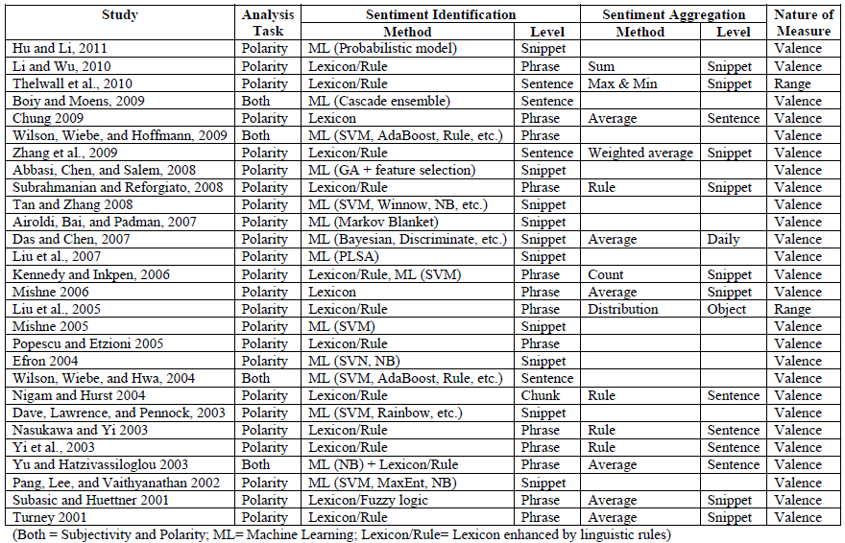
A Brief Summary of Sentiment Analysis Methods
Source: Zhang, Z., Li, X., and Chen, Y. (2012), "Deciphering word-of-mouth in social media: Text-based metrics of consumer reviews,"
ACM Trans. Manage. Inf. Syst. (3:1) 2012, pp 1-23.,

Slide 57
Word-of-Mouth (WOM)
“This book is the best written documentary thus far, yet sadly, there is no soft cover edition.”
“This book is the best written documentary thus far, yet sadly, there is no soft cover edition.”
Source: Zhang, Z., Li, X., and Chen, Y. (2012), "Deciphering word-of-mouth in social media: Text-based metrics of consumer reviews,"
ACM Trans. Manage. Inf. Syst. (3:1) 2012, pp 1-23.,

Slide 58
Word | POS
This | DT
book | NN
is | VBZ
the | DT
best | JJS
written | VBN
documentary | NN
thus | RB
far | RB
, | ,
yet | RB
sadly | RB
, | ,
there | EX
is | VBZ
no | DT
soft | JJ
cover | NN
edition | NN
. | .
This
book
is
the
best
written
documentary
thus
far
,
yet
sadly
,
there
is
no
soft
cover
edition
.
Source: Zhang, Z., Li, X., and Chen, Y. (2012), "Deciphering word-of-mouth in social media: Text-based metrics of consumer reviews,"
ACM Trans. Manage. Inf. Syst. (3:1) 2012, pp 1-23.,

Slide 59
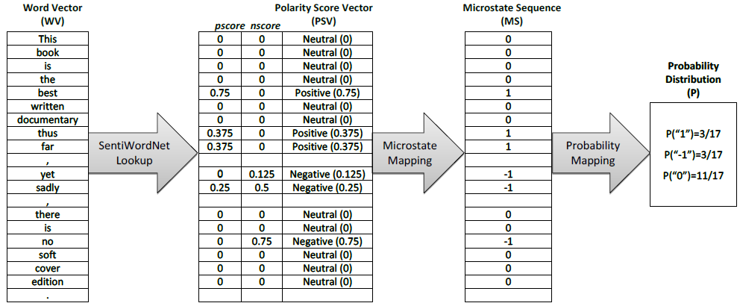
Conversion of text representation
Source: Zhang, Z., Li, X., and Chen, Y. (2012), "Deciphering word-of-mouth in social media: Text-based metrics of consumer reviews,"
ACM Trans. Manage. Inf. Syst. (3:1) 2012, pp 1-23.,

Slide 60
Example of SentiWordNet
POS ID PosScore NegScore SynsetTerms Gloss
a 00217728 0.75 0 beautiful#1 delighting the senses or exciting intellectual or emotional admiration; "a beautiful child"; "beautiful country"; "a beautiful painting"; "a beautiful theory"; "a beautiful party“
a 00227507 0.75 0 best#1 (superlative of `good') having the most positive qualities; "the best film of the year"; "the best solution"; "the best time for planting"; "wore his best suit“
r 00042614 0 0.625 unhappily#2 sadly#1 in an unfortunate way; "sadly he died before he could see his grandchild“
r 00093270 0 0.875 woefully#1 sadly#3 lamentably#1 deplorably#1 in an unfortunate or deplorable manner; "he was sadly neglected"; "it was woefully inadequate“
r 00404501 0 0.25 sadly#2 with sadness; in a sad manner; "`She died last night,' he said sadly"

Slide 61
SenticNet
The car is very old but it is rather not expensive.
The car is very old but it is rather not expensive.
The car is very old but it is rather not expensive.
Source: Cambria, Erik, Soujanya Poria, Rajiv Bajpai, and Björn Schuller. "SenticNet 4: A semantic resource for sentiment analysis based on conceptual primitives." In the 26th International Conference on Computational Linguistics (COLING), Osaka. 2016.

Slide 62
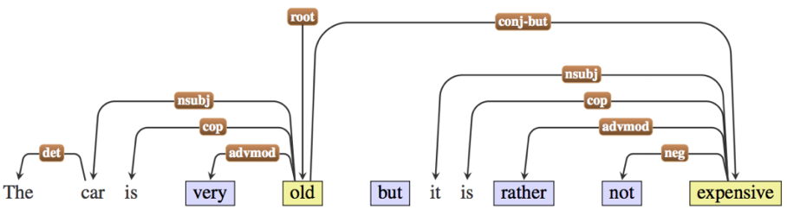
Polarity Detection with SenticNet
The car is very old but it is rather not expensive.
The car is very old but it is rather not expensive.
Source: Cambria, Erik, Soujanya Poria, Rajiv Bajpai, and Björn Schuller. "SenticNet 4: A semantic resource for sentiment analysis based on conceptual primitives." In the 26th International Conference on Computational Linguistics (COLING), Osaka. 2016.

Slide 63
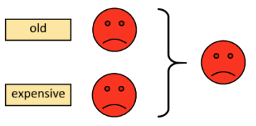
Polarity Detection with SenticNet
Source: Cambria, Erik, Soujanya Poria, Rajiv Bajpai, and Björn Schuller. "SenticNet 4: A semantic resource for sentiment analysis based on conceptual primitives." In the 26th International Conference on Computational Linguistics (COLING), Osaka. 2016.

Slide 64
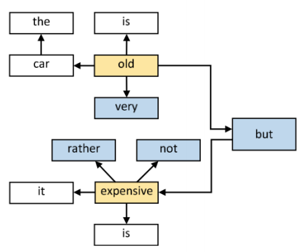
Polarity Detection with SenticNet
Source: Cambria, Erik, Soujanya Poria, Rajiv Bajpai, and Björn Schuller. "SenticNet 4: A semantic resource for sentiment analysis based on conceptual primitives." In the 26th International Conference on Computational Linguistics (COLING), Osaka. 2016.

Slide 65
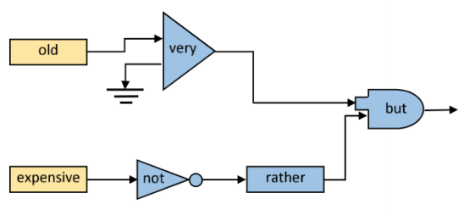
Polarity Detection with SenticNet
Source: Cambria, Erik, Soujanya Poria, Rajiv Bajpai, and Björn Schuller. "SenticNet 4: A semantic resource for sentiment analysis based on conceptual primitives." In the 26th International Conference on Computational Linguistics (COLING), Osaka. 2016.

Slide 66
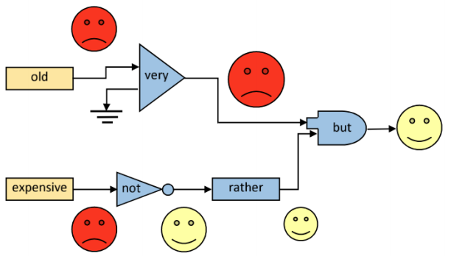
Polarity Detection with SenticNet
Source: Cambria, Erik, Soujanya Poria, Rajiv Bajpai, and Björn Schuller. "SenticNet 4: A semantic resource for sentiment analysis based on conceptual primitives." In the 26th International Conference on Computational Linguistics (COLING), Osaka. 2016.

Slide 67
Evaluation of
Text Mining and Sentiment Analysis
Evaluation of Information Retrieval
Evaluation of Classification Model (Prediction)
  Accuracy
  Precision
  Recall
  F-score

Slide 68
Accuracy
Precision
Validity
Reliability

Slide 70
Accuracy vs. Precision
A
B
High Accuracy
High Precision
Low Accuracy
High Precision
C
D
High Accuracy
Low Precision
Low Accuracy
Low Precision

Slide 71
Accuracy vs. Precision
A
B
High Accuracy
High Precision
Low Accuracy
High Precision
High Validity
High Reliability
Low Validity
High Reliability
C
D
High Accuracy
Low Precision
Low Accuracy
Low Precision
High Validity
Low Reliability
Low Validity
Low Reliability

Slide 72
Accuracy vs. Precision
A
B
High Accuracy
High Precision
Low Accuracy
High Precision
High Validity
High Reliability
Low Validity
High Reliability
C
D
High Accuracy
Low Precision
Low Accuracy
Low Precision
High Validity
Low Reliability
Low Validity
Low Reliability

Slide 73
Accuracy of Classification Models
In classification problems, the primary source for accuracy estimation is the confusion matrix
Source: Turban et al. (2011), Decision Support and Business Intelligence Systems

Slide 74
Estimation Methodologies for Classification
Simple split (or holdout or test sample estimation)
  Split the data into 2 mutually exclusive sets
  training (~70%) and testing (30%)
  For ANN, the data is split into three sub-sets
  (training [~60%], validation [~20%], testing [~20%])
Source: Turban et al. (2011), Decision Support and Business Intelligence Systems

Slide 75
Estimation Methodologies for Classification
k-Fold Cross Validation (rotation estimation)
  Split the data into k mutually exclusive subsets
  Use each subset as testing while using the rest of the subsets as training
  Repeat the experimentation for k times
  Aggregate the test results for true estimation of prediction accuracy training
Other estimation methodologies
  Leave-one-out, bootstrapping, jackknifing
  Area under the ROC curve
Source: Turban et al. (2011), Decision Support and Business Intelligence Systems

Slide 76
Estimation Methodologies for Classification – ROC Curve
Source: Turban et al. (2011), Decision Support and Business Intelligence Systems

Slide 77
Sensitivity
Specificity
=True Positive Rate
=True Negative Rate

Slide 78
True Class
(actual value)
Positive
Negative
total
True
Positive
(TP)
False
Positive
(FP)
Positive
P’
Predictive Class
(prediction outcome)
False
Negative
(FN)
True
Negative
(TN)
Negative
N’
total
P
N
Source: http://en.wikipedia.org/wiki/Receiver_operating_characteristic

Slide 79
True Class
(actual value)
Positive
Negative
total
True
Positive
(TP)
False
Positive
(FP)
Positive
P’
Predictive Class
(prediction outcome)
False
Negative
(FN)
True
Negative
(TN)
Negative
N’
total
P
N
Sensitivity
= True Positive Rate
= Recall
= Hit rate
= TP / (TP + FN)
Source: http://en.wikipedia.org/wiki/Receiver_operating_characteristic

Slide 80
True Class
(actual value)
Positive
Negative
total
True
Positive
(TP)
False
Positive
(FP)
Positive
P’
Predictive Class
(prediction outcome)
False
Negative
(FN)
True
Negative
(TN)
Negative
N’
total
P
N
Specificity
= True Negative Rate
= TN / N
= TN / (TN+ FP)
Source: http://en.wikipedia.org/wiki/Receiver_operating_characteristic

Slide 81
True Class
(actual value)
Precision
= Positive Predictive Value (PPV)
Positive
Negative
total
True
Positive
(TP)
False
Positive
(FP)
Positive
P’
Recall
= True Positive Rate (TPR)
= Sensitivity
= Hit Rate
Predictive Class
(prediction outcome)
False
Negative
(FN)
True
Negative
(TN)
Negative
N’
total
P
N
F1 score (F-score)(F-measure)
is the harmonic mean of precision and recall
= 2TP / (P + P’)
= 2TP / (2TP + FP + FN)
Source: http://en.wikipedia.org/wiki/Receiver_operating_characteristic

Slide 82
A
63
(TP)
28
(FP)
Recall
= True Positive Rate (TPR)
= Sensitivity
= Hit Rate
= TP / (TP + FN)
Specificity
= True Negative Rate
= TN / N
= TN / (TN + FP)
91
37
(FN)
72
(TN)
109
100
100
200
TPR = 0.63
FPR = 0.28
PPV = 0.69
=63/(63+28)
=63/91
Precision
= Positive Predictive Value (PPV)
F1 = 0.66
= 2*(0.63*0.69)/(0.63+0.69)
= (2 * 63) /(100 + 91)
= (0.63 + 0.69) / 2 =1.32 / 2 =0.66
F1 score (F-score)
(F-measure)
is the harmonic mean of precision and recall
= 2TP / (P + P’)
= 2TP / (2TP + FP + FN)
ACC = 0.68
= (63 + 72) / 200
= 135/200 = 67.5
Source: http://en.wikipedia.org/wiki/Receiver_operating_characteristic

Slide 83
A
B
63
(TP)
28
(FP)
77
(TP)
77
(FP)
91
154
37
(FN)
72
(TN)
109
23
(FN)
23
(TN)
46
100
100
200
100
100
200
TPR = 0.63
TPR = 0.77
FPR = 0.77
PPV = 0.50
F1 = 0.61
ACC = 0.50
FPR = 0.28
PPV = 0.69
=63/(63+28)
=63/91
F1 = 0.66
= 2*(0.63*0.69)/(0.63+0.69)
= (2 * 63) /(100 + 91)
= (0.63 + 0.69) / 2 =1.32 / 2 =0.66
Recall
= True Positive Rate (TPR)
= Sensitivity
= Hit Rate
ACC = 0.68
= (63 + 72) / 200
= 135/200 = 67.5
Precision
= Positive Predictive Value (PPV)
Source: http://en.wikipedia.org/wiki/Receiver_operating_characteristic

Slide 84
C
C’
24
(TP)
88
(FP)
76
(TP)
12
(FP)
112
88
76
(FN)
12
(TN)
88
24
(FN)
88
(TN)
112
100
100
200
100
100
200
TPR = 0.24
FPR = 0.88
PPV = 0.21
F1 = 0.22
ACC = 0.18
TPR = 0.76
FPR = 0.12
PPV = 0.86
F1 = 0.81
ACC = 0.82
Recall
= True Positive Rate (TPR)
= Sensitivity
= Hit Rate
Precision
= Positive Predictive Value (PPV)
Source: http://en.wikipedia.org/wiki/Receiver_operating_characteristic

Slide 85
LeCun, Yann,
Yoshua Bengio, and Geoffrey Hinton.
"Deep learning."
Nature 521, no. 7553 (2015): 436-444.

Slide 86
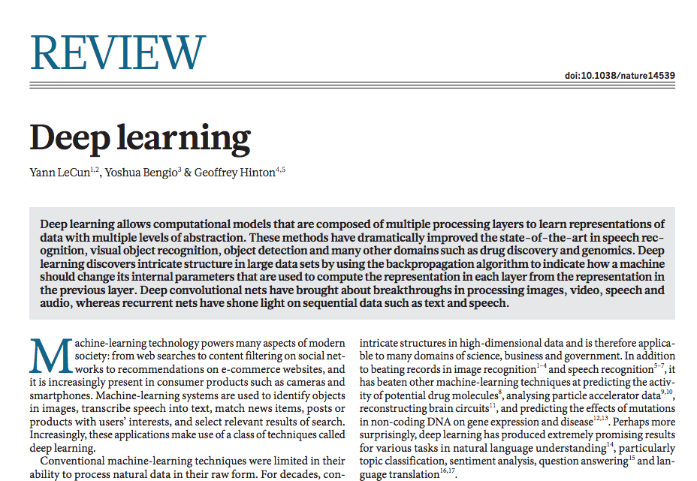
Source: LeCun, Yann, Yoshua Bengio, and Geoffrey Hinton. "Deep learning." Nature 521, no. 7553 (2015): 436-444.

Slide 87
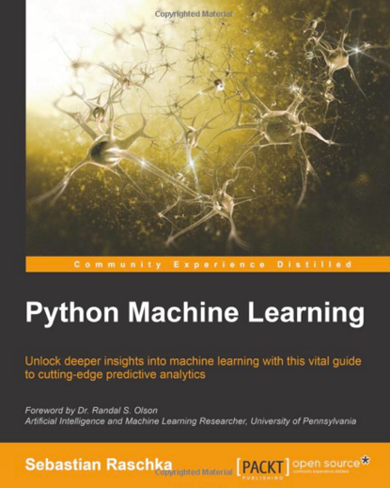
Sebastian Raschka (2015),
Python Machine Learning,
Packt Publishing
Source: http://www.amazon.com/Python-Machine-Learning-Sebastian-Raschka/dp/1783555130
Notes:
Source: Sebastian Raschka (2015), Python Machine Learning, Packt Publishing
Source: http://www.amazon.com/Python-Machine-Learning-Sebastian-Raschka/dp/1783555130

Slide 88
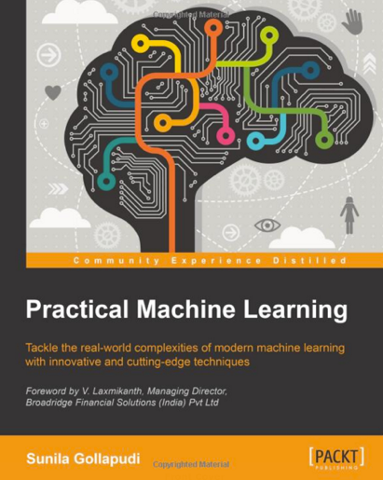
Sunila Gollapudi (2016),
Practical Machine Learning,
Packt Publishing
Source: http://www.amazon.com/Practical-Machine-Learning-Sunila-Gollapudi/dp/178439968X
Notes:
Source: Sunila Gollapudi (2016), Practical Machine Learning, Packt Publishing
Source: http://www.amazon.com/Practical-Machine-Learning-Sunila-Gollapudi/dp/178439968X

Slide 89
Machine Learning Models
Deep Learning
Kernel
Association rules
Ensemble
Decision tree
Dimensionality reduction
Clustering
Regression Analysis
Bayesian
Instance based
Source: Sunila Gollapudi (2016), Practical Machine Learning, Packt Publishing

Slide 90
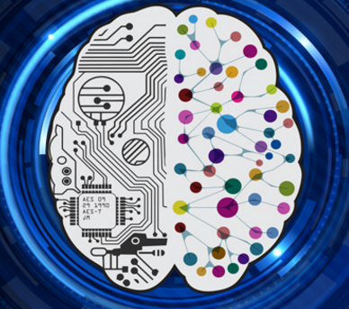
Deep Learning
Intelligence from Big Data
Source: https://www.vlab.org/events/deep-learning/

Slide 91
Deep Learning for
Sentiment Analytics

Slide 92
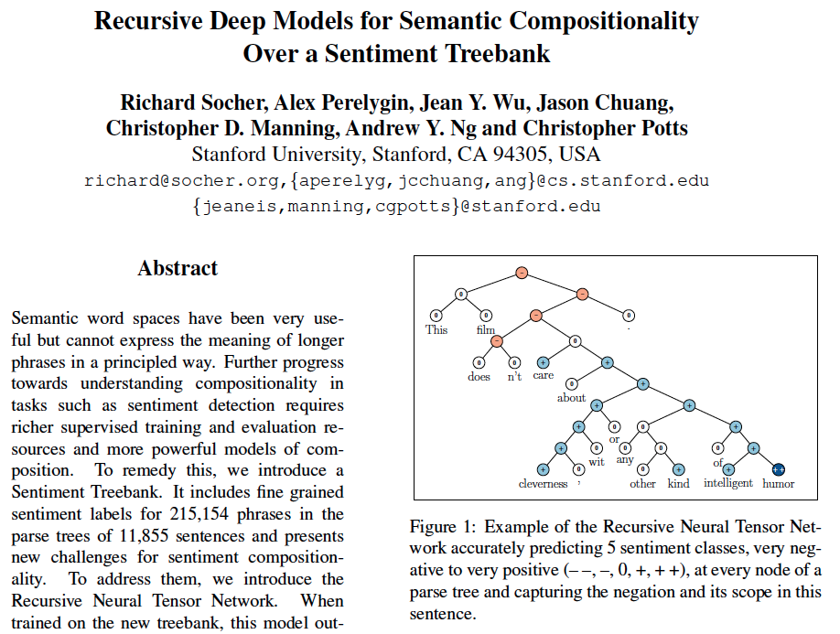
Recursive Deep Models for Semantic Compositionality Over a Sentiment Treebank
Source: Richard Socher et al. (2013) "Recursive Deep Models for Semantic Compositionality Over a Sentiment Treebank", EMNLP 2013

Slide 93
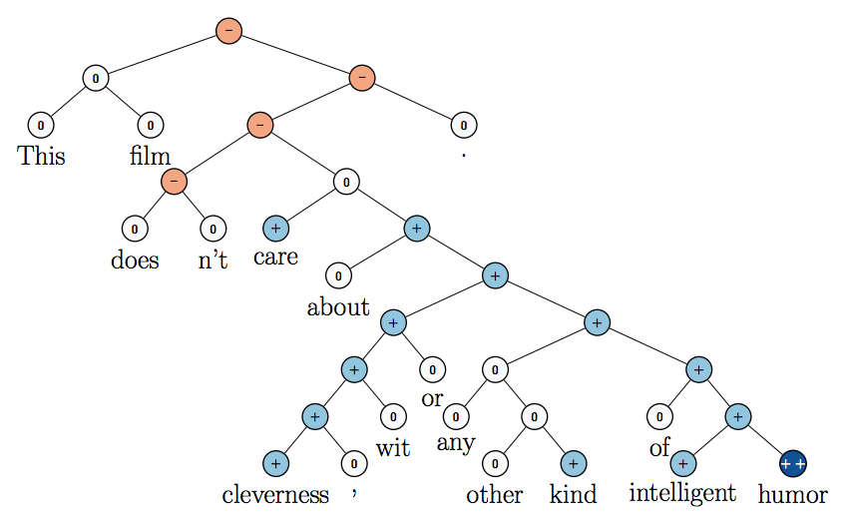
Recursive Neural Tensor Network (RNTN)
Source: Richard Socher et al. (2013) "Recursive Deep Models for Semantic Compositionality Over a Sentiment Treebank", EMNLP 2013

Slide 94
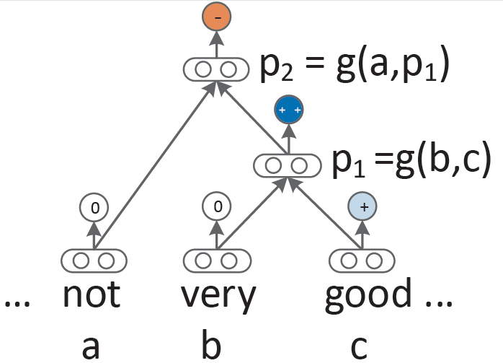
Recursive Neural Network (RNN) models for sentiment
Source: Richard Socher et al. (2013) "Recursive Deep Models for Semantic Compositionality Over a Sentiment Treebank", EMNLP 2013

Slide 95
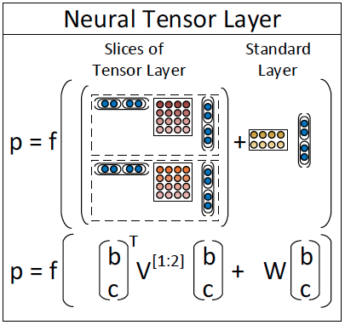
Recursive Neural Tensor Network
(RNTN)
Source: Richard Socher et al. (2013) "Recursive Deep Models for Semantic Compositionality Over a Sentiment Treebank", EMNLP 2013

Slide 96
Roger Dodger is one of the most compelling variations on this theme.
Roger Dodger is one of the least compelling variations on this theme.
Source: Richard Socher et al. (2013) "Recursive Deep Models for Semantic Compositionality Over a Sentiment Treebank", EMNLP 2013

Slide 97
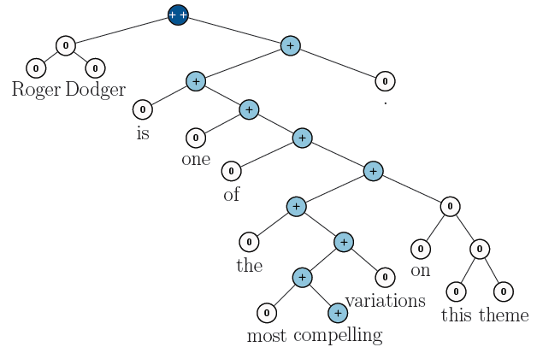
RNTN for Sentiment Analysis
Roger Dodger is one of the most compelling variations on this theme.
Source: Richard Socher et al. (2013) "Recursive Deep Models for Semantic Compositionality Over a Sentiment Treebank", EMNLP 2013

Slide 98
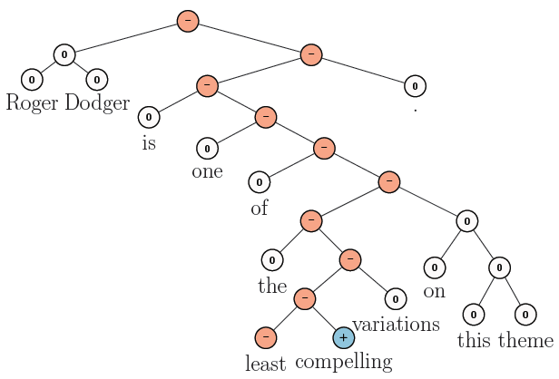
RNTN for Sentiment Analysis
Roger Dodger is one of the least compelling variations on this theme.
Source: Richard Socher et al. (2013) "Recursive Deep Models for Semantic Compositionality Over a Sentiment Treebank", EMNLP 2013

Slide 99
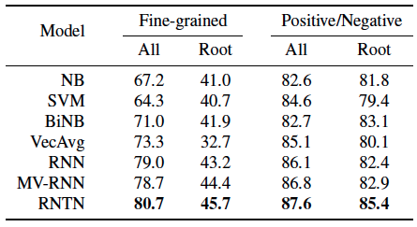
Accuracy for fine grained (5-class) and binary predictions at the sentence level (root) and for all nodes
Source: Richard Socher et al. (2013) "Recursive Deep Models for Semantic Compositionality Over a Sentiment Treebank", EMNLP 2013

Slide 100
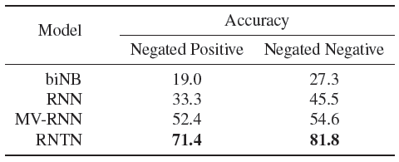
Accuracy of negation detection
Source: Richard Socher et al. (2013) "Recursive Deep Models for Semantic Compositionality Over a Sentiment Treebank", EMNLP 2013

Slide 101
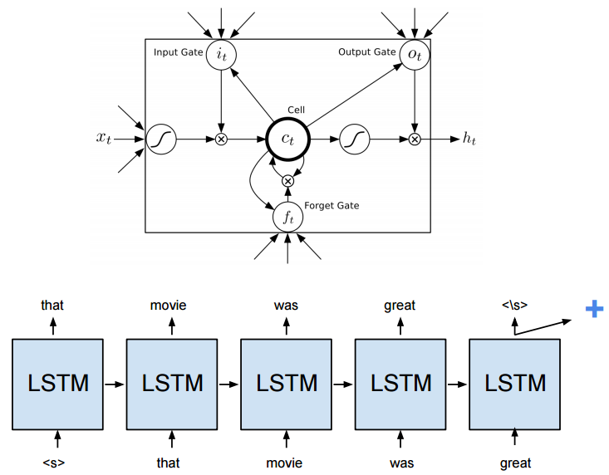
Long Short-Term Memory (LSTM)
Source: https://cs224d.stanford.edu/reports/HongJames.pdf

Slide 102
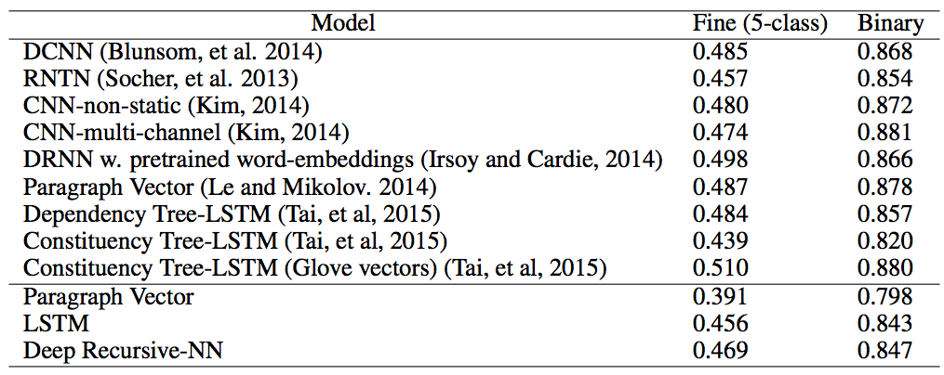
Deep Learning for Sentiment Analysis
CNN RNTN LSTM
Source: https://cs224d.stanford.edu/reports/HongJames.pdf

Slide 103
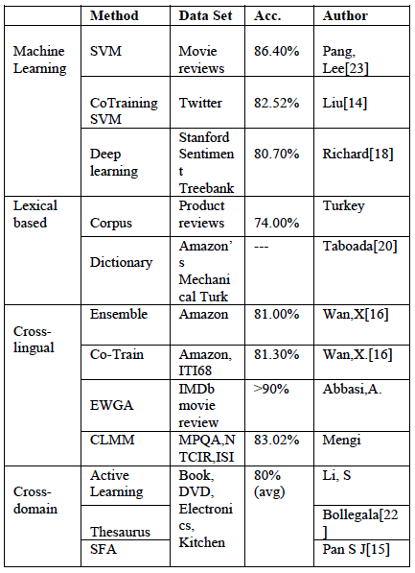
Performance Comparison of
Sentiment Analysis Methods
Vishal Kharde and Sheetal Sonawane (2016), "Sentiment Analysis of Twitter Data: A Survey of Techniques,"
International Journal of Computer Applications, Vol 139, No. 11, 2016. pp.5-15

Slide 104
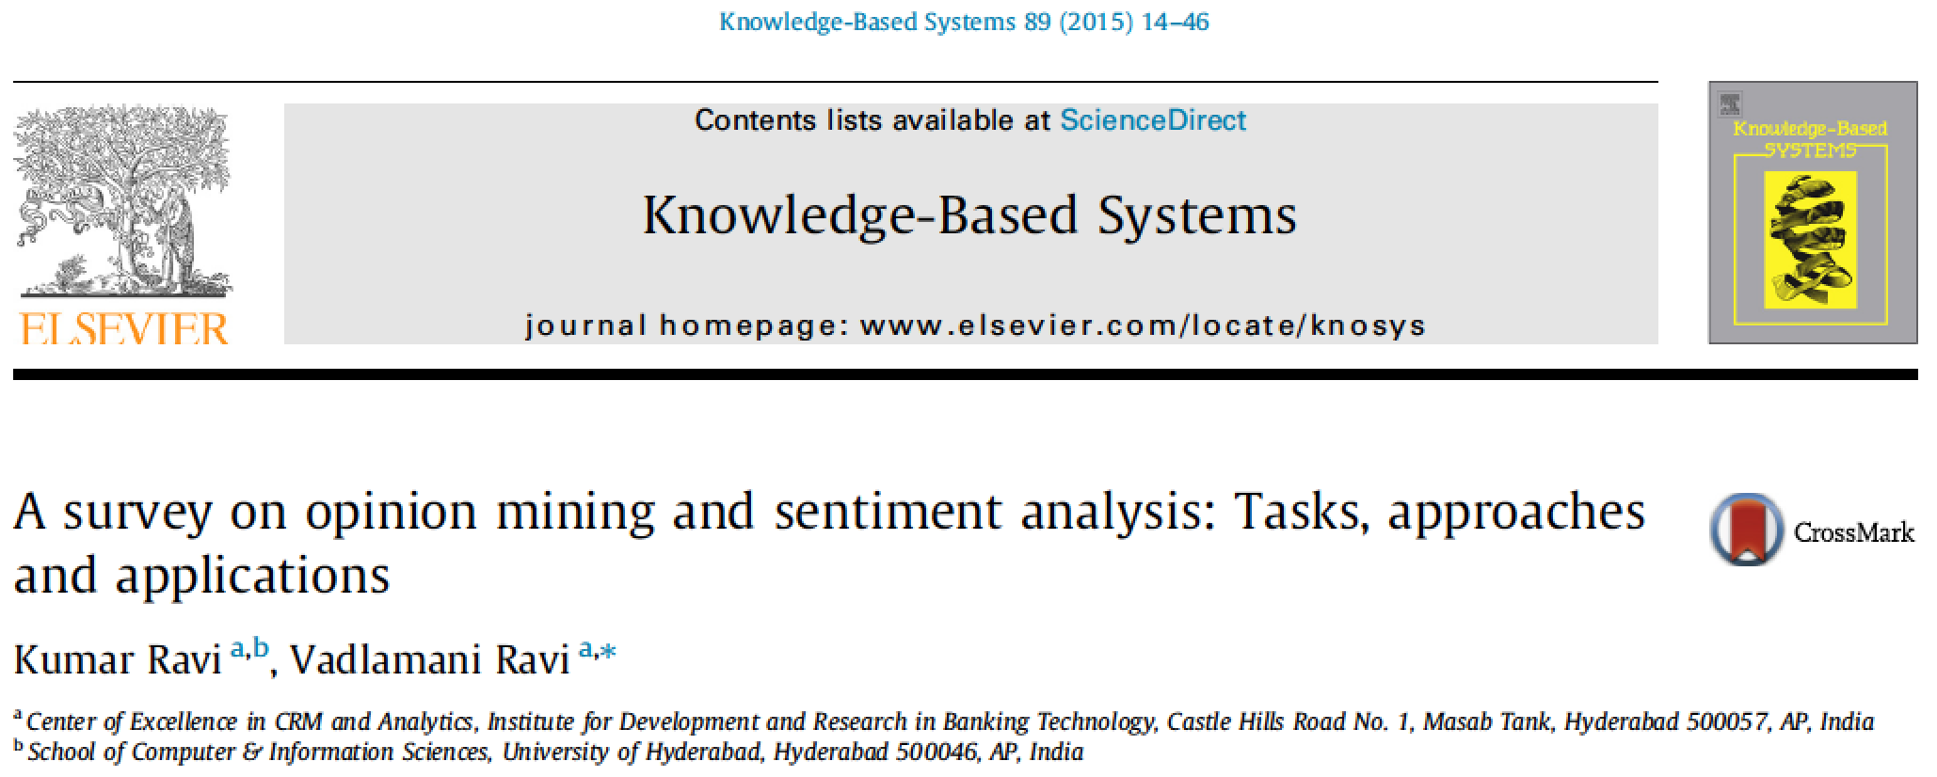
Kumar Ravi and Vadlamani Ravi (2015),
"A survey on opinion mining and sentiment analysis: tasks, approaches and applications."
Knowledge-Based Systems,
89, pp.14-46

Slide 105
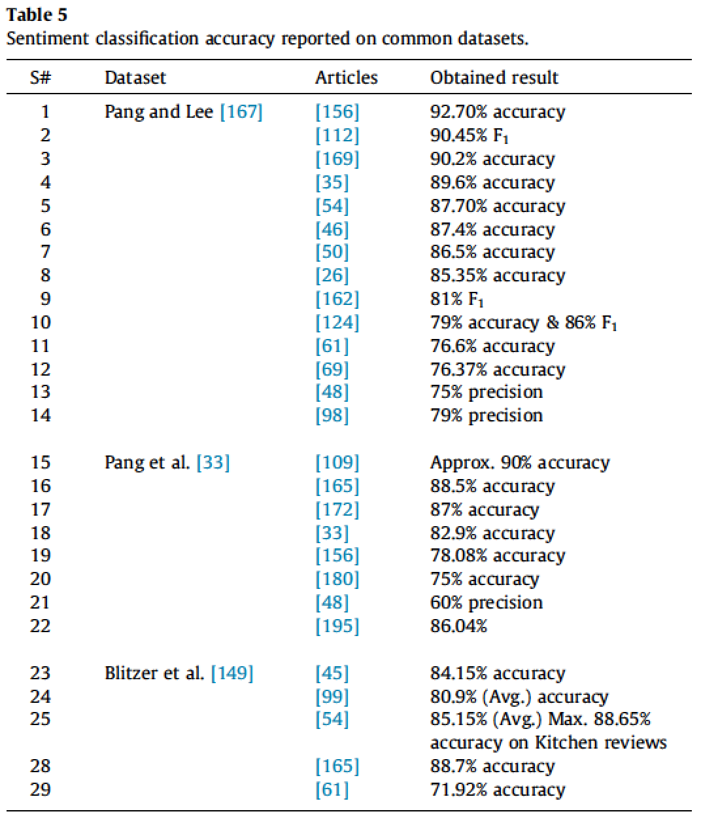
Source: Kumar Ravi and Vadlamani Ravi (2015), "A survey on opinion mining and sentiment analysis: tasks, approaches and applications." Knowledge-Based Systems, 89, pp.14-46.

Slide 106
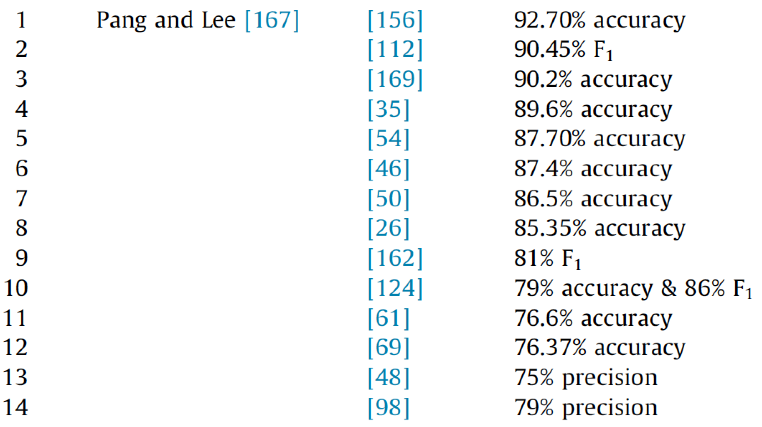
Sentiment Classification Accuracy
B. Pang, L. Lee, A sentiment education: sentiment analysis using subjectivity summarization based on minimum cuts, in: Proceedings of the 42nd Annual Meeting on Association for Computational Linguistics, July 2004, p. 271
Source: Kumar Ravi and Vadlamani Ravi (2015), "A survey on opinion mining and sentiment analysis: tasks, approaches and applications." Knowledge-Based Systems, 89, pp.14-46.

Slide 107
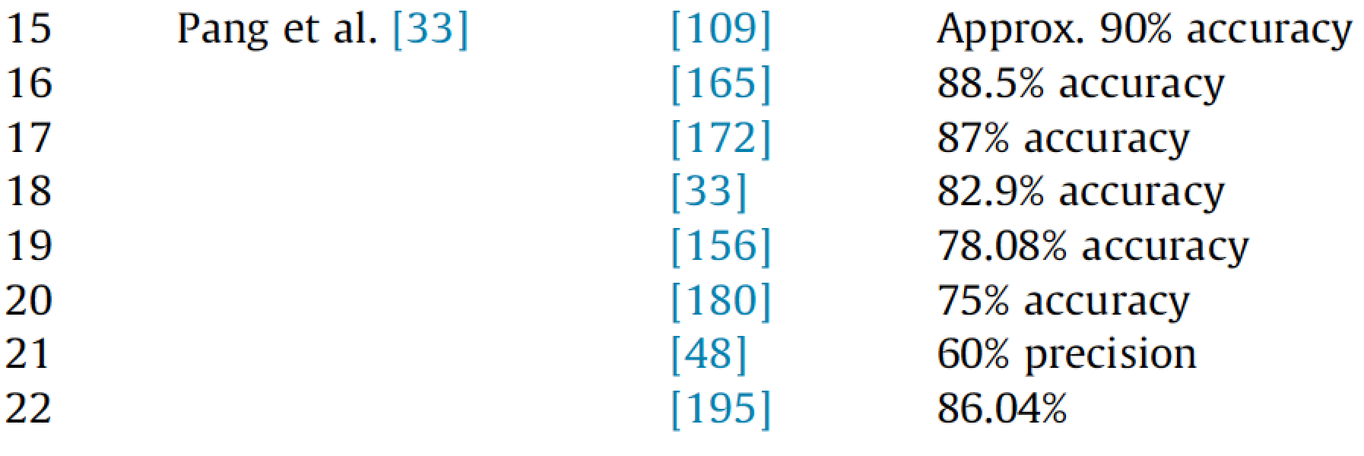
Sentiment Classification Accuracy
B. Pang, L. Lee, S. Vaithyanathan, Thumbs up? Sentiment classification using machine learning techniques, Proceedings of the ACL-02 Conference on Empirical Methods in Natural Language Processing, vol. 10, Association for Computational Linguistics, 2002, pp. 79–86.
Source: Kumar Ravi and Vadlamani Ravi (2015), "A survey on opinion mining and sentiment analysis: tasks, approaches and applications." Knowledge-Based Systems, 89, pp.14-46.

Slide 108
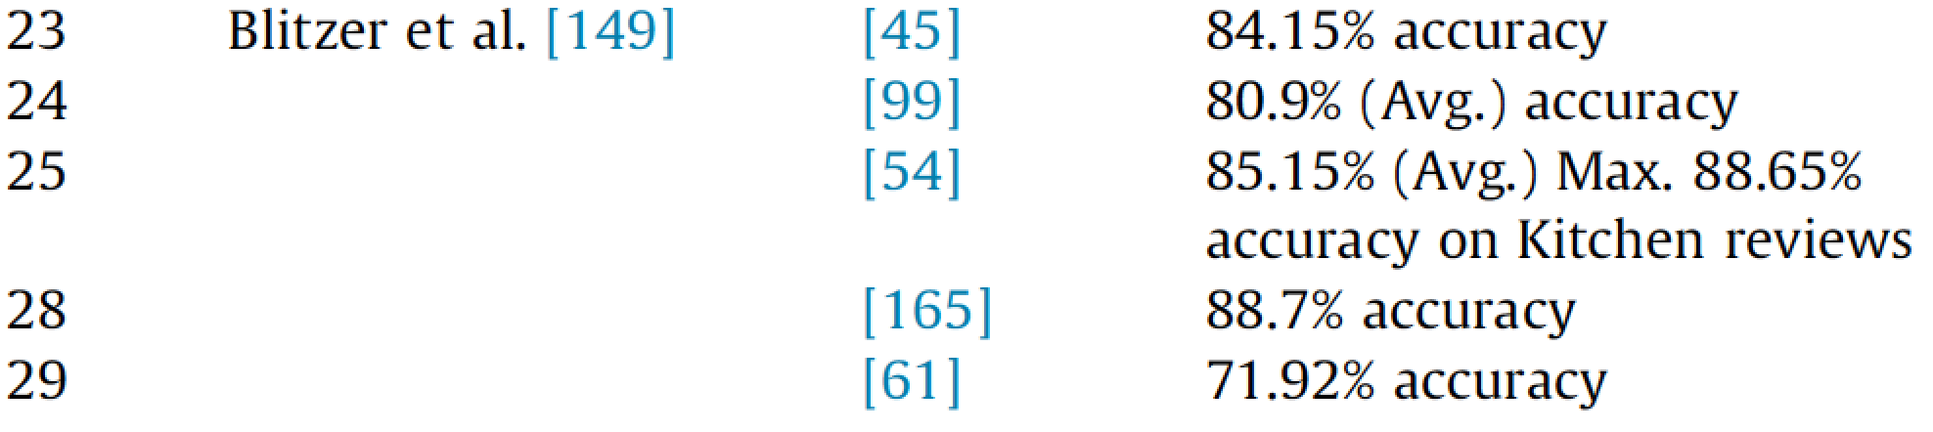
Sentiment Classification Accuracy
J. Blitzer, M. Dredze, F. Pereira, Biographies, bollywood, boom-boxes and blenders: domain adaptation for sentiment classification, in: Proceedings of the 45th Annual Meeting of the Association for Computational Linguistics, ACL’07, vol. 7, 2007, pp. 187–205 (13, 29).
Source: Kumar Ravi and Vadlamani Ravi (2015), "A survey on opinion mining and sentiment analysis: tasks, approaches and applications." Knowledge-Based Systems, 89, pp.14-46.

Slide 109
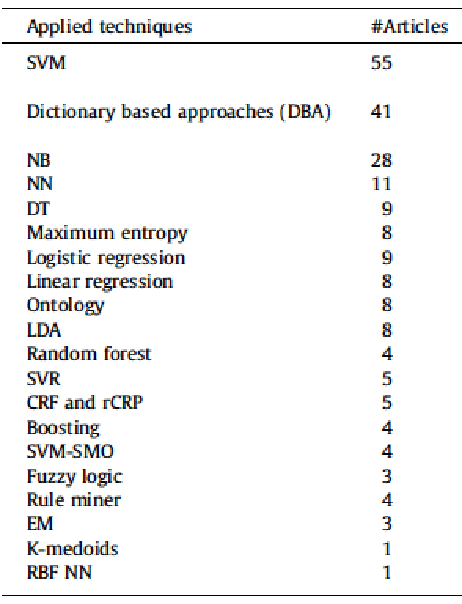
Techniques for Sentiment Analysis
Source: Kumar Ravi and Vadlamani Ravi (2015), "A survey on opinion mining and sentiment analysis: tasks, approaches and applications." Knowledge-Based Systems, 89, pp.14-46.

Slide 110
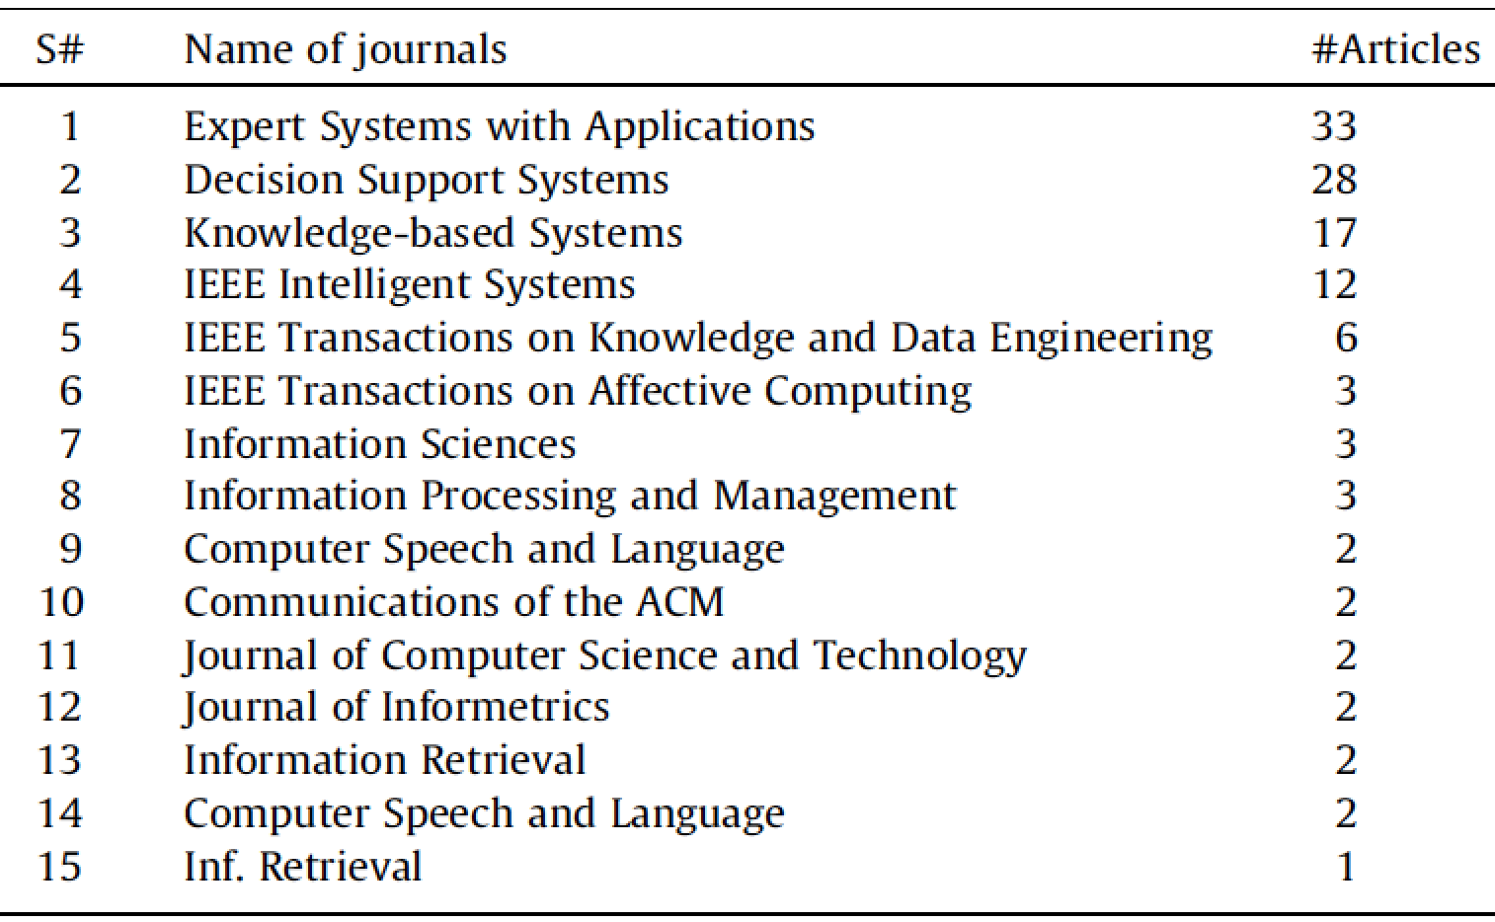
Sentiment Analysis Articles in Journals (2002-2014)
Source: Kumar Ravi and Vadlamani Ravi (2015), "A survey on opinion mining and sentiment analysis: tasks, approaches and applications." Knowledge-Based Systems, 89, pp.14-46.

Slide 111
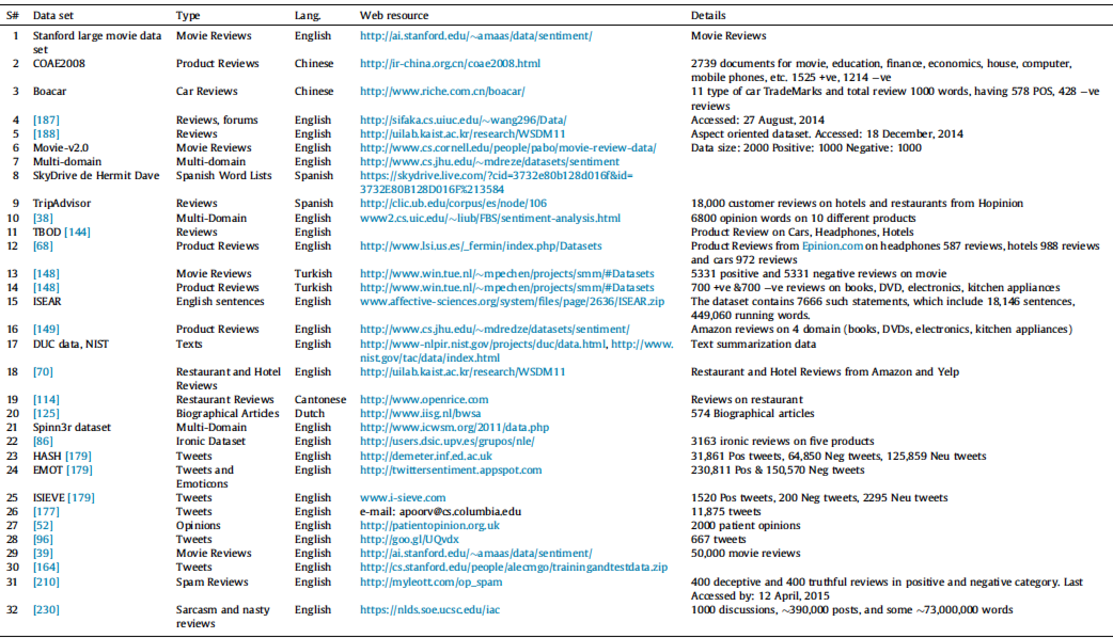
Publicly Available Datasets for Sentiment Analysis
Source: Kumar Ravi and Vadlamani Ravi (2015), "A survey on opinion mining and sentiment analysis: tasks, approaches and applications." Knowledge-Based Systems, 89, pp.14-46.

Slide 112
Sentiment Analysis Datasets
Product Reviews (PR)
Movie Reviews (MR)
Restaurant Reviews (RR)
Micro-blog (MB)
Global domain (G)
Source: Kumar Ravi and Vadlamani Ravi (2015), "A survey on opinion mining and sentiment analysis: tasks, approaches and applications." Knowledge-Based Systems, 89, pp.14-46.

Slide 113
Sentiment Analysis Dictionary
SenticNet (SN)
WordNet (WN)
ConceptNet (CN)
WordNet-Affect (WNA)
Bing Liu Opinion Lexicon (OL)
Source: Kumar Ravi and Vadlamani Ravi (2015), "A survey on opinion mining and sentiment analysis: tasks, approaches and applications." Knowledge-Based Systems, 89, pp.14-46.

Slide 114
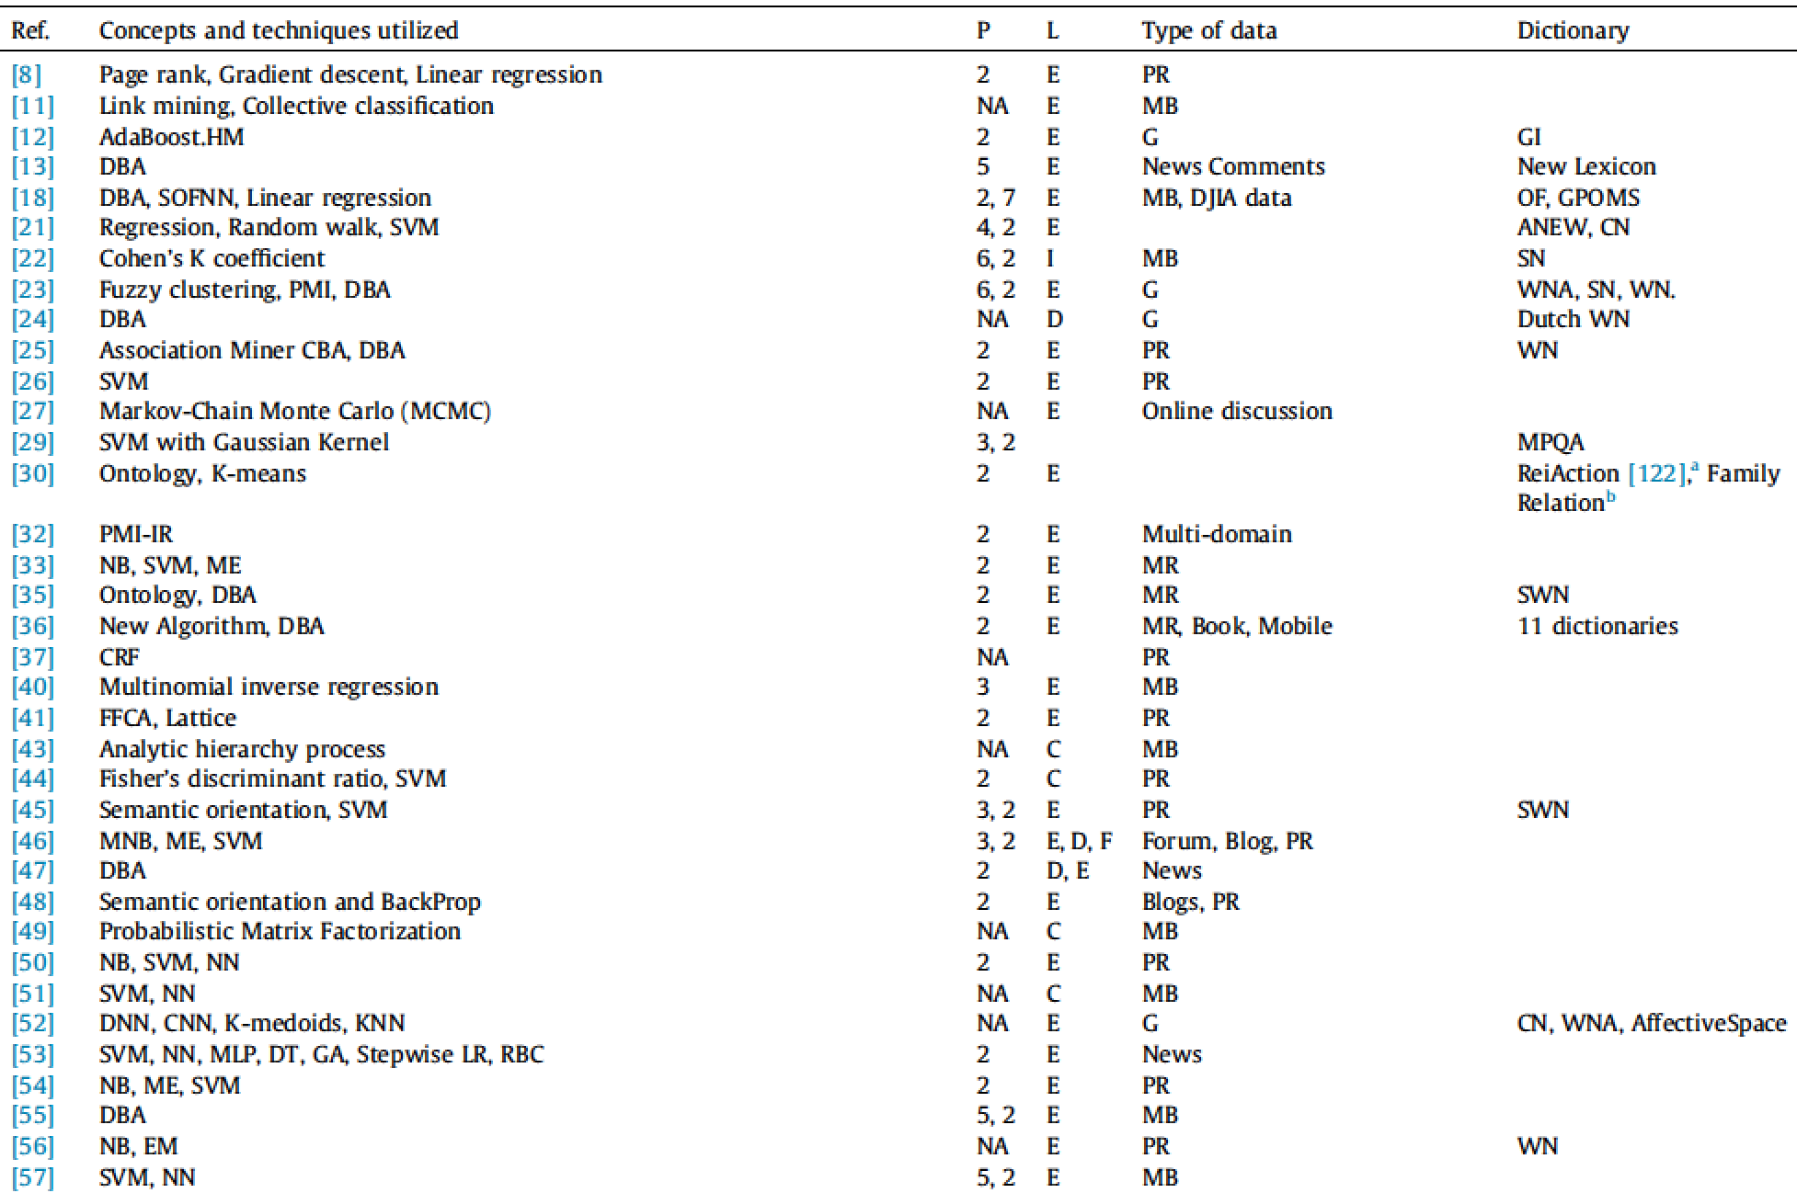
Summary of reviewed articles
Source: Kumar Ravi and Vadlamani Ravi (2015), "A survey on opinion mining and sentiment analysis: tasks, approaches and applications." Knowledge-Based Systems, 89, pp.14-46.

Slide 115
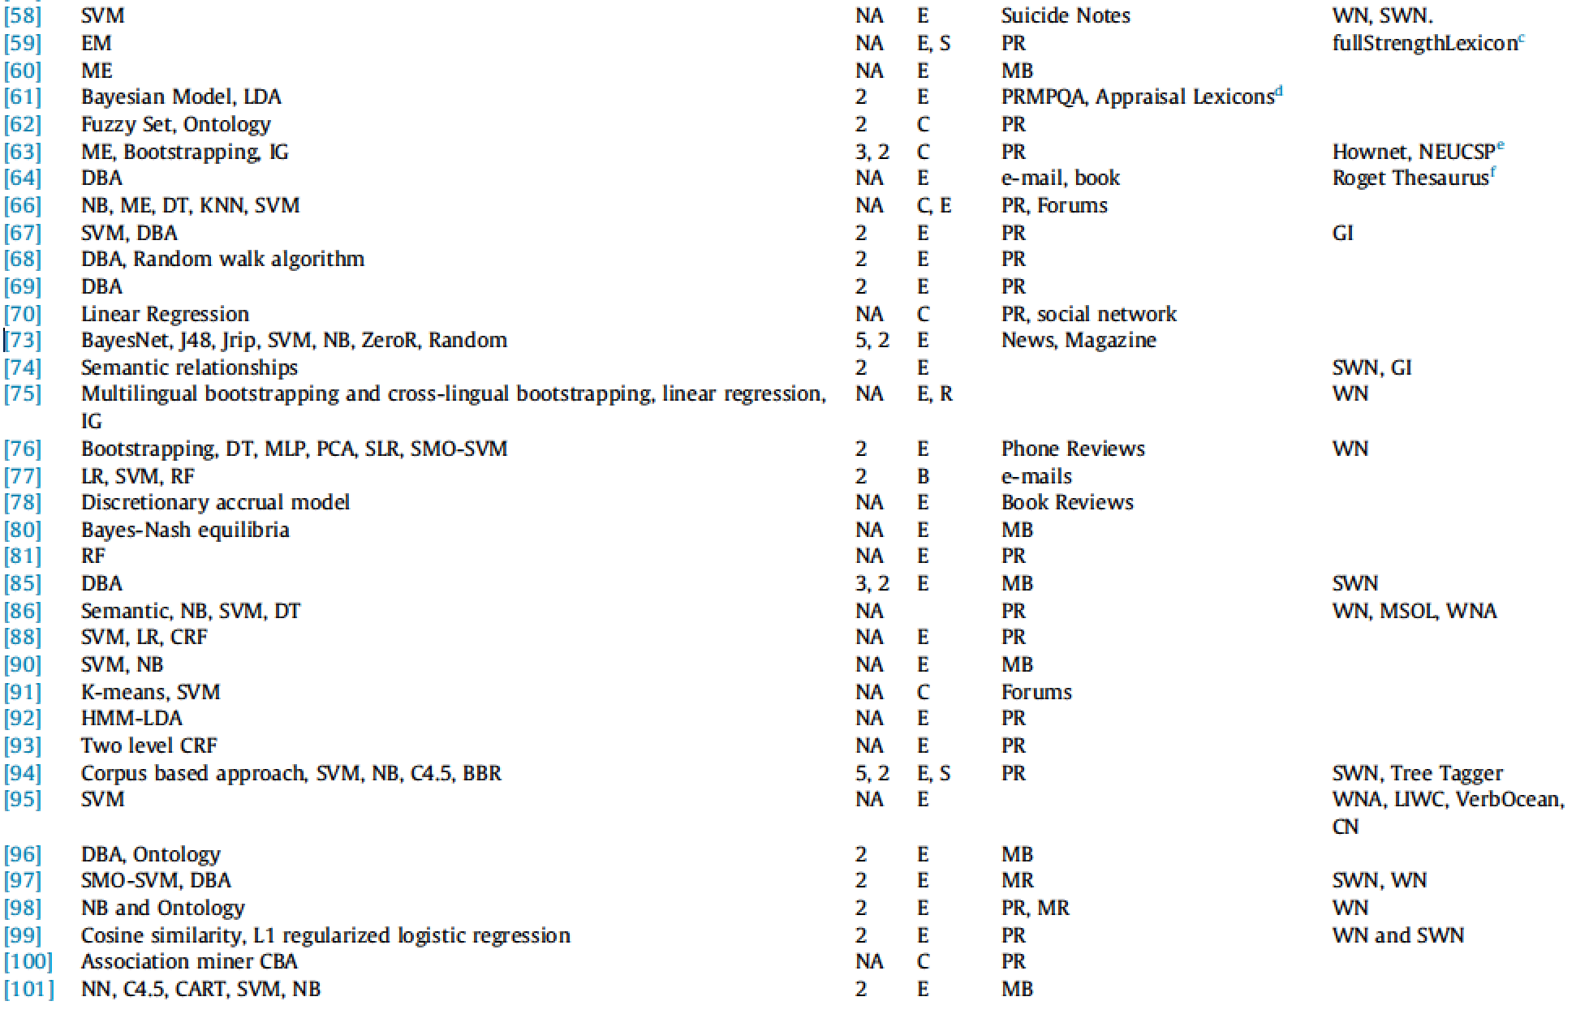
Summary of reviewed articles
Source: Kumar Ravi and Vadlamani Ravi (2015), "A survey on opinion mining and sentiment analysis: tasks, approaches and applications." Knowledge-Based Systems, 89, pp.14-46.

Slide 116
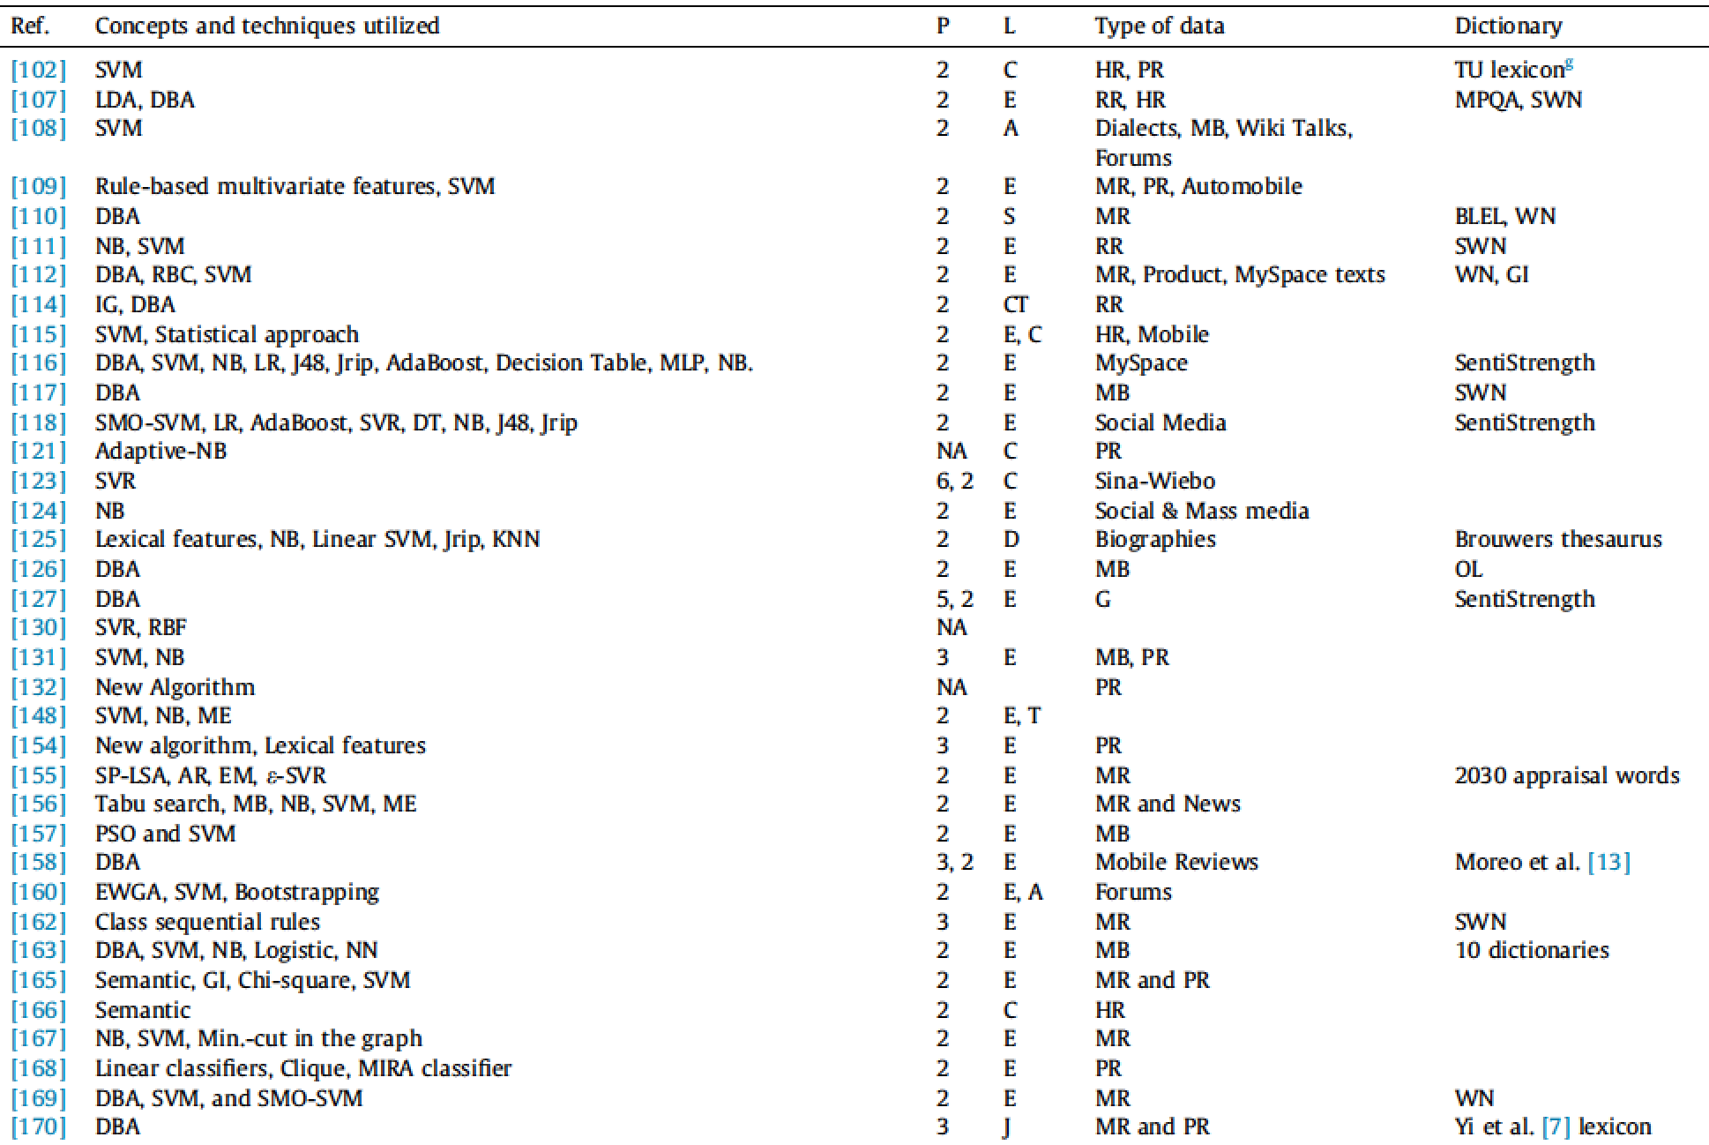
Summary of reviewed articles
Source: Kumar Ravi and Vadlamani Ravi (2015), "A survey on opinion mining and sentiment analysis: tasks, approaches and applications." Knowledge-Based Systems, 89, pp.14-46.

Slide 117
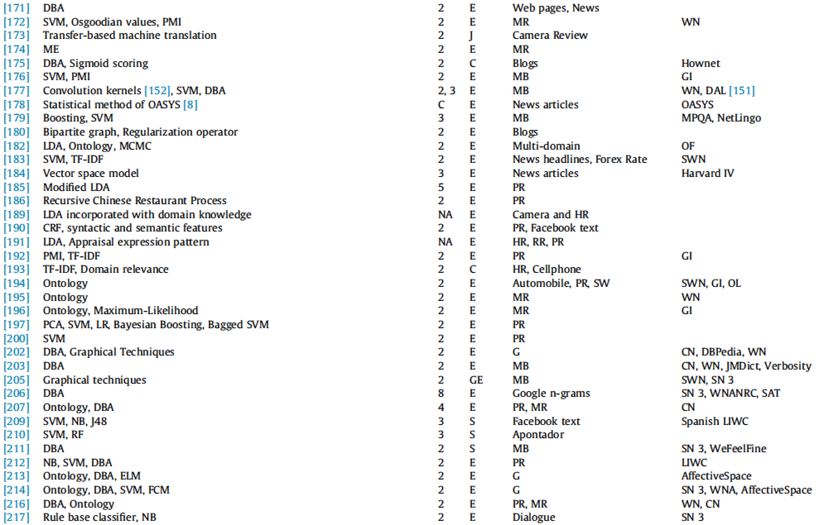
Summary of reviewed articles
Source: Kumar Ravi and Vadlamani Ravi (2015), "A survey on opinion mining and sentiment analysis: tasks, approaches and applications." Knowledge-Based Systems, 89, pp.14-46.

Slide 118
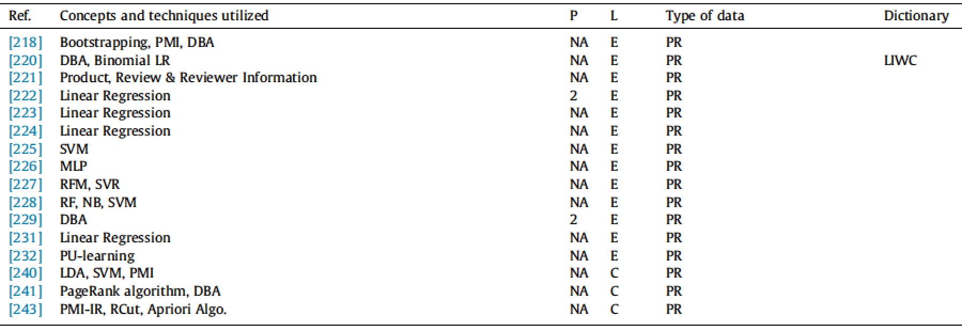
Summary of reviewed articles
Source: Kumar Ravi and Vadlamani Ravi (2015), "A survey on opinion mining and sentiment analysis: tasks, approaches and applications." Knowledge-Based Systems, 89, pp.14-46.

Slide 119
Social Media Monitoring/Analysis

Slide 120
Existing Tools
(“Social Media Monitoring/Analysis")
Radian 6
Social Mention
Overtone OpenMic
Microsoft Dynamics Social Networking Accelerator
SAS Social Media Analytics
Lithium Social Media Monitoring
RightNow Cloud Monitor
Source: Wiltrud Kessler (2012), Introduction to Sentiment Analysis

Slide 121
Word-of-mouth
Voice of the Customer
1. Attensity
  Track social sentiment across brands and competitors
  http://www.attensity.com/home/
2. Clarabridge
  Sentiment and Text Analytics Software
  http://www.clarabridge.com/

Slide 122

Attensity: Track social sentiment across brands and competitors
http://www.attensity.com/
http://www.youtube.com/watch?v=4goxmBEg2Iw#!

Slide 123

Clarabridge: Sentiment and Text Analytics Software
http://www.clarabridge.com/
http://www.youtube.com/watch?v=IDHudt8M9P0

Slide 124

http://www.radian6.com/
http://www.youtube.com/watch?feature=player_embedded&v=8i6Exg3Urg0

Slide 125

http://www.sas.com/software/customer-intelligence/social-media-analytics/

Slide 126

http://www.tweetfeel.com

Slide 127

eLand
http://www.eland.com.tw/

Slide 128

OpView
http://www.opview.com.tw/

Slide 129

http://www.i-buzz.com.tw/

Slide 130
Resources of
Opinion Mining

Slide 131
Datasets of Opinion Mining
Blog06
  25GB TREC test collection
  http://ir.dcs.gla.ac.uk/test collections/access to data.html
Cornell movie-review datasets
  http://www.cs.cornell.edu/people/pabo/movie-review-data/
Customer review datasets
  http://www.cs.uic.edu/∼liub/FBS/CustomerReviewData.zip
Multiple-aspect restaurant reviews
  http://people.csail.mit.edu/bsnyder/naacl07
NTCIR multilingual corpus
  NTCIR Multilingual Opinion-Analysis Task (MOAT)
Source: Bo Pang and Lillian Lee (2008), "Opinion mining and sentiment analysis,” Foundations and Trends in Information Retrieval

Slide 132
Lexical Resources of Opinion Mining
SentiWordnet
  http://sentiwordnet.isti.cnr.it/
General Inquirer
  http://www.wjh.harvard.edu/∼inquirer/
OpinionFinder’s Subjectivity Lexicon
  http://www.cs.pitt.edu/mpqa/
NTU Sentiment Dictionary (NTUSD)
  http://nlg18.csie.ntu.edu.tw:8080/opinion/
Hownet Sentiment
  http://www.keenage.com/html/c_bulletin_2007.htm

Slide 133
Sentiment Analysis Resources
Roget's Thesaurus:
  http://thesaurus.com/Roget-alpha-index.html
Suggested Upper Merged Ontology (SUMO)
  http://www.adampease.org/OP/index.html
Source: Kumar Ravi and Vadlamani Ravi (2015), "A survey on opinion mining and sentiment analysis: tasks, approaches and applications." Knowledge-Based Systems, 89, pp.14-46.

Slide 134
NLP Toolkits
Toolkit | Language | Description
NLTK | Python | http://www.nltk.org/
OpenNLP | JAVA | https://opennlp.apache.org
CoreNLP | JAVA | http://stanfordnlp.github.io/CoreNLP/
Gensim | Python | http://radimrehurek.com/gensim/
FudanNLP | JAVA | https://code.google.com/archive/p/fudannlp/
LTP | C++/Python | http://www.ltp-cloud.com/intro/en/
NiuParser | C++ | http://www.niuparser.com/index.en.html
Source: Sun, Shiliang, Chen Luo, and Junyu Chen. "A review of natural language processing techniques for opinion mining systems." Information Fusion 36 (2017): 10-25.

Slide 135
Annotated corpora for opinion mining
Corpora | Language | Description
MPQA opinion corpora | English | This corpus contains news articles manually annotated using an annotation scheme for opinions. Several versions annotated in different levels are provided. http://mpqa.cs.pitt.edu/corpora/mpqa_corpus/
Movie review polarity dataset | English | The latest version of this dataset contains 1000 positive and 1000 negative processed reviews. http://www.cs.cornell.edu/people/pabo/movie-review-data/review_polarity.tar.gz
Movie review subjectivity dataset | English | This dataset includes 5000 subjective and 5000 objective processed sentences. http://www.cs.cornell.edu/people/pabo/movie-review-data/rotten_imdb.tar.gz
Multi-domain sentiment dataset | English | The dataset is constructed by Amazon product reviews for books, DVDs, electronics and kitchen appliances. Two kinds of datasets are available, one with the number of stars, the other with positive or negative labels. https://www.cs.jhu.edu/~mdredze/datasets/sentiment/
Source: Sun, Shiliang, Chen Luo, and Junyu Chen. "A review of natural language processing techniques for opinion mining systems." Information Fusion 36 (2017): 10-25.

Slide 136
Sentiment lexicons for opinion mining
Lexicon | Language | Description
Bing Liu’s Opinion Lexicon | English | The latest version of this lexicon includes 4,783 negative words and 2,006 positive ones. http://www.cs.uic.edu/~liub/FBS/sentiment-analysis.html
MPQA Subjectivity Lexicon | English | This lexicon includes 8,222 words with their subjectivities (strong or weak), POS tags and polarities. http://mpqa.cs.pitt.edu/lexicons/subj_lexicon/
SentiWordNet | English | SentiWordNet associates words to numerical scores ranging in [0.0, 1.0] which indicate the positivity, negativity and neutrality. For each word, the three scores sum up to 1.0. http://sentiwordnet.isti.cnr.it/
Harvard General Inquirer | English | Harvard General Inquirer contains 182 categories including positive and negative indicators. 1915 positive words and 2291 negative words are marked. http://www.wjh.harvard.edu/~inquirer/
LIWC | English | Linguistic Inquiry and Word Counts (LIWC) provides a lot of categorized regular expressions including some sentiment related categories such as “Negate” and “Anger”. http://liwc.wpengine.com
HowNet | Chinese & English | HowNet provides a Chinese/English vocabulary for sentiment analysis, including 8942 Chinese entries and 8945 English entries. http://www.keenage.com/html/e_index.html
NTUSD | Chinese | NTU Sentiment Dictionary provides 2812 positive words and 8276 negative words in both simplified and traditional Chinese. http://academiasinicanlplab.github.io/
Source: Sun, Shiliang, Chen Luo, and Junyu Chen. "A review of natural language processing techniques for opinion mining systems." Information Fusion 36 (2017): 10-25.

Slide 137
Example of SentiWordNet
POS ID PosScore NegScore SynsetTerms Gloss
a 00217728 0.75 0 beautiful#1 delighting the senses or exciting intellectual or emotional admiration; "a beautiful child"; "beautiful country"; "a beautiful painting"; "a beautiful theory"; "a beautiful party“
a 00227507 0.75 0 best#1 (superlative of `good') having the most positive qualities; "the best film of the year"; "the best solution"; "the best time for planting"; "wore his best suit“
r 00042614 0 0.625 unhappily#2 sadly#1 in an unfortunate way; "sadly he died before he could see his grandchild“
r 00093270 0 0.875 woefully#1 sadly#3 lamentably#1 deplorably#1 in an unfortunate or deplorable manner; "he was sadly neglected"; "it was woefully inadequate“
r 00404501 0 0.25 sadly#2 with sadness; in a sad manner; "`She died last night,' he said sadly"

Slide 138
《知網》情感分析用詞語集（beta版）
“中英文情感分析用詞語集”
  包含詞語約 17887
“中文情感分析用詞語集”
  包含詞語約 9193
“英文情感分析用詞語集”
  包含詞語 8945
Source: http://www.keenage.com/html/c_bulletin_2007.htm

Slide 139
中文情感分析用詞語集
中文正面情感詞語 | 836
中文負面情感詞語 | 1254
中文正面評價詞語 | 3730
中文負面評價詞語 | 3116
中文程度級別詞語 | 219
中文主張詞語 | 38
Total | 9193
Source: http://www.keenage.com/html/c_bulletin_2007.htm

Slide 140
中文情感分析用詞語集
“正面情感”詞語
  如：
  愛，讚賞，快樂，感同身受，好奇，
  喝彩，魂牽夢縈，嘉許 ...
“負面情感”詞語
  如：
  哀傷，半信半疑，鄙視，不滿意，不是滋味兒，後悔，大失所望 ...
Source: http://www.keenage.com/html/c_bulletin_2007.htm

Slide 141
中文情感分析用詞語集
“正面評價”詞語
  如：
  不可或缺，部優，才高八斗，沉魚落雁，
  催人奮進，動聽，對勁兒 ...
“負面評價”詞語
  如：
  醜，苦，超標，華而不實，荒涼，混濁，
  畸輕畸重，價高，空洞無物 ...
Source: http://www.keenage.com/html/c_bulletin_2007.htm

Slide 142
中文情感分析用詞語集
“程度級別”詞語
  1. “極其|extreme / 最|most”
    非常，極，極度，無以倫比，最為
  2. “很|very”
    多麼，分外，格外，著實
  …
“主張”詞語
  1. {perception|感知}
    感覺，覺得，預感
  2. {regard|認為}
    認為，以為，主張
Source: http://www.keenage.com/html/c_bulletin_2007.htm

Slide 143
Opinion Spam Detection

Slide 144
Opinion Spam Detection
Opinion Spam Detection: Detecting Fake Reviews and Reviewers
  Spam Review
  Fake Review
  Bogus Review
  Deceptive review
  Opinion Spammer
  Review Spammer
  Fake Reviewer
  Shill (Stooge or Plant)
Source: http://www.cs.uic.edu/~liub/FBS/fake-reviews.html

Slide 145
Opinion Spamming
Opinion Spamming
  "illegal" activities
    e.g., writing fake reviews, also called shilling
  try to mislead readers or automated opinion mining and sentiment analysis systems by giving undeserving positive opinions to some target entities in order to promote the entities and/or by giving false negative opinions to some other entities in order to damage their reputations.
Source: http://www.cs.uic.edu/~liub/FBS/fake-reviews.html

Slide 146
Forms of Opinion spam
fake reviews (also called bogus reviews)
fake comments
fake blogs
fake social network postings
deceptions
deceptive messages
Source: http://www.cs.uic.edu/~liub/FBS/fake-reviews.html

Slide 147
Fake Review Detection
Methods
  supervised learning
  pattern discovery
  graph-based methods
  relational modeling
Signals
  Review content
  Reviewer abnormal behaviors
  Product related features
  Relationships
Source: http://www.cs.uic.edu/~liub/FBS/fake-reviews.html

Slide 148
Professional Fake Review Writing Services
(some Reputation Management companies)
Post positive reviews
Sponsored reviews
Pay per post
Need someone to write positive reviews about our company (budget: $250-$750 USD)
Fake review writer
Product review writer for hire
Hire a content writer
Fake Amazon book reviews (hiring book reviewers)
People are just having fun (not serious)
Source: http://www.cs.uic.edu/~liub/FBS/fake-reviews.html

Slide 149

Source:http://www.sponsoredreviews.com/

Slide 150

Source: https://payperpost.com/

Slide 151

Source:http://www.freelancer.com/projects/Forum-Posting-Reviews/Need-someone-write-post-positive.html

Slide 152
Papers on Opinion Spam Detection
Jing Wang, Clement. T. Yu, Philip S. Yu, Bing Liu, Weiyi Meng. “Diversionary comments under blog posts." Accepted. ACM Transactions on the Web (TWEB), 2015.
Huayi Li, Zhiyuan Chen, Arjun Mukherjee, Bing Liu and Jidong Shao. "Analyzing and Detecting Opinion Spam on a Large-scale Dataset via Temporal and Spatial Patterns." Short paper at ICWSM-2015, 2015.
Huayi Li, Arjun Mukherjee, Bing Liu, Rachel Kornfieldz and Sherry Emery. Detecting Campaign Promoters on Twitter using Markov Random Fields. to appear in Proceedings of IEEE International Conference on Data Mining (ICDM-2014), December 14-17, 2014.
Huayi Li, Zhiyuan Chen, Bing Liu, Xiaokai Wei and Jidong Shao. Spotting Fake Reviews via Collective Positive-Unlabeled Learning. to appear in Proceedings of IEEE International Conference on Data Mining (ICDM-2014, short paper), December 14-17, 2014.
Tieyun Qian, Bing Liu. Identifying Multiple Userids of the Same Author. To appear in Proceedings of Conference on Empirical Methods in Natural Language Processing (EMNLP-2013), October 18-21, 2013, Seattle, USA.
Arjun Mukherjee, Abhinav Kumar, Bing Liu, Junhui Wang, Meichun Hsu, Malu Castellanos, and Riddhiman Ghosh. Spotting Opinion Spammers using Behavioral Footprints. To appear in Proceedings of SIGKDD International Conference on Knowledge Discovery and Data Mining (KDD-2013), August 11-14 2013 in Chicago, USA.
Arjun Mukherjee, Vivek Venkataraman, Bing Liu, and Natalie Glance. What Yelp Fake Review Filter Might Be Doing. Proceedings of The International AAAI Conference on Weblogs and Social Media (ICWSM-2013), July 8-10, 2013, Boston, USA.
Geli Fei, Arjun Mukherjee, Bing Liu, Meichun Hsu, Malu Castellanos, and Riddhiman Ghosh. Exploiting Burstiness in Reviews for Review Spammer Detection. Proceedings of The International AAAI Conference on Weblogs and Social Media (ICWSM-2013), July 8-10, 2013, Boston, USA.
Source: http://www.cs.uic.edu/~liub/FBS/fake-reviews.html

Slide 153
Papers on Opinion Spam Detection
Arjun Mukherjee, Bing Liu, and Natalie Glance. Spotting Fake Reviewer Groups in Consumer Reviews. International World Wide Web Conference (WWW-2012), Lyon, France, April 16-20, 2012.
Guan Wang, Sihong Xie, Bing Liu, Philip S. Yu. Identify Online Store Review Spammers via Social Review Graph. ACM Transactions on Intelligent Systems and Technology, accepted for publication, 2011.
Guan Wang, Sihong Xie, Bing Liu, Philip S. Yu. Review Graph based Online Store Review Spammer Detection. ICDM-2011, 2011.
Arjun Mukherjee, Bing Liu, Junhui Wang, Natalie Glance, Nitin Jindal. Detecting Group Review Spam. WWW-2011 poster paper, 2011.
Nitin Jindal, Bing Liu and Ee-Peng Lim. "Finding Unusual Review Patterns Using Unexpected Rules" Proceedings of the 19th ACM International Conference on Information and Knowledge Management (CIKM-2010, short paper), Toronto, Canada, Oct 26 - 30, 2010.
Ee-Peng Lim, Viet-An Nguyen, Nitin Jindal, Bing Liu and Hady Lauw. "Detecting Product Review Spammers using Rating Behaviors." Proceedings of the 19th ACM International Conference on Information and Knowledge Management (CIKM-2010, full paper), Toronto, Canada, Oct 26 - 30, 2010.
Nitin Jindal and Bing Liu. "Opinion Spam and Analysis." Proceedings of First ACM International Conference on Web Search and Data Mining (WSDM-2008), Feb 11-12, 2008, Stanford University, Stanford, California, USA.
Nitin Jindal and Bing Liu. "Review Spam Detection." Proceedings of WWW-2007 (poster paper), May 8-12, Banff, Canada.
Source: http://www.cs.uic.edu/~liub/FBS/fake-reviews.html

Slide 154
Text Mining and Analytics Technology

Slide 155
Text
Mining Techniques

Slide 156
Natural Language Processing
(NLP)

Slide 157

Text Mining
http://www.amazon.com/Text-Mining-Applications-Michael-Berry/dp/0470749822/

Slide 158

Web Mining and
Social Networking
http://www.amazon.com/Web-Mining-Social-Networking-Applications/dp/1441977341

Slide 159

Mining the Social Web:
Analyzing Data from Facebook, Twitter, LinkedIn, and Other Social Media Sites
http://www.amazon.com/Mining-Social-Web-Analyzing-Facebook/dp/1449388345

Slide 160

Web Data Mining:
Exploring Hyperlinks, Contents, and Usage Data
http://www.amazon.com/Web-Data-Mining-Data-Centric-Applications/dp/3540378812

Slide 161

Search Engines:
Information Retrieval in Practice
http://www.amazon.com/Search-Engines-Information-Retrieval-Practice/dp/0136072240

Slide 162

Christopher D. Manning and Hinrich Schütze (1999), Foundations of
Statistical Natural Language Processing,
The MIT Press
http://www.amazon.com/Foundations-Statistical-Natural-Language-Processing/dp/0262133601

Slide 163

Steven Bird, Ewan Klein and Edward Loper (2009),
Natural Language Processing with Python,
O'Reilly Media
http://www.amazon.com/Natural-Language-Processing-Python-Steven/dp/0596516495

Slide 164

Natural Language Processing with Python
– Analyzing Text with the Natural Language Toolkit
http://www.nltk.org/book/

Slide 165

Nitin Hardeniya (2015),
NLTK Essentials, Packt Publishing
http://www.amazon.com/NLTK-Essentials-Nitin-Hardeniya/dp/1784396907

Slide 166
Text Mining
(text data mining)
  the process of
  deriving
  high-quality information
  from text
http://en.wikipedia.org/wiki/Text_mining

Slide 167
Typical Text Mining Tasks
Text categorization
Text clustering
Concept/entity extraction
Production of granular taxonomies
Sentiment analysis
Document summarization
Entity relation modeling
  i.e., learning relations between named entities.
http://en.wikipedia.org/wiki/Text_mining

Slide 168
Web Mining
Web mining
  discover useful information or knowledge from the Web hyperlink structure, page content, and usage data.
Three types of web mining tasks
  Web structure mining
  Web content mining
  Web usage mining

Slide 169
Text Mining Concepts
85-90 percent of all corporate data is in some kind of unstructured form (e.g., text)
Unstructured corporate data is doubling in size every 18 months
Tapping into these information sources is not an option, but a need to stay competitive
Answer: text mining
  A semi-automated process of extracting knowledge from unstructured data sources
  a.k.a. text data mining or knowledge discovery in textual databases
Source: Turban et al. (2011), Decision Support and Business Intelligence Systems

Slide 170
Data Mining versus Text Mining
Both seek for novel and useful patterns
Both are semi-automated processes
Difference is the nature of the data:
  Structured versus unstructured data
  Structured data: in databases
  Unstructured data: Word documents, PDF files, text excerpts, XML files, and so on
Text mining – first, impose structure to the data, then mine the structured data
Source: Turban et al. (2011), Decision Support and Business Intelligence Systems

Slide 171
Text Mining Concepts
Benefits of text mining are obvious especially in text-rich data environments
  e.g., law (court orders), academic research (research articles), finance (quarterly reports), medicine (discharge summaries), biology (molecular interactions), technology (patent files), marketing (customer comments), etc.
Electronic communization records (e.g., Email)
  Spam filtering
  Email prioritization and categorization
  Automatic response generation
Source: Turban et al. (2011), Decision Support and Business Intelligence Systems

Slide 172
Text Mining Application Area
Information extraction
Topic tracking
Summarization
Categorization
Clustering
Concept linking
Question answering
Source: Turban et al. (2011), Decision Support and Business Intelligence Systems

Slide 173
Text Mining Terminology
Unstructured or semistructured data
Corpus (and corpora)
Terms
Concepts
Stemming
Stop words (and include words)
Synonyms (and polysemes)
Tokenizing
Source: Turban et al. (2011), Decision Support and Business Intelligence Systems

Slide 174
Text Mining Terminology
Term dictionary
Word frequency
Part-of-speech tagging (POS)
Morphology
Term-by-document matrix (TDM)
  Occurrence matrix
Singular Value Decomposition (SVD)
  Latent Semantic Indexing (LSI)
Source: Turban et al. (2011), Decision Support and Business Intelligence Systems

Slide 175
Natural Language Processing (NLP)
Structuring a collection of text
  Old approach: bag-of-words
  New approach: natural language processing
NLP is …
  a very important concept in text mining
  a subfield of artificial intelligence and computational linguistics
  the studies of "understanding" the natural human language
Syntax versus semantics based text mining
Source: Turban et al. (2011), Decision Support and Business Intelligence Systems

Slide 176
Natural Language Processing (NLP)
What is “Understanding” ?
  Human understands, what about computers?
  Natural language is vague, context driven
  True understanding requires extensive knowledge of a topic
  Can/will computers ever understand natural language the same/accurate way we do?
Source: Turban et al. (2011), Decision Support and Business Intelligence Systems

Slide 177
Natural Language Processing (NLP)
Challenges in NLP
  Part-of-speech tagging
  Text segmentation
  Word sense disambiguation
  Syntax ambiguity
  Imperfect or irregular input
  Speech acts
Dream of AI community
  to have algorithms that are capable of automatically reading and obtaining knowledge from text
Source: Turban et al. (2011), Decision Support and Business Intelligence Systems

Slide 178
Natural Language Processing (NLP)
WordNet
  A laboriously hand-coded database of English words, their definitions, sets of synonyms, and various semantic relations between synonym sets
  A major resource for NLP
  Need automation to be completed
Sentiment Analysis
  A technique used to detect favorable and unfavorable opinions toward specific products and services
  CRM application
Source: Turban et al. (2011), Decision Support and Business Intelligence Systems

Slide 179
NLP Task Categories
Information retrieval (IR)
Information extraction (IE)
Named-entity recognition (NER)
Question answering (QA)
Automatic summarization
Natural language generation and understanding (NLU)
Machine translation (ML)
Foreign language reading and writing
Speech recognition
Text proofing
Optical character recognition (OCR)
Source: Turban et al. (2011), Decision Support and Business Intelligence Systems

Slide 180


CKIP 中研院中文斷詞系統
http://ckipsvr.iis.sinica.edu.tw/
歐巴馬是美國的一位總統
歐巴馬(Nb) 是(SHI) 美國(Nc) 的(DE) 一(Neu) 位(Nf) 總統(Na)

Slide 181

中文文字處理：中文斷詞
抗氣候變遷 白宮籲採緊急行動
中央社中央社 – 2014年5月6日 下午10:58
（中央社華盛頓6日綜合外電報導）白宮今天公布全球暖化對全美及美國經濟關鍵產業造成何種衝擊的新報告，呼籲採取緊急行動對抗氣候變遷。
這份為期4年的調查警告，極端氣候事件將對住家、基礎設施及產業帶來嚴重威脅。
美國總統歐巴馬2008年當選總統時曾在競選造勢時誓言，要讓美國成為對抗氣候變遷與相關「安全威脅」的領頭羊。
但歐巴馬在任上一直未能說服美國國會採取重大行動。
在本週對這項議題採取的新作為中，歐巴馬今天將與數名氣象學家接受電視訪問，討論美國全國氣候評估第3版調查結果。
美國數百名來自政府與民間的頂尖氣候科學家及技術專家，共同投入這項研究，檢視氣候變遷對當今帶來的衝擊並預測將對下個世紀帶來何種影響。
研究人員警告，加州可能發生旱災、奧克拉荷馬州發生草原大火，東岸則可能遭遇海平面上升，尤其佛羅里達，而這些事件多為人類造成。
海平面上升也將吞噬密西西比等低窪地區。
至於超過8000萬人居住且擁有全美部分成長最快都會區的東南部與加勒比海區，「海平面上升加上其他與氣候變遷有關的衝擊，以及地層下陷等既有問題，將對經濟和生態帶來重大影響」。
報告並說：「過去被認為是遙遠未來議題的氣候變遷，已著實成為當前議題。」（譯者：中央社蔡佳伶）1030506
https://tw.news.yahoo.com/%E6%8A%97%E6%B0%A3%E5%80%99%E8%AE%8A%E9%81%B7-%E7%99%BD%E5%AE%AE%E7%B1%B2%E6%8E%A1%E7%B7%8A%E6%80%A5%E8%A1%8C%E5%8B%95-145804493.html

Slide 182

CKIP 中研院中文斷詞系統
http://ckipsvr.iis.sinica.edu.tw/

Slide 183

CKIP 中研院中文斷詞系統
http://ckipsvr.iis.sinica.edu.tw/

Slide 184

http://nlp.stanford.edu/software/index.shtml
Stanford NLP
Software

Slide 185

Stanford CoreNLP
http://nlp.stanford.edu:8080/corenlp/process

Slide 186

Stanford CoreNLP
http://nlp.stanford.edu:8080/corenlp/process
Stanford University is located in California. It is a great university.

Slide 187

Stanford CoreNLP
http://nlp.stanford.edu:8080/corenlp/process
Stanford University is located in California. It is a great university.

Slide 188

Stanford CoreNLP
http://nlp.stanford.edu:8080/corenlp/process
Stanford University is located in California. It is a great university.

Slide 189

Stanford CoreNLP
http://nlp.stanford.edu:8080/corenlp/process
Stanford University is located in California. It is a great university.

Slide 190

Stanford CoreNLP
http://nlp.stanford.edu:8080/corenlp/process

Slide 191

http://nlp.stanford.edu:8080/corenlp/process

Slide 192

Stanford CoreNLP
http://nlp.stanford.edu:8080/corenlp/process
Stanford University is located in California. It is a great university.

Slide 193

Stanford CoreNLP
http://nlp.stanford.edu:8080/corenlp/process
Stanford University is located in California. It is a great university.

Slide 194

Stanford CoreNLP
http://nlp.stanford.edu:8080/corenlp/process
Stanford University is located in California. It is a great university.

Slide 195
Tokens
Id Word Lemma Char begin Char end POS NER Normalized NER Speaker
1 Stanford Stanford 0 8 NNP ORGANIZATION PER0
2 University University 9 19 NNP ORGANIZATION PER0
3 is be 20 22 VBZ O PER0
4 located located 23 30 JJ O PER0
5 in in 31 33 IN O PER0
6 California California 34 44 NNP LOCATION PER0
7 . . 44 45 . O PER0
Parse tree
(ROOT (S (NP (NNP Stanford) (NNP University)) (VP (VBZ is) (ADJP (JJ located) (PP (IN in) (NP (NNP California))))) (. .)))
Uncollapsed dependencies
root ( ROOT-0 , located-4 )
nn ( University-2 , Stanford-1 )
nsubj ( located-4 , University-2 )
cop ( located-4 , is-3 )
prep ( located-4 , in-5 )
pobj ( in-5 , California-6 )
Collapsed dependencies
root ( ROOT-0 , located-4 )
nn ( University-2 , Stanford-1 )
nsubj ( located-4 , University-2 )
cop ( located-4 , is-3 )
prep_in ( located-4 , California-6 )
Collapsed dependencies with CC processed
root ( ROOT-0 , located-4 )
nn ( University-2 , Stanford-1 )
nsubj ( located-4 , University-2 )
cop ( located-4 , is-3 )
prep_in ( located-4 , California-6 )
Stanford CoreNLP
http://nlp.stanford.edu:8080/corenlp/process
Stanford University is located in California. It is a great university.

Slide 196

http://nlp.stanford.edu:8080/corenlp/process

Slide 197

NER for News Article
http://money.cnn.com/2014/05/02/technology/gates-microsoft-stock-sale/index.html
Bill Gates no longer Microsoft's biggest shareholder
By Patrick M. Sheridan @CNNTech May 2, 2014: 5:46 PM ET
Bill Gates sold nearly 8 million shares of Microsoft over the past two days.
NEW YORK (CNNMoney)
For the first time in Microsoft's history, founder Bill Gates is no longer its largest individual shareholder.
In the past two days, Gates has sold nearly 8 million shares of Microsoft (MSFT, Fortune 500), bringing down his total to roughly 330 million.
That puts him behind Microsoft's former CEO Steve Ballmer who owns 333 million shares.
Related: Gates reclaims title of world's richest billionaire
Ballmer, who was Microsoft's CEO until earlier this year, was one of Gates' first hires.
It's a passing of the torch for Gates who has always been the largest single owner of his company's stock. Gates now spends his time and personal fortune helping run the Bill & Melinda Gates foundation.
The foundation has spent $28.3 billion fighting hunger and poverty since its inception back in 1997.

Slide 198

Stanford Named Entity Tagger (NER)
http://nlp.stanford.edu:8080/ner/process

Slide 199

Stanford Named Entity Tagger (NER)
http://nlp.stanford.edu:8080/ner/process

Slide 200

Stanford Named Entity Tagger (NER)
http://nlp.stanford.edu:8080/ner/process

Slide 201

Stanford Named Entity Tagger (NER)
http://nlp.stanford.edu:8080/ner/process

Slide 202

Stanford Named Entity Tagger (NER)
http://nlp.stanford.edu:8080/ner/process

Slide 203

Stanford Named Entity Tagger (NER)
http://nlp.stanford.edu:8080/ner/process

Slide 204


Classifier: english.muc.7class.distsim.crf.ser.gz
Classifier: english.all.3class.distsim.crf.ser.gz

Slide 205
Stanford Named Entity Tagger (NER)
http://nlp.stanford.edu:8080/ner/process
Stanford NER Output Format: inlineXML
Bill Gates no longer <ORGANIZATION>Microsoft</ORGANIZATION>'s biggest shareholder By <PERSON>Patrick M. Sheridan</PERSON> @CNNTech <DATE>May 2, 2014</DATE>: 5:46 PM ET Bill Gates sold nearly 8 million shares of <ORGANIZATION>Microsoft</ORGANIZATION> over the past two days. <LOCATION>NEW YORK</LOCATION> (CNNMoney) For the first time in <ORGANIZATION>Microsoft</ORGANIZATION>'s history, founder <PERSON>Bill Gates</PERSON> is no longer its largest individual shareholder. In the <DATE>past two days</DATE>, Gates has sold nearly 8 million shares of <ORGANIZATION>Microsoft</ORGANIZATION> (<ORGANIZATION>MSFT</ORGANIZATION>, Fortune 500), bringing down his total to roughly 330 million. That puts him behind <ORGANIZATION>Microsoft</ORGANIZATION>'s former CEO <PERSON>Steve Ballmer</PERSON> who owns 333 million shares. Related: Gates reclaims title of world's richest billionaire <PERSON>Ballmer</PERSON>, who was <ORGANIZATION>Microsoft</ORGANIZATION>'s CEO until <DATE>earlier this year</DATE>, was one of Gates' first hires. It's a passing of the torch for Gates who has always been the largest single owner of his company's stock. Gates now spends his time and personal fortune helping run the <ORGANIZATION>Bill & Melinda Gates</ORGANIZATION> foundation. The foundation has spent <MONEY>$28.3 billion</MONEY> fighting hunger and poverty since its inception back in <DATE>1997</DATE>.

Slide 206
Stanford Named Entity Tagger (NER)
http://nlp.stanford.edu:8080/ner/process
Stanford NER Output Format: slashTags
Bill/O Gates/O no/O longer/O Microsoft/ORGANIZATION's/O biggest/O shareholder/O By/O Patrick/PERSON M./PERSON Sheridan/PERSON @CNNTech/O May/DATE 2/DATE,/DATE 2014/DATE:/O 5:46/O PM/O ET/O Bill/O Gates/O sold/O nearly/O 8/O million/O shares/O of/O Microsoft/ORGANIZATION over/O the/O past/O two/O days/O./O NEW/LOCATION YORK/LOCATION -LRB-/OCNNMoney/O-RRB-/O For/O the/O first/O time/O in/O Microsoft/ORGANIZATION's/O history/O,/O founder/O Bill/PERSON Gates/PERSON is/O no/O longer/O its/O largest/O individual/O shareholder/O./O In/O the/O past/DATE two/DATE days/DATE,/O Gates/O has/O sold/O nearly/O 8/O million/O shares/O of/O Microsoft/ORGANIZATION -LRB-/OMSFT/ORGANIZATION,/O Fortune/O 500/O-RRB-/O,/O bringing/O down/O his/O total/O to/O roughly/O 330/O million/O./O That/O puts/O him/O behind/O Microsoft/ORGANIZATION's/O former/O CEO/O Steve/PERSON Ballmer/PERSON who/O owns/O 333/O million/O shares/O./O Related/O:/O Gates/O reclaims/O title/O of/O world/O's/O richest/O billionaire/O Ballmer/PERSON,/O who/O was/O Microsoft/ORGANIZATION's/O CEO/O until/O earlier/DATE this/DATE year/DATE,/O was/O one/O of/O Gates/O'/O first/O hires/O./O It/O's/O a/O passing/O of/O the/O torch/O for/O Gates/O who/O has/O always/O been/O the/O largest/O single/O owner/O of/O his/O company/O's/O stock/O./O Gates/O now/O spends/O his/O time/O and/O personal/O fortune/O helping/O run/O the/O Bill/ORGANIZATION &/ORGANIZATION Melinda/ORGANIZATION Gates/ORGANIZATION foundation/O./O The/O foundation/O has/O spent/O $/MONEY28.3/MONEY billion/MONEY fighting/O hunger/O and/O poverty/O since/O its/O inception/O back/O in/O 1997/DATE./O

Slide 207
Summary
Sentiment Analysis
Architectures of Sentiment Analytics
Opinion Spam Detection
Text Mining Techniques and
Natural Language Processing

Slide 208
References
Cambria, Erik, Soujanya Poria, Rajiv Bajpai, and Björn Schuller. "SenticNet 4: A semantic resource for sentiment analysis based on conceptual primitives." In the 26th International Conference on Computational Linguistics (COLING), Osaka. 2016.
Richard Socher, Alex Perelygin, Jean Y. Wu, Jason Chuang, Christopher D. Manning, Andrew Y. Ng, and Christopher Potts (2013), "Recursive Deep Models for Semantic Compositionality Over a Sentiment Treebank," In Proceedings of the conference on empirical methods in natural language processing (EMNLP), vol. 1631, p. 1642
http://nlp.stanford.edu/~socherr/EMNLP2013_RNTN.pdf
Kumar Ravi and Vadlamani Ravi (2015), "A survey on opinion mining and sentiment analysis: tasks, approaches and applications." Knowledge-Based Systems, 89, pp.14-46.
Vishal Kharde and Sheetal Sonawane (2016), "Sentiment Analysis of Twitter Data: A Survey of Techniques," International Journal of Computer Applications, vol 139, no. 11, 2016. pp.5-15.
Jesus Serrano-Guerrero, Jose A. Olivas, Francisco P. Romero, and Enrique Herrera-Viedma (2015), "Sentiment analysis: A review and comparative analysis of web services," Information Sciences, 311, pp. 18-38.
Steven Struhl (2015), Practical Text Analytics: Interpreting Text and Unstructured Data for Business Intelligence (Marketing Science), Kogan Page
Bing Liu (2015), Sentiment Analysis: Mining Opinions, Sentiments, and Emotions, Cambridge University Press

Slide 209
References
    Bing Liu (2011) , “Web Data Mining: Exploring Hyperlinks, Contents, and Usage Data,” 2nd Edition, Springer.
    http://www.cs.uic.edu/~liub/WebMiningBook.html
    Bing Liu (2013), Opinion Spam Detection: Detecting Fake Reviews and Reviewers, http://www.cs.uic.edu/~liub/FBS/fake-reviews.html
Bo Pang and Lillian Lee (2008), "Opinion mining and sentiment analysis,” Foundations and Trends in Information Retrieval 2(1-2), pp. 1–135, 2008.
Wiltrud Kessler (2012), Introduction to Sentiment Analysis,
http://www.ims.uni-stuttgart.de/~kesslewd/lehre/sentimentanalysis12s/introduction_sentimentanalysis.pdf
Z. Zhang, X. Li, and Y. Chen (2012), "Deciphering word-of-mouth in social media: Text-based metrics of consumer reviews," ACM Trans. Manage. Inf. Syst. (3:1) 2012, pp 1-23.
Efraim Turban, Ramesh Sharda, Dursun Delen (2011), Decision Support and Business Intelligence Systems, Ninth Edition, 2011, Pearson.
Guandong Xu, Yanchun Zhang, Lin Li (2011), Web Mining and Social Networking: Techniques and Applications, 2011, Springer

Slide 210
References
Efraim Turban, Ramesh Sharda, Dursun Delen, Decision Support and Business Intelligence Systems, Ninth Edition, 2011, Pearson.
Steven Bird, Ewan Klein and Edward Loper, Natural Language Processing with Python, 2009, O'Reilly Media, http://www.nltk.org/book/ , http://www.nltk.org/book_1ed/
Nitin Hardeniya, NLTK Essentials, 2015, Packt Publishing
Michael W. Berry and Jacob Kogan, Text Mining: Applications and Theory, 2010, Wiley
Guandong Xu, Yanchun Zhang, Lin Li, Web Mining and Social Networking: Techniques and Applications, 2011, Springer
Matthew A. Russell, Mining the Social Web: Analyzing Data from Facebook, Twitter, LinkedIn, and Other Social Media Sites, 2011, O'Reilly Media
Bing Liu, Web Data Mining: Exploring Hyperlinks, Contents, and Usage Data, 2009, Springer
Bruce Croft, Donald Metzler, and Trevor Strohman, Search Engines: Information Retrieval in Practice, 2008, Addison Wesley, http://www.search-engines-book.com/
Christopher D. Manning and Hinrich Schütze, Foundations of Statistical Natural Language Processing, 1999, The MIT Press
Text Mining, http://en.wikipedia.org/wiki/Text_mining

