Slide 1




大數據行銷研究
Big Data Marketing Research
Tamkang
University
探索性因素分析
(Exploratory Factor Analysis)
1051BDMR06
MIS EMBA (M2262) (8638)
Thu, 12,13,14 (19:20-22:10) (D409)
Min-Yuh Day
戴敏育
Assistant Professor
專任助理教授
Dept. of Information Management, Tamkang University
淡江大學 資訊管理學系
http://mail. tku.edu.tw/myday/
2016-11-04

Slide 2
課程大綱 (Syllabus)
週次 (Week) 日期 (Date) 內容 (Subject/Topics)
1 2016/09/16 中秋節 (調整放假一天)
(Mid-Autumn Festival Holiday)(Day off)
2 2016/09/23 大數據行銷研究課程介紹
(Course Orientation for Big Data Marketing Research)
3 2016/09/30 資料科學與大數據行銷
(Data Science and Big Data Marketing)
4 2016/10/07 大數據行銷分析與研究
(Big Data Marketing Analytics and Research)
5 2016/10/14 測量構念 (Measuring the Construct)
6 2016/10/21 測量與量表 (Measurement and Scaling)

Slide 3
課程大綱 (Syllabus)
週次 (Week) 日期 (Date) 內容 (Subject/Topics)
7 2016/10/28 大數據行銷個案分析 I
(Case Study on Big Data Marketing I)
8 2016/11/04 探索性因素分析 (Exploratory Factor Analysis)
9 2016/11/11 確認性因素分析 (Confirmatory Factor Analysis)
10 2016/11/18 期中報告 (Midterm Presentation)
11 2016/11/25 社群運算與大數據分析
(Social Computing and Big Data Analytics)
12 2016/12/02 社會網路分析 (Social Network Analysis)

Slide 4
課程大綱 (Syllabus)
週次 (Week) 日期 (Date) 內容 (Subject/Topics)
13 2016/12/09 大數據行銷個案分析 II
(Case Study on Big Data Marketing II)
14 2016/12/16 社會網絡分析量測與實務
(Measurements and Practices of Social Network Analysis)
15 2016/12/23 大數據情感分析
(Big Data Sentiment Analysis)
16 2016/12/30 金融科技行銷研究
(FinTech Marketing Research)
17 2017/01/06 期末報告 I (Term Project Presentation I)
18 2017/01/13 期末報告 II (Term Project Presentation II)

Slide 5
Outline
Seven stages of applying factor analysis
Exploratory Factor Analysis (EFA) vs.
Confirmatory Factor Analysis (CFA)
Identify the differences between
component analysis and common factor analysis models
How to determine the number of factors to extract
How to name a factor

Slide 6
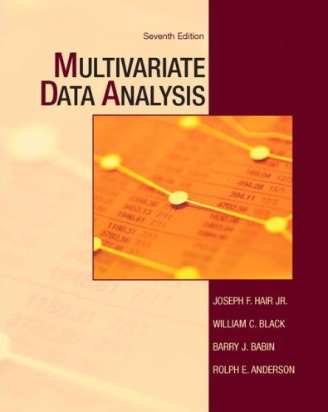
Joseph F. Hair, William C. Black, Barry J. Babin, Rolph E. Anderson, Multivariate Data Analysis, 7th Edition,
Prentice Hall, 2009
(Hair et al., 2009)

Slide 7
Chapter 3
Exploratory Factor Analysis
(Hair et al., 2009)

Slide 8
Exploratory Factor Analysis (EFA)
Definition
  Exploratory factor analysis (EFA)
  is an interdependence technique whose primary purpose is to define the underlying structure among the variables in the analysis.

Slide 9
Exploratory Factor Analysis (EFA)
Examines the interrelationships among a large number of variables and then attempts to explain them in terms of their common underlying dimensions.
These common underlying dimensions are referred to as factors.
A summarization and data reduction technique that does not have independent and dependent variables, but is an interdependence technique in which all variables are considered simultaneously.

Slide 10
Correlation Matrix for
Store Image Elements

Slide 11
Correlation Matrix of Variables After
Grouping Using Factor Analysis
Shaded areas represent variables likely to be grouped together by factor analysis.

Slide 12
Application of Factor Analysis to a Fast-Food Restaurant
Variables
Factors
Waiting Time
Service Quality
Cleanliness
Friendly Employees
Taste
Food Quality
Temperature
Freshness

Slide 13
Factor Analysis Decision Process
Stage 1: Objectives of Factor Analysis
Stage 2: Designing a Factor Analysis
Stage 3: Assumptions in Factor Analysis
Stage 4: Deriving Factors and Assessing Overall Fit
Stage 5: Interpreting the Factors
Stage 6: Validation of Factor Analysis
Stage 7: Additional uses of Factor Analysis Results

Slide 14
Factor Analysis Decision Process
1. Objectives of Factor Analysis
2. Designing a Factor Analysis
3. Assumptions in Factor Analysis
4. Deriving Factors and Assessing Overall Fit
5. Interpreting the Factors
6. Validation of Factor Analysis
7. Additional uses of Factor Analysis Results

Slide 15
Stage 1: Objectives of Factor Analysis
Is the objective exploratory or confirmatory?
Specify the unit of analysis.
Data summarization and/or reduction?
Using factor analysis with other techniques.

Slide 16
Factor Analysis Outcomes
Data summarization
  derives underlying dimensions that, when interpreted and understood, describe the data in a much smaller number of concepts than the original individual variables.
Data reduction
  extends the process of data summarization by deriving an empirical value (factor score or summated scale) for each dimension (factor) and then substituting this value for the original values.

Slide 17
Types of Factor Analysis
Exploratory Factor Analysis (EFA)
  is used to discover the factor structure of a construct and examine its reliability.
  It is data driven.
Confirmatory Factor Analysis (CFA)
  is used to confirm the fit of the hypothesized factor structure to the observed (sample) data.
  It is theory driven.

Slide 18
Factor Analysis Decision Process
1. Objectives of Factor Analysis
2. Designing a Factor Analysis
3. Assumptions in Factor Analysis
4. Deriving Factors and Assessing Overall Fit
5. Interpreting the Factors
6. Validation of Factor Analysis
7. Additional uses of Factor Analysis Results

Slide 19
Stage 2: Designing a Factor Analysis
Three Basic Decisions:
  Calculation of input data – R vs. Q analysis.
  Design of study in terms of number of variables, measurement properties of variables, and the type of variables.
  Sample size necessary.

Slide 20
Rules of Thumb 3–1
Factor Analysis Design
Factor analysis is performed most often only on metric variables, although specialized methods exist for the use of dummy variables. A small number of “dummy variables” can be included in a set of metric variables that are factor analyzed.
If a study is being designed to reveal factor structure, strive to have at least five variables for each proposed factor.
For sample size:
  the sample must have more observations than variables.
  the minimum absolute sample size should be 50 observations.
Maximize the number of observations per variable, with a minimum of five and hopefully at least ten observations per variable.

Slide 21
5 Variables : 1 Factor
(5:1)
Variable 1
Factor 1
Variable 2
Variable 3
Variable 4
Variable 5

Slide 22
Customer Perceived Value, Customer Satisfaction, and Loyalty
Customer Perceived Performance
Customer
Perceived Value
Customer
Satisfaction
Customer
Loyalty
Customer
Expectations
Source: Philip Kotler & Kevin Lane Keller, Marketing Management, 14th ed., Pearson, 2012

Slide 23
5 Variables : 1 Factor
(5:1)
Variable 1
Loyalty
Variable 2
Variable 3
Variable 4
Variable 5
Notes:
Loyalty
1. Say positive things about XYZ to other people.
2. Recommend XYZ to someone who seeks your advice.
3. Encourage friends and relatives to do business with XYZ.
4. Consider XYZ your first choice to buy services.
5. Do more business with XYZ in the next few years.
Source: Valarie A. Zeithaml, Leonard L. Berry and A. Parasuraman, “The Behavioral Consequences of Service Quality,” Journal of Marketing, Vol. 60, No. 2 (Apr., 1996), pp. 31-46

Slide 24
Measuring Loyalty
5 Variables (Items) (5:1)
(Zeithaml, Berry & Parasuraman, 1996)
Say positive things about XYZ to other people.
Loyalty
Recommend XYZ to someone who seeks your advice.
Encourage friends and relatives to do business with XYZ.
Consider XYZ your first choice to buy services.
Do more business with XYZ in the next few years.
Source: Valarie A. Zeithaml, Leonard L. Berry and A. Parasuraman,
“The Behavioral Consequences of Service Quality,” Journal of Marketing, Vol. 60, No. 2 (Apr., 1996), pp. 31-46
Notes:
Loyalty
1. Say positive things about XYZ to other people.
2. Recommend XYZ to someone who seeks your advice.
3. Encourage friends and relatives to do business with XYZ.
4. Consider XYZ your first choice to buy services.
5. Do more business with XYZ in the next few years.
Source: Valarie A. Zeithaml, Leonard L. Berry and A. Parasuraman, “The Behavioral Consequences of Service Quality,” Journal of Marketing, Vol. 60, No. 2 (Apr., 1996), pp. 31-46

Slide 25
minimum absolute sample size should be
50 observations

Slide 26
Sample Size: at least ten observations per variable
(1:10)

Slide 27
Sample Size:
25 variables *
10 observations
(25*10=250)

Slide 28
Factor Analysis Decision Process
1. Objectives of Factor Analysis
2. Designing a Factor Analysis
3. Assumptions in Factor Analysis
4. Deriving Factors and Assessing Overall Fit
5. Interpreting the Factors
6. Validation of Factor Analysis
7. Additional uses of Factor Analysis Results

Slide 29
Stage 3: Assumptions in Factor Analysis
Three Basic Decisions
  Calculation of input data – R vs. Q analysis.
  Design of study in terms of number of variables, measurement properties of variables, and the type of variables.
  Sample size required.

Slide 30
Assumptions
Multicollinearity
  Assessed using MSA (measure of sampling adequacy).
    The MSA is measured by the Kaiser-Meyer-Olkin (KMO) statistic. As a measure of sampling adequacy, the KMO predicts if data are likely to factor well based on correlation and partial correlation. KMO can be used to identify which variables to drop from the factor analysis because they lack multicollinearity.
    There is a KMO statistic for each individual variable, and their sum is the KMO overall statistic. KMO varies from 0 to 1.0. Overall KMO should be .50 or higher to proceed with factor analysis. If it is not, remove the variable with the lowest individual KMO statistic value one at a time until KMO overall rises above .50, and each individual variable KMO is above .50.
Homogeneity of sample factor solutions

Slide 31
Rules of Thumb 3–2
Testing Assumptions of Factor Analysis
There must be a strong conceptual foundation to support the assumption that a structure does exist before the factor analysis is performed.
A statistically significant Bartlett’s test of sphericity (sig. < .05) indicates that sufficient correlations exist among the variables to proceed.
Measure of Sampling Adequacy (MSA) values must exceed .50 for both the overall test and each individual variable. Variables with values less than .50 should be omitted from the factor analysis one at a time, with the smallest one being omitted each time.

Slide 32
Factor Analysis Decision Process
1. Objectives of Factor Analysis
2. Designing a Factor Analysis
3. Assumptions in Factor Analysis
4. Deriving Factors and Assessing Overall Fit
5. Interpreting the Factors
6. Validation of Factor Analysis
7. Additional uses of Factor Analysis Results

Slide 33
Stage 4: Deriving Factors and Assessing Overall Fit
Selecting the factor extraction method – common vs. component analysis.
Determining the number of factors to represent the data.

Slide 34
Extraction Decisions
Which method?
  Principal Components Analysis (PCA)
  Common Factor Analysis
How to rotate?
  Orthogonal or Oblique rotation

Slide 35
Extraction Method Determines the
Types of Variance Carried into the
Factor Matrix
Diagonal Value Variance
Unity (1)
Communality
Total Variance
Common
Specific and Error
Variance extracted
Variance not used

Slide 36
Principal Components vs. Common?
Two Criteria
  Objectives of the factor analysis.
  Amount of prior knowledge about the variance in the variables.

Slide 37
Number of Factors?
A Priori Criterion
Latent Root Criterion
Percentage of Variance
Scree Test Criterion

Slide 38
Eigenvalue Plot for Scree Test Criterion

Slide 39
Rules of Thumb 3–3
Choosing Factor Models and Number of Factors
Although both component and common factor analysis models yield similar results in common research settings (30 or more variables or communalities of .60 for most variables):
  the component analysis model is most appropriate when data reduction is paramount.
  the common factor model is best in well-specified theoretical applications.
Any decision on the number of factors to be retained should be based on several considerations:
  use of several stopping criteria to determine the initial number of factors to retain.
  Factors With Eigenvalues greater than 1.0.
  A pre-determined number of factors based on research objectives and/or prior research.
  Enough factors to meet a specified percentage of variance explained, usually 60% or higher.
  Factors shown by the scree test to have substantial amounts of common variance (i.e., factors before inflection point).
  More factors when there is heterogeneity among sample subgroups.
Consideration of several alternative solutions (one more and one less factor than the initial solution) to ensure the best structure is identified.

Slide 40
Processes of Factor Interpretation
Estimate the Factor Matrix
Factor Rotation
Factor Interpretation
Respecification of factor model, if needed, may involve . . .
  Deletion of variables from analysis
  Desire to use a different rotational approach
  Need to extract a different number of factors
  Desire to change method of extraction

Slide 41
Rotation of Factors
Factor rotation
  the reference axes of the factors are turned about the origin until some other position has been reached.
  Since unrotated factor solutions extract factors based on how much variance they account for, with each subsequent factor accounting for less variance.
  The ultimate effect of rotating the factor matrix is to redistribute the variance from earlier factors to later ones to achieve a simpler, theoretically more meaningful factor pattern.

Slide 42
Two Rotational Approaches
1. Orthogonal
  axes are maintained at 90 degrees.
2. Oblique
  axes are not maintained at 90 degrees.

Slide 43
Orthogonal Factor Rotation
Unrotated Factor II
+1.0
+.50
Rotated Factor II
V₁
V₂
Unrotated Factor I
-1.0 -.50 0
+.50 +1.0
V₃
V₄
-.50
-1.0
Rotated Factor I
V₅

Slide 44
Oblique Factor Rotation
Unrotated Factor II
Orthogonal Rotation: Factor II
+1.0
+.50
V₁
Oblique Rotation: Factor II
V₂
Unrotated Factor I
-1.0 -.50 0
+.50 +1.0
V₃
V₄
Oblique Rotation: Factor I
-.50
-1.0
V₅
Orthogonal Rotation: Factor I

Slide 45
Orthogonal Rotation Methods
Quartimax (simplify rows)
Varimax (simplify columns)
Equimax (combination)

Slide 46
Rules of Thumb 3–4
Choosing Factor Rotation Methods
Orthogonal rotation methods
  are the most widely used rotational methods.
  are The preferred method when the research goal is data reduction to either a smaller number of variables or a set of uncorrelated measures for subsequent use in other multivariate techniques.
Oblique rotation methods
  best suited to the goal of obtaining several theoretically meaningful factors or constructs because, realistically, very few constructs in the “real world” are uncorrelated

Slide 47
Which Factor Loadings Are Significant?
Customary Criteria = Practical Significance.
Sample Size & Statistical Significance.
Number of Factors ( = >) and/or
Variables ( = <) .

Slide 48
Guidelines for Identifying Significant
Factor Loadings Based on Sample Size
Factor Loading Sample Size Needed for Significance*
.30 350
.35 250
.40 200
.45 150
.50 120
.55 100
.60 85
.65 70
.70 60
.75 50
*Significance is based on a .05 significance level (a), a power level of 80 percent, and standard errors assumed to be twice those of conventional correlation coefficients.

Slide 49
Rules of Thumb 3–5
Assessing Factor Loadings
While factor loadings of +.30 to +.40 are minimally acceptable, values greater than + .50 are considered necessary for practical significance.
To be considered significant:
  A smaller loading is needed given either a larger sample size, or a larger number of variables being analyzed.
  A larger loading is needed given a factor solution with a larger number of factors, especially in evaluating the loadings on later factors.
Statistical tests of significance for factor loadings are generally very conservative and should be considered only as starting points needed for including a variable for further consideration.

Slide 50
Factor Analysis Decision Process
1. Objectives of Factor Analysis
2. Designing a Factor Analysis
3. Assumptions in Factor Analysis
4. Deriving Factors and Assessing Overall Fit
5. Interpreting the Factors
6. Validation of Factor Analysis
7. Additional uses of Factor Analysis Results

Slide 51
Stage 5: Interpreting the Factors
Selecting the factor extraction method – common vs. component analysis.
Determining the number of factors to represent the data.

Slide 52
Interpreting a Factor Matrix:
Examine the factor matrix of loadings.
Identify the highest loading across all factors for each variable.
Assess communalities of the variables.
Label the factors.

Slide 53
Rules of Thumb 3–6
Interpreting The Factors
An optimal structure exists when all variables have high loadings only on a single factor.
Variables that cross-load (load highly on two or more factors) are usually deleted unless theoretically justified or the objective is strictly data reduction.
Variables should generally have communalities of greater than .50 to be retained in the analysis.
Respecification of a factor analysis can include options such as:
  deleting a variable(s),
  changing rotation methods, and/or
  increasing or decreasing the number of factors.

Slide 54
Factor Analysis Decision Process
1. Objectives of Factor Analysis
2. Designing a Factor Analysis
3. Assumptions in Factor Analysis
4. Deriving Factors and Assessing Overall Fit
5. Interpreting the Factors
6. Validation of Factor Analysis
7. Additional uses of Factor Analysis Results

Slide 55
Stage 6: Validation of Factor Analysis
Confirmatory Perspective.
Assessing Factor Structure Stability.
Detecting Influential Observations.

Slide 56
Factor Analysis Decision Process
1. Objectives of Factor Analysis
2. Designing a Factor Analysis
3. Assumptions in Factor Analysis
4. Deriving Factors and Assessing Overall Fit
5. Interpreting the Factors
6. Validation of Factor Analysis
7. Additional uses of Factor Analysis Results

Slide 57
Stage 7: Additional Uses of
Factor Analysis Results
Selecting Surrogate Variables
Creating Summated Scales
Computing Factor Scores

Slide 58
Rules of Thumb 3–7
Summated Scales
A summated scale is only as good as the items used to represent the construct. While it may pass all empirical tests, it is useless without theoretical justification.
Never create a summated scale without first assessing its unidimensionality with exploratory or confirmatory factor analysis.
Once a scale is deemed unidimensional, its reliability score, as measured by Cronbach’s alpha:
  should exceed a threshold of .70, although a .60 level can be used in exploratory research.
  the threshold should be raised as the number of items increases, especially as the number of items approaches 10 or more.
With reliability established, validity should be assessed in terms of:
  convergent validity = scale correlates with other like scales.
  discriminant validity = scale is sufficiently different from other related scales.
  nomological validity = scale “predicts” as theoretically suggested.

Slide 59
Rules of Thumb 3–8
Representing Factor Analysis In Other Analyses
The single surrogate variable:
  Advantages: simple to administer and interpret.
  Disadvantages:
    does not represent all “facets” of a factor
    prone to measurement error.
Factor scores:
  Advantages:
    represents all variables loading on the factor,
    best method for complete data reduction.
    Are by default orthogonal and can avoid complications caused by multicollinearity.
  Disadvantages:
    interpretation more difficult since all variables contribute through loadings
    Difficult to replicate across studies.

Slide 60
Rules of Thumb 3–8 (cont.)
Representing Factor Analysis In Other Analyses
Summated scales:
  Advantages:
    compromise between the surrogate variable and factor score options.
    reduces measurement error.
    represents multiple facets of a concept.
    easily replicated across studies.
  Disadvantages:
    includes only the variables that load highly on the factor and excludes those having little or marginal impact.
    not necessarily orthogonal.
    Require extensive analysis of reliability and validity issues.

Slide 61
Description of HBAT Primary Database Variables
Variable Description Variable Type
Data Warehouse Classification Variables
X1 Customer Type nonmetric
X2 Industry Type nonmetric
X3 Firm Size nonmetric
X4 Region nonmetric
X5 Distribution System nonmetric
Performance Perceptions Variables
X6 Product Quality metric
X7 E-Commerce Activities/Website metric
X8 Technical Support metric
X9 Complaint Resolution metric
X10 Advertising metric
X11 Product Line metric
X12 Salesforce Image metric
X13 Competitive Pricing metric
X14 Warranty & Claims metric
X15 New Products metric
X16 Ordering & Billing metric
X17 Price Flexibility metric
X18 Delivery Speed metric
Outcome/Relationship Measures
X19 Satisfaction metric
X20 Likelihood of Recommendation metric
X21 Likelihood of Future Purchase metric
X22 Current Purchase/Usage Level metric
X23 Consider Strategic Alliance/Partnership in Future nonmetric

Slide 62
Rotated Component Matrix
“Reduced Set” of HBAT Perceptions Variables
Component Communality
1 2 3 4
X9 – Complaint Resolution .933 .890
X18 – Delivery Speed .931 .894
X16 – Order & Billing .886 .806
X12 – Salesforce Image .898 .860
X7 – E-Commerce Activities .868 .780
X10 – Advertising .743 .585
X8 – Technical Support .940 .894
X14 – Warranty & Claims .933 .891
X6 – Product Quality .892 .798
X13 – Competitive Pricing -.730 .661
Sum of Squares 2.589 2.216 1.846 1.406 8.057
Percentage of Trace 25.893 22.161 18.457 14.061 80.572
Extraction Method: Principal Component Analysis.
Rotation Method: Varimax.

Slide 63
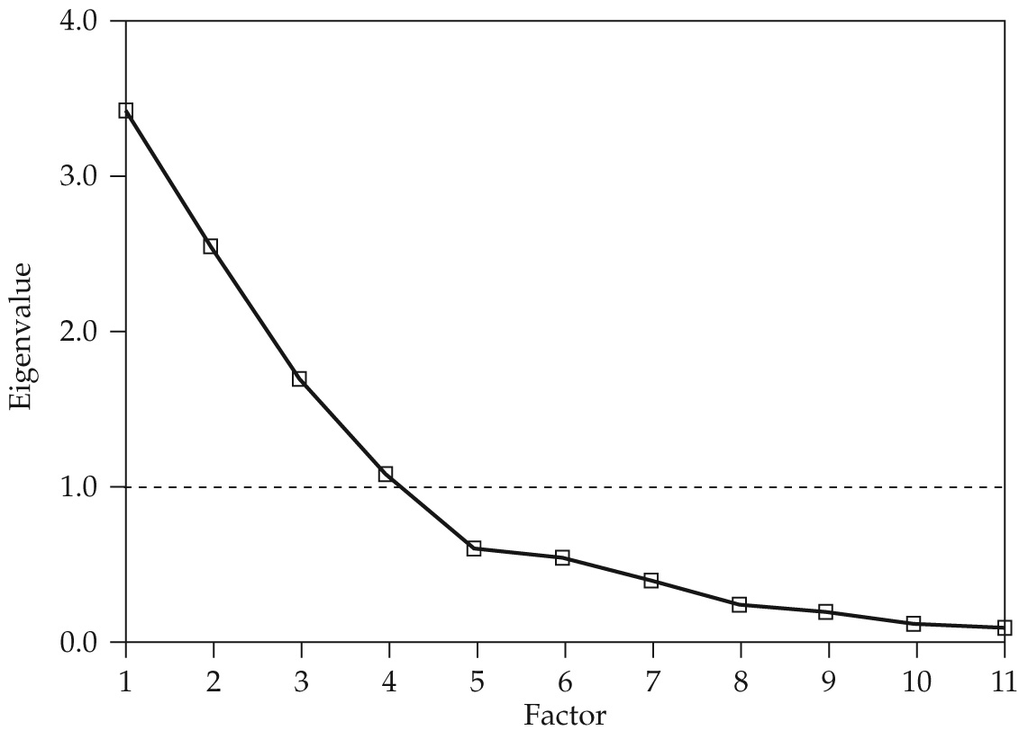
Scree Test for HBAT Component Analysis

Slide 64
Factor Analysis
What are the major uses of factor analysis?
What is the difference between component analysis and common factor analysis?
Is rotation of factors necessary?
How do you decide how many factors to extract?
What is a significant factor loading?
How and why do you name a factor?
Should you use factor scores or summated ratings in follow-up analyses?

Slide 65
Summary
Seven stages of applying factor analysis
Exploratory Factor Analysis (EFA) vs.
Confirmatory Factor Analysis (CFA)
Identify the differences between
component analysis and common factor analysis models
How to determine the number of factors to extract
How to name a factor

Slide 66

蕭文龍 (2016),
統計分析入門與應用：SPSS中文版＋SmartPLS 3（PLS_SEM）,
碁峰資訊
http://24h.pchome.com.tw/books/prod/DJAV0S-A9006UWCI

Slide 67
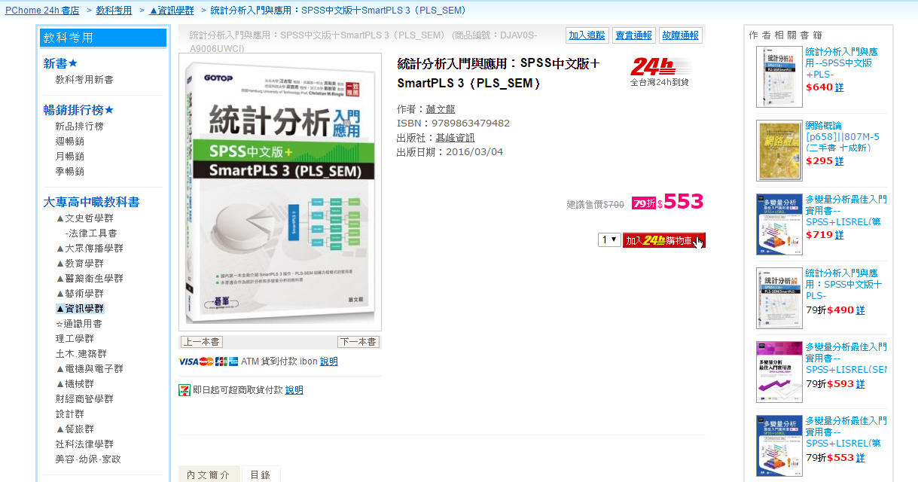
蕭文龍 (2016),
統計分析入門與應用：SPSS中文版＋SmartPLS 3（PLS_SEM）,
碁峰資訊
http://24h.pchome.com.tw/books/prod/DJAV0S-A9006UWCI

Slide 68
蕭文龍 (2016),
統計分析入門與應用：SPSS中文版＋SmartPLS 3（PLS_SEM）,
碁峰資訊
國內第一本全面介紹SmartPLS 3操作、PLS-SEM結構方程模式的實用書。
國內第一本深入探討最新量表發展、中介和調節變數的應用、reflective(反映性)和 formative(形成性)指標的發展和模式的指定。
本書以實用的角度引導學員從學習社會科學概念開始介紹，到完成一份專題、研究生論文和論文投稿，對於大學部專題，碩博士學生，量化的研究人員都有莫大的幫助。
以統計分析(多變量分析)為主軸，整合了理論的介紹、量化的研究、量表的發展、卡方檢定、因素分析、迴歸分析、區別分析和邏輯迴歸、單因子變異數分析、多變量變異數分析、典型相關分析、信度和效度分析、聯合分析多、元尺度和集群分析，第二代統計技術–結構方程模式(SEM)。
Source: http://24h.pchome.com.tw/books/prod/DJAV0S-A9006UWCI

Slide 69
蕭文龍 (2016),
統計分析入門與應用：SPSS中文版＋SmartPLS 3（PLS_SEM）,
碁峰資訊
內容涵蓋SmartPLS 3基本操作、PLS-SEM結構方程模式的學習範例、反映性和形成性指標與模式的指定、二階和高階因果關係、SEM結構方程模式實例、中介和調節變數的應用、論文結構、研究範例和Hayes PROCESS for SPSS軟體使用說明。
本書可作為統計分析和多變量分析的教科書，也是Hair, Black, Babin, and Anderson 所撰寫的 Multivariate data analysis Multivariate Data Analysis多變量分析的最佳輔助參考書籍，更是 Hair, Hult, Ringle, and Sarstedt所撰寫的A Primer on Partial Least Squares Structural Equation Modeling(PLS-SEM)的最佳輔助參考書籍。
Source: http://24h.pchome.com.tw/books/prod/DJAV0S-A9006UWCI

Slide 70
蕭文龍 (2016),
統計分析入門與應用：SPSS中文版＋SmartPLS 3（PLS_SEM）,
碁峰資訊
chapter 01 統計分析簡介與數量方法的基礎
chapter 02 SPSS 的基本操作
chapter 03 量表的發展，信度和效度
chapter 04 檢視資料與敘述性統計
chapter 05 相關分析(Correlation Analysis)
chapter 06 卡方檢定
chapter 07 平均數比較(t 檢定)
chapter 08 因素分析
chapter 09 迴歸分析
chapter 10 區別分析與邏輯迴歸
chapter 11 單變量變異數分析
Source: http://24h.pchome.com.tw/books/prod/DJAV0S-A9006UWCI

Slide 71
蕭文龍 (2016),
統計分析入門與應用：SPSS中文版＋SmartPLS 3（PLS_SEM）,
碁峰資訊
chapter 12 多變量變異數分析
chapter 13 典型相關
chapter 14 聯合分析、多元尺度方法和集群分析
chapter 15 結構方程模式之 Partial Least Squares(PLS)偏最小平方
chapter 16 Smartpls 統計分析軟體介紹
chapter 17 PLS-SEM(SmartPLS) 結構方程模式的學習範例
chapter 18 PLS-SEM 結構方程模式實例
chapter 19 反映性 Reflective 與形成性 Formative 模式
chapter 20 交互作用、中介和調節(干擾)
chapter 21 SmartPLS 3 進階應用介紹
chapter 22 研究流程、論文結構與發表於期刊的建議
appendix A Hayes process 的中介和調節
Source: http://24h.pchome.com.tw/books/prod/DJAV0S-A9006UWCI

Slide 72
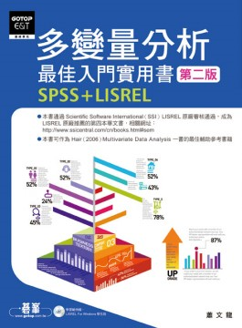
蕭文龍,
多變量分析最佳入門實用書--SPSS+LISREL, 第二版, 碁峰資訊, 2009
Source: http://24h.pchome.com.tw/books/prod/DJAA1L-A41336032

Slide 73

蕭文龍,
多變量分析最佳入門實用書--SPSS+LISREL, 第二版, 碁峰資訊, 2009
Source: http://24h.pchome.com.tw/books/prod/DJAA1L-A41336032

Slide 74

蕭文龍,
多變量分析最佳入門實用書--SPSS+LISREL, 第二版, 碁峰資訊, 2009
本書通過Scientific Software International (SSI) LISREL原廠審核通過， 成為LISREL原廠推薦的第四本華文書，
相關網址：http://www.ssicentral.com/cn/books.html#sem
本書可作為Hair（2006）Multivariate Data Analysis一書的最佳輔助參考書籍
從實用的角度出發，完整介紹社會科學概念、統計軟體的運用以及統計分析，協助學習者完成量化的研究及其相關專題或論文。
內容整合了社會科學概念、量化研究、量表發展與統計分析。
文中納入第二代統計技術，包括結構方程模式(SEM)、LISREL基本操作 SEM結構方程模式範例與SEM結構方程模式實例。
特別介紹研究流程、論文結構與研究範例、EndNote書目管理軟體使用說明、LISREL和Nvivo軟體的取得與說明。
隨書光碟附贈LISREL For Windows學生版
Source: http://24h.pchome.com.tw/books/prod/DJAA1L-A41336032

Slide 75
蕭文龍,
多變量分析最佳入門實用書--SPSS+LISREL, 第二版, 碁峰資訊, 2009
Ch01 社會科學的研究與數量方法的基礎
Ch02 SPSS的基本操作
Ch03 檢視資料與敘述性統計
Ch04 相關分析
Ch05 卡方檢定
Ch06 平均數比較
Ch07 因素分析
Ch08 迴歸分析
Ch09 區別分析與邏輯迴歸
Ch10 單變量變異數分析
Ch11 多變量變異數分析
Ch12 典型相關
Source: http://24h.pchome.com.tw/books/prod/DJAA1L-A41336032

Slide 76
蕭文龍,
多變量分析最佳入門實用書--SPSS+LISREL, 第二版, 碁峰資訊, 2009
Ch13 量表的發展、信度和效度
Ch14 SEM結構方程模式
Ch15 LISREL的基本操作
Ch16 結構方程模式的學習範例
Ch17 結構方程模式的學習範例進階
Ch18 SEM結構方程模式實例
Ch19 聯合分析、多元尺度方法和集群分析
Ch20 交互作用、中介和調節(干擾)效果之驗證
Ch21 研究流程、論文結構與研究範例
附錄A 統計分配表
附錄B ENDNOTE書目管理軟體使用說明
附錄C 軟體的取得與說明LISREL
Source: http://24h.pchome.com.tw/books/prod/DJAA1L-A41336032

Slide 77
References
Joseph F. Hair, William C. Black, Barry J. Babin, Rolph E. Anderson (2009),
Multivariate Data Analysis, 7th Edition, Prentice Hall
Valarie A. Zeithaml, Leonard L. Berry and A. Parasuraman (1996), “The Behavioral Consequences of Service Quality,” Journal of Marketing, Vol. 60, No. 2 (Apr., 1996), pp. 31-46
蕭文龍 (2016), 統計分析入門與應用：SPSS中文版＋SmartPLS 3（PLS_SEM）, 碁峰資訊
蕭文龍 (2009), 多變量分析最佳入門實用書--SPSS+LISREL, 第二版, 碁峰資訊
吳明隆 (2006), SPSS 統計應用學習實務：問卷分析與應用統計, 三版, 知城數位科技

