Slide 1
大數據行銷研究 Big Data Marketing Research
Tamkang University
資料科學與大數據行銷 (Data Science and Big Data Marketing)
1051BDMR02
MIS EMBA (M2262) (8638)
Thu, 12,13,14 (19:20-22:10) (D409)
Min-Yuh Day
戴敏育
Assistant Professor
專任助理教授
Dept. of Information Management, Tamkang University
淡江大學 資訊管理學系
http://mail. tku.edu.tw/myday/
2016-09-30

Slide 2
課程大綱 (Syllabus)
週次 (Week) 日期 (Date) 內容 (Subject/Topics)
1 2016/09/16 中秋節 (調整放假一天) (Mid-Autumn Festival Holiday)(Day off)
2 2016/09/23 大數據行銷研究課程介紹 (Course Orientation for Big Data Marketing Research)
3 2016/09/30 資料科學與大數據行銷 (Data Science and Big Data Marketing)
4 2016/10/07 大數據行銷分析與研究 (Big Data Marketing Analytics and Research)
5 2016/10/14 測量構念 (Measuring the Construct)
6 2016/10/21 測量與量表 (Measurement and Scaling)

Slide 3
課程大綱 (Syllabus)
週次 (Week) 日期 (Date) 內容 (Subject/Topics)
7 2016/10/28 大數據行銷個案分析 I (Case Study on Big Data Marketing I)
8 2016/11/04 探索性因素分析 (Exploratory Factor Analysis)
9 2016/11/11 確認性因素分析 (Confirmatory Factor Analysis)
10 2016/11/18 期中報告 (Midterm Presentation)
11 2016/11/25 社群運算與大數據分析 (Social Computing and Big Data Analytics)
12 2016/12/02 社會網路分析 (Social Network Analysis)

Slide 4
課程大綱 (Syllabus)
週次 (Week) 日期 (Date) 內容 (Subject/Topics)
13 2016/12/09 大數據行銷個案分析 II (Case Study on Big Data Marketing II)
14 2016/12/16 社會網絡分析量測與實務 (Measurements and Practices of Social Network Analysis)
15 2016/12/23 大數據情感分析 (Big Data Sentiment Analysis)
16 2016/12/30 金融科技行銷研究 (FinTech Marketing Research)
17 2017/01/06 期末報告 I (Term Project Presentation I)
18 2017/01/13 期末報告 II (Term Project Presentation II)

Slide 5
Outline
Data Science
Big Data Marketing

Slide 6
Data Science

Slide 7
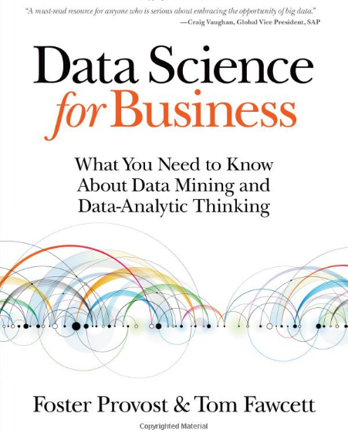
Data Science for Business: What you need to know about data mining and data-analytic thinking, Foster Provost and Tom Fawcett, O'Reilly, 2013
Source: https://www.amazon.com/Data-Science-Business-Data-Analytic-Thinking/dp/1449361323

Slide 8
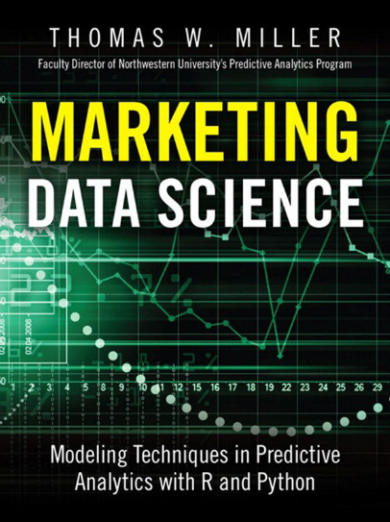
Marketing Data Science: Modeling Techniques in Predictive Analytics with R and Python, Thomas W. Miller, Pearson FT Press, 2015
Source: https://www.amazon.com/Marketing-Data-Science-Techniques-Predictive/dp/0133886557

Slide 9
The Market: A Meeting Place for Buyers and Sellers
Seller History
Sector
Features
Sellers
Brands
Products
Prices
Market
Buyer History
Segment
Attitudes
Buyers
Preferences
Goals / Wants
Needs
Budget
Source: Thomas W. Miller (2013) , Marketing Data Science: Modeling Techniques in Predictive Analytics with R and Python, Pearson FT Press

Slide 10
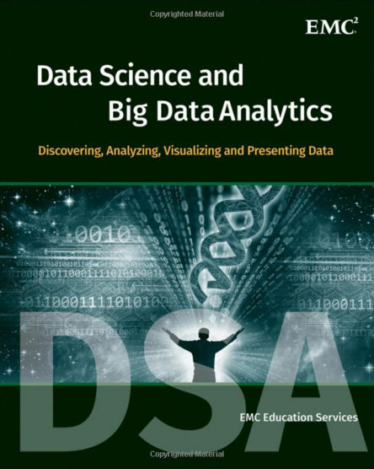
EMC Education Services, Data Science and Big Data Analytics: Discovering, Analyzing, Visualizing and Presenting Data, Wiley, 2015
Source: http://www.amazon.com/Data-Science-Big-Analytics-Discovering/dp/111887613X

Slide 11
Internet Evolution Internet of People (IoP): Social Media Internet of Things (IoT): Machine to Machine
Source: Marc Jadoul (2015), The IoT: The next step in internet evolution, March 11, 2015 http://www2.alcatel-lucent.com/techzine/iot-internet-of-things-next-step-evolution/

Slide 12
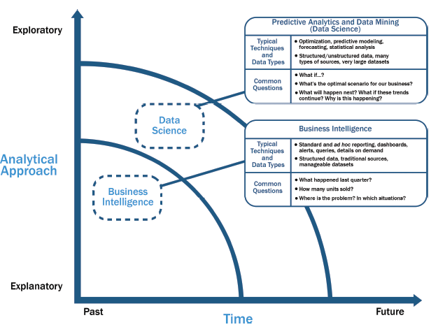
Data Science and Business Intelligence
Source: EMC Education Services, Data Science and Big Data Analytics: Discovering, Analyzing, Visualizing and Presenting Data, Wiley, 2015

Slide 13
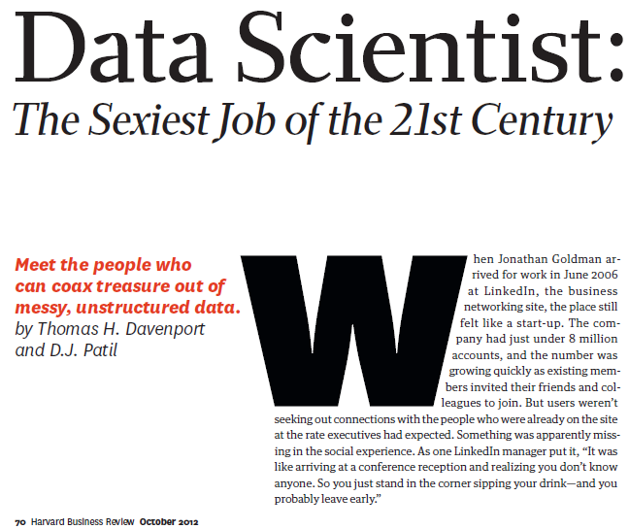
Source: Davenport, T. H., & Patil, D. J. (2012). Data Scientist. Harvard business review

Slide 14
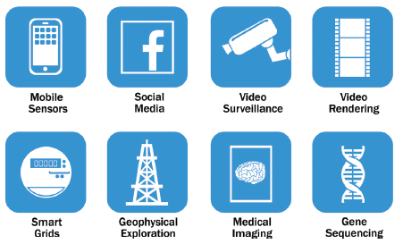
Big Data
Source: EMC Education Services, Data Science and Big Data Analytics: Discovering, Analyzing, Visualizing and Presenting Data, Wiley, 2015

Slide 15
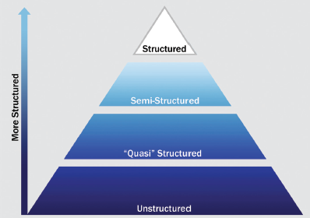
Big Data Growth is increasingly unstructured
Source: EMC Education Services, Data Science and Big Data Analytics: Discovering, Analyzing, Visualizing and Presenting Data, Wiley, 2015

Slide 16
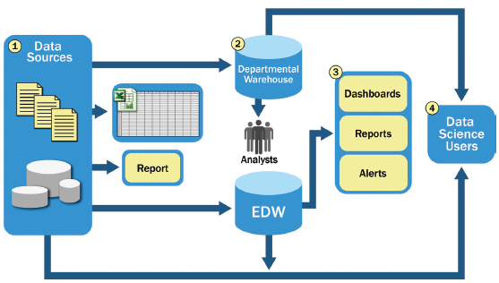
Typical Analytic Architecture
Source: EMC Education Services, Data Science and Big Data Analytics: Discovering, Analyzing, Visualizing and Presenting Data, Wiley, 2015

Slide 17
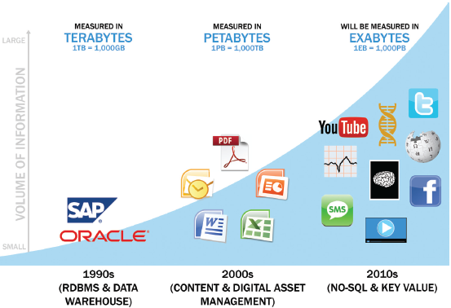
Data Evolution and the Rise of Big Data Sources
Source: EMC Education Services, Data Science and Big Data Analytics: Discovering, Analyzing, Visualizing and Presenting Data, Wiley, 2015

Slide 18
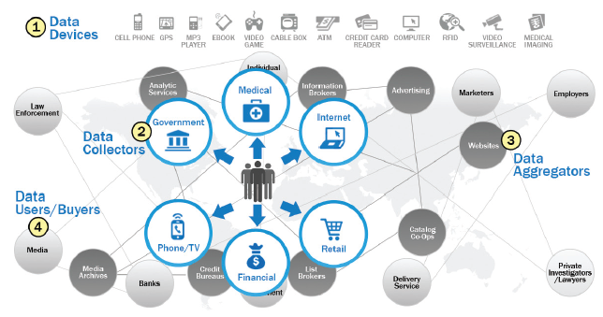
Emerging Big Data Ecosystem
Source: EMC Education Services, Data Science and Big Data Analytics: Discovering, Analyzing, Visualizing and Presenting Data, Wiley, 2015

Slide 19
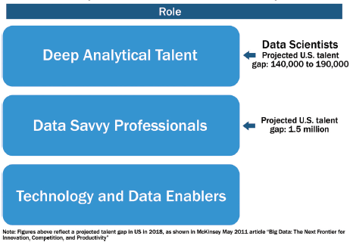
Key Roles for the New Big Data Ecosystem
Source: EMC Education Services, Data Science and Big Data Analytics: Discovering, Analyzing, Visualizing and Presenting Data, Wiley, 2015

Slide 20
Profile of a Data Scientist
Quantitative
mathematics or statistics
Technical
software engineering, machine learning, and programming skills
Skeptical mind-set and critical thinking
Curious and creative
Communicative and collaborative
Source: EMC Education Services, Data Science and Big Data Analytics: Discovering, Analyzing, Visualizing and Presenting Data, Wiley, 2015

Slide 21
Data Scientist Profile
Quantitative
Technical
Curious and Creative
Data Scientist
Skeptical
Communicative and Collaborative
Source: EMC Education Services, Data Science and Big Data Analytics: Discovering, Analyzing, Visualizing and Presenting Data, Wiley, 2015

Slide 22
Big Data Analytics Lifecycle

Slide 23
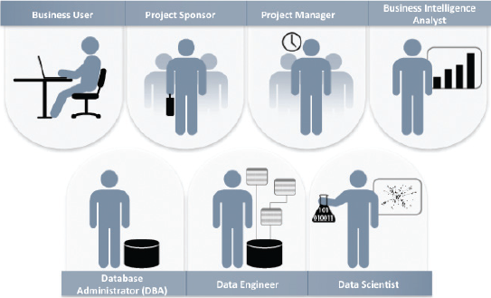
Key Roles for a Successful Analytics Project
Source: EMC Education Services, Data Science and Big Data Analytics: Discovering, Analyzing, Visualizing and Presenting Data, Wiley, 2015

Slide 24
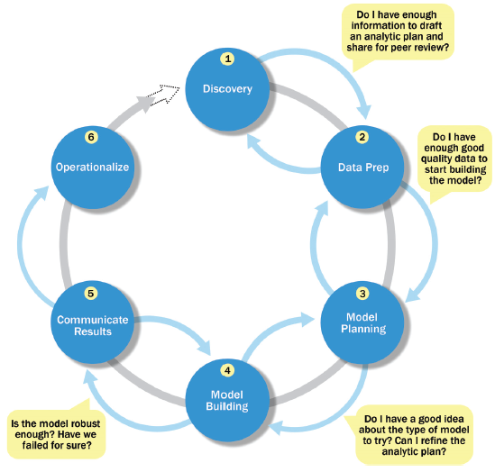
Overview of Data Analytics Lifecycle
Source: EMC Education Services, Data Science and Big Data Analytics: Discovering, Analyzing, Visualizing and Presenting Data, Wiley, 2015

Slide 25
Overview of Data Analytics Lifecycle
1. Discovery
2. Data preparation
3. Model planning
4. Model building
5. Communicate results
6. Operationalize
Source: EMC Education Services, Data Science and Big Data Analytics: Discovering, Analyzing, Visualizing and Presenting Data, Wiley, 2015

Slide 26
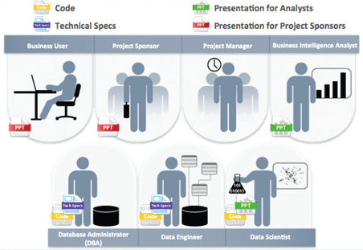
Key Outputs from a Successful Analytics Project
Source: EMC Education Services, Data Science and Big Data Analytics: Discovering, Analyzing, Visualizing and Presenting Data, Wiley, 2015

Slide 27
Big Data Marketing

Slide 28
Big Data Marketing
Source: https://datafloq.com/read/5-Great-Benefits-Big-Data-Marketing-2016/1802

Slide 29
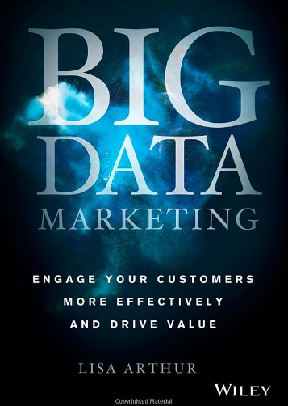
Big Data Marketing: Engage Your Customers More Effectively and Drive Value, Lisa Arthur, Wiley, 2013.
Source: https://www.amazon.com/Big-Data-Marketing-Customers-Effectively/dp/1118733894

Slide 30
Big Data Marketing
Data-driven Marketing
Source: Lisa Arthur (2013), Big Data Marketing: Engage Your Customers More Effectively and Drive Value, Wiley.

Slide 31
Big Data Marketing
Big data marketing is the process of collecting, analyzing, and executing on the insights you’ve derived from big data to encourage customer engagement and improve marketing results
Source: Lisa Arthur (2013), Big Data Marketing: Engage Your Customers More Effectively and Drive Value, Wiley.

Slide 32
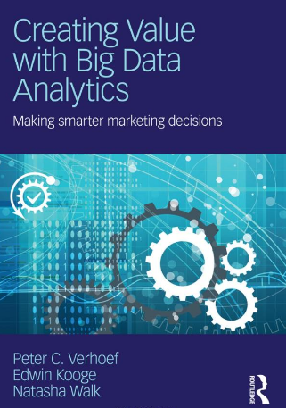
Creating Value with Big Data Analytics: Making Smarter Marketing Decisions, Peter C. Verhoef and Edwin Kooge, Routledge, 2016
Source: https://www.amazon.com/Creating-Value-Big-Data-Analytics/dp/1138837970

Slide 33
Big Data Value Creation Model
Creating Value with Big Data Analytics: Making Smarter Marketing Decisions
Big Data Assets
Big Data Capabilities
Big Data Analytics
Big Data Value
Decision support
Value to the firm
Data
People
Systems
Insights
Data
Data
Data
Actions/ campaigns
Data
Data
Models
Value to the customer
Data
Information based products/ solutions
process
Organization
Data
Source: Peter C. Verhoef and Edwin Kooge (2016), Creating Value with Big Data Analytics: Making Smarter Marketing Decisions, Routledge

Slide 34
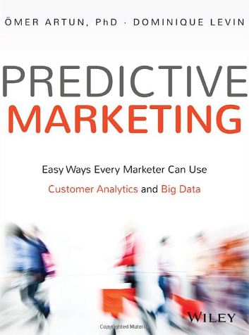
Predictive Marketing: Easy Ways Every Marketer Can Use Customer Analytics and Big Data, Omer Artun and Dominique Levin, Wiley, 2015
Source: https://www.amazon.com/Predictive-Marketing-Marketer-Customer-Analytics/dp/1119037360

Slide 35
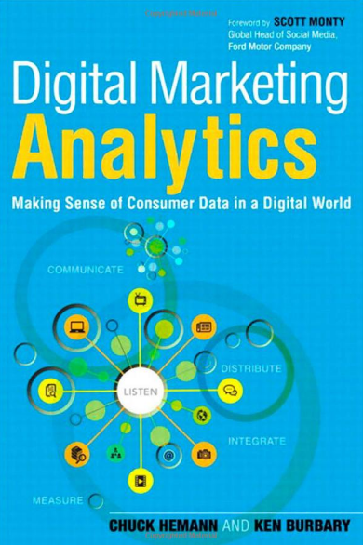
Predictive Marketing: Easy Ways Every Marketer Can Use Customer Analytics and Big Data, Omer Artun and Dominique Levin, Wiley, 2015
Source: https://www.amazon.com/Digital-Marketing-Analytics-Consumer-Biz-Tech/dp/0789750309

Slide 36
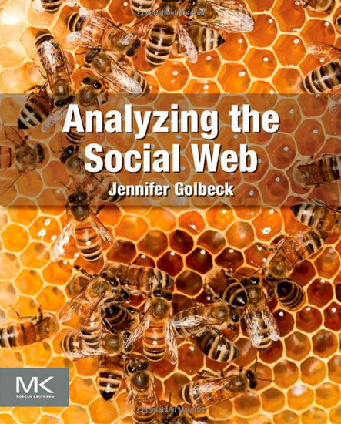
Jennifer Golbeck (2013), Analyzing the Social Web, Morgan Kaufmann
Source: http://www.amazon.com/Analyzing-Social-Web-Jennifer-Golbeck/dp/0124055311

Slide 37
Marketing

Slide 38
Marketing
“Meeting needs profitably”
Source: Philip Kotler & Kevin Lane Keller, Marketing Management, 14th ed., Pearson, 2012

Slide 39
Value
the sum of the tangible and intangible benefits and costs
Source: Philip Kotler & Kevin Lane Keller, Marketing Management, 14th ed., Pearson, 2012

Slide 40
Value
Total customer benefit
Customer perceived value
Total customer cost
Source: Philip Kotler & Kevin Lane Keller, Marketing Management, 14th ed., Pearson, 2012

Slide 41
Customer Value Triad
Quality, Service, and Price (qsp)
Quality
Service
Price
Source: Philip Kotler & Kevin Lane Keller, Marketing Management, 14th ed., Pearson, 2012

Slide 42
Value and Satisfaction
Marketing
identification, creation, communication, delivery, and monitoring of customer value.
Satisfaction
a person’s judgment of a product’s perceived performance in relationship to expectations
Source: Philip Kotler & Kevin Lane Keller, Marketing Management, 14th ed., Pearson, 2012

Slide 43
Building Customer Value, Satisfaction, and Loyalty
Source: Philip Kotler & Kevin Lane Keller, Marketing Management, 14th ed., Pearson, 2012

Slide 44
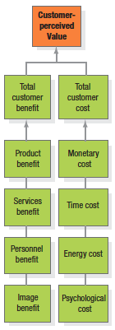
Customer Perceived Value
Source: Philip Kotler & Kevin Lane Keller, Marketing Management, 14th ed., Pearson, 2012

Slide 45
Customer Perceived Value
Product benefit
Total customer benefit
Customer perceived value
Services benefit
Personnel benefit
Image benefit
Monetary cost
Total customer cost
Time cost
Energy cost
Psychological cost
Source: Philip Kotler & Kevin Lane Keller, Marketing Management, 14th ed., Pearson, 2012

Slide 46
Satisfaction
“a person’s feelings of pleasure or disappointment that result from comparing a product’s perceived performance (or outcome) to expectations”
Source: Philip Kotler & Kevin Lane Keller, Marketing Management, 14th ed., Pearson, 2012

Slide 47
Loyalty
“a deeply held commitment to rebuy or repatronize a preferred product or service in the future despite situational influences and marketing efforts having the potential to cause switching behavior.”
Source: Philip Kotler & Kevin Lane Keller, Marketing Management, 14th ed., Pearson, 2012

Slide 48
Customer Perceived Value, Customer Satisfaction, and Loyalty
Customer Perceived Performance
Customer
Perceived Value
Customer
Satisfaction
Customer
Loyalty
Customer
Expectations
Source: Philip Kotler & Kevin Lane Keller, Marketing Management, 14th ed., Pearson, 2012

Slide 49
Marketing
“Marketing is an organizational function and a set of processes for creating, communicating, and delivering value to customers and for managing customer relationships in ways that benefit the organization and its stakeholders.” (Kotler & Keller, 2008)

Slide 50
Marketing Management
“Marketing management is the art and science of choosing target markets and getting, keeping, and growing customers through creating, delivering, and communicating superior customer value.” (Kotler & Keller, 2008)

Slide 51
Marketing Research
“Marketing Research is the planning, collection, and analysis of data relevant to marketing decision making and the communication of the results of this analysis to management.”

Slide 52
The Nature of Marketing Research
Customer
Goals
Marketing Environment
Opportunistic Nature
Marketing Concept
Systems
Marketing Mix

Slide 53
Marketing Research systematic design, collection, analysis, and reporting of data and findings relevant to a specific marketing situation facing the company.
Source: Philip Kotler and Kevin Keller, Marketing Management, 14th Edition, 2011, Prentice Hall

Slide 54
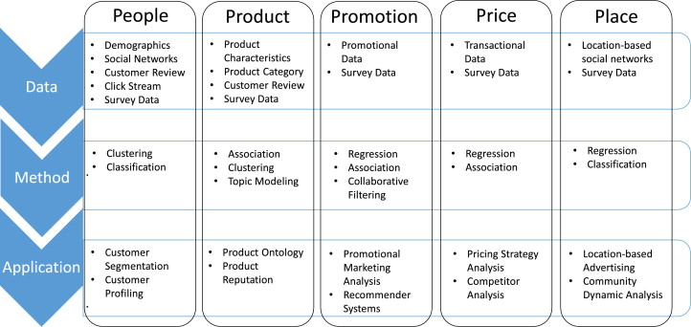
A Marketing Mix Framework for Big Data Management
Source: Fan, S., Lau, R. Y., & Zhao, J. L. (2015). Demystifying big data analytics for business intelligence through the lens of marketing mix. Big Data Research,2(1), 28-32.

Slide 55
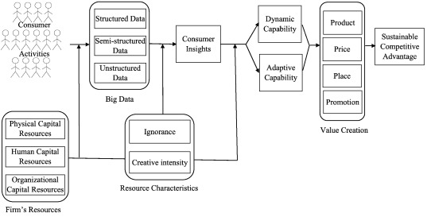
A resource-based view of the impact of Big Data on competitive advantage
Source: Erevelles, S., Fukawa, N., & Swayne, L. (2016). Big Data consumer analytics and the transformation of marketing. Journal of Business Research, 69(2), 897-904.

Slide 56
Big Data Analytics and Data Mining

Slide 57
Business Intelligence (BI) Infrastructure

Slide 58
Data Warehouse Data Mining and Business Intelligence
Increasing potential
to support
business decisions
End User
Decision Making
Data Presentation
Business
Analyst
Visualization Techniques
Data Mining
Data
Analyst
Information Discovery
Data Exploration
Statistical Summary, Querying, and Reporting
Data Preprocessing/Integration, Data Warehouses
Data Sources
DBA
Paper, Files, Web documents, Scientific experiments, Database Systems
Source: Jiawei Han and Micheline Kamber (2006), Data Mining: Concepts and Techniques, Second Edition, Elsevier

Slide 59
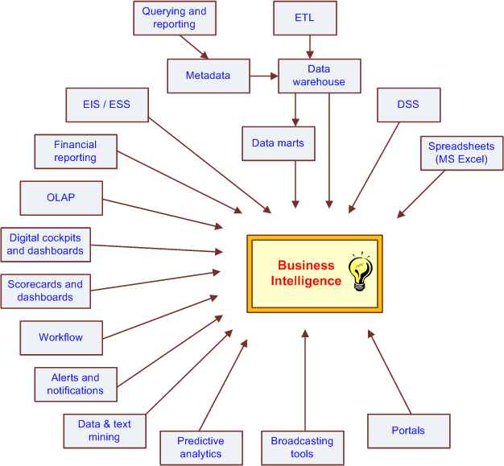
The Evolution of BI Capabilities
Source: Turban et al. (2011), Decision Support and Business Intelligence Systems

Slide 60
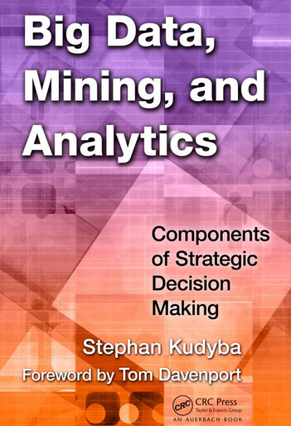
Stephan Kudyba (2014), Big Data, Mining, and Analytics: Components of Strategic Decision Making, Auerbach Publications
Source: http://www.amazon.com/gp/product/1466568704

Slide 61
Architecture of Big Data Analytics
Big Data Analytics Applications
Big Data Sources
Big Data Transformation
Big Data Platforms & Tools
* Internal
* External
* Multiple formats
* Multiple locations
* Multiple applications
Middleware
Hadoop
MapReduce
Pig
Hive
Jaql
Zookeeper
Hbase
Cassandra
Oozie
Avro
Mahout
Others
Queries
Raw Data
Transformed Data
Big Data Analytics
Extract Transform Load
Reports
Data Warehouse
OLAP
Traditional Format CSV, Tables
Data Mining
Source: Stephan Kudyba (2014), Big Data, Mining, and Analytics: Components of Strategic Decision Making, Auerbach Publications

Slide 62
Architecture of Big Data Analytics
Big Data Analytics Applications
Big Data Sources
Big Data Transformation
Big Data Platforms & Tools
* Internal
* External
* Multiple formats
* Multiple locations
* Multiple applications
Data Mining
Big Data Analytics Applications
Middleware
Hadoop
MapReduce
Pig
Hive
Jaql
Zookeeper
Hbase
Cassandra
Oozie
Avro
Mahout
Others
Queries
Raw Data
Transformed Data
Big Data Analytics
Extract Transform Load
Reports
Data Warehouse
OLAP
Traditional Format CSV, Tables
Data Mining
Source: Stephan Kudyba (2014), Big Data, Mining, and Analytics: Components of Strategic Decision Making, Auerbach Publications

Slide 63
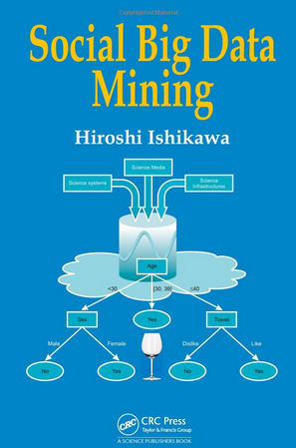
Social Big Data Mining (Hiroshi Ishikawa, 2015)
Source: http://www.amazon.com/Social-Data-Mining-Hiroshi-Ishikawa/dp/149871093X

Slide 64
Architecture for Social Big Data Mining (Hiroshi Ishikawa, 2015)
Enabling Technologies
Analysts
Integrated analysis
Integrated analysis model
Model Construction
Explanation by Model
Conceptual Layer
Natural Language Processing
Information Extraction
Anomaly Detection
Discovery of relationships among heterogeneous data
Large-scale visualization
Construction and confirmation of individual hypothesis
Description and execution of application-specific task
Data Mining
Multivariate analysis
Application specific task
Logical Layer
Parallel distrusted processing
Software
Social Data
Hardware
Physical Layer
Source: Hiroshi Ishikawa (2015), Social Big Data Mining, CRC Press

Slide 65
Big Data Analysis
Too Big, too Unstructured, too many different source to be manageable through traditional databases

Slide 66
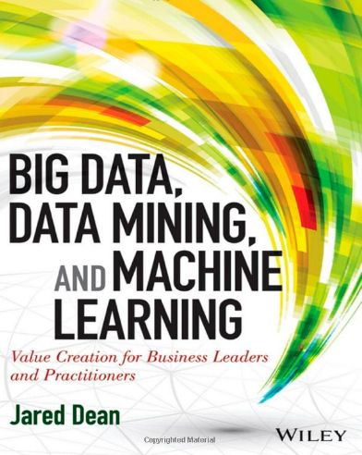
Source: http://www.amazon.com/Data-Mining-Machine-Learning-Practitioners/dp/1118618041

Slide 67
Deep Learning Intelligence from Big Data
Source: https://www.vlab.org/events/deep-learning/

Slide 68
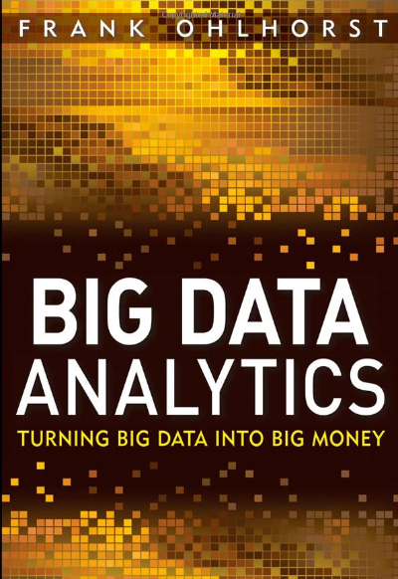
Source: http://www.amazon.com/Big-Data-Analytics-Turning-Money/dp/1118147596

Slide 69
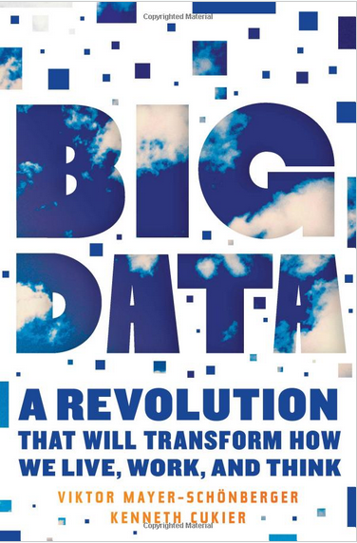
Source: http://www.amazon.com/Big-Data-Revolution-Transform-Mayer-Schonberger/dp/B00D81X2YE

Slide 70
Business Intelligence Trends
Agile Information Management (IM)
Cloud Business Intelligence (BI)
Mobile Business Intelligence (BI)
Analytics
Big Data
Source: http://www.businessspectator.com.au/article/2013/1/22/technology/five-business-intelligence-trends-2013

Slide 71
Business Intelligence and Analytics
Business Intelligence 2.0 (BI 2.0)
Web Intelligence
Web Analytics
Web 2.0
Social Networking and Microblogging sites
Data Trends
Big Data
Platform Technology Trends
Cloud computing platform
Source: Lim, E. P., Chen, H., & Chen, G. (2013). Business Intelligence and Analytics: Research Directions. ACM Transactions on Management Information Systems (TMIS), 3(4), 17

Slide 72
Business Intelligence and Analytics: Research Directions
1. Big Data Analytics
Data analytics using Hadoop / MapReduce framework
2. Text Analytics
From Information Extraction to Question Answering
From Sentiment Analysis to Opinion Mining
3. Network Analysis
Link mining
Community Detection
Social Recommendation
Source: Lim, E. P., Chen, H., & Chen, G. (2013). Business Intelligence and Analytics: Research Directions. ACM Transactions on Management Information Systems (TMIS), 3(4), 17

Slide 73
Big Data, Big Analytics: Emerging Business Intelligence and Analytic Trends for Today's Businesses

Slide 74
Big Data, Prediction vs. Explanation
Source: Agarwal, R., & Dhar, V. (2014). Editorial—Big Data, Data Science, and Analytics: The Opportunity and Challenge for IS Research. Information Systems Research, 25(3), 443-448.

Slide 75
Big Data: The Management Revolution
Source: McAfee, A., & Brynjolfsson, E. (2012). Big data: the management revolution.Harvard business review.

Slide 76
Business Intelligence and Enterprise Analytics
Predictive analytics
Data mining
Business analytics
Web analytics
Big-data analytics
Source: Thomas H. Davenport, "Enterprise Analytics: Optimize Performance, Process, and Decisions Through Big Data", FT Press, 2012

Slide 77
Three Types of Business Analytics
Prescriptive Analytics
Predictive Analytics
Descriptive Analytics
Source: Thomas H. Davenport, "Enterprise Analytics: Optimize Performance, Process, and Decisions Through Big Data", FT Press, 2012

Slide 78
Three Types of Business Analytics
Optimization
“What’s the best that can happen?”
Prescriptive Analytics
Randomized Testing
“What if we try this?”
Predictive Modeling / Forecasting
“What will happen next?”
Predictive Analytics
Statistical Modeling
“Why is this happening?”
Alerts
“What actions are needed?”
Query / Drill Down
“What exactly is the problem?”
Descriptive Analytics
Ad hoc Reports / Scorecards
“How many, how often, where?”
Standard Report
“What happened?”
Source: Thomas H. Davenport, "Enterprise Analytics: Optimize Performance, Process, and Decisions Through Big Data", FT Press, 2012

Slide 79
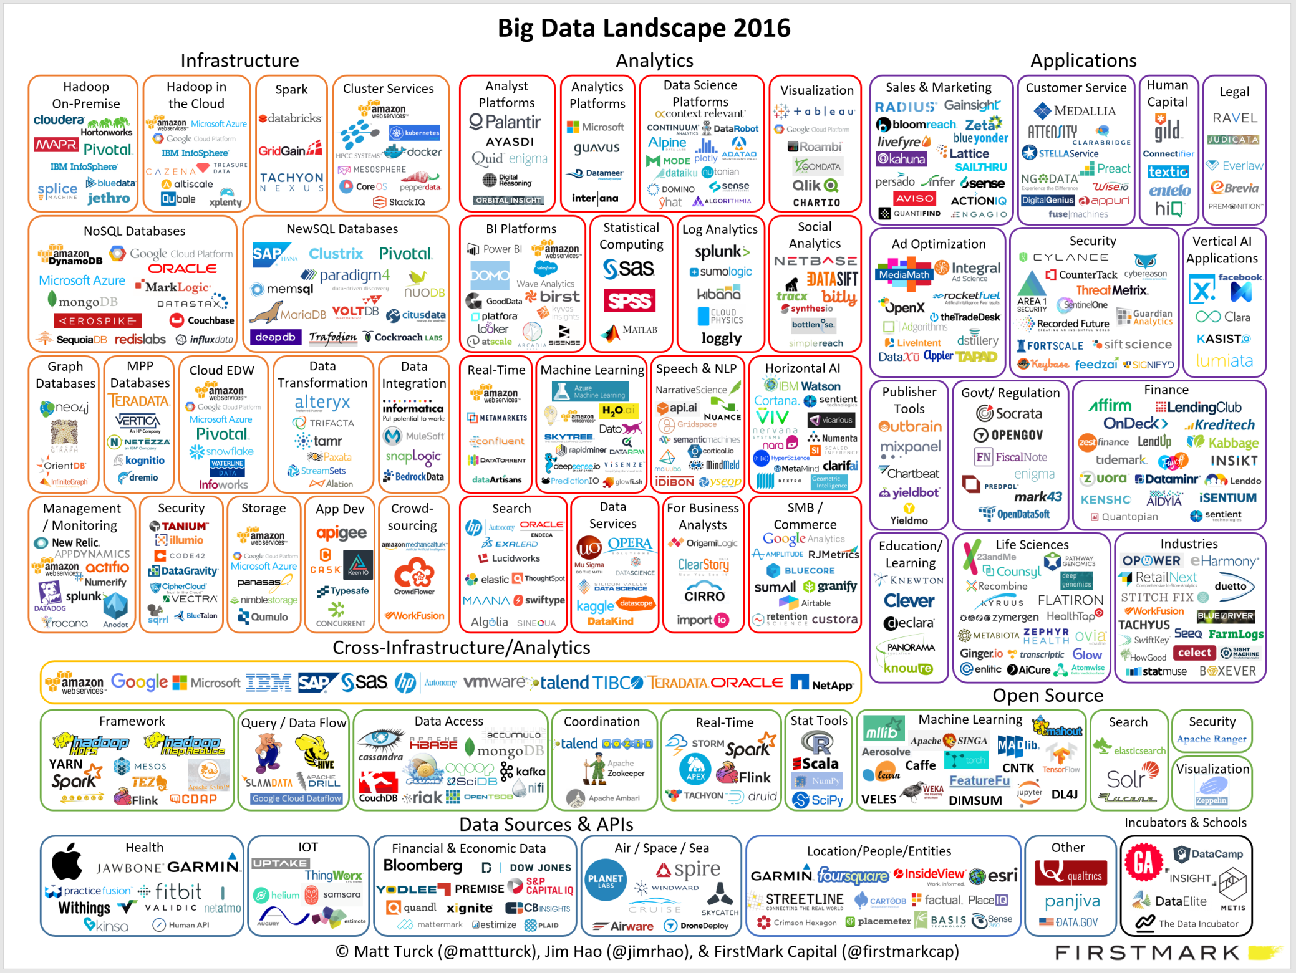
Source: http://mattturck.com/wp-content/uploads/2016/01/matt_turck_big_data_landscape_full.png

Slide 80
Summary
Data Science
Big Data Marketing

Slide 81
References
Lisa Arthur (2013), Big Data Marketing: Engage Your Customers More Effectively and Drive Value, Wiley.
EMC Education Services (2015), Data Science and Big Data Analytics: Discovering, Analyzing, Visualizing and Presenting Data, Wiley.
Foster Provost and Tom Fawcett (2013), Data Science for Business: What you need to know about data mining and data-analytic thinking, O'Reilly
Thomas W. Miller (2013) , Marketing Data Science: Modeling Techniques in Predictive Analytics with R and Python, Pearson FT Press
Peter C. Verhoef and Edwin Kooge (2016), Creating Value with Big Data Analytics: Making Smarter Marketing Decisions, Routledge
Stephan Kudyba (2014), Big Data, Mining, and Analytics: Components of Strategic Decision Making, Auerbach Publications
Fan, S., Lau, R. Y., & Zhao, J. L. (2015). Demystifying big data analytics for business intelligence through the lens of marketing mix. Big Data Research,2(1), 28-32
Erevelles, S., Fukawa, N., & Swayne, L. (2016). Big Data consumer analytics and the transformation of marketing. Journal of Business Research, 69(2), 897-904.

