Slide 1
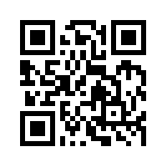
Social Media Apps Programming
Tamkang University
Case Study on Social Media Apps Programming and Marketing in Google Play and App Store
1041SMAP09
TLMXM1A (8687) (M2143) (Fall 2015)
(MIS MBA) (2 Credits, Elective) [Full English Course]
Wed 9,10 (16:10-18:00) B310
Min-Yuh Day, Ph.D.
Assistant Professor
Department of Information Management
Tamkang University
http://mail.tku.edu.tw/myday
2015-12-02

Slide 2
Course Schedule (1/3)
Week Date Subject/Topics
1 2015/09/16 Course Orientation and Introduction to Social Media and Mobile Apps Programming
2 2015/09/23 Introduction to Android / iOS Apps Programming
3 2015/09/30 Developing Android Native Apps with Java (Android Studio) (MIT App Inventor)
4 2015/10/07 Developing iPhone / iPad Native Apps with Swift (XCode)
5 2015/10/14 Mobile Apps using HTML5/CSS3/JavaScript
6 2015/10/21 jQuery Mobile

Slide 3
Course Schedule (2/3)
Week Date Subject/Topics
7 2015/10/28 Create Hybrid Apps with Phonegap
8 2015/11/04 jQuery Mobile/Phonegap
9 2015/11/11 jQuery Mobile/Phonegap
10 2015/11/18 Midterm Exam Week (Midterm Project Report)
11 2015/11/25 Invited Talk: Business Intelligent and Analysis in PIXNET, the Dominant Blog Platform in Taiwan [Speaker: Dr. Rick Cheng-Yu Lu, CTO, PIXNET]
12 2015/12/02 Case Study on Social Media Apps Programming and Marketing in Google Play and App Store

Slide 4
Course Schedule (3/3)
Week Date Subject/Topics
13 2015/12/09 Google Cloud Platform
14 2015/12/16 Google App Engine and Google Map API
15 2015/12/23 Facebook API (Facebook JavaScript SDK) (Integrate Facebook with iOS/Android Apps)
16 2015/12/30 Twitter API
17 2016/01/06 Final Project Presentation
18 2016/01/13 Final Exam Week (Final Project Presentation)

Slide 5
Outline
Case Study on Social Media Apps Programming and Marketing in Google Play and App Store
Business Model
Apps Development Life Cycle
Programming
Marketing

Slide 6
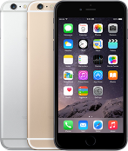
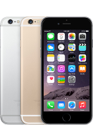
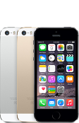
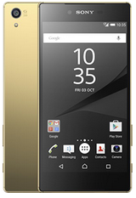
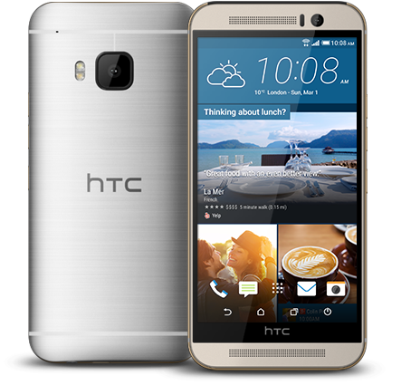
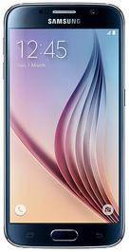
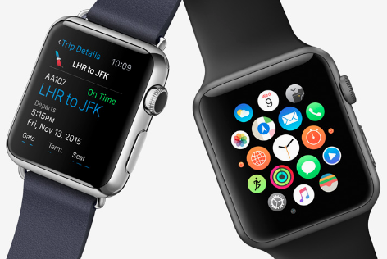
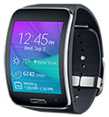
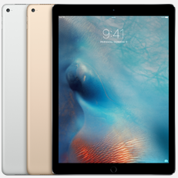
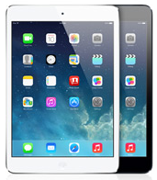
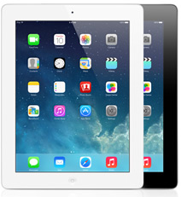
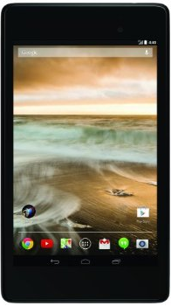
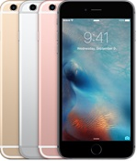
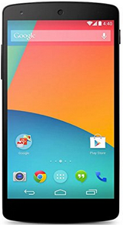
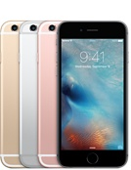
Android /iOS Apps Programming
Native Apps
Hybrid Apps
Mobile Web Apps

Slide 7
Business Model
8
6
2
4
1
Key Partners
Key Activities
Value Proposition
Customer Relationships
Customer Segments
7
3
Key Resources
Channels
9
5
Cost Structure
Revenue Streams
Source: Alexander Osterwalder & Yves Pigneur, Business Model Generation: A Handbook for Visionaries, Game Changers, and Challengers, Wiley, 2010.

Slide 8
How Airbnb Works? Insights into Business Model & Revenue Model
Source: http://nextjuggernaut.com/blog/airbnb-business-model-canvas-how-airbnb-works-revenue-insights/

Slide 9
Airbnb Business Model Canvas
Source: http://nextjuggernaut.com/blog/airbnb-business-model-canvas-how-airbnb-works-revenue-insights/

Slide 10
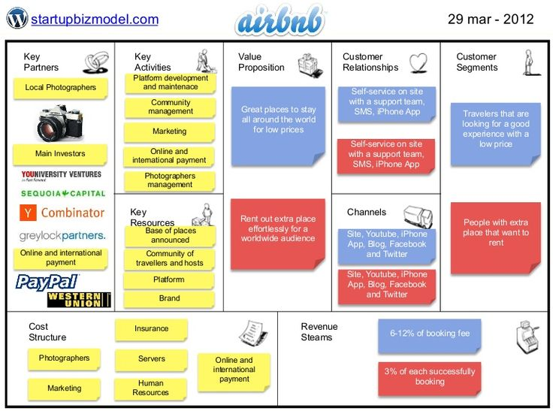
Source: http://www.slideshare.net/ThiagoPaiva/airbnb-12210879

Slide 11
Mobile Apps Marketing
Push Notifications
Loyalty Cards
Click to Call
GPS Coupons and Deals
QR Code Coupons
GPS Directions
Check-In Rewards

Slide 12
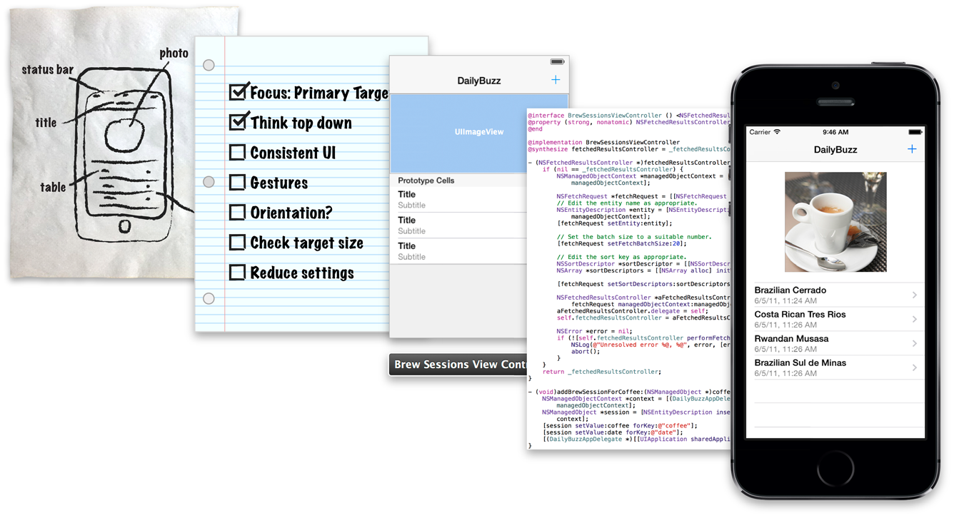
iOS App Development Process
Source: https://developer.apple.com/library/ios/referencelibrary/GettingStarted/RoadMapiOS/AppDevelopmentProcess.html

Slide 13
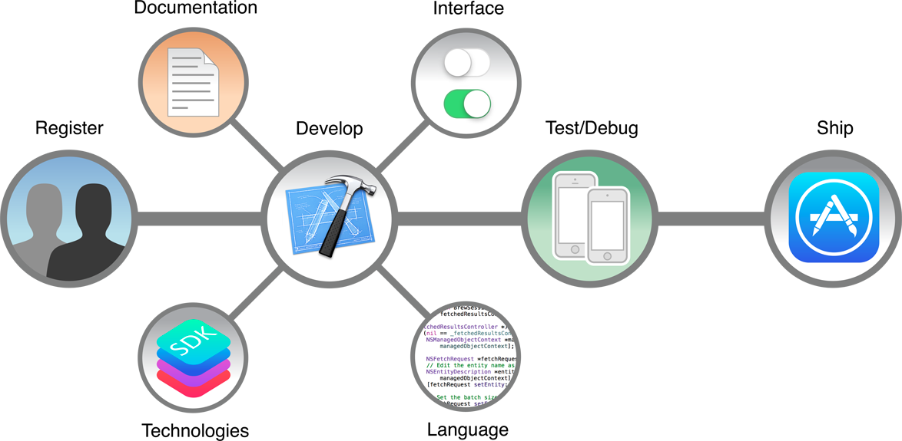
Apps Development Life Cycle
Source: https://developer.apple.com/library/ios/referencelibrary/GettingStarted/RoadMapiOS/WhereToGoFromHere.html

Slide 14
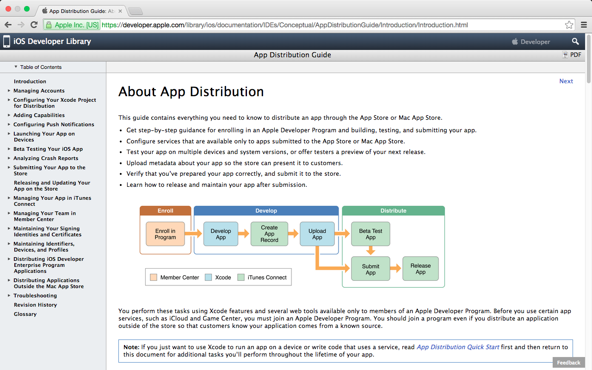
App Distribution on App Store
https://developer.apple.com/library/ios/documentation/IDEs/Conceptual/AppDistributionGuide/Introduction/Introduction.html

Slide 15
App Distribution on App Store
Source: https://developer.apple.com/library/ios/documentation/IDEs/Conceptual/AppDistributionGuide/Introduction/Introduction.html

Slide 16
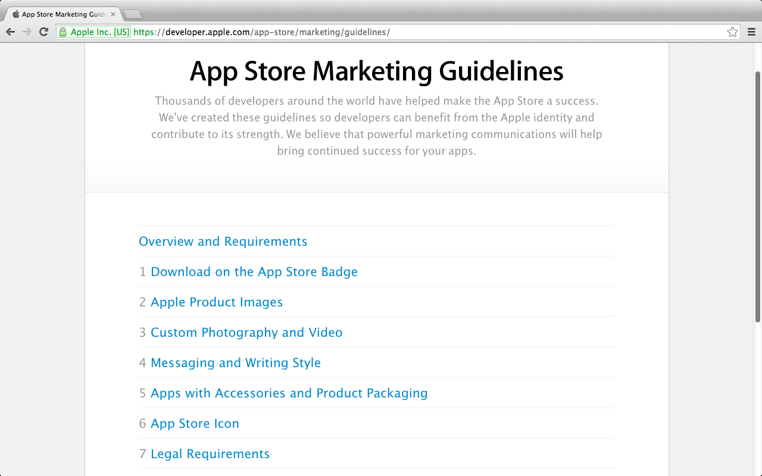
App Store Marketing
https://developer.apple.com/app-store/marketing/guidelines/

Slide 17
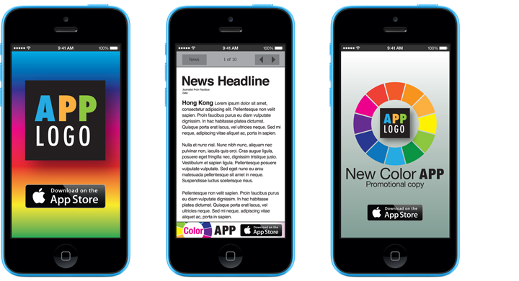
App Marketing
https://developer.apple.com/app-store/marketing/guidelines/

Slide 18
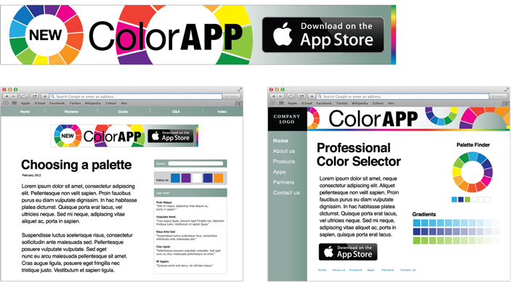
Web Marketing
https://developer.apple.com/app-store/marketing/guidelines/

Slide 19
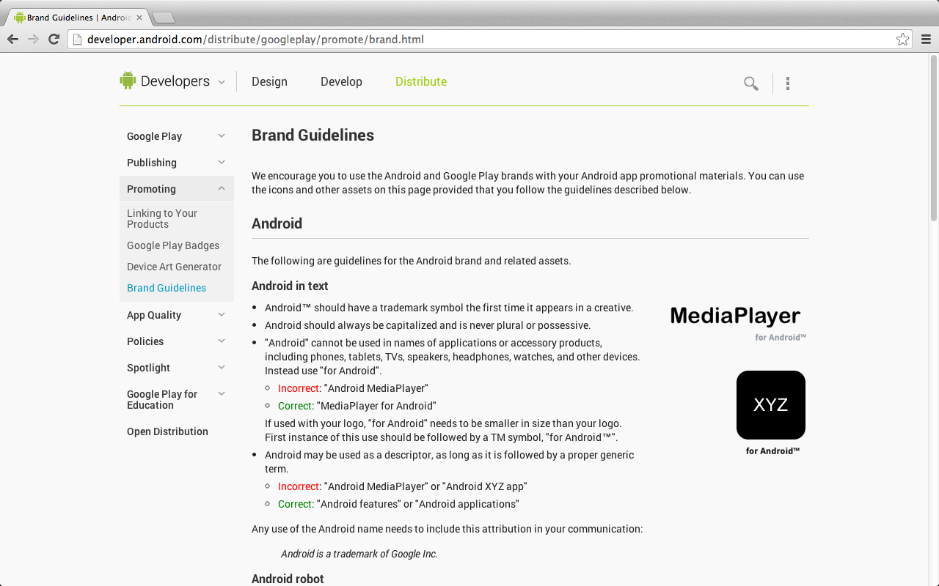
Google Play Brand Guidelines
http://developer.android.com/distribute/googleplay/promote/brand.html

Slide 20
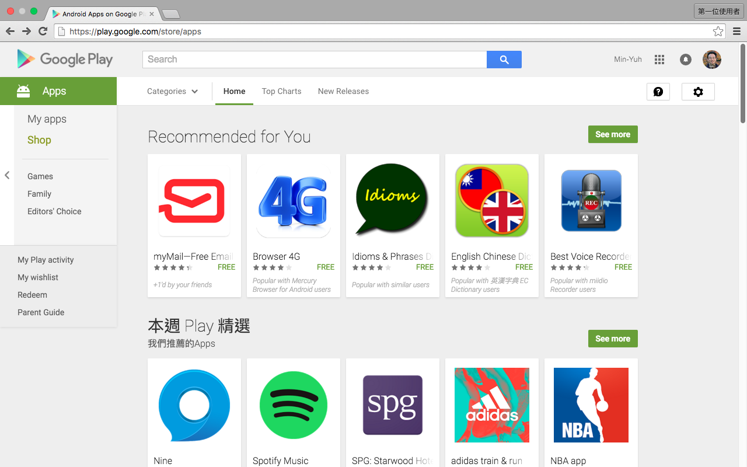
Case Study on Google Play
https://play.google.com/store

Slide 21
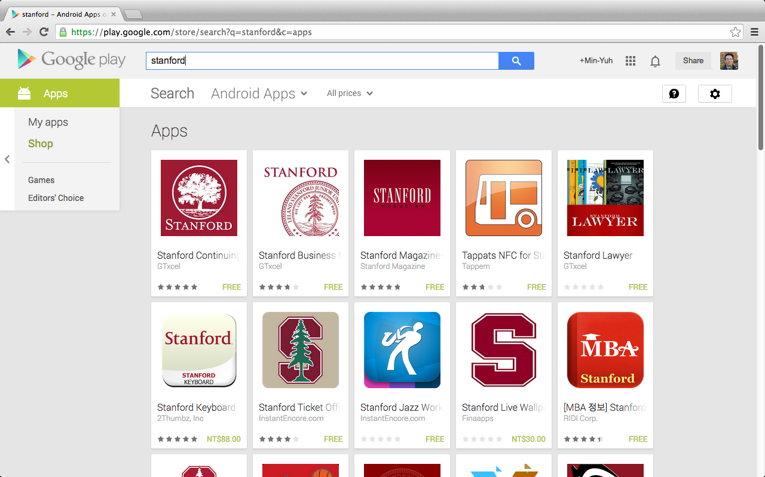
Stanford

Slide 22
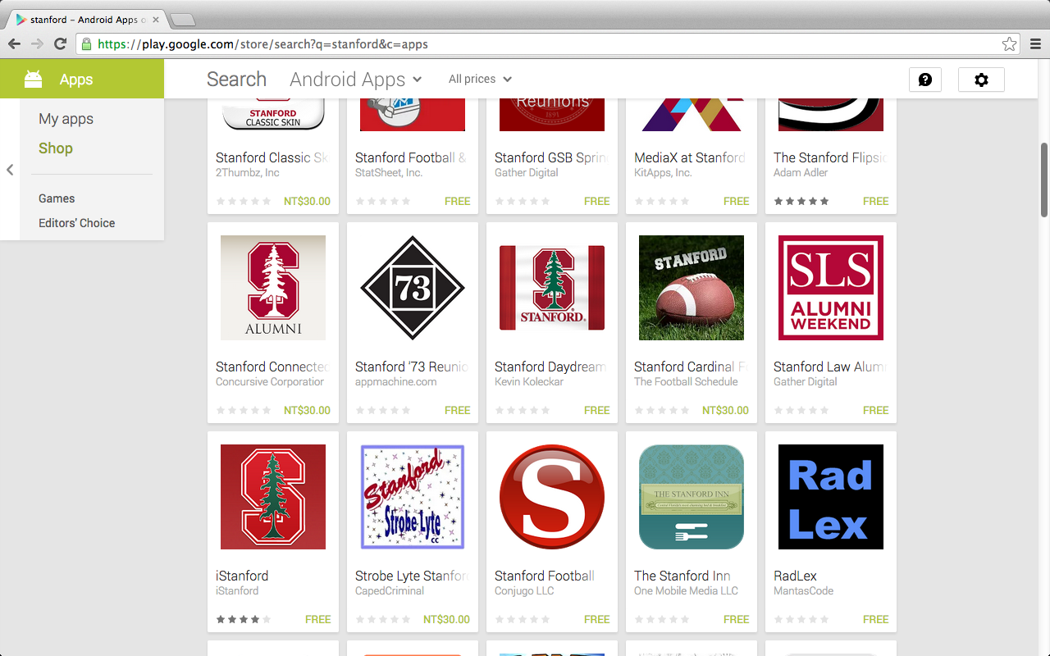
Stanford

Slide 23
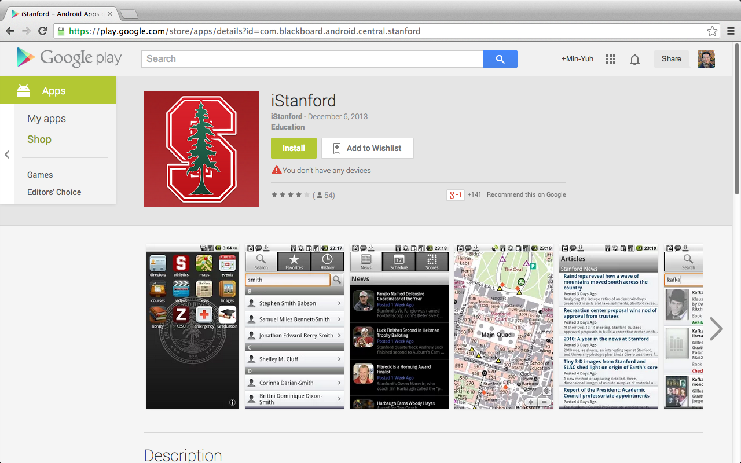
iStanford

Slide 24
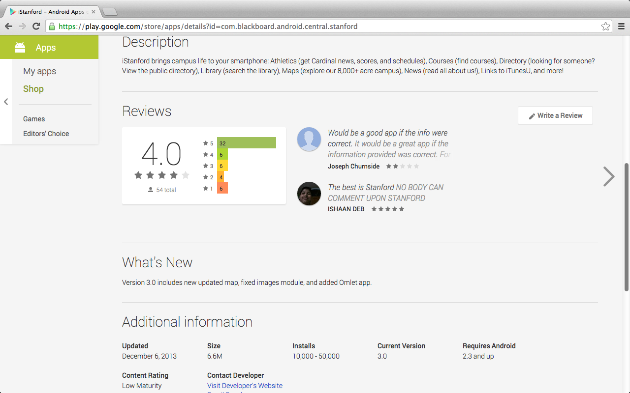
iStanford

Slide 25
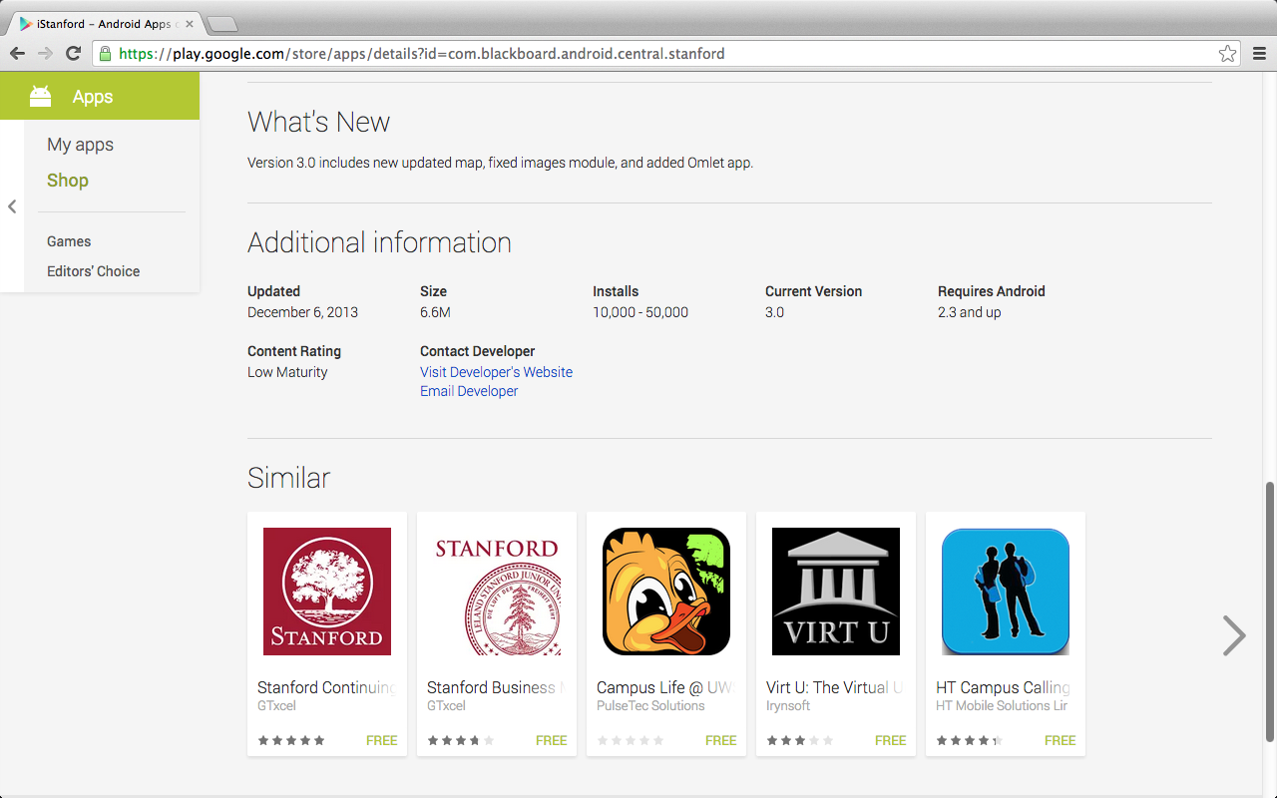
iStanford

Slide 26
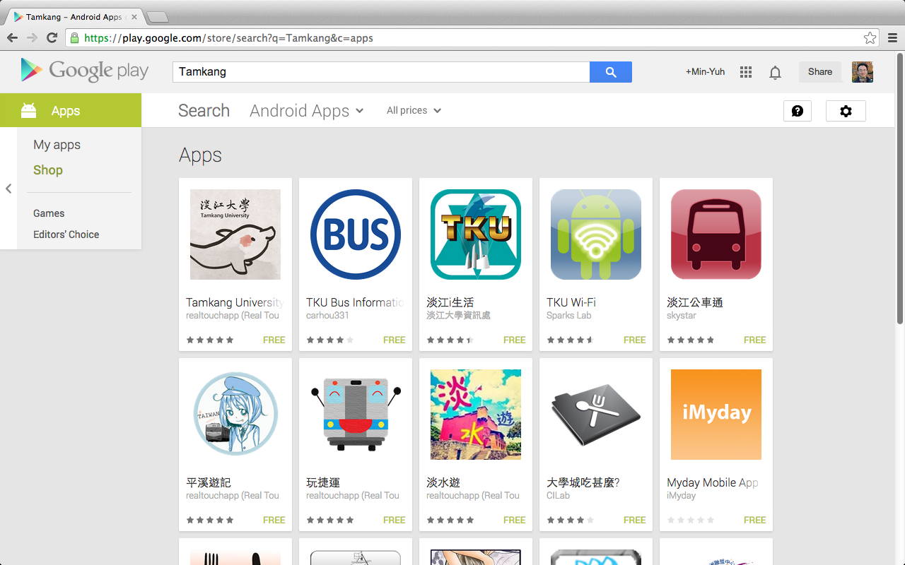
Tamkang
https://play.google.com/store

Slide 27
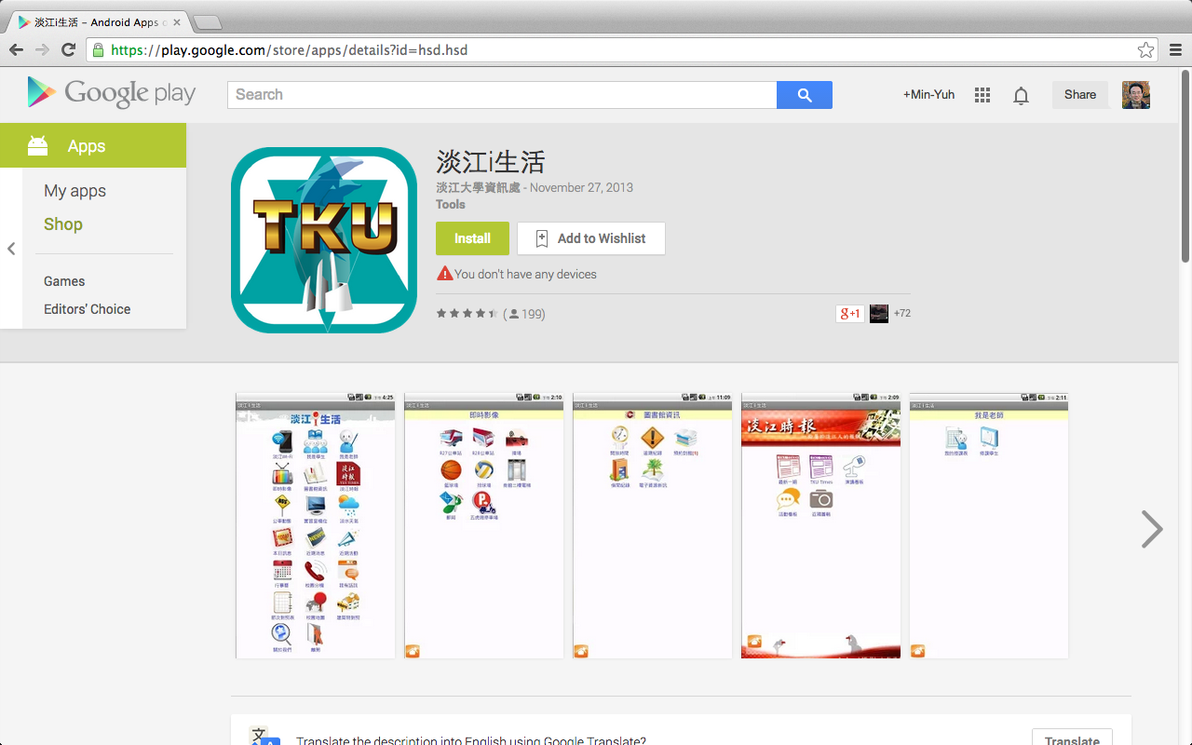
iTKU

Slide 28
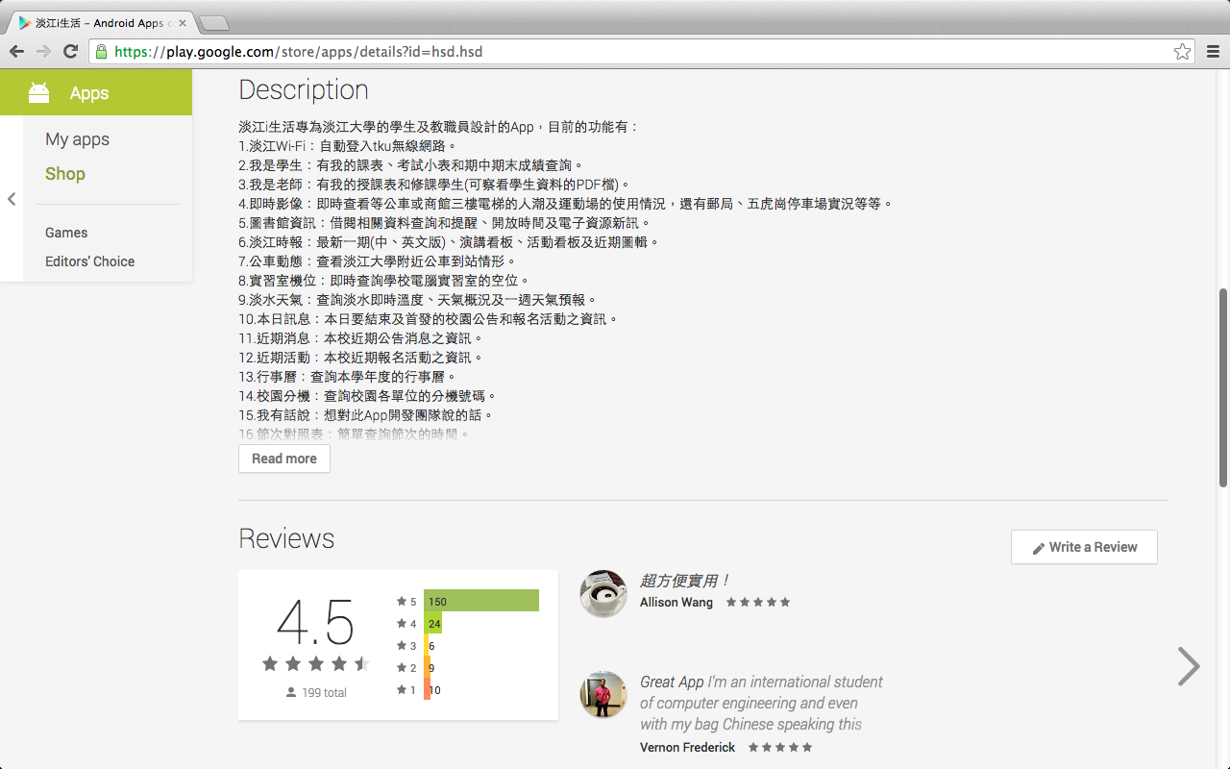
iTKU

Slide 29
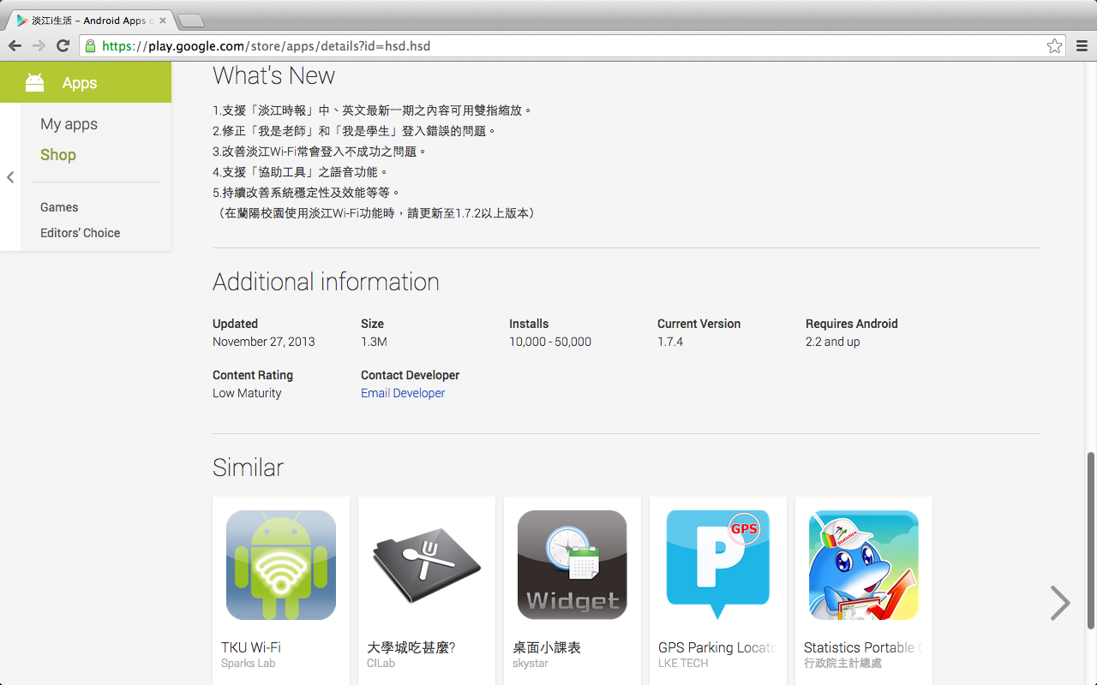
iTKU

Slide 30
iTKU
https://play.google.com/store

Slide 31
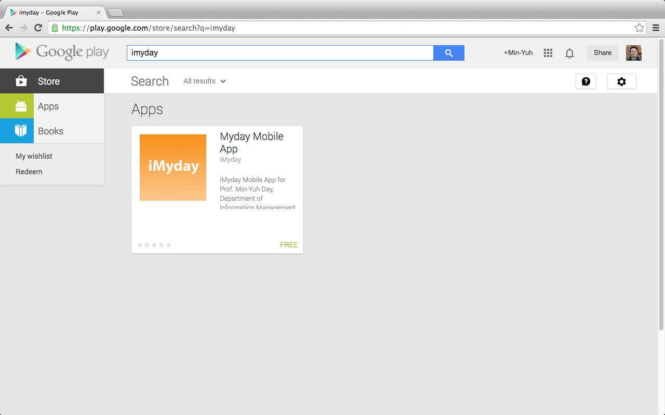
iMyday
https://play.google.com/store

Slide 32
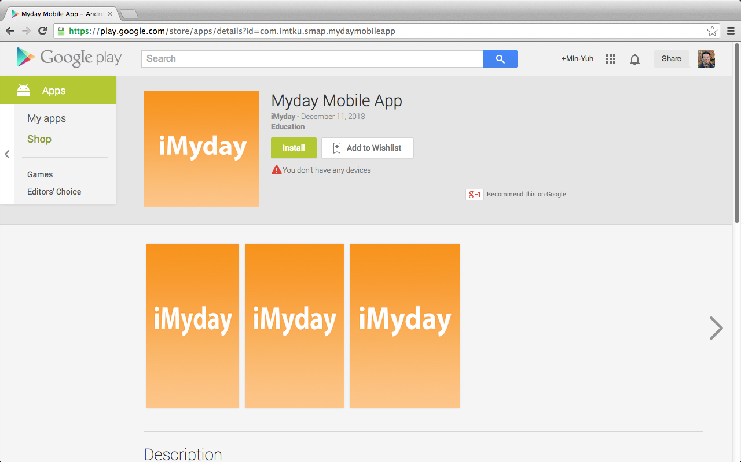
iMyday

Slide 33
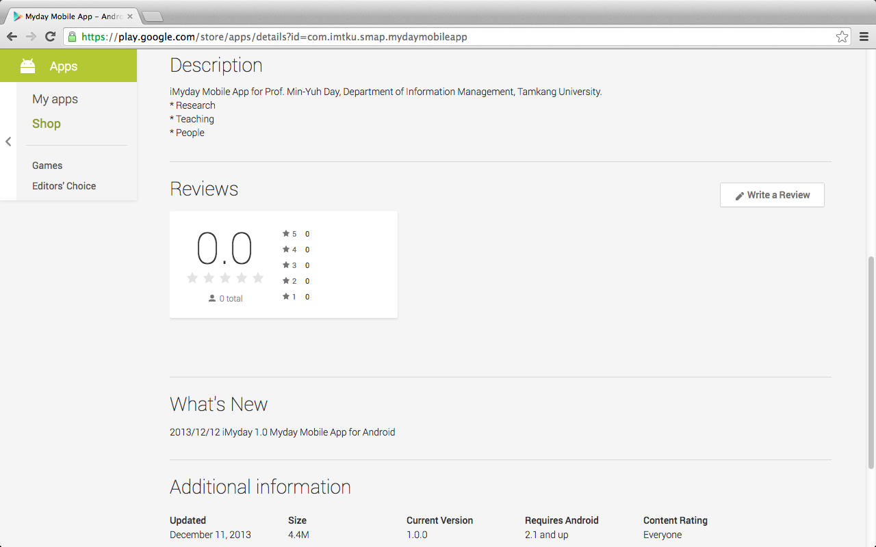
iMyday

Slide 34
PhoneGap iOS: App Store Android: Google Play
provide the correct certificates
signing keys to allow distribution
https://build.phonegap.com/faq

Slide 35
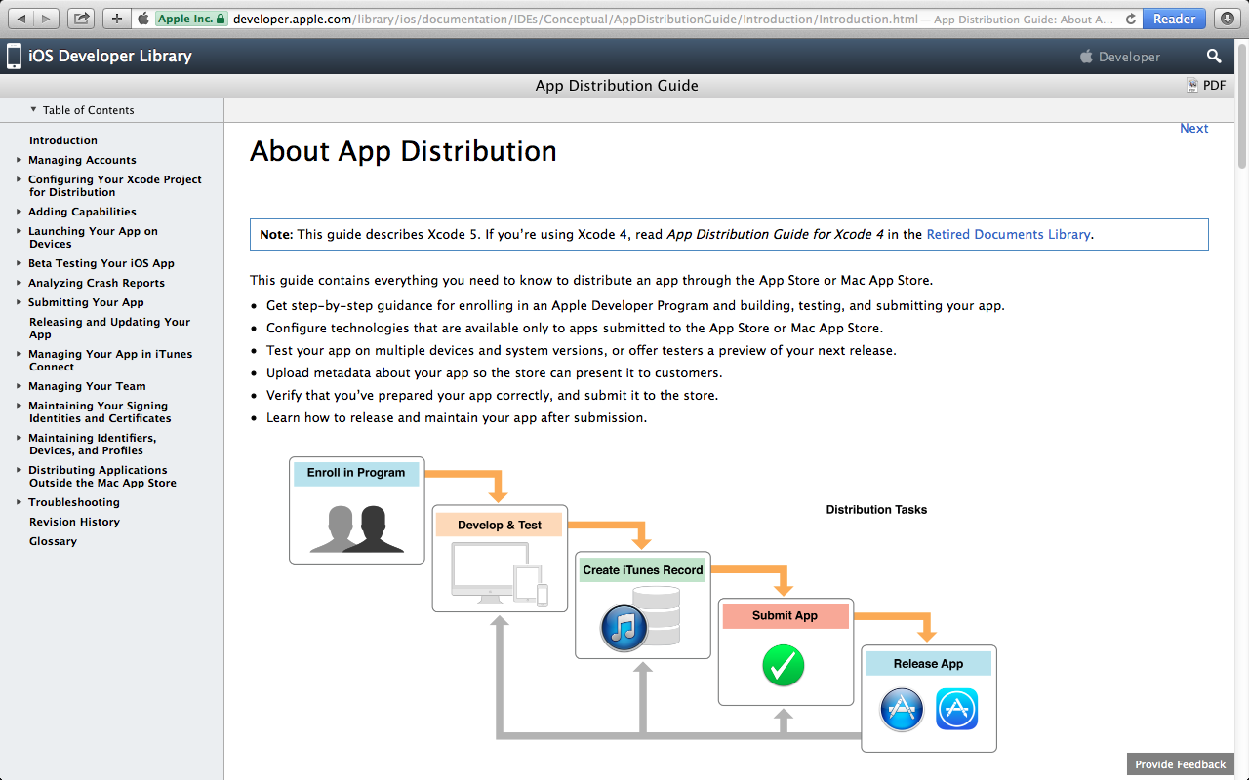
iOS App Distribution on App Store
https://developer.apple.com/library/ios/documentation/IDEs/Conceptual/AppDistributionGuide/Introduction/Introduction.html

Slide 36
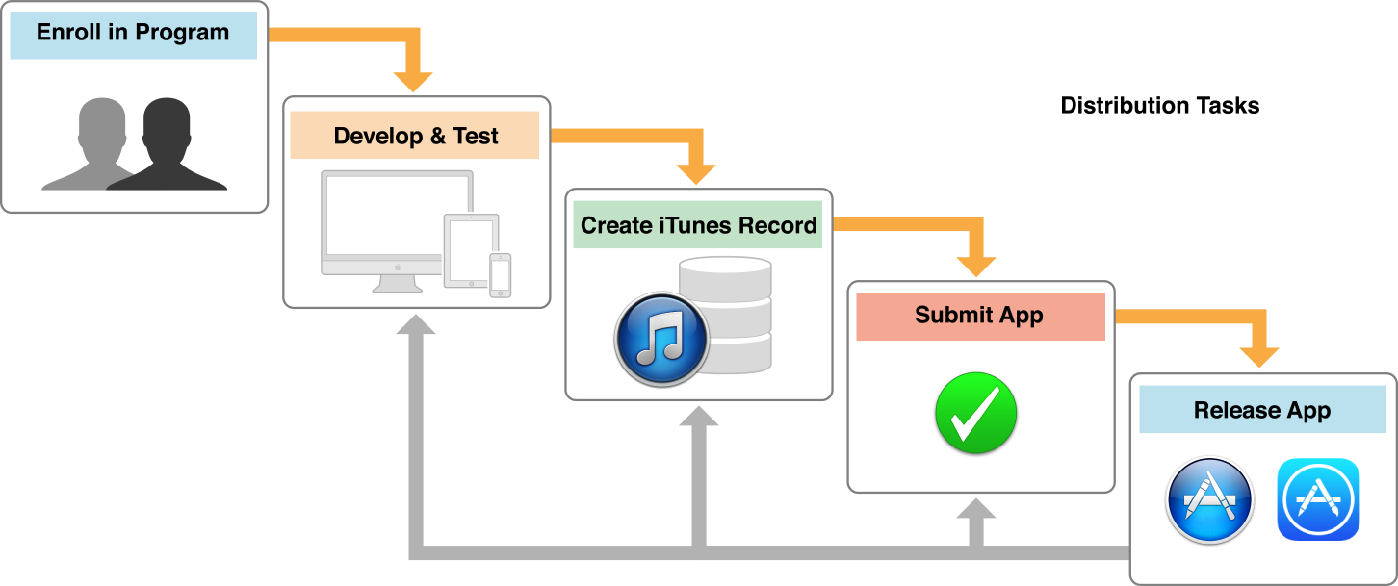
Submit and Release iOS App on App Store
https://developer.apple.com/library/ios/documentation/IDEs/Conceptual/AppDistributionGuide/Introduction/Introduction.html

Slide 37
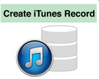
App Metadata
Upload metadata about your app so the store can present it to customers.

Slide 38
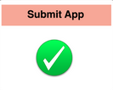
Submit App to App Store
Verify that you’ve prepared your app correctly, and submit it to the store

Slide 39
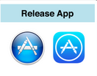
Release App
release and maintain your app after submission

Slide 40
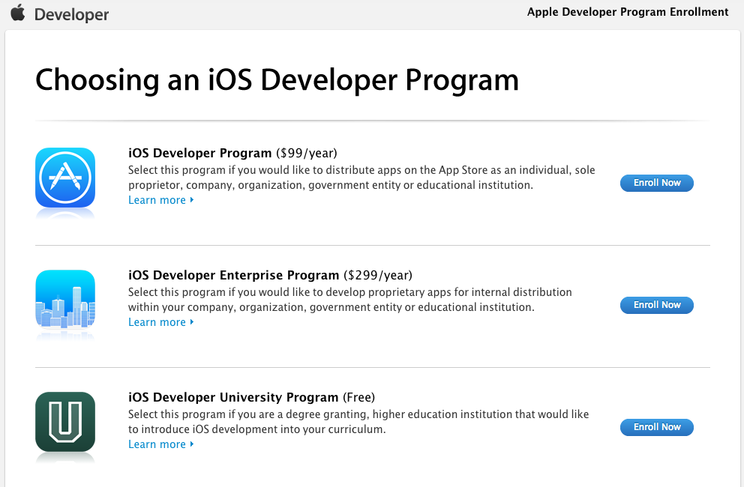
https://developer.apple.com/programs/start/ios/

Slide 41
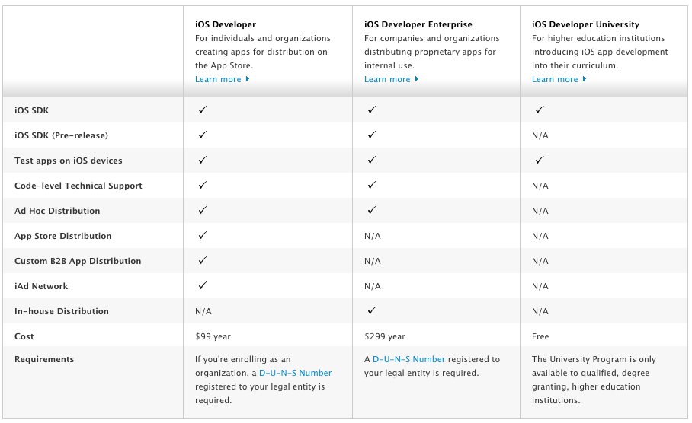
Compare iOS Developer Programs
https://developer.apple.com/programs/start/ios/

Slide 42
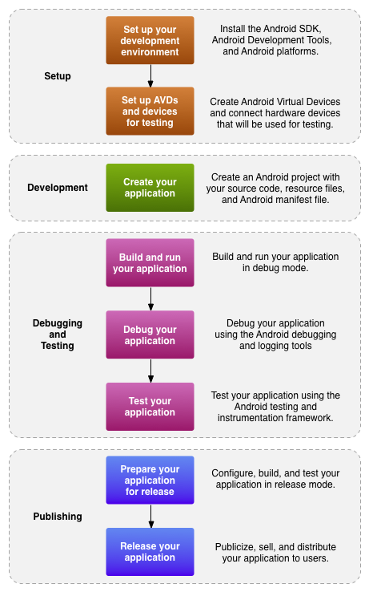
The development process for Android applications
http://developer.android.com/tools/workflow/index.html

Slide 43
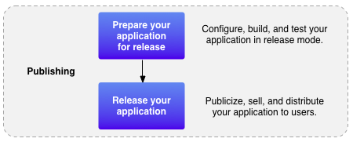
Publishing process for Android applications
http://developer.android.com/tools/workflow/index.html

Slide 44
Publishing is the last phase of the Android application development process
http://developer.android.com/tools/publishing/publishing_overview.html

Slide 45
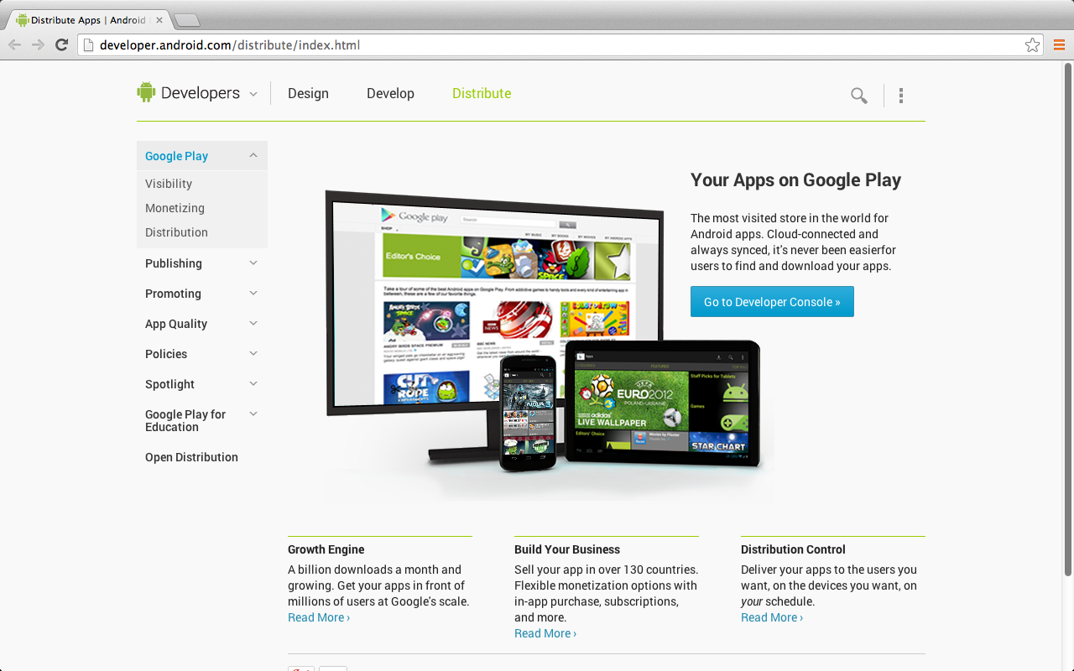
Distribute Your Apps on Google Play
http://developer.android.com/distribute/index.html

Slide 46
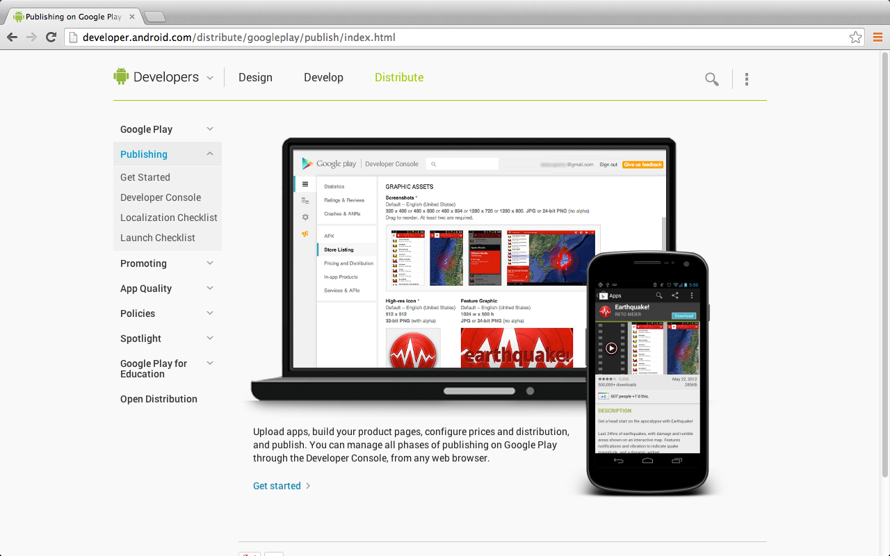
Google Play Publishing
http://developer.android.com/distribute/googleplay/publish/index.html

Slide 47
Launch Checklist for publish your app on Google Play
1. Understand the publishing process
2. Understand Google Play policies
3. Test for core app quality
4. Determine your content rating
5. Determine country distribution
6. Confirm the app's overall size
7. Confirm app compatibility ranges
Source: http://developer.android.com/distribute/googleplay/publish/preparing.html

Slide 48
Launch Checklist for publish your app on Google Play
8. Decide on free or priced
9. Consider In-app Billing
10. Set prices for your apps
11. Start localization early
12. Prepare promotional graphics
13. Build the release-ready APK
14. Plan a beta release
Source: http://developer.android.com/distribute/googleplay/publish/preparing.html

Slide 49
Launch Checklist for publish your app on Google Play
15. Complete the product details
16. Use Google Play badges
17. Final checks and publishing
18. Support users after launch
Source: http://developer.android.com/distribute/googleplay/publish/preparing.html

Slide 50
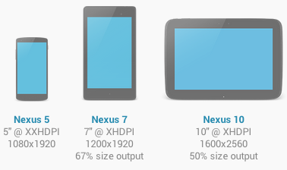

Slide 51
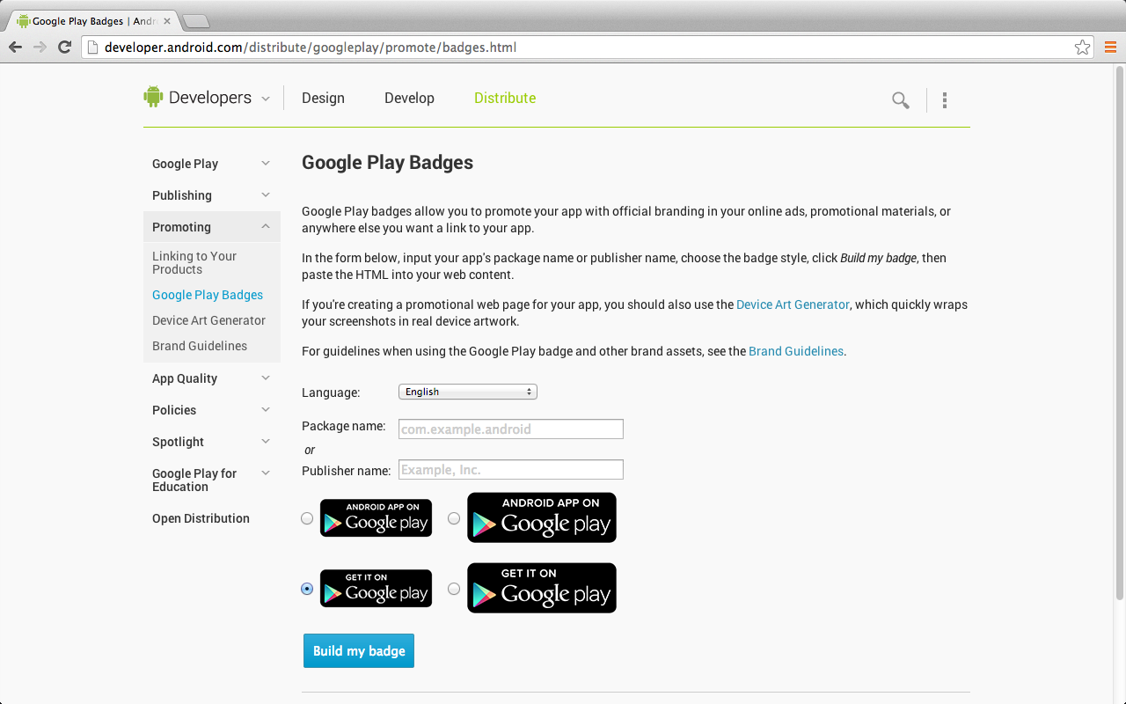
http://developer.android.com/distribute/googleplay/promote/badges.html

Slide 52
Keytool
Keytool
To generate a keystore and private key, used to sign your .apk file.
Keytool is part of the JDK.
Jarsigner (or similar signing tool)
To sign your .apk file with a private key generated by Keytool.
Jarsigner is part of the JDK.
http://developer.android.com/tools/workflow/index.html

Slide 54
Android: Signing in Release Mode
1. Obtain a suitable private key
2. Compile the application in release mode
3. Sign your application with your private key
4. Align the final APK package
$ keytool -genkey -v -keystore my-release-key.keystore
-alias alias_name -keyalg RSA -keysize 2048 –validity 20000
http://developer.android.com/tools/publishing/app-signing.html
Notes:
http://developer.android.com/tools/publishing/app-signing.html
Signing in Release Mode
When your application is ready for release to other users, you must:
1. Obtain a suitable private key
2. Compile the application in release mode
3. Sign your application with your private key
4. Align the final APK package

Slide 55
Android: Signing in Release Mode
keytool -genkey -v -keystore my_release_key.keystore -alias my_android -keyalg RSA –validity 20000
keytool -genkey -v -keystore my-release-key.keystore
-alias alias_name -keyalg RSA -keysize 2048 –validity 20000
http://developer.android.com/tools/publishing/app-signing.html
Notes:
http://developer.android.com/tools/publishing/app-signing.html
Signing in Release Mode
When your application is ready for release to other users, you must:
1. Obtain a suitable private key
2. Compile the application in release mode
3. Sign your application with your private key
4. Align the final APK package

Slide 56
Applications/Utilities/Terminal.app
keytool -genkey -v -keystore my_release_key.keystore -alias my_android -keyalg RSA -validity 20000

Slide 57
my_release_key.keystore

Slide 58
Keytool
Keytool Option Description
-genkey Generate a key pair (public and private keys)
-v Enable verbose output.
-alias <alias_name> An alias for the key. Only the first 8 characters of the alias are used.
-keyalg <alg> The encryption algorithm to use when generating the key. Both DSA and RSA are supported.
-keysize <size> The size of each generated key (bits). 2048 bits or higher.
-validity <valdays> The validity period for the key, in days. Note: A value of 10000 or greater is recommended.
-keystore <keystore-name>.keystore A name for the keystore containing the private key.
http://developer.android.com/tools/publishing/app-signing.html

Slide 59
http://developer.android.com/tools/publishing/app-signing.html

Slide 60
Modify config.xml: icon.png

Slide 61
Modify config.xml: icon.png

Slide 62
Modify config.xml: screen.png

Slide 63
Refine index.css
animation:fad
.blink {
animation:fade 3000ms infinite;
-webkit-animation:fade 3000ms infinite;
}
.blink {
animation:fade 1000ms infinite;
-webkit-animation:fade 1000ms infinite;
}

Slide 64
Refine index.css

Slide 65
Refine App Files and Update app.zip

Slide 66
Update code and Rebuild all on PhoneGap Build

Slide 67
Update code: Upload app.zip

Slide 68
Update code: Upload app.zip

Slide 69
Update code and Rebuild all on PhoneGap Build

Slide 70
Update code and Rebuild all on PhoneGap Build

Slide 71
No key selected: debug.apk

Slide 72
Download debug.apk for Testing

Slide 73
Download debug.apk for Testing

Slide 74
Add a key to Build release.apk for Google Play

Slide 75
Add a key to Build release.apk
No key selected: debug.apk

Slide 76
Add a key to Build release.apk
Add a key: release.apk

Slide 85
Download MydayMobileApp-release.apk from PhoneGap Build

Slide 86
Download MydayMobileApp-release.apk from PhoneGap Build

Slide 87
Download MydayMobileApp-release.apk from PhoneGap Build

Slide 88
app.zip MydayMobileApp-debug.apk my_release_key.keystore MydayMobileApp-release.apk

Slide 89
Demo: Publishing App on Google Play

Slide 90
Google Developers
https://developers.google.com/

Slide 91
Publish App on Google Play Signup Google Developer Account
https://play.google.com/apps/publish/signup/

Slide 92
Google play Developer Distribution Agreement
https://play.google.com/intl/ALL_us/about/developer-distribution-agreement.html

Slide 93
Google play Developer Distribution Agreement

Slide 94
Accept Developer Agreement

Slide 95
Set up Google Wallet

Slide 96
Set up Google Wallet

Slide 97
Review your purchase

Slide 98
Update billing information

Slide 99
Your Payment is Complete

Slide 100
Complete registration

Slide 101
Publish an Android App on Google Play

Slide 106
Publish an Android App on Google Play

Slide 107
Receipt of Google Play Developer Registration Fee

Slide 108
Keytool
keytool -genkey -v -keystore my_release_key.keystore -alias my_android -keyalg RSA -validity 20000

Slide 109
Add a key to Build release.apk
No key selected: debug.apk

Slide 110
Add a key to Build release.apk
Add a key: release.apk

Slide 119
Download MydayMobileApp-release.apk from PhoneGap Build

Slide 120
Download MydayMobileApp-release.apk from PhoneGap Build

Slide 121
Download MydayMobileApp-release.apk from PhoneGap Build

Slide 122
Publish an Android App on Google Play

Slide 123
Publish an Android App on Google Play

Slide 124
Publish an Android App on Google Play

Slide 125
Upload new APK to Production

Slide 126
Upload new APK to Production

Slide 127
MydayMobileApp-release.apk

Slide 128
Upload new APK to Production

Slide 129
Release APK Uploaded to Production

Slide 130
Google play Brand Guidelines
http://developer.android.com/distribute/googleplay/promote/brand.html

Slide 131
Store Listing: Product Details Title, Description, Promo Text

Slide 132
Store Listing: Screenshots

Slide 133
Store Listing: Screenshots

Slide 134
Store Listing: Screenshots

Slide 135
Store Listing: Screenshots

Slide 136
Store Listing: Screenshots

Slide 137
Store Listing: High-res icon, Feature Graphic, Promo Graphic

Slide 138
Store Listing: Categorization, Contact Details, Privacy Policy

Slide 139
Store Listing: Categorization

Slide 140
Store Listing: Categorization

Slide 141
Store Listing: Categorization, Contact Details, Privacy Policy

Slide 142
Pricing & Distribution

Slide 143
Pricing & Distribution

Slide 144
Google play for Education

Slide 145
Google play for Education

Slide 146
Google play for Education

Slide 147
Consent

Slide 148
Ready to publish

Slide 149
Ready to publish

Slide 150
Ready to publish

Slide 151
Ready to publish

Slide 152
Published

Slide 153
Myday Mobile App Statistics

Slide 154
Myday Mobile App Statistics

Slide 155
Myday Mobile App on Google play
https://play.google.com/store/apps/details?id=com.imtku.smap.mydaymobileapp

Slide 156
Update Android App Screenshots
Download Android App on Google play
Capture Screenshot from Android Device
Install app-release.apk on Android Emulator
Android SDK platform tools: abd
abd install myapp-release.apk
Capture Screenshot from Android Emulator

Slide 157
adb install MydayMobileApp-release.apk
iMydaytekiMacBook-Pro:platform-tools imyday$ ./adb install MydayMobileApp-release.apk
2007 KB/s (4647578 bytes in 2.260s)
pkg: /data/local/tmp/MydayMobileApp-release.apk
Success

Slide 158
Capture Screenshot from Android Emulator

Slide 159
Capture Screenshot from Android Emulator

Slide 160
Device Screen Capture

Slide 161
Device Screen Capture

Slide 162
Device Screen Capture (screenshot.png)

Slide 163
Update Screenshots on Google play Store Listing
https://play.google.com/apps/publish/?dev_acc=18117969802857634240#MarketListingPlace:p=com.imtku.smap.mydaymobileapp

Slide 164
Search Tamkang on Google play
https://play.google.com/store/search?q=Tamkang&c=apps

Slide 165
Search iMyday on Google play
https://play.google.com/store/search?q=iMyday&c=apps

Slide 166
Myday Mobile App on Google play
https://play.google.com/store/apps/details?id=com.imtku.smap.mydaymobileapp

Slide 167
Google Play Badges
<a href="https://play.google.com/store/apps/details?id=com.imtku.smap.mydaymobileapp">
<img alt="Android app on Google Play"
src="https://developer.android.com/images/brand/en_app_rgb_wo_60.png" />
</a>
http://developer.android.com/distribute/googleplay/promote/badges.html

Slide 168
Generate and Customize QR Code
http://www.qrhacker.com/

Slide 169
Summary
Case Study on Social Media Apps Programming and Marketing in Google Play and App Store
Business Model
Apps Development Life Cycle
Programming
Marketing

Slide 170
References
Beginning PhoneGap: Mobile Web Framework for JavaScript and HTML5, Rohit Ghatol & Yogesh Patel, Apress, 2012
Learn HTML5 and JavaScript for iOS: Web Standards-based Apps for iPhone, iPad, and iPod touch, Scott Preston, Apress, 2012
PhoneGap
http://phonegap.com/
PhoneGap Build
https://build.phonegap.com/
jQuery Mobile
http://jquerymobile.com/
Introduction to PhoneGap Build
http://tv.adobe.com/watch/building-mobile-apps-with-phonegap-build/introduction-to-phonegap-build-building-your-first-app/

