Slide 1
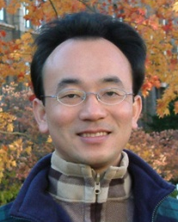
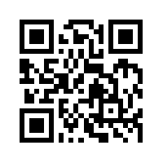
Social Media Apps Programming
Tamkang University
Course Orientation and Introduction to Social Media and Mobile Apps Programming
1041SMAP01
TLMXM1A (8687) (M2143) (Fall 2015)
(MIS MBA) (2 Credits, Elective) [Full English Course]
Wed 9,10 (16:10-18:00) B310
Min-Yuh Day, Ph.D.
Assistant Professor
Department of Information Management
Tamkang University
http://mail.tku.edu.tw/myday
2015-09-16

Slide 2
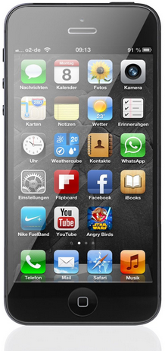
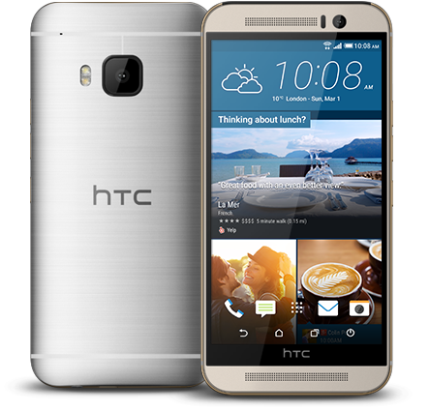
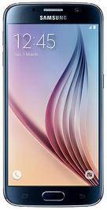
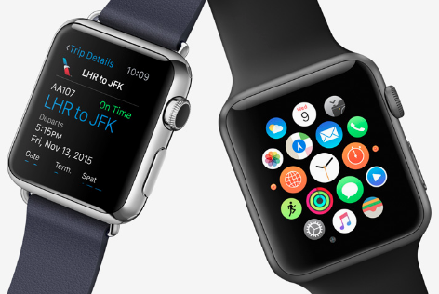
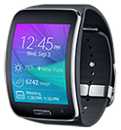
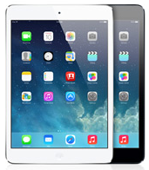
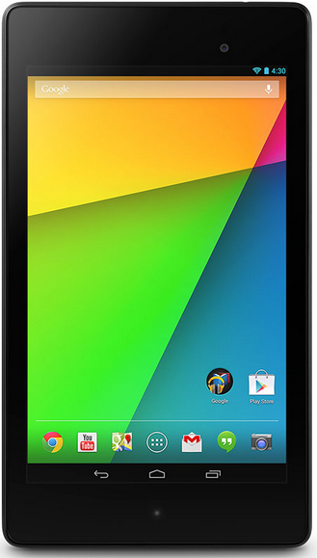
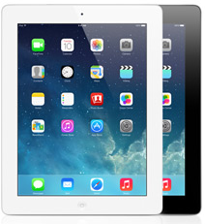
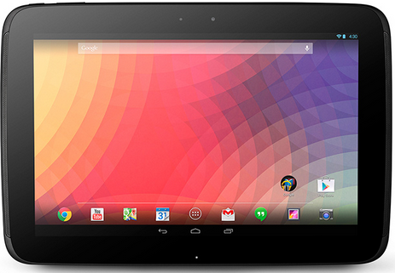
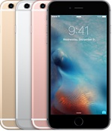
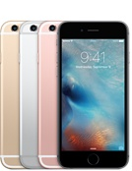
Android /iOS Apps Programming
Native Apps
Hybrid Apps
Mobile Web Apps

Slide 3
Enterprise Apps in 2015
Hybrid Apps
Gartner recommend hybrid apps over native apps development for businesses
Source: http://blog.commontime.com/hybrid-apps-the-right-response-to-byod-in-business/

Slide 4
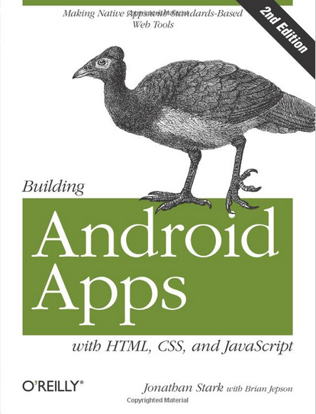
Building Android Apps with HTML, CSS, and JavaScript: Making Native Apps with Standards-Based Web Tools, Jonathan Stark & Brian Jepson, O’reilly, 2012
Source: http://www.amazon.com/Building-Android-Apps-HTML-JavaScript/dp/1449316417

Slide 5
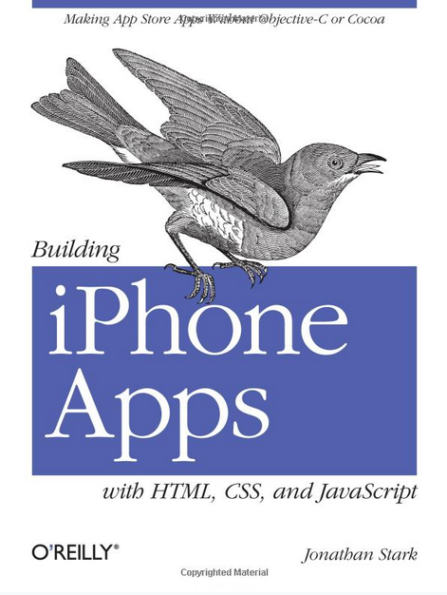
Building iPhone Apps with HTML, CSS, and JavaScript: Making App Store Apps Without Objective-C or Cocoa, Jonathan Stark, O’reilly, 2010
Source: http://www.amazon.com/Building-iPhone-Apps-HTML-JavaScript/dp/0596805780

Slide 6
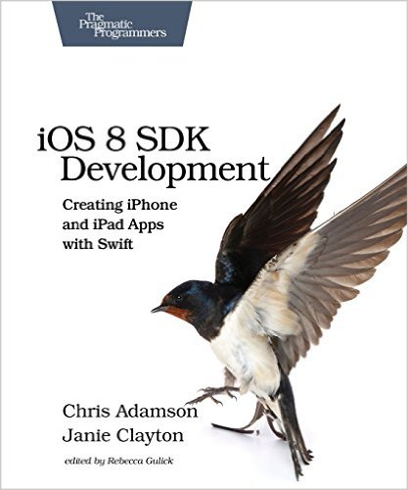
Chris Adamson and Janie Clayton, iOS 8 SDK Development: Creating iPhone and iPad Apps with Swift, Pragmatic Bookshelf, 2nd Edition, 2015
Source: http://www.amazon.com/gp/product/1941222641

Slide 7
App Development Comparison
Device Access
Speed
Development Cost
App Store
Approval Process
Native Apps
Full
Very Fast
Expensive
Available
Mandatory
Hybrid Apps
Full
Native Speed as Necessary
Reasonable
Available
Low Overhead
Web Apps
Partial
Fast
Reasonable
Not Available
None
Source: http://www.scribd.com/doc/50805466/Native-Web-or-Hybrid-Mobile-App-Development

Slide 8
Course Syllabus Tamkang University Academic Year 104, 1st Semester (Fall, 2015)
Tamkang University
Course Title: Social Media Apps Programming
Instructor: Min-Yuh Day
Course Class: TLMXM1A (MIS MBA)
Master’s Program, Department of Information Management, 1A
Details
Selective
One Semester
2 Credits
Time & Place: Wed 9,10 (16:10-18:00) B310

Slide 9
Department Teaching Objectives
Tamkang University
Devoting to the integration and research of information technology and business management knowledge
Cultivating for society, middle and higher level managers with both information capabilities and modern management skills

Slide 10
Department Core Competences
Tamkang University
Use of modern management knowledge
Logical thinking
Critical analysis
Integration of information technology and business management
Research and innovation
Theory and applications data analysis
Information and communication security management
Verbal and writing communication skills

Slide 11
Course Introduction
Tamkang University
This course introduces the fundamental concepts and practices of social media and mobile apps programming.
Topics include
Introduction to Android / iOS apps programming,
Developing Android native apps with Java (Eclipse),
Developing iPhone / iPad apps native apps with Swift (XCode),
Mobile apps using HTML5/CSS3/JavaScript,
jQuery Mobile,
Create hybrid apps with Phonegap,
Google Cloud Platform,
Google app engine, Google map API,
Facebook API,
Twitter API,
Case study on social media apps programming and marketing in Google Play and App Store.

Slide 12
Teaching Objectives
Tamkang University
Students will be able to understand and apply the fundamental concepts and practices of social media and mobile apps programming

Slide 13
Teaching Methods
Tamkang University
Lecture
Discussion
Simulation
Practicum
Problem Solving

Slide 14
Assessment
Practicum
Report
Participation

Slide 15
Course Schedule (1/3)
Week Date Subject/Topics
1 2015/09/16 Course Orientation and Introduction to Social Media and Mobile Apps Programming
2 2015/09/23 Introduction to Android / iOS Apps Programming
3 2015/09/30 Developing Android Native Apps with Java (Eclipse) (MIT App Inventor)
4 2015/10/07 Developing iPhone / iPad Native Apps with Swift (XCode)
5 2015/10/14 Mobile Apps using HTML5/CSS3/JavaScript
6 2015/10/21 jQuery Mobile

Slide 16
Course Schedule (2/3)
Week Date Subject/Topics
7 2015/10/28 Create Hybrid Apps with Phonegap
8 2015/11/04 jQuery Mobile/Phonegap
9 2015/11/11 jQuery Mobile/Phonegap
10 2015/11/18 Midterm Exam Week (Midterm Project Report)
11 2015/11/25 Case Study on Social Media Apps Programming and Marketing in Google Play and App Store
12 2015/12/02 Google Cloud Platform

Slide 17
Course Schedule (3/3)
Week Date Subject/Topics
13 2015/12/09 Google App Engine
14 2015/12/16 Google Map API
15 2015/12/23 Facebook API (Facebook JavaScript SDK) (Integrate Facebook with iOS/Android Apps)
16 2015/12/30 Twitter API
17 2016/01/06 Final Project Presentation
18 2016/01/13 Final Exam Week (Final Project Presentation)

Slide 18
Grading Policy
Mark of Usual: 50%
Final Apps Project: 50%
Midterm Project Report
Final Project Report

Slide 19
Textbooks and References
Textbook: Slides
http://mail.tku.edu.tw/myday/teaching.htm#1041SMAP
Jonathan Stark, Building iPhone Apps with HTML, CSS, and JavaScript: Making App Store Apps Without Objective-C or Cocoa, O’reilly, 2010.
Rohit Ghatol and Yogesh Patel, Beginning PhoneGap: Mobile Web Framework for JavaScript and HTML5, Apress, 2012.
Jon Reid, jQuery Mobile, O’reilly, 2012.
Chris Adamson and Janie Clayton, iOS 8 SDK Development: Creating iPhone and iPad Apps with Swift, Pragmatic Bookshelf, 2nd Edition, 2015

Slide 20
References
jQuery Mobil: http://jquerymobile.com/
PhoneGap: http://phonegap.com/
MIT App Inventor: http://appinventor.mit.edu/
Apple Developer: https://developer.apple.com/
Android Developer: http://developer.android.com/
Facebook Developers: https://developers.facebook.com/
Twitter Developers: https://dev.twitter.com/
Google App Engine: https://developers.google.com/appengine/
Gephi: Social Network Analysis and Visualization: https://gephi.org/
Netvizz: Facebook Netvizz app: https://apps.facebook.com/netvizz/

Slide 21
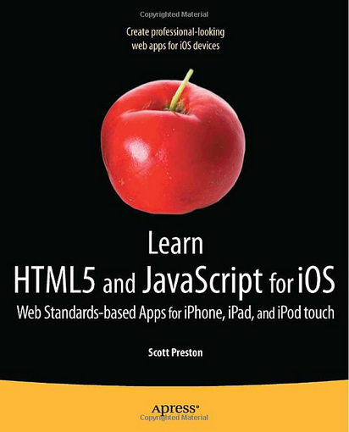
Learn HTML5 and JavaScript for iOS: Web Standards-based Apps for iPhone, iPad, and iPod touch, Scott Preston, Apress, 2012
Source: http://www.amazon.com/Learn-HTML5-JavaScript-iOS-Standards-based/dp/1430240385

Slide 22
Building iPhone Apps with HTML, CSS, and JavaScript: Making App Store Apps Without Objective-C or Cocoa, Jonathan Stark, O’reilly, 2010
Source: http://www.amazon.com/Building-iPhone-Apps-HTML-JavaScript/dp/0596805780

Slide 23
Building Android Apps with HTML, CSS, and JavaScript: Making Native Apps with Standards-Based Web Tools, Jonathan Stark & Brian Jepson, O’reilly, 2012
Source: http://www.amazon.com/Building-Android-Apps-HTML-JavaScript/dp/1449316417

Slide 24
Rohit Ghatol and Yogesh Patel, Beginning PhoneGap: Mobile Web Framework for JavaScript and HTML5, Apress, 2012
Source: http://www.amazon.com/Beginning-PhoneGap-Mobile-Framework-JavaScript/dp/1430239034

Slide 25
Jon Reid, jQuery Mobile, O’reilly, 2012
Source: http://www.amazon.com/jQuery-Mobile-Running-Maximiliano-Firtman/dp/1449397654

Slide 26
Chris Adamson and Janie Clayton, iOS 8 SDK Development: Creating iPhone and iPad Apps with Swift, Pragmatic Bookshelf, 2nd Edition, 2015
Source: http://www.amazon.com/gp/product/1941222641

Slide 27
Responsive Design HTML5/CSS3/JavaScript
Source: http://www.ihealthspot.com/ResponsiveWebsiteDesign.aspx

Slide 28
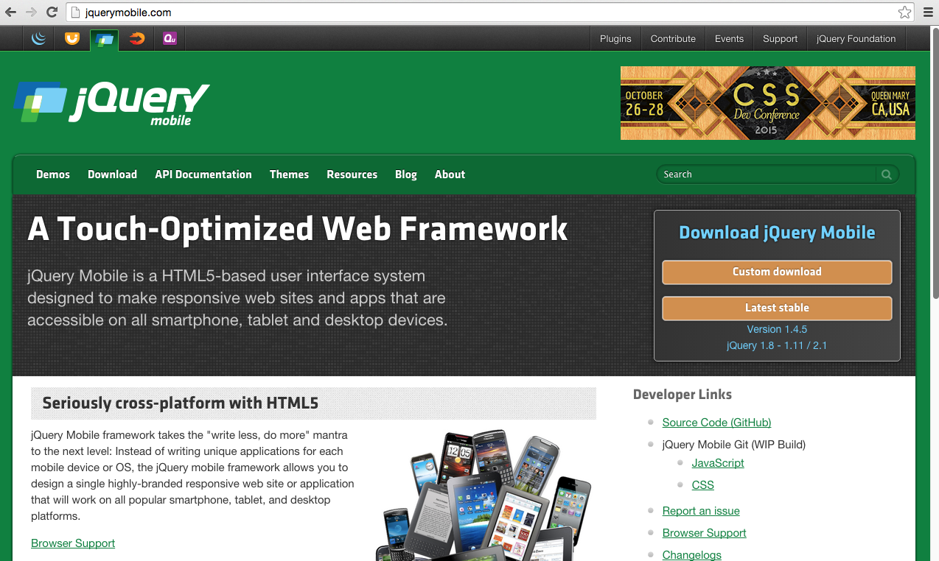
jQuery Mobil: http://jquerymobile.com/

Slide 29
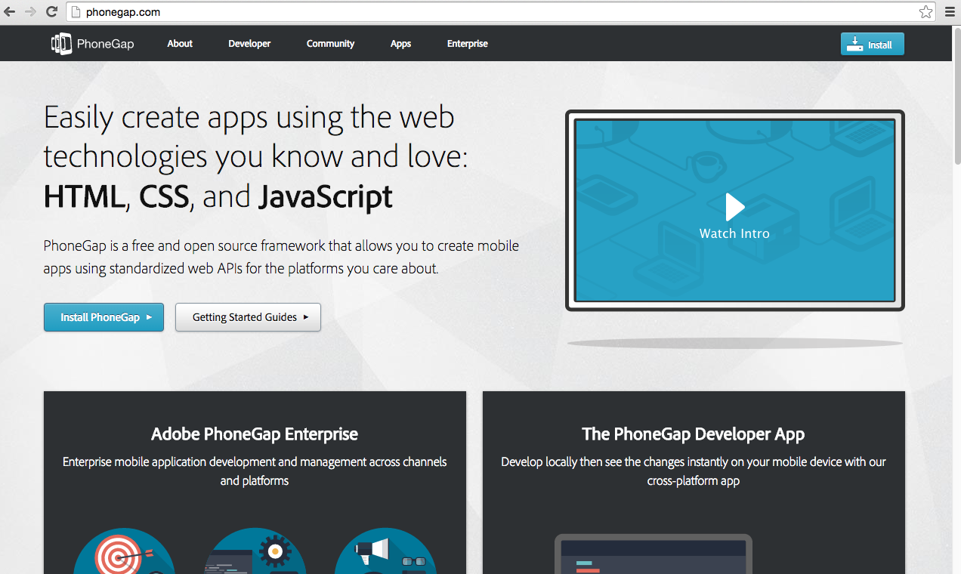
PhoneGap: http://phonegap.com/

Slide 30
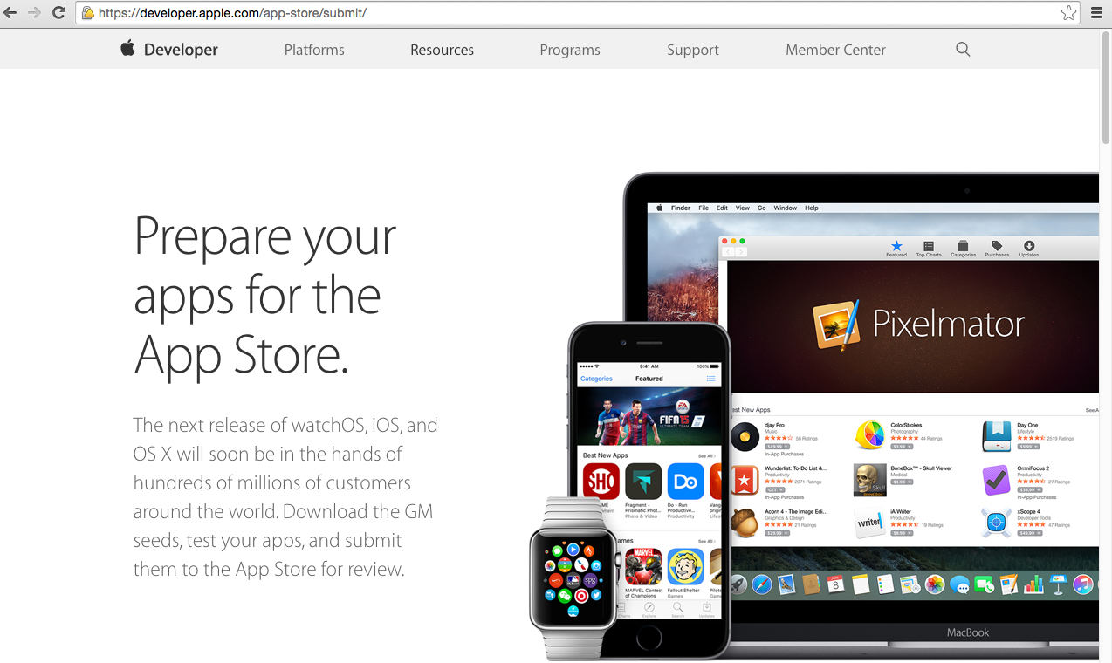
Apple Developer https://developer.apple.com/

Slide 31
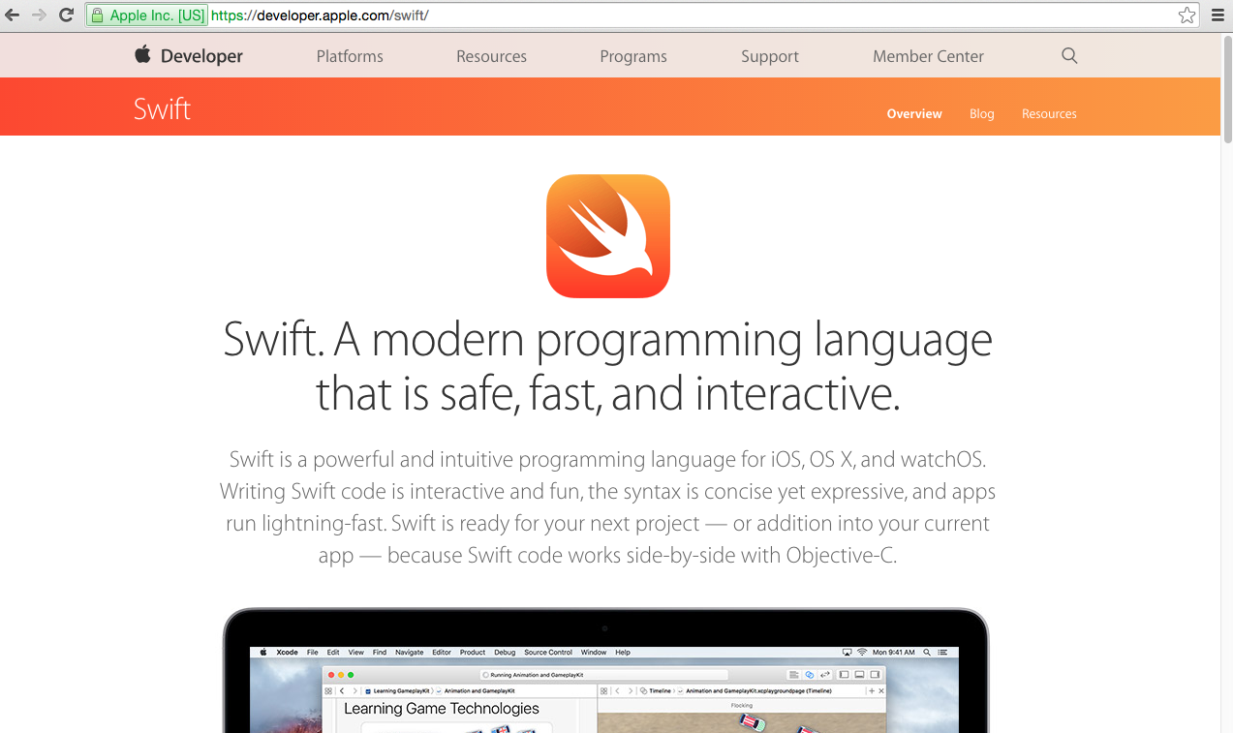
Apple Swift for iOS
Source: https://developer.apple.com/swift/

Slide 32
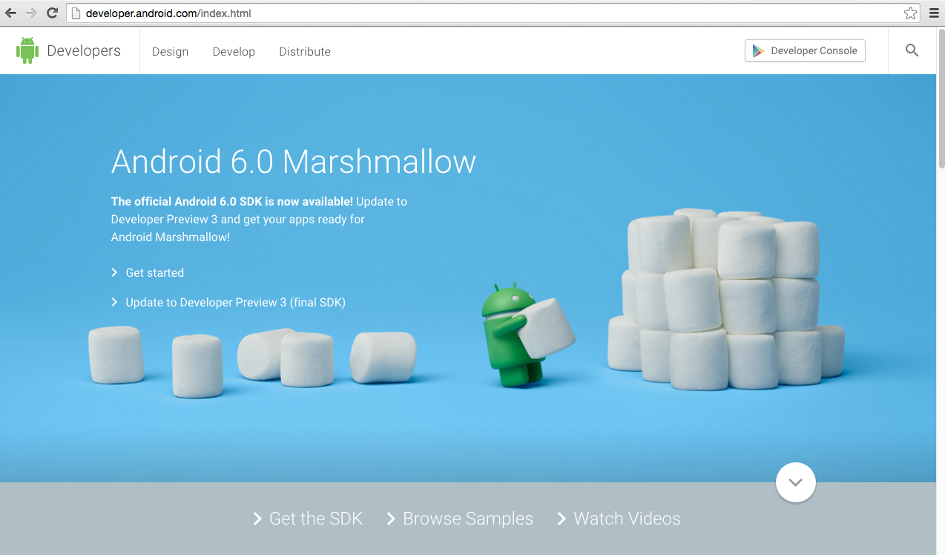
Android Developer http://developer.android.com/

Slide 33
Facebook Developers
https://developers.facebook.com/

Slide 34
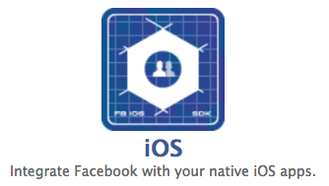
Integrate Facebook with your native iOS apps
https://developers.facebook.com/

Slide 35
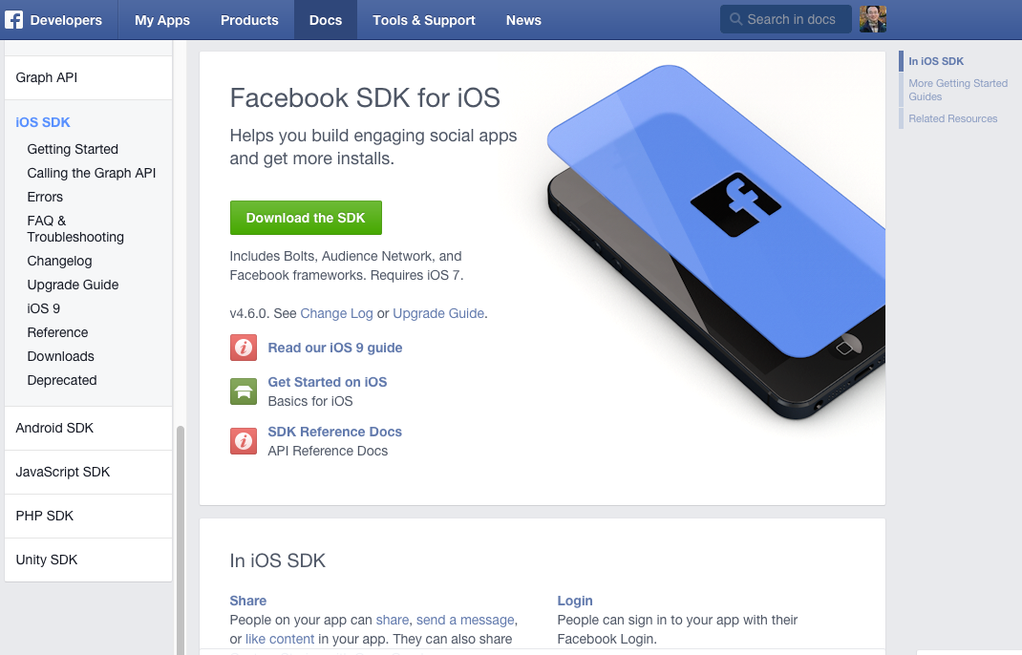
Facebook SDK for iOS
https://developers.facebook.com/docs/ios/

Slide 36
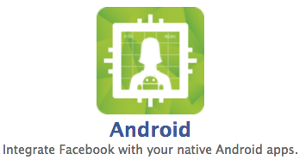
Integrate Facebook with your native Android apps.
https://developers.facebook.com/

Slide 37
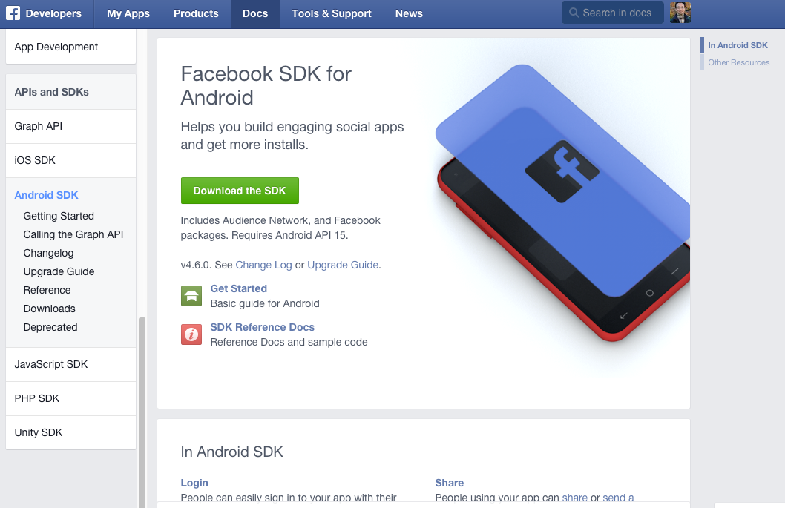
Facebook SDK for Android
Source: https://developers.facebook.com/docs/android

Slide 38
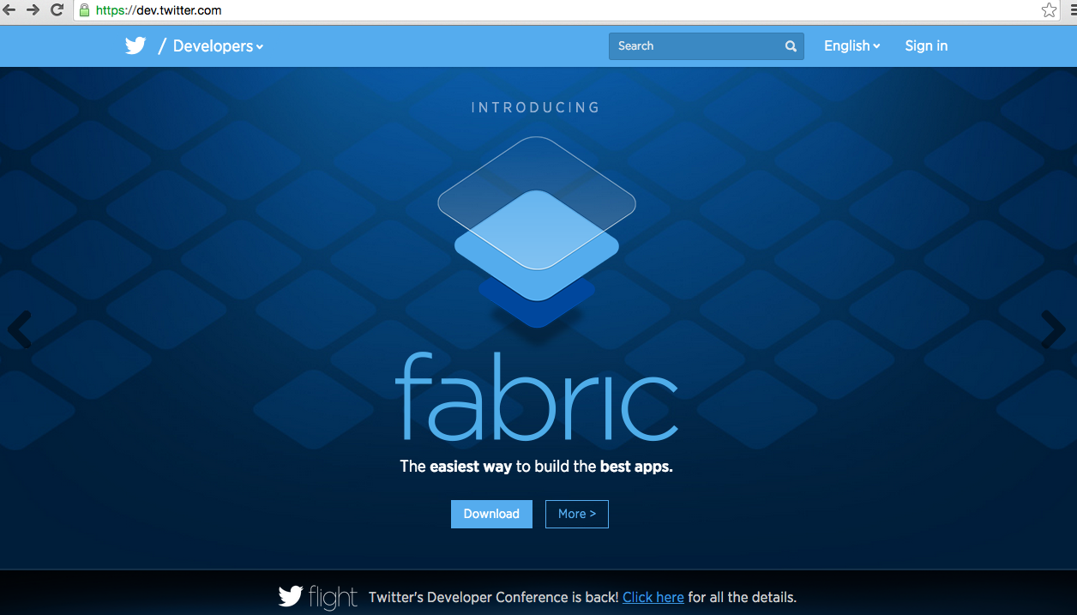
Twitter Developers https://dev.twitter.com/

Slide 39
Google Cloud Platform
https://cloud.google.com/

Slide 40
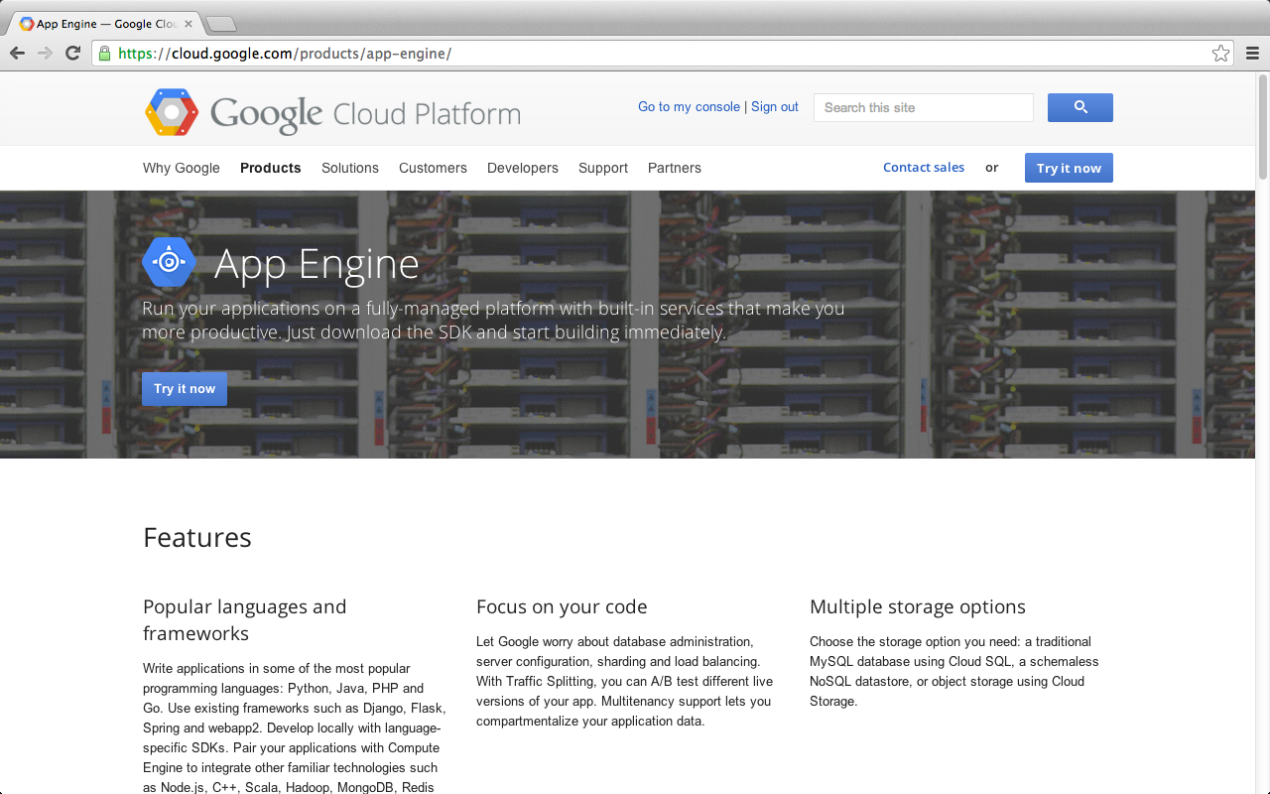
Google App Engine
https://cloud.google.com/products/app-engine/

Slide 41
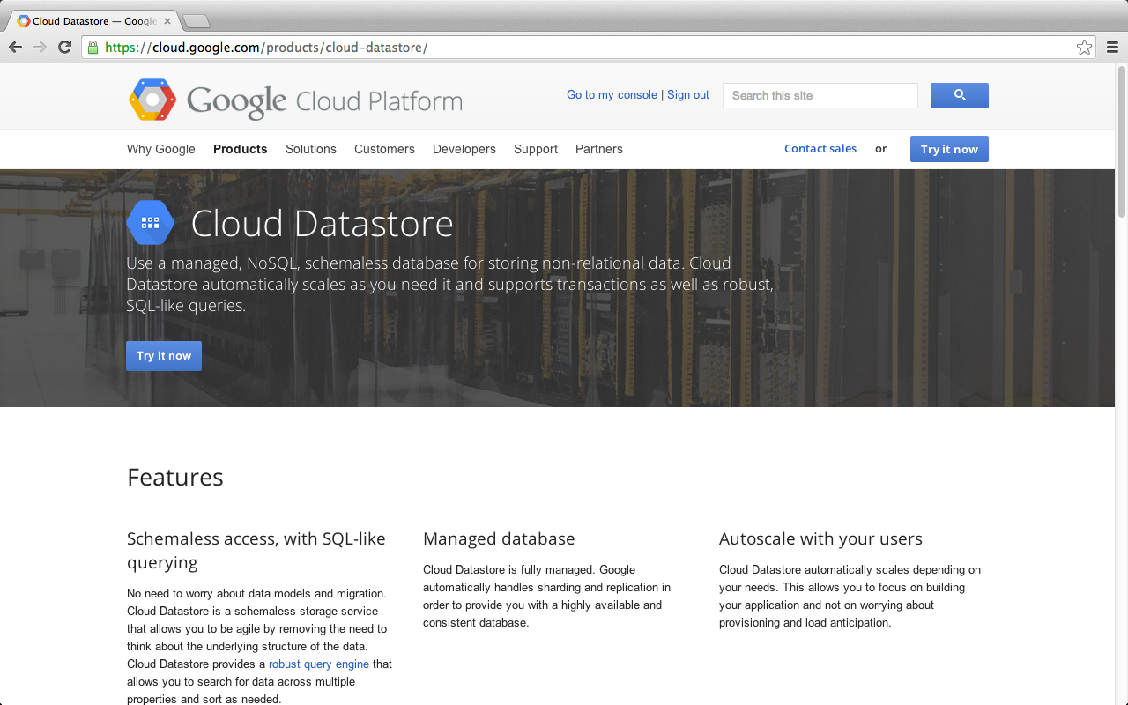
Google Cloud Datastore
https://cloud.google.com/products/cloud-datastore/

Slide 42
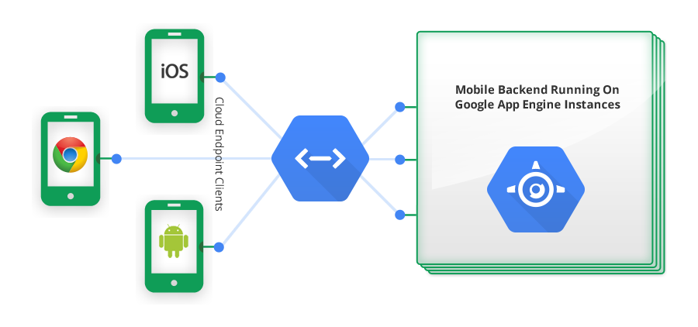
Google Cloud Endpoints
https://developers.google.com/appengine/docs/java/endpoints/

Slide 43
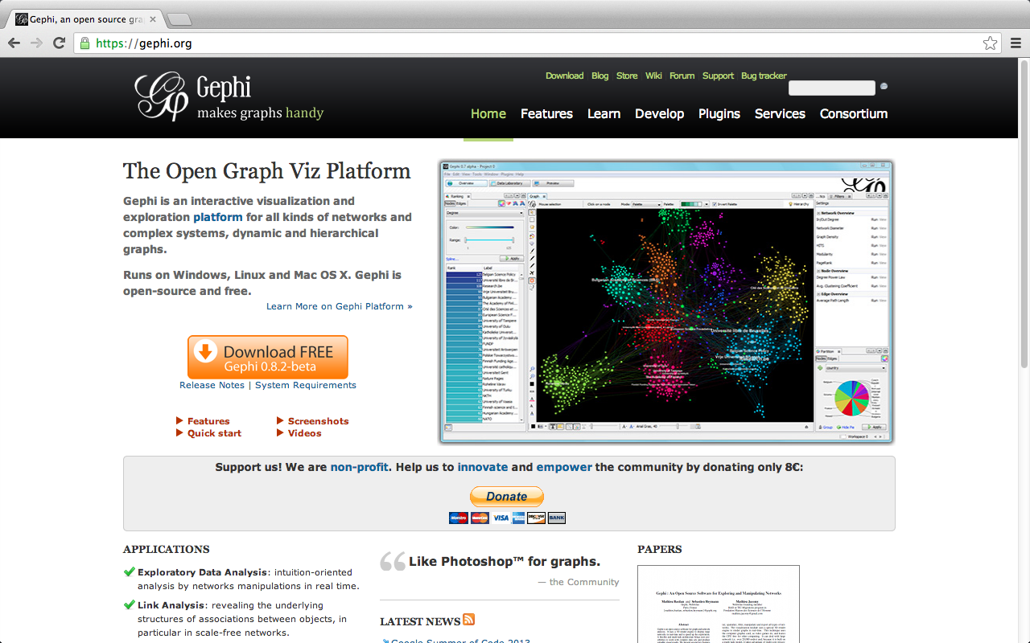
Gephi: Social Network Analysis and Visualization: https://gephi.org/

Slide 44
Summary
This course introduces the fundamental concepts and practices of social media and mobile apps programming.
Topics include
Introduction to Android / iOS apps programming,
Developing Android native apps with Java (Eclipse),
Developing iPhone / iPad apps native apps with Swift (XCode),
Mobile apps using HTML5/CSS3/JavaScript,
jQuery Mobile,
Create hybrid apps with Phonegap,
Google Cloud Platform,
Google app engine, Google map API,
Facebook API,
Twitter API,
Case study on social media apps programming and marketing in Google Play and App Store.

Slide 45
Contact
Tamkang University
Social Media Apps Programming
Min-Yuh Day, Ph.D.
Assistant Professor
Department of Information Management, Tamkang University
Tel: 886-2-26215656 ext. 2846
Fax: 886-2-26209737
Office: B929
Address: No.151, Yingzhuan Rd., Danshui Dist., New Taipei City 25137, Taiwan (R.O.C.)
Email: myday@mail.tku.edu.tw
Web: http://mail.tku.edu.tw/myday/

