Slide 1


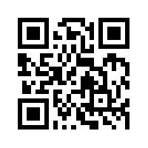
Social Media Apps Programming
Tamkang
University
Facebook API
(Facebook JavaScript SDK)
(Integrate Facebook with iOS/Android Apps)
1031SMAP12
TLMXM1A (8687) (M2143) (Fall 2014)
(MIS MBA) (2 Credits, Elective) [Full English Course]
Thu 8,9 (15:10-17:00) V201
Min-Yuh Day, Ph.D.
Assistant Professor
Department of Information Management
Tamkang University
http://mail.tku.edu.tw/myday
2014-12-24

Slide 2
Course Schedule (1/3)
Week Date Subject/Topics
1 2014/09/17 Course Orientation and Introduction to
Social Media and Mobile Apps Programming
2 2014/09/24 Introduction to Android / iOS Apps
Programming
3 2014/10/01 Developing Android Native Apps with
Java (Eclipse) (MIT App Inventor)
4 2014/10/08 Developing iPhone / iPad Native Apps with
Swift / Objective-C (XCode)
5 2014/10/15 Mobile Apps Using HTML5/CSS3/JavaScript
6 2014/10/22 jQuery Mobile

Slide 3
Course Schedule (2/3)
Week Date Subject/Topics
7 2014/10/29 Create Hybrid Apps with Phonegap
8 2014/11/05 jQuery Mobile/Phonegap
9 2014/11/12 jQuery Mobile/Phonegap
10 2014/11/19 Midterm Exam Week
(Midterm Project Report)
11 2014/11/26 Case Study on Social Media Apps
Programming and Marketing in
Google Play and App Store
12 2014/12/03 Google Cloud Platform

Slide 4
Course Schedule (3/3)
Week Date Subject/Topics
13 2014/12/10 Invited Talk: Social, Data and Business Model
- Let’s see PIXNET
[Invited Speaker: Dr. Rick Cheng-Yu Lu,
Technical Director, PIXNET]
14 2014/12/17 Google App Engine and Google Maps API
15 2014/12/24 Facebook API (Facebook JavaScript SDK)
(Integrate Facebook with iOS/Android Apps)
16 2014/01/31 Twitter API
17 2015/01/07 Final Project Presentation
18 2015/01/14 Final Exam Week (Final Project Report)

Slide 5
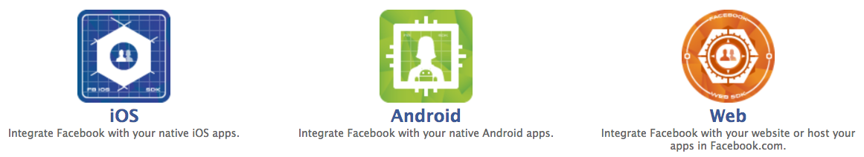
Outline
Facebook API
  Facebook JavaScript SDK
  Integrate Facebook with iOS/Android Apps
  Facebook Login
  Facebook Open Graph API
  Facebook Graph API

Slide 6
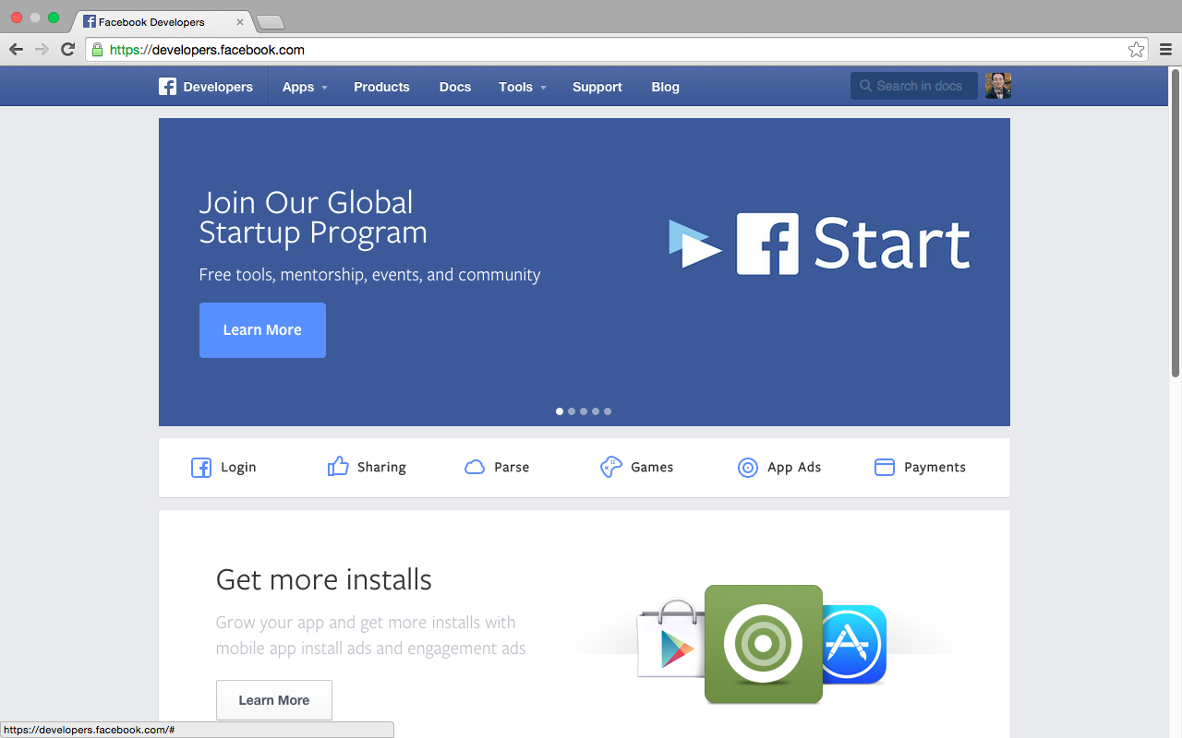
Facebook Developers
https://developers.facebook.com/

Slide 7
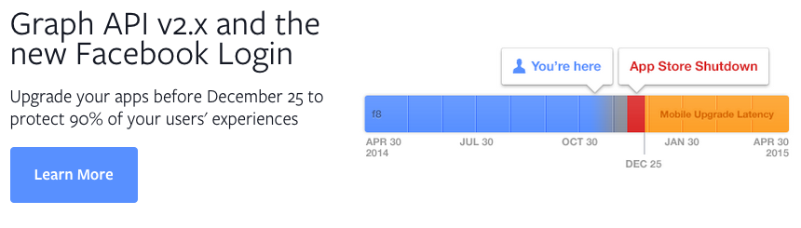
Facebook Graph API v2.x and the new Facebook Login
https://developers.facebook.com/

Slide 8
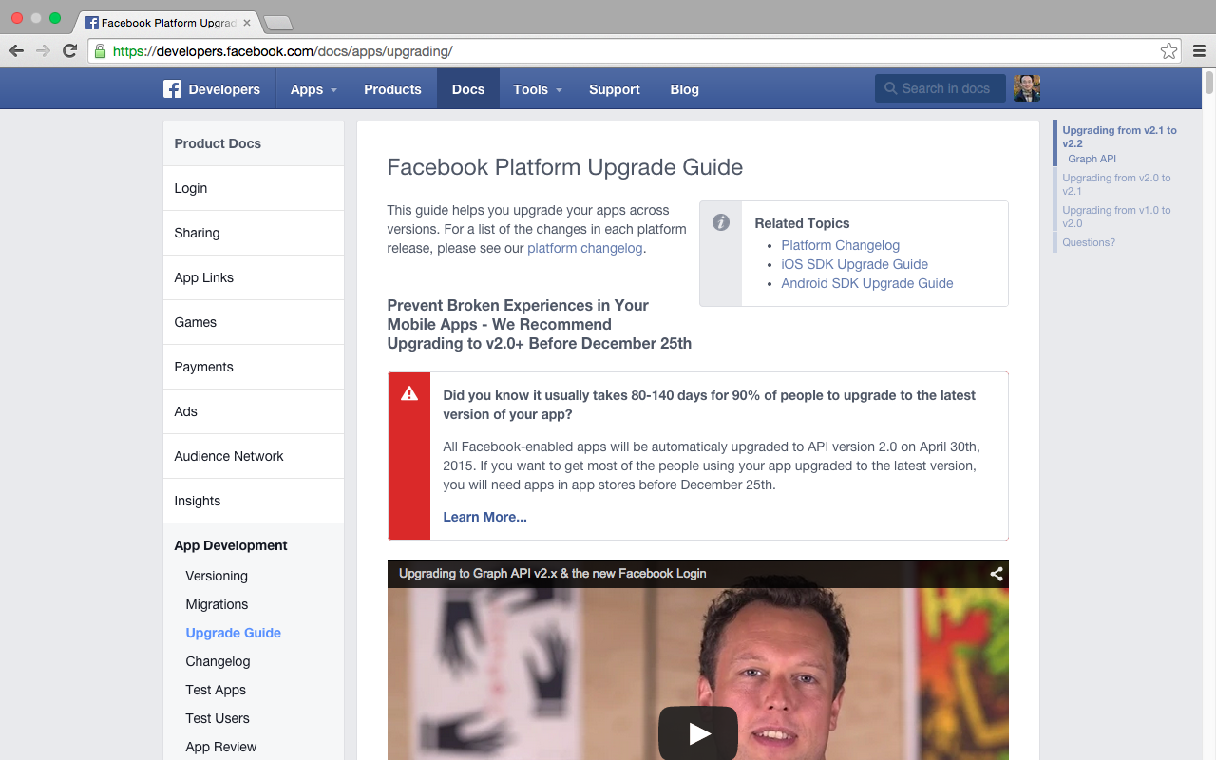
Facebook Platform Upgrade (v2.x)
https://developers.facebook.com/docs/apps/upgrading/

Slide 9
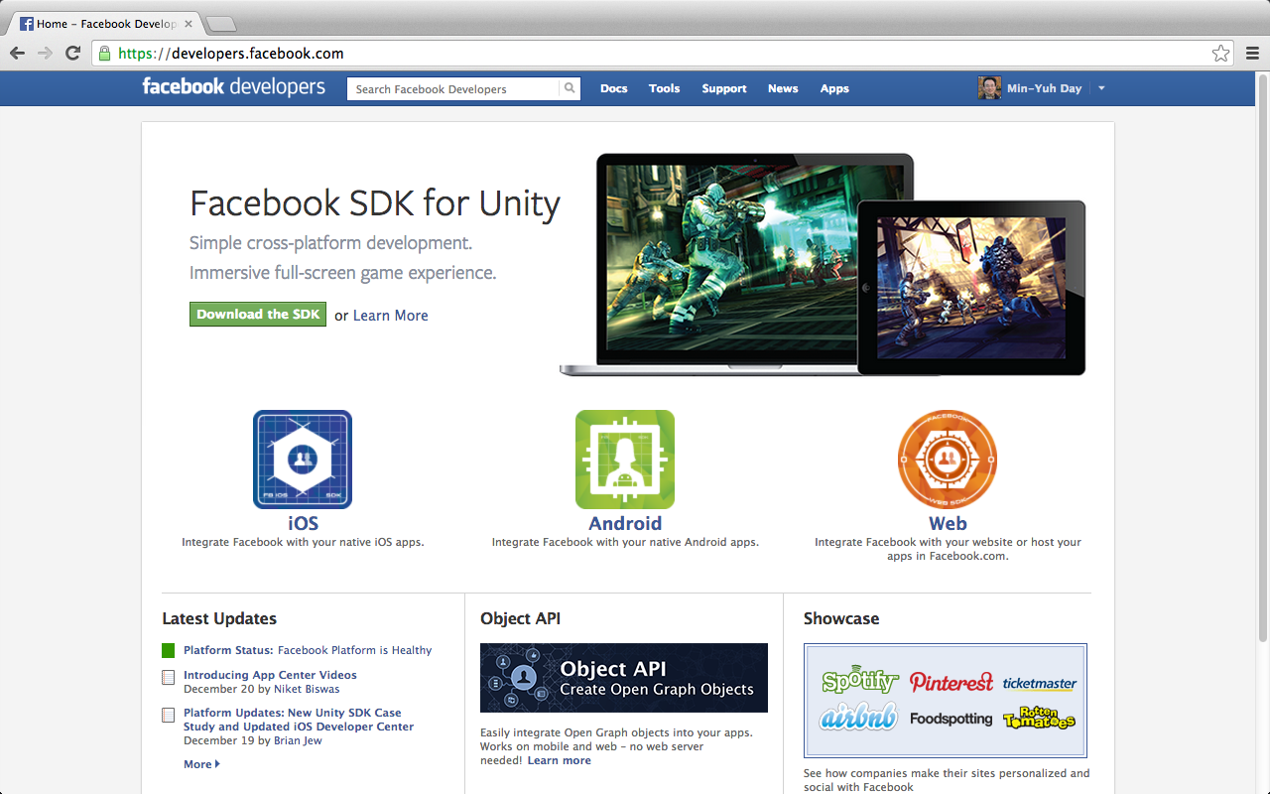
Facebook Developers
https://developers.facebook.com/

Slide 10
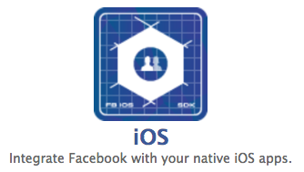
Integrate Facebook with your native iOS apps
https://developers.facebook.com/

Slide 11
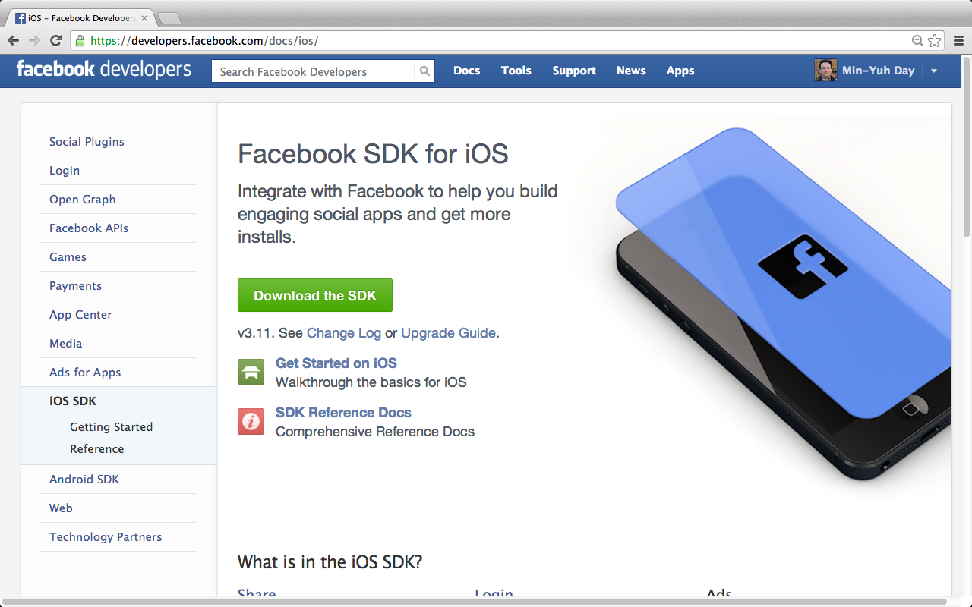
Facebook SDK for iOS
https://developers.facebook.com/docs/ios/

Slide 12
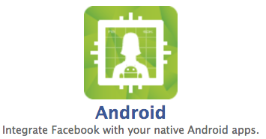
Integrate Facebook with your native Android apps.
https://developers.facebook.com/

Slide 13
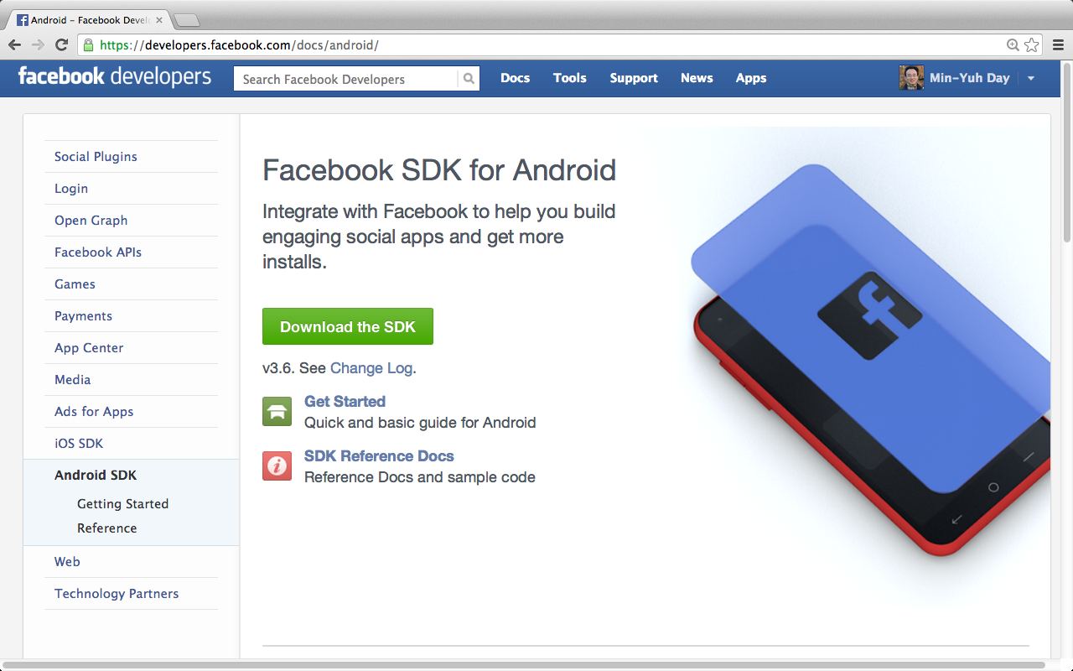
Facebook SDK for Android

Slide 14
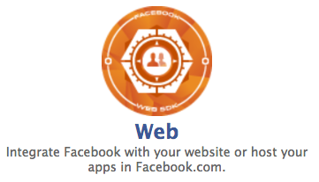
Integrate Facebook with your Web Apps

Slide 15
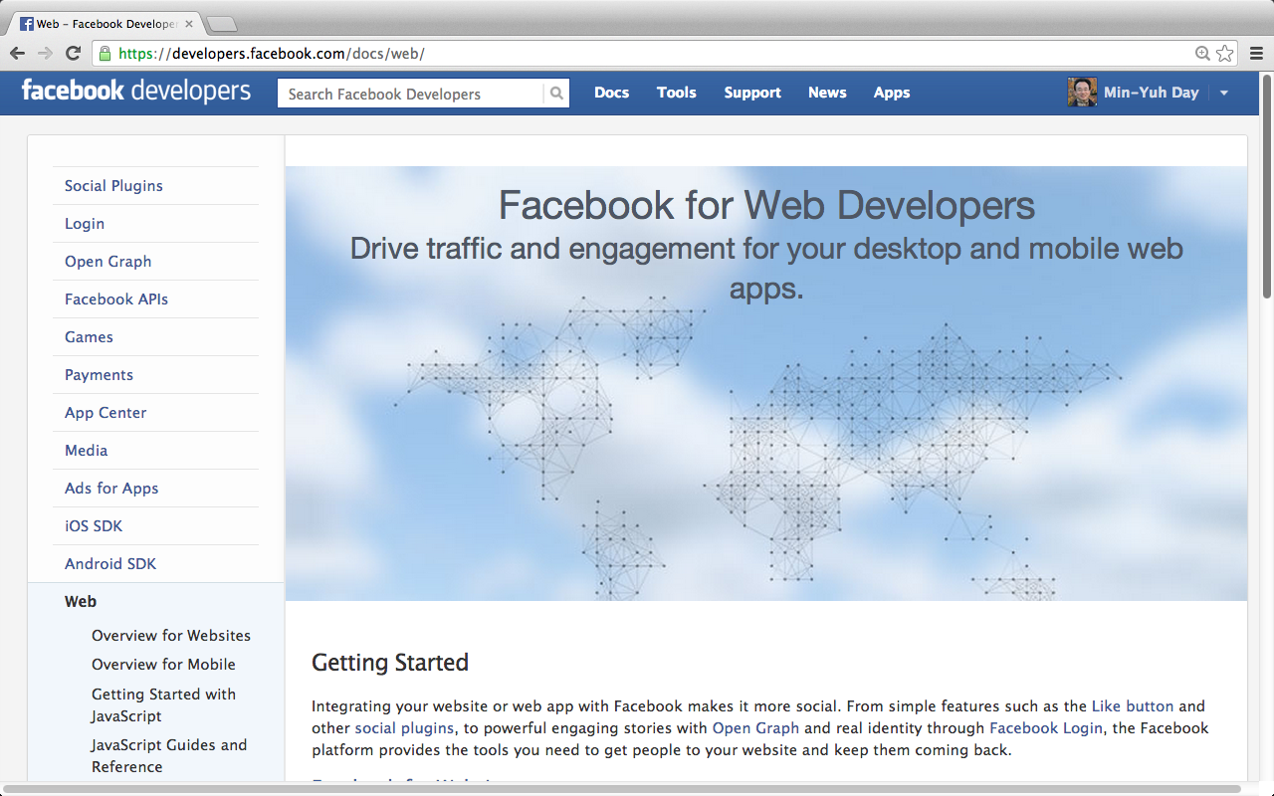
Facebook for Web Developers
https://developers.facebook.com/docs/web/

Slide 16
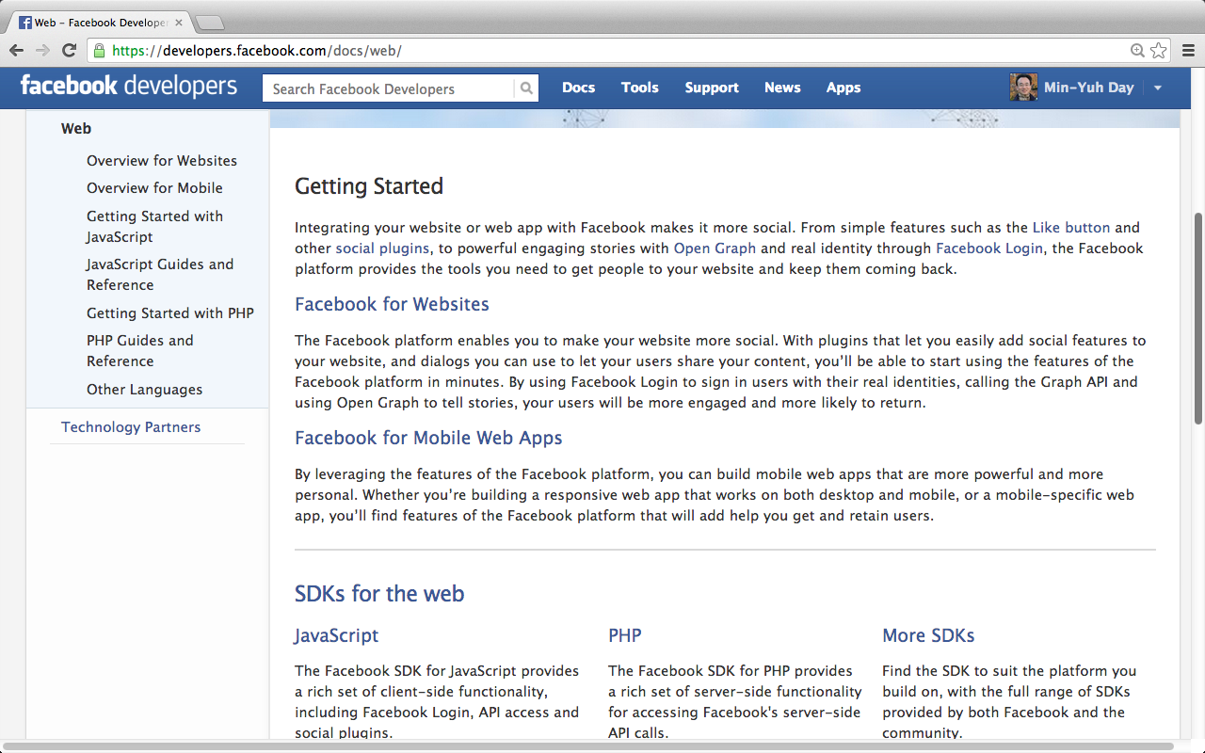
Facebook for Web Developers
https://developers.facebook.com/docs/web/

Slide 17
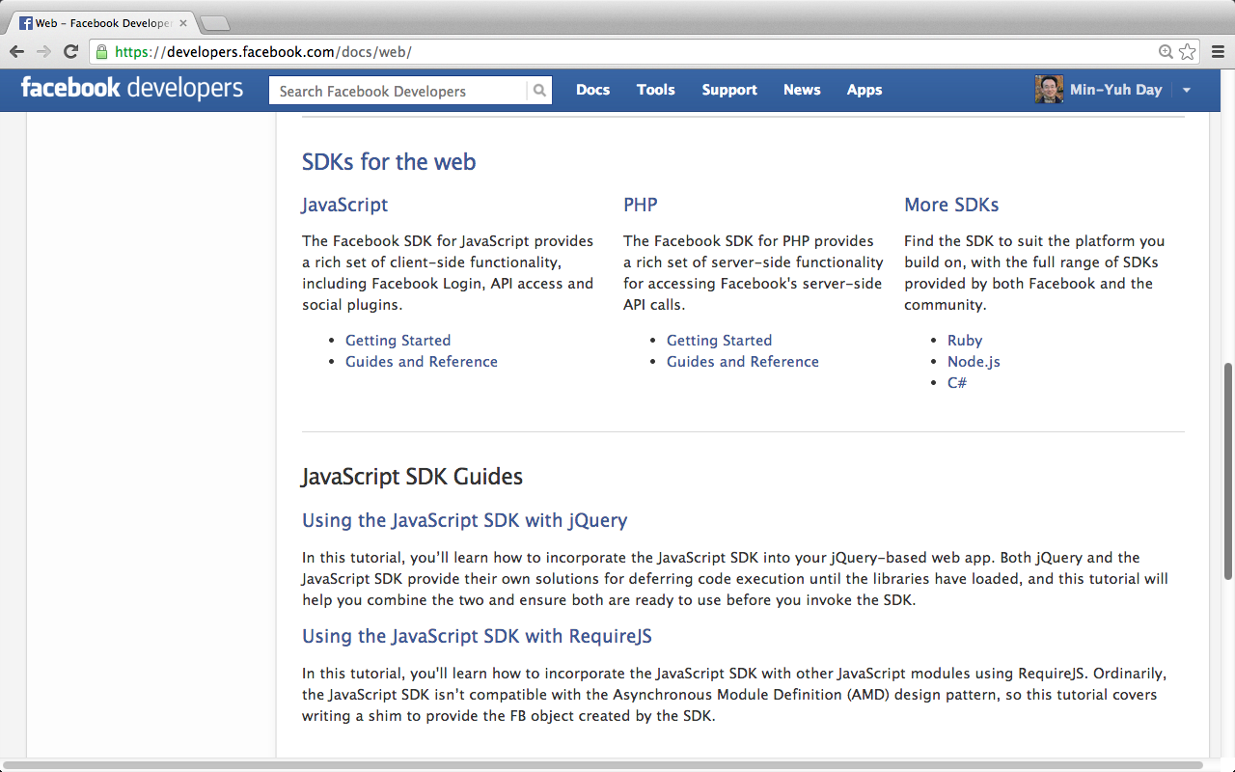
Facebook for Web Developers
https://developers.facebook.com/docs/web/

Slide 18
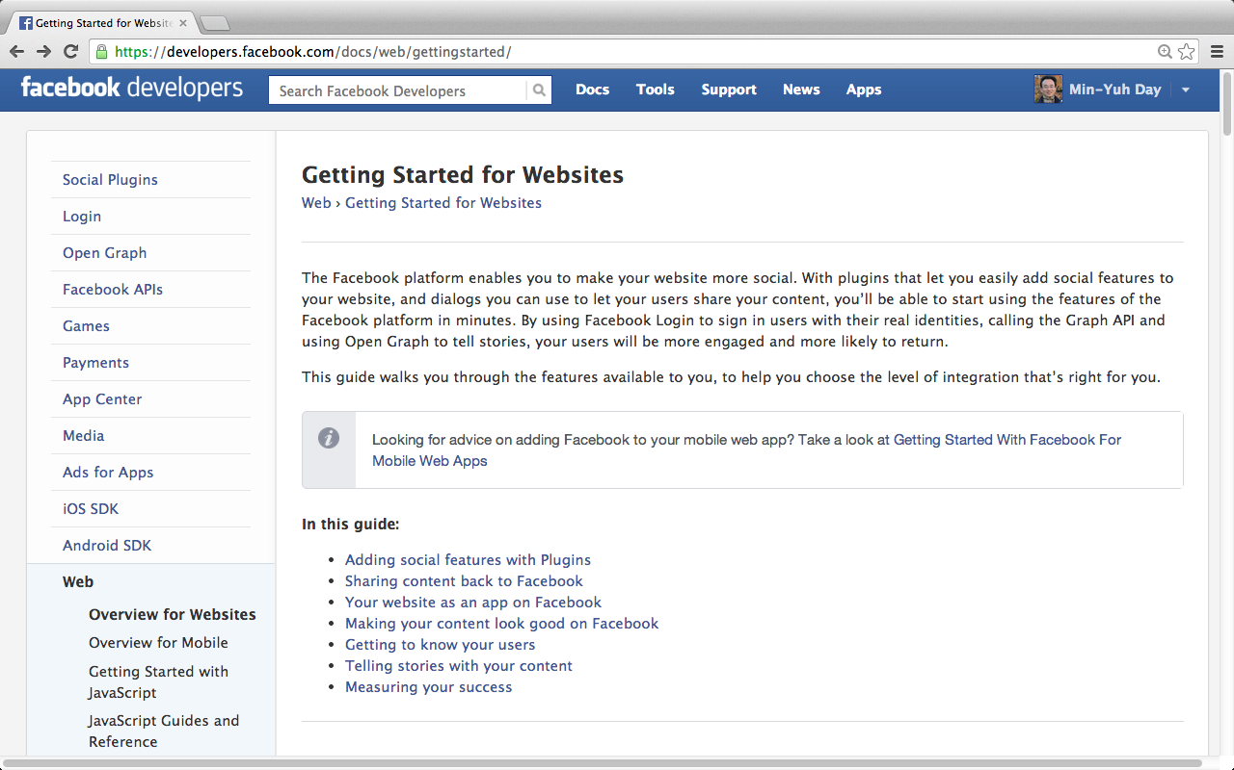
Facebook for Web Developers
https://developers.facebook.com/docs/web/gettingstarted/

Slide 19

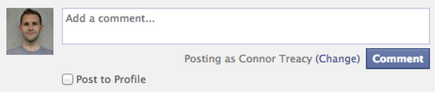
Adding social features with Plugins
Like Button
Comments Box
https://developers.facebook.com/docs/web/gettingstarted/

Slide 20
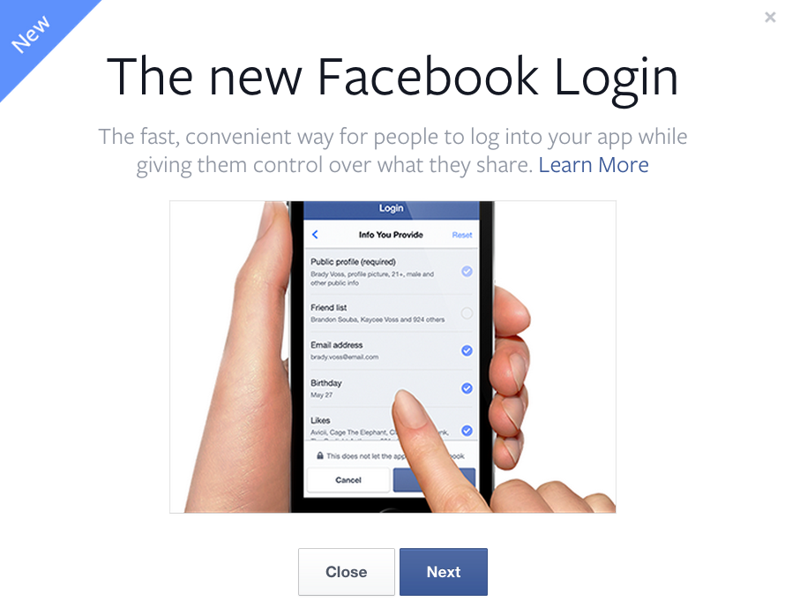
The new Facebook Login
https://developers.facebook.com/docs/facebook-login/v2.2

Slide 21
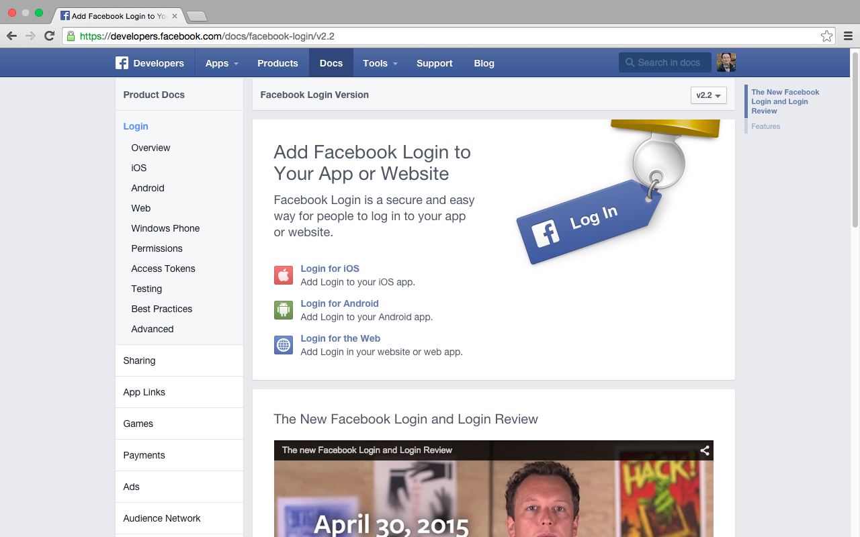
The new Facebook Login (April 30, 2015)
https://developers.facebook.com/docs/facebook-login/v2.2

Slide 22
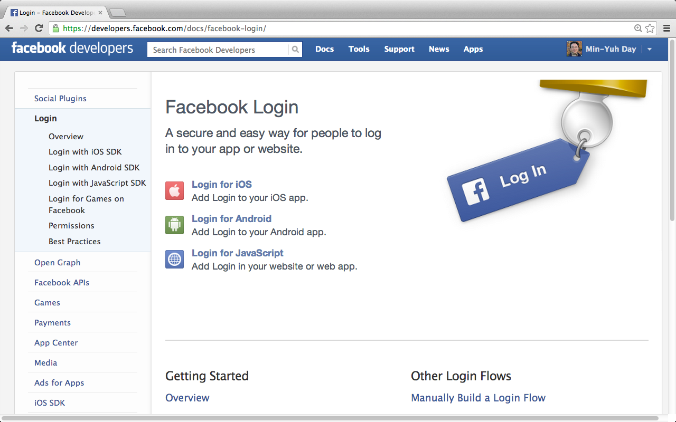
Facebook Login
https://developers.facebook.com/docs/facebook-login/

Slide 23
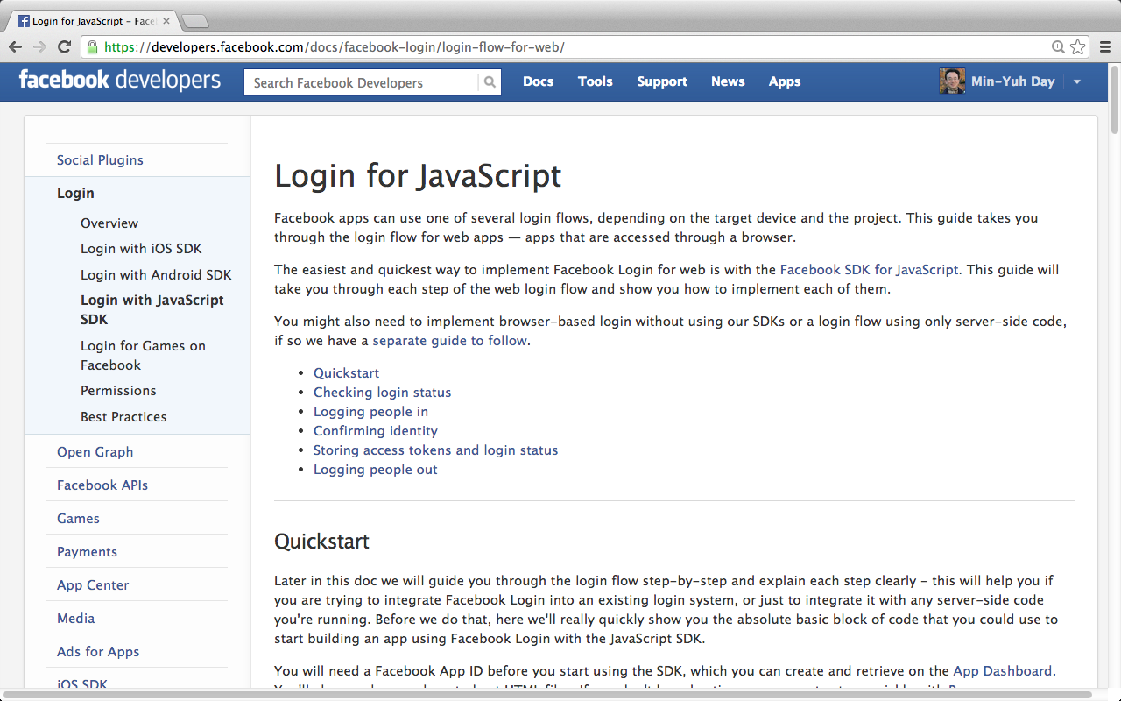
Facebook Login for JavaScript
https://developers.facebook.com/docs/facebook-login/login-flow-for-web/

Slide 24
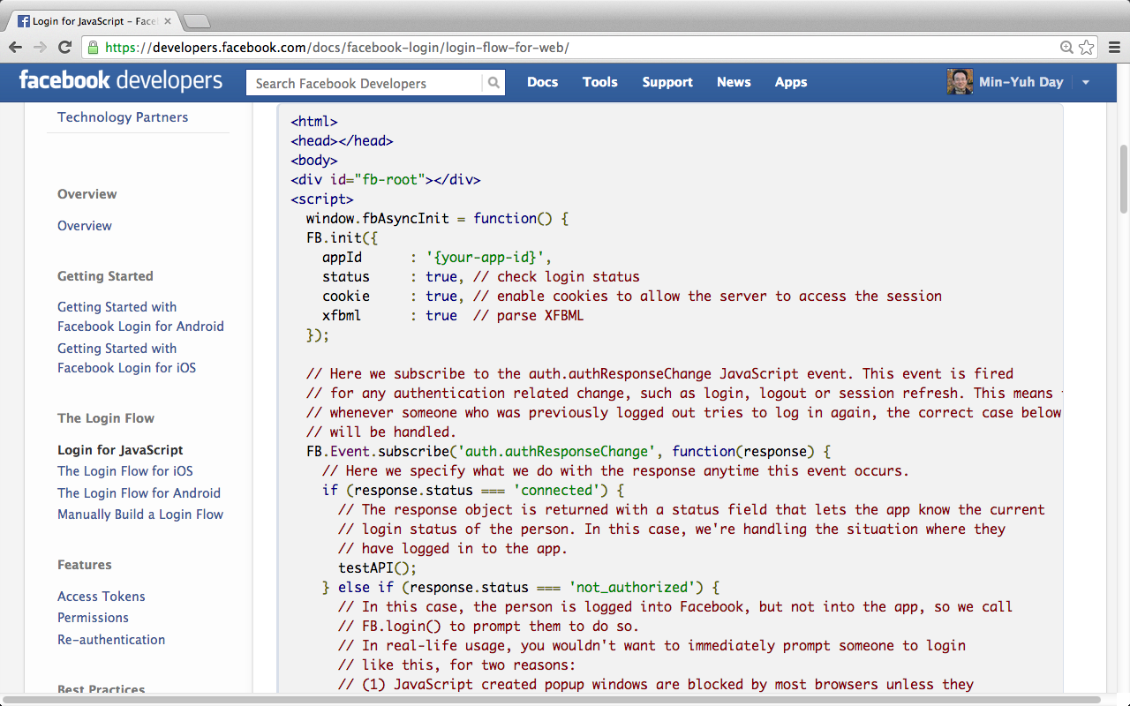
Facebook Login for JavaScript
https://developers.facebook.com/docs/facebook-login/login-flow-for-web/

Slide 25

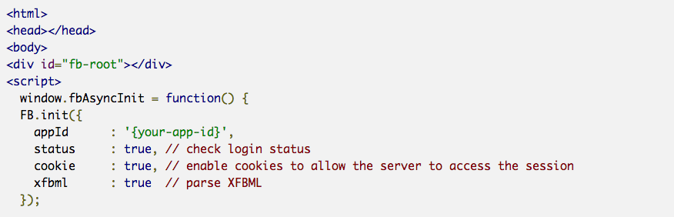
Facebook Login for JavaScript
1/3
https://developers.facebook.com/docs/facebook-login/login-flow-for-web/

Slide 26
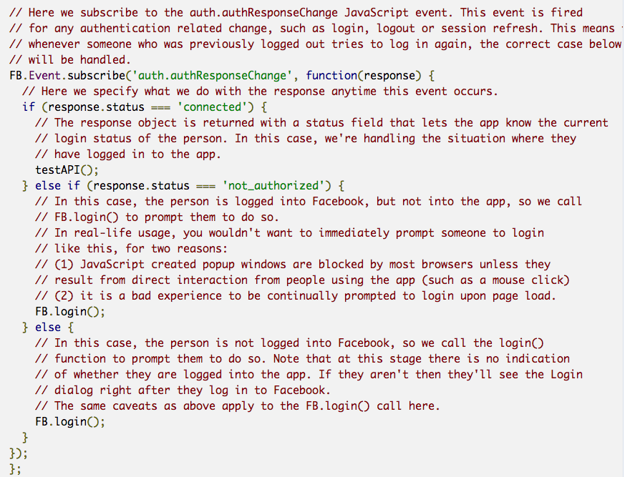
Facebook Login for JavaScript
2/3
https://developers.facebook.com/docs/facebook-login/login-flow-for-web/

Slide 27
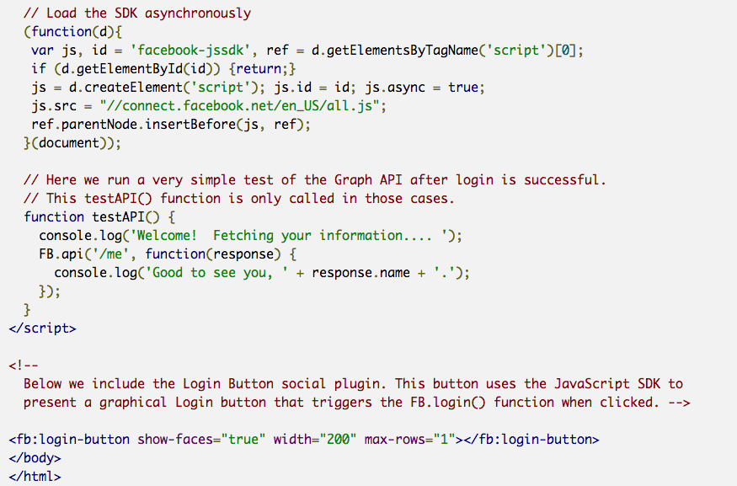
Facebook Login for JavaScript
3/3
https://developers.facebook.com/docs/facebook-login/login-flow-for-web/

Slide 28
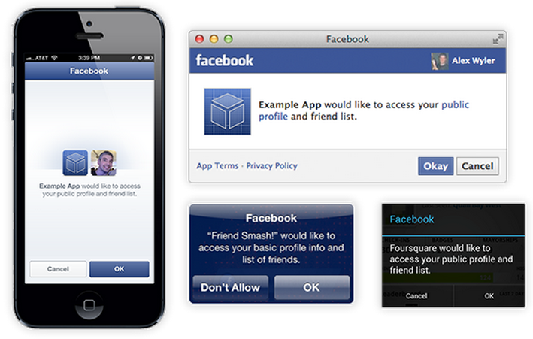
Facebook Login for JavaScript
https://developers.facebook.com/docs/facebook-login/login-flow-for-web/

Slide 29
Demo:
Facebook Apps
Create New App

Slide 30
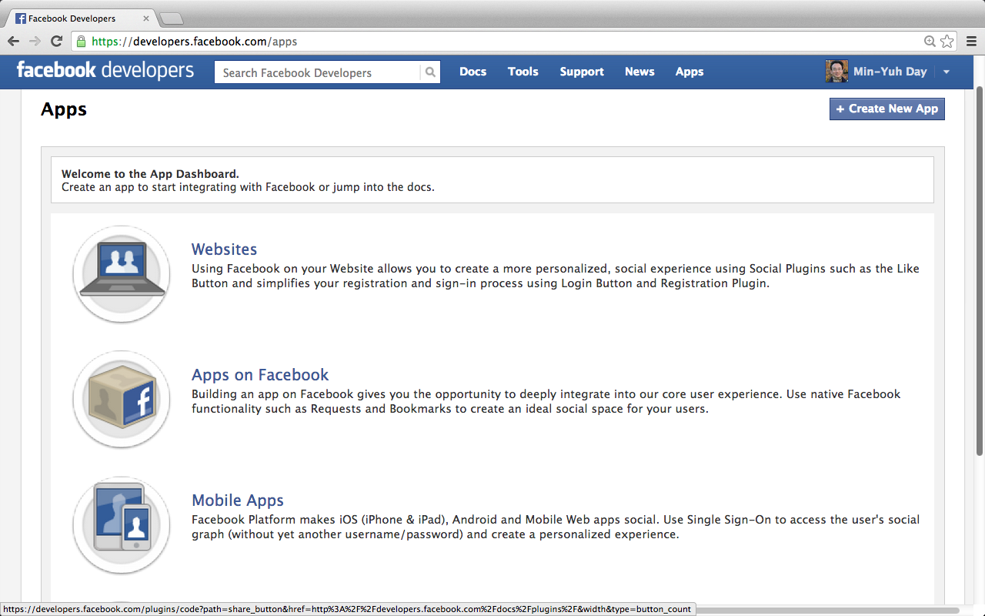
Facebook Apps: Create New App
Apps
https://developers.facebook.com/apps

Slide 31
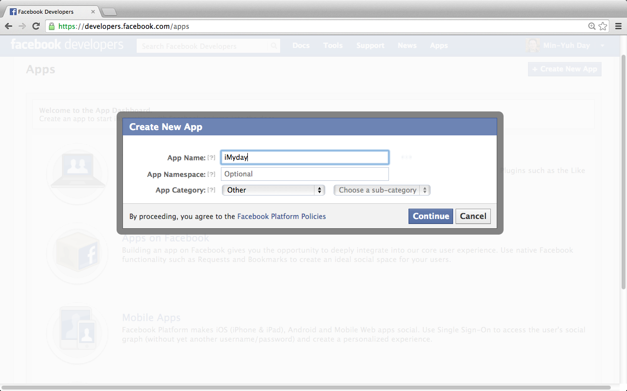
Facebook Apps: Create New App
https://developers.facebook.com/apps

Slide 32
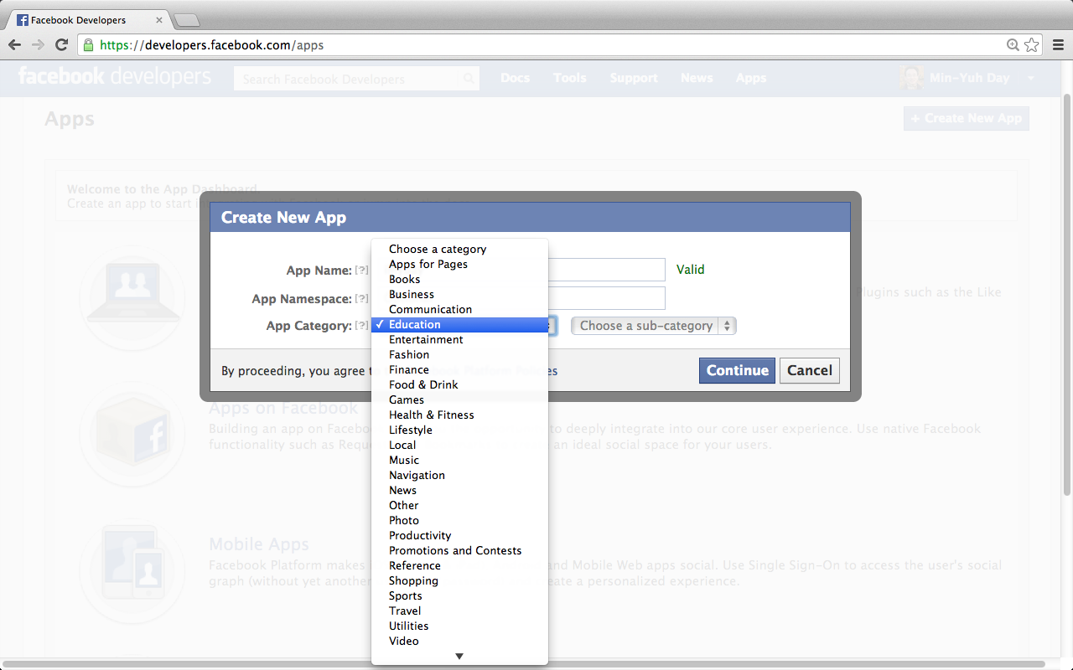
Facebook Apps: Create New App
https://developers.facebook.com/apps

Slide 33
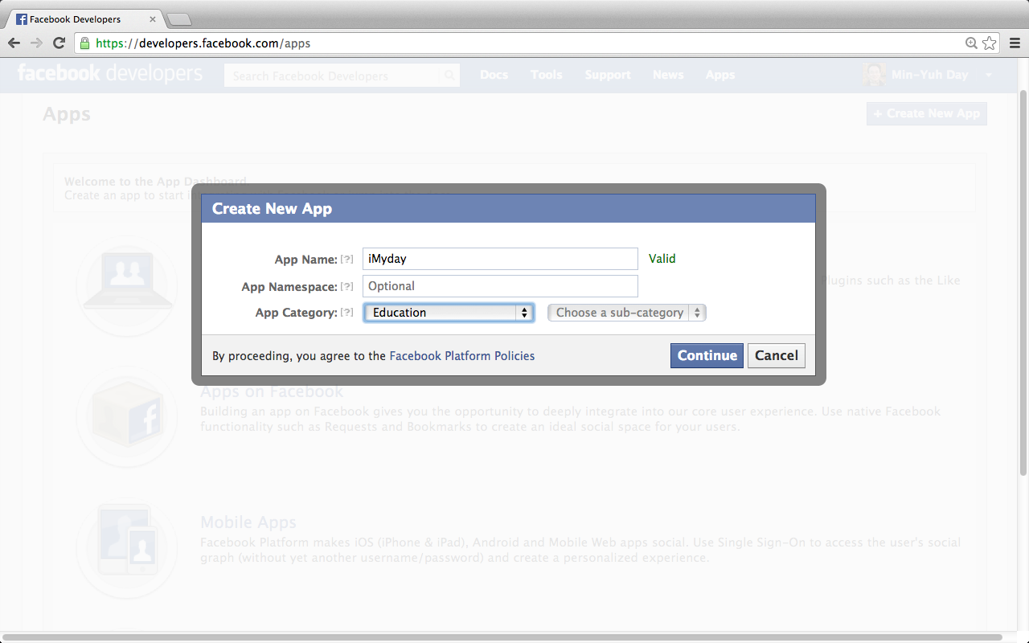
Facebook Apps: Create New App
https://developers.facebook.com/apps

Slide 34
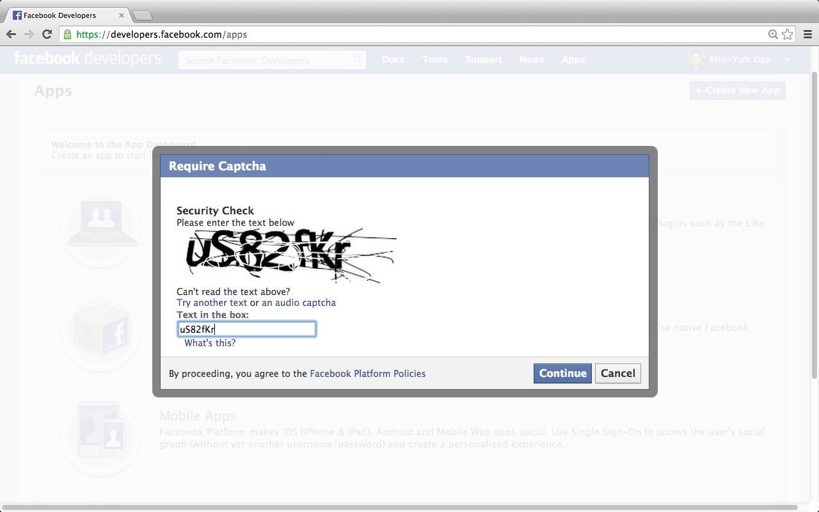
Facebook Apps: Create New App
https://developers.facebook.com/apps

Slide 35
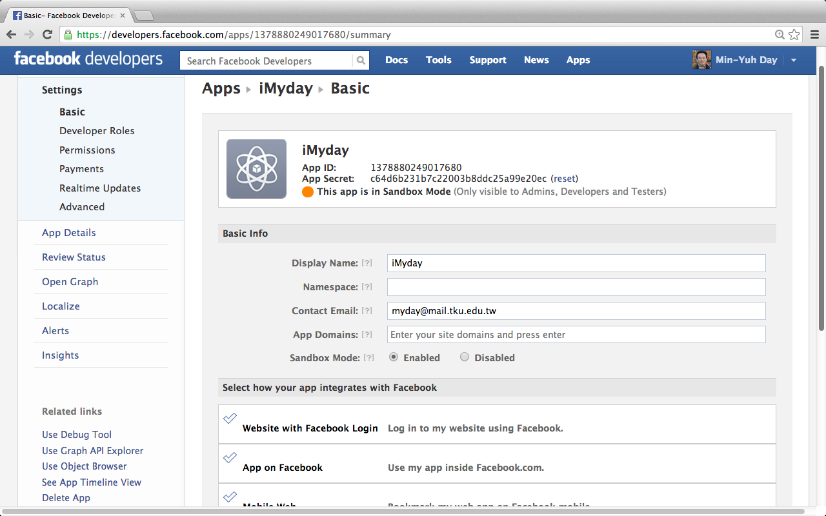
Facebook Apps: Create New App
iMyday
App ID: 1378880249017680
App Secret: c64d6b231b7c22003b8ddc25a99e20ec(reset)

Slide 36
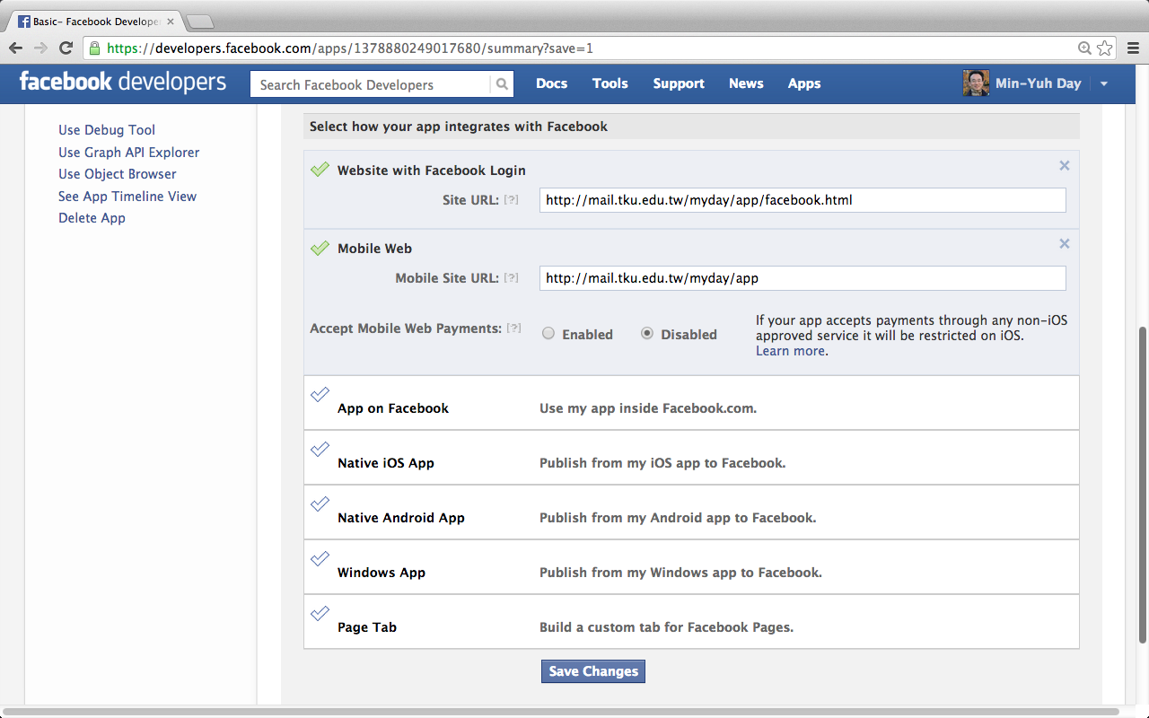
Facebook Apps: Create New App
https://developers.facebook.com/apps

Slide 37
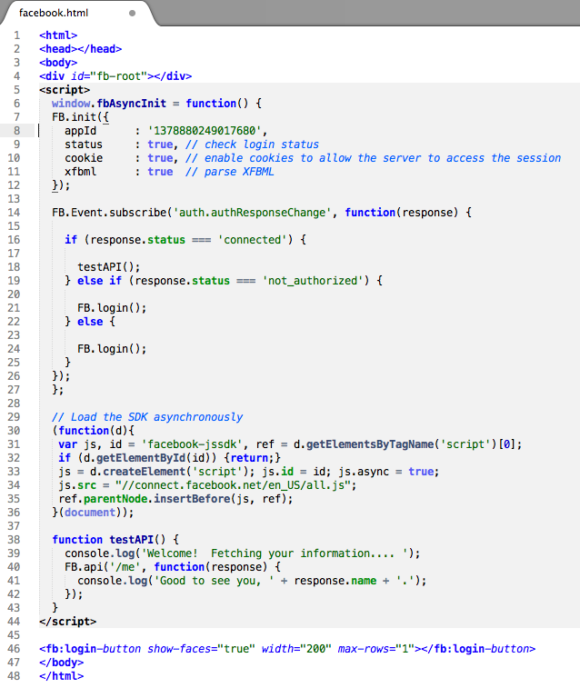
Facebook.html Facebook Login
appID
http://mail.tku.edu.tw/myday/app/facebook.html

Slide 38
Facebook Login appID
<script>
window.fbAsyncInit = function() {
FB.init({
appId : '1378880249017680',
status : true, // check login status
cookie : true, // enable cookies to allow the server to access the session
xfbml : true // parse XFBML
});
http://mail.tku.edu.tw/myday/app/facebook.html

Slide 39
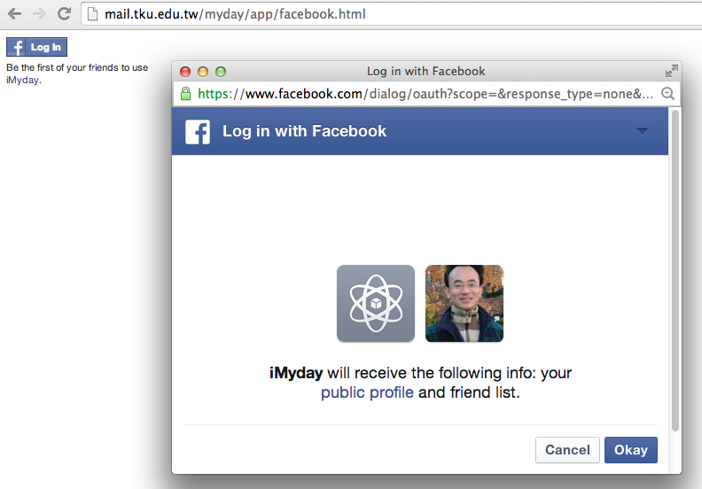
Facebook Login
http://mail.tku.edu.tw/myday/app/facebook.html

Slide 40
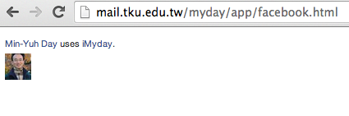
Facebook Login
http://mail.tku.edu.tw/myday/app/facebook.html

Slide 41
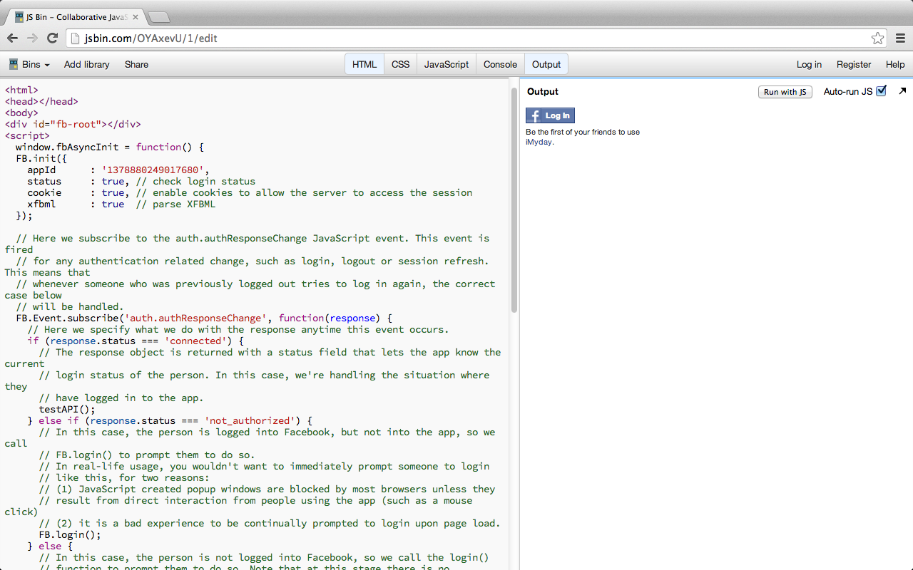
Test Facebook Login on jsbin.com

Slide 42
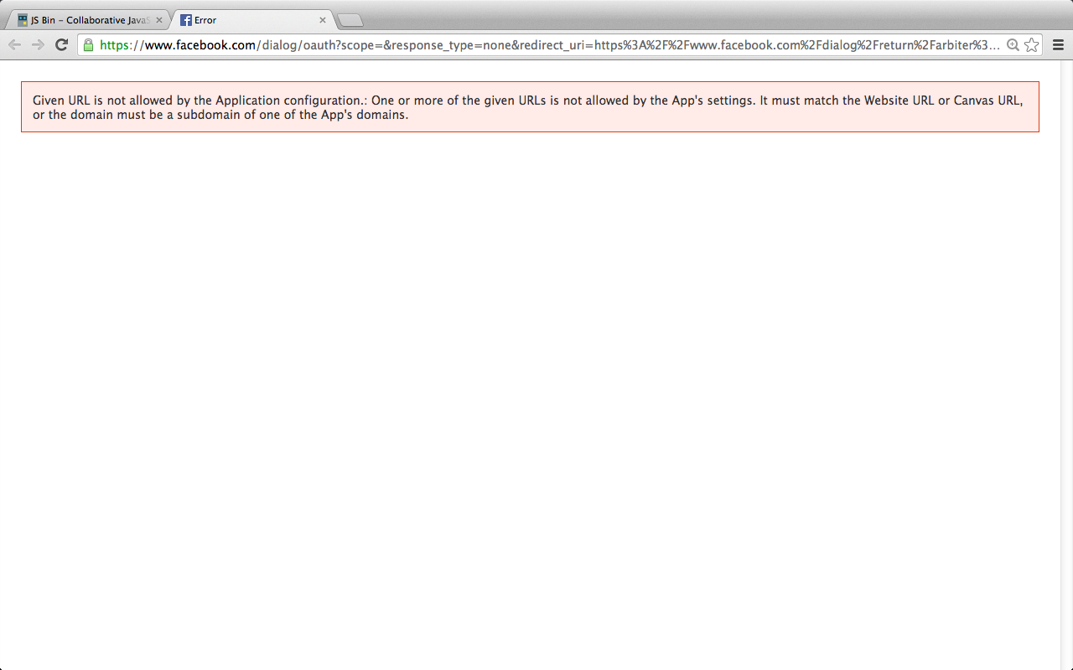

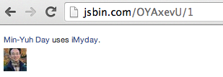
Test Facbook Login on jsbin.com
Select how your app integrates with Facebook
http://jsbin.com/OYAxevU/1

Slide 43
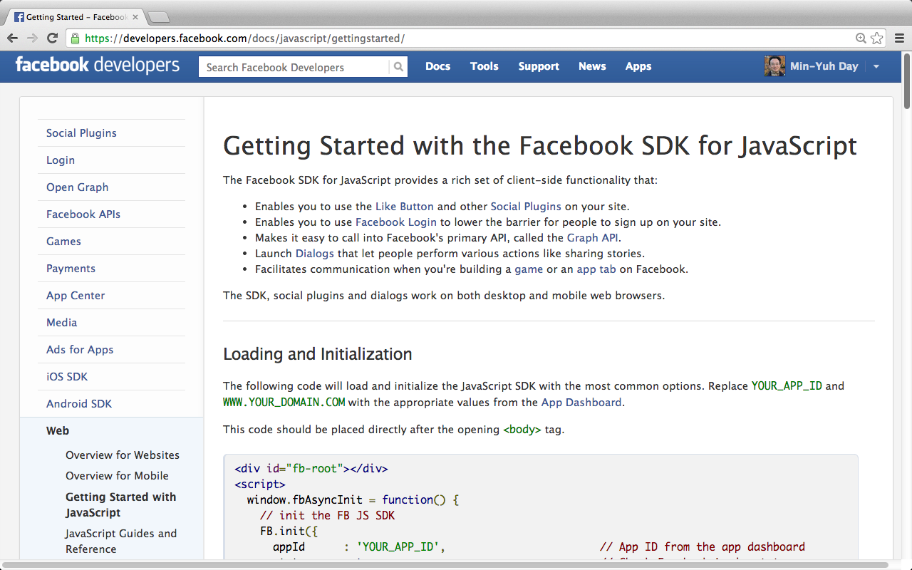
Facebook SDK for JavaScript
https://developers.facebook.com/docs/javascript/gettingstarted/

Slide 44
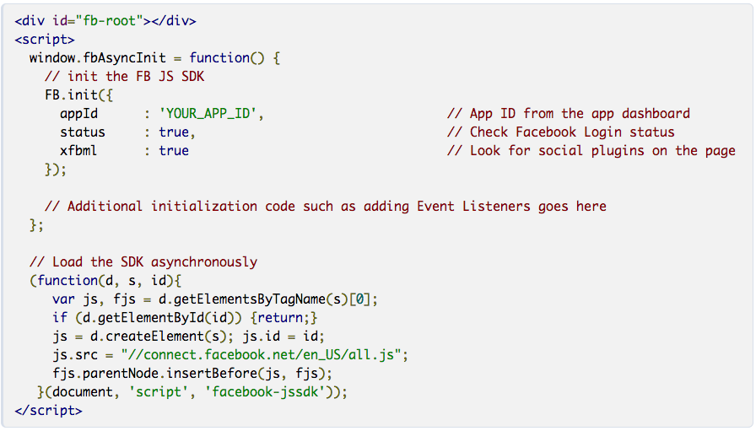
Facebook SDK for JavaScript
https://developers.facebook.com/docs/javascript/gettingstarted/

Slide 45
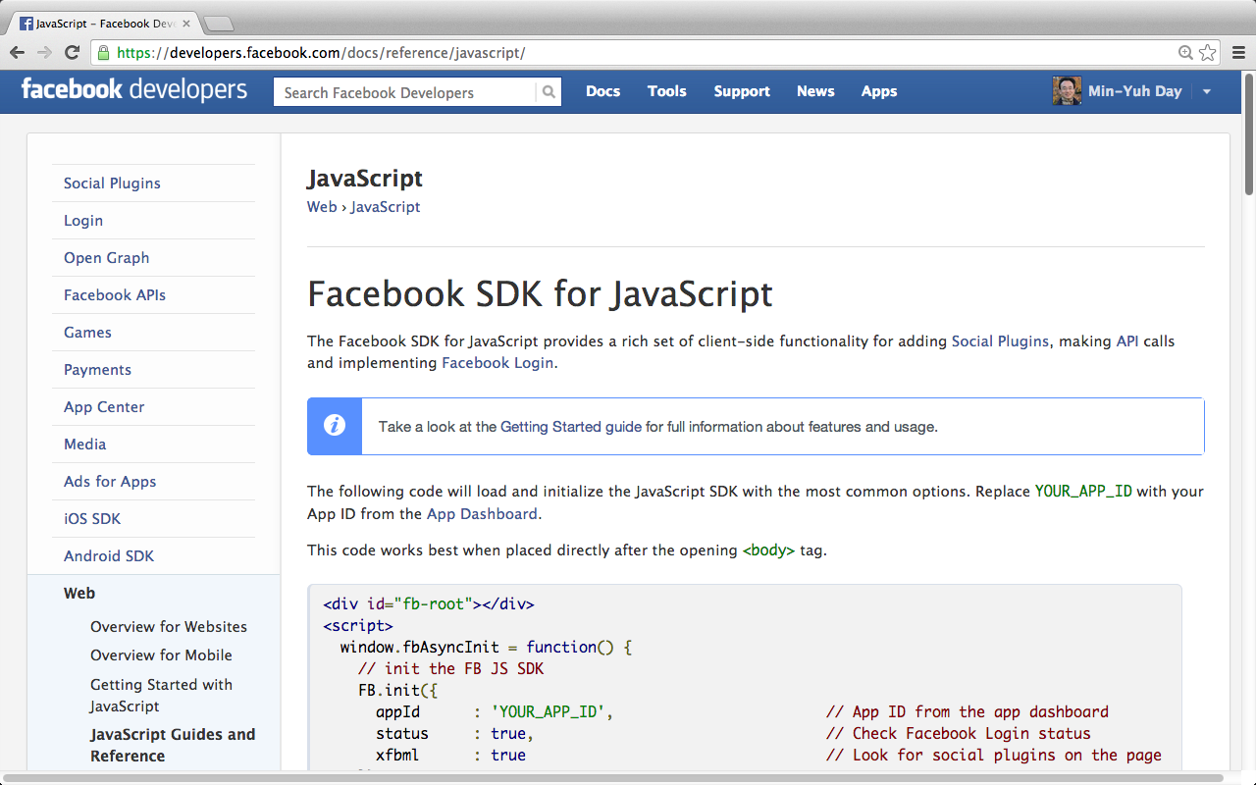
Facebook SDK for JavaScript
https://developers.facebook.com/docs/reference/javascript/

Slide 46
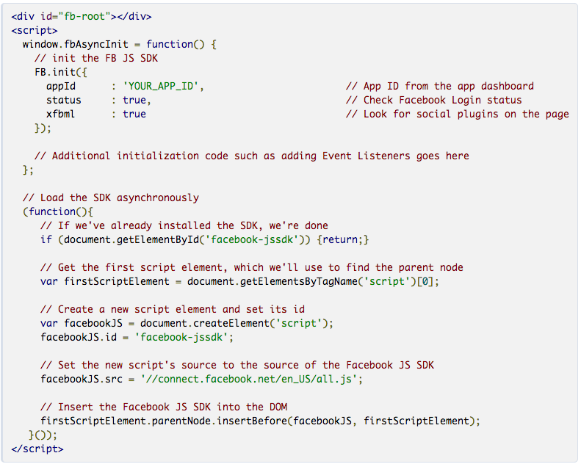
Facebook SDK for JavaScript
https://developers.facebook.com/docs/reference/javascript/
https://developers.facebook.com/docs/reference/javascript/

Slide 47
Facebook SDK for JavaScript
<div id="fb-root"></div>
<script>
window.fbAsyncInit = function() {
// init the FB JS SDK
FB.init({
appId : 'YOUR_APP_ID', // App ID from the app dashboard
status : true, // Check Facebook Login status
xfbml : true // Look for social plugins on the page
});
// Additional initialization code such as adding Event Listeners goes here
};
// Load the SDK asynchronously
(function(){
// If we've already installed the SDK, we're done
if (document.getElementById('facebook-jssdk')) {return;}
// Get the first script element, which we'll use to find the parent node
var firstScriptElement = document.getElementsByTagName('script')[0];
// Create a new script element and set its id
var facebookJS = document.createElement('script');
facebookJS.id = 'facebook-jssdk';
// Set the new script's source to the source of the Facebook JS SDK
facebookJS.src = '//connect.facebook.net/en_US/all.js';
// Insert the Facebook JS SDK into the DOM
firstScriptElement.parentNode.insertBefore(facebookJS, firstScriptElement);
}());
</script>
https://developers.facebook.com/docs/reference/javascript/

Slide 48
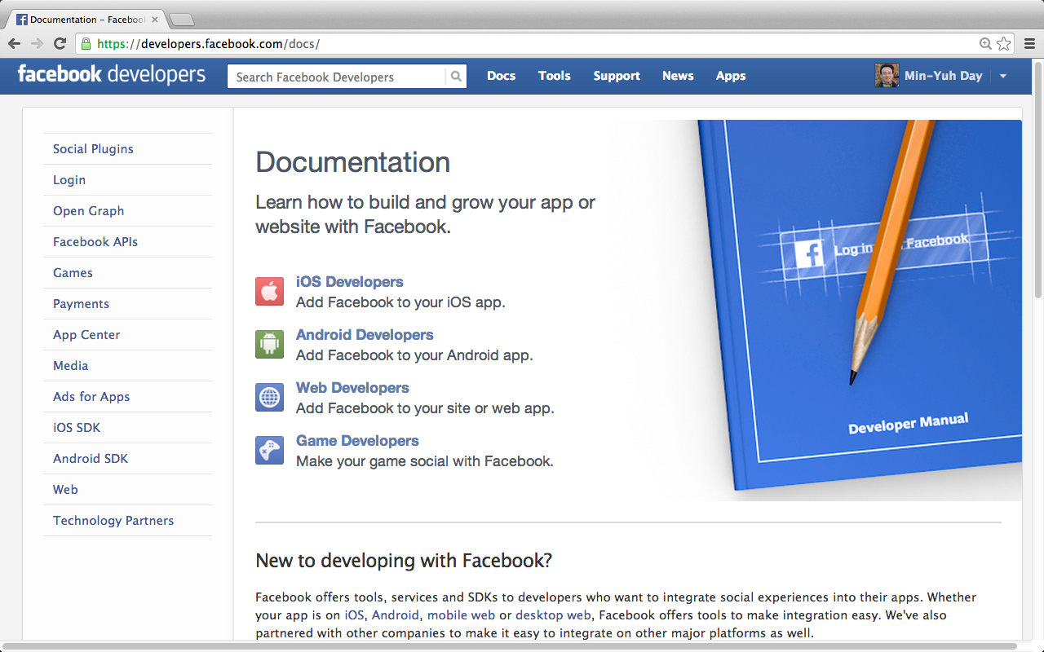
Facebook for Mobile
https://developers.facebook.com/docs/

Slide 49
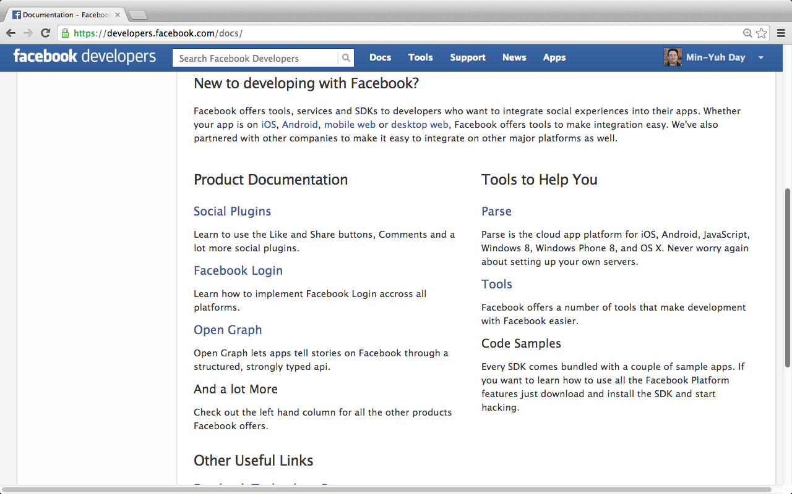
Facebook for Mobile
https://developers.facebook.com/docs/

Slide 50
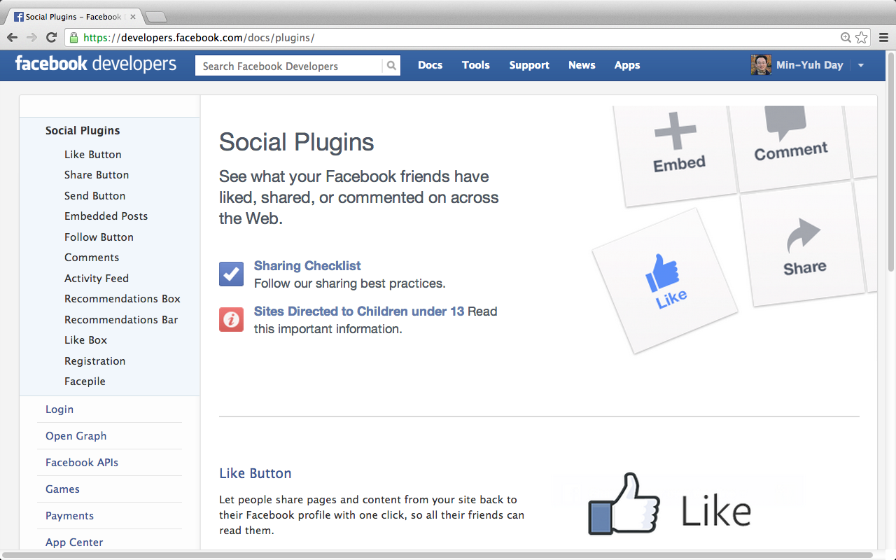
Facebook for Mobile
https://developers.facebook.com/docs/plugins/

Slide 51

Facebook Like Button
Let people share pages and content from your site back to their Facebook profile with one click, so all their friends can read them.
https://developers.facebook.com/docs/plugins/

Slide 52
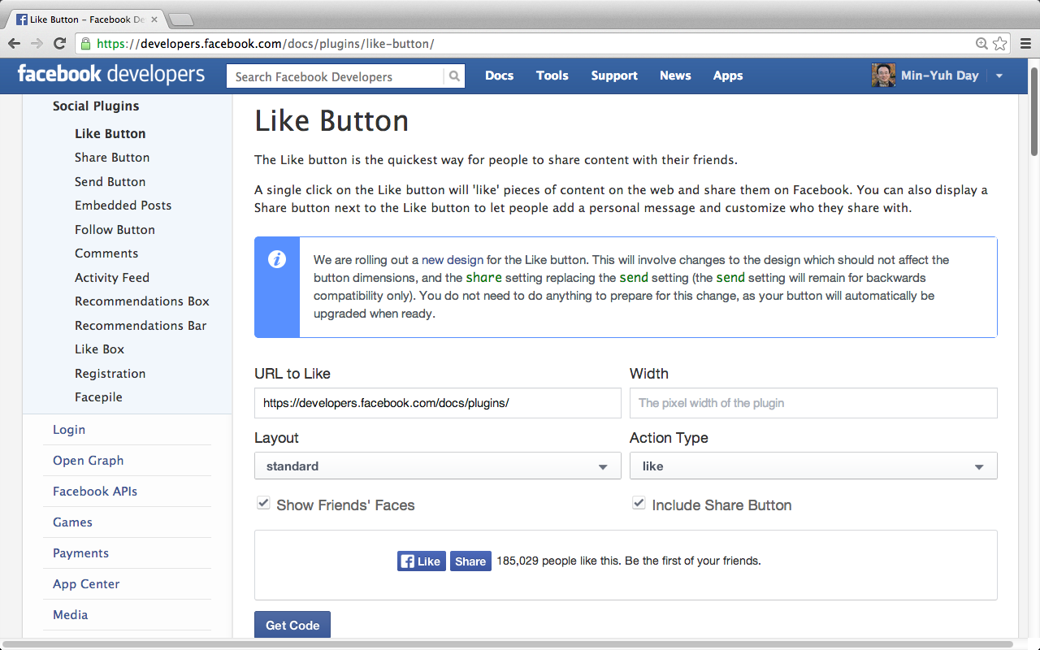
Facebook Like Button
https://developers.facebook.com/docs/plugins/like-button/

Slide 53
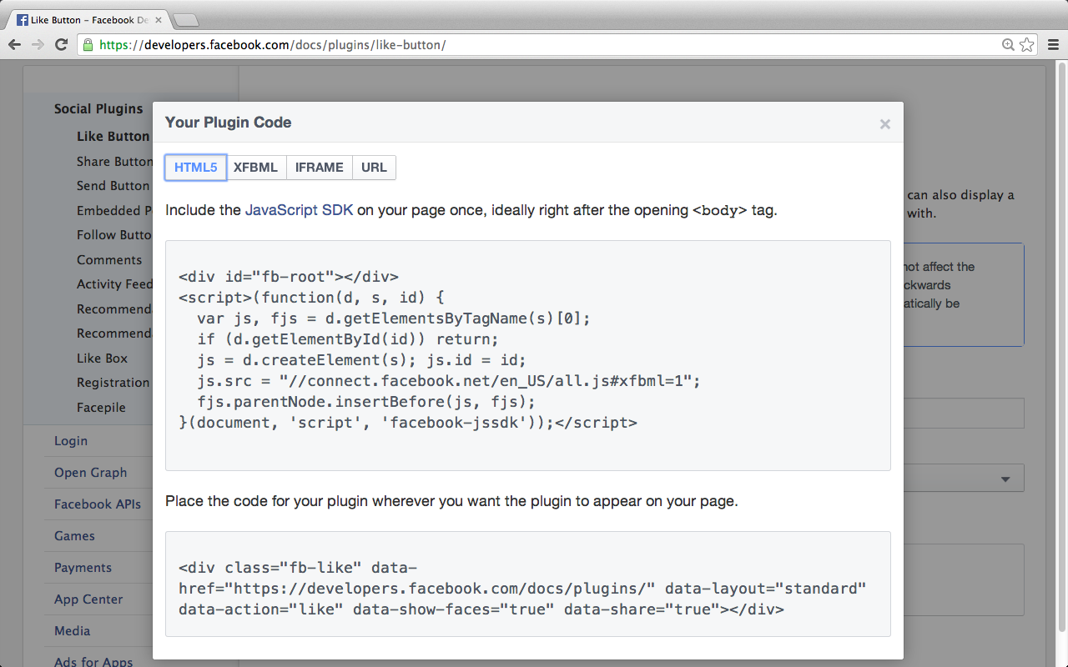
Facebook Like Button
https://developers.facebook.com/docs/plugins/like-button/

Slide 54
Facebook Like Button
<div id="fb-root"></div>
<script>(function(d, s, id) {
var js, fjs = d.getElementsByTagName(s)[0];
if (d.getElementById(id)) return;
js = d.createElement(s); js.id = id;
js.src = "//connect.facebook.net/en_US/all.js#xfbml=1";
fjs.parentNode.insertBefore(js, fjs);
}(document, 'script', 'facebook-jssdk'));</script>
<div class="fb-like" data-href="https://developers.facebook.com/docs/plugins/" data-layout="standard" data-action="like" data-show-faces="true" data-share="true"></div>
https://developers.facebook.com/docs/plugins/like-button/

Slide 55
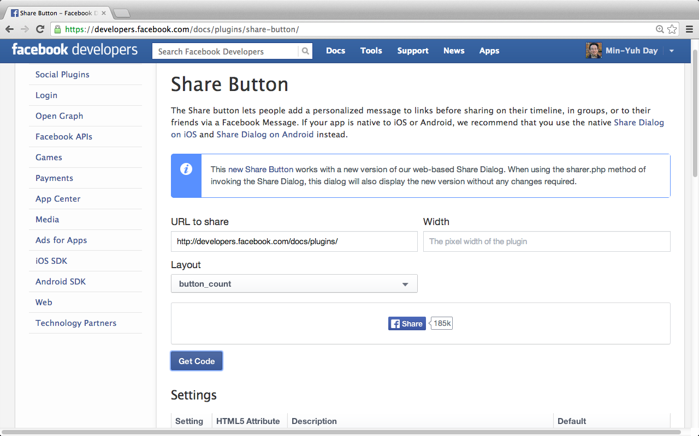
Facebook Share Button
https://developers.facebook.com/docs/plugins/share-button/

Slide 56
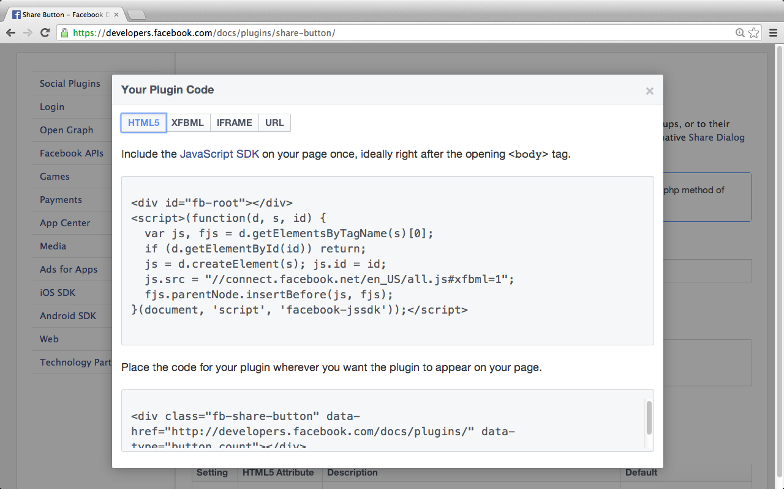
Facebook Share Button
https://developers.facebook.com/docs/plugins/share-button/

Slide 57

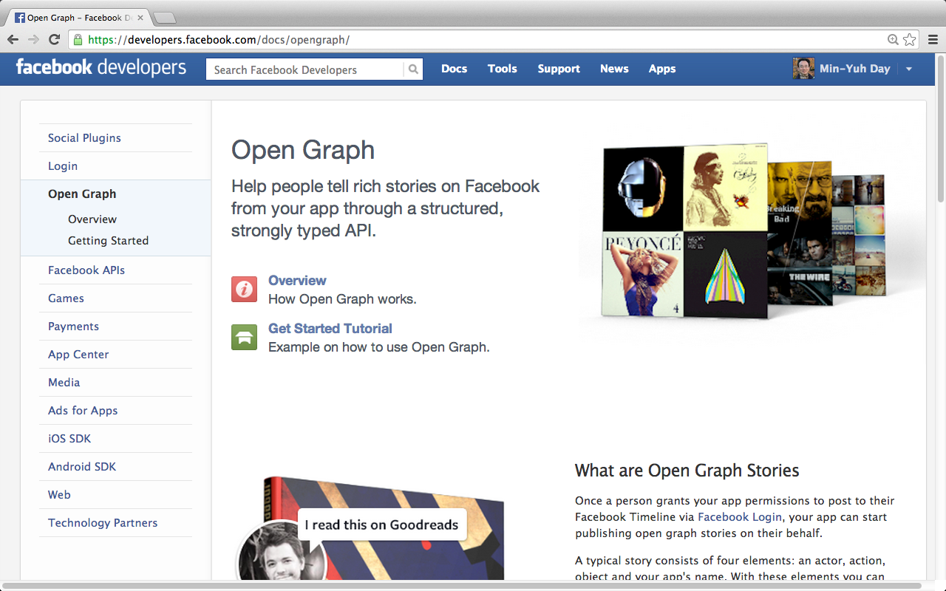
Facebook Open Graph API
https://developers.facebook.com/docs/opengraph/

Slide 58

Open Graph Overview
https://developers.facebook.com/docs/opengraph/overview/

Slide 59

Getting Started with Open Graph
https://developers.facebook.com/docs/opengraph/getting-started/

Slide 60


Step 1: Create a Facebook App
https://developers.facebook.com/docs/opengraph/getting-started/

Slide 61

Step 2: Set Up the App
1/3
https://developers.facebook.com/docs/opengraph/getting-started/

Slide 62


Step 2: Set Up the App
2/3
https://developers.facebook.com/docs/opengraph/getting-started/

Slide 63

Step 2: Set Up the App
3/3
https://developers.facebook.com/docs/opengraph/getting-started/

Slide 64


Step 3: Publish a Story
https://developers.facebook.com/docs/opengraph/getting-started/

Slide 65

Step 3: Publish a Story
https://developers.facebook.com/docs/opengraph/getting-started/

Slide 66



Step 4: Submit Your Actions For Review
https://developers.facebook.com/docs/opengraph/getting-started/

Slide 67

Open Graph
http://www.youtube.com/watch?v=rZMajQAowKs

Slide 68
Facebook Open Graph API
A Facebook API to share information
  From your app
  To Facebook
Ex
  Pinterest
Source: https://www.youtube.com/watch?v=M24gqVJbrN8&list=PL8D1E905D80087F6F

Slide 69

Facebook APIs
https://developers.facebook.com/docs/reference/apis/

Slide 70

Facebook Graph API
https://developers.facebook.com/docs/graph-api/

Slide 71

Quickstart for Graph API
https://developers.facebook.com/docs/graph-api/quickstart/

Slide 72

Getting Started with the Graph API
http://www.youtube.com/watch?v=WteK95AppF4

Slide 73

How the Graph API is structured
https://developers.facebook.com/docs/graph-api/quickstart/

Slide 74

Load the Graph API Explorer
https://developers.facebook.com/docs/graph-api/quickstart/

Slide 75

Facebook Graph API Explorer
https://developers.facebook.com/tools/explorer

Slide 76

Facebook Graph API Explorer /me
https://developers.facebook.com/tools/explorer?method=GET&path=me

Slide 77

Facebook Graph API Explorer /me
https://developers.facebook.com/tools/explorer?method=GET&path=me

Slide 78

Facebook Graph API Explorer /me
https://developers.facebook.com/tools/explorer?method=GET&path=me

Slide 79

Facebook Graph API Explorer /me
https://developers.facebook.com/tools/explorer?method=GET&path=me

Slide 80

Facebook Graph API Explorer /me
https://developers.facebook.com/tools/explorer?method=GET&path=me

Slide 81

Facebook Graph API Explorer /me
https://developers.facebook.com/tools/explorer?method=GET&path=me

Slide 82

Facebook Graph API Explorer /me/friends
https://developers.facebook.com/tools/explorer?method=GET&path=me%2Ffriends

Slide 83


Facebook Graph API Explorer
Publish actions

Slide 84

Facebook Graph API Explorer
Post Message

Slide 85

Facebook Graph API Explorer
Post Message

Slide 86

http://graph.facebook.com/4

Slide 87
Facebook API (JSON) http://graph.facebook.com/4
{
"id": "4",
"first_name": "Mark",
"gender": "male",
"last_name": "Zuckerberg",
"link": "https://www.facebook.com/zuck",
"locale": "en_US",
"name": "Mark Zuckerberg",
"username": "zuck"
}

Slide 88

http://graph.facebook.com/minyuhday

Slide 89
JavaScript vs. JSON
JSON
  JavaScript Object Notation
    Format for sharing data
    Derived from JavaScript
    Language independent
    An alternative to XML
Source: https://www.youtube.com/watch?v=40aKlrL-2V8

Slide 90
JSON
Advantages
  Easy to read
  Easy to write
  Easy to Parse
    Var info = JSON.parse(data);
    Info.name
    Info.position
    Info.courses[i]
  Learner than XML
  Growing support in APIs (i.e., Facebook, Twitter)
  Natural format for JavaScript
  Implementation in many languages
Source: https://www.youtube.com/watch?v=40aKlrL-2V8

Slide 91
JSON
{
“name” : “Min-Yuh Day”
“position” : “Assistant Professor”
“courses” : [
“Social Media Apps Programming”
“Social Media Marketing”
“Data Mining”
]
}
var info = JSON.parse(data);
info.name
info.position
info.courses[i]
Source: https://www.youtube.com/watch?v=40aKlrL-2V8

Slide 92
Summary
Facebook API
  Facebook JavaScript SDK
  Integrate Facebook with iOS/Android Apps
  Facebook Login
  Facebook Open Graph API
  Facebook Graph API

Slide 93
References
Facebook Developers, https://developers.facebook.com/

