Slide 1
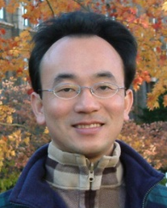
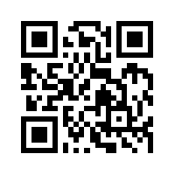
Social Media Apps Programming
Tamkang University
Google Cloud Platform
1031SMAP10
TLMXM1A (8687) (M2143) (Fall 2014)
(MIS MBA) (2 Credits, Elective) [Full English Course]
Thu 8,9 (15:10-17:00) V201
Min-Yuh Day, Ph.D.
Assistant Professor
Department of Information Management
Tamkang University
http://mail.tku.edu.tw/myday
2014-12-03

Slide 2
Course Schedule (1/3)
Week Date Subject/Topics
1 2014/09/17 Course Orientation and Introduction to Social Media and Mobile Apps Programming
2 2014/09/24 Introduction to Android / iOS Apps Programming
3 2014/10/01 Developing Android Native Apps with Java (Eclipse) (MIT App Inventor)
4 2014/10/08 Developing iPhone / iPad Native Apps with Swift / Objective-C (XCode)
5 2014/10/15 Mobile Apps Using HTML5/CSS3/JavaScript
6 2014/10/22 jQuery Mobile

Slide 3
Course Schedule (2/3)
Week Date Subject/Topics
7 2014/10/29 Create Hybrid Apps with Phonegap
8 2014/11/05 jQuery Mobile/Phonegap
9 2014/11/12 jQuery Mobile/Phonegap
10 2014/11/19 Midterm Exam Week (Midterm Project Report)
11 2014/11/26 Case Study on Social Media Apps Programming and Marketing in Google Play and App Store
12 2014/12/03 Google Cloud Platform

Slide 4
Course Schedule (3/3)
Week Date Subject/Topics
13 2014/12/10 Invited Talk: Social, Data and Business Model - Let’s see PIXNET [Invited Speaker: Dr. Rick Cheng-Yu Lu, Technical Director, PIXNET]
14 2014/12/17 Google App Engine and Google Map API
15 2014/12/24 Facebook API (Facebook JavaScript SDK) (Integrate Facebook with iOS/Android Apps)
16 2014/01/31 Twitter API
17 2015/01/07 Final Project Presentation
18 2015/01/14 Final Exam Week (Final Project Report)

Slide 5
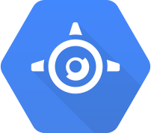
Outline
Google Cloud Platform
Google App Engine
Google Cloud Datastore
Google Cloud Endpoints
Mobile App with Google Cloud Platform

Slide 6
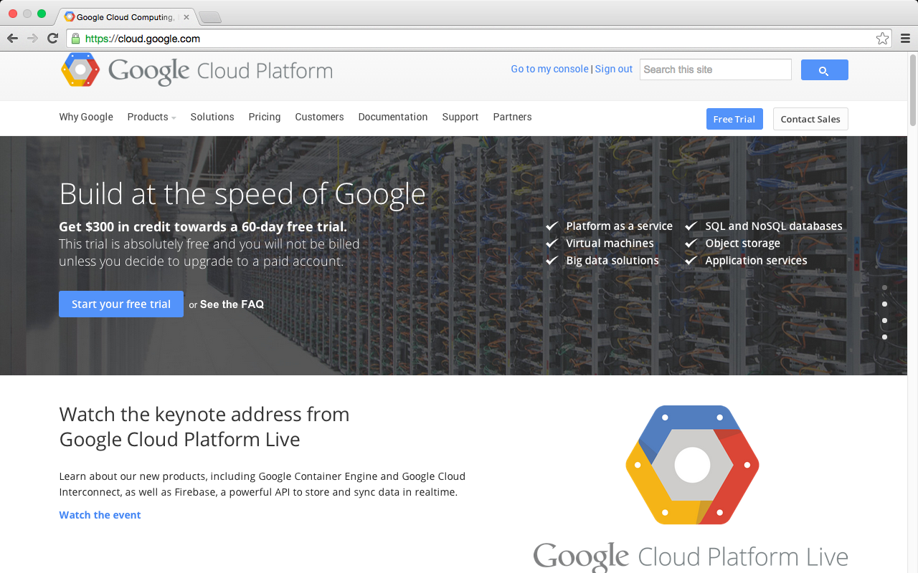
Google Cloud Platform
https://cloud.google.com/

Slide 7
Google Cloud Platform
Google Cloud Platform is a set of modular cloud-based services that allow you to create anything from simple websites to complex applications.
Source: https://cloud.google.com/

Slide 8
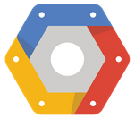
Google Cloud Platform
Hosting + Compute
Storage
Big Data
Services
Source: https://cloud.google.com/products/

Slide 9
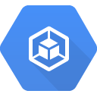
Google Cloud Platform
Compute
Storage
Big Data
Services
App Engine
Cloud Datastore
Cloud Endpoints
Compute Engine
Cloud SQL
Big Query
Translate API
Container Engine
Cloud Storage
Prediction API
Source: https://cloud.google.com/products/

Slide 10
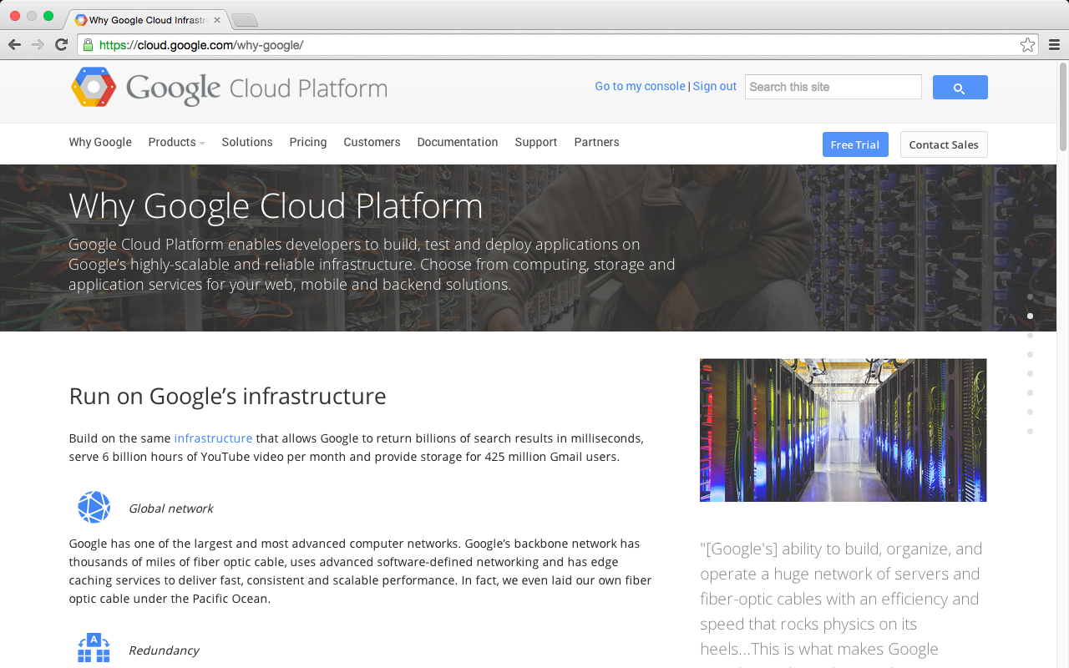
Why Google Cloud Platform
Source: https://cloud.google.com/why-google/

Slide 11
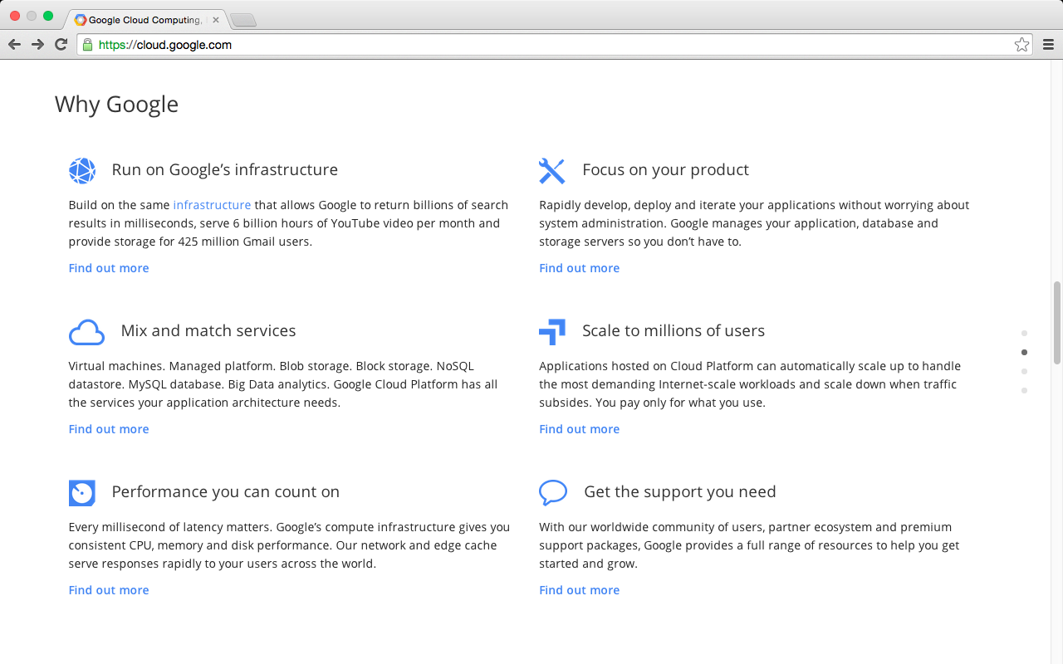
Why Google Cloud Platform
Source: https://cloud.google.com/

Slide 12
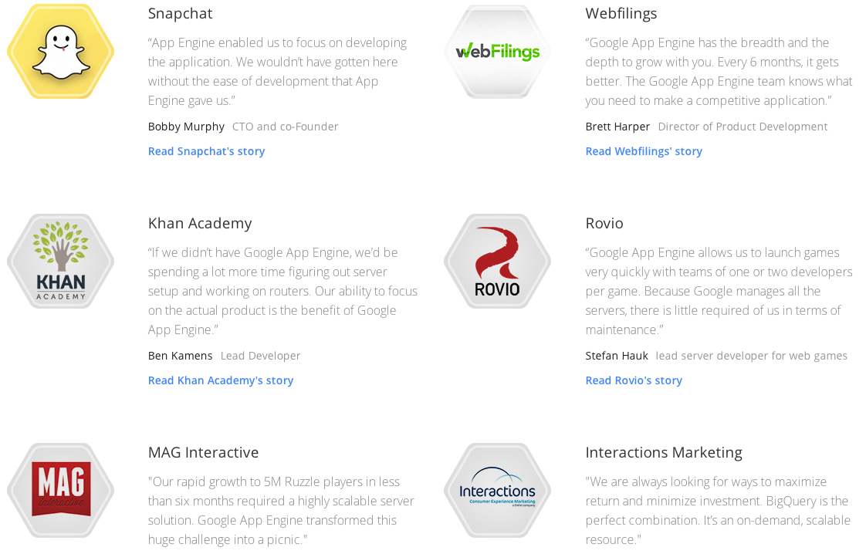
Customers of Google Cloud Platform
Source: https://cloud.google.com/customers/

Slide 13
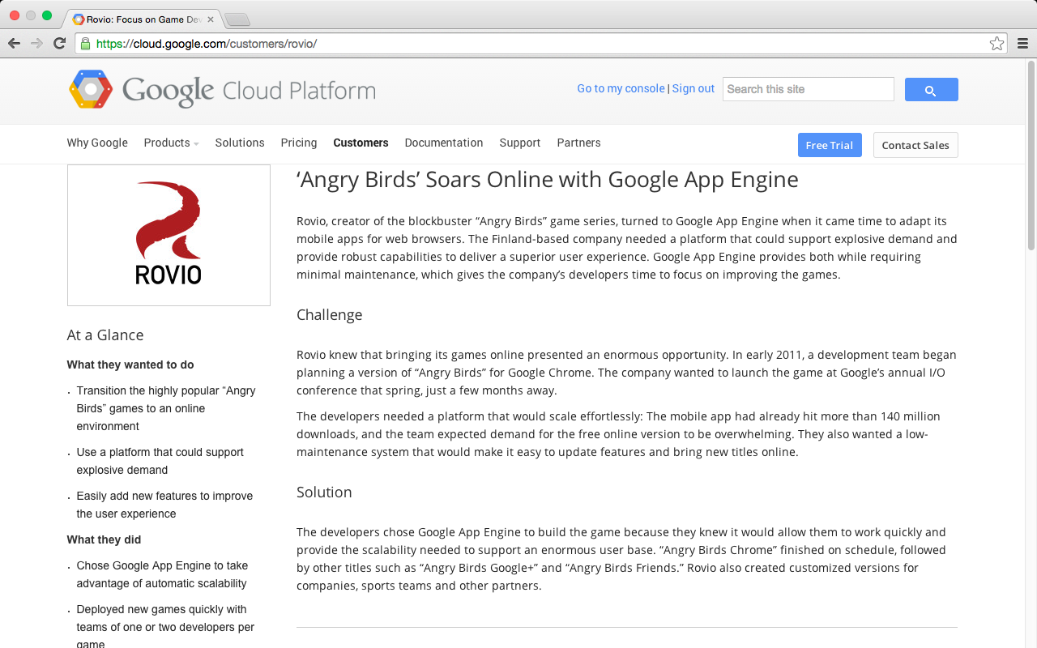
Angry Birds
Source: https://cloud.google.com/customers/

Slide 14
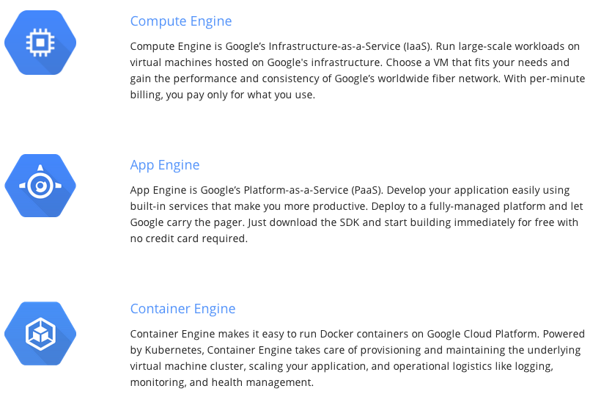
Compute
Source: https://cloud.google.com/products/

Slide 15
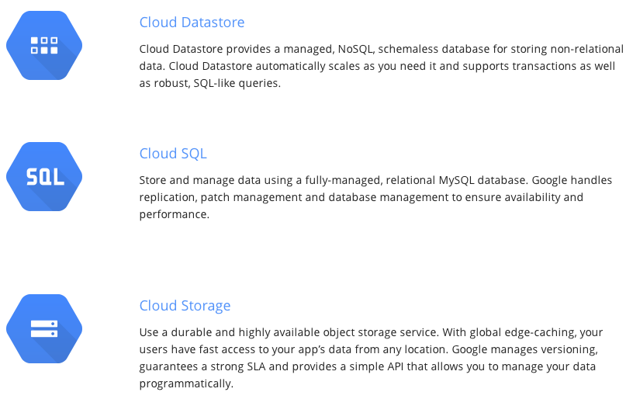
Storage
Source: https://cloud.google.com/products/

Slide 16
BigQuery
Analyze Big Data in the cloud with BigQuery.
Run fast, SQL-like queries against multi-terabyte datasets in seconds.
Scalable and easy to use, BigQuery gives you real-time insights about your data
Source: https://cloud.google.com/products/

Slide 17
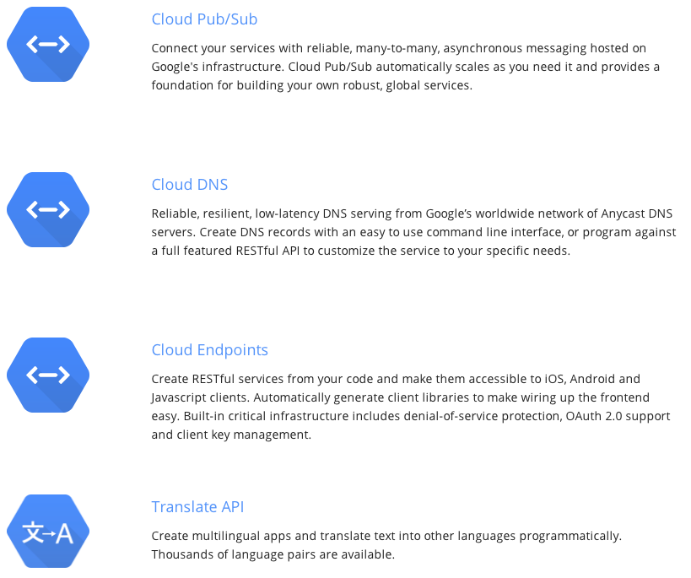
Services
Source: https://cloud.google.com/products/

Slide 18
Prediction API
Use Google’s machine learning algorithms to analyze data and predict future outcomes using a familiar RESTful interface.
Source: https://cloud.google.com/products/

Slide 19
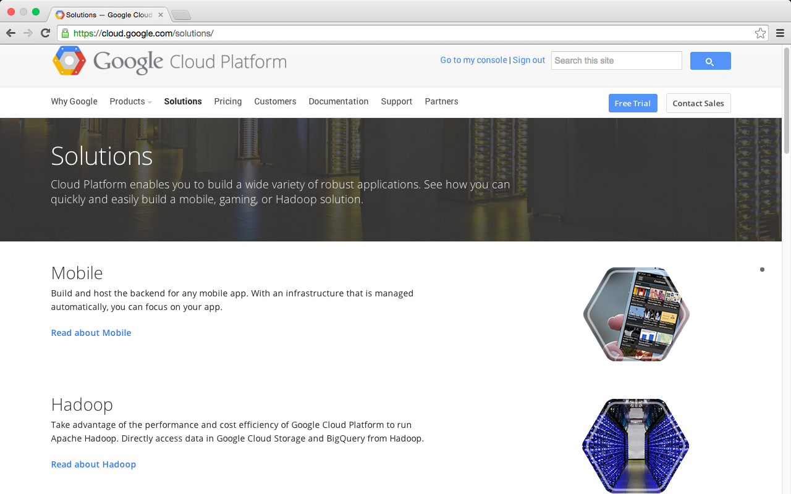
Google Cloud Platform Solutions
Source: https://cloud.google.com/solutions/

Slide 20
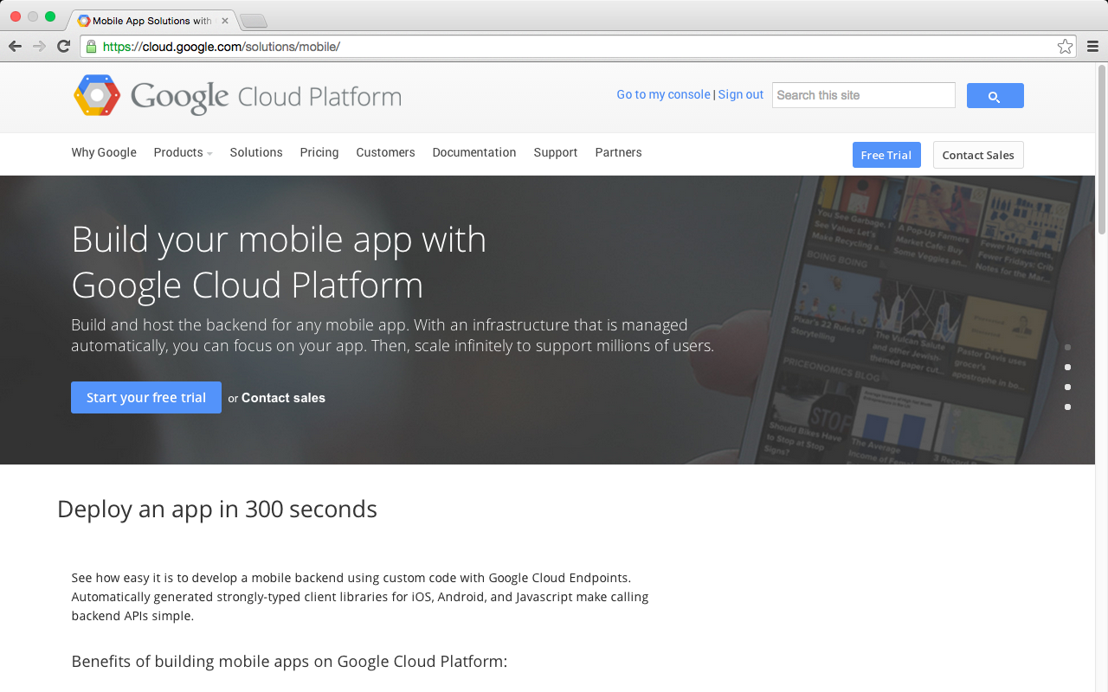
Mobile App with Google Cloud Platform
Source: https://cloud.google.com/solutions/mobile/

Slide 21
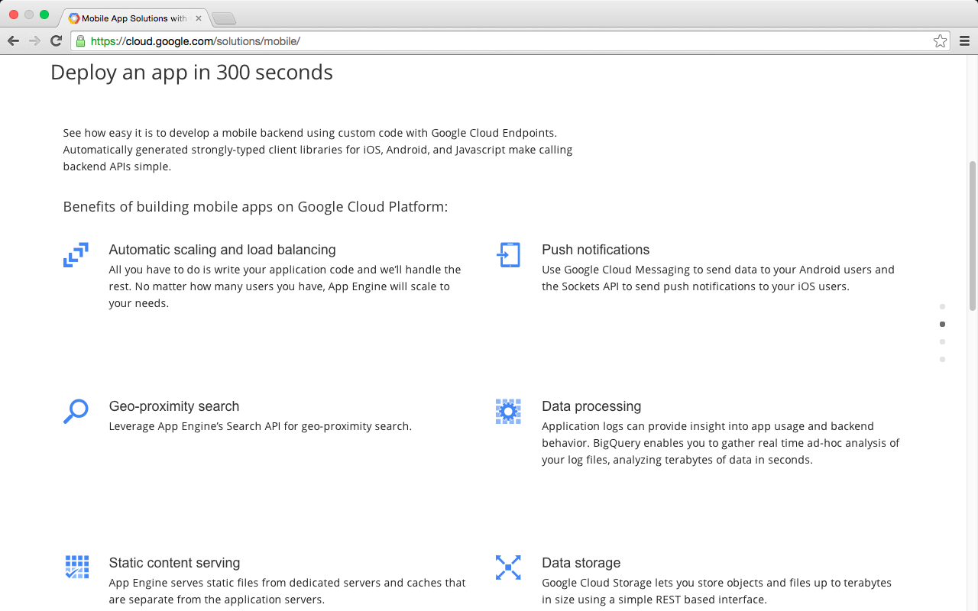
Mobile App with Google Cloud Platform
Source: https://cloud.google.com/solutions/mobile/

Slide 22
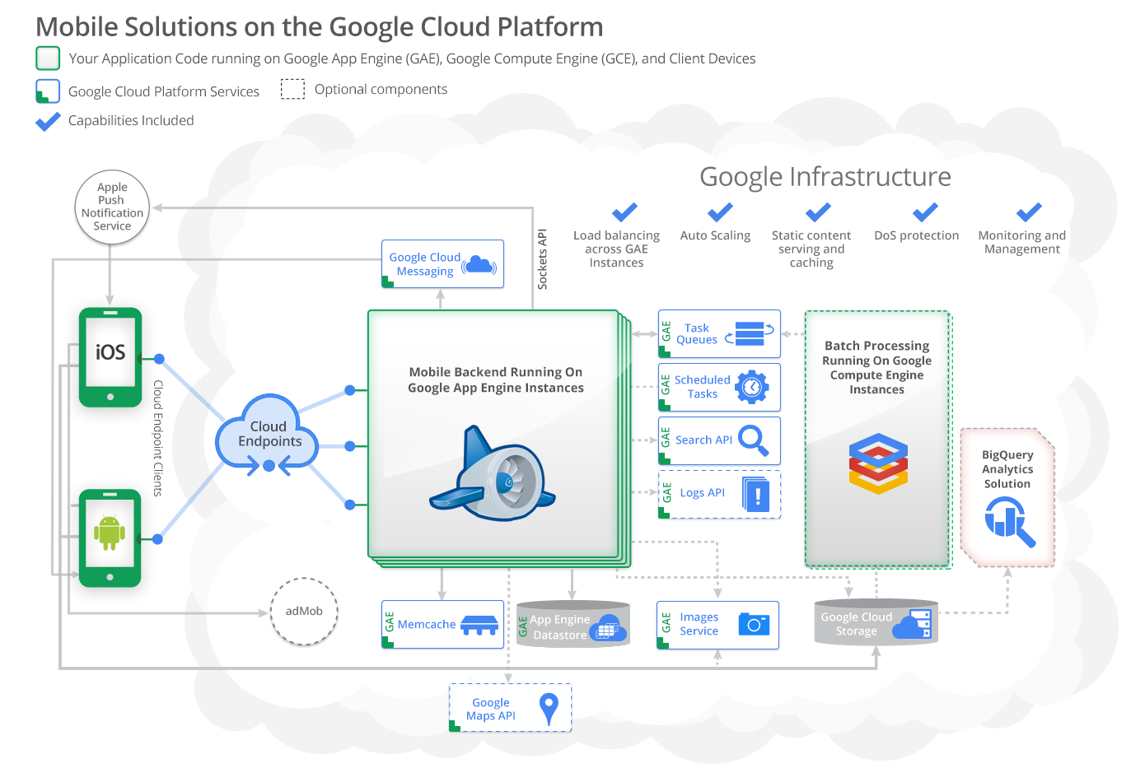
Source: https://cloud.google.com/developers/articles/mobile-application-solutions/

Slide 23
Mobile Solution on Google Cloud Platform
Support for Android and iOS devices through native applications
Storage, retrieval, and processing data outside of mobile devices
Orchestrating push notification to Android and IOS devices
Geo-location awareness and geo-proximity search
User authentication
High scalability
Source: https://cloud.google.com/developers/articles/mobile-application-solutions/

Slide 24
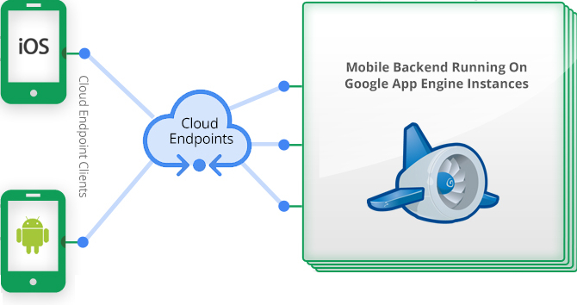
Mobile App Solutions Architecture
Source: https://cloud.google.com/developers/articles/mobile-application-solutions/

Slide 25
Mobile App Solutions Architecture
Android and/or iOS mobile clients.
Google Cloud Endpoints used for communications between the clients and the backend over REST API with optional OAuth2 authentication.
Your mobile backend application code running on Google App Engine and responsible for serving requests from the clients.
Source: https://cloud.google.com/developers/articles/mobile-application-solutions/

Slide 26
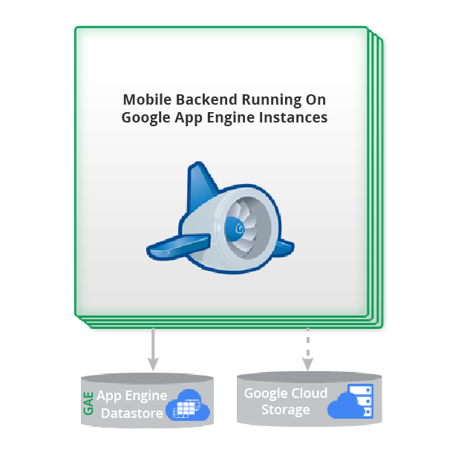
Storing data

Slide 27
Google App Engine Datastore Quotas and limits
Limit | Amount
Maximum entity size | 1 megabyte
Maximum transaction size | 10 megabytes
Maximum number of index entries for an entity | 20000
Maximum number of bytes in composite indexes for an entity | 2 megabytes
Source: https://cloud.google.com/appengine/docs/java/datastore/

Slide 28
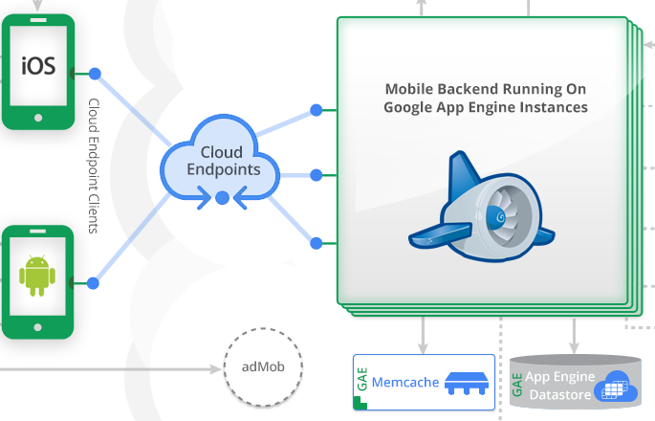
Optimizing data access with Memcache
Source: https://cloud.google.com/developers/articles/mobile-application-solutions/

Slide 29
Google App Engine Platform as a Service (PaaS)
build and run applications on Google’s infrastructure
Source: https://cloud.google.com/appengine/docs

Slide 30
Google App Engine
1 GB of data storage and traffic for free
can be increased by enabling paid applications
Source: https://cloud.google.com/appengine/docs/whatisgoogleappengine

Slide 31
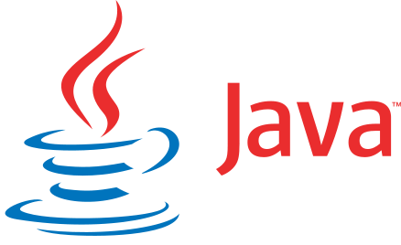
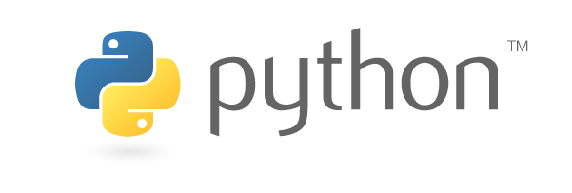
Google App Engine
Google App Engine supports apps written in a variety of programming languages: Python, Java, PHP, Go
Python
Java
PHP
Go
Source: https://cloud.google.com/appengine/docs/whatisgoogleappengine

Slide 32
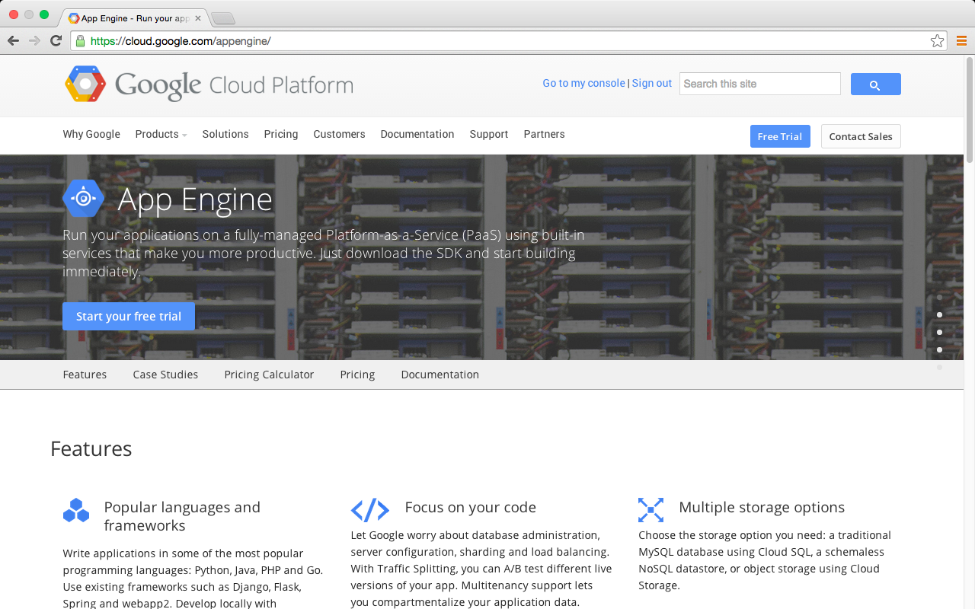
Google App Engine
https://cloud.google.com/appengine/

Slide 33
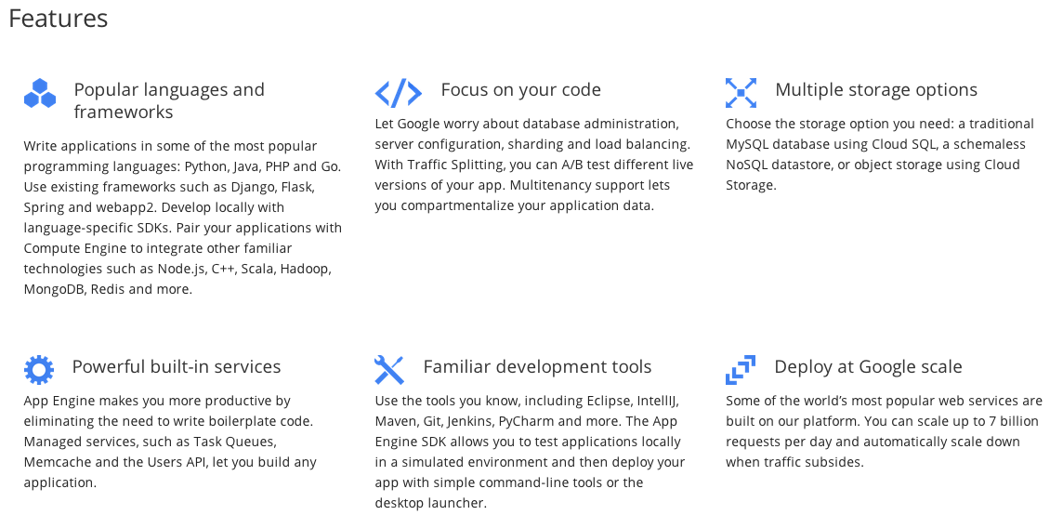
Google App Engine
https://cloud.google.com/appengine/

Slide 34
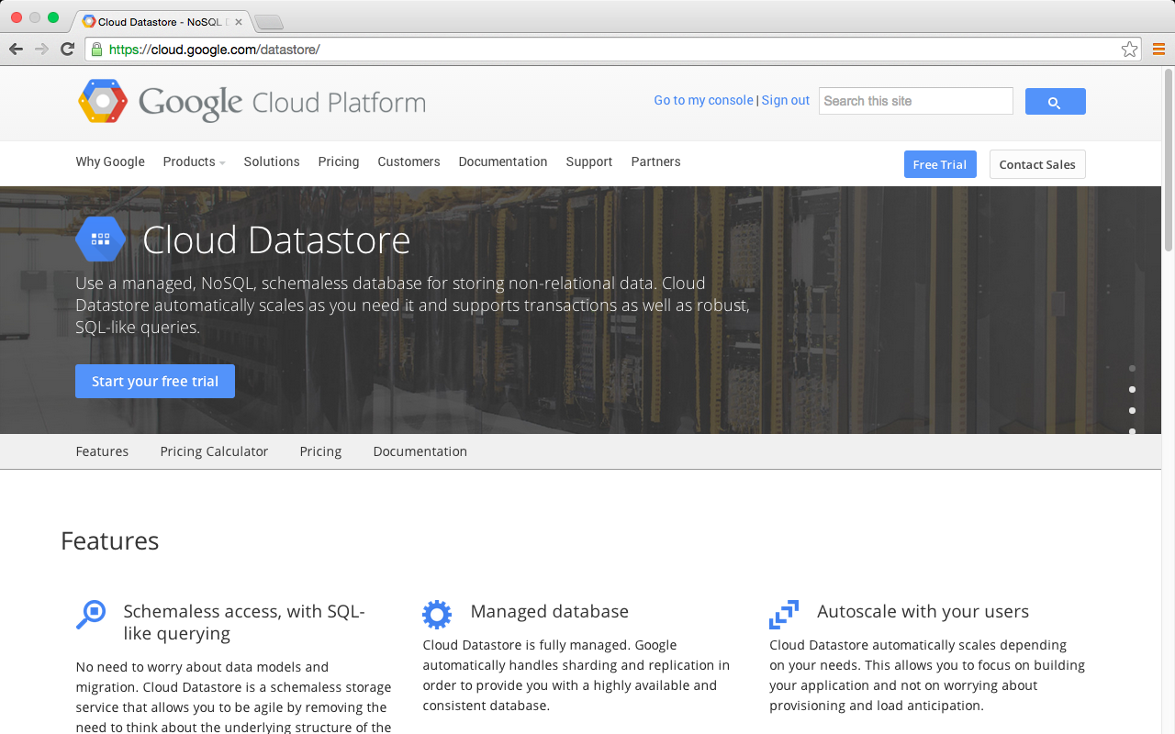
Google Cloud Datastore
https://cloud.google.com/datastore/

Slide 35
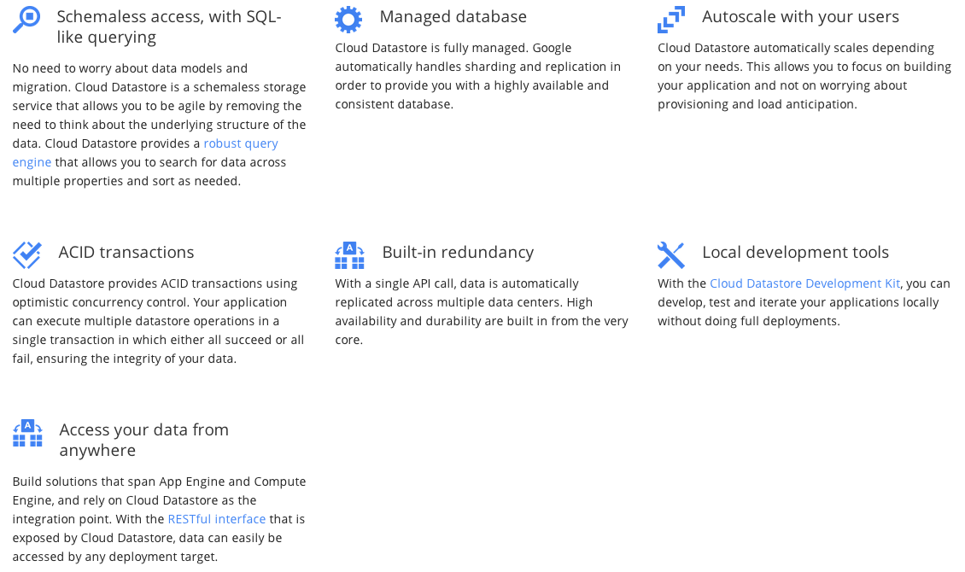
Google Cloud Datastore
https://cloud.google.com/datastore/

Slide 36
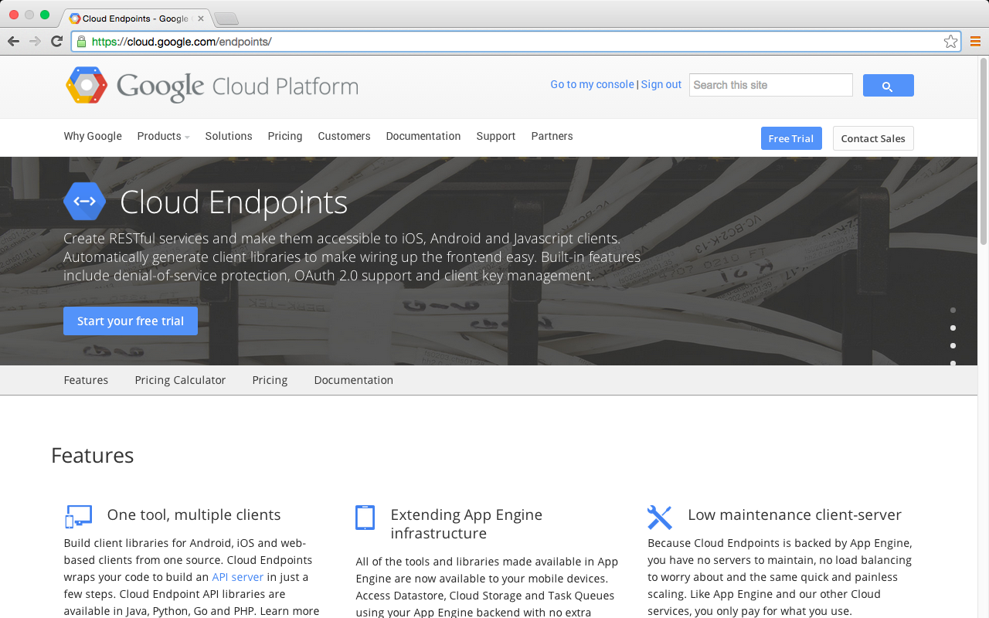
Google Cloud Endpoints
Source: https://cloud.google.com/endpoints/

Slide 37
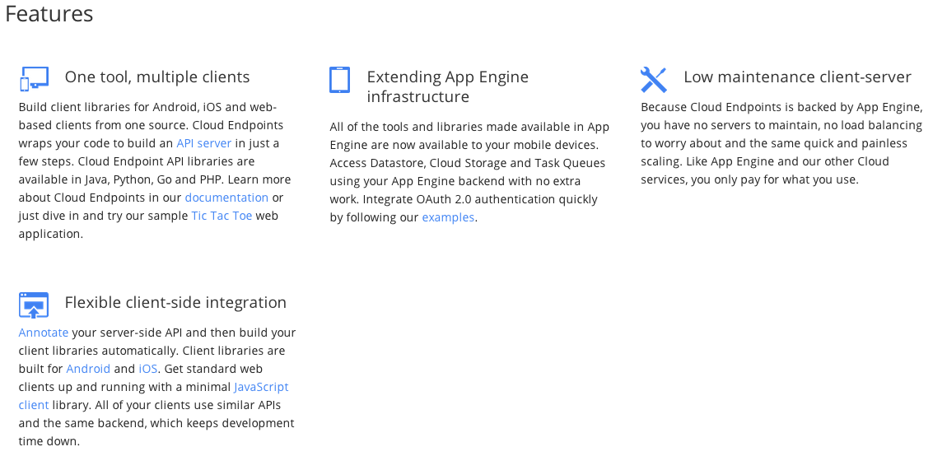
Google Cloud Endpoints
Source: https://cloud.google.com/endpoints/

Slide 38
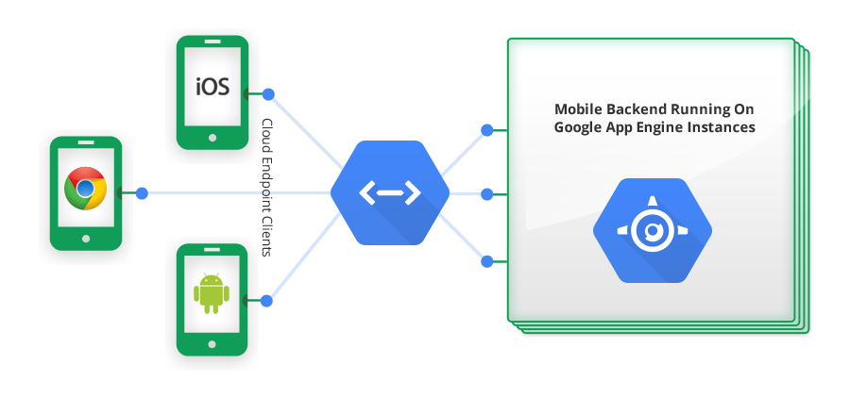
Mobile Apps Backend on Google App Engine
Cloud Endpoints
App Engine
Google Cloud Endpoints Architecture
Source: https://cloud.google.com/appengine/docs/java/endpoints/

Slide 39
Mobile App, Goolge App Engine, Cloud Datasotre
http://www.youtube.com/watch?v=v5u_Owtbfew

Slide 40
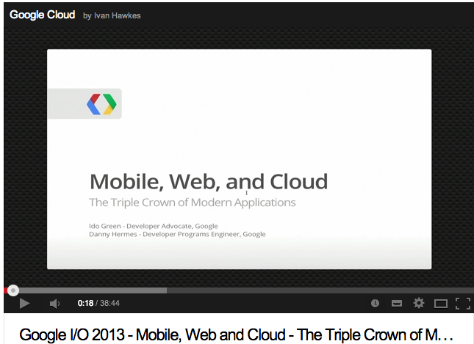
Mobile, Web and Cloud
http://www.youtube.com/watch?v=6_oO9Gwf_do

Slide 41
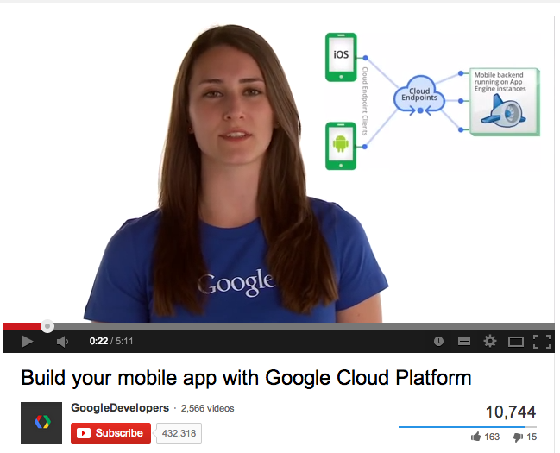
Build your mobile app with Google Cloud Platform
http://www.youtube.com/watch?v=ZZNb1NOPTp8

Slide 42
App Engine Architecture and Services
http://www.youtube.com/watch?v=QJp6hmASstQ
Notes:
Google App Engine Architecture and Services, http://www.youtube.com/watch?v=QJp6hmASstQ
GoogleDevelopers
Published on Feb 5, 2013
This lesson introduces how App Engine solves the needs of a real-time earthquake monitor in Japan, in a robust scalable way that handles peak request throughput during earthquakes without needing to keep server resources up and running all the time.
Learn how to configure your App Engine applications to best take advantage of the underlying Google infrastructure, including edge caching and load balancing, to optimize response speed and minimize cost.

Slide 43
Datastore Introduction
Source: Datastore Introduction, http://www.youtube.com/watch?v=fQazhzcC-rg
Notes:
Datastore Introduction, http://www.youtube.com/watch?v=fQazhzcC-rg
GoogleDevelopers
Published on Feb 5, 2013
Datastore service in App Engine is the core component of the platform and an essential part of learning App Engine technologies. In this lesson we will cover topics including "What is Datastore?", "Datastore Internals" and "Datastore Basic Operation". We will be looking at basic concepts including the difference between a Relational Database and Datastore, scalability, reliability and performance characteristics of Datastore. We will also dive deeper into the underlying technology, Google Bigtable. As basic operations, we will learn Datastore concepts like Entity, Property and Key as well as Datastore APIs.

Slide 44
Google Cloud Datastore
Datasotre is a database (persistent storage) for App Engine
Google App Engine
Traditional Web applications
Web application framework
(AP)
Google App Engine
(Java, Python, Go)
Perl/CGI
PHP
Ruby on Rails
ASP/JSP
Persistent storage
(Database)
Datastore
RDBMS
MySQL
PostgreSQL
SQL Server
Oracle
Source: Datastore Introduction, http://www.youtube.com/watch?v=fQazhzcC-rg

Slide 45
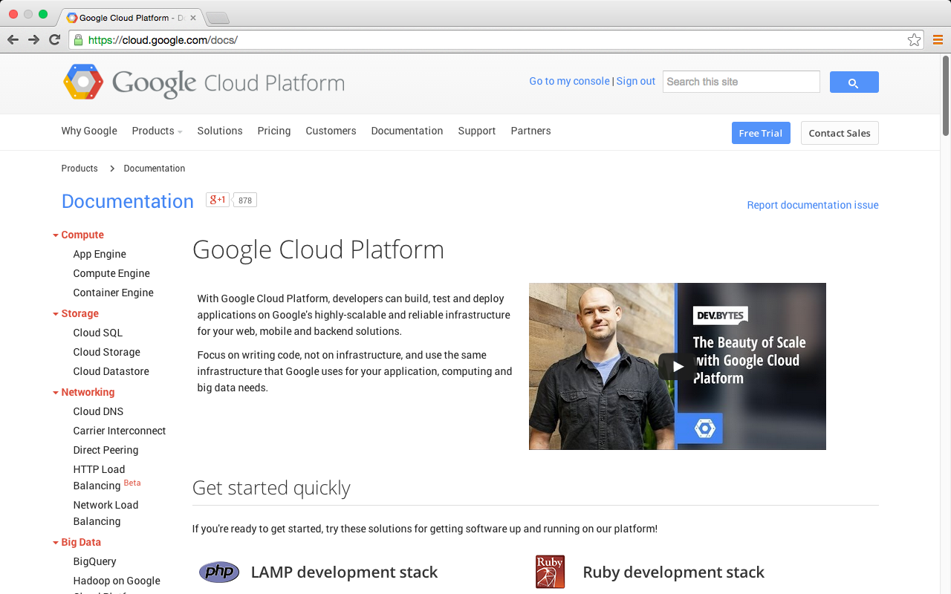
Google Cloud Platform
https://cloud.google.com/docs/

Slide 46
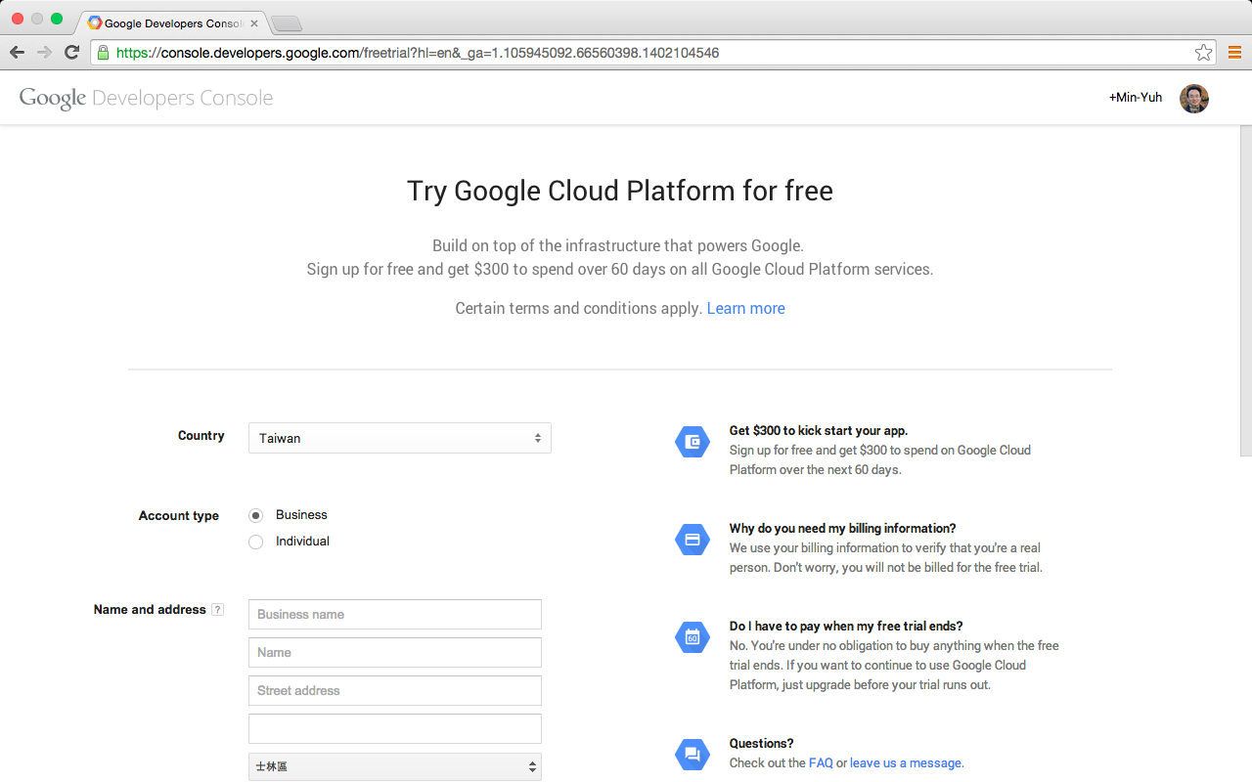
Try Google Cloud Platform for free

Slide 47
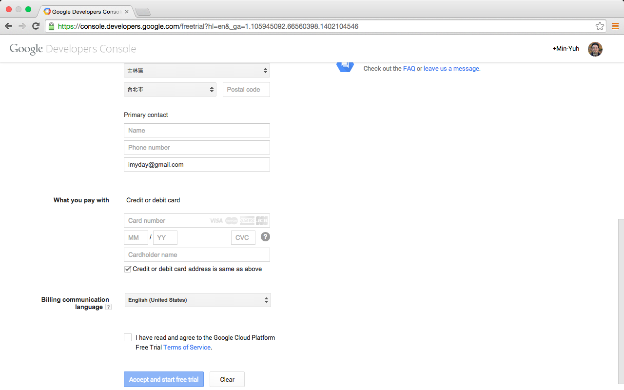
Try Google Cloud Platform for free

Slide 48
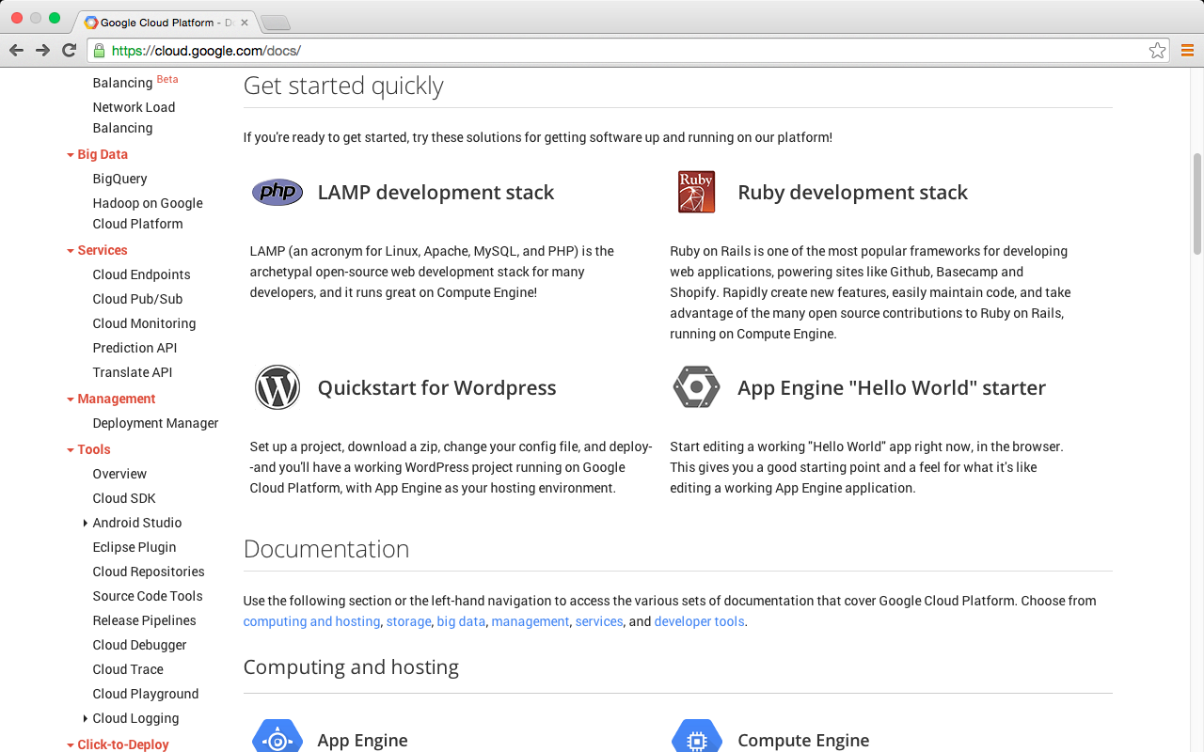
Google Cloud Platform
https://cloud.google.com/docs/

Slide 49
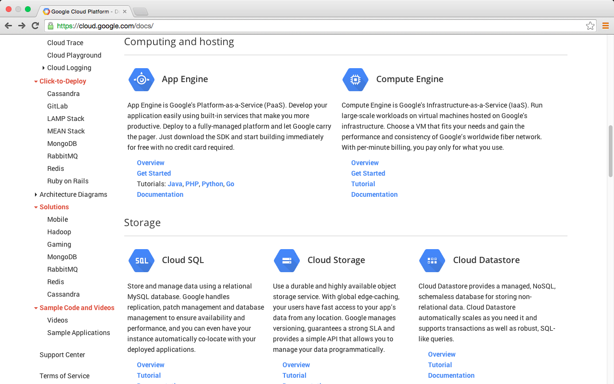
Google Cloud Platform
https://cloud.google.com/docs/

Slide 50
App Engine "Hello World" starter
Google App Engine
https://console.developers.google.com/start/appengine
Deploy your first app in five minutes
Start editing a working "Hello World" app right now, in the browser.
This gives you a good starting point and a feel for what it's like editing a working App Engine application.

Slide 51
Try Google App Engine Now
NAME YOUR PROJECT
SELECT YOUR LANGUAGE
EXPLORE THE STARTER CODE
INSTALL GOOGLE CLOUD SDK
RUN YOUR APP LOCALLY
CREATE YOUR PROJECT AND DEPLOY

Slide 52
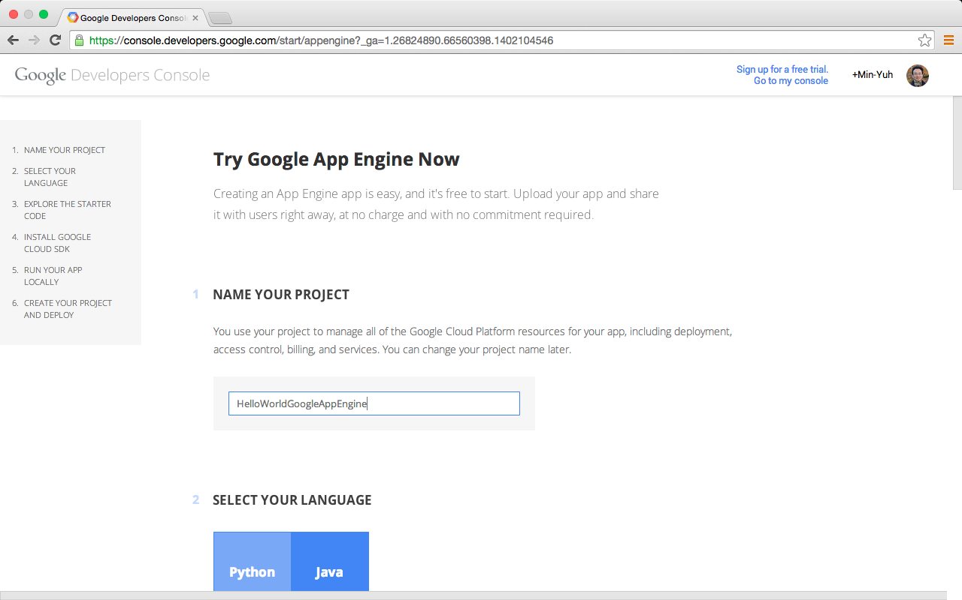
Google App Engine

Slide 53
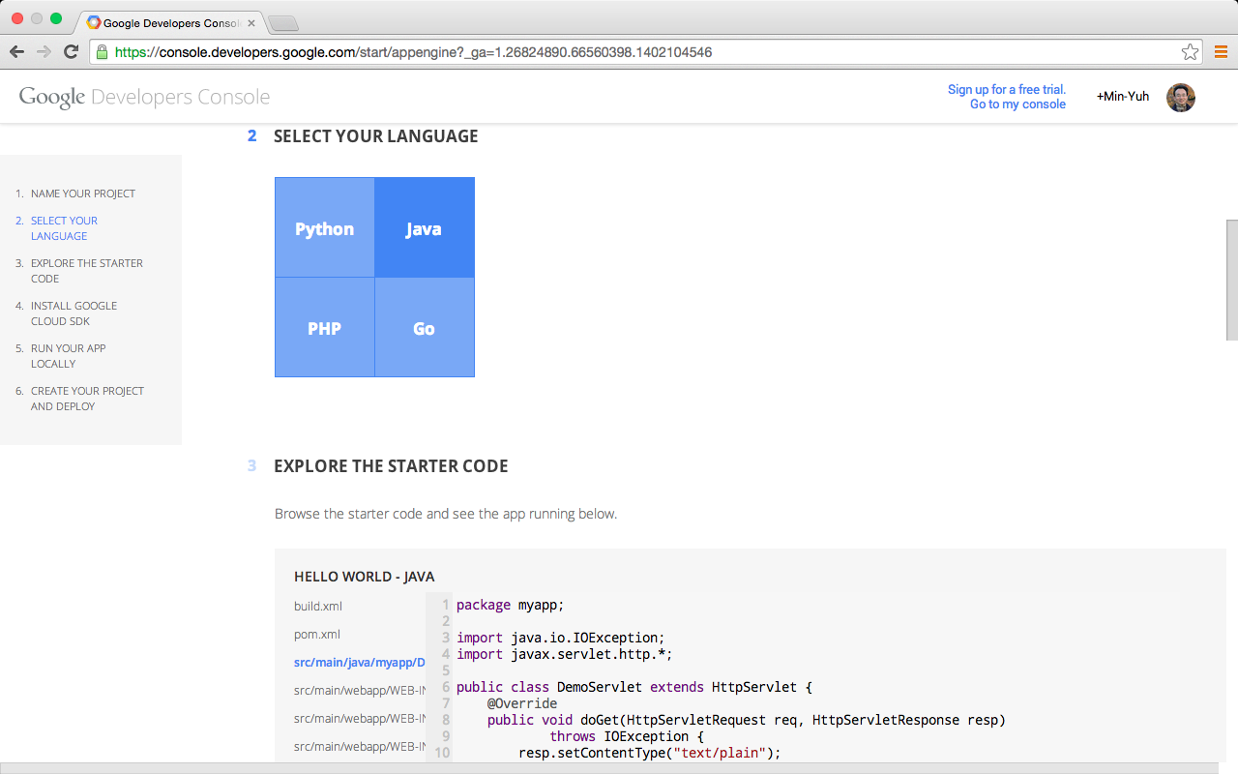
Google App Engine

Slide 54
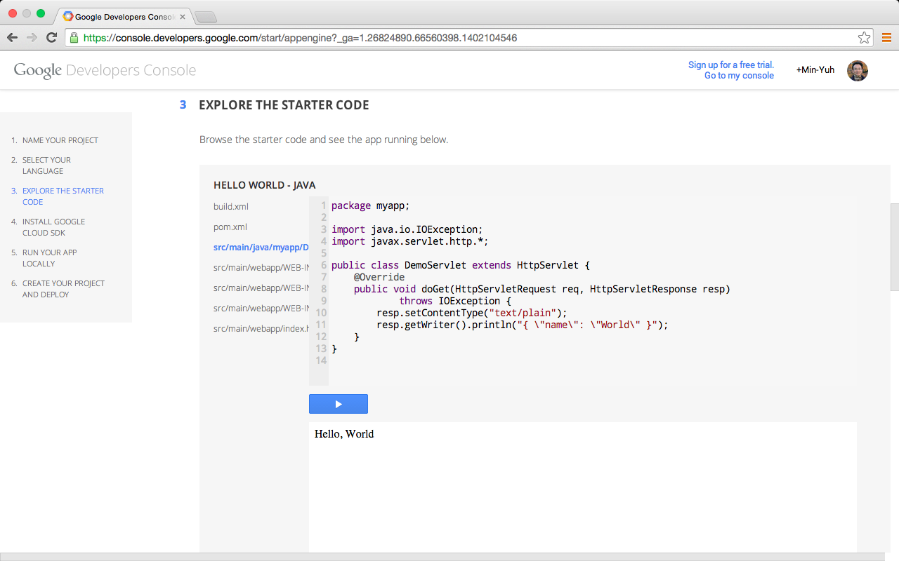
Google App Engine

Slide 55
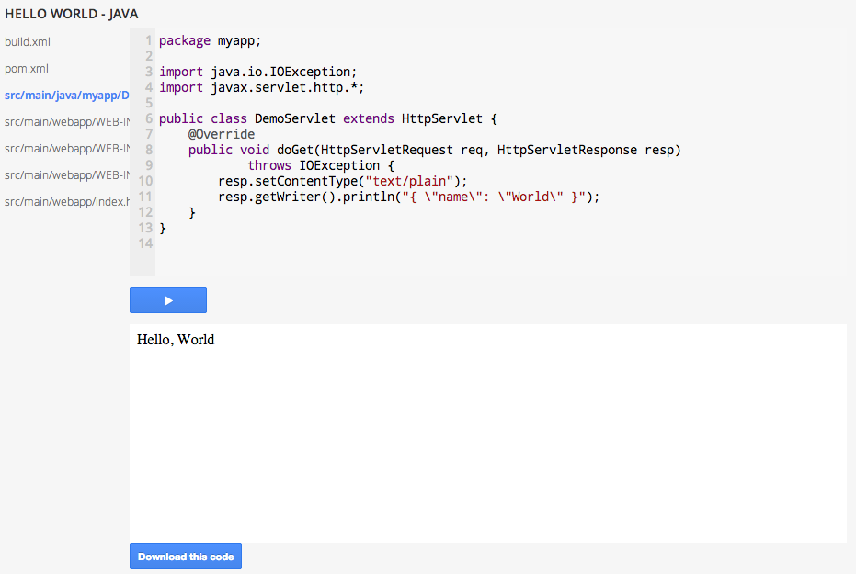
Google App Engine

Slide 56
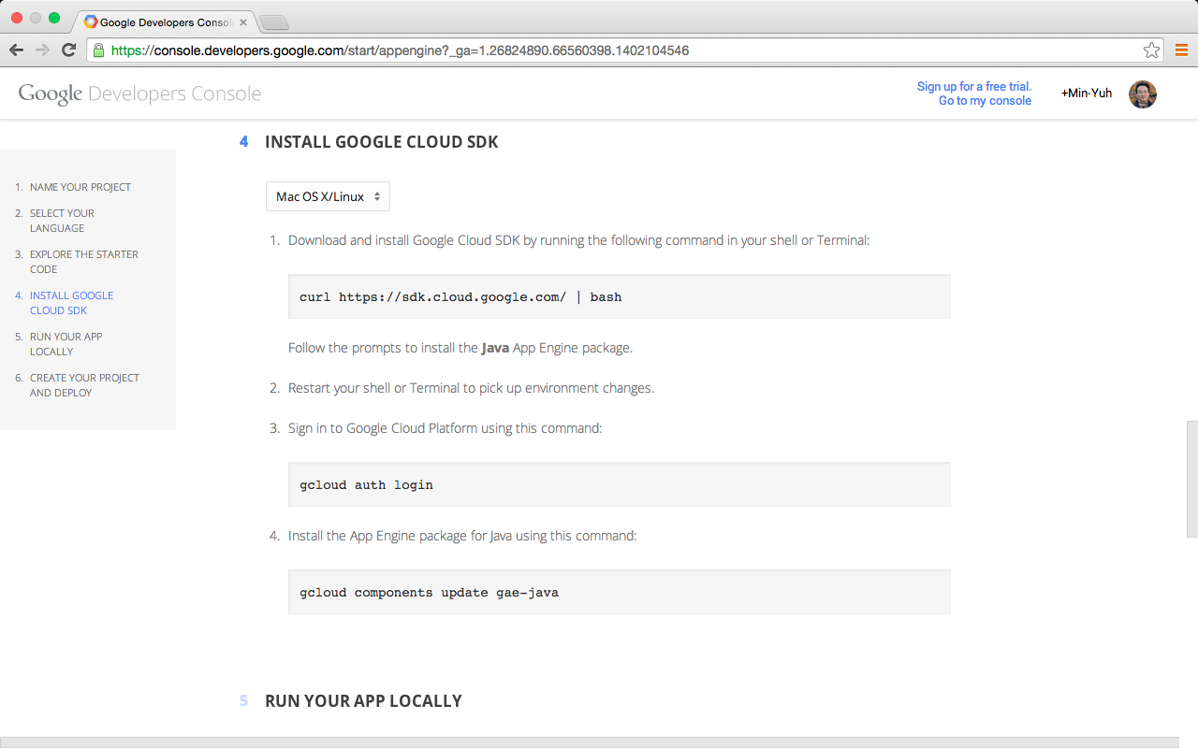
Google App Engine

Slide 57
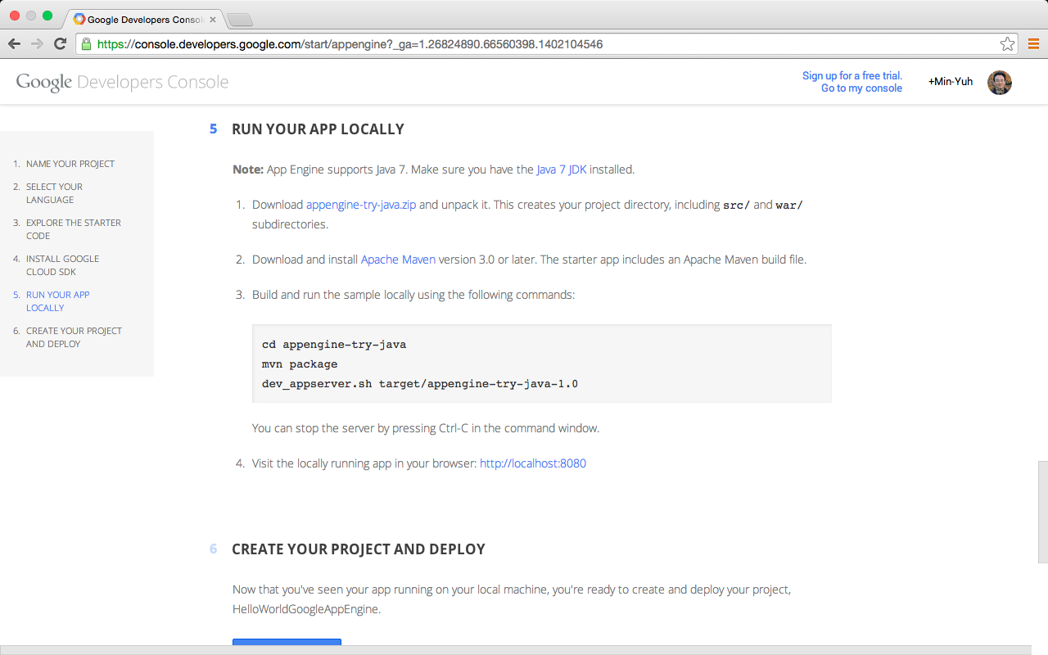
Google App Engine

Slide 58
Google App Engine

Slide 59
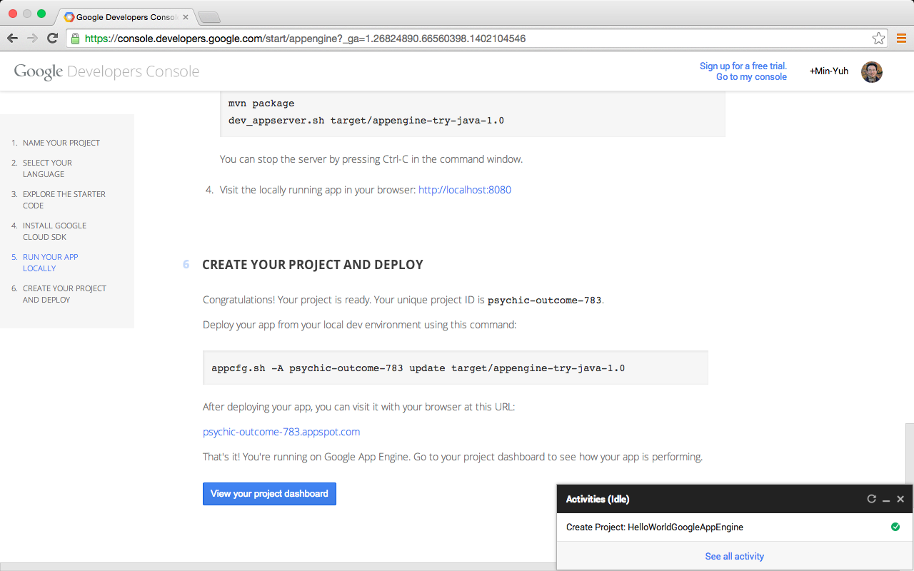
Google App Engine

Slide 60
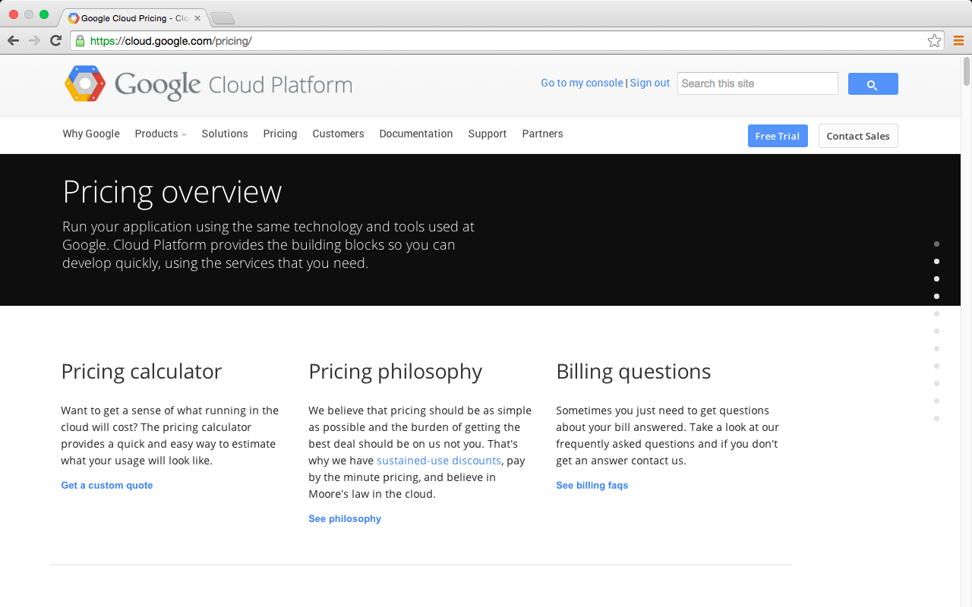
Google Cloud Platform

Slide 61
Summary
Google Cloud Platform
Google App Engine
Google Cloud Datastore
Google Cloud Endpoints
Mobile App with Google Cloud Platform

Slide 62
References
Google Cloud Platform, https://cloud.google.com/
Google App Engine, https://cloud.google.com/appengine/
Google Cloud Datastore, https://cloud.google.com/datastore/
Google Cloud Endpoints, https://cloud.google.com/endpoints/

