Slide 1
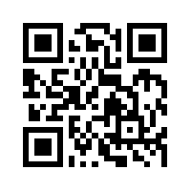
Social Media Apps Programming
Tamkang University
jQuery Mobile
1021SMAP06
TLMXM1A (8687) (M2143) (Fall 2013)
(MIS MBA) (2 Credits, Elective) [Full English Course]
Thu 9,10 (16:10-18:00) V201
Min-Yuh Day, Ph.D.
Assistant Professor
Department of Information Management
Tamkang University
http://mail.tku.edu.tw/myday
2013-11-07

Slide 2
Course Schedule (1/3)
Week Date Subject/Topics
1 2013/09/19 Mid-Autumn Festival (Day off)
2 2013/09/26 Course Orientation and Introduction to Social Media and Mobile Apps Programming
3 2013/10/03 Introduction to Android / iOS Apps Programming
4 2013/10/10 Double Tenth Day (Day off)
5 2013/10/17 Developing Android Native Apps with Java (Eclipse) (MIT App Inventor)
6 2013/10/24 Developing iPhone / iPad Native Apps with Objective-C (Xcode)

Slide 3
Course Schedule (2/3)
Week Date Subject/Topics
7 2013/10/31 Mobile Apps using HTML5/CSS3/JavaScript
8 2013/11/07 jQuery Mobile
9 2013/11/14 Create Hybrid Apps with Phonegap
10 2013/11/21 Midterm Exam Week (Midterm Project Report)
11 2013/11/28 jQuery Mobile/Phonegap
12 2013/12/05 Invited Talk: Social, Mobile and Business Model in PIXNET [Invited Speaker: Dr. Rick Cheng-Yu Lu]

Slide 4
Course Schedule (3/3)
Week Date Subject/Topics
13 2013/12/12 Google App Engine and Google Map API
14 2013/12/19 Facebook API (Facebook JavaScript SDK) (Integrate Facebook with iOS/Android Apps)
15 2013/12/26 Twitter API
16 2014/01/02 Case Study on Social Media Apps Programming and Marketing in Google Play and App Store
17 2014/01/09 Final Project Presentation
18 2014/01/16 Final Exam Week (Final Project Report)

Slide 5
Outline
jQuery Mobile
JavaScript Library
jQuery
jQuery UI
Demo
Building Mobile Apps with JQuery Mobile

Slide 6
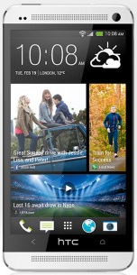
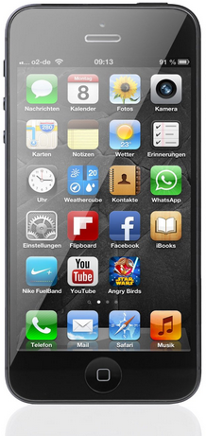
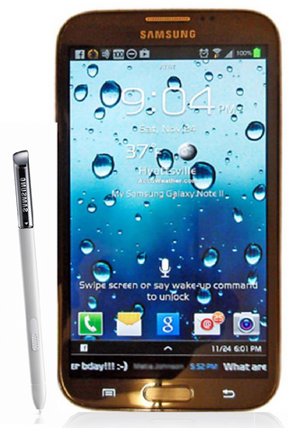
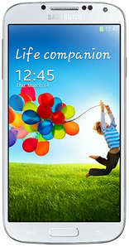
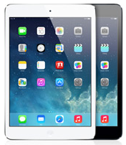
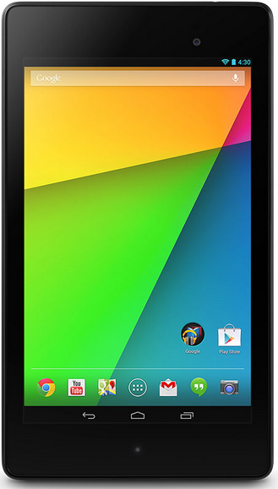
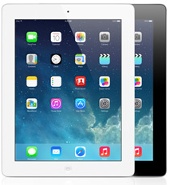
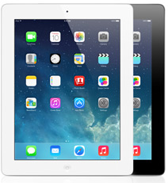
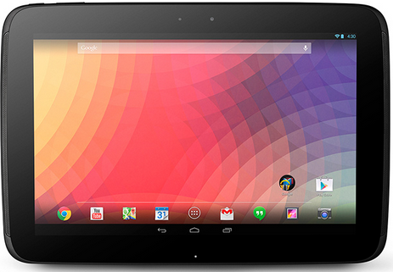
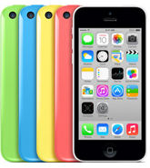
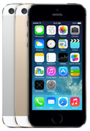
Android /iOS Apps Programming
Native Apps
Hybrid Apps
Mobile Web Apps

Slide 7
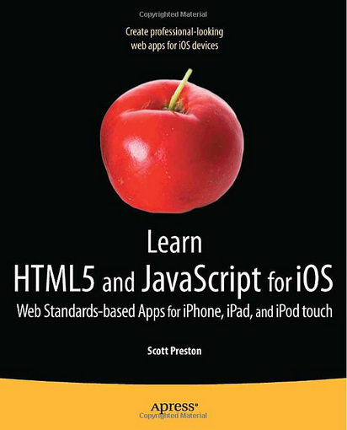
Learn HTML5 and JavaScript for iOS: Web Standards-based Apps for iPhone, iPad, and iPod touch, Scott Preston, Apress, 2012
Source: http://www.amazon.com/Learn-HTML5-JavaScript-iOS-Standards-based/dp/1430240385

Slide 8
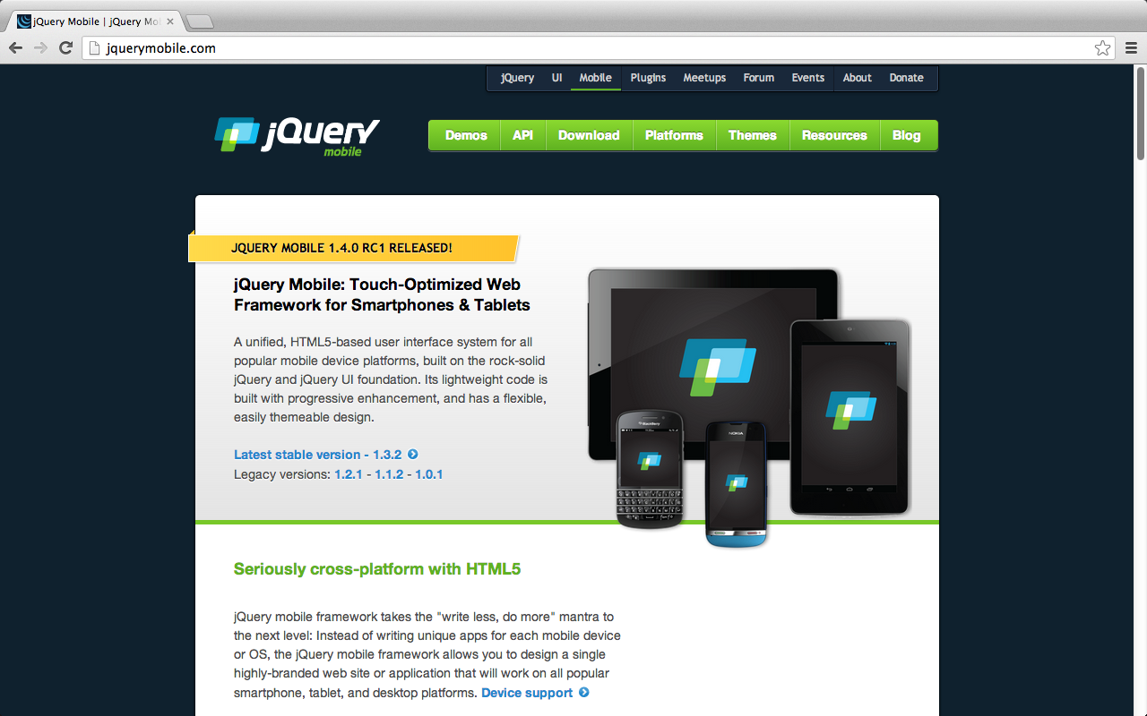
jQuery Mobile
http://jquerymobile.com/

Slide 9
jQuery Mobile
Touch-Optimized Web Framework for Smartphones & Tablets
A unified, HTML5-based user interface system for all popular mobile device platforms
built on the rock-solid jQuery and jQuery UI foundation.
Its lightweight code is built with progressive enhancement, and has a flexible, easily themeable design.
Source: http://jquerymobile.com/

Slide 10
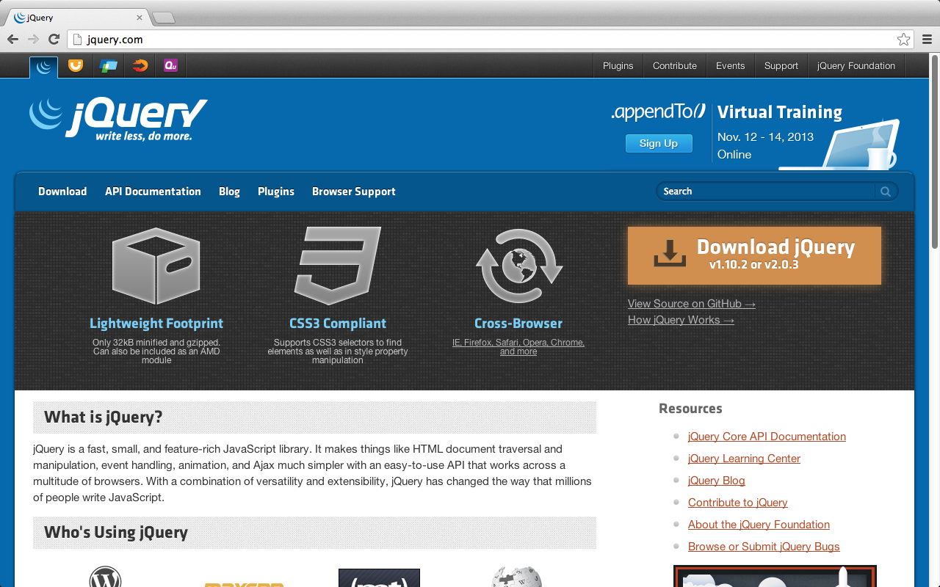
http://jquery.com/

Slide 11
jQuery
jQuery is a fast, small, and feature-rich JavaScript library.
jQuery is the most popular JavaScript library
versatility and extensibility
It makes things like HTML document traversal and manipulation, event handling, animation, and Ajax much simpler with an easy-to-use API that works across a multitude of browsers.
Source: http://jquery.com/

Slide 12
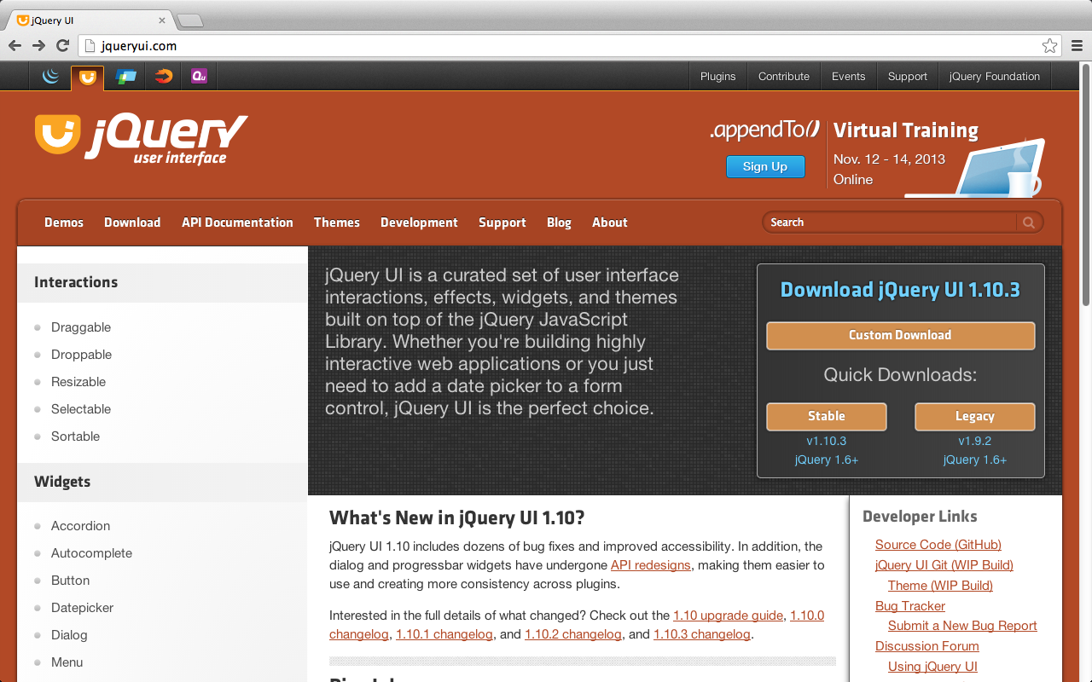
jQuery UI
http://jqueryui.com/

Slide 13
jQuery Mobile
Seriously cross-platform with HTML5
write less, do more
Source: http://jquerymobile.com/

Slide 14
jquery-1.9.1.min.js jquery.mobile.min.css jquery.mobile.min.js
<!DOCTYPE html>
<html>
<head>
<title>Mobile App Title</title>
<meta charset=utf-8 />
<meta name="viewport" content="width=device-width, initial-scale=1" />
<script src="http://code.jquery.com/jquery-1.9.1.min.js"></script>
<link type="text/css" href="http://code.jquery.com/mobile/latest/jquery.mobile.min.css" rel="stylesheet" />
<script type="text/javascript" src="http://code.jquery.com/mobile/latest/jquery.mobile.min.js"></script>
</head>
<body>
</body>
</html>

Slide 15
jQuery Mobile: Mobile Graded Browser Support
jQuery Mobile has broad support for the vast majority of all modern desktop, smartphone, tablet, and e-reader platforms.
A-grade – Full enhanced experience with Ajax-based animated page transitions.
Apple iOS 3.2*-6.1
Tested on the original iPad (4.3 / 5.0), iPad 2 (4.3 / 5.1 / 6.1), iPad 3 (5.1 / 6.0), iPad Mini (6.1), 3GS (4.3), 4 (4.3 / 5.1), and 4S (5.1 / 6.0), and 5 (6.0)
Android 2.1-2.3, 3.2, 4.0, 4.1-4.2 (Jelly Bean)
Tested on the HTC Incredible (2.2), original Droid (2.2), HTC Aria (2.1), Google Nexus S (2.3).
Tested on a Galaxy Nexus and Galaxy 7
Source: http://jquerymobile.com/gbs/

Slide 16
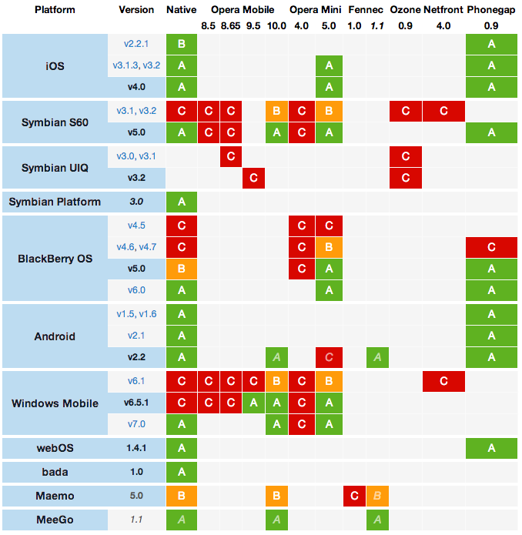
jQuery Mobile: Original Graded Browser Matrix
Source: http://jquerymobile.com/original-graded-browser-matrix/

Slide 17
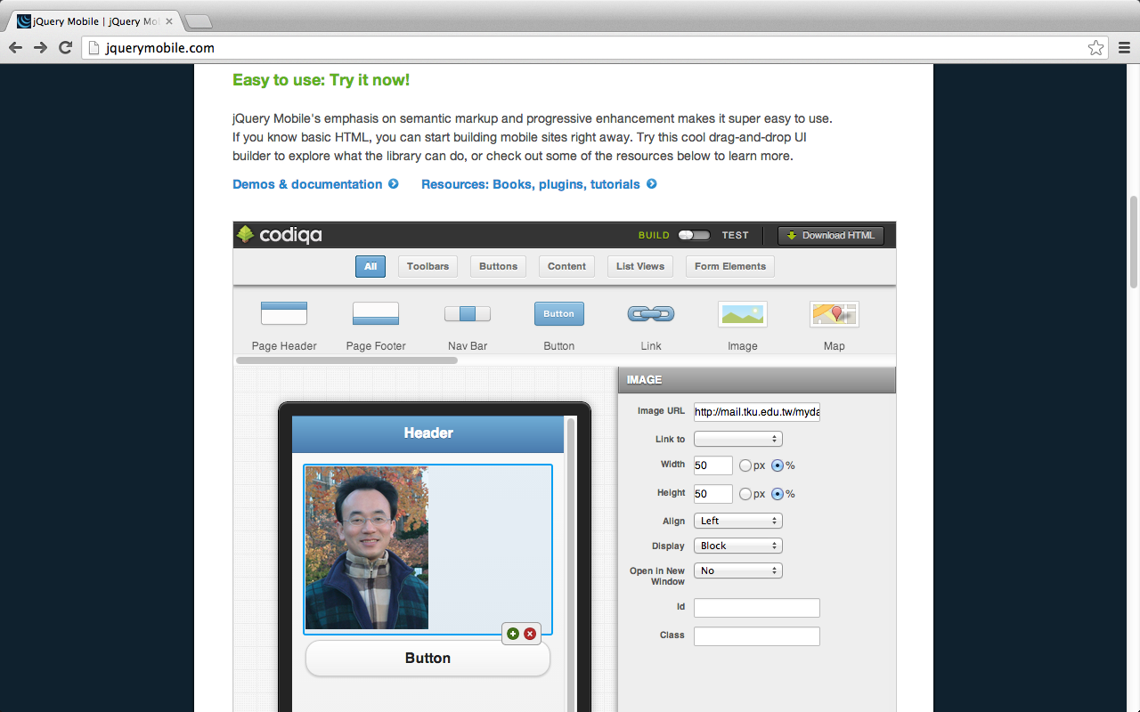
codiqa: drag-and-drop builder for mobile apps
Source: http://jquerymobile.com/

Slide 18
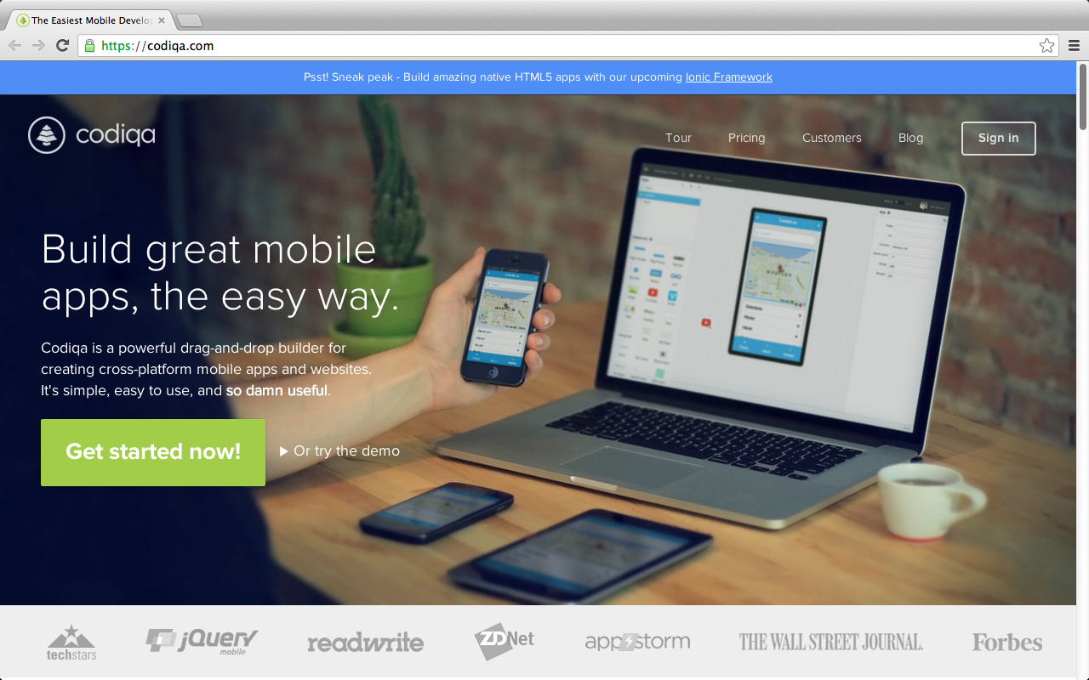
codiqa: drag-and-drop builder for mobile apps
https://codiqa.com/

Slide 19
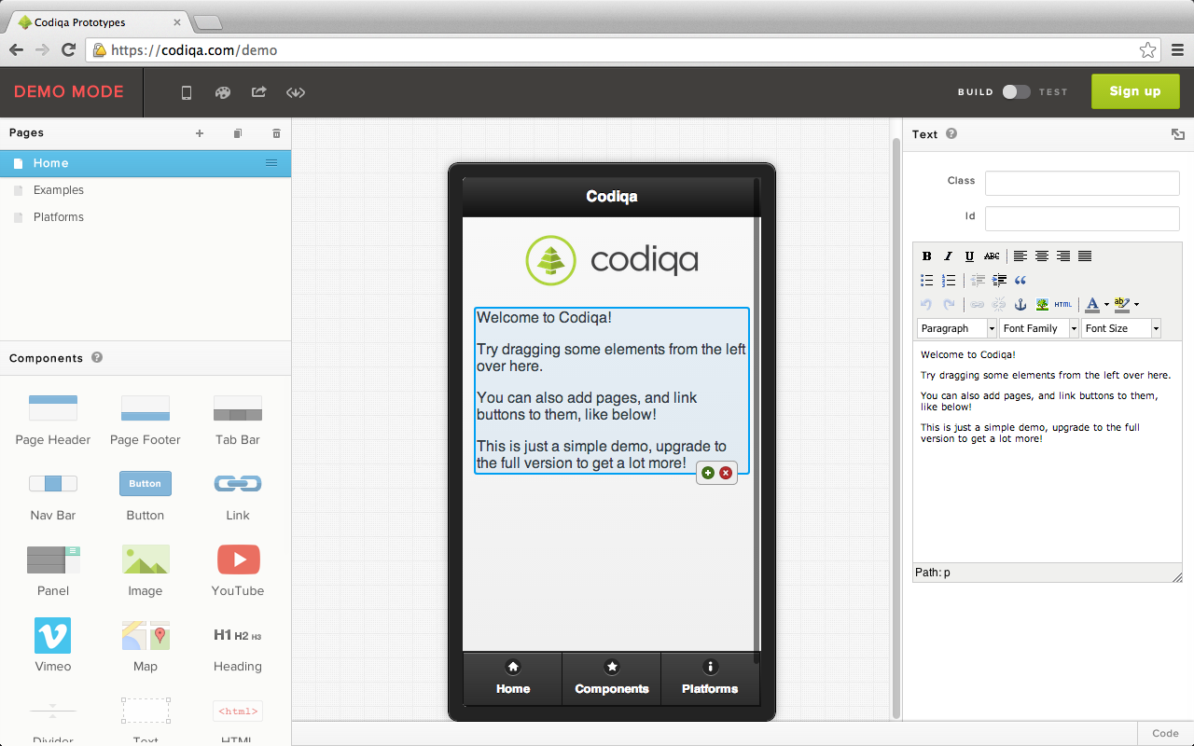
codiqa demo
https://codiqa.com/demo

Slide 20
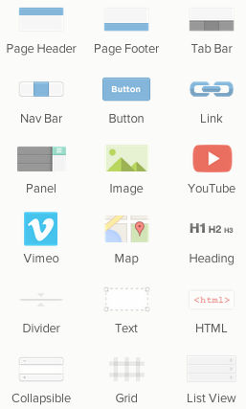
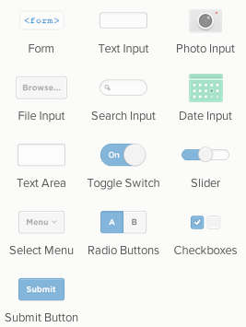
Codiqa Components
https://codiqa.com/demo

Slide 21
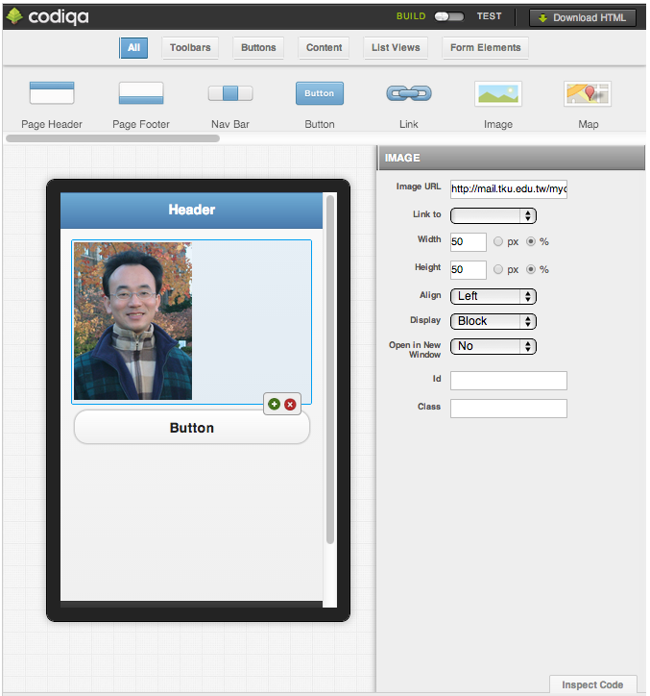
Source: http://jquerymobile.com/

Slide 22
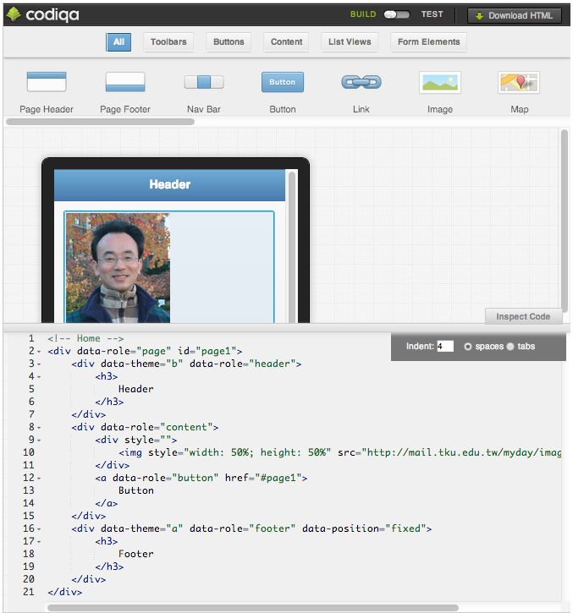
Source: http://jquerymobile.com/

Slide 23
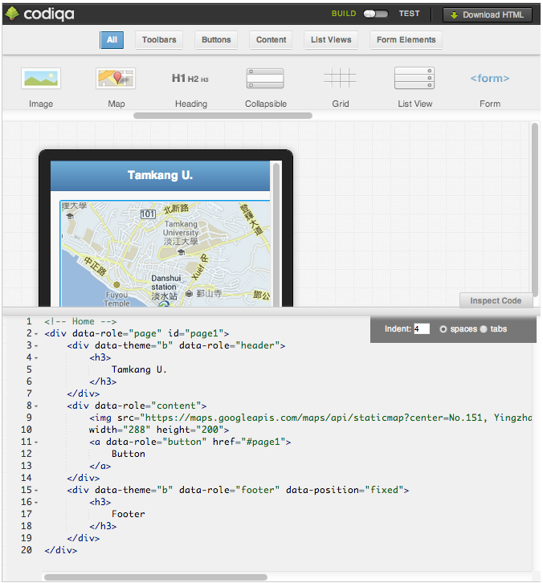
Source: http://jquerymobile.com/

Slide 24
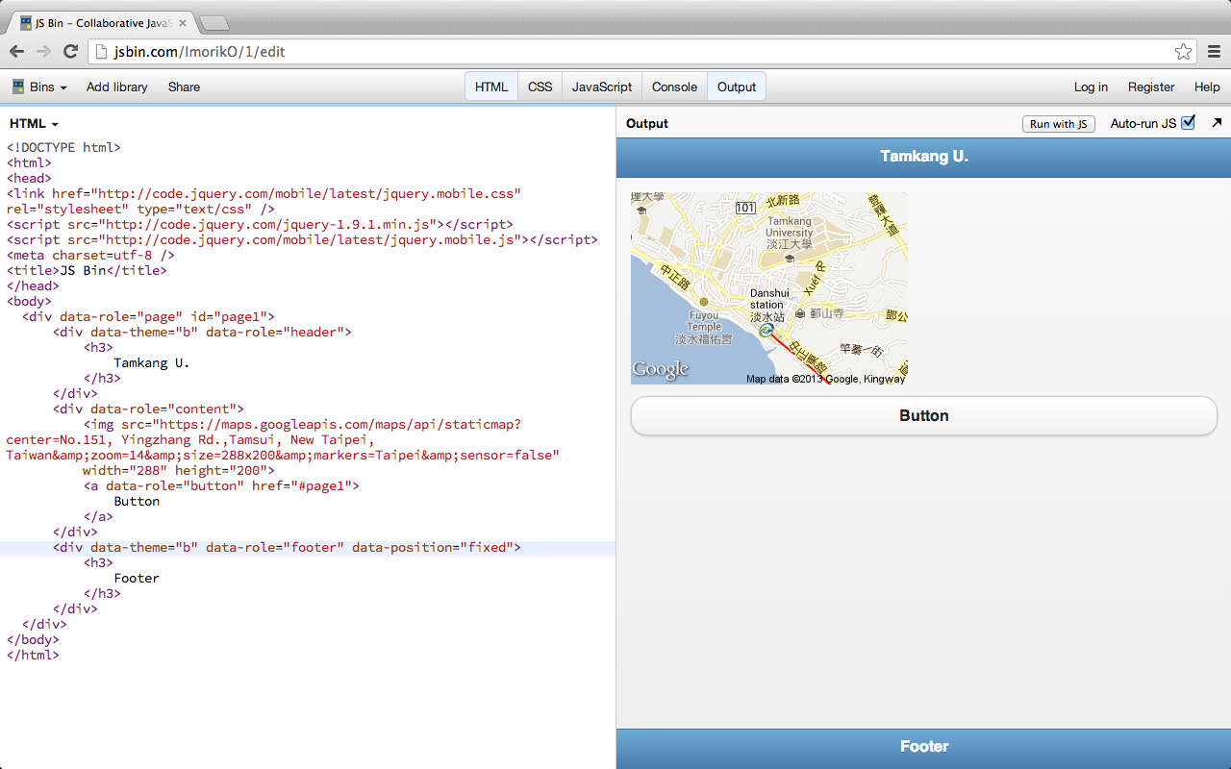
http://jsbin.com/ImorikO/1/edit

Slide 25
<!DOCTYPE html>
<html>
<head>
<link href="http://code.jquery.com/mobile/latest/jquery.mobile.css" rel="stylesheet" type="text/css" />
<script src="http://code.jquery.com/jquery-1.9.1.min.js"></script>
<script src="http://code.jquery.com/mobile/latest/jquery.mobile.js"></script>
<meta charset=utf-8 />
<title>JS Bin</title>
</head>
<body>
<div data-role="page" id="page1">
<div data-theme="b" data-role="header">
<h3>
Tamkang U.
</h3>
</div>
<div data-role="content">
<img src="https://maps.googleapis.com/maps/api/staticmap?center=No.151, Yingzhang Rd.,Tamsui, New Taipei, Taiwan&amp;zoom=14&amp;size=288x200&amp;markers=Taipei&amp;sensor=false"
width="288" height="200">
<a data-role="button" href="#page1">
Button
</a>
</div>
<div data-theme="b" data-role="footer" data-position="fixed">
<h3>
Footer
</h3>
</div>
</div>
</body>
</html>

Slide 26
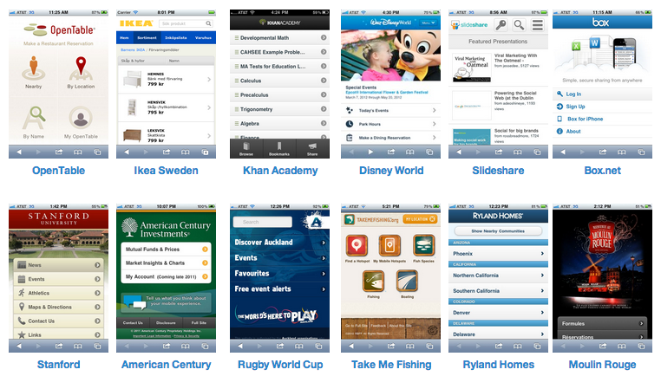
Get inspired: Built with jQuery Mobile
Source: http://jquerymobile.com/
Notes:
Get inspired: Built with jQuery Mobile
There are hundreds of popular web sites and apps built with jQuery Mobile. Here's a small sampling of sites collected on jQM Gallery - be sure to check that site often to see what's new and notable.

Slide 27
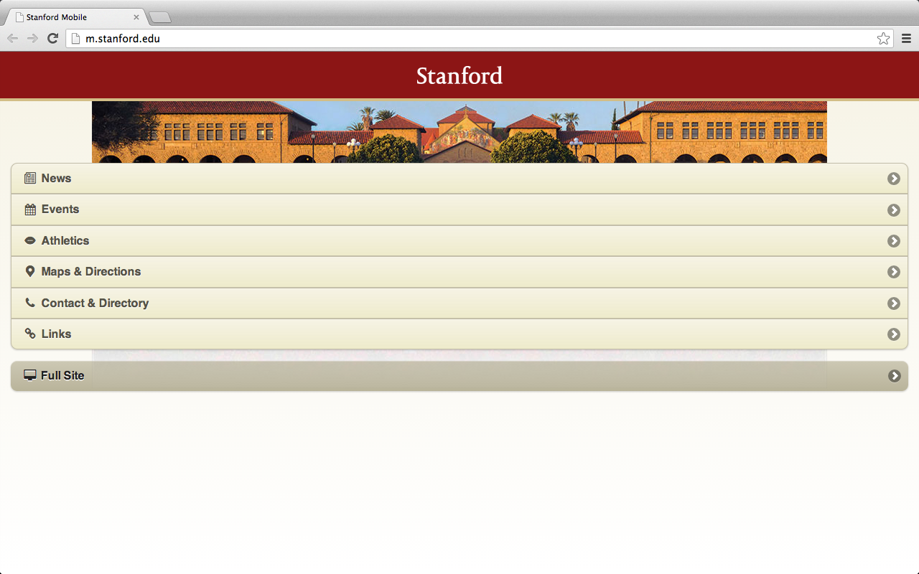
http://m.stanford.edu/

Slide 28
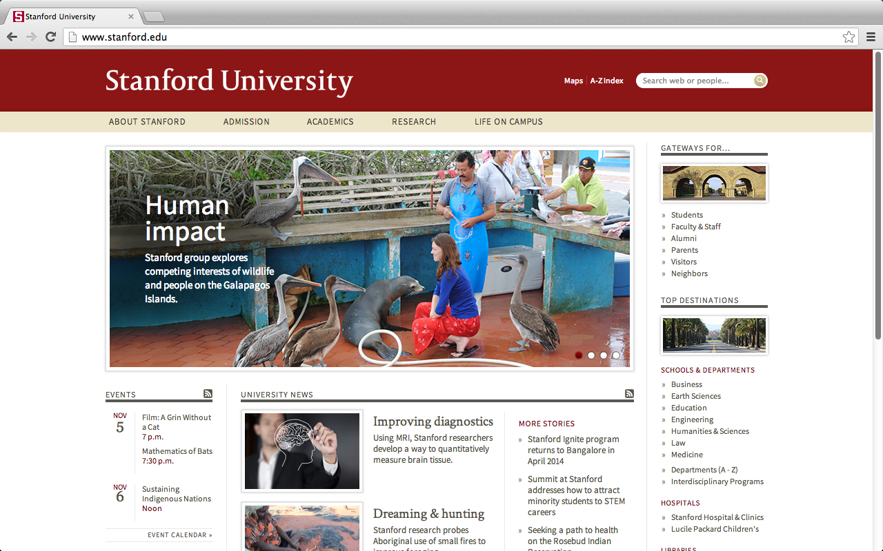
http://www.stanford.edu/

Slide 29
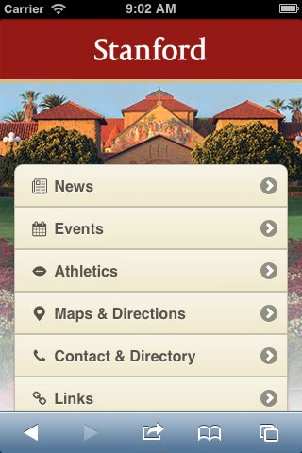
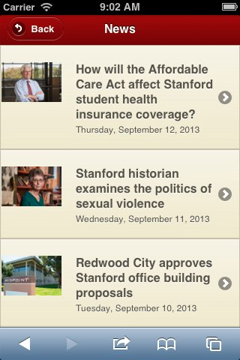
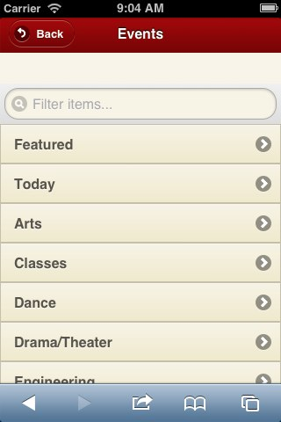
Mobile website for Stanford University http://m.stanford.edu
http://www.jqmgallery.com/2011/06/10/stanford/

Slide 30
data-role="page”
<div data-role="page" id="first" data-theme="b">
<div data-role="header">
<div data-role="content">
<div data-role="page" id="first" data-theme="b">
<div data-role="header">
<h1>Page Header</h1>
</div><!-- /header -->
<div data-role="content">
<p>Page content goes here.</p>
<a href="#second">Go to second page</a>
</div><!-- /content -->
<div data-role="footer" data-position="fixed">
<h4>Page Footer</h4>
</div><!-- /footer -->
</div><!-- /page -->
<div data-role="footer" data-position="fixed">

Slide 31
data-role=“button”
<a href="#" data-role="button" data-icon="star">Star button</a>
Source: http://view.jquerymobile.com/1.3.2/dist/demos/intro/

Slide 32
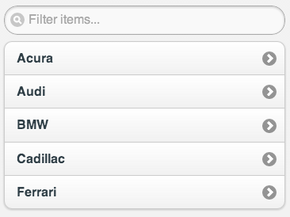
data-role=“listview”
<ul data-role="listview" data-inset="true” data-filter="true">
<li><a href="#">Acura</a></li>
<li><a href="#">Audi</a></li>
<li><a href="#">BMW</a></li>
<li><a href="#">Cadillac</a></li>
<li><a href="#">Ferrari</a></li>
</ul>

Slide 33
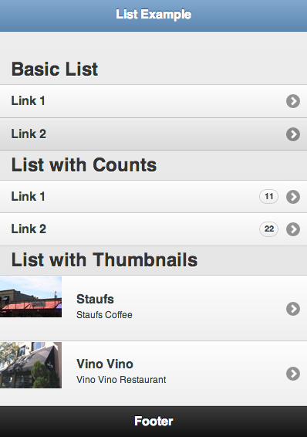
ListView Example
http://www.learnhtml5book.com/chapter5/jquerymobile/lists.html

Slide 34
ListView Example
<div data-role="page" >
<header data-role="header" data-theme="b">
<h1>List Example</h1>
</header>
<section data-role="content">
<h1>Basic List</h1>
<ul data-role="listview">
<li><a href="">Link 1</a></li>
<li><a href="">Link 2</a></li>
</ul>
<h1>List with Counts</h1>
<ul data-role="listview">
<li><a href="">Link 1</a><span class="ui-li-count ui-btn-up-c ui-btn-corner-all">11</span></li>
<li><a href="">Link 2</a><span class="ui-li-count ui-btn-up-c ui-btn-corner-all">22</span></li>
</ul>
<h1>List with Thumbnails</h1>
<ul data-role="listview">
<li><a href="index.html" class="ui-link-inherit">
<img src="staufs_thumb.jpg" class="ui-li-thumb">
<h3 class="ui-li-heading">Staufs</h3>
<p class="ui-li-desc">Staufs Coffee</p>
</a>
</li>
<li><a href="index.html" class="ui-link-inherit">
<img src="vino-vino_thumb.jpg" class="ui-li-thumb">
<h3 class="ui-li-heading">Vino Vino</h3>
<p class="ui-li-desc">Vino Vino Restaurant</p>
</a>
</li>
</ul>
</section>
http://www.learnhtml5book.com/chapter5/jquerymobile/lists.html

Slide 35
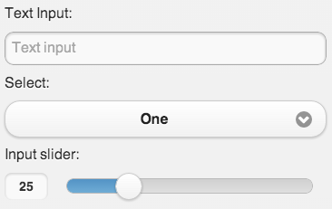
Form Element
<form>
<label for="textinput-s">Text Input:</label>
<input type="text" name="textinput-s" id="textinput-s" placeholder="Text input" value="" data-clear-btn="true">
<label for="select-native-s">Select:</label>
<select name="select-native-s" id="select-native-s">
<option value="small">One</option>
<option value="medium">Two</option>
<option value="large">Three</option>
</select>
<label for="slider-s">Input slider:</label>
<input type="range" name="slider-s" id="slider-s" value="25" min="0" max="100" data-highlight="true">
</form>

Slide 36
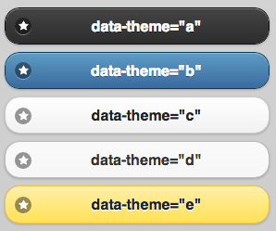
data-theme=“a”
<a href="#" data-role="button" data-icon="star" data-theme="a">data-theme="a"</a>
<a href="#" data-role="button" data-icon="star" data-theme="b">data-theme="b"</a>
<a href="#" data-role="button" data-icon="star”ç>data-theme="c"</a>
<a href="#" data-role="button" data-icon="star" data-theme="d">data-theme="d"</a>
<a href="#" data-role="button" data-icon="star" data-theme="e">data-theme="e"</a>
Source: http://view.jquerymobile.com/1.3.2/dist/demos/intro/

Slide 37
data-icon=“star”
<a href="#" data-role="button" data-icon="star" data-theme="c">data-icon="star"</a>
Custom Icons
.ui-icon-myapp-email {
background-image: url("app-icon-email.png");
}
white icon
18x18 pixels
PNG-8 with alpha transparency
Source: http://view.jquerymobile.com/1.3.2/dist/demos/widgets/icons/

Slide 38
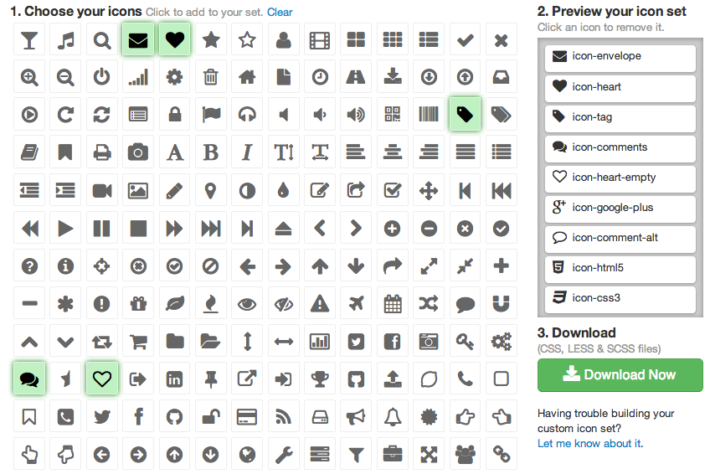
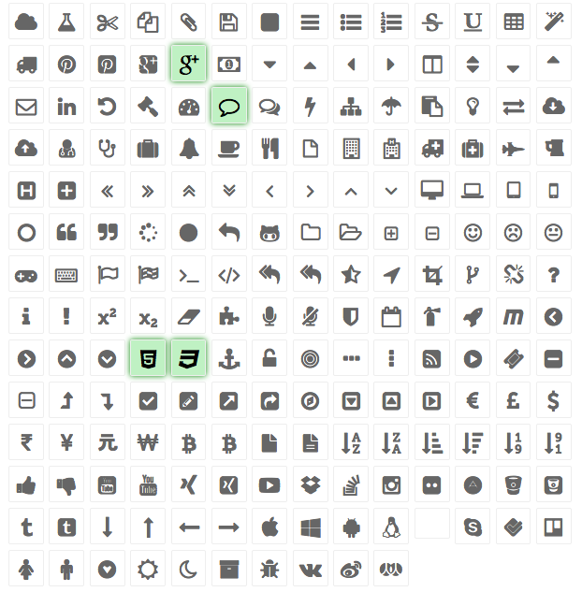
jQuery Mobile Icon Pack
Source: http://jqmiconpack.andymatthews.net/

Slide 39
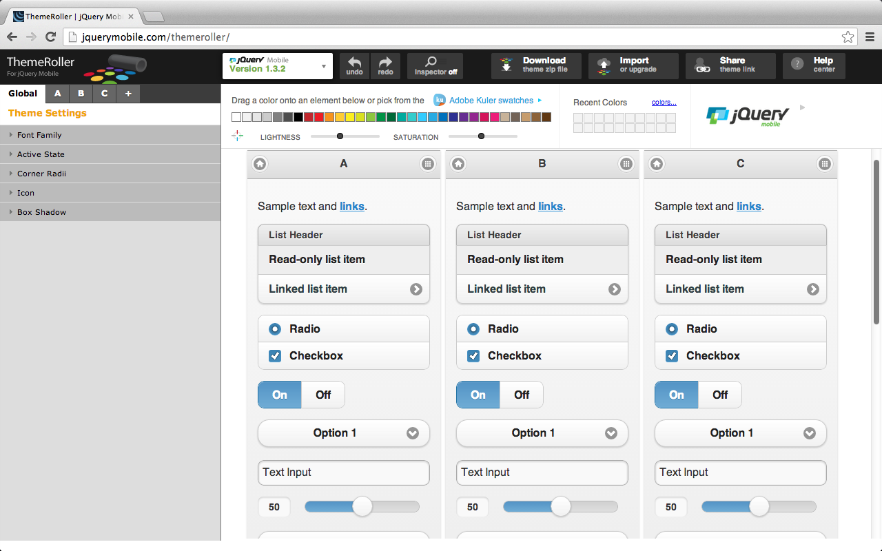
ThemeRoller for jQuery Mobile
http://jquerymobile.com/themeroller/

Slide 40
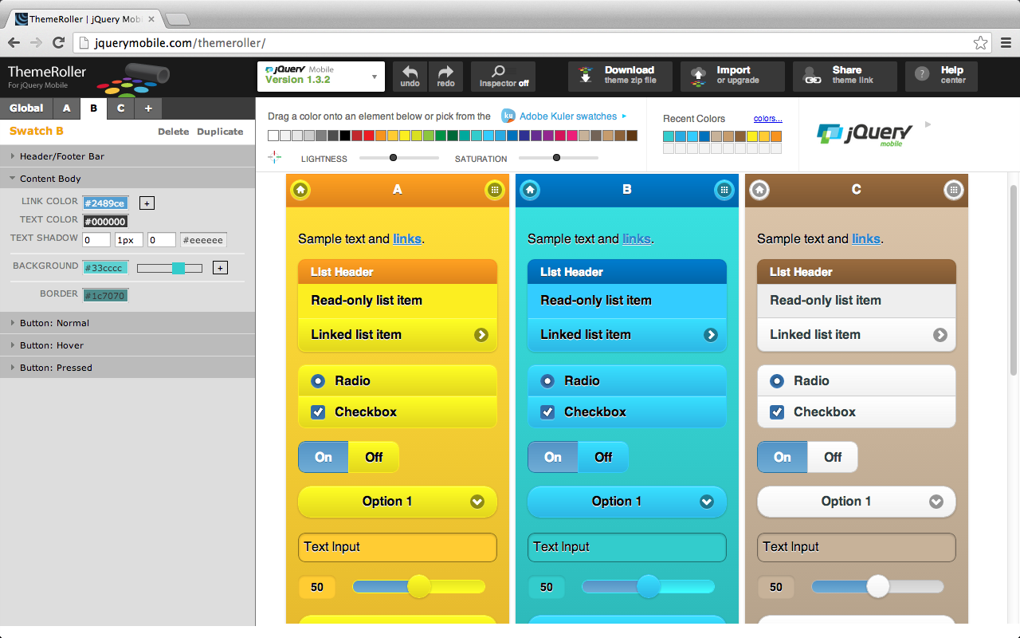
ThemeRoller for jQuery Mobile
http://jquerymobile.com/themeroller/

Slide 41
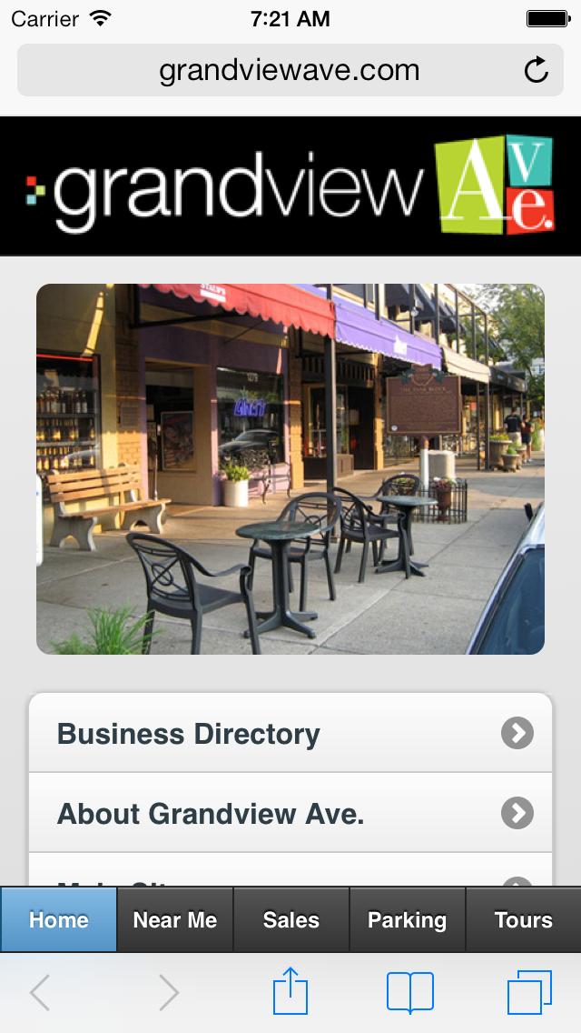
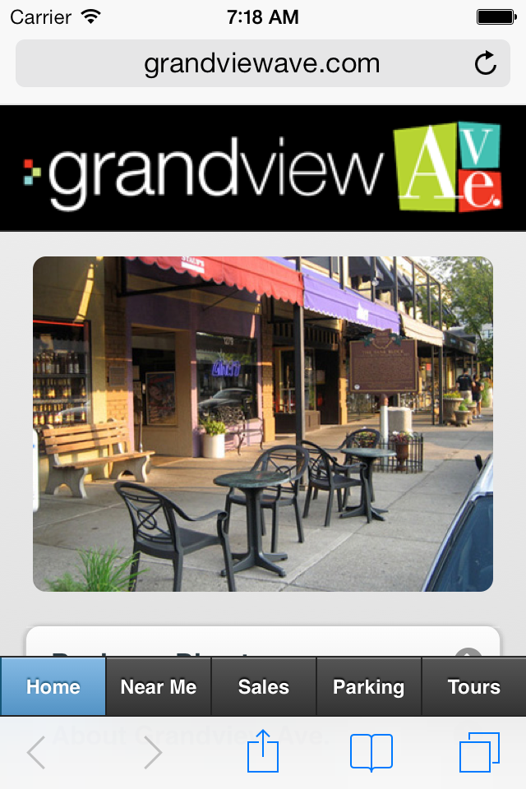
http://grandviewave.com

Slide 42
Demo Building Mobile Apps with jQuery Mobile
http://jsbin.com

Slide 43
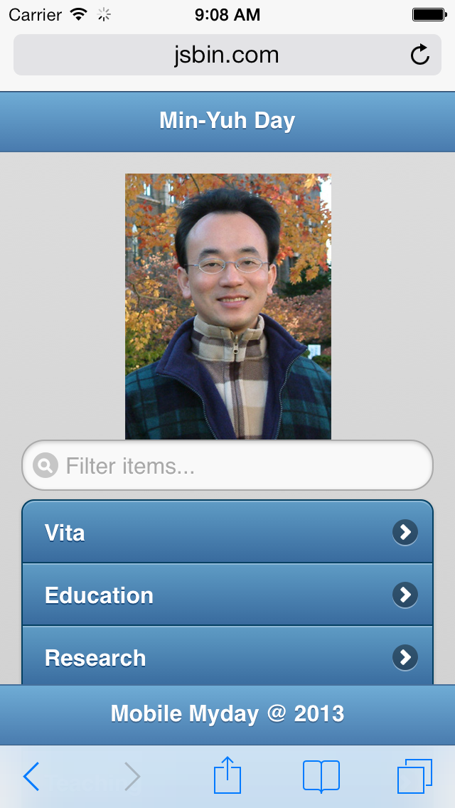
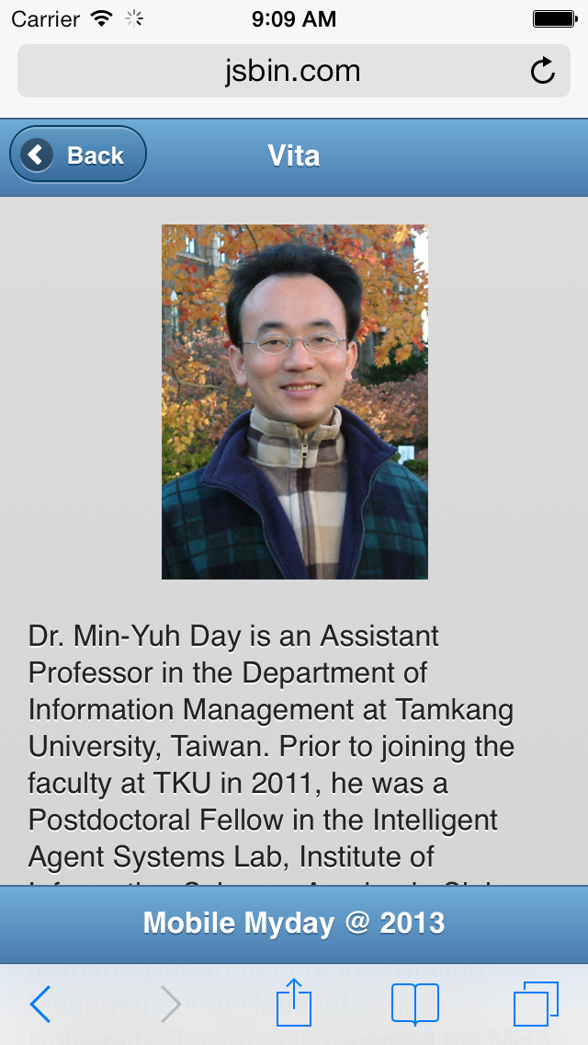
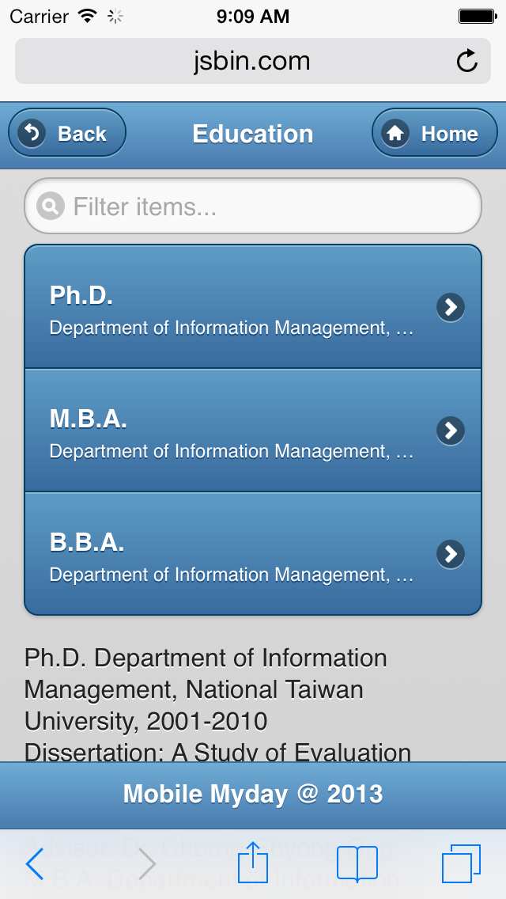
Mobile Myday
http://jsbin.com/IwOMezo

Slide 44
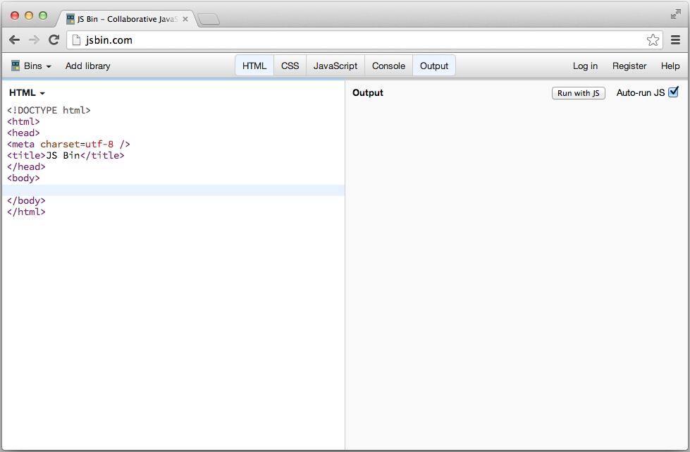
Online Editor: http://jsbin.com
http://jsbin.com/

Slide 45
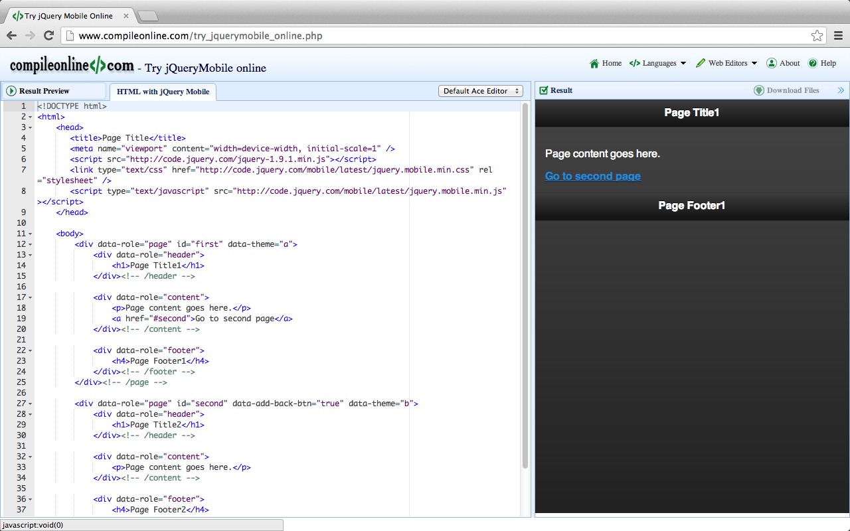
CompileOnline: Try jQueryMobile Online
http://www.compileonline.com/try_jquerymobile_online.php

Slide 46
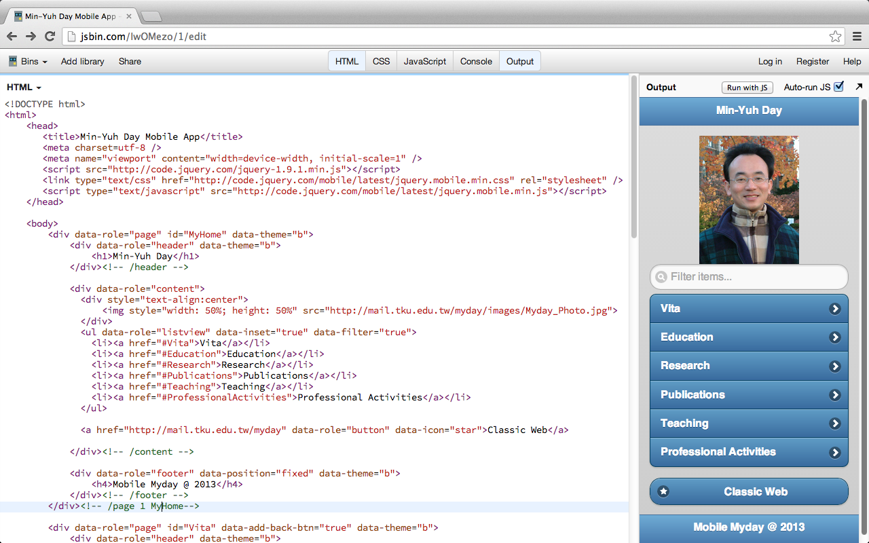
http://jsbin.com/IwOMezo

Slide 47
jQuery jQuery.Mobile js css
<!DOCTYPE html>
<html>
<head>
<title>Min-Yuh Day Mobile App</title>
<meta charset=utf-8 />
<meta name="viewport" content="width=device-width, initial-scale=1" />
<script src="http://code.jquery.com/jquery-1.9.1.min.js"></script>
<link type="text/css" href="http://code.jquery.com/mobile/latest/jquery.mobile.min.css" rel="stylesheet" />
<script type="text/javascript" src="http://code.jquery.com/mobile/latest/jquery.mobile.min.js"></script>
</head>
http://jsbin.com/IwOMezo

Slide 48
Page 1 MyHome
<body>
<div data-role="page" id="first" data-theme="b">
<div data-role="header" data-theme="b">
<h1>Min-Yuh Day</h1>
<a href="index.html" data-icon="home">Home</a>
</div><!-- /header -->
<div data-role="content">
<div style="text-align:center">
<img style="width: 50%; height: 50%" src="http://mail.tku.edu.tw/myday/images/Myday_Photo.jpg">
</div>
<ul data-role="listview" data-inset="true" data-filter="true">
<li><a href="#Vita">Vita</a></li>
<li><a href="#Education">Education</a></li>
<li><a href="#Research">Research</a></li>
<li><a href="#Publications">Publications</a></li>
<li><a href="#Teaching">Teaching</a></li>
<li><a href="#ProfessionalActivities">Professional Activities</a></li>
</ul>
<a href="http://mail.tku.edu.tw/myday" data-role="button" data-icon="star">Classic Web</a>
</div><!-- /content -->
<div data-role="footer" data-position="fixed" data-theme="b">
<h4>Mobile Myday @ 2013</h4>
</div><!-- /footer -->
</div><!-- /page 1-->
http://jsbin.com/IwOMezo

Slide 49
Page 2 Vita
<div data-role="page" id="Vita" data-add-back-btn="true" data-theme="b">
<div data-role="header" data-theme="b">
<h1>Vita</h1>
</div><!-- /header -->
<div data-role="content">
<div style="text-align:center">
<img style="width: 50%; height: 50%" src="http://mail.tku.edu.tw/myday/images/Myday_Photo.jpg">
</div>
<p>Dr. Min-Yuh Day is an Assistant Professor in the Department of Information Management at Tamkang University, Taiwan. ….</p>
</div><!-- /content -->
<div data-role="footer" data-position="fixed" data-theme="b">
<h4>Mobile Myday @ 2013</h4>
</div><!-- /footer -->
</div><!-- /page 2 Vita-->
http://jsbin.com/IwOMezo

Slide 50
Page 3 Education
<div data-role="page" id="Education" data-theme="b">
<div data-role="header" data-position="inline" data-theme="b">
<a data-icon="back" data-rel="back" back-btn="true">Back</a>
<h1>Education</h1>
<a href="#" data-icon="home">Home</a>
</div><!-- /header -->
<div data-role="content">
<ul data-role="listview" data-inset="true" data-filter="true">
<li>
<a href="#" class="ui-link-inherit">
<h3 class="ui-li-heading">Ph.D.</h3>
<p class="ui-li-desc">Department of Information Management, National Taiwan University, 2001-2010</p>
</a>
</li>
<li>
<a href="#" class="ui-link-inherit">
<h3 class="ui-li-heading">M.B.A.</h3>
<p class="ui-li-desc">Department of Information Management, Tamkang University, 1993-1995</p>
</a>
</li>
<li>
<a href="#" class="ui-link-inherit">
<h3 class="ui-li-heading">B.B.A.</h3>
<p class="ui-li-desc">Department of Information Management, Tamkang University, 1989-1993</p>
</a>
</li>
</ul>
</div><!-- /content -->
<div data-role="footer" data-position="fixed" data-theme="b">
<h4>Mobile Myday @ 2013</h4>
</div><!-- /footer -->
</div><!-- /page 3 Education-->
</body>
</html>
http://jsbin.com/IwOMezo

Slide 51
Mobile Myday
http://jsbin.com/IwOMezo

Slide 52
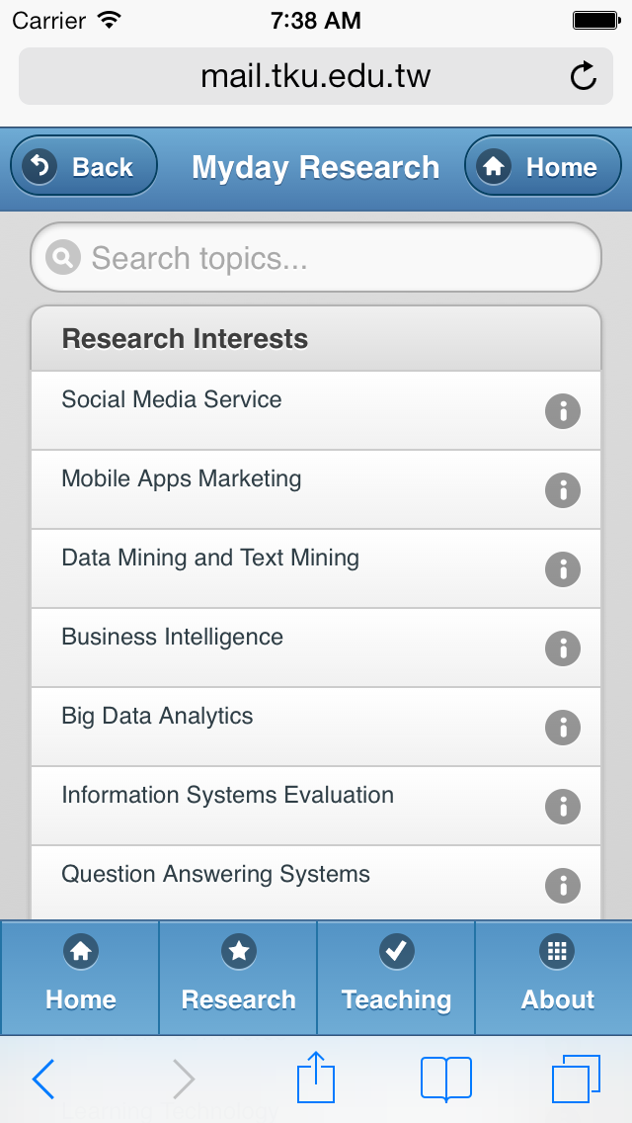
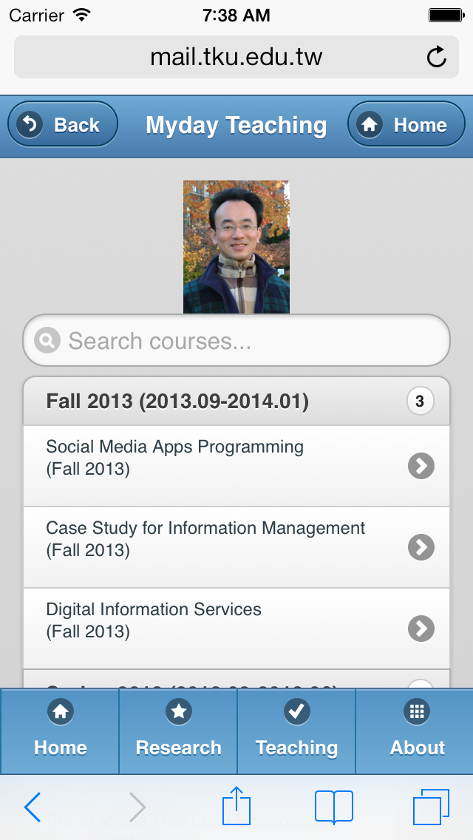
Mobile Myday
http://mail.tku.edu.tw/myday/m

Slide 53
Page 4 Research
<div data-role="page" id="Research" data-theme="b">
<div data-role="header" data-position="inline" data-theme="b">
<a data-icon="back" data-rel="back" back-btn="true">Back</a>
<h1>Myday Research</h1>
<a href="#MyHome" data-icon="home">Home</a>
</div><!-- /header -->
<div data-role="content">
<ul data-role="listview" data-inset="true" data-filter="true" data-filter-placeholder="Search topics..." data-theme="c">
<li data-role="list-divider" data-theme="c">Research Interests</li>
<li data-icon="info"><a href="#"><p>Social Media Service</p></a></li>
<li data-icon="info"><a href="#"><p>Mobile Apps Marketing</p></a></li>
<li data-icon="info"><a href="#"><p>Data Mining and Text Mining</p></a></li>
<li data-icon="info"><a href="#"><p>Business Intelligence</p></a></li>
<li data-icon="info"><a href="#"><p>Big Data Analytics</p></a></li>
<li data-icon="info"><a href="#"><p>Information Systems Evaluation</p></a></li>
<li data-icon="info"><a href="#"><p>Question Answering Systems</p></a></li>
<li data-icon="info"><a href="#"><p>Knowledge Management</p></a></li>
<li data-icon="info"><a href="#"><p>Electronic Commerce</p></a></li>
<li data-icon="info"><a href="#"><p>Learning Technology</p></a></li>
<li data-icon="info"><a href="#"><p>Intelligent Information Systems</p></a></li>
<li data-icon="info"><a href="#"><p>Biomedical Informatics</p></a></li>
</ul>
</div><!-- /content -->
<div data-role="footer" data-position="fixed" data-theme="b">
<div data-role="navbar">
<ul>
<li><a href="#MyHome" class="ui-btn-active ui-state-persist" data-transition="fade" data-icon="home">Home</a></li>
<li><a href="#Research" class="ui-btn-active ui-state-persist" data-transition="fade" data-icon="star">Research</a></li>
<li><a href="#Teaching" class="ui-btn-active ui-state-persist" data-transition="fade" data-icon="check">Teaching</a></li>
<li><a href="#About" class="ui-btn-active ui-state-persist" data-transition="fade" data-icon="grid">About</a></li>
</ul>
</div>
</div><!-- /footer -->
</div><!-- /page 4 Research-->
http://mail.tku.edu.tw/myday/m

Slide 54
Page 5 Teaching
<div data-role="page" id="Teaching" data-theme="b">
<div data-role="header" data-position="inline" data-theme="b">
<a data-icon="back" data-rel="back" back-btn="true">Back</a>
<h1>Myday Teaching</h1>
<a href="#MyHome" data-icon="home">Home</a>
</div><!-- /header -->
<div data-role="content">
<div style="text-align:center">
<img style="width: 25%; height: 25%" src="http://mail.tku.edu.tw/myday/images/Myday_Photo.jpg">
</div>
<ul data-role="listview" data-inset="true" data-filter="true" data-filter-placeholder="Search courses..." data-theme="c">
<li data-role="list-divider" data-theme="c">Fall 2013 (2013.09-2014.01)<span class="ui-li-count">3</span></li>
<li><a href="http://mail.tku.edu.tw/myday/teaching.htm#1021SMAP" rel="external"><p>Social Media Apps Programming <br>(Fall 2013)</p></a></li>
<li><a href="http://mail.tku.edu.tw/myday/teaching.htm#1021CSIM4B" rel="external"><p>Case Study for Information Management <br>(Fall 2013)</p></a></li>
<li><a href="http://mail.tku.edu.tw/myday/teaching.htm#1021IS" rel="external"><p>Digital Information Services <br>(Fall 2013)</p></a></li>
<li data-role="list-divider" data-theme="c">Spring 2013 (2013.02-2013.06)<span class="ui-li-count">4</span></li>
<li><a href="http://mail.tku.edu.tw/myday/teaching.htm#1012BIT" rel="external"><p>Business Intelligence Trends <br>(Spring 2013)</p></a></li>
<li><a href="http://mail.tku.edu.tw/myday/teaching.htm#1012SMMM" rel="external"><p>Social Media Marketing Management <br>(Spring 2013)</p></a></li>
<li><a href="http://mail.tku.edu.tw/myday/teaching.htm#1012DM" rel="external"><p>Data Mining <br>(Spring 2013)</p></a></li>
<li><a href="http://mail.tku.edu.tw/myday/teaching.htm#1012ISM" rel="external"><p>The Issue of Information Security Management <br>(Spring 2013)</p></a></li>
</ul>
</div><!-- /content -->
<div data-role="footer" data-position="fixed" data-theme="b">
<div data-role="navbar">
<ul>
<li><a href="#MyHome" class="ui-btn-active ui-state-persist" data-transition="fade" data-icon="home">Home</a></li>
<li><a href="#Research" class="ui-btn-active ui-state-persist" data-transition="fade" data-icon="star">Research</a></li>
<li><a href="#Teaching" class="ui-btn-active ui-state-persist" data-transition="fade" data-icon="check">Teaching</a></li>
<li><a href="#About" class="ui-btn-active ui-state-persist" data-transition="fade" data-icon="grid">About</a></li>
</ul>
</div>
</div><!-- /footer -->
</div><!-- /page 5 Teaching-->
http://mail.tku.edu.tw/myday/m

Slide 55
Summary
jQuery Mobile
JavaScript Library
jQuery
jQuery UI
Demo
Building Mobile Apps with JQuery Mobile

Slide 56
References
Learn HTML5 and JavaScript for iOS: Web Standards-based Apps for iPhone, iPad, and iPod touch, Scott Preston, Apress, 2012
jQuery Mobile
http://jquerymobile.com/

