Slide 1
Social Media Apps Programming
Tamkang University
Developing iPhone / iPad Native Apps with Objective-C (Xcode)
1021SMAP04
TLMXM1A (8687) (M2143) (Fall 2013)
(MIS MBA) (2 Credits, Elective) [Full English Course]
Thu 9,10 (16:10-18:00) V201
Min-Yuh Day, Ph.D.
Assistant Professor
Department of Information Management
Tamkang University
http://mail.tku.edu.tw/myday
2013-10-24

Slide 2
Course Schedule (1/3)
Week Date Subject/Topics
1 2013/09/19 Mid-Autumn Festival (Day off)
2 2013/09/26 Course Orientation and Introduction to Social Media and Mobile Apps Programming
3 2013/10/03 Introduction to Android / iOS Apps Programming
4 2013/10/10 Double Tenth Day (Day off)
5 2013/10/17 Developing Android Native Apps with Java (Eclipse) (MIT App Inventor)
6 2013/10/24 Developing iPhone / iPad Native Apps with Objective-C (Xcode)

Slide 3
Course Schedule (2/3)
Week Date Subject/Topics
7 2013/10/31 Mobile Apps using HTML5/CSS3/JavaScript
8 2013/11/07 jQuery Mobile
9 2013/11/14 Create Hybrid Apps with Phonegap
10 2013/11/21 Midterm Exam Week (Midterm Project Report)
11 2013/11/28 jQuery Mobile/Phonegap
12 2013/12/05 Google App Engine

Slide 4
Course Schedule (3/3)
Week Date Subject/Topics
13 2013/12/12 Google Map API
14 2013/12/19 Facebook API (Facebook JavaScript SDK) (Integrate Facebook with iOS/Android Apps)
15 2013/12/26 Twitter API
16 2014/01/02 Case Study on Social Media Apps Programming and Marketing in Google Play and App Store
17 2014/01/09 Final Project Presentation
18 2014/01/16 Final Exam Week (Final Project Report)

Slide 5
Outline
Developing iPhone / iPad Native Apps with Objective-C (Xcode)
Mac OS X 10.8, 10.9
Xcode 5
iOS 7
Building Your First iOS App with Xcode 5

Slide 6
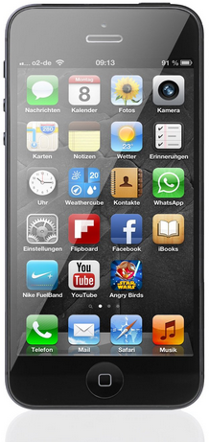
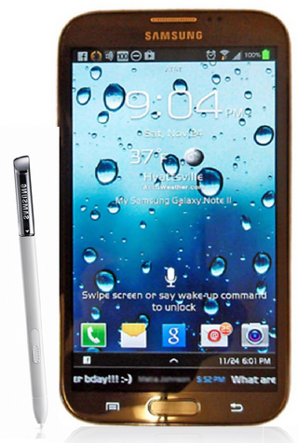
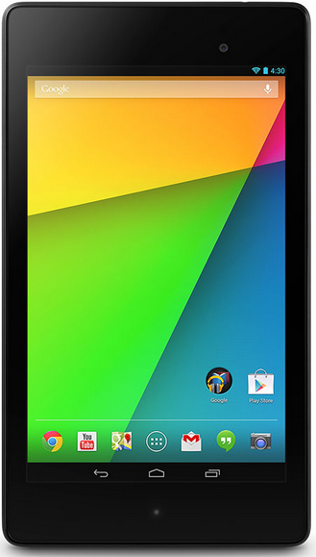
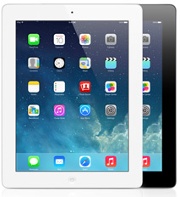
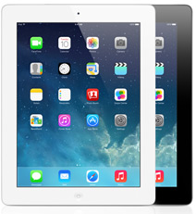
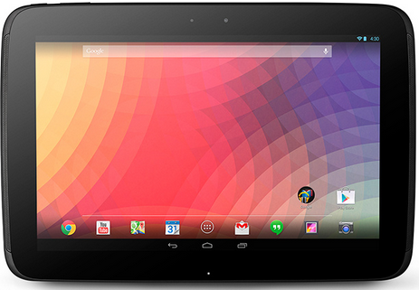
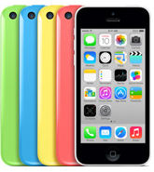
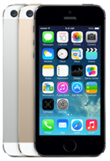
Introduction to Android /iOS Apps Programming
Native Apps
Hybrid Apps
Mobile Web Apps

Slide 7
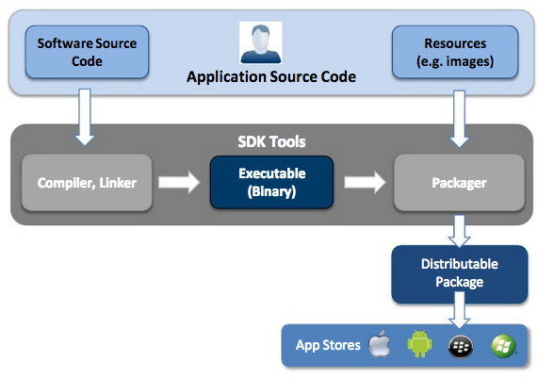
Native App Development
Source: http://www.scribd.com/doc/50805466/Native-Web-or-Hybrid-Mobile-App-Development

Slide 8
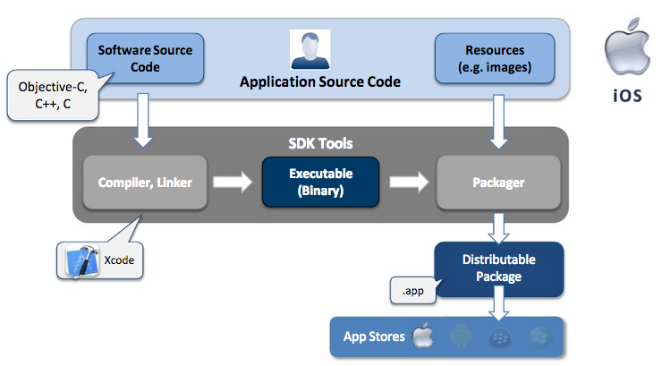
iOS - Native App Development
Source: http://www.scribd.com/doc/50805466/Native-Web-or-Hybrid-Mobile-App-Development

Slide 9
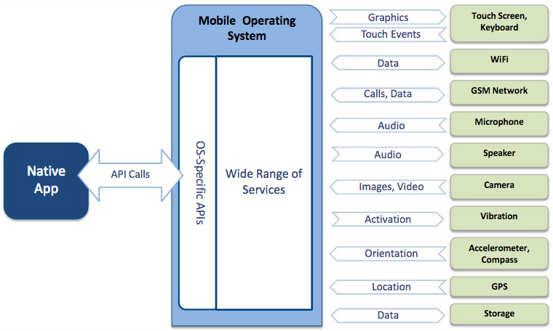
Native App – Interaction with Mobile Device
Source: http://www.scribd.com/doc/50805466/Native-Web-or-Hybrid-Mobile-App-Development

Slide 10
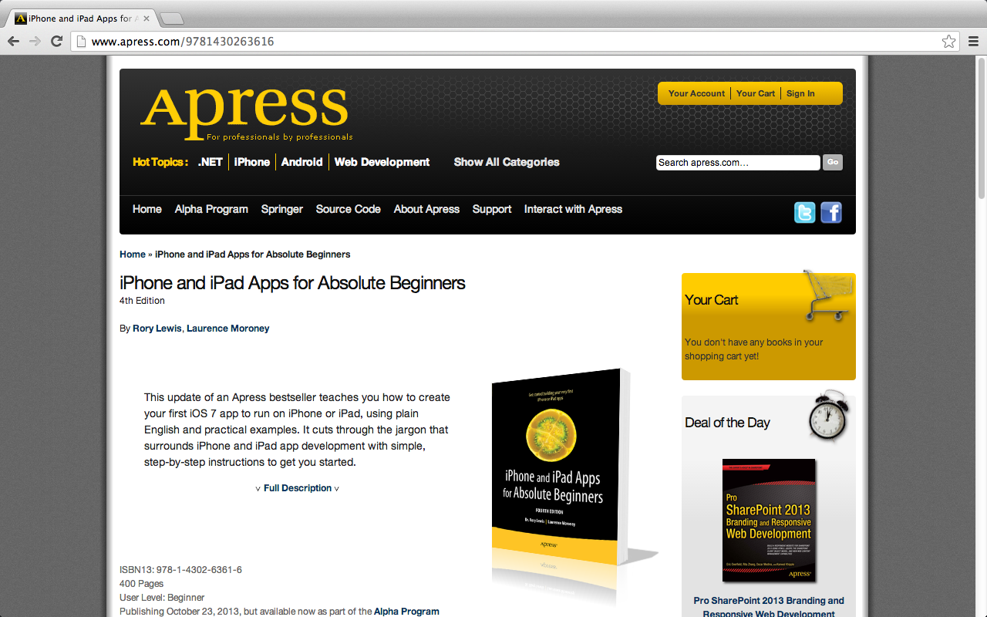
Rory Lewis and Laurence Moroney, iPhone and iPad Apps for Absolute Beginners, 4th Edition, Apress, 2013
http://www.apress.com/9781430263616

Slide 11
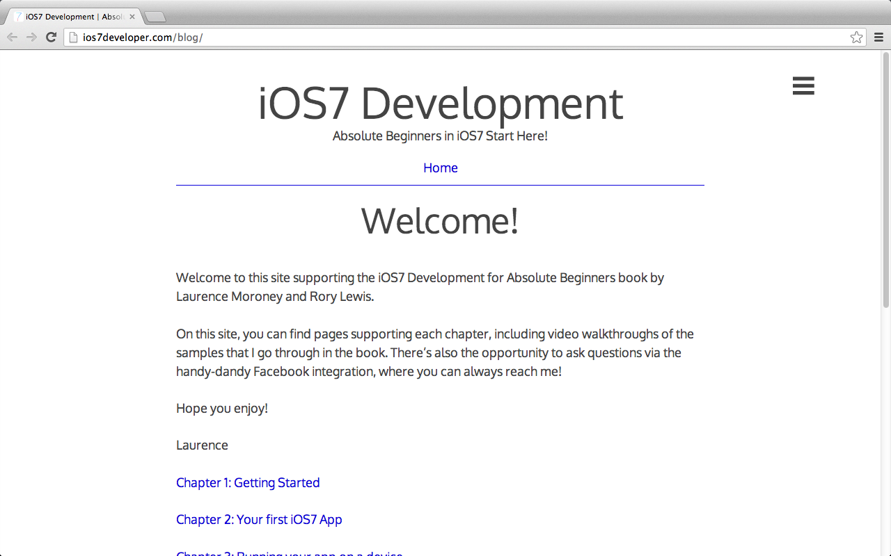
http://ios7developer.com/blog/

Slide 12
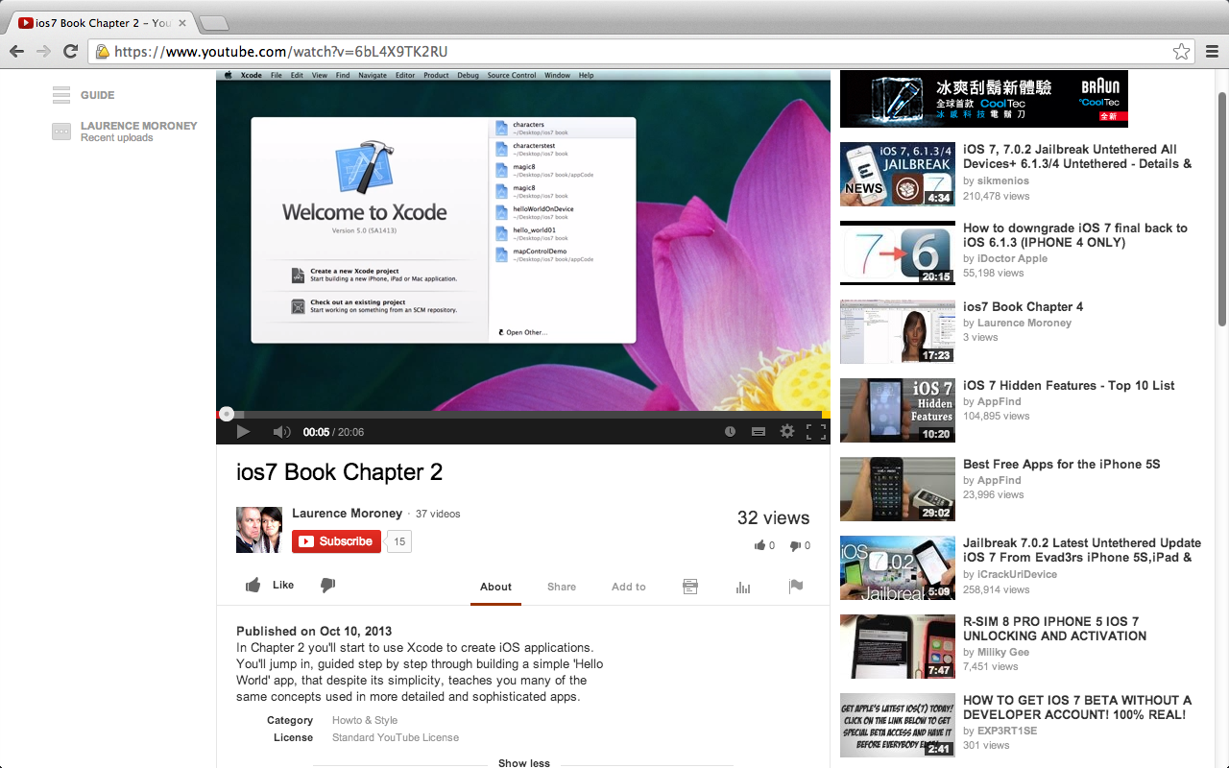
https://www.youtube.com/watch?v=6bL4X9TK2RU

Slide 13
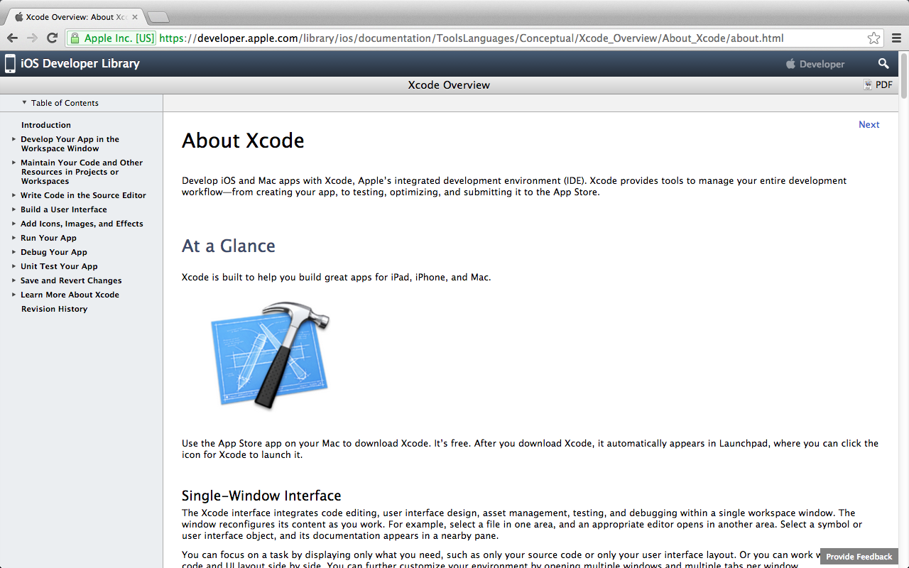
https://developer.apple.com/library/ios/documentation/ToolsLanguages/Conceptual/Xcode_Overview/About_Xcode/about.html

Slide 14
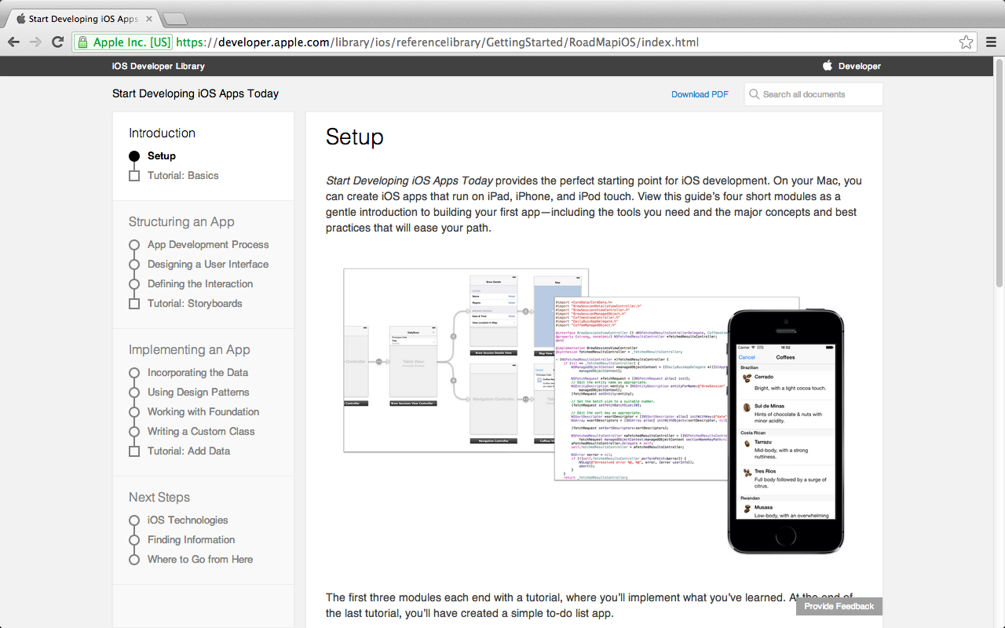
Start Developing iOS Apps Today
Source: https://developer.apple.com/library/ios/referencelibrary/GettingStarted/RoadMapiOS/index.html

Slide 15
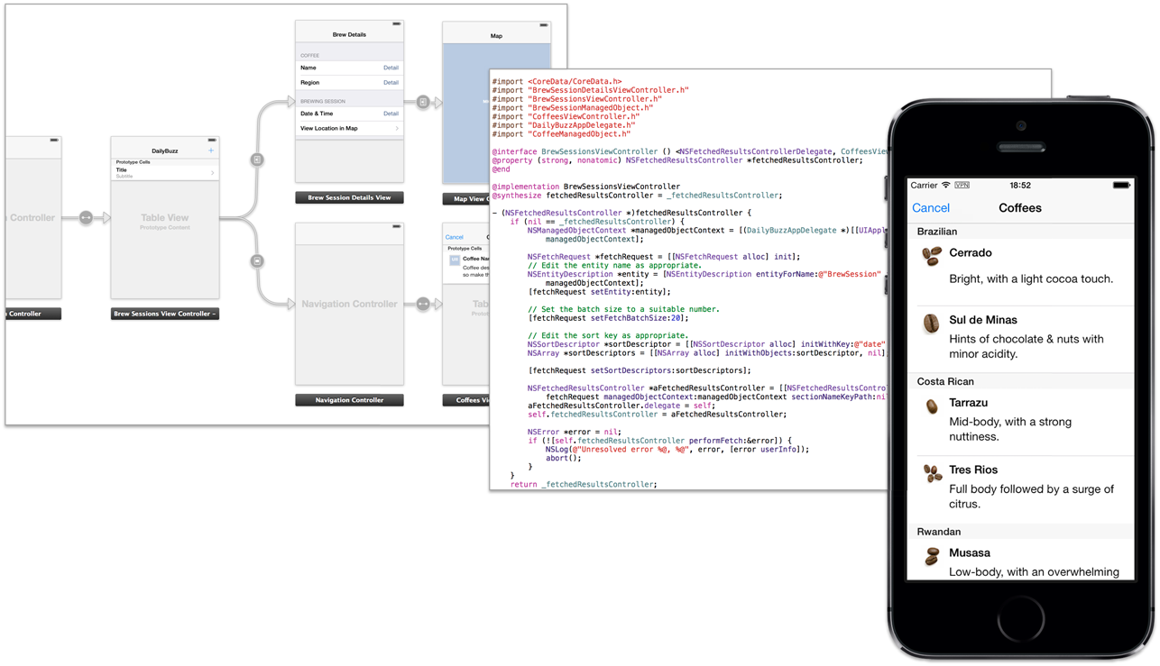
Start Developing iOS Apps Today
Source: https://developer.apple.com/library/ios/referencelibrary/GettingStarted/RoadMapiOS/index.html

Slide 16
Get the Tools
Source: https://developer.apple.com/library/ios/referencelibrary/GettingStarted/RoadMapiOS/index.html

Slide 17
To develop iOS apps, you need:
A Mac computer running OS X 10.7 (Lion) or later
Mac OS X 10.8 (Mountain Lion)
Mac OS X 10.9 (Mavericks)
Xcode
Xcode 5
iOS SDK
Source: https://developer.apple.com/library/ios/referencelibrary/GettingStarted/RoadMapiOS/index.html

Slide 18
Mac OS X 10.9 (Mavericks)

Slide 19
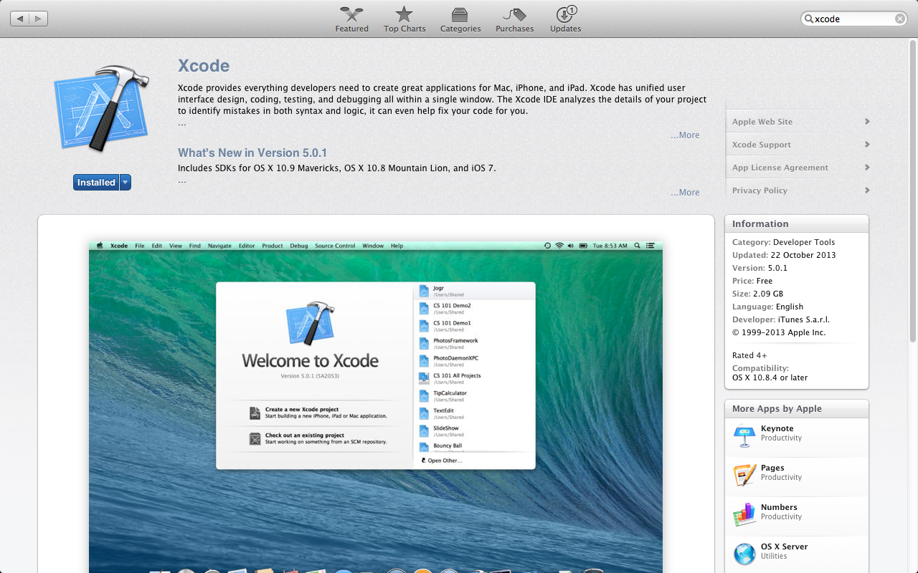
Xcode 5

Slide 20
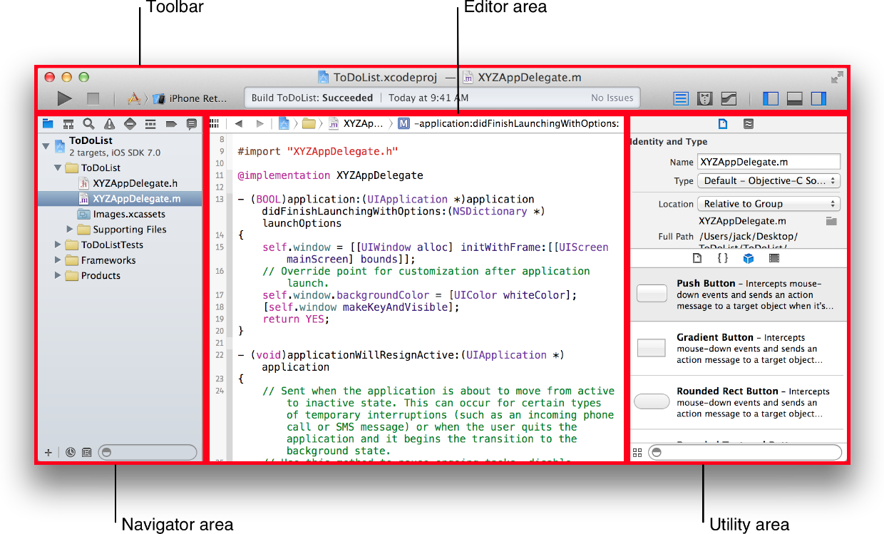
Source: https://developer.apple.com/library/ios/referencelibrary/GettingStarted/RoadMapiOS/index.html

Slide 21
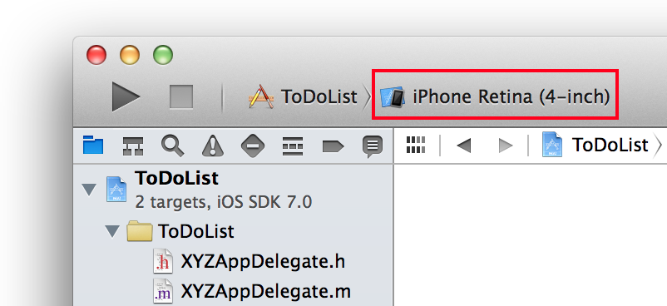
Source: https://developer.apple.com/library/ios/referencelibrary/GettingStarted/RoadMapiOS/index.html

Slide 22
Source: https://developer.apple.com/library/ios/referencelibrary/GettingStarted/RoadMapiOS/index.html

Slide 23
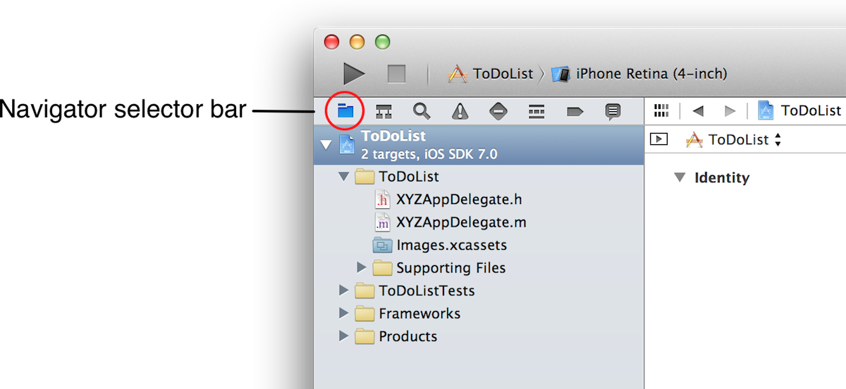
Source: https://developer.apple.com/library/ios/referencelibrary/GettingStarted/RoadMapiOS/index.html

Slide 24
Source: https://developer.apple.com/library/ios/referencelibrary/GettingStarted/RoadMapiOS/index.html

Slide 25
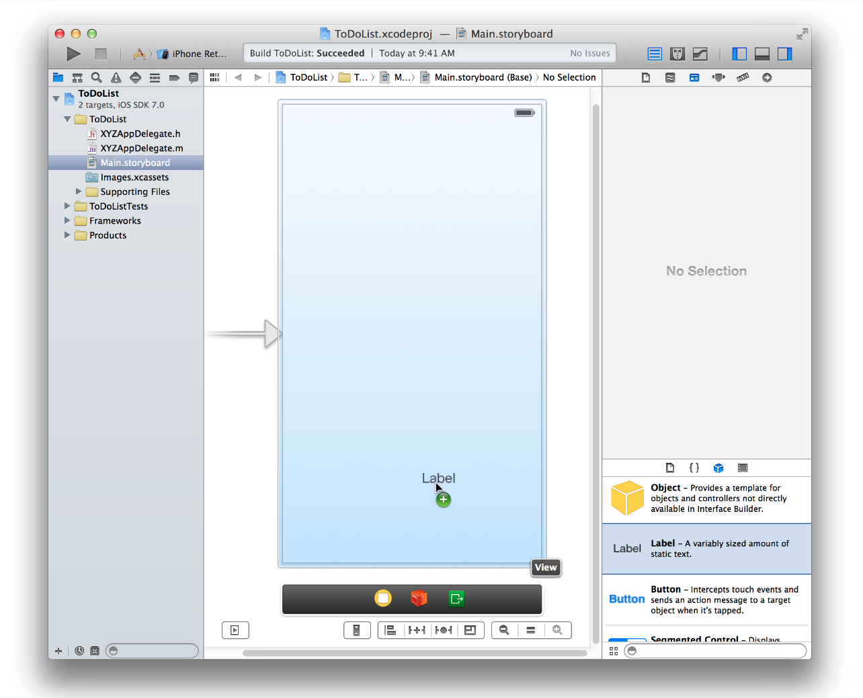
Source: https://developer.apple.com/library/ios/referencelibrary/GettingStarted/RoadMapiOS/index.html

Slide 26
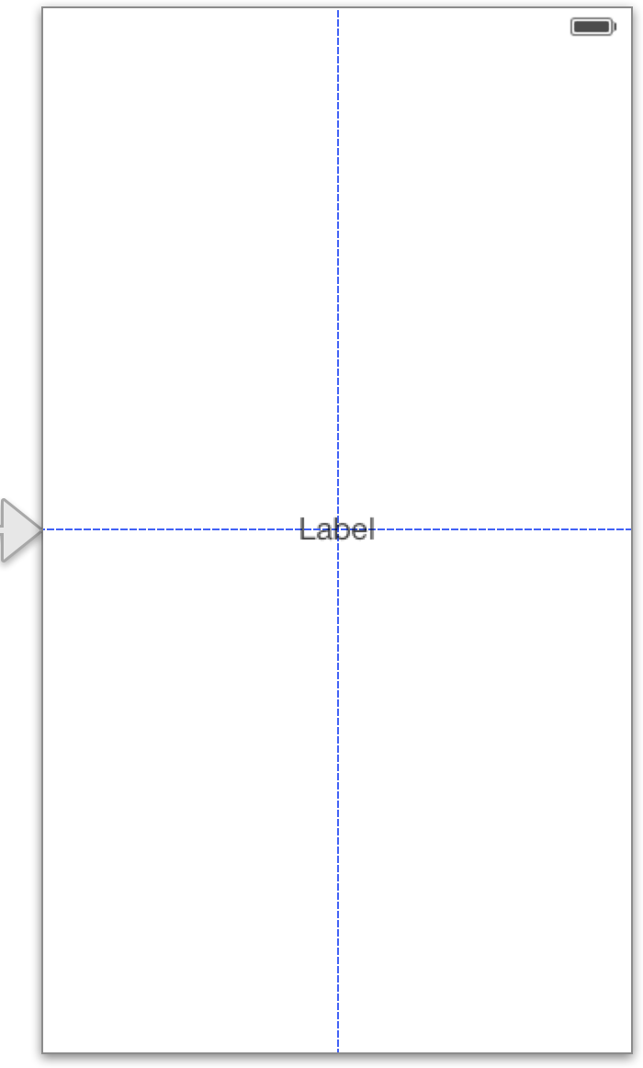
Source: https://developer.apple.com/library/ios/referencelibrary/GettingStarted/RoadMapiOS/index.html

Slide 27
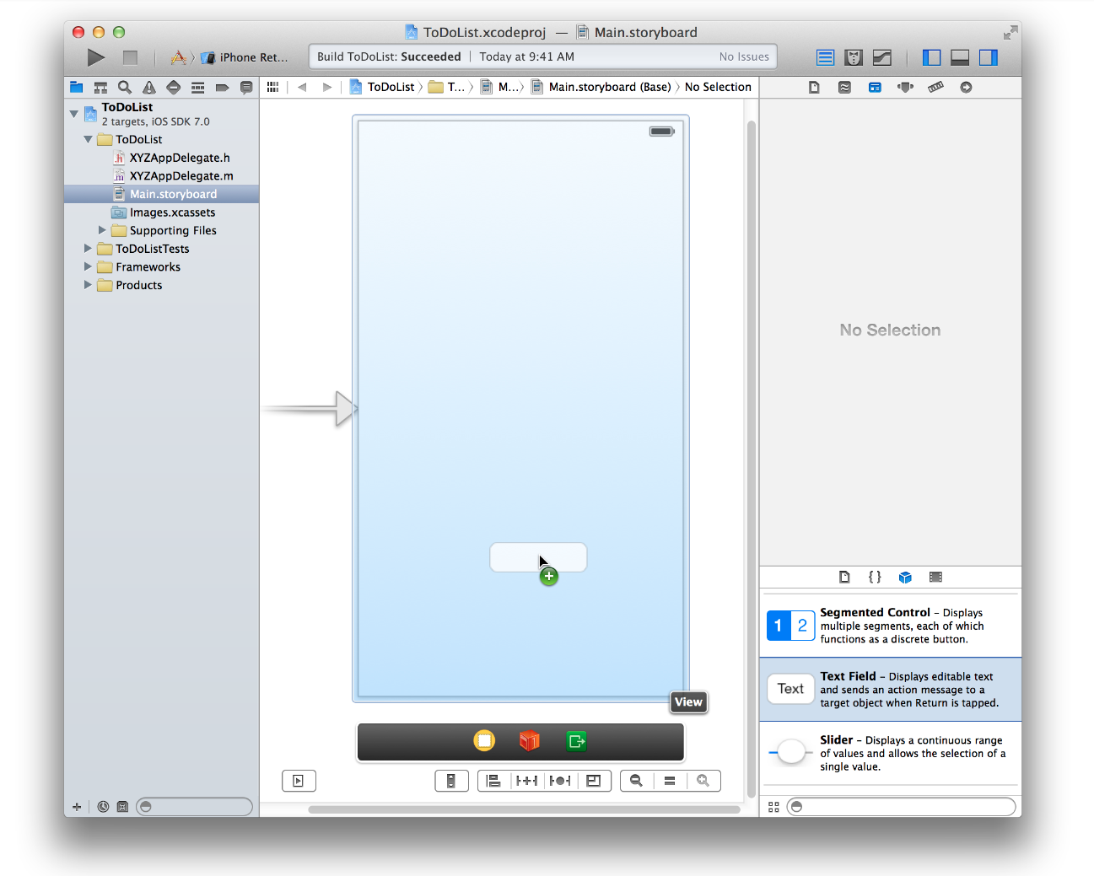
Source: https://developer.apple.com/library/ios/referencelibrary/GettingStarted/RoadMapiOS/index.html

Slide 28
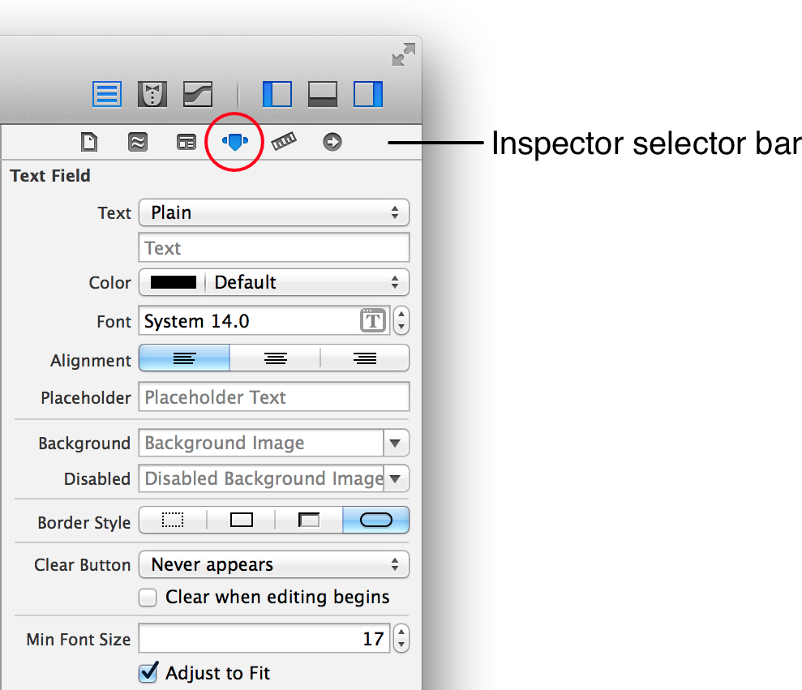
Source: https://developer.apple.com/library/ios/referencelibrary/GettingStarted/RoadMapiOS/index.html

Slide 29
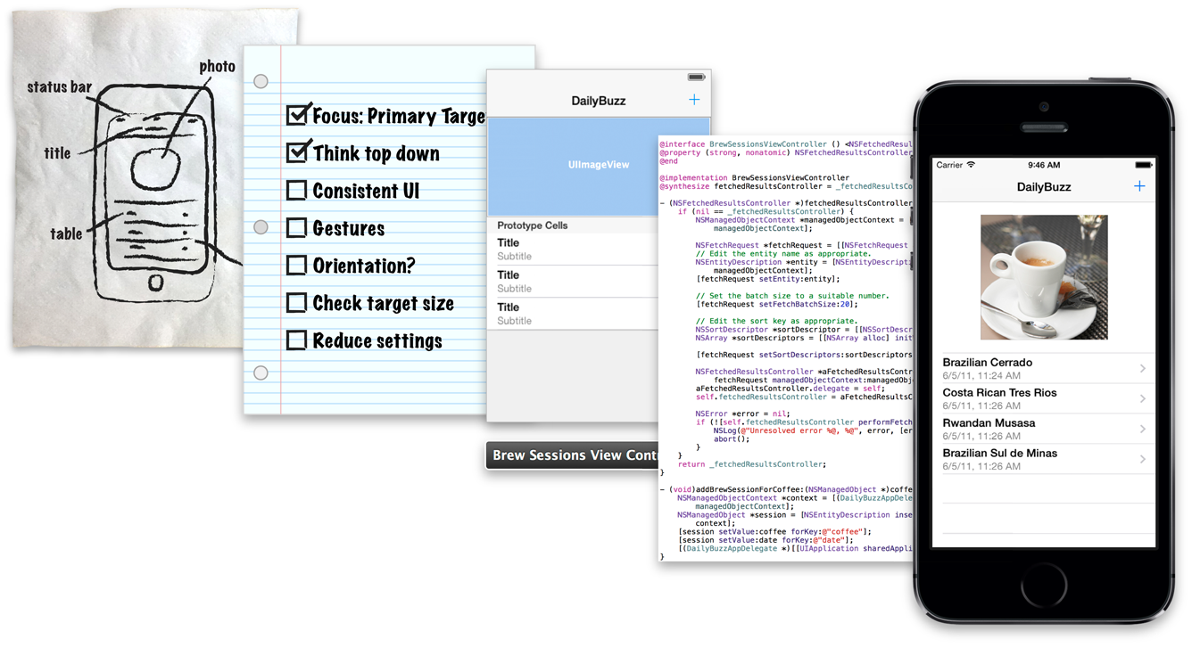
iOS App Development Process
Source: https://developer.apple.com/library/ios/referencelibrary/GettingStarted/RoadMapiOS/AppDevelopmentProcess.htm

Slide 30
iOS App Development Process
Defining the Concept
Designing a User Interface
Defining the Interaction
Implementing the Behavior
Source: https://developer.apple.com/library/ios/referencelibrary/GettingStarted/RoadMapiOS/AppDevelopmentProcess.htm

Slide 31
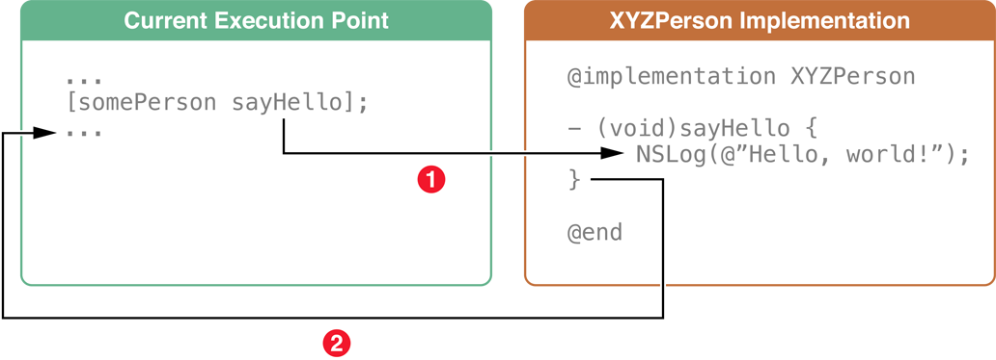
Objects Communicate Through Messages
Source: https://developer.apple.com/library/ios/referencelibrary/GettingStarted/RoadMapiOS/AppDevelopmentProcess.htm

Slide 32
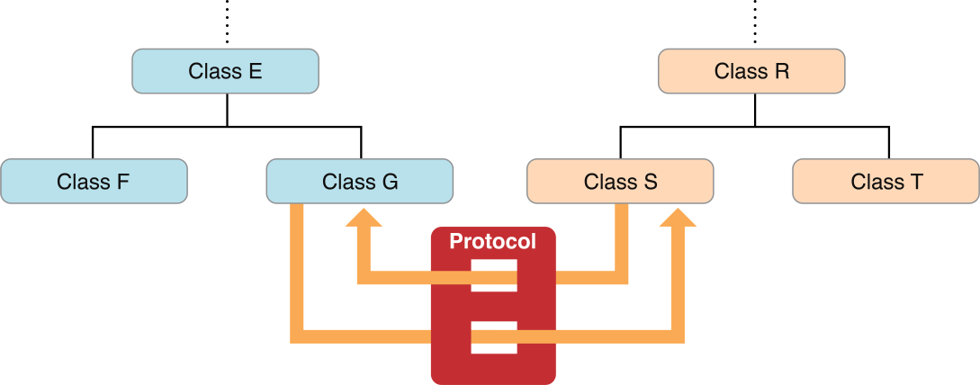
Protocols Define Messaging Contracts
Source: https://developer.apple.com/library/ios/referencelibrary/GettingStarted/RoadMapiOS/AppDevelopmentProcess.htm

Slide 33
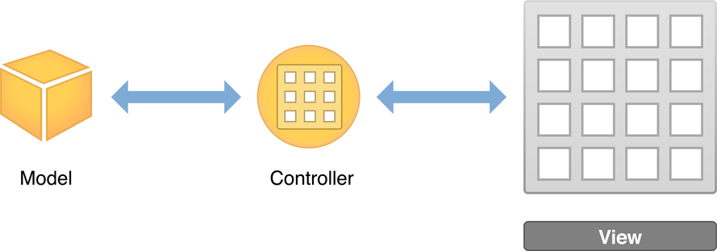
Designing a User Interface
Source: https://developer.apple.com/library/ios/referencelibrary/GettingStarted/RoadMapiOS/DesigningaUserInterface.html

Slide 34
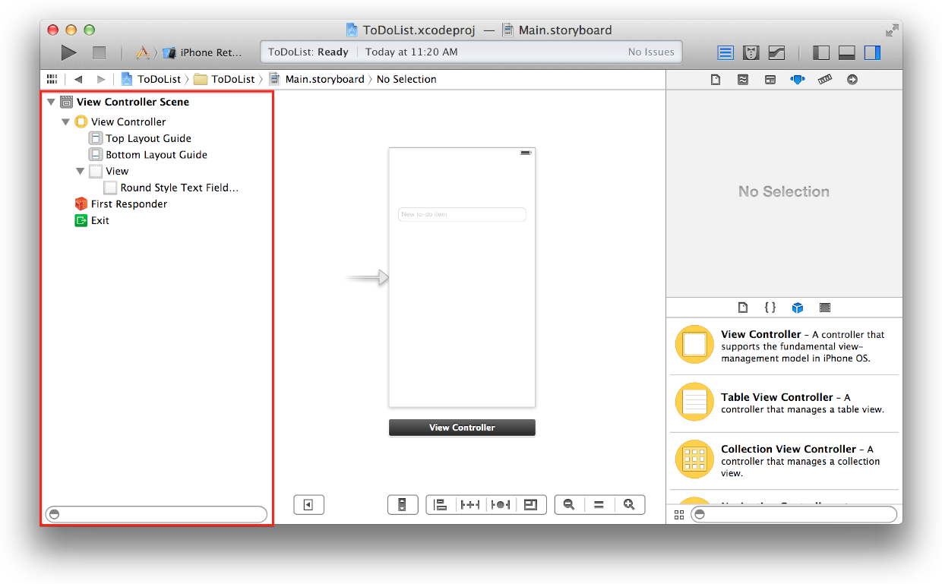
Use Storyboards to Lay Out Views
Source: https://developer.apple.com/library/ios/referencelibrary/GettingStarted/RoadMapiOS/DesigningaUserInterface.html

Slide 35
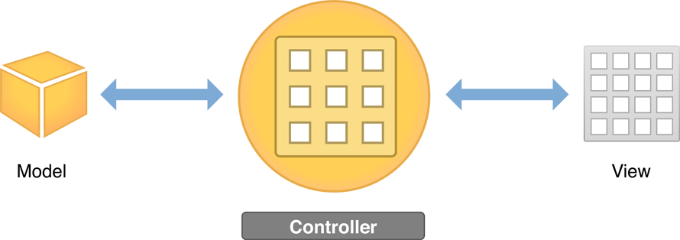
Defining the Interaction
Source: https://developer.apple.com/library/ios/referencelibrary/GettingStarted/RoadMapiOS/DefiningtheInteraction.html

Slide 36
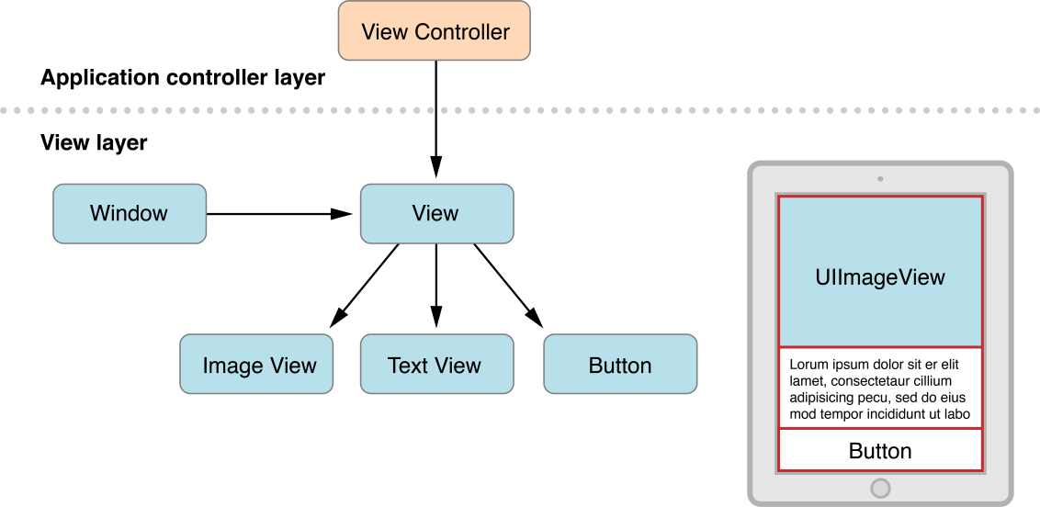
View Controllers
Source: https://developer.apple.com/library/ios/referencelibrary/GettingStarted/RoadMapiOS/DesigningaUserInterface.html

Slide 37
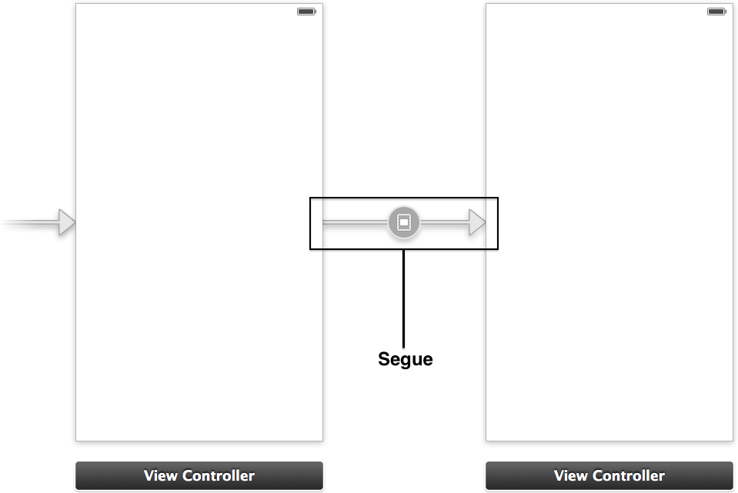
Use Storyboards to Define Navigation
Source: https://developer.apple.com/library/ios/referencelibrary/GettingStarted/RoadMapiOS/DesigningaUserInterface.html

Slide 38
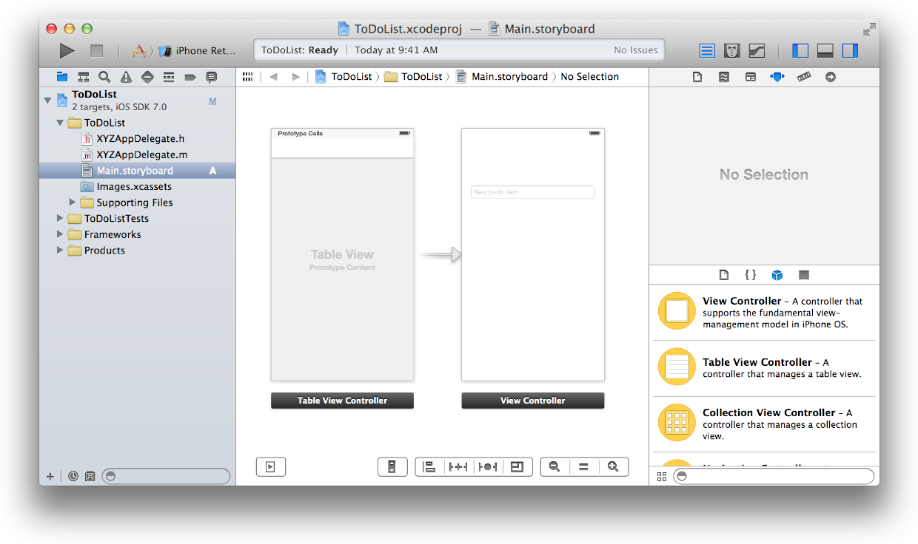
Storyboards
Source: https://developer.apple.com/library/ios/referencelibrary/GettingStarted/RoadMapiOS/DesigningaUserInterface.html

Slide 39
Incorporating the Data
Source: https://developer.apple.com/library/ios/referencelibrary/GettingStarted/RoadMapiOS/IncorporatingtheData.html

Slide 40
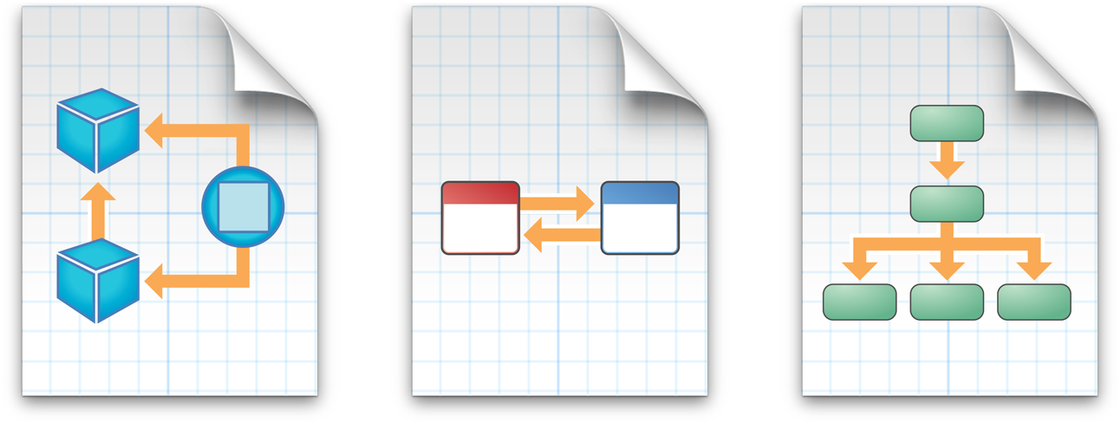
Using Design Patterns
Source: https://developer.apple.com/library/ios/referencelibrary/GettingStarted/RoadMapiOS/DesignPatterns.html

Slide 41
Model-View-Controller (MVC)
Source: https://developer.apple.com/library/ios/referencelibrary/GettingStarted/RoadMapiOS/DesignPatterns.html

Slide 42
Target-Action
Source: https://developer.apple.com/library/ios/referencelibrary/GettingStarted/RoadMapiOS/DesignPatterns.html

Slide 43
Delegation
Source: https://developer.apple.com/library/ios/referencelibrary/GettingStarted/RoadMapiOS/DesignPatterns.html

Slide 44
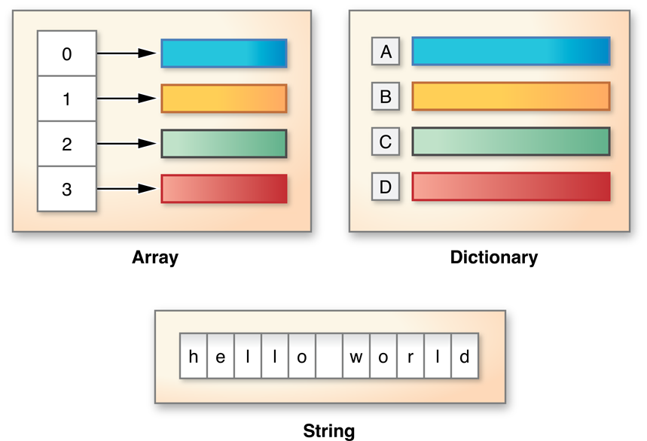
Working with Fundation
Source: https://developer.apple.com/library/ios/referencelibrary/GettingStarted/RoadMapiOS/FoundationClasses.html

Slide 45
NSString
Source: https://developer.apple.com/library/ios/referencelibrary/GettingStarted/RoadMapiOS/FoundationClasses.html

Slide 46
NSNumber
Source: https://developer.apple.com/library/ios/referencelibrary/GettingStarted/RoadMapiOS/FoundationClasses.html

Slide 47
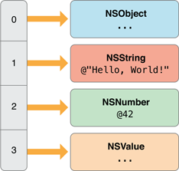
Arrays
Source: https://developer.apple.com/library/ios/referencelibrary/GettingStarted/RoadMapiOS/FoundationClasses.html

Slide 48
Dictionaries
Source: https://developer.apple.com/library/ios/referencelibrary/GettingStarted/RoadMapiOS/FoundationClasses.html

Slide 49
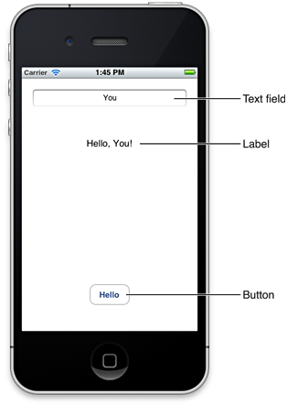
Your First iOS App
https://developer.apple.com/library/ios/documentation/iphone/conceptual/iphone101/Articles/00_Introduction.html

Slide 50
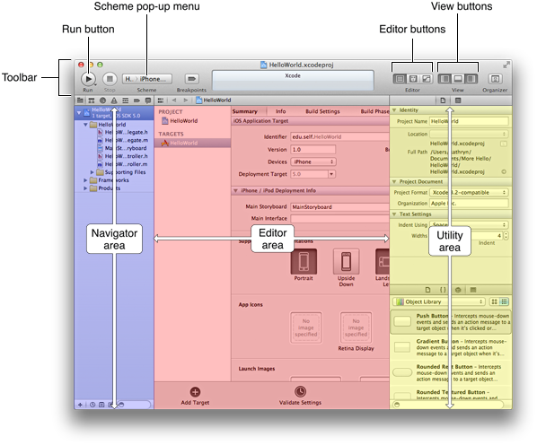
https://developer.apple.com/library/ios/documentation/iphone/conceptual/iphone101/Articles/01_CreatingProject.html

Slide 51
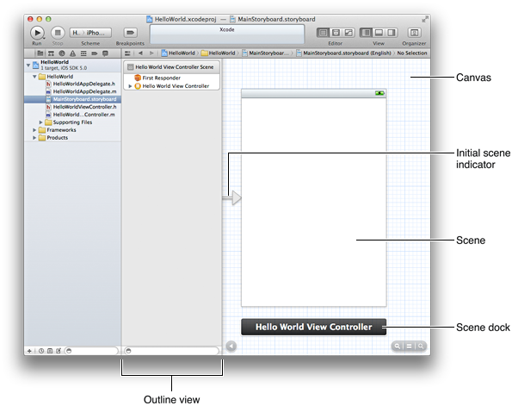
https://developer.apple.com/library/ios/documentation/iphone/conceptual/iphone101/Articles/01_CreatingProject.html

Slide 52
IBOutlet and IBAction
IBOutlet
Interface Builder Outlet
IBAction
Interface Builder Action

Slide 53
Demo: Building Your First iOS App with Xcode 5 (Objective-C)

Slide 54
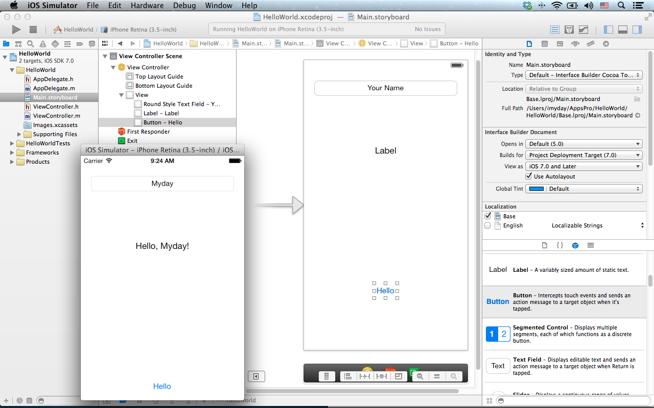

Slide 55
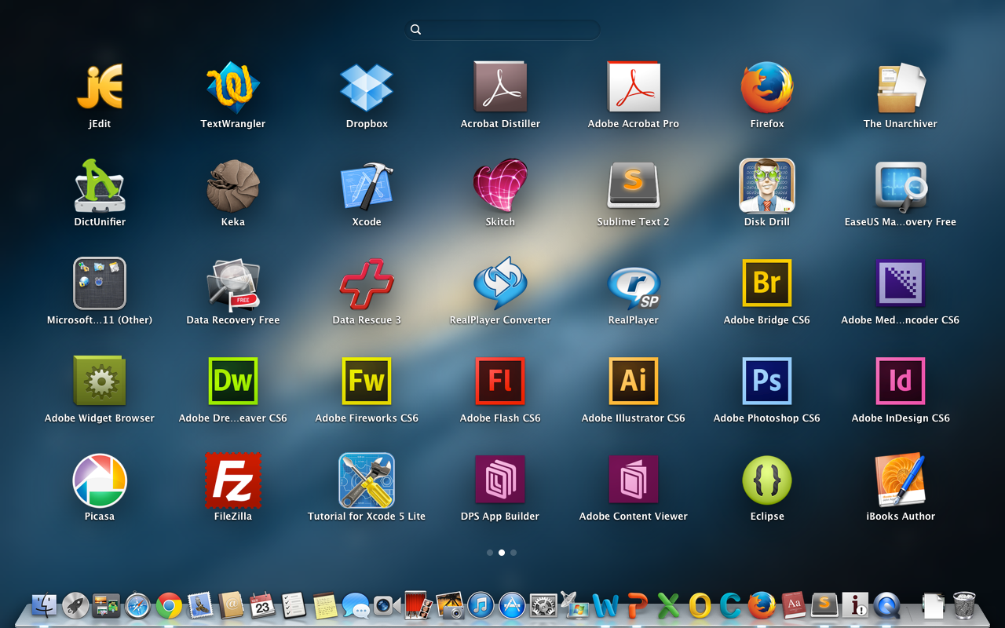

Slide 56
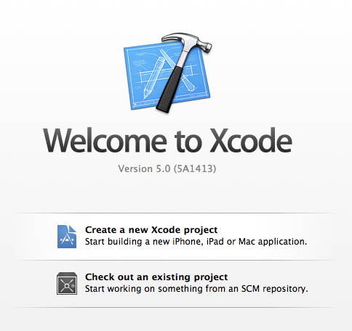

Slide 57
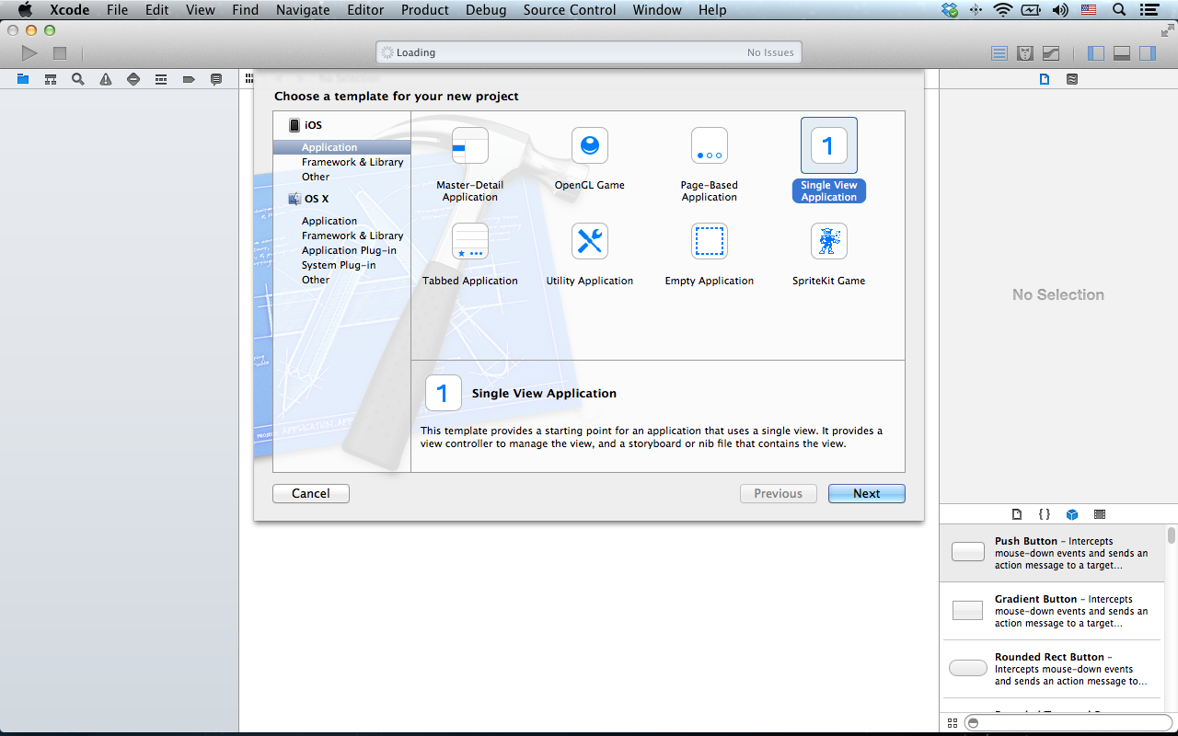

Slide 58
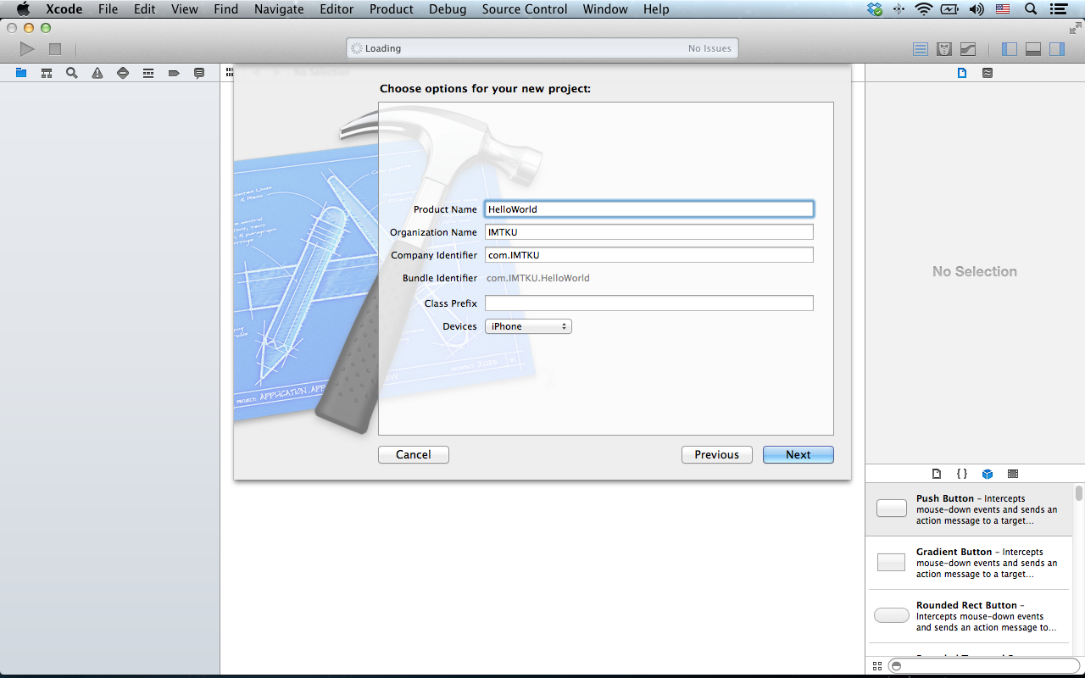

Slide 59
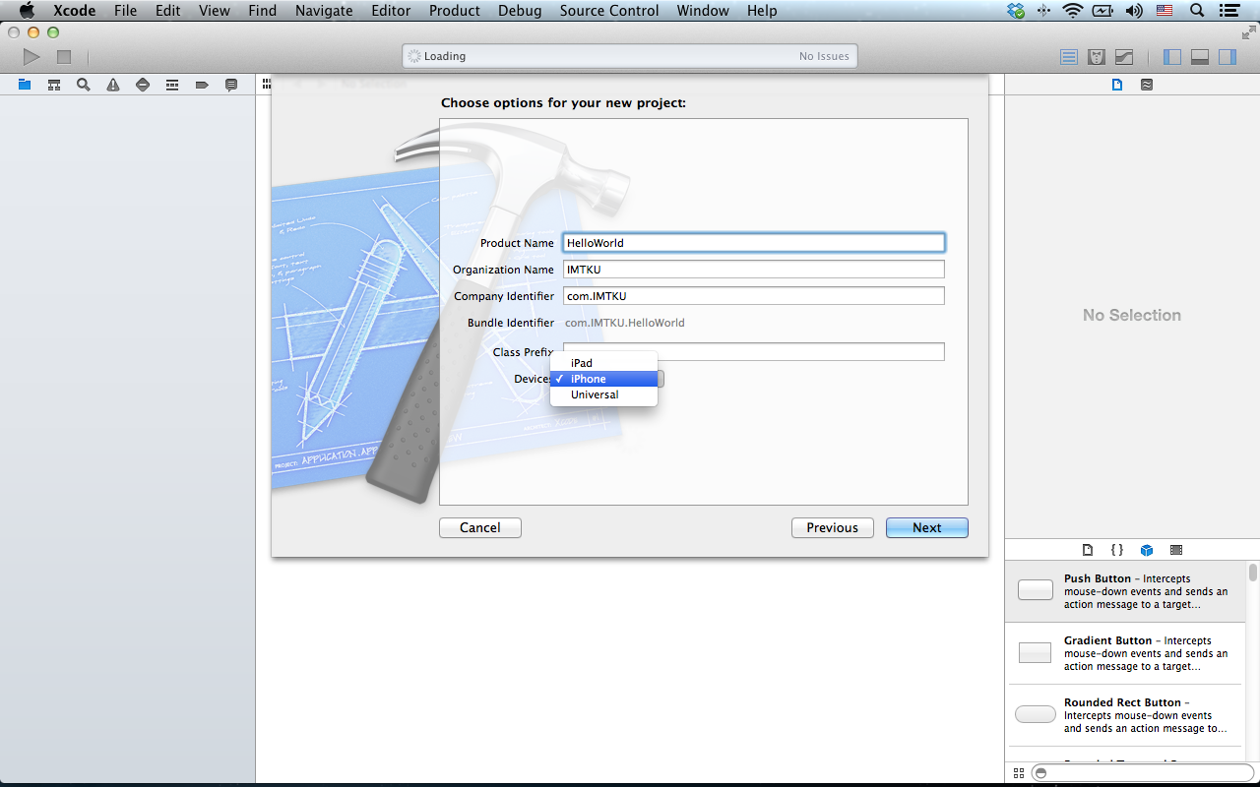

Slide 60
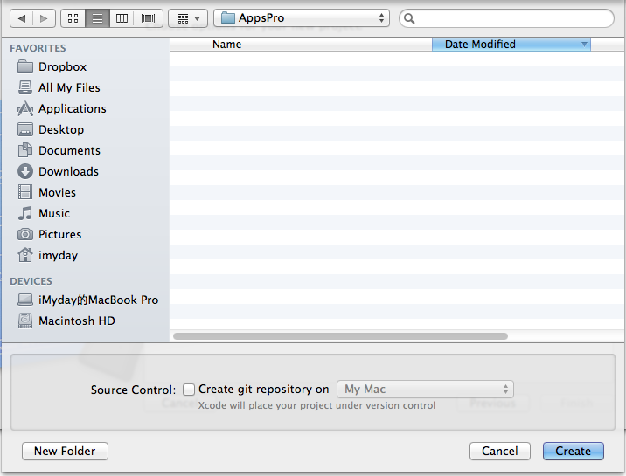

Slide 61
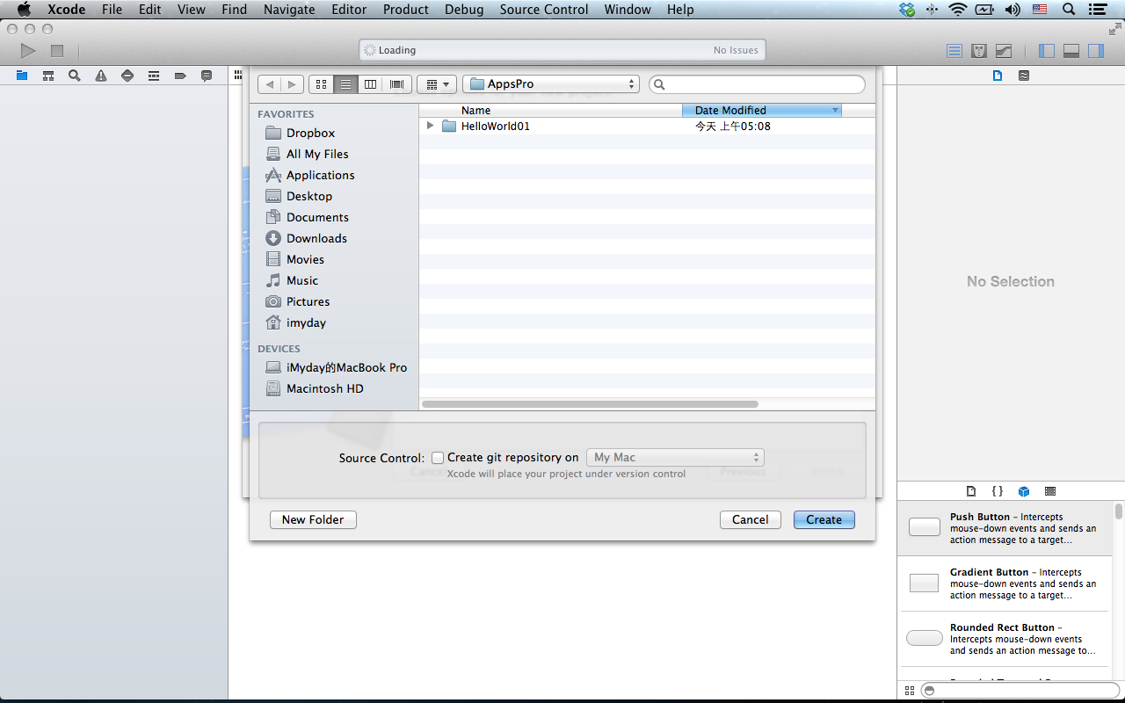

Slide 62
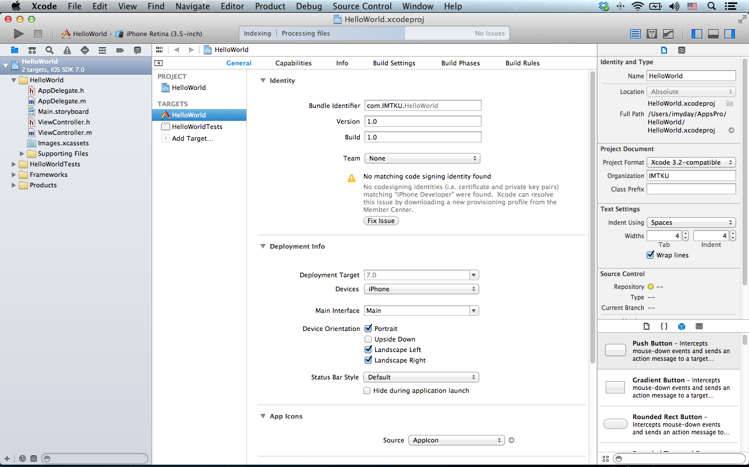

Slide 63
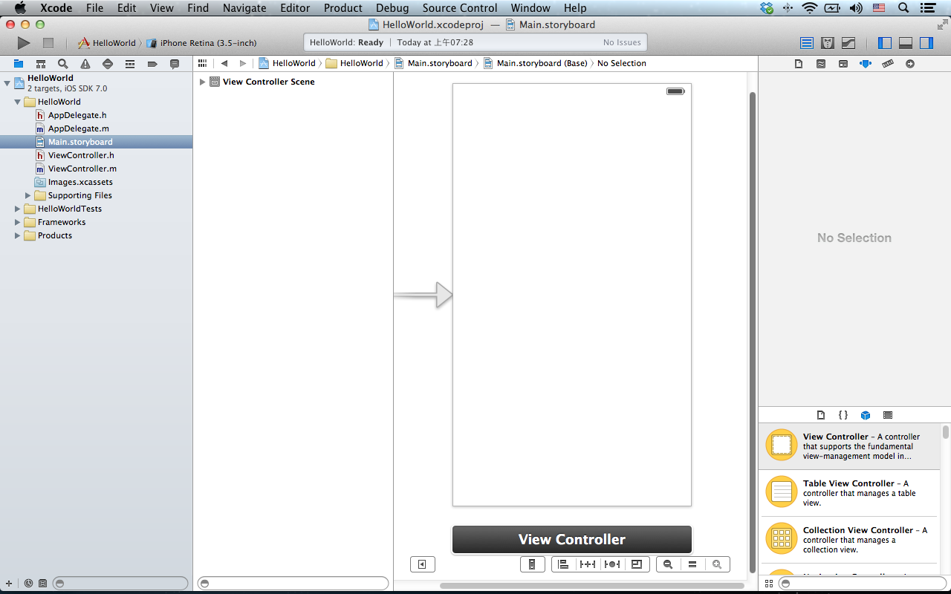

Slide 67
https://developer.apple.com/library/ios/documentation/iphone/conceptual/iphone101/Articles/05_ConfiguringView.html

Slide 79
@property (strong, nonatomic) IBOutlet UITextField *txtYourName;

Slide 80
@property (strong, nonatomic) IBOutlet UITextField *txtYourName;

Slide 82
@property (strong, nonatomic) IBOutlet UILabel *MyLabel;

Slide 83
@property (strong, nonatomic) IBOutlet UILabel *MyLabel;

Slide 88
- (IBAction)btnHello:(id)sender {
_MyLabel.text = @"Hello World Myday";
}

Slide 101
// ViewController.h
// HelloWorld
#import <UIKit/UIKit.h>
@interface ViewController : UIViewController
- (IBAction)btnHello:(id)sender;
@property (strong, nonatomic) IBOutlet UITextField *txtYourName;
@property (strong, nonatomic) IBOutlet UILabel *MyLabel;
@end

Slide 102
// ViewController.m
// HelloWorld
#import "ViewController.h"
@interface ViewController ()
@end
@implementation ViewController
- (void)viewDidLoad
{
[super viewDidLoad];
// Do any additional setup after loading the view, typically from a nib.
}
- (void)didReceiveMemoryWarning
{
[super didReceiveMemoryWarning];
// Dispose of any resources that can be recreated.
}
- (IBAction)btnHello:(id)sender {
_MyLabel.text = @"Hello World Myday";
}
@end

Slide 103
@property (copy, nonatomic) NSString *userName;

Slide 110
- (IBAction)btnHello:(id)sender {
self.userName = self.txtYourName.text;
NSString *nameString = self.userName;
if ([nameString length] == 0) {
nameString = @"World";
}
NSString *greeting = [[NSString alloc] initWithFormat:@"Hello, %@!", nameString];
self.MyLabel.text = greeting;
}

Slide 111
- (BOOL)textFieldShouldReturn:(UITextField *)thetxtYourName {
if (thetxtYourName == self.txtYourName) {
[thetxtYourName resignFirstResponder];
}
return YES;
}

Slide 129
Summary
Developing iPhone / iPad Native Apps with Objective-C (Xcode)
Mac OS X 10.8, 10.9
Xcode 5
iOS 7
Building Your First iOS App with Xcode 5

Slide 130
References
Start Developing iOS Apps Today,
https://developer.apple.com/library/ios/referencelibrary/GettingStarted/RoadMapiOS/
https://developer.apple.com/library/ios/referencelibrary/GettingStarted/RoadMapiOS/RoadMapiOS.pdf
Rory Lewis and Laurence Moroney, iPhone and iPad Apps for Absolute Beginners, 4th Edition, Apress, 2013
iOS 7 Developer,
http://ios7developer.com/blog/

