Slide 1
Tamkang University
Social Media and Sentiment Analysis (社群媒體與情緒分析)
時間：2016/11/01 (二) (2:10-5:00pm)
地點：政治大學綜合院館270407，北棟407教室
主持人：陳恭 主任
Min-Yuh Day
戴敏育
Assistant Professor
專任助理教授
Dept. of Information Management, Tamkang University
淡江大學 資訊管理學系
http://mail. tku.edu.tw/myday/
2016-11-01

Slide 2
Tamkang University
Sentiment Analysis on Social Media (社群媒體情感分析)
Min-Yuh Day
戴敏育
Assistant Professor
專任助理教授
Dept. of Information Management, Tamkang University
淡江大學 資訊管理學系
http://mail. tku.edu.tw/myday/
2016-07

Slide 3
Outline
Architectures of Sentiment Analytics on Social Media
Social Media Monitoring/Analysis
Sentiment Analytics on Social Media: Tools and Applications

Slide 4
Sentiment Analysis on Social Media

Slide 5
Example of Opinion: review segment on iPhone
“I bought an iPhone a few days ago.
It was such a nice phone.
The touch screen was really cool.
The voice quality was clear too.
However, my mother was mad with me as I did not tell her before I bought it.
She also thought the phone was too expensive, and wanted me to return it to the shop. … ”
Source: Bing Liu (2011) , “Web Data Mining: Exploring Hyperlinks, Contents, and Usage Data,” Springer, 2nd Edition,

Slide 6
Example of Opinion: review segment on iPhone
“(1) I bought an iPhone a few days ago.
(2) It was such a nice phone.
(3) The touch screen was really cool.
(4) The voice quality was clear too.
(5) However, my mother was mad with me as I did not tell her before I bought it.
(6) She also thought the phone was too expensive, and wanted me to return it to the shop. … ”
+Positive Opinion
-Negative Opinion
Source: Bing Liu (2011) , “Web Data Mining: Exploring Hyperlinks, Contents, and Usage Data,” Springer, 2nd Edition,

Slide 7
Architectures of Sentiment Analytics

Slide 8
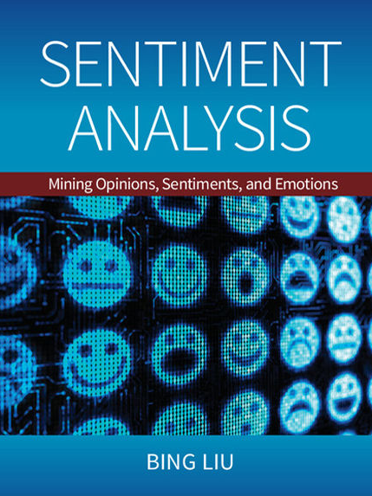
Bing Liu (2015), Sentiment Analysis: Mining Opinions, Sentiments, and Emotions, Cambridge University Press
http://www.amazon.com/Sentiment-Analysis-Opinions-Sentiments-Emotions/dp/1107017890

Slide 9
Sentiment Analysis and Opinion Mining
Computational study of opinions, sentiments, subjectivity, evaluations, attitudes, appraisal, affects, views, emotions, ets., expressed in text.
Reviews, blogs, discussions, news, comments, feedback, or any other documents
Source: Bing Liu (2011) , “Web Data Mining: Exploring Hyperlinks, Contents, and Usage Data,” Springer, 2nd Edition,

Slide 10
Research Area of Opinion Mining
Many names and tasks with difference objective and models
Sentiment analysis
Opinion mining
Sentiment mining
Subjectivity analysis
Affect analysis
Emotion detection
Opinion spam detection
Source: Bing Liu (2011) , “Web Data Mining: Exploring Hyperlinks, Contents, and Usage Data,” Springer, 2nd Edition,

Slide 11
Sentiment Analysis
Sentiment
A thought, view, or attitude, especially one based mainly on emotion instead of reason
Sentiment Analysis
opinion mining
use of natural language processing (NLP) and computational techniques to automate the extraction or classification of sentiment from typically unstructured text

Slide 12
Applications of Sentiment Analysis
Consumer information
Product reviews
Marketing
Consumer attitudes
Trends
Politics
Politicians want to know voters’ views
Voters want to know policitians’ stances and who else supports them
Social
Find like-minded individuals or communities

Slide 13
Sentiment detection
How to interpret features for sentiment detection?
Bag of words (IR)
Annotated lexicons (WordNet, SentiWordNet)
Syntactic patterns
Which features to use?
Words (unigrams)
Phrases/n-grams
Sentences

Slide 14
Problem statement of Opinion Mining
Two aspects of abstraction
Opinion definition
What is an opinion?
What is the structured definition of opinion?
Opinion summarization
Opinion are subjective
An opinion from a single person (unless a VIP) is often not sufficient for action
We need opinions from many people, and thus opinion summarization.
Source: Bing Liu (2011) , “Web Data Mining: Exploring Hyperlinks, Contents, and Usage Data,” Springer, 2nd Edition,

Slide 15
What is an opinion?
Id: Abc123 on 5-1-2008 “I bought an iPhone a few days ago. It is such a nice phone. The touch screen is really cool. The voice quality is clear too. It is much better than my old Blackberry, which was a terrible phone and so difficult to type with its tiny keys. However, my mother was mad with me as I did not tell her before I bought the phone. She also thought the phone was too expensive, …”
One can look at this review/blog at the
Document level
Is this review + or -?
Sentence level
Is each sentence + or -?
Entity and feature/aspect level
Source: Bing Liu (2011) , “Web Data Mining: Exploring Hyperlinks, Contents, and Usage Data,” Springer, 2nd Edition,

Slide 16
Entity and aspect/feature level
Id: Abc123 on 5-1-2008 “I bought an iPhone a few days ago. It is such a nice phone. The touch screen is really cool. The voice quality is clear too. It is much better than my old Blackberry, which was a terrible phone and so difficult to type with its tiny keys. However, my mother was mad with me as I did not tell her before I bought the phone. She also thought the phone was too expensive, …”
What do we see?
Opinion targets: entities and their features/aspects
Sentiments: positive and negative
Opinion holders: persons who hold the opinions
Time: when opinion are expressed
Source: Bing Liu (2011) , “Web Data Mining: Exploring Hyperlinks, Contents, and Usage Data,” Springer, 2nd Edition,

Slide 17
Two main types of opinions
Regular opinions: Sentiment/Opinion expressions on some target entities
Direct opinions: sentiment expressions on one object:
“The touch screen is really cool.”
“The picture quality of this camera is great”
Indirect opinions: comparisons, relations expressing similarities or differences (objective or subjective) of more than one object
“phone X is cheaper than phone Y.” (objective)
“phone X is better than phone Y.” (subjective)
Comparative opinions: comparisons of more than one entity.
“iPhone is better than Blackberry.”
Source: Bing Liu (2011) , “Web Data Mining: Exploring Hyperlinks, Contents, and Usage Data,” Springer, 2nd Edition,

Slide 18
Subjective and Objective
Objective
An objective sentence expresses some factual information about the world.
“I returned the phone yesterday.”
Objective sentences can implicitly indicate opinions
“The earphone broke in two days.”
Subjective
A subjective sentence expresses some personal feelings or beliefs.
“The voice on my phone was not so clear”
Not every subjective sentence contains an opinion
“I wanted a phone with good voice quality”
➔ Subjective analysis
Source: Bing Liu (2011) , “Web Data Mining: Exploring Hyperlinks, Contents, and Usage Data,” Springer, 2nd Edition,

Slide 19
Sentiment Analysis vs. Subjectivity Analysis
Sentiment Analysis
Subjectivity Analysis
Positive
Subjective
Negative
Neutral
Objective

Slide 20
A (regular) opinion
Opinion (a restricted definition)
An opinion (regular opinion) is simply a positive or negative sentiment, view, attitude, emotion, or appraisal about an entity or an aspect of the entity from an opinion holder.
Sentiment orientation of an opinion
Positive, negative, or neutral (no opinion)
Also called:
Opinion orientation
Semantic orientation
Sentiment polarity
Source: Bing Liu (2011) , “Web Data Mining: Exploring Hyperlinks, Contents, and Usage Data,” Springer, 2nd Edition,

Slide 21
Entity and aspect
Definition of Entity:
An entity e is a product, person, event, organization, or topic.
e is represented as
A hierarchy of components, sub-components.
Each node represents a components and is associated with a set of attributes of the components
An opinion can be expressed on any node or attribute of the node
Aspects(features)
represent both components and attribute
Source: Bing Liu (2011) , “Web Data Mining: Exploring Hyperlinks, Contents, and Usage Data,” Springer, 2nd Edition,

Slide 22
Opinion Definition
An opinion is a quintuple (e_{j}, a_{jk}, so_{ijkl}, h_{i}, t_{l}) where
e_{j} is a target entity.
a_{jk} is an aspect/feature of the entity e_{j} .
so_{ijkl} is the sentiment value of the opinion from the opinion holder on feature of entity at time. so_{ijkl} is +ve, -ve, or neu, or more granular ratings
h_{i} is an opinion holder.
t_{l} is the time when the opinion is expressed.
(e_{j}, a_{jk}) is also called opinion target
Source: Bing Liu (2011) , “Web Data Mining: Exploring Hyperlinks, Contents, and Usage Data,” Springer, 2nd Edition,

Slide 23
Terminologies
Entity: object
Aspect: feature, attribute, facet
Opinion holder: opinion source
Topic: entity, aspect
Product features, political issues
Source: Bing Liu (2011) , “Web Data Mining: Exploring Hyperlinks, Contents, and Usage Data,” Springer, 2nd Edition,

Slide 24
Subjectivity and Emotion
Sentence subjectivity
An objective sentence presents some factual information, while a subjective sentence expresses some personal feelings, views, emotions, or beliefs.
Emotion
Emotions are people’s subjective feelings and thoughts.
Source: Bing Liu (2011) , “Web Data Mining: Exploring Hyperlinks, Contents, and Usage Data,” Springer, 2nd Edition,

Slide 25
Classification Based on Supervised Learning
Sentiment classification
Supervised learning Problem
Three classes
Positive
Negative
Neutral
Source: Bing Liu (2011) , “Web Data Mining: Exploring Hyperlinks, Contents, and Usage Data,” Springer, 2nd Edition,

Slide 26
Opinion words in Sentiment classification
topic-based classification
topic-related words are important
e.g., politics, sciences, sports
Sentiment classification
topic-related words are unimportant
opinion words (also called sentiment words)
that indicate positive or negative opinions are important, e.g., great, excellent, amazing, horrible, bad, worst
Source: Bing Liu (2011) , “Web Data Mining: Exploring Hyperlinks, Contents, and Usage Data,” Springer, 2nd Edition,

Slide 27
Features in Opinion Mining
Terms and their frequency
TF-IDF
Part of speech (POS)
Adjectives
Opinion words and phrases
beautiful, wonderful, good, and amazing are positive opinion words
bad, poor, and terrible are negative opinion words.
opinion phrases and idioms, e.g., cost someone an arm and a leg
Rules of opinions
Negations
Syntactic dependency
Source: Bing Liu (2011) , “Web Data Mining: Exploring Hyperlinks, Contents, and Usage Data,” Springer, 2nd Edition,

Slide 28
Sentiment Analysis Architecture
Positive tweets
Negative tweets
Word features
Training set
Features
extractor
Classifier
Features
extractor
Tweet
Positive
Negative
Vishal Kharde and Sheetal Sonawane (2016), "Sentiment Analysis of Twitter Data: A Survey of Techniques," International Journal of Computer Applications, Vol 139, No. 11, 2016. pp.5-15

Slide 29
Sentiment Classification Based on Emoticons
Tweeter
Tweeter Streaming API 1.1
Tweet preprocessing
Based on Positive Emotions
Based on Negative Emotions
Generate Training Dataset for Tweet
Positive tweets
Negative tweets
Test Dataset
Training Dataset
Classifier
Feature Extraction
Positive
Negative
Vishal Kharde and Sheetal Sonawane (2016), "Sentiment Analysis of Twitter Data: A Survey of Techniques," International Journal of Computer Applications, Vol 139, No. 11, 2016. pp.5-15

Slide 30
Lexicon-Based Model
Tokenized Document Collection
Preassembled Word Lists
Sentiment Scoring and Classification:
Polarity
Merged Lexicon
Generic Word Lists
Sentiment Polarity
Vishal Kharde and Sheetal Sonawane (2016), "Sentiment Analysis of Twitter Data: A Survey of Techniques," International Journal of Computer Applications, Vol 139, No. 11, 2016. pp.5-15

Slide 31
Sentiment Analysis Tasks
Object/Feature extraction
Opinionated Document
Subjectivity Classification
Sentiment Classification
Opinion holder extraction
Vishal Kharde and Sheetal Sonawane (2016), "Sentiment Analysis of Twitter Data: A Survey of Techniques," International Journal of Computer Applications, Vol 139, No. 11, 2016. pp.5-15

Slide 32
Sentiment Analysis vs. Subjectivity Analysis
Sentiment Analysis
Subjectivity Analysis
Positive
Subjective
Negative
Neutral
Objective

Slide 33
Levels of Sentiment Analysis
Sentiment Analysis
Word level
Sentiment Analysis
Sentence level
Sentiment Analysis
Document level
Sentiment Analysis
Feature level
Sentiment Analysis
Vishal Kharde and Sheetal Sonawane (2016), "Sentiment Analysis of Twitter Data: A Survey of Techniques," International Journal of Computer Applications, Vol 139, No. 11, 2016. pp.5-15

Slide 34
Sentiment Analysis
Subjectivity Classification
Polarity Determination
Approaches
Machine Learning based
Sentiment Classification
Vagueness resolution in opinionated text
Lexicon based
Sentiment Analysis
Review Usefulness Measurement
Multi- & Cross- Lingual SC
Hybrid approaches
Opinion Spam Detection
Cross-domain SC
Lexicon Creation
Ontology based
Tasks
Non-Ontology based
Aspect Extraction
Application
Source: Kumar Ravi and Vadlamani Ravi (2015), "A survey on opinion mining and sentiment analysis: tasks, approaches and applications." Knowledge-Based Systems, 89, pp.14-46.

Slide 35
Sentiment Classification Techniques
Decision Tree Classifiers
Support Vector Machine (SVM)
Supervised Learning
Neural Network (NN)
Machine Learning Approach
Linear Classifiers
Deep Learning (DL)
Rule-based Classifiers
Naïve Bayes (NB)
Sentiment Analysis
Unsupervised Learning
Probabilistic Classifiers
Bayesian Network (BN)
Dictionary-based Approach
Maximum Entropy (ME)
Lexicon-based Approach
Statistical
Corpus-based Approach
Semantic
Source: Jesus Serrano-Guerrero, Jose A. Olivas, Francisco P. Romero, and Enrique Herrera-Viedma (2015), "Sentiment analysis: A review and comparative analysis of web services," Information Sciences, 311, pp. 18-38.

Slide 36
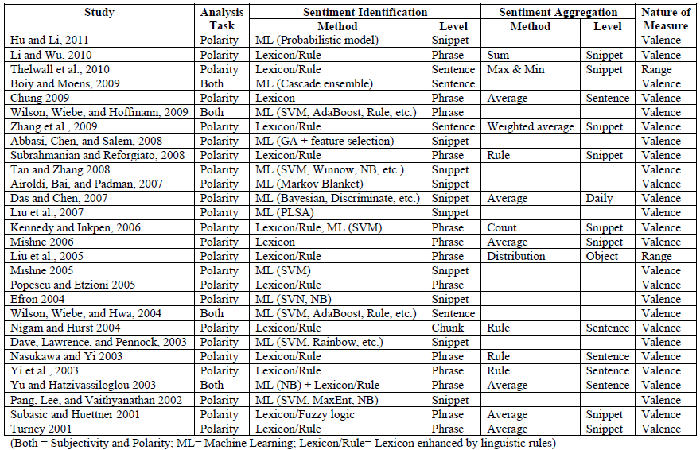
A Brief Summary of Sentiment Analysis Methods
Source: Zhang, Z., Li, X., and Chen, Y. (2012), "Deciphering word-of-mouth in social media: Text-based metrics of consumer reviews," ACM Trans. Manage. Inf. Syst. (3:1) 2012, pp 1-23.,

Slide 37
Word-of-Mouth (WOM)
“This book is the best written documentary thus far, yet sadly, there is no soft cover edition.”
“This book is the best written documentary thus far, yet sadly, there is no soft cover edition.”
Source: Zhang, Z., Li, X., and Chen, Y. (2012), "Deciphering word-of-mouth in social media: Text-based metrics of consumer reviews," ACM Trans. Manage. Inf. Syst. (3:1) 2012, pp 1-23.,

Slide 38
Word | POS
This | DT
book | NN
is | VBZ
the | DT
best | JJS
written | VBN
documentary | NN
thus | RB
far | RB
, | ,
yet | RB
sadly | RB
, | ,
there | EX
is | VBZ
no | DT
soft | JJ
cover | NN
edition | NN
. | .
This
book
is
the
best
written
documentary
thus
far
,
yet
sadly
,
there
is
no
soft
cover
edition
.
Source: Zhang, Z., Li, X., and Chen, Y. (2012), "Deciphering word-of-mouth in social media: Text-based metrics of consumer reviews," ACM Trans. Manage. Inf. Syst. (3:1) 2012, pp 1-23.,

Slide 39
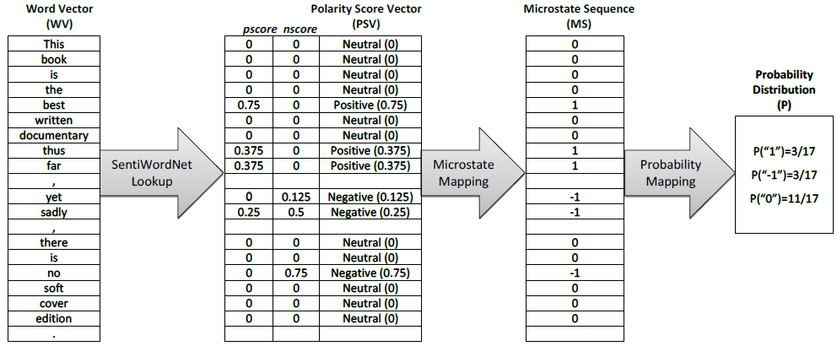
Conversion of text representation
Source: Zhang, Z., Li, X., and Chen, Y. (2012), "Deciphering word-of-mouth in social media: Text-based metrics of consumer reviews," ACM Trans. Manage. Inf. Syst. (3:1) 2012, pp 1-23.,

Slide 40
Example of SentiWordNet
POS ID PosScore NegScore SynsetTerms Gloss
a 00217728 0.75 0 beautiful#1 delighting the senses or exciting intellectual or emotional admiration; "a beautiful child"; "beautiful country"; "a beautiful painting"; "a beautiful theory"; "a beautiful party“
a 00227507 0.75 0 best#1 (superlative of `good') having the most positive qualities; "the best film of the year"; "the best solution"; "the best time for planting"; "wore his best suit“
r 00042614 0 0.625 unhappily#2 sadly#1 in an unfortunate way; "sadly he died before he could see his grandchild“
r 00093270 0 0.875 woefully#1 sadly#3 lamentably#1 deplorably#1 in an unfortunate or deplorable manner; "he was sadly neglected"; "it was woefully inadequate“
r 00404501 0 0.25 sadly#2 with sadness; in a sad manner; "`She died last night,' he said sadly"

Slide 41
SenticNet
The car is very old but it is rather not expensive.
The car is very old but it is rather not expensive.
The car is very old but it is rather not expensive.
Source: Cambria, Erik, Soujanya Poria, Rajiv Bajpai, and Björn Schuller. "SenticNet 4: A semantic resource for sentiment analysis based on conceptual primitives." In the 26th International Conference on Computational Linguistics (COLING), Osaka. 2016.

Slide 42
Polarity Detection with SenticNet
The car is very old but it is rather not expensive.
The car is very old but it is rather not expensive.
Source: Cambria, Erik, Soujanya Poria, Rajiv Bajpai, and Björn Schuller. "SenticNet 4: A semantic resource for sentiment analysis based on conceptual primitives." In the 26th International Conference on Computational Linguistics (COLING), Osaka. 2016.

Slide 43
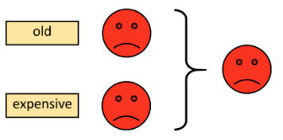
Polarity Detection with SenticNet
Source: Cambria, Erik, Soujanya Poria, Rajiv Bajpai, and Björn Schuller. "SenticNet 4: A semantic resource for sentiment analysis based on conceptual primitives." In the 26th International Conference on Computational Linguistics (COLING), Osaka. 2016.

Slide 44
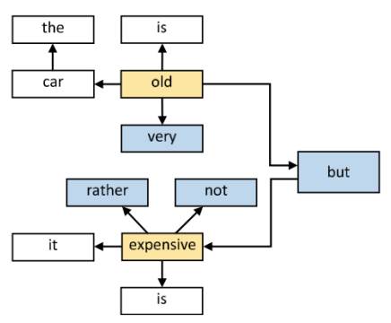
Polarity Detection with SenticNet
Source: Cambria, Erik, Soujanya Poria, Rajiv Bajpai, and Björn Schuller. "SenticNet 4: A semantic resource for sentiment analysis based on conceptual primitives." In the 26th International Conference on Computational Linguistics (COLING), Osaka. 2016.

Slide 45
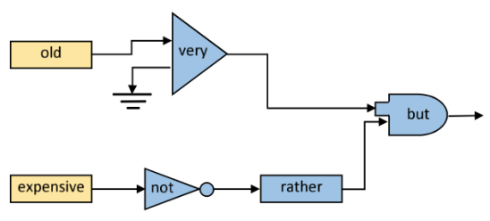
Polarity Detection with SenticNet
Source: Cambria, Erik, Soujanya Poria, Rajiv Bajpai, and Björn Schuller. "SenticNet 4: A semantic resource for sentiment analysis based on conceptual primitives." In the 26th International Conference on Computational Linguistics (COLING), Osaka. 2016.

Slide 46
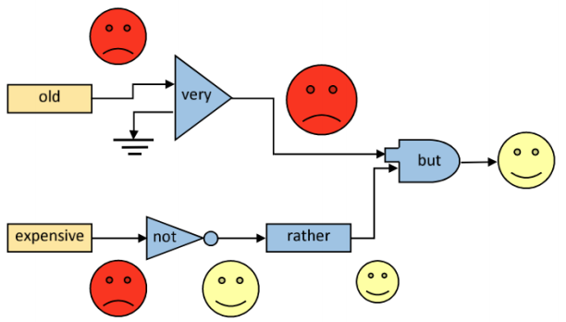
Polarity Detection with SenticNet
Source: Cambria, Erik, Soujanya Poria, Rajiv Bajpai, and Björn Schuller. "SenticNet 4: A semantic resource for sentiment analysis based on conceptual primitives." In the 26th International Conference on Computational Linguistics (COLING), Osaka. 2016.

Slide 47
Evaluation of Text Mining and Sentiment Analysis
Evaluation of Information Retrieval
Evaluation of Classification Model (Prediction)
Accuracy
Precision
Recall
F-score

Slide 48
Deep Learning for Sentiment Analytics

Slide 49
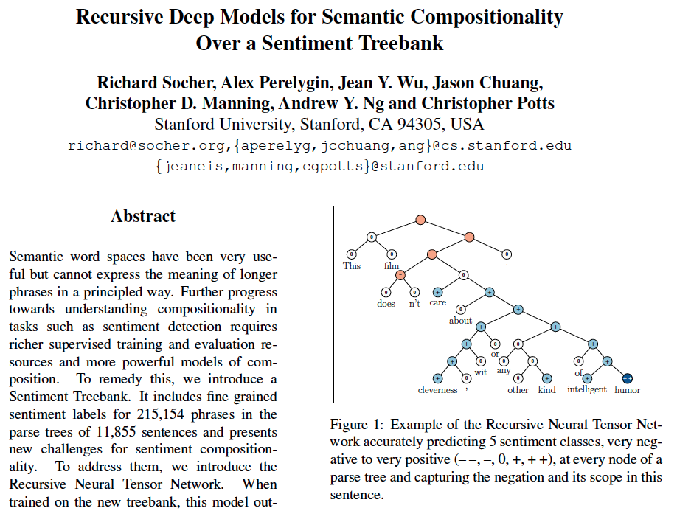
Recursive Deep Models for Semantic Compositionality Over a Sentiment Treebank
Source: Richard Socher et al. (2013) "Recursive Deep Models for Semantic Compositionality Over a Sentiment Treebank", EMNLP 2013

Slide 50
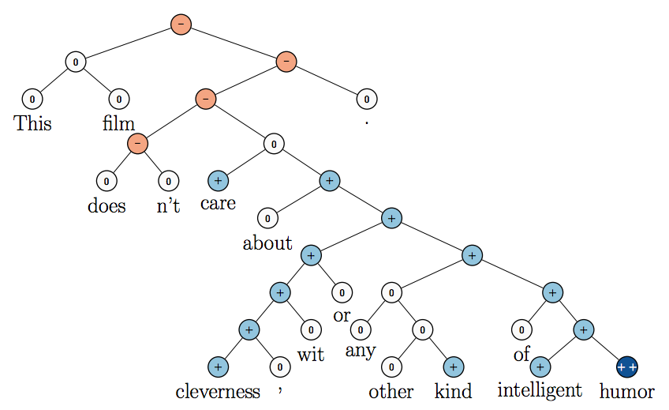
Recursive Neural Tensor Network (RNTN)
Source: Richard Socher et al. (2013) "Recursive Deep Models for Semantic Compositionality Over a Sentiment Treebank", EMNLP 2013

Slide 51
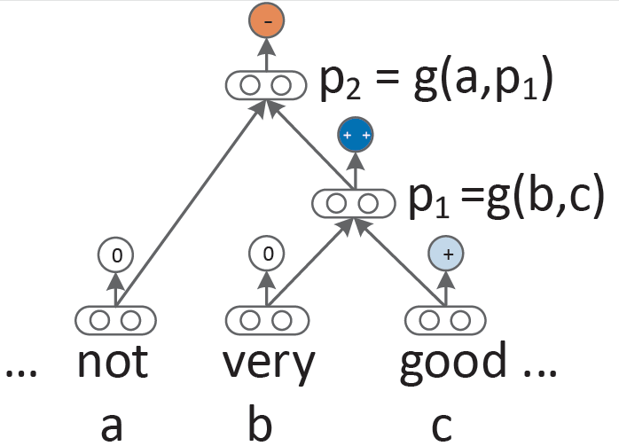
Recursive Neural Network (RNN) models for sentiment
Source: Richard Socher et al. (2013) "Recursive Deep Models for Semantic Compositionality Over a Sentiment Treebank", EMNLP 2013

Slide 52
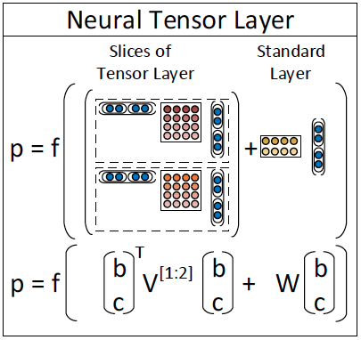
Recursive Neural Tensor Network (RNTN)
Source: Richard Socher et al. (2013) "Recursive Deep Models for Semantic Compositionality Over a Sentiment Treebank", EMNLP 2013

Slide 53
Roger Dodger is one of the most compelling variations on this theme. Roger Dodger is one of the least compelling variations on this theme.
Source: Richard Socher et al. (2013) "Recursive Deep Models for Semantic Compositionality Over a Sentiment Treebank", EMNLP 2013

Slide 54
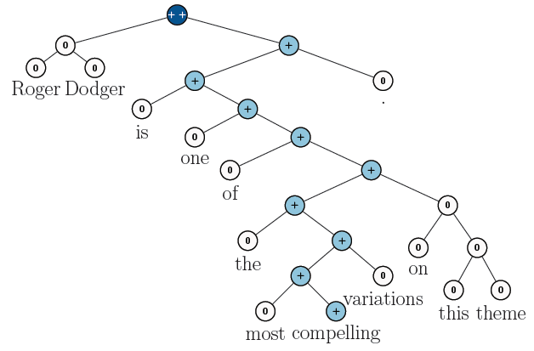
RNTN for Sentiment Analysis
Roger Dodger is one of the most compelling variations on this theme.
Source: Richard Socher et al. (2013) "Recursive Deep Models for Semantic Compositionality Over a Sentiment Treebank", EMNLP 2013

Slide 55
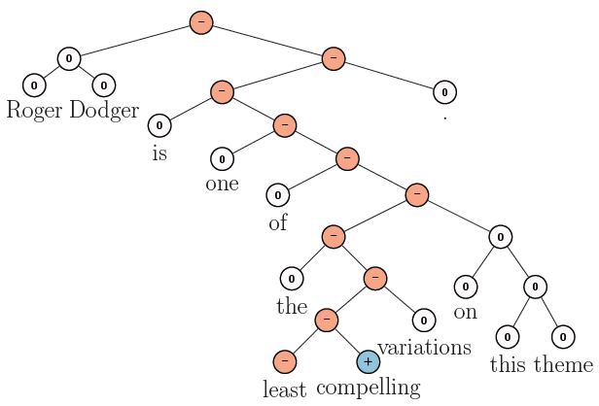
RNTN for Sentiment Analysis
Roger Dodger is one of the least compelling variations on this theme.
Source: Richard Socher et al. (2013) "Recursive Deep Models for Semantic Compositionality Over a Sentiment Treebank", EMNLP 2013

Slide 56
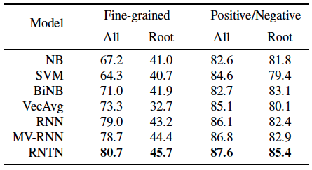
Accuracy for fine grained (5-class) and binary predictions at the sentence level (root) and for all nodes
Source: Richard Socher et al. (2013) "Recursive Deep Models for Semantic Compositionality Over a Sentiment Treebank", EMNLP 2013

Slide 57
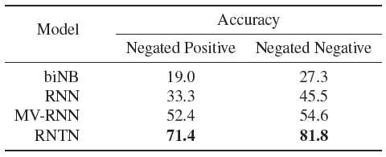
Accuracy of negation detection
Source: Richard Socher et al. (2013) "Recursive Deep Models for Semantic Compositionality Over a Sentiment Treebank", EMNLP 2013

Slide 58
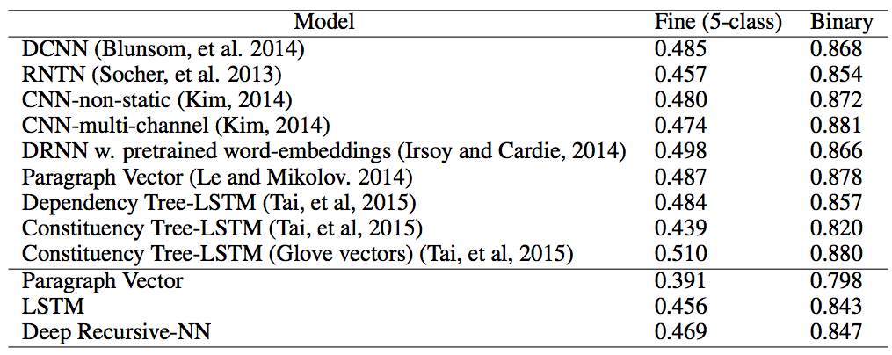
Deep Learning for Sentiment Analysis CNN RNTN LSTM
Source: https://cs224d.stanford.edu/reports/HongJames.pdf

Slide 59
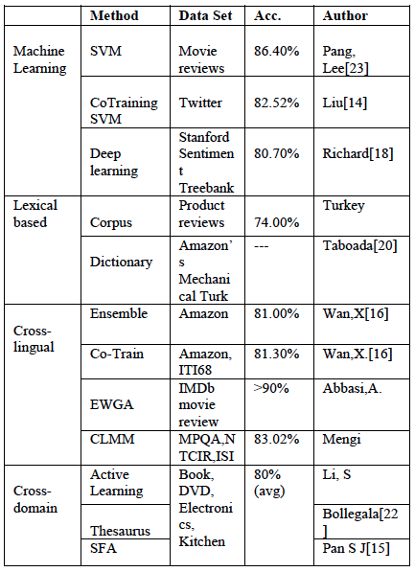
Performance Comparison of Sentiment Analysis Methods
Vishal Kharde and Sheetal Sonawane (2016), "Sentiment Analysis of Twitter Data: A Survey of Techniques," International Journal of Computer Applications, Vol 139, No. 11, 2016. pp.5-15

Slide 60
Social Media Monitoring/Analysis

Slide 61
Existing Tools (“Social Media Monitoring/Analysis")
Radian 6
Social Mention
Overtone OpenMic
Microsoft Dynamics Social Networking Accelerator
SAS Social Media Analytics
Lithium Social Media Monitoring
RightNow Cloud Monitor
Source: Wiltrud Kessler (2012), Introduction to Sentiment Analysis

Slide 62
Word-of-mouth Voice of the Customer
1. Attensity
Track social sentiment across brands and competitors
http://www.attensity.com/home/
2. Clarabridge
Sentiment and Text Analytics Software
http://www.clarabridge.com/

Slide 63
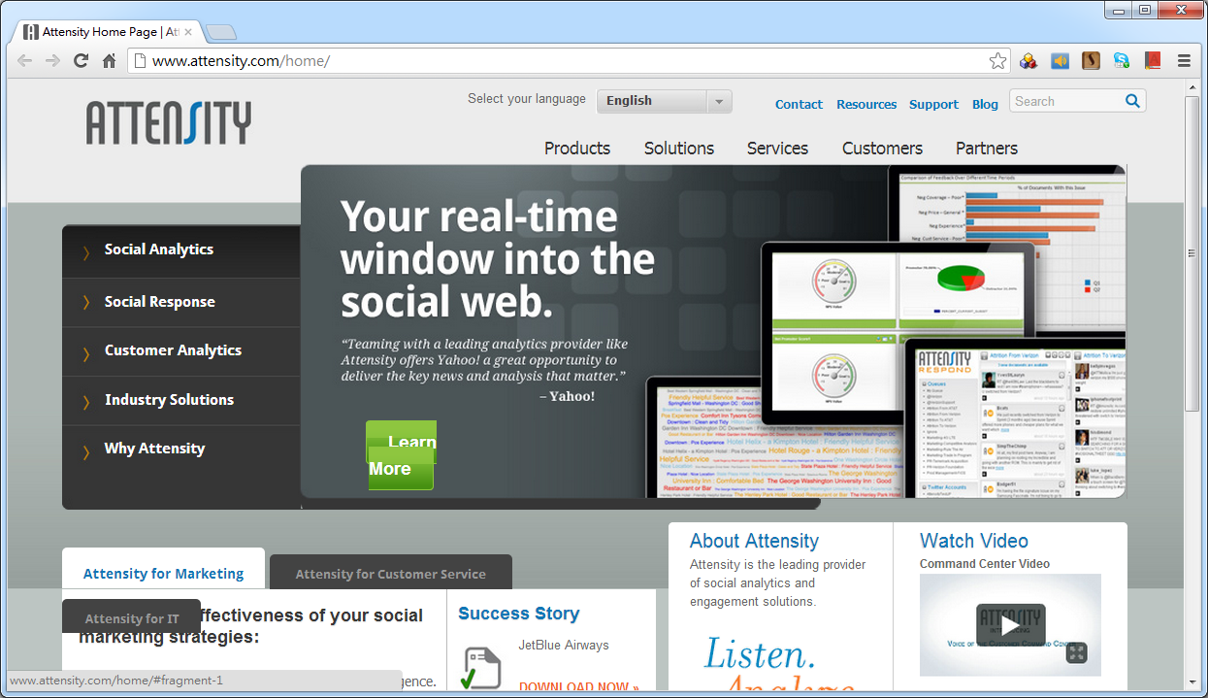
Attensity: Track social sentiment across brands and competitors
http://www.attensity.com/
http://www.youtube.com/watch?v=4goxmBEg2Iw#!

Slide 64
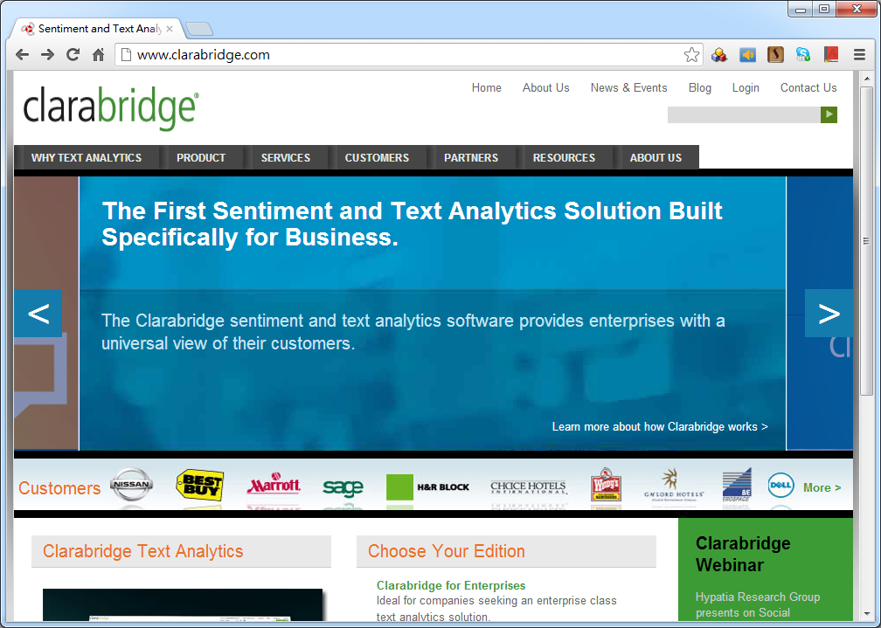
Clarabridge: Sentiment and Text Analytics Software
http://www.clarabridge.com/
http://www.youtube.com/watch?v=IDHudt8M9P0

Slide 65
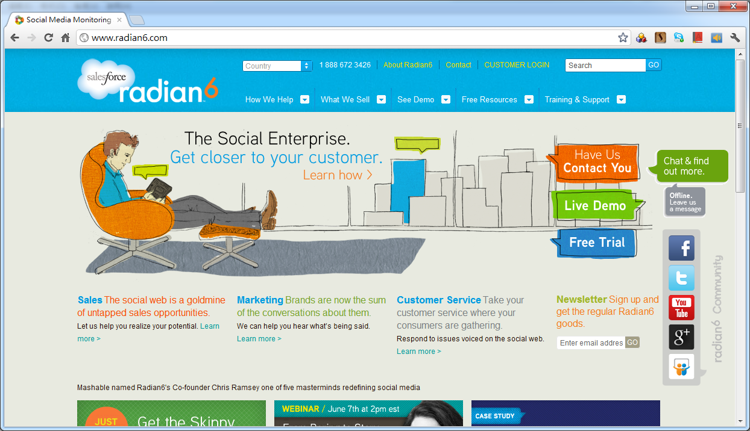
http://www.radian6.com/
http://www.youtube.com/watch?feature=player_embedded&v=8i6Exg3Urg0

Slide 66
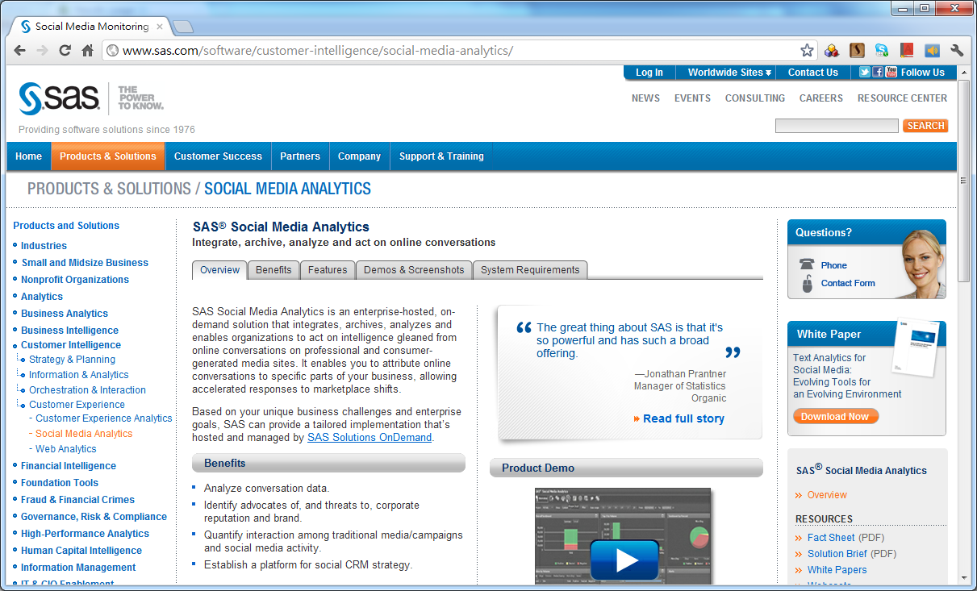
http://www.sas.com/software/customer-intelligence/social-media-analytics/

Slide 67
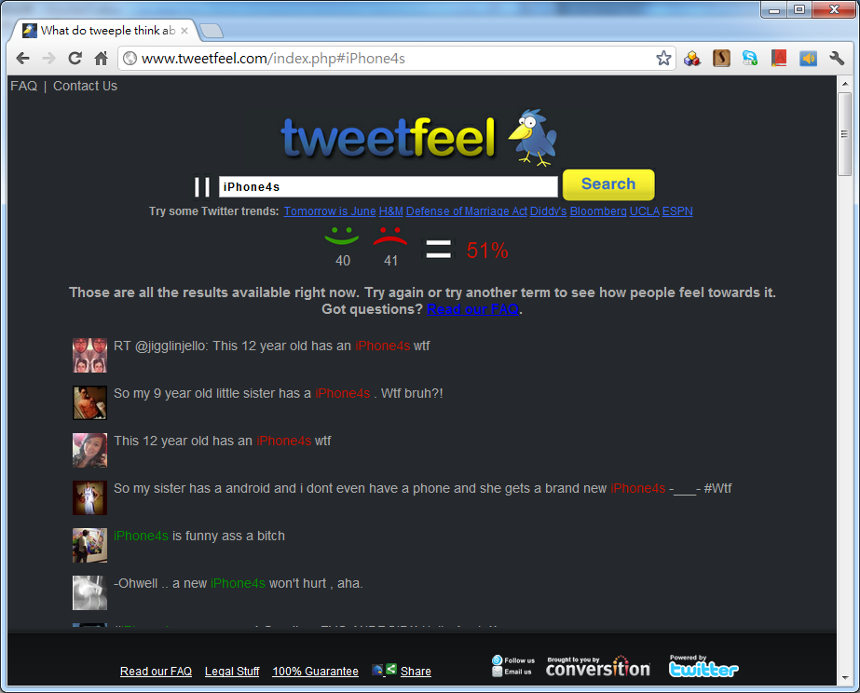
http://www.tweetfeel.com

Slide 68
eLand
http://www.eland.com.tw/

Slide 69
OpView
http://www.opview.com.tw/

Slide 70
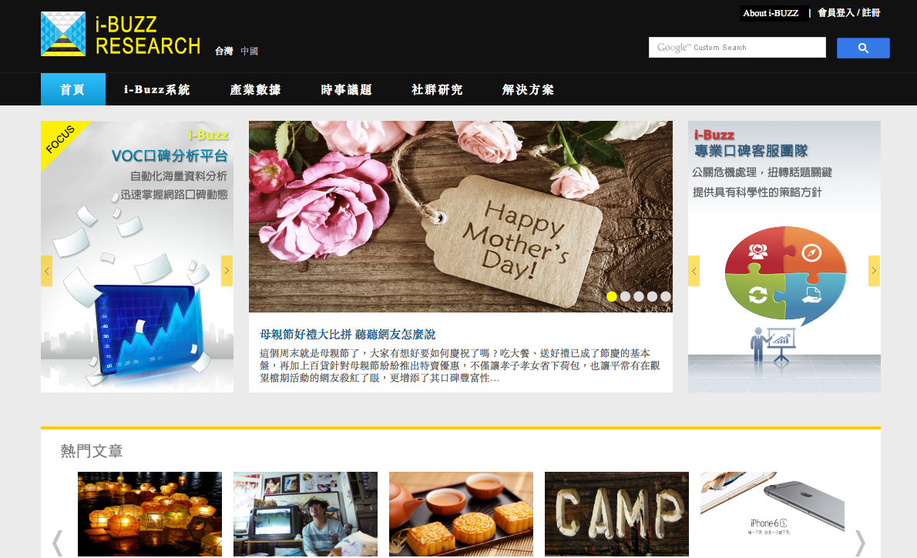
http://www.i-buzz.com.tw/

Slide 71
Resources of Opinion Mining

Slide 72
Datasets of Opinion Mining
Blog06
25GB TREC test collection
http://ir.dcs.gla.ac.uk/test collections/access to data.html
Cornell movie-review datasets
http://www.cs.cornell.edu/people/pabo/movie-review-data/
Customer review datasets
http://www.cs.uic.edu/∼liub/FBS/CustomerReviewData.zip
Multiple-aspect restaurant reviews
http://people.csail.mit.edu/bsnyder/naacl07
NTCIR multilingual corpus
NTCIR Multilingual Opinion-Analysis Task (MOAT)
Source: Bo Pang and Lillian Lee (2008), "Opinion mining and sentiment analysis,” Foundations and Trends in Information Retrieval

Slide 73
Lexical Resources of Opinion Mining
SentiWordnet
http://sentiwordnet.isti.cnr.it/
General Inquirer
http://www.wjh.harvard.edu/∼inquirer/
OpinionFinder’s Subjectivity Lexicon
http://www.cs.pitt.edu/mpqa/
NTU Sentiment Dictionary (NTUSD)
http://nlg18.csie.ntu.edu.tw:8080/opinion/
Hownet Sentiment
http://www.keenage.com/html/c_bulletin_2007.htm

Slide 74
Example of SentiWordNet
POS ID PosScore NegScore SynsetTerms Gloss
a 00217728 0.75 0 beautiful#1 delighting the senses or exciting intellectual or emotional admiration; "a beautiful child"; "beautiful country"; "a beautiful painting"; "a beautiful theory"; "a beautiful party“
a 00227507 0.75 0 best#1 (superlative of `good') having the most positive qualities; "the best film of the year"; "the best solution"; "the best time for planting"; "wore his best suit“
r 00042614 0 0.625 unhappily#2 sadly#1 in an unfortunate way; "sadly he died before he could see his grandchild“
r 00093270 0 0.875 woefully#1 sadly#3 lamentably#1 deplorably#1 in an unfortunate or deplorable manner; "he was sadly neglected"; "it was woefully inadequate“
r 00404501 0 0.25 sadly#2 with sadness; in a sad manner; "`She died last night,' he said sadly"

Slide 75
《知網》情感分析用詞語集（beta版）
“中英文情感分析用詞語集”
包含詞語約 17887
“中文情感分析用詞語集”
包含詞語約 9193
“英文情感分析用詞語集”
包含詞語 8945
Source: http://www.keenage.com/html/c_bulletin_2007.htm

Slide 76
中文情感分析用詞語集
中文正面情感詞語 | 836
中文負面情感詞語 | 1254
中文正面評價詞語 | 3730
中文負面評價詞語 | 3116
中文程度級別詞語 | 219
中文主張詞語 | 38
Total | 9193
Source: http://www.keenage.com/html/c_bulletin_2007.htm

Slide 77
中文情感分析用詞語集
“正面情感”詞語
如： 愛，讚賞，快樂，感同身受，好奇， 喝彩，魂牽夢縈，嘉許 ...
“負面情感”詞語
如： 哀傷，半信半疑，鄙視，不滿意，不是滋味兒，後悔，大失所望 ...
Source: http://www.keenage.com/html/c_bulletin_2007.htm

Slide 78
中文情感分析用詞語集
“正面評價”詞語
如： 不可或缺，部優，才高八斗，沉魚落雁， 催人奮進，動聽，對勁兒 ...
“負面評價”詞語
如： 醜，苦，超標，華而不實，荒涼，混濁， 畸輕畸重，價高，空洞無物 ...
Source: http://www.keenage.com/html/c_bulletin_2007.htm

Slide 79
中文情感分析用詞語集
“程度級別”詞語
1. “極其|extreme / 最|most”
非常，極，極度，無以倫比，最為
2. “很|very”
多麼，分外，格外，著實
…
“主張”詞語
1. {perception|感知}
感覺，覺得，預感
2. {regard|認為}
認為，以為，主張
Source: http://www.keenage.com/html/c_bulletin_2007.htm

Slide 80
Opinion Spam Detection

Slide 81
Opinion Spam Detection
Opinion Spam Detection: Detecting Fake Reviews and Reviewers
Spam Review
Fake Review
Bogus Review
Deceptive review
Opinion Spammer
Review Spammer
Fake Reviewer
Shill (Stooge or Plant)
Source: http://www.cs.uic.edu/~liub/FBS/fake-reviews.html

Slide 82
Opinion Spamming
Opinion Spamming
"illegal" activities
e.g., writing fake reviews, also called shilling
try to mislead readers or automated opinion mining and sentiment analysis systems by giving undeserving positive opinions to some target entities in order to promote the entities and/or by giving false negative opinions to some other entities in order to damage their reputations.
Source: http://www.cs.uic.edu/~liub/FBS/fake-reviews.html

Slide 83
Forms of Opinion spam
fake reviews (also called bogus reviews)
fake comments
fake blogs
fake social network postings
deceptions
deceptive messages
Source: http://www.cs.uic.edu/~liub/FBS/fake-reviews.html

Slide 84
Fake Review Detection
Methods
supervised learning
pattern discovery
graph-based methods
relational modeling
Signals
Review content
Reviewer abnormal behaviors
Product related features
Relationships
Source: http://www.cs.uic.edu/~liub/FBS/fake-reviews.html

Slide 85
Professional Fake Review Writing Services (some Reputation Management companies)
Post positive reviews
Sponsored reviews
Pay per post
Need someone to write positive reviews about our company (budget: $250-$750 USD)
Fake review writer
Product review writer for hire
Hire a content writer
Fake Amazon book reviews (hiring book reviewers)
People are just having fun (not serious)
Source: http://www.cs.uic.edu/~liub/FBS/fake-reviews.html

Slide 86
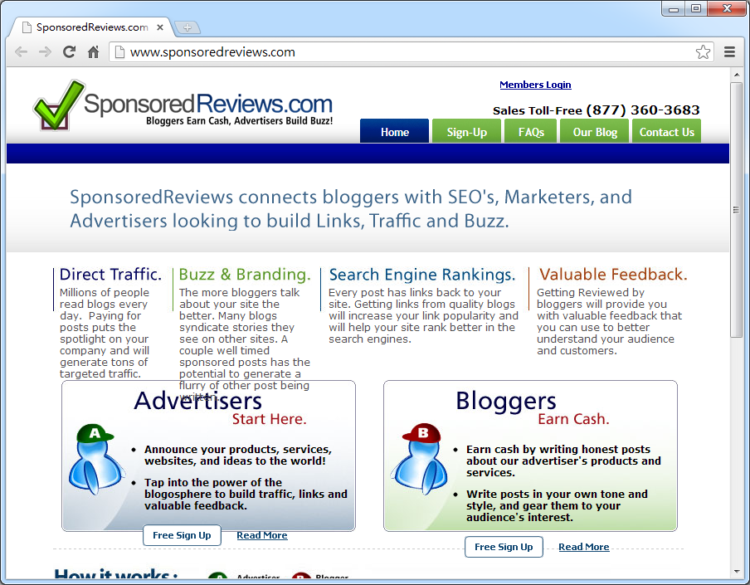
Source:http://www.sponsoredreviews.com/

Slide 87
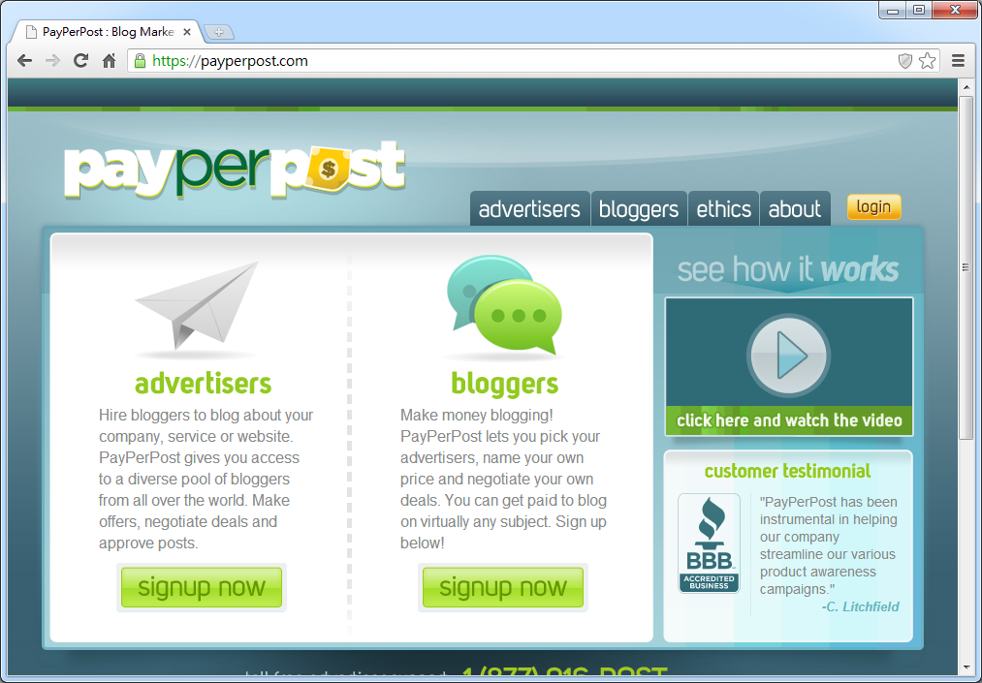
Source: https://payperpost.com/

Slide 88
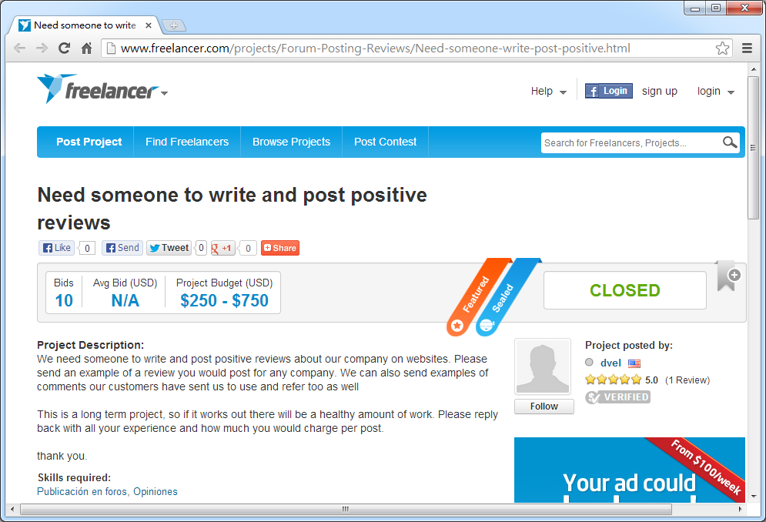
Source:http://www.freelancer.com/projects/Forum-Posting-Reviews/Need-someone-write-post-positive.html

Slide 89
Papers on Opinion Spam Detection
Arjun Mukherjee, Bing Liu, and Natalie Glance. Spotting Fake Reviewer Groups in Consumer Reviews. International World Wide Web Conference (WWW-2012), Lyon, France, April 16-20, 2012.
Guan Wang, Sihong Xie, Bing Liu, Philip S. Yu. Identify Online Store Review Spammers via Social Review Graph. ACM Transactions on Intelligent Systems and Technology, accepted for publication, 2011.
Guan Wang, Sihong Xie, Bing Liu, Philip S. Yu. Review Graph based Online Store Review Spammer Detection. ICDM-2011, 2011.
Arjun Mukherjee, Bing Liu, Junhui Wang, Natalie Glance, Nitin Jindal. Detecting Group Review Spam. WWW-2011 poster paper, 2011.
Nitin Jindal, Bing Liu and Ee-Peng Lim. "Finding Unusual Review Patterns Using Unexpected Rules" Proceedings of the 19th ACM International Conference on Information and Knowledge Management (CIKM-2010, short paper), Toronto, Canada, Oct 26 - 30, 2010.
Ee-Peng Lim, Viet-An Nguyen, Nitin Jindal, Bing Liu and Hady Lauw. "Detecting Product Review Spammers using Rating Behaviors." Proceedings of the 19th ACM International Conference on Information and Knowledge Management (CIKM-2010, full paper), Toronto, Canada, Oct 26 - 30, 2010.
Nitin Jindal and Bing Liu. "Opinion Spam and Analysis." Proceedings of First ACM International Conference on Web Search and Data Mining (WSDM-2008), Feb 11-12, 2008, Stanford University, Stanford, California, USA.
Nitin Jindal and Bing Liu. "Review Spam Detection." Proceedings of WWW-2007 (poster paper), May 8-12, Banff, Canada.
Source: http://www.cs.uic.edu/~liub/FBS/fake-reviews.html

Slide 90
Summary
Architectures of Sentiment Analytics on Social Media
Social Media Monitoring/Analysis
Sentiment Analytics on Social Media: Tools and Applications

Slide 91
References
Bing Liu (2011) , “Web Data Mining: Exploring Hyperlinks, Contents, and Usage Data,” 2nd Edition, Springer. http://www.cs.uic.edu/~liub/WebMiningBook.html
Bing Liu (2013), Opinion Spam Detection: Detecting Fake Reviews and Reviewers, http://www.cs.uic.edu/~liub/FBS/fake-reviews.html
Bo Pang and Lillian Lee (2008), "Opinion mining and sentiment analysis,” Foundations and Trends in Information Retrieval 2(1-2), pp. 1–135, 2008.
Wiltrud Kessler (2012), Introduction to Sentiment Analysis, http://www.ims.uni-stuttgart.de/~kesslewd/lehre/sentimentanalysis12s/introduction_sentimentanalysis.pdf
Z. Zhang, X. Li, and Y. Chen (2012), "Deciphering word-of-mouth in social media: Text-based metrics of consumer reviews," ACM Trans. Manage. Inf. Syst. (3:1) 2012, pp 1-23.
Efraim Turban, Ramesh Sharda, Dursun Delen (2011), Decision Support and Business Intelligence Systems, Ninth Edition, 2011, Pearson.
Guandong Xu, Yanchun Zhang, Lin Li (2011), Web Mining and Social Networking: Techniques and Applications, 2011, Springer

Slide 92
References
Cambria, Erik, Soujanya Poria, Rajiv Bajpai, and Björn Schuller. "SenticNet 4: A semantic resource for sentiment analysis based on conceptual primitives." In the 26th International Conference on Computational Linguistics (COLING), Osaka. 2016.
Richard Socher, Alex Perelygin, Jean Y. Wu, Jason Chuang, Christopher D. Manning, Andrew Y. Ng, and Christopher Potts (2013), "Recursive Deep Models for Semantic Compositionality Over a Sentiment Treebank," In Proceedings of the conference on empirical methods in natural language processing (EMNLP), vol. 1631, p. 1642 http://nlp.stanford.edu/~socherr/EMNLP2013_RNTN.pdf
Kumar Ravi and Vadlamani Ravi (2015), "A survey on opinion mining and sentiment analysis: tasks, approaches and applications." Knowledge-Based Systems, 89, pp.14-46.
Vishal Kharde and Sheetal Sonawane (2016), "Sentiment Analysis of Twitter Data: A Survey of Techniques," International Journal of Computer Applications, vol 139, no. 11, 2016. pp.5-15.
Jesus Serrano-Guerrero, Jose A. Olivas, Francisco P. Romero, and Enrique Herrera-Viedma (2015), "Sentiment analysis: A review and comparative analysis of web services," Information Sciences, 311, pp. 18-38.
Steven Struhl (2015), Practical Text Analytics: Interpreting Text and Unstructured Data for Business Intelligence (Marketing Science), Kogan Page
Bing Liu (2015), Sentiment Analysis: Mining Opinions, Sentiments, and Emotions, Cambridge University Press

