Slide 1




Tamkang
University
Social Media and Opinion Mining
(社群媒體與意見探勘)
時間：2016/10/25 (二) (2:10-5:00pm)
地點：政治大學綜合院館270407，北棟407教室
主持人：陳恭 主任
Min-Yuh Day
戴敏育
Assistant Professor
專任助理教授
Dept. of Information Management, Tamkang University
淡江大學 資訊管理學系
http://mail. tku.edu.tw/myday/
2016-10-25

Slide 2
Outline
Social Media
  Social Media Marketing Analytics
  (社群媒體行銷分析)
Opinion Mining
  Text Mining and Analytics Technology
  (文字探勘分析技術)

Slide 3
Tamkang
University
Social Media Marketing Analytics
(社群媒體行銷分析)
Min-Yuh Day
戴敏育
Assistant Professor
專任助理教授
Dept. of Information Management, Tamkang University
淡江大學 資訊管理學系
http://mail. tku.edu.tw/myday/
2016-07

Slide 4
Outline
Consumer Psychology and Behavior on Social Media
Social Media Marketing Analytics
  Social Media Listening
  Search Analytics
  Content Analytics
  Engagement Analytics
Social Analytics Lifecycle

Slide 5




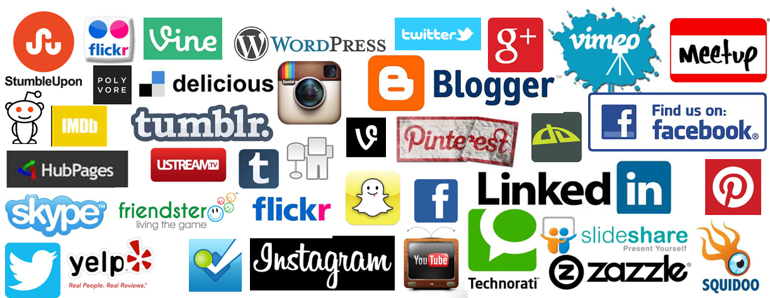
Social Media
Source: http://hungrywolfmarketing.com/2013/09/09/what-are-your-social-marketing-goals/

Slide 6
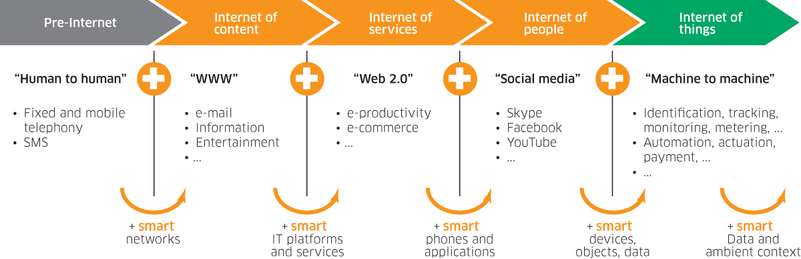
Internet Evolution
Internet of People (IoP): Social Media
Internet of Things (IoT): Machine to Machine
Source: Marc Jadoul (2015), The IoT: The next step in internet evolution, March 11, 2015 http://www2.alcatel-lucent.com/techzine/iot-internet-of-things-next-step-evolution/

Slide 7


Emotions
Love
Anger
Joy
Sadness
Surprise
Fear
Source: Bing Liu (2011) , “Web Data Mining: Exploring Hyperlinks, Contents, and Usage Data,” Springer, 2nd Edition,

Slide 8
Example of Opinion: review segment on iPhone
“I bought an iPhone a few days ago.
It was such a nice phone.
The touch screen was really cool.
The voice quality was clear too.
However, my mother was mad with me as I did not tell her before I bought it.
She also thought the phone was too expensive, and wanted me to return it to the shop. … ”
Source: Bing Liu (2011) , “Web Data Mining: Exploring Hyperlinks, Contents, and Usage Data,” Springer, 2nd Edition,

Slide 9
Example of Opinion:
review segment on iPhone
“(1) I bought an iPhone a few days ago.
(2) It was such a nice phone.
(3) The touch screen was really cool.
(4) The voice quality was clear too.
(5) However, my mother was mad with me as I did not tell her before I bought it.
(6) She also thought the phone was too expensive, and wanted me to return it to the shop. … ”
+Positive Opinion
-Negative Opinion
Source: Bing Liu (2011) , “Web Data Mining: Exploring Hyperlinks, Contents, and Usage Data,” Springer, 2nd Edition,

Slide 10
Social Media Marketing Analytics

Slide 11
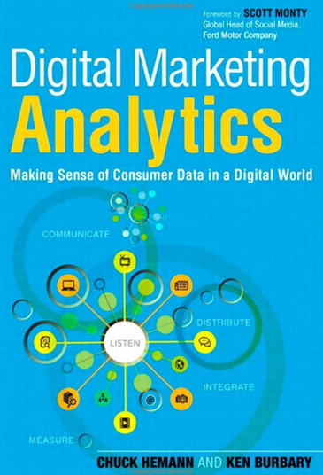
Digital Marketing Analytics:
Making Sense of Consumer Data in a Digital World,
Chuck Hemann and Ken Burbary, Que. 2013
Source: http://www.amazon.com/Digital-Marketing-Analytics-Consumer-Biz-Tech/dp/0789750309

Slide 12
Consumer
Psychology and
Behavior on
Social Media

Slide 13
How consumers think, feel, and act
Source: Philip Kotler & Kevin Lane Keller, Marketing Management, 14th ed., Pearson, 2012

Slide 14
Analyzing Consumer Markets
The aim of marketing is to meet and satisfy target customers’ needs and wants better than competitors.
Marketers must have a thorough understanding of
how consumers think, feel, and act
and offer clear value to each and every target consumer.
Source: Philip Kotler & Kevin Lane Keller, Marketing Management, 14th ed., Pearson, 2012

Slide 15
Customer Perceived Value, Customer Satisfaction, and Loyalty
Customer Perceived Performance
Customer
Perceived Value
Customer
Satisfaction
Customer
Loyalty
Customer
Expectations
Source: Philip Kotler & Kevin Lane Keller, Marketing Management, 14th ed., Pearson, 2012

Slide 16
Social Media Marketing Analytics
Social Media Listening
Search Analytics
Content Analytics
Engagement Analytics
Source: Chuck Hemann and Ken Burbary, Digital Marketing Analytics: Making Sense of Consumer Data in a Digital World, Que. 2013
Notes:
Social Media Listening
Search Analytics
Content Analytics
Engagement Analytics

Slide 17
The Convergence of
Paid, Owned & Earned Media
Promoted
Brand
Content
Paid Media
Traditional Ads
Owned Media
Corporate Ads
Converged
Media
Sponsored
Customer
Brands that
ask for shared
Press Coverage
Earned Media
Organic
Source: “The Converged Media Imperative: How Brands Will Combine Paid, Owned and Earned Media”, Altimeter Group, July 19, 2012)
http://www.altimetergroup.com/2012/07/the-converged-media-imperative/

Slide 18
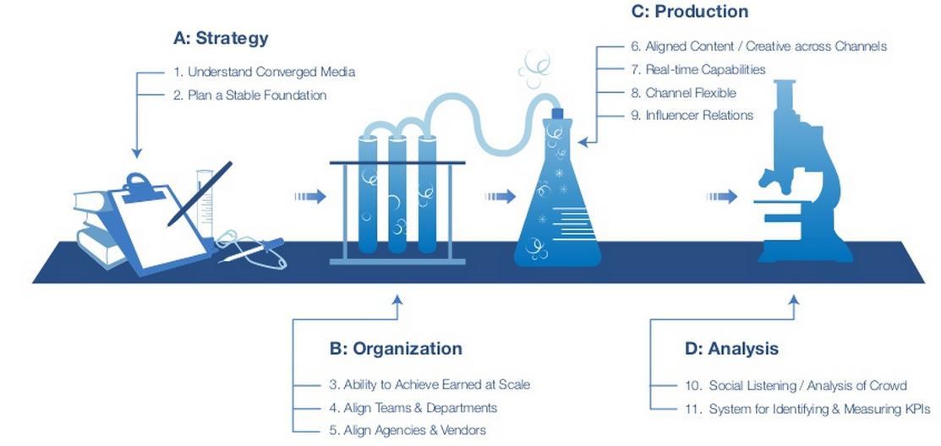
Converged Media
Top 11 Success Criteria
Social Listening / Analysis of Crowd
Source: “The Converged Media Imperative: How Brands Will Combine Paid, Owned and Earned Media”, Altimeter Group, July 19, 2012)
http://www.altimetergroup.com/2012/07/the-converged-media-imperative/

Slide 19
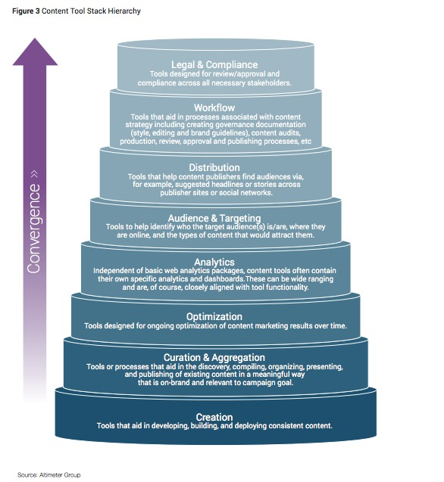
Content Tool Stack Hierarchy
Source: Rebecca Lieb, "Content marketing in 2015 -- research, not predictions", December 16, 2014
http://www.imediaconnection.com/content/37909.asp

Slide 20
Competitive Intelligence
Gather competitive intelligence data
Source: Chuck Hemann and Ken Burbary, Digital Marketing Analytics: Making Sense of Consumer Data in a Digital World, Que. 2013

Slide 21
Google Alexa Compete
Which audience segments are competitors reaching that you are not?
What keywords are successful for your competitors?
What sources are driving traffic to your competitors’ websites?
Source: Chuck Hemann and Ken Burbary, Digital Marketing Analytics: Making Sense of Consumer Data in a Digital World, Que. 2013

Slide 22
Competitive Intelligence
Facebook competitive analysis
Facebook content analysis
YouTube competitive analysis
YouTube channel analysis
Twitter profile analysis
Source: Chuck Hemann and Ken Burbary, Digital Marketing Analytics: Making Sense of Consumer Data in a Digital World, Que. 2013

Slide 23
Web Analytics (Clickstream)
Content Analytics
Mobile Analytics
Source: Chuck Hemann and Ken Burbary, Digital Marketing Analytics: Making Sense of Consumer Data in a Digital World, Que. 2013

Slide 24
Mobile Analytics
Where is my mobile traffic coming from?
What content are mobile users most interested in?
How is my mobile app being used?
What’s working?
What isn’t?
Which mobile platforms work best with my site?
How does mobile user’s engagement with my site compare to traditional web users’ engagement?
Source: Chuck Hemann and Ken Burbary, Digital Marketing Analytics: Making Sense of Consumer Data in a Digital World, Que. 2013

Slide 25
Identifying a
Social Media Listening Tool
Data Capture
Spam Prevention
Integration with Other Data Sources
Cost
Mobile Capability
API Access
Consistent User Interface
Workflow Functionality
Historical Data
Source: Chuck Hemann and Ken Burbary, Digital Marketing Analytics: Making Sense of Consumer Data in a Digital World, Que. 2013

Slide 26
Search Analytics
Free Tools for Collecting Insights Through
  Search Data
  Google Trends
  YouTube Trends
  The Google AdWords Keyword Tool
  Yahoo! Clues
Paid Tools for Collecting Insights Through Search Data
The BrightEdge SEO Platform
Source: Chuck Hemann and Ken Burbary, Digital Marketing Analytics: Making Sense of Consumer Data in a Digital World, Que. 2013

Slide 27
Owned Social Metrics
Facebook page
Twitter account
YouTube channel
Source: Chuck Hemann and Ken Burbary, Digital Marketing Analytics: Making Sense of Consumer Data in a Digital World, Que. 2013

Slide 28
Own Social Media Metrics: Facebook
Total likes
Reach
  Organic
  Paid reach
  Viral reach
Engaged users
People taking about this (PTAT)
Likes, comments, and shares by post
Source: Chuck Hemann and Ken Burbary, Digital Marketing Analytics: Making Sense of Consumer Data in a Digital World, Que. 2013

Slide 29
Own Social Media Metrics:
Twitter
Followers
Retweets
Replies
Clicks and click-through rate (CTR)
Impressions
Source: Chuck Hemann and Ken Burbary, Digital Marketing Analytics: Making Sense of Consumer Data in a Digital World, Que. 2013

Slide 30
Own Social Media Metrics: YouTube
Views
Subscribers
Likes/dislikes
Comments
Favorites
Sharing
Source: Chuck Hemann and Ken Burbary, Digital Marketing Analytics: Making Sense of Consumer Data in a Digital World, Que. 2013

Slide 31
Own Social Media Metrics: SlideShare
Followers
Views
Comments
Shares
Source: Chuck Hemann and Ken Burbary, Digital Marketing Analytics: Making Sense of Consumer Data in a Digital World, Que. 2013

Slide 32
Own Social Media Metrics:
Pinterest
Followers
Number of boards
Number of pins
Likes
Repins
Comments
Source: Chuck Hemann and Ken Burbary, Digital Marketing Analytics: Making Sense of Consumer Data in a Digital World, Que. 2013

Slide 33
Own Social Media Metrics:
Google+
Number of people who have an account circled
+1s
Comments
Source: Chuck Hemann and Ken Burbary, Digital Marketing Analytics: Making Sense of Consumer Data in a Digital World, Que. 2013

Slide 34
Earned Social Media Metrics
Earned conversations
In-network conversations
Source: Chuck Hemann and Ken Burbary, Digital Marketing Analytics: Making Sense of Consumer Data in a Digital World, Que. 2013

Slide 35
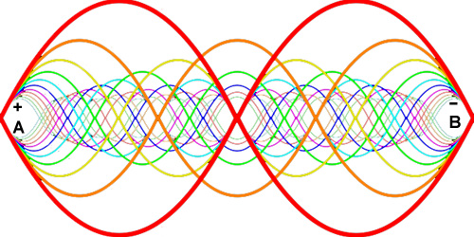
Earned Social Media Metrics:
Earned conversations
Share of voice
Share of conversation
Sentiment
Message resonance
Overall conversation volume
Source: http://www.elvtd.com/elevation/p/beings-of-resonance
Source: Chuck Hemann and Ken Burbary, Digital Marketing Analytics: Making Sense of Consumer Data in a Digital World, Que. 2013

Slide 36
Demystifying Web Data
Visits
Unique page views
Bounce rate
Pages per visit
Traffic sources
Conversion
Source: Chuck Hemann and Ken Burbary, Digital Marketing Analytics: Making Sense of Consumer Data in a Digital World, Que. 2013

Slide 37
Searching for the Right Metrics
Paid Searches
Organic Searches
Source: Chuck Hemann and Ken Burbary, Digital Marketing Analytics: Making Sense of Consumer Data in a Digital World, Que. 2013
Notes:
Searching for the Right Metrics
Paid Searches
Organic Searches

Slide 38
Paid Searches
Impressions
Clicks
Click-through rate (CTR)
Cost per click (CPC)
Impression share
Sales or revenue per click
Average position
Source: Chuck Hemann and Ken Burbary, Digital Marketing Analytics: Making Sense of Consumer Data in a Digital World, Que. 2013

Slide 39
Organic Searches
Known and unknown keywords
Known and unknown branded keywords
Total visits
Total conversions from known keywords
Average search position
Source: Chuck Hemann and Ken Burbary, Digital Marketing Analytics: Making Sense of Consumer Data in a Digital World, Que. 2013

Slide 40
Aligning Digital and Traditional Analytics
Primary Research
  Brand reputation
  Message resonance
  Executive reputation
  Advertising performance
Traditional Media Monitoring
Traditional CRM Data
Source: Chuck Hemann and Ken Burbary, Digital Marketing Analytics: Making Sense of Consumer Data in a Digital World, Que. 2013

Slide 41
Social Media Listening Evolution
Location of conversations
Sentiment
Key message penetration
Key influencers
Source: Chuck Hemann and Ken Burbary, Digital Marketing Analytics: Making Sense of Consumer Data in a Digital World, Que. 2013
Notes:
Social Media Listening Evolution
Location of conversations
Sentiment
Key message penetration
Key influencers

Slide 42
Social Analytics Lifecycle (5 Stages)
1. Discover
2. Analyze
3. Segment
4. Strategy
5. Execution
Source: Chuck Hemann and Ken Burbary, Digital Marketing Analytics: Making Sense of Consumer Data in a Digital World, Que. 2013
Notes:
Social Analytics Lifecycle (5 Stages)
Discover
Analyze
Segment
Strategize
Execute

Slide 43
Social Analytics Lifecycle (5 Stages)
1. Discover
1. Discover
2. Analyze
Social Web
(blogs, social networks, forums/message boards,
Video/phone sharing)
3. Segment
4. Strategy
5. Execution
Source: Chuck Hemann and Ken Burbary, Digital Marketing Analytics: Making Sense of Consumer Data in a Digital World, Que. 2013
Notes:
Social Analytics Lifecycle (5 Stages)
Discover
Analyze
Segment
Strategize
Execute

Slide 44
Social Analytics Lifecycle (5 Stages)
1. Discover
Social Web
(blogs, social networks, forums/message boards,
Video/phone sharing)
2. Analyze
Distill relevant signal from social noise
3. Segment
4. Strategy
5. Execution
Source: Chuck Hemann and Ken Burbary, Digital Marketing Analytics: Making Sense of Consumer Data in a Digital World, Que. 2013
Notes:
Social Analytics Lifecycle (5 Stages)
Discover
Analyze
Segment
Strategize
Execute

Slide 45
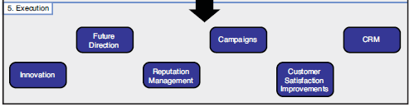
Social Analytics Lifecycle (5 Stages)
1. Discover
Social Web
(blogs, social networks, forums/message boards,
Video/phone sharing)
2. Analyze
Distill relevant signal from social noise
Data Segmentation
(Filter, Group, Tag, Assign)
3. Segment
Strategic Planning
Corps Communication
Customer Care
4. Strategy
Product Development
Marketing & Advertising
Sales
5. Execution
Strategic
Tactical
Source: Chuck Hemann and Ken Burbary, Digital Marketing Analytics: Making Sense of Consumer Data in a Digital World, Que. 2013
Notes:
Social Analytics Lifecycle (5 Stages)
Discover
Analyze
Segment
Strategize
Execute

Slide 46
Social Analytics Lifecycle (5 Stages)
1. Discover
Social Web
(blogs, social networks, forums/message boards,
Video/phone sharing)
2. Analyze
Distill relevant signal from social noise
3. Segment
Data Segmentation
(Filter, Group, Tag, Assign)
4. Strategy
Insights drive focused business strategies
5. Execution
Source: Chuck Hemann and Ken Burbary, Digital Marketing Analytics: Making Sense of Consumer Data in a Digital World, Que. 2013
Notes:
Social Analytics Lifecycle (5 Stages)
Discover
Analyze
Segment
Strategize
Execute

Slide 47
Social Analytics Lifecycle (5 Stages)
1. Discover
Social Web
(blogs, social networks, forums/message boards,
Video/phone sharing)
2. Analyze
Distill relevant signal from social noise
3. Segment
Data Segmentation
(Filter, Group, Tag, Assign)
4. Strategy
Insights drive focused business strategies
Innovation
Future Direction
Reputation Management
Campaigns
Customer Satisfaction Improvements
5. Execution
CRM
Source: Chuck Hemann and Ken Burbary, Digital Marketing Analytics: Making Sense of Consumer Data in a Digital World, Que. 2013
Notes:
Social Analytics Lifecycle (5 Stages)
Discover
Analyze
Segment
Strategize
Execute

Slide 48
Social Analytics Lifecycle (5 Stages)
1. Discover
Social Web
(blogs, social networks, forums/message boards,
Video/phone sharing)
2. Analyze
Distill relevant signal from social noise
3. Segment
Data Segmentation
(Filter, Group, Tag, Assign)
4. Strategy
Insights drive focused business strategies
Innovation
Future Direction
Reputation Management
Campaigns
Customer Satisfaction Improvements
5. Execution
CRM
Source: Chuck Hemann and Ken Burbary, Digital Marketing Analytics: Making Sense of Consumer Data in a Digital World, Que. 2013
Notes:
Social Analytics Lifecycle (5 Stages)
Discover
Analyze
Segment
Strategize
Execute

Slide 49
How consumers think, feel, and act
Source: Philip Kotler & Kevin Lane Keller, Marketing Management, 14th ed., Pearson, 2012

Slide 50
Emotions
Love
Anger
Joy
Sadness
Surprise
Fear
Source: Bing Liu (2011) , “Web Data Mining: Exploring Hyperlinks, Contents, and Usage Data,” Springer, 2nd Edition,

Slide 51
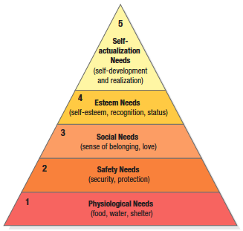

Maslow’s Hierarchy of Needs
Source: Philip Kotler & Kevin Lane Keller, Marketing Management, 14th ed., Pearson, 2012

Slide 52
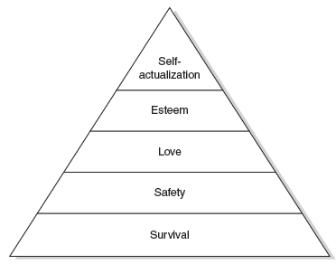
Maslow’s hierarchy of human needs
(Maslow, 1943)

Slide 53
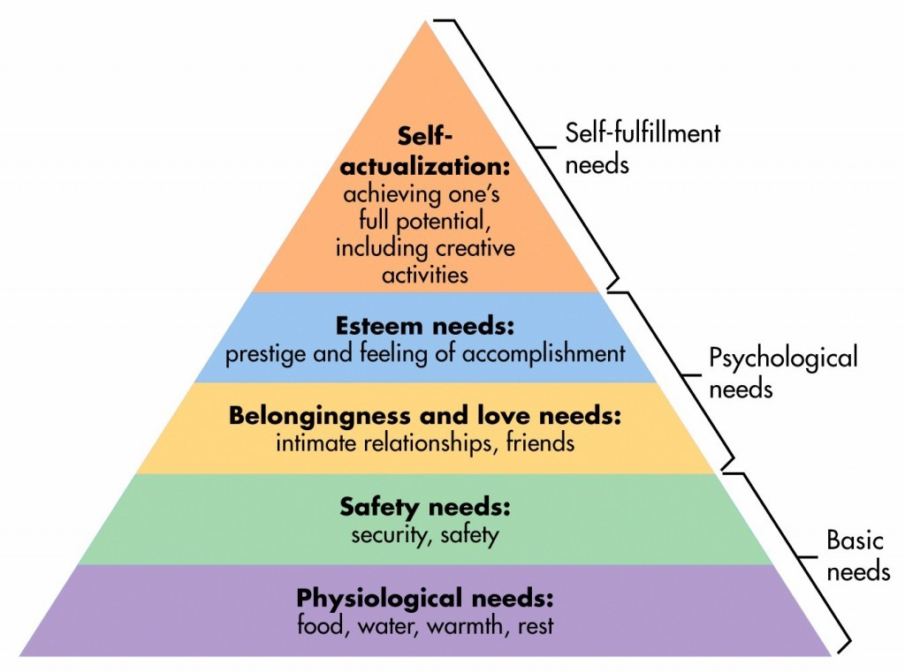
Maslow’s Hierarchy of Needs
Source: http://sixstoriesup.com/social-psyche-what-makes-us-go-social/

Slide 54
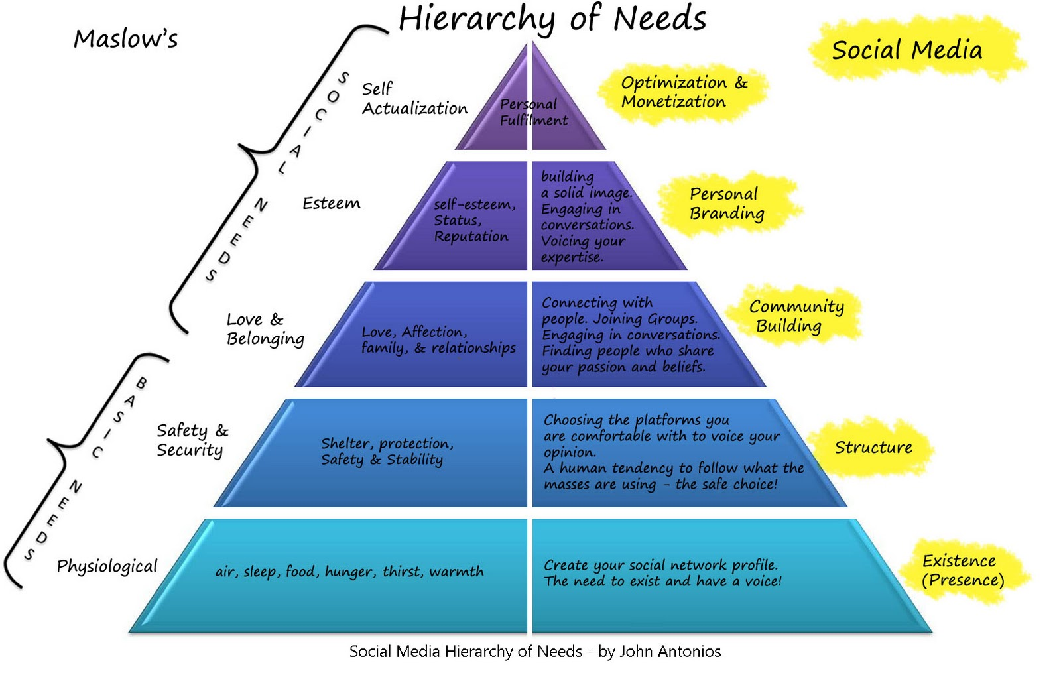
Social Media Hierarchy of Needs
Source: http://2.bp.blogspot.com/_Rta1VZltiMk/TPavcanFtfI/AAAAAAAAACo/OBGnRL5arSU/s1600/social-media-heirarchy-of-needs1.jpg

Slide 55
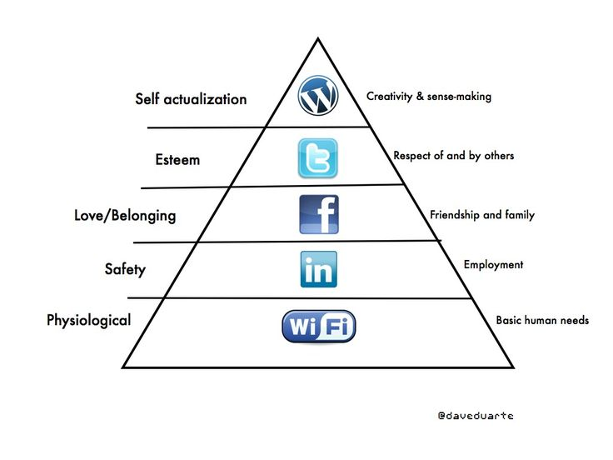

Social Media Hierarchy of Needs
Source: http://www.pinterest.com/pin/18647785930903585/

Slide 56
The Social Feedback Cycle
Consumer Behavior on Social Media
Marketer-Generated
User-Generated
Form
Opinion
Awareness
Consideration
Purchase
Use
Talk
Source: Evans et al. (2010), Social Media Marketing: The Next Generation of Business Engagement

Slide 57






The New Customer Influence Path
Awareness
Consideration
Purchase
Source: Evans et al. (2010), Social Media Marketing: The Next Generation of Business Engagement

Slide 58
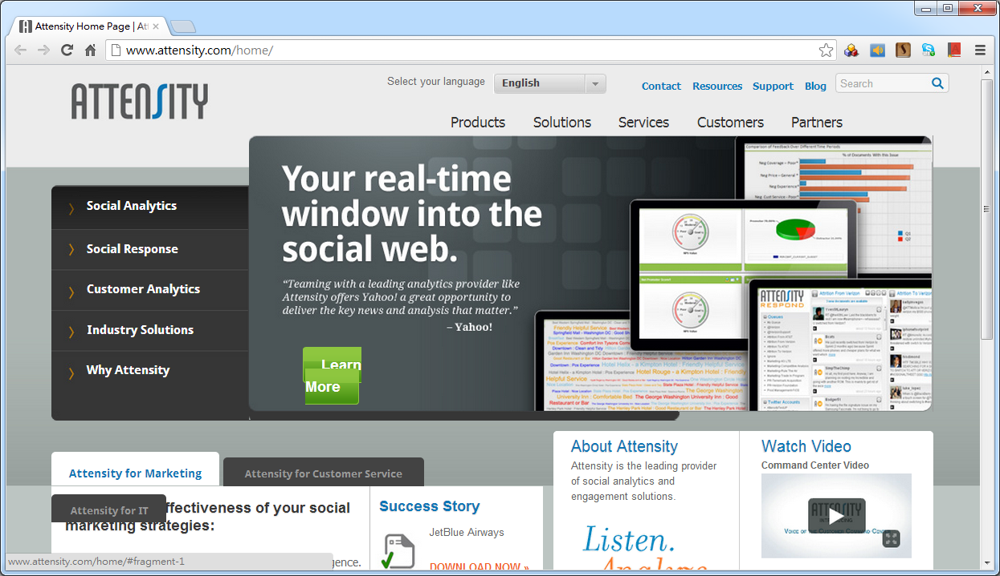
Attensity: Track social sentiment across brands and competitors
http://www.attensity.com/
http://www.youtube.com/watch?v=4goxmBEg2Iw#!

Slide 59
Sentiment Analysis vs.
Subjectivity Analysis
Sentiment Analysis
Subjectivity Analysis
Positive
Subjective
Negative
Neutral
Objective

Slide 60
Example of SentiWordNet
POS ID PosScore NegScore SynsetTerms Gloss
a 00217728 0.75 0 beautiful#1 delighting the senses or exciting intellectual or emotional admiration; "a beautiful child"; "beautiful country"; "a beautiful painting"; "a beautiful theory"; "a beautiful party“
a 00227507 0.75 0 best#1 (superlative of `good') having the most positive qualities; "the best film of the year"; "the best solution"; "the best time for planting"; "wore his best suit“
r 00042614 0 0.625 unhappily#2 sadly#1 in an unfortunate way; "sadly he died before he could see his grandchild“
r 00093270 0 0.875 woefully#1 sadly#3 lamentably#1 deplorably#1 in an unfortunate or deplorable manner; "he was sadly neglected"; "it was woefully inadequate“
r 00404501 0 0.25 sadly#2 with sadness; in a sad manner; "`She died last night,' he said sadly"

Slide 61
Summary
Consumer Psychology and Behavior on Social Media
Social Media Marketing Analytics
  Social Media Listening
  Search Analytics
  Content Analytics
  Engagement Analytics
Social Analytics Lifecycle

Slide 62
References
Chuck Hemann and Ken Burbary, Digital Marketing Analytics: Making Sense of Consumer Data in a Digital World, Que. 2013
Dave Evans, Susan Bratton, and Jake McKee, Social Media Marketing: The Next Generation of Business Engagement, , Sybex, 2010
Liana Evans, Social Media Marketing: Strategies for Engaging in Facebook, Twitter & Other Social Media, Que, 2010.
Hiroshi Ishikawa, Social Big Data Mining Hardcover, CRC Press, 2015
Data Science for Business: What you need to know about data mining and data-analytic thinking, Foster Provost and Tom Fawcett, O'Reilly, 2013

Slide 63
Tamkang
University
Text Mining and Analytics Technology
(文字探勘分析技術)
Min-Yuh Day
戴敏育
Assistant Professor
專任助理教授
Dept. of Information Management, Tamkang University
淡江大學 資訊管理學系
http://mail. tku.edu.tw/myday/
2016-07

Slide 64
Outline
Text Mining
  Differentiate between
  text mining, Web mining and data mining
Natural Language Processing (NLP)
Text Mining Tools and Applications

Slide 65
Text Mining and Analytics Technology

Slide 66
Text
Mining Techniques

Slide 67
Natural Language Processing
(NLP)

Slide 68

Text Mining
http://www.amazon.com/Text-Mining-Applications-Michael-Berry/dp/0470749822/

Slide 69
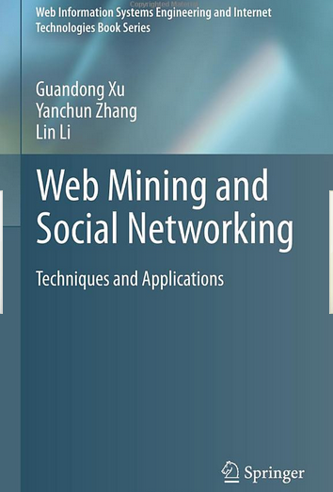
Web Mining and
Social Networking
http://www.amazon.com/Web-Mining-Social-Networking-Applications/dp/1441977341

Slide 70

Mining the Social Web:
Analyzing Data from Facebook, Twitter, LinkedIn, and Other Social Media Sites
http://www.amazon.com/Mining-Social-Web-Analyzing-Facebook/dp/1449388345

Slide 71
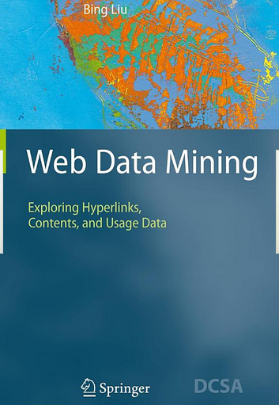
Web Data Mining:
Exploring Hyperlinks, Contents, and Usage Data
http://www.amazon.com/Web-Data-Mining-Data-Centric-Applications/dp/3540378812

Slide 72
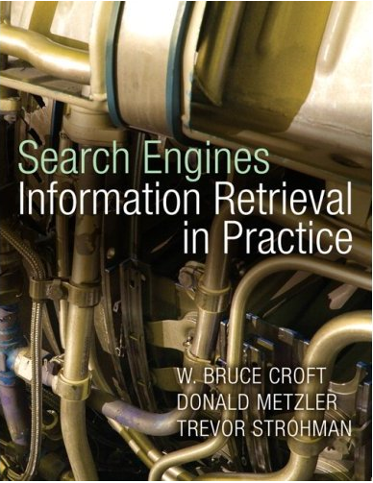
Search Engines:
Information Retrieval in Practice
http://www.amazon.com/Search-Engines-Information-Retrieval-Practice/dp/0136072240

Slide 73
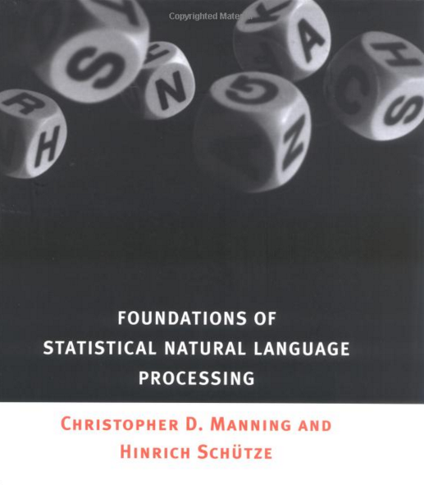
Christopher D. Manning and Hinrich Schütze (1999), Foundations of
Statistical Natural Language Processing,
The MIT Press
http://www.amazon.com/Foundations-Statistical-Natural-Language-Processing/dp/0262133601

Slide 74

Steven Bird, Ewan Klein and Edward Loper (2009),
Natural Language Processing with Python,
O'Reilly Media
http://www.amazon.com/Natural-Language-Processing-Python-Steven/dp/0596516495

Slide 75
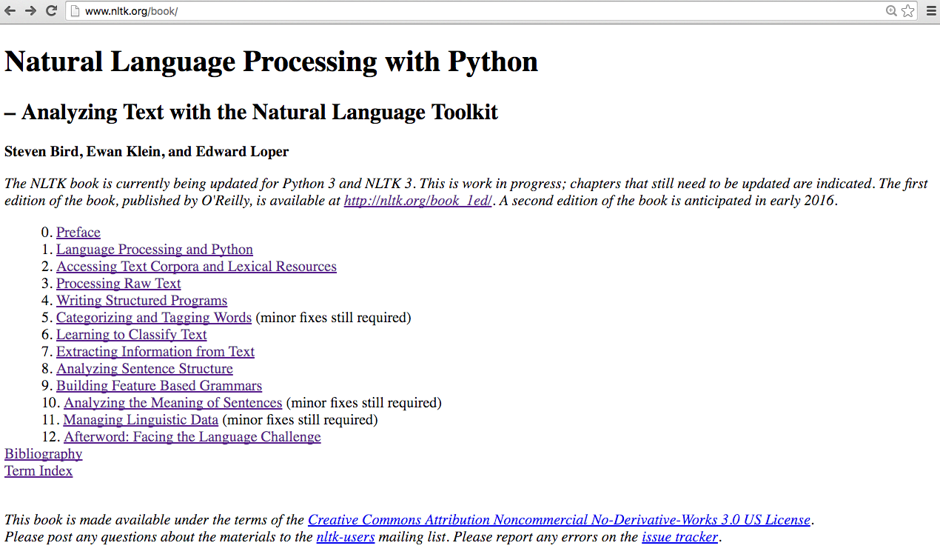
Natural Language Processing with Python
– Analyzing Text with the Natural Language Toolkit
http://www.nltk.org/book/

Slide 76

Nitin Hardeniya (2015),
NLTK Essentials, Packt Publishing
http://www.amazon.com/NLTK-Essentials-Nitin-Hardeniya/dp/1784396907

Slide 77
Text Mining
(text data mining)
  the process of
  deriving
  high-quality information
  from text
http://en.wikipedia.org/wiki/Text_mining

Slide 78
Typical Text Mining Tasks
Text categorization
Text clustering
Concept/entity extraction
Production of granular taxonomies
Sentiment analysis
Document summarization
Entity relation modeling
  i.e., learning relations between named entities.
http://en.wikipedia.org/wiki/Text_mining

Slide 79
Web Mining
Web mining
  discover useful information or knowledge from the Web hyperlink structure, page content, and usage data.
Three types of web mining tasks
  Web structure mining
  Web content mining
  Web usage mining

Slide 80
Text Mining Concepts
85-90 percent of all corporate data is in some kind of unstructured form (e.g., text)
Unstructured corporate data is doubling in size every 18 months
Tapping into these information sources is not an option, but a need to stay competitive
Answer: text mining
  A semi-automated process of extracting knowledge from unstructured data sources
  a.k.a. text data mining or knowledge discovery in textual databases
Source: Turban et al. (2011), Decision Support and Business Intelligence Systems

Slide 81
Data Mining versus Text Mining
Both seek for novel and useful patterns
Both are semi-automated processes
Difference is the nature of the data:
  Structured versus unstructured data
  Structured data: in databases
  Unstructured data: Word documents, PDF files, text excerpts, XML files, and so on
Text mining – first, impose structure to the data, then mine the structured data
Source: Turban et al. (2011), Decision Support and Business Intelligence Systems

Slide 82
Text Mining Concepts
Benefits of text mining are obvious especially in text-rich data environments
  e.g., law (court orders), academic research (research articles), finance (quarterly reports), medicine (discharge summaries), biology (molecular interactions), technology (patent files), marketing (customer comments), etc.
Electronic communization records (e.g., Email)
  Spam filtering
  Email prioritization and categorization
  Automatic response generation
Source: Turban et al. (2011), Decision Support and Business Intelligence Systems

Slide 83
Text Mining Application Area
Information extraction
Topic tracking
Summarization
Categorization
Clustering
Concept linking
Question answering
Source: Turban et al. (2011), Decision Support and Business Intelligence Systems

Slide 84
Text Mining Terminology
Unstructured or semistructured data
Corpus (and corpora)
Terms
Concepts
Stemming
Stop words (and include words)
Synonyms (and polysemes)
Tokenizing
Source: Turban et al. (2011), Decision Support and Business Intelligence Systems

Slide 85
Text Mining Terminology
Term dictionary
Word frequency
Part-of-speech tagging (POS)
Morphology
Term-by-document matrix (TDM)
  Occurrence matrix
Singular Value Decomposition (SVD)
  Latent Semantic Indexing (LSI)
Source: Turban et al. (2011), Decision Support and Business Intelligence Systems

Slide 86
Natural Language Processing (NLP)
Structuring a collection of text
  Old approach: bag-of-words
  New approach: natural language processing
NLP is …
  a very important concept in text mining
  a subfield of artificial intelligence and computational linguistics
  the studies of "understanding" the natural human language
Syntax versus semantics based text mining
Source: Turban et al. (2011), Decision Support and Business Intelligence Systems

Slide 87
Natural Language Processing (NLP)
What is “Understanding” ?
  Human understands, what about computers?
  Natural language is vague, context driven
  True understanding requires extensive knowledge of a topic
  Can/will computers ever understand natural language the same/accurate way we do?
Source: Turban et al. (2011), Decision Support and Business Intelligence Systems

Slide 88
Natural Language Processing (NLP)
Challenges in NLP
  Part-of-speech tagging
  Text segmentation
  Word sense disambiguation
  Syntax ambiguity
  Imperfect or irregular input
  Speech acts
Dream of AI community
  to have algorithms that are capable of automatically reading and obtaining knowledge from text
Source: Turban et al. (2011), Decision Support and Business Intelligence Systems

Slide 89
Natural Language Processing (NLP)
WordNet
  A laboriously hand-coded database of English words, their definitions, sets of synonyms, and various semantic relations between synonym sets
  A major resource for NLP
  Need automation to be completed
Sentiment Analysis
  A technique used to detect favorable and unfavorable opinions toward specific products and services
  CRM application
Source: Turban et al. (2011), Decision Support and Business Intelligence Systems

Slide 90
NLP Task Categories
Information retrieval (IR)
Information extraction (IE)
Named-entity recognition (NER)
Question answering (QA)
Automatic summarization
Natural language generation and understanding (NLU)
Machine translation (ML)
Foreign language reading and writing
Speech recognition
Text proofing
Optical character recognition (OCR)
Source: Turban et al. (2011), Decision Support and Business Intelligence Systems

Slide 91
Text Mining Applications
Marketing applications
  Enables better CRM
Security applications
  ECHELON, OASIS
  Deception detection (…)
Medicine and biology
  Literature-based gene identification (…)
Academic applications
  Research stream analysis
Source: Turban et al. (2011), Decision Support and Business Intelligence Systems

Slide 92
Text Mining Applications
Application Case: Mining for Lies
Deception detection
  A difficult problem
  If detection is limited to only text, then the problem is even more difficult
The study
  analyzed text based testimonies of person of interests at military bases
  used only text-based features (cues)
Source: Turban et al. (2011), Decision Support and Business Intelligence Systems

Slide 93
Text Mining Applications
Application Case: Mining for Lies
Source: Turban et al. (2011), Decision Support and Business Intelligence Systems

Slide 94
Text Mining Applications
Application Case: Mining for Lies
Source: Turban et al. (2011), Decision Support and Business Intelligence Systems

Slide 95
Text Mining Applications
Application Case: Mining for Lies
  371 usable statements are generated
  31 features are used
  Different feature selection methods used
  10-fold cross validation is used
  Results (overall % accuracy)
    Logistic regression 67.28
    Decision trees 71.60
    Neural networks 73.46
Source: Turban et al. (2011), Decision Support and Business Intelligence Systems

Slide 96
Text Mining Applications
(gene/protein interaction identification)
Source: Turban et al. (2011), Decision Support and Business Intelligence Systems

Slide 97
Text Mining Process
Context diagram for the text mining process
Source: Turban et al. (2011), Decision Support and Business Intelligence Systems

Slide 98
Text Mining Process
The three-step text mining process
Source: Turban et al. (2011), Decision Support and Business Intelligence Systems

Slide 99
Text Mining Process
Step 1: Establish the corpus
  Collect all relevant unstructured data
  (e.g., textual documents, XML files, emails, Web pages, short notes, voice recordings…)
  Digitize, standardize the collection
  (e.g., all in ASCII text files)
  Place the collection in a common place
  (e.g., in a flat file, or in a directory as separate files)
Source: Turban et al. (2011), Decision Support and Business Intelligence Systems

Slide 100
Text Mining Process
Step 2: Create the Term–by–Document Matrix
Source: Turban et al. (2011), Decision Support and Business Intelligence Systems

Slide 101
Text Mining Process
Step 2: Create the Term–by–Document Matrix (TDM), cont.
  Should all terms be included?
    Stop words, include words
    Synonyms, homonyms
    Stemming
  What is the best representation of the indices (values in cells)?
    Row counts; binary frequencies; log frequencies;
    Inverse document frequency
Source: Turban et al. (2011), Decision Support and Business Intelligence Systems

Slide 102
Text Mining Process
Step 2: Create the Term–by–Document Matrix (TDM), cont.
  TDM is a sparse matrix. How can we reduce the dimensionality of the TDM?
    Manual - a domain expert goes through it
    Eliminate terms with very few occurrences in very few documents (?)
    Transform the matrix using singular value decomposition (SVD)
    SVD is similar to principle component analysis
Source: Turban et al. (2011), Decision Support and Business Intelligence Systems

Slide 103
Text Mining Process
Step 3: Extract patterns/knowledge
  Classification (text categorization)
  Clustering (natural groupings of text)
    Improve search recall
    Improve search precision
    Scatter/gather
    Query-specific clustering
  Association
  Trend Analysis (…)
Source: Turban et al. (2011), Decision Support and Business Intelligence Systems

Slide 104
Text Mining Application
(research trend identification in literature)
Mining the published IS literature
  MIS Quarterly (MISQ)
  Journal of MIS (JMIS)
  Information Systems Research (ISR)
  Covers 12-year period (1994-2005)
  901 papers are included in the study
  Only the paper abstracts are used
  9 clusters are generated for further analysis
Source: Turban et al. (2011), Decision Support and Business Intelligence Systems

Slide 105
Text Mining Application
(research trend identification in literature)
Source: Turban et al. (2011), Decision Support and Business Intelligence Systems

Slide 106
Text Mining Application
(research trend identification in literature)
Source: Turban et al. (2011), Decision Support and Business Intelligence Systems

Slide 107
Text Mining Application
(research trend identification in literature)
Source: Turban et al. (2011), Decision Support and Business Intelligence Systems

Slide 108
Text Mining Tools
Commercial Software Tools
  SPSS PASW Text Miner
  SAS Enterprise Miner
  Statistica Data Miner
  ClearForest, …
Free Software Tools
  RapidMiner
  GATE
  Spy-EM, …
Source: Turban et al. (2011), Decision Support and Business Intelligence Systems

Slide 109
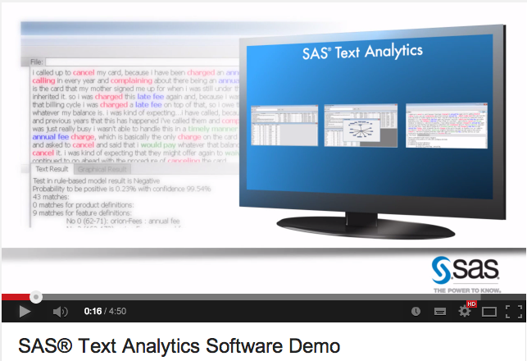

SAS Text Analytics
https://www.youtube.com/watch?v=l1rYdrRCZJ4

Slide 110
Web Mining Overview
Web is the largest repository of data
Data is in HTML, XML, text format
Challenges (of processing Web data)
  The Web is too big for effective data mining
  The Web is too complex
  The Web is too dynamic
  The Web is not specific to a domain
  The Web has everything
Opportunities and challenges are great!
Source: Turban et al. (2011), Decision Support and Business Intelligence Systems

Slide 111
Web Mining
Web mining (or Web data mining) is the process of discovering intrinsic relationships from Web data (textual, linkage, or usage)
Source: Turban et al. (2011), Decision Support and Business Intelligence Systems

Slide 112
Web Content/Structure Mining
Mining of the textual content on the Web
Data collection via Web crawlers
Web pages include hyperlinks
  Authoritative pages
  Hubs
  hyperlink-induced topic search (HITS) alg
Source: Turban et al. (2011), Decision Support and Business Intelligence Systems

Slide 113
Web Usage Mining
Extraction of information from data generated through Web page visits and transactions…
  data stored in server access logs, referrer logs, agent logs, and client-side cookies
  user characteristics and usage profiles
  metadata, such as page attributes, content attributes, and usage data
Clickstream data
Clickstream analysis
Source: Turban et al. (2011), Decision Support and Business Intelligence Systems

Slide 114
Web Usage Mining
Web usage mining applications
  Determine the lifetime value of clients
  Design cross-marketing strategies across products.
  Evaluate promotional campaigns
  Target electronic ads and coupons at user groups based on user access patterns
  Predict user behavior based on previously learned rules and users' profiles
  Present dynamic information to users based on their interests and profiles…
Source: Turban et al. (2011), Decision Support and Business Intelligence Systems

Slide 115
Web Usage Mining
(clickstream analysis)
Source: Turban et al. (2011), Decision Support and Business Intelligence Systems

Slide 116
Web Mining Success Stories
Amazon.com, Ask.com, Scholastic.com, …
Website Optimization Ecosystem
Source: Turban et al. (2011), Decision Support and Business Intelligence Systems

Slide 117
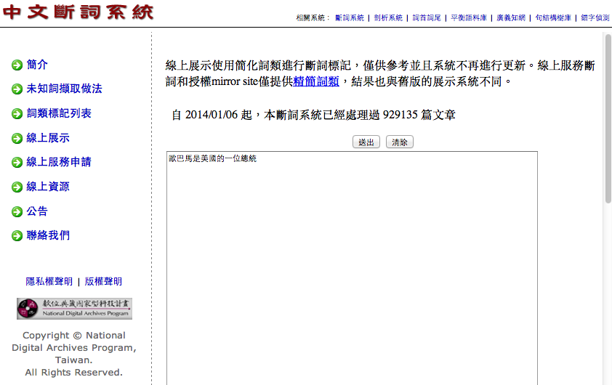

CKIP 中研院中文斷詞系統
http://ckipsvr.iis.sinica.edu.tw/
歐巴馬是美國的一位總統
歐巴馬(Nb) 是(SHI) 美國(Nc) 的(DE) 一(Neu) 位(Nf) 總統(Na)

Slide 118
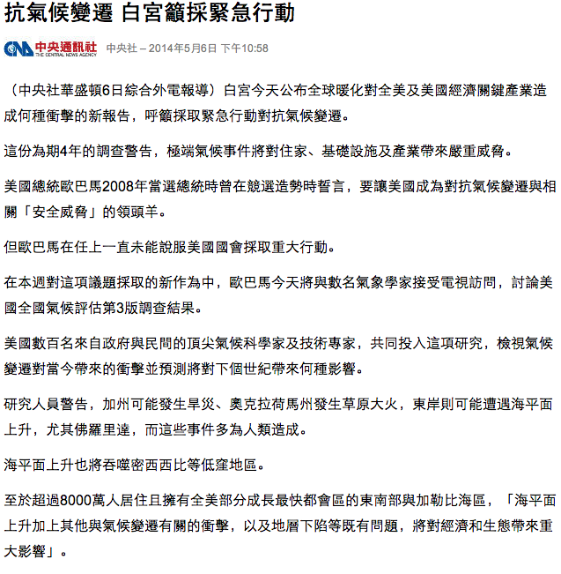
中文文字處理：中文斷詞
抗氣候變遷 白宮籲採緊急行動
中央社中央社 – 2014年5月6日 下午10:58
（中央社華盛頓6日綜合外電報導）白宮今天公布全球暖化對全美及美國經濟關鍵產業造成何種衝擊的新報告，呼籲採取緊急行動對抗氣候變遷。
這份為期4年的調查警告，極端氣候事件將對住家、基礎設施及產業帶來嚴重威脅。
美國總統歐巴馬2008年當選總統時曾在競選造勢時誓言，要讓美國成為對抗氣候變遷與相關「安全威脅」的領頭羊。
但歐巴馬在任上一直未能說服美國國會採取重大行動。
在本週對這項議題採取的新作為中，歐巴馬今天將與數名氣象學家接受電視訪問，討論美國全國氣候評估第3版調查結果。
美國數百名來自政府與民間的頂尖氣候科學家及技術專家，共同投入這項研究，檢視氣候變遷對當今帶來的衝擊並預測將對下個世紀帶來何種影響。
研究人員警告，加州可能發生旱災、奧克拉荷馬州發生草原大火，東岸則可能遭遇海平面上升，尤其佛羅里達，而這些事件多為人類造成。
海平面上升也將吞噬密西西比等低窪地區。
至於超過8000萬人居住且擁有全美部分成長最快都會區的東南部與加勒比海區，「海平面上升加上其他與氣候變遷有關的衝擊，以及地層下陷等既有問題，將對經濟和生態帶來重大影響」。
報告並說：「過去被認為是遙遠未來議題的氣候變遷，已著實成為當前議題。」（譯者：中央社蔡佳伶）1030506
https://tw.news.yahoo.com/%E6%8A%97%E6%B0%A3%E5%80%99%E8%AE%8A%E9%81%B7-%E7%99%BD%E5%AE%AE%E7%B1%B2%E6%8E%A1%E7%B7%8A%E6%80%A5%E8%A1%8C%E5%8B%95-145804493.html

Slide 119
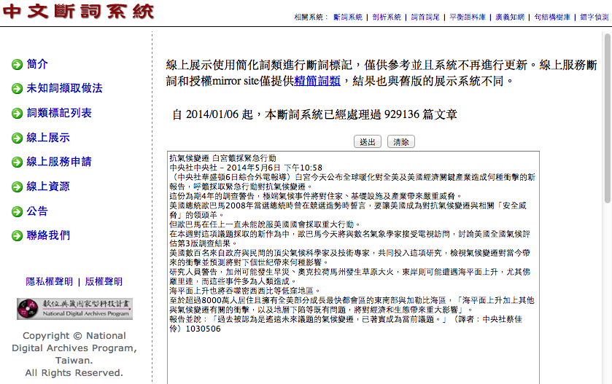
CKIP 中研院中文斷詞系統
http://ckipsvr.iis.sinica.edu.tw/

Slide 120
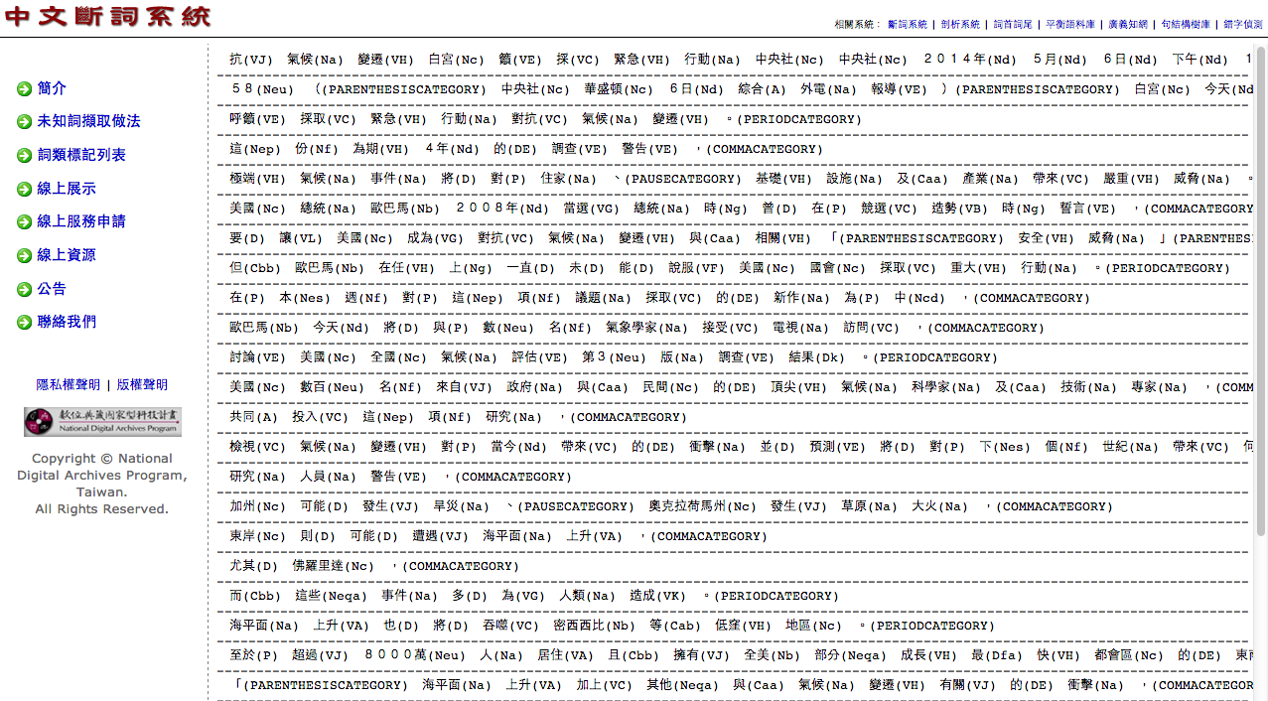
CKIP 中研院中文斷詞系統
http://ckipsvr.iis.sinica.edu.tw/

Slide 121
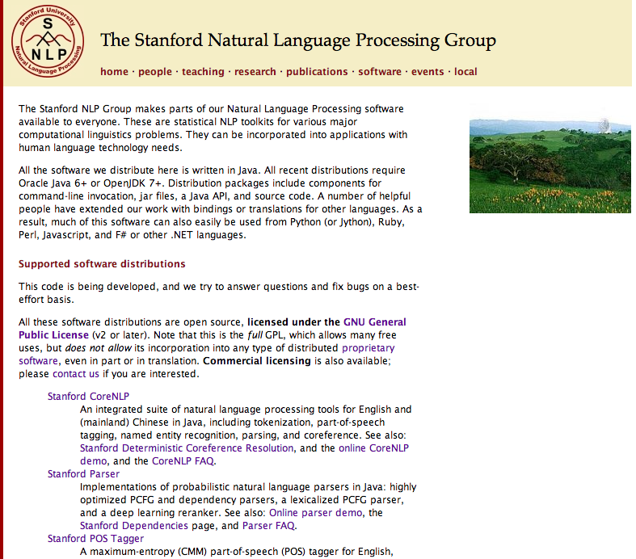
http://nlp.stanford.edu/software/index.shtml
Stanford NLP
Software

Slide 122
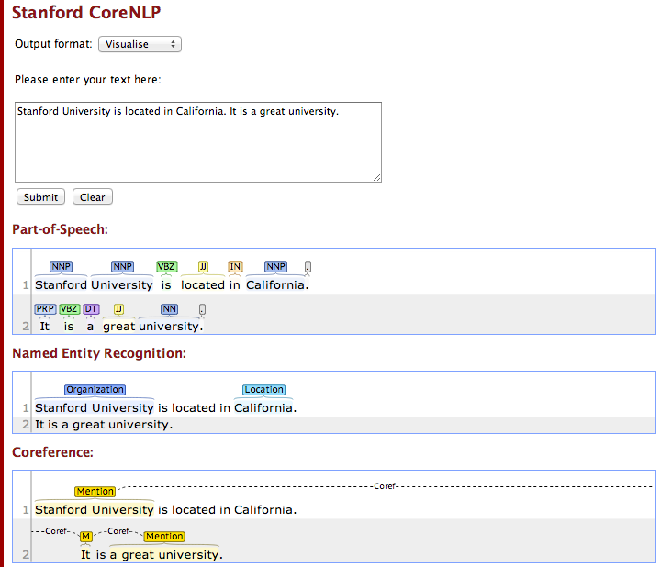
Stanford CoreNLP
http://nlp.stanford.edu:8080/corenlp/process

Slide 123
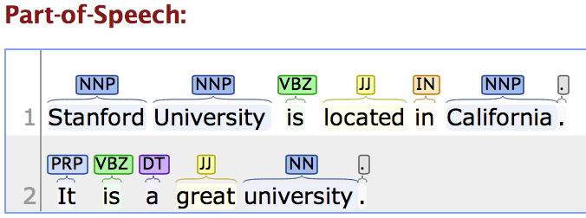
Stanford CoreNLP
http://nlp.stanford.edu:8080/corenlp/process
Stanford University is located in California. It is a great university.

Slide 124
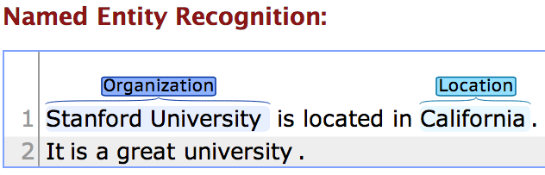
Stanford CoreNLP
http://nlp.stanford.edu:8080/corenlp/process
Stanford University is located in California. It is a great university.

Slide 125
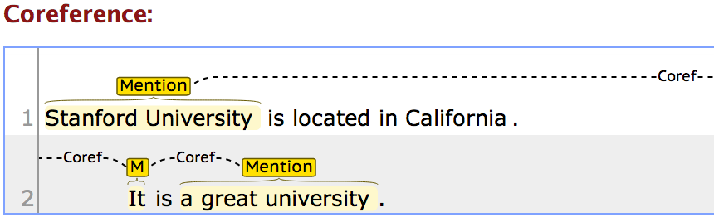
Stanford CoreNLP
http://nlp.stanford.edu:8080/corenlp/process
Stanford University is located in California. It is a great university.

Slide 126
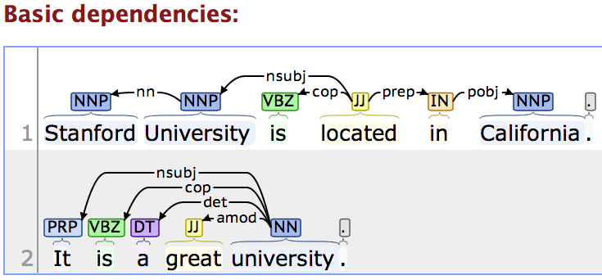
Stanford CoreNLP
http://nlp.stanford.edu:8080/corenlp/process
Stanford University is located in California. It is a great university.

Slide 127
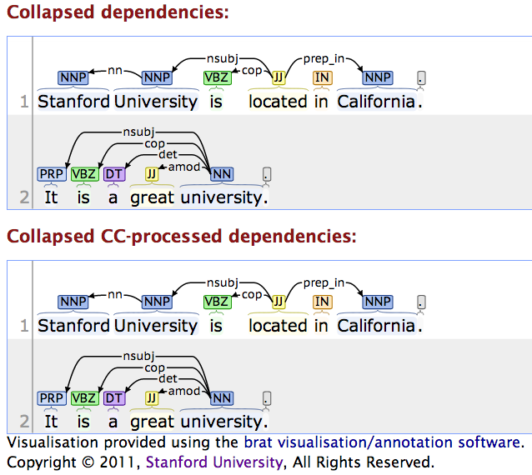
Stanford CoreNLP
http://nlp.stanford.edu:8080/corenlp/process

Slide 128
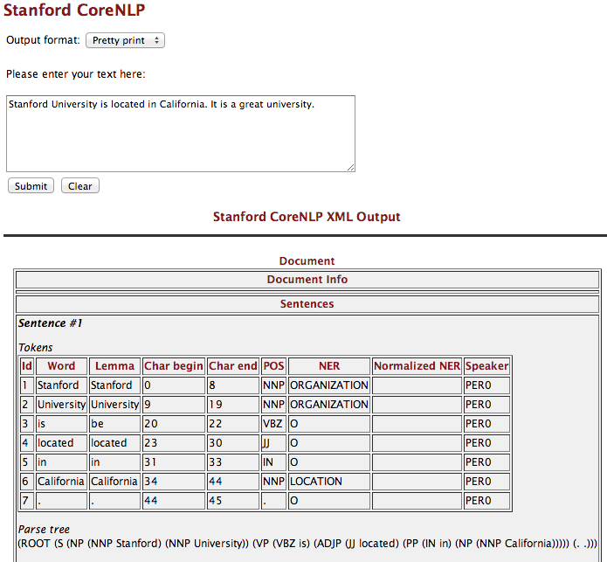
http://nlp.stanford.edu:8080/corenlp/process

Slide 129
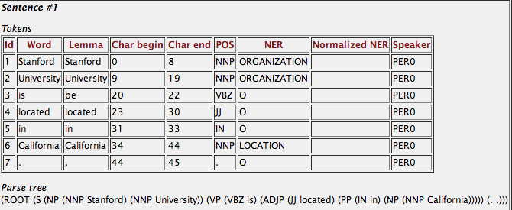
Stanford CoreNLP
http://nlp.stanford.edu:8080/corenlp/process
Stanford University is located in California. It is a great university.

Slide 130
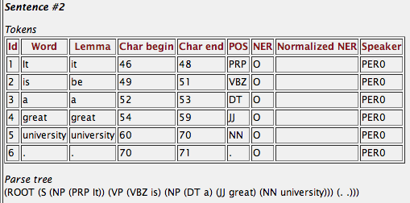
Stanford CoreNLP
http://nlp.stanford.edu:8080/corenlp/process
Stanford University is located in California. It is a great university.

Slide 131
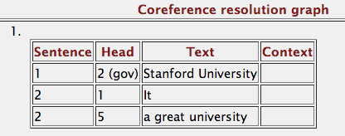
Stanford CoreNLP
http://nlp.stanford.edu:8080/corenlp/process
Stanford University is located in California. It is a great university.

Slide 132
Tokens
Id Word Lemma Char begin Char end POS NER Normalized NER Speaker
1 Stanford Stanford 0 8 NNP ORGANIZATION PER0
2 University University 9 19 NNP ORGANIZATION PER0
3 is be 20 22 VBZ O PER0
4 located located 23 30 JJ O PER0
5 in in 31 33 IN O PER0
6 California California 34 44 NNP LOCATION PER0
7 . . 44 45 . O PER0
Parse tree
(ROOT (S (NP (NNP Stanford) (NNP University)) (VP (VBZ is) (ADJP (JJ located) (PP (IN in) (NP (NNP California))))) (. .)))
Uncollapsed dependencies
root ( ROOT-0 , located-4 )
nn ( University-2 , Stanford-1 )
nsubj ( located-4 , University-2 )
cop ( located-4 , is-3 )
prep ( located-4 , in-5 )
pobj ( in-5 , California-6 )
Collapsed dependencies
root ( ROOT-0 , located-4 )
nn ( University-2 , Stanford-1 )
nsubj ( located-4 , University-2 )
cop ( located-4 , is-3 )
prep_in ( located-4 , California-6 )
Collapsed dependencies with CC processed
root ( ROOT-0 , located-4 )
nn ( University-2 , Stanford-1 )
nsubj ( located-4 , University-2 )
cop ( located-4 , is-3 )
prep_in ( located-4 , California-6 )
Stanford CoreNLP
http://nlp.stanford.edu:8080/corenlp/process
Stanford University is located in California. It is a great university.

Slide 133
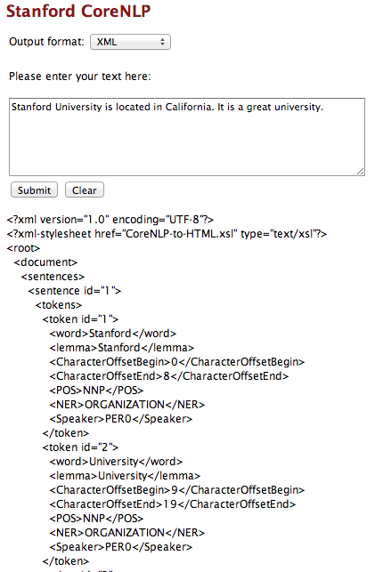
http://nlp.stanford.edu:8080/corenlp/process

Slide 134
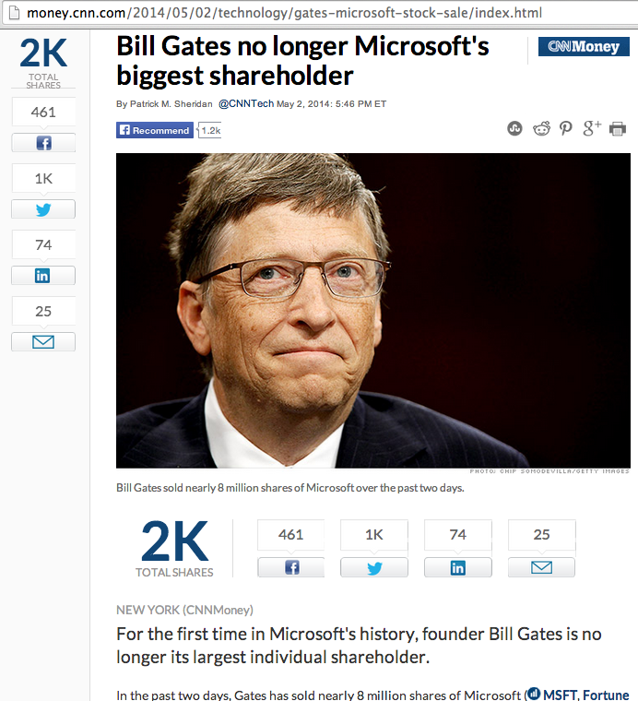
NER for News Article
http://money.cnn.com/2014/05/02/technology/gates-microsoft-stock-sale/index.html
Bill Gates no longer Microsoft's biggest shareholder
By Patrick M. Sheridan @CNNTech May 2, 2014: 5:46 PM ET
Bill Gates sold nearly 8 million shares of Microsoft over the past two days.
NEW YORK (CNNMoney)
For the first time in Microsoft's history, founder Bill Gates is no longer its largest individual shareholder.
In the past two days, Gates has sold nearly 8 million shares of Microsoft (MSFT, Fortune 500), bringing down his total to roughly 330 million.
That puts him behind Microsoft's former CEO Steve Ballmer who owns 333 million shares.
Related: Gates reclaims title of world's richest billionaire
Ballmer, who was Microsoft's CEO until earlier this year, was one of Gates' first hires.
It's a passing of the torch for Gates who has always been the largest single owner of his company's stock. Gates now spends his time and personal fortune helping run the Bill & Melinda Gates foundation.
The foundation has spent $28.3 billion fighting hunger and poverty since its inception back in 1997.

Slide 135
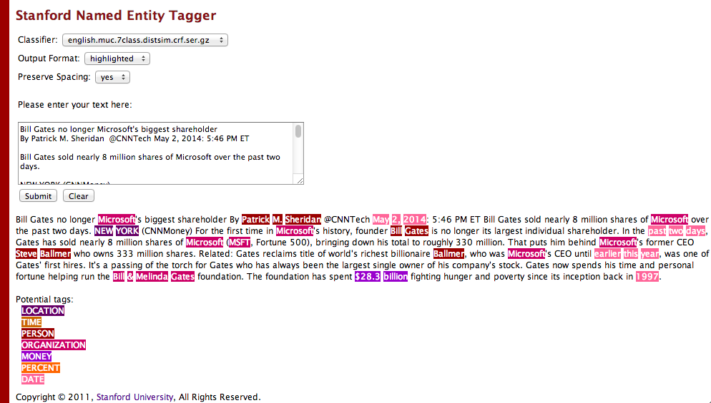
Stanford Named Entity Tagger (NER)
http://nlp.stanford.edu:8080/ner/process

Slide 136
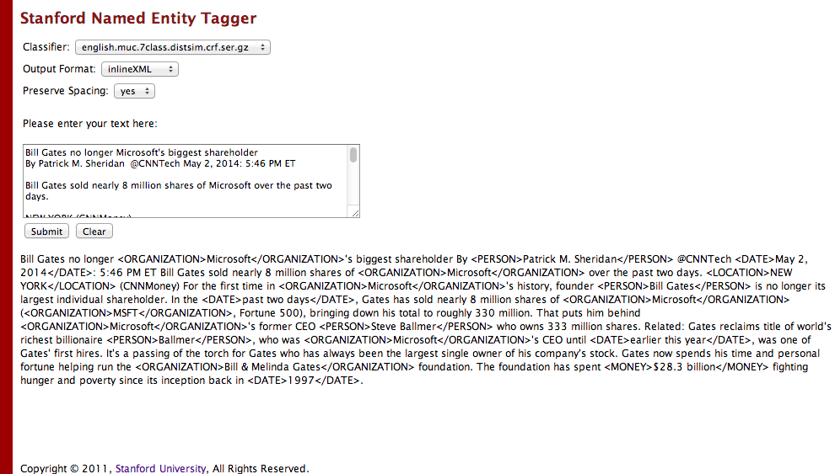
Stanford Named Entity Tagger (NER)
http://nlp.stanford.edu:8080/ner/process

Slide 137
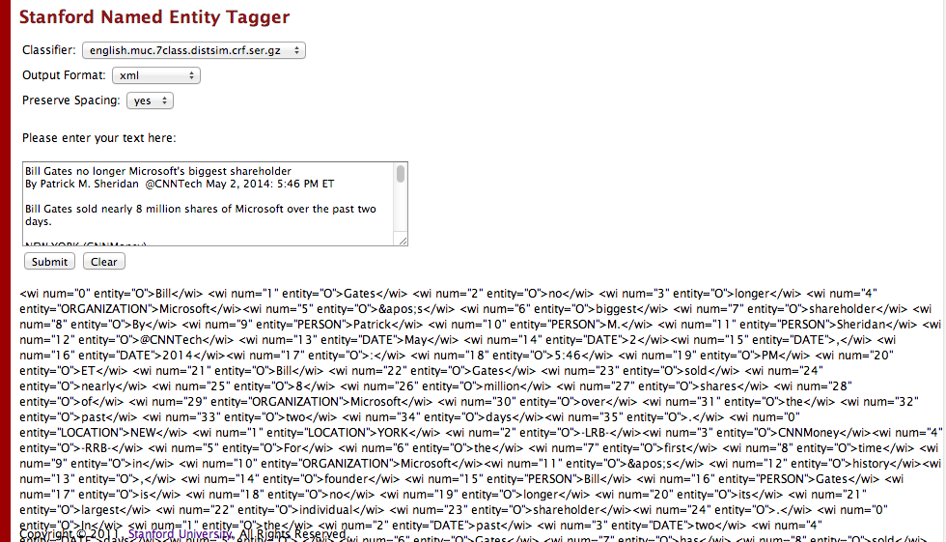
Stanford Named Entity Tagger (NER)
http://nlp.stanford.edu:8080/ner/process

Slide 138
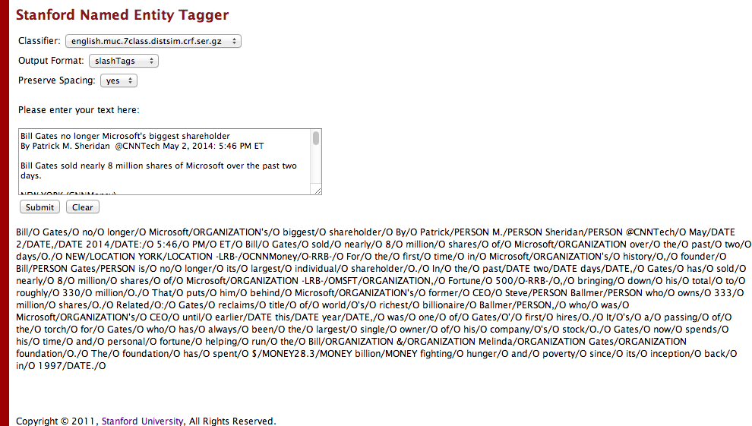
Stanford Named Entity Tagger (NER)
http://nlp.stanford.edu:8080/ner/process

Slide 139
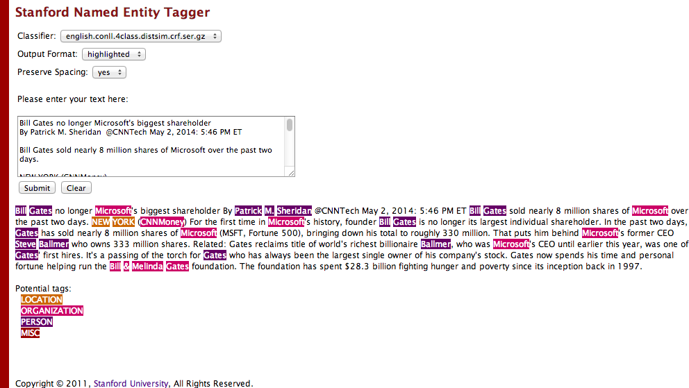
Stanford Named Entity Tagger (NER)
http://nlp.stanford.edu:8080/ner/process

Slide 140
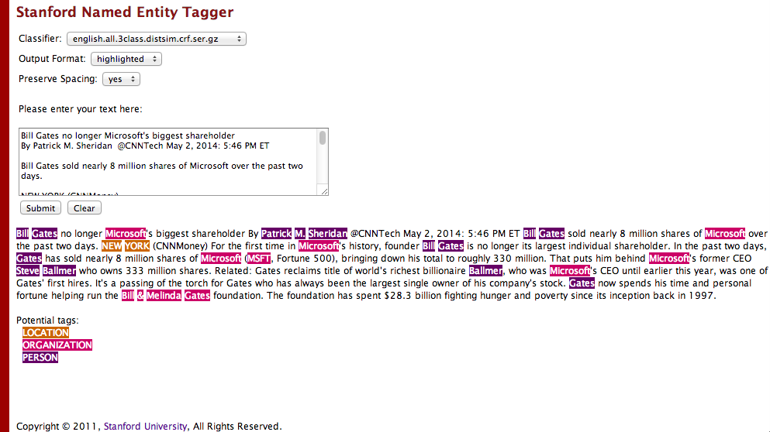
Stanford Named Entity Tagger (NER)
http://nlp.stanford.edu:8080/ner/process

Slide 141
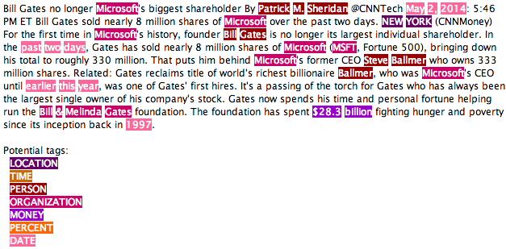
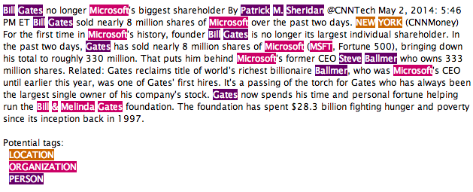
Classifier: english.muc.7class.distsim.crf.ser.gz
Classifier: english.all.3class.distsim.crf.ser.gz

Slide 142
Stanford Named Entity Tagger (NER)
http://nlp.stanford.edu:8080/ner/process
Stanford NER Output Format: inlineXML
Bill Gates no longer <ORGANIZATION>Microsoft</ORGANIZATION>'s biggest shareholder By <PERSON>Patrick M. Sheridan</PERSON> @CNNTech <DATE>May 2, 2014</DATE>: 5:46 PM ET Bill Gates sold nearly 8 million shares of <ORGANIZATION>Microsoft</ORGANIZATION> over the past two days. <LOCATION>NEW YORK</LOCATION> (CNNMoney) For the first time in <ORGANIZATION>Microsoft</ORGANIZATION>'s history, founder <PERSON>Bill Gates</PERSON> is no longer its largest individual shareholder. In the <DATE>past two days</DATE>, Gates has sold nearly 8 million shares of <ORGANIZATION>Microsoft</ORGANIZATION> (<ORGANIZATION>MSFT</ORGANIZATION>, Fortune 500), bringing down his total to roughly 330 million. That puts him behind <ORGANIZATION>Microsoft</ORGANIZATION>'s former CEO <PERSON>Steve Ballmer</PERSON> who owns 333 million shares. Related: Gates reclaims title of world's richest billionaire <PERSON>Ballmer</PERSON>, who was <ORGANIZATION>Microsoft</ORGANIZATION>'s CEO until <DATE>earlier this year</DATE>, was one of Gates' first hires. It's a passing of the torch for Gates who has always been the largest single owner of his company's stock. Gates now spends his time and personal fortune helping run the <ORGANIZATION>Bill & Melinda Gates</ORGANIZATION> foundation. The foundation has spent <MONEY>$28.3 billion</MONEY> fighting hunger and poverty since its inception back in <DATE>1997</DATE>.

Slide 143
Stanford Named Entity Tagger (NER)
http://nlp.stanford.edu:8080/ner/process
Stanford NER Output Format: slashTags
Bill/O Gates/O no/O longer/O Microsoft/ORGANIZATION's/O biggest/O shareholder/O By/O Patrick/PERSON M./PERSON Sheridan/PERSON @CNNTech/O May/DATE 2/DATE,/DATE 2014/DATE:/O 5:46/O PM/O ET/O Bill/O Gates/O sold/O nearly/O 8/O million/O shares/O of/O Microsoft/ORGANIZATION over/O the/O past/O two/O days/O./O NEW/LOCATION YORK/LOCATION -LRB-/OCNNMoney/O-RRB-/O For/O the/O first/O time/O in/O Microsoft/ORGANIZATION's/O history/O,/O founder/O Bill/PERSON Gates/PERSON is/O no/O longer/O its/O largest/O individual/O shareholder/O./O In/O the/O past/DATE two/DATE days/DATE,/O Gates/O has/O sold/O nearly/O 8/O million/O shares/O of/O Microsoft/ORGANIZATION -LRB-/OMSFT/ORGANIZATION,/O Fortune/O 500/O-RRB-/O,/O bringing/O down/O his/O total/O to/O roughly/O 330/O million/O./O That/O puts/O him/O behind/O Microsoft/ORGANIZATION's/O former/O CEO/O Steve/PERSON Ballmer/PERSON who/O owns/O 333/O million/O shares/O./O Related/O:/O Gates/O reclaims/O title/O of/O world/O's/O richest/O billionaire/O Ballmer/PERSON,/O who/O was/O Microsoft/ORGANIZATION's/O CEO/O until/O earlier/DATE this/DATE year/DATE,/O was/O one/O of/O Gates/O'/O first/O hires/O./O It/O's/O a/O passing/O of/O the/O torch/O for/O Gates/O who/O has/O always/O been/O the/O largest/O single/O owner/O of/O his/O company/O's/O stock/O./O Gates/O now/O spends/O his/O time/O and/O personal/O fortune/O helping/O run/O the/O Bill/ORGANIZATION &/ORGANIZATION Melinda/ORGANIZATION Gates/ORGANIZATION foundation/O./O The/O foundation/O has/O spent/O $/MONEY28.3/MONEY billion/MONEY fighting/O hunger/O and/O poverty/O since/O its/O inception/O back/O in/O 1997/DATE./O

Slide 144
Summary
Text Mining
  Differentiate between
  text mining, Web mining and data mining
Natural Language Processing (NLP)
Text Mining Tools and Applications

Slide 145
References
Efraim Turban, Ramesh Sharda, Dursun Delen, Decision Support and Business Intelligence Systems, Ninth Edition, 2011, Pearson.
Steven Bird, Ewan Klein and Edward Loper, Natural Language Processing with Python, 2009, O'Reilly Media, http://www.nltk.org/book/ , http://www.nltk.org/book_1ed/
Nitin Hardeniya, NLTK Essentials, 2015, Packt Publishing
Michael W. Berry and Jacob Kogan, Text Mining: Applications and Theory, 2010, Wiley
Guandong Xu, Yanchun Zhang, Lin Li, Web Mining and Social Networking: Techniques and Applications, 2011, Springer
Matthew A. Russell, Mining the Social Web: Analyzing Data from Facebook, Twitter, LinkedIn, and Other Social Media Sites, 2011, O'Reilly Media
Bing Liu, Web Data Mining: Exploring Hyperlinks, Contents, and Usage Data, 2009, Springer
Bruce Croft, Donald Metzler, and Trevor Strohman, Search Engines: Information Retrieval in Practice, 2008, Addison Wesley, http://www.search-engines-book.com/
Christopher D. Manning and Hinrich Schütze, Foundations of Statistical Natural Language Processing, 1999, The MIT Press
Text Mining, http://en.wikipedia.org/wiki/Text_mining

