Slide 1
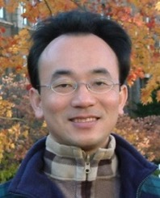
ChatGPT和生成式AI 在綠色金融與ESG的應用 ChatGPT and Generative AI for Green Finance and ESG Applications
時間：2023/6/14日(三)下午13:30-15:30； 15:30-16:00 Q& A
地點：東吳大學崇基樓（法學院）1104 教室
主持人：莊永丞 副院長，東吳大學法學院
Min-Yuh Day, Ph.D, Associate Professor
Institute of Information Management, National Taipei University
https://web.ntpu.edu.tw/~myday
2023-06-14

Slide 2
戴敏育 博士 Min-Yuh Day, Ph.D.
1
Associate Professor, Information Management, NTPU
Visiting Scholar, IIS, Academia Sinica
Ph.D., Information Management, NTU
Director, Intelligent Financial Innovation Technology, IFIT Lab, IM, NTPU
Associate Director, Fintech and Green Finance Center, NTPU
Publications Co-Chairs, IEEE/ACM International Conference on Advances in Social Networks Analysis and Mining (ASONAM 2013- )
Program Co-Chair, IEEE International Workshop on Empirical Methods for Recognizing Inference in TExt (IEEE EM-RITE 2012- )
Publications Chair, The IEEE International Conference on Information Reuse and Integration for Data Science (IEEE IRI 2007- )

Slide 3
Outline
1. ChatGPT and Generative AI
2. Green Finance and Sustainable Finance
3. Generative AI for ESG Applications

Slide 4
ChatGPT and Generative AI

Slide 5
Generative AI (Gen AI) AI Generated Content (AIGC)
Image Generation
Source: Yihan Cao, Siyu Li, Yixin Liu, Zhiling Yan, Yutong Dai, Philip S. Yu, and Lichao Sun (2023). "A Comprehensive Survey of AI-Generated Content (AIGC): A History of Generative AI from GAN to ChatGPT." arXiv preprint arXiv:2303.04226.

Slide 6
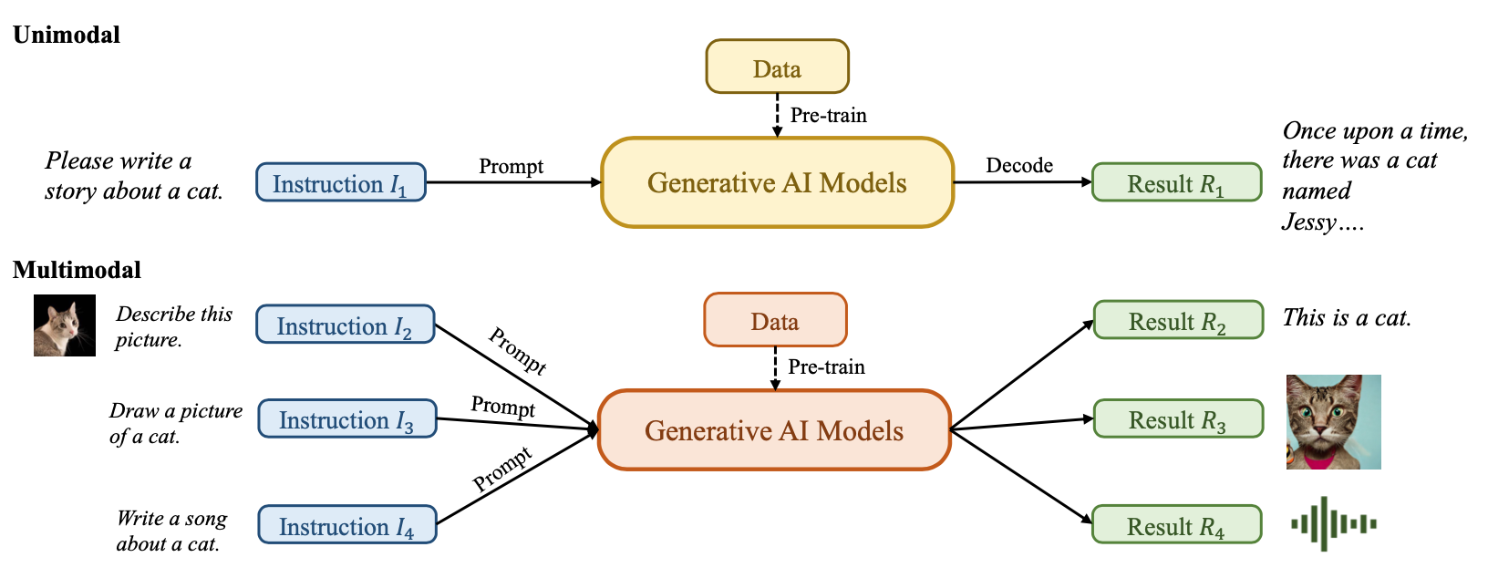
Generative AI (Gen AI) AI Generated Content (AIGC)
Source: Yihan Cao, Siyu Li, Yixin Liu, Zhiling Yan, Yutong Dai, Philip S. Yu, and Lichao Sun (2023). "A Comprehensive Survey of AI-Generated Content (AIGC): A History of Generative AI from GAN to ChatGPT." arXiv preprint arXiv:2303.04226.

Slide 7
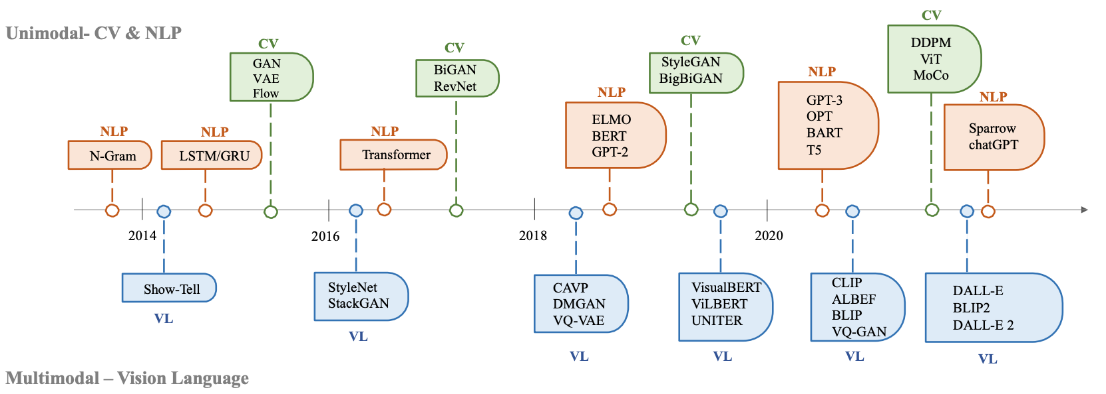
The history of Generative AI in CV, NLP and VL
Source: Yihan Cao, Siyu Li, Yixin Liu, Zhiling Yan, Yutong Dai, Philip S. Yu, and Lichao Sun (2023). "A Comprehensive Survey of AI-Generated Content (AIGC): A History of Generative AI from GAN to ChatGPT." arXiv preprint arXiv:2303.04226.

Slide 8
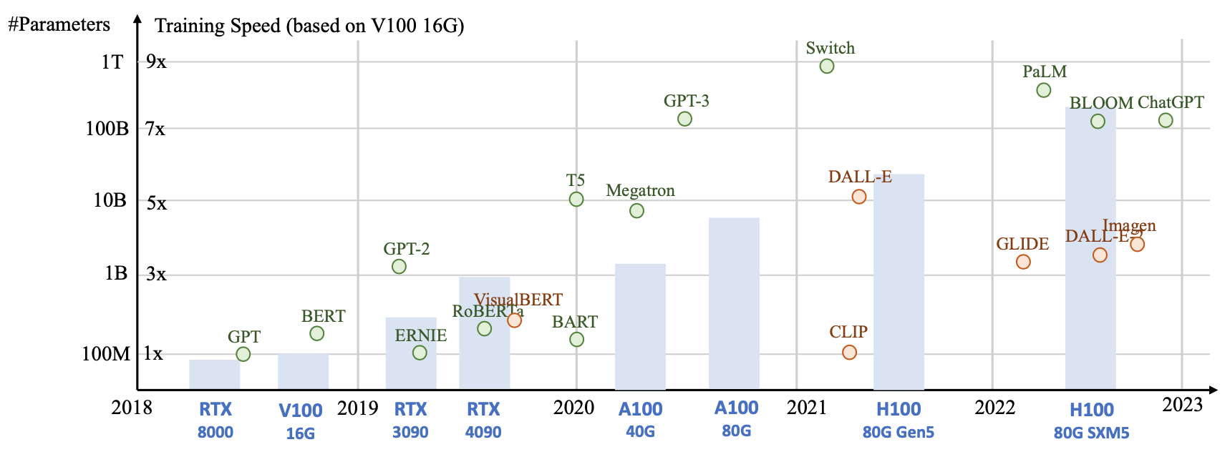
Generative AI Foundation Models
Source: Yihan Cao, Siyu Li, Yixin Liu, Zhiling Yan, Yutong Dai, Philip S. Yu, and Lichao Sun (2023). "A Comprehensive Survey of AI-Generated Content (AIGC): A History of Generative AI from GAN to ChatGPT." arXiv preprint arXiv:2303.04226.

Slide 9
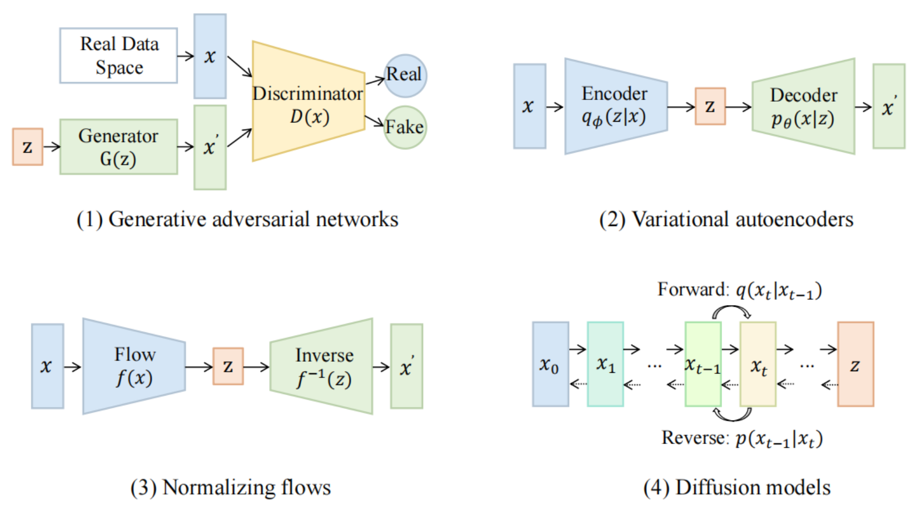
Categories of Vision Generative Models
Source: Yihan Cao, Siyu Li, Yixin Liu, Zhiling Yan, Yutong Dai, Philip S. Yu, and Lichao Sun (2023). "A Comprehensive Survey of AI-Generated Content (AIGC): A History of Generative AI from GAN to ChatGPT." arXiv preprint arXiv:2303.04226.

Slide 10
The General Structure of Generative Vision Language
Source: Yihan Cao, Siyu Li, Yixin Liu, Zhiling Yan, Yutong Dai, Philip S. Yu, and Lichao Sun (2023). "A Comprehensive Survey of AI-Generated Content (AIGC): A History of Generative AI from GAN to ChatGPT." arXiv preprint arXiv:2303.04226.

Slide 11
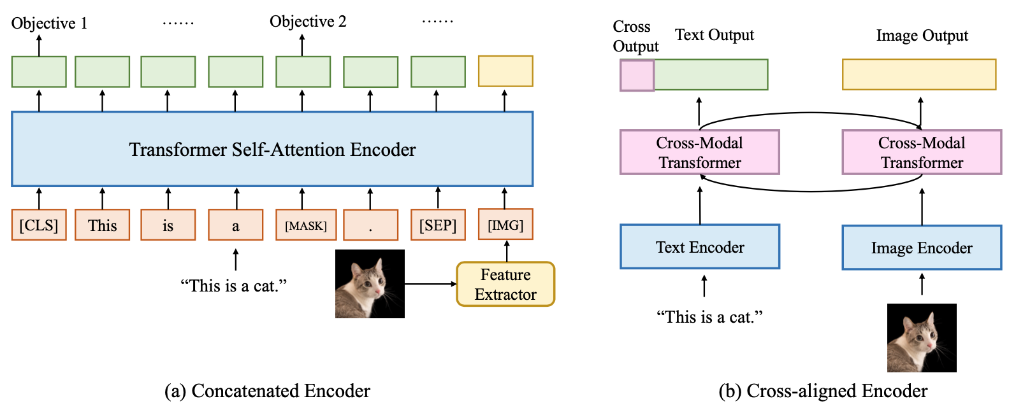
Two Types of Vision Language Encoders: Concatenated Encoders and Cross-aligned Encoders
Source: Yihan Cao, Siyu Li, Yixin Liu, Zhiling Yan, Yutong Dai, Philip S. Yu, and Lichao Sun (2023). "A Comprehensive Survey of AI-Generated Content (AIGC): A History of Generative AI from GAN to ChatGPT." arXiv preprint arXiv:2303.04226.

Slide 12
Two Types of to-language Decoder Models: Jointly-trained Models and Frozen Models
Source: Yihan Cao, Siyu Li, Yixin Liu, Zhiling Yan, Yutong Dai, Philip S. Yu, and Lichao Sun (2023). "A Comprehensive Survey of AI-Generated Content (AIGC): A History of Generative AI from GAN to ChatGPT." arXiv preprint arXiv:2303.04226.

Slide 13
ChatGPT Large Language Models (LLM) Foundation Models

Slide 14
Large Language Models (LLM) (GPT-3, ChatGPT, PaLM, BLOOM, OPT-175B, LLaMA)
ChatGPT
175B
LLaMA
65B
Source: https://lifearchitect.ai/models/

Slide 15
The Transformers Timeline
ULMFit
BERT
RoBERTa
XLM-R
DeBERTa
GPT-Neo
BLOOM
Alpaca
DistrilBERT
T5
PaLM
ChatGPT
Transformer
GPT
GPT-2
GPT-3
GPT-J
OPT-175B
LLaMA
2017
2018
2019
2020
2021
2022
2023
Source: Lewis Tunstall, Leandro von Werra, and Thomas Wolf (2022), Natural Language Processing with Transformers: Building Language Applications with Hugging Face, O'Reilly Media.

Slide 16
Transformer Models
Transformer
Encoder
Decoder
DistilBERT
BERT
T5
GPT
RoBERTa
BART
GPT-2
CTRL
XLM-R
XLM
M2M-100
GPT-3
ALBERT
BigBird
GPT-Neo
GPT-J
ELECTRA
mT0
BLOOM
BLOOMZ
DeBERTa
ChatGPT
GPT-4
Source: Lewis Tunstall, Leandro von Werra, and Thomas Wolf (2022), Natural Language Processing with Transformers: Building Language Applications with Hugging Face, O'Reilly Media.

Slide 17
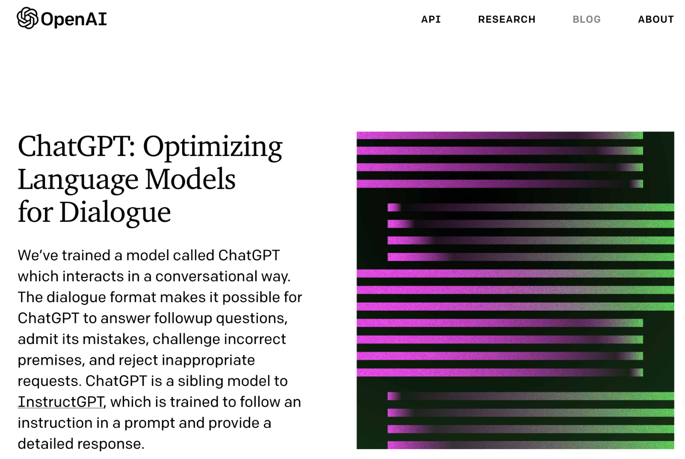
OpenAI ChatGPT
Source: https://openai.com/blog/chatgpt/

Slide 18
Conversational AI to deliver contextual and personal experience to users
Source: Huynh-The, Thien, Quoc-Viet Pham, Xuan-Qui Pham, Thanh Thi Nguyen, Zhu Han, and Dong-Seong Kim (2022). "Artificial Intelligence for the Metaverse: A Survey." arXiv preprint arXiv:2202.10336.

Slide 19
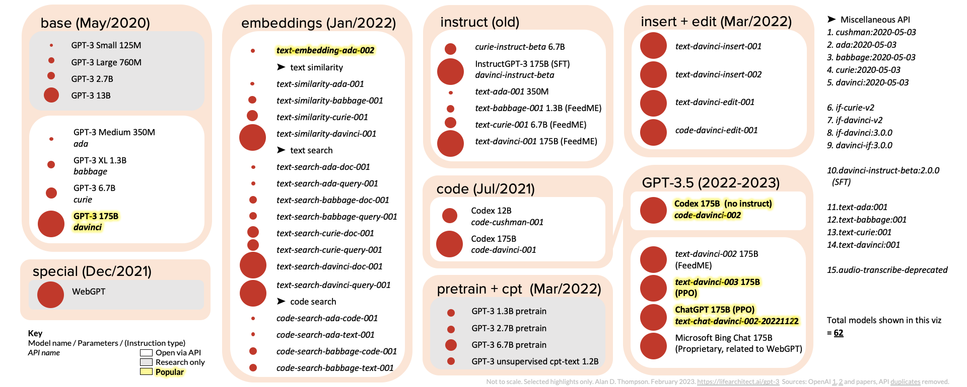
ChatGPT and GPT-3 Family (GPT-3, InstructGPT, GPT-3.5, ChatGPT)
Source: https://lifearchitect.ai/gpt-3/

Slide 20
Evolutionary of ChatGPT Models
GPT-3
GPT-3.5
Source: Ye, Junjie, Xuanting Chen, Nuo Xu, Can Zu, Zekai Shao, Shichun Liu, Yuhan Cui et al. "A comprehensive capability analysis of gpt-3 and gpt-3.5 series models." arXiv preprint arXiv:2303.10420 (2023).

Slide 21
OpenAI ChatGPT and Open LLM GPT-4, LLaMA, Alpaca, Dolly, Cerebras-GPT, GPT4All, Vicuna, ColossalChat, Koala, Phoenix
OpenAI GPT-4
Deepmind Chinchilla
Meta OPT (LLaMA)
Pythia
Stanford Alpaca
Databricks Dolly
Cerebras-GPT
GPT4All
Vicuna
ColossalChat
BAIR Koala
Source: https://www.cerebras.net/blog/cerebras-gpt-a-family-of-open-compute-efficient-large-language-models/

Slide 22
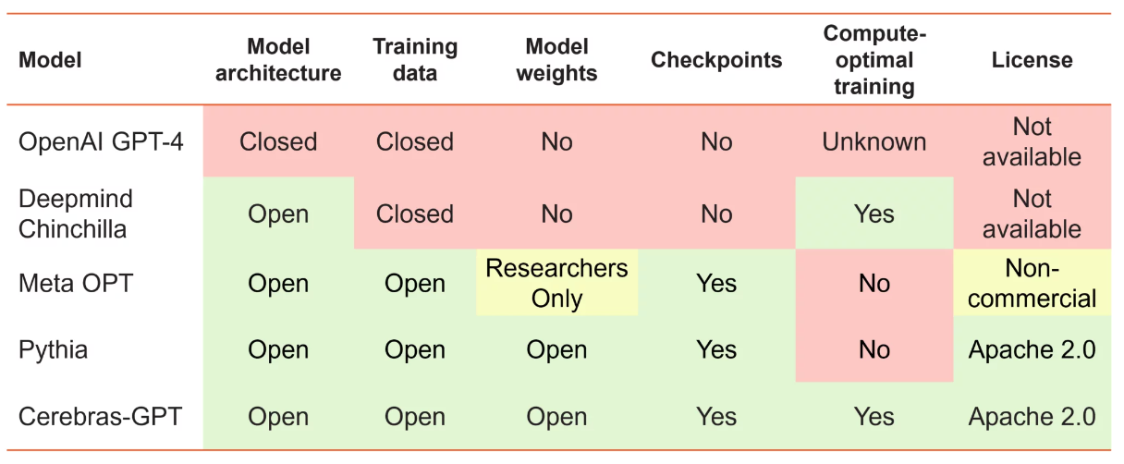
Large Language Models (LMM) Openness and Training Philosophy
Source: https://www.cerebras.net/blog/cerebras-gpt-a-family-of-open-compute-efficient-large-language-models/

Slide 23
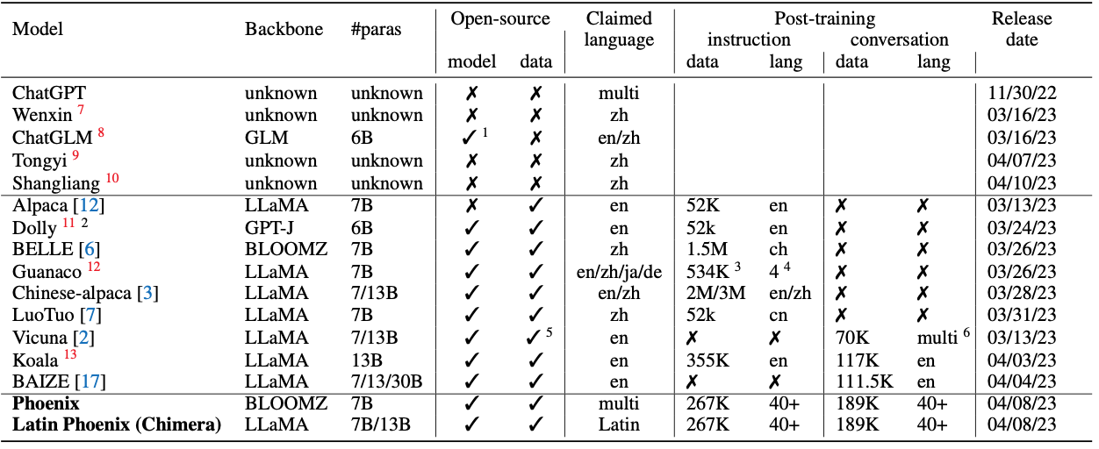
Phoenix: Democratizing ChatGPT across Languages
Source: https://github.com/FreedomIntelligence/LLMZoo

Slide 24
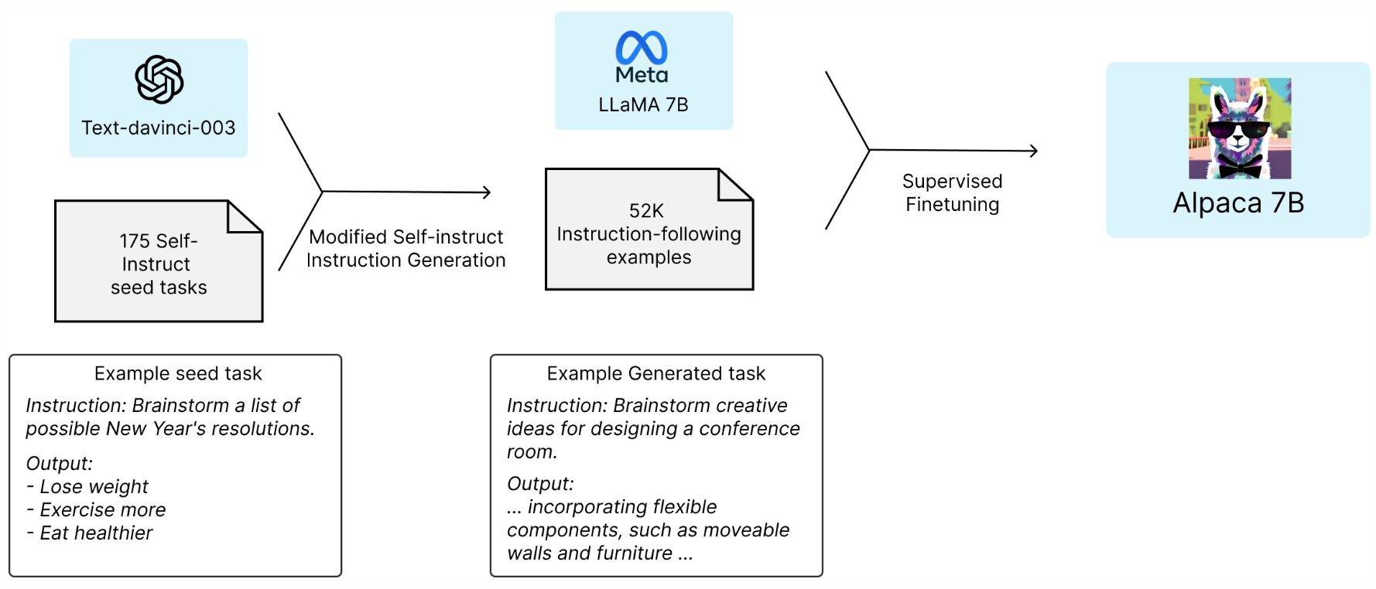
Stanford Alpaca: A Strong, Replicable Instruction-Following Model
Source: https://crfm.stanford.edu/2023/03/13/alpaca.html

Slide 25
GPT4All: Training an Assistant-style Chatbot with Large Scale Data Distillation from GPT-3.5-Turbo
Demo, data and code to train an assistant-style large language model with ~800k GPT-3.5-Turbo Generations based on LLaMa
Reproducibility
Trained LoRa Weights:
gpt4all-lora (four full epochs of training):
https://huggingface.co/nomic-ai/gpt4all-lora
Source: https://github.com/nomic-ai/gpt4all

Slide 26
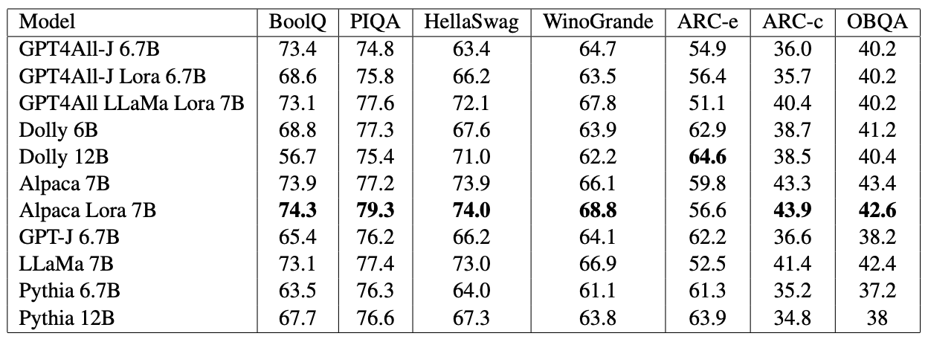
GPT4All-J An Apache-2 Licensed Assistant-Style Chatbot
GPT4All-J (GPT4All v2) based on Open Source GPT-J model
Source: https://github.com/nomic-ai/gpt4all

Slide 27
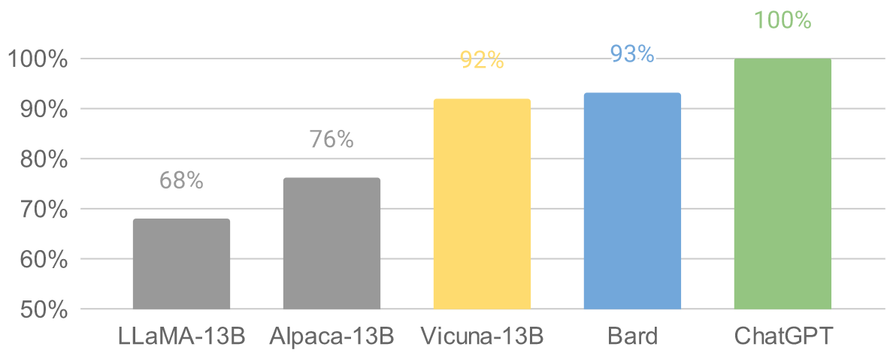
Vicuna: An Open-Source Chatbot Impressing GPT-4 with 90%* ChatGPT Quality by the Team with members from UC Berkeley, CMU, Stanford, and UC San Diego
Vicuna-13B: an open-source chatbot trained by fine-tuning LLaMA on user-shared conversations collected from ShareGPT.
The cost of training Vicuna-13B is around $300.
Source: https://vicuna.lmsys.org/

Slide 28
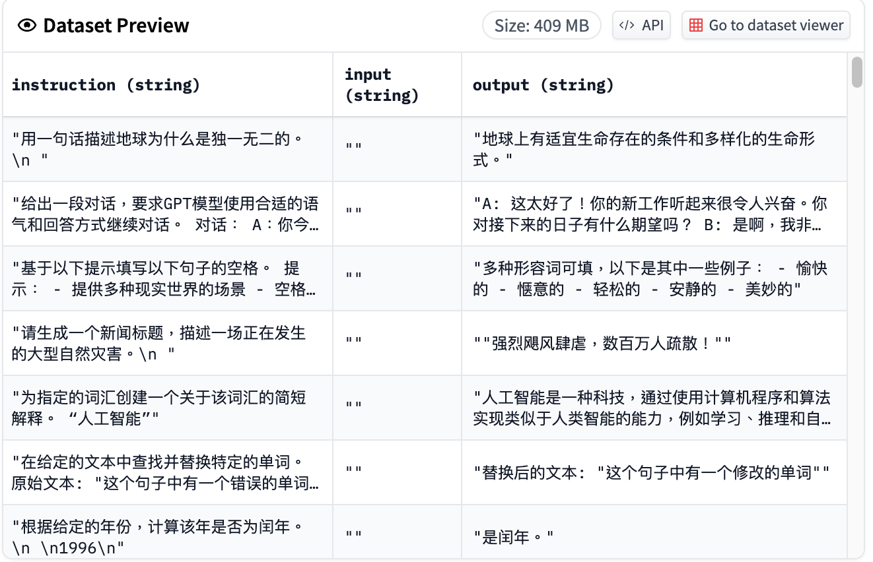
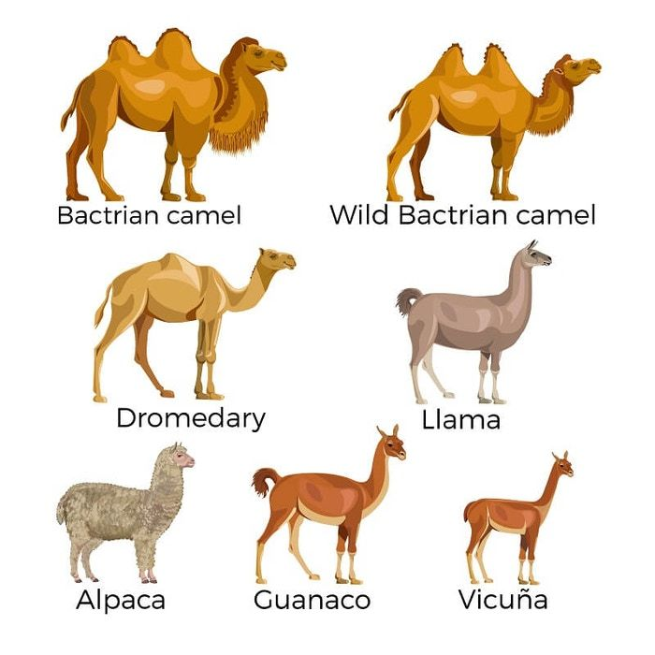
Chinese-Vicuna: A Chinese Instruction-following LLaMA-based Model 一個中文低資源的 llama+lora方案
Chinese-Vicuna based on Guanaco Dataset and Belle Dataset
Source: https://huggingface.co/datasets/Chinese-Vicuna/guanaco_belle_merge_v1.0
Source: https://github.com/Facico/Chinese-Vicuna

Slide 29
StableLM Stability AI Language Models
StableLM-Alpha models are trained on the new dataset that build on The Pile, which contains 1.5 trillion tokens, roughly 3x the size of The Pile.
These models will be trained on up to 1.5 trillion tokens.
The context length for these models is 4096 tokens.
Fine-tuned the model with Stanford Alpaca's procedure using a combination of five recent datasets for conversational agents: Stanford's Alpaca, Nomic-AI's gpt4all, RyokoAI's ShareGPT52K datasets, Databricks labs' Dolly, and Anthropic's HH.
Source: https://github.com/Stability-AI/StableLM

Slide 30
RedPajama a project to create leading open-source models, starts by reproducing LLaMA training dataset of over 1.2 trillion tokens
Dataset | RedPajama | LLaMA*
CommonCrawl | 878 billion | 852 billion
C4 | 175 billion | 190 billion
Github | 59 billion | 100 billion
Books | 26 billion | 25 billion
ArXiv | 28 billion | 33 billion
Wikipedia | 24 billion | 25 billion
StackExchange | 20 billion | 27 billion
Total Tokens | 1.2 trillion | 1.25 trillion
Source: https://github.com/togethercomputer/RedPajama-Data

Slide 31
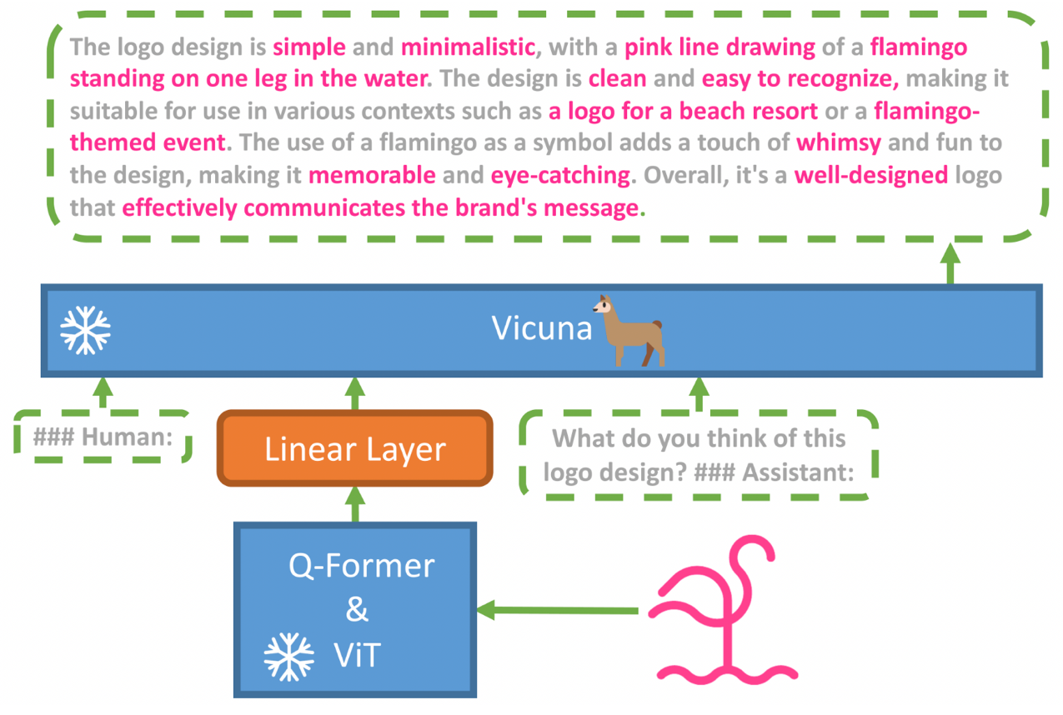
MiniGPT-4: Enhancing Vision-language Understanding with Advanced Large Language Models
Source: https://minigpt-4.github.io/

Slide 32
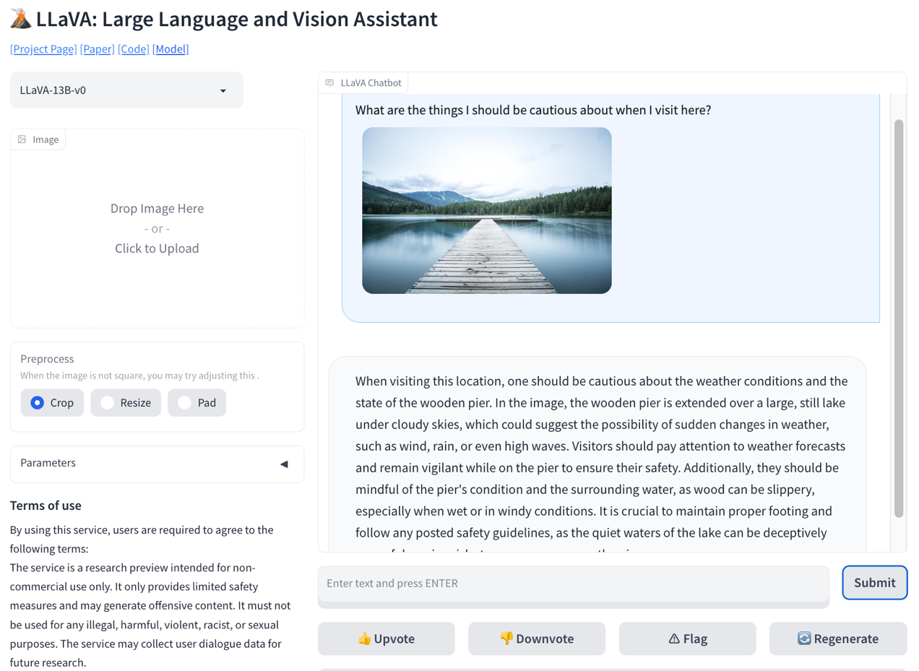
LLaVA: Large Language and Vision Assistant
Source: https://llava-vl.github.io/

Slide 33
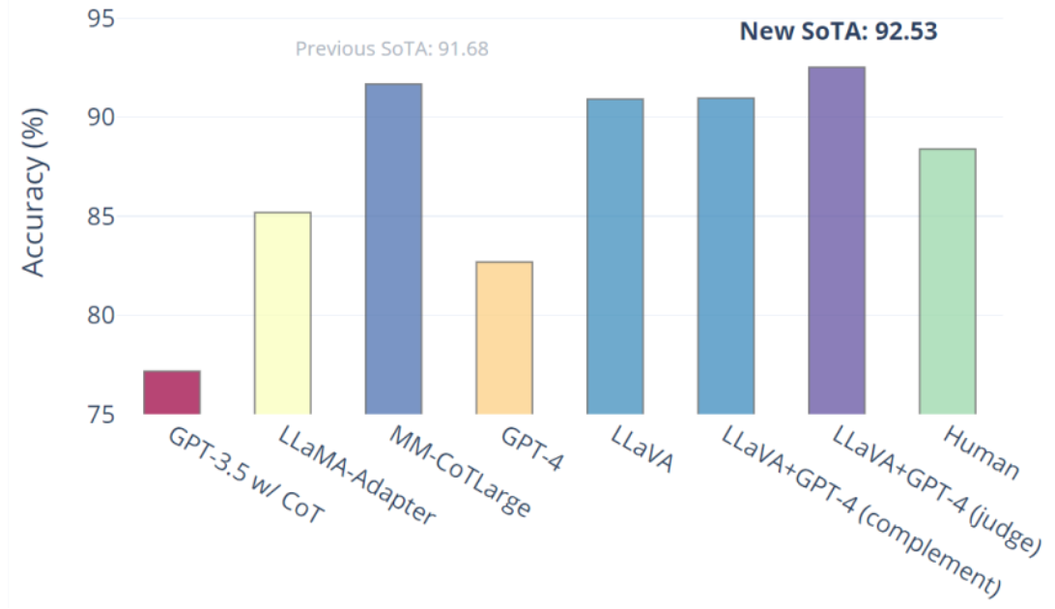
Visual Instruction Tuning LLaVA: Large Language and Vision Assistant University of Wisconsin-Madison, Microsoft Research, Columbia University
Science QA: New SoTA with the synergy of LLaVA with GPT-4
LLaVA represents a novel end-to-end trained large multimodal model that combines a vision encoder and Vicuna for general-purpose visual and language understanding, achieving impressive chat capabilities mimicking spirits of the multimodal GPT-4 and setting a new state-of-the-art accuracy on Science QA.
Source: https://llava-vl.github.io/

Slide 34
Large Language Models (LLMs) Foundation Models

Slide 35
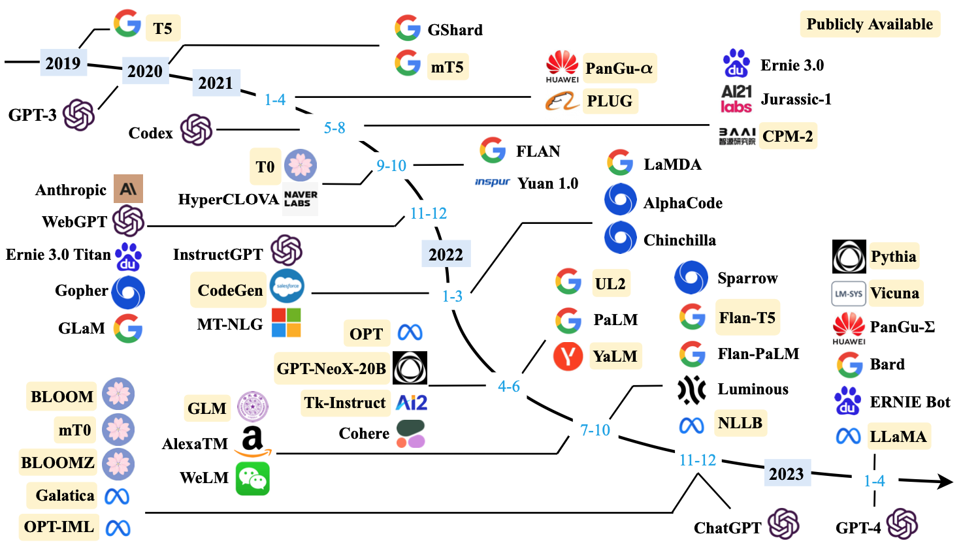
Large Language Models (LLMs) (larger than 10B)
Source: Wayne Xin Zhao, Kun Zhou, Junyi Li, Tianyi Tang, Xiaolei Wang, Yupeng Hou, Yingqian Min et al. (2023) "A Survey of Large Language Models." arXiv preprint arXiv:2303.18223.

Slide 36
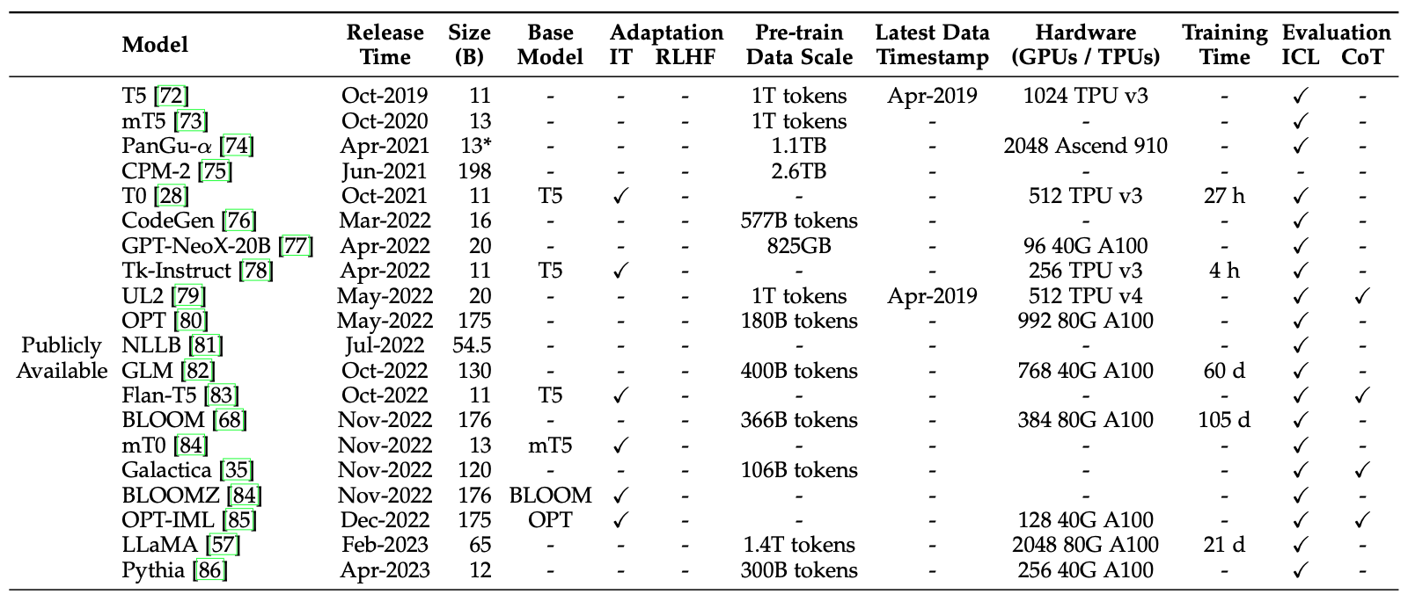
Large Language Models (LLMs) (larger than 10B)
Source: Wayne Xin Zhao, Kun Zhou, Junyi Li, Tianyi Tang, Xiaolei Wang, Yupeng Hou, Yingqian Min et al. (2023) "A Survey of Large Language Models." arXiv preprint arXiv:2303.18223.

Slide 37
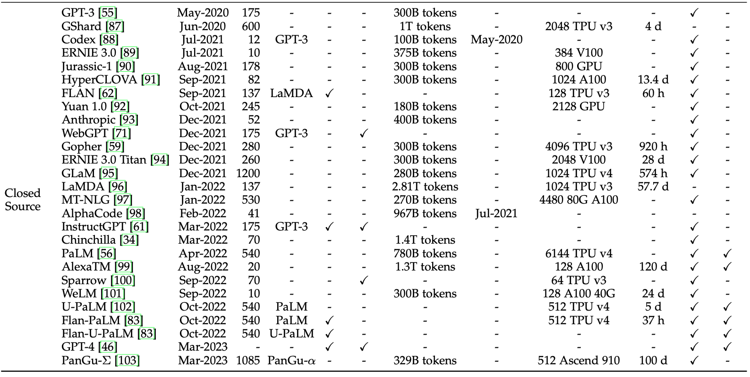
Large Language Models (LLMs) (larger than 10B)
Source: Wayne Xin Zhao, Kun Zhou, Junyi Li, Tianyi Tang, Xiaolei Wang, Yupeng Hou, Yingqian Min et al. (2023) "A Survey of Large Language Models." arXiv preprint arXiv:2303.18223.

Slide 38
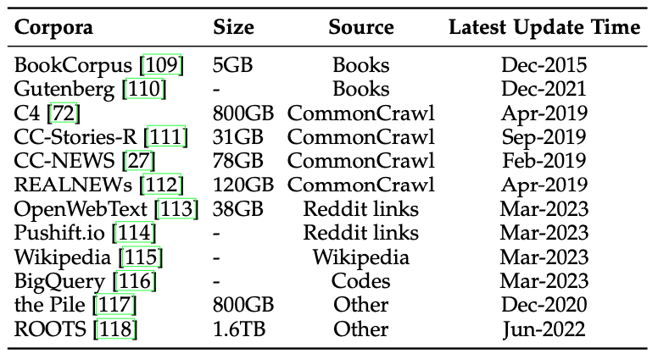
Statistics of Commonly-used Data Sources for LLMs
Source: Wayne Xin Zhao, Kun Zhou, Junyi Li, Tianyi Tang, Xiaolei Wang, Yupeng Hou, Yingqian Min et al. (2023) "A Survey of Large Language Models." arXiv preprint arXiv:2303.18223.

Slide 39
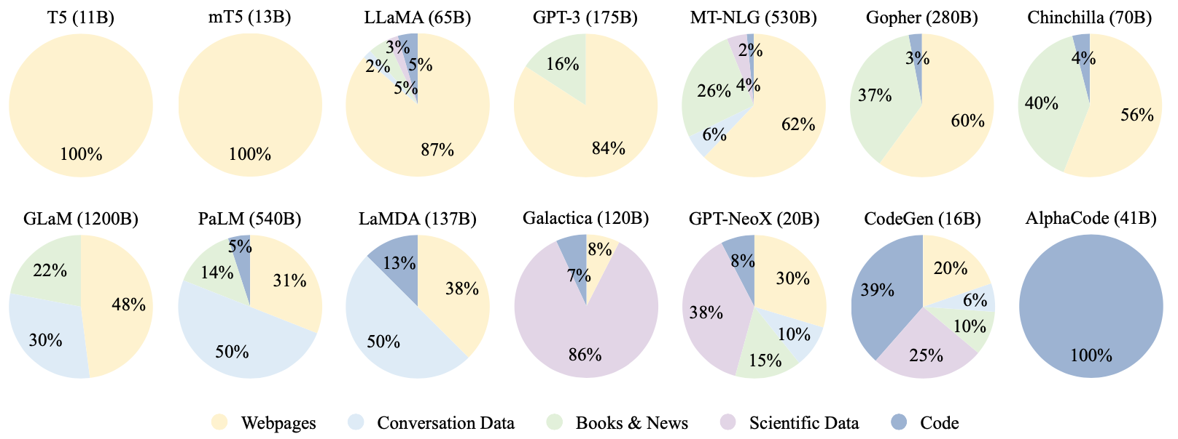
Ratios of various data sources in the pre-training data for existing LLMs
Source: Wayne Xin Zhao, Kun Zhou, Junyi Li, Tianyi Tang, Xiaolei Wang, Yupeng Hou, Yingqian Min et al. (2023) "A Survey of Large Language Models." arXiv preprint arXiv:2303.18223.

Slide 40
Typical Data Preprocessing Pipeline for Pre-training Large Language Models (LLMs)
Source: Wayne Xin Zhao, Kun Zhou, Junyi Li, Tianyi Tang, Xiaolei Wang, Yupeng Hou, Yingqian Min et al. (2023) "A Survey of Large Language Models." arXiv preprint arXiv:2303.18223.

Slide 41
LLMs with Public Configuration Details
Note: PE denotes position embedding, #L denotes the number of layers, #H denotes the number of attention heads, d_{model} denotes the size of hidden states, and MCL denotes the maximum context length during training.
Source: Wayne Xin Zhao, Kun Zhou, Junyi Li, Tianyi Tang, Xiaolei Wang, Yupeng Hou, Yingqian Min et al. (2023) "A Survey of Large Language Models." arXiv preprint arXiv:2303.18223.

Slide 42
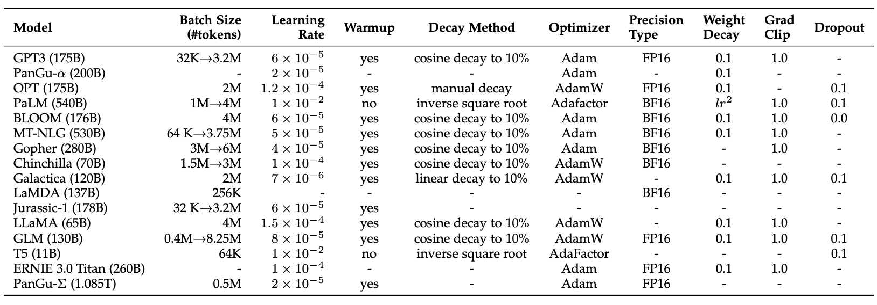
Detailed Optimization Settings of LLMs
Source: Wayne Xin Zhao, Kun Zhou, Junyi Li, Tianyi Tang, Xiaolei Wang, Yupeng Hou, Yingqian Min et al. (2023) "A Survey of Large Language Models." arXiv preprint arXiv:2303.18223.

Slide 43
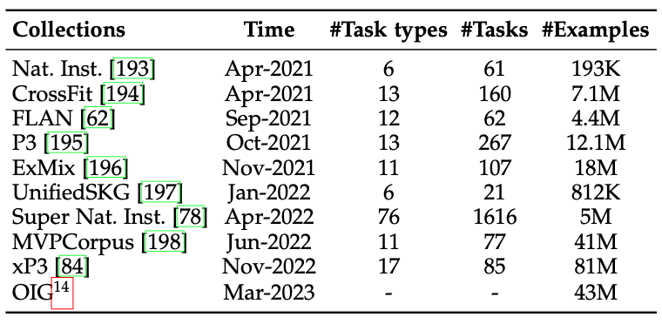
Available Task Collections for Instruction Tuning
Source: Wayne Xin Zhao, Kun Zhou, Junyi Li, Tianyi Tang, Xiaolei Wang, Yupeng Hou, Yingqian Min et al. (2023) "A Survey of Large Language Models." arXiv preprint arXiv:2303.18223.

Slide 44
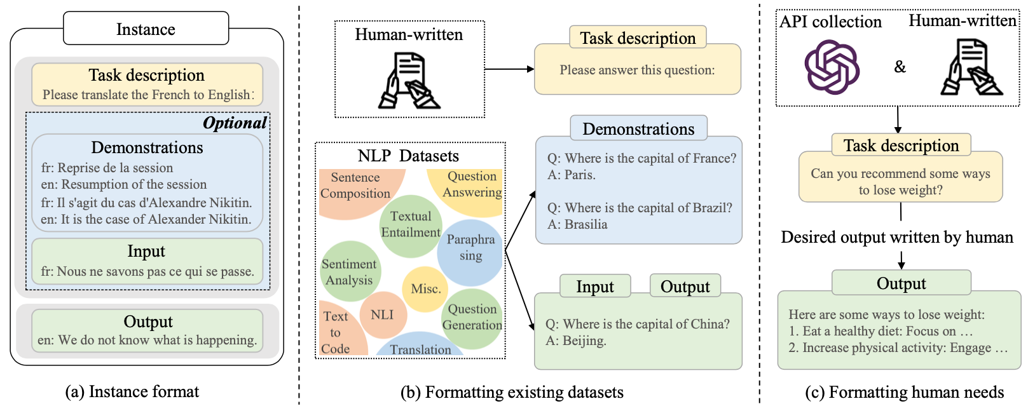
Instance Formatting and Two Different Methods for Constructing the Instruction-formatted Instances
Source: Wayne Xin Zhao, Kun Zhou, Junyi Li, Tianyi Tang, Xiaolei Wang, Yupeng Hou, Yingqian Min et al. (2023) "A Survey of Large Language Models." arXiv preprint arXiv:2303.18223.

Slide 45
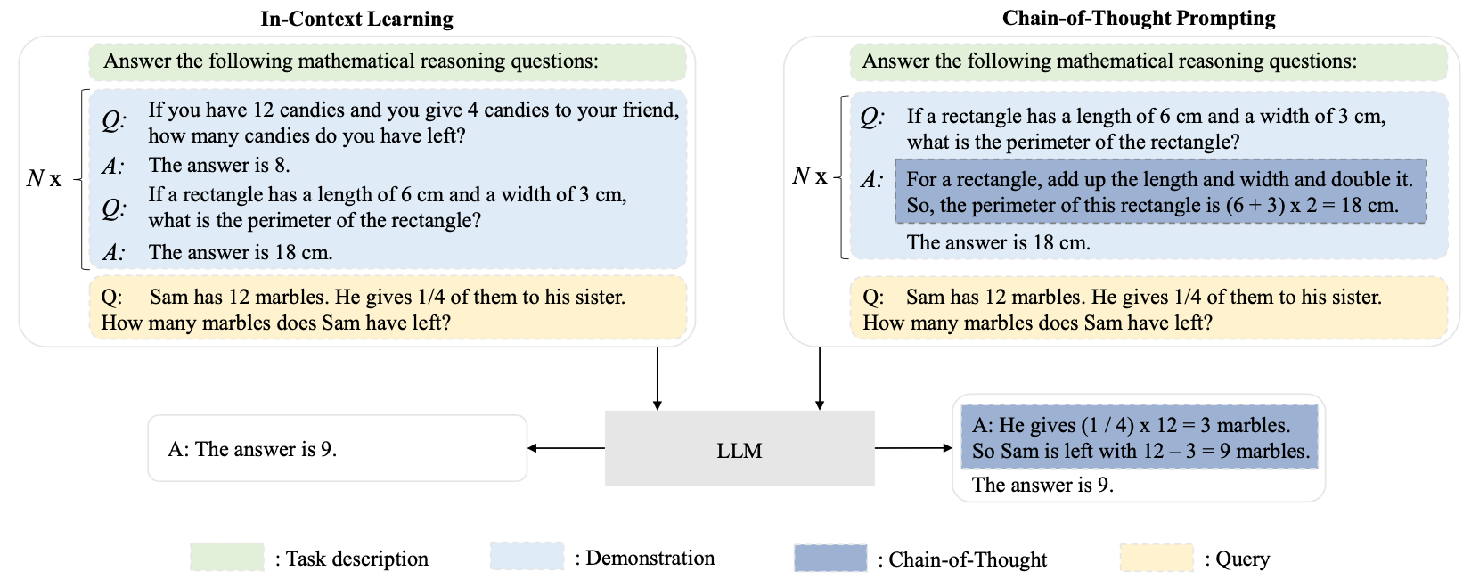
In-context Learning (ICL) and Chain-of-thought (CoT) Prompting
Source: Wayne Xin Zhao, Kun Zhou, Junyi Li, Tianyi Tang, Xiaolei Wang, Yupeng Hou, Yingqian Min et al. (2023) "A Survey of Large Language Models." arXiv preprint arXiv:2303.18223.

Slide 46
Pre-train, Prompt, and Predict: Prompting Methods in Natural Language Processing (LLMs)
Source: Pengfei Liu, Weizhe Yuan, Jinlan Fu, Zhengbao Jiang, Hiroaki Hayashi, and Graham Neubig. (2023) "Pre-train, prompt, and predict: A systematic survey of prompting methods in natural language processing." ACM Computing Surveys 55, no. 9 (2023): 1-35.

Slide 47
Four Paradigms in NLP
Source: Pengfei Liu, Weizhe Yuan, Jinlan Fu, Zhengbao Jiang, Hiroaki Hayashi, and Graham Neubig. (2023) "Pre-train, prompt, and predict: A systematic survey of prompting methods in natural language processing." ACM Computing Surveys 55, no. 9 (2023): 1-35.

Slide 48
Typology of Prompting Methods
Source: Pengfei Liu, Weizhe Yuan, Jinlan Fu, Zhengbao Jiang, Hiroaki Hayashi, and Graham Neubig. (2023) "Pre-train, prompt, and predict: A systematic survey of prompting methods in natural language processing." ACM Computing Surveys 55, no. 9 (2023): 1-35.

Slide 49
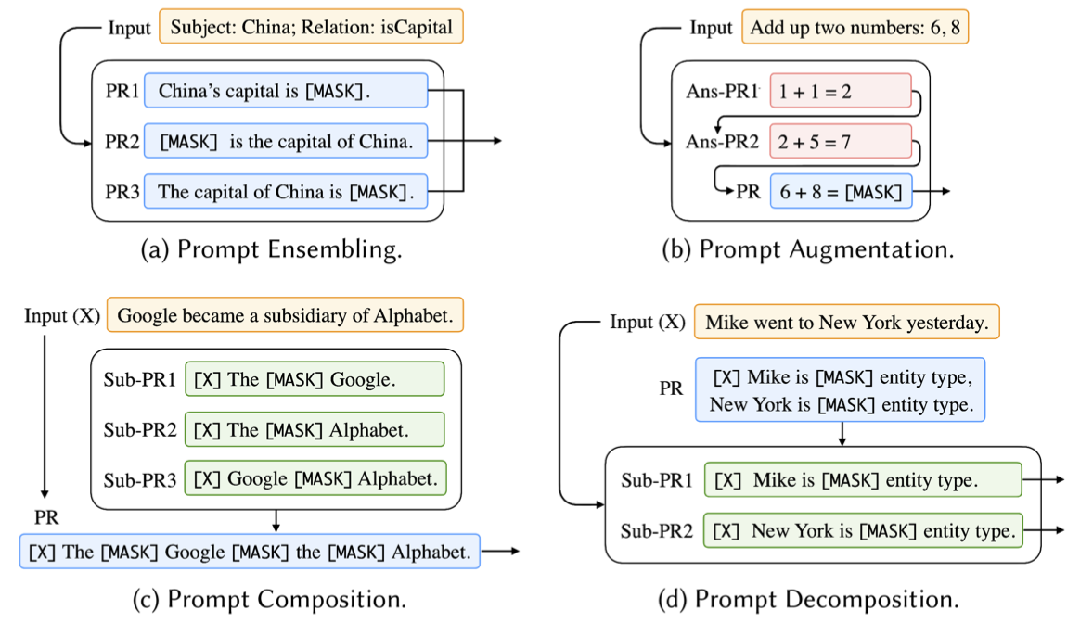
Different Multi-Prompt Learning Strategies
Source: Pengfei Liu, Weizhe Yuan, Jinlan Fu, Zhengbao Jiang, Hiroaki Hayashi, and Graham Neubig. (2023) "Pre-train, prompt, and predict: A systematic survey of prompting methods in natural language processing." ACM Computing Surveys 55, no. 9 (2023): 1-35.

Slide 50
Examples of Input, Template, and Answer for Different Tasks
Source: Pengfei Liu, Weizhe Yuan, Jinlan Fu, Zhengbao Jiang, Hiroaki Hayashi, and Graham Neubig. (2023) "Pre-train, prompt, and predict: A systematic survey of prompting methods in natural language processing." ACM Computing Surveys 55, no. 9 (2023): 1-35.

Slide 51
Characteristics of Different Tuning Strategies
Source: Pengfei Liu, Weizhe Yuan, Jinlan Fu, Zhengbao Jiang, Hiroaki Hayashi, and Graham Neubig. (2023) "Pre-train, prompt, and predict: A systematic survey of prompting methods in natural language processing." ACM Computing Surveys 55, no. 9 (2023): 1-35.

Slide 52
Multi-prompt Learning for Multi-task, Multi-domain, or Multi-lingual Learning
Source: Pengfei Liu, Weizhe Yuan, Jinlan Fu, Zhengbao Jiang, Hiroaki Hayashi, and Graham Neubig. (2023) "Pre-train, prompt, and predict: A systematic survey of prompting methods in natural language processing." ACM Computing Surveys 55, no. 9 (2023): 1-35.

Slide 53
Reinforcement Learning from Human Feedback (RLHF)

Slide 54
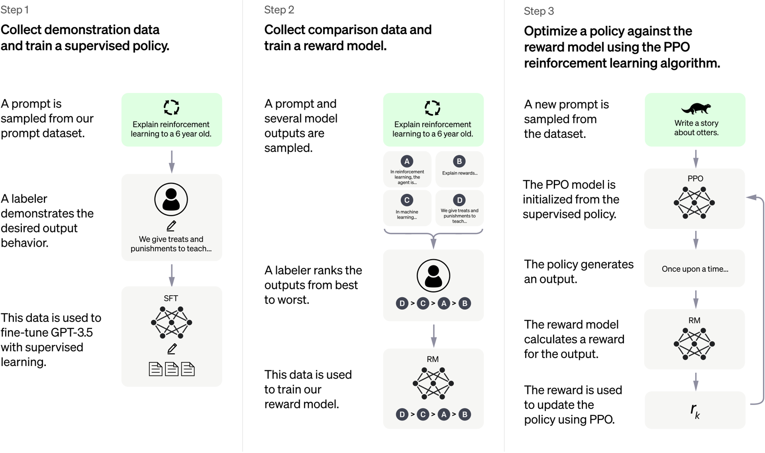
ChatGPT: Optimizing Language Models for Dialogue
Source: https://openai.com/blog/chatgpt/

Slide 55
Training language models to follow instructions with human feedback
InstructGPT and GPT 3.5
Source: Ouyang, L., Wu, J., Jiang, X., Almeida, D., Wainwright, C. L., Mishkin, P., ... & Lowe, R. (2022). Training language models to follow instructions with human feedback. arXiv preprint arXiv:2203.02155.

Slide 56
Reinforcement Learning from Human Feedback (RLHF)
Pretraining a Language Model (LM)
Gathering Data and Training a Reward Model
Fine-tuning the LM with Reinforcement Learning
Source: https://huggingface.co/blog/rlhf

Slide 57
Reinforcement Learning from Human Feedback (RLHF) Step 1. Pretraining a Language Model (LM)
Source: https://huggingface.co/blog/rlhf

Slide 58
Reinforcement Learning from Human Feedback (RLHF) Step 2. Gathering Data and Training a Reward Model
Source: https://huggingface.co/blog/rlhf

Slide 59
Reinforcement Learning from Human Feedback (RLHF) Step 3. Fine-tuning the LM with Reinforcement Learning
Source: https://huggingface.co/blog/rlhf

Slide 60
Generative AI Text, Image, Video, Audio Applications

Slide 61
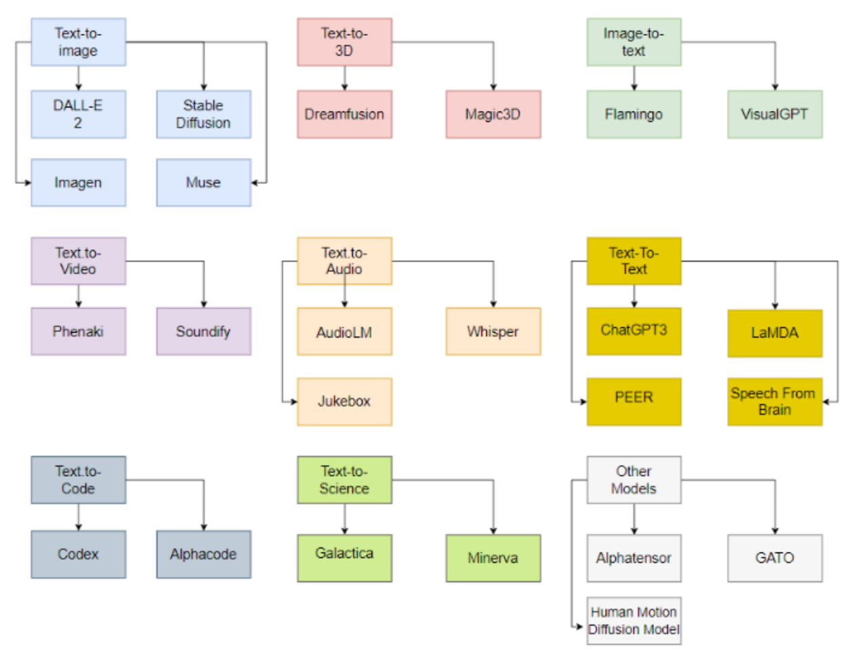
Generative AI Models
ChatGPT is not all you need
Attention is all you need
Source: Gozalo-Brizuela, Roberto, and Eduardo C. Garrido-Merchan (2023). "ChatGPT is not all you need. A State of the Art Review of large Generative AI models." arXiv preprint arXiv:2301.04655 (2023).

Slide 62
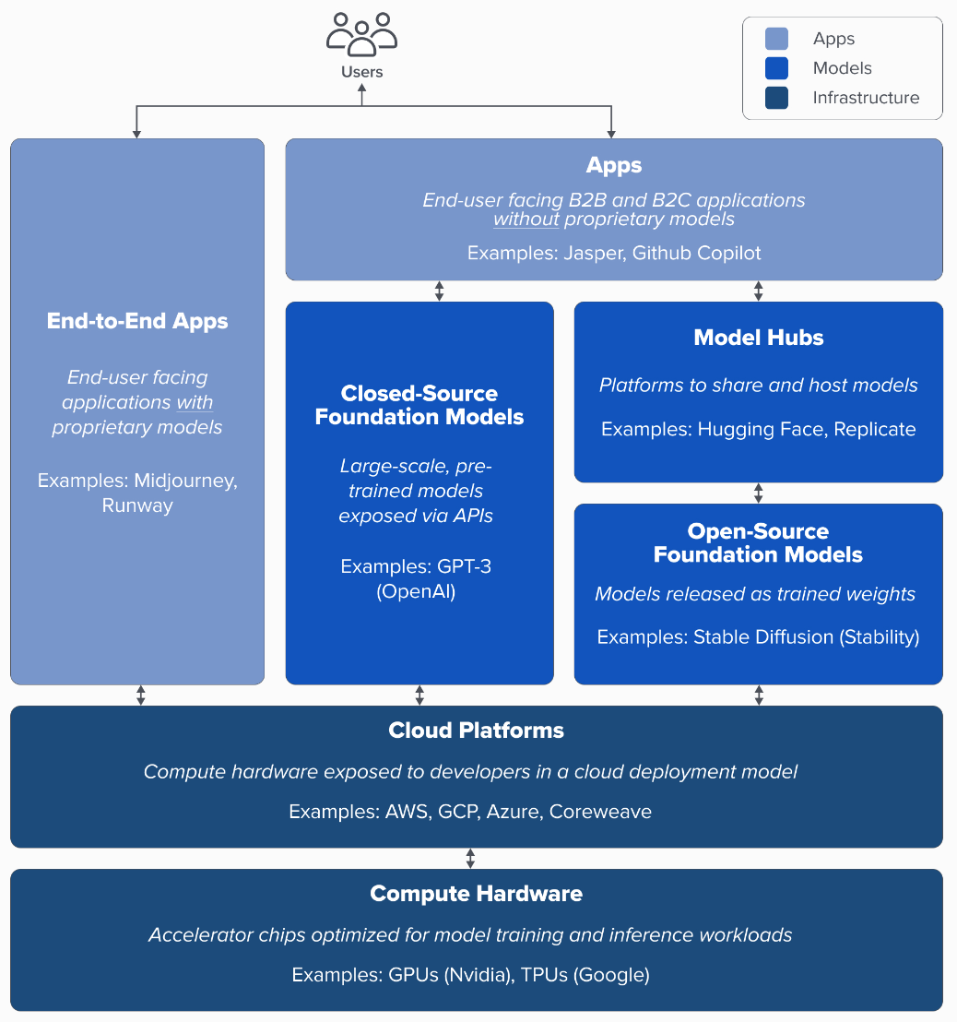
Generative AI Tech Stack
Source: Matt Bornstein, Guido Appenzeller, and Martin Casado (2023), Who Owns the Generative AI Platform?, https://a16z.com/2023/01/19/who-owns-the-generative-ai-platform/

Slide 63
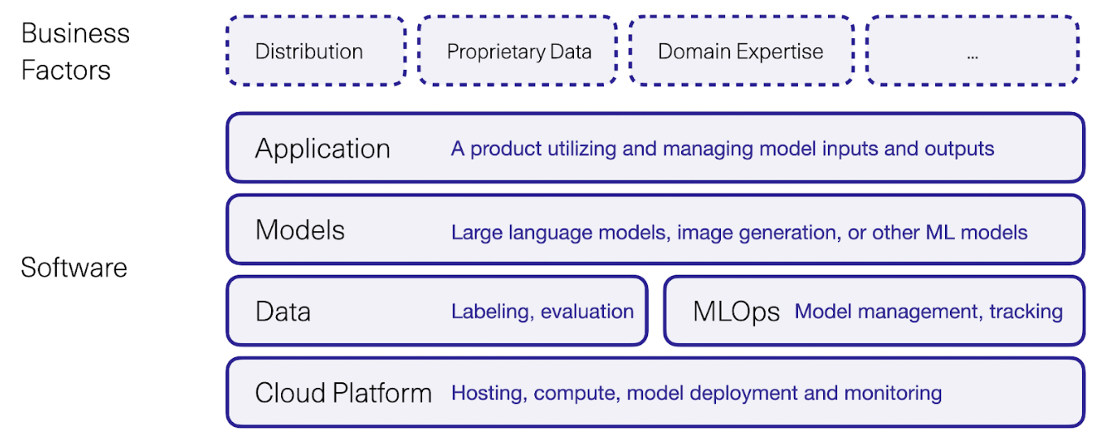
Generative AI Software and Business Factors
Source: Jay Alammar (2023), AI is Eating The World, https://txt.cohere.com/ai-is-eating-the-world/

Slide 64
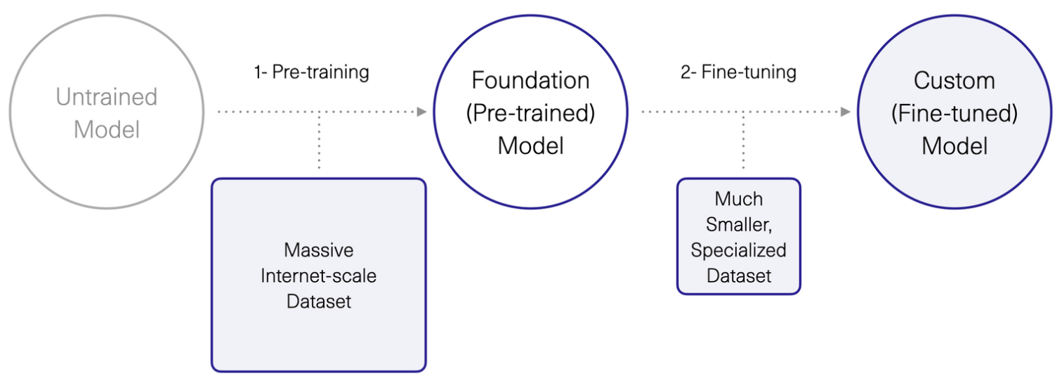
Generative AI 1. Pre-training Foundation (Pre-trained) Model 2. Fine-turning Custom (Fine-tuned) Model
Source: Jay Alammar (2023), AI is Eating The World, https://txt.cohere.com/ai-is-eating-the-world/

Slide 65
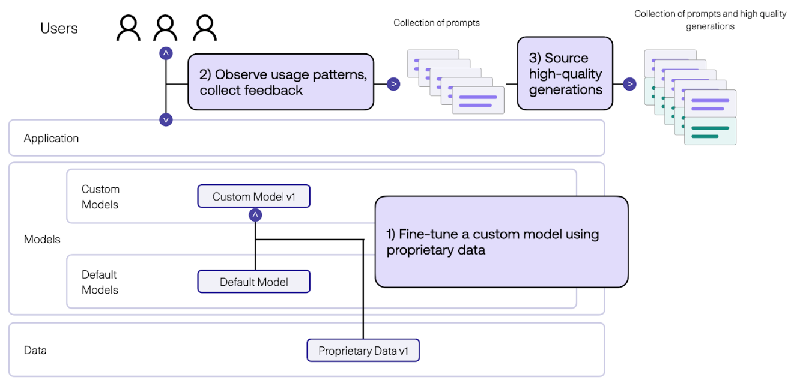
Generative AI Fine-tune Custom Models using Proprietary Data
Source: Jay Alammar (2023), AI is Eating The World, https://txt.cohere.com/ai-is-eating-the-world/

Slide 66
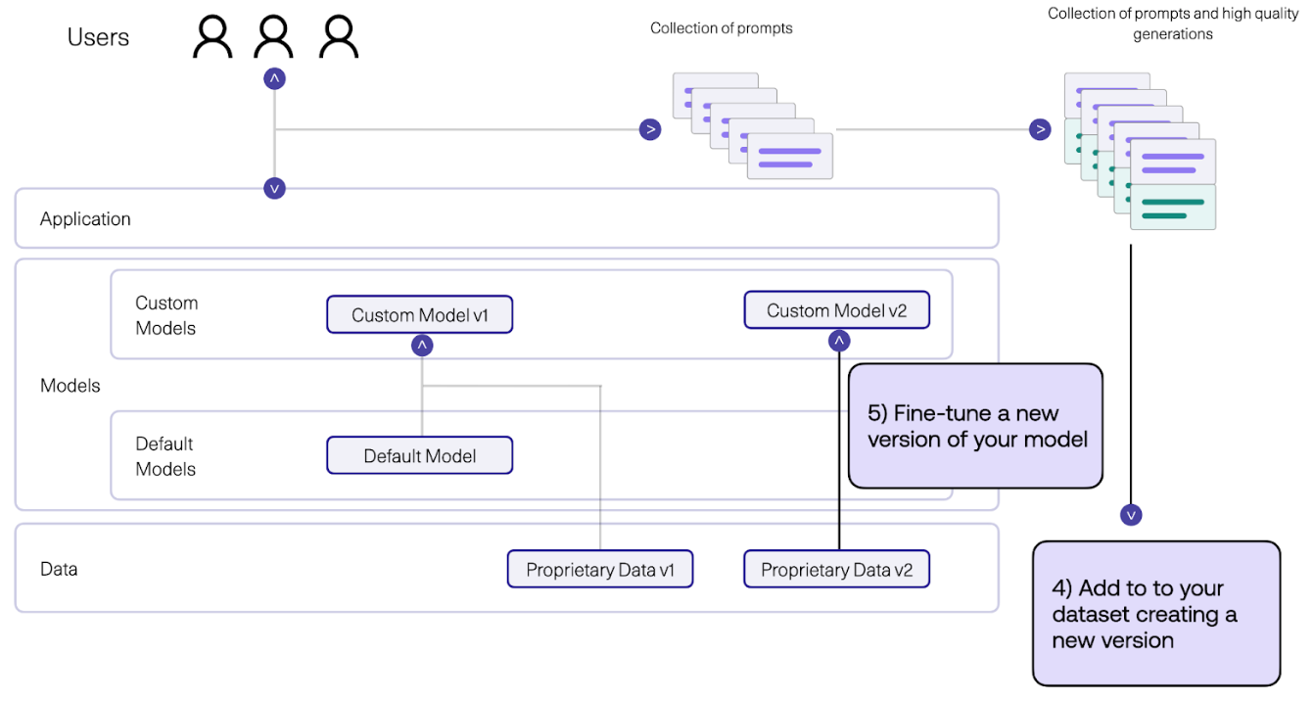
Generative AI Fine-tune Custom Models using Proprietary Data
Source: Jay Alammar (2023), AI is Eating The World, https://txt.cohere.com/ai-is-eating-the-world/

Slide 67
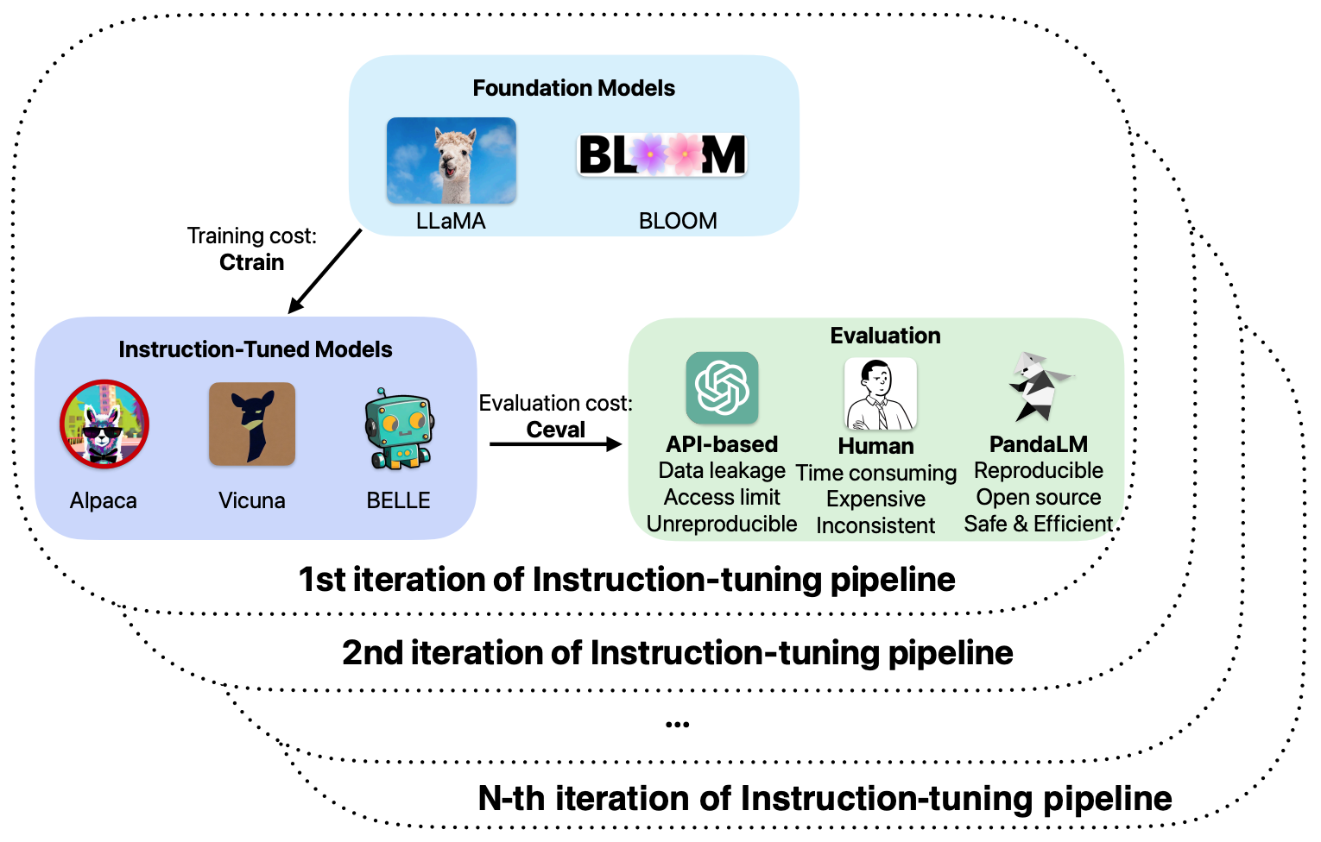
Pipeline of Instruction Tuning LLMs.
Source: Wang, Yidong, Zhuohao Yu, Zhengran Zeng, Linyi Yang, Cunxiang Wang, Hao Chen, Chaoya Jiang et al. "PandaLM: An Automatic Evaluation Benchmark for LLM Instruction Tuning Optimization." arXiv preprint arXiv:2306.05087 (2023).

Slide 68
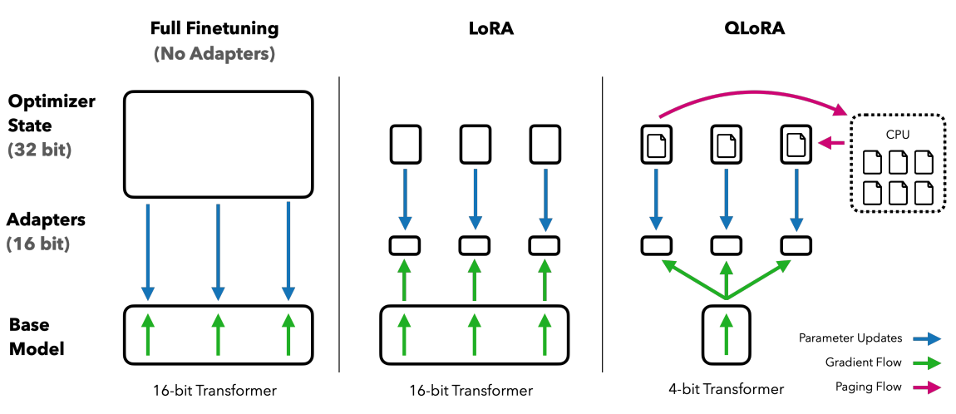
QLoRA: Efficient Finetuning of Quantized LLMs
Source: Dettmers, Tim, Artidoro Pagnoni, Ari Holtzman, and Luke Zettlemoyer. "QLoRA: Efficient Finetuning of Quantized LLMs." arXiv preprint arXiv:2305.14314 (2023).

Slide 69
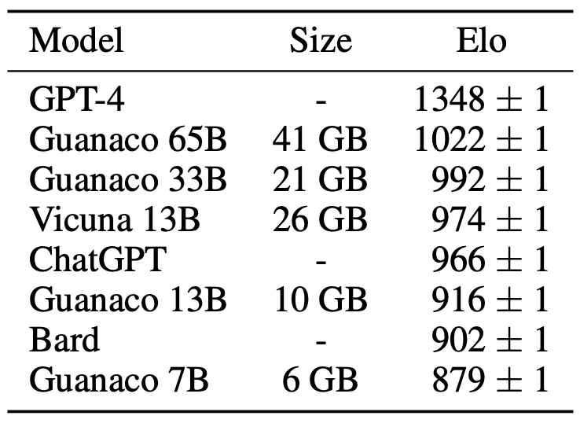
QLoRA: Efficient Finetuning of Quantized LLMs
QLoRA reduces the average memory requirements of finetuning a 65B parameter model from >780GB of GPU memory to <48GB
Source: Dettmers, Tim, Artidoro Pagnoni, Ari Holtzman, and Luke Zettlemoyer. "QLoRA: Efficient Finetuning of Quantized LLMs." arXiv preprint arXiv:2305.14314 (2023).

Slide 70
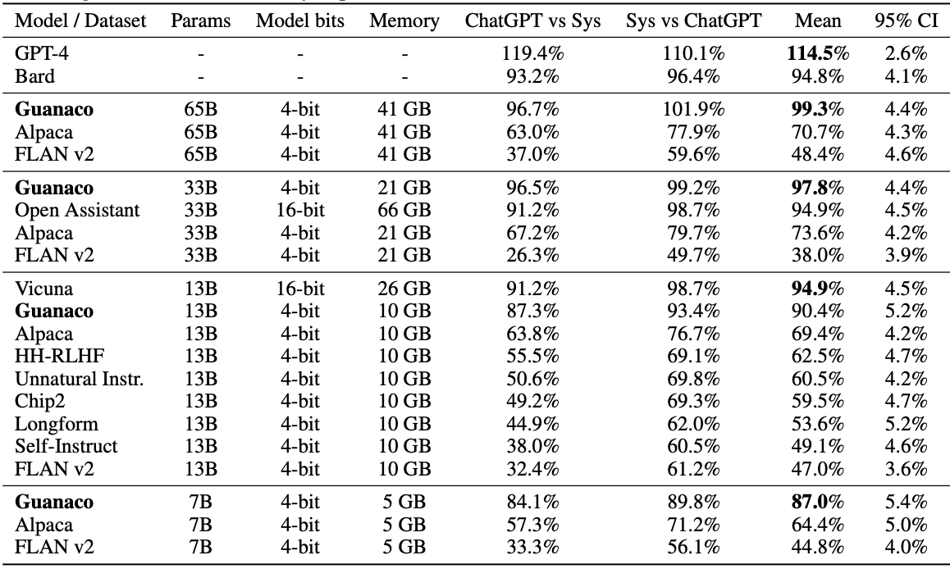
QLoRA: Efficient Finetuning of Quantized LLMs
Source: Dettmers, Tim, Artidoro Pagnoni, Ari Holtzman, and Luke Zettlemoyer. "QLoRA: Efficient Finetuning of Quantized LLMs." arXiv preprint arXiv:2305.14314 (2023).

Slide 71
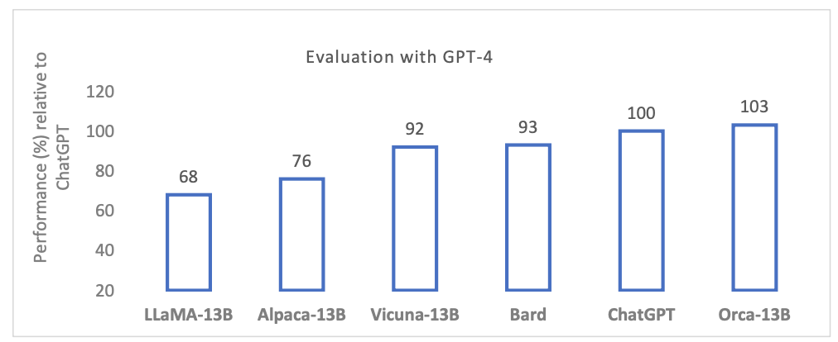
Orca: Progressive Learning from Complex Explanation Traces of GPT-4
Source: Mukherjee, Subhabrata, Arindam Mitra, Ganesh Jawahar, Sahaj Agarwal, Hamid Palangi, and Ahmed Awadallah. "Orca: Progressive Learning from Complex Explanation Traces of GPT-4." arXiv preprint arXiv:2306.02707 (2023).

Slide 72
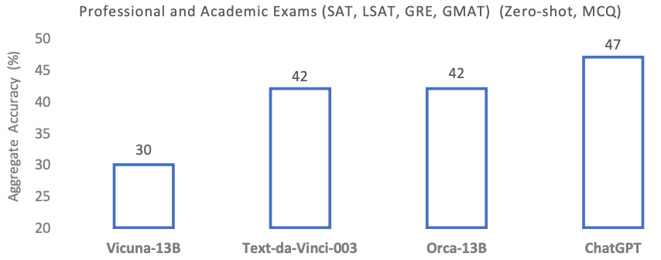
Orca-13B and ChatGPT for GRE and GMAT
Source: Mukherjee, Subhabrata, Arindam Mitra, Ganesh Jawahar, Sahaj Agarwal, Hamid Palangi, and Ahmed Awadallah. "Orca: Progressive Learning from Complex Explanation Traces of GPT-4." arXiv preprint arXiv:2306.02707 (2023).

Slide 73
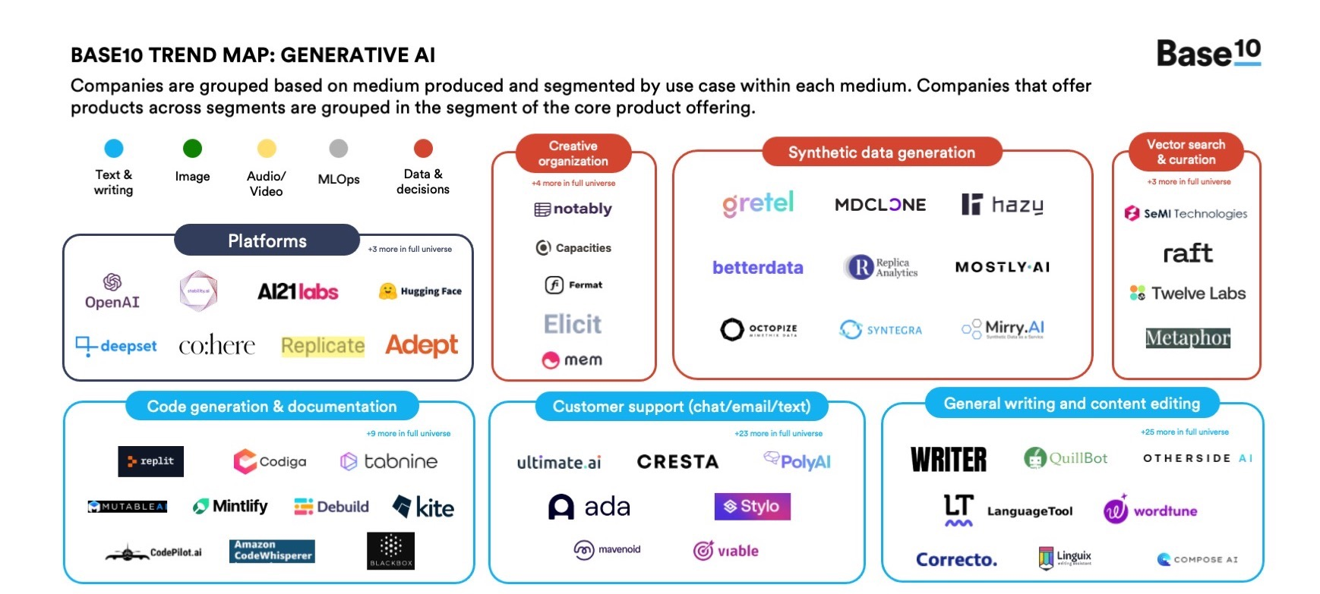
Generative AI
Source: https://base10.vc/post/generative-ai-mission-critical/

Slide 74
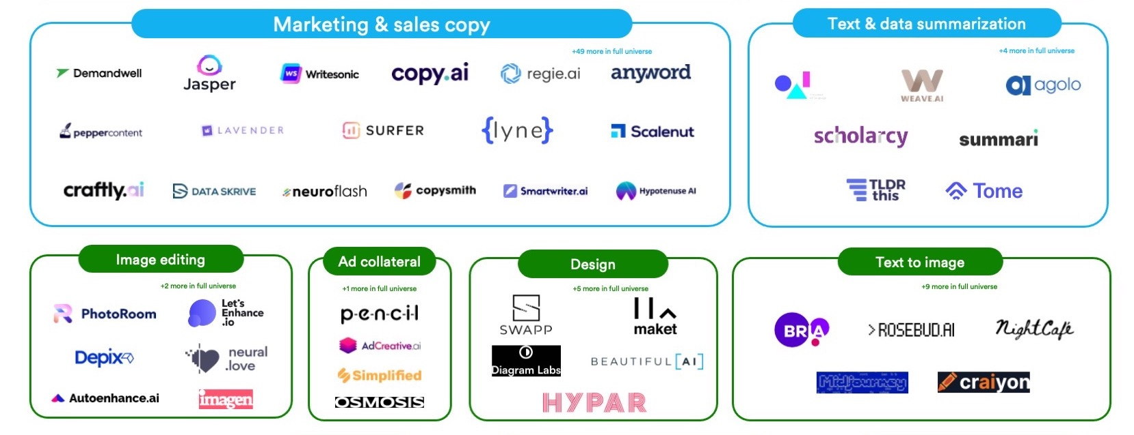
Generative AI
Source: https://base10.vc/post/generative-ai-mission-critical/

Slide 75
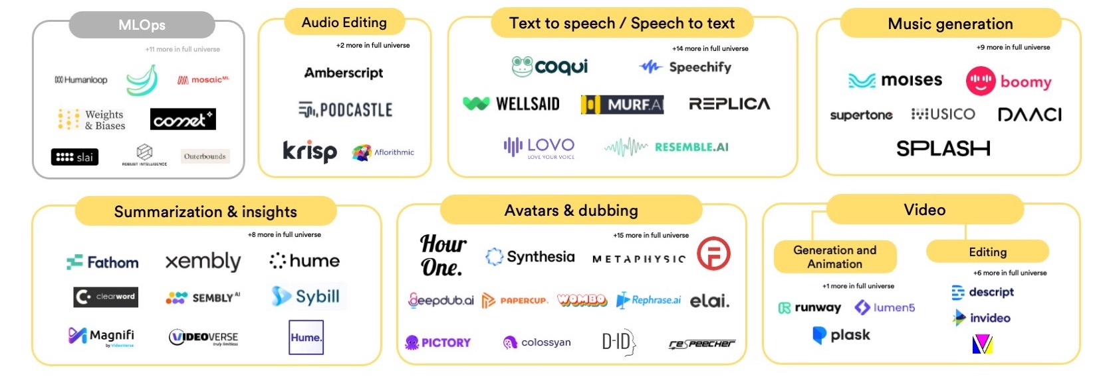
Generative AI
Source: https://base10.vc/post/generative-ai-mission-critical/

Slide 76
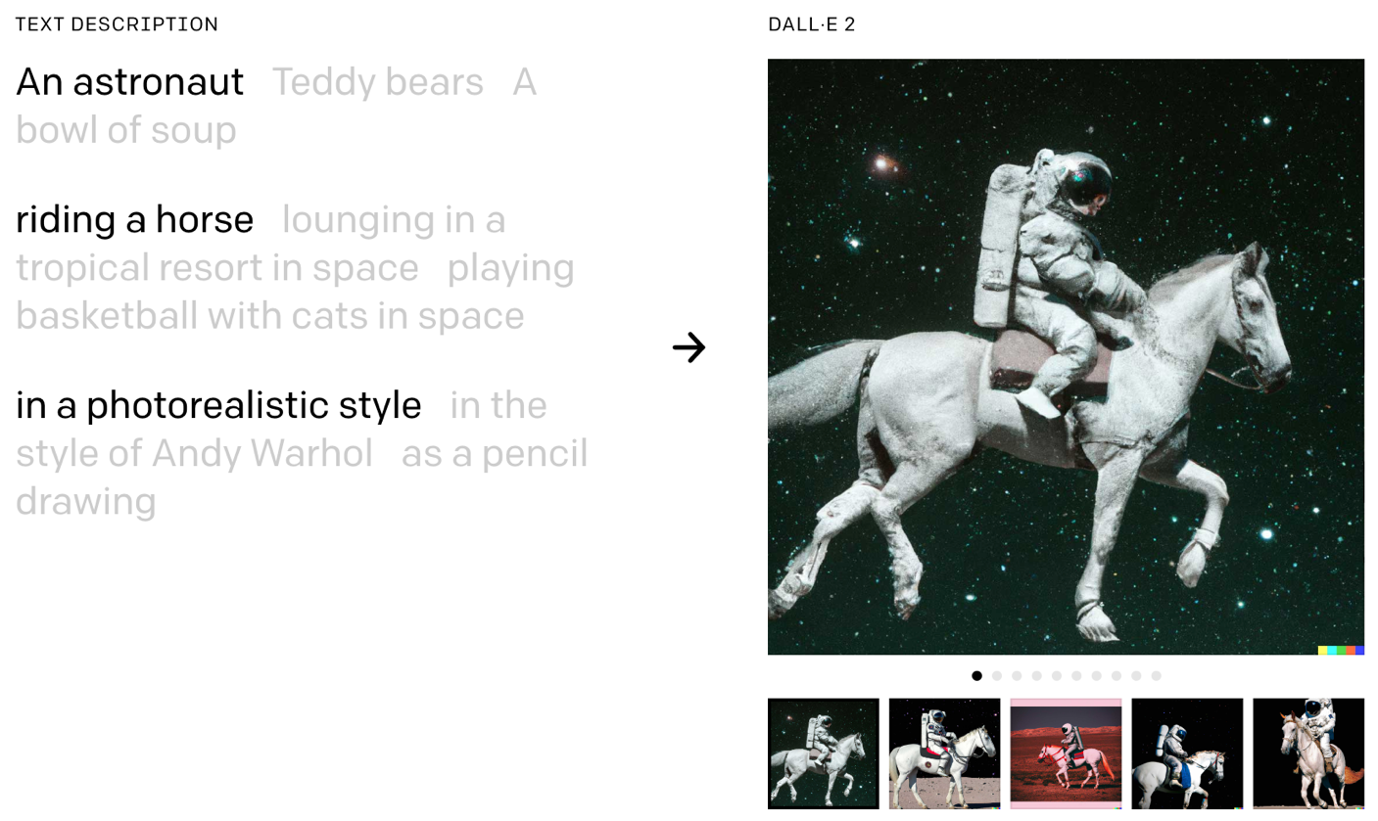
DALL·E 2 Create original, realistic images and art from a text description. It can combine concepts, attributes, and styles.
https://openai.com/dall-e-2/

Slide 77
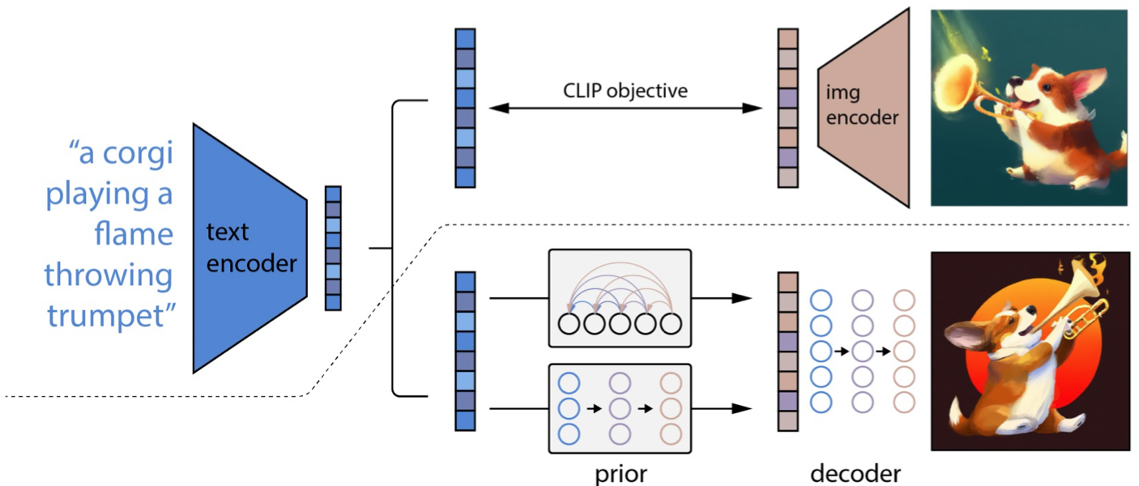
The Model Structure of DALL-E-2
CLIP Pre-training
Image Generation
Source: Yihan Cao, Siyu Li, Yixin Liu, Zhiling Yan, Yutong Dai, Philip S. Yu, and Lichao Sun (2023). "A Comprehensive Survey of AI-Generated Content (AIGC): A History of Generative AI from GAN to ChatGPT." arXiv preprint arXiv:2303.04226.

Slide 78
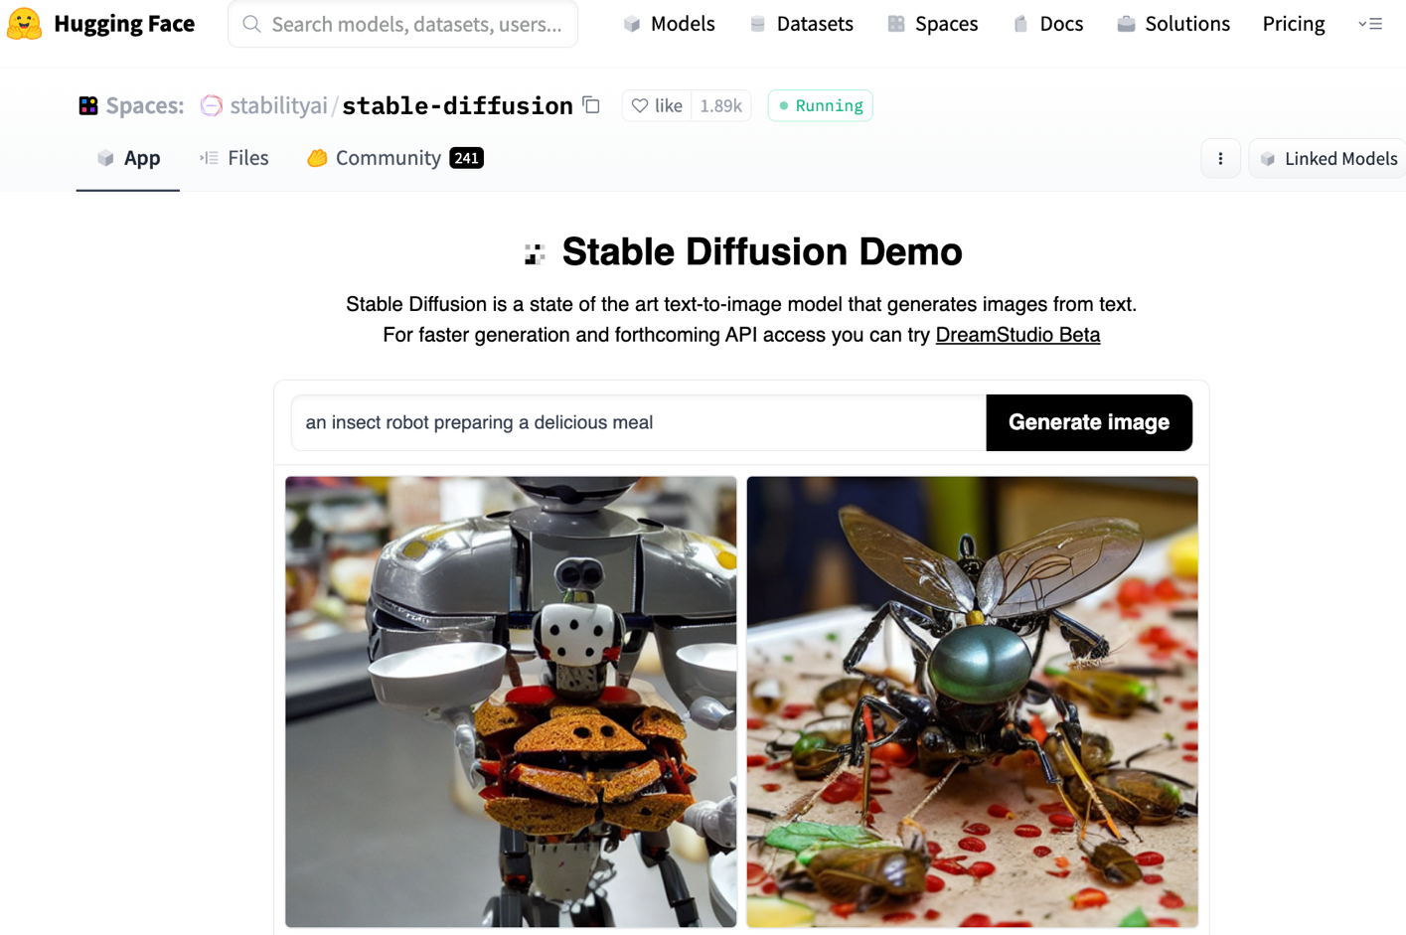
Stable Diffusion
https://huggingface.co/spaces/stabilityai/stable-diffusion

Slide 79
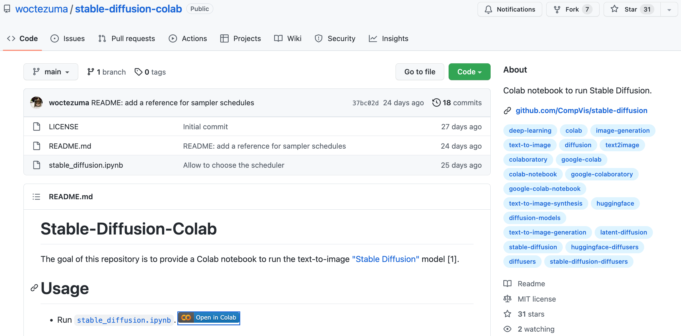
Stable Diffusion Colab
https://github.com/woctezuma/stable-diffusion-colab

Slide 80
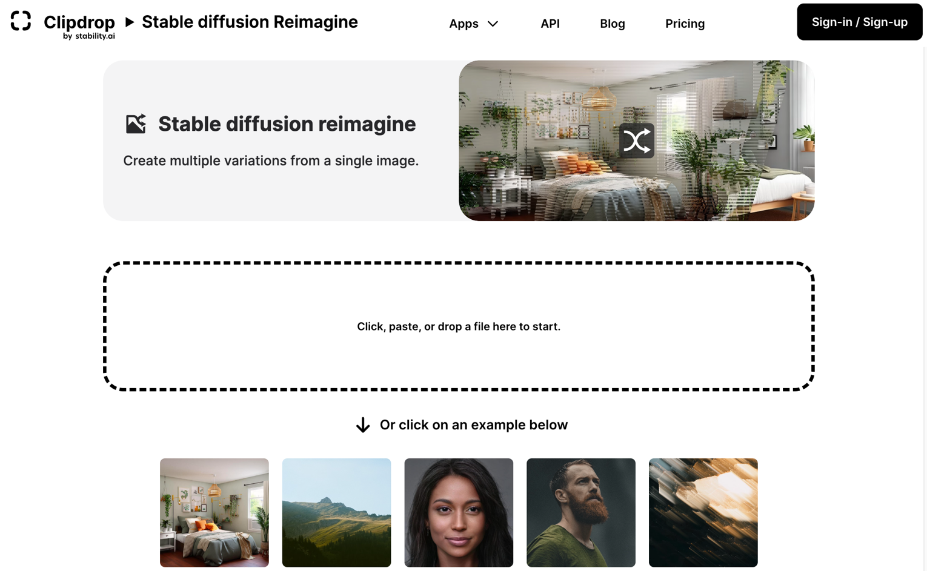
Stable Diffusion Reimagine
https://clipdrop.co/stable-diffusion-reimagine

Slide 81
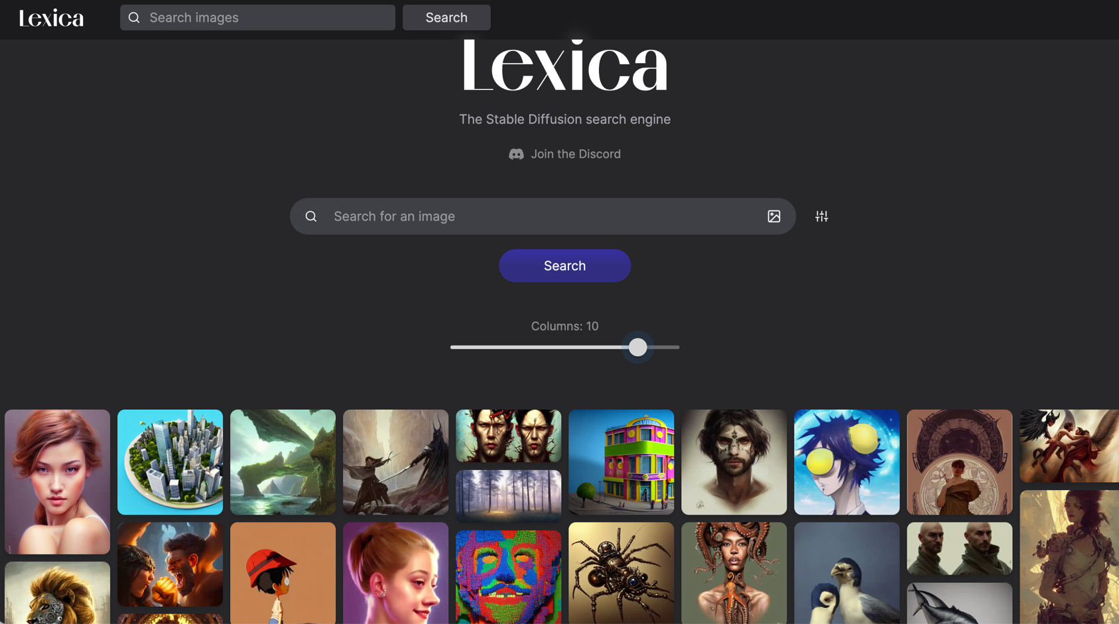
Lexica Art: Search Stable Diffusion images and prompts
https://lexica.art/

Slide 82
Civitai: Stable Diffusion AI Art Models
https://civitai.com/

Slide 83
NLG from a Multilingual, Multimodal and Multi-task perspective
Source: Erdem, Erkut, Menekse Kuyu, Semih Yagcioglu, Anette Frank, Letitia Parcalabescu, Barbara Plank, Andrii Babii et al. "Neural Natural Language Generation: A Survey on Multilinguality, Multimodality, Controllability and Learning." Journal of Artificial Intelligence Research 73 (2022): 1131-1207.

Slide 84
Text-and-Video Dialog Generation Models with Hierarchical Attention
Source: Erdem, Erkut, Menekse Kuyu, Semih Yagcioglu, Anette Frank, Letitia Parcalabescu, Barbara Plank, Andrii Babii et al. "Neural Natural Language Generation: A Survey on Multilinguality, Multimodality, Controllability and Learning." Journal of Artificial Intelligence Research 73 (2022): 1131-1207.

Slide 85
Multimodal Few-Shot Learning with Frozen Language Models
Curated samples with about five seeds required to get past well-known language model failure modes of either repeating text for the prompt or emitting text that does not pertain to the image.
These samples demonstrate the ability to generate open-ended outputs that adapt to both images and text, and to make use of facts that it has learned during language-only pre-training.
Source: Maria Tsimpoukelli, Jacob L. Menick, Serkan Cabi, S. M. Eslami, Oriol Vinyals, and Felix Hill (2021). "Multimodal few-shot learning with frozen language models." Advances in Neural Information Processing Systems 34 (2021): 200-212.

Slide 86
Multimodal Pipeline that includes three different modalities (Image, Text. Audio)
Source: Bayoudh, Khaled, Raja Knani, Fayçal Hamdaoui, and Abdellatif Mtibaa (2022). "A survey on deep multimodal learning for computer vision: advances, trends, applications, and datasets." The Visual Computer 38, no. 8: 2939-2970.

Slide 87
Video and Audio Multimodal Fusion
Source: Bayoudh, Khaled, Raja Knani, Fayçal Hamdaoui, and Abdellatif Mtibaa (2022). "A survey on deep multimodal learning for computer vision: advances, trends, applications, and datasets." The Visual Computer 38, no. 8: 2939-2970.

Slide 88
Visual and Textual Representation
Source: Bayoudh, Khaled, Raja Knani, Fayçal Hamdaoui, and Abdellatif Mtibaa (2022). "A survey on deep multimodal learning for computer vision: advances, trends, applications, and datasets." The Visual Computer 38, no. 8: 2939-2970.

Slide 89
Hybrid Multimodal Data Fusion
Text
Audio
Image
Text
Speech
Video
Source: Bayoudh, Khaled, Raja Knani, Fayçal Hamdaoui, and Abdellatif Mtibaa (2022). "A survey on deep multimodal learning for computer vision: advances, trends, applications, and datasets." The Visual Computer 38, no. 8: 2939-2970.

Slide 90
Multimodal Transfer Learning
Source: Bayoudh, Khaled, Raja Knani, Fayçal Hamdaoui, and Abdellatif Mtibaa (2022). "A survey on deep multimodal learning for computer vision: advances, trends, applications, and datasets." The Visual Computer 38, no. 8: 2939-2970.

Slide 91
CLIP: Learning Transferable Visual Models From Natural Language Supervision
Source: Radford, Alec, Jong Wook Kim, Chris Hallacy, Aditya Ramesh, Gabriel Goh, Sandhini Agarwal, Girish Sastry et al. (2021) "Learning transferable visual models from natural language supervision." In International Conference on Machine Learning, pp. 8748-8763. PMLR.

Slide 92
ViLT: Vision-and-Language Transformer Without Convolution or Region Supervision
Source: Kim, Wonjae, Bokyung Son, and Ildoo Kim (2021). "Vilt: Vision-and-language transformer without convolution or region supervision." In International Conference on Machine Learning, pp. 5583-5594. PMLR.

Slide 93
wav2vec 2.0: A framework for self-supervised learning of speech representations
Source: Baevski, Alexei, Yuhao Zhou, Abdelrahman Mohamed, and Michael Auli. "wav2vec 2.0: A framework for self-supervised learning of speech representations." Advances in Neural Information Processing Systems 33 (2020): 12449-12460.

Slide 94
Whisper: Robust Speech Recognition via Large-Scale Weak Supervision
Source: Radford, Alec, Jong Wook Kim, Tao Xu, Greg Brockman, Christine McLeavey, and Ilya Sutskever. Robust speech recognition via large-scale weak supervision. Tech. Rep., Technical report, OpenAI, 2022.

Slide 95
Microsoft Azure Text to Speech (TTS)
Source: https://azure.microsoft.com/en-gb/products/cognitive-services/text-to-speech/

Slide 96
Hugging Face
https://huggingface.co/

Slide 97
BLOOM BigScience Large Open-science Open-access Multilingual Language Model
Source: https://huggingface.co/bigscience/bloom

Slide 98
OpenAI Whisper
Source: https://huggingface.co/spaces/openai/whisper

Slide 99
Generative AI Research Areas, Applications and Companies
Source: Yihan Cao, Siyu Li, Yixin Liu, Zhiling Yan, Yutong Dai, Philip S. Yu, and Lichao Sun (2023). "A Comprehensive Survey of AI-Generated Content (AIGC): A History of Generative AI from GAN to ChatGPT." arXiv preprint arXiv:2303.04226.

Slide 100
Applications of Generative AI Models
Source: Yihan Cao, Siyu Li, Yixin Liu, Zhiling Yan, Yutong Dai, Philip S. Yu, and Lichao Sun (2023). "A Comprehensive Survey of AI-Generated Content (AIGC): A History of Generative AI from GAN to ChatGPT." arXiv preprint arXiv:2303.04226.

Slide 101
Green Finance and Sustainable Finance

Slide 102
AI for Environmental, Social, and Governance (AI4ESG)
Source: Nenad Tomašev, Julien Cornebise, Frank Hutter, Shakir Mohamed, Angela Picciariello, Bec Connelly, Danielle Belgrave et al. (2020) "AI for social good: unlocking the opportunity for positive impact." Nature Communications 11, no. 1: 1-6.

Slide 103
AI for Social Good (AI4SG)
Source: Nenad Tomašev, Julien Cornebise, Frank Hutter, Shakir Mohamed, Angela Picciariello, Bec Connelly, Danielle Belgrave et al. (2020) "AI for social good: unlocking the opportunity for positive impact." Nature Communications 11, no. 1: 1-6.

Slide 104
Sustainability SDGs CSR ESG

Slide 105
Sustainable Development Goals (SDGs)
Source: https://sdgs.un.org/goals

Slide 106
Sustainable Development Goals (SDGs) and 5P
Partnership
Peace
Prosperity
People
Planet
Source: Folke, Carl, Reinette Biggs, Albert V. Norström, Belinda Reyers, and Johan Rockström. "Social-ecological resilience and biosphere-based sustainability science.”Ecology and Society 21, no. 3 (2016).

Slide 107
Evolution of Sustainable Finance Research
Topic
SDGs: Sustainable Development Goals
SDGs
Innovative Financial Instrument
Impact Investing
ESG: Environmental, Social, and Governance
CSR: Corporate Social Responsibility
Conscious Capitalism
Climate Financing
Carbon Financing
Green Financing
Ethical Investing
Socially Responsible Investing
1986
1995
2005
2015
2020
Source: Kumar, S., Sharma, D., Rao, S., Lim, W. M., & Mangla, S. K. (2022). Past, present, and future of sustainable finance: Insights from big data analytics through machine learning of scholarly research. Annals of Operations Research, 1-44.

Slide 108
Green Finance Generic term implying use or diversion of financial resources to deploy and support projects with long term positive impact on the environment
Source: Bhattacharyya, Rupsha. "Green finance for energy transition, climate action and sustainable development: overview of concepts, applications, implementation and challenges." Green Finance 4, no. 1 (2022): 1-35.

Slide 109
Sustainable Finance Finances deployed in support of projects that ensure just, sustainable and inclusive growth or attainment of one or more sustainable development goals
Source: Bhattacharyya, Rupsha. "Green finance for energy transition, climate action and sustainable development: overview of concepts, applications, implementation and challenges." Green Finance 4, no. 1 (2022): 1-35.

Slide 110
Carbon Finance
Financial instruments based on economic value of carbon emissions which an organization cannot avoid but which it offsets by funding other compensatory projects that contribute to carbon emissions reduction
Source: Bhattacharyya, Rupsha. "Green finance for energy transition, climate action and sustainable development: overview of concepts, applications, implementation and challenges." Green Finance 4, no. 1 (2022): 1-35.

Slide 111
Climate Finance
Finances deployed in support of low carbon and climate resilient projects that help in climate change mitigation and adaptation efforts, particularly in the energy and infrastructure sectors
Source: Bhattacharyya, Rupsha. "Green finance for energy transition, climate action and sustainable development: overview of concepts, applications, implementation and challenges." Green Finance 4, no. 1 (2022): 1-35.

Slide 112
ESG Investing
Investments considering the broad range of environmental (e.g. climate change, pollution biodiversity loss), social (e.g. working conditions, human rights, salary or compensation structures) and governance (e.g. board composition, diversity and inclusion, taxes) characteristics of the projects or companies being invested in; ethical and business sustainability considerations are integral part of financing
Source: Bhattacharyya, Rupsha. "Green finance for energy transition, climate action and sustainable development: overview of concepts, applications, implementation and challenges." Green Finance 4, no. 1 (2022): 1-35.

Slide 113
Impact Investing
Investing in projects that solve a social or environmental problem; the focus is on the positive impact rather than the means used to produce that impact
Source: Bhattacharyya, Rupsha. "Green finance for energy transition, climate action and sustainable development: overview of concepts, applications, implementation and challenges." Green Finance 4, no. 1 (2022): 1-35.

Slide 114
Dynamic Trends of Green Finance and Energy Policy
Source: Wang, Moran, Xuerong Li, and Shouyang Wang. (2021) "Discovering research trends and opportunities of green finance and energy policy: A data-driven scientometric analysis." Energy Policy 154 (2021): 112295.

Slide 115
ESG: Environmental Social Governance

Slide 116
CSR: Corporate Social Responsibility

Slide 117
ESG to 17 SDGs
Source: Henrik Skaug Sætra (2021) "A Framework for Evaluating and Disclosing the ESG Related Impacts of AI with the SDGs." Sustainability 13, no. 15 (2021): 8503.

Slide 118
ESG to 17 SDGs
Source: https://sustainometric.com/esg-to-sdgs-connected-paths-to-a-sustainable-future/

Slide 119
Generative AI for ESG Applications

Slide 120
AI and Sustainability Development Goals (SDGs)
Source: Schoormann, T., Strobel, G., Möller, F., Petrik, D., & Zschech, P. (2023). Artificial Intelligence for Sustainability—A Systematic Review of Information Systems Literature. Communications of the Association for Information Systems, 52(1), 8.

Slide 121
AI for Sustainability
Source: Schoormann, T., Strobel, G., Möller, F., Petrik, D., & Zschech, P. (2023). Artificial Intelligence for Sustainability—A Systematic Review of Information Systems Literature. Communications of the Association for Information Systems, 52(1), 8.

Slide 122
Sustainable Productivity: Finance ESG
Source: Huang, Ziqi, Yang Shen, Jiayi Li, Marcel Fey, and Christian Brecher (2021). "A survey on AI-driven digital twins in Industry 4.0: Smart manufacturing and advanced robotics." Sensors 21, no. 19: 6340.

Slide 123
Sustainable Resilient Manufacturing ESG
Source: Huang, Ziqi, Yang Shen, Jiayi Li, Marcel Fey, and Christian Brecher (2021). "A survey on AI-driven digital twins in Industry 4.0: Smart manufacturing and advanced robotics." Sensors 21, no. 19: 6340.

Slide 124
ESG Indexes
MSCI ESG Index
Dow Jones Sustainability Indices (DJSI)
FTSE ESG Index

Slide 125
MSCI ESG Rating Framework
Source: https://www.msci.com/documents/1296102/21901542/ESG-Ratings-Methodology-Exec-Summary.pdf

Slide 126
MSCI ESG Key Issue Hierarchy
Source: https://www.msci.com/documents/1296102/21901542/ESG-Ratings-Methodology-Exec-Summary.pdf

Slide 127
MSCI Governance Model Structure
Source: https://www.msci.com/documents/1296102/21901542/ESG-Ratings-Methodology-Exec-Summary.pdf

Slide 128
MSCI Hierarchy of ESG Scores
Source: https://www.msci.com/documents/1296102/21901542/ESG-Ratings-Methodology-Exec-Summary.pdf

Slide 129
DJSI S&P Global ESG Score
Source: DJSI, S&P Global Corporate Sustainability Assessment (CSA), https://www.spglobal.com/esg/solutions/data-intelligence-esg-scores

Slide 130
FTSE Russell ESG Ratings
Source: https://www.ftserussell.com/data/sustainability-and-esg-data/esg-ratings

Slide 131
Sustainalytics ESG Risk Ratings
Analyst-based approach
Sustainalytics’ ESG Risk Ratings measure a company’s exposure to industry-specific material ESG risks and how well a company is managing those risks.
Source: https://www.sustainalytics.com/esg-data

Slide 132
Truvalue ESG Ranks
TruValue Labs
Machine-based approach
Truvalue Labs applies AI to analyze over 100,000 sources and uncover ESG risks and opportunities hidden in unstructured text.
The ESG Ranks data service produces an overall company rank based on industry percentile leveraging the 26 ESG categories defined by the Sustainability Accounting Standards Board (SASB).
The data feed covers 20,000+ companies with more than 13 years of history.
Source: :https://developer.truvaluelabs.com/data/esg-ranks

Slide 133
Analyst-driven vs. AI-driven ESG
Sustainalytics
Truvalue Labs
Source: Mark Tulay (2020), Man vs. machine: A tale of two sustainability ratings systems, GreenBiz, https://www.greenbiz.com/article/man-vs-machine-tale-two-sustainability-ratings-systems

Slide 134
Analyst based ESG Research AI based ESG Research
Source: https://www.esganalytics.io/insights/how-data-is-accelerating-esg

Slide 135
ESG Analytics: NLP Taxonomy
Source: https://www.esganalytics.io/insights/how-data-is-accelerating-esg

Slide 136
Top ESG Reporting Software
Environmental, Social and Governance (ESG) Reporting software or Sustainability software helps organizations manage their operational data, evaluate their impact on the environment and provide reporting to perform audits.
Source: https://www.softwarereviews.com/categories/environmental-social-and-governance-reporting

Slide 137
Emitwise
Emitwise is the carbon management platform for companies with complex manufacturing supply chains to confidently understand, track and reduce their complete carbon footprint.
Combining 100 years of carbon accounting experience and machine learning technology, we accelerate climate action by increasing the accuracy of scope 3 emissions.
The platform empowers manufacturers and their supply chains to make carbon-led business decisions that lower risk, increase profitability and deliver ambitious climate action.
Source: https://www.softwarereviews.com/categories/environmental-social-and-governance-reporting

Slide 138
Workiva ESG
Workiva is a cloud native platform that simplifies the complexities of reporting and compliance.
Workiva ESG is the end-to-end platform that allows you to integrate financial data, nonfinancial data, and XBRL.
Workiva, the platform that streamlines your entire ESG process.
Automate data collection, utilize frameworks, and directly connect to all your ESG reports. in meaningful glossy reports, accurate survey responses, and regulatory filings with integrated XBRL tagging.
Source: https://www.softwarereviews.com/categories/environmental-social-and-governance-reporting

Slide 139
Acknowledgments: Research Projects
Applying AI technology to construct knowledge graphs of cryptocurrency anti-money laundering: a few-shot learning model
MOST, 110-2410-H-305-013-MY2, 2021/08/01~2023/07/31
Fintech Green Finance for Carbon Market Index, Corporate Finance, and Environmental Policies. Carbon Emission Sentiment Index with AI Text Analytics
NTPU, 112-NTPU_ORDA-F-003，2023/01/01~2024/12/31
Research on speech processing, synthesis, recognition, and sentence construction of people with language disabilities. Multimodal Cross-lingual Task-Oriented Dialogue System
NTPU, 112-NTPU_ORDA-F-004, 2023/01/01~2025/12/31
Use deep learning to identify commercially dental implant systems - observational study
USTP-NTPU-TMU, USTP-NTPU-TMU-112-01, 2023/01/01~2023/12/31
Metaverse Avatar Automatic Metadata Generation Module
FormosaVerse x NTPU, NTPU-111A413E01, 2022/12/01~2023/11/30
Establishment and Implement of Smart Assistive Technology for Dementia Care and Its Socio-Economic Impacts. Intelligent, individualized and precise care with smart AT and system integration
MOST, 111-2627-M-038-001-, 2022/08/01~2023/07/31

Slide 140
Summary
1. ChatGPT and Generative AI
2. Green Finance and Sustainable Finance
3. Generative AI for ESG Applications

Slide 141
References
Yihan Cao, Siyu Li, Yixin Liu, Zhiling Yan, Yutong Dai, Philip S. Yu, and Lichao Sun (2023). "A Comprehensive Survey of AI-Generated Content (AIGC): A History of Generative AI from GAN to ChatGPT." arXiv preprint arXiv:2303.04226.
Pengfei Liu, Weizhe Yuan, Jinlan Fu, Zhengbao Jiang, Hiroaki Hayashi, and Graham Neubig. (2023) "Pre-train, prompt, and predict: A systematic survey of prompting methods in natural language processing." ACM Computing Surveys 55, no. 9 (2023): 1-35.
Wayne Xin Zhao, Kun Zhou, Junyi Li, Tianyi Tang, Xiaolei Wang, Yupeng Hou, Yingqian Min et al. (2023) "A Survey of Large Language Models." arXiv preprint arXiv:2303.18223.
Thorsten Schoormann, Gero Strobel, Frederik Möller, Dimitri Petrik, and Patrick Zschech (2023). "Artificial Intelligence for Sustainability—A Systematic Review of Information Systems Literature." Communications of the Association for Information Systems 52, no. 1 (2023): 8.
Junliang Wang, Chuqiao Xu, Jie Zhang, and Ray Zhong (2022). "Big data analytics for intelligent manufacturing systems: A review." Journal of Manufacturing Systems 62 (2022): 738-752.
Ouyang, L., Wu, J., Jiang, X., Almeida, D., Wainwright, C. L., Mishkin, P., ... & Lowe, R. (2022). Training language models to follow instructions with human feedback. arXiv preprint arXiv:2203.02155.

Slide 142
ChatGPT和生成式AI 在綠色金融與ESG的應用 ChatGPT and Generative AI for Green Finance and ESG Applications
Q & A
時間：2023/6/14日(三)下午13:30-15:30； 15:30-16:00 Q& A
地點：東吳大學崇基樓（法學院）1104 教室
主持人：莊永丞 副院長，東吳大學法學院
Min-Yuh Day, Ph.D, Associate Professor
Institute of Information Management, National Taipei University
https://web.ntpu.edu.tw/~myday
2023-06-14

