Slide 1



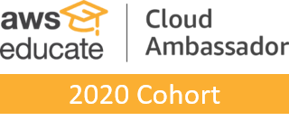

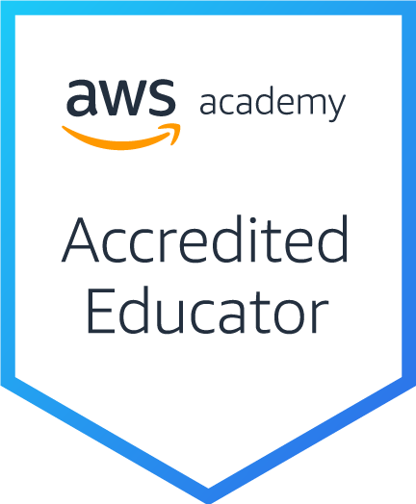
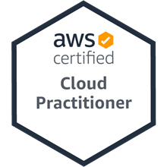
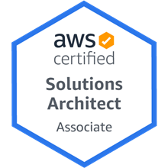
AWS Relational Database Service (RDS): Lab 10
Creating an Amazon RDS Database Instance
雲端運算基礎入門
Introduction to Cloud Computing
Time: 2022/5/20 (Friday) 18:30-20:30
Place: 電資406室, 國立臺北大學 (NTPU)
https://meet.google.com/efw-mxft-jav
戴敏育 副教授
Min-Yuh Day, Ph.D, Associate Professor
國立臺北大學 資訊管理研究所
Institute of Information Management, National Taipei University
https://web.ntpu.edu.tw/~myday
2022-05-20

Slide 2


戴敏育 博士
(Min-Yuh Day, Ph.D.)
1
國立臺北大學 資訊管理研究所 副教授
中央研究院 資訊科學研究所 訪問學人
國立臺灣大學 資訊管理 博士
Publications Co-Chairs, IEEE/ACM International Conference on
Advances in Social Networks Analysis and Mining (ASONAM 2013- )
Program Co-Chair, IEEE International Workshop on
Empirical Methods for Recognizing Inference in TExt (IEEE EM-RITE 2012- )
Publications Chair, The IEEE International Conference on
Information Reuse and Integration for Data Science (IEEE IRI)

Slide 3
Outline
AWS RDS: Lab 10
Creating an Amazon RDS Database Instance
  AWS Academy Introduction to Cloud: Semester 1
  Module 10: Databases
  Lab 10 - RDS
    Module 10 Lab: Creating an Amazon RDS Database Instance

Slide 4

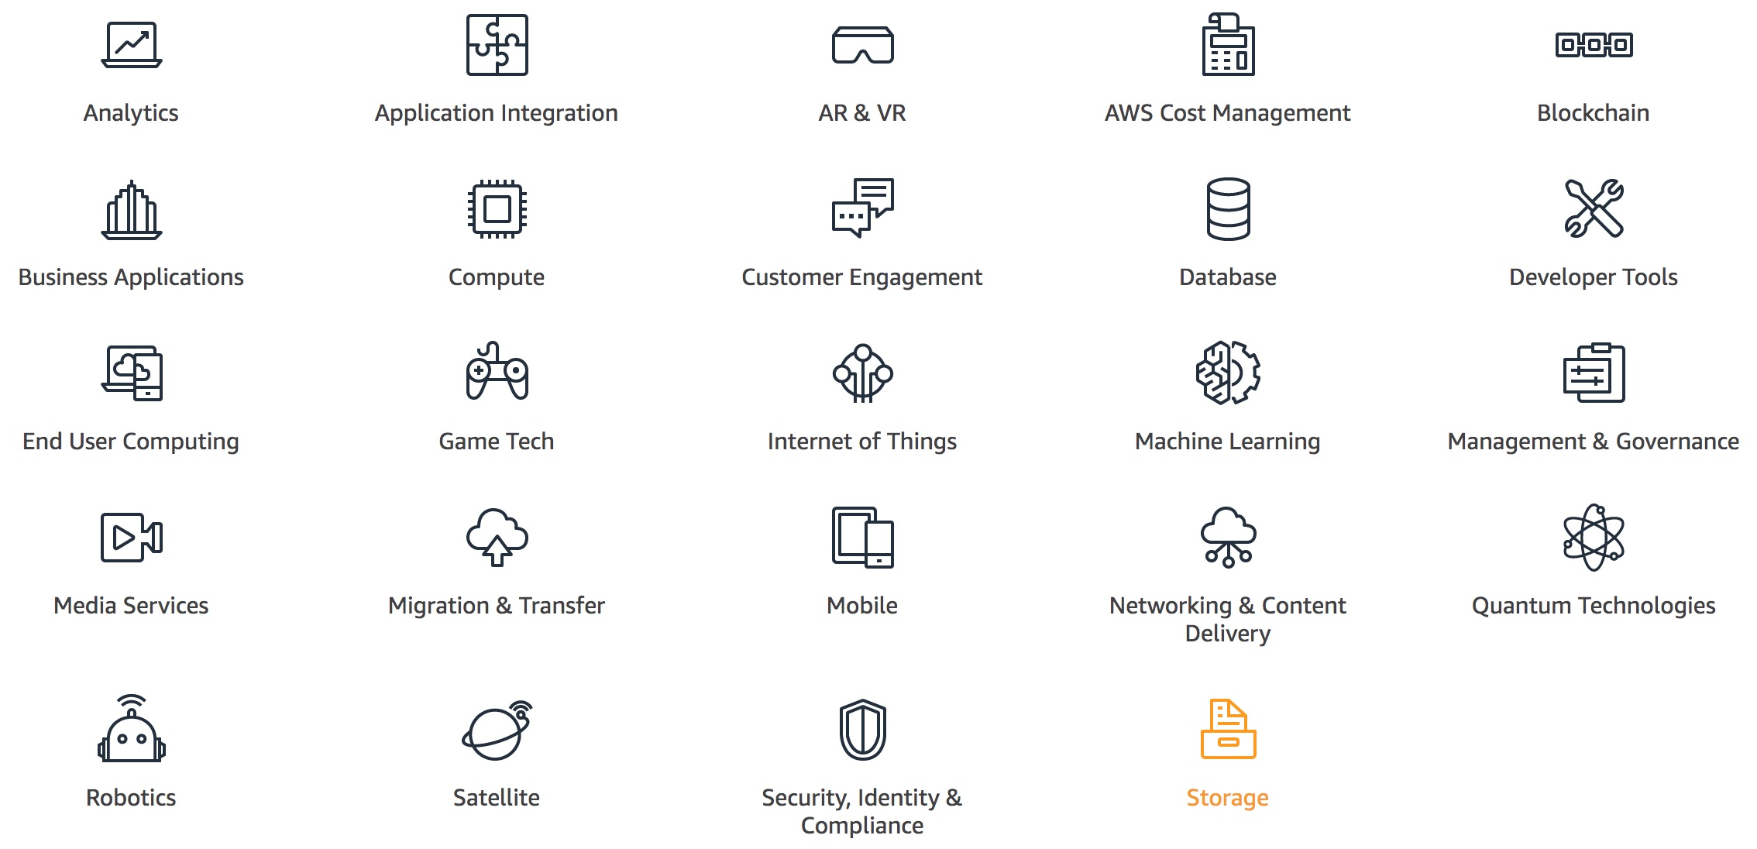
AWS Products and Services
Source: https://aws.amazon.com/

Slide 5
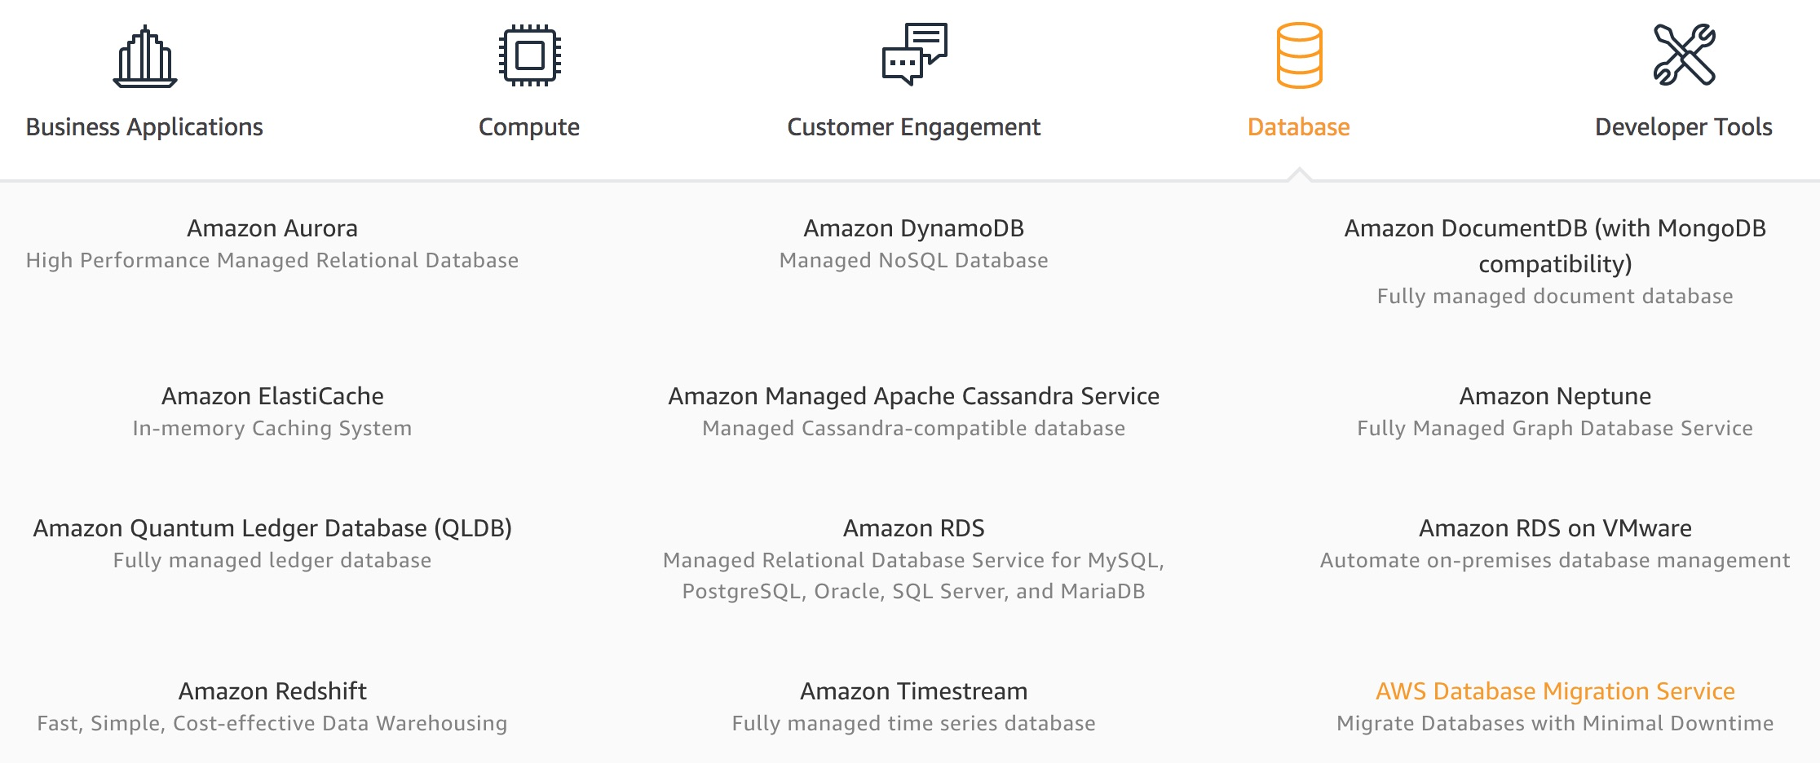
AWS Database
Source: https://aws.amazon.com/

Slide 6
AWS RDS: Lab 10
Creating an Amazon RDS Database Instance

Slide 7
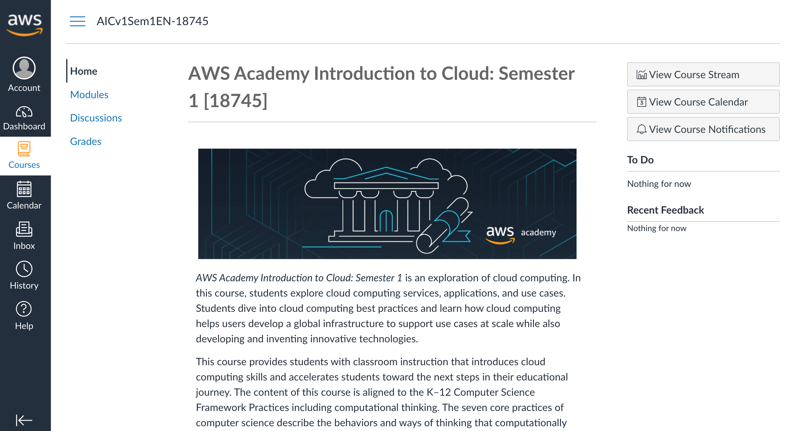
AWS Academy Introduction to Cloud: Semester 1 [18745]
AWS AICv1Sem1EN
https://awsacademy.instructure.com/courses/18745
Source: AWS Academy Introduction to Cloud: Semester 1, https://awsacademy.instructure.com/courses/18745

Slide 8
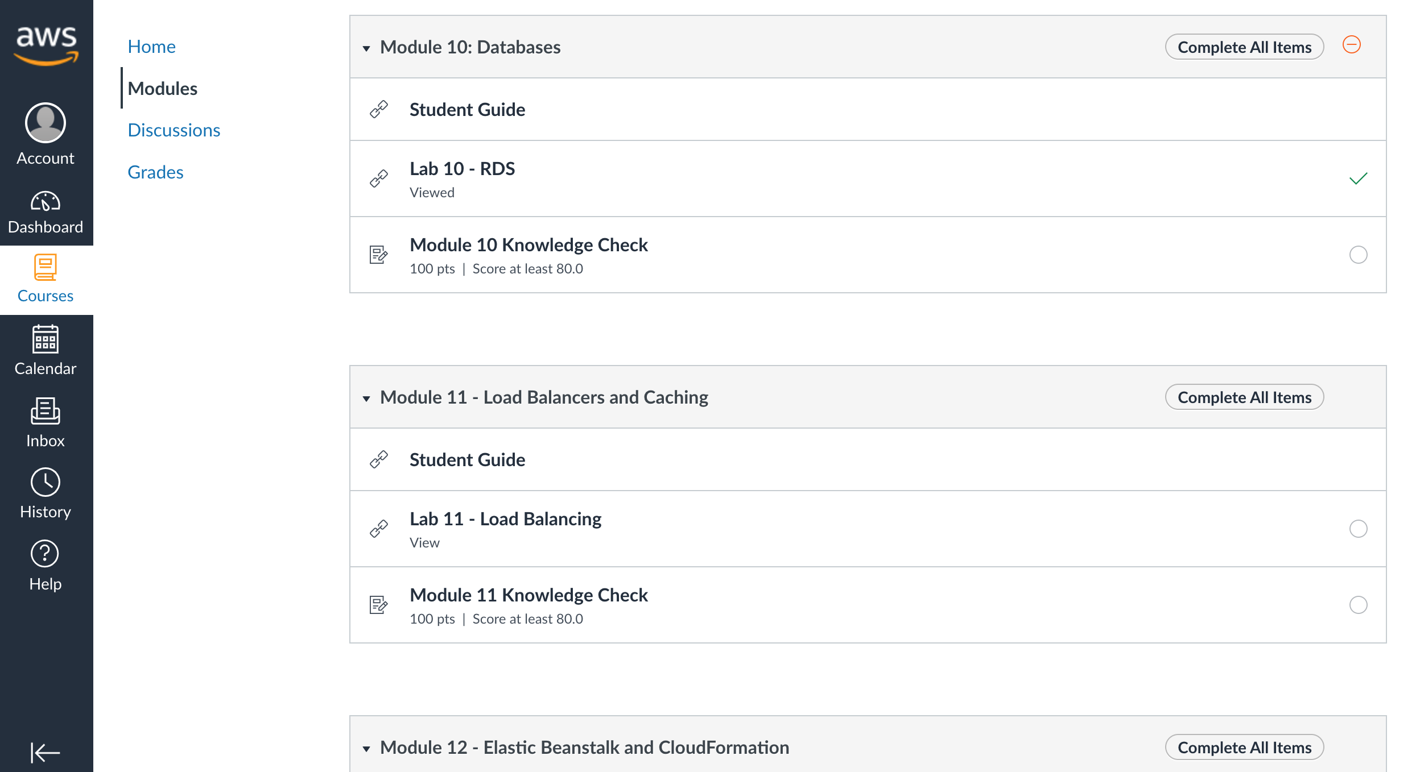
AWS Academy Introduction to Cloud: Semester 1 [18745]
Module 10 Databases: Lab 10 - RDS
Source: AWS Academy Introduction to Cloud: Semester 1, https://awsacademy.instructure.com/courses/18745

Slide 9
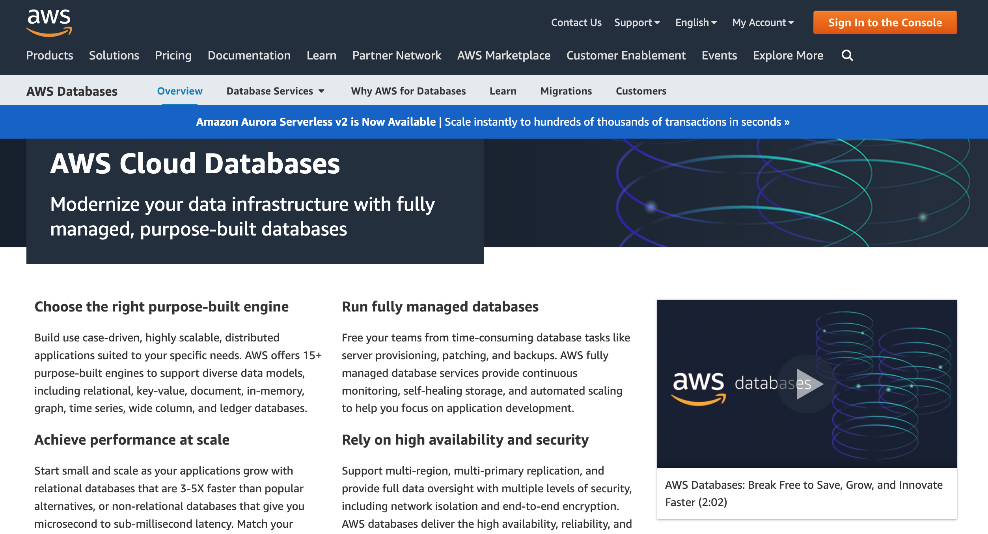
Amazon Databases
https://aws.amazon.com/products/databases/

Slide 10
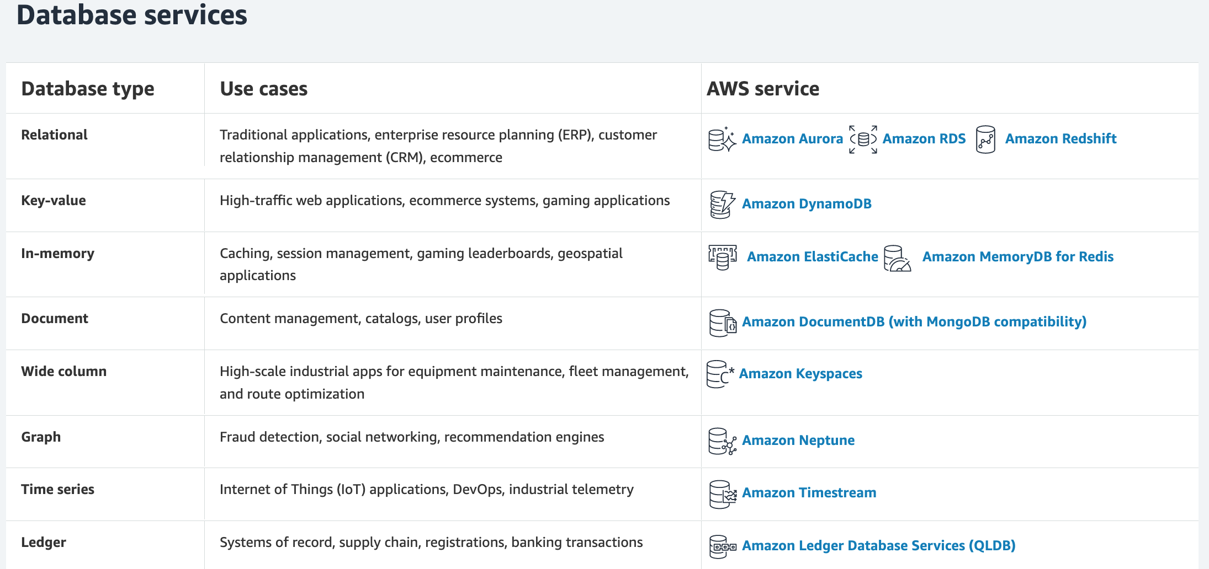
Amazon Databases
https://aws.amazon.com/products/databases/

Slide 11
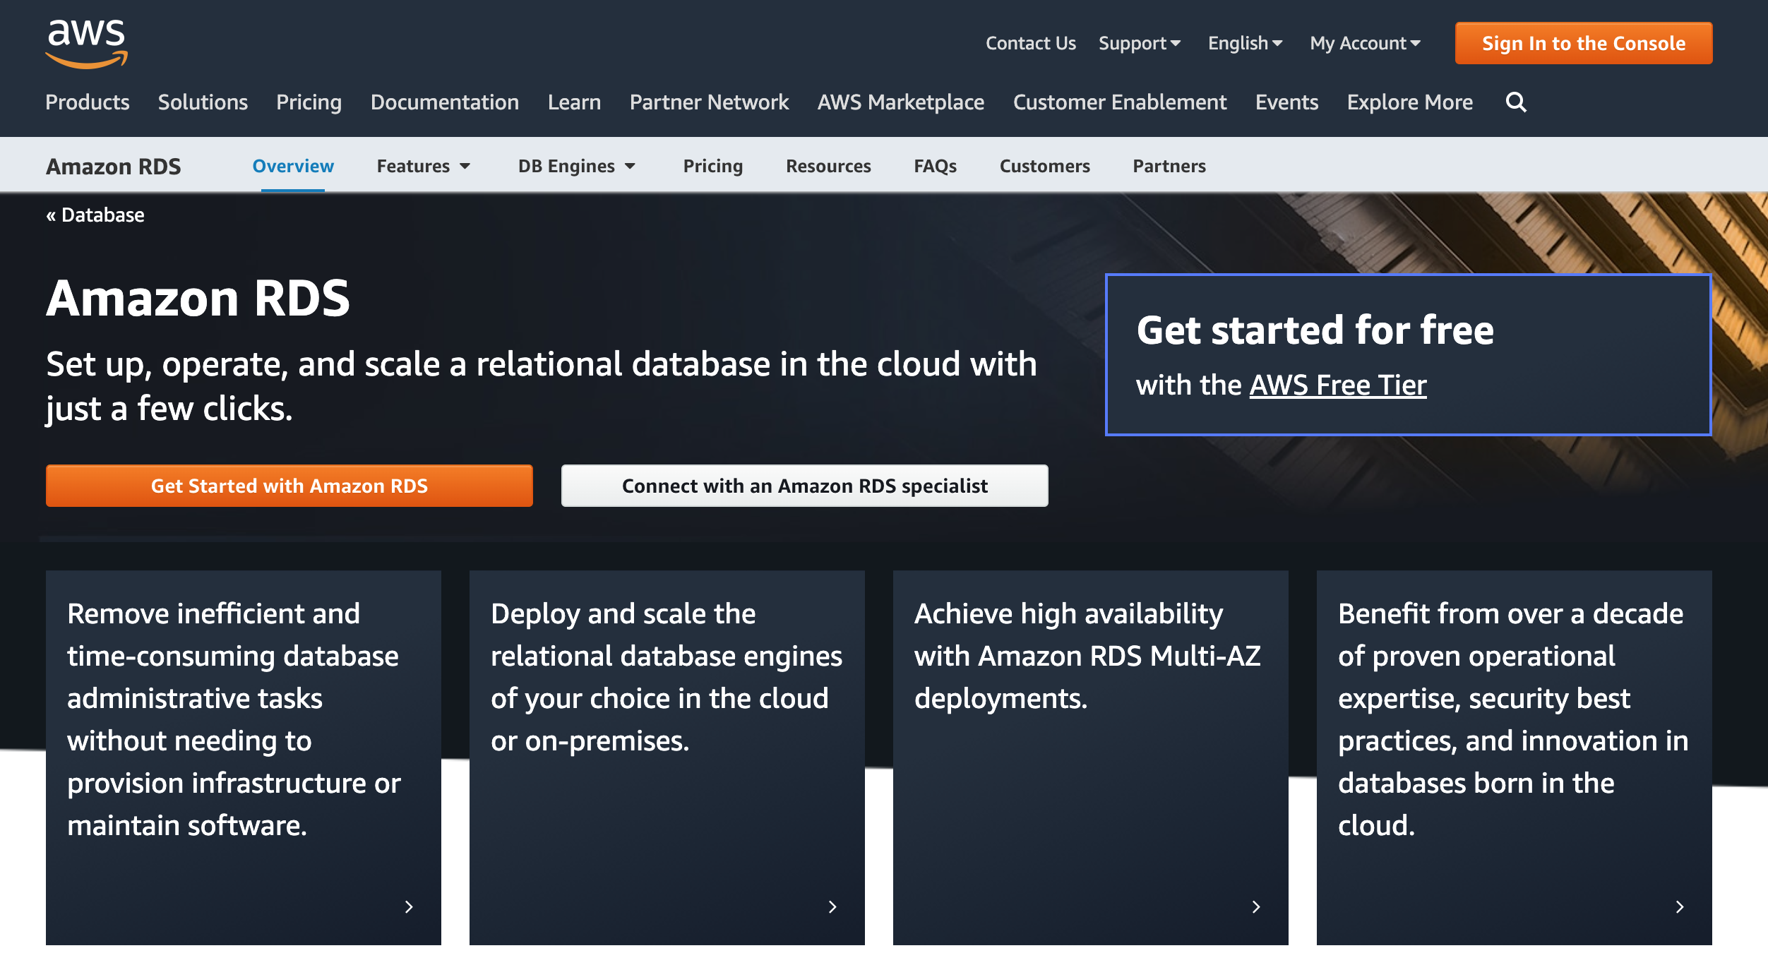
Amazon Relational Database Service (RDS)
https://aws.amazon.com/rds/

Slide 12
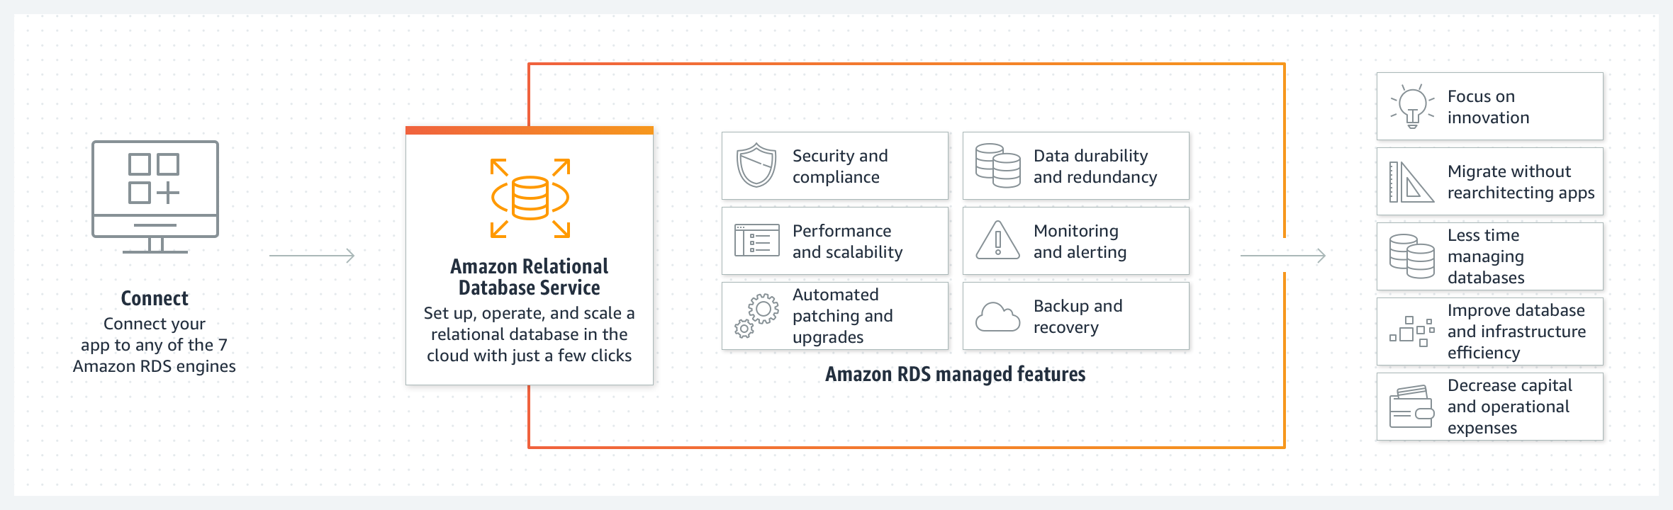
Amazon Relational Database Service (RDS)
https://aws.amazon.com/rds/

Slide 13
Module 10: Databases
In this module, you will learn about the
Amazon Relational Database Service (Amazon RDS),
Amazon DynamoDB, and
data warehousing with Amazon Redshift.
You will also compare
relational and nonrelational databases and
online transaction processing (OLTP) and
online analytic processing (OLAP).
Source: AWS Academy Introduction to Cloud: Semester 1, https://awsacademy.instructure.com/courses/18745

Slide 14
Module 10: Databases
Module description
In this module, you will recommend a
relational or nonrelational database
depending on a given scenario.
You will create an RDS DB instance.
You will also learn about and discuss
appropriate usage of
relational and nonrelational database systems.
Source: AWS Academy Introduction to Cloud: Semester 1, https://awsacademy.instructure.com/courses/18745

Slide 15
OLTP and OLAP
Many different types of databases are available.
To decide which type of database you need, it is important to know how the data will be processed.
There are two types of data processing:
online transaction processing (OLTP) and
online analytic processing (OLAP).
Source: AWS Academy Introduction to Cloud: Semester 1, https://awsacademy.instructure.com/courses/18745

Slide 16
AWS database services
Amazon RDS is the classic relational database that uses
SQL, Oracle, Aurora, or other similar database systems.
  Think of this as a gradebook in which each student is a row and all students are attached to the same number of assignments (columns).
  Businesses can use code to search for specific data based on the information in the rows and columns.
  Amazon RDS is useful for companies that are storing a moderate amount of data that is uniform in structure, meaning each unique ID (such as student name) is attached to the same number of data points (grades).
Source: AWS Academy Introduction to Cloud: Semester 1, https://awsacademy.instructure.com/courses/18745

Slide 17
Amazon Relational Database Service
(Amazon RDS)
Amazon RDS is primarily used for OLTP because it has better methods for maintaining
the integrity and consistency of the database when processing data.
Source: AWS Academy Introduction to Cloud: Semester 1, https://awsacademy.instructure.com/courses/18745

Slide 18
DynamoDB
DynamoDB is a nonrelational database, meaning that you can’t use traditional systems such as SQL or Aurora.
Each item in the database is stored as a key-value pair or a JavaScript Object Notation (JSON) file.
This means that each row can have a different number of columns.
The entries do not all have to be matched in the same way.
This permits flexibility in processing that works well for blogging, gaming, and advertising.
Source: AWS Academy Introduction to Cloud: Semester 1, https://awsacademy.instructure.com/courses/18745

Slide 19
Aurora
Aurora is a relational database engine that is specifically made to work with the AWS Cloud.
Aurora is up to five times faster than standard MySQL databases and three times faster than standard PostgreSQL databases.
It is designed to provide the security, availability, and reliability of commercial databases at one-tenth the cost.
Aurora is fully managed by Amazon RDS, which automates time-consuming administrative tasks such as
hardware provisioning, database setup, patching, and backups.
Source: AWS Academy Introduction to Cloud: Semester 1, https://awsacademy.instructure.com/courses/18745

Slide 20
Amazon Redshift
Amazon Redshift is a fast, fully managed data warehouse that makes it efficient and cost effective to analyze all your data using standard SQL and your existing BI tools.
Source: AWS Academy Introduction to Cloud: Semester 1, https://awsacademy.instructure.com/courses/18745

Slide 21
AWS Academy Introduction to Cloud: Semester 1 [18745]
Module 10 Databases: Lab 10 - RDS
Module 10 Lab: Creating an Amazon RDS Database Instance
Lab overview
Follow these steps to create an
Amazon Relational Database Service (Amazon RDS)
database (DB) instance that maintains data
used by a web application.
Duration
This lab requires approximately 20 minutes to complete.
Source: AWS Academy Introduction to Cloud: Semester 1, https://awsacademy.instructure.com/courses/18745

Slide 22
Module 10 Lab:
Creating an Amazon RDS Database Instance
Access the AWS Management Console
Task 1. Set up an RDS DB instance
Task 2. Download and install SQL Server Management Studio
Task 3. Make your database publicly accessible
Task 4. Update your VPC security group
Task 5. Connect to your DB instance
Task 6. Explore the structure of the relational database
Lab complete
Source: AWS Academy Introduction to Cloud: Semester 1, https://awsacademy.instructure.com/courses/18745

Slide 23
AWS Academy Introduction to Cloud: Semester 1 [18745]
AWS AICv1Sem1EN
https://awsacademy.instructure.com/courses/18745
Source: AWS Academy Introduction to Cloud: Semester 1, https://awsacademy.instructure.com/courses/18745

Slide 24
AWS Academy Introduction to Cloud: Semester 1 [18745]
Module 10 Databases: Lab 10 - RDS
Source: AWS Academy Introduction to Cloud: Semester 1, https://awsacademy.instructure.com/courses/18745

Slide 25
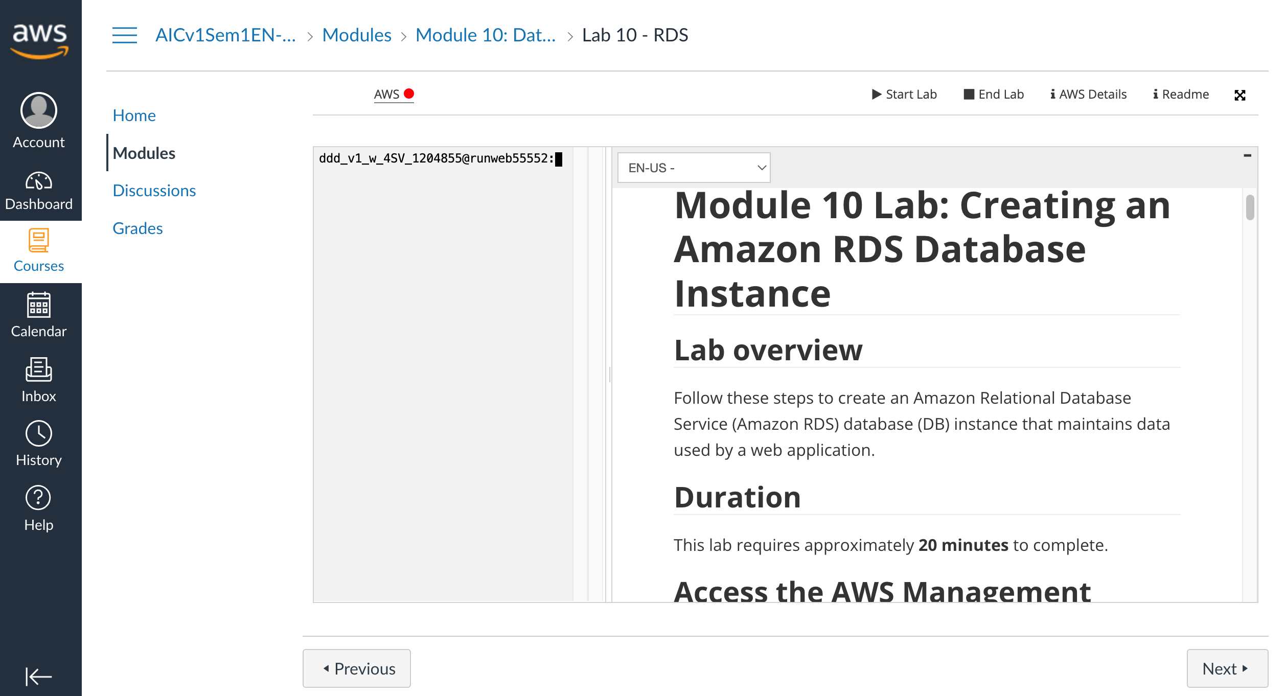
AWS Academy Introduction to Cloud: Semester 1 [18745]
Module 10 Databases: Lab 10 - RDS
https://awsacademy.instructure.com/courses/18745/modules/items/1536201
Source: AWS Academy Introduction to Cloud: Semester 1, https://awsacademy.instructure.com/courses/18745

Slide 26
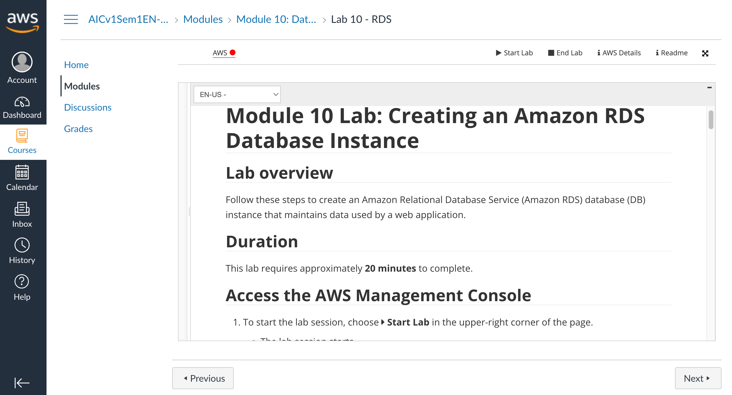
AWS Academy Introduction to Cloud: Semester 1 [18745]
Module 10 Databases: Lab 10 - RDS
https://awsacademy.instructure.com/courses/18745/modules/items/1536201
Source: AWS Academy Introduction to Cloud: Semester 1, https://awsacademy.instructure.com/courses/18745

Slide 27
AWS Academy Introduction to Cloud: Semester 1
Module 10 Databases: Lab 10 - RDS
Access the AWS Management Console
To start the lab session, choose Start Lab in the upper-right corner of the page.
  The lab session starts.
  A timer displays in the upper-right corner of the page and shows the time remaining in the session.
  Tip: To refresh the session length at any time, choose Start Lab again before the timer reaches 0:00.
  Before continuing, wait until the lab environment is ready. The environment is ready when the lab details appear on the right side of the page and the circle icon next to the AWS link in the upper-left corner turns green.
To return to these instructions, choose the Readme link in the upper-right corner.
To connect to the AWS Management Console, choose the AWS link in the upper-left corner, above the terminal window.
  A new browser tab opens and connects you to the AWS Management Console.
Source: AWS Academy Introduction to Cloud: Semester 1, https://awsacademy.instructure.com/courses/18745

Slide 28
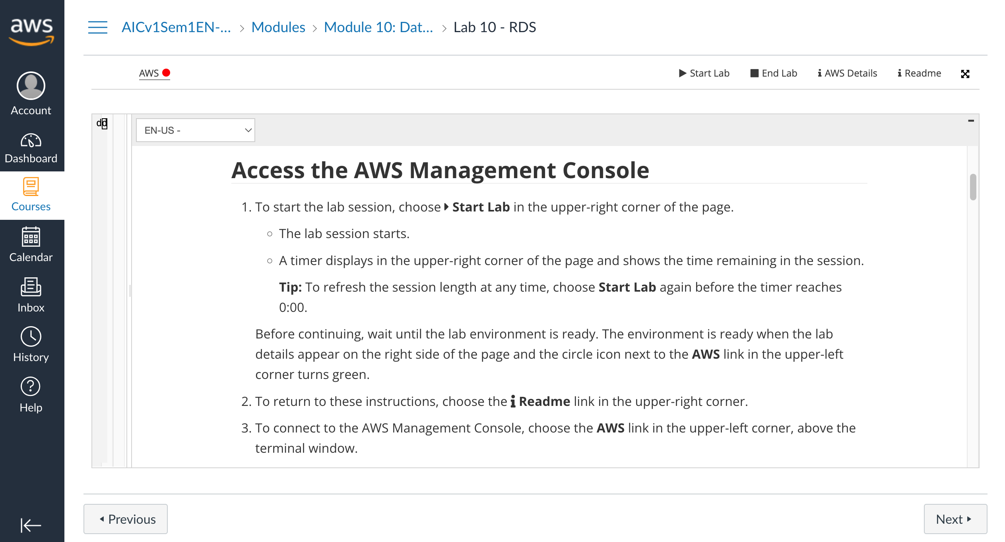
AWS Academy Introduction to Cloud: Semester 1
Module 10 Databases: Lab 10 - RDS
1
1. To start the lab session, choose Start Lab in the upper-right corner of the page.
Source: AWS Academy Introduction to Cloud: Semester 1, https://awsacademy.instructure.com/courses/18745

Slide 29
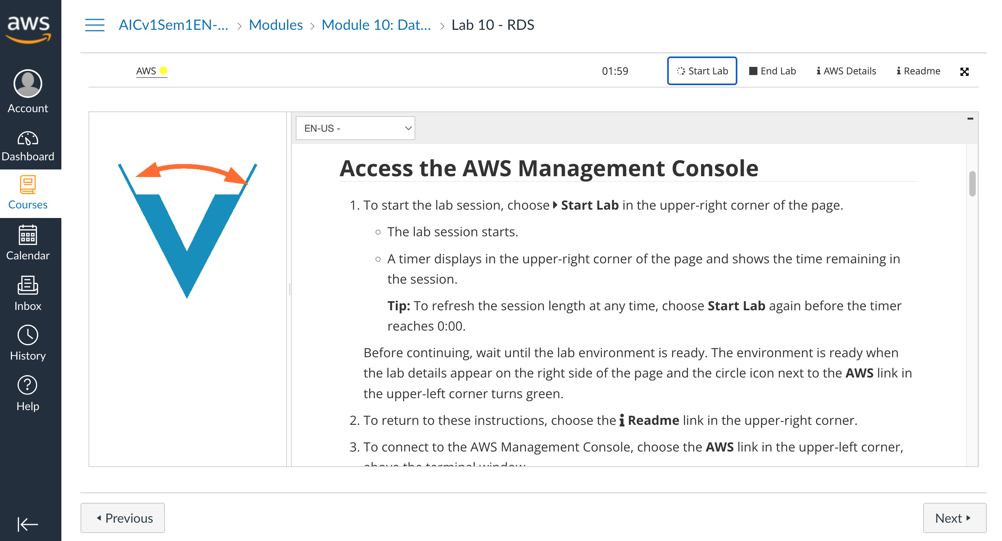
AWS Academy Introduction to Cloud: Semester 1
Module 10 Databases: Lab 10 - RDS
Source: AWS Academy Introduction to Cloud: Semester 1, https://awsacademy.instructure.com/courses/18745

Slide 30

AWS Academy Introduction to Cloud: Semester 1
Module 10 Databases: Lab 10 - RDS
2
2. To return to these instructions, choose the Readme link in the upper-right corner.
Source: AWS Academy Introduction to Cloud: Semester 1, https://awsacademy.instructure.com/courses/18745

Slide 31

AWS Academy Introduction to Cloud: Semester 1
Module 10 Databases: Lab 10 - RDS
3
3. To connect to the AWS Management Console, choose the AWS link in the upper-left corner, above the terminal window.
  A new browser tab opens and connects you to the AWS Management Console.
Source: AWS Academy Introduction to Cloud: Semester 1, https://awsacademy.instructure.com/courses/18745

Slide 32
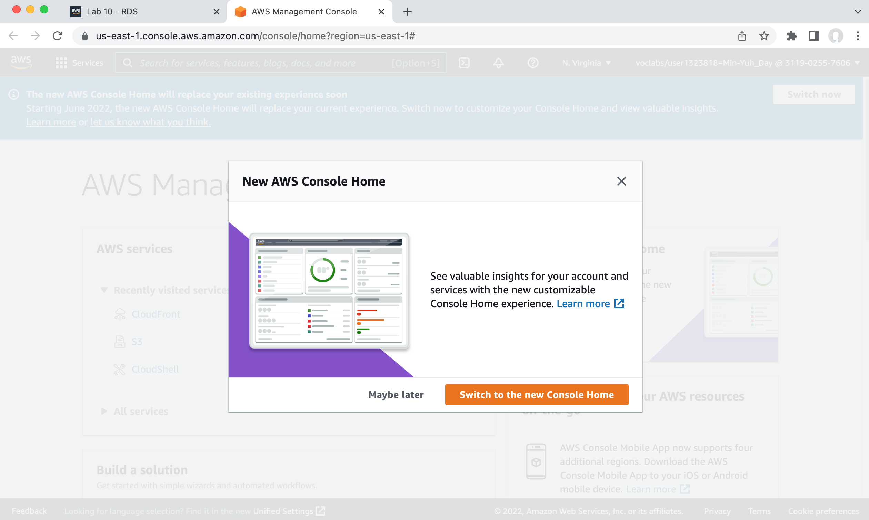
AWS Academy Introduction to Cloud: Semester 1
Module 10 Databases: Lab 10 - RDS
Region: us-east-1
Lab ID: arn:aws:cloudformation:us-east-1:547970237064:stack/c53687a865001l2152087t1w547970237064/1eaf4fc0-d7de-11ec-90bd-0e4b09deb6f5
Creation Time: 2022-05-19T18:42:34-0700
Start session at: 2022-05-19T18:42:34-0700
Remaining session time: 02:00:00(120 minutes)
Source: AWS Academy Introduction to Cloud: Semester 1, https://awsacademy.instructure.com/courses/18745

Slide 33
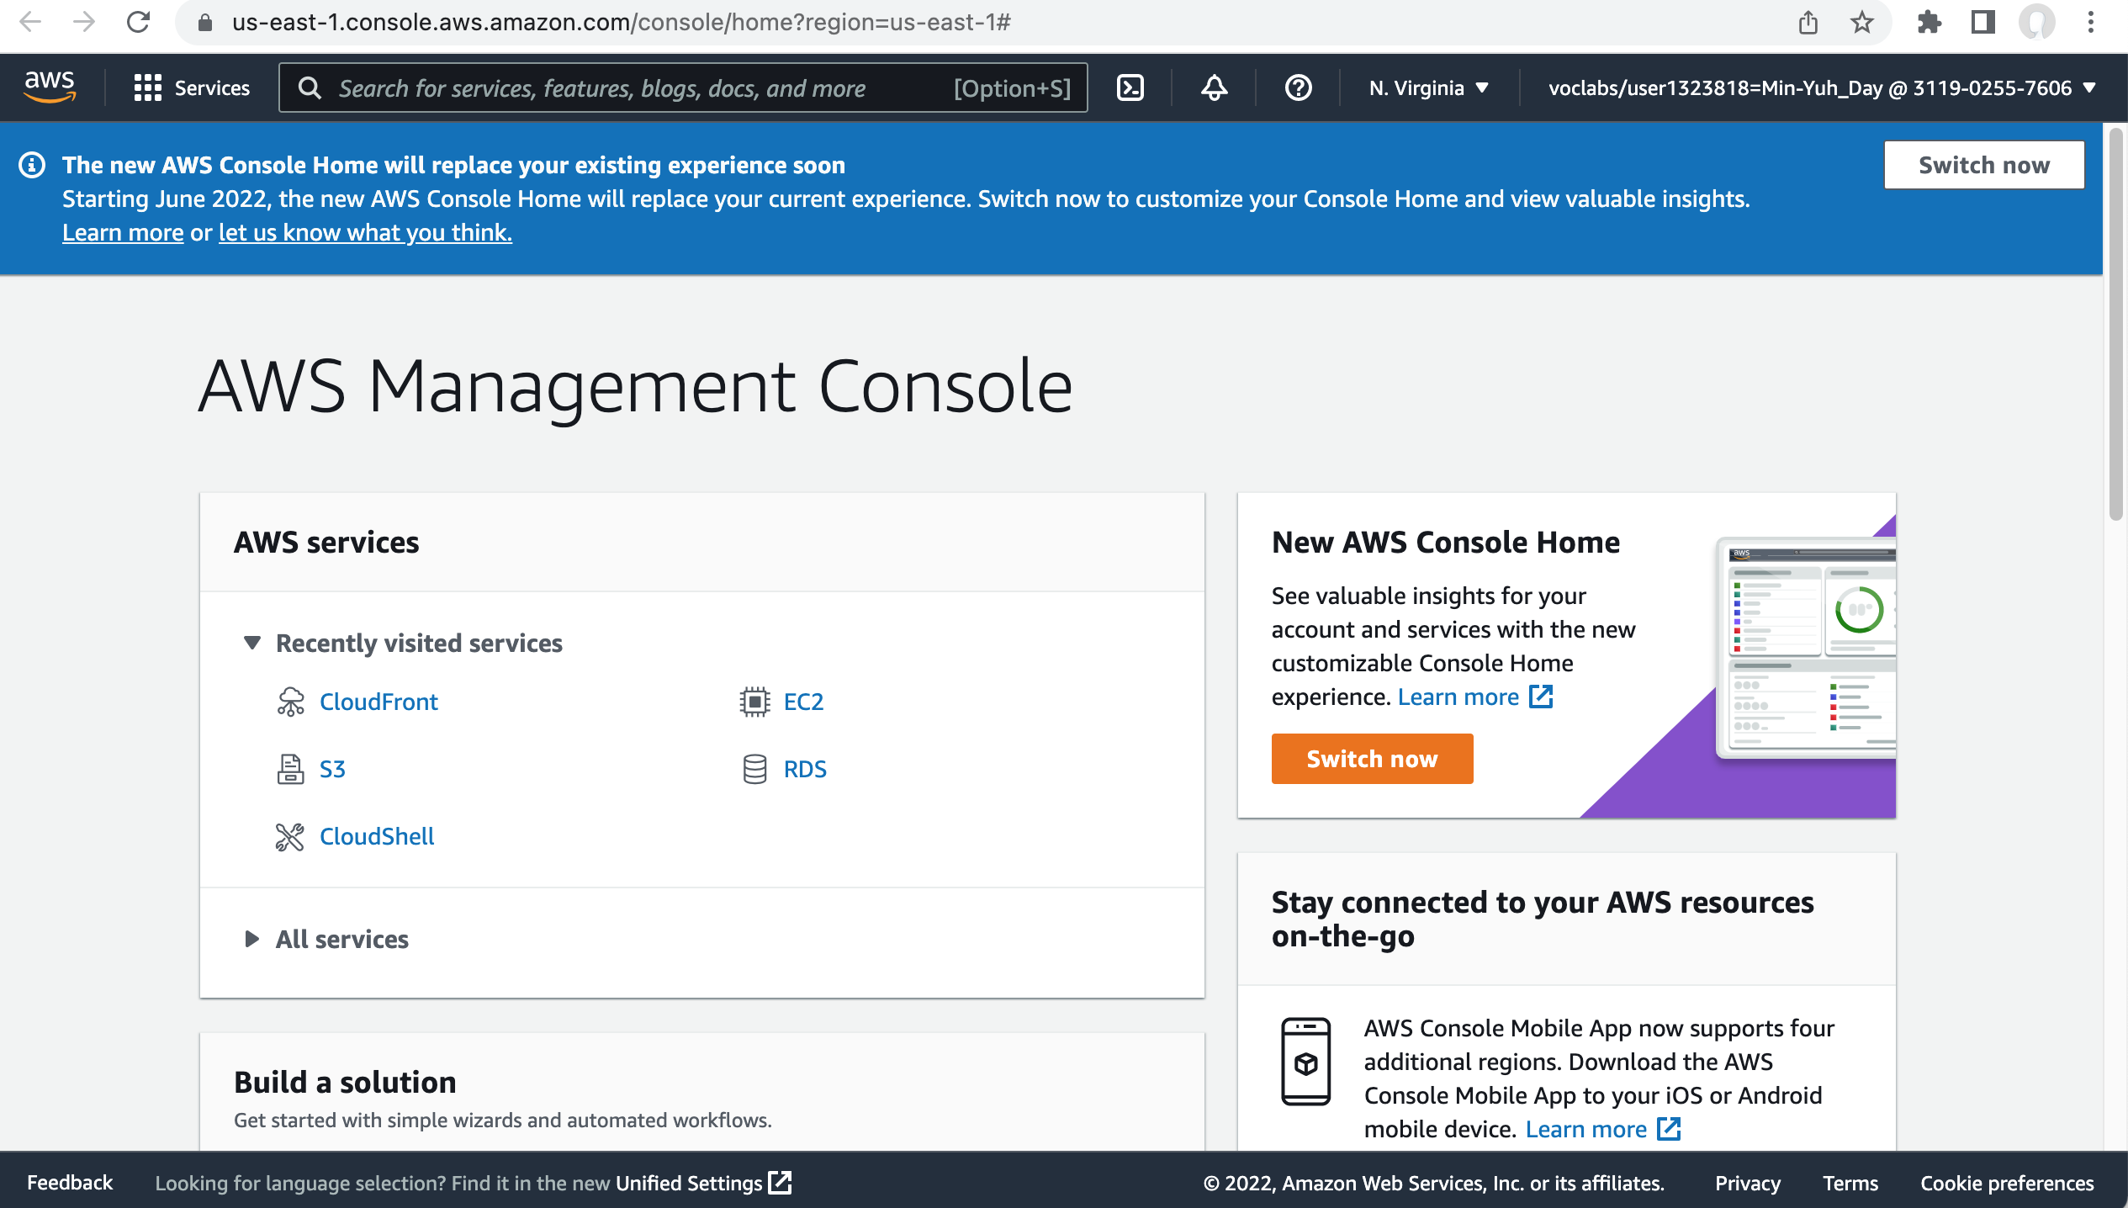
AWS Academy Introduction to Cloud: Semester 1
Module 10 Databases: Lab 10 - RDS
Source: AWS Academy Introduction to Cloud: Semester 1, https://awsacademy.instructure.com/courses/18745

Slide 34
AWS Academy Introduction to Cloud: Semester 1
Module 10 Databases: Lab 10 - RDS
Task 1. Set up an RDS DB instance
Choose the Services menu, locate the Database category, and then choose RDS.
Choose Create database.
In the Choose a database creation method section, choose Easy create.
In the Configuration section, configure:
  For Engine type, choose Microsoft SQL Server.
  For DB instance size, choose Free tier.
  Check the box next to Auto generate a password.
Choose Create database.
Your new database displays in the list of databases. The status is Creating.
In the banner at the top of the page, choose View credential details.
Your login credentials display.
Save the credential information to a text editor to user later in this lab.
To close the pop-up window, choose Close.
Source: AWS Academy Introduction to Cloud: Semester 1, https://awsacademy.instructure.com/courses/18745

Slide 35
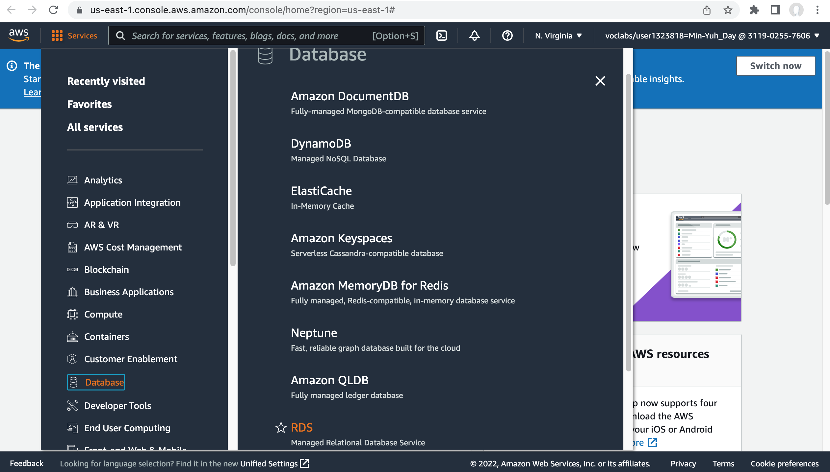
AWS Academy Introduction to Cloud: Semester 1
Module 10 Databases: Lab 10 - RDS
4
Task 1. Set up an RDS DB instance
Choose the Services menu, locate the Database category, and then choose RDS.
Source: AWS Academy Introduction to Cloud: Semester 1, https://awsacademy.instructure.com/courses/18745

Slide 36
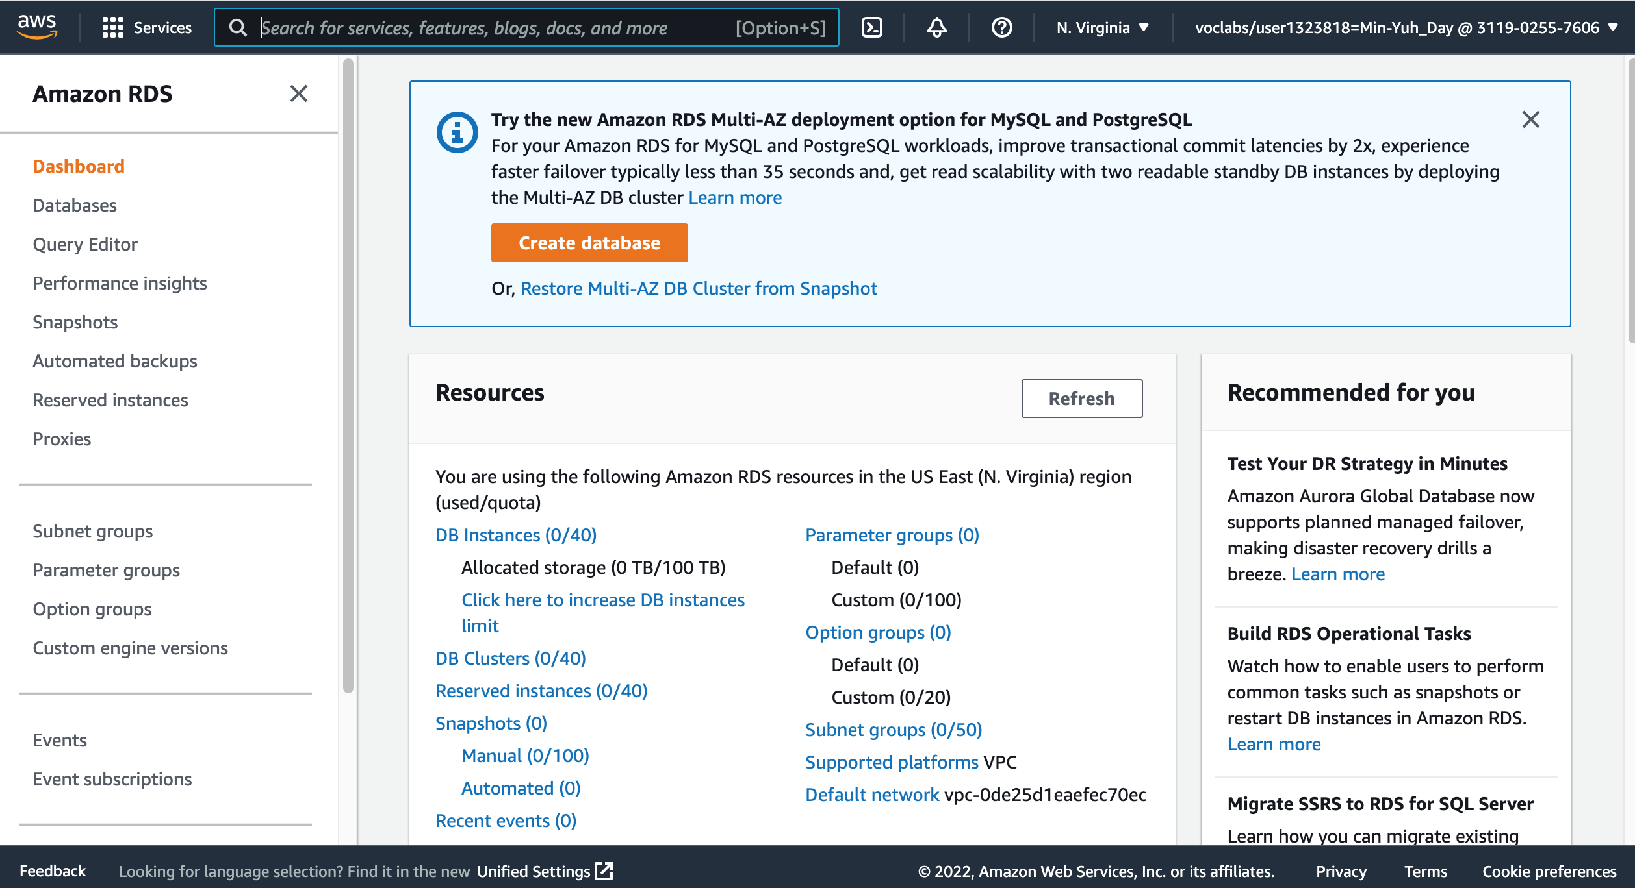
AWS Academy Introduction to Cloud: Semester 1
Module 10 Databases: Lab 10 - RDS
5
5. Choose Create database.
Source: AWS Academy Introduction to Cloud: Semester 1, https://awsacademy.instructure.com/courses/18745

Slide 37
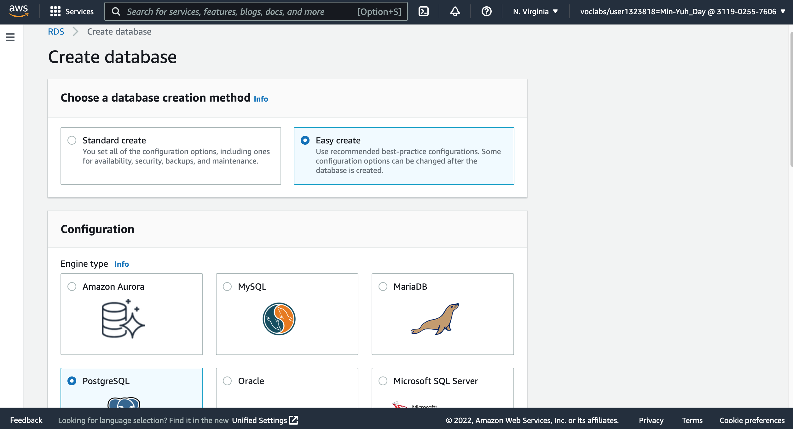
AWS Academy Introduction to Cloud: Semester 1
Module 10 Databases: Lab 10 - RDS
6
6. In the Choose a database creation method section, choose Easy create.
Source: AWS Academy Introduction to Cloud: Semester 1, https://awsacademy.instructure.com/courses/18745

Slide 38
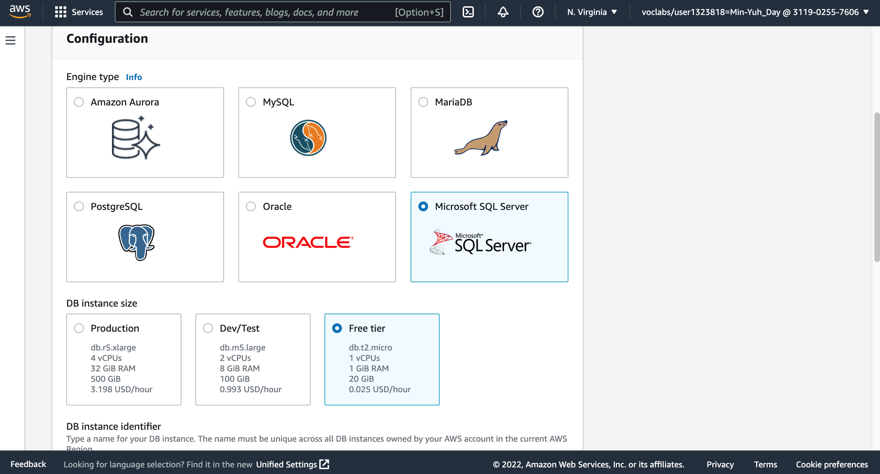
AWS Academy Introduction to Cloud: Semester 1
Module 10 Databases: Lab 10 - RDS
7. In the Configuration section, configure:
  For Engine type, choose Microsoft SQL Server.
  For DB instance size, choose Free tier.
  Check the box next to Auto generate a password.
7
7
Source: AWS Academy Introduction to Cloud: Semester 1, https://awsacademy.instructure.com/courses/18745

Slide 39
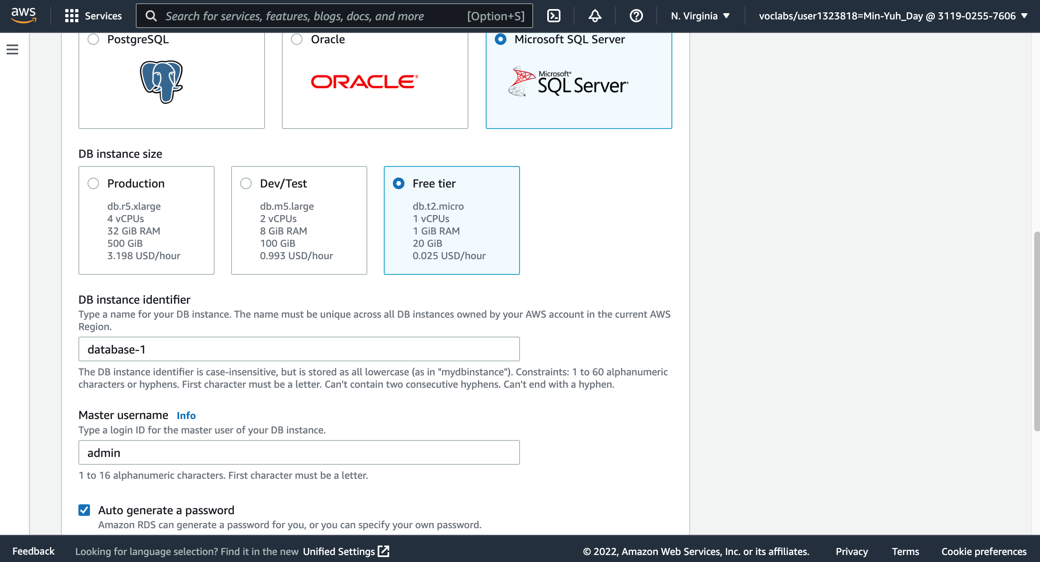
AWS Academy Introduction to Cloud: Semester 1
Module 10 Databases: Lab 10 - RDS
7
7
7. In the Configuration section, configure:
  For Engine type, choose Microsoft SQL Server.
  For DB instance size, choose Free tier.
  Check the box next to Auto generate a password.
7
Source: AWS Academy Introduction to Cloud: Semester 1, https://awsacademy.instructure.com/courses/18745

Slide 40
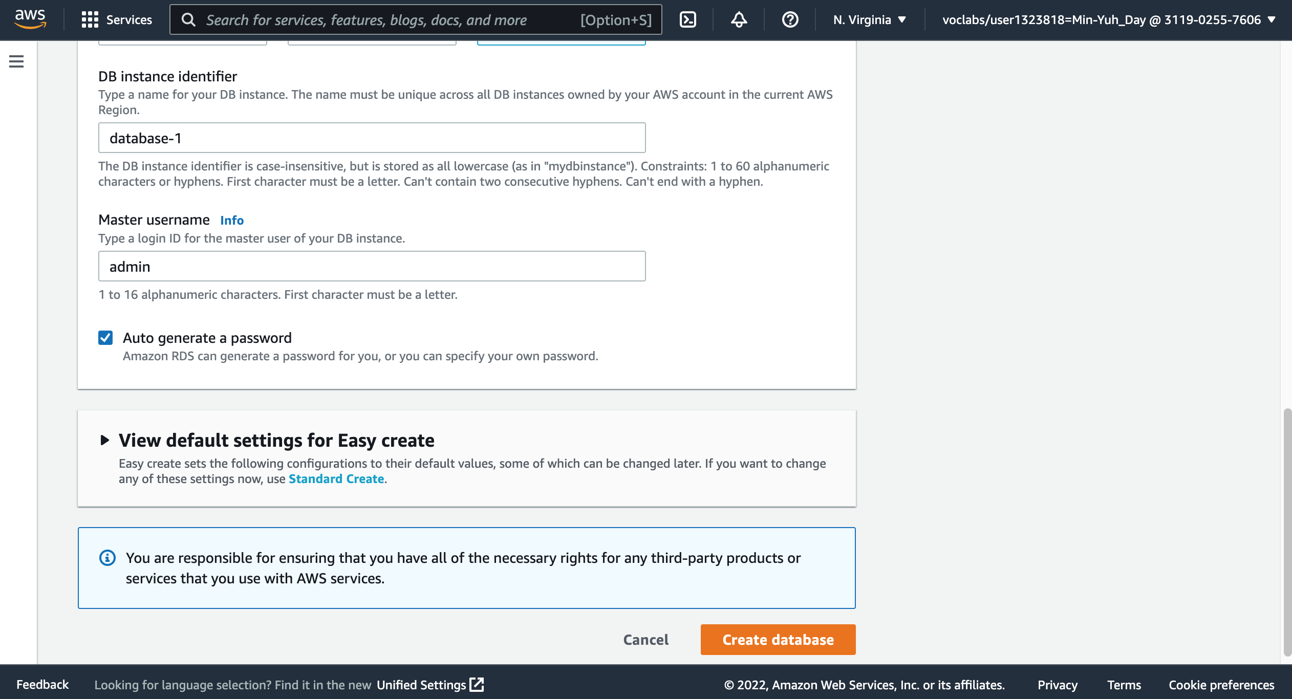
AWS Academy Introduction to Cloud: Semester 1
Module 10 Databases: Lab 10 - RDS
8. Choose Create database.
Your new database displays in the list of databases. The status is Creating.
8
Source: AWS Academy Introduction to Cloud: Semester 1, https://awsacademy.instructure.com/courses/18745

Slide 41
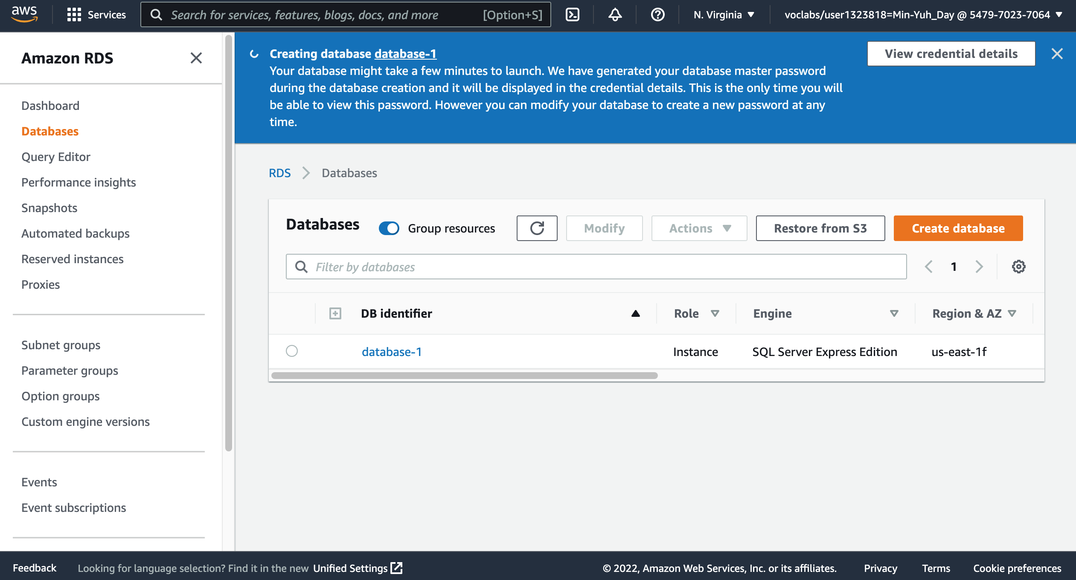
AWS Academy Introduction to Cloud: Semester 1
Module 10 Databases: Lab 10 - RDS
9
In the banner at the top of the page, choose View credential details.
Your login credentials display.
Source: AWS Academy Introduction to Cloud: Semester 1, https://awsacademy.instructure.com/courses/18745

Slide 42
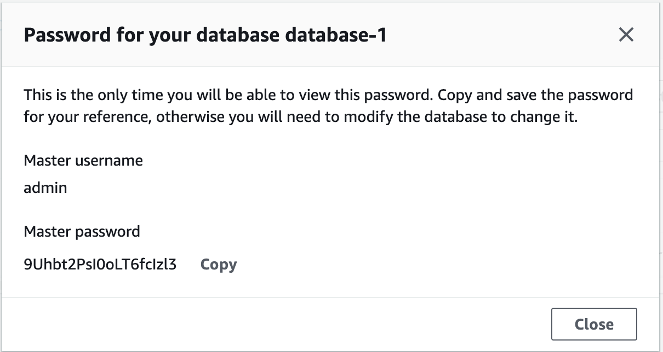
AWS Academy Introduction to Cloud: Semester 1
Module 10 Databases: Lab 10 - RDS
9
In the banner at the top of the page, choose View credential details.
Your login credentials display.
Source: AWS Academy Introduction to Cloud: Semester 1, https://awsacademy.instructure.com/courses/18745

Slide 43
AWS Academy Introduction to Cloud: Semester 1
Module 10 Databases: Lab 10 - RDS
Password for your database database-1
This is the only time you will be able to view this password. Copy and save the password for your reference, otherwise you will need to modify the database to change it.
Master username
admin
Master password 9Uhbt2PsI0oLT6fcIzl3
10
admin
9Uhbt2PsI0oLT6fcIzl3
11
Save the credential information to a text editor to user later in this lab.
11. To close the pop-up window, choose Close.
Source: AWS Academy Introduction to Cloud: Semester 1, https://awsacademy.instructure.com/courses/18745

Slide 44
AWS Academy Introduction to Cloud: Semester 1
Module 10 Databases: Lab 10 - RDS
12
13
14
Task 2. Download and install SQL Server Management Studio
To connect to your RDS DB instance, you will need to download and install SQL Server Management Studio.
In a new browser tab or window, go to https://aka.ms/ssmsfullsetup.
Download the installation package to your computer.
When the download completes, open and run the installation program.
Note: If you are unable to install new software on your local machine, follow the instructions to use the Amazon Elastic Compute Cloud (Amazon EC2) instance that was launched in this lab environment.
Source: AWS Academy Introduction to Cloud: Semester 1, https://awsacademy.instructure.com/courses/18745

Slide 45
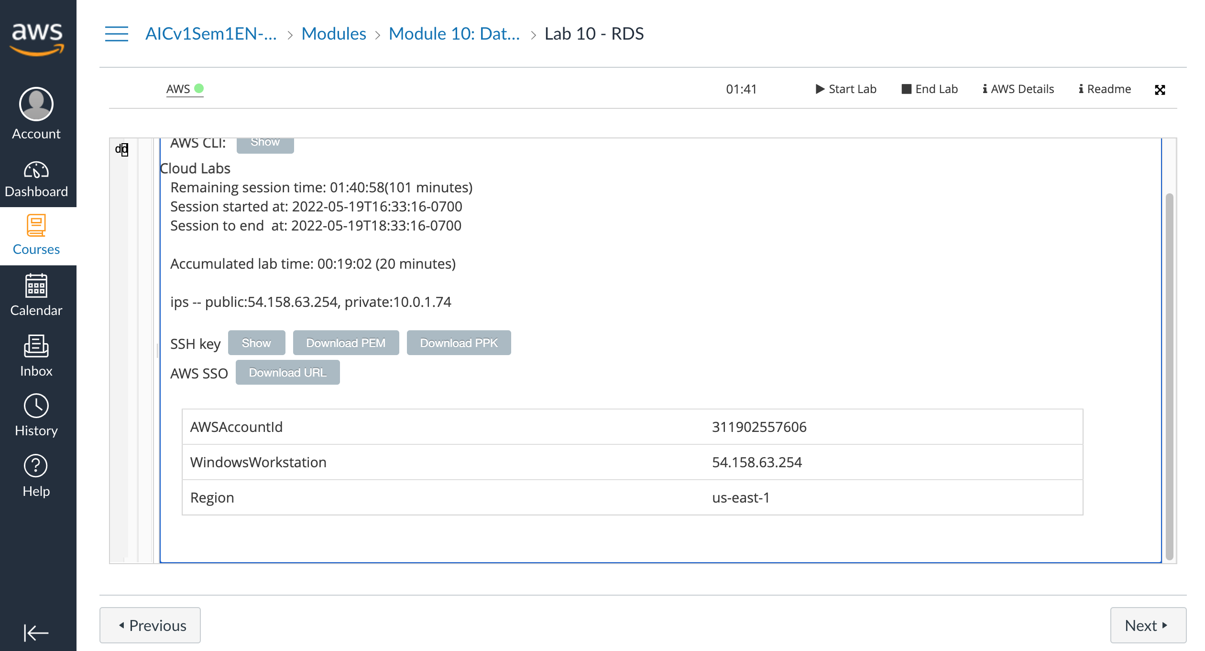
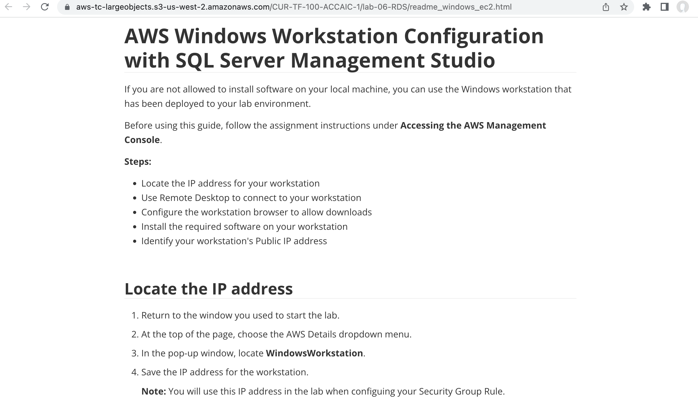
AWS Academy Introduction to Cloud: Semester 1
Module 10 Databases: Lab 10 - RDS
AWSAccountId 311902557606
WindowsWorkstation 54.158.63.254
Region us-east-1
Source: AWS Academy Introduction to Cloud: Semester 1, https://awsacademy.instructure.com/courses/18745

Slide 46
AWS Academy Introduction to Cloud: Semester 1
Module 10 Databases: Lab 10 - RDS
https://aws-tc-largeobjects.s3-us-west-2.amazonaws.com/CUR-TF-100-ACCAIC-1/lab-06-RDS/readme_windows_ec2.html
Source: AWS Academy Introduction to Cloud: Semester 1, https://awsacademy.instructure.com/courses/18745

Slide 47
AWS Academy Introduction to Cloud: Semester 1
Module 10 Databases: Lab 10 - RDS
AWS Windows Workstation Configuration with
SQL Server Management Studio (SSMS)
If you are not allowed to install software on your local machine, you can use the Windows workstation that has been deployed to your lab environment.
Before using this guide, follow the assignment instructions under Accessing the AWS Management Console.
Steps:
Locate the IP address for your workstation
Use Remote Desktop to connect to your workstation
Configure the workstation browser to allow downloads
Install the required software on your workstation
Identify your workstation's Public IP address
Source: AWS Academy Introduction to Cloud: Semester 1, https://awsacademy.instructure.com/courses/18745

Slide 48
AWS Windows Workstation Configuration with SQL Server Management Studio (SSMS)
Step 1. Locate the IP address
Step 2. Connect to the workstation
Step 3. Configure the browser
Step 4. Download SQL Server Management Studio
Step 5. Install the software
Step 6. Return to the instructions for the lab assignment.

Slide 49
AWS Academy Introduction to Cloud: Semester 1
Module 10 Databases: Lab 10 - RDS
Locate the IP address
Return to the window you used to start the lab.
At the top of the page, choose the AWS Details dropdown menu.
In the pop-up window, locate WindowsWorkstation.
Save the IP address for the workstation.
  Note: You will use this IP address in the lab when configuring your Security Group Rule.
Source: AWS Academy Introduction to Cloud: Semester 1, https://awsacademy.instructure.com/courses/18745

Slide 50
AWS Academy Introduction to Cloud: Semester 1
Module 10 Databases: Lab 10 - RDS
1
2
Locate the IP address
Return to the window you used to start the lab.
At the top of the page, choose the AWS Details dropdown menu.
Source: AWS Academy Introduction to Cloud: Semester 1, https://awsacademy.instructure.com/courses/18745

Slide 51
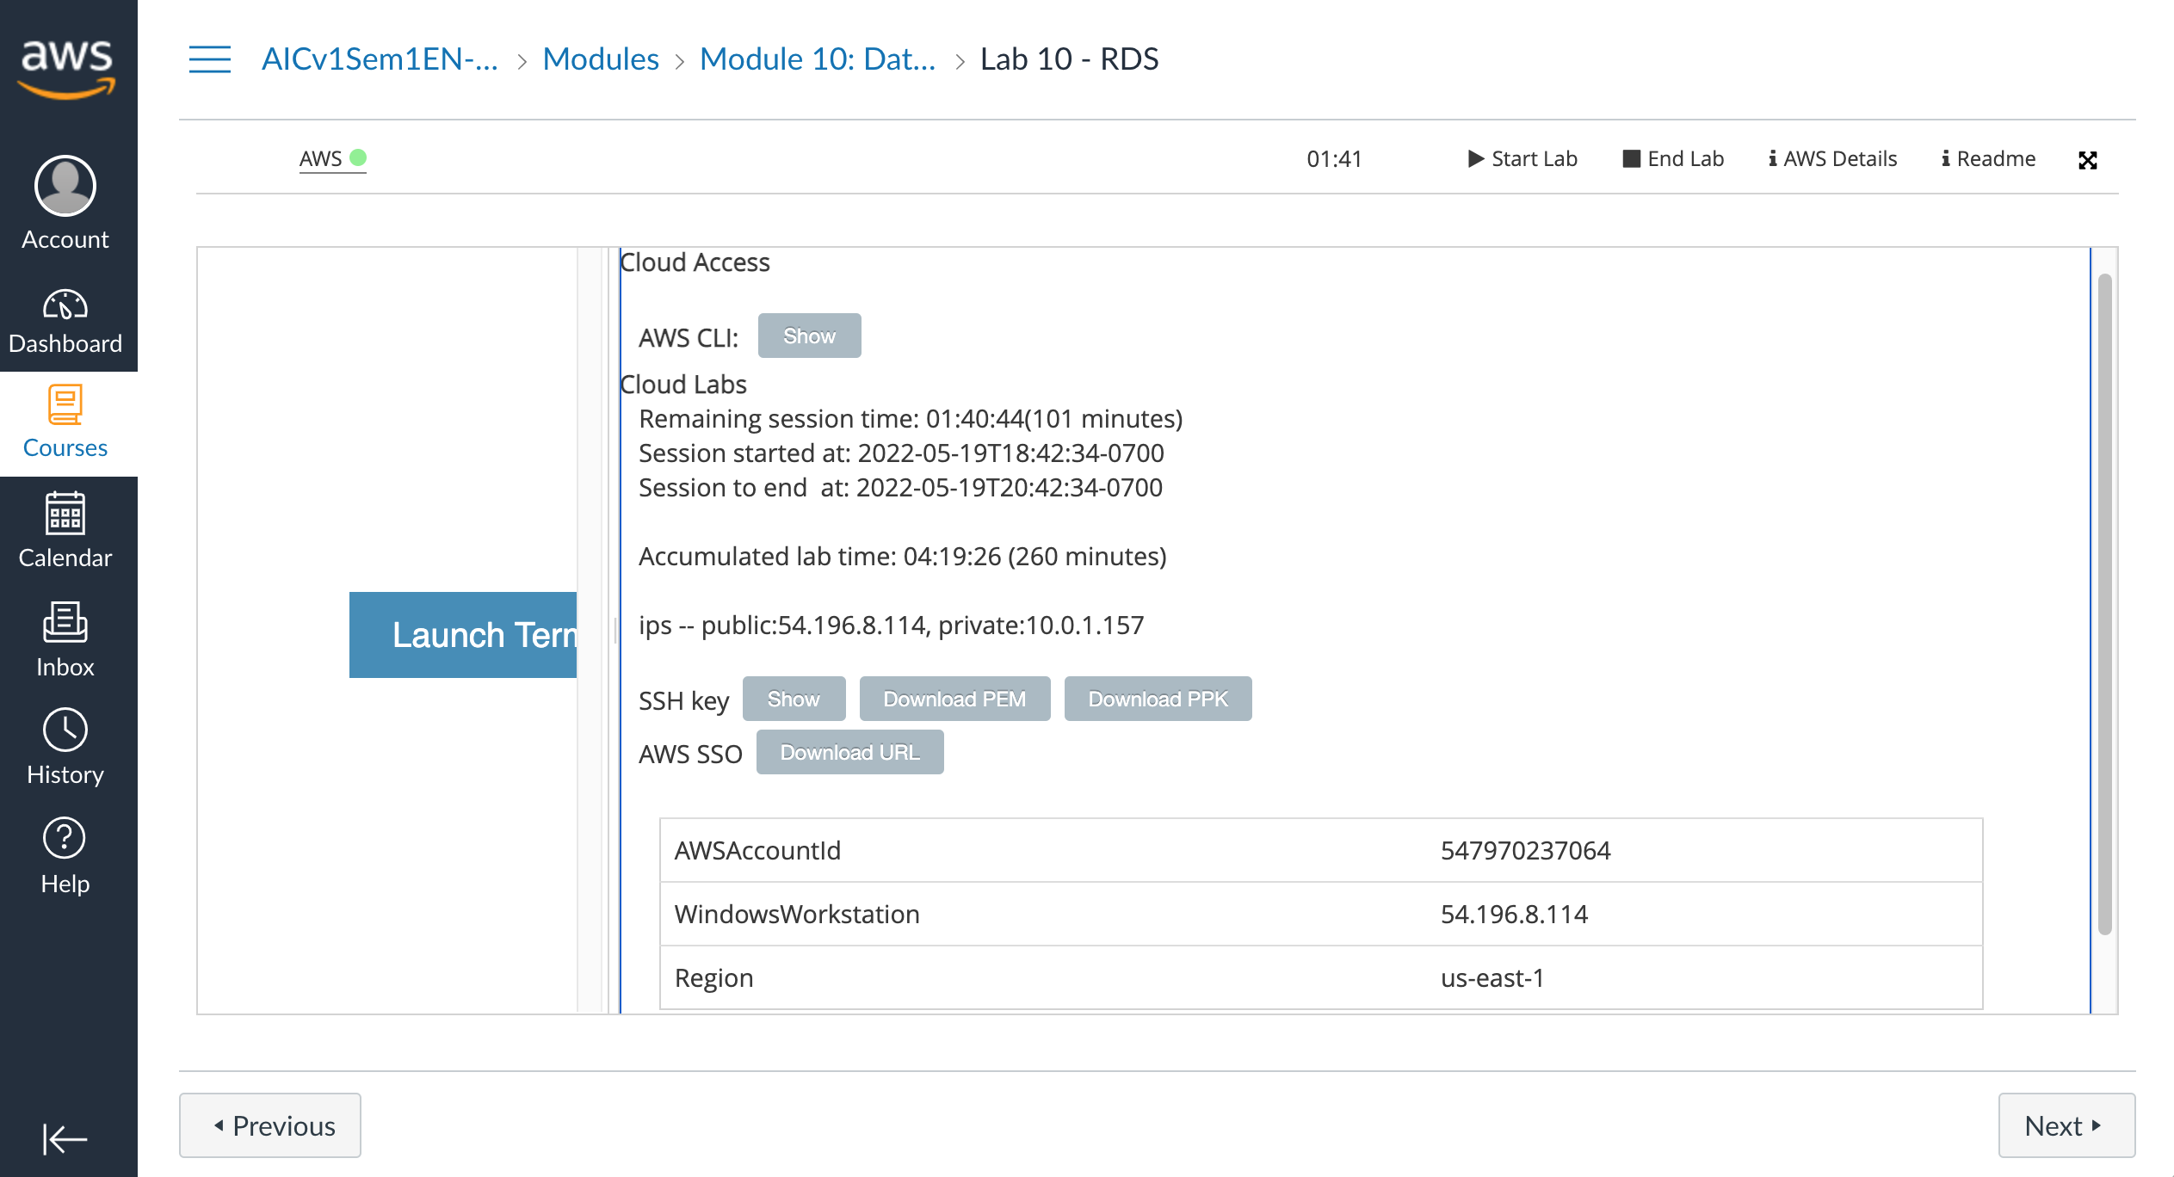
AWS Academy Introduction to Cloud: Semester 1
Module 10 Databases: Lab 10 - RDS
3. In the pop-up window, locate WindowsWorkstation.
4. Save the IP address for the workstation.
  Note: You will use this IP address in the lab when configuring your Security Group Rule.
AWSAccountId | 547970237064
WindowsWorkstation | 54.196.8.114
Region | us-east-1
3
4
Source: AWS Academy Introduction to Cloud: Semester 1, https://awsacademy.instructure.com/courses/18745

Slide 52
AWS Academy Introduction to Cloud: Semester 1
Module 10 Databases: Lab 10 - RDS
Connect to the workstation
Depending on your Operating System, you will start one of the following applications:
Operating System | Application
Windows | Remote Desktop Connection
Chrome | Chrome Remote Desktop
Mac | Microsoft Remote Desktop
Source: AWS Academy Introduction to Cloud: Semester 1, https://awsacademy.instructure.com/courses/18745

Slide 53
AWS Academy Introduction to Cloud: Semester 1
Module 10 Databases: Lab 10 - RDS
Start the remote desktop application.
Use the plus symbol to add a new connection.
  Note: Do not choose the Workspace option.
When prompted, enter the WindowsWorkstation IP address, and choose Add.
Doubleclick on the connection you just created.
When prompted, enter the following values:
  Username: Administrator
  Password: Welcome1
Choose Continue.
Source: AWS Academy Introduction to Cloud: Semester 1, https://awsacademy.instructure.com/courses/18745

Slide 54
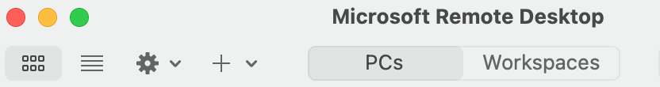
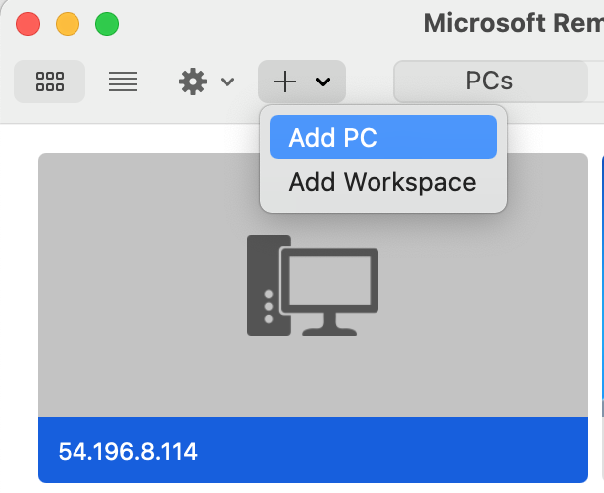
AWS Academy Introduction to Cloud: Semester 1
Module 10 Databases: Lab 10 - RDS
5
6
Start the remote desktop application.
Use the plus symbol to add a new connection.
  Note: Do not choose the Workspace option.
Source: AWS Academy Introduction to Cloud: Semester 1, https://awsacademy.instructure.com/courses/18745

Slide 55
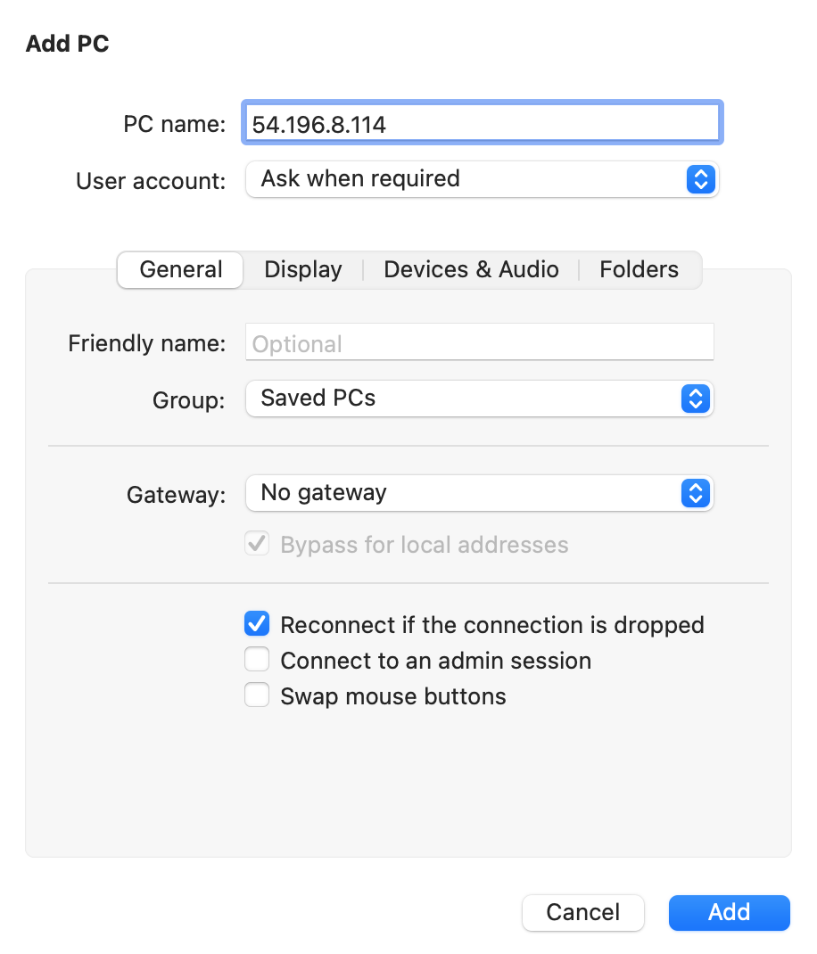
AWS Academy Introduction to Cloud: Semester 1
Module 10 Databases: Lab 10 - RDS
7
7
7. When prompted, enter the WindowsWorkstation IP address, and choose Add.
AWSAccountId | 547970237064
WindowsWorkstation | 54.196.8.114
Region | us-east-1
7
Source: AWS Academy Introduction to Cloud: Semester 1, https://awsacademy.instructure.com/courses/18745

Slide 56
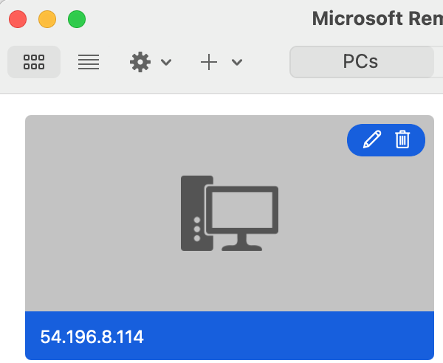
AWS Academy Introduction to Cloud: Semester 1
Module 10 Databases: Lab 10 - RDS
8. Doubleclick on the connection you just created.
8
Source: AWS Academy Introduction to Cloud: Semester 1, https://awsacademy.instructure.com/courses/18745

Slide 57
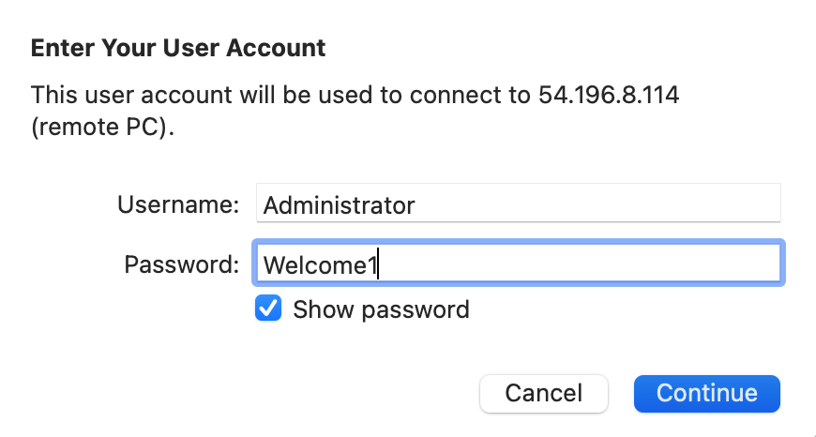
AWS Academy Introduction to Cloud: Semester 1
Module 10 Databases: Lab 10 - RDS
9
10
9. When prompted, enter the following values:
  Username: Administrator
  Password: Welcome1
10. Choose Continue.
Source: AWS Academy Introduction to Cloud: Semester 1, https://awsacademy.instructure.com/courses/18745

Slide 58
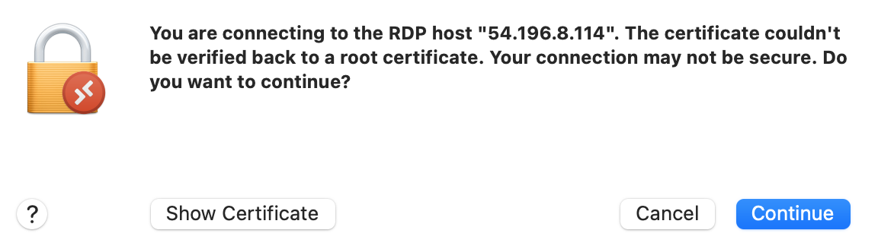
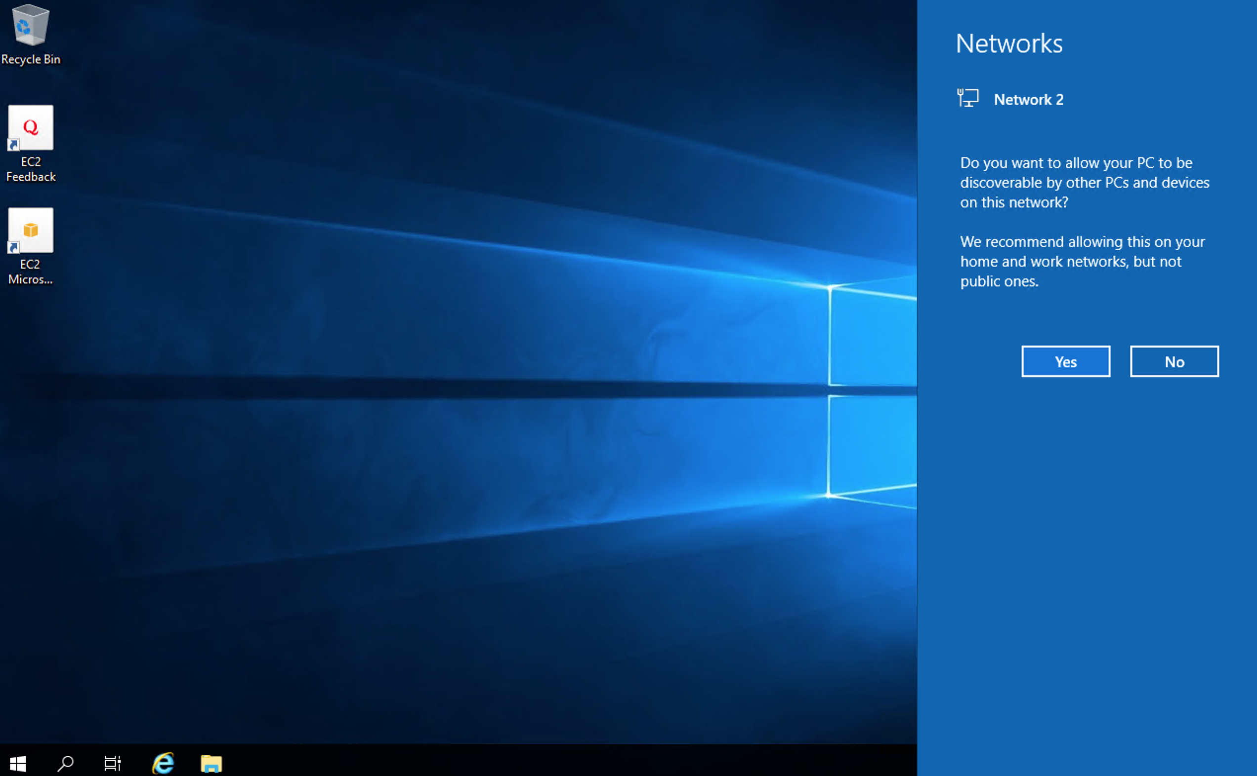
AWS Academy Introduction to Cloud: Semester 1
Module 10 Databases: Lab 10 - RDS
10
Source: AWS Academy Introduction to Cloud: Semester 1, https://awsacademy.instructure.com/courses/18745

Slide 59
AWS Academy Introduction to Cloud: Semester 1
Module 10 Databases: Lab 10 - RDS
Configure the browser
From the task bar at the bottom of the screen, open Internet Explorer (ie).
In the Setup Internet Explorer pop-up window, choose OK.
In the top right corner of the ie window, choose the small gear-shaped icon.
From the drop down menu, select Internet Options.
Select the Security tab.
In the box labeled "Select a zone to view or change security settings", select Trusted Sites .
Choose the Sites button.
In the text box labeled, "Add this website to the zone", enter https://*.microsoft.com.
Choose Add.
In the same text box, enter https://*.azure.com.
Choose Add.
Choose Close
Choose Ok.
Source: AWS Academy Introduction to Cloud: Semester 1, https://awsacademy.instructure.com/courses/18745

Slide 60
AWS Academy Introduction to Cloud: Semester 1
Module 10 Databases: Lab 10 - RDS
From the task bar at the bottom of the screen, open Internet Explorer (ie).
11
Source: AWS Academy Introduction to Cloud: Semester 1, https://awsacademy.instructure.com/courses/18745

Slide 61
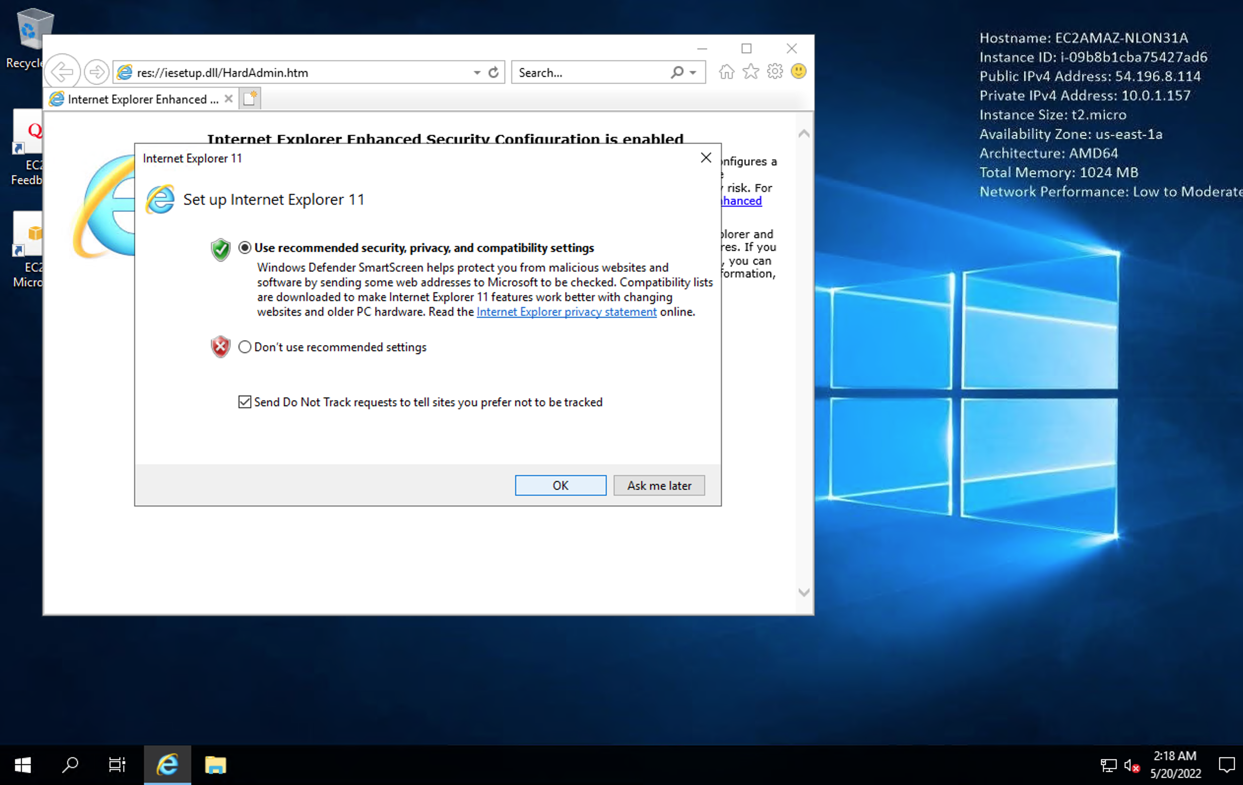
AWS Academy Introduction to Cloud: Semester 1
Module 10 Databases: Lab 10 - RDS
12
12. In the Setup Internet Explorer pop-up window, choose OK.
Source: AWS Academy Introduction to Cloud: Semester 1, https://awsacademy.instructure.com/courses/18745

Slide 62
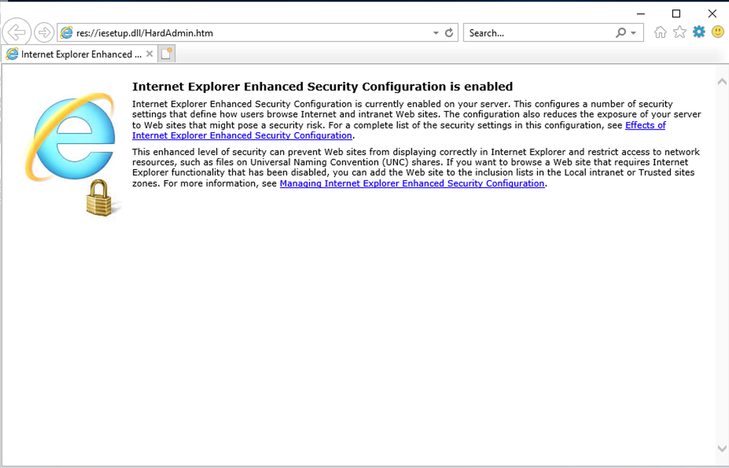
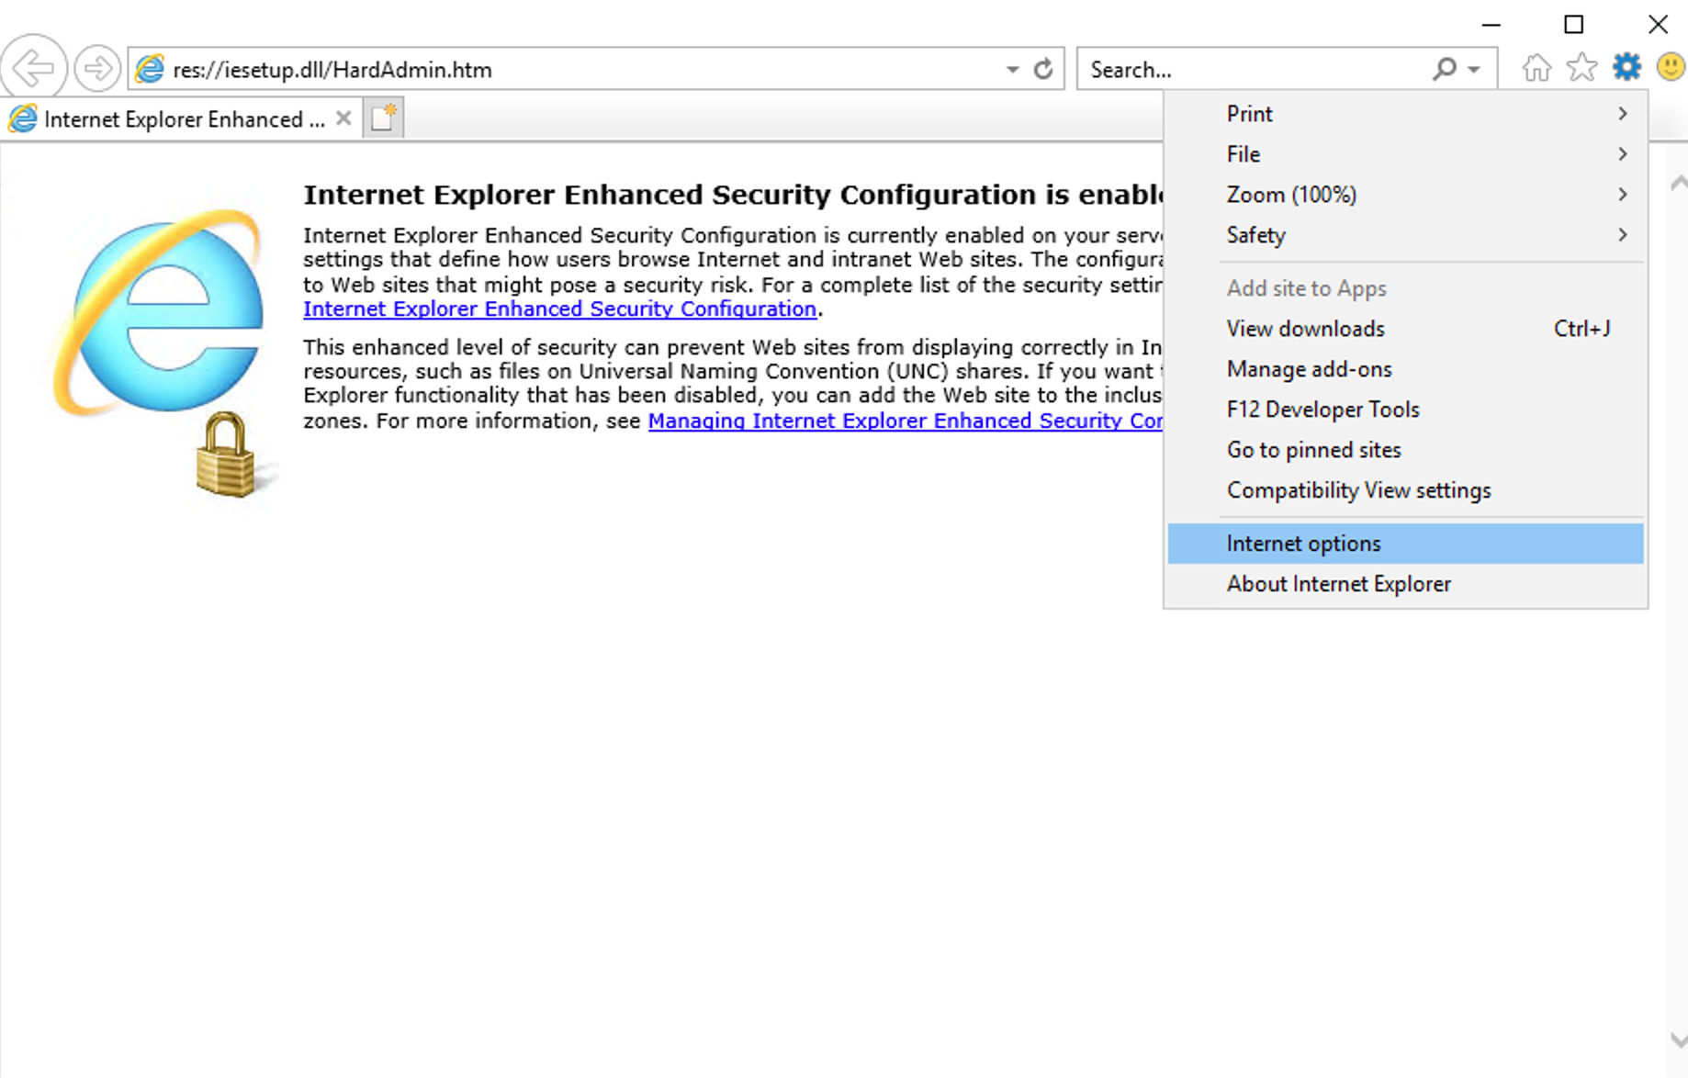
AWS Academy Introduction to Cloud: Semester 1
Module 10 Databases: Lab 10 - RDS
13
14
13. In the top right corner of the ie window, choose the small gear-shaped icon.
14. From the drop down menu, select Internet Options.
Source: AWS Academy Introduction to Cloud: Semester 1, https://awsacademy.instructure.com/courses/18745

Slide 63
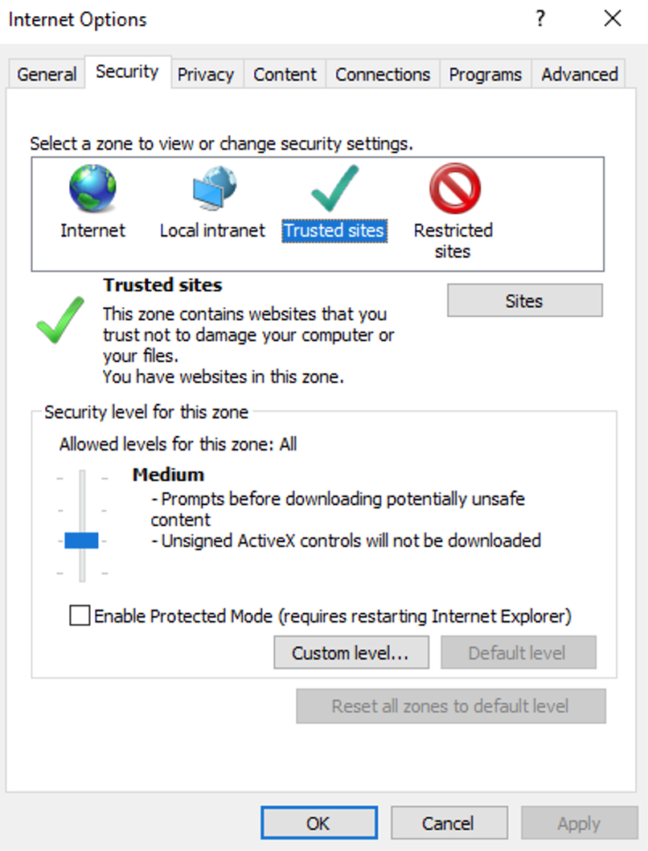
AWS Academy Introduction to Cloud: Semester 1
Module 10 Databases: Lab 10 - RDS
15
15. Select the Security tab.
16. In the box labeled "Select a zone to view or change security settings", select Trusted Sites .
17. Choose the Sites button.
16
17
Source: AWS Academy Introduction to Cloud: Semester 1, https://awsacademy.instructure.com/courses/18745

Slide 64
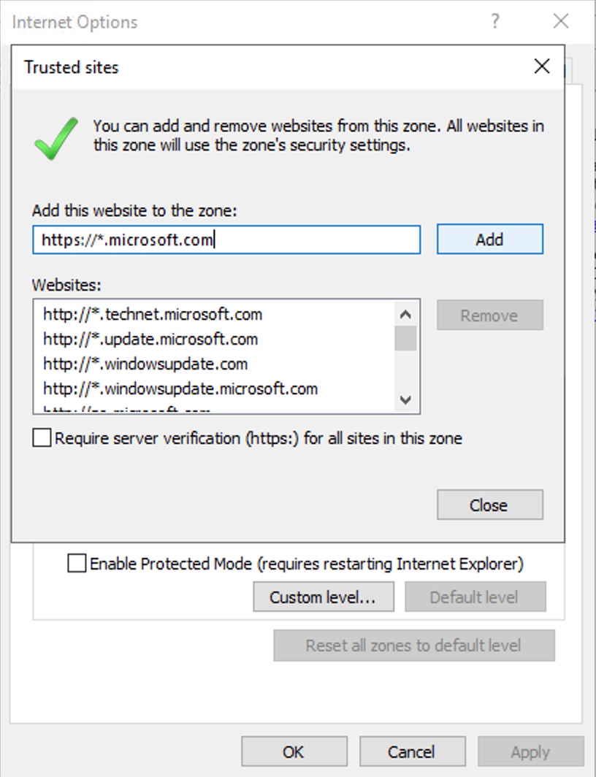
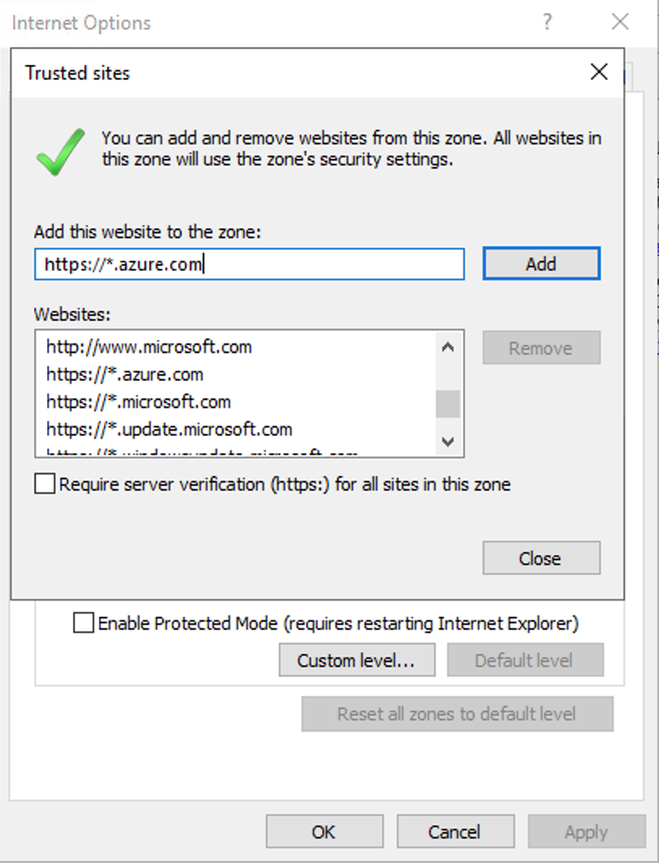
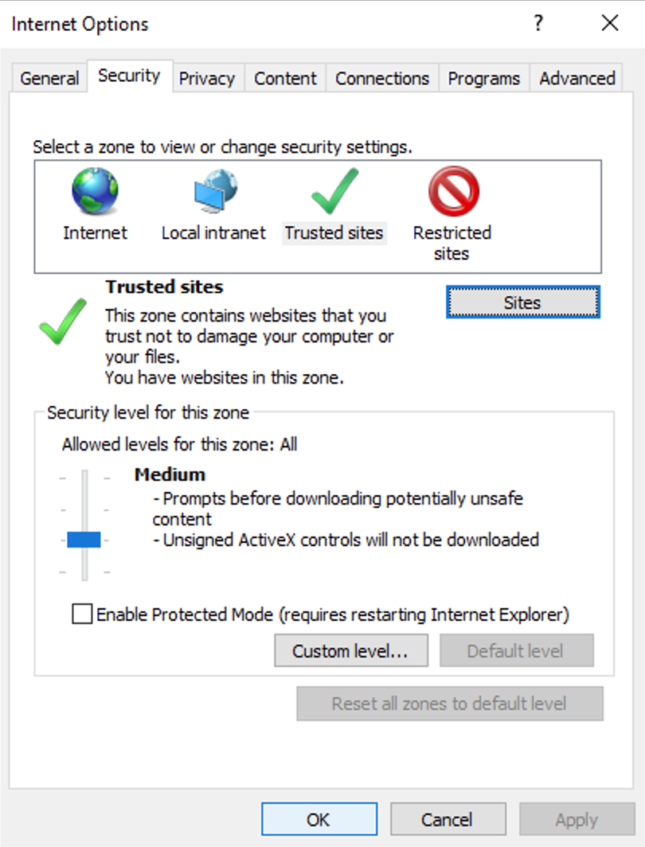
AWS Academy Introduction to Cloud: Semester 1
Module 10 Databases: Lab 10 - RDS
18
19
20
21
22
18. In the text box labeled, "Add this website to the zone", enter https://*.microsoft.com.
19. Choose Add.
20. In the same text box, enter https://*.azure.com.
21. Choose Add.
22. Choose Close
23
23. Choose Ok.
Source: AWS Academy Introduction to Cloud: Semester 1, https://awsacademy.instructure.com/courses/18745

Slide 65
AWS Academy Introduction to Cloud: Semester 1
Module 10 Databases: Lab 10 - RDS
Download SQL Server Management Studio
In the ie window, enter the following URL: https://aka.ms/ssmsfullsetup and press enter.
If you are prompted with pop-up windows, choose accept and close the windows.
You will see a warning at the bottom of the browser window similar to - This type of file could harm your computer. Choose Save to download the file.
Source: AWS Academy Introduction to Cloud: Semester 1, https://awsacademy.instructure.com/courses/18745

Slide 66
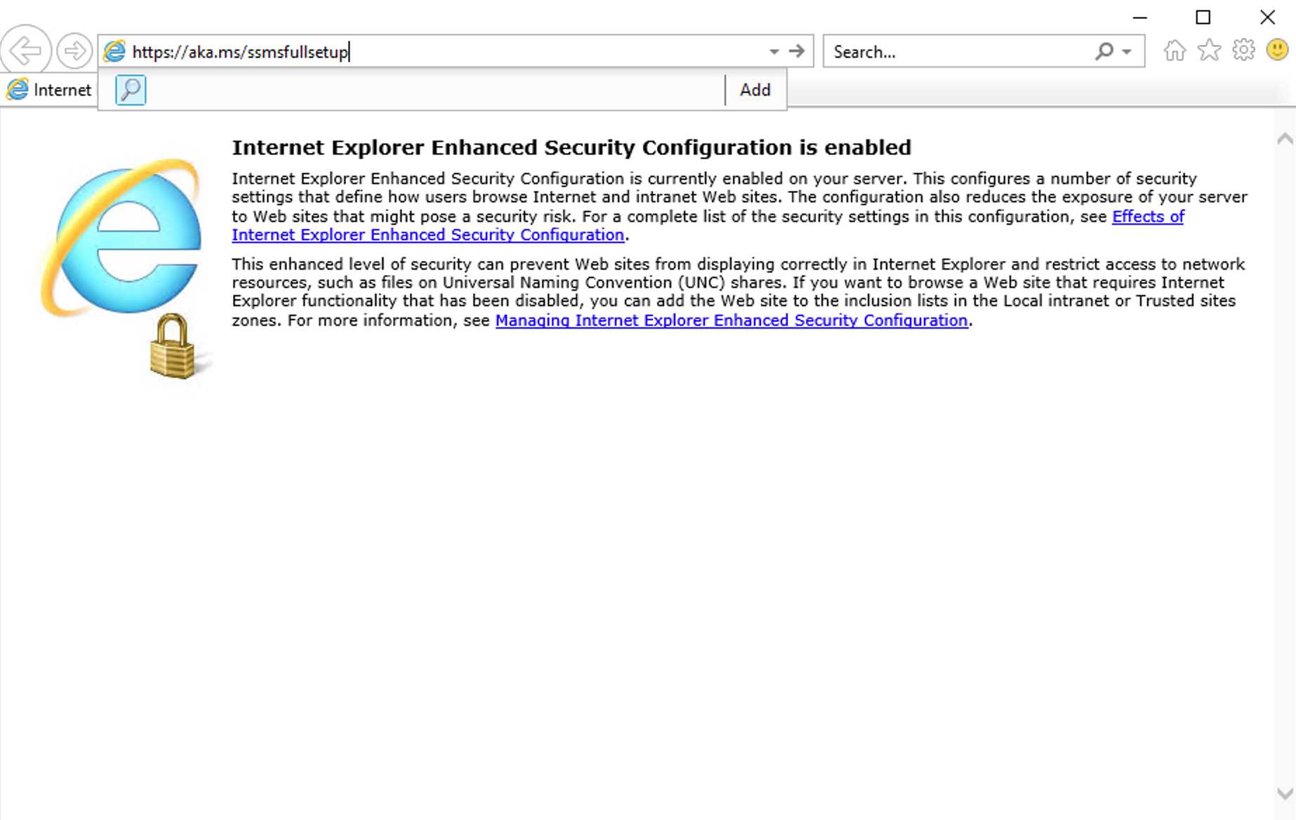
AWS Academy Introduction to Cloud: Semester 1
Module 10 Databases: Lab 10 - RDS
24
https://aka.ms/ssmsfullsetup
Download SQL Server Management Studio
In the ie window, enter the following URL: https://aka.ms/ssmsfullsetup and press enter.
Source: AWS Academy Introduction to Cloud: Semester 1, https://awsacademy.instructure.com/courses/18745

Slide 67
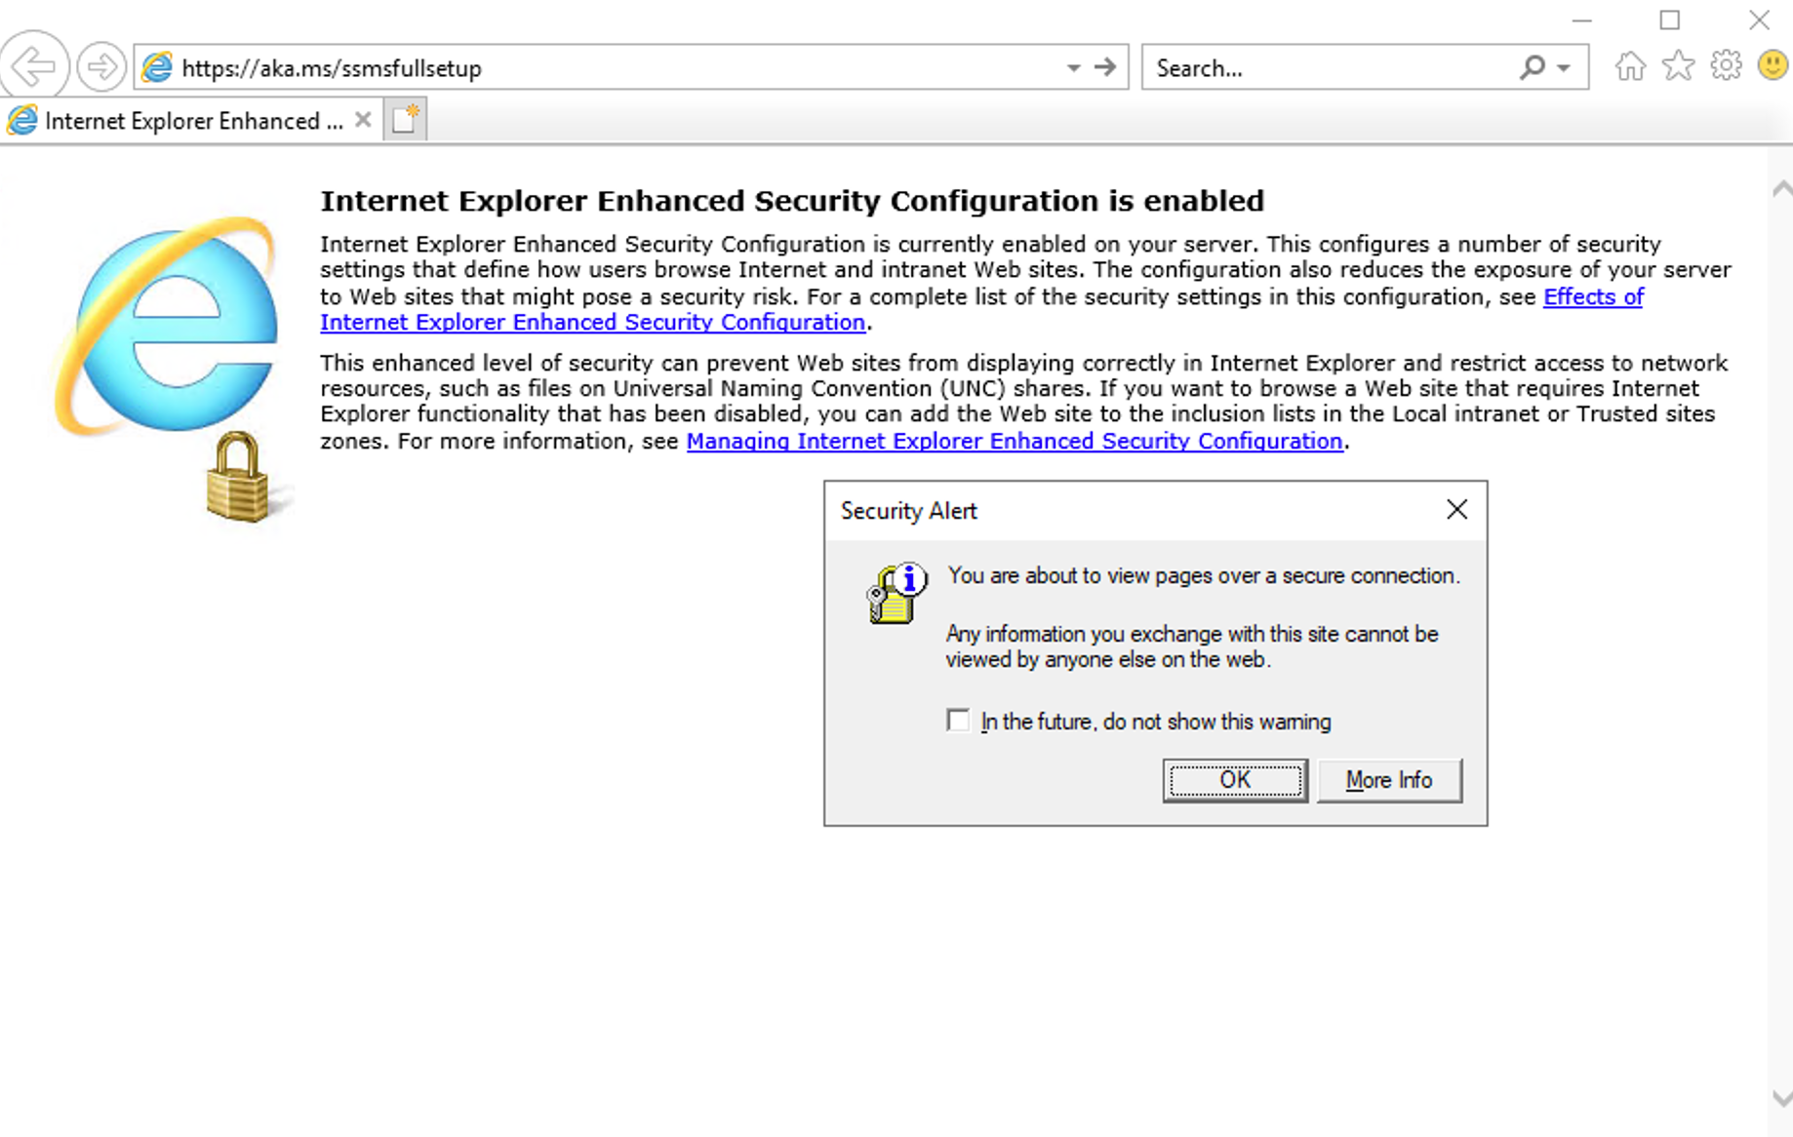
AWS Academy Introduction to Cloud: Semester 1
Module 10 Databases: Lab 10 - RDS
25
25. If you are prompted with pop-up windows, choose accept and close the windows.
26. You will see a warning at the bottom of the browser window similar to - This type of file could harm your computer. Choose Save to download the file.
Source: AWS Academy Introduction to Cloud: Semester 1, https://awsacademy.instructure.com/courses/18745

Slide 68
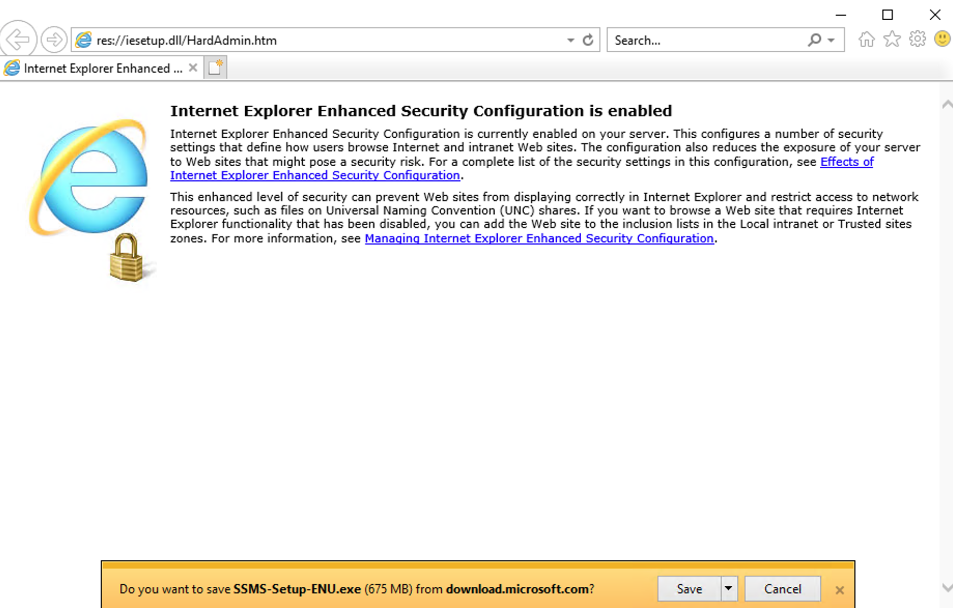
AWS Academy Introduction to Cloud: Semester 1
Module 10 Databases: Lab 10 - RDS
26. You will see a warning at the bottom of the browser window similar to - This type of file could harm your computer. Choose Save to download the file.
26
Source: AWS Academy Introduction to Cloud: Semester 1, https://awsacademy.instructure.com/courses/18745

Slide 69
AWS Academy Introduction to Cloud: Semester 1
Module 10 Databases: Lab 10 - RDS
Install the software
Once you receive the message confirming that the download has completed, choose the Run button.
You will be promted to Click "install" to begin. Choose the Install button.
Once the installation has completed, choose Close.
Source: AWS Academy Introduction to Cloud: Semester 1, https://awsacademy.instructure.com/courses/18745

Slide 70
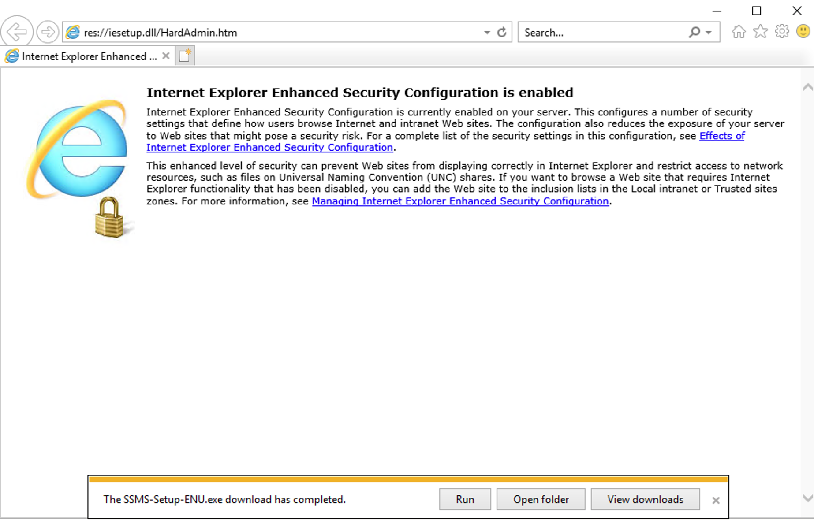
AWS Academy Introduction to Cloud: Semester 1
Module 10 Databases: Lab 10 - RDS
Install the software
Once you receive the message confirming that the download has completed, choose the Run button.
27
Source: AWS Academy Introduction to Cloud: Semester 1, https://awsacademy.instructure.com/courses/18745

Slide 71
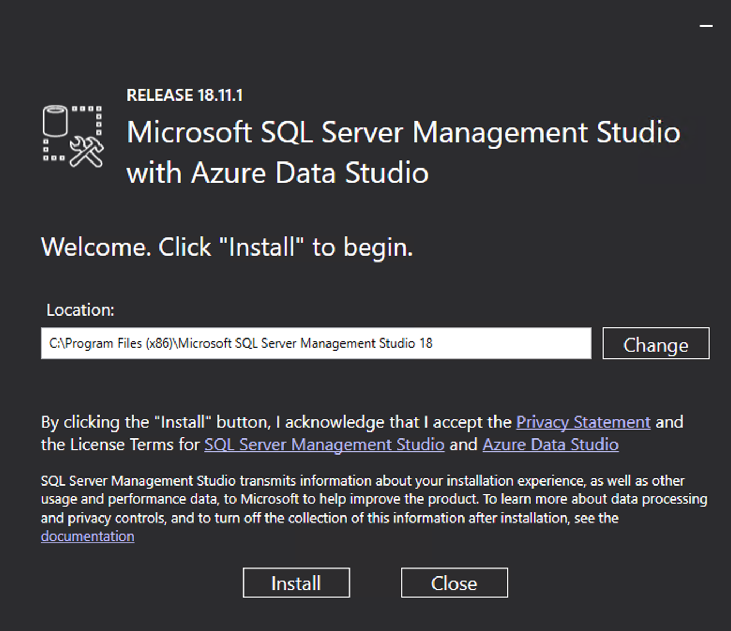
AWS Academy Introduction to Cloud: Semester 1
Module 10 Databases: Lab 10 - RDS
28. You will be promted to Click "install" to begin. Choose the Install button.
28
Source: AWS Academy Introduction to Cloud: Semester 1, https://awsacademy.instructure.com/courses/18745

Slide 72
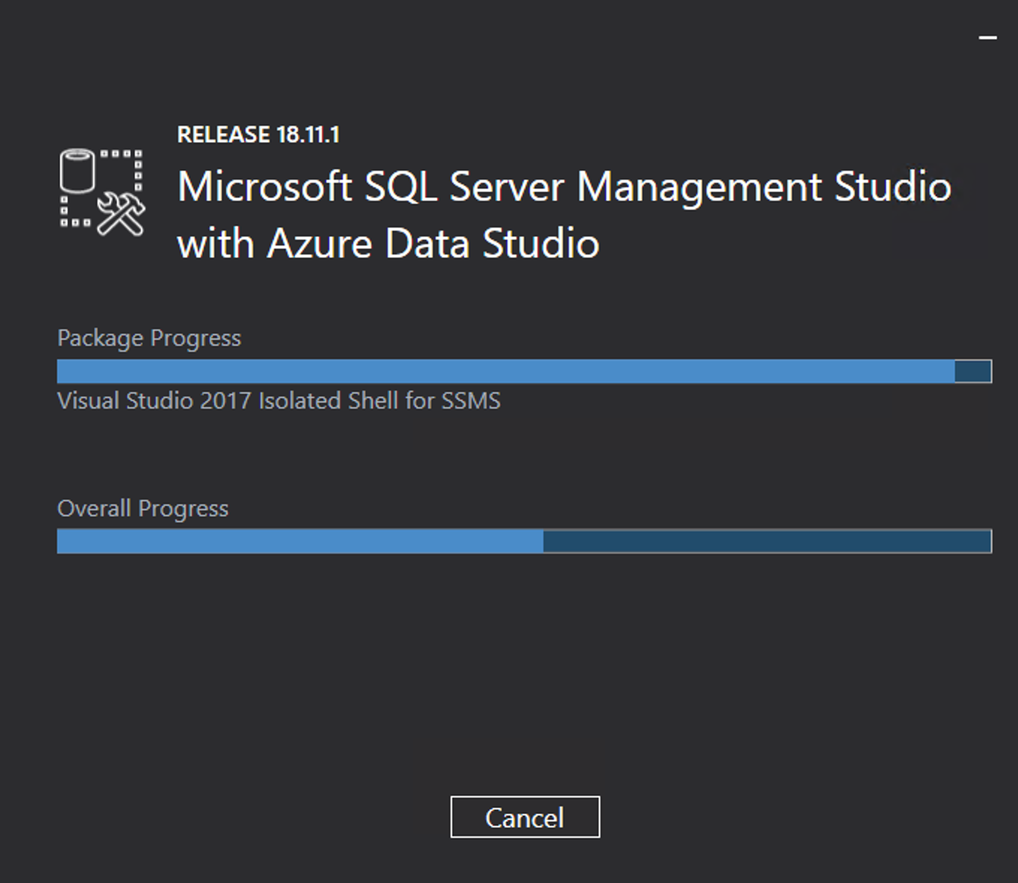
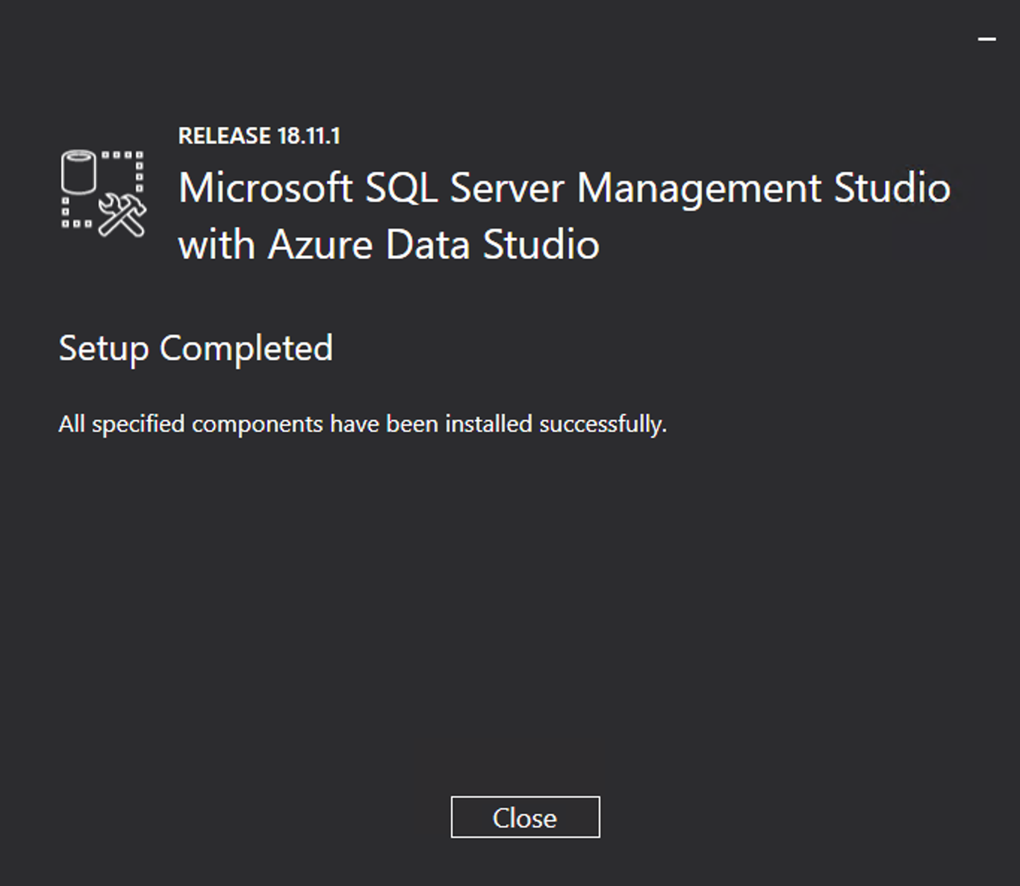
AWS Academy Introduction to Cloud: Semester 1
Module 10 Databases: Lab 10 - RDS
29. Once the installation has completed, choose Close.
29
Source: AWS Academy Introduction to Cloud: Semester 1, https://awsacademy.instructure.com/courses/18745

Slide 73
AWS Academy Introduction to Cloud: Semester 1
Module 10 Databases: Lab 10 - RDS
Return to the instructions for the lab assignment.
When you are instructed to perform tasks on your local machine, you can now use the AWS workstation instead.
Source: AWS Academy Introduction to Cloud: Semester 1, https://awsacademy.instructure.com/courses/18745

Slide 74
AWS Windows Workstation Configuration with SQL Server Management Studio (SSMS)
Step 1. Locate the IP address
Step 2. Connect to the workstation
Step 3. Configure the browser
Step 4. Download SQL Server Management Studio
Step 5. Install the software
Step 6. Return to the instructions for the lab assignment.

Slide 75
AWS Academy Introduction to Cloud: Semester 1
Module 10 Databases: Lab 10 - RDS
Task 3. Make your database publicly accessible
In the Amazon RDS console, choose the name of the SQL Server database that you created.
  In the Connectivity & security section, for Security, notice that Public accessibility is currently set to No.
To change this setting, choose Modify at the top of the page.
Scroll down to the Connectivity section, and expand Additional configuration.
For Public access, choose Publicly accessible.
Scroll to the bottom of the page, and choose Continue.
In the Scheduling of modifications section, for When to apply modifications, choose Apply immediately.
Choose Modify DB Instance.
  After about 30 seconds, the Status for the database changes to Modifying. Before continuing, wait until the status changes to Available.
  Tip: You might need to refresh the database information. To refresh, choose the refresh icon.
Source: AWS Academy Introduction to Cloud: Semester 1, https://awsacademy.instructure.com/courses/18745

Slide 76

AWS Academy Introduction to Cloud: Semester 1
Module 10 Databases: Lab 10 - RDS
15
Source: AWS Academy Introduction to Cloud: Semester 1, https://awsacademy.instructure.com/courses/18745

Slide 77

AWS Academy Introduction to Cloud: Semester 1
Module 10 Databases: Lab 10 - RDS
15
Task 3. Make your database publicly accessible
In the Amazon RDS console, choose the name of the SQL Server database that you created.
  In the Connectivity & security section, for Security, notice that Public accessibility is currently set to No.
Source: AWS Academy Introduction to Cloud: Semester 1, https://awsacademy.instructure.com/courses/18745

Slide 78

AWS Academy Introduction to Cloud: Semester 1
Module 10 Databases: Lab 10 - RDS
Task 3. Make your database publicly accessible
In the Amazon RDS console, choose the name of the SQL Server database that you created.
  In the Connectivity & security section, for Security, notice that Public accessibility is currently set to No.
15
15
Source: AWS Academy Introduction to Cloud: Semester 1, https://awsacademy.instructure.com/courses/18745

Slide 79
AWS Academy Introduction to Cloud: Semester 1
Module 10 Databases: Lab 10 - RDS
16
16. To change this setting, choose Modify at the top of the page.
Source: AWS Academy Introduction to Cloud: Semester 1, https://awsacademy.instructure.com/courses/18745

Slide 80

AWS Academy Introduction to Cloud: Semester 1
Module 10 Databases: Lab 10 - RDS
17. Scroll down to the Connectivity section, and expand
Additional configuration.
17
Source: AWS Academy Introduction to Cloud: Semester 1, https://awsacademy.instructure.com/courses/18745

Slide 81

AWS Academy Introduction to Cloud: Semester 1
Module 10 Databases: Lab 10 - RDS
17. Scroll down to the Connectivity section, and expand
Additional configuration.
17
Source: AWS Academy Introduction to Cloud: Semester 1, https://awsacademy.instructure.com/courses/18745

Slide 82

AWS Academy Introduction to Cloud: Semester 1
Module 10 Databases: Lab 10 - RDS
18. For Public access, choose Publicly accessible.
18
Source: AWS Academy Introduction to Cloud: Semester 1, https://awsacademy.instructure.com/courses/18745

Slide 83

AWS Academy Introduction to Cloud: Semester 1
Module 10 Databases: Lab 10 - RDS
19. Scroll to the bottom of the page, and choose Continue.
19
Source: AWS Academy Introduction to Cloud: Semester 1, https://awsacademy.instructure.com/courses/18745

Slide 84

AWS Academy Introduction to Cloud: Semester 1
Module 10 Databases: Lab 10 - RDS
20. In the Scheduling of modifications section, for When to apply modifications, choose Apply immediately.
21. Choose Modify DB Instance.
  After about 30 seconds, the Status for the database changes to Modifying. Before continuing, wait until the status changes to Available.
  Tip: You might need to refresh the database information. To refresh, choose the refresh icon.
20
21
Source: AWS Academy Introduction to Cloud: Semester 1, https://awsacademy.instructure.com/courses/18745

Slide 85

AWS Academy Introduction to Cloud: Semester 1
Module 10 Databases: Lab 10 - RDS
  After about 30 seconds, the Status for the database changes to Modifying. Before continuing, wait until the status changes to Available.
  Tip: You might need to refresh the database information. To refresh, choose the refresh icon.
Source: AWS Academy Introduction to Cloud: Semester 1, https://awsacademy.instructure.com/courses/18745

Slide 86
AWS Academy Introduction to Cloud: Semester 1
Module 10 Databases: Lab 10 - RDS
Task 4. Update your VPC security group
By default, the virtual private cloud (VPC) default security group does not permit inbound SQL Server traffic from external sources. In this task, you will turn on inbound SQL Server connections from your IP address.
Note: If you are using the EC2 instance, you will use the WindowsWorkstation IP address that you saved earlier. In this case, skip the next few steps to get your IP address.
First, get your IP address.
In a new browser tab or window, go to https://whatismyipaddress.com/.
Copy the IPv4 value to a text editor to use later in this lab.
Now, modify the security group to permit inbound SQL Server connections from your computer or the WindowsWorkstation instance.
Source: AWS Academy Introduction to Cloud: Semester 1, https://awsacademy.instructure.com/courses/18745

Slide 87
AWS Academy Introduction to Cloud: Semester 1
Module 10 Databases: Lab 10 - RDS
Task 4. Update your VPC security group
Return to the browser tab that is open to the AWS console. Ensure that you are on the RDS > Databases page.
Choose the name of the database you created.
In the Connectivity & security section, under VPC security groups, choose the name of the security group.
  The security group name looks similar to the following: default (sg-a12345b6)
On the Security Groups page, choose the Inbound rules tab.
Choose Edit inbound rules, and choose Add rule.
For Type, choose MSSQL.
For Source, choose Custom, and enter your IP address or the IP address of the WindowsWorkstation instance in the text box.
Add /32 at the end of the IP address. The full text should look similar to the following: 123.12.123.23/32
Choose Save rules.
Source: AWS Academy Introduction to Cloud: Semester 1, https://awsacademy.instructure.com/courses/18745

Slide 88

AWS Academy Introduction to Cloud: Semester 1
Module 10 Databases: Lab 10 - RDS
22
54.196.8.114
In a new browser tab or window, go to https://whatismyipaddress.com/.
Copy the IPv4 value to a text editor to use later in this lab.
22
Source: AWS Academy Introduction to Cloud: Semester 1, https://awsacademy.instructure.com/courses/18745

Slide 89

AWS Academy Introduction to Cloud: Semester 1
Module 10 Databases: Lab 10 - RDS
24
25
Return to the browser tab that is open to the AWS console.
Ensure that you are on the RDS > Databases page.
Choose the name of the database you created.
Source: AWS Academy Introduction to Cloud: Semester 1, https://awsacademy.instructure.com/courses/18745

Slide 90

AWS Academy Introduction to Cloud: Semester 1
Module 10 Databases: Lab 10 - RDS
26. In the Connectivity & security section, under VPC security groups, choose the name of the security group.
  The security group name looks similar to the following: default (sg-a12345b6)
26
Source: AWS Academy Introduction to Cloud: Semester 1, https://awsacademy.instructure.com/courses/18745

Slide 91

AWS Academy Introduction to Cloud: Semester 1
Module 10 Databases: Lab 10 - RDS
27. On the Security Groups page, choose the Inbound rules tab.
27
Source: AWS Academy Introduction to Cloud: Semester 1, https://awsacademy.instructure.com/courses/18745

Slide 92

AWS Academy Introduction to Cloud: Semester 1
Module 10 Databases: Lab 10 - RDS
27. On the Security Groups page, choose the Inbound rules tab.
27
28
28. Choose Edit inbound rules, and choose Add rule.
Source: AWS Academy Introduction to Cloud: Semester 1, https://awsacademy.instructure.com/courses/18745

Slide 93

AWS Academy Introduction to Cloud: Semester 1
Module 10 Databases: Lab 10 - RDS
28
28. Choose Edit inbound rules, and choose Add rule.
Source: AWS Academy Introduction to Cloud: Semester 1, https://awsacademy.instructure.com/courses/18745

Slide 94

AWS Academy Introduction to Cloud: Semester 1
Module 10 Databases: Lab 10 - RDS
29
29. For Type, choose MSSQL.
Source: AWS Academy Introduction to Cloud: Semester 1, https://awsacademy.instructure.com/courses/18745

Slide 95

AWS Academy Introduction to Cloud: Semester 1
Module 10 Databases: Lab 10 - RDS
30
31
30. For Source, choose Custom, and enter your IP address or the IP address of the WindowsWorkstation instance in the text box.
31. Add /32 at the end of the IP address. The full text should look similar to the following: 123.12.123.23/32
32. Choose Save rules.
32
Source: AWS Academy Introduction to Cloud: Semester 1, https://awsacademy.instructure.com/courses/18745

Slide 96

AWS Academy Introduction to Cloud: Semester 1
Module 10 Databases: Lab 10 - RDS
Source: AWS Academy Introduction to Cloud: Semester 1, https://awsacademy.instructure.com/courses/18745

Slide 97
AWS Academy Introduction to Cloud: Semester 1
Module 10 Databases: Lab 10 - RDS
Task 5. Connect to your DB instance
First, you will need to find the Domain Name System (DNS) endpoint and port number for your DB instance.
Return to the RDS > Databases page.
Choose the name of the database you created.
On the Connectivity & security tab, copy the Endpoint value to a text editor.
  The endpoint looks similar to the following: sample-instance.abc2defghije.us-west-2.rds.amazonaws.com
Notice the Port number.
  The default port for SQL Server is 1433.
  If your port number is different, copy that value to your text editor.
Open the Microsoft SQL Server Management Studio application.
  Note: If you are using the EC2 instance, start the Microsoft SQL Server Management Studio application in your remote desktop window.
  The Connect to Server dialog box appears.
For Server type, choose Database Engine.
Source: AWS Academy Introduction to Cloud: Semester 1, https://awsacademy.instructure.com/courses/18745

Slide 98
AWS Academy Introduction to Cloud: Semester 1
Module 10 Databases: Lab 10 - RDS
Task 5. Connect to your DB instance
For Server name, enter the database endpoint value that you copied.
At the end of the endpoint value, add a comma ( , ) and the port number (the default port number is 1433).
  For example, your server name should look similar to the following: database.abc2defghije.us-west-2.rds.amazonaws.com,1433
For Authentication, choose SQL Server Authentication.
For Login, enter the username for your DB instance.
  This is also known as the administrator username. The default is admin.
For Password, enter the password that you copied for your DB instance.
  This is also known as the administrator user password.
Choose Connect.
  After a few moments, you are connected to your database.
  If the connection does not succeed, repeat Task 4 to update the default security group. When you add the inbound rule, for Source, choose Anywhere instead of My IP. (Note: Only select Anywhere for the purpose of this lab. This selection presents a security risk in the real world.)
Source: AWS Academy Introduction to Cloud: Semester 1, https://awsacademy.instructure.com/courses/18745

Slide 99

AWS Academy Introduction to Cloud: Semester 1
Module 10 Databases: Lab 10 - RDS
AWSAccountId | 547970237064
WindowsWorkstation | 54.196.8.114
Region | us-east-1
Source: AWS Academy Introduction to Cloud: Semester 1, https://awsacademy.instructure.com/courses/18745

Slide 100

AWS Academy Introduction to Cloud: Semester 1
Module 10 Databases: Lab 10 - RDS
Task 5. Connect to your DB instance
First, you will need to find the Domain Name System (DNS) endpoint and port number for your DB instance.
Return to the RDS > Databases page.
Choose the name of the database you created.
On the Connectivity & security tab, copy the Endpoint value to a text editor.
  The endpoint looks similar to the following:
  sample-instance.abc2defghije.us-west-2.rds.amazonaws.com
Notice the Port number.
  The default port for SQL Server is 1433.
  If your port number is different, copy that value to your text editor.
33
34
database-1.csstehym9d6x.us-east-1.rds.amazonaws.com
35
36
Source: AWS Academy Introduction to Cloud: Semester 1, https://awsacademy.instructure.com/courses/18745

Slide 101

AWS Academy Introduction to Cloud: Semester 1
Module 10 Databases: Lab 10 - RDS
37. Open the Microsoft SQL Server Management Studio application.
  Note: If you are using the EC2 instance, start the Microsoft SQL Server Management Studio application in your remote desktop window.
  The Connect to Server dialog box appears.
37
Source: AWS Academy Introduction to Cloud: Semester 1, https://awsacademy.instructure.com/courses/18745

Slide 102

AWS Academy Introduction to Cloud: Semester 1
Module 10 Databases: Lab 10 - RDS
For Server type, choose Database Engine.
38
39
40
For Server name, enter the database endpoint value that you copied.
At the end of the endpoint value, add a comma ( , ) and the port number (the default port number is 1433).
  For example, your server name should look similar to the following: database.abc2defghije.us-west-2.rds.amazonaws.com,1433
database-1.csstehym9d6x.us-east-1.rds.amazonaws.com,1433
Source: AWS Academy Introduction to Cloud: Semester 1, https://awsacademy.instructure.com/courses/18745

Slide 103

AWS Academy Introduction to Cloud: Semester 1
Module 10 Databases: Lab 10 - RDS
41
41. For Authentication, choose SQL Server Authentication.
Source: AWS Academy Introduction to Cloud: Semester 1, https://awsacademy.instructure.com/courses/18745

Slide 104

AWS Academy Introduction to Cloud: Semester 1
Module 10 Databases: Lab 10 - RDS
42. For Login, enter the username for your DB instance.
  This is also known as the administrator username. The default is admin.
For Password, enter the password that you copied for your DB instance.
  This is also known as the administrator user password.
42
43
Master username admin
Master password 9Uhbt2PsI0oLT6fcIzl3
Source: AWS Academy Introduction to Cloud: Semester 1, https://awsacademy.instructure.com/courses/18745

Slide 105
AWS Academy Introduction to Cloud: Semester 1
Module 10 Databases: Lab 10 - RDS
44
44. Choose Connect.
  After a few moments, you are connected to your database.
  If the connection does not succeed, repeat Task 4 to update the default security group. When you add the inbound rule, for Source, choose Anywhere instead of My IP. (Note: Only select Anywhere for the purpose of this lab. This selection presents a security risk in the real world.)
Source: AWS Academy Introduction to Cloud: Semester 1, https://awsacademy.instructure.com/courses/18745

Slide 106

AWS Academy Introduction to Cloud: Semester 1
Module 10 Databases: Lab 10 - RDS
Source: AWS Academy Introduction to Cloud: Semester 1, https://awsacademy.instructure.com/courses/18745

Slide 107
AWS Academy Introduction to Cloud: Semester 1
Module 10 Databases: Lab 10 - RDS
Task 6. Explore the structure of the relational database
Great work! You can explore the structure of the relational database by expanding the areas in the Object Explorer pane.
You will see that the SQL Server has built-in system databases such as model, msdb, and tempdb. You can even create a new database if you would like to experiment more.
Source: AWS Academy Introduction to Cloud: Semester 1, https://awsacademy.instructure.com/courses/18745

Slide 108

AWS Academy Introduction to Cloud: Semester 1
Module 10 Databases: Lab 10 - RDS
Task 6. Explore the structure of the relational database
Great work! You can explore the structure of the relational database by expanding the areas in the Object Explorer pane.
You will see that the SQL Server has built-in system databases such as model, msdb, and tempdb. You can even create a new database if you would like to experiment more.
Source: AWS Academy Introduction to Cloud: Semester 1, https://awsacademy.instructure.com/courses/18745

Slide 109
AWS Academy Introduction to Cloud: Semester 1
Module 10 Databases: Lab 10 - RDS
Lab complete
Congratulations! You have completed the lab.
Log out of the AWS Management Console.
  In the upper-right corner of the page, choose your user name. Your user name begins with voclabs/user.
  Choose Sign Out.
Choose End Lab at the top of this page, and then select Yes to confirm that you want to end the lab.
Source: AWS Academy Introduction to Cloud: Semester 1, https://awsacademy.instructure.com/courses/18745

Slide 110

AWS Academy Introduction to Cloud: Semester 1
Module 10 Databases: Lab 10 - RDS
Source: AWS Academy Introduction to Cloud: Semester 1, https://awsacademy.instructure.com/courses/18745

Slide 111

AWS Academy Introduction to Cloud: Semester 1
Module 10 Databases: Lab 10 - RDS
Source: AWS Academy Introduction to Cloud: Semester 1, https://awsacademy.instructure.com/courses/18745

Slide 112
Module 10 Lab:
Creating an Amazon RDS Database Instance
Access the AWS Management Console
Task 1. Set up an RDS DB instance
Task 2. Download and install SQL Server Management Studio
Task 3. Make your database publicly accessible
Task 4. Update your VPC security group
Task 5. Connect to your DB instance
Task 6. Explore the structure of the relational database
Lab complete
Source: AWS Academy Introduction to Cloud: Semester 1, https://awsacademy.instructure.com/courses/18745

Slide 113
Summary
AWS RDS: Lab 10
Creating an Amazon RDS Database Instance
  AWS Academy Introduction to Cloud: Semester 1
  Module 10: Databases
  Lab 10 - RDS
    Module 10 Lab: Creating an Amazon RDS Database Instance

Slide 114
References
https://aws.amazon.com/certification/
https://www.aws.training/
https://aws.amazon.com/training/awsacademy/
https://aws.amazon.com/education/awseducate/
AWS Academy Introduction to Cloud: Semester 1
  https://awsacademy.instructure.com/courses/18745
AWS Certified Cloud Practitioner
  https://aws.amazon.com/certification/certified-cloud-practitioner/
AWS Certified Solutions Architect – Associate
  https://aws.amazon.com/certification/certified-solutions-architect-associate/
AWS Cloud Practitioner Essentials (Second Edition)
  https://aws.amazon.com/training/course-descriptions/cloud-practitioner-essentials/
Architecting on AWS
  https://aws.amazon.com/training/course-descriptions/architect/

Slide 115
AWS Relational Database Service (RDS): Lab 10
Creating an Amazon RDS Database Instance
雲端運算基礎入門
Introduction to Cloud Computing
Q & A
Time: 2022/5/20 (Friday) 18:30-20:30
Place: 電資406室, 國立臺北大學 (NTPU)
https://meet.google.com/efw-mxft-jav
戴敏育 副教授
Min-Yuh Day, Ph.D, Associate Professor
國立臺北大學 資訊管理研究所
Institute of Information Management, National Taipei University
https://web.ntpu.edu.tw/~myday
2022-05-20

