Slide 1




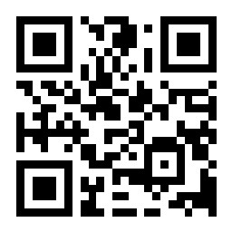





AWS Educate 高中生雲端推廣線上講座
雲端、金融與數據科學：跨領域學習
(Cloud, Finance, and Data Science: Interdisciplinary Learning)
Time: 2021/8/12 (Thu) 18:30 - 20:30 pm (18:40-19:10 pm)
Host: AWS Educate Ambassador in Taiwan
戴敏育 副教授
Min-Yuh Day, Ph.D, Associate Professor
國立臺北大學 資訊管理研究所
Institute of Information Management, National Taipei University
https://web.ntpu.edu.tw/~myday
2021-08-12
https://app.sli.do/event/0wq99hvv/

Slide 2


戴敏育 博士
(Min-Yuh Day, Ph.D.)
1
國立臺北大學 資訊管理研究所 副教授
中央研究院 資訊科學研究所 訪問學人
國立臺灣大學 資訊管理 博士
Publications Co-Chairs, IEEE/ACM International Conference on
Advances in Social Networks Analysis and Mining (ASONAM 2013- )
Program Co-Chair, IEEE International Workshop on
Empirical Methods for Recognizing Inference in TExt (IEEE EM-RITE 2012- )
Publications Chair, The IEEE International Conference on
Information Reuse and Integration (IEEE IRI)

Slide 3

Agenda
NTPU AWS 雲創學院跨領域學習
雲端、金融與數據科學
金融資料科學跨領域學習歷程
https://app.sli.do/event/0wq99hvv/

Slide 4
國立臺北大學 AWS 雲創學院
Amazon Web Services (AWS)
  全球廣泛採納的雲端平台，透過全球資料中心提供超過175項功能完整的服務，包含資料庫、運算分析、網路、開發人員工具、資訊安全和企業應用等，不但能在AWS上運行 R, Python, C++ 等程式語言，也可延伸至AI與機器學習、區塊鏈、物聯網、資料湖 (Data Lake)、大數據分析、遊戲開發及電子商務等多樣化的應用情境中。
國立臺北大學推動AWS雲創學院發展
  期望鼓勵全校各院系相關課程教師，
  於教學中導入雲端概念與AWS應用，透過帶領學生實作練習，
  增進學生學習成效以及和產業接軌的機會。

Slide 6
AWS雲端應用導入教學
企業雲端運算入門 (Foundation of Business Cloud Computing)
  (BA4, NTPU) (Spring 2021)
大數據分析 (Big Data Analytics)
  (MBA, IM, NTPU) (Fall 2020)
軟體工程 (Software Engineering)
  (MBA, IM, NTPU) (Fall 2020)
雲端服務架構實務 (Cloud Services Architecting Practices)
  (MI4, TKU) (Spring 2021, Fall 2020, Spring 2020, Fall 2019)
https://web.ntpu.edu.tw/~myday/teaching.htm

Slide 7
課程理論中融入AWS概念
智慧金融量化分析 (Artificial Intelligence in Finance and Quantitative)
  國立台北大學資管所碩士班 (Fall 2021)
人工智慧文本分析 (Artificial Intelligence for Text Analytics)
  國立台北大學資管所碩士班 (Spring 2022)
人工智慧 (Artificial Intelligence)
  國立台北大學資管所碩士班 (Spring 2021)
資料探勘 (Data Mining)
  國立台北大學資管所碩士班 (Spring 2021)
  (電子商務碩士學分學程)
https://web.ntpu.edu.tw/~myday/teaching.htm

Slide 8
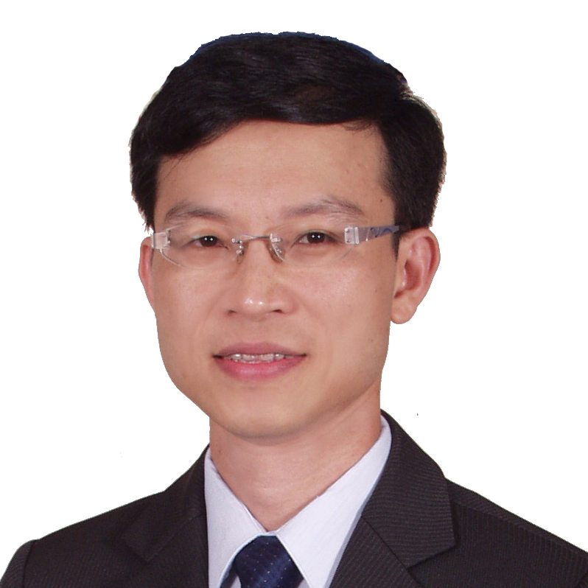
企業雲端運算入門
(Foundation of Business Cloud Computing)
雲端概念概述
(Cloud Concepts Overview)
企業雲端運算入門 (Foundation of Business Cloud Computing) (BA4, NTPU) (Spring 2021)
(AWS Academy Cloud Foundations; ACF) (AWS Certified Cloud Practitioner)
(BA4, NTPU) (3 Credits, Elective) (U4010) (自主學習課程)(商業智慧與大數據分析學士學分學程)
(1092) (國立台北大學企管系4A, 4B) (選修3學分) (授課教師：謝榮桂，戴敏育) (2021.02 - 2021.06)
(週三 Wed, 6, 7, 8, 14:10-17:00) (台北大學三峽校區 文3F10_L)
謝榮桂 (Jung-Kuei Hsieh), 戴敏育 (Min-Yuh Day)
National Taipei University
國立臺北大學
2021-02-24

Slide 9
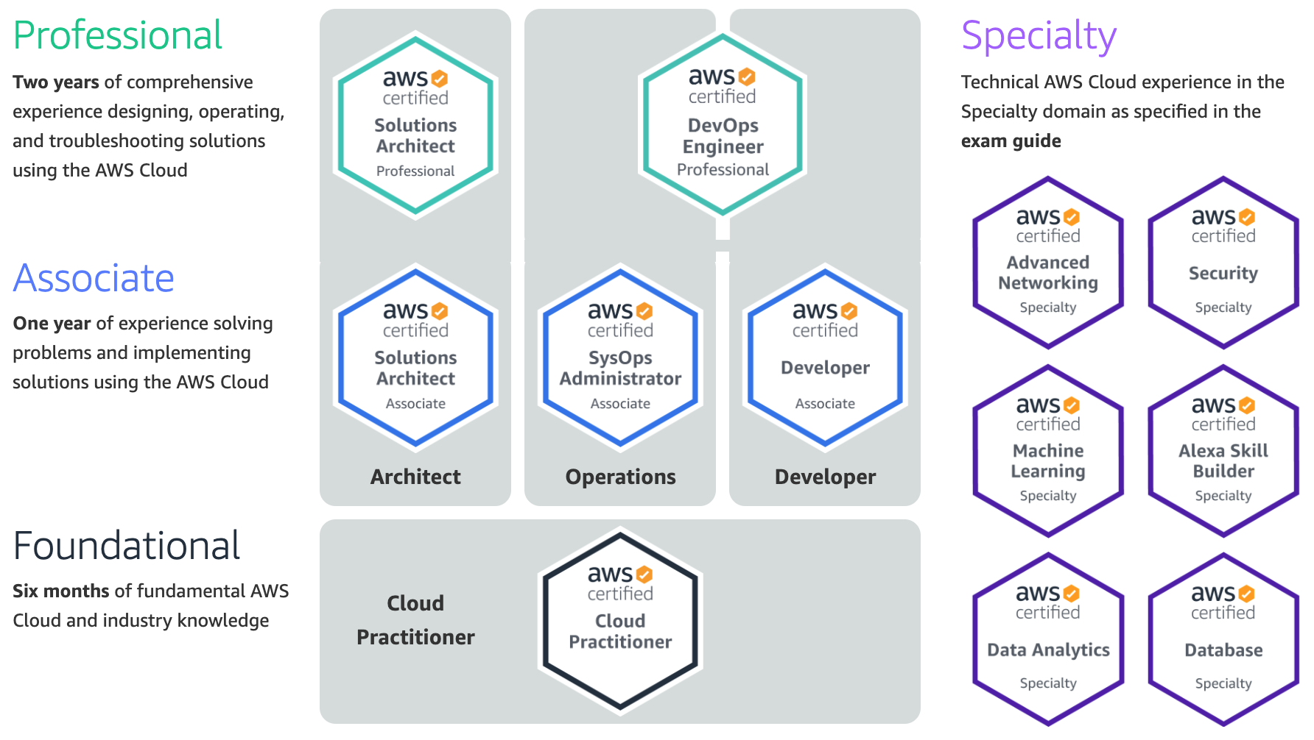
AWS Certification
2
SAA
1
CLF
https://aws.amazon.com/certification/

Slide 10
AWS Certified Cloud Practitioner
(CLF-C01)
1
Source: https://aws.amazon.com/certification/certified-cloud-practitioner/

Slide 11
AWS Certified Solutions Architect –
Associate (SAA-C02)
2
Source: https://aws.amazon.com/certification/certified-solutions-architect-associate

Slide 12
Agenda
NTPU AWS 雲創學院跨領域學習
雲端、金融與數據科學
金融資料科學跨領域學習歷程
https://app.sli.do/event/0wq99hvv/

Slide 13
FinTech ABCD
AI
Block Chain
Cloud Computing
Big Data

Slide 14
FinTech

Slide 15
Financial Technology
FinTech
“providing
financial services
by making use of software and
modern technology”
Source: https://www.fintechweekly.com/fintech-definition

Slide 16
Financial Services

Slide 17

Financial Services
Source: http://www.crackitt.com/7-reasons-why-your-fintech-startup-needs-visual-marketing/

Slide 18
AI, Big Data, Cloud Computing
Evolution of Decision Support, Business Intelligence, and Analytics
AI
AI
Cloud Computing
Big Data
DM
BI
Source: Ramesh Sharda, Dursun Delen, and Efraim Turban (2017),
Business Intelligence, Analytics, and Data Science: A Managerial Perspective, 4th Edition, Pearson

Slide 19
AI, ML, DL
Artificial Intelligence (AI)
Machine Learning (ML)
Supervised
Learning
Unsupervised Learning
Deep Learning (DL)
CNN
RNN LSTM GRU
GAN
Semi-supervised Learning
Reinforcement Learning
Source: https://leonardoaraujosantos.gitbooks.io/artificial-inteligence/content/deep_learning.html

Slide 20
Value Creation by Big Data Analytics
(Grover et al., 2018)
Source: Varun Grover, Roger HL Chiang, Ting-Peng Liang, and Dongsong Zhang (2018), "Creating Strategic Business Value from Big Data Analytics: A Research Framework", Journal of Management Information Systems, 35, no. 2, pp. 388-423.

Slide 21
Architecture of Big Data Analytics
Big Data
Analytics
Applications
Big Data
Sources
Big Data
Transformation
Big Data
Platforms & Tools
* Internal
* External
* Multiple formats
* Multiple
locations
* Multiple applications
Middleware
Hadoop
MapReduce
Pig
Hive
Jaql
Zookeeper
Hbase
Cassandra
Oozie
Avro
Mahout
Others
Queries
Raw
Data
Transformed
Data
Big Data
Analytics
Extract Transform Load
Reports
Data Warehouse
OLAP
Traditional Format
CSV, Tables
Data Mining
Source: Stephan Kudyba (2014), Big Data, Mining, and Analytics: Components of Strategic Decision Making, Auerbach Publications

Slide 22
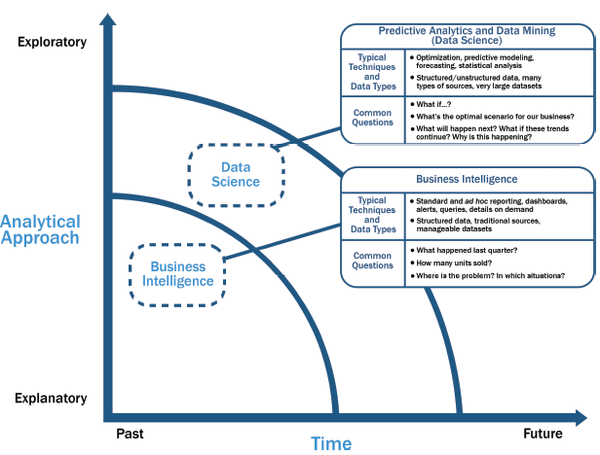
Data Science and
Business Intelligence
Source: EMC Education Services, Data Science and Big Data Analytics: Discovering, Analyzing, Visualizing and Presenting Data, Wiley, 2015

Slide 23
Data Science and
Business Intelligence
Predictive Analytics
and Data Mining
(Data Science)
Source: EMC Education Services, Data Science and Big Data Analytics: Discovering, Analyzing, Visualizing and Presenting Data, Wiley, 2015

Slide 24
Data Science and
Business Intelligence
Predictive Analytics
and Data Mining
(Data Science)
Structured/unstructured data, many types of sources,
very large datasets
Optimization, predictive modeling, forecasting statistical analysis
What if…?
What’s the optimal scenario for our business?
What will happen next?
What if these trends countinue?
Why is this happening?
Source: EMC Education Services, Data Science and Big Data Analytics: Discovering, Analyzing, Visualizing and Presenting Data, Wiley, 2015

Slide 25
Profile of a Data Scientist
Quantitative
  mathematics or statistics
Technical
  software engineering,
  machine learning,
  and programming skills
Skeptical mind-set and critical thinking
Curious and creative
Communicative and collaborative
Source: EMC Education Services, Data Science and Big Data Analytics: Discovering, Analyzing, Visualizing and Presenting Data, Wiley, 2015

Slide 26
Data Scientist Profile
Quantitative
Technical
Curious
and
Creative
Data Scientist
Skeptical
Communicative
and
Collaborative
Source: EMC Education Services, Data Science and Big Data Analytics: Discovering, Analyzing, Visualizing and Presenting Data, Wiley, 2015

Slide 27
Framework for BD and BI Research
Data Collection
Data Storage
Data Analytics
Infrastructure
Business
Medicate
Supply Chain
Engineering
Services
Technology
Application
Impact
Management
Value Creation
Individual Impact
Organizational Impact
Social Impact
Adoption of BD/BI
Cost Benefit
Security/Privacy
Human Resource
Source: Ting-Peng Liang and Yu-Hsi Liu (2018), "Research Landscape of Business Intelligence and Big Data analytics: A bibliometrics study”,
Expert Systems with Applications, Volume 111, 30, 2018, pp. 2-10

Slide 28
Business Intelligence and Big Data analytics
Source: Ting-Peng Liang and Yu-Hsi Liu (2018), "Research Landscape of Business Intelligence and Big Data analytics: A bibliometrics study”,
Expert Systems with Applications, Volume 111, 30, 2018, pp. 2-10

Slide 29
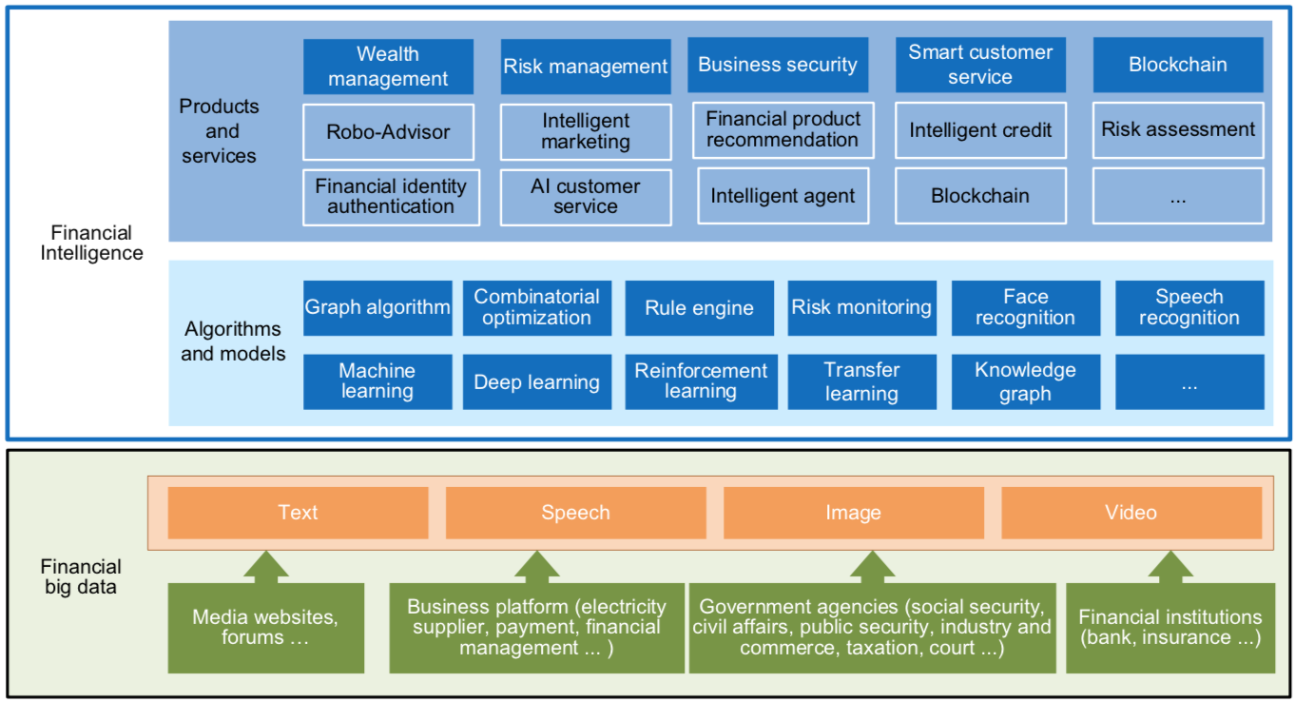
FinBrain: when Finance meets AI 2.0
(Zheng et al., 2019)
Source: Xiao-lin Zheng, Meng-ying Zhu, Qi-bing Li, Chao-chao Chen, and Yan-chao Tan (2019), "Finbrain: When finance meets AI 2.0." Frontiers of Information Technology & Electronic Engineering 20, no. 7, pp. 914-924

Slide 30
Technology-driven
Financial Industry Development
Development stage | Driving technology | Main landscape | Inclusive finance | Relationship between technology and finance
Fintech 1.0 (financial IT) | Computer | Credit card, ATM, and CRMS | Low | Technology as a tool
Fintech 2.0 (Internet finance) | Mobile Internet | Marketplace lending, third-party payment, crowdfunding, and Internet insurance | Medium | Technology-driven change
Fintech 3.0 (financial intelligence) | AI, Big Data, Cloud Computing, Blockchain | Intelligent finance | High | Deep fusion
Source: Xiao-lin Zheng, Meng-ying Zhu, Qi-bing Li, Chao-chao Chen, and Yan-chao Tan (2019), "Finbrain: When finance meets AI 2.0." Frontiers of Information Technology & Electronic Engineering 20, no. 7, pp. 914-924

Slide 31
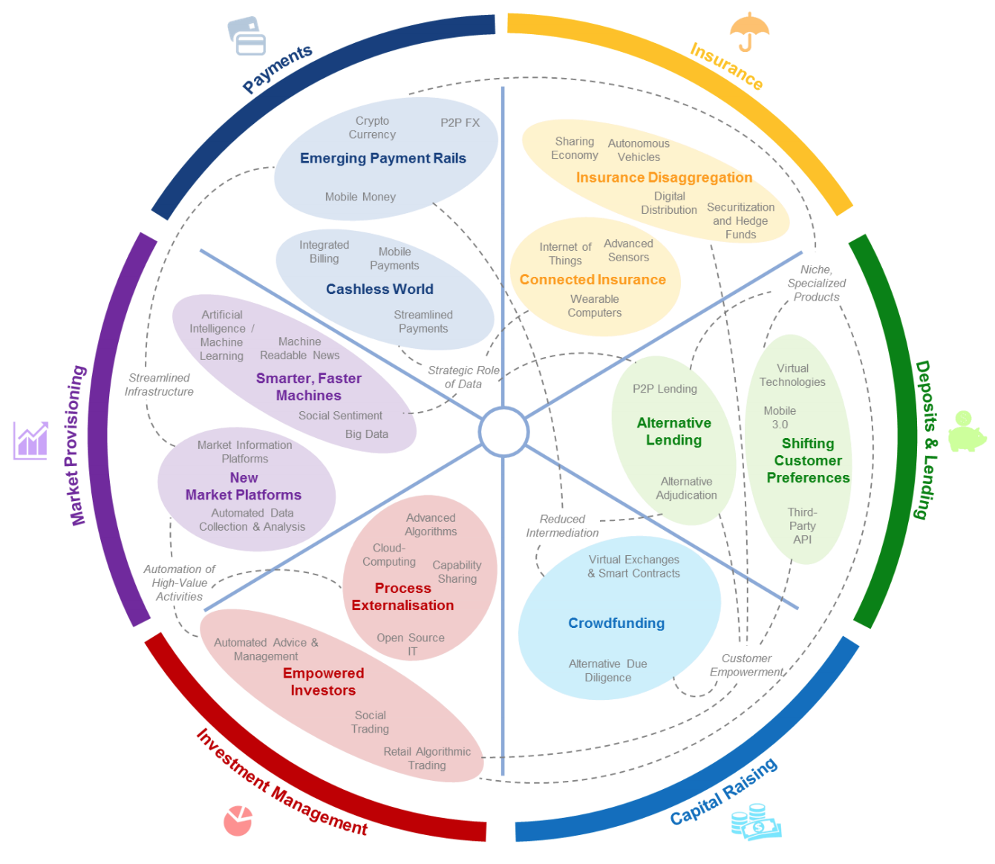
FinTech: Financial Services Innovation
Source: http://www3.weforum.org/docs/WEF_The_future__of_financial_services.pdf

Slide 32
FinTech:
Financial Services Innovation
1. Payments
2. Insurance
3. Deposits & Lending
4. Capital Raising
5. Investment Management
6. Market Provisioning
Source: http://www3.weforum.org/docs/WEF_The_future__of_financial_services.pdf

Slide 33
FinTech: Investment Management
5
Source: http://www3.weforum.org/docs/WEF_The_future__of_financial_services.pdf

Slide 34
FinTech: Market Provisioning
6
Source: http://www3.weforum.org/docs/WEF_The_future__of_financial_services.pdf

Slide 35
Deep learning for financial applications: Topic-Model Heatmap
Source: Ahmet Murat Ozbayoglu, Mehmet Ugur Gudelek, and Omer Berat Sezer (2020). "Deep learning for financial applications: A survey." Applied Soft Computing (2020): 106384.

Slide 36
Deep learning for financial applications: Topic-Feature Heatmap
Source: Ahmet Murat Ozbayoglu, Mehmet Ugur Gudelek, and Omer Berat Sezer (2020). "Deep learning for financial applications: A survey." Applied Soft Computing (2020): 106384.

Slide 37
Deep learning for financial applications: Topic-Dataset Heatmap
Source: Ahmet Murat Ozbayoglu, Mehmet Ugur Gudelek, and Omer Berat Sezer (2020). "Deep learning for financial applications: A survey." Applied Soft Computing (2020): 106384.

Slide 38
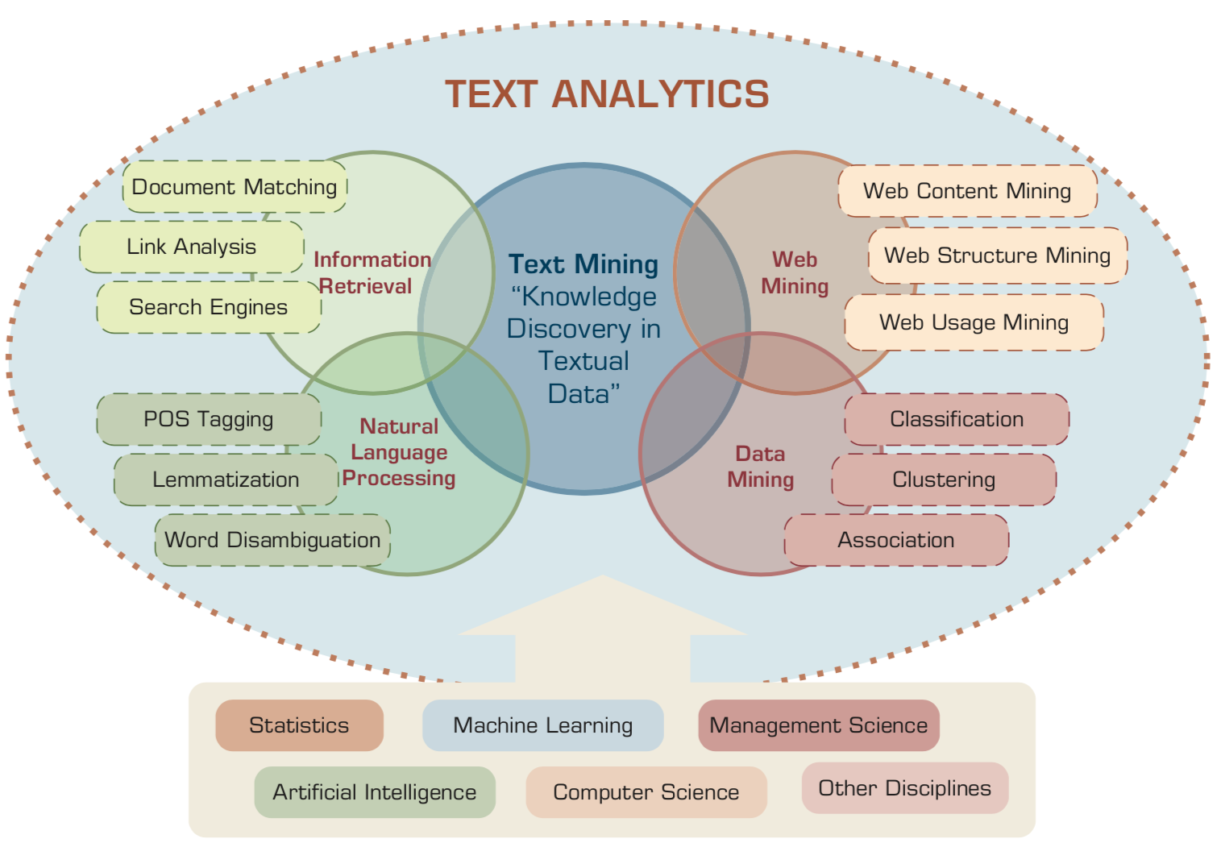
Text Analytics and Text Mining
Source: Ramesh Sharda, Dursun Delen, and Efraim Turban (2017), Business Intelligence, Analytics, and Data Science: A Managerial Perspective, 4th Edition, Pearson

Slide 39
Agenda
NTPU AWS 雲創學院跨領域學習
雲端、金融與數據科學
金融資料科學跨領域學習歷程
https://app.sli.do/event/0wq99hvv/

Slide 40
金融資料科學跨領域學習歷程
對想踏入金融資料科學有興趣的高中生
準備建議
  學習資源
    AWS Educate
  活動參與
    AWS Educate Ambassador in Taiwan
  學習歷程
https://app.sli.do/event/0wq99hvv/

Slide 41
Summary
NTPU AWS 雲創學院跨領域學習
雲端、金融與數據科學
金融資料科學跨領域學習歷程
https://app.sli.do/event/0wq99hvv/

Slide 42
AWS Educate 高中生雲端推廣線上講座
Q & A
雲端、金融與數據科學：跨領域學習
(Cloud, Finance, and Data Science: Interdisciplinary Learning)
Time: 2021/8/12 (Thu) 18:30 - 20:30 pm (18:40-19:10 pm)
Host: AWS Educate Ambassador in Taiwan
戴敏育 副教授
Min-Yuh Day, Ph.D, Associate Professor
國立臺北大學 資訊管理研究所
Institute of Information Management, National Taipei University
https://web.ntpu.edu.tw/~myday
2021-08-12
https://app.sli.do/event/0wq99hvv/

