Slide 1


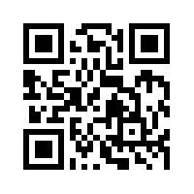
Text Mining and
Natural Language Processing
(文字探勘與自然語言處理)
Tamkang
University
Time: 2017/01/23 (Mon) (14:00-17:00)
Place: 國立臺北護理健康大學 城區部 (台北市內江街89號) C302
Host: 祝國忠 院長 (健康科技學院院長)
Min-Yuh Day
戴敏育
Assistant Professor
專任助理教授
Dept. of Information Management, Tamkang University
淡江大學 資訊管理學系
http://mail. tku.edu.tw/myday/
2017-01-23

Slide 2




戴敏育 博士
(Min-Yuh Day, Ph.D.)
淡江大學資管系專任助理教授
中央研究院資訊科學研究所訪問學人
國立台灣大學資訊管理博士
Publications Co-Chairs, IEEE/ACM International Conference on
Advances in Social Networks Analysis and Mining (ASONAM 2013- )
Program Co-Chair, IEEE International Workshop on
Empirical Methods for Recognizing Inference in TExt (IEEE EM-RITE 2012- )
Workshop Chair, The IEEE International Conference on
Information Reuse and Integration (IEEE IRI)

Slide 3
Text Mining
(TM)

Slide 4
Natural Language Processing
(NLP)

Slide 5
Outline
Text mining
  Differentiate between
  text mining, Web mining and data mining
  Web mining
    Web content mining
    Web structure mining
    Web usage mining
Natural Language Processing (NLP)
  Natural Language Processing with NLTK in Python

Slide 6
Python for Big Data Analytics
Source: http://spectrum.ieee.org/computing/software/the-2016-top-programming-languages

Slide 7
Python: Analytics and Data Science Software
Source: http://www.kdnuggets.com/2016/06/r-python-top-analytics-data-mining-data-science-software.html

Slide 8
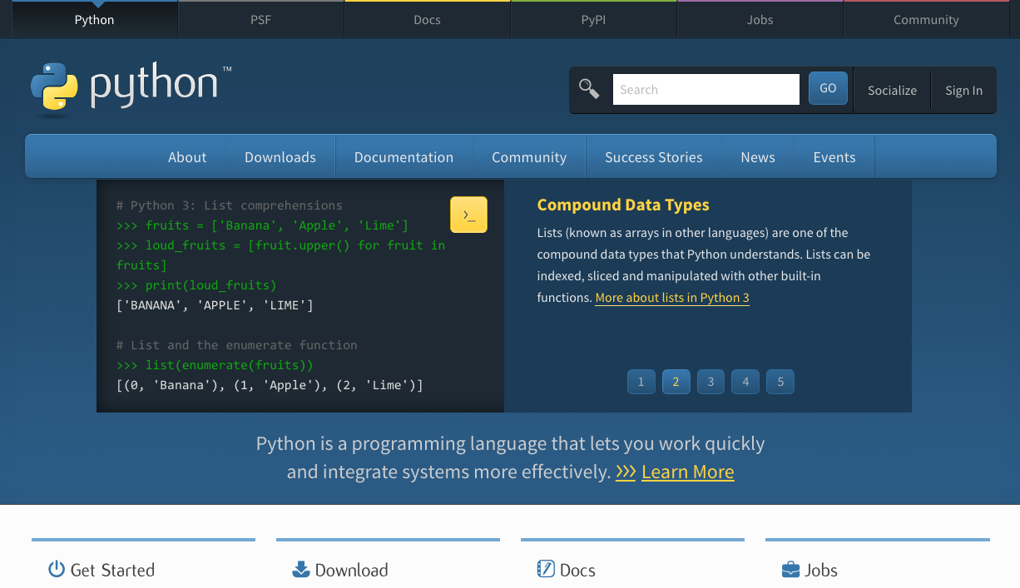
Python
https://www.python.org/

Slide 9

Python is an interpreted, object-oriented, high-level programming language with dynamic semantics.
Source: https://www.python.org/doc/essays/blurb/

Slide 10
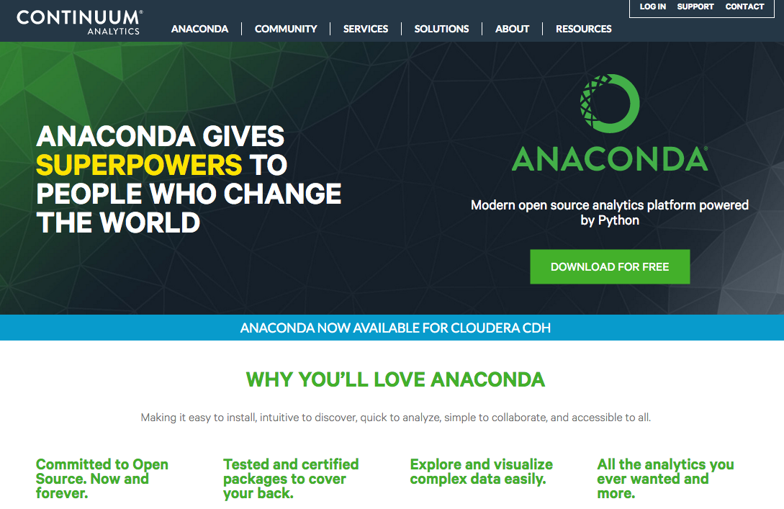
Anaconda
https://www.continuum.io/

Slide 11
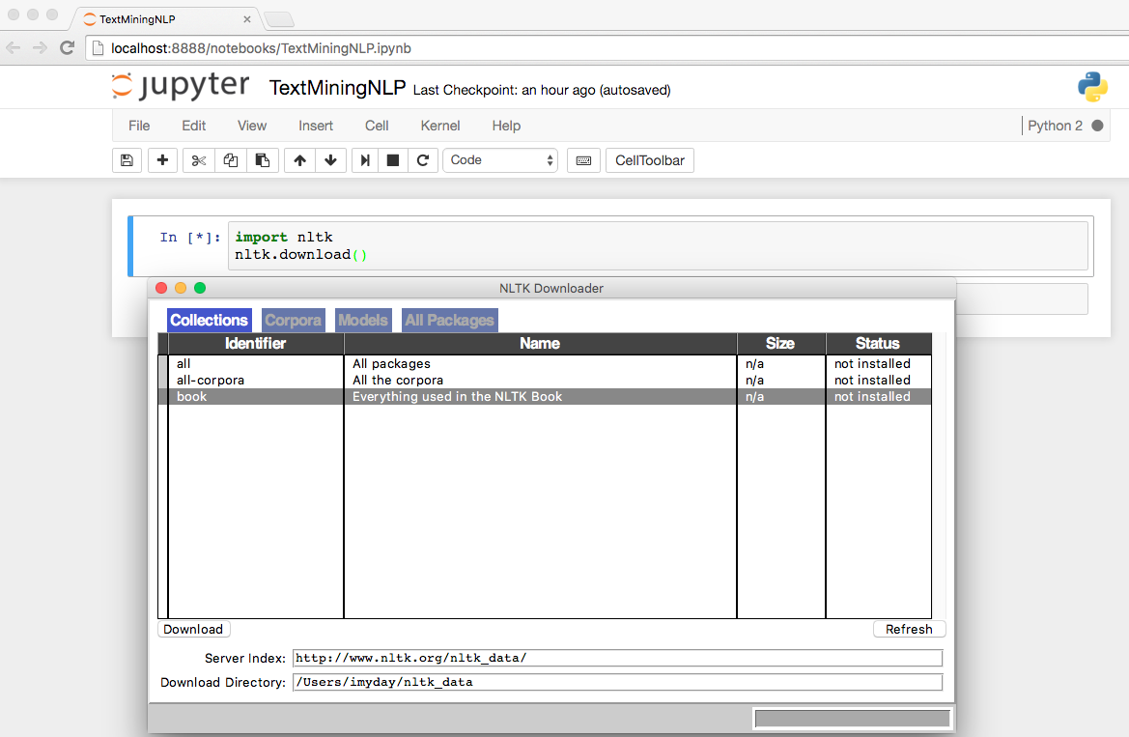
import nltk
nltk.download()
Source: http://www.nltk.org/

Slide 12

Text Mining
http://www.amazon.com/Text-Mining-Applications-Michael-Berry/dp/0470749822/

Slide 13
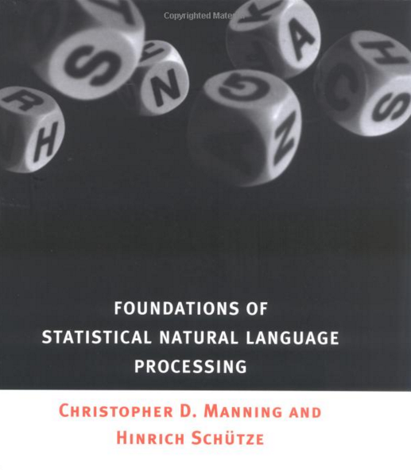
Christopher D. Manning and Hinrich Schütze (1999), Foundations of
Statistical Natural Language Processing,
The MIT Press
http://www.amazon.com/Foundations-Statistical-Natural-Language-Processing/dp/0262133601

Slide 14
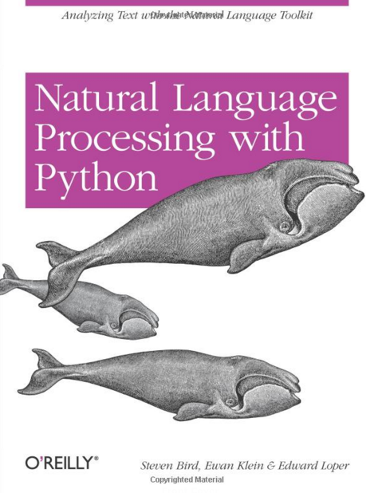
Steven Bird, Ewan Klein and Edward Loper (2009),
Natural Language Processing with Python,
O'Reilly Media
http://www.amazon.com/Natural-Language-Processing-Python-Steven/dp/0596516495

Slide 15
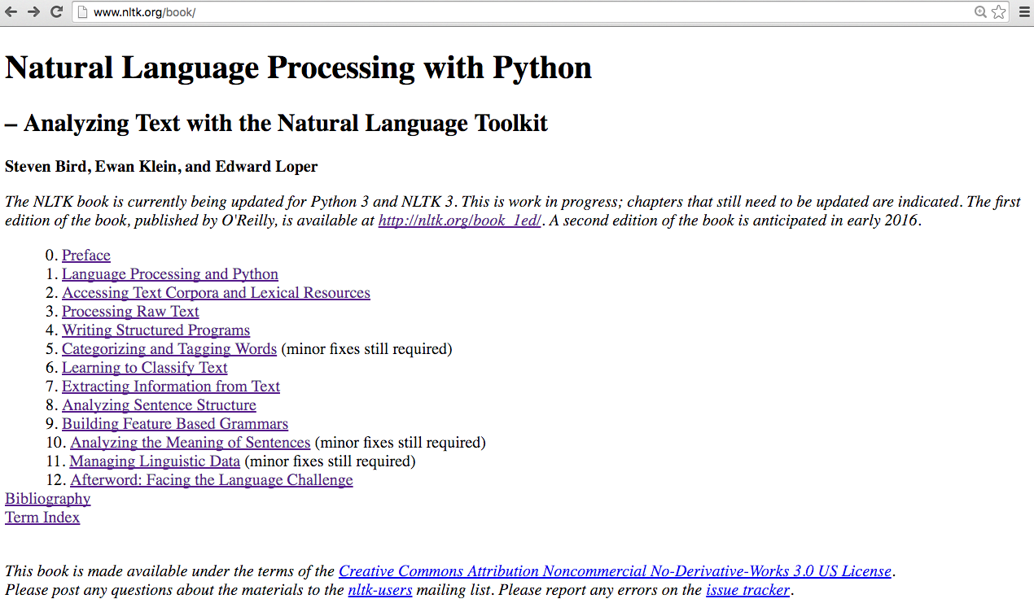
Natural Language Processing with Python
– Analyzing Text with the Natural Language Toolkit
http://www.nltk.org/book/

Slide 16
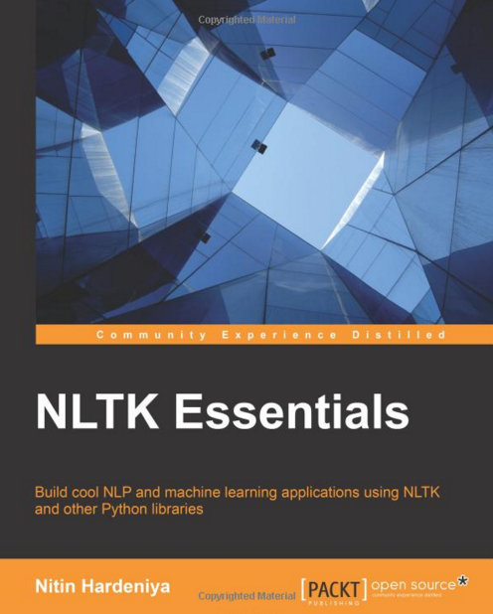
Nitin Hardeniya (2015),
NLTK Essentials, Packt Publishing
http://www.amazon.com/NLTK-Essentials-Nitin-Hardeniya/dp/1784396907

Slide 17
Text Mining
(text data mining)
  the process of
  deriving
  high-quality information
  from text
http://en.wikipedia.org/wiki/Text_mining

Slide 18
Big Data Analytics

Slide 19
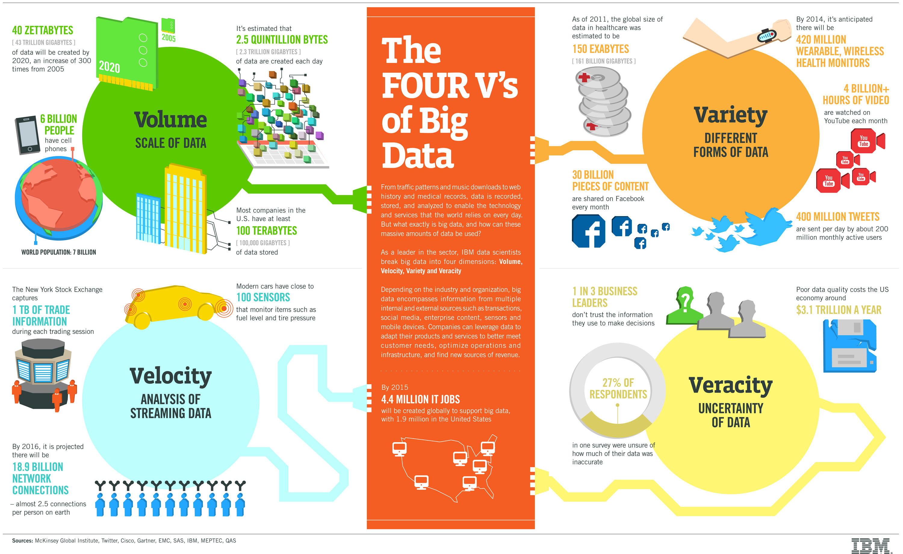
Big Data 4 V
Source: https://www-01.ibm.com/software/data/bigdata/

Slide 20
Value

Slide 21
Architecture of Big Data Analytics
Big Data
Analytics
Applications
Big Data
Sources
Big Data
Transformation
Big Data
Platforms & Tools
* Internal
* External
* Multiple formats
* Multiple
locations
* Multiple applications
Middleware
Hadoop
MapReduce
Pig
Hive
Jaql
Zookeeper
Hbase
Cassandra
Oozie
Avro
Mahout
Others
Queries
Raw
Data
Transformed
Data
Big Data
Analytics
Extract Transform Load
Reports
Data Warehouse
OLAP
Traditional Format
CSV, Tables
Data Mining
Source: Stephan Kudyba (2014), Big Data, Mining, and Analytics: Components of Strategic Decision Making, Auerbach Publications

Slide 22
Architecture of Big Data Analytics
Big Data
Analytics
Applications
Big Data
Sources
Big Data
Transformation
Big Data
Platforms & Tools
* Internal
* External
* Multiple formats
* Multiple
locations
* Multiple applications
Data Mining
Big Data Analytics Applications
Middleware
Hadoop
MapReduce
Pig
Hive
Jaql
Zookeeper
Hbase
Cassandra
Oozie
Avro
Mahout
Others
Queries
Raw
Data
Transformed
Data
Big Data
Analytics
Extract Transform Load
Reports
Data Warehouse
OLAP
Traditional Format
CSV, Tables
Data Mining
Source: Stephan Kudyba (2014), Big Data, Mining, and Analytics: Components of Strategic Decision Making, Auerbach Publications

Slide 23
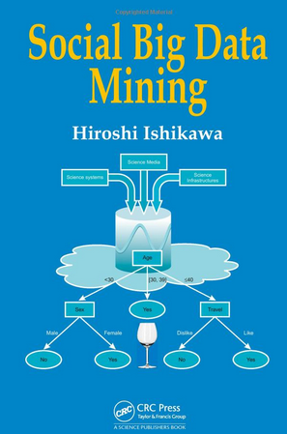
Social Big Data Mining
(Hiroshi Ishikawa, 2015)
Source: http://www.amazon.com/Social-Data-Mining-Hiroshi-Ishikawa/dp/149871093X

Slide 24
Architecture for
Social Big Data Mining
(Hiroshi Ishikawa, 2015)
Enabling Technologies
Analysts
Integrated analysis
Integrated analysis model
Model Construction
Explanation by Model
Conceptual Layer
Natural Language Processing
Information Extraction
Anomaly Detection
Discovery of relationships
among heterogeneous data
Large-scale visualization
Construction and
confirmation
of individual
hypothesis
Description and
execution of
application-specific
task
Data
Mining
Multivariate analysis
Application specific task
Logical Layer
Parallel distrusted processing
Software
Social Data
Hardware
Physical Layer
Source: Hiroshi Ishikawa (2015), Social Big Data Mining, CRC Press

Slide 25
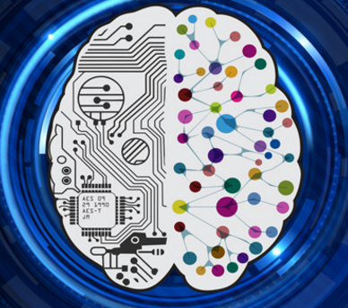
Deep Learning
Intelligence from Big Data
Source: https://www.vlab.org/events/deep-learning/

Slide 26
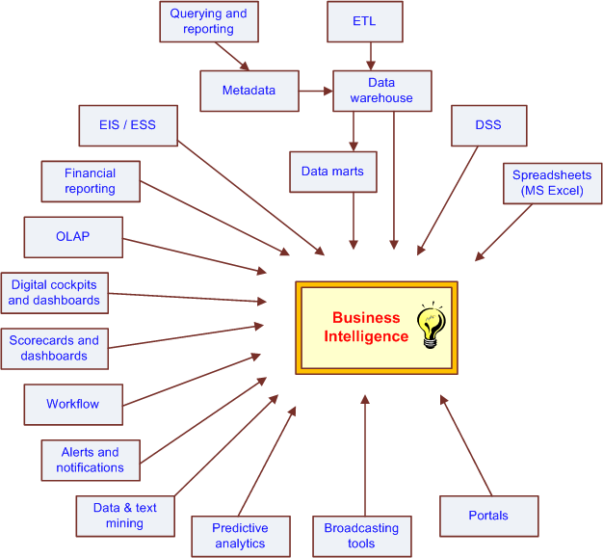
The Evolution of BI Capabilities
Source: Turban et al. (2011), Decision Support and Business Intelligence Systems

Slide 27
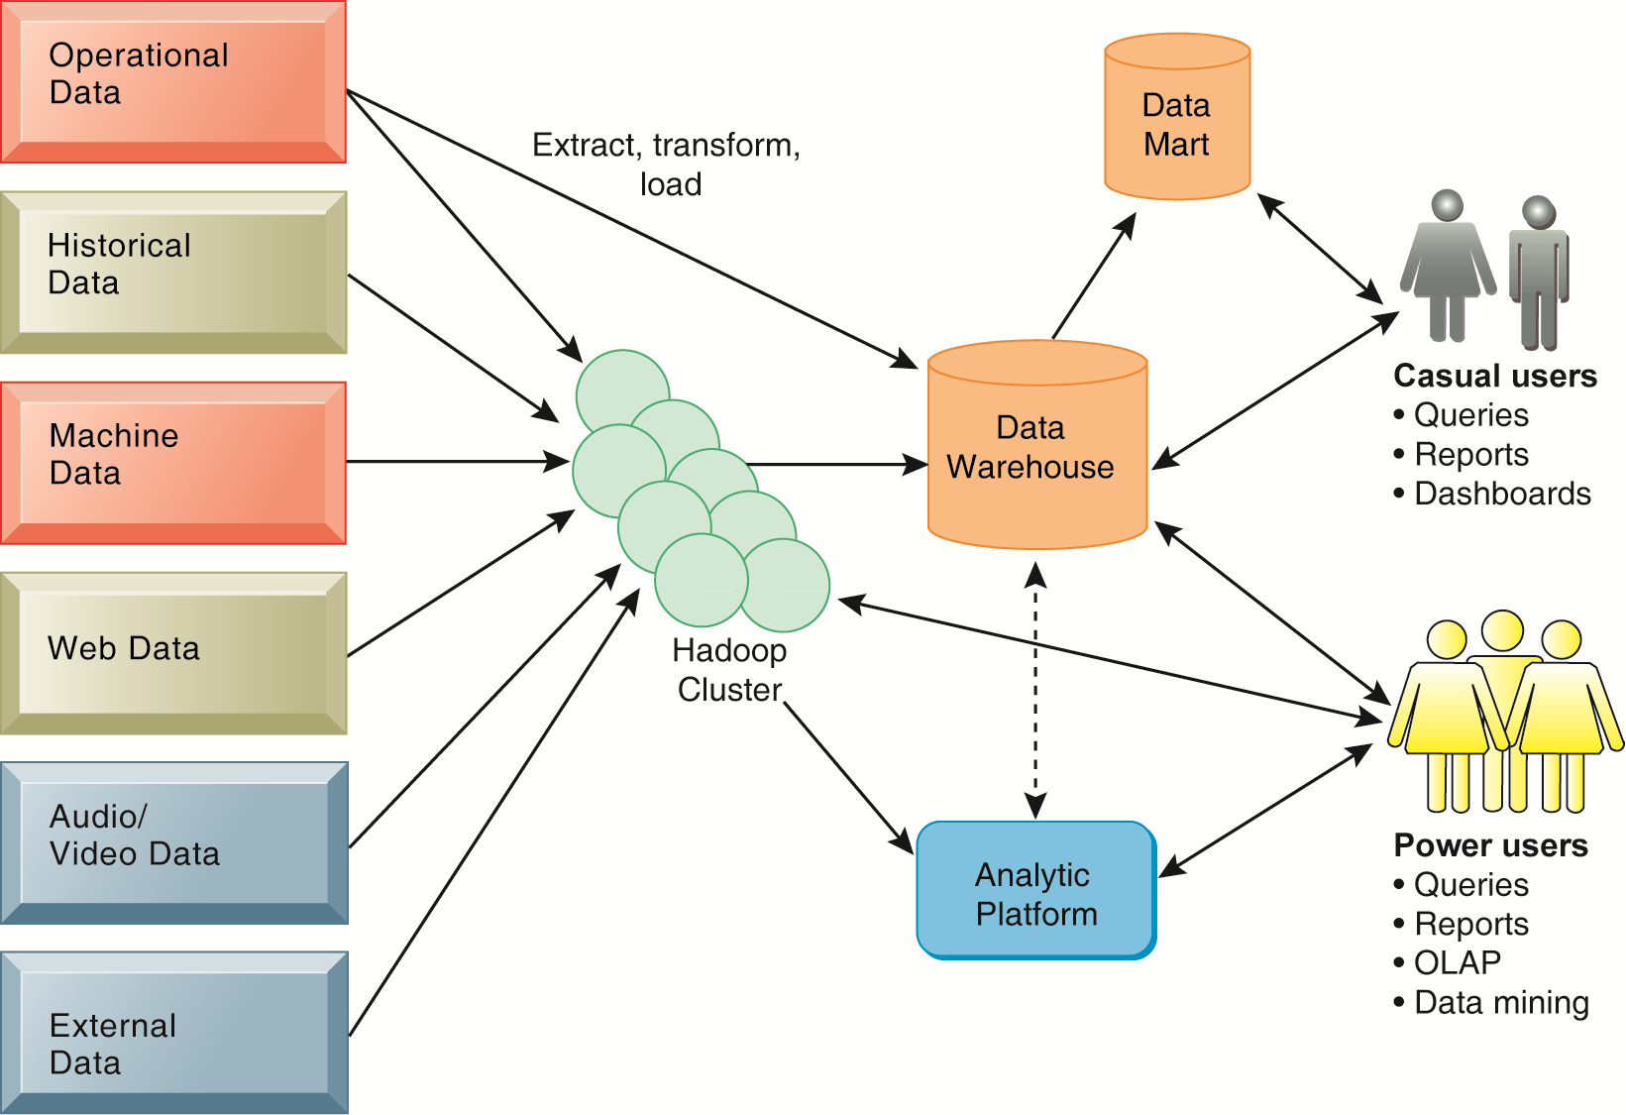
Business Intelligence (BI) Infrastructure

Slide 28




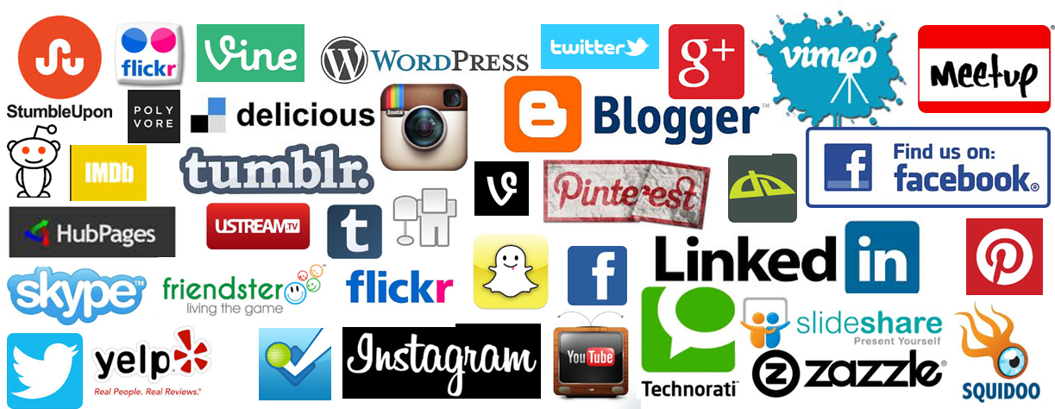
Social Media
Source: http://hungrywolfmarketing.com/2013/09/09/what-are-your-social-marketing-goals/

Slide 29
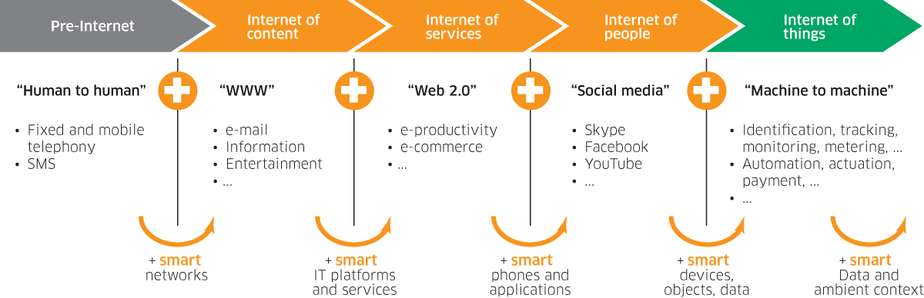
Internet Evolution
Internet of People (IoP): Social Media
Internet of Things (IoT): Machine to Machine
Source: Marc Jadoul (2015), The IoT: The next step in internet evolution, March 11, 2015 http://www2.alcatel-lucent.com/techzine/iot-internet-of-things-next-step-evolution/

Slide 30


Emotions
Love
Anger
Joy
Sadness
Surprise
Fear
Source: Bing Liu (2011) , “Web Data Mining: Exploring Hyperlinks, Contents, and Usage Data,” Springer, 2nd Edition,

Slide 31
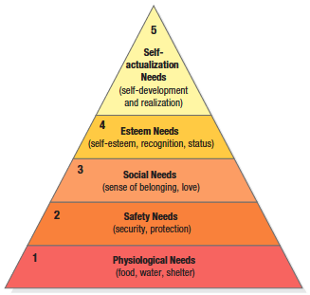

Maslow’s Hierarchy of Needs
Source: Philip Kotler & Kevin Lane Keller, Marketing Management, 14th ed., Pearson, 2012

Slide 32
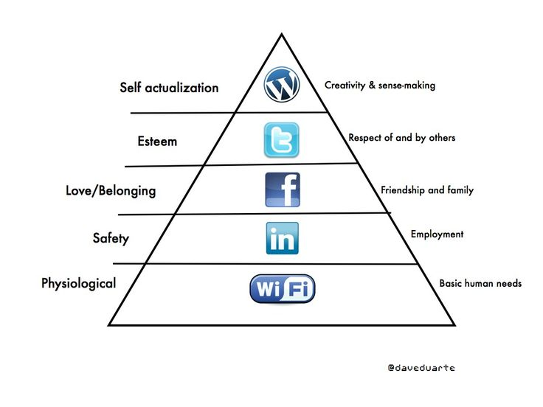

Social Media Hierarchy of Needs
Source: http://www.pinterest.com/pin/18647785930903585/

Slide 33
The Social Feedback Cycle
Consumer Behavior on Social Media
Marketer-Generated
User-Generated
Form
Opinion
Awareness
Consideration
Purchase
Use
Talk
Source: Evans et al. (2010), Social Media Marketing: The Next Generation of Business Engagement

Slide 34






The New Customer Influence Path
Awareness
Consideration
Purchase
Source: Evans et al. (2010), Social Media Marketing: The Next Generation of Business Engagement

Slide 35
Example of Opinion: review segment on iPhone
“I bought an iPhone a few days ago.
It was such a nice phone.
The touch screen was really cool.
The voice quality was clear too.
However, my mother was mad with me as I did not tell her before I bought it.
She also thought the phone was too expensive, and wanted me to return it to the shop. … ”
Source: Bing Liu (2011) , “Web Data Mining: Exploring Hyperlinks, Contents, and Usage Data,” Springer, 2nd Edition,

Slide 36
Example of Opinion:
review segment on iPhone
“(1) I bought an iPhone a few days ago.
(2) It was such a nice phone.
(3) The touch screen was really cool.
(4) The voice quality was clear too.
(5) However, my mother was mad with me as I did not tell her before I bought it.
(6) She also thought the phone was too expensive, and wanted me to return it to the shop. … ”
+Positive Opinion
-Negative Opinion
Source: Bing Liu (2011) , “Web Data Mining: Exploring Hyperlinks, Contents, and Usage Data,” Springer, 2nd Edition,

Slide 37
Text Mining
Technologies

Slide 38
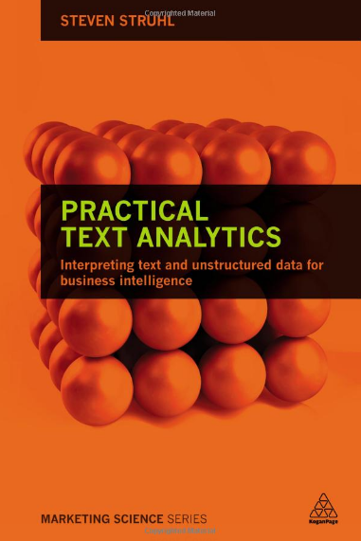
Steven Struhl (2015),
Practical Text Analytics:
Interpreting Text and Unstructured Data for Business Intelligence (Marketing Science), Kogan Page
http://www.amazon.com/Practical-Text-Analytics-Interpreting-Unstructured/dp/0749474017

Slide 39
Text Mining Concepts
85-90 percent of all corporate data is in some kind of unstructured form (e.g., text)
Unstructured corporate data is doubling in size every 18 months
Tapping into these information sources is not an option, but a need to stay competitive
Answer: text mining
  A semi-automated process of extracting knowledge from unstructured data sources
  a.k.a. text data mining or knowledge discovery in textual databases
Source: Turban et al. (2011), Decision Support and Business Intelligence Systems

Slide 40
Text mining
Text Data Mining
Intelligent Text Analysis
Knowledge-Discovery in Text (KDT)
Source: Vishal Gupta and Gurpreet S. Lehal (2009), "A survey of text mining techniques and applications,"
Journal of emerging technologies in web intelligence, vol. 1, no. 1, pp. 60-76.

Slide 41
Text Mining: the process of extracting interesting and non-trivial information and knowledge from unstructured text.
Source: Vishal Gupta and Gurpreet S. Lehal (2009), "A survey of text mining techniques and applications,"
Journal of emerging technologies in web intelligence, vol. 1, no. 1, pp. 60-76.

Slide 42
Text Mining: discovery by computer of new, previously unknown information, by automatically extracting information from different written resources.
Source: Vishal Gupta and Gurpreet S. Lehal (2009), "A survey of text mining techniques and applications,"
Journal of emerging technologies in web intelligence, vol. 1, no. 1, pp. 60-76.

Slide 43
Natural Language Processing
(NLP)
Text Mining
(TM)

Slide 44
An example of Text Mining
Knowledge
Analyze Text
Management Information System
Information Extraction
Classification
Summarization
Retrieve and preprocess document
Clustering
Document Collection
Source: Vishal Gupta and Gurpreet S. Lehal (2009), "A survey of text mining techniques and applications,"
Journal of emerging technologies in web intelligence, vol. 1, no. 1, pp. 60-76.

Slide 45
Overview of
Information Extraction based
Text Mining Framework
Text Data Mining
Text
Text
DB
Text
Information Extraction
Data Mining
Rule
Source: Vishal Gupta and Gurpreet S. Lehal (2009), "A survey of text mining techniques and applications,"
Journal of emerging technologies in web intelligence, vol. 1, no. 1, pp. 60-76.

Slide 46
Text Mining Technologies
Statistics
Machine Learning
Pattern Recognition
Database Systems
Visualization
Text Mining
Natural Language Processing
Algorithms
Information Retrieval
Applications
High-performance Computing
Adapted from: Jiawei Han and Micheline Kamber (2011), Data Mining: Concepts and Techniques, Third Edition, Elsevier

Slide 47
Data Mining versus Text Mining
Both seek for novel and useful patterns
Both are semi-automated processes
Difference is the nature of the data:
  Structured versus unstructured data
  Structured data: in databases
  Unstructured data: Word documents, PDF files, text excerpts, XML files, and so on
Text mining – first, impose structure to the data, then mine the structured data
Source: Turban et al. (2011), Decision Support and Business Intelligence Systems

Slide 48


Data Mining:
Core Analytics Process
The KDD Process for
Extracting Useful Knowledge from Volumes of Data
Source: Fayyad, U., Piatetsky-Shapiro, G., & Smyth, P. (1996). The KDD Process for Extracting Useful Knowledge from Volumes of Data. Communications of the ACM, 39(11), 27-34.

Slide 49
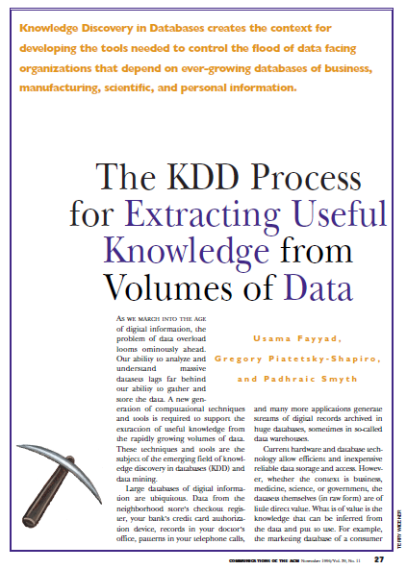
Fayyad, U., Piatetsky-Shapiro, G., & Smyth, P. (1996).
The KDD Process for
Extracting Useful Knowledge from Volumes of Data.
Communications of the ACM, 39(11), 27-34.

Slide 50
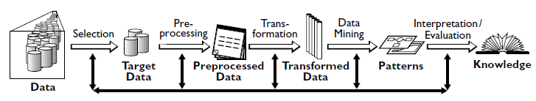
Data Mining
Knowledge Discovery in Databases (KDD) Process
(Fayyad et al., 1996)
Source: Fayyad, U., Piatetsky-Shapiro, G., & Smyth, P. (1996). The KDD Process for Extracting Useful Knowledge from Volumes of Data. Communications of the ACM, 39(11), 27-34.

Slide 51
Data Mining Processing Pipeline
(Charu Aggarwal, 2015)
Data Collection
Data Preprocessing
Analytical Processing
Output
for
Analyst
Feature Extraction
Cleaning
and
Integration
Building
Block 1
Building
Block 2
Feedback (Optional)
Feedback (Optional)
Source: Charu Aggarwal (2015), Data Mining: The Textbook Hardcover, Springer

Slide 52
Text Mining Process
Context diagram for the text mining process
Source: Turban et al. (2011), Decision Support and Business Intelligence Systems

Slide 53
Text Mining Process
The three-step text mining process
Source: Turban et al. (2011), Decision Support and Business Intelligence Systems

Slide 54
Text Mining Process
Step 1: Establish the corpus
  Collect all relevant unstructured data
  (e.g., textual documents, XML files, emails, Web pages, short notes, voice recordings…)
  Digitize, standardize the collection
  (e.g., all in ASCII text files)
  Place the collection in a common place
  (e.g., in a flat file, or in a directory as separate files)
Source: Turban et al. (2011), Decision Support and Business Intelligence Systems

Slide 55
Text Mining Process
Step 2: Create the Term–by–Document Matrix
Source: Turban et al. (2011), Decision Support and Business Intelligence Systems

Slide 56
Text Mining Process
Step 2: Create the Term–by–Document Matrix (TDM), cont.
  Should all terms be included?
    Stop words, include words
    Synonyms, homonyms
    Stemming
  What is the best representation of the indices (values in cells)?
    Row counts; binary frequencies; log frequencies;
    Inverse document frequency
Source: Turban et al. (2011), Decision Support and Business Intelligence Systems

Slide 57
Text Mining Process
Step 2: Create the Term–by–Document Matrix (TDM), cont.
  TDM is a sparse matrix. How can we reduce the dimensionality of the TDM?
    Manual - a domain expert goes through it
    Eliminate terms with very few occurrences in very few documents (?)
    Transform the matrix using singular value decomposition (SVD)
    SVD is similar to principle component analysis
Source: Turban et al. (2011), Decision Support and Business Intelligence Systems

Slide 58
Text Mining Process
Step 3: Extract patterns/knowledge
  Classification (text categorization)
  Clustering (natural groupings of text)
    Improve search recall
    Improve search precision
    Scatter/gather
    Query-specific clustering
  Association
  Trend Analysis (…)
Source: Turban et al. (2011), Decision Support and Business Intelligence Systems

Slide 59
Web Mining
Web mining (or Web data mining) is the process of discovering intrinsic relationships from Web data (textual, linkage, or usage)
Source: Turban et al. (2011), Decision Support and Business Intelligence Systems

Slide 60
Text Mining Concepts
Benefits of text mining are obvious especially in text-rich data environments
  e.g., law (court orders), academic research (research articles), finance (quarterly reports), medicine (discharge summaries), biology (molecular interactions), technology (patent files), marketing (customer comments), etc.
Electronic communization records (e.g., Email)
  Spam filtering
  Email prioritization and categorization
  Automatic response generation
Source: Turban et al. (2011), Decision Support and Business Intelligence Systems

Slide 61
Text Mining Application Area
Information extraction
Topic tracking
Summarization
Categorization
Clustering
Concept linking
Question answering
Source: Turban et al. (2011), Decision Support and Business Intelligence Systems

Slide 62
Text Mining Terminology
Unstructured or semistructured data
Corpus (and corpora)
Terms
Concepts
Stemming
Stop words (and include words)
Synonyms (and polysemes)
Tokenizing
Source: Turban et al. (2011), Decision Support and Business Intelligence Systems

Slide 63
Text Mining Terminology
Term dictionary
Word frequency
Part-of-speech tagging (POS)
Morphology
Term-by-document matrix (TDM)
  Occurrence matrix
Singular Value Decomposition (SVD)
  Latent Semantic Indexing (LSI)
Source: Turban et al. (2011), Decision Support and Business Intelligence Systems

Slide 64
Natural Language Processing (NLP)
Structuring a collection of text
  Old approach: bag-of-words
  New approach: natural language processing
NLP is …
  a very important concept in text mining
  a subfield of artificial intelligence and computational linguistics
  the studies of "understanding" the natural human language
Syntax versus semantics based text mining
Source: Turban et al. (2011), Decision Support and Business Intelligence Systems

Slide 65
Natural Language Processing (NLP)
What is “Understanding” ?
  Human understands, what about computers?
  Natural language is vague, context driven
  True understanding requires extensive knowledge of a topic
  Can/will computers ever understand natural language the same/accurate way we do?
Source: Turban et al. (2011), Decision Support and Business Intelligence Systems

Slide 66
Natural Language Processing (NLP)
Challenges in NLP
  Part-of-speech tagging
  Text segmentation
  Word sense disambiguation
  Syntax ambiguity
  Imperfect or irregular input
  Speech acts
Dream of AI community
  to have algorithms that are capable of automatically reading and obtaining knowledge from text
Source: Turban et al. (2011), Decision Support and Business Intelligence Systems

Slide 67
Natural Language Processing (NLP)
WordNet
  A laboriously hand-coded database of English words, their definitions, sets of synonyms, and various semantic relations between synonym sets
  A major resource for NLP
  Need automation to be completed
Sentiment Analysis
  A technique used to detect favorable and unfavorable opinions toward specific products and services
  CRM application
Source: Turban et al. (2011), Decision Support and Business Intelligence Systems

Slide 68
NLP Task Categories
Information retrieval (IR)
Information extraction (IE)
Named-entity recognition (NER)
Question answering (QA)
Automatic summarization
Natural language generation and understanding (NLU)
Machine translation (ML)
Foreign language reading and writing
Speech recognition
Text proofing
Optical character recognition (OCR)
Source: Turban et al. (2011), Decision Support and Business Intelligence Systems

Slide 69
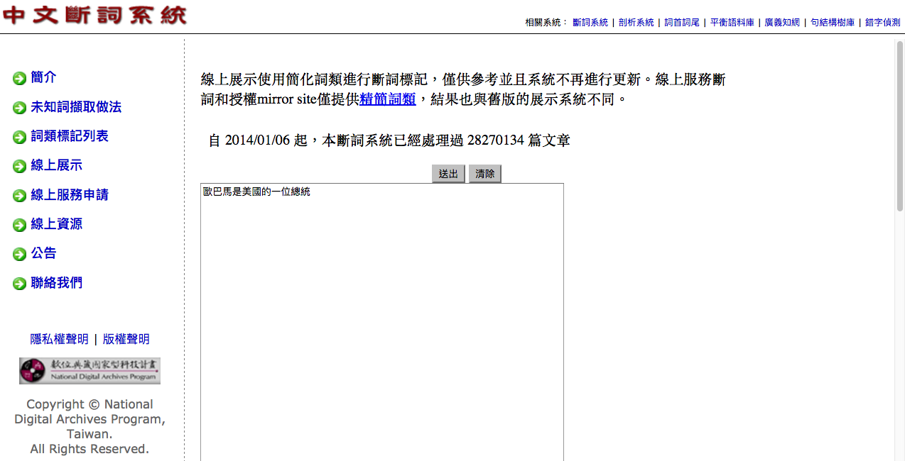

CKIP 中研院中文斷詞系統
http://ckipsvr.iis.sinica.edu.tw/
歐巴馬是美國的一位總統
歐巴馬(Nb) 是(SHI) 美國(Nc) 的(DE) 一(Neu) 位(Nf) 總統(Na)

Slide 70
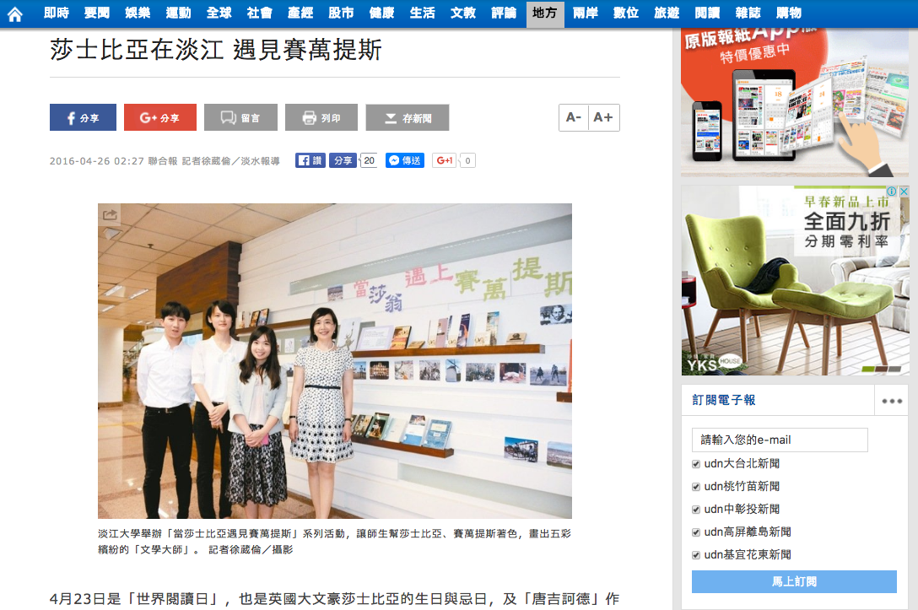
中文文字處理：中文斷詞
莎士比亞在淡江 遇見賽萬提斯
2016-04-26 02:27 聯合報 記者徐葳倫／淡水報導
分享4月23日是「世界閱讀日」，也是英國大文豪莎士比亞的生日與忌日，及「唐吉訶德」作者賽萬提斯逝世之日。英專起家的淡江大學舉辦「當莎士比亞遇見賽萬提斯」活動，規畫主題書展、彩繪活動，並添購新書，拉近學生與經典文學的距離。
首波登場的「主題書展」，展出2大文豪經典作品的原著、各種譯本以及DVD、電子書等數位化資料，校方也添購許多新書，吸引學生「搶鮮」閱讀經典名作。現場還規畫「彩繪大師」，讓學生發揮創意，畫出五彩繽紛的莎士比亞和賽萬提斯人像。
英語系四年級學生陳彥伶說，讀英語系接觸莎士比亞作品，但過去沒有舉辦書展時，這些作品都放在圖書館8樓，現在搬到1樓大廳陳列，不僅有很多莎士比亞、賽萬提斯的經典新書，還可藉由電子書、電影理解兩位作家，是以前沒有過的體驗。
英語系四年級學生鄭少淮表示，莎士比亞的「馬克白」、「羅密歐與茱麗葉」都已經讀過很多次，從經典文學中理解不同城市、國家的文化。
日文系學生賴喬郁說，原本只是喜歡塗鴉才來參加活動，後來才知道畫的是2個大文豪，接觸他們的作品，文學經典「原來離我這麼近」。
淡江大學外語學院院長陳小雀表示，莎士比亞的「to be, or not to be; that is the question」，賽萬提斯的「看得越多，行得越遠；書讀得越多，知識就越廣博」，都是來自文學的名言，校方希望用最簡單的方式，讓學生知道「文學不難」，就在你我身邊。
http://udn.com/news/story/7323/1653437-%E8%8E%8E%E5%A3%AB%E6%AF%94%E4%BA%9E%E5%9C%A8%E6%B7%A1%E6%B1%9F-%E9%81%87%E8%A6%8B%E8%B3%BD%E8%90%AC%E6%8F%90%E6%96%AF

Slide 71
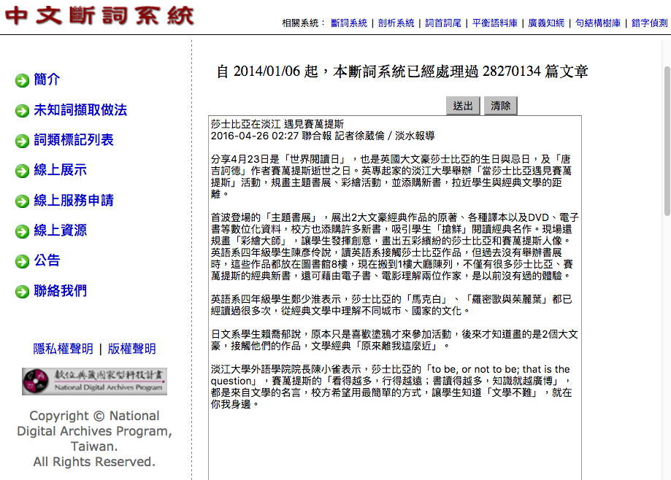
CKIP 中研院中文斷詞系統
http://ckipsvr.iis.sinica.edu.tw/

Slide 72
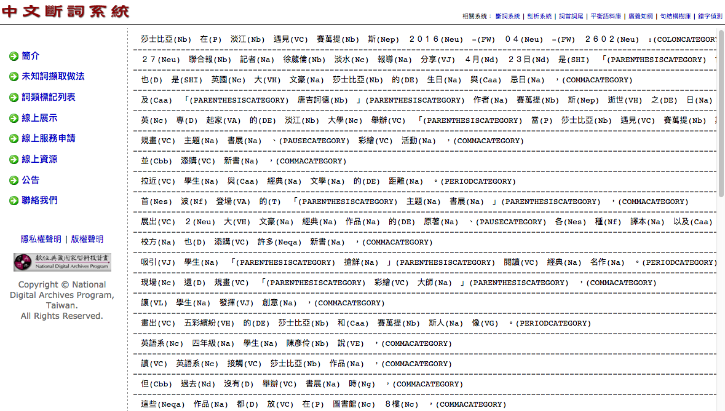
CKIP 中研院中文斷詞系統
http://ckipsvr.iis.sinica.edu.tw/

Slide 73
CKIP 中研院中文斷詞系統
http://ckipsvr.iis.sinica.edu.tw/
莎士比亞在淡江 遇見賽萬提斯
2016-04-26 02:27 聯合報 記者徐葳倫／淡水報導
分享4月23日是「世界閱讀日」，也是英國大文豪莎士比亞的生日與忌日，及「唐吉訶德」作者賽萬提斯逝世之日。英專起家的淡江大學舉辦「當莎士比亞遇見賽萬提斯」活動，規畫主題書展、彩繪活動，並添購新書，拉近學生與經典文學的距離。
莎士比亞(Nb) 在(P) 淡江(Nb) 遇見(VC) 賽萬提(Nb) 斯(Nep) ２０１６(Neu) -(FW) ０４(Neu) -(FW) ２６０２(Neu) :(COLONCATEGORY)
２７(Neu) 聯合報(Nb) 記者(Na) 徐葳倫(Nb) 淡水(Nc) 報導(Na) 分享(VJ) ４月(Nd) ２３日(Nd) 是(SHI) 「(PARENTHESISCATEGORY) 世界(Nc) 閱讀日(Na) 」(PARENTHESISCATEGORY) ，(COMMACATEGORY)
也(D) 是(SHI) 英國(Nc) 大(VH) 文豪(Na) 莎士比亞(Nb) 的(DE) 生日(Na) 與(Caa) 忌日(Na) ，(COMMACATEGORY)
及(Caa) 「(PARENTHESISCATEGORY) 唐吉訶德(Nb) 」(PARENTHESISCATEGORY) 作者(Na) 賽萬提(Nb) 斯(Nep) 逝世(VH) 之(DE) 日(Na) 。(PERIODCATEGORY)
英(Nc) 專(D) 起家(VA) 的(DE) 淡江(Nb) 大學(Nc) 舉辦(VC) 「(PARENTHESISCATEGORY) 當(P) 莎士比亞(Nb) 遇見(VC) 賽萬提(Nb) 斯(Nep) 」(PARENTHESISCATEGORY) 活動(Na) ，(COMMACATEGORY)
規畫(VC) 主題(Na) 書展(Na) 、(PAUSECATEGORY) 彩繪(VC) 活動(Na) ，(COMMACATEGORY)
並(Cbb) 添購(VC) 新書(Na) ，(COMMACATEGORY)
拉近(VC) 學生(Na) 與(Caa) 經典(Na) 文學(Na) 的(DE) 距離(Na) 。(PERIODCATEGORY)

Slide 74
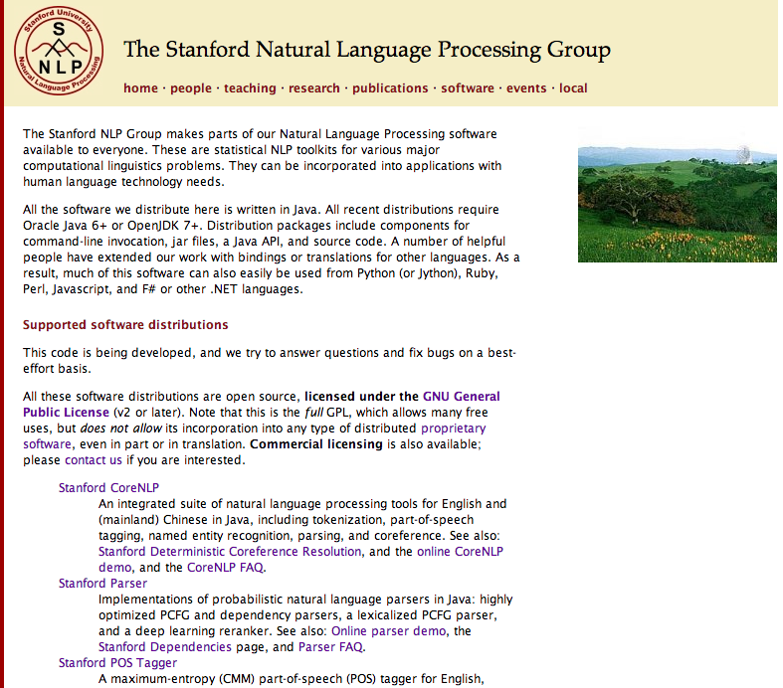
http://nlp.stanford.edu/software/index.shtml
Stanford NLP
Software

Slide 75
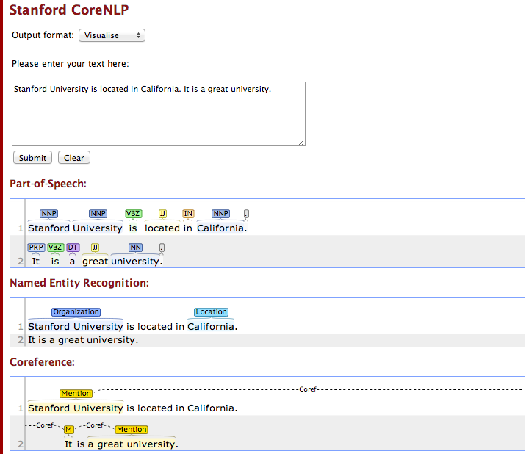
Stanford CoreNLP
http://nlp.stanford.edu:8080/corenlp/process

Slide 76
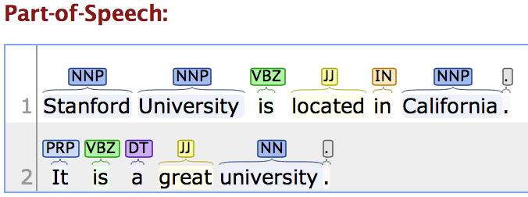
Stanford CoreNLP
http://nlp.stanford.edu:8080/corenlp/process
Stanford University is located in California. It is a great university.

Slide 77
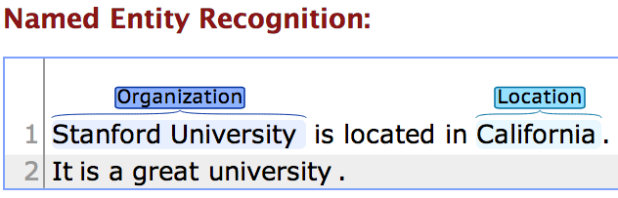
Stanford CoreNLP
http://nlp.stanford.edu:8080/corenlp/process
Stanford University is located in California. It is a great university.

Slide 78
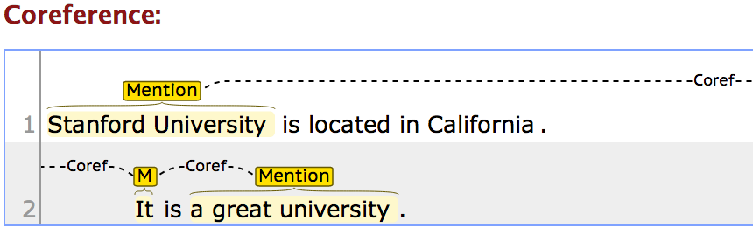
Stanford CoreNLP
http://nlp.stanford.edu:8080/corenlp/process
Stanford University is located in California. It is a great university.

Slide 79
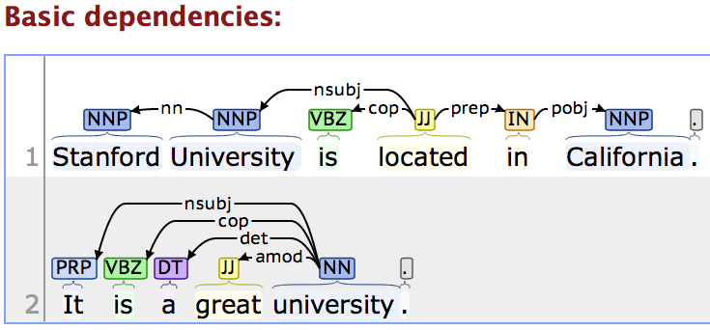
Stanford CoreNLP
http://nlp.stanford.edu:8080/corenlp/process
Stanford University is located in California. It is a great university.

Slide 80
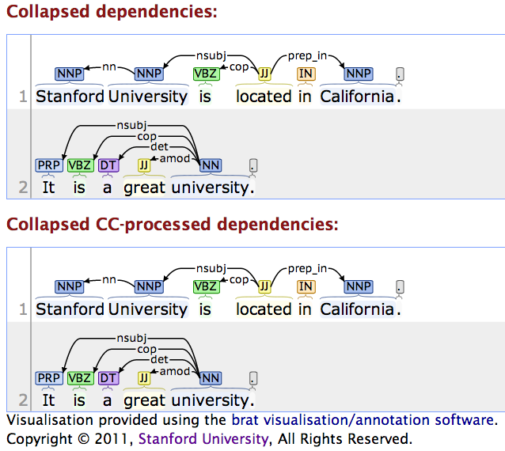
Stanford CoreNLP
http://nlp.stanford.edu:8080/corenlp/process

Slide 81
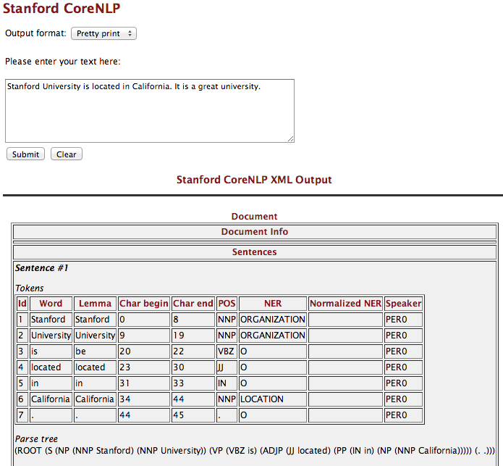
http://nlp.stanford.edu:8080/corenlp/process

Slide 82
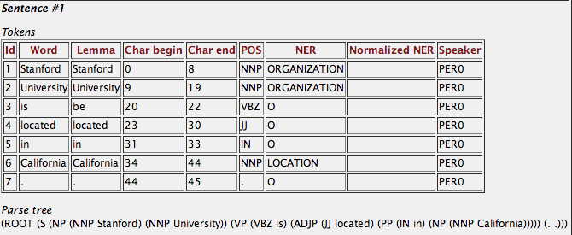
Stanford CoreNLP
http://nlp.stanford.edu:8080/corenlp/process
Stanford University is located in California. It is a great university.

Slide 83
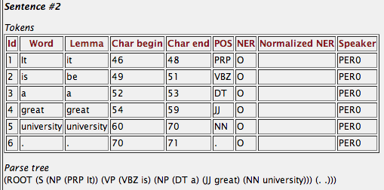
Stanford CoreNLP
http://nlp.stanford.edu:8080/corenlp/process
Stanford University is located in California. It is a great university.

Slide 84
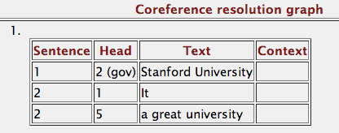
Stanford CoreNLP
http://nlp.stanford.edu:8080/corenlp/process
Stanford University is located in California. It is a great university.

Slide 85
Tokens
Id Word Lemma Char begin Char end POS NER Normalized NER Speaker
1 Stanford Stanford 0 8 NNP ORGANIZATION PER0
2 University University 9 19 NNP ORGANIZATION PER0
3 is be 20 22 VBZ O PER0
4 located located 23 30 JJ O PER0
5 in in 31 33 IN O PER0
6 California California 34 44 NNP LOCATION PER0
7 . . 44 45 . O PER0
Parse tree
(ROOT (S (NP (NNP Stanford) (NNP University)) (VP (VBZ is) (ADJP (JJ located) (PP (IN in) (NP (NNP California))))) (. .)))
Uncollapsed dependencies
root ( ROOT-0 , located-4 )
nn ( University-2 , Stanford-1 )
nsubj ( located-4 , University-2 )
cop ( located-4 , is-3 )
prep ( located-4 , in-5 )
pobj ( in-5 , California-6 )
Collapsed dependencies
root ( ROOT-0 , located-4 )
nn ( University-2 , Stanford-1 )
nsubj ( located-4 , University-2 )
cop ( located-4 , is-3 )
prep_in ( located-4 , California-6 )
Collapsed dependencies with CC processed
root ( ROOT-0 , located-4 )
nn ( University-2 , Stanford-1 )
nsubj ( located-4 , University-2 )
cop ( located-4 , is-3 )
prep_in ( located-4 , California-6 )
Stanford CoreNLP
http://nlp.stanford.edu:8080/corenlp/process
Stanford University is located in California. It is a great university.

Slide 86
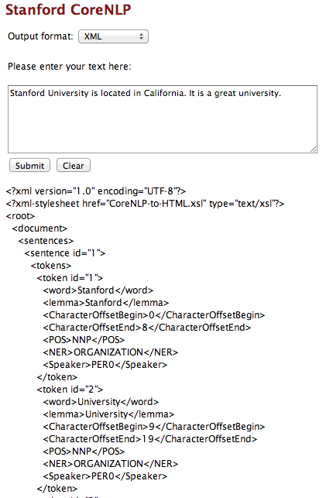
http://nlp.stanford.edu:8080/corenlp/process

Slide 87
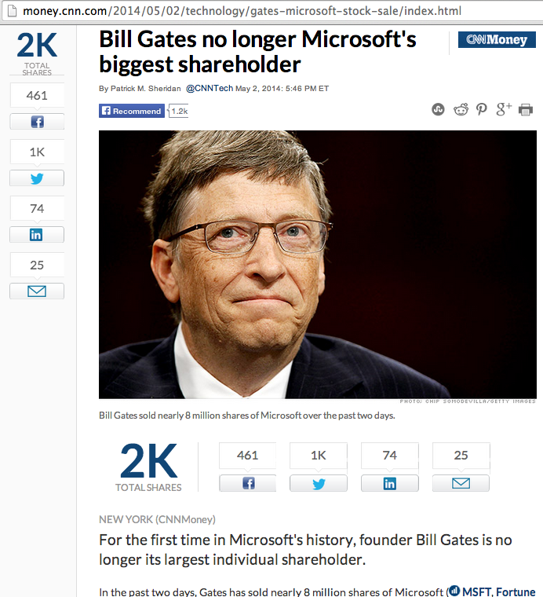
NER for News Article
http://money.cnn.com/2014/05/02/technology/gates-microsoft-stock-sale/index.html
Bill Gates no longer Microsoft's biggest shareholder
By Patrick M. Sheridan @CNNTech May 2, 2014: 5:46 PM ET
Bill Gates sold nearly 8 million shares of Microsoft over the past two days.
NEW YORK (CNNMoney)
For the first time in Microsoft's history, founder Bill Gates is no longer its largest individual shareholder.
In the past two days, Gates has sold nearly 8 million shares of Microsoft (MSFT, Fortune 500), bringing down his total to roughly 330 million.
That puts him behind Microsoft's former CEO Steve Ballmer who owns 333 million shares.
Related: Gates reclaims title of world's richest billionaire
Ballmer, who was Microsoft's CEO until earlier this year, was one of Gates' first hires.
It's a passing of the torch for Gates who has always been the largest single owner of his company's stock. Gates now spends his time and personal fortune helping run the Bill & Melinda Gates foundation.
The foundation has spent $28.3 billion fighting hunger and poverty since its inception back in 1997.

Slide 88
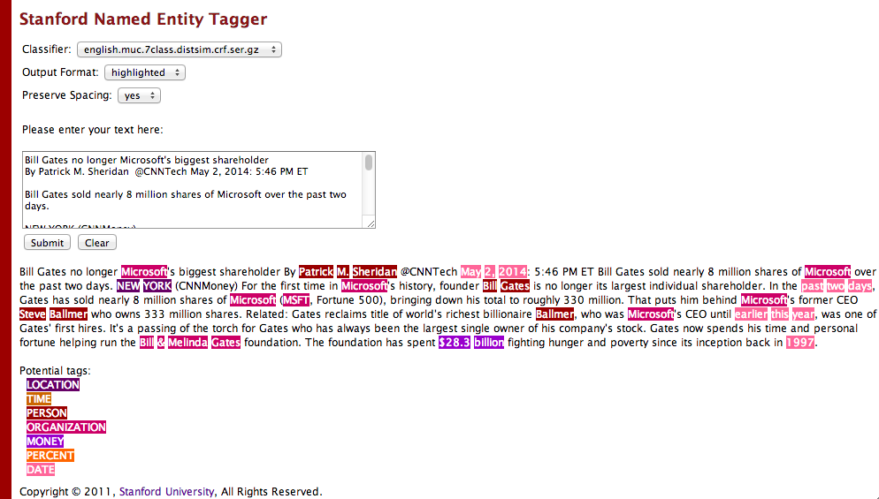
Stanford Named Entity Tagger (NER)
http://nlp.stanford.edu:8080/ner/process

Slide 89
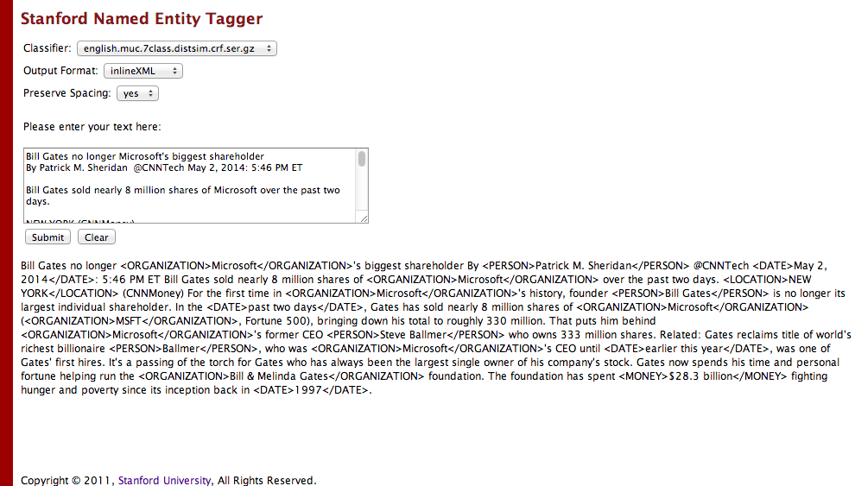
Stanford Named Entity Tagger (NER)
http://nlp.stanford.edu:8080/ner/process

Slide 90
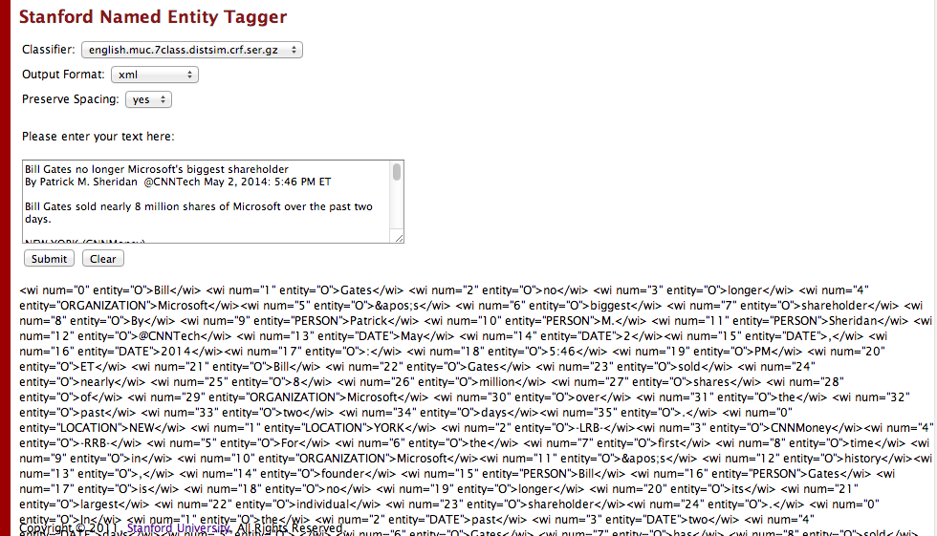
Stanford Named Entity Tagger (NER)
http://nlp.stanford.edu:8080/ner/process

Slide 91
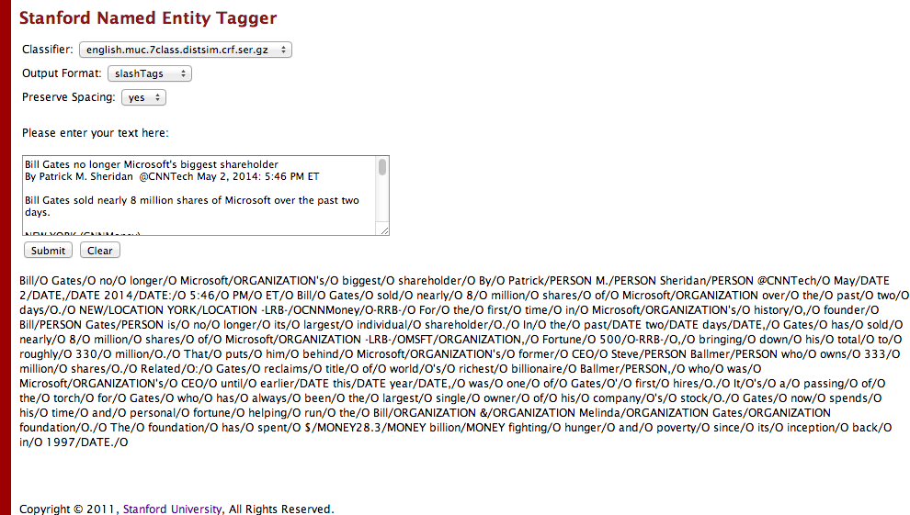
Stanford Named Entity Tagger (NER)
http://nlp.stanford.edu:8080/ner/process

Slide 92
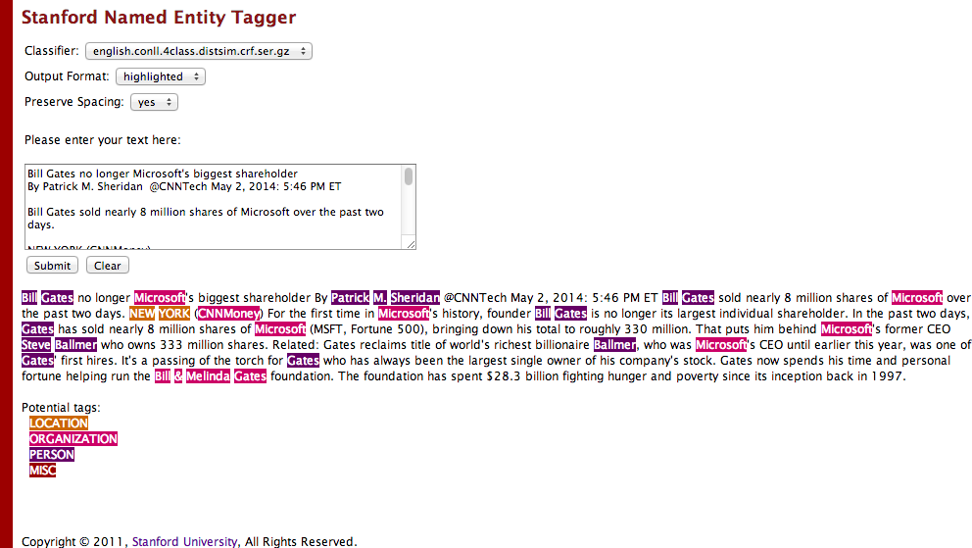
Stanford Named Entity Tagger (NER)
http://nlp.stanford.edu:8080/ner/process

Slide 93
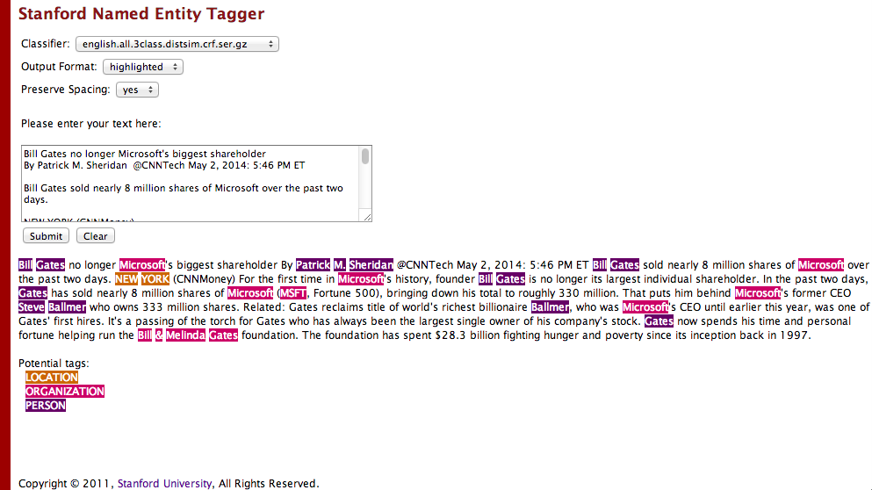
Stanford Named Entity Tagger (NER)
http://nlp.stanford.edu:8080/ner/process

Slide 94
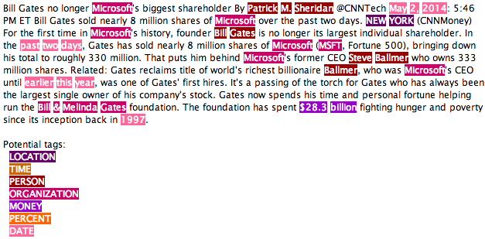
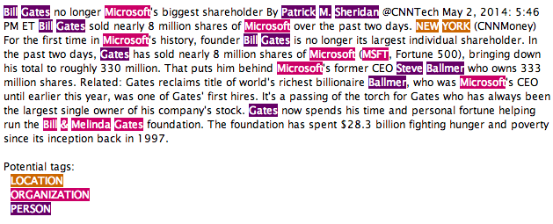
Classifier: english.muc.7class.distsim.crf.ser.gz
Classifier: english.all.3class.distsim.crf.ser.gz

Slide 95
Stanford Named Entity Tagger (NER)
http://nlp.stanford.edu:8080/ner/process
Stanford NER Output Format: inlineXML
Bill Gates no longer <ORGANIZATION>Microsoft</ORGANIZATION>'s biggest shareholder By <PERSON>Patrick M. Sheridan</PERSON> @CNNTech <DATE>May 2, 2014</DATE>: 5:46 PM ET Bill Gates sold nearly 8 million shares of <ORGANIZATION>Microsoft</ORGANIZATION> over the past two days. <LOCATION>NEW YORK</LOCATION> (CNNMoney) For the first time in <ORGANIZATION>Microsoft</ORGANIZATION>'s history, founder <PERSON>Bill Gates</PERSON> is no longer its largest individual shareholder. In the <DATE>past two days</DATE>, Gates has sold nearly 8 million shares of <ORGANIZATION>Microsoft</ORGANIZATION> (<ORGANIZATION>MSFT</ORGANIZATION>, Fortune 500), bringing down his total to roughly 330 million. That puts him behind <ORGANIZATION>Microsoft</ORGANIZATION>'s former CEO <PERSON>Steve Ballmer</PERSON> who owns 333 million shares. Related: Gates reclaims title of world's richest billionaire <PERSON>Ballmer</PERSON>, who was <ORGANIZATION>Microsoft</ORGANIZATION>'s CEO until <DATE>earlier this year</DATE>, was one of Gates' first hires. It's a passing of the torch for Gates who has always been the largest single owner of his company's stock. Gates now spends his time and personal fortune helping run the <ORGANIZATION>Bill & Melinda Gates</ORGANIZATION> foundation. The foundation has spent <MONEY>$28.3 billion</MONEY> fighting hunger and poverty since its inception back in <DATE>1997</DATE>.

Slide 96
Stanford Named Entity Tagger (NER)
http://nlp.stanford.edu:8080/ner/process
Stanford NER Output Format: slashTags
Bill/O Gates/O no/O longer/O Microsoft/ORGANIZATION's/O biggest/O shareholder/O By/O Patrick/PERSON M./PERSON Sheridan/PERSON @CNNTech/O May/DATE 2/DATE,/DATE 2014/DATE:/O 5:46/O PM/O ET/O Bill/O Gates/O sold/O nearly/O 8/O million/O shares/O of/O Microsoft/ORGANIZATION over/O the/O past/O two/O days/O./O NEW/LOCATION YORK/LOCATION -LRB-/OCNNMoney/O-RRB-/O For/O the/O first/O time/O in/O Microsoft/ORGANIZATION's/O history/O,/O founder/O Bill/PERSON Gates/PERSON is/O no/O longer/O its/O largest/O individual/O shareholder/O./O In/O the/O past/DATE two/DATE days/DATE,/O Gates/O has/O sold/O nearly/O 8/O million/O shares/O of/O Microsoft/ORGANIZATION -LRB-/OMSFT/ORGANIZATION,/O Fortune/O 500/O-RRB-/O,/O bringing/O down/O his/O total/O to/O roughly/O 330/O million/O./O That/O puts/O him/O behind/O Microsoft/ORGANIZATION's/O former/O CEO/O Steve/PERSON Ballmer/PERSON who/O owns/O 333/O million/O shares/O./O Related/O:/O Gates/O reclaims/O title/O of/O world/O's/O richest/O billionaire/O Ballmer/PERSON,/O who/O was/O Microsoft/ORGANIZATION's/O CEO/O until/O earlier/DATE this/DATE year/DATE,/O was/O one/O of/O Gates/O'/O first/O hires/O./O It/O's/O a/O passing/O of/O the/O torch/O for/O Gates/O who/O has/O always/O been/O the/O largest/O single/O owner/O of/O his/O company/O's/O stock/O./O Gates/O now/O spends/O his/O time/O and/O personal/O fortune/O helping/O run/O the/O Bill/ORGANIZATION &/ORGANIZATION Melinda/ORGANIZATION Gates/ORGANIZATION foundation/O./O The/O foundation/O has/O spent/O $/MONEY28.3/MONEY billion/MONEY fighting/O hunger/O and/O poverty/O since/O its/O inception/O back/O in/O 1997/DATE./O

Slide 97
自然語言處理與資訊檢索研究資源
http://mail.tku.edu.tw/myday/resources/
淡江大學資訊管理學系
(Department of Information Management, Tamkang University)
自然語言處理與資訊檢索研究資源
(Resources of Natural Language Processing and Information Retrieval)
1. 中央研究院CKIP中文斷詞系統
授權單位：中央研究院詞庫小組
授權金額：免費授權學術使用。
授權日期：2011.03.31。
CKIP: http://ckipsvr.iis.sinica.edu.tw/
2. 「中央研究院中英雙語詞網」(The Academia Sinica Bilingual Wordnet)
「中央研究院中英雙語詞網」(The Academia Sinica Bilingual Wordnet)，
授權「淡江大學資訊管理學系」(Department of Information Management, Tamkang University)學術使用。
授權單位：中央研究院，中華民國計算語言學學會
授權金額：「中央研究院中英雙語詞網」(The Academia Sinica Bilingual Wordnet) 國內非營利機構(1-10人使用) 非會員：NT$61,000元，
授權日期：2011.05.16。
Sinica BOW: http://bow.ling.sinica.edu.tw/

Slide 98
自然語言處理與資訊檢索研究資源
http://mail.tku.edu.tw/myday/resources/
3. 開放式中研院專名問答系統 (OpenASQA)
授權單位：中央研究院資訊科學研究所智慧型代理人系統實驗室
授權金額：免費授權學術使用。
授權日期：2011.05.05。
ASQA: http://asqa.iis.sinica.edu.tw/

Slide 99
自然語言處理與資訊檢索研究資源
http://mail.tku.edu.tw/myday/resources/
4. 哈工大資訊檢索研究中心(HIT-CIR)語言技術平臺
語料資源
哈工大資訊檢索研究中心漢語依存樹庫 ［HIT-CIR Chinese Dependency Treebank］
哈工大資訊檢索研究中心同義詞詞林擴展版 ［HIT-CIR Tongyici Cilin (Extended)］
語言處理模組
斷句 (SplitSentence: Sentence Splitting)
詞法分析 (IRLAS: Lexical Analysis System)
基於SVMTool的詞性標注 (PosTag: Part-of-speech Tagging)
命名實體識別 (NER: Named Entity Recognition)
基於動態局部優化的依存句法分析 (Parser: Dependency Parsing)
基於圖的依存句法分析 (GParser: Graph-based DP)
全文詞義消歧 (WSD: Word Sense Disambiguation)
淺層語義標注模組 (SRL: hallow Semantics Labeling)
資料表示
語言技術置標語言 (LTML: Language Technology Markup Language)
視覺化工具
LTML視覺化XSL
授權單位：哈工大資訊檢索研究中心(HIT-CIR)
授權金額：免費授權學術使用。
授權日期：2011.05.03。
HIT IR: http://ir.hit.edu.cn/

Slide 100
Architectures of
Sentiment Analytics

Slide 101
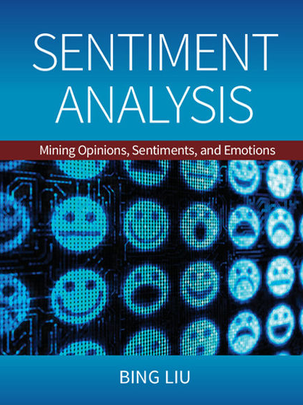
Bing Liu (2015),
Sentiment Analysis:
Mining Opinions, Sentiments, and Emotions,
Cambridge University Press
http://www.amazon.com/Sentiment-Analysis-Opinions-Sentiments-Emotions/dp/1107017890

Slide 102
Sentiment Analysis and
Opinion Mining
Computational study of
opinions,
sentiments,
subjectivity,
evaluations,
attitudes,
appraisal,
affects,
views,
emotions,
ets., expressed in text.
  Reviews, blogs, discussions, news, comments, feedback, or any other documents
Source: Bing Liu (2011) , “Web Data Mining: Exploring Hyperlinks, Contents, and Usage Data,” Springer, 2nd Edition,

Slide 103
Research Area of Opinion Mining
Many names and tasks with difference objective and models
  Sentiment analysis
  Opinion mining
  Sentiment mining
  Subjectivity analysis
  Affect analysis
  Emotion detection
  Opinion spam detection
Source: Bing Liu (2011) , “Web Data Mining: Exploring Hyperlinks, Contents, and Usage Data,” Springer, 2nd Edition,

Slide 104
Example of Opinion:
review segment on iPhone
“(1) I bought an iPhone a few days ago.
(2) It was such a nice phone.
(3) The touch screen was really cool.
(4) The voice quality was clear too.
(5) However, my mother was mad with me as I did not tell her before I bought it.
(6) She also thought the phone was too expensive, and wanted me to return it to the shop. … ”
+Positive Opinion
-Negative Opinion
Source: Bing Liu (2011) , “Web Data Mining: Exploring Hyperlinks, Contents, and Usage Data,” Springer, 2nd Edition,

Slide 105
Sentiment Analysis Architecture
Positive
tweets
Negative
tweets
Word
features
Training
set
Features
extractor
Classifier
Features
extractor
Tweet
Positive
Negative
Vishal Kharde and Sheetal Sonawane (2016), "Sentiment Analysis of Twitter Data: A Survey of Techniques,"
International Journal of Computer Applications, Vol 139, No. 11, 2016. pp.5-15

Slide 106
Sentiment Classification Based on Emoticons
Tweeter
Tweeter Streaming API 1.1
Tweet preprocessing
Based on Positive Emotions
Based on Negative Emotions
Generate Training Dataset for Tweet
Positive tweets
Negative tweets
Test Dataset
Training Dataset
Classifier
Feature Extraction
Positive
Negative
Vishal Kharde and Sheetal Sonawane (2016), "Sentiment Analysis of Twitter Data: A Survey of Techniques,"
International Journal of Computer Applications, Vol 139, No. 11, 2016. pp.5-15

Slide 107
Lexicon-Based Model
Tokenized Document Collection
Preassembled Word Lists
Sentiment Scoring and Classification:
Polarity
Merged
Lexicon
Generic
Word Lists
Sentiment
Polarity
Vishal Kharde and Sheetal Sonawane (2016), "Sentiment Analysis of Twitter Data: A Survey of Techniques,"
International Journal of Computer Applications, Vol 139, No. 11, 2016. pp.5-15

Slide 108
Sentiment Analysis Tasks
Object/Feature extraction
Opinionated Document
Subjectivity Classification
Sentiment Classification
Opinion holder extraction
Vishal Kharde and Sheetal Sonawane (2016), "Sentiment Analysis of Twitter Data: A Survey of Techniques,"
International Journal of Computer Applications, Vol 139, No. 11, 2016. pp.5-15

Slide 109
Sentiment Analysis vs.
Subjectivity Analysis
Sentiment Analysis
Subjectivity Analysis
Positive
Subjective
Negative
Neutral
Objective

Slide 110
Levels of Sentiment Analysis
Sentiment Analysis
Word
level
Sentiment Analysis
Sentence
level
Sentiment Analysis
Document
level
Sentiment Analysis
Feature level
Sentiment Analysis
Vishal Kharde and Sheetal Sonawane (2016), "Sentiment Analysis of Twitter Data: A Survey of Techniques,"
International Journal of Computer Applications, Vol 139, No. 11, 2016. pp.5-15

Slide 111
Sentiment Analysis
Subjectivity
Classification
Polarity Determination
Approaches
Machine Learning based
Sentiment Classification
Vagueness resolution in opinionated text
Lexicon based
Sentiment Analysis
Review Usefulness Measurement
Multi- & Cross- Lingual SC
Hybrid
approaches
Opinion Spam Detection
Cross-domain SC
Lexicon Creation
Ontology based
Tasks
Non-Ontology based
Aspect Extraction
Application
Source: Kumar Ravi and Vadlamani Ravi (2015), "A survey on opinion mining and sentiment analysis: tasks, approaches and applications." Knowledge-Based Systems, 89, pp.14-46.

Slide 112
Sentiment Classification Techniques
Decision Tree Classifiers
Support Vector Machine (SVM)
Supervised Learning
Neural Network (NN
Machine Learning Approach
Linear Classifiers
Deep Learning (DL)
Rule-based Classifiers
Naïve Bayes
(NB)
Sentiment Analysis
Unsupervised Learning
Probabilistic Classifiers
Bayesian Network (BN)
Dictionary-based Approach
Maximum Entropy (ME)
Lexicon-based Approach
Statistical
Corpus-based Approach
Semantic
Source: Jesus Serrano-Guerrero, Jose A. Olivas, Francisco P. Romero, and Enrique Herrera-Viedma (2015),
"Sentiment analysis: A review and comparative analysis of web services," Information Sciences, 311, pp. 18-38.

Slide 113
Example of SentiWordNet
POS ID PosScore NegScore SynsetTerms Gloss
a 00217728 0.75 0 beautiful#1 delighting the senses or exciting intellectual or emotional admiration; "a beautiful child"; "beautiful country"; "a beautiful painting"; "a beautiful theory"; "a beautiful party“
a 00227507 0.75 0 best#1 (superlative of `good') having the most positive qualities; "the best film of the year"; "the best solution"; "the best time for planting"; "wore his best suit“
r 00042614 0 0.625 unhappily#2 sadly#1 in an unfortunate way; "sadly he died before he could see his grandchild“
r 00093270 0 0.875 woefully#1 sadly#3 lamentably#1 deplorably#1 in an unfortunate or deplorable manner; "he was sadly neglected"; "it was woefully inadequate“
r 00404501 0 0.25 sadly#2 with sadness; in a sad manner; "`She died last night,' he said sadly"

Slide 114
Evaluation of
Text Mining and Sentiment Analysis
Evaluation of Information Retrieval
Evaluation of Classification Model (Prediction)
  Accuracy
  Precision
  Recall
  F-score

Slide 115
Natural Language Processing with
NLTK in Python

Slide 116

Source: https://www.python.org/community/logos/

Slide 117
Python for Big Data Analytics
Source: http://spectrum.ieee.org/computing/software/the-2016-top-programming-languages

Slide 118
Python: Analytics and Data Science Software
Source: http://www.kdnuggets.com/2016/06/r-python-top-analytics-data-mining-data-science-software.html

Slide 119
Python
https://www.python.org/

Slide 120
Python is an interpreted, object-oriented, high-level programming language with dynamic semantics.
Source: https://www.python.org/doc/essays/blurb/

Slide 121
Anaconda
https://www.continuum.io/

Slide 122
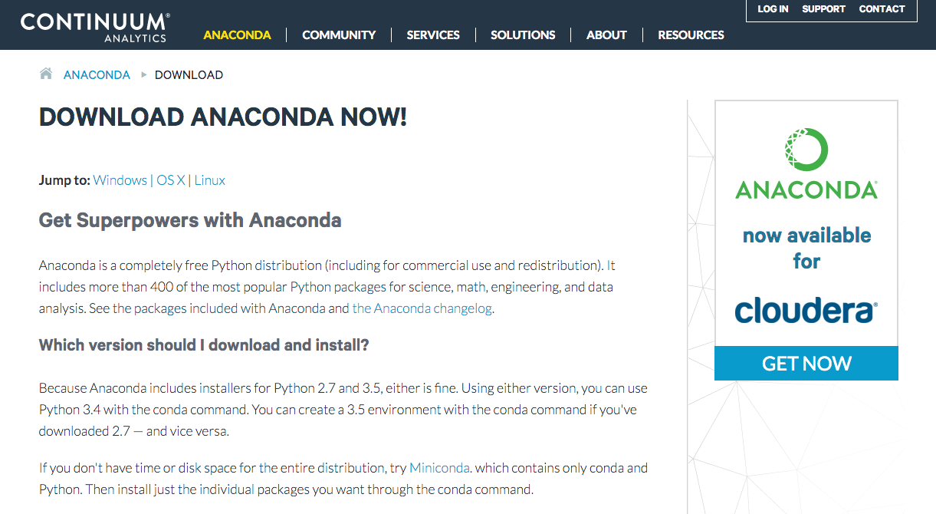
Download Anaconda
https://www.continuum.io/downloads

Slide 123
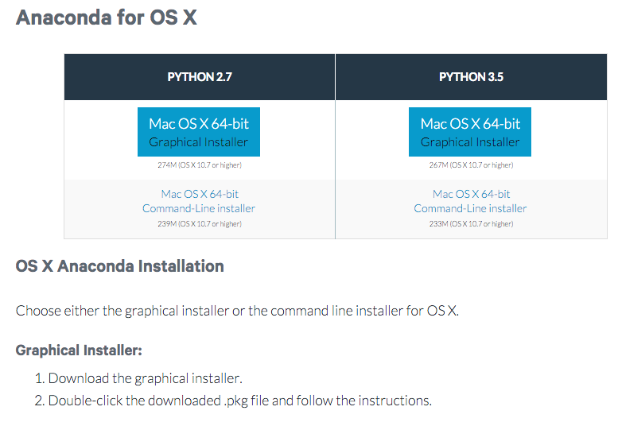
Download Anaconda Python 3.5
https://www.continuum.io/downloads

Slide 124
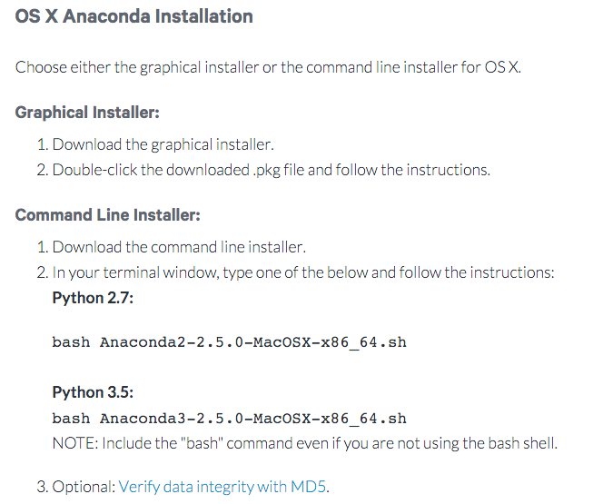
OS X Anaconda Installation
https://www.continuum.io/downloads

Slide 125

Anaconda-Navigator

Slide 126
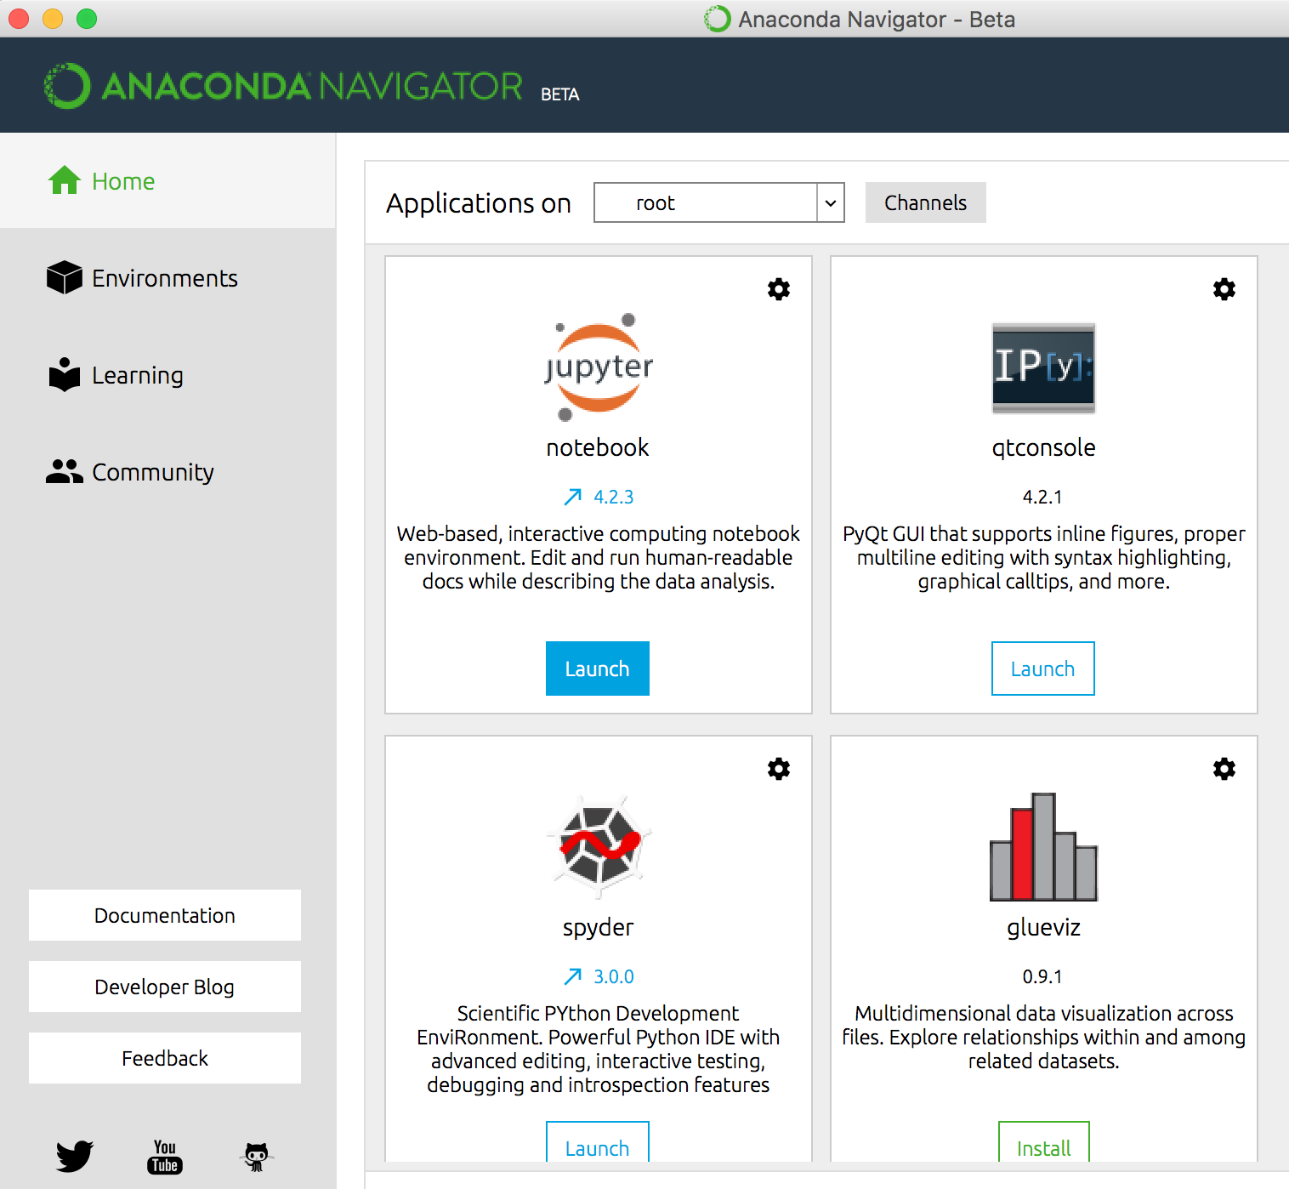
Jupyter notebook

Slide 127
Python versions (py2 and py3)
Python 0.9.0 released in 1991 (first release)
Python 1.0 released in 1994
Python 2.0 released in 2000
Python 2.6 released in 2008
Python 2.7 released in 2010
Python 3.0 released in 2008
Python 3.3 released in 2010
Python 3.4 released in 2014
Python 3.5 released in 2015
Source: Yves Hilpisch (2014), Python for Finance: Analyze Big Financial Data, O'Reilly

Slide 128
Python (Python 2.7 & Python 3.5)
Standard Syntax
Python 2
Python 3
Old
Py2
Py3
only
Py2&3
Source: PyCon Australia (2014), Writing Python 2/3 compatible code by Edward Schofield
https://www.youtube.com/watch?v=KOqk8j11aAI

Slide 129
from __future__ import ...
Python 2
Python 3
Old Py2
Py2&3
Py3
only
Source: PyCon Australia (2014), Writing Python 2/3 compatible code by Edward Schofield
https://www.youtube.com/watch?v=KOqk8j11aAI

Slide 130
from future.builtins import *
Python 2
Python 3
Py2&3
Py3
only
Old Py2
Source: PyCon Australia (2014), Writing Python 2/3 compatible code by Edward Schofield
https://www.youtube.com/watch?v=KOqk8j11aAI

Slide 131
from past.builtins import *
Python 2
Python 3
Py2&3
Py3
only
Old Py2
Source: PyCon Australia (2014), Writing Python 2/3 compatible code by Edward Schofield
https://www.youtube.com/watch?v=KOqk8j11aAI

Slide 132
ipython notebook

Slide 133

ipython notebook

Slide 134

jupyter notebook
Python 3

Slide 135

jupyter notebook
Python 3

Slide 136

jupyter notebook
Python 2

Slide 137

jupyter notebook
Python 2

Slide 138

ipython notebook
jupyter notebook

Slide 139

jupyter notebook

Slide 140

jupyter notebook

Slide 141

print(‘Hello World, Python’)

Slide 142

print(‘Hello World, Python’)

Slide 143
print
# Python 2 only:
print 'Hello’
# Python 2 and 3:
print('Hello')
# Python 2 only:
print 'Hello', 'Guido’
# Python 2 and 3:
from __future__ import print_function #(at top of module)
print('Hello', 'Guido')
http://python-future.org/compatible_idioms.html

Slide 144

Writing Python 2-3 compatible code
Essential syntax differences
http://python-future.org/compatible_idioms.html

Slide 145
Unicode (text) string literals
# Python 2 only
s1 = 'The Zen of Python'
s2 = u'きたないのよりきれいな方がいい\n'
# Python 2 and 3
s1 = u'The Zen of Python'
s2 = u'きたないのよりきれいな方がいい\n'
http://python-future.org/compatible_idioms.html

Slide 146
Unicode (text) string literals
# Python 2 and 3
from __future__ import unicode_literals # at top of module
s1 = 'The Zen of Python'
s2 = 'きたないのよりきれいな方がいい\n'
http://python-future.org/compatible_idioms.html

Slide 147
Source: https://www.python.org/community/logos/

Slide 148
Text input and output
print("Hello World")
print("Hello World\nThis is a message")
x = 3
print(x)
x = 2
y = 3
print(x, ' ', y)
name = input("Enter a name: ")
x = int(input("What is x? "))
x = float(input("Write a number"))
Source: http://pythonprogramminglanguage.com/text-input-and-output/

Slide 149
Variables
x = 2
price = 2.5
word = 'Hello'
word = 'Hello'
word = "Hello"
word = '''Hello'''
x = 2
x = x + 1
x = 5
Source: http://pythonprogramminglanguage.com/

Slide 150

Python Basic Operators
print('7 + 2 =', 7 + 2)
print('7 - 2 =', 7 - 2)
print('7 * 2 =', 7 * 2)
print('7 / 2 =', 7 / 2)
print('7 // 2 =', 7 // 2)
print('7 % 2 =', 7 % 2)
print('7 ** 2 =', 7 ** 2)

Slide 151
BMI Calculator in Python
height_cm = float(input("Enter your height in cm: "))
weight_kg = float(input("Enter your weight in kg: "))
height_m = height_cm/100
BMI = (weight_kg/(height_m**2))
print("Your BMI is: " + str(round(BMI,1)))
Source: http://code.activestate.com/recipes/580615-bmi-code/

Slide 152
If statements
> greater than
< smaller than
== equals
!= is not
score = 80
if score >=60 :
print("Pass")
else:
print("Fail")
Source: http://pythonprogramminglanguage.com/

Slide 153
For loops
for i in range(1,11):
print(i)
1
2
3
4
5
6
7
8
9
10
Source: http://pythonprogramminglanguage.com/

Slide 154
For loops
for i in range(1,10):
for j in range(1,10):
print(i, ' * ' , j , ' = ', i*j)
9 * 1 = 9
9 * 2 = 18
9 * 3 = 27
9 * 4 = 36
9 * 5 = 45
9 * 6 = 54
9 * 7 = 63
9 * 8 = 72
9 * 9 = 81
Source: http://pythonprogramminglanguage.com/

Slide 155
Functions
def convertCMtoM(xcm):
m = xcm/100
return m
cm = 180
m = convertCMtoM(cm)
print(str(m))
1.8

Slide 156
Lists
x = [60, 70, 80, 90]
print(len(x))
print(x[0])
print(x[1])
print(x[-1])
60
70
90

Slide 157
Tuples
A tuple in Python is a collection that
cannot be modified.
A tuple is defined using parenthesis.
x = (10, 20, 30, 40, 50)
print(x[0])
print(x[1])
print(x[2])
print(x[-1])
10
20
30
50
Source: http://pythonprogramminglanguage.com/tuples/

Slide 158
Python Ecosystem

Slide 159




Python Ecosystem import math
math.log?

Slide 160
NumPy
NumPy provides a
multidimensional array object
to store homogenous or heterogeneous data; it also provides optimized functions/methods to operate on this array object.
Source: Yves Hilpisch (2014), Python for Finance: Analyze Big Financial Data, O'Reilly

Slide 161
v = range(1, 6) print(v)
2 * v import numpy as np v = np.arange(1, 6) v
2 * v
NumPy
Source: Yves Hilpisch (2014), Python for Finance: Analyze Big Financial Data, O'Reilly

Slide 162


Slide 163
Compatible
Python 2 and Python 3 Code
print()
Exceptions
Division
Unicode strings
Bad imports
Source: DrapsTV (2016), Compatible Python 2 & 3 Code
https://www.youtube.com/watch?v=5Pwc-Rd4qJA

Slide 164
Compatible
Python 2 and Python 3 Code
print()
print(“This works in py2 and py3”)
from __future__ import print_function
print(“Hello”, “World”)
Source: DrapsTV (2016), Compatible Python 2 & 3 Code
https://www.youtube.com/watch?v=5Pwc-Rd4qJA

Slide 165
File IO with open()
# Python 2 only
f = open('myfile.txt')
data = f.read() # as a byte string
text = data.decode('utf-8')
# Python 2 and 3: alternative 1
from io import open
f = open('myfile.txt', 'rb')
data = f.read() # as bytes
text = data.decode('utf-8') # unicode, not bytes
# Python 2 and 3: alternative 2
from io import open
f = open('myfile.txt', encoding='utf-8')
text = f.read() # unicode, not bytes
https://github.com/PythonCharmers/python-future/blob/master/docs/notebooks/Writing%20Python%202-3%20compatible%20code.ipynb

Slide 166

Six: Python 2 and 3 Compatibility Library
https://pythonhosted.org/six/

Slide 167

Conda Test Drive
http://conda.pydata.org/docs/test-drive.html

Slide 168

Managing Conda and Anaconda
http://conda.pydata.org/docs/_downloads/conda-cheatsheet.pdf

Slide 169

Managing environments
http://conda.pydata.org/docs/_downloads/conda-cheatsheet.pdf

Slide 170

Managing Python
http://conda.pydata.org/docs/_downloads/conda-cheatsheet.pdf

Slide 171

Managing Packages in Python
http://conda.pydata.org/docs/_downloads/conda-cheatsheet.pdf

Slide 172

PyCharm: Python IDE
http://www.jetbrains.com/pycharm/

Slide 173

NLTK (Natural Language Toolkit)
http://www.nltk.org/

Slide 174


jupyter notebook

Slide 175

Jupyter New Terminal

Slide 176

conda list

Slide 177

conda list
nltk 3.1 py27_0

Slide 178

help('modules')

Slide 179

import nltk
Source: http://www.nltk.org/

Slide 180
import nltk
nltk.download()
Source: http://www.nltk.org/

Slide 181

import nltk
nltk.download()
Source: http://www.nltk.org/

Slide 182

import nltk
nltk.download()
Source: http://www.nltk.org/

Slide 183

nltk_data

Slide 184
At eight o'clock on Thursday morning Arthur didn't feel very good.
Source: http://www.nltk.org/

Slide 185
[('At', 'IN'),
('eight', 'CD'),
("o'clock", 'NN'),
('on', 'IN'),
('Thursday', 'NNP'),
('morning', 'NN'),
('Arthur', 'NNP'),
('did', 'VBD'),
("n't", 'RB'),
('feel', 'VB'),
('very', 'RB'),
('good', 'JJ'),
('.', '.')]
Source: http://www.nltk.org/

Slide 186

import nltk
sentence = "At eight o'clock on Thursday morning Arthur didn't feel very good."
tokens = nltk.word_tokenize(sentence)
tokens
print(tokens)
Source: http://www.nltk.org/

Slide 187

tagged = nltk.pos_tag(tokens)
tagged[0:6]
Source: http://www.nltk.org/

Slide 188

tagged
Source: http://www.nltk.org/

Slide 189

At eight o'clock on Thursday morning Arthur didn't feel very good.
print(tagged)
[('At', 'IN'), ('eight', 'CD'), ("o'clock", 'NN'), ('on', 'IN'), ('Thursday', 'NNP'), ('morning', 'NN'), ('Arthur', 'NNP'), ('did', 'VBD'), ("n't", 'RB'), ('feel', 'VB'), ('very', 'RB'), ('good', 'JJ'), ('.', '.')]
Source: http://www.nltk.org/

Slide 190

entities = nltk.chunk.ne_chunk(tagged)
entities
Tree('S', [('At', 'IN'), ('eight', 'CD'), ("o'clock", 'JJ'),
('on', 'IN'), ('Thursday', 'NNP'), ('morning', 'NN'),
Tree('PERSON', [('Arthur', 'NNP')]),
('did', 'VBD'), ("n't", 'RB'), ('feel', 'VB'),
('very', 'RB'), ('good', 'JJ'), ('.', '.')])
Source: http://www.nltk.org/

Slide 191


from nltk.corpus import treebank
t = treebank.parsed_sents('wsj_0001.mrg')[0]
t.draw()
Source: http://www.nltk.org/

Slide 192

wsj_0001.mrg

Slide 193

wsj_0001.mrg
Source: http://www.nltk.org/

Slide 194

Python Jieba “结巴”中文分词
https://github.com/fxsjy/jieba

Slide 195
Python Jieba “结巴”中文分词
import jieba
import jieba.posseg as pseg
sentence = "銀行產業正在改變，金融機構欲挖角科技人才"
words = jieba.cut(sentence)
print(sentence)
print(" ".join(words))
wordspos = pseg.cut(sentence)
result = ''
for word, pos in wordspos:
print(word + ' (' + pos + ')')
result = result + ' ' + word + '(' + pos + ')'
print(result.strip())

Slide 196


import jieba words = jieba.cut(sentence)

Slide 197
Python Jieba “结巴”中文分词
https://github.com/fxsjy/jieba
jieba.set_dictionary('data/dict.txt.big')
  #/anaconda/lib/python3.5/site-packages/jieba
  dict.txt (5.4MB)(349,046)
  dict.txt.big.txt (8.6MB)(584,429)
  dict.txt.small.txt (1.6MB)(109,750)
  dict.tw.txt (4.2MB)(308,431)
https://github.com/ldkrsi/jieba-zh_TW
  結巴中文斷詞台灣繁體版本

Slide 198

Sebastian Raschka (2015),
Python Machine Learning,
Packt Publishing
Source: http://www.amazon.com/Python-Machine-Learning-Sebastian-Raschka/dp/1783555130
Notes:
Source: Sebastian Raschka (2015), Python Machine Learning, Packt Publishing
Source: http://www.amazon.com/Python-Machine-Learning-Sebastian-Raschka/dp/1783555130

Slide 199

Sunila Gollapudi (2016),
Practical Machine Learning,
Packt Publishing
Source: http://www.amazon.com/Practical-Machine-Learning-Sunila-Gollapudi/dp/178439968X
Notes:
Source: Sunila Gollapudi (2016), Practical Machine Learning, Packt Publishing
Source: http://www.amazon.com/Practical-Machine-Learning-Sunila-Gollapudi/dp/178439968X

Slide 200
Machine Learning Models
Deep Learning
Kernel
Association rules
Ensemble
Decision tree
Dimensionality reduction
Clustering
Regression Analysis
Bayesian
Instance based
Source: Sunila Gollapudi (2016), Practical Machine Learning, Packt Publishing

Slide 201
Summary
Differentiate between
text mining, Web mining and data mining
Text mining
Web mining
  Web content mining
  Web structure mining
  Web usage mining
Natural Language Processing (NLP)
Natural Language Processing with NLTK in Python

Slide 202
References
Efraim Turban, Ramesh Sharda, Dursun Delen, Decision Support and Business Intelligence Systems, Ninth Edition, 2011, Pearson.
Steven Bird, Ewan Klein and Edward Loper, Natural Language Processing with Python, 2009, O'Reilly Media, http://www.nltk.org/book/ , http://www.nltk.org/book_1ed/
Nitin Hardeniya, NLTK Essentials, 2015, Packt Publishing
Michael W. Berry and Jacob Kogan, Text Mining: Applications and Theory, 2010, Wiley
Guandong Xu, Yanchun Zhang, Lin Li, Web Mining and Social Networking: Techniques and Applications, 2011, Springer
Matthew A. Russell, Mining the Social Web: Analyzing Data from Facebook, Twitter, LinkedIn, and Other Social Media Sites, 2011, O'Reilly Media
Bing Liu, Web Data Mining: Exploring Hyperlinks, Contents, and Usage Data, 2009, Springer
Bruce Croft, Donald Metzler, and Trevor Strohman, Search Engines: Information Retrieval in Practice, 2008, Addison Wesley, http://www.search-engines-book.com/
Christopher D. Manning and Hinrich Schütze, Foundations of Statistical Natural Language Processing, 1999, The MIT Press
Text Mining, http://en.wikipedia.org/wiki/Text_mining

Slide 203
Text Mining and
Natural Language Processing
(文字探勘與自然語言處理)
Q & A
Tamkang
University
Time: 2017/01/23 (Mon) (14:00-17:00)
Place: 國立臺北護理健康大學 城區部 (台北市內江街89號) C302
Host: 祝國忠 院長 (健康科技學院院長)
Min-Yuh Day
戴敏育
Assistant Professor
專任助理教授
Dept. of Information Management, Tamkang University
淡江大學 資訊管理學系
http://mail. tku.edu.tw/myday/
2017-01-23

