Slide 1
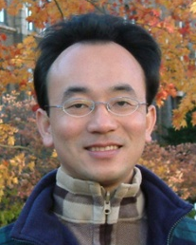
Tamkang University
Social Computing and Big Data Analytics (社群運算大數據分析)
Time: 2016/04/18 (14:00-16:00) Place: China Airlines
Min-Yuh Day
戴敏育
Assistant Professor
專任助理教授
Dept. of Information Management, Tamkang University
淡江大學 資訊管理學系
http://mail. tku.edu.tw/myday/
2016-04-18

Slide 2
戴敏育 博士 (Min-Yuh Day, Ph.D.)
淡江大學資管系專任助理教授
中央研究院資訊科學研究所訪問學人
國立台灣大學資訊管理博士
Publications Co-Chairs, IEEE/ACM International Conference on Advances in Social Networks Analysis and Mining (ASONAM 2013- )
Program Co-Chair, IEEE International Workshop on Empirical Methods for Recognizing Inference in TExt (IEEE EM-RITE 2012- )
Workshop Chair, The IEEE International Conference on Information Reuse and Integration (IEEE IRI)

Slide 3
Outline
Social Computing and Big Data Analytics
Analyzing the Social Web: Social Network Analysis

Slide 4
Business Insights with Social Analytics

Slide 5
Social Computing
Social Network Analysis
Link mining
Community Detection
Social Recommendation

Slide 6
Internet Evolution Internet of People (IoP): Social Media Internet of Things (IoT): Machine to Machine
Source: Marc Jadoul (2015), The IoT: The next step in internet evolution, March 11, 2015 http://www2.alcatel-lucent.com/techzine/iot-internet-of-things-next-step-evolution/

Slide 7
Big Data Analytics and Data Mining

Slide 8
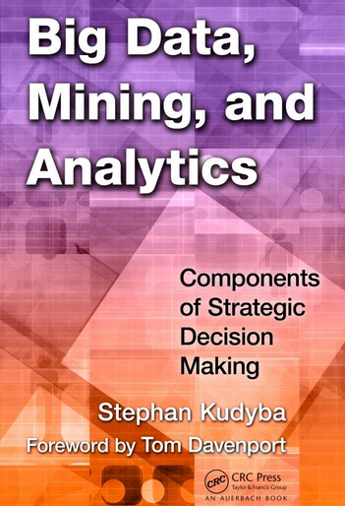
Stephan Kudyba (2014), Big Data, Mining, and Analytics: Components of Strategic Decision Making, Auerbach Publications
Source: http://www.amazon.com/gp/product/1466568704

Slide 9
Architecture of Big Data Analytics
Big Data Analytics Applications
Big Data Sources
Big Data Transformation
Big Data Platforms & Tools
* Internal
* External
* Multiple formats
* Multiple locations
* Multiple applications
Middleware
Hadoop
MapReduce
Pig
Hive
Jaql
Zookeeper
Hbase
Cassandra
Oozie
Avro
Mahout
Others
Queries
Raw Data
Transformed Data
Big Data Analytics
Extract Transform Load
Reports
Data Warehouse
OLAP
Traditional Format CSV, Tables
Data Mining
Source: Stephan Kudyba (2014), Big Data, Mining, and Analytics: Components of Strategic Decision Making, Auerbach Publications

Slide 10
Architecture of Big Data Analytics
Big Data Analytics Applications
Big Data Sources
Big Data Transformation
Big Data Platforms & Tools
* Internal
* External
* Multiple formats
* Multiple locations
* Multiple applications
Data Mining
Big Data Analytics Applications
Middleware
Hadoop
MapReduce
Pig
Hive
Jaql
Zookeeper
Hbase
Cassandra
Oozie
Avro
Mahout
Others
Queries
Raw Data
Transformed Data
Big Data Analytics
Extract Transform Load
Reports
Data Warehouse
OLAP
Traditional Format CSV, Tables
Data Mining
Source: Stephan Kudyba (2014), Big Data, Mining, and Analytics: Components of Strategic Decision Making, Auerbach Publications

Slide 11
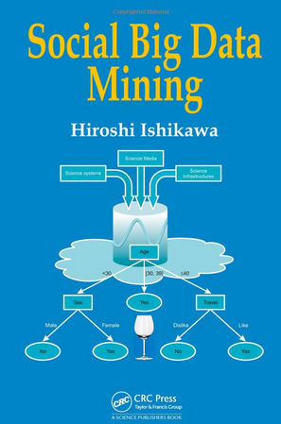
Social Big Data Mining (Hiroshi Ishikawa, 2015)
Source: http://www.amazon.com/Social-Data-Mining-Hiroshi-Ishikawa/dp/149871093X

Slide 12
Architecture for Social Big Data Mining (Hiroshi Ishikawa, 2015)
Enabling Technologies
Analysts
Integrated analysis
Integrated analysis model
Model Construction
Explanation by Model
Conceptual Layer
Natural Language Processing
Information Extraction
Anomaly Detection
Discovery of relationships among heterogeneous data
Large-scale visualization
Construction and confirmation of individual hypothesis
Description and execution of application-specific task
Data Mining
Multivariate analysis
Application specific task
Logical Layer
Parallel distrusted processing
Software
Social Data
Hardware
Physical Layer
Source: Hiroshi Ishikawa (2015), Social Big Data Mining, CRC Press

Slide 13
Business Intelligence (BI) Infrastructure

Slide 14
Analyzing the Social Web: Social Network Analysis

Slide 15
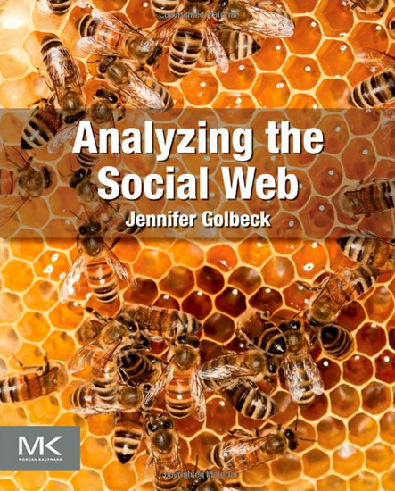
Jennifer Golbeck (2013), Analyzing the Social Web, Morgan Kaufmann
Source: http://www.amazon.com/Analyzing-Social-Web-Jennifer-Golbeck/dp/0124055311

Slide 16
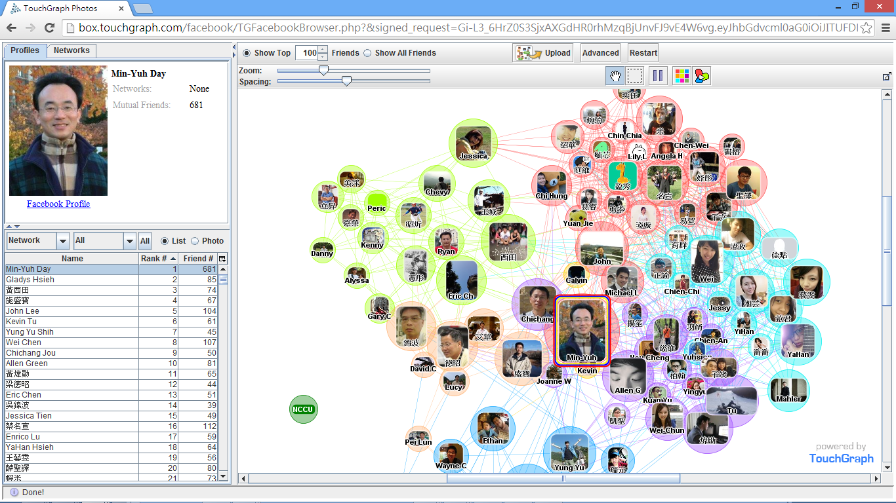
Social Network Analysis (SNA) Facebook TouchGraph

Slide 17
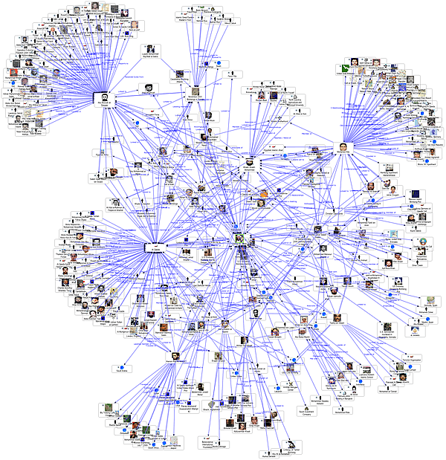
Social Network Analysis
Source: http://www.fmsasg.com/SocialNetworkAnalysis/

Slide 18
Social Network Analysis
A social network is a social structure of people, related (directly or indirectly) to each other through a common relation or interest
Social network analysis (SNA) is the study of social networks to understand their structure and behavior

Slide 19
Centrality Prestige
Social Network Analysis (SNA)

Slide 20
Degree
C
A
D
B
E
Source: https://www.youtube.com/watch?v=89mxOdwPfxA

Slide 21
Degree
C
A: 2
B: 4
C: 2
D:1
E: 1
A
D
B
E
Source: https://www.youtube.com/watch?v=89mxOdwPfxA

Slide 22
Density
C
A
D
B
E
Source: https://www.youtube.com/watch?v=89mxOdwPfxA

Slide 23
Density
Edges (Links): 5
Total Possible Edges: 10
Density: 5/10 = 0.5
C
A
D
B
E
Source: https://www.youtube.com/watch?v=89mxOdwPfxA

Slide 24
Density
A
E
I
C
G
H
B
J
D
F
Nodes (n): 10
Edges (Links): 13
Total Possible Edges: (n * (n-1)) / 2 = (10 * 9) / 2 = 45
Density: 13/45 = 0.29

Slide 25
Which Node is Most Important?
A
E
I
C
G
H
B
J
D
F

Slide 26
Centrality
Important or prominent actors are those that are linked or involved with other actors extensively.
A person with extensive contacts (links) or communications with many other people in the organization is considered more important than a person with relatively fewer contacts.
The links can also be called ties. A central actor is one involved in many ties.
Source: Bing Liu (2011) , “Web Data Mining: Exploring Hyperlinks, Contents, and Usage Data”

Slide 27
Social Network Analysis (SNA)
Degree Centrality
Betweenness Centrality
Closeness Centrality

Slide 28
Degree Centrality

Slide 29
Social Network Analysis: Degree Centrality
A
E
I
C
G
H
B
J
D
F

Slide 30
Social Network Analysis: Degree Centrality
Node | Score | Standardized Score
A | 2 | 2/10 = 0.2
B | 2 | 2/10 = 0.2
C | 5 | 5/10 = 0.5
D | 3 | 3/10 = 0.3
E | 3 | 3/10 = 0.3
F | 2 | 2/10 = 0.2
G | 4 | 4/10 = 0.4
H | 3 | 3/10 = 0.3
I | 1 | 1/10 = 0.1
J | 1 | 1/10 = 0.1
A
E
I
C
G
H
B
J
D
F

Slide 31
Betweenness Centrality

Slide 32
Betweenness centrality:
Connectivity
Number of shortest paths going through the actor

Slide 33
Betweenness Centrality
Where g_{jk} = the number of shortest paths connecting jk
g_{jk}(i) = the number that actor i is on.
Normalized Betweenness Centrality
Number of pairs of vertices excluding the vertex itself
Source: https://www.youtube.com/watch?v=RXohUeNCJiU

Slide 34
Betweenness Centrality
C
A:
B→C: 0/1 = 0
B→D: 0/1 = 0
B→E: 0/1 = 0
C→D: 0/1 = 0
C→E: 0/1 = 0
D→E: 0/1 = 0
Total: 0
A
D
B
E
A: Betweenness Centrality = 0

Slide 35
Betweenness Centrality
C
B:
A→C: 0/1 = 0
A→D: 1/1 = 1
A→E: 1/1 = 1
C→D: 1/1 = 1
C→E: 1/1 = 1
D→E: 1/1 = 1
Total: 5
A
D
B
E
B: Betweenness Centrality = 5

Slide 36
Betweenness Centrality
C
C:
A→B: 0/1 = 0
A→D: 0/1 = 0
A→E: 0/1 = 0
B→D: 0/1 = 0
B→E: 0/1 = 0
D→E: 0/1 = 0
Total: 0
A
D
B
E
C: Betweenness Centrality = 0

Slide 37
Betweenness Centrality
C
A: 0
B: 5
C: 0
D: 0
E: 0
A
D
B
E

Slide 38
Which Node is Most Important?
F
G
H
B
E
A
C
I
D
J
F
H
B
E
A
C
D
J

Slide 39
Which Node is Most Important?
F
G
H
B
E
A
C
I
D
J
F
G
H
E
A
I
D
J

Slide 40
Betweenness Centrality
B
E
A
C
D

Slide 41
Betweenness Centrality
C
A:
B→C: 0/1 = 0
B→D: 0/1 = 0
B→E: 0/1 = 0
C→D: 0/1 = 0
C→E: 0/1 = 0
D→E: 0/1 = 0
Total: 0
A
D
B
E
A: Betweenness Centrality = 0

Slide 42
Closeness Centrality

Slide 43
Social Network Analysis: Closeness Centrality
C→A: 1
C→B: 1
C→D: 1
C→E: 1
C→F: 2
C→G: 1
C→H: 2
C→I: 3
C→J: 3
Total=15
A
E
I
C
G
H
B
J
D
F
C: Closeness Centrality = 15/9 = 1.67

Slide 44
Social Network Analysis: Closeness Centrality
G→A: 2
G→B: 2
G→C: 1
G→D: 2
G→E: 1
G→F: 1
G→H: 1
G→I: 2
G→J: 2
Total=14
A
E
I
C
G
H
B
J
D
F
G: Closeness Centrality = 14/9 = 1.56

Slide 45
Social Network Analysis: Closeness Centrality
H→A: 3
H→B: 3
H→C: 2
H→D: 2
H→E: 2
H→F: 2
H→G: 1
H→I: 1
H→J: 1
Total=17
A
E
I
C
G
H
B
J
D
F
H: Closeness Centrality = 17/9 = 1.89

Slide 46
Social Network Analysis: Closeness Centrality
A
E
I
C
G
H
B
J
D
F
G: Closeness Centrality = 14/9 = 1.56
1
C: Closeness Centrality = 15/9 = 1.67
2
H: Closeness Centrality = 17/9 = 1.89
3

Slide 47
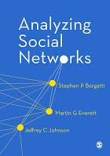
Social Network Analysis (SNA) Tools
NetworkX
igraph
Gephi
UCINet
Pajek

Slide 48
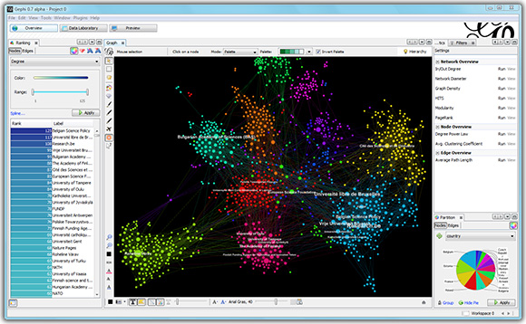
Gephi The Open Graph Viz Platform
Source: https://gephi.org/

Slide 49
Application of SNA
Social Network Analysis of Research Collaboration in Information Reuse and Integration
Source: Min-Yuh Day, Sheng-Pao Shih, Weide Chang (2011), "Social Network Analysis of Research Collaboration in Information Reuse and Integration"

Slide 50
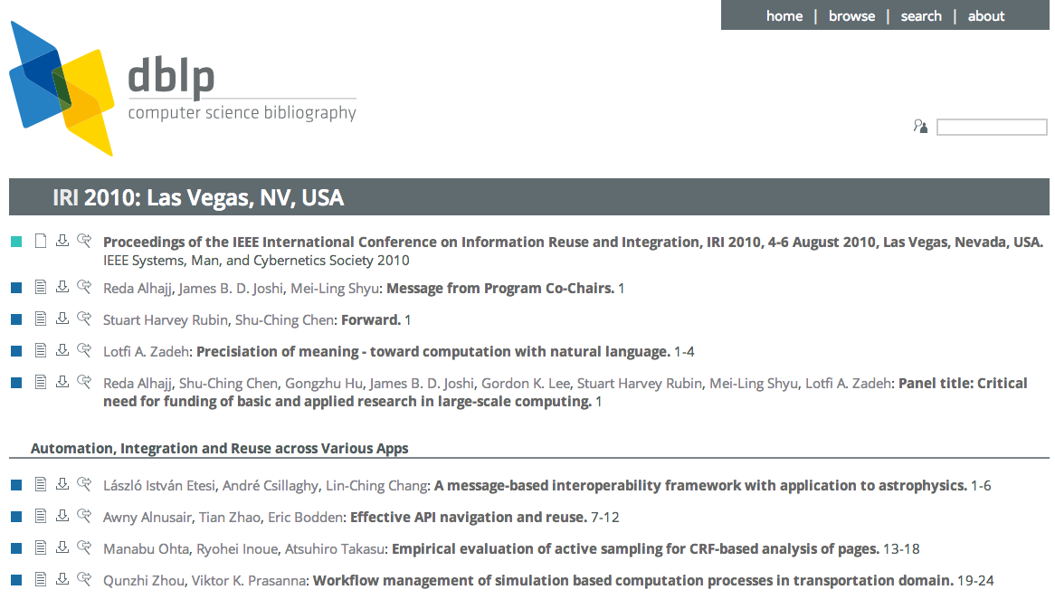
Example of SNA Data Source
Source: http://www.informatik.uni-trier.de/~ley/db/conf/iri/iri2010.html

Slide 51
Research Question
RQ1: What are the scientific collaboration patterns in the IRI research community?
RQ2: Who are the prominent researchers in the IRI community?
Source: Min-Yuh Day, Sheng-Pao Shih, Weide Chang (2011), "Social Network Analysis of Research Collaboration in Information Reuse and Integration"

Slide 52
Methodology
Developed a simple web focused crawler program to download literature information about all IRI papers published between 2003 and 2010 from IEEE Xplore and DBLP.
767 paper
1599 distinct author
Developed a program to convert the list of coauthors into the format of a network file which can be readable by social network analysis software.
UCINet and Pajek were used in this study for the social network analysis.
Source: Min-Yuh Day, Sheng-Pao Shih, Weide Chang (2011), "Social Network Analysis of Research Collaboration in Information Reuse and Integration"

Slide 53
Top10 prolific authors (IRI 2003-2010)
Stuart Harvey Rubin
Taghi M. Khoshgoftaar
Shu-Ching Chen
Mei-Ling Shyu
Mohamed E. Fayad
Reda Alhajj
Du Zhang
Wen-Lian Hsu
Jason Van Hulse
Min-Yuh Day
Source: Min-Yuh Day, Sheng-Pao Shih, Weide Chang (2011), "Social Network Analysis of Research Collaboration in Information Reuse and Integration"

Slide 54
Data Analysis and Discussion
Closeness Centrality
Collaborated widely
Betweenness Centrality
Collaborated diversely
Degree Centrality
Collaborated frequently
Visualization of Social Network Analysis
Insight into the structural characteristics of research collaboration networks
Source: Min-Yuh Day, Sheng-Pao Shih, Weide Chang (2011), "Social Network Analysis of Research Collaboration in Information Reuse and Integration"

Slide 55
Top 20 authors with the highest closeness scores
Rank | ID | Closeness | Author
1 | 3 | 0.024675 | Shu-Ching Chen
2 | 1 | 0.022830 | Stuart Harvey Rubin
3 | 4 | 0.022207 | Mei-Ling Shyu
4 | 6 | 0.020013 | Reda Alhajj
5 | 61 | 0.019700 | Na Zhao
6 | 260 | 0.018936 | Min Chen
7 | 151 | 0.018230 | Gordon K. Lee
8 | 19 | 0.017962 | Chengcui Zhang
9 | 1043 | 0.017962 | Isai Michel Lombera
10 | 1027 | 0.017962 | Michael Armella
11 | 443 | 0.017448 | James B. Law
12 | 157 | 0.017082 | Keqi Zhang
13 | 253 | 0.016731 | Shahid Hamid
14 | 1038 | 0.016618 | Walter Z. Tang
15 | 959 | 0.016285 | Chengjun Zhan
16 | 957 | 0.016285 | Lin Luo
17 | 956 | 0.016285 | Guo Chen
18 | 955 | 0.016285 | Xin Huang
19 | 943 | 0.016285 | Sneh Gulati
20 | 960 | 0.016071 | Sheng-Tun Li
Source: Min-Yuh Day, Sheng-Pao Shih, Weide Chang (2011), "Social Network Analysis of Research Collaboration in Information Reuse and Integration"

Slide 56
Top 20 authors with the highest betweeness scores
Rank | ID | Betweenness | Author
1 | 1 | 0.000752 | Stuart Harvey Rubin
2 | 3 | 0.000741 | Shu-Ching Chen
3 | 2 | 0.000406 | Taghi M. Khoshgoftaar
4 | 66 | 0.000385 | Xingquan Zhu
5 | 4 | 0.000376 | Mei-Ling Shyu
6 | 6 | 0.000296 | Reda Alhajj
7 | 65 | 0.000256 | Xindong Wu
8 | 19 | 0.000194 | Chengcui Zhang
9 | 39 | 0.000185 | Wei Dai
10 | 15 | 0.000107 | Narayan C. Debnath
11 | 31 | 0.000094 | Qianhui Althea Liang
12 | 151 | 0.000094 | Gordon K. Lee
13 | 7 | 0.000085 | Du Zhang
14 | 30 | 0.000072 | Baowen Xu
15 | 41 | 0.000067 | Hongji Yang
16 | 270 | 0.000060 | Zhiwei Xu
17 | 5 | 0.000043 | Mohamed E. Fayad
18 | 110 | 0.000042 | Abhijit S. Pandya
19 | 106 | 0.000042 | Sam Hsu
20 | 8 | 0.000042 | Wen-Lian Hsu
Source: Min-Yuh Day, Sheng-Pao Shih, Weide Chang (2011), "Social Network Analysis of Research Collaboration in Information Reuse and Integration"

Slide 57
Top 20 authors with the highest degree scores
Rank | ID | Degree | Author
1 | 3 | 0.035044 | Shu-Ching Chen
2 | 1 | 0.034418 | Stuart Harvey Rubin
3 | 2 | 0.030663 | Taghi M. Khoshgoftaar
4 | 6 | 0.028786 | Reda Alhajj
5 | 8 | 0.028786 | Wen-Lian Hsu
6 | 10 | 0.024406 | Min-Yuh Day
7 | 4 | 0.022528 | Mei-Ling Shyu
8 | 17 | 0.021277 | Richard Tzong-Han Tsai
9 | 14 | 0.017522 | Eduardo Santana de Almeida
10 | 16 | 0.017522 | Roumen Kountchev
11 | 40 | 0.016896 | Hong-Jie Dai
12 | 15 | 0.015645 | Narayan C. Debnath
13 | 9 | 0.015019 | Jason Van Hulse
14 | 25 | 0.013767 | Roumiana Kountcheva
15 | 28 | 0.013141 | Silvio Romero de Lemos Meira
16 | 24 | 0.013141 | Vladimir Todorov
17 | 23 | 0.013141 | Mariofanna G. Milanova
18 | 5 | 0.013141 | Mohamed E. Fayad
19 | 19 | 0.012516 | Chengcui Zhang
20 | 18 | 0.011890 | Waleed W. Smari
Source: Min-Yuh Day, Sheng-Pao Shih, Weide Chang (2011), "Social Network Analysis of Research Collaboration in Information Reuse and Integration"

Slide 58
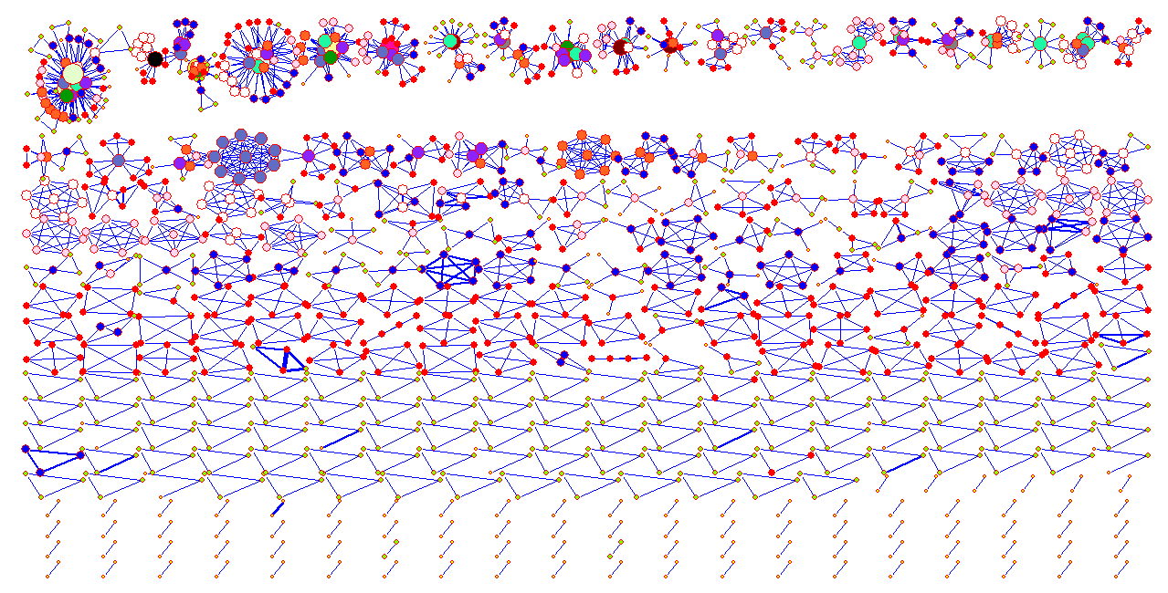
Visualization of IRI (IEEE IRI 2003-2010) co-authorship network (global view)
Source: Min-Yuh Day, Sheng-Pao Shih, Weide Chang (2011), "Social Network Analysis of Research Collaboration in Information Reuse and Integration"

Slide 59
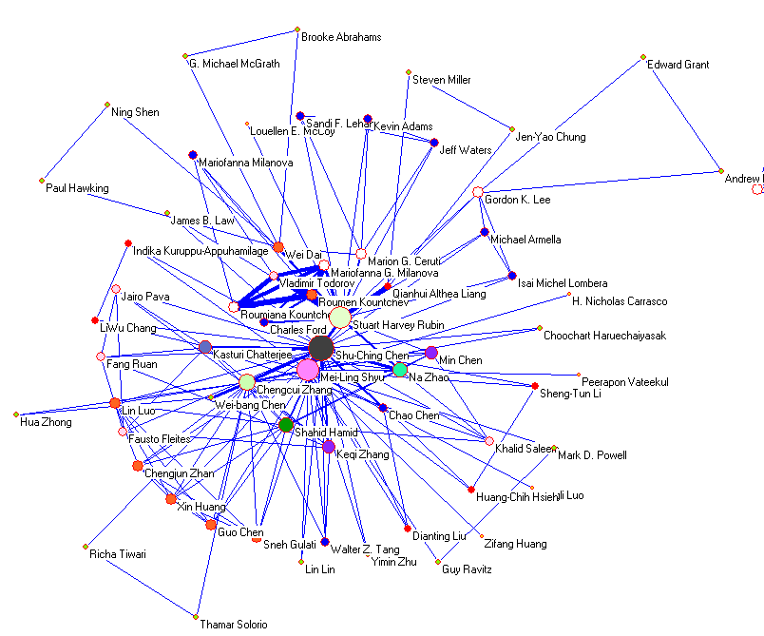
Source: Min-Yuh Day, Sheng-Pao Shih, Weide Chang (2011), "Social Network Analysis of Research Collaboration in Information Reuse and Integration"

Slide 60
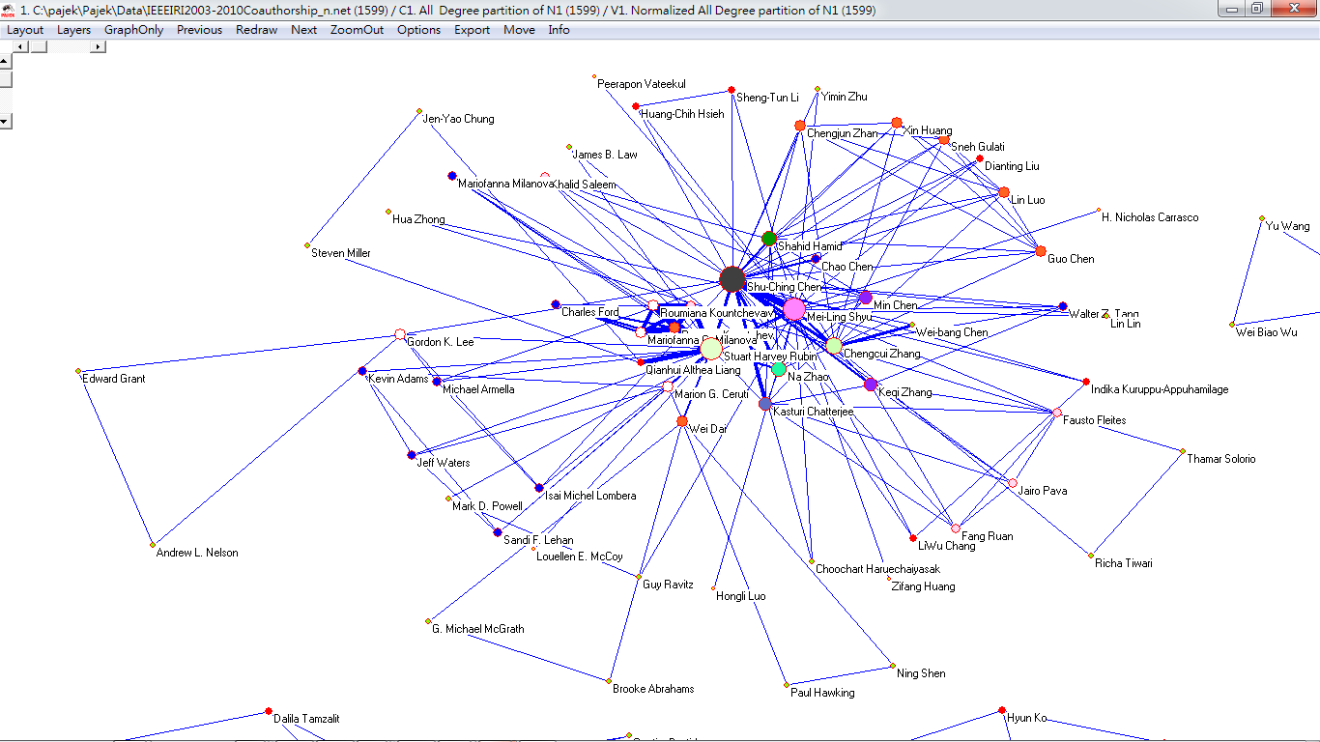
Visualization of Social Network Analysis
Source: Min-Yuh Day, Sheng-Pao Shih, Weide Chang (2011), "Social Network Analysis of Research Collaboration in Information Reuse and Integration"

Slide 61
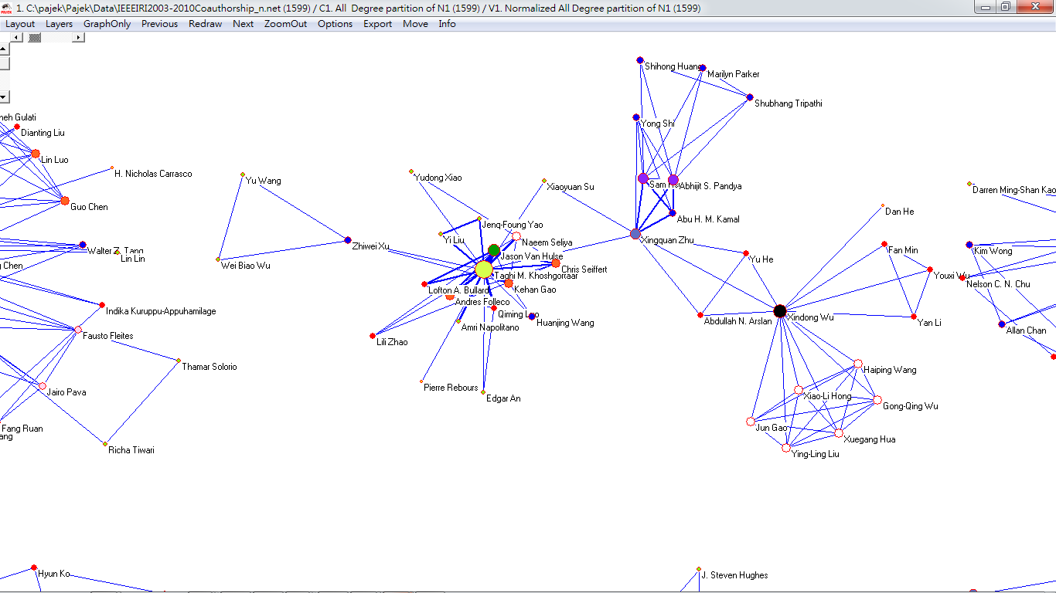
Visualization of Social Network Analysis
Source: Min-Yuh Day, Sheng-Pao Shih, Weide Chang (2011), "Social Network Analysis of Research Collaboration in Information Reuse and Integration"

Slide 62
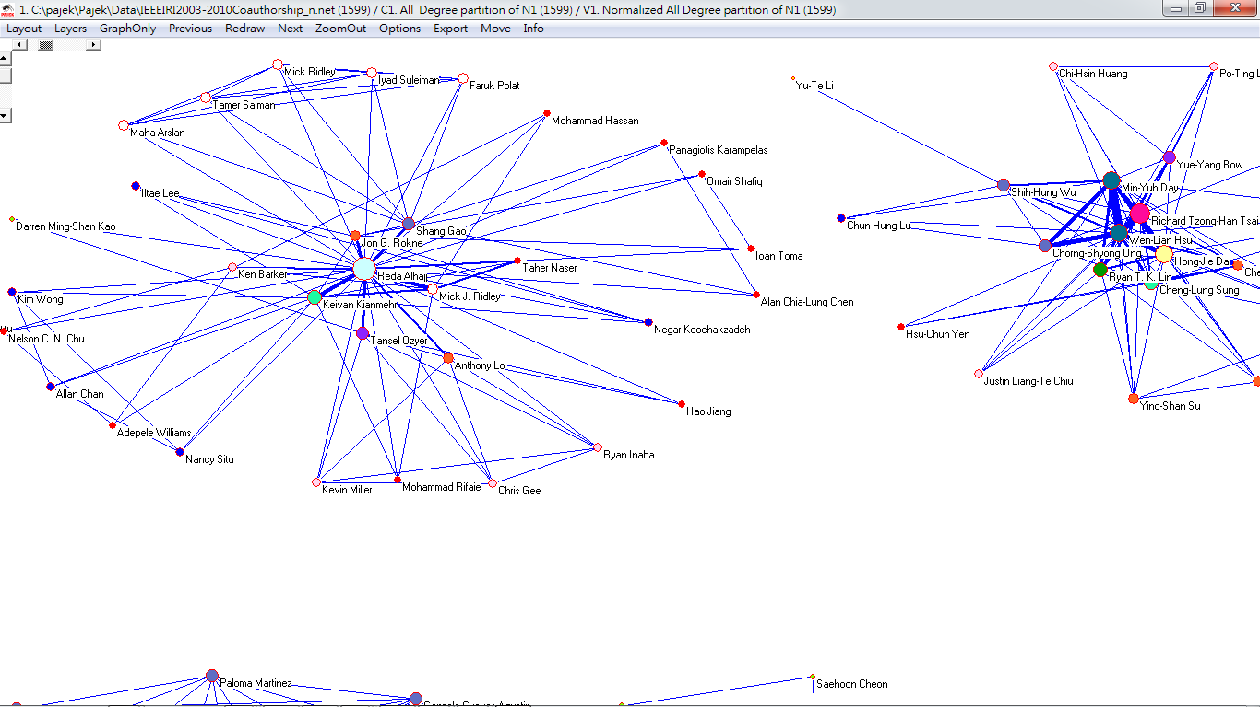
Visualization of Social Network Analysis
Source: Min-Yuh Day, Sheng-Pao Shih, Weide Chang (2011), "Social Network Analysis of Research Collaboration in Information Reuse and Integration"

Slide 63
Summary
Social Computing and Big Data Analytics
Analyzing the Social Web: Social Network Analysis

Slide 64
References
Jiawei Han and Micheline Kamber (2011), Data Mining: Concepts and Techniques, Third Edition, Elsevier
Jennifer Golbeck (2013), Analyzing the Social Web, Morgan Kaufmann
Stephan Kudyba (2014), Big Data, Mining, and Analytics: Components of Strategic Decision Making, Auerbach Publications
Hiroshi Ishikawa (2015), Social Big Data Mining, CRC Press

Slide 65
Q & A
Tamkang University
Social Computing and Big Data Analytics (社群運算大數據分析)
Time: 2016/04/18 (14:00-16:00) Place: China Airlines
Min-Yuh Day
戴敏育
Assistant Professor
專任助理教授
Dept. of Information Management, Tamkang University
淡江大學 資訊管理學系
http://mail. tku.edu.tw/myday/
2016-04-18

